Slide 1
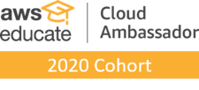
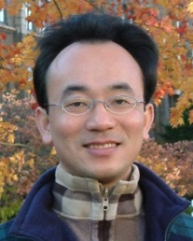
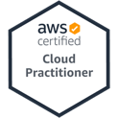
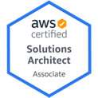
Foundations of Python Programming
Python for Accounting Applications
1121PAA03
ACC2, NTPU (M5265) (Fall 2023) Wed 6, 7, 8, (14:10-17:00) (9:10-12:00) (B3F10)
Min-Yuh Day, Ph.D, Associate Professor
Institute of Information Management, National Taipei University
https://web.ntpu.edu.tw/~myday
2023-09-27

Slide 2
Syllabus
Week Date Subject/Topics
1 2023/09/13 Introduction to Python for Accounting Applications
2 2023/09/20 Python Programming and Data Science
3 2023/09/27 Foundations of Python Programming
4 2023/10/04 Data Structures
5 2023/10/11 Control Logic and Loops
6 2023/10/18 Functions and Modules
7 2023/10/25 Files and Exception Handling
8 2023/11/01 Midterm Project Report

Slide 3
Syllabus
Week Date Subject/Topics
9 2023/11/08 Data Analytics and Visualization with Python
10 2023/11/15 Obtaining Data From the Web with Python
11 2023/11/22 Statistical Analysis with Python
12 2023/11/29 Machine Learning with Python
13 2023/12/06 Text Analytics with Python and Large Language Models (LLMs)
14 2023/12/13 Applications of Accounting Data Analytics with Python
15 2023/12/20 Applications of ESG Data Analytics with Python
16 2023/12/27 Final Project Report

Slide 4
Foundations of Python Programming

Slide 5
Outline
Python Syntax
Python Comments
Python Variables
Python Data Types
Python Numbers
Python Casting
Python Strings
Python Operators
Python Booleans

Slide 6
Python Programming

Slide 7
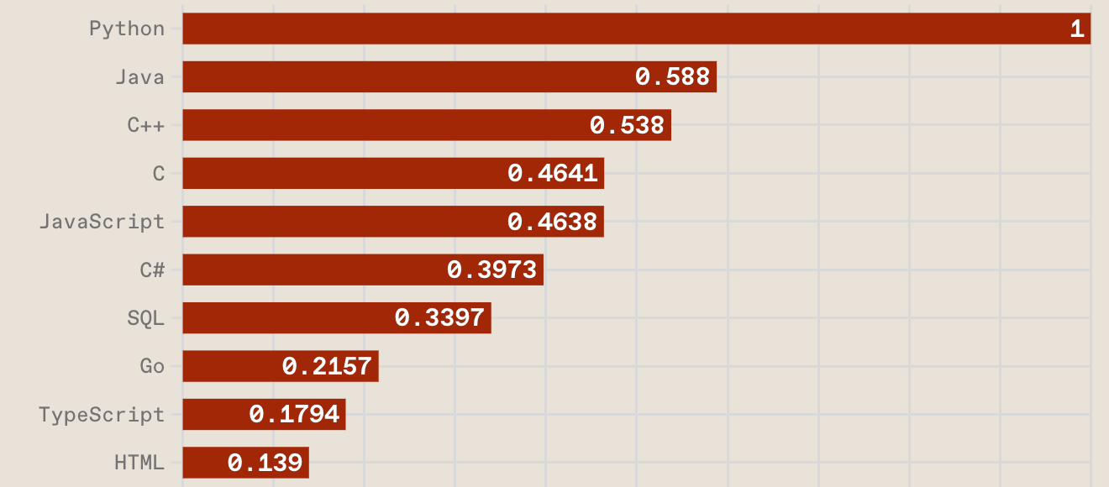
Top Programming Languages
https://spectrum.ieee.org/the-top-programming-languages-2023

Slide 8
Python is an interpreted, object-oriented, high-level programming language with dynamic semantics.
Source: https://www.python.org/doc/essays/blurb/

Slide 9
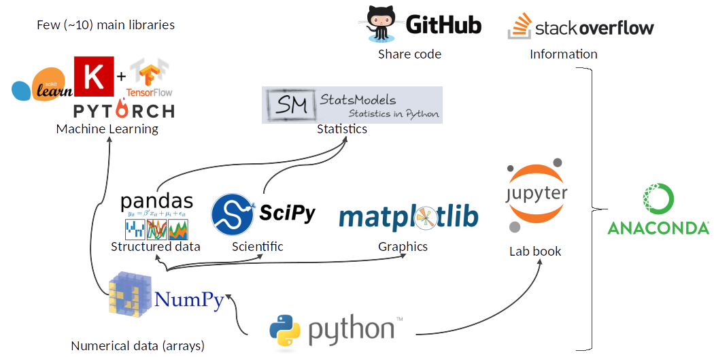
Python Ecosystem for Data Science
Source: https://medium.com/pyfinance/why-python-is-best-choice-for-financial-data-modeling-in-2019-c0d0d1858c45

Slide 10
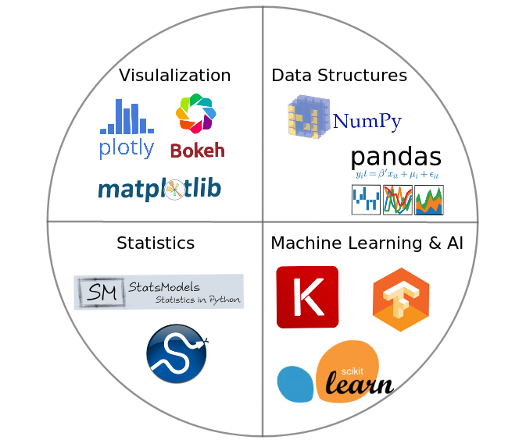
Python Ecosystem for Data Science
Source:https://duchesnay.github.io/pystatsml/introduction/python_ecosystem.html

Slide 11
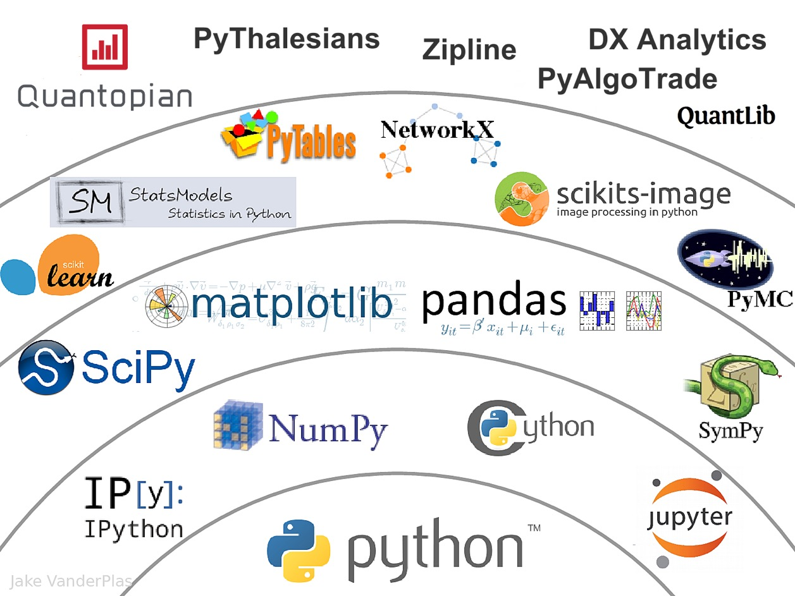
The Quant Finance PyData Stack
Source: http://nbviewer.jupyter.org/format/slides/github/quantopian/pyfolio/blob/master/pyfolio/examples/overview_slides.ipynb#/5

Slide 12
Numpy
NumPy
Base N-dimensional array package

Slide 13
Python matplotlib
Source: https://matplotlib.org/

Slide 14
Python Pandas
http://pandas.pydata.org/

Slide 15
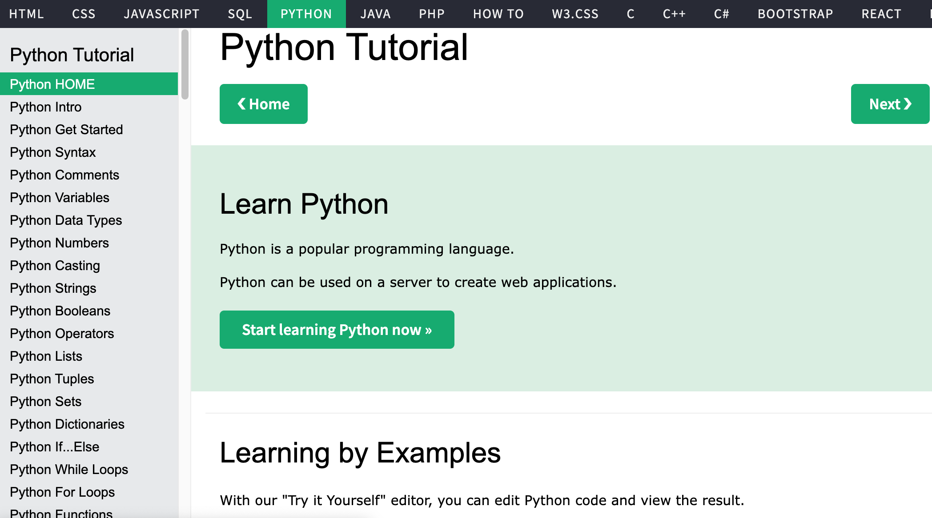
W3Schools Python
https://www.w3schools.com/python/

Slide 16
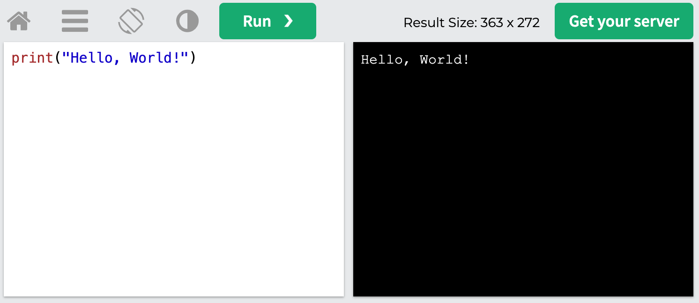
W3Schools Python: Try Python
https://www.w3schools.com/python/trypython.asp?filename=demo_default

Slide 17
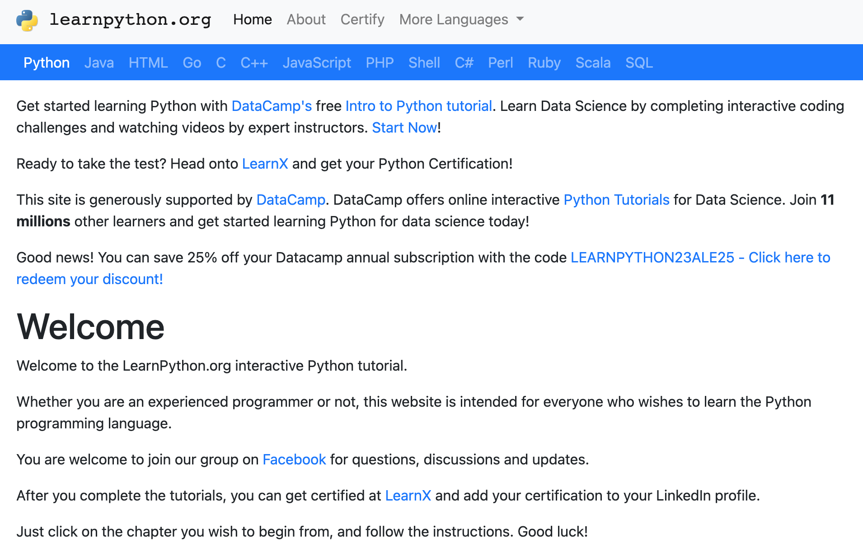
LearnPython.org
https://www.learnpython.org/

Slide 18
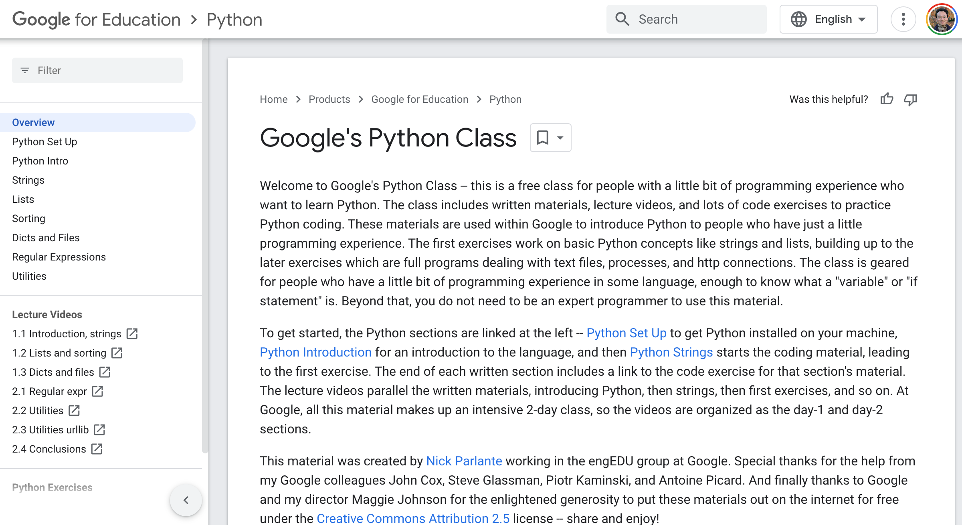
Google’s Python Class
https://developers.google.com/edu/python

Slide 19
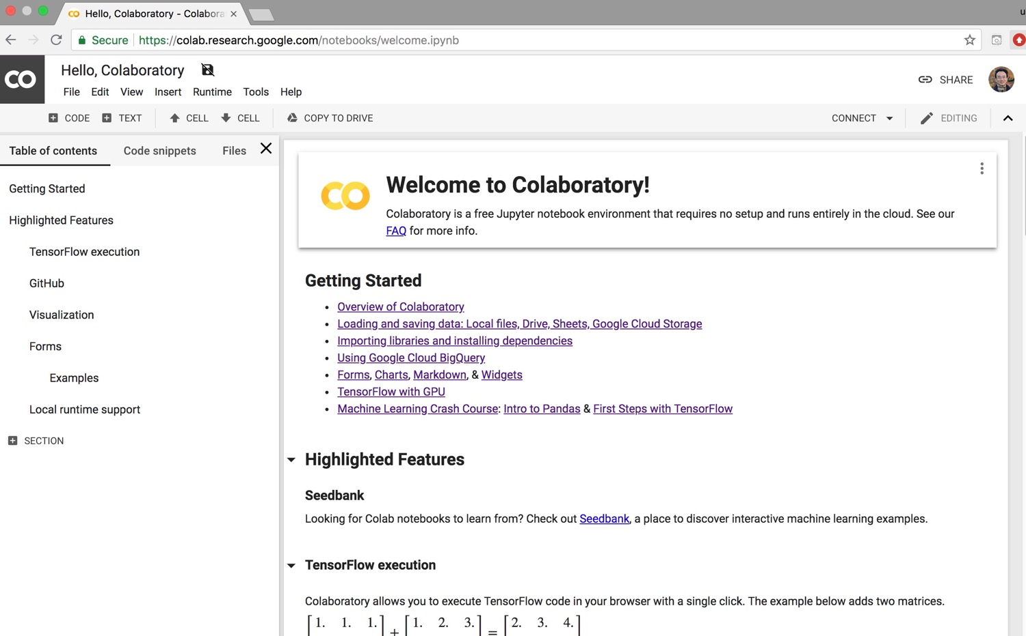
Google Colab
https://colab.research.google.com/notebooks/welcome.ipynb

Slide 20
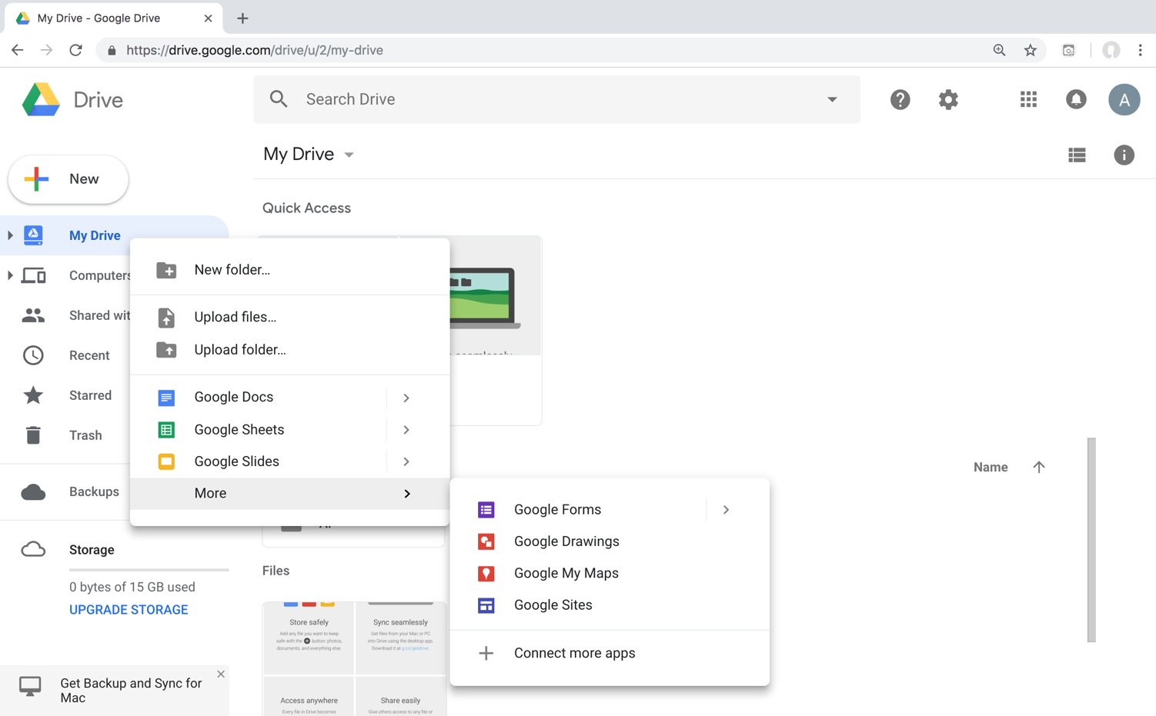
Connect Google Colab in Google Drive

Slide 21
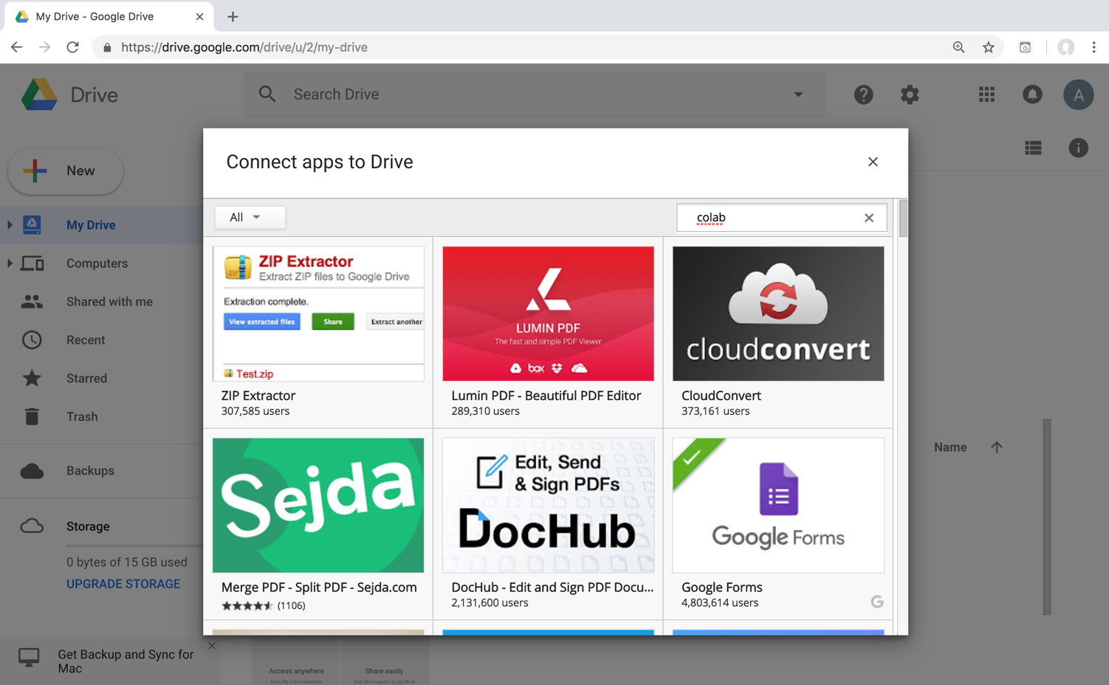
Google Colab

Slide 22
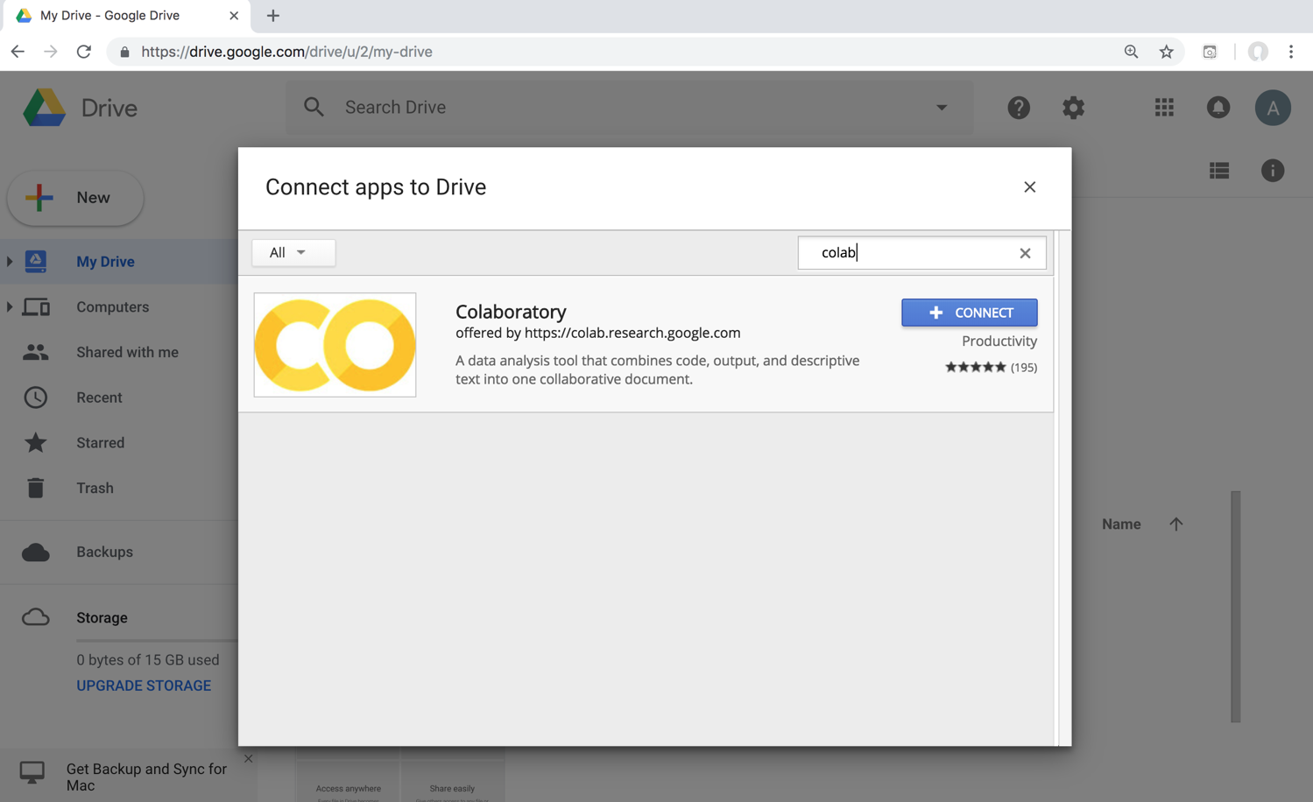
Google Colab

Slide 23
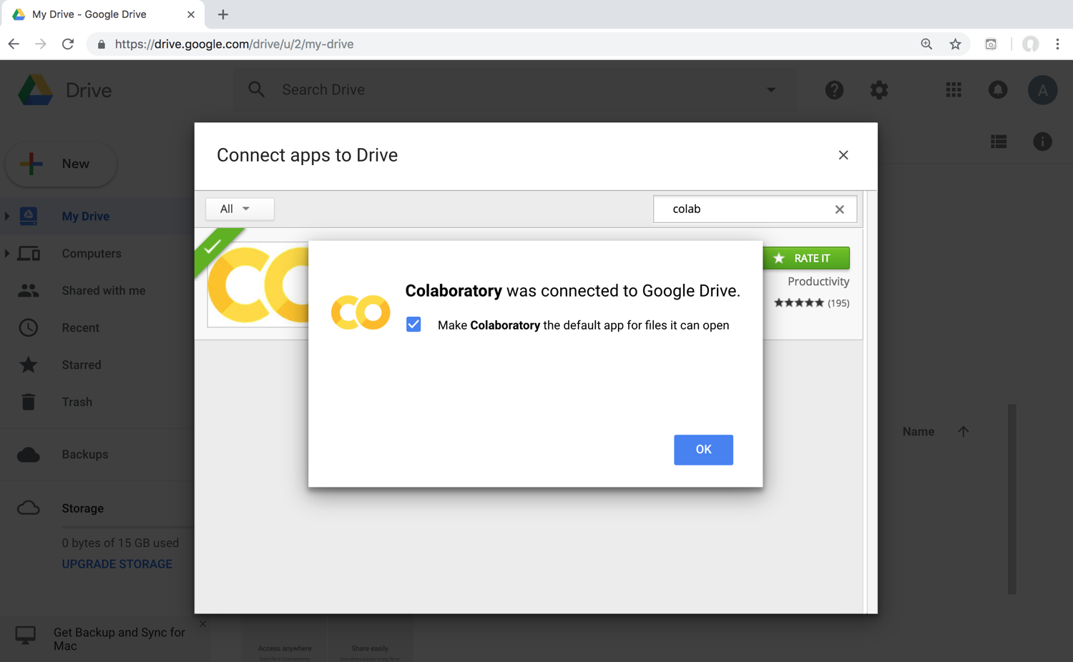
Connect Colaboratory to Google Drive

Slide 24
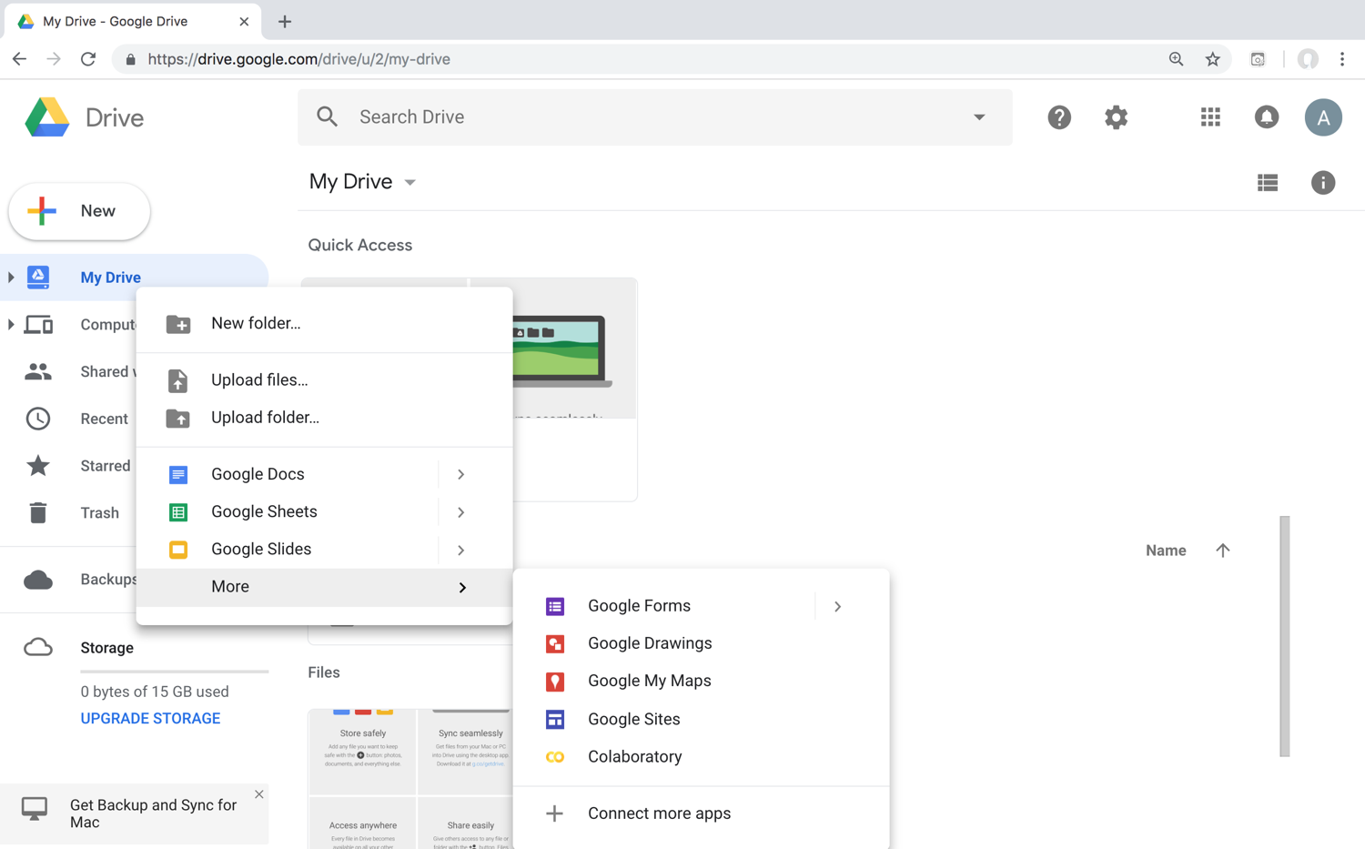
Google Colab

Slide 25
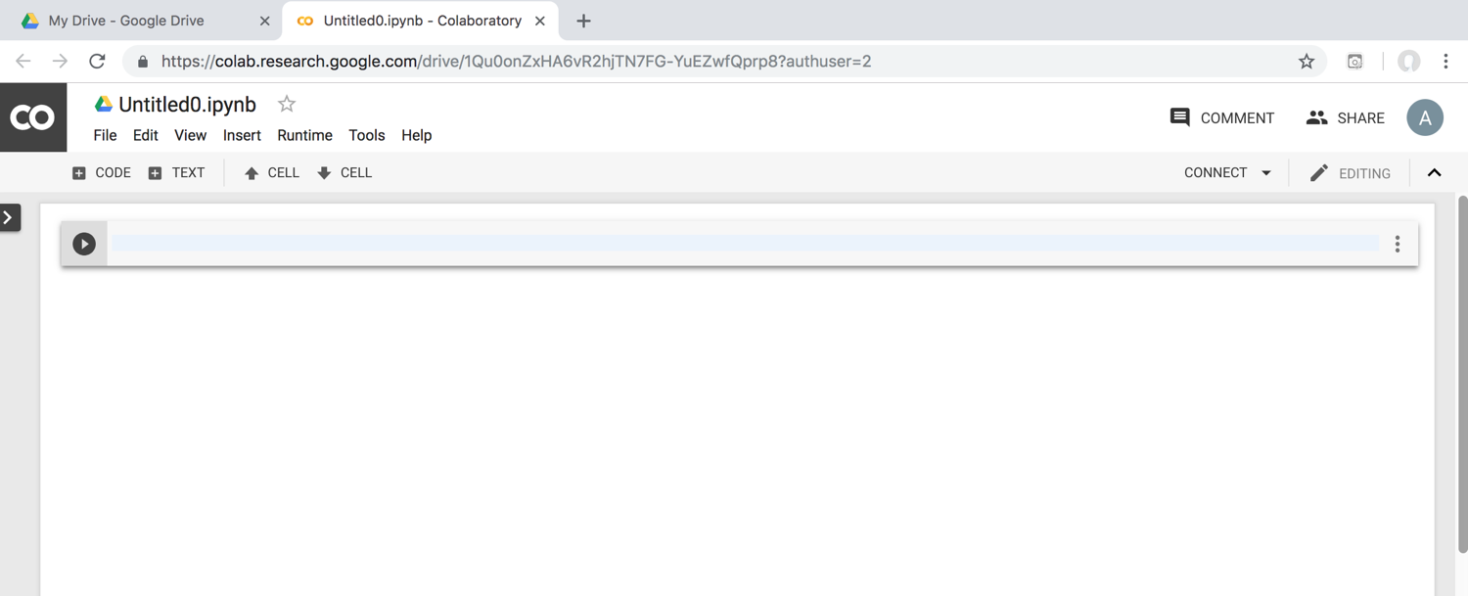
Google Colab

Slide 26
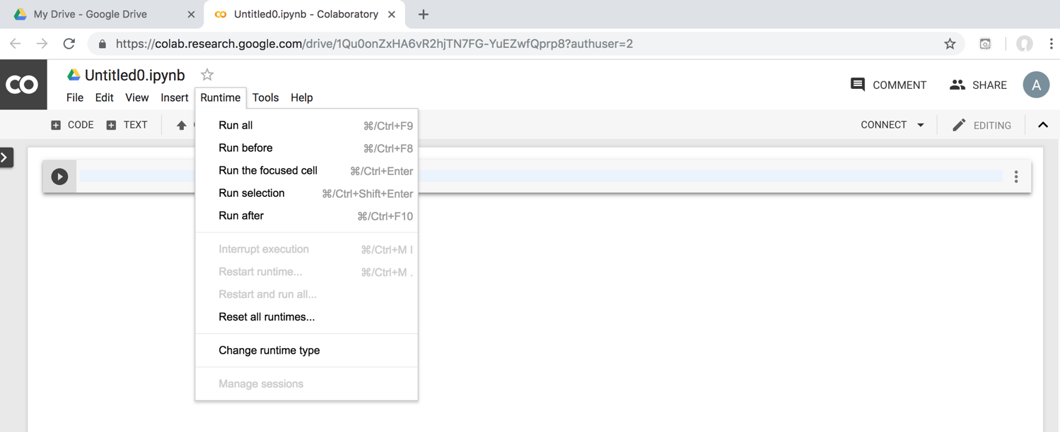
Google Colab

Slide 27
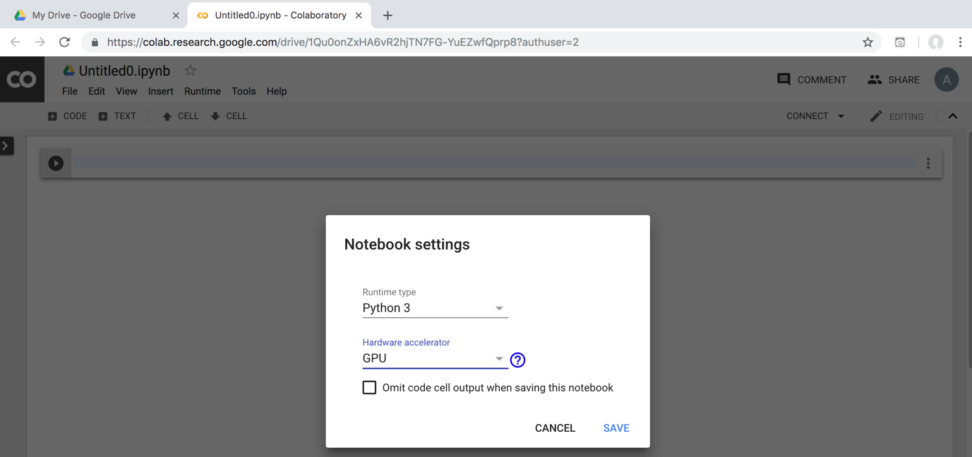
Run Jupyter Notebook Python3 GPU Google Colab

Slide 28
Google Colab Python Hello World print('Hello World')

Slide 29
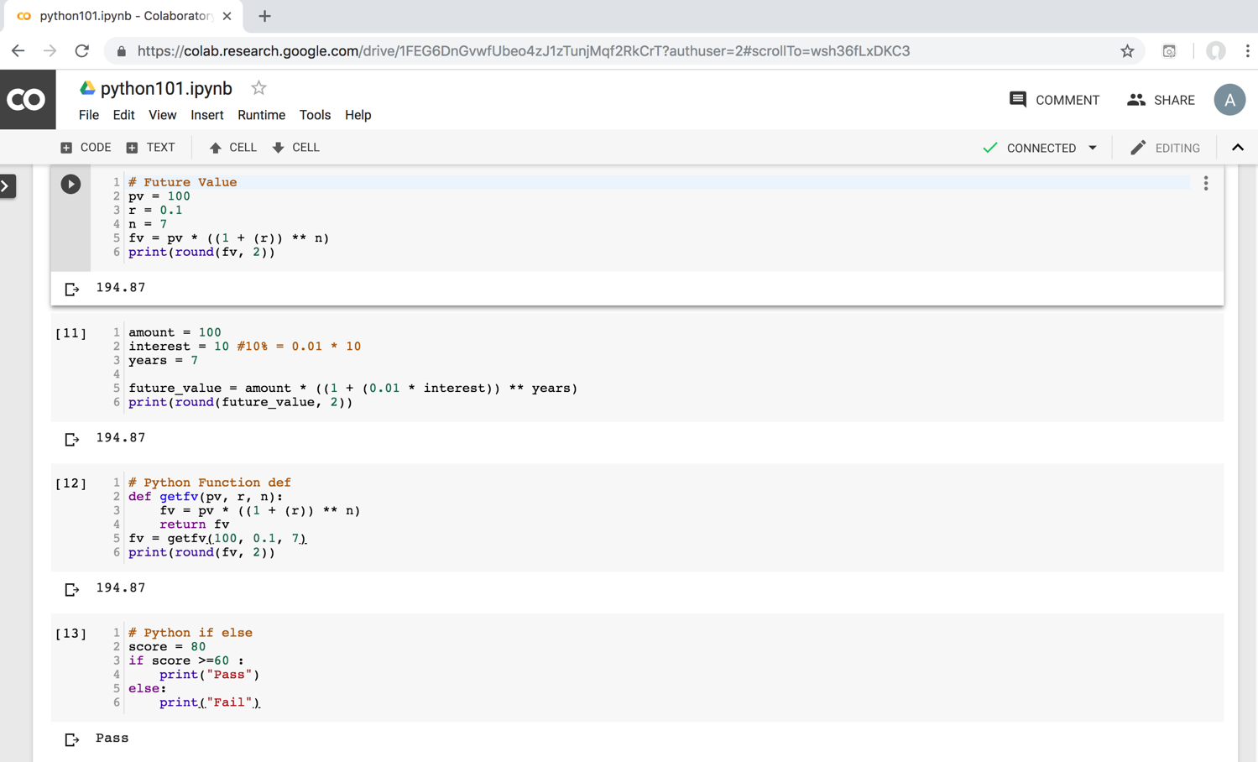
Python in Google Colab (Python101)
https://colab.research.google.com/drive/1FEG6DnGvwfUbeo4zJ1zTunjMqf2RkCrT
https://tinyurl.com/aintpupython101

Slide 30
Anaconda The Most Popular Python Data Science Platform
Source: https://www.anaconda.com/

Slide 31
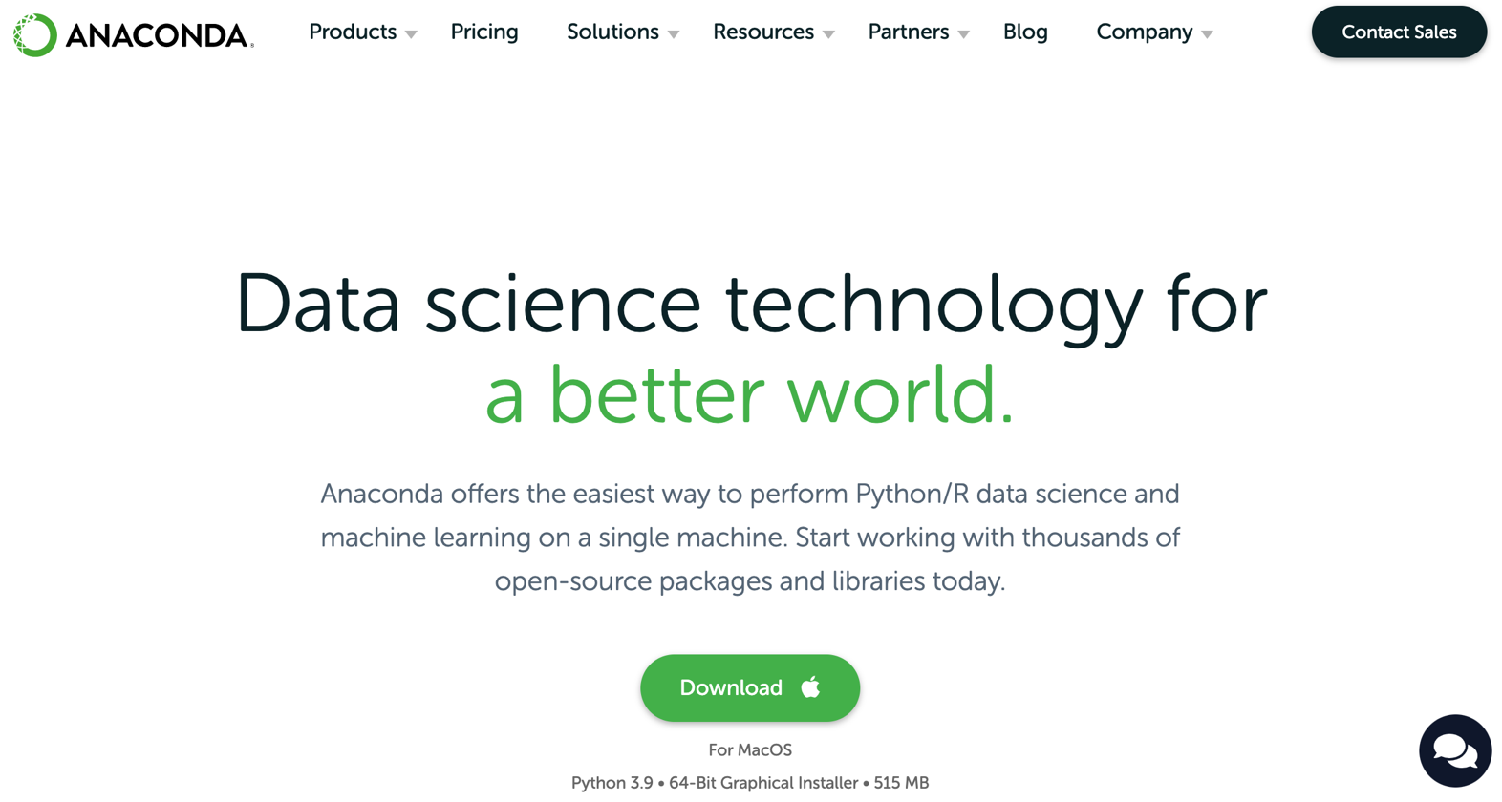
Download Anaconda
https://www.anaconda.com/download

Slide 32
Python HelloWorld

Slide 33
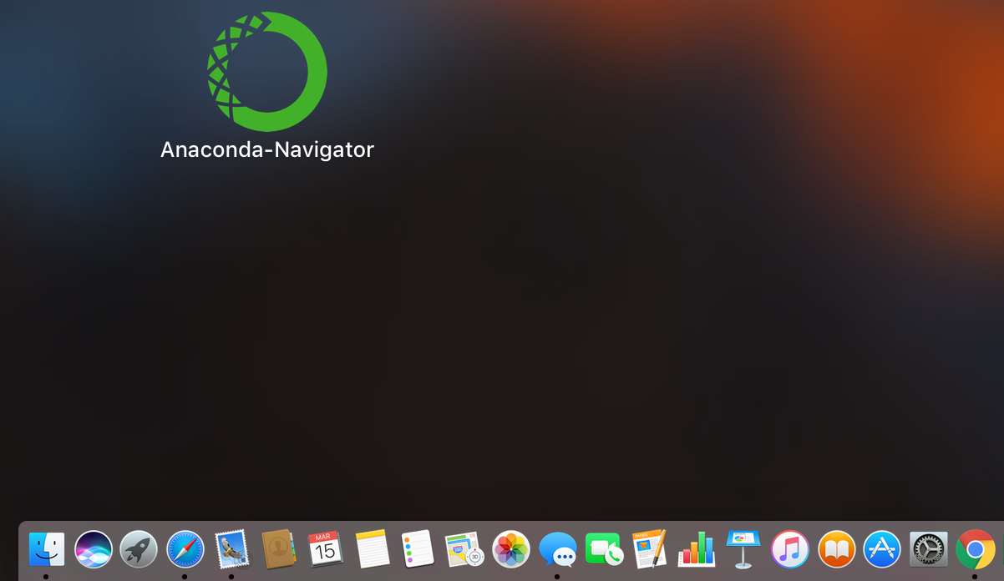
Anaconda-Navigator
Launchpad

Slide 34
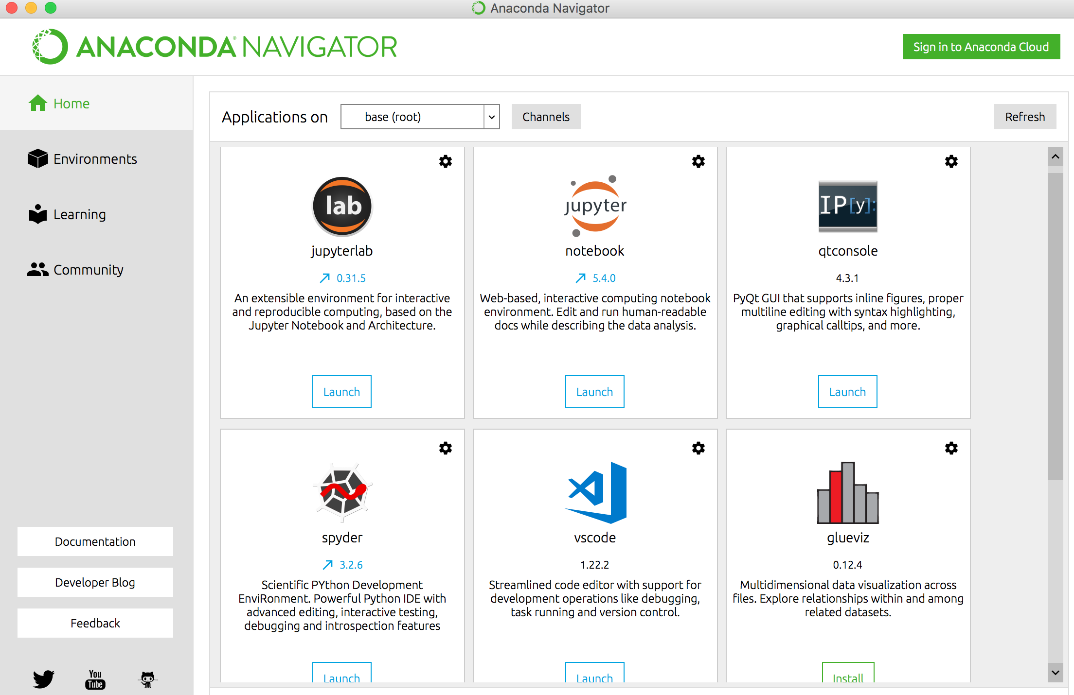
Anaconda Navigator

Slide 35
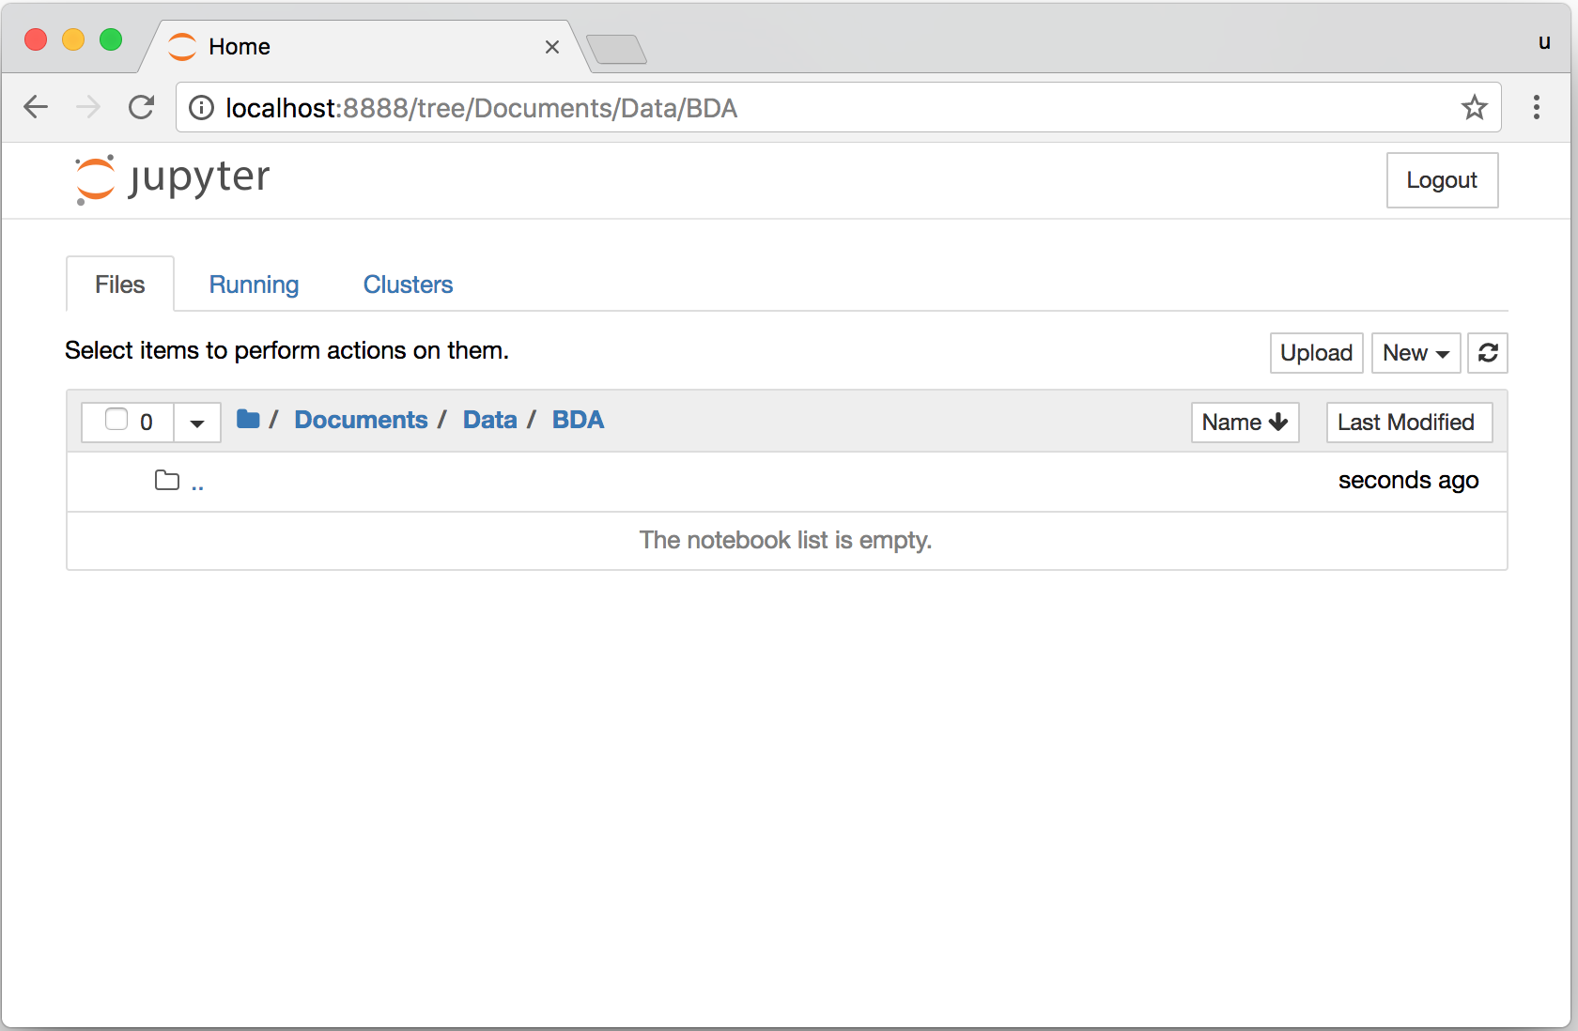
Jupyter Notebook

Slide 36
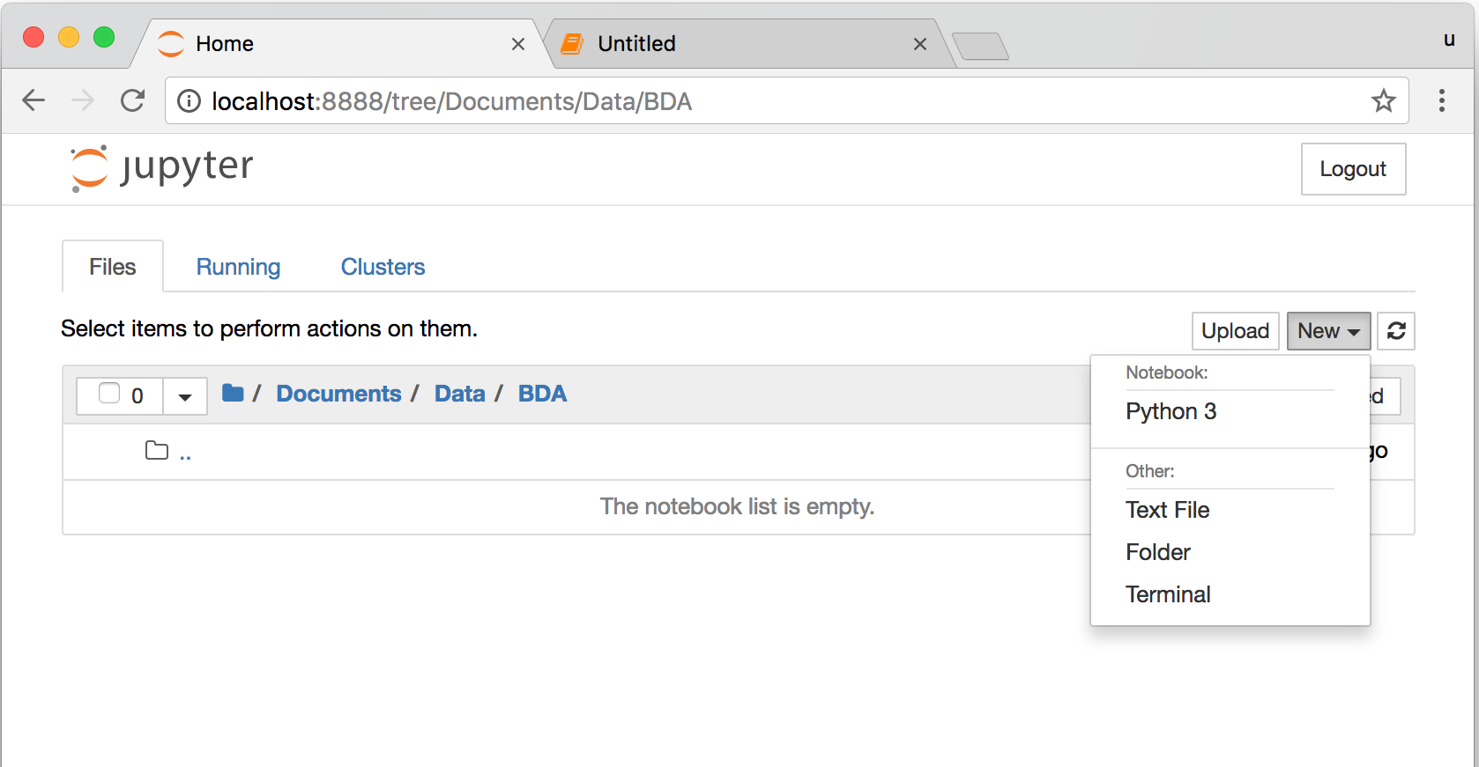
Jupyter Notebook New Python 3

Slide 37
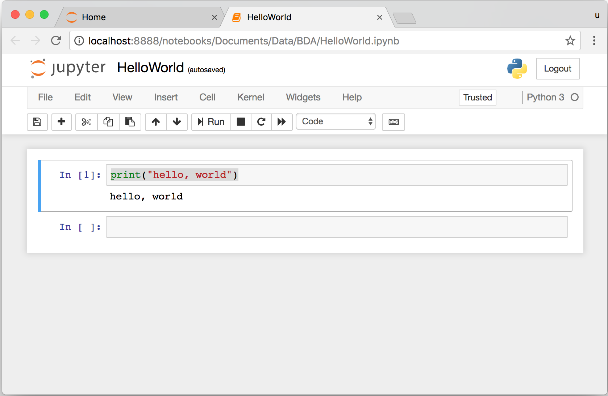
print("hello, world")
Notes:
print("hello, world")

Slide 38
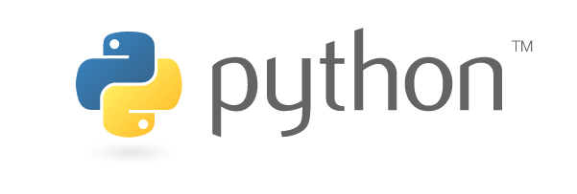
Source: https://www.python.org/community/logos/

Slide 39
Python Programming

Slide 40
Python Hello World print("Hello World")
print("Hello World")

Slide 41
Python Syntax # comment
# comment

Slide 42
Python Syntax Indentation the spaces at the beginning of a code line 4 spaces
score = 80
if score >=60 :
print("Pass")

Slide 43
Python Variables
# Python Variables
x = 2
price = 2.5
word = 'Hello'
word = 'Hello'
word = "Hello"
word = '''Hello'''

Slide 44
Python Variables
x = 2
y = x + 1

Slide 45
python_version()
# comment
from platform import python_version
print("Python Version:", python_version())
Python Version: 3.10.12

Slide 46
Python Data Types
x = "Hello World" #str
x = 2 #int
x = 2.5 #float
x = 7j #complex

Slide 47
Python Data Types
x = ["apple", "banana", "cherry"] #list
x = ("apple", "banana", "cherry") #tuple
x = range(6) #range
x = {"name" : "Tom", "age" : 20} #dict
x = {"apple", "banana", "cherry"} #set
x = frozenset({"apple", "banana", "cherry"}) #frozenset

Slide 48
Python Data Types
x = True #bool
x = b"Hello" #bytes
x = bytearray(5) #bytearray
x = memoryview(bytes(5)) #memoryview
x = None #NoneType

Slide 49
Python Casting
x = str(3) # x will be '3'
y = int(3) # y will be 3
z = float(3) # z will be 3.0
print(x, type(x))
print(y, type(y))
print(z, type(z))
3 <class 'str’>
3 <class 'int’>
3.0 <class 'float'>

Slide 50
Python Numbers
x = 2 # int
y = 3.4 # float
z = 7j #complex
print(x, type(x))
print(y, type(y))
print(z, type(z))
2 <class 'int’>
3.4 <class 'float’>
7j <class 'complex'>

Slide 51
Python Arithmetic Operators
Operator Name Example
+ Addition 7 + 2 = 9
- Subtraction 7 - 2 = 5
* Multiplication 7 * 2 = 14
/ Division 7 / 2 = 3.5
// Floor division 7 // 2 = 3 (Quotient)
% Modulus 7 % 2 = 1 (Remainder)
** Exponentiation 7 ** 2 = 49

Slide 52
Python Basic Operators
print('7 + 2 =', 7 + 2)
print('7 - 2 =', 7 - 2)
print('7 * 2 =', 7 * 2)
print('7 / 2 =', 7 / 2)
print('7 // 2 =', 7 // 2)
print('7 % 2 =', 7 % 2)
print('7 ** 2 =', 7 ** 2)
7 + 2 = 9
7 - 2 = 5
7 * 2 = 14
7 / 2 = 3.5
7 // 2 = 3
7 % 2 = 1
7 ** 2 = 49

Slide 53
Python Booleans: True or False
# Python Booleans: True or False
print(3 > 2)
print(3 == 2)
print(3 < 2)

Slide 54
Python BMI Calculator
# BMI Calculator in Python
height_cm = 170
weight_kg = 60
height_m = height_cm/100
BMI = (weight_kg/(height_m**2))
print("Your BMI is: " + str(round(BMI,1)))
Your BMI is: 20.8

Slide 55
Future value of a specified principal amount, rate of interest, and a number of years
Source: https://www.w3resource.com/python-exercises/python-basic-exercise-39.php

Slide 56
How much is your $100 worth after 7 years?
# How much is your $100 worth after 7 years?
fv = 100 * 1.1 ** 7
print('fv = ', round(fv, 2))
# output = 194.87
fv = 194.87

Slide 57
Future Value
# Future Value
pv = 100
r = 0.1
n = 7
fv = pv * ((1 + (r)) ** n)
print(round(fv, 2))
194.87

Slide 58
Future Value
# Future Value
amount = 100
interest = 10 #10% = 0.01 * 10
years = 7
future_value = amount * ((1 + (0.01 * interest)) ** years)
print(round(future_value, 2))
194.87

Slide 59
Summary
Python Syntax
Python Comments
Python Variables
Python Data Types
Python Numbers
Python Casting
Python Strings
Python Operators
Python Booleans

Slide 60
References
Wes McKinney (2022), "Python for Data Analysis: Data Wrangling with pandas, NumPy, and Jupyter", 3rd Edition, O'Reilly Media.
Aurélien Géron (2023), Hands-On Machine Learning with Scikit-Learn, Keras, and TensorFlow: Concepts, Tools, and Techniques to Build Intelligent Systems, 3rd Edition, O’Reilly Media.
Steven D'Ascoli (2022), Artificial Intelligence and Deep Learning with Python: Every Line of Code Explained For Readers New to AI and New to Python, Independently published.
Stuart Russell and Peter Norvig (2020), Artificial Intelligence: A Modern Approach, 4th Edition, Pearson.
Varun Grover, Roger HL Chiang, Ting-Peng Liang, and Dongsong Zhang (2018), "Creating Strategic Business Value from Big Data Analytics: A Research Framework", Journal of Management Information Systems, 35, no. 2, pp. 388-423.
Junliang Wang, Chuqiao Xu, Jie Zhang, and Ray Zhong (2022). "Big data analytics for intelligent manufacturing systems: A review." Journal of Manufacturing Systems 62 (2022): 738-752.
Ramesh Sharda, Dursun Delen, and Efraim Turban (2017), Business Intelligence, Analytics, and Data Science: A Managerial Perspective, 4th Edition, Pearson
Python Programming, https://pythonprogramming.net/
Python, https://www.python.org/
Python Programming Language, http://pythonprogramminglanguage.com/
Numpy, http://www.numpy.org/
Pandas, http://pandas.pydata.org/
Skikit-learn, http://scikit-learn.org/
W3Schools Python, https://www.w3schools.com/python/
Learn Python, https://www.learnpython.org/
Google’s Python Class, https://developers.google.com/edu/python
Min-Yuh Day (2023), Python 101, https://tinyurl.com/aintpupython101

