Slide 1


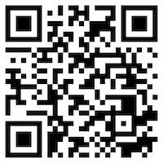





Introduction to
Artificial Intelligence for Text Analytics
Artificial Intelligence for Text Analytics
1121AITA01
MBA, IM, NTPU (M5265) (Fall 2023)
Tue 2, 3, 4 (9:10-12:00) (B3F17)
Min-Yuh Day, Ph.D,
Associate Professor
Institute of Information Management, National Taipei University
https://web.ntpu.edu.tw/~myday
https://meet.google.com/miy-fbif-max
2023-09-13

Slide 2










Min-Yuh Day, Ph.D.
Associate Professor, Information Management, NTPU
Visiting Scholar, IIS, Academia Sinica
Ph.D., Information Management, NTU
Director, Intelligent Financial Innovation Technology, IFIT Lab, IM, NTPU
Associate Director, Fintech and Green Finance Center, NTPU
Artificial Intelligence, Financial Technology, Big Data Analytics,
Data Mining and Text Mining, Electronic Commerce

Slide 3
Course Syllabus
National Taipei University
Academic Year 112, 1st Semester (Fall 2023)
Course Title: Artificial Intelligence for Text Analytics
Instructor: Min-Yuh Day
Course Class: MBA, IM, NTPU (3 Credits, Elective)
Details
  EMI Course
  (3 Credits, Elective, One Semester) (M5265)
Time & Place: Wed, 2, 3, 4, (9:10-12:00) (B3F17)
Google Meet: https://meet.google.com/miy-fbif-max
https://meet.google.com/miy-fbif-max

Slide 4
Course Objectives
Understand the fundamental concepts and research issues of Artificial Intelligence for Text Analytics.
Equip with Hands-on practices of Artificial Intelligence for Text Analytics.
Conduct information systems research in the context of Artificial Intelligence for Text Analytics.

Slide 5
Course Outline
This course introduces the fundamental concepts, research issues, and hands-on practices of Artificial Intelligence for Text Analytics.
Topics include:
  Introduction to Introduction to Artificial Intelligence for Text Analytics
  Foundations of Text Analytics: Natural Language Processing (NLP)
  Python for Natural Language Processing
  Natural Language Processing with Transformers
  Text Classification and Sentiment Analysis
  Multilingual Named Entity Recognition (NER), Text Similarity and Clustering
  Text Summarization and Topic Models
  Text Generation with Large Language Models (LLMs)
  Question Answering and Dialogue Systems
  Deep Learning, Generative AI, Transfer Learning,
  Zero-Shot, and Few-Shot Learning for Text Analytics
  Case Study on Artificial Intelligence for Text Analytics

Slide 6
Core Competence
Exploring new knowledge in information technology, system development and application 80 %
Internet marketing planning ability 10 %
Thesis writing and independent research skills 10 %

Slide 7
Four Fundamental Qualities
Professionalism
  Creative thinking and Problem-solving 40 %
  Comprehensive Integration 40 %
Interpersonal Relationship
  Communication and Coordination 10 %
  Teamwork 5 %
Ethics
  Honesty and Integrity 0 %
  Self-Esteem and Self-reflection 0 %
International Vision
  Caring for Diversity 0 %
  Interdisciplinary Vision 5 %

Slide 8
College Learning Goals
Ethics/Corporate Social Responsibility
Global Knowledge/Awareness
Communication
Analytical and Critical Thinking

Slide 9
Department Learning Goals
Information Technologies and
System Development Capabilities
Internet Marketing Management Capabilities
Research capabilities

Slide 10
Syllabus
Week Date Subject/Topics
1 2023/09/13 Introduction to Artificial Intelligence for Text Analytics
2 2023/09/20 Foundations of Text Analytics:
Natural Language Processing (NLP)
3 2023/09/27 Python for Natural Language Processing
4 2023/10/04 Natural Language Processing with Transformers
5 2023/10/11 Case Study on Artificial Intelligence for Text Analytics I
6 2023/10/18 Text Classification and Sentiment Analysis

Slide 11
Syllabus
Week Date Subject/Topics
7 2023/10/25 Multilingual Named Entity Recognition (NER)
8 2023/11/01 Midterm Project Report
9 2023/11/08 Text Similarity and Clustering
10 2023/11/15 Text Summarization and Topic Models
11 2023/11/22 Text Generation with Large Language Models (LLMs)
12 2023/11/29 Case Study on Artificial Intelligence for Text Analytics II

Slide 12
Syllabus
Week Date Subject/Topics
13 2023/12/06 Question Answering and Dialogue Systems
14 2023/12/13 Deep Learning, Generative AI, Transfer Learning,
Zero-Shot, and Few-Shot Learning for Text Analytics
15 2023/12/20 Final Project Report I
16 2023/12/27 Final Project Report II

Slide 13
Teaching Methods and Activities
Lecture
Discussion
Practicum

Slide 14
Evaluation Methods
Individual Presentation 60 %
Group Presentation 10 %
Case Report 10 %
Class Participation 10 %
Assignment 10 %

Slide 15
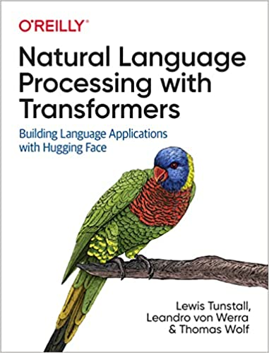
Required Texts
Lewis Tunstall, Leandro von Werra, and Thomas Wolf (2022), Natural Language Processing with Transformers:
Building Language Applications with Hugging Face,
O'Reilly Media.
Source: https://www.amazon.com/Natural-Language-Processing-Transformers-Applications/dp/1098103246

Slide 16
Reference Books
Denis Rothman (2021), Transformers for Natural Language Processing: Build innovative deep neural network architectures for NLP with Python, PyTorch, TensorFlow, BERT, RoBERTa, and more, Packt Publishing.
Savaş Yıldırım and Meysam Asgari-Chenaghlu (2021), Mastering Transformers: Build state-of-the-art models from scratch with advanced natural language processing techniques, Packt Publishing.
Sudharsan Ravichandiran (2021), Getting Started with Google BERT: Build and train state-of-the-art natural language processing models using BERT, Packt Publishing.
Sowmya Vajjala, Bodhisattwa Majumder, Anuj Gupta (2020), Practical Natural Language Processing: A Comprehensive Guide to Building Real-World NLP Systems, O'Reilly Media.

Slide 17
Other References
Dipanjan Sarkar (2019), Text Analytics with Python: A Practitioner’s Guide to Natural Language Processing, Second Edition. APress.
Benjamin Bengfort, Rebecca Bilbro, and Tony Ojeda (2018), Applied Text Analysis with Python: Enabling Language-Aware Data Products with Machine Learning, O’Reilly.
Charu C. Aggarwal (2018), Machine Learning for Text, Springer.
Gabe Ignatow and Rada F. Mihalcea (2017), An Introduction to Text Mining: Research Design, Data Collection, and Analysis, SAGE Publications.
Aurélien Géron (2019), Hands-On Machine Learning with Scikit-Learn, Keras, and TensorFlow: Concepts, Tools, and Techniques to Build Intelligent Systems, 2nd Edition, O’Reilly Media.
Frederick Kaefer and Paul Kaefer (2020), Introduction to Python Programming for Business and Social Science Applications, SAGE Publications
Vic Anand, Khrystyna Bochkay, and Roman Chychyla (2020), Using Python for Text Analysis in Accounting Research, Now Publishers.

Slide 18
Lewis Tunstall, Leandro von Werra, and Thomas Wolf (2022),
Natural Language Processing with Transformers:
Building Language Applications with Hugging Face,
O'Reilly Media.
Source: https://www.amazon.com/Natural-Language-Processing-Transformers-Applications/dp/1098103246

Slide 19
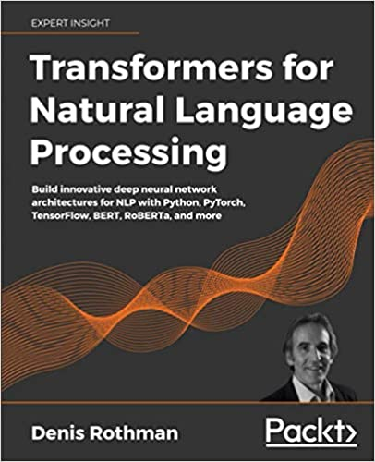
Denis Rothman (2021),
Transformers for Natural Language Processing:
Build innovative deep neural network architectures for NLP with Python, PyTorch, TensorFlow, BERT, RoBERTa, and more,
Packt Publishing.
Source: https://www.amazon.com/Transformers-Natural-Language-Processing-architectures/dp/1800565798

Slide 20
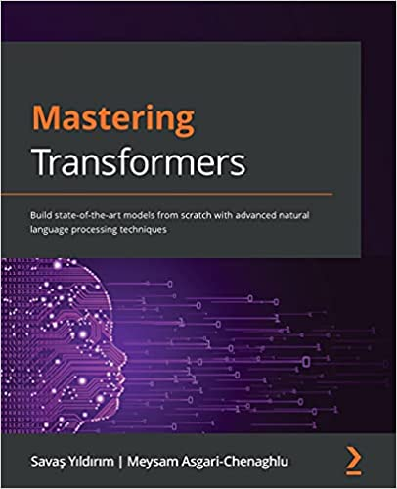
Savaş Yıldırım and Meysam Asgari-Chenaghlu (2021),
Mastering Transformers:
Build state-of-the-art models from scratch with advanced natural language processing techniques,
Packt Publishing.
Source: https://www.amazon.com/Mastering-Transformers-state-art-processing/dp/1801077657/

Slide 21
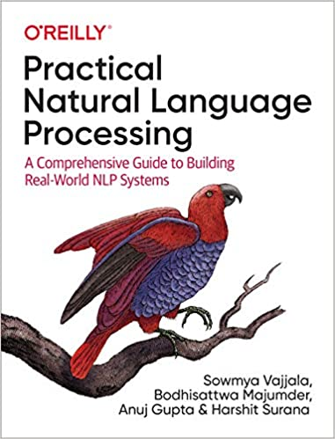
Sowmya Vajjala, Bodhisattwa Majumder, Anuj Gupta (2020), Practical Natural Language Processing:
A Comprehensive Guide to Building Real-World NLP Systems,
O'Reilly Media.
Source: https://www.amazon.com/Practical-Natural-Language-Processing-Pragmatic/dp/1492054054

Slide 22
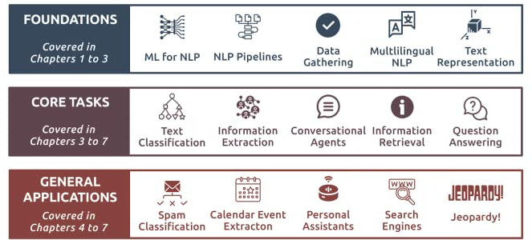
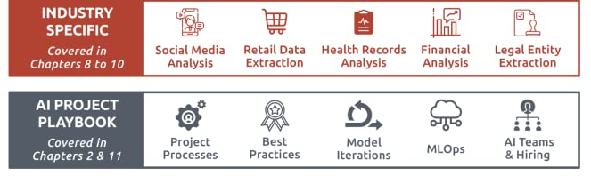
Source: Sowmya Vajjala, Bodhisattwa Majumder, Anuj Gupta (2020), Practical Natural Language Processing: A Comprehensive Guide to Building Real-World NLP Systems, O'Reilly Media.
Source: https://www.amazon.com/Practical-Natural-Language-Processing-Pragmatic/dp/1492054054

Slide 23
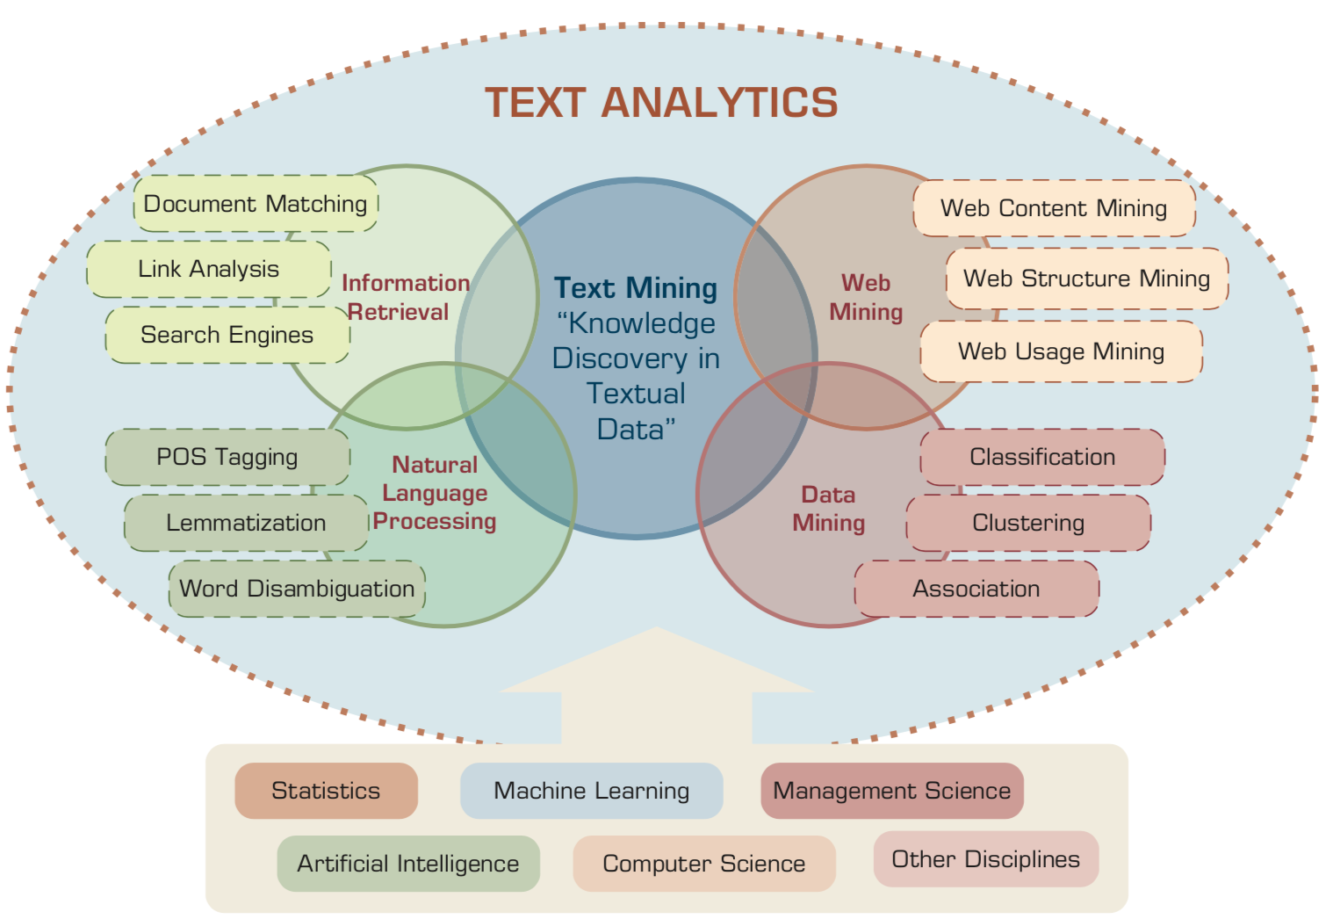
Text Analytics and Text Mining
Source: Ramesh Sharda, Dursun Delen, and Efraim Turban (2017), Business Intelligence, Analytics, and Data Science: A Managerial Perspective, 4th Edition, Pearson

Slide 24
Artificial Intelligence
(AI)

Slide 25
AI, Big Data, Cloud Computing
Evolution of Decision Support, Business Intelligence, and Analytics
AI
AI
Cloud Computing
Big Data
DM
BI
Source: Ramesh Sharda, Dursun Delen, and Efraim Turban (2017),
Business Intelligence, Analytics, and Data Science: A Managerial Perspective, 4th Edition, Pearson

Slide 26
The Rise of AI
Source: DHL (2018), Artificial Intelligence in Logistics,
http://www.globalhha.com/doclib/data/upload/doc_con/5e50c53c5bf67.pdf/

Slide 27
Definition of
Artificial Intelligence (A.I.)

Slide 28
Artificial Intelligence
“… the science and engineering of making intelligent machines”
(John McCarthy, 1955)
Source: https://digitalintelligencetoday.com/artificial-intelligence-defined-useful-list-of-popular-definitions-from-business-and-science/

Slide 29
Artificial Intelligence
“… technology that thinks and acts like humans”
Source: https://digitalintelligencetoday.com/artificial-intelligence-defined-useful-list-of-popular-definitions-from-business-and-science/

Slide 30
Artificial Intelligence
“… intelligence exhibited by machines or software”
Source: https://digitalintelligencetoday.com/artificial-intelligence-defined-useful-list-of-popular-definitions-from-business-and-science/

Slide 31
4 Approaches of AI
Thinking Humanly | Thinking Rationally
Acting Humanly | Acting Rationally
Source: Stuart Russell and Peter Norvig (2020), Artificial Intelligence: A Modern Approach, 4th Edition, Pearson

Slide 32
4 Approaches of AI
2. Thinking Humanly: The Cognitive Modeling Approach | 3. Thinking Rationally: The “Laws of Thought” Approach
1. Acting Humanly: The Turing Test Approach (1950) | 4. Acting Rationally: The Rational Agent Approach
Source: Stuart Russell and Peter Norvig (2020), Artificial Intelligence: A Modern Approach, 4th Edition, Pearson

Slide 33
AI Acting Humanly:
The Turing Test Approach
(Alan Turing, 1950)
Knowledge Representation
Automated Reasoning
Machine Learning (ML)
  Deep Learning (DL)
Computer Vision (Image, Video)
Natural Language Processing (NLP)
Robotics
Source: Stuart Russell and Peter Norvig (2020), Artificial Intelligence: A Modern Approach, 4th Edition, Pearson

Slide 34
Text Analytics
(TA)

Slide 35
Text Analytics
Text Analytics =
Information Retrieval +
Information Extraction +
Data Mining +
Web Mining
Text Analytics =
Information Retrieval +
Text Mining
Source: Ramesh Sharda, Dursun Delen, and Efraim Turban (2017), Business Intelligence, Analytics, and Data Science: A Managerial Perspective, 4th Edition, Pearson

Slide 36
Text Mining
Text Data Mining
Knowledge Discovery in
Textual Databases
Source: Ramesh Sharda, Dursun Delen, and Efraim Turban (2017), Business Intelligence, Analytics, and Data Science: A Managerial Perspective, 4th Edition, Pearson

Slide 37
Application Areas of Text Mining
Information extraction
Topic tracking
Summarization
Categorization
Clustering
Concept linking
Question answering
Source: Ramesh Sharda, Dursun Delen, and Efraim Turban (2017), Business Intelligence, Analytics, and Data Science: A Managerial Perspective, 4th Edition, Pearson

Slide 38


Emotions
Love
Anger
Joy
Sadness
Surprise
Fear
Source: Bing Liu (2011) , “Web Data Mining: Exploring Hyperlinks, Contents, and Usage Data,” Springer, 2nd Edition,

Slide 39
Example of Opinion: review segment on iPhone
“I bought an iPhone a few days ago.
It was such a nice phone.
The touch screen was really cool.
The voice quality was clear too.
However, my mother was mad with me as I did not tell her before I bought it.
She also thought the phone was too expensive, and wanted me to return it to the shop. … ”
Source: Bing Liu (2011) , “Web Data Mining: Exploring Hyperlinks, Contents, and Usage Data,” Springer, 2nd Edition,

Slide 40
Example of Opinion:
review segment on iPhone
“(1) I bought an iPhone a few days ago.
(2) It was such a nice phone.
(3) The touch screen was really cool.
(4) The voice quality was clear too.
(5) However, my mother was mad with me as I did not tell her before I bought it.
(6) She also thought the phone was too expensive, and wanted me to return it to the shop. … ”
+Positive Opinion
-Negative Opinion
Source: Bing Liu (2011) , “Web Data Mining: Exploring Hyperlinks, Contents, and Usage Data,” Springer, 2nd Edition,

Slide 41
Sentiment Analysis
Subjectivity
Classification
Polarity Determination
Approaches
Machine Learning based
Sentiment Classification
Vagueness resolution in opinionated text
Lexicon based
Sentiment Analysis
Review Usefulness Measurement
Multi- & Cross- Lingual SC
Hybrid
approaches
Opinion Spam Detection
Cross-domain SC
Lexicon Creation
Ontology based
Tasks
Non-Ontology based
Aspect Extraction
Application
Source: Kumar Ravi and Vadlamani Ravi (2015), "A survey on opinion mining and sentiment analysis: tasks, approaches and applications." Knowledge-Based Systems, 89, pp.14-46.

Slide 42
Sentiment Classification Techniques
Decision Tree Classifiers
Support Vector Machine (SVM)
Supervised Learning
Neural Network (NN
Machine Learning Approach
Linear Classifiers
Deep Learning (DL)
Rule-based Classifiers
Naïve Bayes
(NB)
Sentiment Analysis
Unsupervised Learning
Probabilistic Classifiers
Bayesian Network (BN)
Dictionary-based Approach
Maximum Entropy (ME)
Lexicon-based Approach
Statistical
Corpus-based Approach
Semantic
Source: Jesus Serrano-Guerrero, Jose A. Olivas, Francisco P. Romero, and Enrique Herrera-Viedma (2015),
"Sentiment analysis: A review and comparative analysis of web services," Information Sciences, 311, pp. 18-38.

Slide 43
Text Mining
Technologies

Slide 44
Natural Language Processing
(NLP)
Text Mining
(TM)

Slide 45
Text mining
Text Data Mining
Intelligent Text Analysis
Knowledge-Discovery in Text (KDT)
Source: Vishal Gupta and Gurpreet S. Lehal (2009), "A survey of text mining techniques and applications,"
Journal of emerging technologies in web intelligence, vol. 1, no. 1, pp. 60-76.

Slide 46
Text Mining
(text data mining)
  the process of
  deriving
  high-quality information
  from text
http://en.wikipedia.org/wiki/Text_mining

Slide 47
Text Mining: the process of extracting interesting and non-trivial information and knowledge from unstructured text.
Source: Vishal Gupta and Gurpreet S. Lehal (2009), "A survey of text mining techniques and applications,"
Journal of emerging technologies in web intelligence, vol. 1, no. 1, pp. 60-76.

Slide 48
Text Mining: discovery by computer of new, previously unknown information, by automatically extracting information from different written resources.
Source: Vishal Gupta and Gurpreet S. Lehal (2009), "A survey of text mining techniques and applications,"
Journal of emerging technologies in web intelligence, vol. 1, no. 1, pp. 60-76.

Slide 49
An example of Text Mining
Knowledge
Analyze Text
Management Information System
Information Extraction
Classification
Summarization
Retrieve and preprocess document
Clustering
Document Collection
Source: Vishal Gupta and Gurpreet S. Lehal (2009), "A survey of text mining techniques and applications,"
Journal of emerging technologies in web intelligence, vol. 1, no. 1, pp. 60-76.

Slide 50
Overview of
Information Extraction based
Text Mining Framework
Text Data Mining
Text
Text
DB
Text
Information Extraction
Data Mining
Rule
Source: Vishal Gupta and Gurpreet S. Lehal (2009), "A survey of text mining techniques and applications,"
Journal of emerging technologies in web intelligence, vol. 1, no. 1, pp. 60-76.

Slide 51
Natural Language Processing (NLP)
Natural language processing (NLP)
is an important component of
text mining and
is a subfield of
artificial intelligence and
computational linguistics.
Source: Ramesh Sharda, Dursun Delen, and Efraim Turban (2017), Business Intelligence, Analytics, and Data Science: A Managerial Perspective, 4th Edition, Pearson

Slide 52
Natural Language Processing (NLP)
Part-of-speech tagging
Text segmentation
Word sense disambiguation
Syntactic ambiguity
Imperfect or irregular input
Speech acts
Source: Ramesh Sharda, Dursun Delen, and Efraim Turban (2017), Business Intelligence, Analytics, and Data Science: A Managerial Perspective, 4th Edition, Pearson

Slide 53
NLP Tasks
Question answering
Automatic summarization
Natural language generation
Natural language understanding
Machine translation
Foreign language reading
Foreign language writing.
Speech recognition
Text-to-speech
Text proofing
Optical character recognition
Source: Ramesh Sharda, Dursun Delen, and Efraim Turban (2017), Business Intelligence, Analytics, and Data Science: A Managerial Perspective, 4th Edition, Pearson

Slide 54
NLP
Source: http://blog.aylien.com/leveraging-deep-learning-for-multilingual/

Slide 55
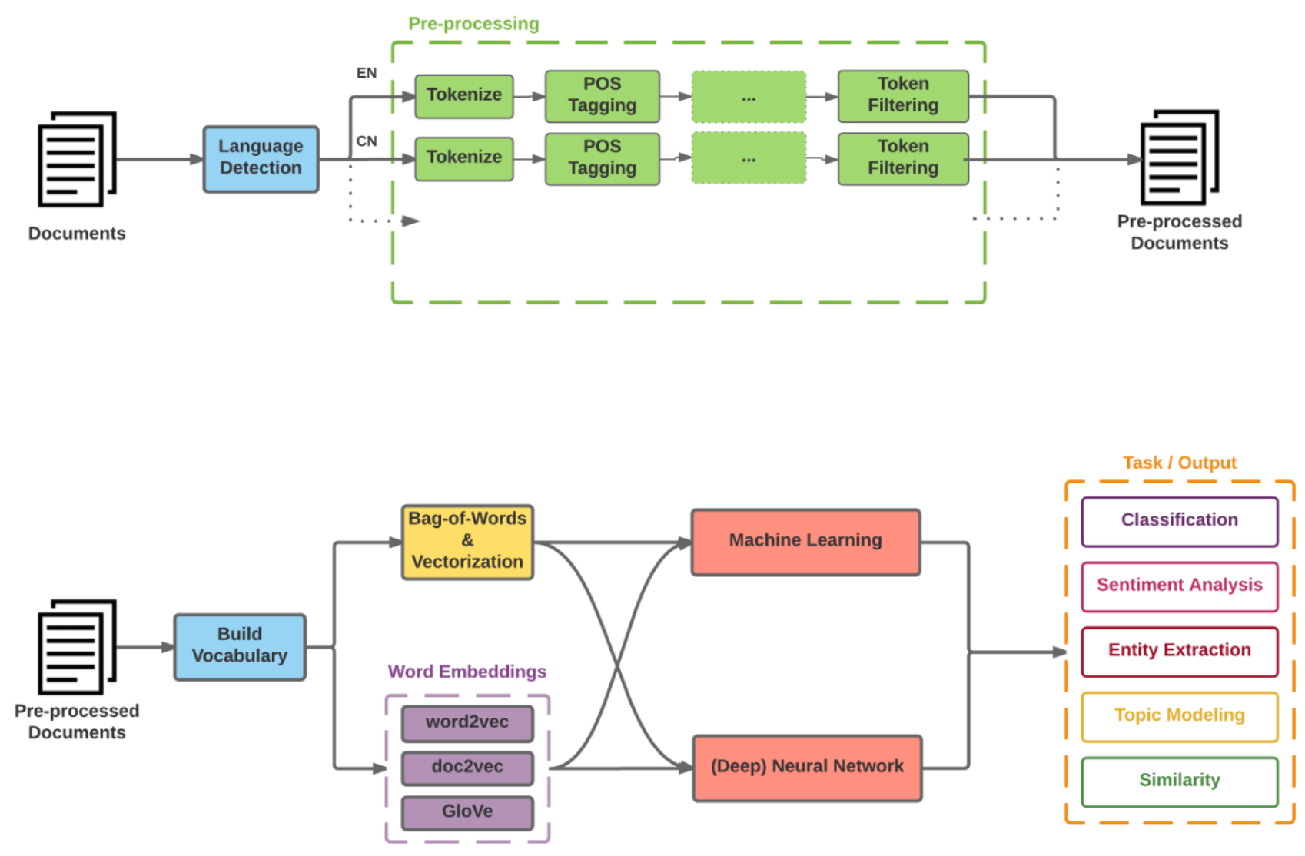
Modern NLP Pipeline
Source: https://github.com/fortiema/talks/blob/master/opendata2016sh/pragmatic-nlp-opendata2016sh.pdf

Slide 56
Modern NLP Pipeline
Source: http://mattfortier.me/2017/01/31/nlp-intro-pt-1-overview/

Slide 57
Deep Learning NLP
Source: http://mattfortier.me/2017/01/31/nlp-intro-pt-1-overview/

Slide 58
Lewis Tunstall, Leandro von Werra, and Thomas Wolf (2022),
Natural Language Processing with Transformers:
Building Language Applications with Hugging Face,
O'Reilly Media.
Source: https://www.amazon.com/Natural-Language-Processing-Transformers-Applications/dp/1098103246

Slide 59
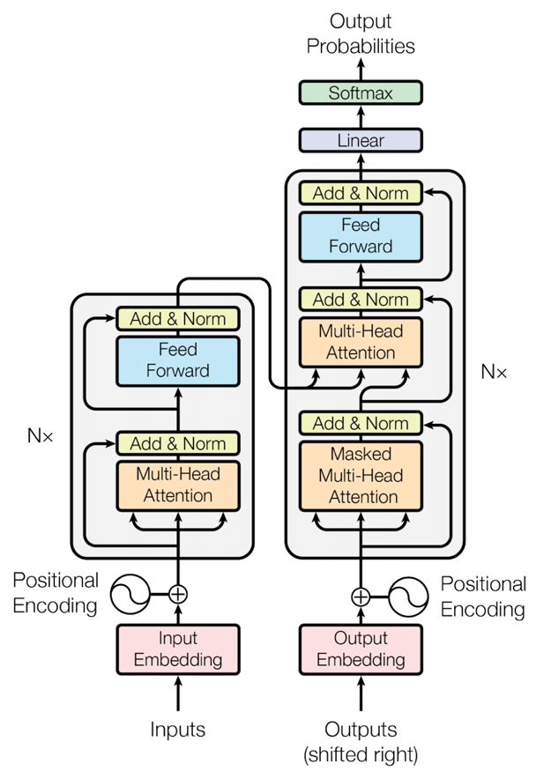
Transformer (Attention is All You Need)
(Vaswani et al., 2017)
Source: Vaswani, Ashish, Noam Shazeer, Niki Parmar, Jakob Uszkoreit, Llion Jones, Aidan N. Gomez, Łukasz Kaiser, and Illia Polosukhin. "Attention is all you need." In Advances in neural information processing systems, pp. 5998-6008. 2017.

Slide 60
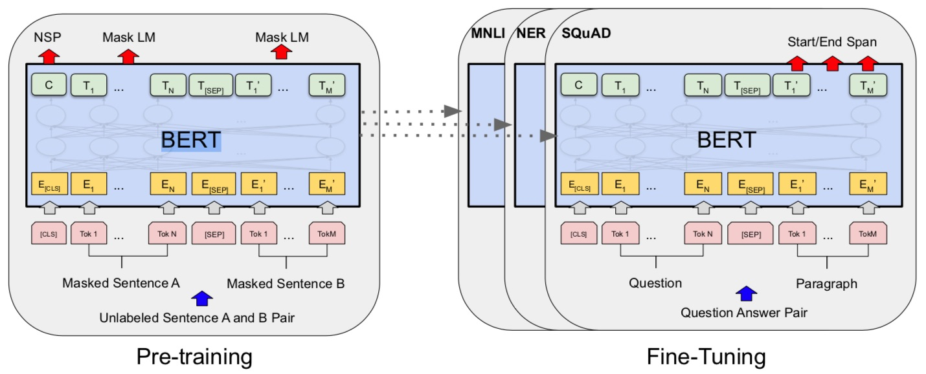
BERT: Pre-training of Deep Bidirectional Transformers for Language Understanding
BERT (Bidirectional Encoder Representations from Transformers)
Overall pre-training and fine-tuning procedures for BERT
Source: Devlin, Jacob, Ming-Wei Chang, Kenton Lee, and Kristina Toutanova (2018).
"Bert: Pre-training of deep bidirectional transformers for language understanding." arXiv preprint arXiv:1810.04805.

Slide 61
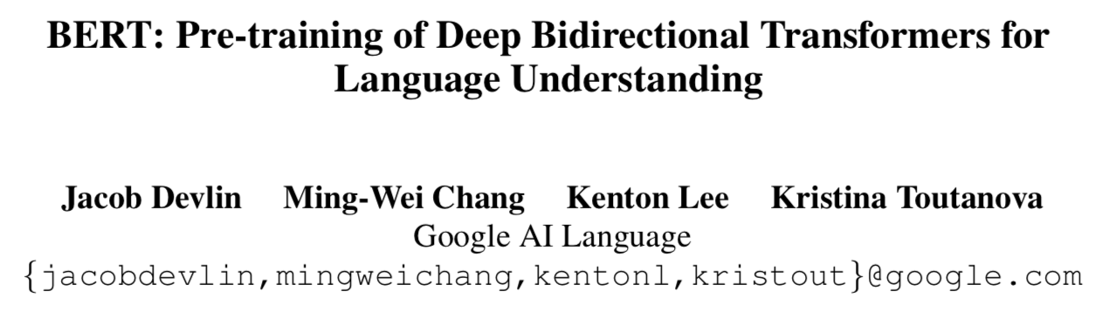
BERT:
Pre-training of Deep
Bidirectional Transformers for Language Understanding
Source: Devlin, Jacob, Ming-Wei Chang, Kenton Lee, and Kristina Toutanova (2018).
"BERT: Pre-training of Deep Bidirectional Transformers for Language Understanding." arXiv preprint arXiv:1810.04805

Slide 62
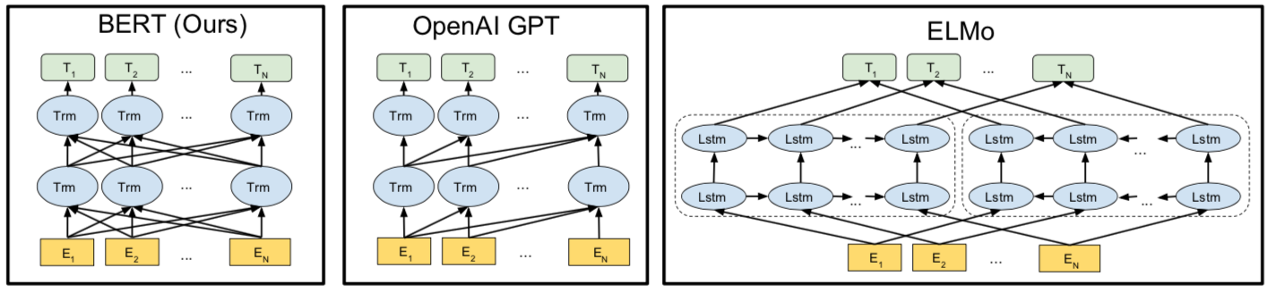
BERT
Bidirectional Encoder Representations from Transformers
Pre-training model architectures
BERT uses a bidirectional Transformer.
OpenAI GPT uses a left-to-right Transformer.
ELMo uses the concatenation of independently trained left-to-right and right- to-left LSTM to generate features for downstream tasks.
Among three, only BERT representations are jointly conditioned on both left and right context in all layers.
Source: Devlin, Jacob, Ming-Wei Chang, Kenton Lee, and Kristina Toutanova (2018).
"BERT: Pre-training of Deep Bidirectional Transformers for Language Understanding." arXiv preprint arXiv:1810.04805

Slide 63
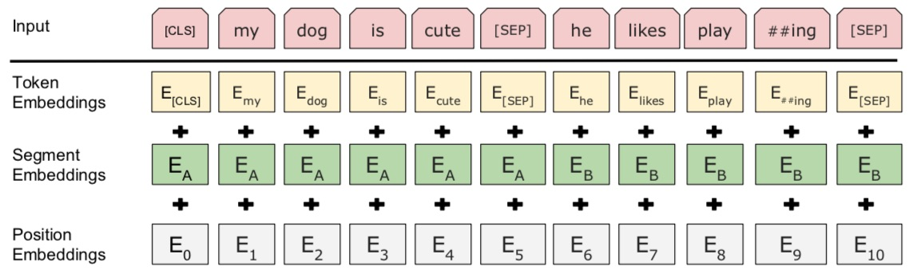
BERT: Pre-training of Deep Bidirectional Transformers for Language Understanding
BERT (Bidirectional Encoder Representations from Transformers)
BERT input representation
The input embeddings is the sum of the token embeddings,
the segmentation embeddings and the position embeddings.
Source: Devlin, Jacob, Ming-Wei Chang, Kenton Lee, and Kristina Toutanova (2018).
"Bert: Pre-training of deep bidirectional transformers for language understanding." arXiv preprint arXiv:1810.04805.

Slide 64
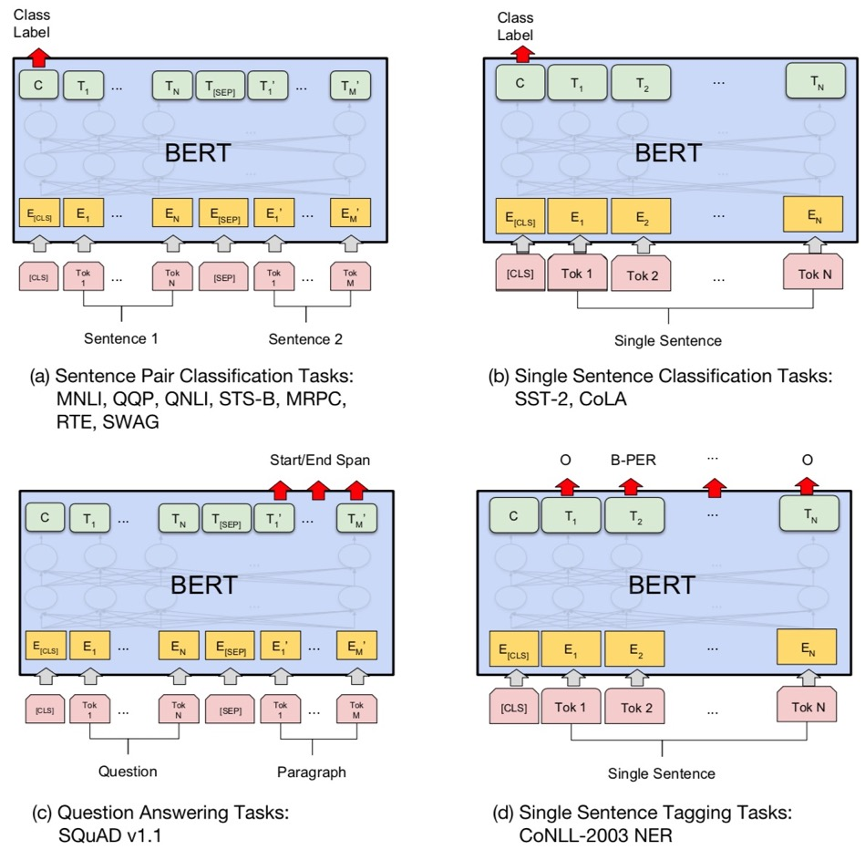
Fine-tuning BERT on NLP Tasks
Source: Devlin, Jacob, Ming-Wei Chang, Kenton Lee, and Kristina Toutanova (2018).
"BERT: Pre-training of Deep Bidirectional Transformers for Language Understanding." arXiv preprint arXiv:1810.04805

Slide 65
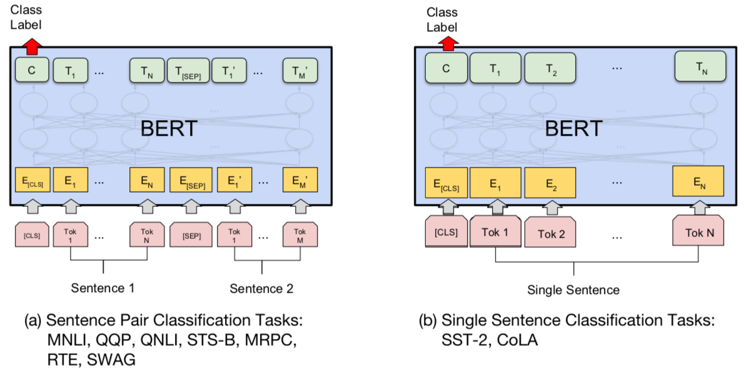
BERT Sequence-level tasks
Source: Devlin, Jacob, Ming-Wei Chang, Kenton Lee, and Kristina Toutanova (2018).
"BERT: Pre-training of Deep Bidirectional Transformers for Language Understanding." arXiv preprint arXiv:1810.04805

Slide 66
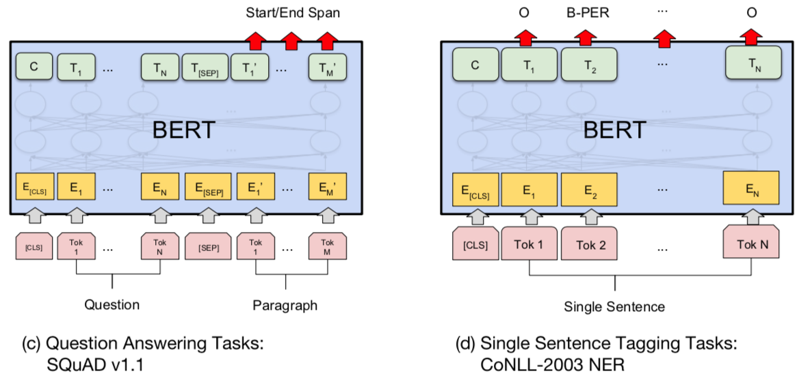
BERT Token-level tasks
Source: Devlin, Jacob, Ming-Wei Chang, Kenton Lee, and Kristina Toutanova (2018).
"BERT: Pre-training of Deep Bidirectional Transformers for Language Understanding." arXiv preprint arXiv:1810.04805

Slide 67
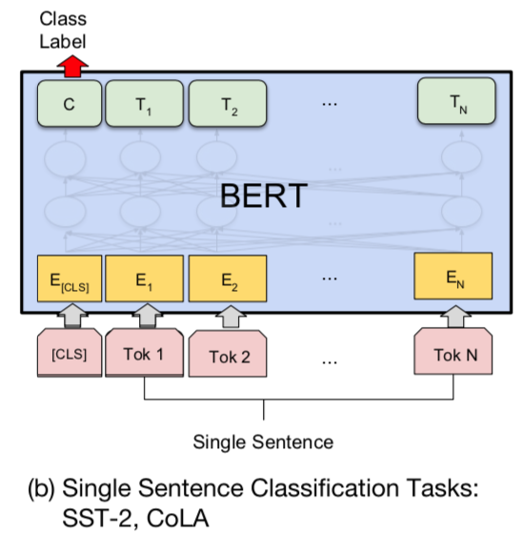
Sentiment Analysis:
Single Sentence Classification
Source: Devlin, Jacob, Ming-Wei Chang, Kenton Lee, and Kristina Toutanova (2018).
"BERT: Pre-training of Deep Bidirectional Transformers for Language Understanding." arXiv preprint arXiv:1810.04805

Slide 68
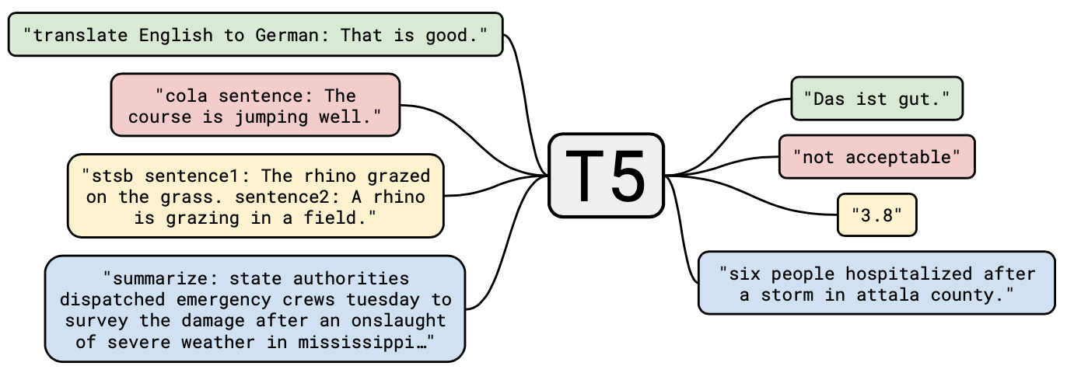
T5
Text-to-Text Transfer Transformer
Source: JColin Raffel, Noam Shazeer, Adam Roberts, Katherine Lee, Sharan Narang, Michael Matena, Yanqi Zhou, Wei Li, and Peter J. Liu (2019). "Exploring the limits of transfer learning with a unified text-to-text transformer." arXiv preprint arXiv:1910.10683 (2019).

Slide 69
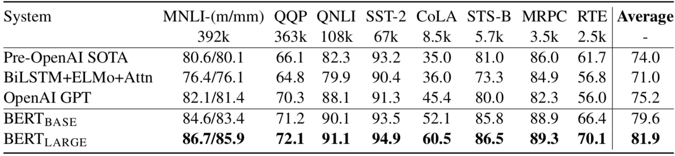
General Language Understanding Evaluation (GLUE) benchmark
GLUE Test results
MNLI: Multi-Genre Natural Language Inference
QQP: Quora Question Pairs
QNLI: Question Natural Language Inference
SST-2: The Stanford Sentiment Treebank
CoLA: The Corpus of Linguistic Acceptability
STS-B:The Semantic Textual Similarity Benchmark
MRPC: Microsoft Research Paraphrase Corpus
RTE: Recognizing Textual Entailment
Source: Devlin, Jacob, Ming-Wei Chang, Kenton Lee, and Kristina Toutanova (2018).
"BERT: Pre-training of Deep Bidirectional Transformers for Language Understanding." arXiv preprint arXiv:1810.04805

Slide 70
Generative AI
Text, Image, Video, Audio Applications

Slide 71
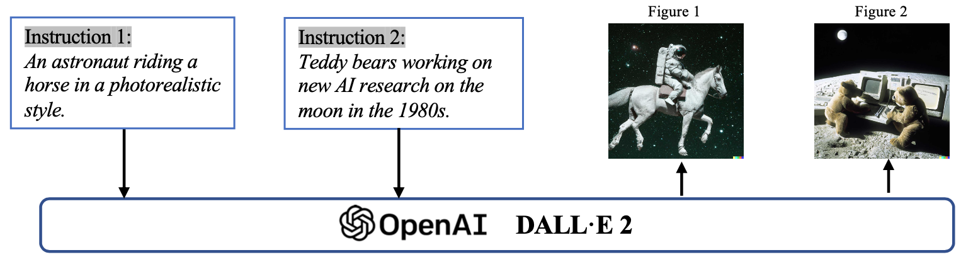
Generative AI (Gen AI)
AI Generated Content (AIGC)
Image Generation
Source: Yihan Cao, Siyu Li, Yixin Liu, Zhiling Yan, Yutong Dai, Philip S. Yu, and Lichao Sun (2023). "A Comprehensive Survey of AI-Generated Content (AIGC): A History of Generative AI from GAN to ChatGPT." arXiv preprint arXiv:2303.04226.

Slide 72
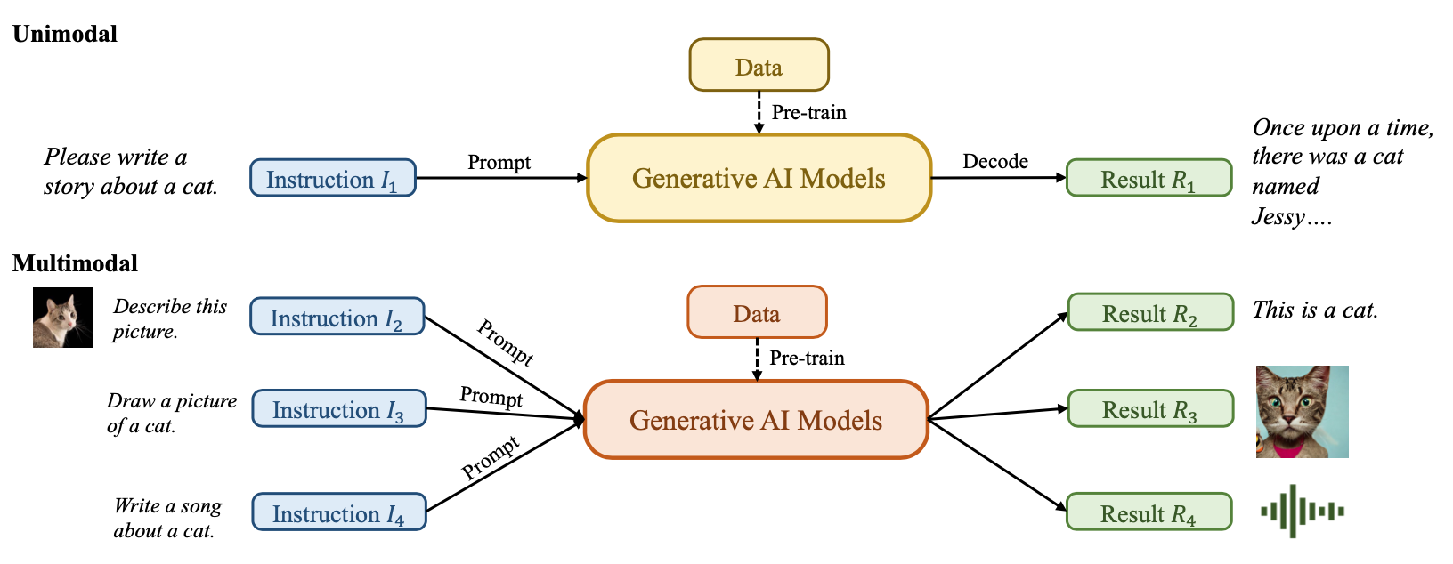
Generative AI (Gen AI)
AI Generated Content (AIGC)
Source: Yihan Cao, Siyu Li, Yixin Liu, Zhiling Yan, Yutong Dai, Philip S. Yu, and Lichao Sun (2023). "A Comprehensive Survey of AI-Generated Content (AIGC): A History of Generative AI from GAN to ChatGPT." arXiv preprint arXiv:2303.04226.

Slide 73
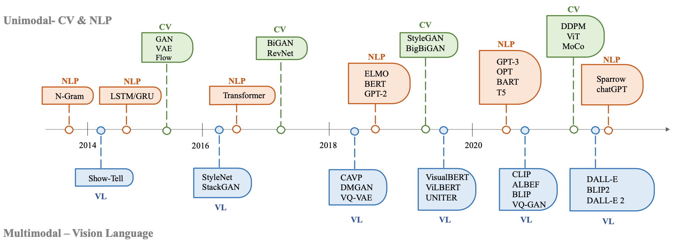
The history of Generative AI in CV, NLP and VL
Source: Yihan Cao, Siyu Li, Yixin Liu, Zhiling Yan, Yutong Dai, Philip S. Yu, and Lichao Sun (2023). "A Comprehensive Survey of AI-Generated Content (AIGC): A History of Generative AI from GAN to ChatGPT." arXiv preprint arXiv:2303.04226.

Slide 74
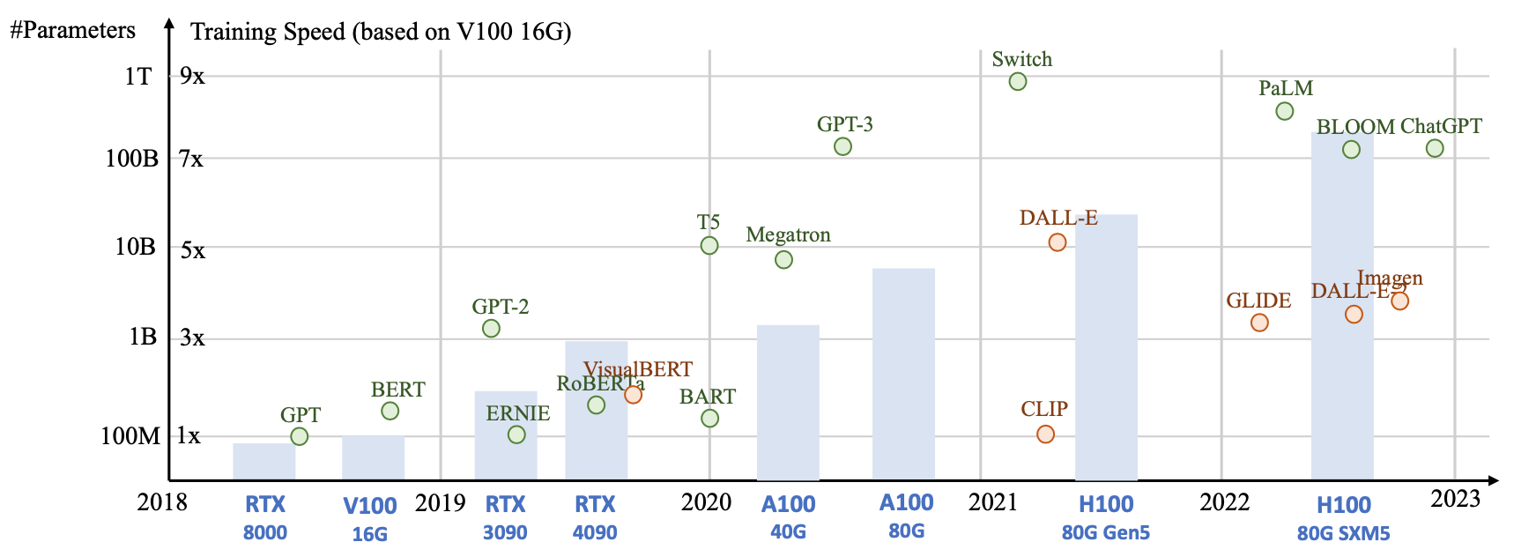
Generative AI
Foundation Models
Source: Yihan Cao, Siyu Li, Yixin Liu, Zhiling Yan, Yutong Dai, Philip S. Yu, and Lichao Sun (2023). "A Comprehensive Survey of AI-Generated Content (AIGC): A History of Generative AI from GAN to ChatGPT." arXiv preprint arXiv:2303.04226.

Slide 75
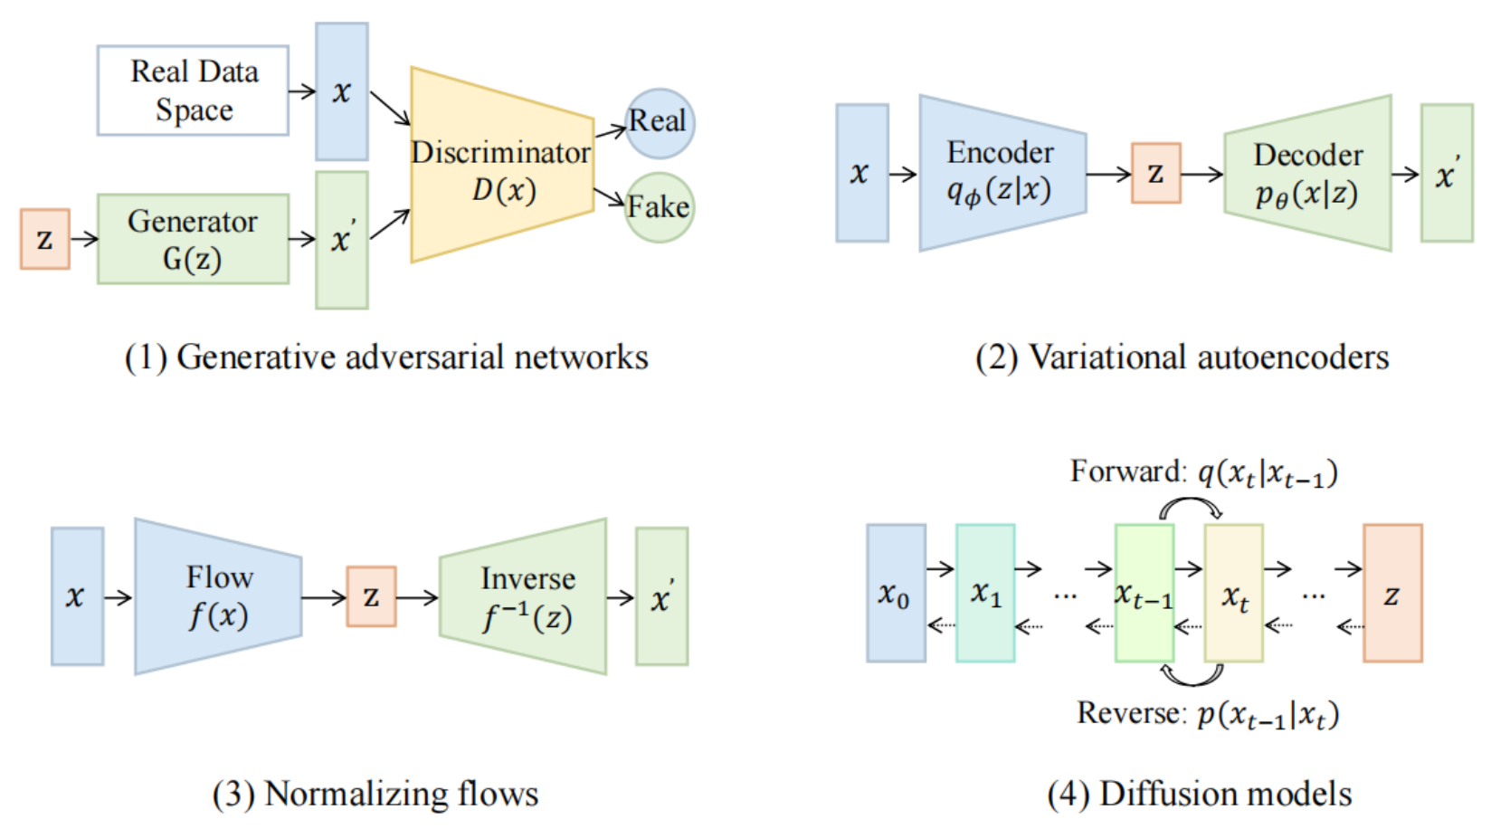
Categories of Vision Generative Models
Source: Yihan Cao, Siyu Li, Yixin Liu, Zhiling Yan, Yutong Dai, Philip S. Yu, and Lichao Sun (2023). "A Comprehensive Survey of AI-Generated Content (AIGC): A History of Generative AI from GAN to ChatGPT." arXiv preprint arXiv:2303.04226.

Slide 76
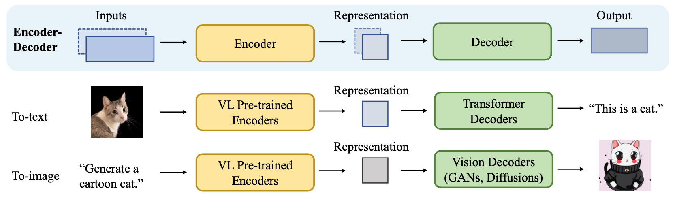
The General Structure of
Generative Vision Language
Source: Yihan Cao, Siyu Li, Yixin Liu, Zhiling Yan, Yutong Dai, Philip S. Yu, and Lichao Sun (2023). "A Comprehensive Survey of AI-Generated Content (AIGC): A History of Generative AI from GAN to ChatGPT." arXiv preprint arXiv:2303.04226.

Slide 77
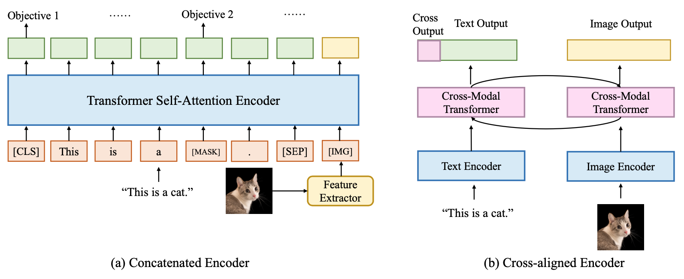
Two Types of Vision Language Encoders: Concatenated Encoders and Cross-aligned Encoders
Source: Yihan Cao, Siyu Li, Yixin Liu, Zhiling Yan, Yutong Dai, Philip S. Yu, and Lichao Sun (2023). "A Comprehensive Survey of AI-Generated Content (AIGC): A History of Generative AI from GAN to ChatGPT." arXiv preprint arXiv:2303.04226.

Slide 78
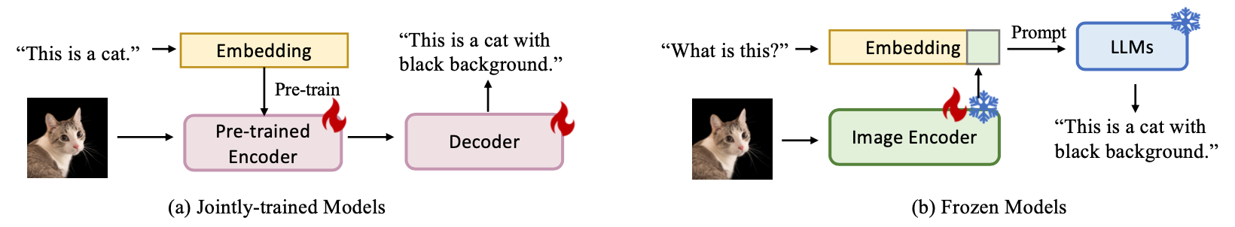
Two Types of to-language Decoder Models: Jointly-trained Models and Frozen Models
Source: Yihan Cao, Siyu Li, Yixin Liu, Zhiling Yan, Yutong Dai, Philip S. Yu, and Lichao Sun (2023). "A Comprehensive Survey of AI-Generated Content (AIGC): A History of Generative AI from GAN to ChatGPT." arXiv preprint arXiv:2303.04226.

Slide 79
ChatGPT
Large Language Models (LLMs)
Foundation Models

Slide 80
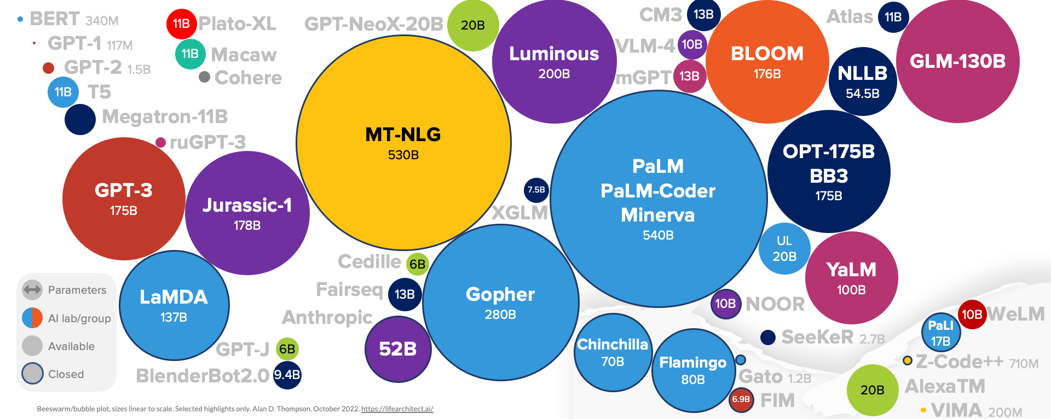
Large Language Models (LLM)
(GPT-3, ChatGPT, PaLM, BLOOM, OPT-175B, LLaMA)
ChatGPT
175B
LLaMA
65B
Source: https://lifearchitect.ai/models/

Slide 81
The Transformers Timeline
ULMFit
BERT
RoBERTa
XLM-R
DeBERTa
GPT-Neo
BLOOM
Alpaca
DistrilBERT
T5
PaLM
ChatGPT
Llama2
Transformer
GPT
GPT-2
GPT-3
GPT-J
OPT-175B
Llama
2017
2018
2019
2020
2021
2022
2023
Source: Lewis Tunstall, Leandro von Werra, and Thomas Wolf (2022), Natural Language Processing with Transformers: Building Language Applications with Hugging Face, O'Reilly Media.

Slide 82
Transformer Models
Transformer
Encoder
Decoder
DistilBERT
BERT
T5
GPT
RoBERTa
BART
GPT-2
CTRL
XLM-R
XLM
M2M-100
GPT-3
ALBERT
BigBird
GPT-Neo
GPT-J
ELECTRA
mT0
BLOOM
BLOOMZ
DeBERTa
ChatGPT
GPT-4
Source: Lewis Tunstall, Leandro von Werra, and Thomas Wolf (2022), Natural Language Processing with Transformers: Building Language Applications with Hugging Face, O'Reilly Media.

Slide 83
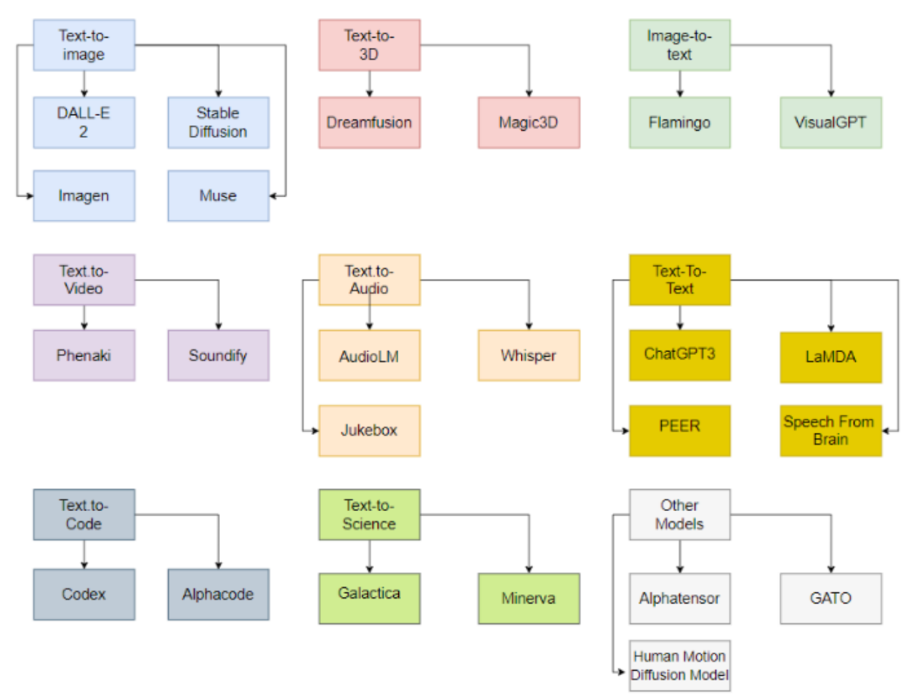
Generative AI Models
ChatGPT
is not
all you need
Attention
is
all you need
Source: Gozalo-Brizuela, Roberto, and Eduardo C. Garrido-Merchan (2023). "ChatGPT is not all you need. A State of the Art Review of large Generative AI models." arXiv preprint arXiv:2301.04655 (2023).

Slide 84
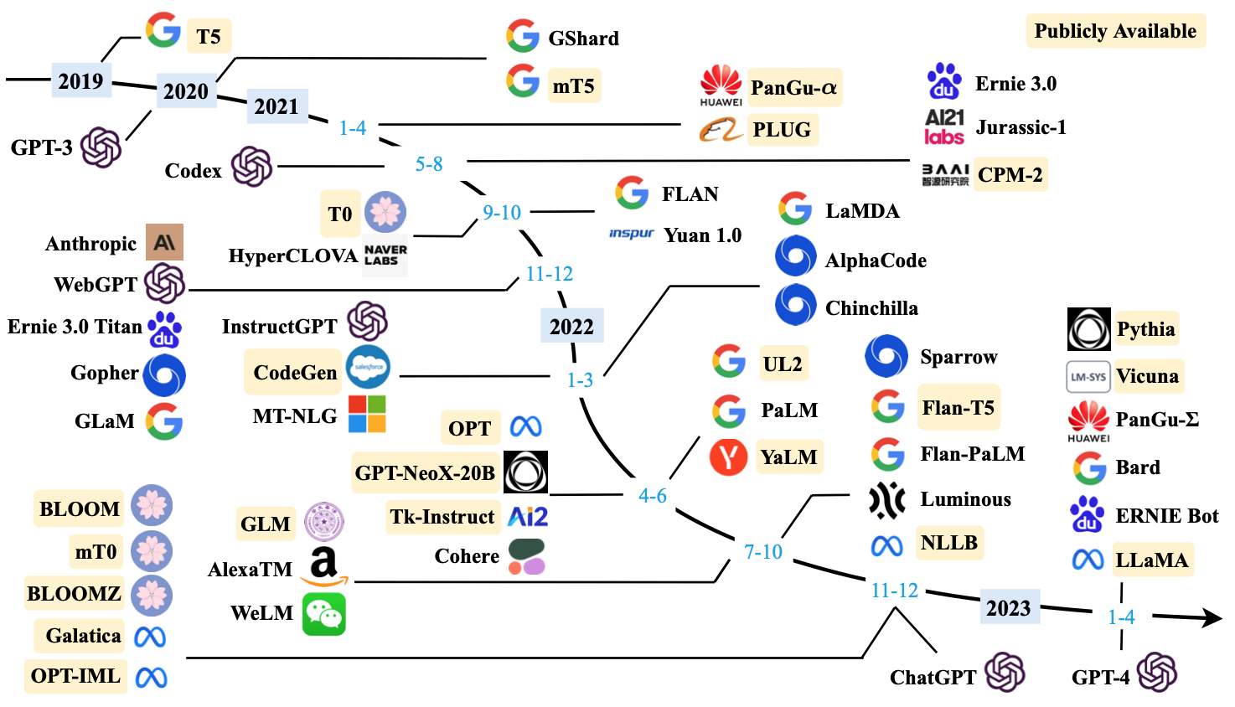
Large Language Models (LLMs) (larger than 10B)
Source: Wayne Xin Zhao, Kun Zhou, Junyi Li, Tianyi Tang, Xiaolei Wang, Yupeng Hou, Yingqian Min et al. (2023) "A Survey of Large Language Models." arXiv preprint arXiv:2303.18223.

Slide 85
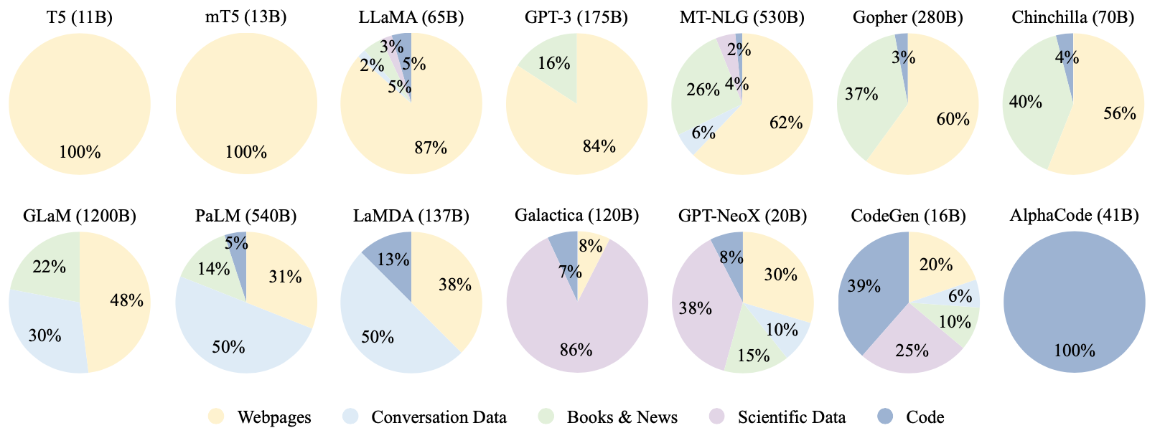
Ratios of various data sources in the pre-training data for existing LLMs
Source: Wayne Xin Zhao, Kun Zhou, Junyi Li, Tianyi Tang, Xiaolei Wang, Yupeng Hou, Yingqian Min et al. (2023) "A Survey of Large Language Models." arXiv preprint arXiv:2303.18223.

Slide 86
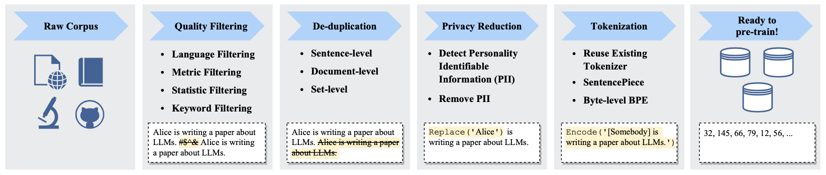
Typical Data Preprocessing Pipeline for
Pre-training Large Language Models (LLMs)
Source: Wayne Xin Zhao, Kun Zhou, Junyi Li, Tianyi Tang, Xiaolei Wang, Yupeng Hou, Yingqian Min et al. (2023) "A Survey of Large Language Models." arXiv preprint arXiv:2303.18223.

Slide 87
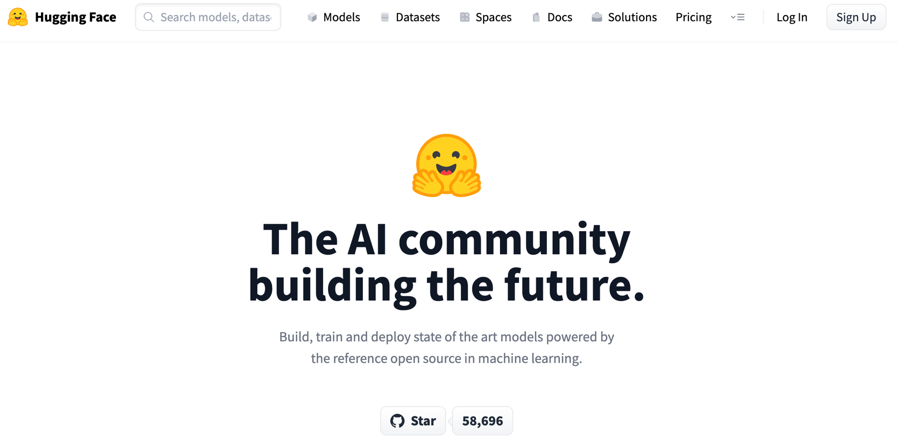
Hugging Face
https://huggingface.co/

Slide 88
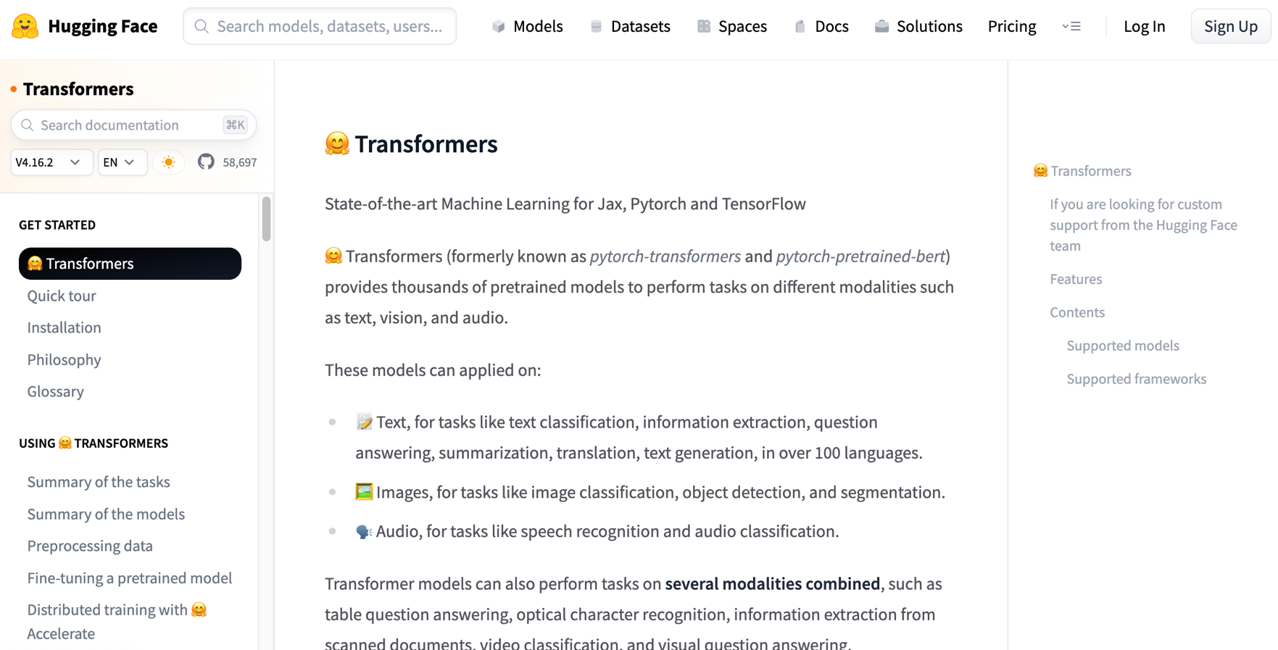
Hugging Face Transformers
https://huggingface.co/docs/transformers/index

Slide 89
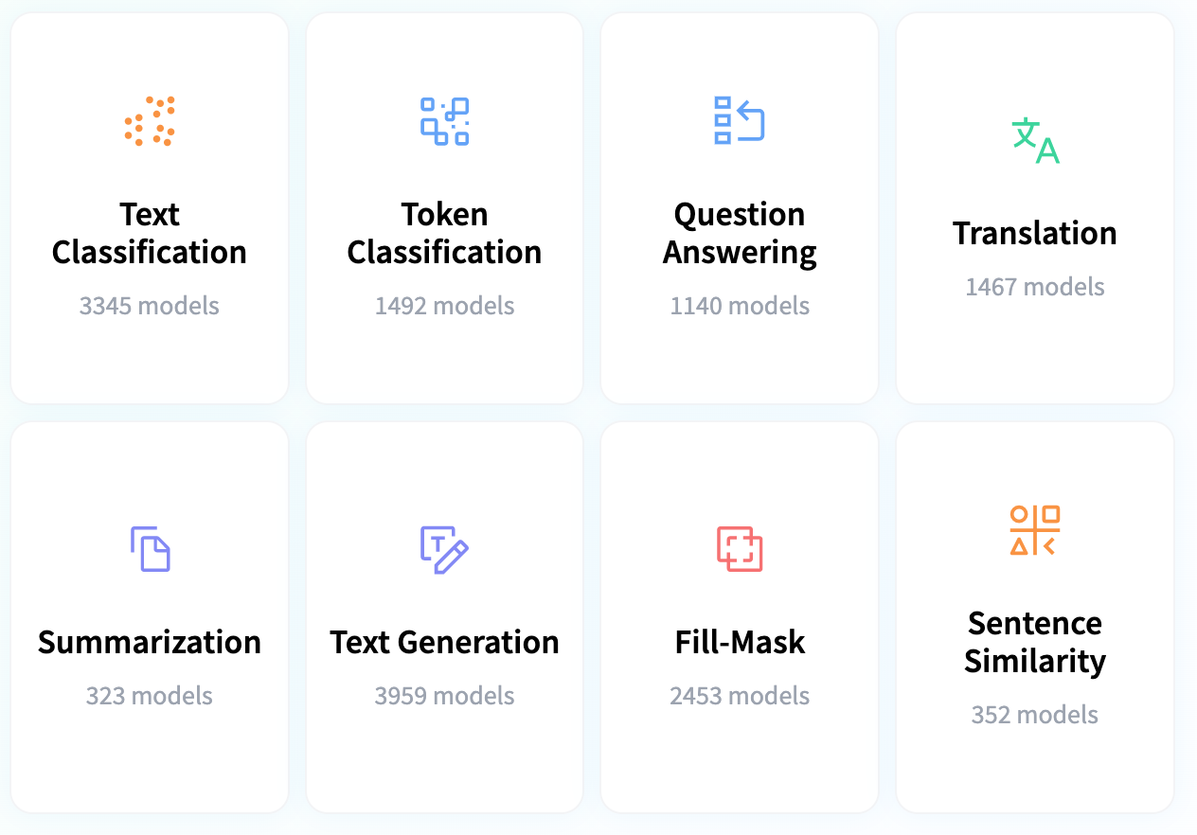
Hugging Face Tasks
Natural Language Processing
https://huggingface.co/tasks

Slide 90
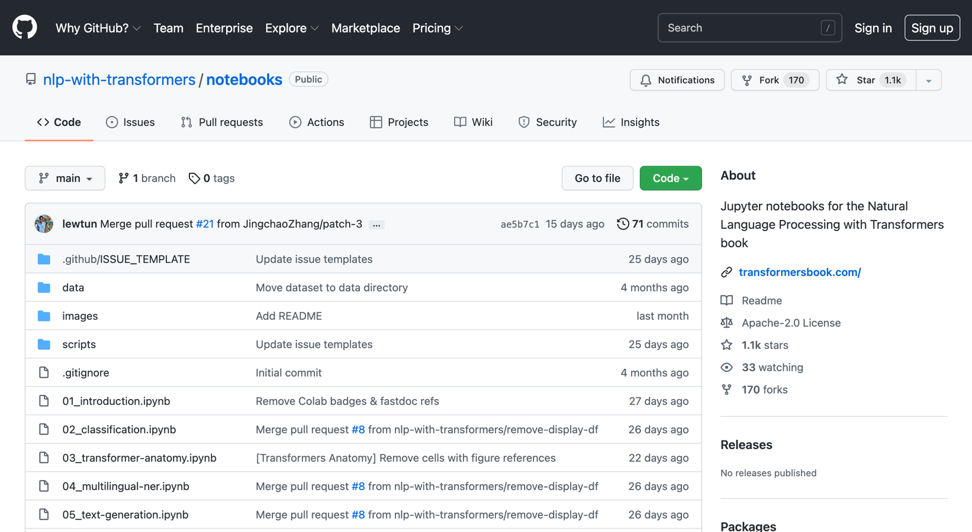
NLP with Transformers Github
https://github.com/nlp-with-transformers/notebooks

Slide 91
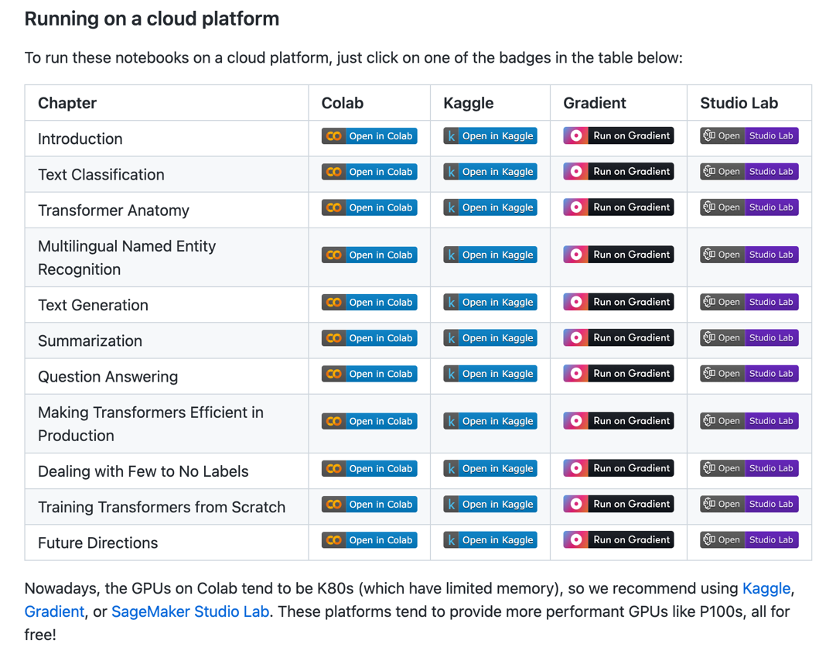
NLP with Transformers Github Notebooks
https://github.com/nlp-with-transformers/notebooks

Slide 92
NLP with Transformers
!git clone https://github.com/nlp-with-transformers/notebooks.git
%cd notebooks
from install import *
install_requirements()
from utils import *
setup_chapter()
Source: Lewis Tunstall, Leandro von Werra, and Thomas Wolf (2022), Natural Language Processing with Transformers: Building Language Applications with Hugging Face, O'Reilly Media.
https://github.com/nlp-with-transformers/notebooks

Slide 93
Text Classification
text = """Dear Amazon, last week I ordered an Optimus Prime action figure \
from your online store in Germany. Unfortunately, when I opened the package, \
I discovered to my horror that I had been sent an action figure of Megatron \
instead! As a lifelong enemy of the Decepticons, I hope you can understand my \
dilemma. To resolve the issue, I demand an exchange of Megatron for the \
Optimus Prime figure I ordered. Enclosed are copies of my records concerning \
this purchase. I expect to hear from you soon. Sincerely, Bumblebee."""
Source: Lewis Tunstall, Leandro von Werra, and Thomas Wolf (2022), Natural Language Processing with Transformers: Building Language Applications with Hugging Face, O'Reilly Media.
https://github.com/nlp-with-transformers/notebooks

Slide 94
Text Classification
text = """Dear Amazon, last week I ordered an Optimus Prime action figure \
from your online store in Germany. Unfortunately, when I opened the package, \
I discovered to my horror that I had been sent an action figure of Megatron \
instead! As a lifelong enemy of the Decepticons, I hope you can understand my \
dilemma. To resolve the issue, I demand an exchange of Megatron for the \
Optimus Prime figure I ordered. Enclosed are copies of my records concerning \
this purchase. I expect to hear from you soon. Sincerely, Bumblebee."""
from transformers import pipeline
classifier = pipeline("text-classification")
import pandas as pd
outputs = classifier(text)
pd.DataFrame(outputs)
 | label | score
0 | NEGATIVE | 0.901546
Source: Lewis Tunstall, Leandro von Werra, and Thomas Wolf (2022), Natural Language Processing with Transformers: Building Language Applications with Hugging Face, O'Reilly Media.
https://github.com/nlp-with-transformers/notebooks

Slide 95
Text Classification
from transformers import pipeline
classifier = pipeline("text-classification")
import pandas as pd
outputs = classifier(text)
pd.DataFrame(outputs)
 | label | score
0 | NEGATIVE | 0.901546
Source: Lewis Tunstall, Leandro von Werra, and Thomas Wolf (2022), Natural Language Processing with Transformers: Building Language Applications with Hugging Face, O'Reilly Media.
https://github.com/nlp-with-transformers/notebooks

Slide 96
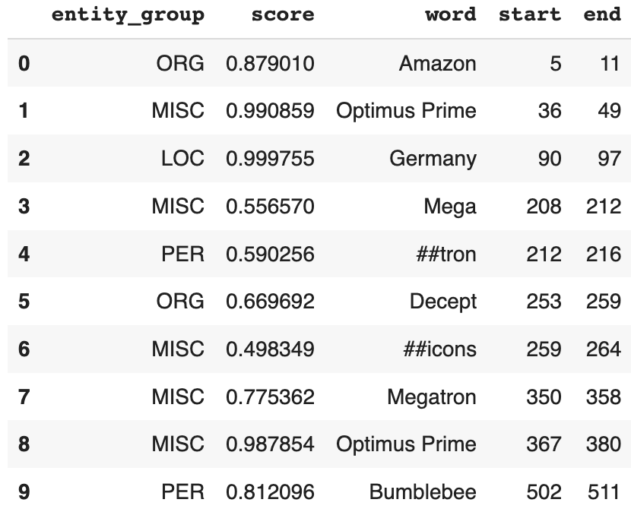
Named Entity Recognition
ner_tagger = pipeline("ner", aggregation_strategy="simple")
outputs = ner_tagger(text)
pd.DataFrame(outputs)
Source: Lewis Tunstall, Leandro von Werra, and Thomas Wolf (2022), Natural Language Processing with Transformers: Building Language Applications with Hugging Face, O'Reilly Media.
https://github.com/nlp-with-transformers/notebooks

Slide 97
Question Answering
reader = pipeline("question-answering")
question = "What does the customer want?"
outputs = reader(question=question, context=text)
pd.DataFrame([outputs])
 | score | start | end | answer
0 | 0.631292 | 335 | 358 | an exchange of Megatron
Source: Lewis Tunstall, Leandro von Werra, and Thomas Wolf (2022), Natural Language Processing with Transformers: Building Language Applications with Hugging Face, O'Reilly Media.
https://github.com/nlp-with-transformers/notebooks

Slide 98
Summarization
summarizer = pipeline("summarization")
outputs = summarizer(text, max_length=45, clean_up_tokenization_spaces=True)
print(outputs[0]['summary_text'])
Bumblebee ordered an Optimus Prime action figure from your online store in Germany. Unfortunately, when I opened the package, I discovered to my horror that I had been sent an action figure of Megatron instead.
Source: Lewis Tunstall, Leandro von Werra, and Thomas Wolf (2022), Natural Language Processing with Transformers: Building Language Applications with Hugging Face, O'Reilly Media.
https://github.com/nlp-with-transformers/notebooks

Slide 99
Translation
translator = pipeline("translation_en_to_de",
model="Helsinki-NLP/opus-mt-en-de")
outputs = translator(text, clean_up_tokenization_spaces=True, min_length=100)
print(outputs[0]['translation_text'])
Sehr geehrter Amazon, letzte Woche habe ich eine Optimus Prime Action Figur aus Ihrem Online-Shop in Deutschland bestellt. Leider, als ich das Paket öffnete, entdeckte ich zu meinem Entsetzen, dass ich stattdessen eine Action Figur von Megatron geschickt worden war! Als lebenslanger Feind der Decepticons, Ich hoffe, Sie können mein Dilemma verstehen. Um das Problem zu lösen, Ich fordere einen Austausch von Megatron für die Optimus Prime Figur habe ich bestellt. Anbei sind Kopien meiner Aufzeichnungen über diesen Kauf. Ich erwarte, bald von Ihnen zu hören. Aufrichtig, Bumblebee.
Source: Lewis Tunstall, Leandro von Werra, and Thomas Wolf (2022), Natural Language Processing with Transformers: Building Language Applications with Hugging Face, O'Reilly Media.
https://github.com/nlp-with-transformers/notebooks

Slide 100
Text Generation
from transformers import set_seed
set_seed(42) # Set the seed to get reproducible results
generator = pipeline("text-generation")
response = "Dear Bumblebee, I am sorry to hear that your order was mixed up."
prompt = text + "\n\nCustomer service response:\n" + response
outputs = generator(prompt, max_length=200)
print(outputs[0]['generated_text'])
Customer service response:
Dear Bumblebee, I am sorry to hear that your order was mixed up. The order was completely mislabeled, which is very common in our online store, but I can appreciate it because it was my understanding from this site and our customer service of the previous day that your order was not made correct in our mind and that we are in a process of resolving this matter. We can assure you that your order
Source: Lewis Tunstall, Leandro von Werra, and Thomas Wolf (2022), Natural Language Processing with Transformers: Building Language Applications with Hugging Face, O'Reilly Media.
https://github.com/nlp-with-transformers/notebooks

Slide 101
Text Generation
Dear Amazon, last week I ordered an Optimus Prime action figure from your online store in Germany. Unfortunately, when I opened the package, I discovered to my horror that I had been sent an action figure of Megatron instead! As a lifelong enemy of the Decepticons, I hope you can understand my dilemma. To resolve the issue, I demand an exchange of Megatron for the Optimus Prime figure I ordered. Enclosed are copies of my records concerning this purchase. I expect to hear from you soon. Sincerely, Bumblebee.
Customer service response:
Dear Bumblebee, I am sorry to hear that your order was mixed up. The order was completely mislabeled, which is very common in our online store, but I can appreciate it because it was my understanding from this site and our customer service of the previous day that your order was not made correct in our mind and that we are in a process of resolving this matter. We can assure you that your order
Source: Lewis Tunstall, Leandro von Werra, and Thomas Wolf (2022), Natural Language Processing with Transformers: Building Language Applications with Hugging Face, O'Reilly Media.
https://github.com/nlp-with-transformers/notebooks

Slide 102
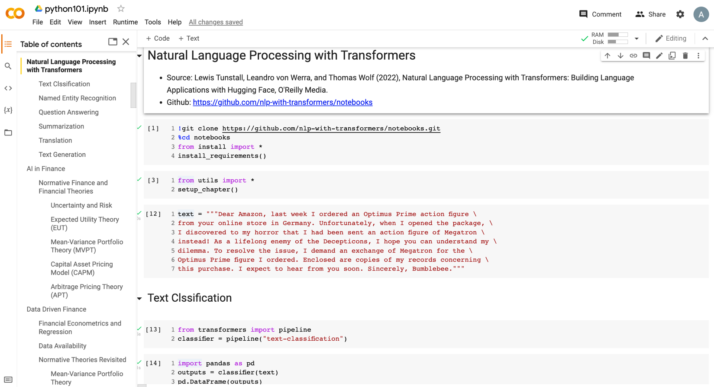
Python in Google Colab (Python101)
https://colab.research.google.com/drive/1FEG6DnGvwfUbeo4zJ1zTunjMqf2RkCrT
https://tinyurl.com/aintpupython101

Slide 103
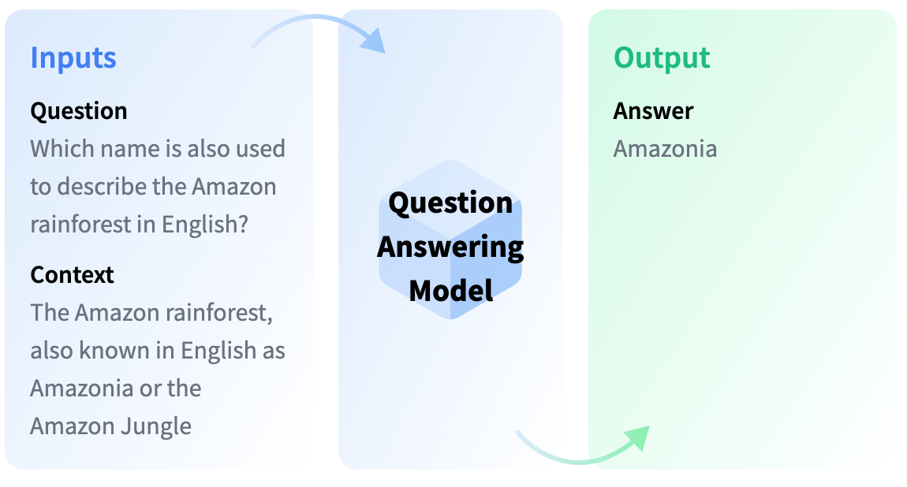
Question Answering
https://huggingface.co/tasks/question-answering

Slide 104
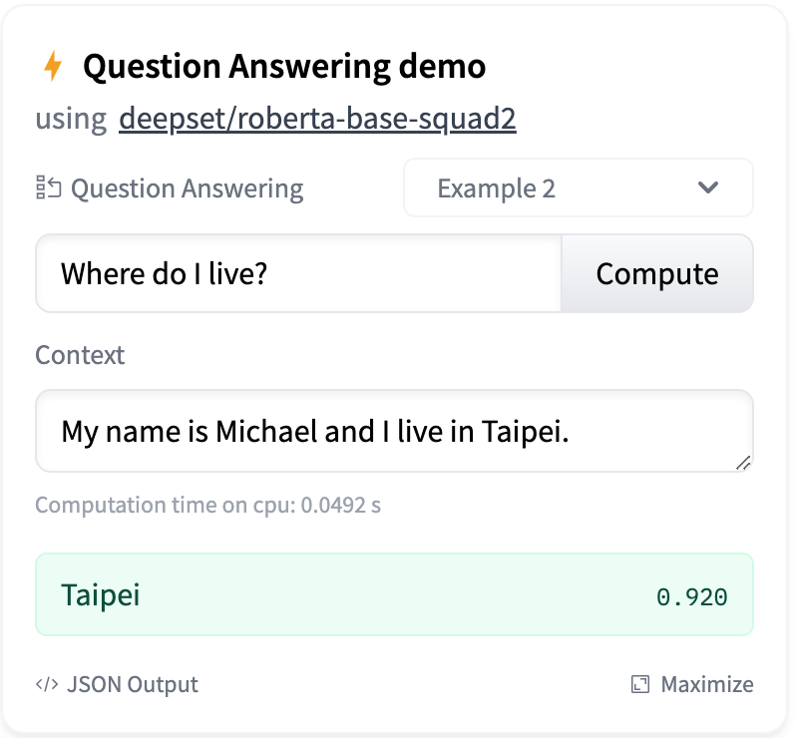
Question Answering
https://huggingface.co/tasks/question-answering

Slide 105
Question Answering
!pip install transformers
from transformers import pipeline
qamodel = pipeline("question-answering")
question = "Where do I live?"
context = "My name is Michael and I live in Taipei."
qamodel(question = question, context = context)
{'answer': 'Taipei', 'end': 39, 'score': 0.9730741381645203, 'start': 33}
https://tinyurl.com/aintpupython101

Slide 106
Question Answering
from transformers import pipeline
qamodel = pipeline("question-answering", model ='deepset/roberta-base-squad2')
question = "Where do I live?"
context = "My name is Michael and I live in Taipei."
output = qamodel(question = question, context = context)
print(output['answer’])
Taipei
https://tinyurl.com/aintpupython101

Slide 107
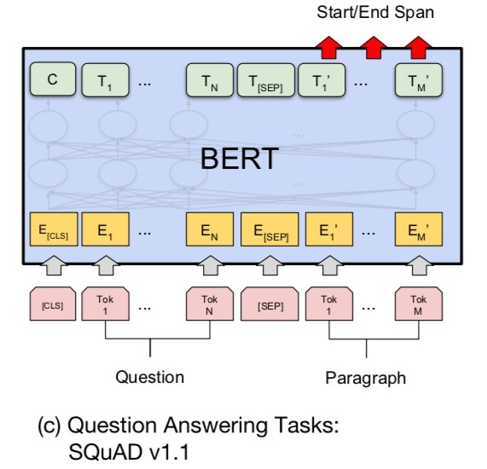
Fine-tuning BERT on
Question Answering (QA)
Source: Devlin, Jacob, Ming-Wei Chang, Kenton Lee, and Kristina Toutanova (2018).
"Bert: Pre-training of deep bidirectional transformers for language understanding." arXiv preprint arXiv:1810.04805.

Slide 108
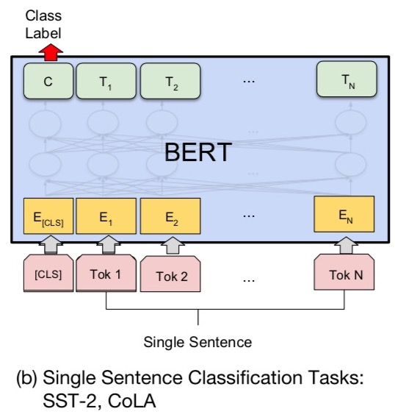
Fine-tuning BERT on Dialogue
Intent Detection (ID; Classification)
Source: Devlin, Jacob, Ming-Wei Chang, Kenton Lee, and Kristina Toutanova (2018).
"Bert: Pre-training of deep bidirectional transformers for language understanding." arXiv preprint arXiv:1810.04805.

Slide 109
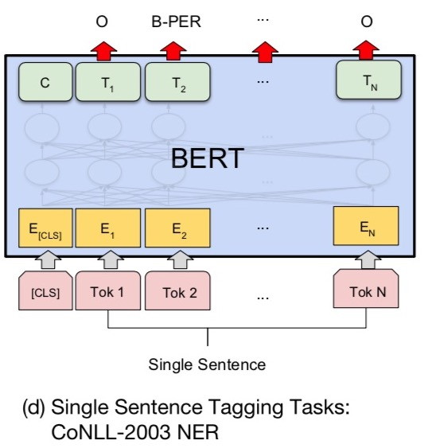
Fine-tuning BERT on Dialogue
Slot Filling (SF)
Source: Devlin, Jacob, Ming-Wei Chang, Kenton Lee, and Kristina Toutanova (2018).
"Bert: Pre-training of deep bidirectional transformers for language understanding." arXiv preprint arXiv:1810.04805.

Slide 110
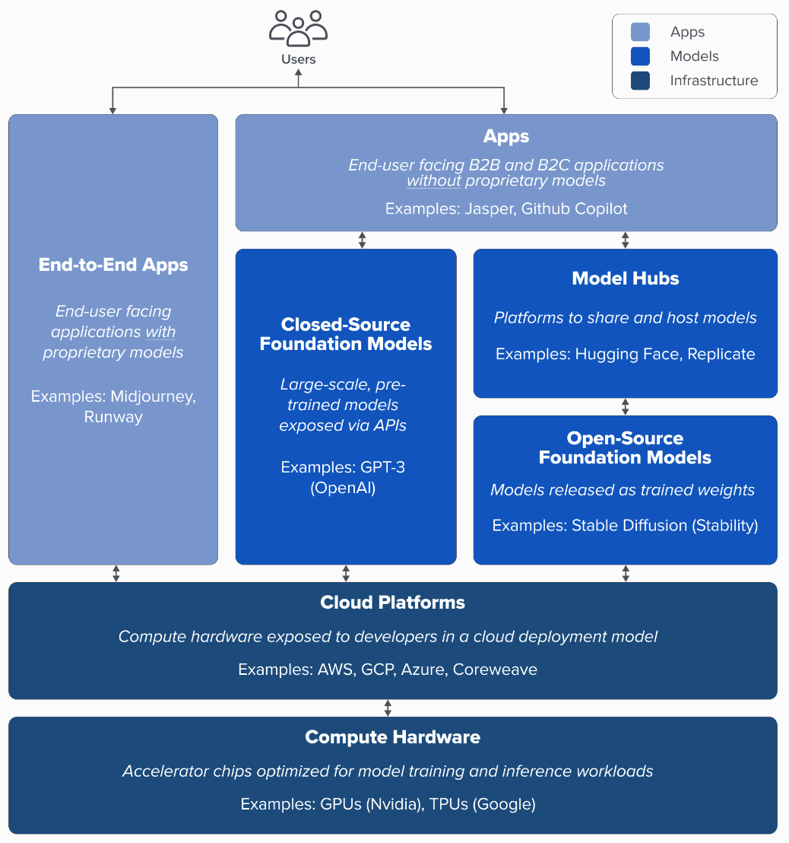
Generative AI
Tech Stack
Source: Matt Bornstein, Guido Appenzeller, and Martin Casado (2023), Who Owns the Generative AI Platform?, https://a16z.com/2023/01/19/who-owns-the-generative-ai-platform/

Slide 111
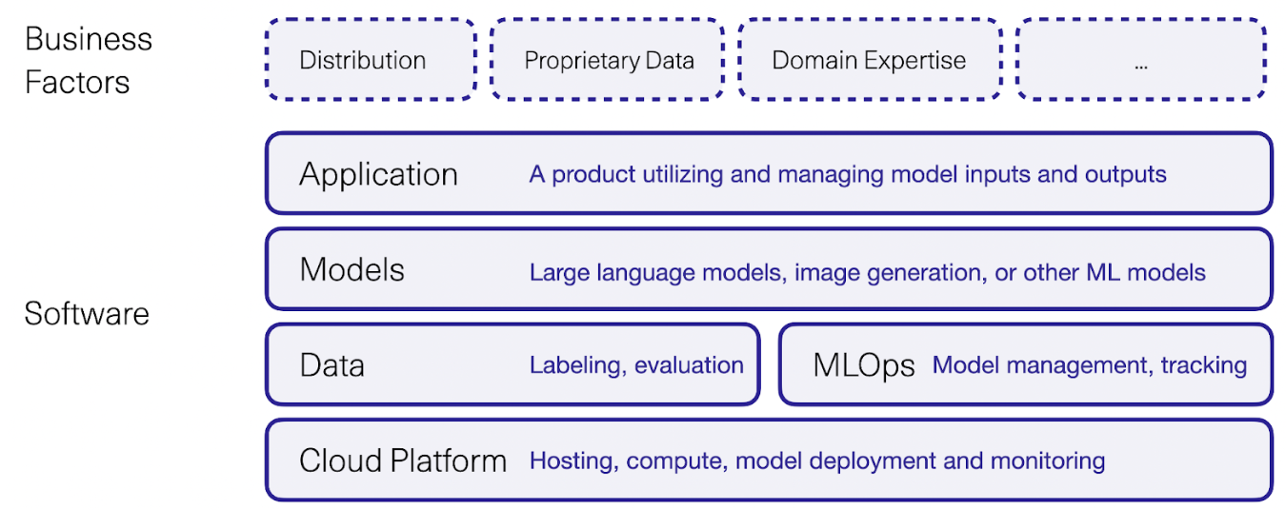
Generative AI Software and Business Factors
Source: Jay Alammar (2023), AI is Eating The World, https://txt.cohere.com/ai-is-eating-the-world/

Slide 112
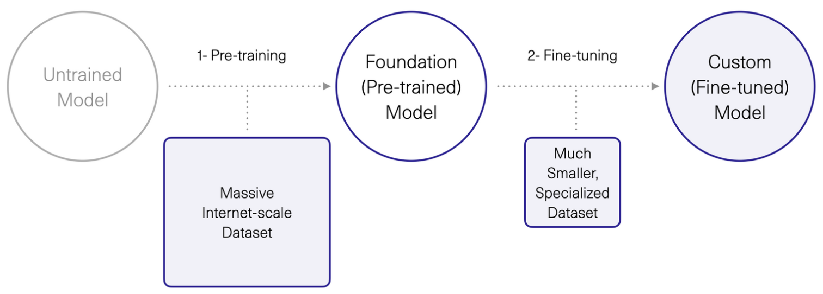
Generative AI
1. Pre-training Foundation (Pre-trained) Model
2. Fine-turning Custom (Fine-tuned) Model
Source: Jay Alammar (2023), AI is Eating The World, https://txt.cohere.com/ai-is-eating-the-world/

Slide 113
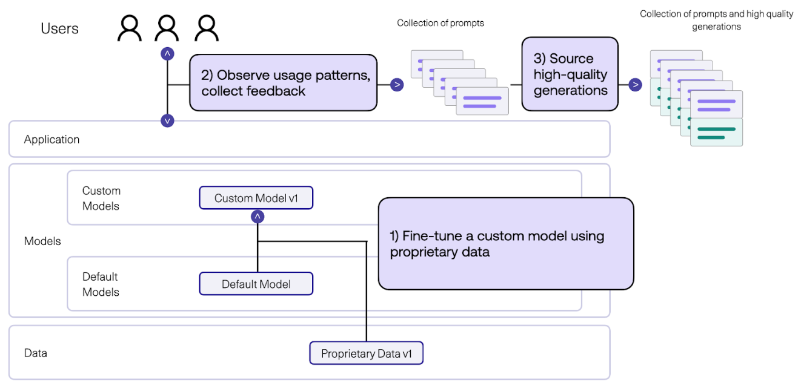
Generative AI
Fine-tune Custom Models using Proprietary Data
Source: Jay Alammar (2023), AI is Eating The World, https://txt.cohere.com/ai-is-eating-the-world/

Slide 114
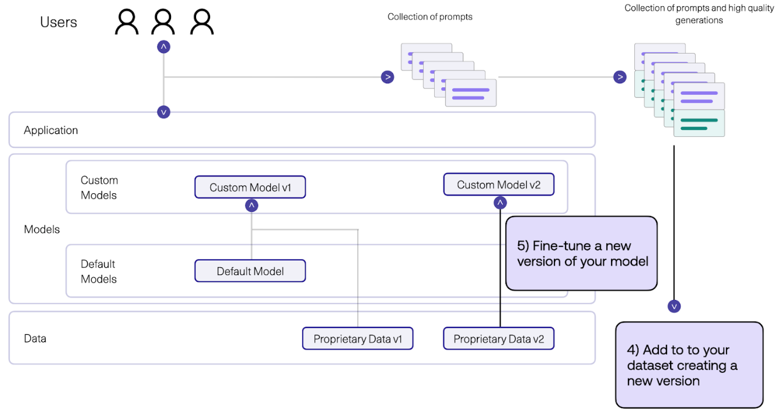
Generative AI
Fine-tune Custom Models using Proprietary Data
Source: Jay Alammar (2023), AI is Eating The World, https://txt.cohere.com/ai-is-eating-the-world/

Slide 115

Pipeline of Instruction Tuning LLMs
Source: Wang, Yidong, Zhuohao Yu, Zhengran Zeng, Linyi Yang, Cunxiang Wang, Hao Chen, Chaoya Jiang et al. "PandaLM: An Automatic Evaluation Benchmark for LLM Instruction Tuning Optimization." arXiv preprint arXiv:2306.05087 (2023).

Slide 116

Instance Formatting and Two Different Methods for Constructing the
Instruction-formatted Instances
Source: Wayne Xin Zhao, Kun Zhou, Junyi Li, Tianyi Tang, Xiaolei Wang, Yupeng Hou, Yingqian Min et al. (2023) "A Survey of Large Language Models." arXiv preprint arXiv:2303.18223.

Slide 117

In-context Learning (ICL) and
Chain-of-thought (CoT) Prompting
Source: Wayne Xin Zhao, Kun Zhou, Junyi Li, Tianyi Tang, Xiaolei Wang, Yupeng Hou, Yingqian Min et al. (2023) "A Survey of Large Language Models." arXiv preprint arXiv:2303.18223.

Slide 118

Four Paradigms in NLP
Source: Pengfei Liu, Weizhe Yuan, Jinlan Fu, Zhengbao Jiang, Hiroaki Hayashi, and Graham Neubig. (2023) "Pre-train, prompt, and predict: A systematic survey of prompting methods in natural language processing." ACM Computing Surveys 55, no. 9 (2023): 1-35.

Slide 119

Typology of Prompting Methods
Source: Pengfei Liu, Weizhe Yuan, Jinlan Fu, Zhengbao Jiang, Hiroaki Hayashi, and Graham Neubig. (2023) "Pre-train, prompt, and predict: A systematic survey of prompting methods in natural language processing." ACM Computing Surveys 55, no. 9 (2023): 1-35.

Slide 120

Different Multi-Prompt Learning Strategies
Source: Pengfei Liu, Weizhe Yuan, Jinlan Fu, Zhengbao Jiang, Hiroaki Hayashi, and Graham Neubig. (2023) "Pre-train, prompt, and predict: A systematic survey of prompting methods in natural language processing." ACM Computing Surveys 55, no. 9 (2023): 1-35.

Slide 121

Characteristics of Different Tuning Strategies
Source: Pengfei Liu, Weizhe Yuan, Jinlan Fu, Zhengbao Jiang, Hiroaki Hayashi, and Graham Neubig. (2023) "Pre-train, prompt, and predict: A systematic survey of prompting methods in natural language processing." ACM Computing Surveys 55, no. 9 (2023): 1-35.

Slide 122

Multi-prompt Learning for
Multi-task, Multi-domain, or Multi-lingual Learning
Source: Pengfei Liu, Weizhe Yuan, Jinlan Fu, Zhengbao Jiang, Hiroaki Hayashi, and Graham Neubig. (2023) "Pre-train, prompt, and predict: A systematic survey of prompting methods in natural language processing." ACM Computing Surveys 55, no. 9 (2023): 1-35.

Slide 123

NLG from a Multilingual,
Multimodal and Multi-task perspective
Source: Erdem, Erkut, Menekse Kuyu, Semih Yagcioglu, Anette Frank, Letitia Parcalabescu, Barbara Plank, Andrii Babii et al.
"Neural Natural Language Generation: A Survey on Multilinguality, Multimodality, Controllability and Learning." Journal of Artificial Intelligence Research 73 (2022): 1131-1207.

Slide 124

Text-and-Video Dialog Generation Models with Hierarchical Attention
Source: Erdem, Erkut, Menekse Kuyu, Semih Yagcioglu, Anette Frank, Letitia Parcalabescu, Barbara Plank, Andrii Babii et al.
"Neural Natural Language Generation: A Survey on Multilinguality, Multimodality, Controllability and Learning." Journal of Artificial Intelligence Research 73 (2022): 1131-1207.

Slide 125

Multimodal Few-Shot Learning with
Frozen Language Models
Curated samples with about five seeds required to get past well-known language model failure modes of either repeating text for the prompt or emitting text that does not pertain to the image.
These samples demonstrate the ability to generate open-ended outputs that adapt to both images and text, and to make use of facts that it has learned during language-only pre-training.
Source: Maria Tsimpoukelli, Jacob L. Menick, Serkan Cabi, S. M. Eslami, Oriol Vinyals, and Felix Hill (2021). "Multimodal few-shot learning with frozen language models."
Advances in Neural Information Processing Systems 34 (2021): 200-212.

Slide 126

Multimodal Pipeline that includes three different modalities (Image, Text. Audio)
Source: Bayoudh, Khaled, Raja Knani, Fayçal Hamdaoui, and Abdellatif Mtibaa (2022).
"A survey on deep multimodal learning for computer vision: advances, trends, applications, and datasets." The Visual Computer 38, no. 8: 2939-2970.

Slide 127

Video and Audio Multimodal Fusion
Source: Bayoudh, Khaled, Raja Knani, Fayçal Hamdaoui, and Abdellatif Mtibaa (2022).
"A survey on deep multimodal learning for computer vision: advances, trends, applications, and datasets." The Visual Computer 38, no. 8: 2939-2970.

Slide 128

Visual and Textual Representation
Source: Bayoudh, Khaled, Raja Knani, Fayçal Hamdaoui, and Abdellatif Mtibaa (2022).
"A survey on deep multimodal learning for computer vision: advances, trends, applications, and datasets." The Visual Computer 38, no. 8: 2939-2970.

Slide 129

Hybrid Multimodal Data Fusion
Text
Audio
Image
Text
Speech
Video
Source: Bayoudh, Khaled, Raja Knani, Fayçal Hamdaoui, and Abdellatif Mtibaa (2022).
"A survey on deep multimodal learning for computer vision: advances, trends, applications, and datasets." The Visual Computer 38, no. 8: 2939-2970.

Slide 130

Multimodal Transfer Learning
Source: Bayoudh, Khaled, Raja Knani, Fayçal Hamdaoui, and Abdellatif Mtibaa (2022).
"A survey on deep multimodal learning for computer vision: advances, trends, applications, and datasets." The Visual Computer 38, no. 8: 2939-2970.

Slide 131

CLIP: Learning Transferable Visual Models From Natural Language Supervision
Source: Radford, Alec, Jong Wook Kim, Chris Hallacy, Aditya Ramesh, Gabriel Goh, Sandhini Agarwal, Girish Sastry et al. (2021) "Learning transferable visual models from natural language supervision." In International Conference on Machine Learning, pp. 8748-8763. PMLR.

Slide 132

ViLT: Vision-and-Language Transformer Without Convolution or Region Supervision
Source: Kim, Wonjae, Bokyung Son, and Ildoo Kim (2021). "Vilt: Vision-and-language transformer without convolution or region supervision."
In International Conference on Machine Learning, pp. 5583-5594. PMLR.

Slide 133

wav2vec 2.0:
A framework for self-supervised learning of speech representations
Source: Baevski, Alexei, Yuhao Zhou, Abdelrahman Mohamed, and Michael Auli.
"wav2vec 2.0: A framework for self-supervised learning of speech representations." Advances in Neural Information Processing Systems 33 (2020): 12449-12460.

Slide 134

Whisper:
Robust Speech Recognition via Large-Scale Weak Supervision
Source: Radford, Alec, Jong Wook Kim, Tao Xu, Greg Brockman, Christine McLeavey, and Ilya Sutskever. Robust speech recognition via large-scale weak supervision. Tech. Rep., Technical report, OpenAI, 2022.

Slide 135

Llama-2: Comparison to closed-source models (GPT-3.5, GPT-4, PaLM) on academic benchmarks
Results for GPT-3.5 and GPT-4 are from OpenAI (2023).
Results for the PaLM model are from Chowdhery et al. (2022).
Results for the PaLM-2-L are from Anil et al. (2023).
Source: Touvron, Hugo, Louis Martin, Kevin Stone, Peter Albert, Amjad Almahairi, Yasmine Babaei, Nikolay Bashlykov et al. (2023) "Llama 2: Open Foundation and Fine-Tuned Chat Models." arXiv preprint arXiv:2307.09288 (2023).

Slide 136

Llama 2:
Open Foundation and Fine-Tuned Chat Models
Source: Touvron, Hugo, Louis Martin, Kevin Stone, Peter Albert, Amjad Almahairi, Yasmine Babaei, Nikolay Bashlykov et al. (2023) "Llama 2: Open Foundation and Fine-Tuned Chat Models." arXiv preprint arXiv:2307.09288 (2023).

Slide 137

InstructBLIP
Vision-Language Models with Instruction Tuning
Source: Dai, Wenliang, Junnan Li, Dongxu Li, Anthony Meng Huat Tiong, Junqi Zhao, Weisheng Wang, Boyang Li, Pascale Fung, and Steven Hoi.
"InstructBLIP: Towards General-purpose Vision-Language Models with Instruction Tuning." arXiv preprint arXiv:2305.06500 (2023).

Slide 138

Model Architecture of InstructBLIP
Vision-Language Models with Instruction Tuning
Source: Dai, Wenliang, Junnan Li, Dongxu Li, Anthony Meng Huat Tiong, Junqi Zhao, Weisheng Wang, Boyang Li, Pascale Fung, and Steven Hoi.
"InstructBLIP: Towards General-purpose Vision-Language Models with Instruction Tuning." arXiv preprint arXiv:2305.06500 (2023).

Slide 139

Vision-Language Instruction Tuning: Datasets
Source: Dai, Wenliang, Junnan Li, Dongxu Li, Anthony Meng Huat Tiong, Junqi Zhao, Weisheng Wang, Boyang Li, Pascale Fung, and Steven Hoi.
"InstructBLIP: Towards General-purpose Vision-Language Models with Instruction Tuning." arXiv preprint arXiv:2305.06500 (2023).

Slide 140

Instruction Tuning vs. Multitask Learning based on BLIP-2 FlanT5XL
Source: Dai, Wenliang, Junnan Li, Dongxu Li, Anthony Meng Huat Tiong, Junqi Zhao, Weisheng Wang, Boyang Li, Pascale Fung, and Steven Hoi.
"InstructBLIP: Towards General-purpose Vision-Language Models with Instruction Tuning." arXiv preprint arXiv:2305.06500 (2023).

Slide 141

Finetuning BLIP-2 and InstructBLIP on downstream datasets
Source: Dai, Wenliang, Junnan Li, Dongxu Li, Anthony Meng Huat Tiong, Junqi Zhao, Weisheng Wang, Boyang Li, Pascale Fung, and Steven Hoi.
"InstructBLIP: Towards General-purpose Vision-Language Models with Instruction Tuning." arXiv preprint arXiv:2305.06500 (2023).

Slide 142

InstructBLIP
Vision-Language Models with Instruction Tuning
LLaVA
Large Language and Vision Assistant
MiniGPT-4
Source: Dai, Wenliang, Junnan Li, Dongxu Li, Anthony Meng Huat Tiong, Junqi Zhao, Weisheng Wang, Boyang Li, Pascale Fung, and Steven Hoi.
"InstructBLIP: Towards General-purpose Vision-Language Models with Instruction Tuning." arXiv preprint arXiv:2305.06500 (2023).

Slide 143

Python in Google Colab (Python101)
https://colab.research.google.com/drive/1FEG6DnGvwfUbeo4zJ1zTunjMqf2RkCrT
https://tinyurl.com/aintpupython101

Slide 144

Python in Google Colab (Python101)
https://colab.research.google.com/drive/1FEG6DnGvwfUbeo4zJ1zTunjMqf2RkCrT
https://tinyurl.com/aintpupython101

Slide 145

Python in Google Colab (Python101)
https://colab.research.google.com/drive/1FEG6DnGvwfUbeo4zJ1zTunjMqf2RkCrT
https://tinyurl.com/aintpupython101

Slide 146

Python in Google Colab (Python101)
https://colab.research.google.com/drive/1FEG6DnGvwfUbeo4zJ1zTunjMqf2RkCrT
https://tinyurl.com/aintpupython101

Slide 147

Python in Google Colab (Python101)
https://colab.research.google.com/drive/1FEG6DnGvwfUbeo4zJ1zTunjMqf2RkCrT
https://tinyurl.com/aintpupython101

Slide 148

Python in Google Colab (Python101)
https://colab.research.google.com/drive/1FEG6DnGvwfUbeo4zJ1zTunjMqf2RkCrT
https://tinyurl.com/aintpupython101

Slide 149
Python in Google Colab (Python101)
https://colab.research.google.com/drive/1FEG6DnGvwfUbeo4zJ1zTunjMqf2RkCrT
https://tinyurl.com/aintpupython101

Slide 150



Teaching
Artificial Intelligence in Finance and Quantitative
  Fall 2021, Fall 2022, Fall 2023
Artificial Intelligence for Text Analytics
  Spring 2022, Fall 2023
Big Data Analytics
  Fall 2020, Spring 2023
Software Engineering
  Fall 2020, Fall, 2021, Spring 2022, Spring 2023
Artificial Intelligence
  Spring 2021, Fall 2022
Data Mining
  Spring 2021
Foundation of Business Cloud Computing
  Spring 2021, Spring 2022, Spring 2023
Python for Accounting Applications
  Fall 2023
https://web.ntpu.edu.tw/~myday/teaching.htm

Slide 151
Research Projects
Applying AI technology to construct knowledge graphs of cryptocurrency anti-money laundering: a few-shot learning model
  MOST, 110-2410-H-305-013-MY2, 2021/08/01~2023/07/31
Fintech Green Finance for Carbon Market Index, Corporate Finance, and Environmental Policies. Carbon Emission Sentiment Index with AI Text Analytics
  NTPU, 112-NTPU_ORDA-F-003，2023/01/01~2024/12/31
Digital Support, Unimpeded Communication: The Development, Support and Promotion of AI-assisted Communication Assistive Devices for Speech Impairment. Multimodal Cross-lingual Task-Oriented Dialogue System for Inclusive Communication Support
  NSTC 112-2425-H-305-002-, 2023/05/01-2026/04/30
Establishment and Implement of Smart Assistive Technology for Dementia Care and Its Socio-Economic Impacts. Intelligent, individualized and precise care with smart AT and system integration
  NSTC, NSTC, 112-2627-M-038-001-, 2023/08/01~2024/07/31
Use deep learning to identify commercially dental implant systems - observational study
  USTP-NTPU-TMU, USTP-NTPU-TMU-112-01, 2023/01/01~2023/12/31
Metaverse AI Multimodal Cross-Language Task-Oriented Dialogue System
  ATEC Group x NTPU, NTPU-112A413E01, 2023/05/01~2026/04/30
Metaverse Avatar Automatic Metadata Generation Module
  FormosaVerse x NTPU, NTPU-111A413E01, 2022/12/01~2023/11/30
Pilot Study on Universal Data Processing for Code Generation Engine
  III x NTPU, NTPU-112A513E01, 2023/08/01~2023/12/22
https://web.ntpu.edu.tw/~myday/cindex.htm#projects

Slide 152
Summary
This course introduces the fundamental concepts, research issues, and hands-on practices of Artificial Intelligence for Text Analytics.
Topics include:
  Introduction to Introduction to Artificial Intelligence for Text Analytics
  Foundations of Text Analytics: Natural Language Processing (NLP)
  Python for Natural Language Processing
  Natural Language Processing with Transformers
  Text Classification and Sentiment Analysis
  Multilingual Named Entity Recognition (NER), Text Similarity and Clustering
  Text Summarization and Topic Models
  Text Generation with Large Language Models (LLMs)
  Question Answering and Dialogue Systems
  Deep Learning, Generative AI, Transfer Learning,
  Zero-Shot, and Few-Shot Learning for Text Analytics
  Case Study on Artificial Intelligence for Text Analytics

Slide 153
Artificial Intelligence for Text Analytics
Contact Information
Min-Yuh Day, Ph.D.
Associate Professor
Institute of Information Management, National Taipei University
Tel: 02-86741111 ext. 66873
Office: B8F12
Address: 151, University Rd., San Shia District, New Taipei City, 23741 Taiwan
Email: myday@gm.ntpu.edu.tw
Web: http://web.ntpu.edu.tw/~myday/

