Slide 1
Foundations of Big Data Analysis in Python
Big Data Analysis
1112BDA03
MBA, IM, NTPU (M6031) (Spring 2023) Tue 2, 3, 4 (9:10-12:00) (B8F40)
Min-Yuh Day, Ph.D, Associate Professor
Institute of Information Management, National Taipei University
https://web.ntpu.edu.tw/~myday
https://meet.google.com/paj-zhhj-mya
2023-03-14

Slide 2
Syllabus
Week Date Subject/Topics
1 2023/02/21 Introduction to Big Data Analysis
2 2023/02/28 (Day Off)
3 2023/03/07 AI, Data Science, and Big Data Analysis
4 2023/03/14 Foundations of Big Data Analysis in Python
5 2023/03/21 Case Study on Big Data Analysis I
6 2023/03/28 Machine Learning: SAS Viya, Data Preparation and Algorithm Selection

Slide 3
Syllabus
Week Date Subject/Topics
7 2023/04/04 (Children's Day) (Day off)
8 2023/04/11 Midterm Project Report
9 2023/04/18 Machine Learning: Decision Trees and Ensembles of Trees
10 2023/04/25 Machine Learning: Neural Networks (NN) and Support Vector Machines (SVM)
11 2023/05/02 Case Study on Big Data Analysis II
12 2023/05/09 Machine Learning: Model Assessment and Deployment

Slide 4
Syllabus
Week Date Subject/Topics
13 2023/05/16 ChatGPT and Large Language Models (LLM) for Big Data Analysis
14 2023/05/23 Deep Learning for Finance Big Data Analysis
15 2023/05/30 Final Project Report I
16 2023/06/06 Final Project Report II
17 2023/06/13 Self-learning
18 2023/06/20 Self-learning

Slide 5
Foundations of Big Data Analysis in Python

Slide 6
Outline
Foundations of Big Data Analysis in Python
Python Ecosystem for Data Science
Python
Programming language
Numpy
Scientific computing
Pandas
Data structures and data analysis tools

Slide 7
Python

Slide 8
Python is an interpreted, object-oriented, high-level programming language with dynamic semantics.
Source: https://www.python.org/doc/essays/blurb/

Slide 9
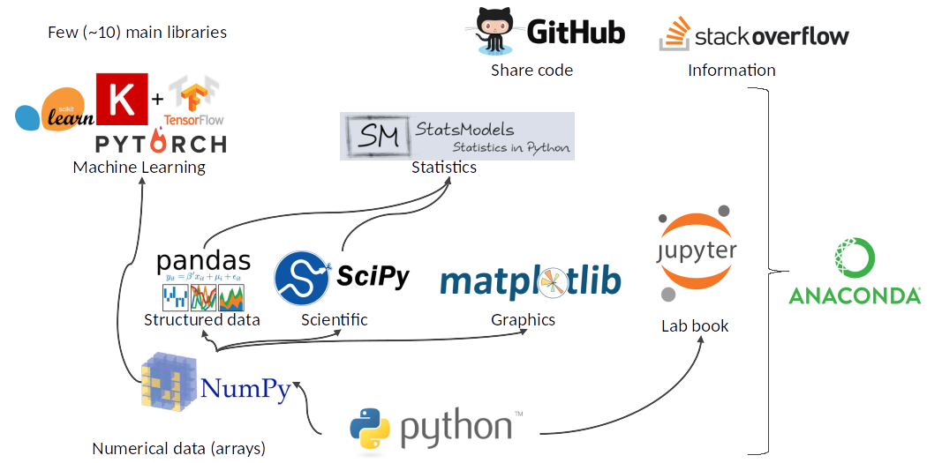
Python Ecosystem for Data Science
Source: https://medium.com/pyfinance/why-python-is-best-choice-for-financial-data-modeling-in-2019-c0d0d1858c45

Slide 10
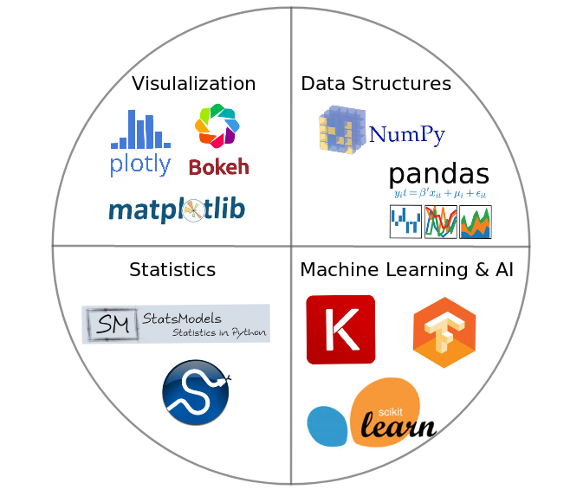
Python Ecosystem for Data Science
Source:https://duchesnay.github.io/pystatsml/introduction/python_ecosystem.html

Slide 11
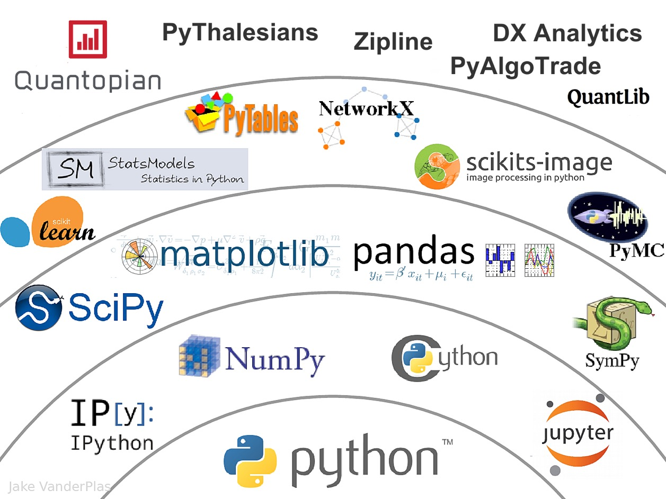
The Quant Finance PyData Stack
Source: http://nbviewer.jupyter.org/format/slides/github/quantopian/pyfolio/blob/master/pyfolio/examples/overview_slides.ipynb#/5

Slide 12
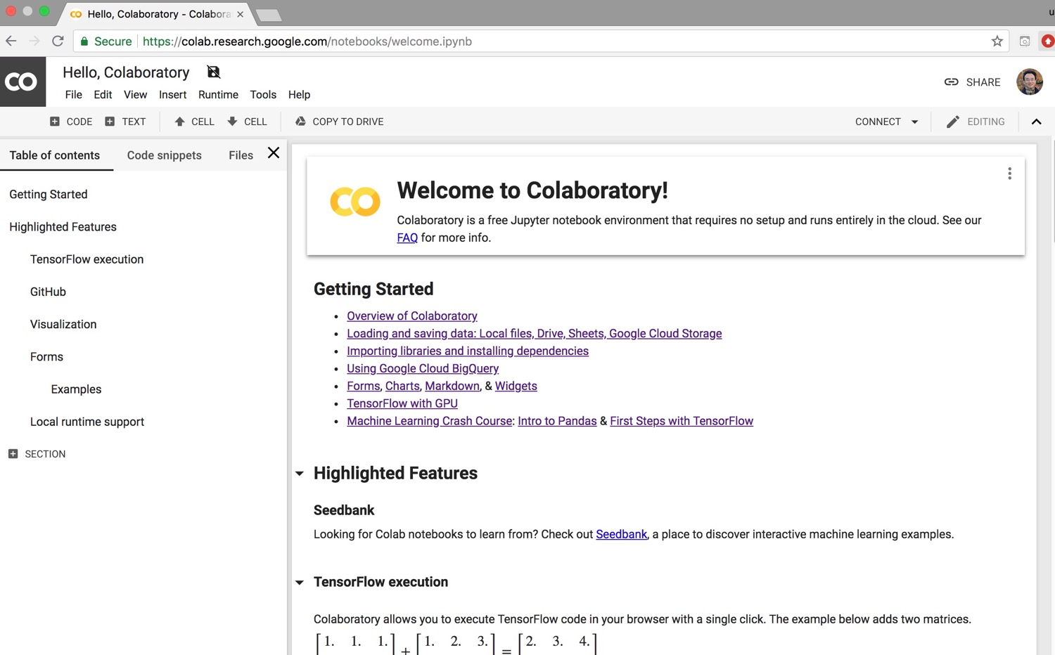
Google Colab
https://colab.research.google.com/notebooks/welcome.ipynb

Slide 13
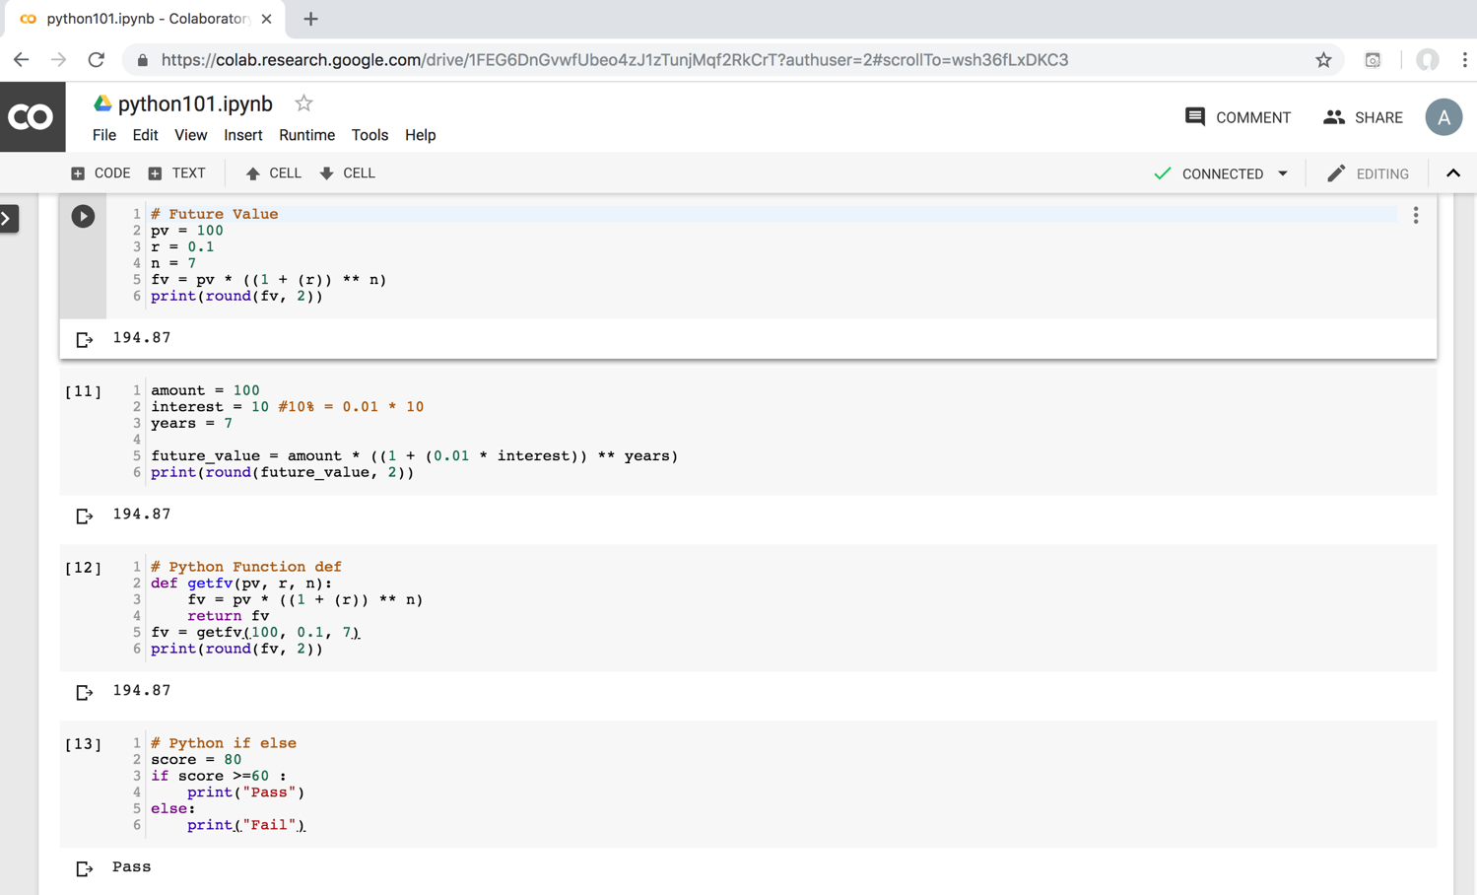
Python in Google Colab (Python101)
https://colab.research.google.com/drive/1FEG6DnGvwfUbeo4zJ1zTunjMqf2RkCrT
https://tinyurl.com/aintpupython101

Slide 14
Numpy
NumPy
Base N-dimensional array package

Slide 15
Python matplotlib
Source: https://matplotlib.org/

Slide 16
Python Pandas
http://pandas.pydata.org/

Slide 17
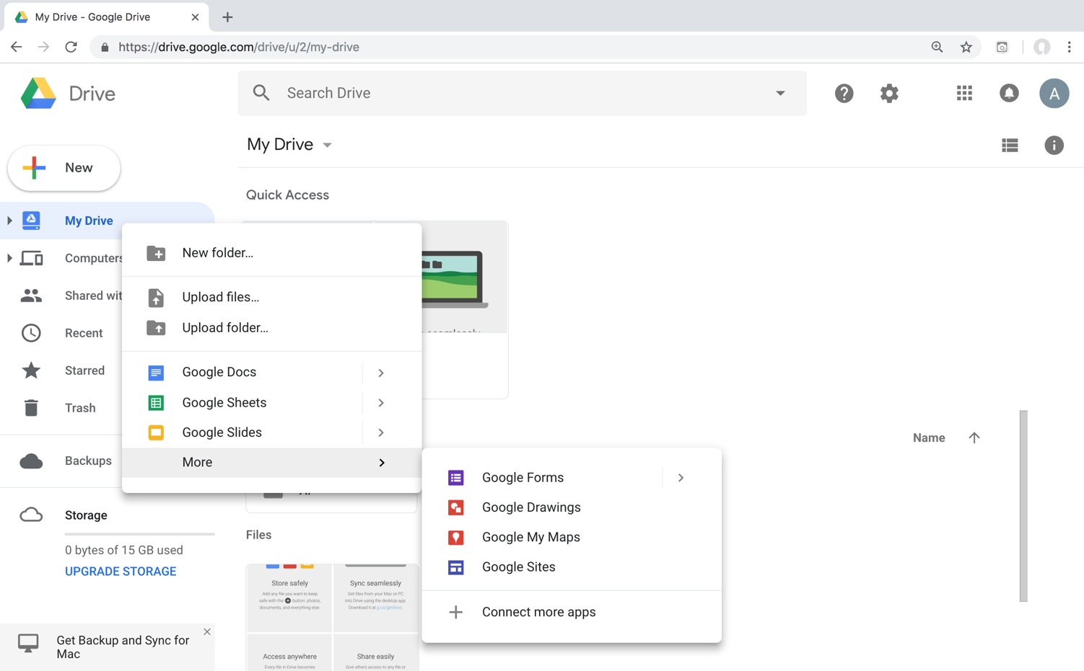
Connect Google Colab in Google Drive

Slide 18
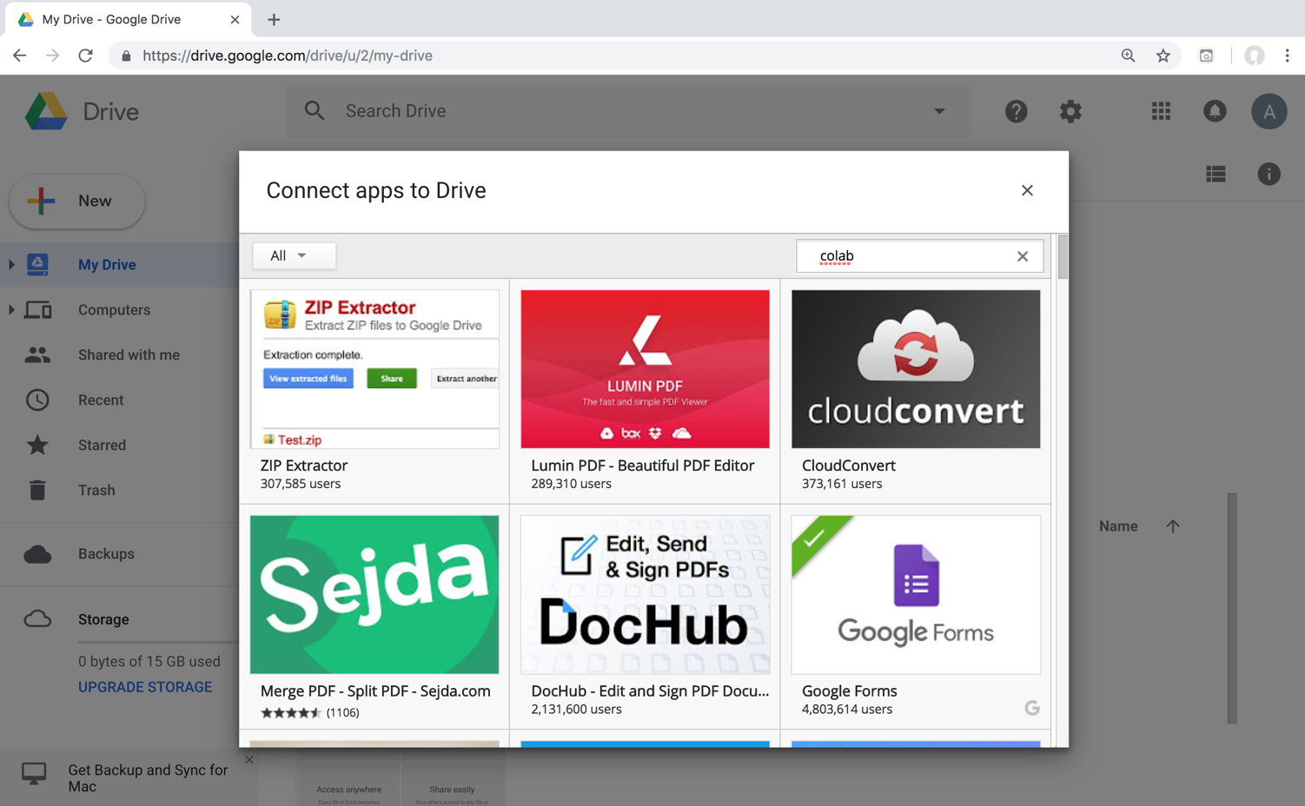
Google Colab

Slide 19
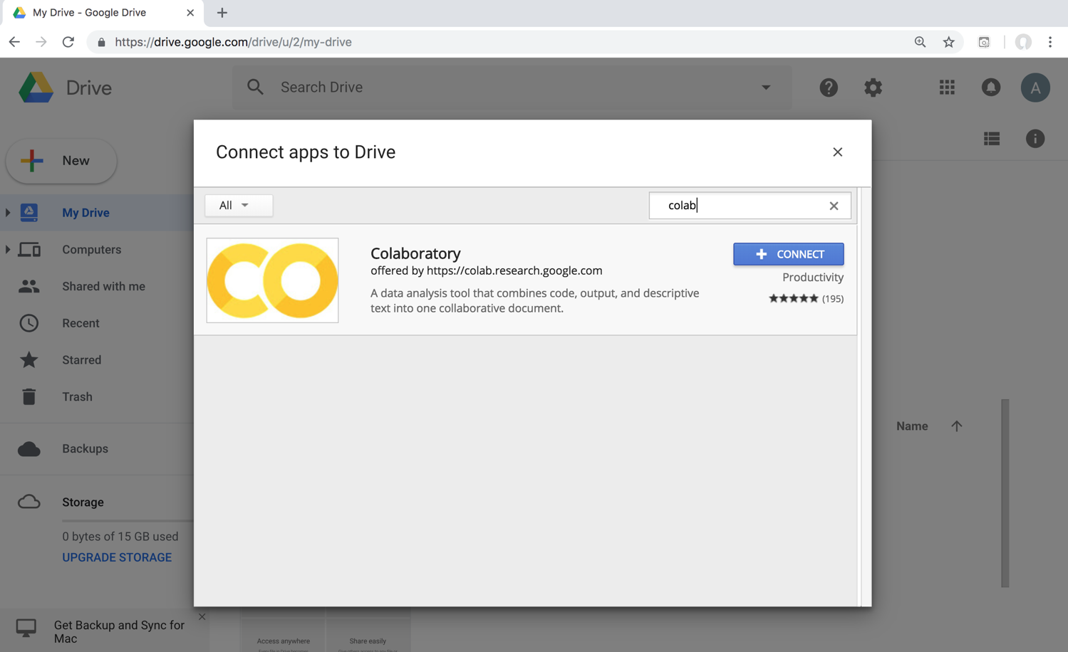
Google Colab

Slide 20
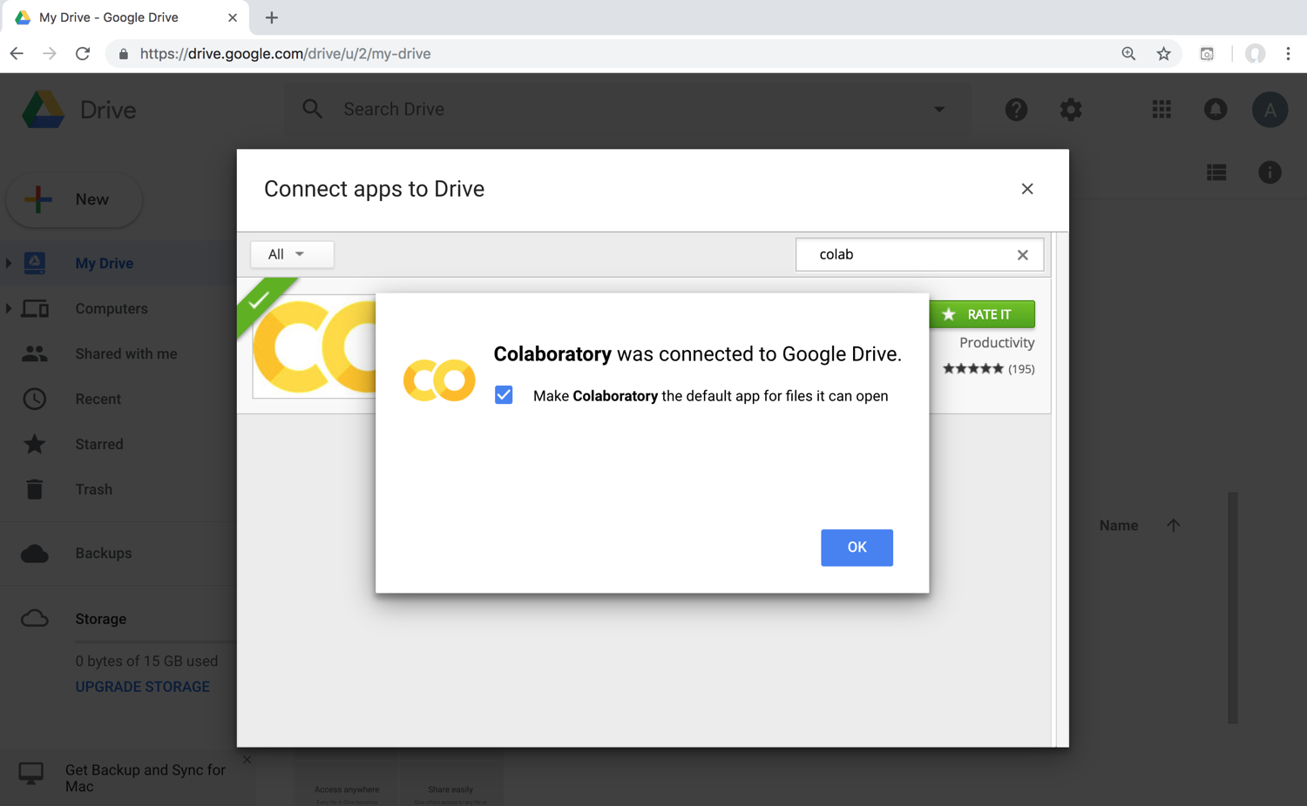
Connect Colaboratory to Google Drive

Slide 21
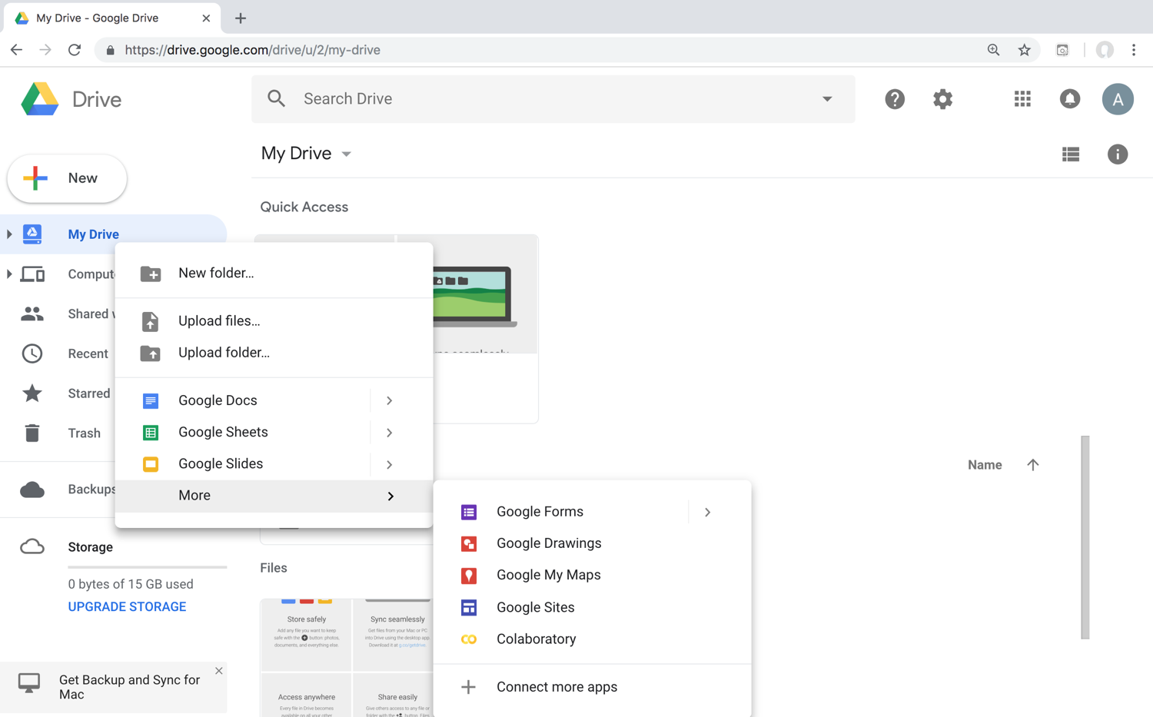
Google Colab

Slide 22
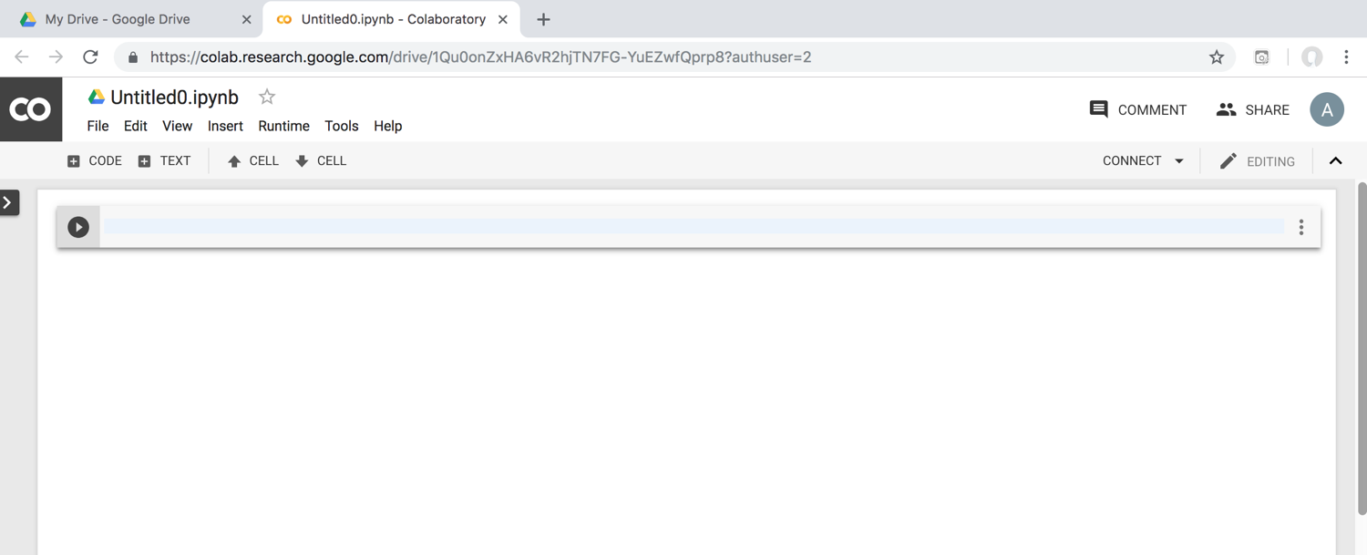
Google Colab

Slide 23
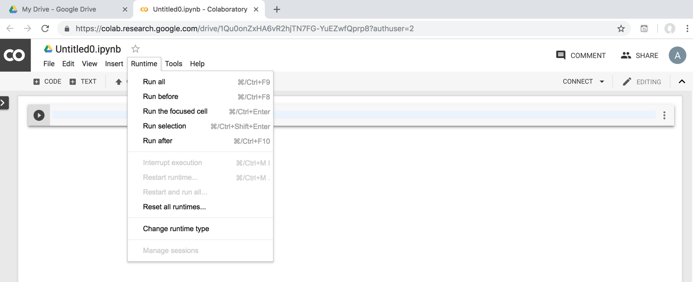
Google Colab

Slide 24
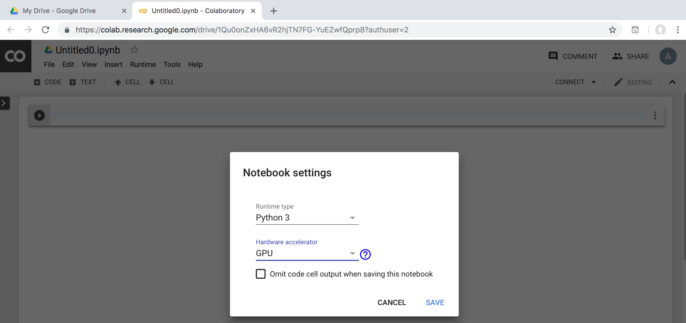
Run Jupyter Notebook Python3 GPU Google Colab

Slide 25
Google Colab Python Hello World print('Hello World')

Slide 26
Anaconda The Most Popular Python Data Science Platform
Source: https://www.anaconda.com/

Slide 27
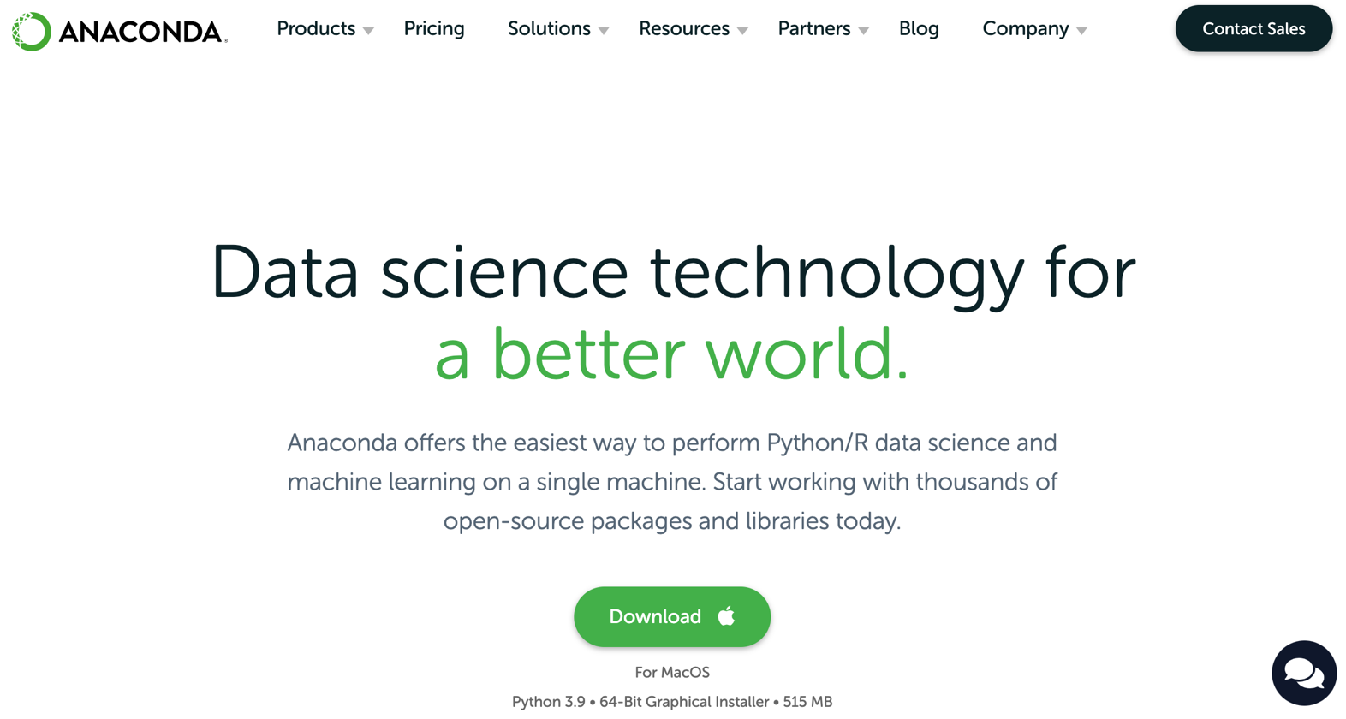
Download Anaconda
https://www.anaconda.com/download

Slide 28
Python HelloWorld

Slide 29
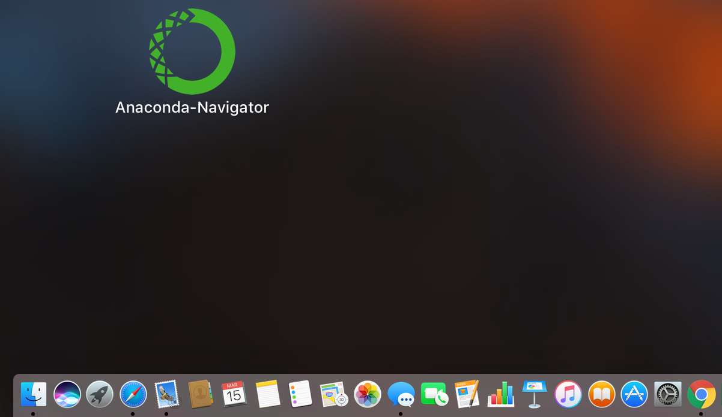
Anaconda-Navigator
Launchpad

Slide 30
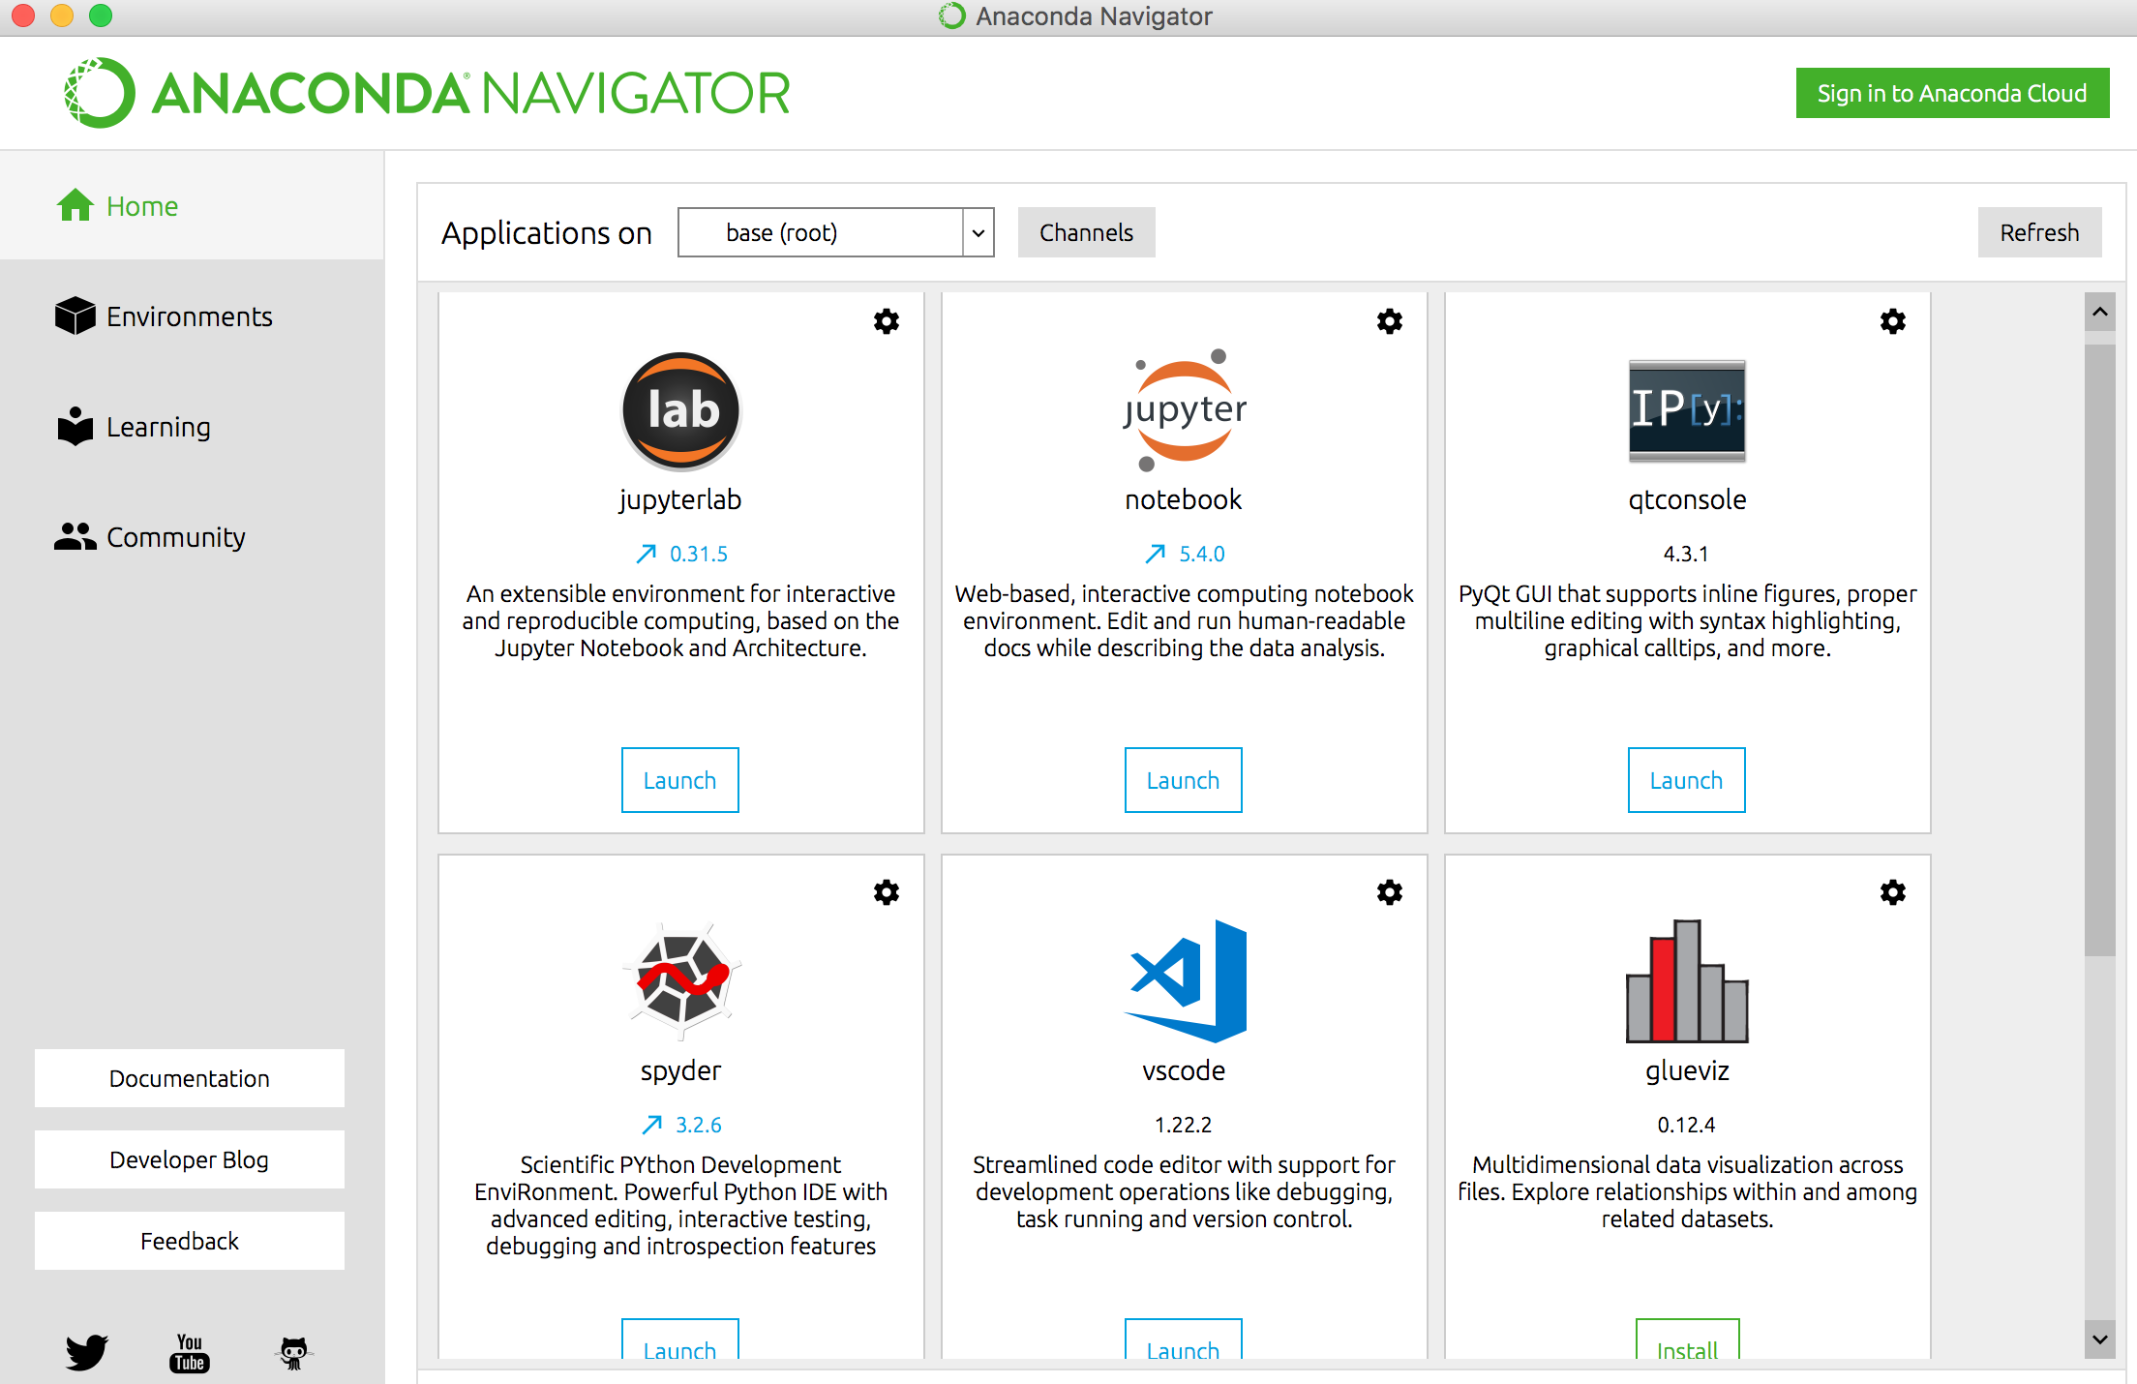
Anaconda Navigator

Slide 31
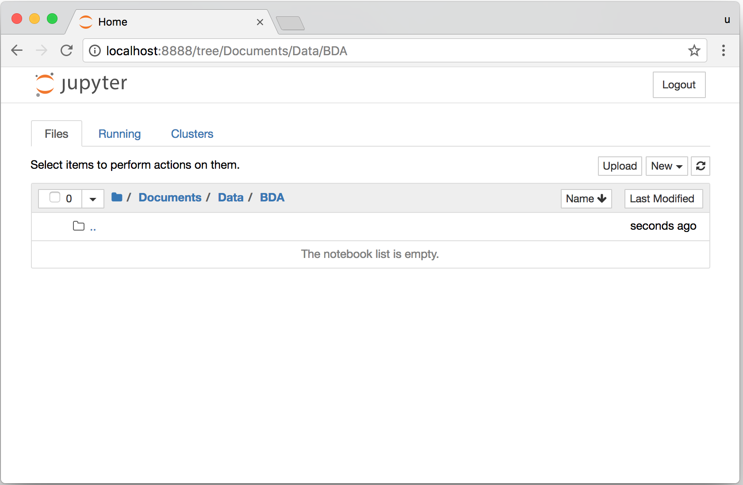
Jupyter Notebook

Slide 32
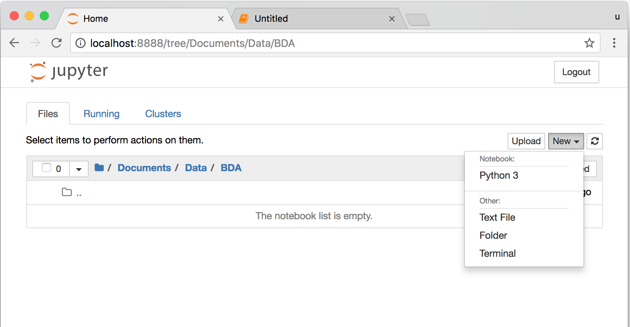
Jupyter Notebook New Python 3

Slide 33
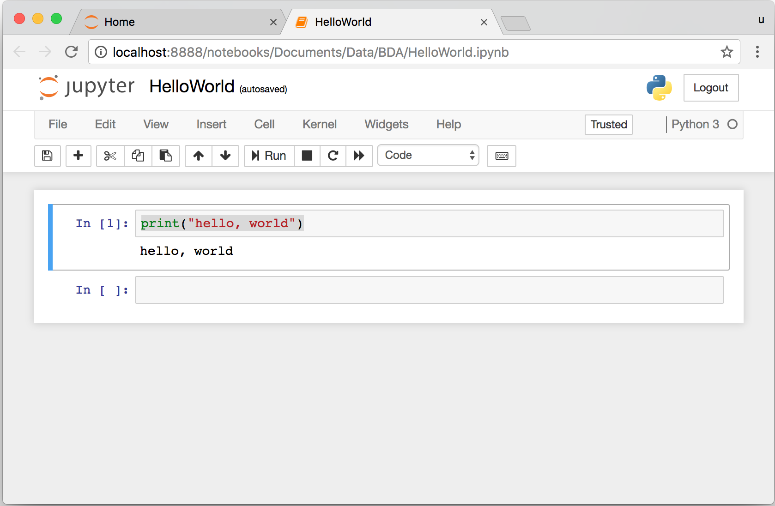
print("hello, world")
Notes:
print("hello, world")

Slide 34
Python Programming

Slide 35
Source: https://www.python.org/community/logos/

Slide 36
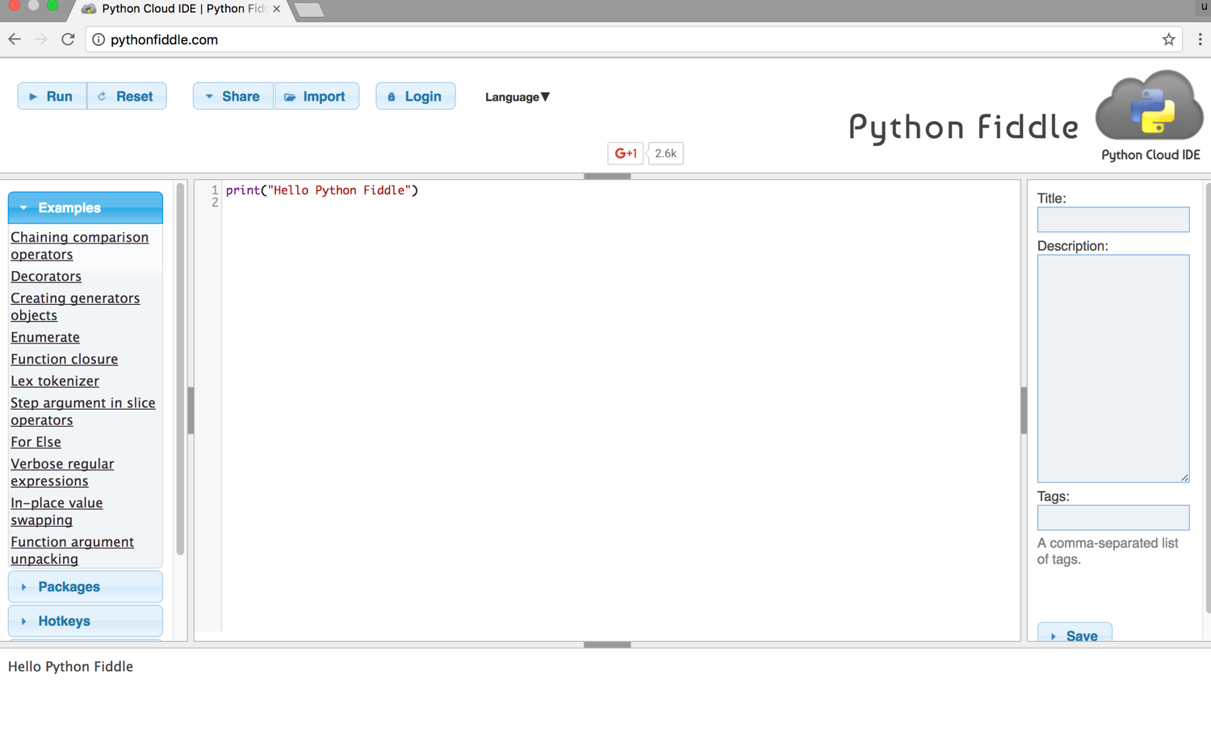
Python Fiddle
http://pythonfiddle.com/

Slide 37
Text input and output
print("Hello World")
print("Hello World\nThis is a message")
x = 3
print(x)
x = 2
y = 3
print(x, ' ', y)
name = input("Enter a name: ")
x = int(input("What is x? "))
x = float(input("Write a number "))
Source: http://pythonprogramminglanguage.com/text-input-and-output/
Notes:
print("Hello World")
print("Hello World\nThis is a message")
x = 3
print(x)
x = 2
y = 3
print(x, ' ', y)
name = input("Enter a name: ")
x = int(input("What is x? "))
x = float(input("Write a number "))

Slide 38
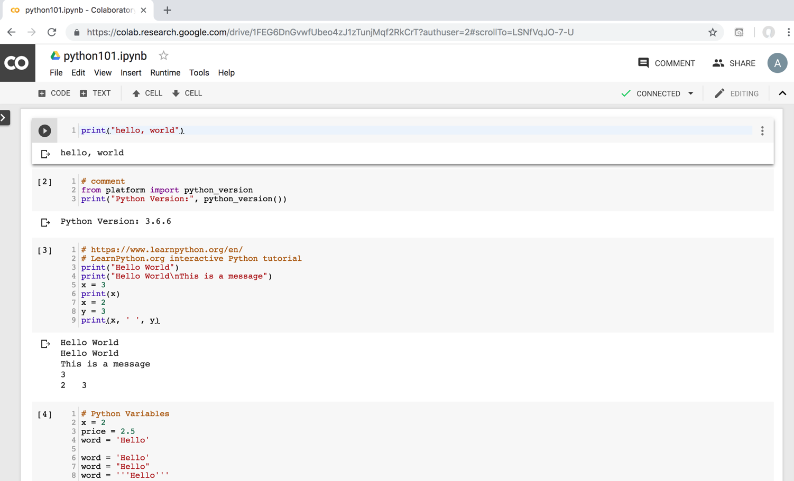
Python in Google Colab
https://colab.research.google.com/drive/1FEG6DnGvwfUbeo4zJ1zTunjMqf2RkCrT
https://tinyurl.com/aintpupython101

Slide 39
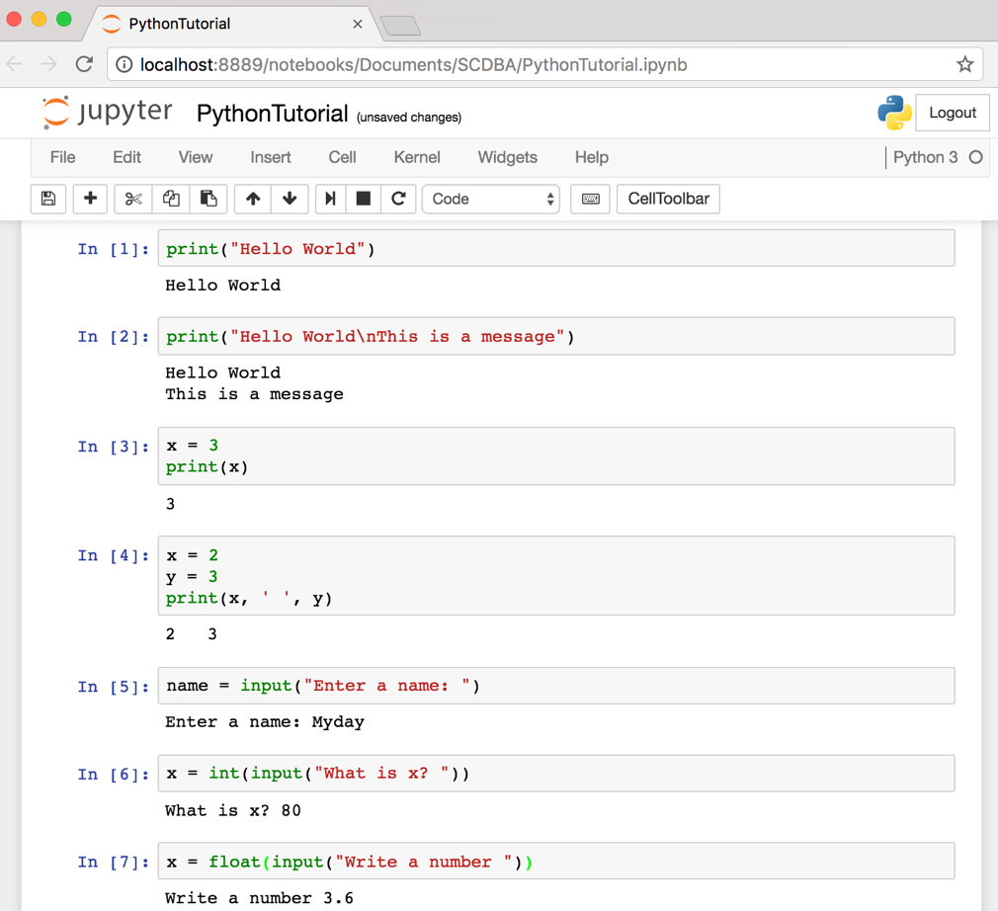
Text input and output
Source: http://pythonprogramminglanguage.com/text-input-and-output/
Notes:
print("Hello World")
print("Hello World\nThis is a message")
x = 3
print(x)
x = 2
y = 3
print(x, ' ', y)
name = input("Enter a name: ")
x = int(input("What is x? "))
x = float(input("Write a number "))

Slide 40
Variables
x = 2
price = 2.5
word = 'Hello'
word = 'Hello'
word = "Hello"
word = '''Hello'''
x = 2
x = x + 1
x = 5
Source: http://pythonprogramminglanguage.com/

Slide 41
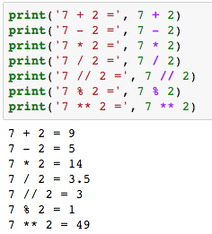
Python Basic Operators
print('7 + 2 =', 7 + 2)
print('7 - 2 =', 7 - 2)
print('7 * 2 =', 7 * 2)
print('7 / 2 =', 7 / 2)
print('7 // 2 =', 7 // 2)
print('7 % 2 =', 7 % 2)
print('7 ** 2 =', 7 ** 2)

Slide 42
BMI Calculator in Python
height_cm = float(input("Enter your height in cm: "))
weight_kg = float(input("Enter your weight in kg: "))
height_m = height_cm/100
BMI = (weight_kg/(height_m**2))
print("Your BMI is: " + str(round(BMI,1)))
Source: http://code.activestate.com/recipes/580615-bmi-code/

Slide 43
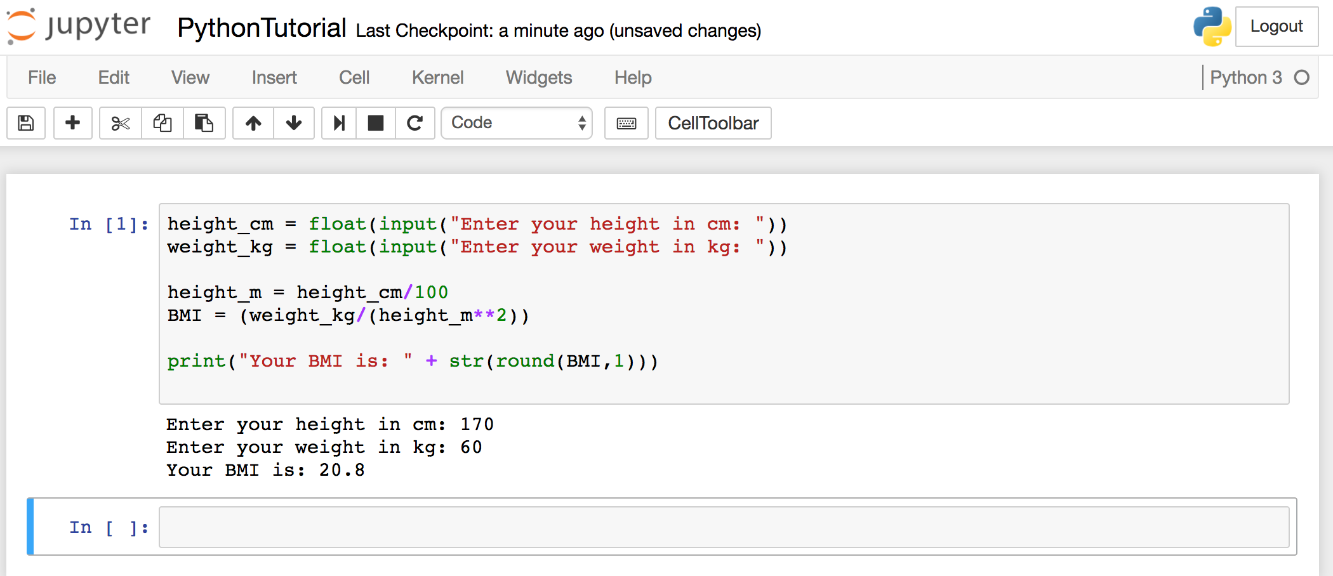
BMI Calculator in Python
Source: http://code.activestate.com/recipes/580615-bmi-code/
Notes:
height_cm = float(input("Enter your height in cm: "))
weight_kg = float(input("Enter your weight in kg: "))
height_m = height_cm/100
BMI = (weight_kg/(height_m**2))
print("Your BMI is: " + str(round(BMI,1)))

Slide 44
Future value of a specified principal amount, rate of interest, and a number of years
Source: https://www.w3resource.com/python-exercises/python-basic-exercise-39.php

Slide 45
Future Value (FV)
# How much is your $100 worth after 7 years?
print(100 * 1.1 ** 7)
# output = 194.87
Source: https://www.w3resource.com/python-exercises/python-basic-exercise-39.php

Slide 46
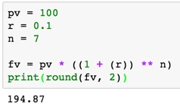
Future Value (FV)
pv = 100
r = 0.1
n = 7
fv = pv * ((1 + (r)) ** n)
print(round(fv, 2))

Slide 47
Future Value (FV)
amount = 100
interest = 10 #10% = 0.01 * 10
years = 7
future_value = amount * ((1 + (0.01 * interest)) ** years)
print(round(future_value, 2))
Source: https://www.w3resource.com/python-exercises/python-basic-exercise-39.php
Notes:
amount = 100
interest = 10 #10% = 0.01 * 10
years = 7
future_value = amount * ((1 + (0.01 * interest)) ** years)
print(round(future_value, 2))

Slide 48
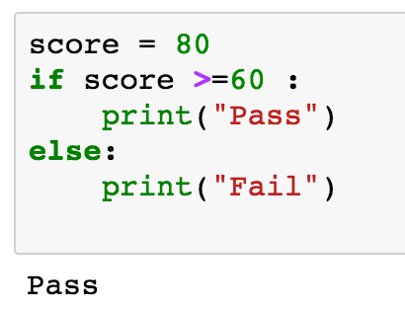
if statements
> greater than
< smaller than
== equals
!= is not
score = 80
if score >=60 :
print("Pass")
else:
print("Fail")
Source: http://pythonprogramminglanguage.com/

Slide 49
if elif else
score = 90
grade = ""
if score >=90:
grade = "A"
elif score >= 80:
grade = "B"
elif score >= 70:
grade = "C"
elif score >= 60:
grade = "D"
else:
grade = "E"
print(grade)
# grade = ”A”
A
http://pythontutor.com/visualize.html
https://goo.gl/E6w5ph
Source: http://pythonprogramminglanguage.com/
Notes:
http://pythontutor.com/visualize.html
https://goo.gl/E6w5ph

Slide 50
for loops
for i in range(1,11):
print(i)
1
2
3
4
5
6
7
8
9
10
Source: http://pythonprogramminglanguage.com/
Notes:
https://goo.gl/YpxMYo

Slide 51
for loops
for i in range(1,10):
for j in range(1,10):
print(i, ' * ' , j , ' = ', i*j)
9 * 1 = 9
9 * 2 = 18
9 * 3 = 27
9 * 4 = 36
9 * 5 = 45
9 * 6 = 54
9 * 7 = 63
9 * 8 = 72
9 * 9 = 81
Source: http://pythonprogramminglanguage.com/
Notes:
for i in range(1,10):
for j in range(1,10):
print(i, ' * ' , j , ' = ', i*j)

Slide 52
while loops
age = 10
while age < 20:
print(age)
age = age + 1
10
11
12
13
14
15
16
17
18
19
Source: https://learnpython.trinket.io/learn-python-part-8-loops#/while-loops/about-while-loops
Notes:
age = 10
while age < 20:
print(age)
age = age + 1

Slide 53
def Functions
def convertCMtoM(xcm):
m = xcm/100
return m
cm = 180
m = convertCMtoM(cm)
print(str(m))
1.8
Notes:
https://goo.gl/6K5qUn

Slide 54
Lists []
x = [60, 70, 80, 90]
print(len(x))
print(x[0])
print(x[1])
print(x[-1])
4
60
70
90

Slide 55
Tuples ()
A tuple in Python is a collection that cannot be modified. A tuple is defined using parenthesis.
x = (10, 20, 30, 40, 50)
print(x[0])
print(x[1])
print(x[2])
print(x[-1])
10
20
30
50
Source: http://pythonprogramminglanguage.com/tuples/

Slide 56
Dictionary {key : value}
k = { 'EN':'English', 'FR':'French' }
print(k['EN'])
English
Source: http://pythonprogramminglanguage.com/dictionary/

Slide 57
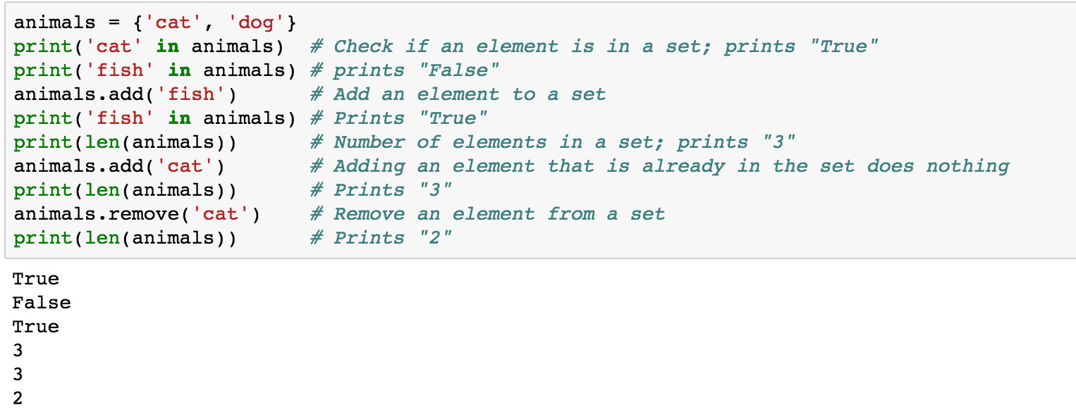
Sets {}
animals = {'cat', 'dog'}
animals = {'cat', 'dog'}
print('cat' in animals)
print('fish' in animals)
animals.add('fish')
print('fish' in animals)
print(len(animals))
animals.add('cat')
print(len(animals))
animals.remove('cat')
print(len(animals))
Source: http://cs231n.github.io/python-numpy-tutorial/
Notes:
#Sets
animals = {'cat', 'dog'}
print('cat' in animals) # Check if an element is in a set; prints "True"
print('fish' in animals) # prints "False"
animals.add('fish') # Add an element to a set
print('fish' in animals) # Prints "True"
print(len(animals)) # Number of elements in a set; prints "3"
animals.add('cat') # Adding an element that is already in the set does nothing
print(len(animals)) # Prints "3"
animals.remove('cat') # Remove an element from a set
print(len(animals)) # Prints "2”
Source: http://cs231n.github.io/python-numpy-tutorial/

Slide 58
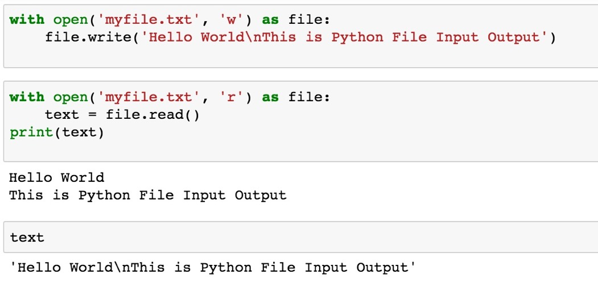
File Input / Output
with open('myfile.txt', 'w') as file:
file.write('Hello World\nThis is Python File Input Output')
with open('myfile.txt', 'r') as file:
text = file.read()
print(text)
Source: https://github.com/TiesdeKok/LearnPythonforResearch/blob/master/0_python_basics.ipynb
Notes:
with open('myfile.txt', 'w') as file:
file.write('Hello World\nThis is Python File Input Output')
with open('myfile.txt', 'r') as file:
text = file.read()
print(text)
with open('myfile.txt', 'a+') as file:
file.write('\n' + 'New line')
with open('myfile.txt', 'r') as file:
text = file.read()
print(text)

Slide 59
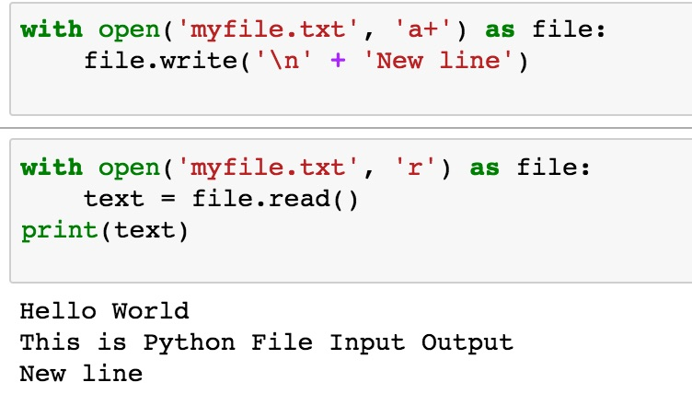
File Input / Output
with open('myfile.txt', 'a+') as file:
file.write('\n' + 'New line')
with open('myfile.txt', 'r') as file:
text = file.read()
print(text)
Source: https://github.com/TiesdeKok/LearnPythonforResearch/blob/master/0_python_basics.ipynb
Notes:
with open('myfile.txt', 'w') as file:
file.write('Hello World\nThis is Python File Input Output')
with open('myfile.txt', 'r') as file:
text = file.read()
print(text)
with open('myfile.txt', 'a+') as file:
file.write('\n' + 'New line')
with open('myfile.txt', 'r') as file:
text = file.read()
print(text)

Slide 60
try except finally
try:
file = open("myfile.txt")
#file = open("myfile.txt", 'w')
file.write("Python write file")
print("file saved")
except:
print("Exception file Error")
finally:
file.close()
print("finally process")
Exception file Error
finally process
Source: https://pythonbasics.org/try-except/
Notes:
try:
file = open("myfile.txt")
#file = open("myfile.txt", 'w')
file.write("Python write file")
print("file saved")
except:
print("Exception file Error")
finally:
file.close()
print("finally process")

Slide 61
class
class Person:
def __init__(self, name, age):
self.name = name
self.age = age
def myfunc(self):
print("Hello my name is " + self.name)
p1 = Person("Alan", 20)
p1.myfunc()
print(p1.name)
print(p1.age)
Hello my name is Alan
Alan
20
Source: https://www.w3schools.com/python/python_classes.asp
Notes:
class Person:
def __init__(self, name, age):
self.name = name
self.age = age
def myfunc(self):
print("Hello my name is " + self.name)
p1 = Person("Alan", 20)
p1.myfunc()
print(p1.name)
print(p1.age)

Slide 62
Big Data Analytics with Numpy in Python

Slide 63
Numpy
NumPy
Base N-dimensional array package

Slide 64
NumPy is the fundamental package for scientific computing with Python.
Source: http://www.numpy.org/

Slide 65
NumPy
NumPy
NumPy provides a multidimensional array object to store homogenous or heterogeneous data; it also provides optimized functions/methods to operate on this array object.
Source: Yves Hilpisch (2014), Python for Finance: Analyze Big Financial Data, O'Reilly

Slide 66
NumPy ndarray
NumPy
One-dimensional Array (1-D Array)
0 | 1 |  |  | n-1
1 | 2 | 3 | 4 | 5
Two-dimensional Array (2-D Array)
 | 0 | 1 |  |  | n-1
0 | 1 | 2 | 3 | 4 | 5
1 | 6 | 7 | 8 | 9 | 10
 | 11 | 12 | 13 | 14 | 15
m-1 | 16 | 17 | 18 | 19 | 20

Slide 67
v = list(range(1, 6)) v 2 * v import numpy as np v = np.arange(1, 6) v 2 * v
NumPy
NumPy
Source: Yves Hilpisch (2014), Python for Finance: Analyze Big Financial Data, O'Reilly
Notes:
# pip3 install numpy
# pip install numpy
# sudo pip3 install numpy
import numpy as np

Slide 68
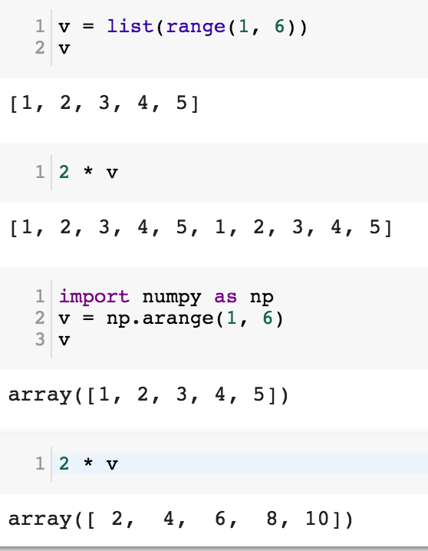
NumPy
Base N-dimensional array package

Slide 69
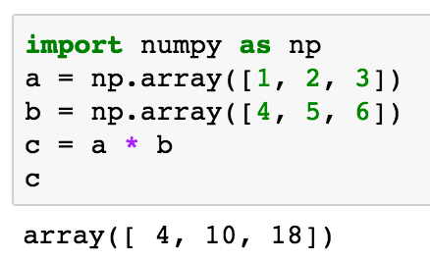
import numpy as np a = np.array([1, 2, 3]) b = np.array([4, 5, 6]) c = a * b c
NumPy Create Array
NumPy
Source: Yves Hilpisch (2014), Python for Finance: Analyze Big Financial Data, O'Reilly

Slide 70
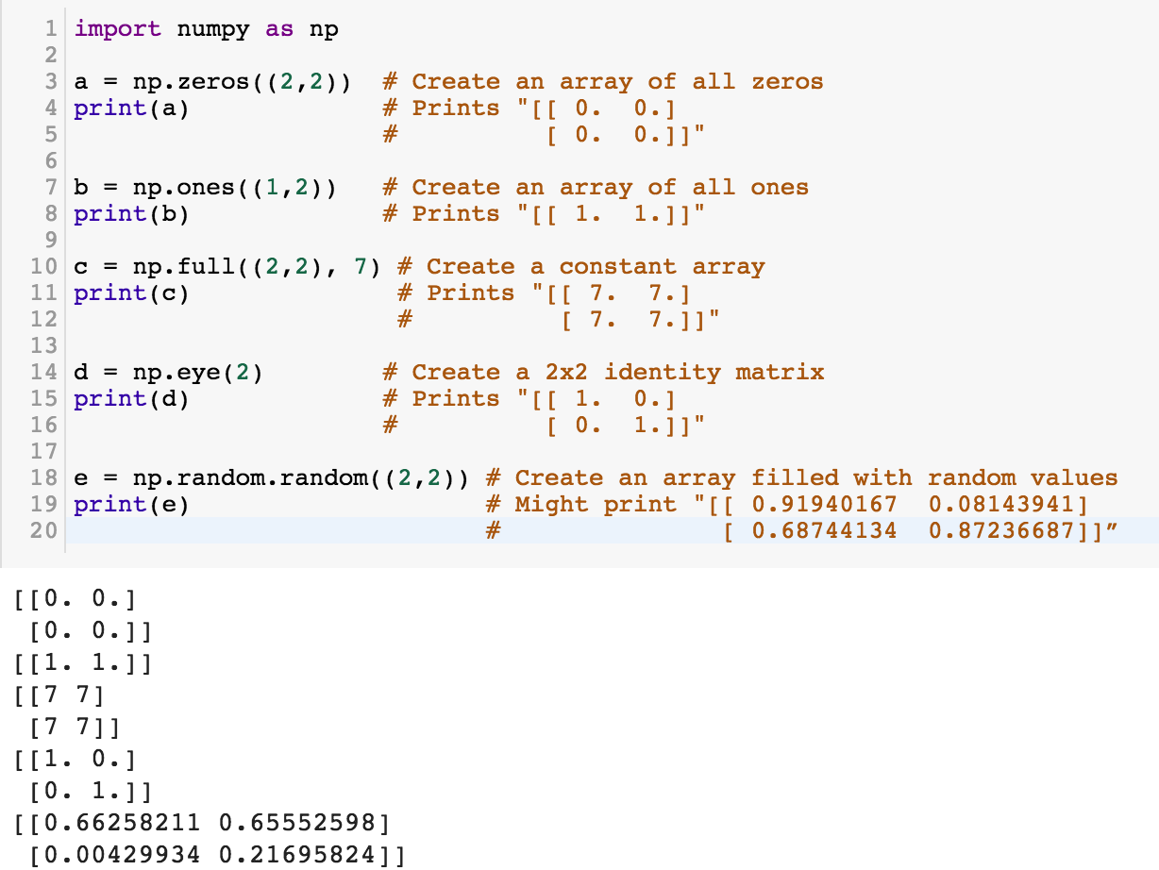
NumPy
NumPy
Source: http://cs231n.github.io/python-numpy-tutorial/
Notes:
import numpy as np
a = np.zeros((2,2)) # Create an array of all zeros
print(a) # Prints "[[ 0. 0.]
# [ 0. 0.]]"
b = np.ones((1,2)) # Create an array of all ones
print(b) # Prints "[[ 1. 1.]]"
c = np.full((2,2), 7) # Create a constant array
print(c) # Prints "[[ 7. 7.]
# [ 7. 7.]]"
d = np.eye(2) # Create a 2x2 identity matrix
print(d) # Prints "[[ 1. 0.]
# [ 0. 1.]]"
e = np.random.random((2,2)) # Create an array filled with random values
print(e) # Might print "[[ 0.91940167 0.08143941]
# [ 0.68744134 0.87236687]]”
Source: http://cs231n.github.io/python-numpy-tutorial/

Slide 71
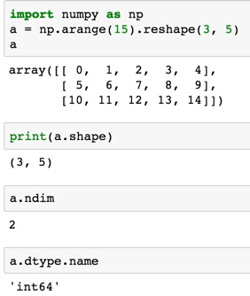
import numpy as np
a = np.arange(15).reshape(3, 5)
a.shape
a.ndim
a.dtype.name
Source: https://docs.scipy.org/doc/numpy-dev/user/quickstart.html
Notes:
Numpy Tutorial
Source: https://docs.scipy.org/doc/numpy-dev/user/quickstart.html
In [1]:
import numpy as np
a = np.arange(15).reshape(3, 5)
a
Out[1]:
array([[ 0, 1, 2, 3, 4],
[ 5, 6, 7, 8, 9],
[10, 11, 12, 13, 14]])
In [2]:
print(a.shape)
(3, 5)
In [3]:
a.ndim
Out[3]:
2
In [4]:
a.dtype.name
Out[4]:
'int64'
In [5]:
a.itemsize
Out[5]:
8
In [6]:
a.size
Out[6]:
15
In [7]:
type(a)
Out[7]:
numpy.ndarray
In [8]:
b = np.array([1, 2, 3])
In [9]:
b
Out[9]:
array([1, 2, 3])
In [10]:
type(b)
Out[10]:
numpy.ndarray

Slide 72
Matrix
Source: https://simple.wikipedia.org/wiki/Matrix_(mathematics)

Slide 73
NumPy ndarray: Multidimensional Array Object

Slide 74
NumPy ndarray
One-dimensional Array (1-D Array)
0 | 1 |  |  | n-1
1 | 2 | 3 | 4 | 5
Two-dimensional Array (2-D Array)
 | 0 | 1 |  |  | n-1
0 | 1 | 2 | 3 | 4 | 5
1 | 6 | 7 | 8 | 9 | 10
 | 11 | 12 | 13 | 14 | 15
m-1 | 16 | 17 | 18 | 19 | 20

Slide 75
import numpy as np a = np.array([1,2,3,4,5])
One-dimensional Array (1-D Array)
0 | 1 |  |  | n-1
1 | 2 | 3 | 4 | 5

Slide 76
a = np.array([[1,2,3,4,5],[6,7,8,9,10],[11,12,13,14,15],[16,17,18,19,20]])
Two-dimensional Array (2-D Array)
 | 0 | 1 |  |  | n-1
0 | 1 | 2 | 3 | 4 | 5
1 | 6 | 7 | 8 | 9 | 10
 | 11 | 12 | 13 | 14 | 15
m-1 | 16 | 17 | 18 | 19 | 20

Slide 77
import numpy as np a = np.array([[0, 1, 2, 3], [10, 11, 12, 13], [20, 21, 22, 23]])
a
0 | 1 | 2 | 3
10 | 11 | 12 | 13
20 | 21 | 22 | 23
Notes:
import numpy as np a = np.array([[0, 1, 2, 3], [10, 11, 12, 13], [20, 21, 22, 23]])
a

Slide 78
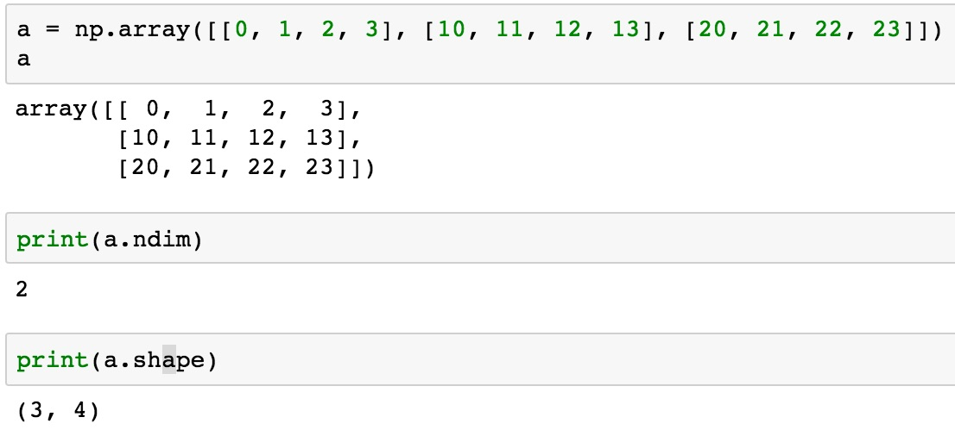
a = np.array([[0, 1, 2, 3], [10, 11, 12, 13], [20, 21, 22, 23]])
0 | 1 | 2 | 3
10 | 11 | 12 | 13
20 | 21 | 22 | 23

Slide 79
NumPy Basics: Arrays and Vectorized Computation
Source: https://www.safaribooksonline.com/library/view/python-for-data/9781449323592/ch04.html

Slide 80
NumPy Array
Source: https://www.safaribooksonline.com/library/view/python-for-data/9781449323592/ch04.html

Slide 81
Numpy Array
Source: https://www.safaribooksonline.com/library/view/python-for-data/9781449323592/ch04.html

Slide 82
Tensor
3
a rank 0 tensor; this is a scalar with shape []
[1. ,2., 3.]
a rank 1 tensor; this is a vector with shape [3]
[[1., 2., 3.], [4., 5., 6.]]
a rank 2 tensor; a matrix with shape [2, 3]
[[[1., 2., 3.]], [[7., 8., 9.]]]
a rank 3 tensor with shape [2, 1, 3]
https://www.tensorflow.org/

Slide 83
Scalar
80
Vector
[50 60 70]
Matrix
50 60 70
55 65 75
[50 60 70] [70 80 90]
[55 65 75] [75 85 95]
Tensor

Slide 84
pandas Python Data Analysis Library providing high-performance, easy-to-use data structures and data analysis tools for the Python programming language.
Source: http://pandas.pydata.org/

Slide 85
pandas: powerful Python data analysis toolkit
Tabular data with heterogeneously-typed columns, as in an SQL table or Excel spreadsheet
Ordered and unordered (not necessarily fixed-frequency) time series data.
Arbitrary matrix data (homogeneously typed or heterogeneous) with row and column labels
Any other form of observational / statistical data sets. The data actually need not be labeled at all to be placed into a pandas data structure
Source: http://pandas.pydata.org/pandas-docs/stable/

Slide 86
Series DataFrame
Primary data structures of pandas
Series (1-dimensional)
DataFrame (2-dimensional)
Handle the vast majority of typical use cases in finance, statistics, social science, and many areas of engineering.
Source: http://pandas.pydata.org/pandas-docs/stable/

Slide 87
pandas DataFrame
DataFrame provides everything that R’s data.frame provides and much more.
pandas is built on top of NumPy and is intended to integrate well within a scientific computing environment with many other 3rd party libraries.

Slide 88
pandas Comparison with SAS
pandas | SAS
DataFrame | data set
column | variable
row | observation
groupby | BY-group
NaN | .
Source: http://pandas.pydata.org/pandas-docs/stable/comparison_with_sas.html

Slide 89
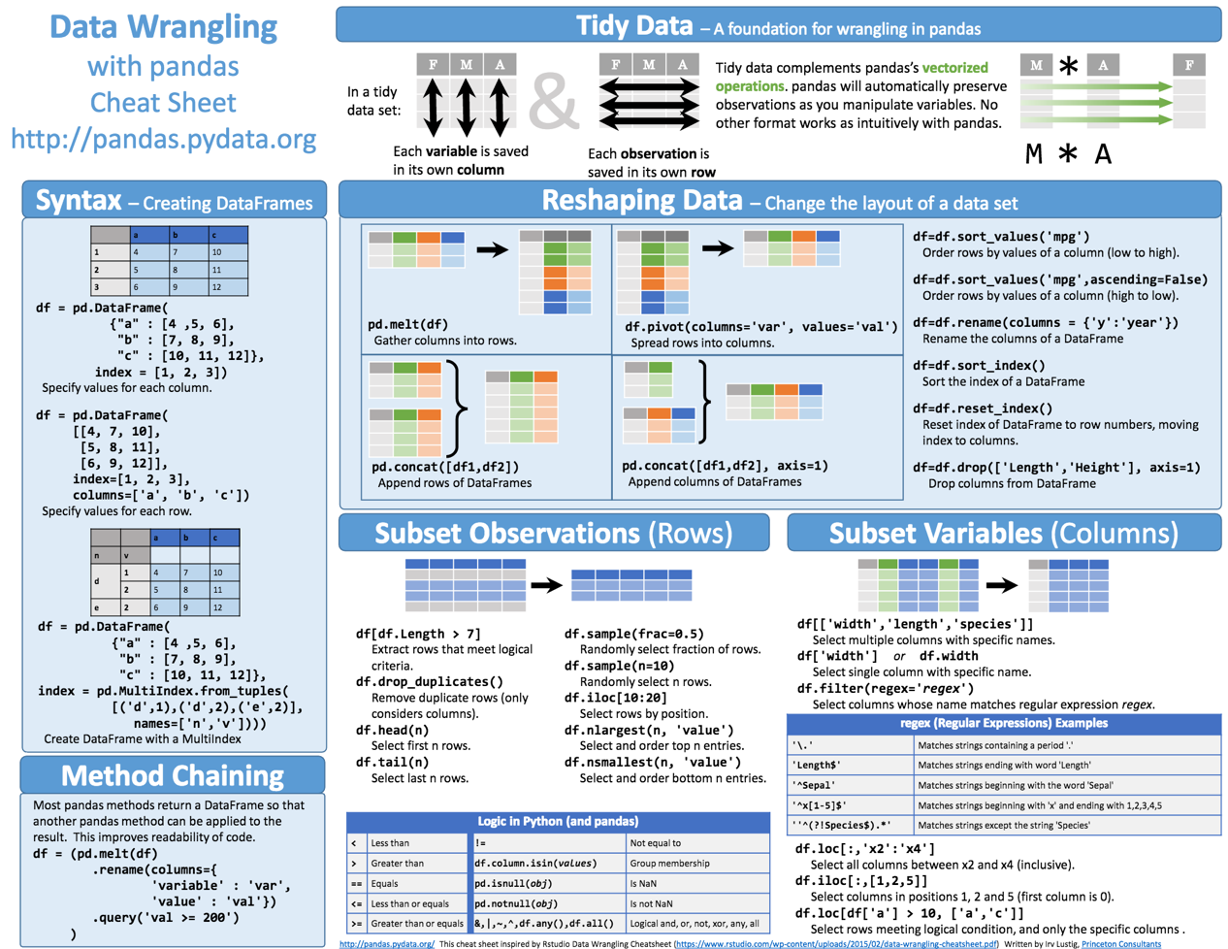
Python Pandas Cheat Sheet
Source: https://github.com/pandas-dev/pandas/blob/master/doc/cheatsheet/Pandas_Cheat_Sheet.pdf

Slide 90
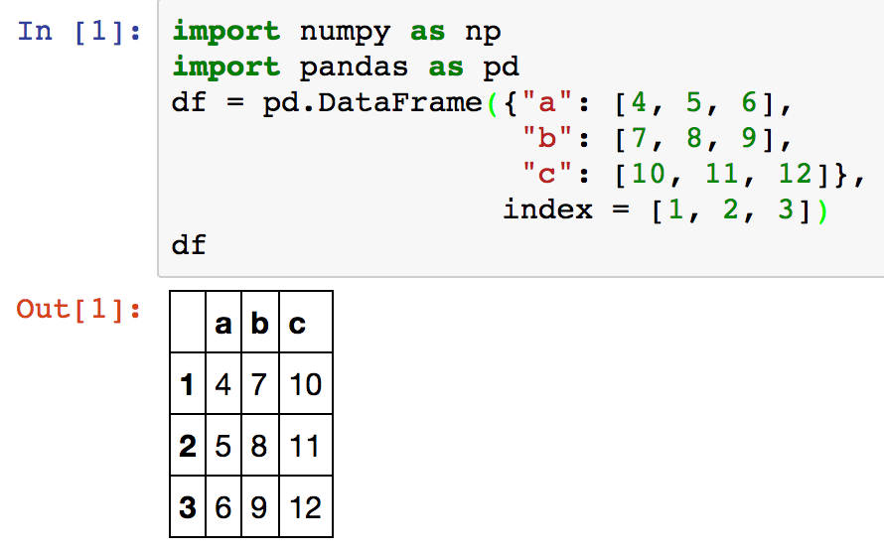
Creating pd.DataFrame
 | a | b | c
1 | 4 | 7 | 10
2 | 5 | 8 | 11
3 | 6 | 9 | 12
import pandas as pd
df = pd.DataFrame({"a": [4, 5, 6],
"b": [7, 8, 9],
"c": [10, 11, 12]},
index = [1, 2, 3])
Source: https://github.com/pandas-dev/pandas/blob/master/doc/cheatsheet/Pandas_Cheat_Sheet.pdf
Notes:
import numpy as np
import pandas as pd
df = pd.DataFrame({"a": [4, 5, 6],
"b": [7, 8, 9],
"c": [10, 11, 12]},
index = [1, 2, 3])
df

Slide 91
Pandas DataFrame
type(df)

Slide 92
import numpy as np
import pandas as pd
import matplotlib.pyplot as plt
print('pandas imported')
s = pd.Series([1,3,5,np.nan,6,8])
s
dates = pd.date_range('20181001', periods=6)
dates
Source: http://pandas.pydata.org/pandas-docs/stable/10min.html

Slide 93
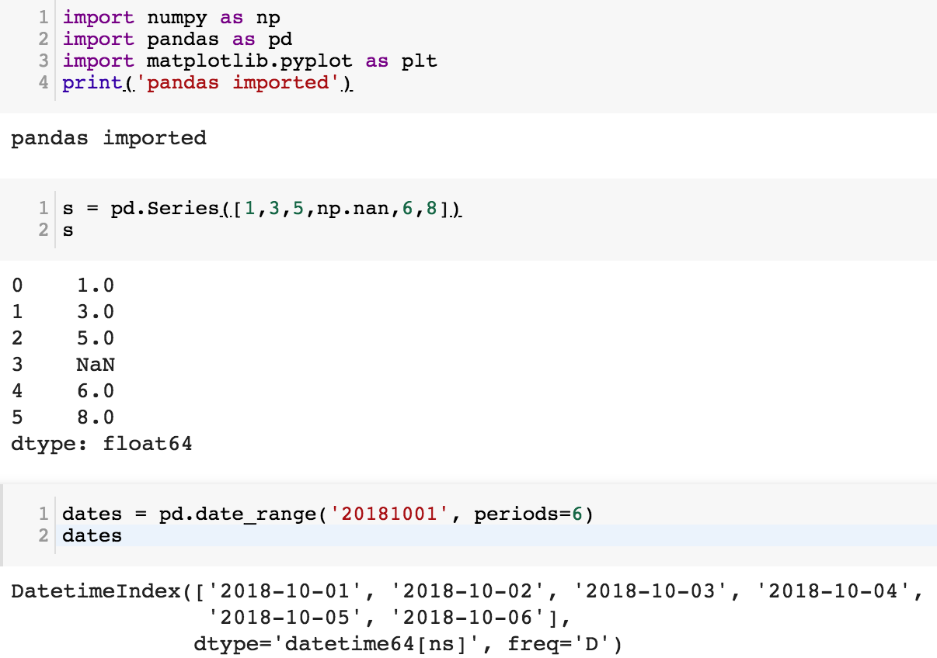

Slide 94
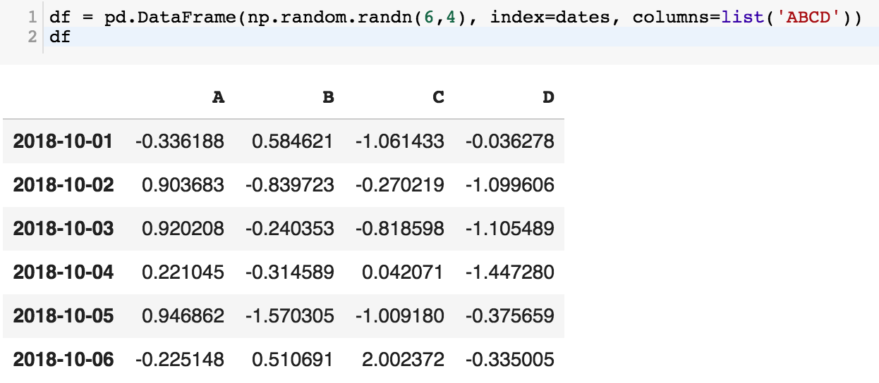
df = pd.DataFrame(np.random.randn(6,4), index=dates, columns=list('ABCD'))
df

Slide 95
df = pd.DataFrame(np.random.randn(3,5), index=['student1','student2','student3'], columns=list('ABCDE'))
df

Slide 96
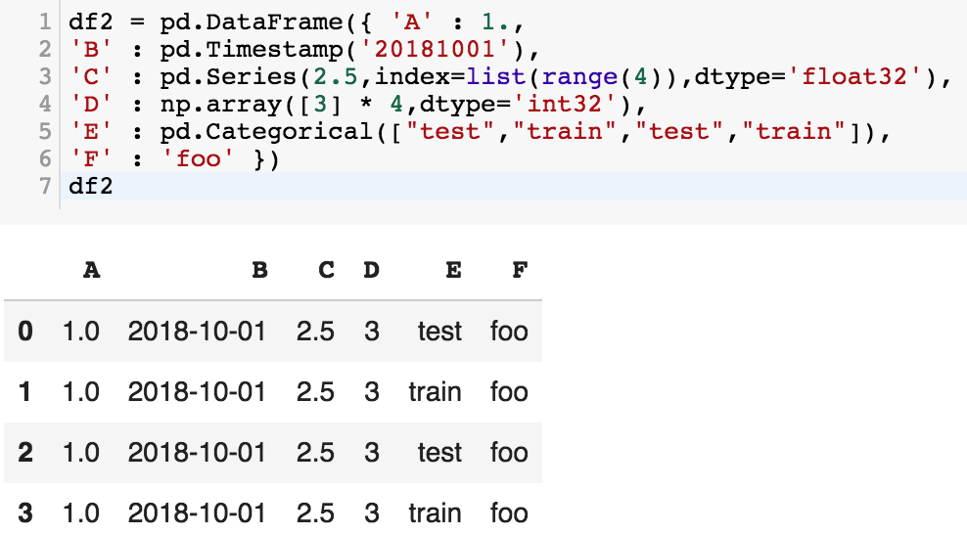
df2 = pd.DataFrame({ 'A' : 1.,
'B' : pd.Timestamp('20181001'),
'C' : pd.Series(2.5,index=list(range(4)),dtype='float32'),
'D' : np.array([3] * 4,dtype='int32'),
'E' : pd.Categorical(["test","train","test","train"]),
'F' : 'foo' })
df2

Slide 97
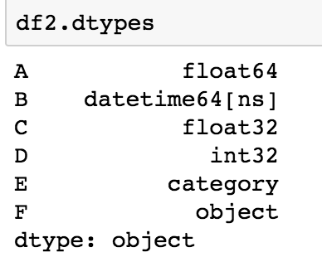
df2.dtypes

Slide 98
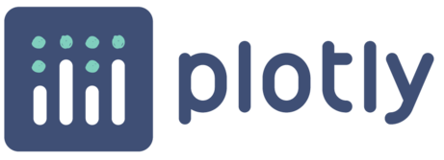
Python Data Analysis and Visualization
Altair

Slide 99
Python Pandas
http://pandas.pydata.org/

Slide 100
Python matplotlib
Source: https://matplotlib.org/

Slide 101
Python seaborn
Source: https://seaborn.pydata.org/

Slide 102
Python plotly
Source: https://plotly.com/python/

Slide 103
Python bokeh
Source: https://bokeh.org/

Slide 104
Python Altair
Altair
Source: https://altair-viz.github.io/

Slide 105
Python matplotlib
https://matplotlib.org/

Slide 106
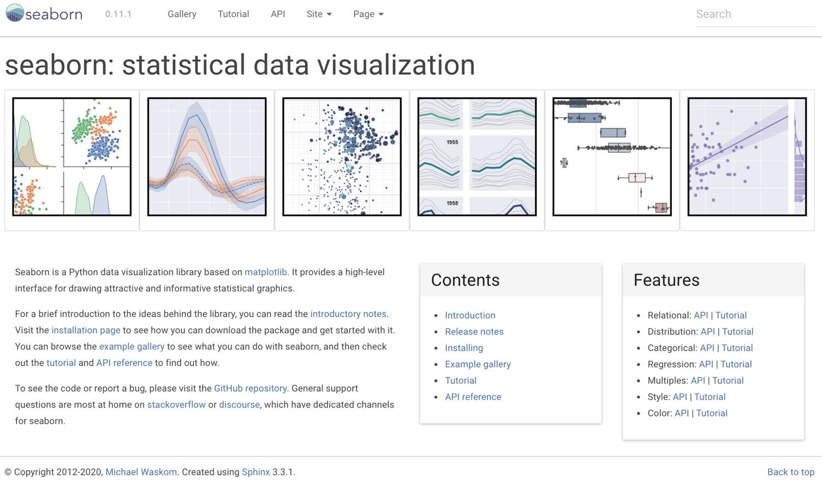
Python Seaborn
https://seaborn.pydata.org/

Slide 107
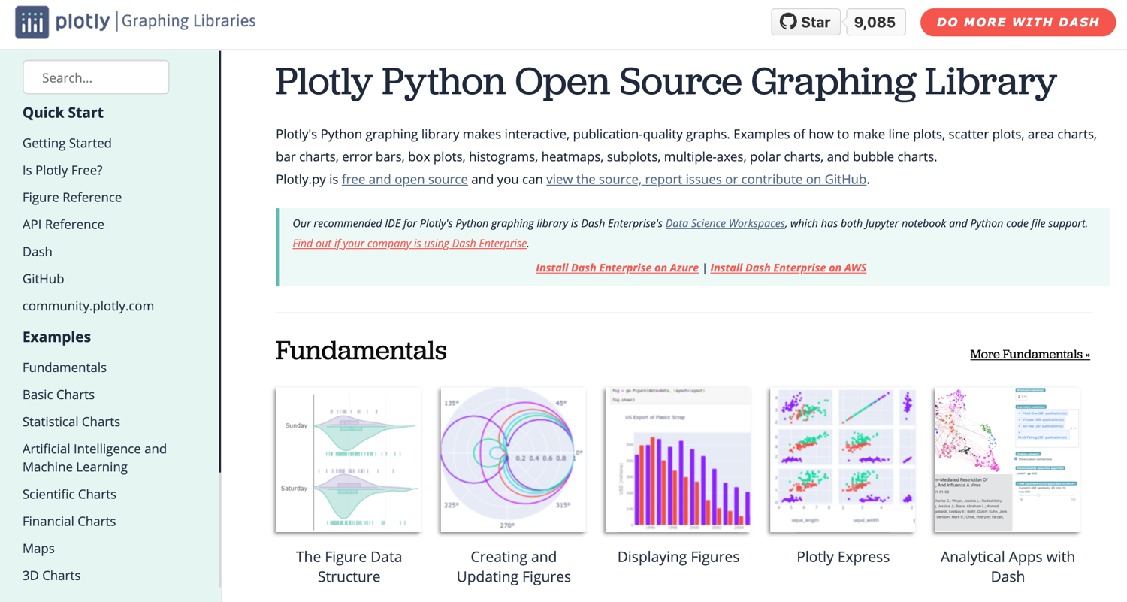
Python Plotly Graphing Library
https://plotly.com/python/

Slide 108
Python Plotly Graphing Library
https://plotly.com/python/

Slide 109
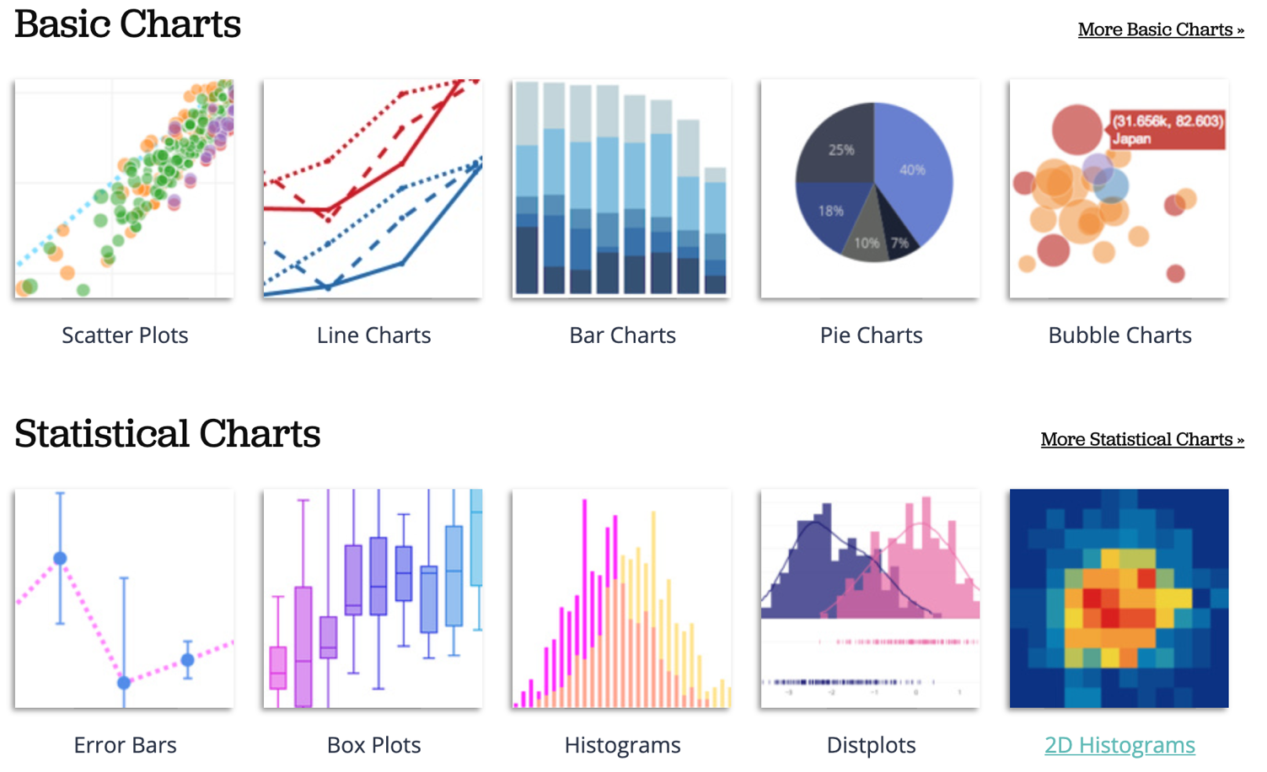
Python Plotly Graphing Library
https://plotly.com/python/

Slide 110
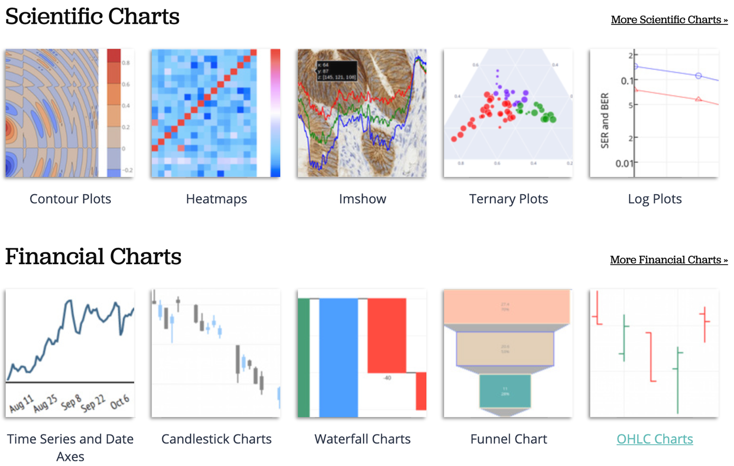
Python Plotly Graphing Library
https://plotly.com/python/

Slide 111
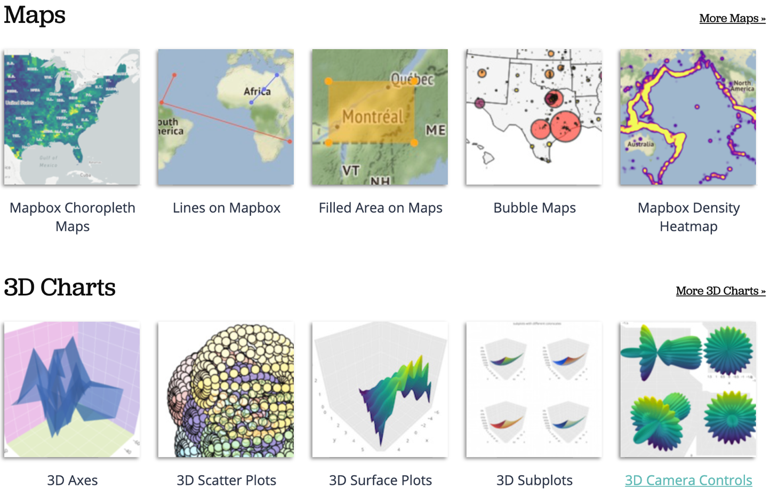
Python Plotly Graphing Library
https://plotly.com/python/

Slide 112
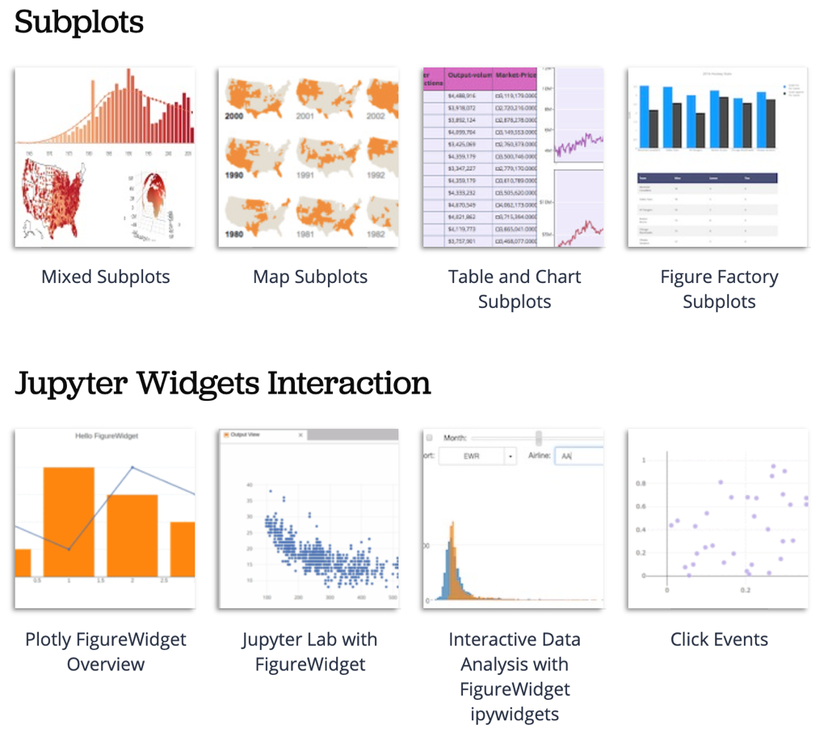
Python Plotly Graphing Library
https://plotly.com/python/

Slide 113
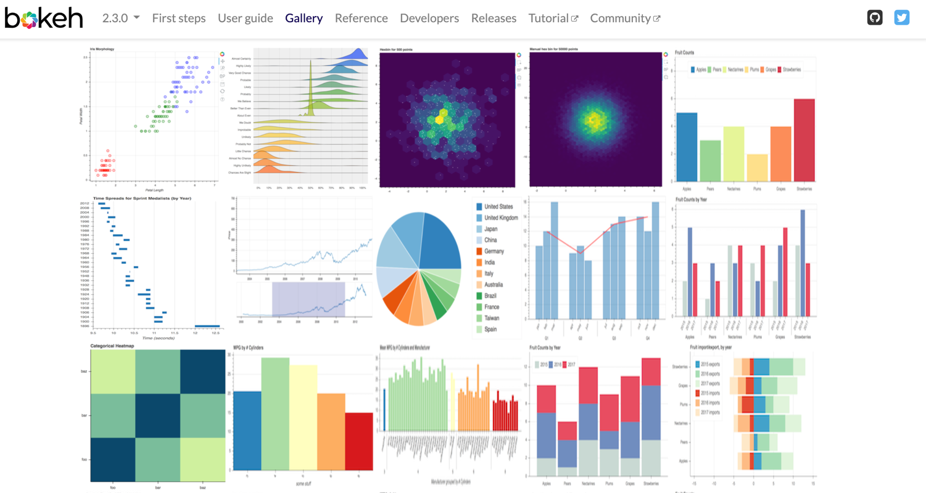
Python Bokeh
https://bokeh.org/

Slide 114
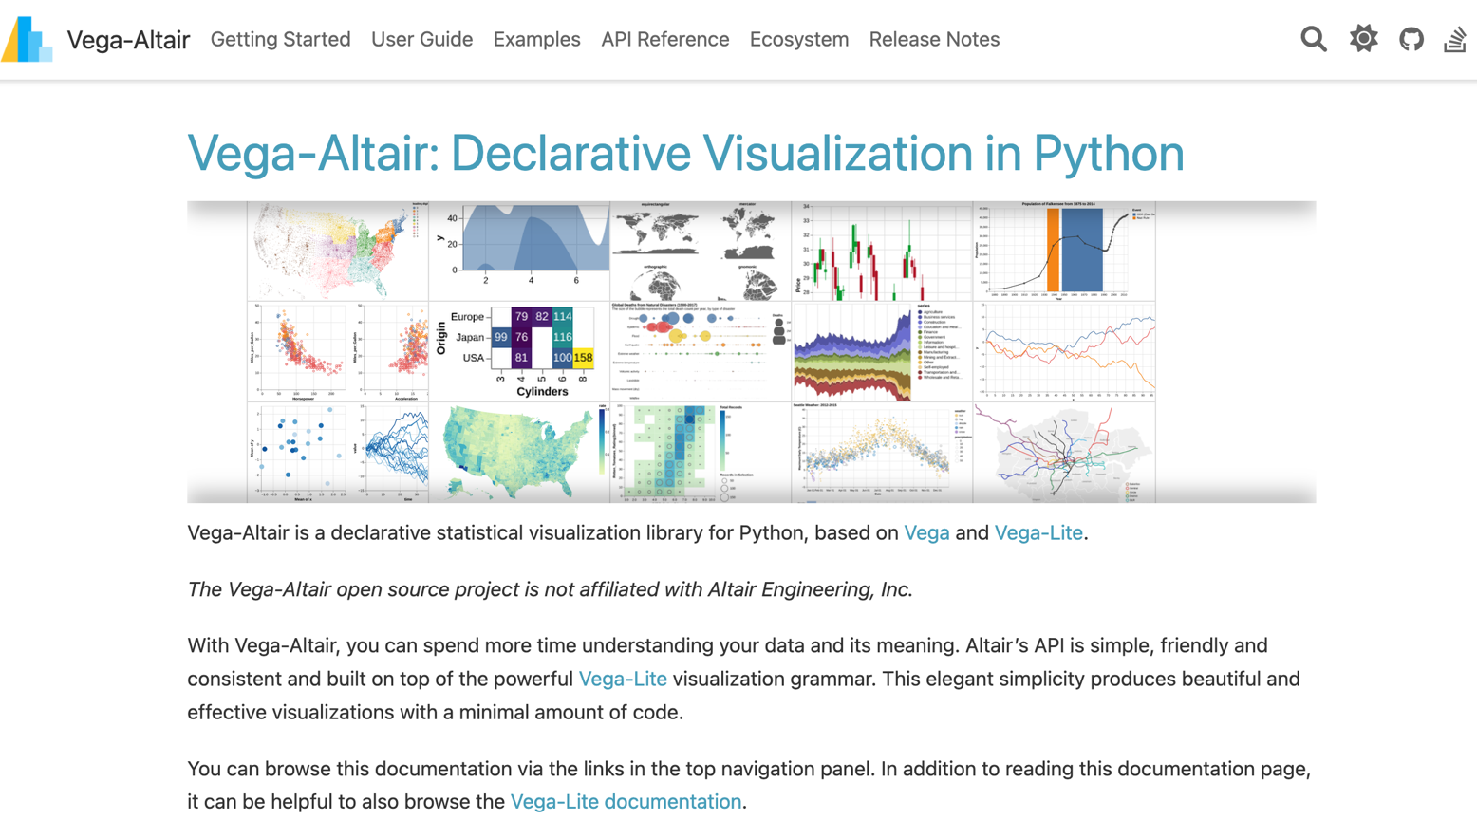
Python Altair
https://altair-viz.github.io/

Slide 115
Iris flower data set
setosa
versicolor
virginica
Source: https://en.wikipedia.org/wiki/Iris_flower_data_set
Source: http://suruchifialoke.com/2016-10-13-machine-learning-tutorial-iris-classification/

Slide 116
Iris Classfication
Source: http://suruchifialoke.com/2016-10-13-machine-learning-tutorial-iris-classification/

Slide 117
iris.data
https://archive.ics.uci.edu/ml/machine-learning-databases/iris/iris.data
5.1,3.5,1.4,0.2,Iris-setosa 4.9,3.0,1.4,0.2,Iris-setosa 4.7,3.2,1.3,0.2,Iris-setosa 4.6,3.1,1.5,0.2,Iris-setosa 5.0,3.6,1.4,0.2,Iris-setosa 5.4,3.9,1.7,0.4,Iris-setosa 4.6,3.4,1.4,0.3,Iris-setosa 5.0,3.4,1.5,0.2,Iris-setosa 4.4,2.9,1.4,0.2,Iris-setosa 4.9,3.1,1.5,0.1,Iris-setosa 5.4,3.7,1.5,0.2,Iris-setosa 4.8,3.4,1.6,0.2,Iris-setosa 4.8,3.0,1.4,0.1,Iris-setosa 4.3,3.0,1.1,0.1,Iris-setosa 5.8,4.0,1.2,0.2,Iris-setosa 5.7,4.4,1.5,0.4,Iris-setosa 5.4,3.9,1.3,0.4,Iris-setosa 5.1,3.5,1.4,0.3,Iris-setosa 5.7,3.8,1.7,0.3,Iris-setosa 5.1,3.8,1.5,0.3,Iris-setosa 5.4,3.4,1.7,0.2,Iris-setosa 5.1,3.7,1.5,0.4,Iris-setosa 4.6,3.6,1.0,0.2,Iris-setosa 5.1,3.3,1.7,0.5,Iris-setosa 4.8,3.4,1.9,0.2,Iris-setosa 5.0,3.0,1.6,0.2,Iris-setosa 5.0,3.4,1.6,0.4,Iris-setosa 5.2,3.5,1.5,0.2,Iris-setosa 5.2,3.4,1.4,0.2,Iris-setosa 4.7,3.2,1.6,0.2,Iris-setosa 4.8,3.1,1.6,0.2,Iris-setosa 5.4,3.4,1.5,0.4,Iris-setosa 5.2,4.1,1.5,0.1,Iris-setosa 5.5,4.2,1.4,0.2,Iris-setosa 4.9,3.1,1.5,0.1,Iris-setosa 5.0,3.2,1.2,0.2,Iris-setosa 5.5,3.5,1.3,0.2,Iris-setosa 4.9,3.1,1.5,0.1,Iris-setosa 4.4,3.0,1.3,0.2,Iris-setosa 5.1,3.4,1.5,0.2,Iris-setosa 5.0,3.5,1.3,0.3,Iris-setosa 4.5,2.3,1.3,0.3,Iris-setosa 4.4,3.2,1.3,0.2,Iris-setosa 5.0,3.5,1.6,0.6,Iris-setosa 5.1,3.8,1.9,0.4,Iris-setosa 4.8,3.0,1.4,0.3,Iris-setosa 5.1,3.8,1.6,0.2,Iris-setosa 4.6,3.2,1.4,0.2,Iris-setosa 5.3,3.7,1.5,0.2,Iris-setosa 5.0,3.3,1.4,0.2,Iris-setosa 7.0,3.2,4.7,1.4,Iris-versicolor 6.4,3.2,4.5,1.5,Iris-versicolor 6.9,3.1,4.9,1.5,Iris-versicolor 5.5,2.3,4.0,1.3,Iris-versicolor 6.5,2.8,4.6,1.5,Iris-versicolor 5.7,2.8,4.5,1.3,Iris-versicolor 6.3,3.3,4.7,1.6,Iris-versicolor 4.9,2.4,3.3,1.0,Iris-versicolor 6.6,2.9,4.6,1.3,Iris-versicolor 5.2,2.7,3.9,1.4,Iris-versicolor 5.0,2.0,3.5,1.0,Iris-versicolor 5.9,3.0,4.2,1.5,Iris-versicolor 6.0,2.2,4.0,1.0,Iris-versicolor 6.1,2.9,4.7,1.4,Iris-versicolor 5.6,2.9,3.6,1.3,Iris-versicolor 6.7,3.1,4.4,1.4,Iris-versicolor 5.6,3.0,4.5,1.5,Iris-versicolor 5.8,2.7,4.1,1.0,Iris-versicolor 6.2,2.2,4.5,1.5,Iris-versicolor 5.6,2.5,3.9,1.1,Iris-versicolor 5.9,3.2,4.8,1.8,Iris-versicolor 6.1,2.8,4.0,1.3,Iris-versicolor 6.3,2.5,4.9,1.5,Iris-versicolor 6.1,2.8,4.7,1.2,Iris-versicolor 6.4,2.9,4.3,1.3,Iris-versicolor 6.6,3.0,4.4,1.4,Iris-versicolor 6.8,2.8,4.8,1.4,Iris-versicolor 6.7,3.0,5.0,1.7,Iris-versicolor 6.0,2.9,4.5,1.5,Iris-versicolor 5.7,2.6,3.5,1.0,Iris-versicolor 5.5,2.4,3.8,1.1,Iris-versicolor 5.5,2.4,3.7,1.0,Iris-versicolor 5.8,2.7,3.9,1.2,Iris-versicolor 6.0,2.7,5.1,1.6,Iris-versicolor 5.4,3.0,4.5,1.5,Iris-versicolor 6.0,3.4,4.5,1.6,Iris-versicolor 6.7,3.1,4.7,1.5,Iris-versicolor 6.3,2.3,4.4,1.3,Iris-versicolor 5.6,3.0,4.1,1.3,Iris-versicolor 5.5,2.5,4.0,1.3,Iris-versicolor 5.5,2.6,4.4,1.2,Iris-versicolor 6.1,3.0,4.6,1.4,Iris-versicolor 5.8,2.6,4.0,1.2,Iris-versicolor 5.0,2.3,3.3,1.0,Iris-versicolor 5.6,2.7,4.2,1.3,Iris-versicolor 5.7,3.0,4.2,1.2,Iris-versicolor 5.7,2.9,4.2,1.3,Iris-versicolor 6.2,2.9,4.3,1.3,Iris-versicolor 5.1,2.5,3.0,1.1,Iris-versicolor 5.7,2.8,4.1,1.3,Iris-versicolor 6.3,3.3,6.0,2.5,Iris-virginica 5.8,2.7,5.1,1.9,Iris-virginica 7.1,3.0,5.9,2.1,Iris-virginica 6.3,2.9,5.6,1.8,Iris-virginica 6.5,3.0,5.8,2.2,Iris-virginica 7.6,3.0,6.6,2.1,Iris-virginica 4.9,2.5,4.5,1.7,Iris-virginica 7.3,2.9,6.3,1.8,Iris-virginica 6.7,2.5,5.8,1.8,Iris-virginica 7.2,3.6,6.1,2.5,Iris-virginica 6.5,3.2,5.1,2.0,Iris-virginica 6.4,2.7,5.3,1.9,Iris-virginica 6.8,3.0,5.5,2.1,Iris-virginica 5.7,2.5,5.0,2.0,Iris-virginica 5.8,2.8,5.1,2.4,Iris-virginica 6.4,3.2,5.3,2.3,Iris-virginica 6.5,3.0,5.5,1.8,Iris-virginica 7.7,3.8,6.7,2.2,Iris-virginica 7.7,2.6,6.9,2.3,Iris-virginica 6.0,2.2,5.0,1.5,Iris-virginica 6.9,3.2,5.7,2.3,Iris-virginica 5.6,2.8,4.9,2.0,Iris-virginica 7.7,2.8,6.7,2.0,Iris-virginica 6.3,2.7,4.9,1.8,Iris-virginica 6.7,3.3,5.7,2.1,Iris-virginica 7.2,3.2,6.0,1.8,Iris-virginica 6.2,2.8,4.8,1.8,Iris-virginica 6.1,3.0,4.9,1.8,Iris-virginica 6.4,2.8,5.6,2.1,Iris-virginica 7.2,3.0,5.8,1.6,Iris-virginica 7.4,2.8,6.1,1.9,Iris-virginica 7.9,3.8,6.4,2.0,Iris-virginica 6.4,2.8,5.6,2.2,Iris-virginica 6.3,2.8,5.1,1.5,Iris-virginica 6.1,2.6,5.6,1.4,Iris-virginica 7.7,3.0,6.1,2.3,Iris-virginica 6.3,3.4,5.6,2.4,Iris-virginica 6.4,3.1,5.5,1.8,Iris-virginica 6.0,3.0,4.8,1.8,Iris-virginica 6.9,3.1,5.4,2.1,Iris-virginica 6.7,3.1,5.6,2.4,Iris-virginica 6.9,3.1,5.1,2.3,Iris-virginica 5.8,2.7,5.1,1.9,Iris-virginica 6.8,3.2,5.9,2.3,Iris-virginica 6.7,3.3,5.7,2.5,Iris-virginica 6.7,3.0,5.2,2.3,Iris-virginica 6.3,2.5,5.0,1.9,Iris-virginica 6.5,3.0,5.2,2.0,Iris-virginica 6.2,3.4,5.4,2.3,Iris-virginica 5.9,3.0,5.1,1.8,Iris-virginica
setosa
virginica
versicolor

Slide 118
Iris Data Visualization
Source: https://seaborn.pydata.org/generated/seaborn.pairplot.html

Slide 119
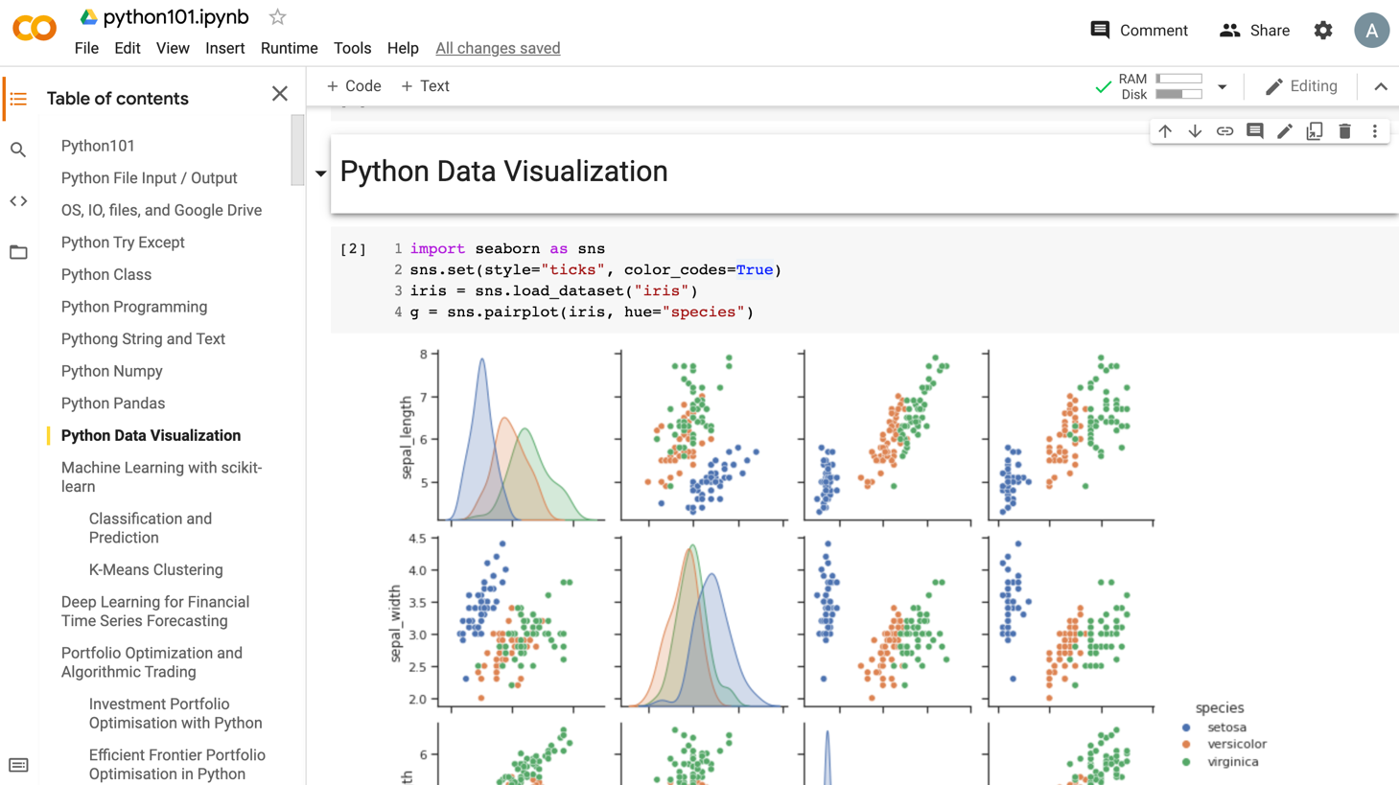
Data Visualization in Google Colab
https://tinyurl.com/aintpupython101

Slide 120
import seaborn as sns
sns.set(style="ticks", color_codes=True)
iris = sns.load_dataset("iris")
g = sns.pairplot(iris, hue="species")
Source: https://seaborn.pydata.org/generated/seaborn.pairplot.html

Slide 121
import numpy as np
import pandas as pd
%matplotlib inline
import matplotlib.pyplot as plt
import seaborn as sns
from pandas.plotting import scatter_matrix

Slide 122
url = "https://archive.ics.uci.edu/ml/machine-learning-databases/iris/iris.data"
names = ['sepal-length', 'sepal-width', 'petal-length', 'petal-width', 'class']
df = pd.read_csv(url, names=names)
print(df.head(10))

Slide 123
df.tail(10)

Slide 124
df.describe()

Slide 125
print(df.info())
print(df.shape)

Slide 126
df.groupby('class').size()

Slide 127
plt.rcParams["figure.figsize"] = (10,8)
df.plot(kind='box', subplots=True, layout=(2,2), sharex=False, sharey=False)
plt.show()

Slide 128
df.hist()
plt.show()

Slide 129
scatter_matrix(df)
plt.show()

Slide 130
sns.pairplot(df, hue="class", size=2)

Slide 131
Wes McKinney (2022), "Python for Data Analysis: Data Wrangling with pandas, NumPy, and Jupyter", 3rd Edition, O'Reilly Media.
https://github.com/wesm/pydata-book

Slide 132
Wes McKinney (2022), "Python for Data Analysis: Data Wrangling with pandas, NumPy, and Jupyter", 3rd Edition, O'Reilly Media.
Source: https://github.com/wesm/pydata-book/blob/3rd-edition/ch04.ipynb

Slide 133
Python in Google Colab (Python101)
https://colab.research.google.com/drive/1FEG6DnGvwfUbeo4zJ1zTunjMqf2RkCrT
https://tinyurl.com/aintpupython101

Slide 134
Python in Google Colab (Python101)
https://colab.research.google.com/drive/1FEG6DnGvwfUbeo4zJ1zTunjMqf2RkCrT
https://tinyurl.com/aintpupython101

Slide 135
Papers with Code State-of-the-Art (SOTA)
https://paperswithcode.com/sota

Slide 136
Summary
Foundations of Big Data Analysis in Python
Python Ecosystem for Data Science
Python
Programming language
Numpy
Scientific computing
Pandas
Data structures and data analysis tools

Slide 137
References
Wes McKinney (2022), "Python for Data Analysis: Data Wrangling with pandas, NumPy, and Jupyter", 3rd Edition, O'Reilly Media.
Steven D'Ascoli (2022), Artificial Intelligence and Deep Learning with Python: Every Line of Code Explained For Readers New to AI and New to Python, Independently published.
Aurélien Géron (2019), Hands-On Machine Learning with Scikit-Learn, Keras, and TensorFlow: Concepts, Tools, and Techniques to Build Intelligent Systems, 2nd Edition, O’Reilly Media.
Python Programming, https://pythonprogramming.net/
Python, https://www.python.org/
Python Programming Language, http://pythonprogramminglanguage.com/
Numpy, http://www.numpy.org/
Pandas, http://pandas.pydata.org/
Skikit-learn, http://scikit-learn.org/
Min-Yuh Day (2023), Python 101, https://tinyurl.com/aintpupython101

