Slide 1








AI, Data Science, and
Big Data Analysis
Big Data Analysis
1112BDA02
MBA, IM, NTPU (M6031) (Spring 2023)
Tue 2, 3, 4 (9:10-12:00) (B8F40)
Min-Yuh Day, Ph.D,
Associate Professor
Institute of Information Management, National Taipei University
https://web.ntpu.edu.tw/~myday
https://meet.google.com/paj-zhhj-mya
2023-03-07

Slide 2
Syllabus
Week Date Subject/Topics
1 2023/02/21 Introduction to Big Data Analysis
2 2023/02/28 (Day Off)
3 2023/03/07 AI, Data Science, and Big Data Analysis
4 2023/03/14 Foundations of Big Data Analysis in Python
5 2023/03/21 Case Study on Big Data Analysis I
6 2023/03/28 Machine Learning: SAS Viya, Data Preparation and
Algorithm Selection

Slide 3
Syllabus
Week Date Subject/Topics
7 2023/04/04 (Children's Day) (Day off)
8 2023/04/11 Midterm Project Report
9 2023/04/18 Machine Learning: Decision Trees and Ensembles of Trees
10 2023/04/25 Machine Learning: Neural Networks (NN) and
Support Vector Machines (SVM)
11 2023/05/02 Case Study on Big Data Analysis II
12 2023/05/09 Machine Learning: Model Assessment and Deployment

Slide 4
Syllabus
Week Date Subject/Topics
13 2023/05/16 ChatGPT and Large Language Models (LLM)
for Big Data Analysis
14 2023/05/23 Deep Learning for Finance Big Data Analysis
15 2023/05/30 Final Project Report I
16 2023/06/06 Final Project Report II
17 2023/06/13 Self-learning
18 2023/06/20 Self-learning

Slide 5
AI
Data Science
Big Data Analysis

Slide 6
FinTech ABCD
AI
Block Chain
Cloud Computing
Big Data

Slide 7
AI, Big Data, Cloud Computing
Evolution of Decision Support, Business Intelligence, and Analytics
AI
AI
Cloud Computing
Big Data
DM
BI
Source: Ramesh Sharda, Dursun Delen, and Efraim Turban (2017),
Business Intelligence, Analytics, and Data Science: A Managerial Perspective, 4th Edition, Pearson

Slide 8
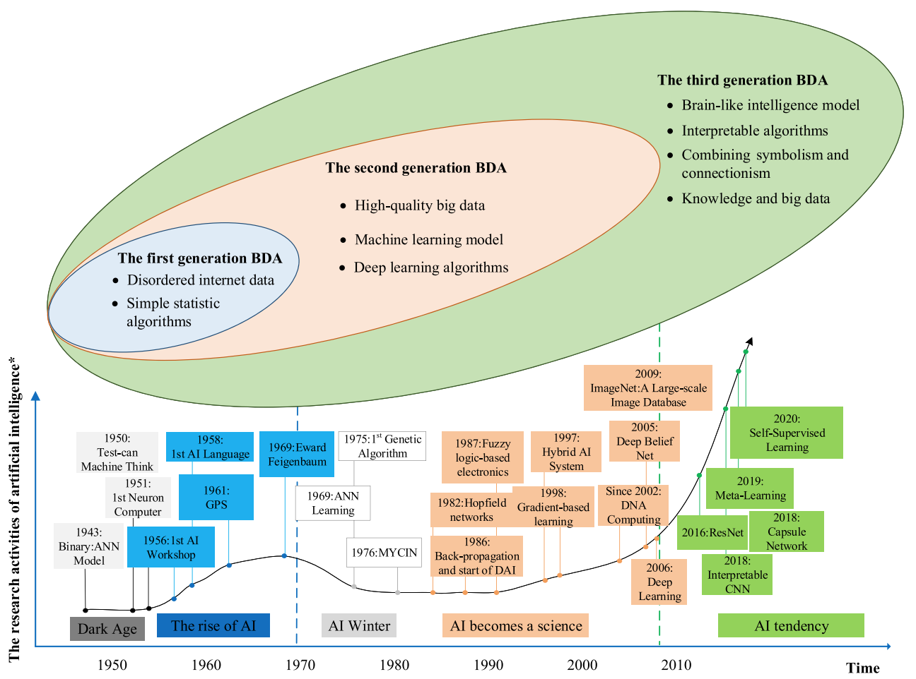
The Development of Big Data Analytics
Source: Wang, Junliang, Chuqiao Xu, Jie Zhang, and Ray Zhong (2022). "Big data analytics for intelligent manufacturing systems: A review." Journal of Manufacturing Systems 62 (2022): 738-752.

Slide 9
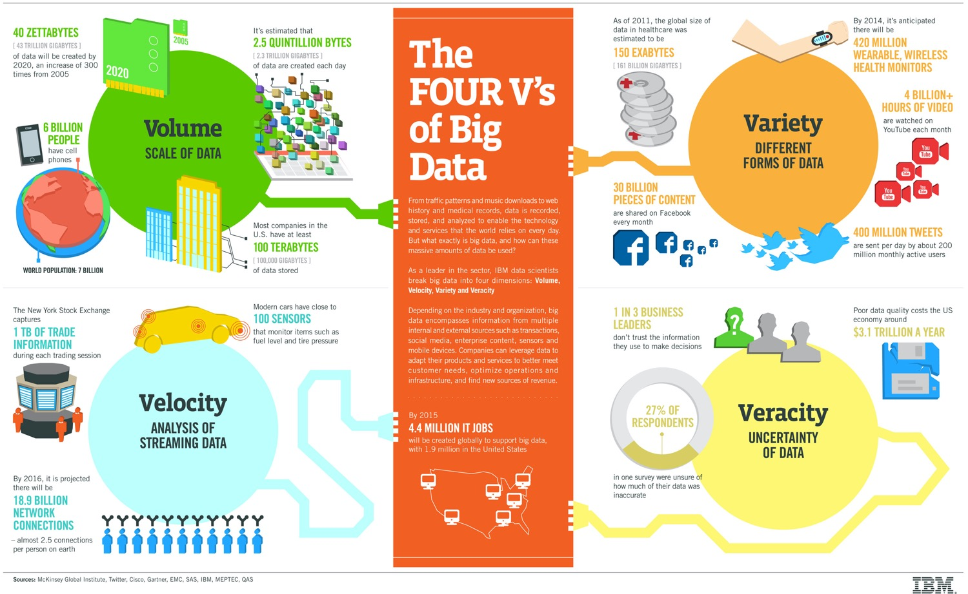
Big Data 4 V
Source: https://www-01.ibm.com/software/data/bigdata/

Slide 10
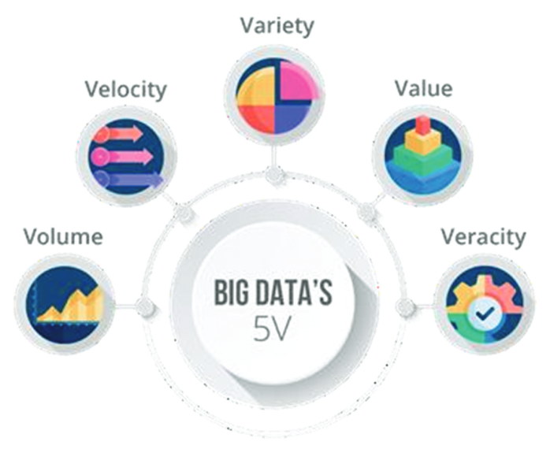
Big Data 5 V
Value
Source: Arun Amaithi Rajan and Vetriselvi V (2023). "Systematic Survey: Secure and Privacy-Preserving Big Data Analytics in Cloud." Journal of Computer Information Systems (2023): 1-21

Slide 11
Artificial Intelligence
Machine Learning & Deep Learning
Source: https://blogs.nvidia.com/blog/2016/07/29/whats-difference-artificial-intelligence-machine-learning-deep-learning-ai/

Slide 12
AI, ML, DL
Artificial Intelligence (AI)
Machine Learning (ML)
Supervised
Learning
Unsupervised Learning
Deep Learning (DL)
CNN
RNN LSTM GRU
GAN
Semi-supervised Learning
Reinforcement Learning
Source: https://leonardoaraujosantos.gitbooks.io/artificial-inteligence/content/deep_learning.html

Slide 13
Artificial Intelligence
(AI)

Slide 14
Definition of
Artificial Intelligence (A.I.)

Slide 15
Artificial Intelligence
“… the science and engineering of making intelligent machines”
(John McCarthy, 1955)
Source: https://digitalintelligencetoday.com/artificial-intelligence-defined-useful-list-of-popular-definitions-from-business-and-science/

Slide 16
Artificial Intelligence
“… technology that thinks and acts like humans”
Source: https://digitalintelligencetoday.com/artificial-intelligence-defined-useful-list-of-popular-definitions-from-business-and-science/

Slide 17
Artificial Intelligence
“… intelligence exhibited by machines or software”
Source: https://digitalintelligencetoday.com/artificial-intelligence-defined-useful-list-of-popular-definitions-from-business-and-science/

Slide 18
4 Approaches of AI
Thinking Humanly | Thinking Rationally
Acting Humanly | Acting Rationally
Source: Stuart Russell and Peter Norvig (2020), Artificial Intelligence: A Modern Approach, 4th Edition, Pearson

Slide 19
4 Approaches of AI
2. Thinking Humanly: The Cognitive Modeling Approach | 3. Thinking Rationally: The “Laws of Thought” Approach
1. Acting Humanly: The Turing Test Approach (1950) | 4. Acting Rationally: The Rational Agent Approach
Source: Stuart Russell and Peter Norvig (2020), Artificial Intelligence: A Modern Approach, 4th Edition, Pearson

Slide 20
AI Acting Humanly:
The Turing Test Approach
(Alan Turing, 1950)
Knowledge Representation
Automated Reasoning
Machine Learning (ML)
  Deep Learning (DL)
Computer Vision (Image, Video)
Natural Language Processing (NLP)
Robotics
Source: Stuart Russell and Peter Norvig (2020), Artificial Intelligence: A Modern Approach, 4th Edition, Pearson

Slide 21
AI in
FinTech

Slide 22
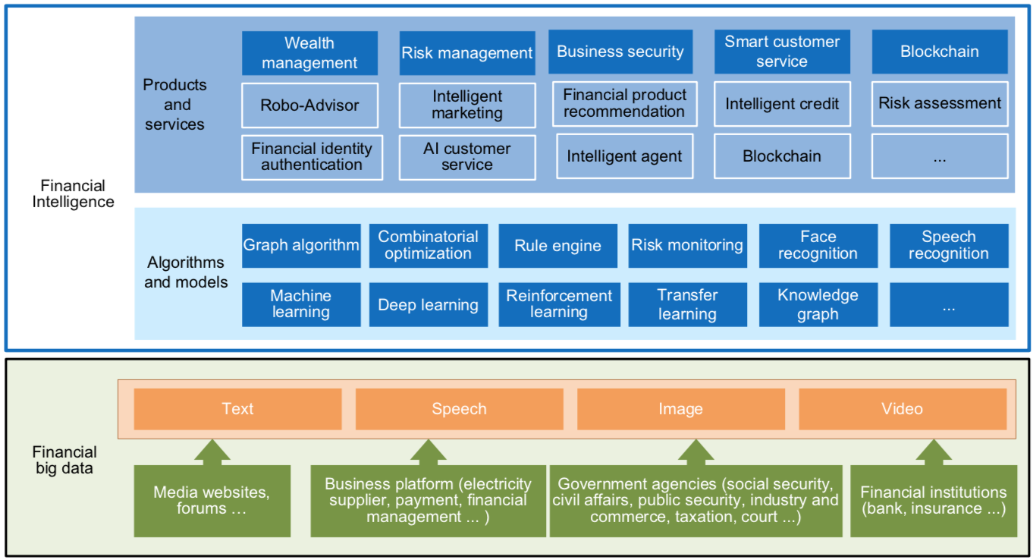
FinBrain: when Finance meets AI 2.0
(Zheng et al., 2019)
Source: Xiao-lin Zheng, Meng-ying Zhu, Qi-bing Li, Chao-chao Chen, and Yan-chao Tan (2019), "Finbrain: When finance meets AI 2.0." Frontiers of Information Technology & Electronic Engineering 20, no. 7, pp. 914-924

Slide 23
AI 2.0
a new generation of AI
based on the
novel information environment of
major changes and
the development of
new goals.
Yunhe Pan (2016), "Heading toward artificial intelligence 2.0." Engineering 2, no. 4, 409-413.

Slide 24
Technology-driven
Financial Industry Development
Development stage | Driving technology | Main landscape | Inclusive finance | Relationship between technology and finance
Fintech 1.0 (financial IT) | Computer | Credit card, ATM, and CRMS | Low | Technology as a tool
Fintech 2.0 (Internet finance) | Mobile Internet | Marketplace lending, third-party payment, crowdfunding, and Internet insurance | Medium | Technology-driven change
Fintech 3.0 (financial intelligence) | AI, Big Data, Cloud Computing, Blockchain | Intelligent finance | High | Deep fusion
Source: Xiao-lin Zheng, Meng-ying Zhu, Qi-bing Li, Chao-chao Chen, and Yan-chao Tan (2019), "Finbrain: When finance meets AI 2.0." Frontiers of Information Technology & Electronic Engineering 20, no. 7, pp. 914-924

Slide 25
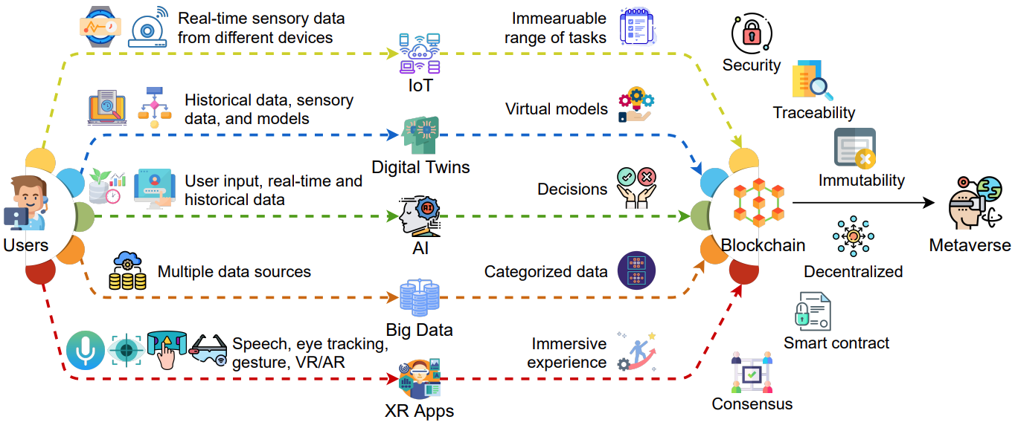
AI and Blockchain
Key Enabling Technologies of the Metaverse
Source: Gadekallu, Thippa Reddy, Thien Huynh-The, Weizheng Wang, Gokul Yenduri, Pasika Ranaweera, Quoc-Viet Pham, Daniel Benevides da Costa, and Madhusanka Liyanage (2022).
"Blockchain for the Metaverse: A Review." arXiv preprint arXiv:2203.09738..

Slide 26
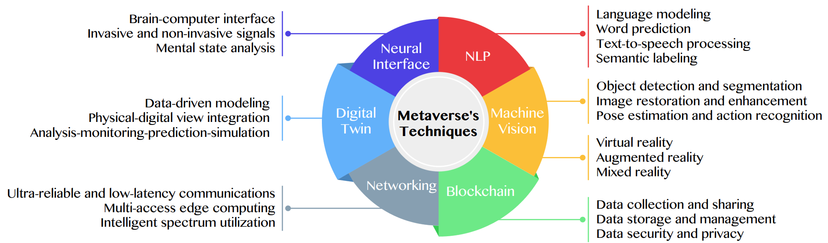
Primary Technical Aspects in the Metaverse
AI with ML algorithms and DL architectures is advancing the user experience in the virtual world
Source: Huynh-The, Thien, Quoc-Viet Pham, Xuan-Qui Pham, Thanh Thi Nguyen, Zhu Han, and Dong-Seong Kim (2022).
"Artificial Intelligence for the Metaverse: A Survey." arXiv preprint arXiv:2202.10336.

Slide 27
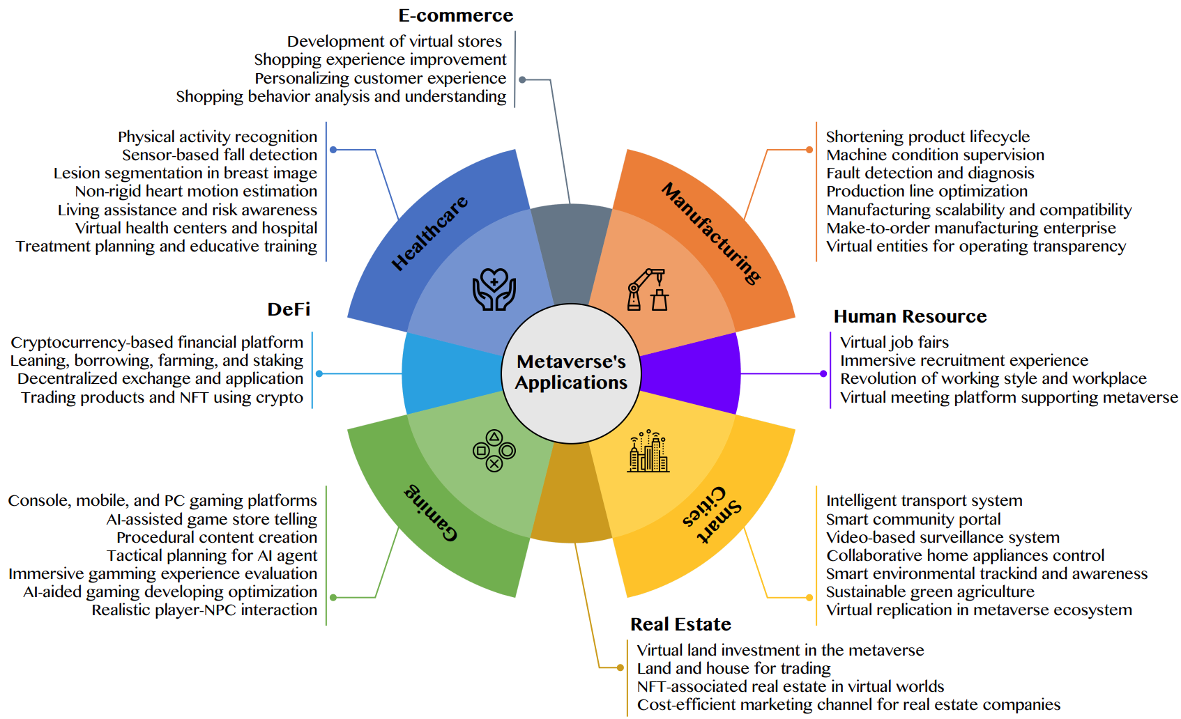
AI for the Metaverse in the Application Aspects healthcare, manufacturing, smart cities, gaming
E-commerce, human resources, real estate, and DeFi
Source: Huynh-The, Thien, Quoc-Viet Pham, Xuan-Qui Pham, Thanh Thi Nguyen, Zhu Han, and Dong-Seong Kim (2022).
"Artificial Intelligence for the Metaverse: A Survey." arXiv preprint arXiv:2202.10336.

Slide 28
Data Science

Slide 29
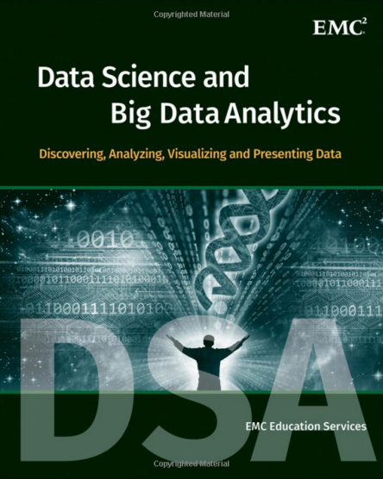
EMC Education Services,
Data Science and Big Data Analytics:
Discovering, Analyzing, Visualizing and Presenting Data,
Wiley, 2015
Source: http://www.amazon.com/Data-Science-Big-Analytics-Discovering/dp/111887613X

Slide 30
Data Analyst
Data analyst is just another term for professionals who were doing BI in the form of data compilation, cleaning, reporting, and perhaps some visualization.
Their skill sets included Excel, some SQL knowledge, and reporting.
You would recognize those capabilities as descriptive or reporting analytics.
Source: Ramesh Sharda, Dursun Delen, and Efraim Turban (2017), Business Intelligence, Analytics, and Data Science: A Managerial Perspective, 4th Edition, Pearson

Slide 31
Data Scientist
Data scientist is responsible for predictive analysis, statistical analysis, and more advanced analytical tools and algorithms.
They may have a deeper knowledge of algorithms and may recognize them under various labels—data mining, knowledge discovery, or machine learning.
Some of these professionals may also need deeper programming knowledge to be able to write code for data cleaning/analysis in current Web-oriented languages such as Java or Python and statistical languages such as R.
Many analytics professionals also need to build significant expertise in statistical modeling, experimentation, and analysis.
Source: Ramesh Sharda, Dursun Delen, and Efraim Turban (2017), Business Intelligence, Analytics, and Data Science: A Managerial Perspective, 4th Edition, Pearson

Slide 32
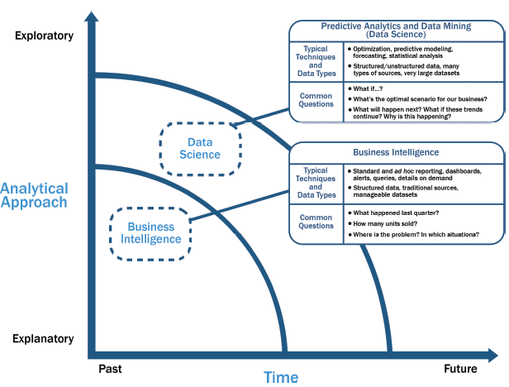
Data Science and
Business Intelligence
Source: EMC Education Services, Data Science and Big Data Analytics: Discovering, Analyzing, Visualizing and Presenting Data, Wiley, 2015

Slide 33
Data Science and
Business Intelligence
Predictive Analytics
and Data Mining
(Data Science)
Source: EMC Education Services, Data Science and Big Data Analytics: Discovering, Analyzing, Visualizing and Presenting Data, Wiley, 2015

Slide 34
Data Science and
Business Intelligence
Predictive Analytics
and Data Mining
(Data Science)
Structured/unstructured data, many types of sources,
very large datasets
Optimization, predictive modeling, forecasting statistical analysis
What if…?
What’s the optimal scenario for our business?
What will happen next?
What if these trends countinue?
Why is this happening?
Source: EMC Education Services, Data Science and Big Data Analytics: Discovering, Analyzing, Visualizing and Presenting Data, Wiley, 2015

Slide 35
Profile of a Data Scientist
Quantitative
  mathematics or statistics
Technical
  software engineering,
  machine learning,
  and programming skills
Skeptical mind-set and critical thinking
Curious and creative
Communicative and collaborative
Source: EMC Education Services, Data Science and Big Data Analytics: Discovering, Analyzing, Visualizing and Presenting Data, Wiley, 2015

Slide 36
Data Scientist Profile
Quantitative
Technical
Curious
and
Creative
Data Scientist
Skeptical
Communicative
and
Collaborative
Source: EMC Education Services, Data Science and Big Data Analytics: Discovering, Analyzing, Visualizing and Presenting Data, Wiley, 2015

Slide 37
Big Data Analytics Lifecycle

Slide 38
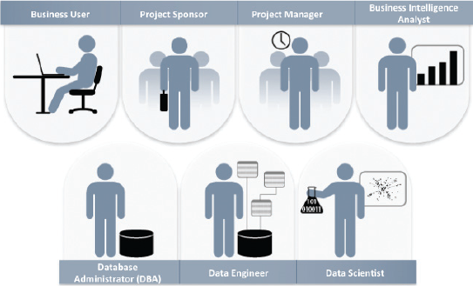
Key Roles for a
Successful Analytics Project
Source: EMC Education Services, Data Science and Big Data Analytics: Discovering, Analyzing, Visualizing and Presenting Data, Wiley, 2015

Slide 39
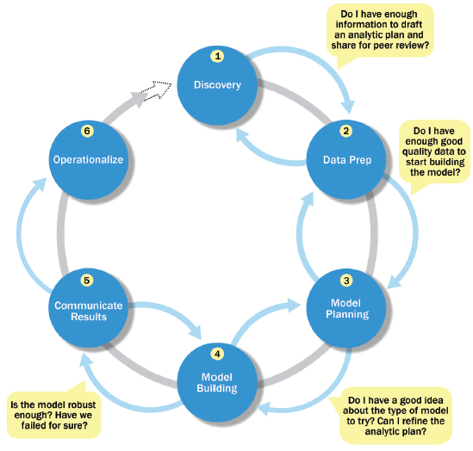
Overview of Data Analytics Lifecycle
Source: EMC Education Services, Data Science and Big Data Analytics: Discovering, Analyzing, Visualizing and Presenting Data, Wiley, 2015

Slide 40
Overview of Data Analytics Lifecycle
1. Discovery
2. Data preparation
3. Model planning
4. Model building
5. Communicate results
6. Operationalize
Source: EMC Education Services, Data Science and Big Data Analytics: Discovering, Analyzing, Visualizing and Presenting Data, Wiley, 2015

Slide 41
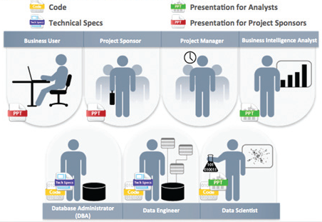
Key Outputs from a
Successful Analytics Project
Source: EMC Education Services, Data Science and Big Data Analytics: Discovering, Analyzing, Visualizing and Presenting Data, Wiley, 2015

Slide 42
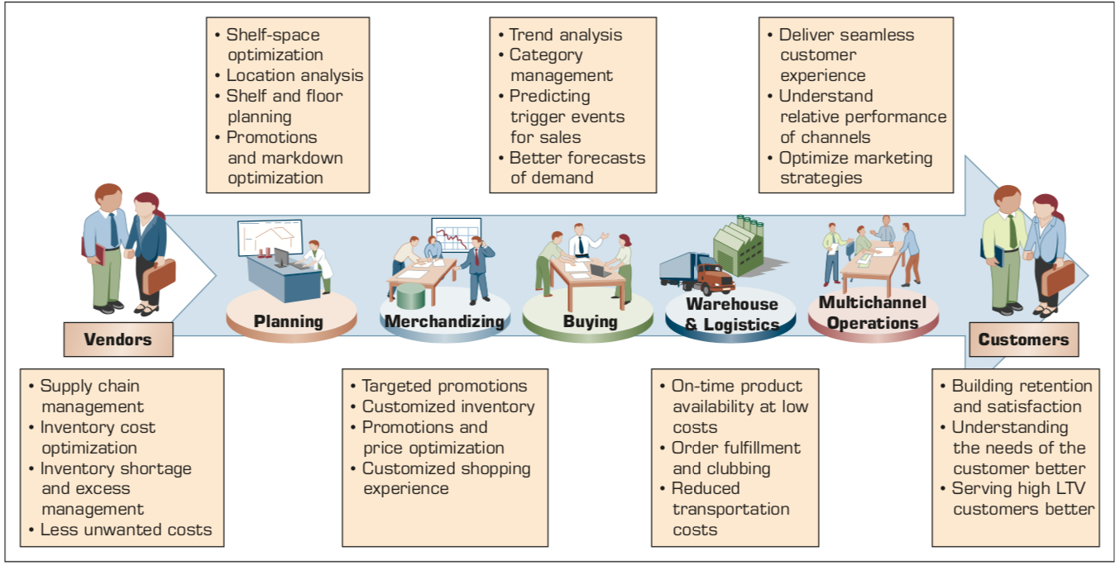
Example of Analytics Applications in a Retail Value Chain
Retail Value Chain
Critical needs at every touch point of the Retail Value Chain
Source: Ramesh Sharda, Dursun Delen, and Efraim Turban (2017), Business Intelligence, Analytics, and Data Science: A Managerial Perspective, 4th Edition, Pearson

Slide 43
Analytics Ecosystem
Source: Ramesh Sharda, Dursun Delen, and Efraim Turban (2017), Business Intelligence, Analytics, and Data Science: A Managerial Perspective, 4th Edition, Pearson

Slide 44
Job Titles of Analytics
Source: Ramesh Sharda, Dursun Delen, and Efraim Turban (2017), Business Intelligence, Analytics, and Data Science: A Managerial Perspective, 4th Edition, Pearson

Slide 45
Three Types of Analytics
Source: Ramesh Sharda, Dursun Delen, and Efraim Turban (2017), Business Intelligence, Analytics, and Data Science: A Managerial Perspective, 4th Edition, Pearson

Slide 46
A Data to Knowledge Continuum
Source: Ramesh Sharda, Dursun Delen, and Efraim Turban (2017), Business Intelligence, Analytics, and Data Science: A Managerial Perspective, 4th Edition, Pearson

Slide 47
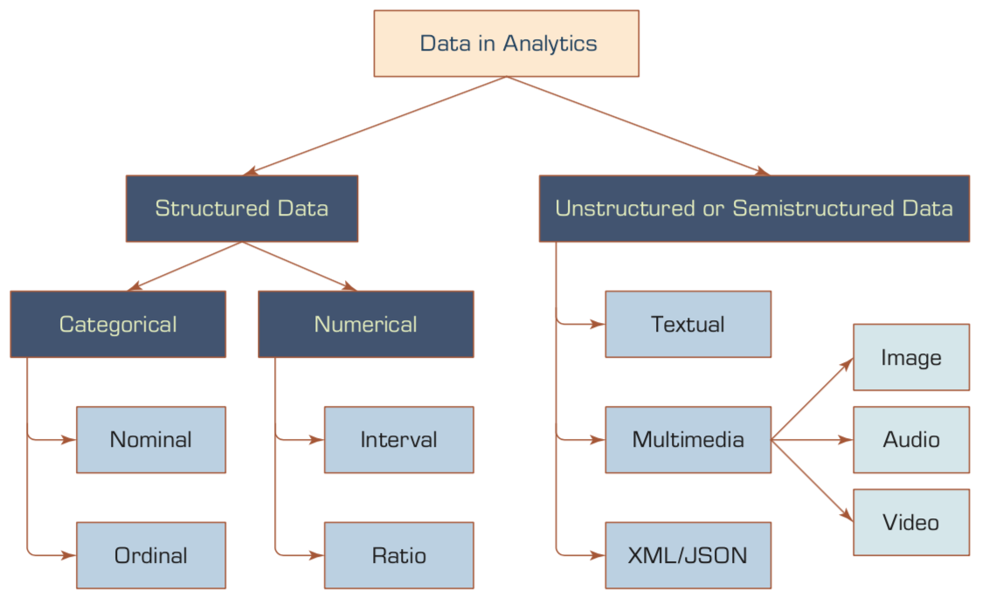
A Simple Taxonomy of Data
Source: Ramesh Sharda, Dursun Delen, and Efraim Turban (2017), Business Intelligence, Analytics, and Data Science: A Managerial Perspective, 4th Edition, Pearson

Slide 48
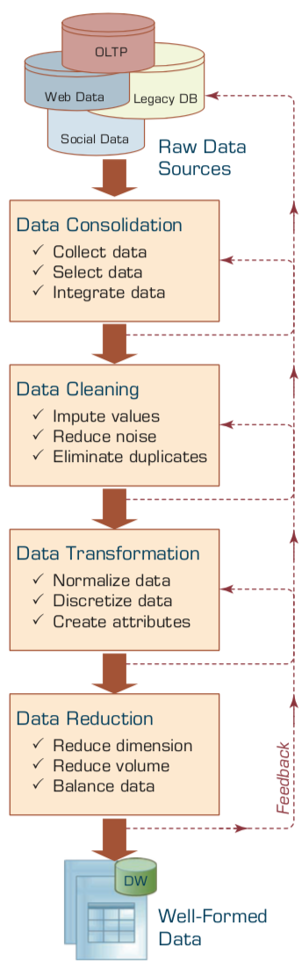
Data Preprocessing Steps
Source: Ramesh Sharda, Dursun Delen, and Efraim Turban (2017), Business Intelligence, Analytics, and Data Science: A Managerial Perspective, 4th Edition, Pearson

Slide 49
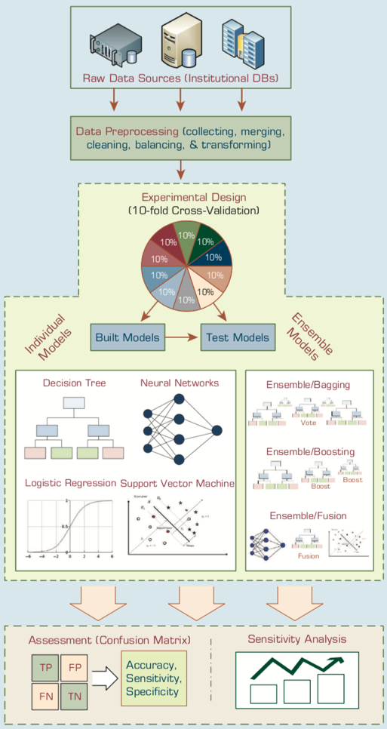
An Analytics Approach to Predicting Student Attrition
Source: Ramesh Sharda, Dursun Delen, and Efraim Turban (2017), Business Intelligence, Analytics, and Data Science: A Managerial Perspective, 4th Edition, Pearson

Slide 50
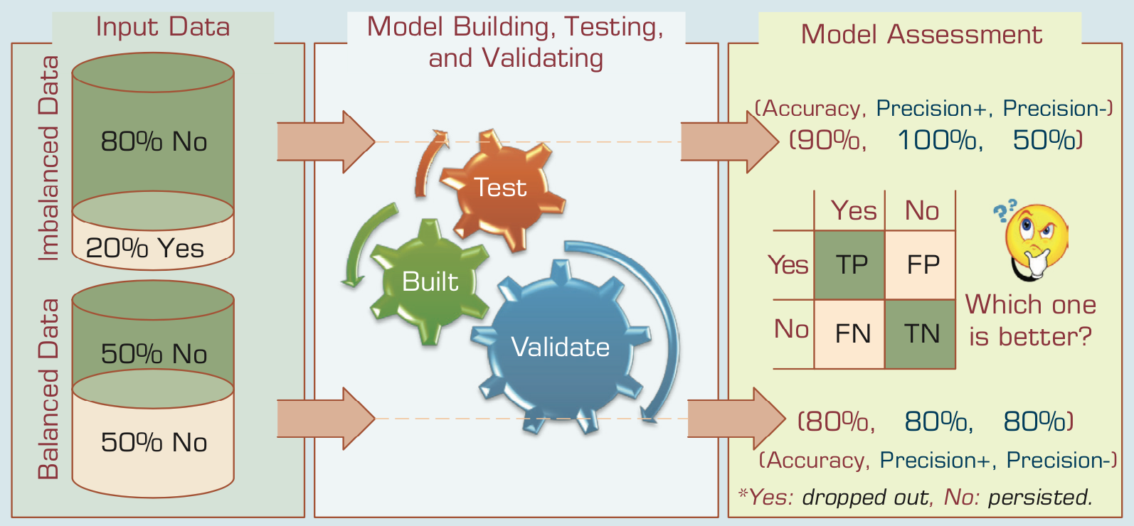
A Graphical Depiction of the
Class Imbalance Problem
Source: Ramesh Sharda, Dursun Delen, and Efraim Turban (2017), Business Intelligence, Analytics, and Data Science: A Managerial Perspective, 4th Edition, Pearson

Slide 51
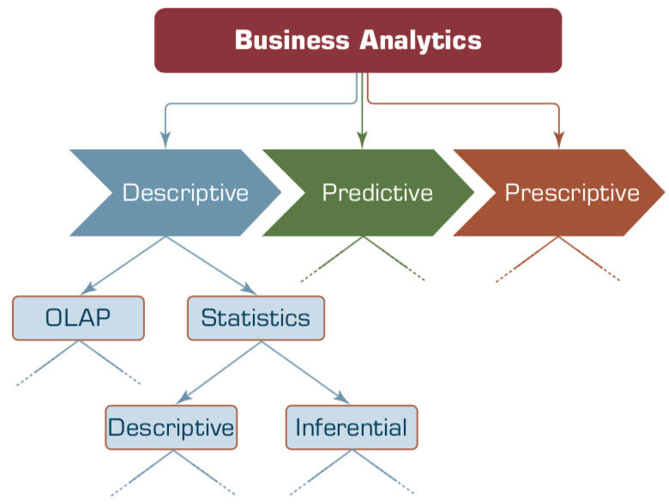
Relationship between Statistics and Descriptive Analytics
Source: Ramesh Sharda, Dursun Delen, and Efraim Turban (2017), Business Intelligence, Analytics, and Data Science: A Managerial Perspective, 4th Edition, Pearson

Slide 52
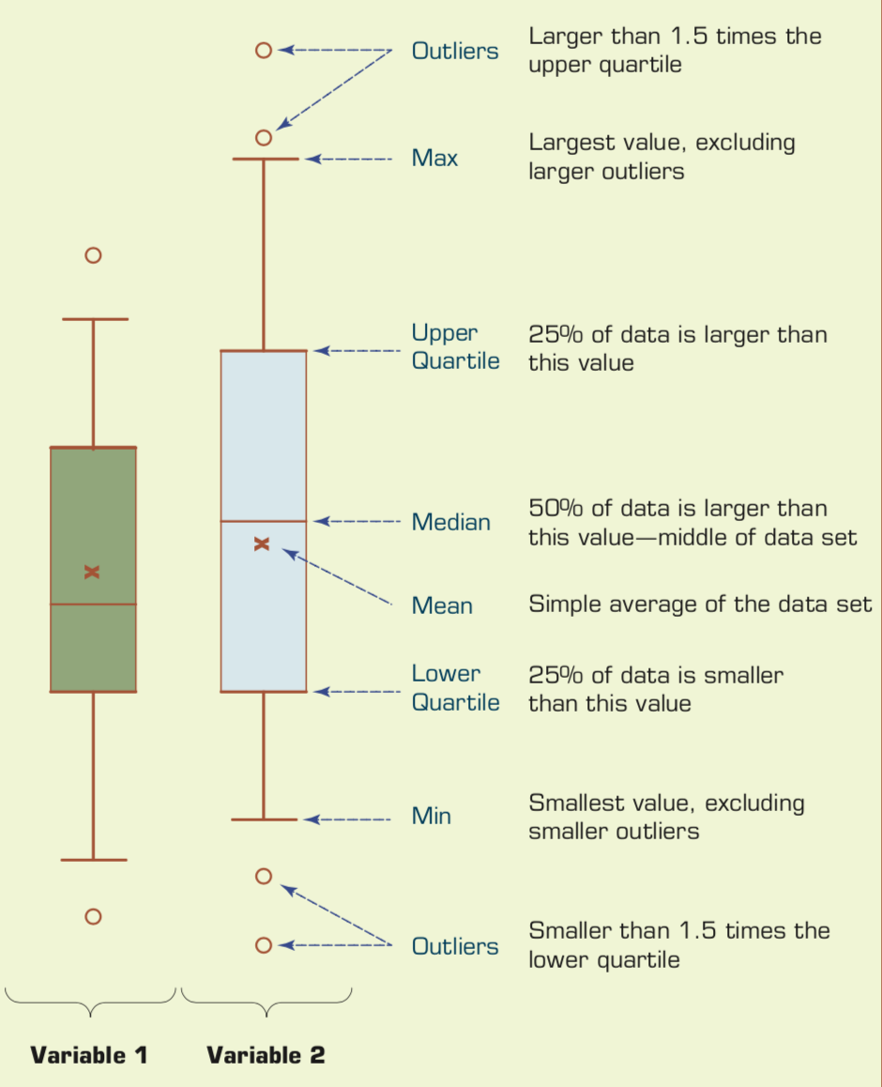
Understanding the Specifics about
Box-and-Whiskers Plots
Source: Ramesh Sharda, Dursun Delen, and Efraim Turban (2017), Business Intelligence, Analytics, and Data Science: A Managerial Perspective, 4th Edition, Pearson

Slide 53
Big Data Analytics
(BDA)

Slide 54
Value Creation by Big Data Analytics
(Grover et al., 2018)
Source: Varun Grover, Roger HL Chiang, Ting-Peng Liang, and Dongsong Zhang (2018), "Creating Strategic Business Value from Big Data Analytics: A Research Framework", Journal of Management Information Systems, 35, no. 2, pp. 388-423.

Slide 55
Architecture of Big Data Analytics
Big Data
Analytics
Applications
Big Data
Sources
Big Data
Transformation
Big Data
Platforms & Tools
* Internal
* External
* Multiple formats
* Multiple
locations
* Multiple applications
Middleware
Hadoop
MapReduce
Pig
Hive
Jaql
Zookeeper
Hbase
Cassandra
Oozie
Avro
Mahout
Others
Queries
Raw
Data
Transformed
Data
Big Data
Analytics
Extract Transform Load
Reports
Data Warehouse
OLAP
Traditional Format
CSV, Tables
Data Mining
Source: Stephan Kudyba (2014), Big Data, Mining, and Analytics: Components of Strategic Decision Making, Auerbach Publications

Slide 56
Architecture of Big Data Analytics
Big Data
Analytics
Applications
Big Data
Sources
Big Data
Transformation
Big Data
Platforms & Tools
* Internal
* External
* Multiple formats
* Multiple
locations
* Multiple applications
Data Mining
Big Data Analytics Applications
Middleware
Hadoop
MapReduce
Pig
Hive
Jaql
Zookeeper
Hbase
Cassandra
Oozie
Avro
Mahout
Others
Queries
Raw
Data
Transformed
Data
Big Data
Analytics
Extract Transform Load
Reports
Data Warehouse
OLAP
Traditional Format
CSV, Tables
Data Mining
Source: Stephan Kudyba (2014), Big Data, Mining, and Analytics: Components of Strategic Decision Making, Auerbach Publications

Slide 57
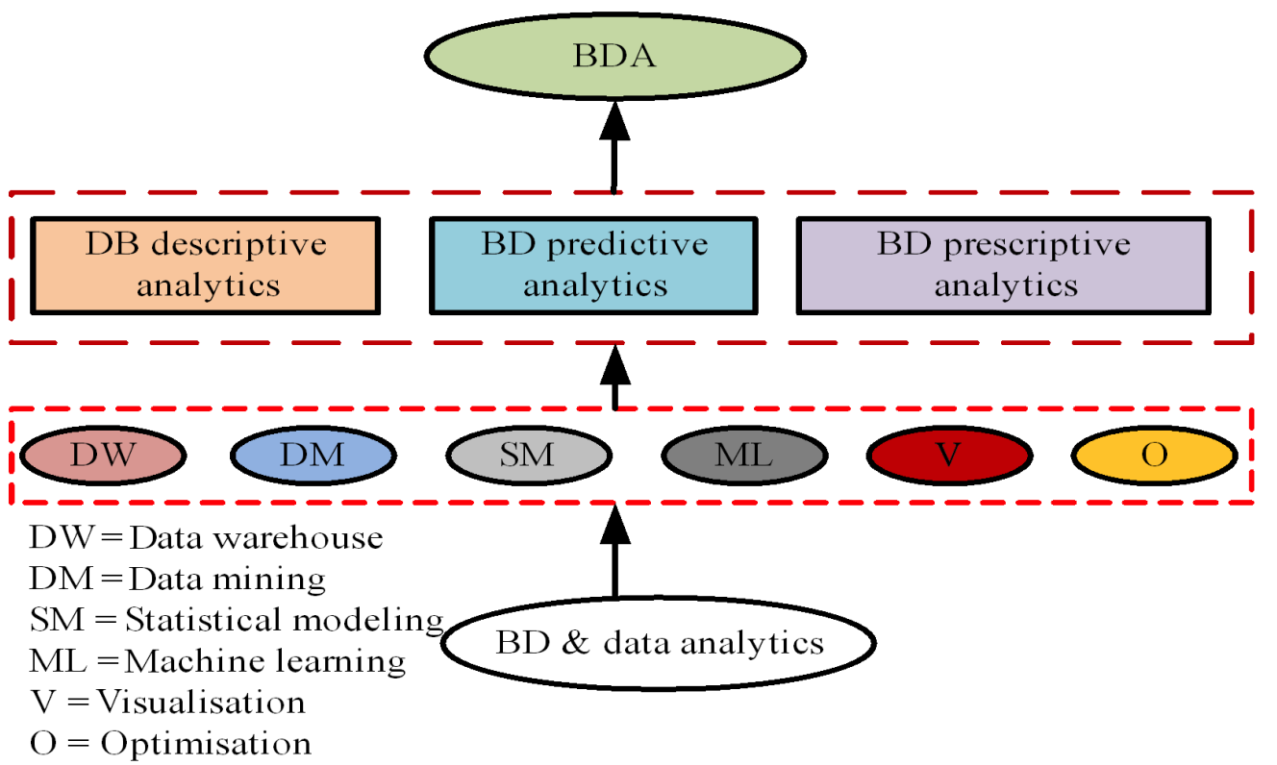
Taxonomy of Big Data Analytics (BDA)
Source: Isaac Kofi Nti, Juanita Ahia Quarcoo, Justice Aning, and Godfred Kusi Fosu (2022). "A mini-review of machine learning in big data analytics: Applications, challenges, and prospects."
Big Data Mining and Analytics 5, no. 2 (2022): 81-97.

Slide 58
Framework for BD and BI Research
Data Collection
Data Storage
Data Analytics
Infrastructure
Business
Medicate
Supply Chain
Engineering
Services
Technology
Application
Impact
Management
Value Creation
Individual Impact
Organizational Impact
Social Impact
Adoption of BD/BI
Cost Benefit
Security/Privacy
Human Resource
Source: Ting-Peng Liang and Yu-Hsi Liu (2018), "Research Landscape of Business Intelligence and Big Data analytics: A bibliometrics study”,
Expert Systems with Applications, Volume 111, 30, 2018, pp. 2-10

Slide 59
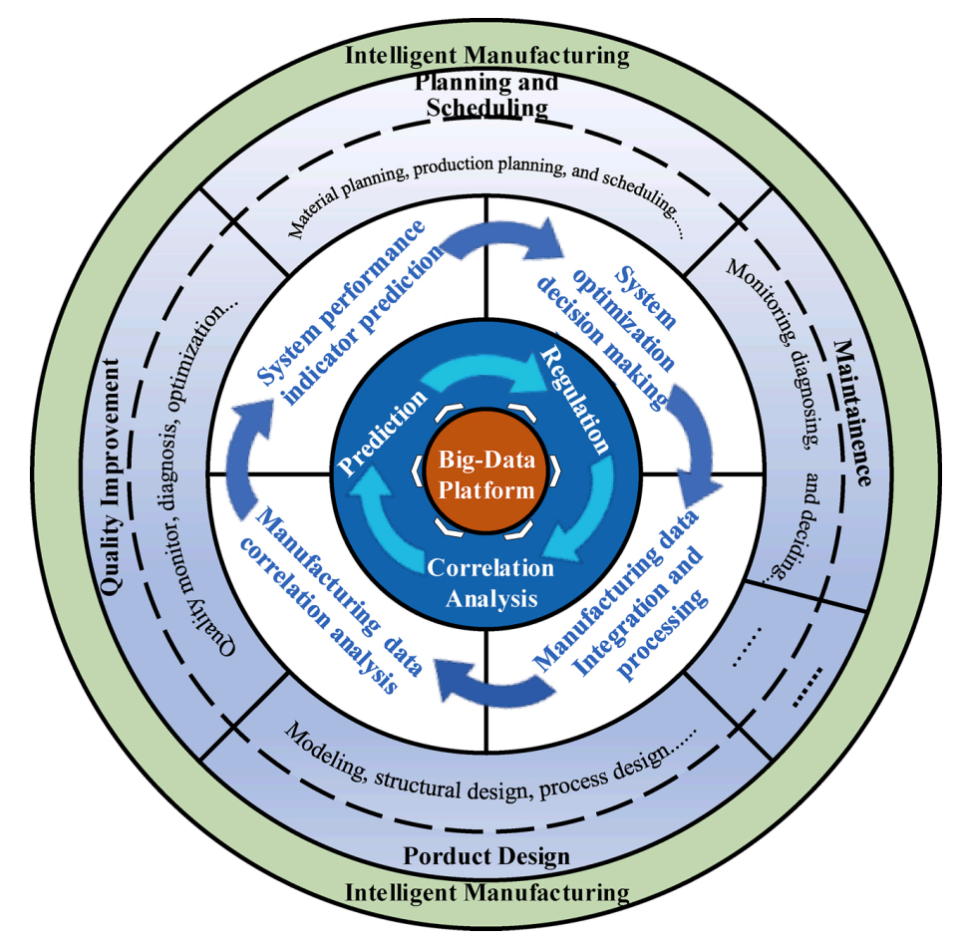
Big Data Driven Intelligent Manufacturing
Source: Wang, Junliang, Chuqiao Xu, Jie Zhang, and Ray Zhong (2022). "Big data analytics for intelligent manufacturing systems: A review." Journal of Manufacturing Systems 62 (2022): 738-752.

Slide 60
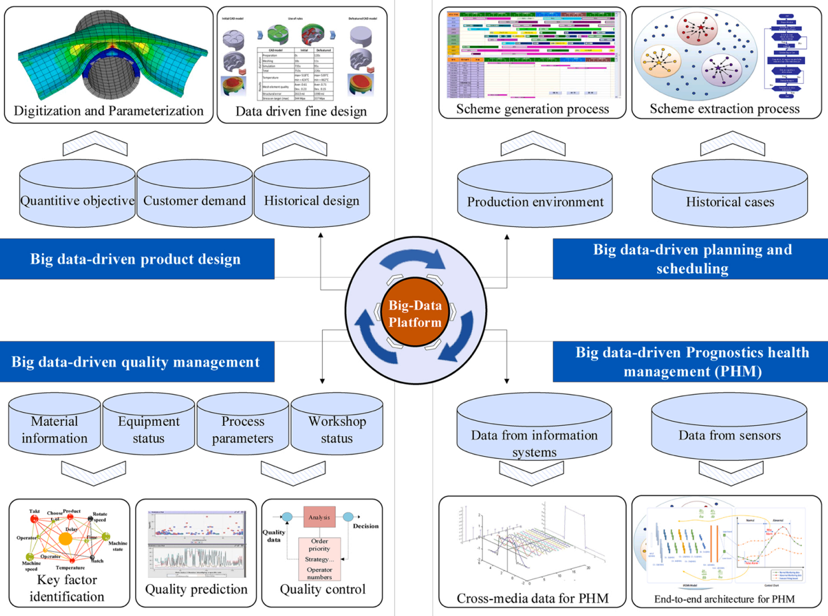
Applications of BDA in Manufacturing Systems
Source: Wang, Junliang, Chuqiao Xu, Jie Zhang, and Ray Zhong (2022). "Big data analytics for intelligent manufacturing systems: A review." Journal of Manufacturing Systems 62 (2022): 738-752.

Slide 61
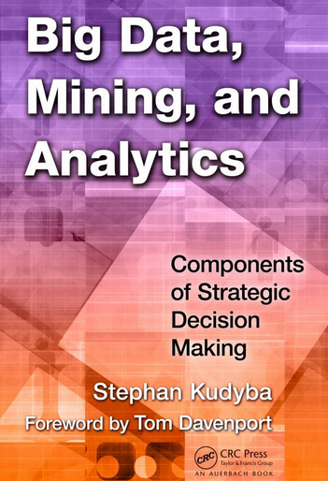
Stephan Kudyba (2014),
Big Data, Mining, and Analytics:
Components of Strategic Decision Making, Auerbach Publications
Source: http://www.amazon.com/gp/product/1466568704

Slide 62
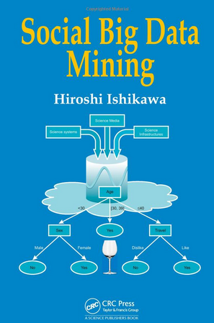
Social Big Data Mining
(Hiroshi Ishikawa, 2015)
Source: http://www.amazon.com/Social-Data-Mining-Hiroshi-Ishikawa/dp/149871093X

Slide 63
Architecture for
Social Big Data Mining
(Hiroshi Ishikawa, 2015)
Enabling Technologies
Analysts
Integrated analysis
Integrated analysis model
Model Construction
Explanation by Model
Conceptual Layer
Natural Language Processing
Information Extraction
Anomaly Detection
Discovery of relationships
among heterogeneous data
Large-scale visualization
Construction and
confirmation
of individual
hypothesis
Description and
execution of
application-specific
task
Data
Mining
Multivariate analysis
Application specific task
Logical Layer
Parallel distrusted processing
Software
Social Data
Hardware
Physical Layer
Source: Hiroshi Ishikawa (2015), Social Big Data Mining, CRC Press

Slide 64
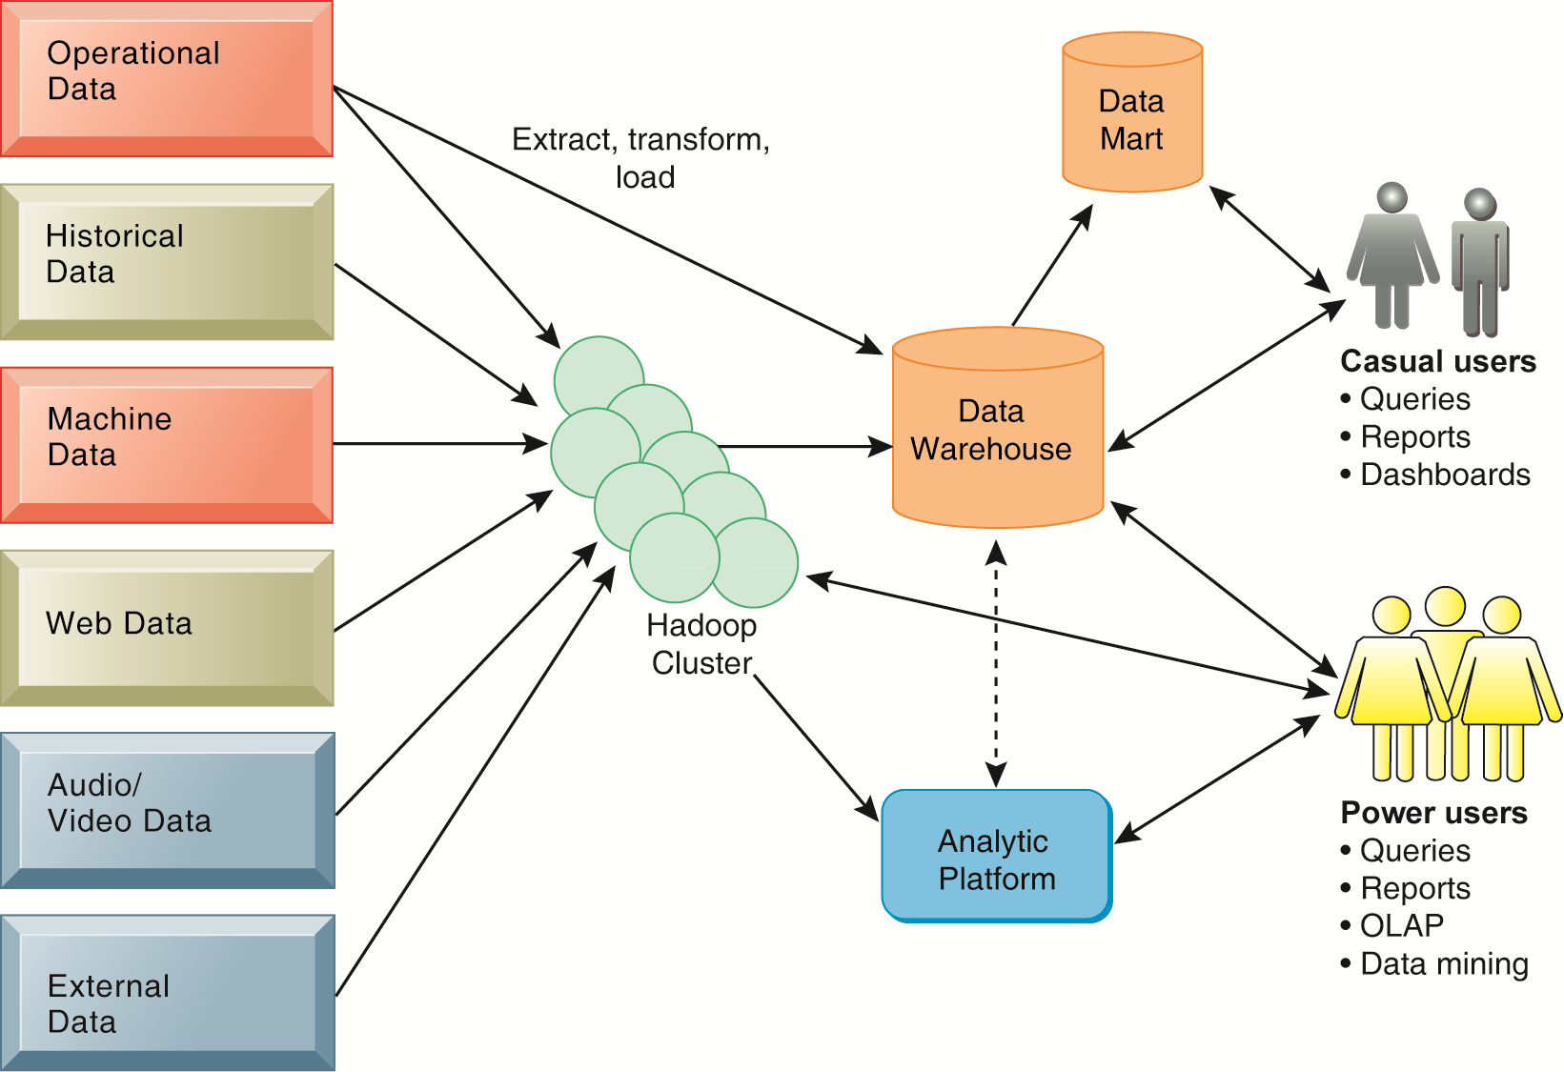
Business Intelligence (BI) Infrastructure

Slide 65
Data Warehouse
Data Mining and Business Intelligence
Increasing potential
to support
business decisions
End User
Decision Making
Data Presentation
Business
Analyst
Visualization Techniques
Data Mining
Data
Analyst
Information Discovery
Data Exploration
Statistical Summary, Querying, and Reporting
Data Preprocessing/Integration, Data Warehouses
Data Sources
DBA
Paper, Files, Web documents, Scientific experiments, Database Systems
Source: Jiawei Han and Micheline Kamber (2006), Data Mining: Concepts and Techniques, Second Edition, Elsevier

Slide 66
A High-Level Architecture of BI
Source: Ramesh Sharda, Dursun Delen, and Efraim Turban (2017),
Business Intelligence, Analytics, and Data Science: A Managerial Perspective, 4th Edition, Pearson

Slide 67
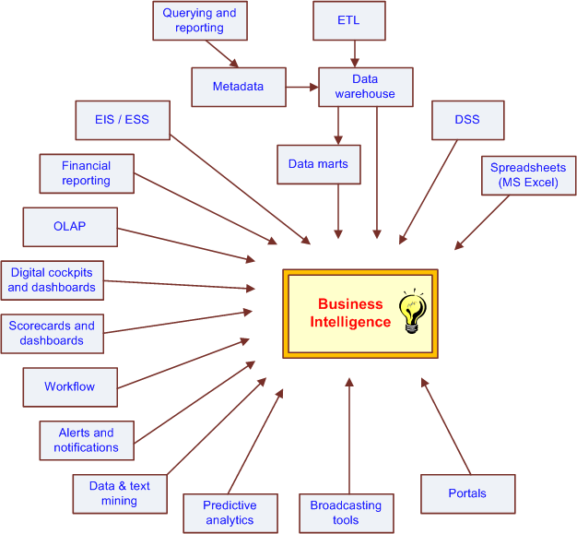
The Evolution of BI Capabilities
Source: Turban et al. (2011), Decision Support and Business Intelligence Systems

Slide 68
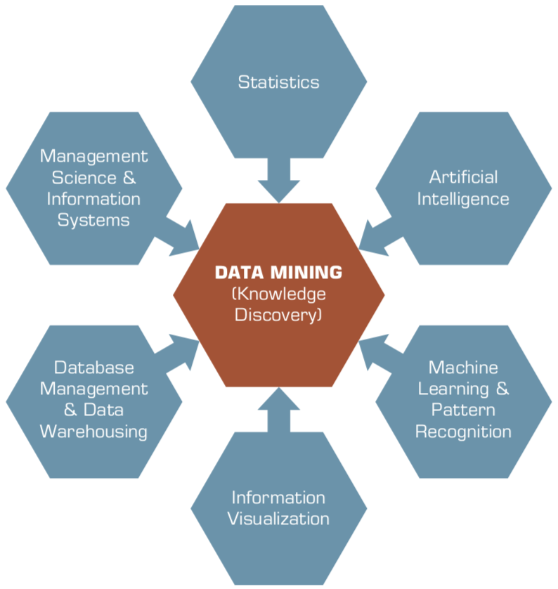
Data Mining
Is a Blend of Multiple Disciplines
Source: Ramesh Sharda, Dursun Delen, and Efraim Turban (2017), Business Intelligence, Analytics, and Data Science: A Managerial Perspective, 4th Edition, Pearson

Slide 69
Data Mining at the
Intersection of Many Disciplines
Source: Turban et al. (2011), Decision Support and Business Intelligence Systems

Slide 70
Big Data, Data Mining, and Machine Learning: Value Creation for Business Leaders and Practitioners,
Jared Dean,
Wiley, 2014.
Source: https://www.amazon.com/Data-Mining-Machine-Learning-Practitioners/dp/1118618041

Slide 71
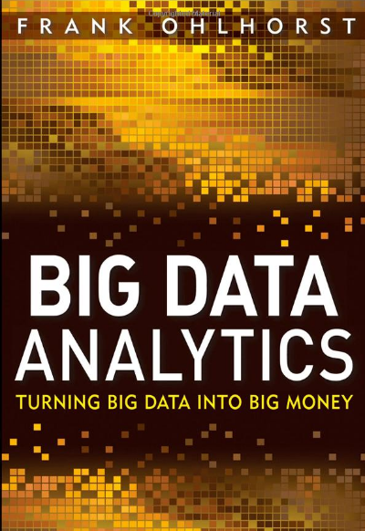
Source: http://www.amazon.com/Big-Data-Analytics-Turning-Money/dp/1118147596

Slide 72
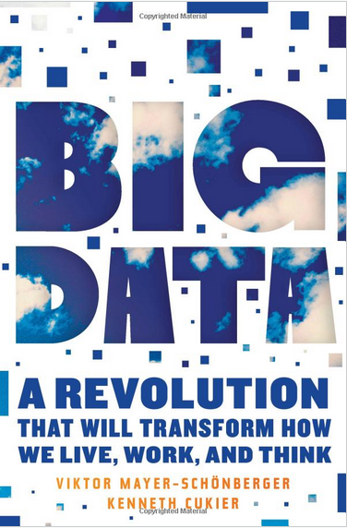
Source: http://www.amazon.com/Big-Data-Revolution-Transform-Mayer-Schonberger/dp/B00D81X2YE

Slide 73
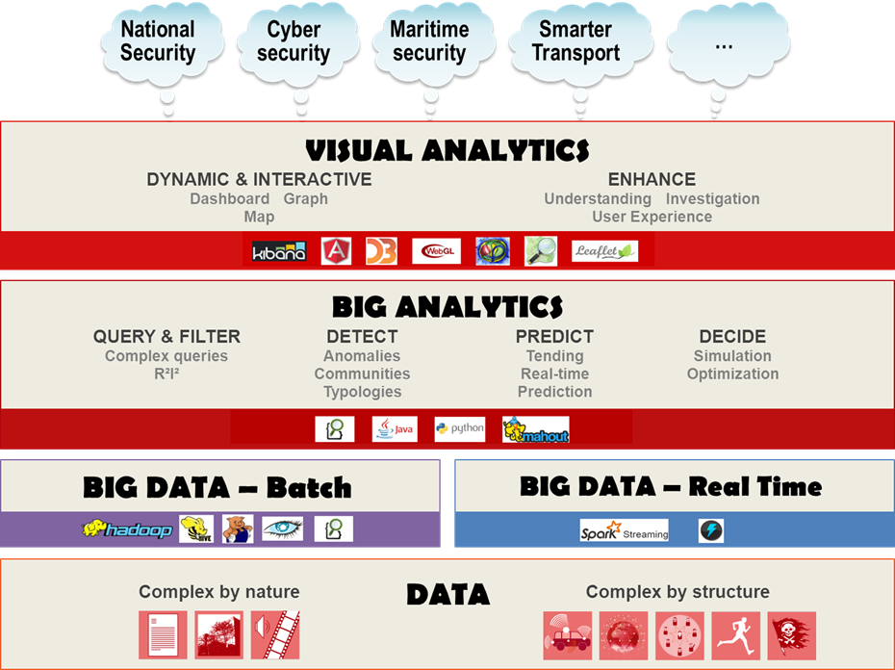
Source: https://www.thalesgroup.com/en/worldwide/big-data/big-data-big-analytics-visual-analytics-what-does-it-all-mean

Slide 74
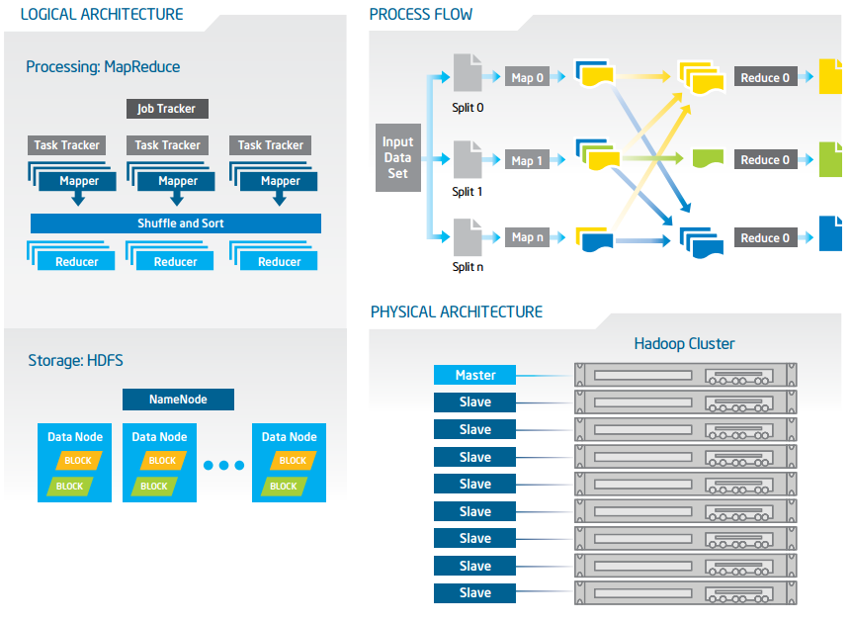
Big Data with Hadoop Architecture
Source: https://software.intel.com/sites/default/files/article/402274/etl-big-data-with-hadoop.pdf

Slide 75
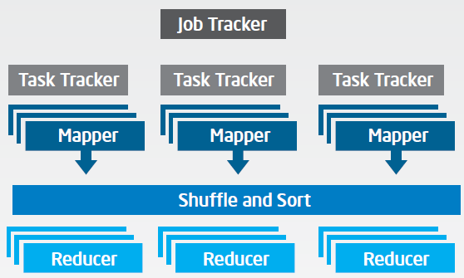
Big Data with Hadoop Architecture
Logical Architecture
Processing: MapReduce
Source: https://software.intel.com/sites/default/files/article/402274/etl-big-data-with-hadoop.pdf

Slide 76
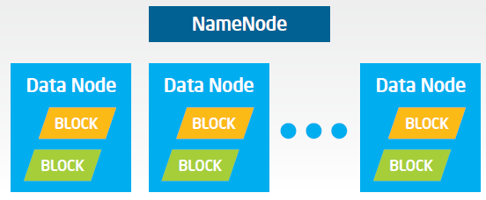
Big Data with Hadoop Architecture
Logical Architecture
Storage: HDFS
Source: https://software.intel.com/sites/default/files/article/402274/etl-big-data-with-hadoop.pdf

Slide 77
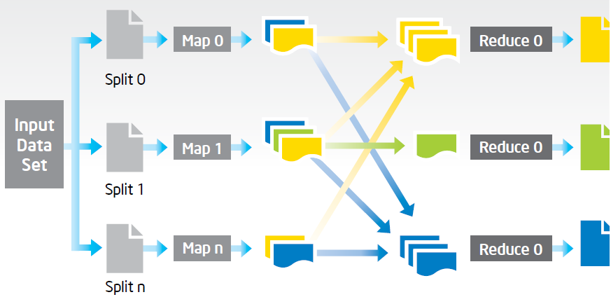
Big Data with Hadoop Architecture
Process Flow
Source: https://software.intel.com/sites/default/files/article/402274/etl-big-data-with-hadoop.pdf

Slide 78
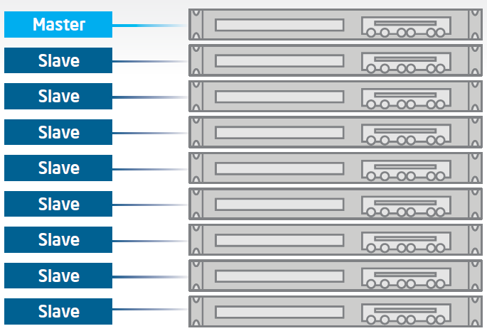
Big Data with Hadoop Architecture
Hadoop Cluster
Source: https://software.intel.com/sites/default/files/article/402274/etl-big-data-with-hadoop.pdf

Slide 79
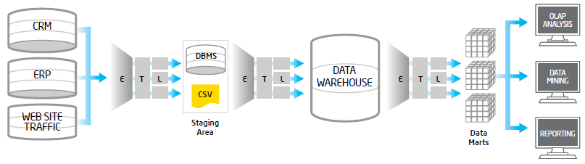
Traditional ETL Architecture
Source: https://software.intel.com/sites/default/files/article/402274/etl-big-data-with-hadoop.pdf

Slide 80
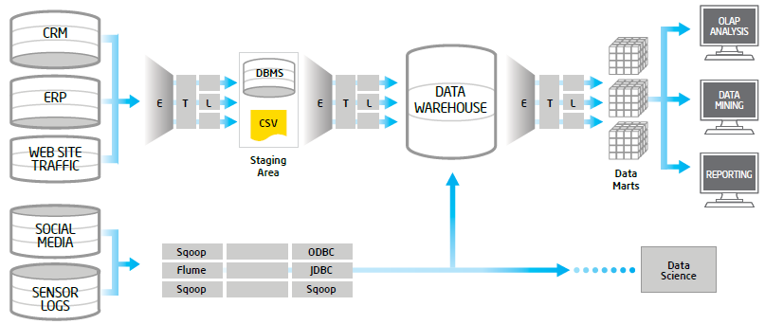
Offload ETL with Hadoop
(Big Data Architecture)
Source: https://software.intel.com/sites/default/files/article/402274/etl-big-data-with-hadoop.pdf

Slide 81
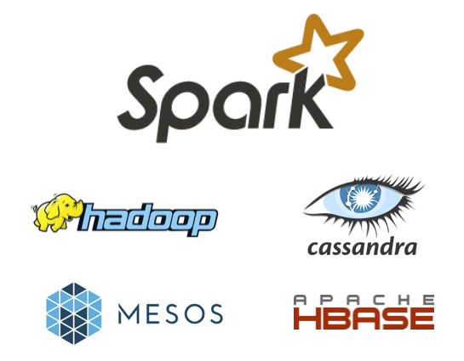
Spark and Hadoop
Source: http://spark.apache.org/

Slide 82
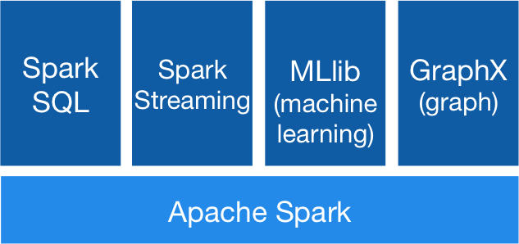
Spark Ecosystem
Source: http://spark.apache.org/

Slide 83
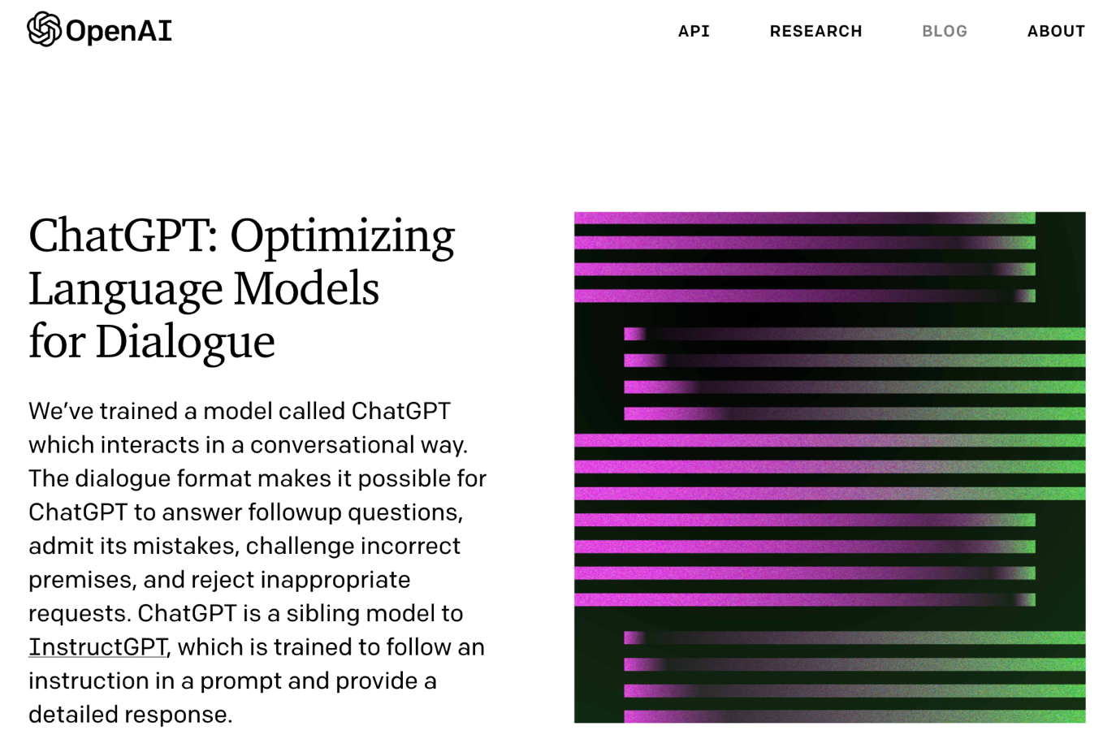
OpenAI ChatGPT
Source: https://openai.com/blog/chatgpt/

Slide 84
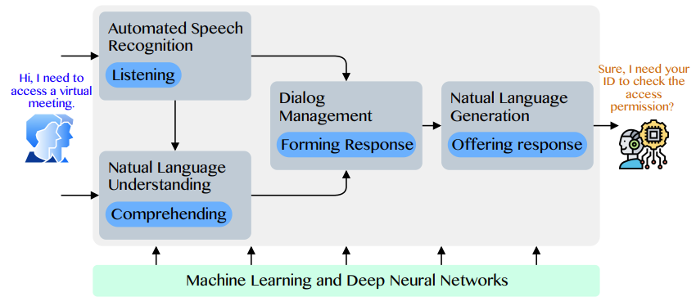
Conversational AI to deliver contextual and personal experience to users
Source: Huynh-The, Thien, Quoc-Viet Pham, Xuan-Qui Pham, Thanh Thi Nguyen, Zhu Han, and Dong-Seong Kim (2022).
"Artificial Intelligence for the Metaverse: A Survey." arXiv preprint arXiv:2202.10336.

Slide 85
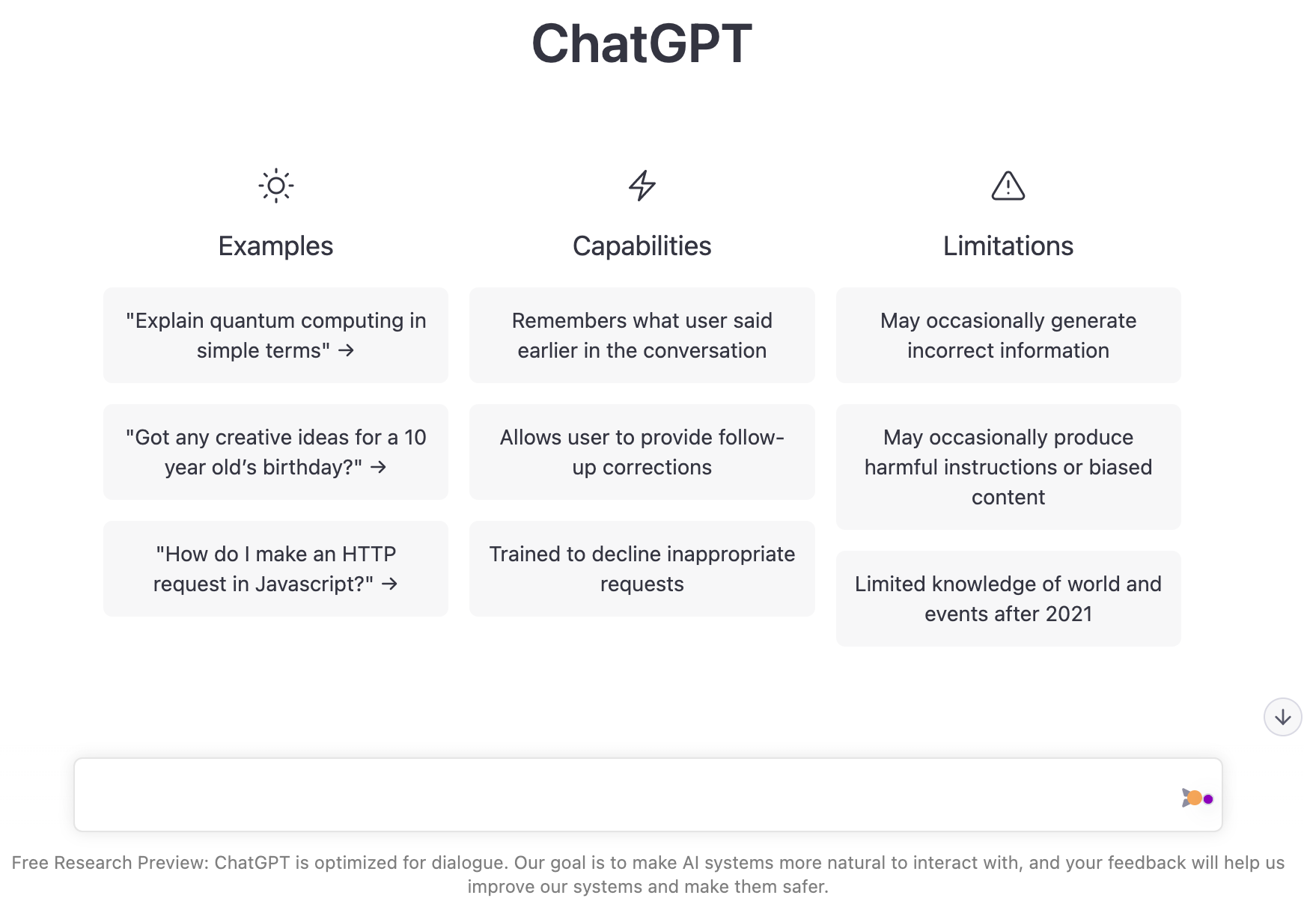
OpenAI ChatGPT
Source: https://chat.openai.com/chat

Slide 86
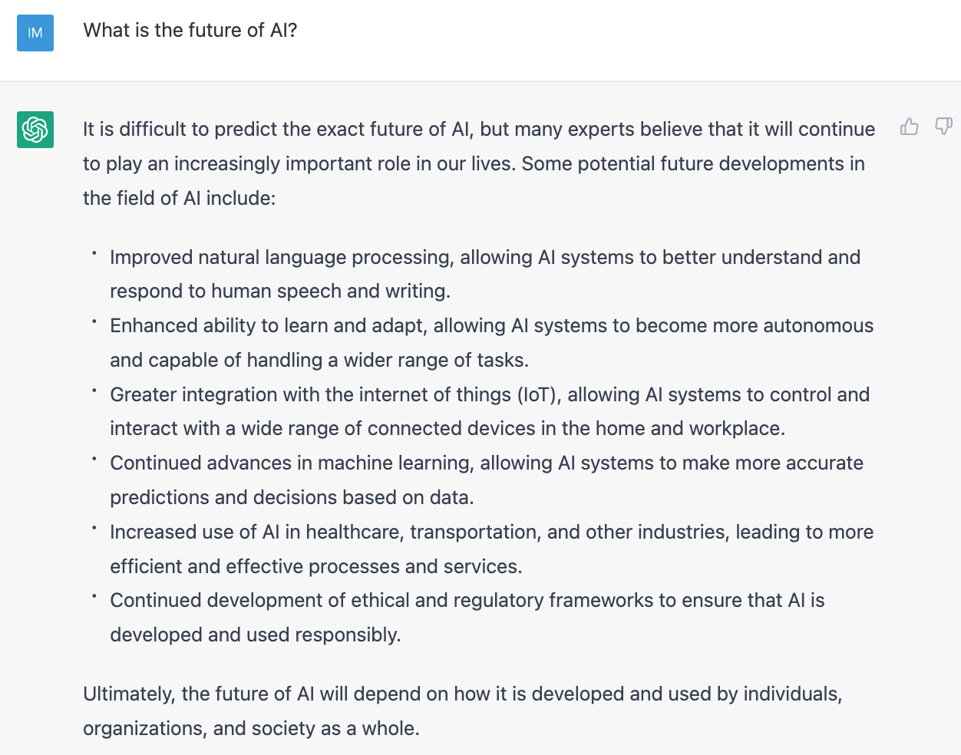
OpenAI ChatGPT
Source: https://chat.openai.com/chat

Slide 87
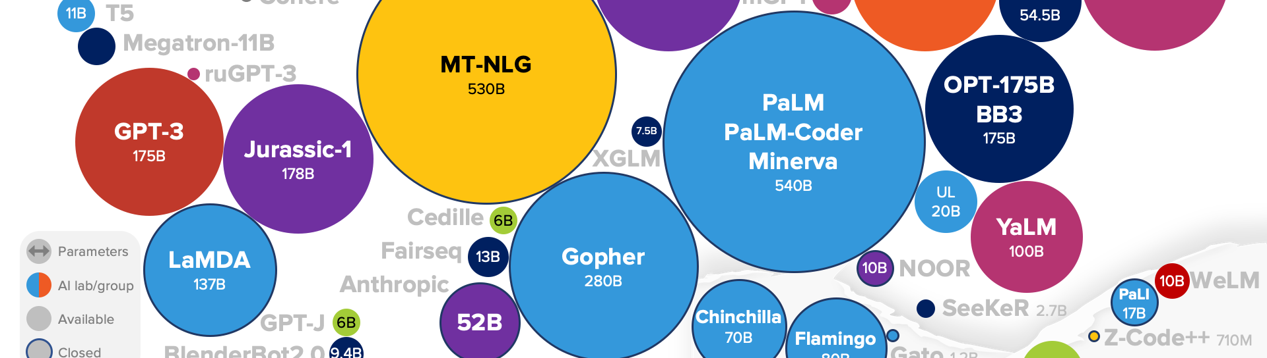
Large Language Models (LLM)
(GPT-3, ChatGPT, PaLM, BLOOM, OPT-175B, LLaMA)
ChatGPT
175B
LLaMA
65B
Source: https://lifearchitect.ai/models/

Slide 88
The Transformers Timeline
ULMFit
BERT
RoBERTa
XLM-R
DeBERTa
GPT-Neo
BLOOM
DistrilBERT
T5
PaLM
ChatGPT
Transformer
GPT
GPT-2
GPT-3
GPT-J
OPT-175B
LLaMA
2017
2018
2019
2020
2021
2022
2023
Source: Lewis Tunstall, Leandro von Werra, and Thomas Wolf (2022), Natural Language Processing with Transformers: Building Language Applications with Hugging Face, O'Reilly Media.

Slide 89
Transformer Models
Transformer
Encoder
Decoder
DistilBERT
BERT
T5
GPT
RoBERTa
BART
GPT-2
CTRL
XLM-R
XLM
M2M-100
GPT-3
ALBERT
BigBird
GPT-Neo
GPT-J
ELECTRA
mT0
BLOOM
BLOOMZ
DeBERTa
ChatGPT
Source: Lewis Tunstall, Leandro von Werra, and Thomas Wolf (2022), Natural Language Processing with Transformers: Building Language Applications with Hugging Face, O'Reilly Media.

Slide 90
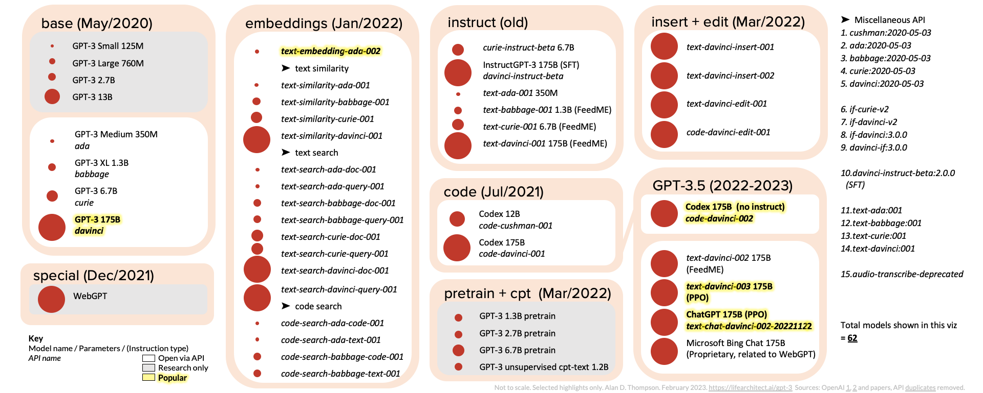
ChatGPT and GPT-3 Family
(GPT-3, InstructGPT, GPT-3.5, ChatGPT)
Source: https://lifearchitect.ai/gpt-3/

Slide 91
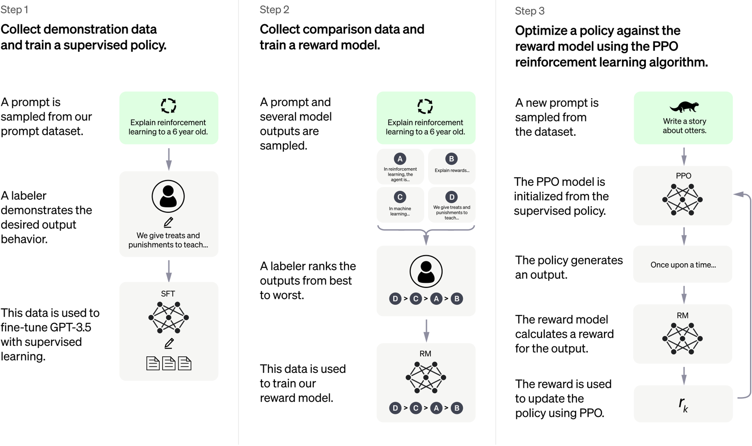
ChatGPT: Optimizing Language Models for Dialogue
Source: https://openai.com/blog/chatgpt/

Slide 92
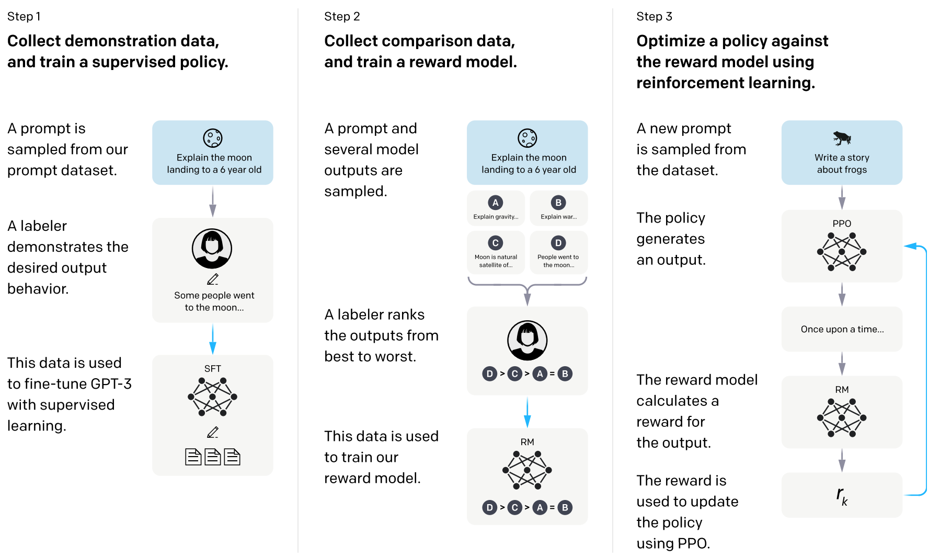
Training language models to follow instructions with human feedback
InstructGPT and GPT 3.5
Source: Ouyang, L., Wu, J., Jiang, X., Almeida, D., Wainwright, C. L., Mishkin, P., ... & Lowe, R. (2022). Training language models to follow instructions with human feedback. arXiv preprint arXiv:2203.02155.

Slide 93
Reinforcement Learning from Human Feedback (RLHF)
Pretraining a Language Model (LM)
Gathering Data and Training a Reward Model
Fine-tuning the LM with Reinforcement Learning
Source: https://huggingface.co/blog/rlhf

Slide 94
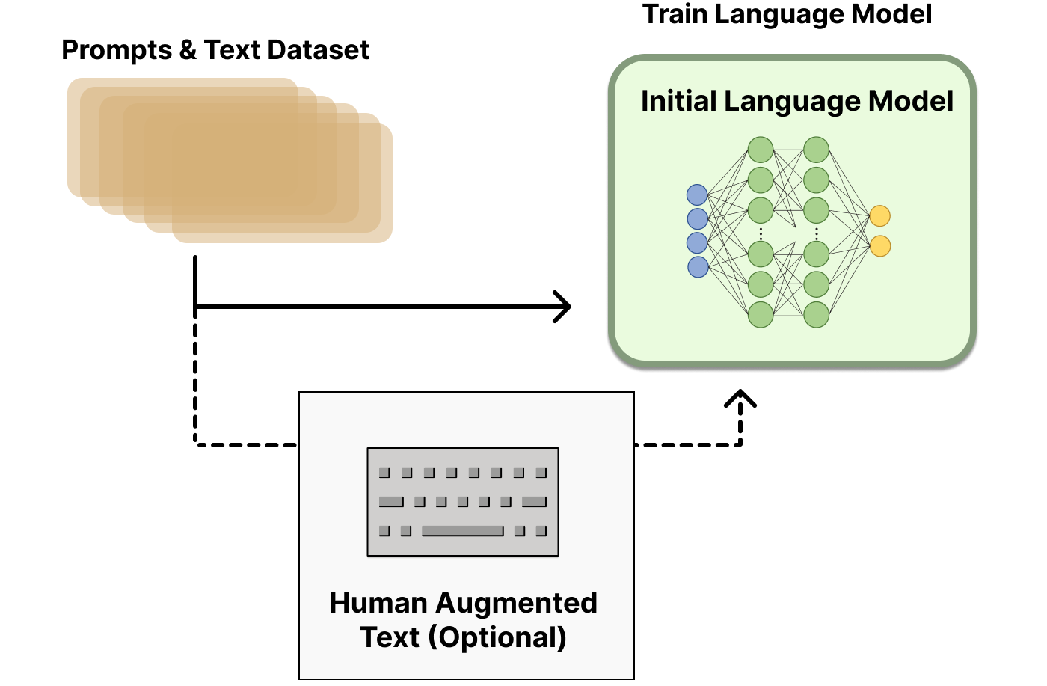
Reinforcement Learning
from Human Feedback (RLHF)
Step 1. Pretraining a Language Model (LM)
Source: https://huggingface.co/blog/rlhf

Slide 95
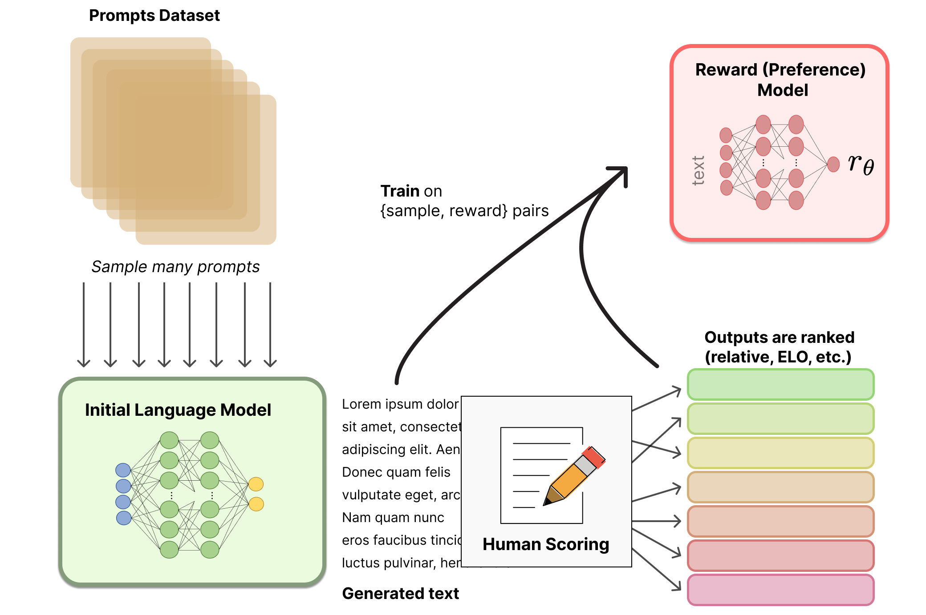
Reinforcement Learning from Human Feedback (RLHF)
Step 2. Gathering Data and
Training a
Reward Model
Source: https://huggingface.co/blog/rlhf

Slide 96
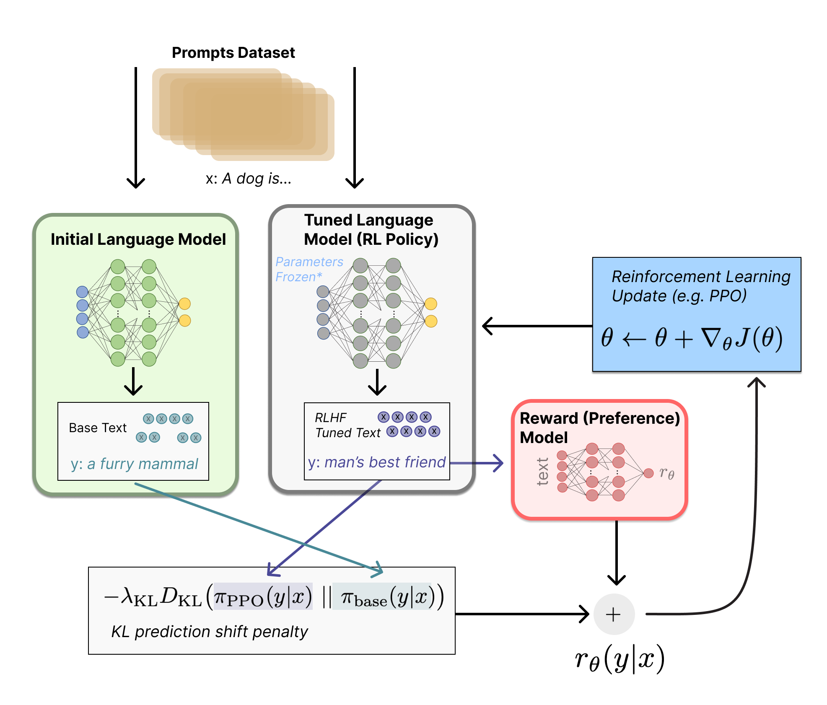
Reinforcement Learning from Human Feedback (RLHF)
Step 3. Fine-tuning the LM with Reinforcement Learning
Source: https://huggingface.co/blog/rlhf

Slide 97
Generative AI
Gen AI

Slide 98

Generative AI Models
ChatGPT
is not
all you need
Attention
is
all you need
Source: Gozalo-Brizuela, Roberto, and Eduardo C. Garrido-Merchan (2023). "ChatGPT is not all you need. A State of the Art Review of large Generative AI models." arXiv preprint arXiv:2301.04655 (2023).

Slide 99

Generative AI
Source: https://base10.vc/post/generative-ai-mission-critical/

Slide 100

Generative AI
Source: https://base10.vc/post/generative-ai-mission-critical/

Slide 101

Generative AI
Source: https://base10.vc/post/generative-ai-mission-critical/

Slide 102

DALL·E 2
Create original, realistic images and art from a text description.
It can combine concepts, attributes, and styles.
https://openai.com/dall-e-2/

Slide 103

Stable Diffusion
https://huggingface.co/spaces/stabilityai/stable-diffusion

Slide 104

Stable Diffusion Colab
https://github.com/woctezuma/stable-diffusion-colab

Slide 105

Lexica Art: Search Stable Diffusion images and prompts
https://lexica.art/

Slide 106

NLG from a Multilingual,
Multimodal and Multi-task perspective
Source: Erdem, Erkut, Menekse Kuyu, Semih Yagcioglu, Anette Frank, Letitia Parcalabescu, Barbara Plank, Andrii Babii et al.
"Neural Natural Language Generation: A Survey on Multilinguality, Multimodality, Controllability and Learning." Journal of Artificial Intelligence Research 73 (2022): 1131-1207.

Slide 107

Text-and-Video Dialog Generation Models with Hierarchical Attention
Source: Erdem, Erkut, Menekse Kuyu, Semih Yagcioglu, Anette Frank, Letitia Parcalabescu, Barbara Plank, Andrii Babii et al.
"Neural Natural Language Generation: A Survey on Multilinguality, Multimodality, Controllability and Learning." Journal of Artificial Intelligence Research 73 (2022): 1131-1207.

Slide 108

Multimodal Few-Shot Learning with
Frozen Language Models
Curated samples with about five seeds required to get past well-known language model failure modes of either repeating text for the prompt or emitting text that does not pertain to the image.
These samples demonstrate the ability to generate open-ended outputs that adapt to both images and text, and to make use of facts that it has learned during language-only pre-training.
Source: Maria Tsimpoukelli, Jacob L. Menick, Serkan Cabi, S. M. Eslami, Oriol Vinyals, and Felix Hill (2021). "Multimodal few-shot learning with frozen language models."
Advances in Neural Information Processing Systems 34 (2021): 200-212.

Slide 109

Multimodal Pipeline that includes three different modalities (Image, Text. Audio)
Source: Bayoudh, Khaled, Raja Knani, Fayçal Hamdaoui, and Abdellatif Mtibaa (2022).
"A survey on deep multimodal learning for computer vision: advances, trends, applications, and datasets." The Visual Computer 38, no. 8: 2939-2970.

Slide 110

Video and Audio Multimodal Fusion
Source: Bayoudh, Khaled, Raja Knani, Fayçal Hamdaoui, and Abdellatif Mtibaa (2022).
"A survey on deep multimodal learning for computer vision: advances, trends, applications, and datasets." The Visual Computer 38, no. 8: 2939-2970.

Slide 111

Visual and Textual Representation
Source: Bayoudh, Khaled, Raja Knani, Fayçal Hamdaoui, and Abdellatif Mtibaa (2022).
"A survey on deep multimodal learning for computer vision: advances, trends, applications, and datasets." The Visual Computer 38, no. 8: 2939-2970.

Slide 112

Hybrid Multimodal Data Fusion
Text
Audio
Image
Text
Speech
Video
Source: Bayoudh, Khaled, Raja Knani, Fayçal Hamdaoui, and Abdellatif Mtibaa (2022).
"A survey on deep multimodal learning for computer vision: advances, trends, applications, and datasets." The Visual Computer 38, no. 8: 2939-2970.

Slide 113

Multimodal Transfer Learning
Source: Bayoudh, Khaled, Raja Knani, Fayçal Hamdaoui, and Abdellatif Mtibaa (2022).
"A survey on deep multimodal learning for computer vision: advances, trends, applications, and datasets." The Visual Computer 38, no. 8: 2939-2970.

Slide 114

CLIP: Learning Transferable Visual Models From Natural Language Supervision
Source: Radford, Alec, Jong Wook Kim, Chris Hallacy, Aditya Ramesh, Gabriel Goh, Sandhini Agarwal, Girish Sastry et al. (2021) "Learning transferable visual models from natural language supervision." In International Conference on Machine Learning, pp. 8748-8763. PMLR.

Slide 115

ViLT: Vision-and-Language Transformer Without Convolution or Region Supervision
Source: Kim, Wonjae, Bokyung Son, and Ildoo Kim (2021). "Vilt: Vision-and-language transformer without convolution or region supervision."
In International Conference on Machine Learning, pp. 5583-5594. PMLR.

Slide 116

wav2vec 2.0:
A framework for self-supervised learning of speech representations
Source: Baevski, Alexei, Yuhao Zhou, Abdelrahman Mohamed, and Michael Auli.
"wav2vec 2.0: A framework for self-supervised learning of speech representations." Advances in Neural Information Processing Systems 33 (2020): 12449-12460.

Slide 117

Whisper:
Robust Speech Recognition via Large-Scale Weak Supervision
Source: Radford, Alec, Jong Wook Kim, Tao Xu, Greg Brockman, Christine McLeavey, and Ilya Sutskever. Robust speech recognition via large-scale weak supervision. Tech. Rep., Technical report, OpenAI, 2022.

Slide 118

Microsoft Azure
Text to Speech (TTS)
Source: https://azure.microsoft.com/en-gb/products/cognitive-services/text-to-speech/

Slide 119

Hugging Face
https://huggingface.co/

Slide 120

BLOOM
BigScience Large Open-science Open-access Multilingual Language Model
Source: https://huggingface.co/bigscience/bloom

Slide 121

OpenAI Whisper
Source: https://huggingface.co/spaces/openai/whisper

Slide 122

Tom Lawry (2020),
AI in Health:
A Leader’s Guide to Winning in the New Age of Intelligent Health Systems,
HIMSS Publishing
Source: Tom Lawry (2020), AI in Health: A Leader’s Guide to Winning in the New Age of Intelligent Health Systems, HIMSS Publishing
https://www.amazon.com/Health-HIMSS-Book-Tom-Lawry/dp/0367333716/

Slide 123

AI in Healthcare
Source: Secinaro, Silvana, Davide Calandra, Aurelio Secinaro, Vivek Muthurangu, and Paolo Biancone. "The role of artificial intelligence in healthcare: a structured literature review." BMC Medical Informatics and Decision Making 21, no. 1 (2021): 1-23.

Slide 124

Computer Vision in the Metaverse with scene understanding, object detection, and human action/activity recognition
Source: Huynh-The, Thien, Quoc-Viet Pham, Xuan-Qui Pham, Thanh Thi Nguyen, Zhu Han, and Dong-Seong Kim (2022).
"Artificial Intelligence for the Metaverse: A Survey." arXiv preprint arXiv:2202.10336.

Slide 125

Computer Vision:
Image Classification, Object Detection,
Object Instance Segmentation
Source: DHL (2018), Artificial Intelligence in Logistics,
http://www.globalhha.com/doclib/data/upload/doc_con/5e50c53c5bf67.pdf/

Slide 126

Computer Vision: Object Detection
Source: Li Liu, Wanli Ouyang, Xiaogang Wang, Paul Fieguth, Jie Chen, Xinwang Liu, and Matti Pietikäinen. "Deep learning for generic object detection: A survey." International journal of computer vision 128, no. 2 (2020): 261-318.

Slide 127

YOLOv7:
Trainable bag-of-freebies sets new state-of-the-art for real-time object detectors
Source: Wang, Chien-Yao, Alexey Bochkovskiy, and Hong-Yuan Mark Liao.
"YOLOv7: Trainable bag-of-freebies sets new state-of-the-art for real-time object detectors." arXiv preprint arXiv:2207.02696 (2022).

Slide 128

Multimodal Fall Detection
Ambient Assisted Living (AAL)
Source: Xefteris, Vasileios-Rafail, Athina Tsanousa, Georgios Meditskos, Stefanos Vrochidis, and Ioannis Kompatsiaris. "Performance, challenges, and limitations in multimodal fall detection systems: a review." IEEE Sensors Journal (2021).

Slide 129

Multimodal Fall Detection
Ambient Assisted Living (AAL)
Source: Xefteris, Vasileios-Rafail, Athina Tsanousa, Georgios Meditskos, Stefanos Vrochidis, and Ioannis Kompatsiaris. "Performance, challenges, and limitations in multimodal fall detection systems: a review." IEEE Sensors Journal (2021).

Slide 130

Challenges of Multimodal Fall Detection
Source: Xefteris, Vasileios-Rafail, Athina Tsanousa, Georgios Meditskos, Stefanos Vrochidis, and Ioannis Kompatsiaris. "Performance, challenges, and limitations in multimodal fall detection systems: a review." IEEE Sensors Journal (2021).

Slide 131

Fall Detection
Non-Wearable Sensors Fusion
Source: Xefteris, Vasileios-Rafail, Athina Tsanousa, Georgios Meditskos, Stefanos Vrochidis, and Ioannis Kompatsiaris. "Performance, challenges, and limitations in multimodal fall detection systems: a review." IEEE Sensors Journal (2021).

Slide 132

Fall Detection Datasets
Source: Oumaima, Guendoul, Ait Abdelali Hamd, Tabii Youness, Oulad Haj Thami Rachid, and Bourja Omar.
"Vision-based fall detection and prevention for the elderly people: A review & ongoing research." In 2021 Fifth International Conference On Intelligent Computing in Data Sciences (ICDS), pp. 1-6. IEEE, 2021.

Slide 133

Human Action Recognition
(HAR)
Source: Sun, Zehua, Qiuhong Ke, Hossein Rahmani, Mohammed Bennamoun, Gang Wang, and Jun Liu. "Human action recognition from various data modalities: A review." IEEE transactions on pattern analysis and machine intelligence (2022).

Slide 134

Human Action Recognition (HAR)
Modality
Source: Sun, Zehua, Qiuhong Ke, Hossein Rahmani, Mohammed Bennamoun, Gang Wang, and Jun Liu. "Human action recognition from various data modalities: A review." IEEE transactions on pattern analysis and machine intelligence (2022).

Slide 135

Human Action Recognition (HAR)
Modality
Source: Sun, Zehua, Qiuhong Ke, Hossein Rahmani, Mohammed Bennamoun, Gang Wang, and Jun Liu. "Human action recognition from various data modalities: A review." IEEE transactions on pattern analysis and machine intelligence (2022).

Slide 136

Fall Detection
Source: https://www.ankecare.com/article/1929-2022-05-09-08-29-47

Slide 137

BlazePose:
On-device Real-time Body Pose tracking
BlazePose 33 Keypoint topology
0. Nose
1. Left eye inner
2. Left eye
3. Left eye outer
4. Right eye inner
5. Right eye
6. Right eye outer
7. Left ear
8. Right ear
9. Mouth left
10. Mouth right
11. Left shoulder
12. Right shoulder
13. Left elbow
14. Right elbow
15. Left wrist
16. Right wrist
17. Left pinky #1 knuckle
18. Right pinky #1 knuckle
19. Left index #1 knuckle
20. Right index #1 knuckle
21. Left thumb #2 knuckle
22. Right thumb #2 knuckle
23. Left hip
24. Right hip
25. Left knee
26. Right knee
27. Left ankle
28. Right ankle
29. Left heel
30. Right heel
31. Left foot index
32. Right foot index
SourceBazarevsky, Valentin, Ivan Grishchenko, Karthik Raveendran, Tyler Zhu, Fan Zhang, and Matthias Grundmann.
"Blazepose: On-device real-time body pose tracking." arXiv preprint arXiv:2006.10204 (2020).

Slide 138

BlazePose results on yoga and fitness poses
SourceBazarevsky, Valentin, Ivan Grishchenko, Karthik Raveendran, Tyler Zhu, Fan Zhang, and Matthias Grundmann.
"Blazepose: On-device real-time body pose tracking." arXiv preprint arXiv:2006.10204 (2020).

Slide 139

OpenPose vs. BlazePose
Source: Alsawadi, Motasem S., El-Sayed M. El-Kenawy, and Miguel Rio. "Using BlazePose on Spatial Temporal Graph Convolutional Networks for Action Recognition." Computers, Materials and Continua 74, no. 1 (2022): 19-36.

Slide 140

Papers with Code
State-of-the-Art (SOTA)
https://paperswithcode.com/sota

Slide 141
Summary
AI
Data Science
Big Data Analysis

Slide 142
References
Stuart Russell and Peter Norvig (2020), Artificial Intelligence: A Modern Approach, 4th Edition, Pearson.
Aurélien Géron (2019), Hands-On Machine Learning with Scikit-Learn, Keras, and TensorFlow: Concepts, Tools, and Techniques to Build Intelligent Systems, 2nd Edition, O’Reilly Media.
Steven D'Ascoli (2022), Artificial Intelligence and Deep Learning with Python: Every Line of Code Explained For Readers New to AI and New to Python, Independently published.
Varun Grover, Roger HL Chiang, Ting-Peng Liang, and Dongsong Zhang (2018), "Creating Strategic Business Value from Big Data Analytics: A Research Framework", Journal of Management Information Systems, 35, no. 2, pp. 388-423.
Junliang Wang, Chuqiao Xu, Jie Zhang, and Ray Zhong (2022). "Big data analytics for intelligent manufacturing systems: A review." Journal of Manufacturing Systems 62 (2022): 738-752.
Ramesh Sharda, Dursun Delen, and Efraim Turban (2017), Business Intelligence, Analytics, and Data Science: A Managerial Perspective, 4th Edition, Pearson
Arun Amaithi Rajan and Vetriselvi V (2023). "Systematic Survey: Secure and Privacy-Preserving Big Data Analytics in Cloud." Journal of Computer Information Systems (2023): 1-21
Lewis Tunstall, Leandro von Werra, and Thomas Wolf (2022), Natural Language Processing with Transformers: Building Language Applications with Hugging Face, O'Reilly Media.
Ouyang, L., Wu, J., Jiang, X., Almeida, D., Wainwright, C. L., Mishkin, P., ... & Lowe, R. (2022). Training language models to follow instructions with human feedback. arXiv preprint arXiv:2203.02155.
Gozalo-Brizuela, Roberto, and Eduardo C. Garrido-Merchan (2023). "ChatGPT is not all you need. A State of the Art Review of large Generative AI models." arXiv preprint arXiv:2301.04655 (2023).
Chien-Yao Wang, Alexey Bochkovskiy, and Hong-Yuan Mark Liao. (2022) "YOLOv7: Trainable bag-of-freebies sets new state-of-the-art for real-time object detectors." arXiv preprint arXiv:2207.02696.
Alec Radford, Jong Wook Kim, Chris Hallacy, Aditya Ramesh, Gabriel Goh, Sandhini Agarwal, Girish Sastry et al. (2021) "Learning transferable visual models from natural language supervision." In International Conference on Machine Learning, pp. 8748-8763. PMLR.
Wonjae Kim, Bokyung Son, and Ildoo Kim. (2021) "Vilt: Vision-and-language transformer without convolution or region supervision." In International Conference on Machine Learning, pp. 5583-5594. PMLR.
Meng-Hao Guo, Tian-Xing Xu, Jiang-Jiang Liu, Zheng-Ning Liu, Peng-Tao Jiang, Tai-Jiang Mu, Song-Hai Zhang, Ralph R. Martin, Ming-Ming Cheng, and Shi-Min Hu. (2022) "Attention mechanisms in computer vision: A survey." Computational Visual Media ,:1-38.
Valentin Bazarevsky, Ivan Grishchenko, Karthik Raveendran, Tyler Zhu, Fan Zhang, and Matthias Grundmann.(2020) "Blazepose: On-device real-time body pose tracking." arXiv preprint arXiv:2006.10204.
Huynh-The, Thien, Quoc-Viet Pham, Xuan-Qui Pham, Thanh Thi Nguyen, Zhu Han, and Dong-Seong Kim (2022). "Artificial Intelligence for the Metaverse: A Survey." arXiv preprint arXiv:2202.10336.
Min-Yuh Day (2023), Python 101, https://tinyurl.com/aintpupython101

