Slide 1
Finance Theory
Artificial Intelligence in Finance and Quantitative Analysis
1111AIFQA05
MBA, IM, NTPU (M6132) (Fall 2022) Tue 2, 3, 4 (9:10-12:00) (B8F40)
Min-Yuh Day, Ph.D, Associate Professor
Institute of Information Management, National Taipei University
https://web.ntpu.edu.tw/~myday
https://meet.google.com/paj-zhhj-mya
2022-10-18

Slide 2
Syllabus
Week Date Subject/Topics
1 2022/09/13 Introduction to Artificial Intelligence in Finance and Quantitative Analysis
2 2022/09/20 AI in FinTech: Metaverse, Web3, DeFi, NFT, Financial Services Innovation and Applications
3 2022/09/27 Investing Psychology and Behavioral Finance
4 2022/10/04 Event Studies in Finance
5 2022/10/11 Case Study on AI in Finance and Quantitative Analysis I
6 2022/10/18 Finance Theory

Slide 3
Syllabus
Week Date Subject/Topics
7 2022/10/25 Data-Driven Finance
8 2022/11/01 Midterm Project Report
9 2022/11/08 Financial Econometrics
10 2022/11/15 AI-First Finance
11 2022/11/22 Industry Practices of AI in Finance and Quantitative Analysis
12 2022/11/29 Case Study on AI in Finance and Quantitative Analysis II

Slide 4
Syllabus
Week Date Subject/Topics
13 2022/12/06 Deep Learning in Finance; Reinforcement Learning in Finance
14 2022/12/13 Algorithmic Trading; Risk Management; Trading Bot and Event-Based Backtesting
15 2022/12/20 Final Project Report I
16 2022/12/27 Final Project Report II
17 2023/01/03 Self-learning
18 2023/01/10 Self-learning

Slide 5
Financial Theories

Slide 6
Financial Theories
Uncertainty and Risk
Expected Utility Theory (EUT)
Mean-Variance Portfolio Theory (MVPT)
Capital Asset Pricing Model (CAPM)
Arbitrage Pricing Theory (APT)
Source: Yves Hilpisch (2020), Artificial Intelligence in Finance: A Python-Based Guide, O’Reilly Media.

Slide 7
Major Normative Financial Theories and Models
Normative Theory
Based on assumptions (mathematically, axioms) and derives insights, results, and more from the set of relevant assumptions.
Positive theory
Based on observation, experiments, data, relationships, and the like and describes phenomena given the insights gained from the available information and the derived results.
Source: Yves Hilpisch (2020), Artificial Intelligence in Finance: A Python-Based Guide, O’Reilly Media.

Slide 8
Normative Finance
The CAPM is based on many unrealistic assumptions.
The assumption that investors care only about the mean and variance of one-period portfolio returns is extreme. (Eugene Fama and Kenneth French, 2004)
Source: Yves Hilpisch (2020), Artificial Intelligence in Finance: A Python-Based Guide, O’Reilly Media.

Slide 9
Uncertainty and Risk
Financial theory deals with investment, trading, and valuation in the presence of uncertainty and risk.
The focus is on fundamental concepts from probability theory that build the backbone of quantitative finance.
Source: Yves Hilpisch (2020), Artificial Intelligence in Finance: A Python-Based Guide, O’Reilly Media.

Slide 10
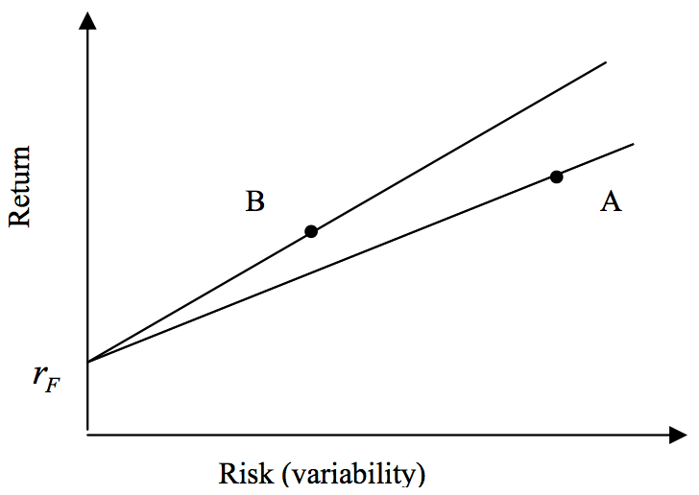
Risk and Return
Source: Bacon, Carl. "How sharp is the Sharpe-ratio?-Risk-adjusted Performance Measures." Statpro White Paper (2000).

Slide 11
Sharpe Ratio
$$Sharpe Ratio= \frac{Portofolio Return−Risk Free Return}{Portofolio Risk}$$
Source: Bacon, Carl. "How sharp is the Sharpe-ratio?-Risk-adjusted Performance Measures." Statpro White Paper (2000).

Slide 12
Sharpe Ratio
$$Sharpe Ratio SR= \frac{r_{P}−r_{F}}{σ_{P}}$$
Where
r_{P} = portfolio return
r_{F} = risk free rate
σ_{P} = portfolio risk (variability, standard deviation of return)
Source: Bacon, Carl. "How sharp is the Sharpe-ratio?-Risk-adjusted Performance Measures." Statpro White Paper (2000).

Slide 13
Sortino Ratio
$$Sortino Ratio = \frac{r_{P}−r_{T}}{σ_{D}}$$
Where
r_{P} = portfolio return
r_{T} = Minimum Target Return
σ_{D} = Downside Risk
$$Downside Risk{ σ}_{D}= \sqrt{\sum_{i=1}^{n}{\frac{\min\left[\left(ri−rT\right),0\right]2}{n}}}$$
Source: Bacon, Carl. "How sharp is the Sharpe-ratio?-Risk-adjusted Performance Measures." Statpro White Paper (2000).

Slide 14
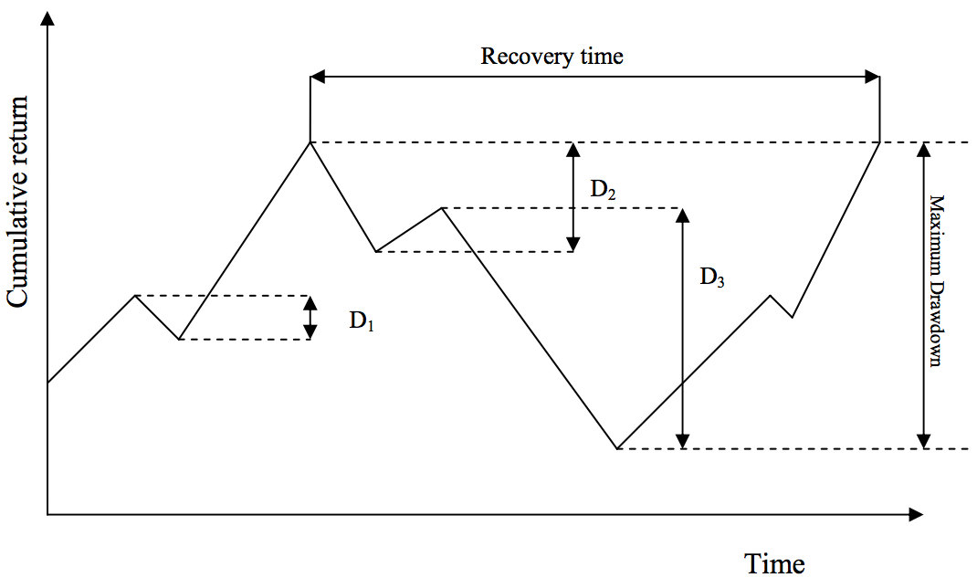
Max Drawdown
Source: Bacon, Carl. "How sharp is the Sharpe-ratio?-Risk-adjusted Performance Measures." Statpro White Paper (2000).

Slide 15
Traded Assets
In the economy, two assets are traded.
The first is a risky asset, the stock, with a certain price today of S₀ = 10 and an uncertain payoff tomorrow.
The second is a risk-less asset, the bond, with a certain price today of B₀ = 10 and a certain payoff tomorrow.
Source: Yves Hilpisch (2020), Artificial Intelligence in Finance: A Python-Based Guide, O’Reilly Media.

Slide 16
Arbitrage Pricing
Deriving the fair value of a European call option on the stock with a strike price of K = 14.5
Arbitrage pricing theory can be considered one of the strongest financial theories with some of the most robust mathematical results, such as the fundamental theorem of asset pricing (FTAP).
Source: Yves Hilpisch (2020), Artificial Intelligence in Finance: A Python-Based Guide, O’Reilly Media.

Slide 17
Expected Utility Theory (EUT)
Expected utility theory (EUT)
1940s
cornerstone of financial theory
One of the central paradigms for modeling decision making under uncertainty
Source: Yves Hilpisch (2020), Artificial Intelligence in Finance: A Python-Based Guide, O’Reilly Media.

Slide 18
Expected Utility Theory
Expected utility theory (EUT)
EUT is an axiomatic theory
von Neumann and Morgenstern (1944)
Axiomatic
Major results of the theory can be deduced from a small number of axioms only
Axioms and normative theory
An axiom is a proposition regarded as self-evidently true without proof.
Source: Yves Hilpisch (2020), Artificial Intelligence in Finance: A Python-Based Guide, O’Reilly Media.

Slide 19
Preferences of an Agent
Assume an agent with preferences ⪰ is faced with the problem of investing in the two traded assets of the model economy M².
One possible set of axioms leading to EUT
Completeness
Transitivity
Continuity
Independence
Dominance
Source: Yves Hilpisch (2020), Artificial Intelligence in Finance: A Python-Based Guide, O’Reilly Media.

Slide 20
Utility functions
A utility function is a way to represent the preferences ⪰ of an agent in a mathematical and numerical way in that such a function assigns a numerical value to a certain payoff.
Source: Yves Hilpisch (2020), Artificial Intelligence in Finance: A Python-Based Guide, O’Reilly Media.

Slide 21
Expected Utility Functions
Von Neumann and Morgenstern (1944) show that if the preferences of an agent ⪰ satisfy the preceding five axioms, then there exists an expected utility function.
Source: Yves Hilpisch (2020), Artificial Intelligence in Finance: A Python-Based Guide, O’Reilly Media.

Slide 22
Risk aversion
In finance, the concept of risk aversion is important.
The most commonly used measure of risk aversion is the Arrow-Pratt measure of absolute risk aversion (ARA) (Pratt, 1964).
ARA(x) > 0, risk‐averse
ARA(x) = 0, risk‐neutral
ARA(x) < 0, risk‐loving
Source: Yves Hilpisch (2020), Artificial Intelligence in Finance: A Python-Based Guide, O’Reilly Media.

Slide 23
Mean-Variance Portfolio Theory (MVPT)
Mean-variance portfolio (MVP) theory
Markowitz (1952)
cornerstone in financial theory
One of the first theories of investment under uncertainty that focused on statistical measures only for the construction of stock investment portfolios.
MVP completely abstracts from fundamentals of a company that might drive its stock performance or assumptions about the future competitiveness of a company that might be important for the growth prospects of a company.
Source: Yves Hilpisch (2020), Artificial Intelligence in Finance: A Python-Based Guide, O’Reilly Media.

Slide 24
Mean-Variance Portfolio Theory (MVPT)
The only input data that counts is the time series of share prices and statistics derived therefrom, such as the (historical) annualized mean return and the (historical) annualized variance of the returns.
The central assumption of MVP, according to Markowitz (1952), is that investors only care about expected returns and the variance of these returns.
Source: Yves Hilpisch (2020), Artificial Intelligence in Finance: A Python-Based Guide, O’Reilly Media.

Slide 25
Mean-Variance Portfolio Theory (MVPT)
Portfolio statistics
returns vector
expected return
vector of expected returns
expected return of the portfolio
covariance matrix
expected variance of the portfolio
expected volatility of the portfolio
Source: Yves Hilpisch (2020), Artificial Intelligence in Finance: A Python-Based Guide, O’Reilly Media.

Slide 26
Sharpe ratio
Sharpe (1966) introduces a measure to judge the risk-adjusted performance of mutual funds and other portfolios, or even single risky assets.
It relates the (expected, realized) return of a portfolio to its (expected, realized) volatility.
Sharpe ratio $π=\frac{μ}{σ}$
If r represents the risk-less short rate, the risk premium or excess return of a portfolio phi over a risk-free alternative is defined by μ^{phi} − r
Sharpe ratio $π=\frac{μ−r}{σ}$
Source: Yves Hilpisch (2020), Artificial Intelligence in Finance: A Python-Based Guide, O’Reilly Media.

Slide 27
Investment Opportunity Set Simulated expected portfolio volatility and return (one risky asset)
Source: Yves Hilpisch (2020), Artificial Intelligence in Finance: A Python-Based Guide, O’Reilly Media.

Slide 28
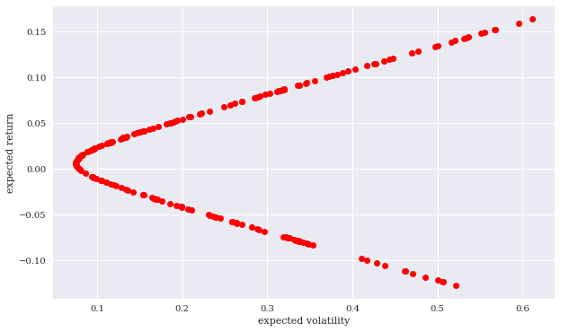
Investment Opportunity Set Simulated expected portfolio volatility and return (two risky assets)
Source: Yves Hilpisch (2020), Artificial Intelligence in Finance: A Python-Based Guide, O’Reilly Media.

Slide 29
Minimum volatility and maximum Sharpe ratio portfolios
Source: Yves Hilpisch (2020), Artificial Intelligence in Finance: A Python-Based Guide, O’Reilly Media.

Slide 30
Efficient Frontier
An efficient portfolio
has a maximum expected return (risk) given its expected risk (return)
All those portfolios that have a lower expected return than the minimum risk portfolio are inefficient.
Efficient frontier
The set of all efficient portfolios
Agents will only choose a portfolio that lies on the efficient frontier
Source: Yves Hilpisch (2020), Artificial Intelligence in Finance: A Python-Based Guide, O’Reilly Media.

Slide 31
Portfolio Optimization Efficient Frontier
Efficient Frontier
Return
Risk
Source: Tucker Balch (2012), Investment Science: Portfolio Optimization, https://www.youtube.com/watch?v=5qbMhXXq0vI

Slide 32
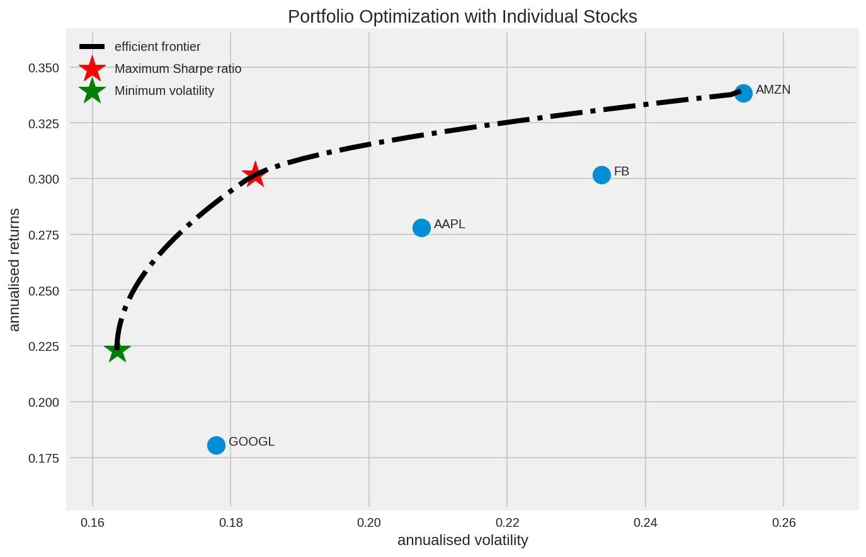
Portfolio Optimization Efficient Frontier
https://tinyurl.com/aintpupython101

Slide 33
Efficient Frontier
Source: Yves Hilpisch (2020), Artificial Intelligence in Finance: A Python-Based Guide, O’Reilly Media.

Slide 34
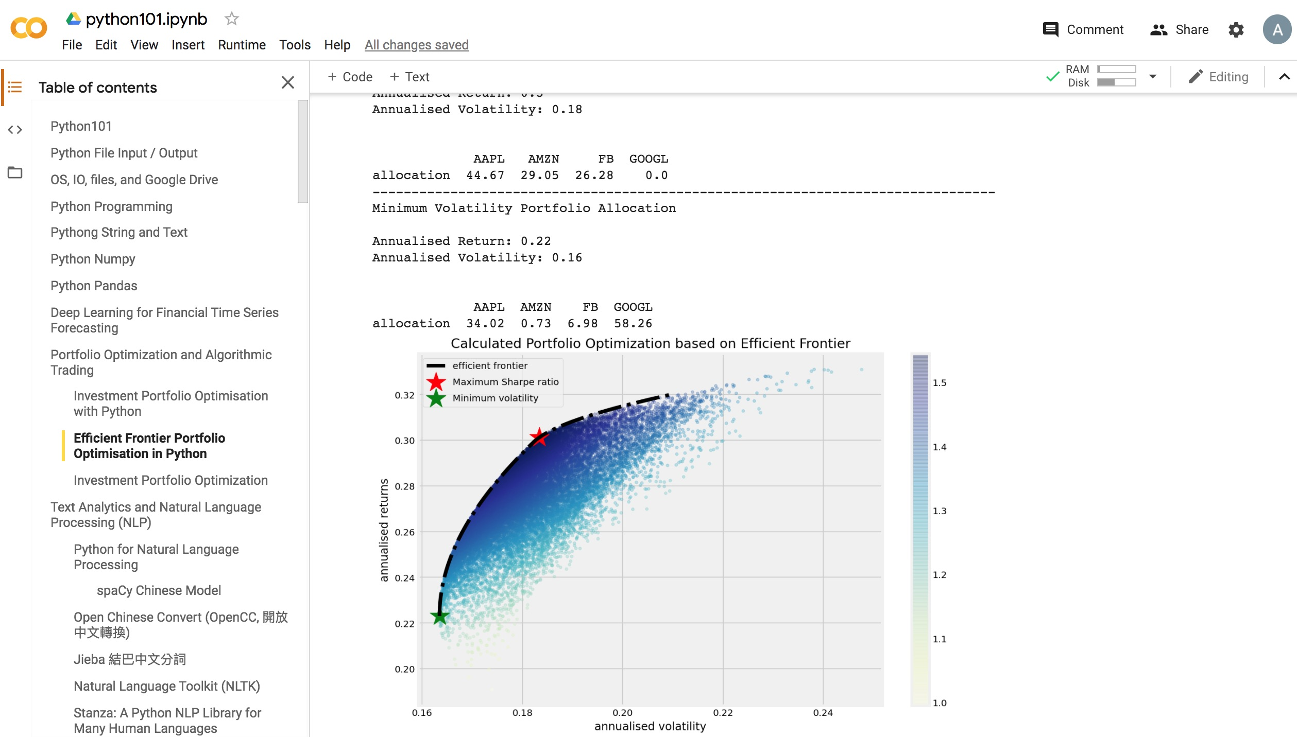
Portfolio Optimization and Algorithmic Trading
https://colab.research.google.com/drive/1FEG6DnGvwfUbeo4zJ1zTunjMqf2RkCrT
https://tinyurl.com/aintpupython101

Slide 35
Capital Asset Pricing Model (CAPM)
Capital Asset Pricing Model (CAPM)
One of the most widely documented and applied models in finance
It relates in linear fashion the expected return for a single stock to the expected return of the market portfolio, usually approximated by a broad stock index such as the S&P 500.
Sharpe (1964) and Lintner (1965)
Source: Yves Hilpisch (2020), Artificial Intelligence in Finance: A Python-Based Guide, O’Reilly Media.

Slide 36
Capital Asset Pricing Model (CAPM)
Capital asset prices: A theory of market equilibrium under conditions of risk
WF Sharpe - The journal of finance, 1964 - Wiley Online Library
ONE OF THE PROBLEMS which has plagued those attempting to predict the behavior of capital markets is the absence of a body of positive microeconomic theory dealing with conditions of risk. Although many useful insights can be obtained from the traditional models of investment under conditions of certainty, the pervasive influence of risk in financial transactions has forced those working in this area to adopt models of price behavior which are little more than assertions. A typical classroom explanation of the determination of …
Cite Cited by 30490 Related articles All 26 versions
Source: Sharpe, William F. "Capital asset prices: A theory of market equilibrium under conditions of risk." The journal of finance 19, no. 3 (1964): 425-442.

Slide 37
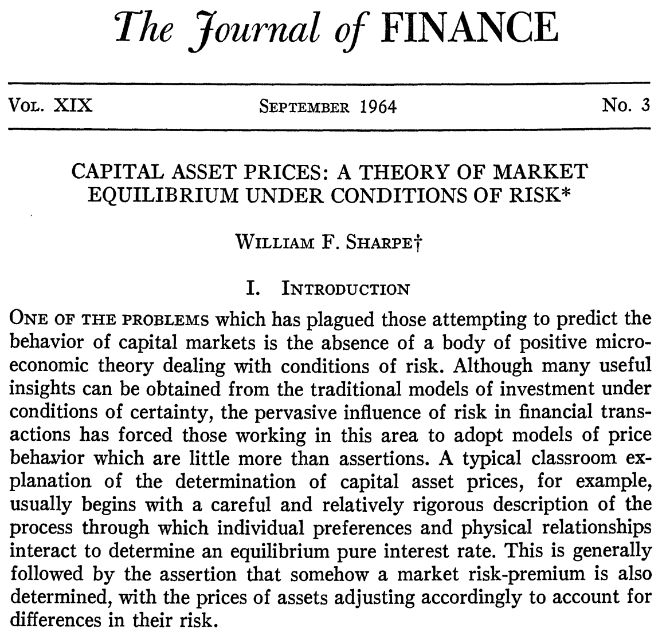
Capital Asset Pricing Model (CAPM)
Source: Sharpe, William F. "Capital asset prices: A theory of market equilibrium under conditions of risk." The journal of finance 19, no. 3 (1964): 425-442.

Slide 38
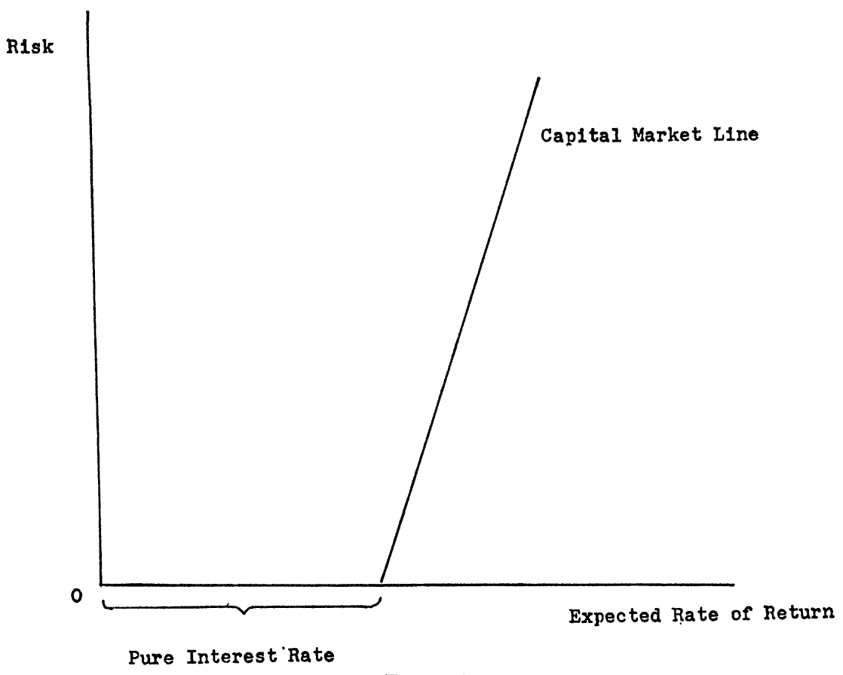
Capital Asset Pricing Model (CAPM)
Source: Sharpe, William F. "Capital asset prices: A theory of market equilibrium under conditions of risk." The journal of finance 19, no. 3 (1964): 425-442.

Slide 39
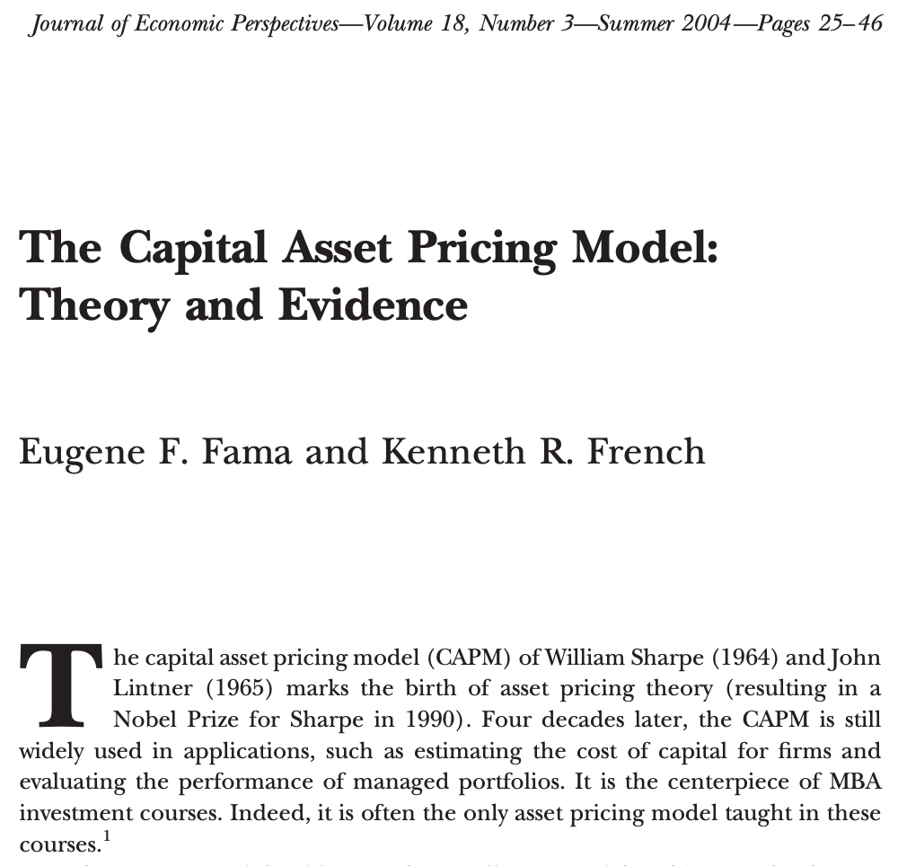
Capital Asset Pricing Model (CAPM)
Source: Fama, Eugene F., and Kenneth R. French. "The capital asset pricing model: Theory and evidence." Journal of economic perspectives 18, no. 3 (2004): 25-46.

Slide 40
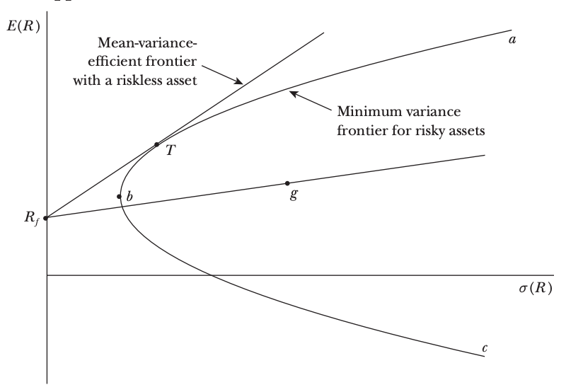
Investment Opportunities
Source: Fama, Eugene F., and Kenneth R. French. "The capital asset pricing model: Theory and evidence." Journal of economic perspectives 18, no. 3 (2004): 25-46.

Slide 41
Capital Asset Pricing Model (CAPM)
E(R_{i}) = R_{f} + 𝛃_{iM} [E(R_{M}) - R_{f}]
The expected return on any asset i is the risk-free interest rate, R_{f}, plus a risk premium, which is the asset’s market beta, 𝛃_{iM} , times the premium per unit of beta risk, E(R_{M})-R_{f}
Source: Fama, Eugene F., and Kenneth R. French. "The capital asset pricing model: Theory and evidence." Journal of economic perspectives 18, no. 3 (2004): 25-46.

Slide 42
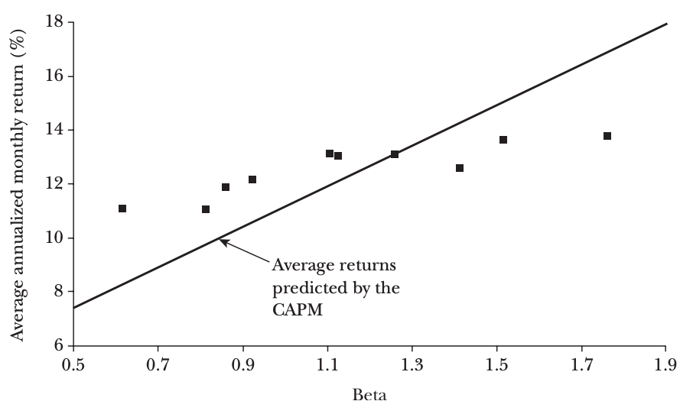
Capital Asset Pricing Model (CAPM)
Average Annualized Monthly Return versus Beta for Value Weight Portfolios Formed on Prior Beta, 1928–2003
Source: Fama, Eugene F., and Kenneth R. French. "The capital asset pricing model: Theory and evidence." Journal of economic perspectives 18, no. 3 (2004): 25-46.

Slide 43
Capital Asset Pricing Model (CAPM)
Capital market theory is a positive theory in that it hypothesizes how investors do behave rather than how investors should behave, as in the case of modern portfolio theory (MVP)
It is reasonable to view capital market theory as an extension of portfolio theory, but it is important to understand that MVP is not based on the validity, or lack thereof, of capital market theory.
Source: Yves Hilpisch (2020), Artificial Intelligence in Finance: A Python-Based Guide, O’Reilly Media.

Slide 44
Capital Asset Pricing Model (CAPM)
The specific equilibrium model of interest to many investors is known as the capital asset pricing model, typically referred to as the CAPM.
It allows us to assess the relevant risk of an individual security as well as to assess the relationship between risk and the returns expected from investing.
The CAPM is attractive as an equilibrium model because of its simplicity and its implications.
Source: Yves Hilpisch (2020), Artificial Intelligence in Finance: A Python-Based Guide, O’Reilly Media.

Slide 45
Capital Asset Pricing Model (CAPM)
In the CAPM, agents are assumed to invest according to MVP, caring only about the risk and return statistics of risky assets over one period.
In a capital market equilibrium, all available assets are held by all agents and the markets clear.
Market portfolio (set of tradable assets) must lie on the efficient frontier.
Two fund separation theorem
Every agent will hold a combination of the market portfolio and the risk-free asset in equilibrium.
The set of all such portfolios is called the Capital Market Line (CML).
Source: Yves Hilpisch (2020), Artificial Intelligence in Finance: A Python-Based Guide, O’Reilly Media.

Slide 46
Capital Market Line (CML)
Source: Yves Hilpisch (2020), Artificial Intelligence in Finance: A Python-Based Guide, O’Reilly Media.

Slide 47
Capital Market Line with Two Risky Assets
Source: Yves Hilpisch (2020), Artificial Intelligence in Finance: A Python-Based Guide, O’Reilly Media.

Slide 48
Indifference curves in risk-return space
Source: Yves Hilpisch (2020), Artificial Intelligence in Finance: A Python-Based Guide, O’Reilly Media.

Slide 49
Optimal Portfolio on the Capital Market Line (CML)
Source: Yves Hilpisch (2020), Artificial Intelligence in Finance: A Python-Based Guide, O’Reilly Media.

Slide 50
Arbitrage Pricing Theory (APT)
Arbitrage Pricing Theory (APT)
One of the major generalizations of the Capital Asset Pricing Model (CAPM)
Ross (1971) and Ross (1976)
The purpose of this paper is to examine rigorously the arbitrage model of capital asset pricing developed in Ross (1971).
The arbitrage model was proposed as an alternative to the mean variance capital asset pricing model, introduced by Sharpe, Lintner, and Treynor, that has become the major analytic tool for explaining phenomena observed in capital markets for risky assets.
Source: Yves Hilpisch (2020), Artificial Intelligence in Finance: A Python-Based Guide, O’Reilly Media.

Slide 51
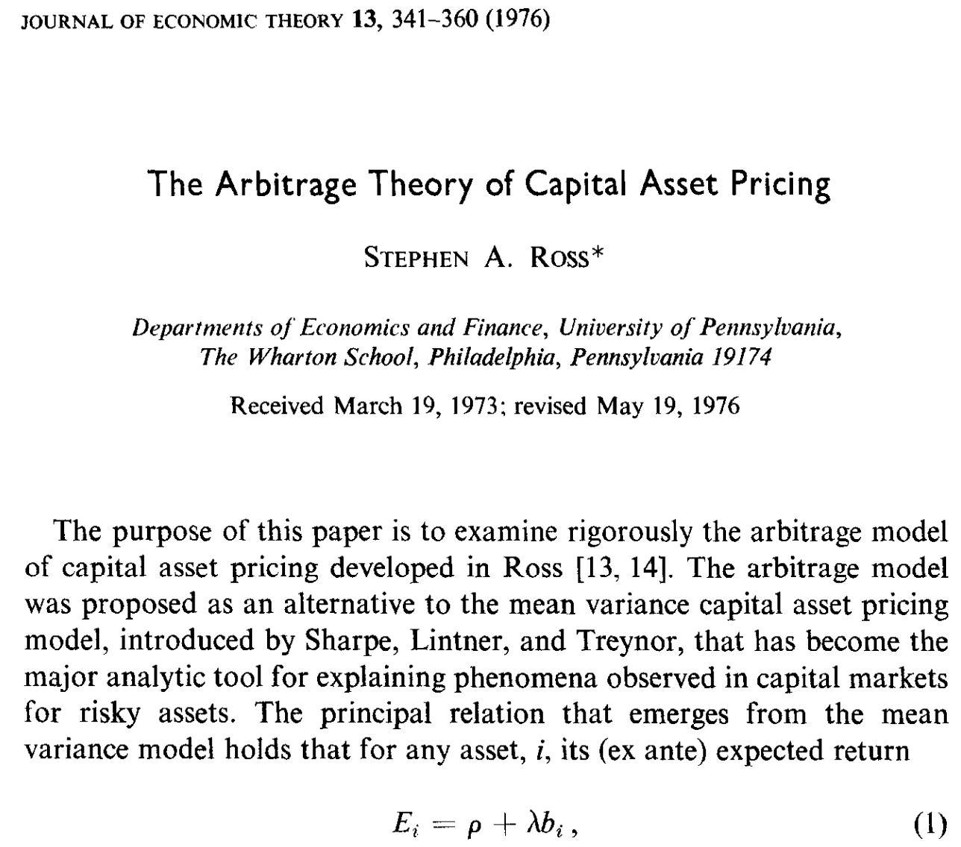
Arbitrage Pricing Theory (APT)
Source: Ross, Stephen A. "The arbitrage theory of capital asset pricing." Journal of Economic Theory 13, no. 3 (1976): 341-360.

Slide 52
Arbitrage Pricing Theory (APT)
The APT is a generalization of the CAPM to multiple risk factors.
APT does not assume that the market portfolio is the only relevant risk factor
There are rather multiple types of risk that together are assumed to drive the performance (expected returns) of a stock.
Such risk factors might include size, volatility, value, and momentum.
Source: Yves Hilpisch (2020), Artificial Intelligence in Finance: A Python-Based Guide, O’Reilly Media.

Slide 53
Capital Asset Pricing Model (CAPM) Arbitrage Pricing Theory (APT)
Capital Asset Pricing Model (CAPM)
univariate ordinary least-squares (OLS) regression
Arbitrage Pricing Theory (APT)
multivariate ordinary least-squares (OLS) regression
Source: Yves Hilpisch (2020), Artificial Intelligence in Finance: A Python-Based Guide, O’Reilly Media.

Slide 54
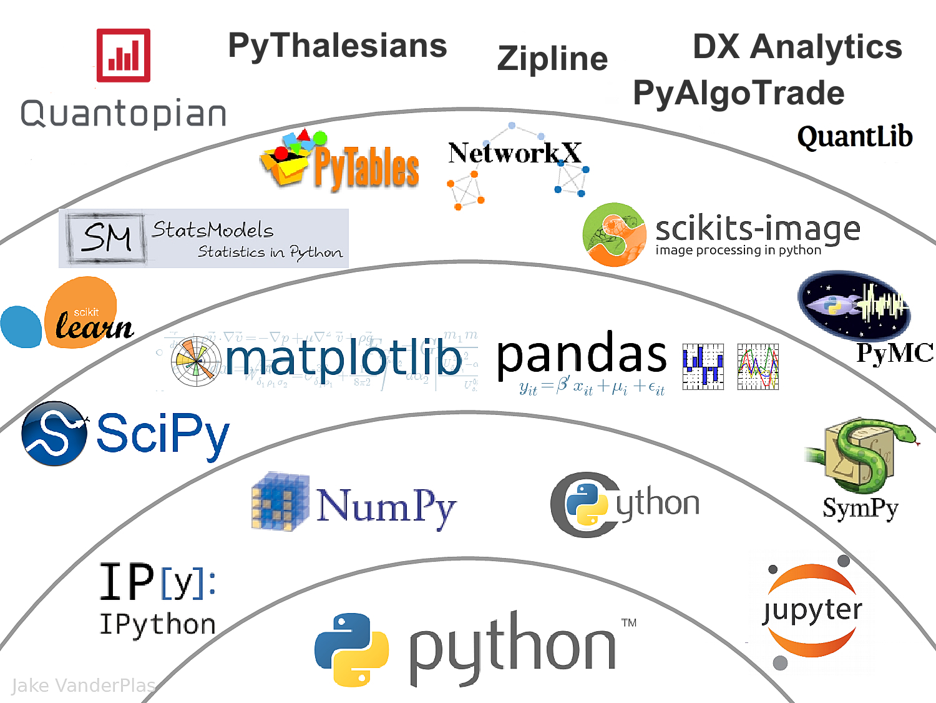
The Quant Finance PyData Stack
Source: http://nbviewer.jupyter.org/format/slides/github/quantopian/pyfolio/blob/master/pyfolio/examples/overview_slides.ipynb#/5

Slide 55
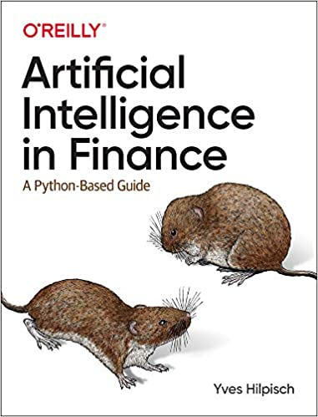
Yves Hilpisch (2020), Artificial Intelligence in Finance: A Python-Based Guide, O’Reilly
Source: https://www.amazon.com/Artificial-Intelligence-Finance-Python-Based-Guide/dp/1492055433

Slide 56
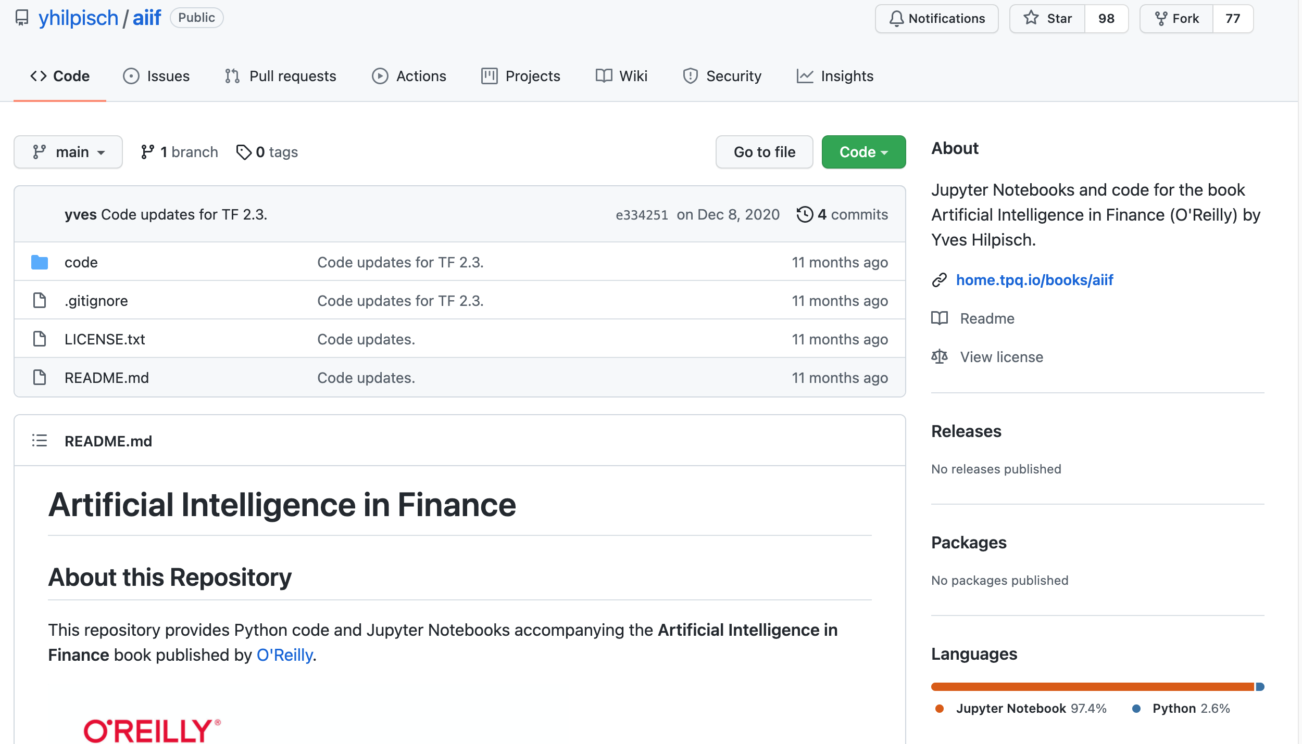
Yves Hilpisch (2020), Artificial Intelligence in Finance: A Python-Based Guide, O’Reilly
https://github.com/yhilpisch/aiif
Source: https://github.com/yhilpisch/aiif

Slide 57
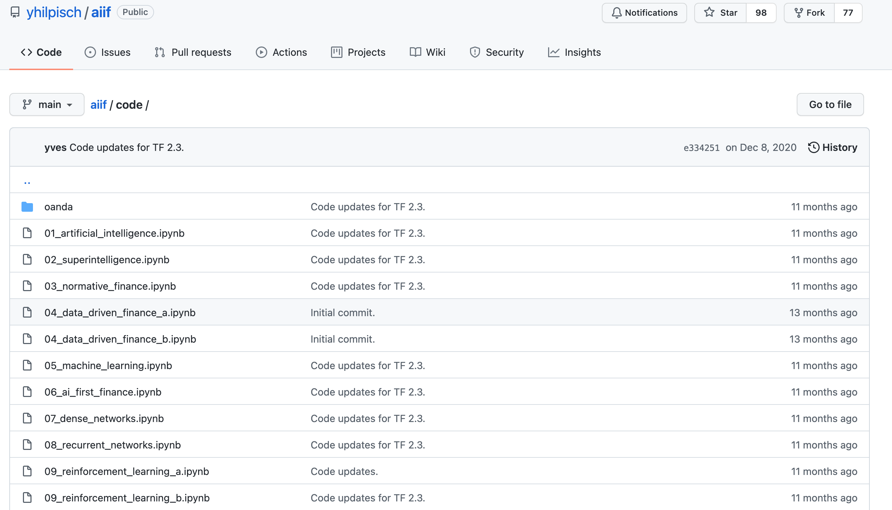
Yves Hilpisch (2020), Artificial Intelligence in Finance: A Python-Based Guide, O’Reilly
https://github.com/yhilpisch/aiif/tree/main/code
Source: https://github.com/yhilpisch/aiif/tree/main/code

Slide 58
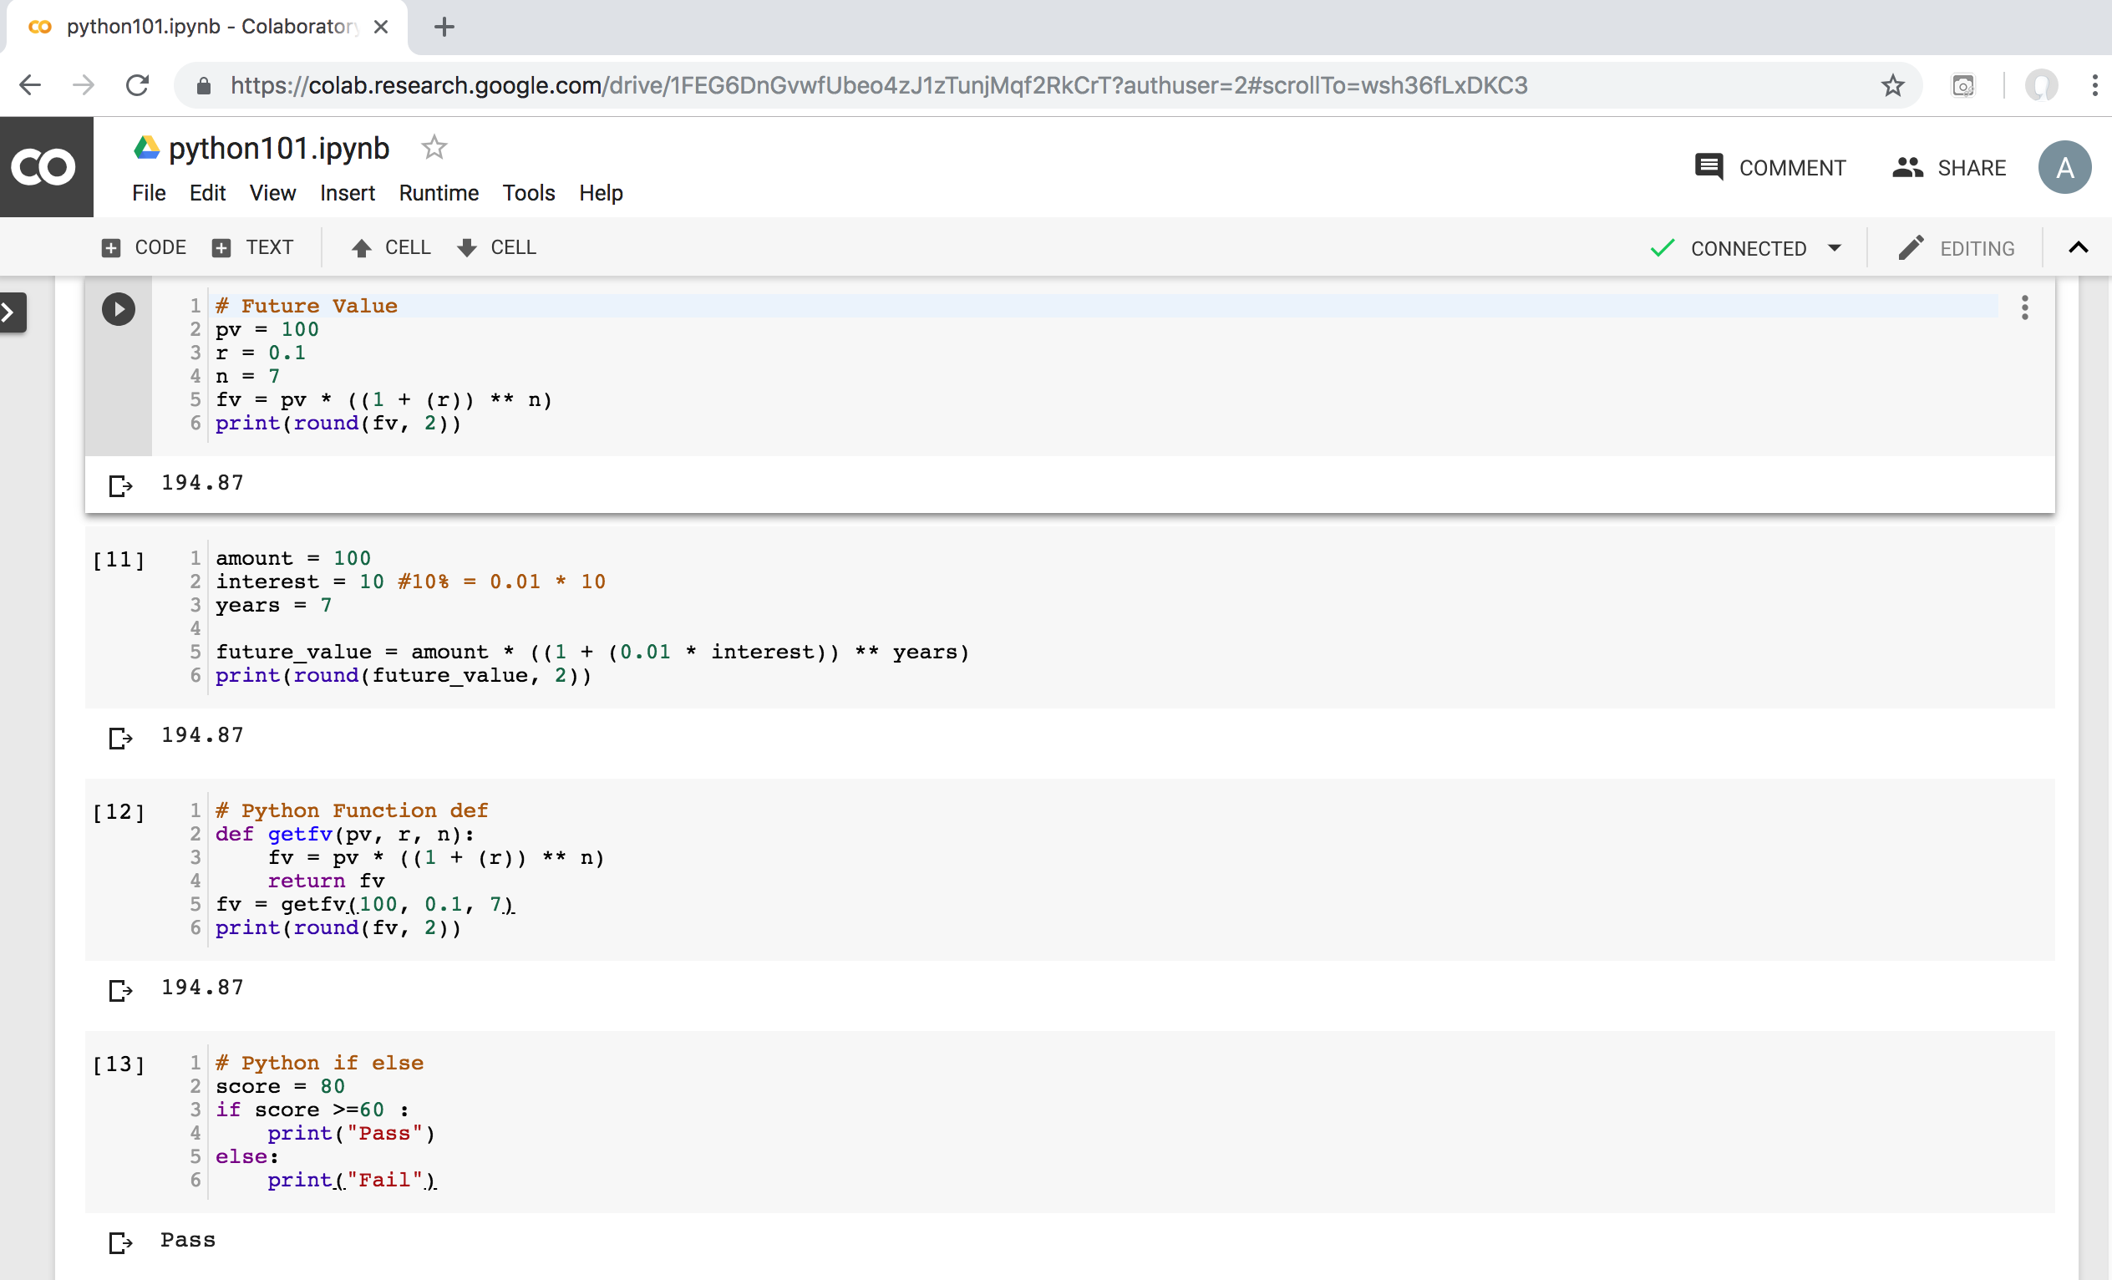
Python in Google Colab (Python101)
https://colab.research.google.com/drive/1FEG6DnGvwfUbeo4zJ1zTunjMqf2RkCrT
https://tinyurl.com/aintpupython101

Slide 59
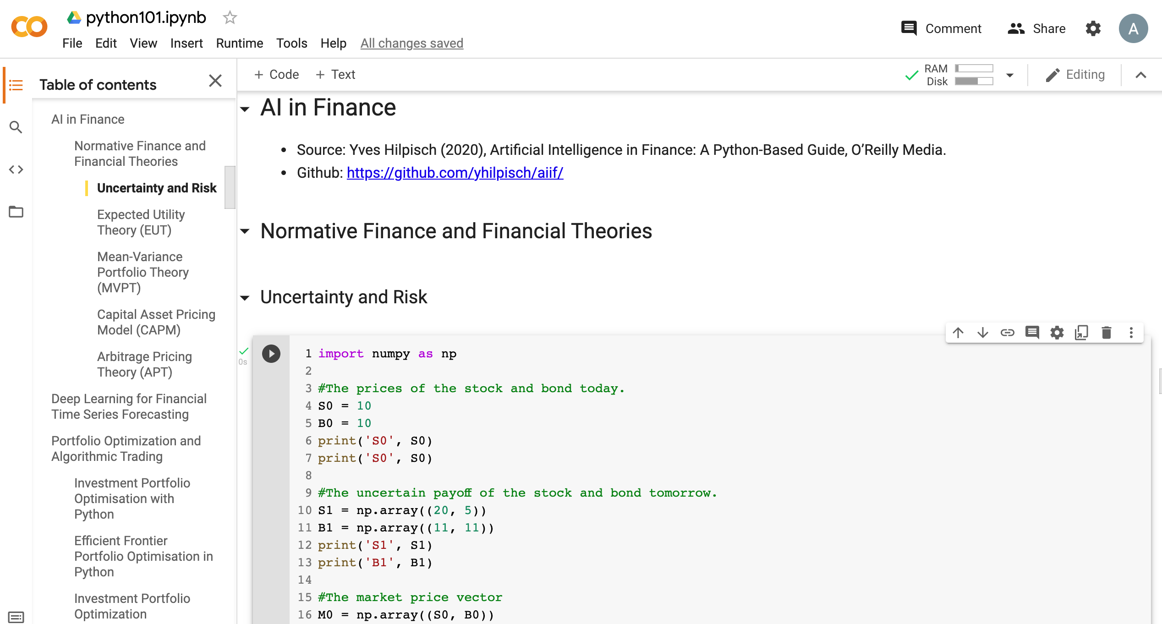
Python in Google Colab (Python101)
https://colab.research.google.com/drive/1FEG6DnGvwfUbeo4zJ1zTunjMqf2RkCrT
https://tinyurl.com/aintpupython101

Slide 60
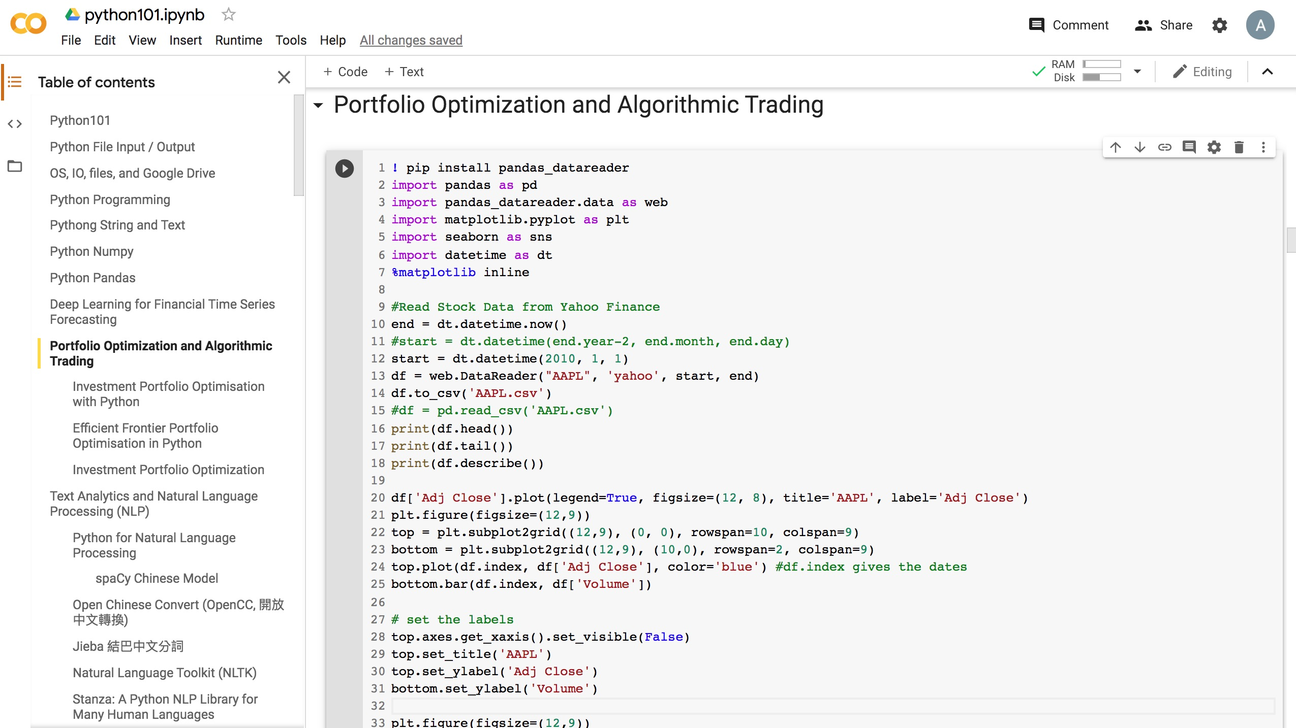
Python in Google Colab (Python101)
https://colab.research.google.com/drive/1FEG6DnGvwfUbeo4zJ1zTunjMqf2RkCrT
https://tinyurl.com/aintpupython101

Slide 61
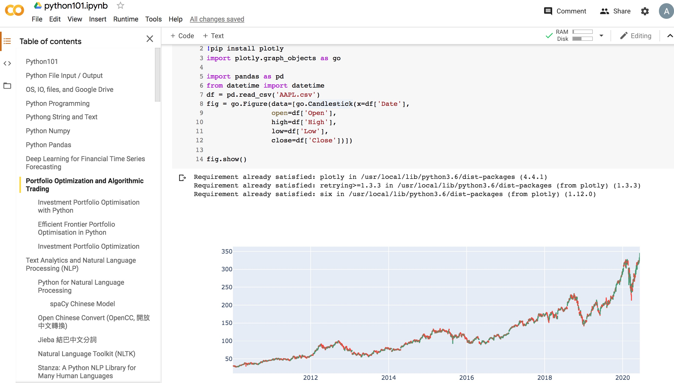
Python in Google Colab (Python101)
https://colab.research.google.com/drive/1FEG6DnGvwfUbeo4zJ1zTunjMqf2RkCrT
https://tinyurl.com/aintpupython101

Slide 62
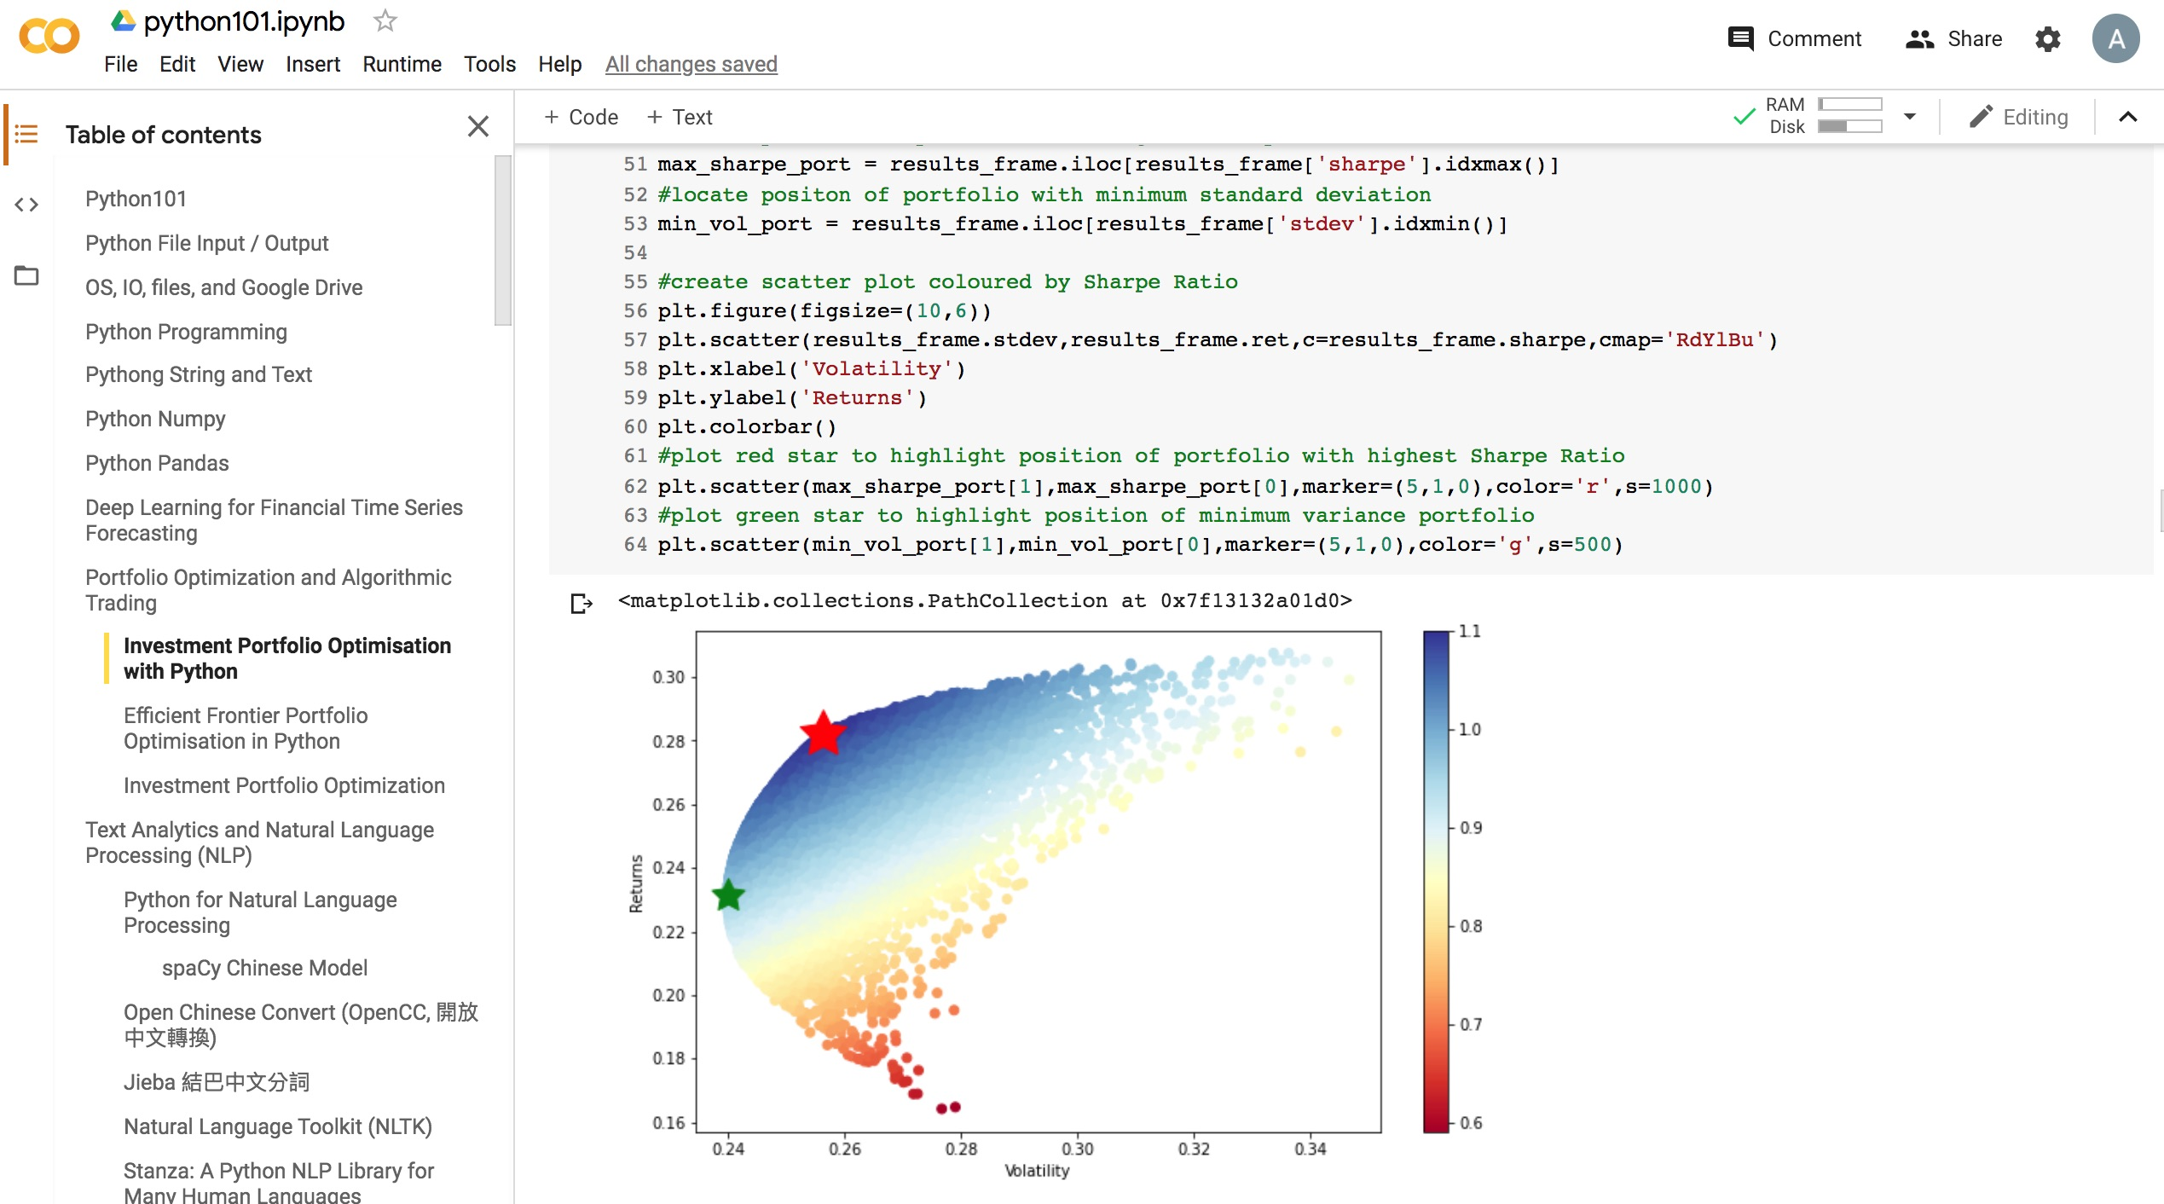
Python in Google Colab (Python101)
https://colab.research.google.com/drive/1FEG6DnGvwfUbeo4zJ1zTunjMqf2RkCrT
https://tinyurl.com/aintpupython101

Slide 63
Python in Google Colab (Python101)
https://colab.research.google.com/drive/1FEG6DnGvwfUbeo4zJ1zTunjMqf2RkCrT
https://tinyurl.com/aintpupython101

Slide 64
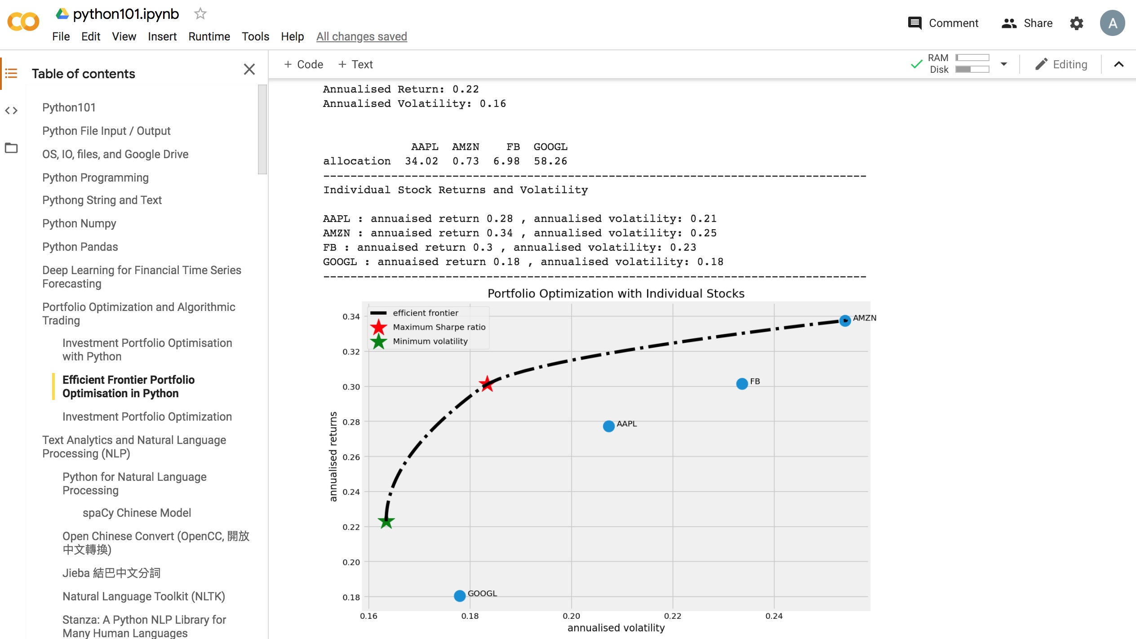
Python in Google Colab (Python101)
https://colab.research.google.com/drive/1FEG6DnGvwfUbeo4zJ1zTunjMqf2RkCrT
Portfolio Optimization
Efficient Frontier Portfolio Optimization
https://tinyurl.com/aintpupython101

Slide 65
Summary
Uncertainty and Risk
Expected Utility Theory (EUT)
Mean-Variance Portfolio Theory (MVPT)
Capital Asset Pricing Model (CAPM)
Arbitrage Pricing Theory (APT)
Source: Yves Hilpisch (2020), Artificial Intelligence in Finance: A Python-Based Guide, O’Reilly Media.

Slide 66
References
Yves Hilpisch (2020), Artificial Intelligence in Finance: A Python-Based Guide, O’Reilly Media, https://github.com/yhilpisch/aiif .
Fishburn, P. C. (1968). Utility theory. Management science, 14(5), 335-378.
Fama, E. F., & French, K. R. (2004). The capital asset pricing model: Theory and evidence. Journal of economic perspectives, 18(3), 25-46.
Markowitz, H. (1952). PORTFOLIO SELECTION. The Journal of Finance, 7(1), 77-91.
Pratt, J. W. (1964). Risk aversion in the small and in the large, econometrics 32, jan.
Ross, S. A. (1976). The arbitrage theory of capital asset pricing. Journal of Economic Theory, 13(3), 341-60.
Sharpe, W. F. (1964). Capital asset prices: A theory of market equilibrium under conditions of risk. The journal of finance, 19(3), 425-442.
Min-Yuh Day (2022), Python 101, https://tinyurl.com/aintpupython101

