Slide 1


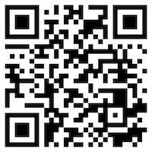





Deep Learning and
Reinforcement Learning
Artificial Intelligence
1111AI07
MBA, IM, NTPU (M6132) (Fall 2022)
Wed 2, 3, 4 (9:10-12:00) (B8F40)
Min-Yuh Day, Ph.D,
Associate Professor
Institute of Information Management, National Taipei University
https://web.ntpu.edu.tw/~myday
https://meet.google.com/miy-fbif-max
2022-11-09

Slide 2
Syllabus
Week Date Subject/Topics
1 2022/09/14 Introduction to Artificial Intelligence
2 2022/09/21 Artificial Intelligence and Intelligent Agents
3 2022/09/28 Problem Solving
4 2022/10/05 Knowledge, Reasoning and Knowledge Representation;
Uncertain Knowledge and Reasoning
5 2022/10/12 Case Study on Artificial Intelligence I
6 2022/10/19 Machine Learning: Supervised and Unsupervised Learning

Slide 3
Syllabus
Week Date Subject/Topics
7 2022/10/26 The Theory of Learning and Ensemble Learning
8 2022/11/02 Midterm Project Report
9 2022/11/09 Deep Learning and Reinforcement Learning
10 2022/11/16 Deep Learning for Natural Language Processing
11 2022/11/23 Invited Talk: AI for Information Retrieval
12 2022/11/30 Case Study on Artificial Intelligence II

Slide 4
Syllabus
Week Date Subject/Topics
13 2022/12/07 Computer Vision and Robotics
14 2022/12/14 Philosophy and Ethics of AI and the Future of AI
15 2022/12/21 Final Project Report I
16 2022/12/28 Final Project Report II
17 2023/01/04 Self-learning
18 2023/01/11 Self-learning

Slide 5
Deep Learning and
Reinforcement Learning

Slide 6
Outline
Deep Learning (DL)
  Neural Networks (NN)
  Convolutional Neural Networks (CNN)
  Recurrent Neural Networks (RNN)
Reinforcement Learning (RL)
  Markov Decision Processes (MDP)
  Deep Reinforcement Learning (DRL) Algorithms
    SARSA
    Q-Learning
    DQN, A3C, Rainbow

Slide 7
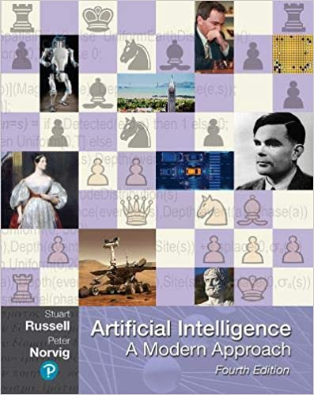
Stuart Russell and Peter Norvig (2020),
Artificial Intelligence: A Modern Approach,
4th Edition, Pearson
Source: Stuart Russell and Peter Norvig (2020), Artificial Intelligence: A Modern Approach, 4th Edition, Pearson
https://www.amazon.com/Artificial-Intelligence-A-Modern-Approach/dp/0134610997/

Slide 8
Artificial Intelligence:
A Modern Approach
Artificial Intelligence
Problem Solving
Knowledge and Reasoning
Uncertain Knowledge and Reasoning
Machine Learning
Communicating, Perceiving, and Acting
Philosophy and Ethics of AI
Source: Stuart Russell and Peter Norvig (2020), Artificial Intelligence: A Modern Approach, 4th Edition, Pearson

Slide 9
Artificial Intelligence:
Machine Learning
Source: Stuart Russell and Peter Norvig (2020), Artificial Intelligence: A Modern Approach, 4th Edition, Pearson

Slide 10
Artificial Intelligence:
5. Machine Learning
Learning from Examples
Learning Probabilistic Models
Deep Learning
Reinforcement Learning
Source: Stuart Russell and Peter Norvig (2020), Artificial Intelligence: A Modern Approach, 4th Edition, Pearson

Slide 11
Artificial Intelligence:
Reinforcement Learning
Learning from Rewards
Passive Reinforcement Learning
Active Reinforcement Learning
Generalization in Reinforcement Learning
Policy Search
Apprenticeship and Inverse Reinforcement Learning
Applications of Reinforcement Learning
Source: Stuart Russell and Peter Norvig (2020), Artificial Intelligence: A Modern Approach, 4th Edition, Pearson

Slide 12
Reinforcement Learning (DL)
Agent
Environment
Source: Richard S. Sutton & Andrew G. Barto (2018), Reinforcement Learning: An Introduction, 2nd Edition, A Bradford Book.

Slide 13
Reinforcement Learning (DL)
1
2
observation
Agent
action
3
reward
Environment
Source: Richard S. Sutton & Andrew G. Barto (2018), Reinforcement Learning: An Introduction, 2nd Edition, A Bradford Book.

Slide 14
Reinforcement Learning (DL)
1
2
observation
Agent
action
O_{t}
A_{t}
3
reward
R_{t}
Environment
Source: Richard S. Sutton & Andrew G. Barto (2018), Reinforcement Learning: An Introduction, 2nd Edition, A Bradford Book.

Slide 15
Agents interact with environments through sensors and actuators
Source: Stuart Russell and Peter Norvig (2020), Artificial Intelligence: A Modern Approach, 4th Edition, Pearson

Slide 16
AI Acting Humanly:
The Turing Test Approach
(Alan Turing, 1950)
Knowledge Representation
Automated Reasoning
Machine Learning (ML)
  Deep Learning (DL)
Computer Vision (Image, Video)
Natural Language Processing (NLP)
Robotics
Source: Stuart Russell and Peter Norvig (2020), Artificial Intelligence: A Modern Approach, 4th Edition, Pearson

Slide 17
Artificial Intelligence
Machine Learning & Deep Learning
Source: https://blogs.nvidia.com/blog/2016/07/29/whats-difference-artificial-intelligence-machine-learning-deep-learning-ai/

Slide 18
AI, ML, DL
Artificial Intelligence (AI)
Machine Learning (ML)
Supervised
Learning
Unsupervised Learning
Deep Learning (DL)
CNN
RNN LSTM GRU
GAN
Semi-supervised Learning
Reinforcement Learning
Source: https://leonardoaraujosantos.gitbooks.io/artificial-inteligence/content/deep_learning.html

Slide 19
3 Machine Learning Algorithms
Source: Enrico Galimberti, http://blogs.teradata.com/data-points/tree-machine-learning-algorithms/

Slide 20

Machine Learning (ML)
Source: https://www.mactores.com/services/aws-big-data-machine-learning-cognitive-services/

Slide 21
Stock Market Movement Forecast:
ML Phases of the stock market modeling
Source: O. Bustos and A. Pomares-Quimbaya (2020), "Stock Market Movement Forecast: A Systematic Review." Expert Systems with Applications (2020): 113464.

Slide 22
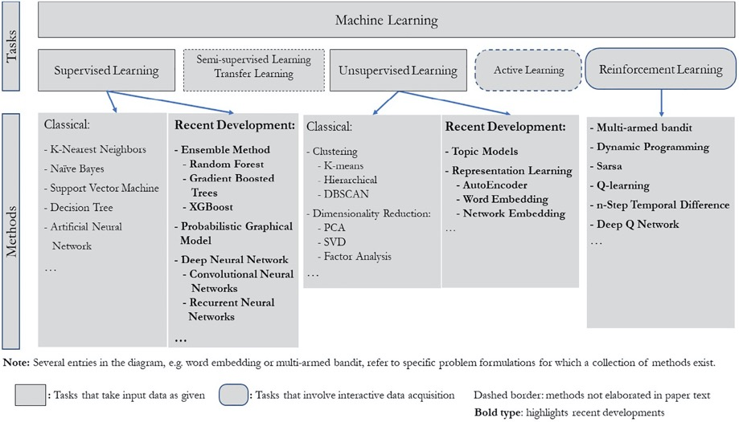
Machine Learning Tasks and Methods
Source: Liye Ma and Baohong Sun (2020), "Machine learning and AI in marketing – Connecting computing power to human insights." International Journal of Research in Marketing, 37, no. 3, 481-504.

Slide 23
Machine Learning

Slide 24
Machine Learning
Supervised Learning (Classification)
Learning from Examples
y = f(x)
x
y
input
Output
label

Slide 25
Machine Learning
Supervised Learning (Classification)
Learning from Examples
y = f(x)
Example
5.1,3.5,1.4,0.2,Iris-setosa 4.9,3.0,1.4,0.2,Iris-setosa 4.7,3.2,1.3,0.2,Iris-setosa 7.0,3.2,4.7,1.4,Iris-versicolor 6.4,3.2,4.5,1.5,Iris-versicolor 6.9,3.1,4.9,1.5,Iris-versicolor 6.3,3.3,6.0,2.5,Iris-virginica 5.8,2.7,5.1,1.9,Iris-virginica 7.1,3.0,5.9,2.1,Iris-virginica
y
x

Slide 26
Time Series Data
[10, 20, 30, 40, 50, 60, 70, 80, 90]
X
Y
[10 20 30] 40
[20 30 40] 50
[30 40 50] 60
[40 50 60] 70
[50 60 70] 80
[60 70 80] 90

Slide 27
Time Series Data
[100, 110, 120, 130, 140, 150]
Y
X
Y
[100 110 120 130 140] 150
X_{t1}
X_{t2}
X_{t3}
X_{t4}
X_{t5}

Slide 28
Linear function
y = f(x)
y = w₁x + w₀
h_{w}(x) = w₁x + w₀
Source: Stuart Russell and Peter Norvig (2020), Artificial Intelligence: A Modern Approach, 4th Edition, Pearson

Slide 29
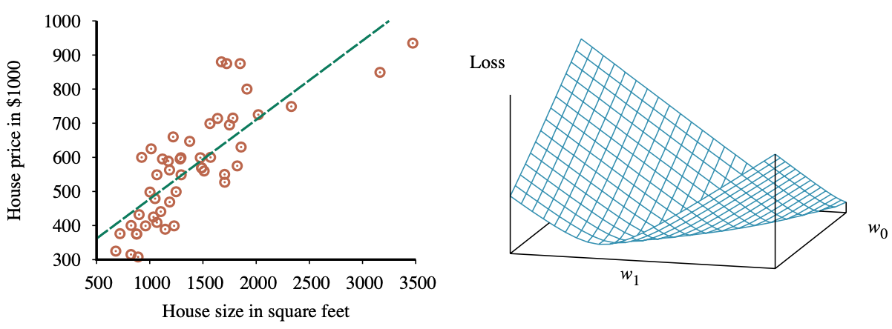
Linear Regression Weight Space
h_{w}(x) = w₁x + w₀
w* = argmin_{w} Loss(h_{w})
y = 0.232 x + 246
Loss function for Weights (w₁, w₀)
Source: Stuart Russell and Peter Norvig (2020), Artificial Intelligence: A Modern Approach, 4th Edition, Pearson

Slide 30
Deep Learning

Slide 31
Deep Learning and
Neural Networks

Slide 32

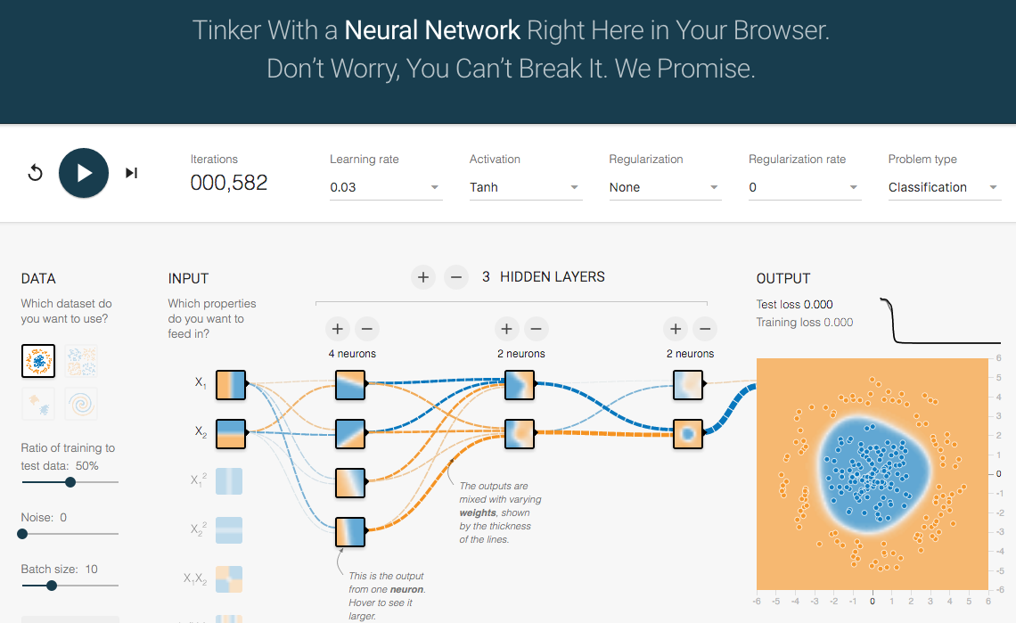
TensorFlow Playground
http://playground.tensorflow.org/

Slide 33
Tensor
3
  # a rank 0 tensor; this is a scalar with shape []
[1. ,2., 3.]
  # a rank 1 tensor; this is a vector with shape [3]
[[1., 2., 3.], [4., 5., 6.]]
  # a rank 2 tensor; a matrix with shape [2, 3]
[[[1., 2., 3.]], [[7., 8., 9.]]]
  # a rank 3 tensor with shape [2, 1, 3]
https://www.tensorflow.org/

Slide 34
Scalar
80
Vector
[50 60 70]
Matrix
50 60 70
55 65 75
[50 60 70] [70 80 90]
[55 65 75] [75 85 95]
Tensor

Slide 35
Deep Learning and
Neural Networks

Slide 36
Deep Learning Foundations:
Neural Networks

Slide 37
Deep Learning and
Neural Networks
Input Layer
(X)
Hidden Layer
(H)
Output Layer
(Y)
X1
Y
X2

Slide 38
Deep Learning and
Neural Networks
Input Layer
(X)
Hidden Layer
(H)
Output Layer
(Y)

Slide 39
Deep Learning and
Neural Networks
Input Layer
(X)
Hidden Layers
(H)
Output Layer
(Y)
Deep Neural Networks
Deep Learning

Slide 40
Deep Learning and
Deep Neural Networks

Slide 41
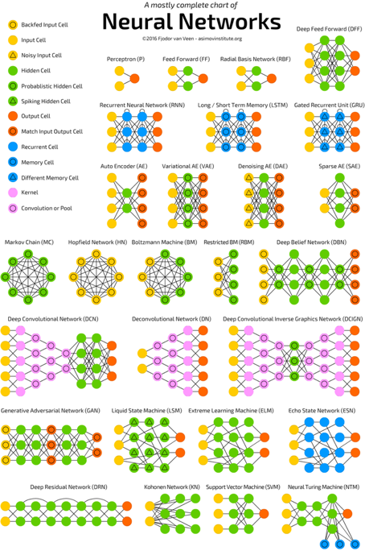
Neural Networks
(NN)
Source: http://www.asimovinstitute.org/neural-network-zoo/

Slide 42
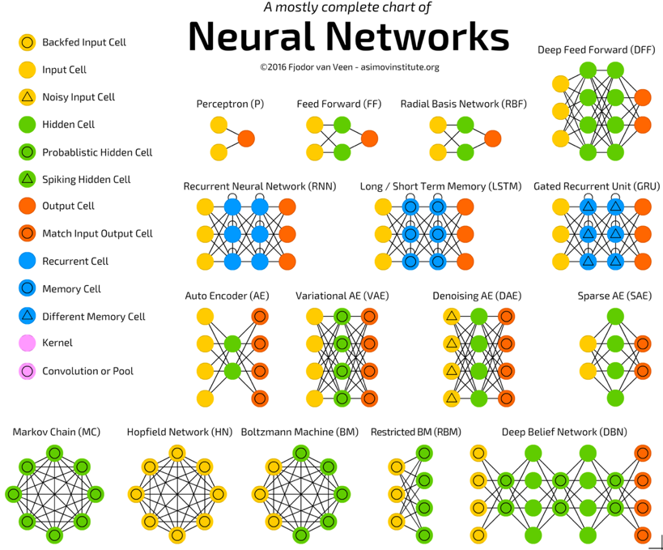
Source: http://www.asimovinstitute.org/neural-network-zoo/

Slide 43
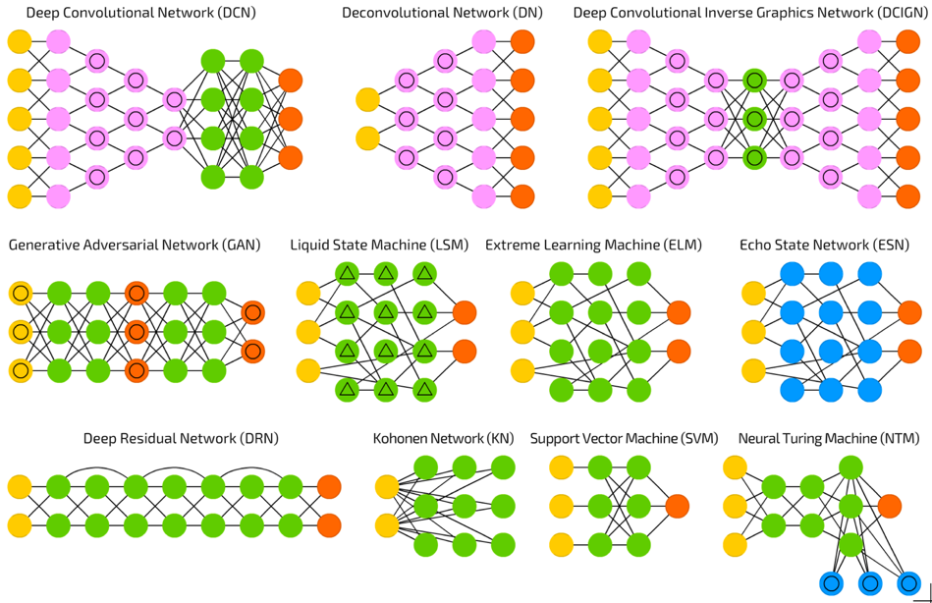
Source: http://www.asimovinstitute.org/neural-network-zoo/

Slide 44
Convolutional Neural Networks
(CNN or Deep Convolutional Neural Networks, DCNN)
LeCun, Yann, et al. “Gradient-based learning applied to document recognition.” Proceedings of the IEEE 86.11 (1998): 2278-2324.
Source: http://www.asimovinstitute.org/neural-network-zoo/

Slide 45
Recurrent Neural Networks
(RNN)
Elman, Jeffrey L. “Finding structure in time.” Cognitive science 14.2 (1990): 179-211
Source: http://www.asimovinstitute.org/neural-network-zoo/

Slide 46
Long / Short Term Memory
(LSTM)
Hochreiter, Sepp, and Jürgen Schmidhuber. “Long short-term memory.” Neural computation 9.8 (1997): 1735-1780.
Source: http://www.asimovinstitute.org/neural-network-zoo/

Slide 47
Gated Recurrent Units
(GRU)
Chung, Junyoung, et al. “Empirical evaluation of gated recurrent neural networks on sequence modeling.” arXiv preprint arXiv:1412.3555 (2014).
Source: http://www.asimovinstitute.org/neural-network-zoo/

Slide 48
Generative Adversarial Networks (GAN)
Goodfellow, Ian, et al. “Generative adversarial nets.” Advances in Neural Information Processing Systems. 2014.
Source: http://www.asimovinstitute.org/neural-network-zoo/

Slide 49
Support Vector Machines
(SVM)
Cortes, Corinna, and Vladimir Vapnik. “Support-vector networks.” Machine learning 20.3 (1995): 273-297.
Source: http://www.asimovinstitute.org/neural-network-zoo/

Slide 50
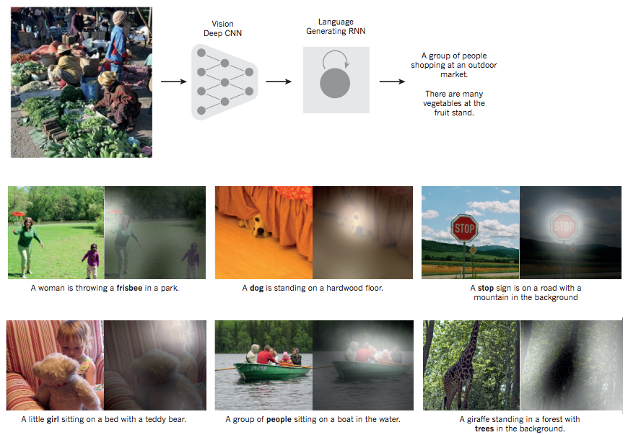
From image to text
Source: LeCun, Yann, Yoshua Bengio, and Geoffrey Hinton. "Deep learning." Nature 521, no. 7553 (2015): 436-444.

Slide 51
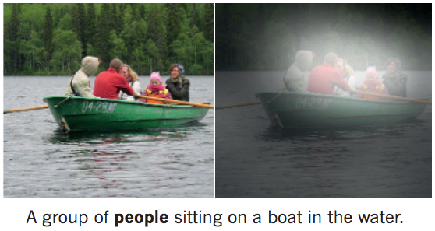
From image to text
Image: deep convolution neural network (CNN)
Text: recurrent neural network (RNN)
Source: LeCun, Yann, Yoshua Bengio, and Geoffrey Hinton. "Deep learning." Nature 521, no. 7553 (2015): 436-444.

Slide 52
Neural Networks
Input Layer
(X)
Hidden Layer
(H)
Output Layer
(Y)
X1
Y
X2
Source: https://www.youtube.com/watch?v=bxe2T-V8XRs&index=1&list=PLiaHhY2iBX9hdHaRr6b7XevZtgZRa1PoU

Slide 53
The Neuron
x₁
w₁
w₂
x₂
y
…
…
w_{n}
x_{n}
Source: Jeff Dean (2016), Large-Scale Deep Learning For Building Intelligent Computer Systems, WSDM 2016

Slide 54
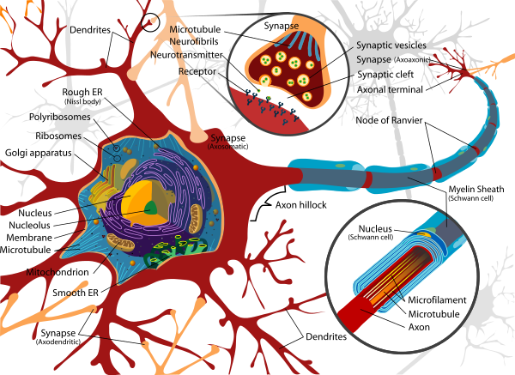
Neuron and Synapse
Source: https://en.wikipedia.org/wiki/Neuron

Slide 55
The Neuron
x₁
w₁
w₂
x₂
y
…
…
w_{n}
x_{n}
Source: Jeff Dean (2016), Large-Scale Deep Learning For Building Intelligent Computer Systems, WSDM 2016

Slide 56
y = max ( 0, -0.21 * x₁ + 0.3 * x₂ + 0.7 * x₃ )
Weights
x₁
-0.21
x₂
0.3
y
Inputs
0.7
x₃
Source: Jeff Dean (2016), Large-Scale Deep Learning For Building Intelligent Computer Systems, WSDM 2016

Slide 57
Neural Networks
Source: https://www.youtube.com/watch?v=bxe2T-V8XRs&index=1&list=PLiaHhY2iBX9hdHaRr6b7XevZtgZRa1PoU

Slide 58
Neural Networks
Input Layer
(X)
Hidden Layer
(H)
Output Layer
(Y)
X1
Y
X2
Source: https://www.youtube.com/watch?v=bxe2T-V8XRs&index=1&list=PLiaHhY2iBX9hdHaRr6b7XevZtgZRa1PoU

Slide 59
Neural Networks
Input Layer
(X)
Hidden Layers
(H)
Output Layer
(Y)
Deep Neural Networks
Deep Learning
Source: https://www.youtube.com/watch?v=bxe2T-V8XRs&index=1&list=PLiaHhY2iBX9hdHaRr6b7XevZtgZRa1PoU

Slide 60
Neural Networks
Input Layer
(X)
Hidden Layer
(H)
Output Layer
(Y)
Neuron
Synapse
Synapse
Neuron
X1
Y
X2
Source: https://www.youtube.com/watch?v=bxe2T-V8XRs&index=1&list=PLiaHhY2iBX9hdHaRr6b7XevZtgZRa1PoU

Slide 61
Neural Networks
Input Layer
(X)
Hidden Layer
(H)
Output Layer
(Y)
Hours
Sleep
Score
Hours
Study
Source: https://www.youtube.com/watch?v=bxe2T-V8XRs&index=1&list=PLiaHhY2iBX9hdHaRr6b7XevZtgZRa1PoU

Slide 62
Neural Networks
Input Layer
(X)
Hidden Layer
(H)
Output Layer
(Y)
Source: https://www.youtube.com/watch?v=P2HPcj8lRJE&list=PLjJh1vlSEYgvGod9wWiydumYl8hOXixNu&index=2

Slide 63
Neural Networks
Input Layer
(X)
Hidden Layer
(H)
Output Layer
(Y)
X1
Y
X2
Source: https://www.youtube.com/watch?v=bxe2T-V8XRs&index=1&list=PLiaHhY2iBX9hdHaRr6b7XevZtgZRa1PoU

Slide 64
X Y
Hours
Sleep
Hours
Study
Score
3 5 75
5 1 82
10 2 93
8 3 ?
Source: https://www.youtube.com/watch?v=bxe2T-V8XRs&index=1&list=PLiaHhY2iBX9hdHaRr6b7XevZtgZRa1PoU

Slide 65
X Y
Hours
Sleep
Hours
Study
Score
3 5 75
Training
5 1 82
10 2 93
8 3 ?
Testing
Source: https://www.youtube.com/watch?v=bxe2T-V8XRs&index=1&list=PLiaHhY2iBX9hdHaRr6b7XevZtgZRa1PoU

Slide 66
Y = W X + b
Source: https://www.youtube.com/watch?v=G8eNWzxOgqE

Slide 67
Output
input
Y = W X + b
Weights
bias
Trained
Source: https://www.youtube.com/watch?v=G8eNWzxOgqE

Slide 68
2.0
1.0
0.1
0.7
0.2
0.1
W X + b = Y
Scores
Probabilities
Source: https://www.youtube.com/watch?v=G8eNWzxOgqE

Slide 69
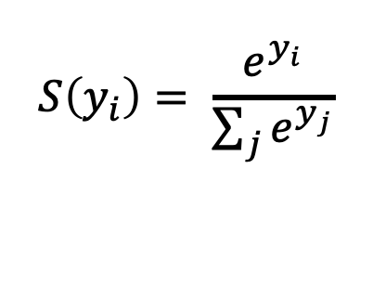
SoftMAX
2.0
1.0
0.1
0.7
0.2
0.1
W X + b = Y
$$S\left(y_{i}\right)= \frac{e^{y_{i}}}{\sum_{j}{e^{y_{j}}}}$$
Logits
Scores
Probabilities
Source: https://www.youtube.com/watch?v=G8eNWzxOgqE

Slide 70
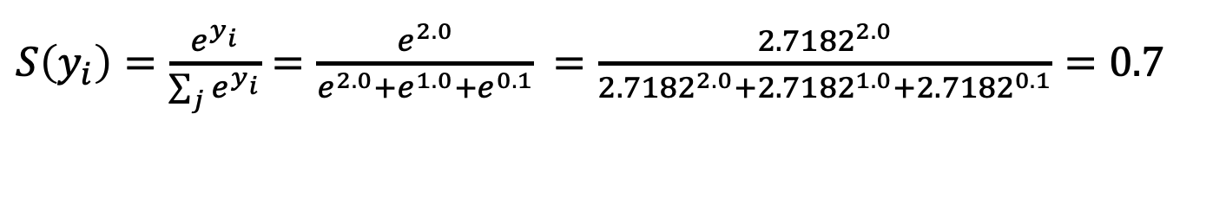
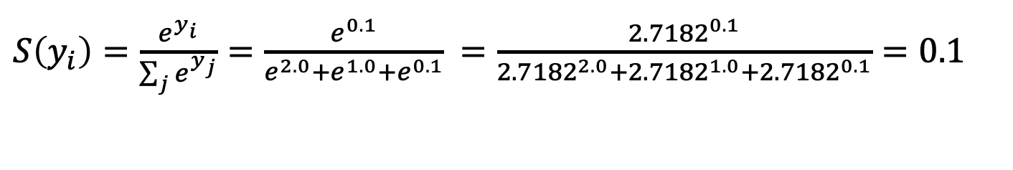
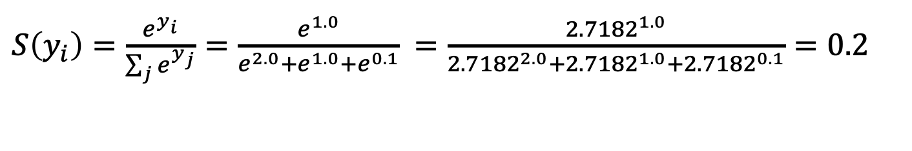
$S\left(y_{i}\right)=\frac{e^{y_{i}}}{\sum_{j}{e^{y_{i}}}}=\frac{e^{2.0}}{e^{2.0}+e^{1.0}+e^{0.1}}$ $=\frac{{2.7182}^{2.0}}{{2.7182}^{2.0}+{2.7182}^{1.0}+{2.7182}^{0.1}}=0.7$
$S\left(y_{i}\right)=\frac{e^{y_{i}}}{\sum_{j}{e^{y_{j}}}}=\frac{e^{1.0}}{e^{2.0}+e^{1.0}+e^{0.1}}$ $=\frac{{2.7182}^{1.0}}{{2.7182}^{2.0}+{2.7182}^{1.0}+{2.7182}^{0.1}}=0.2$
$S\left(y_{i}\right)=\frac{e^{y_{i}}}{\sum_{j}{e^{y_{j}}}}=\frac{e^{0.1}}{e^{2.0}+e^{1.0}+e^{0.1}}$ $=\frac{{2.7182}^{0.1}}{{2.7182}^{2.0}+{2.7182}^{1.0}+{2.7182}^{0.1}}=0.1$
2.0
1.0
0.1
0.7
0.2
0.1
W X + b = Y
$$S\left(y_{i}\right)= \frac{e^{y_{i}}}{\sum_{j}{e^{y_{j}}}}$$
Logits
Scores
Probabilities
Source: https://www.youtube.com/watch?v=G8eNWzxOgqE

Slide 71
Training a Network
=
Minimize the Cost Function
Source: https://www.youtube.com/watch?v=bxe2T-V8XRs&index=1&list=PLiaHhY2iBX9hdHaRr6b7XevZtgZRa1PoU

Slide 72
Training a Network
=
Minimize the Cost Function
Minimize the Loss Function
Source: https://www.youtube.com/watch?v=bxe2T-V8XRs&index=1&list=PLiaHhY2iBX9hdHaRr6b7XevZtgZRa1PoU

Slide 73



Error = Predict Y - Actual Y
Error : Cost : Loss
100
$$y$$
$$\hat{y}$$
75
$$e$$
50
25
Test1
Test2
Test3
Source: https://www.youtube.com/watch?v=bxe2T-V8XRs&index=1&list=PLiaHhY2iBX9hdHaRr6b7XevZtgZRa1PoU

Slide 74
Error = Predict Y - Actual Y
Error : Cost : Loss
100
$$y$$
$$\hat{y}$$
75
$$e$$
50
25
Test1
Test2
Test3
Source: https://www.youtube.com/watch?v=bxe2T-V8XRs&index=1&list=PLiaHhY2iBX9hdHaRr6b7XevZtgZRa1PoU

Slide 75
Error = Predict Y - Actual Y
Error : Cost : Loss
100
$$y$$
$$\hat{y}$$
75
$$e$$
50
25
Test1
Test2
Test3
Source: https://www.youtube.com/watch?v=bxe2T-V8XRs&index=1&list=PLiaHhY2iBX9hdHaRr6b7XevZtgZRa1PoU

Slide 76
Activation Functions

Slide 77
Activation Functions
Sigmoid
TanH
ReLU
(Rectified Linear Unit)
[0, 1]
[-1, 1]
f(x) = max(0, x)
Source: http://cs231n.github.io/neural-networks-1/

Slide 78
Activation Functions
Source: http://adilmoujahid.com/posts/2016/06/introduction-deep-learning-python-caffe/

Slide 79
Loss
Function

Slide 80
Binary Classification: 2 Class
Activation Function:
Sigmoid
Loss Function:
Binary Cross-Entropy

Slide 81
Multiple Classification: 10 Class
Activation Function:
SoftMAX
Loss Function:
Categorical Cross-Entropy

Slide 82
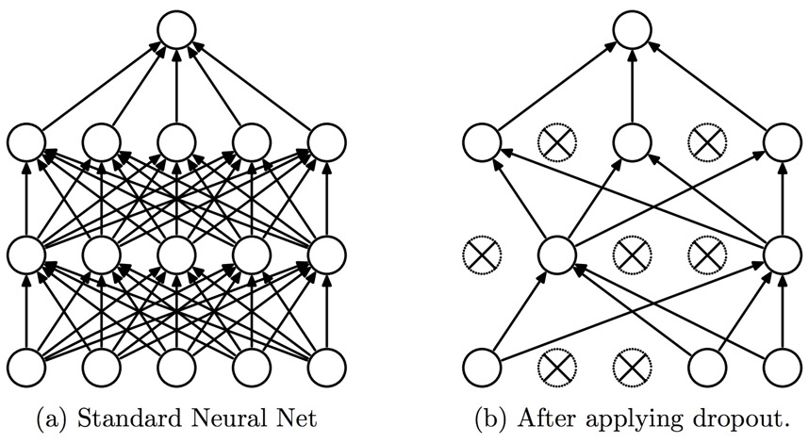
Dropout
Dropout: a simple way to prevent neural networks from overfitting
Source: Srivastava, Nitish, Geoffrey E. Hinton, Alex Krizhevsky, Ilya Sutskever, and Ruslan Salakhutdinov.
"Dropout: a simple way to prevent neural networks from overfitting." Journal of machine learning research 15, no. 1 (2014): 1929-1958.

Slide 83
Learning Algorithm
While not done:
  Pick a random training example “(input, label)”
  Run neural network on “input”
  Adjust weights on edges to make output closer to “label”
Source: Jeff Dean (2016), Large-Scale Deep Learning For Building Intelligent Computer Systems, WSDM 2016

Slide 84
y = max ( 0, -0.21 * x₁ + 0.3 * x₂ + 0.7 * x₃ )
Weights
x₁
-0.21
x₂
0.3
y
Inputs
0.7
x₃
Source: Jeff Dean (2016), Large-Scale Deep Learning For Building Intelligent Computer Systems, WSDM 2016

Slide 85
Next time:
y = max ( 0, -0.23 * x₁ + 0.31 * x₂ + 0.65 * x₃ )
y = max ( 0, -0.21 * x₁ + 0.3 * x₂ + 0.7 * x₃ )
Weights
-0.23
x₁
-0.21
0.31
x₂
0.3
y
Inputs
0.65
x₃
0.7
Source: Jeff Dean (2016), Large-Scale Deep Learning For Building Intelligent Computer Systems, WSDM 2016

Slide 86
Optimizer:
Stochastic Gradient Descent
(SGD)
J(w)
Initial
weight
Gradient
Global cost
minimum
w

Slide 87
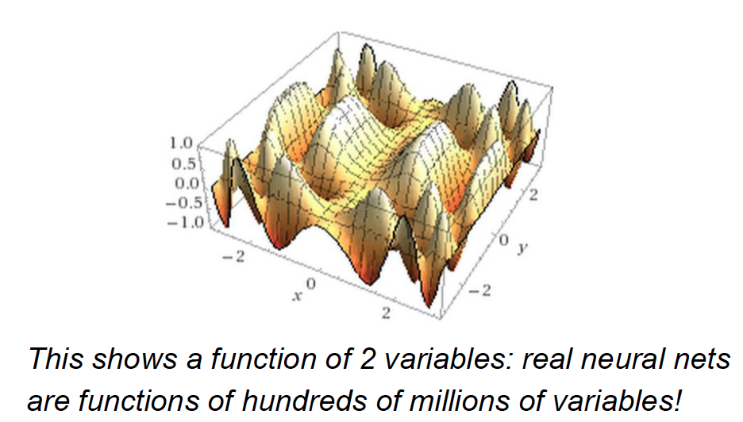
Source: Jeff Dean (2016), Large-Scale Deep Learning For Building Intelligent Computer Systems, WSDM 2016

Slide 88
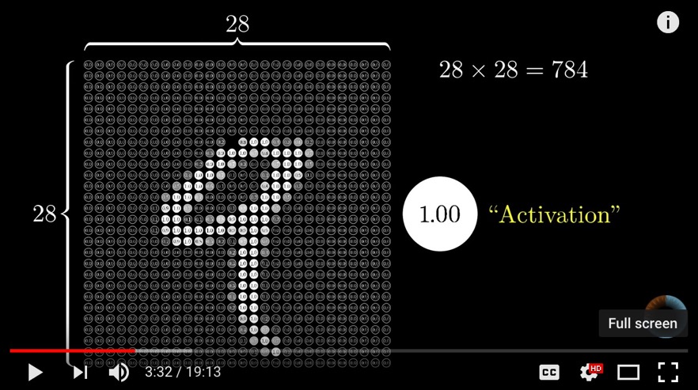
Neural Network and Deep Learning
Source: 3Blue1Brown (2017), But what *is* a Neural Network? | Chapter 1, deep learning, https://www.youtube.com/watch?v=aircAruvnKk

Slide 89
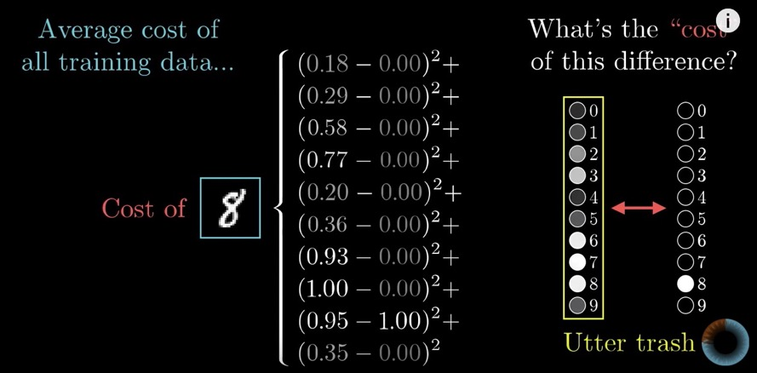
Gradient Descent how neural networks learn
Source: 3Blue1Brown (2017), Gradient descent, how neural networks learn | Chapter 2, deep learning, https://www.youtube.com/watch?v=IHZwWFHWa-w

Slide 90
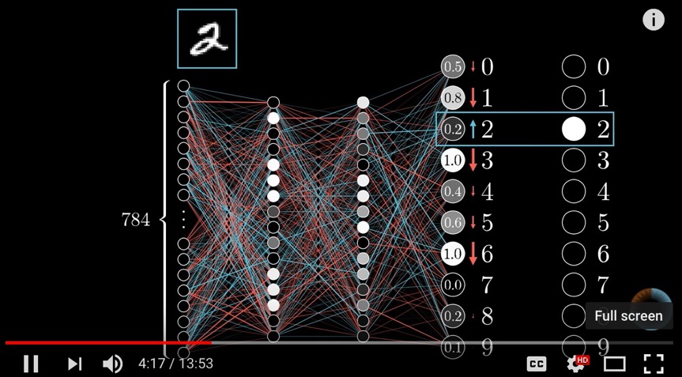
Backpropagation
Source: 3Blue1Brown (2017), What is backpropagation really doing? | Chapter 3, deep learning, https://www.youtube.com/watch?v=Ilg3gGewQ5U

Slide 91
Convolutional Neural Networks (CNN)

Slide 92
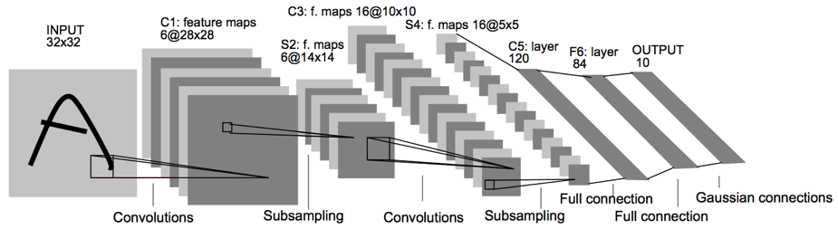
Convolutional Neural Networks
(CNN)
Architecture of LeNet-5 (7 Layers)
(LeCun et al., 1998)
Source: http://yann.lecun.com/exdb/publis/pdf/lecun-01a.pdf
Source: LeCun, Yann, Léon Bottou, Yoshua Bengio, and Patrick Haffner.
"Gradient-based learning applied to document recognition." Proceedings of the IEEE 86, no. 11 (1998): 2278-2324.

Slide 93
Convolutional Neural Networks
(CNN)
Convolution
Pooling
Fully Connection (FC) (Flattening)

Slide 94
A friendly introduction to
Convolutional Neural Networks and Image Recognition
+
-
4
-4
-
+
-4
4
1
-1
1
-1
1
-1
1
-1
1
-
+
-4
4
+
-
4
-4
Convolution Layer
Pooling Layer
Source: Luis Serrano (2017), A friendly introduction to Convolutional Neural Networks and Image Recognition,
https://www.youtube.com/watch?v=2-Ol7ZB0MmU

Slide 95
A friendly introduction to
Convolutional Neural Networks and Image Recognition
1
-1
1
1
-1
-1
1
-1
1
-1
1
-1
-1
1
1
-1
1
-1
1
-1
1
-1
1
-1
1
1
-1
-1
1
-1
1
-1
-1
1
-1
-1
1
-1
1
-1
-1
-1
-1
-1
1
-1
-1
-1
1
1
-1
1
-1
-1
-1
1
-1
1
-1
-1
1
-1
-1
1
-1
-1
-1
-1
Source: Luis Serrano (2017), A friendly introduction to Convolutional Neural Networks and Image Recognition,
https://www.youtube.com/watch?v=2-Ol7ZB0MmU

Slide 96
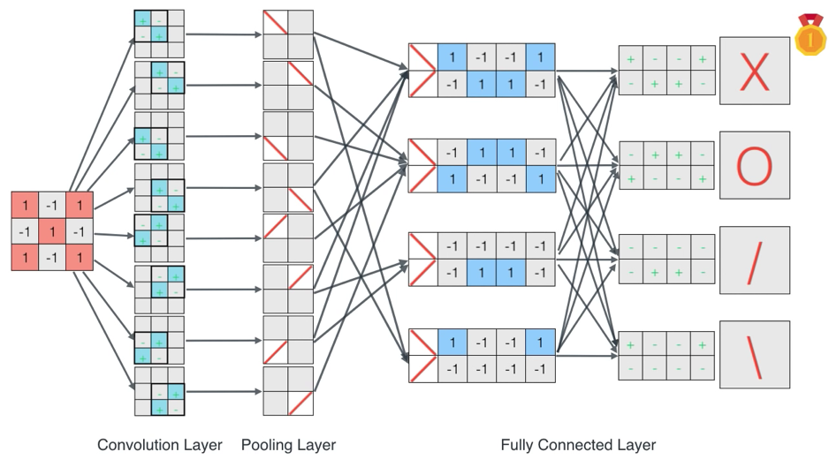
A friendly introduction to
Convolutional Neural Networks and Image Recognition
Source: Luis Serrano (2017), A friendly introduction to Convolutional Neural Networks and Image Recognition,
https://www.youtube.com/watch?v=2-Ol7ZB0MmU

Slide 97
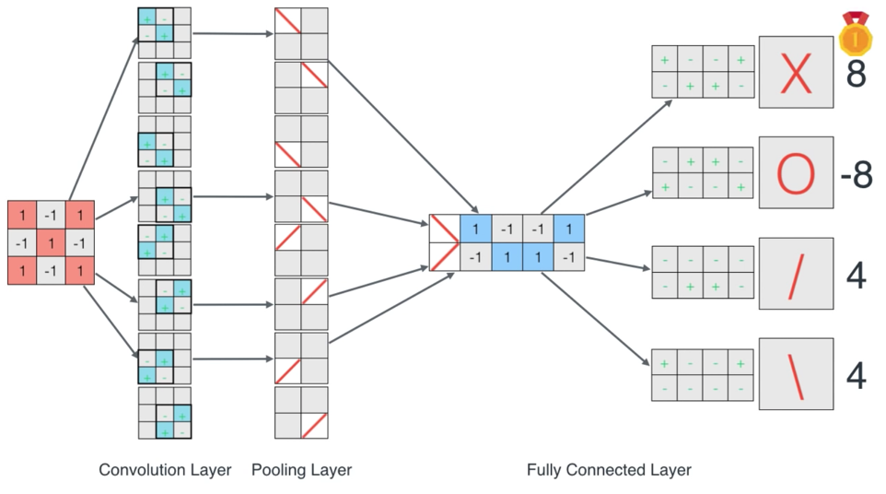
A friendly introduction to
Convolutional Neural Networks and Image Recognition
Source: Luis Serrano (2017), A friendly introduction to Convolutional Neural Networks and Image Recognition,
https://www.youtube.com/watch?v=2-Ol7ZB0MmU

Slide 98
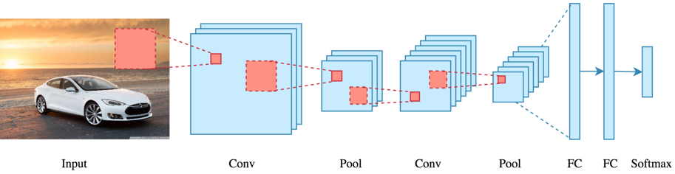
CNN Architecture
Source: Arden Dertat (2017), Applied Deep Learning - Part 4: Convolutional Neural Networks, https://towardsdatascience.com/applied-deep-learning-part-4-convolutional-neural-networks-584bc134c1e2

Slide 99
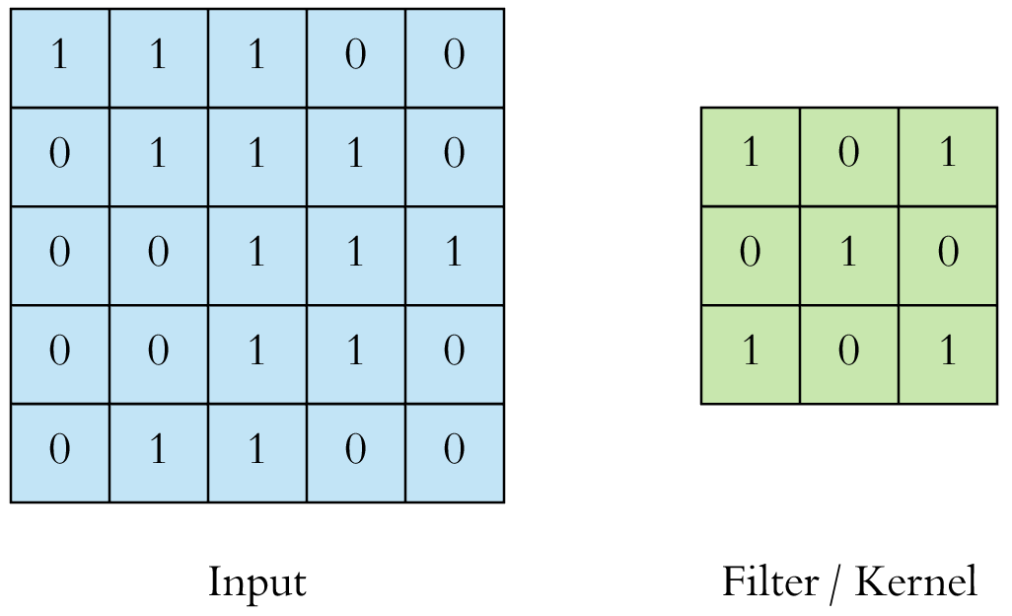
CNN Convolution Layer
Convolution is a mathematical operation to merge two sets of information
3x3 convolution
Source: Arden Dertat (2017), Applied Deep Learning - Part 4: Convolutional Neural Networks, https://towardsdatascience.com/applied-deep-learning-part-4-convolutional-neural-networks-584bc134c1e2

Slide 100
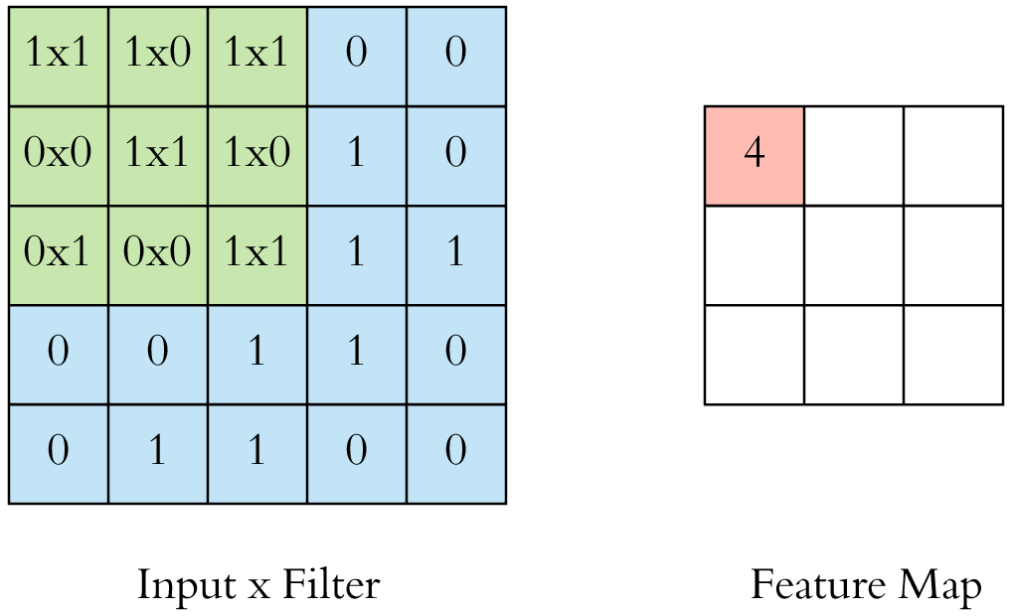
CNN Convolution Layer
Input x Filter --> Feature Map
receptive field: 3x3
Source: Arden Dertat (2017), Applied Deep Learning - Part 4: Convolutional Neural Networks, https://towardsdatascience.com/applied-deep-learning-part-4-convolutional-neural-networks-584bc134c1e2

Slide 101
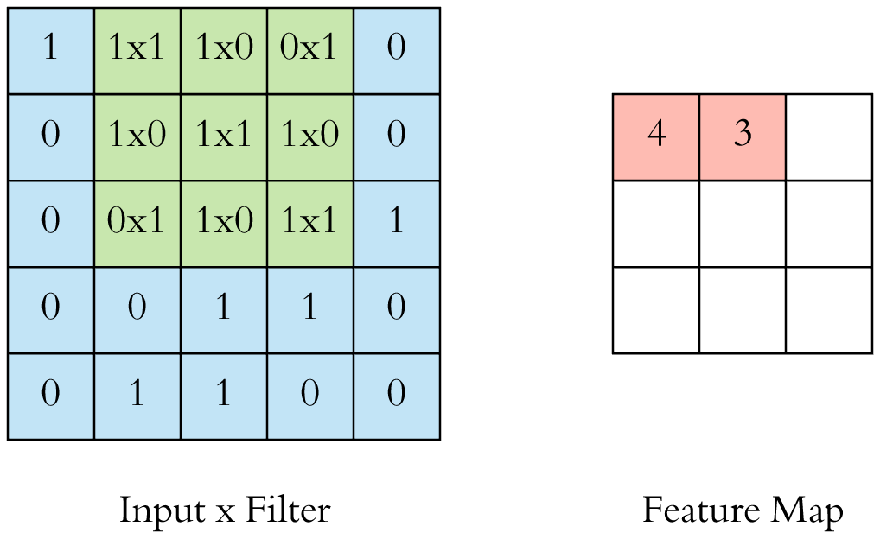
CNN Convolution Layer
Input x Filter --> Feature Map
receptive field: 3x3
Source: Arden Dertat (2017), Applied Deep Learning - Part 4: Convolutional Neural Networks, https://towardsdatascience.com/applied-deep-learning-part-4-convolutional-neural-networks-584bc134c1e2

Slide 102
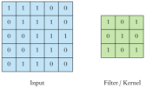
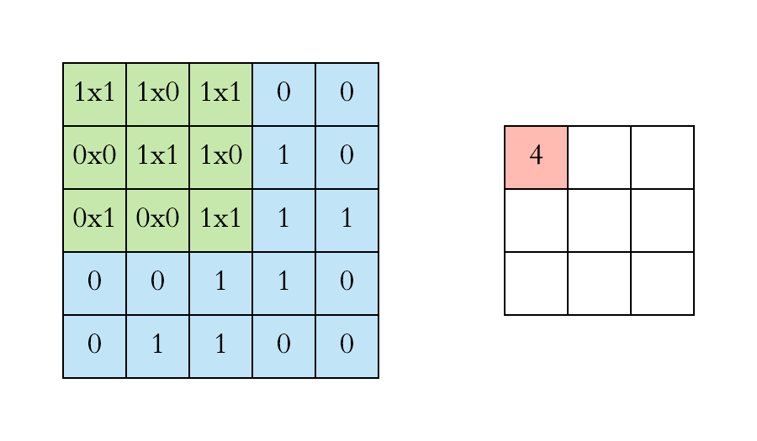
CNN Convolution Layer
Example convolution operation shown in 2D using a 3x3 filter
Source: Arden Dertat (2017), Applied Deep Learning - Part 4: Convolutional Neural Networks, https://towardsdatascience.com/applied-deep-learning-part-4-convolutional-neural-networks-584bc134c1e2

Slide 103
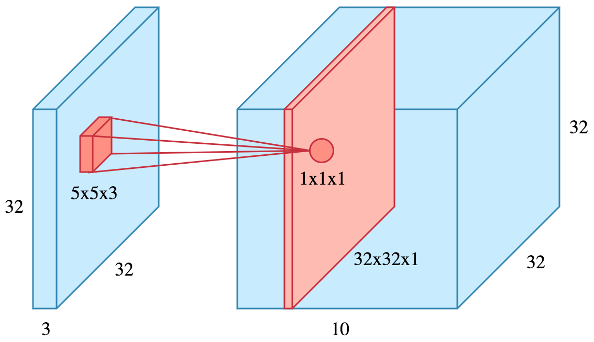
CNN Convolution Layer
10 different filters
10 feature maps of size 32x32x1
final output of the convolution layer:
a volume of size 32x32x10
Source: Arden Dertat (2017), Applied Deep Learning - Part 4: Convolutional Neural Networks, https://towardsdatascience.com/applied-deep-learning-part-4-convolutional-neural-networks-584bc134c1e2

Slide 104
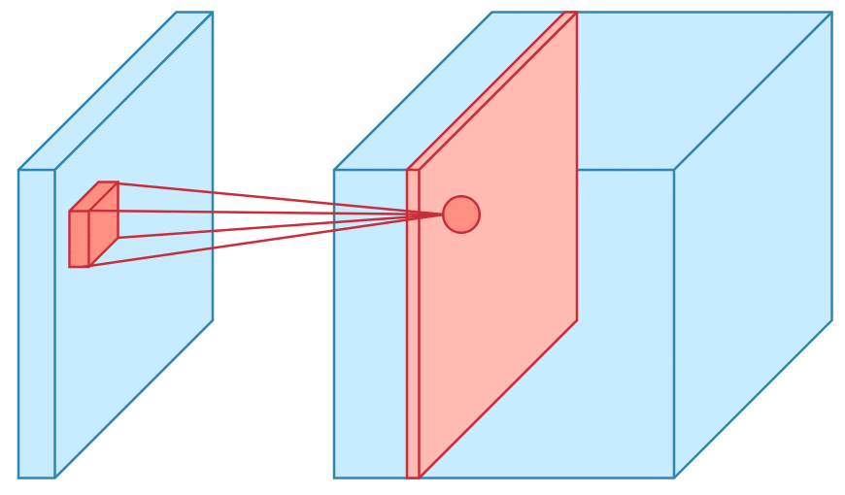
CNN Convolution Layer
Sliding operation at 4 locations
Source: Arden Dertat (2017), Applied Deep Learning - Part 4: Convolutional Neural Networks, https://towardsdatascience.com/applied-deep-learning-part-4-convolutional-neural-networks-584bc134c1e2

Slide 105
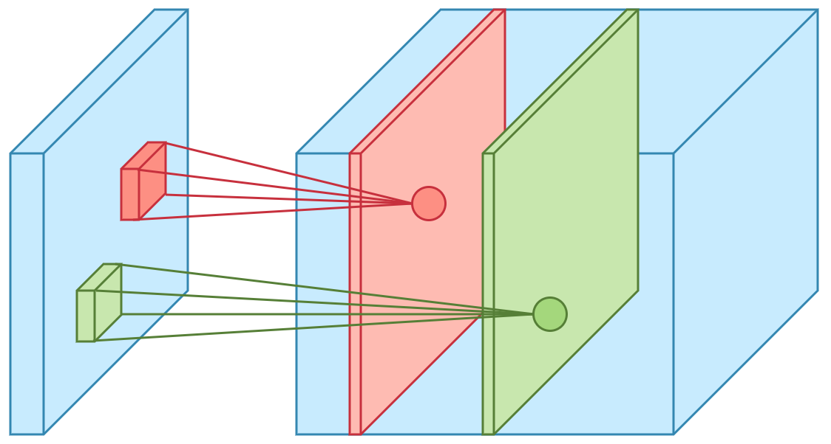
CNN Convolution Layer
two feature maps
Source: Arden Dertat (2017), Applied Deep Learning - Part 4: Convolutional Neural Networks, https://towardsdatascience.com/applied-deep-learning-part-4-convolutional-neural-networks-584bc134c1e2

Slide 106
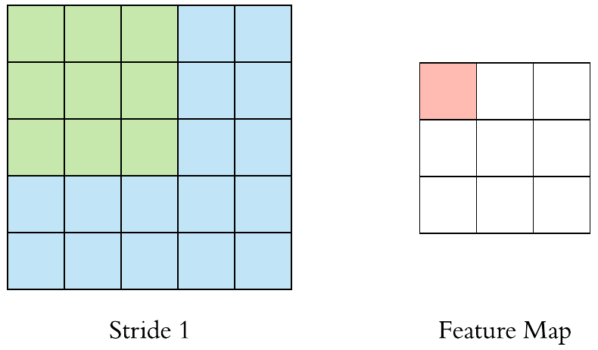
CNN Convolution Layer
Stride specifies how much
we move the convolution filter at each step
Source: Arden Dertat (2017), Applied Deep Learning - Part 4: Convolutional Neural Networks, https://towardsdatascience.com/applied-deep-learning-part-4-convolutional-neural-networks-584bc134c1e2

Slide 107
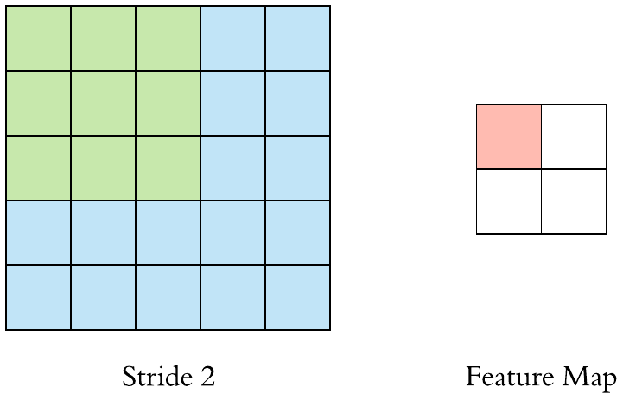
CNN Convolution Layer
Stride specifies how much
we move the convolution filter at each step
Source: Arden Dertat (2017), Applied Deep Learning - Part 4: Convolutional Neural Networks, https://towardsdatascience.com/applied-deep-learning-part-4-convolutional-neural-networks-584bc134c1e2

Slide 108
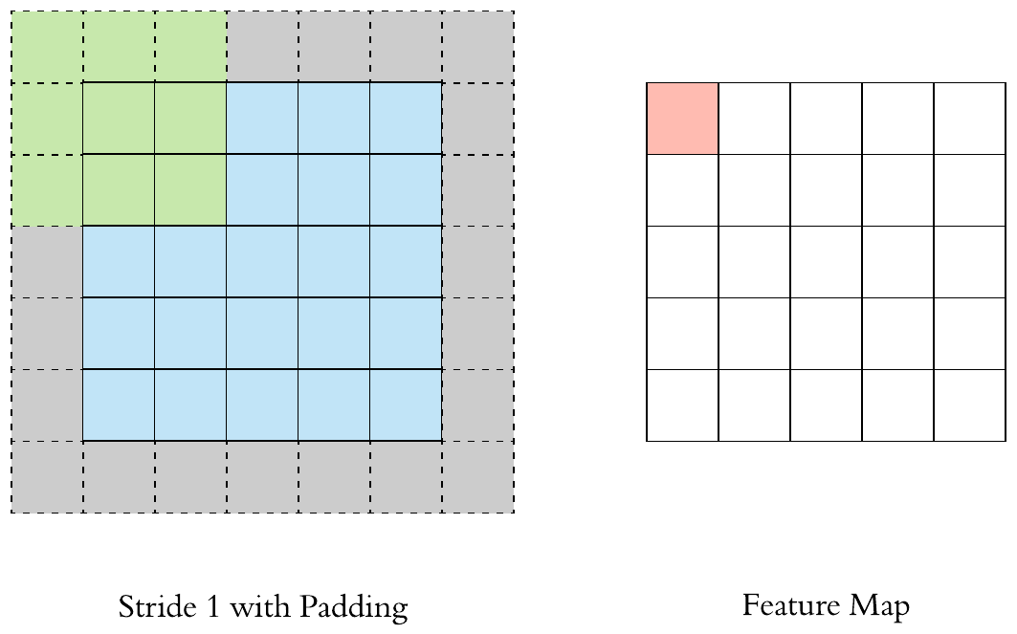
CNN Convolution Layer
Stride 1 with Padding
Source: Arden Dertat (2017), Applied Deep Learning - Part 4: Convolutional Neural Networks, https://towardsdatascience.com/applied-deep-learning-part-4-convolutional-neural-networks-584bc134c1e2

Slide 109
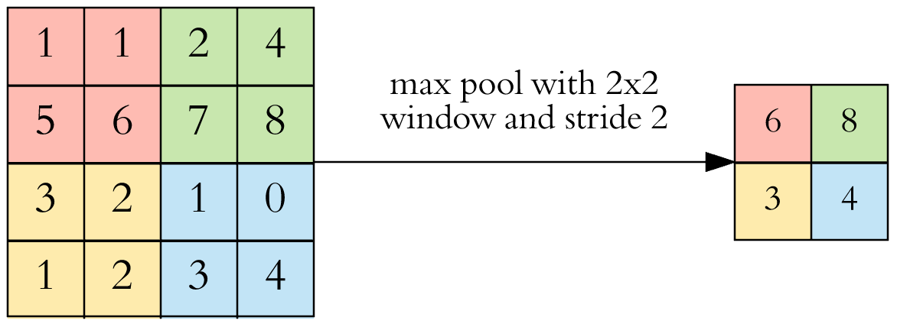
CNN Pooling Layer
Max Pooling
Source: Arden Dertat (2017), Applied Deep Learning - Part 4: Convolutional Neural Networks, https://towardsdatascience.com/applied-deep-learning-part-4-convolutional-neural-networks-584bc134c1e2

Slide 110
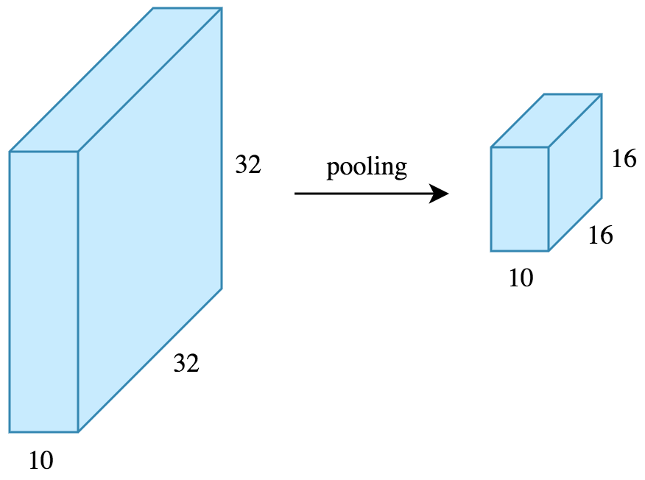
CNN Pooling Layer
Source: Arden Dertat (2017), Applied Deep Learning - Part 4: Convolutional Neural Networks, https://towardsdatascience.com/applied-deep-learning-part-4-convolutional-neural-networks-584bc134c1e2

Slide 111
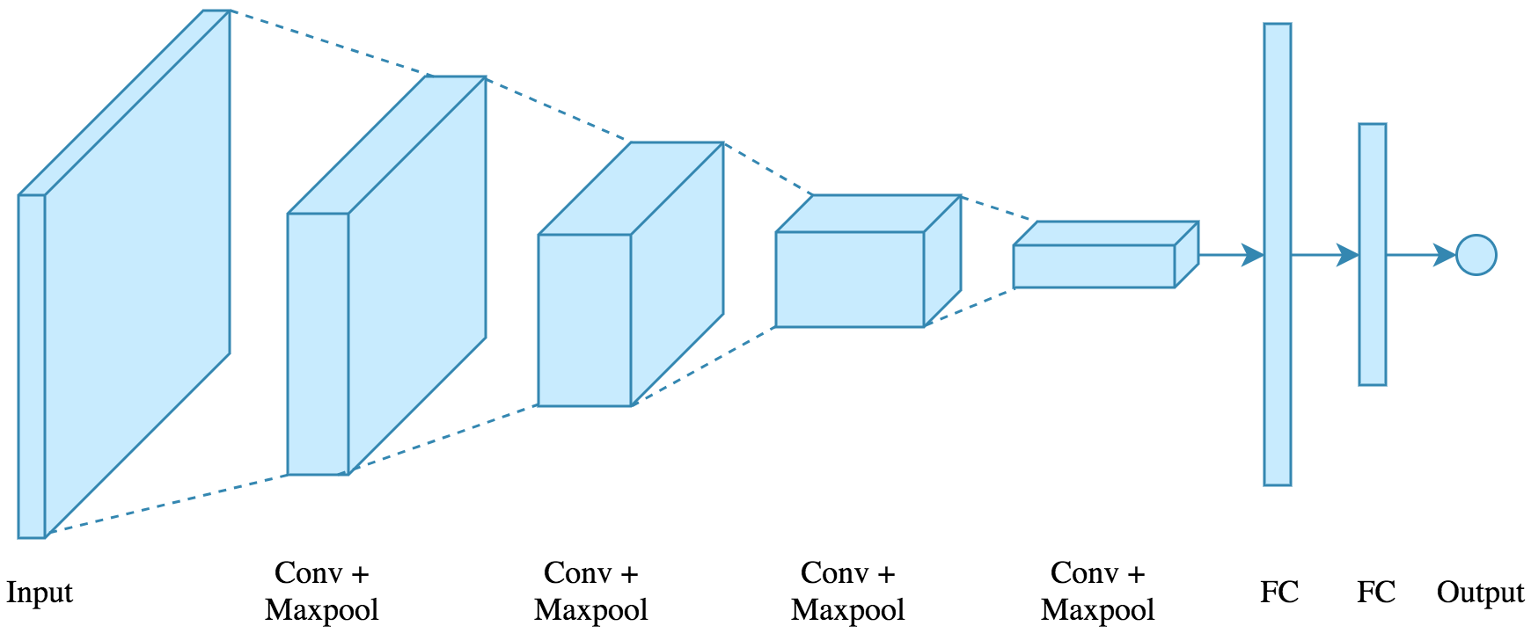
CNN Architecture
4 convolution + pooling layers,
followed by 2 fully connected layers
Source: Arden Dertat (2017), Applied Deep Learning - Part 4: Convolutional Neural Networks, https://towardsdatascience.com/applied-deep-learning-part-4-convolutional-neural-networks-584bc134c1e2

Slide 112
CNN Architecture
4 convolution + pooling layers,
followed by 2 fully connected layers
https://gist.github.com/ardendertat/0fc5515057c47e7386fe04e9334504e3
model = Sequential()
model.add(Conv2D(32, (3, 3), activation='relu', padding='same', name='conv_1',
input_shape=(150, 150, 3)))
model.add(MaxPooling2D((2, 2), name='maxpool_1'))
model.add(Conv2D(64, (3, 3), activation='relu', padding='same', name='conv_2'))
model.add(MaxPooling2D((2, 2), name='maxpool_2'))
model.add(Conv2D(128, (3, 3), activation='relu', padding='same', name='conv_3'))
model.add(MaxPooling2D((2, 2), name='maxpool_3'))
model.add(Conv2D(128, (3, 3), activation='relu', padding='same', name='conv_4'))
model.add(MaxPooling2D((2, 2), name='maxpool_4'))
model.add(Flatten())
model.add(Dropout(0.5))
model.add(Dense(512, activation='relu', name='dense_1'))
model.add(Dense(128, activation='relu', name='dense_2'))
model.add(Dense(1, activation='sigmoid', name='output'))
Source: Arden Dertat (2017), Applied Deep Learning - Part 4: Convolutional Neural Networks, https://towardsdatascience.com/applied-deep-learning-part-4-convolutional-neural-networks-584bc134c1e2

Slide 113
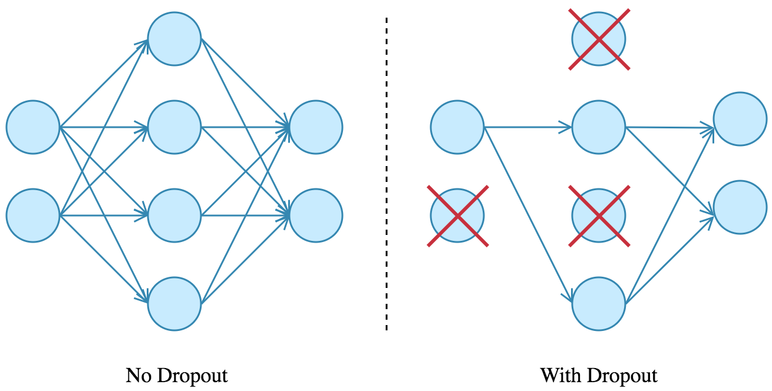
Dropout
Source: Arden Dertat (2017), Applied Deep Learning - Part 4: Convolutional Neural Networks, https://towardsdatascience.com/applied-deep-learning-part-4-convolutional-neural-networks-584bc134c1e2

Slide 114
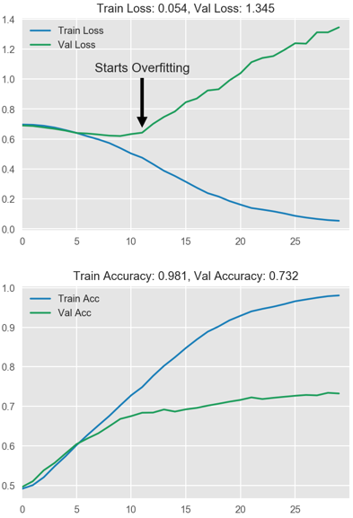
Model Performance
Source: Arden Dertat (2017), Applied Deep Learning - Part 4: Convolutional Neural Networks, https://towardsdatascience.com/applied-deep-learning-part-4-convolutional-neural-networks-584bc134c1e2

Slide 115
Visual Recognition
Image Classification

Slide 116
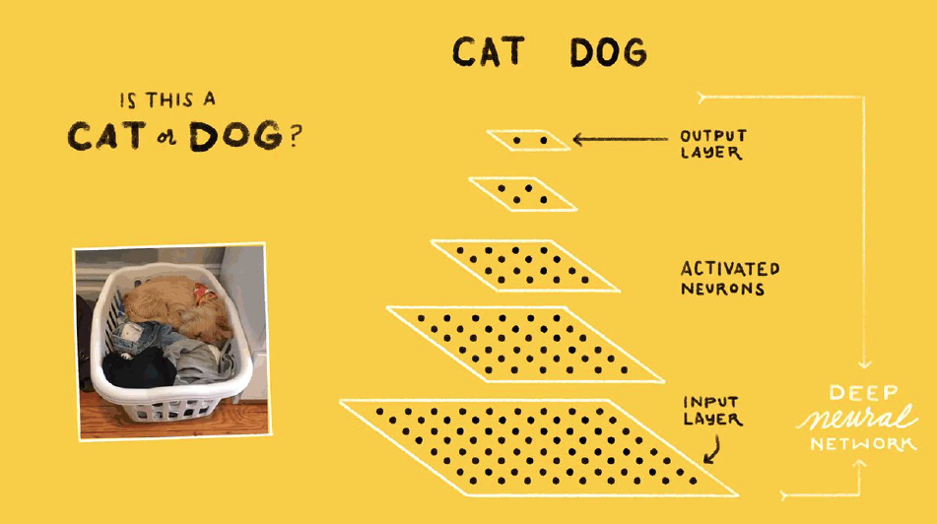
Source: Jeff Dean (2016), Large-Scale Deep Learning For Building Intelligent Computer Systems, WSDM 2016

Slide 117
Convolutional Neural Networks (CNNs / ConvNets)
http://cs231n.github.io/convolutional-networks/

Slide 118

A regular 3-layer Neural Network
http://cs231n.github.io/convolutional-networks/

Slide 119
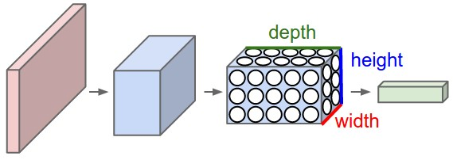
A ConvNet arranges its neurons in three dimensions
(width, height, depth)
http://cs231n.github.io/convolutional-networks/

Slide 120
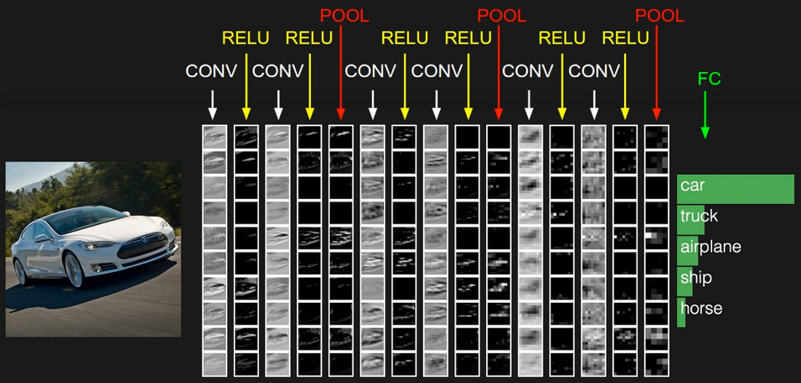
The activations of an example ConvNet architecture.
http://cs231n.github.io/convolutional-networks/

Slide 121
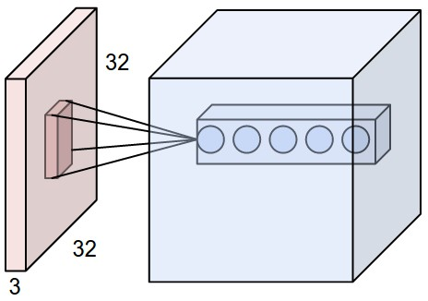
ConvNets
32x32x3 CIFAR-10 image
first Convolutional layer
http://cs231n.github.io/convolutional-networks/

Slide 122
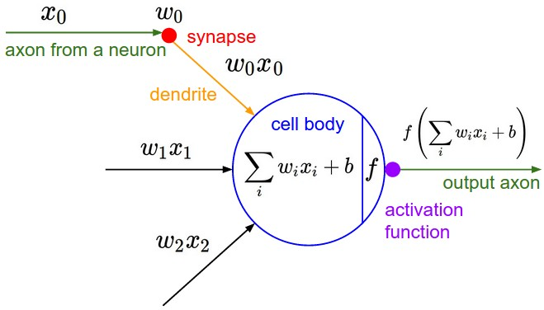
ConvNets
http://cs231n.github.io/convolutional-networks/

Slide 123
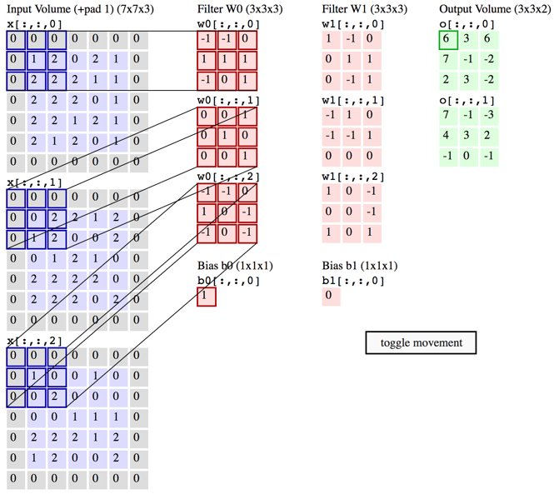
Convolution Demo
http://cs231n.github.io/convolutional-networks/

Slide 124
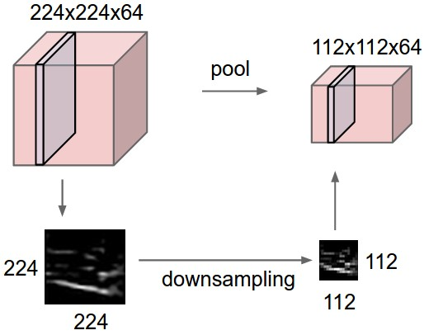
ConvNets
input volume of size [224x224x64]
is pooled with filter size 2, stride 2
into output volume of size [112x112x64]
http://cs231n.github.io/convolutional-networks/

Slide 125
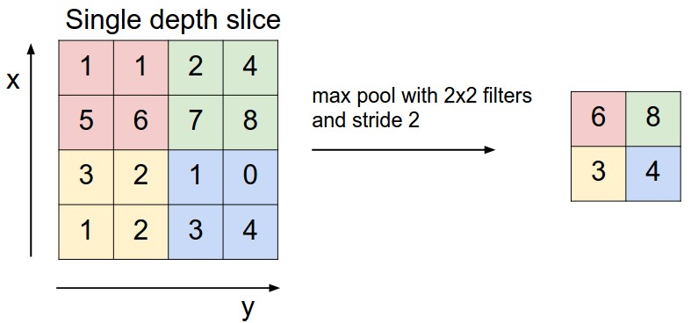
ConvNets max pooling
http://cs231n.github.io/convolutional-networks/

Slide 126

Convolutional Neural Networks (CNN) (LeNet)
Source: http://deeplearning.net/tutorial/lenet.html

Slide 127
Recurrent
Neural Networks (RNN)

Slide 128
Recurrent Neural Networks (RNN)
y_{t-2}
y_{t-1}
y_{t}
y_{t+1}
y_{t+2}
output
h_{t-2}
h_{t-1}
h_{t}
h_{t+1}
h_{t+2}
hidden
X_{t-2}
X_{t-1}
X_{t}
X_{t+1}
X_{t+2}
Input

Slide 129
Recurrent Neural Networks (RNN)
Time Series Forecasting
110
120
130
140
150
y_{t-2}
y_{t-1}
y_{t}
y_{t+1}
y_{t+2}
output
h_{t-2}
h_{t-1}
h_{t}
h_{t+1}
h_{t+2}
hidden
X_{t-2}
X_{t-1}
X_{t}
X_{t+1}
X_{t+2}
Input
100
110
120
130
140

Slide 130
Recurrent Neural Networks (RNN)
y
output
h_{t-2}
h_{t-1}
h_{t}
h_{t+1}
h_{t+2}
hidden
X_{t-2}
X_{t-1}
X_{t}
X_{t+1}
X_{t+2}
Input

Slide 131

Recurrent Neural Networks (RNN)
Sentiment Analysis
y
output
h_{t-2}
h_{t-1}
h_{t}
h_{t+1}
h_{t+2}
hidden
X_{t-2}
X_{t-1}
X_{t}
X_{t+1}
X_{t+2}
Input
This
movie
is
very
good

Slide 132

Recurrent Neural Networks (RNN)
Sentiment Analysis
y
output
h_{t-2}
h_{t-1}
h_{t}
h_{t+1}
h_{t+2}
hidden
X_{t-2}
X_{t-1}
X_{t}
X_{t+1}
X_{t+2}
Input
This
movie
is
very
boring

Slide 133
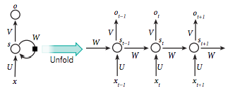
Recurrent Neural Network (RNN)
Source: LeCun, Yann, Yoshua Bengio, and Geoffrey Hinton. "Deep learning." Nature 521, no. 7553 (2015): 436-444.

Slide 134
RNN
Source: Christopher Olah, (2015) Understanding LSTM Networks, http://colah.github.io/posts/2015-08-Understanding-LSTMs/

Slide 135
RNN long-term dependencies
I grew up in France… I speak fluent French.
Source: Christopher Olah, (2015) Understanding LSTM Networks, http://colah.github.io/posts/2015-08-Understanding-LSTMs/

Slide 136
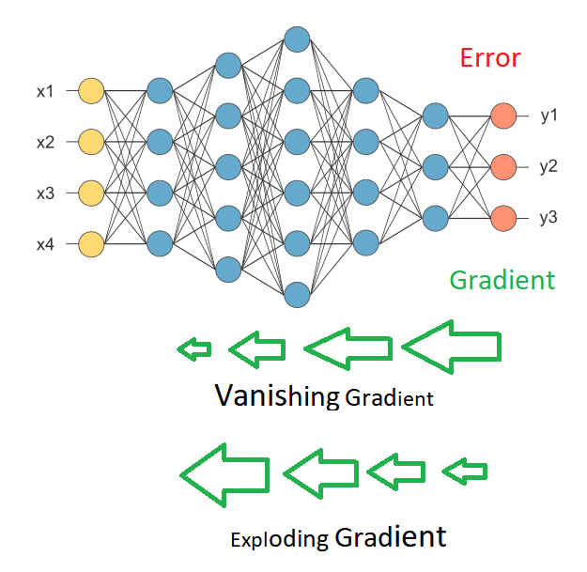
Vanishing Gradient
Exploding Gradient
Source: https://medium.com/deep-math-machine-learning-ai/chapter-10-1-deepnlp-lstm-long-short-term-memory-networks-with-math-21477f8e4235

Slide 137
Recurrent Neural Networks (RNN)
y_{t-2}
y_{t-1}
y_{t}
y_{t+1}
y_{t+2}
output
V
V
V
V
W
W
W
W
h_{t-2}
h_{t-1}
h_{t}
h_{t+1}
h_{t+2}
hidden
U
U
U
U
X_{t-2}
X_{t-1}
X_{t}
X_{t+1}
X_{t+2}
Input

Slide 138
RNN
Vanishing Gradient problem
Exploding Gradient problem
Error
y_{t-2}
y_{t-1}
y_{t}
y_{t+1}
y_{t+2}
output
V
V
V
V
W
W
W
W
h_{t-2}
h_{t-1}
h_{t}
h_{t+1}
h_{t+2}
hidden
U
U
U
U
X_{t-2}
X_{t-1}
X_{t}
X_{t+1}
X_{t+2}
Input
if |W| < 1 (Vanishing)
if |W| > 1 (Exploding)
Source: https://medium.com/deep-math-machine-learning-ai/chapter-10-1-deepnlp-lstm-long-short-term-memory-networks-with-math-21477f8e4235

Slide 139
RNN
Vanishing Gradient problem
Error
y_{t-2}
y_{t-1}
y_{t}
y_{t+1}
y_{t+2}
output
V
V
V
V
0.9
0.9
0.9
0.9
h_{t-2}
h_{t-1}
h_{t}
h_{t+1}
h_{t+2}
hidden
U
U
U
U
X_{t-2}
X_{t-1}
X_{t}
X_{t+1}
X_{t+2}
Input
W = 0.9 < 1 (Vanishing)
Source: https://medium.com/deep-math-machine-learning-ai/chapter-10-1-deepnlp-lstm-long-short-term-memory-networks-with-math-21477f8e4235

Slide 140
RNN
Exploding Gradient problem
Error
y_{t-2}
y_{t-1}
y_{t}
y_{t+1}
y_{t+2}
output
V
V
V
V
1.1
1.1
1.1
1.1
h_{t-2}
h_{t-1}
h_{t}
h_{t+1}
h_{t+2}
hidden
U
U
U
U
X_{t-2}
X_{t-1}
X_{t}
X_{t+1}
X_{t+2}
Input
W = 1.1 > 1 (Exploding)
Source: https://medium.com/deep-math-machine-learning-ai/chapter-10-1-deepnlp-lstm-long-short-term-memory-networks-with-math-21477f8e4235

Slide 141
RNN LSTM
RNN
LSTM
Source: Christopher Olah, (2015) Understanding LSTM Networks, http://colah.github.io/posts/2015-08-Understanding-LSTMs/

Slide 142
Long Short Term Memory
(LSTM)
Source: Christopher Olah, (2015) Understanding LSTM Networks, http://colah.github.io/posts/2015-08-Understanding-LSTMs/

Slide 143
Long Short Term Memory
(LSTM)
forget
gate
input
gate
output
gate
Source: Christopher Olah, (2015) Understanding LSTM Networks, http://colah.github.io/posts/2015-08-Understanding-LSTMs/

Slide 144
Gated Recurrent Unit
(GRU)
Source: Christopher Olah, (2015) Understanding LSTM Networks, http://colah.github.io/posts/2015-08-Understanding-LSTMs/

Slide 145
Gated Recurrent Unit
(GRU)
reset
gate
update
gate
Source: Christopher Olah, (2015) Understanding LSTM Networks, http://colah.github.io/posts/2015-08-Understanding-LSTMs/

Slide 146

LSTM
Source: Shi Yan (2016), Understanding LSTM and its diagrams, https://medium.com/mlreview/understanding-lstm-and-its-diagrams-37e2f46f1714

Slide 147

LSTM vs GRU
LSTM
GRU
i, f and o are the input, forget and output gates, respectively.
c and c˜ denote the memory cell and the new memory cell content.
r and z are the reset and update gates, and h and h˜ are the activation and the candidate activation.
Source: Chung, Junyoung, Caglar Gulcehre, KyungHyun Cho, and Yoshua Bengio. "Empirical evaluation of gated recurrent neural networks on sequence modeling." arXiv preprint arXiv:1412.3555 (2014).

Slide 148
Long Short Term Memory
(LSTM)
h_{t}
C_{t-1}
C_{t}
X
+
tanh
f_{t}
i_{t}
X
o_{t}
X
∼
C_{t}
h_{t-1}
σ
σ
tanh
σ
h_{t}
x_{t}
Source: Christopher Olah, (2015) Understanding LSTM Networks, http://colah.github.io/posts/2015-08-Understanding-LSTMs/

Slide 149
Long Short Term Memory
(LSTM)
forget
gate
input
gate
output
gate
h_{t}
C_{t-1}
C_{t}
X
+
tanh
f_{t}
i_{t}
X
o_{t}
X
∼
C_{t}
h_{t-1}
σ
σ
tanh
σ
h_{t}
x_{t}
Source: Christopher Olah, (2015) Understanding LSTM Networks, http://colah.github.io/posts/2015-08-Understanding-LSTMs/

Slide 150

LSTM
Memory state (C)
Source: Christopher Olah, (2015) Understanding LSTM Networks, http://colah.github.io/posts/2015-08-Understanding-LSTMs/

Slide 151

LSTM forget gate (f)
Source: Christopher Olah, (2015) Understanding LSTM Networks, http://colah.github.io/posts/2015-08-Understanding-LSTMs/

Slide 152

LSTM input gate (i)
Source: Christopher Olah, (2015) Understanding LSTM Networks, http://colah.github.io/posts/2015-08-Understanding-LSTMs/

Slide 153

LSTM
Memory state (C)
Source: Christopher Olah, (2015) Understanding LSTM Networks, http://colah.github.io/posts/2015-08-Understanding-LSTMs/

Slide 154

LSTM output gate (o)
Source: Christopher Olah, (2015) Understanding LSTM Networks, http://colah.github.io/posts/2015-08-Understanding-LSTMs/

Slide 155

LSTM forget (f), input (i), output (o) gates
Source: Christopher Olah, (2015) Understanding LSTM Networks, http://colah.github.io/posts/2015-08-Understanding-LSTMs/

Slide 156

Gated Recurrent Unit
(GRU) update (z), reset (r) gates
Source: Christopher Olah, (2015) Understanding LSTM Networks, http://colah.github.io/posts/2015-08-Understanding-LSTMs/

Slide 157

LSTM Recurrent Neural Network
Traditional Neural Network
Music
Generation
Sentiment
Classification
Name
Entity
Recognition
Machine
Translation
Source: https://github.com/Vict0rSch/deep_learning/tree/master/keras/recurrent

Slide 158
Long Short Term Memory (LSTM) for Time Series Forecasting
h_{t-2}
h_{t-1}
h_{t}
h_{t+1}
h_{t+2}
LSTM
LSTM
LSTM
LSTM
LSTM
X_{t-2}
X_{t-1}
X_{t}
X_{t+1}
X_{t+2}

Slide 159
Time Series Data
[100, 110, 120, 130, 140, 150]
Y
X
Y
[100 110 120 130 140] 150
X_{t1}
X_{t2}
X_{t3}
X_{t4}
X_{t5}

Slide 160
Time Series Data
[10, 20, 30, 40, 50, 60, 70, 80, 90]
X
Y
[10 20 30] 40
[20 30 40] 50
[30 40 50] 60
[40 50 60] 70
[50 60 70] 80
[60 70 80] 90

Slide 161


TensorFlow
https://www.tensorflow.org/

Slide 162

PyTorch
https://pytorch.org/

Slide 163

TensorFlow
An end-to-end open source
machine learning platform.
The core open source library to help you develop and train ML models.
Get started quickly by running
Colab notebooks directly in your browser.
https://www.tensorflow.org/

Slide 164

TensorFlow 2.0
https://www.tensorflow.org/overview/

Slide 165

TensorFlow
Image Classification
https://www.tensorflow.org/tutorials/keras/classification

Slide 166

Image Classification
Fashion MNIST dataset
https://www.tensorflow.org/tutorials/keras/classification

Slide 167

Text Classification with TF Hub
https://www.tensorflow.org/tutorials/keras/text_classification_with_hub

Slide 168

Text Classification with Pre Text
https://www.tensorflow.org/tutorials/keras/text_classification

Slide 169

Regression
https://www.tensorflow.org/tutorials/keras/regression

Slide 170

TensorFlow 2.0
Time Series Forecasting
https://www.tensorflow.org/tutorials/structured_data/time_series

Slide 171

Basic Classification
Fashion MNIST Image Classification
https://colab.research.google.com/drive/19PJOJi1vn1kjcutlzNHjRSLbeVl4kd5z
Source: https://colab.research.google.com/github/tensorflow/docs/blob/master/site/en/tutorials/keras/basic_classification.ipynb

Slide 172

Text Classification
IMDB Movie Reviews
https://colab.research.google.com/drive/1x16h1GhHsLIrLYtPCvCHaoO1W-i_gror
Source: https://colab.research.google.com/github/tensorflow/docs/blob/master/site/en/tutorials/keras/basic_text_classification.ipynb

Slide 173

Basic Regression
Predict House Prices
https://colab.research.google.com/drive/1v4c8ZHTnRtgd2_25K_AURjR6SCVBRdlj
Source: https://colab.research.google.com/github/tensorflow/docs/blob/master/site/en/tutorials/keras/basic_regression.ipynb

Slide 174

Python in Google Colab (Python101)
https://colab.research.google.com/drive/1FEG6DnGvwfUbeo4zJ1zTunjMqf2RkCrT
https://tinyurl.com/aintpupython101

Slide 175
Reinforcement Learning

Slide 176
Reinforcement Learning (RL)
Computer Science
Engineering
Machine
Learning
Neuroscience
Optimal
Control
Reward
System
Reinforcement
Learning
Operations
Research
Classical/Operant
Conditioning
Mathematics
Bounded
Rationality
Psychology
Economics
Source: David Silver (2015), Introduction to reinforcement learning, https://www.youtube.com/playlist?list=PLqYmG7hTraZDM-OYHWgPebj2MfCFzFObQ

Slide 177
Branches of Machine Learning (ML)
Reinforcement Learning (RL)
No Labels
No feedback
Find hidden structure
Labeled data
Direct feedback
Predict
Supervised
Learning
Unsupervised
Learning
Machine
Learning
Reinforcement
Learning
Decision process
Reward system
Learn series of actions
Source: David Silver (2015), Introduction to reinforcement learning, https://www.youtube.com/playlist?list=PLqYmG7hTraZDM-OYHWgPebj2MfCFzFObQ

Slide 178
David Silver (2015),
Introduction to reinforcement learning
Elementary Reinforcement Learning
  1: Introduction to Reinforcement Learning
  2: Markov Decision Processes
  3: Planning by Dynamic Programming
  4: Model-Free Prediction
  5: Model-Free Control
Reinforcement Learning in Practice
  6: Value Function Approximation
  7: Policy Gradient Methods
  8: Integrating Learning and Planning
  9: Exploration and Exploitation
  10: Case Study: RL in Classic Games
Source: David Silver (2015), Introduction to reinforcement learning, https://www.youtube.com/playlist?list=PLqYmG7hTraZDM-OYHWgPebj2MfCFzFObQ

Slide 179
Reinforcement Learning
AlphaZero (AZ) and AlphaGo Zero (AZ0)
AlphaZero (Silver et al., 2018)
  A general reinforcement learning algorithm that masters chess, shogi, and Go through self-play. (Science)
AlphaGo Zero (Silver et al., 2017)
  Mastering the game of Go without human knowledge (Nature)

Slide 180

AlphaZero:
Shedding new light on the grand games of chess, shogi and Go
https://www.youtube.com/watch?v=7L2sUGcOgh0

Slide 181

AlphaZero
A general reinforcement learning algorithm
that masters chess, shogi, and Go through self-play
Source: David Silver et al. (2018), "A general reinforcement learning algorithm that masters chess, shogi, and Go through self-play." Science 362, no. 6419 (2018): 1140-1144.

Slide 182

AlphaZero’s search procedure
Source: David Silver et al. (2018), "A general reinforcement learning algorithm that masters chess, shogi, and Go through self-play." Science 362, no. 6419 (2018): 1140-1144.

Slide 183

Self-play reinforcement learning in AlphaGo Zero
Source: David Silver et al. (2017), "Mastering the game of Go without human knowledge." Nature 550 (2017): 354–359.

Slide 184

Richard S. Sutton & Andrew G. Barto (2018),
Reinforcement Learning: An Introduction,
2nd Edition, A Bradford Book
Source: Richard S. Sutton & Andrew G. Barto (2018), Reinforcement Learning: An Introduction, 2nd Edition, A Bradford Book.
https://www.amazon.com/Reinforcement-Learning-Introduction-Adaptive-Computation/dp/0262039249

Slide 185
Reinforcement learning
Reinforcement learning is
learning what to do
—how to map situations to actions
—so as to maximize a numerical reward signal.
Source: Richard S. Sutton & Andrew G. Barto (2018), Reinforcement Learning: An Introduction, 2nd Edition, A Bradford Book.

Slide 186
Two most important distinguishing features of reinforcement learning
trial-and-error search
delayed reward
Source: Richard S. Sutton & Andrew G. Barto (2018), Reinforcement Learning: An Introduction, 2nd Edition, A Bradford Book.

Slide 187
Reinforcement Learning (DL)
Agent
Environment
Source: Richard S. Sutton & Andrew G. Barto (2018), Reinforcement Learning: An Introduction, 2nd Edition, A Bradford Book.

Slide 188
Reinforcement Learning (DL)
1
2
observation
Agent
action
3
reward
Environment
Source: Richard S. Sutton & Andrew G. Barto (2018), Reinforcement Learning: An Introduction, 2nd Edition, A Bradford Book.

Slide 189
Reinforcement Learning (DL)
1
2
observation
Agent
action
O_{t}
A_{t}
3
reward
R_{t}
Environment
Source: Richard S. Sutton & Andrew G. Barto (2018), Reinforcement Learning: An Introduction, 2nd Edition, A Bradford Book.

Slide 190
Agent and Environment
At each step t the agent:
  Executes action A_{t}
  Receives observation O_{t}
  Receives scalar reward R_{t}
The environment:
  Receives action A_{t}
  Emits observation O_{t+1}
  Emits scalar reward R_{t+1}
t increments at env. step
observation
action
Agent
O_{t}
A_{t}
reward
R_{t}
Environment
Source: David Silver (2015), Introduction to reinforcement learning, https://www.youtube.com/playlist?list=PLqYmG7hTraZDM-OYHWgPebj2MfCFzFObQ

Slide 191
History and State
The history is the sequence of observations, actions, rewards
  H_{t} = O₁, A₁, R₁,...,A_{t-1},O_{t},R_{t}
i.e. all observable variables up to time t
i.e. the sensorimotor stream of a robot or embodied agent
What happens next depends on the history:
  The agent selects actions
  The environment selects observations/rewards
State is the information used to determine what happens next
Formally, state is a function of the history:
  S_{t} =f(H_{t})
Source: David Silver (2015), Introduction to reinforcement learning, https://www.youtube.com/playlist?list=PLqYmG7hTraZDM-OYHWgPebj2MfCFzFObQ

Slide 192
Information State
An information state (a.k.a. Markov state) contains all useful information from the history.
Definition
    A state S_{t} is Markov if and only if
    P[S_{t+1} | S_{t}] = P[S_{t+1} | S₁,...,S_{t}]
“The future is independent of the past given the present”
  H_{1:t} → S_{t} → H_{t+1:∞}
Once the state is known, the history may be thrown away i.e. The state is a sufficient statistic of the future
The environment state S_{t}^{e} is Markov
The history H_{t} is Markov
Source: David Silver (2015), Introduction to reinforcement learning, https://www.youtube.com/playlist?list=PLqYmG7hTraZDM-OYHWgPebj2MfCFzFObQ

Slide 193
Fully Observable Environments
Full observability:
  agent directly observes environment state
  Agent state = environment state = information state
  Formally, this is a
  Markov decision process (MDP)
state
Agent
action
S_{t}
A_{t}
reward
R_{t}
Environment
Source: David Silver (2015), Introduction to reinforcement learning, https://www.youtube.com/playlist?list=PLqYmG7hTraZDM-OYHWgPebj2MfCFzFObQ

Slide 194
Partially Observable Environments
Partial observability: agent indirectly observes environment
  A robot with camera vision isn’t told its absolute location
  A trading agent only observes current prices
  A poker playing agent only observes public cards
Now agent state ≠ environment state
Formally this is a partially observable Markov decision process (POMDP)
Agent must construct its own state representation Sª_{t}, e.g.
  Complete history: Sª_{t} = H_{t}
  Beliefs of environment state: Sª_{t} = (P[S^{e}_{t} = s₁],...,P[S^{e}_{t} = s_{n}])
  Recurrent neural network: Sª_{t} = σ(Sª_{t-1} W_{s} + O_{t} W_{o} )
Source: David Silver (2015), Introduction to reinforcement learning, https://www.youtube.com/playlist?list=PLqYmG7hTraZDM-OYHWgPebj2MfCFzFObQ

Slide 195
Reinforcement Learning (DL)
The Agent-Environment Interaction in a Markov Decision Process (MDP)
Agent
state
reward
action
S_{t}
R_{t}
A_{t}
R_{t+1}
Environment
S_{t+1}
Source: Richard S. Sutton & Andrew G. Barto (2018), Reinforcement Learning: An Introduction, 2nd Edition, A Bradford Book.

Slide 196
Characteristics of
Reinforcement Learning
No supervisor, only a reward signal
Feedback is delayed, not instantaneous
Time really matters
(sequential, non i.i.d data)
Agent’s actions affect the subsequent data it receives
Source: David Silver (2015), Introduction to reinforcement learning, https://www.youtube.com/playlist?list=PLqYmG7hTraZDM-OYHWgPebj2MfCFzFObQ

Slide 197
Examples of Reinforcement Learning
Make a humanoid robot walk
Play may different Atari games better than humans
Manage an investment portfolio
Source: David Silver (2015), Introduction to reinforcement learning, https://www.youtube.com/playlist?list=PLqYmG7hTraZDM-OYHWgPebj2MfCFzFObQ

Slide 198
Examples of Rewards
Make a humanoid robot walk
  +ve reward for forward motion
  -ve reward for falling over
Play may different Atari games better than humans
  +/-ve reward for increasing/decreasing score
Manage an investment portfolio
  +ve reward for each $ in bank
Source: David Silver (2015), Introduction to reinforcement learning, https://www.youtube.com/playlist?list=PLqYmG7hTraZDM-OYHWgPebj2MfCFzFObQ

Slide 199
Sequential Decision Making
Goal: select actions to maximize total future reward
Actions may have long term consequence
Reward may be delayed
It may be better to sacrifice immediate reward to gain more long-term reward
Examples:
  A financial investment (may take months to mature)
  Blocking opponent moves (might help winning chances many moves from now)
Source: David Silver (2015), Introduction to reinforcement learning, https://www.youtube.com/playlist?list=PLqYmG7hTraZDM-OYHWgPebj2MfCFzFObQ

Slide 200
Elements of Reinforcement Learning
Agent
Environment
Policy
Reward signal
Value function
Model
Source: Richard S. Sutton & Andrew G. Barto (2018), Reinforcement Learning: An Introduction, 2nd Edition, A Bradford Book.

Slide 201
Elements of Reinforcement Learning
Policy
  Agent’s behavior
  It is a map from state to action
Reward signal
  The goal of a reinforcement learning problem
Value function
  How good is each state and/or action
  A prediction of future reward
Model
  Agent’s representation of the environment
Source: Richard S. Sutton & Andrew G. Barto (2018), Reinforcement Learning: An Introduction, 2nd Edition, A Bradford Book.

Slide 202
Major Components of an RL Agent
Policy: agent’s behaviour function
Value function: how good is each state and/or action
Model: agent’s representation of the environment
Source: David Silver (2015), Introduction to reinforcement learning, https://www.youtube.com/playlist?list=PLqYmG7hTraZDM-OYHWgPebj2MfCFzFObQ

Slide 203
Policy
A policy is the agent’s behaviour
It is a map from state to action, e.g.
  Deterministic policy: a = π(s)
  Stochastic policy: π(a|s) = P[A_{t} = a|S_{t} = s]
Source: David Silver (2015), Introduction to reinforcement learning, https://www.youtube.com/playlist?list=PLqYmG7hTraZDM-OYHWgPebj2MfCFzFObQ

Slide 204
Value Function
Value function is a prediction of future reward
Used to evaluate the goodness/badness of states
And therefore to select between actions, e.g.
      v_{π}(s)=E_{π} [R_{t+1}+γR_{t+2}+γ²R_{t+3}+...|S_{t} =s]
Source: David Silver (2015), Introduction to reinforcement learning, https://www.youtube.com/playlist?list=PLqYmG7hTraZDM-OYHWgPebj2MfCFzFObQ

Slide 205
Model
A model predicts what the environment will do next
P predicts the next state
R predicts the next (immediate) reward, e.g.
    Pª_{ss′} = P[S_{t+1} =s′ |S_{t+1}=s, A_{t}=a]
    Rª_{s} = E[R_{t+1} |S_{t} =s, A_{t} =a]
Source: David Silver (2015), Introduction to reinforcement learning, https://www.youtube.com/playlist?list=PLqYmG7hTraZDM-OYHWgPebj2MfCFzFObQ

Slide 206
Reinforcement Learning
Value Based
  No Policy (Implicit)
  Value Function
Policy Based
  Policy
  No Value Function
Actor Critic
  Policy
  Value Function
Source: David Silver (2015), Introduction to reinforcement learning, https://www.youtube.com/playlist?list=PLqYmG7hTraZDM-OYHWgPebj2MfCFzFObQ

Slide 207
Reinforcement Learning
Model Free
  Policy and/or Value Function
  No Model
Model Based
  Policy and/or Value Function
  Model
Source: David Silver (2015), Introduction to reinforcement learning, https://www.youtube.com/playlist?list=PLqYmG7hTraZDM-OYHWgPebj2MfCFzFObQ

Slide 208
Reinforcement Learning (RL) Taxonomy
Model-Free
Value Function
Actor
Critic
Policy
Model-Based
Policy-Based
Value-Based
Model
Source: David Silver (2015), Introduction to reinforcement learning, https://www.youtube.com/playlist?list=PLqYmG7hTraZDM-OYHWgPebj2MfCFzFObQ

Slide 209

Reinforcement Learning (RL)
A Taxonomy of RL Algorithms
Source: https://spinningup.openai.com/en/latest/spinningup/rl_intro2.html

Slide 210
Learning and Planning
Two fundamental problems in sequential decision making
  Reinforcement Learning
    The environment is initially unknown
    The agent interacts with environment
    The agent improves its policy
  Planning
    A model of the environment is known
    The agent performs computations with its model
    (without any external interaction)
    The agent improves its policy
    a.k.a deliberation, reasoning, introspection, pondering, thought, search
Source: David Silver (2015), Introduction to reinforcement learning, https://www.youtube.com/playlist?list=PLqYmG7hTraZDM-OYHWgPebj2MfCFzFObQ

Slide 211

Atari Example:
Reinforcement Learning
Rules of the game are unknown
Learn directly from interactive game-play
Pick actions on joystick, see pixels and scores
Source: David Silver (2015), Introduction to reinforcement learning, https://www.youtube.com/playlist?list=PLqYmG7hTraZDM-OYHWgPebj2MfCFzFObQ

Slide 212

Atari Example:
Planning
Rules of the game are known
Can query emulator
  perfect model inside agent’s brain
If I take action a from state s:
  what would the next state be?
  what would the score be?
Plan ahead to find optimal policy
  e.g. tree search
Source: David Silver (2015), Introduction to reinforcement learning, https://www.youtube.com/playlist?list=PLqYmG7hTraZDM-OYHWgPebj2MfCFzFObQ

Slide 213
Exploration and Exploitation
Reinforcement learning is like trial-and-error learning
The agent should discover a good policy
From its experiences of the environment
Without losing too much reward along the way
Exploration finds more information about the environment
Exploitation exploits known information to maximise reward
It is usually important to explore as well as exploit
Source: David Silver (2015), Introduction to reinforcement learning, https://www.youtube.com/playlist?list=PLqYmG7hTraZDM-OYHWgPebj2MfCFzFObQ

Slide 214
Exploration and Exploitation
Examples
Restaurant Selection
  Exploitation: Go to your favorite restaurant
  Exploration: Try a new restaurant
Online Banner Advertisements
  Exploitation: Show the most successful advert
  Exploration: Show a different advert
Source: David Silver (2015), Introduction to reinforcement learning, https://www.youtube.com/playlist?list=PLqYmG7hTraZDM-OYHWgPebj2MfCFzFObQ

Slide 215
Exploration and Exploitation
Examples
Oil Drilling
  Exploitation: Drill at the best known location
  Exploration: Drill at a new location
Game Playing
  Exploitation: Play the move you believe is best
  Exploration: Play an experimental move
Source: David Silver (2015), Introduction to reinforcement learning, https://www.youtube.com/playlist?list=PLqYmG7hTraZDM-OYHWgPebj2MfCFzFObQ

Slide 216
Prediction and Control
Prediction: evaluate the future
  Given a policy
Control: optimize the future
  Find the best policy
Source: David Silver (2015), Introduction to reinforcement learning, https://www.youtube.com/playlist?list=PLqYmG7hTraZDM-OYHWgPebj2MfCFzFObQ

Slide 217

Markov Decision Processes (MDP)
Example: Student MDP
Source: David Silver (2015), Introduction to reinforcement learning, https://www.youtube.com/playlist?list=PLqYmG7hTraZDM-OYHWgPebj2MfCFzFObQ

Slide 218

Generalized Policy Iteration (GPI)
evaluation
V → v_{𝜋}
𝜋
V
𝜋 → greedy (V)
improvement
𝜋*
v*
Source: Richard S. Sutton & Andrew G. Barto (2018), Reinforcement Learning: An Introduction, 2nd Edition, A Bradford Book.

Slide 219
Generalized Policy Iteration (GPI)
Any iteration of policy evaluation and policy improvement,
independent of their granularity.
evaluation
Ｑ → q_{𝜋}
𝜋
Ｑ
𝜋 → greedy (Ｑ)
improvement
Source: Richard S. Sutton & Andrew G. Barto (2018), Reinforcement Learning: An Introduction, 2nd Edition, A Bradford Book.

Slide 220
Temporal-Difference (TD) Learning
SARSA: On-policy TD Control
Q-learning: Off-policy TD Control
Source: Richard S. Sutton & Andrew G. Barto (2018), Reinforcement Learning: An Introduction, 2nd Edition, A Bradford Book.

Slide 221
SARSA
(state-action-reward-state-action)
On-policy TD Control
Q(S_{t}, A_{t}) ← Q(S_{t}, A_{t}) + α[R_{t+1} + γ Q(S_{t+1}, A_{t+1}) - Q(S_{t}, A_{t}) ]
S, A
R
S’
A’
SARSA
Source: Richard S. Sutton & Andrew G. Barto (2018), Reinforcement Learning: An Introduction, 2nd Edition, A Bradford Book.

Slide 222
Q-learning
Off-policy TD Control
(Watkins, 1989)
Q(S_{t}, A_{t}) ← Q(S_{t}, A_{t}) + α[R_{t+1} + γ max Q(S_{t+1}, a) - Q(S_{t}, A_{t}) ]
S, A
R
S’
A’
Q-learning
Source: Richard S. Sutton & Andrew G. Barto (2018), Reinforcement Learning: An Introduction, 2nd Edition, A Bradford Book.

Slide 223
Q-learning and Expected SARSA
S, A
S, A
R
R
S’
S’
A’
A’
Q-learning
Expected SARSA
Source: Richard S. Sutton & Andrew G. Barto (2018), Reinforcement Learning: An Introduction, 2nd Edition, A Bradford Book.

Slide 224

Q-learning and Double Q-learning
Source: Richard S. Sutton & Andrew G. Barto (2018), Reinforcement Learning: An Introduction, 2nd Edition, A Bradford Book.

Slide 225

n-step methods for sate-action value
Source: Richard S. Sutton & Andrew G. Barto (2018), Reinforcement Learning: An Introduction, 2nd Edition, A Bradford Book.

Slide 226

Reinforcement Learning
Actor-Critic (AC) Architecture
Source: https://www.kdnuggets.com/2018/03/5-things-reinforcement-learning.html

Slide 227
Reinforcement Learning
Actor-Critic (AC) Learning Methods
Policy
(Actor)
State
Action
Critique
Value Table
(Critic)
State
Reward
Environment

Slide 228

Reinforcement Learning Methods
Source: Richard S. Sutton & Andrew G. Barto (2018), Reinforcement Learning: An Introduction, 2nd Edition, A Bradford Book.

Slide 229

Monte Carlo Tree Search (MCTS)
Source: Richard S. Sutton & Andrew G. Barto (2018), Reinforcement Learning: An Introduction, 2nd Edition, A Bradford Book.

Slide 230

Monte Carlo Tree Search (MCTS)
MCTS in AlphaGo Zero
Source: David Silver et al. (2017), "Mastering the game of Go without human knowledge." Nature 550 (2017): 354–359.

Slide 231

MCTS in AlphaGo Zero
a: Each simulation traverses the tree by selecting the edge with maximum action value Q, plus an upper confidence bound U that depends on a stored prior probability P and visit count N for that edge (which is incremented once traversed).
Source: David Silver et al. (2017), "Mastering the game of Go without human knowledge." Nature 550 (2017): 354–359.

Slide 232

MCTS in AlphaGo Zero
b: The leaf node is expanded and the associated position s is evaluated by the neural network (P(s, ·),V(s)) = f_{θ}(s); the vector of P values are stored in the outgoing edges from s.
Source: David Silver et al. (2017), "Mastering the game of Go without human knowledge." Nature 550 (2017): 354–359.

Slide 233

MCTS in AlphaGo Zero
c: Action value Q is updated to track the mean of all evaluations V in the subtree below that action
Source: David Silver et al. (2017), "Mastering the game of Go without human knowledge." Nature 550 (2017): 354–359.

Slide 234

MCTS in AlphaGo Zero
d: Once the search is complete, search probabilities π are returned, proportional to N^{1/τ}, where N is the visit count of each move from the root state and τ is a parameter controlling temperature.
Source: David Silver et al. (2017), "Mastering the game of Go without human knowledge." Nature 550 (2017): 354–359.

Slide 235

Reinforcement Learning
Actor Critic ANN
Source: Richard S. Sutton & Andrew G. Barto (2018), Reinforcement Learning: An Introduction, 2nd Edition, A Bradford Book.

Slide 236
Reinforcement Learning
General Dyna Architecture
Policy/value functions
planning update
direct DL
update
simulated experience
real experience
model
learning
search
control
Model
Environment
Source: Richard S. Sutton & Andrew G. Barto (2018), Reinforcement Learning: An Introduction, 2nd Edition, A Bradford Book.

Slide 237
Dyna:
Integrated Planning, Acting, and Learning
value/policy
acting
planning
direct
RL
model
experience
model
learning
Source: Richard S. Sutton & Andrew G. Barto (2018), Reinforcement Learning: An Introduction, 2nd Edition, A Bradford Book.

Slide 238
Model-Based RL
value/policy
acting
planning
model
experience
model
learning
Source: Richard S. Sutton & Andrew G. Barto (2018), Reinforcement Learning: An Introduction, 2nd Edition, A Bradford Book.

Slide 239
Model-Free RL
(DQN, A3C)
value/policy
acting
planning
direct
RL
model
experience
model
learning
Source: Richard S. Sutton & Andrew G. Barto (2018), Reinforcement Learning: An Introduction, 2nd Edition, A Bradford Book.

Slide 240
Reinforcement Learning Algorithms
Deep Reinforcement Learning (DRL)
Dynamic Programming
Markov Decision Process (MDP)
Monte Carlo Method
Q-Learning
TD Learning
Partially Observable MDP
(POMDP)
Actor-Critic Methods
Deep Q Network (DQN)
Double DQN
Neural Fitted Q Learning
Deep Recurrent Q Network (DQRN)
A3C
Rainbow
Source: https://amitray.com/deep-learning-past-present-and-future-a-review/

Slide 241

Human-level control through deep reinforcement learning (DQN)
Schematic illustration of the convolutional neural network
Source: Volodymyr Mnih, Koray Kavukcuoglu, David Silver, Andrei A. Rusu, Joel Veness, Marc G. Bellemare, Alex Graves et al. "Human-level control through deep reinforcement learning." Nature 518, no. 7540 (2015): 529.

Slide 242
Deep Q-Network (DQN)
Q-value
Q-value 1
Q-value 2
Q-value 3
Network
Network
State
Action
State
State
State
Source: https://neuro.cs.ut.ee/demystifying-deep-reinforcement-learning/

Slide 243

Reinforcement Learning with policy represented via DNN
Source: Hongzi Mao, Mohammad Alizadeh, Ishai Menache, and Srikanth Kandula. (2016) "Resource management with deep reinforcement learning." In Proceedings of the 15th ACM Workshop on Hot Topics in Networks, pp. 50-56. ACM, 2016.

Slide 244

Reinforcement Learning
Deep Q-Learning in FIFA 18
Source: https://towardsdatascience.com/using-deep-q-learning-in-fifa-18-to-perfect-the-art-of-free-kicks-f2e4e979ee66

Slide 245

Asynchronous Advantage Actor-Critic
(A3C)
Source: https://medium.com/emergent-future/simple-reinforcement-learning-with-tensorflow-part-8-asynchronous-actor-critic-agents-a3c-c88f72a5e9f2

Slide 246

Training workflow of each worker agent in A3C
Source: https://medium.com/emergent-future/simple-reinforcement-learning-with-tensorflow-part-8-asynchronous-actor-critic-agents-a3c-c88f72a5e9f2

Slide 247

Reinforcement Learning
Example: PCMAN
Source: https://www.kdnuggets.com/2018/03/5-things-reinforcement-learning.html

Slide 248

Dueling Network Architectures for Deep Reinforcement Learning
Single stream Q-network
Dueling Q-network
Source: Ziyu Wang et al. (2015). "Dueling network architectures for deep reinforcement learning." arXiv preprint arXiv:1511.06581 (2015)

Slide 249

Rainbow: Combining improvements in deep reinforcement learning
Source: Matteo Hessel, Joseph Modayil, Hado Van Hasselt, Tom Schaul, Georg Ostrovski, Will Dabney, Dan Horgan, Bilal Piot, Mohammad Azar, and David Silver (2017). "Rainbow: Combining improvements in deep reinforcement learning." arXiv preprint arXiv:1710.02298 (2017).

Slide 250

A Typical Strategy Development Workflow
Source: http://www.wildml.com/2018/02/introduction-to-learning-to-trade-with-reinforcement-learning/

Slide 251

Reinforcement Learning (RL) in Trading Strategies
Source: http://www.wildml.com/2018/02/introduction-to-learning-to-trade-with-reinforcement-learning/

Slide 252

Portfolio management system in equity market neutral using reinforcement learning
(Wu et al., 2021)
Source: Mu-En Wu, Jia-Hao Syu, Jerry Chun-Wei Lin, and Jan-Ming Ho. "Portfolio management system in equity market neutral using reinforcement learning."
Applied Intelligence (2021): 1-13.

Slide 253

FinRL:
A Deep Reinforcement Learning Library for
Automated Stock Trading in Quantitative Finance
Source: Xiao-Yang Liu, Hongyang Yang, Qian Chen, Runjia Zhang, Liuqing Yang, Bowen Xiao, and Christina Dan Wang (2020). "FinRL: A Deep Reinforcement Learning Library for Automated Stock Trading in Quantitative Finance." arXiv preprint arXiv:2011.09607 (2020).

Slide 254

FinRL
Deep Reinforcement Learning Algorithms
Source: Xiao-Yang Liu, Hongyang Yang, Qian Chen, Runjia Zhang, Liuqing Yang, Bowen Xiao, and Christina Dan Wang (2020). "FinRL: A Deep Reinforcement Learning Library for Automated Stock Trading in Quantitative Finance." arXiv preprint arXiv:2011.09607 (2020).

Slide 255

FinRL:
A Deep Reinforcement Learning Library for
Automated Stock Trading in Quantitative Finance
Evaluation of Trading Performance
Training-Validation-Testing Flow
Source: Xiao-Yang Liu, Hongyang Yang, Qian Chen, Runjia Zhang, Liuqing Yang, Bowen Xiao, and Christina Dan Wang (2020). "FinRL: A Deep Reinforcement Learning Library for Automated Stock Trading in Quantitative Finance." arXiv preprint arXiv:2011.09607 (2020).

Slide 256

Reinforcement Learning (RL)
FinRL
Performance of single stock trading using Proximal policy optimization (PPO) in the FinRL library
Source: Xiao-Yang Liu, Hongyang Yang, Qian Chen, Runjia Zhang, Liuqing Yang, Bowen Xiao, and Christina Dan Wang (2020). "FinRL: A Deep Reinforcement Learning Library for Automated Stock Trading in Quantitative Finance." arXiv preprint arXiv:2011.09607 (2020).

Slide 257

Reinforcement Learning (RL)
FinRL
Performance of multiple stock trading and portfolio allocation using the FinRL library
Source: Xiao-Yang Liu, Hongyang Yang, Qian Chen, Runjia Zhang, Liuqing Yang, Bowen Xiao, and Christina Dan Wang (2020). "FinRL: A Deep Reinforcement Learning Library for Automated Stock Trading in Quantitative Finance." arXiv preprint arXiv:2011.09607 (2020).

Slide 258

Reinforcement Learning (RL)
FinRL
Performance of single stock trading using Proximal policy optimization (PPO) in the FinRL library
Source: Xiao-Yang Liu, Hongyang Yang, Qian Chen, Runjia Zhang, Liuqing Yang, Bowen Xiao, and Christina Dan Wang (2020). "FinRL: A Deep Reinforcement Learning Library for Automated Stock Trading in Quantitative Finance." arXiv preprint arXiv:2011.09607 (2020).

Slide 259

Reinforcement Learning (RL)
FinRL
Performance of multiple stock trading and portfolio allocation over the DJIA constituents stocks using the FinRL library
Source: Xiao-Yang Liu, Hongyang Yang, Qian Chen, Runjia Zhang, Liuqing Yang, Bowen Xiao, and Christina Dan Wang (2020). "FinRL: A Deep Reinforcement Learning Library for Automated Stock Trading in Quantitative Finance." arXiv preprint arXiv:2011.09607 (2020).

Slide 260
Deep Reinforcement Learning Library
OpenAI Gym
Google Dopamine
RLlib
Horizon
FinRL

Slide 261

Open AI Gym
https://gym.openai.com/

Slide 262

Google Dopamine
Dopamine is a research framework
for fast prototyping of
reinforcement learning algorithms.
https://github.com/google/dopamine

Slide 263

Deep Reinforcement Learning
Dopamine Colab Examples
DQN Rainbow
https://colab.research.google.com/github/google/dopamine/blob/master/dopamine/colab/agents.ipynb

Slide 264

RLlib:
Scalable Reinforcement Learning
https://docs.ray.io/en/master/rllib.html

Slide 265

Aurélien Géron (2019),
Hands-On Machine Learning with Scikit-Learn, Keras, and TensorFlow: Concepts, Tools, and Techniques to Build Intelligent Systems, 2nd Edition
O’Reilly Media, 2019
https://github.com/ageron/handson-ml2
Source: https://www.amazon.com/Hands-Machine-Learning-Scikit-Learn-TensorFlow/dp/1492032646/

Slide 266

Hands-On Machine Learning with
Scikit-Learn, Keras, and TensorFlow
Notebooks
The Machine Learning landscape
End-to-end Machine Learning project
Classification
Training Models
Support Vector Machines
Decision Trees
Ensemble Learning and Random Forests
Dimensionality Reduction
Unsupervised Learning Techniques
Artificial Neural Nets with Keras
Training Deep Neural Networks
Custom Models and Training with TensorFlow
Loading and Preprocessing Data
Deep Computer Vision Using Convolutional Neural Networks
Processing Sequences Using RNNs and CNNs
Natural Language Processing with RNNs and Attention
Representation Learning Using Autoencoders
Reinforcement Learning
Training and Deploying TensorFlow Models at Scale
https://github.com/ageron/handson-ml2

Slide 267
Stuart Russell and Peter Norvig (2020),
Artificial Intelligence: A Modern Approach,
4th Edition, Pearson
Source: Stuart Russell and Peter Norvig (2020), Artificial Intelligence: A Modern Approach, 4th Edition, Pearson
https://www.amazon.com/Artificial-Intelligence-A-Modern-Approach/dp/0134610997/

Slide 268
Artificial Intelligence: A Modern Approach (AIMA)
Artificial Intelligence: A Modern Approach (AIMA)
  http://aima.cs.berkeley.edu/
AIMA Python
  http://aima.cs.berkeley.edu/python/readme.html
  https://github.com/aimacode/aima-python
Learning
  http://aima.cs.berkeley.edu/python/learning.html
Source: Stuart Russell and Peter Norvig (2020), Artificial Intelligence: A Modern Approach, 4th Edition, Pearson

Slide 269

Artificial Intelligence: A Modern Approach (AIMA)
http://aima.cs.berkeley.edu/

Slide 270

Papers with Code
State-of-the-Art (SOTA)
https://paperswithcode.com/sota

Slide 271
Summary
Deep Learning (DL)
  Neural Networks (NN)
  Convolutional Neural Networks (CNN)
  Recurrent Neural Networks (RNN)
Reinforcement Learning (RL)
  Markov Decision Processes (MDP)
  Deep Reinforcement Learning (DRL) Algorithms
    SARSA
    Q-Learning
    DQN, A3C, Rainbow

Slide 272
References
Stuart Russell and Peter Norvig (2020), Artificial Intelligence: A Modern Approach, 4th Edition, Pearson.
Aurélien Géron (2019), Hands-On Machine Learning with Scikit-Learn, Keras, and TensorFlow: Concepts, Tools, and Techniques to Build Intelligent Systems, 2nd Edition, O’Reilly Media.
Steven D'Ascoli (2022), Artificial Intelligence and Deep Learning with Python: Every Line of Code Explained For Readers New to AI and New to Python, Independently published.
Nithin Buduma, Nikhil Buduma, Joe Papa (2022), Fundamentals of Deep Learning: Designing Next-Generation Machine Intelligence Algorithms, 2nd Edition, ‎O'Reilly Media.
Ahmet Murat Ozbayoglu, Mehmet Ugur Gudelek, and Omer Berat Sezer (2020). "Deep learning for financial applications: A survey." Applied Soft Computing (2020): 106384.
Omer Berat Sezer, Mehmet Ugur Gudelek, and Ahmet Murat Ozbayoglu (2020), "Financial time series forecasting with deep learning: A systematic literature review: 2005–2019." Applied Soft Computing 90 (2020): 106181.
Deep Learning Basics: Neural Networks Demystified,
https://www.youtube.com/playlist?list=PLiaHhY2iBX9hdHaRr6b7XevZtgZRa1PoU
Deep Learning SIMPLIFIED,
https://www.youtube.com/playlist?list=PLjJh1vlSEYgvGod9wWiydumYl8hOXixNu
3Blue1Brown (2017), But what *is* a Neural Network? | Chapter 1, deep learning, https://www.youtube.com/watch?v=aircAruvnKk
3Blue1Brown (2017), Gradient descent, how neural networks learn | Chapter 2, deep learning, https://www.youtube.com/watch?v=IHZwWFHWa-w
3Blue1Brown (2017), What is backpropagation really doing? | Chapter 3, deep learning, https://www.youtube.com/watch?v=Ilg3gGewQ5U
Richard S. Sutton & Andrew G. Barto (2018), Reinforcement Learning: An Introduction, 2nd Edition, A Bradford Book.
David Silver (2015), Introduction to reinforcement learning, https://www.youtube.com/playlist?list=PLqYmG7hTraZDM-OYHWgPebj2MfCFzFObQ
David Silver, Thomas Hubert, Julian Schrittwieser, Ioannis Antonoglou, Matthew Lai, Arthur Guez, Marc Lanctot, Laurent Sifre, Dharshan Kumaran, Thore Graepel, Timothy Lillicrap, Karen Simonyan, Demis Hassabis (2018), "A general reinforcement learning algorithm that masters chess, shogi, and Go through self-play." Science 362, no. 6419 (2018): 1140-1144.
David Silver, Julian Schrittwieser, Karen Simonyan, Ioannis Antonoglou, Aja Huang, Arthur Guez, Thomas Hubert, Lucas Baker, Matthew Lai, Adrian Bolton, Yutian Chen, Timothy Lillicrap, Fan Hui, Laurent Sifre, George van den Driessche, Thore Graepel, and Demis Hassabis (2017), "Mastering the game of Go without human knowledge." Nature 550 (2017): 354–359.
Hado Van Hasselt, Arthur Guez, and David Silver (2016). "Deep Reinforcement Learning with Double Q-Learning." In AAAI, vol. 2, p. 5. 2016.
Matteo Hessel, Joseph Modayil, Hado Van Hasselt, Tom Schaul, Georg Ostrovski, Will Dabney, Dan Horgan, Bilal Piot, Mohammad Azar, and David Silver (2017). "Rainbow: Combining improvements in deep reinforcement learning." arXiv preprint arXiv:1710.02298 (2017).
Volodymyr Mnih, Koray Kavukcuoglu, David Silver, Andrei A. Rusu, Joel Veness, Marc G. Bellemare, Alex Graves et al. (2015) "Human-level control through deep reinforcement learning." Nature 518, no. 7540 (2015): 529.
Ziyu Wang, Tom Schaul, Matteo Hessel, Hado Van Hasselt, Marc Lanctot, and Nando De Freitas (2015). "Dueling network architectures for deep reinforcement learning." arXiv preprint arXiv:1511.06581 (2015).
Xiao-Yang Liu, Hongyang Yang, Qian Chen, Runjia Zhang, Liuqing Yang, Bowen Xiao, and Christina Dan Wang (2020). "FinRL: A Deep Reinforcement Learning Library for Automated Stock Trading in Quantitative Finance." arXiv preprint arXiv:2011.09607 (2020).
Mu-En Wu, Jia-Hao Syu, Jerry Chun-Wei Lin, and Jan-Ming Ho. "Portfolio management system in equity market neutral using reinforcement learning." Applied Intelligence (2021): 1-13.
Min-Yuh Day (2022), Python 101, https://tinyurl.com/aintpupython101

