Slide 1
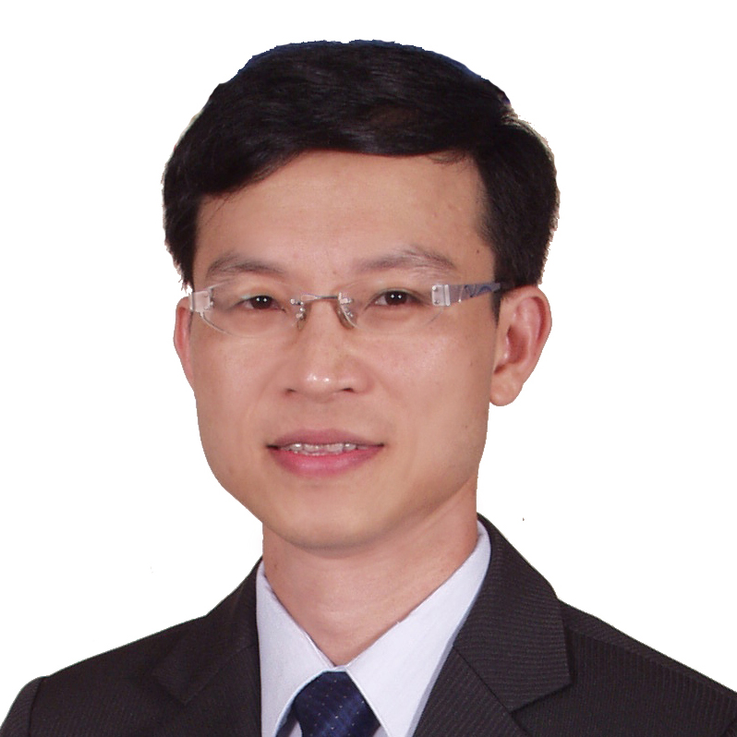
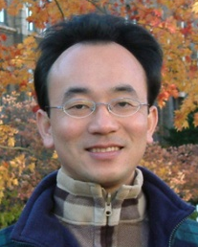
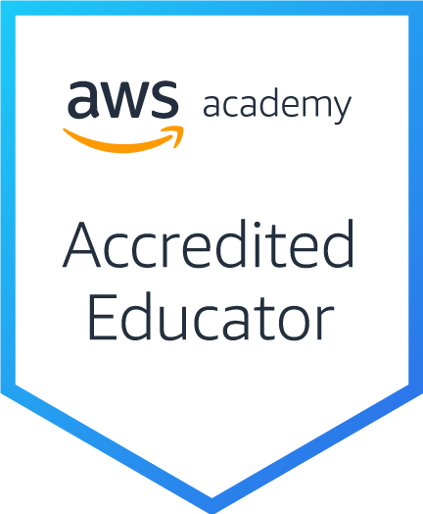
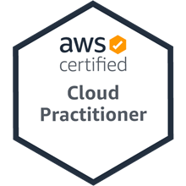
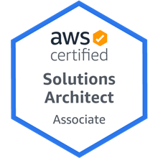
企業雲端運算入門 (Foundation of Business Cloud Computing)
雲端概念概述 (Cloud Concepts Overview)
企業雲端運算入門 (Foundation of Business Cloud Computing) (BA4, NTPU) (Spring 2022)
(AWS Academy Cloud Foundations; ACF) (AWS Certified Cloud Practitioner)
(BA4, NTPU) (3 Credits, Elective) (U4010) (自主學習課程)(商業智慧與大數據分析學士學分學程)
(1102) (國立台北大學企管系4A, 4B) (選修3學分) (授課教師：謝榮桂，戴敏育) (2022.02 - 2022.06)
(週三 Wed, 6, 7, 8, 14:10-17:00) (台北大學三峽校區 文3F10_L)
謝榮桂 (Jung-Kuei Hsieh), 戴敏育 (Min-Yuh Day)
National Taipei University
國立臺北大學
2022-02-23

Slide 3
國立臺北大學 110學年度第2學期 課程大綱 Spring 2022 (2022.02 - 2022.06)
課程名稱 ：企業雲端運算入門 (Foundation of Business Cloud Computing)
應修系級 Major：企業管理學系4A , 4B, 商業智慧與大數據分析學士學分學程
授課教師 Instructor：謝榮桂 戴敏育
選修類別 Required/Elective：選 (Elective)
學 分 Credit(s) ：3 學分
週三 Wed, 6, 7, 8, 14:10-17:00
(台北大學三峽校區 文3F10_L)
(自主學習課程)

Slide 4
教學目標
本課程主要介紹亞馬遜公司的雲端運算服務 Amazon Web Services (AWS)， 對於想要全面瞭解企業雲端運算概念的同學， 本課程將詳細介紹 雲概念、 AWS 核心服務、 安全性、 架構、 定價和相關支援等服務， 並以通過認證 AWS Certified Cloud Practitioner為目標。

Slide 5
Course Objectives
This course introduces Amazon Web Services (AWS), the cloud computing service of Amazon.
For students who want to fully understand the concept of enterprise cloud computing, this course will introduce the AWS Academy Cloud Foundations.
Topics include Cloud Concepts Overview, Cloud Economics and Billing, AWS Global Infrastructure Overview, AWS Cloud Security, Networking and Content Delivery, Cloud Compute, Cloud Storage, Cloud Databases, Cloud Architecture, Cloud Automatic Scaling and Monitoring.
The course objective is training students to pass the certification of AWS Certified Cloud Practitioner.

Slide 6
內容綱要
說明如何使用 AWS 帳戶的最佳實務
說明AWS架構完善的框架和設計原則
說明AWS高可用性和可靠性
描述AWS設計決策的業務影響
描述AWS如何設置組織結構以簡化帳單和提高帳戶可見性
說明AWS替代支援選項和功能

Slide 7
Course Outline
Cloud Concepts Overview
Cloud Economics and Billing
AWS Global Infrastructure Overview
AWS Cloud Security
Networking and Content Delivery
Cloud Compute
Cloud Storage
Cloud Databases
Cloud Architecture
Cloud Automatic Scaling and Monitoring

Slide 8
課程大綱 (Syllabus)
週次 (Week) 日期 (Date) 內容 (Subject/Topics)
1 2022/02/23 雲端概念概述 (Cloud Concepts Overview)
2 2022/03/02 雲端經濟與計費 (Cloud Economics and Billing)
3 2022/03/09 AWS全球基礎設施概述 (AWS Global Infrastructure Overview)
4 2022/03/16 AWS雲端安全 (AWS Cloud Security)
5 2022/03/23 網路和內容交付 (Networking and Content Delivery)
6 2022/03/30 雲端計算 (Cloud Compute)

Slide 9
課程大綱 (Syllabus)
週次 (Week) 日期 (Date) 內容 (Subject/Topics)
7 2022/04/06 放假一天 (Make-up Holiday, No Classes)
8 2022/04/13 雲端儲存 (Cloud Storage)
9 2022/04/20 雲端數據庫 (Cloud Databases)
10 2022/04/27 雲端架構 (Cloud Architecture)
11 2022/05/04 雲端自動擴展和監控 (Cloud Automatic Scaling and Monitoring)
12 2022/05/11 學生自主學習 (Self-learning)

Slide 10
課程大綱 (Syllabus)
週次 (Week) 日期 (Date) 內容 (Subject/Topics)
13 2022/05/18 學生自主學習 (Self-learning)
14 2022/05/25 雲端專案成果報告與討論 (Cloud Project Presentation and Discussion)
15 2022/06/01 學生自主學習 (Self-learning)
16 2022/06/08 期末專案成果報告 (Final Project Presentation)
17 2022/06/15 學生自主學習 (Self-learning)
18 2022/06/22 學生自主學習 (Self-learning)

Slide 11
評量方式 (Evaluation Methods)
課堂參與 (Class Participation): 20 %
個人報告 (Individual Presentation): 80 %
其他評量方式(Other Evaluation Methods): AWS認證成績

Slide 12
其他參考資料 (Other References)
https://aws.amazon.com/training/awsacademy/
https://aws.amazon.com/education/awseducate/
https://www.aws.training/
AWS Cloud Practitioner Essentials (Second Edition)
https://aws.amazon.com/training/course-descriptions/cloud-practitioner-essentials/
AWS Certified Cloud Practitioner
https://aws.amazon.com/certification/certified-cloud-practitioner/
Architecting on AWS
https://aws.amazon.com/training/course-descriptions/architect/
AWS Certified Solutions Architect – Associate
https://aws.amazon.com/certification/certified-solutions-architect-associate/
Ben Piper and David Clinton (2019), AWS Certified Solutions Architect Study Guide: Associate SAA-C01 Exam, 2 edition, Sybex, 2019

Slide 13
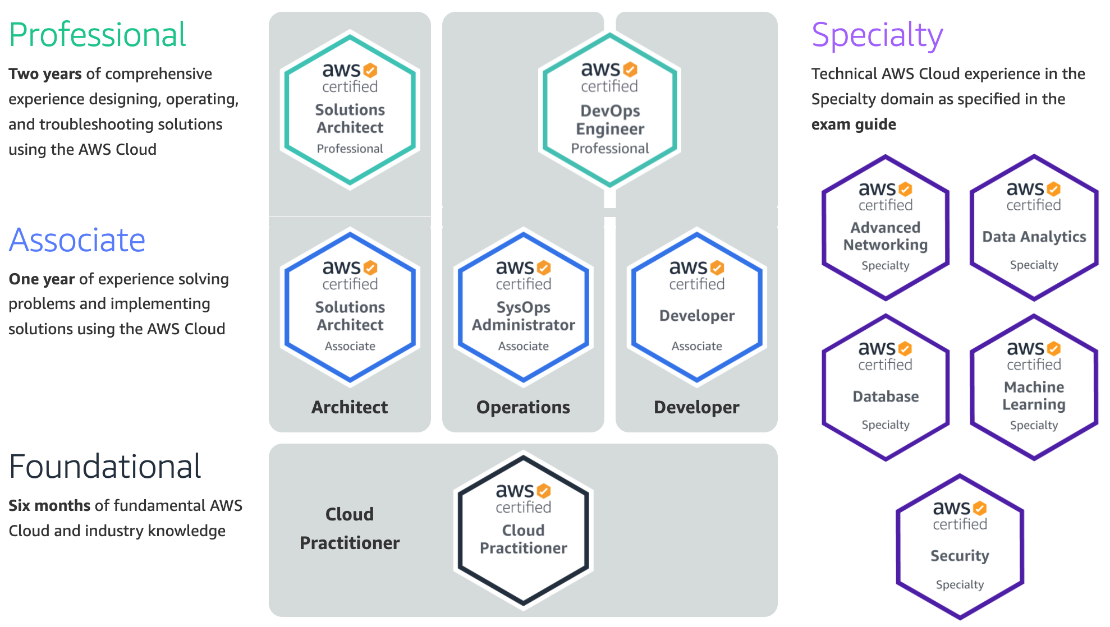
Available AWS Certifications
2
SAA
1
CLF
https://aws.amazon.com/certification/

Slide 14
AWS Certified Cloud Practitioner
This certification provides individuals in a larger variety of cloud and technology roles with a way to validate their AWS Cloud knowledge and enhance their professional credibility.
This exam covers four domains, including cloud concepts, security, technology, and billing and pricing.
https://aws.amazon.com/certification/certified-cloud-practitioner/

Slide 15
AWS Certified Solutions Architect – Associate
This certification validates your ability to effectively demonstrate knowledge of how to architect and deploy secure and robust applications on AWS technologies.
This exam is for anyone with at least one year of hands-on experience designing available, cost-efficient, fault-tolerant, and scalable and distributed systems on AWS.
https://aws.amazon.com/certification/certified-solutions-architect-associate/

Slide 16
AWS Academy and Certifications
1
AWS Academy Cloud Foundations (ACF)
AWS Certified Cloud Practitioner (CLF-C01) (2021/05)
https://aws.amazon.com/certification/certified-cloud-practitioner/
AWS Academy Cloud Architecting (ACA)
AWS Certified Solutions Architect – Associate (SAA-C02)
https://aws.amazon.com/certification/certified-solutions-architect-associate/
2
https://aws.amazon.com/training/awsacademy/

Slide 17
AWS Academy and Certifications
1
AWS Academy Cloud Foundations (ACF)
AWS Certified Cloud Practitioner (CLF-C01) (2021/05)
https://aws.amazon.com/certification/certified-cloud-practitioner/
AWS Cloud Practitioner Essentials (Second Edition)
https://aws.amazon.com/training/course-descriptions/cloud-practitioner-essentials/
AWS Technical Essentials
https://aws.amazon.com/training/course-descriptions/essentials/
AWS Academy Cloud Architecting (ACA)
AWS Certified Solutions Architect – Associate (SAA-C02)
https://aws.amazon.com/certification/certified-solutions-architect-associate/
Architecting on AWS
https://aws.amazon.com/training/course-descriptions/architect/
2
https://aws.amazon.com/training/awsacademy/

Slide 18
AWS Certified Cloud Practitioner (CLF-C01)
Domain | % of Examination
Domain 1: Cloud Concepts | 26%
Domain 2: Security and Compliance | 25%
Domain 3: Technology | 33%
Domain 4: Billing and Pricing | 16%
TOTAL | 100%
Source: https://aws.amazon.com/certification/certified-cloud-practitioner/

Slide 19
AWS Certified Solutions Architect – Associate (SAA-C02)
Domain | % of Examination
Domain 1: Design Resilient Architectures | 30%
Domain 2: Design High-Performing Architectures | 28%
Domain 3: Specify Secure Applications and Architectures | 24%
Domain 4: Design Cost-Optimized Architectures | 18%
TOTAL | 100%
Source: https://aws.amazon.com/certification/certified-solutions-architect-associate

Slide 20
AWS Certified Cloud Practitioner (CLF-C01)
Source: https://aws.amazon.com/certification/certified-cloud-practitioner/

Slide 21
AWS Certified Cloud Practitioner (CLF-C01)
Domain 1: Cloud Concepts
1.1 Define the AWS Cloud and its value proposition
1.2 Identify aspects of AWS Cloud economics
1.3 List the different cloud architecture design principles
Source: https://aws.amazon.com/certification/certified-cloud-practitioner/

Slide 22
AWS Certified Cloud Practitioner (CLF-C01)
Domain 2: Security and Compliance
2.1 Define the AWS shared responsibility model
2.2 Define AWS Cloud security and compliance concepts
2.3 Identify AWS access management capabilities
2.4 Identify resources for security support
Source: https://aws.amazon.com/certification/certified-cloud-practitioner/

Slide 23
AWS Certified Cloud Practitioner (CLF-C01)
Domain 3: Technology
3.1 Define methods of deploying and operating in the AWS Cloud
3.2 Define the AWS global infrastructure
3.3 Identify the core AWS services
3.4 Identify resources for technology support
Source: https://aws.amazon.com/certification/certified-cloud-practitioner/

Slide 24
AWS Certified Cloud Practitioner (CLF-C01)
Domain 4: Billing and Pricing
4.1 Compare and contrast the various pricing models for AWS
4.2 Recognize the various account structures in relation to AWS billing and pricing
4.3 Identify resources available for billing support
Source: https://aws.amazon.com/certification/certified-cloud-practitioner/

Slide 25
AWS Certified Solutions Architect – Associate (SAA-C02)
Source: https://aws.amazon.com/certification/certified-solutions-architect-associate

Slide 26
AWS Certified Solutions Architect – Associate (SAA-C02)
Domain 1: Design Resilient Architectures
1.1 Design a multi-tier architecture solution
1.2 Design highly available and/or fault-tolerant architectures
1.3 Design decoupling mechanisms using AWS services
1.4 Choose appropriate resilient storage
Source: https://aws.amazon.com/certification/certified-solutions-architect-associate

Slide 27
AWS Certified Solutions Architect – Associate (SAA-C02)
Domain 2: Design High-Performing Architectures
2.1 Identify elastic and scalable compute solutions for a workload
2.2 Select high-performing and scalable storage solutions for a workload
2.3 Select high-performing networking solutions for a workload
2.4 Choose high-performing database solutions for a workload
Source: https://aws.amazon.com/certification/certified-solutions-architect-associate

Slide 28
AWS Certified Solutions Architect – Associate (SAA-C02)
Domain 3: Design Secure Applications and Architectures
3.1 Design secure access to AWS resources
3.2 Design secure application tiers
3.3 Select appropriate data security options
Source: https://aws.amazon.com/certification/certified-solutions-architect-associate

Slide 29
AWS Certified Solutions Architect – Associate (SAA-C02)
Domain 4: Design Cost-Optimized Architectures
4.1 Identify cost-effective storage solutions
4.2 Identify cost-effective compute and database services
4.3 Design cost-optimized network architectures
Source: https://aws.amazon.com/certification/certified-solutions-architect-associate

Slide 30
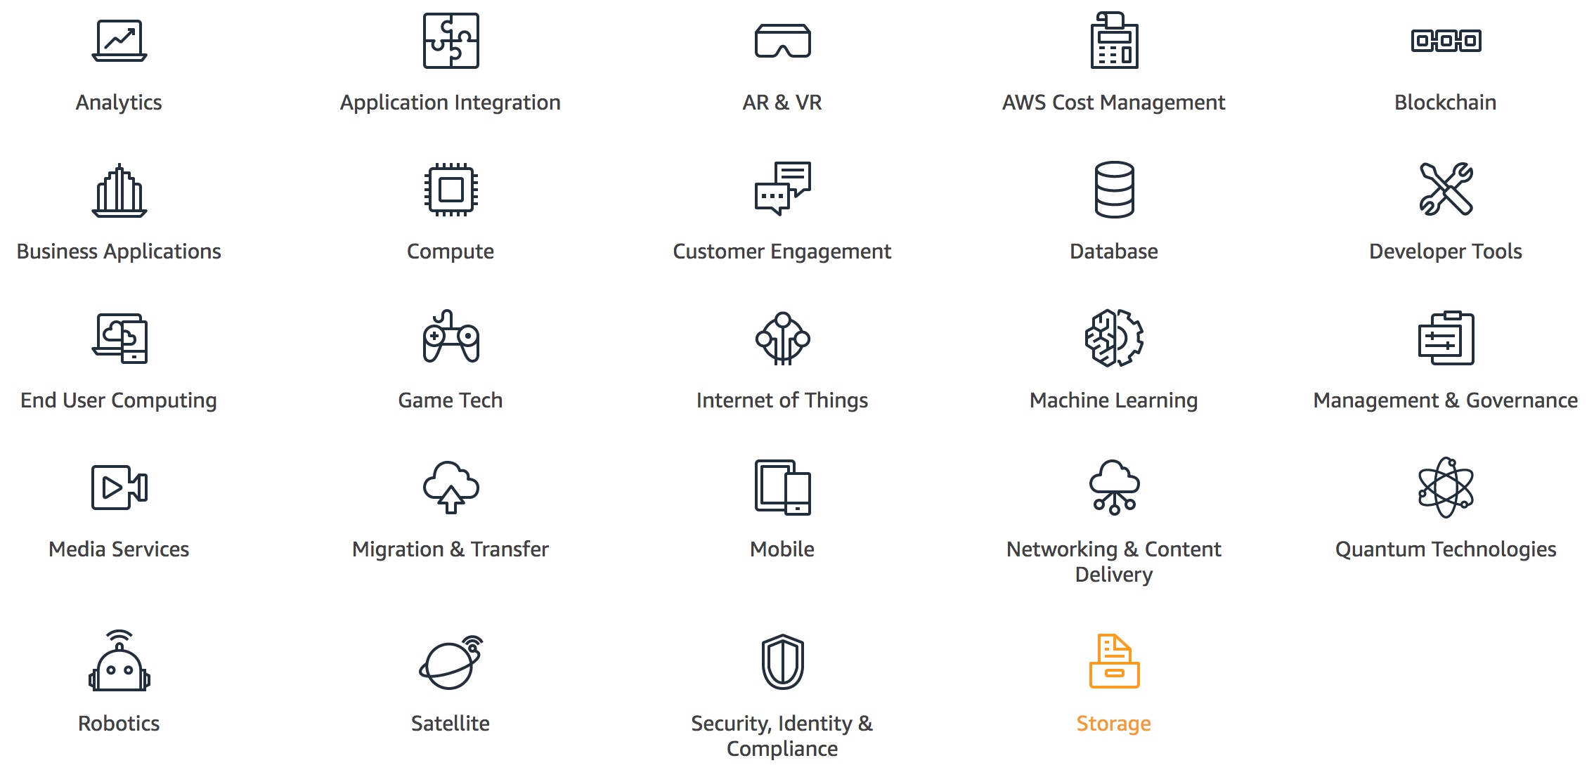
AWS Products and Services
Source: https://aws.amazon.com/

Slide 31
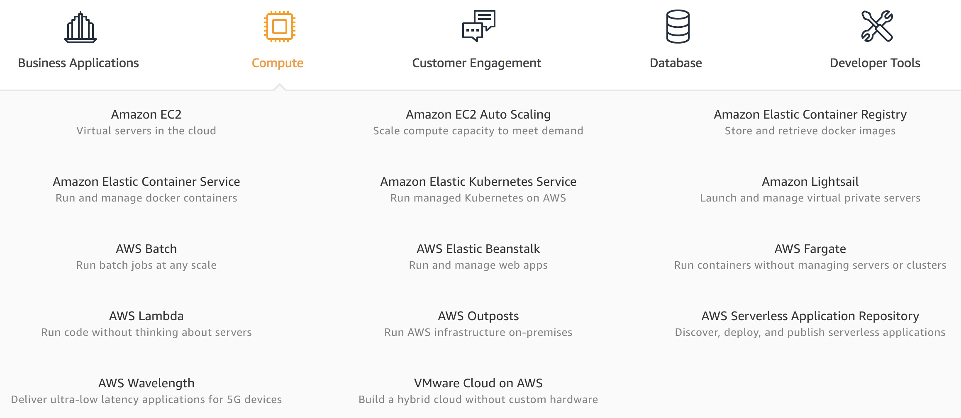
AWS Compute
Source: https://aws.amazon.com/

Slide 32
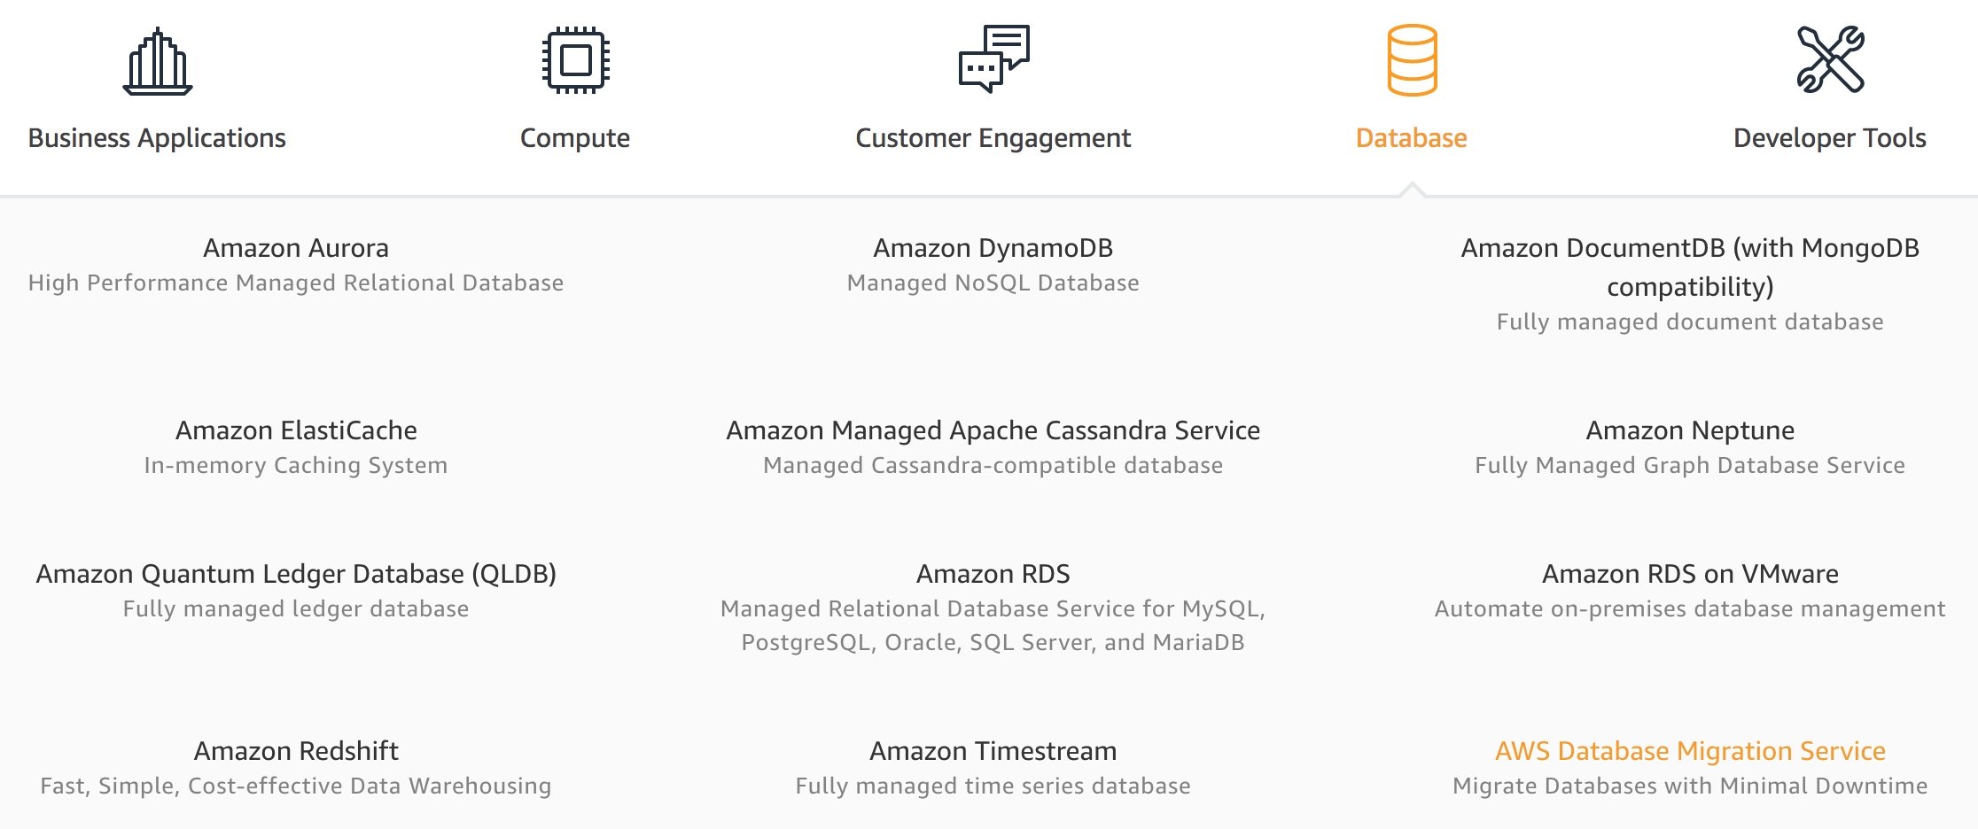
AWS Database
Source: https://aws.amazon.com/

Slide 33
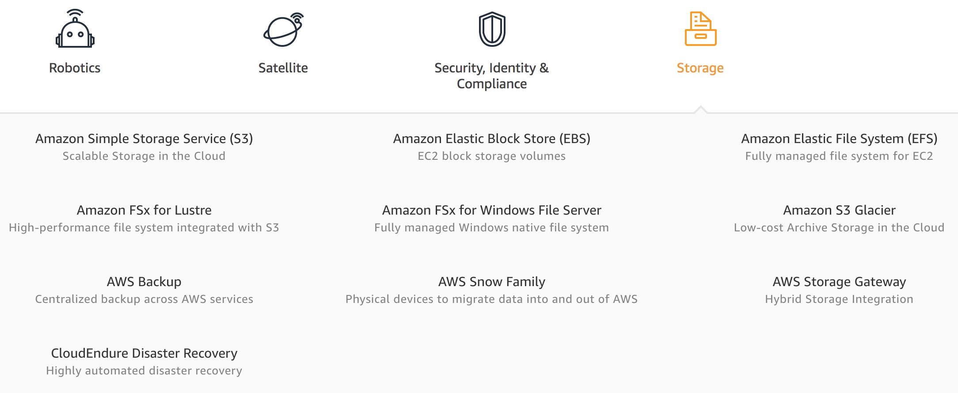
AWS Storage
Source: https://aws.amazon.com/

Slide 34
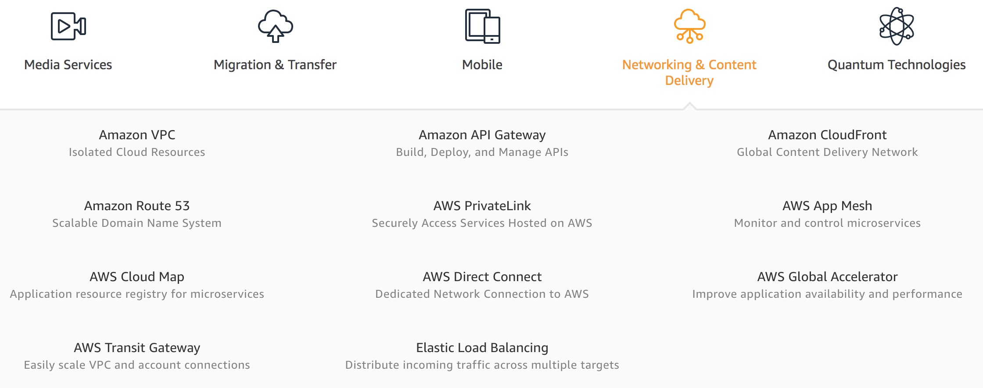
AWS Networking & Content Dilivery
Source: https://aws.amazon.com/

Slide 35
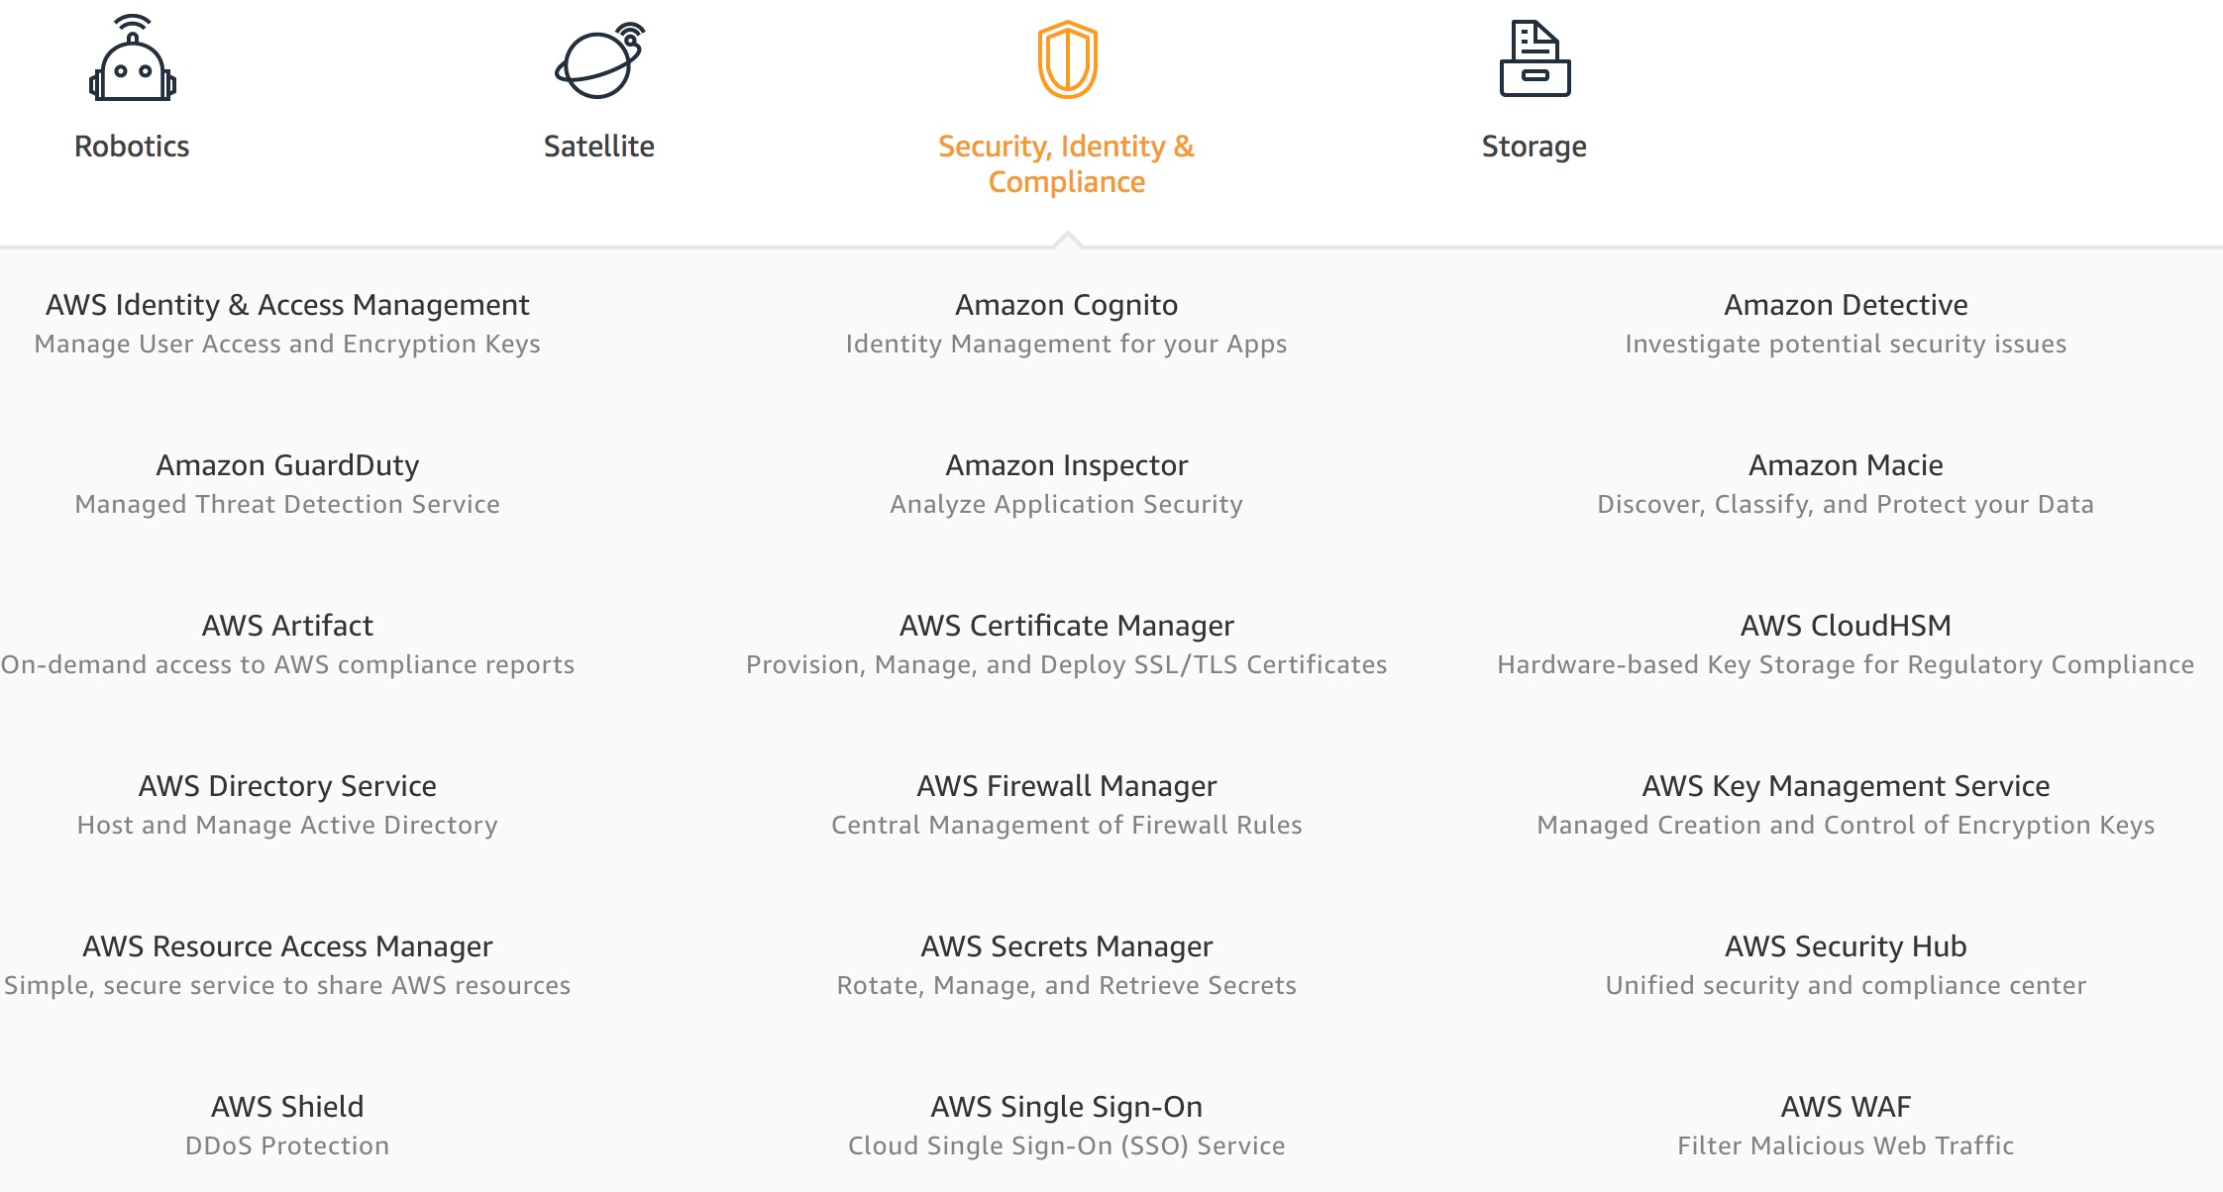
AWS Security, Identity & Compliance
Source: https://aws.amazon.com/

Slide 36
AWS Cost Management
Source: https://aws.amazon.com/

Slide 37
AWS Services
Amazon EC2
Virtual servers in the cloud
Amazon Simple Storage Service (S3)
Scalable storage in the cloud
Amazon Aurora
High performance managed relational database
Amazon DynamoDB
Managed NoSQL database
Amazon RDS
Managed relational database service for MySQL, PostgreSQL, Oracle, SQL Server, and MariaDB
Source: https://aws.amazon.com/

Slide 38
AWS Services
AWS Lambda
Run code without thinking about servers
AWS Elastic Beanstalk
Run and manage web apps
Amazon VPC
Isolated cloud resources
Amazon Lightsail
Launch and manage virtual private servers
Amazon SageMaker
Build, train, and deploy machine learning models at scale
Source: https://aws.amazon.com/

Slide 39
Web Application with AWS Core Services

Slide 40
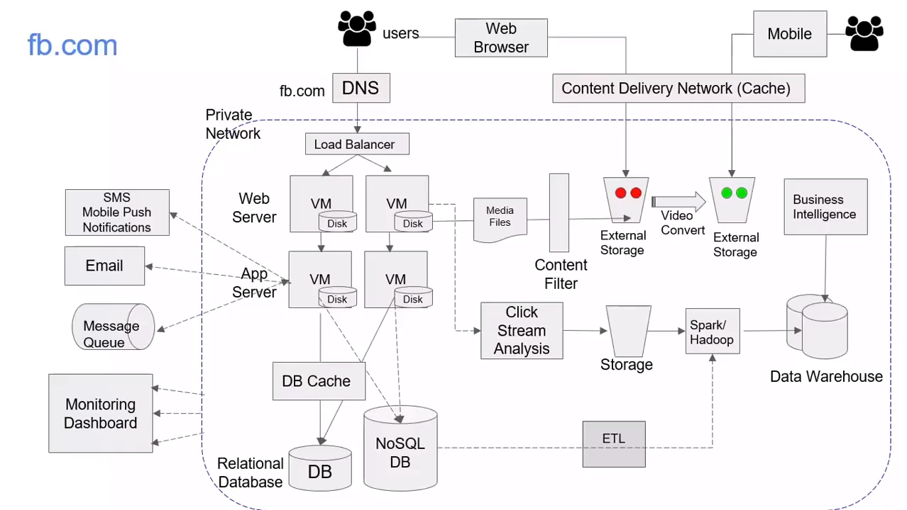
Source: AWS Training Center (2019), Introduction to AWS Services, https://youtu.be/Z3SYDTMP3ME

Slide 41
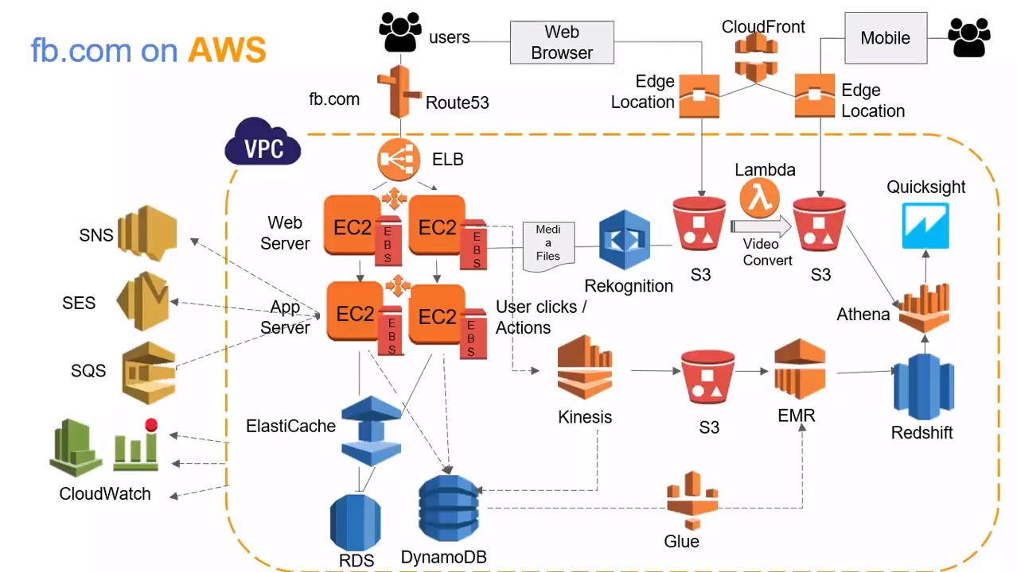
Source: AWS Training Center (2019), Introduction to AWS Services, https://youtu.be/Z3SYDTMP3ME

Slide 42
Source: AWS Training Center (2019), Introduction to AWS Services, https://youtu.be/Z3SYDTMP3ME

Slide 43
Source: AWS Training Center (2019), Introduction to AWS Services, https://youtu.be/Z3SYDTMP3ME

Slide 44
Source: AWS Training Center (2019), Introduction to AWS Services, https://youtu.be/Z3SYDTMP3ME

Slide 45
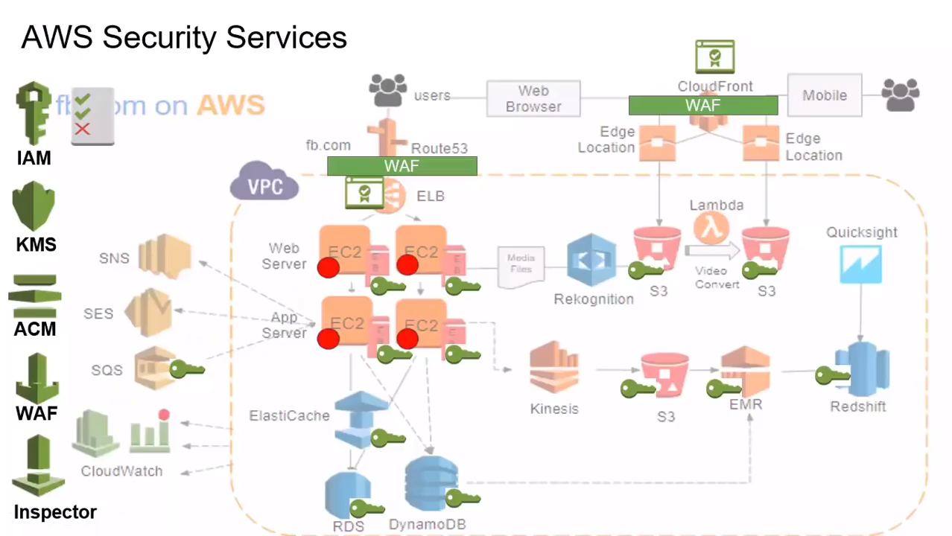
Source: AWS Training Center (2019), Introduction to AWS Services, https://youtu.be/Z3SYDTMP3ME

Slide 46
Source: AWS Training Center (2019), Introduction to AWS Services, https://youtu.be/Z3SYDTMP3ME

Slide 47
AWS Serverless Architecture

Slide 48
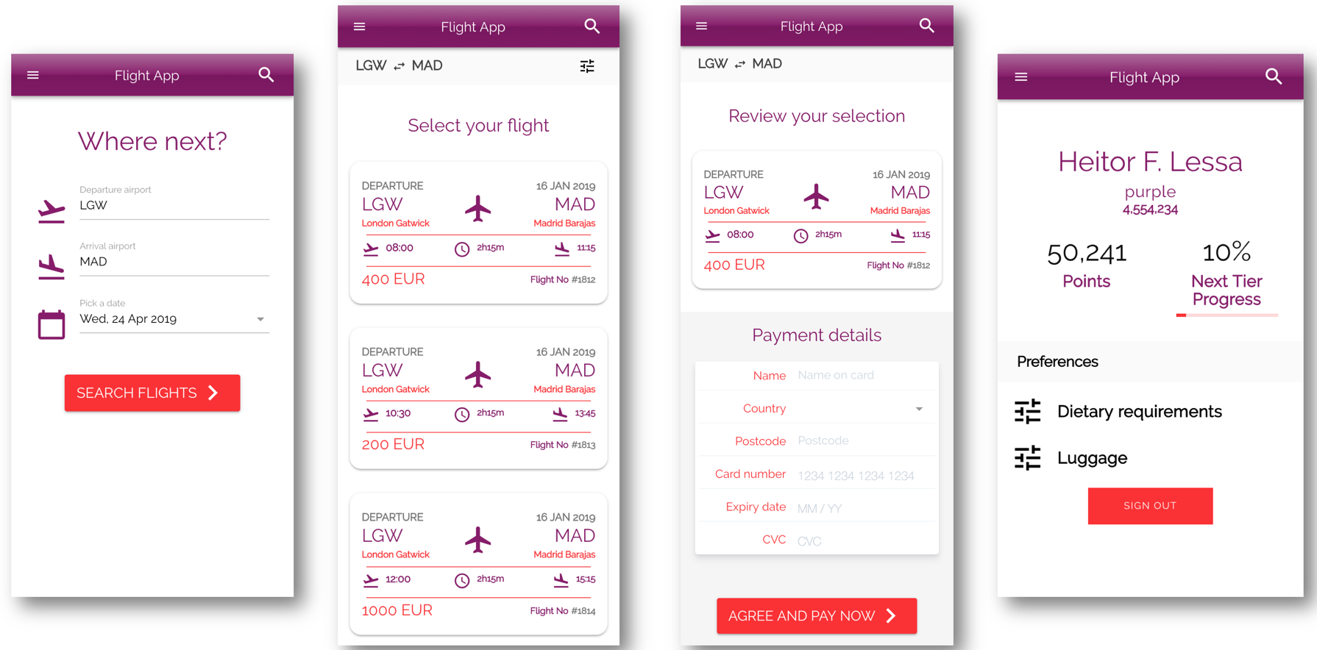
AWS Serverless Airline Booking
Source: https://github.com/aws-samples/aws-serverless-airline-booking

Slide 49
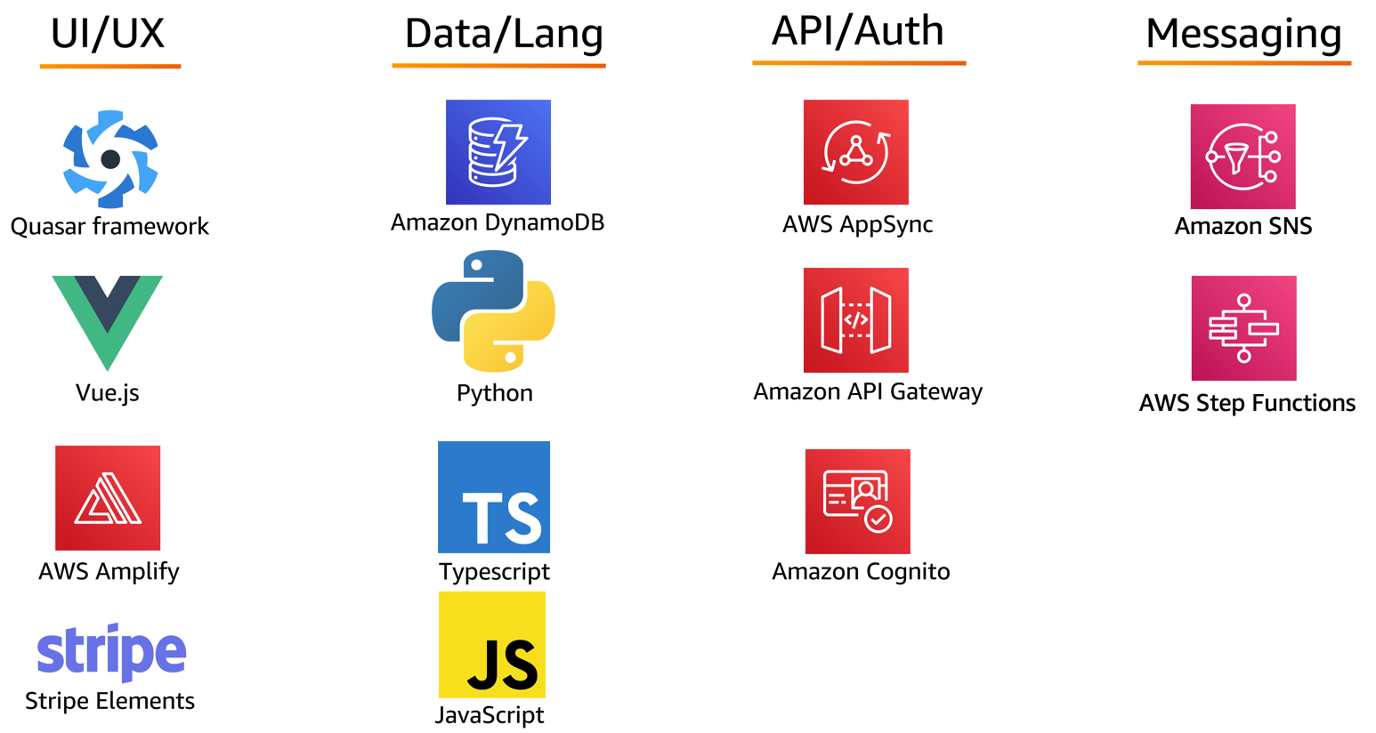
AWS Serverless Airline Booking Stack
Source: https://github.com/aws-samples/aws-serverless-airline-booking

Slide 50
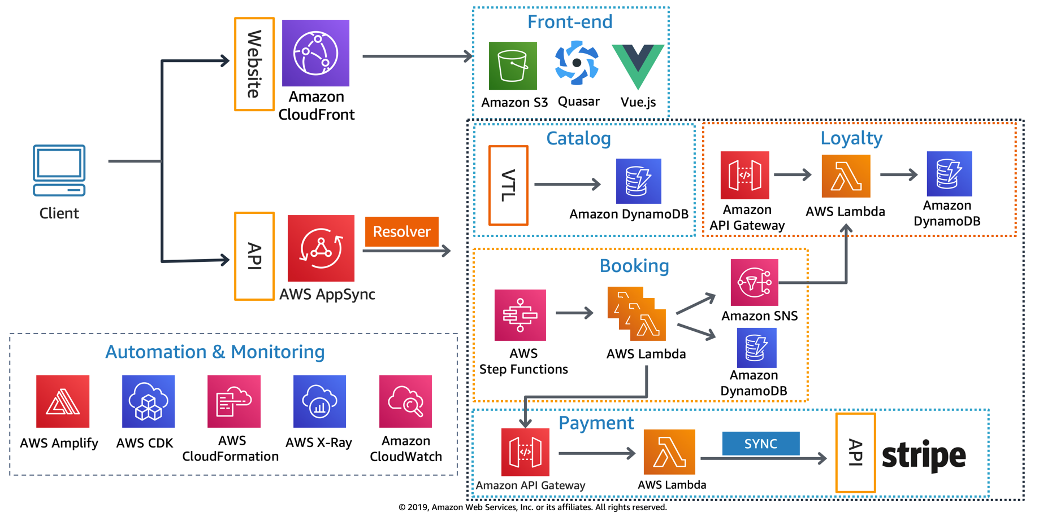
AWS Serverless Airline Booking High level infrastructure architecture
Source: https://github.com/aws-samples/aws-serverless-airline-booking

Slide 51
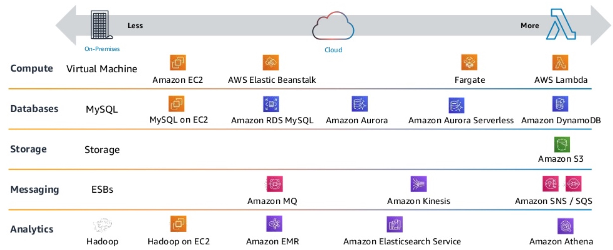
AWS Serverless Architecture AWS Operational Responsibility Models
Source: Heitor Lessa (2019), How to build a full stack serverless airline ticketing web app, https://www.youtube.com/watch?v=MyoOeHTp2pg

Slide 52
Build a Serverless Web Application

Slide 53
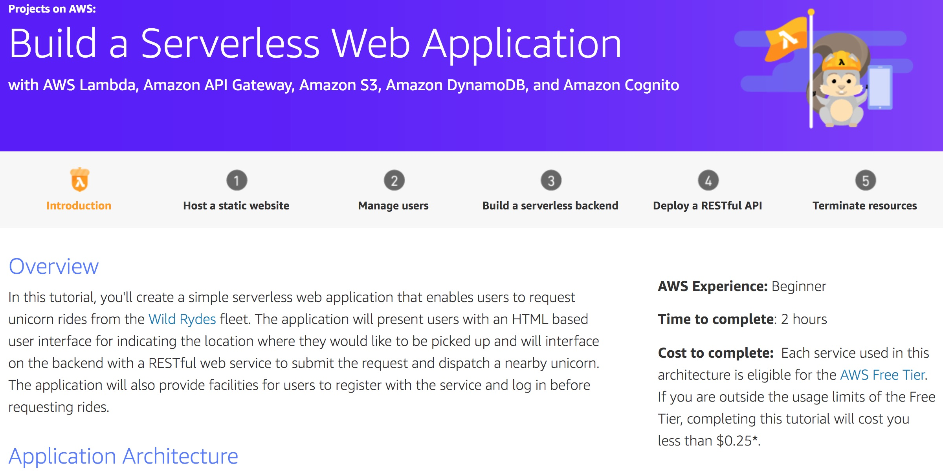
Build a Serverless Web Application
Source: https://aws.amazon.com/getting-started/projects/build-serverless-web-app-lambda-apigateway-s3-dynamodb-cognito/

Slide 54
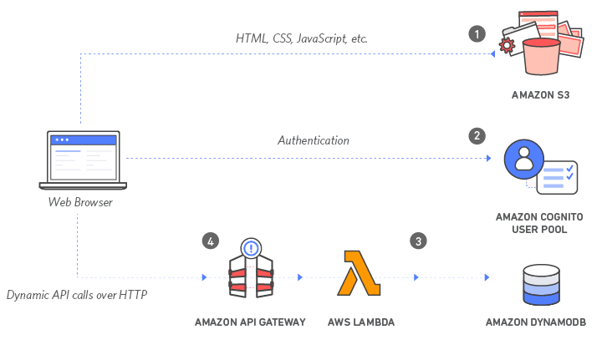
Build a Serverless Web Application with Amazon S3, AWS Lambda, Amazon API Gateway, Amazon DynamoDB, and Amazon Cognito
Source: https://aws.amazon.com/getting-started/projects/build-serverless-web-app-lambda-apigateway-s3-dynamodb-cognito/

Slide 55
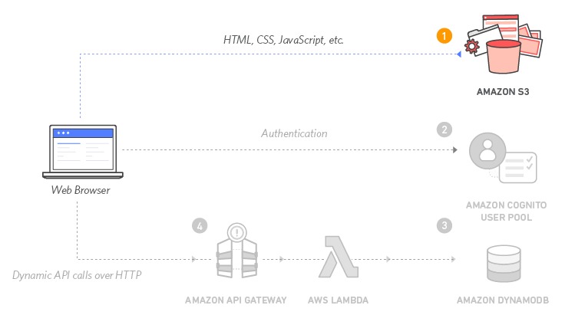
Build a Serverless Web Application with Amazon S3, AWS Lambda, Amazon API Gateway, Amazon DynamoDB, and Amazon Cognito
1
Source: https://aws.amazon.com/getting-started/projects/build-serverless-web-app-lambda-apigateway-s3-dynamodb-cognito/

Slide 56
Build a Serverless Web Application with Amazon S3, AWS Lambda, Amazon API Gateway, Amazon DynamoDB, and Amazon Cognito
1
Static Web Hosting
Amazon S3 hosts static web resources including HTML, CSS, JavaScript, and image files which are loaded in the user's browser.
Source: https://aws.amazon.com/getting-started/projects/build-serverless-web-app-lambda-apigateway-s3-dynamodb-cognito/

Slide 57
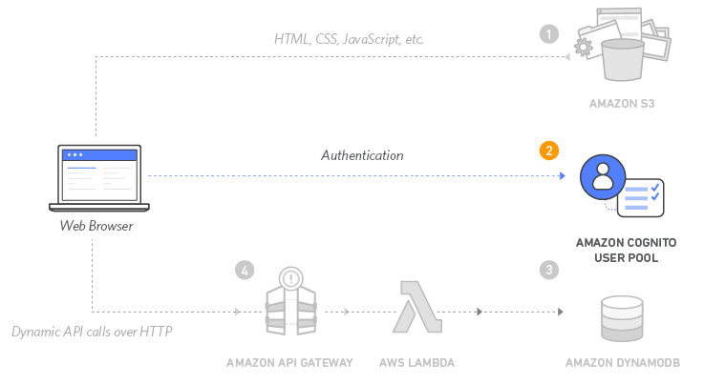
Build a Serverless Web Application with Amazon S3, AWS Lambda, Amazon API Gateway, Amazon DynamoDB, and Amazon Cognito
2
Source: https://aws.amazon.com/getting-started/projects/build-serverless-web-app-lambda-apigateway-s3-dynamodb-cognito/

Slide 58
Build a Serverless Web Application with Amazon S3, AWS Lambda, Amazon API Gateway, Amazon DynamoDB, and Amazon Cognito
2
User Management
Amazon Cognito provides user management and authentication functions to secure the backend API.
Source: https://aws.amazon.com/getting-started/projects/build-serverless-web-app-lambda-apigateway-s3-dynamodb-cognito/

Slide 59
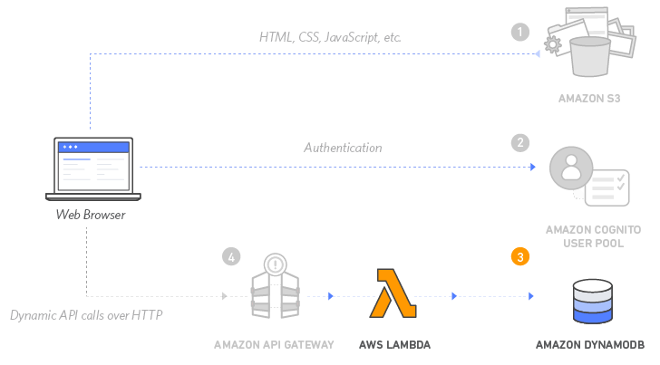
Build a Serverless Web Application with Amazon S3, AWS Lambda, Amazon API Gateway, Amazon DynamoDB, and Amazon Cognito
3
Source: https://aws.amazon.com/getting-started/projects/build-serverless-web-app-lambda-apigateway-s3-dynamodb-cognito/

Slide 60
Build a Serverless Web Application with Amazon S3, AWS Lambda, Amazon API Gateway, Amazon DynamoDB, and Amazon Cognito
3
Serverless Backend
Amazon DynamoDB provides a persistence layer where data can be stored by the API's Lambda function.
Source: https://aws.amazon.com/getting-started/projects/build-serverless-web-app-lambda-apigateway-s3-dynamodb-cognito/

Slide 61
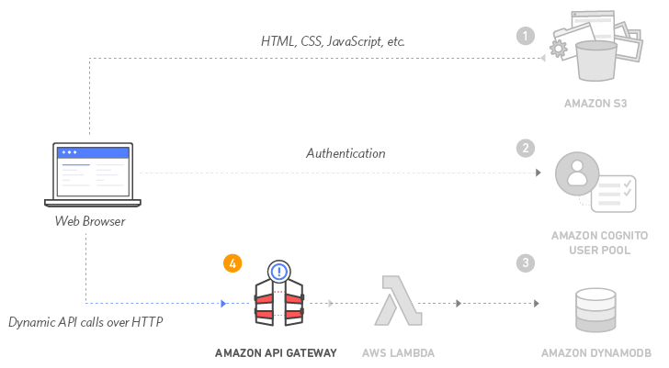
Build a Serverless Web Application with Amazon S3, AWS Lambda, Amazon API Gateway, Amazon DynamoDB, and Amazon Cognito
4
Source: https://aws.amazon.com/getting-started/projects/build-serverless-web-app-lambda-apigateway-s3-dynamodb-cognito/

Slide 62
Build a Serverless Web Application with Amazon S3, AWS Lambda, Amazon API Gateway, Amazon DynamoDB, and Amazon Cognito
4
RESTful API
JavaScript executed in the browser sends and receives data from a public backend API built using Lambda and API Gateway.
Source: https://aws.amazon.com/getting-started/projects/build-serverless-web-app-lambda-apigateway-s3-dynamodb-cognito/

Slide 63
Build a Serverless Web Application with Amazon S3, AWS Lambda, Amazon API Gateway, Amazon DynamoDB, and Amazon Cognito
5
Terminate resources
Resource Cleanup
You will terminate an Amazon S3 bucket, an Amazon Cognito User Pool, an AWS Lambda function, an IAM role, a DynamoDB table, a REST API, and a CloudWatch Log. It is a best practice to delete resources you are no longer using to avoid unwanted charges.
Source: https://aws.amazon.com/getting-started/projects/build-serverless-web-app-lambda-apigateway-s3-dynamodb-cognito/

Slide 64
Summary
Cloud Concepts Overview
Cloud Economics and Billing
AWS Global Infrastructure Overview
AWS Cloud Security
Networking and Content Delivery
Cloud Compute
Cloud Storage
Cloud Databases
Cloud Architecture
Cloud Automatic Scaling and Monitoring

Slide 65
企業雲端運算入門 (Foundation of Business Cloud Computing)
雲端概念概述 (Cloud Concepts Overview)
企業雲端運算入門 (Foundation of Business Cloud Computing) (BA4, NTPU) (Spring 2022)
(AWS Academy Cloud Foundations; ACF) (AWS Certified Cloud Practitioner)
(BA4, NTPU) (3 Credits, Elective) (U4010) (自主學習課程)(商業智慧與大數據分析學士學分學程)
(1102) (國立台北大學企管系4A, 4B) (選修3學分) (授課教師：謝榮桂，戴敏育) (2022.02 - 2022.06)
(週三 Wed, 6, 7, 8, 14:10-17:00) (台北大學三峽校區 文3F10_L)
謝榮桂 (Jung-Kuei Hsieh), 戴敏育 (Min-Yuh Day)
National Taipei University
國立臺北大學
http://web.ntpu.edu.tw/~myday/teaching.htm#1102FBCC

