Slide 1








Foundations of Text Analytics:
Natural Language Processing (NLP)
Artificial Intelligence for Text Analytics
1102AITA02
MBA, IM, NTPU (M5026) (Spring 2022)
Tue 2, 3, 4 (9:10-12:00) (B8F40)
Min-Yuh Day, Ph.D,
Associate Professor
Institute of Information Management, National Taipei University
https://web.ntpu.edu.tw/~myday
https://meet.google.com/paj-zhhj-mya
2022-03-01

Slide 2
Syllabus
Week Date Subject/Topics
1 2022/02/22 Introduction to Artificial Intelligence for Text Analytics
2 2022/03/01 Foundations of Text Analytics:
Natural Language Processing (NLP)
3 2022/03/08 Python for Natural Language Processing
4 2022/03/15 Natural Language Processing with Transformers
5 2022/03/22 Case Study on Artificial Intelligence for Text Analytics I
6 2022/03/29 Text Classification and Sentiment Analysis

Slide 3
Syllabus
Week Date Subject/Topics
7 2022/04/05 Tomb-Sweeping Day (Holiday, No Classes)
8 2022/04/12 Midterm Project Report
9 2022/04/19 Multilingual Named Entity Recognition (NER),
Text Similarity and Clustering
10 2022/04/26 Text Summarization and Topic Models
11 2022/05/03 Text Generation
12 2022/05/10 Case Study on Artificial Intelligence for Text Analytics II

Slide 4
Syllabus
Week Date Subject/Topics
13 2022/05/17 Question Answering and Dialogue Systems
14 2022/05/24 Deep Learning, Transfer Learning,
Zero-Shot, and Few-Shot Learning for Text Analytics
15 2022/05/31 Final Project Report I
16 2022/06/07 Final Project Report II
17 2022/06/14 Self-learning
18 2022/06/21 Self-learning

Slide 5
Foundations of
Text Analytics:
Natural Language Processing (NLP)

Slide 6
Outline
Text Analytics and Text Mining
Natural Language Processing (NLP)
Text Analytics with Python

Slide 7
Artificial Intelligence
(AI)

Slide 8
Text Analytics
(TA)

Slide 9
Text Mining
(TM)

Slide 10
Natural Language Processing
(NLP)

Slide 11
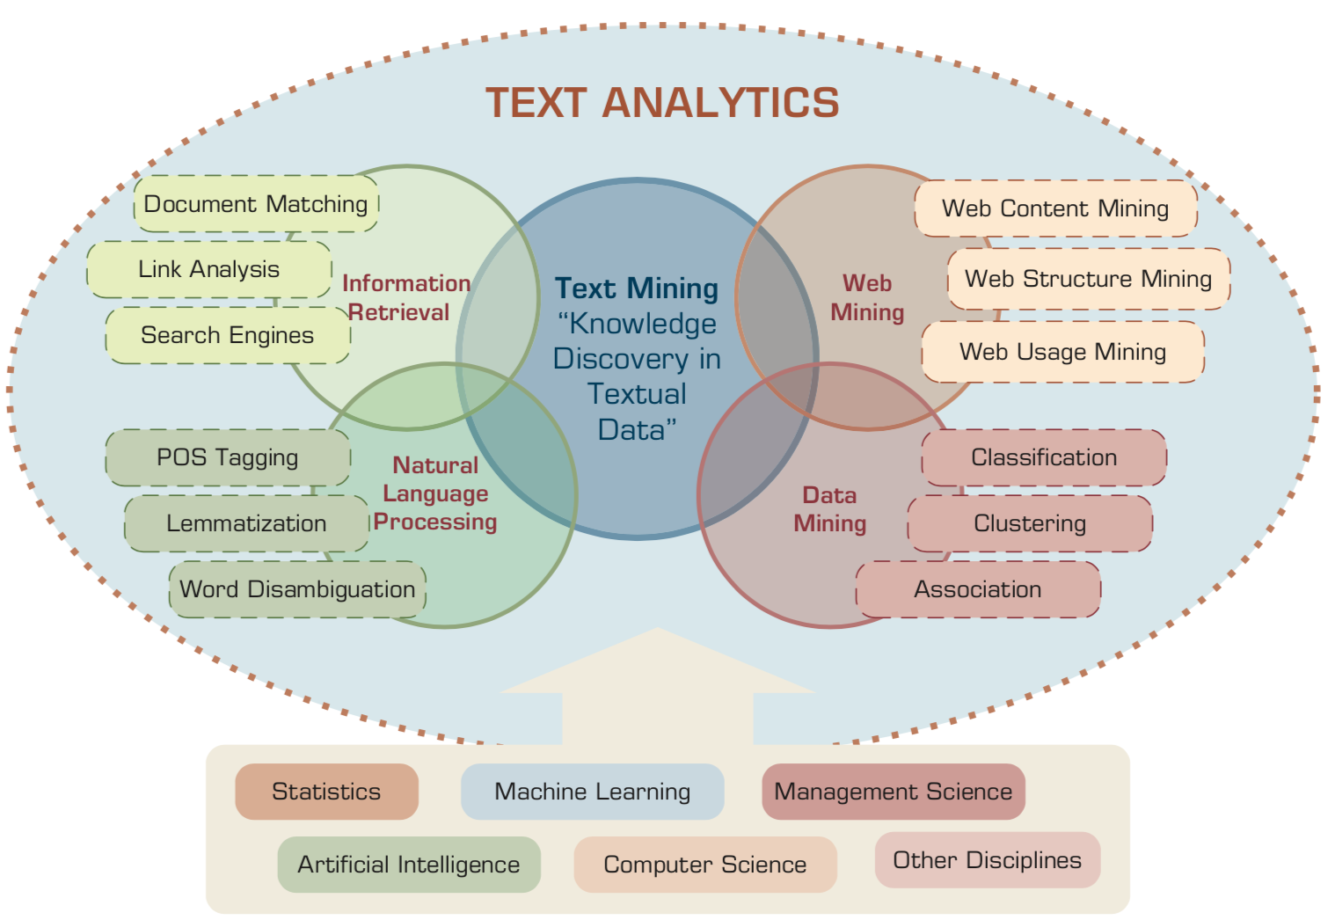
Text Analytics and Text Mining
Source: Ramesh Sharda, Dursun Delen, and Efraim Turban (2017), Business Intelligence, Analytics, and Data Science: A Managerial Perspective, 4th Edition, Pearson

Slide 12
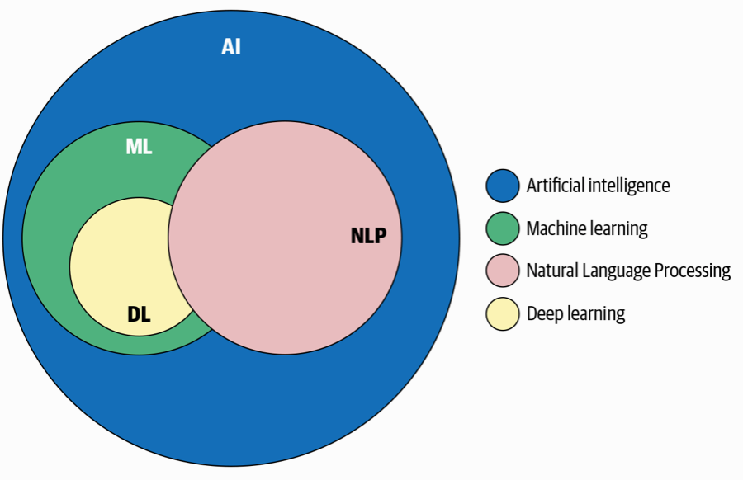
AI, NLP, ML, DL
Source: Sowmya Vajjala, Bodhisattwa Majumder, Anuj Gupta (2020), Practical Natural Language Processing: A Comprehensive Guide to Building Real-World NLP Systems, O'Reilly Media.

Slide 13
Artificial Intelligence
(AI)

Slide 14
AI, Big Data, Cloud Computing
Evolution of Decision Support, Business Intelligence, and Analytics
AI
AI
Cloud Computing
Big Data
DM
BI
Source: Ramesh Sharda, Dursun Delen, and Efraim Turban (2017),
Business Intelligence, Analytics, and Data Science: A Managerial Perspective, 4th Edition, Pearson

Slide 15
The Rise of AI
Source: DHL (2018), Artificial Intelligence in Logistics,
http://www.globalhha.com/doclib/data/upload/doc_con/5e50c53c5bf67.pdf/

Slide 16
Definition of
Artificial Intelligence (A.I.)

Slide 17
Artificial Intelligence
“… the science and engineering of making intelligent machines”
(John McCarthy, 1955)
Source: https://digitalintelligencetoday.com/artificial-intelligence-defined-useful-list-of-popular-definitions-from-business-and-science/

Slide 18
Artificial Intelligence
“… technology that thinks and acts like humans”
Source: https://digitalintelligencetoday.com/artificial-intelligence-defined-useful-list-of-popular-definitions-from-business-and-science/

Slide 19
Artificial Intelligence
“… intelligence exhibited by machines or software”
Source: https://digitalintelligencetoday.com/artificial-intelligence-defined-useful-list-of-popular-definitions-from-business-and-science/

Slide 20
4 Approaches of AI
Thinking Humanly | Thinking Rationally
Acting Humanly | Acting Rationally
Source: Stuart Russell and Peter Norvig (2020), Artificial Intelligence: A Modern Approach, 4th Edition, Pearson

Slide 21
4 Approaches of AI
2. Thinking Humanly: The Cognitive Modeling Approach | 3. Thinking Rationally: The “Laws of Thought” Approach
1. Acting Humanly: The Turing Test Approach (1950) | 4. Acting Rationally: The Rational Agent Approach
Source: Stuart Russell and Peter Norvig (2020), Artificial Intelligence: A Modern Approach, 4th Edition, Pearson

Slide 22
AI Acting Humanly:
The Turing Test Approach
(Alan Turing, 1950)
Knowledge Representation
Automated Reasoning
Machine Learning (ML)
  Deep Learning (DL)
Computer Vision (Image, Video)
Natural Language Processing (NLP)
Robotics
Source: Stuart Russell and Peter Norvig (2020), Artificial Intelligence: A Modern Approach, 4th Edition, Pearson

Slide 23
Text Analytics and
Text Mining

Slide 24
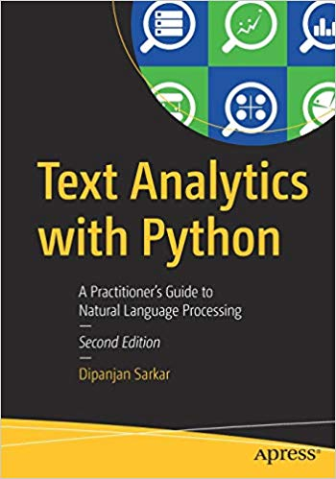
Dipanjan Sarkar (2019),
Text Analytics with Python:
A Practitioner’s Guide to Natural Language Processing,
Second Edition. APress.
Source: https://www.amazon.com/Text-Analytics-Python-Practitioners-Processing/dp/1484243536

Slide 25
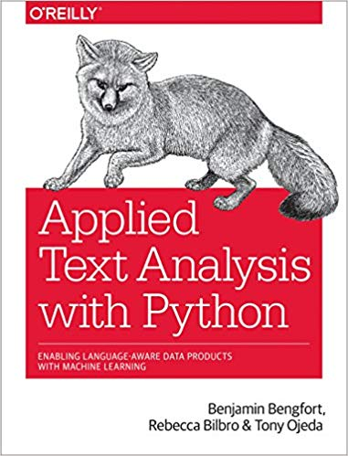
Benjamin Bengfort, Rebecca Bilbro, and Tony Ojeda (2018),
Applied Text Analysis with Python:
Enabling Language-Aware Data Products with Machine Learning, O’Reilly.
Source: https://www.amazon.com/Applied-Text-Analysis-Python-Language-Aware/dp/1491963042

Slide 26
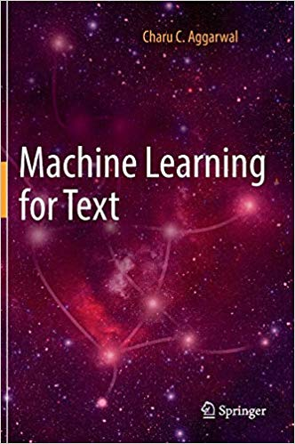
Charu C. Aggarwal (2018),
Machine Learning for Text,
Springer
Source: https://www.amazon.com/Machine-Learning-Text-Charu-Aggarwal/dp/3319735306

Slide 27
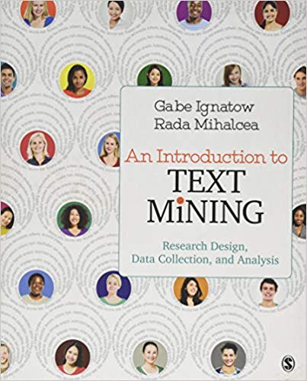
Gabe Ignatow and Rada F. Mihalcea (2017),
An Introduction to Text Mining:
Research Design, Data Collection, and Analysis,
SAGE Publications.
Source: https://www.amazon.com/Introduction-Text-Mining-Research-Collection/dp/1506337007

Slide 28
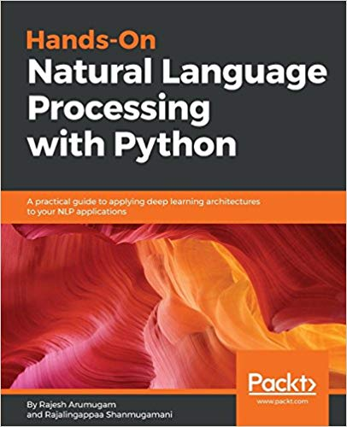
Rajesh Arumugam (2018),
Hands-On Natural Language Processing with Python:
A practical guide to applying deep learning architectures to your NLP applications, Packt
https://www.amazon.com/Hands-Natural-Language-Processing-Python/dp/178913949X

Slide 29
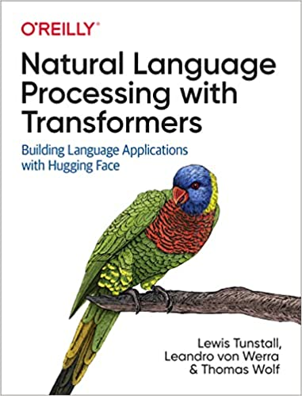
Lewis Tunstall, Leandro von Werra, and Thomas Wolf (2022),
Natural Language Processing with Transformers:
Building Language Applications with Hugging Face,
O'Reilly Media.
Source: https://www.amazon.com/Natural-Language-Processing-Transformers-Applications/dp/1098103246

Slide 30
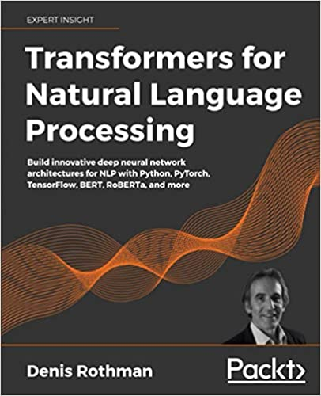
Denis Rothman (2021),
Transformers for Natural Language Processing:
Build innovative deep neural network architectures for NLP with Python, PyTorch, TensorFlow, BERT, RoBERTa, and more,
Packt Publishing.
Source: https://www.amazon.com/Transformers-Natural-Language-Processing-architectures/dp/1800565798

Slide 31
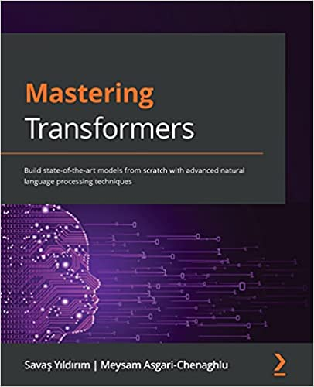
Savaş Yıldırım and Meysam Asgari-Chenaghlu (2021),
Mastering Transformers:
Build state-of-the-art models from scratch with advanced natural language processing techniques,
Packt Publishing.
Source: https://www.amazon.com/Mastering-Transformers-state-art-processing/dp/1801077657/

Slide 32
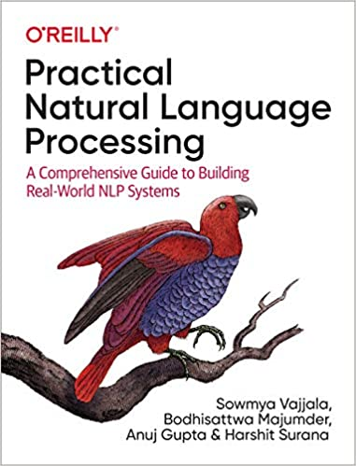
Sowmya Vajjala, Bodhisattwa Majumder, Anuj Gupta (2020), Practical Natural Language Processing:
A Comprehensive Guide to Building Real-World NLP Systems,
O'Reilly Media.
Source: https://www.amazon.com/Practical-Natural-Language-Processing-Pragmatic/dp/1492054054

Slide 33
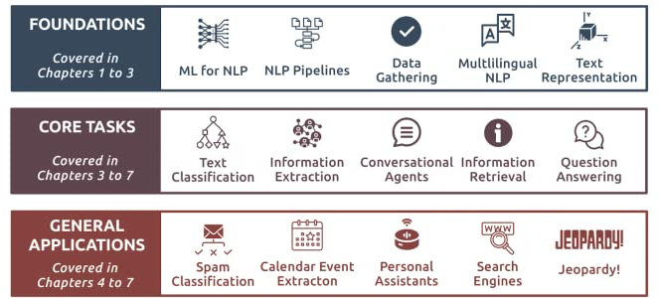
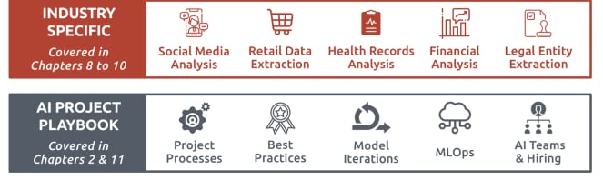
Source: Sowmya Vajjala, Bodhisattwa Majumder, Anuj Gupta (2020), Practical Natural Language Processing: A Comprehensive Guide to Building Real-World NLP Systems, O'Reilly Media.
Source: https://www.amazon.com/Practical-Natural-Language-Processing-Pragmatic/dp/1492054054

Slide 34
Text Analytics
(TA)

Slide 35
Text Analytics
Text Analytics =
Information Retrieval +
Information Extraction +
Data Mining +
Web Mining
Text Analytics =
Information Retrieval +
Text Mining
Source: Ramesh Sharda, Dursun Delen, and Efraim Turban (2017), Business Intelligence, Analytics, and Data Science: A Managerial Perspective, 4th Edition, Pearson

Slide 36
Text Mining
Text Data Mining
Knowledge Discovery in
Textual Databases
Source: Ramesh Sharda, Dursun Delen, and Efraim Turban (2017), Business Intelligence, Analytics, and Data Science: A Managerial Perspective, 4th Edition, Pearson

Slide 37
Text Mining Technologies
Statistics
Machine Learning
Pattern Recognition
Database Systems
Visualization
Text Mining
Natural Language Processing
Algorithms
Information Retrieval
Applications
High-performance Computing
Adapted from: Jiawei Han and Micheline Kamber (2011), Data Mining: Concepts and Techniques, Third Edition, Elsevier

Slide 38
Application Areas of Text Mining
Information extraction
Topic tracking
Summarization
Categorization
Clustering
Concept linking
Question answering
Source: Ramesh Sharda, Dursun Delen, and Efraim Turban (2017), Business Intelligence, Analytics, and Data Science: A Managerial Perspective, 4th Edition, Pearson

Slide 39


Emotions
Love
Anger
Joy
Sadness
Surprise
Fear
Source: Bing Liu (2011) , “Web Data Mining: Exploring Hyperlinks, Contents, and Usage Data,” Springer, 2nd Edition,

Slide 40
Example of Opinion: review segment on iPhone
“I bought an iPhone a few days ago.
It was such a nice phone.
The touch screen was really cool.
The voice quality was clear too.
However, my mother was mad with me as I did not tell her before I bought it.
She also thought the phone was too expensive, and wanted me to return it to the shop. … ”
Source: Bing Liu (2011) , “Web Data Mining: Exploring Hyperlinks, Contents, and Usage Data,” Springer, 2nd Edition,

Slide 41
Example of Opinion:
review segment on iPhone
“(1) I bought an iPhone a few days ago.
(2) It was such a nice phone.
(3) The touch screen was really cool.
(4) The voice quality was clear too.
(5) However, my mother was mad with me as I did not tell her before I bought it.
(6) She also thought the phone was too expensive, and wanted me to return it to the shop. … ”
+Positive Opinion
-Negative Opinion
Source: Bing Liu (2011) , “Web Data Mining: Exploring Hyperlinks, Contents, and Usage Data,” Springer, 2nd Edition,

Slide 42
Sentiment Analysis
Subjectivity
Classification
Polarity Determination
Approaches
Machine Learning based
Sentiment Classification
Vagueness resolution in opinionated text
Lexicon based
Sentiment Analysis
Review Usefulness Measurement
Multi- & Cross- Lingual SC
Hybrid
approaches
Opinion Spam Detection
Cross-domain SC
Lexicon Creation
Ontology based
Tasks
Non-Ontology based
Aspect Extraction
Application
Source: Kumar Ravi and Vadlamani Ravi (2015), "A survey on opinion mining and sentiment analysis: tasks, approaches and applications." Knowledge-Based Systems, 89, pp.14-46.

Slide 43
Sentiment Classification Techniques
Decision Tree Classifiers
Support Vector Machine (SVM)
Supervised Learning
Neural Network (NN
Machine Learning Approach
Linear Classifiers
Deep Learning (DL)
Rule-based Classifiers
Naïve Bayes
(NB)
Sentiment Analysis
Unsupervised Learning
Probabilistic Classifiers
Bayesian Network (BN)
Dictionary-based Approach
Maximum Entropy (ME)
Lexicon-based Approach
Statistical
Corpus-based Approach
Semantic
Source: Jesus Serrano-Guerrero, Jose A. Olivas, Francisco P. Romero, and Enrique Herrera-Viedma (2015),
"Sentiment analysis: A review and comparative analysis of web services," Information Sciences, 311, pp. 18-38.

Slide 44
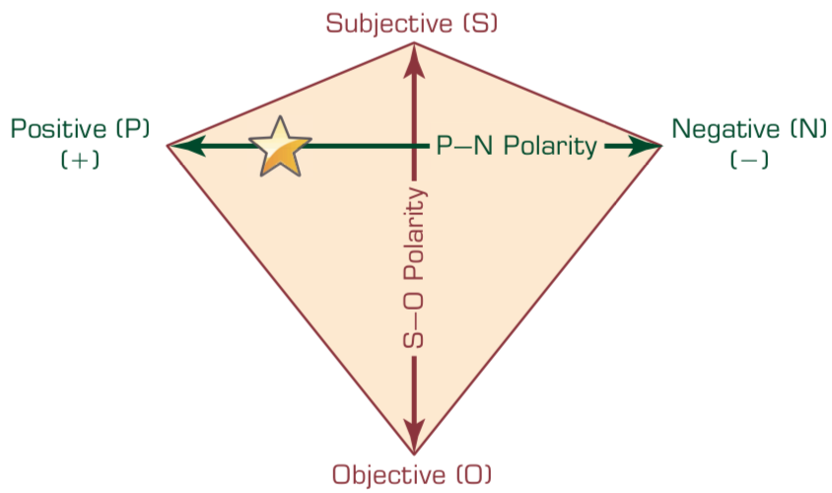
P–N Polarity and
S–O Polarity Relationship
Source: Ramesh Sharda, Dursun Delen, and Efraim Turban (2017), Business Intelligence, Analytics, and Data Science: A Managerial Perspective, 4th Edition, Pearson

Slide 45
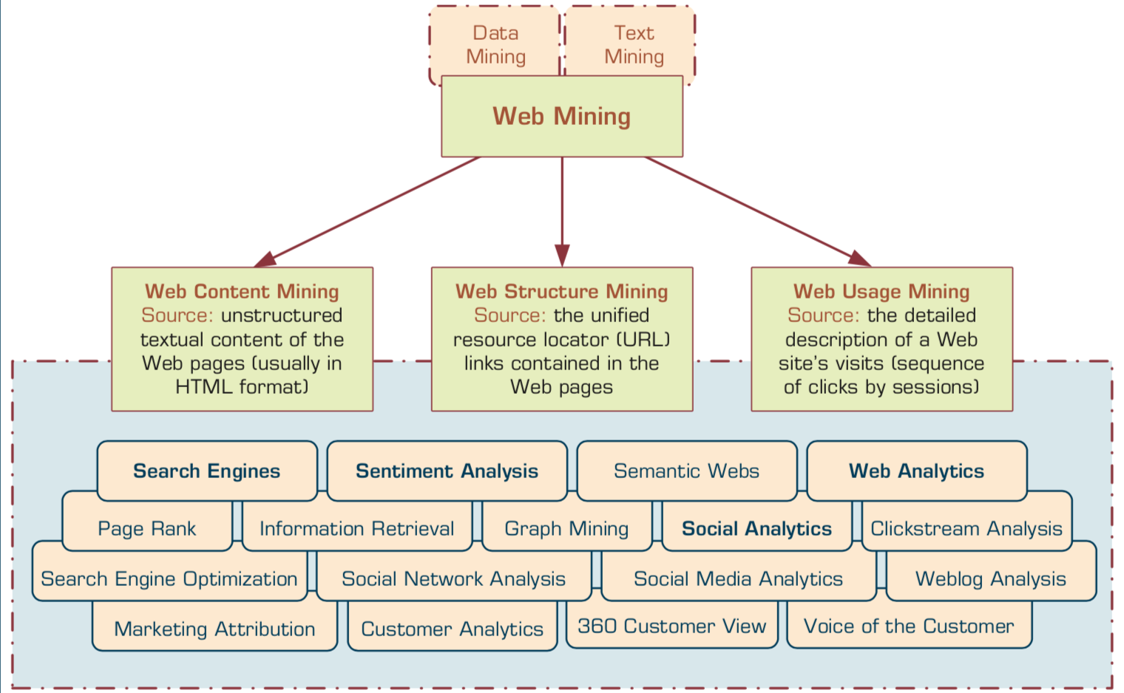
Taxonomy of Web Mining
Source: Ramesh Sharda, Dursun Delen, and Efraim Turban (2017), Business Intelligence, Analytics, and Data Science: A Managerial Perspective, 4th Edition, Pearson

Slide 46
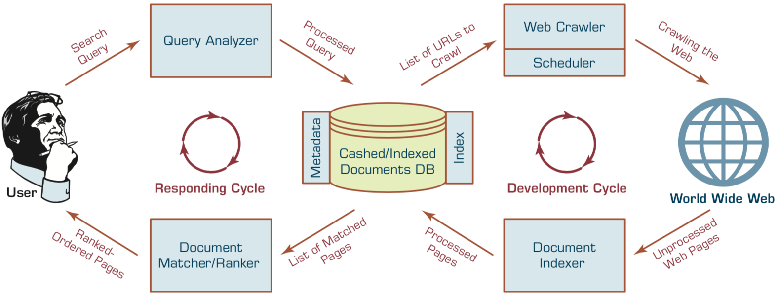
Structure of a
Typical Internet Search Engine
Source: Ramesh Sharda, Dursun Delen, and Efraim Turban (2017), Business Intelligence, Analytics, and Data Science: A Managerial Perspective, 4th Edition, Pearson

Slide 47
Web Usage Mining
(Web Analytics)
Web usage mining (Web analytics)
is the extraction of useful information
from data generated
through Web page visits and transactions.
Clickstream Analysis
Source: Ramesh Sharda, Dursun Delen, and Efraim Turban (2017), Business Intelligence, Analytics, and Data Science: A Managerial Perspective, 4th Edition, Pearson

Slide 48
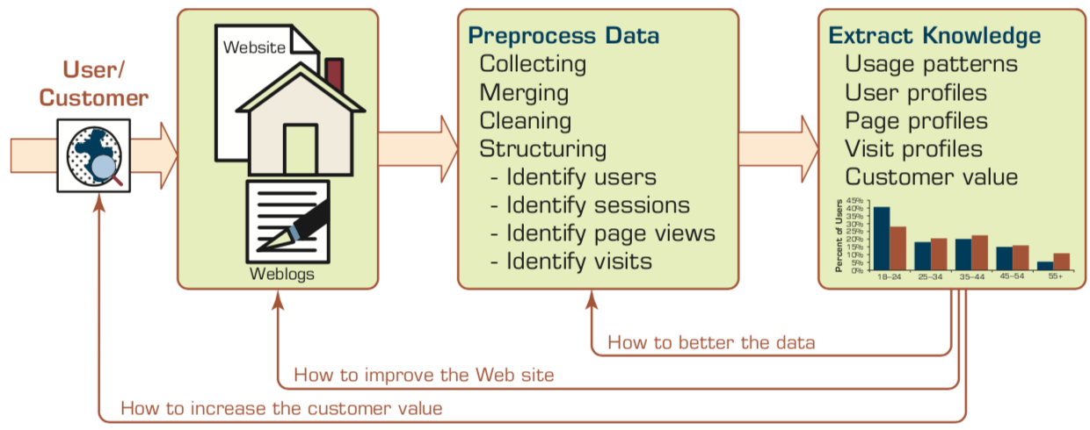
Extraction of Knowledge from Web Usage Data
Source: Ramesh Sharda, Dursun Delen, and Efraim Turban (2017), Business Intelligence, Analytics, and Data Science: A Managerial Perspective, 4th Edition, Pearson

Slide 49
Social Analytics
Social analytics is defined as
monitoring, analyzing,
measuring and interpreting
digital interactions and
relationships of people, topics, ideas and content.
Source: Ramesh Sharda, Dursun Delen, and Efraim Turban (2017), Business Intelligence, Analytics, and Data Science: A Managerial Perspective, 4th Edition, Pearson

Slide 50
Branches of Social Analytics
Social Network Analysis (SNA)
Social Analytics
Social Media Analytics
Source: Ramesh Sharda, Dursun Delen, and Efraim Turban (2017), Business Intelligence, Analytics, and Data Science: A Managerial Perspective, 4th Edition, Pearson

Slide 51
Text Mining
Technologies

Slide 52
Natural Language Processing
(NLP)
Text Mining
(TM)

Slide 53
Text mining
Text Data Mining
Intelligent Text Analysis
Knowledge-Discovery in Text (KDT)
Source: Vishal Gupta and Gurpreet S. Lehal (2009), "A survey of text mining techniques and applications,"
Journal of emerging technologies in web intelligence, vol. 1, no. 1, pp. 60-76.

Slide 54
Text Mining
(text data mining)
  the process of
  deriving
  high-quality information
  from text
http://en.wikipedia.org/wiki/Text_mining

Slide 55
Text Mining: the process of extracting interesting and non-trivial information and knowledge from unstructured text.
Source: Vishal Gupta and Gurpreet S. Lehal (2009), "A survey of text mining techniques and applications,"
Journal of emerging technologies in web intelligence, vol. 1, no. 1, pp. 60-76.

Slide 56
Text Mining: discovery by computer of new, previously unknown information, by automatically extracting information from different written resources.
Source: Vishal Gupta and Gurpreet S. Lehal (2009), "A survey of text mining techniques and applications,"
Journal of emerging technologies in web intelligence, vol. 1, no. 1, pp. 60-76.

Slide 57
An example of Text Mining
Knowledge
Analyze Text
Management Information System
Information Extraction
Classification
Summarization
Retrieve and preprocess document
Clustering
Document Collection
Source: Vishal Gupta and Gurpreet S. Lehal (2009), "A survey of text mining techniques and applications,"
Journal of emerging technologies in web intelligence, vol. 1, no. 1, pp. 60-76.

Slide 58
Overview of
Information Extraction based
Text Mining Framework
Text Data Mining
Text
Text
DB
Text
Information Extraction
Data Mining
Rule
Source: Vishal Gupta and Gurpreet S. Lehal (2009), "A survey of text mining techniques and applications,"
Journal of emerging technologies in web intelligence, vol. 1, no. 1, pp. 60-76.

Slide 59
Natural Language Processing (NLP)
Natural language processing (NLP)
is an important component of
text mining and
is a subfield of
artificial intelligence and
computational linguistics.
Source: Ramesh Sharda, Dursun Delen, and Efraim Turban (2017), Business Intelligence, Analytics, and Data Science: A Managerial Perspective, 4th Edition, Pearson

Slide 60
Natural Language Processing (NLP) and Text Mining
Raw text
Sentence Segmentation
Tokenization
Part-of-Speech (POS)
Stop word removal
word’s stem
am → am
having → hav
word’s lemma
am → be
having → have
Stemming / Lemmatization
Dependency Parser
String Metrics & Matching
Source: Nitin Hardeniya (2015), NLTK Essentials, Packt Publishing; Florian Leitner (2015), Text mining - from Bayes rule to dependency parsing

Slide 61
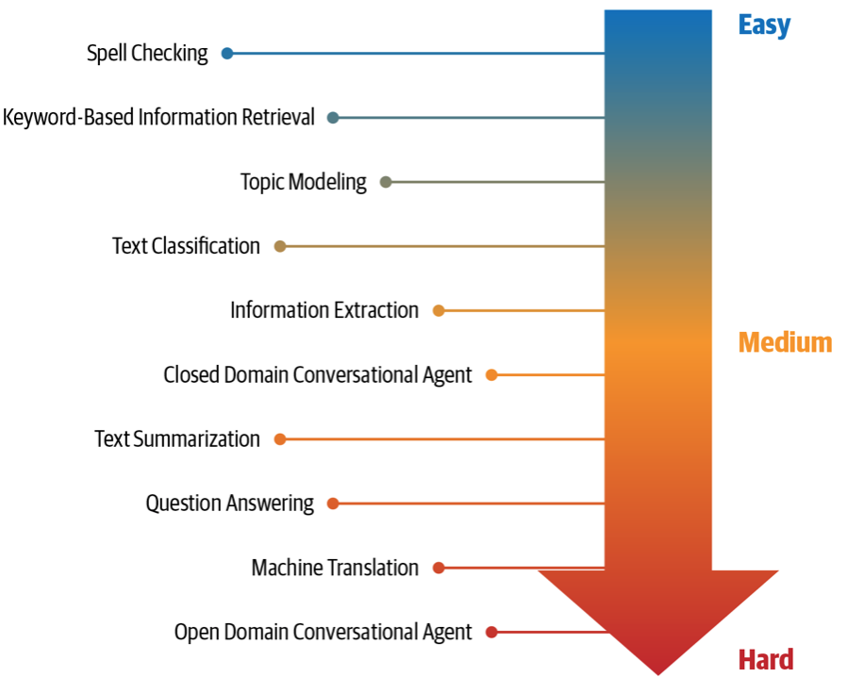
NLP Tasks
Source: Sowmya Vajjala, Bodhisattwa Majumder, Anuj Gupta (2020), Practical Natural Language Processing: A Comprehensive Guide to Building Real-World NLP Systems, O'Reilly Media.

Slide 62
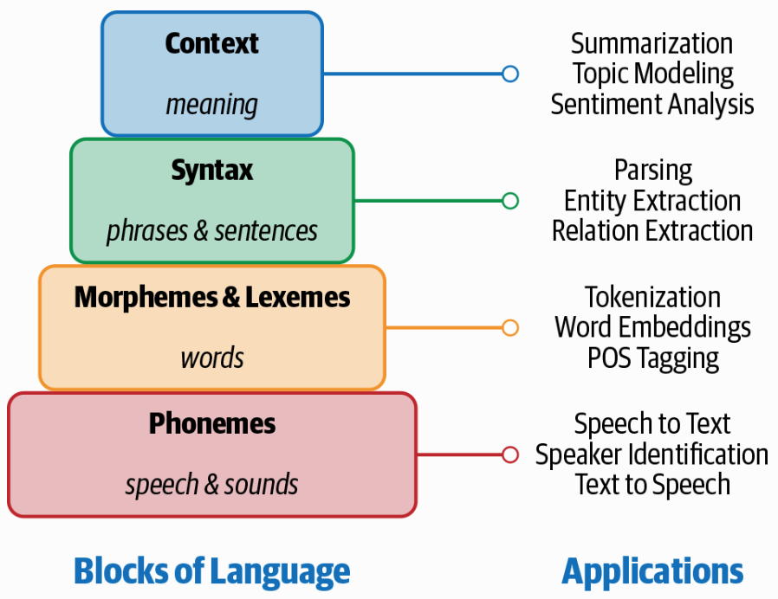
Building Blocks of Language and Applications
Source: Sowmya Vajjala, Bodhisattwa Majumder, Anuj Gupta (2020), Practical Natural Language Processing: A Comprehensive Guide to Building Real-World NLP Systems, O'Reilly Media.

Slide 63
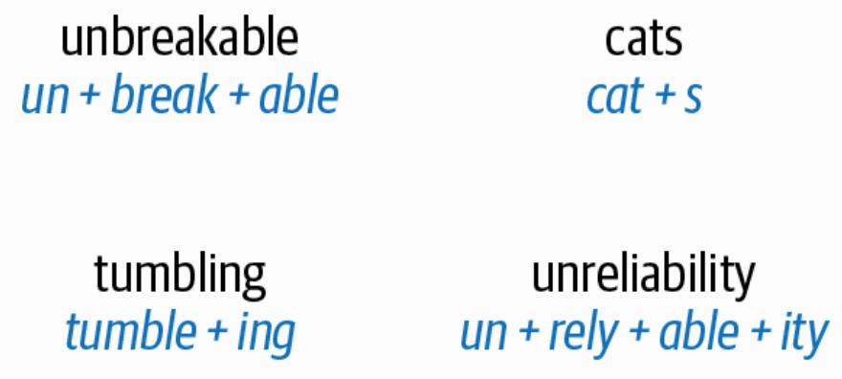
Morpheme Examples
Source: Sowmya Vajjala, Bodhisattwa Majumder, Anuj Gupta (2020), Practical Natural Language Processing: A Comprehensive Guide to Building Real-World NLP Systems, O'Reilly Media.

Slide 64
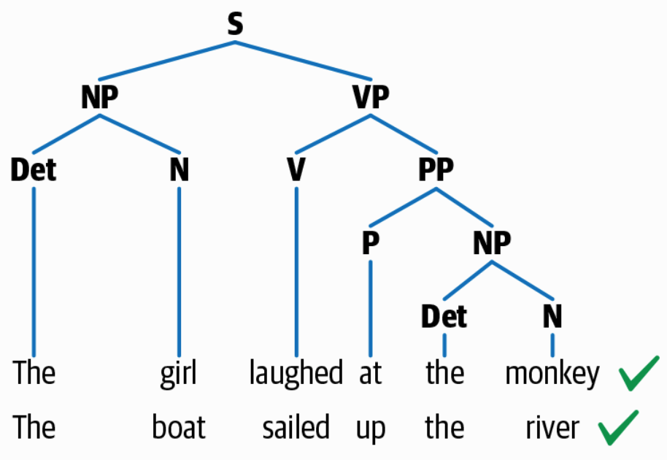
Syntactic Structure
Source: Sowmya Vajjala, Bodhisattwa Majumder, Anuj Gupta (2020), Practical Natural Language Processing: A Comprehensive Guide to Building Real-World NLP Systems, O'Reilly Media.

Slide 65
Text Summarization
Text Input
Dictionary / Thesaurus
Pre-processing
Text Structure Analysis
Word Segmentation
Occurrence Statistic
POS Tagging
Keyword Extraction
Weigh Words & Sentences
Sentences Selection
Rough Summary Generation
Smoothing
Summary Output
Source: Vishal Gupta and Gurpreet S. Lehal (2009), "A survey of text mining techniques and applications,"
Journal of emerging technologies in web intelligence, vol. 1, no. 1, pp. 60-76.

Slide 66
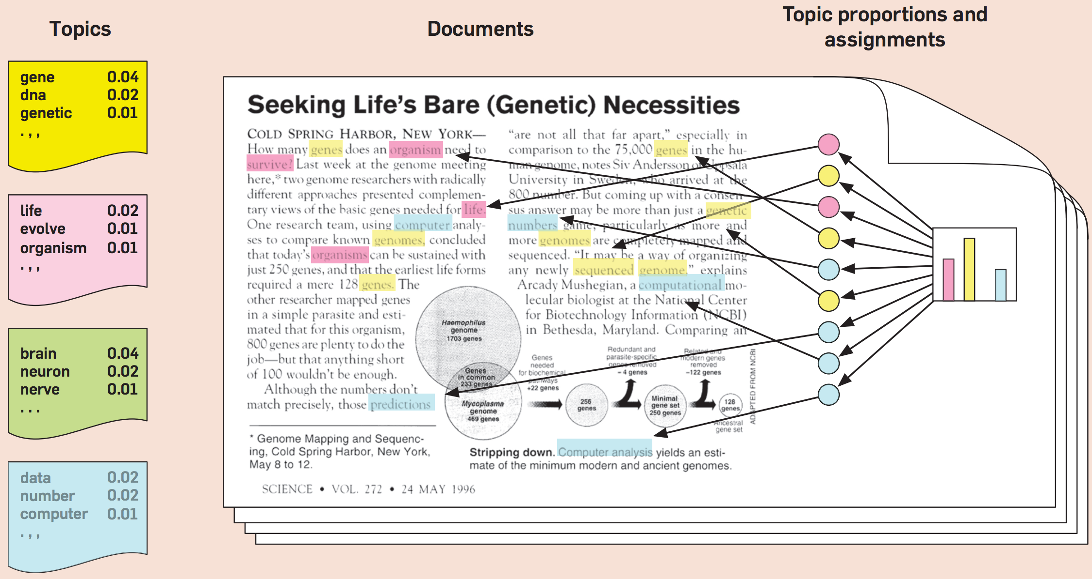
Topic Modeling
Source: Blei, David M. "Probabilistic topic models." Communications of the ACM 55, no. 4 (2012): 77-84.

Slide 67
Natural Language Processing (NLP)
Part-of-speech tagging
Text segmentation
Word sense disambiguation
Syntactic ambiguity
Imperfect or irregular input
Speech acts
Source: Ramesh Sharda, Dursun Delen, and Efraim Turban (2017), Business Intelligence, Analytics, and Data Science: A Managerial Perspective, 4th Edition, Pearson

Slide 68
NLP Tasks
Question answering
Automatic summarization
Natural language generation
Natural language understanding
Machine translation
Foreign language reading
Foreign language writing.
Speech recognition
Text-to-speech
Text proofing
Optical character recognition
Source: Ramesh Sharda, Dursun Delen, and Efraim Turban (2017), Business Intelligence, Analytics, and Data Science: A Managerial Perspective, 4th Edition, Pearson

Slide 69
NLP
Source: http://blog.aylien.com/leveraging-deep-learning-for-multilingual/

Slide 70
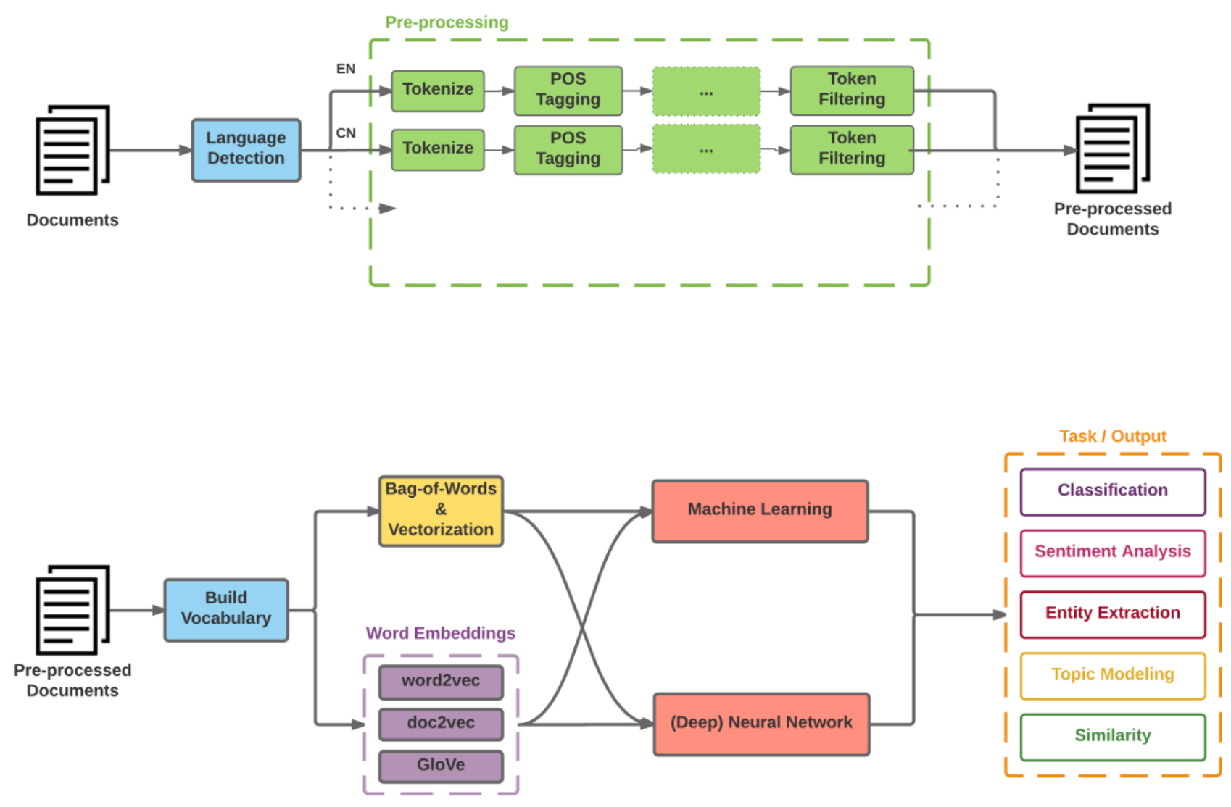
Modern NLP Pipeline
Source: https://github.com/fortiema/talks/blob/master/opendata2016sh/pragmatic-nlp-opendata2016sh.pdf

Slide 71
Modern NLP Pipeline
Source: http://mattfortier.me/2017/01/31/nlp-intro-pt-1-overview/

Slide 72
Deep Learning NLP
Source: http://mattfortier.me/2017/01/31/nlp-intro-pt-1-overview/

Slide 73
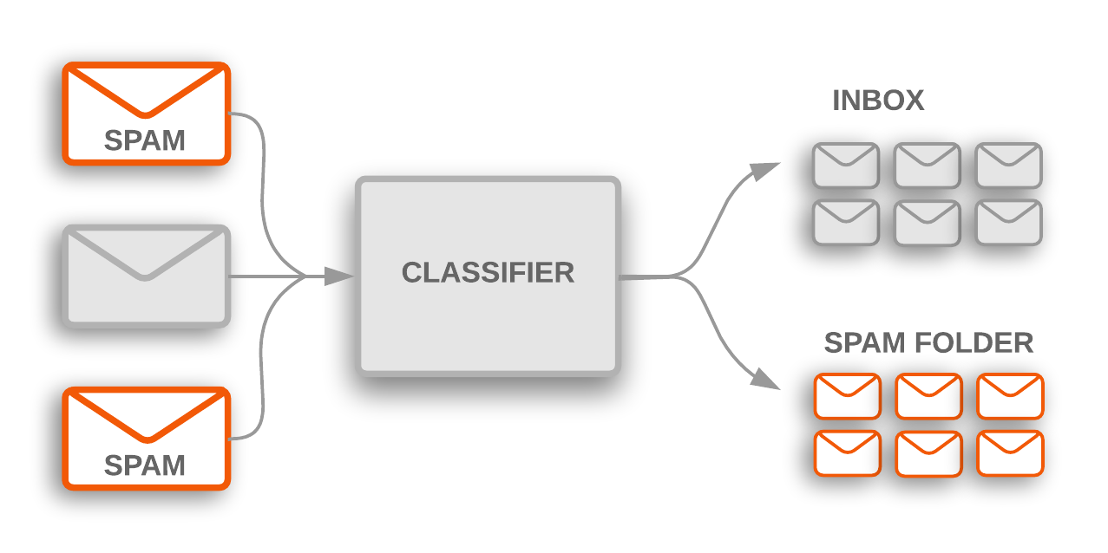
Text Classification
Source: https://developers.google.com/machine-learning/guides/text-classification/

Slide 74
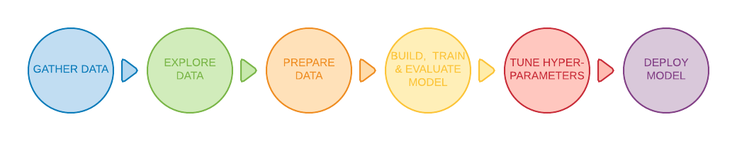
Text Classification Workflow
Step 1: Gather Data
Step 2: Explore Your Data
Step 2.5: Choose a Model*
Step 3: Prepare Your Data
Step 4: Build, Train, and Evaluate Your Model
Step 5: Tune Hyperparameters
Step 6: Deploy Your Model
Source: https://developers.google.com/machine-learning/guides/text-classification/

Slide 75
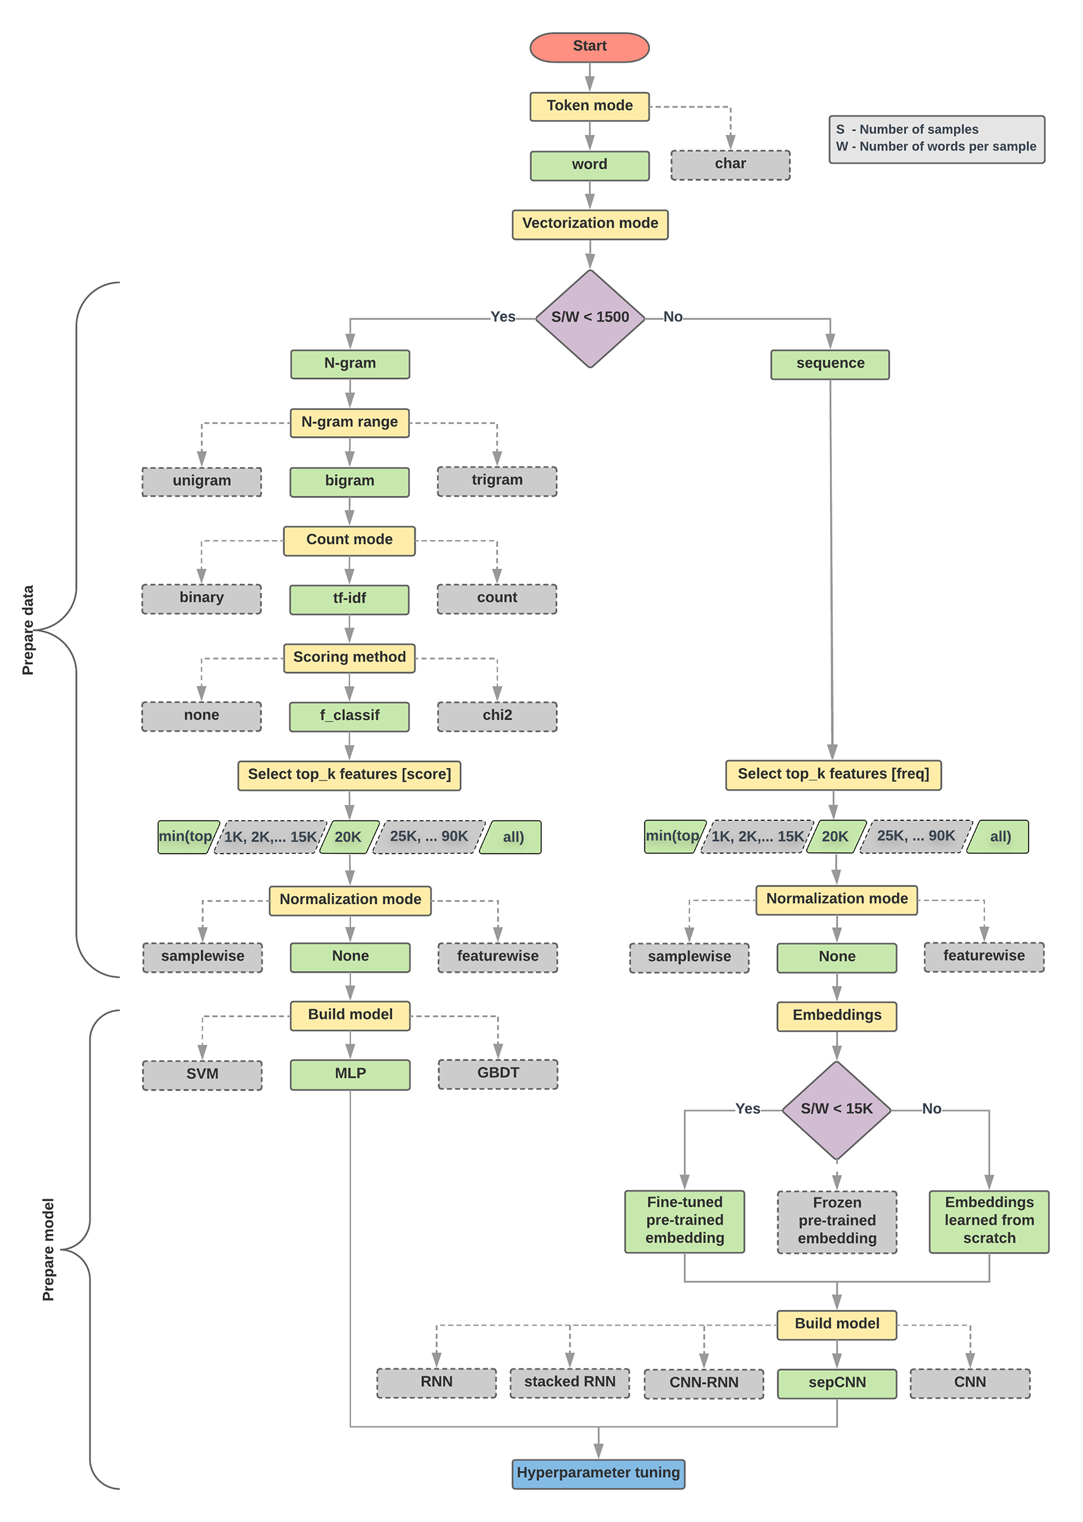
Text Classification Flowchart
Source: https://developers.google.com/machine-learning/guides/text-classification/step-2-5

Slide 76
Text Classification S/W<1500: N-gram
Source: https://developers.google.com/machine-learning/guides/text-classification/step-2-5

Slide 77
Text Classification S/W>=1500: Sequence
Source: https://developers.google.com/machine-learning/guides/text-classification/step-2-5

Slide 78
Step 2.5: Choose a Model
Samples/Words < 1500
150,000/100 = 1500
IMDb review dataset,
the samples/words-per-sample ratio is ~ 144
Source: https://developers.google.com/machine-learning/guides/text-classification/step-2-5

Slide 79
Step 2.5: Choose a Model
Samples/Words < 15,000
1,500,000/100 = 15,000
Source: https://developers.google.com/machine-learning/guides/text-classification/step-2-5

Slide 80
Step 3: Prepare Your Data
Texts:
T1: ’The mouse ran up the clock'
T2: ’The mouse ran down’
Token Index:
{'the': 1, 'mouse’: 2, 'ran': 3, 'up': 4, 'clock': 5, 'down': 6,}.
  NOTE: 'the' occurs most frequently,
  so the index value of 1 is assigned to it.
  Some libraries reserve index 0 for unknown tokens,
  as is the case here.
Sequence of token indexes:
T1: ‘The mouse ran up the clock’ =
[1, 2, 3, 4, 1, 5]
T1: ’The mouse ran down’ =
[1, 2, 3, 6]
Source: https://developers.google.com/machine-learning/guides/text-classification/step-3

Slide 81
One-hot encoding
'The mouse ran up the clock’ =
[ [0, 1, 0, 0, 0, 0, 0],
[0, 0, 1, 0, 0, 0, 0],
[0, 0, 0, 1, 0, 0, 0],
[0, 0, 0, 0, 1, 0, 0],
[0, 1, 0, 0, 0, 0, 0],
[0, 0, 0, 0, 0, 1, 0] ]
The
mouse
ran
up
the
clock
1
2
3
4
1
5
[0, 1, 2, 3, 4, 5, 6]
Source: https://developers.google.com/machine-learning/guides/text-classification/step-3

Slide 82
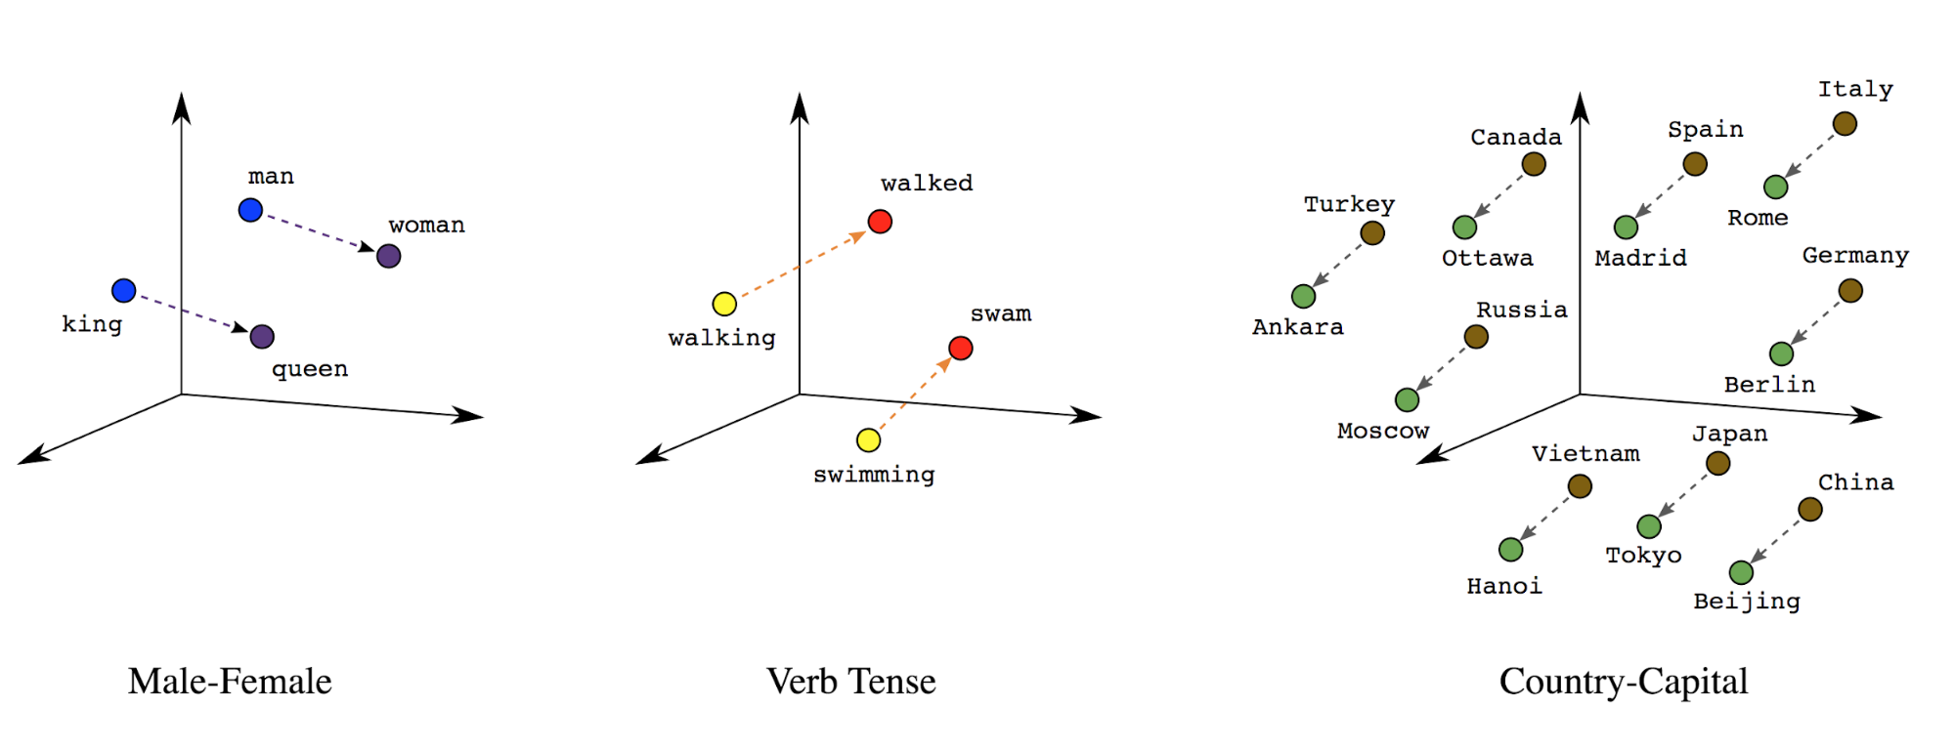
Word embeddings
Source: https://developers.google.com/machine-learning/guides/text-classification/step-3

Slide 83
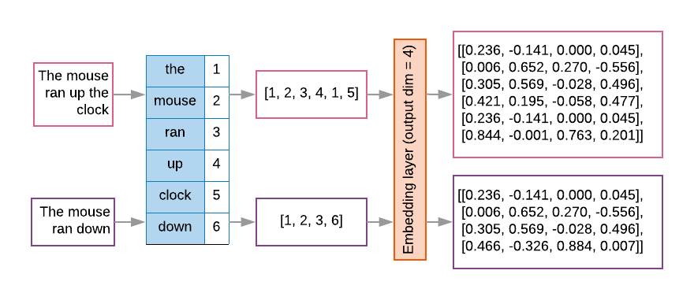
Word embeddings
Source: https://developers.google.com/machine-learning/guides/text-classification/step-3

Slide 84
Vector Representations of Words
Word Embeddings
Word2Vec
GloVe

Slide 85
Modern NLP Pipeline
Source: https://github.com/fortiema/talks/blob/master/opendata2016sh/pragmatic-nlp-opendata2016sh.pdf

Slide 86
Facebook Research FastText
Pre-trained word vectors
Word2Vec
wiki.zh.vec (861MB)
332647 word
300 vec
Pre-trained word vectors for 90 languages,
trained on Wikipedia using fastText.
These vectors in dimension 300 were obtained using the skip-gram model with default parameters.
https://github.com/facebookresearch/fastText/blob/master/pretrained-vectors.md
Source: Bojanowski, Piotr, Edouard Grave, Armand Joulin, and Tomas Mikolov. "Enriching word vectors with subword information." arXiv preprint arXiv:1607.04606 (2016).

Slide 87
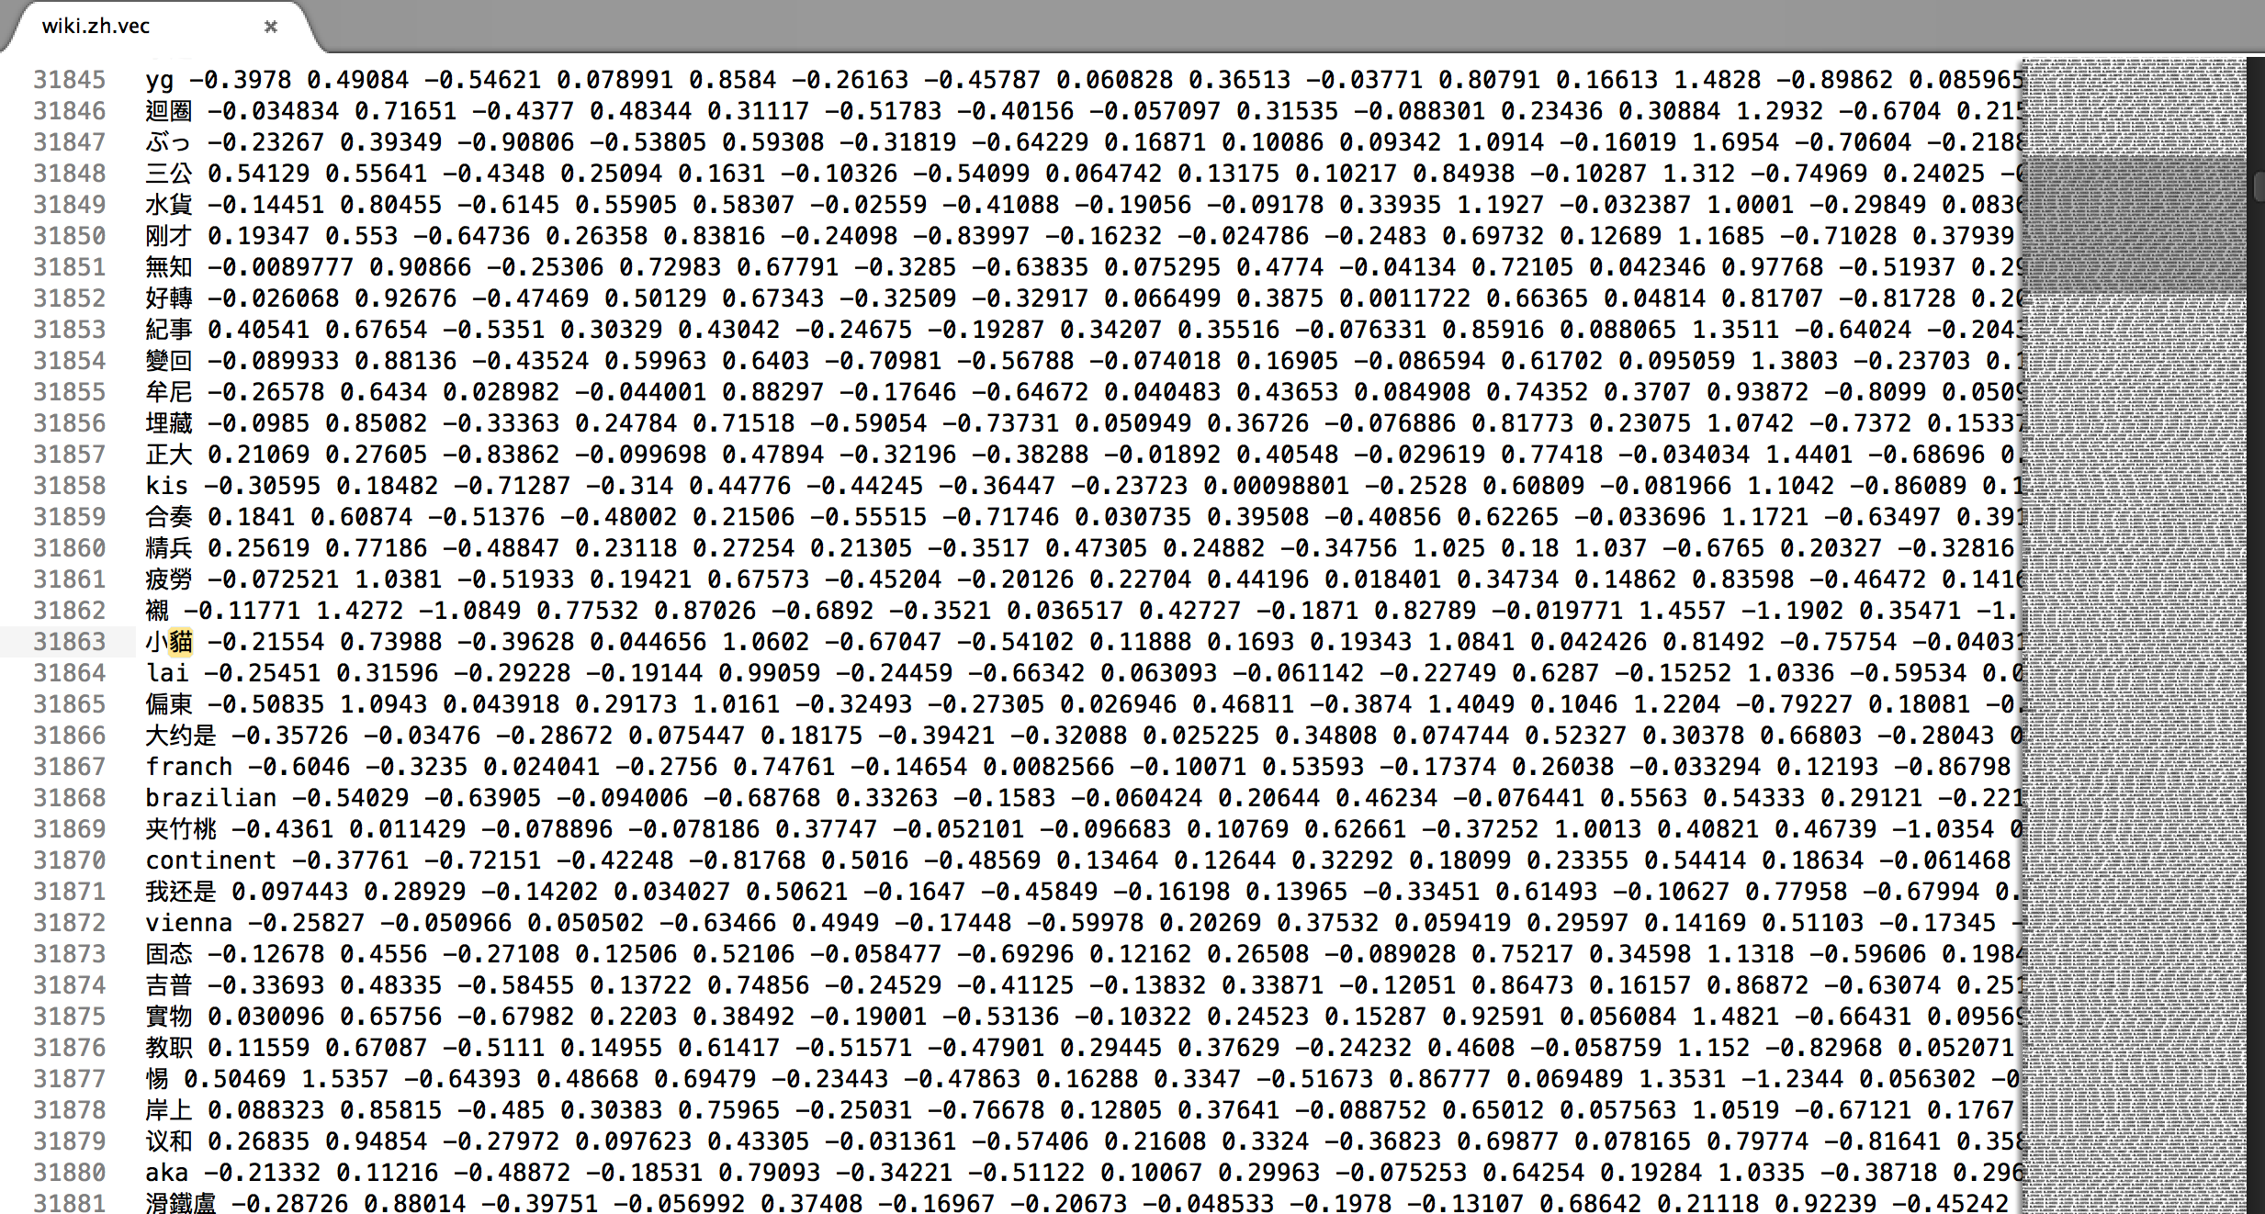
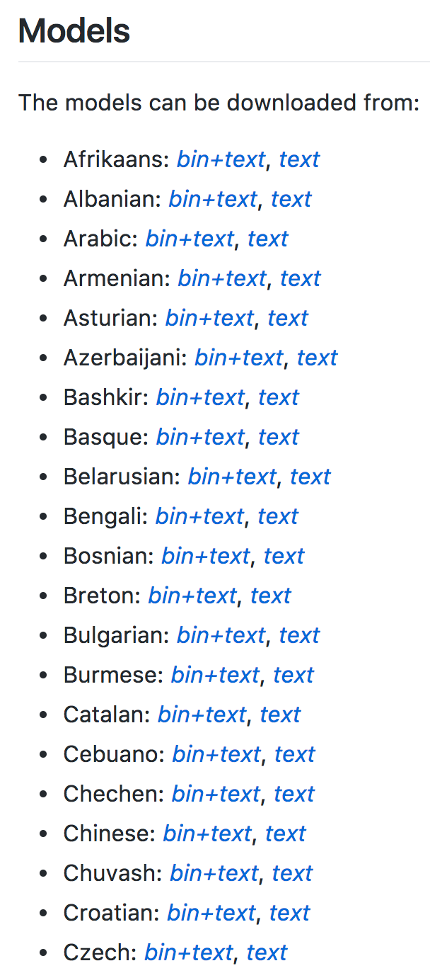
Facebook Research FastText Word2Vec: wiki.zh.vec
(861MB) (332647 word 300 vec)
https://github.com/facebookresearch/fastText/blob/master/pretrained-vectors.md

Slide 88
Word Embeddings in LSTM RNN
Source: https://avisingh599.github.io/deeplearning/visual-qa/

Slide 89
Sequence to Sequence
(Seq2Seq)
Source: https://google.github.io/seq2seq/

Slide 90
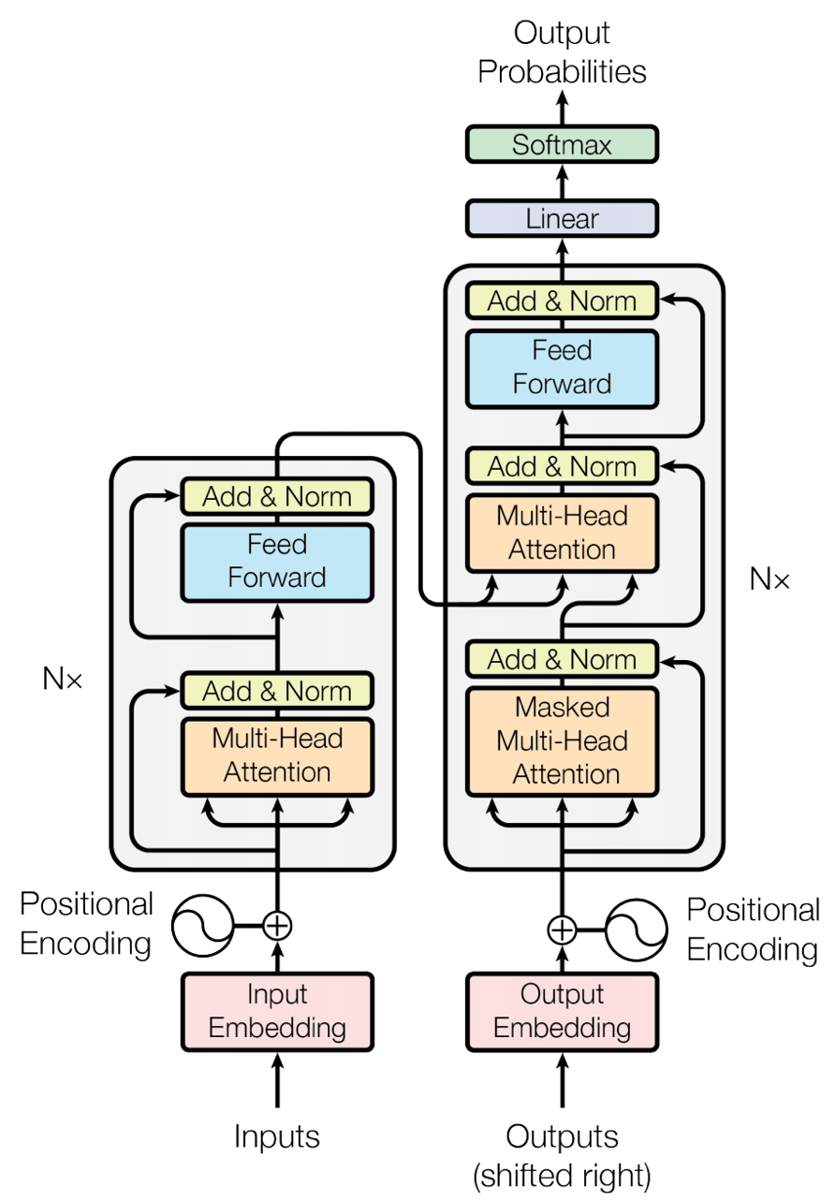
Transformer (Attention is All You Need)
(Vaswani et al., 2017)
Source: Vaswani, Ashish, Noam Shazeer, Niki Parmar, Jakob Uszkoreit, Llion Jones, Aidan N. Gomez, Łukasz Kaiser, and Illia Polosukhin. "Attention is all you need." In Advances in neural information processing systems, pp. 5998-6008. 2017.

Slide 91
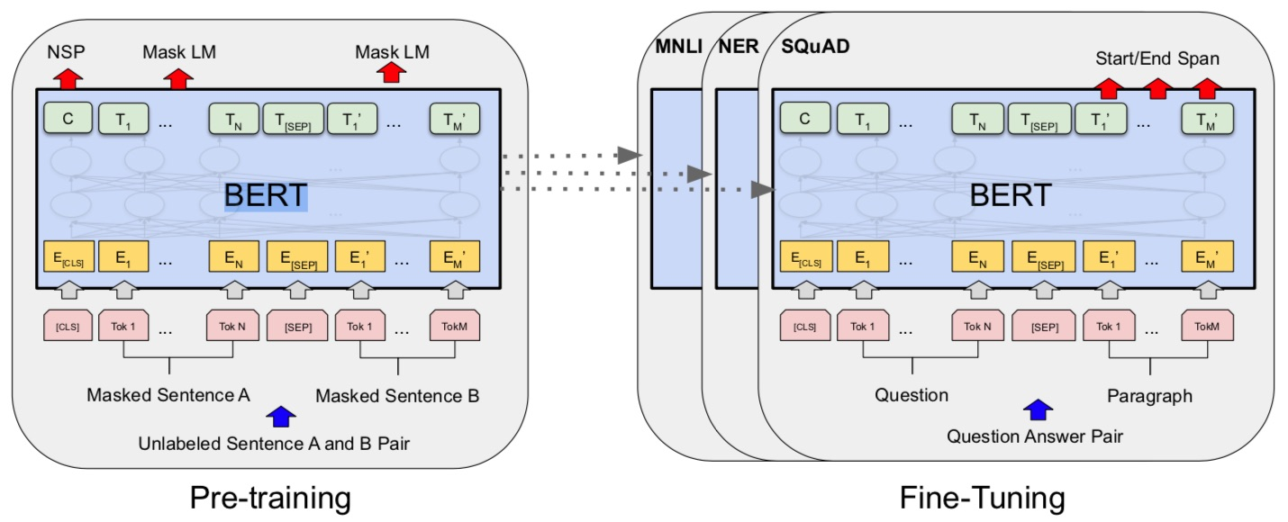
BERT: Pre-training of Deep Bidirectional Transformers for Language Understanding
BERT (Bidirectional Encoder Representations from Transformers)
Overall pre-training and fine-tuning procedures for BERT
Source: Devlin, Jacob, Ming-Wei Chang, Kenton Lee, and Kristina Toutanova (2018).
"Bert: Pre-training of deep bidirectional transformers for language understanding." arXiv preprint arXiv:1810.04805.

Slide 92
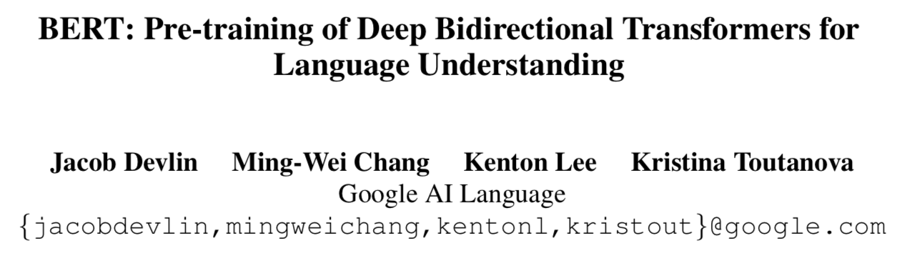
BERT:
Pre-training of Deep
Bidirectional Transformers for Language Understanding
Source: Devlin, Jacob, Ming-Wei Chang, Kenton Lee, and Kristina Toutanova (2018).
"BERT: Pre-training of Deep Bidirectional Transformers for Language Understanding." arXiv preprint arXiv:1810.04805

Slide 93
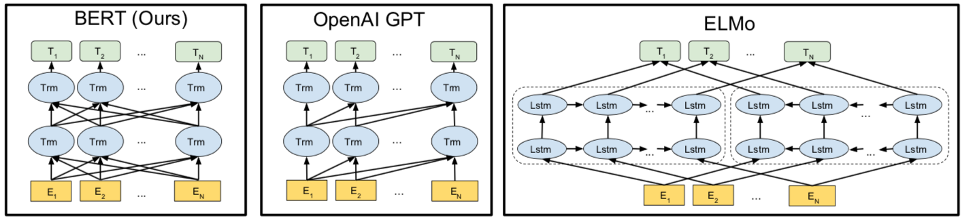
BERT
Bidirectional Encoder Representations from Transformers
Pre-training model architectures
BERT uses a bidirectional Transformer.
OpenAI GPT uses a left-to-right Transformer.
ELMo uses the concatenation of independently trained left-to-right and right- to-left LSTM to generate features for downstream tasks.
Among three, only BERT representations are jointly conditioned on both left and right context in all layers.
Source: Devlin, Jacob, Ming-Wei Chang, Kenton Lee, and Kristina Toutanova (2018).
"BERT: Pre-training of Deep Bidirectional Transformers for Language Understanding." arXiv preprint arXiv:1810.04805

Slide 94
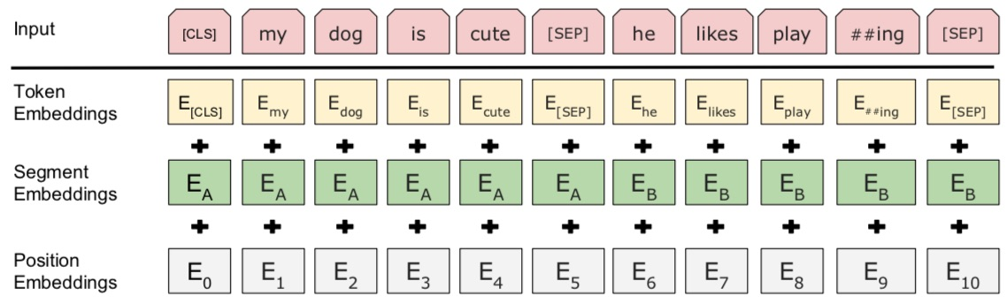
BERT: Pre-training of Deep Bidirectional Transformers for Language Understanding
BERT (Bidirectional Encoder Representations from Transformers)
BERT input representation
The input embeddings is the sum of the token embeddings,
the segmentation embeddings and the position embeddings.
Source: Devlin, Jacob, Ming-Wei Chang, Kenton Lee, and Kristina Toutanova (2018).
"Bert: Pre-training of deep bidirectional transformers for language understanding." arXiv preprint arXiv:1810.04805.

Slide 95
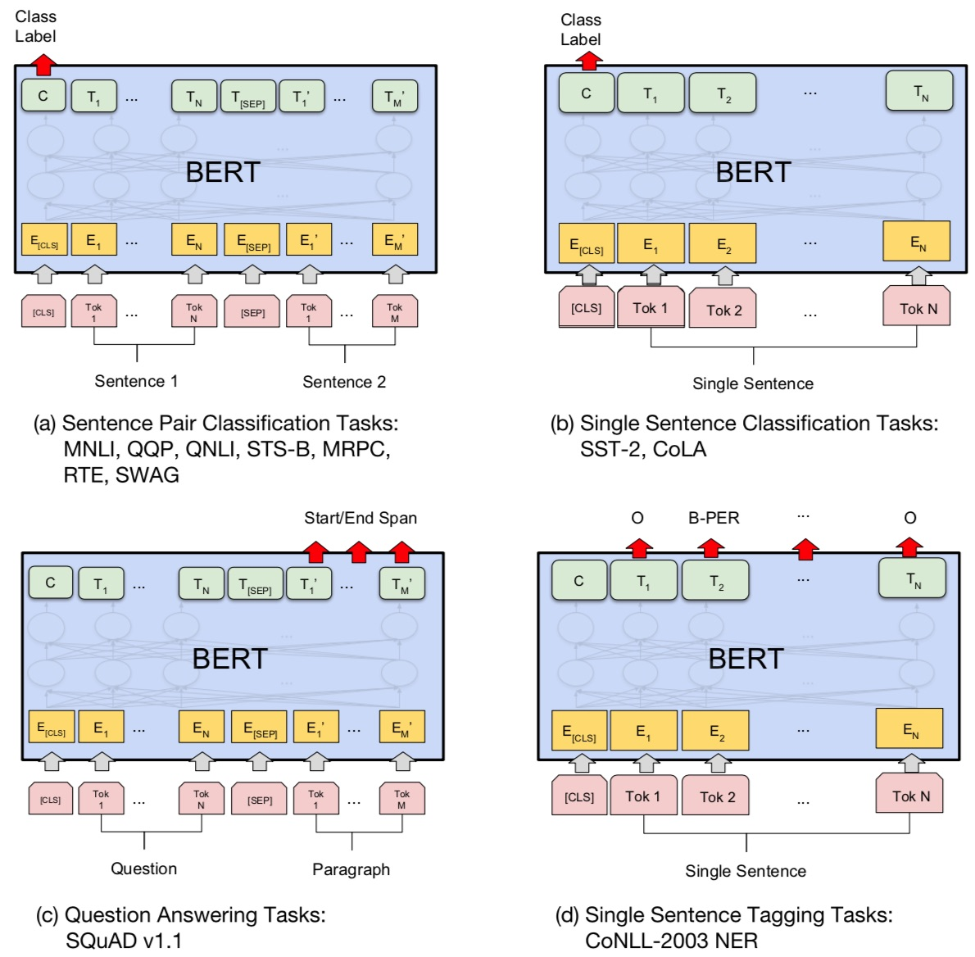
Fine-tuning BERT on NLP Tasks
Source: Devlin, Jacob, Ming-Wei Chang, Kenton Lee, and Kristina Toutanova (2018).
"BERT: Pre-training of Deep Bidirectional Transformers for Language Understanding." arXiv preprint arXiv:1810.04805

Slide 96
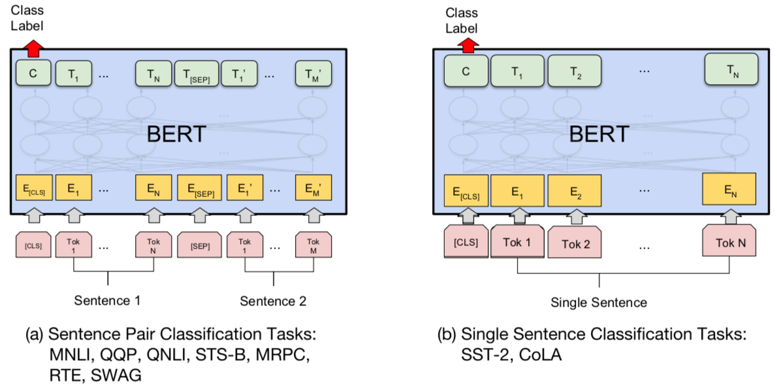
BERT Sequence-level tasks
Source: Devlin, Jacob, Ming-Wei Chang, Kenton Lee, and Kristina Toutanova (2018).
"BERT: Pre-training of Deep Bidirectional Transformers for Language Understanding." arXiv preprint arXiv:1810.04805

Slide 97
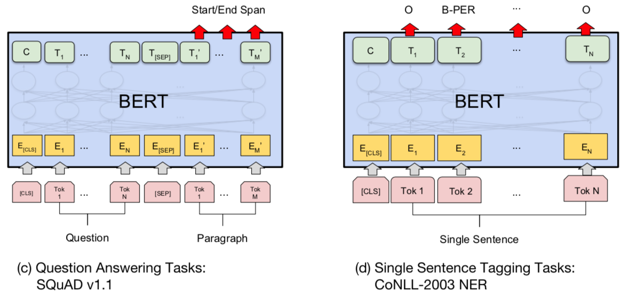
BERT Token-level tasks
Source: Devlin, Jacob, Ming-Wei Chang, Kenton Lee, and Kristina Toutanova (2018).
"BERT: Pre-training of Deep Bidirectional Transformers for Language Understanding." arXiv preprint arXiv:1810.04805

Slide 98
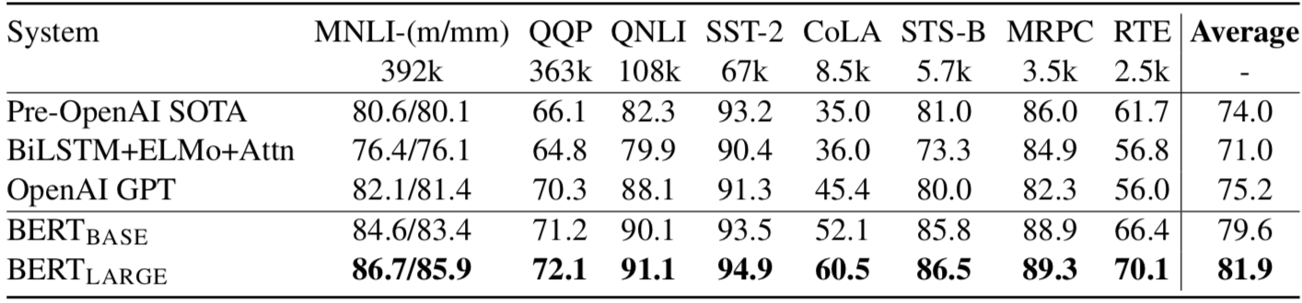
General Language Understanding Evaluation (GLUE) benchmark
GLUE Test results
MNLI: Multi-Genre Natural Language Inference
QQP: Quora Question Pairs
QNLI: Question Natural Language Inference
SST-2: The Stanford Sentiment Treebank
CoLA: The Corpus of Linguistic Acceptability
STS-B:The Semantic Textual Similarity Benchmark
MRPC: Microsoft Research Paraphrase Corpus
RTE: Recognizing Textual Entailment
Source: Devlin, Jacob, Ming-Wei Chang, Kenton Lee, and Kristina Toutanova (2018).
"BERT: Pre-training of Deep Bidirectional Transformers for Language Understanding." arXiv preprint arXiv:1810.04805

Slide 99
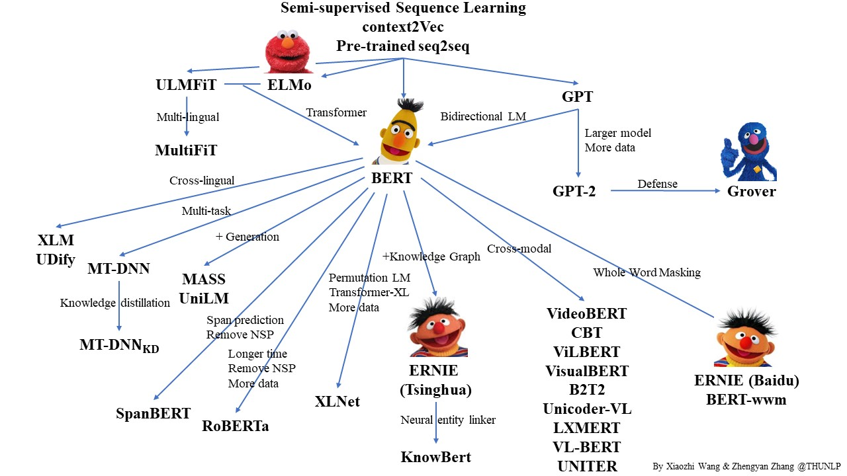
Pre-trained Language Model (PLM)
Source: https://github.com/thunlp/PLMpapers

Slide 100
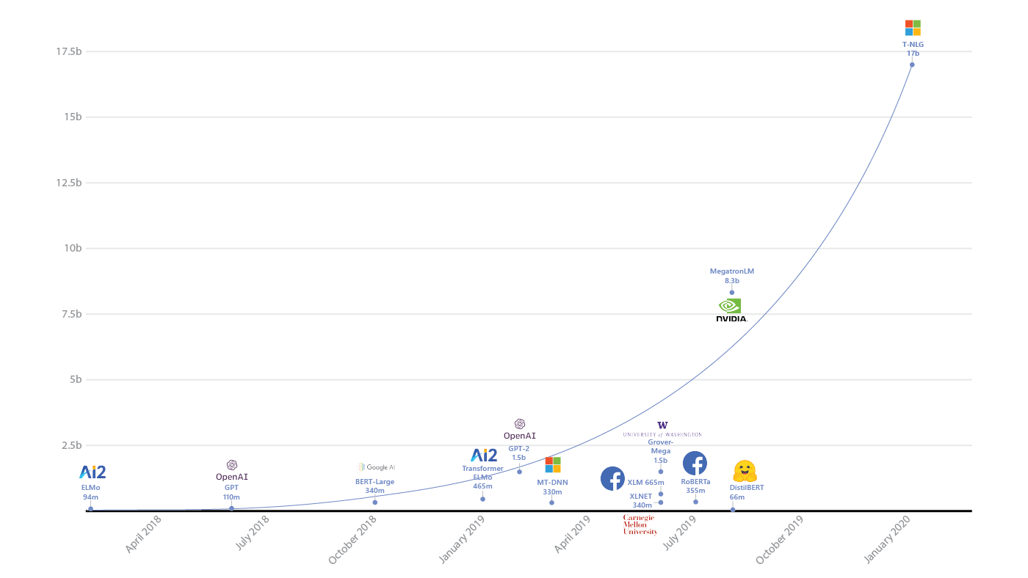
Transformers Pre-trained Language Model
T-NLG
17b
90+ Models
MegatronLM
8.3b
GPT-2
1.5b
BERT-Large
340m
RoBERTa
355m
DistilBERT
66m
2018
2019
2020
2021
2022
Source: https://www.microsoft.com/en-us/research/blog/turing-nlg-a-17-billion-parameter-language-model-by-microsoft/

Slide 101
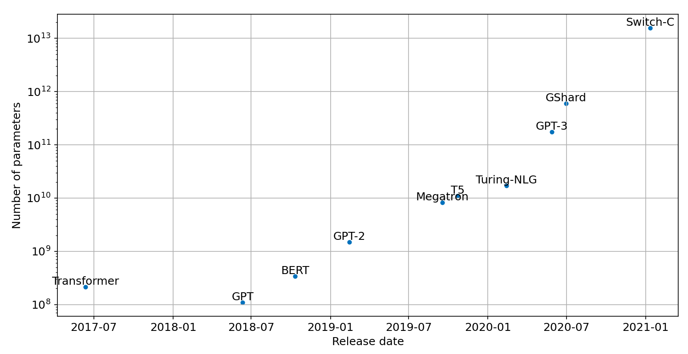
Scaling Transformers

Slide 102
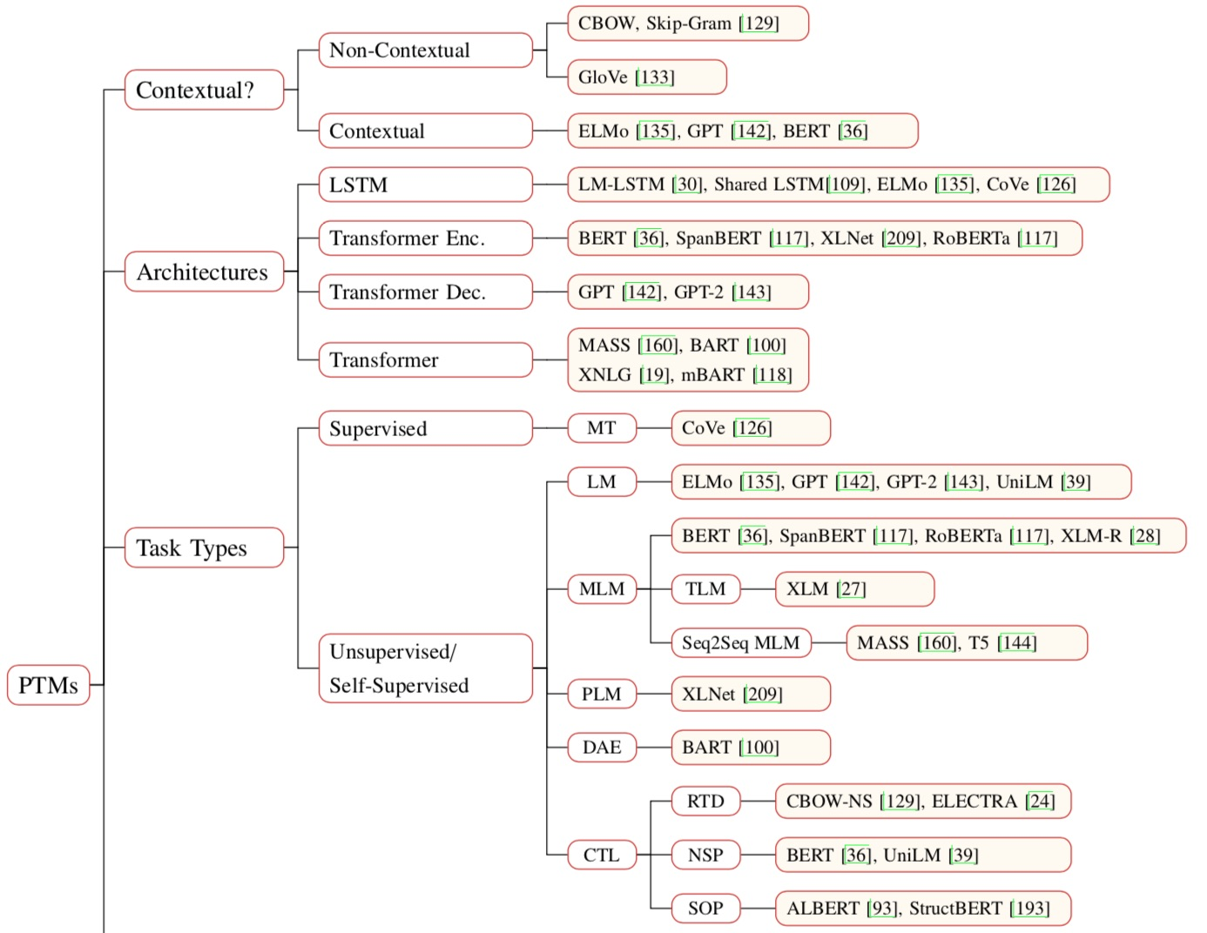
Pre-trained Models (PTM)
Source: Qiu, Xipeng, Tianxiang Sun, Yige Xu, Yunfan Shao, Ning Dai, and Xuanjing Huang. "Pre-trained Models for Natural Language Processing: A Survey." arXiv preprint arXiv:2003.08271 (2020).

Slide 103
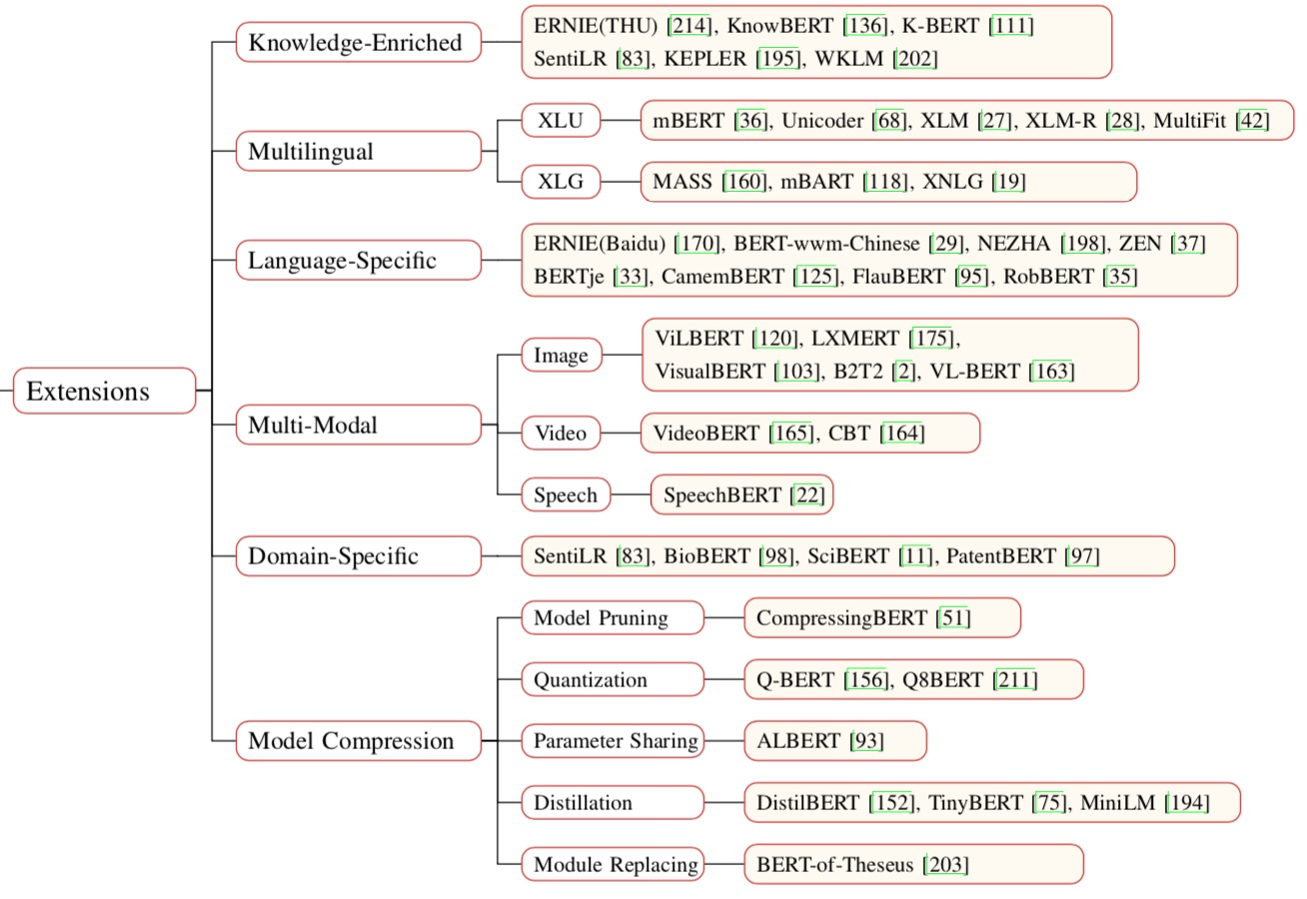
Pre-trained Models (PTM)
Source: Qiu, Xipeng, Tianxiang Sun, Yige Xu, Yunfan Shao, Ning Dai, and Xuanjing Huang. "Pre-trained Models for Natural Language Processing: A Survey." arXiv preprint arXiv:2003.08271 (2020).

Slide 104
Transformers
State-of-the-art Natural Language Processing for TensorFlow 2.0 and PyTorch
Transformers
  pytorch-transformers
  pytorch-pretrained-bert
provides state-of-the-art general-purpose architectures
  (BERT, GPT-2, RoBERTa, XLM, DistilBert, XLNet, CTRL...)
  for Natural Language Understanding (NLU) and
  Natural Language Generation (NLG)
  with over 32+ pretrained models
  in 100+ languages
  and deep interoperability between
  TensorFlow 2.0 and
  PyTorch.
Source: https://github.com/huggingface/transformers

Slide 105
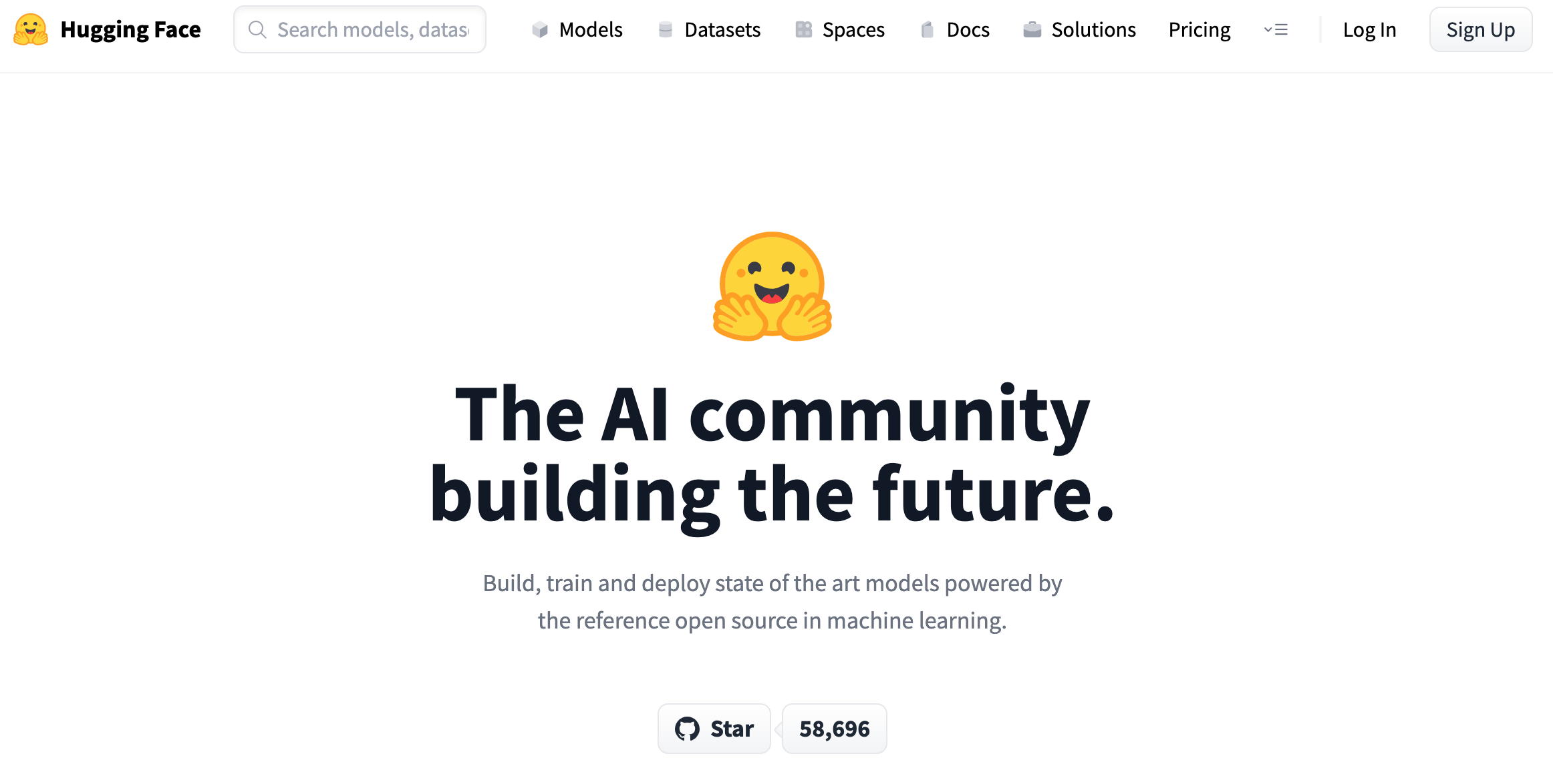
Hugging Face
https://huggingface.co/

Slide 106
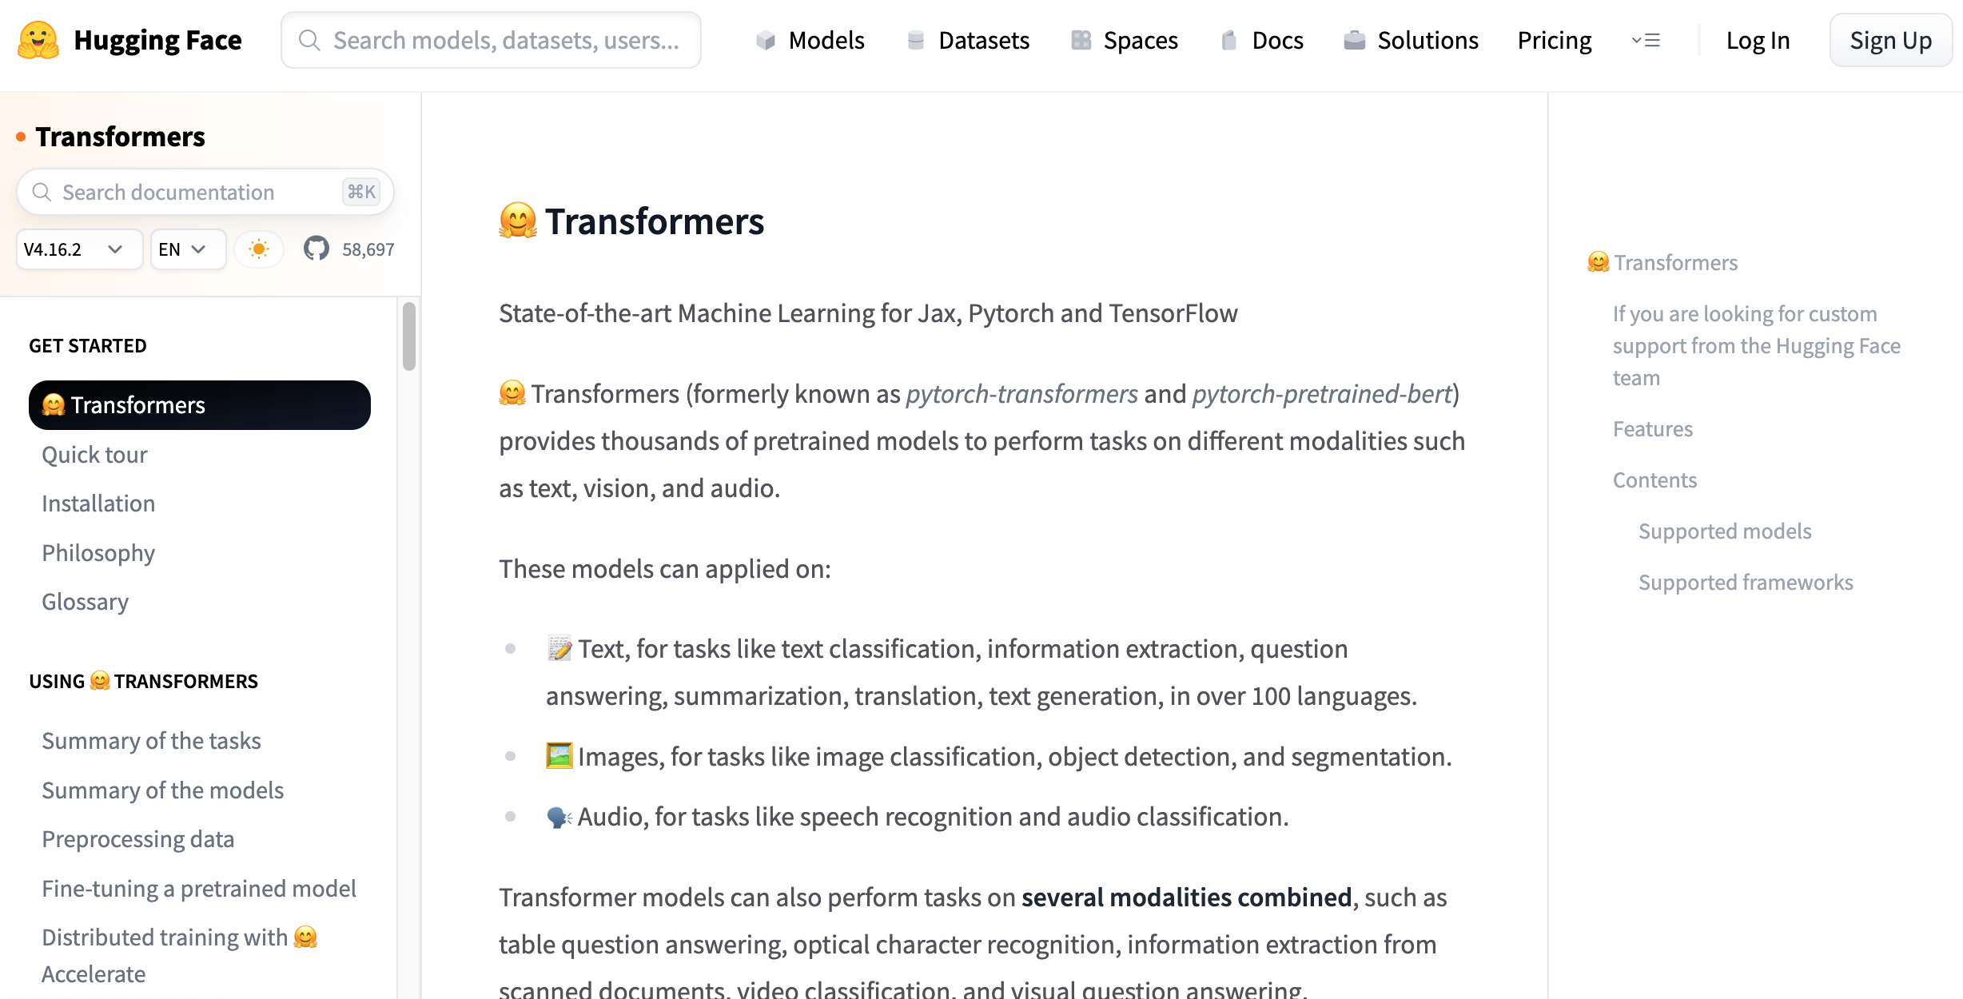
Hugging Face Transformers
https://huggingface.co/docs/transformers/index

Slide 107
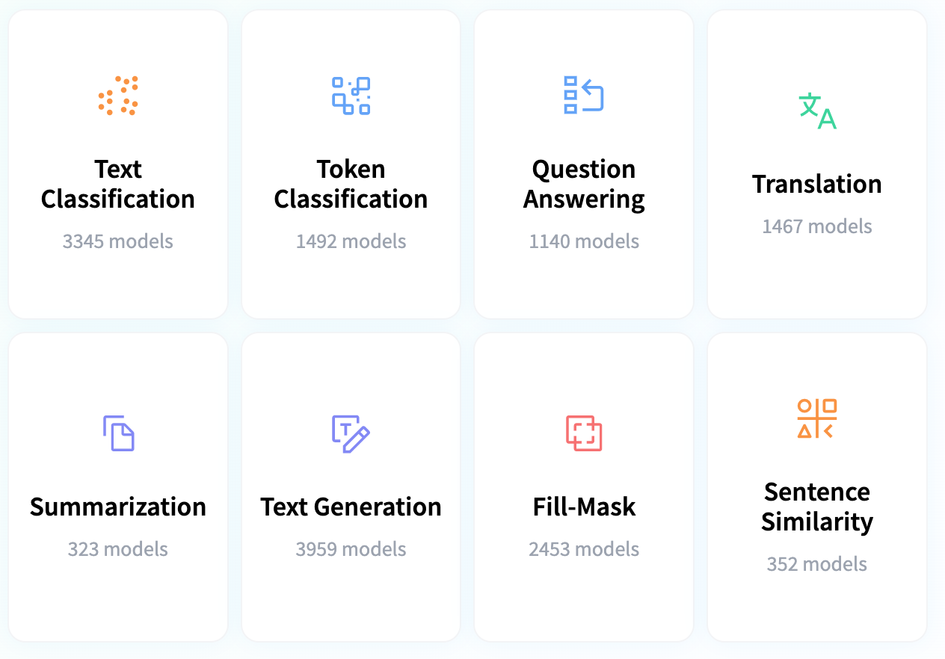
Hugging Face Tasks
Natural Language Processing
https://huggingface.co/tasks

Slide 108
Text Analytics with Python

Slide 109
NLP
Libraries and
Tools

Slide 110

Source: https://www.python.org/community/logos/

Slide 111
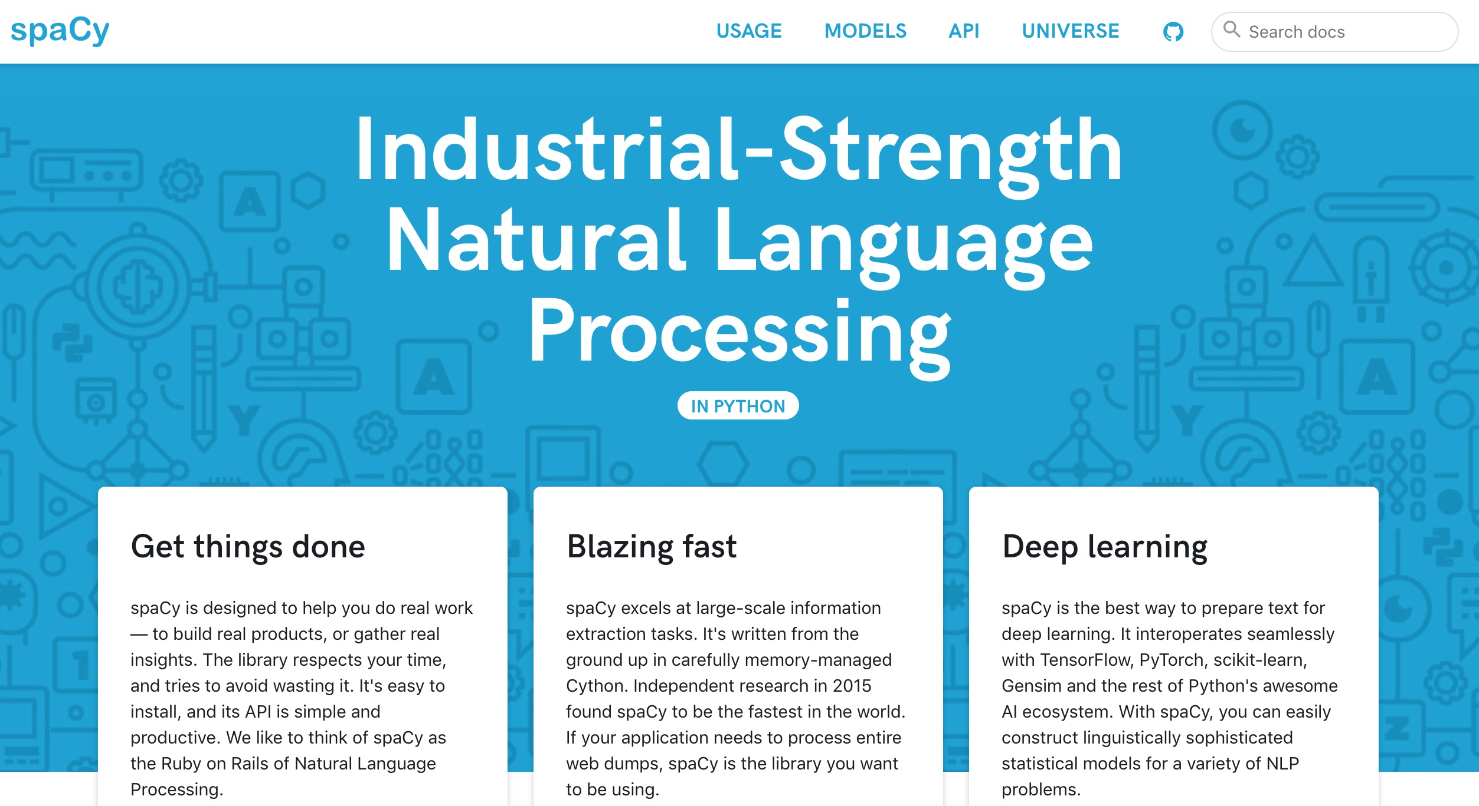
spaCy:
Natural Language Processing
https://spacy.io/

Slide 112
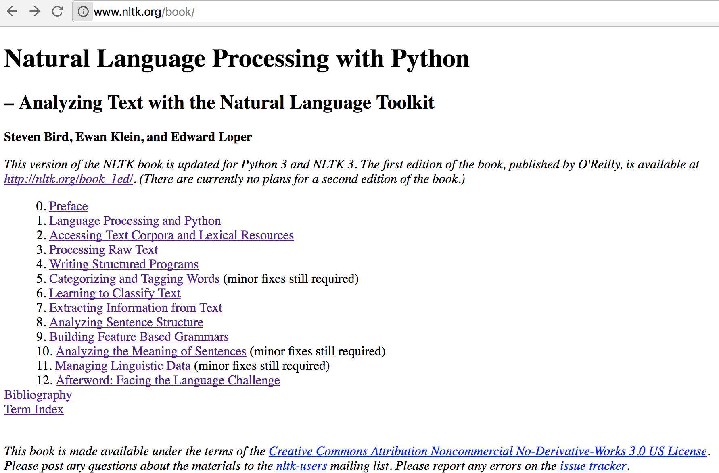
Natural Language Processing with Python
– Analyzing Text with the Natural Language Toolkit
NLTK
http://www.nltk.org/book/

Slide 113
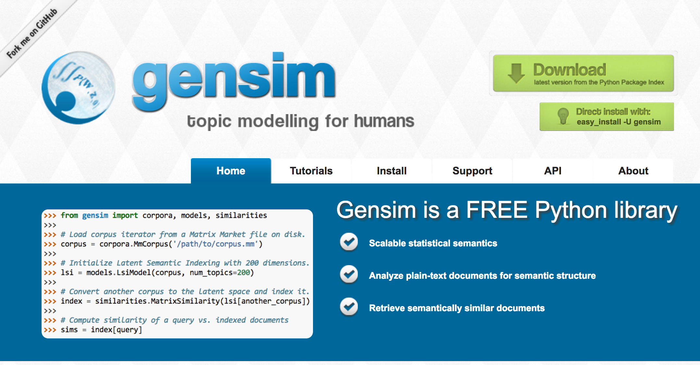
gensim
https://radimrehurek.com/gensim/

Slide 114

TextBlob
https://textblob.readthedocs.io

Slide 115

Polyglot
https://polyglot.readthedocs.io/

Slide 116

scikit-learn
http://scikit-learn.org/

Slide 117

Python in Google Colab (Python101)
https://colab.research.google.com/drive/1FEG6DnGvwfUbeo4zJ1zTunjMqf2RkCrT
https://tinyurl.com/aintpupython101

Slide 118

Python in Google Colab (Python101)
https://colab.research.google.com/drive/1FEG6DnGvwfUbeo4zJ1zTunjMqf2RkCrT
https://tinyurl.com/aintpupython101

Slide 119

Python in Google Colab (Python101)
https://colab.research.google.com/drive/1FEG6DnGvwfUbeo4zJ1zTunjMqf2RkCrT
https://tinyurl.com/aintpupython101

Slide 120

Python in Google Colab (Python101)
https://colab.research.google.com/drive/1FEG6DnGvwfUbeo4zJ1zTunjMqf2RkCrT
https://tinyurl.com/aintpupython101

Slide 121

Python in Google Colab (Python101)
https://colab.research.google.com/drive/1FEG6DnGvwfUbeo4zJ1zTunjMqf2RkCrT
https://tinyurl.com/aintpupython101

Slide 122

Python in Google Colab (Python101)
https://colab.research.google.com/drive/1FEG6DnGvwfUbeo4zJ1zTunjMqf2RkCrT
https://tinyurl.com/aintpupython101

Slide 123
Python in Google Colab (Python101)
https://colab.research.google.com/drive/1FEG6DnGvwfUbeo4zJ1zTunjMqf2RkCrT
https://tinyurl.com/aintpupython101

Slide 124

NLP with Transformers Github
https://github.com/nlp-with-transformers/notebooks

Slide 125

NLP with Transformers Github Notebooks
https://github.com/nlp-with-transformers/notebooks

Slide 126

NLP Benchmark Datasets
Source: Amirsina Torfi, Rouzbeh A. Shirvani, Yaser Keneshloo, Nader Tavvaf, and Edward A. Fox (2020).
"Natural Language Processing Advancements By Deep Learning: A Survey." arXiv preprint arXiv:2003.01200.

Slide 127
Summary
Text Analytics and Text Mining
Natural Language Processing (NLP)
Text Analytics with Python

Slide 128
References
Lewis Tunstall, Leandro von Werra, and Thomas Wolf (2022), Natural Language Processing with Transformers: Building Language Applications with Hugging Face, O'Reilly Media.
Denis Rothman (2021), Transformers for Natural Language Processing: Build innovative deep neural network architectures for NLP with Python, PyTorch, TensorFlow, BERT, RoBERTa, and more, Packt Publishing.
Savaş Yıldırım and Meysam Asgari-Chenaghlu (2021), Mastering Transformers: Build state-of-the-art models from scratch with advanced natural language processing techniques, Packt Publishing.
Sowmya Vajjala, Bodhisattwa Majumder, Anuj Gupta (2020), Practical Natural Language Processing: A Comprehensive Guide to Building Real-World NLP Systems, O'Reilly Media.
Ramesh Sharda, Dursun Delen, and Efraim Turban (2017), Business Intelligence, Analytics, and Data Science: A Managerial Perspective, 4th Edition, Pearson.
Dipanjan Sarkar (2019), Text Analytics with Python: A Practitioner’s Guide to Natural Language Processing, Second Edition. APress.
Benjamin Bengfort, Rebecca Bilbro, and Tony Ojeda (2018), Applied Text Analysis with Python:
Enabling Language-Aware Data Products with Machine Learning, O’Reilly.
Charu C. Aggarwal (2018), Machine Learning for Text, Springer.
Gabe Ignatow and Rada F. Mihalcea (2017), An Introduction to Text Mining: Research Design, Data Collection, and Analysis, SAGE Publications.
Rajesh Arumugam (2018), Hands-On Natural Language Processing with Python: A practical guide to applying deep learning architectures to your NLP applications, Packt.
Jake VanderPlas (2016), Python Data Science Handbook: Essential Tools for Working with Data, O'Reilly Media.
Devlin, Jacob, Ming-Wei Chang, Kenton Lee, and Kristina Toutanova (2018). "BERT: Pre-training of Deep Bidirectional Transformers for Language Understanding." arXiv preprint arXiv:1810.04805.
Christopher D. Manning and Hinrich Schütze (1999), Foundations of Statistical Natural Language Processing, The MIT Press.
Bruce Croft, Donald Metzler, and Trevor Strohman (2008), Search Engines: Information Retrieval in Practice, Addison Wesley, http://www.search-engines-book.com/
Steven Bird, Ewan Klein and Edward Loper (2009), Natural Language Processing with Python, O'Reilly Media, http://www.nltk.org/book/ , http://www.nltk.org/book_1ed/
Bing Liu (2009), Web Data Mining: Exploring Hyperlinks, Contents, and Usage Data, Springer.
The Super Duper NLP Repo, https://notebooks.quantumstat.com/
Min-Yuh Day (2022), Python 101, https://tinyurl.com/aintpupython101

