Slide 1


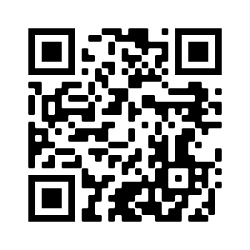





Introduction to
Artificial Intelligence for Text Analytics
Artificial Intelligence for Text Analytics
1102AITA01
MBA, IM, NTPU (M5026) (Spring 2022)
Tue 2, 3, 4 (9:10-12:00) (B8F40)
Min-Yuh Day, Ph.D,
Associate Professor
Institute of Information Management, National Taipei University
https://web.ntpu.edu.tw/~myday
https://meet.google.com/paj-zhhj-mya
2022-02-22

Slide 2







Min-Yuh Day, Ph.D.
Associate Professor, Information Management, NTPU
Visiting Scholar, IIS, Academia Sinica
Ph.D., Information Management, NTU
Director, Intelligent Financial Innovation Technology, IFIT Lab, IM, NTPU
Artificial Intelligence, Financial Technology, Big Data Analytics,
Data Mining and Text Mining, Electronic Commerce

Slide 3
Course Syllabus
National Taipei University
Academic Year 110, 2nd Semester (Spring 2022)
Course Title: Artificial Intelligence for Text Analytics
Instructor: Min-Yuh Day
Course Class: MBA, IM, NTPU (3 Credits, Elective)
Details
  In-Class and Distance Learning EMI Course
  (3 Credits, Elective, One Semester) (M5026)
Time & Place: Tue, 2, 3, 4, (9:10-12:00) (B8F40)
Google Meet: https://meet.google.com/paj-zhhj-mya
https://meet.google.com/paj-zhhj-mya

Slide 4
Course Objectives
Understand the fundamental concepts and research issues of Artificial Intelligence for Text Analytics.
Equip with Hands-on practices of Artificial Intelligence for Text Analytics.
Conduct information systems research in the context of Artificial Intelligence for Text Analytics.

Slide 5
Course Outline
This course introduces the fundamental concepts, research issues, and hands-on practices of Artificial Intelligence for Text Analytics.
Topics include:
  Introduction to Introduction to Artificial Intelligence for Text Analytics
  Foundations of Text Analytics: Natural Language Processing (NLP)
  Python for Natural Language Processing
  Natural Language Processing with Transformers
  Text Classification and Sentiment Analysis
  Multilingual Named Entity Recognition (NER), Text Similarity and Clustering
  Text Summarization and Topic Models
  Text Generation
  Question Answering and Dialogue Systems
  Deep Learning, Transfer Learning, Zero-Shot, and Few-Shot Learning for Text Analytics
  Case Study on Artificial Intelligence for Text Analytics

Slide 6
Core Competence
Exploring new knowledge in information technology, system development and application 80 %
Internet marketing planning ability 10 %
Thesis writing and independent research skills 10 %

Slide 7
Four Fundamental Qualities
Professionalism
  Creative thinking and Problem-solving 40 %
  Comprehensive Integration 40 %
Interpersonal Relationship
  Communication and Coordination 10 %
  Teamwork 5 %
Ethics
  Honesty and Integrity 0 %
  Self-Esteem and Self-reflection 0 %
International Vision
  Caring for Diversity 0 %
  Interdisciplinary Vision 5 %

Slide 8
College Learning Goals
Ethics/Corporate Social Responsibility
Global Knowledge/Awareness
Communication
Analytical and Critical Thinking

Slide 9
Department Learning Goals
Information Technologies and
System Development Capabilities
Internet Marketing Management Capabilities
Research capabilities

Slide 10
Syllabus
Week Date Subject/Topics
1 2022/02/22 Introduction to Artificial Intelligence for Text Analytics
2 2022/03/01 Foundations of Text Analytics:
Natural Language Processing (NLP)
3 2022/03/08 Python for Natural Language Processing
4 2022/03/15 Natural Language Processing with Transformers
5 2022/03/22 Case Study on Artificial Intelligence for Text Analytics I
6 2022/03/29 Text Classification and Sentiment Analysis

Slide 11
Syllabus
Week Date Subject/Topics
7 2022/04/05 Tomb-Sweeping Day (Holiday, No Classes)
8 2022/04/12 Midterm Project Report
9 2022/04/19 Multilingual Named Entity Recognition (NER),
Text Similarity and Clustering
10 2022/04/26 Text Summarization and Topic Models
11 2022/05/03 Text Generation
12 2022/05/10 Case Study on Artificial Intelligence for Text Analytics II

Slide 12
Syllabus
Week Date Subject/Topics
13 2022/05/17 Question Answering and Dialogue Systems
14 2022/05/24 Deep Learning, Transfer Learning,
Zero-Shot, and Few-Shot Learning for Text Analytics
15 2022/05/31 Final Project Report I
16 2022/06/07 Final Project Report II
17 2022/06/14 Self-learning
18 2022/06/21 Self-learning

Slide 13
Teaching Methods and Activities
Lecture
Discussion
Practicum

Slide 14
Evaluation Methods
Individual Presentation 60 %
Group Presentation 10 %
Case Report 10 %
Class Participation 10 %
Assignment 10 %

Slide 15
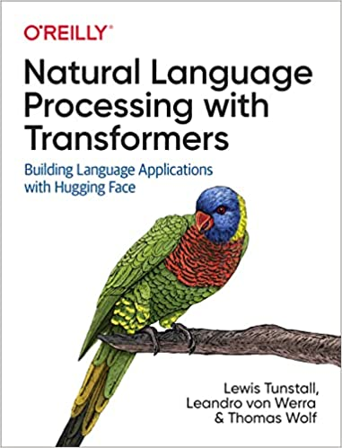
Required Texts
Lewis Tunstall, Leandro von Werra, and Thomas Wolf (2022), Natural Language Processing with Transformers:
Building Language Applications with Hugging Face,
O'Reilly Media.
Source: https://www.amazon.com/Natural-Language-Processing-Transformers-Applications/dp/1098103246

Slide 16
Reference Books
Denis Rothman (2021), Transformers for Natural Language Processing: Build innovative deep neural network architectures for NLP with Python, PyTorch, TensorFlow, BERT, RoBERTa, and more, Packt Publishing.
Savaş Yıldırım and Meysam Asgari-Chenaghlu (2021), Mastering Transformers: Build state-of-the-art models from scratch with advanced natural language processing techniques, Packt Publishing.
Sudharsan Ravichandiran (2021), Getting Started with Google BERT: Build and train state-of-the-art natural language processing models using BERT, Packt Publishing.
Sowmya Vajjala, Bodhisattwa Majumder, Anuj Gupta (2020), Practical Natural Language Processing: A Comprehensive Guide to Building Real-World NLP Systems, O'Reilly Media.

Slide 17
Other References
Dipanjan Sarkar (2019), Text Analytics with Python: A Practitioner’s Guide to Natural Language Processing, Second Edition. APress.
Benjamin Bengfort, Rebecca Bilbro, and Tony Ojeda (2018), Applied Text Analysis with Python: Enabling Language-Aware Data Products with Machine Learning, O’Reilly.
Charu C. Aggarwal (2018), Machine Learning for Text, Springer.
Gabe Ignatow and Rada F. Mihalcea (2017), An Introduction to Text Mining: Research Design, Data Collection, and Analysis, SAGE Publications.
Aurélien Géron (2019), Hands-On Machine Learning with Scikit-Learn, Keras, and TensorFlow: Concepts, Tools, and Techniques to Build Intelligent Systems, 2nd Edition, O’Reilly Media.
Frederick Kaefer and Paul Kaefer (2020), Introduction to Python Programming for Business and Social Science Applications, SAGE Publications
Vic Anand, Khrystyna Bochkay, and Roman Chychyla (2020), Using Python for Text Analysis in Accounting Research, Now Publishers.

Slide 18
Lewis Tunstall, Leandro von Werra, and Thomas Wolf (2022),
Natural Language Processing with Transformers:
Building Language Applications with Hugging Face,
O'Reilly Media.
Source: https://www.amazon.com/Natural-Language-Processing-Transformers-Applications/dp/1098103246

Slide 19
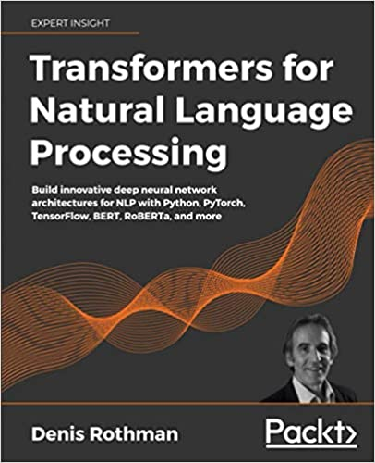
Denis Rothman (2021),
Transformers for Natural Language Processing:
Build innovative deep neural network architectures for NLP with Python, PyTorch, TensorFlow, BERT, RoBERTa, and more,
Packt Publishing.
Source: https://www.amazon.com/Transformers-Natural-Language-Processing-architectures/dp/1800565798

Slide 20
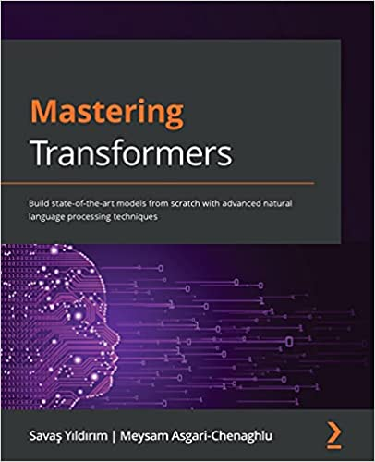
Savaş Yıldırım and Meysam Asgari-Chenaghlu (2021),
Mastering Transformers:
Build state-of-the-art models from scratch with advanced natural language processing techniques,
Packt Publishing.
Source: https://www.amazon.com/Mastering-Transformers-state-art-processing/dp/1801077657/

Slide 21
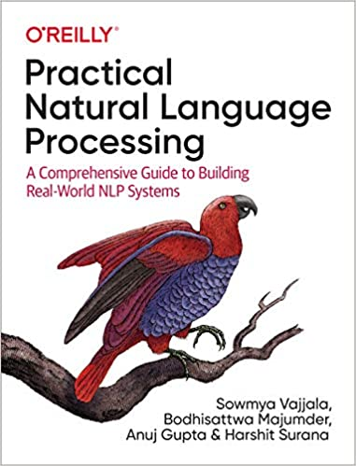
Sowmya Vajjala, Bodhisattwa Majumder, Anuj Gupta (2020), Practical Natural Language Processing:
A Comprehensive Guide to Building Real-World NLP Systems,
O'Reilly Media.
Source: https://www.amazon.com/Practical-Natural-Language-Processing-Pragmatic/dp/1492054054

Slide 22
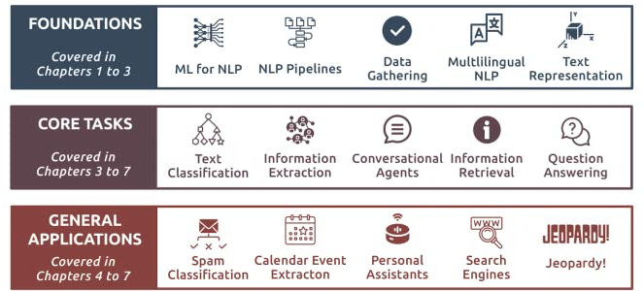
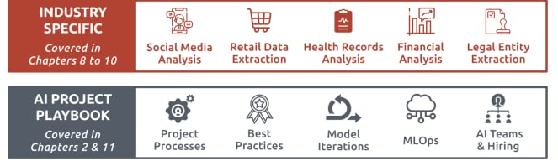
Source: Sowmya Vajjala, Bodhisattwa Majumder, Anuj Gupta (2020), Practical Natural Language Processing: A Comprehensive Guide to Building Real-World NLP Systems, O'Reilly Media.
Source: https://www.amazon.com/Practical-Natural-Language-Processing-Pragmatic/dp/1492054054

Slide 23
Artificial Intelligence
(AI)

Slide 24
Text Analytics
(TA)

Slide 25
Text Mining
(TM)

Slide 26
Natural Language Processing
(NLP)

Slide 27
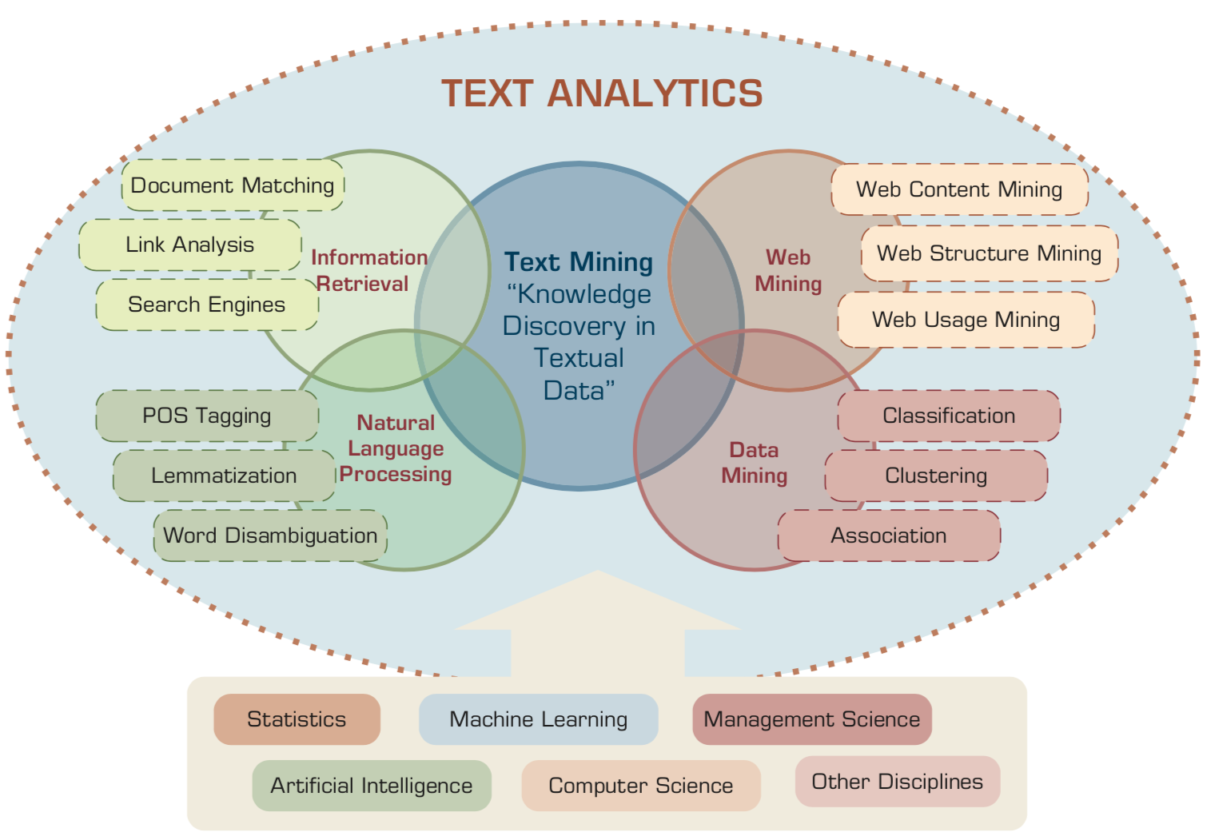
Text Analytics and Text Mining
Source: Ramesh Sharda, Dursun Delen, and Efraim Turban (2017), Business Intelligence, Analytics, and Data Science: A Managerial Perspective, 4th Edition, Pearson

Slide 28
Artificial Intelligence
(AI)

Slide 29
AI, Big Data, Cloud Computing
Evolution of Decision Support, Business Intelligence, and Analytics
AI
AI
Cloud Computing
Big Data
DM
BI
Source: Ramesh Sharda, Dursun Delen, and Efraim Turban (2017),
Business Intelligence, Analytics, and Data Science: A Managerial Perspective, 4th Edition, Pearson

Slide 30
The Rise of AI
Source: DHL (2018), Artificial Intelligence in Logistics,
http://www.globalhha.com/doclib/data/upload/doc_con/5e50c53c5bf67.pdf/

Slide 31
Definition of
Artificial Intelligence (A.I.)

Slide 32
Artificial Intelligence
“… the science and engineering of making intelligent machines”
(John McCarthy, 1955)
Source: https://digitalintelligencetoday.com/artificial-intelligence-defined-useful-list-of-popular-definitions-from-business-and-science/

Slide 33
Artificial Intelligence
“… technology that thinks and acts like humans”
Source: https://digitalintelligencetoday.com/artificial-intelligence-defined-useful-list-of-popular-definitions-from-business-and-science/

Slide 34
Artificial Intelligence
“… intelligence exhibited by machines or software”
Source: https://digitalintelligencetoday.com/artificial-intelligence-defined-useful-list-of-popular-definitions-from-business-and-science/

Slide 35
4 Approaches of AI
Thinking Humanly | Thinking Rationally
Acting Humanly | Acting Rationally
Source: Stuart Russell and Peter Norvig (2020), Artificial Intelligence: A Modern Approach, 4th Edition, Pearson

Slide 36
4 Approaches of AI
2. Thinking Humanly: The Cognitive Modeling Approach | 3. Thinking Rationally: The “Laws of Thought” Approach
1. Acting Humanly: The Turing Test Approach (1950) | 4. Acting Rationally: The Rational Agent Approach
Source: Stuart Russell and Peter Norvig (2020), Artificial Intelligence: A Modern Approach, 4th Edition, Pearson

Slide 37
AI Acting Humanly:
The Turing Test Approach
(Alan Turing, 1950)
Knowledge Representation
Automated Reasoning
Machine Learning (ML)
  Deep Learning (DL)
Computer Vision (Image, Video)
Natural Language Processing (NLP)
Robotics
Source: Stuart Russell and Peter Norvig (2020), Artificial Intelligence: A Modern Approach, 4th Edition, Pearson

Slide 38
Text Analytics
(TA)

Slide 39
Text Analytics
Text Analytics =
Information Retrieval +
Information Extraction +
Data Mining +
Web Mining
Text Analytics =
Information Retrieval +
Text Mining
Source: Ramesh Sharda, Dursun Delen, and Efraim Turban (2017), Business Intelligence, Analytics, and Data Science: A Managerial Perspective, 4th Edition, Pearson

Slide 40
Text Mining
Text Data Mining
Knowledge Discovery in
Textual Databases
Source: Ramesh Sharda, Dursun Delen, and Efraim Turban (2017), Business Intelligence, Analytics, and Data Science: A Managerial Perspective, 4th Edition, Pearson

Slide 41
Application Areas of Text Mining
Information extraction
Topic tracking
Summarization
Categorization
Clustering
Concept linking
Question answering
Source: Ramesh Sharda, Dursun Delen, and Efraim Turban (2017), Business Intelligence, Analytics, and Data Science: A Managerial Perspective, 4th Edition, Pearson

Slide 42


Emotions
Love
Anger
Joy
Sadness
Surprise
Fear
Source: Bing Liu (2011) , “Web Data Mining: Exploring Hyperlinks, Contents, and Usage Data,” Springer, 2nd Edition,

Slide 43
Example of Opinion: review segment on iPhone
“I bought an iPhone a few days ago.
It was such a nice phone.
The touch screen was really cool.
The voice quality was clear too.
However, my mother was mad with me as I did not tell her before I bought it.
She also thought the phone was too expensive, and wanted me to return it to the shop. … ”
Source: Bing Liu (2011) , “Web Data Mining: Exploring Hyperlinks, Contents, and Usage Data,” Springer, 2nd Edition,

Slide 44
Example of Opinion:
review segment on iPhone
“(1) I bought an iPhone a few days ago.
(2) It was such a nice phone.
(3) The touch screen was really cool.
(4) The voice quality was clear too.
(5) However, my mother was mad with me as I did not tell her before I bought it.
(6) She also thought the phone was too expensive, and wanted me to return it to the shop. … ”
+Positive Opinion
-Negative Opinion
Source: Bing Liu (2011) , “Web Data Mining: Exploring Hyperlinks, Contents, and Usage Data,” Springer, 2nd Edition,

Slide 45
Sentiment Analysis
Subjectivity
Classification
Polarity Determination
Approaches
Machine Learning based
Sentiment Classification
Vagueness resolution in opinionated text
Lexicon based
Sentiment Analysis
Review Usefulness Measurement
Multi- & Cross- Lingual SC
Hybrid
approaches
Opinion Spam Detection
Cross-domain SC
Lexicon Creation
Ontology based
Tasks
Non-Ontology based
Aspect Extraction
Application
Source: Kumar Ravi and Vadlamani Ravi (2015), "A survey on opinion mining and sentiment analysis: tasks, approaches and applications." Knowledge-Based Systems, 89, pp.14-46.

Slide 46
Sentiment Classification Techniques
Decision Tree Classifiers
Support Vector Machine (SVM)
Supervised Learning
Neural Network (NN
Machine Learning Approach
Linear Classifiers
Deep Learning (DL)
Rule-based Classifiers
Naïve Bayes
(NB)
Sentiment Analysis
Unsupervised Learning
Probabilistic Classifiers
Bayesian Network (BN)
Dictionary-based Approach
Maximum Entropy (ME)
Lexicon-based Approach
Statistical
Corpus-based Approach
Semantic
Source: Jesus Serrano-Guerrero, Jose A. Olivas, Francisco P. Romero, and Enrique Herrera-Viedma (2015),
"Sentiment analysis: A review and comparative analysis of web services," Information Sciences, 311, pp. 18-38.

Slide 47
Text Mining
Technologies

Slide 48
Natural Language Processing
(NLP)
Text Mining
(TM)

Slide 49
Text mining
Text Data Mining
Intelligent Text Analysis
Knowledge-Discovery in Text (KDT)
Source: Vishal Gupta and Gurpreet S. Lehal (2009), "A survey of text mining techniques and applications,"
Journal of emerging technologies in web intelligence, vol. 1, no. 1, pp. 60-76.

Slide 50
Text Mining
(text data mining)
  the process of
  deriving
  high-quality information
  from text
http://en.wikipedia.org/wiki/Text_mining

Slide 51
Text Mining: the process of extracting interesting and non-trivial information and knowledge from unstructured text.
Source: Vishal Gupta and Gurpreet S. Lehal (2009), "A survey of text mining techniques and applications,"
Journal of emerging technologies in web intelligence, vol. 1, no. 1, pp. 60-76.

Slide 52
Text Mining: discovery by computer of new, previously unknown information, by automatically extracting information from different written resources.
Source: Vishal Gupta and Gurpreet S. Lehal (2009), "A survey of text mining techniques and applications,"
Journal of emerging technologies in web intelligence, vol. 1, no. 1, pp. 60-76.

Slide 53
An example of Text Mining
Knowledge
Analyze Text
Management Information System
Information Extraction
Classification
Summarization
Retrieve and preprocess document
Clustering
Document Collection
Source: Vishal Gupta and Gurpreet S. Lehal (2009), "A survey of text mining techniques and applications,"
Journal of emerging technologies in web intelligence, vol. 1, no. 1, pp. 60-76.

Slide 54
Overview of
Information Extraction based
Text Mining Framework
Text Data Mining
Text
Text
DB
Text
Information Extraction
Data Mining
Rule
Source: Vishal Gupta and Gurpreet S. Lehal (2009), "A survey of text mining techniques and applications,"
Journal of emerging technologies in web intelligence, vol. 1, no. 1, pp. 60-76.

Slide 55
Natural Language Processing (NLP)
Natural language processing (NLP)
is an important component of
text mining and
is a subfield of
artificial intelligence and
computational linguistics.
Source: Ramesh Sharda, Dursun Delen, and Efraim Turban (2017), Business Intelligence, Analytics, and Data Science: A Managerial Perspective, 4th Edition, Pearson

Slide 56
Natural Language Processing (NLP)
Part-of-speech tagging
Text segmentation
Word sense disambiguation
Syntactic ambiguity
Imperfect or irregular input
Speech acts
Source: Ramesh Sharda, Dursun Delen, and Efraim Turban (2017), Business Intelligence, Analytics, and Data Science: A Managerial Perspective, 4th Edition, Pearson

Slide 57
NLP Tasks
Question answering
Automatic summarization
Natural language generation
Natural language understanding
Machine translation
Foreign language reading
Foreign language writing.
Speech recognition
Text-to-speech
Text proofing
Optical character recognition
Source: Ramesh Sharda, Dursun Delen, and Efraim Turban (2017), Business Intelligence, Analytics, and Data Science: A Managerial Perspective, 4th Edition, Pearson

Slide 58
NLP
Source: http://blog.aylien.com/leveraging-deep-learning-for-multilingual/

Slide 59
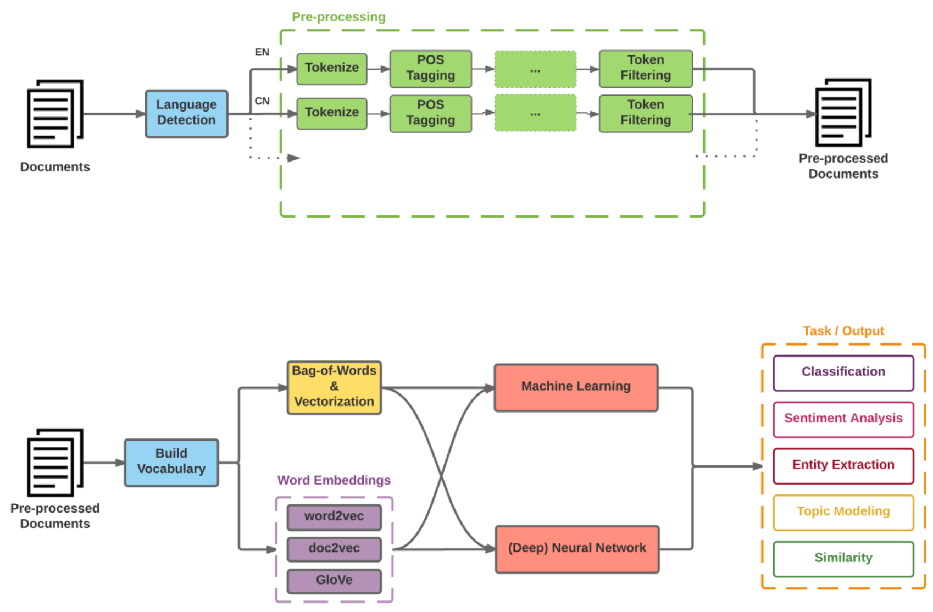
Modern NLP Pipeline
Source: https://github.com/fortiema/talks/blob/master/opendata2016sh/pragmatic-nlp-opendata2016sh.pdf

Slide 60
Modern NLP Pipeline
Source: http://mattfortier.me/2017/01/31/nlp-intro-pt-1-overview/

Slide 61
Deep Learning NLP
Source: http://mattfortier.me/2017/01/31/nlp-intro-pt-1-overview/

Slide 62
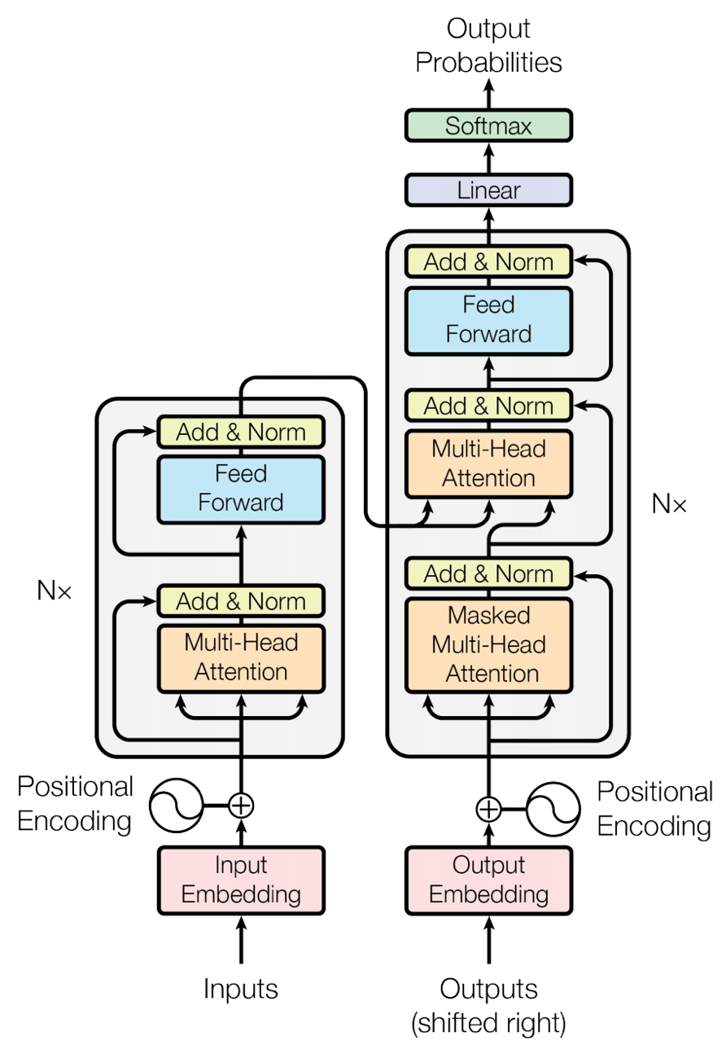
Transformer (Attention is All You Need)
(Vaswani et al., 2017)
Source: Vaswani, Ashish, Noam Shazeer, Niki Parmar, Jakob Uszkoreit, Llion Jones, Aidan N. Gomez, Łukasz Kaiser, and Illia Polosukhin. "Attention is all you need." In Advances in neural information processing systems, pp. 5998-6008. 2017.

Slide 63
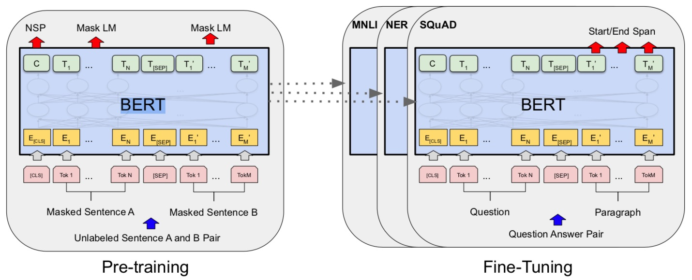
BERT: Pre-training of Deep Bidirectional Transformers for Language Understanding
BERT (Bidirectional Encoder Representations from Transformers)
Overall pre-training and fine-tuning procedures for BERT
Source: Devlin, Jacob, Ming-Wei Chang, Kenton Lee, and Kristina Toutanova (2018).
"Bert: Pre-training of deep bidirectional transformers for language understanding." arXiv preprint arXiv:1810.04805.

Slide 64
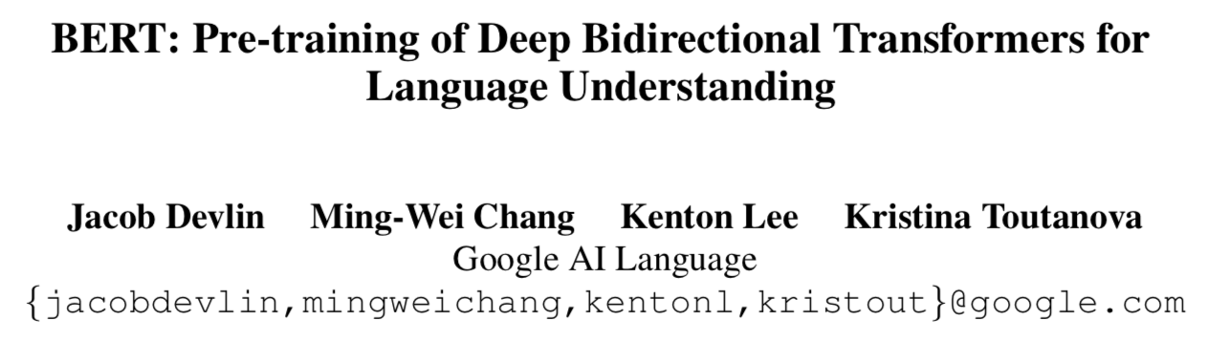
BERT:
Pre-training of Deep
Bidirectional Transformers for Language Understanding
Source: Devlin, Jacob, Ming-Wei Chang, Kenton Lee, and Kristina Toutanova (2018).
"BERT: Pre-training of Deep Bidirectional Transformers for Language Understanding." arXiv preprint arXiv:1810.04805

Slide 65
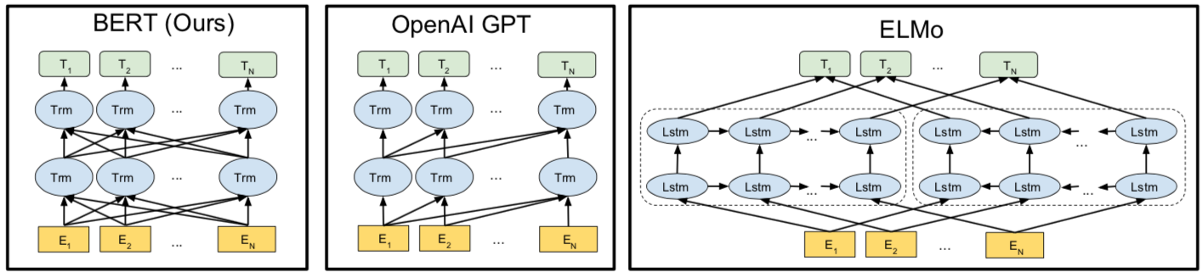
BERT
Bidirectional Encoder Representations from Transformers
Pre-training model architectures
BERT uses a bidirectional Transformer.
OpenAI GPT uses a left-to-right Transformer.
ELMo uses the concatenation of independently trained left-to-right and right- to-left LSTM to generate features for downstream tasks.
Among three, only BERT representations are jointly conditioned on both left and right context in all layers.
Source: Devlin, Jacob, Ming-Wei Chang, Kenton Lee, and Kristina Toutanova (2018).
"BERT: Pre-training of Deep Bidirectional Transformers for Language Understanding." arXiv preprint arXiv:1810.04805

Slide 66
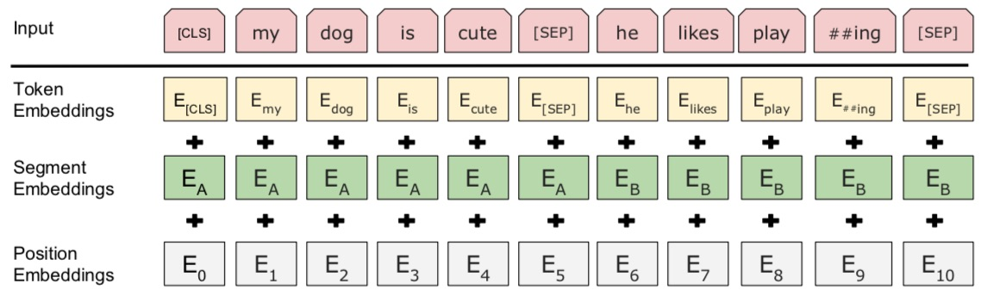
BERT: Pre-training of Deep Bidirectional Transformers for Language Understanding
BERT (Bidirectional Encoder Representations from Transformers)
BERT input representation
The input embeddings is the sum of the token embeddings,
the segmentation embeddings and the position embeddings.
Source: Devlin, Jacob, Ming-Wei Chang, Kenton Lee, and Kristina Toutanova (2018).
"Bert: Pre-training of deep bidirectional transformers for language understanding." arXiv preprint arXiv:1810.04805.

Slide 67
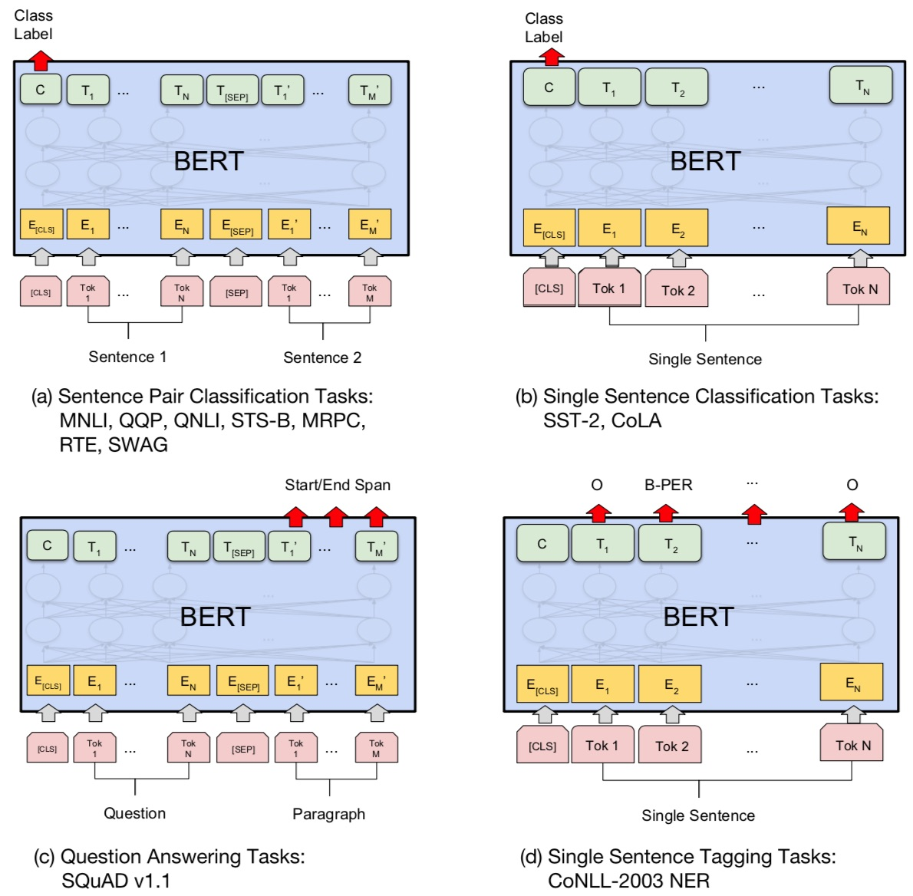
Fine-tuning BERT on NLP Tasks
Source: Devlin, Jacob, Ming-Wei Chang, Kenton Lee, and Kristina Toutanova (2018).
"BERT: Pre-training of Deep Bidirectional Transformers for Language Understanding." arXiv preprint arXiv:1810.04805

Slide 68
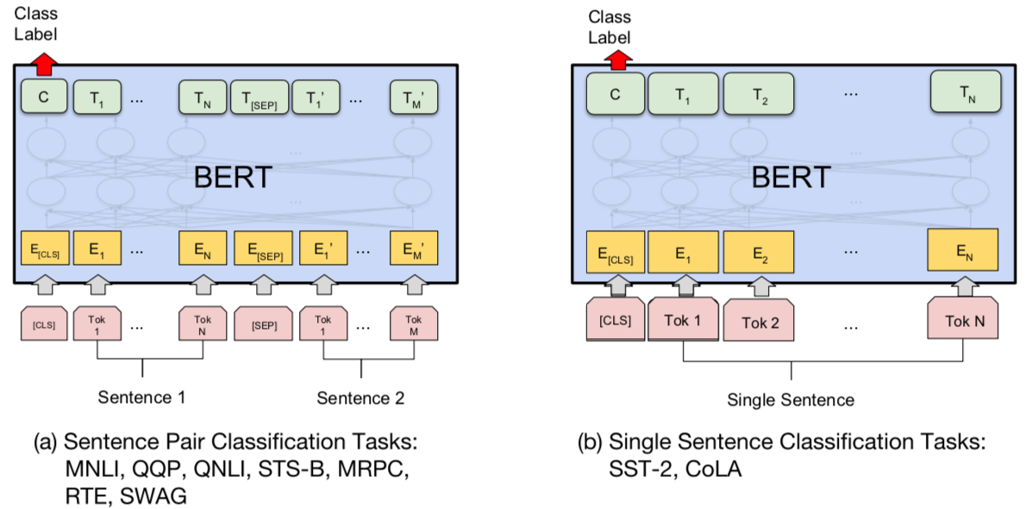
BERT Sequence-level tasks
Source: Devlin, Jacob, Ming-Wei Chang, Kenton Lee, and Kristina Toutanova (2018).
"BERT: Pre-training of Deep Bidirectional Transformers for Language Understanding." arXiv preprint arXiv:1810.04805

Slide 69
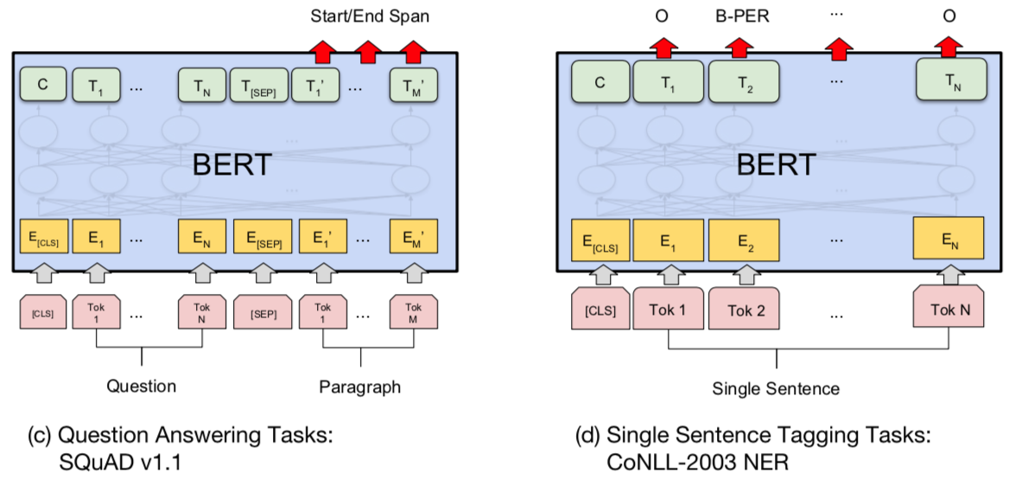
BERT Token-level tasks
Source: Devlin, Jacob, Ming-Wei Chang, Kenton Lee, and Kristina Toutanova (2018).
"BERT: Pre-training of Deep Bidirectional Transformers for Language Understanding." arXiv preprint arXiv:1810.04805

Slide 70
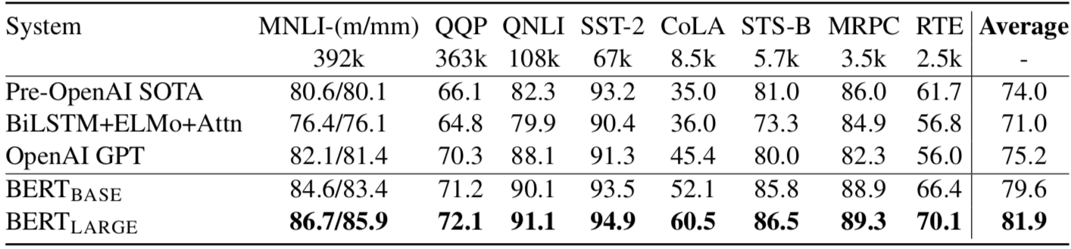
General Language Understanding Evaluation (GLUE) benchmark
GLUE Test results
MNLI: Multi-Genre Natural Language Inference
QQP: Quora Question Pairs
QNLI: Question Natural Language Inference
SST-2: The Stanford Sentiment Treebank
CoLA: The Corpus of Linguistic Acceptability
STS-B:The Semantic Textual Similarity Benchmark
MRPC: Microsoft Research Paraphrase Corpus
RTE: Recognizing Textual Entailment
Source: Devlin, Jacob, Ming-Wei Chang, Kenton Lee, and Kristina Toutanova (2018).
"BERT: Pre-training of Deep Bidirectional Transformers for Language Understanding." arXiv preprint arXiv:1810.04805

Slide 71
Transformers
State-of-the-art Natural Language Processing for TensorFlow 2.0 and PyTorch
Transformers
  pytorch-transformers
  pytorch-pretrained-bert
provides state-of-the-art general-purpose architectures
  (BERT, GPT-2, RoBERTa, XLM, DistilBert, XLNet, CTRL...)
  for Natural Language Understanding (NLU) and
  Natural Language Generation (NLG)
  with over 32+ pretrained models
  in 100+ languages
  and deep interoperability between
  TensorFlow 2.0 and
  PyTorch.
Source: https://github.com/huggingface/transformers

Slide 72
Text Analytics with Python

Slide 73

Source: https://www.python.org/community/logos/

Slide 74
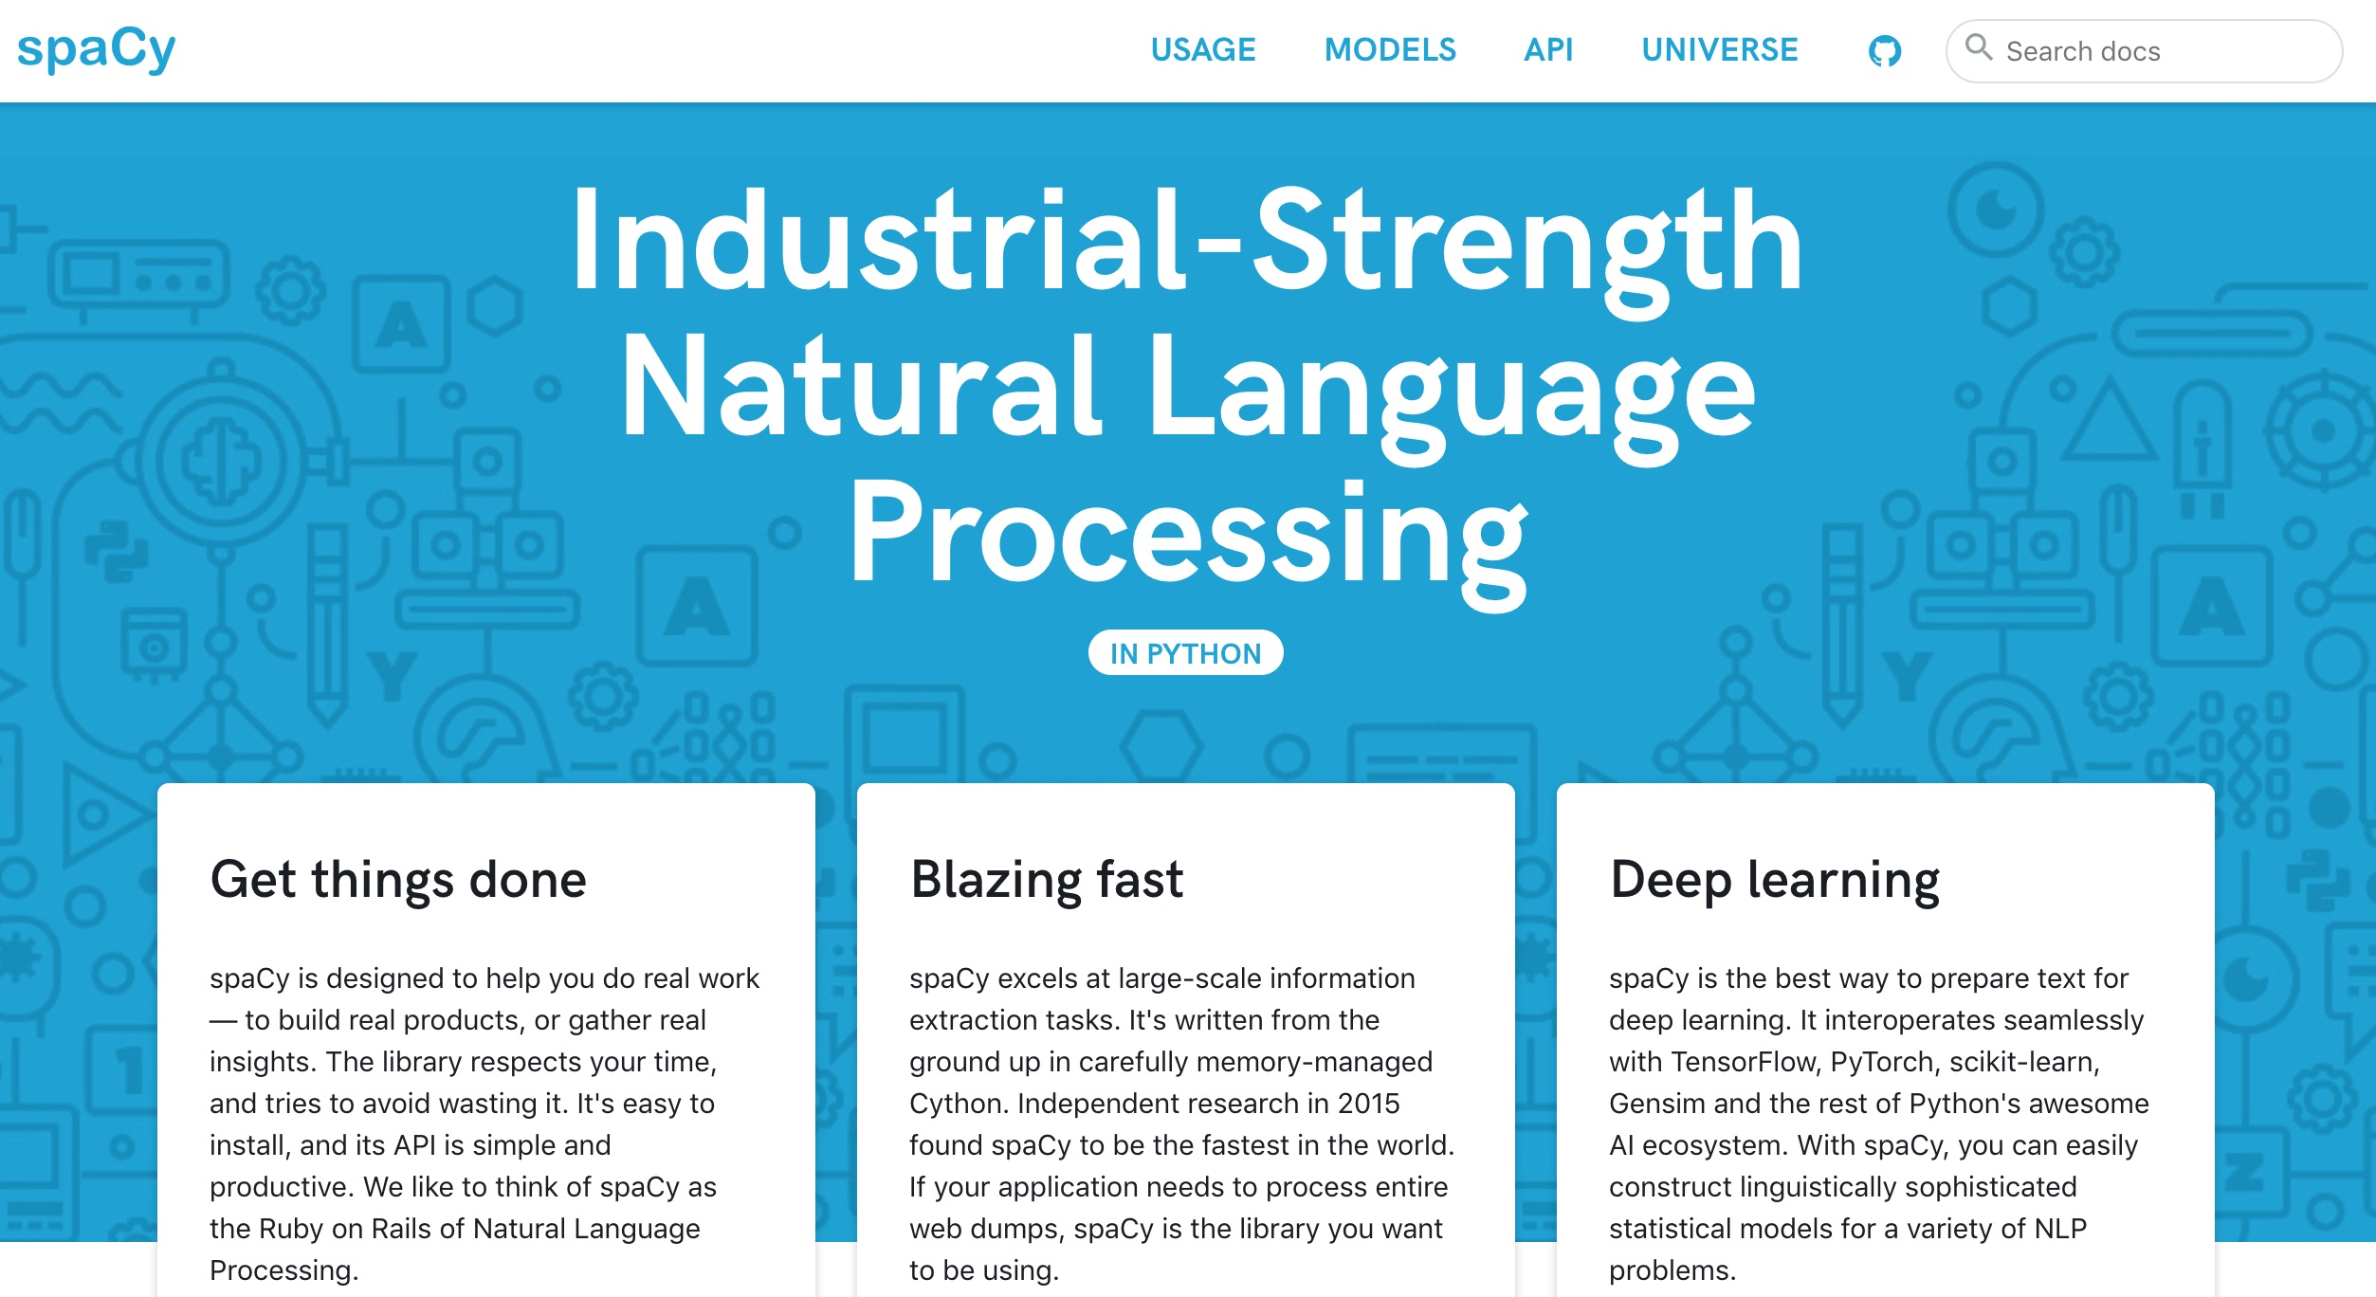
spaCy:
Natural Language Processing
https://spacy.io/

Slide 75
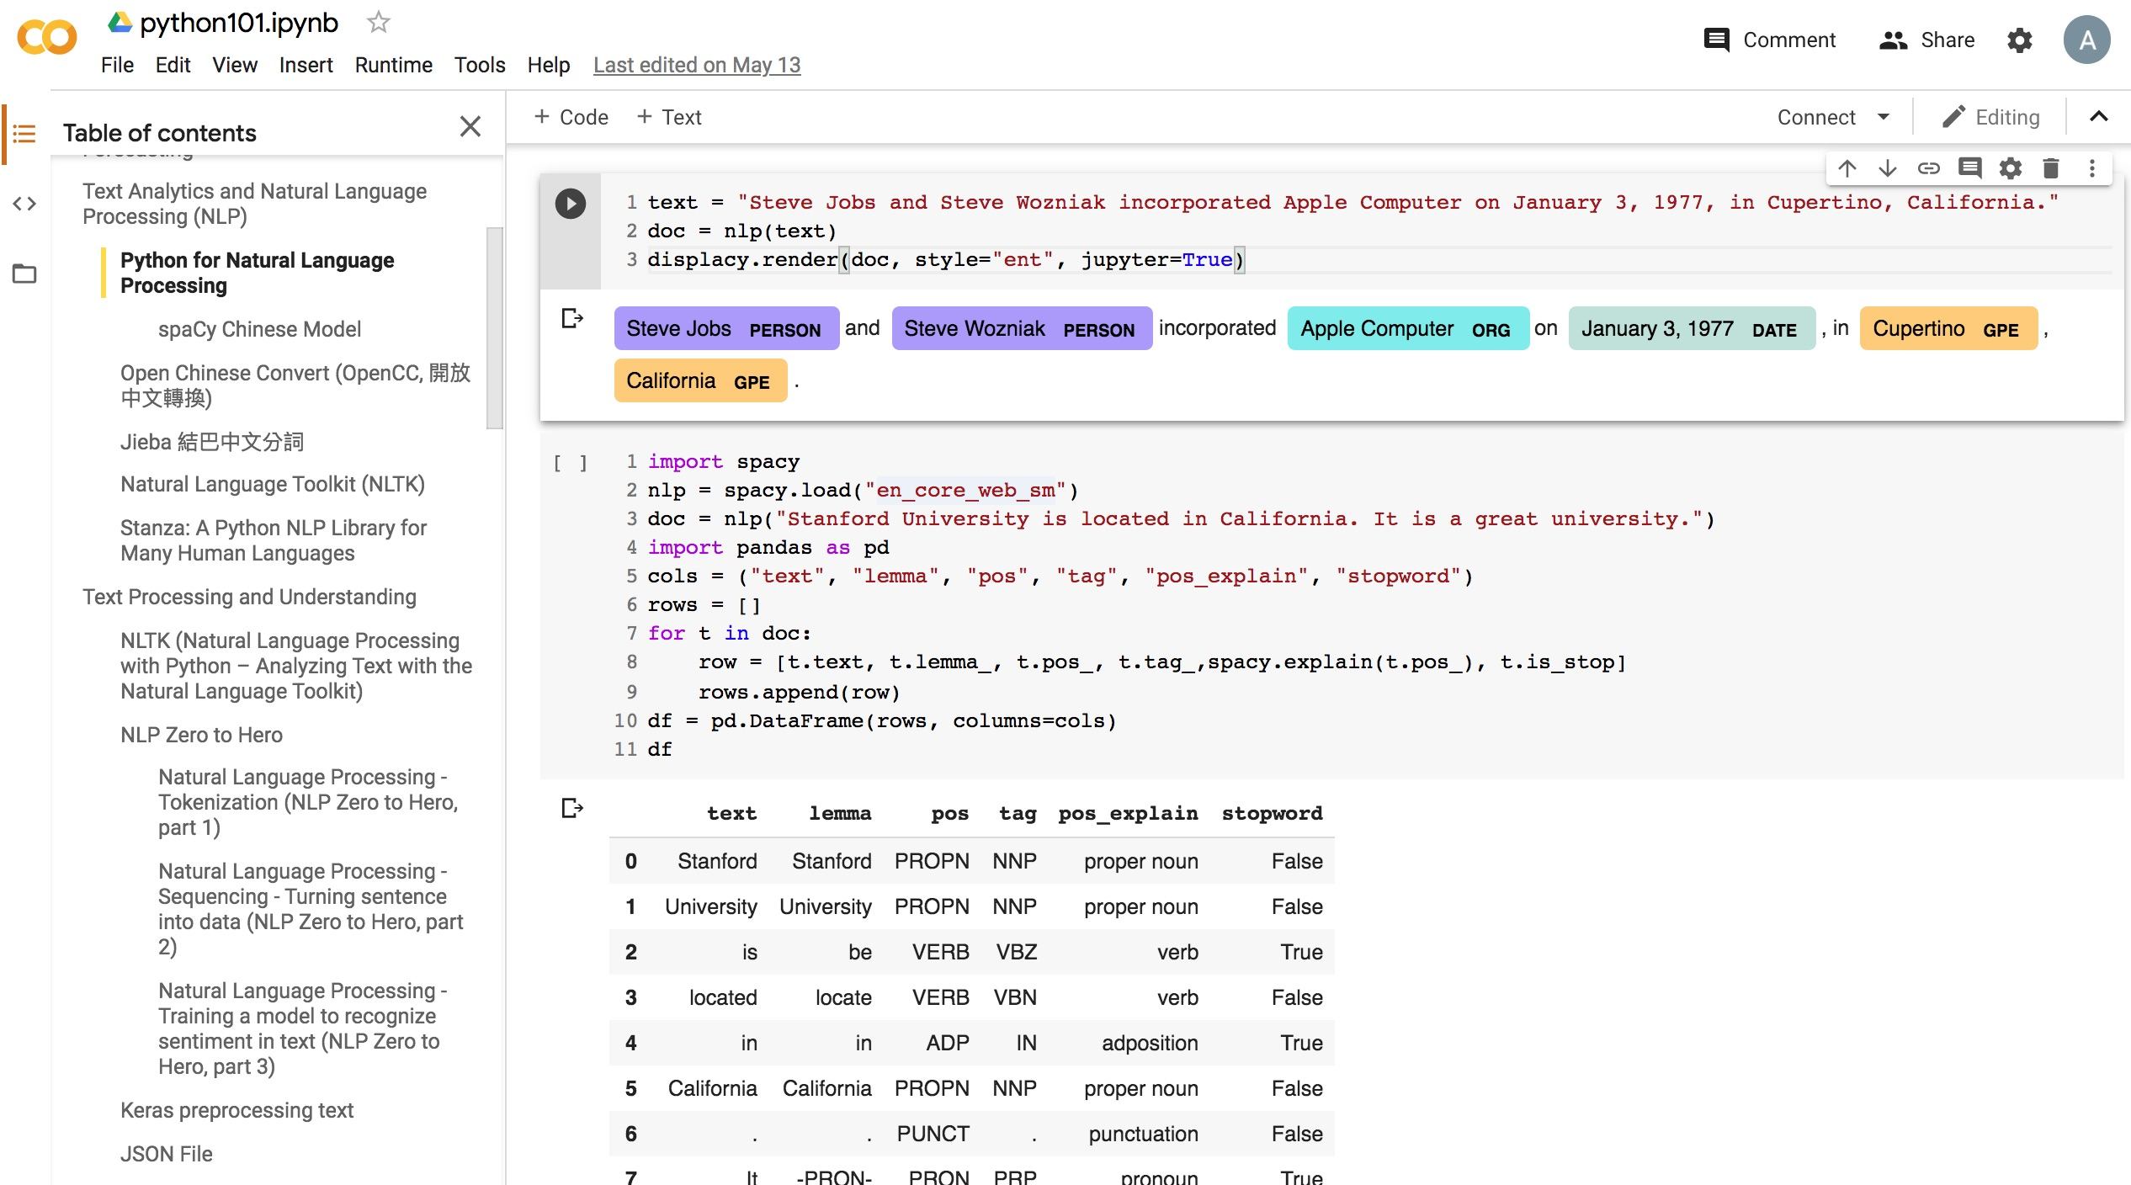
Python in Google Colab (Python101)
https://colab.research.google.com/drive/1FEG6DnGvwfUbeo4zJ1zTunjMqf2RkCrT
https://tinyurl.com/aintpupython101

Slide 76
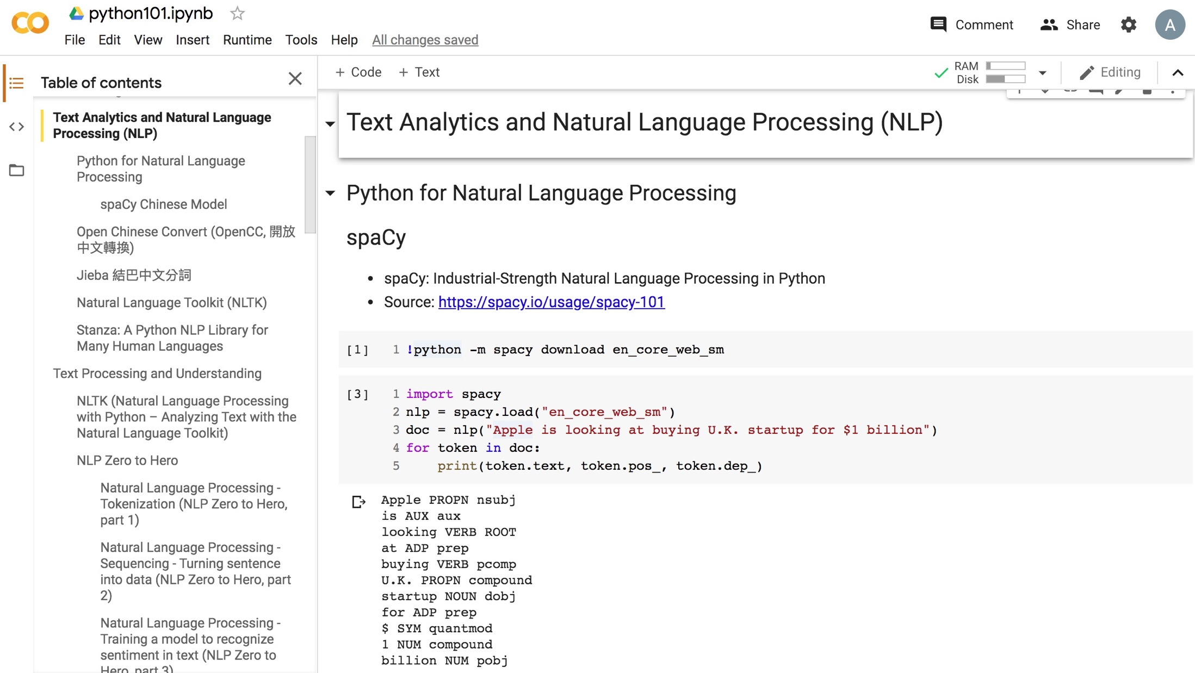
Python in Google Colab (Python101)
https://colab.research.google.com/drive/1FEG6DnGvwfUbeo4zJ1zTunjMqf2RkCrT
https://tinyurl.com/aintpupython101

Slide 77
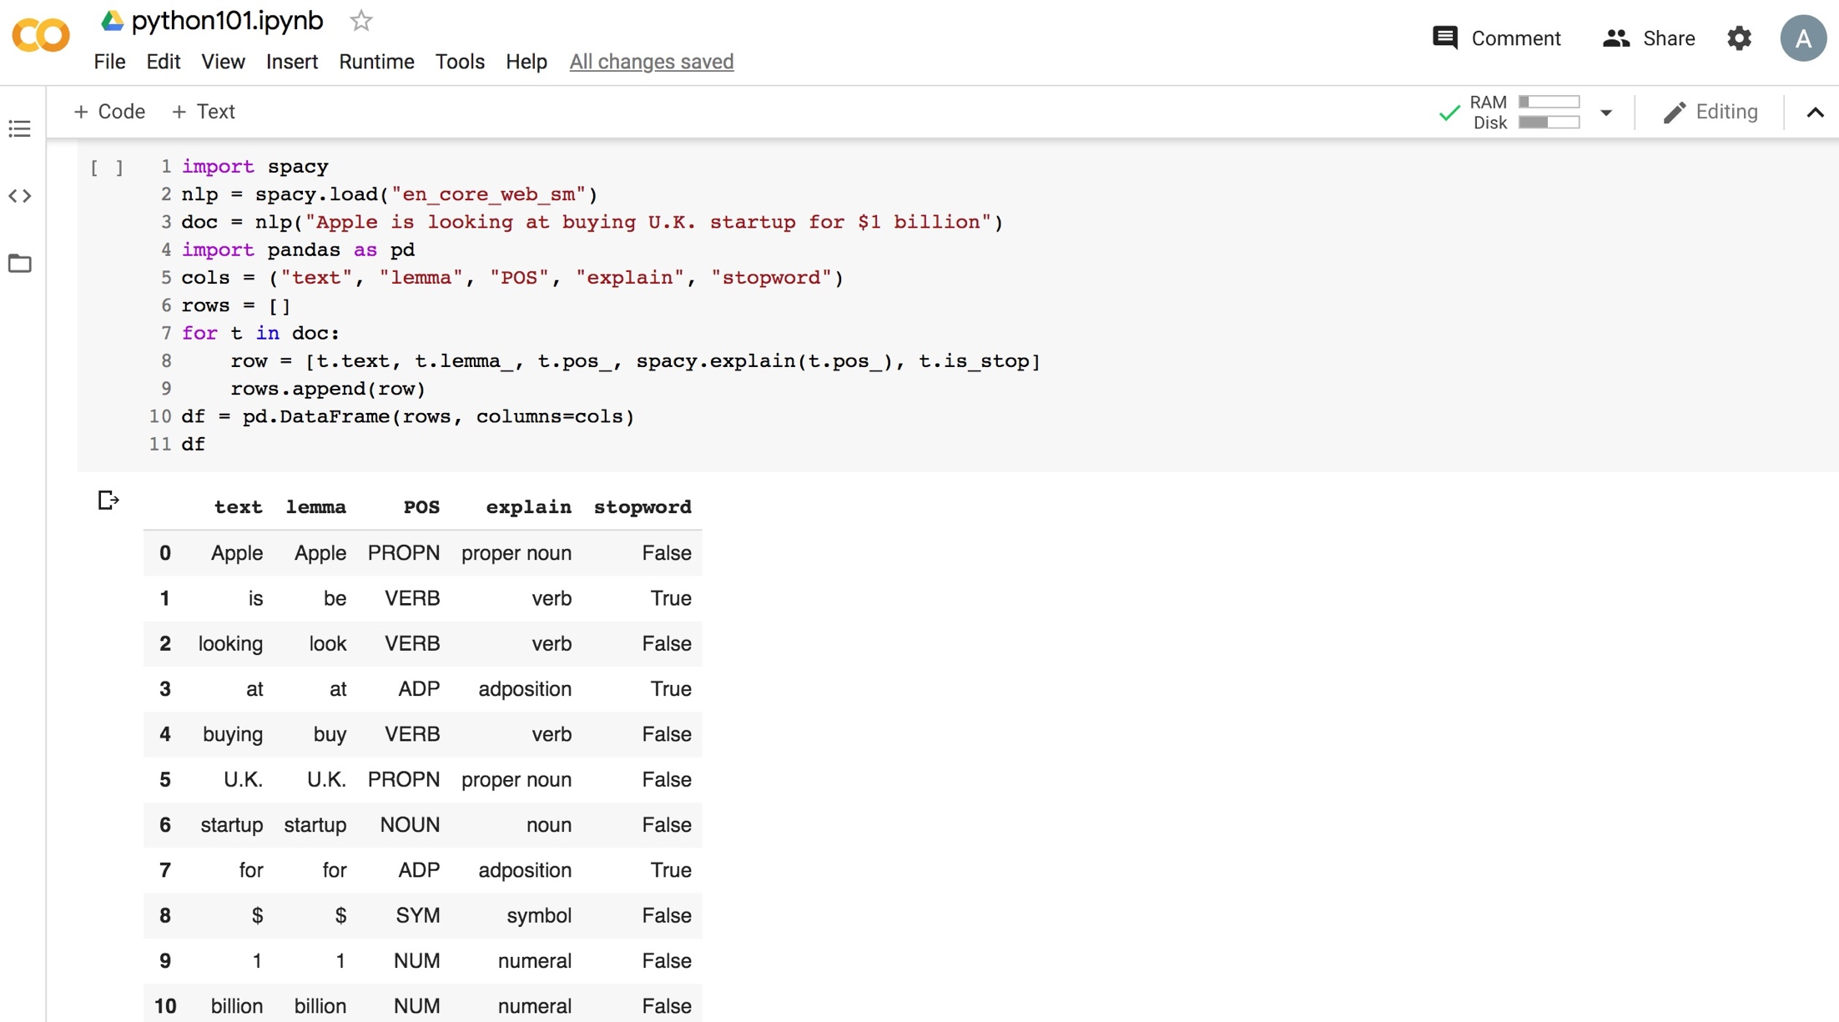
Python in Google Colab (Python101)
https://colab.research.google.com/drive/1FEG6DnGvwfUbeo4zJ1zTunjMqf2RkCrT
https://tinyurl.com/aintpupython101

Slide 78
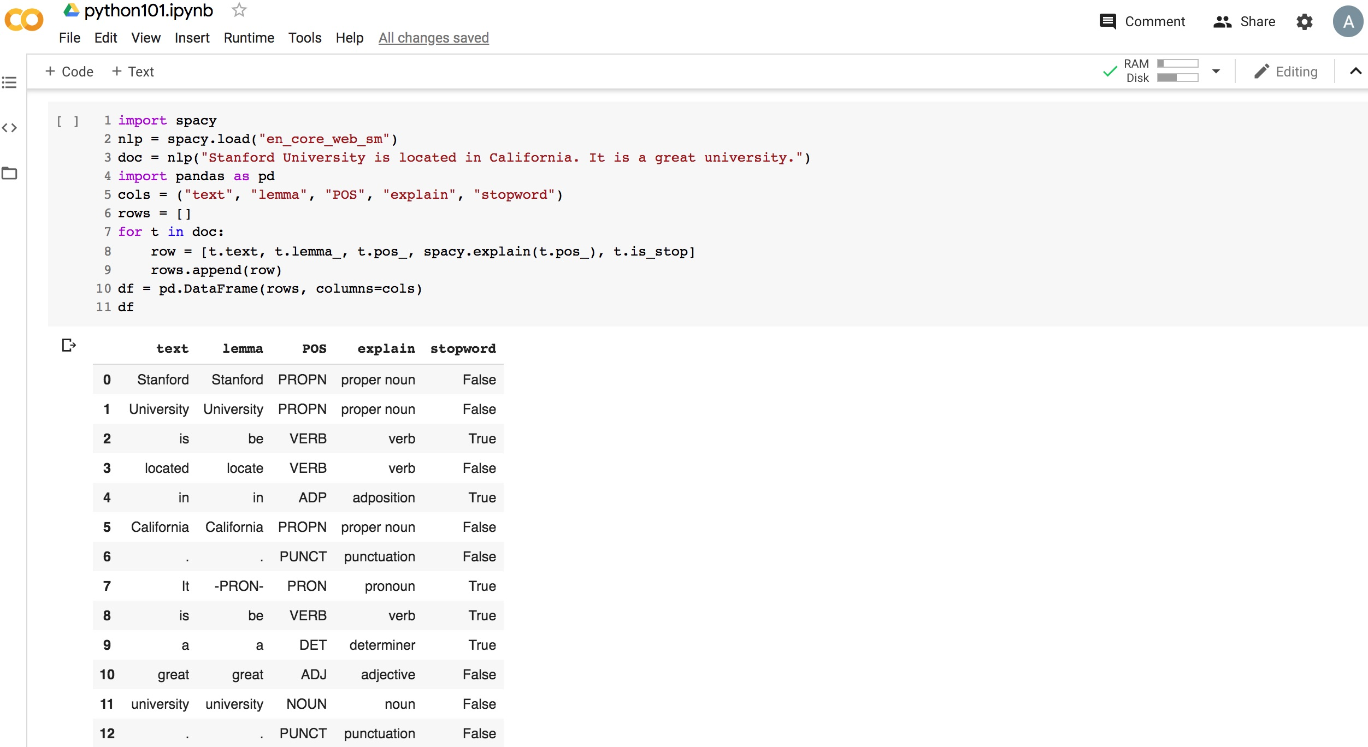
Python in Google Colab (Python101)
https://colab.research.google.com/drive/1FEG6DnGvwfUbeo4zJ1zTunjMqf2RkCrT
https://tinyurl.com/aintpupython101

Slide 79
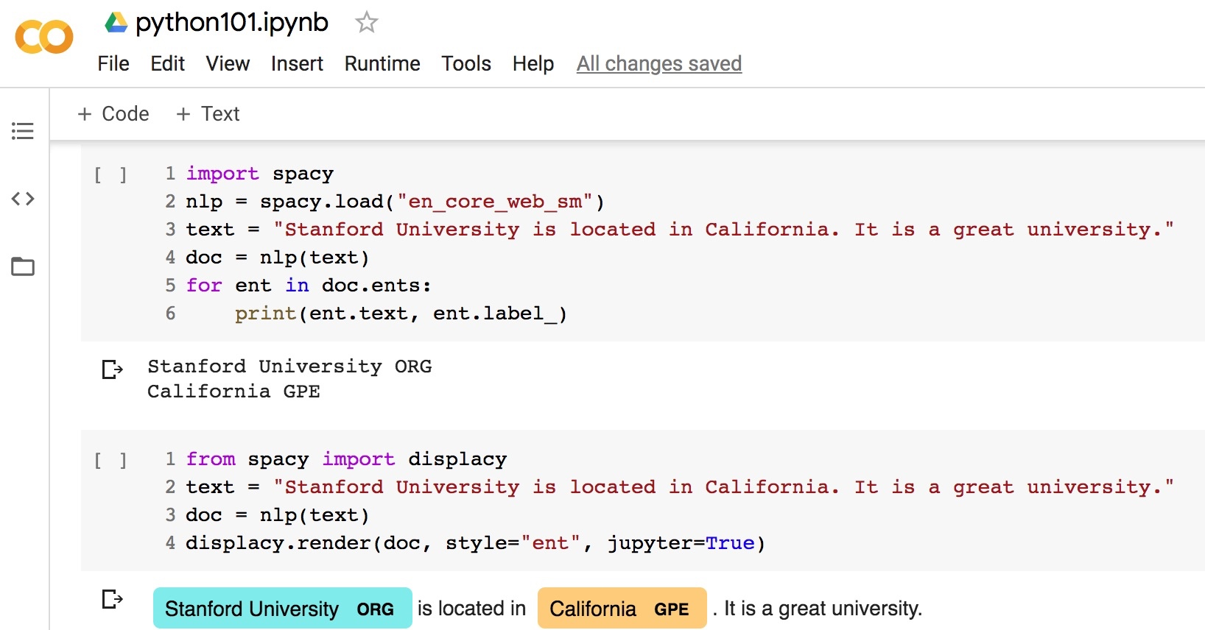
Python in Google Colab (Python101)
https://colab.research.google.com/drive/1FEG6DnGvwfUbeo4zJ1zTunjMqf2RkCrT
https://tinyurl.com/aintpupython101

Slide 80
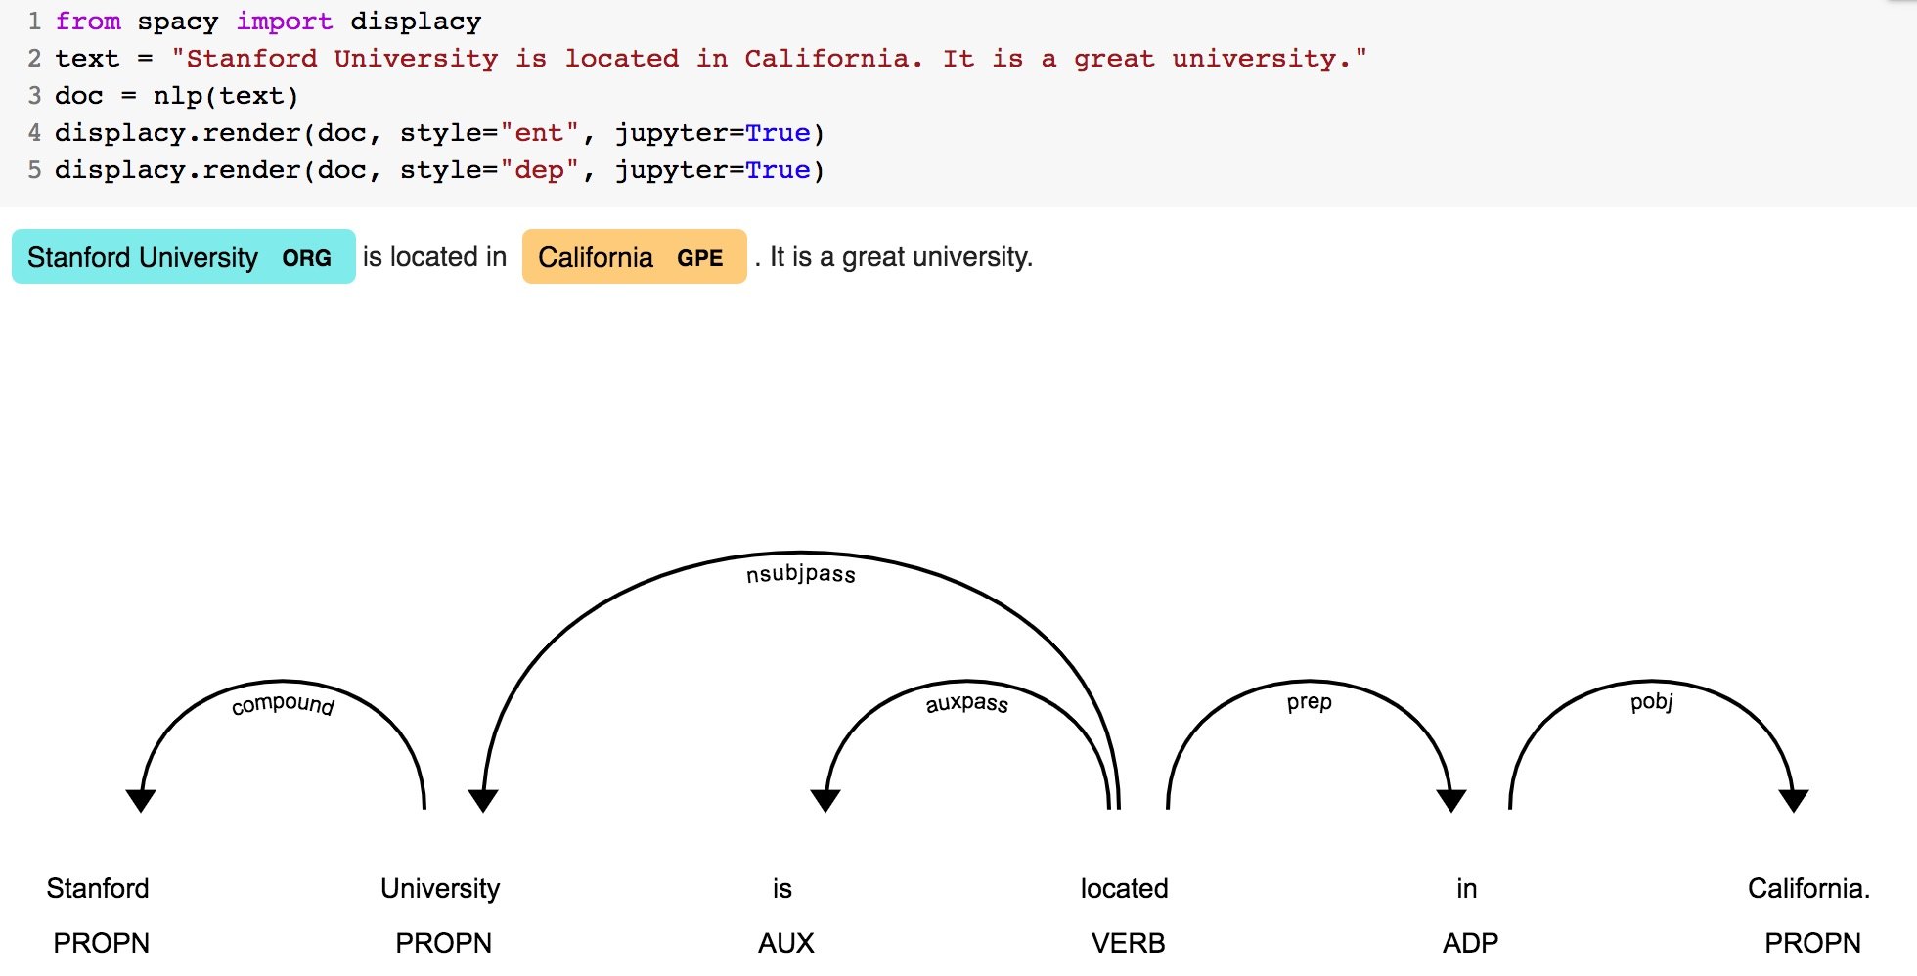
Python in Google Colab (Python101)
https://colab.research.google.com/drive/1FEG6DnGvwfUbeo4zJ1zTunjMqf2RkCrT
https://tinyurl.com/aintpupython101

Slide 81
Python in Google Colab (Python101)
https://colab.research.google.com/drive/1FEG6DnGvwfUbeo4zJ1zTunjMqf2RkCrT
https://tinyurl.com/aintpupython101

Slide 82

Teaching
Artificial Intelligence for Text Analytics
  Spring 2022
Software Engineering
  Fall 2020, Fall, 2021, Spring 2022
Artificial Intelligence in Finance and Quantitative
  Fall 2021
Artificial Intelligence
  Spring 2021
Data Mining
  Spring 2021
Big Data Analytics
  Fall 2020
Foundation of Business Cloud Computing
  Spring 2021, Spring 2022
https://web.ntpu.edu.tw/~myday/teaching.htm

Slide 83
Research Project
Applying AI technology to construct knowledge graphs of cryptocurrency anti-money laundering: a few-shot learning model
  MOST, 110-2410-H-305-013-MY2, 2021/08/01~2023/07/31
AI for Corporate Sustainability Assessment and Cross Language Corporate Sustainability Reports Generative Mode
  NTPU, 111-NTPU_ORDA-F-001，2022/01/01~2022/12/31
Artificial Intelligence for FinTech Knowledge Graph from Patent Textual Analytics
  NTPU, 111-NTPU_ORDA-F-003, 2022/01/01~2022/12/31
https://web.ntpu.edu.tw/~myday/cindex.htm#projects

Slide 84
Summary
This course introduces the fundamental concepts, research issues, and hands-on practices of Artificial Intelligence for Text Analytics.
Topics include:
  Introduction to Introduction to Artificial Intelligence for Text Analytics
  Foundations of Text Analytics: Natural Language Processing (NLP)
  Python for Natural Language Processing
  Natural Language Processing with Transformers
  Text Classification and Sentiment Analysis
  Multilingual Named Entity Recognition (NER), Text Similarity and Clustering
  Text Summarization and Topic Models
  Text Generation
  Question Answering and Dialogue Systems
  Deep Learning, Transfer Learning, Zero-Shot, and Few-Shot Learning for Text Analytics
  Case Study on Artificial Intelligence for Text Analytics

Slide 85
Artificial Intelligence for Text Analytics
Contact Information
Min-Yuh Day, Ph.D.
Associate Professor
Institute of Information Management, National Taipei University
Tel: 02-86741111 ext. 66873
Office: B8F12
Address: 151, University Rd., San Shia District, New Taipei City, 23741 Taiwan
Email: myday@gm.ntpu.edu.tw
Web: http://web.ntpu.edu.tw/~myday/

