Slide 1
金融計量經濟學 (Financial Econometrics)
智慧金融量化分析 (Artificial Intelligence in Finance and Quantitative Analysis)
1101AIFQA07
MBA, IM, NTPU (M6132) (Fall 2021) Tue 2, 3, 4 (9:10-12:00) (8F40)
戴敏育 副教授
Min-Yuh Day, Ph.D, Associate Professor
國立臺北大學 資訊管理研究所
Institute of Information Management, National Taipei University
https://web.ntpu.edu.tw/~myday
2021-11-23

Slide 2
課程大綱 (Syllabus)
週次 (Week) 日期 (Date) 內容 (Subject/Topics)
1 2021/09/28 智慧金融量化分析概論 (Introduction to Artificial Intelligence in Finance and Quantitative Analysis)
2 2021/10/05 AI 金融科技: 金融服務創新應用 (AI in FinTech: Financial Services Innovation and Application)
3 2021/10/12 投資心理學與行為財務學 (Investing Psychology and Behavioral Finance)
4 2021/10/19 財務金融事件研究法 (Event Studies in Finance)
5 2021/10/26 智慧金融量化分析個案研究 I (Case Study on AI in Finance and Quantitative Analysis I)
6 2021/11/02 財務金融理論 (Finance Theory)

Slide 3
課程大綱 (Syllabus)
週次 (Week) 日期 (Date) 內容 (Subject/Topics)
7 2021/11/09 數據驅動財務金融 (Data-Driven Finance)
8 2021/11/16 期中報告 (Midterm Project Report)
9 2021/11/23 金融計量經濟學 (Financial Econometrics)
10 2021/11/30 人工智慧優先金融 (AI-First Finance)
11 2021/12/07 智慧金融量化分析產業實務 (Industry Practices of AI in Finance and Quantitative Analysis )
12 2021/12/14 智慧金融量化分析個案研究 II (Case Study on AI in Finance and Quantitative Analysis II)

Slide 4
課程大綱 (Syllabus)
週次 (Week) 日期 (Date) 內容 (Subject/Topics)
13 2021/12/21 財務金融深度學習(Deep Learning in Finance); 財務金融強化學習 (Reinforcement Learning in Finance)
14 2021/12/28 演算法交易 (Algorithmic Trading); 風險管理 (Risk Management); 交易機器人與基於事件的回測 (Trading Bot and Event-Based Backtesting)
15 2022/01/04 期末報告 I (Final Project Report I)
16 2022/01/11 期末報告 II (Final Project Report II)
17 2022/01/18 學生自主學習 (Self-learning)
18 2022/01/25 學生自主學習 (Self-learning)

Slide 5
Financial Econometrics and Machine Learning

Slide 6
Financial Econometrics and Machine Learning
Financial Econometrics
Financial Theories
OLS Regression
Machine Learning
Learning
Evaluation
Bias and variance
Cross-validation
Source: Yves Hilpisch (2020), Artificial Intelligence in Finance: A Python-Based Guide, O’Reilly Media.

Slide 7
Financial Econometrics
The discipline at the intersection of mathematics, statistics, and finance that applies such methods to financial market data is typically called financial econometrics.
Finance
Mathematics
Statistics
Financial Econometrics
Source: Yves Hilpisch (2020), Artificial Intelligence in Finance: A Python-Based Guide, O’Reilly Media.

Slide 8
Financial Econometrics (Chris Brooks, 2019)
Financial econometrics
the application of statistical techniques to problems in finance
Financial econometrics can be useful for testing theories in finance, determining asset prices or returns, testing hypotheses concerning the relationships between variables, examining the effect on financial markets of changes in economic conditions, forecasting future values of financial variables and for financial decision-making.
Source: Chris Brooks (2019), Introductory Econometrics for Finance, 4th Edition, Cambridge University Press

Slide 9
Financial Econometrics
[Financial] econometrics is the quantitative application of statistical and mathematical models using [financial] data to develop financial theories or test existing hypotheses in finance and to forecast future trends from historical data.
It subjects real-world [financial] data to statistical trials and then compares and contrasts the results against the [financial] theory or theories being tested.
Source: Yves Hilpisch (2020), Artificial Intelligence in Finance: A Python-Based Guide, O’Reilly Media.

Slide 10
Topics of Financial Econometrics (Oliver Linton, 2019)
Econometric
Return Predictability and the Efficient Markets Hypothesis
Robust Tests and Tests of Nonlinear Predictability of Returns
Empirical Market Microstructure
Event Study Analysis
Portfolio Choice and Testing the Capital Asset Pricing Model
Multifactor Pricing Models
Source: Oliver Linton (2019), Financial Econometrics: Models and Methods, Cambridge University Press

Slide 11
Topics of Financial Econometrics (Oliver Linton, 2019)
Present Value Relations
Intertemporal Equilibrium Pricing
Volatility
Continuous Time Processes
Yield Curve
Risk Management and Tail Estimation
Source: Oliver Linton (2019), Financial Econometrics: Models and Methods, Cambridge University Press

Slide 12
Applications of Financial Econometrics (Chris Brooks, 2019)
Testing whether financial markets are weak-form informationally efficient
Testing whether the capital asset pricing model (CAPM) or arbitrage pricing theory (APT) represent superior models for the determination of returns on risky assets
Measuring and forecasting the volatility of bond returns
Explaining the determinants of bond credit ratings used by the ratings agencies
Modelling long-term relationships between prices and exchange rates
Source: Chris Brooks (2019), Introductory Econometrics for Finance, 4th Edition, Cambridge University Press

Slide 13
Applications of Financial Econometrics (Chris Brooks, 2019)
Determining the optimal hedge ratio for a spot position in oil
Testing technical trading rules to determine which makes the most money
Testing the hypothesis that earnings or dividend announcements have no effect on stock prices
Testing whether spot or futures markets react more rapidly to news
Forecasting the correlation between the stock indices of two countries
Source: Chris Brooks (2019), Introductory Econometrics for Finance, 4th Edition, Cambridge University Press

Slide 14
Machine Learning and Financial Econometrics
ML and DL methods are able to discover statistical inefficiencies and even economic inefficiencies that are not discoverable by traditional econometric methods, such as multivariate OLS regression.
Source: Yves Hilpisch (2020), Artificial Intelligence in Finance: A Python-Based Guide, O’Reilly Media.

Slide 15
Normative Financial Theories
Normative financial theories mostly rely on assumptions and axioms in combination with deduction as the major analytical method to arrive at their central results.
Expected utility theory (EUT) assumes that agents have the same utility function no matter what state of the world unfolds and that they maximize expected utility under conditions of uncertainty.
Mean-variance portfolio (MVP) theory describes how investors should invest under conditions of uncertainty assuming that only the expected return and the expected volatility of a portfolio over one period count.
Source: Yves Hilpisch (2020), Artificial Intelligence in Finance: A Python-Based Guide, O’Reilly Media.

Slide 16
Normative Financial Theories
The capital asset pricing model (CAPM) assumes that only the nondiversifiable market risk explains the expected return and the expected volatility of a stock over one period.
Arbitrage pricing theory (APT) assumes that a number of identifiable risk factors explains the expected return and the expected volatility of a stock over time; admittedly, compared to the other theories, the formulation of APT is rather broad and allows for wide-ranging interpretations.
Source: Yves Hilpisch (2020), Artificial Intelligence in Finance: A Python-Based Guide, O’Reilly Media.

Slide 17
Financial Econometrics and Regression
One of the major tools in financial econometrics is regression, in both its univariate and multivariate forms
$y=α+β x$
$y=α+β1 x1+β2 x2$
$y=α+β1 x1+β2 x2+β3 x3$
Regression is also a central tool in statistical learning in general
Source: Yves Hilpisch (2020), Artificial Intelligence in Finance: A Python-Based Guide, O’Reilly Media.

Slide 18
CAPM and APT OLS regression
Both the CAPM and the APT relate the output variables with the relevant input factors in linear fashion.
From an econometric point of view, both models are implemented based on linear ordinary least-squares (OLS) regression.
CAPM: univariate linear OLS regression
APT: multivariate OLS regression
Source: Yves Hilpisch (2020), Artificial Intelligence in Finance: A Python-Based Guide, O’Reilly Media.

Slide 19
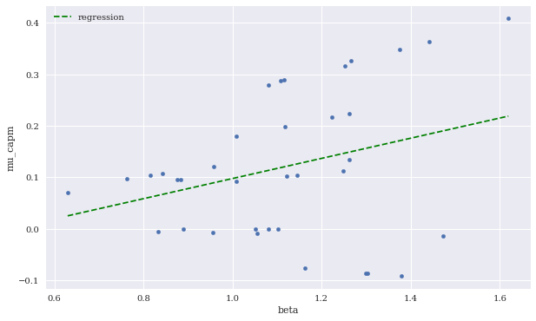
Expected CAPM return versus beta (including linear regression)
Source: Yves Hilpisch (2020), Artificial Intelligence in Finance: A Python-Based Guide, O’Reilly Media.

Slide 20
Expected CAPM return versus beta (including linear regression)
Source: Yves Hilpisch (2020), Artificial Intelligence in Finance: A Python-Based Guide, O’Reilly Media.

Slide 21
Machine Learning
Learning
Data: Features, Labels
Success (Loss Function): MSE
Capacity (Model Fit)
Evaluation
Bias and variance
Cross-validation
Source: Yves Hilpisch (2020), Artificial Intelligence in Finance: A Python-Based Guide, O’Reilly Media.

Slide 22
Learning (Mitchell, 1997)
A computer program is said to learn from experience E with respect to some class of tasks T and performance measure P, if its performance at tasks in T, as measured by P, improves with experience E.
Source: Yves Hilpisch (2020), Artificial Intelligence in Finance: A Python-Based Guide, O’Reilly Media.

Slide 23
Performance Measure
The measure of success for estimation problems
mean-squared error (MSE)
Classification problems
accuracy ratio
Source: Yves Hilpisch (2020), Artificial Intelligence in Finance: A Python-Based Guide, O’Reilly Media.

Slide 24
EUR/USD exchange rate as time series (monthly)
Source: Yves Hilpisch (2020), Artificial Intelligence in Finance: A Python-Based Guide, O’Reilly Media.

Slide 25
Sample data set
Source: Yves Hilpisch (2020), Artificial Intelligence in Finance: A Python-Based Guide, O’Reilly Media.

Slide 26
Sample data and cubic regression line
Source: Yves Hilpisch (2020), Artificial Intelligence in Finance: A Python-Based Guide, O’Reilly Media.

Slide 27
Sample data and neural network approximation
Source: Yves Hilpisch (2020), Artificial Intelligence in Finance: A Python-Based Guide, O’Reilly Media.

Slide 28
MSE values against number of training epochs
Source: Yves Hilpisch (2020), Artificial Intelligence in Finance: A Python-Based Guide, O’Reilly Media.

Slide 29
Regression lines for different highest degrees
Source: Yves Hilpisch (2020), Artificial Intelligence in Finance: A Python-Based Guide, O’Reilly Media.

Slide 30
Sample data and DNN approximation (higher capacity)
Source: Yves Hilpisch (2020), Artificial Intelligence in Finance: A Python-Based Guide, O’Reilly Media.

Slide 31
Training and validation data including regression fits
Source: Yves Hilpisch (2020), Artificial Intelligence in Finance: A Python-Based Guide, O’Reilly Media.

Slide 32
Training and validation data including DNN predictions
Source: Yves Hilpisch (2020), Artificial Intelligence in Finance: A Python-Based Guide, O’Reilly Media.

Slide 33
MSE values for DNN model on the training and validation data sets
Source: Yves Hilpisch (2020), Artificial Intelligence in Finance: A Python-Based Guide, O’Reilly Media.

Slide 34
Test data and predictions from OLS regression and the DNN model
Source: Yves Hilpisch (2020), Artificial Intelligence in Finance: A Python-Based Guide, O’Reilly Media.

Slide 35
High bias and high variance OLS regression fits
Source: Yves Hilpisch (2020), Artificial Intelligence in Finance: A Python-Based Guide, O’Reilly Media.

Slide 36
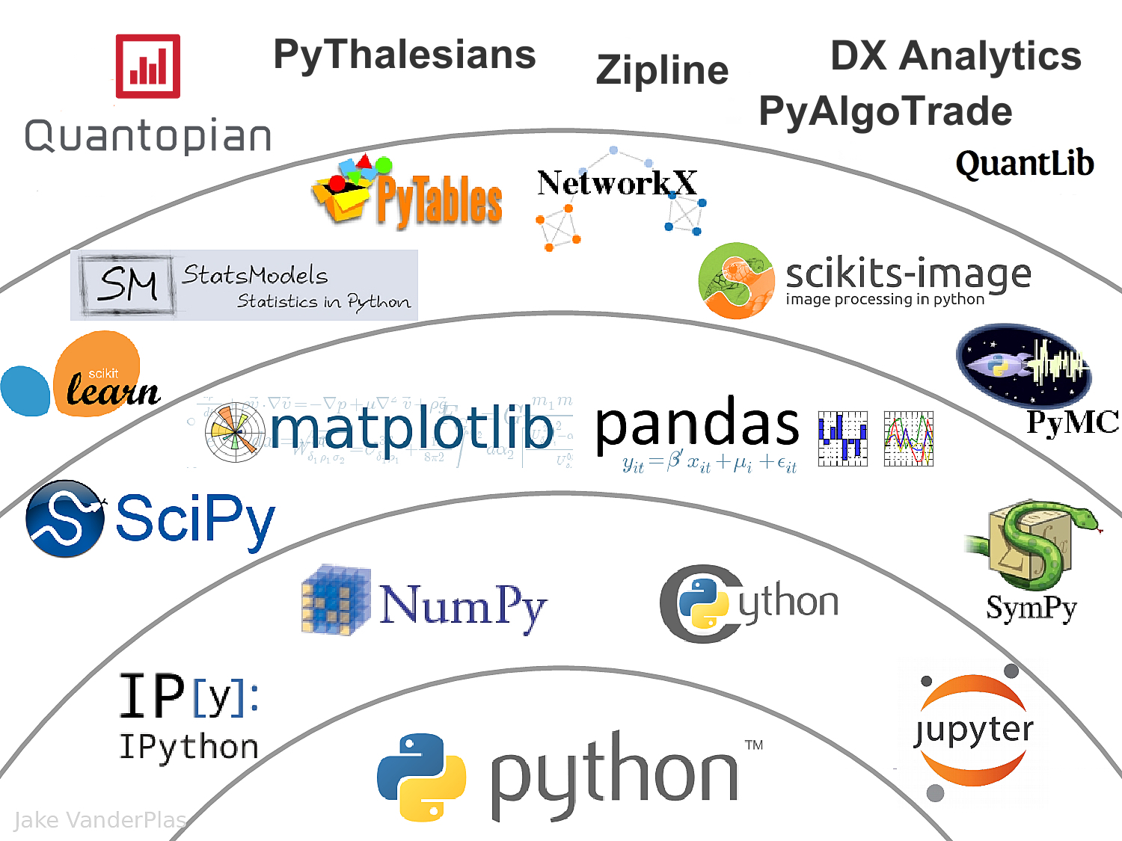
The Quant Finance PyData Stack
Source: http://nbviewer.jupyter.org/format/slides/github/quantopian/pyfolio/blob/master/pyfolio/examples/overview_slides.ipynb#/5

Slide 37
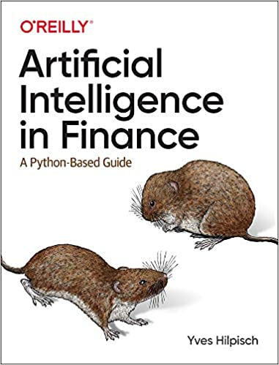
Yves Hilpisch (2020), Artificial Intelligence in Finance: A Python-Based Guide, O’Reilly
Source: https://www.amazon.com/Artificial-Intelligence-Finance-Python-Based-Guide/dp/1492055433

Slide 38
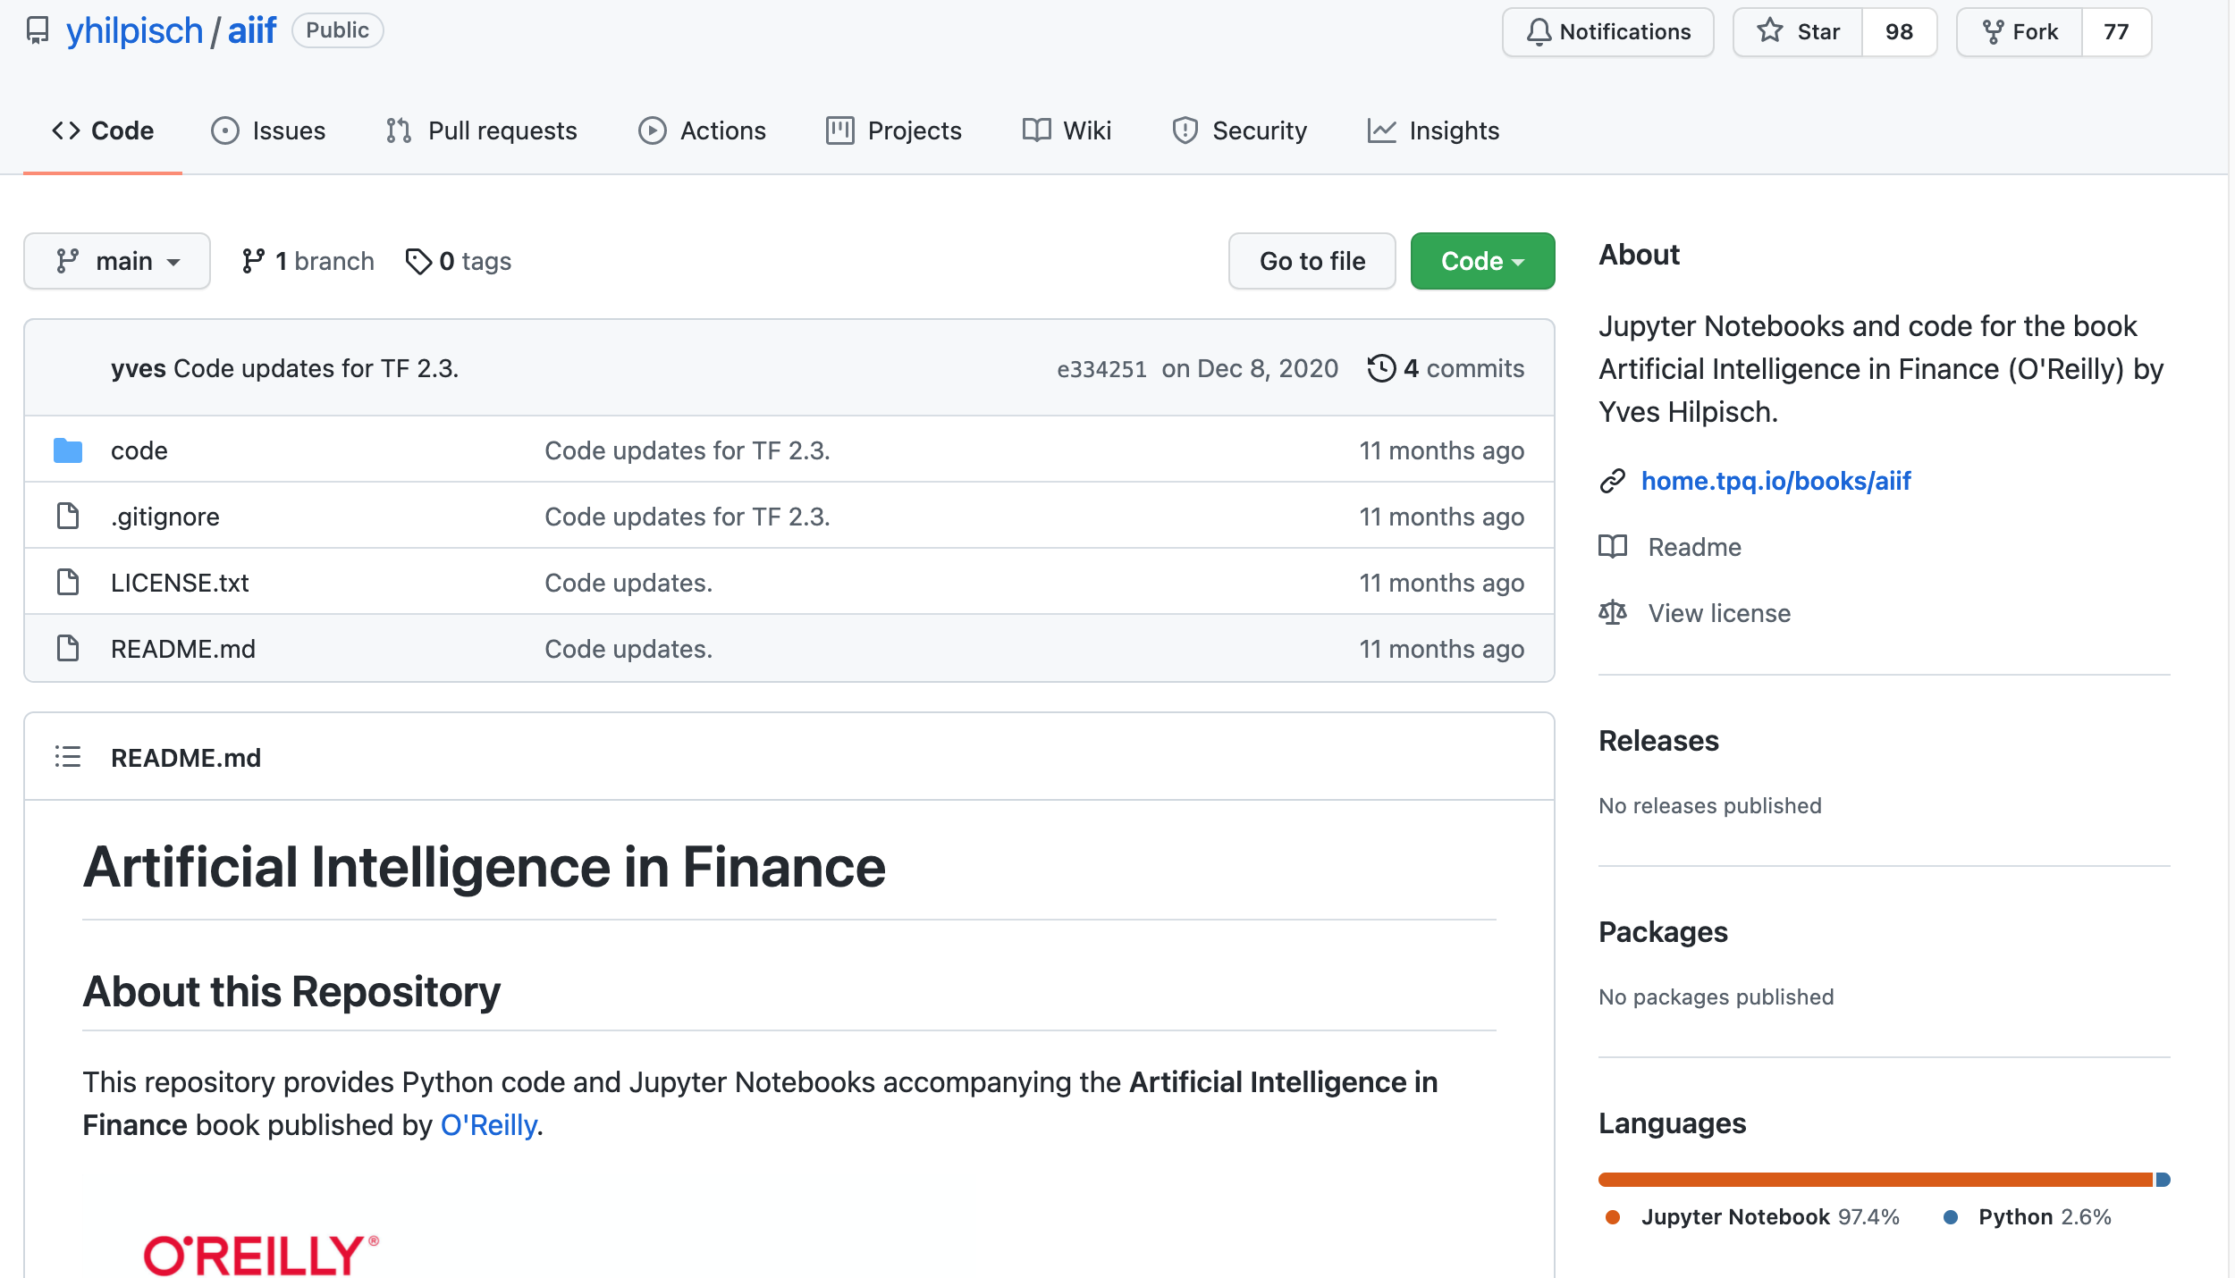
Yves Hilpisch (2020), Artificial Intelligence in Finance: A Python-Based Guide, O’Reilly
https://github.com/yhilpisch/aiif
Source: https://github.com/yhilpisch/aiif

Slide 39
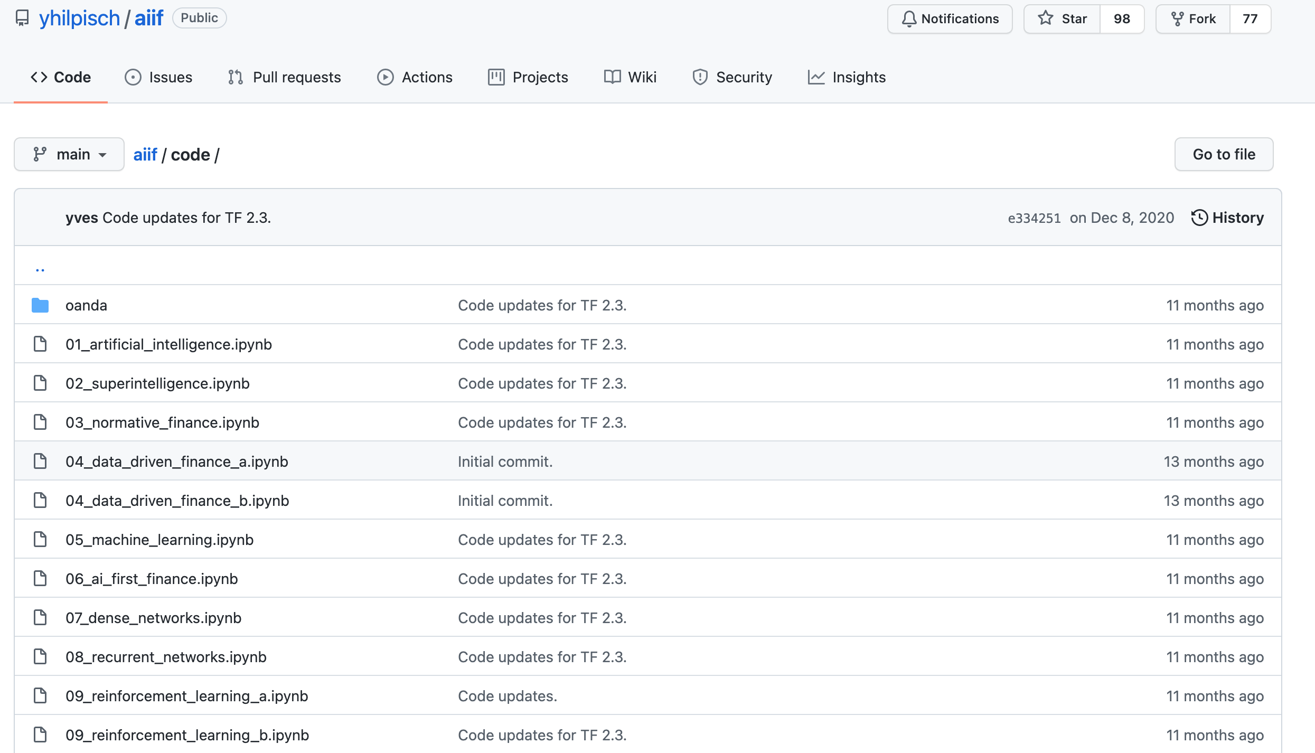
Yves Hilpisch (2020), Artificial Intelligence in Finance: A Python-Based Guide, O’Reilly
https://github.com/yhilpisch/aiif/tree/main/code
Source: https://github.com/yhilpisch/aiif/tree/main/code

Slide 40
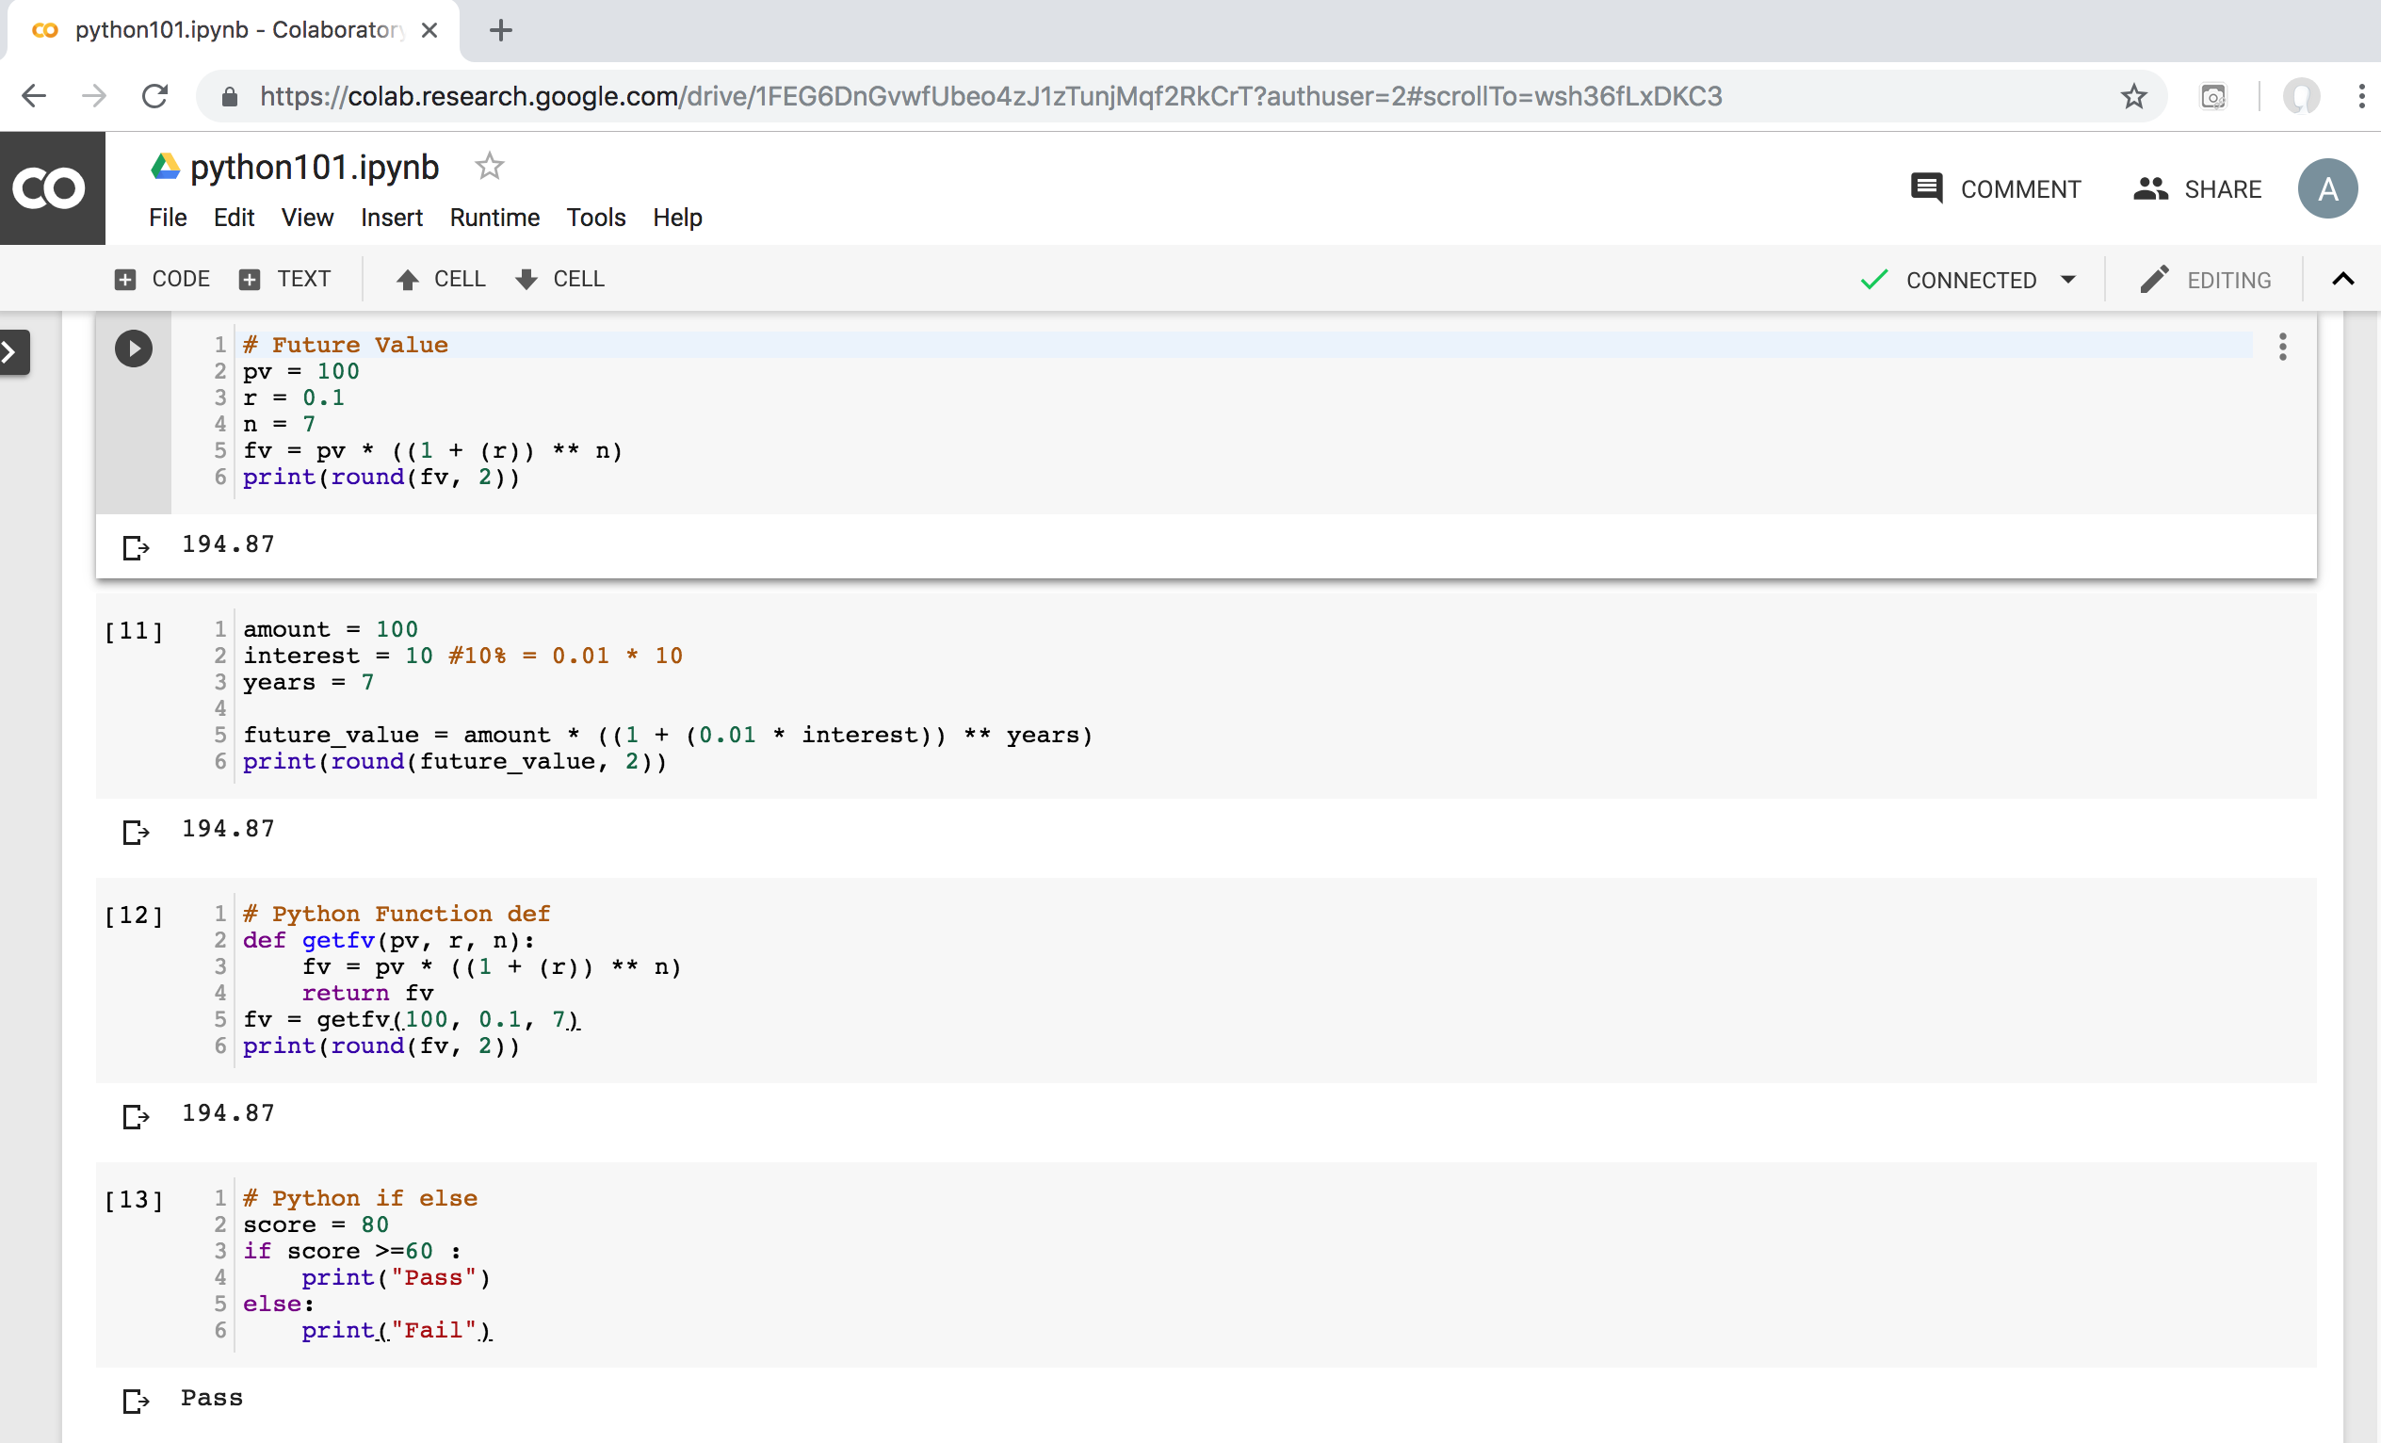
Python in Google Colab (Python101)
https://colab.research.google.com/drive/1FEG6DnGvwfUbeo4zJ1zTunjMqf2RkCrT
https://tinyurl.com/aintpupython101

Slide 41
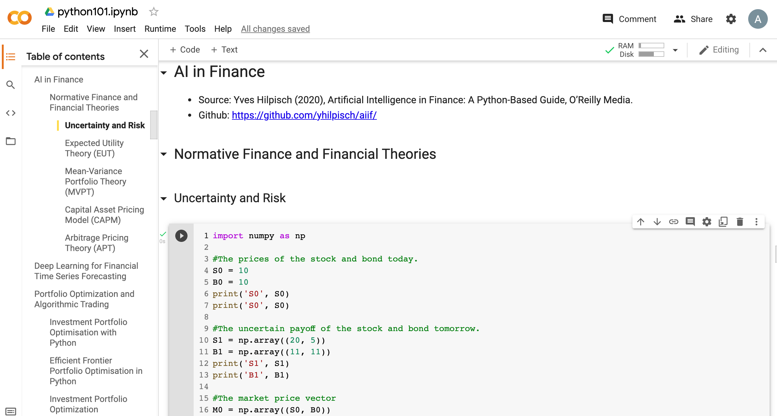
Python in Google Colab (Python101)
https://colab.research.google.com/drive/1FEG6DnGvwfUbeo4zJ1zTunjMqf2RkCrT
https://tinyurl.com/aintpupython101

Slide 42
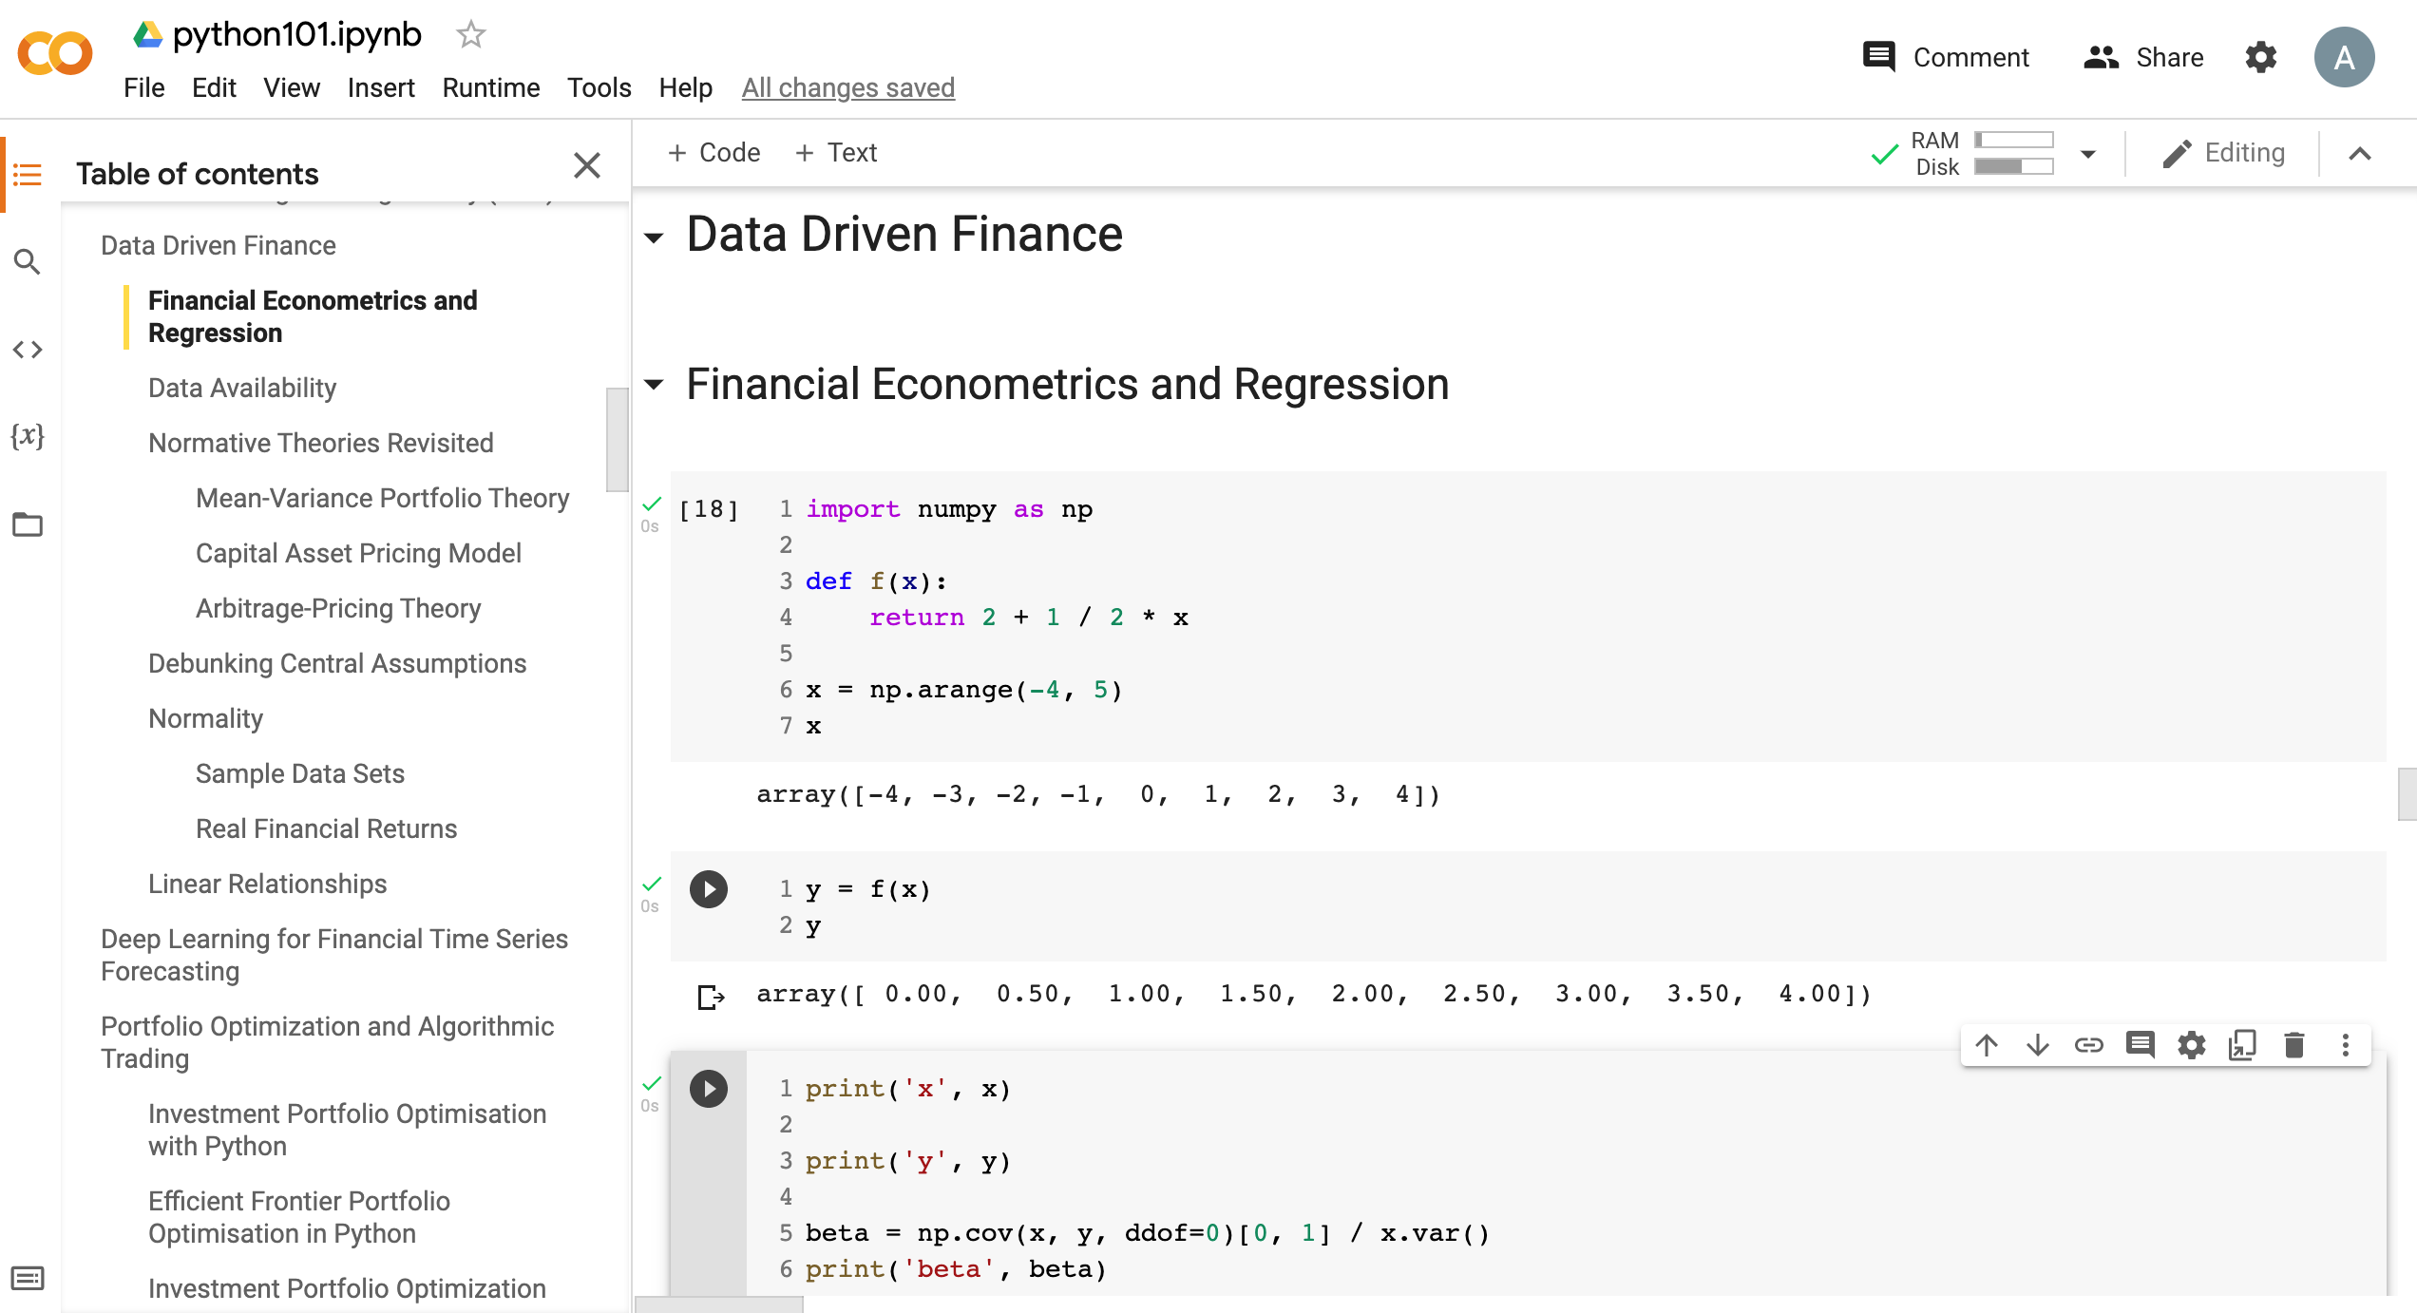
Python in Google Colab (Python101)
https://tinyurl.com/aintpupython101

Slide 43
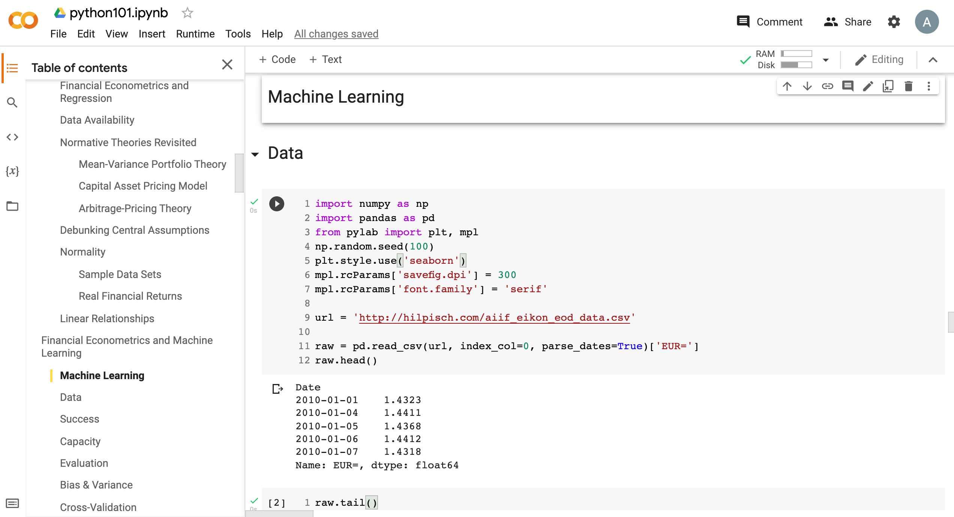
Python in Google Colab (Python101)
https://tinyurl.com/aintpupython101

Slide 44
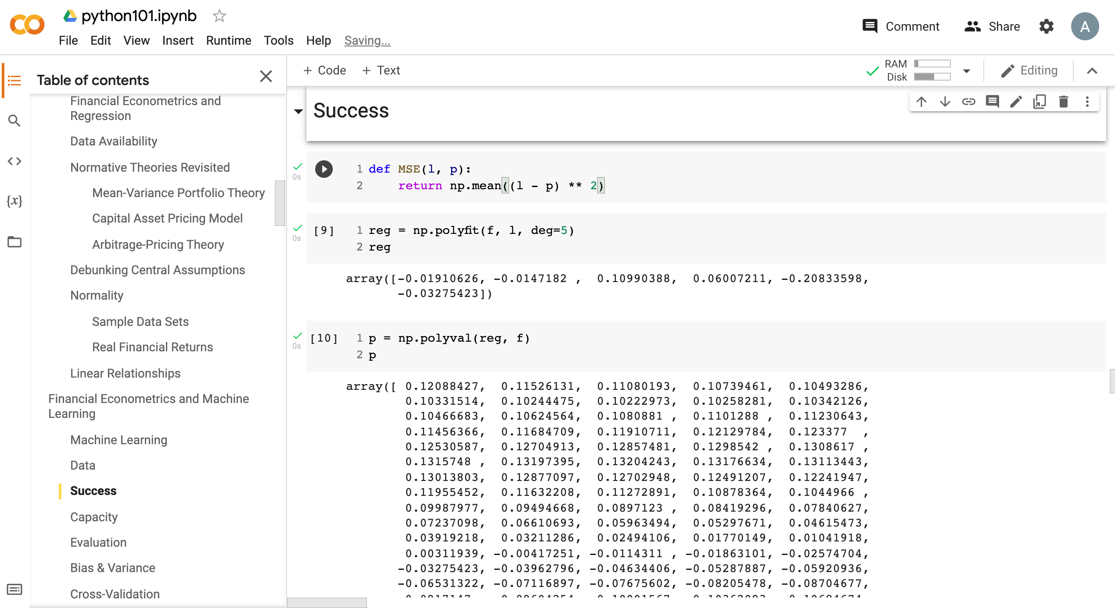
Python in Google Colab (Python101)
https://tinyurl.com/aintpupython101

Slide 45
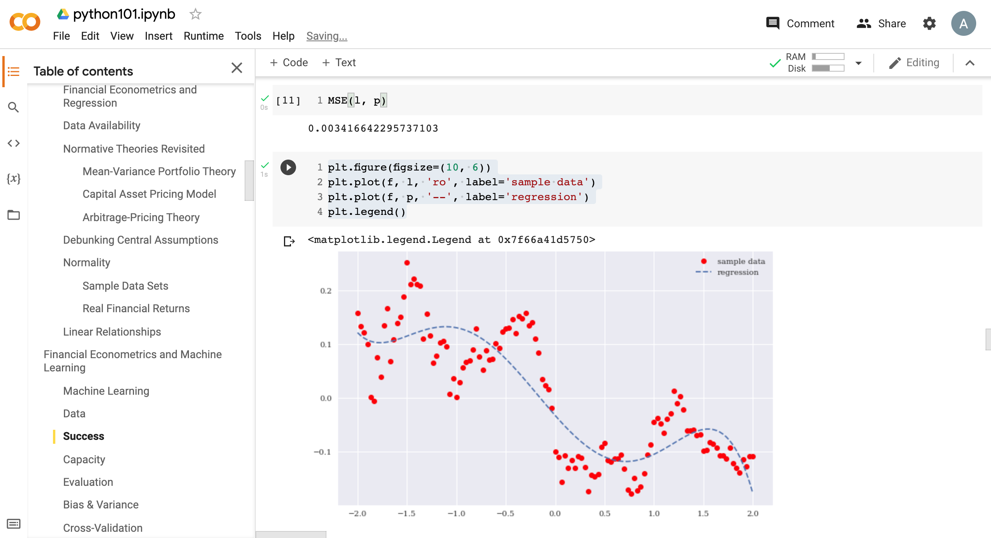
Python in Google Colab (Python101)
https://tinyurl.com/aintpupython101

Slide 46
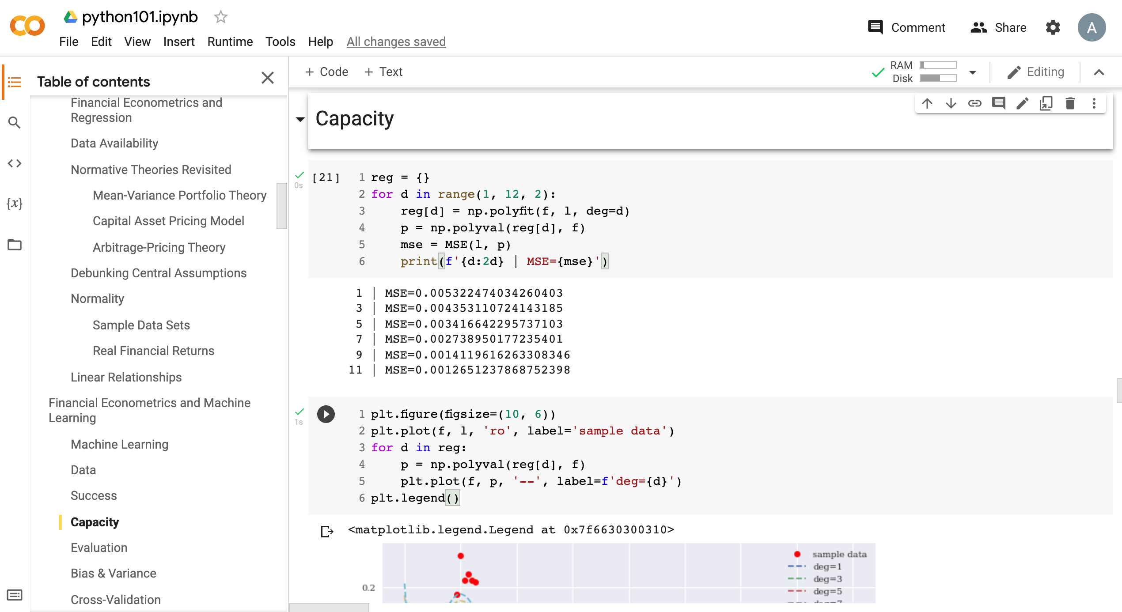
Python in Google Colab (Python101)
https://tinyurl.com/aintpupython101

Slide 47
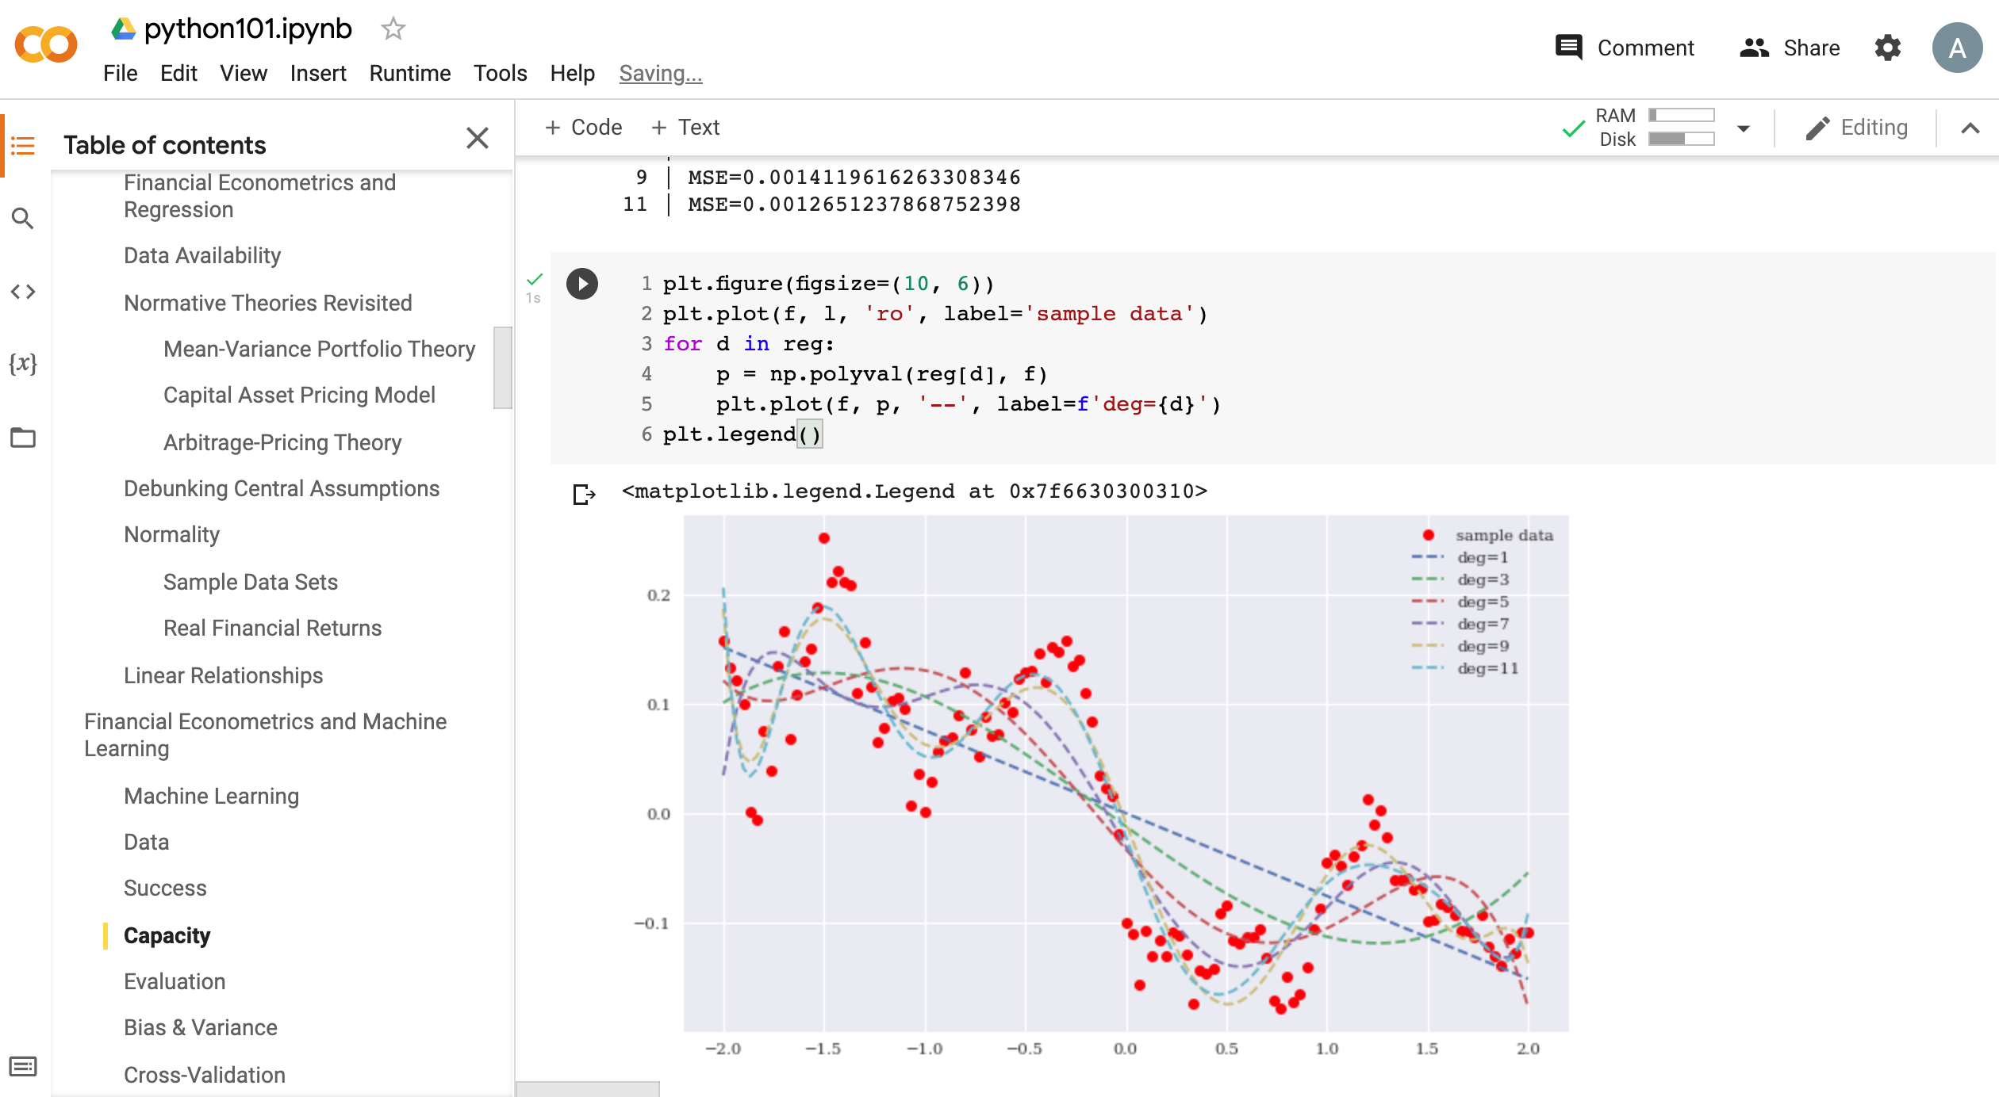
Python in Google Colab (Python101)
https://tinyurl.com/aintpupython101

Slide 48
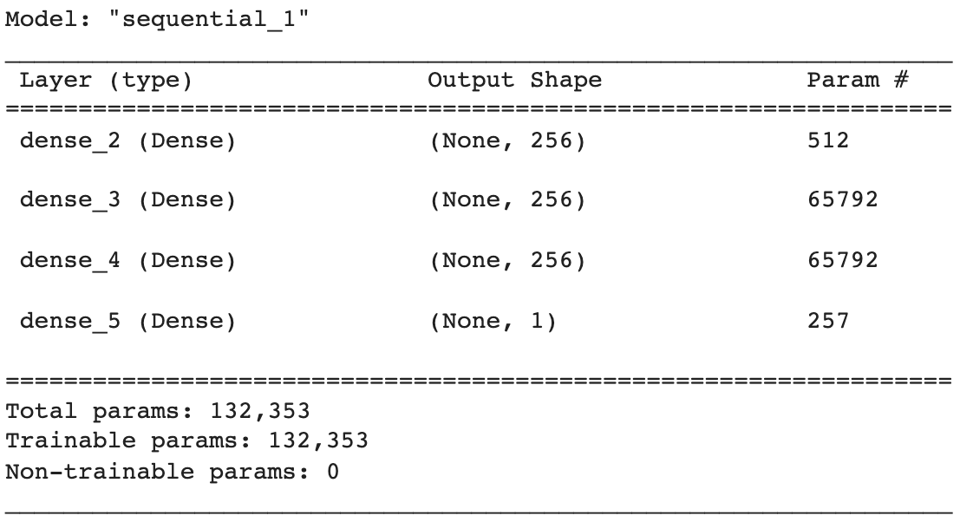
Python in Google Colab (Python101)
def create_dnn_model(hl=1, hu=256):
''' Function to create Keras DNN model.
Parameters
==========
hl: int
number of hidden layers
hu: int
number of hidden units (per layer)
'''
model = Sequential()
for _ in range(hl):
model.add(Dense(hu, activation='relu', input_dim=1))
model.add(Dense(1, activation='linear'))
model.compile(loss='mse', optimizer='rmsprop')
return model
model = create_dnn_model(3)
model.summary()
https://tinyurl.com/aintpupython101

Slide 49
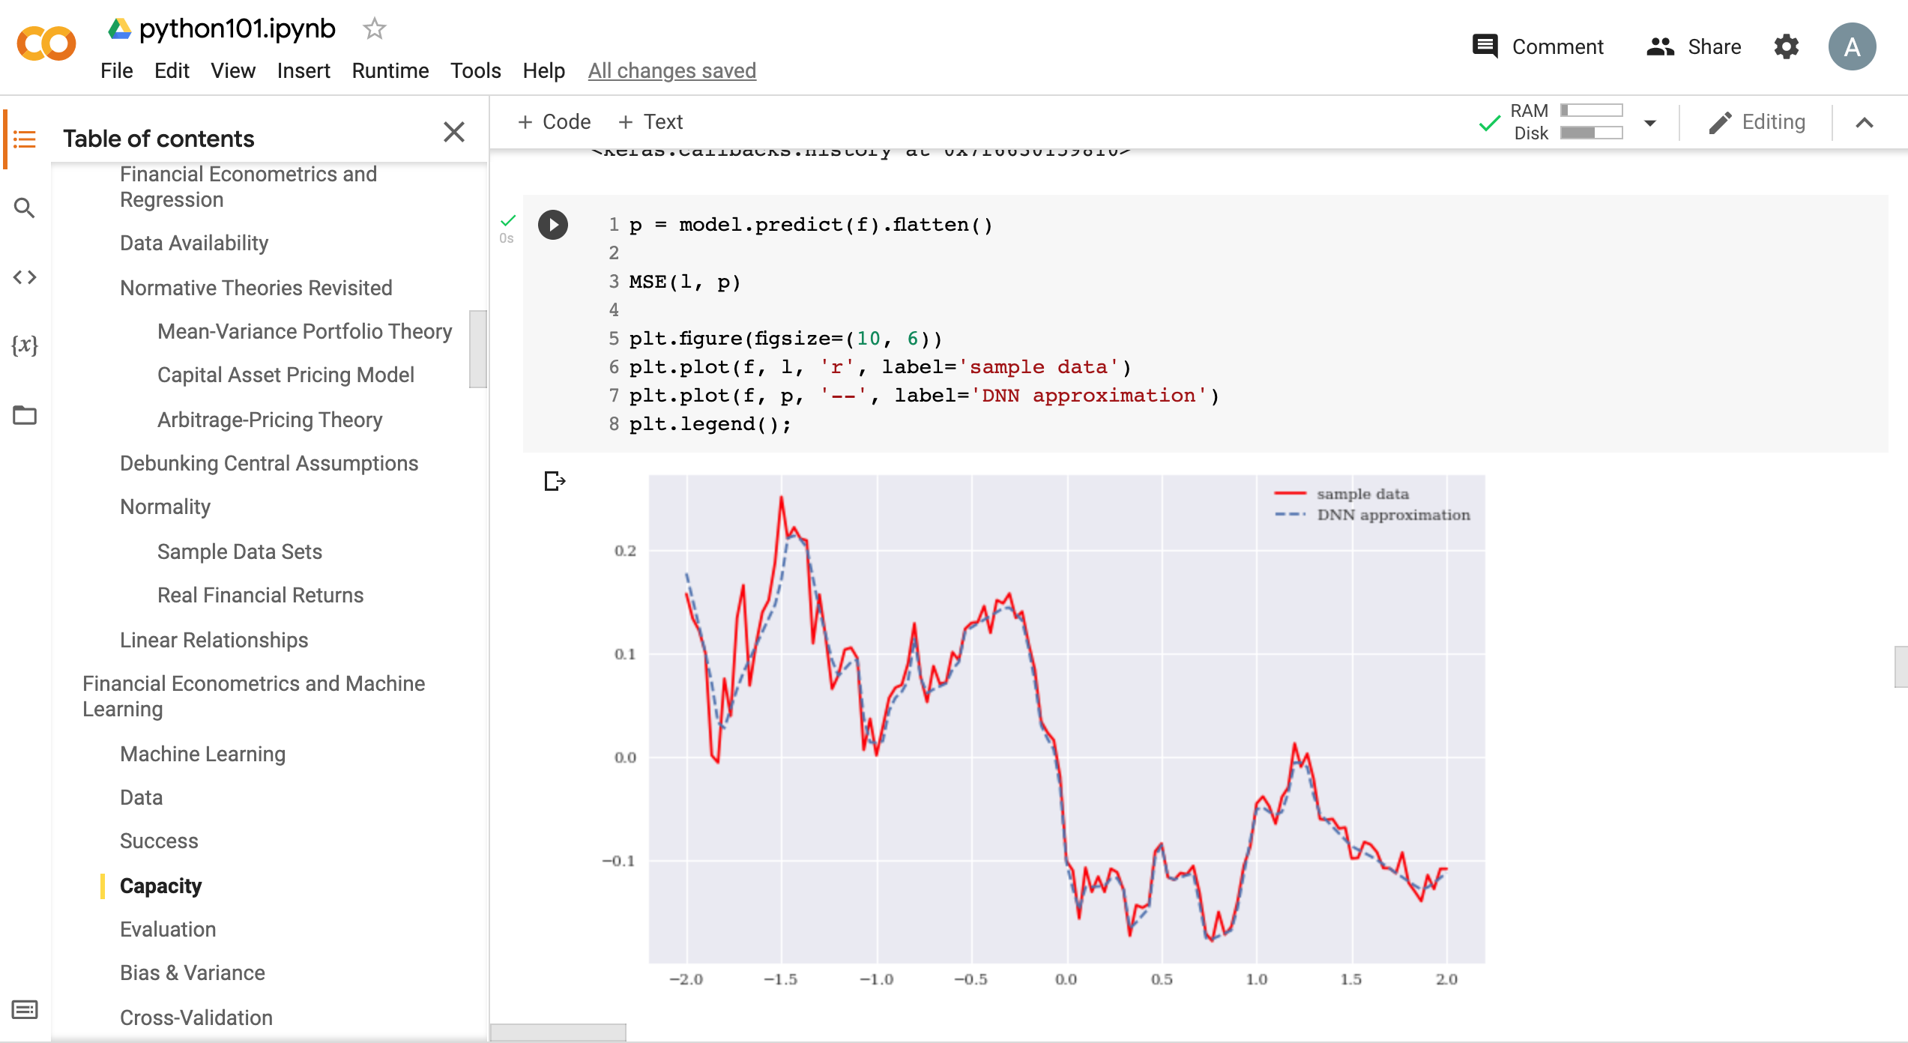
Python in Google Colab (Python101)
https://tinyurl.com/aintpupython101

Slide 50
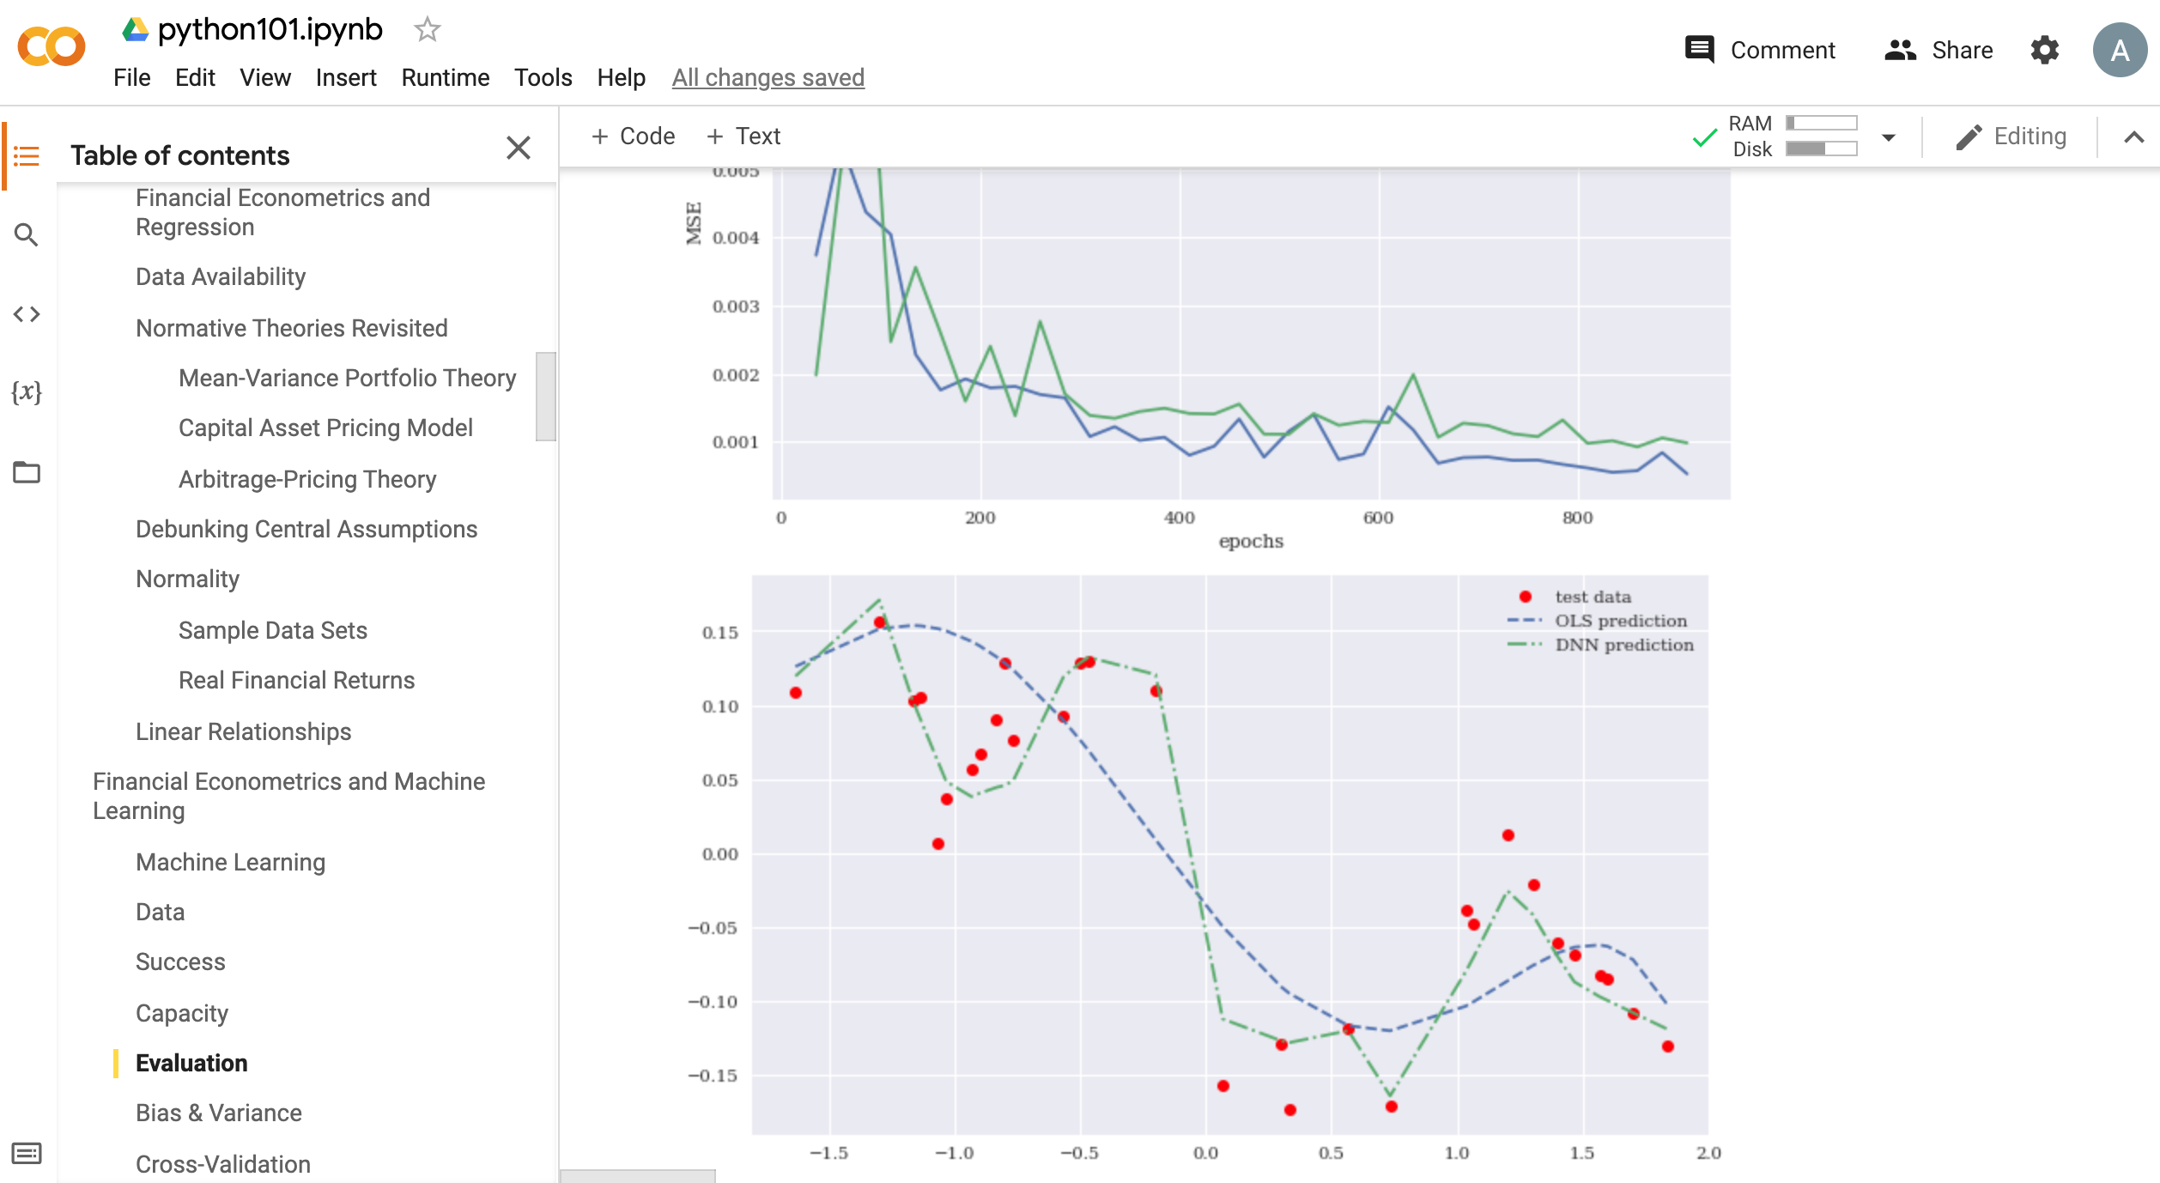
Python in Google Colab (Python101)
https://tinyurl.com/aintpupython101

Slide 51
Summary
Financial Econometrics
Financial Theories
OLS Regression
Machine Learning
Learning
Evaluation
Bias and variance
Cross-validation
Source: Yves Hilpisch (2020), Artificial Intelligence in Finance: A Python-Based Guide, O’Reilly Media.

Slide 52
References
Yves Hilpisch (2020), Artificial Intelligence in Finance: A Python-Based Guide, O’Reilly Media, https://github.com/yhilpisch/aiif .
Chris Brooks (2019), Introductory Econometrics for Finance, 4th Edition, Cambridge University Press
Oliver Linton (2019), Financial Econometrics: Models and Methods, Cambridge University Press
Tom Mitchell (1997), Machine Learning, McGraw-Hill.
Min-Yuh Day (2021), Python 101, https://tinyurl.com/aintpupython101

