Slide 1



資料探勘
(Data Mining)
非監督學習：
集群分析，行銷市場區隔
(Unsupervised Learning: Cluster Analysis, Market Segmentation)
1092DM06
MBA, IM, NTPU (M5026) (Spring 2021)
Tue 2, 3, 4 (9:10-12:00) (B8F40)
Min-Yuh Day
戴敏育
Associate Professor
副教授
Institute of Information Management, National Taipei University
國立臺北大學 資訊管理研究所
https://web.ntpu.edu.tw/~myday
2021-04-13

Slide 2
課程大綱 (Syllabus)
週次 (Week) 日期 (Date) 內容 (Subject/Topics)
1 2021/02/23 資料探勘介紹 (Introduction to data mining)
2 2021/03/02 ABC：人工智慧，大數據，雲端運算
(ABC: AI, Big Data, Cloud Computing)
3 2021/03/09 Python資料探勘的基礎
(Foundations of Data Mining in Python)
4 2021/03/16 資料科學與資料探勘：發現，分析，可視化和呈現數據
(Data Science and Data Mining:
Discovering, Analyzing, Visualizing and Presenting Data)
5 2021/03/23 非監督學習：關聯分析，購物籃分析
(Unsupervised Learning: Association Analysis,
Market Basket Analysis)
6 2021/03/30 資料探勘個案研究 I
(Case Study on Data Mining I)

Slide 3
課程大綱 (Syllabus)
週次 (Week) 日期 (Date) 內容 (Subject/Topics)
7 2021/04/06 放假一天 (Day off)
8 2021/04/13 非監督學習：集群分析，行銷市場區隔
(Unsupervised Learning: Cluster Analysis, Market Segmentation)
9 2021/04/20 期中報告 (Midterm Project Report)
10 2021/04/27 監督學習：分類和預測
(Supervised Learning: Classification and Prediction)
11 2021/05/04 機器學習和深度學習
(Machine Learning and Deep Learning)
12 2021/05/11 卷積神經網絡
(Convolutional Neural Networks)

Slide 4
課程大綱 (Syllabus)
週次 (Week) 日期 (Date) 內容 (Subject/Topics)
13 2021/05/18 資料探勘個案研究 II
(Case Study on Data Mining II)
14 2021/05/25 遞歸神經網絡
(Recurrent Neural Networks)
15 2021/06/01 強化學習
(Reinforcement Learning)
16 2021/06/08 社交網絡分析
(Social Network Analysis)
17 2021/06/15 期末報告 I (Final Project Report I)
18 2021/06/22 期末報告 II (Final Project Report II)

Slide 5
Unsupervised Learning:
Cluster Analysis, Market Segmentation

Slide 6
Outline
Unsupervised Learning
Cluster Analysis
Market Segmentation
K-Means Clustering

Slide 7
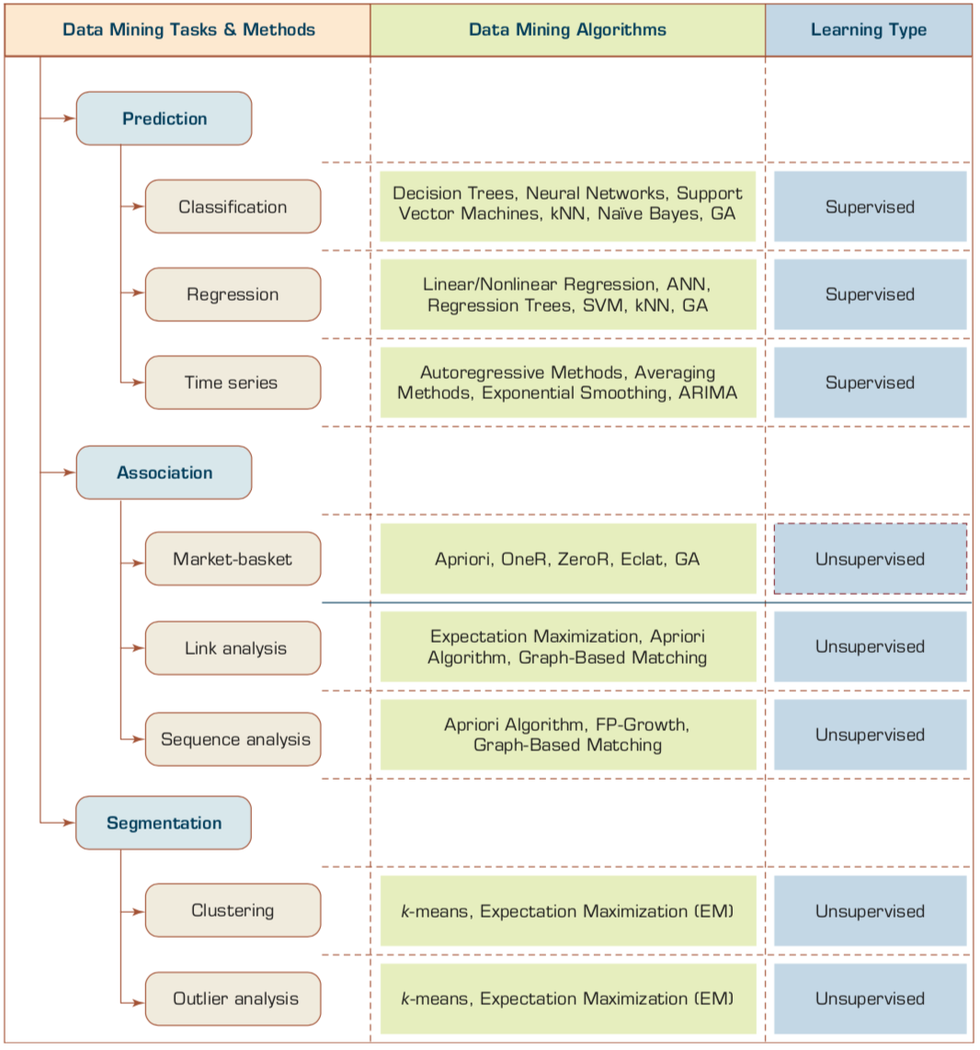
Data Mining Tasks & Methods
Unsupervised Learning:
Cluster Analysis, Market Segmentation
Segmentation
Source: Ramesh Sharda, Dursun Delen, and Efraim Turban (2017), Business Intelligence, Analytics, and Data Science: A Managerial Perspective, 4th Edition, Pearson

Slide 8
Example of Cluster Analysis
Point | P | P(x,y)
p01 | a | (3, 4)
p02 | b | (3, 6)
p03 | c | (3, 8)
p04 | d | (4, 5)
p05 | e | (4, 7)
p06 | f | (5, 1)
p07 | g | (5, 5)
p08 | h | (7, 3)
p09 | i | (7, 5)
p10 | j | (8, 5)

Slide 9
K-Means Clustering
Point | P | P(x,y) | m1 distance | m2 distance | Cluster
p01 | a | (3, 4) | 1.95 | 3.78 | Cluster1
p02 | b | (3, 6) | 0.69 | 4.51 | Cluster1
p03 | c | (3, 8) | 2.27 | 5.86 | Cluster1
p04 | d | (4, 5) | 0.89 | 3.13 | Cluster1
p05 | e | (4, 7) | 1.22 | 4.45 | Cluster1
p06 | f | (5, 1) | 5.01 | 3.05 | Cluster2
p07 | g | (5, 5) | 1.57 | 2.30 | Cluster1
p08 | h | (7, 3) | 4.37 | 0.56 | Cluster2
p09 | i | (7, 5) | 3.43 | 1.52 | Cluster2
p10 | j | (8, 5) | 4.41 | 1.95 | Cluster2
 | m1 | (3.67, 5.83)
 | m2 | (6.75, 3.50)

Slide 10
Cluster Analysis

Slide 11
Cluster Analysis
Used for automatic identification of
natural groupings of things
Part of the machine-learning family
Employ unsupervised learning
Learns the clusters of things from past data, then assigns new instances
There is not an output variable
Also known as segmentation
Source: Turban et al. (2011), Decision Support and Business Intelligence Systems

Slide 12
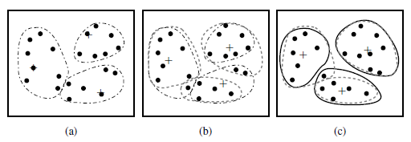
Cluster Analysis
Clustering of a set of objects based on the k-means method.
(The mean of each cluster is marked by a “+”.)
Source: Han & Kamber (2006)

Slide 13
Cluster Analysis
Clustering results may be used to
  Identify natural groupings of customers
  Identify rules for assigning new cases to classes for targeting/diagnostic purposes
  Provide characterization, definition, labeling of populations
  Decrease the size and complexity of problems
  for other data mining methods
  Identify outliers in a specific domain
  (e.g., rare-event detection)
Source: Turban et al. (2011), Decision Support and Business Intelligence Systems

Slide 14
Example of Cluster Analysis
Point | P | P(x,y)
p01 | a | (3, 4)
p02 | b | (3, 6)
p03 | c | (3, 8)
p04 | d | (4, 5)
p05 | e | (4, 7)
p06 | f | (5, 1)
p07 | g | (5, 5)
p08 | h | (7, 3)
p09 | i | (7, 5)
p10 | j | (8, 5)

Slide 15
Cluster Analysis for Data Mining
Analysis methods
  Statistical methods
  (including both hierarchical and nonhierarchical),
  such as k-means, k-modes, and so on
  Neural networks
  (adaptive resonance theory [ART],
  self-organizing map [SOM])
  Fuzzy logic (e.g., fuzzy c-means algorithm)
  Genetic algorithms
Divisive versus Agglomerative methods
Source: Turban et al. (2011), Decision Support and Business Intelligence Systems

Slide 16
Cluster Analysis for Data Mining
How many clusters?
  There is not a “truly optimal” way to calculate it
  Heuristics are often used
    Look at the sparseness of clusters
    Number of clusters = (n/2)^{1/2} (n: no of data points)
    Use Akaike information criterion (AIC)
    Use Bayesian information criterion (BIC)
Most cluster analysis methods involve the use of a distance measure to calculate the closeness between pairs of items
  Euclidian versus Manhattan (rectilinear) distance
Source: Turban et al. (2011), Decision Support and Business Intelligence Systems

Slide 17
k-Means Clustering Algorithm
k : pre-determined number of clusters
Algorithm (Step 0: determine value of k)
Step 1: Randomly generate k random points as initial cluster centers
Step 2: Assign each point to the nearest cluster center
Step 3: Re-compute the new cluster centers
Repetition step: Repeat steps 2 and 3 until some convergence criterion is met (usually that the assignment of points to clusters becomes stable)
Source: Turban et al. (2011), Decision Support and Business Intelligence Systems

Slide 18
Cluster Analysis for Data Mining - k-Means Clustering Algorithm
Source: Turban et al. (2011), Decision Support and Business Intelligence Systems

Slide 19
Similarity
Distance

Slide 20
Similarity and Dissimilarity Between Objects
Distances are normally used to measure the similarity or dissimilarity between two data objects
Some popular ones include: Minkowski distance:
  where i = (x_{i1}, x_{i2}, …, x_{ip}) and j = (x_{j1}, x_{j2}, …, x_{jp}) are two p-dimensional data objects, and q is a positive integer
If q = 1, d is Manhattan distance
Source: Han & Kamber (2006)

Slide 21
Similarity and Dissimilarity Between Objects (Cont.)
If q = 2, d is Euclidean distance:
  Properties
    d(i,j) ≥ 0
    d(i,i) = 0
    d(i,j) = d(j,i)
    d(i,j) ≤ d(i,k) + d(k,j)
Also, one can use weighted distance, parametric Pearson product moment correlation, or other disimilarity measures
Source: Han & Kamber (2006)

Slide 22
Euclidean distance vs
Manhattan distance
Distance of two point x₁ = (1, 2) and x₂ (3, 5)
Euclidean distance:
= ((3-1)² + (5-2)² )^{1/2}
= (2² + 3²)^{1/2}
= (4 + 9)^{1/2}
= (13)^{1/2}
= 3.61
5
x₂ (3, 5)
4
3
3.61
3
2
2
x₁ = (1, 2)
1
Manhattan distance:
= (3-1) + (5-2)
= 2 + 3
= 5
1
2
3

Slide 23
The K-Means Clustering Method
Example
10
10
9
9
8
8
7
7
6
6
5
5
4
Assign each objects to most similar center
Update the cluster means
4
3
3
2
2
1
1
0
0
0
1
2
3
4
5
6
7
8
9
10
0
1
2
3
4
5
6
7
8
9
10
reassign
reassign
K=2
Arbitrarily choose K object as initial cluster center
Update the cluster means
Source: Han & Kamber (2006)

Slide 24
K-Means Clustering

Slide 25
Example of Cluster Analysis
Point | P | P(x,y)
p01 | a | (3, 4)
p02 | b | (3, 6)
p03 | c | (3, 8)
p04 | d | (4, 5)
p05 | e | (4, 7)
p06 | f | (5, 1)
p07 | g | (5, 5)
p08 | h | (7, 3)
p09 | i | (7, 5)
p10 | j | (8, 5)

Slide 26
K-Means Clustering
Step by Step
Point | P | P(x,y)
p01 | a | (3, 4)
p02 | b | (3, 6)
p03 | c | (3, 8)
p04 | d | (4, 5)
p05 | e | (4, 7)
p06 | f | (5, 1)
p07 | g | (5, 5)
p08 | h | (7, 3)
p09 | i | (7, 5)
p10 | j | (8, 5)

Slide 27
K-Means Clustering
Step 1: K=2, Arbitrarily choose K object as initial cluster center
Point | P | P(x,y)
p01 | a | (3, 4)
p02 | b | (3, 6)
p03 | c | (3, 8)
p04 | d | (4, 5)
p05 | e | (4, 7)
p06 | f | (5, 1)
p07 | g | (5, 5)
p08 | h | (7, 3)
p09 | i | (7, 5)
p10 | j | (8, 5)
Initial | m1 | (3, 4)
Initial | m2 | (8, 5)
M₂ = (8, 5)
m₁ = (3, 4)

Slide 28
Step 2: Compute seed points as the centroids of the clusters of the current partition
Step 3: Assign each objects to most similar center
Point | P | P(x,y) | m1 distance | m2 distance | Cluster
p01 | a | (3, 4) | 0.00 | 5.10 | Cluster1
p02 | b | (3, 6) | 2.00 | 5.10 | Cluster1
p03 | c | (3, 8) | 4.00 | 5.83 | Cluster1
p04 | d | (4, 5) | 1.41 | 4.00 | Cluster1
p05 | e | (4, 7) | 3.16 | 4.47 | Cluster1
p06 | f | (5, 1) | 3.61 | 5.00 | Cluster1
p07 | g | (5, 5) | 2.24 | 3.00 | Cluster1
p08 | h | (7, 3) | 4.12 | 2.24 | Cluster2
p09 | i | (7, 5) | 4.12 | 1.00 | Cluster2
p10 | j | (8, 5) | 5.10 | 0.00 | Cluster2
Initial | m1 | (3, 4)
Initial | m2 | (8, 5)
M₂ = (8, 5)
m₁ = (3, 4)
K-Means Clustering

Slide 29
Step 2: Compute seed points as the centroids of the clusters of the current partition
Step 3: Assign each objects to most similar center
Point | P | P(x,y) | m1 distance | m2 distance | Cluster
p01 | a | (3, 4) | 0.00 | 5.10 | Cluster1
p02 | b | (3, 6) | 2.00 | 5.10 | Cluster1
p03 | c | (3, 8) | 4.00 | 5.83 | Cluster1
p04 | d | (4, 5) | 1.41 | 4.00 | Cluster1
p05 | e | (4, 7) | 3.16 | 4.47 | Cluster1
p06 | f | (5, 1) | 3.61 | 5.00 | Cluster1
p07 | g | (5, 5) | 2.24 | 3.00 | Cluster1
p08 | h | (7, 3) | 4.12 | 2.24 | Cluster2
p09 | i | (7, 5) | 4.12 | 1.00 | Cluster2
p10 | j | (8, 5) | 5.10 | 0.00 | Cluster2
Initial | m1 | (3, 4)
Initial | m2 | (8, 5)
M₂ = (8, 5)
Euclidean distance b(3,6) ←→m2(8,5)
= ((8-3)² + (5-6)² )^{1/2}
= (5² + (-1)²)^{1/2}
= (25 + 1)^{1/2}
= (26)^{1/2}
= 5.10
m₁ = (3, 4)
Euclidean distance b(3,6) ←→m1(3,4)
= ((3-3)² + (4-6)² )^{1/2}
= (0² + (-2)²)^{1/2}
= (0 + 4)^{1/2}
= (4)^{1/2}
= 2.00
K-Means Clustering

Slide 30
Step 4: Update the cluster means,
Repeat Step 2, 3,
stop when no more new assignment
Point | P | P(x,y) | m1 distance | m2 distance | Cluster
p01 | a | (3, 4) | 1.43 | 4.34 | Cluster1
p02 | b | (3, 6) | 1.22 | 4.64 | Cluster1
p03 | c | (3, 8) | 2.99 | 5.68 | Cluster1
p04 | d | (4, 5) | 0.20 | 3.40 | Cluster1
p05 | e | (4, 7) | 1.87 | 4.27 | Cluster1
p06 | f | (5, 1) | 4.29 | 4.06 | Cluster2
p07 | g | (5, 5) | 1.15 | 2.42 | Cluster1
p08 | h | (7, 3) | 3.80 | 1.37 | Cluster2
p09 | i | (7, 5) | 3.14 | 0.75 | Cluster2
p10 | j | (8, 5) | 4.14 | 0.95 | Cluster2
 | m1 | (3.86, 5.14)
 | m2 | (7.33, 4.33)
m₁ = (3.86, 5.14)
M₂ = (7.33, 4.33)
K-Means Clustering

Slide 31
Step 4: Update the cluster means,
Repeat Step 2, 3,
stop when no more new assignment
Point | P | P(x,y) | m1 distance | m2 distance | Cluster
p01 | a | (3, 4) | 1.95 | 3.78 | Cluster1
p02 | b | (3, 6) | 0.69 | 4.51 | Cluster1
p03 | c | (3, 8) | 2.27 | 5.86 | Cluster1
p04 | d | (4, 5) | 0.89 | 3.13 | Cluster1
p05 | e | (4, 7) | 1.22 | 4.45 | Cluster1
p06 | f | (5, 1) | 5.01 | 3.05 | Cluster2
p07 | g | (5, 5) | 1.57 | 2.30 | Cluster1
p08 | h | (7, 3) | 4.37 | 0.56 | Cluster2
p09 | i | (7, 5) | 3.43 | 1.52 | Cluster2
p10 | j | (8, 5) | 4.41 | 1.95 | Cluster2
 | m1 | (3.67, 5.83)
 | m2 | (6.75, 3.50)
m₁ = (3.67, 5.83)
M₂ = (6.75., 3.50)
K-Means Clustering

Slide 32
stop when no more new assignment
Point | P | P(x,y) | m1 distance | m2 distance | Cluster
p01 | a | (3, 4) | 1.95 | 3.78 | Cluster1
p02 | b | (3, 6) | 0.69 | 4.51 | Cluster1
p03 | c | (3, 8) | 2.27 | 5.86 | Cluster1
p04 | d | (4, 5) | 0.89 | 3.13 | Cluster1
p05 | e | (4, 7) | 1.22 | 4.45 | Cluster1
p06 | f | (5, 1) | 5.01 | 3.05 | Cluster2
p07 | g | (5, 5) | 1.57 | 2.30 | Cluster1
p08 | h | (7, 3) | 4.37 | 0.56 | Cluster2
p09 | i | (7, 5) | 3.43 | 1.52 | Cluster2
p10 | j | (8, 5) | 4.41 | 1.95 | Cluster2
 | m1 | (3.67, 5.83)
 | m2 | (6.75, 3.50)
K-Means Clustering

Slide 33
K-Means Clustering (K=2, two clusters)
stop when no more new assignment
Point | P | P(x,y) | m1 distance | m2 distance | Cluster
p01 | a | (3, 4) | 1.95 | 3.78 | Cluster1
p02 | b | (3, 6) | 0.69 | 4.51 | Cluster1
p03 | c | (3, 8) | 2.27 | 5.86 | Cluster1
p04 | d | (4, 5) | 0.89 | 3.13 | Cluster1
p05 | e | (4, 7) | 1.22 | 4.45 | Cluster1
p06 | f | (5, 1) | 5.01 | 3.05 | Cluster2
p07 | g | (5, 5) | 1.57 | 2.30 | Cluster1
p08 | h | (7, 3) | 4.37 | 0.56 | Cluster2
p09 | i | (7, 5) | 3.43 | 1.52 | Cluster2
p10 | j | (8, 5) | 4.41 | 1.95 | Cluster2
 | m1 | (3.67, 5.83)
 | m2 | (6.75, 3.50)
K-Means Clustering

Slide 34
K-Means Clustering
Point | P | P(x,y) | m1 distance | m2 distance | Cluster
p01 | a | (3, 4) | 1.95 | 3.78 | Cluster1
p02 | b | (3, 6) | 0.69 | 4.51 | Cluster1
p03 | c | (3, 8) | 2.27 | 5.86 | Cluster1
p04 | d | (4, 5) | 0.89 | 3.13 | Cluster1
p05 | e | (4, 7) | 1.22 | 4.45 | Cluster1
p06 | f | (5, 1) | 5.01 | 3.05 | Cluster2
p07 | g | (5, 5) | 1.57 | 2.30 | Cluster1
p08 | h | (7, 3) | 4.37 | 0.56 | Cluster2
p09 | i | (7, 5) | 3.43 | 1.52 | Cluster2
p10 | j | (8, 5) | 4.41 | 1.95 | Cluster2
 | m1 | (3.67, 5.83)
 | m2 | (6.75, 3.50)

Slide 35
Market Segmentation

Slide 36
Marketing

Slide 37
Marketing
“Meeting
needs profitably”

Slide 38
Marketing
“Marketing is an organizational function
and a set of processes for
creating, communicating, and delivering
value to customers and
for managing customer relationships
in ways that benefit the organization and its stakeholders.”

Slide 39
Marketing
Management

Slide 40
Marketing Management
“Marketing management is the
art and science
of choosing target markets
and getting, keeping, and growing
customers through
creating, delivering, and communicating
superior customer value.”

Slide 41
Marketing Management Tasks
Developing market strategies and plans
Capturing marketing insights
Connecting with customers
Building strong brands
Creating value
Delivering value
Communicating value
Creating successful long-term growth

Slide 42
The Essence of
Strategic Marketing (STP)
Segmentation
Targeting
Positioning

Slide 43
Machine Learning
Unsupervised Learning
Cluster Analysis
K-Means Clustering

Slide 44
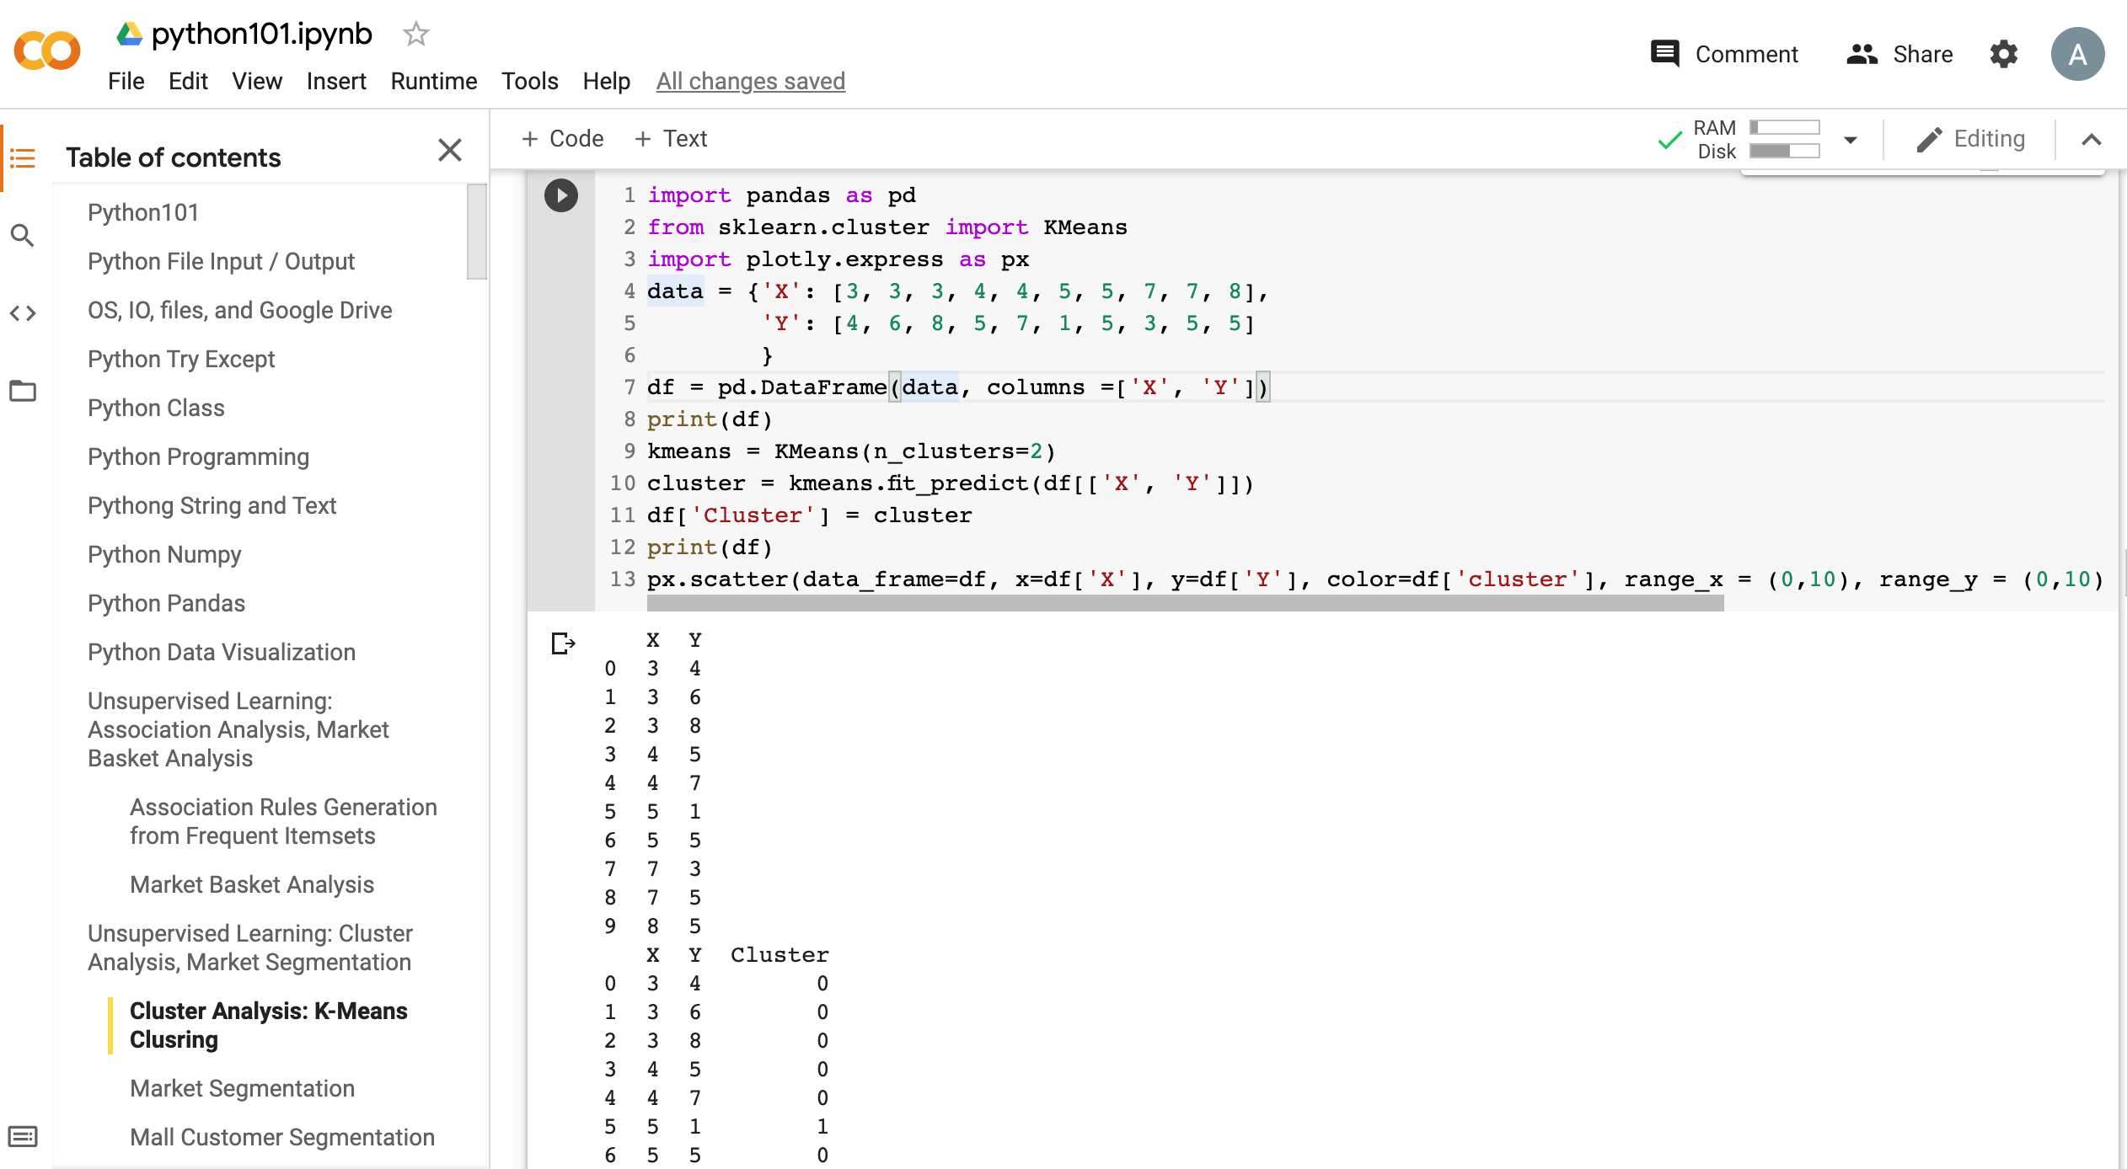
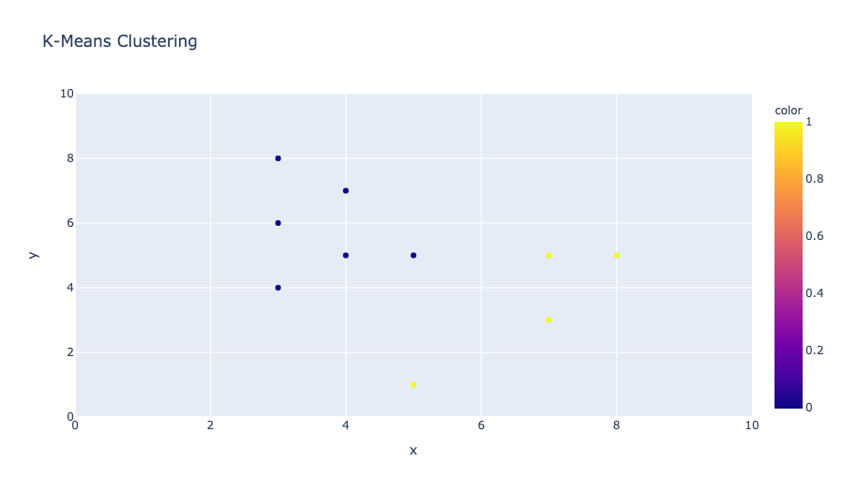
Python in Google Colab (Python101)
https://colab.research.google.com/drive/1FEG6DnGvwfUbeo4zJ1zTunjMqf2RkCrT
https://tinyurl.com/aintpupython101

Slide 45
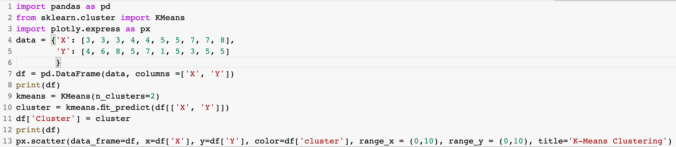
from sklearn.cluster import KMeans
kmeans = KMeans(n_clusters=2)
cluster = kmeans.fit_predict(df[['X', 'Y']])
https://tinyurl.com/aintpupython101

Slide 46
from sklearn.cluster import KMeans
kmeans = KMeans(n_clusters=2)
cluster = kmeans.fit_predict(df[['X', 'Y']])
import pandas as pd
from sklearn.cluster import KMeans
import plotly.express as px
data = {'X': [3, 3, 3, 4, 4, 5, 5, 7, 7, 8],
'Y': [4, 6, 8, 5, 7, 1, 5, 3, 5, 5]
}
df = pd.DataFrame(data, columns =['X', 'Y'])
print(df)
kmeans = KMeans(n_clusters=2)
cluster = kmeans.fit_predict(df[['X', 'Y']])
df['Cluster'] = cluster
print(df)
px.scatter(data_frame=df, x=df['X'], y=df['Y'], color=df['cluster'], range_x = (0,10), range_y = (0,10), title='K-Means Clustering')
https://tinyurl.com/aintpupython101

Slide 47
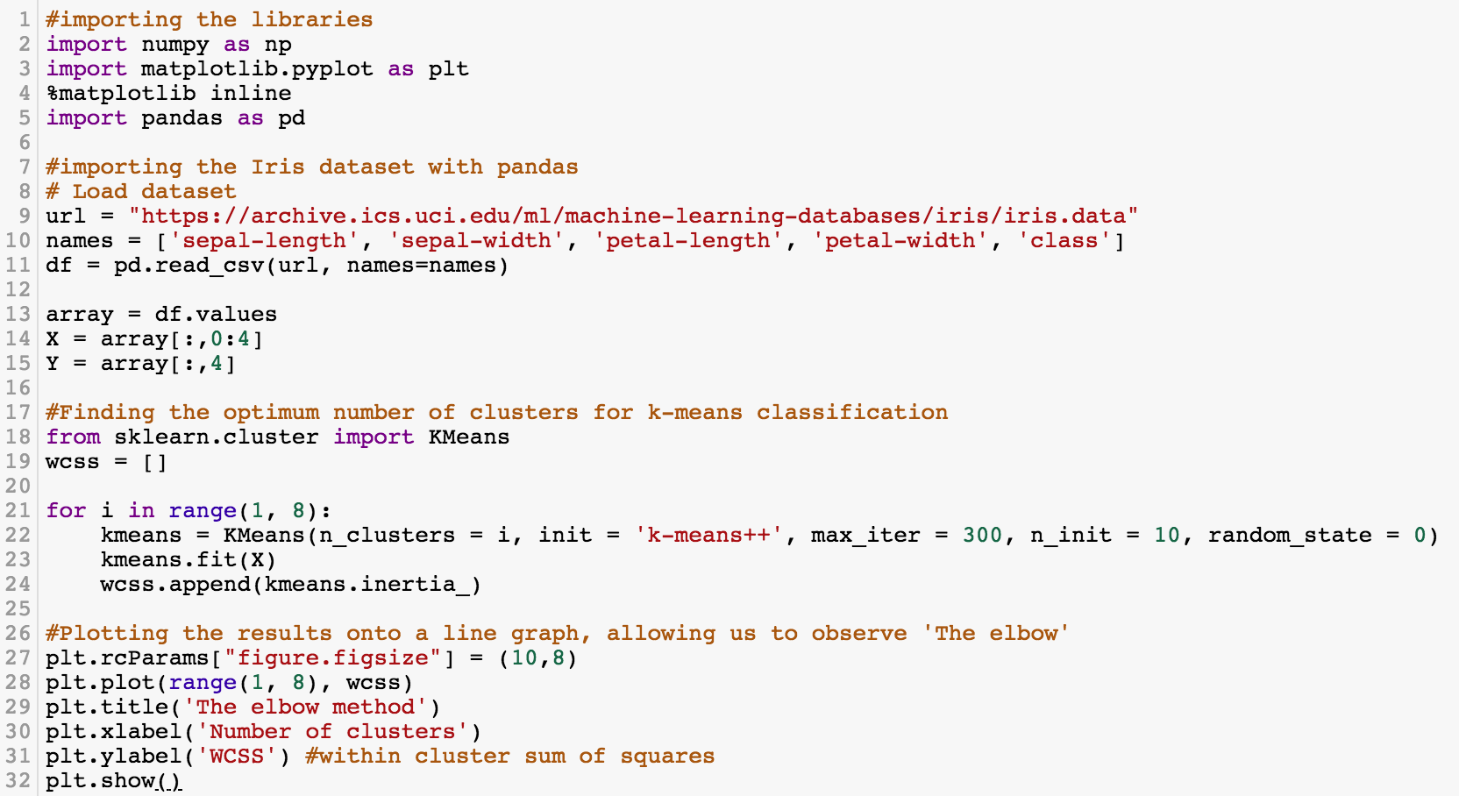
K-Means Clustering
https://tinyurl.com/aintpupython101

Slide 48
#importing the libraries
import numpy as np
import matplotlib.pyplot as plt
%matplotlib inline
import pandas as pd
#importing the Iris dataset with pandas
# Load dataset
url = "https://archive.ics.uci.edu/ml/machine-learning-databases/iris/iris.data"
names = ['sepal-length', 'sepal-width', 'petal-length', 'petal-width', 'class']
df = pd.read_csv(url, names=names)
array = df.values
X = array[:,0:4]
Y = array[:,4]
https://tinyurl.com/aintpupython101

Slide 49
#Finding the optimum number of clusters for k-means classification
from sklearn.cluster import KMeans
wcss = []
for i in range(1, 8):
kmeans = KMeans(n_clusters = i, init = 'k-means++', max_iter = 300, n_init = 10, random_state = 0)
kmeans.fit(X)
wcss.append(kmeans.inertia_)
#Plotting the results onto a line graph, allowing us to observe 'The elbow'
plt.rcParams["figure.figsize"] = (10,8)
plt.plot(range(1, 8), wcss)
plt.title('The elbow method')
plt.xlabel('Number of clusters')
plt.ylabel('WCSS') #within cluster sum of squares
plt.show()
https://tinyurl.com/aintpupython101

Slide 50
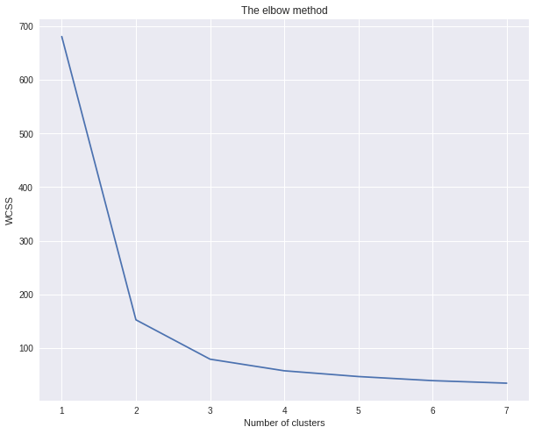
K-Means Clustering
The elbow method (k=3)
https://tinyurl.com/aintpupython101

Slide 51
kmeans = KMeans(n_clusters = 3, init = 'k-means++', max_iter = 300, n_init = 10, random_state = 0)
y_kmeans = kmeans.fit_predict(X)
https://tinyurl.com/aintpupython101

Slide 52
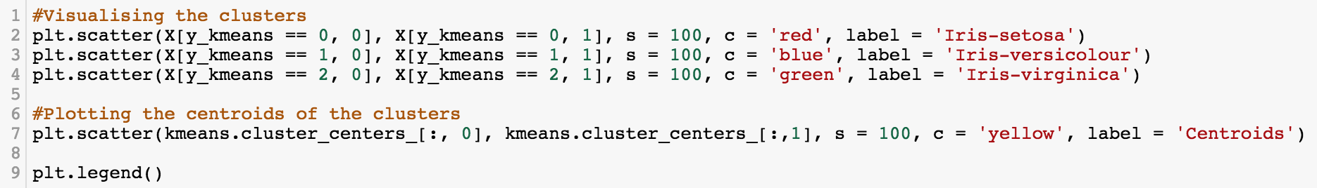
#Visualising the clusters
plt.scatter(X[y_kmeans == 0, 0], X[y_kmeans == 0, 1], s = 100, c = 'red', label = 'Iris-setosa')
plt.scatter(X[y_kmeans == 1, 0], X[y_kmeans == 1, 1], s = 100, c = 'blue', label = 'Iris-versicolour')
plt.scatter(X[y_kmeans == 2, 0], X[y_kmeans == 2, 1], s = 100, c = 'green', label = 'Iris-virginica')
#Plotting the centroids of the clusters
plt.scatter(kmeans.cluster_centers_[:, 0], kmeans.cluster_centers_[:,1], s = 100, c = 'yellow', label = 'Centroids')
plt.legend()
https://tinyurl.com/aintpupython101

Slide 53
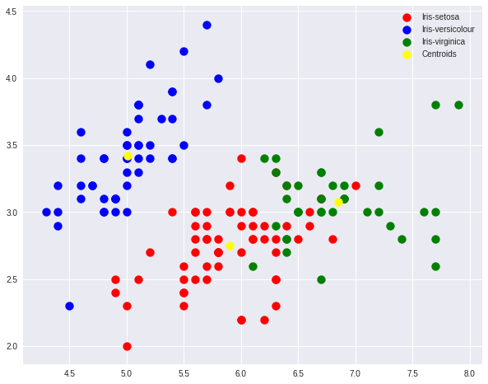
K-Means Clustering
https://tinyurl.com/aintpupython101

Slide 54
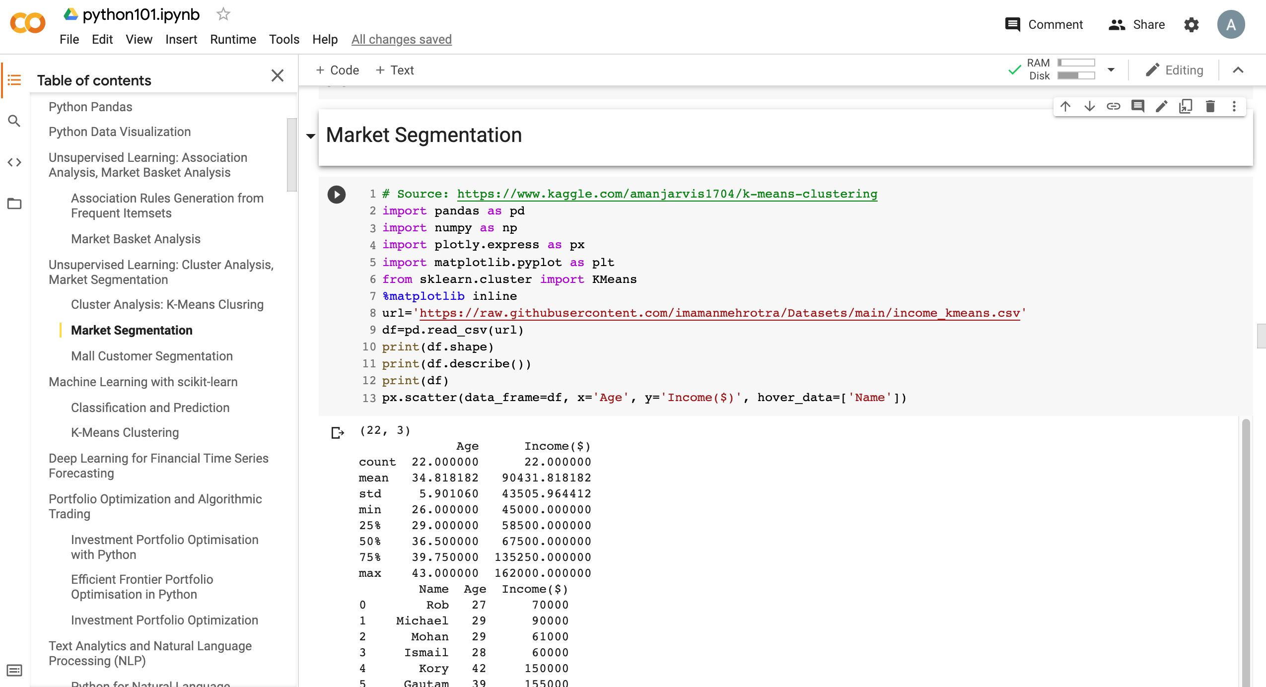
Market Segmentation
https://tinyurl.com/aintpupython101

Slide 55
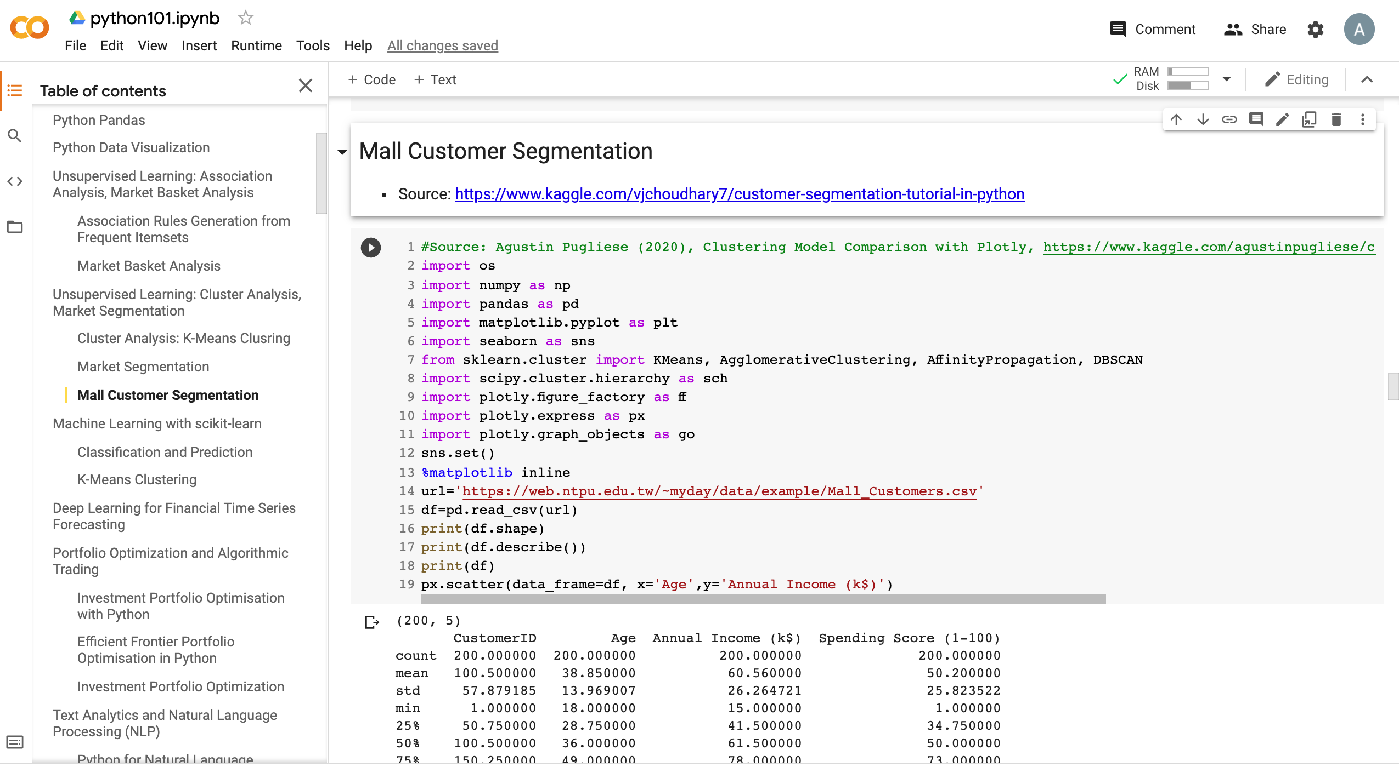
Mall Customer Segmentation
https://tinyurl.com/aintpupython101

Slide 56
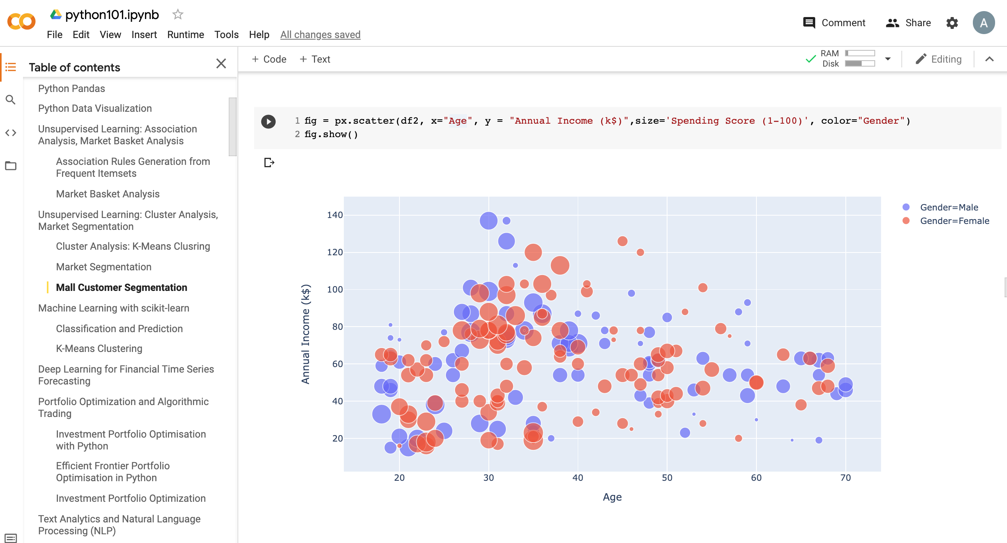
Mall Customer Segmentation
https://tinyurl.com/aintpupython101

Slide 57
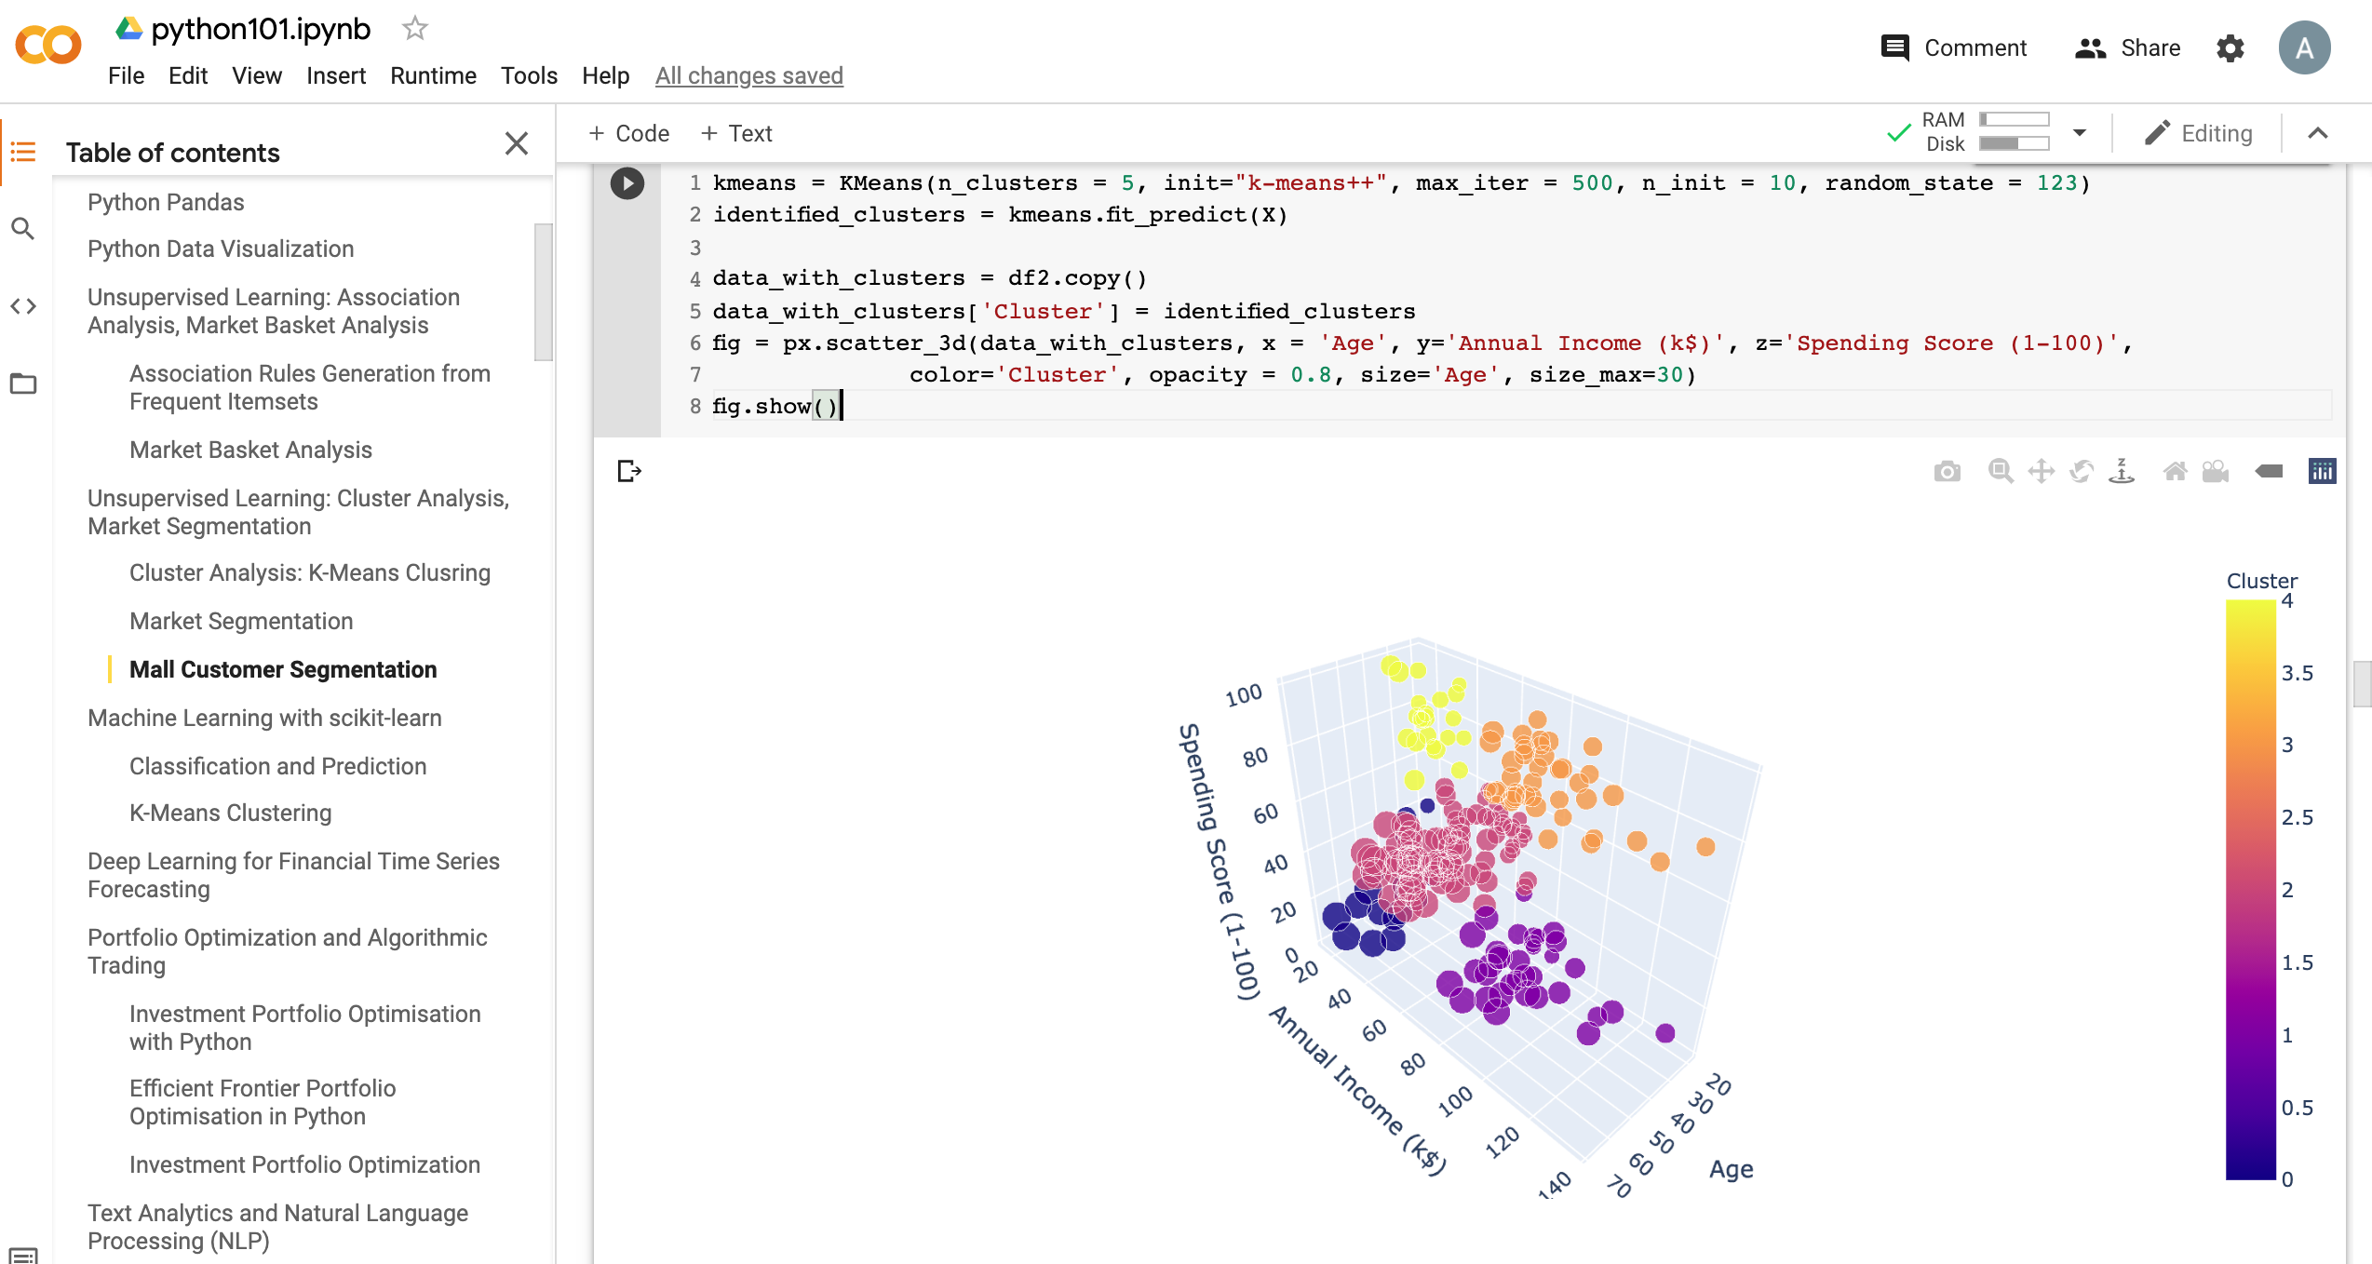
Mall Customer Segmentation
https://tinyurl.com/aintpupython101

Slide 58
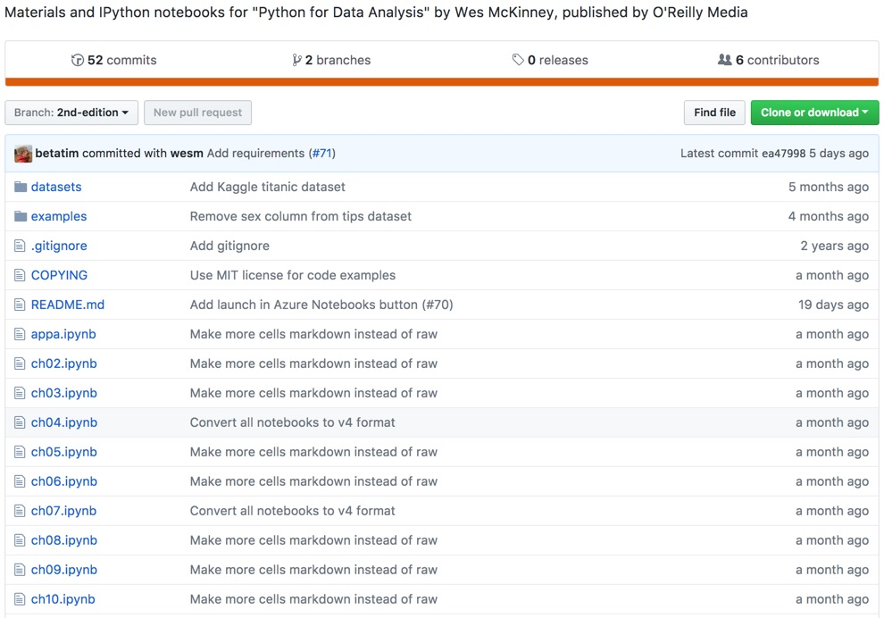
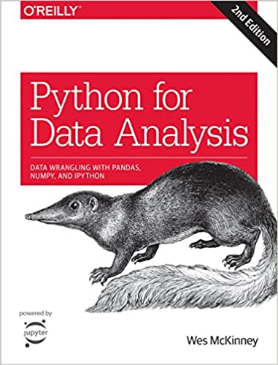
Wes McKinney (2017), "Python for Data Analysis: Data Wrangling with Pandas, NumPy, and IPython", 2nd Edition, O'Reilly Media.
https://github.com/wesm/pydata-book

Slide 59

Aurélien Géron (2019),
Hands-On Machine Learning with Scikit-Learn, Keras, and TensorFlow: Concepts, Tools, and Techniques to Build Intelligent Systems, 2nd Edition
O’Reilly Media, 2019
https://github.com/ageron/handson-ml2
Source: https://www.amazon.com/Hands-Machine-Learning-Scikit-Learn-TensorFlow/dp/1492032646/

Slide 60

Hands-On Machine Learning with
Scikit-Learn, Keras, and TensorFlow
Notebooks
The Machine Learning landscape
End-to-end Machine Learning project
Classification
Training Models
Support Vector Machines
Decision Trees
Ensemble Learning and Random Forests
Dimensionality Reduction
Unsupervised Learning Techniques
Artificial Neural Nets with Keras
Training Deep Neural Networks
Custom Models and Training with TensorFlow
Loading and Preprocessing Data
Deep Computer Vision Using Convolutional Neural Networks
Processing Sequences Using RNNs and CNNs
Natural Language Processing with RNNs and Attention
Representation Learning Using Autoencoders
Reinforcement Learning
Training and Deploying TensorFlow Models at Scale
https://github.com/ageron/handson-ml2

Slide 61
Python in Google Colab (Python101)
https://colab.research.google.com/drive/1FEG6DnGvwfUbeo4zJ1zTunjMqf2RkCrT
https://tinyurl.com/aintpupython101

Slide 62
Summary
Unsupervised Learning
Cluster Analysis
Market Segmentation
K-Means Clustering

Slide 63
References
Jiawei Han and Micheline Kamber (2006), Data Mining: Concepts and Techniques, Second Edition, Elsevier, 2006.
Jiawei Han, Micheline Kamber and Jian Pei (2011), Data Mining: Concepts and Techniques, Third Edition, Morgan Kaufmann 2011.
Efraim Turban, Ramesh Sharda, Dursun Delen (2011), Decision Support and Business Intelligence Systems, Ninth Edition, Pearson.
Ramesh Sharda, Dursun Delen, and Efraim Turban (2017), Business Intelligence, Analytics, and Data Science: A Managerial Perspective, 4th Edition, Pearson.
Jake VanderPlas (2016), Python Data Science Handbook: Essential Tools for Working with Data, O'Reilly Media.
Robert Layton (2017), Learning Data Mining with Python - Second Edition, Packt Publishing.
Wes McKinney (2017), "Python for Data Analysis: Data Wrangling with Pandas, NumPy, and IPython", 2nd Edition, O'Reilly Media.
Aurélien Géron (2019), Hands-On Machine Learning with Scikit-Learn, Keras, and TensorFlow: Concepts, Tools, and Techniques to Build Intelligent Systems, 2nd Edition, O’Reilly Media.
https://github.com/wesm/pydata-book
Min-Yuh Day (2021), Python 101, https://tinyurl.com/aintpupython101

