Slide 1
軟體工程 (Software Engineering)
雲端運算與雲軟體架構 (Cloud Computing and Cloud Software Architecture)
1091SE07
MBA, IM, NTPU (M5118) (Fall 2020) Tue 2, 3, 4 (9:10-12:00) (B8F40)
Min-Yuh Day
戴敏育
Associate Professor
副教授
Institute of Information Management, National Taipei University
國立臺北大學 資訊管理研究所
https://web.ntpu.edu.tw/~myday
2020-11-03

Slide 2
課程大綱 (Syllabus)
週次 (Week) 日期 (Date) 內容 (Subject/Topics)
1 2020/09/15 軟體工程概論 (Introduction to Software Engineering)
2 2020/09/22 軟體產品與專案管理：軟體產品管理，原型設計 (Software Products and Project Management: Software product management and prototyping)
3 2020/09/29 敏捷軟體工程：敏捷方法、Scrum、極限程式設計 (Agile Software Engineering: Agile methods, Scrum, and Extreme Programming)
4 2020/10/06 功能、場景和故事 (Features, Scenarios, and Stories)
5 2020/10/13 軟體架構：架構設計、系統分解、分散式架構 (Software Architecture: Architectural design, System decomposition, and Distribution architecture)
6 2020/10/20 軟體工程個案研究 I (Case Study on Software Engineering I)

Slide 3
課程大綱 (Syllabus)
週次 (Week) 日期 (Date) 內容 (Subject/Topics)
7 2020/10/27 基於雲的軟體：虛擬化和容器、軟體即服務 (Cloud-Based Software: Virtualization and containers, Everything as a service, Software as a service)
8 2020/11/03 雲端運算與雲軟體架構 (Cloud Computing and Cloud Software Architecture)
9 2020/11/10 期中報告 (Midterm Project Report)
10 2020/11/17 微服務架構：RESTful服務、服務部署 (Microservices Architecture, RESTful services, Service deployment)
11 2020/11/24 軟體工程產業實務 (Industry Practices of Software Engineering)
12 2020/12/01 安全和隱私 (Security and Privacy)

Slide 4
課程大綱 (Syllabus)
週次 (Week) 日期 (Date) 內容 (Subject/Topics)
13 2020/12/08 軟體工程個案研究 II (Case Study on Software Engineering II)
14 2020/12/15 可靠的程式設計 (Reliable Programming)
15 2020/12/22 測試：功能測試、測試自動化、 測試驅動的開發、程式碼審查 (Testing: Functional testing, Test automation, Test-driven development, and Code reviews)
16 2020/12/29 DevOps和程式碼管理： 程式碼管理和DevOps自動化 (DevOps and Code Management: Code management and DevOps automation)
17 2021/01/05 期末報告 I (Final Project Report I)
18 2021/01/12 期末報告 II (Final Project Report I)

Slide 5
Software Engineering and Project Management
Analyze
Requirements definition
Design
System and Software design
Build
Implementation and
unit testing
Test
Integration and system testing
Deliver
Operation and maintenance
Project Management

Slide 6
Product management concerns
Business needs
Product manager
Technology constraints
Customer experience

Slide 7
Technical interactions of product managers
Product vision management
Product backlog management
User stories and scenarios
Product manager
Acceptance testing
Customer testing
User interface design

Slide 8
Software Development Life Cycle (SDLC) The waterfall model
Requirements definition
System and Software design
Implementation and unit testing
Integration and system testing
Operation and maintenance

Slide 9
Plan-based and Agile development
Plan-based development
Requirements engineering
Requirements specification
Design and implementation
Requirements change requests
Agile development
Requirements engineering
Design and implementation

Slide 10
The Continuum of Life Cycles
High
Incremental
Agile
Frequency of Delivery
Predictive
Iterative
Low
Low
High
Degree of Change

Slide 11
Predictive Life Cycle
Analyze
Design
Build
Test
Deliver

Slide 12
Iterative Life Cycle
Prototype
Refine
Analyze
Analyze
Design
Build
Test
Deliver

Slide 13
A Life Cycle of Varying-Sized Increments
Analyze
Design
Build
Test
Deliver
Analyze
Design
Build
Test
Deliver
Analyze
Design
Build
Test
Deliver

Slide 14
Iteration-Based and Flow-Based Agile Life Cycles
Iteration-Based Agile
Requirements
Analysis
Design
Build
Test
Requirements
Analysis
Design
Build
Test
Requirements
Analysis
Design
Build
Test
Requirements
Analysis
Design
Build
Test
Repeat as needed
…
Requirements
Analysis
Design
Build
Test
Requirements
Analysis
Design
Build
Test
Flow-Based Agile
Requirements
Analysis
Design
Build
Test
the number of features in the WIP limit
Requirements
Analysis
Design
Build
Test
the number of features in the WIP limit
Requirements
Analysis
Design
Build
Test
the number of features in the WIP limit
Repeat as needed
…
Requirements
Analysis
Design
Build
Test
the number of features in the WIP limit
Requirements
Analysis
Design
Build
Test
the number of features in the WIP limit

Slide 15
From personas to features
1
Personas
A way of representing users
inspire
Natural language descriptions of a user interacting with a software product
2
Scenarios
are-developed-into
3
inspire
Stories
Natural language descriptions of something that is needed or wanted by users
4
Features
define
Fragments of product functionality

Slide 16
Multi-tier client-server architecture
Client 1
Client 2
Web Server
Application Server
Database Server
Client 3
Client …

Slide 17
Service-oriented Architecture
Client 1
S1
S2
Client 2
S3
Web Server
Service gateway
S4
Client 3
S5
Client …
S6
Services

Slide 18
VM
Container
Virtual web server
Virtual mail server
User 1 Container 1
User 2 Container 2
Server software
Server software
Application software
Application software
Guest OS
Guest OS
Server software
Server software
Hypervisor
Container manager
Host OS
Host OS
Server Hardware
Server Hardware

Slide 19
Everything as a service
Photo editing
Software as a service (SaaS)
Logistics management
Cloud management Monitoring
Platform as a service (PaaS)
Database
Software development
Storage Network
Infrastructure as a service (IaaS)
Computing Virtualization
Cloud data center

Slide 20
Software as a service
Software customers
Software provider
Software services
Cloud Infrastructure
Cloud provider

Slide 21
Cloud Computing and Cloud Software Architecture

Slide 22
Outline
Cloud Computing and Cloud Software Architecture
AWS Certified Cloud Practitioner (CLF-C01)
AWS Certified Solutions Architect – Associate (SAA-C02)
Web Application with AWS Core Services
AWS Serverless Architecture
Build a Serverless Web Application with Amazon S3, AWS Lambda, Amazon API Gateway, Amazon DynamoDB, and Amazon Cognito

Slide 23
AWS Certifications
2
SAA
1
CLF
https://aws.amazon.com/certification/

Slide 24
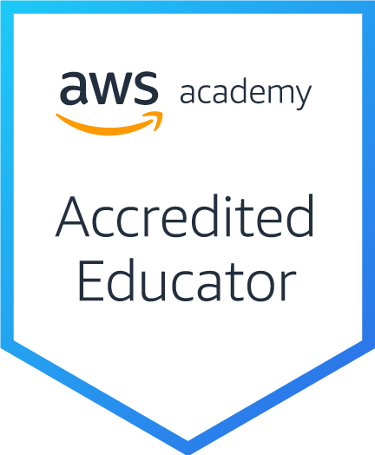
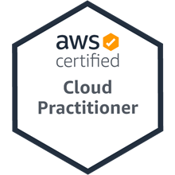
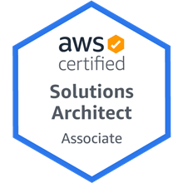
AWS Certifications

Slide 25
AWS Certified Cloud Practitioner
This certification provides individuals in a larger variety of cloud and technology roles with a way to validate their AWS Cloud knowledge and enhance their professional credibility.
This exam covers four domains, including cloud concepts, security, technology, and billing and pricing.
https://aws.amazon.com/certification/certified-cloud-practitioner/

Slide 26
AWS Certified Solutions Architect – Associate
This certification validates your ability to effectively demonstrate knowledge of how to architect and deploy secure and robust applications on AWS technologies.
This exam is for anyone with at least one year of hands-on experience designing available, cost-efficient, fault-tolerant, and scalable and distributed systems on AWS.
https://aws.amazon.com/certification/certified-solutions-architect-associate/

Slide 27
AWS Academy and Certifications
AWS Academy Cloud Foundations (ACF)
AWS Certified Cloud Practitioner (CLF-C01)
https://aws.amazon.com/certification/certified-cloud-practitioner/
AWS Academy Cloud Architecting (ACA)
AWS Certified Solutions Architect – Associate (SAA-C02)
https://aws.amazon.com/certification/certified-solutions-architect-associate/
1
2
https://aws.amazon.com/training/awsacademy/

Slide 28
AWS Certified Cloud Practitioner (CLF-C01)
Domain | % of Examination
Domain 1: Cloud Concepts | 26%
Domain 2: Security and Compliance | 25%
Domain 3: Technology | 33%
Domain 4: Billing and Pricing | 16%
TOTAL | 100%
Source: https://aws.amazon.com/certification/certified-cloud-practitioner/

Slide 29
AWS Certified Solutions Architect – Associate (SAA-C02)
Domain | % of Examination
Domain 1: Design Resilient Architectures | 30%
Domain 2: Design High-Performing Architectures | 28%
Domain 3: Specify Secure Applications and Architectures | 24%
Domain 4: Design Cost-Optimized Architectures | 18%
TOTAL | 100%
Source: https://aws.amazon.com/certification/certified-solutions-architect-associate

Slide 30
AWS Certified Cloud Practitioner (CLF-C01)
Source: https://aws.amazon.com/certification/certified-cloud-practitioner/

Slide 31
AWS Certified Cloud Practitioner (CLF-C01)
Domain 1: Cloud Concepts
1.1 Define the AWS Cloud and its value proposition
1.2 Identify aspects of AWS Cloud economics
1.3 List the different cloud architecture design principles
Source: https://aws.amazon.com/certification/certified-cloud-practitioner/

Slide 32
AWS Certified Cloud Practitioner (CLF-C01)
Domain 2: Security and Compliance
2.1 Define the AWS shared responsibility model
2.2 Define AWS Cloud security and compliance concepts
2.3 Identify AWS access management capabilities
2.4 Identify resources for security support
Source: https://aws.amazon.com/certification/certified-cloud-practitioner/

Slide 33
AWS Certified Cloud Practitioner (CLF-C01)
Domain 3: Technology
3.1 Define methods of deploying and operating in the AWS Cloud
3.2 Define the AWS global infrastructure
3.3 Identify the core AWS services
3.4 Identify resources for technology support
Source: https://aws.amazon.com/certification/certified-cloud-practitioner/

Slide 34
AWS Certified Cloud Practitioner (CLF-C01)
Domain 4: Billing and Pricing
4.1 Compare and contrast the various pricing models for AWS
4.2 Recognize the various account structures in relation to AWS billing and pricing
4.3 Identify resources available for billing support
Source: https://aws.amazon.com/certification/certified-cloud-practitioner/

Slide 35
AWS Certified Solutions Architect – Associate (SAA-C02)
Source: https://aws.amazon.com/certification/certified-solutions-architect-associate

Slide 36
AWS Certified Solutions Architect – Associate (SAA-C02)
Domain 1: Design Resilient Architectures
1.1 Design a multi-tier architecture solution
1.2 Design highly available and/or fault-tolerant architectures
1.3 Design decoupling mechanisms using AWS services
1.4 Choose appropriate resilient storage
Source: https://aws.amazon.com/certification/certified-solutions-architect-associate

Slide 37
AWS Certified Solutions Architect – Associate (SAA-C02)
Domain 2: Design High-Performing Architectures
2.1 Identify elastic and scalable compute solutions for a workload
2.2 Select high-performing and scalable storage solutions for a workload
2.3 Select high-performing networking solutions for a workload
2.4 Choose high-performing database solutions for a workload
Source: https://aws.amazon.com/certification/certified-solutions-architect-associate

Slide 38
AWS Certified Solutions Architect – Associate (SAA-C02)
Domain 3: Design Secure Applications and Architectures
3.1 Design secure access to AWS resources
3.2 Design secure application tiers
3.3 Select appropriate data security options
Source: https://aws.amazon.com/certification/certified-solutions-architect-associate

Slide 39
AWS Certified Solutions Architect – Associate (SAA-C02)
Domain 4: Design Cost-Optimized Architectures
4.1 Identify cost-effective storage solutions
4.2 Identify cost-effective compute and database services
4.3 Design cost-optimized network architectures
Source: https://aws.amazon.com/certification/certified-solutions-architect-associate

Slide 40
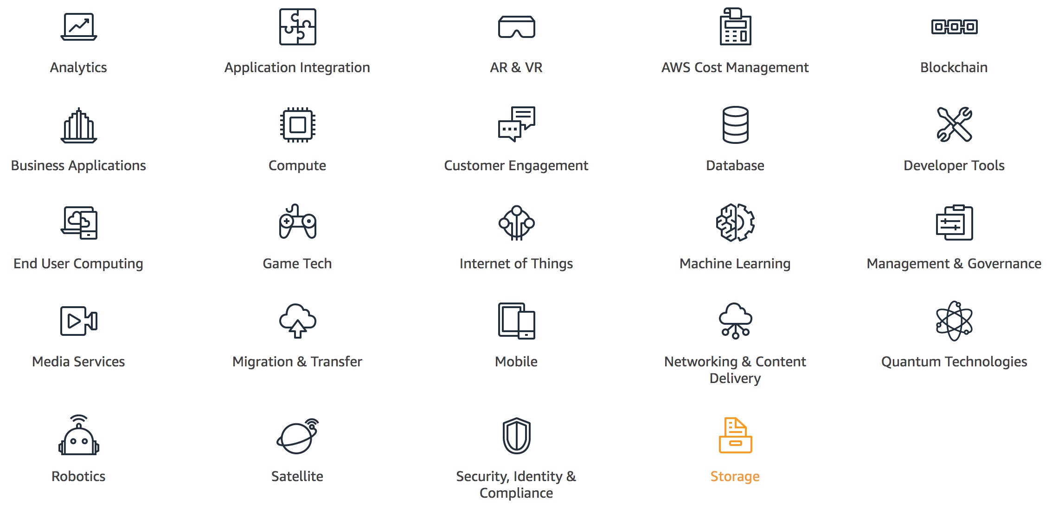
AWS Products and Services
Source: https://aws.amazon.com/

Slide 41
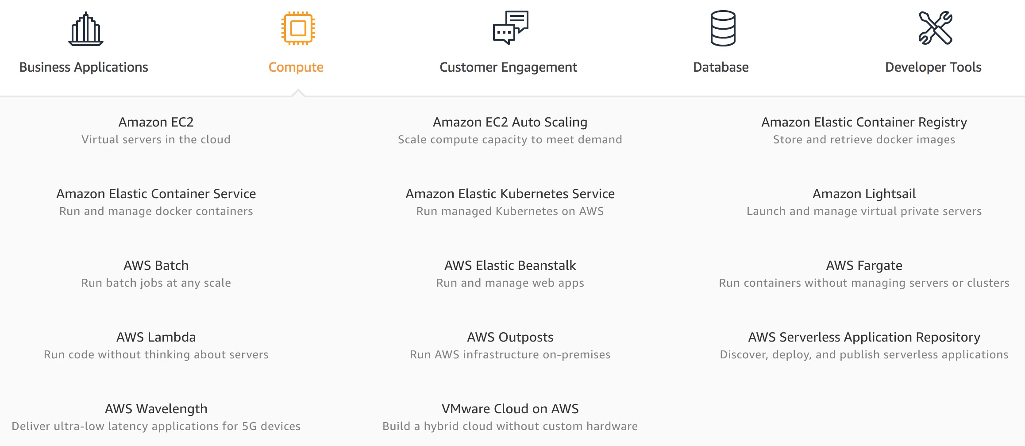
AWS Compute
Source: https://aws.amazon.com/

Slide 42
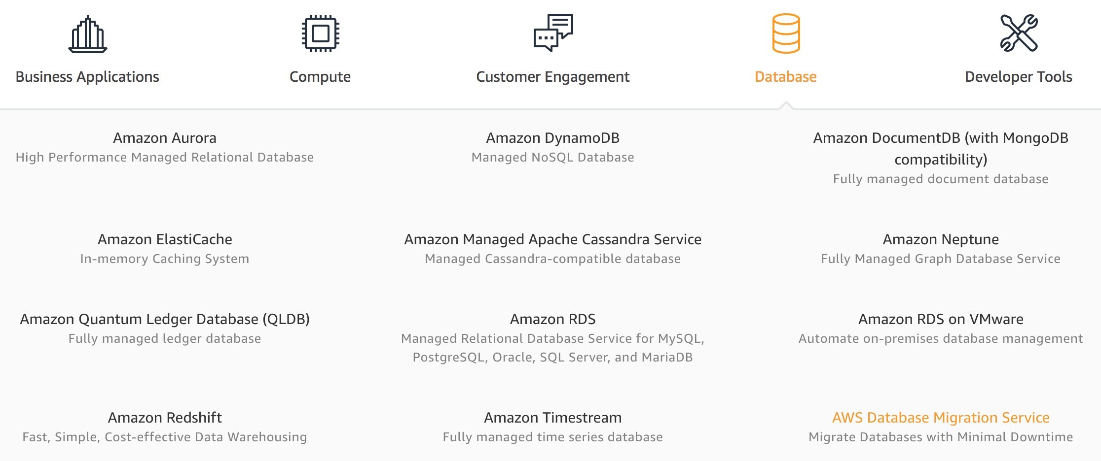
AWS Database
Source: https://aws.amazon.com/

Slide 43
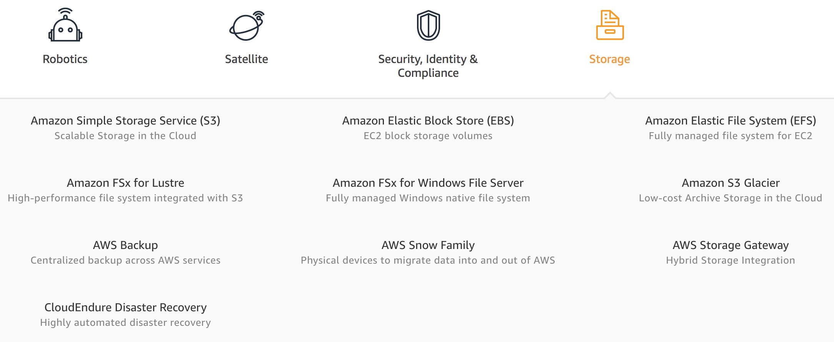
AWS Storage
Source: https://aws.amazon.com/

Slide 44
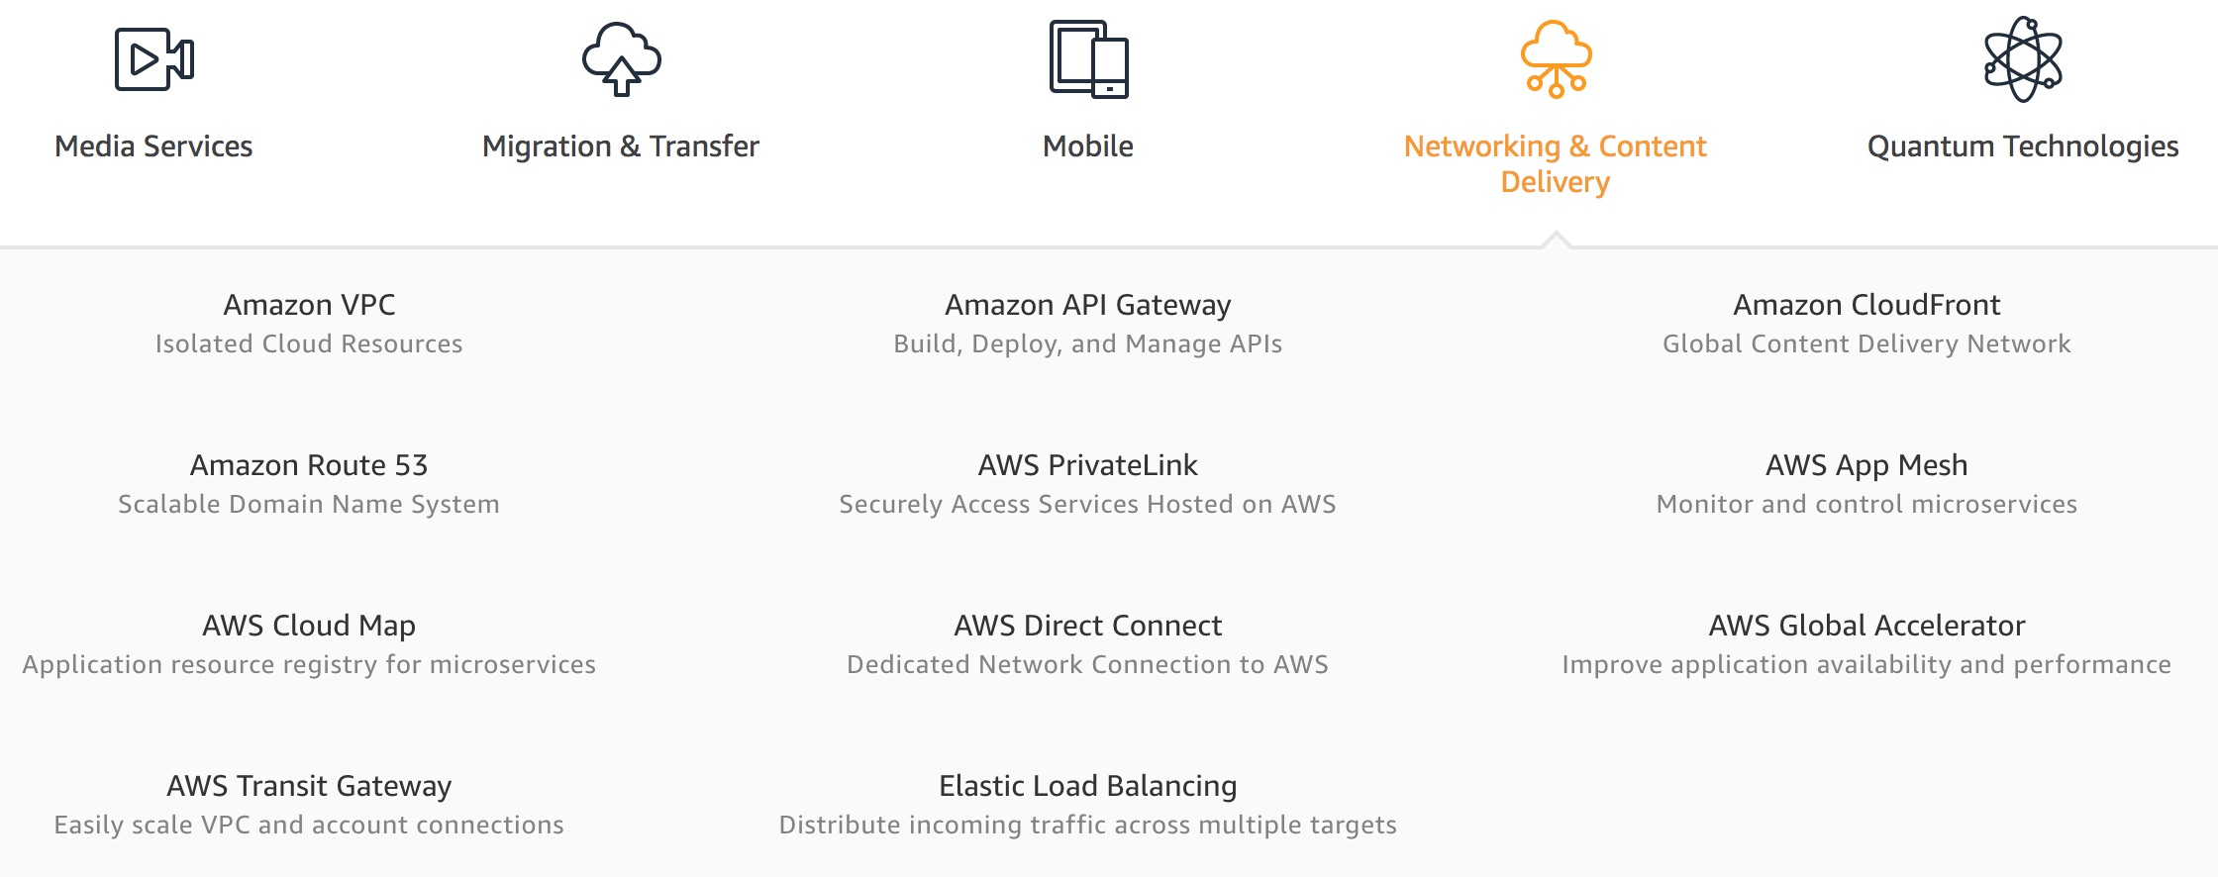
AWS Networking & Content Delivery
Source: https://aws.amazon.com/

Slide 45
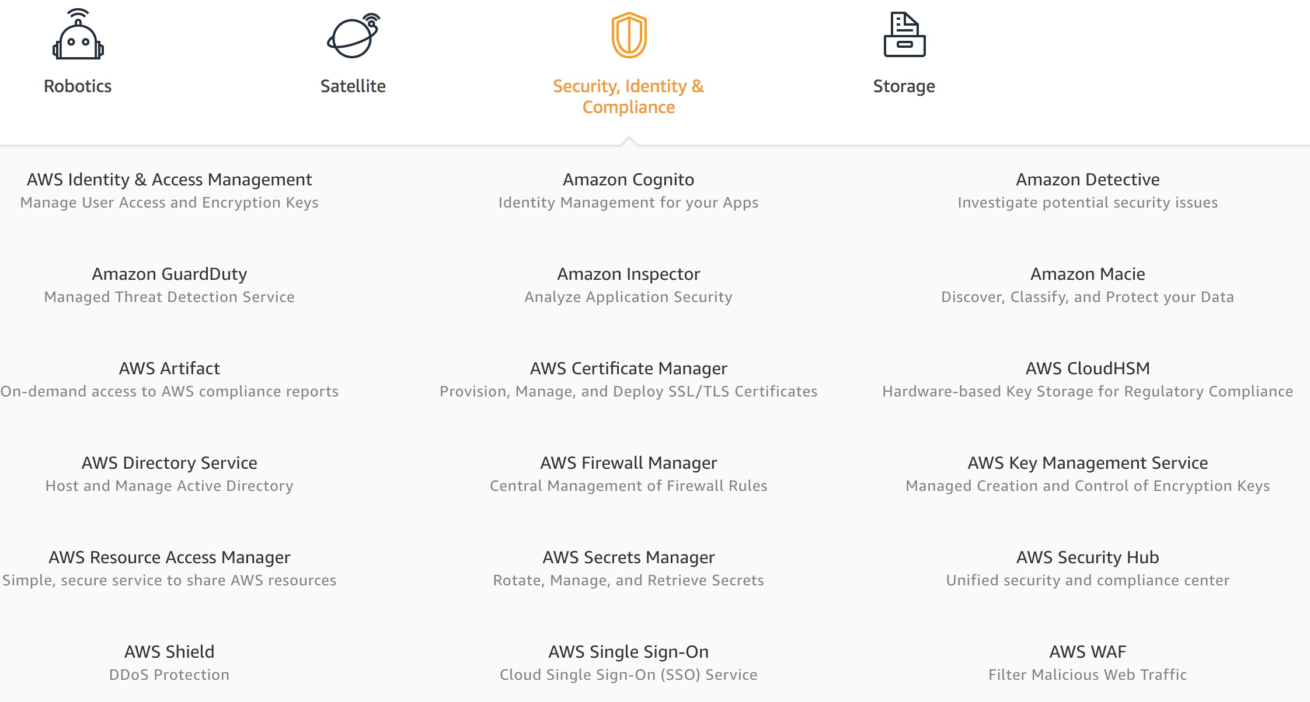
AWS Security, Identity & Compliance
Source: https://aws.amazon.com/

Slide 46
AWS Cost Management
Source: https://aws.amazon.com/

Slide 47
AWS Services
Amazon EC2
Virtual servers in the cloud
Amazon Simple Storage Service (S3)
Scalable storage in the cloud
Amazon Aurora
High performance managed relational database
Amazon DynamoDB
Managed NoSQL database
Amazon RDS
Managed relational database service for MySQL, PostgreSQL, Oracle, SQL Server, and MariaDB
Source: https://aws.amazon.com/

Slide 48
AWS Services
AWS Lambda
Run code without thinking about servers
AWS Elastic Beanstalk
Run and manage web apps
Amazon VPC
Isolated cloud resources
Amazon Lightsail
Launch and manage virtual private servers
Amazon SageMaker
Build, train, and deploy machine learning models at scale
Source: https://aws.amazon.com/

Slide 49
Web Application with AWS Core Services

Slide 50
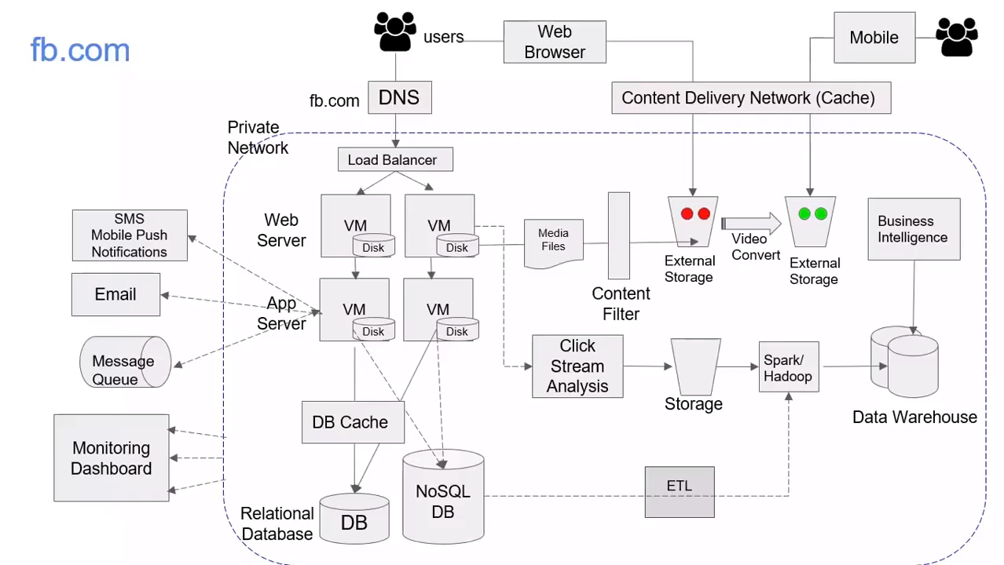
Software Architecture
Source: AWS Training Center (2019), Introduction to AWS Services, https://youtu.be/Z3SYDTMP3ME

Slide 51
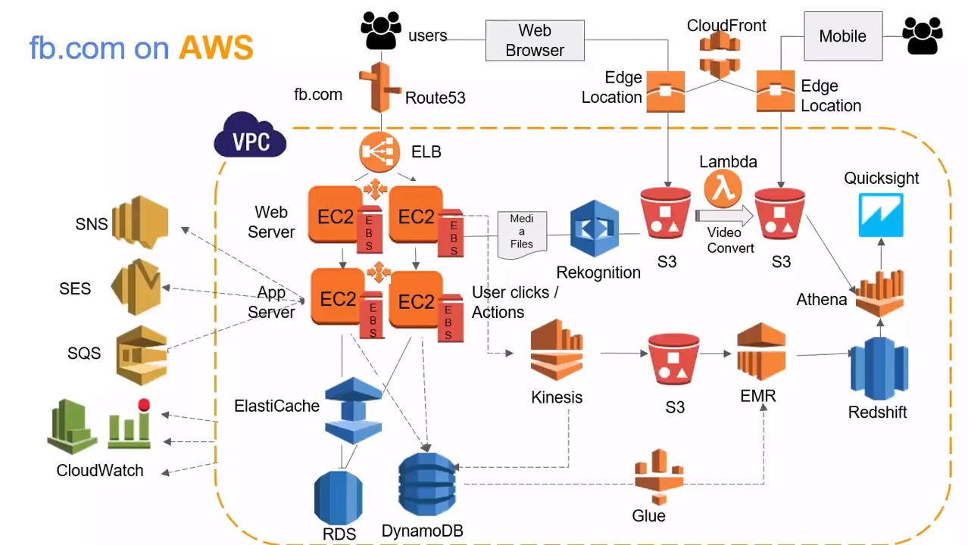
Cloud Software Architecture
Source: AWS Training Center (2019), Introduction to AWS Services, https://youtu.be/Z3SYDTMP3ME

Slide 52
Cloud Software Architecture
Source: AWS Training Center (2019), Introduction to AWS Services, https://youtu.be/Z3SYDTMP3ME

Slide 53
Cloud Software Architecture
Source: AWS Training Center (2019), Introduction to AWS Services, https://youtu.be/Z3SYDTMP3ME

Slide 54
Cloud Software Architecture
Source: AWS Training Center (2019), Introduction to AWS Services, https://youtu.be/Z3SYDTMP3ME

Slide 55
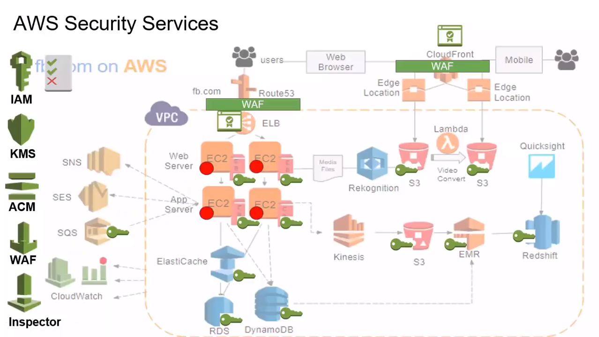
Cloud Software Architecture
Source: AWS Training Center (2019), Introduction to AWS Services, https://youtu.be/Z3SYDTMP3ME

Slide 56
Cloud Software Architecture
Source: AWS Training Center (2019), Introduction to AWS Services, https://youtu.be/Z3SYDTMP3ME

Slide 57
AWS Serverless Architecture

Slide 58
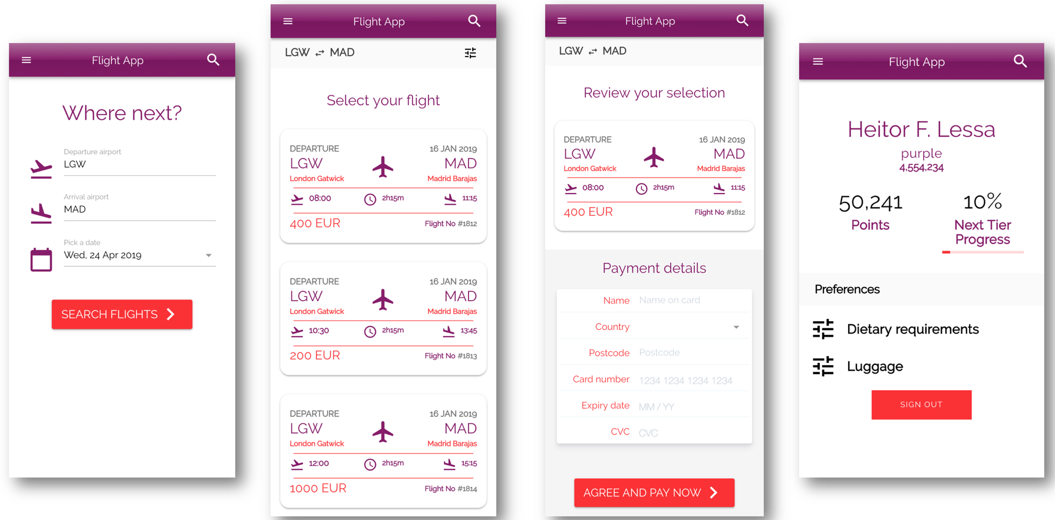
AWS Serverless Airline Booking
Source: https://github.com/aws-samples/aws-serverless-airline-booking

Slide 59
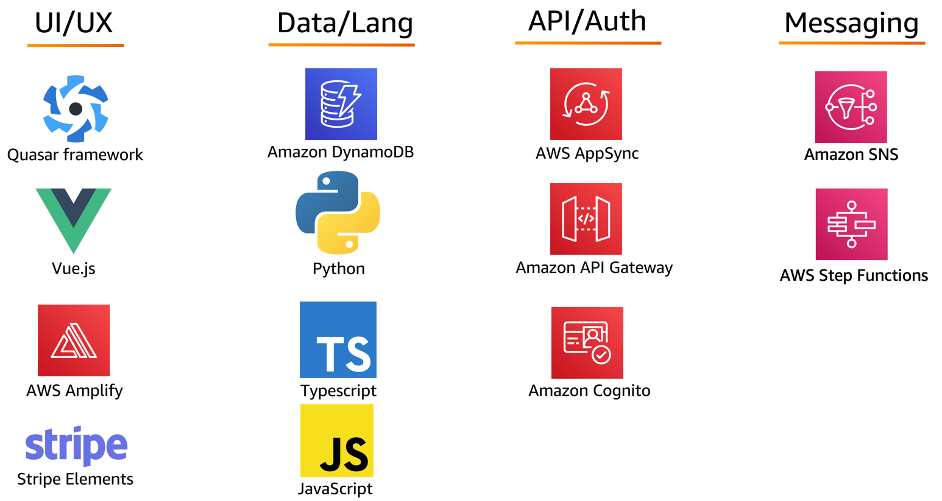
AWS Serverless Airline Booking Stack
Source: https://github.com/aws-samples/aws-serverless-airline-booking

Slide 60
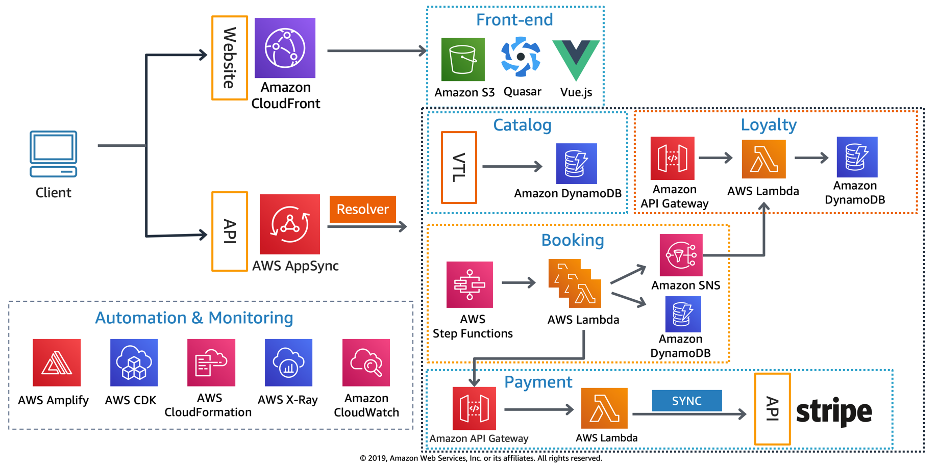
AWS Serverless Airline Booking High level infrastructure architecture
Source: https://github.com/aws-samples/aws-serverless-airline-booking

Slide 61
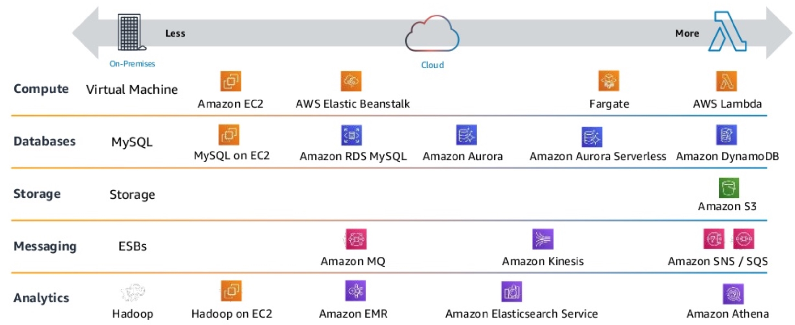
AWS Serverless Architecture AWS Operational Responsibility Models
Source: Heitor Lessa (2019), How to build a full stack serverless airline ticketing web app, https://www.youtube.com/watch?v=MyoOeHTp2pg

Slide 62
Build a Serverless Web Application

Slide 63
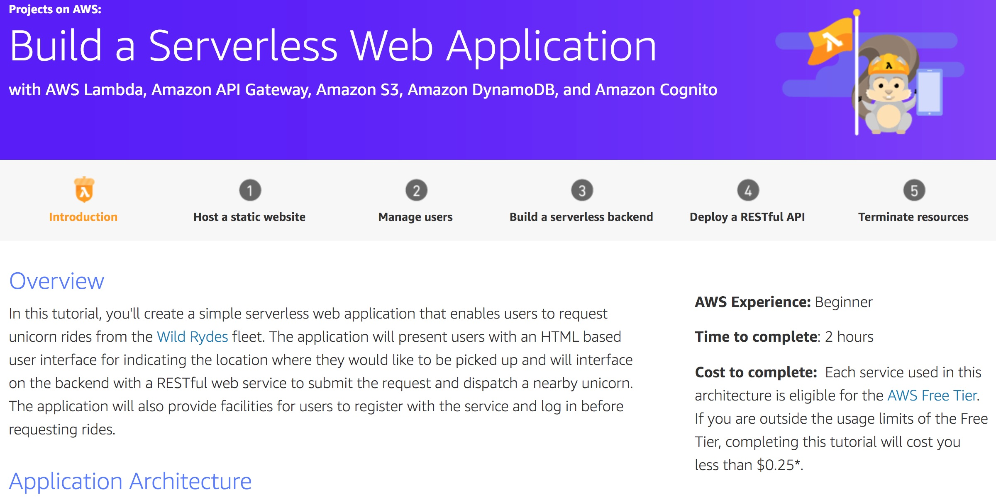
Build a Serverless Web Application
Source: https://aws.amazon.com/getting-started/projects/build-serverless-web-app-lambda-apigateway-s3-dynamodb-cognito/

Slide 64
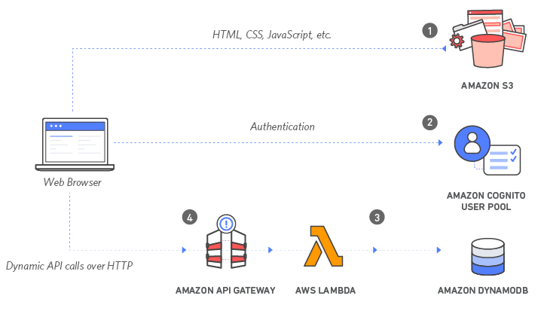
Build a Serverless Web Application with Amazon S3, AWS Lambda, Amazon API Gateway, Amazon DynamoDB, and Amazon Cognito
Source: https://aws.amazon.com/getting-started/projects/build-serverless-web-app-lambda-apigateway-s3-dynamodb-cognito/

Slide 65
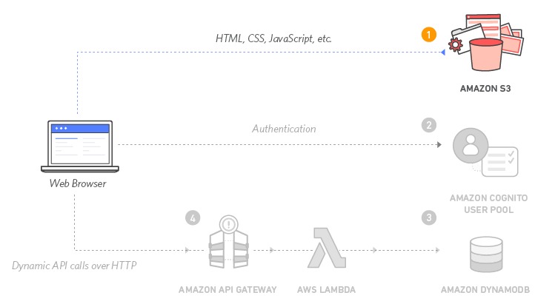
Build a Serverless Web Application with Amazon S3, AWS Lambda, Amazon API Gateway, Amazon DynamoDB, and Amazon Cognito
1
Source: https://aws.amazon.com/getting-started/projects/build-serverless-web-app-lambda-apigateway-s3-dynamodb-cognito/

Slide 66
Build a Serverless Web Application with Amazon S3, AWS Lambda, Amazon API Gateway, Amazon DynamoDB, and Amazon Cognito
1
Static Web Hosting
Amazon S3 hosts static web resources including HTML, CSS, JavaScript, and image files which are loaded in the user's browser.
Source: https://aws.amazon.com/getting-started/projects/build-serverless-web-app-lambda-apigateway-s3-dynamodb-cognito/

Slide 67
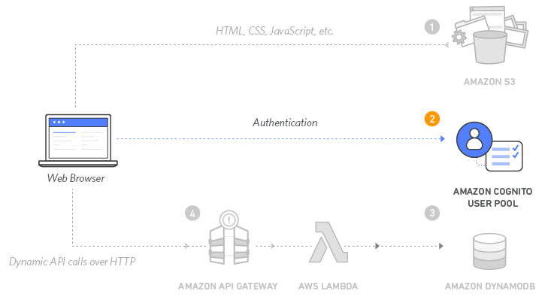
Build a Serverless Web Application with Amazon S3, AWS Lambda, Amazon API Gateway, Amazon DynamoDB, and Amazon Cognito
2
Source: https://aws.amazon.com/getting-started/projects/build-serverless-web-app-lambda-apigateway-s3-dynamodb-cognito/

Slide 68
Build a Serverless Web Application with Amazon S3, AWS Lambda, Amazon API Gateway, Amazon DynamoDB, and Amazon Cognito
2
User Management
Amazon Cognito provides user management and authentication functions to secure the backend API.
Source: https://aws.amazon.com/getting-started/projects/build-serverless-web-app-lambda-apigateway-s3-dynamodb-cognito/

Slide 69
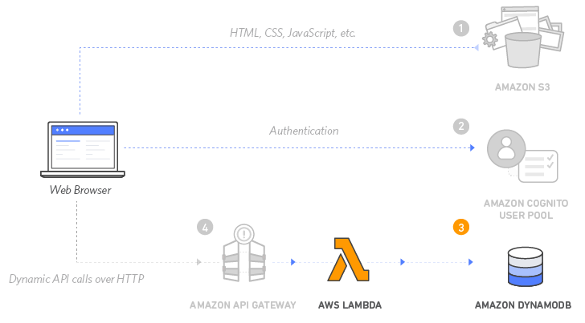
Build a Serverless Web Application with Amazon S3, AWS Lambda, Amazon API Gateway, Amazon DynamoDB, and Amazon Cognito
3
Source: https://aws.amazon.com/getting-started/projects/build-serverless-web-app-lambda-apigateway-s3-dynamodb-cognito/

Slide 70
Build a Serverless Web Application with Amazon S3, AWS Lambda, Amazon API Gateway, Amazon DynamoDB, and Amazon Cognito
3
Serverless Backend
Amazon DynamoDB provides a persistence layer where data can be stored by the API's Lambda function.
Source: https://aws.amazon.com/getting-started/projects/build-serverless-web-app-lambda-apigateway-s3-dynamodb-cognito/

Slide 71
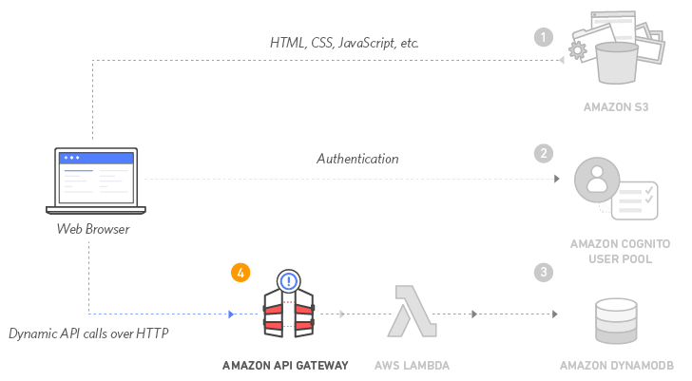
Build a Serverless Web Application with Amazon S3, AWS Lambda, Amazon API Gateway, Amazon DynamoDB, and Amazon Cognito
4
Source: https://aws.amazon.com/getting-started/projects/build-serverless-web-app-lambda-apigateway-s3-dynamodb-cognito/

Slide 72
Build a Serverless Web Application with Amazon S3, AWS Lambda, Amazon API Gateway, Amazon DynamoDB, and Amazon Cognito
4
RESTful API
JavaScript executed in the browser sends and receives data from a public backend API built using Lambda and API Gateway.
Source: https://aws.amazon.com/getting-started/projects/build-serverless-web-app-lambda-apigateway-s3-dynamodb-cognito/

Slide 73
Build a Serverless Web Application with Amazon S3, AWS Lambda, Amazon API Gateway, Amazon DynamoDB, and Amazon Cognito
5
Terminate resources
Resource Cleanup
You will terminate an Amazon S3 bucket, an Amazon Cognito User Pool, an AWS Lambda function, an IAM role, a DynamoDB table, a REST API, and a CloudWatch Log. It is a best practice to delete resources you are no longer using to avoid unwanted charges.
Source: https://aws.amazon.com/getting-started/projects/build-serverless-web-app-lambda-apigateway-s3-dynamodb-cognito/

Slide 74
Summary
Cloud Computing and Cloud Software Architecture
AWS Certified Cloud Practitioner (CLF-C01)
AWS Certified Solutions Architect – Associate (SAA-C02)
Web Application with AWS Core Services
AWS Serverless Architecture
Build a Serverless Web Application with Amazon S3, AWS Lambda, Amazon API Gateway, Amazon DynamoDB, and Amazon Cognito

Slide 75
References
Ian Sommerville (2019), Engineering Software Products: An Introduction to Modern Software Engineering, Pearson.
Ian Sommerville (2015), Software Engineering, 10th Edition, Pearson.
Titus Winters, Tom Manshreck, and Hyrum Wright (2020), Software Engineering at Google: Lessons Learned from Programming Over Time, O'Reilly Media.
Project Management Institute (2017), A Guide to the Project Management Body of Knowledge (PMBOK Guide), Sixth Edition, Project Management Institute
Project Management Institute (2017), Agile Practice Guide, Project Management Institute

Slide 76
References
Ben Piper and David Clinton (2019), AWS Certified Solutions Architect Study Guide: Associate SAA-C01 Exam, 2 edition, Sybex, 2019
AWS Cloud Practitioner Essentials (Second Edition)
https://aws.amazon.com/training/course-descriptions/cloud-practitioner-essentials/
AWS Certified Cloud Practitioner
https://aws.amazon.com/certification/certified-cloud-practitioner/
AWS Certified Solutions Architect – Associate
https://aws.amazon.com/certification/certified-solutions-architect-associate/
AWS Academy Cloud Foundations (AWS ACF), AWS Academy
AWS Academy Cloud Architecting (AWS ACA), AWS Academy

