Slide 1
大數據分析 (Big Data Analysis)
Python 大數據分析基礎 (Foundations of Big Data Analysis in Python)
1091BDA03
MBA, IM, NTPU (M5127) (Fall 2020) Wed 7, ,8, 9 (15:10-18:00) (B8F40)
Min-Yuh Day
戴敏育
Associate Professor
副教授
Institute of Information Management, National Taipei University
國立臺北大學 資訊管理研究所
https://web.ntpu.edu.tw/~myday
2020-09-30

Slide 2
課程大綱 (Syllabus)
週次 (Week) 日期 (Date) 內容 (Subject/Topics)
1 2020/09/16 大數據分析介紹 (Introduction to Big Data Analysis)
2 2020/09/23 AI人工智慧與大數據分析 (AI and Big Data Analysis)
3 2020/09/30 Python 大數據分析基礎 (Foundations of Big Data Analysis in Python)
4 2020/10/07 數位沙盒第一堂課：數位沙盒服務平台簡介 (Digital Sandbox Lesson 1: Introduction to FintechSpace Digital Sandbox)
5 2020/10/14 數位沙盒第二堂課：工程師操作說明與實作教學 (Digital Sandbox Lesson 2: Hands-on Practices)
6 2020/10/21 Python Pandas 大數據量化分析 (Quantitative Big Data Analysis with Pandas in Python)

Slide 3
課程大綱 (Syllabus)
週次 (Week) 日期 (Date) 內容 (Subject/Topics)
7 2020/10/28 數位沙盒第三堂課：學生小組討論實作與成果發表 (Digital Sandbox Lesson 3: Learning Teams Hands-on Project Discussion and Project Presentation)
8 2020/11/04 Python Scikit-Learn 機器學習 I (Machine Learning with Scikit-Learn In Python I)
9 2020/11/11 期中報告 (Midterm Project Report)
10 2020/11/18 Python Scikit-Learn 機器學習 II (Machine Learning with Scikit-Learn In Python II)
11 2020/11/25 TensorFlow 深度學習金融大數據分析 I (Deep Learning for Finance Big Data Analysis with TensorFlow I)
12 2020/12/02 大數據分析個案研究 (Case Study on Big Data Analysis)

Slide 4
課程大綱 (Syllabus)
週次 (Week) 日期 (Date) 內容 (Subject/Topics)
13 2020/12/09 TensorFlow 深度學習金融大數據分析 II (Deep Learning for Finance Big Data Analysis with TensorFlow II)
14 2020/12/16 TensorFlow 深度學習金融大數據分析 III (Deep Learning for Finance Big Data Analysis with TensorFlow III)
15 2020/12/23 AI 機器人理財顧問 (Artificial Intelligence for Robo-Advisors)
16 2020/12/30 金融科技智慧型交談機器人 (Conversational Commerce and Intelligent Chatbots for Fintech)
17 2021/01/06 期末報告 I (Final Project Report I)
18 2021/01/13 期末報告 II (Final Project Report I)

Slide 5
Foundations of Big Data Analysis in Python

Slide 6
Outline
Foundations of Big Data Analysis in Python
Python
Programming language
Numpy
Scientific computing

Slide 7
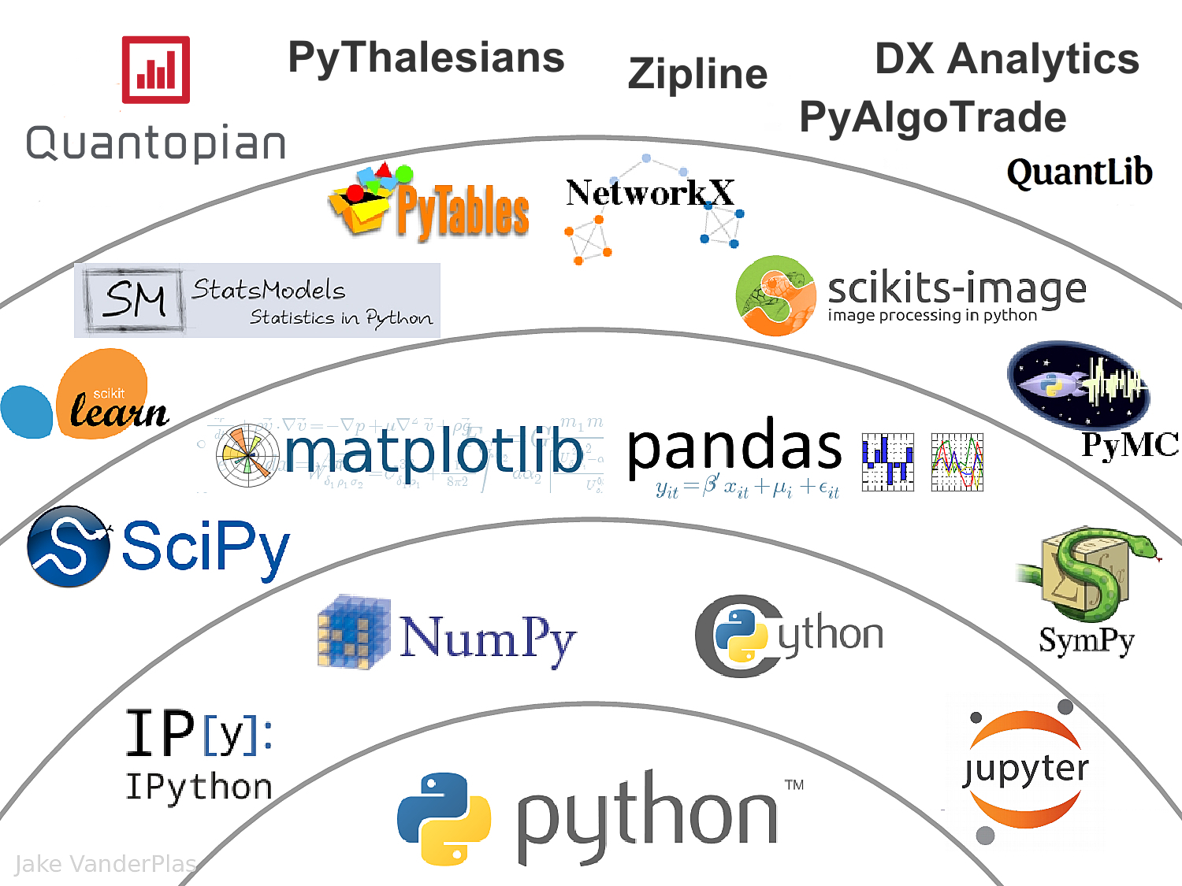
The Quant Finance PyData Stack
Source: http://nbviewer.jupyter.org/format/slides/github/quantopian/pyfolio/blob/master/pyfolio/examples/overview_slides.ipynb#/5

Slide 8
Python

Slide 9
Python is an interpreted, object-oriented, high-level programming language with dynamic semantics.
Source: https://www.python.org/doc/essays/blurb/

Slide 10
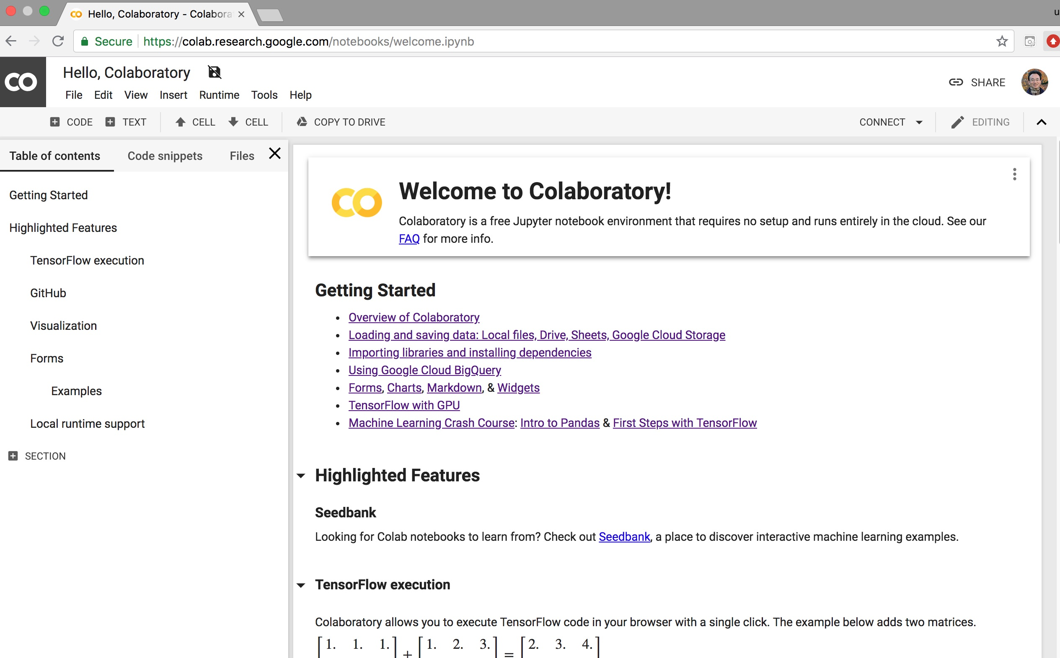
Google Colab
https://colab.research.google.com/notebooks/welcome.ipynb

Slide 11
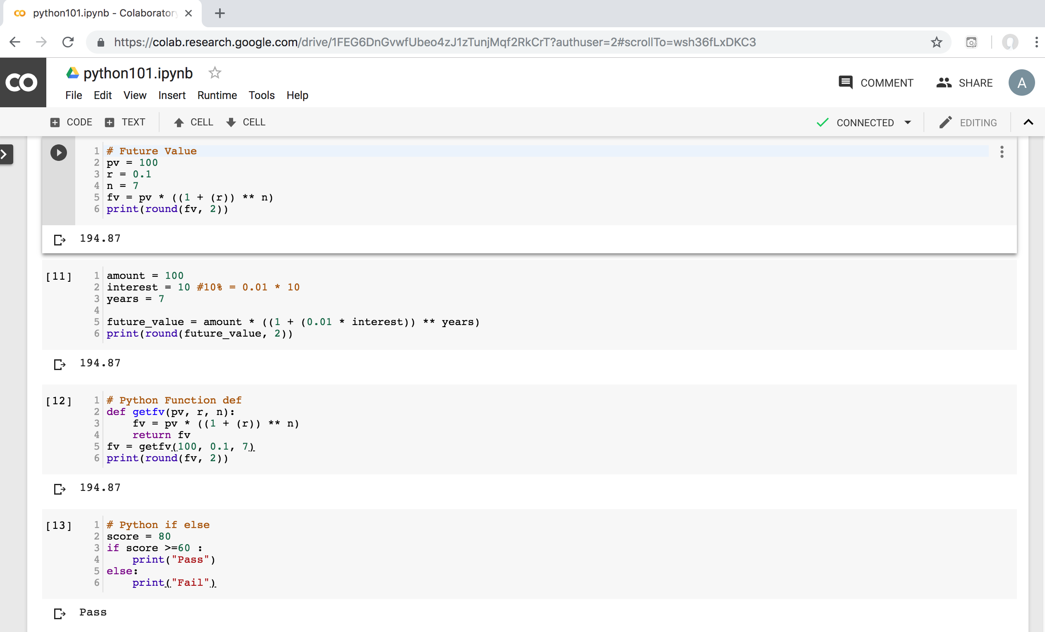
Python in Google Colab (Python101)
https://colab.research.google.com/drive/1FEG6DnGvwfUbeo4zJ1zTunjMqf2RkCrT
https://tinyurl.com/aintpupython101

Slide 12
Numpy
NumPy
Base N-dimensional array package

Slide 13
Python matplotlib
Source: https://matplotlib.org/

Slide 14
Python Pandas
http://pandas.pydata.org/

Slide 15
Iris flower data set
setosa
versicolor
virginica
Source: https://en.wikipedia.org/wiki/Iris_flower_data_set
Source: http://suruchifialoke.com/2016-10-13-machine-learning-tutorial-iris-classification/

Slide 16
Iris Classfication
Source: http://suruchifialoke.com/2016-10-13-machine-learning-tutorial-iris-classification/

Slide 17
iris.data
https://archive.ics.uci.edu/ml/machine-learning-databases/iris/iris.data
5.1,3.5,1.4,0.2,Iris-setosa 4.9,3.0,1.4,0.2,Iris-setosa 4.7,3.2,1.3,0.2,Iris-setosa 4.6,3.1,1.5,0.2,Iris-setosa 5.0,3.6,1.4,0.2,Iris-setosa 5.4,3.9,1.7,0.4,Iris-setosa 4.6,3.4,1.4,0.3,Iris-setosa 5.0,3.4,1.5,0.2,Iris-setosa 4.4,2.9,1.4,0.2,Iris-setosa 4.9,3.1,1.5,0.1,Iris-setosa 5.4,3.7,1.5,0.2,Iris-setosa 4.8,3.4,1.6,0.2,Iris-setosa 4.8,3.0,1.4,0.1,Iris-setosa 4.3,3.0,1.1,0.1,Iris-setosa 5.8,4.0,1.2,0.2,Iris-setosa 5.7,4.4,1.5,0.4,Iris-setosa 5.4,3.9,1.3,0.4,Iris-setosa 5.1,3.5,1.4,0.3,Iris-setosa 5.7,3.8,1.7,0.3,Iris-setosa 5.1,3.8,1.5,0.3,Iris-setosa 5.4,3.4,1.7,0.2,Iris-setosa 5.1,3.7,1.5,0.4,Iris-setosa 4.6,3.6,1.0,0.2,Iris-setosa 5.1,3.3,1.7,0.5,Iris-setosa 4.8,3.4,1.9,0.2,Iris-setosa 5.0,3.0,1.6,0.2,Iris-setosa 5.0,3.4,1.6,0.4,Iris-setosa 5.2,3.5,1.5,0.2,Iris-setosa 5.2,3.4,1.4,0.2,Iris-setosa 4.7,3.2,1.6,0.2,Iris-setosa 4.8,3.1,1.6,0.2,Iris-setosa 5.4,3.4,1.5,0.4,Iris-setosa 5.2,4.1,1.5,0.1,Iris-setosa 5.5,4.2,1.4,0.2,Iris-setosa 4.9,3.1,1.5,0.1,Iris-setosa 5.0,3.2,1.2,0.2,Iris-setosa 5.5,3.5,1.3,0.2,Iris-setosa 4.9,3.1,1.5,0.1,Iris-setosa 4.4,3.0,1.3,0.2,Iris-setosa 5.1,3.4,1.5,0.2,Iris-setosa 5.0,3.5,1.3,0.3,Iris-setosa 4.5,2.3,1.3,0.3,Iris-setosa 4.4,3.2,1.3,0.2,Iris-setosa 5.0,3.5,1.6,0.6,Iris-setosa 5.1,3.8,1.9,0.4,Iris-setosa 4.8,3.0,1.4,0.3,Iris-setosa 5.1,3.8,1.6,0.2,Iris-setosa 4.6,3.2,1.4,0.2,Iris-setosa 5.3,3.7,1.5,0.2,Iris-setosa 5.0,3.3,1.4,0.2,Iris-setosa 7.0,3.2,4.7,1.4,Iris-versicolor 6.4,3.2,4.5,1.5,Iris-versicolor 6.9,3.1,4.9,1.5,Iris-versicolor 5.5,2.3,4.0,1.3,Iris-versicolor 6.5,2.8,4.6,1.5,Iris-versicolor 5.7,2.8,4.5,1.3,Iris-versicolor 6.3,3.3,4.7,1.6,Iris-versicolor 4.9,2.4,3.3,1.0,Iris-versicolor 6.6,2.9,4.6,1.3,Iris-versicolor 5.2,2.7,3.9,1.4,Iris-versicolor 5.0,2.0,3.5,1.0,Iris-versicolor 5.9,3.0,4.2,1.5,Iris-versicolor 6.0,2.2,4.0,1.0,Iris-versicolor 6.1,2.9,4.7,1.4,Iris-versicolor 5.6,2.9,3.6,1.3,Iris-versicolor 6.7,3.1,4.4,1.4,Iris-versicolor 5.6,3.0,4.5,1.5,Iris-versicolor 5.8,2.7,4.1,1.0,Iris-versicolor 6.2,2.2,4.5,1.5,Iris-versicolor 5.6,2.5,3.9,1.1,Iris-versicolor 5.9,3.2,4.8,1.8,Iris-versicolor 6.1,2.8,4.0,1.3,Iris-versicolor 6.3,2.5,4.9,1.5,Iris-versicolor 6.1,2.8,4.7,1.2,Iris-versicolor 6.4,2.9,4.3,1.3,Iris-versicolor 6.6,3.0,4.4,1.4,Iris-versicolor 6.8,2.8,4.8,1.4,Iris-versicolor 6.7,3.0,5.0,1.7,Iris-versicolor 6.0,2.9,4.5,1.5,Iris-versicolor 5.7,2.6,3.5,1.0,Iris-versicolor 5.5,2.4,3.8,1.1,Iris-versicolor 5.5,2.4,3.7,1.0,Iris-versicolor 5.8,2.7,3.9,1.2,Iris-versicolor 6.0,2.7,5.1,1.6,Iris-versicolor 5.4,3.0,4.5,1.5,Iris-versicolor 6.0,3.4,4.5,1.6,Iris-versicolor 6.7,3.1,4.7,1.5,Iris-versicolor 6.3,2.3,4.4,1.3,Iris-versicolor 5.6,3.0,4.1,1.3,Iris-versicolor 5.5,2.5,4.0,1.3,Iris-versicolor 5.5,2.6,4.4,1.2,Iris-versicolor 6.1,3.0,4.6,1.4,Iris-versicolor 5.8,2.6,4.0,1.2,Iris-versicolor 5.0,2.3,3.3,1.0,Iris-versicolor 5.6,2.7,4.2,1.3,Iris-versicolor 5.7,3.0,4.2,1.2,Iris-versicolor 5.7,2.9,4.2,1.3,Iris-versicolor 6.2,2.9,4.3,1.3,Iris-versicolor 5.1,2.5,3.0,1.1,Iris-versicolor 5.7,2.8,4.1,1.3,Iris-versicolor 6.3,3.3,6.0,2.5,Iris-virginica 5.8,2.7,5.1,1.9,Iris-virginica 7.1,3.0,5.9,2.1,Iris-virginica 6.3,2.9,5.6,1.8,Iris-virginica 6.5,3.0,5.8,2.2,Iris-virginica 7.6,3.0,6.6,2.1,Iris-virginica 4.9,2.5,4.5,1.7,Iris-virginica 7.3,2.9,6.3,1.8,Iris-virginica 6.7,2.5,5.8,1.8,Iris-virginica 7.2,3.6,6.1,2.5,Iris-virginica 6.5,3.2,5.1,2.0,Iris-virginica 6.4,2.7,5.3,1.9,Iris-virginica 6.8,3.0,5.5,2.1,Iris-virginica 5.7,2.5,5.0,2.0,Iris-virginica 5.8,2.8,5.1,2.4,Iris-virginica 6.4,3.2,5.3,2.3,Iris-virginica 6.5,3.0,5.5,1.8,Iris-virginica 7.7,3.8,6.7,2.2,Iris-virginica 7.7,2.6,6.9,2.3,Iris-virginica 6.0,2.2,5.0,1.5,Iris-virginica 6.9,3.2,5.7,2.3,Iris-virginica 5.6,2.8,4.9,2.0,Iris-virginica 7.7,2.8,6.7,2.0,Iris-virginica 6.3,2.7,4.9,1.8,Iris-virginica 6.7,3.3,5.7,2.1,Iris-virginica 7.2,3.2,6.0,1.8,Iris-virginica 6.2,2.8,4.8,1.8,Iris-virginica 6.1,3.0,4.9,1.8,Iris-virginica 6.4,2.8,5.6,2.1,Iris-virginica 7.2,3.0,5.8,1.6,Iris-virginica 7.4,2.8,6.1,1.9,Iris-virginica 7.9,3.8,6.4,2.0,Iris-virginica 6.4,2.8,5.6,2.2,Iris-virginica 6.3,2.8,5.1,1.5,Iris-virginica 6.1,2.6,5.6,1.4,Iris-virginica 7.7,3.0,6.1,2.3,Iris-virginica 6.3,3.4,5.6,2.4,Iris-virginica 6.4,3.1,5.5,1.8,Iris-virginica 6.0,3.0,4.8,1.8,Iris-virginica 6.9,3.1,5.4,2.1,Iris-virginica 6.7,3.1,5.6,2.4,Iris-virginica 6.9,3.1,5.1,2.3,Iris-virginica 5.8,2.7,5.1,1.9,Iris-virginica 6.8,3.2,5.9,2.3,Iris-virginica 6.7,3.3,5.7,2.5,Iris-virginica 6.7,3.0,5.2,2.3,Iris-virginica 6.3,2.5,5.0,1.9,Iris-virginica 6.5,3.0,5.2,2.0,Iris-virginica 6.2,3.4,5.4,2.3,Iris-virginica 5.9,3.0,5.1,1.8,Iris-virginica
setosa
virginica
versicolor

Slide 18
Iris Data Visualization
Source: https://seaborn.pydata.org/generated/seaborn.pairplot.html

Slide 19
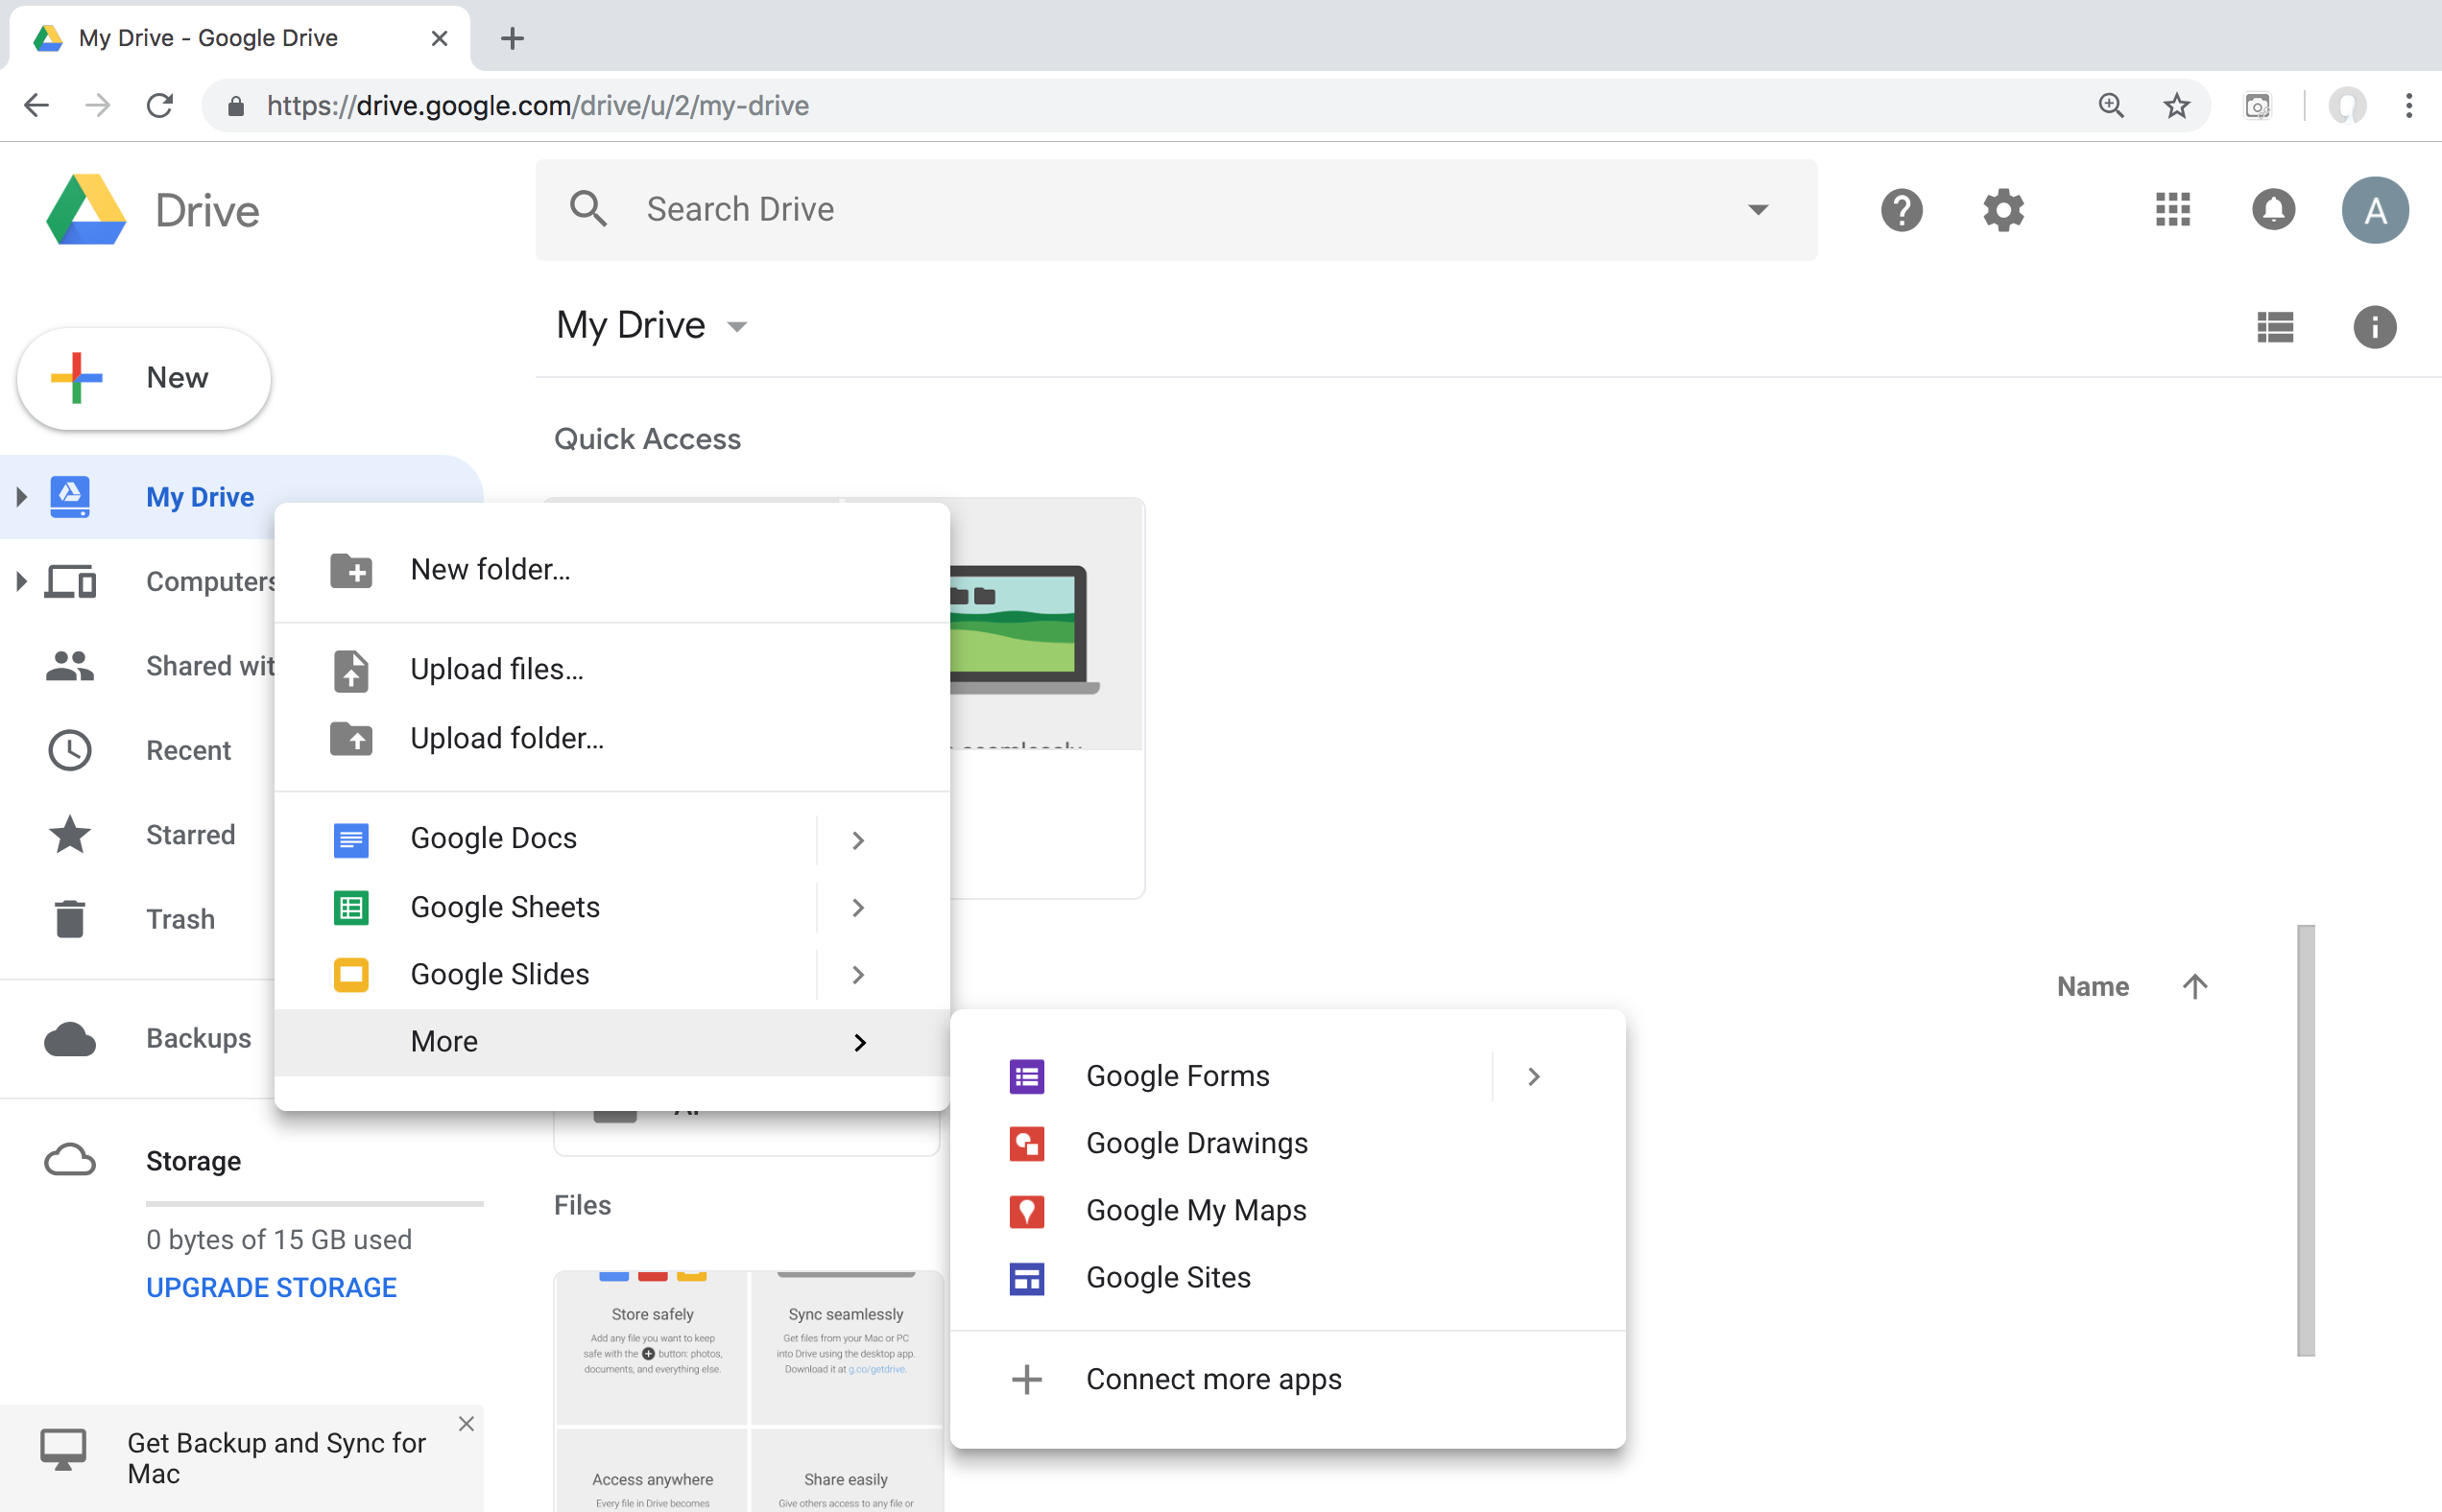
Connect Google Colab in Google Drive

Slide 20
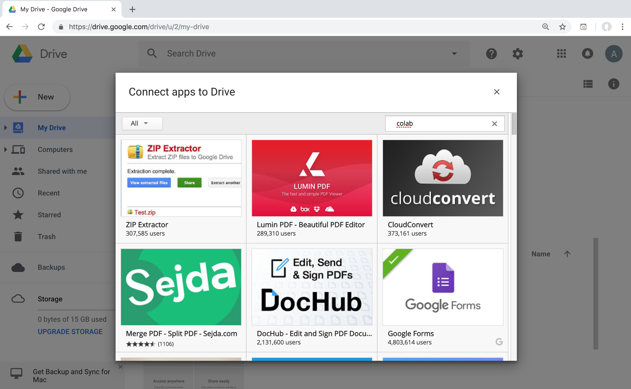
Google Colab

Slide 21
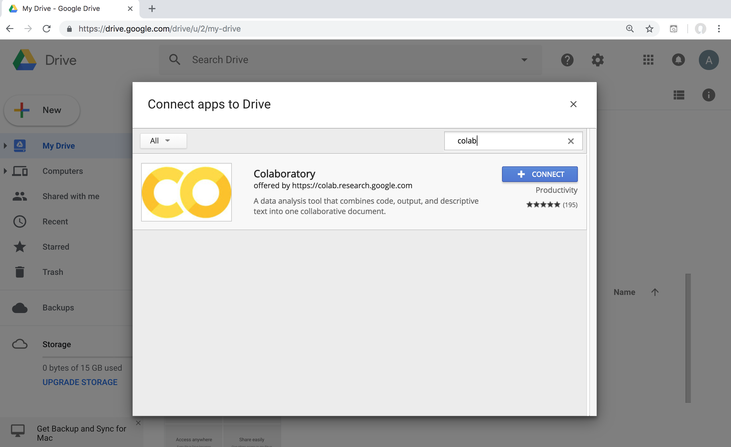
Google Colab

Slide 22
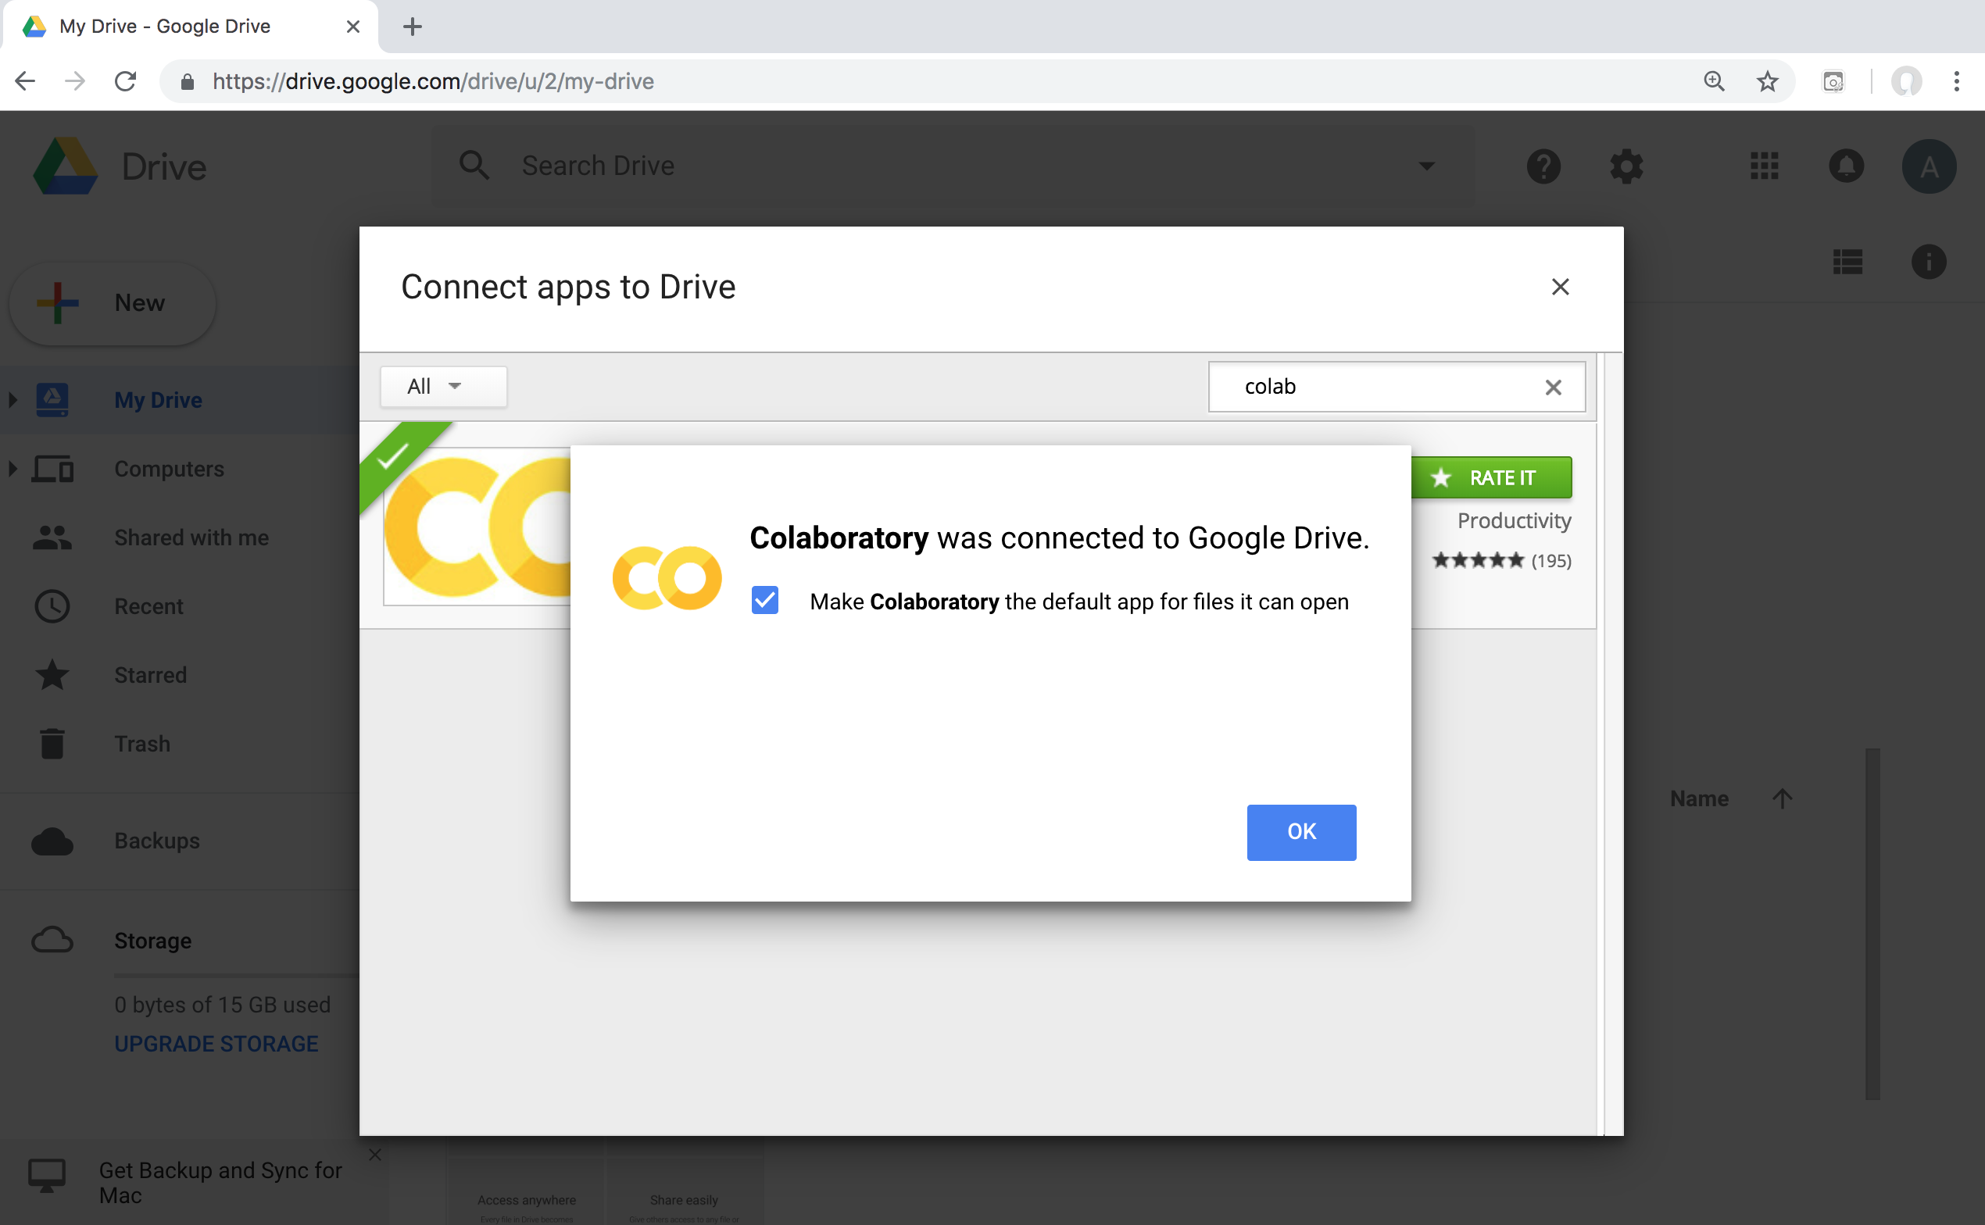
Connect Colaboratory to Google Drive

Slide 23
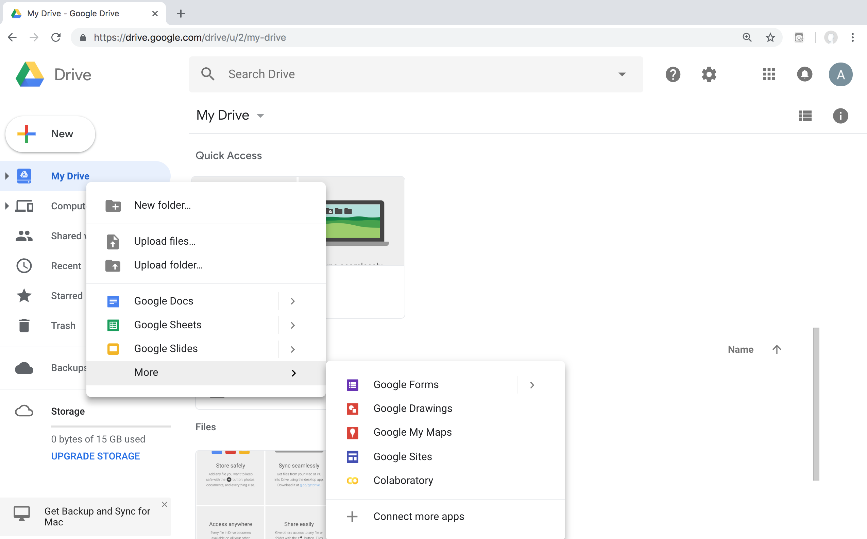
Google Colab

Slide 24
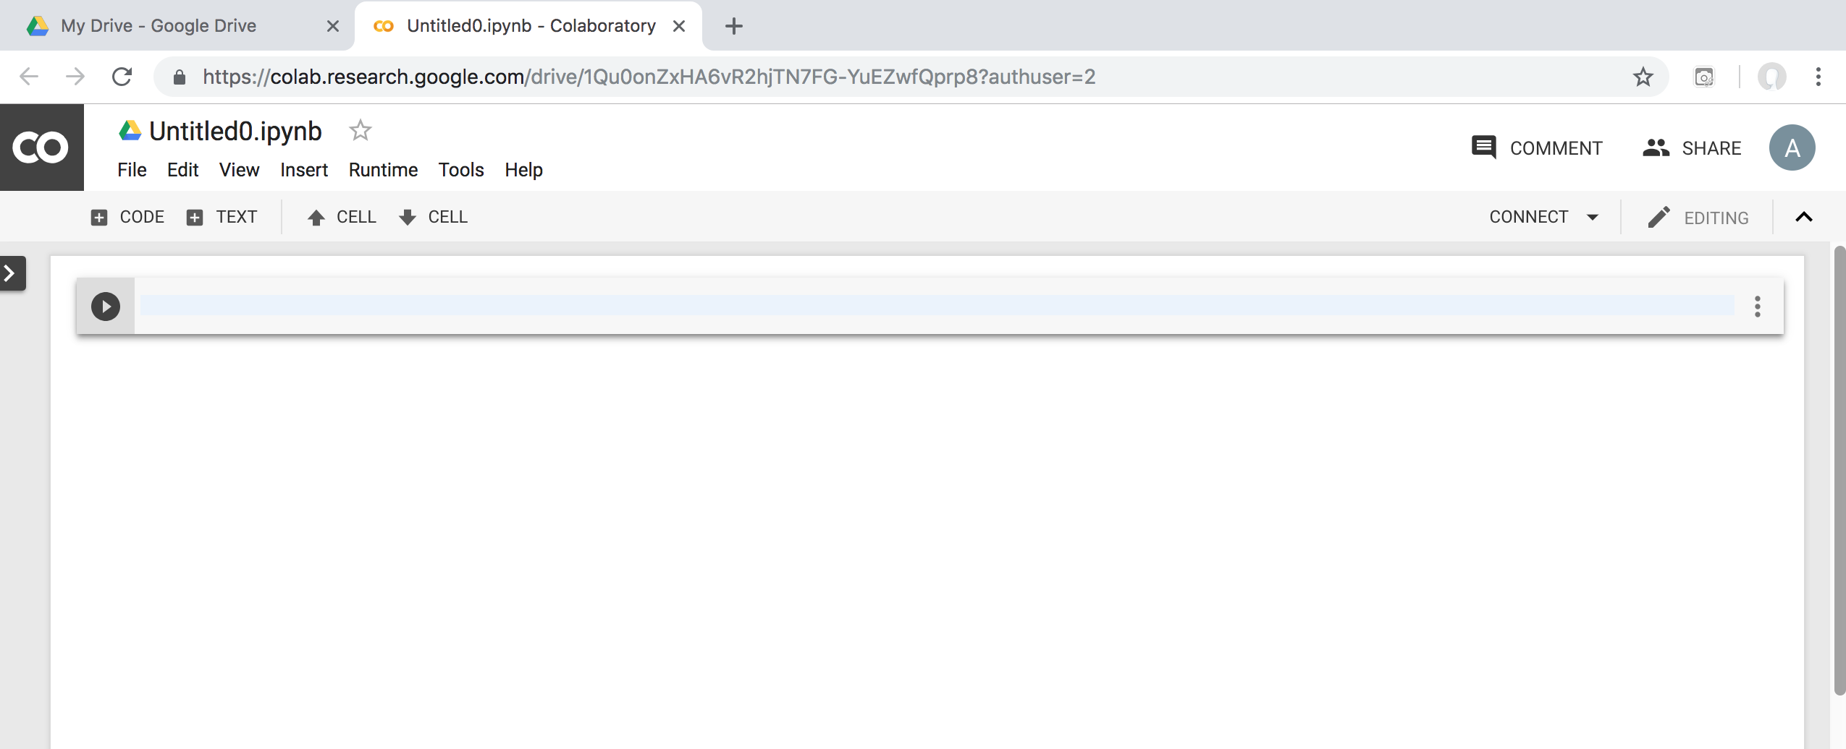
Google Colab

Slide 25
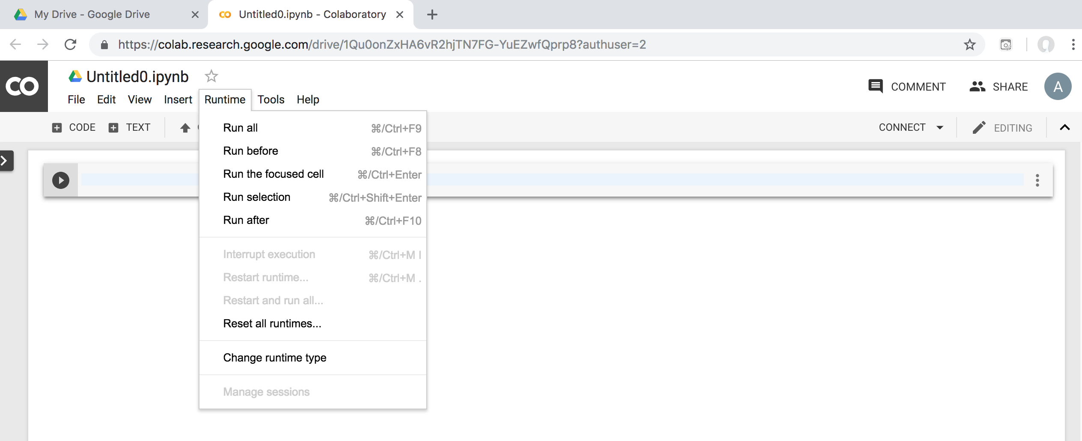
Google Colab

Slide 26
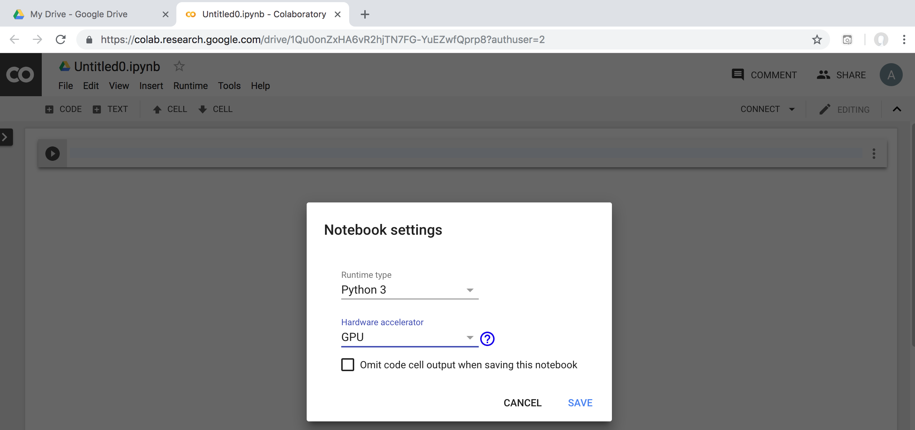
Run Jupyter Notebook Python3 GPU Google Colab

Slide 27
Google Colab Python Hello World print('Hello World')

Slide 28
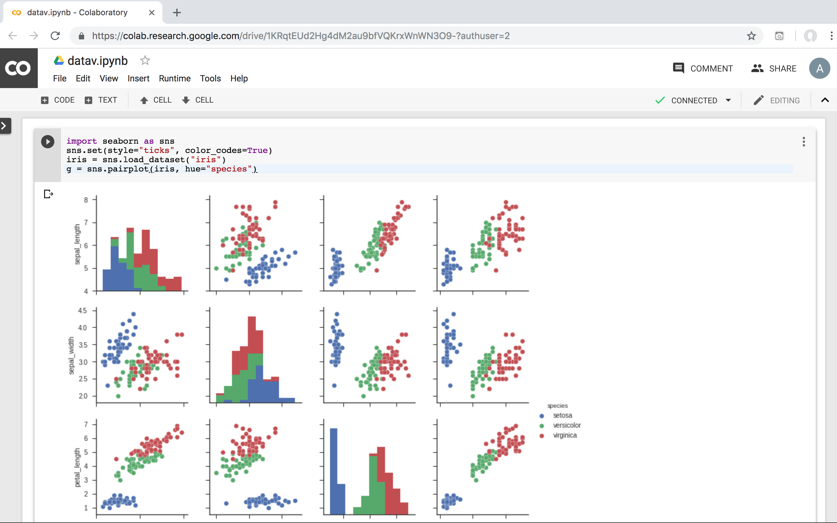
Data Visualization in Google Colab
https://colab.research.google.com/drive/1KRqtEUd2Hg4dM2au9bfVQKrxWnWN3O9-
Source: https://seaborn.pydata.org/generated/seaborn.pairplot.html

Slide 29
import seaborn as sns
sns.set(style="ticks", color_codes=True)
iris = sns.load_dataset("iris")
g = sns.pairplot(iris, hue="species")
Source: https://seaborn.pydata.org/generated/seaborn.pairplot.html

Slide 30
https://colab.research.google.com/drive/1KRqtEUd2Hg4dM2au9bfVQKrxWnWN3O9-
import numpy as np
import pandas as pd
%matplotlib inline
import matplotlib.pyplot as plt
import seaborn as sns
from pandas.plotting import scatter_matrix
# Load dataset
url = "https://archive.ics.uci.edu/ml/machine-learning-databases/iris/iris.data"
names = ['sepal-length', 'sepal-width', 'petal-length', 'petal-width', 'class']
df = pd.read_csv(url, names=names)
print(df.head(10))
print(df.tail(10))
print(df.describe())
print(df.info())
print(df.shape)
print(df.groupby('class').size())
plt.rcParams["figure.figsize"] = (10,8)
df.plot(kind='box', subplots=True, layout=(2,2), sharex=False, sharey=False)
plt.show()
df.hist()
plt.show()
scatter_matrix(df)
plt.show()
sns.pairplot(df, hue="class", size=2)
Source: https://machinelearningmastery.com/machine-learning-in-python-step-by-step/
Notes:
# coding: utf-8
# Source: https://machinelearningmastery.com/machine-learning-in-python-step-by-step/
# https://colab.research.google.com/drive/1KRqtEUd2Hg4dM2au9bfVQKrxWnWN3O9-
import numpy as np
import pandas as pd
%matplotlib inline
import matplotlib.pyplot as plt
import seaborn as sns
from pandas.plotting import scatter_matrix
# Load dataset
url = "https://archive.ics.uci.edu/ml/machine-learning-databases/iris/iris.data"
names = ['sepal-length', 'sepal-width', 'petal-length', 'petal-width', 'class']
df = pd.read_csv(url, names=names)
print(df.head(10))
print(df.tail(10))
print(df.describe())
print(df.info())
print(df.shape)
print(df.groupby('class').size())
plt.rcParams["figure.figsize"] = (10,8)
df.plot(kind='box', subplots=True, layout=(2,2), sharex=False, sharey=False)
plt.show()
df.hist()
plt.show()
scatter_matrix(df)
plt.show()
sns.pairplot(df, hue="class", size=2)

Slide 31
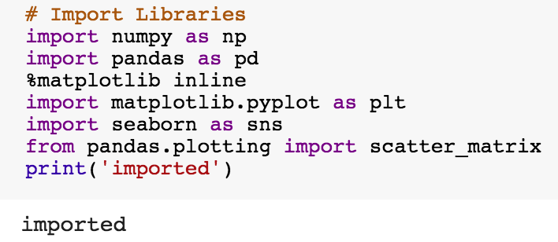
import numpy as np
import pandas as pd
%matplotlib inline
import matplotlib.pyplot as plt
import seaborn as sns
from pandas.plotting import scatter_matrix

Slide 32
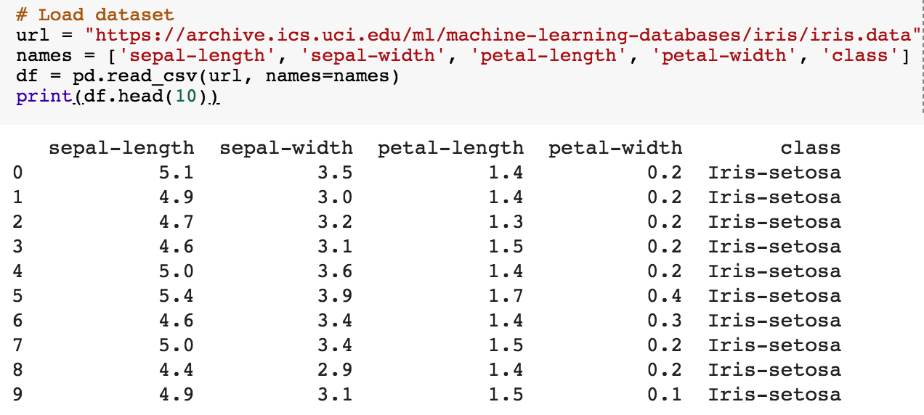
url = "https://archive.ics.uci.edu/ml/machine-learning-databases/iris/iris.data"
names = ['sepal-length', 'sepal-width', 'petal-length', 'petal-width', 'class']
df = pd.read_csv(url, names=names)
print(df.head(10))

Slide 33
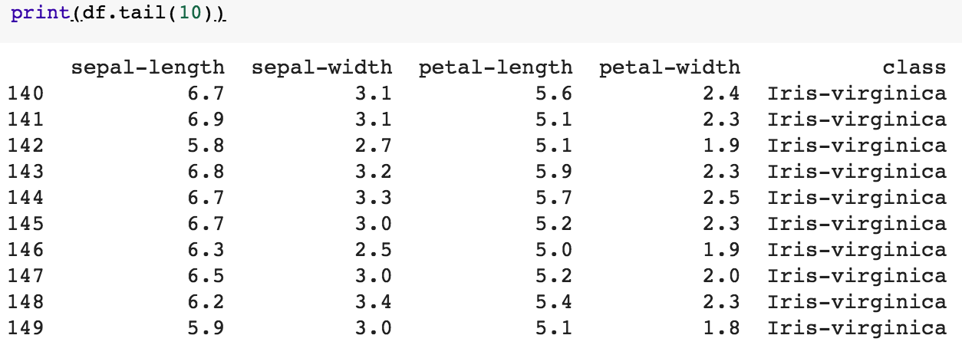
df.tail(10)

Slide 34
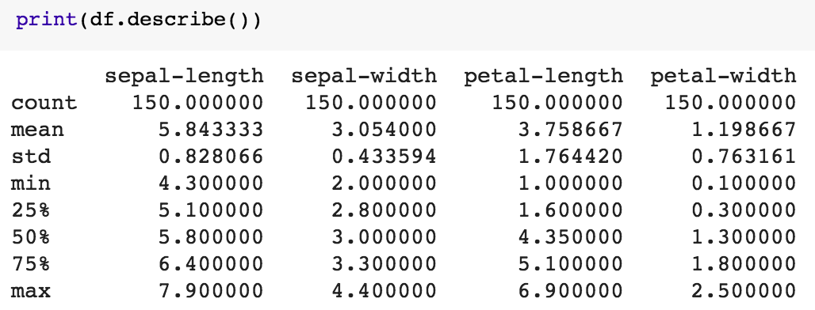
df.describe()

Slide 35
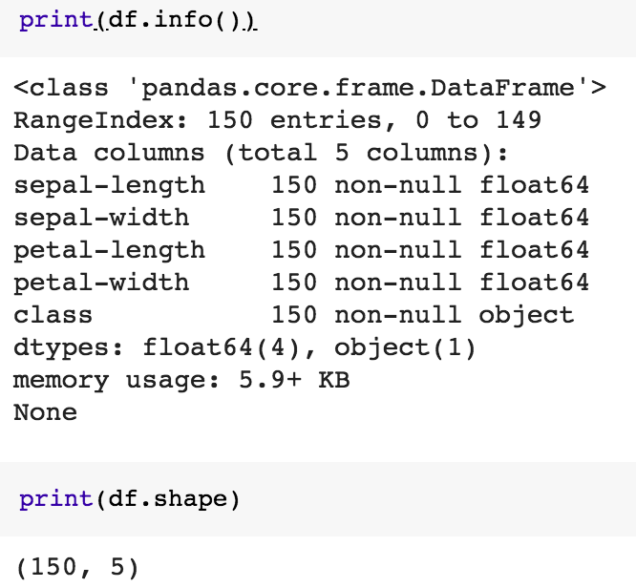
print(df.info())
print(df.shape)

Slide 36
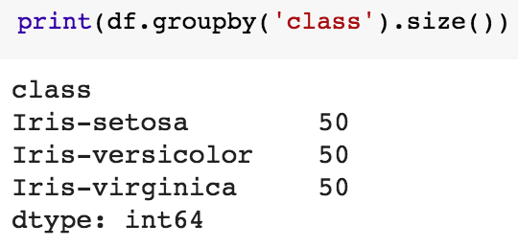
df.groupby('class').size()

Slide 37
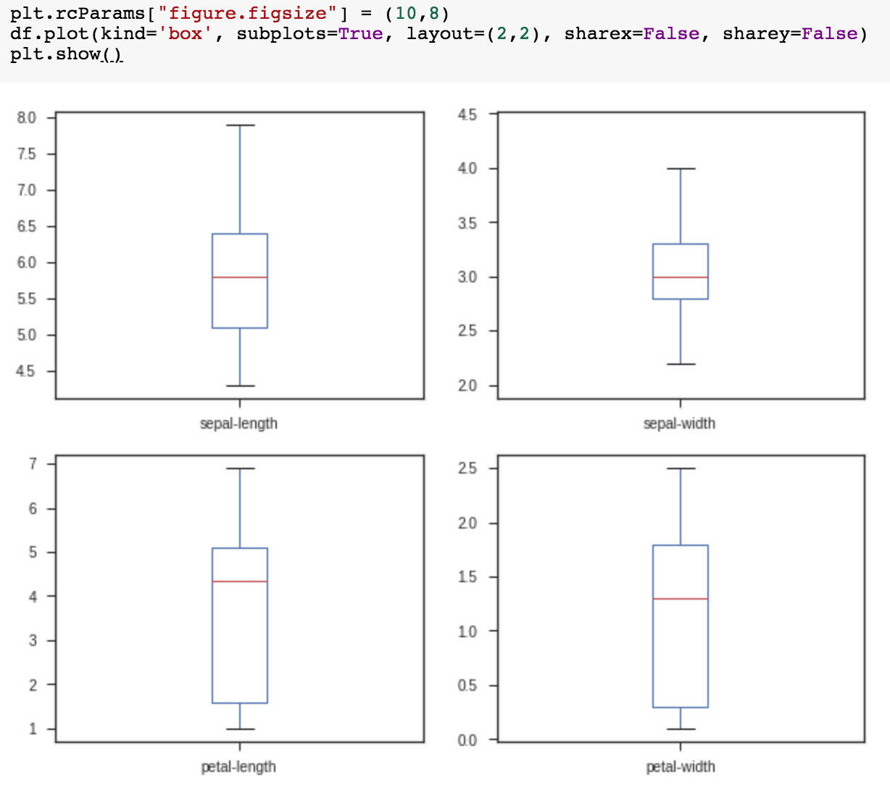
plt.rcParams["figure.figsize"] = (10,8)
df.plot(kind='box', subplots=True, layout=(2,2), sharex=False, sharey=False)
plt.show()

Slide 38
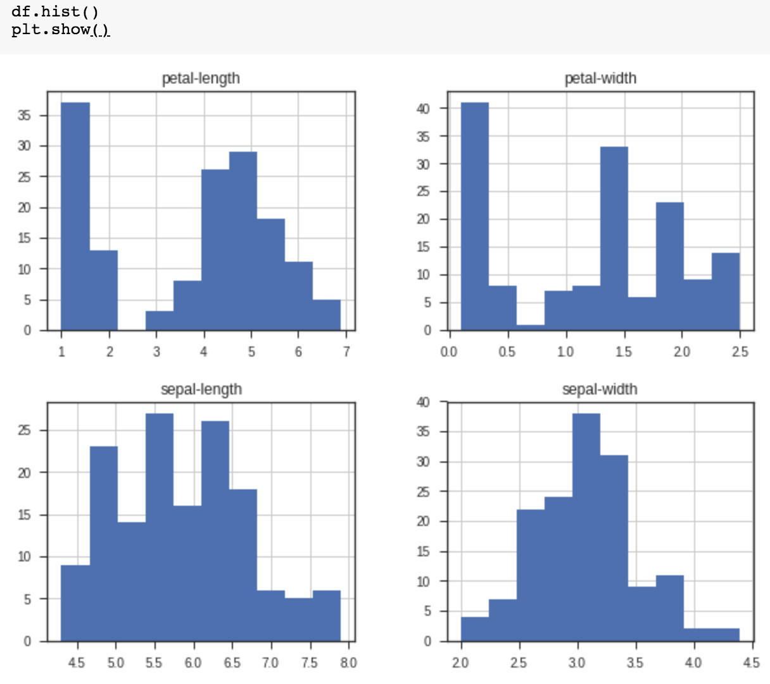
df.hist()
plt.show()

Slide 39
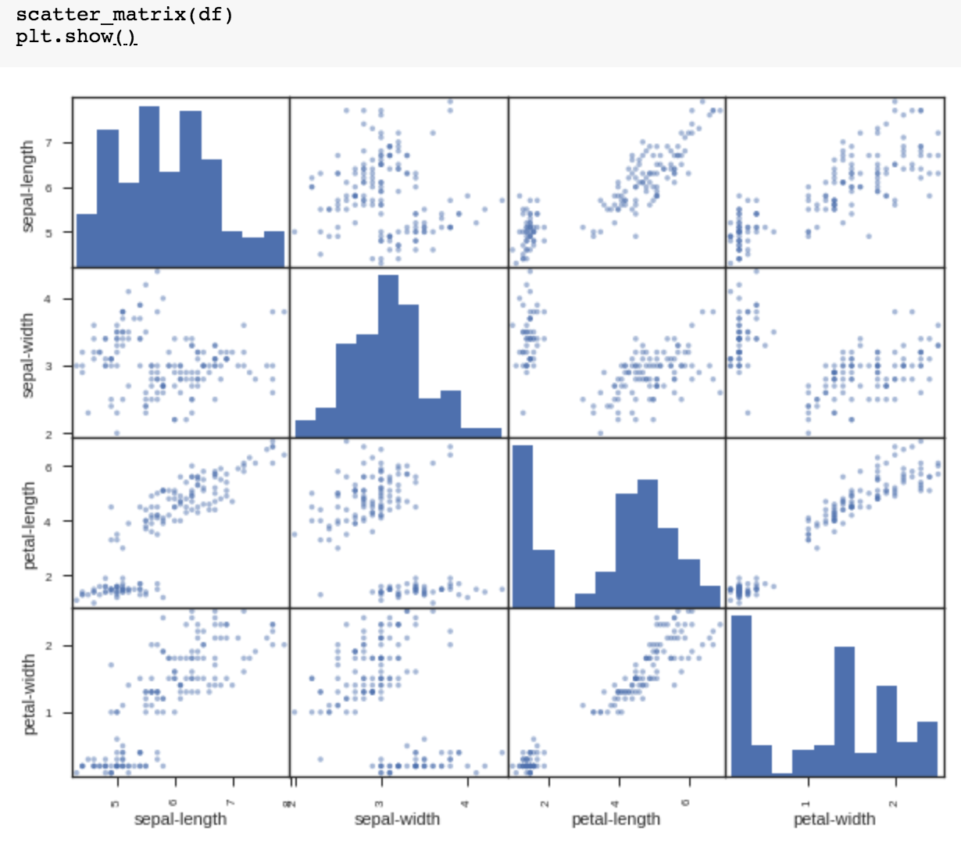
scatter_matrix(df)
plt.show()

Slide 40
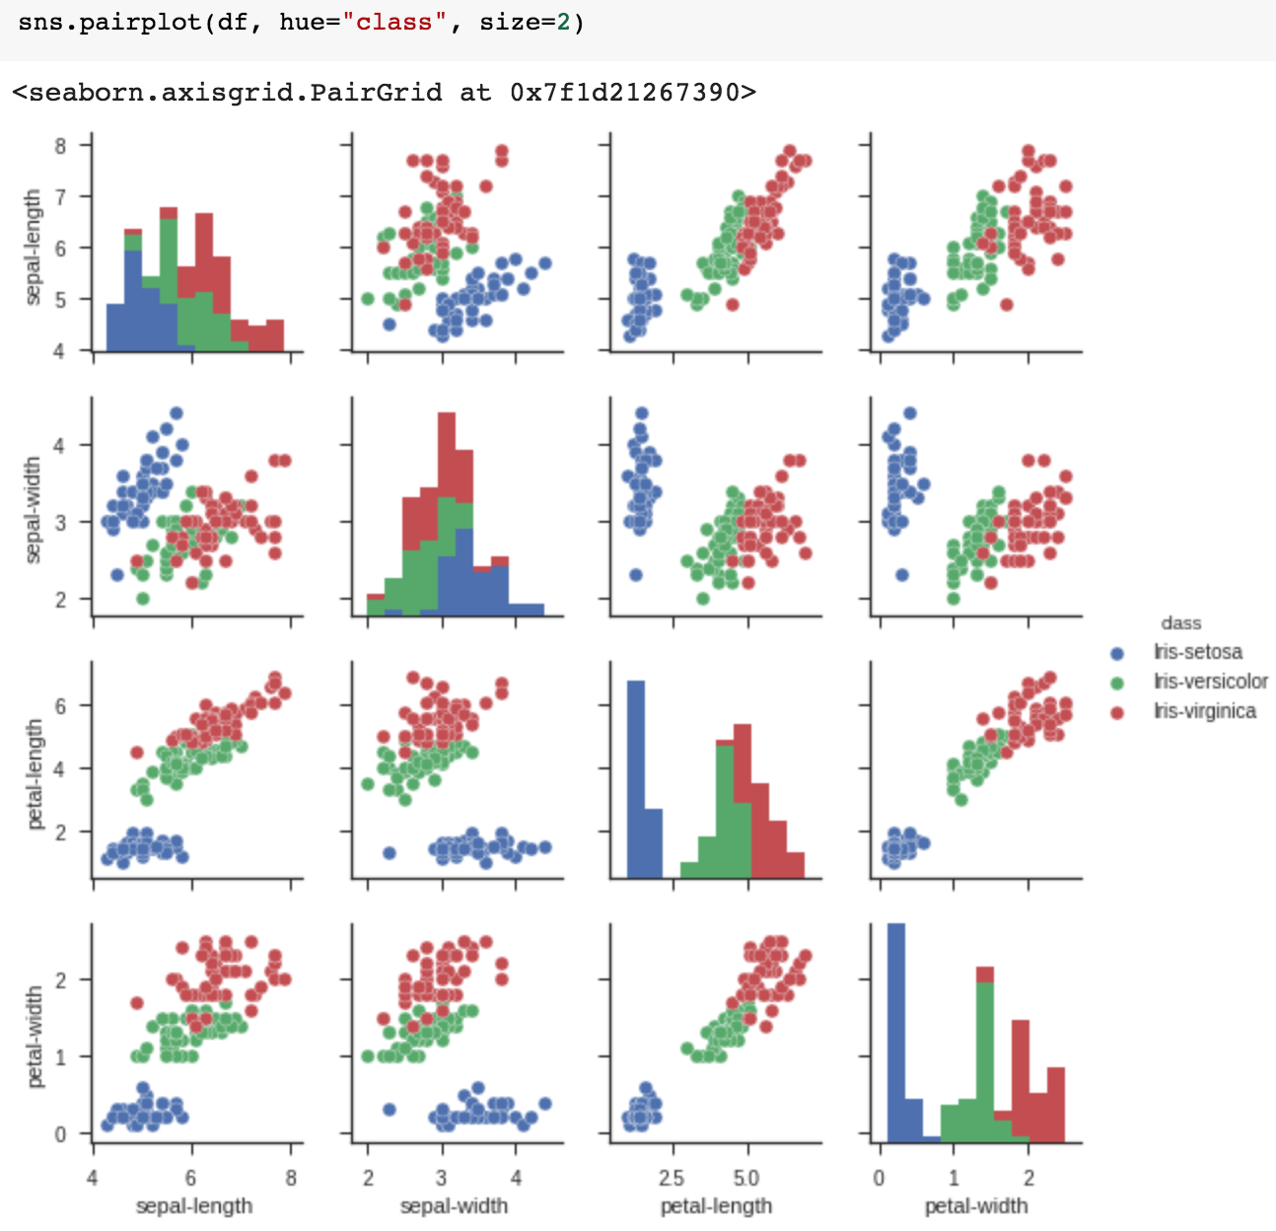
sns.pairplot(df, hue="class", size=2)

Slide 41
Anaconda The Most Popular Python Data Science Platform
Source: https://www.anaconda.com/

Slide 42
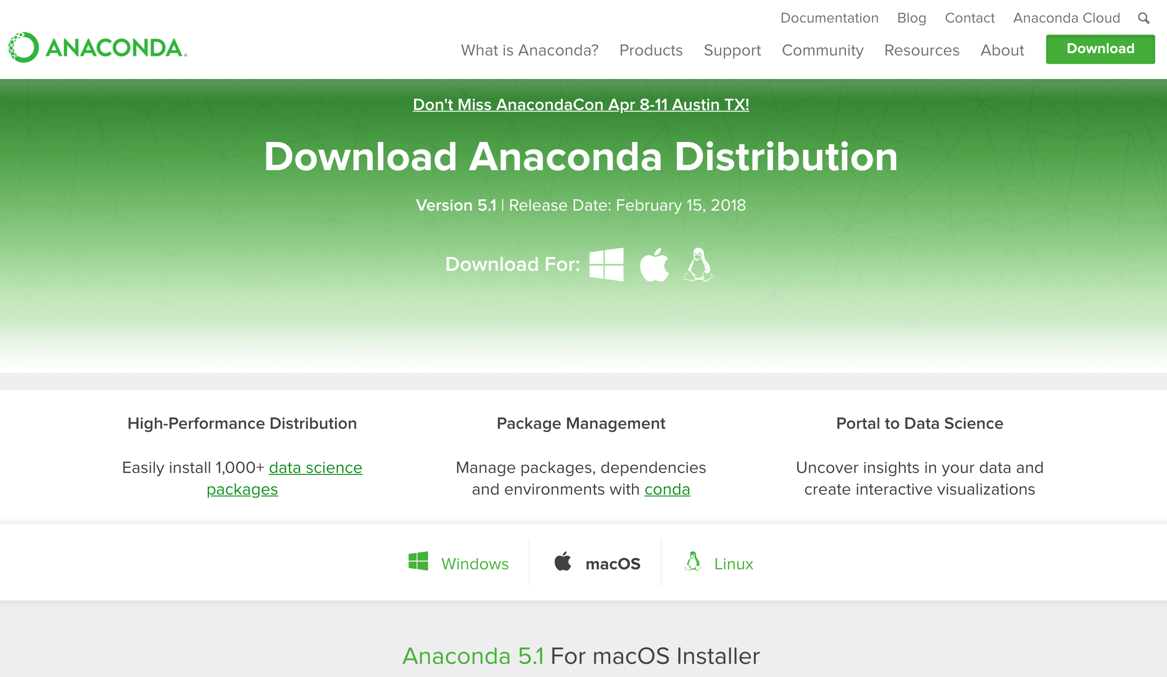
Download Anaconda
https://www.anaconda.com/download

Slide 43
Python HelloWorld

Slide 44
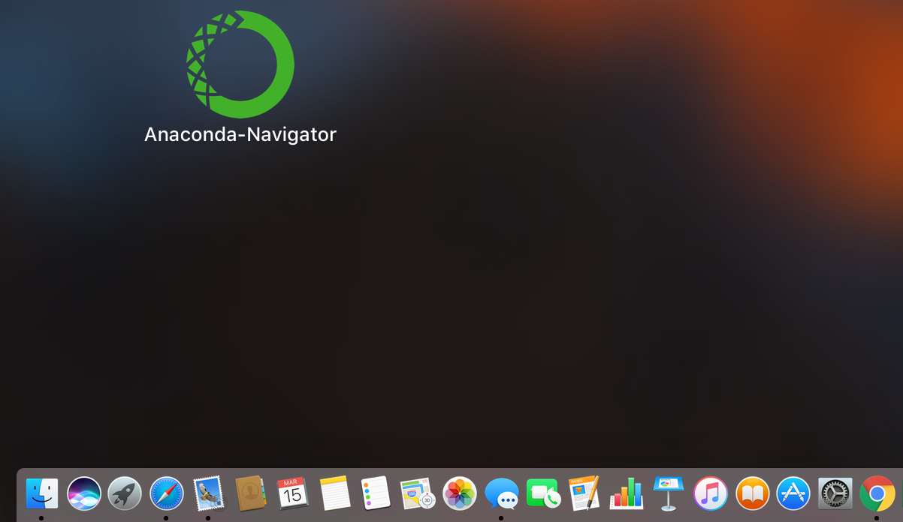
Anaconda-Navigator
Launchpad

Slide 45
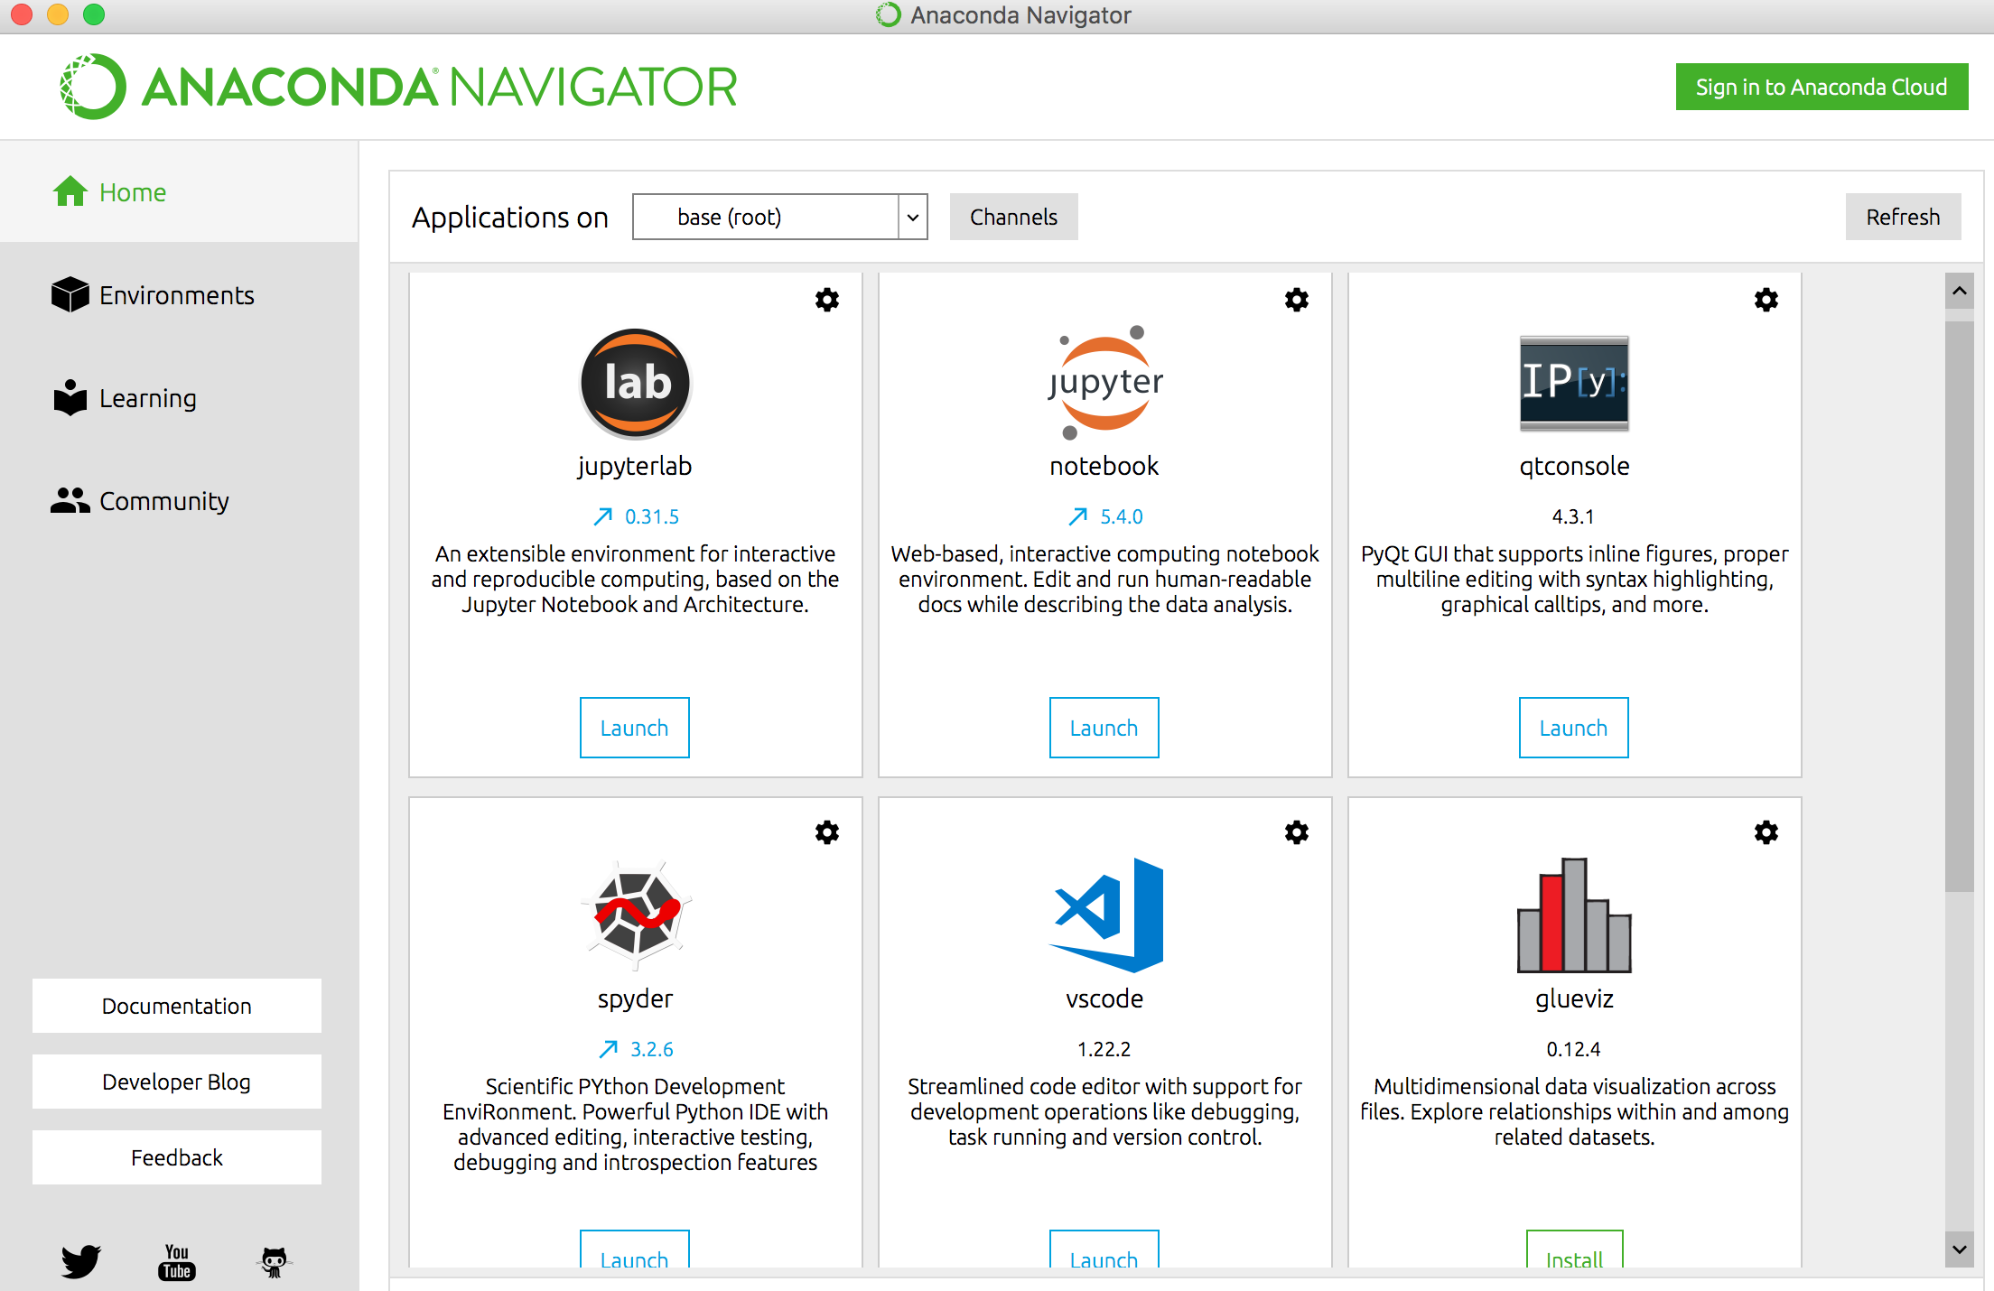
Anaconda Navigator

Slide 46
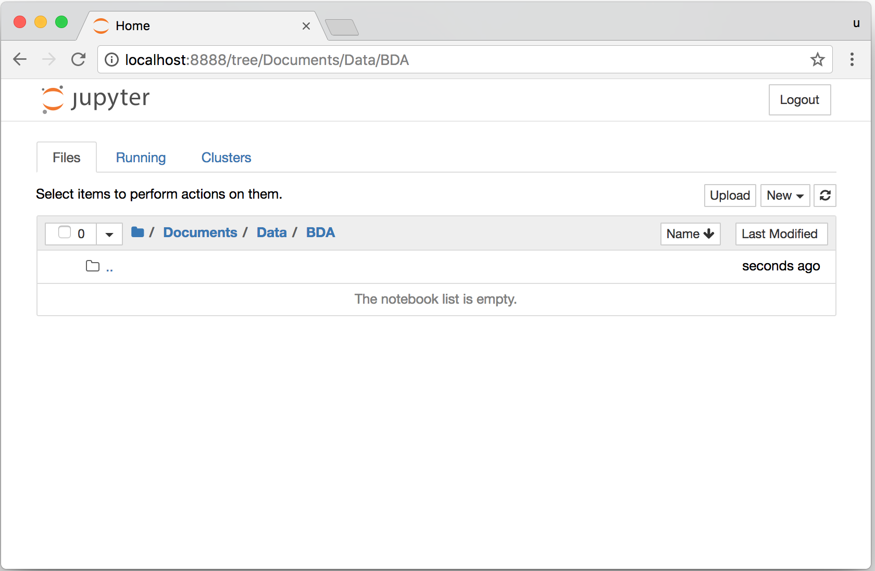
Jupyter Notebook

Slide 47
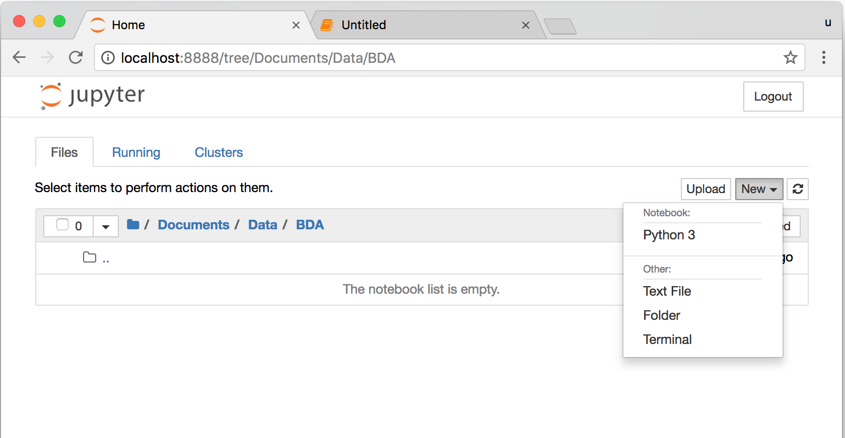
Jupyter Notebook New Python 3

Slide 48
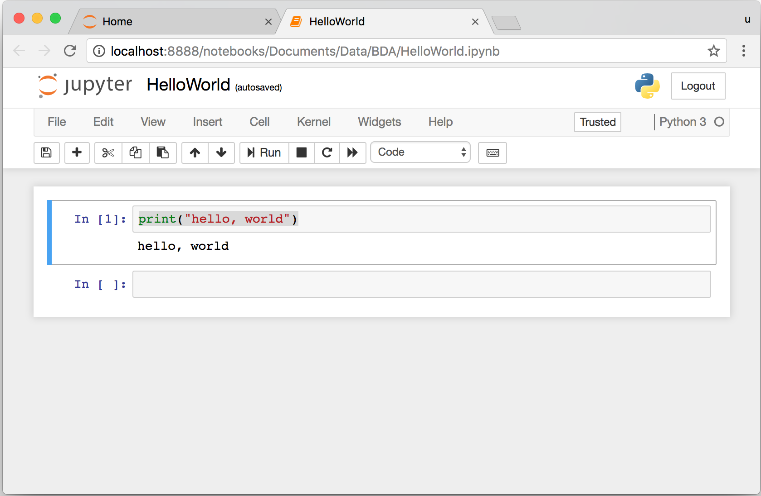
print("hello, world")
Notes:
print("hello, world")

Slide 49
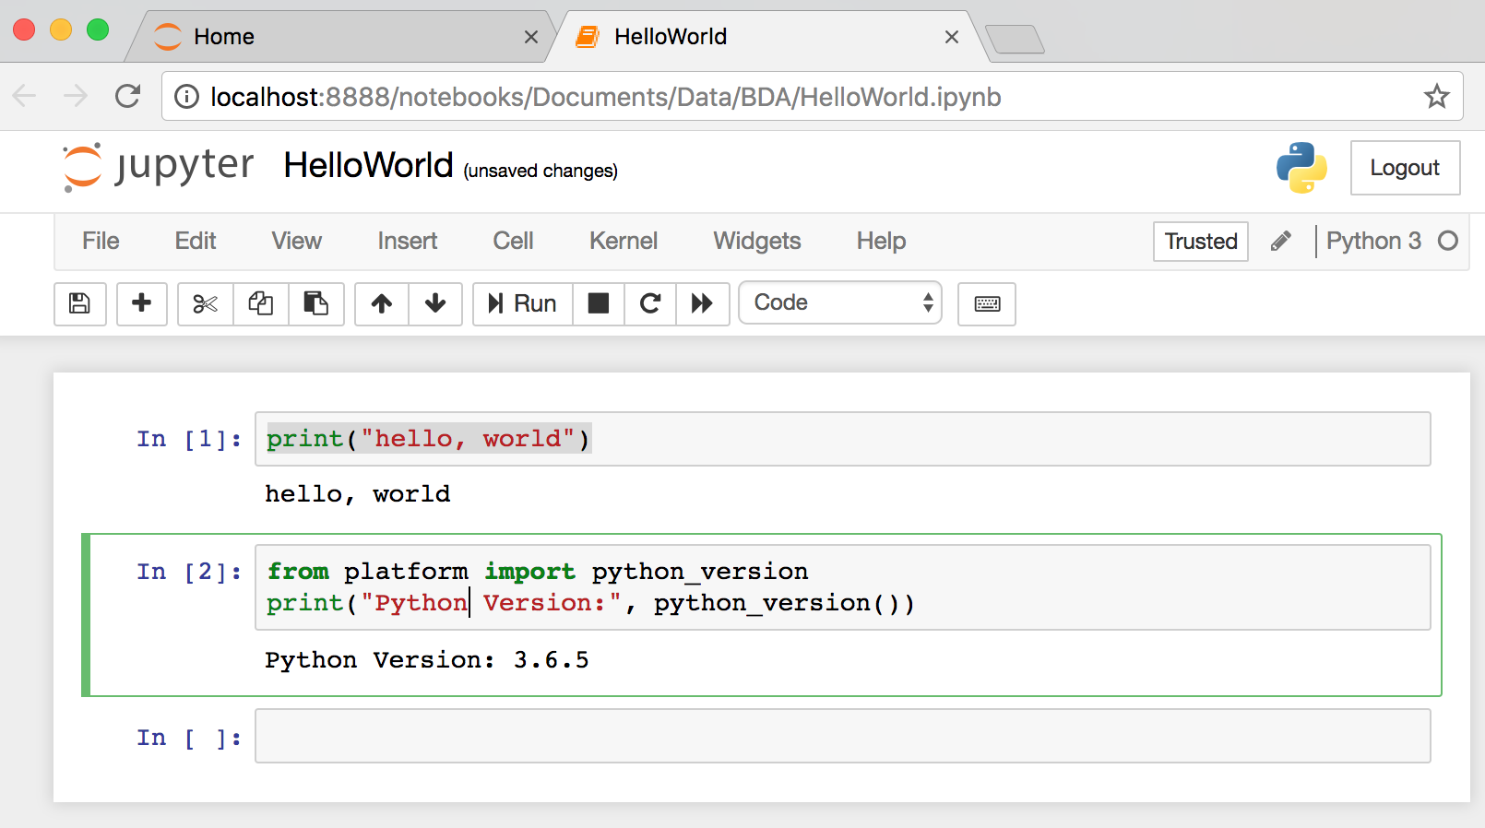
from platform import python_version
print("Python Version:", python_version())
Notes:
from platform import python_version
print("Python Version:", python_version())

Slide 50
Python Programming

Slide 51
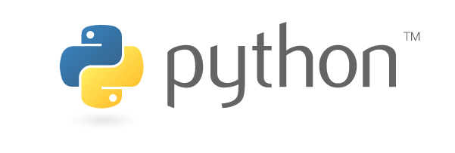
Source: https://www.python.org/community/logos/

Slide 52
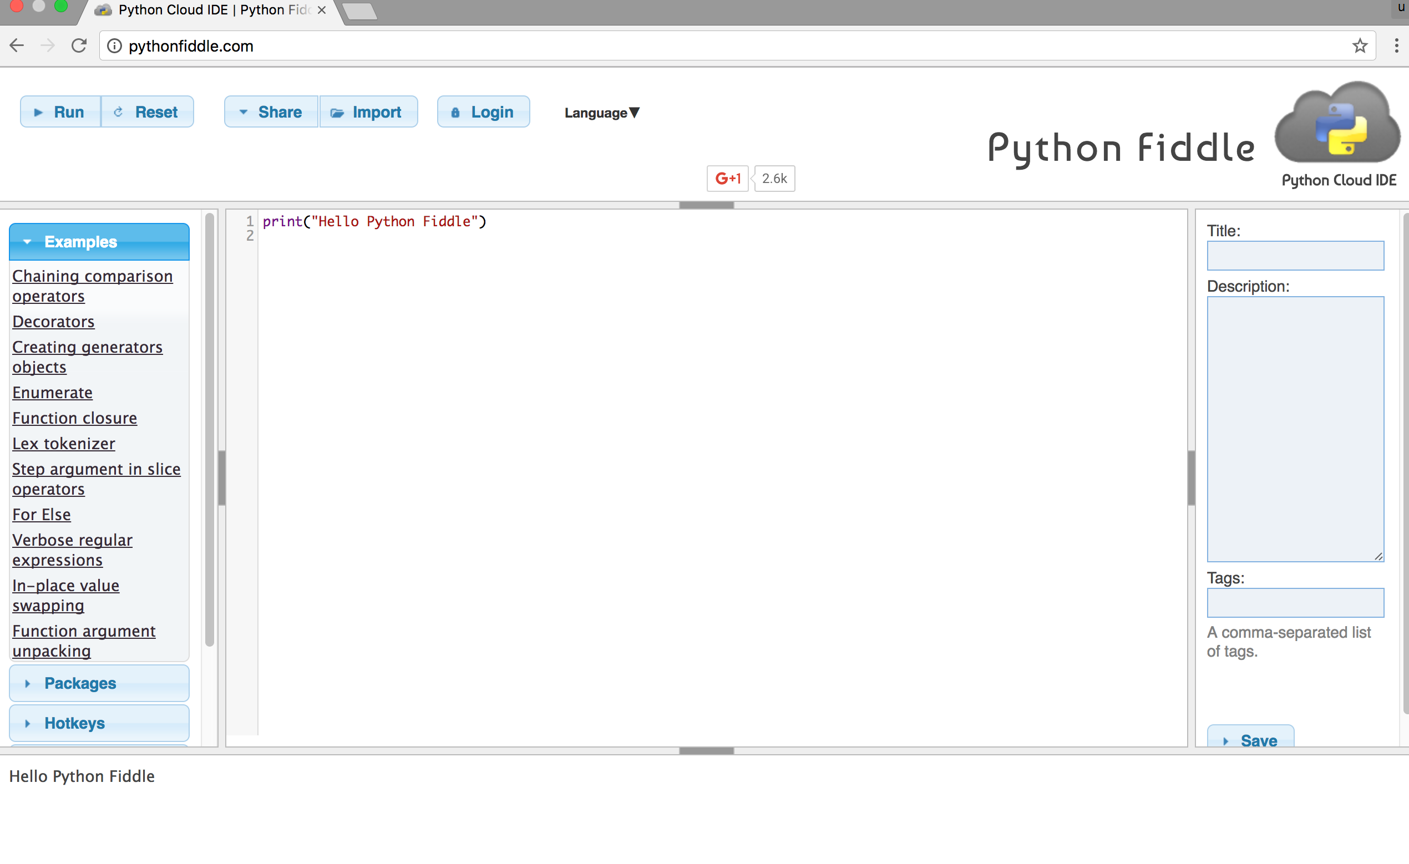
Python Fiddle
http://pythonfiddle.com/

Slide 53
Text input and output
print("Hello World")
print("Hello World\nThis is a message")
x = 3
print(x)
x = 2
y = 3
print(x, ' ', y)
name = input("Enter a name: ")
x = int(input("What is x? "))
x = float(input("Write a number "))
Source: http://pythonprogramminglanguage.com/text-input-and-output/
Notes:
print("Hello World")
print("Hello World\nThis is a message")
x = 3
print(x)
x = 2
y = 3
print(x, ' ', y)
name = input("Enter a name: ")
x = int(input("What is x? "))
x = float(input("Write a number "))

Slide 54
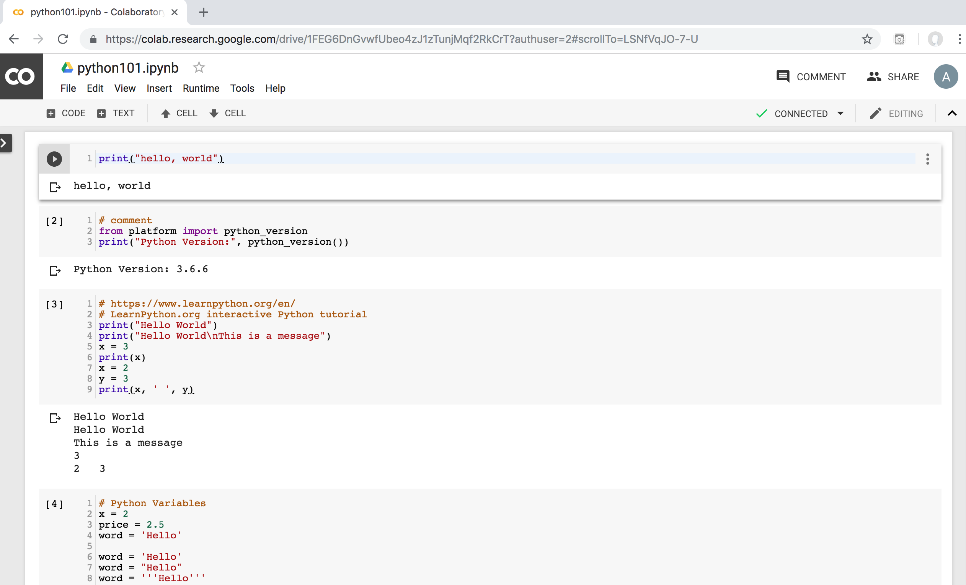
Python in Google Colab
https://colab.research.google.com/drive/1FEG6DnGvwfUbeo4zJ1zTunjMqf2RkCrT
https://tinyurl.com/aintpupython101

Slide 55
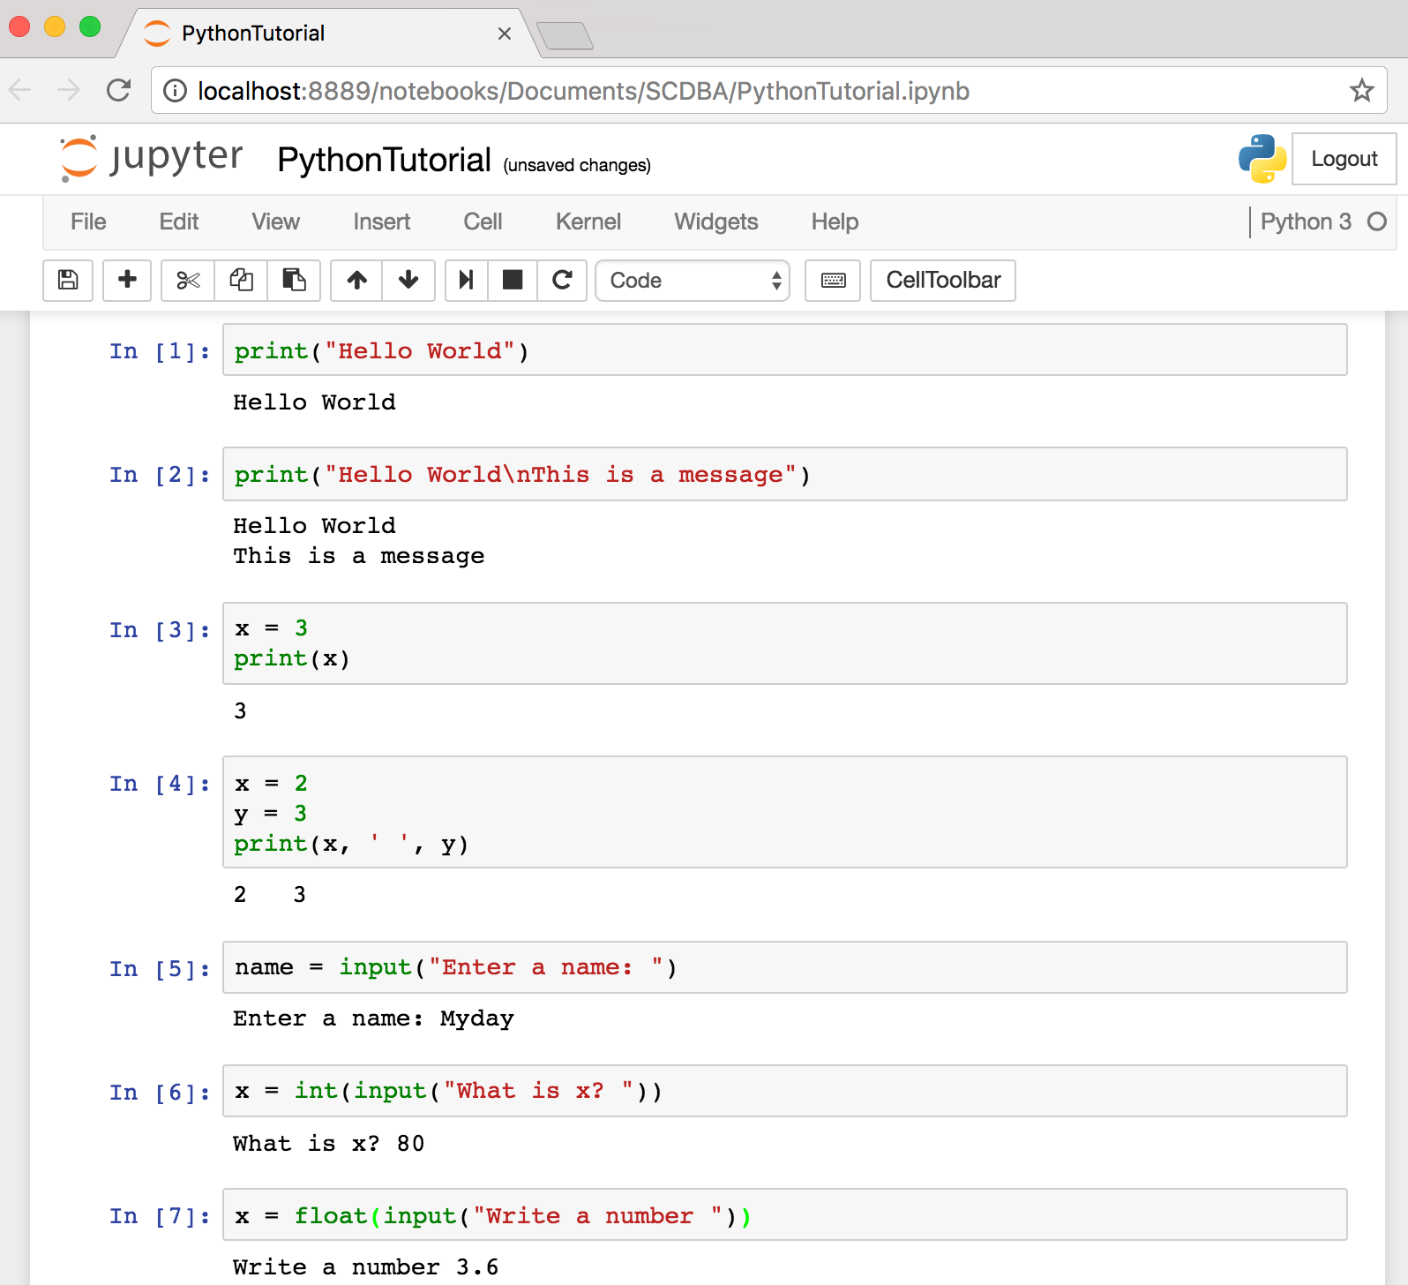
Text input and output
Source: http://pythonprogramminglanguage.com/text-input-and-output/
Notes:
print("Hello World")
print("Hello World\nThis is a message")
x = 3
print(x)
x = 2
y = 3
print(x, ' ', y)
name = input("Enter a name: ")
x = int(input("What is x? "))
x = float(input("Write a number "))

Slide 56
Variables
x = 2
price = 2.5
word = 'Hello'
word = 'Hello'
word = "Hello"
word = '''Hello'''
x = 2
x = x + 1
x = 5
Source: http://pythonprogramminglanguage.com/

Slide 57
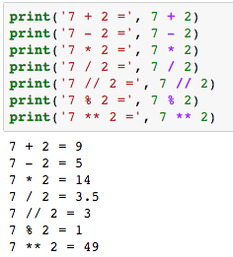
Python Basic Operators
print('7 + 2 =', 7 + 2)
print('7 - 2 =', 7 - 2)
print('7 * 2 =', 7 * 2)
print('7 / 2 =', 7 / 2)
print('7 // 2 =', 7 // 2)
print('7 % 2 =', 7 % 2)
print('7 ** 2 =', 7 ** 2)

Slide 58
BMI Calculator in Python
height_cm = float(input("Enter your height in cm: "))
weight_kg = float(input("Enter your weight in kg: "))
height_m = height_cm/100
BMI = (weight_kg/(height_m**2))
print("Your BMI is: " + str(round(BMI,1)))
Source: http://code.activestate.com/recipes/580615-bmi-code/

Slide 59
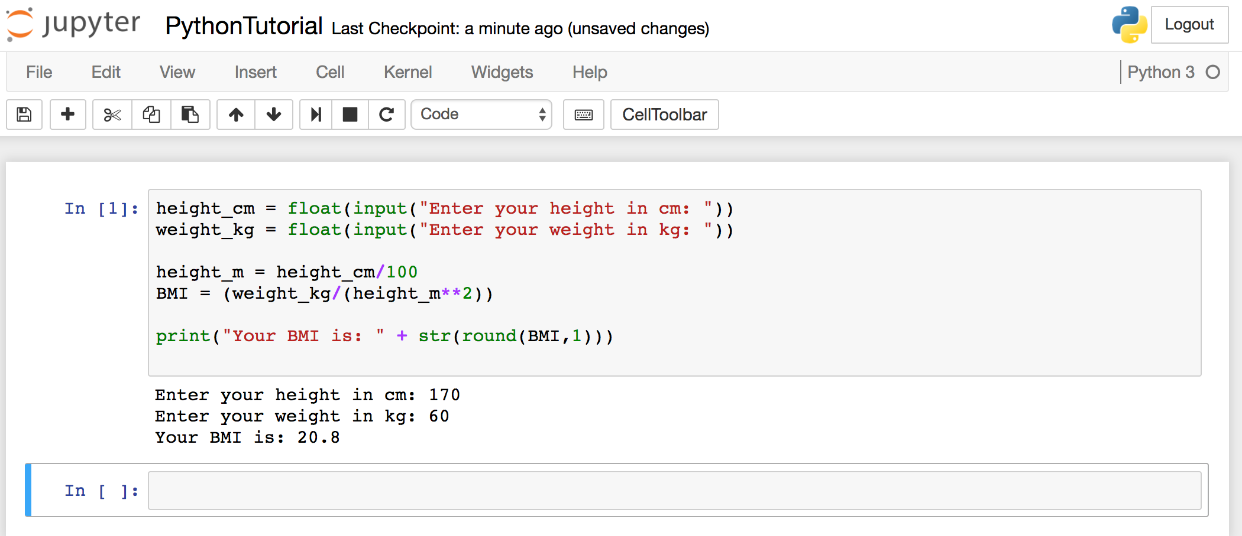
BMI Calculator in Python
Source: http://code.activestate.com/recipes/580615-bmi-code/
Notes:
height_cm = float(input("Enter your height in cm: "))
weight_kg = float(input("Enter your weight in kg: "))
height_m = height_cm/100
BMI = (weight_kg/(height_m**2))
print("Your BMI is: " + str(round(BMI,1)))

Slide 60
Future value of a specified principal amount, rate of interest, and a number of years
Source: https://www.w3resource.com/python-exercises/python-basic-exercise-39.php

Slide 61
Future Value (FV)
# How much is your $100 worth after 7 years?
print(100 * 1.1 ** 7)
# output = 194.87
Source: https://www.w3resource.com/python-exercises/python-basic-exercise-39.php

Slide 62
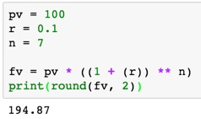
Future Value (FV)
pv = 100
r = 0.1
n = 7
fv = pv * ((1 + (r)) ** n)
print(round(fv, 2))

Slide 63
Future Value (FV)
amount = 100
interest = 10 #10% = 0.01 * 10
years = 7
future_value = amount * ((1 + (0.01 * interest)) ** years)
print(round(future_value, 2))
Source: https://www.w3resource.com/python-exercises/python-basic-exercise-39.php
Notes:
amount = 100
interest = 10 #10% = 0.01 * 10
years = 7
future_value = amount * ((1 + (0.01 * interest)) ** years)
print(round(future_value, 2))

Slide 64
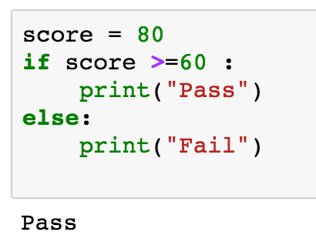
if statements
> greater than
< smaller than
== equals
!= is not
score = 80
if score >=60 :
print("Pass")
else:
print("Fail")
Source: http://pythonprogramminglanguage.com/

Slide 65
if elif else
score = 90
grade = ""
if score >=90:
grade = "A"
elif score >= 80:
grade = "B"
elif score >= 70:
grade = "C"
elif score >= 60:
grade = "D"
else:
grade = "E"
print(grade)
# grade = ”A”
A
http://pythontutor.com/visualize.html
https://goo.gl/E6w5ph
Source: http://pythonprogramminglanguage.com/
Notes:
http://pythontutor.com/visualize.html
https://goo.gl/E6w5ph

Slide 66
for loops
for i in range(1,11):
print(i)
1
2
3
4
5
6
7
8
9
10
Source: http://pythonprogramminglanguage.com/
Notes:
https://goo.gl/YpxMYo

Slide 67
for loops
for i in range(1,10):
for j in range(1,10):
print(i, ' * ' , j , ' = ', i*j)
9 * 1 = 9
9 * 2 = 18
9 * 3 = 27
9 * 4 = 36
9 * 5 = 45
9 * 6 = 54
9 * 7 = 63
9 * 8 = 72
9 * 9 = 81
Source: http://pythonprogramminglanguage.com/
Notes:
for i in range(1,10):
for j in range(1,10):
print(i, ' * ' , j , ' = ', i*j)

Slide 68
while loops
age = 10
while age < 20:
print(age)
age = age + 1
10
11
12
13
14
15
16
17
18
19
Source: https://learnpython.trinket.io/learn-python-part-8-loops#/while-loops/about-while-loops
Notes:
age = 10
while age < 20:
print(age)
age = age + 1

Slide 69
Functions
def convertCMtoM(xcm):
m = xcm/100
return m
cm = 180
m = convertCMtoM(cm)
print(str(m))
1.8
Notes:
https://goo.gl/6K5qUn

Slide 70
Lists
x = [60, 70, 80, 90]
print(len(x))
print(x[0])
print(x[1])
print(x[-1])
4
60
70
90

Slide 71
Tuples
A tuple in Python is a collection that cannot be modified. A tuple is defined using parenthesis.
x = (10, 20, 30, 40, 50)
print(x[0])
print(x[1])
print(x[2])
print(x[-1])
10
20
30
50
Source: http://pythonprogramminglanguage.com/tuples/

Slide 72
Dictionary
k = { 'EN':'English', 'FR':'French' }
print(k['EN'])
English
Source: http://pythonprogramminglanguage.com/dictionary/

Slide 73
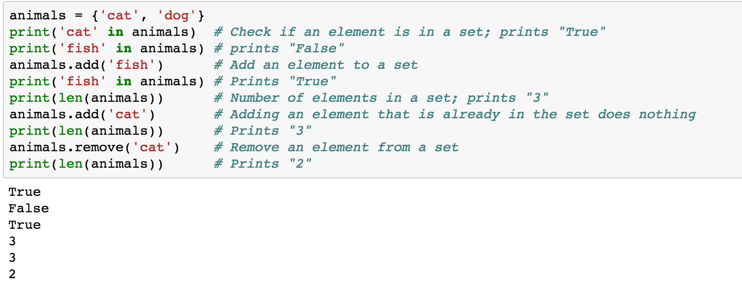
Sets
animals = {'cat', 'dog'}
animals = {'cat', 'dog'}
print('cat' in animals)
print('fish' in animals)
animals.add('fish')
print('fish' in animals)
print(len(animals))
animals.add('cat')
print(len(animals))
animals.remove('cat')
print(len(animals))
Source: http://cs231n.github.io/python-numpy-tutorial/
Notes:
#Sets
animals = {'cat', 'dog'}
print('cat' in animals) # Check if an element is in a set; prints "True"
print('fish' in animals) # prints "False"
animals.add('fish') # Add an element to a set
print('fish' in animals) # Prints "True"
print(len(animals)) # Number of elements in a set; prints "3"
animals.add('cat') # Adding an element that is already in the set does nothing
print(len(animals)) # Prints "3"
animals.remove('cat') # Remove an element from a set
print(len(animals)) # Prints "2”
Source: http://cs231n.github.io/python-numpy-tutorial/

Slide 74
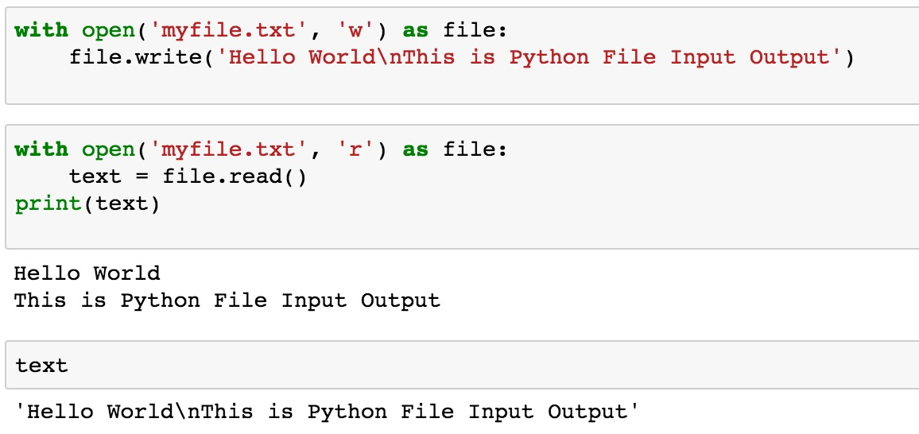
File Input / Output
with open('myfile.txt', 'w') as file:
file.write('Hello World\nThis is Python File Input Output')
with open('myfile.txt', 'r') as file:
text = file.read()
print(text)
Source: https://github.com/TiesdeKok/LearnPythonforResearch/blob/master/0_python_basics.ipynb
Notes:
with open('myfile.txt', 'w') as file:
file.write('Hello World\nThis is Python File Input Output')
with open('myfile.txt', 'r') as file:
text = file.read()
print(text)
with open('myfile.txt', 'a+') as file:
file.write('\n' + 'New line')
with open('myfile.txt', 'r') as file:
text = file.read()
print(text)

Slide 75
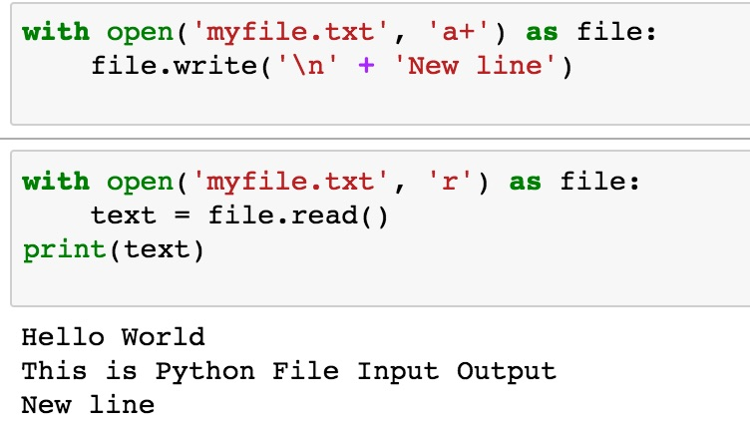
File Input / Output
with open('myfile.txt', 'a+') as file:
file.write('\n' + 'New line')
with open('myfile.txt', 'r') as file:
text = file.read()
print(text)
Source: https://github.com/TiesdeKok/LearnPythonforResearch/blob/master/0_python_basics.ipynb
Notes:
with open('myfile.txt', 'w') as file:
file.write('Hello World\nThis is Python File Input Output')
with open('myfile.txt', 'r') as file:
text = file.read()
print(text)
with open('myfile.txt', 'a+') as file:
file.write('\n' + 'New line')
with open('myfile.txt', 'r') as file:
text = file.read()
print(text)

Slide 76
Big Data Analytics with Numpy in Python

Slide 77
Numpy
NumPy
Base N-dimensional array package

Slide 78
NumPy is the fundamental package for scientific computing with Python.
Source: http://www.numpy.org/

Slide 79
NumPy
NumPy
NumPy provides a multidimensional array object to store homogenous or heterogeneous data; it also provides optimized functions/methods to operate on this array object.
Source: Yves Hilpisch (2014), Python for Finance: Analyze Big Financial Data, O'Reilly

Slide 80
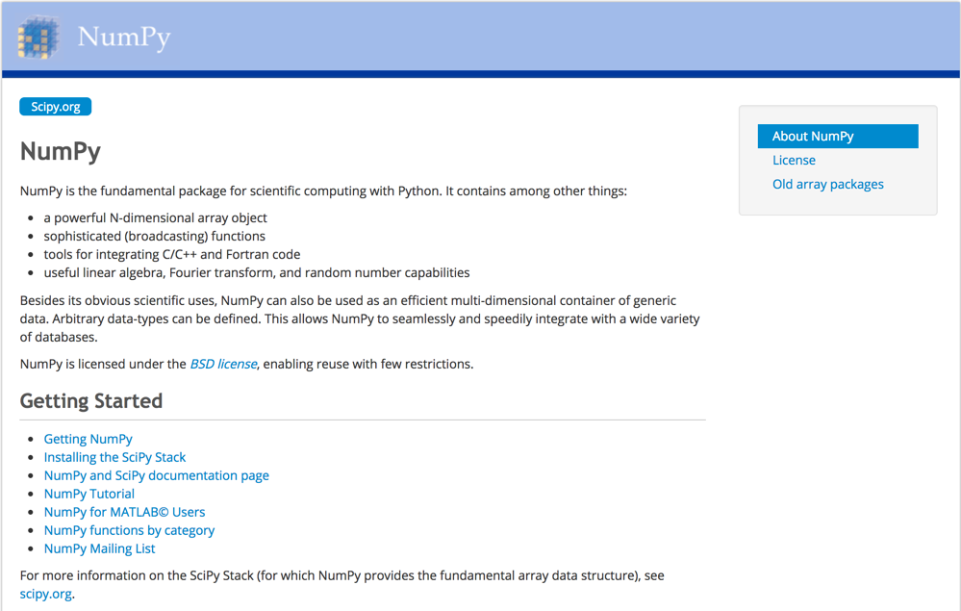
NumPy
http://www.numpy.org/

Slide 81
NumPy ndarray
NumPy
One-dimensional Array (1-D Array)
0 | 1 |  |  | n-1
1 | 2 | 3 | 4 | 5
Two-dimensional Array (2-D Array)
 | 0 | 1 |  |  | n-1
0 | 1 | 2 | 3 | 4 | 5
1 | 6 | 7 | 8 | 9 | 10
 | 11 | 12 | 13 | 14 | 15
m-1 | 16 | 17 | 18 | 19 | 20

Slide 82
v = list(range(1, 6)) v 2 * v import numpy as np v = np.arange(1, 6) v 2 * v
NumPy
NumPy
Source: Yves Hilpisch (2014), Python for Finance: Analyze Big Financial Data, O'Reilly
Notes:
# pip3 install numpy
# pip install numpy
# sudo pip3 install numpy
import numpy as np

Slide 83
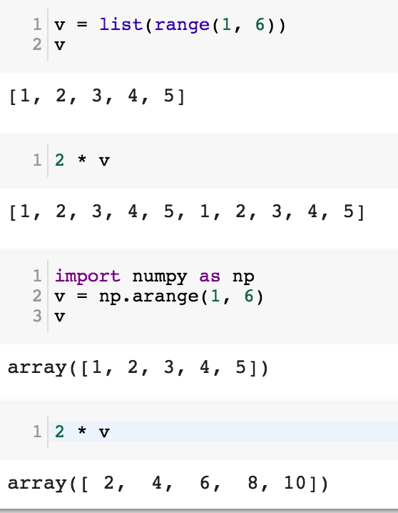
NumPy
Base N-dimensional array package

Slide 84
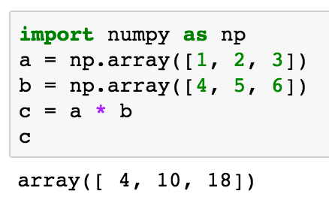
import numpy as np a = np.array([1, 2, 3]) b = np.array([4, 5, 6]) c = a * b c
NumPy Create Array
NumPy
Source: Yves Hilpisch (2014), Python for Finance: Analyze Big Financial Data, O'Reilly

Slide 85
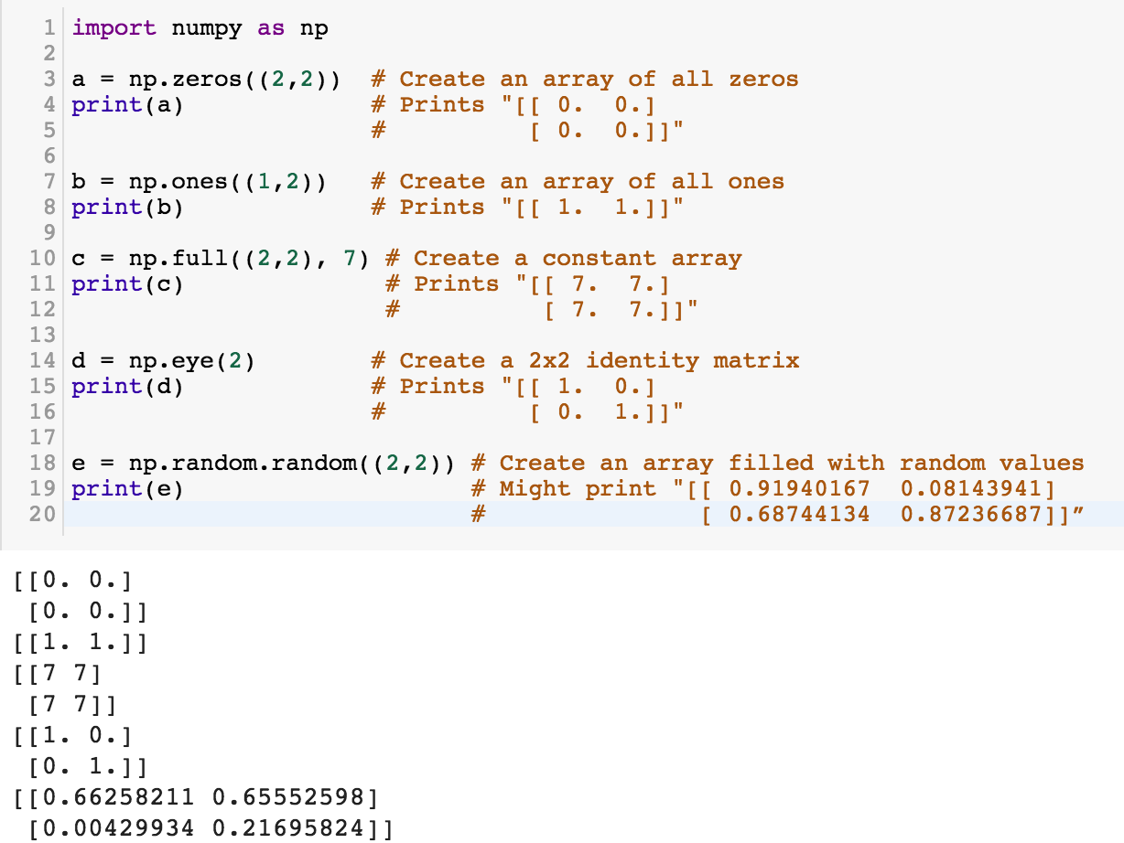
NumPy
NumPy
Source: http://cs231n.github.io/python-numpy-tutorial/
Notes:
import numpy as np
a = np.zeros((2,2)) # Create an array of all zeros
print(a) # Prints "[[ 0. 0.]
# [ 0. 0.]]"
b = np.ones((1,2)) # Create an array of all ones
print(b) # Prints "[[ 1. 1.]]"
c = np.full((2,2), 7) # Create a constant array
print(c) # Prints "[[ 7. 7.]
# [ 7. 7.]]"
d = np.eye(2) # Create a 2x2 identity matrix
print(d) # Prints "[[ 1. 0.]
# [ 0. 1.]]"
e = np.random.random((2,2)) # Create an array filled with random values
print(e) # Might print "[[ 0.91940167 0.08143941]
# [ 0.68744134 0.87236687]]”
Source: http://cs231n.github.io/python-numpy-tutorial/

Slide 86
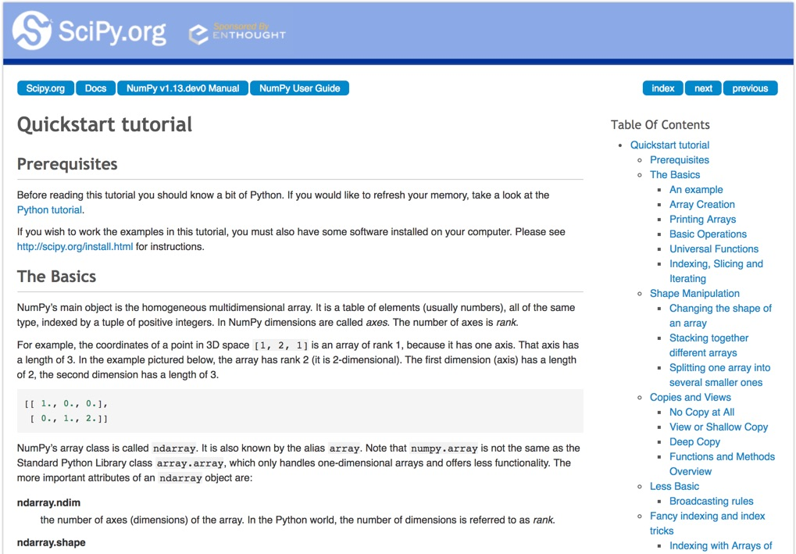
Numpy Quickstart Tutorial
https://docs.scipy.org/doc/numpy-dev/user/quickstart.html

Slide 87
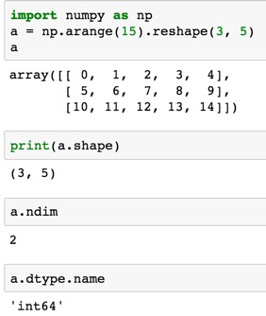
import numpy as np
a = np.arange(15).reshape(3, 5)
a.shape
a.ndim
a.dtype.name
Source: https://docs.scipy.org/doc/numpy-dev/user/quickstart.html
Notes:
Numpy Tutorial
Source: https://docs.scipy.org/doc/numpy-dev/user/quickstart.html
In [1]:
import numpy as np
a = np.arange(15).reshape(3, 5)
a
Out[1]:
array([[ 0, 1, 2, 3, 4],
[ 5, 6, 7, 8, 9],
[10, 11, 12, 13, 14]])
In [2]:
print(a.shape)
(3, 5)
In [3]:
a.ndim
Out[3]:
2
In [4]:
a.dtype.name
Out[4]:
'int64'
In [5]:
a.itemsize
Out[5]:
8
In [6]:
a.size
Out[6]:
15
In [7]:
type(a)
Out[7]:
numpy.ndarray
In [8]:
b = np.array([1, 2, 3])
In [9]:
b
Out[9]:
array([1, 2, 3])
In [10]:
type(b)
Out[10]:
numpy.ndarray

Slide 88
Matrix
Source: https://simple.wikipedia.org/wiki/Matrix_(mathematics)

Slide 89
NumPy ndarray: Multidimensional Array Object

Slide 90
NumPy ndarray
One-dimensional Array (1-D Array)
0 | 1 |  |  | n-1
1 | 2 | 3 | 4 | 5
Two-dimensional Array (2-D Array)
 | 0 | 1 |  |  | n-1
0 | 1 | 2 | 3 | 4 | 5
1 | 6 | 7 | 8 | 9 | 10
 | 11 | 12 | 13 | 14 | 15
m-1 | 16 | 17 | 18 | 19 | 20

Slide 91
import numpy as np a = np.array([1,2,3,4,5])
One-dimensional Array (1-D Array)
0 | 1 |  |  | n-1
1 | 2 | 3 | 4 | 5

Slide 92
a = np.array([[1,2,3,4,5],[6,7,8,9,10],[11,12,13,14,15],[16,17,18,19,20]])
Two-dimensional Array (2-D Array)
 | 0 | 1 |  |  | n-1
0 | 1 | 2 | 3 | 4 | 5
1 | 6 | 7 | 8 | 9 | 10
 | 11 | 12 | 13 | 14 | 15
m-1 | 16 | 17 | 18 | 19 | 20

Slide 93
import numpy as np a = np.array([[0, 1, 2, 3], [10, 11, 12, 13], [20, 21, 22, 23]])
a
0 | 1 | 2 | 3
10 | 11 | 12 | 13
20 | 21 | 22 | 23
Notes:
import numpy as np a = np.array([[0, 1, 2, 3], [10, 11, 12, 13], [20, 21, 22, 23]])
a

Slide 94
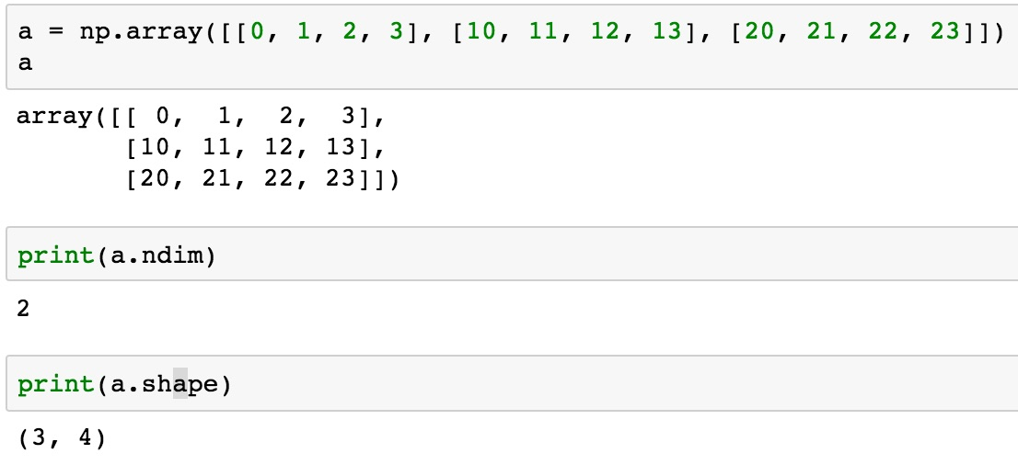
a = np.array([[0, 1, 2, 3], [10, 11, 12, 13], [20, 21, 22, 23]])
0 | 1 | 2 | 3
10 | 11 | 12 | 13
20 | 21 | 22 | 23

Slide 95
NumPy Basics: Arrays and Vectorized Computation
Source: https://www.safaribooksonline.com/library/view/python-for-data/9781449323592/ch04.html

Slide 96
NumPy Array
Source: https://www.safaribooksonline.com/library/view/python-for-data/9781449323592/ch04.html

Slide 97
Numpy Array
Source: https://www.safaribooksonline.com/library/view/python-for-data/9781449323592/ch04.html

Slide 98
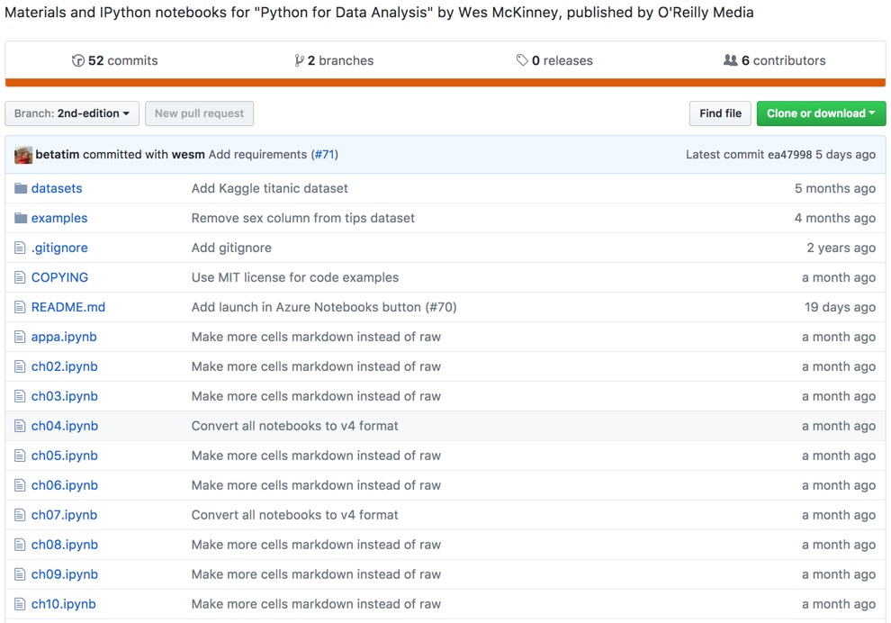
Wes McKinney (2017), "Python for Data Analysis: Data Wrangling with Pandas, NumPy, and IPython", 2nd Edition, O'Reilly Media.
https://github.com/wesm/pydata-book

Slide 99
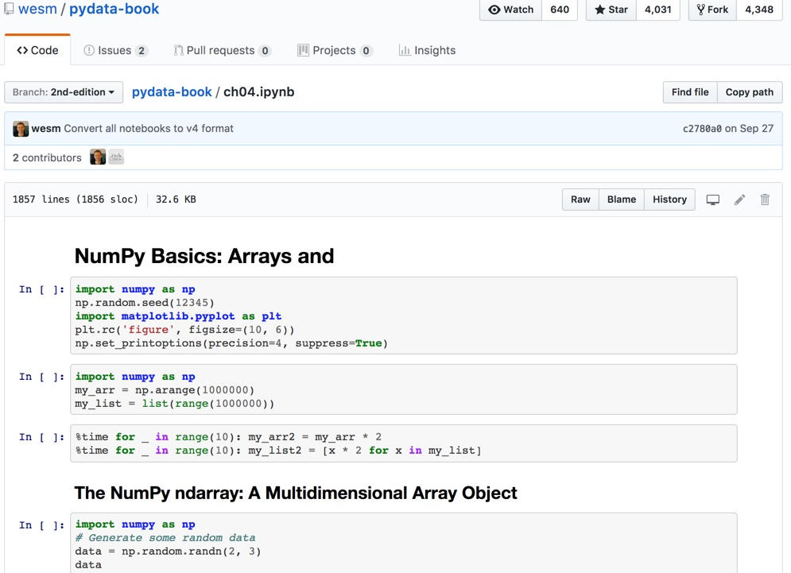
Wes McKinney (2017), "Python for Data Analysis: Data Wrangling with Pandas, NumPy, and IPython", 2nd Edition, O'Reilly Media.
Source: https://github.com/wesm/pydata-book/blob/2nd-edition/ch04.ipynb

Slide 100
Summary
Foundations of Big Data Analysis in Python
Python
Programming language
Numpy
Scientific computing

Slide 101
References
Wes McKinney (2017), "Python for Data Analysis: Data Wrangling with Pandas, NumPy, and IPython", 2nd Edition, O'Reilly Media. https://github.com/wesm/pydata-book
Ties de Kok (2017), Learn Python for Research, https://github.com/TiesdeKok/LearnPythonforResearch
Avinash Jain (2017), Introduction To Python Programming, Udemy, https://www.udemy.com/pythonforbeginnersintro/
Python Programming, https://pythonprogramming.net/
Python, https://www.python.org/
Python Programming Language, http://pythonprogramminglanguage.com/
Numpy, http://www.numpy.org/
Pandas, http://pandas.pydata.org/
Skikit-learn, http://scikit-learn.org/
Data School (2015), Machine learning in Python with scikit-learn, https://www.youtube.com/playlist?list=PL5-da3qGB5ICeMbQuqbbCOQWcS6OYBr5A
Jason Brownlee (2016), Your First Machine Learning Project in Python Step-By-Step, https://machinelearningmastery.com/machine-learning-in-python-step-by-step/
Min-Yuh Day (2020), Python 101, https://tinyurl.com/aintpupython101

