Slide 1
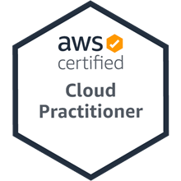
AWS Content Delivery Network: Lab 5 Using CloudFront as a CDN for a Website
雲端運算基礎入門 Introduction to Cloud Computing
Time: 2022/5/6 (Friday) 18:30-20:30
Place: 電資406室, 國立臺北大學 (NTPU)
戴敏育 副教授
Min-Yuh Day, Ph.D, Associate Professor
國立臺北大學 資訊管理研究所
Institute of Information Management, National Taipei University
https://web.ntpu.edu.tw/~myday
2022-05-06

Slide 2
戴敏育 博士 (Min-Yuh Day, Ph.D.)
1
國立臺北大學 資訊管理研究所 副教授
中央研究院 資訊科學研究所 訪問學人
國立臺灣大學 資訊管理 博士
Publications Co-Chairs, IEEE/ACM International Conference on Advances in Social Networks Analysis and Mining (ASONAM 2013- )
Program Co-Chair, IEEE International Workshop on Empirical Methods for Recognizing Inference in TExt (IEEE EM-RITE 2012- )
Publications Chair, The IEEE International Conference on Information Reuse and Integration for Data Science (IEEE IRI)

Slide 3
Outline
AWS Content Delivery Network: Lab 5 Using CloudFront as a CDN for a Website
AWS Academy Introduction to Cloud: Semester 1
Module 5 Content Delivery
Lab 5 - Amazon CloudFront

Slide 4
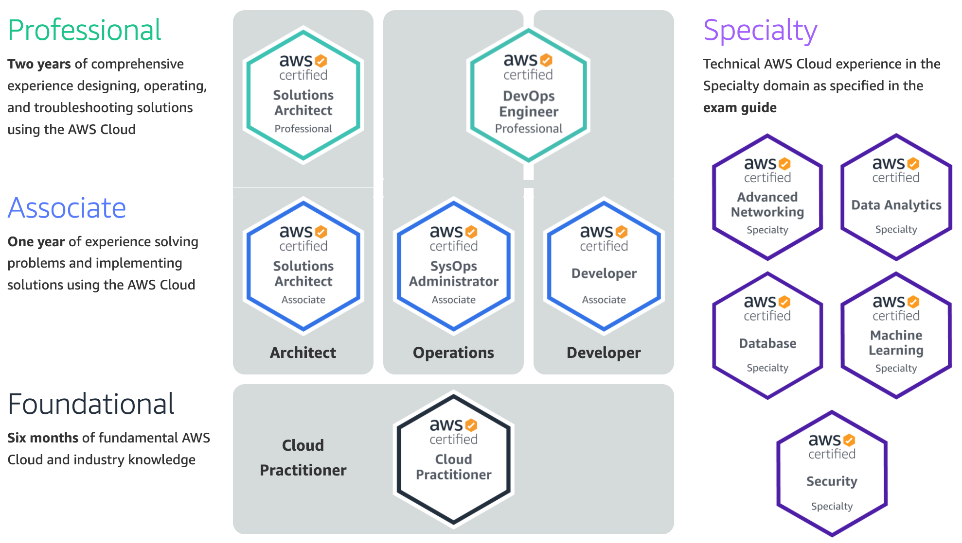
Available AWS Certifications
3
SAP
2
SAA
1
CLF
https://aws.amazon.com/certification/

Slide 5
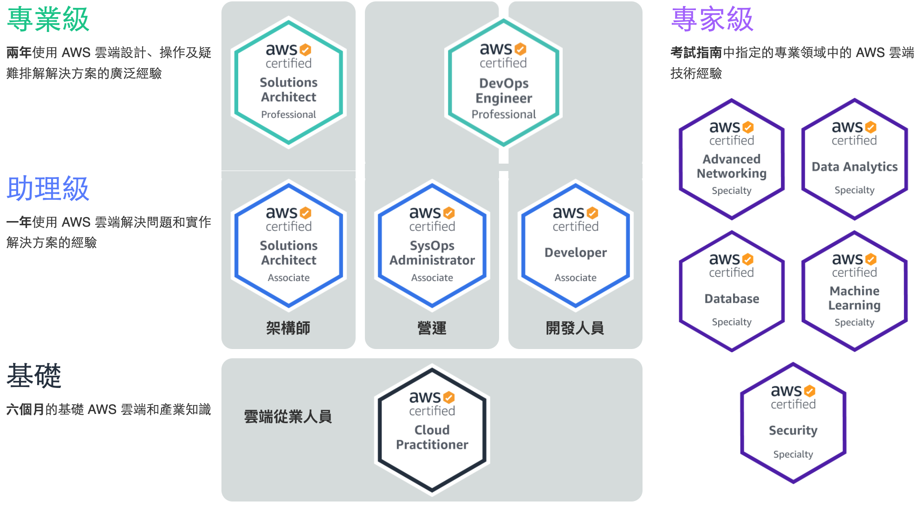
Available AWS Certifications
3
SAP
2
SAA
1
CLF
https://aws.amazon.com/certification/

Slide 6
企業雲端運算入門 (Foundation of Business Cloud Computing)
雲端概念概述 (Cloud Concepts Overview)
企業雲端運算入門 (Foundation of Business Cloud Computing) (BA4, NTPU) (Spring 2022)
(AWS Academy Cloud Foundations; ACF) (AWS Certified Cloud Practitioner)
(BA4, NTPU) (3 Credits, Elective) (U4010) (自主學習課程)(商業智慧與大數據分析學士學分學程)
(1102) (國立台北大學企管系4A, 4B) (選修3學分) (授課教師：謝榮桂，戴敏育) (2022.02 - 2022.06)
(週三 Wed, 6, 7, 8, 14:10-17:00) (台北大學三峽校區 商3F10)
謝榮桂 (Jung-Kuei Hsieh), 戴敏育 (Min-Yuh Day)
National Taipei University
國立臺北大學
2022-02-23

Slide 8
教學目標
本課程主要介紹亞馬遜公司的雲端運算服務 Amazon Web Services (AWS)， 對於想要全面瞭解企業雲端運算概念的同學， 本課程將詳細介紹 雲概念、 AWS 核心服務、 安全性、 架構、 定價和相關支援等服務， 並以通過認證 AWS Certified Cloud Practitioner為目標。

Slide 9
Course Objectives
This course introduces Amazon Web Services (AWS), the cloud computing service of Amazon.
For students who want to fully understand the concept of enterprise cloud computing, this course will introduce the AWS Academy Cloud Foundations.
Topics include Cloud Concepts Overview, Cloud Economics and Billing, AWS Global Infrastructure Overview, AWS Cloud Security, Networking and Content Delivery, Cloud Compute, Cloud Storage, Cloud Databases, Cloud Architecture, Cloud Automatic Scaling and Monitoring.
The course objective is training students to pass the certification of AWS Certified Cloud Practitioner.

Slide 10
內容綱要
說明如何使用 AWS 帳戶的最佳實務
說明AWS架構完善的框架和設計原則
說明AWS高可用性和可靠性
描述AWS設計決策的業務影響
描述AWS如何設置組織結構以簡化帳單和提高帳戶可見性
說明AWS替代支援選項和功能

Slide 11
Course Outline
Cloud Concepts Overview
Cloud Economics and Billing
AWS Global Infrastructure Overview
AWS Cloud Security
Networking and Content Delivery
Cloud Compute
Cloud Storage
Cloud Databases
Cloud Architecture
Cloud Automatic Scaling and Monitoring

Slide 12
課程大綱 (Syllabus)
週次 (Week) 日期 (Date) 內容 (Subject/Topics)
1 2022/02/23 雲端概念概述 (Cloud Concepts Overview)
2 2022/03/02 雲端經濟與計費 (Cloud Economics and Billing)
3 2022/03/09 AWS全球基礎設施概述 (AWS Global Infrastructure Overview)
4 2022/03/16 AWS雲端安全 (AWS Cloud Security)
5 2022/03/23 網路和內容交付 (Networking and Content Delivery)
6 2022/03/30 雲端計算 (Cloud Compute)

Slide 13
課程大綱 (Syllabus)
週次 (Week) 日期 (Date) 內容 (Subject/Topics)
7 2022/04/06 放假一天 (Make-up Holiday, No Classes)
8 2022/04/13 雲端儲存 (Cloud Storage)
9 2022/04/20 雲端數據庫 (Cloud Databases)
10 2022/04/27 雲端架構 (Cloud Architecture)
11 2022/05/04 雲端自動擴展和監控 (Cloud Automatic Scaling and Monitoring)
12 2022/05/11 學生自主學習 (Self-learning)

Slide 14
課程大綱 (Syllabus)
週次 (Week) 日期 (Date) 內容 (Subject/Topics)
13 2022/05/18 學生自主學習 (Self-learning)
14 2022/05/25 雲端專案成果報告與討論 (Cloud Project Presentation and Discussion)
15 2022/06/01 學生自主學習 (Self-learning)
16 2022/06/08 期末專案成果報告 (Final Project Presentation)
17 2022/06/15 學生自主學習 (Self-learning)
18 2022/06/22 學生自主學習 (Self-learning)

Slide 15
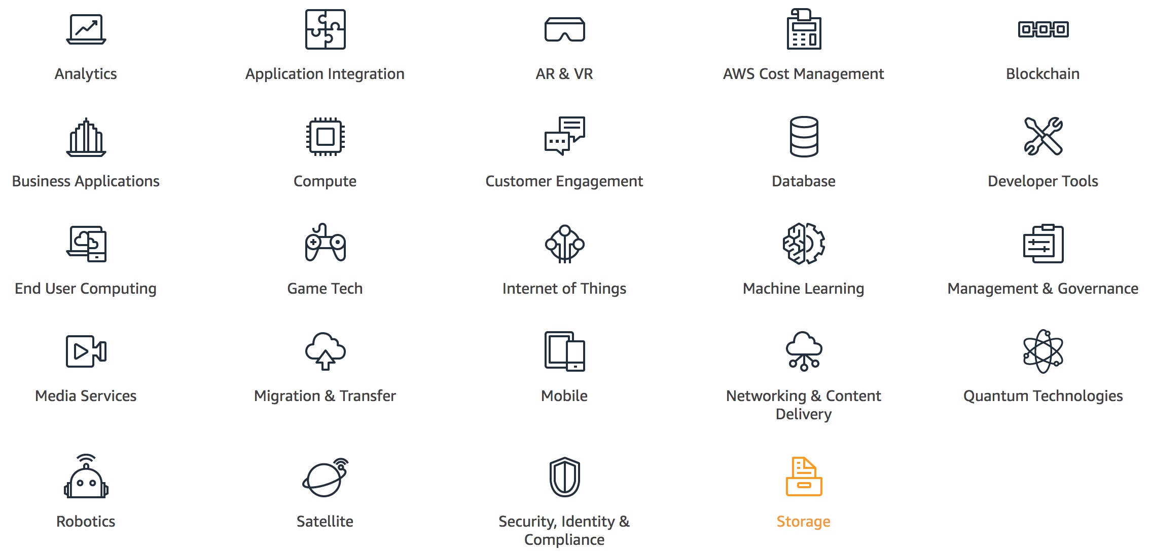
AWS Products and Services
Source: https://aws.amazon.com/

Slide 16
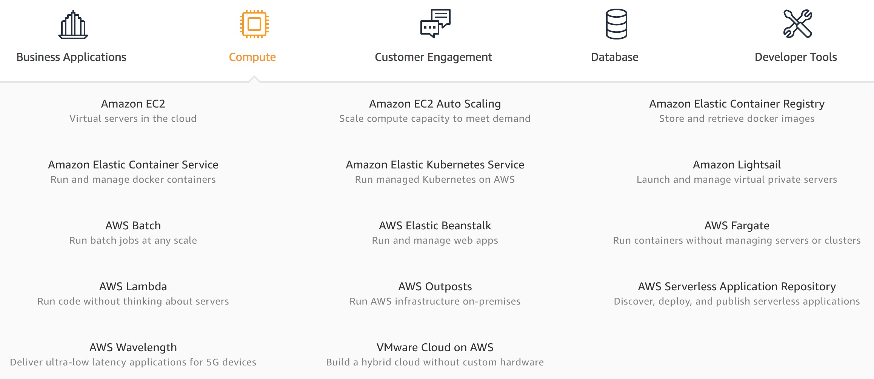
AWS Compute
Source: https://aws.amazon.com/

Slide 17
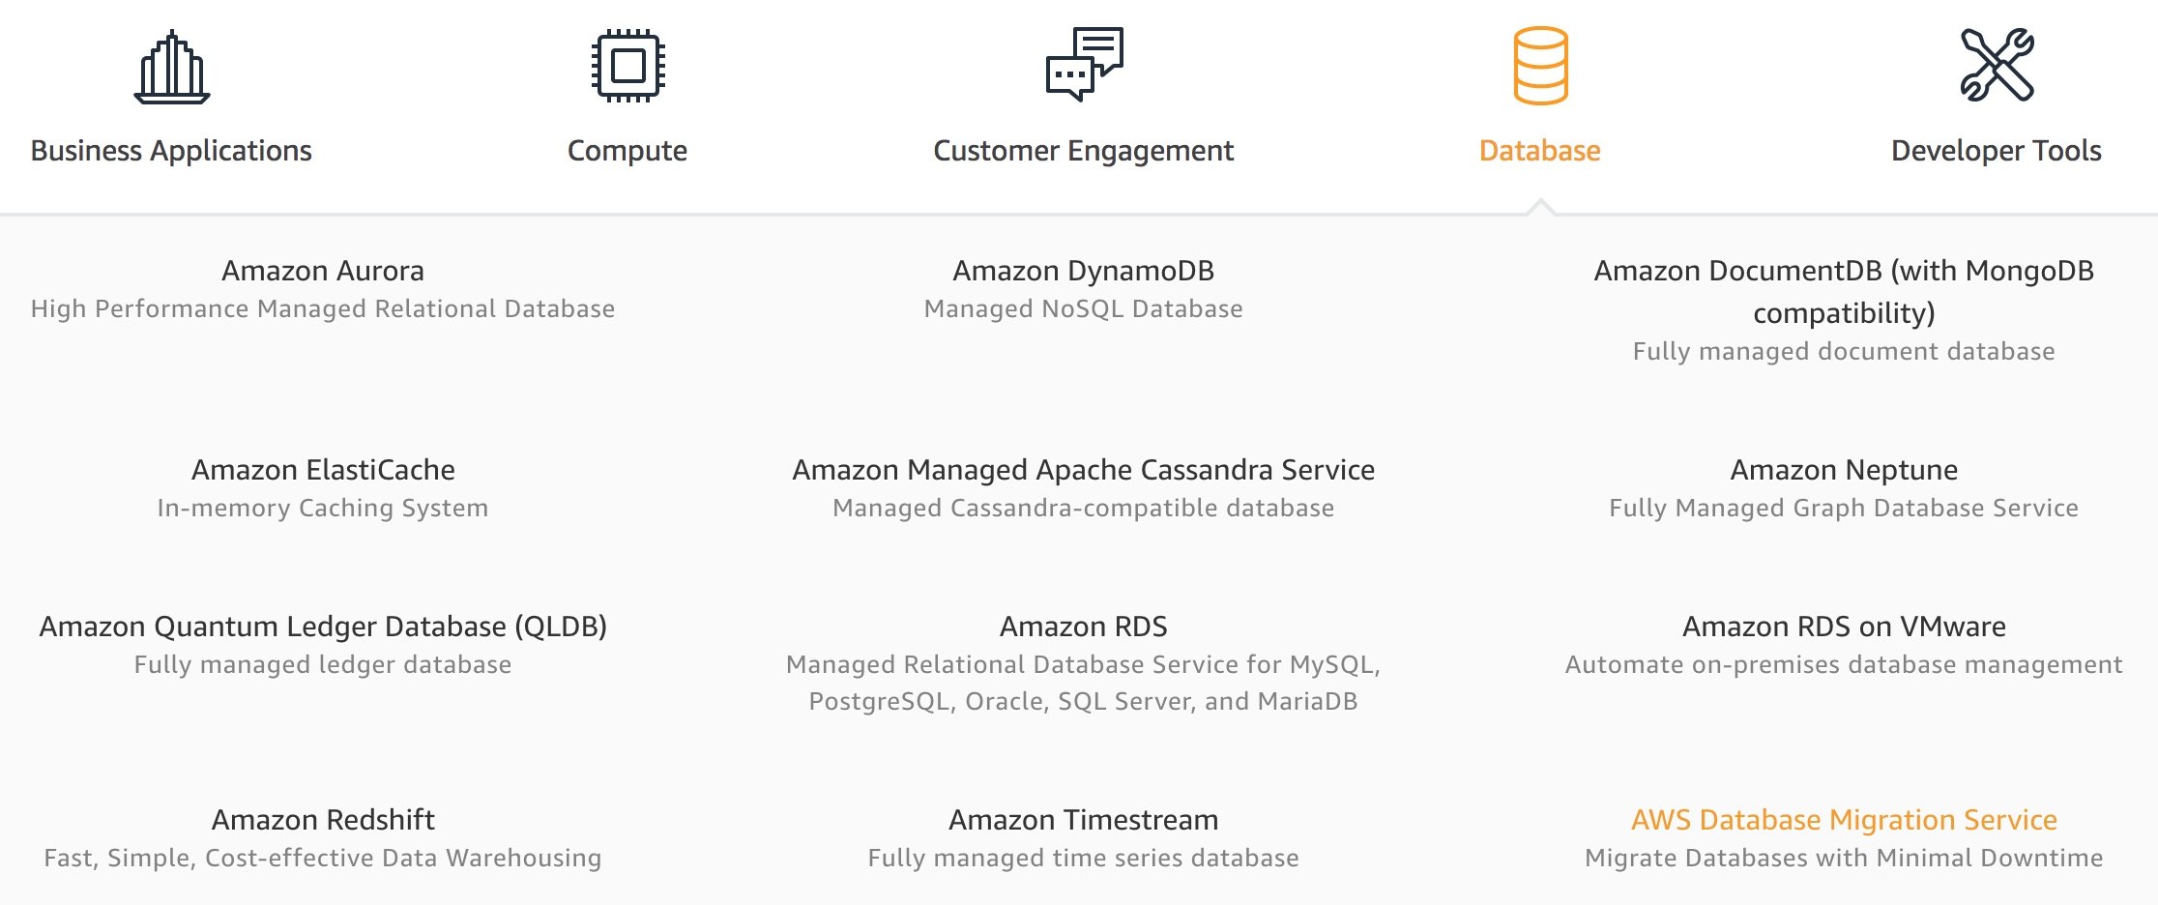
AWS Database
Source: https://aws.amazon.com/

Slide 18
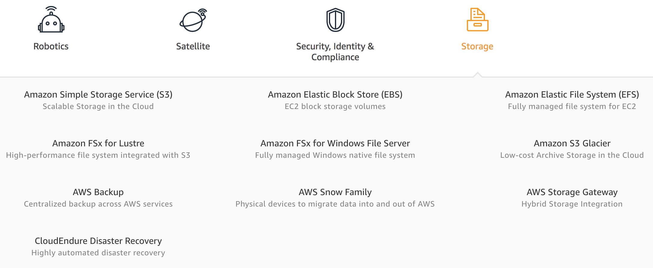
AWS Storage
Source: https://aws.amazon.com/

Slide 19
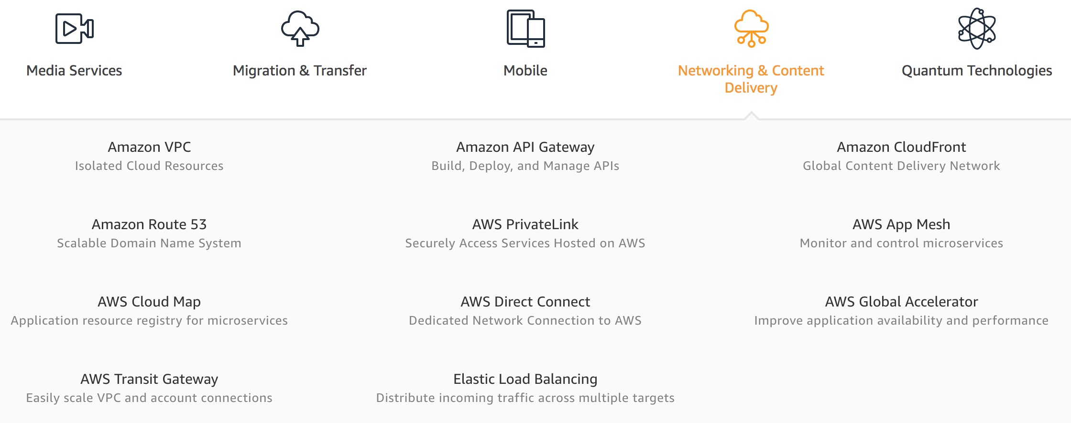
AWS Networking & Content Dilivery
Source: https://aws.amazon.com/

Slide 20
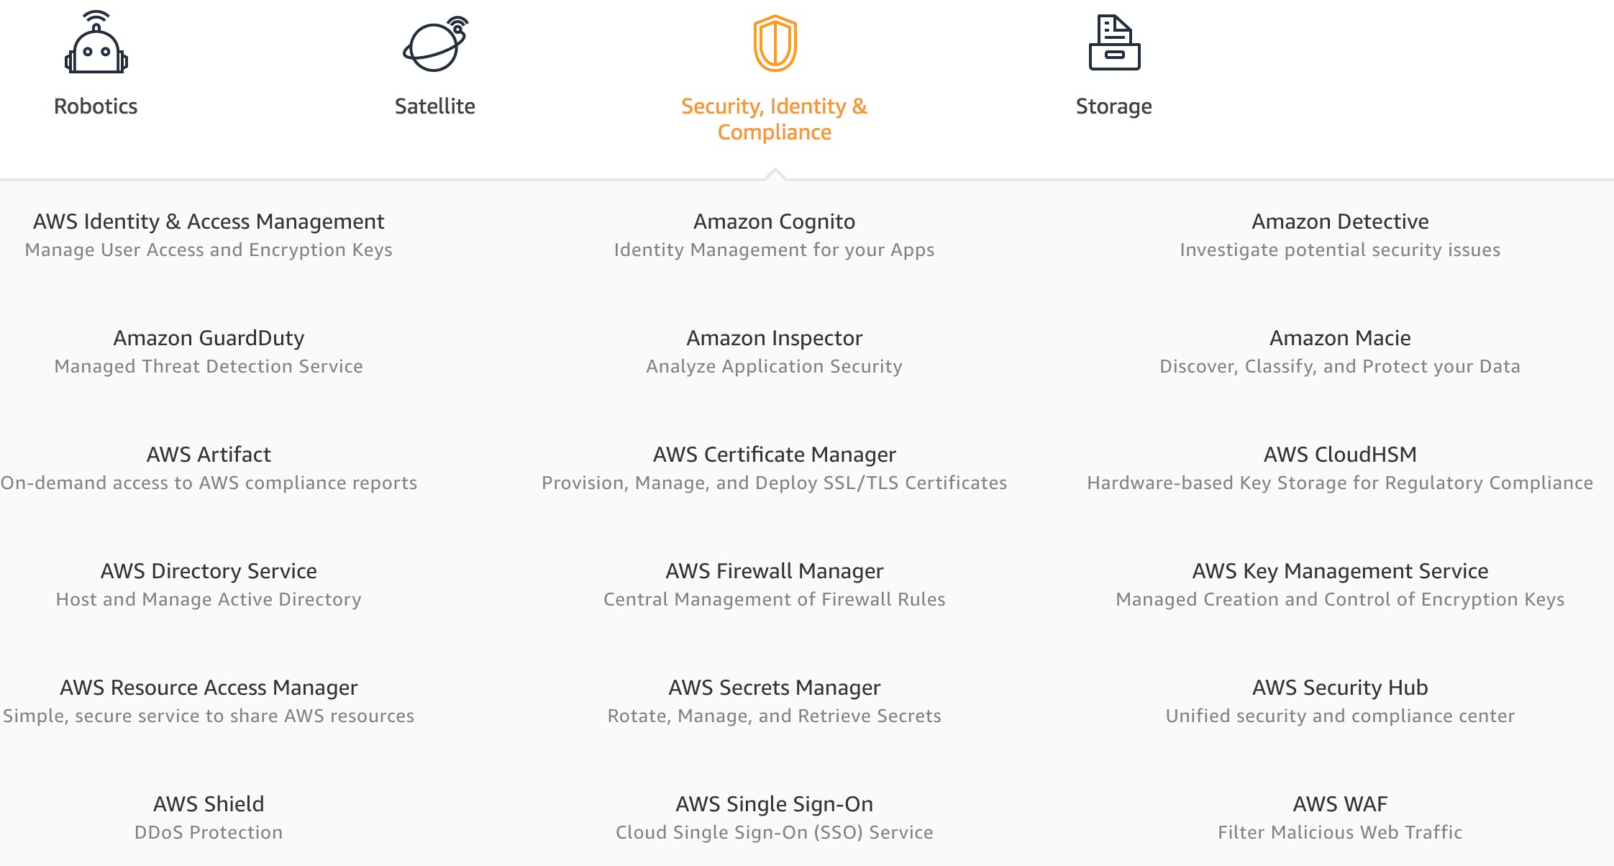
AWS Security, Identity & Compliance
Source: https://aws.amazon.com/

Slide 21
AWS Cost Management
Source: https://aws.amazon.com/

Slide 22
AWS Content Delivery Network: Lab 5 Using CloudFront as a CDN for a Website

Slide 23
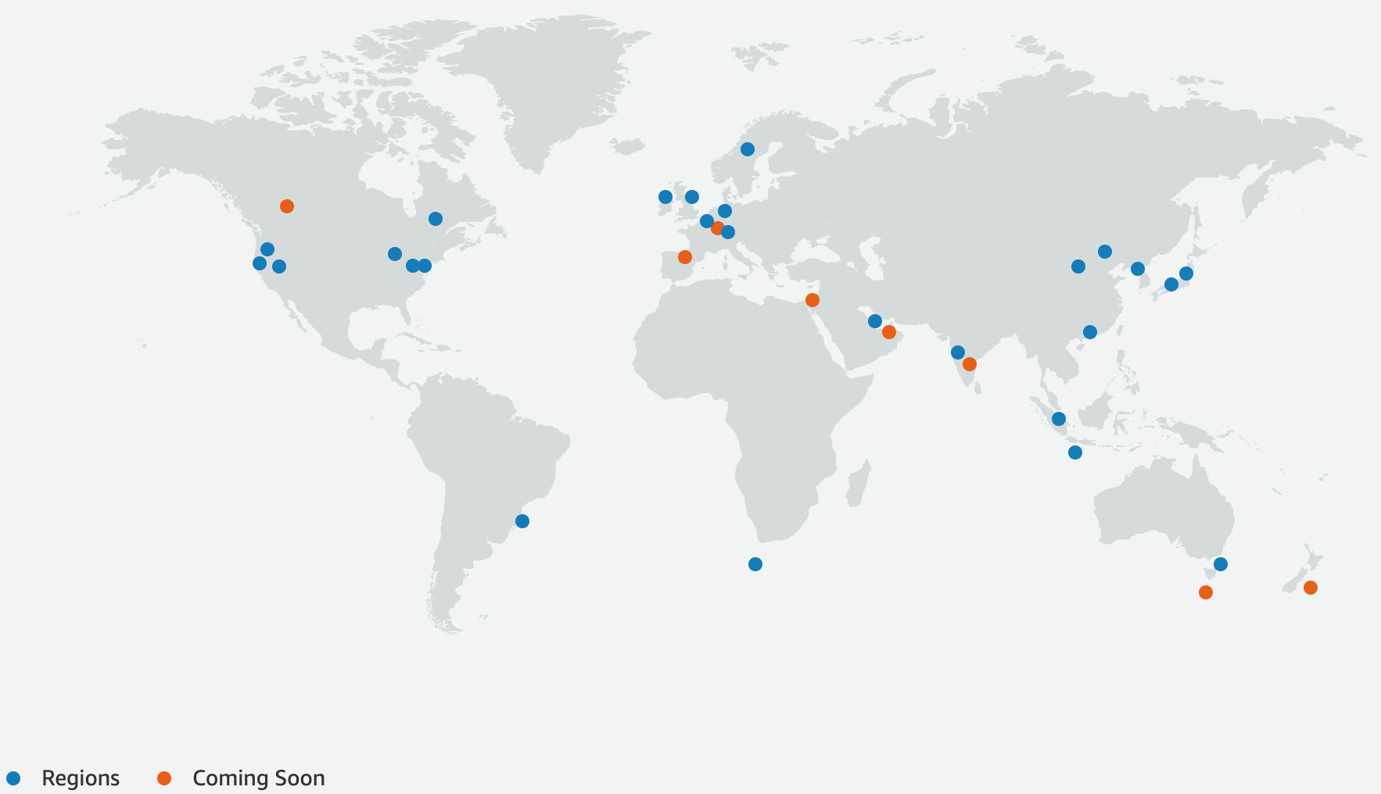
AWS Global Cloud Infrastructure
Source: https://aws.amazon.com/about-aws/global-infrastructure/

Slide 24
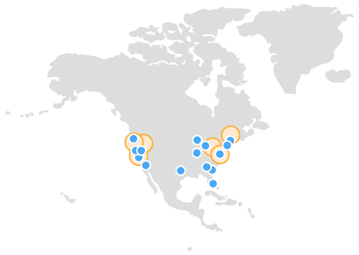
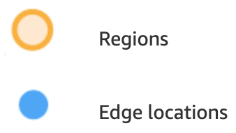
AWS Global Cloud Infrastructure Regions and Availability Zones
US West (Oregon) Region Availability Zones: 4 Launched 2011 Local Zones: 7 Launched 2019
US East (Northern Virginia) Region Availability Zones: 6 Launched 2006
Local Zones: 10 Launched 2020
Source: https://aws.amazon.com/about-aws/global-infrastructure/

Slide 25
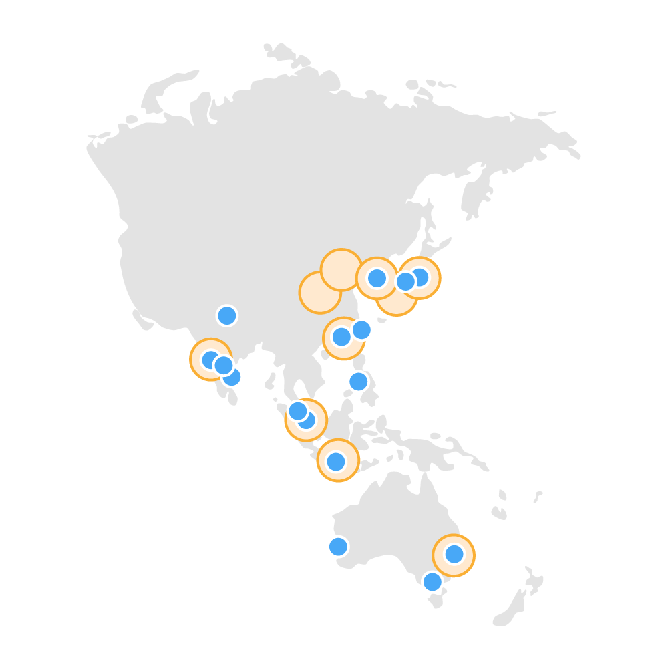
AWS Global Cloud Infrastructure Regions and Availability Zones
Asia Pacific (Tokyo) Region Availability Zones: 4 Launched 2011
Asia Pacific (Singapore) Region Availability Zones: 3 Launched 2010
Asia Pacific (Sydney) Region Availability Zones: 3 Launched 2012
Source: https://aws.amazon.com/about-aws/global-infrastructure/

Slide 26
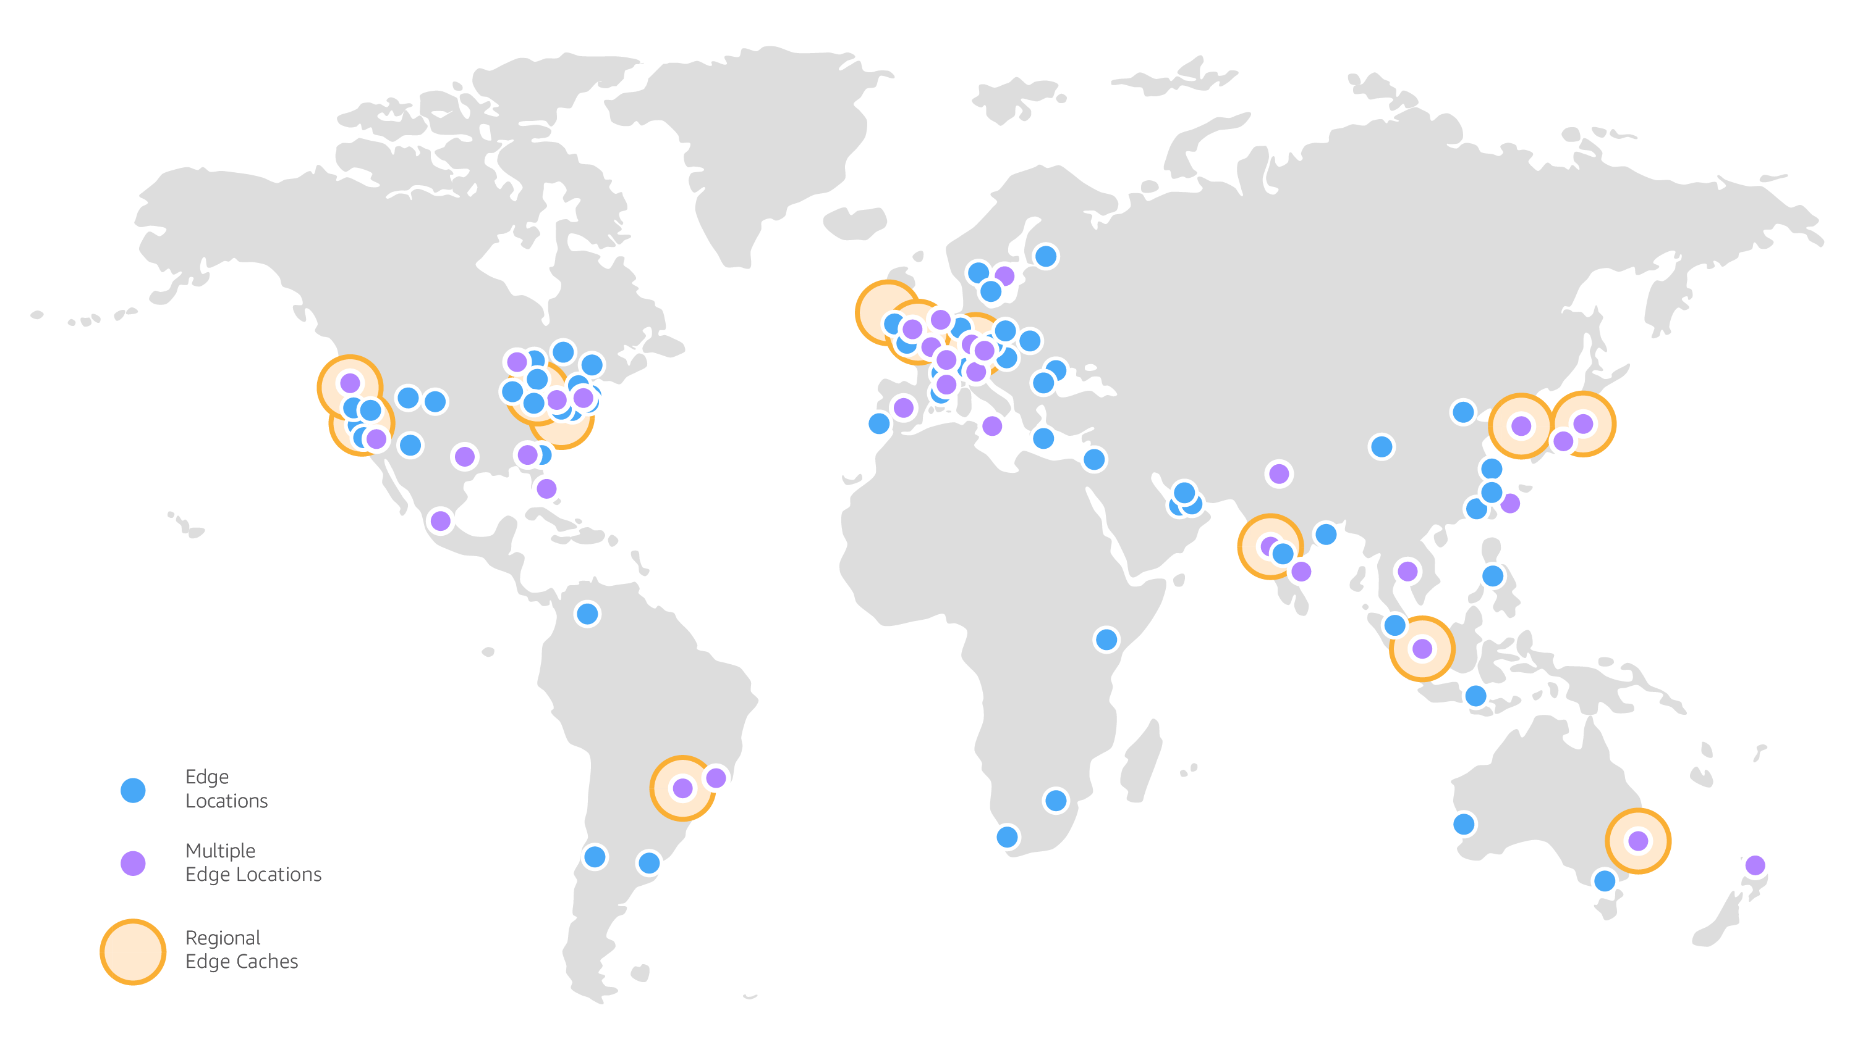
Amazon CloudFront Global Edge Network: Edge locations, Regional Edge caches
Source: https://aws.amazon.com/cloudfront/features/

Slide 27
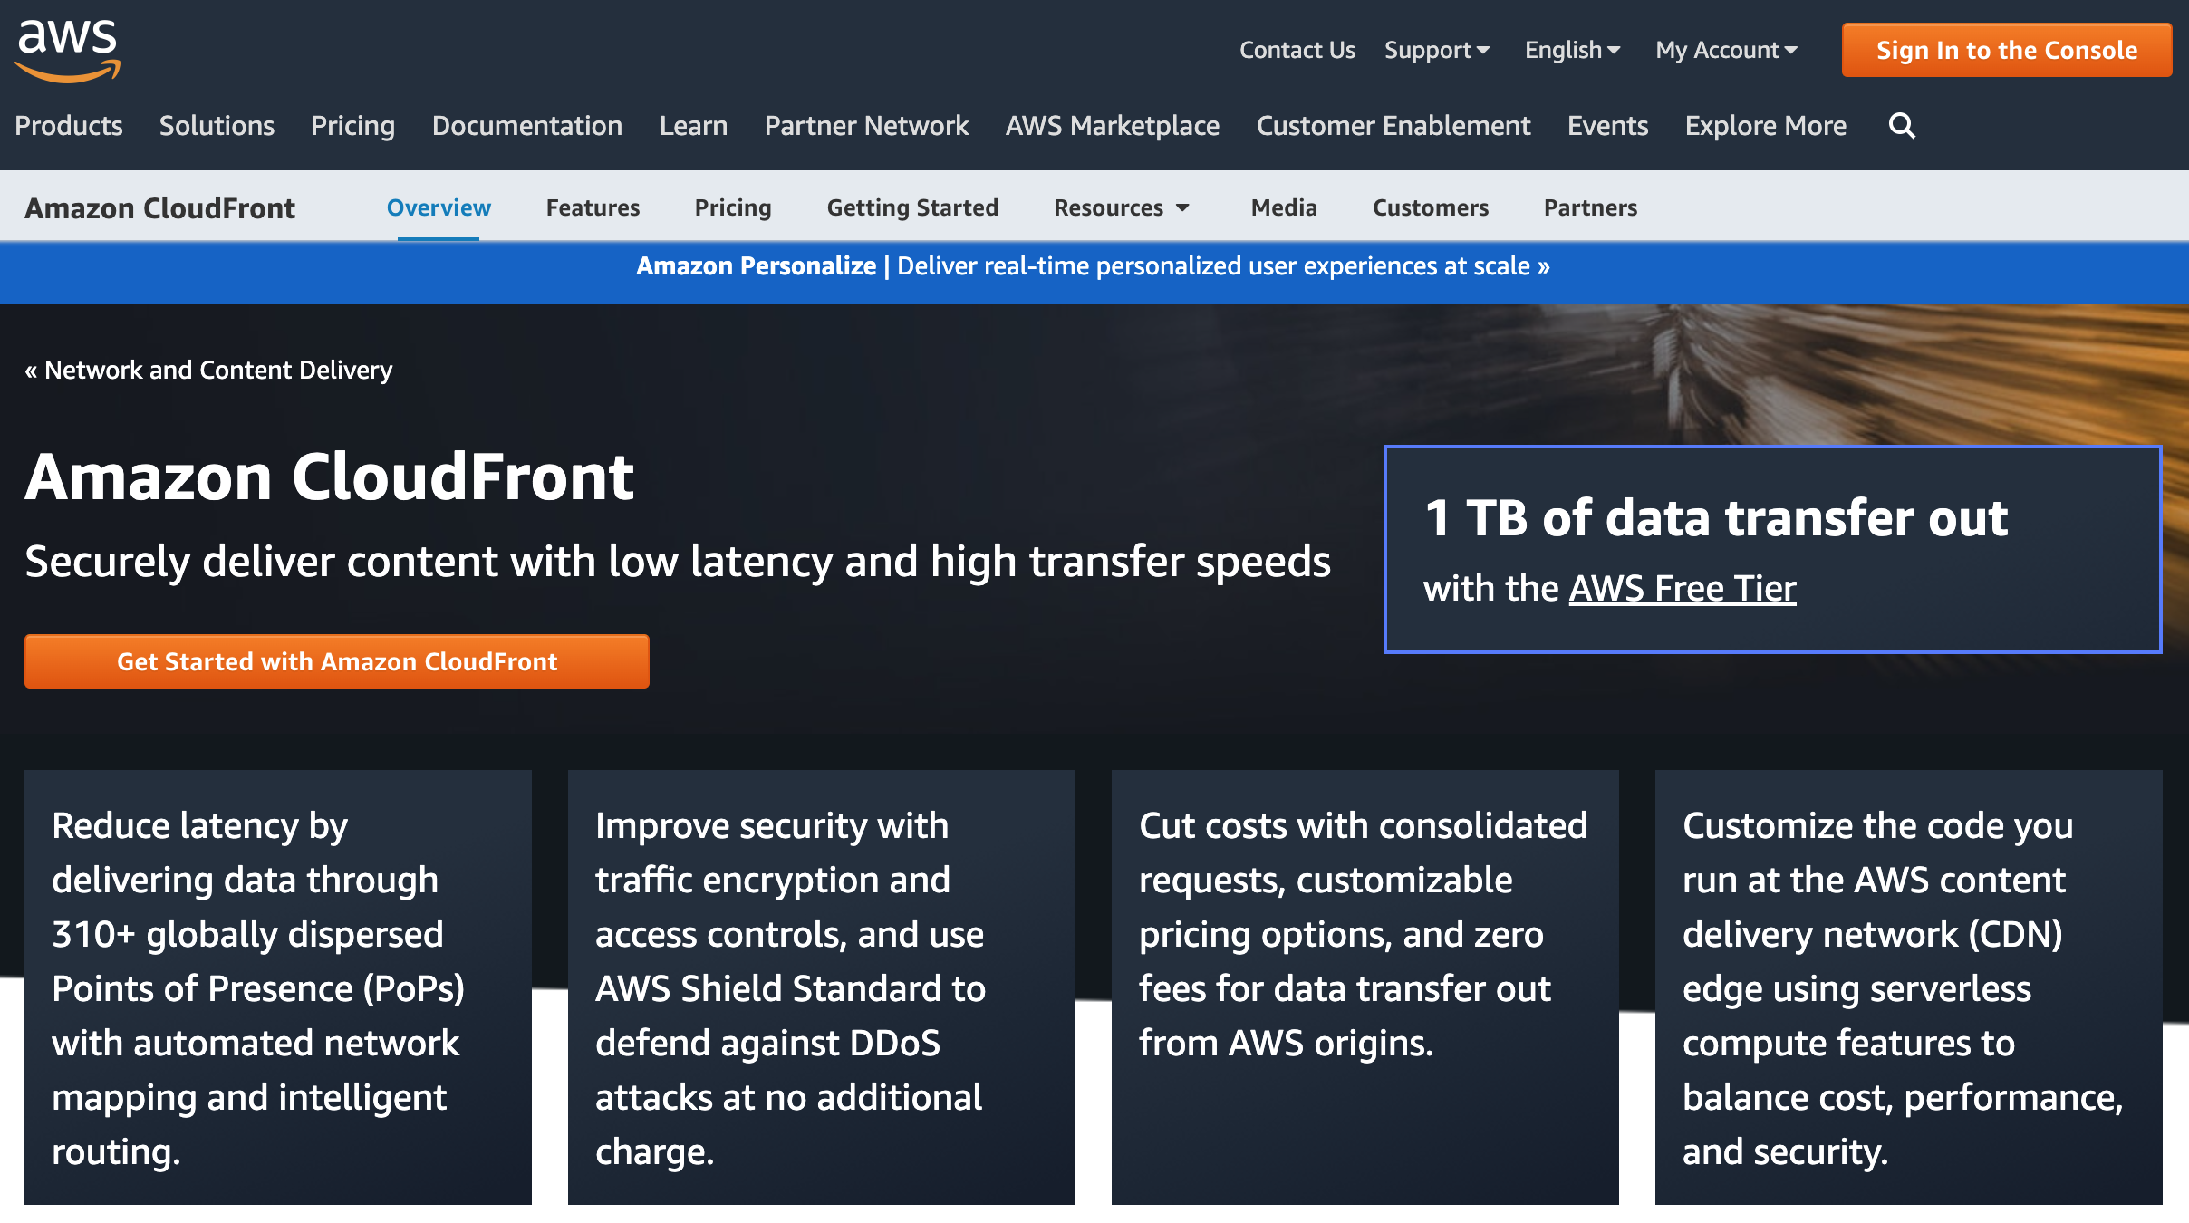
Amazon CloudFront
https://aws.amazon.com/cloudfront/

Slide 28
AWS Academy Introduction to Cloud: Semester 1 [18745] Module 5 Content Delivery: Lab 5 - Amazon CloudFront
Module 5 Lab: Using CloudFront as a CDN for a Website
Lab overview
In this lab, you will use Amazon CloudFront as a content delivery network (CDN) for a website that is stored in the Amazon Simple Storage Service (Amazon S3).
Duration
This lab requires approximately 40 minutes to complete.
Source: AWS Academy Introduction to Cloud: Semester 1, https://awsacademy.instructure.com/courses/18745

Slide 29
Module 5 Lab: Using CloudFront as a CDN for a Website
Access the AWS Management Console
Task 1. Create an S3 bucket using the AWS CLI
Task 2. Add a bucket policy
Task 3. Upload an HTML document
Task 4. Test your website
Task 5. Create a CloudFront distribution to serve your website
Lab complete
Source: AWS Academy Introduction to Cloud: Semester 1, https://awsacademy.instructure.com/courses/18745

Slide 30
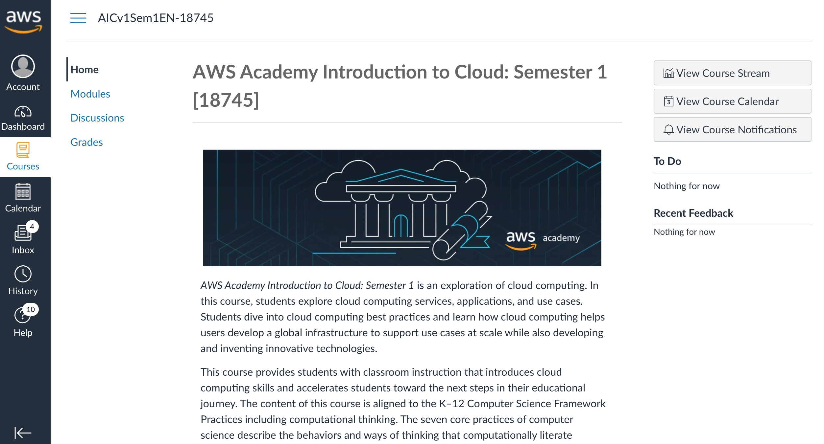
AWS Academy Introduction to Cloud: Semester 1 [18745] AWS AICv1Sem1EN
https://awsacademy.instructure.com/courses/18745
Source: AWS Academy Introduction to Cloud: Semester 1, https://awsacademy.instructure.com/courses/18745

Slide 31
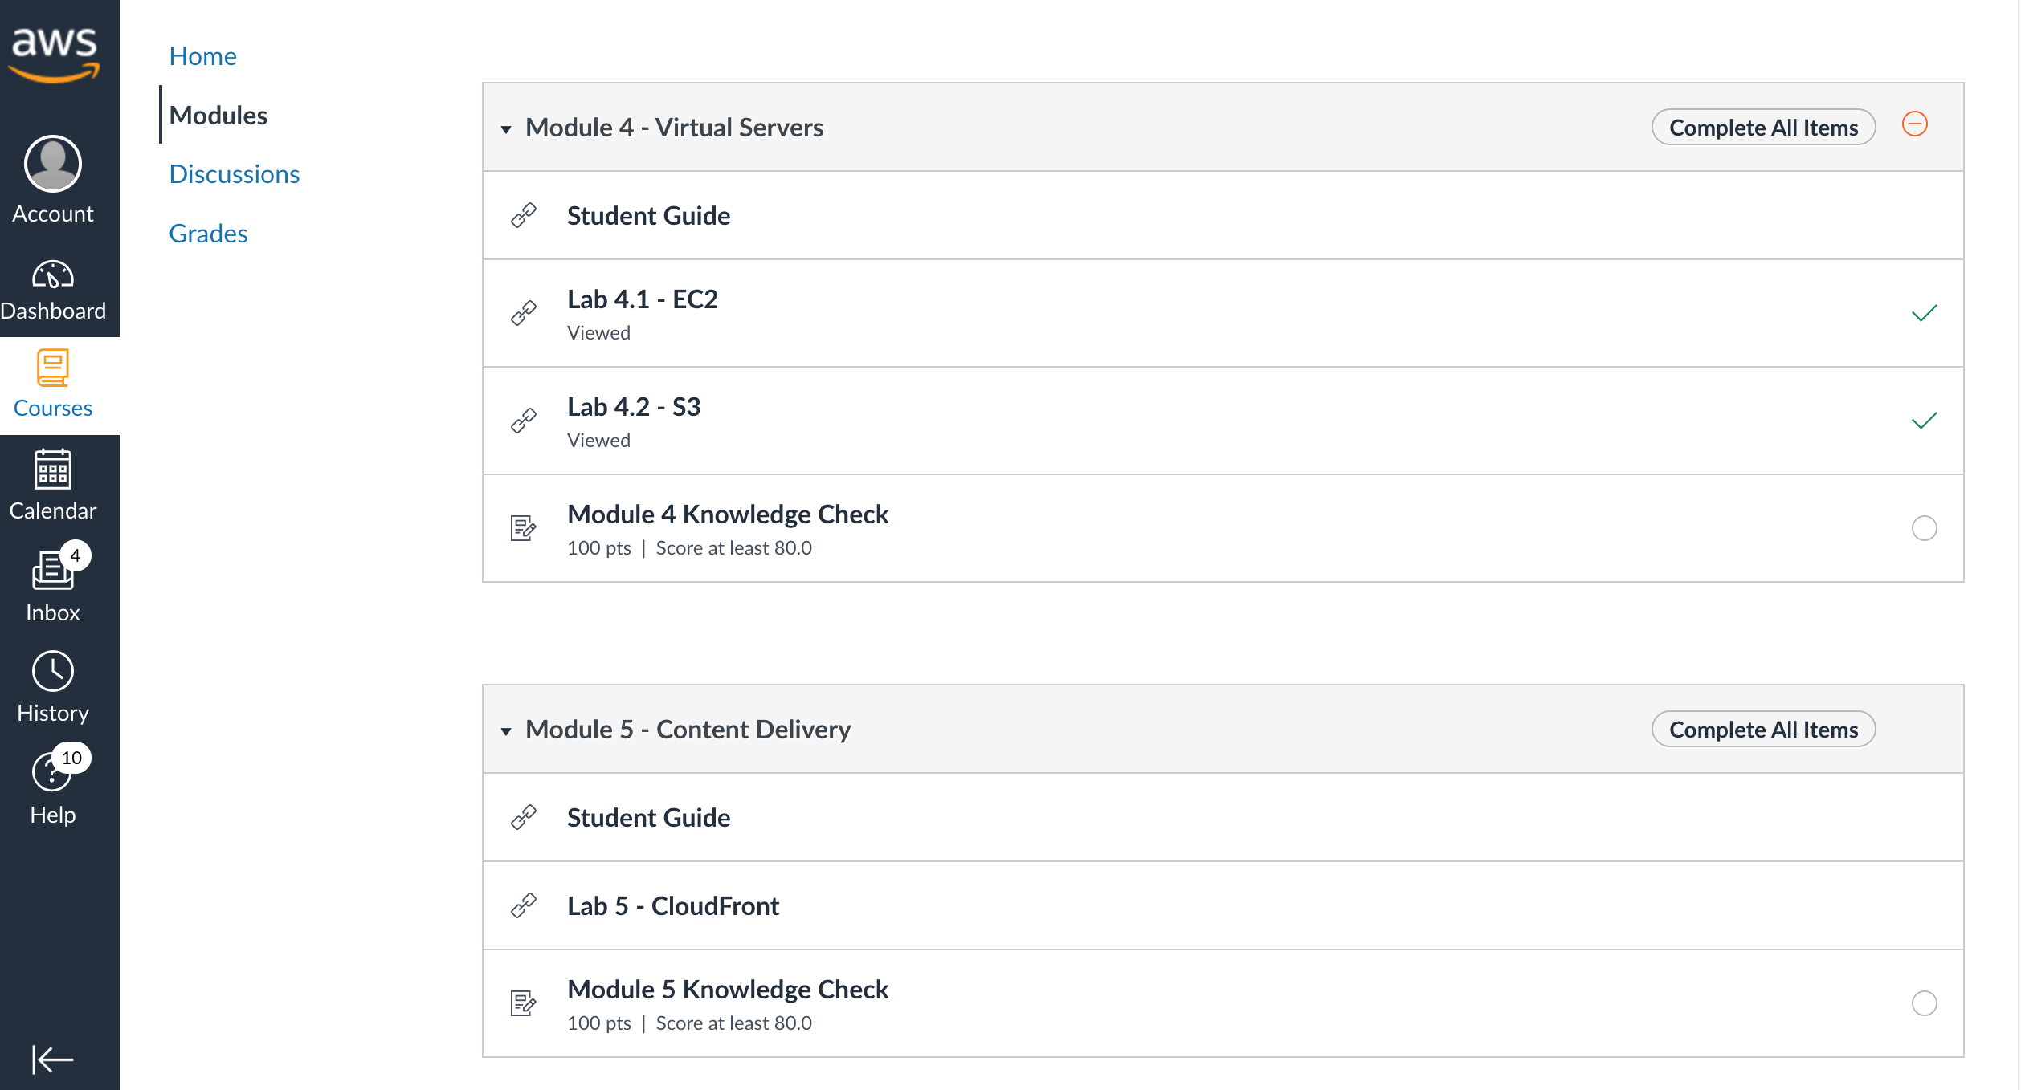
AWS Academy Introduction to Cloud: Semester 1 [18745] Module 5 Content Delivery: Lab 5 - Amazon CloudFront
Source: AWS Academy Introduction to Cloud: Semester 1, https://awsacademy.instructure.com/courses/18745

Slide 32
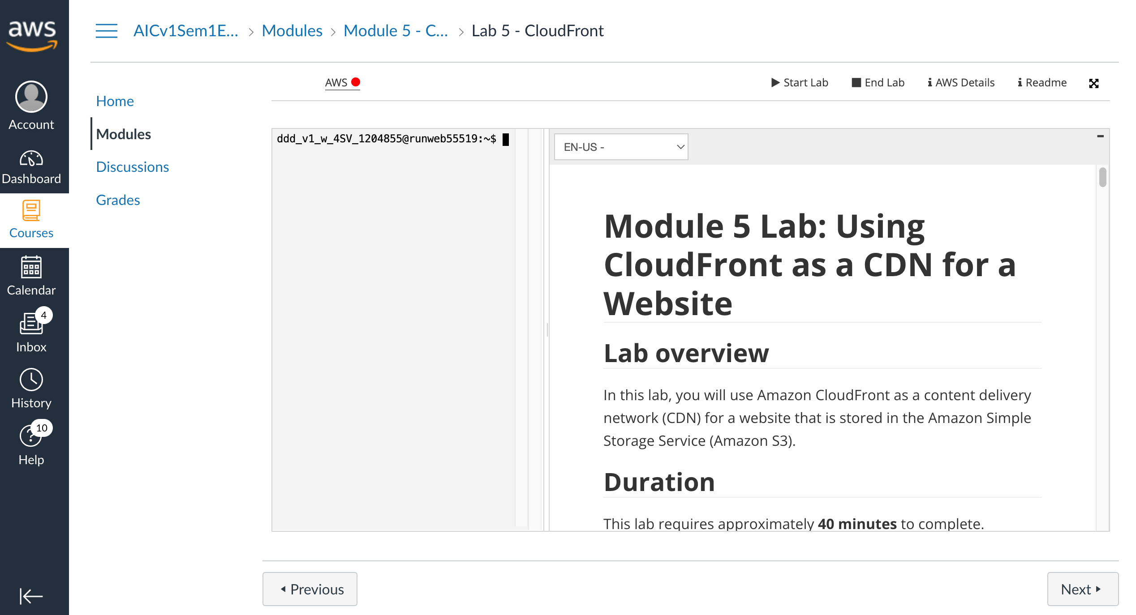
AWS Academy Introduction to Cloud: Semester 1 [18745] Module 5 Content Delivery: Lab 5 - Amazon CloudFront
https://awsacademy.instructure.com/courses/18745/modules/items/1536169
Source: AWS Academy Introduction to Cloud: Semester 1, https://awsacademy.instructure.com/courses/18745

Slide 33
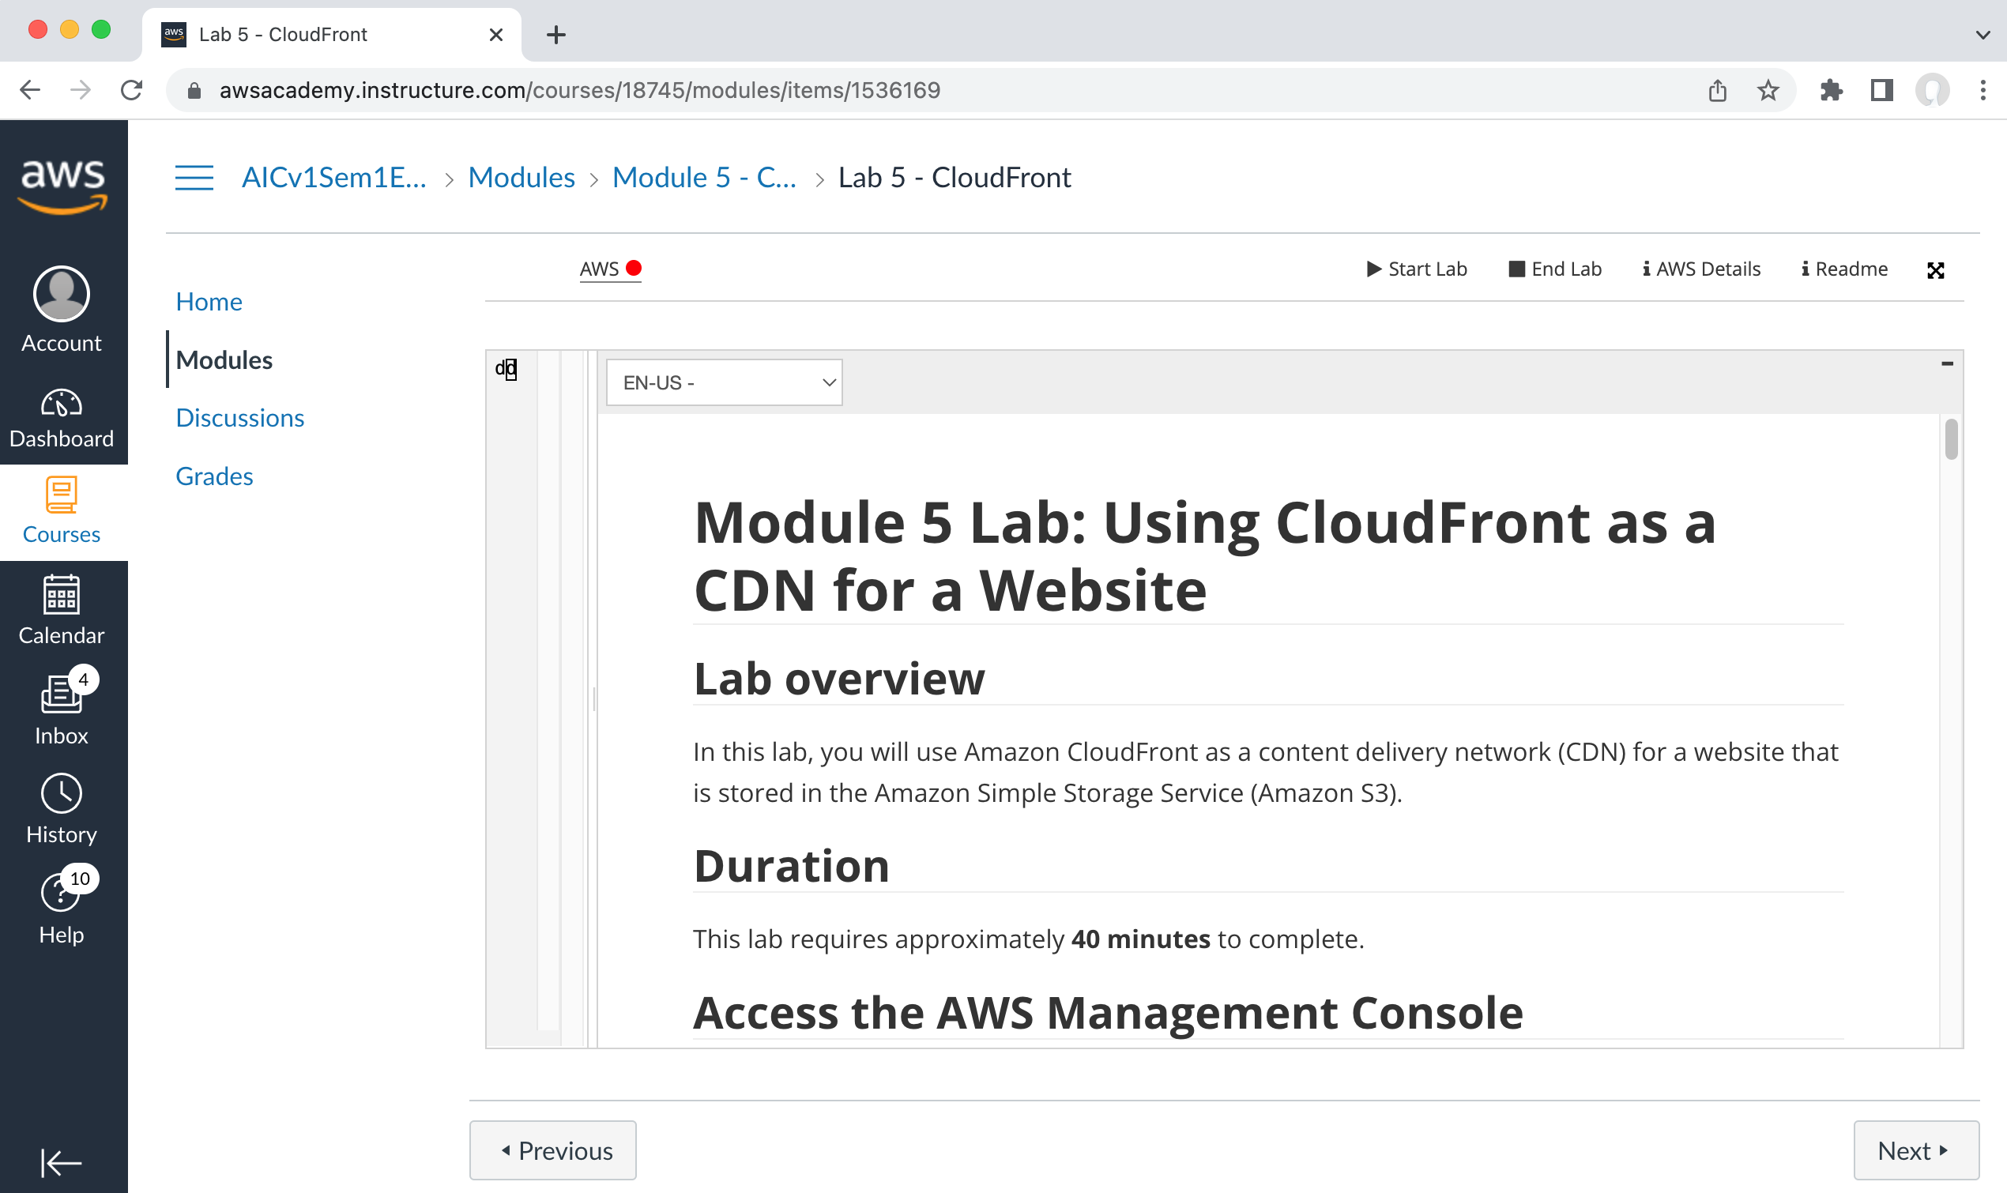
AWS Academy Introduction to Cloud: Semester 1 [18745] Module 5 Content Delivery: Lab 5 - Amazon CloudFront
https://awsacademy.instructure.com/courses/18745/modules/items/1536169
Source: AWS Academy Introduction to Cloud: Semester 1, https://awsacademy.instructure.com/courses/18745

Slide 34
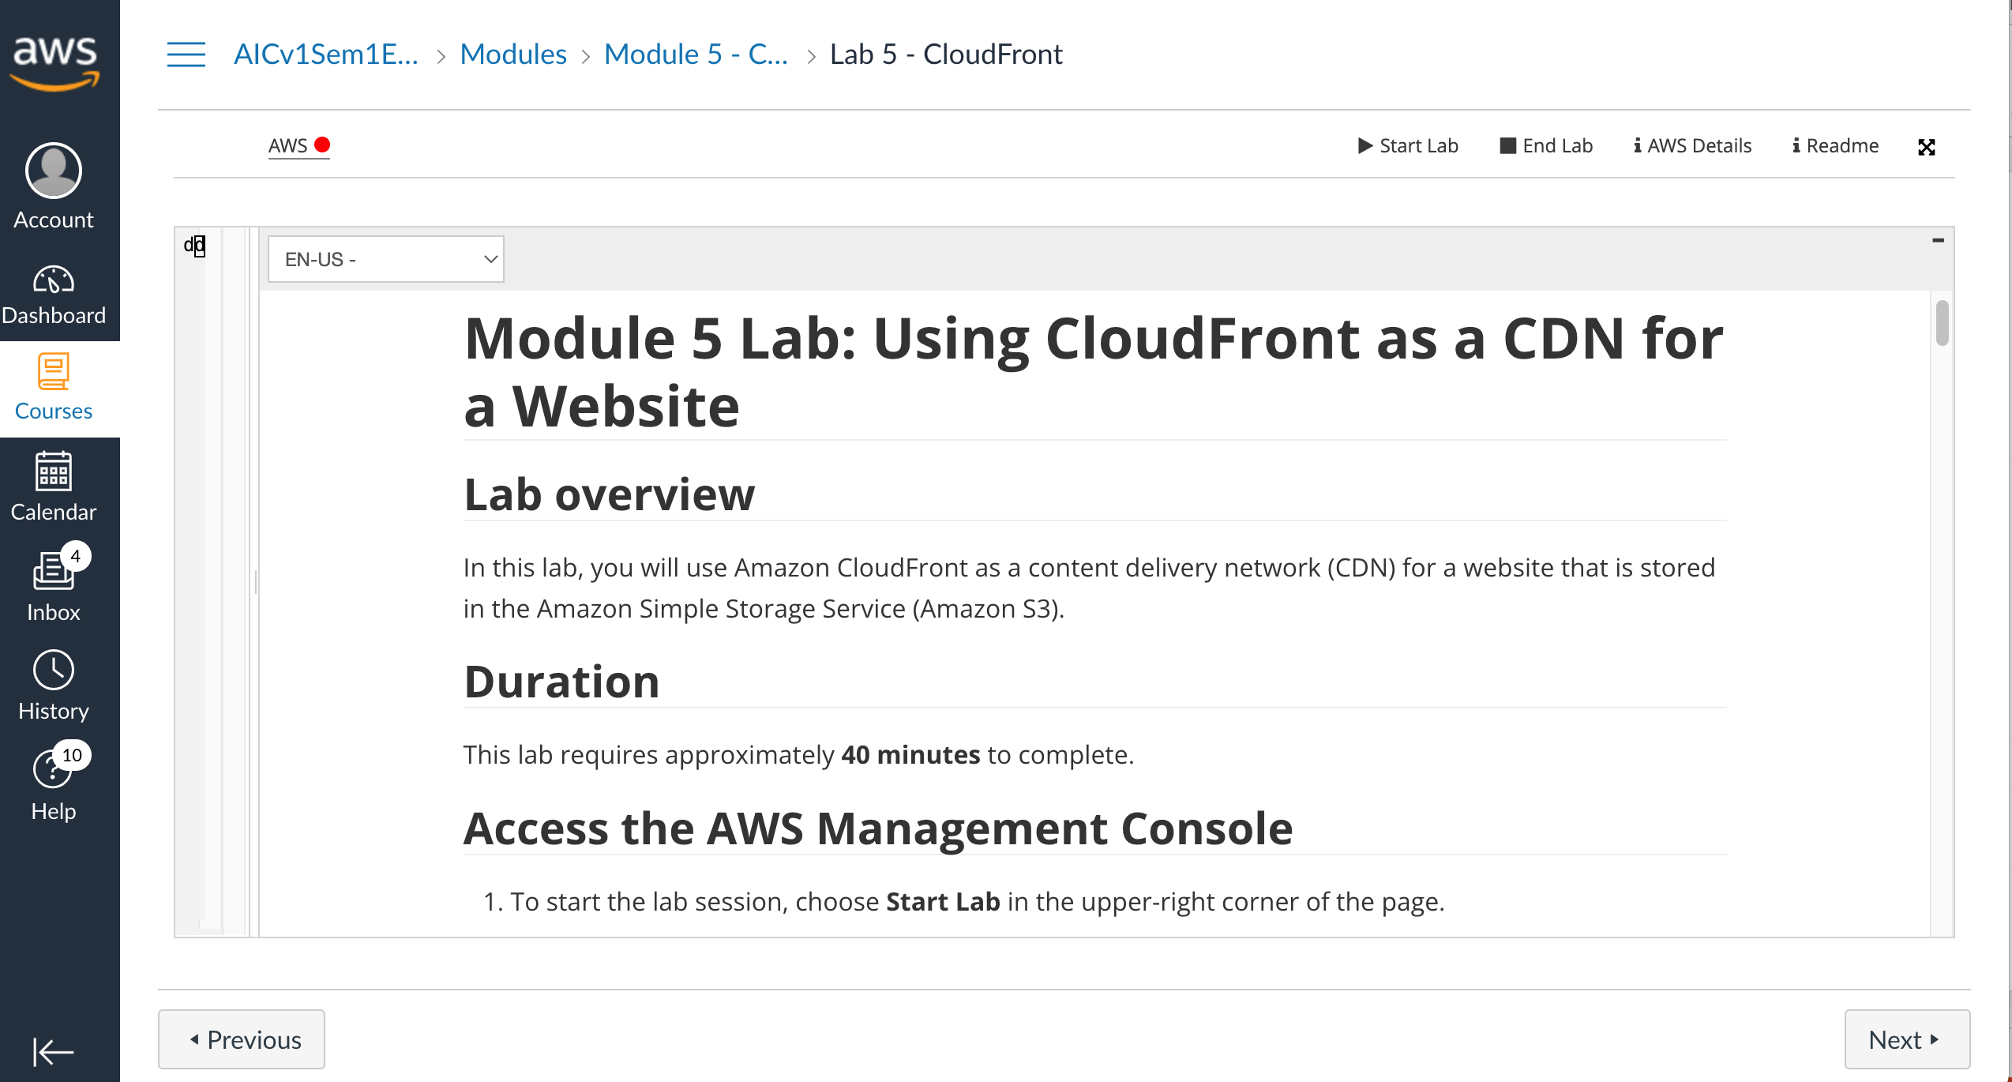
AWS Academy Introduction to Cloud: Semester 1 [18745] Module 5 Content Delivery: Lab 5 - Amazon CloudFront
Source: AWS Academy Introduction to Cloud: Semester 1, https://awsacademy.instructure.com/courses/18745

Slide 35
AWS Academy Introduction to Cloud: Semester 1 Module 5 Content Delivery: Lab 5 - Amazon CloudFront
Access the AWS Management Console
To start the lab session, choose Start Lab in the upper-right corner of the page.
The lab session starts.
A timer displays in the upper-right corner of the page and shows the time remaining in the session.
Tip: To refresh the session length at any time, choose Start Lab again before the timer reaches 0:00.
Before continuing, wait until the lab environment is ready. The environment is ready when the lab details appear on the right side of the page and the circle icon next to the AWS link in the upper-left corner turns green.
To return to these instructions, choose the Readme link in the upper-right corner.
To connect to the AWS Management Console, choose the AWS link in the upper-left corner, above the terminal window.
A new browser tab opens and connects you to the AWS Management Console.
Source: AWS Academy Introduction to Cloud: Semester 1, https://awsacademy.instructure.com/courses/18745

Slide 36
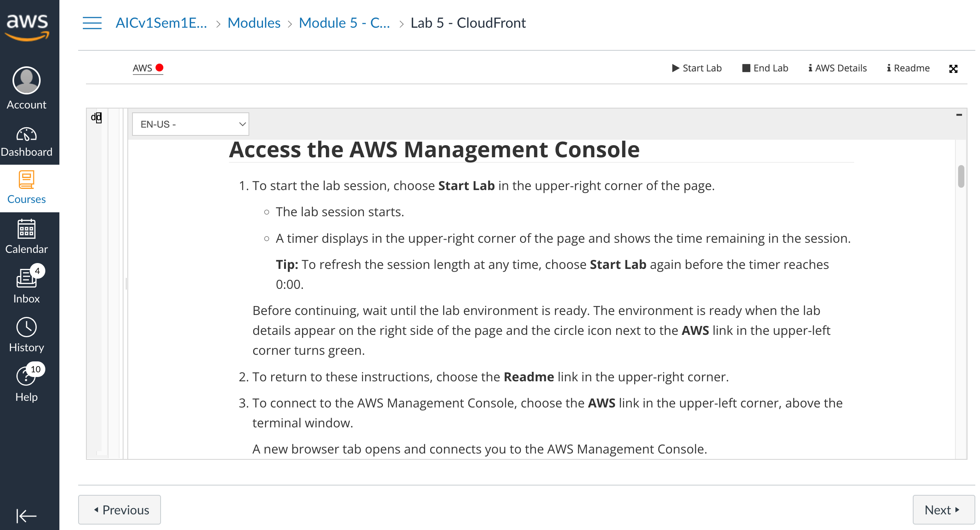
AWS Academy Introduction to Cloud: Semester 1 Module 5 Content Delivery: Lab 5 - Amazon CloudFront
1
1. To start the lab session, choose Start Lab in the upper-right corner of the page.
Source: AWS Academy Introduction to Cloud: Semester 1, https://awsacademy.instructure.com/courses/18745

Slide 37
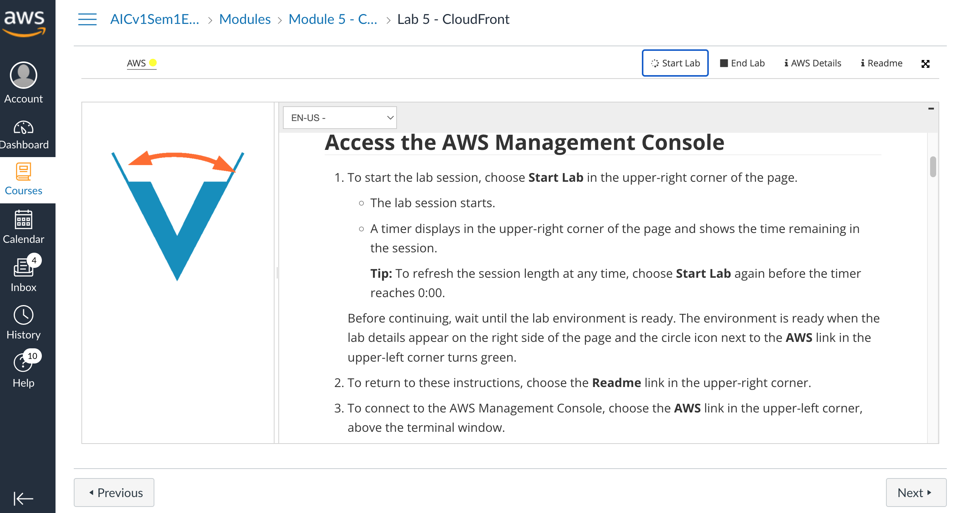
AWS Academy Introduction to Cloud: Semester 1 Module 5 Content Delivery: Lab 5 - Amazon CloudFront
Source: AWS Academy Introduction to Cloud: Semester 1, https://awsacademy.instructure.com/courses/18745

Slide 38
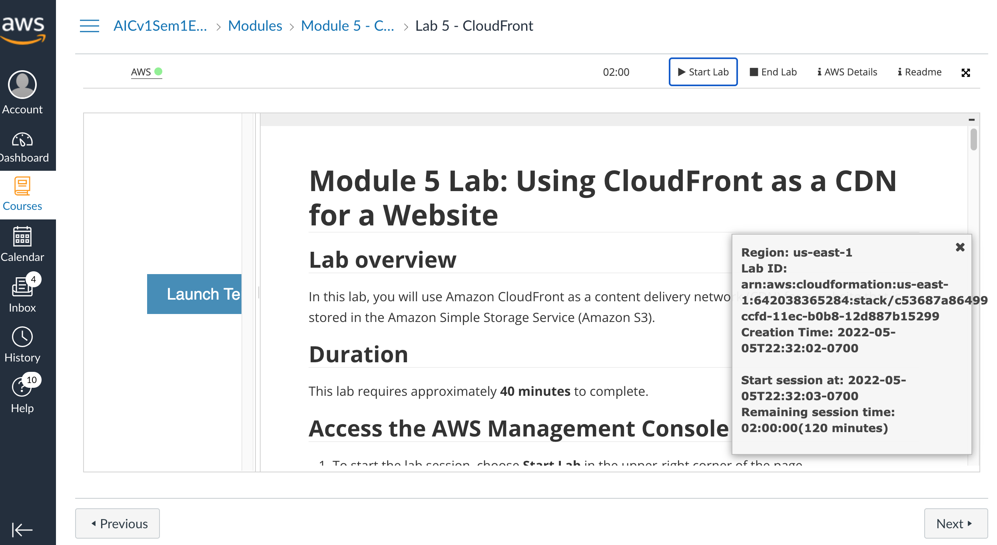
AWS Academy Introduction to Cloud: Semester 1 Module 5 Content Delivery: Lab 5 - Amazon CloudFront
Source: AWS Academy Introduction to Cloud: Semester 1, https://awsacademy.instructure.com/courses/18745

Slide 39
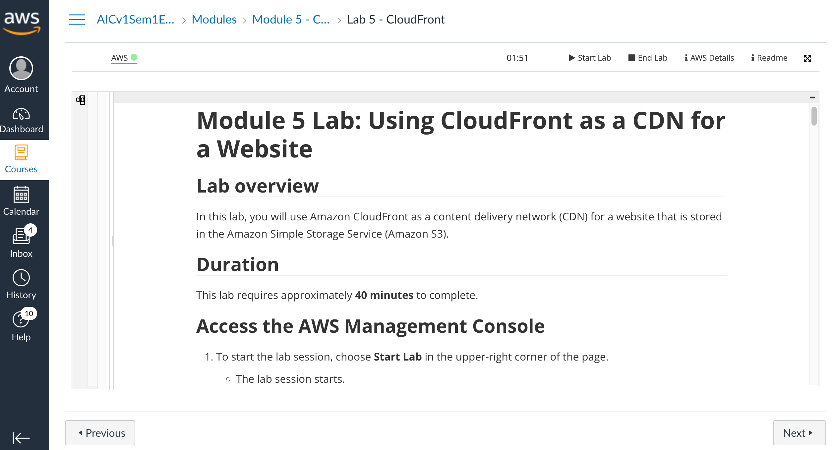
AWS Academy Introduction to Cloud: Semester 1 Module 5 Content Delivery: Lab 5 - Amazon CloudFront
2
2. To return to these instructions, choose the Readme link in the upper-right corner.
Source: AWS Academy Introduction to Cloud: Semester 1, https://awsacademy.instructure.com/courses/18745

Slide 40
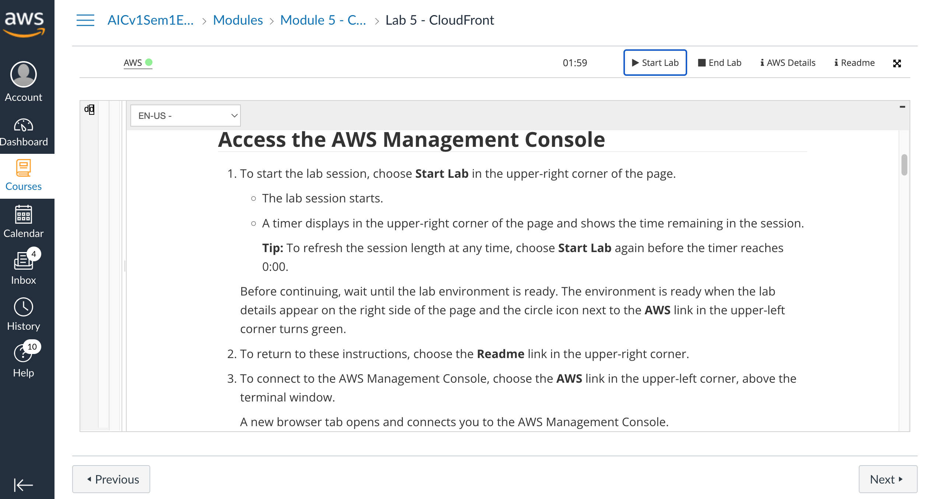
AWS Academy Introduction to Cloud: Semester 1 Module 5 Content Delivery: Lab 5 - Amazon CloudFront
Source: AWS Academy Introduction to Cloud: Semester 1, https://awsacademy.instructure.com/courses/18745

Slide 41
AWS Academy Introduction to Cloud: Semester 1 Module 5 Content Delivery: Lab 5 - Amazon CloudFront
3
3. To connect to the AWS Management Console, choose the AWS link in the upper-left corner, above the terminal window.
A new browser tab opens and connects you to the AWS Management Console.
Source: AWS Academy Introduction to Cloud: Semester 1, https://awsacademy.instructure.com/courses/18745

Slide 42
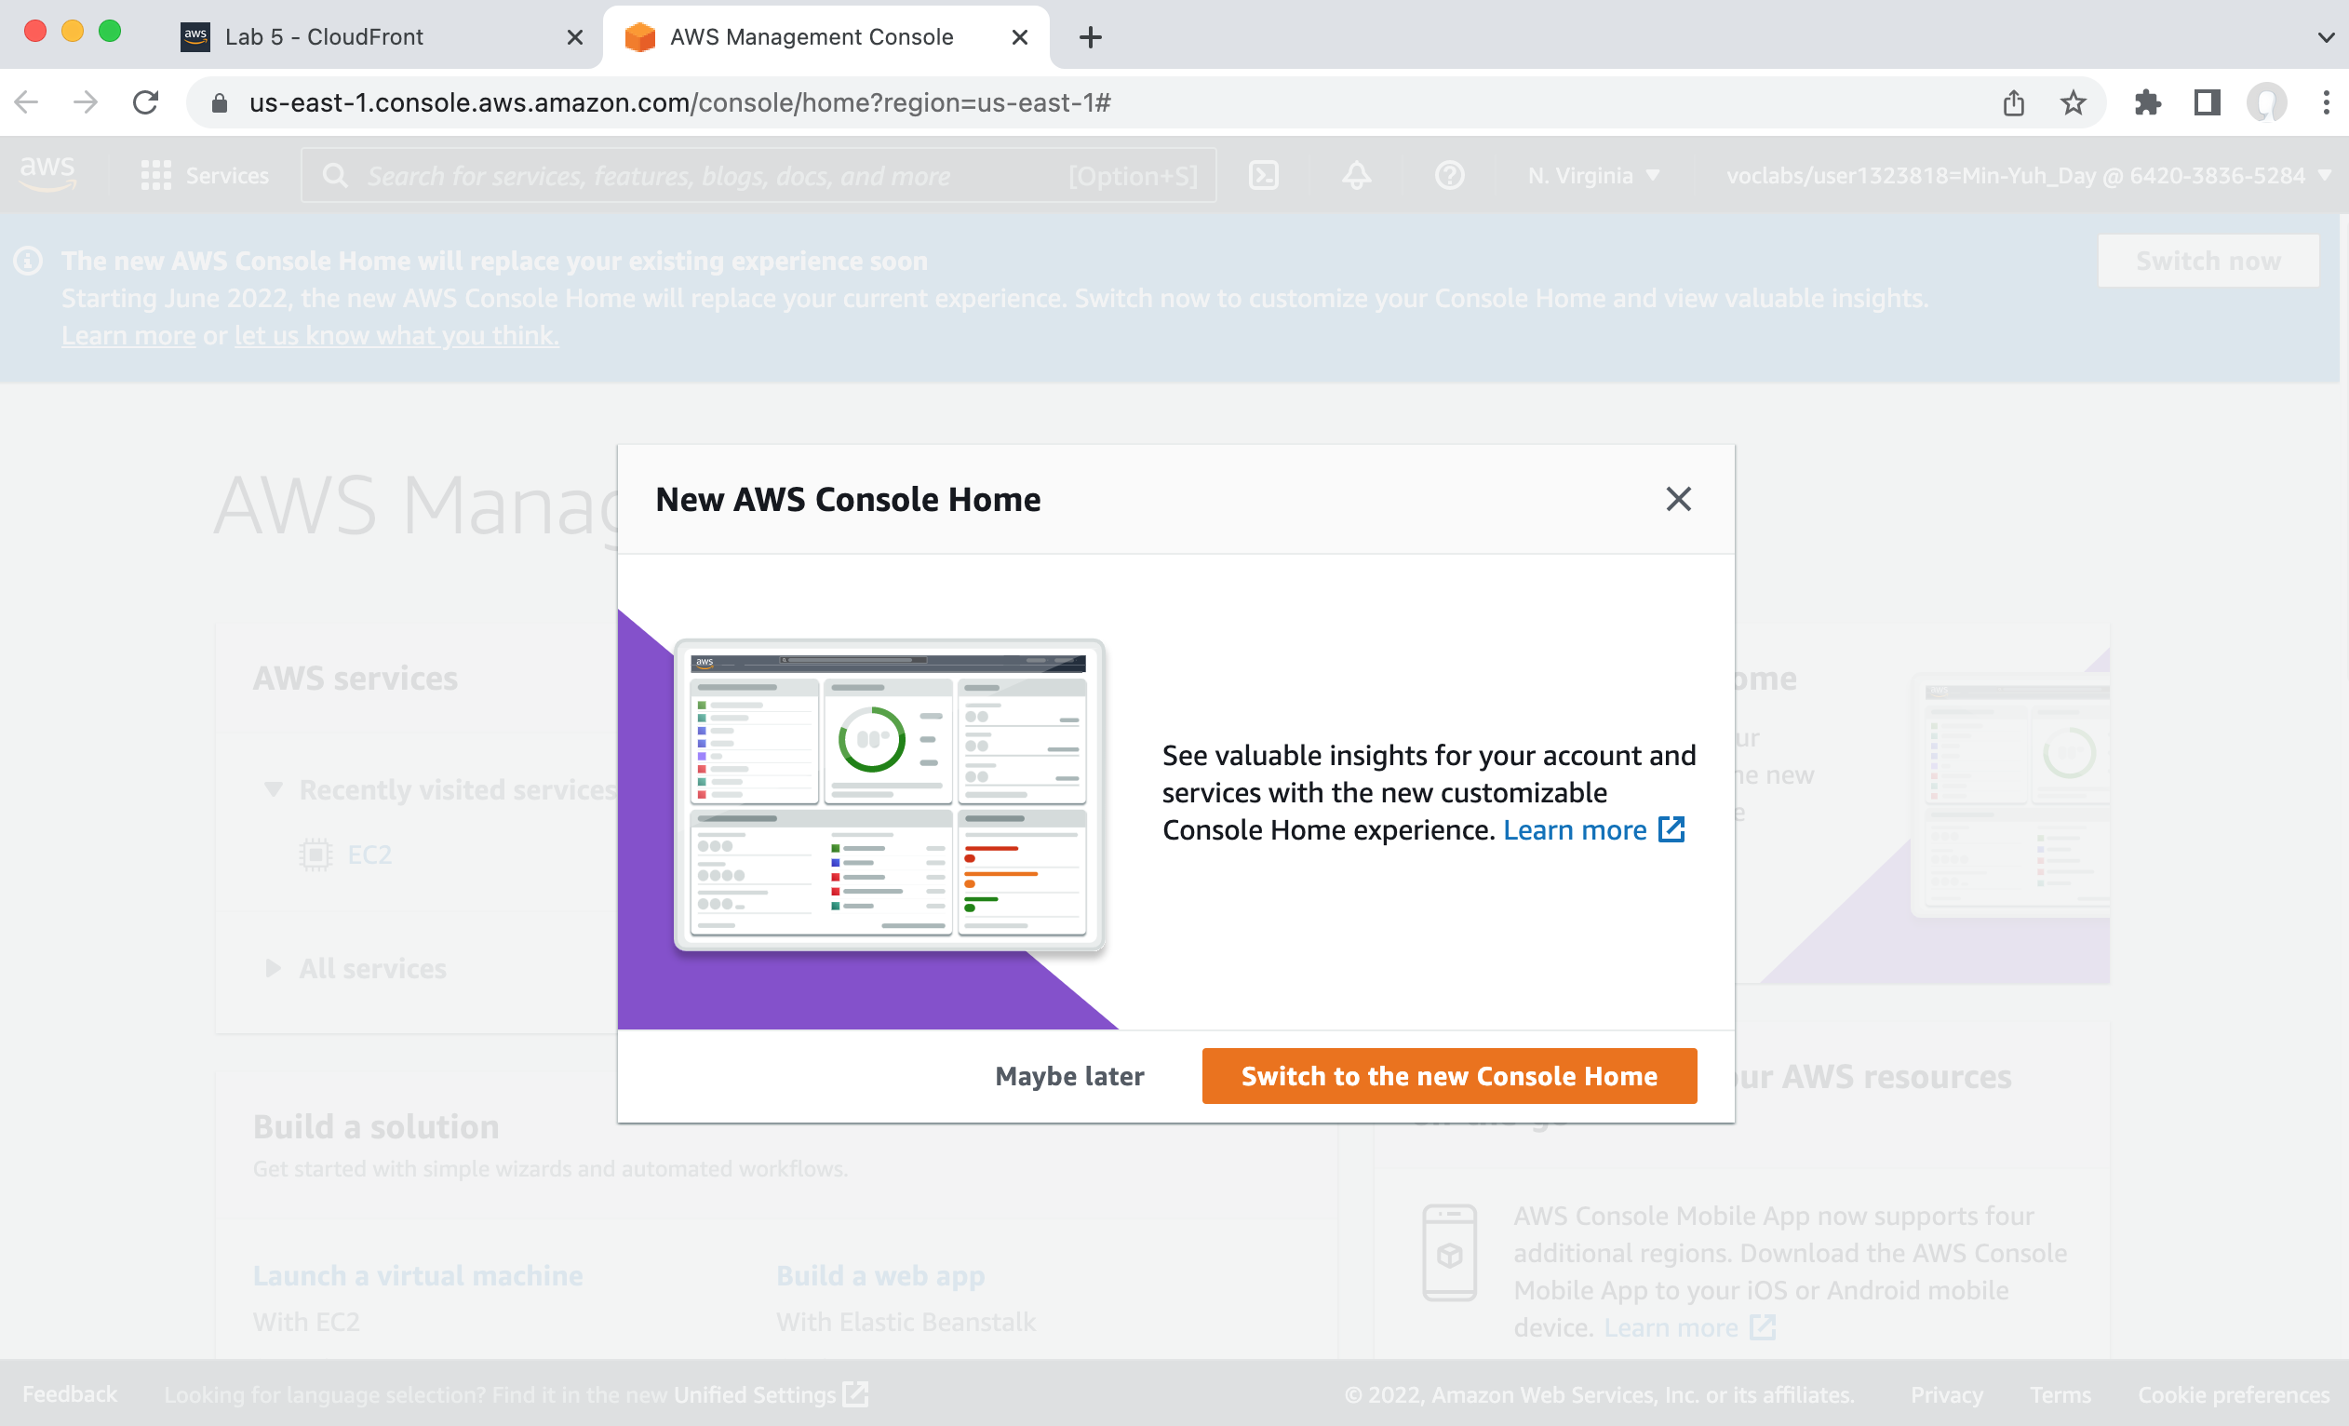
AWS Academy Introduction to Cloud: Semester 1 Module 5 Content Delivery: Lab 5 - Amazon CloudFront
Source: AWS Academy Introduction to Cloud: Semester 1, https://awsacademy.instructure.com/courses/18745

Slide 43
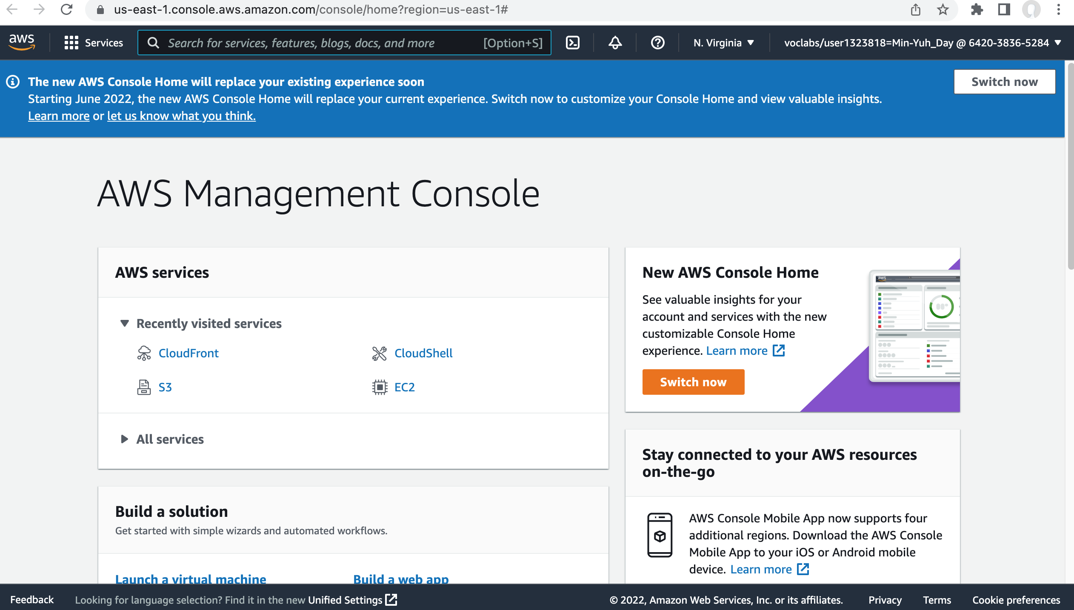
AWS Academy Introduction to Cloud: Semester 1 Module 5 Content Delivery: Lab 5 - Amazon CloudFront
Source: AWS Academy Introduction to Cloud: Semester 1, https://awsacademy.instructure.com/courses/18745

Slide 44
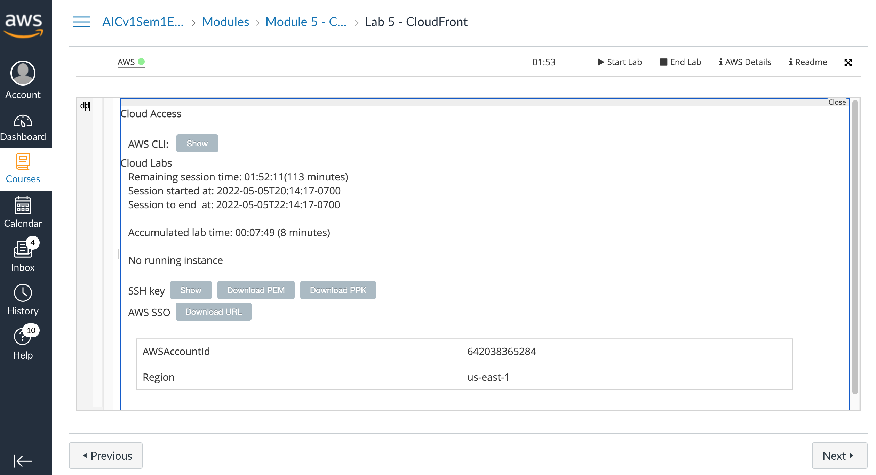
AWS Academy Introduction to Cloud: Semester 1 Module 5 Content Delivery: Lab 5 - Amazon CloudFront
Source: AWS Academy Introduction to Cloud: Semester 1, https://awsacademy.instructure.com/courses/18745

Slide 45
AWS Academy Introduction to Cloud: Semester 1 Module 5 Content Delivery: Lab 5 - Amazon CloudFront
Task 1. Create an S3 bucket using the AWS CLI
4. Choose the Services menu, locate the Developer Tools services, and select CloudShell.
If a welcome pop-up window appears, choose Close.
AWS CloudShell is a browser-based shell that gives you command line access to your AWS resources in the selected AWS Region.
5. Copy and paste the following code into a text editor:
cd ~
aws s3api create-bucket --bucket (bucket-name) --region us-east-1
cd ~
aws s3api create-bucket --bucket mydaylabbucket20220506 --region us-east-1
6. In the code that you copied, replace (bucket-name) with a unique Domain Name System (DNS)-compliant name for your new bucket.
7. Run the updated code in the CloudShell terminal.
If a pop-up window appears, choose Paste.
The output should look similar to the following:
{
"Location": "/mylabbucket12345”
}
Source: AWS Academy Introduction to Cloud: Semester 1, https://awsacademy.instructure.com/courses/18745

Slide 46
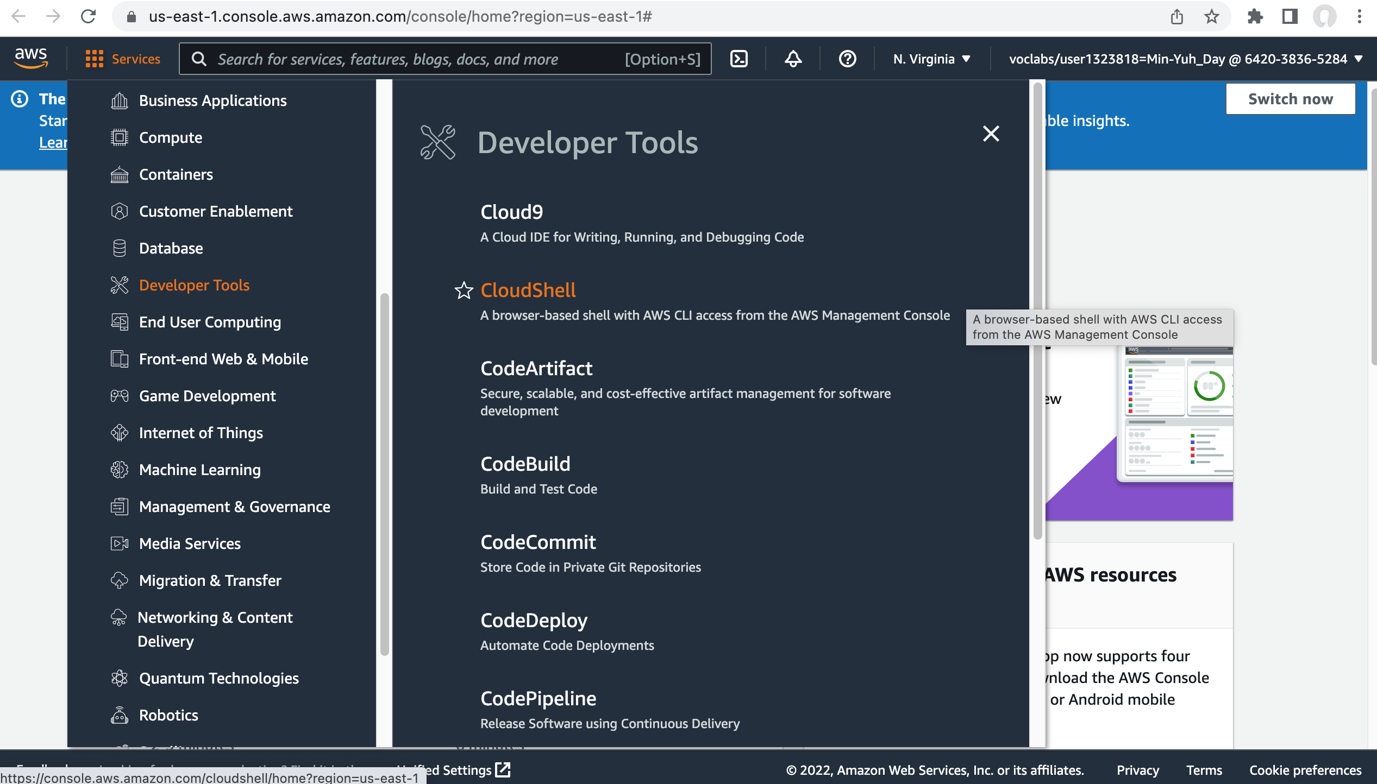
AWS Academy Introduction to Cloud: Semester 1 Module 5 Content Delivery: Lab 5 - Amazon CloudFront
4
Task 1. Create an S3 bucket using the AWS CLI
4. Choose the Services menu, locate the Developer Tools services, and select CloudShell.
If a welcome pop-up window appears, choose Close.
AWS CloudShell is a browser-based shell that gives you command line access to your AWS resources in the selected AWS Region.
Source: AWS Academy Introduction to Cloud: Semester 1, https://awsacademy.instructure.com/courses/18745

Slide 47
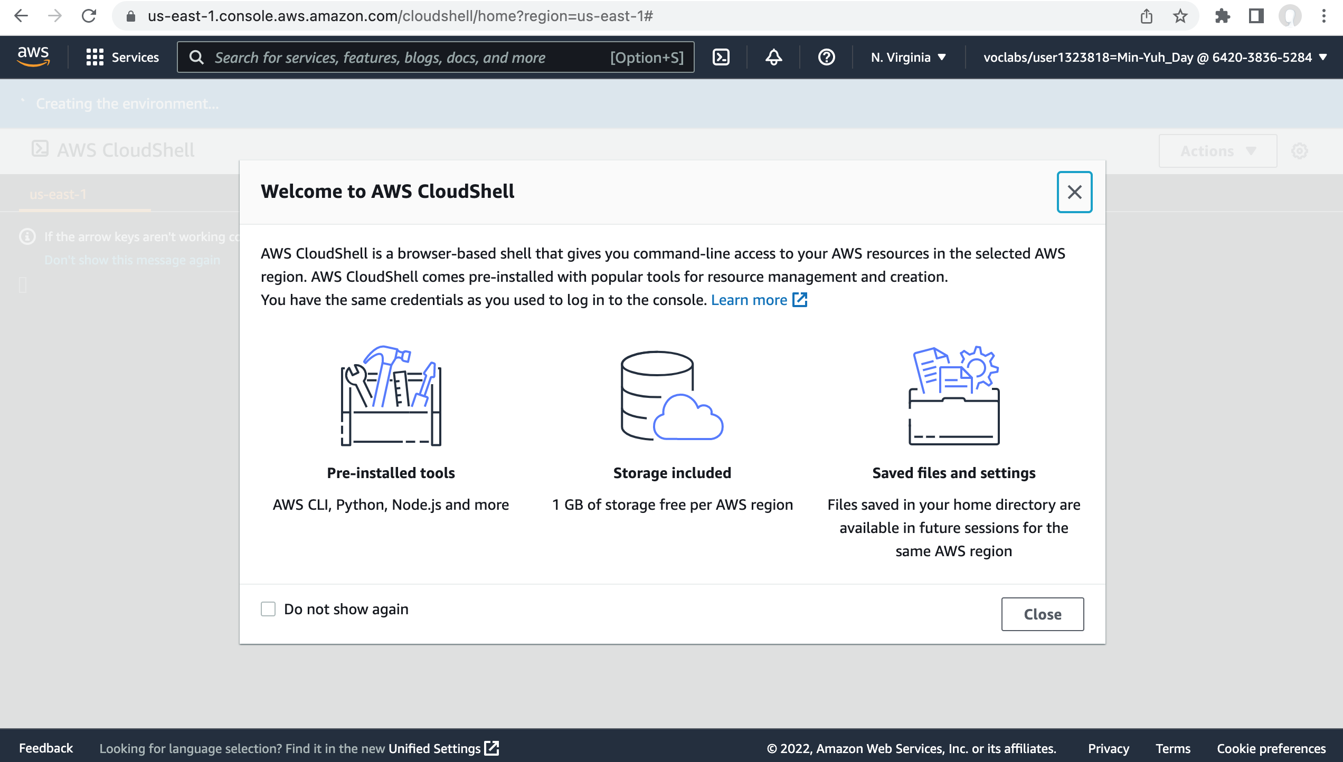
AWS Academy Introduction to Cloud: Semester 1 Module 5 Content Delivery: Lab 5 - Amazon CloudFront
Source: AWS Academy Introduction to Cloud: Semester 1, https://awsacademy.instructure.com/courses/18745

Slide 48
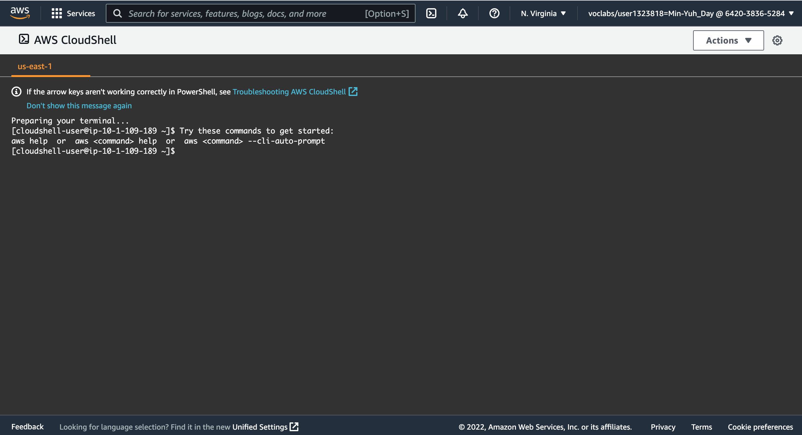
AWS Academy Introduction to Cloud: Semester 1 Module 5 Content Delivery: Lab 5 - Amazon CloudFront
5
5. Copy and paste the following code into a text editor:
cd ~
aws s3api create-bucket --bucket (bucket-name) --region us-east-1
Source: AWS Academy Introduction to Cloud: Semester 1, https://awsacademy.instructure.com/courses/18745

Slide 49
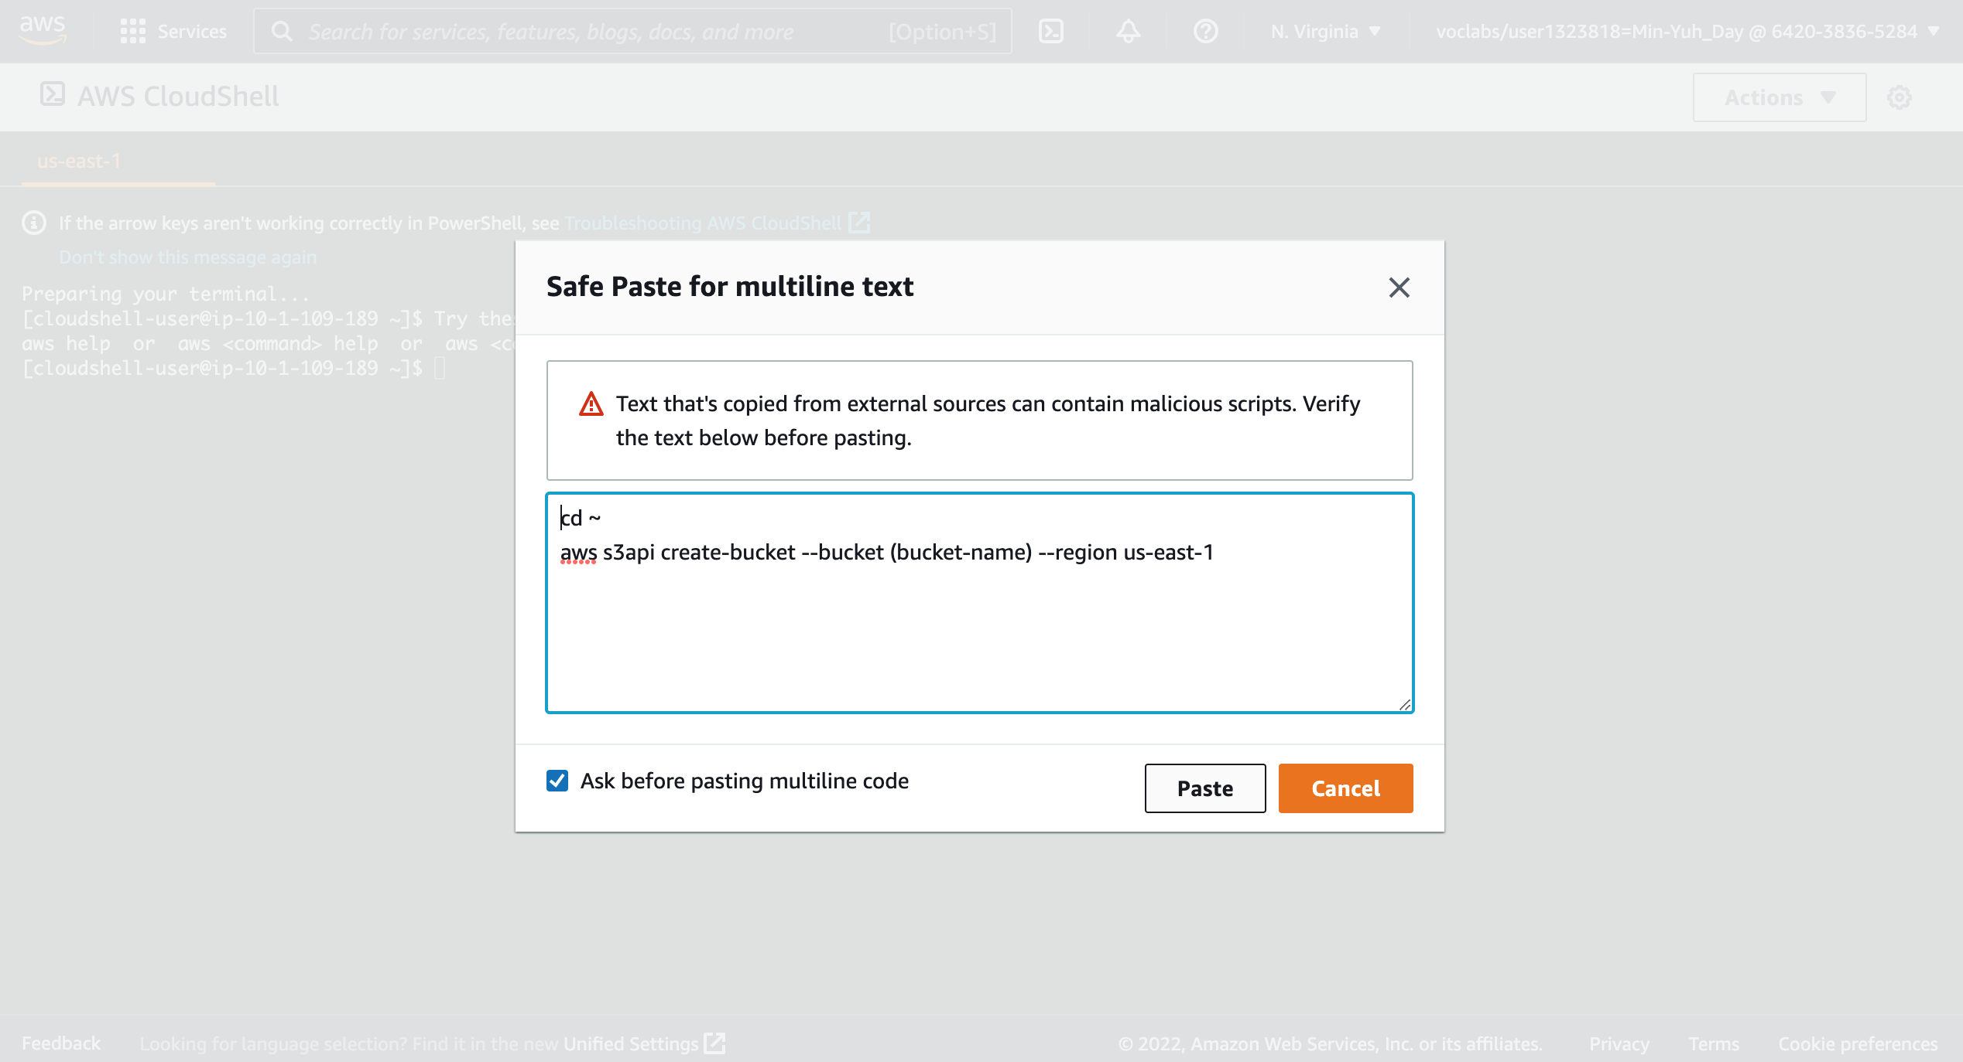
AWS Academy Introduction to Cloud: Semester 1 Module 5 Content Delivery: Lab 5 - Amazon CloudFront
5
5. Copy and paste the following code into a text editor:
cd ~
aws s3api create-bucket --bucket (bucket-name) --region us-east-1
Source: AWS Academy Introduction to Cloud: Semester 1, https://awsacademy.instructure.com/courses/18745

Slide 50
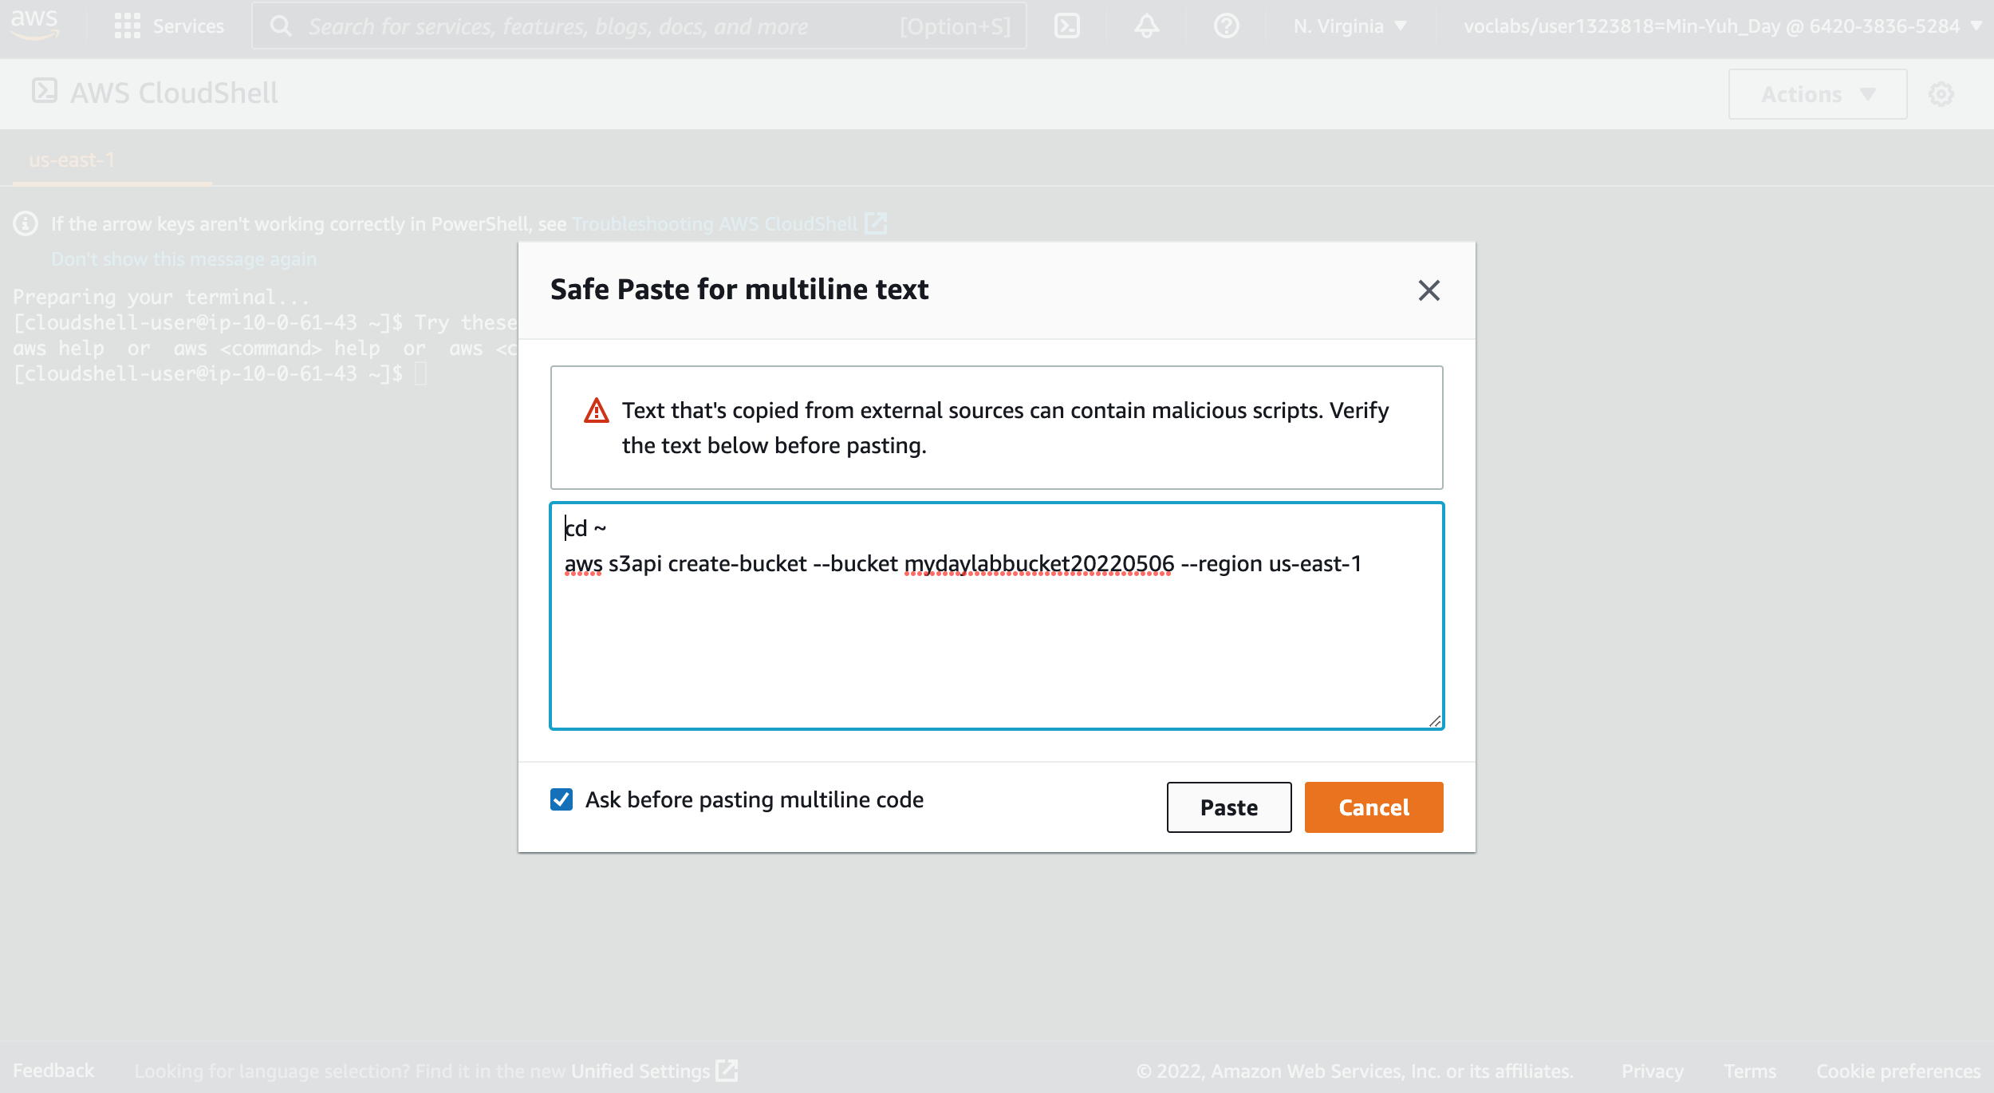
AWS Academy Introduction to Cloud: Semester 1 Module 5 Content Delivery: Lab 5 - Amazon CloudFront
6
7
5. Copy and paste the following code into a text editor:
cd ~
aws s3api create-bucket --bucket (bucket-name) --region us-east-1
5. Copy and paste the following code into a text editor:
cd ~
aws s3api create-bucket --bucket mydaylabbucket20220506 --region us-east-1
Source: AWS Academy Introduction to Cloud: Semester 1, https://awsacademy.instructure.com/courses/18745

Slide 51
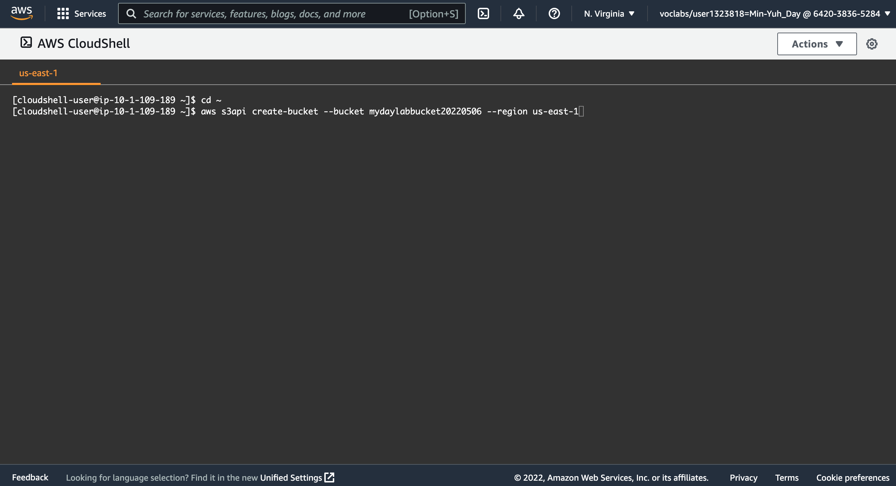
AWS Academy Introduction to Cloud: Semester 1 Module 5 Content Delivery: Lab 5 - Amazon CloudFront
5. Copy and paste the following code into a text editor:
cd ~
aws s3api create-bucket --bucket (bucket-name) --region us-east-1
5. Copy and paste the following code into a text editor:
cd ~
aws s3api create-bucket --bucket mydaylabbucket20220506 --region us-east-1
Source: AWS Academy Introduction to Cloud: Semester 1, https://awsacademy.instructure.com/courses/18745

Slide 52
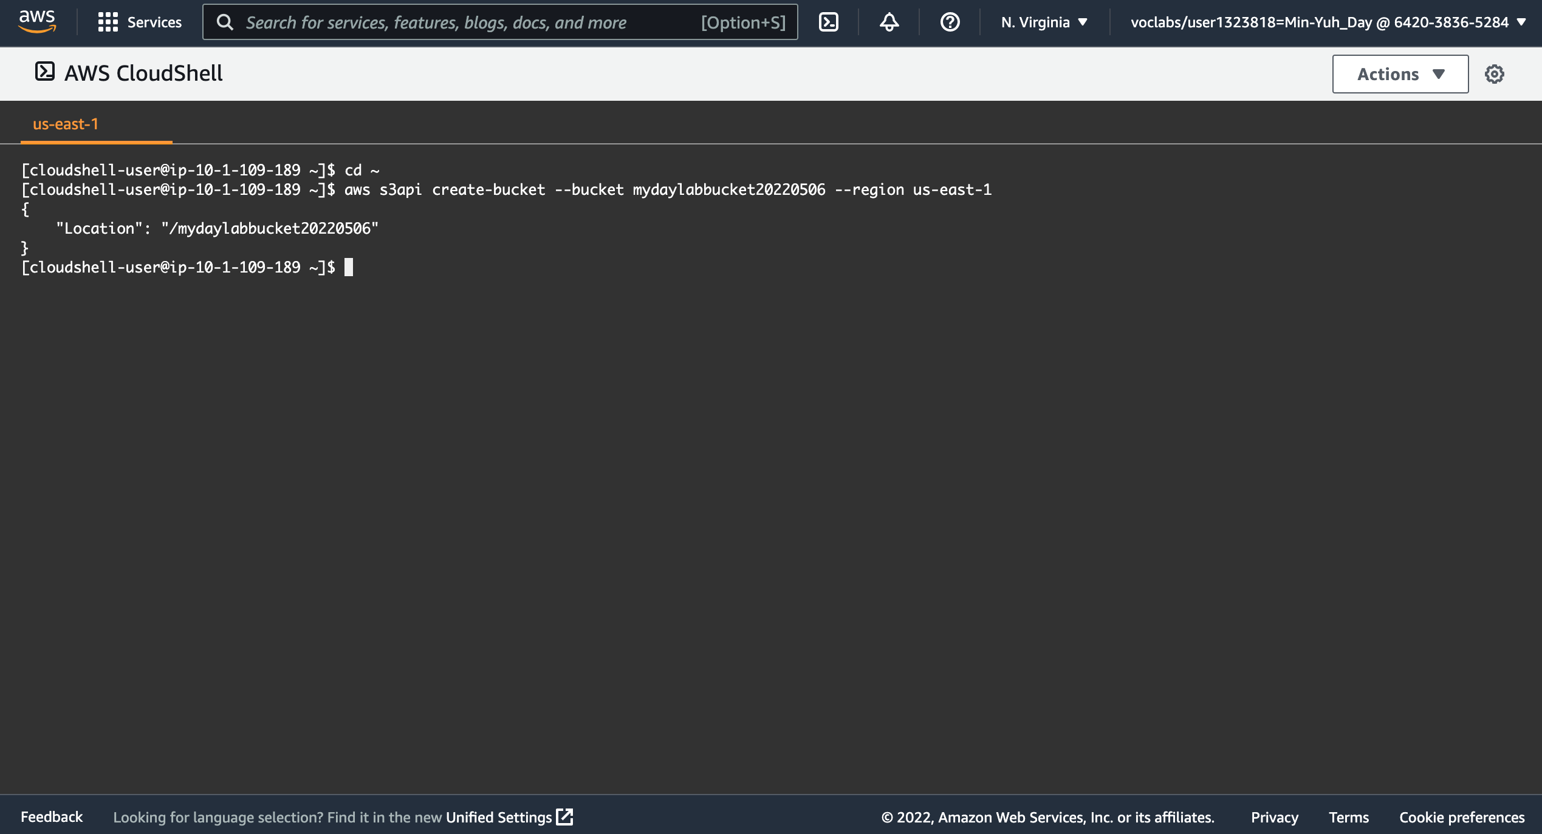
AWS Academy Introduction to Cloud: Semester 1 Module 5 Content Delivery: Lab 5 - Amazon CloudFront
6
(bucket-name)
mylabbucket12345
mydaylabbucket20220506
yourbucket20220506
7
5. Copy and paste the following code into a text editor:
cd ~
aws s3api create-bucket --bucket mydaylabbucket20220506 --region us-east-1
6. In the code that you copied, replace (bucket-name) with a unique Domain Name System (DNS)-compliant name for your new bucket.
7. Run the updated code in the CloudShell terminal.
If a pop-up window appears, choose Paste.
The output should look similar to the following:
{
"Location": "/mylabbucket12345”
}
Source: AWS Academy Introduction to Cloud: Semester 1, https://awsacademy.instructure.com/courses/18745

Slide 53
AWS Academy Introduction to Cloud: Semester 1 Module 5 Content Delivery: Lab 5 - Amazon CloudFront
Task 2. Add a bucket policy
In this task, you will add a bucket policy through the AWS CLI to make the content publicly available.
In the console, choose the Services menu, locate the Storage section, and choose S3.
Choose the name of the bucket that you just created.
Choose the Permissions tab.
In the Bucket policy section, choose Edit.
To grant public read access for your website, copy and paste the following bucket policy into the policy editor.
In the policy, replace example-bucket with the name of your bucket.
At the bottom of the page, choose Save changes.
{
"Version":"2012-10-17",
"Statement":[
{
"Sid":"PublicReadForGetBucketObjects",
"Effect":"Allow",
"Principal":"*",
"Action":[
"s3:GetObject"
],
"Resource":[
"arn:aws:s3:::example-bucket/*"
]
}
]
}
Source: AWS Academy Introduction to Cloud: Semester 1, https://awsacademy.instructure.com/courses/18745

Slide 54
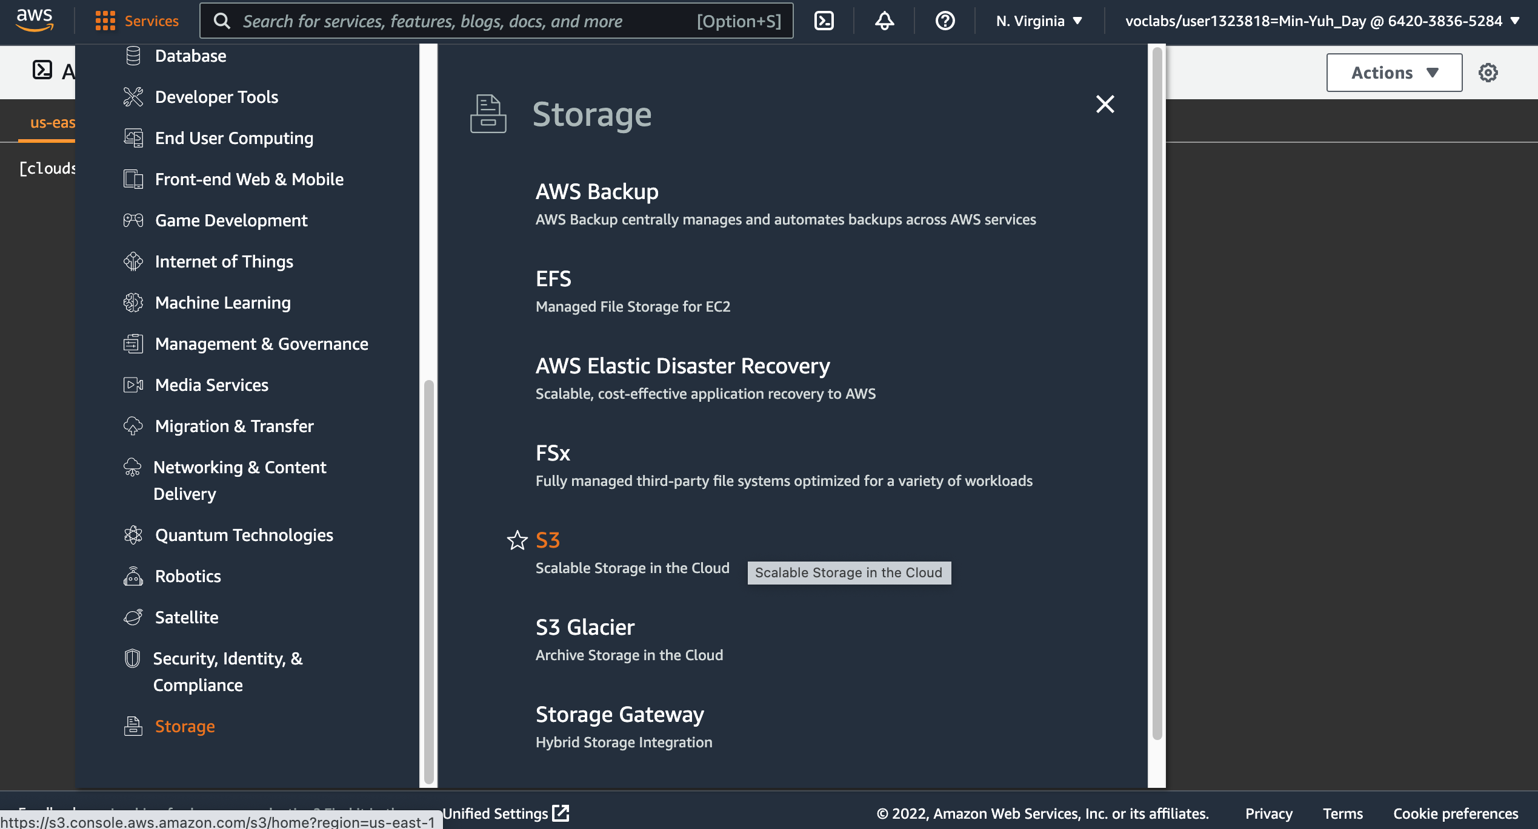
AWS Academy Introduction to Cloud: Semester 1 Module 5 Content Delivery: Lab 5 - Amazon CloudFront
8
8
8
In the console, choose the Services menu, locate the Storage section, and choose S3.
Source: AWS Academy Introduction to Cloud: Semester 1, https://awsacademy.instructure.com/courses/18745

Slide 55
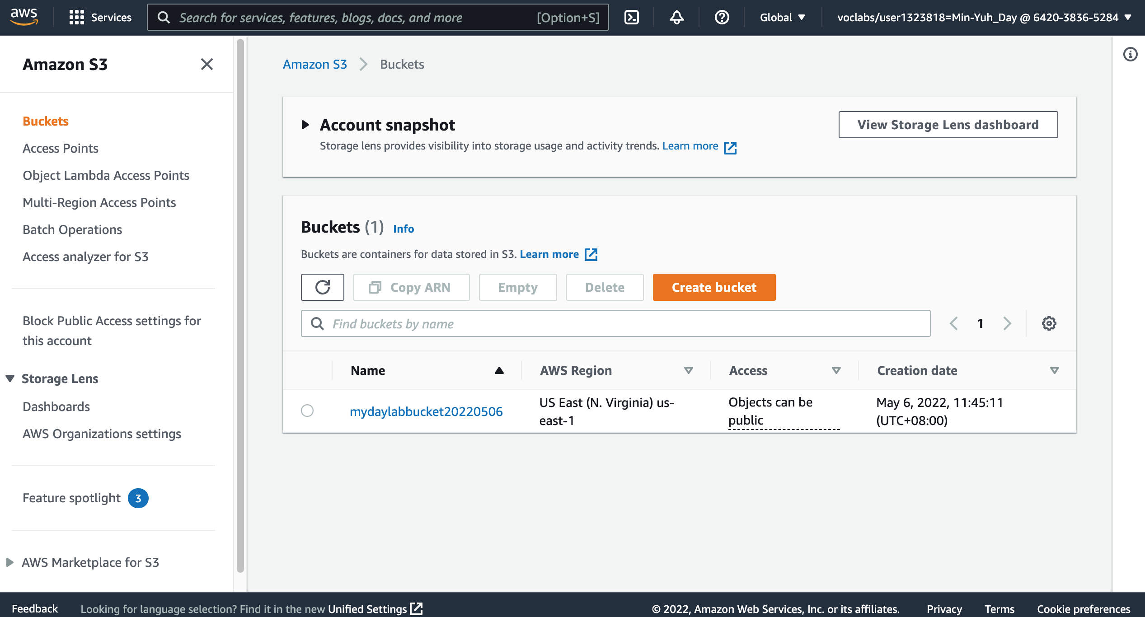
AWS Academy Introduction to Cloud: Semester 1 Module 5 Content Delivery: Lab 5 - Amazon CloudFront
9
9. Choose the name of the bucket that you just created.
Source: AWS Academy Introduction to Cloud: Semester 1, https://awsacademy.instructure.com/courses/18745

Slide 56
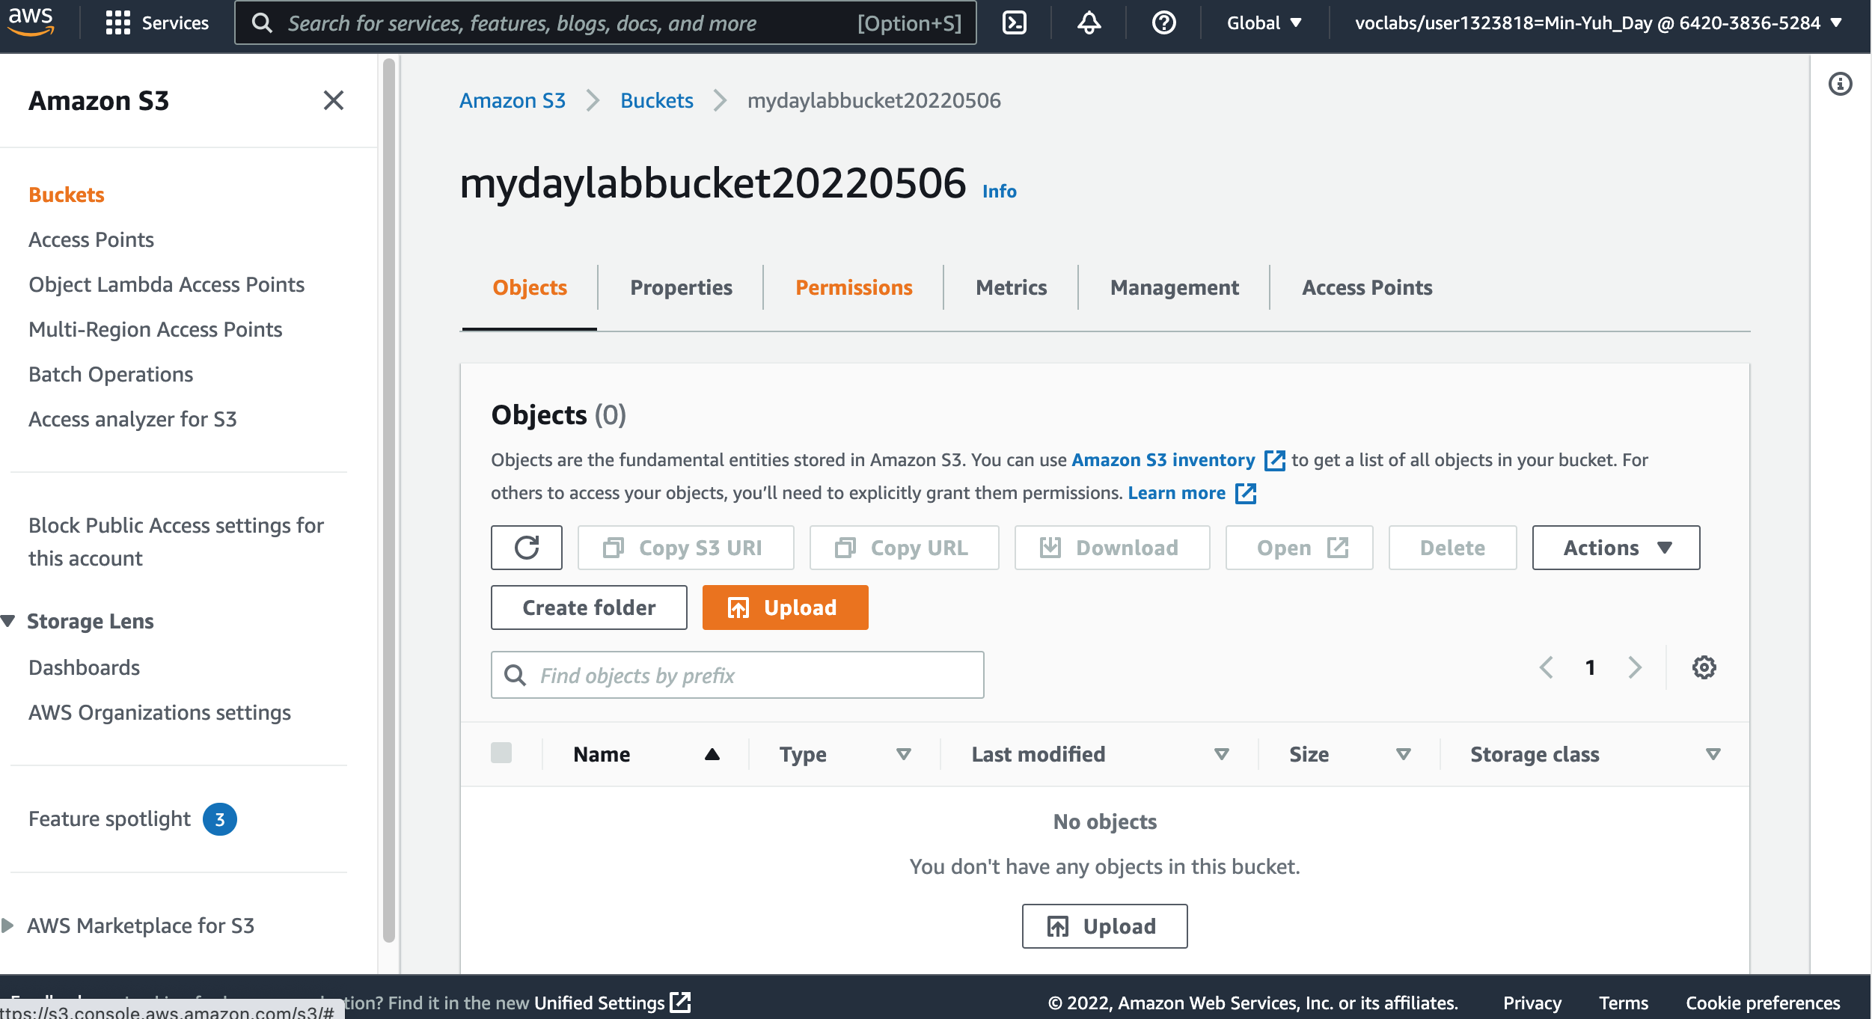
AWS Academy Introduction to Cloud: Semester 1 Module 5 Content Delivery: Lab 5 - Amazon CloudFront
10
10. Choose the Permissions tab
Source: AWS Academy Introduction to Cloud: Semester 1, https://awsacademy.instructure.com/courses/18745

Slide 57
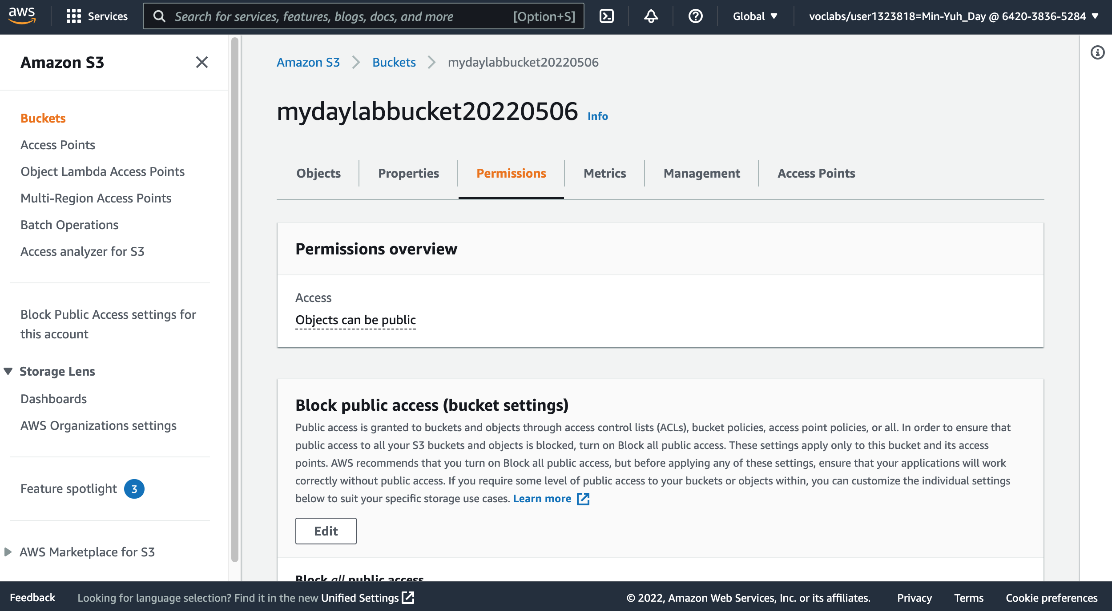
AWS Academy Introduction to Cloud: Semester 1 Module 5 Content Delivery: Lab 5 - Amazon CloudFront
10
10. Choose the Permissions tab
Source: AWS Academy Introduction to Cloud: Semester 1, https://awsacademy.instructure.com/courses/18745

Slide 58
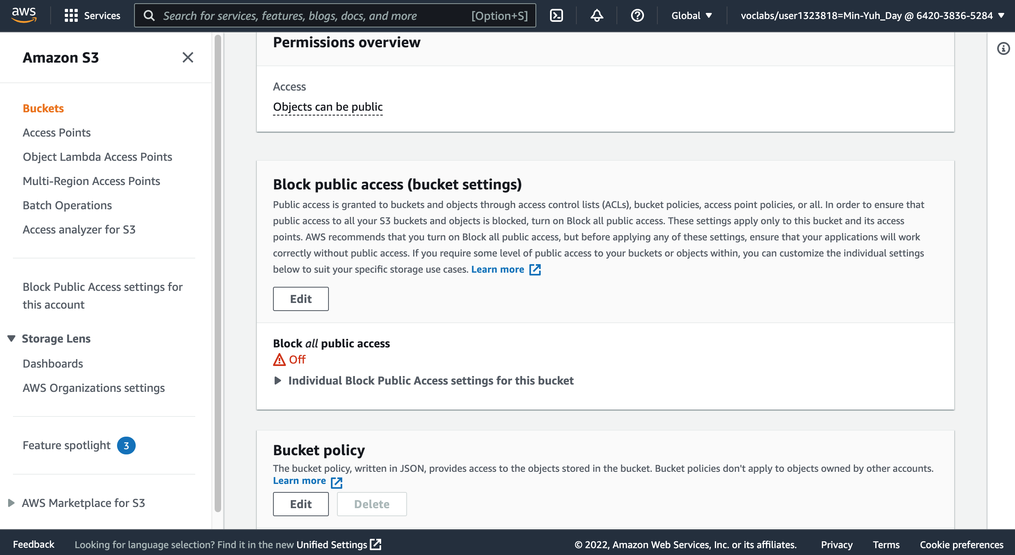
AWS Academy Introduction to Cloud: Semester 1 Module 5 Content Delivery: Lab 5 - Amazon CloudFront
11
11. In the Bucket policy section, choose Edit.
Source: AWS Academy Introduction to Cloud: Semester 1, https://awsacademy.instructure.com/courses/18745

Slide 59
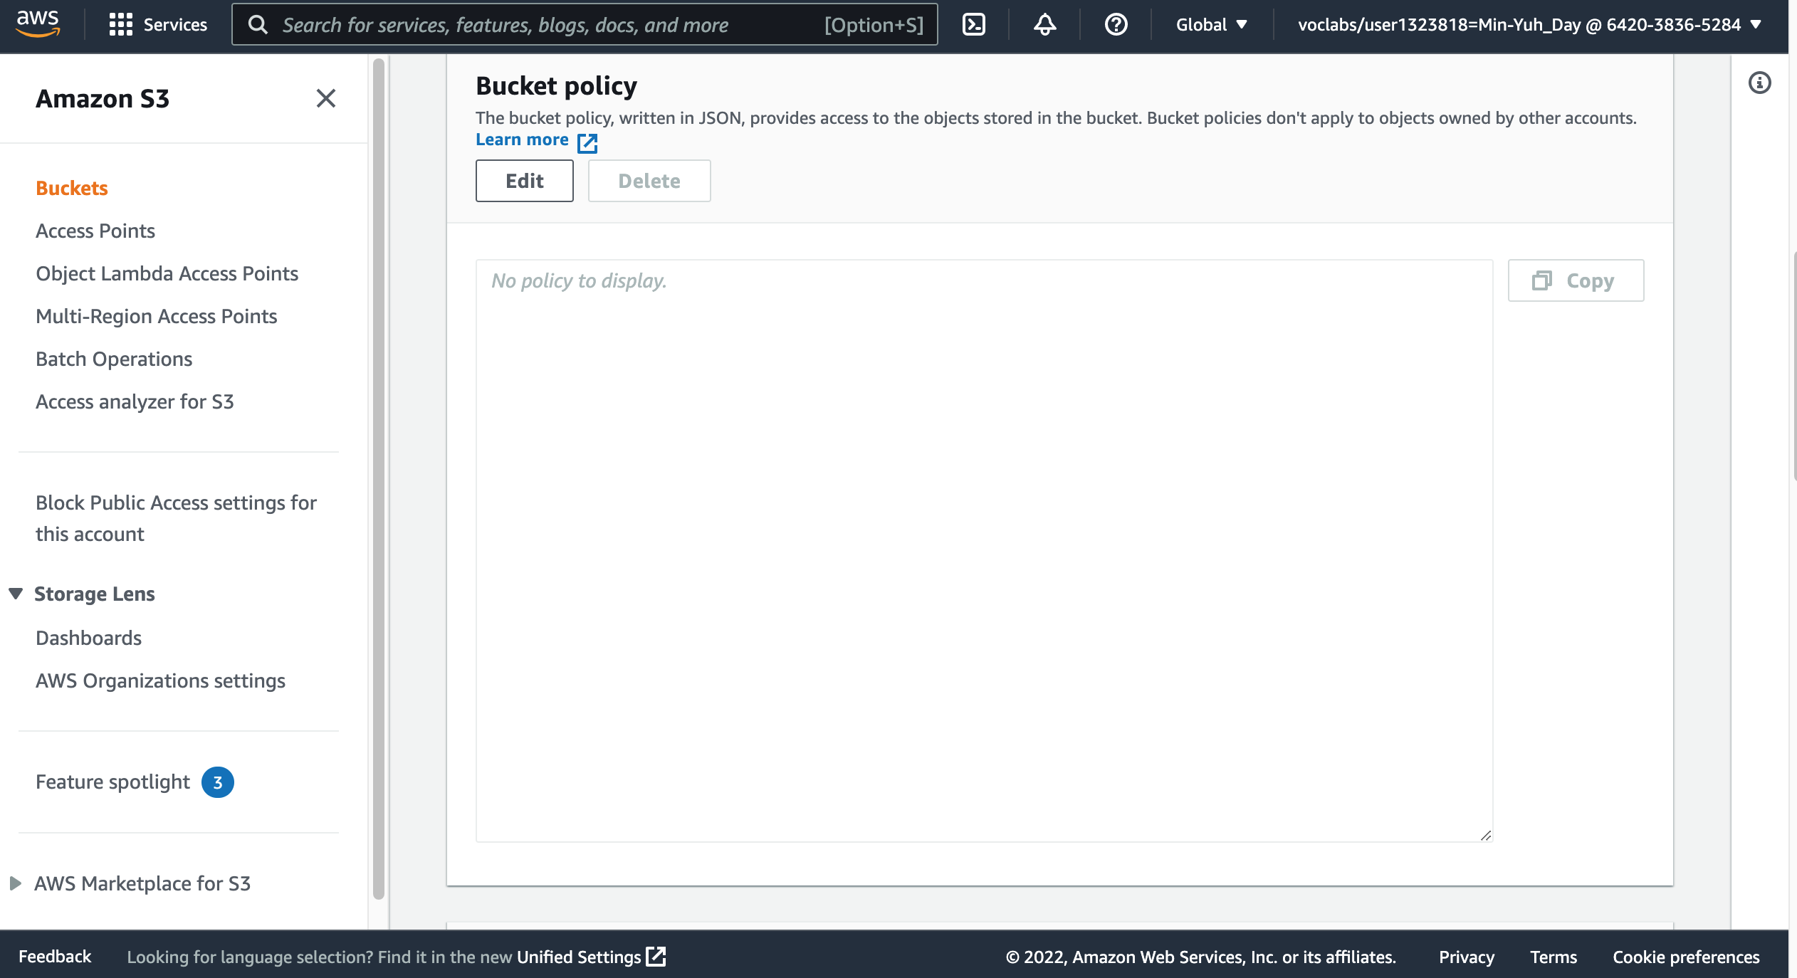
AWS Academy Introduction to Cloud: Semester 1 Module 5 Content Delivery: Lab 5 - Amazon CloudFront
11
11. In the Bucket policy section, choose Edit.
Source: AWS Academy Introduction to Cloud: Semester 1, https://awsacademy.instructure.com/courses/18745

Slide 60
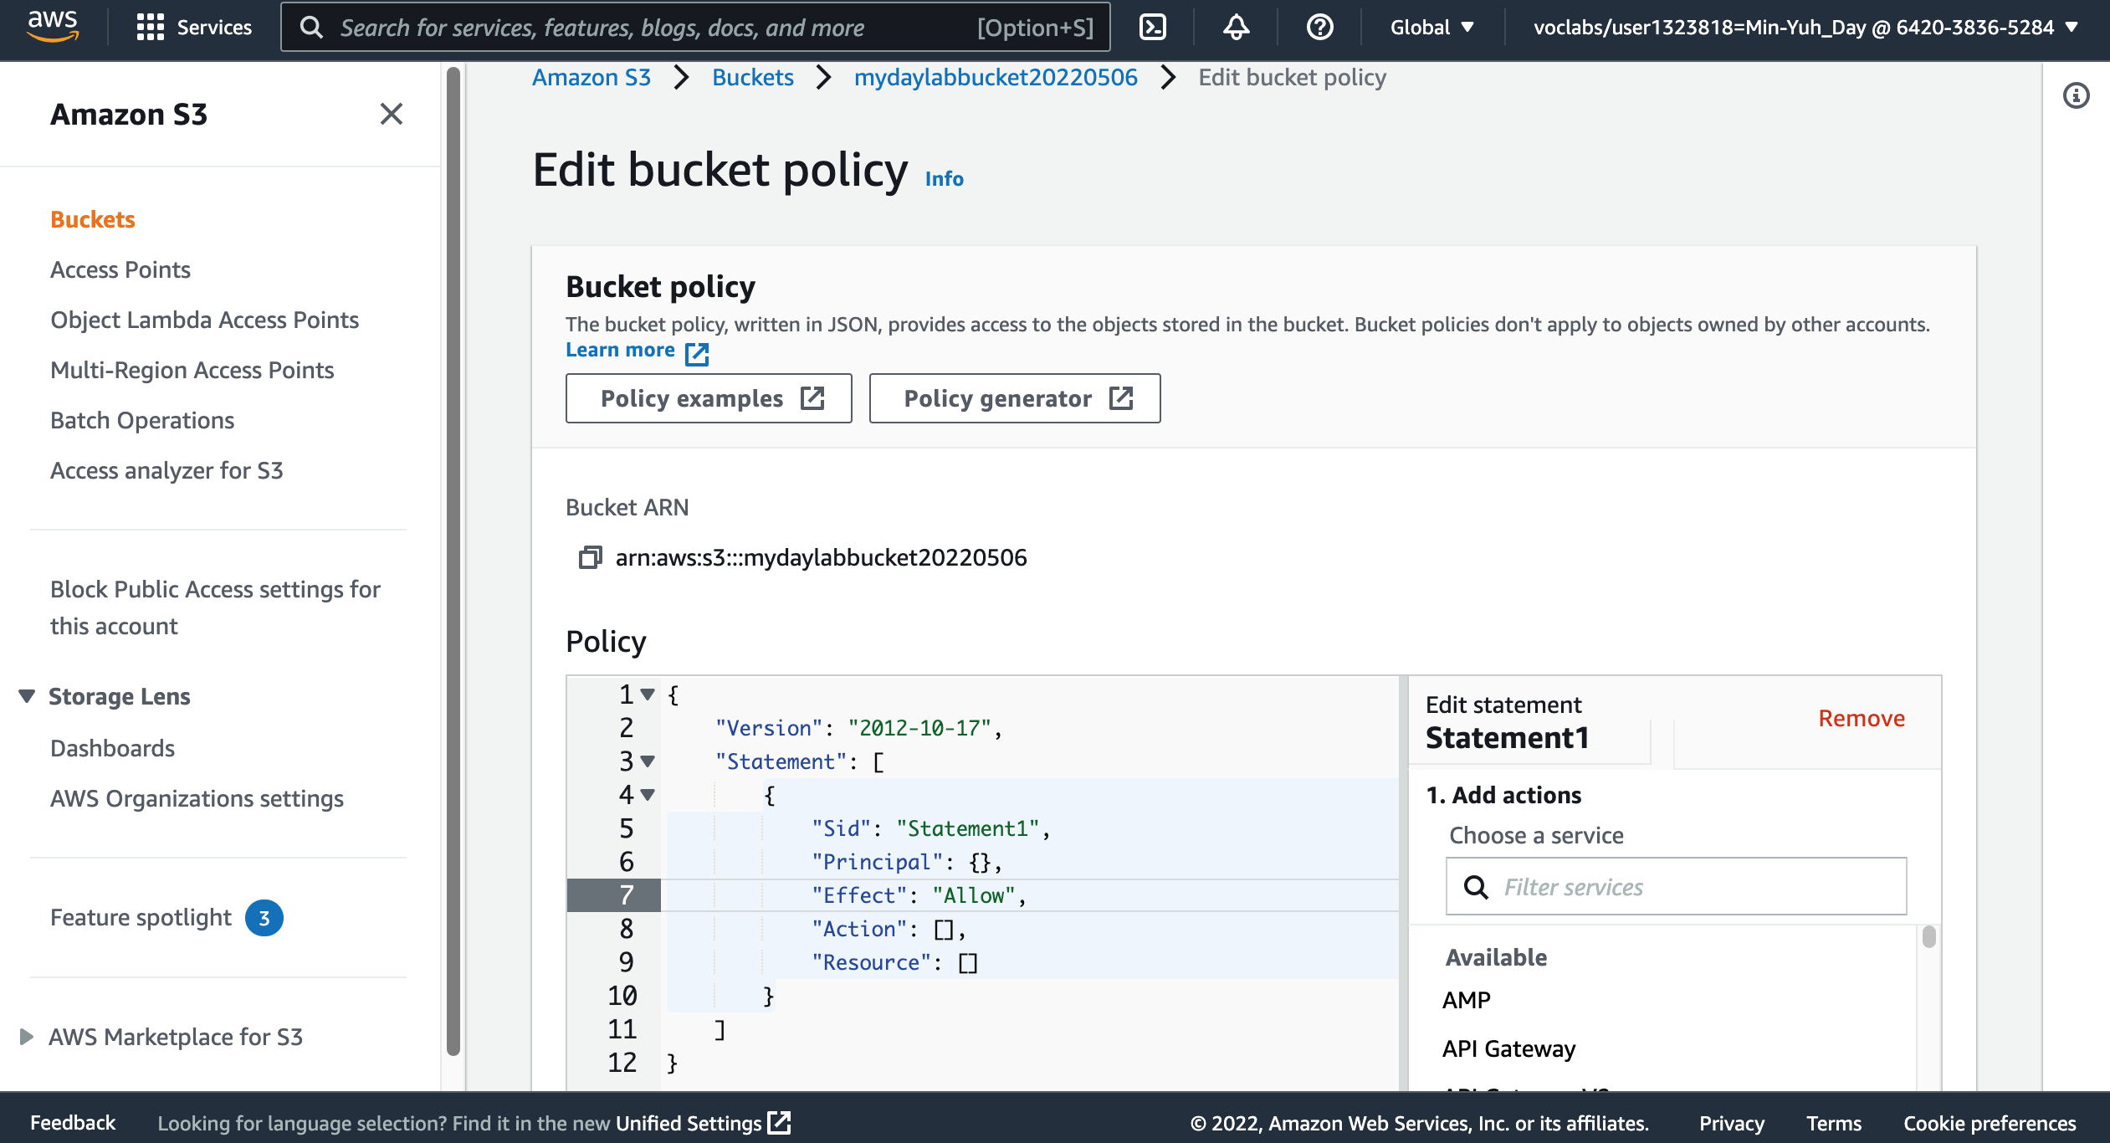
AWS Academy Introduction to Cloud: Semester 1 Module 5 Content Delivery: Lab 5 - Amazon CloudFront
12
12. To grant public read access for your website, copy and paste the following bucket policy into the policy editor.
{
"Version":"2012-10-17",
"Statement":[
{
"Sid":"PublicReadForGetBucketObjects",
"Effect":"Allow",
"Principal":"*",
"Action":[
"s3:GetObject"
],
"Resource":[
"arn:aws:s3:::example-bucket/*"
]
}
]
}
Source: AWS Academy Introduction to Cloud: Semester 1, https://awsacademy.instructure.com/courses/18745

Slide 61
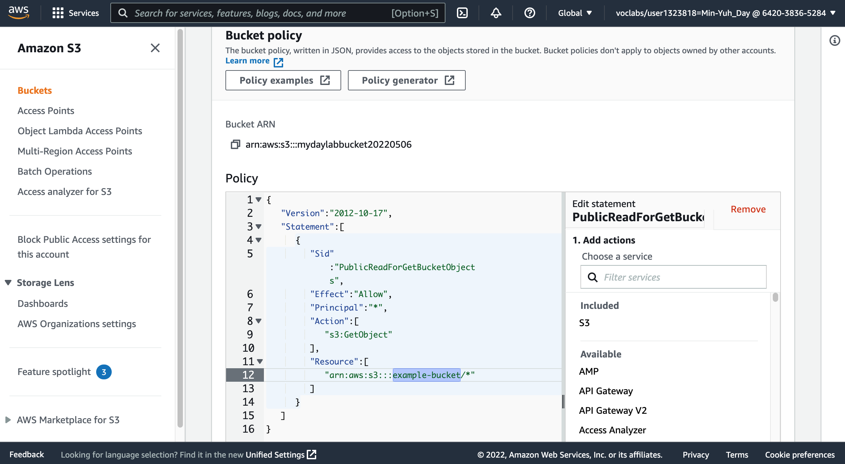
AWS Academy Introduction to Cloud: Semester 1 Module 5 Content Delivery: Lab 5 - Amazon CloudFront
13. In the policy, replace example-bucket with the name of your bucket.
13
Source: AWS Academy Introduction to Cloud: Semester 1, https://awsacademy.instructure.com/courses/18745

Slide 62
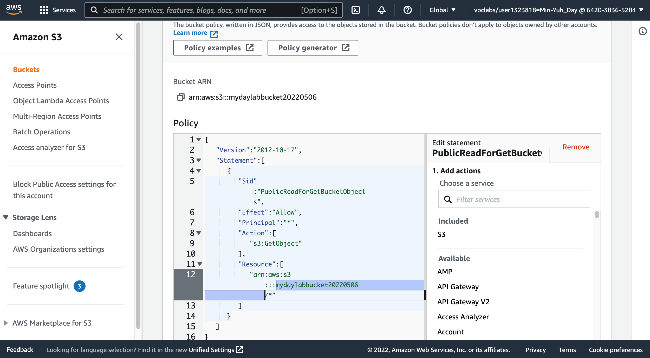
AWS Academy Introduction to Cloud: Semester 1 Module 5 Content Delivery: Lab 5 - Amazon CloudFront
13. In the policy, replace example-bucket with the name of your bucket.
{
"Version":"2012-10-17",
"Statement":[
{
"Sid":"PublicReadForGetBucketObjects",
"Effect":"Allow",
"Principal":"*",
"Action":[
"s3:GetObject"
],
"Resource":[
"arn:aws:s3:::mydaylabbucket20220506/*"
]
}
]
}
13
Source: AWS Academy Introduction to Cloud: Semester 1, https://awsacademy.instructure.com/courses/18745

Slide 63
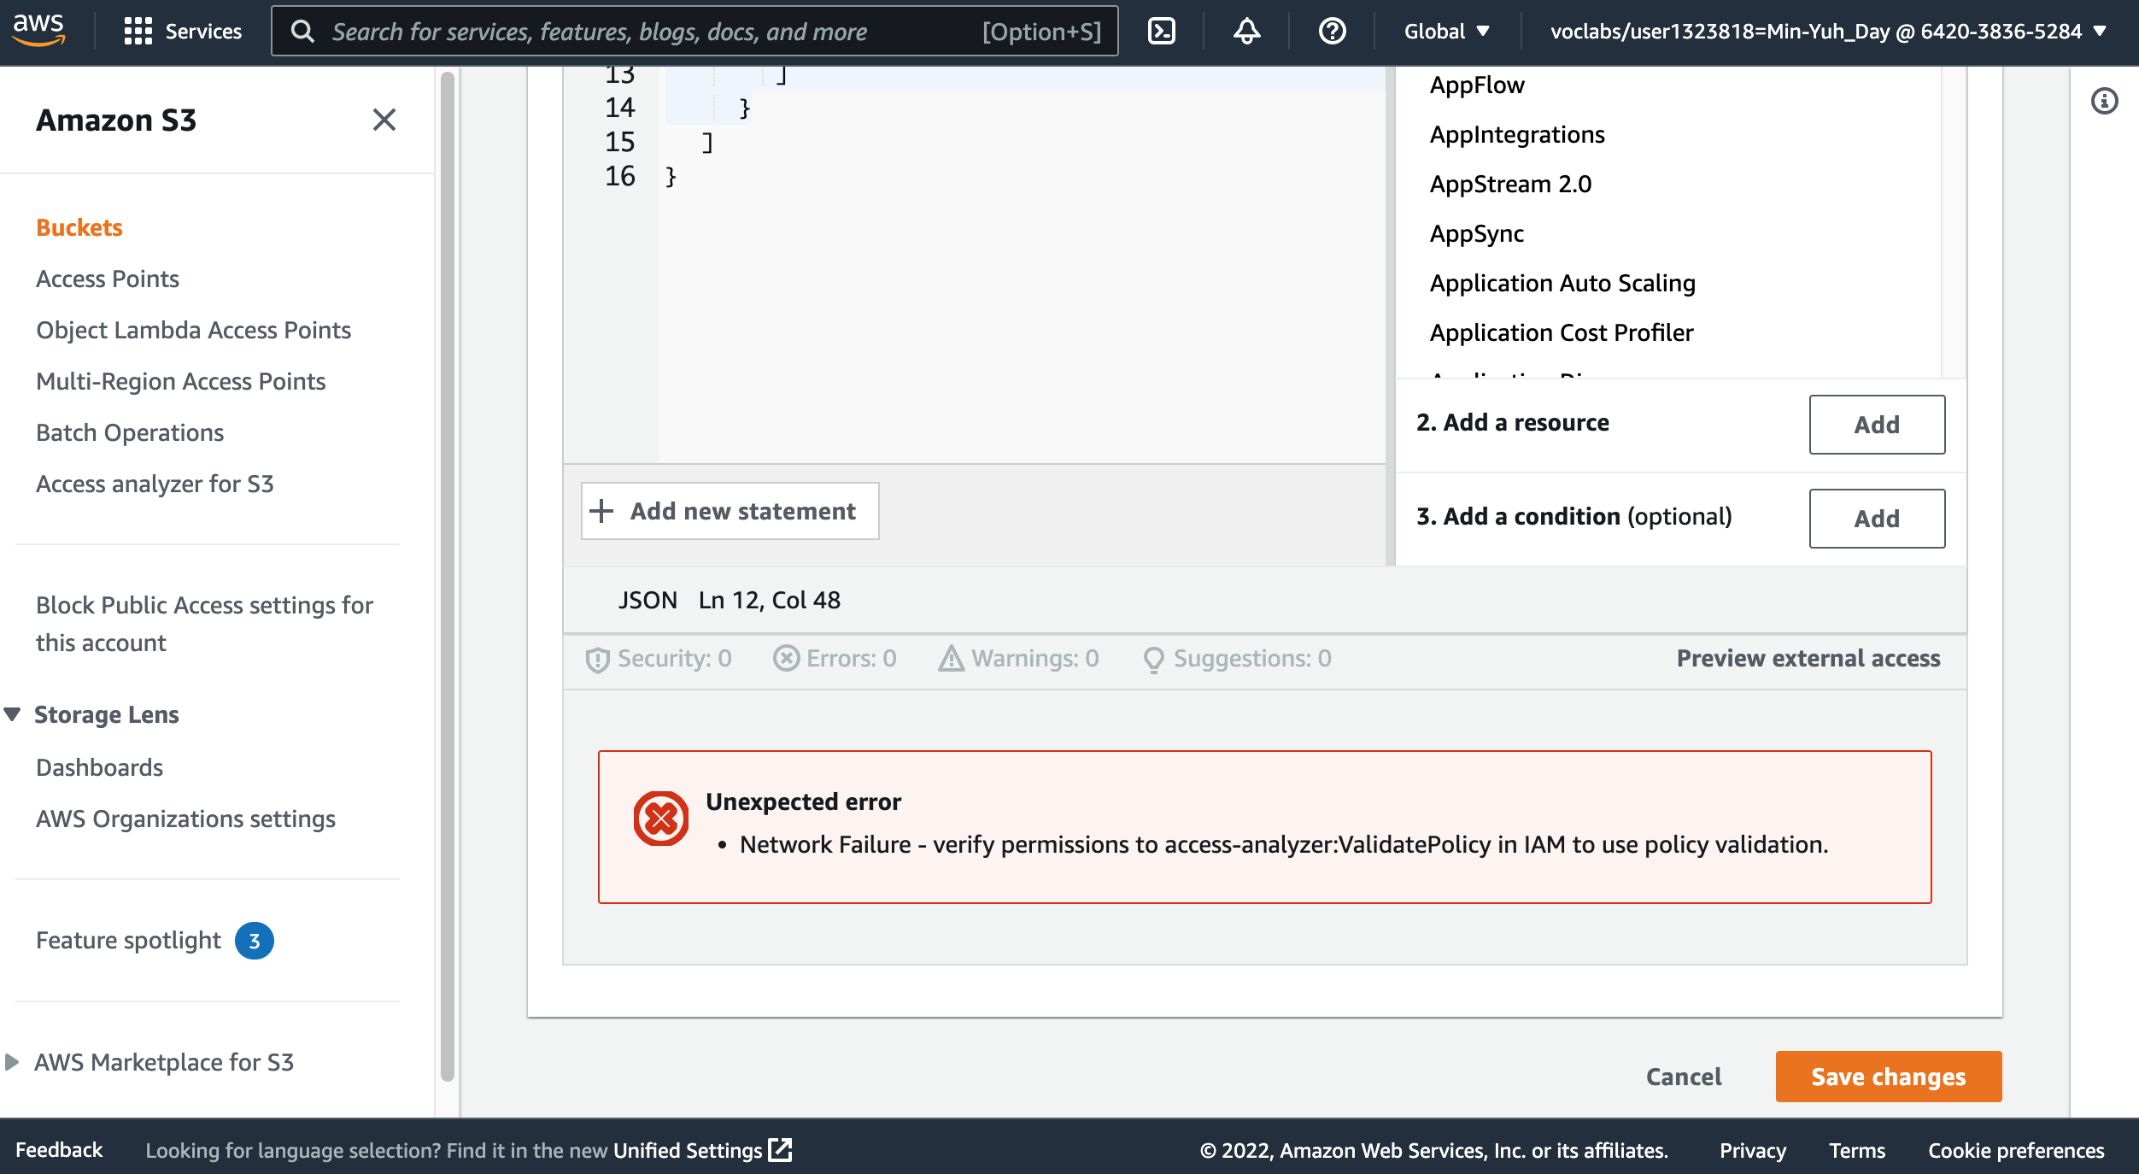
AWS Academy Introduction to Cloud: Semester 1 Module 5 Content Delivery: Lab 5 - Amazon CloudFront
14. At the bottom of the page, choose Save changes.
14
Source: AWS Academy Introduction to Cloud: Semester 1, https://awsacademy.instructure.com/courses/18745

Slide 64
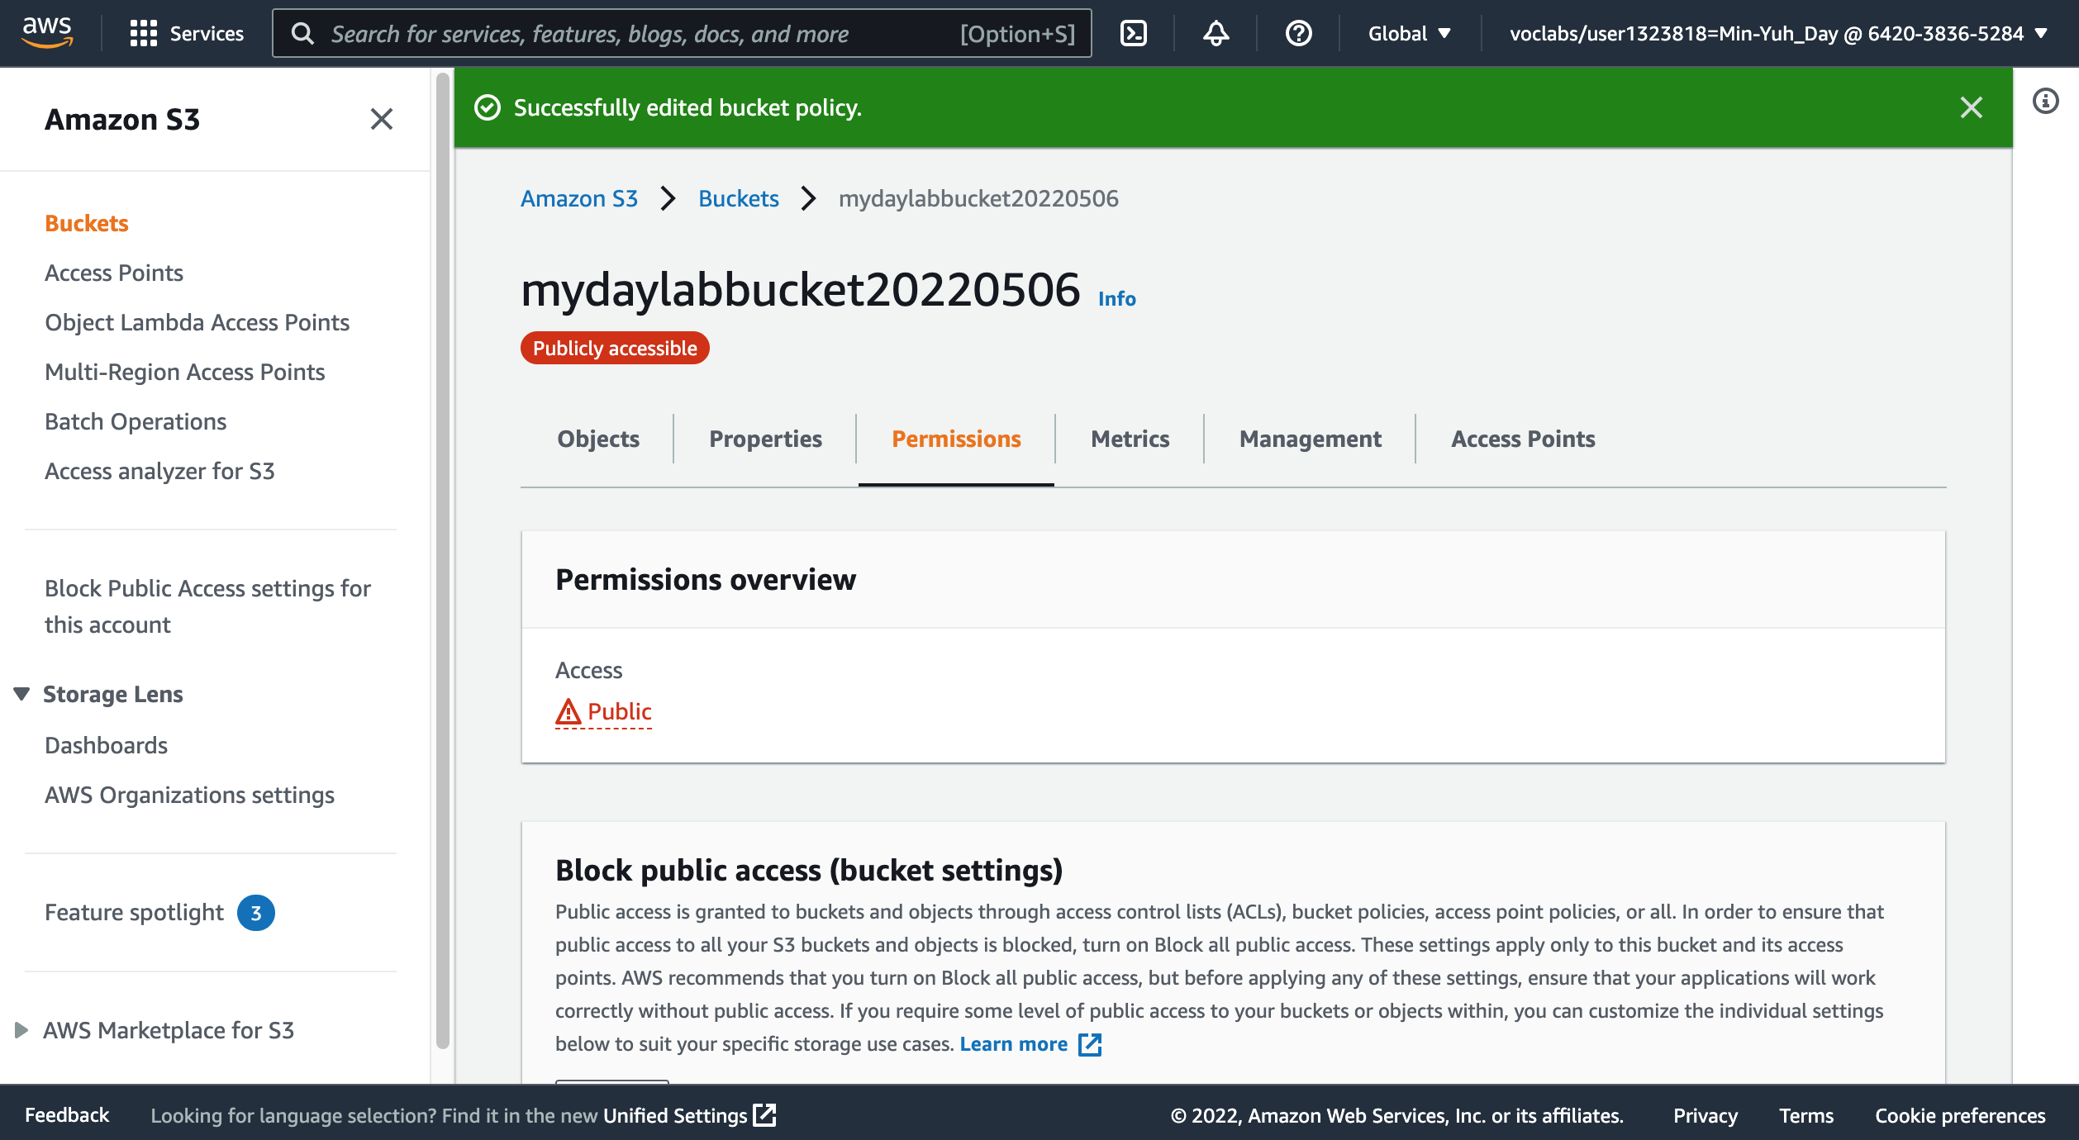
AWS Academy Introduction to Cloud: Semester 1 Module 5 Content Delivery: Lab 5 - Amazon CloudFront
Source: AWS Academy Introduction to Cloud: Semester 1, https://awsacademy.instructure.com/courses/18745

Slide 65
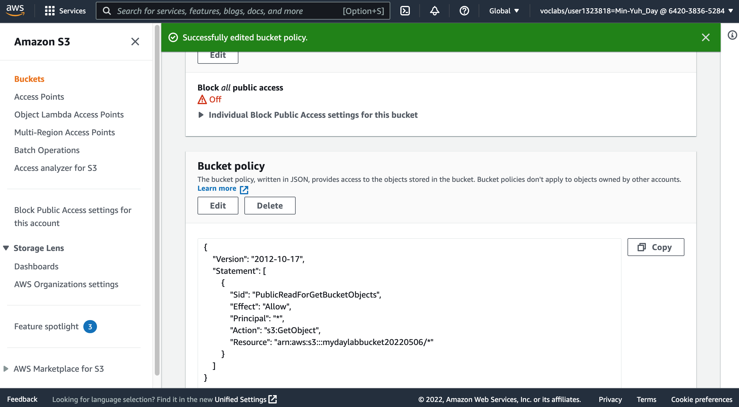
AWS Academy Introduction to Cloud: Semester 1 Module 5 Content Delivery: Lab 5 - Amazon CloudFront
Source: AWS Academy Introduction to Cloud: Semester 1, https://awsacademy.instructure.com/courses/18745

Slide 66
AWS Academy Introduction to Cloud: Semester 1 Module 5 Content Delivery: Lab 5 - Amazon CloudFront
Task 3. Upload an HTML document
In this task, you will upload the index.html file for your webpage to the S3 bucket.
Open the context menu (right-click) for the following link, and then choose Save link as: index.html
Save the index.html file to your local computer.
In the console, choose the Objects tab.
Upload the index.html file to your bucket.
Choose Upload.
Drag and drop the index.html file onto the upload page. An alternative is to choose Add files, navigate to the file, and choose Open.
Expand the Permissions section.
Under Predefined ACLs, select Grant public-read access.
A warning message similar to Granting public-read access is not recommend appears below the setting you selected.
Below the warning, check the box next to I understand....
At the bottom of the page, choose Upload.
Choose Close.
The index.html file appears in the Objects list.
Source: AWS Academy Introduction to Cloud: Semester 1, https://awsacademy.instructure.com/courses/18745

Slide 67
AWS Academy Introduction to Cloud: Semester 1 Module 5 Content Delivery: Lab 5 - Amazon CloudFront
Open the context menu (right-click) for the following link, and then choose Save link as: index.html
Save the index.html file to your local computer.
index.html
<html>
<h1>Hello World. Take me to your leader.</h1>
</html>
Source: AWS Academy Introduction to Cloud: Semester 1, https://awsacademy.instructure.com/courses/18745

Slide 68
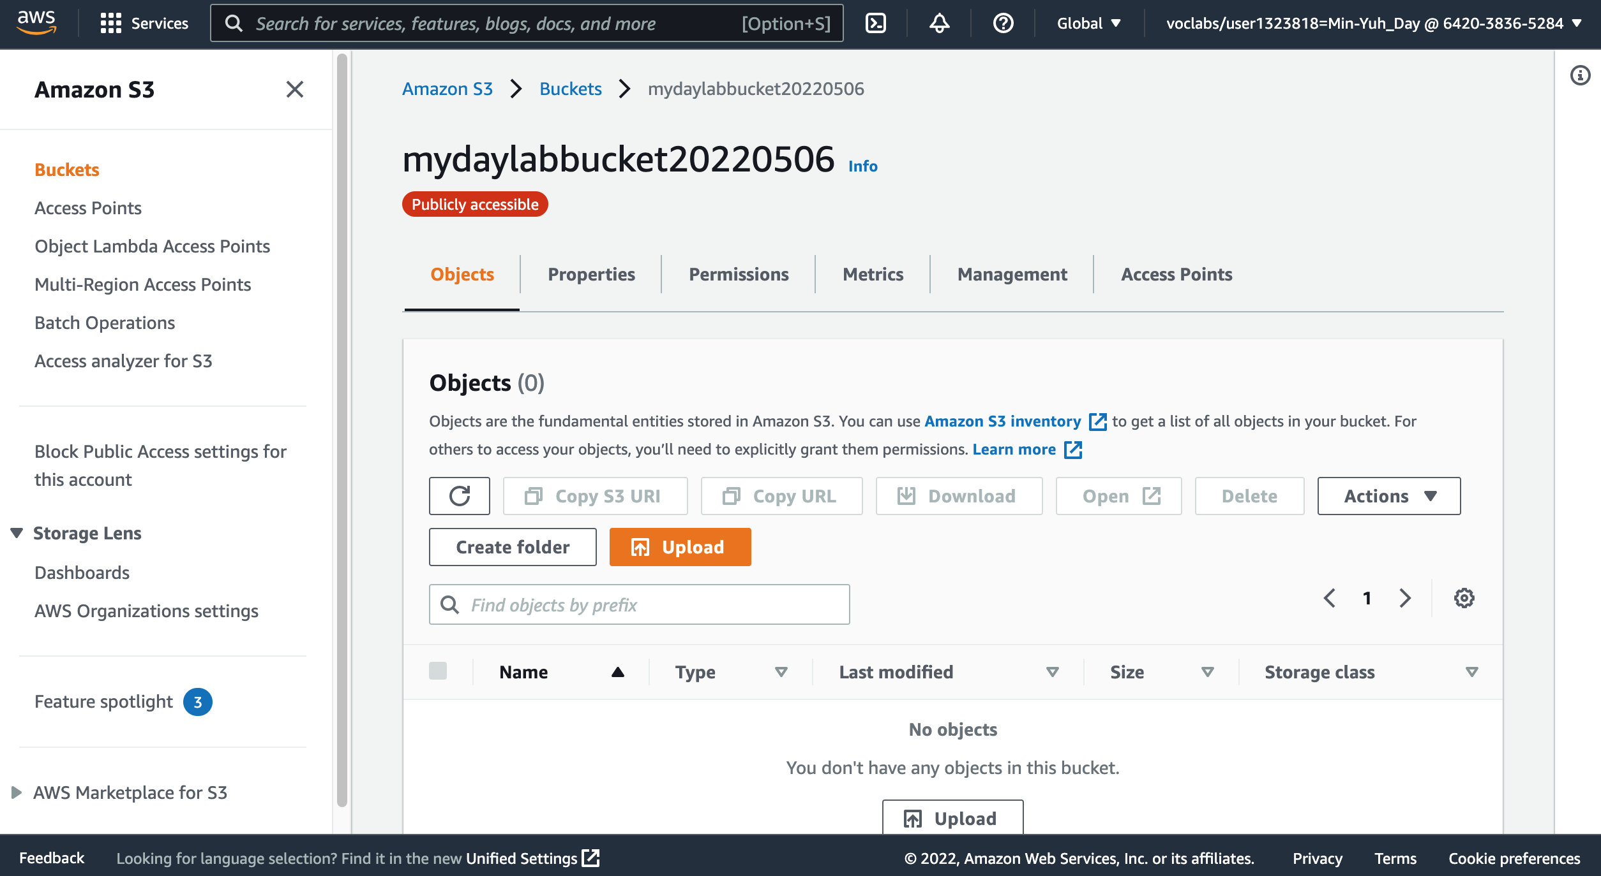
AWS Academy Introduction to Cloud: Semester 1 Module 5 Content Delivery: Lab 5 - Amazon CloudFront
17
17. In the console, choose the Objects tab.
18
18. Upload the index.html file to your bucket. Choose Upload.
Source: AWS Academy Introduction to Cloud: Semester 1, https://awsacademy.instructure.com/courses/18745

Slide 69
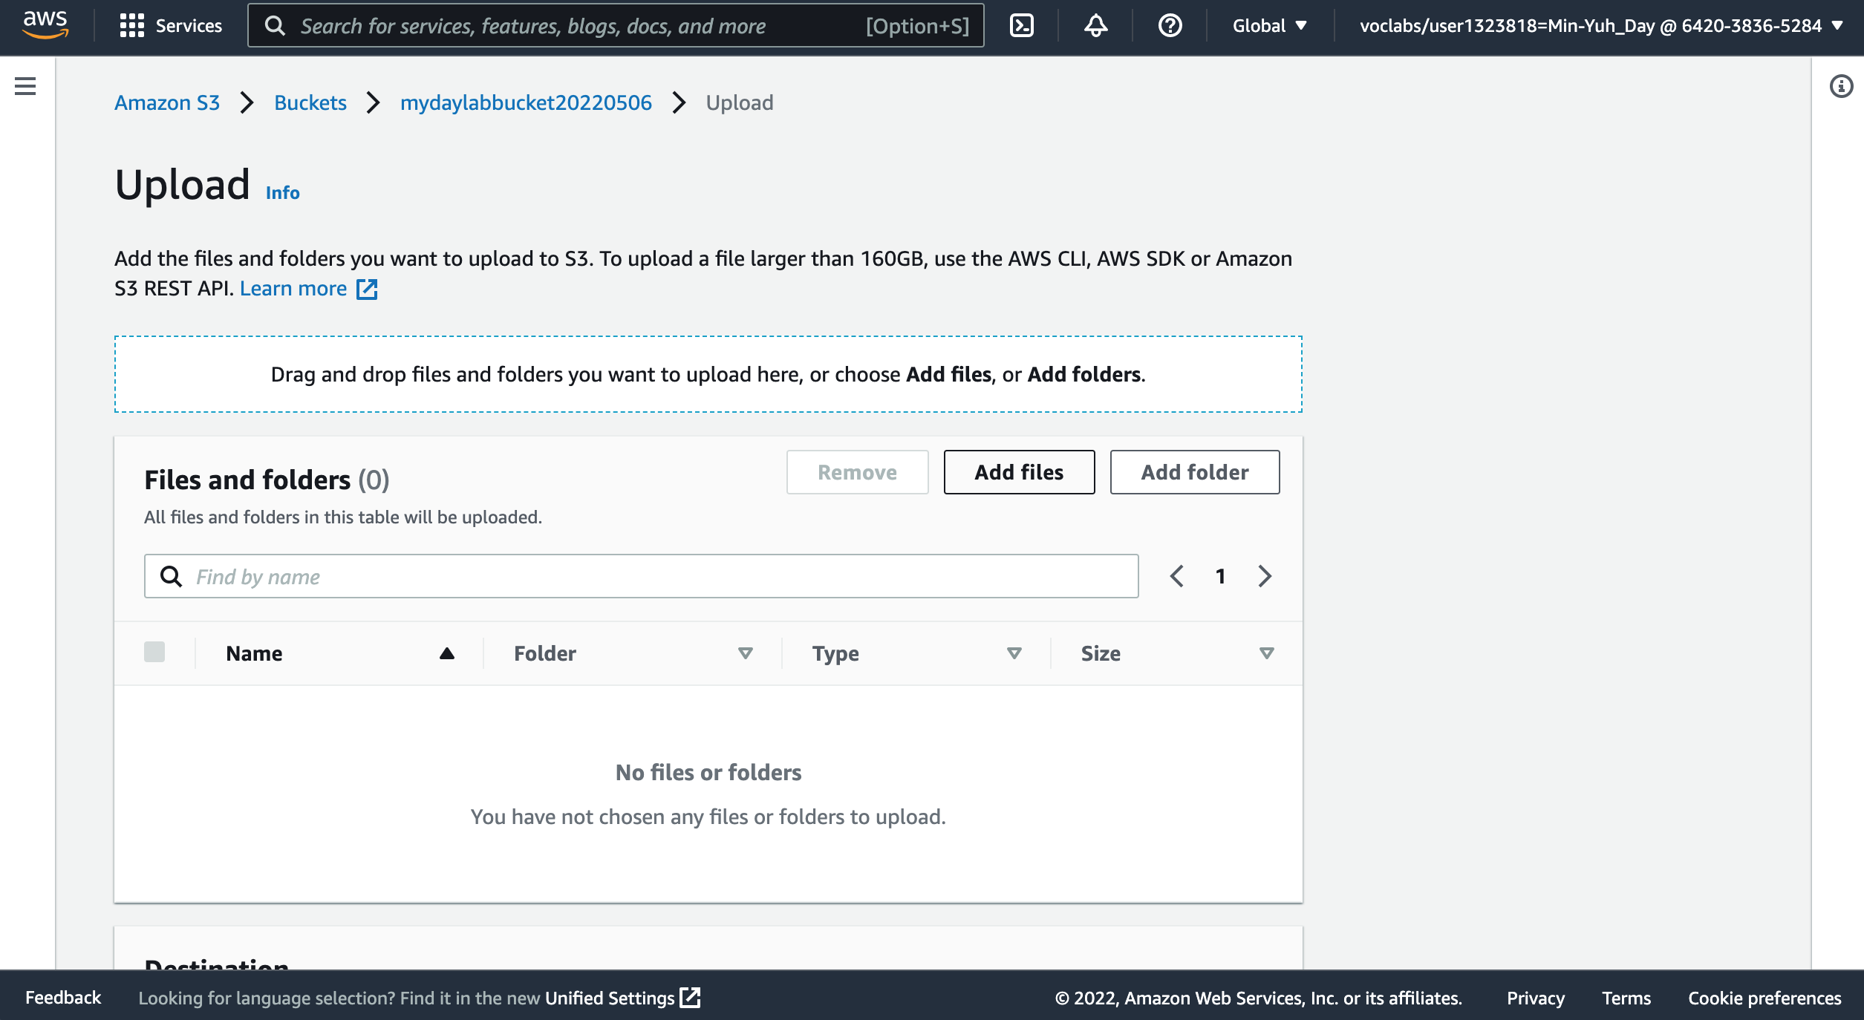
AWS Academy Introduction to Cloud: Semester 1 Module 5 Content Delivery: Lab 5 - Amazon CloudFront
18
18 Upload the index.html file to your bucket.
Choose Upload.
Drag and drop the index.html file onto the upload page. An alternative is to choose Add files, navigate to the file, and choose Open.
Source: AWS Academy Introduction to Cloud: Semester 1, https://awsacademy.instructure.com/courses/18745

Slide 70
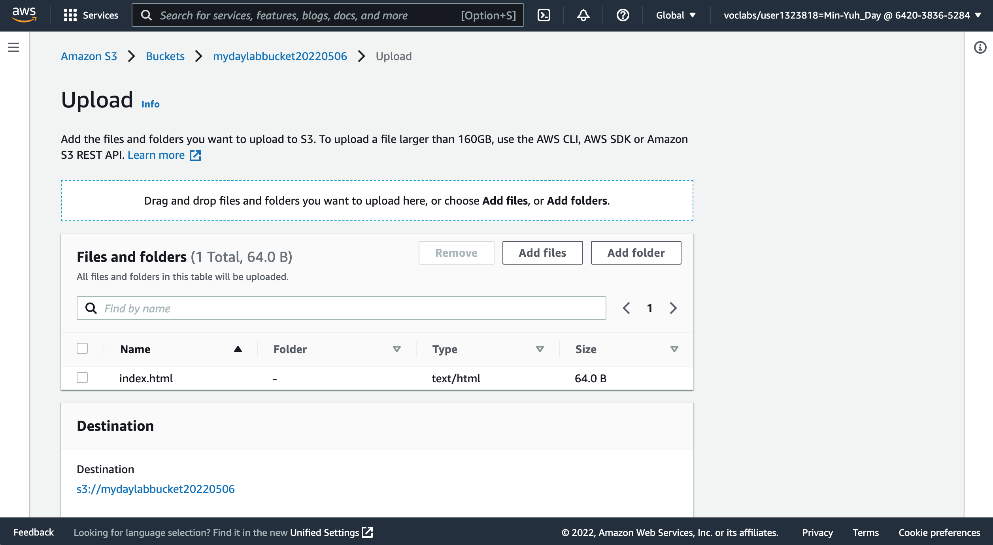
AWS Academy Introduction to Cloud: Semester 1 Module 5 Content Delivery: Lab 5 - Amazon CloudFront
18
18 Upload the index.html file to your bucket.
Choose Upload.
Drag and drop the index.html file onto the upload page. An alternative is to choose Add files, navigate to the file, and choose Open.
Source: AWS Academy Introduction to Cloud: Semester 1, https://awsacademy.instructure.com/courses/18745

Slide 71
AWS Academy Introduction to Cloud: Semester 1 Module 5 Content Delivery: Lab 5 - Amazon CloudFront
19
Expand the Permissions section.
Source: AWS Academy Introduction to Cloud: Semester 1, https://awsacademy.instructure.com/courses/18745

Slide 72
AWS Academy Introduction to Cloud: Semester 1 Module 5 Content Delivery: Lab 5 - Amazon CloudFront
20
20. Under Predefined ACLs, select Grant public-read access.
Source: AWS Academy Introduction to Cloud: Semester 1, https://awsacademy.instructure.com/courses/18745

Slide 73
AWS Academy Introduction to Cloud: Semester 1 Module 5 Content Delivery: Lab 5 - Amazon CloudFront
20. Under Predefined ACLs, select Grant public-read access.
A warning message similar to Granting public-read access is not recommend appears below the setting you selected.
20
21
21. Below the warning, check the box next to I understand....
22. At the bottom of the page, choose Upload.
22
Source: AWS Academy Introduction to Cloud: Semester 1, https://awsacademy.instructure.com/courses/18745

Slide 74
AWS Academy Introduction to Cloud: Semester 1 Module 5 Content Delivery: Lab 5 - Amazon CloudFront
23
24. Choose Close.
Source: AWS Academy Introduction to Cloud: Semester 1, https://awsacademy.instructure.com/courses/18745

Slide 75
AWS Academy Introduction to Cloud: Semester 1 Module 5 Content Delivery: Lab 5 - Amazon CloudFront
Source: AWS Academy Introduction to Cloud: Semester 1, https://awsacademy.instructure.com/courses/18745

Slide 76
AWS Academy Introduction to Cloud: Semester 1 Module 5 Content Delivery: Lab 5 - Amazon CloudFront
The index.html file appears in the Objects list.
Source: AWS Academy Introduction to Cloud: Semester 1, https://awsacademy.instructure.com/courses/18745

Slide 77
AWS Academy Introduction to Cloud: Semester 1 Module 5 Content Delivery: Lab 5 - Amazon CloudFront
Task 4. Test your website
Select the Properties tab, and scroll down to the Static website hosting section.
Choose Edit.
Select Enable.
In the Index document text box, enter index.html
Select Save changes.
Scroll down to the Static website hosting section again, and copy the Bucket website endpoint URL to your clipboard.
Open a new tab in your web browser, paste the URL you just copied, and press Enter.
The Hello World webpage should display. You have successfully hosted a static website using an S3 bucket!
Source: AWS Academy Introduction to Cloud: Semester 1, https://awsacademy.instructure.com/courses/18745

Slide 78
AWS Academy Introduction to Cloud: Semester 1 Module 5 Content Delivery: Lab 5 - Amazon CloudFront
24
Select the Properties tab, and scroll down to the Static website hosting section.
Source: AWS Academy Introduction to Cloud: Semester 1, https://awsacademy.instructure.com/courses/18745

Slide 79
AWS Academy Introduction to Cloud: Semester 1 Module 5 Content Delivery: Lab 5 - Amazon CloudFront
Select the Properties tab, and scroll down to the Static website hosting section.
24
25. Choose Edit.
Source: AWS Academy Introduction to Cloud: Semester 1, https://awsacademy.instructure.com/courses/18745

Slide 80
AWS Academy Introduction to Cloud: Semester 1 Module 5 Content Delivery: Lab 5 - Amazon CloudFront
26
26. Select Enable.
Source: AWS Academy Introduction to Cloud: Semester 1, https://awsacademy.instructure.com/courses/18745

Slide 81
AWS Academy Introduction to Cloud: Semester 1 Module 5 Content Delivery: Lab 5 - Amazon CloudFront
27
27. In the Index document text box, enter index.html
Source: AWS Academy Introduction to Cloud: Semester 1, https://awsacademy.instructure.com/courses/18745

Slide 82
AWS Academy Introduction to Cloud: Semester 1 Module 5 Content Delivery: Lab 5 - Amazon CloudFront
28
28. Select Save changes.
Source: AWS Academy Introduction to Cloud: Semester 1, https://awsacademy.instructure.com/courses/18745

Slide 83
AWS Academy Introduction to Cloud: Semester 1 Module 5 Content Delivery: Lab 5 - Amazon CloudFront
29
29. Scroll down to the Static website hosting section again, and copy the Bucket website endpoint URL to your clipboard.
Source: AWS Academy Introduction to Cloud: Semester 1, https://awsacademy.instructure.com/courses/18745

Slide 84
AWS Academy Introduction to Cloud: Semester 1 Module 5 Content Delivery: Lab 5 - Amazon CloudFront
29
29. Scroll down to the Static website hosting section again, and copy the Bucket website endpoint URL to your clipboard.
29
Source: AWS Academy Introduction to Cloud: Semester 1, https://awsacademy.instructure.com/courses/18745

Slide 85
AWS Academy Introduction to Cloud: Semester 1 Module 5 Content Delivery: Lab 5 - Amazon CloudFront
http://mydaylabbucket20220506.s3-website-us-east-1.amazonaws.com/
30
30. Open a new tab in your web browser, paste the URL you just copied, and press Enter.
The Hello World webpage should display. You have successfully hosted a static website using an S3 bucket!
Source: AWS Academy Introduction to Cloud: Semester 1, https://awsacademy.instructure.com/courses/18745

Slide 86
AWS Academy Introduction to Cloud: Semester 1 Module 5 Content Delivery: Lab 5 - Amazon CloudFront
Task 5. Create a CloudFront distribution to serve your website
In this task, you will create an Amazon CloudFront distribution to serve your website.
Choose the Services menu, locate the Networking & Content Delivery section, and choose CloudFront.
Choose Create Distribution.
Under Web, choose Get Started.
Choose the text box next to Origin Domain Name and select the endpoint from your S3 bucket.
For Viewer Protocol Policy, ensure that HTTP and HTTPS is selected.
Scroll to the bottom of the page and select Create Distribution.
A new CloudFront distribution displays in the distributions list. The Status will say In Progress until your website has been distributed. This may take up to 20 minutes.
When the Status says Deployed, you can test your distribution.
Copy the Domain Name value for your distribution and save it to a text editor to use in a later step.
Source: AWS Academy Introduction to Cloud: Semester 1, https://awsacademy.instructure.com/courses/18745

Slide 87
AWS Academy Introduction to Cloud: Semester 1 Module 5 Content Delivery: Lab 5 - Amazon CloudFront
Task 5. Create a CloudFront distribution to serve your website
Create a new HTML file to test the distribution.
Find and download an image from the internet.
Navigate to your S3 bucket and upload the image file to it, making sure to grant public access as you did when uploading the HTML file earlier in this lab.
Create a new text file using Notepad and copy the following text into it:
<html>
<head>My CloudFront Test</head>
<body> <p>My test content goes here.</p>
<p><img src="http://domain-name/object-name" alt="my test image">
</body>
</html>
Replace domain-name with the domain name that you copied earlier for your CloudFront distribution.
Replace object-name with the file name of the picture file that you uploaded to your S3 bucket.
The edited line of code should look similar to the following:
<p><img src="http://d2f1zrxb2zaf30.cloudfront.net/picture.jpg" alt="my test image">
Save the text file with an HTML extension.
Use an internet browser to open the HTML file that you just created.
If the image that you uploaded shows, your CloudFront distribution was successful. If not, repeat the lab.
Source: AWS Academy Introduction to Cloud: Semester 1, https://awsacademy.instructure.com/courses/18745

Slide 88
AWS Academy Introduction to Cloud: Semester 1 Module 5 Content Delivery: Lab 5 - Amazon CloudFront
Choose the Services menu, locate the Networking & Content Delivery section, and choose CloudFront.
31
Source: AWS Academy Introduction to Cloud: Semester 1, https://awsacademy.instructure.com/courses/18745

Slide 89
AWS Academy Introduction to Cloud: Semester 1 Module 5 Content Delivery: Lab 5 - Amazon CloudFront
32
32. Choose Create Distribution.
Source: AWS Academy Introduction to Cloud: Semester 1, https://awsacademy.instructure.com/courses/18745

Slide 90
AWS Academy Introduction to Cloud: Semester 1 Module 5 Content Delivery: Lab 5 - Amazon CloudFront
33. Under Web, choose Get Started.
33
34
34. Choose the text box next to Origin Domain Name and select the endpoint from your S3 bucket.
Source: AWS Academy Introduction to Cloud: Semester 1, https://awsacademy.instructure.com/courses/18745

Slide 91
AWS Academy Introduction to Cloud: Semester 1 Module 5 Content Delivery: Lab 5 - Amazon CloudFront
34
34. Choose the text box next to Origin Domain Name and select the endpoint from your S3 bucket.
Source: AWS Academy Introduction to Cloud: Semester 1, https://awsacademy.instructure.com/courses/18745

Slide 92
AWS Academy Introduction to Cloud: Semester 1 Module 5 Content Delivery: Lab 5 - Amazon CloudFront
34. Choose the text box next to Origin Domain Name and select the endpoint from your S3 bucket.
34
Source: AWS Academy Introduction to Cloud: Semester 1, https://awsacademy.instructure.com/courses/18745

Slide 93
AWS Academy Introduction to Cloud: Semester 1 Module 5 Content Delivery: Lab 5 - Amazon CloudFront
35
35. For Viewer Protocol Policy, ensure that HTTP and HTTPS is selected.
Source: AWS Academy Introduction to Cloud: Semester 1, https://awsacademy.instructure.com/courses/18745

Slide 94
AWS Academy Introduction to Cloud: Semester 1 Module 5 Content Delivery: Lab 5 - Amazon CloudFront
36. Scroll to the bottom of the page and select Create Distribution.
A new CloudFront distribution displays in the distributions list. The Status will say In Progress until your website has been distributed. This may take up to 20 minutes.
When the Status says Deployed, you can test your distribution.
36
Source: AWS Academy Introduction to Cloud: Semester 1, https://awsacademy.instructure.com/courses/18745

Slide 95
AWS Academy Introduction to Cloud: Semester 1 Module 5 Content Delivery: Lab 5 - Amazon CloudFront
37. Copy the Domain Name value for your distribution and save it to a text editor to use in a later step.
37
https://dj1ero5u806ee.cloudfront.net
Source: AWS Academy Introduction to Cloud: Semester 1, https://awsacademy.instructure.com/courses/18745

Slide 96
AWS Academy Introduction to Cloud: Semester 1 Module 5 Content Delivery: Lab 5 - Amazon CloudFront
Create a new HTML file to test the distribution.
Find and download an image from the internet.
Navigate to your S3 bucket and upload the image file to it, making sure to grant public access as you did when uploading the HTML file earlier in this lab.
Create a new text file using Notepad and copy the following text into it:
<html>
<head>My CloudFront Test</head>
<body> <p>My test content goes here.</p>
<p><img src="http://domain-name/object-name" alt="my test image">
</body>
</html>
Replace domain-name with the domain name that you copied earlier for your CloudFront distribution.
Replace object-name with the file name of the picture file that you uploaded to your S3 bucket.
The edited line of code should look similar to the following:
<p><img src="http://d2f1zrxb2zaf30.cloudfront.net/picture.jpg" alt="my test image">
Save the text file with an HTML extension.
38
Source: AWS Academy Introduction to Cloud: Semester 1, https://awsacademy.instructure.com/courses/18745

Slide 97
AWS Academy Introduction to Cloud: Semester 1 Module 5 Content Delivery: Lab 5 - Amazon CloudFront
38. Navigate to your S3 bucket and upload the image file to it, making sure to grant public access as you did when uploading the HTML file earlier in this lab.
38
Source: AWS Academy Introduction to Cloud: Semester 1, https://awsacademy.instructure.com/courses/18745

Slide 98
AWS Academy Introduction to Cloud: Semester 1 Module 5 Content Delivery: Lab 5 - Amazon CloudFront
38. Navigate to your S3 bucket and upload the image file to it, making sure to grant public access as you did when uploading the HTML file earlier in this lab.
38
Source: AWS Academy Introduction to Cloud: Semester 1, https://awsacademy.instructure.com/courses/18745

Slide 99
AWS Academy Introduction to Cloud: Semester 1 Module 5 Content Delivery: Lab 5 - Amazon CloudFront
38. Navigate to your S3 bucket and upload the image file to it, making sure to grant public access as you did when uploading the HTML file earlier in this lab.
38
Source: AWS Academy Introduction to Cloud: Semester 1, https://awsacademy.instructure.com/courses/18745

Slide 100
AWS Academy Introduction to Cloud: Semester 1 Module 5 Content Delivery: Lab 5 - Amazon CloudFront
39
https://dj1ero5u806ee.cloudfront.net/index2.html
39. Use an internet browser to open the HTML file that you just created.
If the image that you uploaded shows, your CloudFront distribution was successful. If not, repeat the lab.
<html>
<head>My CloudFront Test</head>
<body>
<p>Min-Yuh Day at AWS S3 CloudFront</p>
<p><img src="https://dj1ero5u806ee.cloudfront.net/Myday_Photo.jpg" alt="Myday image">
</body>
</html>
Source: AWS Academy Introduction to Cloud: Semester 1, https://awsacademy.instructure.com/courses/18745

Slide 101
AWS Academy Introduction to Cloud: Semester 1 Module 5 Content Delivery: Lab 5 - Amazon CloudFront
39. Use an internet browser to open the HTML file that you just created.
If the image that you uploaded shows, your CloudFront distribution was successful. If not, repeat the lab.
39
https://dj1ero5u806ee.cloudfront.net/Myday_Photo.jpg
Source: AWS Academy Introduction to Cloud: Semester 1, https://awsacademy.instructure.com/courses/18745

Slide 102
AWS Academy Introduction to Cloud: Semester 1 Module 5 Content Delivery: Lab 5 - Amazon CloudFront
Lab complete
Congratulations! You have completed the lab.
Log out of the AWS Management Console.
In the upper-right corner of the page, choose your user name. Your user name begins with voclabs/user.
Choose Sign Out.
Choose End Lab at the top of this page, and then select Yes to confirm that you want to end the lab.
Source: AWS Academy Introduction to Cloud: Semester 1, https://awsacademy.instructure.com/courses/18745

Slide 103
AWS Academy Introduction to Cloud: Semester 1 Module 5 Content Delivery: Lab 5 - Amazon CloudFront
40
Log out of the AWS Management Console.
In the upper-right corner of the page, choose your user name. Your user name begins with voclabs/user.
Choose Sign Out.
Source: AWS Academy Introduction to Cloud: Semester 1, https://awsacademy.instructure.com/courses/18745

Slide 104
AWS Academy Introduction to Cloud: Semester 1 Module 5 Content Delivery: Lab 5 - Amazon CloudFront
40
Log out of the AWS Management Console.
In the upper-right corner of the page, choose your user name. Your user name begins with voclabs/user.
Choose Sign Out.
Source: AWS Academy Introduction to Cloud: Semester 1, https://awsacademy.instructure.com/courses/18745

Slide 105
AWS Academy Introduction to Cloud: Semester 1 Module 5 Content Delivery: Lab 5 - Amazon CloudFront
Source: AWS Academy Introduction to Cloud: Semester 1, https://awsacademy.instructure.com/courses/18745

Slide 106
AWS Academy Introduction to Cloud: Semester 1 Module 5 Content Delivery: Lab 5 - Amazon CloudFront
41
Choose End Lab at the top of this page, and then select Yes to confirm that you want to end the lab.
Source: AWS Academy Introduction to Cloud: Semester 1, https://awsacademy.instructure.com/courses/18745

Slide 107
AWS Academy Introduction to Cloud: Semester 1 Module 5 Content Delivery: Lab 5 - Amazon CloudFront
41
Choose End Lab at the top of this page, and then select Yes to confirm that you want to end the lab.
Source: AWS Academy Introduction to Cloud: Semester 1, https://awsacademy.instructure.com/courses/18745

Slide 108
AWS Academy Introduction to Cloud: Semester 1 Module 5 Content Delivery: Lab 5 - Amazon CloudFront
Source: AWS Academy Introduction to Cloud: Semester 1, https://awsacademy.instructure.com/courses/18745

Slide 109
AWS Academy Introduction to Cloud: Semester 1 Module 5 Content Delivery: Lab 5 - Amazon CloudFront
https://dj1ero5u806ee.cloudfront.net/index.html
Source: AWS Academy Introduction to Cloud: Semester 1, https://awsacademy.instructure.com/courses/18745

Slide 110
AWS Academy Introduction to Cloud: Semester 1 Module 5 Content Delivery: Lab 5 - Amazon CloudFront
Source: AWS Academy Introduction to Cloud: Semester 1, https://awsacademy.instructure.com/courses/18745

Slide 111
Web Application with AWS Core Services

Slide 112
Source: AWS Training Center (2019), Introduction to AWS Services, https://youtu.be/Z3SYDTMP3ME

Slide 113
Source: AWS Training Center (2019), Introduction to AWS Services, https://youtu.be/Z3SYDTMP3ME

Slide 114
Source: AWS Training Center (2019), Introduction to AWS Services, https://youtu.be/Z3SYDTMP3ME

Slide 115
Source: AWS Training Center (2019), Introduction to AWS Services, https://youtu.be/Z3SYDTMP3ME

Slide 116
Source: AWS Training Center (2019), Introduction to AWS Services, https://youtu.be/Z3SYDTMP3ME

Slide 117
Source: AWS Training Center (2019), Introduction to AWS Services, https://youtu.be/Z3SYDTMP3ME

Slide 118
Source: AWS Training Center (2019), Introduction to AWS Services, https://youtu.be/Z3SYDTMP3ME

Slide 119
AWS Serverless Architecture

Slide 120
AWS Serverless Airline Booking
Source: https://github.com/aws-samples/aws-serverless-airline-booking

Slide 121
AWS Serverless Airline Booking Stack
Source: https://github.com/aws-samples/aws-serverless-airline-booking

Slide 122
AWS Serverless Airline Booking High level infrastructure architecture
Source: https://github.com/aws-samples/aws-serverless-airline-booking

Slide 123
AWS Serverless Architecture AWS Operational Responsibility Models
Source: Heitor Lessa (2019), How to build a full stack serverless airline ticketing web app, https://www.youtube.com/watch?v=MyoOeHTp2pg

Slide 124
Build a Serverless Web Application

Slide 125
Build a Serverless Web Application
Source: https://aws.amazon.com/getting-started/projects/build-serverless-web-app-lambda-apigateway-s3-dynamodb-cognito/

Slide 126
Build a Serverless Web Application with Amazon S3, AWS Lambda, Amazon API Gateway, Amazon DynamoDB, and Amazon Cognito
Source: https://aws.amazon.com/getting-started/projects/build-serverless-web-app-lambda-apigateway-s3-dynamodb-cognito/

Slide 127
Build a Serverless Web Application with Amazon S3, AWS Lambda, Amazon API Gateway, Amazon DynamoDB, and Amazon Cognito
1
Source: https://aws.amazon.com/getting-started/projects/build-serverless-web-app-lambda-apigateway-s3-dynamodb-cognito/

Slide 128
Build a Serverless Web Application with Amazon S3, AWS Lambda, Amazon API Gateway, Amazon DynamoDB, and Amazon Cognito
1
Static Web Hosting
Amazon S3 hosts static web resources including HTML, CSS, JavaScript, and image files which are loaded in the user's browser.
Source: https://aws.amazon.com/getting-started/projects/build-serverless-web-app-lambda-apigateway-s3-dynamodb-cognito/

Slide 129
Build a Serverless Web Application with Amazon S3, AWS Lambda, Amazon API Gateway, Amazon DynamoDB, and Amazon Cognito
2
Source: https://aws.amazon.com/getting-started/projects/build-serverless-web-app-lambda-apigateway-s3-dynamodb-cognito/

Slide 130
Build a Serverless Web Application with Amazon S3, AWS Lambda, Amazon API Gateway, Amazon DynamoDB, and Amazon Cognito
2
User Management
Amazon Cognito provides user management and authentication functions to secure the backend API.
Source: https://aws.amazon.com/getting-started/projects/build-serverless-web-app-lambda-apigateway-s3-dynamodb-cognito/

Slide 131
Build a Serverless Web Application with Amazon S3, AWS Lambda, Amazon API Gateway, Amazon DynamoDB, and Amazon Cognito
3
Source: https://aws.amazon.com/getting-started/projects/build-serverless-web-app-lambda-apigateway-s3-dynamodb-cognito/

Slide 132
Build a Serverless Web Application with Amazon S3, AWS Lambda, Amazon API Gateway, Amazon DynamoDB, and Amazon Cognito
3
Serverless Backend
Amazon DynamoDB provides a persistence layer where data can be stored by the API's Lambda function.
Source: https://aws.amazon.com/getting-started/projects/build-serverless-web-app-lambda-apigateway-s3-dynamodb-cognito/

Slide 133
Build a Serverless Web Application with Amazon S3, AWS Lambda, Amazon API Gateway, Amazon DynamoDB, and Amazon Cognito
4
Source: https://aws.amazon.com/getting-started/projects/build-serverless-web-app-lambda-apigateway-s3-dynamodb-cognito/

Slide 134
Build a Serverless Web Application with Amazon S3, AWS Lambda, Amazon API Gateway, Amazon DynamoDB, and Amazon Cognito
4
RESTful API
JavaScript executed in the browser sends and receives data from a public backend API built using Lambda and API Gateway.
Source: https://aws.amazon.com/getting-started/projects/build-serverless-web-app-lambda-apigateway-s3-dynamodb-cognito/

Slide 135
Build a Serverless Web Application with Amazon S3, AWS Lambda, Amazon API Gateway, Amazon DynamoDB, and Amazon Cognito
5
Terminate resources
Resource Cleanup
You will terminate an Amazon S3 bucket, an Amazon Cognito User Pool, an AWS Lambda function, an IAM role, a DynamoDB table, a REST API, and a CloudWatch Log. It is a best practice to delete resources you are no longer using to avoid unwanted charges.
Source: https://aws.amazon.com/getting-started/projects/build-serverless-web-app-lambda-apigateway-s3-dynamodb-cognito/

Slide 136
Summary
AWS Content Delivery Network: Lab 5 Using CloudFront as a CDN for a Website
AWS Academy Introduction to Cloud: Semester 1
Module 5 Content Delivery
Lab 5 - Amazon CloudFront

Slide 137
References
https://aws.amazon.com/certification/
https://www.aws.training/
https://aws.amazon.com/training/awsacademy/
https://aws.amazon.com/education/awseducate/
AWS Academy Introduction to Cloud: Semester 1
https://awsacademy.instructure.com/courses/18745
AWS Certified Cloud Practitioner
https://aws.amazon.com/certification/certified-cloud-practitioner/
AWS Certified Solutions Architect – Associate
https://aws.amazon.com/certification/certified-solutions-architect-associate/
AWS Cloud Practitioner Essentials (Second Edition)
https://aws.amazon.com/training/course-descriptions/cloud-practitioner-essentials/
Architecting on AWS
https://aws.amazon.com/training/course-descriptions/architect/

Slide 138
AWS Content Delivery Network: Lab 5 Using CloudFront as a CDN for a Website
雲端運算基礎入門 Introduction to Cloud Computing
Q & A
Time: 2022/5/6 (Friday) 18:30-20:30
Place: 電資406室, 國立臺北大學 (NTPU)
戴敏育 副教授
Min-Yuh Day, Ph.D, Associate Professor
國立臺北大學 資訊管理研究所
Institute of Information Management, National Taipei University
https://web.ntpu.edu.tw/~myday
2022-05-06

