Slide 1
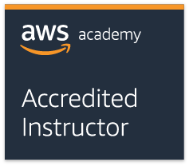
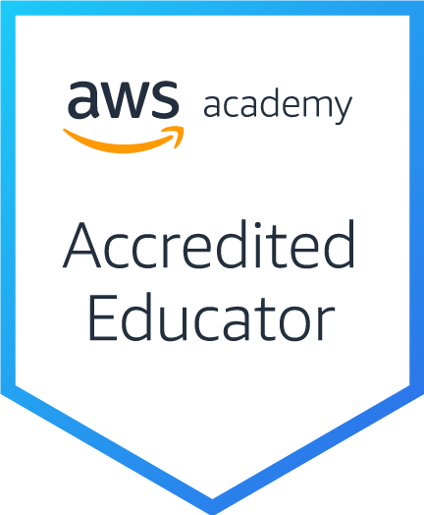
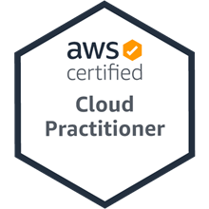
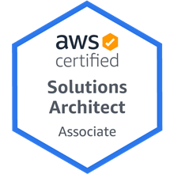
雲端應用程式開發 淡江大學資訊管理學系 鄭啟斌 教授
Tamkang University
AWS 認證
AWS Certification Overview
2021-05-27 (四) 7,8 14:10-15:00 Online
戴敏育 副教授
Min-Yuh Day, Ph.D, Associate Professor
國立臺北大學 資訊管理研究所
Institute of Information Management, National Taipei University
https://web.ntpu.edu.tw/~myday
2021-05-27

Slide 2
戴敏育 博士 (Min-Yuh Day, Ph.D.)
1
Tamkang University
國立台北大學 資訊管理研究所 副教授
中央研究院 資訊科學研究所 訪問學人
國立台灣大學 資訊管理 博士
Publications Co-Chairs, IEEE/ACM International Conference on Advances in Social Networks Analysis and Mining (ASONAM 2013- )
Program Co-Chair, IEEE International Workshop on Empirical Methods for Recognizing Inference in TExt (IEEE EM-RITE 2012- )
Publications Chair, The IEEE International Conference on Information Reuse and Integration (IEEE IRI)
2

Slide 3
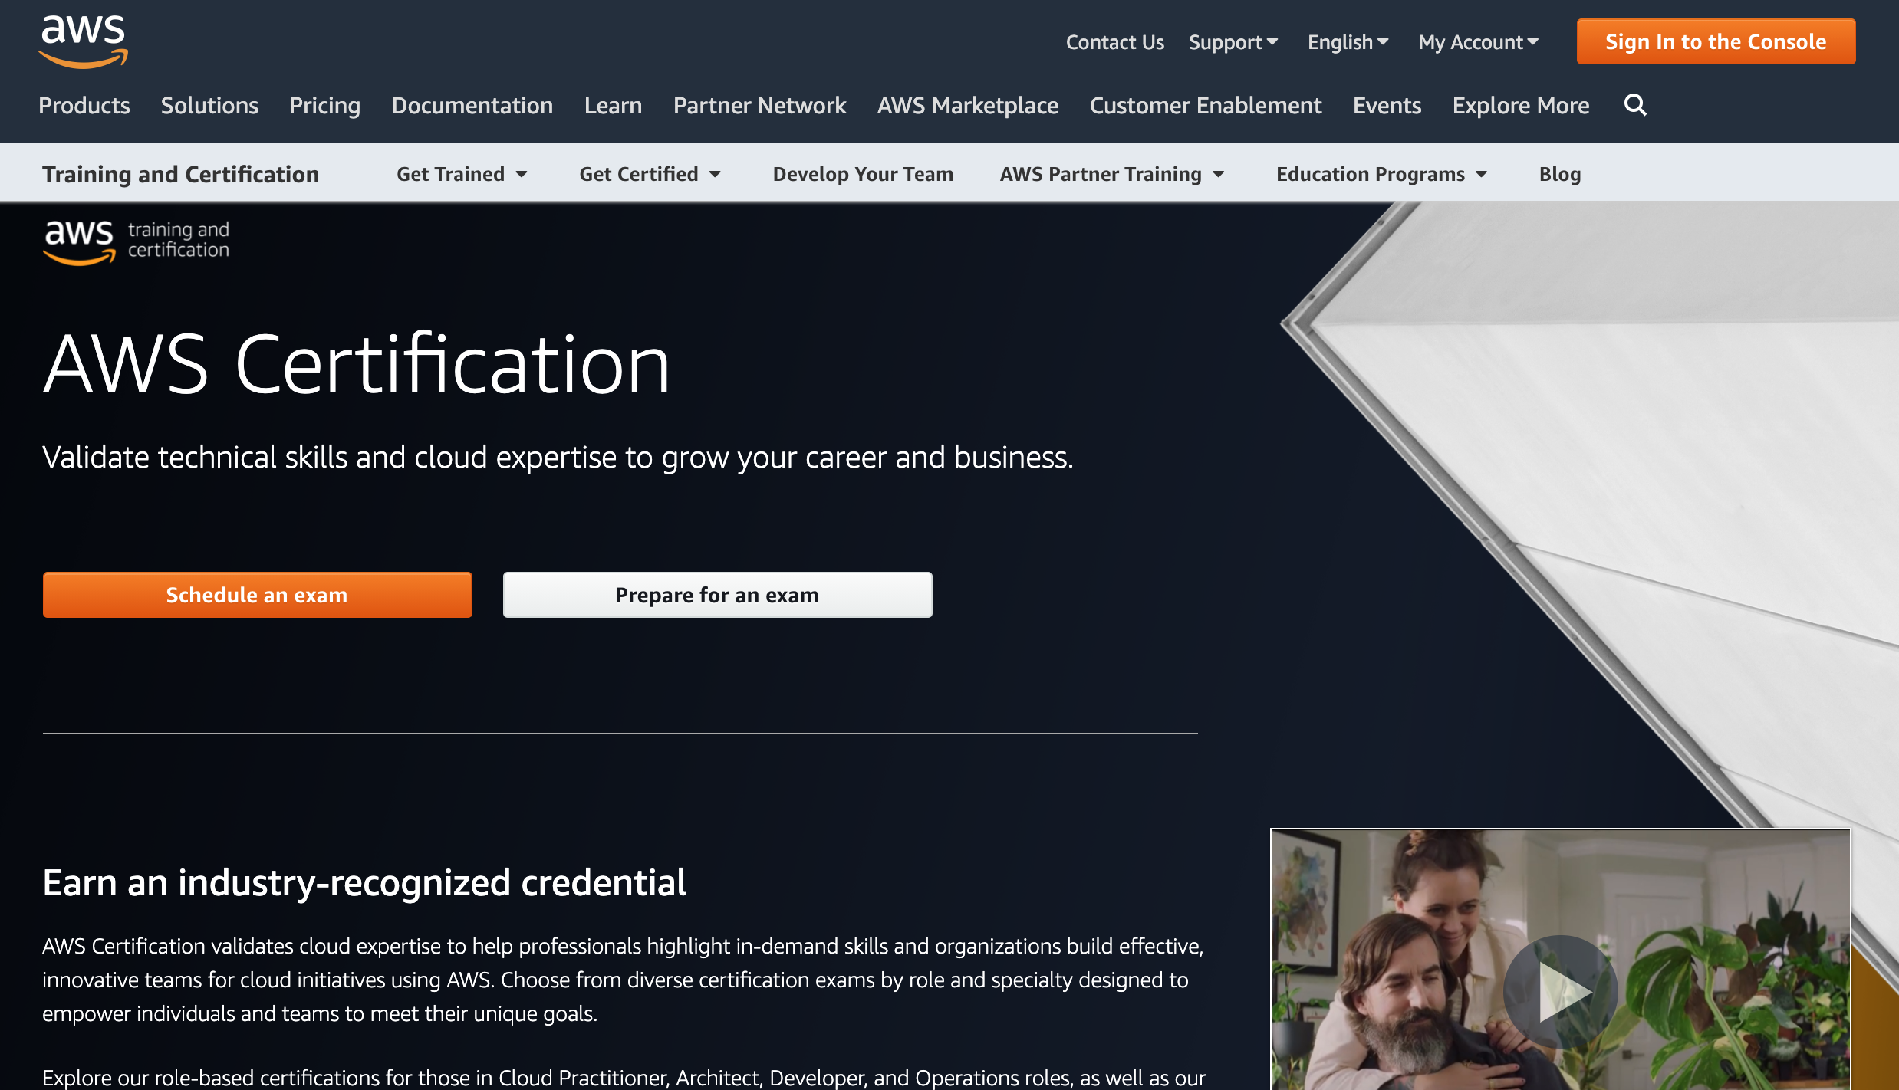
https://aws.amazon.com/certification/

Slide 4
https://aws.amazon.com/certification/

Slide 5
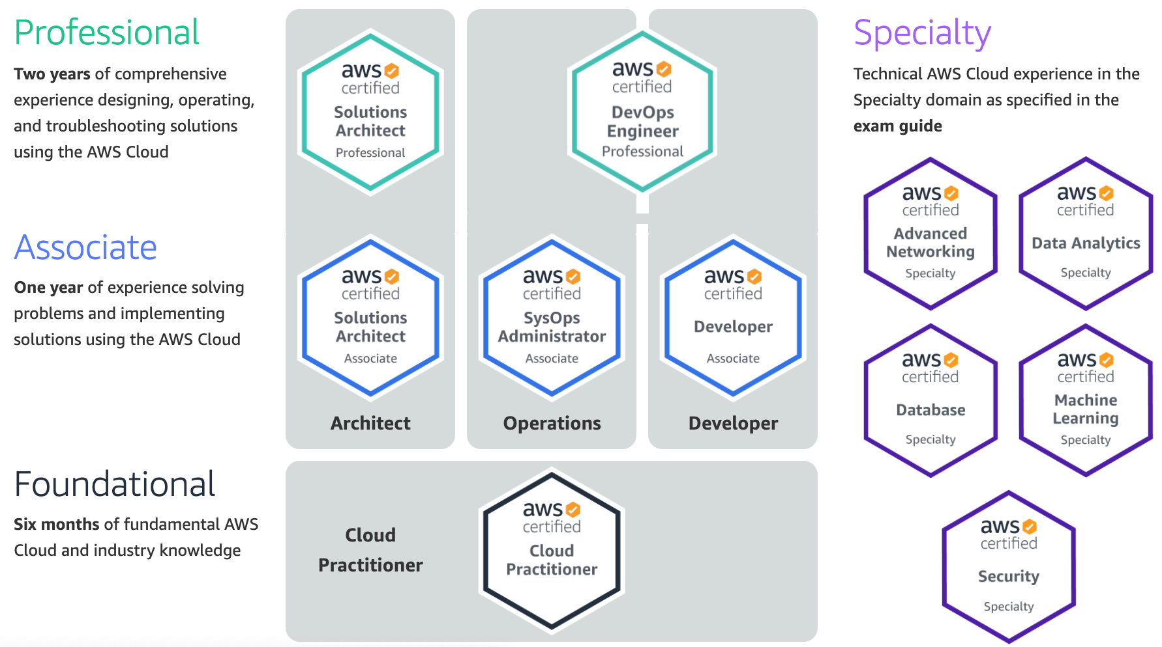
AWS Certification
2
SAA
1
CLF
https://aws.amazon.com/certification/

Slide 6
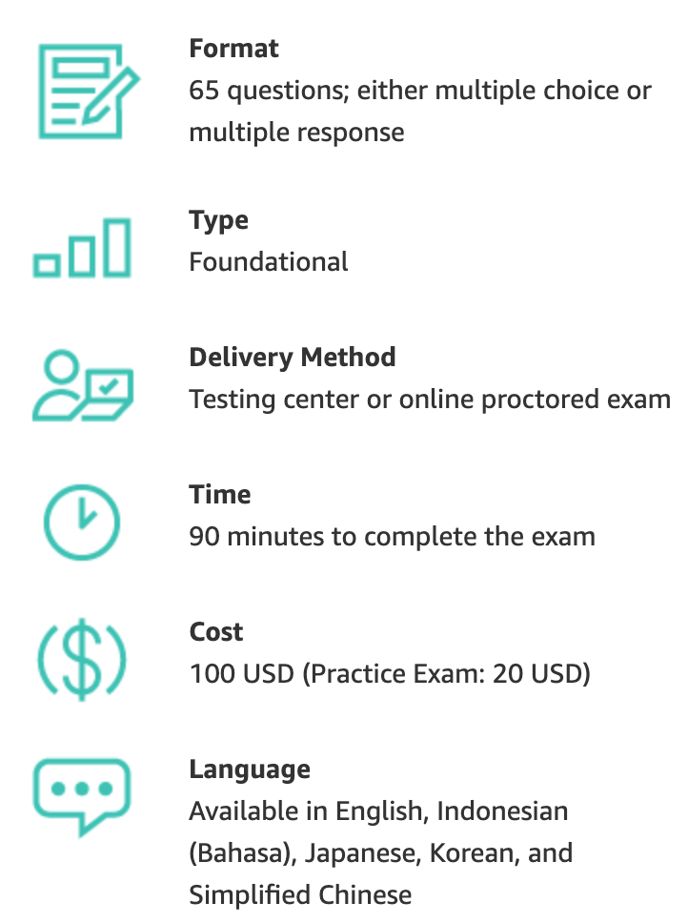
AWS Certification
https://aws.amazon.com/certification/

Slide 7
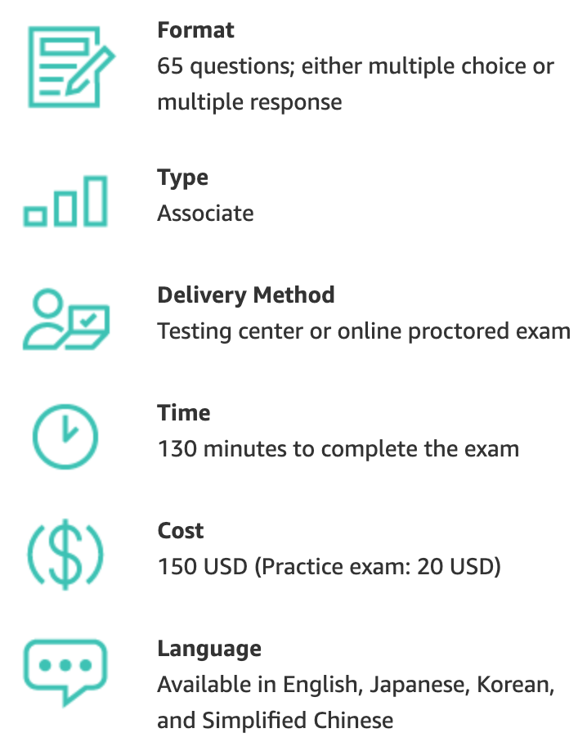
AWS Certification
https://aws.amazon.com/certification/

Slide 8
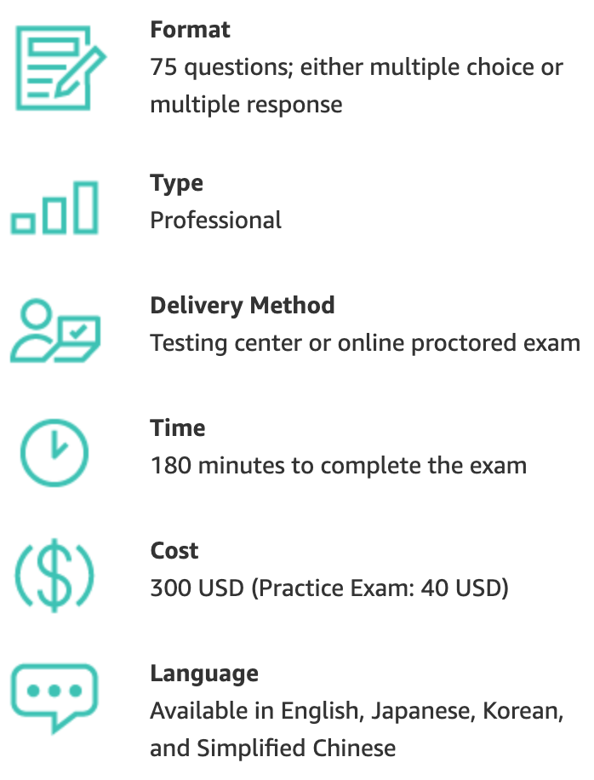
AWS Certification
https://aws.amazon.com/certification/

Slide 9
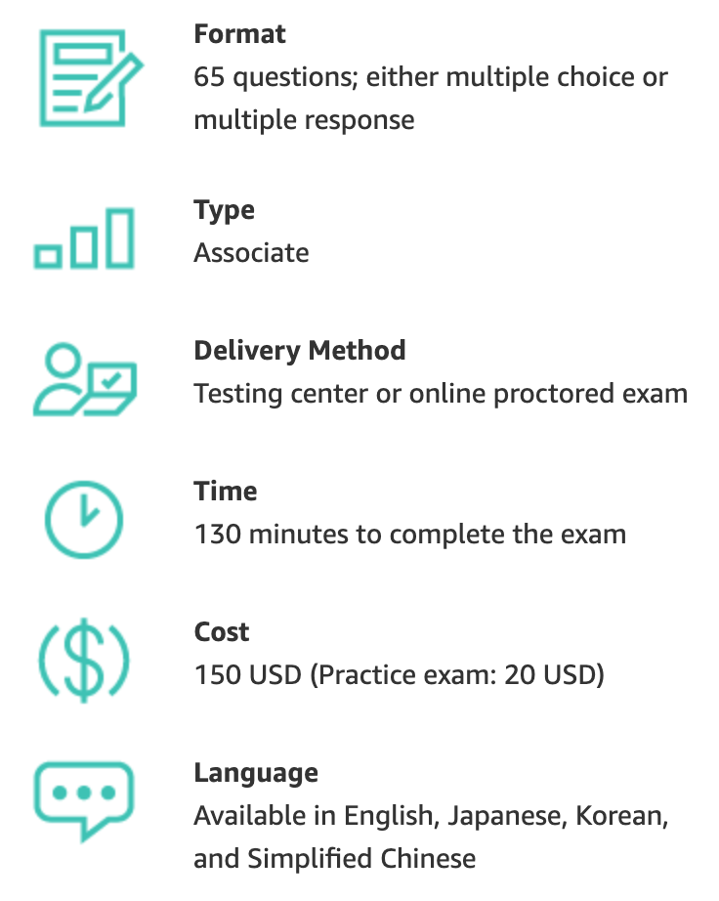
AWS Certification
https://aws.amazon.com/certification/

Slide 10
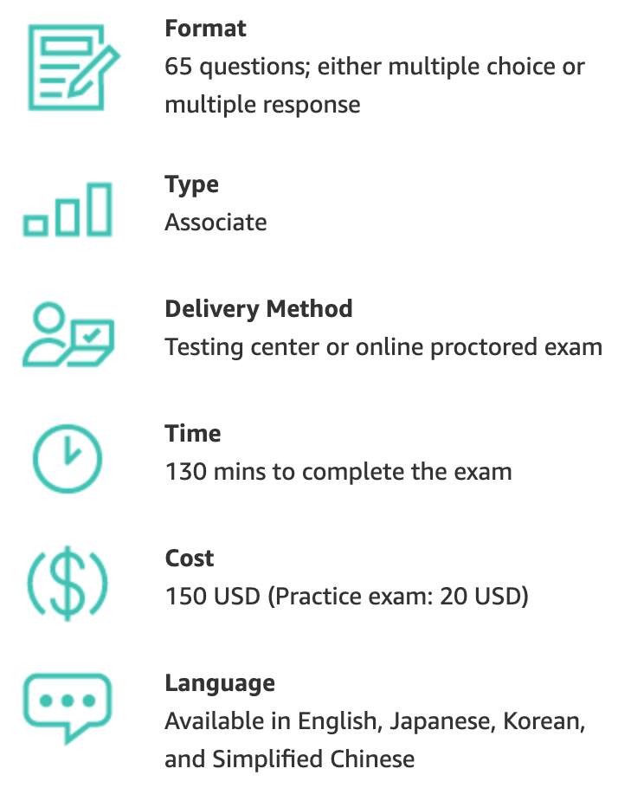
AWS Certification
https://aws.amazon.com/certification/

Slide 11
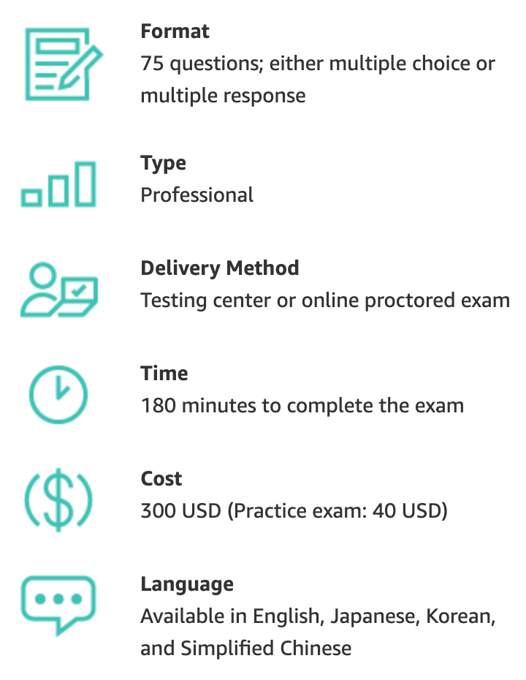
AWS Certification
https://aws.amazon.com/certification/

Slide 12
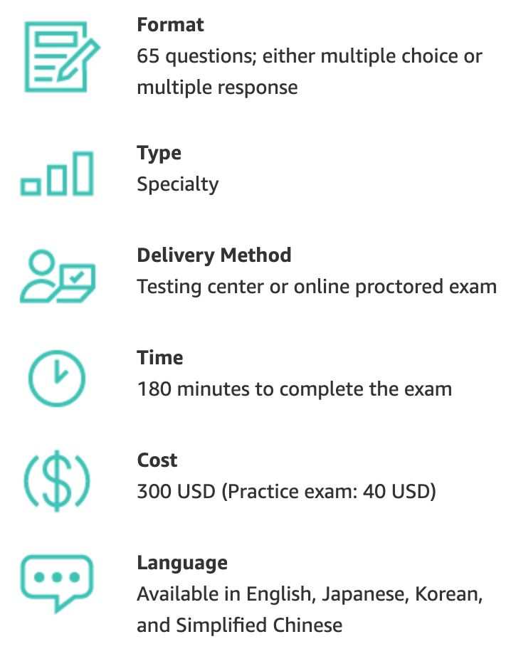
AWS Certification
https://aws.amazon.com/certification/

Slide 13
AWS Certified Cloud Practitioner (CLF-C01)
Source: https://aws.amazon.com/certification/certified-cloud-practitioner/

Slide 14
AWS Certified Cloud Practitioner
This certification provides individuals in a larger variety of cloud and technology roles with a way to validate their AWS Cloud knowledge and enhance their professional credibility.
This exam covers four domains, including cloud concepts, security, technology, and billing and pricing.
https://aws.amazon.com/certification/certified-cloud-practitioner/

Slide 15
AWS Certified Solutions Architect – Associate (SAA-C02)
Source: https://aws.amazon.com/certification/certified-solutions-architect-associate

Slide 16
AWS Certified Solutions Architect – Associate
This certification validates your ability to effectively demonstrate knowledge of how to architect and deploy secure and robust applications on AWS technologies.
This exam is for anyone with at least one year of hands-on experience designing available, cost-efficient, fault-tolerant, and scalable and distributed systems on AWS.
https://aws.amazon.com/certification/certified-solutions-architect-associate/

Slide 17
AWS Academy and Certifications
1
AWS Academy Cloud Foundations (ACF)
AWS Certified Cloud Practitioner (CLF-C01)
https://aws.amazon.com/certification/certified-cloud-practitioner/
AWS Academy Cloud Architecting (ACA)
AWS Certified Solutions Architect – Associate (SAA-C02)
https://aws.amazon.com/certification/certified-solutions-architect-associate/
2
https://aws.amazon.com/training/awsacademy/

Slide 18
AWS Academy and Certifications
1
AWS Academy Cloud Foundations (ACF)
AWS Certified Cloud Practitioner (CLF-C01) (2021/05)
https://aws.amazon.com/certification/certified-cloud-practitioner/
AWS Cloud Practitioner Essentials (Second Edition)
https://aws.amazon.com/training/course-descriptions/cloud-practitioner-essentials/
AWS Technical Essentials
https://aws.amazon.com/training/course-descriptions/essentials/
AWS Academy Cloud Architecting (ACA)
AWS Certified Solutions Architect – Associate (SAA-C02)
https://aws.amazon.com/certification/certified-solutions-architect-associate/
Architecting on AWS
https://aws.amazon.com/training/course-descriptions/architect/
2
https://aws.amazon.com/training/awsacademy/

Slide 19
AWS Certified Cloud Practitioner (CLF-C01)
Domain | % of Examination
Domain 1: Cloud Concepts | 26%
Domain 2: Security and Compliance | 25%
Domain 3: Technology | 33%
Domain 4: Billing and Pricing | 16%
TOTAL | 100%
Source: https://aws.amazon.com/certification/certified-cloud-practitioner/

Slide 20
AWS Certified Solutions Architect – Associate (SAA-C02)
Domain | % of Examination
Domain 1: Design Resilient Architectures | 30%
Domain 2: Design High-Performing Architectures | 28%
Domain 3: Specify Secure Applications and Architectures | 24%
Domain 4: Design Cost-Optimized Architectures | 18%
TOTAL | 100%
Source: https://aws.amazon.com/certification/certified-solutions-architect-associate

Slide 21
AWS Certified Cloud Practitioner (CLF-C01)
Source: https://aws.amazon.com/certification/certified-cloud-practitioner/

Slide 22
AWS Certified Cloud Practitioner (CLF-C01)
Domain 1: Cloud Concepts
1.1 Define the AWS Cloud and its value proposition
1.2 Identify aspects of AWS Cloud economics
1.3 List the different cloud architecture design principles
Source: https://aws.amazon.com/certification/certified-cloud-practitioner/

Slide 23
AWS Certified Cloud Practitioner (CLF-C01)
Domain 2: Security and Compliance
2.1 Define the AWS shared responsibility model
2.2 Define AWS Cloud security and compliance concepts
2.3 Identify AWS access management capabilities
2.4 Identify resources for security support
Source: https://aws.amazon.com/certification/certified-cloud-practitioner/

Slide 24
AWS Certified Cloud Practitioner (CLF-C01)
Domain 3: Technology
3.1 Define methods of deploying and operating in the AWS Cloud
3.2 Define the AWS global infrastructure
3.3 Identify the core AWS services
3.4 Identify resources for technology support
Source: https://aws.amazon.com/certification/certified-cloud-practitioner/

Slide 25
AWS Certified Cloud Practitioner (CLF-C01)
Domain 4: Billing and Pricing
4.1 Compare and contrast the various pricing models for AWS
4.2 Recognize the various account structures in relation to AWS billing and pricing
4.3 Identify resources available for billing support
Source: https://aws.amazon.com/certification/certified-cloud-practitioner/

Slide 26
AWS Certified Solutions Architect – Associate (SAA-C02)
Source: https://aws.amazon.com/certification/certified-solutions-architect-associate

Slide 27
AWS Certified Solutions Architect – Associate (SAA-C02)
Domain 1: Design Resilient Architectures
1.1 Design a multi-tier architecture solution
1.2 Design highly available and/or fault-tolerant architectures
1.3 Design decoupling mechanisms using AWS services
1.4 Choose appropriate resilient storage
Source: https://aws.amazon.com/certification/certified-solutions-architect-associate

Slide 28
AWS Certified Solutions Architect – Associate (SAA-C02)
Domain 2: Design High-Performing Architectures
2.1 Identify elastic and scalable compute solutions for a workload
2.2 Select high-performing and scalable storage solutions for a workload
2.3 Select high-performing networking solutions for a workload
2.4 Choose high-performing database solutions for a workload
Source: https://aws.amazon.com/certification/certified-solutions-architect-associate

Slide 29
AWS Certified Solutions Architect – Associate (SAA-C02)
Domain 3: Design Secure Applications and Architectures
3.1 Design secure access to AWS resources
3.2 Design secure application tiers
3.3 Select appropriate data security options
Source: https://aws.amazon.com/certification/certified-solutions-architect-associate

Slide 30
AWS Certified Solutions Architect – Associate (SAA-C02)
Domain 4: Design Cost-Optimized Architectures
4.1 Identify cost-effective storage solutions
4.2 Identify cost-effective compute and database services
4.3 Design cost-optimized network architectures
Source: https://aws.amazon.com/certification/certified-solutions-architect-associate

Slide 31
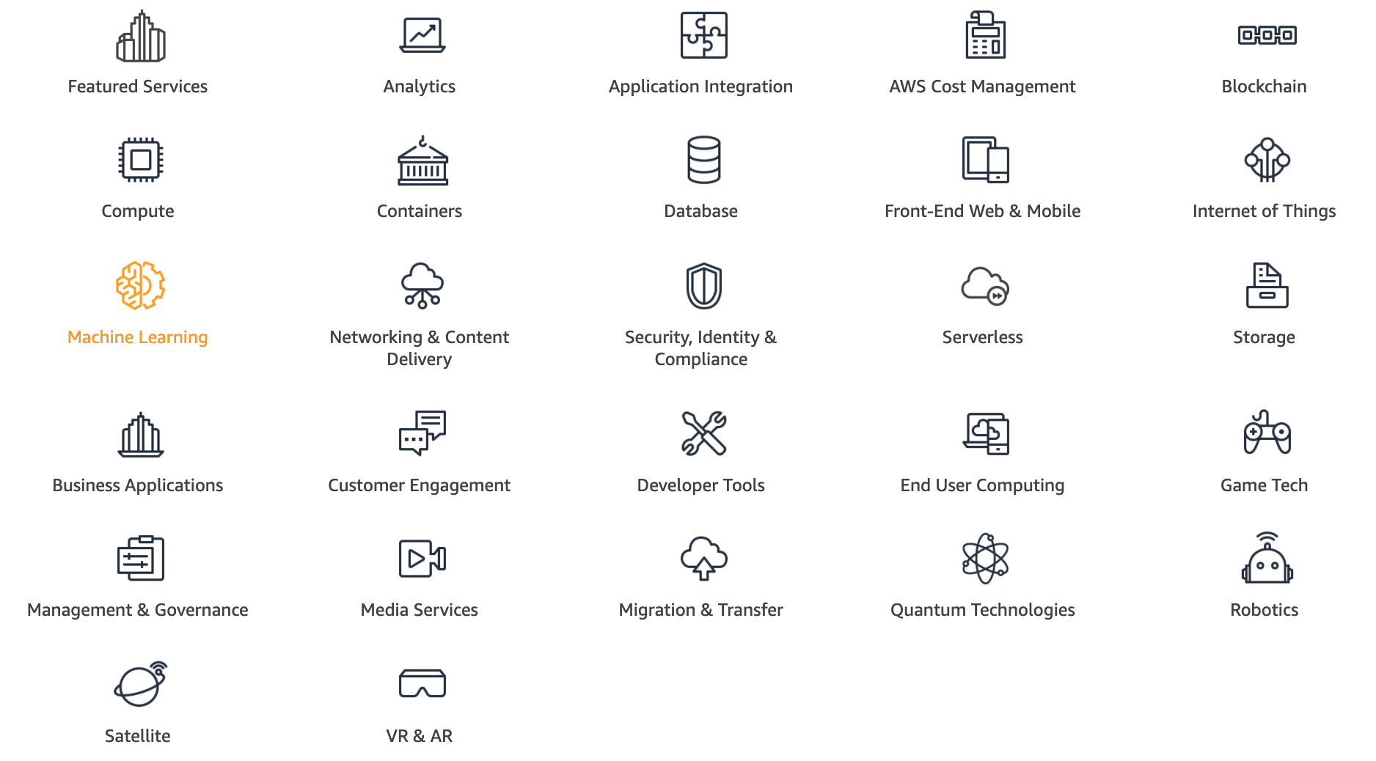
AWS Products and Services
Source: https://aws.amazon.com/

Slide 32
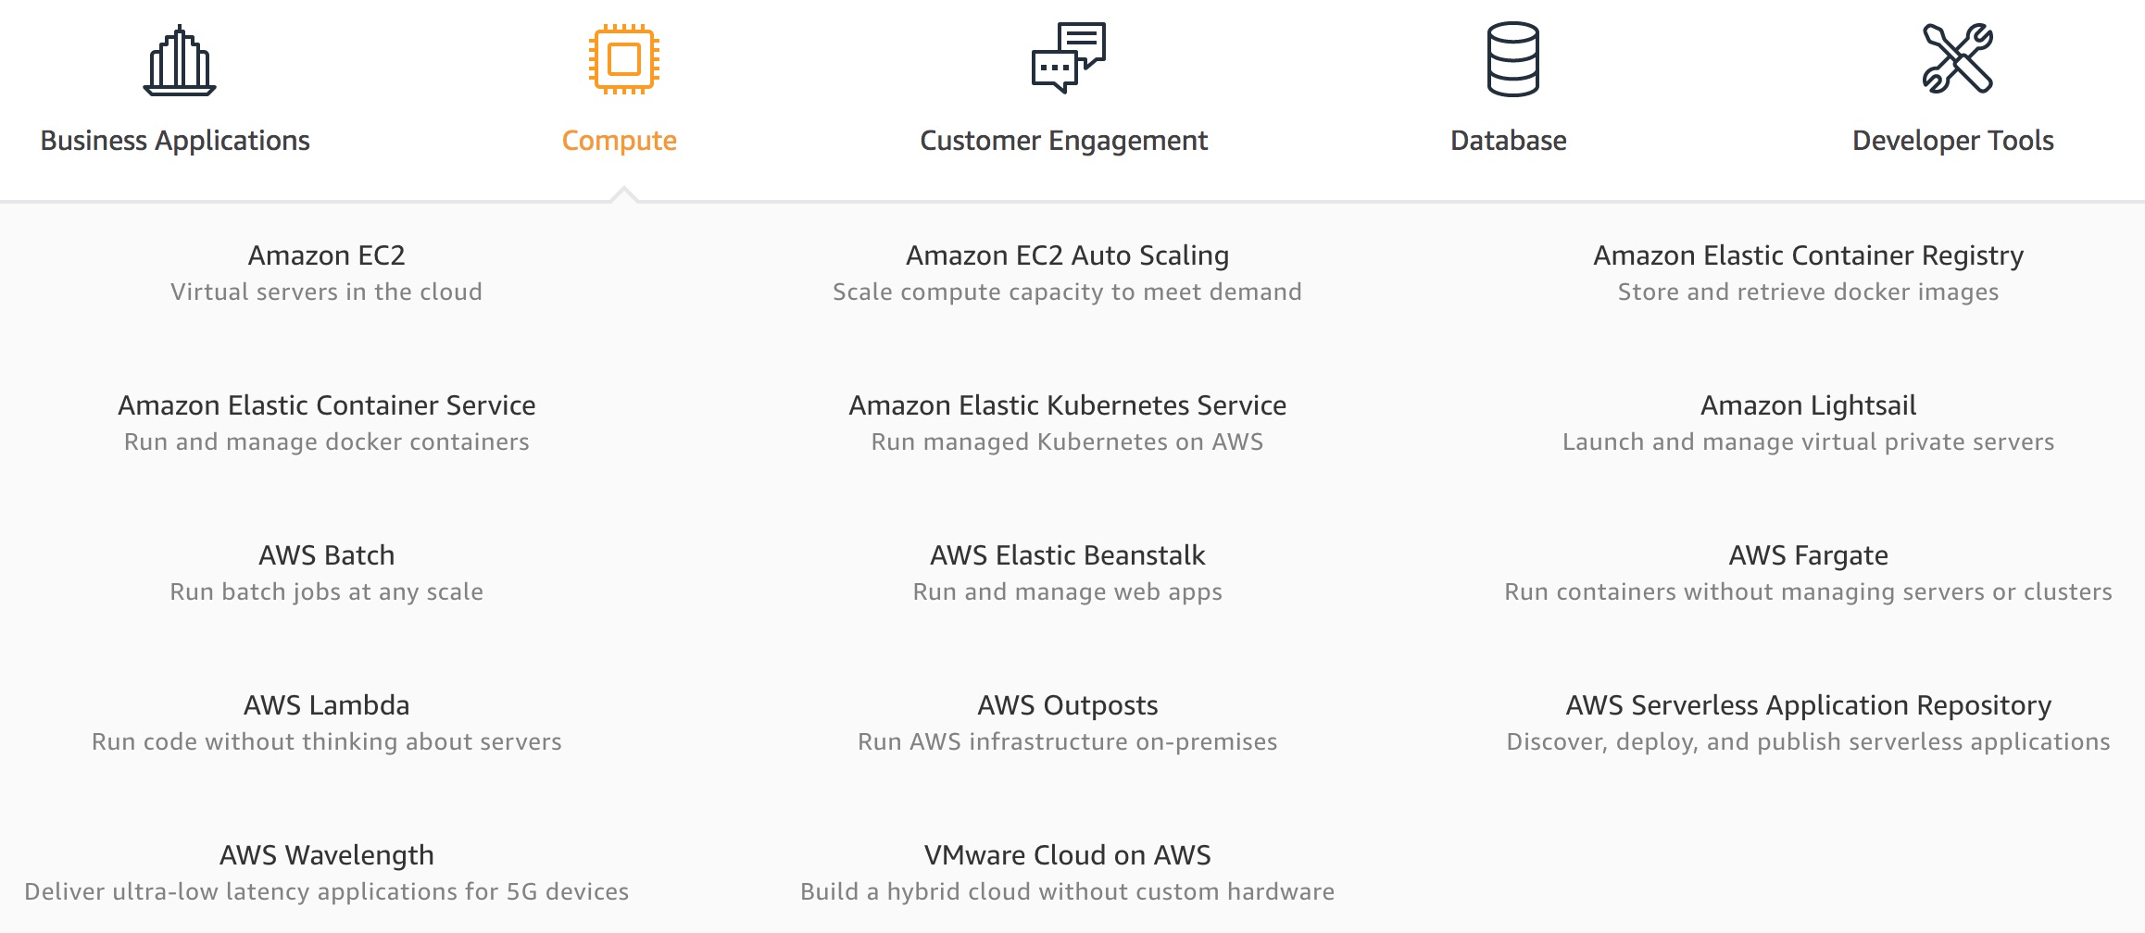
AWS Compute
Source: https://aws.amazon.com/

Slide 33
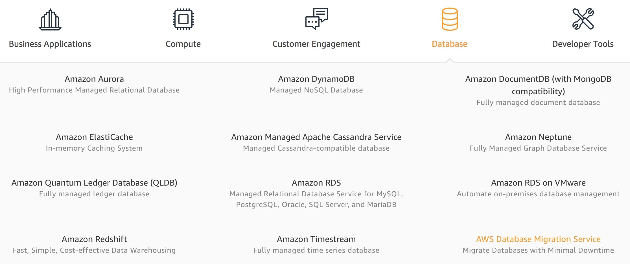
AWS Database
Source: https://aws.amazon.com/

Slide 34
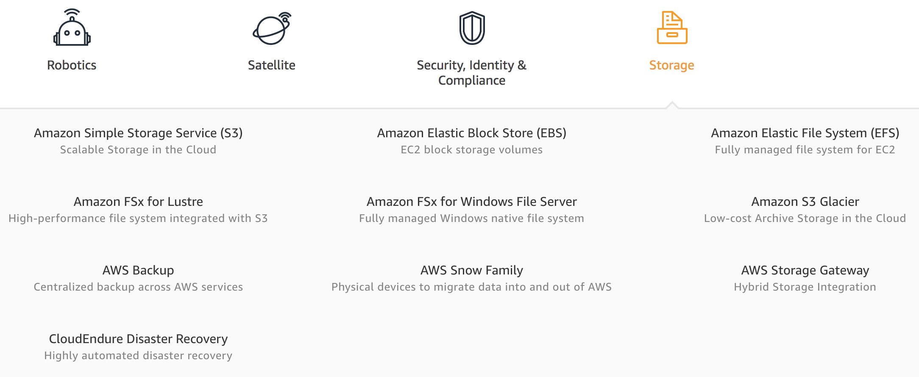
AWS Storage
Source: https://aws.amazon.com/

Slide 35
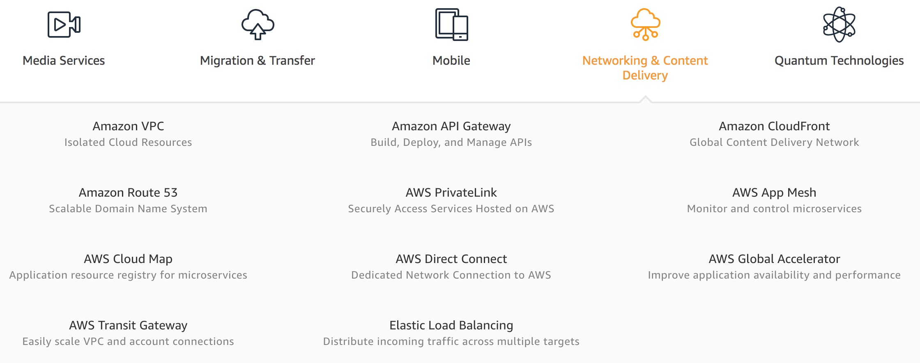
AWS Networking & Content Dilivery
Source: https://aws.amazon.com/

Slide 36
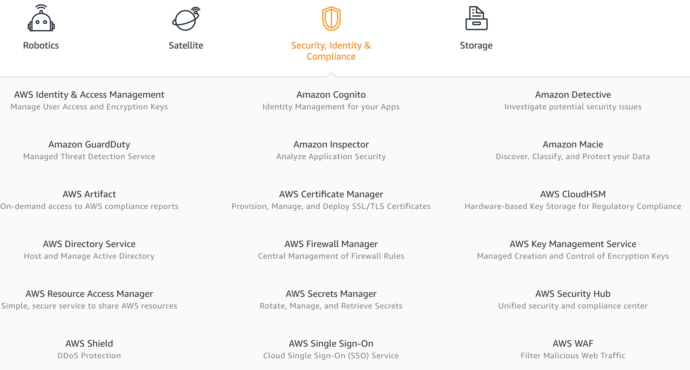
AWS Security, Identity & Compliance
Source: https://aws.amazon.com/

Slide 37
AWS Cost Management
Source: https://aws.amazon.com/

Slide 38
AWS Services
Amazon EC2
Virtual servers in the cloud
Amazon Simple Storage Service (S3)
Scalable storage in the cloud
Amazon Aurora
High performance managed relational database
Amazon DynamoDB
Managed NoSQL database
Amazon RDS
Managed relational database service for MySQL, PostgreSQL, Oracle, SQL Server, and MariaDB
Source: https://aws.amazon.com/

Slide 39
AWS Services
AWS Lambda
Run code without thinking about servers
AWS Elastic Beanstalk
Run and manage web apps
Amazon VPC
Isolated cloud resources
Amazon Lightsail
Launch and manage virtual private servers
Amazon SageMaker
Build, train, and deploy machine learning models at scale
Source: https://aws.amazon.com/

Slide 40
References
https://aws.amazon.com/certification/
https://www.aws.training/
https://aws.amazon.com/training/awsacademy/
https://aws.amazon.com/education/awseducate/
AWS Certified Cloud Practitioner
https://aws.amazon.com/certification/certified-cloud-practitioner/
AWS Certified Solutions Architect – Associate
https://aws.amazon.com/certification/certified-solutions-architect-associate/
AWS Cloud Practitioner Essentials (Second Edition)
https://aws.amazon.com/training/course-descriptions/cloud-practitioner-essentials/
Architecting on AWS
https://aws.amazon.com/training/course-descriptions/architect/

Slide 41
雲端應用程式開發 淡江大學資訊管理學系 鄭啟斌 教授
Tamkang University
Q & A
AWS 認證
AWS Certification Overview
2021-05-27 (四) 7,8 14:10-15:00 Online
戴敏育 副教授
Min-Yuh Day, Ph.D, Associate Professor
國立臺北大學 資訊管理研究所
Institute of Information Management, National Taipei University
https://web.ntpu.edu.tw/~myday
2021-05-27

