Slide 1








人工智慧金融大數據分析
AI in Finance Big Data Analytics
Host: 林正偉 教授 (Prof. Jeng-Wei Lin)
Department of Information Management, Tunghai University
Time: 13:10-16:00, June 5, 2021 (Saturday)
Place: THU, Google Meet
Min-Yuh Day
戴敏育
Associate Professor
副教授
Institute of Information Management, National Taipei University
國立臺北大學 資訊管理研究所
https://web.ntpu.edu.tw/~myday
2021-06-05

Slide 2



戴敏育 博士
(Min-Yuh Day, Ph.D.)
國立台北大學 資訊管理研究所 副教授
中央研究院 資訊科學研究所 訪問學人
國立台灣大學 資訊管理 博士
Publications Co-Chairs, IEEE/ACM International Conference on
Advances in Social Networks Analysis and Mining (ASONAM 2013- )
Program Co-Chair, IEEE International Workshop on
Empirical Methods for Recognizing Inference in TExt (IEEE EM-RITE 2012- )
Publications Chair, The IEEE International Conference on
Information Reuse and Integration (IEEE IRI)

Slide 3
Outline
Artificial Intelligence
Finance Big Data Analytics
Deep Learning for
Financial Applications

Slide 4
AI, Big Data, FinTech
Financial Technology, FinTech (Spring 2017)
Big Data Analytics in Finance
Artificial Intelligence for Investment Analysis
AI in Financial Application
AI in Finance Big Data Analytics

Slide 5
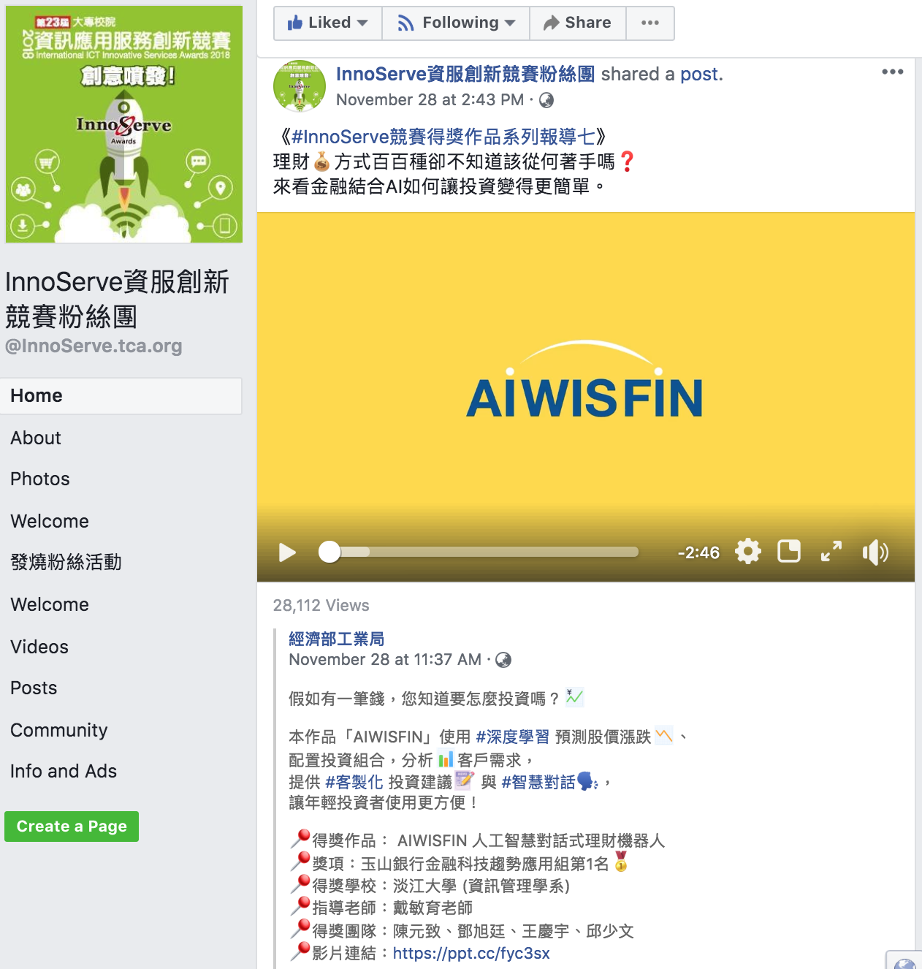
AIWISFIN
AI Conversational Robo-Advisor
(人工智慧對話式理財機器人)
First Place, InnoServe Awards 2018
https://www.youtube.com/watch?v=sEhmyoTXmGk

Slide 6

2018 The 23th International ICT
Innovative Services Awards
(InnoServe Awards 2018)
Annual ICT application competition held for university and college students
The largest and the most significant contest in Taiwan.
More than ten thousand teachers and students from over one hundred universities and colleges have participated in the Contest.
https://innoserve.tca.org.tw/award.aspx

Slide 7
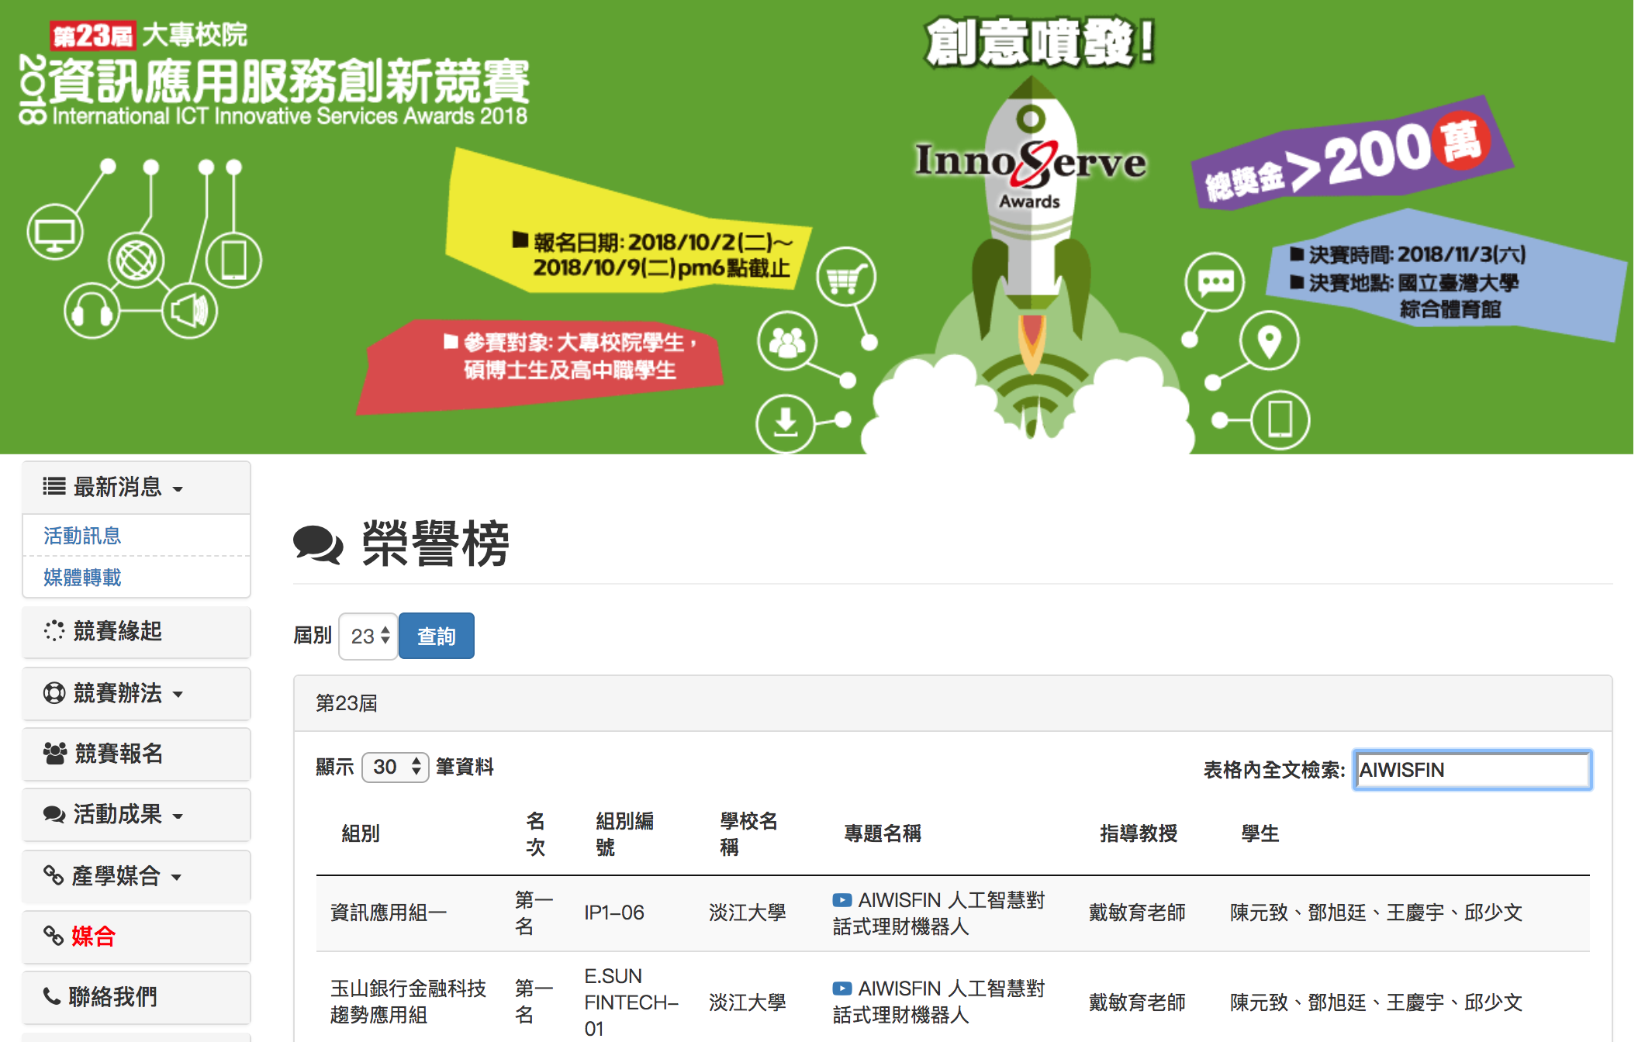
2018 International ICT Innovative Services Awards (InnoServe Awards 2018)
(2018第23屆大專校院資訊應用服務創新競賽)
https://innoserve.tca.org.tw/award.aspx

Slide 8
AI

Slide 9
The Rise of AI
Source: DHL (2018), Artificial Intelligence in Logistics,
http://www.globalhha.com/doclib/data/upload/doc_con/5e50c53c5bf67.pdf/

Slide 10
Definition of
Artificial Intelligence (A.I.)

Slide 11
Artificial Intelligence
“… the science and engineering of making intelligent machines”
(John McCarthy, 1955)
Source: https://digitalintelligencetoday.com/artificial-intelligence-defined-useful-list-of-popular-definitions-from-business-and-science/

Slide 12
Artificial Intelligence
“… technology that thinks and acts like humans”
Source: https://digitalintelligencetoday.com/artificial-intelligence-defined-useful-list-of-popular-definitions-from-business-and-science/

Slide 13
Artificial Intelligence
“… intelligence exhibited by machines or software”
Source: https://digitalintelligencetoday.com/artificial-intelligence-defined-useful-list-of-popular-definitions-from-business-and-science/

Slide 14
4 Approaches of AI
Thinking Humanly | Thinking Rationally
Acting Humanly | Acting Rationally
Source: Stuart Russell and Peter Norvig (2020), Artificial Intelligence: A Modern Approach, 4th Edition, Pearson

Slide 15
4 Approaches of AI
2. Thinking Humanly: The Cognitive Modeling Approach | 3. Thinking Rationally: The “Laws of Thought” Approach
1. Acting Humanly: The Turing Test Approach (1950) | 4. Acting Rationally: The Rational Agent Approach
Source: Stuart Russell and Peter Norvig (2020), Artificial Intelligence: A Modern Approach, 4th Edition, Pearson

Slide 16
AI Acting Humanly:
The Turing Test Approach
(Alan Turing, 1950)
Knowledge Representation
Automated Reasoning
Machine Learning (ML)
  Deep Learning (DL)
Computer Vision (Image, Video)
Natural Language Processing (NLP)
Robotics
Source: Stuart Russell and Peter Norvig (2020), Artificial Intelligence: A Modern Approach, 4th Edition, Pearson

Slide 17



Tamkang University
2011
Tamkang
University
IMTKU Textual Entailment System for
Recognizing Inference in Text
at NTCIR-9 RITE
Department of Information Management
Tamkang University, Taiwan
Min-Yuh Day
Chun Tu
myday@mail.tku.edu.tw
NTCIR-9 Workshop, December 6-9, 2011, Tokyo, Japan

Slide 18



IMTKU Textual Entailment System for
Recognizing Inference in Text at NTCIR-10 RITE-2
Tamkang University
2013
Tamkang
University
Department of Information Management
Tamkang University, Taiwan
Min-Yuh Day
Chun Tu
Hou-Cheng Vong
Shih-Wei Wu
Shih-Jhen Huang
myday@mail.tku.edu.tw
NTCIR-10 Conference, June 18-21, 2013, Tokyo, Japan

Slide 19
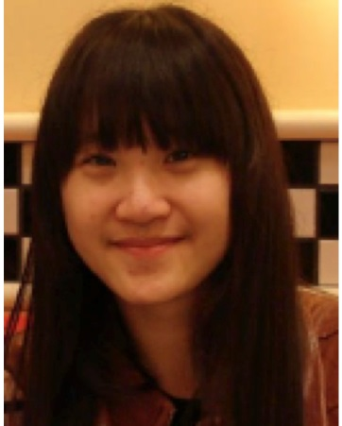







IMTKU Textual Entailment System for
Recognizing Inference in Text at NTCIR-11 RITE-VAL
2014
Tamkang University
Min-Yuh Day
Ya-Jung Wang
Che-Wei Hsu
En-Chun Tu
Huai-Wen Hsu
Yu-An Lin
Shang-Yu Wu
Yu-Hsuan Tai
Cheng-Chia Tsai
NTCIR-11 Conference, December 8-12, 2014, Tokyo, Japan

Slide 20


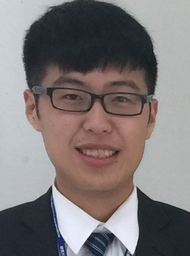


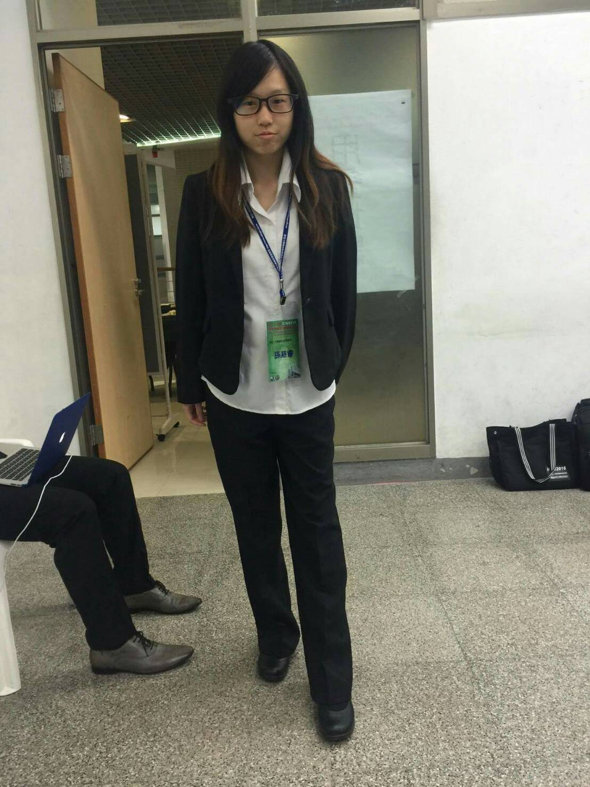
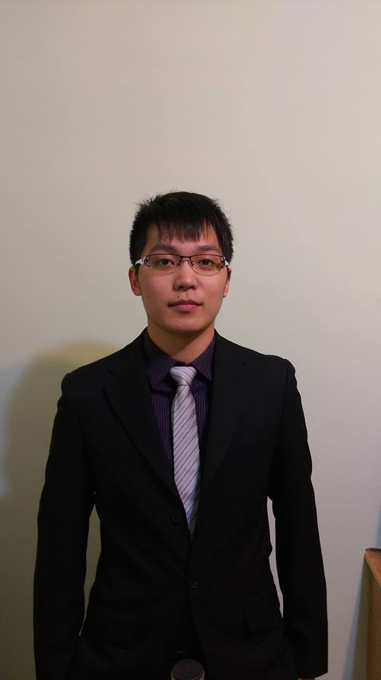
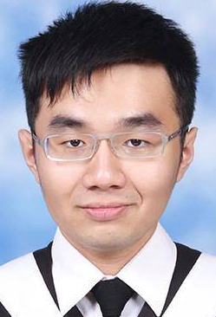
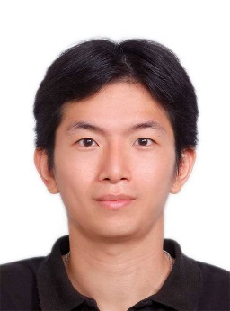

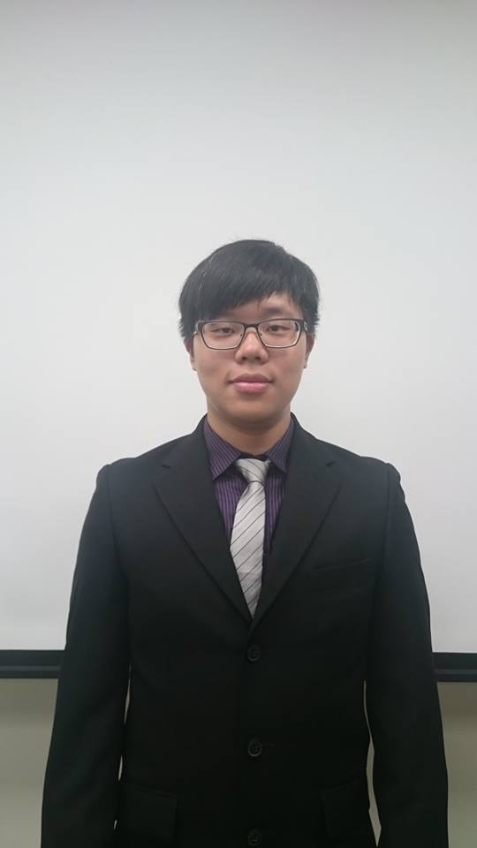
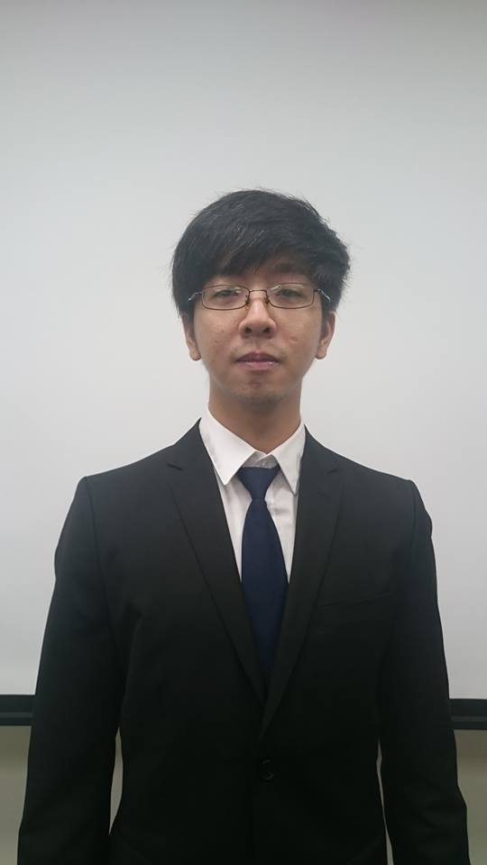
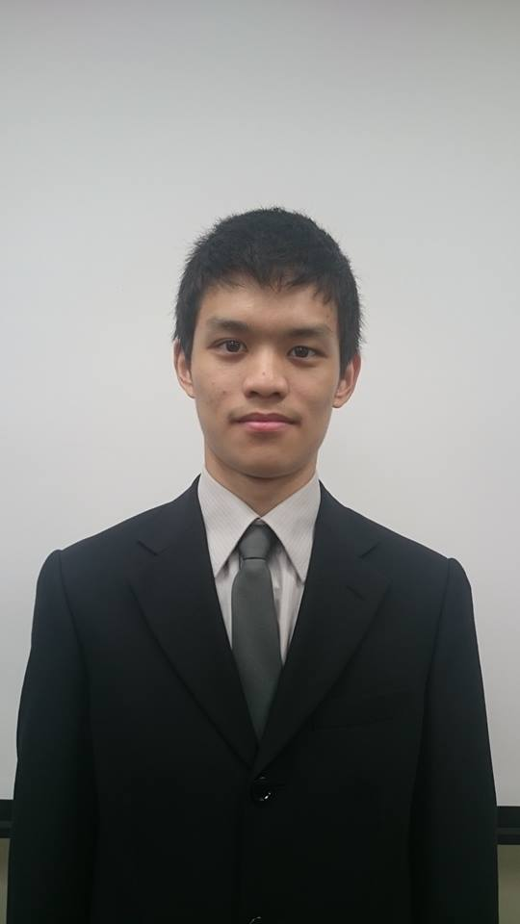

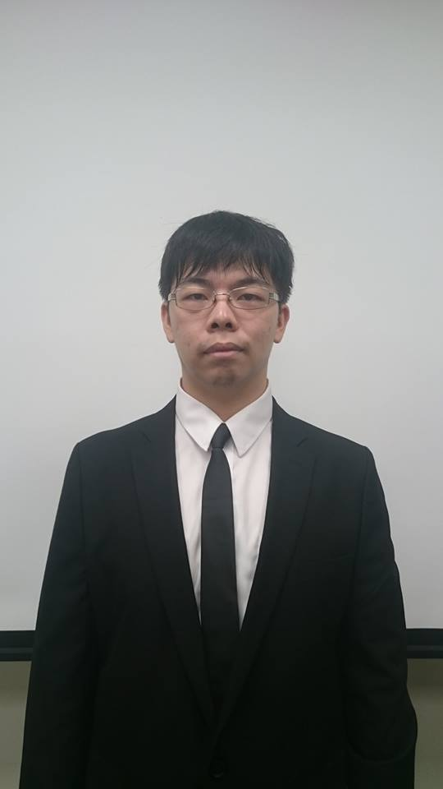
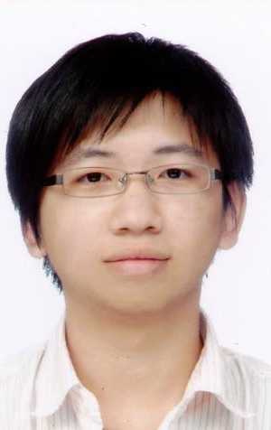
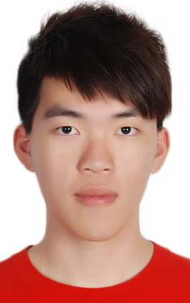
IMTKU Question Answering System for
World History Exams at NTCIR-12 QA Lab2
2016
Tamkang University
Department of Information Management
Tamkang University, Taiwan
Sagacity Technology
Min-Yuh Day
Cheng-Chia Tsai
Wei-Chun Chung
Hsiu-Yuan Chang
Tzu-Jui Sun
Yuan-Jie Tsai
Jin-Kun Lin
Cheng-Hung Lee
Yu-Ming Guo
Yue-Da Lin
Wei-Ming Chen
Yun-Da Tsai
Cheng-Jhih Han
Yi-Jing Lin
Yi-Heng Chiang
Ching-Yuan Chien
myday@mail.tku.edu.tw
NTCIR-12 Conference, June 7-10, 2016, Tokyo, Japan

Slide 21
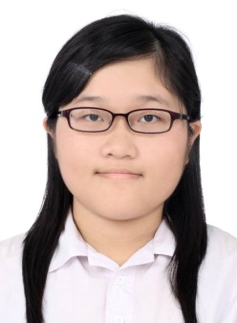

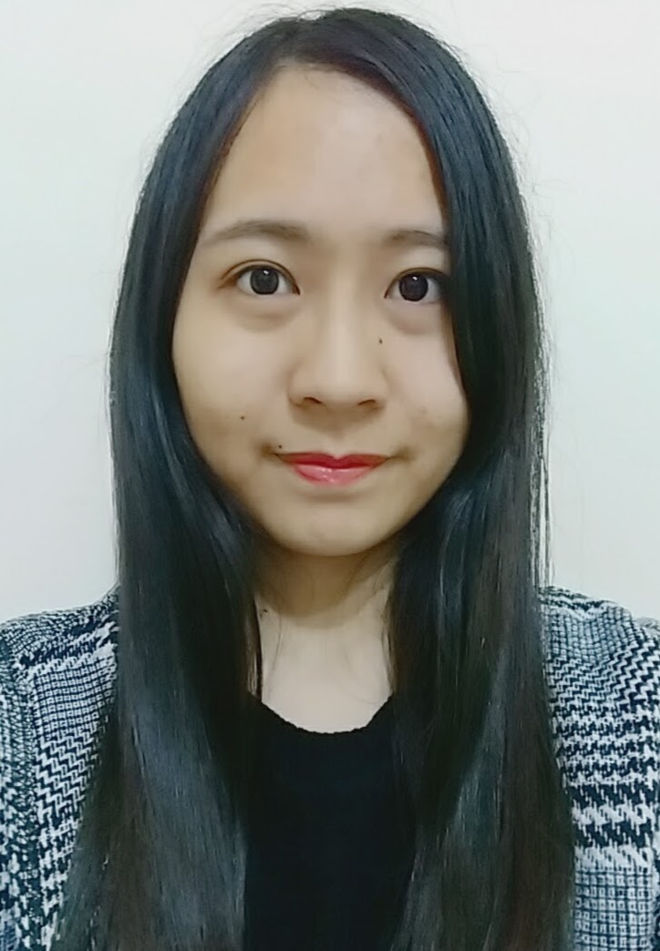

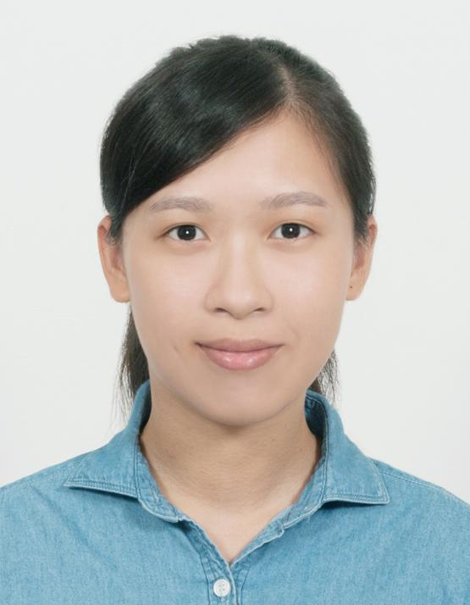

IMTKU Question Answering System for
World History Exams at NTCIR-13 QALab-3
2017
Tamkang University
Department of Information Management
Tamkang University, Taiwan
Min-Yuh Day
Chao-Yu Chen
Wanchu Huang
Shi-Ya Zheng
I-Hsuan Huang
Tz-Rung Chen
Min-Chun Kuo
Yue-Da Lin
Yi-Jing Lin
myday@mail.tku.edu.tw
NTCIR-13 Conference, December 5-8, 2017, Tokyo, Japan

Slide 22




IMTKU Emotional Dialogue System for
Short Text Conversation at NTCIR-14 STC-3 (CECG) Task
2019
Tamkang University
Department of Information Management
Tamkang University, Taiwan
Min-Yuh Day
Chi-Sheng Hung
Yi-Jun Xie
Jhih-Yi Chen
Yu-Ling Kuo
Jian-Ting Lin
myday@mail.tku.edu.tw
NTCIR-14 Conference, June 10-13, 2019, Tokyo, Japan

Slide 23


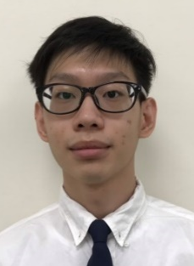
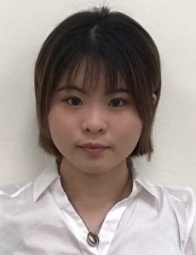
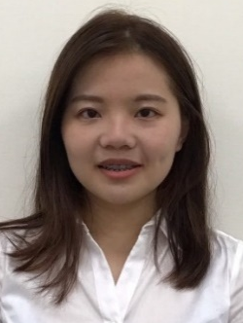

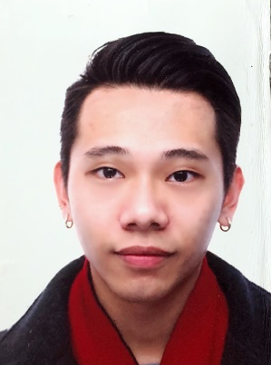

IMTKU Multi-Turn Dialogue System Evaluation at the NTCIR-15 DialEval-1
Dialogue Quality and Nugget Detection
2020
Tamkang University
¹ Zeals Co., Ltd. Tokyo, Japan
² Information Management, Tamkang University, Taiwan
³ Information Management, National Taipei University, Taiwan
Mike Tian-Jian Jiang¹
Zhao-Xian Gu²
Cheng-Jhe Chiang²
Yueh-Chia Wu²
Yu-Chen Huang²
Cheng-Han Chiu²
Sheng-Ru Shaw²
Min-Yuh Day³
NTCIR-15 Conference, December 8-11, 2020, Tokyo, Japan

Slide 24
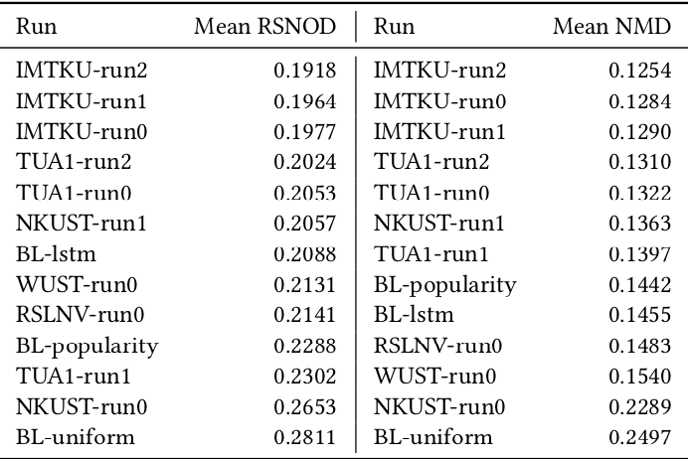
NTCIR-15 Dialogue Evaluation (DialEval-1) Task
Dialogue Quality (DQ) and Nugget Detection (ND)
Chinese Dialogue Quality (S-score) Results (Zeng et al., 2020)
2020
Source: Zeng, Zhaohao, Sosuke Kato, Tetsuya Sakai, and Inho Kang (2020), “Overview of the NTCIR-15 Dialogue Evaluation (DialEval-1) Task”, Proceedings of NTCIR-15, 2020

Slide 25
Transformer-based
Models Selection
Fine-tuning Techniques
FinNum-2
BERT
DialEval-1
Discriminative Fine-tuning
Transfer
Learning
RoBERTa
One-cycle Policy
XLM-RoBERTa
Optimization
Tokenization Tricks
Pre-trained Models
Source: Jiang, Mike Tian-Jian, Shih-Hung Wu, Yi-Kun Chen, Zhao-Xian Gu, Cheng-Jhe Chiang, Yueh-Chia Wu, Yu-Chen Huang, Cheng-Han Chiu, Sheng-Ru Shaw, and Min-Yuh Day (2020). "Fine-tuning techniques and data augmentation on transformer-based models for conversational texts and noisy user-generated content." In 2020 IEEE/ACM International Conference on Advances in Social Networks Analysis and Mining (ASONAM), pp. 919-925. IEEE, 2020.

Slide 26
IMTKU Emotional Dialogue System Architecture
1
3
4
Retrieval-Based Model
Emotion Classification
Model
Response
Ranking
Generation-Based Model
2
NTCIR-14 Conference, June 10-13, 2019, Tokyo, Japan

Slide 27
Short Text Conversation Task
(STC-3)
Chinese Emotional Conversation Generation (CECG) Subtask
Source: http://coai.cs.tsinghua.edu.cn/hml/challenge.html

Slide 28
NTCIR Short Text Conversation
STC-1, STC-2, STC-3
Source: https://waseda.app.box.com/v/STC3atNTCIR-14

Slide 29
Finance
Big Data Analytics

Slide 30
FinTech ABCD
AI
Block Chain
Cloud Computing
Big Data

Slide 31
AI, Big Data, Cloud Computing
Evolution of Decision Support, Business Intelligence, and Analytics
AI
AI
Cloud Computing
Big Data
DM
BI
Source: Ramesh Sharda, Dursun Delen, and Efraim Turban (2017),
Business Intelligence, Analytics, and Data Science: A Managerial Perspective, 4th Edition, Pearson

Slide 32
Value Creation by Big Data Analytics
(Grover et al., 2018)
Source: Varun Grover, Roger HL Chiang, Ting-Peng Liang, and Dongsong Zhang (2018), "Creating Strategic Business Value from Big Data Analytics: A Research Framework", Journal of Management Information Systems, 35, no. 2, pp. 388-423.

Slide 33
Architecture of Big Data Analytics
Big Data
Analytics
Applications
Big Data
Sources
Big Data
Transformation
Big Data
Platforms & Tools
* Internal
* External
* Multiple formats
* Multiple
locations
* Multiple applications
Middleware
Hadoop
MapReduce
Pig
Hive
Jaql
Zookeeper
Hbase
Cassandra
Oozie
Avro
Mahout
Others
Queries
Raw
Data
Transformed
Data
Big Data
Analytics
Extract Transform Load
Reports
Data Warehouse
OLAP
Traditional Format
CSV, Tables
Data Mining
Source: Stephan Kudyba (2014), Big Data, Mining, and Analytics: Components of Strategic Decision Making, Auerbach Publications

Slide 34
Business Intelligence, Analytics, and Data Science:
A Managerial Perspective, 4th Edition,
Ramesh Sharda, Dursun Delen, and Efraim Turban,
Pearson, 2017.
Source: https://www.amazon.com/Business-Intelligence-Analytics-Data-Science/dp/0134633288

Slide 35
Big Data, Data Mining, and Machine Learning: Value Creation for Business Leaders and Practitioners,
Jared Dean,
Wiley, 2014.
Source: https://www.amazon.com/Data-Mining-Machine-Learning-Practitioners/dp/1118618041

Slide 36
Social Network Based Big Data Analysis and Applications,
Lecture Notes in Social Networks,
Mehmet Kaya, Jalal Kawash, Suheil Khoury, Min-Yuh Day,
Springer International Publishing, 2018.
Source: https://www.amazon.com/Network-Analysis-Applications-Lecture-Networks/dp/3319781952

Slide 37
AI 2.0
a new generation of AI
based on the
novel information environment of
major changes and
the development of
new goals.
Yunhe Pan (2016), "Heading toward artificial intelligence 2.0." Engineering 2, no. 4, 409-413.

Slide 38
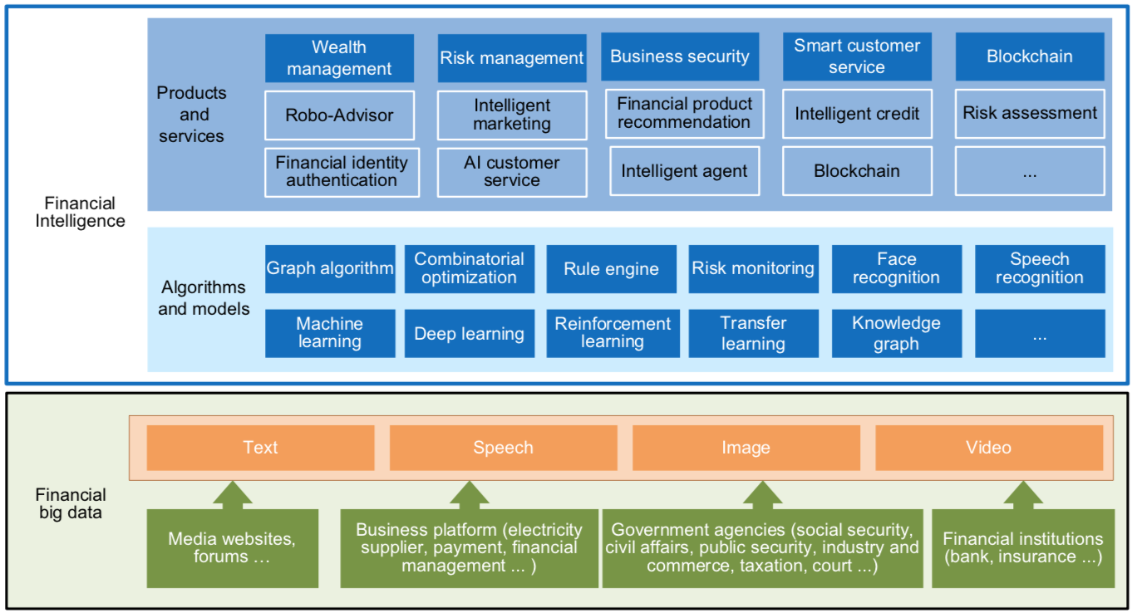
FinBrain: when Finance meets AI 2.0
(Zheng et al., 2019)
Source: Xiao-lin Zheng, Meng-ying Zhu, Qi-bing Li, Chao-chao Chen, and Yan-chao Tan (2019), "Finbrain: When finance meets AI 2.0." Frontiers of Information Technology & Electronic Engineering 20, no. 7, pp. 914-924

Slide 39
Technology-driven
Financial Industry Development
Development stage | Driving technology | Main landscape | Inclusive finance | Relationship between technology and finance
Fintech 1.0 (financial IT) | Computer | Credit card, ATM, and CRMS | Low | Technology as a tool
Fintech 2.0 (Internet finance) | Mobile Internet | Marketplace lending, third-party payment, crowdfunding, and Internet insurance | Medium | Technology-driven change
Fintech 3.0 (financial intelligence) | AI, Big Data, Cloud Computing, Blockchain | Intelligent finance | High | Deep fusion
Source: Xiao-lin Zheng, Meng-ying Zhu, Qi-bing Li, Chao-chao Chen, and Yan-chao Tan (2019), "Finbrain: When finance meets AI 2.0." Frontiers of Information Technology & Electronic Engineering 20, no. 7, pp. 914-924

Slide 40
Evolution of top keywords in
“BD & BI” publications
2014
2015
2016
2017
Management
Text Mining
Data Mining
Data Science
Big Data Analytics
Social Media
Business Analytics
Information System
Cloud Computing
Data Warehouse
Knowledge Management
Source: Ting-Peng Liang and Yu-Hsi Liu (2018), "Research Landscape of Business Intelligence and Big Data analytics: A bibliometrics study”,
Expert Systems with Applications, Volume 111, 30, 2018, pp. 2-10

Slide 41
Framework for BD and BI Research
Data Collection
Data Storage
Data Analytics
Infrastructure
Business
Medicate
Supply Chain
Engineering
Services
Technology
Application
Impact
Management
Value Creation
Individual Impact
Organizational Impact
Social Impact
Adoption of BD/BI
Cost Benefit
Security/Privacy
Human Resource
Source: Ting-Peng Liang and Yu-Hsi Liu (2018), "Research Landscape of Business Intelligence and Big Data analytics: A bibliometrics study”,
Expert Systems with Applications, Volume 111, 30, 2018, pp. 2-10

Slide 42
Business Intelligence and Big Data analytics
Source: Ting-Peng Liang and Yu-Hsi Liu (2018), "Research Landscape of Business Intelligence and Big Data analytics: A bibliometrics study”,
Expert Systems with Applications, Volume 111, 30, 2018, pp. 2-10

Slide 43
FinTech

Slide 44
Financial Technology
FinTech
“providing
financial services
by making use of software and
modern technology”
Source: https://www.fintechweekly.com/fintech-definition

Slide 45
Financial Services

Slide 46

Financial Services
Source: http://www.crackitt.com/7-reasons-why-your-fintech-startup-needs-visual-marketing/

Slide 47
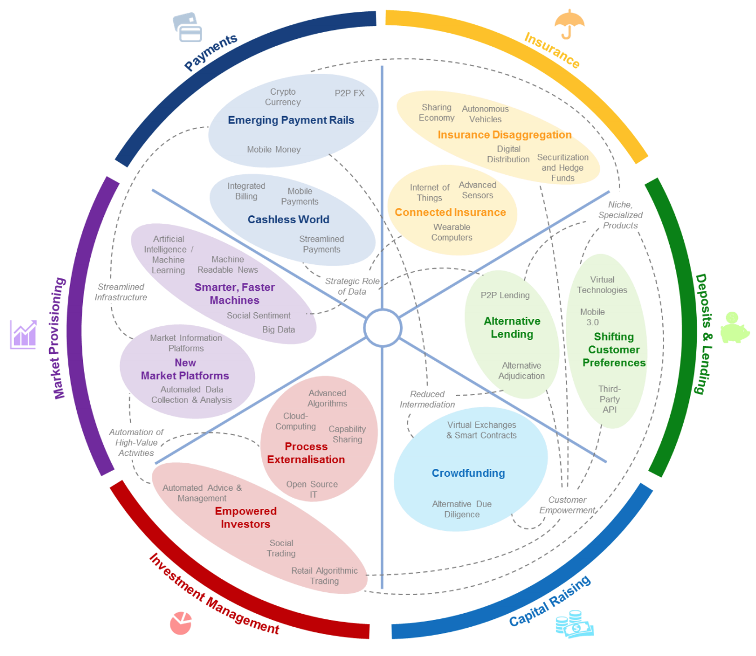
FinTech: Financial Services Innovation
Source: http://www3.weforum.org/docs/WEF_The_future__of_financial_services.pdf

Slide 48
FinTech:
Financial Services Innovation
1. Payments
2. Insurance
3. Deposits & Lending
4. Capital Raising
5. Investment Management
6. Market Provisioning
Source: http://www3.weforum.org/docs/WEF_The_future__of_financial_services.pdf

Slide 49
FinTech: Investment Management
5
Source: http://www3.weforum.org/docs/WEF_The_future__of_financial_services.pdf

Slide 50
FinTech: Market Provisioning
6
Source: http://www3.weforum.org/docs/WEF_The_future__of_financial_services.pdf

Slide 51
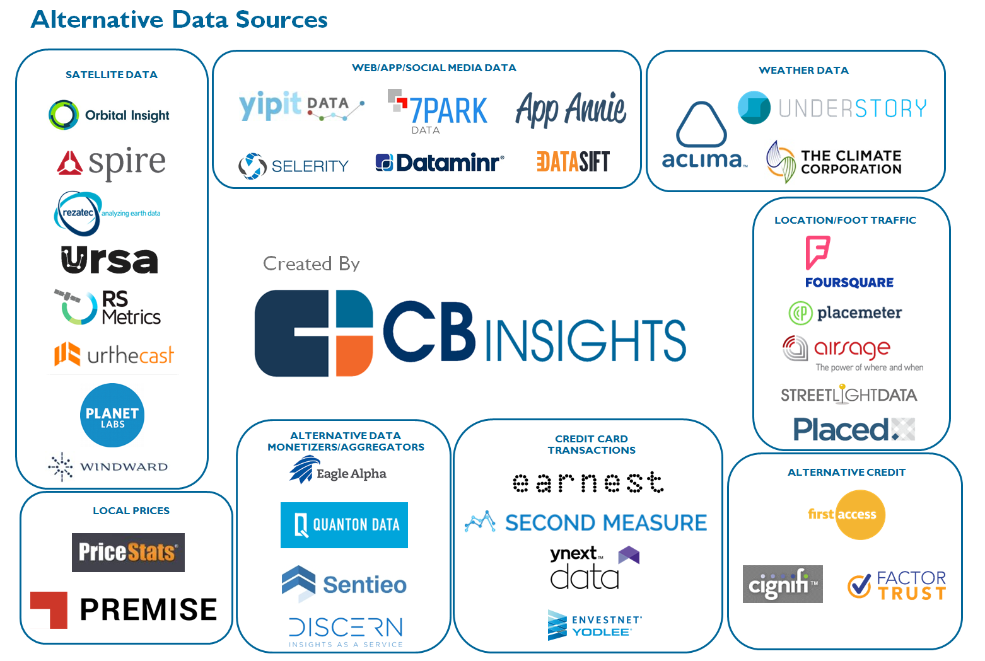
The New Alpha: 30+ Startups Providing Alternative Data For Sophisticated Investors
Source: https://www.cbinsights.com/blog/alternative-data-startups-market-map-company-list/

Slide 52
AI in
FinTech

Slide 53
Robo-Advisors

Slide 54
FinTech high-level classification
Lending
Payments
Robo Advisors
Analytics
Others
Profile
Advice
Re-Balance
Indexing
Source: Paolo Sironi (2016), “FinTech Innovation: From Robo-Advisors to Goal Based Investing and Gamification”, Wiley.

Slide 55
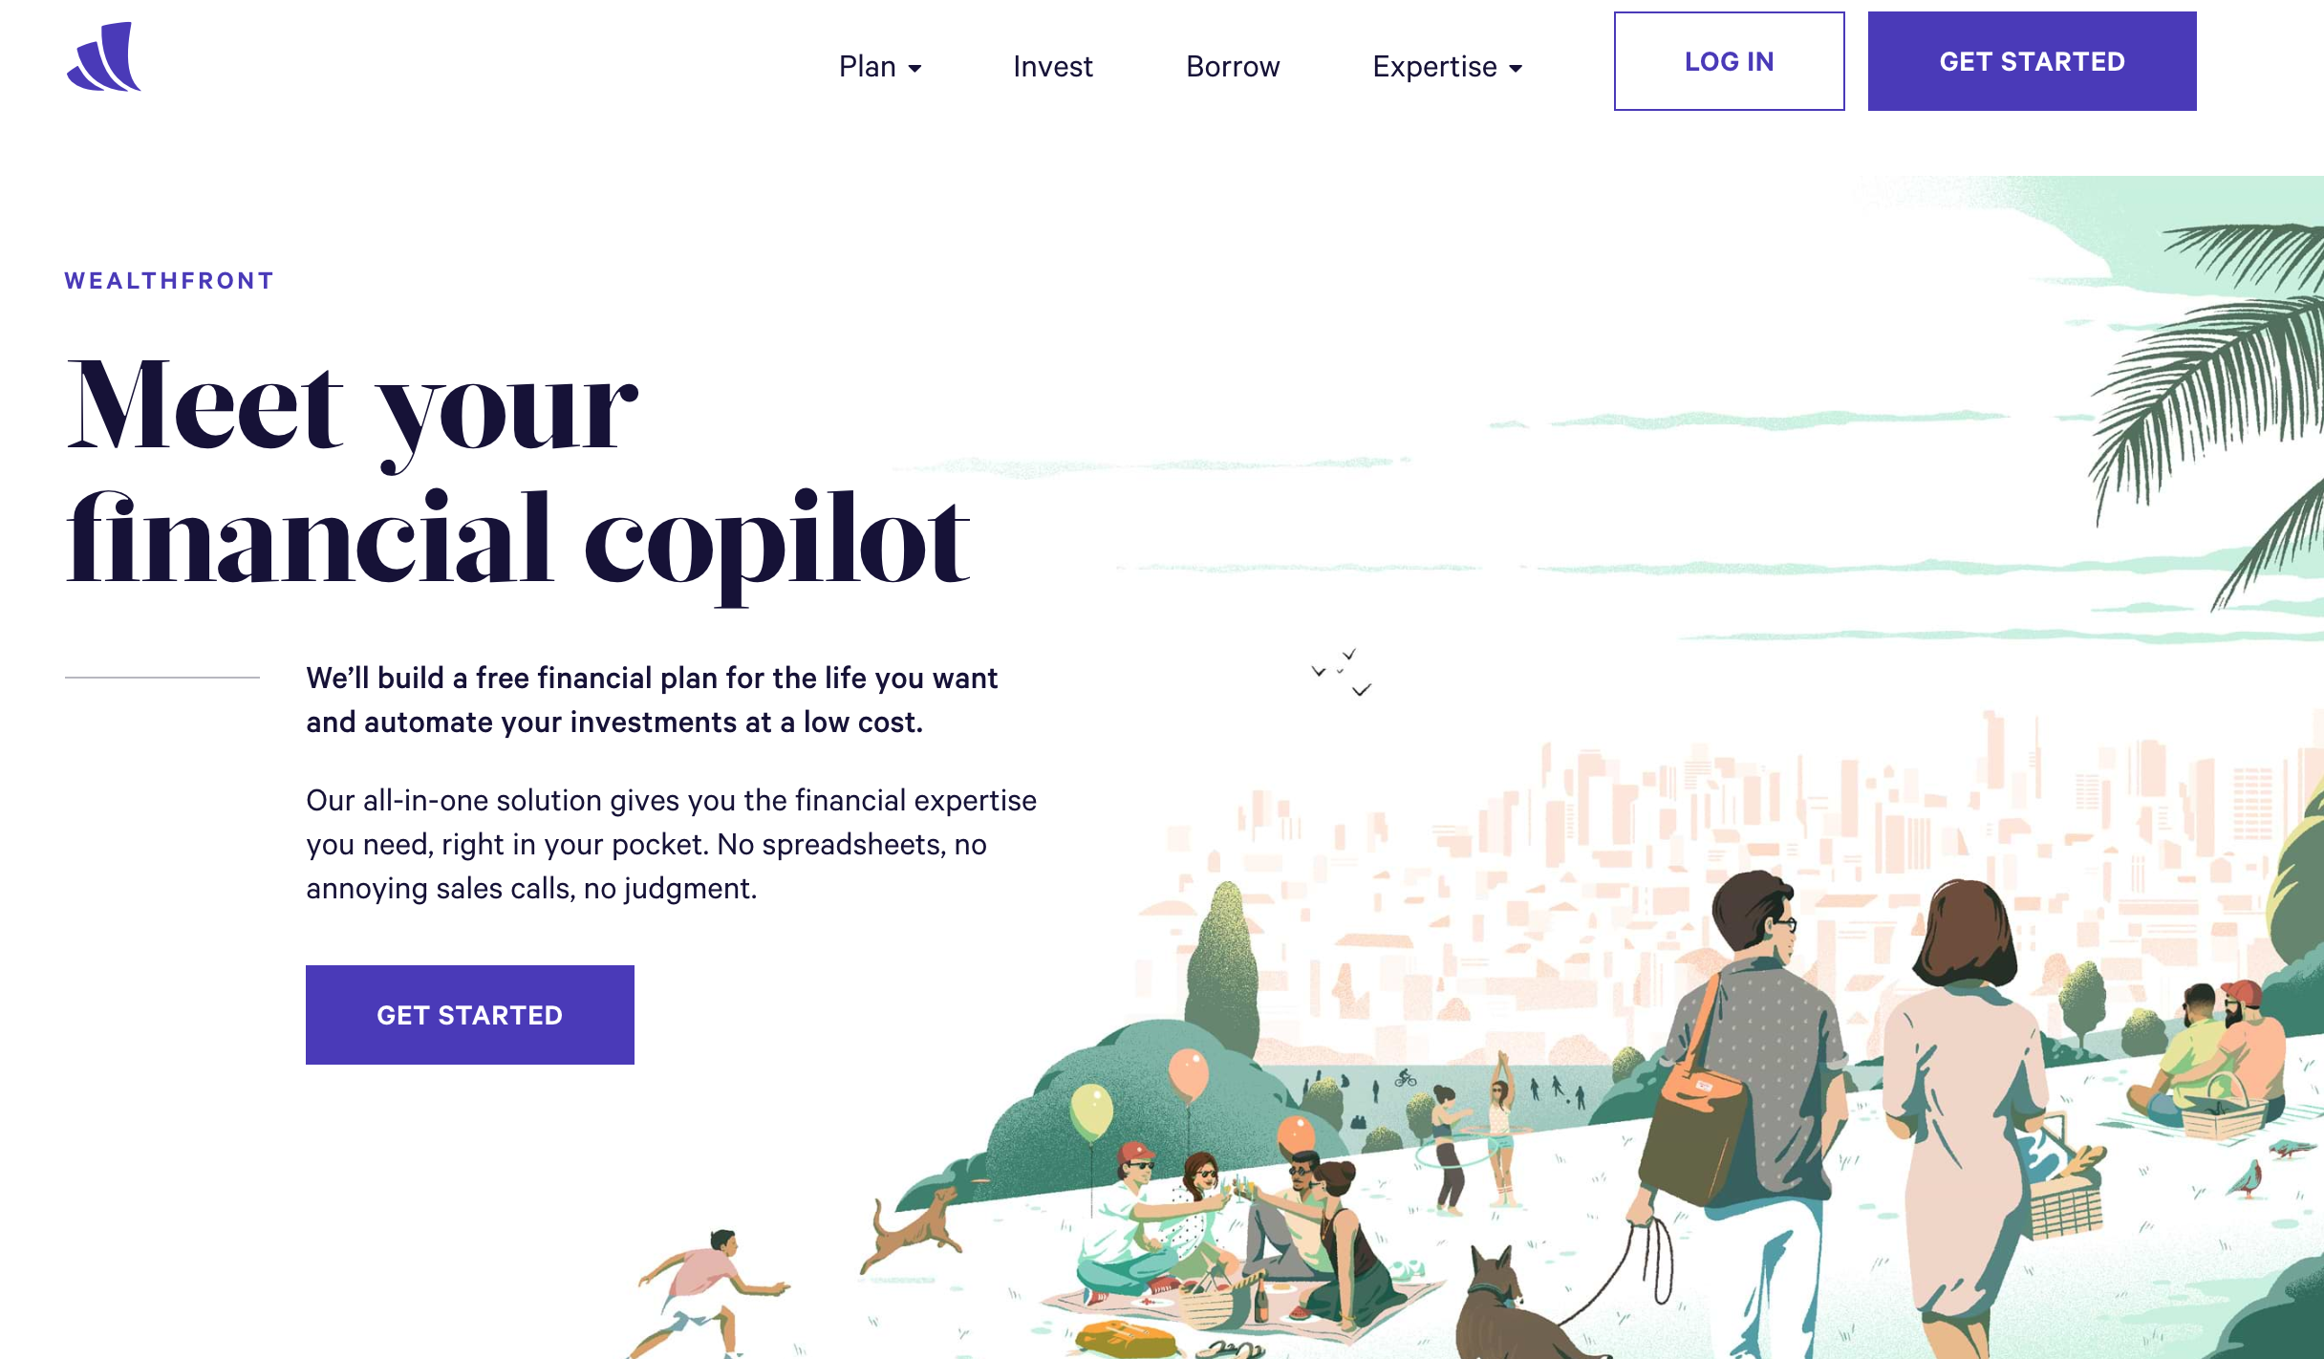
Wealthfront
Financial Planning & Robo-Investing for Millennials
https://www.wealthfront.com/

Slide 56
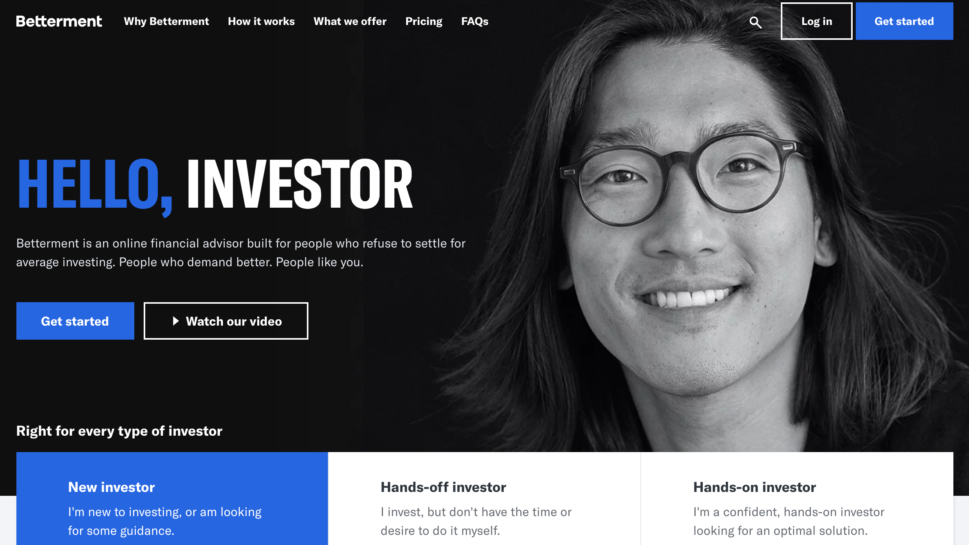
Betterment
Online Financial Advisor
https://www.betterment.com/

Slide 57
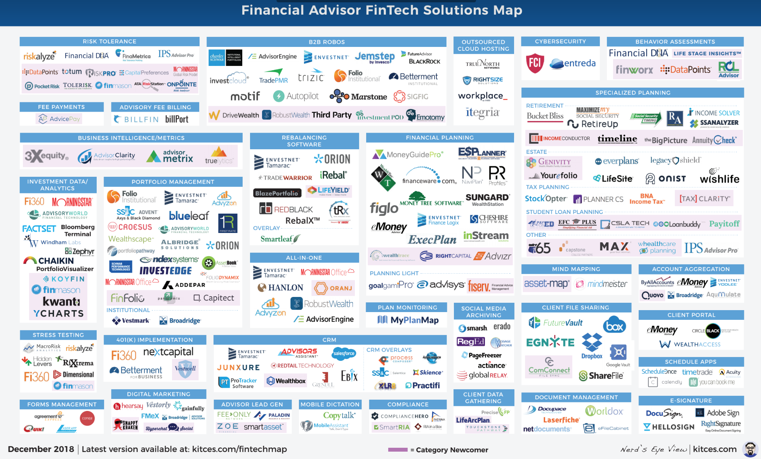
Financial Advisor FinTech Solutions
Source: https://www.kitces.com/fintechmap

Slide 58
From Algorithmic Trading to Personal Finance Bots: 41 Startups Bringing
AI to Fintech
Source: https://www.cbinsights.com/blog/artificial-intelligence-fintech-market-map-company-list/

Slide 59
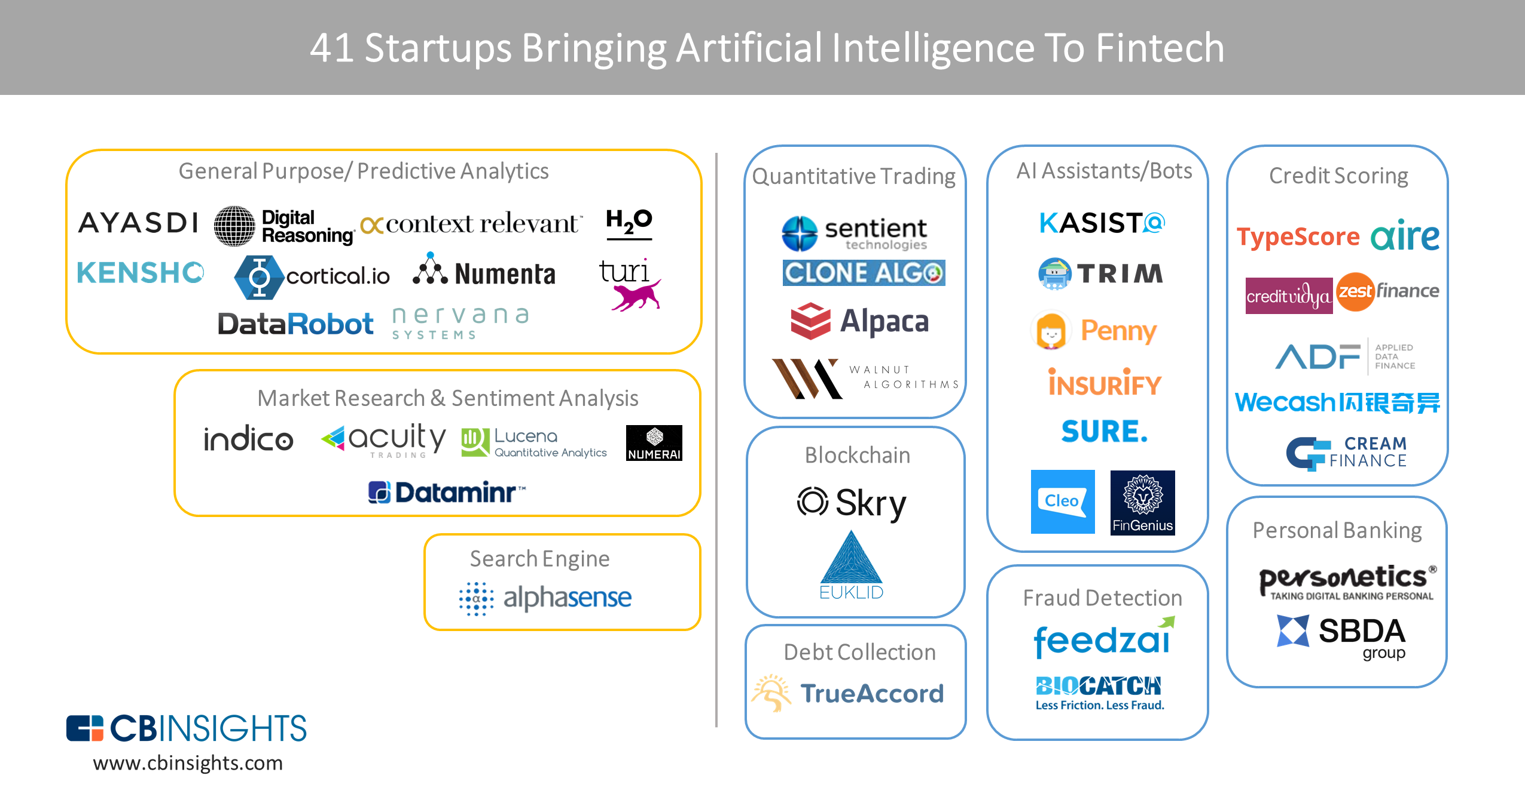
From Algorithmic Trading To Personal Finance Bots: 41 Startups Bringing AI To Fintech
AI in Fintech
Source: https://www.cbinsights.com/blog/artificial-intelligence-fintech-market-map-company-list/

Slide 60
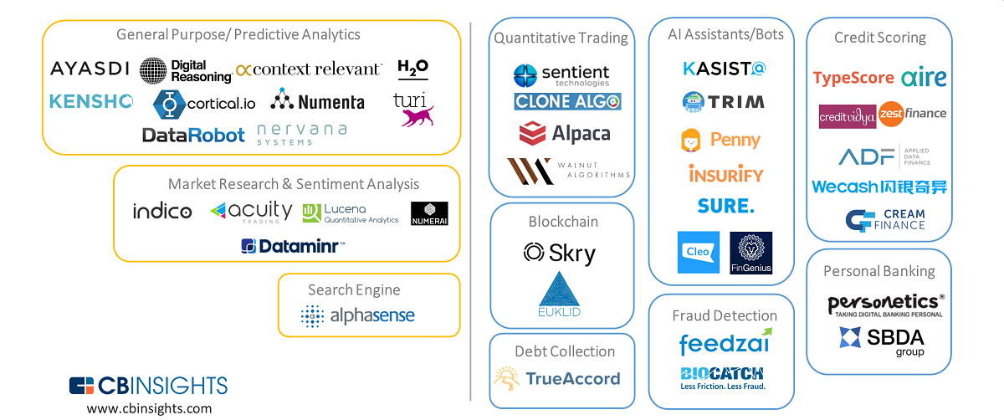
Artificial Intelligence (AI) in Fintech
Source: https://www.cbinsights.com/blog/artificial-intelligence-fintech-market-map-company-list/

Slide 61
Artificial Intelligence (AI) in Fintech
Source: https://www.cbinsights.com/blog/artificial-intelligence-fintech-market-map-company-list/

Slide 62
AI Humanoid
Robo-Advisor

Slide 63
AI Humanoid Robo-Advisor for Multi-channel Conversational Commerce
AI Portfolio
Asset Allocation
Multichannel
Platforms
Web
LINE
Facebook
Humanoid Robot
AI Conversation
Dialog System

Slide 64
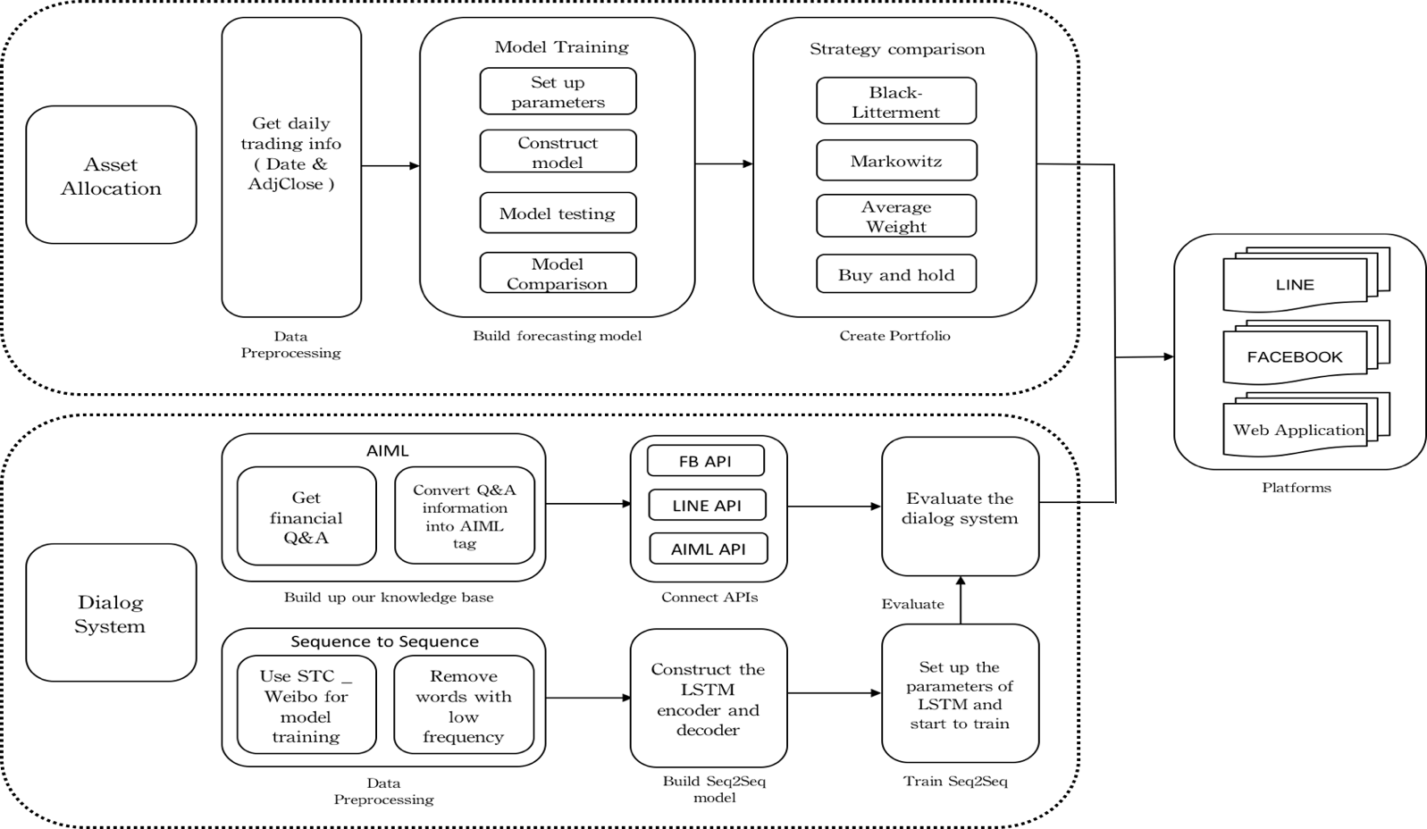
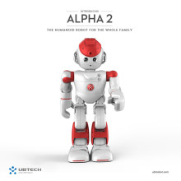

System Architecture of
AI Humanoid Robo-Advisor
AI Humanoid
Robo-advisor

Slide 65
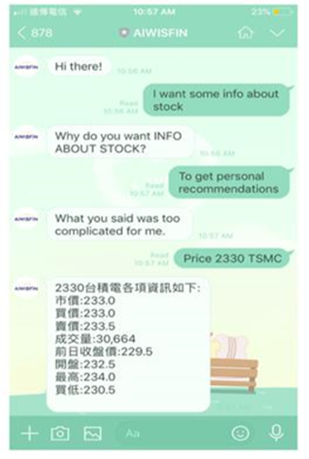
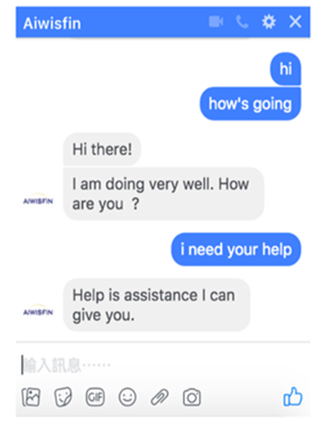
Conversational Model
(LINE, FB Messenger)

Slide 66

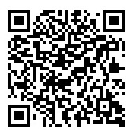
Conversational Robo-Advisor
Multichannel UI/UX
Robots
ALPHA 2
ZENBO

Slide 67
Deep Learning for
Financial Applications

Slide 68
AI, ML, DL
Artificial Intelligence (AI)
Machine Learning (ML)
Supervised
Learning
Unsupervised Learning
Deep Learning (DL)
CNN
RNN LSTM GRU
GAN
Semi-supervised Learning
Reinforcement Learning
Source: https://leonardoaraujosantos.gitbooks.io/artificial-inteligence/content/deep_learning.html

Slide 69
Machine Learning + Deep Learning
Source: Enrico Galimberti, http://blogs.teradata.com/data-points/tree-machine-learning-algorithms/

Slide 70
Stock Market Movement Forecast:
Phases of the stock market modeling
Source: O. Bustos and A. Pomares-Quimbaya (2020), "Stock Market Movement Forecast: A Systematic Review."
Expert Systems with Applications (2020): 113464.

Slide 71
Deep learning for financial applications:
A survey
Applied Soft Computing (2020)
Source:
Ahmet Murat Ozbayoglu, Mehmet Ugur Gudelek, and Omer Berat Sezer (2020). "Deep learning for financial applications: A survey."
Applied Soft Computing (2020): 106384.

Slide 72
Financial time series forecasting with deep learning:
A systematic literature review:
2005–2019
Applied Soft Computing (2020)
Source:
Omer Berat Sezer, Mehmet Ugur Gudelek, and Ahmet Murat Ozbayoglu (2020), "Financial time series forecasting with deep learning: A systematic literature review: 2005–2019." Applied Soft Computing 90 (2020): 106181.

Slide 73
Deep learning for financial applications: Topics
Source: Ahmet Murat Ozbayoglu, Mehmet Ugur Gudelek, and Omer Berat Sezer (2020). "Deep learning for financial applications: A survey." Applied Soft Computing (2020): 106384.

Slide 74
Deep learning for financial applications: Deep Learning Models
Source: Ahmet Murat Ozbayoglu, Mehmet Ugur Gudelek, and Omer Berat Sezer (2020). "Deep learning for financial applications: A survey." Applied Soft Computing (2020): 106384.

Slide 75
Deep learning for financial applications: Topic-Model Heatmap
Source: Ahmet Murat Ozbayoglu, Mehmet Ugur Gudelek, and Omer Berat Sezer (2020). "Deep learning for financial applications: A survey." Applied Soft Computing (2020): 106384.

Slide 76
Deep learning for financial applications: Topic-Feature Heatmap
Source: Ahmet Murat Ozbayoglu, Mehmet Ugur Gudelek, and Omer Berat Sezer (2020). "Deep learning for financial applications: A survey." Applied Soft Computing (2020): 106384.

Slide 77
Deep learning for financial applications: Topic-Dataset Heatmap
Source: Ahmet Murat Ozbayoglu, Mehmet Ugur Gudelek, and Omer Berat Sezer (2020). "Deep learning for financial applications: A survey." Applied Soft Computing (2020): 106384.

Slide 78
Deep learning for financial applications:
Algo-trading applications embedded with time series forecasting models
Source: Ahmet Murat Ozbayoglu, Mehmet Ugur Gudelek, and Omer Berat Sezer (2020). "Deep learning for financial applications: A survey." Applied Soft Computing (2020): 106384.

Slide 79
Deep learning for financial applications:
Algo-trading applications embedded with time series forecasting models
Source: Ahmet Murat Ozbayoglu, Mehmet Ugur Gudelek, and Omer Berat Sezer (2020). "Deep learning for financial applications: A survey." Applied Soft Computing (2020): 106384.

Slide 80
Deep learning for financial applications:
Classification (buy–sell signal, or trend detection) based algo-trading models
Source: Ahmet Murat Ozbayoglu, Mehmet Ugur Gudelek, and Omer Berat Sezer (2020). "Deep learning for financial applications: A survey." Applied Soft Computing (2020): 106384.

Slide 81
Deep learning for financial applications:
Stand-alone and/or other algorithmic models
Source: Ahmet Murat Ozbayoglu, Mehmet Ugur Gudelek, and Omer Berat Sezer (2020). "Deep learning for financial applications: A survey." Applied Soft Computing (2020): 106384.

Slide 82
Deep learning for financial applications:
Credit scoring or classification studies
Source: Ahmet Murat Ozbayoglu, Mehmet Ugur Gudelek, and Omer Berat Sezer (2020). "Deep learning for financial applications: A survey." Applied Soft Computing (2020): 106384.

Slide 83
Deep learning for financial applications:
Financial distress, bankruptcy, bank risk, mortgage risk, crisis forecasting studies.
Source: Ahmet Murat Ozbayoglu, Mehmet Ugur Gudelek, and Omer Berat Sezer (2020). "Deep learning for financial applications: A survey." Applied Soft Computing (2020): 106384.

Slide 84
Deep learning for financial applications:
Fraud detection studies
Source: Ahmet Murat Ozbayoglu, Mehmet Ugur Gudelek, and Omer Berat Sezer (2020). "Deep learning for financial applications: A survey." Applied Soft Computing (2020): 106384.

Slide 85
Deep learning for financial applications:
Portfolio management studies
Source: Ahmet Murat Ozbayoglu, Mehmet Ugur Gudelek, and Omer Berat Sezer (2020). "Deep learning for financial applications: A survey." Applied Soft Computing (2020): 106384.

Slide 86
Deep learning for financial applications:
Asset pricing and derivatives market studies
Source: Ahmet Murat Ozbayoglu, Mehmet Ugur Gudelek, and Omer Berat Sezer (2020). "Deep learning for financial applications: A survey." Applied Soft Computing (2020): 106384.

Slide 87
Deep learning for financial applications:
Cryptocurrency and blockchain studies
Source: Ahmet Murat Ozbayoglu, Mehmet Ugur Gudelek, and Omer Berat Sezer (2020). "Deep learning for financial applications: A survey." Applied Soft Computing (2020): 106384.

Slide 88
Deep learning for financial applications:
Financial sentiment studies coupled with text mining for forecasting
Source: Ahmet Murat Ozbayoglu, Mehmet Ugur Gudelek, and Omer Berat Sezer (2020). "Deep learning for financial applications: A survey." Applied Soft Computing (2020): 106384.

Slide 89
Deep learning for financial applications:
Text mining studies without sentiment analysis for forecasting
Source: Ahmet Murat Ozbayoglu, Mehmet Ugur Gudelek, and Omer Berat Sezer (2020). "Deep learning for financial applications: A survey." Applied Soft Computing (2020): 106384.

Slide 90
Deep learning for financial applications:
Text mining studies without sentiment analysis for forecasting
Source: Ahmet Murat Ozbayoglu, Mehmet Ugur Gudelek, and Omer Berat Sezer (2020). "Deep learning for financial applications: A survey." Applied Soft Computing (2020): 106384.

Slide 91
Deep learning for financial applications:
Financial sentiment studies coupled with text mining without forecasting
Source: Ahmet Murat Ozbayoglu, Mehmet Ugur Gudelek, and Omer Berat Sezer (2020). "Deep learning for financial applications: A survey." Applied Soft Computing (2020): 106384.

Slide 92
Deep learning for financial applications:
Other text mining studies
Source: Ahmet Murat Ozbayoglu, Mehmet Ugur Gudelek, and Omer Berat Sezer (2020). "Deep learning for financial applications: A survey." Applied Soft Computing (2020): 106384.

Slide 93
Deep learning for financial applications:
Other theoretical or conceptual studies
Source: Ahmet Murat Ozbayoglu, Mehmet Ugur Gudelek, and Omer Berat Sezer (2020). "Deep learning for financial applications: A survey." Applied Soft Computing (2020): 106384.

Slide 94
Deep learning for financial applications:
Other financial applications
Source: Ahmet Murat Ozbayoglu, Mehmet Ugur Gudelek, and Omer Berat Sezer (2020). "Deep learning for financial applications: A survey." Applied Soft Computing (2020): 106384.

Slide 95
Financial time series forecasting with deep learning: Topic-model heatmap
Source: Omer Berat Sezer, Mehmet Ugur Gudelek, and Ahmet Murat Ozbayoglu (2020), "Financial time series forecasting with deep learning:
A systematic literature review: 2005–2019." Applied Soft Computing 90 (2020): 106181.

Slide 96
Stock price forecasting using only raw time series data
Source: Omer Berat Sezer, Mehmet Ugur Gudelek, and Ahmet Murat Ozbayoglu (2020), "Financial time series forecasting with deep learning:
A systematic literature review: 2005–2019." Applied Soft Computing 90 (2020): 106181.

Slide 97
Stock price forecasting using various data
Source: Omer Berat Sezer, Mehmet Ugur Gudelek, and Ahmet Murat Ozbayoglu (2020), "Financial time series forecasting with deep learning:
A systematic literature review: 2005–2019." Applied Soft Computing 90 (2020): 106181.

Slide 98
Summary
Artificial Intelligence
Finance Big Data Analytics
Deep Learning for
Financial Applications

Slide 99
References
Stuart Russell and Peter Norvig (2020), Artificial Intelligence: A Modern Approach, 4th Edition, Pearson
Aurélien Géron (2019), Hands-On Machine Learning with Scikit-Learn, Keras, and TensorFlow: Concepts, Tools, and Techniques to Build Intelligent Systems, 2nd Edition, O’Reilly Media.
Ahmet Murat Ozbayoglu, Mehmet Ugur Gudelek, and Omer Berat Sezer (2020). "Deep learning for financial applications: A survey." Applied Soft Computing (2020): 106384.
Omer Berat Sezer, Mehmet Ugur Gudelek, and Ahmet Murat Ozbayoglu (2020), "Financial time series forecasting with deep learning: A systematic literature review: 2005–2019." Applied Soft Computing 90 (2020): 106181
Ramesh Sharda, Dursun Delen, and Efraim Turban (2017), Business Intelligence, Analytics, and Data Science: A Managerial Perspective, 4th Edition, Pearson
Varun Grover, Roger HL Chiang, Ting-Peng Liang, and Dongsong Zhang (2018), "Creating Strategic Business Value from Big Data Analytics: A Research Framework", Journal of Management Information Systems, 35, no. 2, pp. 388-423.
Stephan Kudyba (2014), Big Data, Mining, and Analytics: Components of Strategic Decision Making, Auerbach Publications
Xiao-lin Zheng, Meng-ying Zhu, Qi-bing Li, Chao-chao Chen, and Yan-chao Tan (2019), "Finbrain: When finance meets AI 2.0." Frontiers of Information Technology & Electronic Engineering 20, no. 7, pp. 914-924
Ting-Peng Liang and Yu-Hsi Liu (2018), "Research Landscape of Business Intelligence and Big Data analytics: A bibliometrics study”, Expert Systems with Applications, Volume 111, 30, 2018, pp. 2-10
Min-Yuh Day (2021), Python 101, https://tinyurl.com/aintpupython101

Slide 100
Q & A
人工智慧金融大數據分析
AI in Finance Big Data Analytics
Host: 林正偉 教授 (Prof. Jeng-Wei Lin)
Department of Information Management, Tunghai University
Time: 13:10-16:00, June 5, 2021 (Saturday)
Place: THU, Google Meet
Min-Yuh Day
戴敏育
Associate Professor
副教授
Institute of Information Management, National Taipei University
國立臺北大學 資訊管理研究所
https://web.ntpu.edu.tw/~myday
2021-06-05

