Slide 1
指導老師：戴敏育
淡江資管碩一
組員：陳柏帆 699630454
詹益璋 699630470
2011/05/13

Slide 2
Abstract
Although the flow construct has been widely studied over the past decade in marketing and related fields, it has proven to be an elusive construct to measure and model.
while the unique characteristics of the Internet contributed to our belief that flow was an important construct for understanding consumer use of the Web in 1996, the environment of the Web itself has changed radically over the past decade.

Slide 3
Thus, we consider the current context of the Internet, including virtual worlds, for the role and application of the flow construct, as well as important related constructs that will be useful for understanding compelling experiences in the contemporary online environment.

Slide 4
Introduction
A little over ten years ago, we proposed that commercial Web sites would benefit by facilitating what has been called the experience of “flow” (Hoffman and Novak 1996) and offered one way for marketers to think about how consumers experience this new environment.

Slide 5
Yet, despite some initial skepticism, it is clear that the Internet has become indispensable to many individuals in their daily lives (Hoffman, Novak, and Venkatesh 2004) and Internet commerce has become an important source of growth for many firms.

Slide 6
U.S. retail ecommerce sales, excluding travel, are expected to reach $146 billion in 2008, representing a 14.3% growth rate from the previous year, as compared to a 3.5% increase in total U.S. retail sales (eMarketer 2008).

Slide 7
Our research has emphasized flow in human–computer interaction, specifically interaction with the Web, and we observe that some people are more likely to reach a state of flow than others (Novak, Hoffman, and Yung, 2000).

Slide 8
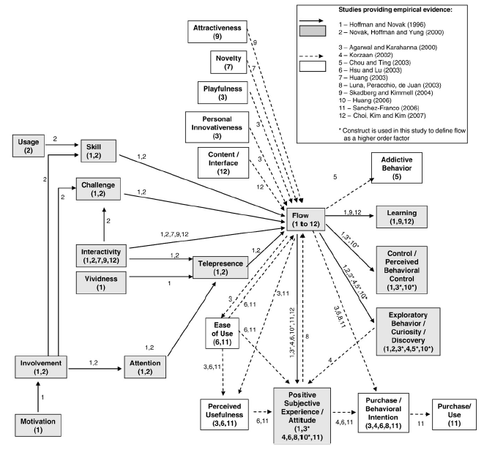

Slide 9
The flow concept remains murky
Flow is something most individuals have experienced in various contexts, and so researchers (and respondents) have an intuitive and experience-based understanding of the flow construct.

Slide 10
Such a wide range of operational definitions and measures may have the unfortunate consequence of hindering the systematic progression of empirical research on flow.

Slide 11
Recommendations for flow measurement
Unidimensional measures
Multidimensional measures

Slide 12
Marketing outcomes of flow
Attitudes, behavioral intentions, and behavior
Influencing attitudes, and subsequent behavioral intentions and behavior
Learning
Flow was the most important factor contributing to increased learning

Slide 13
Control
Increased perceived behavioral control was an outcome of flow
Exploratory behavior
Curiosity contributed to flow
Discovery contributed to flow

Slide 14
Recent developments
The impact of simulated shopping experiences on flow and its outcomes

Slide 15
Flow in virtual worlds
Second Life (http://secondlife.com)
Complexity and sophistication of its virtual social and economic environment
Social context to virtual worlds
Interactivity in virtual worlds

Slide 16
Powerful and often affectively-laden background context to user interactions
Manipulate virtual objects
Learning curve

Slide 17
Research questions: flow and virtual worlds
Early experience of flow in a virtual world can reduce the drop out rate for new users
Virtual worlds themselves can be designed to increase the likelihood of a flow experience

Slide 18
Experience of flow impacts learning in virtual environments
Coexistence in virtual worlds of skill-based habits of use with the experience of flow.

Slide 19
Concluding observations from the virtual field
Huang's (2003) analysis of the impact of Web attributes and flow experience on consumer's perceptions of Website performance shows that interactivity is a key aspect of improving consumer's evaluations of a Web site.

Slide 20
Déjà vu all over again
Research has established that flow produces positive attitudes and leads to numerous positive marketing outcomes, but much remains unaddressed.
We hope this paper may offer some small stimulation on where to look next.

Slide 21
Q & A Time
指導老師：戴敏育
淡江資管碩一
組員：陳柏帆 699630454
詹益璋 699630470
2011/05/13

