Slide 1
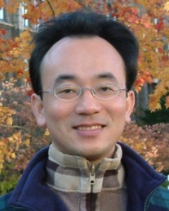
Control Logic and Loops
Python for Accounting Applications
1121PAA05
ACC2, NTPU (M5265) (Fall 2023) Wed 6, 7, 8, (14:10-17:00) (9:10-12:00) (B3F10)
Min-Yuh Day, Ph.D, Associate Professor
Institute of Information Management, National Taipei University
https://web.ntpu.edu.tw/~myday
2023-10-11

Slide 2
Syllabus
Week Date Subject/Topics
1 2023/09/13 Introduction to Python for Accounting Applications
2 2023/09/20 Python Programming and Data Science
3 2023/09/27 Foundations of Python Programming
4 2023/10/04 Data Structures
5 2023/10/11 Control Logic and Loops
6 2023/10/18 Functions and Modules
7 2023/10/25 Files and Exception Handling
8 2023/11/01 Midterm Project Report

Slide 3
Syllabus
Week Date Subject/Topics
9 2023/11/08 Data Analytics and Visualization with Python
10 2023/11/15 Obtaining Data From the Web with Python
11 2023/11/22 Statistical Analysis with Python
12 2023/11/29 Machine Learning with Python
13 2023/12/06 Text Analytics with Python and Large Language Models (LLMs)
14 2023/12/13 Applications of Accounting Data Analytics with Python
15 2023/12/20 Applications of ESG Data Analytics with Python
16 2023/12/27 Final Project Report

Slide 4
Python Control Logic and Loops

Slide 5
Outline
Python if else
if elif else
Booleans: True, False
Operators: ==, !=, >, <, >=, <=, and, or, not
Python for Loops
for
Python while Loops
While
break
continue

Slide 6
Python Data Structures
fruits = ["apple", "banana", "cherry"] #lists []
colors = ("red", "green", "blue") #tuples ()
animals = {'cat', 'dog'} #sets {}
person = {"name" : "Tom", "age" : 20} #dictionaries {}

Slide 7
Python Programming

Slide 8
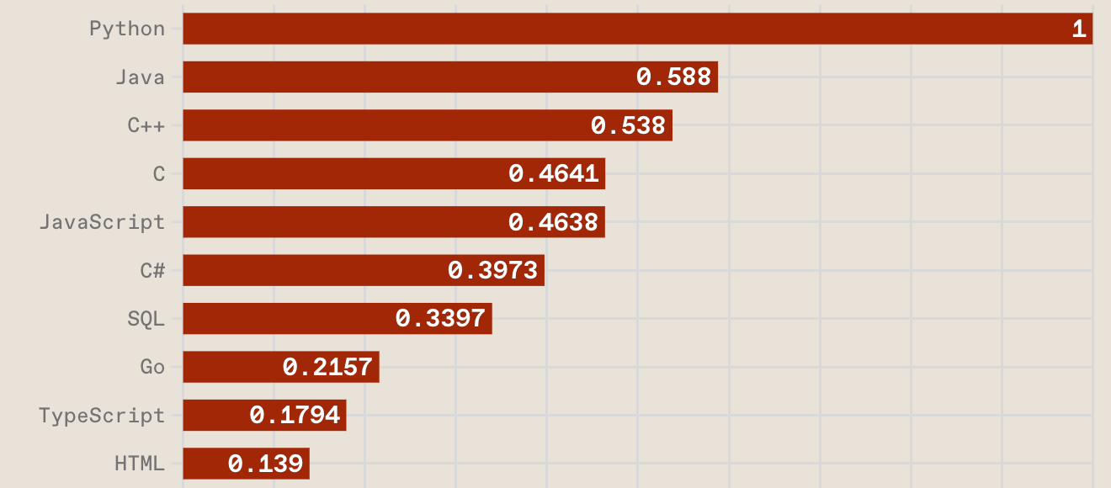
Top Programming Languages
https://spectrum.ieee.org/the-top-programming-languages-2023

Slide 9
Python is an interpreted, object-oriented, high-level programming language with dynamic semantics.
Source: https://www.python.org/doc/essays/blurb/

Slide 10
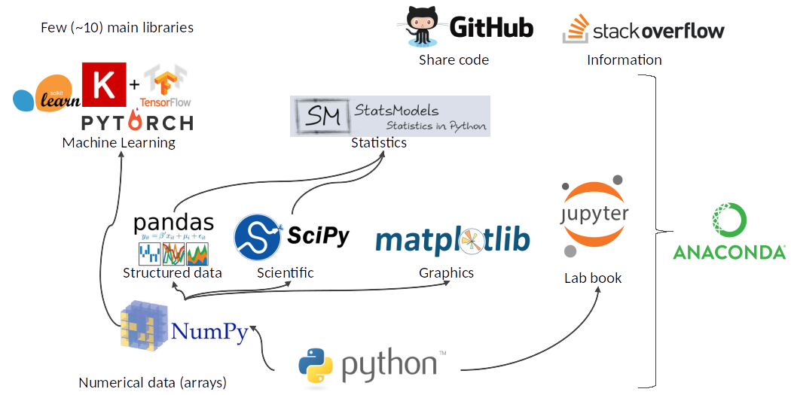
Python Ecosystem for Data Science
Source: https://medium.com/pyfinance/why-python-is-best-choice-for-financial-data-modeling-in-2019-c0d0d1858c45

Slide 11
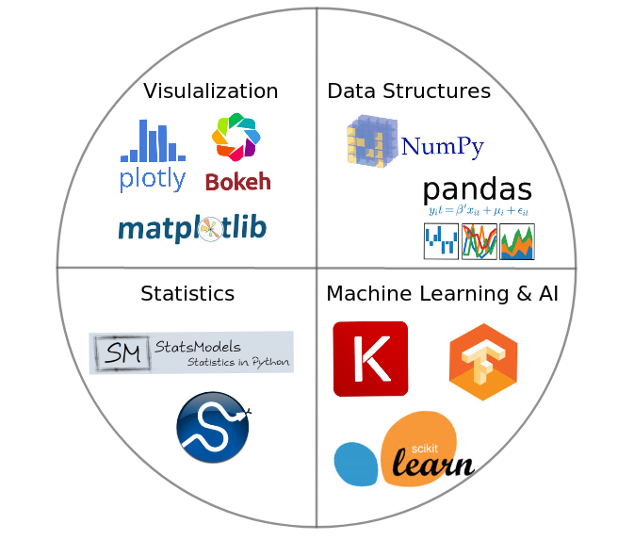
Python Ecosystem for Data Science
Source:https://duchesnay.github.io/pystatsml/introduction/python_ecosystem.html

Slide 12
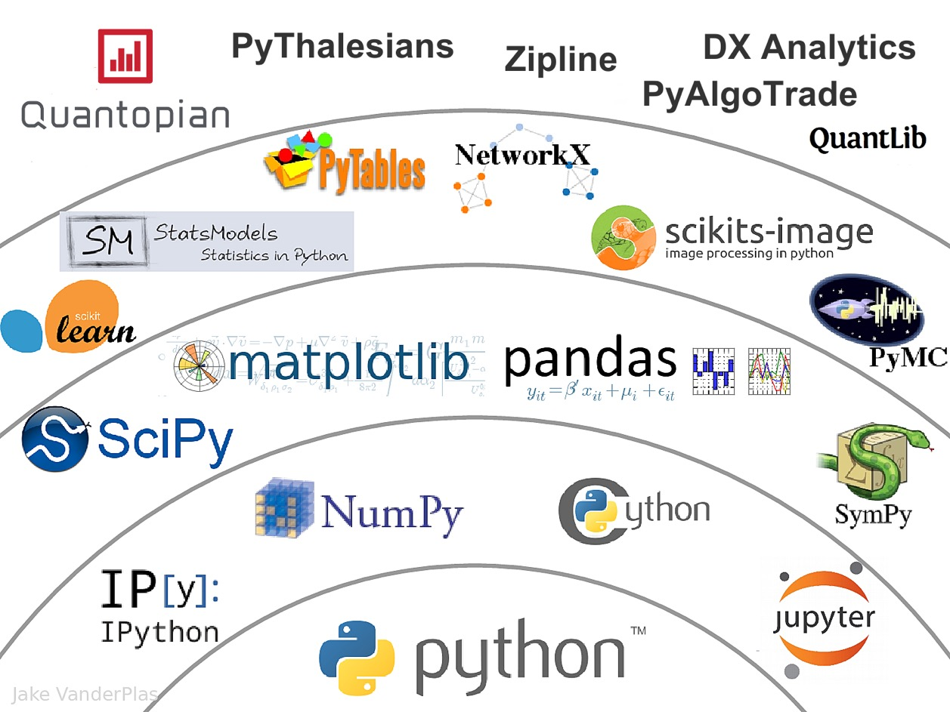
The Quant Finance PyData Stack
Source: http://nbviewer.jupyter.org/format/slides/github/quantopian/pyfolio/blob/master/pyfolio/examples/overview_slides.ipynb#/5

Slide 13
Numpy
NumPy
Base N-dimensional array package

Slide 14
Python matplotlib
Source: https://matplotlib.org/

Slide 15
Python Pandas
http://pandas.pydata.org/

Slide 16
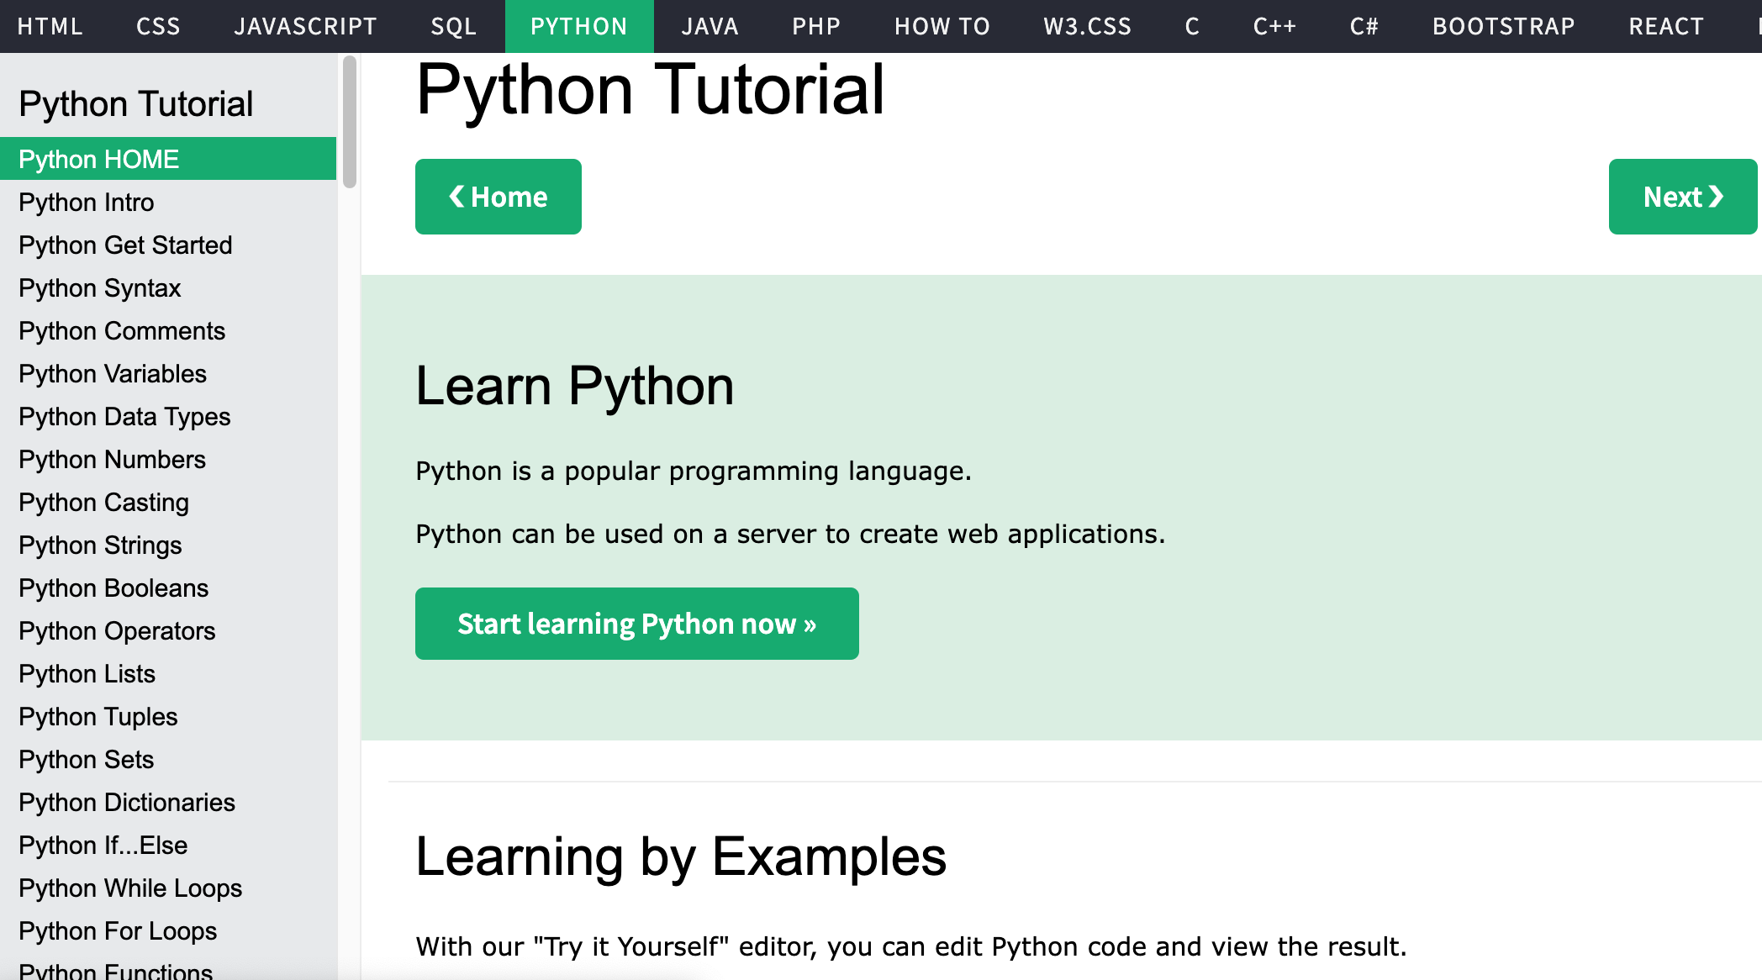
W3Schools Python
https://www.w3schools.com/python/

Slide 17
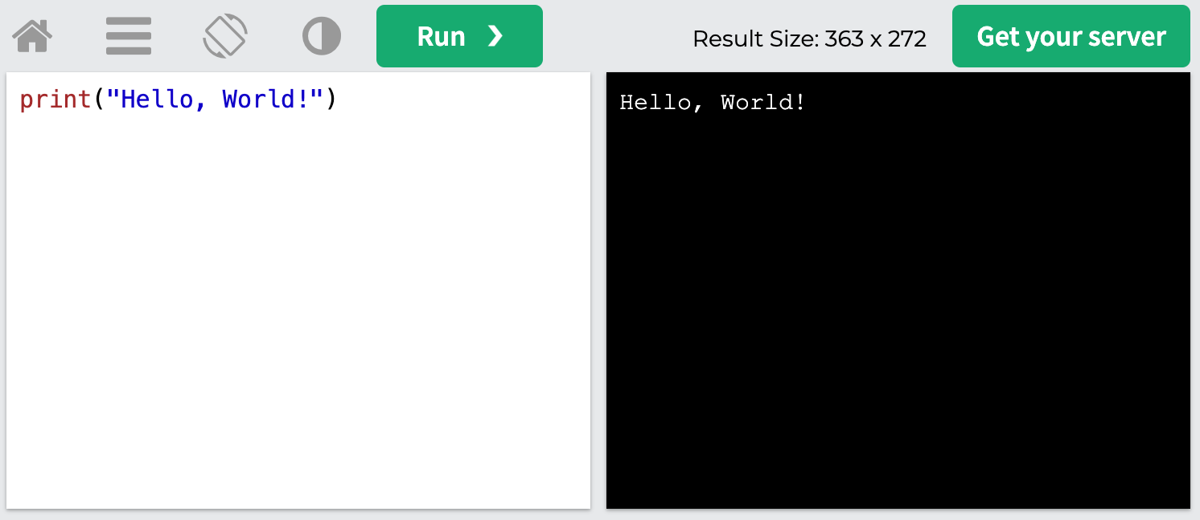
W3Schools Python: Try Python
https://www.w3schools.com/python/trypython.asp?filename=demo_default

Slide 18
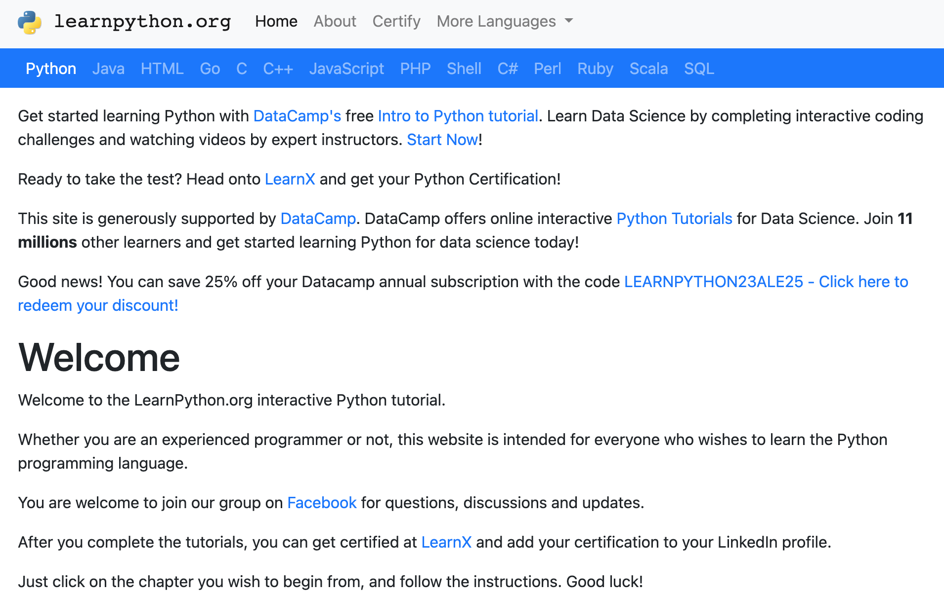
LearnPython.org
https://www.learnpython.org/

Slide 19
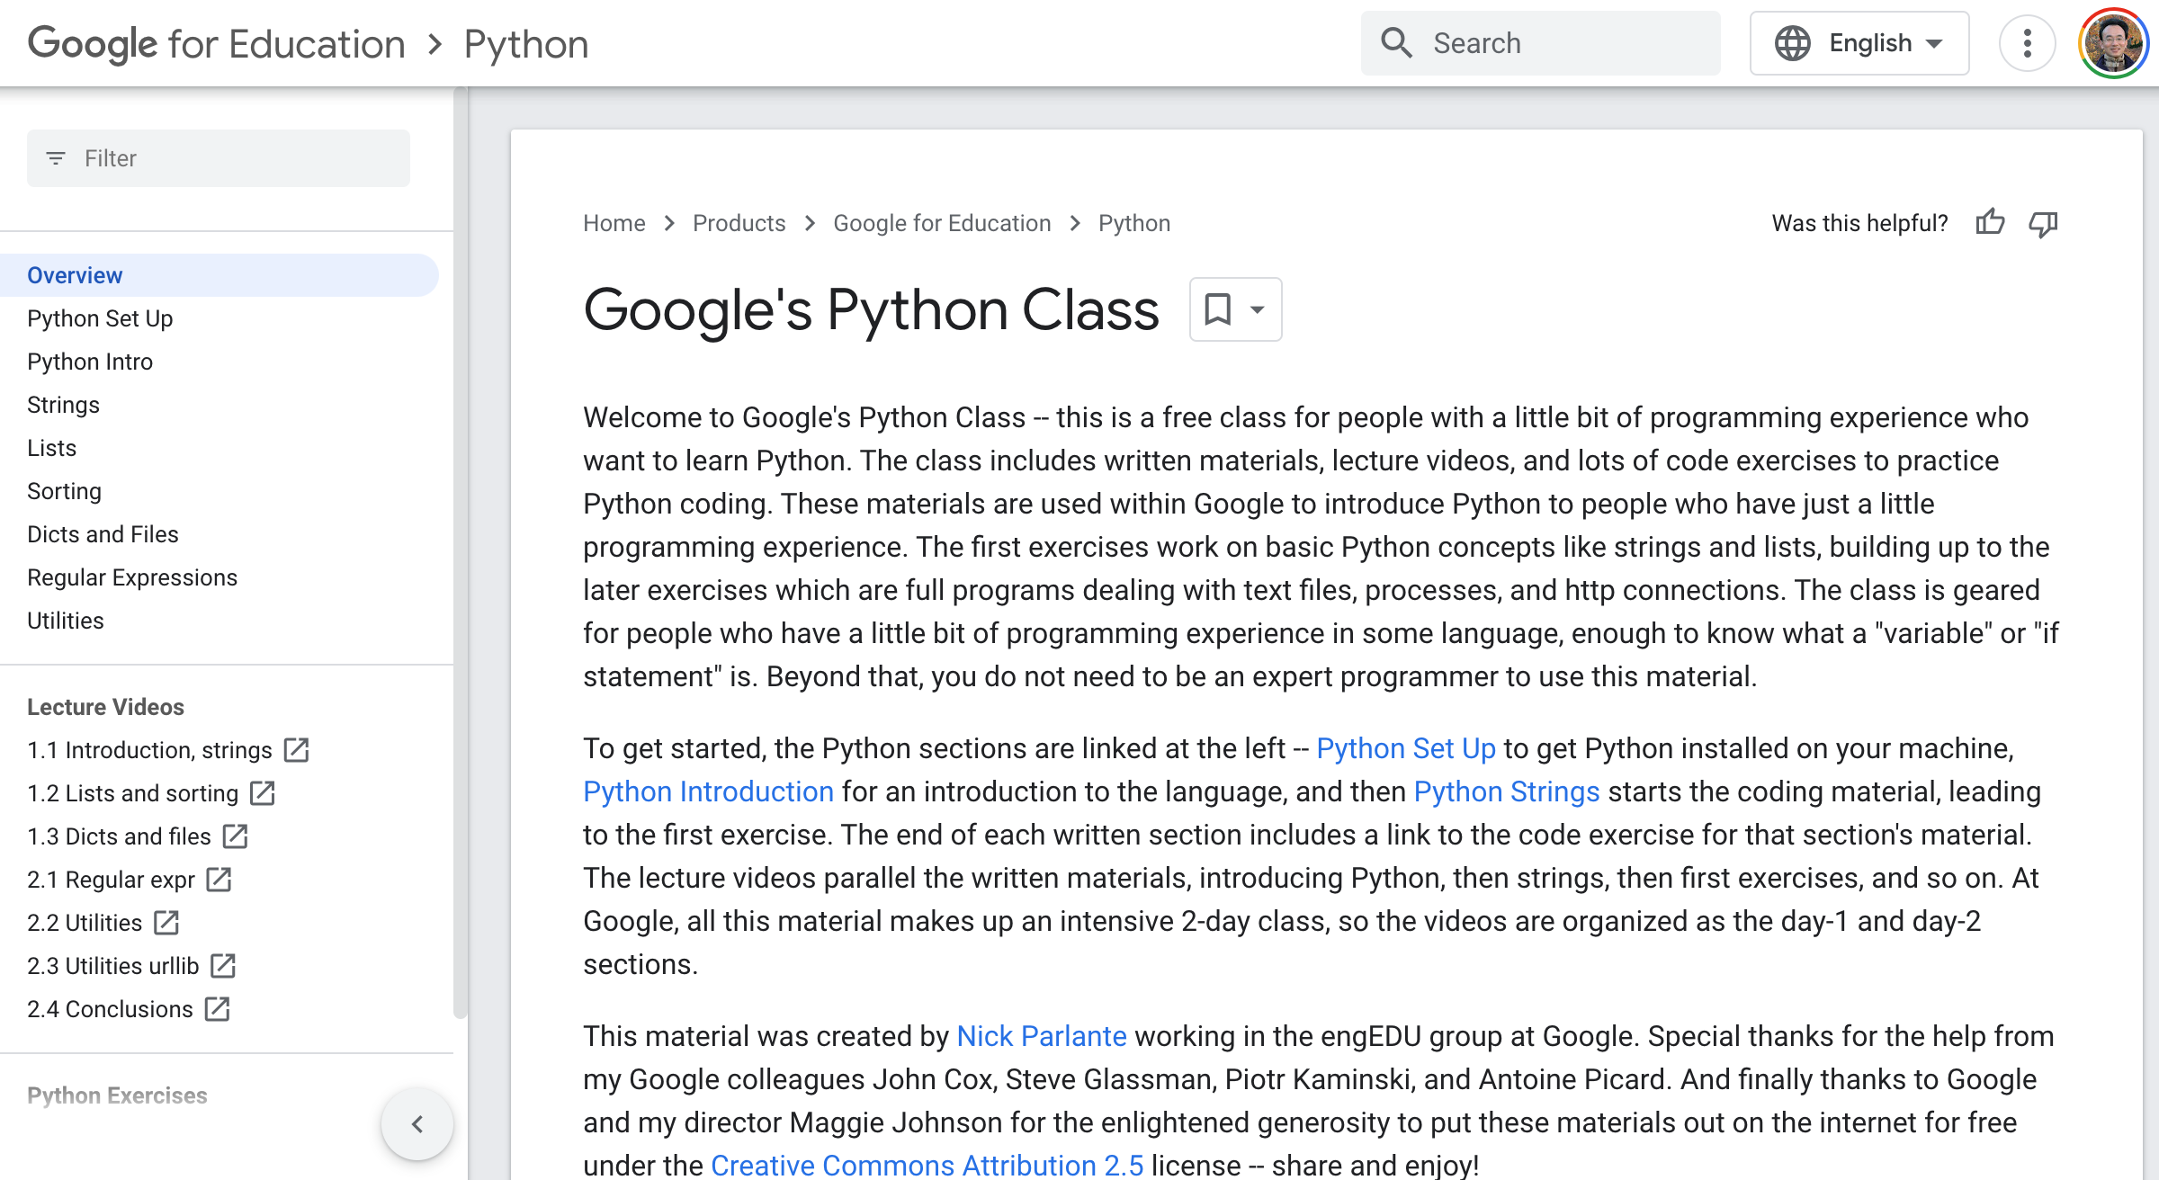
Google’s Python Class
https://developers.google.com/edu/python

Slide 20
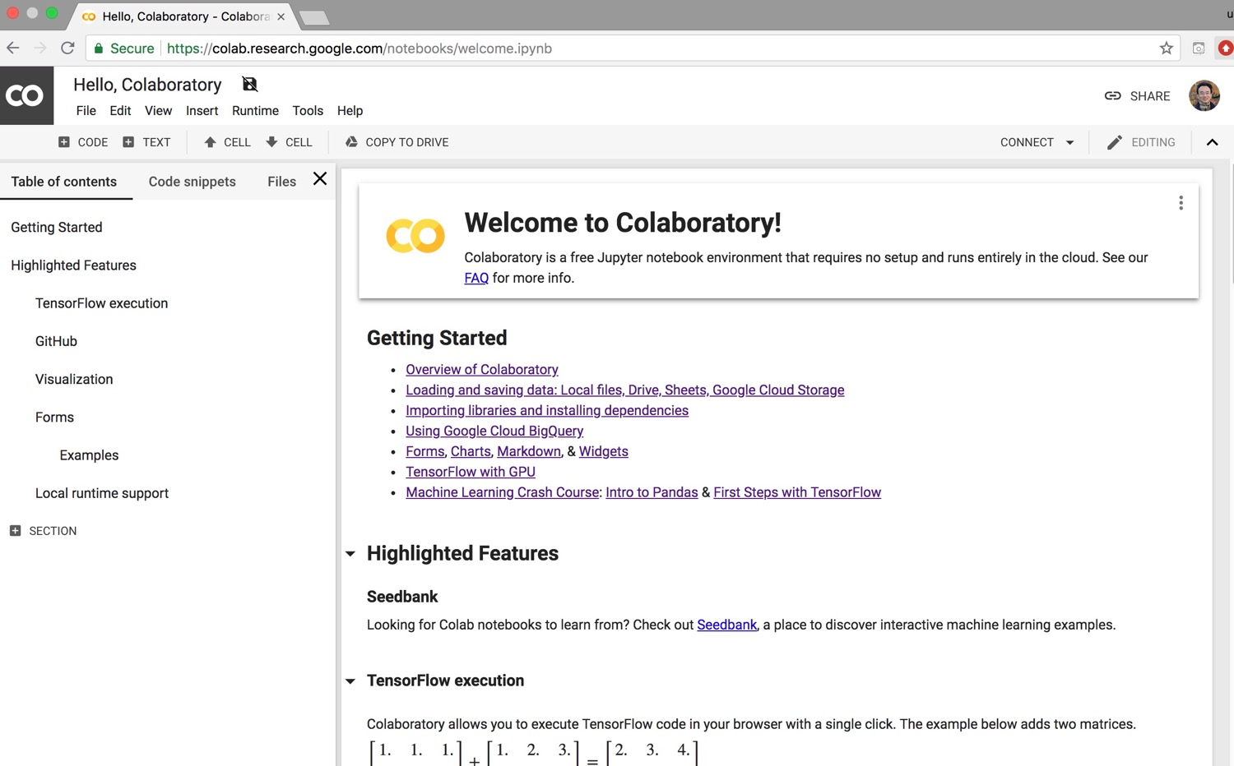
Google Colab
https://colab.research.google.com/notebooks/welcome.ipynb

Slide 21
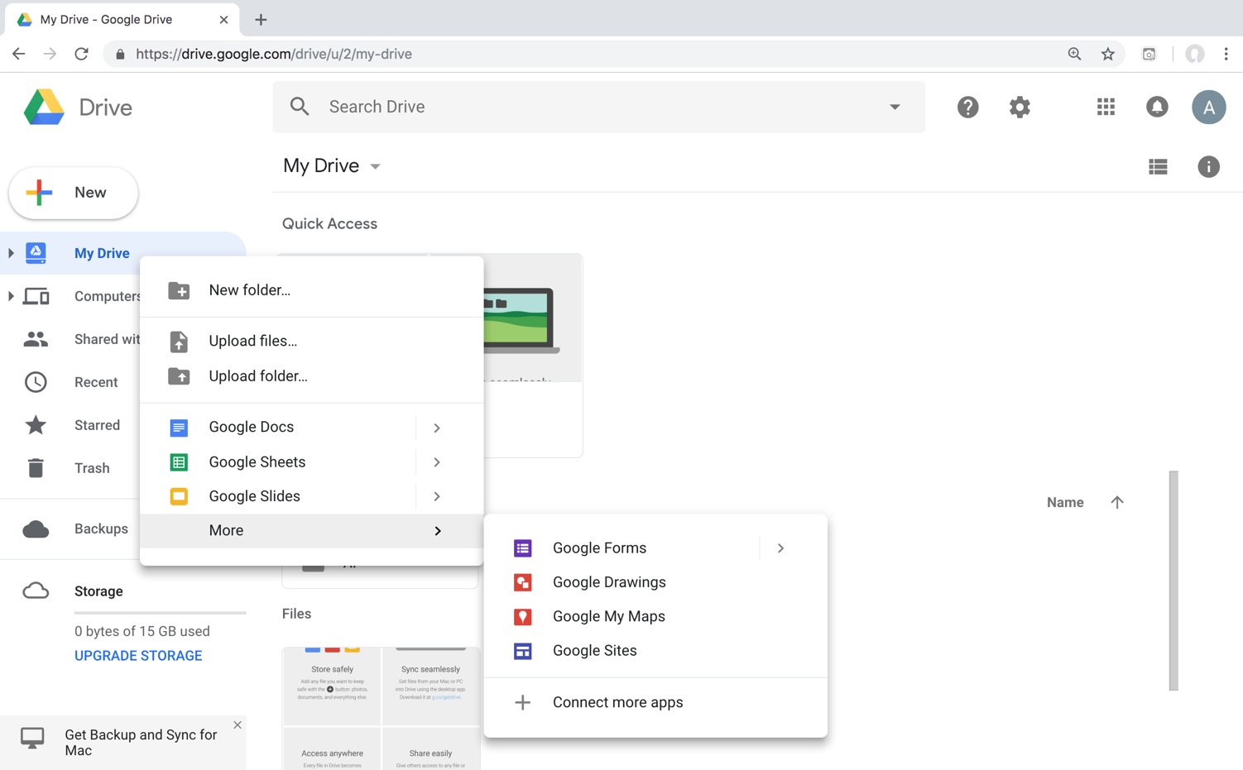
Connect Google Colab in Google Drive

Slide 22
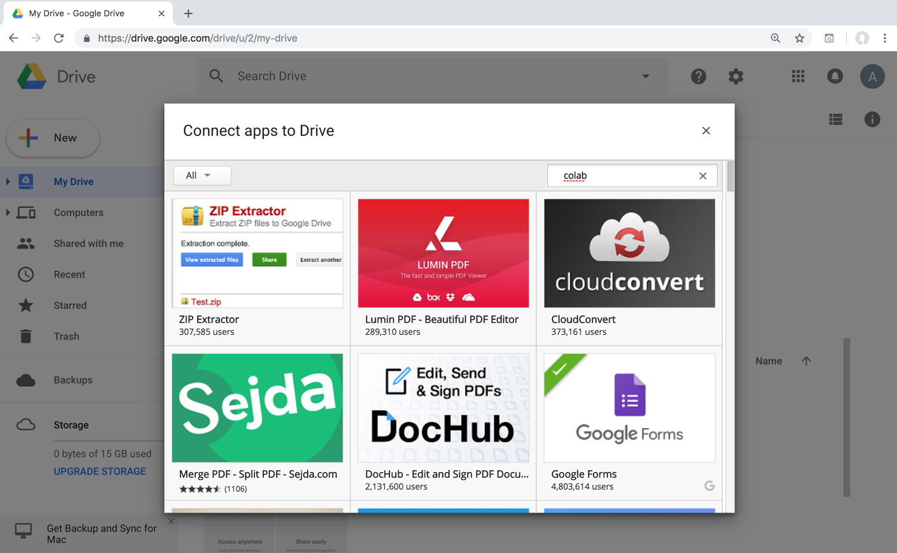
Google Colab

Slide 23
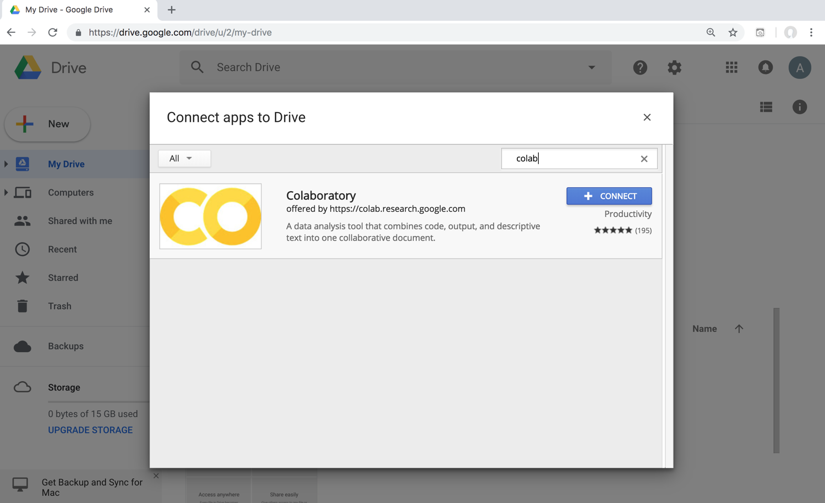
Google Colab

Slide 24
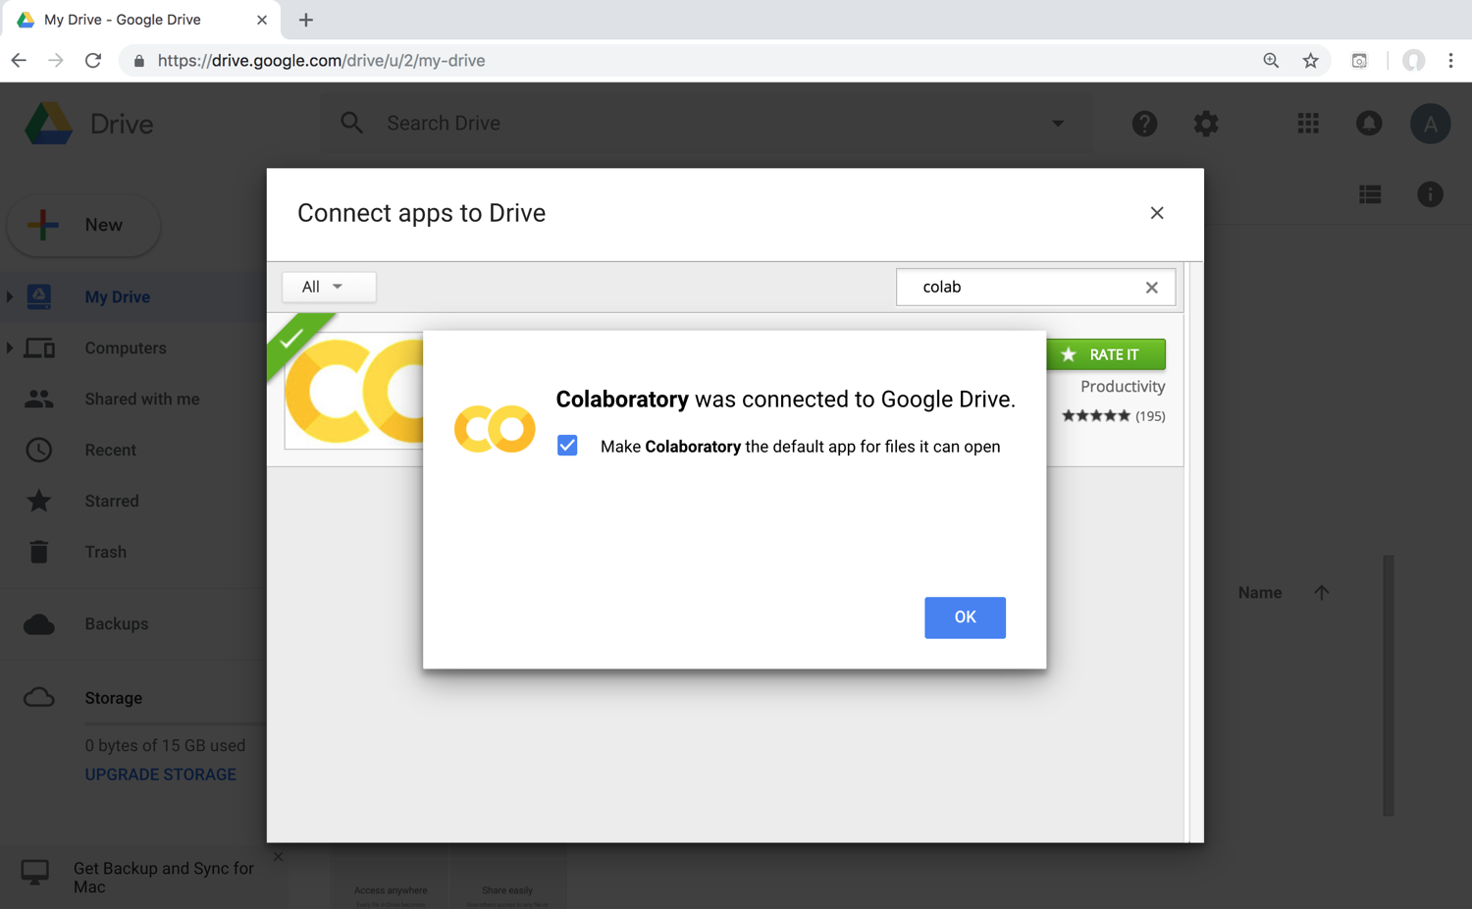
Connect Colaboratory to Google Drive

Slide 25
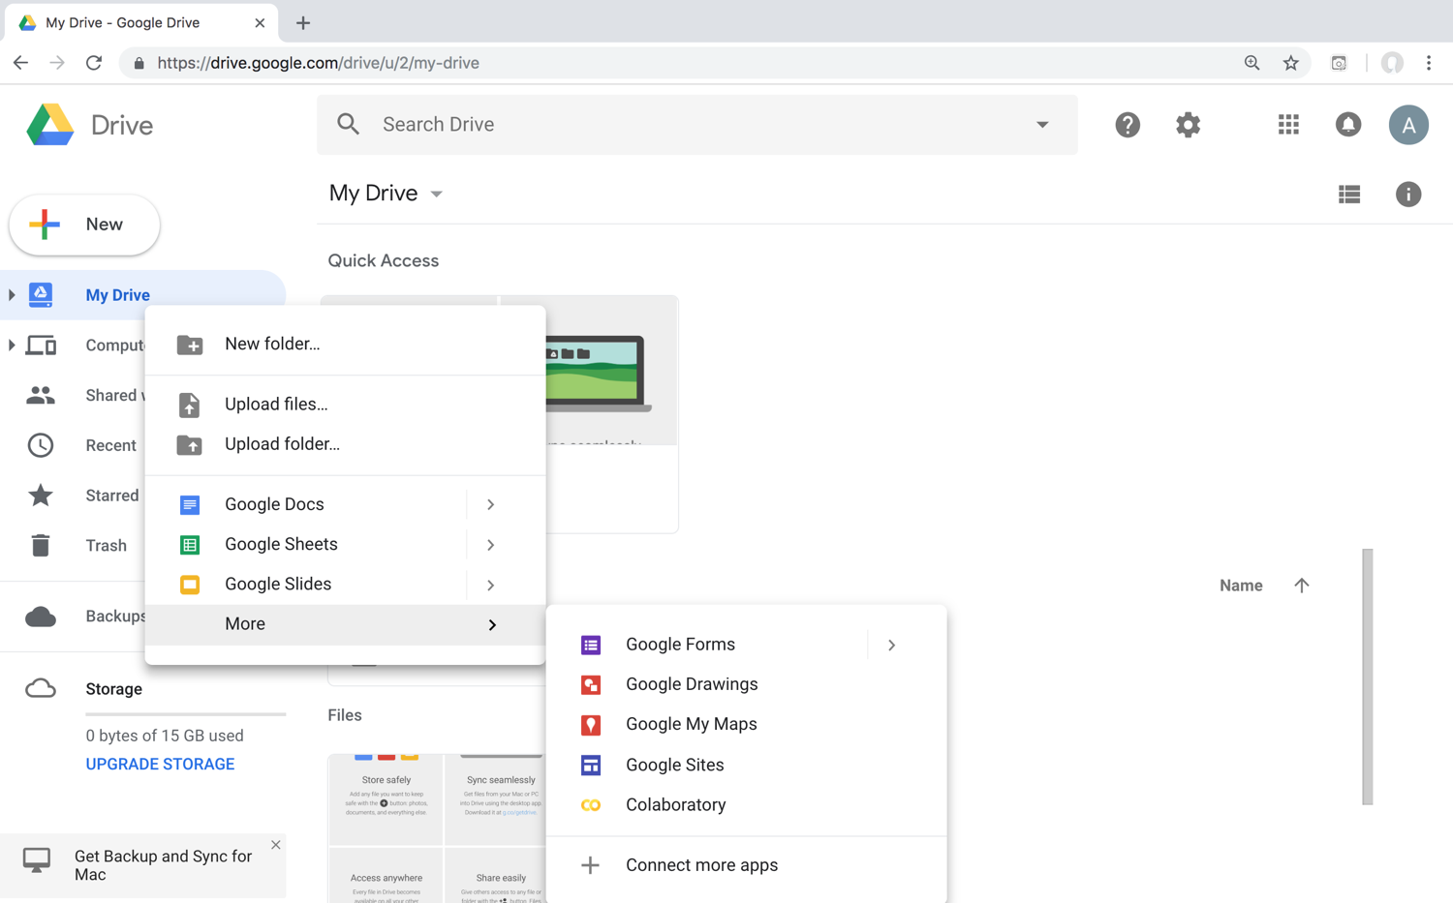
Google Colab

Slide 26
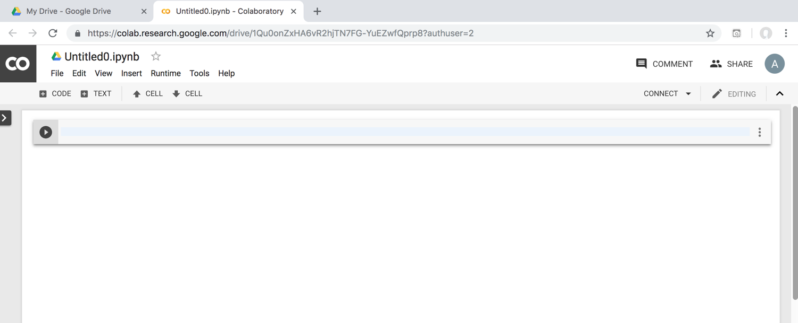
Google Colab

Slide 27
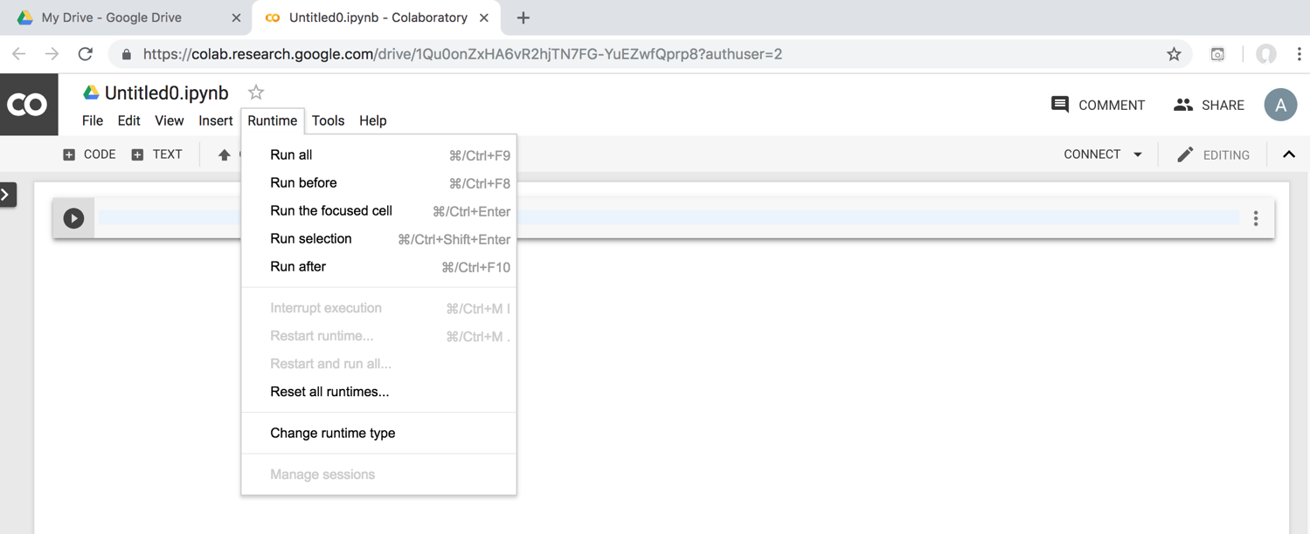
Google Colab

Slide 28
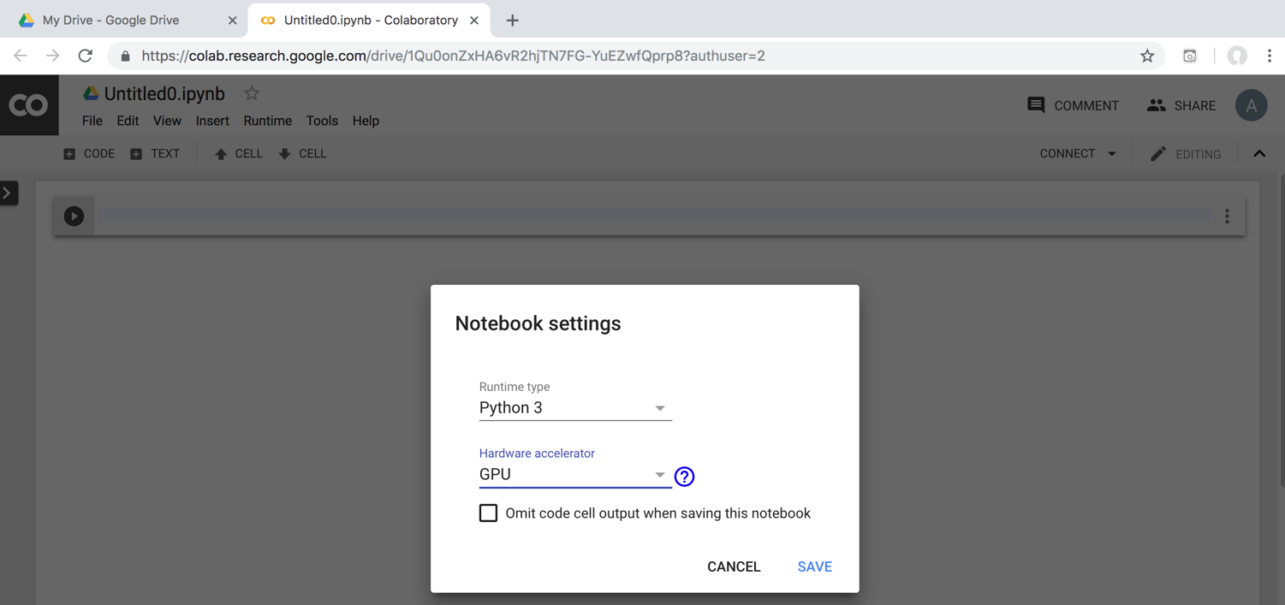
Run Jupyter Notebook Python3 GPU Google Colab

Slide 29
Google Colab Python Hello World print('Hello World')

Slide 30
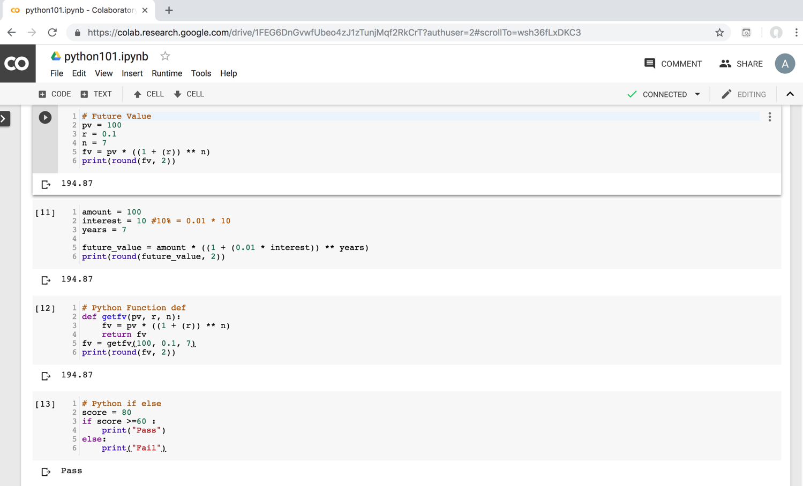
Python in Google Colab (Python101)
https://colab.research.google.com/drive/1FEG6DnGvwfUbeo4zJ1zTunjMqf2RkCrT
https://tinyurl.com/aintpupython101

Slide 31
Source: https://www.python.org/community/logos/

Slide 32
Python Programming

Slide 33
Python Hello World print("Hello World")
print("Hello World")

Slide 34
Python Syntax # comment
# comment

Slide 35
Python Syntax Indentation the spaces at the beginning of a code line 4 spaces
score = 80
if score >=60 :
print("Pass")

Slide 36
Python Variables
# Python Variables
x = 2
price = 2.5
word = 'Hello'
word = 'Hello'
word = "Hello"
word = '''Hello'''

Slide 37
Python Variables
x = 2
y = x + 1

Slide 38
python_version()
# comment
from platform import python_version
print("Python Version:", python_version())
Python Version: 3.10.12

Slide 39
Python Data Types
x = "Hello World" #str
x = 2 #int
x = 2.5 #float
x = 7j #complex

Slide 40
Python Data Types
x = ["apple", "banana", "cherry"] #list
x = ("apple", "banana", "cherry") #tuple
x = range(6) #range
x = {"name" : "Tom", "age" : 20} #dict
x = {"apple", "banana", "cherry"} #set
x = frozenset({"apple", "banana", "cherry"}) #frozenset

Slide 41
Python Data Types
x = True #bool
x = b"Hello" #bytes
x = bytearray(5) #bytearray
x = memoryview(bytes(5)) #memoryview
x = None #NoneType

Slide 42
Python Casting
x = str(3) # x will be '3'
y = int(3) # y will be 3
z = float(3) # z will be 3.0
print(x, type(x))
print(y, type(y))
print(z, type(z))
3 <class 'str’>
3 <class 'int’>
3.0 <class 'float'>

Slide 43
Python Numbers
x = 2 # int
y = 3.4 # float
z = 7j #complex
print(x, type(x))
print(y, type(y))
print(z, type(z))
2 <class 'int’>
3.4 <class 'float’>
7j <class 'complex'>

Slide 44
Python Arithmetic Operators
Operator Name Example
+ Addition 7 + 2 = 9
- Subtraction 7 - 2 = 5
* Multiplication 7 * 2 = 14
/ Division 7 / 2 = 3.5
// Floor division 7 // 2 = 3 (Quotient)
% Modulus 7 % 2 = 1 (Remainder)
** Exponentiation 7 ** 2 = 49

Slide 45
Python Basic Operators
print('7 + 2 =', 7 + 2)
print('7 - 2 =', 7 - 2)
print('7 * 2 =', 7 * 2)
print('7 / 2 =', 7 / 2)
print('7 // 2 =', 7 // 2)
print('7 % 2 =', 7 % 2)
print('7 ** 2 =', 7 ** 2)
7 + 2 = 9
7 - 2 = 5
7 * 2 = 14
7 / 2 = 3.5
7 // 2 = 3
7 % 2 = 1
7 ** 2 = 49

Slide 46
Python Booleans: True or False
# Python Booleans: True or False
print(3 > 2)
print(3 == 2)
print(3 < 2)

Slide 47
Python BMI Calculator
# BMI Calculator in Python
height_cm = 170
weight_kg = 60
height_m = height_cm/100
BMI = (weight_kg/(height_m**2))
print("Your BMI is: " + str(round(BMI,1)))
Your BMI is: 20.8

Slide 48
Future value of a specified principal amount, rate of interest, and a number of years
Source: https://www.w3resource.com/python-exercises/python-basic-exercise-39.php

Slide 49
How much is your $100 worth after 7 years?
# How much is your $100 worth after 7 years?
fv = 100 * 1.1 ** 7
print('fv = ', round(fv, 2))
# output = 194.87
fv = 194.87

Slide 50
Future Value
# Future Value
pv = 100
r = 0.1
n = 7
fv = pv * ((1 + (r)) ** n)
print(round(fv, 2))
194.87

Slide 51
Future Value
# Future Value
amount = 100
interest = 10 #10% = 0.01 * 10
years = 7
future_value = amount * ((1 + (0.01 * interest)) ** years)
print(round(future_value, 2))
194.87

Slide 52
Python Data Structures

Slide 53
Python Data Types
x = ["apple", "banana", "cherry"] #list
x = ("apple", "banana", "cherry") #tuple
x = {"name" : "Tom", "age" : 20} #dict
x = {"apple", "banana", "cherry"} #set

Slide 54
Python Collections
There are four collection data types in the Python programming language
List []
a collection which is ordered and changeable. Allows duplicate members.
Tuple ()
a collection which is ordered and unchangeable. Allows duplicate members.
Set {}
a collection which is unordered, unchangeable, and unindexed. No duplicate members.
Dictionary {k:v}
a collection which is ordered and changeable. No duplicate members.

Slide 55
Python Dictionaries {k:v}
As of Python version 3.7, dictionaries are ordered.
In Python 3.6 and earlier, dictionaries are unordered.

Slide 56
Lists []
x = [60, 70, 80, 90]
print(len(x))
print(x[0])
print(x[1])
print(x[-1])
4
60
70
90

Slide 57
Lists []
len(): how many items
type(): data type
list() constructor: creating a new list

Slide 58
Python List Methods
Method Description
append() Adds an element at the end of the list
clear() Removes all the elements from the list
copy() Returns a copy of the list
count() Returns the number of elements with the specified value
extend() Add the elements of a list (or any iterable), to the end of the current list
index() Returns the index of the first element with the specified value
insert() Adds an element at the specified position
pop() Removes the element at the specified position
remove() Removes the item with the specified value
reverse() Reverses the order of the list
sort() Sorts the list
https://www.w3schools.com/python/python_lists_methods.asp

Slide 59
Tuples ()
A tuple in Python is a collection that cannot be modified. A tuple is defined using parenthesis.
x = (10, 20, 30, 40, 50)
print(x[0])
print(x[1])
print(x[2])
print(x[-1])
10
20
30
50
Source: http://pythonprogramminglanguage.com/tuples/

Slide 60
Sets {}
animals = {'cat', 'dog'}
print('cat' in animals)
print('fish' in animals)
animals.add('fish')
print('fish' in animals) print(len(animals))
animals.add('cat’)
print(len(animals))
animals.remove('cat')
print(len(animals))
True
False
True
3
3
2
Source: http://cs231n.github.io/python-numpy-tutorial/

Slide 61
Dictionary {key : value}
Python Dictionary
Key → Value
'EN’ → 'English’
'FR’ → 'French'
k = { 'EN':'English', 'FR':'French' }
print(k['EN'])
English
Source: http://pythonprogramminglanguage.com/dictionary/

Slide 62
Python Data Structures
fruits = ["apple", "banana", "cherry"] #lists []
colors = ("red", "green", "blue") #tuples ()
animals = {'cat', 'dog'} #sets {}
person = {"name" : "Tom", "age" : 20} #dictionaries {}
https://tinyurl.com/aintpupython101

Slide 63
Python for Accounting Applications
# Python Lists
expenses = [72.50, 80.75, 50.00, 90.25]
total_expenses = sum(expenses)
print("Total expenses:", total_expenses)
Total expenses: 293.5
https://tinyurl.com/aintpupython101

Slide 64
Python for Accounting Applications
# Python Tuples
accounts = (("Cash", 1001), ("Accounts Receivable", 1002), ("Inventory", 1003))
for account in accounts:
print("Account name:", account[0], "Account number:", account[1])
Account name: Cash Account number: 1001
Account name: Accounts Receivable Account number: 1002 Account name: Inventory Account number: 1003
https://tinyurl.com/aintpupython101

Slide 65
Python for Accounting Applications
# Python Sets
account_numbers = {1001, 1002, 1003}
new_account_number = 1004
if new_account_number not in account_numbers:
print("Account number", new_account_number, "is not in use.")
Account number 1004 is not in use.
https://tinyurl.com/aintpupython101

Slide 66
Python for Accounting Applications
# Python Dictionaries
accounts = {"1001": {"name": "Cash", "balance": 500.00, "type": "Asset"},
"1002": {"name": "Accounts Receivable", "balance": 1000.00, "type": "Asset"},
"2001": {"name": "Accounts Payable", "balance": 750.00, "type": "Liability"}}
for account_number, account_info in accounts.items():
print("Account number:", account_number)
print("Account name:", account_info["name"])
print("Account balance:", account_info["balance"])
print("Account type:", account_info["type"])
Account number: 1001
Account name: Cash
Account balance: 500.0
Account type: Asset
Account number: 1002
Account name: Accounts Receivable
Account balance: 1000.0
Account type: Asset
Account number: 2001
Account name: Accounts Payable
Account balance: 750.0
Account type: Liability
https://tinyurl.com/aintpupython101

Slide 67
Python Control Logic and Loops

Slide 68
Python Control Logic and Loops
Python if else
if elif else
Booleans: True, False
Operators: ==, !=, >, <, >=, <=, and, or, not
Python for Loops
for
Python while Loops
While
break
continue

Slide 69
Python if...else
Python if...else
if elif else
Booleans: True, False
Operators: ==, !=, >, <, >=, <=, and, or, not

Slide 70
Python Conditions and If statements
Python supports the usual logical conditions from mathematics:
Equals: a == b
Not Equals: a != b
Less than: a < b
Less than or equal to: a <= b
Greater than: a > b
Greater than or equal to: a >= b

Slide 71
Python Comparison Operators
Operator | Name | Example
== | Equal | x == y
!= | Not equal | x != y
> | Greater than | x > y
< | Less than | x < y
>= | Greater than or equal to | x >= y
<= | Less than or equal to | x <= y
Source: https://www.w3schools.com/python/python_operators.asp

Slide 72
Python Logical Operators
Operator | Description | Example
and | Returns True if both statements are true | x < 5 and x < 10
or | Returns True if one of the statements is true | x < 5 or x < 4
not | Reverse the result, returns False if the result is true | not(x < 5 and x < 10)
Source: https://www.w3schools.com/python/python_operators.asp

Slide 73
Python if
# Python if
score = 80
if score >=60 :
print("Pass")
https://tinyurl.com/aintpupython101

Slide 74
Python if else
# Python if else
score = 80
if score >=60 :
print("Pass")
else:
print("Fail")
https://tinyurl.com/aintpupython101

Slide 75
Python if elif else
score = 95
if score >= 90 :
print("A")
elif score >=60 :
print("Pass")
else:
print("Fail")

Slide 76
Python if elif else
# Python if elif else
score = 90
grade = ""
if score >=90:
grade = "A"
elif score >= 80:
grade = "B"
elif score >= 70:
grade = "C"
elif score >= 60:
grade = "D"
else:
grade = "E"
print(grade)

Slide 77
Python for Loops
for i in range(1,6):
print(i)
1
2
3
4
5
https://tinyurl.com/aintpupython101

Slide 78
Python for loops
# for loops
for i in range(1,10):
for j in range(1,10):
print(i, ' * ' , j , ' = ', i*j)
https://tinyurl.com/aintpupython101

Slide 79
Python while Loops
while
break
continue

Slide 80
Python while loops
# while loops
age = 10
while age < 20:
print(age)
age = age + 1
https://tinyurl.com/aintpupython101

Slide 81
Summary
Python if else
if elif else
Booleans: True, False
Operators: ==, !=, >, <, >=, <=, and, or, not
Python for Loops
for
Python while Loops
while
break
continue

Slide 82
References
Wes McKinney (2022), "Python for Data Analysis: Data Wrangling with pandas, NumPy, and Jupyter", 3rd Edition, O'Reilly Media.
Aurélien Géron (2023), Hands-On Machine Learning with Scikit-Learn, Keras, and TensorFlow: Concepts, Tools, and Techniques to Build Intelligent Systems, 3rd Edition, O’Reilly Media.
Steven D'Ascoli (2022), Artificial Intelligence and Deep Learning with Python: Every Line of Code Explained For Readers New to AI and New to Python, Independently published.
Stuart Russell and Peter Norvig (2020), Artificial Intelligence: A Modern Approach, 4th Edition, Pearson.
Varun Grover, Roger HL Chiang, Ting-Peng Liang, and Dongsong Zhang (2018), "Creating Strategic Business Value from Big Data Analytics: A Research Framework", Journal of Management Information Systems, 35, no. 2, pp. 388-423.
Junliang Wang, Chuqiao Xu, Jie Zhang, and Ray Zhong (2022). "Big data analytics for intelligent manufacturing systems: A review." Journal of Manufacturing Systems 62 (2022): 738-752.
Ramesh Sharda, Dursun Delen, and Efraim Turban (2017), Business Intelligence, Analytics, and Data Science: A Managerial Perspective, 4th Edition, Pearson
Python Programming, https://pythonprogramming.net/
Python, https://www.python.org/
Python Programming Language, http://pythonprogramminglanguage.com/
Numpy, http://www.numpy.org/
Pandas, http://pandas.pydata.org/
Skikit-learn, http://scikit-learn.org/
W3Schools Python, https://www.w3schools.com/python/
Learn Python, https://www.learnpython.org/
Google’s Python Class, https://developers.google.com/edu/python
Min-Yuh Day (2023), Python 101, https://tinyurl.com/aintpupython101

