Slide 1
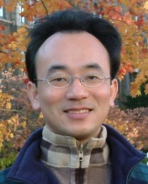
Natural Language Processing with Transformers
Artificial Intelligence for Text Analytics
1121AITA04
MBA, IM, NTPU (M5265) (Fall 2023) Tue 2, 3, 4 (9:10-12:00) (B3F17)
Min-Yuh Day, Ph.D, Associate Professor
Institute of Information Management, National Taipei University
https://web.ntpu.edu.tw/~myday
https://meet.google.com/miy-fbif-max
2023-10-04

Slide 2
Syllabus
Week Date Subject/Topics
1 2023/09/13 Introduction to Artificial Intelligence for Text Analytics
2 2023/09/20 Foundations of Text Analytics: Natural Language Processing (NLP)
3 2023/09/27 Python for Natural Language Processing
4 2023/10/04 Natural Language Processing with Transformers
5 2023/10/11 Case Study on Artificial Intelligence for Text Analytics I
6 2023/10/18 Text Classification and Sentiment Analysis

Slide 3
Syllabus
Week Date Subject/Topics
7 2023/10/25 Multilingual Named Entity Recognition (NER)
8 2023/11/01 Midterm Project Report
9 2023/11/08 Text Similarity and Clustering
10 2023/11/15 Text Summarization and Topic Models
11 2023/11/22 Text Generation with Large Language Models (LLMs)
12 2023/11/29 Case Study on Artificial Intelligence for Text Analytics II

Slide 4
Syllabus
Week Date Subject/Topics
13 2023/12/06 Question Answering and Dialogue Systems
14 2023/12/13 Deep Learning, Generative AI, Transfer Learning, Zero-Shot, and Few-Shot Learning for Text Analytics
15 2023/12/20 Final Project Report I
16 2023/12/27 Final Project Report II

Slide 5
Natural Language Processing with Transformers

Slide 6
Outline
Natural Language Processing with Transformers
Transformer (Attention is All You Need)
BERT: Pre-training of Deep Bidirectional Transformers for Language Understanding
ChatGPT: Large Language Models (LLMs), Foundation Models
Encoder-Decoder
Attention Mechanisms
Transfer Learning in NLP: Pre-train, Fine-tune

Slide 7
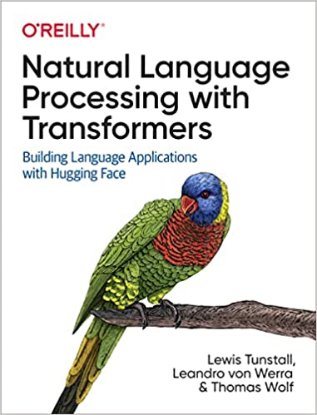
Lewis Tunstall, Leandro von Werra, and Thomas Wolf (2022), Natural Language Processing with Transformers: Building Language Applications with Hugging Face, O'Reilly Media.
Source: https://www.amazon.com/Natural-Language-Processing-Transformers-Applications/dp/1098103246

Slide 8
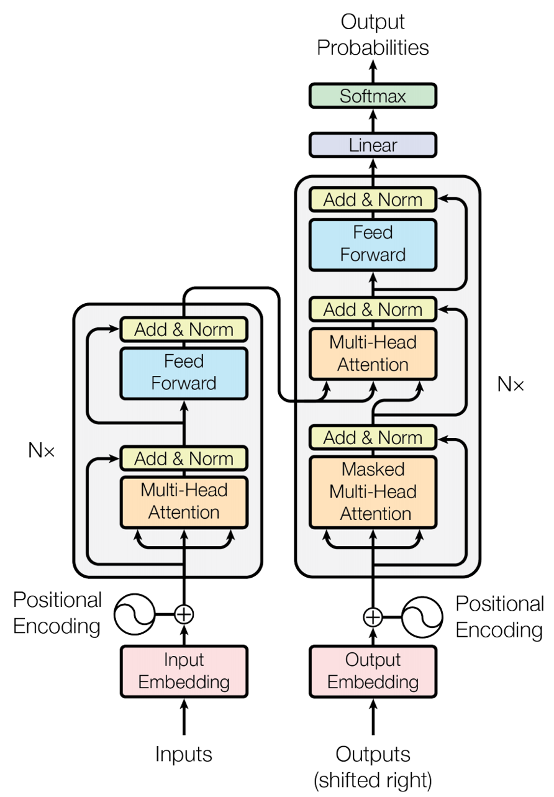
Transformer (Attention is All You Need) (Vaswani et al., 2017)
Source: Vaswani, Ashish, Noam Shazeer, Niki Parmar, Jakob Uszkoreit, Llion Jones, Aidan N. Gomez, Łukasz Kaiser, and Illia Polosukhin. "Attention is all you need." In Advances in neural information processing systems, pp. 5998-6008. 2017.

Slide 9
The Transformers Timeline
ULMFit
BERT
RoBERTa
XLM-R
DeBERTa
GPT-Neo
BLOOM
Alpaca
DistrilBERT
T5
PaLM
ChatGPT
Llama2
Transformer
GPT
GPT-2
GPT-3
GPT-J
OPT-175B
Llama
2017
2018
2019
2020
2021
2022
2023
Source: Lewis Tunstall, Leandro von Werra, and Thomas Wolf (2022), Natural Language Processing with Transformers: Building Language Applications with Hugging Face, O'Reilly Media.

Slide 10
Transformer Models
Transformer
Encoder
Decoder
DistilBERT
BERT
T5
GPT
RoBERTa
BART
GPT-2
CTRL
XLM-R
XLM
M2M-100
GPT-3
ALBERT
BigBird
GPT-Neo
GPT-J
ELECTRA
mT0
BLOOM
BLOOMZ
DeBERTa
ChatGPT
GPT-4
Source: Lewis Tunstall, Leandro von Werra, and Thomas Wolf (2022), Natural Language Processing with Transformers: Building Language Applications with Hugging Face, O'Reilly Media.

Slide 11
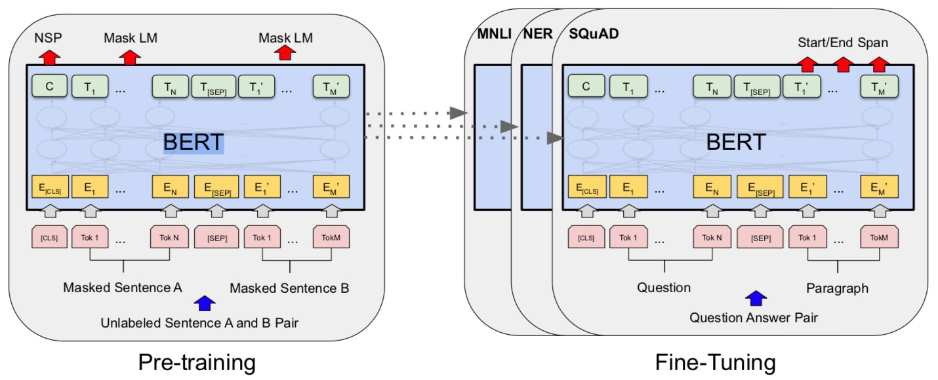
BERT: Pre-training of Deep Bidirectional Transformers for Language Understanding
BERT (Bidirectional Encoder Representations from Transformers)
Overall pre-training and fine-tuning procedures for BERT
Source: Devlin, Jacob, Ming-Wei Chang, Kenton Lee, and Kristina Toutanova (2018). "Bert: Pre-training of deep bidirectional transformers for language understanding." arXiv preprint arXiv:1810.04805.

Slide 12
BERT: Pre-training of Deep Bidirectional Transformers for Language Understanding
Source: Devlin, Jacob, Ming-Wei Chang, Kenton Lee, and Kristina Toutanova (2018). "BERT: Pre-training of Deep Bidirectional Transformers for Language Understanding." arXiv preprint arXiv:1810.04805

Slide 13
BERT Bidirectional Encoder Representations from Transformers
Pre-training model architectures
BERT uses a bidirectional Transformer.
OpenAI GPT uses a left-to-right Transformer.
ELMo uses the concatenation of independently trained left-to-right and right- to-left LSTM to generate features for downstream tasks.
Among three, only BERT representations are jointly conditioned on both left and right context in all layers.
Source: Devlin, Jacob, Ming-Wei Chang, Kenton Lee, and Kristina Toutanova (2018). "BERT: Pre-training of Deep Bidirectional Transformers for Language Understanding." arXiv preprint arXiv:1810.04805

Slide 14
BERT: Pre-training of Deep Bidirectional Transformers for Language Understanding
BERT (Bidirectional Encoder Representations from Transformers)
BERT input representation
The input embeddings is the sum of the token embeddings, the segmentation embeddings and the position embeddings.
Source: Devlin, Jacob, Ming-Wei Chang, Kenton Lee, and Kristina Toutanova (2018). "Bert: Pre-training of deep bidirectional transformers for language understanding." arXiv preprint arXiv:1810.04805.

Slide 15
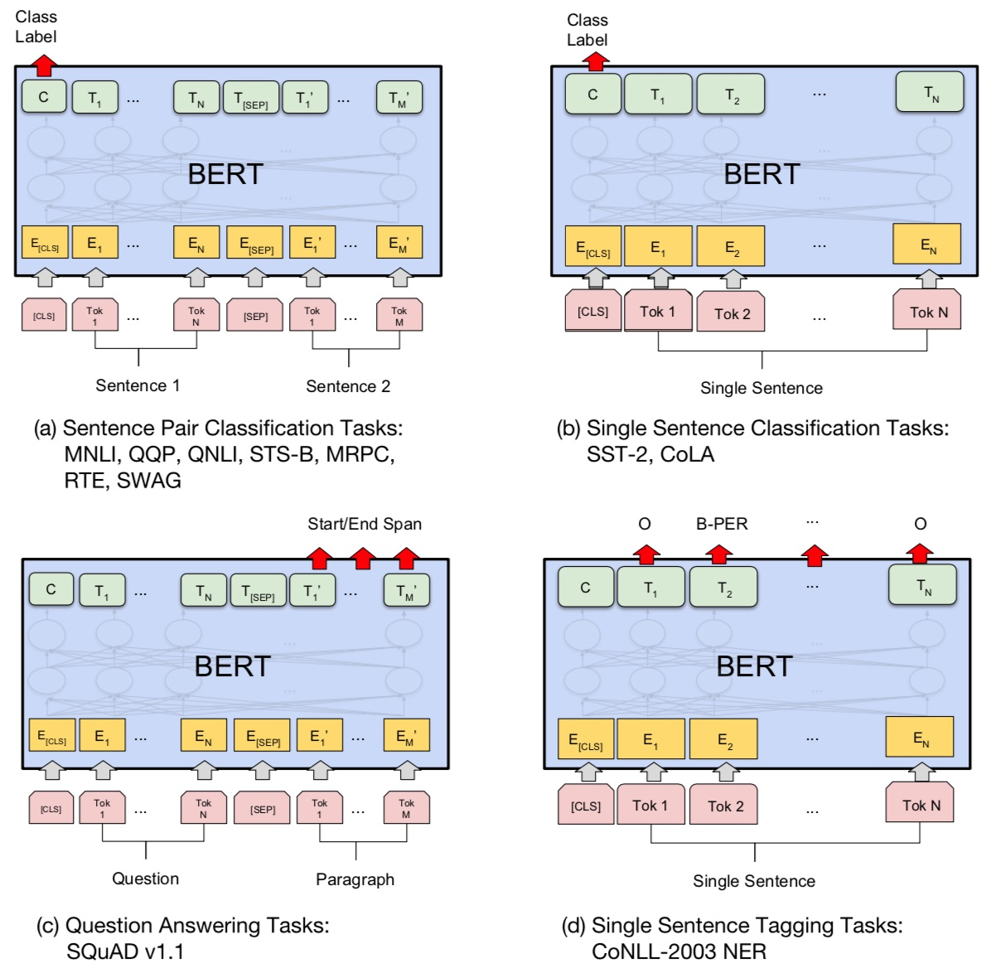
Fine-tuning BERT on NLP Tasks
Source: Devlin, Jacob, Ming-Wei Chang, Kenton Lee, and Kristina Toutanova (2018). "BERT: Pre-training of Deep Bidirectional Transformers for Language Understanding." arXiv preprint arXiv:1810.04805

Slide 16
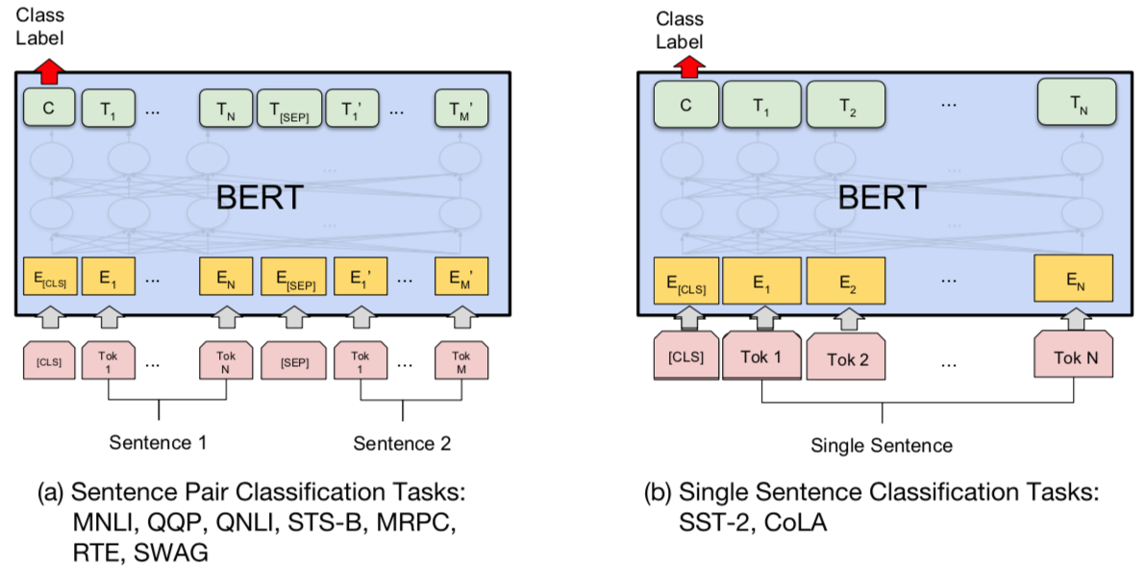
BERT Sequence-level tasks
Source: Devlin, Jacob, Ming-Wei Chang, Kenton Lee, and Kristina Toutanova (2018). "BERT: Pre-training of Deep Bidirectional Transformers for Language Understanding." arXiv preprint arXiv:1810.04805

Slide 17
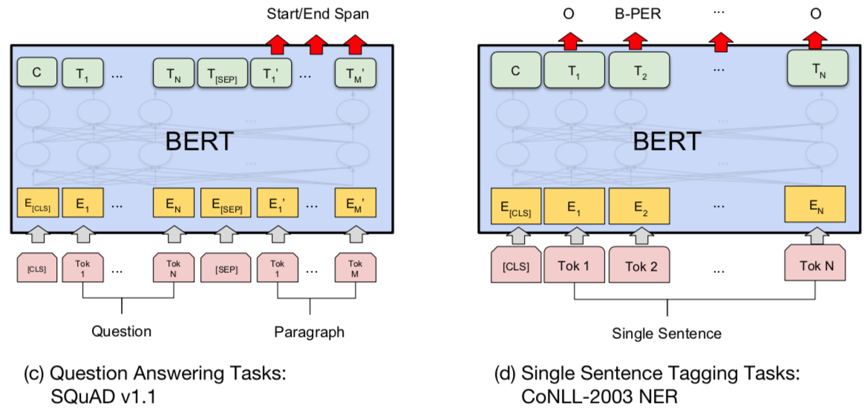
BERT Token-level tasks
Source: Devlin, Jacob, Ming-Wei Chang, Kenton Lee, and Kristina Toutanova (2018). "BERT: Pre-training of Deep Bidirectional Transformers for Language Understanding." arXiv preprint arXiv:1810.04805

Slide 18
Sentiment Analysis: Single Sentence Classification
Source: Devlin, Jacob, Ming-Wei Chang, Kenton Lee, and Kristina Toutanova (2018). "BERT: Pre-training of Deep Bidirectional Transformers for Language Understanding." arXiv preprint arXiv:1810.04805

Slide 19
ChatGPT Large Language Models (LLMs) Foundation Models

Slide 20
Large Language Models (LLM) (GPT-3, ChatGPT, PaLM, BLOOM, OPT-175B, LLaMA)
ChatGPT
175B
LLaMA
65B
Source: https://lifearchitect.ai/models/

Slide 21
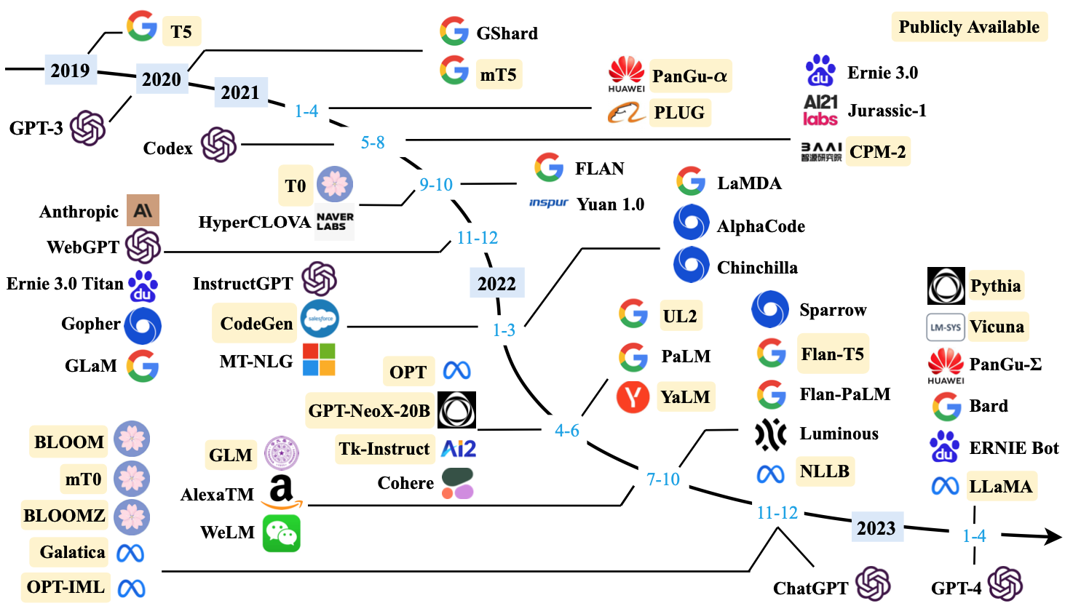
Large Language Models (LLMs) (larger than 10B)
Source: Wayne Xin Zhao, Kun Zhou, Junyi Li, Tianyi Tang, Xiaolei Wang, Yupeng Hou, Yingqian Min et al. (2023) "A Survey of Large Language Models." arXiv preprint arXiv:2303.18223.

Slide 22
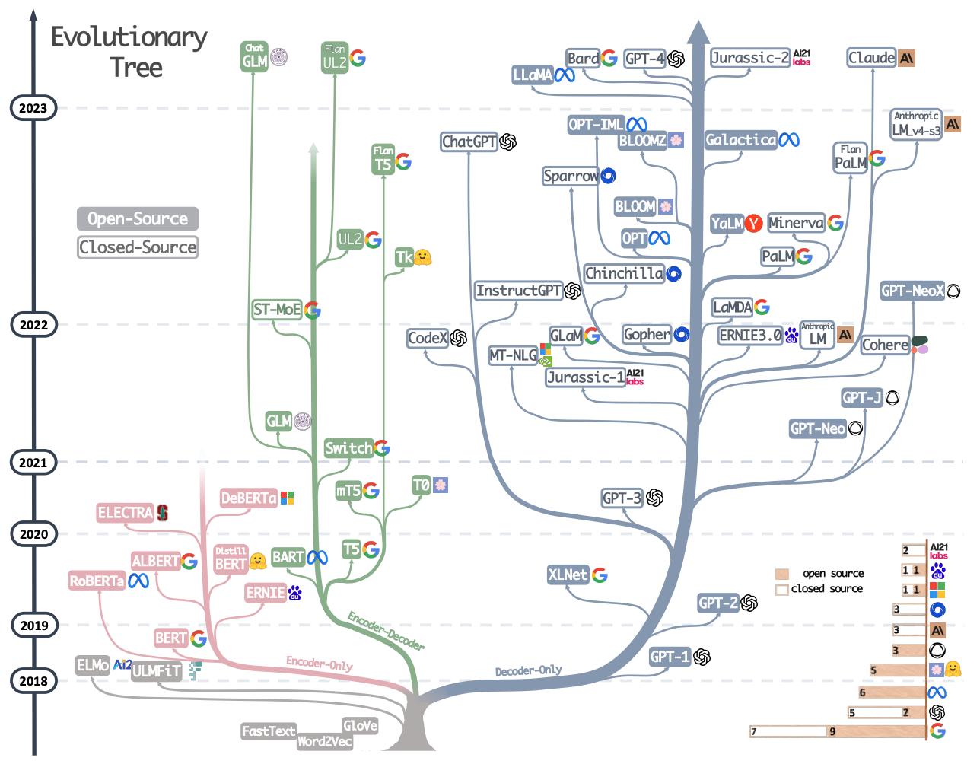
Large Language Models (LLMs) Evolutionary Tree
Source: Jingfeng Yang, Hongye Jin, Ruixiang Tang, Xiaotian Han, Qizhang Feng, Haoming Jiang, Bing Yin, and Xia Hu (2023). "Harnessing the power of llms in practice: A survey on chatgpt and beyond." arXiv preprint arXiv:2304.13712.

Slide 23
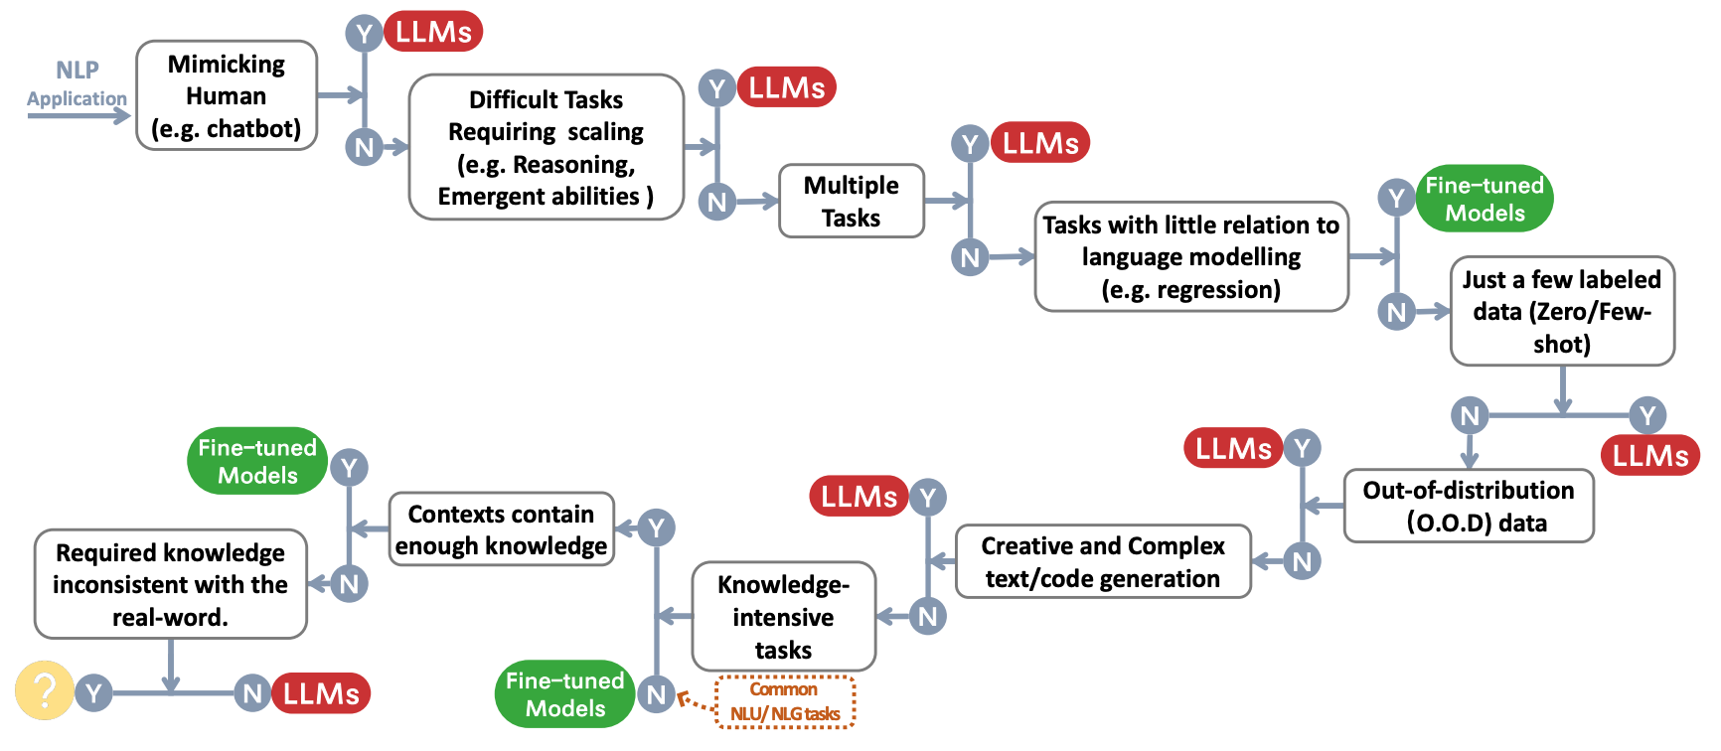
The Decision Flow for Choosing LLMs or Fine-tuned Models for NLP Applications
Source: Jingfeng Yang, Hongye Jin, Ruixiang Tang, Xiaotian Han, Qizhang Feng, Haoming Jiang, Bing Yin, and Xia Hu (2023). "Harnessing the power of llms in practice: A survey on chatgpt and beyond." arXiv preprint arXiv:2304.13712.

Slide 24
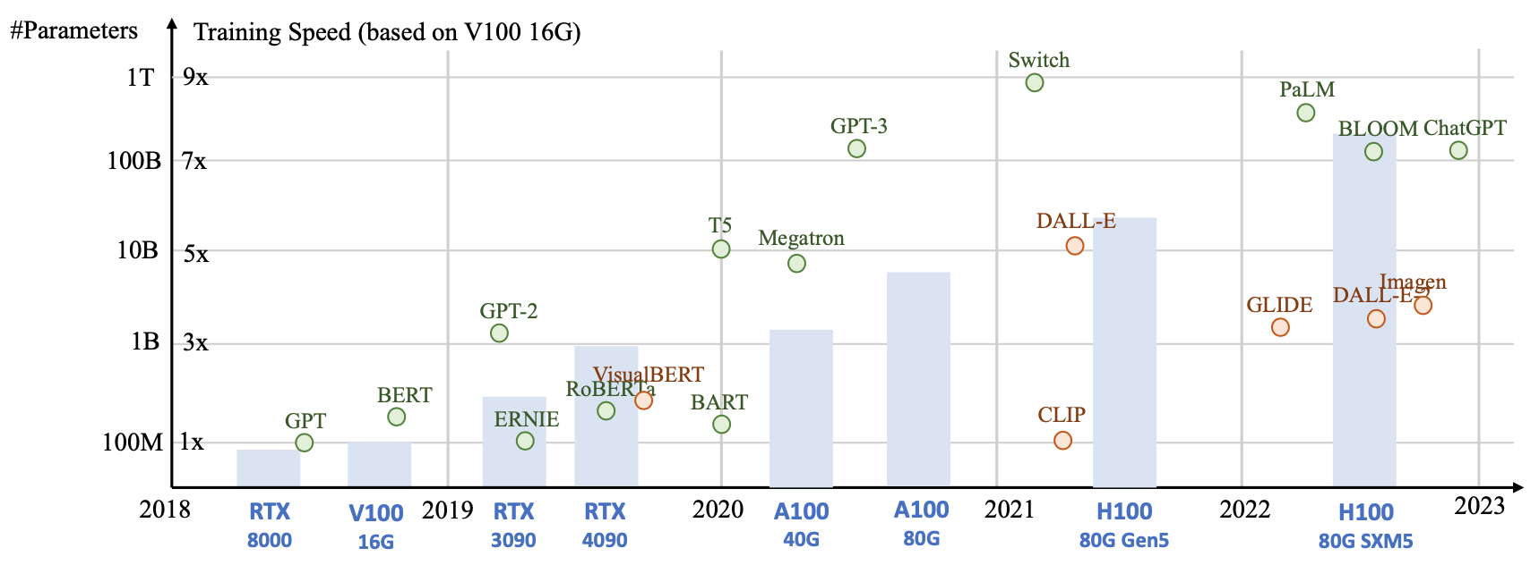
Generative AI Foundation Models
Source: Yihan Cao, Siyu Li, Yixin Liu, Zhiling Yan, Yutong Dai, Philip S. Yu, and Lichao Sun (2023). "A Comprehensive Survey of AI-Generated Content (AIGC): A History of Generative AI from GAN to ChatGPT." arXiv preprint arXiv:2303.04226.

Slide 25
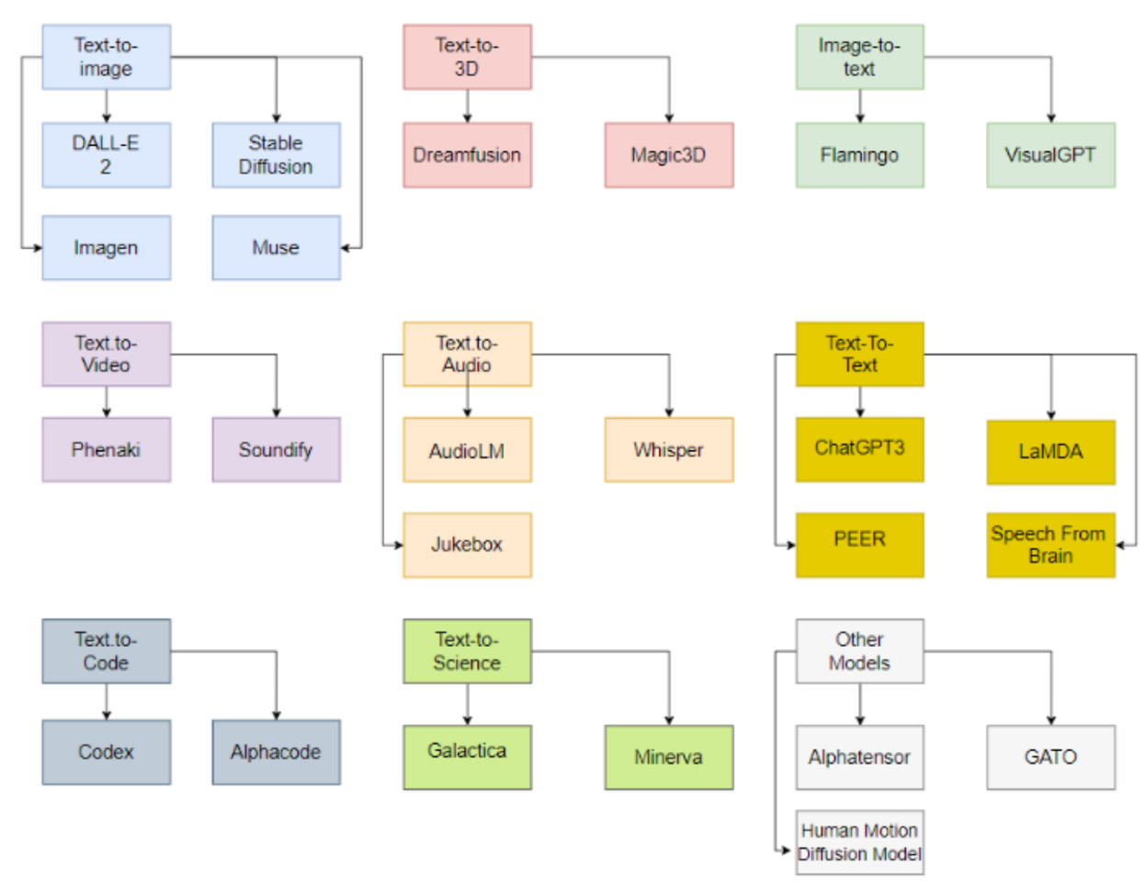
Generative AI Models
ChatGPT is not all you need
Attention is all you need
Source: Gozalo-Brizuela, Roberto, and Eduardo C. Garrido-Merchan (2023). "ChatGPT is not all you need. A State of the Art Review of large Generative AI models." arXiv preprint arXiv:2301.04655 (2023).

Slide 26
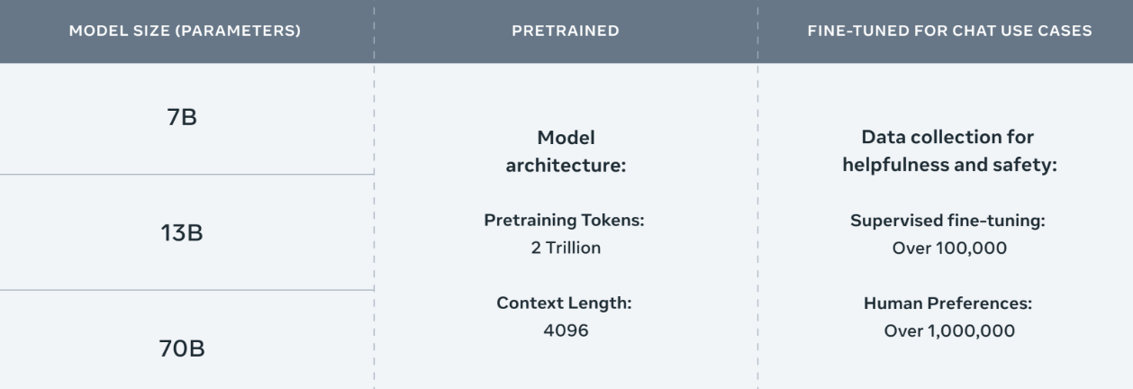
Meta Llama-2 70B: Best Open Source and Commercial LLM (Llama-2, Falcon, MPT)
Llama 2 pretrained models are trained on 2 trillion tokens, and have double the context length than Llama 1. Its fine-tuned models have been trained on over 1 million human annotations.
Source: https://ai.meta.com/llama/

Slide 27
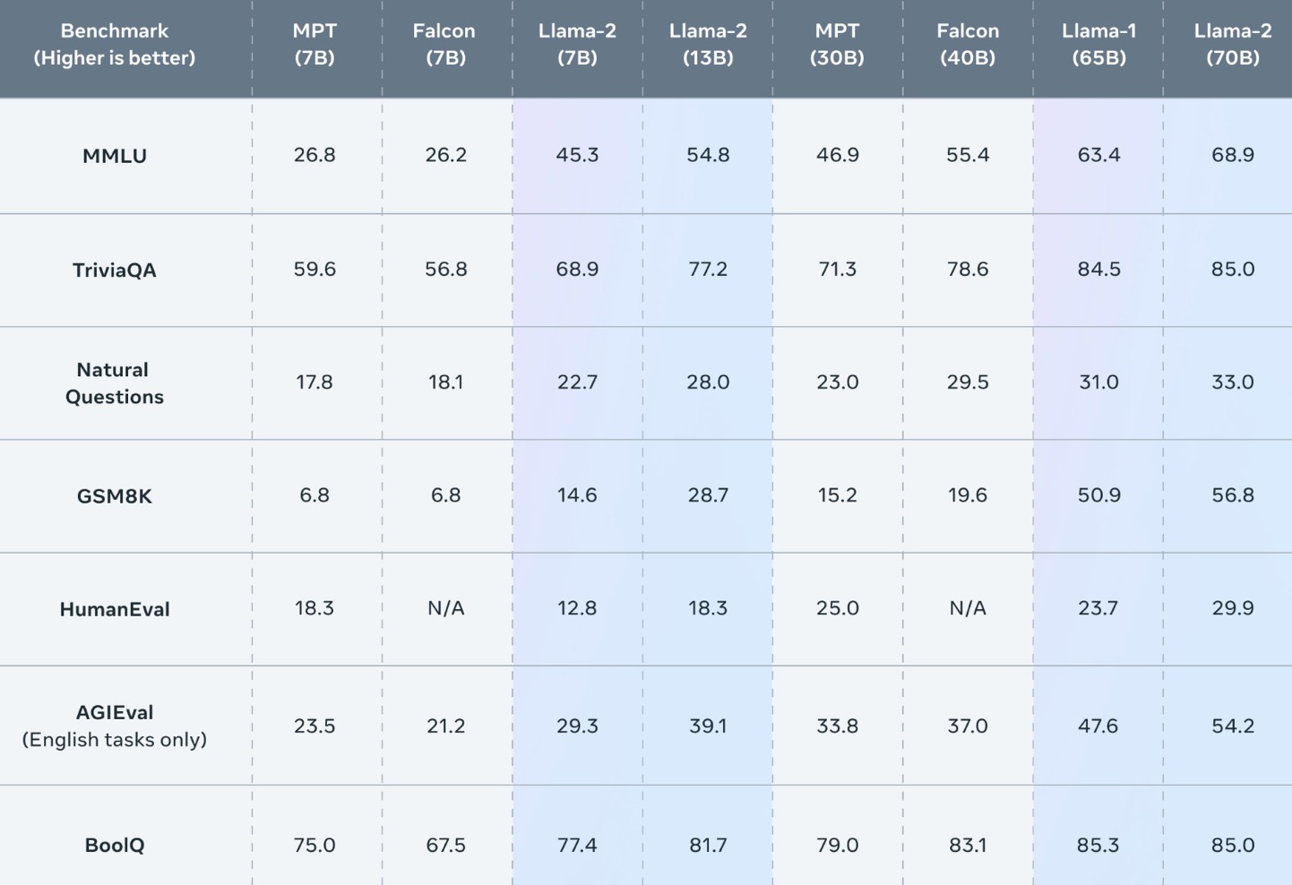
Meta Llama-2 70B: Best Open Source and Commercial LLM (Llama-2, Falcon, MPT)
Llama 2 outperforms other open source language models on many external benchmarks, including reasoning, coding, proficiency, and knowledge tests.
Source: https://ai.meta.com/llama/

Slide 28
Llama-2: Comparison to closed-source models (GPT-3.5, GPT-4, PaLM) on academic benchmarks
Results for GPT-3.5 and GPT-4 are from OpenAI (2023).
Results for the PaLM model are from Chowdhery et al. (2022).
Results for the PaLM-2-L are from Anil et al. (2023).
Source: Touvron, Hugo, Louis Martin, Kevin Stone, Peter Albert, Amjad Almahairi, Yasmine Babaei, Nikolay Bashlykov et al. (2023) "Llama 2: Open Foundation and Fine-Tuned Chat Models." arXiv preprint arXiv:2307.09288 (2023).

Slide 29
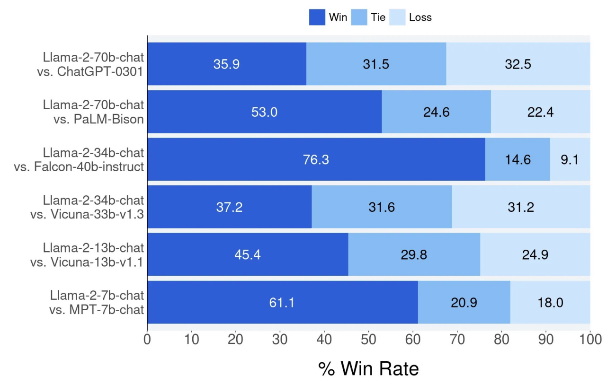
Llama-2 Chat: Helpfulness Human Evaluation
Source: Touvron, Hugo, Louis Martin, Kevin Stone, Peter Albert, Amjad Almahairi, Yasmine Babaei, Nikolay Bashlykov et al. (2023) "Llama 2: Open Foundation and Fine-Tuned Chat Models." arXiv preprint arXiv:2307.09288 (2023).

Slide 30
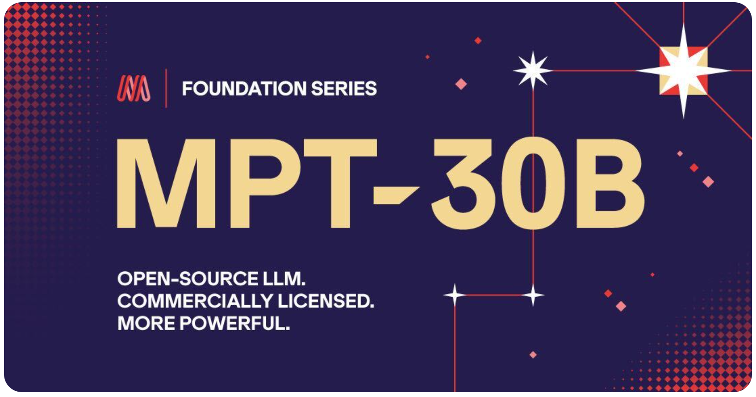
MPT-30B, MPT-7B LLaMa-30B, LLaMa-7B
Source: https://www.mosaicml.com/blog/mpt-30b

Slide 31
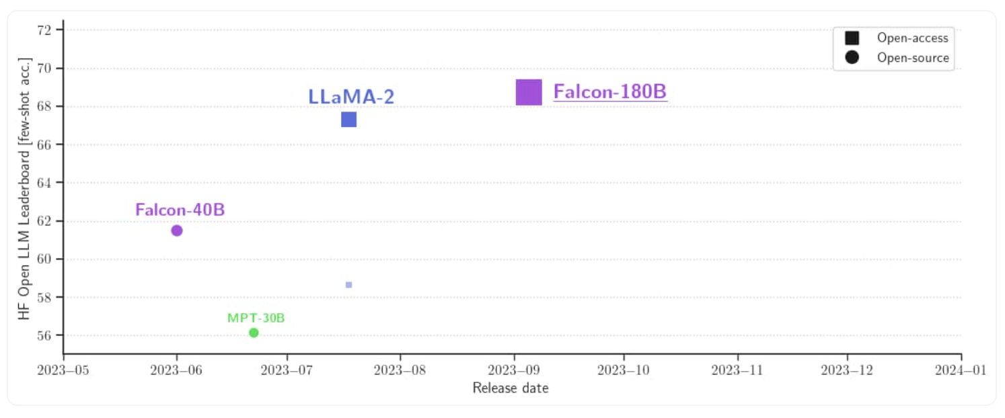
Falcon 180B
Source: https://huggingface.co/blog/falcon-180b

Slide 32
Falcon 180B, Llama 2 70B, MPT 30B
Source: https://huggingface.co/blog/falcon-180b

Slide 33
Falcon 180B Hardware requirements
NVIDIA A100 80 GB: $16,135
Source: https://huggingface.co/blog/falcon-180b

Slide 34
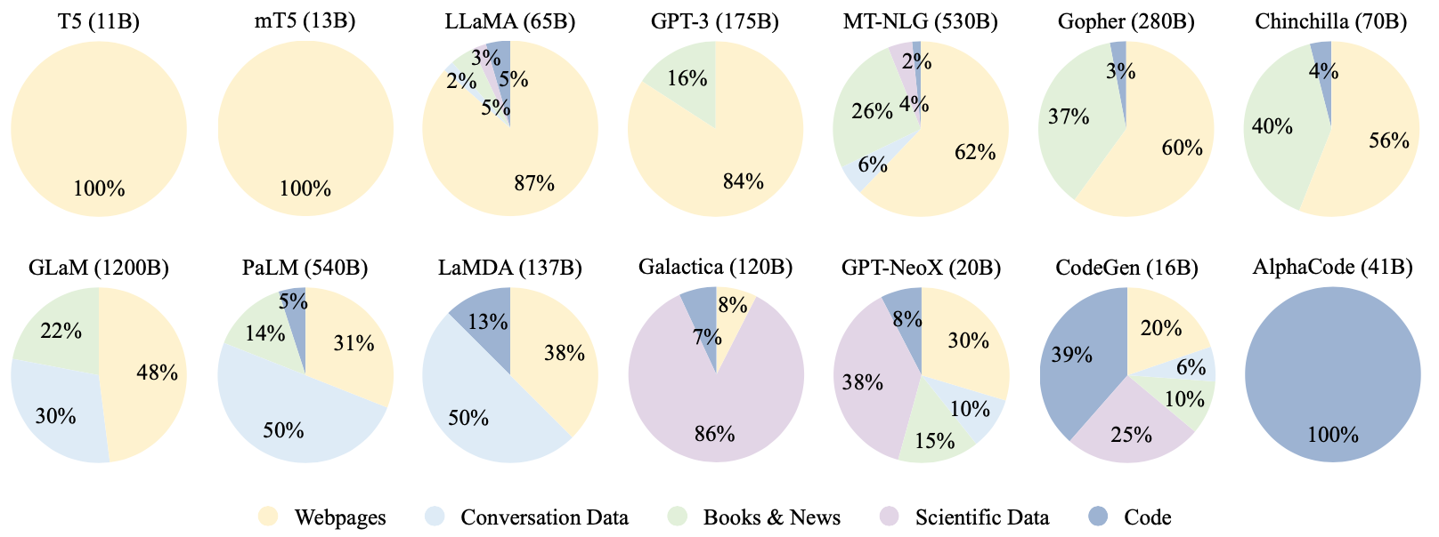
Ratios of various data sources in the pre-training data for existing LLMs
Source: Wayne Xin Zhao, Kun Zhou, Junyi Li, Tianyi Tang, Xiaolei Wang, Yupeng Hou, Yingqian Min et al. (2023) "A Survey of Large Language Models." arXiv preprint arXiv:2303.18223.

Slide 35
Typical Data Preprocessing Pipeline for Pre-training Large Language Models (LLMs)
Source: Wayne Xin Zhao, Kun Zhou, Junyi Li, Tianyi Tang, Xiaolei Wang, Yupeng Hou, Yingqian Min et al. (2023) "A Survey of Large Language Models." arXiv preprint arXiv:2303.18223.

Slide 36
The Encoder-Decoder Framework
The encoder-decoder framework
Attention Mechanisms
Transfer Learning in NLP
Source: Lewis Tunstall, Leandro von Werra, and Thomas Wolf (2022), Natural Language Processing with Transformers: Building Language Applications with Hugging Face, O'Reilly Media.

Slide 37
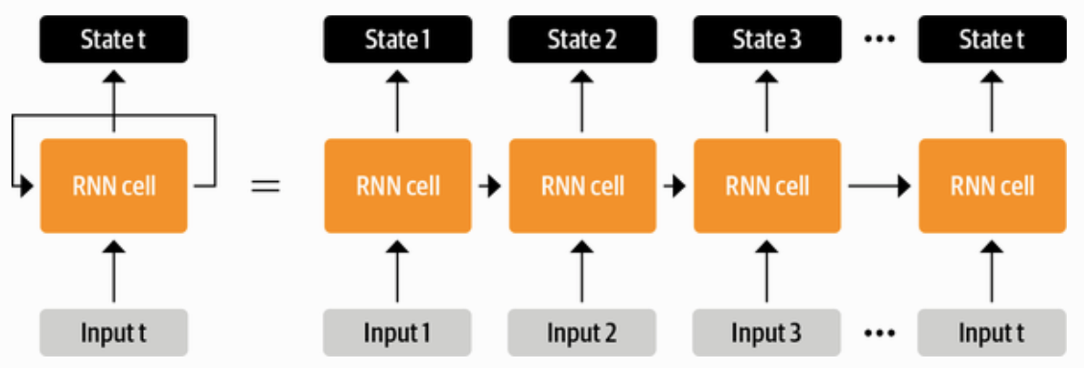
RNN
Source: Lewis Tunstall, Leandro von Werra, and Thomas Wolf (2022), Natural Language Processing with Transformers: Building Language Applications with Hugging Face, O'Reilly Media.

Slide 38
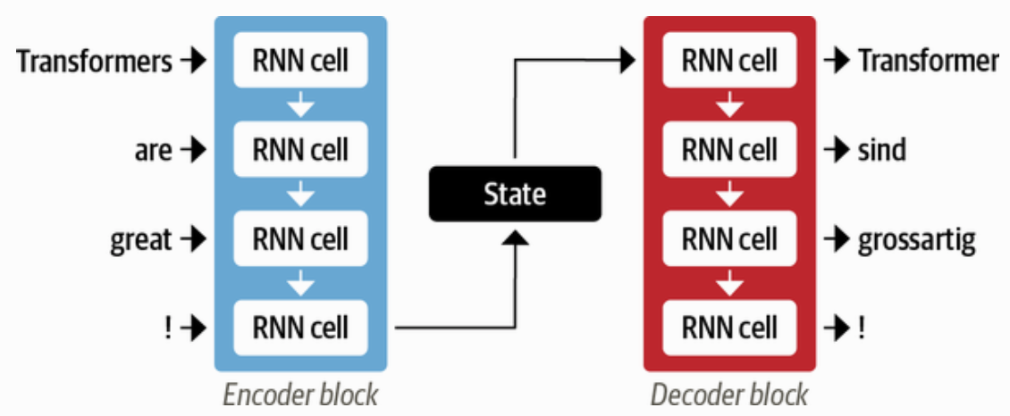
An encoder-decoder architecture with a pair of RNN
Source: Lewis Tunstall, Leandro von Werra, and Thomas Wolf (2022), Natural Language Processing with Transformers: Building Language Applications with Hugging Face, O'Reilly Media.

Slide 39
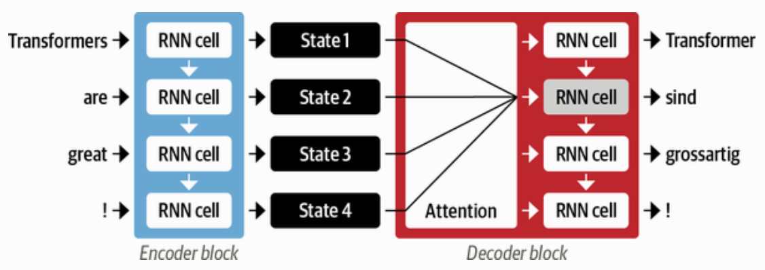
Attention Mechanisms
An encoder-decoder architecture with an attention mechanism
Source: Lewis Tunstall, Leandro von Werra, and Thomas Wolf (2022), Natural Language Processing with Transformers: Building Language Applications with Hugging Face, O'Reilly Media.

Slide 40
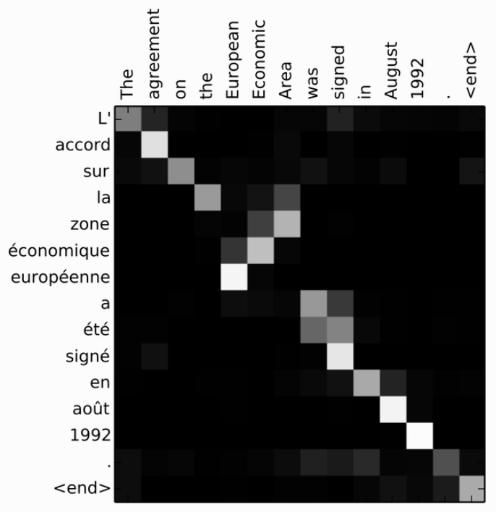
RNN Encoder-Decoder alignment of words in English and the generated translation in French
Source: Lewis Tunstall, Leandro von Werra, and Thomas Wolf (2022), Natural Language Processing with Transformers: Building Language Applications with Hugging Face, O'Reilly Media.

Slide 41
Encoder-Decoder Architecture of the Original Transformer
Source: Lewis Tunstall, Leandro von Werra, and Thomas Wolf (2022), Natural Language Processing with Transformers: Building Language Applications with Hugging Face, O'Reilly Media.

Slide 42
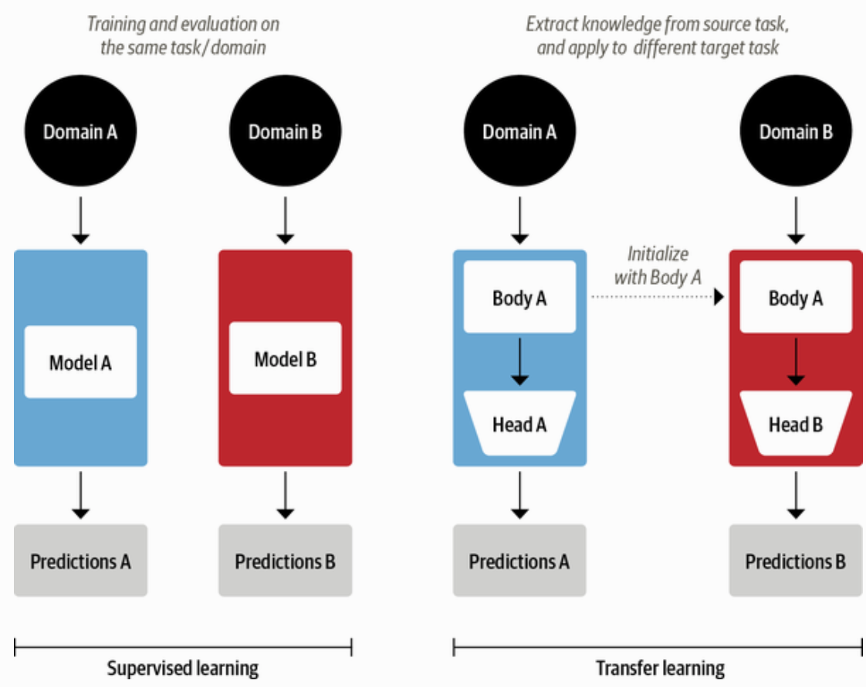
Comparison of Traditional Supervised Learning and Transfer Learning
Source: Lewis Tunstall, Leandro von Werra, and Thomas Wolf (2022), Natural Language Processing with Transformers: Building Language Applications with Hugging Face, O'Reilly Media.

Slide 43
ULMFiT: 3 Steps Transfer Learning in NLP
Wikitet
103
IMDB
IMDB
Language Model
Language Model
Classifier
1. Pretraining
2. Domain adaptation
3. Fine-tuning
Source: Lewis Tunstall, Leandro von Werra, and Thomas Wolf (2022), Natural Language Processing with Transformers: Building Language Applications with Hugging Face, O'Reilly Media.

Slide 44
Four Paradigms in NLP
Source: Pengfei Liu, Weizhe Yuan, Jinlan Fu, Zhengbao Jiang, Hiroaki Hayashi, and Graham Neubig. (2023) "Pre-train, prompt, and predict: A systematic survey of prompting methods in natural language processing." ACM Computing Surveys 55, no. 9 (2023): 1-35.

Slide 45
An overview of the Hugging Face Ecosystem
Hugging Face Hub
Models
Datasets
Metrics
Docs
Tokenizers
Transformers
Datasets
Accelerate
Source: Lewis Tunstall, Leandro von Werra, and Thomas Wolf (2022), Natural Language Processing with Transformers: Building Language Applications with Hugging Face, O'Reilly Media.

Slide 46
A typical pipeline for training transformer models with the Datasets, Tokenizers, and Transformers libraries
Datasets
Tokenizers
Transformers
Datasets
Load and process datasets
Tokenize input texts
Load models, train and infer
Load metrics evaluate models
Source: Lewis Tunstall, Leandro von Werra, and Thomas Wolf (2022), Natural Language Processing with Transformers: Building Language Applications with Hugging Face, O'Reilly Media.
https://github.com/nlp-with-transformers/notebooks

Slide 47
The Illustrated Transformer Jay Alammar (2018)
Source: Jay Alammar (2018), The Illustrated Transformer, http://jalammar.github.io/illustrated-transformer/

Slide 48
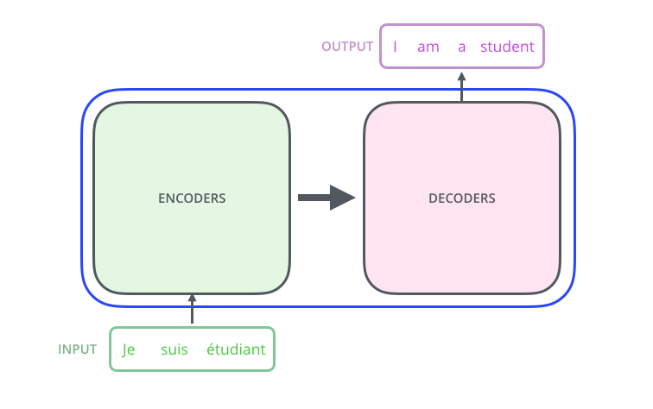
The Illustrated Transformer Jay Alammar (2018)
Source: Jay Alammar (2018), The Illustrated Transformer, http://jalammar.github.io/illustrated-transformer/

Slide 49
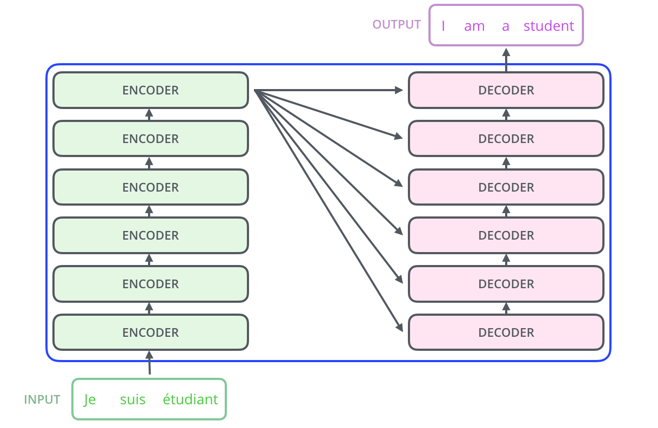
The Illustrated Transformer Jay Alammar (2018)
Source: Jay Alammar (2018), The Illustrated Transformer, http://jalammar.github.io/illustrated-transformer/

Slide 50
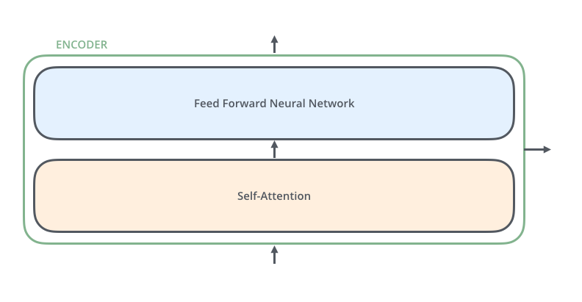
The Illustrated Transformer Jay Alammar (2018)
Source: Jay Alammar (2018), The Illustrated Transformer, http://jalammar.github.io/illustrated-transformer/

Slide 51
The Illustrated Transformer Jay Alammar (2018)
Source: Jay Alammar (2018), The Illustrated Transformer, http://jalammar.github.io/illustrated-transformer/

Slide 52
The Illustrated Transformer Jay Alammar (2018)
Each word is embedded into a vector of size 512.
Source: Jay Alammar (2018), The Illustrated Transformer, http://jalammar.github.io/illustrated-transformer/

Slide 53
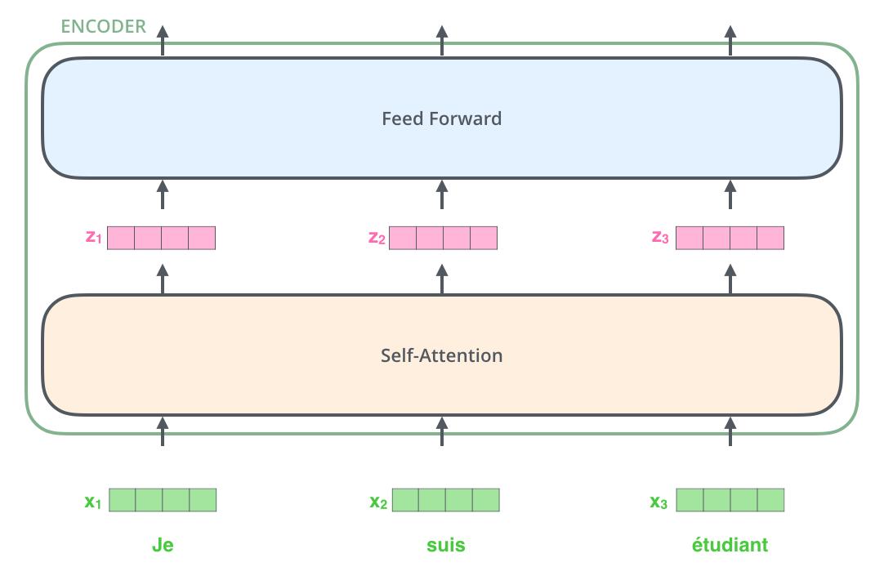
The Illustrated Transformer Jay Alammar (2018)
Source: Jay Alammar (2018), The Illustrated Transformer, http://jalammar.github.io/illustrated-transformer/

Slide 54
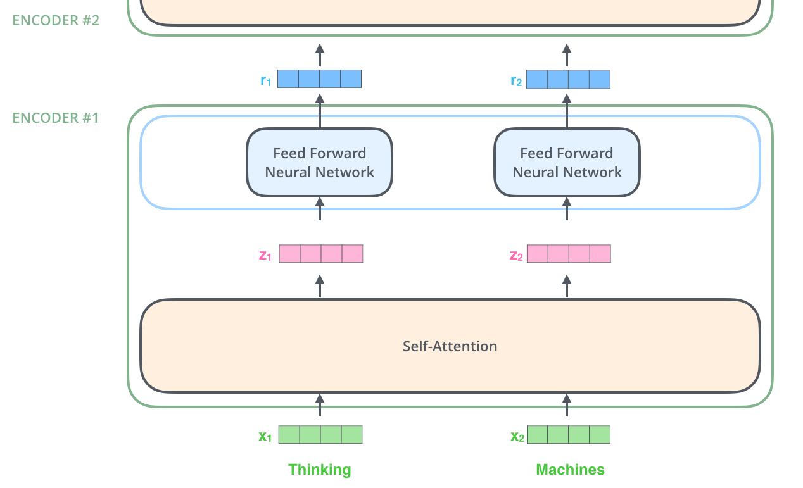
The Illustrated Transformer Jay Alammar (2018)
Source: Jay Alammar (2018), The Illustrated Transformer, http://jalammar.github.io/illustrated-transformer/

Slide 55
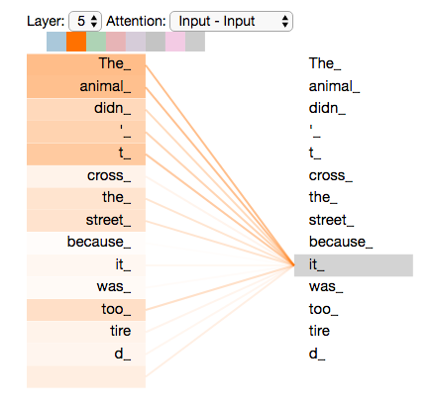
The Illustrated Transformer Jay Alammar (2018)
Source: Jay Alammar (2018), The Illustrated Transformer, http://jalammar.github.io/illustrated-transformer/

Slide 56
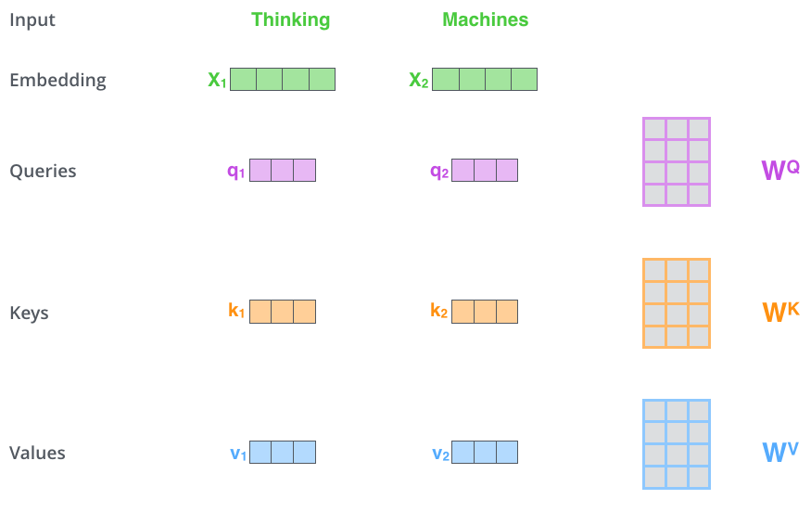
Multiplying x1 by the WQ weight matrix produces q1, the "query" vector associated with that word. We end up creating a "query", a "key", and a "value" projection of each word in the input sentence.
Source: Jay Alammar (2018), The Illustrated Transformer, http://jalammar.github.io/illustrated-transformer/

Slide 57
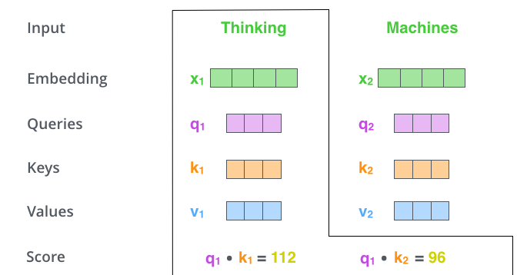
The Illustrated Transformer Jay Alammar (2018)
Source: Jay Alammar (2018), The Illustrated Transformer, http://jalammar.github.io/illustrated-transformer/

Slide 58
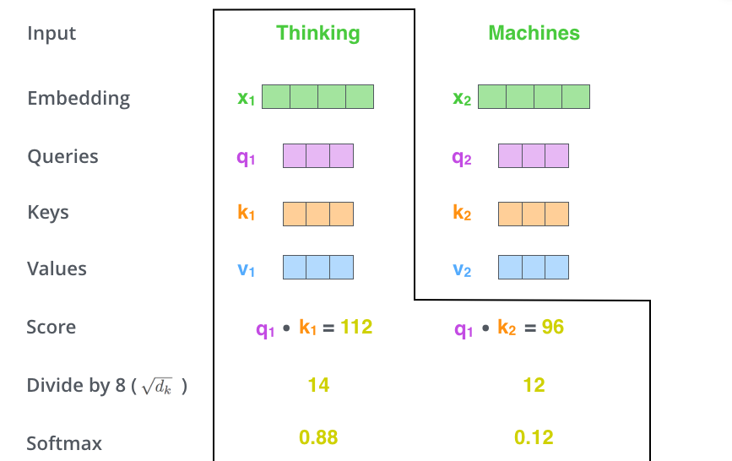
The Illustrated Transformer Jay Alammar (2018)
Source: Jay Alammar (2018), The Illustrated Transformer, http://jalammar.github.io/illustrated-transformer/

Slide 59
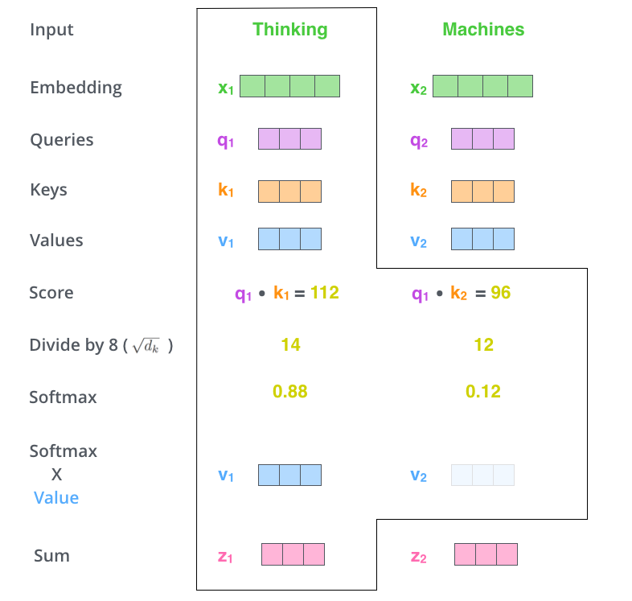
Source: Jay Alammar (2018), The Illustrated Transformer, http://jalammar.github.io/illustrated-transformer/

Slide 60
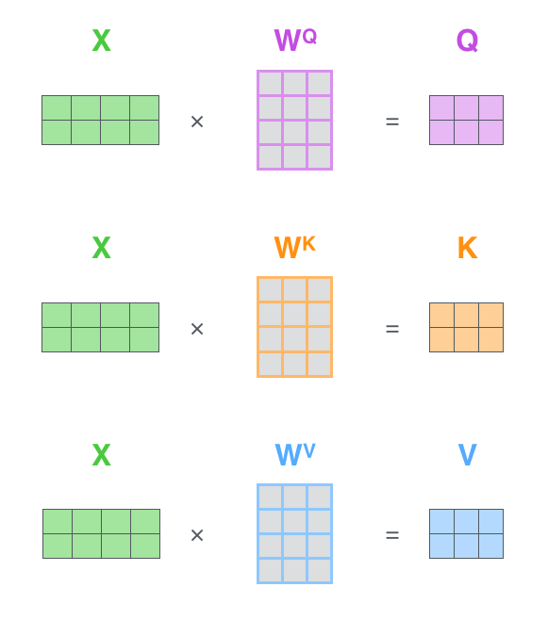
Matrix Calculation of Self-Attention
Source: Jay Alammar (2018), The Illustrated Transformer, http://jalammar.github.io/illustrated-transformer/

Slide 61
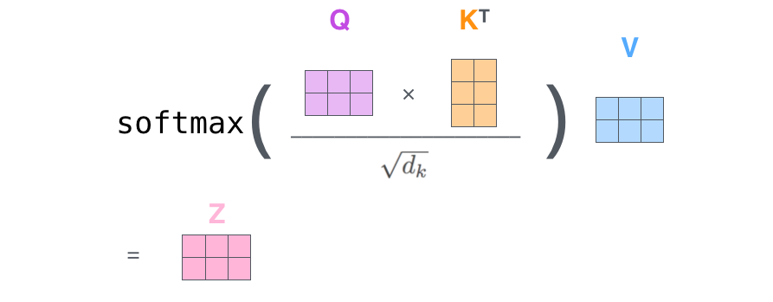
The self-attention calculation in matrix form
Source: Jay Alammar (2018), The Illustrated Transformer, http://jalammar.github.io/illustrated-transformer/

Slide 62
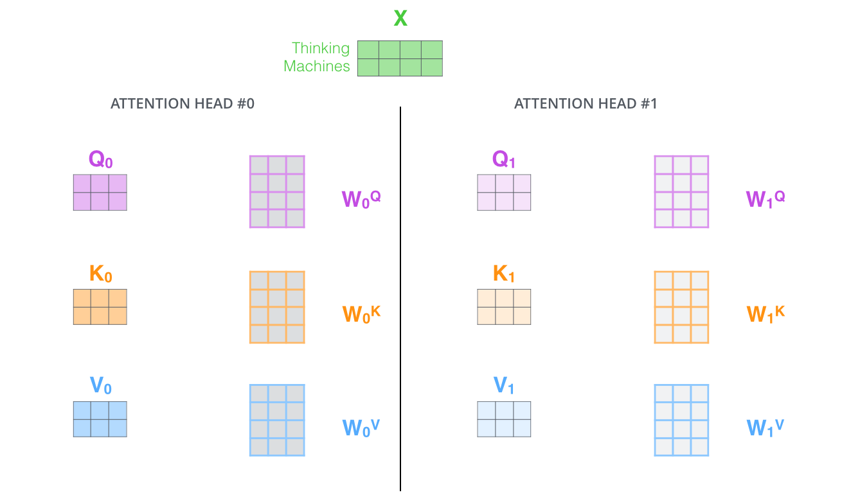
Multi-headed Attention
Source: Jay Alammar (2018), The Illustrated Transformer, http://jalammar.github.io/illustrated-transformer/

Slide 63
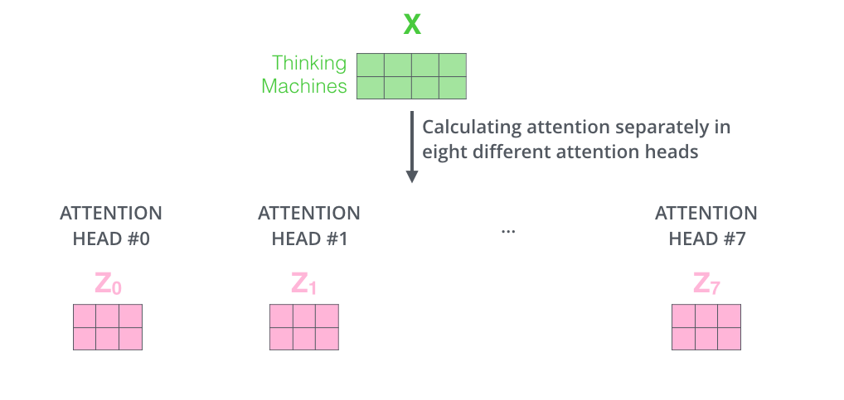
Multi-headed Attention
Source: Jay Alammar (2018), The Illustrated Transformer, http://jalammar.github.io/illustrated-transformer/

Slide 64
Multi-headed Attention
Source: Jay Alammar (2018), The Illustrated Transformer, http://jalammar.github.io/illustrated-transformer/

Slide 65
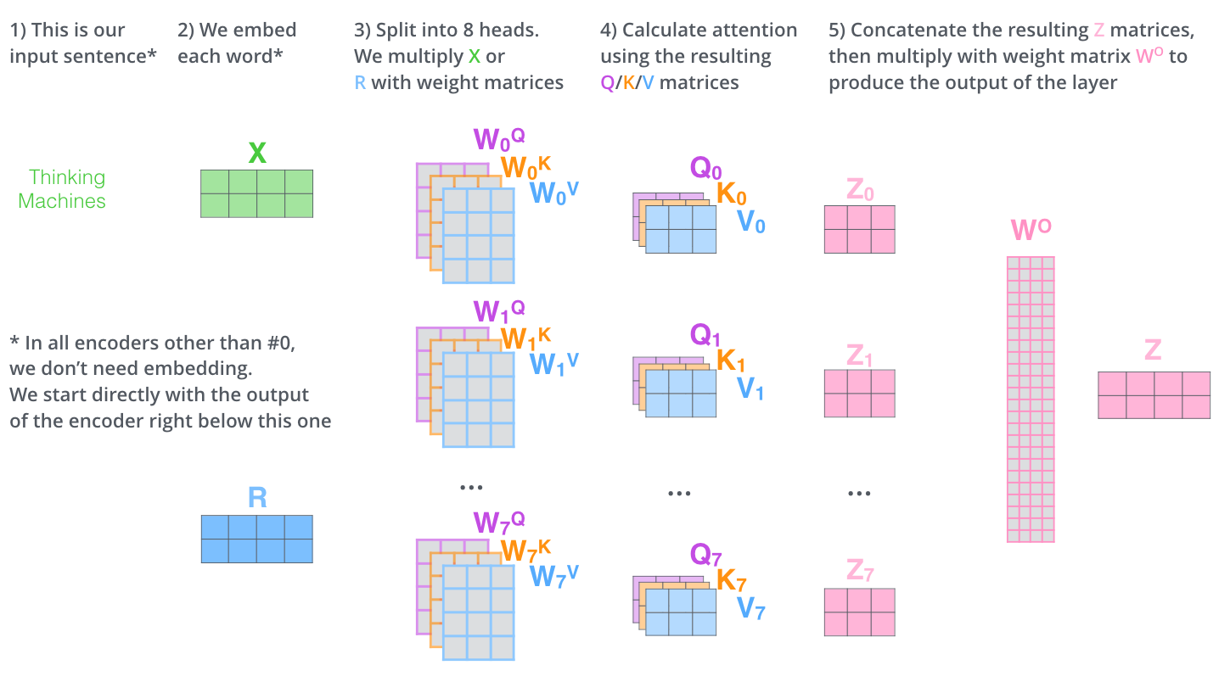
Multi-headed Attention
Source: Jay Alammar (2018), The Illustrated Transformer, http://jalammar.github.io/illustrated-transformer/

Slide 66
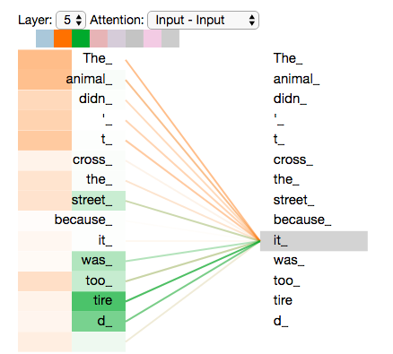
As we encode the word "it", one attention head is focusing most on "the animal", while another is focusing on "tired" -- in a sense, the model's representation of the word "it" bakes in some of the representation of both "animal" and "tired".
Source: Jay Alammar (2018), The Illustrated Transformer, http://jalammar.github.io/illustrated-transformer/

Slide 67
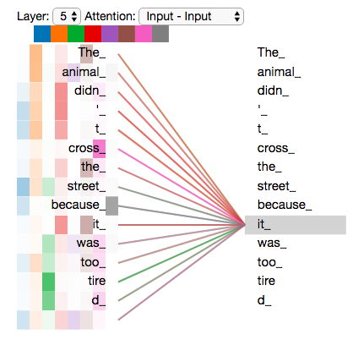
Add all the attention heads
Source: Jay Alammar (2018), The Illustrated Transformer, http://jalammar.github.io/illustrated-transformer/

Slide 68
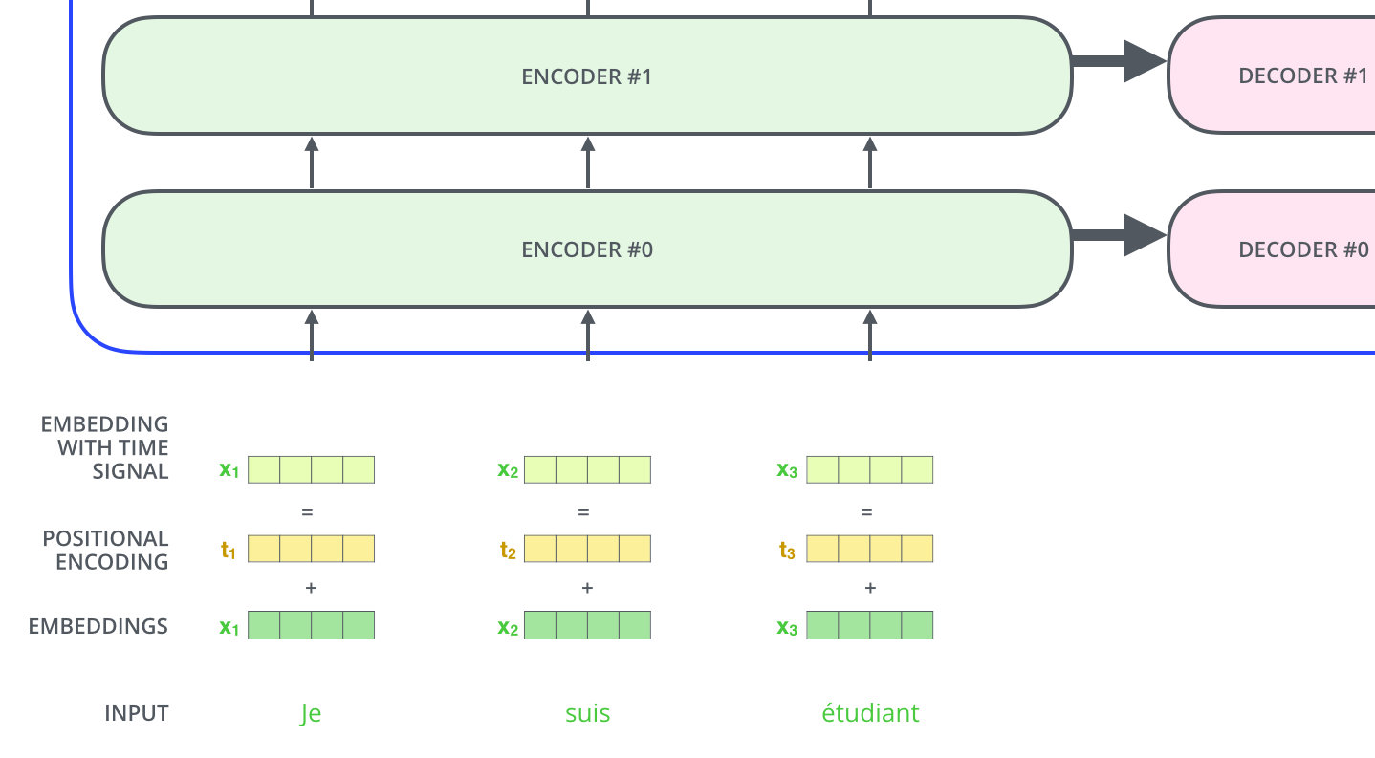
Positional Encoding
To give the model a sense of the order of the words, we add positional encoding vectors -- the values of which follow a specific pattern.
Source: Jay Alammar (2018), The Illustrated Transformer, http://jalammar.github.io/illustrated-transformer/

Slide 69
Positional Encoding
Positional encoding with a toy embedding size of 4
Source: Jay Alammar (2018), The Illustrated Transformer, http://jalammar.github.io/illustrated-transformer/

Slide 70
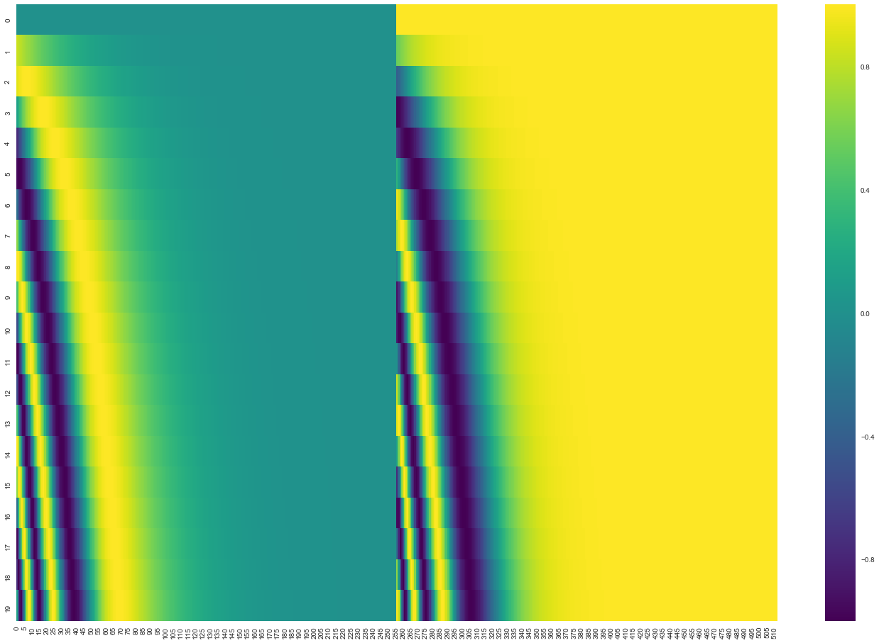
Positional encoding for 20 words (rows) with an embedding size of 512 (columns)
You can see that it appears split in half down the center. That's because the values of the left half are generated by one function (which uses sine), and the right half is generated by another function (which uses cosine). They're then concatenated to form each of the positional encoding vectors.
Source: Jay Alammar (2018), The Illustrated Transformer, http://jalammar.github.io/illustrated-transformer/

Slide 71
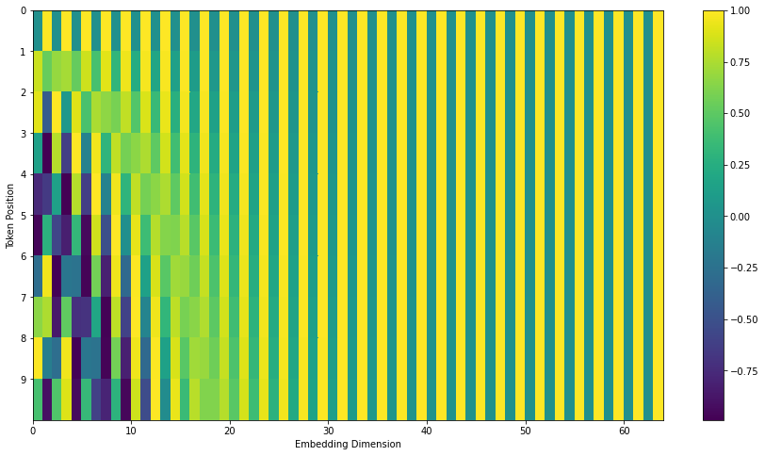
Transformers Positional Encoding
Source: Jay Alammar (2018), The Illustrated Transformer, http://jalammar.github.io/illustrated-transformer/

Slide 72
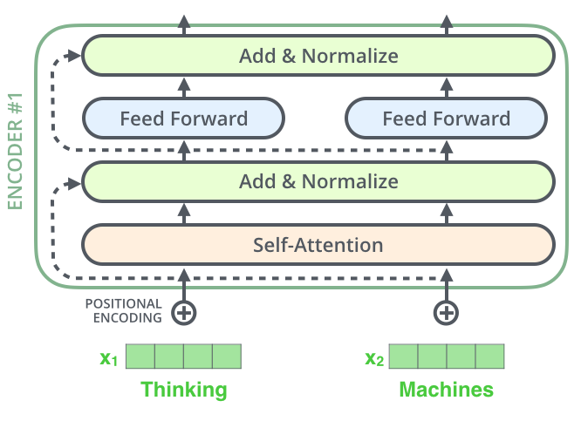
The Residuals
Source: Jay Alammar (2018), The Illustrated Transformer, http://jalammar.github.io/illustrated-transformer/

Slide 73
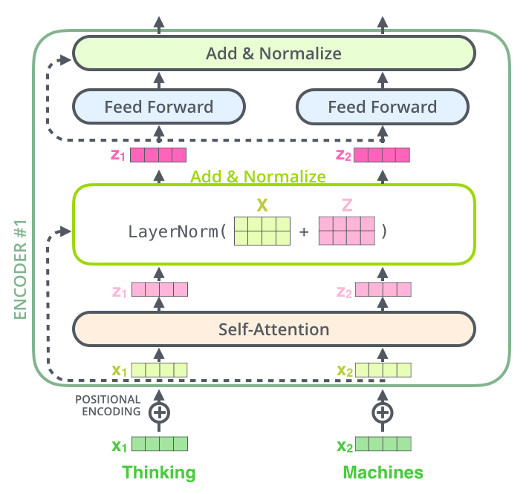
Source: Jay Alammar (2018), The Illustrated Transformer, http://jalammar.github.io/illustrated-transformer/

Slide 74
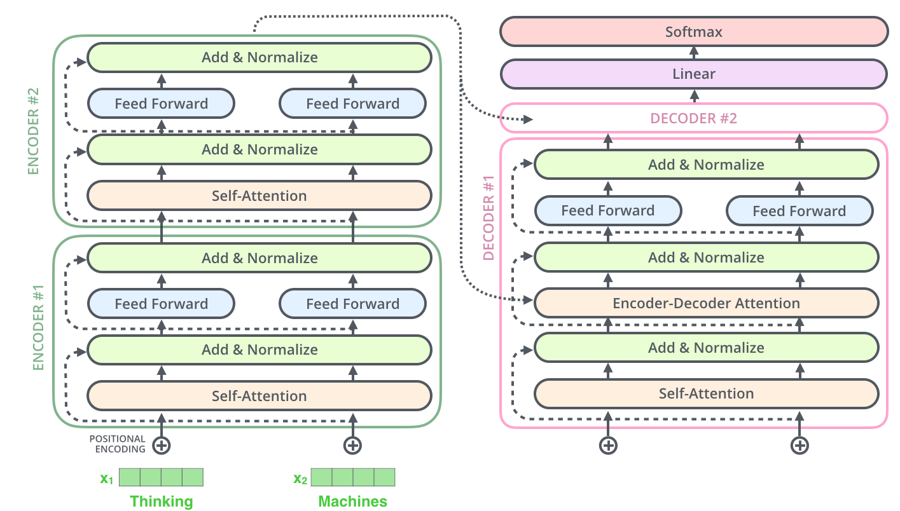
Source: Jay Alammar (2018), The Illustrated Transformer, http://jalammar.github.io/illustrated-transformer/

Slide 75
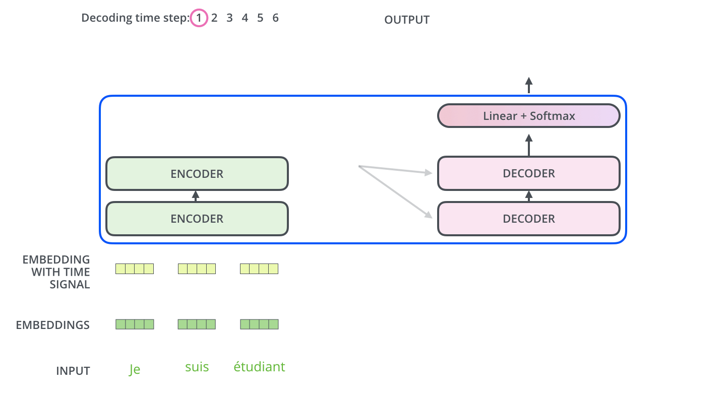
The Decoder Side
Source: Jay Alammar (2018), The Illustrated Transformer, http://jalammar.github.io/illustrated-transformer/

Slide 76
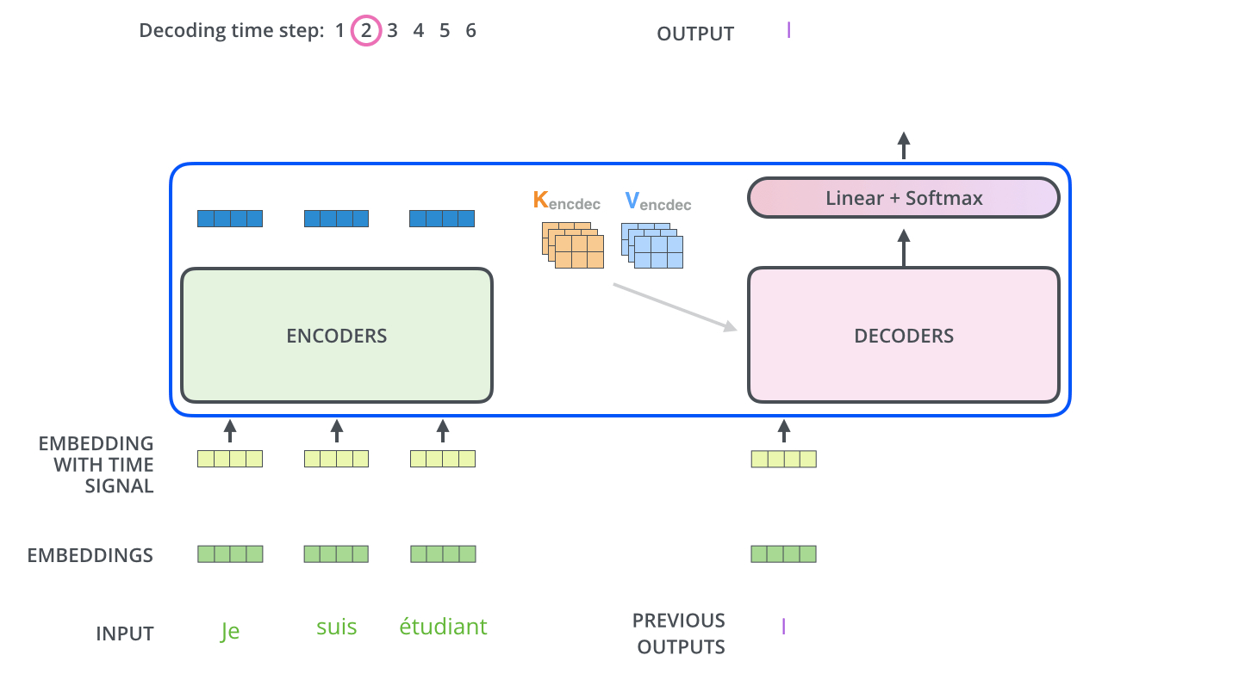
The Decoder Side
Source: Jay Alammar (2018), The Illustrated Transformer, http://jalammar.github.io/illustrated-transformer/

Slide 77
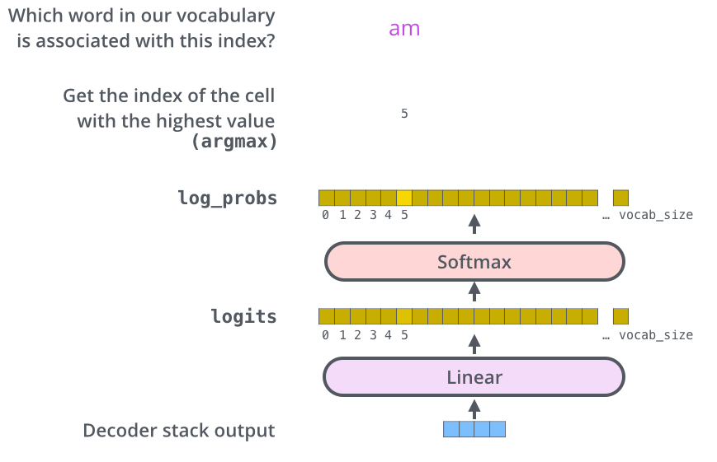
The Final Linear and Softmax Layer
Source: Jay Alammar (2018), The Illustrated Transformer, http://jalammar.github.io/illustrated-transformer/

Slide 78
The output vocabulary
The output vocabulary of our model is created in the preprocessing phase before we even begin training.
Source: Jay Alammar (2018), The Illustrated Transformer, http://jalammar.github.io/illustrated-transformer/

Slide 79
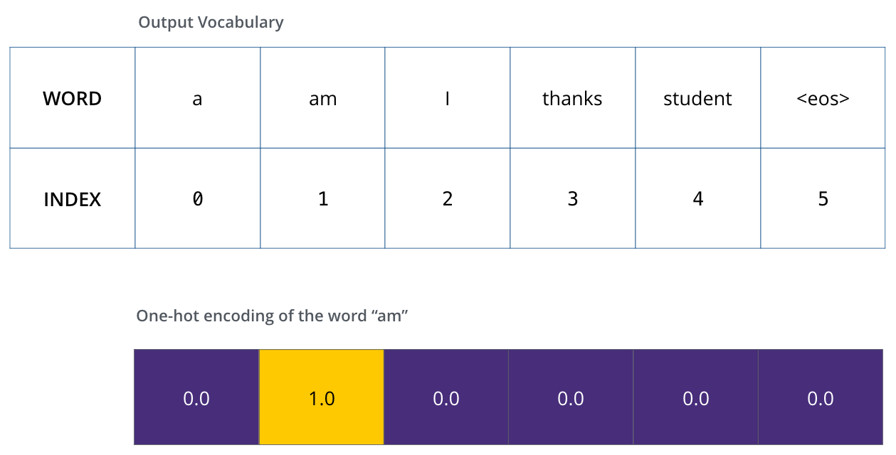
Example: one-hot encoding of output vocabulary
Source: Jay Alammar (2018), The Illustrated Transformer, http://jalammar.github.io/illustrated-transformer/

Slide 80
The Loss Function
Source: Jay Alammar (2018), The Illustrated Transformer, http://jalammar.github.io/illustrated-transformer/

Slide 81
Source: Jay Alammar (2018), The Illustrated Transformer, http://jalammar.github.io/illustrated-transformer/

Slide 82
Source: Jay Alammar (2018), The Illustrated Transformer, http://jalammar.github.io/illustrated-transformer/

Slide 83
Transformers State-of-the-art Natural Language Processing for TensorFlow 2.0 and PyTorch
Transformers
pytorch-transformers
pytorch-pretrained-bert
provides state-of-the-art general-purpose architectures
(BERT, GPT-2, RoBERTa, XLM, DistilBert, XLNet, CTRL...)
for Natural Language Understanding (NLU) and Natural Language Generation (NLG) with over 32+ pretrained models in 100+ languages and deep interoperability between TensorFlow 2.0 and PyTorch.
Source: https://github.com/huggingface/transformers

Slide 84
Hugging Face
https://huggingface.co/

Slide 85
Hugging Face Transformers
https://huggingface.co/docs/transformers/index

Slide 86
Hugging Face Tasks Natural Language Processing
https://huggingface.co/tasks

Slide 87
NLP with Transformers Github
https://github.com/nlp-with-transformers/notebooks

Slide 88
NLP with Transformers Github Notebooks
https://github.com/nlp-with-transformers/notebooks

Slide 89
NLP with Transformers
!git clone https://github.com/nlp-with-transformers/notebooks.git
%cd notebooks
from install import *
install_requirements()
from utils import *
setup_chapter()
Source: Lewis Tunstall, Leandro von Werra, and Thomas Wolf (2022), Natural Language Processing with Transformers: Building Language Applications with Hugging Face, O'Reilly Media.
https://github.com/nlp-with-transformers/notebooks

Slide 90
Text Classification
text = """Dear Amazon, last week I ordered an Optimus Prime action figure \
from your online store in Germany. Unfortunately, when I opened the package, \
I discovered to my horror that I had been sent an action figure of Megatron \
instead! As a lifelong enemy of the Decepticons, I hope you can understand my \
dilemma. To resolve the issue, I demand an exchange of Megatron for the \
Optimus Prime figure I ordered. Enclosed are copies of my records concerning \
this purchase. I expect to hear from you soon. Sincerely, Bumblebee."""
Source: Lewis Tunstall, Leandro von Werra, and Thomas Wolf (2022), Natural Language Processing with Transformers: Building Language Applications with Hugging Face, O'Reilly Media.
https://github.com/nlp-with-transformers/notebooks

Slide 91
Text Classification
text = """Dear Amazon, last week I ordered an Optimus Prime action figure \
from your online store in Germany. Unfortunately, when I opened the package, \
I discovered to my horror that I had been sent an action figure of Megatron \
instead! As a lifelong enemy of the Decepticons, I hope you can understand my \
dilemma. To resolve the issue, I demand an exchange of Megatron for the \
Optimus Prime figure I ordered. Enclosed are copies of my records concerning \
this purchase. I expect to hear from you soon. Sincerely, Bumblebee."""
from transformers import pipeline classifier = pipeline("text-classification")
import pandas as pd outputs = classifier(text)
pd.DataFrame(outputs)
 | label | score
0 | NEGATIVE | 0.901546
Source: Lewis Tunstall, Leandro von Werra, and Thomas Wolf (2022), Natural Language Processing with Transformers: Building Language Applications with Hugging Face, O'Reilly Media.
https://github.com/nlp-with-transformers/notebooks

Slide 92
Text Classification
from transformers import pipeline classifier = pipeline("text-classification")
import pandas as pd outputs = classifier(text)
pd.DataFrame(outputs)
 | label | score
0 | NEGATIVE | 0.901546
Source: Lewis Tunstall, Leandro von Werra, and Thomas Wolf (2022), Natural Language Processing with Transformers: Building Language Applications with Hugging Face, O'Reilly Media.
https://github.com/nlp-with-transformers/notebooks

Slide 93
Named Entity Recognition
ner_tagger = pipeline("ner", aggregation_strategy="simple")
outputs = ner_tagger(text)
pd.DataFrame(outputs)
Source: Lewis Tunstall, Leandro von Werra, and Thomas Wolf (2022), Natural Language Processing with Transformers: Building Language Applications with Hugging Face, O'Reilly Media.
https://github.com/nlp-with-transformers/notebooks

Slide 94
Question Answering
reader = pipeline("question-answering")
question = "What does the customer want?"
outputs = reader(question=question, context=text)
pd.DataFrame([outputs])
 | score | start | end | answer
0 | 0.631292 | 335 | 358 | an exchange of Megatron
Source: Lewis Tunstall, Leandro von Werra, and Thomas Wolf (2022), Natural Language Processing with Transformers: Building Language Applications with Hugging Face, O'Reilly Media.
https://github.com/nlp-with-transformers/notebooks

Slide 95
Summarization
summarizer = pipeline("summarization")
outputs = summarizer(text, max_length=45, clean_up_tokenization_spaces=True)
print(outputs[0]['summary_text'])
Bumblebee ordered an Optimus Prime action figure from your online store in Germany. Unfortunately, when I opened the package, I discovered to my horror that I had been sent an action figure of Megatron instead.
Source: Lewis Tunstall, Leandro von Werra, and Thomas Wolf (2022), Natural Language Processing with Transformers: Building Language Applications with Hugging Face, O'Reilly Media.
https://github.com/nlp-with-transformers/notebooks

Slide 96
Translation
translator = pipeline("translation_en_to_de",
model="Helsinki-NLP/opus-mt-en-de")
outputs = translator(text, clean_up_tokenization_spaces=True, min_length=100)
print(outputs[0]['translation_text'])
Sehr geehrter Amazon, letzte Woche habe ich eine Optimus Prime Action Figur aus Ihrem Online-Shop in Deutschland bestellt. Leider, als ich das Paket öffnete, entdeckte ich zu meinem Entsetzen, dass ich stattdessen eine Action Figur von Megatron geschickt worden war! Als lebenslanger Feind der Decepticons, Ich hoffe, Sie können mein Dilemma verstehen. Um das Problem zu lösen, Ich fordere einen Austausch von Megatron für die Optimus Prime Figur habe ich bestellt. Anbei sind Kopien meiner Aufzeichnungen über diesen Kauf. Ich erwarte, bald von Ihnen zu hören. Aufrichtig, Bumblebee.
Source: Lewis Tunstall, Leandro von Werra, and Thomas Wolf (2022), Natural Language Processing with Transformers: Building Language Applications with Hugging Face, O'Reilly Media.
https://github.com/nlp-with-transformers/notebooks

Slide 97
Text Generation
from transformers import set_seed
set_seed(42) # Set the seed to get reproducible results
generator = pipeline("text-generation")
response = "Dear Bumblebee, I am sorry to hear that your order was mixed up."
prompt = text + "\n\nCustomer service response:\n" + response
outputs = generator(prompt, max_length=200)
print(outputs[0]['generated_text'])
Customer service response:
Dear Bumblebee, I am sorry to hear that your order was mixed up. The order was completely mislabeled, which is very common in our online store, but I can appreciate it because it was my understanding from this site and our customer service of the previous day that your order was not made correct in our mind and that we are in a process of resolving this matter. We can assure you that your order
Source: Lewis Tunstall, Leandro von Werra, and Thomas Wolf (2022), Natural Language Processing with Transformers: Building Language Applications with Hugging Face, O'Reilly Media.
https://github.com/nlp-with-transformers/notebooks

Slide 98
Text Generation
Dear Amazon, last week I ordered an Optimus Prime action figure from your online store in Germany. Unfortunately, when I opened the package, I discovered to my horror that I had been sent an action figure of Megatron instead! As a lifelong enemy of the Decepticons, I hope you can understand my dilemma. To resolve the issue, I demand an exchange of Megatron for the Optimus Prime figure I ordered. Enclosed are copies of my records concerning this purchase. I expect to hear from you soon. Sincerely, Bumblebee.
Customer service response:
Dear Bumblebee, I am sorry to hear that your order was mixed up. The order was completely mislabeled, which is very common in our online store, but I can appreciate it because it was my understanding from this site and our customer service of the previous day that your order was not made correct in our mind and that we are in a process of resolving this matter. We can assure you that your order
Source: Lewis Tunstall, Leandro von Werra, and Thomas Wolf (2022), Natural Language Processing with Transformers: Building Language Applications with Hugging Face, O'Reilly Media.
https://github.com/nlp-with-transformers/notebooks

Slide 99
NLTK Gensim Word2Vec Visualization
import nltk
import gensim
import plotly.express as px nltk.download('punkt') text = 'king queen man woman'
data = [nltk.word_tokenize(text)]
model = gensim.models.Word2Vec(sentences=data, min_count=1, vector_size=100, window=5)
words = list(model.wv.index_to_key)
vectors = model.wv[words]
fig = px.scatter(x=vectors[:, 0], y=vectors[:, 1], text=words)
fig.show()
https://tinyurl.com/aintpupython101

Slide 100
NLTK Gensim Word2Vec Visualization
https://tinyurl.com/aintpupython101

Slide 101
Transformers Tokenizer Embeddings
!pip install transformers
!pip install torch
import torch
from transformers import BertTokenizer, BertModel
model_name = 'bert-base-uncased' #'bert-base-chinese'
model = BertModel.from_pretrained(model_name)
tokenizer = BertTokenizer.from_pretrained(model_name)
def get_bert_embeddings(text):
inputs = tokenizer(text, return_tensors="pt", truncation=True, padding=True, max_length=512)
with torch.no_grad():
outputs = model(**inputs)
embeddings = outputs.last_hidden_state.mean(dim=1).squeeze().numpy()
return embeddings
text = "I love apple."
embeddings = get_bert_embeddings(text)
print(embeddings)
https://tinyurl.com/aintpupython101

Slide 102
Python in Google Colab (Python101)
https://colab.research.google.com/drive/1FEG6DnGvwfUbeo4zJ1zTunjMqf2RkCrT
https://tinyurl.com/aintpupython101

Slide 103
Summary
Natural Language Processing with Transformers
Transformer (Attention is All You Need)
BERT: Pre-training of Deep Bidirectional Transformers for Language Understanding
ChatGPT: Large Language Models (LLMs), Foundation Models
Encoder-Decoder
Attention Mechanisms
Transfer Learning in NLP: Pre-train, Fine-tune

Slide 104
References
Lewis Tunstall, Leandro von Werra, and Thomas Wolf (2022), Natural Language Processing with Transformers: Building Language Applications with Hugging Face, O'Reilly Media.
Denis Rothman (2021), Transformers for Natural Language Processing: Build innovative deep neural network architectures for NLP with Python, PyTorch, TensorFlow, BERT, RoBERTa, and more, Packt Publishing.
Savaş Yıldırım and Meysam Asgari-Chenaghlu (2021), Mastering Transformers: Build state-of-the-art models from scratch with advanced natural language processing techniques, Packt Publishing.
Sowmya Vajjala, Bodhisattwa Majumder, Anuj Gupta (2020), Practical Natural Language Processing: A Comprehensive Guide to Building Real-World NLP Systems, O'Reilly Media.
Jacob Devlin, Ming-Wei Chang, Kenton Lee, and Kristina Toutanova (2018). "BERT: Pre-training of Deep Bidirectional Transformers for Language Understanding." arXiv preprint arXiv:1810.04805.
Hugo Touvron, Louis Martin, Kevin Stone, Peter Albert, Amjad Almahairi, Yasmine Babaei, Nikolay Bashlykov et al. (2023) "Llama 2: Open Foundation and Fine-Tuned Chat Models." arXiv preprint arXiv:2307.09288 (2023).
Yihan Cao, Siyu Li, Yixin Liu, Zhiling Yan, Yutong Dai, Philip S. Yu, and Lichao Sun (2023). "A Comprehensive Survey of AI-Generated Content (AIGC): A History of Generative AI from GAN to ChatGPT." arXiv preprint arXiv:2303.04226.
Pengfei Liu, Weizhe Yuan, Jinlan Fu, Zhengbao Jiang, Hiroaki Hayashi, and Graham Neubig. (2023) "Pre-train, prompt, and predict: A systematic survey of prompting methods in natural language processing." ACM Computing Surveys 55, no. 9 (2023): 1-35.
Wayne Xin Zhao, Kun Zhou, Junyi Li, Tianyi Tang, Xiaolei Wang, Yupeng Hou, Yingqian Min et al. (2023) "A Survey of Large Language Models." arXiv preprint arXiv:2303.18223.
The Super Duper NLP Repo, https://notebooks.quantumstat.com/
Jay Alammar (2018), The Illustrated Transformer, http://jalammar.github.io/illustrated-transformer/
Jay Alammar (2019), A Visual Guide to Using BERT for the First Time, http://jalammar.github.io/a-visual-guide-to-using-bert-for-the-first-time/
NLP with Transformer, https://github.com/nlp-with-transformers/notebooks
Min-Yuh Day (2023), Python 101, https://tinyurl.com/aintpupython101

