Slide 1
ChatGPT and Large Language Models (LLM) for Big Data Analysis
Big Data Analysis
1112BDA08
MBA, IM, NTPU (M6031) (Spring 2023) Tue 2, 3, 4 (9:10-12:00) (B8F40)
Min-Yuh Day, Ph.D, Associate Professor
Institute of Information Management, National Taipei University
https://web.ntpu.edu.tw/~myday
https://meet.google.com/paj-zhhj-mya
2023-05-16

Slide 2
Syllabus
Week Date Subject/Topics
1 2023/02/21 Introduction to Big Data Analysis
2 2023/02/28 (Day Off)
3 2023/03/07 AI, Data Science, and Big Data Analysis
4 2023/03/14 Foundations of Big Data Analysis in Python
5 2023/03/21 Case Study on Big Data Analysis I
6 2023/03/28 Machine Learning: SAS Viya, Data Preparation and Algorithm Selection

Slide 3
Syllabus
Week Date Subject/Topics
7 2023/04/04 (Children's Day) (Day off)
8 2023/04/11 Midterm Project Report
9 2023/04/18 Machine Learning: Decision Trees and Ensembles of Trees
10 2023/04/25 Machine Learning: Neural Networks (NN) and Support Vector Machines (SVM)
11 2023/05/02 Case Study on Big Data Analysis II
12 2023/05/09 Machine Learning: Model Assessment and Deployment

Slide 4
Syllabus
Week Date Subject/Topics
13 2023/05/16 ChatGPT and Large Language Models (LLM) for Big Data Analysis
14 2023/05/23 Deep Learning for Finance Big Data Analysis
15 2023/05/30 Final Project Report I
16 2023/06/06 Final Project Report II
17 2023/06/13 Self-learning
18 2023/06/20 Self-learning

Slide 5
Outline
ChatGPT
Large Language Models (LLMs)
Foundation Models for Big Data Analytics

Slide 6
ChatGPT Large Language Models (LLM) Foundation Models

Slide 7
Generative AI (Gen AI) AI Generated Content (AIGC)

Slide 8
Generative AI (Gen AI) AI Generated Content (AIGC)
Image Generation
Source: Yihan Cao, Siyu Li, Yixin Liu, Zhiling Yan, Yutong Dai, Philip S. Yu, and Lichao Sun (2023). "A Comprehensive Survey of AI-Generated Content (AIGC): A History of Generative AI from GAN to ChatGPT." arXiv preprint arXiv:2303.04226.

Slide 9
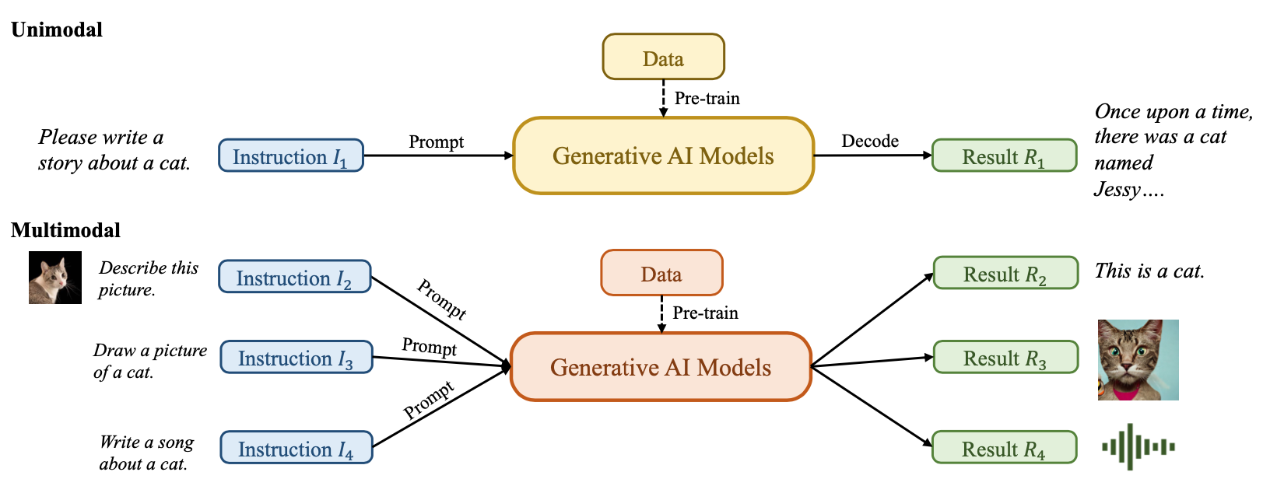
Generative AI (Gen AI) AI Generated Content (AIGC)
Source: Yihan Cao, Siyu Li, Yixin Liu, Zhiling Yan, Yutong Dai, Philip S. Yu, and Lichao Sun (2023). "A Comprehensive Survey of AI-Generated Content (AIGC): A History of Generative AI from GAN to ChatGPT." arXiv preprint arXiv:2303.04226.

Slide 10
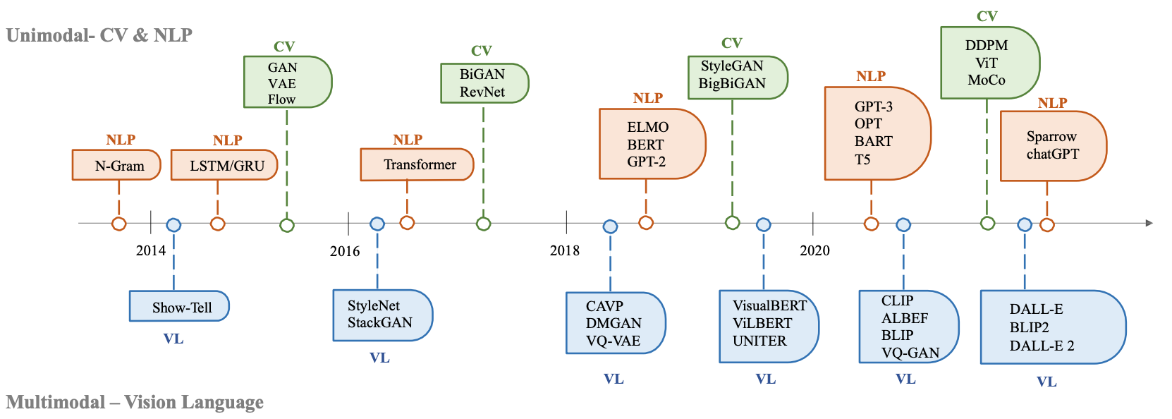
The history of Generative AI in CV, NLP and VL
Source: Yihan Cao, Siyu Li, Yixin Liu, Zhiling Yan, Yutong Dai, Philip S. Yu, and Lichao Sun (2023). "A Comprehensive Survey of AI-Generated Content (AIGC): A History of Generative AI from GAN to ChatGPT." arXiv preprint arXiv:2303.04226.

Slide 11
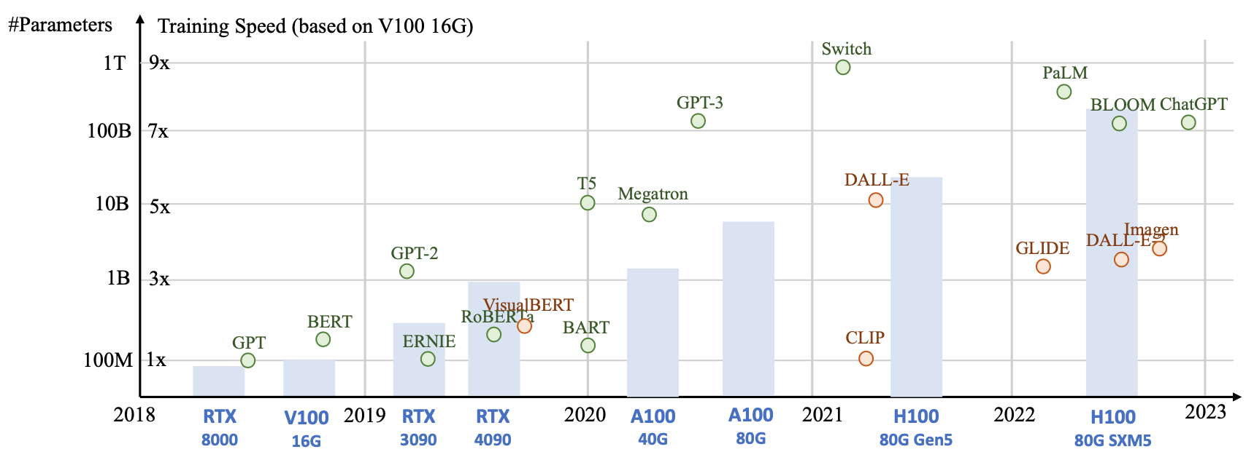
Generative AI Foundation Models
Source: Yihan Cao, Siyu Li, Yixin Liu, Zhiling Yan, Yutong Dai, Philip S. Yu, and Lichao Sun (2023). "A Comprehensive Survey of AI-Generated Content (AIGC): A History of Generative AI from GAN to ChatGPT." arXiv preprint arXiv:2303.04226.

Slide 12
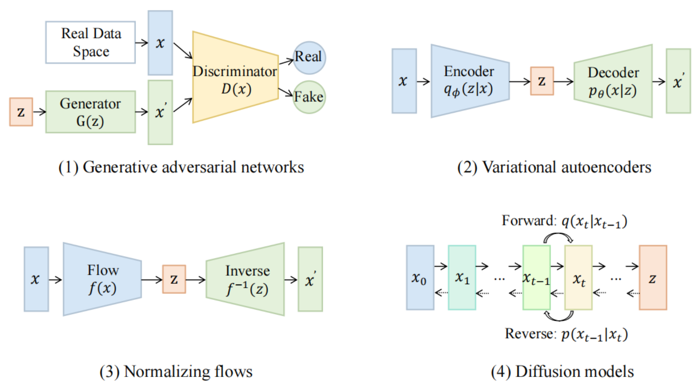
Categories of Vision Generative Models
Source: Yihan Cao, Siyu Li, Yixin Liu, Zhiling Yan, Yutong Dai, Philip S. Yu, and Lichao Sun (2023). "A Comprehensive Survey of AI-Generated Content (AIGC): A History of Generative AI from GAN to ChatGPT." arXiv preprint arXiv:2303.04226.

Slide 13
The General Structure of Generative Vision Language
Source: Yihan Cao, Siyu Li, Yixin Liu, Zhiling Yan, Yutong Dai, Philip S. Yu, and Lichao Sun (2023). "A Comprehensive Survey of AI-Generated Content (AIGC): A History of Generative AI from GAN to ChatGPT." arXiv preprint arXiv:2303.04226.

Slide 14
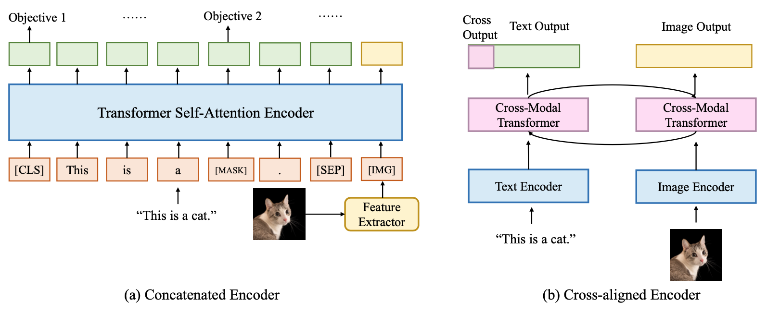
Two Types of Vision Language Encoders: Concatenated Encoders and Cross-aligned Encoders
Source: Yihan Cao, Siyu Li, Yixin Liu, Zhiling Yan, Yutong Dai, Philip S. Yu, and Lichao Sun (2023). "A Comprehensive Survey of AI-Generated Content (AIGC): A History of Generative AI from GAN to ChatGPT." arXiv preprint arXiv:2303.04226.

Slide 15
Two Types of to-language Decoder Models: Jointly-trained Models and Frozen Models
Source: Yihan Cao, Siyu Li, Yixin Liu, Zhiling Yan, Yutong Dai, Philip S. Yu, and Lichao Sun (2023). "A Comprehensive Survey of AI-Generated Content (AIGC): A History of Generative AI from GAN to ChatGPT." arXiv preprint arXiv:2303.04226.

Slide 16
Large Language Models (LLM) (GPT-3, ChatGPT, PaLM, BLOOM, OPT-175B, LLaMA)
ChatGPT
175B
LLaMA
65B
Source: https://lifearchitect.ai/models/

Slide 17
The Transformers Timeline
ULMFit
BERT
RoBERTa
XLM-R
DeBERTa
GPT-Neo
BLOOM
Alpaca
DistrilBERT
T5
PaLM
ChatGPT
Transformer
GPT
GPT-2
GPT-3
GPT-J
OPT-175B
LLaMA
2017
2018
2019
2020
2021
2022
2023
Source: Lewis Tunstall, Leandro von Werra, and Thomas Wolf (2022), Natural Language Processing with Transformers: Building Language Applications with Hugging Face, O'Reilly Media.

Slide 18
Transformer Models
Transformer
Encoder
Decoder
DistilBERT
BERT
T5
GPT
RoBERTa
BART
GPT-2
CTRL
XLM-R
XLM
M2M-100
GPT-3
ALBERT
BigBird
GPT-Neo
GPT-J
ELECTRA
mT0
BLOOM
BLOOMZ
DeBERTa
ChatGPT
GPT-4
Source: Lewis Tunstall, Leandro von Werra, and Thomas Wolf (2022), Natural Language Processing with Transformers: Building Language Applications with Hugging Face, O'Reilly Media.

Slide 19
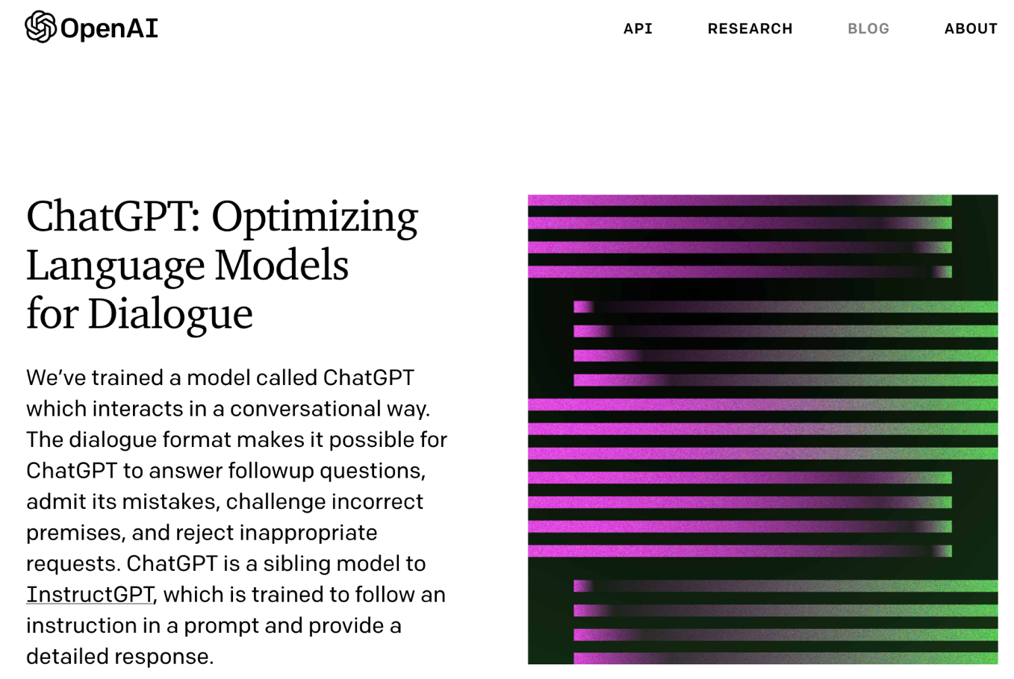
OpenAI ChatGPT
Source: https://openai.com/blog/chatgpt/

Slide 20
Conversational AI to deliver contextual and personal experience to users
Source: Huynh-The, Thien, Quoc-Viet Pham, Xuan-Qui Pham, Thanh Thi Nguyen, Zhu Han, and Dong-Seong Kim (2022). "Artificial Intelligence for the Metaverse: A Survey." arXiv preprint arXiv:2202.10336.

Slide 21
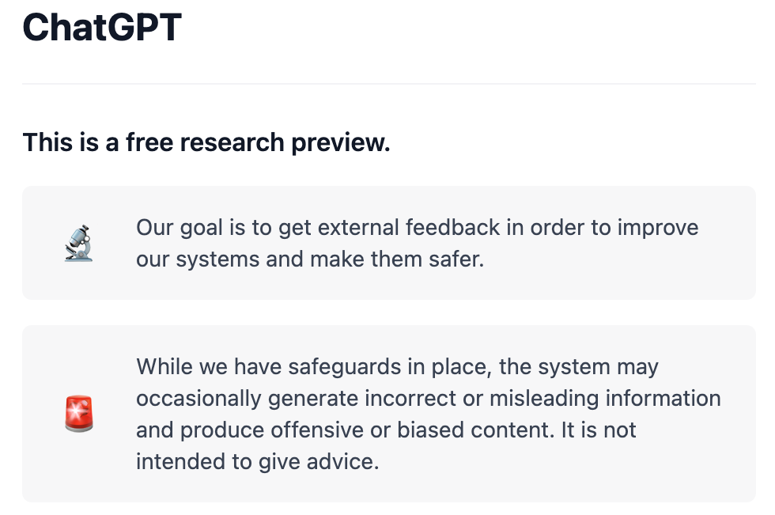
OpenAI ChatGPT
Source: https://chat.openai.com/chat

Slide 22
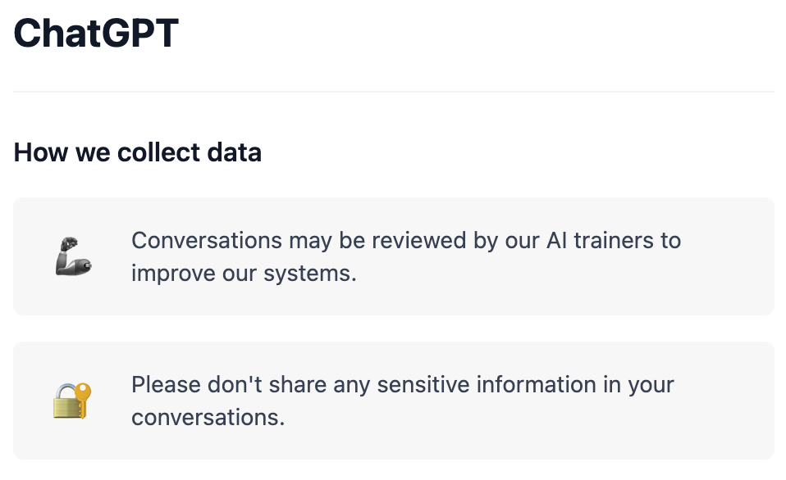
OpenAI ChatGPT
Source: https://chat.openai.com/chat

Slide 23
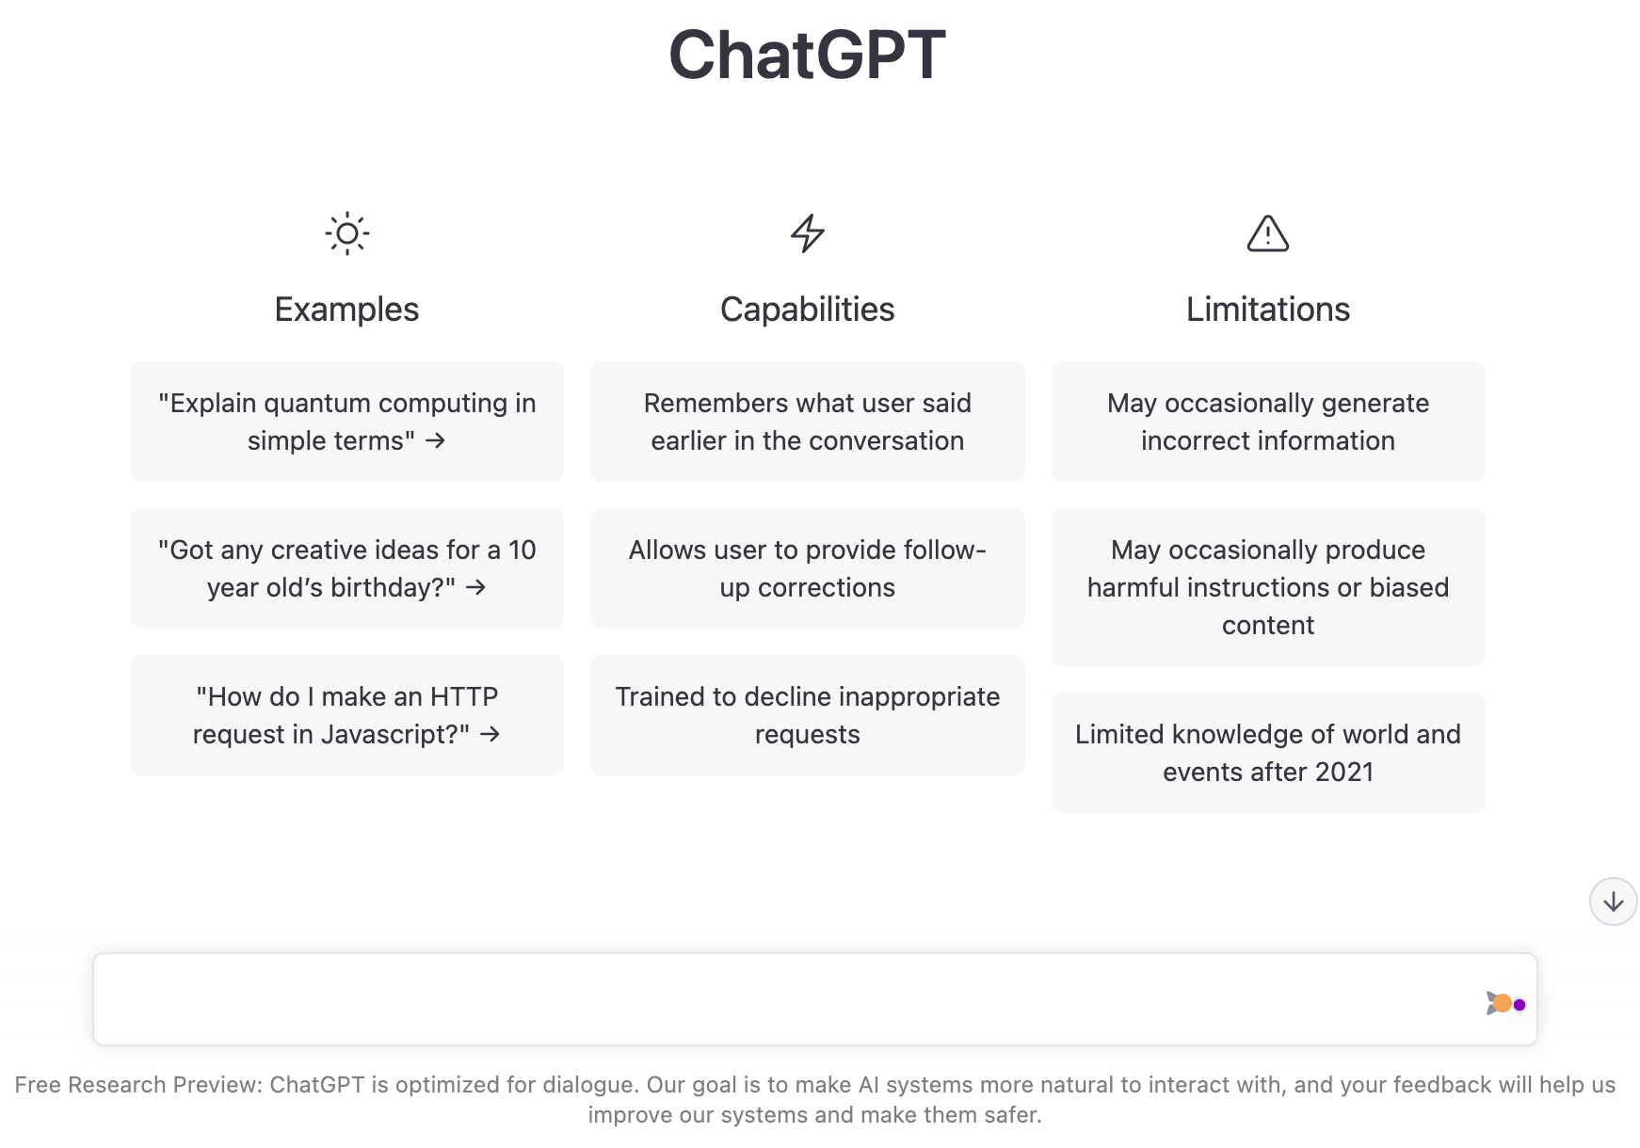
OpenAI ChatGPT
Source: https://chat.openai.com/chat

Slide 24
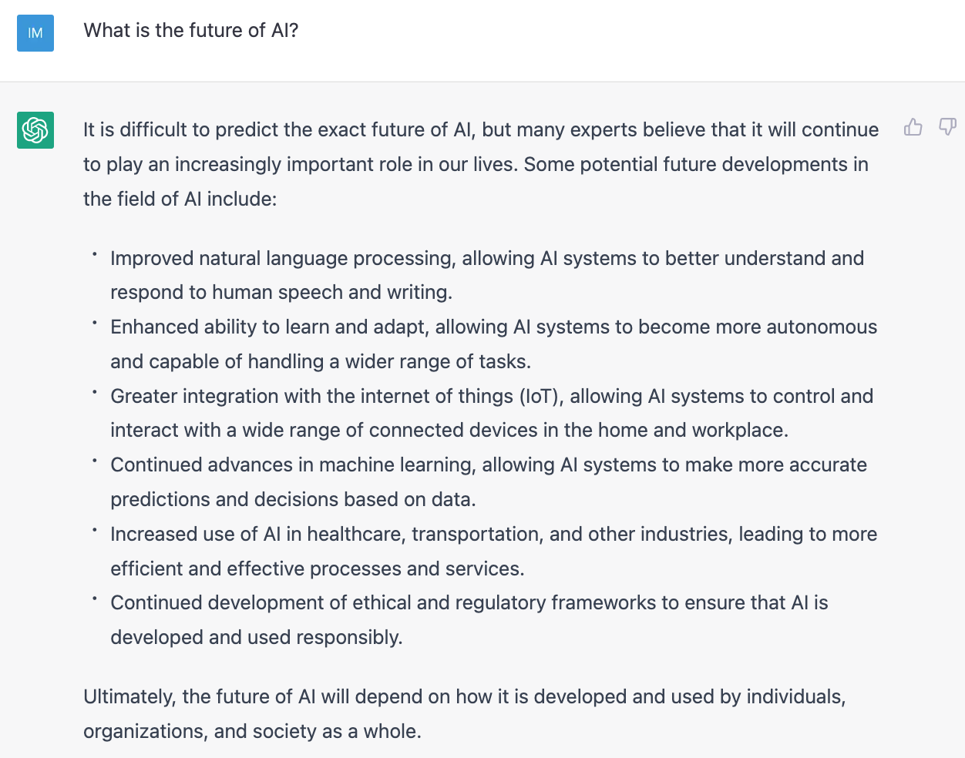
OpenAI ChatGPT
Source: https://chat.openai.com/chat

Slide 25
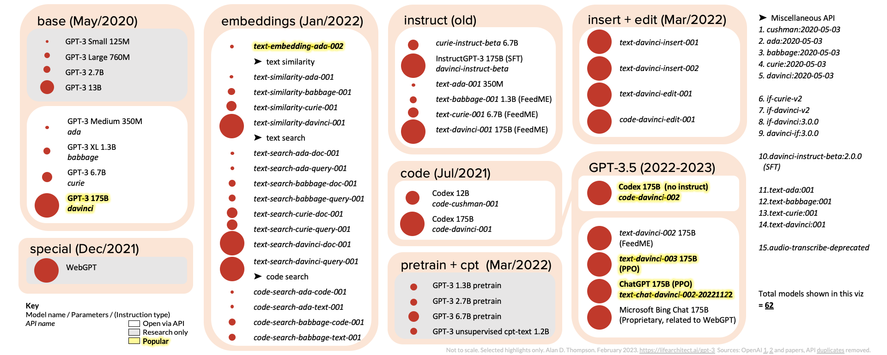
ChatGPT and GPT-3 Family (GPT-3, InstructGPT, GPT-3.5, ChatGPT)
Source: https://lifearchitect.ai/gpt-3/

Slide 26
OpenAI ChatGPT and Open LLM GPT-4, LLaMA, Alpaca, Dolly, Cerebras-GPT, GPT4All, Vicuna, ColossalChat, Koala, Phoenix
OpenAI GPT-4
Deepmind Chinchilla
Meta OPT (LLaMA)
Pythia
Stanford Alpaca
Databricks Dolly
Cerebras-GPT
GPT4All
Vicuna
ColossalChat
BAIR Koala
Source: https://www.cerebras.net/blog/cerebras-gpt-a-family-of-open-compute-efficient-large-language-models/

Slide 27
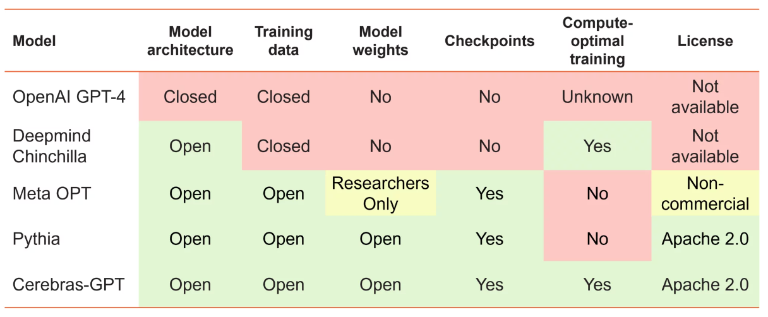
Large Language Models (LMM) Openness and Training Philosophy
Source: https://www.cerebras.net/blog/cerebras-gpt-a-family-of-open-compute-efficient-large-language-models/

Slide 28
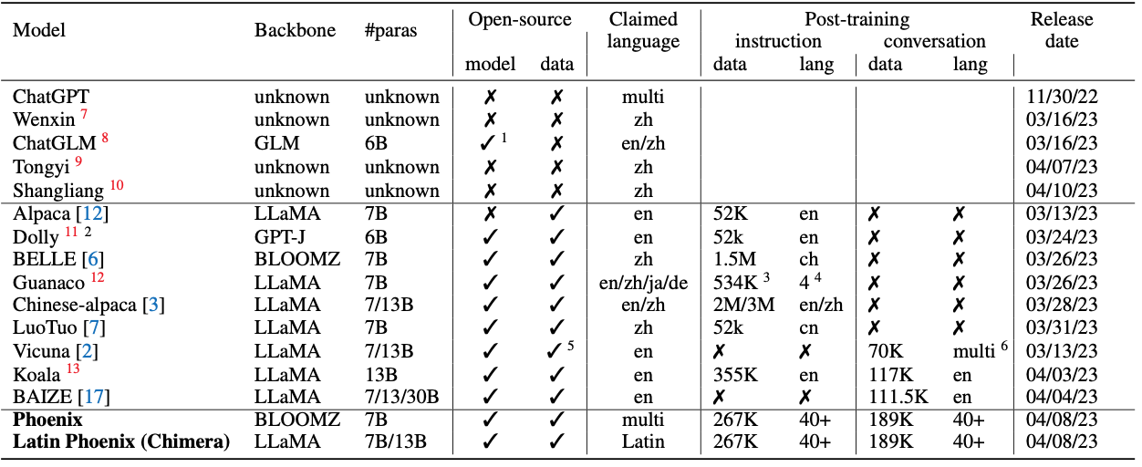
Phoenix: Democratizing ChatGPT across Languages
Source: https://github.com/FreedomIntelligence/LLMZoo

Slide 29
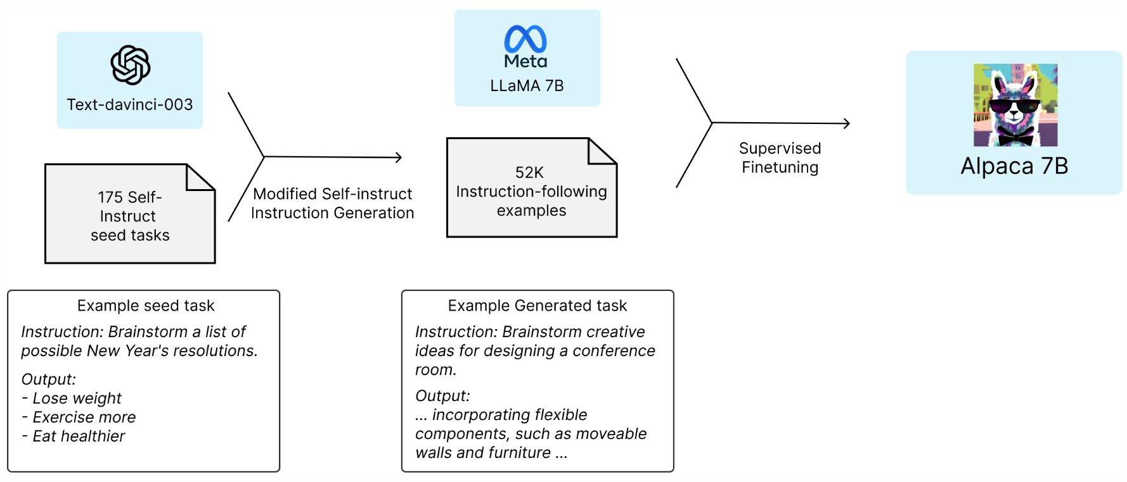
Stanford Alpaca: A Strong, Replicable Instruction-Following Model
Source: https://crfm.stanford.edu/2023/03/13/alpaca.html

Slide 30
GPT4All: Training an Assistant-style Chatbot with Large Scale Data Distillation from GPT-3.5-Turbo
Demo, data and code to train an assistant-style large language model with ~800k GPT-3.5-Turbo Generations based on LLaMa
Reproducibility
Trained LoRa Weights:
gpt4all-lora (four full epochs of training):
https://huggingface.co/nomic-ai/gpt4all-lora
Source: https://github.com/nomic-ai/gpt4all

Slide 31
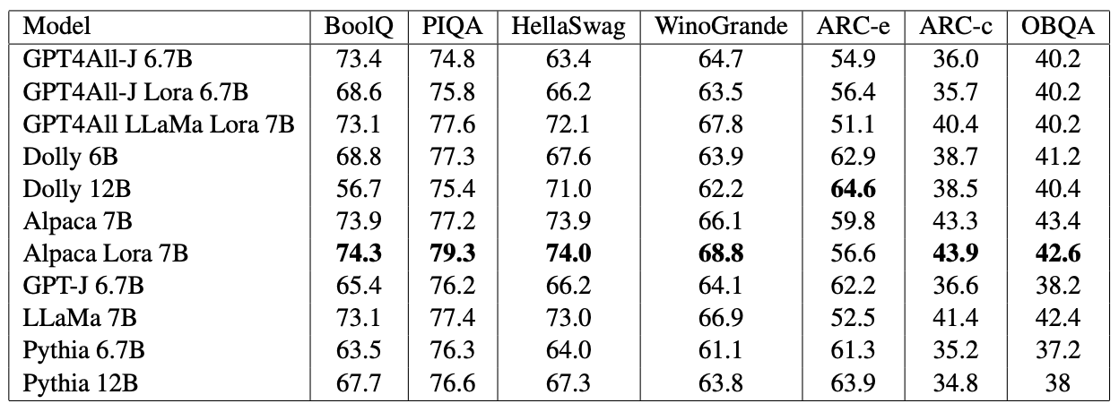
GPT4All-J An Apache-2 Licensed Assistant-Style Chatbot
GPT4All-J (GPT4All v2) based on Open Source GPT-J model
Source: https://github.com/nomic-ai/gpt4all

Slide 32
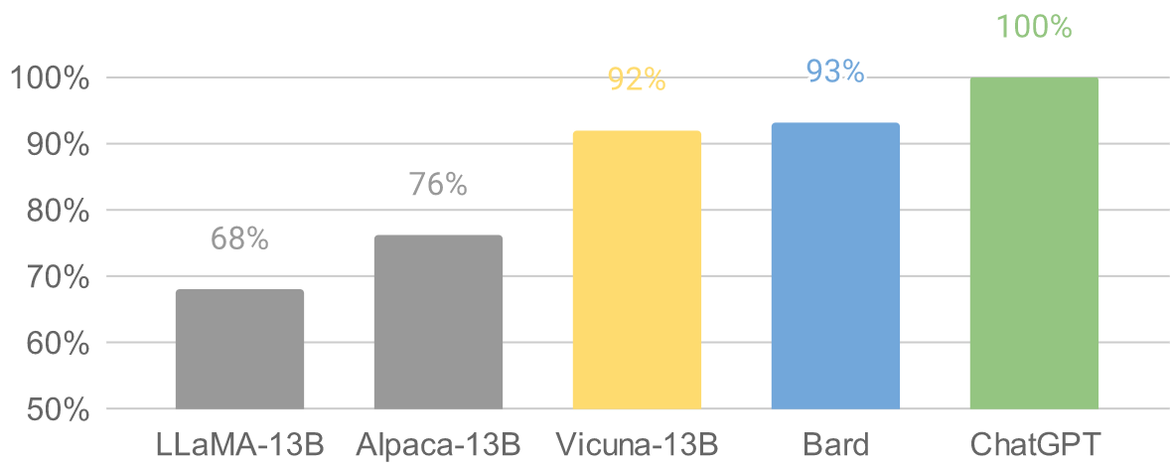
Vicuna: An Open-Source Chatbot Impressing GPT-4 with 90%* ChatGPT Quality by the Team with members from UC Berkeley, CMU, Stanford, and UC San Diego
Vicuna-13B: an open-source chatbot trained by fine-tuning LLaMA on user-shared conversations collected from ShareGPT.
The cost of training Vicuna-13B is around $300.
Source: https://vicuna.lmsys.org/

Slide 33
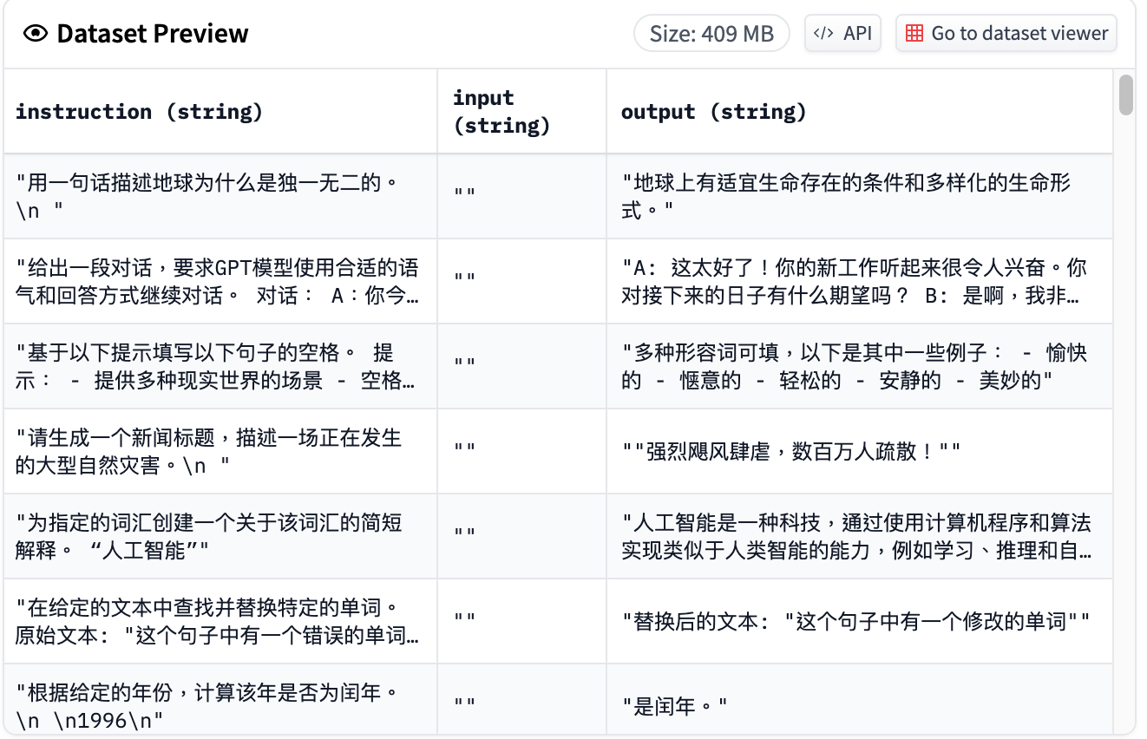
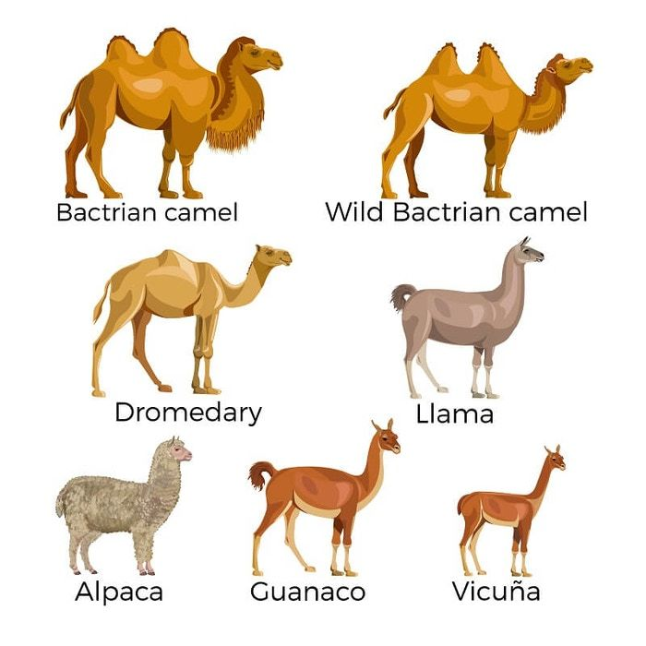
Chinese-Vicuna: A Chinese Instruction-following LLaMA-based Model 一個中文低資源的 llama+lora方案
Chinese-Vicuna based on Guanaco Dataset and Belle Dataset
Source: https://huggingface.co/datasets/Chinese-Vicuna/guanaco_belle_merge_v1.0
Source: https://github.com/Facico/Chinese-Vicuna

Slide 34
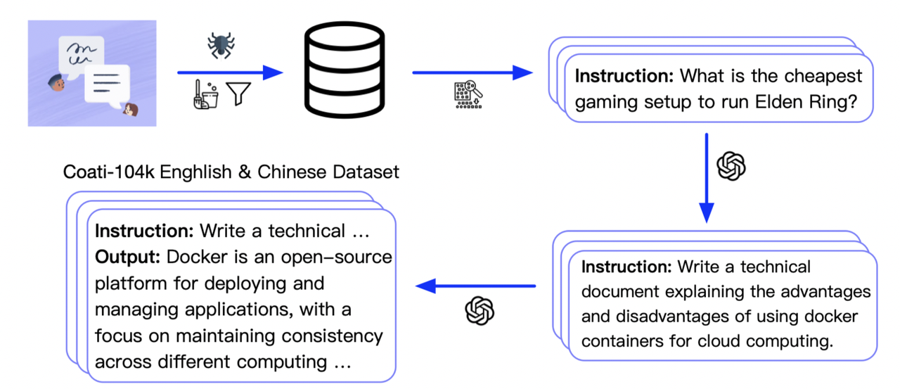
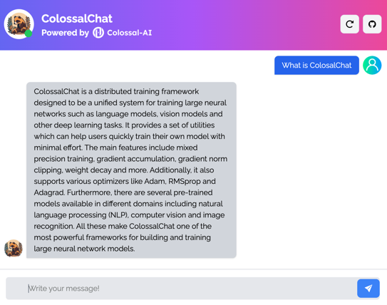
ColossalChat
ColossalChat is the project to implement LLM with RLHF, powered by the Colossal-AI project.
Coati stands for ColossalAI Talking Intelligence.
Source: https://chat.colossalai.org/
https://github.com/hpcaitech/ColossalAI/tree/main/applications/Chat

Slide 35
Dolly v2 Open Source Instruction-Tuned LLM
Databricks’ Dolly is an instruction-following large language model trained on the Databricks machine learning platform that is licensed for commercial use.
Based on pythia-12b, Dolly is trained on ~15k instruction/response fine tuning records databricks-dolly-15k generated by Databricks employees in capability domains from the InstructGPT paper, including brainstorming, classification, closed QA, generation, information extraction, open QA and summarization.
dolly-v2-12b is not a state-of-the-art model, but does exhibit surprisingly high quality instruction following behavior not characteristic of the foundation model on which it is based.
Source: https://github.com/databrickslabs/dolly

Slide 36
StableLM Stability AI Language Models
StableLM-Alpha models are trained on the new dataset that build on The Pile, which contains 1.5 trillion tokens, roughly 3x the size of The Pile.
These models will be trained on up to 1.5 trillion tokens.
The context length for these models is 4096 tokens.
Fine-tuned the model with Stanford Alpaca's procedure using a combination of five recent datasets for conversational agents: Stanford's Alpaca, Nomic-AI's gpt4all, RyokoAI's ShareGPT52K datasets, Databricks labs' Dolly, and Anthropic's HH.
Source: https://github.com/Stability-AI/StableLM

Slide 37
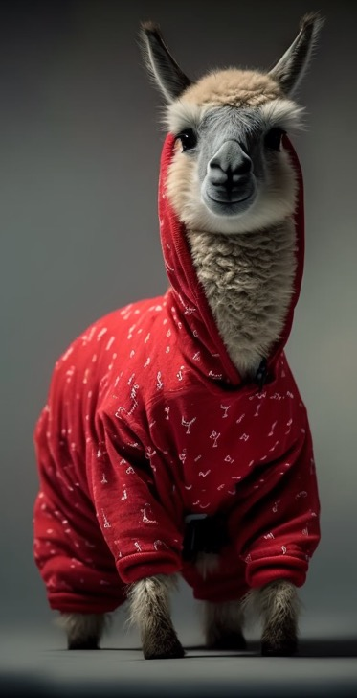
RedPajama a project to create leading open-source models, starts by reproducing LLaMA training dataset of over 1.2 trillion tokens
Dataset | RedPajama | LLaMA*
CommonCrawl | 878 billion | 852 billion
C4 | 175 billion | 190 billion
Github | 59 billion | 100 billion
Books | 26 billion | 25 billion
ArXiv | 28 billion | 33 billion
Wikipedia | 24 billion | 25 billion
StackExchange | 20 billion | 27 billion
Total Tokens | 1.2 trillion | 1.25 trillion
Source: https://github.com/togethercomputer/RedPajama-Data

Slide 38
Chat with Open Large Language Models
https://chat.lmsys.org/

Slide 39
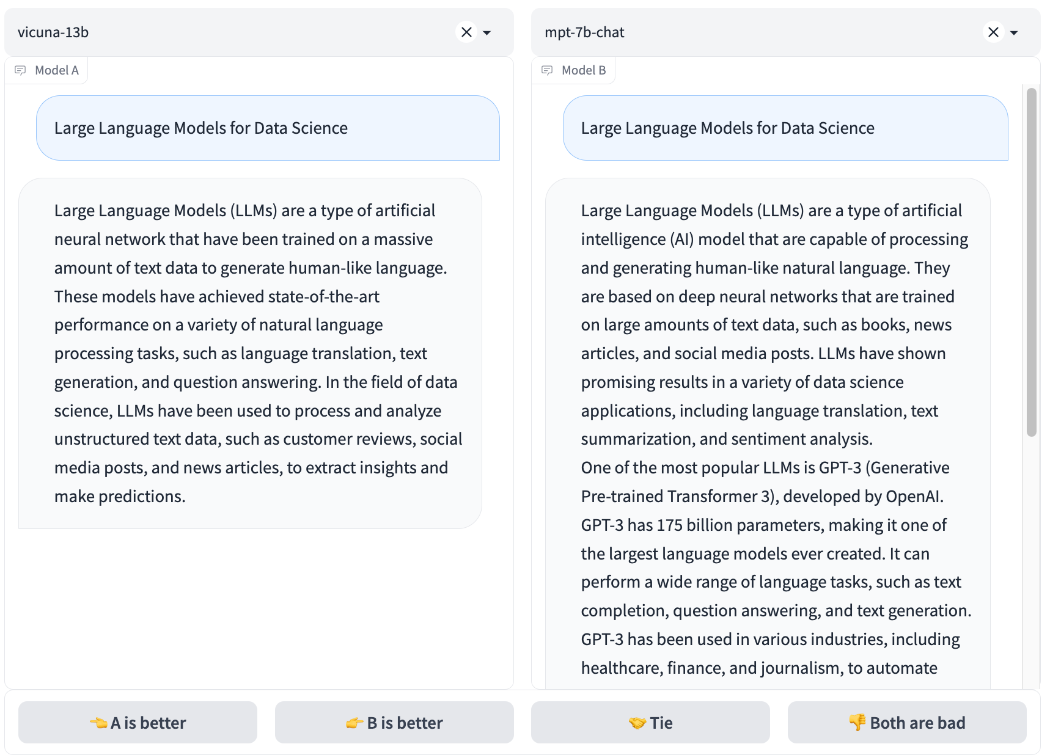
Chat with Open Large Language Models: Chatbot Arena
https://chat.lmsys.org/

Slide 40
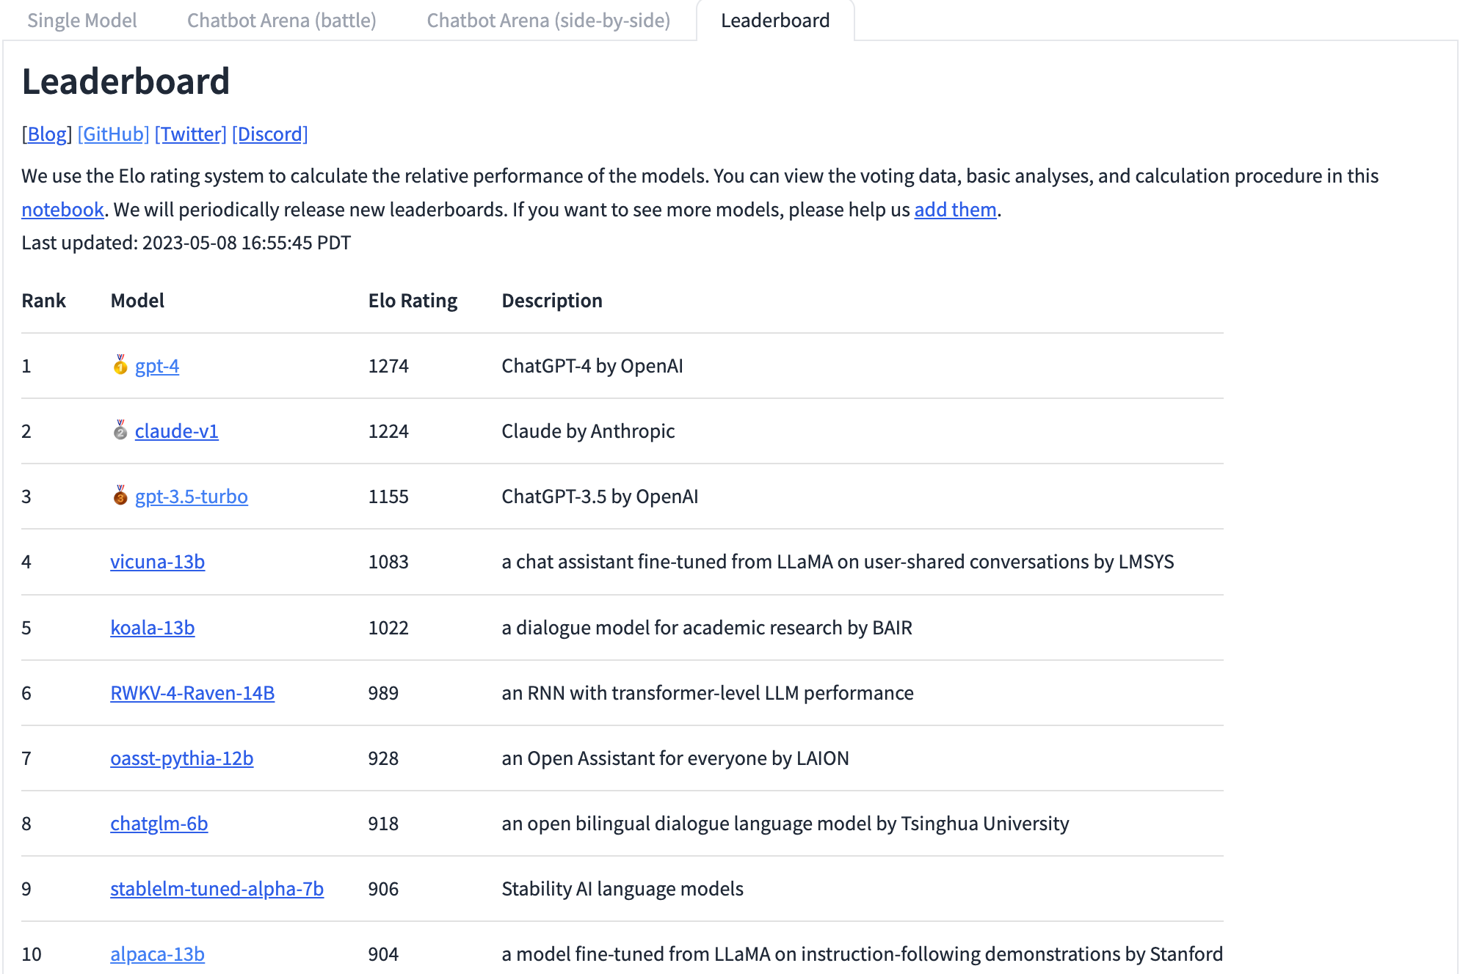
Chat with Open Large Language Models: Leaderboard
https://chat.lmsys.org/

Slide 41
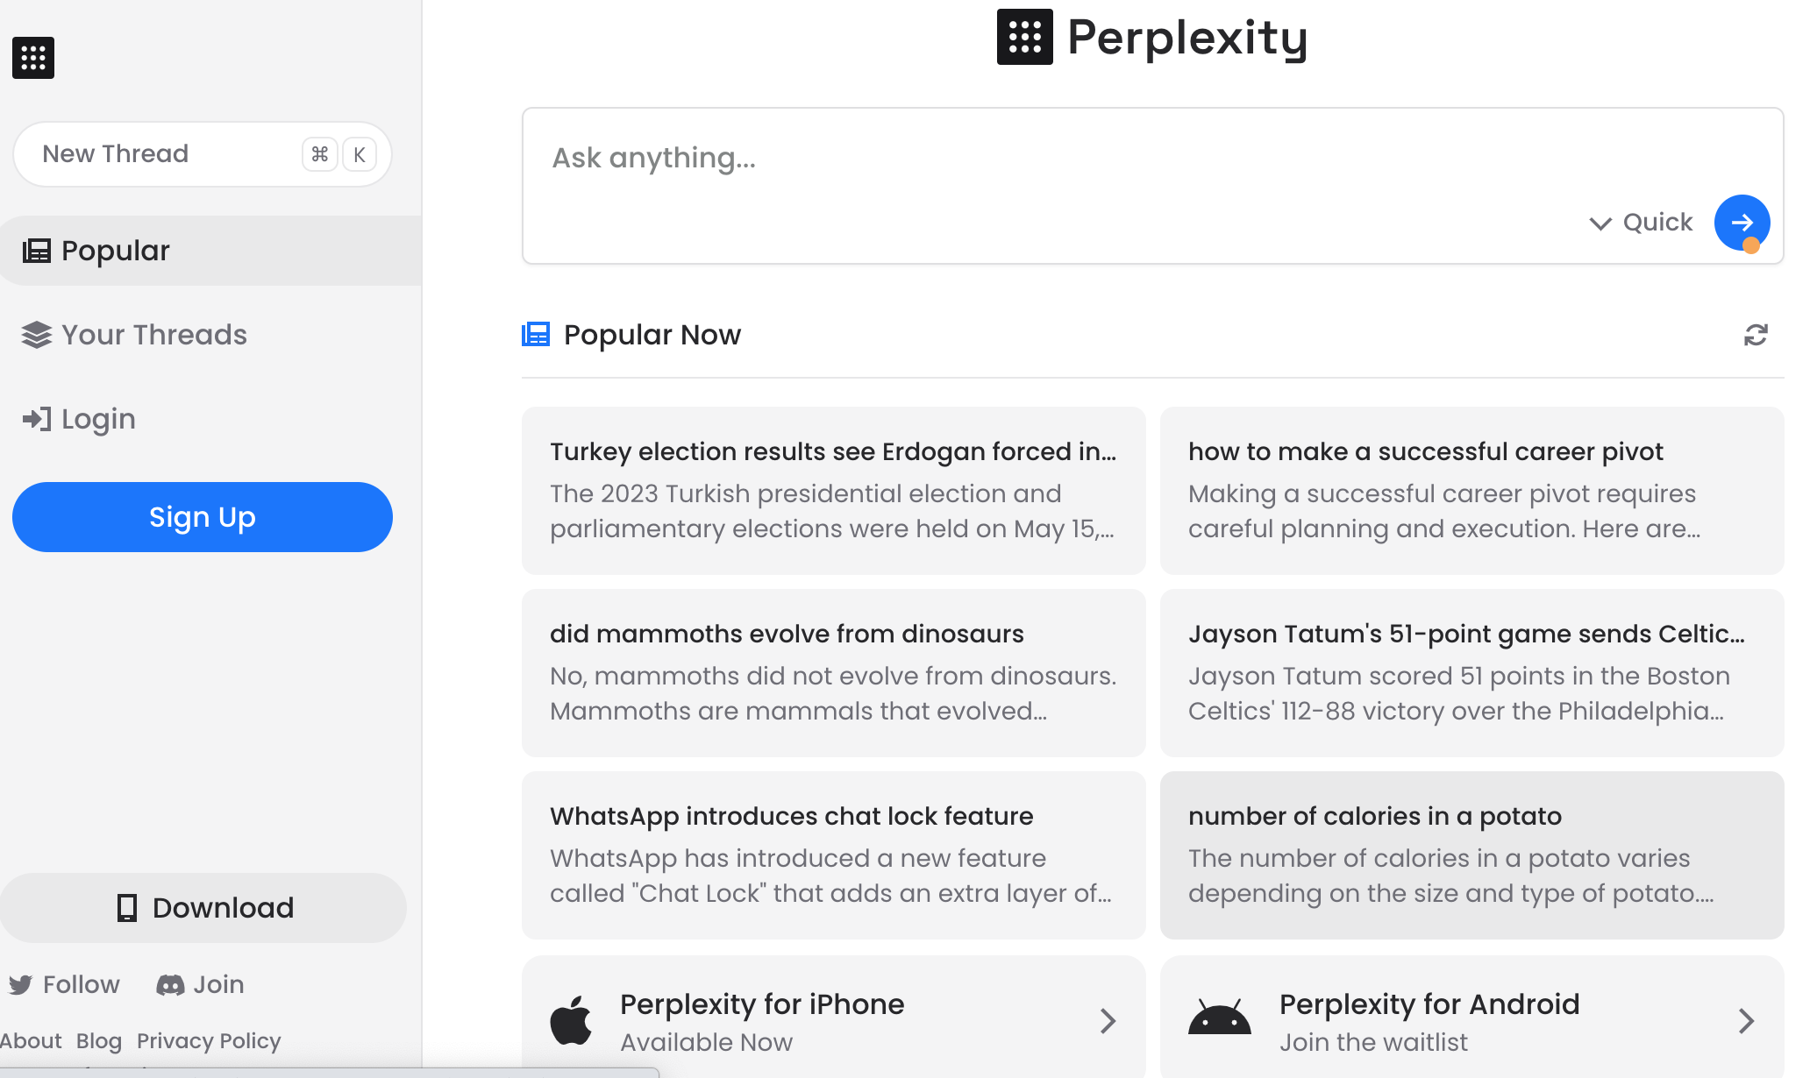
Perplexity.ai
https://www.perplexity.ai/

Slide 42
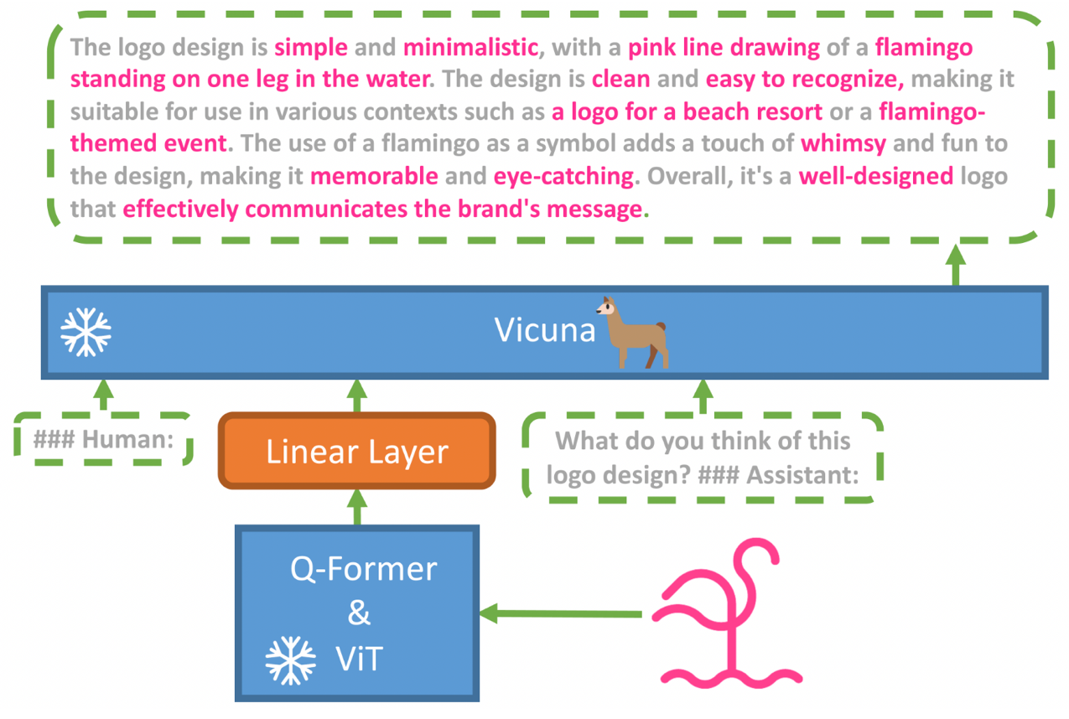
MiniGPT-4: Enhancing Vision-language Understanding with Advanced Large Language Models
Source: https://minigpt-4.github.io/

Slide 43
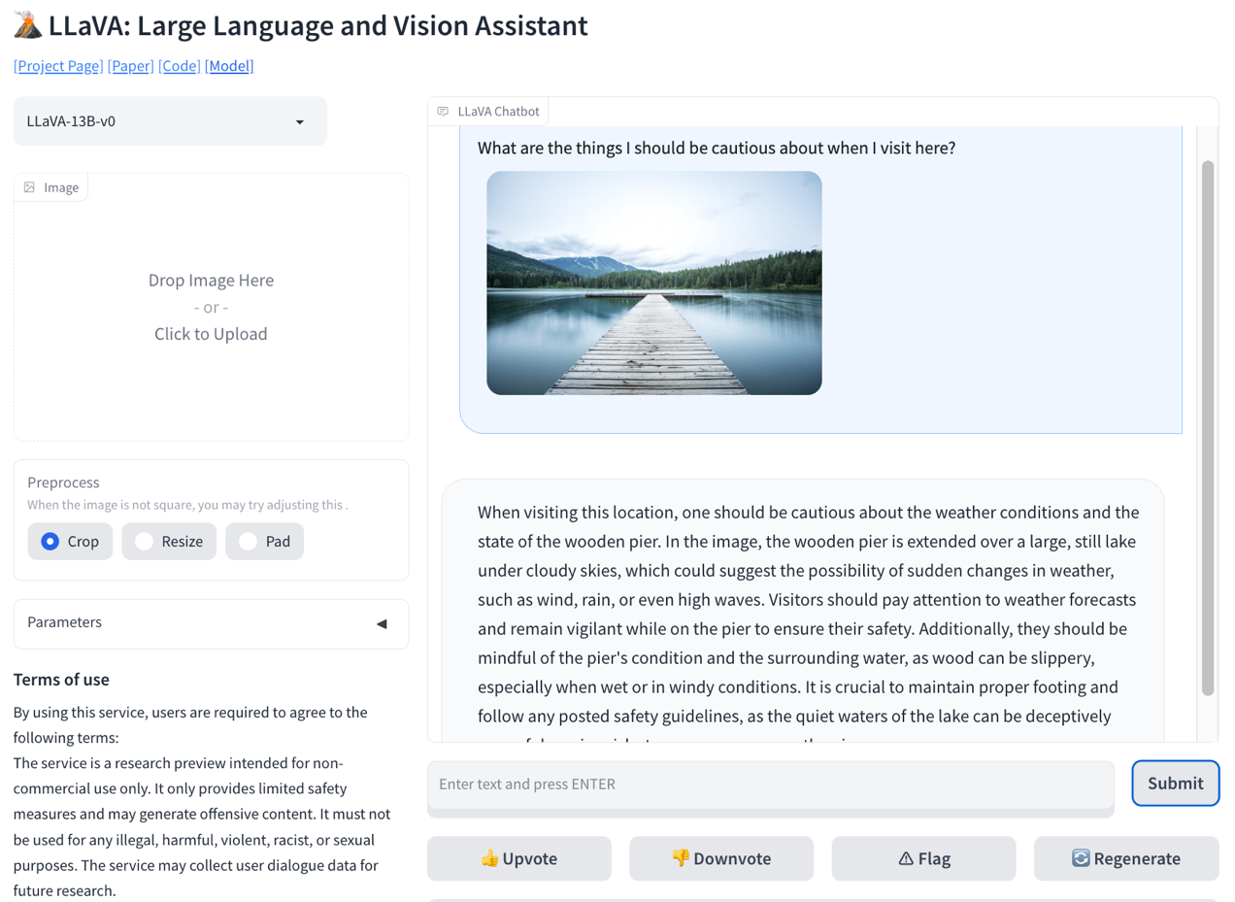
LLaVA: Large Language and Vision Assistant
Source: https://llava-vl.github.io/

Slide 44
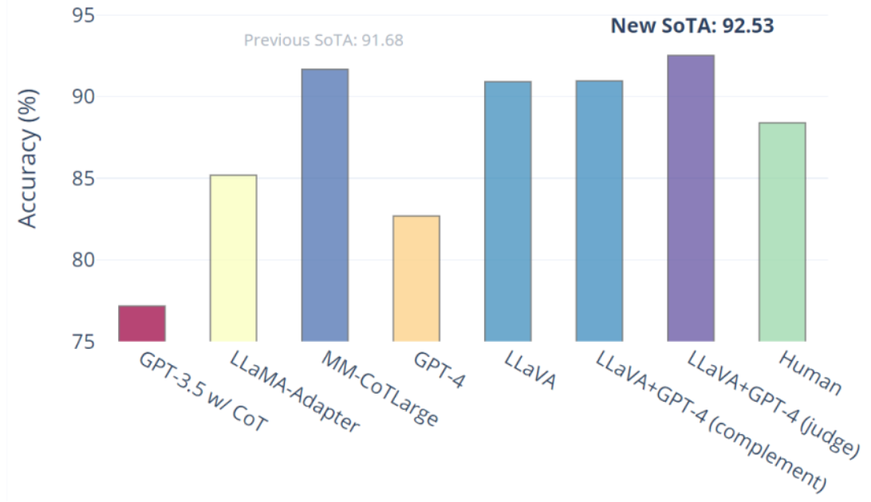
Visual Instruction Tuning LLaVA: Large Language and Vision Assistant University of Wisconsin-Madison, Microsoft Research, Columbia University
Science QA: New SoTA with the synergy of LLaVA with GPT-4
LLaVA represents a novel end-to-end trained large multimodal model that combines a vision encoder and Vicuna for general-purpose visual and language understanding, achieving impressive chat capabilities mimicking spirits of the multimodal GPT-4 and setting a new state-of-the-art accuracy on Science QA.
Source: https://llava-vl.github.io/

Slide 45
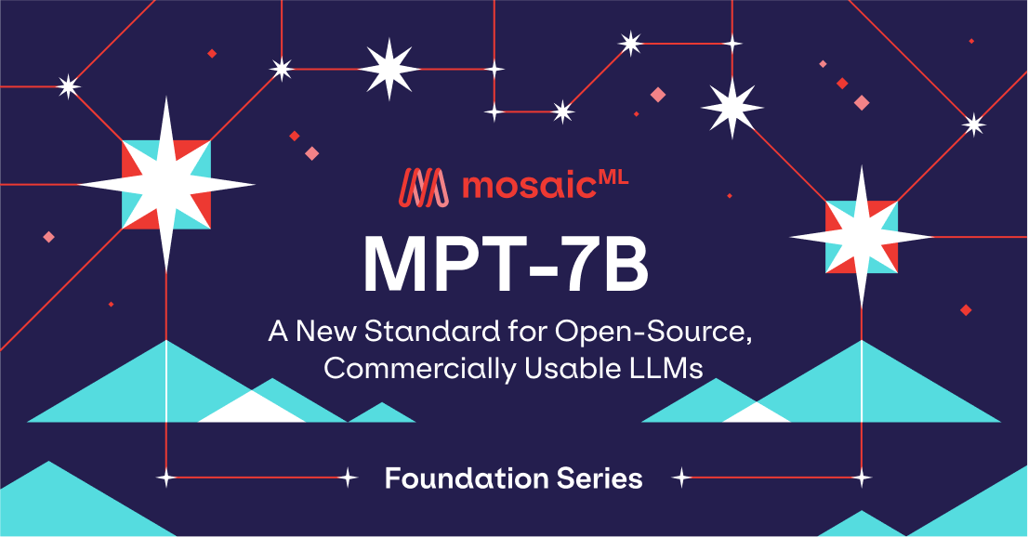
MPT-7B: A New Standard for Open-Source, Commercially Usable LLMs
Source: https://www.mosaicml.com/blog/mpt-7b

Slide 46
MPT-7B (MosaicML Pretrained Transformer) vs. open source models on academic tasks
Source: https://www.mosaicml.com/blog/mpt-7b

Slide 47
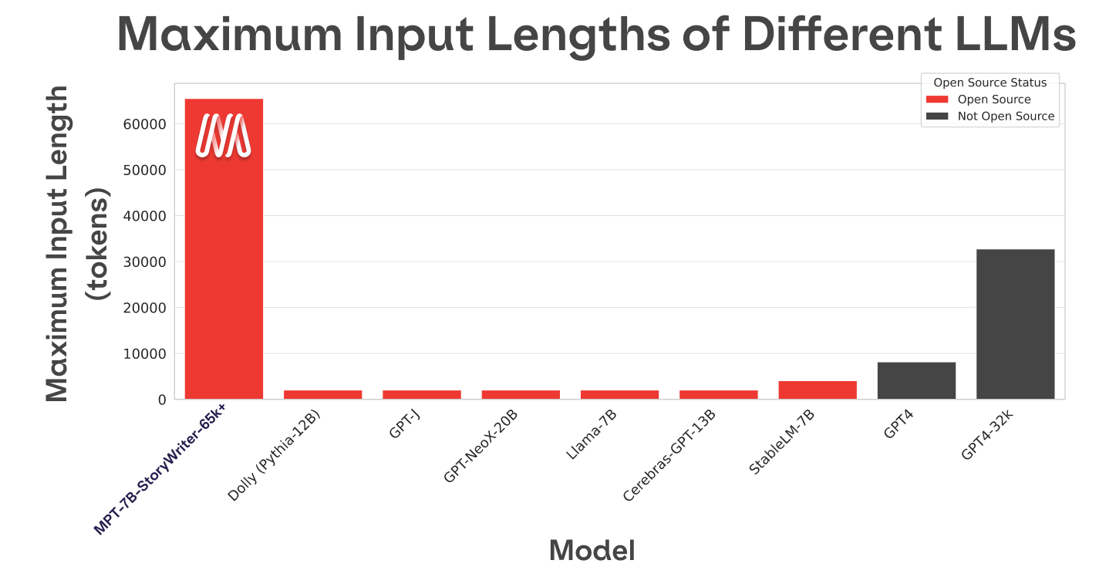
MPT-7B-StoryWriter-65k+
Source: https://www.mosaicml.com/blog/mpt-7b

Slide 48
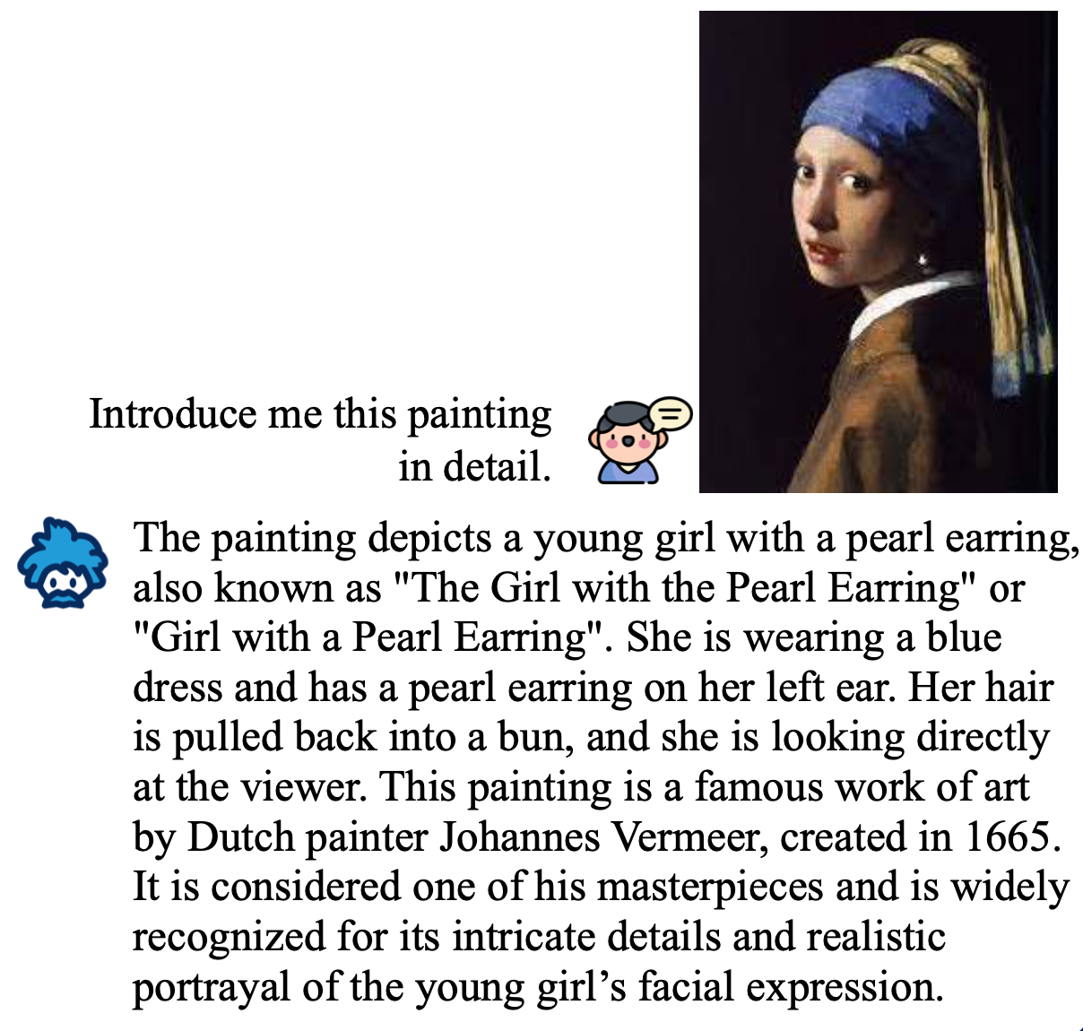
InstructBLIP Vision-Language Models with Instruction Tuning
Source: Dai, Wenliang, Junnan Li, Dongxu Li, Anthony Meng Huat Tiong, Junqi Zhao, Weisheng Wang, Boyang Li, Pascale Fung, and Steven Hoi. "InstructBLIP: Towards General-purpose Vision-Language Models with Instruction Tuning." arXiv preprint arXiv:2305.06500 (2023).

Slide 49
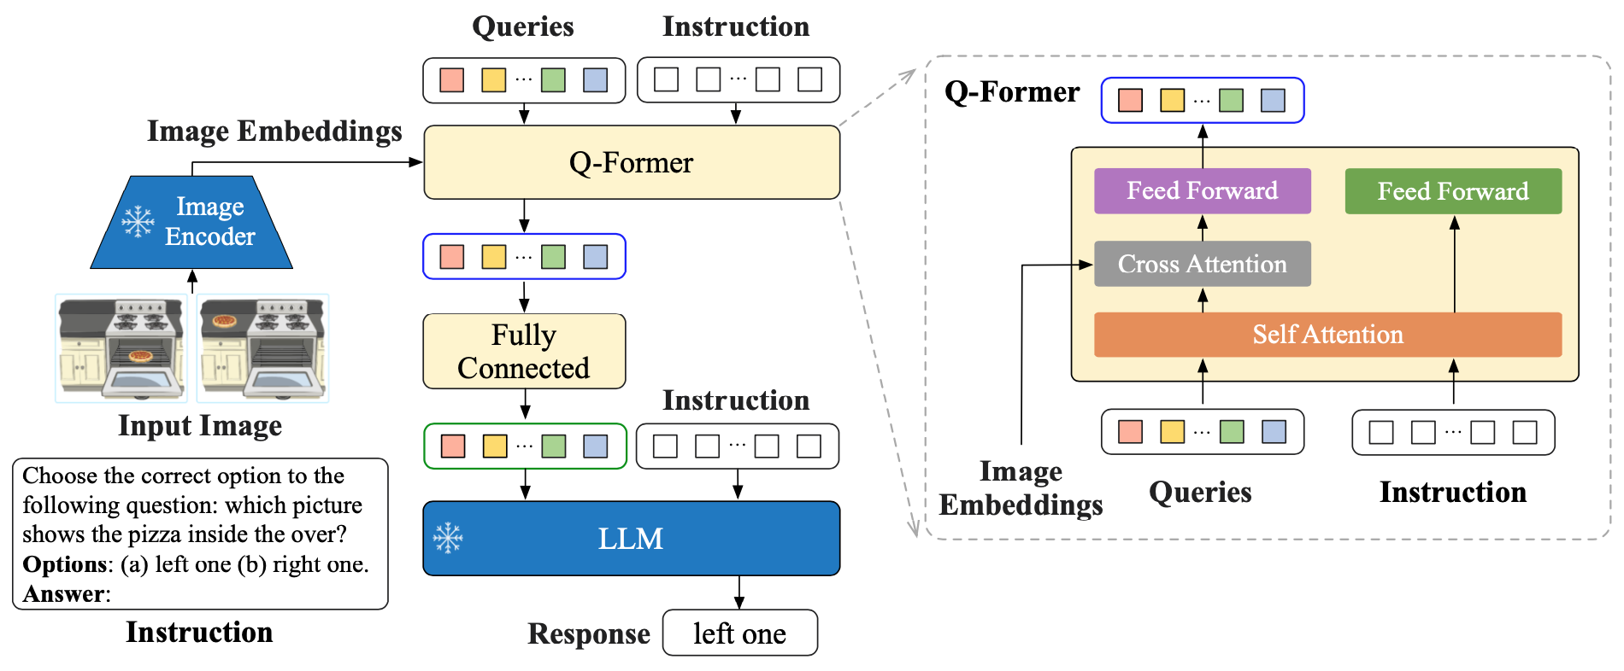
Model Architecture of InstructBLIP Vision-Language Models with Instruction Tuning
Source: Dai, Wenliang, Junnan Li, Dongxu Li, Anthony Meng Huat Tiong, Junqi Zhao, Weisheng Wang, Boyang Li, Pascale Fung, and Steven Hoi. "InstructBLIP: Towards General-purpose Vision-Language Models with Instruction Tuning." arXiv preprint arXiv:2305.06500 (2023).

Slide 50
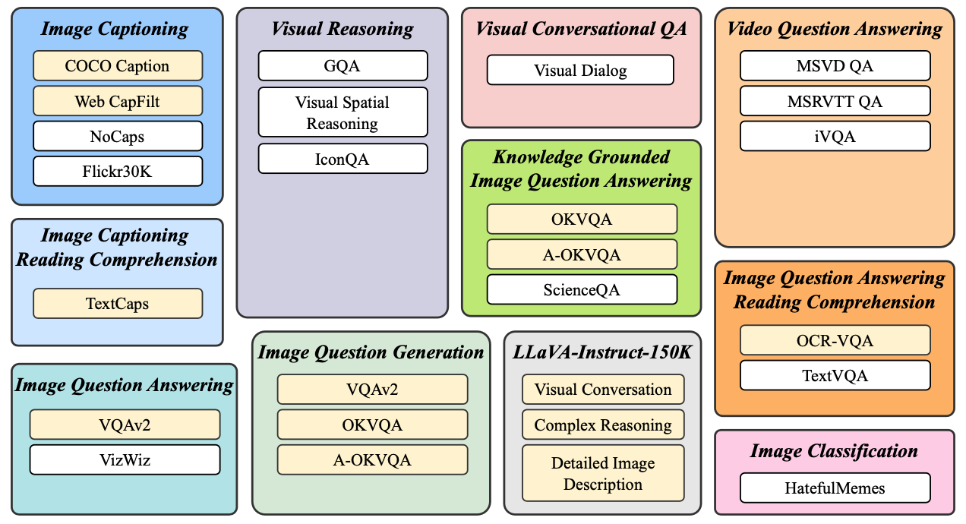
Vision-Language Instruction Tuning: Datasets
Source: Dai, Wenliang, Junnan Li, Dongxu Li, Anthony Meng Huat Tiong, Junqi Zhao, Weisheng Wang, Boyang Li, Pascale Fung, and Steven Hoi. "InstructBLIP: Towards General-purpose Vision-Language Models with Instruction Tuning." arXiv preprint arXiv:2305.06500 (2023).

Slide 51
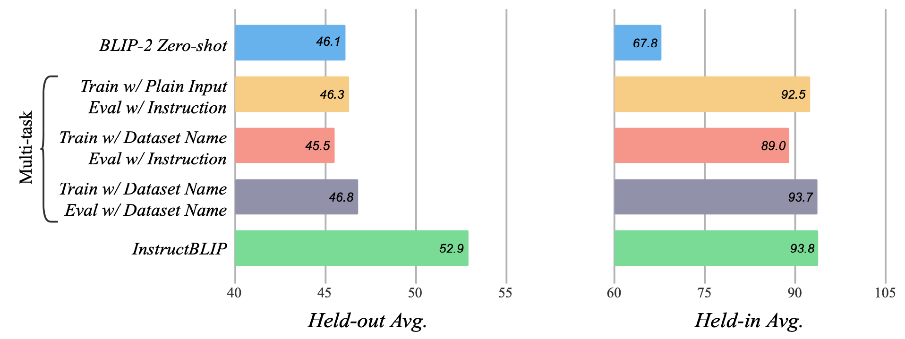
Instruction Tuning vs. Multitask Learning based on BLIP-2 FlanT5XL
Source: Dai, Wenliang, Junnan Li, Dongxu Li, Anthony Meng Huat Tiong, Junqi Zhao, Weisheng Wang, Boyang Li, Pascale Fung, and Steven Hoi. "InstructBLIP: Towards General-purpose Vision-Language Models with Instruction Tuning." arXiv preprint arXiv:2305.06500 (2023).

Slide 52
Finetuning BLIP-2 and InstructBLIP on downstream datasets
Source: Dai, Wenliang, Junnan Li, Dongxu Li, Anthony Meng Huat Tiong, Junqi Zhao, Weisheng Wang, Boyang Li, Pascale Fung, and Steven Hoi. "InstructBLIP: Towards General-purpose Vision-Language Models with Instruction Tuning." arXiv preprint arXiv:2305.06500 (2023).

Slide 53
InstructBLIP Vision-Language Models with Instruction Tuning LLaVA Large Language and Vision Assistant MiniGPT-4
Source: Dai, Wenliang, Junnan Li, Dongxu Li, Anthony Meng Huat Tiong, Junqi Zhao, Weisheng Wang, Boyang Li, Pascale Fung, and Steven Hoi. "InstructBLIP: Towards General-purpose Vision-Language Models with Instruction Tuning." arXiv preprint arXiv:2305.06500 (2023).

Slide 54
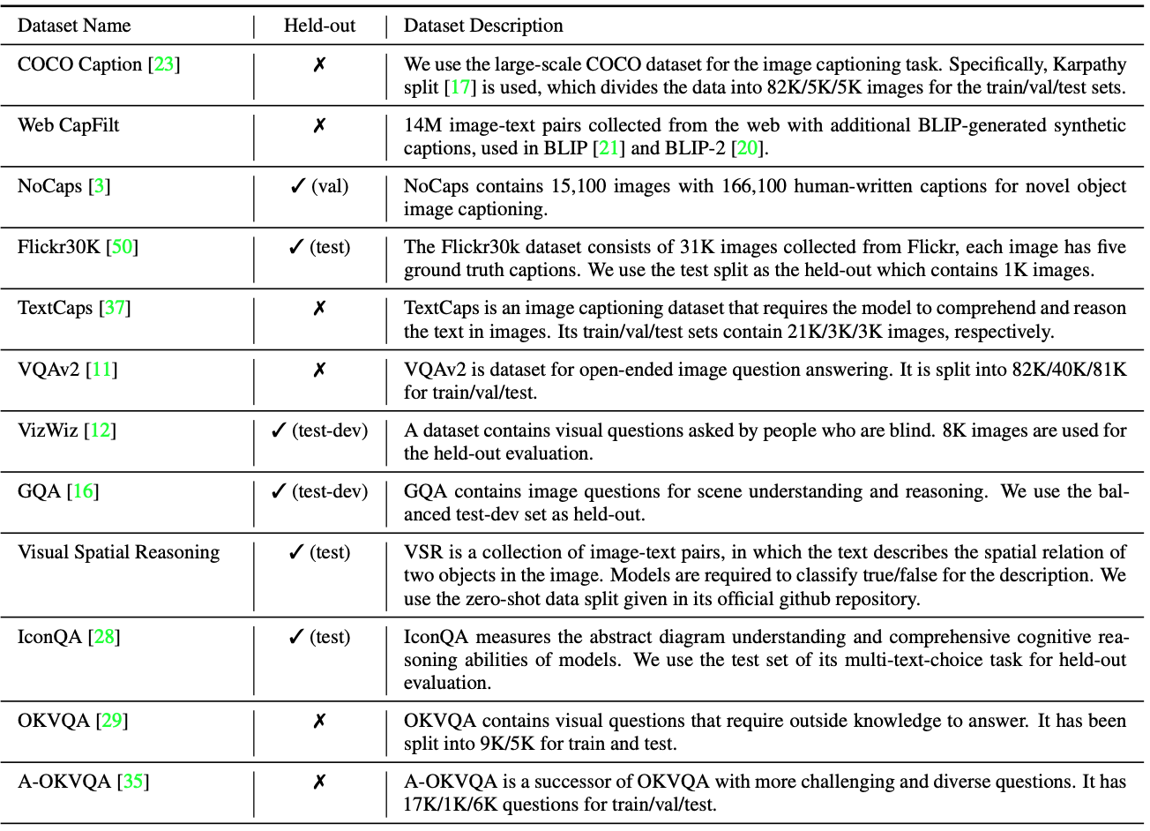
Instruction Tuning Datasets
Source: Dai, Wenliang, Junnan Li, Dongxu Li, Anthony Meng Huat Tiong, Junqi Zhao, Weisheng Wang, Boyang Li, Pascale Fung, and Steven Hoi. "InstructBLIP: Towards General-purpose Vision-Language Models with Instruction Tuning." arXiv preprint arXiv:2305.06500 (2023).

Slide 55
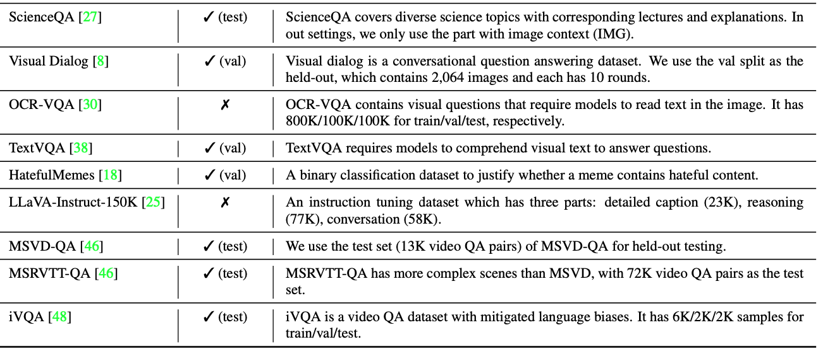
Instruction Tuning Datasets
Source: Dai, Wenliang, Junnan Li, Dongxu Li, Anthony Meng Huat Tiong, Junqi Zhao, Weisheng Wang, Boyang Li, Pascale Fung, and Steven Hoi. "InstructBLIP: Towards General-purpose Vision-Language Models with Instruction Tuning." arXiv preprint arXiv:2305.06500 (2023).

Slide 56
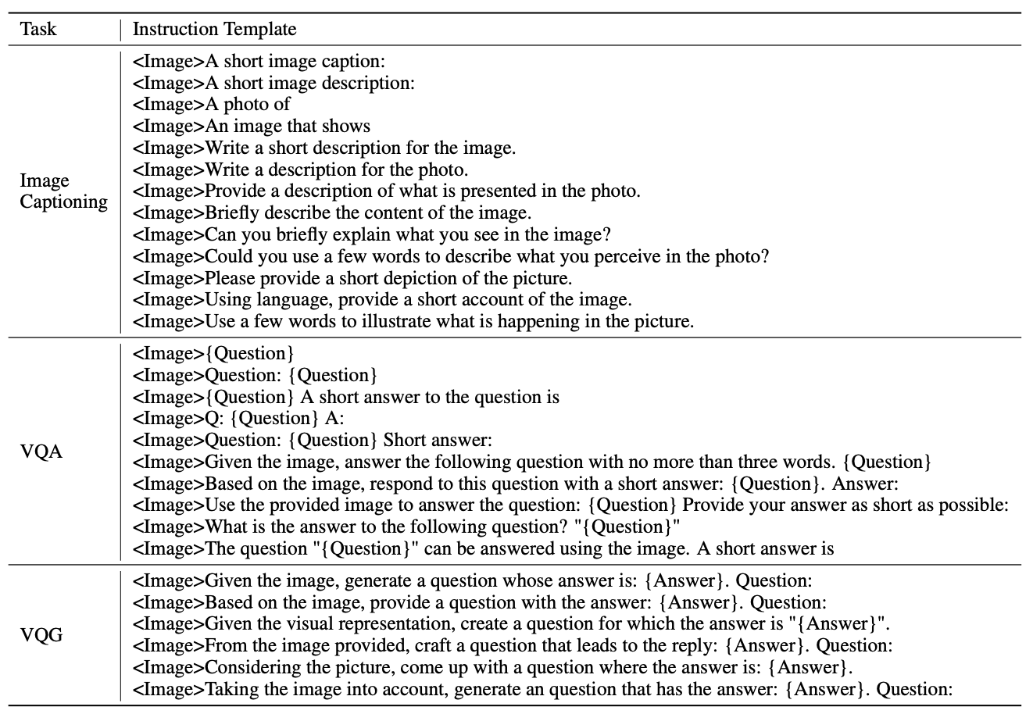
Instruction Templates
Image Captioning
VQA
Vision Question Answering
VQG
Vision Question Generation
Source: Dai, Wenliang, Junnan Li, Dongxu Li, Anthony Meng Huat Tiong, Junqi Zhao, Weisheng Wang, Boyang Li, Pascale Fung, and Steven Hoi. "InstructBLIP: Towards General-purpose Vision-Language Models with Instruction Tuning." arXiv preprint arXiv:2305.06500 (2023).

Slide 57
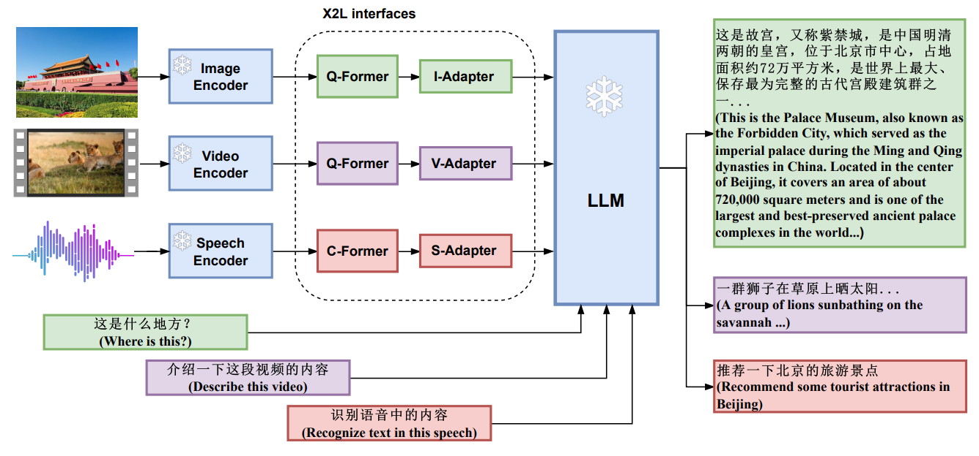
X-LLM: Bootstrapping Advanced Large Language Models by Treating Multi-Modalities as Foreign Languages
Source: Chen, Feilong, Minglun Han, Haozhi Zhao, Qingyang Zhang, Jing Shi, Shuang Xu, and Bo Xu. "X-LLM: Bootstrapping Advanced Large Language Models by Treating Multi-Modalities as Foreign Languages." arXiv preprint arXiv:2305.04160 (2023).

Slide 58
Large Language Models (LLMs) Foundation Models

Slide 59
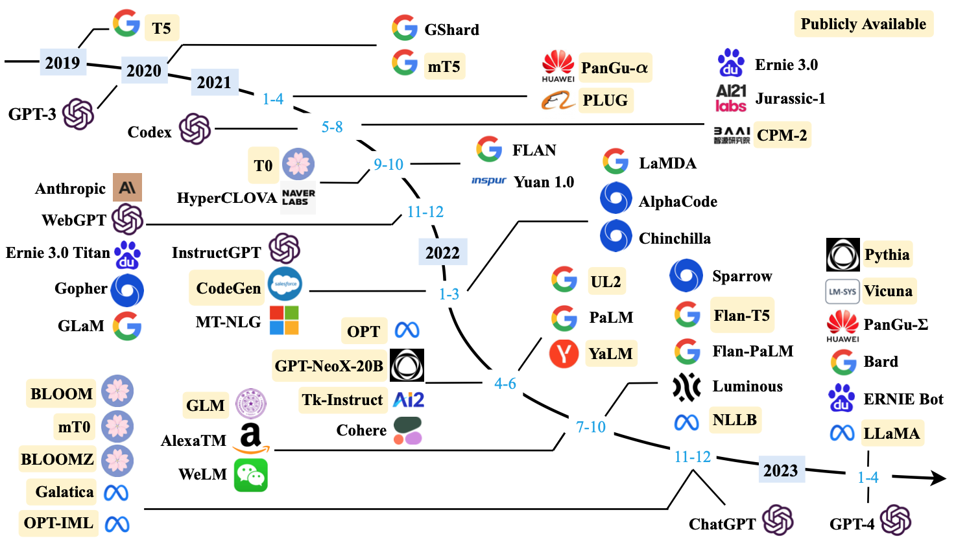
Large Language Models (LLMs) (larger than 10B)
Source: Wayne Xin Zhao, Kun Zhou, Junyi Li, Tianyi Tang, Xiaolei Wang, Yupeng Hou, Yingqian Min et al. (2023) "A Survey of Large Language Models." arXiv preprint arXiv:2303.18223.

Slide 60
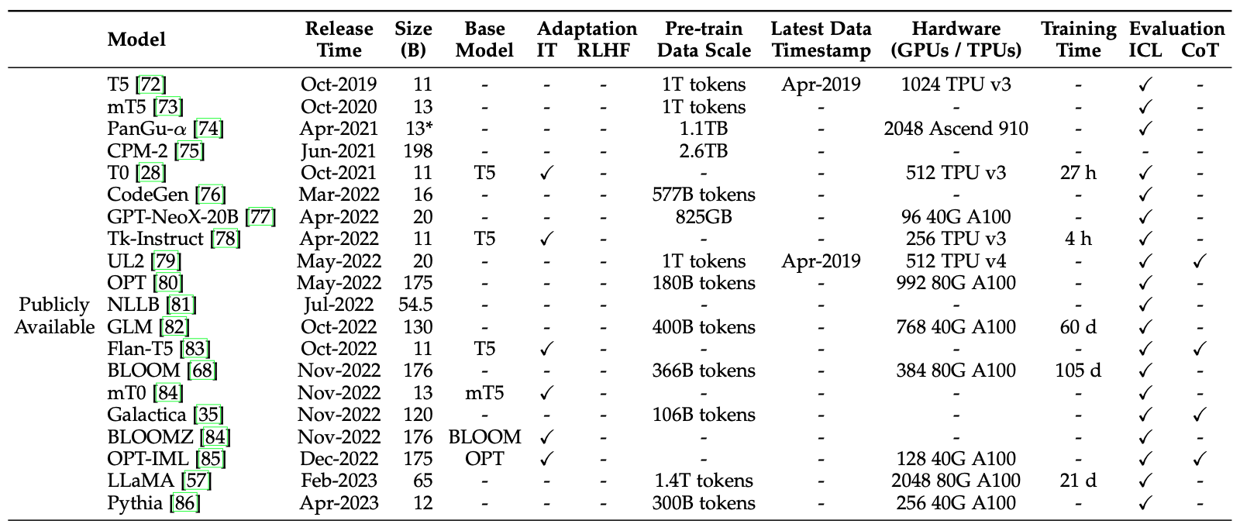
Large Language Models (LLMs) (larger than 10B)
Source: Wayne Xin Zhao, Kun Zhou, Junyi Li, Tianyi Tang, Xiaolei Wang, Yupeng Hou, Yingqian Min et al. (2023) "A Survey of Large Language Models." arXiv preprint arXiv:2303.18223.

Slide 61
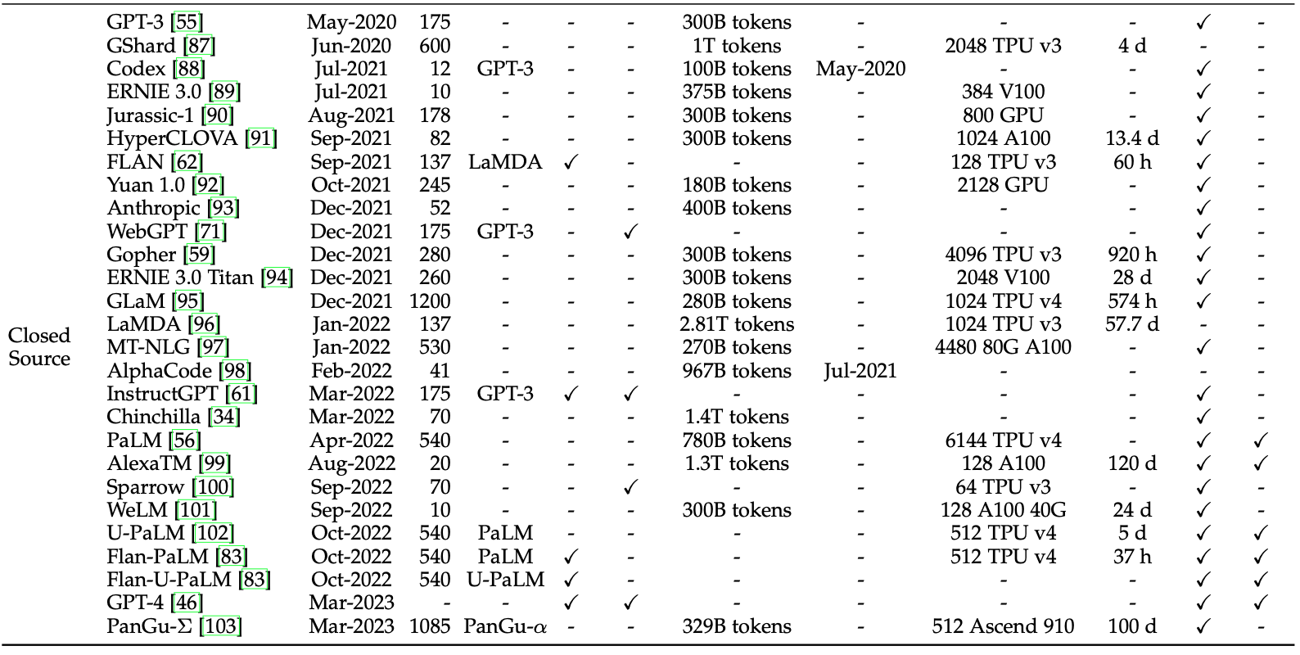
Large Language Models (LLMs) (larger than 10B)
Source: Wayne Xin Zhao, Kun Zhou, Junyi Li, Tianyi Tang, Xiaolei Wang, Yupeng Hou, Yingqian Min et al. (2023) "A Survey of Large Language Models." arXiv preprint arXiv:2303.18223.

Slide 62
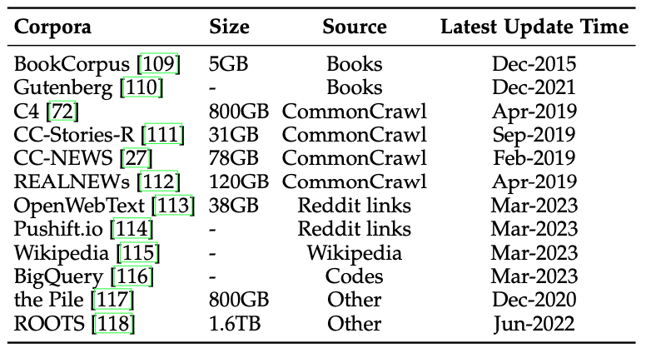
Statistics of Commonly-used Data Sources for LLMs
Source: Wayne Xin Zhao, Kun Zhou, Junyi Li, Tianyi Tang, Xiaolei Wang, Yupeng Hou, Yingqian Min et al. (2023) "A Survey of Large Language Models." arXiv preprint arXiv:2303.18223.

Slide 63
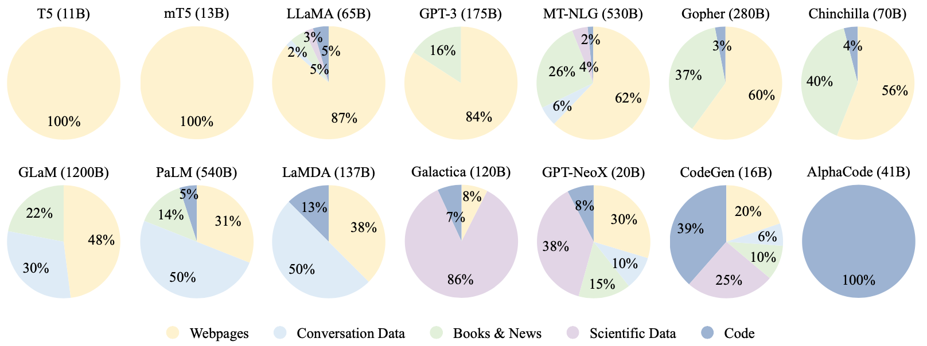
Ratios of various data sources in the pre-training data for existing LLMs
Source: Wayne Xin Zhao, Kun Zhou, Junyi Li, Tianyi Tang, Xiaolei Wang, Yupeng Hou, Yingqian Min et al. (2023) "A Survey of Large Language Models." arXiv preprint arXiv:2303.18223.

Slide 64
Typical Data Preprocessing Pipeline for Pre-training Large Language Models (LLMs)
Source: Wayne Xin Zhao, Kun Zhou, Junyi Li, Tianyi Tang, Xiaolei Wang, Yupeng Hou, Yingqian Min et al. (2023) "A Survey of Large Language Models." arXiv preprint arXiv:2303.18223.

Slide 65
LLMs with Public Configuration Details
Note: PE denotes position embedding, #L denotes the number of layers, #H denotes the number of attention heads, d_{model} denotes the size of hidden states, and MCL denotes the maximum context length during training.
Source: Wayne Xin Zhao, Kun Zhou, Junyi Li, Tianyi Tang, Xiaolei Wang, Yupeng Hou, Yingqian Min et al. (2023) "A Survey of Large Language Models." arXiv preprint arXiv:2303.18223.

Slide 66
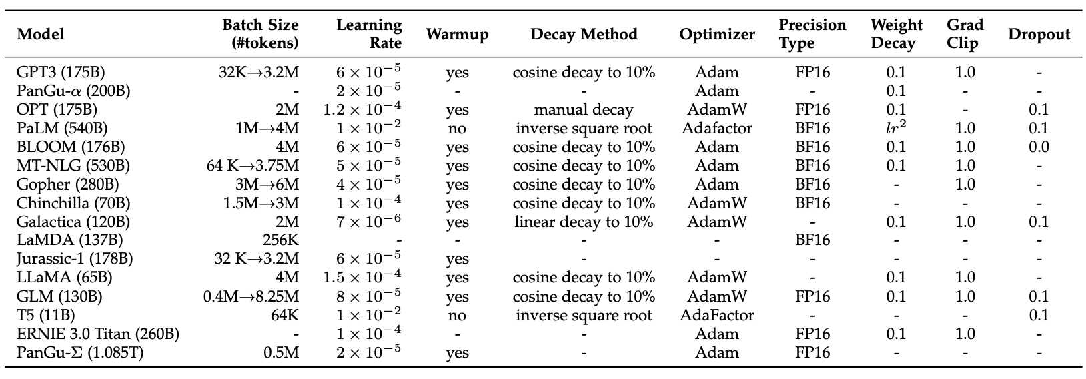
Detailed Optimization Settings of LLMs
Source: Wayne Xin Zhao, Kun Zhou, Junyi Li, Tianyi Tang, Xiaolei Wang, Yupeng Hou, Yingqian Min et al. (2023) "A Survey of Large Language Models." arXiv preprint arXiv:2303.18223.

Slide 67
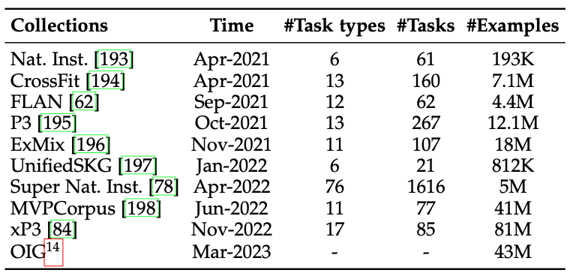
Available Task Collections for Instruction Tuning
Source: Wayne Xin Zhao, Kun Zhou, Junyi Li, Tianyi Tang, Xiaolei Wang, Yupeng Hou, Yingqian Min et al. (2023) "A Survey of Large Language Models." arXiv preprint arXiv:2303.18223.

Slide 68
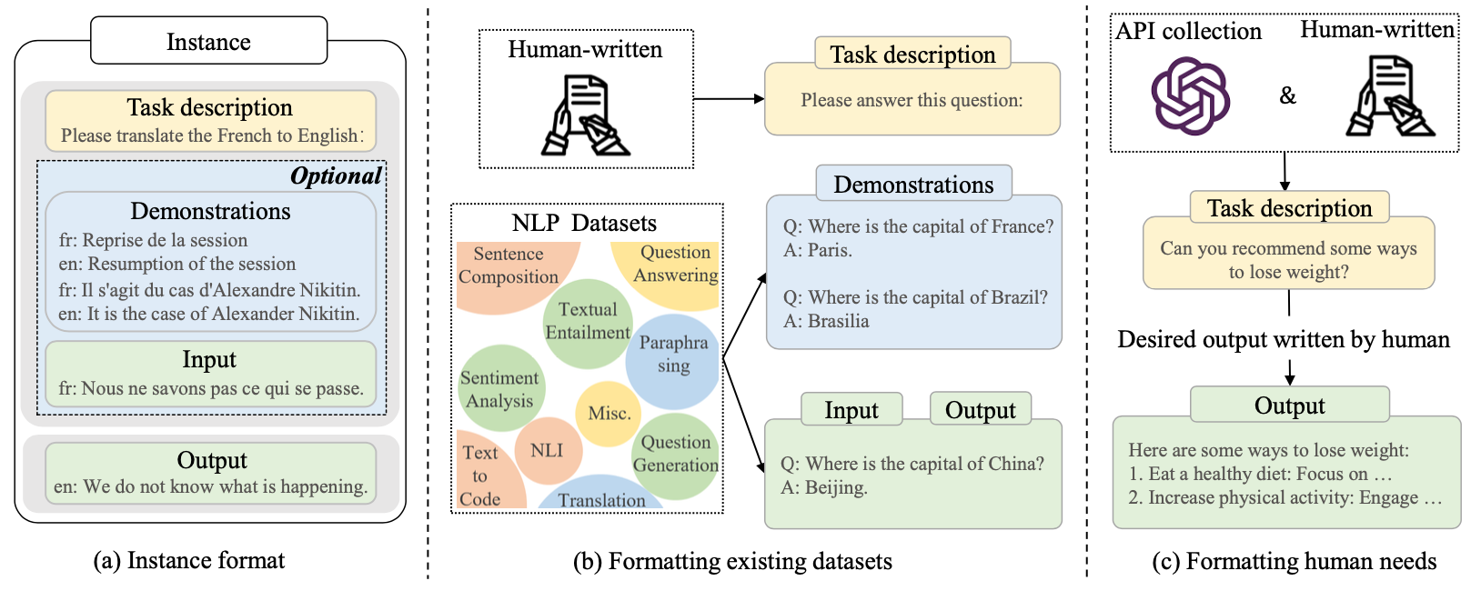
Instance Formatting and Two Different Methods for Constructing the Instruction-formatted Instances
Source: Wayne Xin Zhao, Kun Zhou, Junyi Li, Tianyi Tang, Xiaolei Wang, Yupeng Hou, Yingqian Min et al. (2023) "A Survey of Large Language Models." arXiv preprint arXiv:2303.18223.

Slide 69
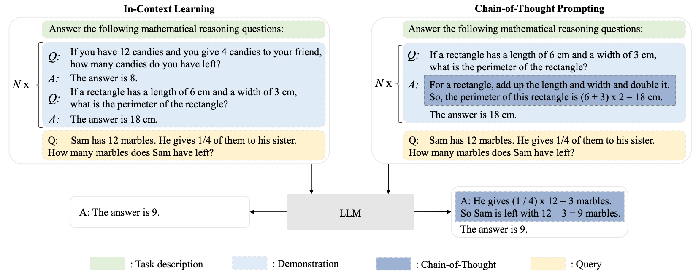
In-context Learning (ICL) and Chain-of-thought (CoT) Prompting
Source: Wayne Xin Zhao, Kun Zhou, Junyi Li, Tianyi Tang, Xiaolei Wang, Yupeng Hou, Yingqian Min et al. (2023) "A Survey of Large Language Models." arXiv preprint arXiv:2303.18223.

Slide 70
Pre-train, Prompt, and Predict: Prompting Methods in Natural Language Processing (LLMs)
Source: Pengfei Liu, Weizhe Yuan, Jinlan Fu, Zhengbao Jiang, Hiroaki Hayashi, and Graham Neubig. (2023) "Pre-train, prompt, and predict: A systematic survey of prompting methods in natural language processing." ACM Computing Surveys 55, no. 9 (2023): 1-35.

Slide 71
Four Paradigms in NLP
Source: Pengfei Liu, Weizhe Yuan, Jinlan Fu, Zhengbao Jiang, Hiroaki Hayashi, and Graham Neubig. (2023) "Pre-train, prompt, and predict: A systematic survey of prompting methods in natural language processing." ACM Computing Surveys 55, no. 9 (2023): 1-35.

Slide 72
Typology of Prompting Methods
Source: Pengfei Liu, Weizhe Yuan, Jinlan Fu, Zhengbao Jiang, Hiroaki Hayashi, and Graham Neubig. (2023) "Pre-train, prompt, and predict: A systematic survey of prompting methods in natural language processing." ACM Computing Surveys 55, no. 9 (2023): 1-35.

Slide 73
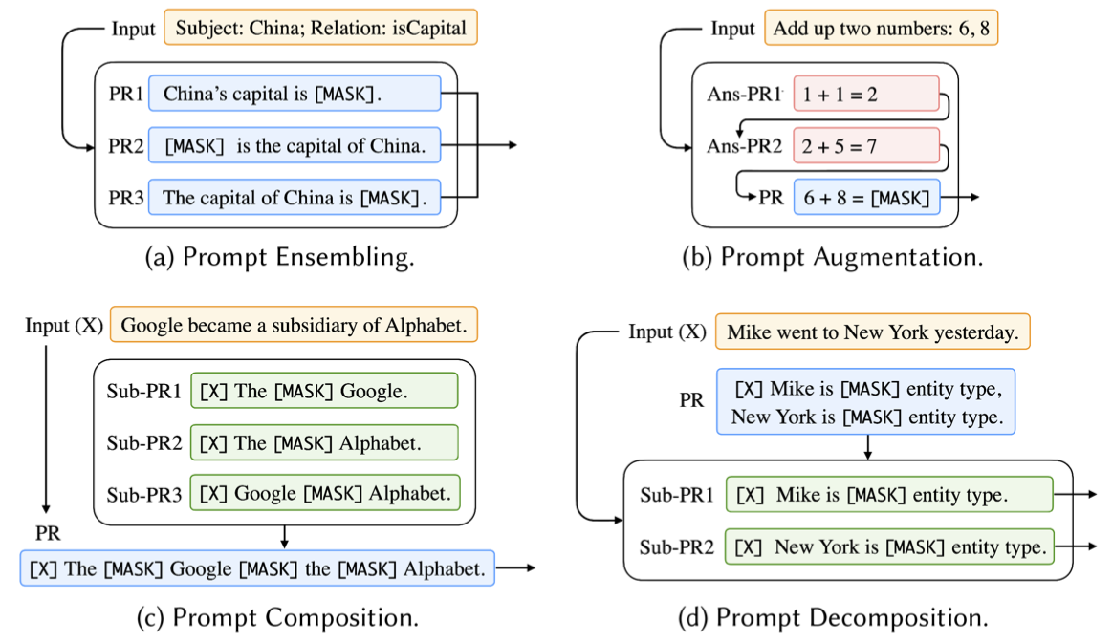
Different Multi-Prompt Learning Strategies
Source: Pengfei Liu, Weizhe Yuan, Jinlan Fu, Zhengbao Jiang, Hiroaki Hayashi, and Graham Neubig. (2023) "Pre-train, prompt, and predict: A systematic survey of prompting methods in natural language processing." ACM Computing Surveys 55, no. 9 (2023): 1-35.

Slide 74
Examples of Input, Template, and Answer for Different Tasks
Source: Pengfei Liu, Weizhe Yuan, Jinlan Fu, Zhengbao Jiang, Hiroaki Hayashi, and Graham Neubig. (2023) "Pre-train, prompt, and predict: A systematic survey of prompting methods in natural language processing." ACM Computing Surveys 55, no. 9 (2023): 1-35.

Slide 75
Characteristics of Different Tuning Strategies
Source: Pengfei Liu, Weizhe Yuan, Jinlan Fu, Zhengbao Jiang, Hiroaki Hayashi, and Graham Neubig. (2023) "Pre-train, prompt, and predict: A systematic survey of prompting methods in natural language processing." ACM Computing Surveys 55, no. 9 (2023): 1-35.

Slide 76
Multi-prompt Learning for Multi-task, Multi-domain, or Multi-lingual Learning
Source: Pengfei Liu, Weizhe Yuan, Jinlan Fu, Zhengbao Jiang, Hiroaki Hayashi, and Graham Neubig. (2023) "Pre-train, prompt, and predict: A systematic survey of prompting methods in natural language processing." ACM Computing Surveys 55, no. 9 (2023): 1-35.

Slide 77
Reinforcement Learning from Human Feedback (RLHF)

Slide 78
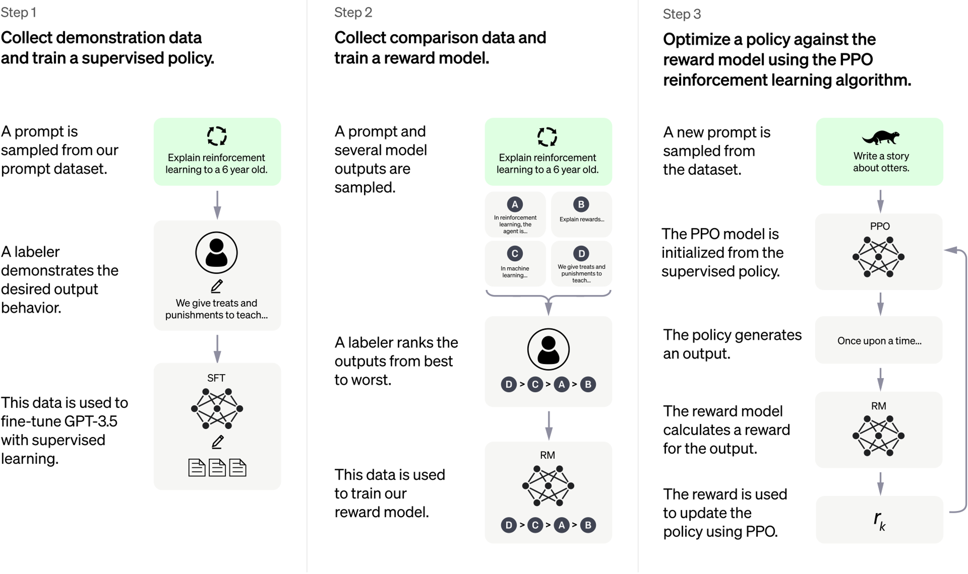
ChatGPT: Optimizing Language Models for Dialogue
Source: https://openai.com/blog/chatgpt/

Slide 79
Training language models to follow instructions with human feedback
InstructGPT and GPT 3.5
Source: Ouyang, L., Wu, J., Jiang, X., Almeida, D., Wainwright, C. L., Mishkin, P., ... & Lowe, R. (2022). Training language models to follow instructions with human feedback. arXiv preprint arXiv:2203.02155.

Slide 80
Reinforcement Learning from Human Feedback (RLHF)
Pretraining a Language Model (LM)
Gathering Data and Training a Reward Model
Fine-tuning the LM with Reinforcement Learning
Source: https://huggingface.co/blog/rlhf

Slide 81
Reinforcement Learning from Human Feedback (RLHF) Step 1. Pretraining a Language Model (LM)
Source: https://huggingface.co/blog/rlhf

Slide 82
Reinforcement Learning from Human Feedback (RLHF) Step 2. Gathering Data and Training a Reward Model
Source: https://huggingface.co/blog/rlhf

Slide 83
Reinforcement Learning from Human Feedback (RLHF) Step 3. Fine-tuning the LM with Reinforcement Learning
Source: https://huggingface.co/blog/rlhf

Slide 84
Foundation Models for Big Data Analytics

Slide 85
Generative AI Text, Image, Video, Audio Applications

Slide 86
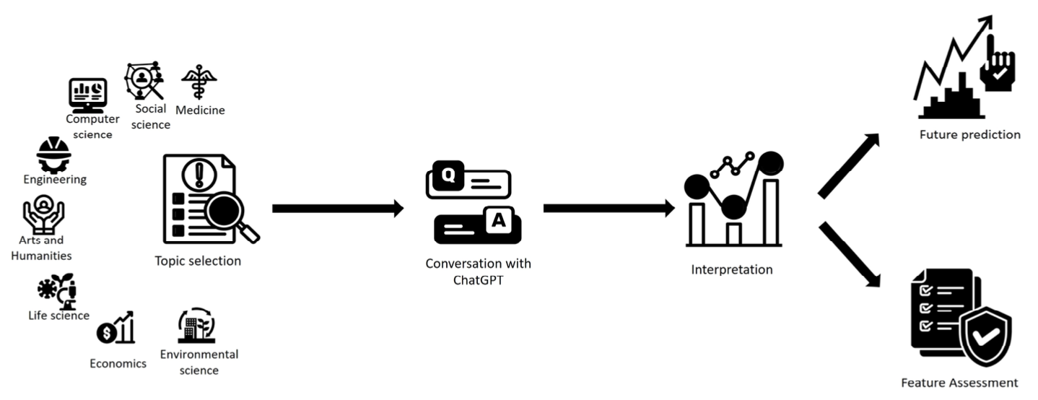
ChatGPT Research
A common trend identified in the reported chatGPT research
Source: Sohail, Shahab Saquib, Faiza Farhat, Yassine Himeur, Mohammad Nadeem, Dag Øivind Madsen, Yashbir Singh, Shadi Atalla, and Wathiq Mansoor. "The Future of GPT: A Taxonomy of Existing ChatGPT Research, Current Challenges, and Possible Future Directions." Current Challenges, and Possible Future Directions (April 8, 2023) (2023).

Slide 87
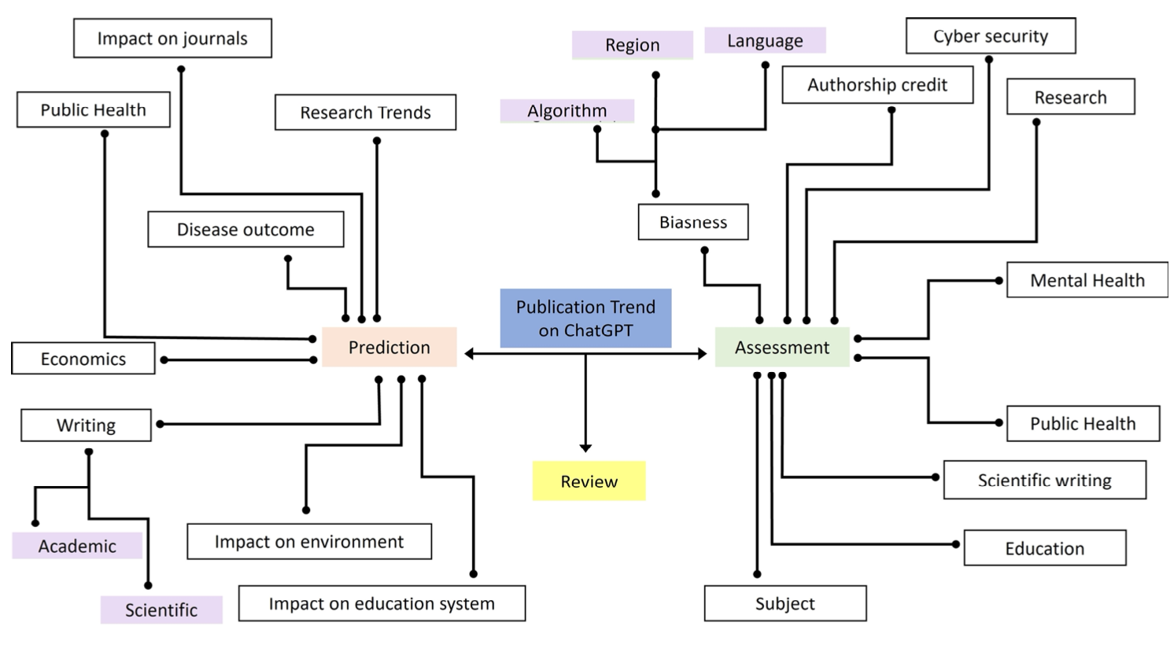
Taxonomy of Literature on ChatGPT
Source: Sohail, Shahab Saquib, Faiza Farhat, Yassine Himeur, Mohammad Nadeem, Dag Øivind Madsen, Yashbir Singh, Shadi Atalla, and Wathiq Mansoor. "The Future of GPT: A Taxonomy of Existing ChatGPT Research, Current Challenges, and Possible Future Directions." Current Challenges, and Possible Future Directions (April 8, 2023) (2023).

Slide 88
Enhancing the Conversational Ability of ChatGPT
Source: Sohail, Shahab Saquib, Faiza Farhat, Yassine Himeur, Mohammad Nadeem, Dag Øivind Madsen, Yashbir Singh, Shadi Atalla, and Wathiq Mansoor. "The Future of GPT: A Taxonomy of Existing ChatGPT Research, Current Challenges, and Possible Future Directions." Current Challenges, and Possible Future Directions (April 8, 2023) (2023).

Slide 89
Domain/Person Specific Personalization of ChatGPT
Source: Sohail, Shahab Saquib, Faiza Farhat, Yassine Himeur, Mohammad Nadeem, Dag Øivind Madsen, Yashbir Singh, Shadi Atalla, and Wathiq Mansoor. "The Future of GPT: A Taxonomy of Existing ChatGPT Research, Current Challenges, and Possible Future Directions." Current Challenges, and Possible Future Directions (April 8, 2023) (2023).

Slide 90
Technological Integration for Multimodal AI
Source: Sohail, Shahab Saquib, Faiza Farhat, Yassine Himeur, Mohammad Nadeem, Dag Øivind Madsen, Yashbir Singh, Shadi Atalla, and Wathiq Mansoor. "The Future of GPT: A Taxonomy of Existing ChatGPT Research, Current Challenges, and Possible Future Directions." Current Challenges, and Possible Future Directions (April 8, 2023) (2023).

Slide 91
Trustworthy AI: Interplay of Various Factors
Source: Sohail, Shahab Saquib, Faiza Farhat, Yassine Himeur, Mohammad Nadeem, Dag Øivind Madsen, Yashbir Singh, Shadi Atalla, and Wathiq Mansoor. "The Future of GPT: A Taxonomy of Existing ChatGPT Research, Current Challenges, and Possible Future Directions." Current Challenges, and Possible Future Directions (April 8, 2023) (2023).

Slide 92
Generative AI Research Areas, Applications and Companies
Source: Yihan Cao, Siyu Li, Yixin Liu, Zhiling Yan, Yutong Dai, Philip S. Yu, and Lichao Sun (2023). "A Comprehensive Survey of AI-Generated Content (AIGC): A History of Generative AI from GAN to ChatGPT." arXiv preprint arXiv:2303.04226.

Slide 93
Applications of Generative AI Models
Source: Yihan Cao, Siyu Li, Yixin Liu, Zhiling Yan, Yutong Dai, Philip S. Yu, and Lichao Sun (2023). "A Comprehensive Survey of AI-Generated Content (AIGC): A History of Generative AI from GAN to ChatGPT." arXiv preprint arXiv:2303.04226.

Slide 94
Generative AI Models
ChatGPT is not all you need
Attention is all you need
Source: Gozalo-Brizuela, Roberto, and Eduardo C. Garrido-Merchan (2023). "ChatGPT is not all you need. A State of the Art Review of large Generative AI models." arXiv preprint arXiv:2301.04655 (2023).

Slide 95
Generative AI Tech Stack
Source: Matt Bornstein, Guido Appenzeller, and Martin Casado (2023), Who Owns the Generative AI Platform?, https://a16z.com/2023/01/19/who-owns-the-generative-ai-platform/

Slide 96
Generative AI Software and Business Factors
Source: Jay Alammar (2023), AI is Eating The World, https://txt.cohere.com/ai-is-eating-the-world/

Slide 97
Generative AI 1. Pre-training Foundation (Pre-trained) Model 2. Fine-turning Custom (Fine-tuned) Model
Source: Jay Alammar (2023), AI is Eating The World, https://txt.cohere.com/ai-is-eating-the-world/

Slide 98
Generative AI Fine-tune Custom Models using Proprietary Data
Source: Jay Alammar (2023), AI is Eating The World, https://txt.cohere.com/ai-is-eating-the-world/

Slide 99
Generative AI Fine-tune Custom Models using Proprietary Data
Source: Jay Alammar (2023), AI is Eating The World, https://txt.cohere.com/ai-is-eating-the-world/

Slide 100
Evaluating the Code Quality of AI-Assisted Code Generation Tools: An Empirical Study on GitHub Copilot, Amazon CodeWhisperer, and ChatGPT

Slide 101
AI-Assisted Code Generation Tools: GitHub Copilot, Amazon CodeWhisperer, and ChatGPT
RQ1 What is the quality of the code generated by the code generation tools?
RQ1.1 How valid are the code generation tools’ code suggestions?
RQ1.2 How correct are code generation tools’ code suggestions?
RQ1.3 How secure are code generation tools’ code suggestions?
RQ1.4 How reliable are code generation tools’ code suggestions?
RQ1.5 How maintainable are code generation tools’ code suggestions?
RQ2 What is the impact of using the docstrings on the generated code quality?
RQ3 What is the impact of using meaningful function names on the generated code quality?
RQ4 How did the code generation tools evolve over time?

Slide 102
AI-Assisted Code Generation Tools: GitHub Copilot, Amazon CodeWhisperer, and ChatGPT

Slide 103
AI-Assisted Code Generation Tools: Experiment Setup

Slide 104
AI-Assisted Code Generation Tools: Experiment Workflow

Slide 105
AI-Assisted Code Generation Tools: Code Correctness

Slide 106
AI-Assisted Code Generation Tools: Code Correctness
ChatGPT
GitHub Copilot

Slide 107
Code Generation Models: BERT, T5, GPT-3, CodeBERT CodeGPT, CodeX
Pretrained
Model
Backbone
Parameter
Pretrained Dataset
Size of Dataset
Trained Language

Slide 108
Generative AI
Source: https://base10.vc/post/generative-ai-mission-critical/

Slide 109
Generative AI
Source: https://base10.vc/post/generative-ai-mission-critical/

Slide 110
Generative AI
Source: https://base10.vc/post/generative-ai-mission-critical/

Slide 111
DALL·E 2 Create original, realistic images and art from a text description. It can combine concepts, attributes, and styles.
https://openai.com/dall-e-2/

Slide 112
The Model Structure of DALL-E-2
CLIP Pre-training
Image Generation
Source: Yihan Cao, Siyu Li, Yixin Liu, Zhiling Yan, Yutong Dai, Philip S. Yu, and Lichao Sun (2023). "A Comprehensive Survey of AI-Generated Content (AIGC): A History of Generative AI from GAN to ChatGPT." arXiv preprint arXiv:2303.04226.

Slide 113
Stable Diffusion
https://huggingface.co/spaces/stabilityai/stable-diffusion

Slide 114
Stable Diffusion Colab
https://github.com/woctezuma/stable-diffusion-colab

Slide 115
Stable Diffusion Reimagine
https://clipdrop.co/stable-diffusion-reimagine

Slide 116
Lexica Art: Search Stable Diffusion images and prompts
https://lexica.art/

Slide 117
Civitai: Stable Diffusion AI Art Models
https://civitai.com/

Slide 118
NLG from a Multilingual, Multimodal and Multi-task perspective
Source: Erdem, Erkut, Menekse Kuyu, Semih Yagcioglu, Anette Frank, Letitia Parcalabescu, Barbara Plank, Andrii Babii et al. "Neural Natural Language Generation: A Survey on Multilinguality, Multimodality, Controllability and Learning." Journal of Artificial Intelligence Research 73 (2022): 1131-1207.

Slide 119
Text-and-Video Dialog Generation Models with Hierarchical Attention
Source: Erdem, Erkut, Menekse Kuyu, Semih Yagcioglu, Anette Frank, Letitia Parcalabescu, Barbara Plank, Andrii Babii et al. "Neural Natural Language Generation: A Survey on Multilinguality, Multimodality, Controllability and Learning." Journal of Artificial Intelligence Research 73 (2022): 1131-1207.

Slide 120
Multimodal Few-Shot Learning with Frozen Language Models
Curated samples with about five seeds required to get past well-known language model failure modes of either repeating text for the prompt or emitting text that does not pertain to the image.
These samples demonstrate the ability to generate open-ended outputs that adapt to both images and text, and to make use of facts that it has learned during language-only pre-training.
Source: Maria Tsimpoukelli, Jacob L. Menick, Serkan Cabi, S. M. Eslami, Oriol Vinyals, and Felix Hill (2021). "Multimodal few-shot learning with frozen language models." Advances in Neural Information Processing Systems 34 (2021): 200-212.

Slide 121
Multimodal Pipeline that includes three different modalities (Image, Text. Audio)
Source: Bayoudh, Khaled, Raja Knani, Fayçal Hamdaoui, and Abdellatif Mtibaa (2022). "A survey on deep multimodal learning for computer vision: advances, trends, applications, and datasets." The Visual Computer 38, no. 8: 2939-2970.

Slide 122
Video and Audio Multimodal Fusion
Source: Bayoudh, Khaled, Raja Knani, Fayçal Hamdaoui, and Abdellatif Mtibaa (2022). "A survey on deep multimodal learning for computer vision: advances, trends, applications, and datasets." The Visual Computer 38, no. 8: 2939-2970.

Slide 123
Visual and Textual Representation
Source: Bayoudh, Khaled, Raja Knani, Fayçal Hamdaoui, and Abdellatif Mtibaa (2022). "A survey on deep multimodal learning for computer vision: advances, trends, applications, and datasets." The Visual Computer 38, no. 8: 2939-2970.

Slide 124
Hybrid Multimodal Data Fusion
Text
Audio
Image
Text
Speech
Video
Source: Bayoudh, Khaled, Raja Knani, Fayçal Hamdaoui, and Abdellatif Mtibaa (2022). "A survey on deep multimodal learning for computer vision: advances, trends, applications, and datasets." The Visual Computer 38, no. 8: 2939-2970.

Slide 125
Multimodal Transfer Learning
Source: Bayoudh, Khaled, Raja Knani, Fayçal Hamdaoui, and Abdellatif Mtibaa (2022). "A survey on deep multimodal learning for computer vision: advances, trends, applications, and datasets." The Visual Computer 38, no. 8: 2939-2970.

Slide 126
CLIP: Learning Transferable Visual Models From Natural Language Supervision
Source: Radford, Alec, Jong Wook Kim, Chris Hallacy, Aditya Ramesh, Gabriel Goh, Sandhini Agarwal, Girish Sastry et al. (2021) "Learning transferable visual models from natural language supervision." In International Conference on Machine Learning, pp. 8748-8763. PMLR.

Slide 127
ViLT: Vision-and-Language Transformer Without Convolution or Region Supervision
Source: Kim, Wonjae, Bokyung Son, and Ildoo Kim (2021). "Vilt: Vision-and-language transformer without convolution or region supervision." In International Conference on Machine Learning, pp. 5583-5594. PMLR.

Slide 128
wav2vec 2.0: A framework for self-supervised learning of speech representations
Source: Baevski, Alexei, Yuhao Zhou, Abdelrahman Mohamed, and Michael Auli. "wav2vec 2.0: A framework for self-supervised learning of speech representations." Advances in Neural Information Processing Systems 33 (2020): 12449-12460.

Slide 129
Whisper: Robust Speech Recognition via Large-Scale Weak Supervision
Source: Radford, Alec, Jong Wook Kim, Tao Xu, Greg Brockman, Christine McLeavey, and Ilya Sutskever. Robust speech recognition via large-scale weak supervision. Tech. Rep., Technical report, OpenAI, 2022.

Slide 130
Microsoft Azure Text to Speech (TTS)
Source: https://azure.microsoft.com/en-gb/products/cognitive-services/text-to-speech/

Slide 131
Hugging Face
https://huggingface.co/

Slide 132
BLOOM BigScience Large Open-science Open-access Multilingual Language Model
Source: https://huggingface.co/bigscience/bloom

Slide 133
OpenAI Whisper
Source: https://huggingface.co/spaces/openai/whisper

Slide 134
Computer vision in the metaverse with scene understanding, object detection, and human action/activity recognition
Source: Huynh-The, Thien, Quoc-Viet Pham, Xuan-Qui Pham, Thanh Thi Nguyen, Zhu Han, and Dong-Seong Kim (2022). "Artificial Intelligence for the Metaverse: A Survey." arXiv preprint arXiv:2202.10336.

Slide 135
DUALENC: A KG-to-Text Generation Model KG and Graph via Dual-encoding
Source: Yihan Cao, Siyu Li, Yixin Liu, Zhiling Yan, Yutong Dai, Philip S. Yu, and Lichao Sun (2023). "A Comprehensive Survey of AI-Generated Content (AIGC): A History of Generative AI from GAN to ChatGPT." arXiv preprint arXiv:2303.04226.

Slide 136
Papers with Code State-of-the-Art (SOTA)
https://paperswithcode.com/sota

Slide 137
Summary
ChatGPT
Large Language Models (LLMs)
Foundation Models for Big Data Analytics

Slide 138
References
Yihan Cao, Siyu Li, Yixin Liu, Zhiling Yan, Yutong Dai, Philip S. Yu, and Lichao Sun (2023). "A Comprehensive Survey of AI-Generated Content (AIGC): A History of Generative AI from GAN to ChatGPT." arXiv preprint arXiv:2303.04226.
Pengfei Liu, Weizhe Yuan, Jinlan Fu, Zhengbao Jiang, Hiroaki Hayashi, and Graham Neubig. (2023) "Pre-train, prompt, and predict: A systematic survey of prompting methods in natural language processing." ACM Computing Surveys 55, no. 9 (2023): 1-35.
Wayne Xin Zhao, Kun Zhou, Junyi Li, Tianyi Tang, Xiaolei Wang, Yupeng Hou, Yingqian Min et al. (2023) "A Survey of Large Language Models." arXiv preprint arXiv:2303.18223.
Gozalo-Brizuela, Roberto, and Eduardo C. Garrido-Merchan (2023). "ChatGPT is not all you need. A State of the Art Review of large Generative AI models." arXiv preprint arXiv:2301.04655 (2023).
Wenliang Dai, Junnan Li, Dongxu Li, Anthony Meng Huat Tiong, Junqi Zhao, Weisheng Wang, Boyang Li, Pascale Fung, and Steven Hoi. (2023) "InstructBLIP: Towards General-purpose Vision-Language Models with Instruction Tuning." arXiv preprint arXiv:2305.06500 (2023).
Shahab Saquib Sohail, Faiza Farhat, Yassine Himeur, Mohammad Nadeem, Dag Øivind Madsen, Yashbir Singh, Shadi Atalla, and Wathiq Mansoor (2023). "The Future of GPT: A Taxonomy of Existing ChatGPT Research, Current Challenges, and Possible Future Directions." Current Challenges, and Possible Future Directions (April 8, 2023) (2023).
Stuart Russell and Peter Norvig (2020), Artificial Intelligence: A Modern Approach, 4th Edition, Pearson
Thorsten Schoormann, Gero Strobel, Frederik Möller, Dimitri Petrik, and Patrick Zschech (2023). "Artificial Intelligence for Sustainability—A Systematic Review of Information Systems Literature." Communications of the Association for Information Systems 52, no. 1 (2023): 8.
Junliang Wang, Chuqiao Xu, Jie Zhang, and Ray Zhong (2022). "Big data analytics for intelligent manufacturing systems: A review." Journal of Manufacturing Systems 62 (2022): 738-752.
Longbing Cao (2022). "Decentralized ai: Edge intelligence and smart blockchain, metaverse, web3, and desci." IEEE Intelligent Systems 37, no. 3: 6-19.
Qinglin Yang, Yetong Zhao, Huawei Huang, Zehui Xiong, Jiawen Kang, and Zibin Zheng (2022). "Fusing blockchain and AI with metaverse: A survey." IEEE Open Journal of the Computer Society 3 : 122-136.
Russell Belk, Mariam Humayun, and Myriam Brouard (2022). "Money, possessions, and ownership in the Metaverse: NFTs, cryptocurrencies, Web3 and Wild Markets." Journal of Business Research 153: 198-205.
Thien Huynh-The, Quoc-Viet Pham, Xuan-Qui Pham, Thanh Thi Nguyen, Zhu Han, and Dong-Seong Kim (2022). "Artificial Intelligence for the Metaverse: A Survey." arXiv preprint arXiv:2202.10336.
Thippa Reddy Gadekallu, Thien Huynh-The, Weizheng Wang, Gokul Yenduri, Pasika Ranaweera, Quoc-Viet Pham, Daniel Benevides da Costa, and Madhusanka Liyanage (2022). "Blockchain for the Metaverse: A Review." arXiv preprint arXiv:2203.09738.
Ouyang, L., Wu, J., Jiang, X., Almeida, D., Wainwright, C. L., Mishkin, P., ... & Lowe, R. (2022). Training language models to follow instructions with human feedback. arXiv preprint arXiv:2203.02155.

