Slide 1








Event Studies in Finance
Artificial Intelligence in Finance and Quantitative Analysis
1111AIFQA04
MBA, IM, NTPU (M6132) (Fall 2022)
Tue 2, 3, 4 (9:10-12:00) (B8F40)
Min-Yuh Day, Ph.D,
Associate Professor
Institute of Information Management, National Taipei University
https://web.ntpu.edu.tw/~myday
https://meet.google.com/paj-zhhj-mya
2022-10-04

Slide 2
Syllabus
Week Date Subject/Topics
1 2022/09/13 Introduction to Artificial Intelligence in Finance and
Quantitative Analysis
2 2022/09/20 AI in FinTech: Metaverse, Web3, DeFi, NFT,
Financial Services Innovation and Applications
3 2022/09/27 Investing Psychology and Behavioral Finance
4 2022/10/04 Event Studies in Finance
5 2022/10/11 Case Study on AI in Finance and Quantitative Analysis I
6 2022/10/18 Finance Theory

Slide 3
Syllabus
Week Date Subject/Topics
7 2022/10/25 Data-Driven Finance
8 2022/11/01 Midterm Project Report
9 2022/11/08 Financial Econometrics
10 2022/11/15 AI-First Finance
11 2022/11/22 Industry Practices of AI in Finance and Quantitative
Analysis
12 2022/11/29 Case Study on AI in Finance and Quantitative Analysis II

Slide 4
Syllabus
Week Date Subject/Topics
13 2022/12/06 Deep Learning in Finance;
Reinforcement Learning in Finance
14 2022/12/13 Algorithmic Trading; Risk Management;
Trading Bot and Event-Based Backtesting
15 2022/12/20 Final Project Report I
16 2022/12/27 Final Project Report II
17 2023/01/03 Self-learning
18 2023/01/10 Self-learning

Slide 5
Event Studies in Finance

Slide 6
Outline
Event Studies in Finance
Event Studies for Financial Research
Event Study Methodology
Efficient Market Hypothesis (EMH)
  Efficient Markets
  Inefficient Markets

Slide 7
Doron Kliger and Gregory Gurevich (2014),
Event Studies for Financial Research:
A Comprehensive Guide,
Palgrave Macmillan
Source: https://www.amazon.com/Event-Studies-Financial-Research-Comprehensive/dp/1137435380/

Slide 8
Event Studies in Finance
Event studies are widely used in finance research
to investigate the implications of
  Announcements of corporate initiatives
    Mergers and acquisitions, equity and debt issuance, dividends and repurchases, corporate restructuring
  Regulatory changes
    Board reform, compensation, changes in taxation, workplace safety
  Macroeconomic shocks on stock prices
    The COVID-19 pandemic, Brexit, the Paris Agreement
Source: El Ghoul, Sadok, Omrane Guedhami, Sattar A. Mansi, and Oumar Sy (2022). "Event studies in international finance research." Journal of International Business Studies : 1-21.

Slide 9
Firm-level Event Studies
M&As
Restructuring
Equity issuance
Dividends
Analyst forecasts and recommendations
Earnings
Source: El Ghoul, Sadok, Omrane Guedhami, Sattar A. Mansi, and Oumar Sy (2022). "Event studies in international finance research." Journal of International Business Studies : 1-21.

Slide 10
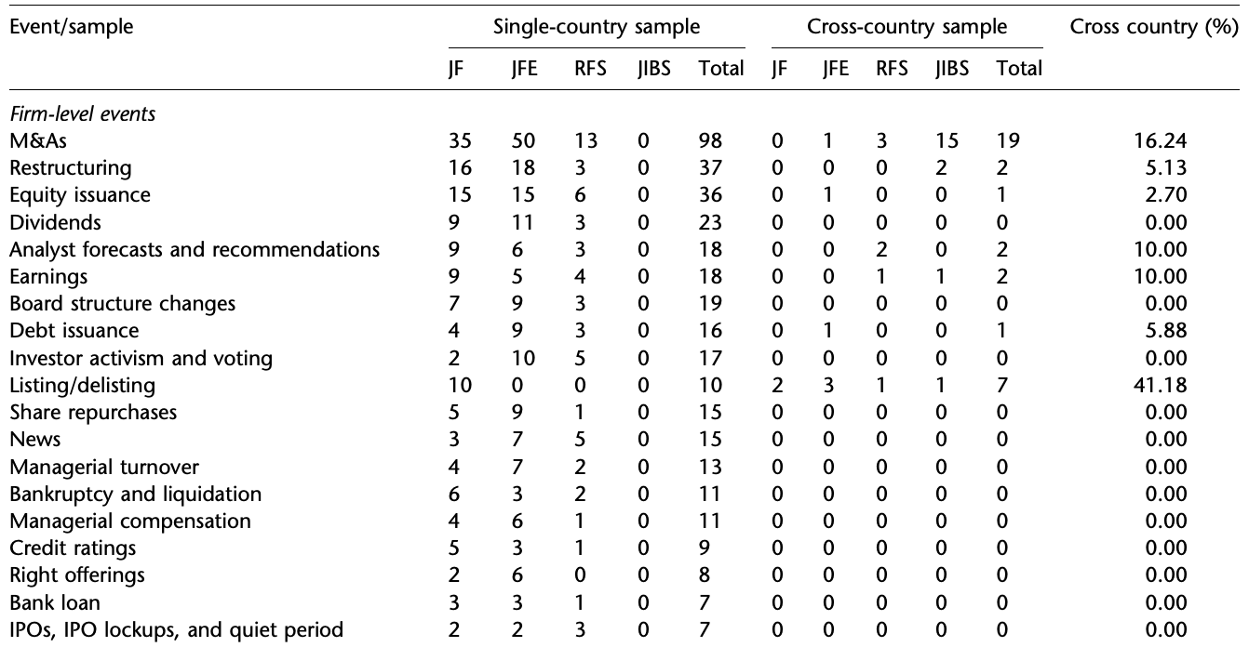
Single- and Cross-county Event Studies published in the four major finance and IB journals
Firm-level events
Source: El Ghoul, Sadok, Omrane Guedhami, Sattar A. Mansi, and Oumar Sy (2022). "Event studies in international finance research." Journal of International Business Studies : 1-21.

Slide 11
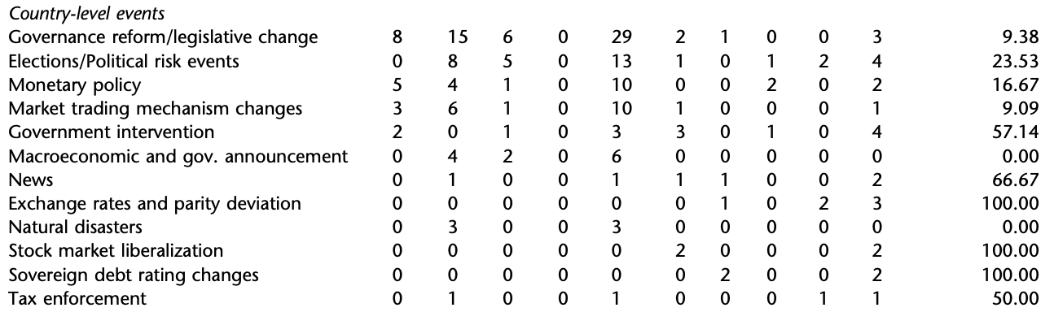
Single- and Cross-county Event Studies published in the four major finance and IB journals
Country-level events
Source: El Ghoul, Sadok, Omrane Guedhami, Sattar A. Mansi, and Oumar Sy (2022). "Event studies in international finance research." Journal of International Business Studies : 1-21.

Slide 12
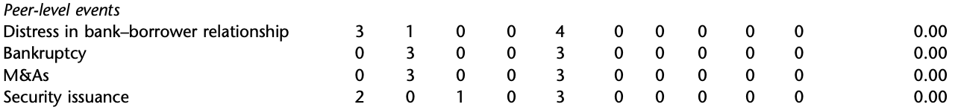
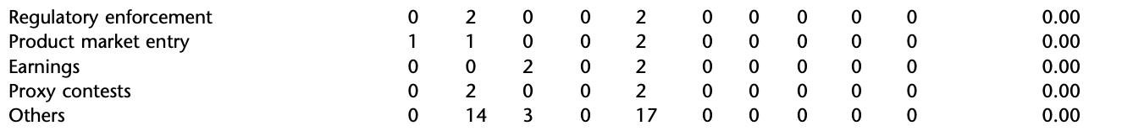
Single- and Cross-county Event Studies published in the four major finance and IB journals
Peer-level events
Source: El Ghoul, Sadok, Omrane Guedhami, Sattar A. Mansi, and Oumar Sy (2022). "Event studies in international finance research." Journal of International Business Studies : 1-21.

Slide 13
Event Studies for
Financial Research

Slide 14
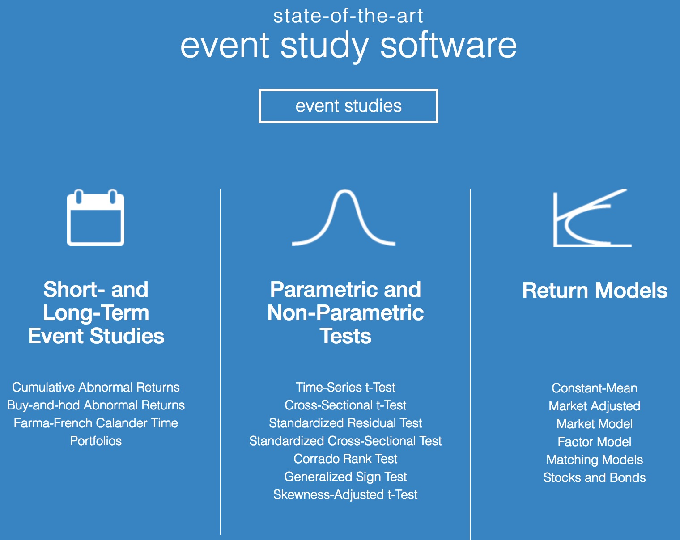
https://eventstudymetrics.com/

Slide 15
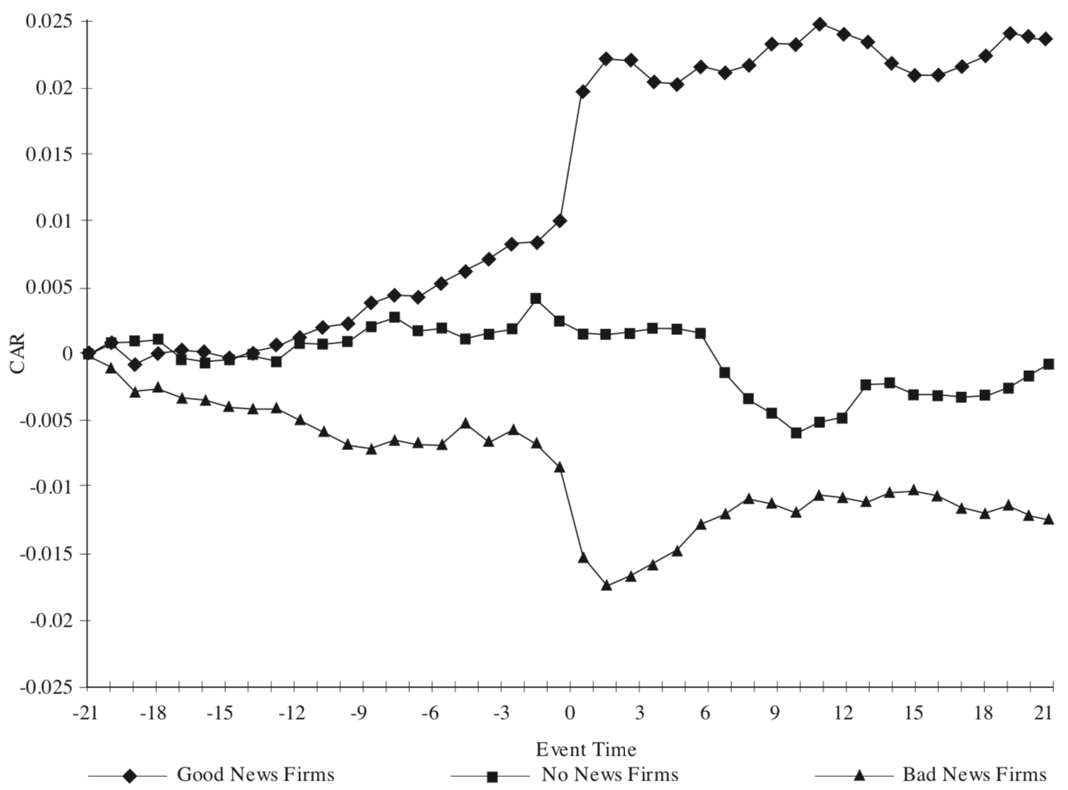
Event Studies in Economics and Finance
Good News
No News
Bad News
Source: MacKinlay, A. C. (1997). Event studies in economics and finance. Journal of economic literature, 35(1), 13-39.

Slide 16
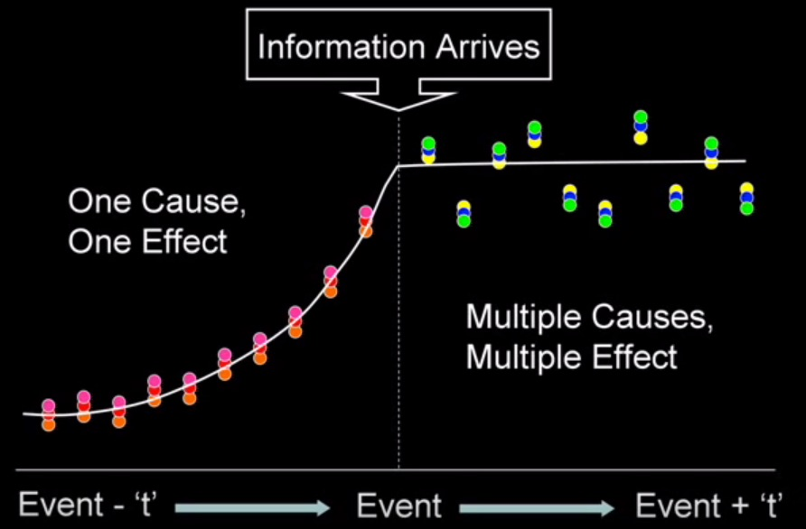
Event Study
Source: Rajesh Mudholkar (2014), "Event studies: Confirms Market Efficiency or Behavioral Anomalies?", https://www.youtube.com/watch?v=VErwDaQNB74

Slide 17
Event Study
Time line for an event study
Event
Source: https://eventstudymetrics.com/index.php/event-study-methodology/

Slide 18
Event Study Methodology
estimation
window
event
window
post event
window
T₀
T₁
0
T₂
T₃
L₁
L₂
Source: https://eventstudymetrics.com/index.php/event-study-methodology/

Slide 19
Event Study Methodology
estimation
window
event
window
post event
window
-30
-5 -4 -3 -2 -1 0 +1 +2 +3 +4 +5
+30
T₀
T₁
0
T₂
T₃
L₁
L₂
Source: https://eventstudymetrics.com/index.php/event-study-methodology/

Slide 20
Event Study Methodology
estimation
window
event
window
post event
window
-260
-10 0 +10
+30
T₀
T₁
0
T₂
T₃
L₁
L₂
Source: https://eventstudymetrics.com/index.php/event-study-methodology/

Slide 21
Efficient Markets

Slide 22
Behavioral Economics

Slide 23
Behavioral Finance

Slide 24
Rational Behavior
Irrational Behavior

Slide 25
Emotion
Sentiment

Slide 26
Modern Financial Research
Theoretical Finance
  study of logical relationships among assets.
Empirical Finance
  study of data in order to infer relationships.
Behavioral Finance
  integrates psychology into the investment process.
Source: Robert A. Strong (2004), Practical Investment Management, South-Western

Slide 27
Behavioral Finance Themes
Heuristic-Driven Bias
Framing Dependence
Inefficient Markets
Source: Hersh Shefrin (2007), “Beyond Greed and Fear: Understanding Behavioral Finance and the Psychology of Investing”, Oxford University Press.

Slide 28
Efficient Market Hypothesis
(EMH)
Source: Doron Kliger and Gregory Gurevich (2014), Event Studies for Financial Research: A Comprehensive Guide, Palgrave Macmillan

Slide 29
Efficient Market Hypothesis (EMH) (Fama, 1970)
Efficient capital markets: A review of theory and empirical work
EF Fama - The Journal of Finance, 1970
This paper reviews the theoretical and empirical iterature on the efficient markets model.
After a discussion of the theory, empirical work concerned with the adjustment of security
prices to three relevant information subsets is considered. First, weak form tests, in which the
information set is just historical prices, are discussed. Then semi-strong form tests, in which
the concern is whether prices efficiently adjust to other information that is obviously ...
Cited by 34710 Related articles All 27 versions
Malkiel, B. G., & Fama, E. F. (1970).
Efficient capital markets: A review of theory and empirical work. The Journal of Finance, 25(2), 383-417.

Slide 30
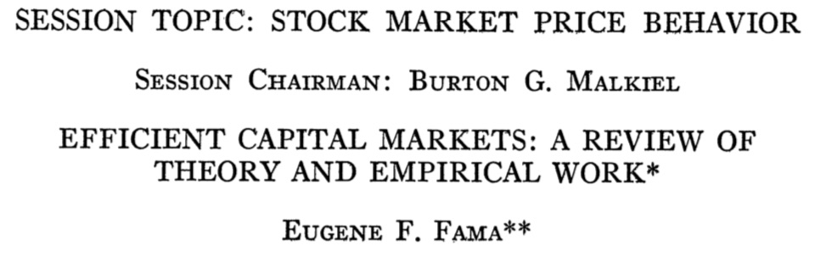
Efficient Market Hypothesis (EMH) (Fama, 1970)
Malkiel, B. G., & Fama, E. F. (1970).
Efficient capital markets: A review of theory and empirical work. The Journal of Finance, 25(2), 383-417.

Slide 31
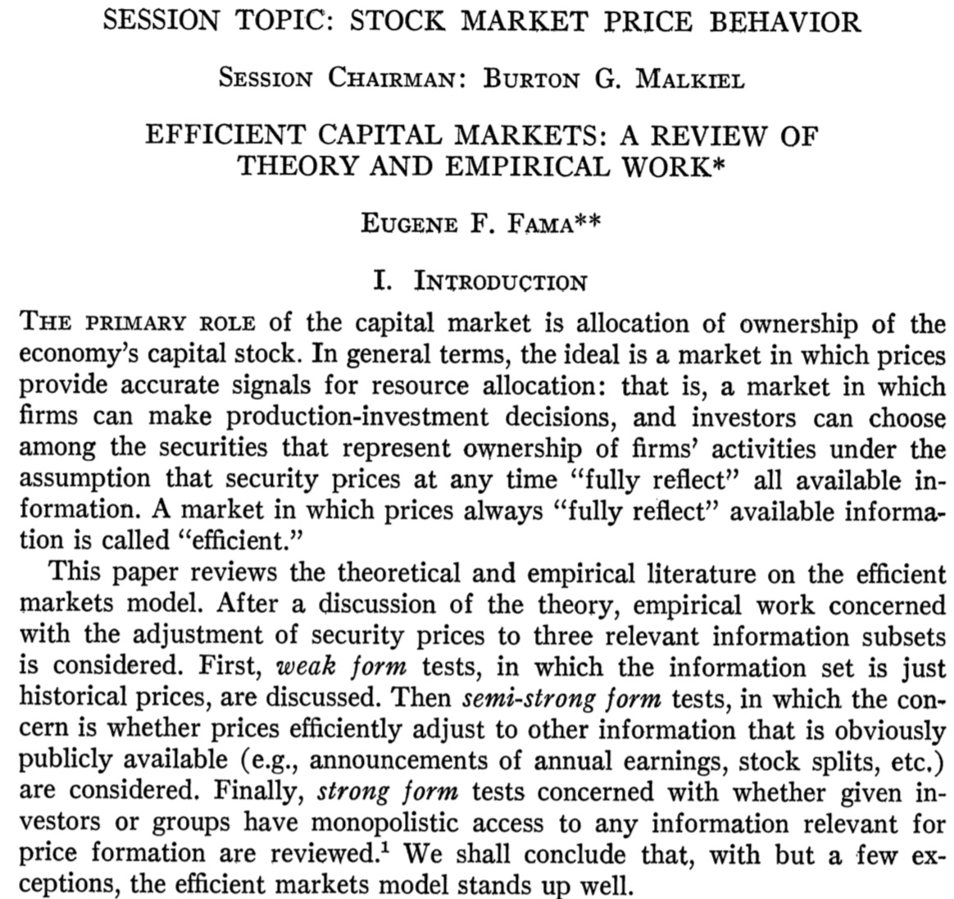
Efficient Market Hypothesis (EMH) (Fama, 1970)
Source: Malkiel, B. G., & Fama, E. F. (1970). Efficient capital markets: A review of theory and empirical work. The Journal of Finance, 25(2), 383-417.

Slide 32
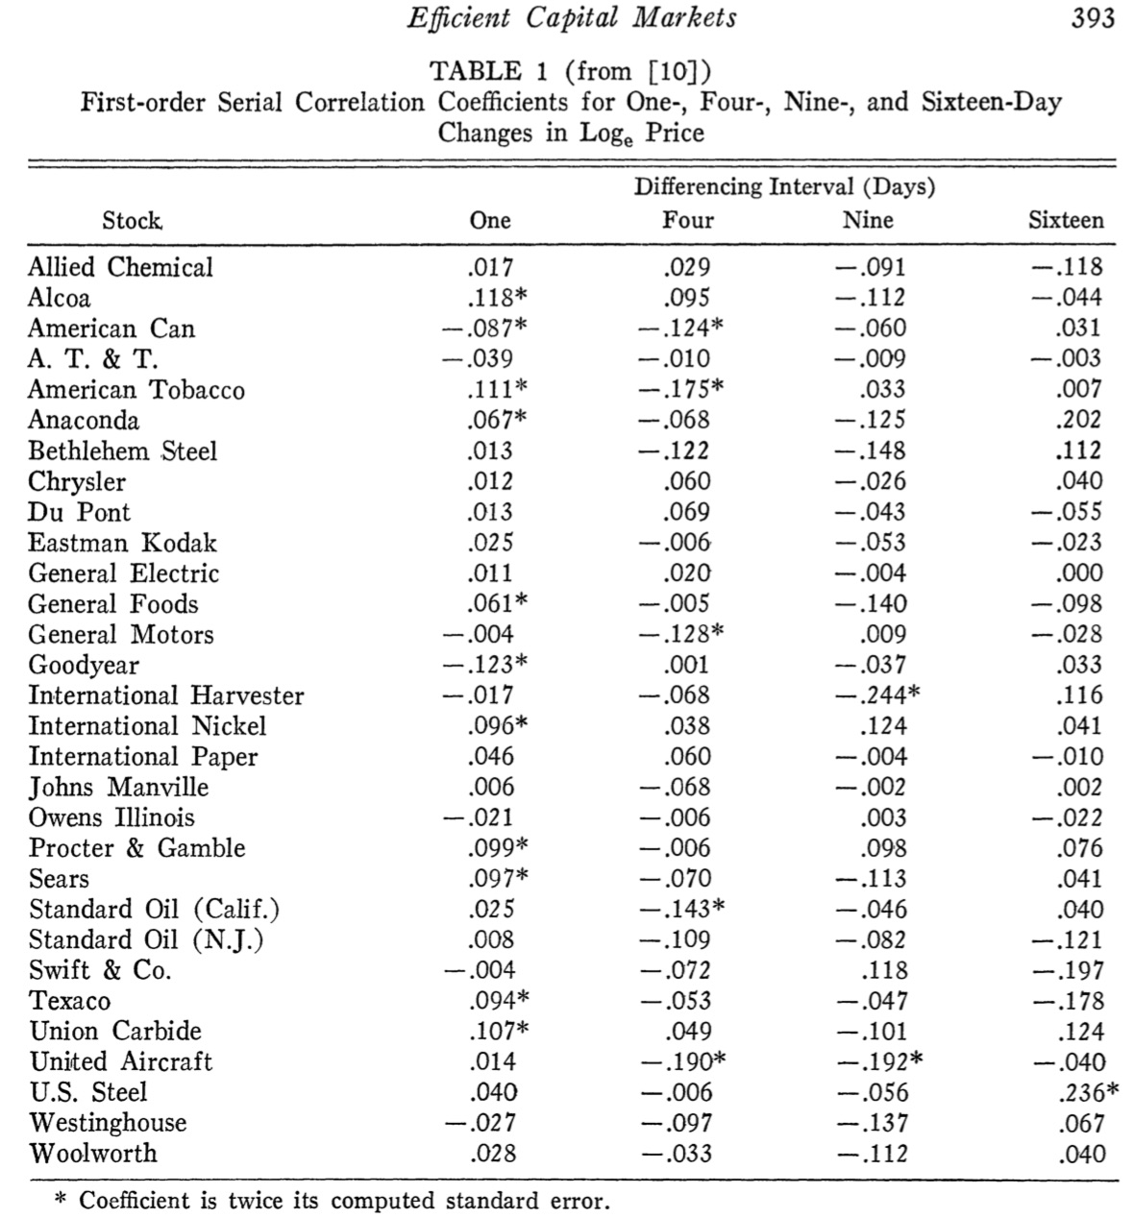
Source: Malkiel, B. G., & Fama, E. F. (1970). Efficient capital markets: A review of theory and empirical work. The Journal of Finance, 25(2), 383-417.

Slide 33
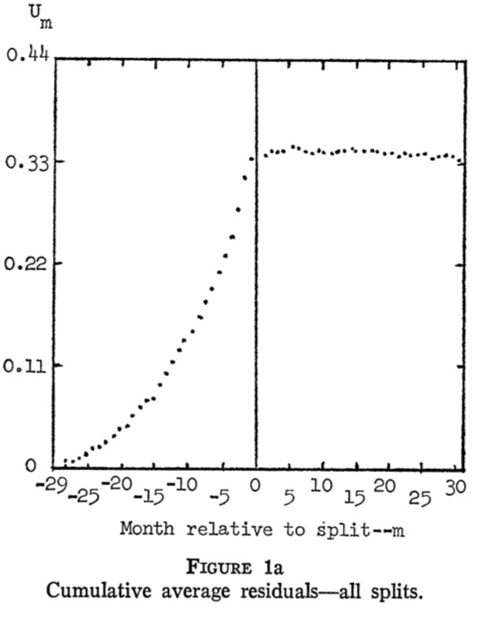
Cumulative Average Residuals
Source: Malkiel, B. G., & Fama, E. F. (1970). Efficient capital markets: A review of theory and empirical work. The Journal of Finance, 25(2), 383-417.

Slide 34
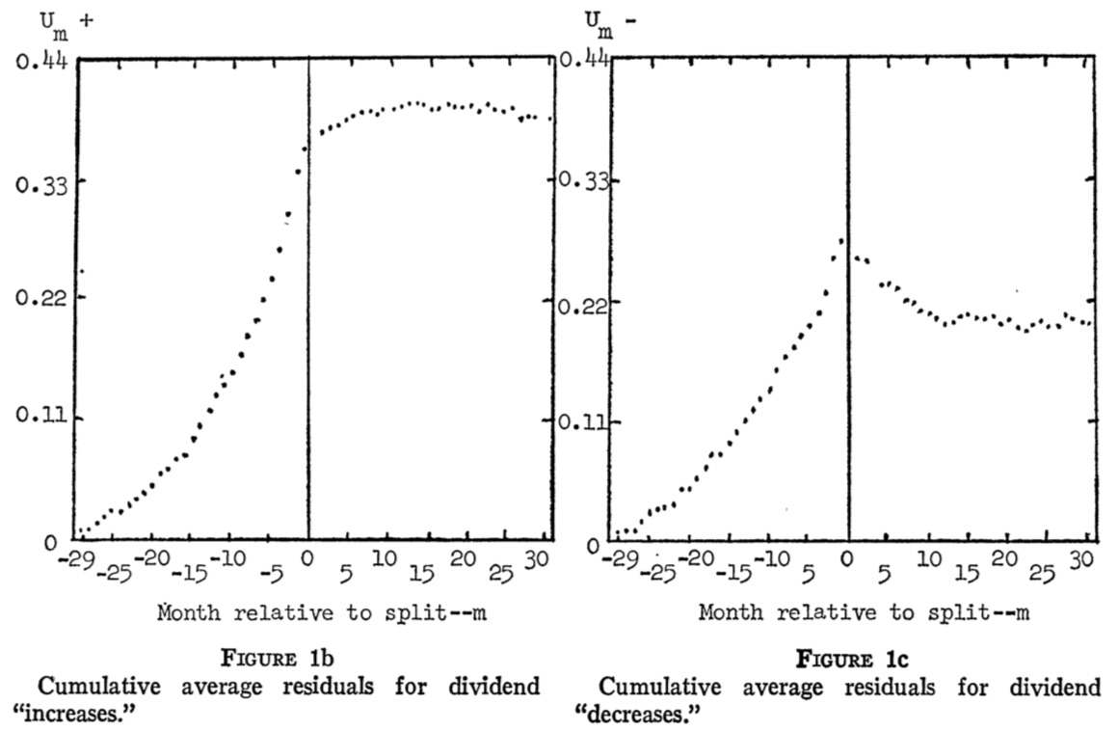
Cumulative Average Residuals
Source: Malkiel, B. G., & Fama, E. F. (1970). Efficient capital markets: A review of theory and empirical work. The Journal of Finance, 25(2), 383-417.

Slide 35
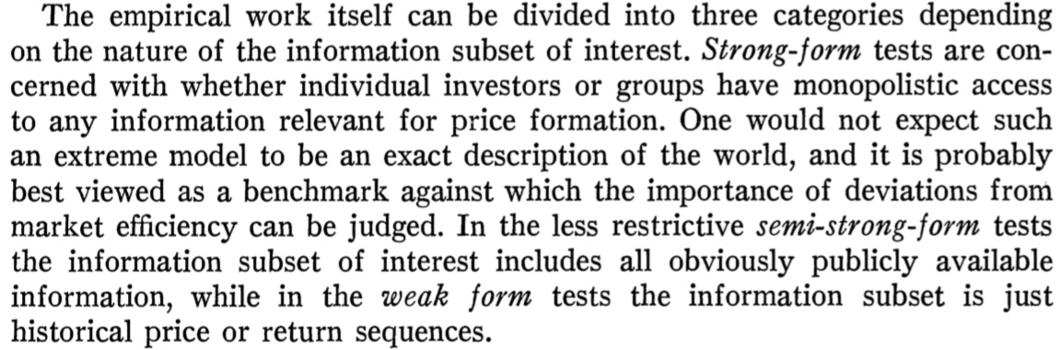
Market Efficiency
Source: Malkiel, B. G., & Fama, E. F. (1970). Efficient capital markets: A review of theory and empirical work. The Journal of Finance, 25(2), 383-417.

Slide 36
Types of Efficiency Market
Weak Form
  Security prices reflect all information found in
  past prices and volume.
Semi-Strong Form
  Security prices reflect all publicly available information.
Strong Form
  Security prices reflect all information—public and private.
Source: Ross et al. (2005), "Corporate Finance", 7th Edition, McGraw−Hill

Slide 37
Can Financing Decisions
Create Value?
Source: Ross et al. (2005), "Corporate Finance", 7th Edition, McGraw−Hill

Slide 38
What Sort of Financing Decisions?
Typical financing decisions include:
  How much debt and equity to sell
  When (or if) to pay dividends
  When to sell debt and equity
Just as we can use NPV criteria to evaluate investment decisions, we can use NPV to evaluate financing decisions.
Source: Ross et al. (2005), "Corporate Finance", 7th Edition, McGraw−Hill

Slide 39
How to Create Value through Financing
Fool Investors
  Empirical evidence suggests that it is hard to fool investors consistently.
Reduce Costs or Increase Subsidies
  Certain forms of financing have tax advantages or carry other subsidies.
Create a New Security
  Sometimes a firm can find a previously-unsatisfied clientele and issue new securities at favorable prices.
  In the long-run, this value creation is relatively small, however.
Source: Ross et al. (2005), "Corporate Finance", 7th Edition, McGraw−Hill

Slide 40
Efficient Capital Markets
An efficient capital market is one in which stock prices fully reflect available information.
The EMH has implications for investors and firms.
  Since information is reflected in security prices quickly, knowing information when it is released does an investor no good.
  Firms should expect to receive the fair value for securities that they sell. Firms cannot profit from fooling investors in an efficient market.
Source: Ross et al. (2005), "Corporate Finance", 7th Edition, McGraw−Hill

Slide 41
Reaction of Stock Price to New Information in Efficient and Inefficient Markets
Stock Price
Overreaction to “good news” with reversion
Delayed response to “good news”
Efficient market response to “good news”
-30 -20 -10 0 +10 +20 +30
Days before (-) and after (+) announcement
Source: Ross et al. (2005), "Corporate Finance", 7th Edition, McGraw−Hill

Slide 42
Reaction of Stock Price to New Information in Efficient and Inefficient Markets
Efficient market response to “bad news”
Stock Price
Delayed response to “bad news”
Overreaction to “bad news” with reversion
-30 -20 -10 0 +10 +20 +30
Days before (-) and after (+) announcement
Source: Ross et al. (2005), "Corporate Finance", 7th Edition, McGraw−Hill

Slide 43
Versions of EMH/Info-Efficiency
Weak-form efficiency:
  Prices reflect all information contained in past prices
Semi-strong-form efficiency:
  Prices reflect all publicly available information
Strong-form efficiency:
  Prices reflect all relevant information, include private (insider) information
all public & private info
all public info
past market info
Source: Markus K. Brunnermeier (2015), “Lecture 10: Market Efficiency”, Finance 501: Asset Pricing, Princeton University

Slide 44
Relationship among
Three Different Information Sets
All information
relevant to a stock
Information set
of publicly available
information
Information
set of
past prices
Source: Ross et al. (2005), "Corporate Finance", 7th Edition, McGraw−Hill

Slide 45
Efficient Market
An efficient market incorporates information in security prices.
There are three forms of the EMH:
  Weak-Form EMH
    Security prices reflect past price data.
  Semistrong-Form EMH
    Security prices reflect publicly available information.
  Strong-Form EMH
    Security prices reflect all information.
There is abundant evidence for the first two forms of the EMH.
Source: Ross et al. (2005), "Corporate Finance", 7th Edition, McGraw−Hill

Slide 46
Why Technical Analysis Fails
Investor behavior tends to eliminate any profit opportunity associated with stock price patterns.
Stock Price
If it were possible to make big money simply by finding “the pattern” in the stock price movements, everyone would do it and the profits would be competed away.
Sell
Sell
Buy
Buy
Time
Source: Ross et al. (2005), "Corporate Finance", 7th Edition, McGraw−Hill

Slide 47
Evidence on Market Efficiency
Return Predictability Studies
Event Studies
Performance Studies
Source: Markus K. Brunnermeier (2015), “Lecture 10: Market Efficiency”, Finance 501: Asset Pricing, Princeton University

Slide 48
Event Studies
Objective
  Examine if new (company specific) information is incorporated into the
  stock price in one single price jump upon public release?
Source: Markus K. Brunnermeier (2015), “Lecture 10: Market Efficiency”, Finance 501: Asset Pricing, Princeton University

Slide 49
Event Studies Methodology
Define as day “zero” the day the information is released
Calculate the daily returns R_{it} the 30 days around day “zero”:
t = -30, -29,…-1, 0, 1,…, 29, 30
Calculate the daily returns R_{mt} for the same days on the market (or a comparison group of firms of similar industry and risk)
Define Abnormal Returns (AR) as the difference
Calculate Average Abnormal Returns (AAR) over all N events in the sample for all 60 reference days
Cumulate the returns on the first T days to CAAR
AR_{it}= R_{it} –R_{mt}
Source: Markus K. Brunnermeier (2015), “Lecture 10: Market Efficiency”, Finance 501: Asset Pricing, Princeton University

Slide 50
Event Studies Methodology
Step 1.
Define as day “zero” the day the information is released
Source: Markus K. Brunnermeier (2015), “Lecture 10: Market Efficiency”, Finance 501: Asset Pricing, Princeton University

Slide 51
Event Studies Methodology
Step 2.
Calculate the daily returns R_{it}
the 30 days around day “zero”:
t = -30, -29,…-1, 0, 1,…, 29, 30
Source: Markus K. Brunnermeier (2015), “Lecture 10: Market Efficiency”, Finance 501: Asset Pricing, Princeton University

Slide 52
Event Studies Methodology
Step 3.
Calculate the daily returns
R_{mt} for the same days on the market (or a comparison group of firms of similar industry and risk)
Source: Markus K. Brunnermeier (2015), “Lecture 10: Market Efficiency”, Finance 501: Asset Pricing, Princeton University

Slide 53
Event Studies Methodology
Step 4.
Define
Abnormal Returns (AR)
as the difference
AR_{it}= R_{it} –R_{mt}
Source: Markus K. Brunnermeier (2015), “Lecture 10: Market Efficiency”, Finance 501: Asset Pricing, Princeton University

Slide 54
Event Studies Methodology
Step 5.
Calculate
Average Abnormal Returns (AAR)
over all N events in the sample for
all 60 reference days
Source: Markus K. Brunnermeier (2015), “Lecture 10: Market Efficiency”, Finance 501: Asset Pricing, Princeton University

Slide 55
Event Studies Methodology
Step 6.
Cumulate the returns on the
first T days to
Cumulative Average Abnormal Returns (CAAR)
Source: Markus K. Brunnermeier (2015), “Lecture 10: Market Efficiency”, Finance 501: Asset Pricing, Princeton University

Slide 56
Event Studies Methodology
Define as day “zero” the day the information is released
Calculate the daily returns R_{it} the 30 days around day “zero”:
t = -30, -29,…-1, 0, 1,…, 29, 30
Calculate the daily returns R_{mt} for the same days on the market (or a comparison group of firms of similar industry and risk)
Define Abnormal Returns (AR) as the difference
Calculate Average Abnormal Returns (AAR) over all N events in the sample for all 60 reference days
Cumulate the returns on the first T days to CAAR
AR_{it}= R_{it} –R_{mt}
Source: Markus K. Brunnermeier (2015), “Lecture 10: Market Efficiency”, Finance 501: Asset Pricing, Princeton University

Slide 57
Market Efficiency in Event Studies
Over-reaction
Efficient Reaction
Under-reaction
T
-30 | -25 | -20 | -15 | -10 | -5 | 0 | 5 | 10 | 15 | 20 | 25 | 30
Source: Markus K. Brunnermeier (2015), “Lecture 10: Market Efficiency”, Finance 501: Asset Pricing, Princeton University

Slide 58
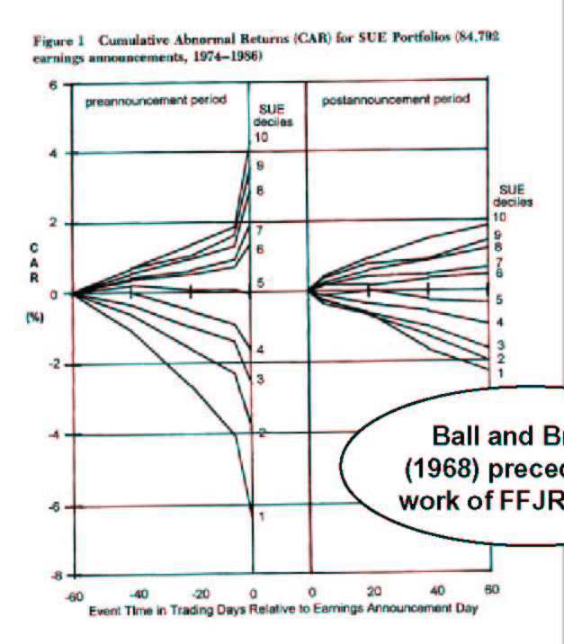
Event Study:
Earning Announcements
Event Study by
Ball and Brown (1968)
Pre-announcement drift prior to
earnings due to insider trading
! against strong-form
Post-announcement drift
! against semi-strong form
Source: Markus K. Brunnermeier (2015), “Lecture 10: Market Efficiency”, Finance 501: Asset Pricing, Princeton University

Slide 59
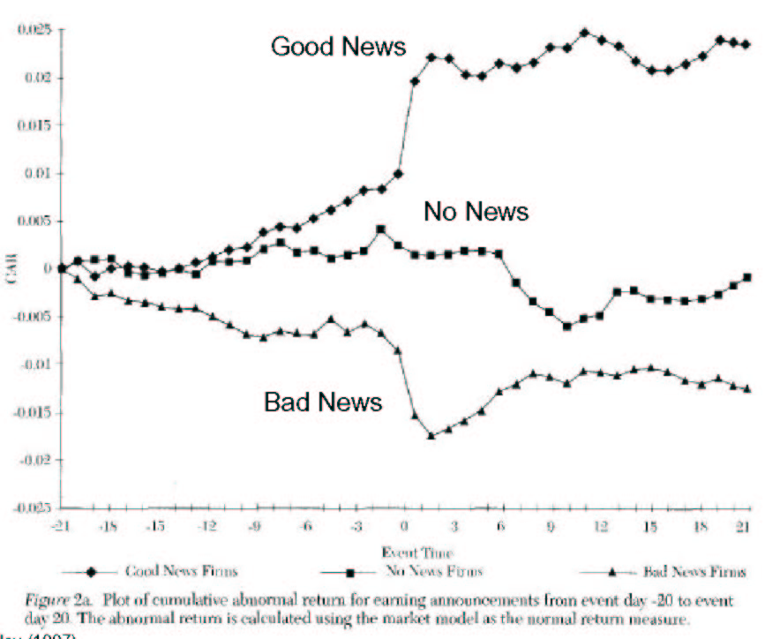
Event Study:
Earning Announcement
Source: Markus K. Brunnermeier (2015), “Lecture 10: Market Efficiency”, Finance 501: Asset Pricing, Princeton University

Slide 60
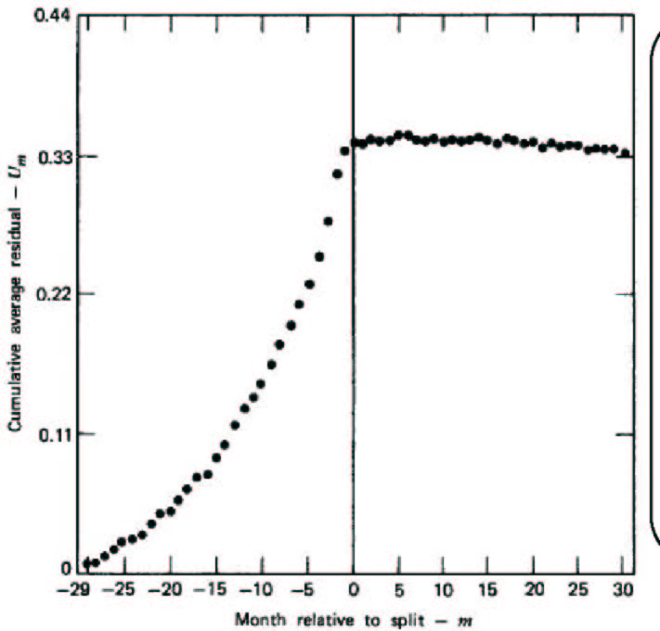
Event Study: Stock Splits
Event Study on Stock Splits by
Fama-French-Fischer-Jensen-Roll
(1969)
Split is a signal of good profit
Pre-announcement drift can be due
to selection bias (only good firms
split) or insider trading.
! inconclusive
No post-announcement drift
! for weak form
Selection bias or
Insider trading
Source: Markus K. Brunnermeier (2015), “Lecture 10: Market Efficiency”, Finance 501: Asset Pricing, Princeton University

Slide 61
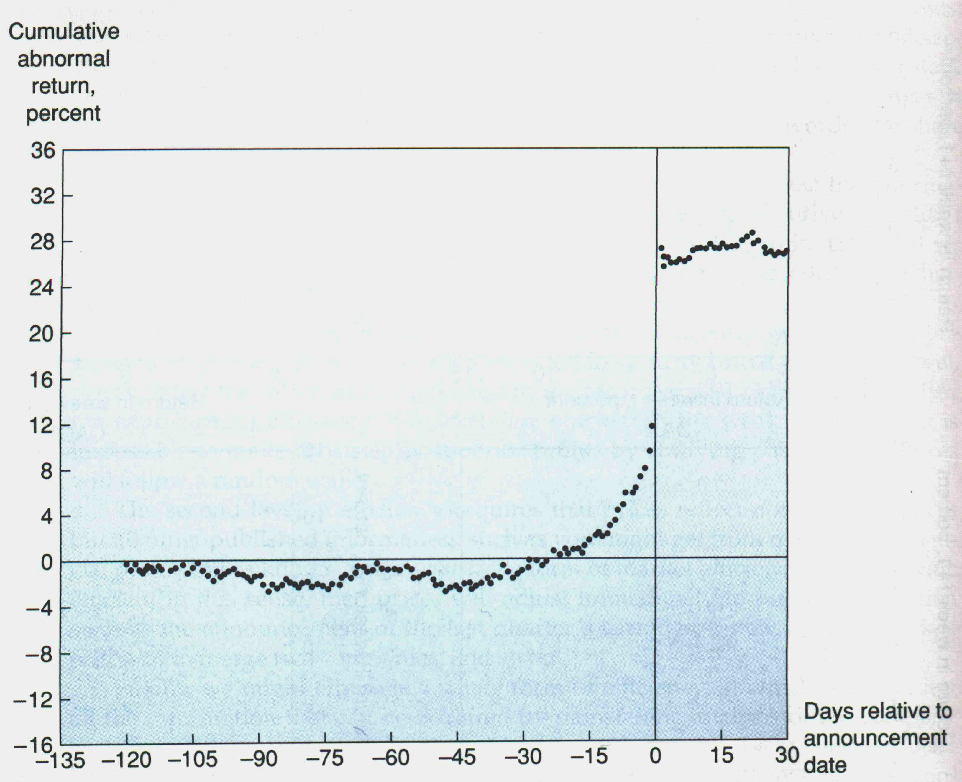
Event Study: Take-over
Source: Markus K. Brunnermeier (2015), “Lecture 10: Market Efficiency”, Finance 501: Asset Pricing, Princeton University

Slide 62
Event Study: Death of CEO
Source: Markus K. Brunnermeier (2015), “Lecture 10: Market Efficiency”, Finance 501: Asset Pricing, Princeton University

Slide 63
Evidence I: Predictabilities Studies
Statistical variables have only low forecasting power, but
  But some forecasting power for P/E or B/M
  Short-run momentum and long-run reversals
Calendar specific abnormal returns due to Monay effect, January effect etc.
CAVEAT: Data mining: Find variables with spurious forecasting power if we search enough
Source: Markus K. Brunnermeier (2015), “Lecture 10: Market Efficiency”, Finance 501: Asset Pricing, Princeton University

Slide 64
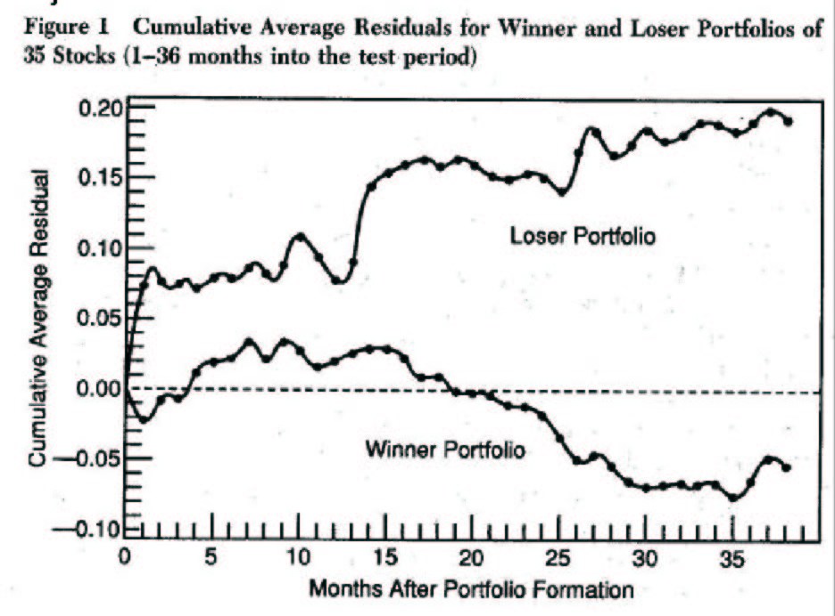
Long-Run Reversals
Long-run Reversals
Returns to previous 5 year’s
winner-loser stocks
(market adjusted returns)
Source: Markus K. Brunnermeier (2015), “Lecture 10: Market Efficiency”, Finance 501: Asset Pricing, Princeton University

Slide 65
Short-run Momentum
Momentum
Monthly Difference Between Winner and
Loser Portfolios at Announcement Dates
1.0%
0.5%
0.0%
Monthly Difference Between Winner and
25
31
33
35
Loser Portfolios
1
3
5
7
9
11
13
15
17
19
21
23
27
29
-0.5%
-1.0%
-1.5%
Months Following 6 Month Performance Period
Source: Markus K. Brunnermeier (2015), “Lecture 10: Market Efficiency”, Finance 501: Asset Pricing, Princeton University

Slide 66
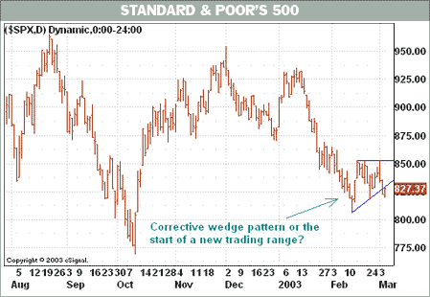
Getting Technical
Barron’s March 5, 2003
Source: Ross et al. (2005), "Corporate Finance", 7th Edition, McGraw−Hill

Slide 67
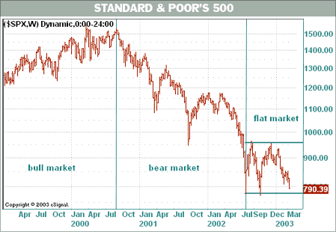
Getting Technical
Back to Buy Low, Sell High Barron’s March 12, 2003
Source: Ross et al. (2005), "Corporate Finance", 7th Edition, McGraw−Hill

Slide 68
What Pattern Do You See?
With different patterns, you may believe that you can predict the next value in the series—even though you know it is random.
Source: Ross et al. (2005), "Corporate Finance", 7th Edition, McGraw−Hill

Slide 69
Event Studies: Dividend Omissions
Efficient market response to “bad news”
S.H. Szewczyk, G.P. Tsetsekos, and Z. Santout “Do Dividend Omissions Signal Future Earnings or Past Earnings?” Journal of Investing (Spring 1997)
Source: Ross et al. (2005), "Corporate Finance", 7th Edition, McGraw−Hill

Slide 70
The Record of Mutual Funds
Taken from Lubos Pastor and Robert F. Stambaugh, “Evaluating and Investing in Equity Mutual Funds,” unpublished paper, Graduate School of Business, University of Chicago (March 2000).
Source: Ross et al. (2005), "Corporate Finance", 7th Edition, McGraw−Hill

Slide 71
Weak Form Market Efficiency
Security prices reflect all information found in past prices and volume.
If the weak form of market efficiency holds, then technical analysis is of no value.
Often weak-form efficiency is represented as
P_{t} = P_{t-1} + Expected return + random error t
Since stock prices only respond to new information, which by definition arrives randomly, stock prices are said to follow a random walk.
Source: Ross et al. (2005), "Corporate Finance", 7th Edition, McGraw−Hill
Notes:
Stock prices following a random walk is not the same thing as stock prices having random returns.

Slide 72
Market Efficiency
One group of studies of strong-form market efficiency investigates insider trading.
A number of studies support the view that insider trading is abnormally profitable.
Thus, strong-form efficiency does not seem to be substantiated by the evidence
Source: Ross et al. (2005), "Corporate Finance", 7th Edition, McGraw−Hill

Slide 73
Why Doesn’t Everybody Believe the EMH?
There are optical illusions, mirages, and apparent patterns in charts of stock market returns.
The truth is less interesting.
There is some evidence against market efficiency:
  Seasonality
  Small versus Large stocks
  Value versus growth stocks
The tests of market efficiency are weak.
Source: Ross et al. (2005), "Corporate Finance", 7th Edition, McGraw−Hill

Slide 74
Efficient Markets

Slide 75
Inefficient Markets

Slide 76
Behavioral Finance

Slide 77

Python in Google Colab (Python101)
https://colab.research.google.com/drive/1FEG6DnGvwfUbeo4zJ1zTunjMqf2RkCrT
https://tinyurl.com/aintpupython101

Slide 78
Summary
Event Studies in Finance
Event Studies for Financial Research
Event Study Methodology
Efficient Market Hypothesis (EMH)
  Efficient Markets
  Inefficient Markets

Slide 79
References
Doron Kliger and Gregory Gurevich (2014), Event Studies for Financial Research: A Comprehensive Guide, Palgrave Macmillan
El Ghoul, Sadok, Omrane Guedhami, Sattar A. Mansi, and Oumar Sy (2022). "Event studies in international finance research." Journal of International Business Studies : 1-21.
Malkiel, B. G., & Fama, E. F. (1970), Efficient capital markets: A review of theory and empirical work. The Journal of Finance, 25(2), 383-417.
MacKinlay, A. C. (1997), Event studies in economics and finance. Journal of economic literature, 35(1), 13-39.
Ross et al. (2005), Corporate Finance, 7th Edition, McGraw−Hill
Richard H. Thaler (2016), Misbehaving: The Making of Behavioral Economics, W. W. Norton & Company
Lucy Ackert and Richard Deaves (2009), “Behavioral Finance: Psychology, Decision-Making, and Markets”, South-Western College Pub.
Hersh Shefrin (2007), “Beyond Greed and Fear: Understanding Behavioral Finance and the Psychology of Investing”, Oxford University Press.
Edwin Burton and Sunit N. Shah (2013), “Behavioral Finance: Understanding the Social, Cognitive, and Economic Debates”, Wiley.
Schertler, A. (2021). Listing of classical options and the pricing of discount certificates. Journal of Banking & Finance, 123.
Pandey, D. K., & Kumari, V. (2021). Event study on the reaction of the developed and emerging stock markets to the 2019-nCoV outbreak. International Review of Economics & Finance, 71, 467-483.
Naidu, D., & Ranjeeni, K. (2021). Effect of coronavirus fear on the performance of Australian stock returns: Evidence from an event study. Pacific-Basin Finance Journal, 66.
Cahill, D., Baur, D. G., Liu, Z. X., & Yang, J. W. (2020). I am a blockchain too: How does the market respond to companies' interest in blockchain? Journal of Banking & Finance, 113.
Loipersberger, F. (2018). The effect of supranational banking supervision on the financial sector: Event study evidence from Europe. Journal of Banking & Finance, 91, 34-48.
Lanfear, M. G., Lioui, A., & Siebert, M. G. (2019). Market anomalies and disaster risk: Evidence from extreme weather events. Journal of Financial Markets, 46.
Dutta, A., Knif, J., Kolari, J. W., & Pynnonen, S. (2018). A robust and powerful test of abnormal stock returns in long-horizon event studies. Journal of Empirical Finance, 47, 1-24.
Gu, X., Zhang, W. Q., & Cheng, S. (2021). How do investors in Chinese stock market react to external uncertainty? An event study to the Sino-US disputes. Pacific-Basin Finance Journal, 68.
Bohmann, M., Michayluk, D., Patel, V., & Walsh, K. (2019). Liquidity and earnings in event studies: Does data granularity matter? Pacific-Basin Finance Journal, 54, 118-131.
Fan, R., Talavera, O., & Tran, V. (2020). Social media bots and stock markets. European Financial Management, 26(3), 753-777.
Lee, J., & Ryu, D. (2019). The impacts of public news announcements on intraday implied volatility dynamics. Journal of Futures Markets, 39(6), 656-685.
Yves Hilpisch (2020), Artificial Intelligence in Finance: A Python-Based Guide, O’Reilly Media.
Aurélien Géron (2019), Hands-On Machine Learning with Scikit-Learn, Keras, and TensorFlow: Concepts, Tools, and Techniques to Build Intelligent Systems, 2nd Edition, O’Reilly Media.
Yves Hilpisch (2018), Python for Finance: Mastering Data-Driven Finance, 2nd Edition, O'Reilly Media.
Paolo Sironi (2016), “FinTech Innovation: From Robo-Advisors to Goal Based Investing and Gamification”, Wiley.
Chris Kelliher (2022), Quantitative Finance With Python: A Practical Guide to Investment Management, Trading, and Financial Engineering, Chapman and Hall/CRC.

Slide 80
References
Yensen Ni, Min-Yuh Day, Yi-Rung Cheng, and Paoyu Huang (2022), "Can Investors Profit by Utilizing Technical Trading Strategies? Evidence from Korean and Chinese Stock Markets", Financial Innovation, Volume 8, 54, June 2022, pp. 1-21.
Min-Yuh Day, Yensen Ni, Chinning Hsu, and Paoyu Huang (2022), "Do Investment Strategies Matter for Trading Global Clean Energy and Global Energy ETFs?", Energies, Volume 15, Number 9, 3 May 2022, 3328, pp. 1-15.
Min-Yuh Day, Pao-Yu Huang, Yirung Cheng, Yin-Tzu Lin, and Yensen Ni (2022), "Profitable day trading Bitcoin futures following continuous bullish (bearish) candlesticks", Applied Economics Letters, Volume 29, Issue 10, May 2022, pp. 947-954.
Min-Yuh Day, Yirung Cheng, Paoyu Huang, and Yensen Ni (2022), "The Profitability of Bollinger Bands Trading Bitcoin Futures", Applied Economics Letters, 31 March 2022, pp. 1-7.
Min-Yuh Day, Yirung Cheng, Paoyu Huang, and Yensen Ni (2022), "The profitability of trading US stocks in Quarter 4 - evidence from trading signals emitted by SOI and RSI", Applied Economics Letters, 17 February 2022, pp. 1-6.
Yulu Liao, Min-Yuh Day, Yirung Cheng, Paoyu Huang, and Yensen Ni (2021), "The profitability of Technical Trading for Hotel Stocks Under COVID-19 Pandemic", Journal of Computers, Volume 32, Number 5, October 2021, pp. 44-54.
Yulu Liao, Min-Yuh Day, Yirung Cheng, Paoyu Huang, and Yensen Ni (2021), "Does CBOE volatility index jumped or located at a higher level matter for evaluating DJ 30, NASDAQ, and S&P500 index subsequent performance", Journal of Computers, Volume 32, Number 4, August 2021, pp. 57-66.
Yensen Ni, Min-Yuh Day, and Paoyu Huang (2020), "Trading Stocks Following Sharp Movements in the USDX, GBP/USD, and USD/CNY", Financial Innovation, Volume 6, 35, 2020, pp. 1-17.
Yensen Ni, Min-Yuh Day, Paoyu Huang, and Shang-Ru Yua (2020), "The profitability of Bollinger Bands: Evidence from the constituent stocks of Taiwan 50", Physica A: Statistical Mechanics and its Applications, Volume 551, 1 August 2020, 124144, pp. 1-14.
Yensen Ni, Paoyu Huang, Yaochia Ku, Yiching Liao, and Min-Yuh Day (2020), "Investing Strategies as Stochastic Oscillator Indicators Staying in Overreaction Zones for Consecutive Days with Big Data Concerns", Journal of Computers, Volume 31, Number 1, February 2020, pp. 1-17.
Yensen Ni, Manhwa Wu, Min-Yuh Day, and Paoyu Huang (2020), "Do sharp movements in oil prices matter for stock markets?", Physica A: Statistical Mechanics and its Applications, Volume 539, 1 February 2020, pp. 1-11.
Min-Yuh Day, Paoyu Huang, and Yensen Ni (2019), "Trading as sharp movements in oil prices and technical trading signals emitted with big data concerns", Physica A: Statistical Mechanics and its Applications, Volume 525, 1 July 2019, pp. 349-372.
Yensen Ni, Min-Yuh Day, and Paoyu Huang (2019), "Does Data Frequency Matter for Trading Signals Emitted by Various Technical Trading Rules? ", Pacific Business Review International, Volume 11, Issue 10, April 2019, pp. 7-17.
Min-Yuh Day, Manhwa Wu, Paoyu Huang, and Yensen Ni (2018), "Investing Strategies as a Sharp Movement in Exchange Rates Occurred– Evidence for the Constituent Stocks of SSE 50 and TW 50", The Journal of Investing, Volume 27, Issue 4, Winter 2018, pp. 58-68.
Min-Yuh Day, Paoyu Huang, Yensen Ni, and Yuhsin Chen (2018), "Do Implicit Phenomena Matter? Evidence from China Stock Index Futures", The Journal of Alternative Investments, Volume 21, Issue 1, Summer 2018, pp. 79-91.
Yensen Ni, Yirung Cheng, Paoyu Huang, and Min-Yuh Day (2018), "Trading strategies in terms of continuous rising (falling) prices or continuous bullish (bearish) candlesticks emitted", Physica A: Statistical Mechanics and its Applications, Volume 501, 1 July 2018, pp. 188-204.
Min-Yuh Day, Paoyu Huang, Yensen Ni, and Yuhsin Chen (2018), "Do Intraday Large Price Changes Matter for Trading Index Futures? Evidence from China Futures Markets", Journal of Financial Studies, Volume 26, Number 2, June 2018, pp. 139-174.

