Slide 1


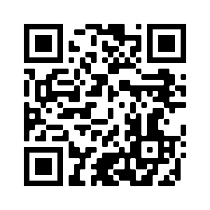





Introduction to Artificial Intelligence in Finance and Quantitative Analysis
Artificial Intelligence in Finance and Quantitative Analysis
1111AIFQA01
MBA, IM, NTPU (M6132) (Fall 2022)
Tue 2, 3, 4 (9:10-12:00) (B8F40)
Min-Yuh Day, Ph.D,
Associate Professor
Institute of Information Management, National Taipei University
https://web.ntpu.edu.tw/~myday
https://meet.google.com/paj-zhhj-mya
2022-09-13

Slide 2











Min-Yuh Day, Ph.D.
Associate Professor, Information Management, NTPU
Visiting Scholar, IIS, Academia Sinica
Ph.D., Information Management, NTU
Director, Intelligent Financial Innovation Technology, IFIT Lab, IM, NTPU
Artificial Intelligence, Financial Technology, Big Data Analytics,
Data Mining and Text Mining, Electronic Commerce

Slide 3
Course Syllabus
National Taipei University
Academic Year 111, 1st Semester (Fall 2022)
Course Title: Artificial Intelligence in Finance and Quantitative Analysis
Instructor: Min-Yuh Day
Course Class: MBA, IM, NTPU (3 Credits, Elective)
Details
  In-Class and Distance Learning EMI Course
  (3 Credits, Elective, One Semester) (M6132)
Time & Place: Tue, 2, 3, 4, (9:10-12:00) (B8F40)
Google Meet: https://meet.google.com/paj-zhhj-mya
https://meet.google.com/paj-zhhj-mya

Slide 4
Course Objectives
Understand the fundamental concepts and research issues of Artificial Intelligence in Finance and Quantitative Analysis.
Equip with Hands-on practices of Artificial Intelligence in Finance and Quantitative Analysis.
Conduct information systems research in the context of Artificial Intelligence in Finance and Quantitative Analysis.

Slide 5
Course Outline
This course introduces the fundamental concepts, research issues, and hands-on practices of AI in Finance and Quantitative Analysis.
Topics include:
  Introduction to Artificial Intelligence in Finance and Quantitative Analysis
  AI in FinTech: Metaverse, Web3, DeFi, NFT, Financial Services Innovation and Applications,
  Investing Psychology and Behavioral Finance
  Event Studies in Finance
  Finance Theory
  Data-Driven Finance
  Financial Econometrics
  AI-First Finance
  Deep Learning in Finance
  Reinforcement Learning in Finance
  Algorithmic Trading, Risk Management, Trading Bot and Event-Based Backtesting
  Case Study on AI in Finance and Quantitative Analysis.

Slide 6
Core Competence
Exploring new knowledge in information technology, system development and application 80 %
Internet marketing planning ability 10 %
Thesis writing and independent research skills 10 %

Slide 7
Four Fundamental Qualities
Professionalism
  Creative thinking and Problem-solving 40 %
  Comprehensive Integration 40 %
Interpersonal Relationship
  Communication and Coordination 10 %
  Teamwork 5 %
Ethics
  Honesty and Integrity 0 %
  Self-Esteem and Self-reflection 0 %
International Vision
  Caring for Diversity 0 %
  Interdisciplinary Vision 5 %

Slide 8
College Learning Goals
Ethics/Corporate Social Responsibility
Global Knowledge/Awareness
Communication
Analytical and Critical Thinking

Slide 9
Department Learning Goals
Information Technologies and
System Development Capabilities
Internet Marketing Management Capabilities
Research capabilities

Slide 10
Syllabus
Week Date Subject/Topics
1 2022/09/13 Introduction to Artificial Intelligence in Finance and
Quantitative Analysis
2 2022/09/20 AI in FinTech: Metaverse, Web3, DeFi, NFT,
Financial Services Innovation and Applications
3 2022/09/27 Investing Psychology and Behavioral Finance
4 2022/10/04 Event Studies in Finance
5 2022/10/11 Case Study on AI in Finance and Quantitative Analysis I
6 2022/10/18 Finance Theory

Slide 11
Syllabus
Week Date Subject/Topics
7 2022/10/25 Data-Driven Finance
8 2022/11/01 Midterm Project Report
9 2022/11/08 Financial Econometrics
10 2022/11/15 AI-First Finance
11 2022/11/22 Industry Practices of AI in Finance and Quantitative
Analysis
12 2022/11/29 Case Study on AI in Finance and Quantitative Analysis II

Slide 12
Syllabus
Week Date Subject/Topics
13 2022/12/06 Deep Learning in Finance;
Reinforcement Learning in Finance
14 2022/12/13 Algorithmic Trading; Risk Management;
Trading Bot and Event-Based Backtesting
15 2022/12/20 Final Project Report I
16 2022/12/27 Final Project Report II
17 2023/01/03 Self-learning
18 2023/01/10 Self-learning

Slide 13
Teaching Methods and Activities
Lecture
Discussion
Practicum

Slide 14
Evaluation Methods
Individual Presentation 60 %
Group Presentation 10 %
Case Report 10 %
Class Participation 10 %
Assignment 10 %

Slide 15
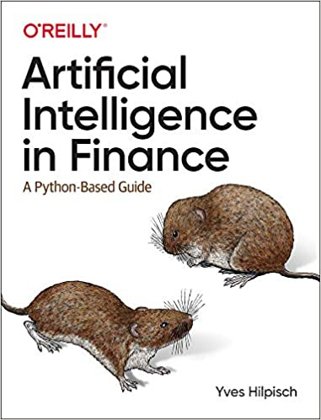
Required Texts
Yves Hilpisch (2020),
Artificial Intelligence in Finance: A Python-Based Guide,
O’Reilly Media.
Source: https://www.amazon.com/Artificial-Intelligence-Finance-Python-Based-Guide/dp/1492055433

Slide 16
Reference Books
Stefan Jansen (2020), Machine Learning for Algorithmic Trading: Predictive models to extract signals from market and alternative data for systematic trading strategies with Python, 2nd Edition, Packt Publishing.
Aurélien Géron (2019), Hands-On Machine Learning with Scikit-Learn, Keras, and TensorFlow: Concepts, Tools, and Techniques to Build Intelligent Systems, 2nd Edition, O’Reilly Media.
Hariom Tatsat, Sahil Puri, Brad Lookabaugh (2020), Machine Learning and Data Science Blueprints for Finance: From Building Trading Strategies to Robo-Advisors Using Python, O'Reilly Media
Chris Kelliher (2022), Quantitative Finance With Python: A Practical Guide to Investment Management, Trading, and Financial Engineering, Chapman and Hall/CRC.
Abdullah Karasan (2021), Machine Learning for Financial Risk Management with Python: Algorithms for Modeling Risk, O’Reilly Media.
Yves Hilpisch (2018), Python for Finance: Mastering Data-Driven Finance, 2nd Edition, O'Reilly Media.

Slide 17
Other References
Paolo Sironi (2016), FinTech Innovation: From Robo-Advisors to Goal Based Investing and Gamification, Wiley.
Yves Hilpisch (2020), Financial Theory with Python: A Gentle Introduction, O’Reilly Media.
Yves Hilpisch (2020), Python for Algorithmic Trading: From Idea to Cloud Deployment, O’Reilly Media.
Yuxing Yan (2017), Python for Finance: Apply powerful finance models and quantitative analysis with Python, Second Edition, Packt Publishing.

Slide 18
Yves Hilpisch (2020),
Artificial Intelligence in Finance:
A Python-Based Guide,
O’Reilly
Source: https://www.amazon.com/Artificial-Intelligence-Finance-Python-Based-Guide/dp/1492055433

Slide 19
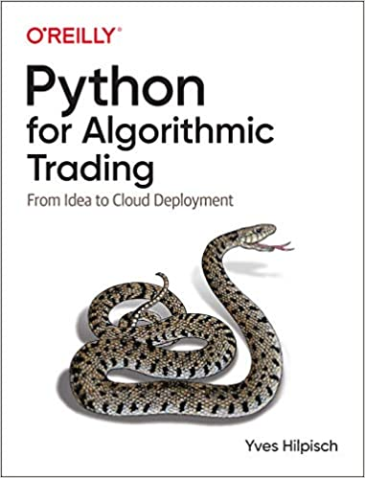
Yves Hilpisch (2020),
Python for Algorithmic Trading:
From Idea to Cloud Deployment,
O’Reilly
Source: https://www.amazon.com/Python-Algorithmic-Trading-Cloud-Deployment/dp/149205335X

Slide 20
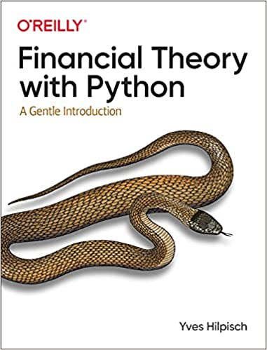
Yves Hilpisch (2021),
Financial Theory with Python:
A Gentle Introduction,
O’Reilly
Source: https://www.amazon.com/Financial-Theory-Python-Gentle-Introduction/dp/1098104358

Slide 21
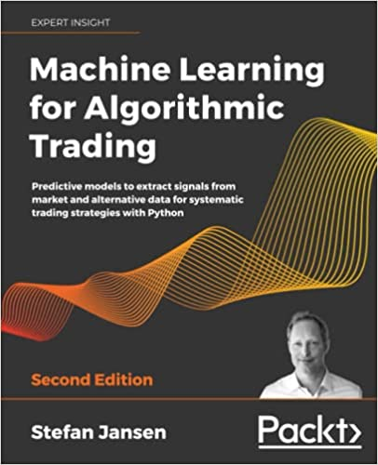
Stefan Jansen (2020),
Machine Learning for Algorithmic Trading:
Predictive models to extract signals from market and alternative data for systematic trading strategies with Python, 2nd Edition,
Packt Publishing.
Source: https://www.amazon.com/Machine-Learning-Algorithmic-Trading-alternative/dp/1839217715/

Slide 22
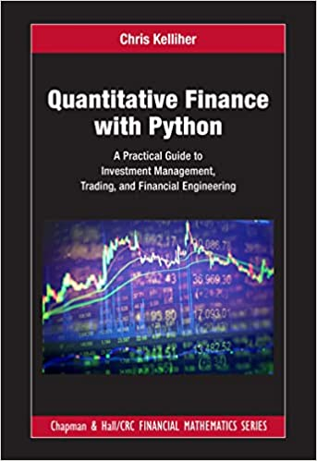
Chris Kelliher (2022),
Quantitative Finance With Python:
A Practical Guide to Investment Management, Trading, and Financial Engineering, Chapman and Hall/CRC.
Source: https://www.amazon.com/Quantitative-Finance-Python-Engineering-Mathematics/dp/1032014431/

Slide 23
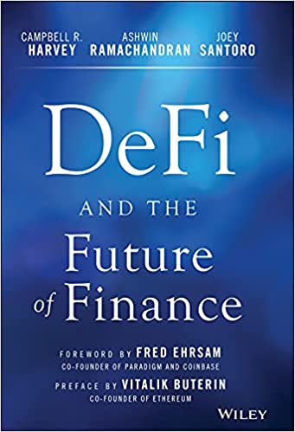
Campbell R. Harvey, Ashwin Ramachandran, Joey Santoro, Fred Ehrsam (2021),
DeFi and the Future of Finance,
Wiley
Source: https://www.amazon.com/DeFi-Future-Finance-Campbell-Harvey-ebook/dp/B09DJV2QLC

Slide 24
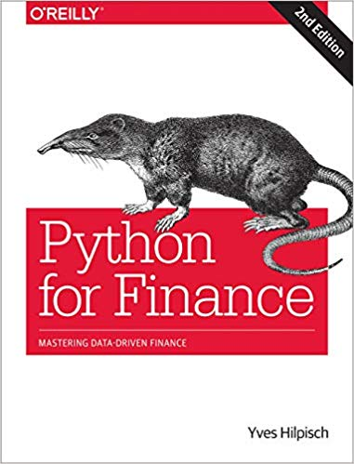
Yves Hilpisch (2018),
Python for Finance: Mastering Data-Driven Finance, O'Reilly
Source: https://www.amazon.com/Python-Finance-Mastering-Data-Driven/dp/1492024333

Slide 25
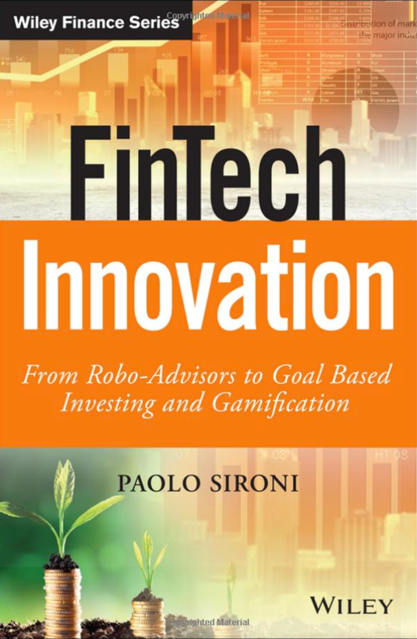
Paolo Sironi (2016)
FinTech Innovation:
From Robo-Advisors to Goal Based Investing and Gamification,
Wiley
Source: https://www.amazon.com/FinTech-Innovation-Robo-Advisors-Investing-Gamification/dp/1119226988

Slide 26
Doron Kliger and Gregory Gurevich (2014),
Event Studies for Financial Research:
A Comprehensive Guide,
Palgrave Macmillan
Source: https://www.amazon.com/Event-Studies-Financial-Research-Comprehensive/dp/1137435380/

Slide 27
Yuxing Yan (2017),
Python for Finance: Apply powerful finance models and quantitative analysis with Python, Second Edition, Packt Publishing
Source: https://www.amazon.com/Python-Finance-powerful-quantitative-analysis/dp/1787125696

Slide 28
Artificial Intelligence
(AI)

Slide 29
AI, Big Data, Cloud Computing
Evolution of Decision Support, Business Intelligence, and Analytics
AI
AI
Cloud Computing
Big Data
DM
BI
Source: Ramesh Sharda, Dursun Delen, and Efraim Turban (2017),
Business Intelligence, Analytics, and Data Science: A Managerial Perspective, 4th Edition, Pearson

Slide 30
The Rise of AI
Source: DHL (2018), Artificial Intelligence in Logistics,
http://www.globalhha.com/doclib/data/upload/doc_con/5e50c53c5bf67.pdf/

Slide 31
Definition of
Artificial Intelligence (A.I.)

Slide 32
Artificial Intelligence
“… the science and engineering of making intelligent machines”
(John McCarthy, 1955)
Source: https://digitalintelligencetoday.com/artificial-intelligence-defined-useful-list-of-popular-definitions-from-business-and-science/

Slide 33
Artificial Intelligence
“… technology that thinks and acts like humans”
Source: https://digitalintelligencetoday.com/artificial-intelligence-defined-useful-list-of-popular-definitions-from-business-and-science/

Slide 34
Artificial Intelligence
“… intelligence exhibited by machines or software”
Source: https://digitalintelligencetoday.com/artificial-intelligence-defined-useful-list-of-popular-definitions-from-business-and-science/

Slide 35
4 Approaches of AI
Thinking Humanly | Thinking Rationally
Acting Humanly | Acting Rationally
Source: Stuart Russell and Peter Norvig (2020), Artificial Intelligence: A Modern Approach, 4th Edition, Pearson

Slide 36
4 Approaches of AI
2. Thinking Humanly: The Cognitive Modeling Approach | 3. Thinking Rationally: The “Laws of Thought” Approach
1. Acting Humanly: The Turing Test Approach (1950) | 4. Acting Rationally: The Rational Agent Approach
Source: Stuart Russell and Peter Norvig (2020), Artificial Intelligence: A Modern Approach, 4th Edition, Pearson

Slide 37
AI Acting Humanly:
The Turing Test Approach
(Alan Turing, 1950)
Knowledge Representation
Automated Reasoning
Machine Learning (ML)
  Deep Learning (DL)
Computer Vision (Image, Video)
Natural Language Processing (NLP)
Robotics
Source: Stuart Russell and Peter Norvig (2020), Artificial Intelligence: A Modern Approach, 4th Edition, Pearson

Slide 38
FinTech

Slide 39
Financial Technology

Slide 40
FinTech

Slide 41
Financial Technology
FinTech
“providing
financial services
by making use of software and
modern technology”
Source: https://www.fintechweekly.com/fintech-definition

Slide 42
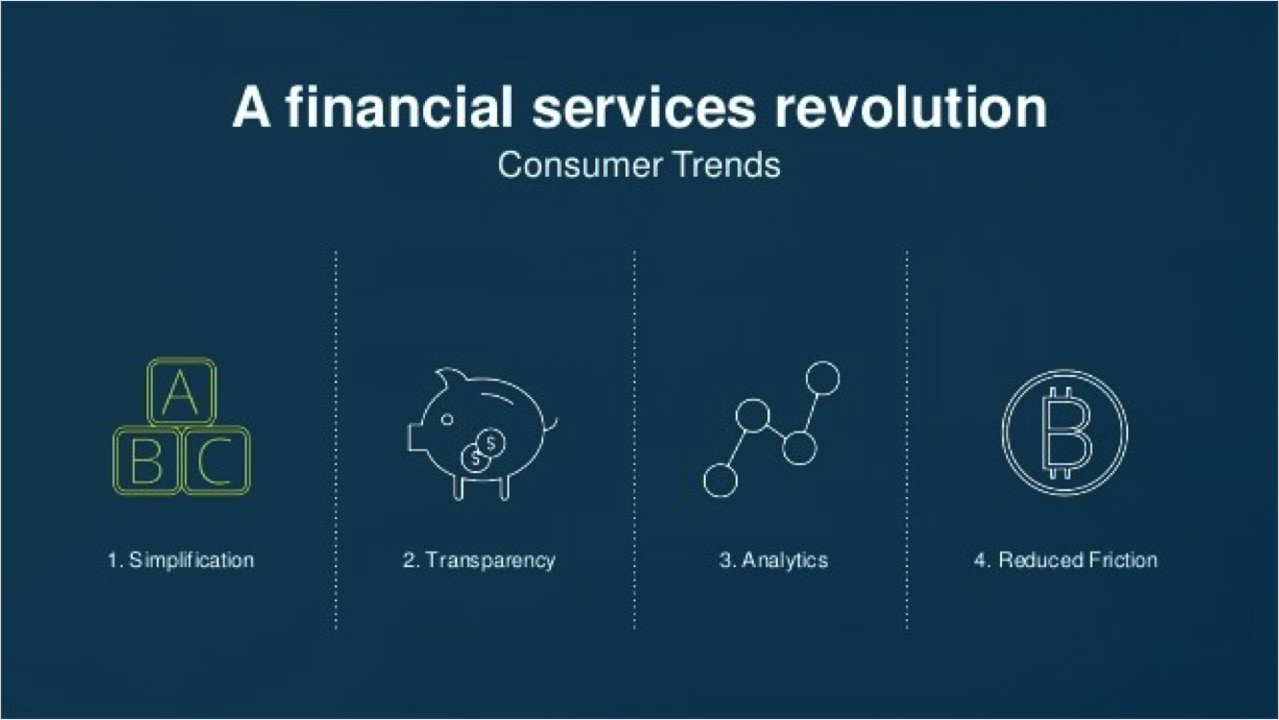
Financial Revolution with Fintech
Source: http://www.hedgethink.com/fintech/european-fintech-top-100/

Slide 43
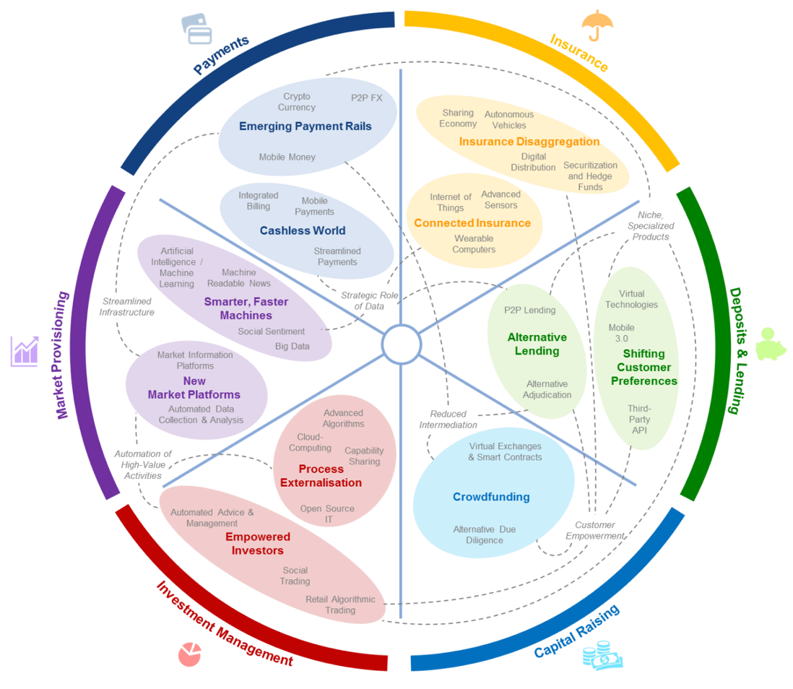
FinTech: Financial Services Innovation
Source: http://www3.weforum.org/docs/WEF_The_future__of_financial_services.pdf

Slide 44
FinTech:
Financial Services Innovation
1. Payments
2. Insurance
3. Deposits & Lending
4. Capital Raising
5. Investment Management
6. Market Provisioning
Source: http://www3.weforum.org/docs/WEF_The_future__of_financial_services.pdf

Slide 45
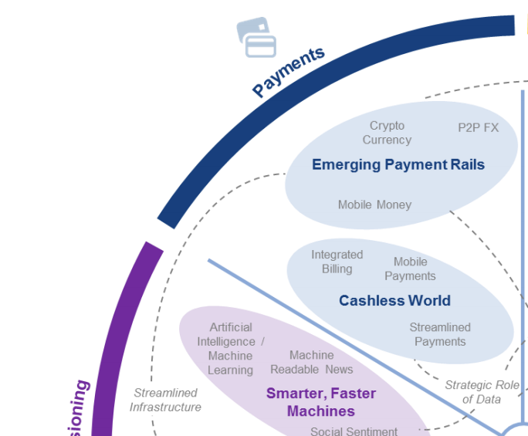
FinTech: Payment
1
Source: http://www3.weforum.org/docs/WEF_The_future__of_financial_services.pdf

Slide 46
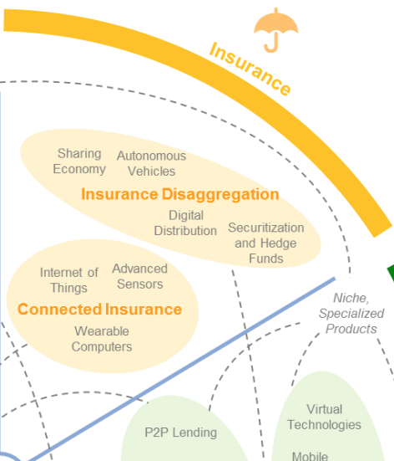
FinTech: Insurance
2
Source: http://www3.weforum.org/docs/WEF_The_future__of_financial_services.pdf

Slide 47
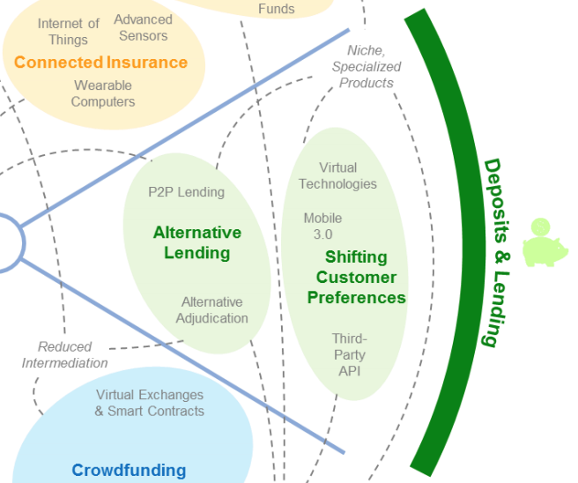
FinTech: Deposits & Lending
3
Source: http://www3.weforum.org/docs/WEF_The_future__of_financial_services.pdf

Slide 48
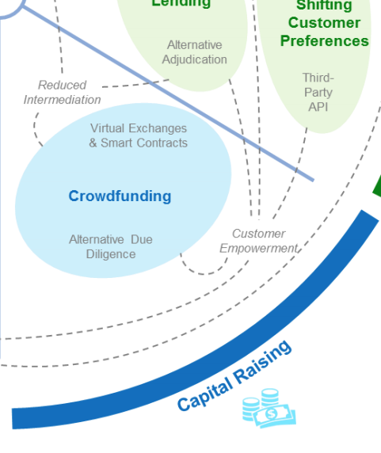
FinTech: Capital Raising
4
Source: http://www3.weforum.org/docs/WEF_The_future__of_financial_services.pdf

Slide 49
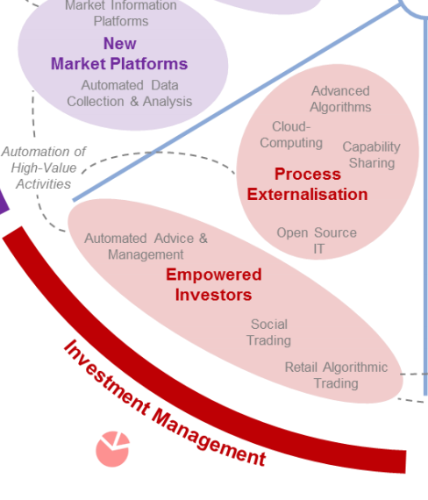
FinTech: Investment Management
5
Source: http://www3.weforum.org/docs/WEF_The_future__of_financial_services.pdf

Slide 50
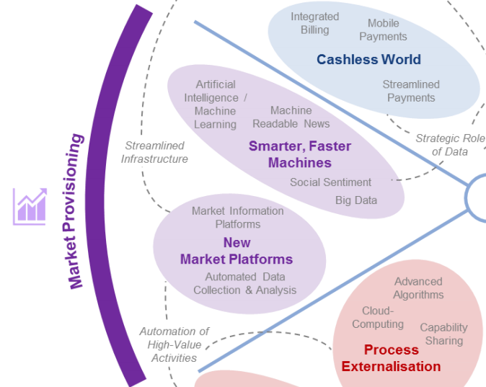
FinTech: Market Provisioning
6
Source: http://www3.weforum.org/docs/WEF_The_future__of_financial_services.pdf

Slide 51
AI in
FinTech

Slide 52
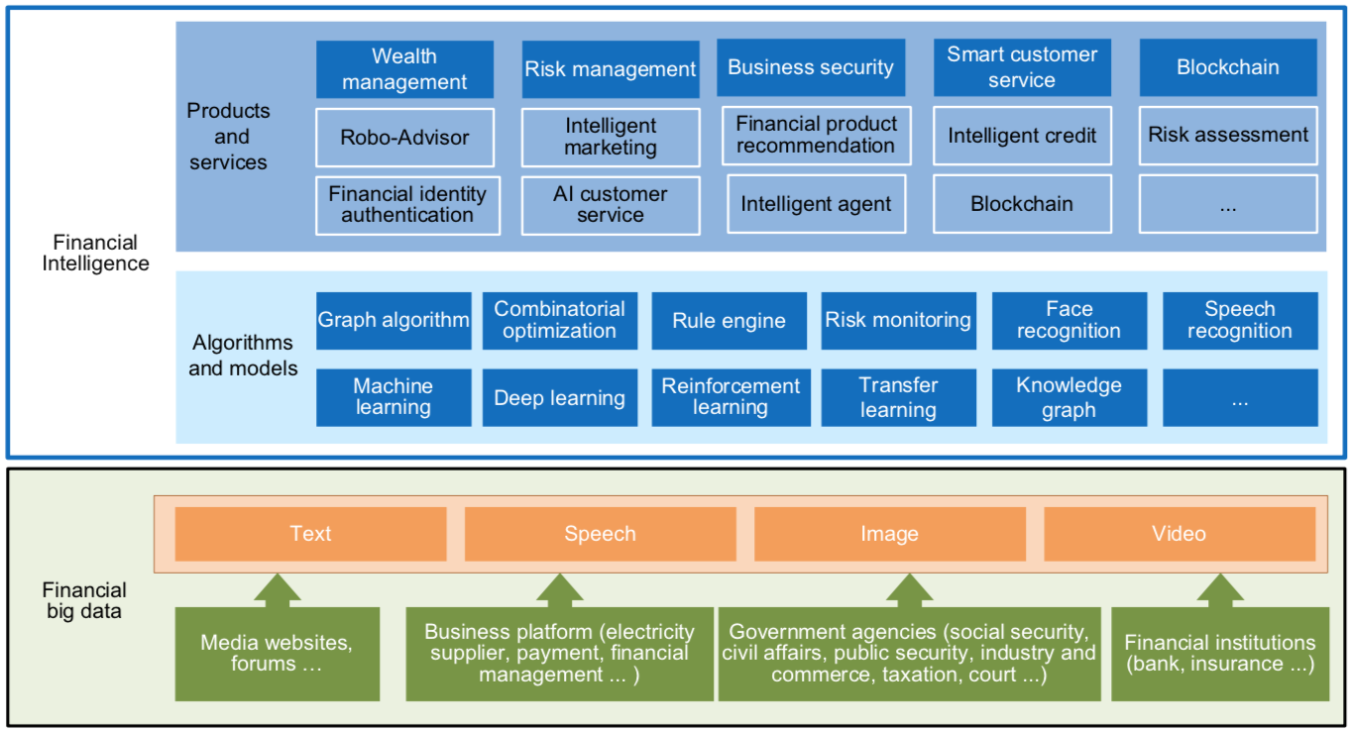
FinBrain: when Finance meets AI 2.0
(Zheng et al., 2019)
Source: Xiao-lin Zheng, Meng-ying Zhu, Qi-bing Li, Chao-chao Chen, and Yan-chao Tan (2019), "Finbrain: When finance meets AI 2.0." Frontiers of Information Technology & Electronic Engineering 20, no. 7, pp. 914-924

Slide 53
AI 2.0
a new generation of AI
based on the
novel information environment of
major changes and
the development of
new goals.
Yunhe Pan (2016), "Heading toward artificial intelligence 2.0." Engineering 2, no. 4, 409-413.

Slide 54
Technology-driven
Financial Industry Development
Development stage | Driving technology | Main landscape | Inclusive finance | Relationship between technology and finance
Fintech 1.0 (financial IT) | Computer | Credit card, ATM, and CRMS | Low | Technology as a tool
Fintech 2.0 (Internet finance) | Mobile Internet | Marketplace lending, third-party payment, crowdfunding, and Internet insurance | Medium | Technology-driven change
Fintech 3.0 (financial intelligence) | AI, Big Data, Cloud Computing, Blockchain | Intelligent finance | High | Deep fusion
Source: Xiao-lin Zheng, Meng-ying Zhu, Qi-bing Li, Chao-chao Chen, and Yan-chao Tan (2019), "Finbrain: When finance meets AI 2.0." Frontiers of Information Technology & Electronic Engineering 20, no. 7, pp. 914-924

Slide 55
Deep learning for financial applications:
A survey
Applied Soft Computing (2020)
Source:
Ahmet Murat Ozbayoglu, Mehmet Ugur Gudelek, and Omer Berat Sezer (2020). "Deep learning for financial applications: A survey."
Applied Soft Computing (2020): 106384.

Slide 56
Financial time series forecasting with deep learning:
A systematic literature review:
2005–2019
Applied Soft Computing (2020)
Source:
Omer Berat Sezer, Mehmet Ugur Gudelek, and Ahmet Murat Ozbayoglu (2020), "Financial time series forecasting with deep learning: A systematic literature review: 2005–2019." Applied Soft Computing 90 (2020): 106181.

Slide 57
Deep learning for financial applications: Topics
Source: Ahmet Murat Ozbayoglu, Mehmet Ugur Gudelek, and Omer Berat Sezer (2020). "Deep learning for financial applications: A survey." Applied Soft Computing (2020): 106384.

Slide 58
Deep learning for financial applications: Deep Learning Models
Source: Ahmet Murat Ozbayoglu, Mehmet Ugur Gudelek, and Omer Berat Sezer (2020). "Deep learning for financial applications: A survey." Applied Soft Computing (2020): 106384.

Slide 59
Deep learning for financial applications: Topic-Model Heatmap
Source: Ahmet Murat Ozbayoglu, Mehmet Ugur Gudelek, and Omer Berat Sezer (2020). "Deep learning for financial applications: A survey." Applied Soft Computing (2020): 106384.

Slide 60
Deep learning for financial applications: Topic-Feature Heatmap
Source: Ahmet Murat Ozbayoglu, Mehmet Ugur Gudelek, and Omer Berat Sezer (2020). "Deep learning for financial applications: A survey." Applied Soft Computing (2020): 106384.

Slide 61
Deep learning for financial applications: Topic-Dataset Heatmap
Source: Ahmet Murat Ozbayoglu, Mehmet Ugur Gudelek, and Omer Berat Sezer (2020). "Deep learning for financial applications: A survey." Applied Soft Computing (2020): 106384.

Slide 62
Deep learning for financial applications:
Algo-trading applications embedded with time series forecasting models
Source: Ahmet Murat Ozbayoglu, Mehmet Ugur Gudelek, and Omer Berat Sezer (2020). "Deep learning for financial applications: A survey." Applied Soft Computing (2020): 106384.

Slide 63
Deep learning for financial applications:
Algo-trading applications embedded with time series forecasting models
Source: Ahmet Murat Ozbayoglu, Mehmet Ugur Gudelek, and Omer Berat Sezer (2020). "Deep learning for financial applications: A survey." Applied Soft Computing (2020): 106384.

Slide 64
Deep learning for financial applications:
Classification (buy–sell signal, or trend detection) based algo-trading models
Source: Ahmet Murat Ozbayoglu, Mehmet Ugur Gudelek, and Omer Berat Sezer (2020). "Deep learning for financial applications: A survey." Applied Soft Computing (2020): 106384.

Slide 65
Deep learning for financial applications:
Stand-alone and/or other algorithmic models
Source: Ahmet Murat Ozbayoglu, Mehmet Ugur Gudelek, and Omer Berat Sezer (2020). "Deep learning for financial applications: A survey." Applied Soft Computing (2020): 106384.

Slide 66
Deep learning for financial applications:
Credit scoring or classification studies
Source: Ahmet Murat Ozbayoglu, Mehmet Ugur Gudelek, and Omer Berat Sezer (2020). "Deep learning for financial applications: A survey." Applied Soft Computing (2020): 106384.

Slide 67
Deep learning for financial applications:
Financial distress, bankruptcy, bank risk, mortgage risk, crisis forecasting studies.
Source: Ahmet Murat Ozbayoglu, Mehmet Ugur Gudelek, and Omer Berat Sezer (2020). "Deep learning for financial applications: A survey." Applied Soft Computing (2020): 106384.

Slide 68
Deep learning for financial applications:
Fraud detection studies
Source: Ahmet Murat Ozbayoglu, Mehmet Ugur Gudelek, and Omer Berat Sezer (2020). "Deep learning for financial applications: A survey." Applied Soft Computing (2020): 106384.

Slide 69
Deep learning for financial applications:
Portfolio management studies
Source: Ahmet Murat Ozbayoglu, Mehmet Ugur Gudelek, and Omer Berat Sezer (2020). "Deep learning for financial applications: A survey." Applied Soft Computing (2020): 106384.

Slide 70
Deep learning for financial applications:
Asset pricing and derivatives market studies
Source: Ahmet Murat Ozbayoglu, Mehmet Ugur Gudelek, and Omer Berat Sezer (2020). "Deep learning for financial applications: A survey." Applied Soft Computing (2020): 106384.

Slide 71
Deep learning for financial applications:
Cryptocurrency and blockchain studies
Source: Ahmet Murat Ozbayoglu, Mehmet Ugur Gudelek, and Omer Berat Sezer (2020). "Deep learning for financial applications: A survey." Applied Soft Computing (2020): 106384.

Slide 72
Deep learning for financial applications:
Financial sentiment studies coupled with text mining for forecasting
Source: Ahmet Murat Ozbayoglu, Mehmet Ugur Gudelek, and Omer Berat Sezer (2020). "Deep learning for financial applications: A survey." Applied Soft Computing (2020): 106384.

Slide 73
Deep learning for financial applications:
Text mining studies without sentiment analysis for forecasting
Source: Ahmet Murat Ozbayoglu, Mehmet Ugur Gudelek, and Omer Berat Sezer (2020). "Deep learning for financial applications: A survey." Applied Soft Computing (2020): 106384.

Slide 74
Deep learning for financial applications:
Text mining studies without sentiment analysis for forecasting
Source: Ahmet Murat Ozbayoglu, Mehmet Ugur Gudelek, and Omer Berat Sezer (2020). "Deep learning for financial applications: A survey." Applied Soft Computing (2020): 106384.

Slide 75
Deep learning for financial applications:
Financial sentiment studies coupled with text mining without forecasting
Source: Ahmet Murat Ozbayoglu, Mehmet Ugur Gudelek, and Omer Berat Sezer (2020). "Deep learning for financial applications: A survey." Applied Soft Computing (2020): 106384.

Slide 76
Deep learning for financial applications:
Other text mining studies
Source: Ahmet Murat Ozbayoglu, Mehmet Ugur Gudelek, and Omer Berat Sezer (2020). "Deep learning for financial applications: A survey." Applied Soft Computing (2020): 106384.

Slide 77
Deep learning for financial applications:
Other theoretical or conceptual studies
Source: Ahmet Murat Ozbayoglu, Mehmet Ugur Gudelek, and Omer Berat Sezer (2020). "Deep learning for financial applications: A survey." Applied Soft Computing (2020): 106384.

Slide 78
Deep learning for financial applications:
Other financial applications
Source: Ahmet Murat Ozbayoglu, Mehmet Ugur Gudelek, and Omer Berat Sezer (2020). "Deep learning for financial applications: A survey." Applied Soft Computing (2020): 106384.

Slide 79
Financial time series forecasting with deep learning: Topic-model heatmap
Source: Omer Berat Sezer, Mehmet Ugur Gudelek, and Ahmet Murat Ozbayoglu (2020), "Financial time series forecasting with deep learning:
A systematic literature review: 2005–2019." Applied Soft Computing 90 (2020): 106181.

Slide 80
Stock price forecasting using only raw time series data
Source: Omer Berat Sezer, Mehmet Ugur Gudelek, and Ahmet Murat Ozbayoglu (2020), "Financial time series forecasting with deep learning:
A systematic literature review: 2005–2019." Applied Soft Computing 90 (2020): 106181.

Slide 81
Stock price forecasting using various data
Source: Omer Berat Sezer, Mehmet Ugur Gudelek, and Ahmet Murat Ozbayoglu (2020), "Financial time series forecasting with deep learning:
A systematic literature review: 2005–2019." Applied Soft Computing 90 (2020): 106181.

Slide 82
Stock Market Movement Forecast:
Phases of the stock market modeling
Source: O. Bustos and A. Pomares-Quimbaya (2020), "Stock Market Movement Forecast: A Systematic Review."
Expert Systems with Applications (2020): 113464.

Slide 83
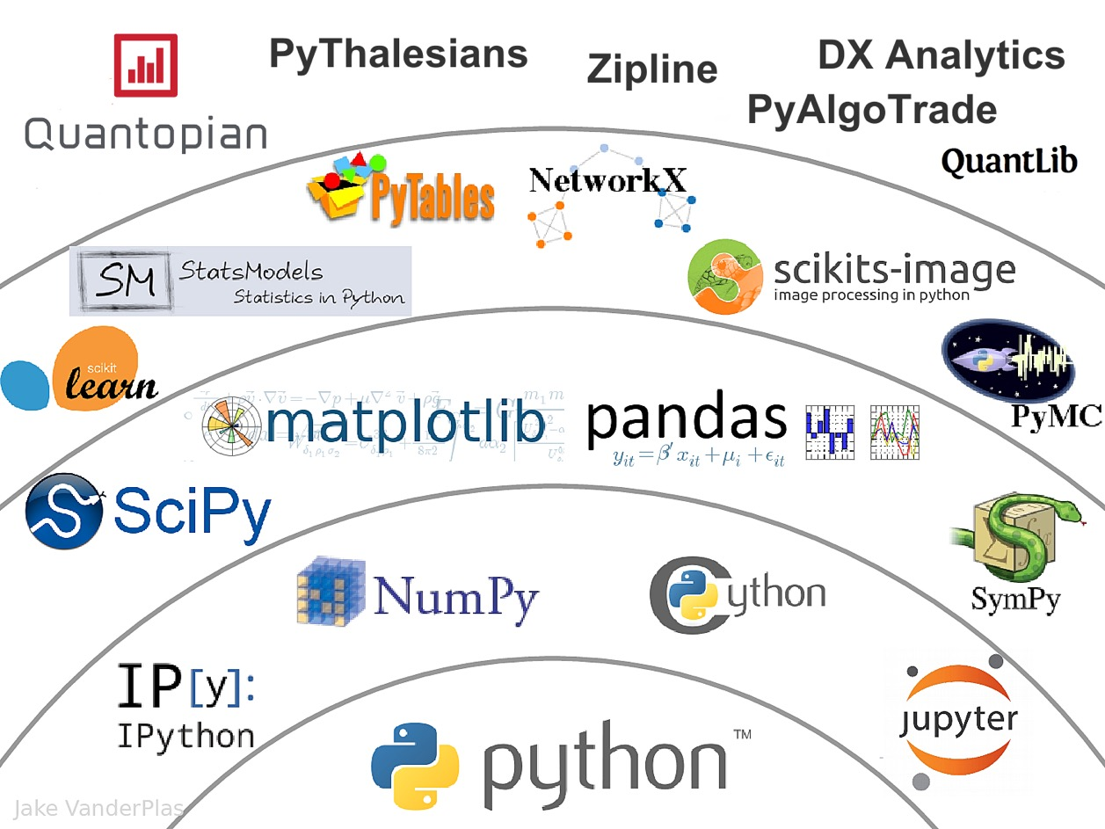
The Quant Finance PyData Stack
Source: http://nbviewer.jupyter.org/format/slides/github/quantopian/pyfolio/blob/master/pyfolio/examples/overview_slides.ipynb#/5

Slide 84
Yves Hilpisch (2020),
Artificial Intelligence in Finance:
A Python-Based Guide,
O’Reilly
Source: https://www.amazon.com/Artificial-Intelligence-Finance-Python-Based-Guide/dp/1492055433

Slide 85
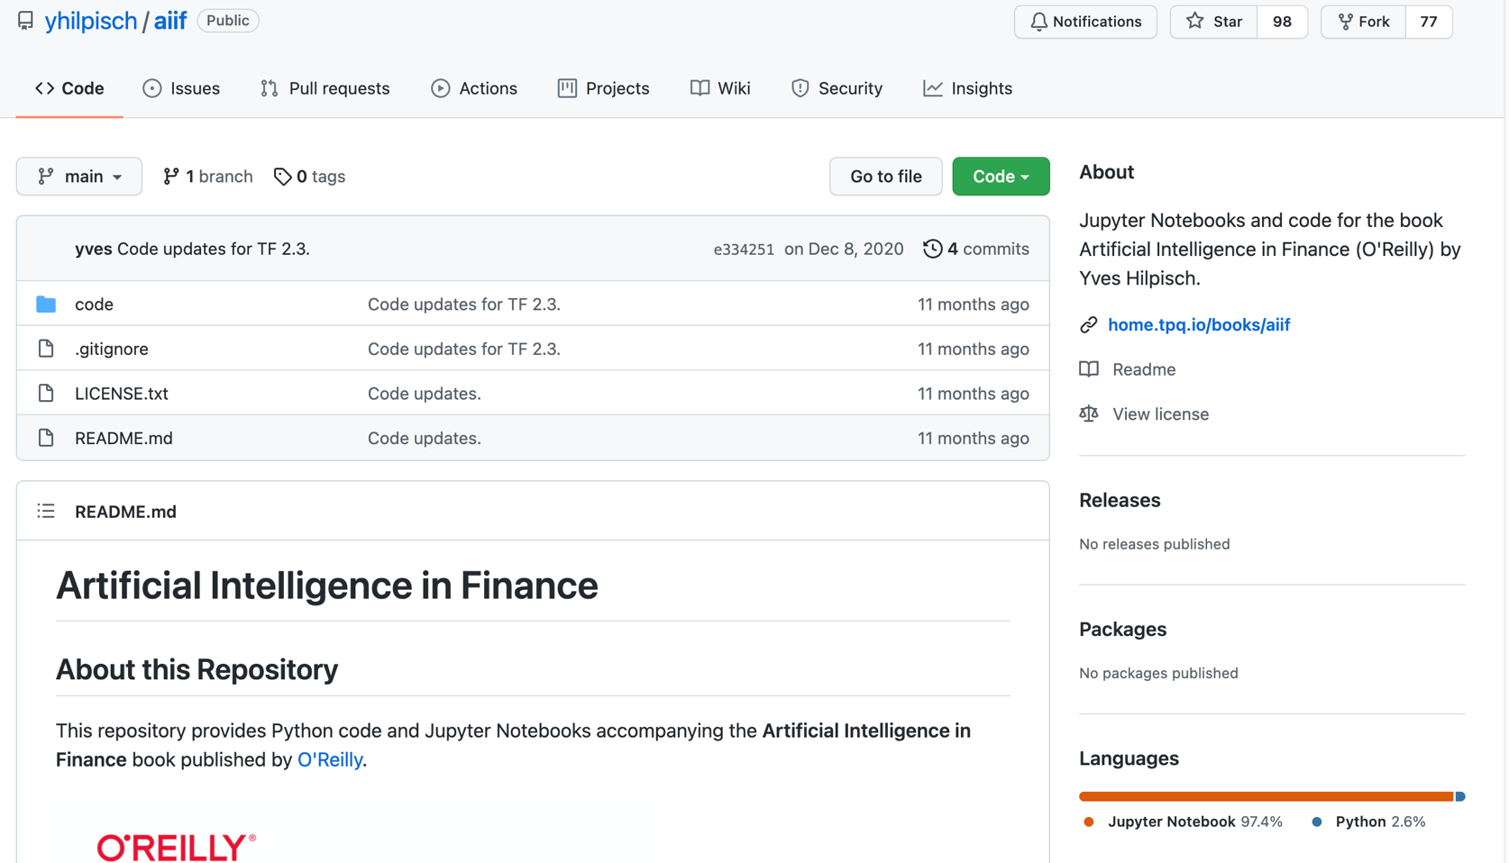
Yves Hilpisch (2020), Artificial Intelligence in Finance: A Python-Based Guide, O’Reilly
https://github.com/yhilpisch/aiif
Source: https://github.com/yhilpisch/aiif

Slide 86
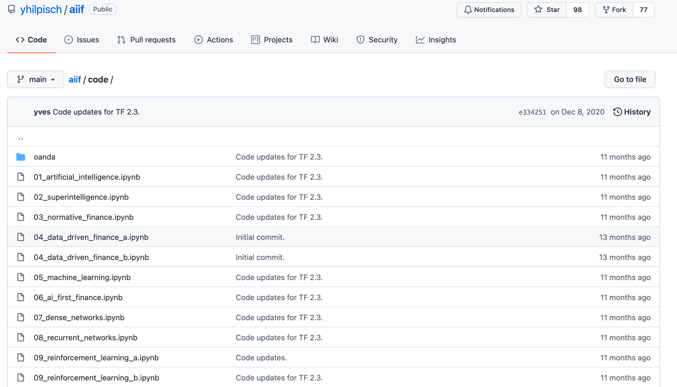
Yves Hilpisch (2020), Artificial Intelligence in Finance: A Python-Based Guide, O’Reilly
https://github.com/yhilpisch/aiif/tree/main/code
Source: https://github.com/yhilpisch/aiif/tree/main/code

Slide 87

Python in Google Colab (Python101)
https://colab.research.google.com/drive/1FEG6DnGvwfUbeo4zJ1zTunjMqf2RkCrT
https://tinyurl.com/aintpupython101

Slide 88
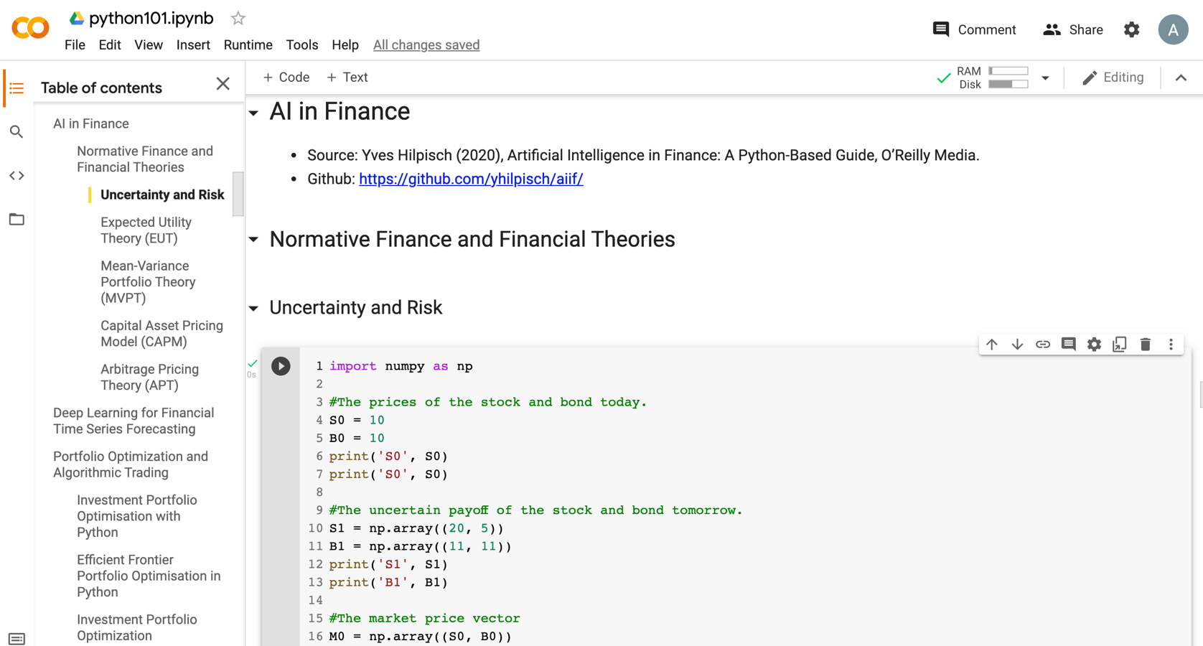
Python in Google Colab (Python101)
https://colab.research.google.com/drive/1FEG6DnGvwfUbeo4zJ1zTunjMqf2RkCrT
https://tinyurl.com/aintpupython101

Slide 89
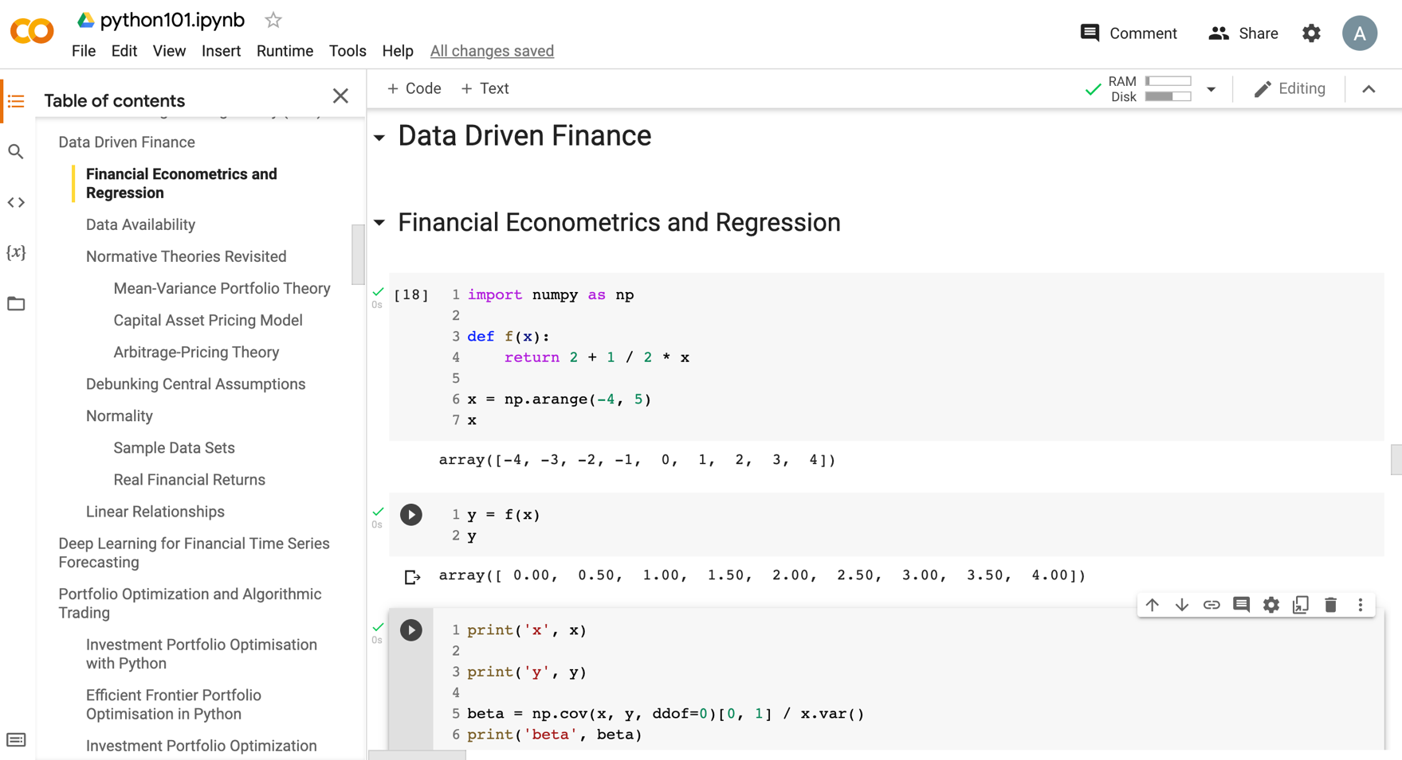
Python in Google Colab (Python101)
https://tinyurl.com/aintpupython101

Slide 90
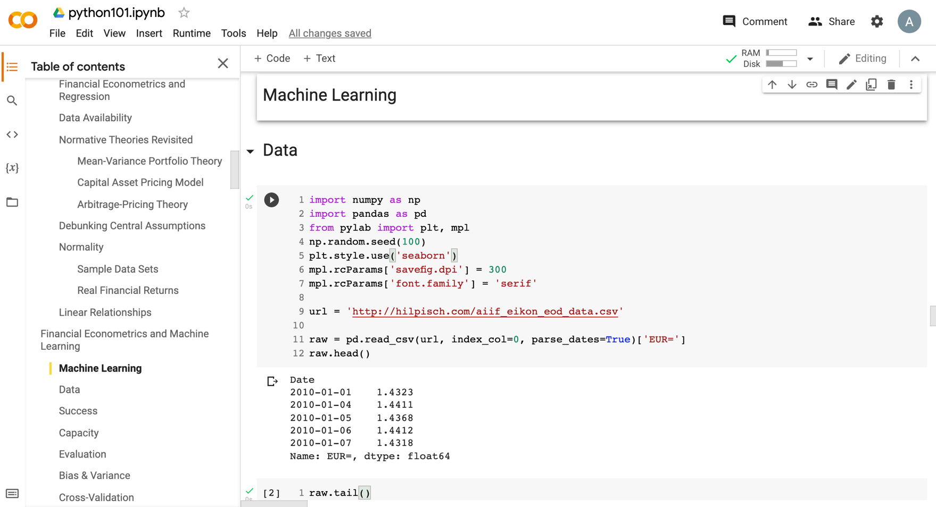
Python in Google Colab (Python101)
https://tinyurl.com/aintpupython101

Slide 91
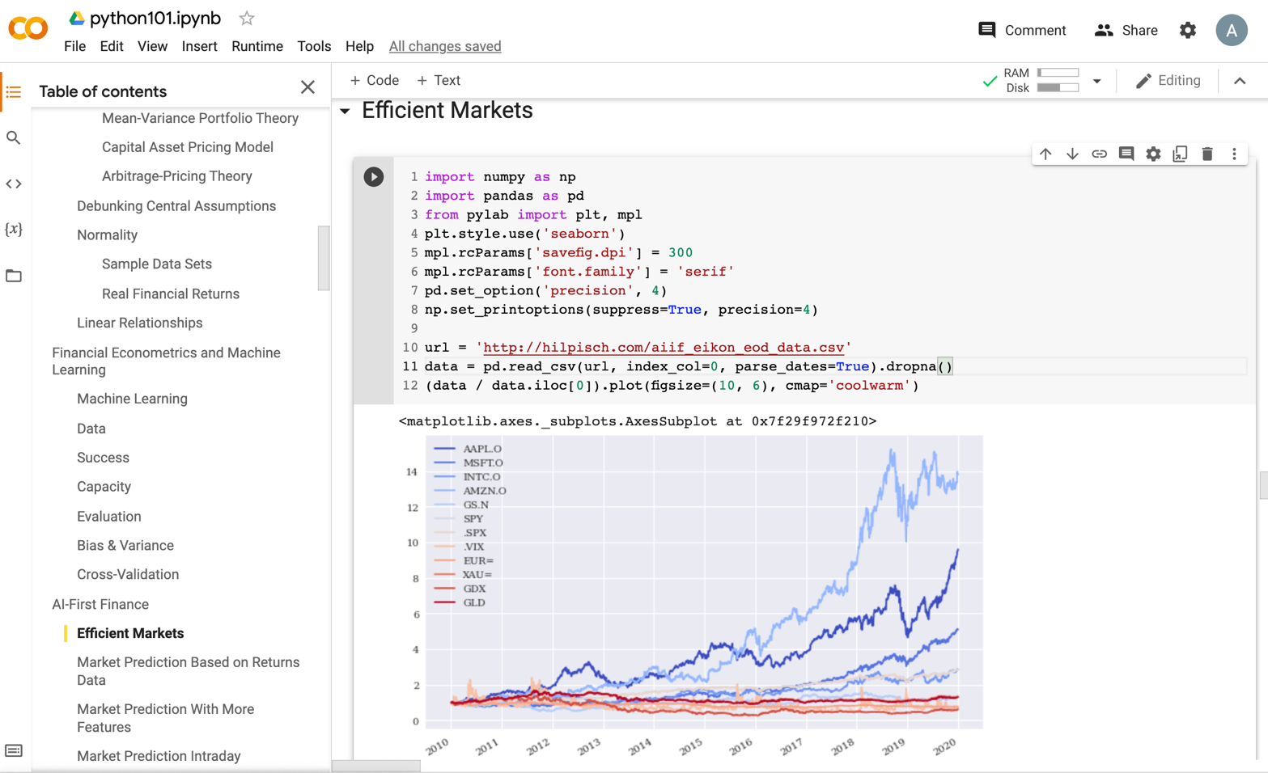
Python in Google Colab (Python101)
https://tinyurl.com/aintpupython101

Slide 92
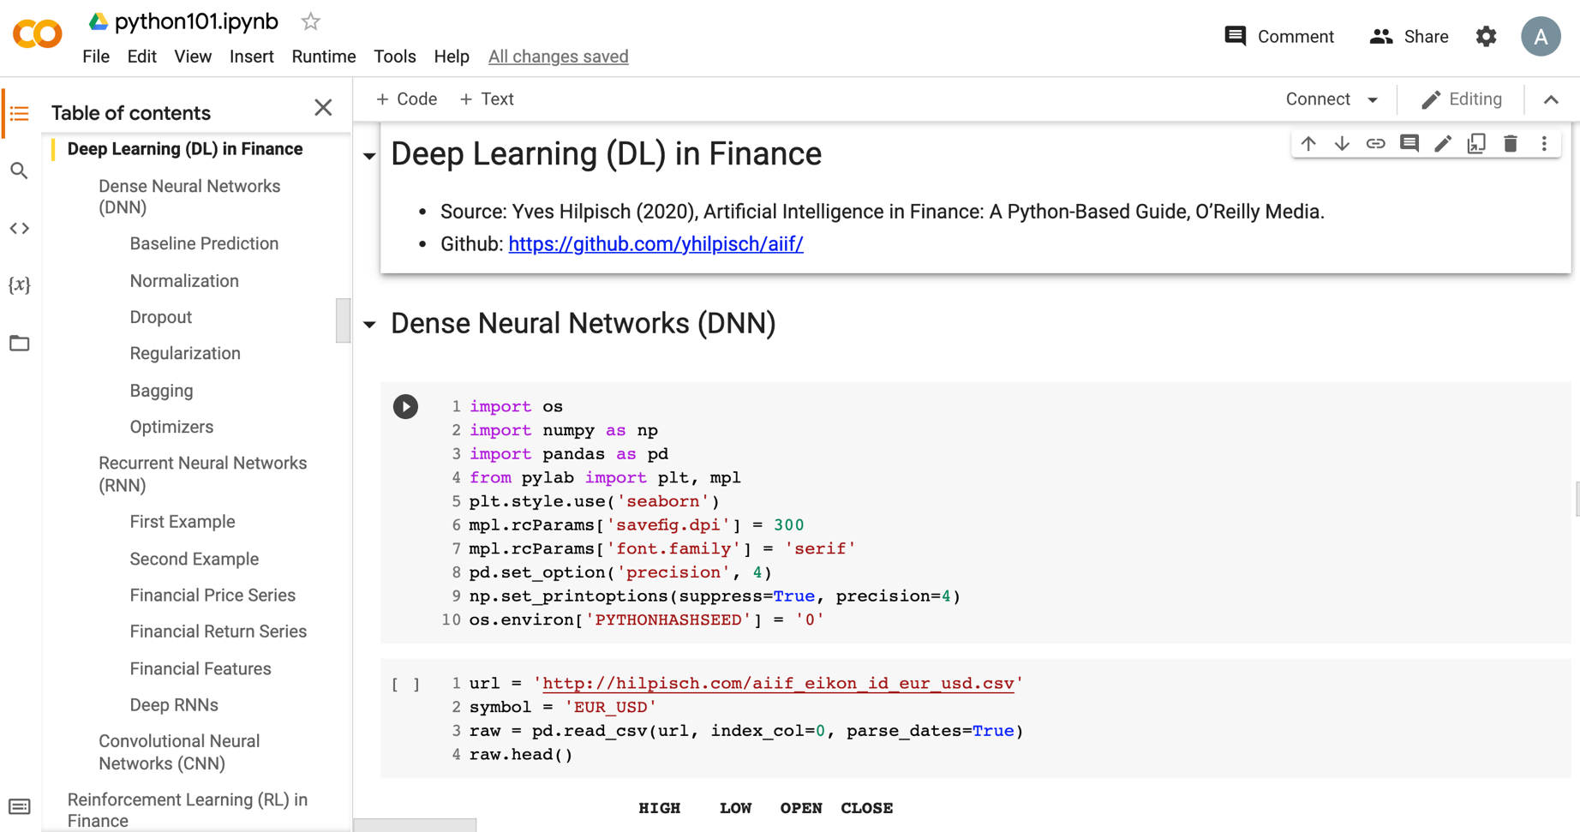
Python in Google Colab (Python101)
https://tinyurl.com/aintpupython101

Slide 93
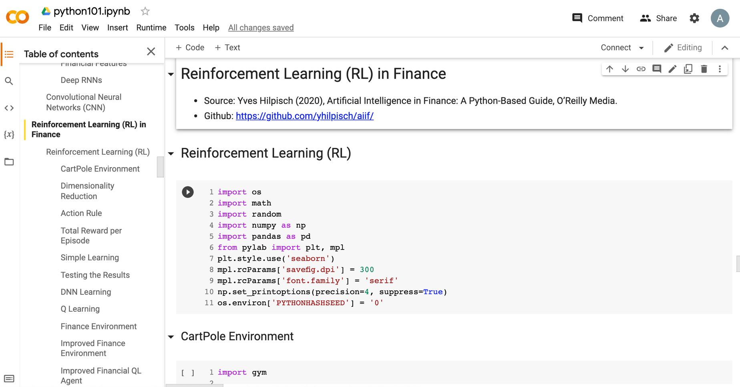
Python in Google Colab (Python101)
https://tinyurl.com/aintpupython101

Slide 94
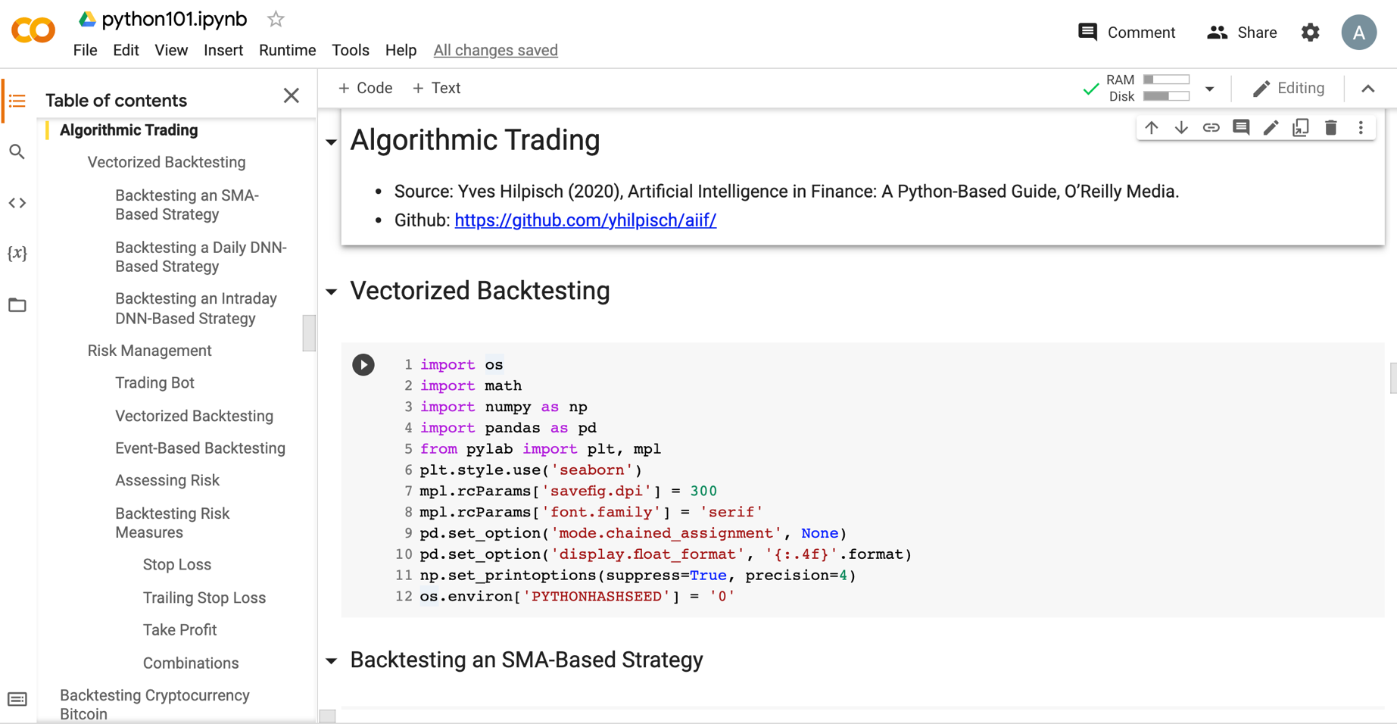
Python in Google Colab (Python101)
https://tinyurl.com/aintpupython101

Slide 95
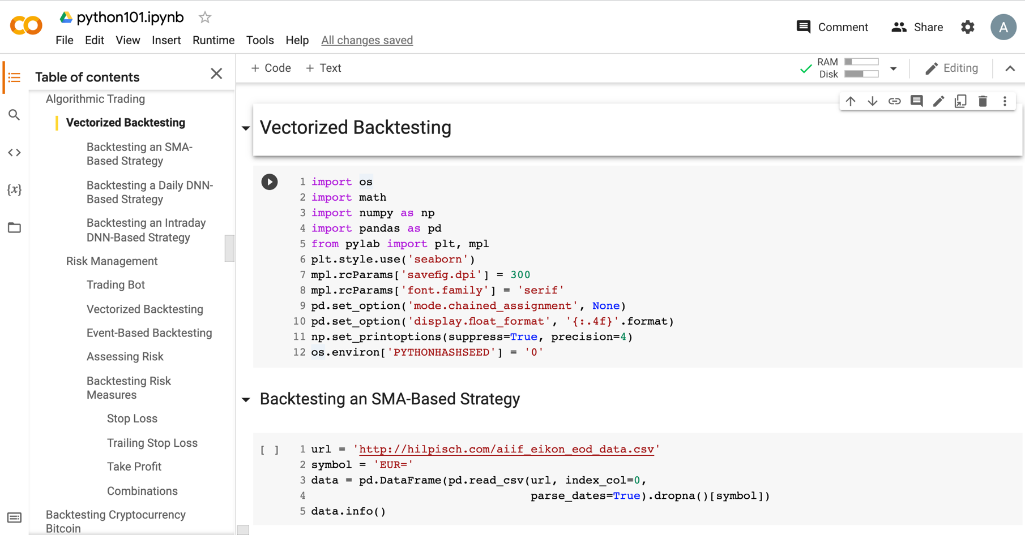
Python in Google Colab (Python101)
https://tinyurl.com/aintpupython101

Slide 96
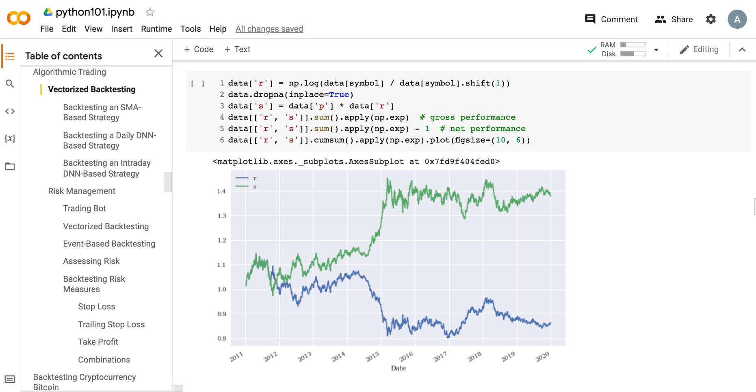
Python in Google Colab (Python101)
https://tinyurl.com/aintpupython101

Slide 97
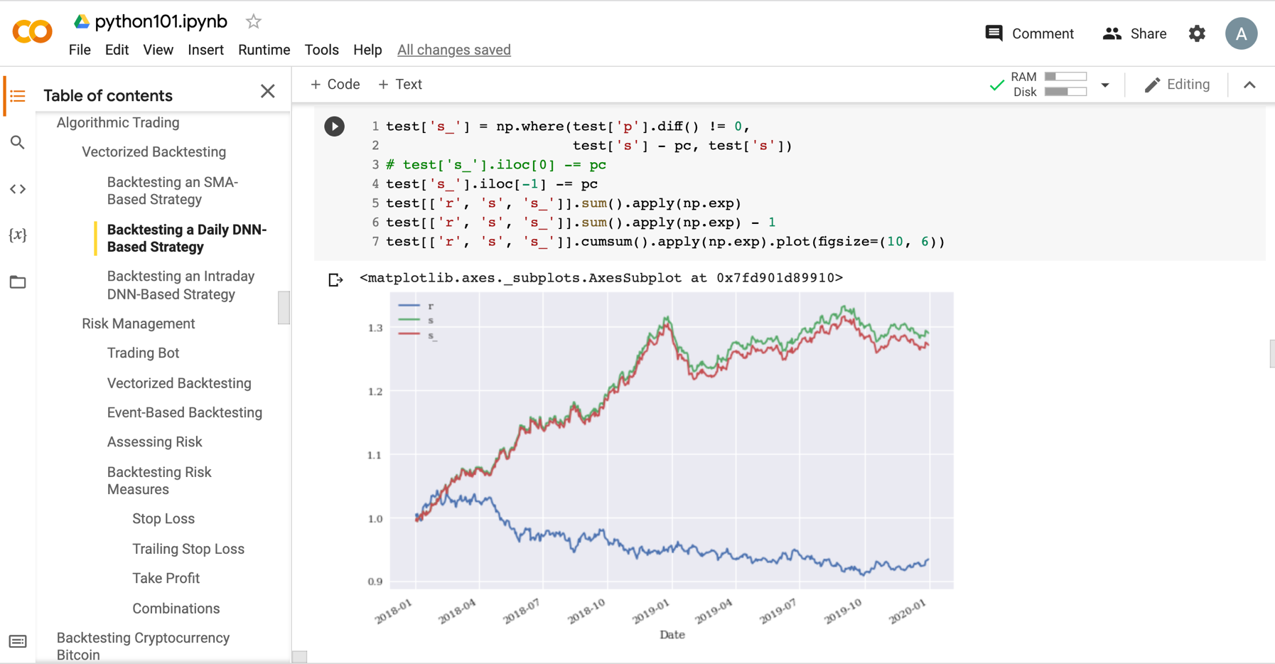
Python in Google Colab (Python101)
https://tinyurl.com/aintpupython101

Slide 98
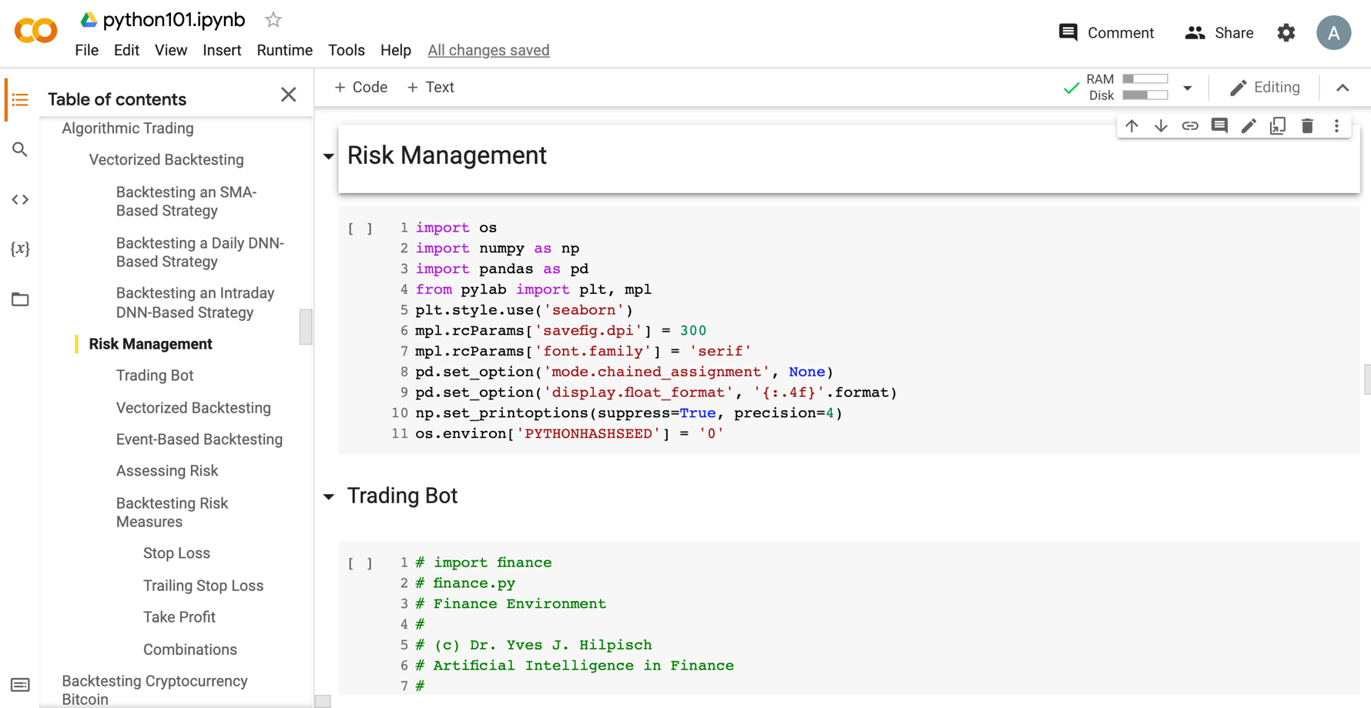
Python in Google Colab (Python101)
https://tinyurl.com/aintpupython101

Slide 99
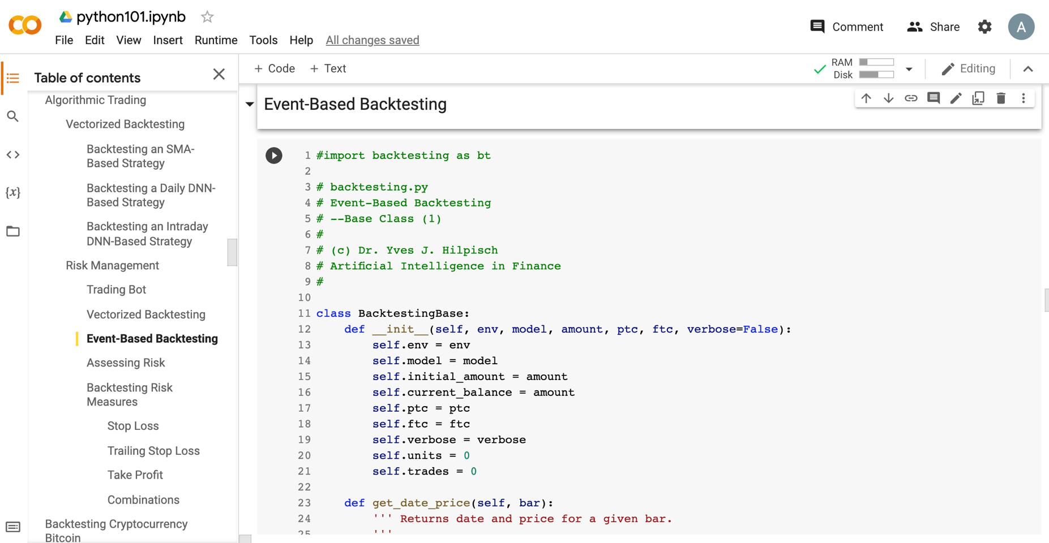
Python in Google Colab (Python101)
https://tinyurl.com/aintpupython101

Slide 100
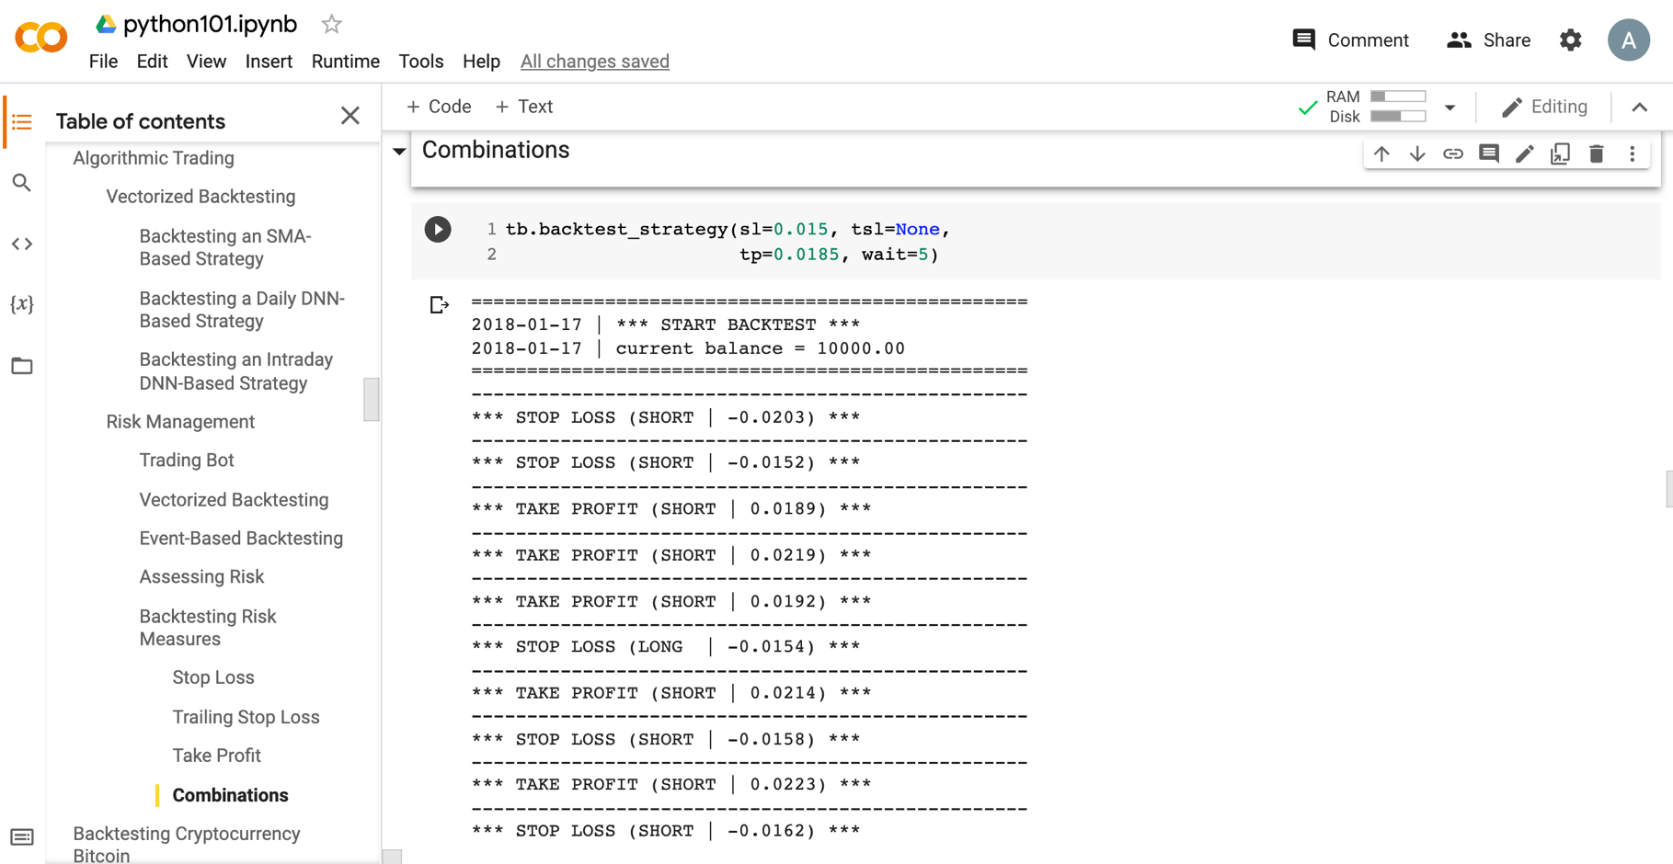
Python in Google Colab (Python101)
https://tinyurl.com/aintpupython101

Slide 101
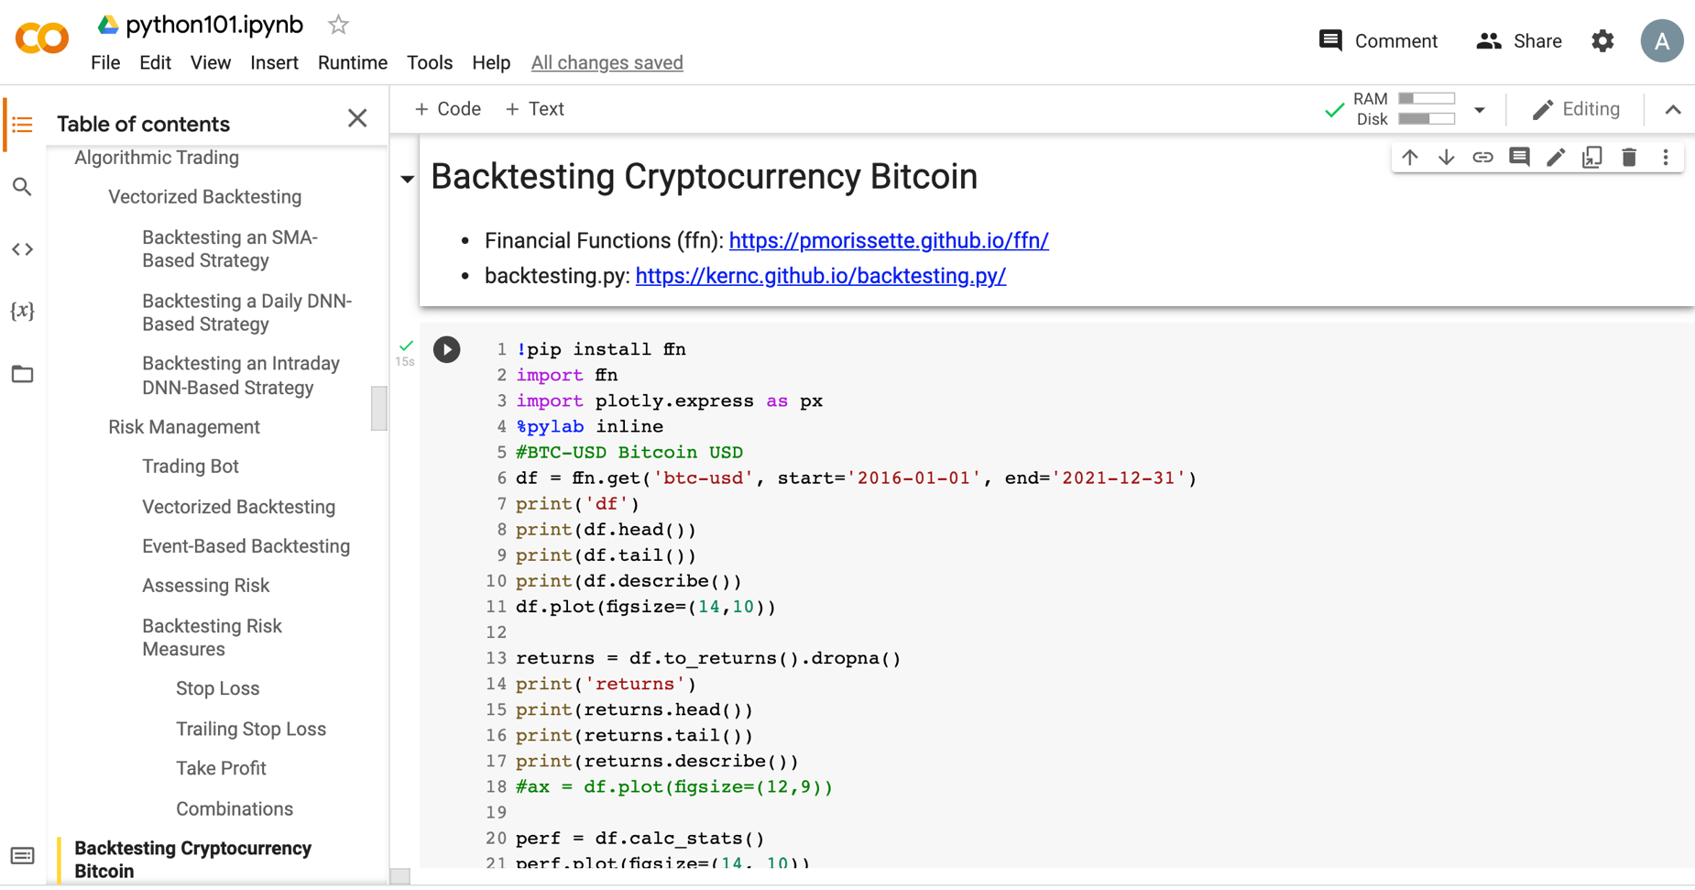
Python in Google Colab (Python101)
https://tinyurl.com/aintpupython101

Slide 102
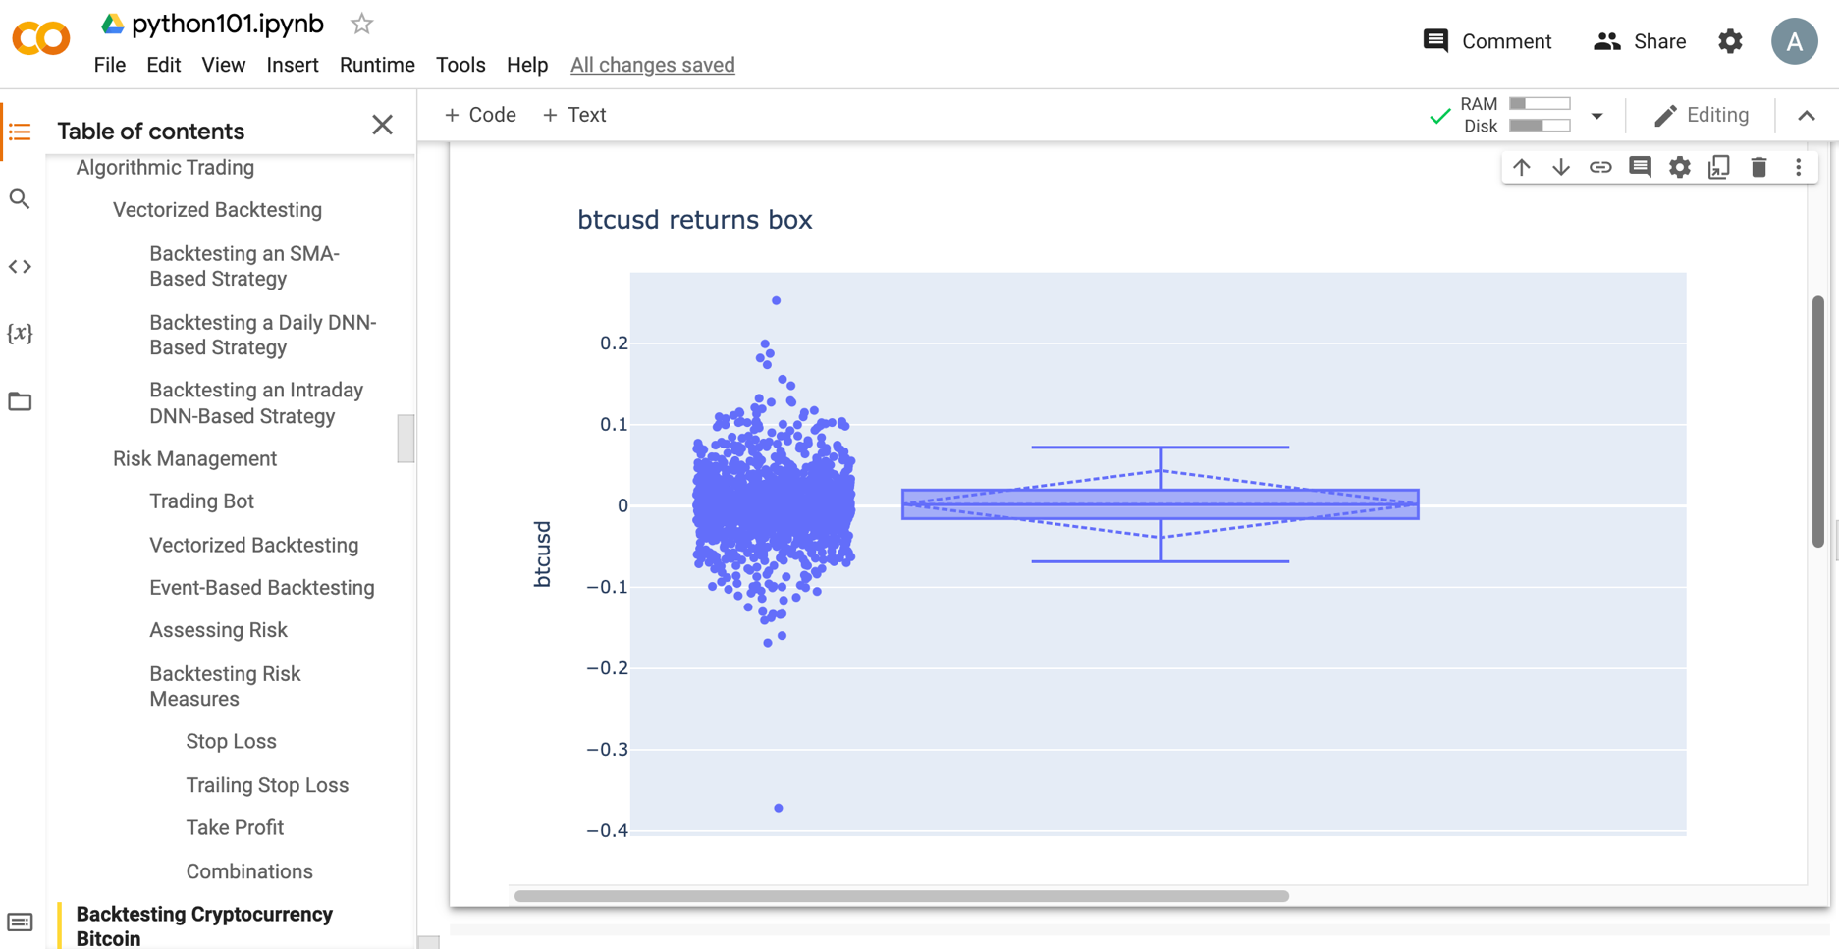
Python in Google Colab (Python101)
https://tinyurl.com/aintpupython101

Slide 103
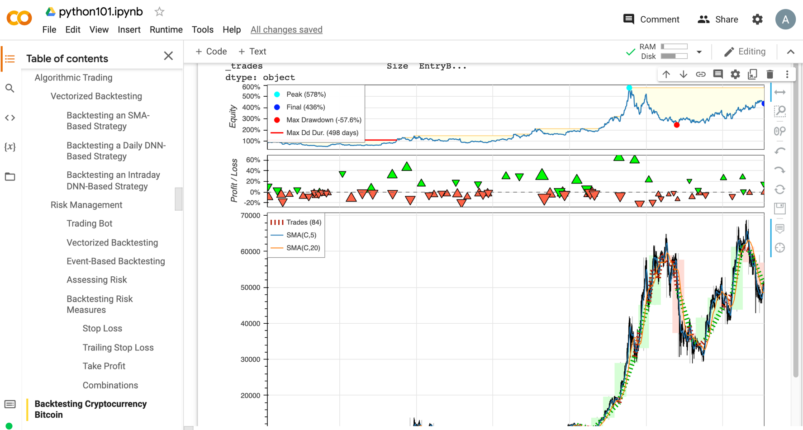
Python in Google Colab (Python101)
https://tinyurl.com/aintpupython101

Slide 104
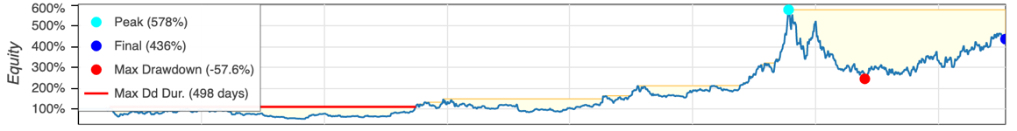
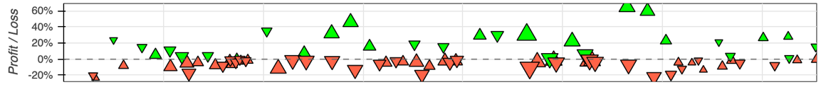
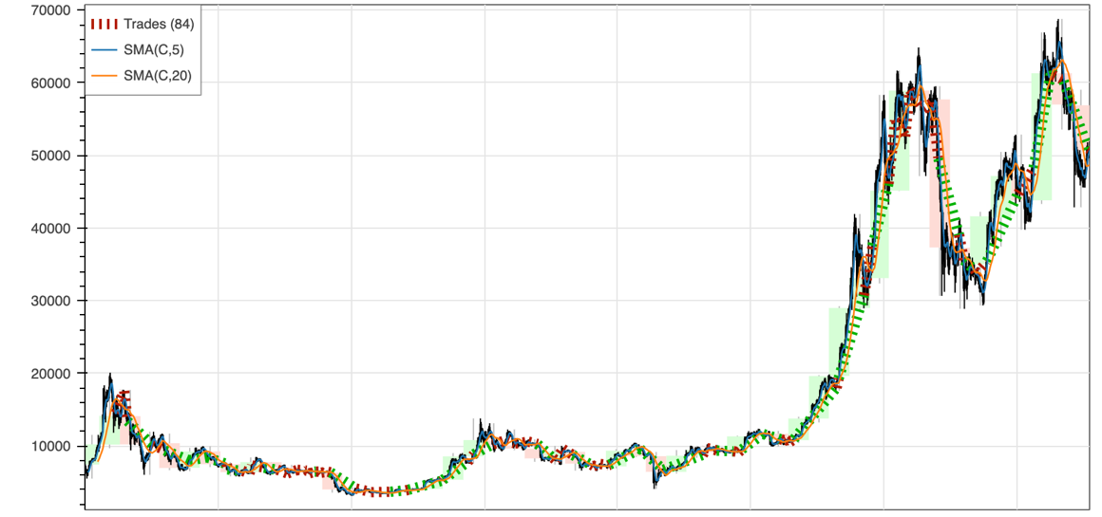
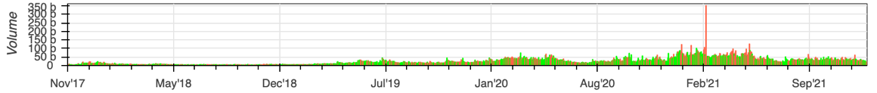
https://tinyurl.com/aintpupython101

Slide 105

Teaching
Artificial Intelligence in Finance and Quantitative
  Fall 2021, Fall 2022
Artificial Intelligence
  Spring 2021, Fall 2022
Software Engineering
  Fall 2020, Fall, 2021, Spring 2022, Spring 2023
Artificial Intelligence for Text Analytics
  Spring 2022
Data Mining
  Spring 2021
Big Data Analytics
  Fall 2020
Foundation of Business Cloud Computing
  Spring 2021, Spring 2022, Spring 2023
https://web.ntpu.edu.tw/~myday/teaching.htm

Slide 106
Research Project
Applying AI technology to construct knowledge graphs of cryptocurrency anti-money laundering: a few-shot learning model
  MOST, 110-2410-H-305-013-MY2, 2021/08/01~2023/07/31
AI for Corporate Sustainability Assessment and Cross Language Corporate Sustainability Reports Generative Mode
  NTPU, 111-NTPU_ORDA-F-001，2022/01/01~2022/12/31
Artificial Intelligence for FinTech Knowledge Graph from Patent Textual Analytics
  NTPU, 111-NTPU_ORDA-F-003, 2022/01/01~2022/12/31
https://web.ntpu.edu.tw/~myday/cindex.htm#projects

Slide 107
Summary
This course introduces the fundamental concepts, research issues, and hands-on practices of AI in Finance and Quantitative Analysis.
Topics include:
  Introduction to Artificial Intelligence in Finance and Quantitative Analysis
  AI in FinTech: Metaverse, Web3, DeFi, NFT, Financial Services Innovation and Applications,
  Investing Psychology and Behavioral Finance
  Event Studies in Finance
  Finance Theory
  Data-Driven Finance
  Financial Econometrics
  AI-First Finance
  Deep Learning in Finance
  Reinforcement Learning in Finance
  Algorithmic Trading, Risk Management, Trading Bot and Event-Based Backtesting
  Case Study on AI in Finance and Quantitative Analysis.

Slide 108

AI in Finance and Quantitative Analysis
Contact Information
Min-Yuh Day, Ph.D.
Associate Professor
Institute of Information Management, National Taipei University
Tel: 02-86741111 ext. 66873
Office: B8F12
Address: 151, University Rd., San Shia District, New Taipei City, 23741 Taiwan
Email: myday@gm.ntpu.edu.tw
Web: http://web.ntpu.edu.tw/~myday/

