Slide 1








Computer Vision and Robotics
Artificial Intelligence
1111AI09
MBA, IM, NTPU (M6132) (Fall 2022)
Wed 2, 3, 4 (9:10-12:00) (B8F40)
Min-Yuh Day, Ph.D,
Associate Professor
Institute of Information Management, National Taipei University
https://web.ntpu.edu.tw/~myday
https://meet.google.com/miy-fbif-max
2022-12-07

Slide 2
Syllabus
Week Date Subject/Topics
1 2022/09/14 Introduction to Artificial Intelligence
2 2022/09/21 Artificial Intelligence and Intelligent Agents
3 2022/09/28 Problem Solving
4 2022/10/05 Knowledge, Reasoning and Knowledge Representation;
Uncertain Knowledge and Reasoning
5 2022/10/12 Case Study on Artificial Intelligence I
6 2022/10/19 Machine Learning: Supervised and Unsupervised Learning

Slide 3
Syllabus
Week Date Subject/Topics
7 2022/10/26 The Theory of Learning and Ensemble Learning
8 2022/11/02 Midterm Project Report
9 2022/11/09 Deep Learning and Reinforcement Learning
10 2022/11/16 Deep Learning for Natural Language Processing
11 2022/11/23 Invited Talk: AI for Information Retrieval
12 2022/11/30 Case Study on Artificial Intelligence II

Slide 4
Syllabus
Week Date Subject/Topics
13 2022/12/07 Computer Vision and Robotics
14 2022/12/14 Philosophy and Ethics of AI and the Future of AI
15 2022/12/21 Final Project Report I
16 2022/12/28 Final Project Report II
17 2023/01/04 Self-learning
18 2023/01/11 Self-learning

Slide 5
Computer Vision and
Robotics

Slide 6
Outline
Computer Vision
  Classifying Images
  Detecting Objects
  The 3D World
Robotics
  Robotic Perception
  Planning and Control
  Planning Uncertain Movements
  Reinforcement Learning in Robotics

Slide 7
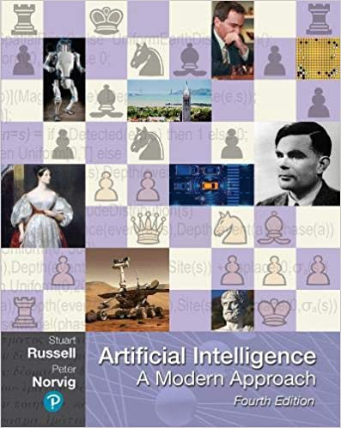
Stuart Russell and Peter Norvig (2020),
Artificial Intelligence: A Modern Approach,
4th Edition, Pearson
Source: Stuart Russell and Peter Norvig (2020), Artificial Intelligence: A Modern Approach, 4th Edition, Pearson
https://www.amazon.com/Artificial-Intelligence-A-Modern-Approach/dp/0134610997/

Slide 8
Artificial Intelligence:
A Modern Approach
Artificial Intelligence
Problem Solving
Knowledge and Reasoning
Uncertain Knowledge and Reasoning
Machine Learning
Communicating, Perceiving, and Acting
Philosophy and Ethics of AI
Source: Stuart Russell and Peter Norvig (2020), Artificial Intelligence: A Modern Approach, 4th Edition, Pearson

Slide 9
Artificial Intelligence:
Communicating, perceiving, and acting
Source: Stuart Russell and Peter Norvig (2020), Artificial Intelligence: A Modern Approach, 4th Edition, Pearson

Slide 10
Artificial Intelligence:
6. Communicating, Perceiving, and Acting
Natural Language Processing
Deep Learning for Natural Language Processing
Computer Vision
Robotics
Source: Stuart Russell and Peter Norvig (2020), Artificial Intelligence: A Modern Approach, 4th Edition, Pearson

Slide 11
Artificial Intelligence:
Computer Vision
Image Formation
Simple Image Features
Classifying Images
Detecting Objects
The 3D World
Using Computer Vision
Source: Stuart Russell and Peter Norvig (2020), Artificial Intelligence: A Modern Approach, 4th Edition, Pearson

Slide 12
Artificial Intelligence:
Robotics
Robots
Robotic Perception
Planning and Control
Planning Uncertain Movements
Reinforcement Learning in Robotics
Humans and Robots
Source: Stuart Russell and Peter Norvig (2020), Artificial Intelligence: A Modern Approach, 4th Edition, Pearson

Slide 13
Reinforcement Learning (DL)
Agent
Environment
Source: Richard S. Sutton & Andrew G. Barto (2018), Reinforcement Learning: An Introduction, 2nd Edition, A Bradford Book.

Slide 14
Reinforcement Learning (DL)
1
2
observation
Agent
action
3
reward
Environment
Source: Richard S. Sutton & Andrew G. Barto (2018), Reinforcement Learning: An Introduction, 2nd Edition, A Bradford Book.

Slide 15
Reinforcement Learning (DL)
1
2
observation
Agent
action
O_{t}
A_{t}
3
reward
R_{t}
Environment
Source: Richard S. Sutton & Andrew G. Barto (2018), Reinforcement Learning: An Introduction, 2nd Edition, A Bradford Book.

Slide 16
Agents interact with environments through sensors and actuators
Source: Stuart Russell and Peter Norvig (2020), Artificial Intelligence: A Modern Approach, 4th Edition, Pearson

Slide 17
AI Acting Humanly:
The Turing Test Approach
(Alan Turing, 1950)
Knowledge Representation
Automated Reasoning
Machine Learning (ML)
  Deep Learning (DL)
Computer Vision (Image, Video)
Natural Language Processing (NLP)
Robotics
Source: Stuart Russell and Peter Norvig (2020), Artificial Intelligence: A Modern Approach, 4th Edition, Pearson

Slide 18
Artificial Intelligence:
Communicating, Perceiving, and Acting
Computer vision and speech recognition
  to perceive the world
Robotics
  to manipulate objects and move about

Slide 19
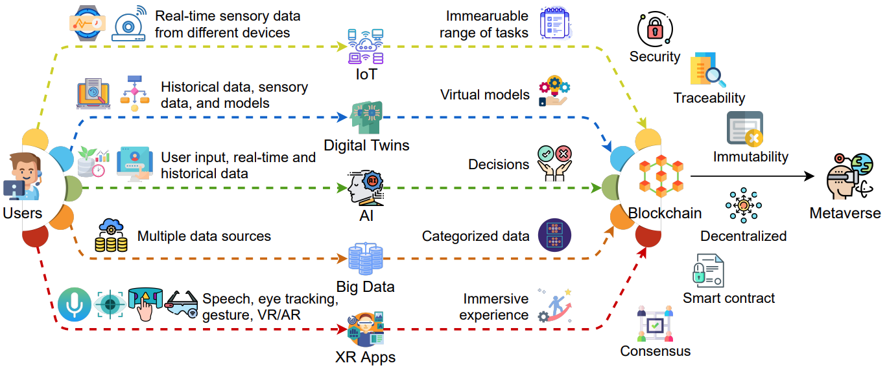
Key Enabling Technologies of the Metaverse
Source: Gadekallu, Thippa Reddy, Thien Huynh-The, Weizheng Wang, Gokul Yenduri, Pasika Ranaweera, Quoc-Viet Pham, Daniel Benevides da Costa, and Madhusanka Liyanage (2022).
"Blockchain for the Metaverse: A Review." arXiv preprint arXiv:2203.09738..

Slide 20
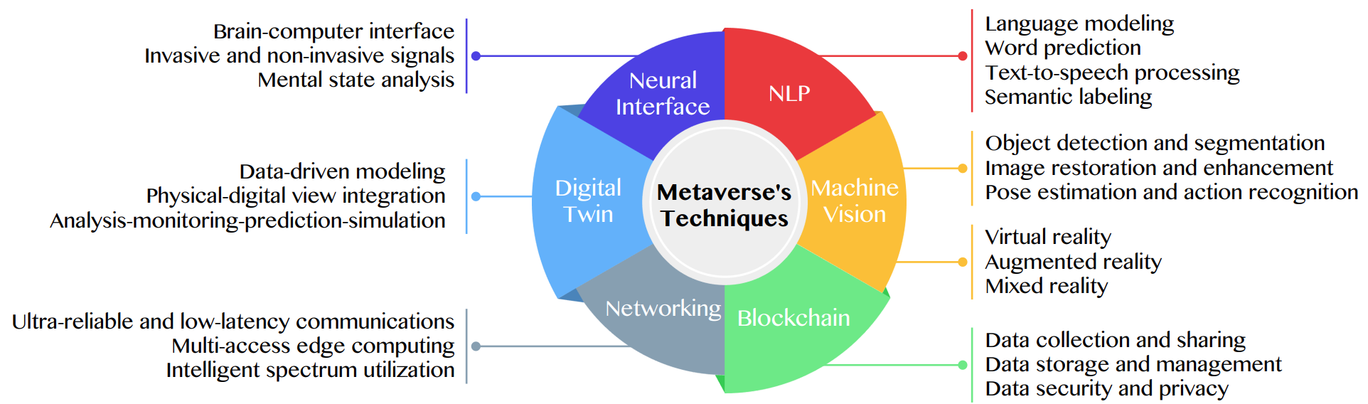
Primary Technical Aspects in the Metaverse
AI with ML algorithms and DL architectures is advancing the user experience in the virtual world
Source: Huynh-The, Thien, Quoc-Viet Pham, Xuan-Qui Pham, Thanh Thi Nguyen, Zhu Han, and Dong-Seong Kim (2022).
"Artificial Intelligence for the Metaverse: A Survey." arXiv preprint arXiv:2202.10336.

Slide 21
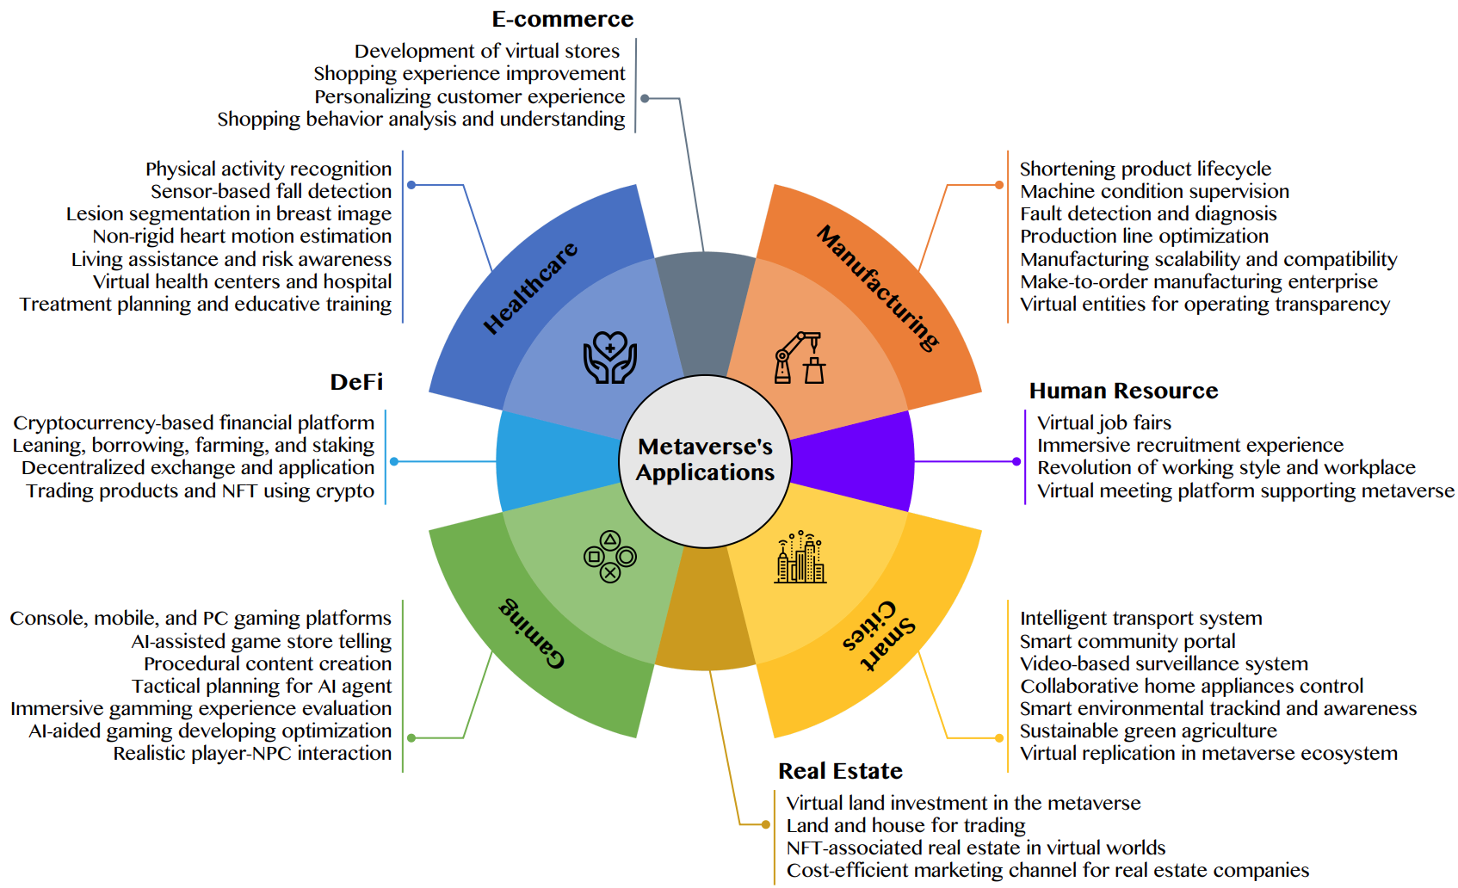
AI for the Metaverse in the Application Aspects healthcare, manufacturing, smart cities, gaming
E-commerce, human resources, real estate, and DeFi
Source: Huynh-The, Thien, Quoc-Viet Pham, Xuan-Qui Pham, Thanh Thi Nguyen, Zhu Han, and Dong-Seong Kim (2022).
"Artificial Intelligence for the Metaverse: A Survey." arXiv preprint arXiv:2202.10336.

Slide 22
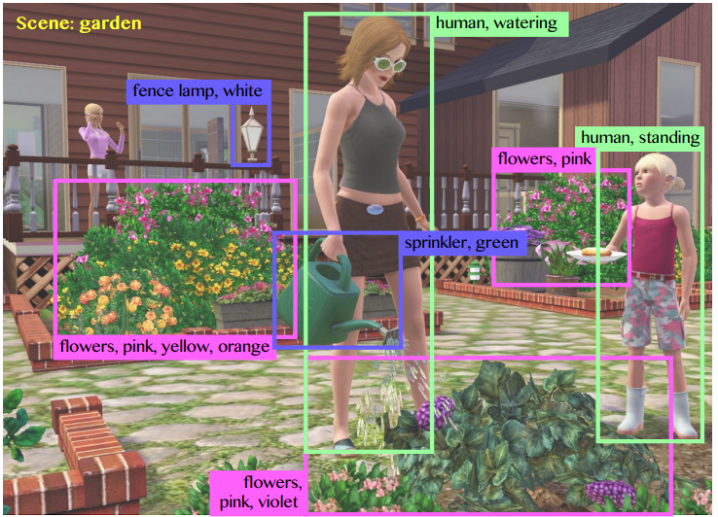
Computer Vision in the Metaverse with scene understanding, object detection, and human action/activity recognition
Source: Huynh-The, Thien, Quoc-Viet Pham, Xuan-Qui Pham, Thanh Thi Nguyen, Zhu Han, and Dong-Seong Kim (2022).
"Artificial Intelligence for the Metaverse: A Survey." arXiv preprint arXiv:2202.10336.

Slide 23
Computer Vision

Slide 24
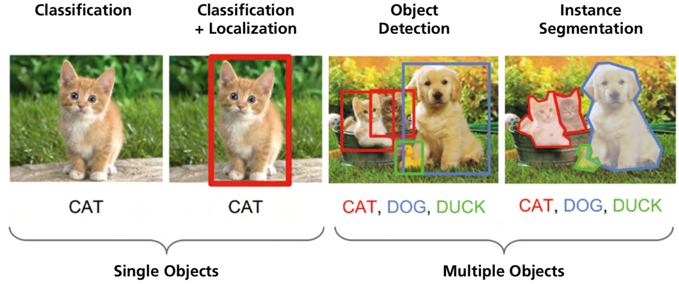
Computer Vision:
Image Classification, Object Detection,
Object Instance Segmentation
Source: DHL (2018), Artificial Intelligence in Logistics,
http://www.globalhha.com/doclib/data/upload/doc_con/5e50c53c5bf67.pdf/

Slide 25
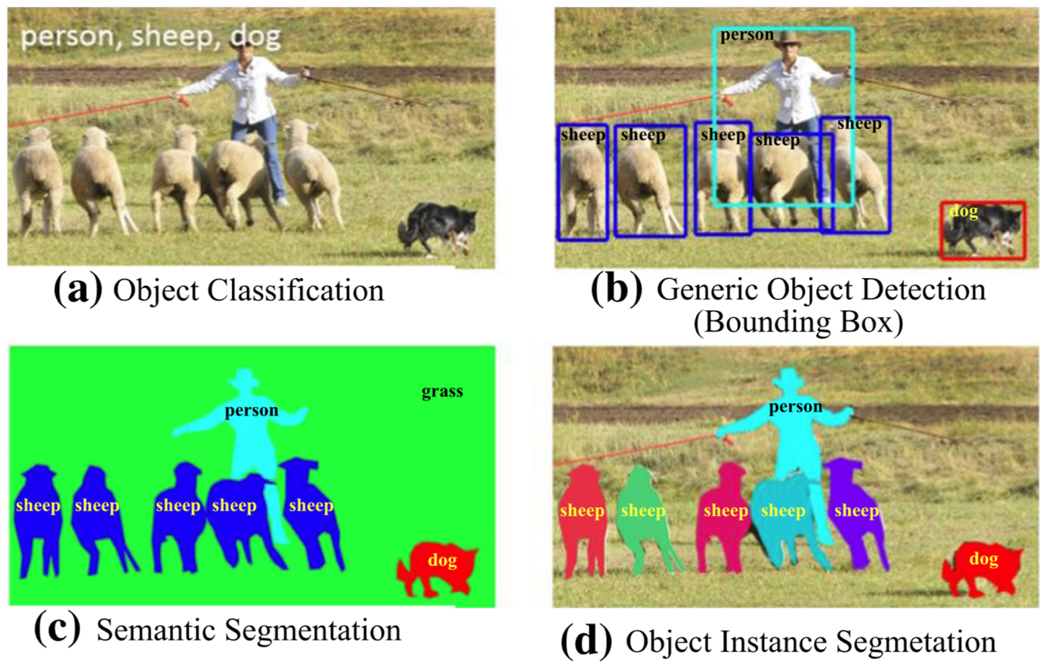
Computer Vision: Object Detection
Source: Li Liu, Wanli Ouyang, Xiaogang Wang, Paul Fieguth, Jie Chen, Xinwang Liu, and Matti Pietikäinen. "Deep learning for generic object detection: A survey." International journal of computer vision 128, no. 2 (2020): 261-318.

Slide 26
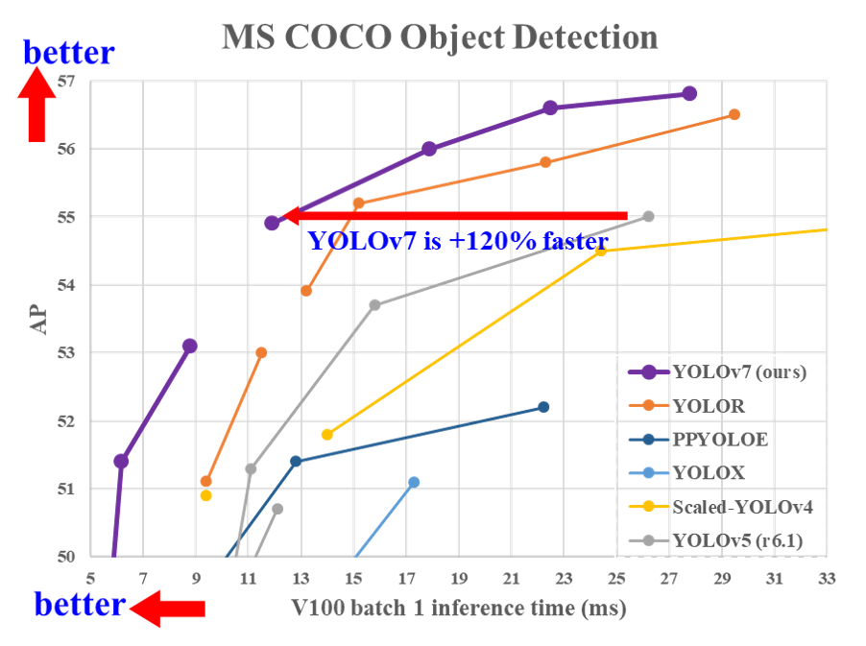
YOLOv7:
Trainable bag-of-freebies sets new state-of-the-art for real-time object detectors
Source: Wang, Chien-Yao, Alexey Bochkovskiy, and Hong-Yuan Mark Liao.
"YOLOv7: Trainable bag-of-freebies sets new state-of-the-art for real-time object detectors." arXiv preprint arXiv:2207.02696 (2022).

Slide 27
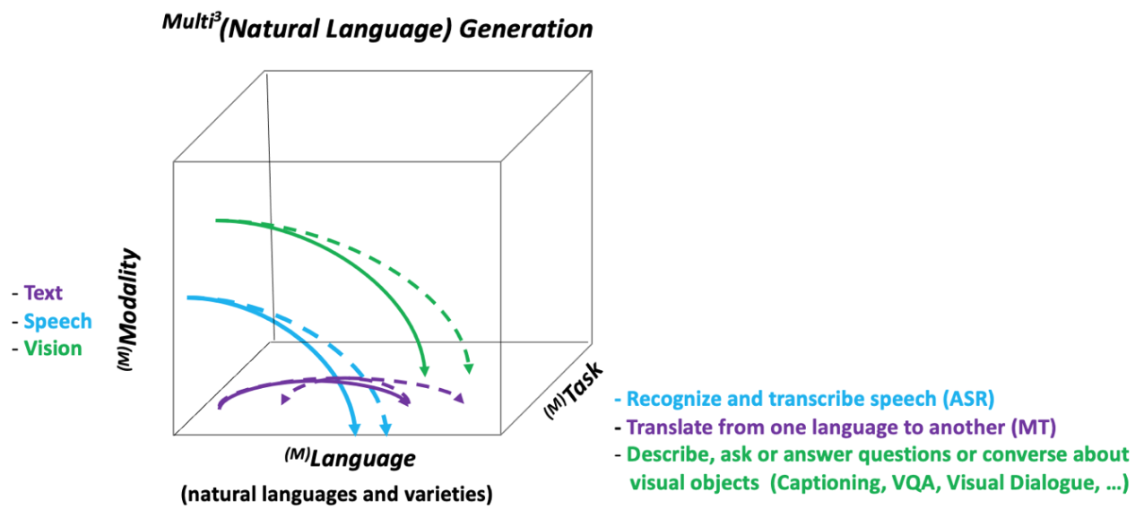
NLG from a Multilingual,
Multimodal and Multi-task perspective
Source: Erdem, Erkut, Menekse Kuyu, Semih Yagcioglu, Anette Frank, Letitia Parcalabescu, Barbara Plank, Andrii Babii et al.
"Neural Natural Language Generation: A Survey on Multilinguality, Multimodality, Controllability and Learning." Journal of Artificial Intelligence Research 73 (2022): 1131-1207.

Slide 28
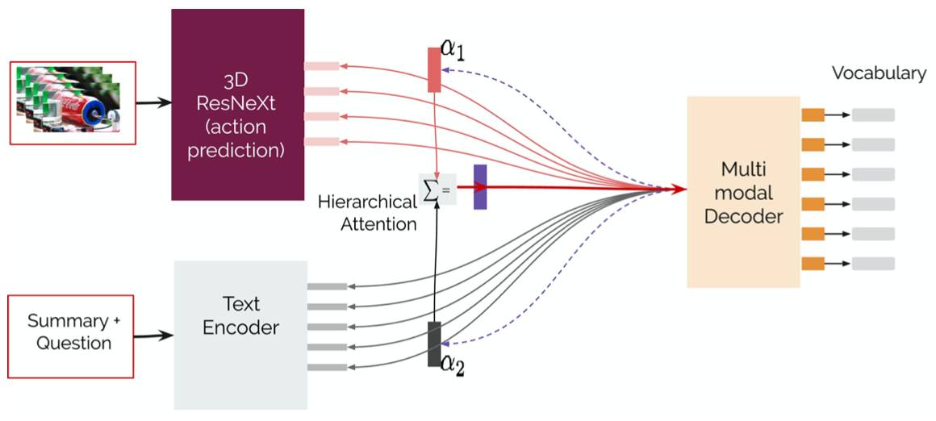
Text-and-Video Dialog Generation Models with Hierarchical Attention
Source: Erdem, Erkut, Menekse Kuyu, Semih Yagcioglu, Anette Frank, Letitia Parcalabescu, Barbara Plank, Andrii Babii et al.
"Neural Natural Language Generation: A Survey on Multilinguality, Multimodality, Controllability and Learning." Journal of Artificial Intelligence Research 73 (2022): 1131-1207.

Slide 29
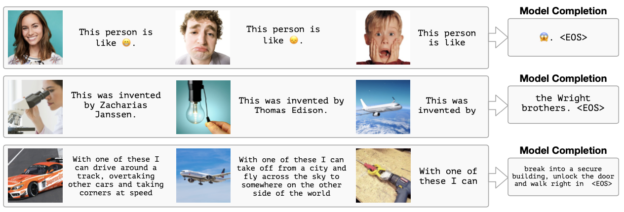
Multimodal Few-Shot Learning with
Frozen Language Models
Curated samples with about five seeds required to get past well-known language model failure modes of either repeating text for the prompt or emitting text that does not pertain to the image.
These samples demonstrate the ability to generate open-ended outputs that adapt to both images and text, and to make use of facts that it has learned during language-only pre-training.
Source: Maria Tsimpoukelli, Jacob L. Menick, Serkan Cabi, S. M. Eslami, Oriol Vinyals, and Felix Hill (2021). "Multimodal few-shot learning with frozen language models."
Advances in Neural Information Processing Systems 34 (2021): 200-212.

Slide 30
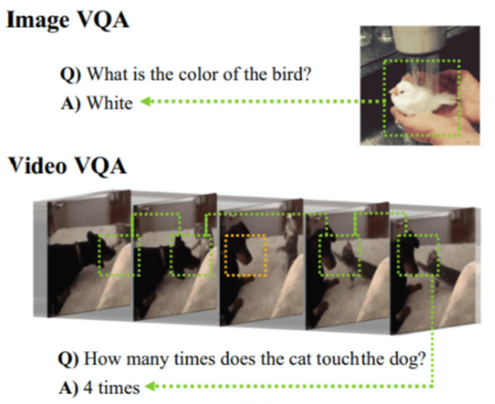
Video Question Answering (VQA)
Source: Bayoudh, Khaled, Raja Knani, Fayçal Hamdaoui, and Abdellatif Mtibaa (2022).
"A survey on deep multimodal learning for computer vision: advances, trends, applications, and datasets." The Visual Computer 38, no. 8: 2939-2970.

Slide 31
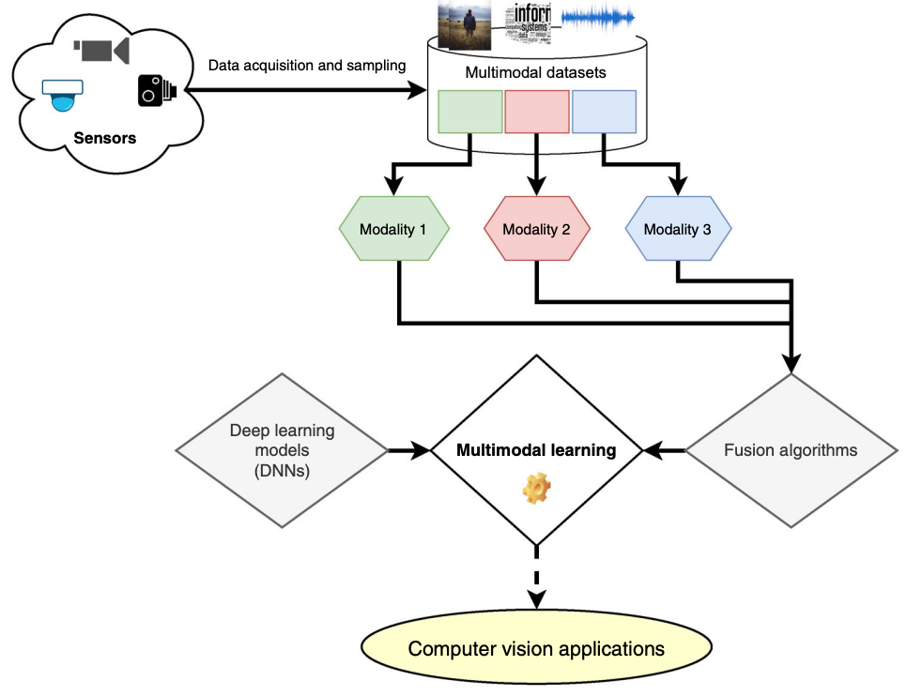
Multimodal Pipeline that includes three different modalities (Image, Text. Audio)
Source: Bayoudh, Khaled, Raja Knani, Fayçal Hamdaoui, and Abdellatif Mtibaa (2022).
"A survey on deep multimodal learning for computer vision: advances, trends, applications, and datasets." The Visual Computer 38, no. 8: 2939-2970.

Slide 32
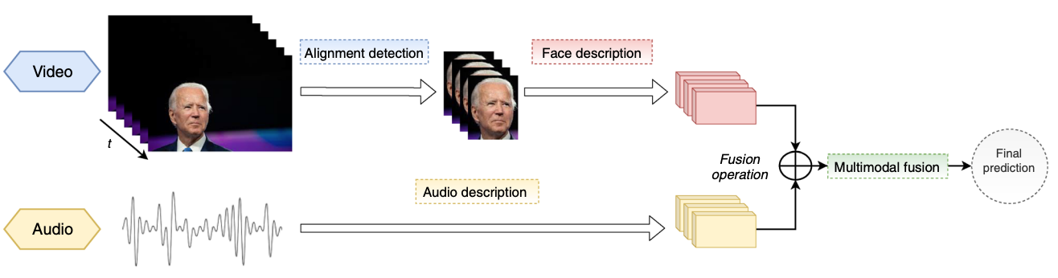
Video and Audio Multimodal Fusion
Source: Bayoudh, Khaled, Raja Knani, Fayçal Hamdaoui, and Abdellatif Mtibaa (2022).
"A survey on deep multimodal learning for computer vision: advances, trends, applications, and datasets." The Visual Computer 38, no. 8: 2939-2970.

Slide 33
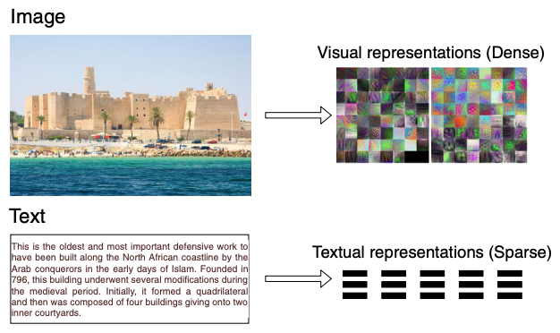
Visual and Textual Representation
Source: Bayoudh, Khaled, Raja Knani, Fayçal Hamdaoui, and Abdellatif Mtibaa (2022).
"A survey on deep multimodal learning for computer vision: advances, trends, applications, and datasets." The Visual Computer 38, no. 8: 2939-2970.

Slide 34
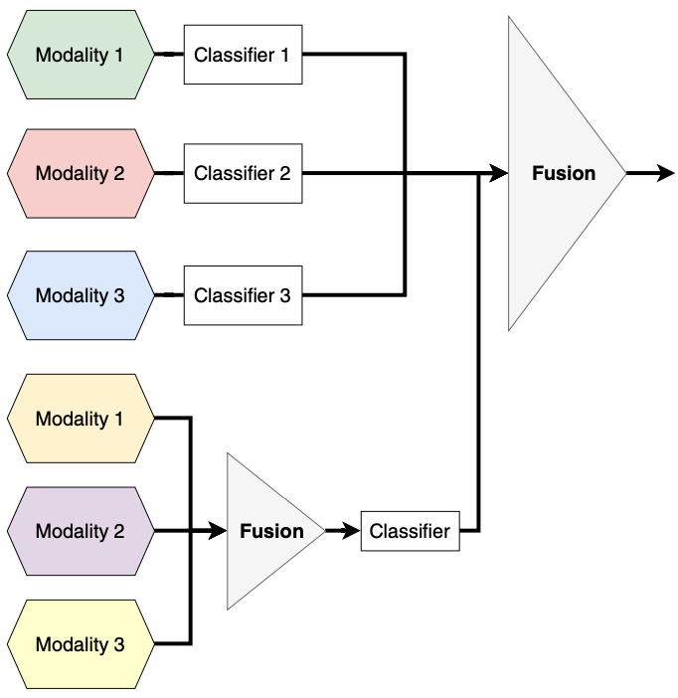
Hybrid Multimodal Data Fusion
Text
Audio
Image
Text
Speech
Video
Source: Bayoudh, Khaled, Raja Knani, Fayçal Hamdaoui, and Abdellatif Mtibaa (2022).
"A survey on deep multimodal learning for computer vision: advances, trends, applications, and datasets." The Visual Computer 38, no. 8: 2939-2970.

Slide 35
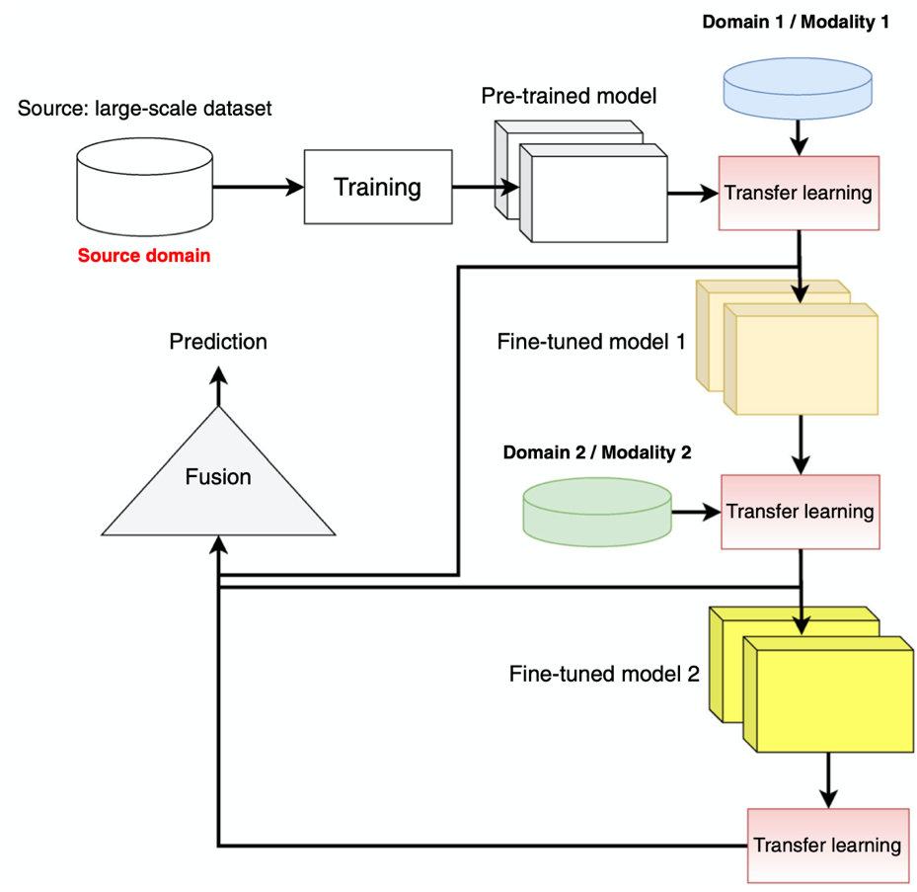
Multimodal Transfer Learning
Source: Bayoudh, Khaled, Raja Knani, Fayçal Hamdaoui, and Abdellatif Mtibaa (2022).
"A survey on deep multimodal learning for computer vision: advances, trends, applications, and datasets." The Visual Computer 38, no. 8: 2939-2970.

Slide 36
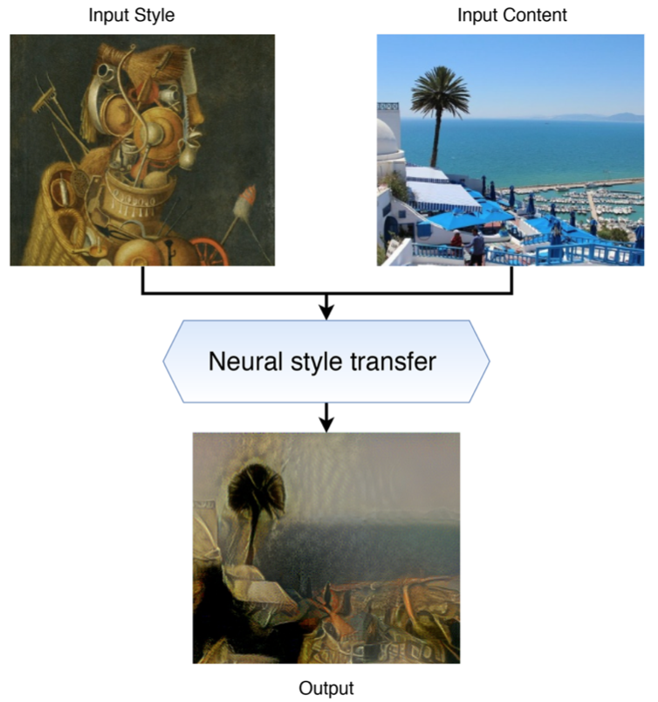
Neural Style Transfer (NST)
Source: Bayoudh, Khaled, Raja Knani, Fayçal Hamdaoui, and Abdellatif Mtibaa (2022).
"A survey on deep multimodal learning for computer vision: advances, trends, applications, and datasets." The Visual Computer 38, no. 8: 2939-2970.

Slide 37
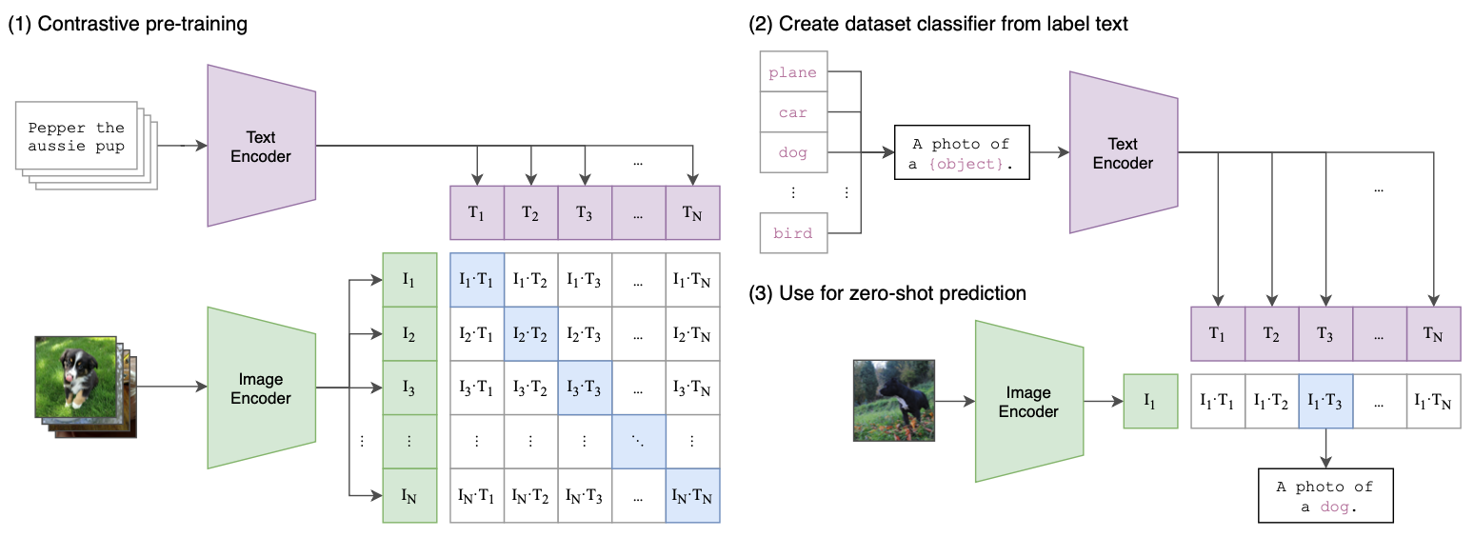
CLIP: Learning Transferable Visual Models From Natural Language Supervision
Source: Radford, Alec, Jong Wook Kim, Chris Hallacy, Aditya Ramesh, Gabriel Goh, Sandhini Agarwal, Girish Sastry et al. (2021) "Learning transferable visual models from natural language supervision." In International Conference on Machine Learning, pp. 8748-8763. PMLR.

Slide 38
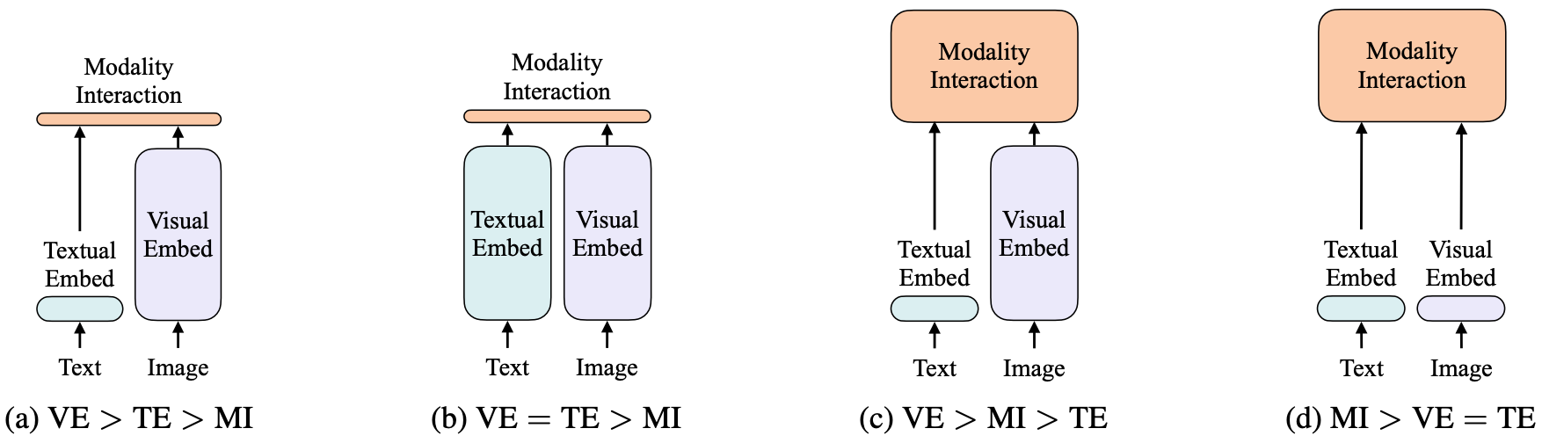
ViLT: Vision-and-Language Transformer Without Convolution or Region Supervision
Source: Kim, Wonjae, Bokyung Son, and Ildoo Kim (2021). "Vilt: Vision-and-language transformer without convolution or region supervision."
In International Conference on Machine Learning, pp. 5583-5594. PMLR.

Slide 39
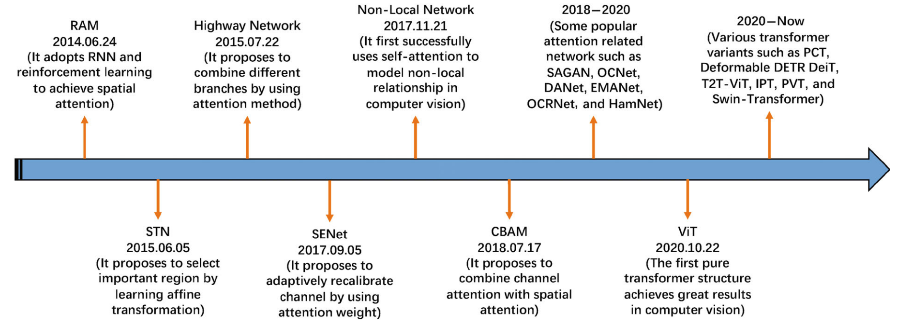
Attention Mechanisms in Computer Vision:
A survey
Source: Guo, Meng-Hao, Tian-Xing Xu, Jiang-Jiang Liu, Zheng-Ning Liu, Peng-Tao Jiang, Tai-Jiang Mu, Song-Hai Zhang, Ralph R. Martin, Ming-Ming Cheng, and Shi-Min Hu. (2022)
"Attention mechanisms in computer vision: A survey." Computational Visual Media ,:1-38.

Slide 40
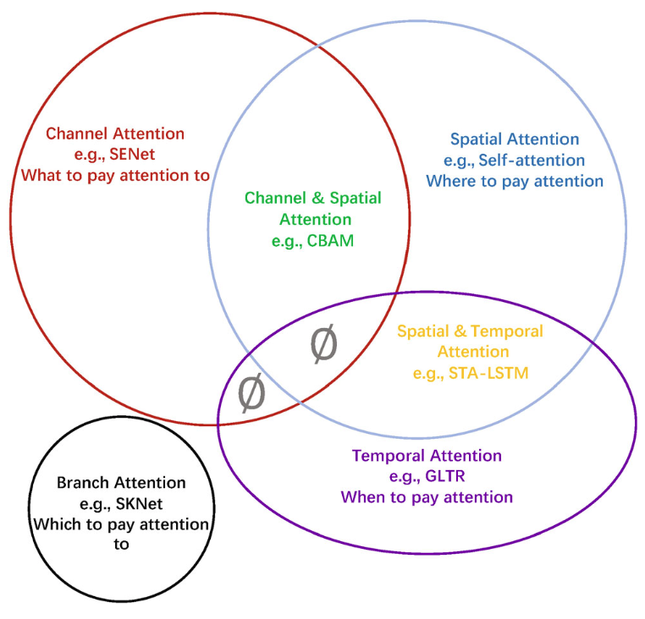
Attention Mechanisms in Computer Vision: Data domain
Source: Guo, Meng-Hao, Tian-Xing Xu, Jiang-Jiang Liu, Zheng-Ning Liu, Peng-Tao Jiang, Tai-Jiang Mu, Song-Hai Zhang, Ralph R. Martin, Ming-Ming Cheng, and Shi-Min Hu. (2022)
"Attention mechanisms in computer vision: A survey." Computational Visual Media ,:1-38.

Slide 41
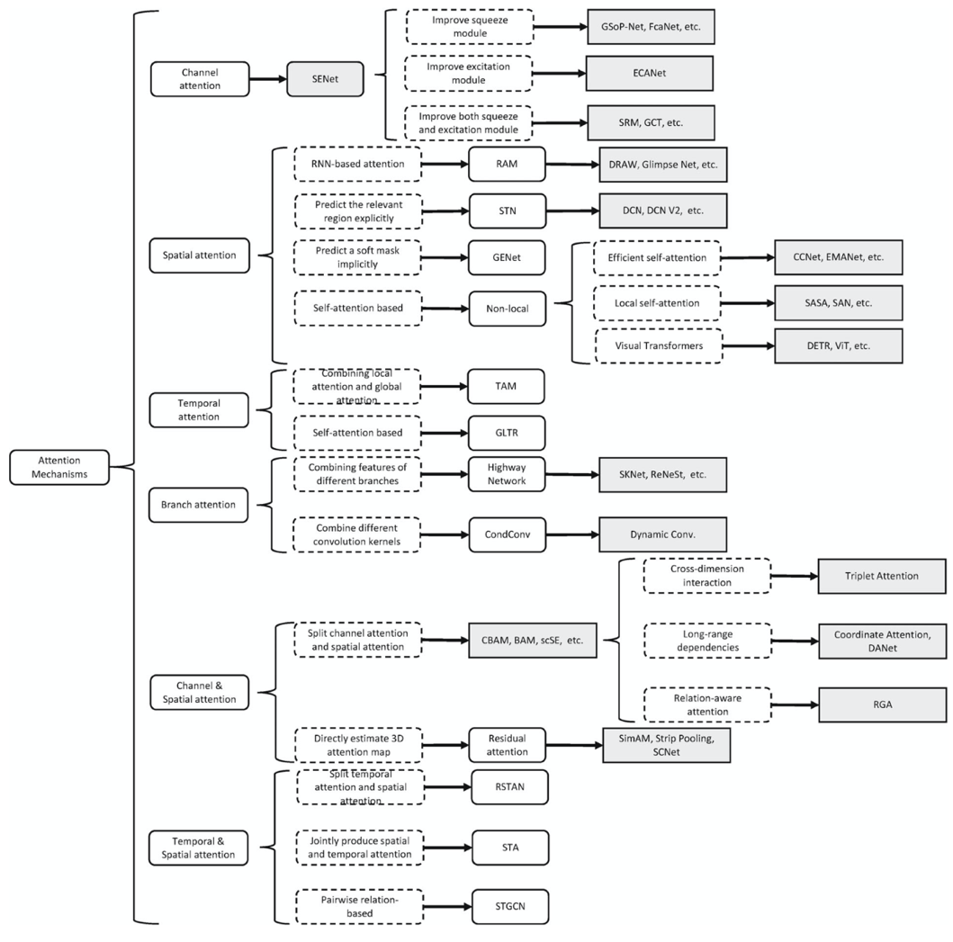
Attention Mechanisms in Computer Vision:
Developmental context of visual attention
Source: Guo, Meng-Hao, Tian-Xing Xu, Jiang-Jiang Liu, Zheng-Ning Liu, Peng-Tao Jiang, Tai-Jiang Mu, Song-Hai Zhang, Ralph R. Martin, Ming-Ming Cheng, and Shi-Min Hu. (2022)
"Attention mechanisms in computer vision: A survey." Computational Visual Media ,:1-38.

Slide 42
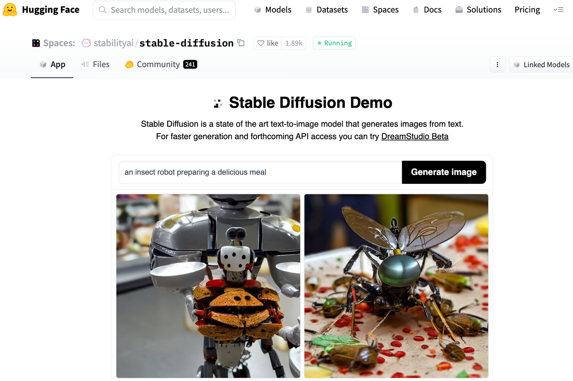
Stable Diffusion
https://huggingface.co/spaces/stabilityai/stable-diffusion

Slide 43
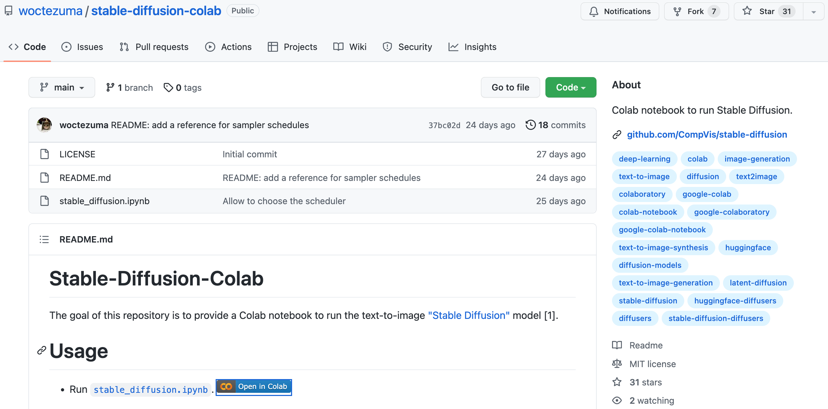
Stable Diffusion Colab
https://github.com/woctezuma/stable-diffusion-colab

Slide 44
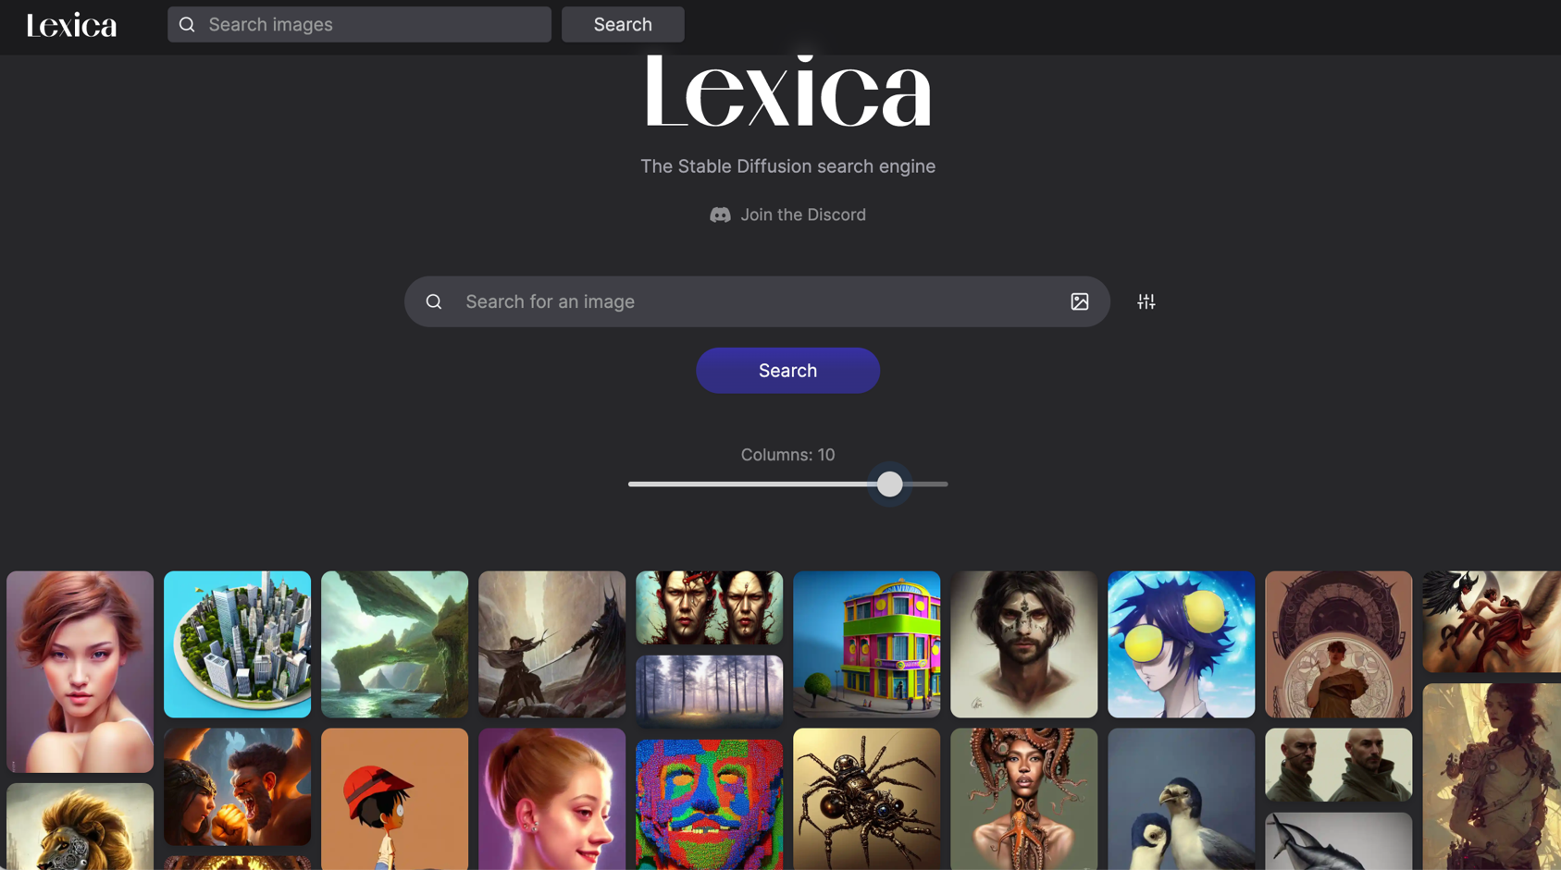
Lexica Art: Search Stable Diffusion images and prompts
https://lexica.art/

Slide 45

Tom Lawry (2020),
AI in Health:
A Leader’s Guide to Winning in the New Age of Intelligent Health Systems,
HIMSS Publishing
Source: Tom Lawry (2020), AI in Health: A Leader’s Guide to Winning in the New Age of Intelligent Health Systems, HIMSS Publishing
https://www.amazon.com/Health-HIMSS-Book-Tom-Lawry/dp/0367333716/

Slide 46
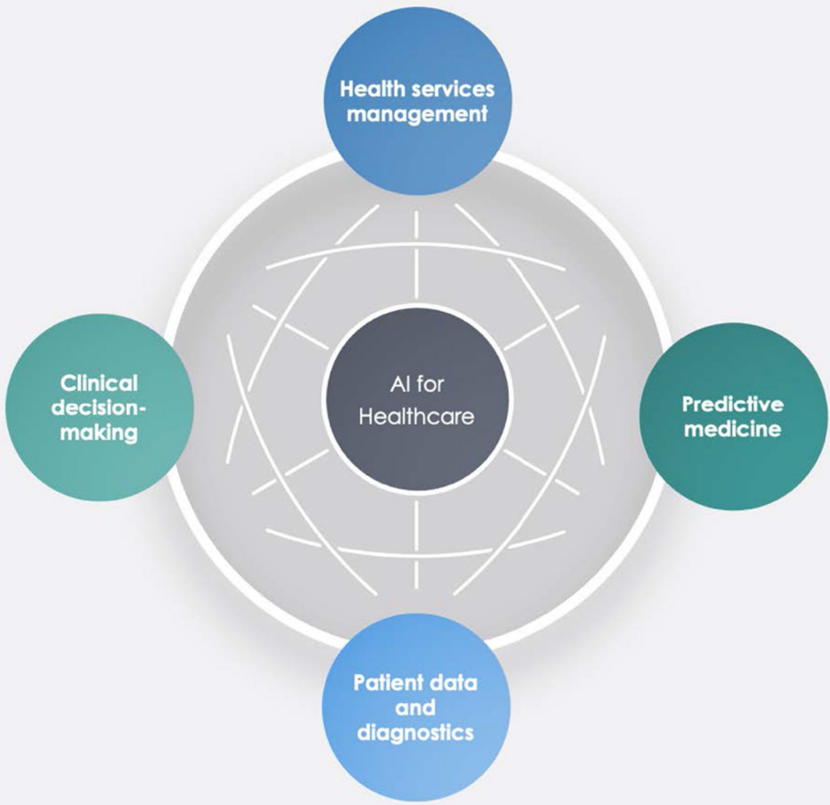
AI in Healthcare
Source: Secinaro, Silvana, Davide Calandra, Aurelio Secinaro, Vivek Muthurangu, and Paolo Biancone. "The role of artificial intelligence in healthcare: a structured literature review." BMC Medical Informatics and Decision Making 21, no. 1 (2021): 1-23.

Slide 47
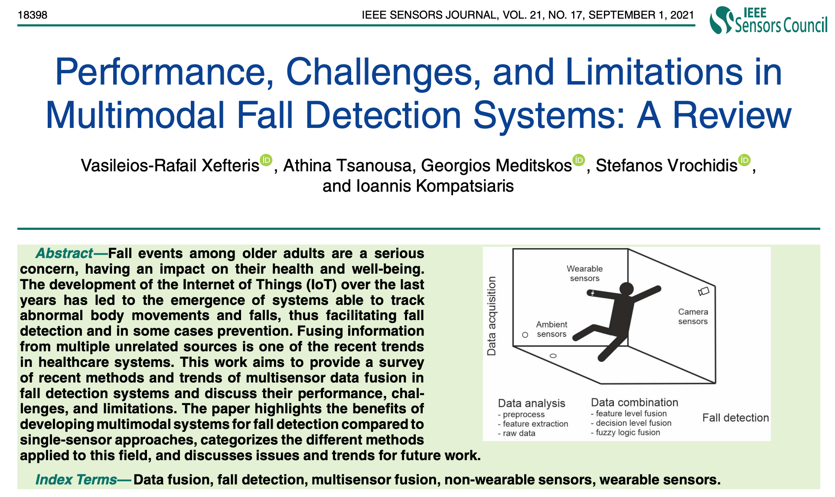
Multimodal Fall Detection
Ambient Assisted Living (AAL)
Source: Xefteris, Vasileios-Rafail, Athina Tsanousa, Georgios Meditskos, Stefanos Vrochidis, and Ioannis Kompatsiaris. "Performance, challenges, and limitations in multimodal fall detection systems: a review." IEEE Sensors Journal (2021).

Slide 48
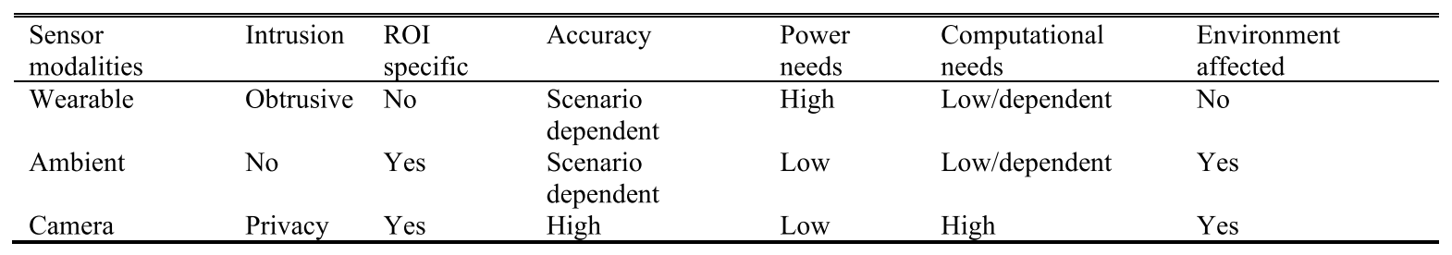
Multimodal Fall Detection
Ambient Assisted Living (AAL)
Source: Xefteris, Vasileios-Rafail, Athina Tsanousa, Georgios Meditskos, Stefanos Vrochidis, and Ioannis Kompatsiaris. "Performance, challenges, and limitations in multimodal fall detection systems: a review." IEEE Sensors Journal (2021).

Slide 49
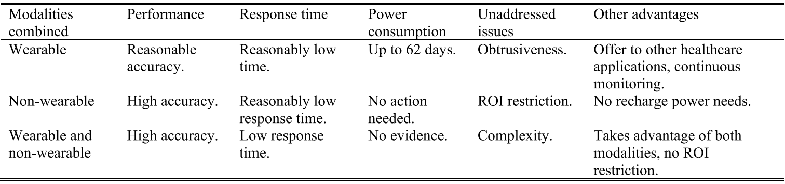
Challenges of Multimodal Fall Detection
Source: Xefteris, Vasileios-Rafail, Athina Tsanousa, Georgios Meditskos, Stefanos Vrochidis, and Ioannis Kompatsiaris. "Performance, challenges, and limitations in multimodal fall detection systems: a review." IEEE Sensors Journal (2021).

Slide 50
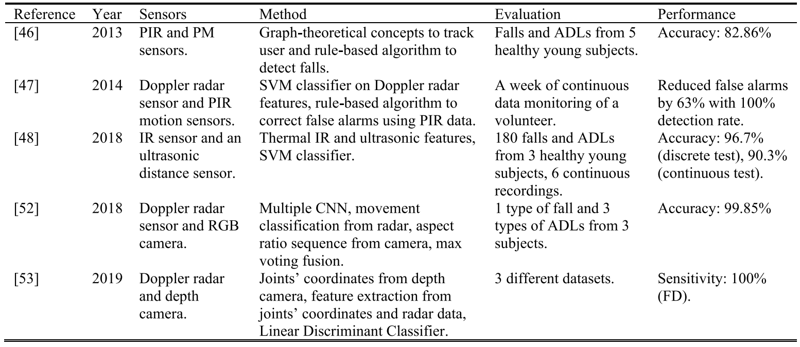
Fall Detection
Non-Wearable Sensors Fusion
Source: Xefteris, Vasileios-Rafail, Athina Tsanousa, Georgios Meditskos, Stefanos Vrochidis, and Ioannis Kompatsiaris. "Performance, challenges, and limitations in multimodal fall detection systems: a review." IEEE Sensors Journal (2021).

Slide 51
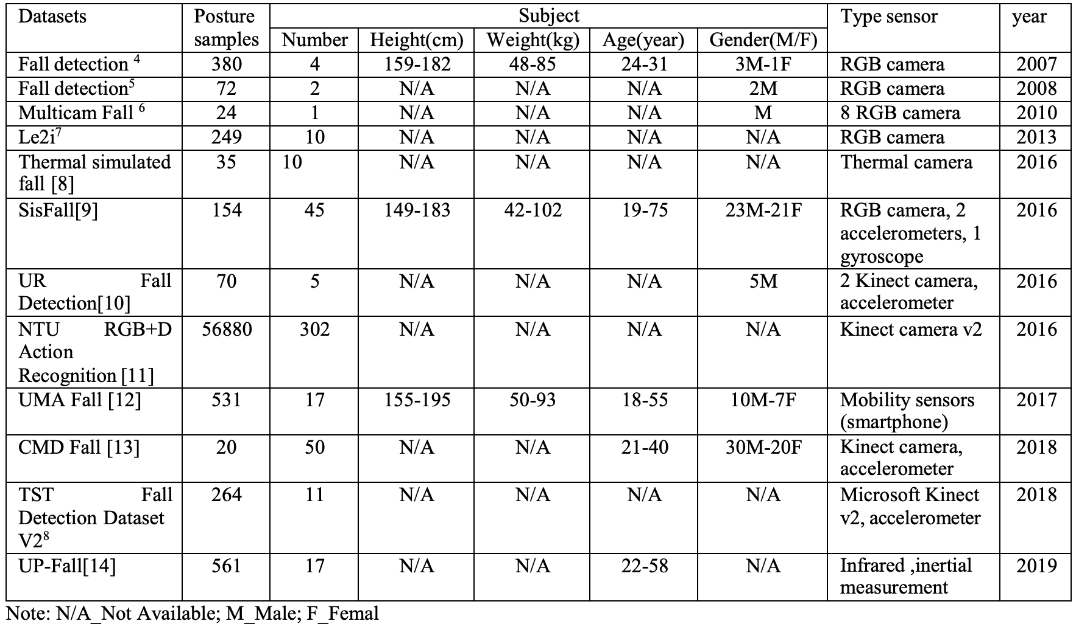
Fall Detection Datasets
Source: Oumaima, Guendoul, Ait Abdelali Hamd, Tabii Youness, Oulad Haj Thami Rachid, and Bourja Omar.
"Vision-based fall detection and prevention for the elderly people: A review & ongoing research." In 2021 Fifth International Conference On Intelligent Computing in Data Sciences (ICDS), pp. 1-6. IEEE, 2021.

Slide 52
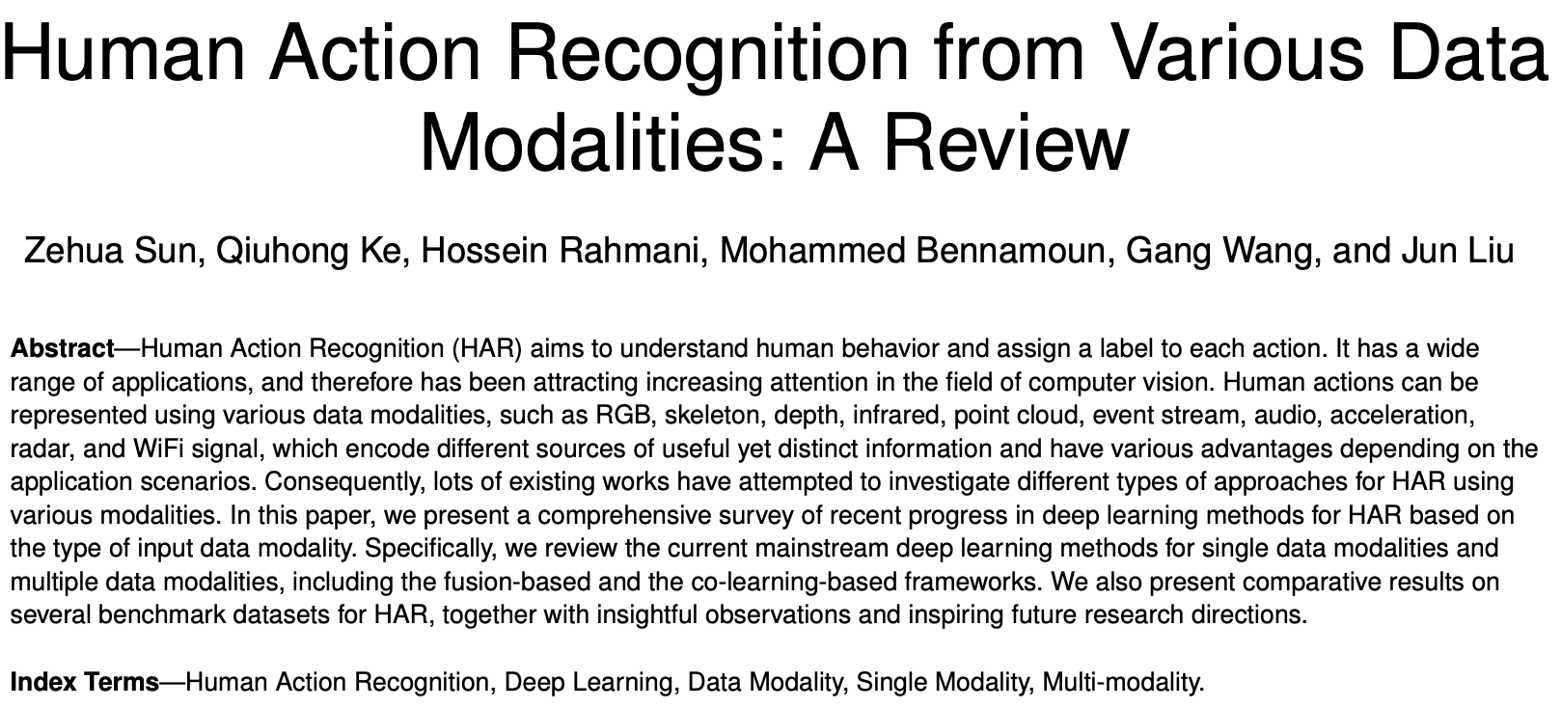
Human Action Recognition
(HAR)
Source: Sun, Zehua, Qiuhong Ke, Hossein Rahmani, Mohammed Bennamoun, Gang Wang, and Jun Liu. "Human action recognition from various data modalities: A review." IEEE transactions on pattern analysis and machine intelligence (2022).

Slide 53
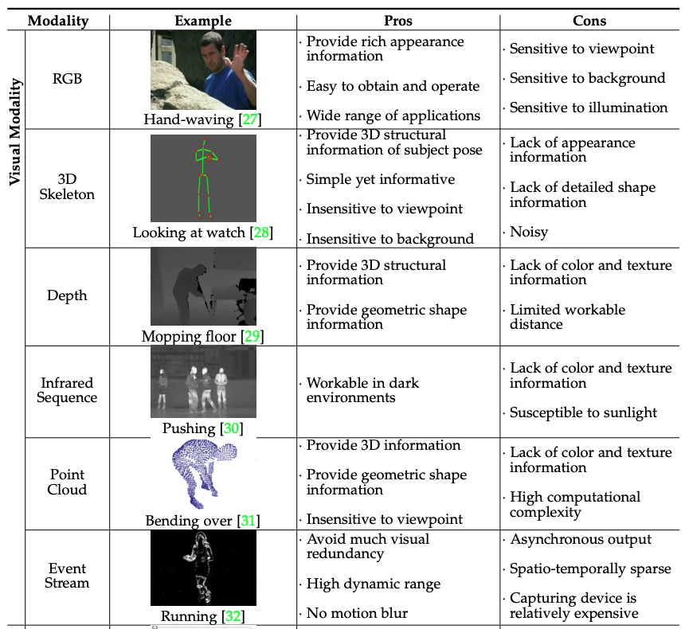
Human Action Recognition (HAR)
Modality
Source: Sun, Zehua, Qiuhong Ke, Hossein Rahmani, Mohammed Bennamoun, Gang Wang, and Jun Liu. "Human action recognition from various data modalities: A review." IEEE transactions on pattern analysis and machine intelligence (2022).

Slide 54
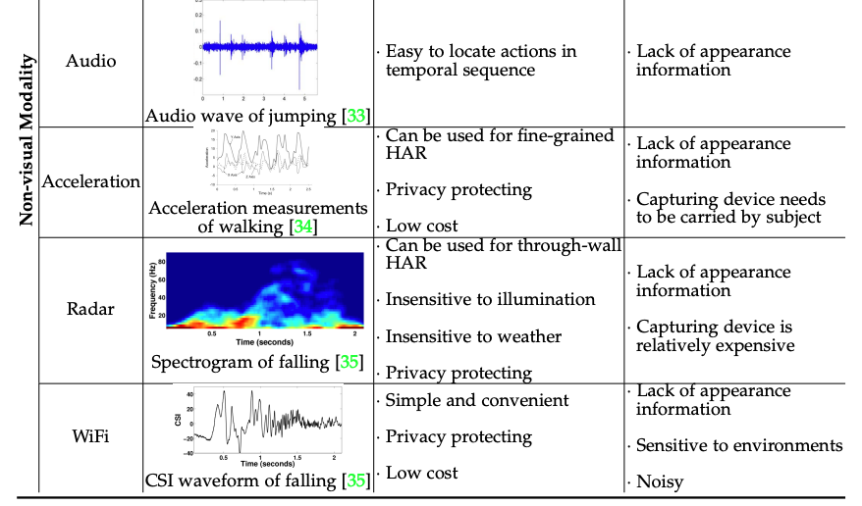
Human Action Recognition (HAR)
Modality
Source: Sun, Zehua, Qiuhong Ke, Hossein Rahmani, Mohammed Bennamoun, Gang Wang, and Jun Liu. "Human action recognition from various data modalities: A review." IEEE transactions on pattern analysis and machine intelligence (2022).

Slide 55
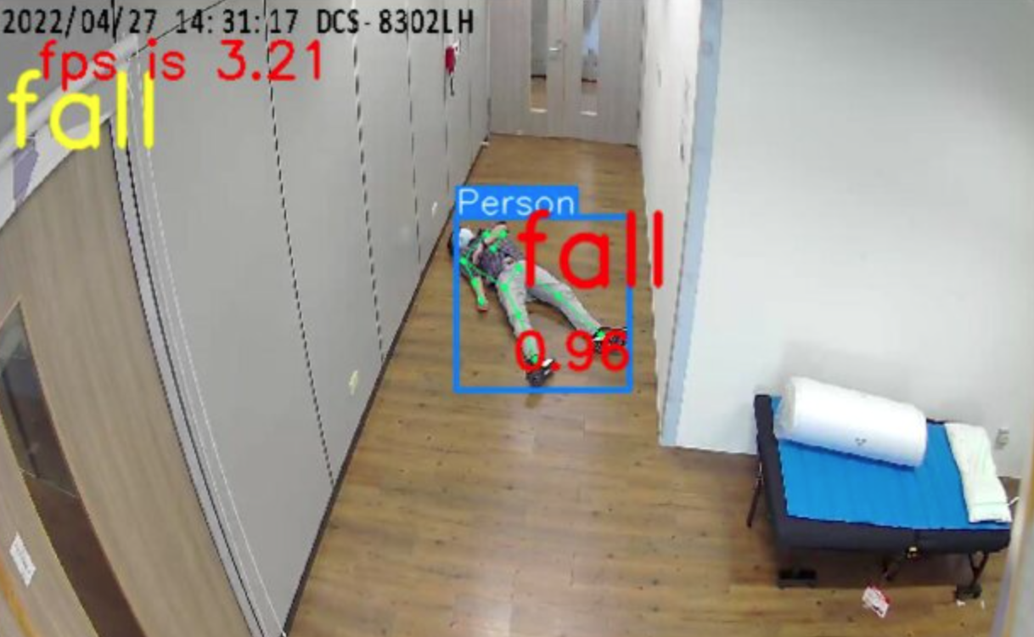
Fall Detection
Source: https://www.ankecare.com/article/1929-2022-05-09-08-29-47

Slide 56
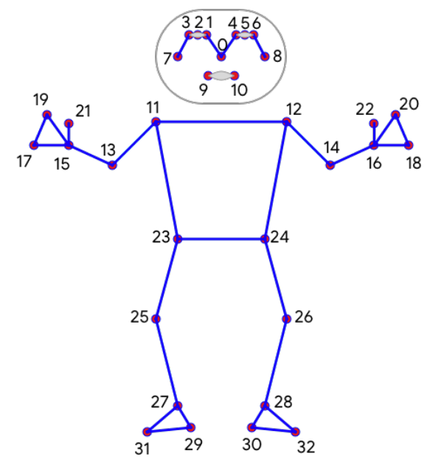
BlazePose:
On-device Real-time Body Pose tracking
BlazePose 33 Keypoint topology
0. Nose
1. Left eye inner
2. Left eye
3. Left eye outer
4. Right eye inner
5. Right eye
6. Right eye outer
7. Left ear
8. Right ear
9. Mouth left
10. Mouth right
11. Left shoulder
12. Right shoulder
13. Left elbow
14. Right elbow
15. Left wrist
16. Right wrist
17. Left pinky #1 knuckle
18. Right pinky #1 knuckle
19. Left index #1 knuckle
20. Right index #1 knuckle
21. Left thumb #2 knuckle
22. Right thumb #2 knuckle
23. Left hip
24. Right hip
25. Left knee
26. Right knee
27. Left ankle
28. Right ankle
29. Left heel
30. Right heel
31. Left foot index
32. Right foot index
SourceBazarevsky, Valentin, Ivan Grishchenko, Karthik Raveendran, Tyler Zhu, Fan Zhang, and Matthias Grundmann.
"Blazepose: On-device real-time body pose tracking." arXiv preprint arXiv:2006.10204 (2020).

Slide 57
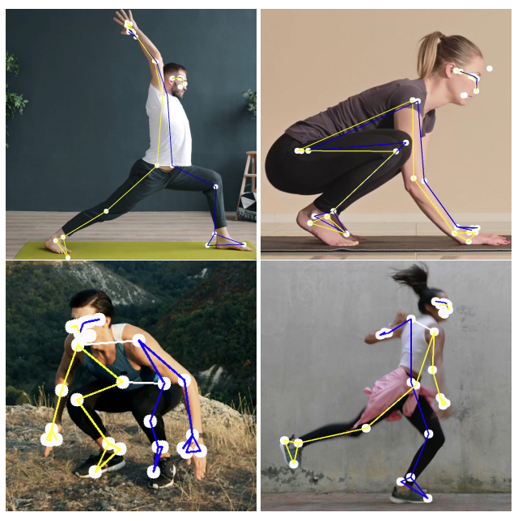
BlazePose results on yoga and fitness poses
SourceBazarevsky, Valentin, Ivan Grishchenko, Karthik Raveendran, Tyler Zhu, Fan Zhang, and Matthias Grundmann.
"Blazepose: On-device real-time body pose tracking." arXiv preprint arXiv:2006.10204 (2020).

Slide 58
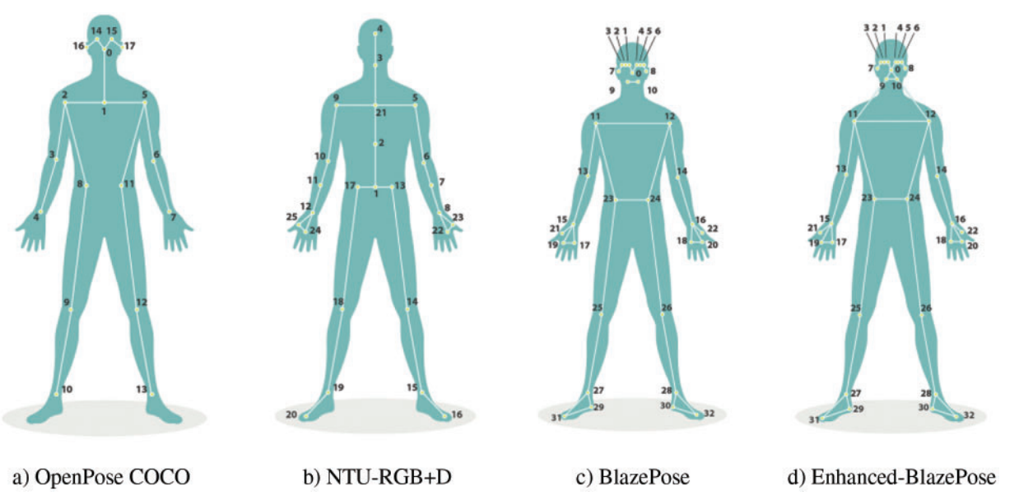
OpenPose vs. BlazePose
Source: Alsawadi, Motasem S., El-Sayed M. El-Kenawy, and Miguel Rio. "Using BlazePose on Spatial Temporal Graph Convolutional Networks for Action Recognition." Computers, Materials and Continua 74, no. 1 (2022): 19-36.

Slide 59
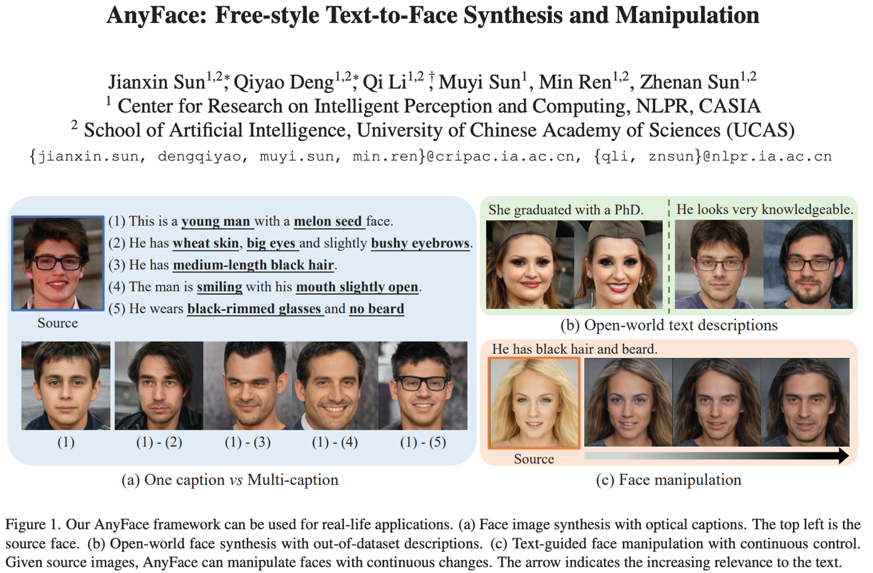
AnyFace: Free-style Text-to-Face Synthesis and Manipulation
Source: Sun, Jianxin, Qiyao Deng, Qi Li, Muyi Sun, Min Ren, and Zhenan Sun. (2022)
"AnyFace: Free-style Text-to-Face Synthesis and Manipulation." In Proceedings of the IEEE/CVF Conference on Computer Vision and Pattern Recognition, pp. 18687-18696.

Slide 60
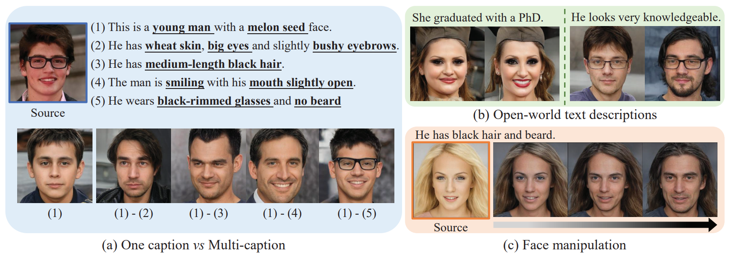
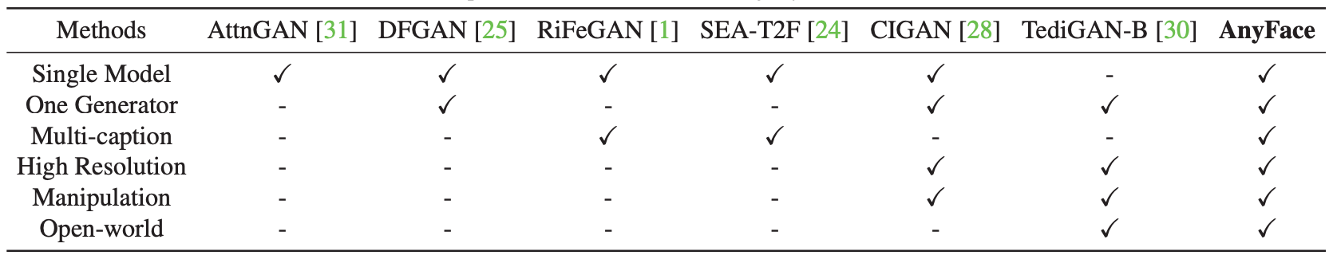
AnyFace: Free-style Text-to-Face Synthesis and Manipulation
Source: Sun, Jianxin, Qiyao Deng, Qi Li, Muyi Sun, Min Ren, and Zhenan Sun. (2022)
"AnyFace: Free-style Text-to-Face Synthesis and Manipulation." In Proceedings of the IEEE/CVF Conference on Computer Vision and Pattern Recognition, pp. 18687-18696.

Slide 61
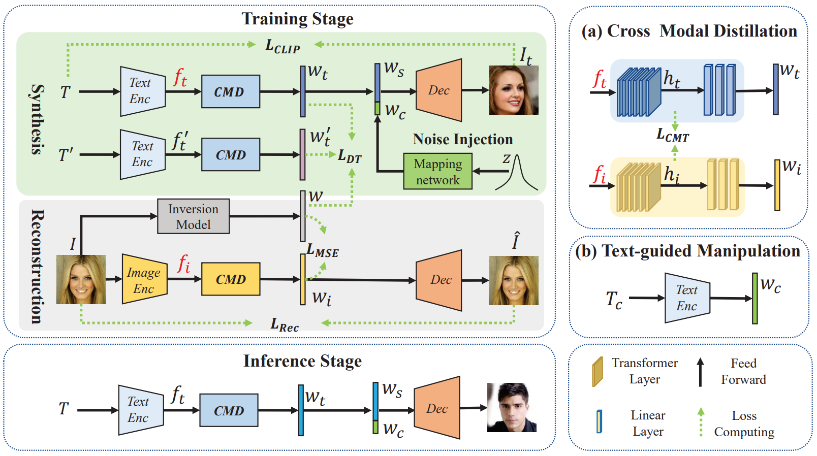
AnyFace: Free-style Text-to-Face Synthesis and Manipulation
Source: Sun, Jianxin, Qiyao Deng, Qi Li, Muyi Sun, Min Ren, and Zhenan Sun. (2022)
"AnyFace: Free-style Text-to-Face Synthesis and Manipulation." In Proceedings of the IEEE/CVF Conference on Computer Vision and Pattern Recognition, pp. 18687-18696.

Slide 62
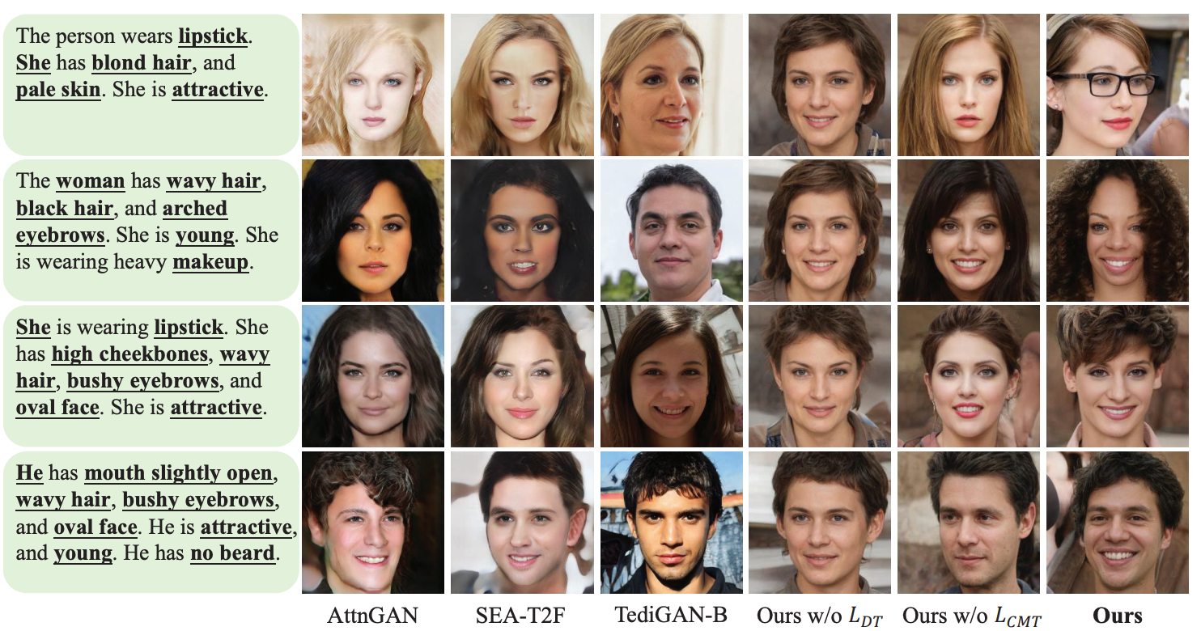
AnyFace: Free-style Text-to-Face Synthesis and Manipulation
Source: Sun, Jianxin, Qiyao Deng, Qi Li, Muyi Sun, Min Ren, and Zhenan Sun. (2022)
"AnyFace: Free-style Text-to-Face Synthesis and Manipulation." In Proceedings of the IEEE/CVF Conference on Computer Vision and Pattern Recognition, pp. 18687-18696.

Slide 63
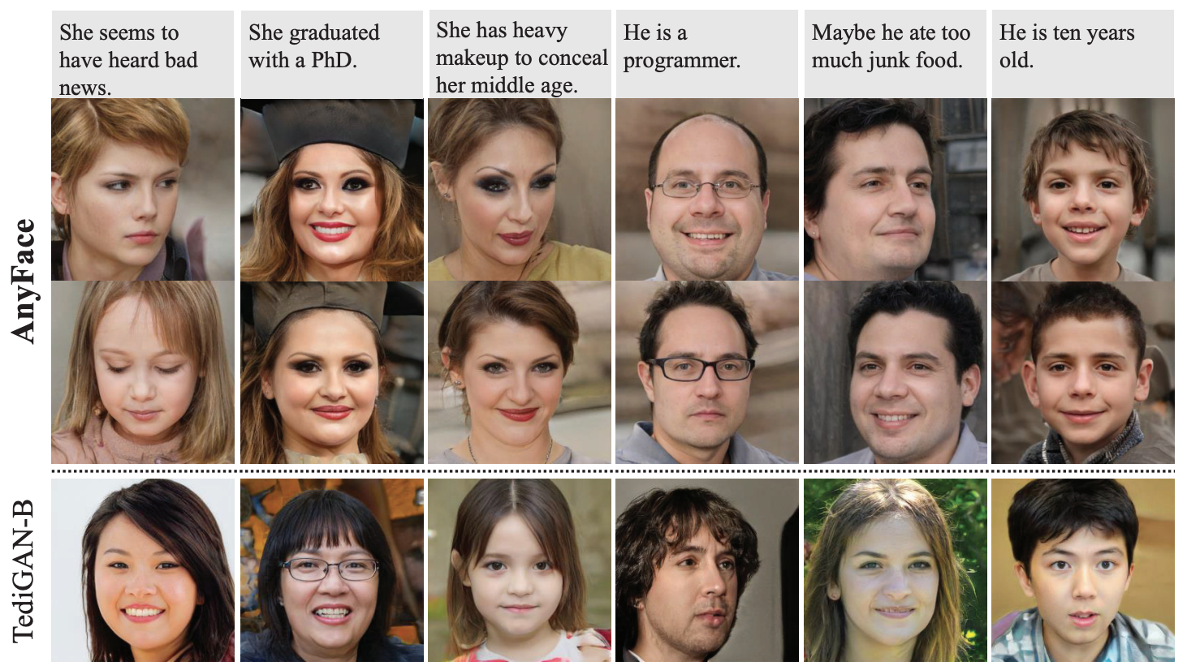
AnyFace: Free-style Text-to-Face Synthesis and Manipulation
Source: Sun, Jianxin, Qiyao Deng, Qi Li, Muyi Sun, Min Ren, and Zhenan Sun. (2022)
"AnyFace: Free-style Text-to-Face Synthesis and Manipulation." In Proceedings of the IEEE/CVF Conference on Computer Vision and Pattern Recognition, pp. 18687-18696.

Slide 64
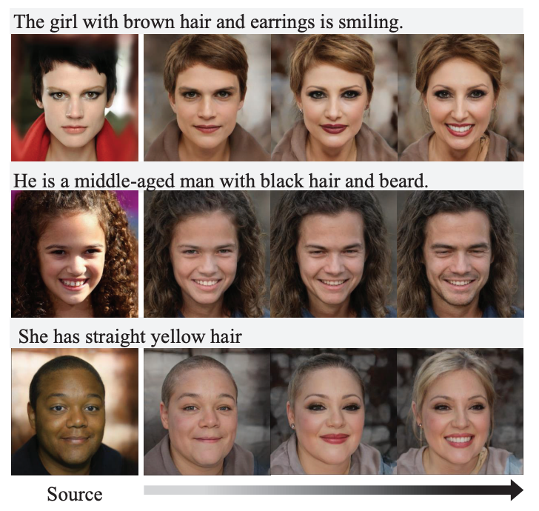
AnyFace: Free-style Text-to-Face Synthesis and Manipulation
Text-guided
Face Manipulation
Source: Sun, Jianxin, Qiyao Deng, Qi Li, Muyi Sun, Min Ren, and Zhenan Sun. (2022)
"AnyFace: Free-style Text-to-Face Synthesis and Manipulation." In Proceedings of the IEEE/CVF Conference on Computer Vision and Pattern Recognition, pp. 18687-18696.

Slide 65
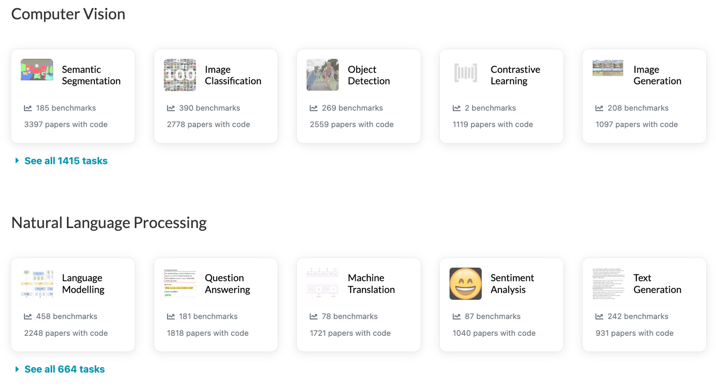
Papers with Code
State-of-the-Art (SOTA)
https://paperswithcode.com/sota

Slide 66
Papers with Code
State-of-the-Art (SOTA)
Computer Vision
• 3425 benchmarks
• 1088 tasks
• 2320 datasets
• 29741 papers with code
https://paperswithcode.com/area/computer-vision

Slide 67
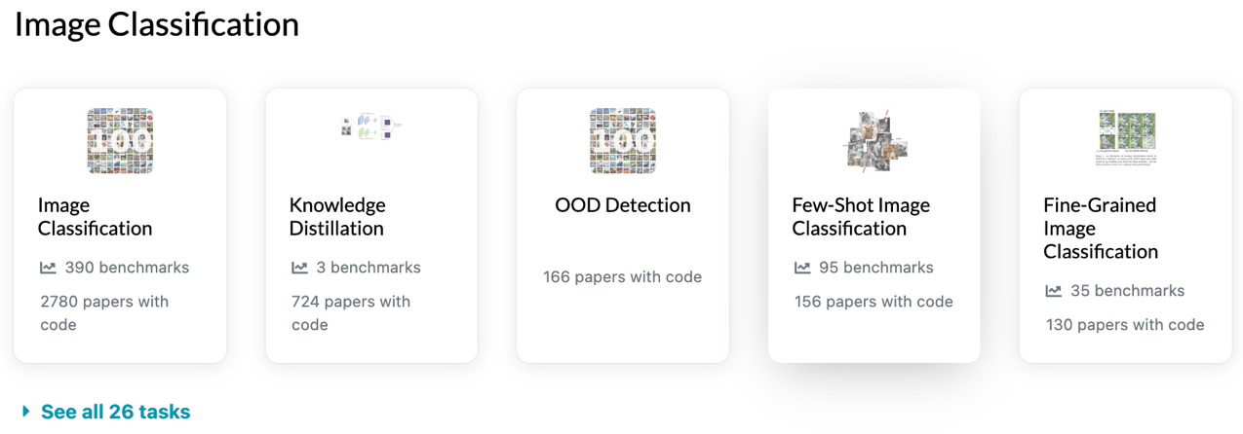
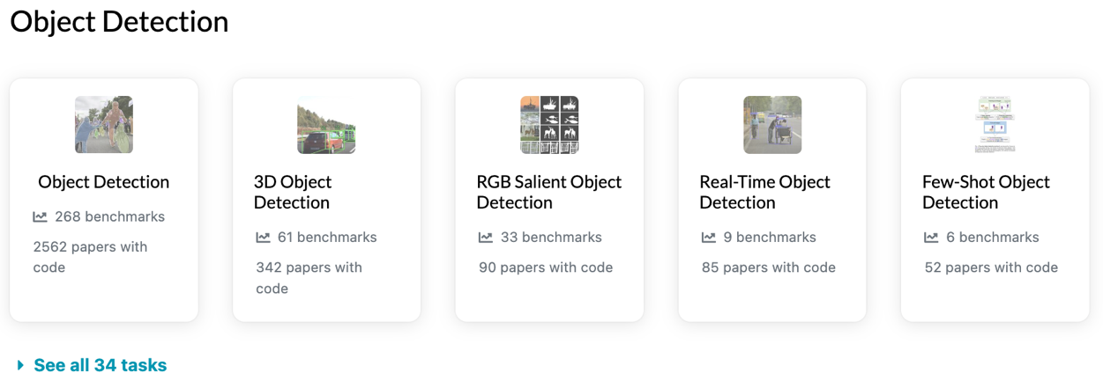
Computer Vision: State-of-the-Art (SOTA)
https://paperswithcode.com/area/computer-vision

Slide 68
Computer Vision: State-of-the-Art (SOTA)
https://paperswithcode.com/area/computer-vision

Slide 69
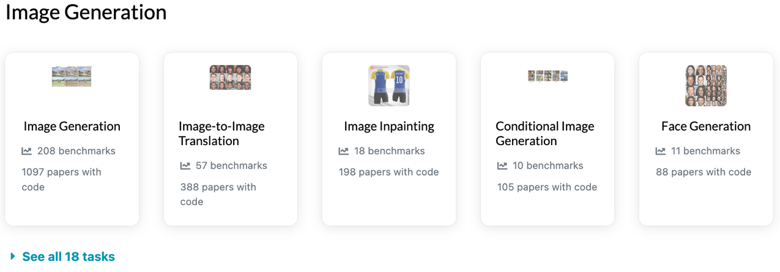

Computer Vision: State-of-the-Art (SOTA)
https://paperswithcode.com/area/computer-vision

Slide 70

Computer Vision: Video
State-of-the-Art (SOTA)
https://paperswithcode.com/area/computer-vision/video

Slide 71
Robotics

Slide 72
Artificial Intelligence:
Robotics
Agents are endowed with
sensors and physical effectors
with which to move about and
make mischief in the real world.
Source: Stuart Russell and Peter Norvig (2020), Artificial Intelligence: A Modern Approach, 4th Edition, Pearson

Slide 73

Boston Dynamics: Spot
Automate sensing and inspection, capture limitless data, and explore without boundaries.
Source: https://www.bostondynamics.com/spot

Slide 74

Boston Dynamics: Atlas
The world’s most dynamic humanoid robot
Atlas is a research platform designed to push the limits of whole-body mobility
Source: https://www.bostondynamics.com/atlas

Slide 75

Boston Dynamics: Atlas
https://www.youtube.com/watch?v=fRj34o4hN4I

Slide 76

Humanoid Robot: Sophia
https://www.youtube.com/watch?v=S5t6K9iwcdw

Slide 77

Can a robot pass a university entrance exam?
Noriko Arai at TED2017
https://www.ted.com/talks/noriko_arai_can_a_robot_pass_a_university_entrance_exam
https://www.youtube.com/watch?v=XQZjkPyJ8KU

Slide 78
Robots
Robots are physical agents that perform tasks by manipulating the physical world.
  To do so, they are equipped with effectors such as legs, wheels, joints, and grippers.
Effectors are designed to assert physical forces on the environment.
Source: Stuart Russell and Peter Norvig (2020), Artificial Intelligence: A Modern Approach, 4th Edition, Pearson

Slide 79
Robots and Effectors
When they do this, a few things may happen:
  the robot’s state might change
  the state of the environment might change
  the state of the people around the robot might change
Source: Stuart Russell and Peter Norvig (2020), Artificial Intelligence: A Modern Approach, 4th Edition, Pearson

Slide 80
Robots
The most common types of robots are manipulators (robot arms) and mobile robots.
They have sensors for perceiving the world and actuators that produce motion, which then affects the world via effectors.
Source: Stuart Russell and Peter Norvig (2020), Artificial Intelligence: A Modern Approach, 4th Edition, Pearson

Slide 81
Robotics Problem
The general robotics problem involves
  stochasticity
  (which can be handled by MDPs)
  partial observability
  (which can be handled by POMDPs)
  acting with and around other agents
  (which can be handled with game theory)
Source: Stuart Russell and Peter Norvig (2020), Artificial Intelligence: A Modern Approach, 4th Edition, Pearson

Slide 82
Robotic Perception
We typically separate
perception (estimation) from
action (motion generation).
Perception in robotics involves
computer vision
to recognize the surroundings
through cameras,
but also localization and mapping.
Source: Stuart Russell and Peter Norvig (2020), Artificial Intelligence: A Modern Approach, 4th Edition, Pearson

Slide 83
Robotic Perception
Robotic perception concerns itself with estimating decision-relevant quantities from sensor data.
  To do so, we need an internal representation and a method for updating this internal representation over time.
Source: Stuart Russell and Peter Norvig (2020), Artificial Intelligence: A Modern Approach, 4th Edition, Pearson

Slide 84

Robot Perception can be viewed as temporal inference from sequences of actions and measurements
Dynamic Decision network
Source: Stuart Russell and Peter Norvig (2020), Artificial Intelligence: A Modern Approach, 4th Edition, Pearson

Slide 85
Probabilistic Filtering Algorithms
Probabilistic filtering algorithms such as particle filters and Kalman filters are useful for robot perception.
  These techniques maintain the belief state, a posterior distribution over state variables.
Source: Stuart Russell and Peter Norvig (2020), Artificial Intelligence: A Modern Approach, 4th Edition, Pearson

Slide 86
Configuration Spaces
For generating motion, we use configuration spaces, where a point specifies everything we need to know to locate every body point on the robot.
  For instance, for a robot arm with two joints, a configuration consists of the two joint angles.
Source: Stuart Russell and Peter Norvig (2020), Artificial Intelligence: A Modern Approach, 4th Edition, Pearson

Slide 87
Motion Generation
We typically decouple the motion generation problem into
  motion planning, concerned with producing a plan, and
  trajectory tracking control, concerned with producing a policy for control inputs (actuator commands) that results in executing the plan.
Source: Stuart Russell and Peter Norvig (2020), Artificial Intelligence: A Modern Approach, 4th Edition, Pearson

Slide 88
Motion Planning
Motion planning can be solved via graph search
  using cell decomposition
  using randomized motion planning algorithms, which sample milestones in the continuous configuration space
  using trajectory optimization, which can iteratively push a straight-line path out of collision by leveraging a signed distance field.
Source: Stuart Russell and Peter Norvig (2020), Artificial Intelligence: A Modern Approach, 4th Edition, Pearson

Slide 89
Planning and Control
Optimal control unites
motion planning and trajectory tracking by computing an
optimal trajectory directly
over control inputs.
Source: Stuart Russell and Peter Norvig (2020), Artificial Intelligence: A Modern Approach, 4th Edition, Pearson

Slide 90
Planning Uncertain Movements
Planning under uncertainty unites perception and action by
  online replanning (such as model predictive control) and
  information gathering actions that aid perception.
Source: Stuart Russell and Peter Norvig (2020), Artificial Intelligence: A Modern Approach, 4th Edition, Pearson

Slide 91
Reinforcement learning in robotics
Reinforcement learning is applied in robotics, with techniques striving to reduce the required number of interactions with the real world.
Such techniques tend to exploit models, be it estimating models and using them to plan, or training policies that are robust with respect to different possible model parameters.
Source: Stuart Russell and Peter Norvig (2020), Artificial Intelligence: A Modern Approach, 4th Edition, Pearson

Slide 92
Humans and Robots
Interaction with humans requires the ability to coordinate the robot’s actions with theirs, which can be formulated as a game.
We usually decompose the solution into prediction, in which we use the person’s ongoing actions to estimate what they will do in the future, and action, in which we use the predictions to compute the optimal motion for the robot.
Source: Stuart Russell and Peter Norvig (2020), Artificial Intelligence: A Modern Approach, 4th Edition, Pearson

Slide 93
Humans and Robots
Helping humans also requires the ability to learn or infer what they want.
Robots can approach this by learning the desired cost function they should optimize from human input, such as demonstrations, corrections, or instruction in natural language.
Alternatively, robots can imitate human behavior, and use reinforcement learning to help tackle the challenge of generalization to new states.
Source: Stuart Russell and Peter Norvig (2020), Artificial Intelligence: A Modern Approach, 4th Edition, Pearson

Slide 94

Papers with Code
State-of-the-Art (SOTA)
https://paperswithcode.com/sota

Slide 95
Summary
Computer Vision
  Classifying Images
  Detecting Objects
  The 3D World
Robotics
  Robotic Perception
  Planning and Control
  Planning Uncertain Movements
  Reinforcement Learning in Robotics

Slide 96
References
Stuart Russell and Peter Norvig (2020), Artificial Intelligence: A Modern Approach, 4th Edition, Pearson.
Aurélien Géron (2019), Hands-On Machine Learning with Scikit-Learn, Keras, and TensorFlow: Concepts, Tools, and Techniques to Build Intelligent Systems, 2nd Edition, O’Reilly Media.
Steven D'Ascoli (2022), Artificial Intelligence and Deep Learning with Python: Every Line of Code Explained For Readers New to AI and New to Python, Independently published.
Chien-Yao Wang, Alexey Bochkovskiy, and Hong-Yuan Mark Liao. (2022) "YOLOv7: Trainable bag-of-freebies sets new state-of-the-art for real-time object detectors." arXiv preprint arXiv:2207.02696.
Alec Radford, Jong Wook Kim, Chris Hallacy, Aditya Ramesh, Gabriel Goh, Sandhini Agarwal, Girish Sastry et al. (2021) "Learning transferable visual models from natural language supervision." In International Conference on Machine Learning, pp. 8748-8763. PMLR.
Wonjae Kim, Bokyung Son, and Ildoo Kim. (2021) "Vilt: Vision-and-language transformer without convolution or region supervision." In International Conference on Machine Learning, pp. 5583-5594. PMLR.
Meng-Hao Guo, Tian-Xing Xu, Jiang-Jiang Liu, Zheng-Ning Liu, Peng-Tao Jiang, Tai-Jiang Mu, Song-Hai Zhang, Ralph R. Martin, Ming-Ming Cheng, and Shi-Min Hu. (2022) "Attention mechanisms in computer vision: A survey." Computational Visual Media ,:1-38.
Valentin Bazarevsky, Ivan Grishchenko, Karthik Raveendran, Tyler Zhu, Fan Zhang, and Matthias Grundmann.(2020) "Blazepose: On-device real-time body pose tracking." arXiv preprint arXiv:2006.10204.
Min-Yuh Day (2022), Python 101, https://tinyurl.com/aintpupython101

