Slide 1








The Theory of Learning and
Ensemble Learning
Artificial Intelligence
1111AI06
MBA, IM, NTPU (M6132) (Fall 2022)
Wed 2, 3, 4 (9:10-12:00) (B8F40)
Min-Yuh Day, Ph.D,
Associate Professor
Institute of Information Management, National Taipei University
https://web.ntpu.edu.tw/~myday
https://meet.google.com/miy-fbif-max
2022-10-26

Slide 2
Syllabus
Week Date Subject/Topics
1 2022/09/14 Introduction to Artificial Intelligence
2 2022/09/21 Artificial Intelligence and Intelligent Agents
3 2022/09/28 Problem Solving
4 2022/10/05 Knowledge, Reasoning and Knowledge Representation;
Uncertain Knowledge and Reasoning
5 2022/10/12 Case Study on Artificial Intelligence I
6 2022/10/19 Machine Learning: Supervised and Unsupervised Learning

Slide 3
Syllabus
Week Date Subject/Topics
7 2022/10/26 The Theory of Learning and Ensemble Learning
8 2022/11/02 Midterm Project Report
9 2022/11/09 Deep Learning and Reinforcement Learning
10 2022/11/16 Deep Learning for Natural Language Processing
11 2022/11/23 Invited Talk: AI for Information Retrieval
12 2022/11/30 Case Study on Artificial Intelligence II

Slide 4
Syllabus
Week Date Subject/Topics
13 2022/12/07 Computer Vision and Robotics
14 2022/12/14 Philosophy and Ethics of AI and the Future of AI
15 2022/12/21 Final Project Report I
16 2022/12/28 Final Project Report II
17 2023/01/04 Self-learning
18 2023/01/11 Self-learning

Slide 5
The Theory of Learning and
Ensemble Learning

Slide 6
Outline
The Theory of Learning
  Computational Learning Theory
  Probably Approximately Correct (PAC) Learning
Ensemble Learning
  Bagging: Random forests
  Stacking
  Boosting: Gradient boosting
  Online learning
Meta Learning: Learning to Learn

Slide 7
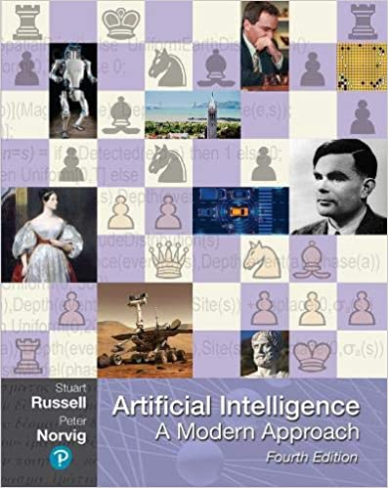
Stuart Russell and Peter Norvig (2020),
Artificial Intelligence: A Modern Approach,
4th Edition, Pearson
Source: Stuart Russell and Peter Norvig (2020), Artificial Intelligence: A Modern Approach, 4th Edition, Pearson
https://www.amazon.com/Artificial-Intelligence-A-Modern-Approach/dp/0134610997/

Slide 8
Artificial Intelligence:
A Modern Approach
Artificial Intelligence
Problem Solving
Knowledge and Reasoning
Uncertain Knowledge and Reasoning
Machine Learning
Communicating, Perceiving, and Acting
Philosophy and Ethics of AI
Source: Stuart Russell and Peter Norvig (2020), Artificial Intelligence: A Modern Approach, 4th Edition, Pearson

Slide 9
Artificial Intelligence:
Machine Learning
Source: Stuart Russell and Peter Norvig (2020), Artificial Intelligence: A Modern Approach, 4th Edition, Pearson

Slide 10
Artificial Intelligence:
5. Machine Learning
Learning from Examples
Learning Probabilistic Models
Deep Learning
Reinforcement Learning
Source: Stuart Russell and Peter Norvig (2020), Artificial Intelligence: A Modern Approach, 4th Edition, Pearson

Slide 11
Reinforcement Learning (DL)
Agent
Environment
Source: Richard S. Sutton & Andrew G. Barto (2018), Reinforcement Learning: An Introduction, 2nd Edition, A Bradford Book.

Slide 12
Reinforcement Learning (DL)
1
2
observation
Agent
action
3
reward
Environment
Source: Richard S. Sutton & Andrew G. Barto (2018), Reinforcement Learning: An Introduction, 2nd Edition, A Bradford Book.

Slide 13
Reinforcement Learning (DL)
1
2
observation
Agent
action
O_{t}
A_{t}
3
reward
R_{t}
Environment
Source: Richard S. Sutton & Andrew G. Barto (2018), Reinforcement Learning: An Introduction, 2nd Edition, A Bradford Book.

Slide 14
Agents interact with environments through sensors and actuators
Source: Stuart Russell and Peter Norvig (2020), Artificial Intelligence: A Modern Approach, 4th Edition, Pearson

Slide 15
Machine Learning
Supervised Learning (Classification)
Learning from Examples
y = f(x)
x
y

Slide 16
Machine Learning
Supervised Learning (Classification)
Learning from Examples
y = f(x)
x
y
input
Output
label

Slide 17
Machine Learning
Supervised Learning (Classification)
Learning from Examples
y = f(x)
5.1,3.5,1.4,0.2,Iris-setosa 4.9,3.0,1.4,0.2,Iris-setosa 4.7,3.2,1.3,0.2,Iris-setosa 7.0,3.2,4.7,1.4,Iris-versicolor 6.4,3.2,4.5,1.5,Iris-versicolor 6.9,3.1,4.9,1.5,Iris-versicolor 6.3,3.3,6.0,2.5,Iris-virginica 5.8,2.7,5.1,1.9,Iris-virginica 7.1,3.0,5.9,2.1,Iris-virginica

Slide 18
Machine Learning
Supervised Learning (Classification)
Learning from Examples
y = f(x)
Example
5.1,3.5,1.4,0.2,Iris-setosa 4.9,3.0,1.4,0.2,Iris-setosa 4.7,3.2,1.3,0.2,Iris-setosa 7.0,3.2,4.7,1.4,Iris-versicolor 6.4,3.2,4.5,1.5,Iris-versicolor 6.9,3.1,4.9,1.5,Iris-versicolor 6.3,3.3,6.0,2.5,Iris-virginica 5.8,2.7,5.1,1.9,Iris-virginica 7.1,3.0,5.9,2.1,Iris-virginica

Slide 19
Machine Learning
Supervised Learning (Classification)
Learning from Examples
y = f(x)
Example
5.1,3.5,1.4,0.2,Iris-setosa 4.9,3.0,1.4,0.2,Iris-setosa 4.7,3.2,1.3,0.2,Iris-setosa 7.0,3.2,4.7,1.4,Iris-versicolor 6.4,3.2,4.5,1.5,Iris-versicolor 6.9,3.1,4.9,1.5,Iris-versicolor 6.3,3.3,6.0,2.5,Iris-virginica 5.8,2.7,5.1,1.9,Iris-virginica 7.1,3.0,5.9,2.1,Iris-virginica
y
x

Slide 20
Artificial Intelligence
Machine Learning & Deep Learning
Source: https://blogs.nvidia.com/blog/2016/07/29/whats-difference-artificial-intelligence-machine-learning-deep-learning-ai/

Slide 21
AI, ML, DL
Artificial Intelligence (AI)
Machine Learning (ML)
Supervised
Learning
Unsupervised Learning
Deep Learning (DL)
CNN
RNN LSTM GRU
GAN
Semi-supervised Learning
Reinforcement Learning
Source: https://leonardoaraujosantos.gitbooks.io/artificial-inteligence/content/deep_learning.html

Slide 22
The
Theory of Learning

Slide 23
The Theory of Learning
Computational Learning Theory
Probably approximately correct (PAC)
Source: Stuart Russell and Peter Norvig (2020), Artificial Intelligence: A Modern Approach, 4th Edition, Pearson

Slide 24
The Theory of Learning
How can we be sure that our learned hypothesis will predict well for previously unseen inputs?
  How do we know that the hypothesis h is close to the target function f
  if we don’t know what is?
How many examples do we need to get a good h?
What hypothesis space should we use?
If the hypothesis space is very complex,
can we even find the best h or do we have to settle for a local maximum?
How complex should h be?
How do we avoid overfitting?

Slide 25
Computational Learning Theory
Intersection of AI, statistics, and
theoretical computer science.
Any hypothesis that is seriously wrong will almost certainly be “found out” with high probability after a small number of examples.
Source: Stuart Russell and Peter Norvig (2020), Artificial Intelligence: A Modern Approach, 4th Edition, Pearson

Slide 26
Probably approximately correct (PAC)
Any hypothesis that is consistent with a sufficiently large set of training examples is unlikely to be seriously wrong.
PAC learning algorithm:
  Any learning algorithm that returns hypotheses that are probably approximately correct.
Source: Stuart Russell and Peter Norvig (2020), Artificial Intelligence: A Modern Approach, 4th Edition, Pearson

Slide 27
Linear function
y = f(x)
y = w₁x + w₀
h_{w}(x) = w₁x + w₀
Source: Stuart Russell and Peter Norvig (2020), Artificial Intelligence: A Modern Approach, 4th Edition, Pearson

Slide 28
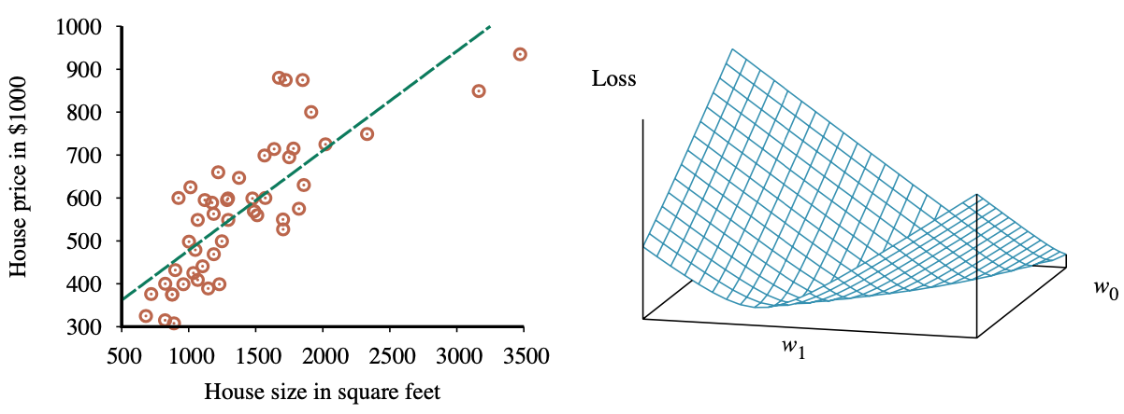
Linear Regression Weight Space
h_{w}(x) = w₁x + w₀
w* = argmin_{w} Loss(h_{w})
y = 0.232 x + 246
Loss function for Weights (w₁, w₀)
Source: Stuart Russell and Peter Norvig (2020), Artificial Intelligence: A Modern Approach, 4th Edition, Pearson

Slide 29
Ensemble Learning

Slide 30
Ensemble Learning
Select a collection, or ensemble,
of hypotheses, h₁, h₂, …, h_{n}
, and combine their predictions
by averaging, voting, or
by another level of machine learning.
Source: Stuart Russell and Peter Norvig (2020), Artificial Intelligence: A Modern Approach, 4th Edition, Pearson

Slide 31
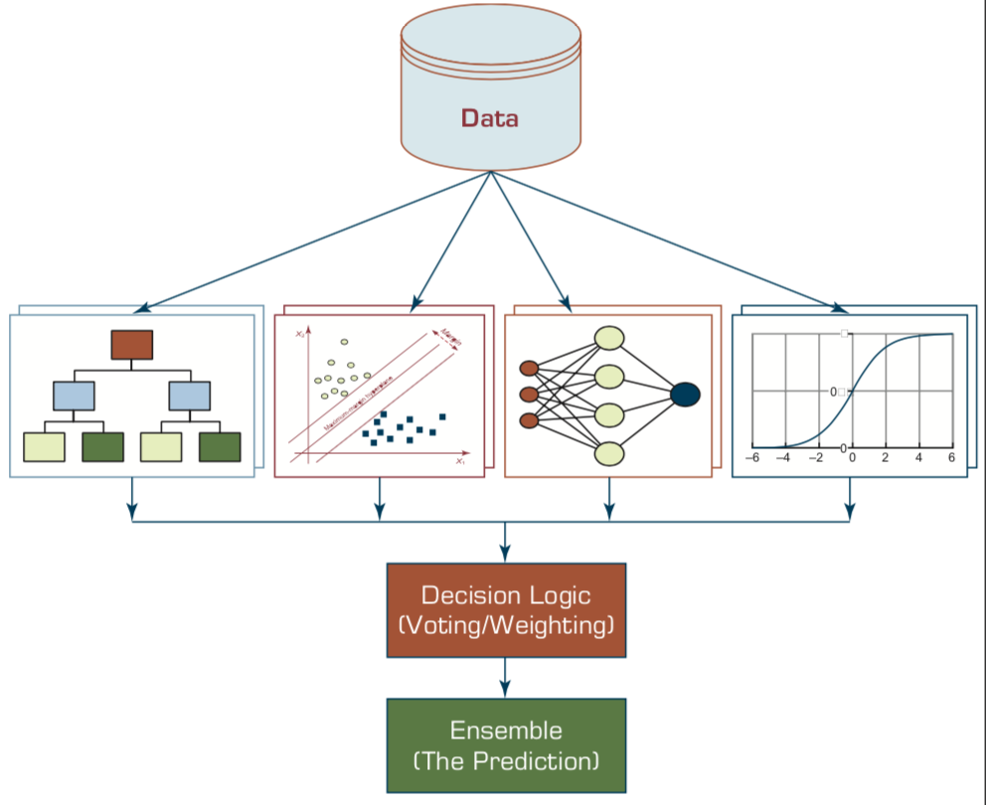
Ensemble Models
Heterogeneous Ensemble
Source: Ramesh Sharda, Dursun Delen, and Efraim Turban (2017), Business Intelligence, Analytics, and Data Science: A Managerial Perspective, 4th Edition, Pearson

Slide 32
Ensemble Learning
Base model
  individual hypotheses
  h₁, h₂, …, h_{n}
Ensemble model
  hypotheses combination
Source: Stuart Russell and Peter Norvig (2020), Artificial Intelligence: A Modern Approach, 4th Edition, Pearson

Slide 33
Why Ensemble Learning
Reduce bias
Reduce variance
Source: Stuart Russell and Peter Norvig (2020), Artificial Intelligence: A Modern Approach, 4th Edition, Pearson

Slide 34
Ensemble Learning
Bagging
  Random forests
Stacking
Boosting
  Gradient boosting
Online learning
Source: Stuart Russell and Peter Norvig (2020), Artificial Intelligence: A Modern Approach, 4th Edition, Pearson

Slide 35
Ensemble Learning: Bagging
Bagging
  Generate distinct training sets by sampling with replacement from the original training set.
Classification:
  Plurality Vote (Majority Vote)
Regression:
  Average
Source: Stuart Russell and Peter Norvig (2020), Artificial Intelligence: A Modern Approach, 4th Edition, Pearson

Slide 36
Ensemble Learning: Random forests
Random forest model is a form of decision tree bagging in which we take extra steps to make the ensemble of trees more diverse, to reduce variance.
The key idea is to randomly vary the attribute choices (rather than the training examples)
Source: Stuart Russell and Peter Norvig (2020), Artificial Intelligence: A Modern Approach, 4th Edition, Pearson

Slide 37
Ensemble Learning: Random forests
Extremely randomized trees (ExtraTrees)
  Use randomness in selecting the split point value
  for each selected attribute, we randomly sample several candidate values from a uniform distribution over the attribute’s range
Source: Stuart Russell and Peter Norvig (2020), Artificial Intelligence: A Modern Approach, 4th Edition, Pearson

Slide 38
Ensemble Learning: Stacking
Staking
  Stacked generalization combines multiple base models from different model classes trained on the same data.
Bagging
  Combines multiple base models of the same model class trained on different data.
Source: Stuart Russell and Peter Norvig (2020), Artificial Intelligence: A Modern Approach, 4th Edition, Pearson

Slide 39
Ensemble Learning: Boosting
Boosting
  The most popular ensemble method
Weighted training set
Source: Stuart Russell and Peter Norvig (2020), Artificial Intelligence: A Modern Approach, 4th Edition, Pearson

Slide 40
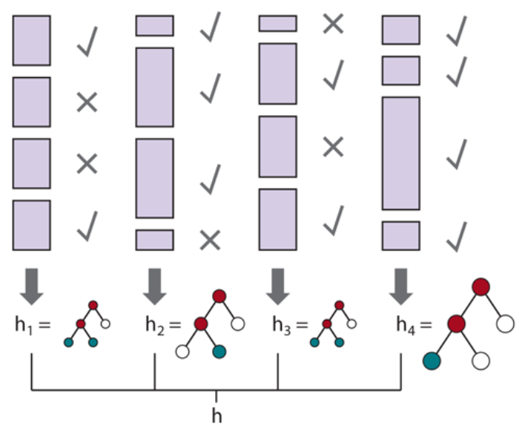
Ensemble Learning: Boosting
Source: Stuart Russell and Peter Norvig (2020), Artificial Intelligence: A Modern Approach, 4th Edition, Pearson

Slide 41
Ensemble Learning:
Gradient boosting
Gradient boosting
  Gradient boosting is a form of boosting using gradient descent
Gradient boosting machines (GBM)
Gradient boosted regression trees (GBRT)
Popular method for regression and classification of factored tabular data
Source: Stuart Russell and Peter Norvig (2020), Artificial Intelligence: A Modern Approach, 4th Edition, Pearson

Slide 42
Ensemble Learning:
Online learning
Online learning
  Data are not i.i.d.
  (independent and identically distributed)
  An agent receives an input x_{i} from nature, predicts the corresponding y_{i} and then is told the correct answer.
Source: Stuart Russell and Peter Norvig (2020), Artificial Intelligence: A Modern Approach, 4th Edition, Pearson

Slide 43
Meta Learning:
Learning to Learn

Slide 44
Deep Learning
Transfer Learning
Few-Shot Learning
Meta Learning

Slide 45
Deep Learning, Transfer Learning,
Few-Shot Learning, Meta Learning
Deep Learning
  Transfer Learning
    Pre-training, Fine-Tuning (FT)
Meta Learning: Learning to Learn
Few-Shot Learning (FSL)
One-Shot Learning (1SL)
Zero-Shot Learning (0SL)(ZSL)

Slide 46
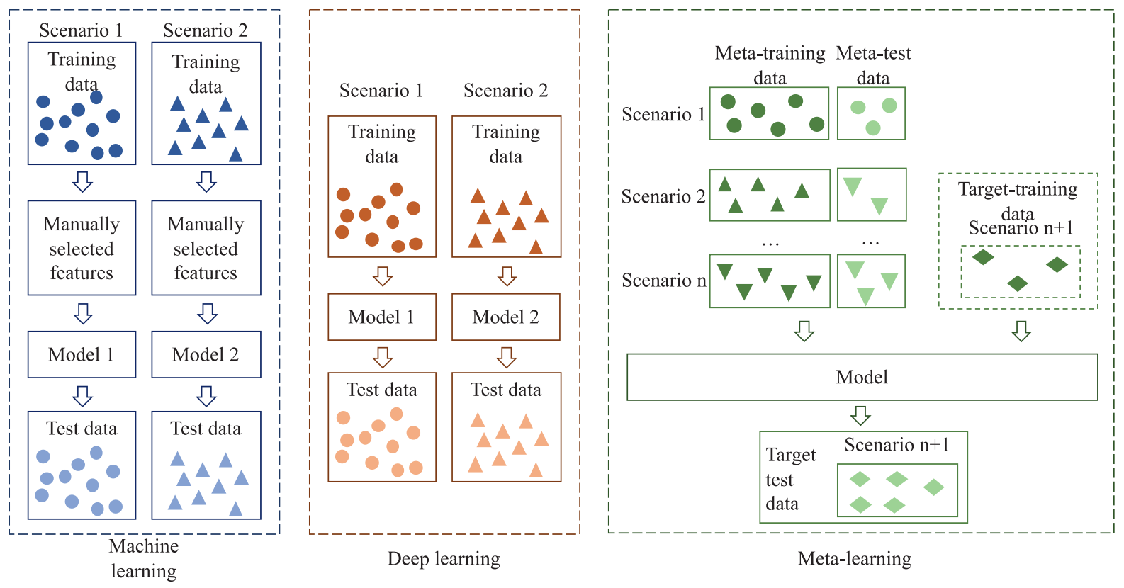
Machine Learning, Deep Learning, Meta Learning
Source: Luo, Shuai, Yujie Li, Pengxiang Gao, Yichuan Wang, and Seiichi Serikawa. "Meta-seg: A survey of meta-learning for image segmentation." Pattern Recognition (2022): 108586.

Slide 47
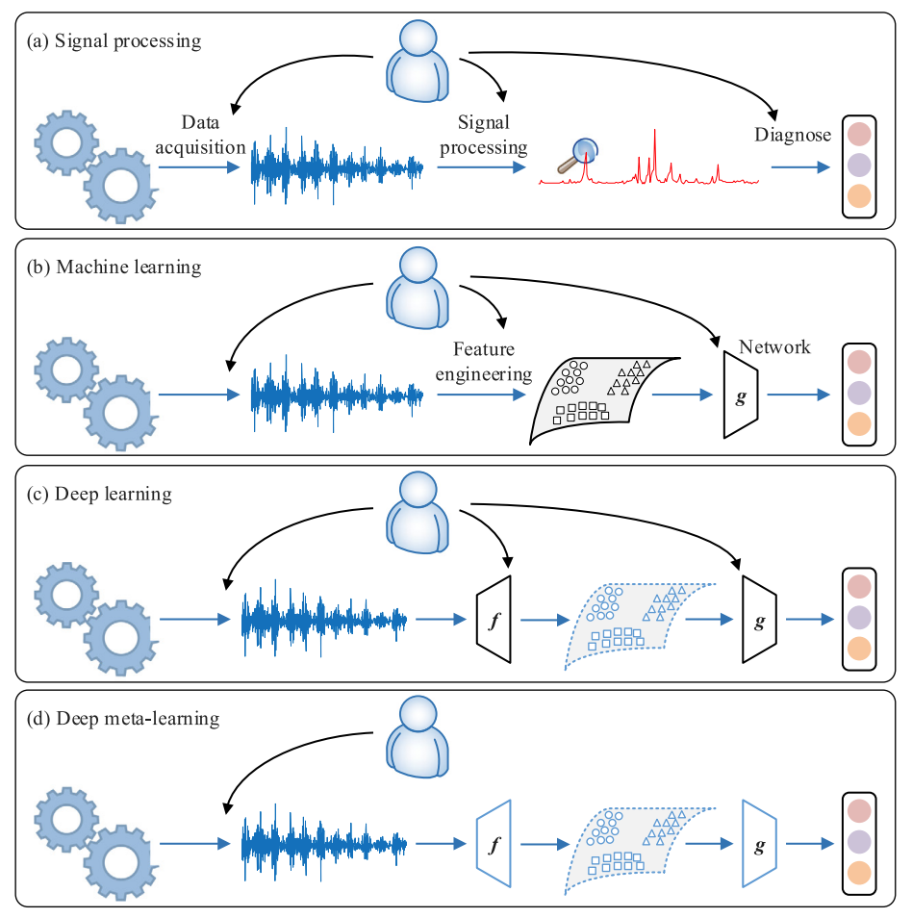
Machine Learning, Deep Learning, Meta Learning
Source: Feng, Yong, Jinglong Chen, Jingsong Xie, Tianci Zhang, Haixin Lv, and Tongyang Pan. "Meta-learning as a promising approach for few-shot cross-domain fault diagnosis: Algorithms, applications, and prospects." Knowledge-Based Systems 235 (2022): 107646.

Slide 48
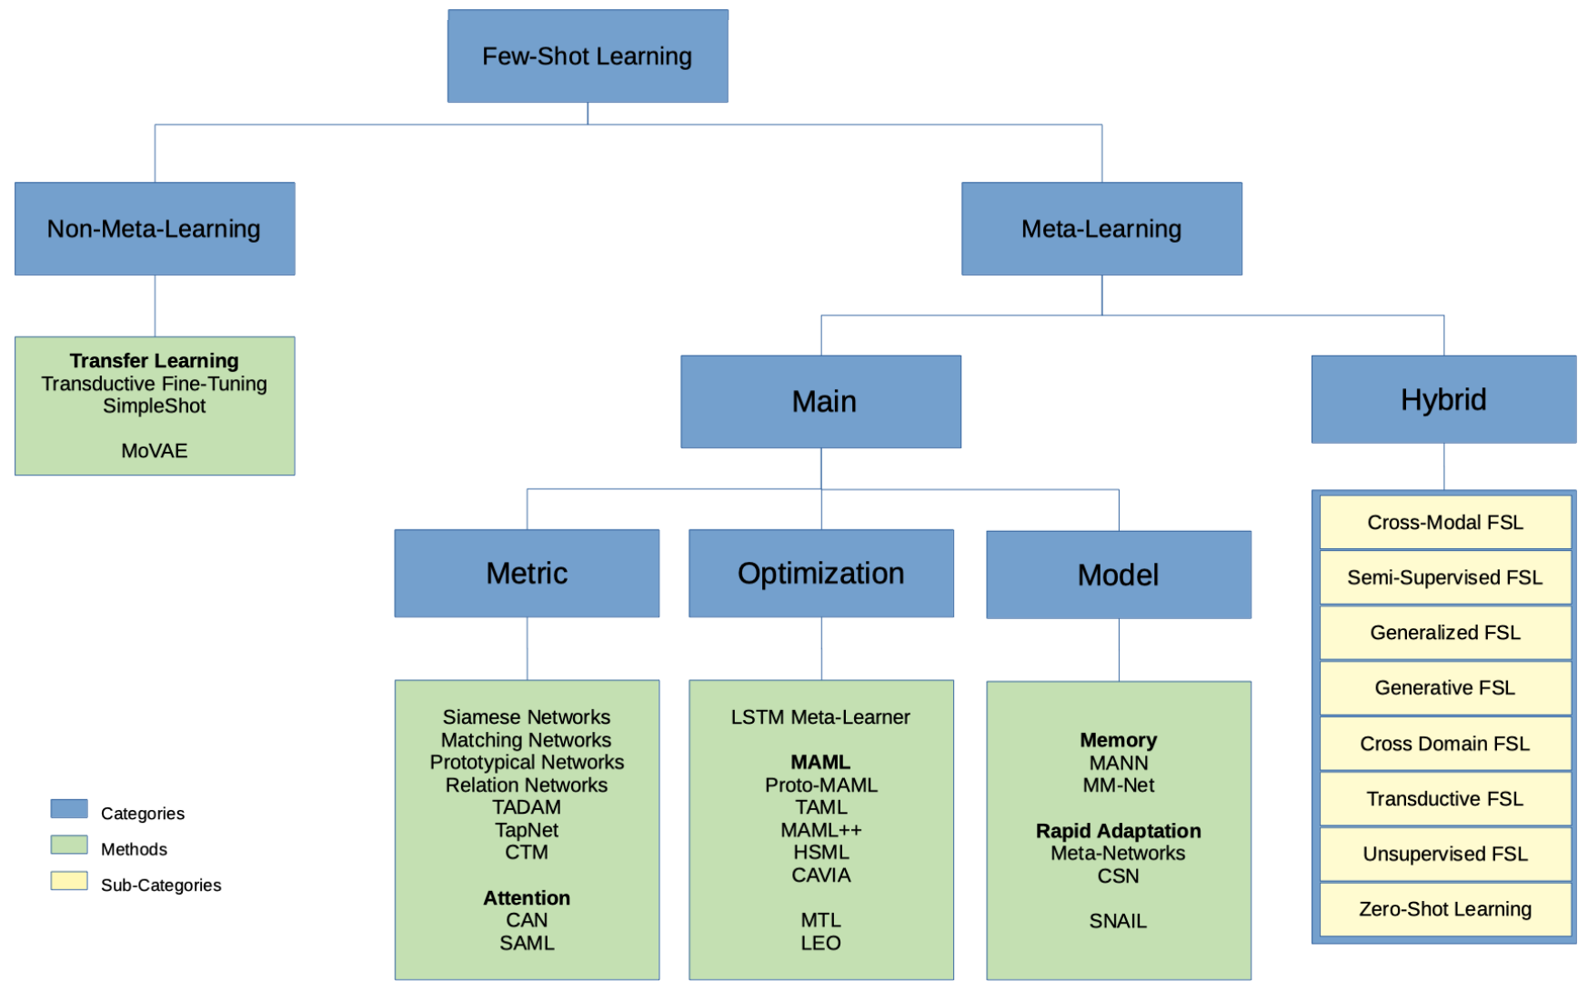
Few-Shot Learning (FSL) and Meta Learning
Machine learning from few training examples
Source: Parnami, Archit, and Minwoo Lee. "Learning from Few Examples: A Summary of Approaches to Few-Shot Learning." arXiv preprint arXiv:2203.04291 (2022).

Slide 49
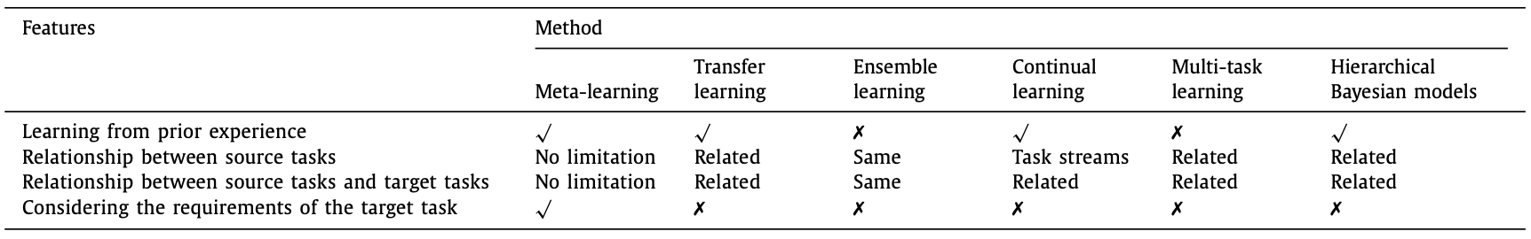
Meta Learning, Transfer Learning,
Ensemble Learning, Continual Learning,
Multi-Task Learning
Source: Luo, Shuai, Yujie Li, Pengxiang Gao, Yichuan Wang, and Seiichi Serikawa. "Meta-seg: A survey of meta-learning for image segmentation." Pattern Recognition (2022): 108586.

Slide 50
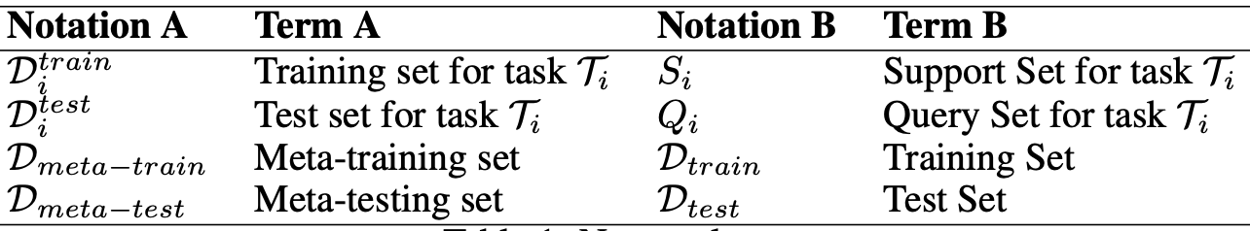
Meta-Learning and Few-shot Learning
Notations and Terms
Optimization-based
Meta-learning
Metric-based
Meta-learning
Source: Parnami, Archit, and Minwoo Lee. "Learning from Few Examples: A Summary of Approaches to Few-Shot Learning." arXiv preprint arXiv:2203.04291 (2022).

Slide 51
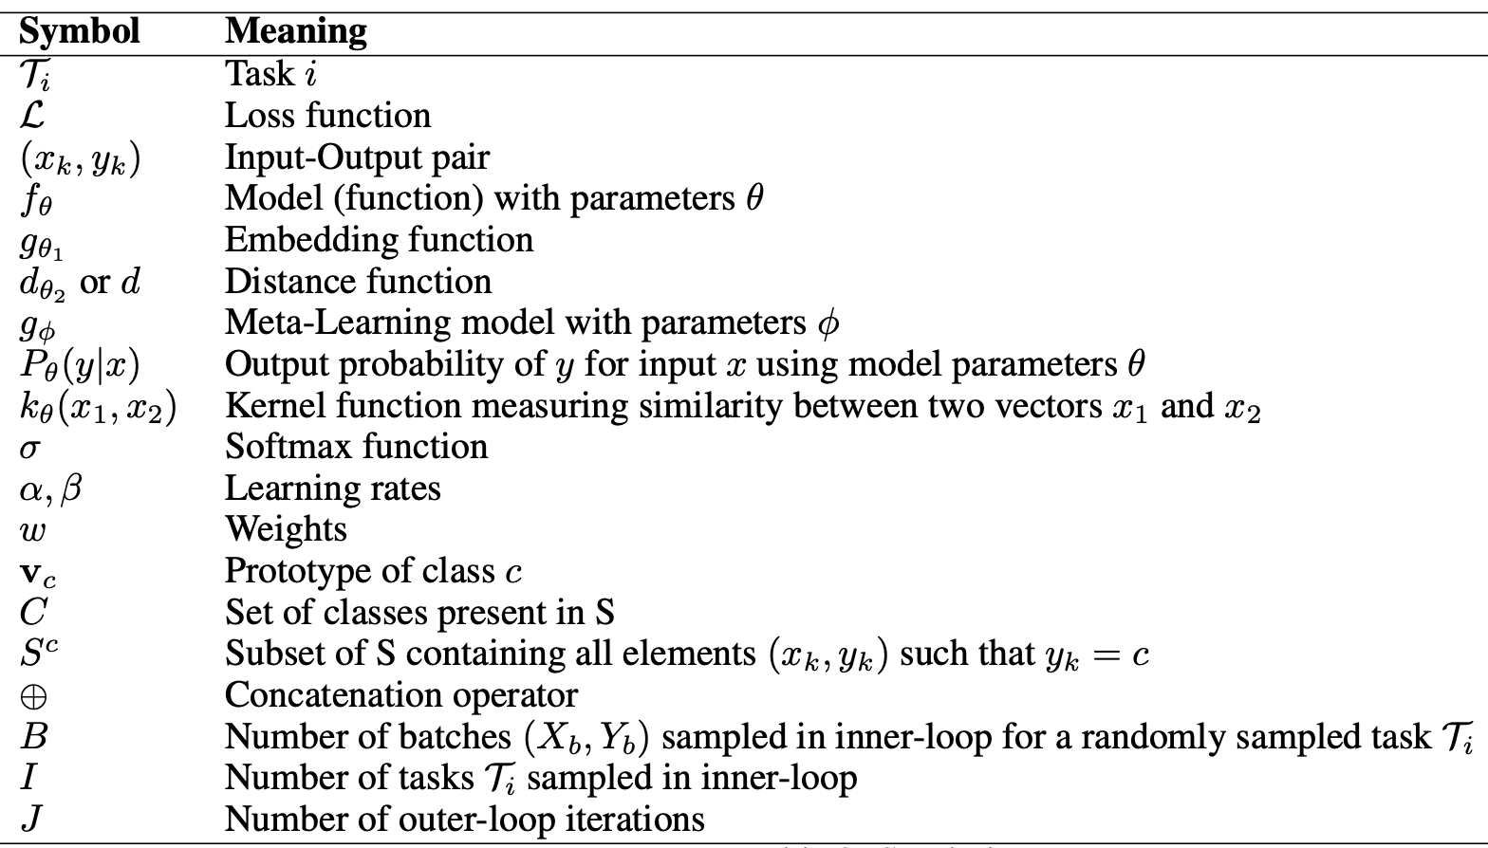
Meta-Learning Symbols
Source: Parnami, Archit, and Minwoo Lee. "Learning from Few Examples: A Summary of Approaches to Few-Shot Learning." arXiv preprint arXiv:2203.04291 (2022).

Slide 52
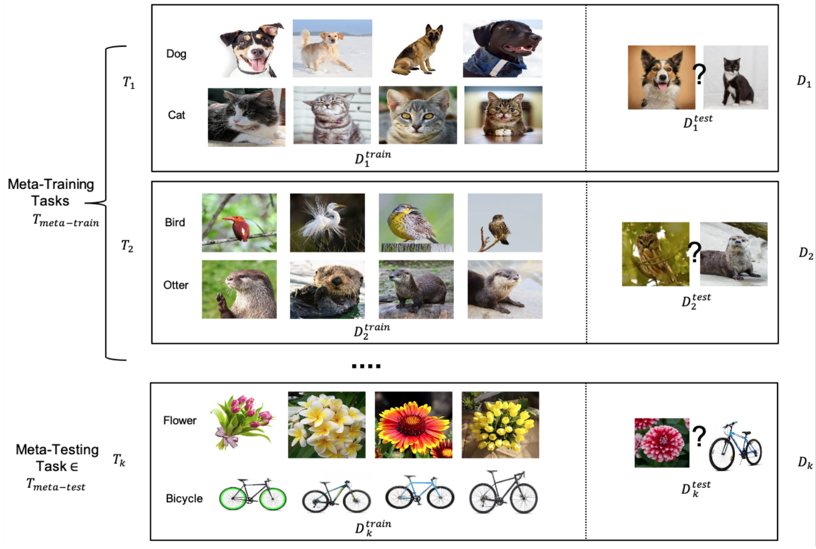
Meta-Learning Example Setup
Source: Parnami, Archit, and Minwoo Lee. "Learning from Few Examples: A Summary of Approaches to Few-Shot Learning." arXiv preprint arXiv:2203.04291 (2022).

Slide 53
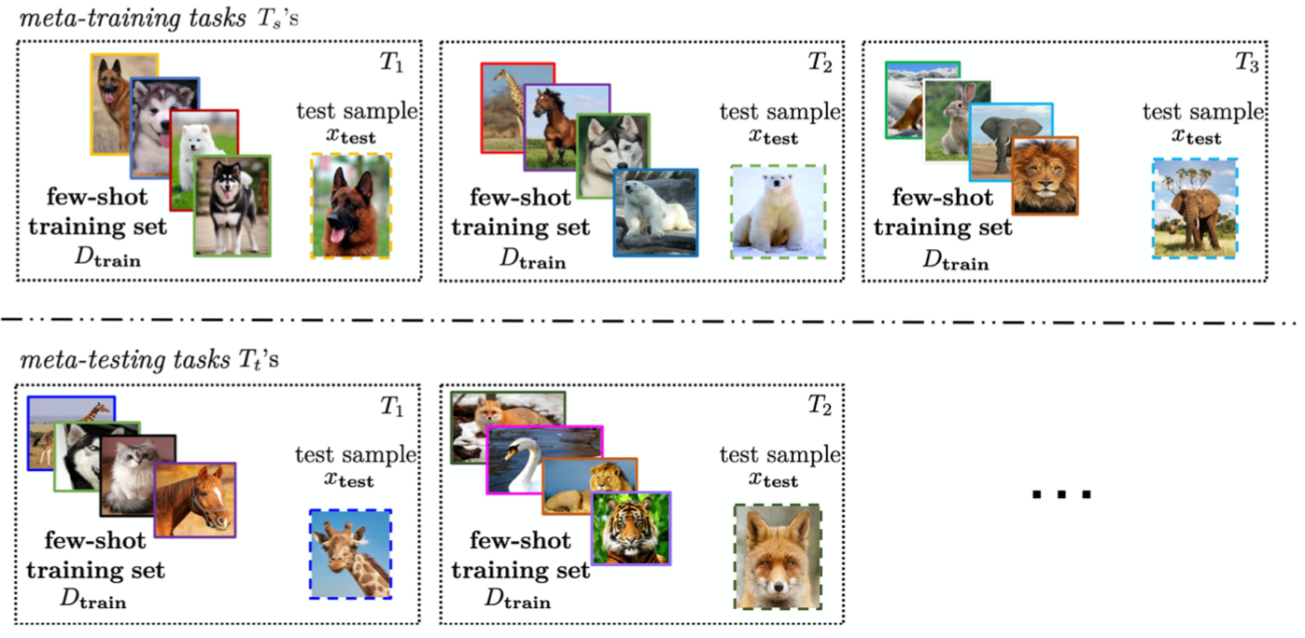
Few-Shot Learning (FSL)
Solving the FSL problem by meta-learning
Source: Yaqing Wang, Quanming Yao, James T. Kwok, and Lionel M. Ni (2020). "Generalizing from a few examples: A survey on few-shot learning." ACM computing surveys (csur) 53, no. 3 (2020): 1-34.

Slide 54
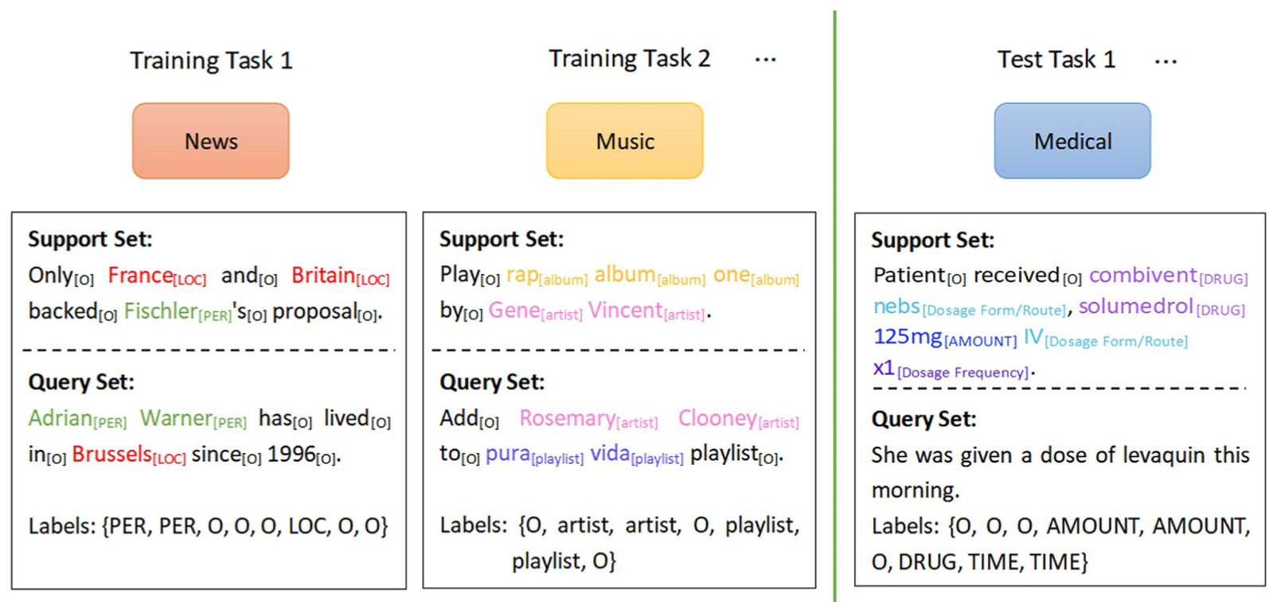
Few-Shot Learning (FSL)
Meta-learning
Each task mimics the few-shot scenario, and can be completely non-overlapping.
Support sets are used to train; query sets are used to evaluate the model
Source: Yao Ge, Yuting Guo, Yuan-Chi Yang, Mohammed Ali Al-Garadi, and Abeed Sarker (2022). "Few-shot learning for medical text: A systematic review." arXiv preprint arXiv:2204.14081 (2022).

Slide 55
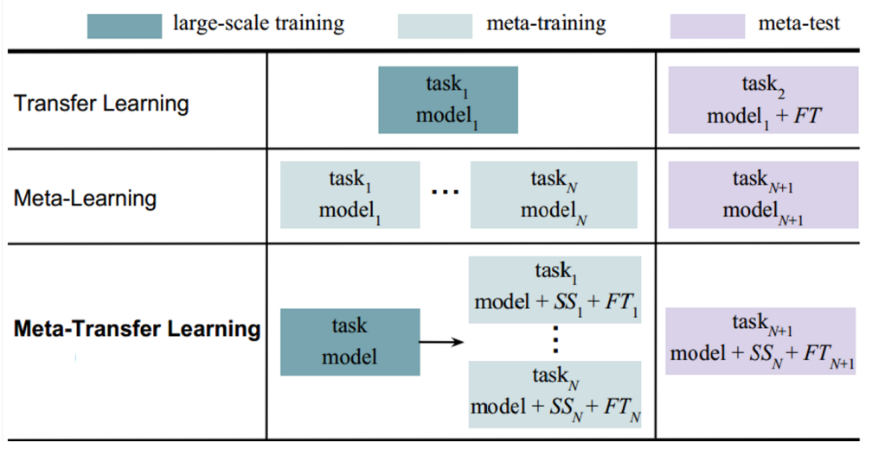
Meta-Task Learning (MTL)
Transfer Learning Strategy for Meta-Learning
Source: Parnami, Archit, and Minwoo Lee. "Learning from Few Examples: A Summary of Approaches to Few-Shot Learning." arXiv preprint arXiv:2203.04291 (2022).

Slide 56
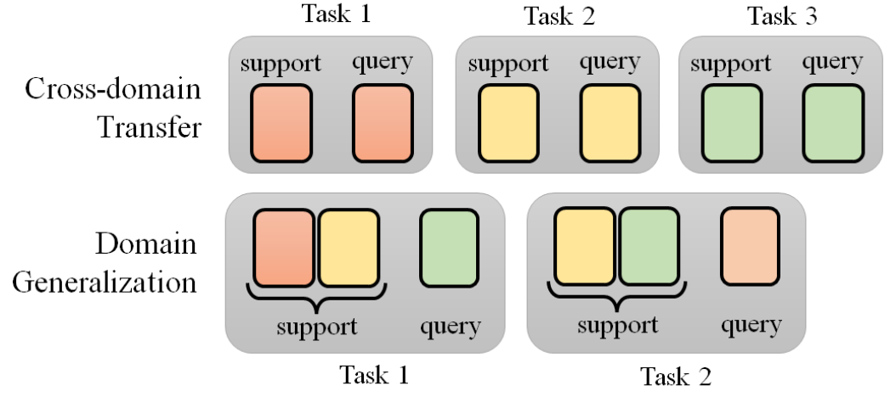
Meta Learning
The task construction of cross-domain transfer and domain generalization
Source: Lee, Hung-yi, Shang-Wen Li, and Ngoc Thang Vu. "Meta Learning for Natural Language Processing: A Survey." arXiv preprint arXiv:2205.01500 (2022).

Slide 57
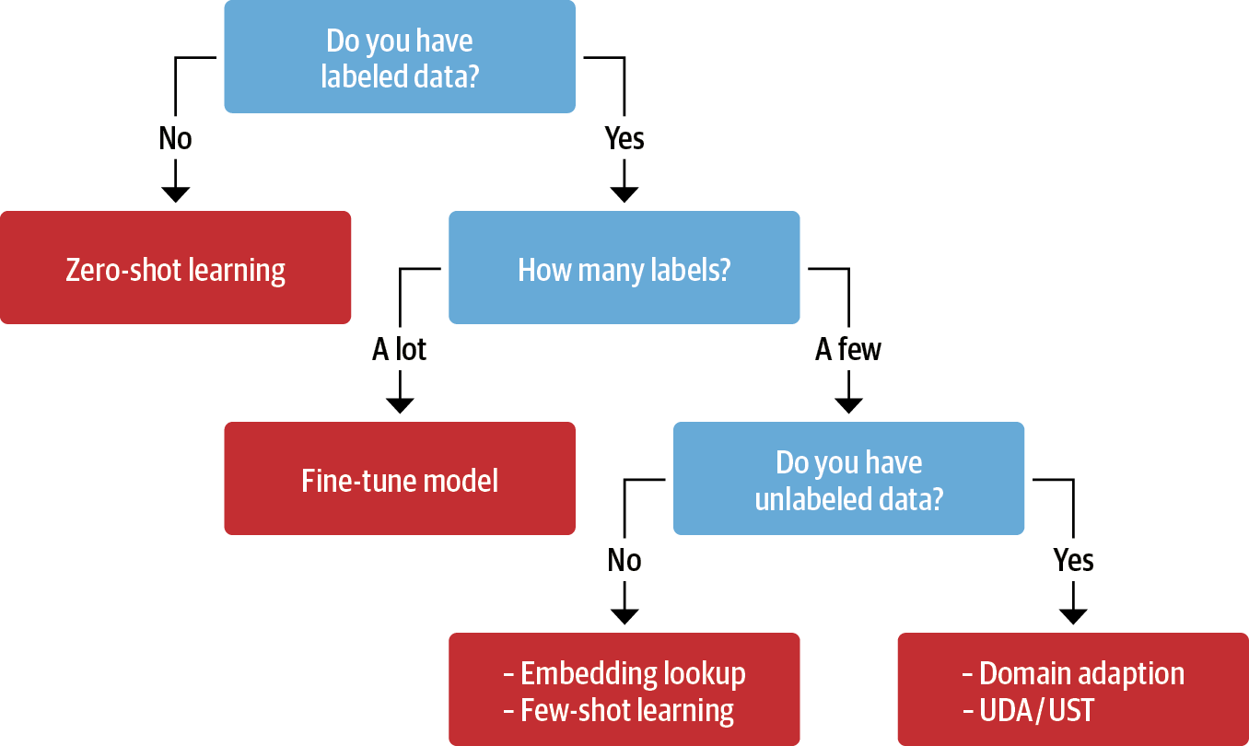
Transfer Learning, Fine-tuning, Few-shot learning
Unsupervised Data Augmentation
(UDA)
Uncertainty-aware Self-Training
(UST)
Source: Lewis Tunstall, Leandro von Werra, and Thomas Wolf (2022), Natural Language Processing with Transformers: Building Language Applications with Hugging Face, O'Reilly Media.

Slide 58
Transfer Learning
Pre-training
Fine-Tuning
Transfer Learning

Slide 59
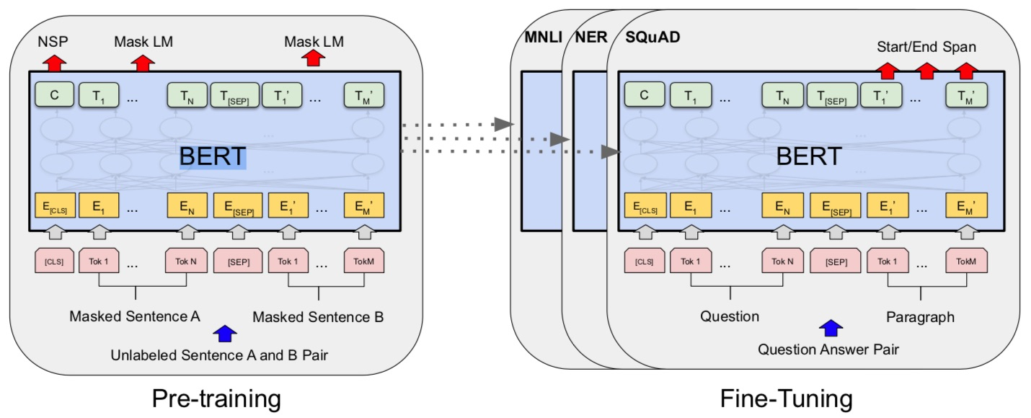
BERT: Pre-training of Deep Bidirectional Transformers for Language Understanding
BERT (Bidirectional Encoder Representations from Transformers)
Overall pre-training and fine-tuning procedures for BERT
Source: Devlin, Jacob, Ming-Wei Chang, Kenton Lee, and Kristina Toutanova (2018).
"Bert: Pre-training of deep bidirectional transformers for language understanding." arXiv preprint arXiv:1810.04805.

Slide 60
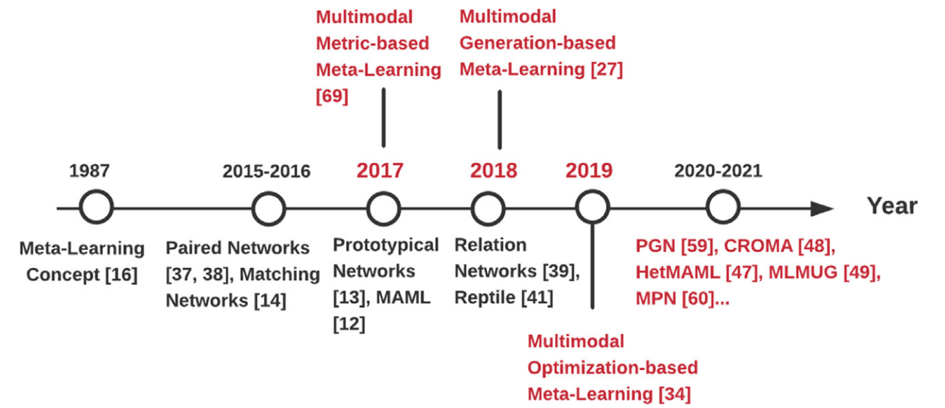
Meta Learning
Source: TMa, Yao, Shilin Zhao, Weixiao Wang, Yaoman Li, and Irwin King. "Multimodality in meta-learning: A comprehensive survey." Knowledge-Based Systems (2022): 108976.

Slide 61
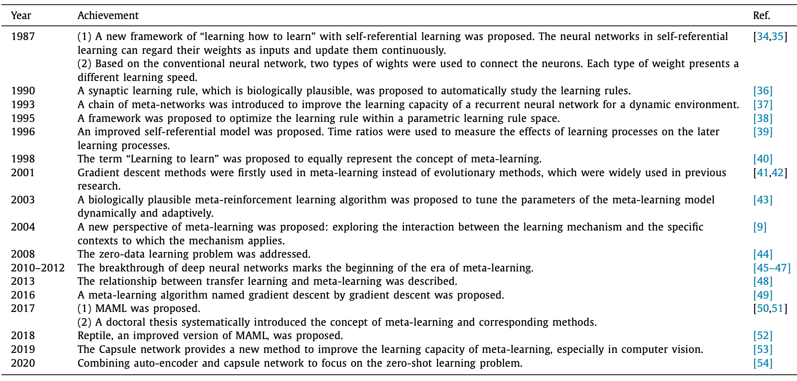
Meta Learning
Source: TMa, Yao, Shilin Zhao, Weixiao Wang, Yaoman Li, and Irwin King. "Multimodality in meta-learning: A comprehensive survey." Knowledge-Based Systems (2022): 108976.

Slide 62
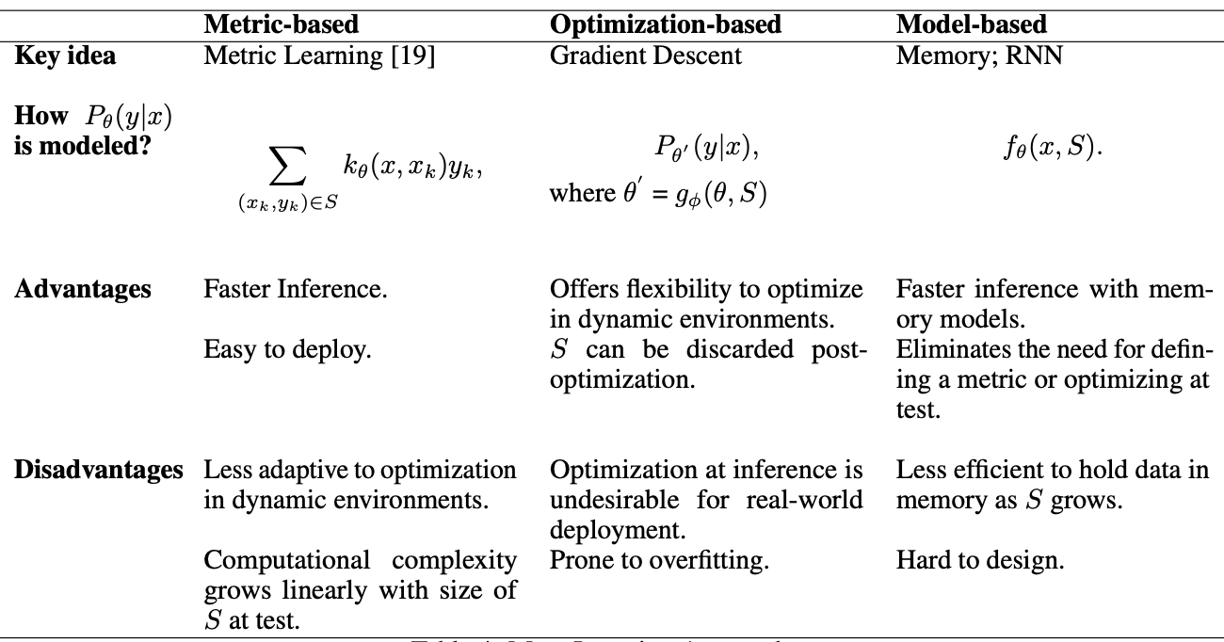
Meta-learning Approaches
Source: Parnami, Archit, and Minwoo Lee. "Learning from Few Examples: A Summary of Approaches to Few-Shot Learning." arXiv preprint arXiv:2203.04291 (2022).

Slide 63
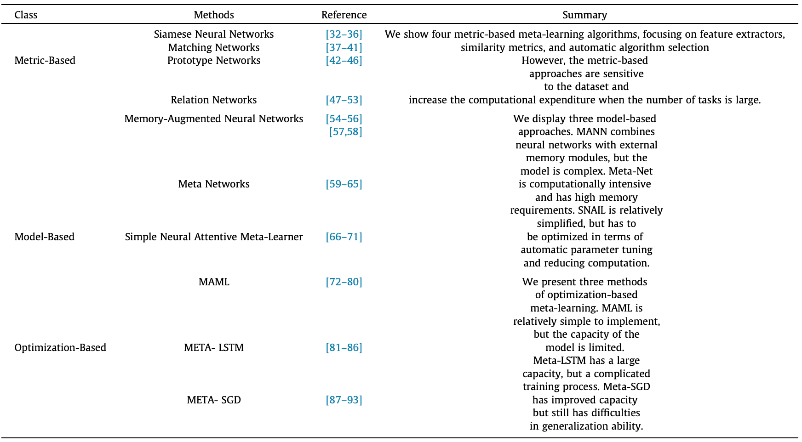
Meta Learning: Learning to Learn
Source: Tian, Yingjie, Xiaoxi Zhao, and Wei Huang. "Meta-learning approaches for learning-to-learn in deep learning: A survey." Neurocomputing 494 (2022): 203-223.

Slide 64
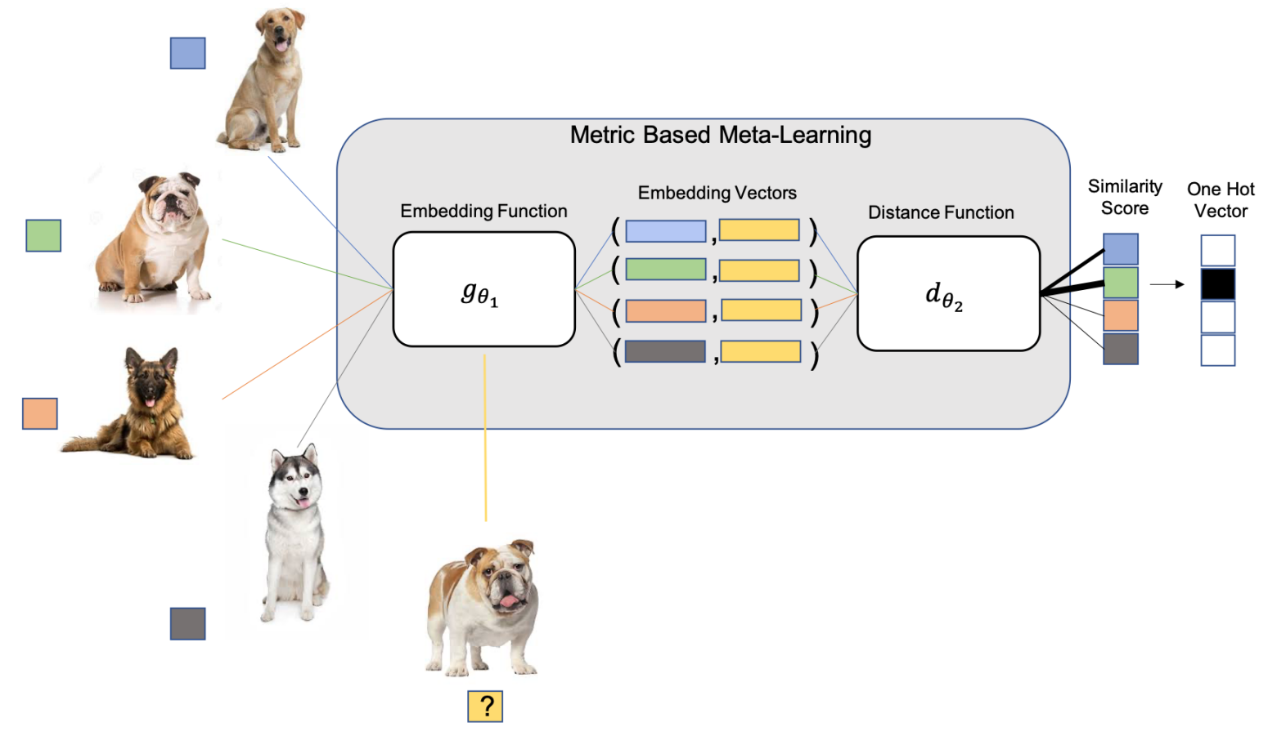
Metric-based Meta-learning
M-Way K-Shot Task (4-way-1-shot classification task)
Source: Parnami, Archit, and Minwoo Lee. "Learning from Few Examples: A Summary of Approaches to Few-Shot Learning." arXiv preprint arXiv:2203.04291 (2022).

Slide 65
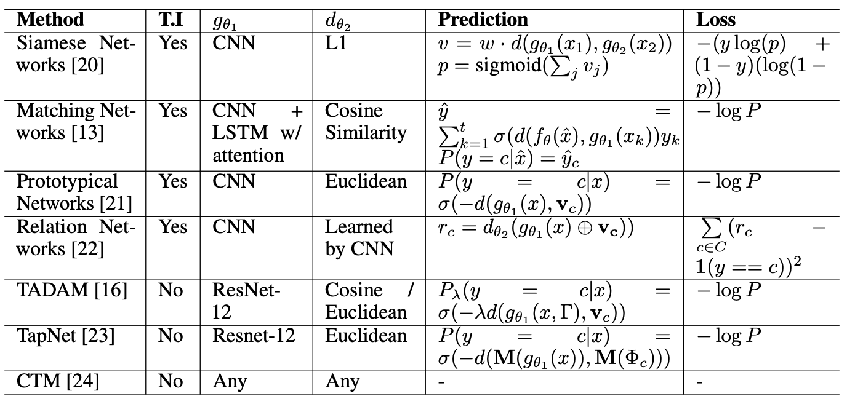
Metric-based Meta-Learning Methods
Source: Parnami, Archit, and Minwoo Lee. "Learning from Few Examples: A Summary of Approaches to Few-Shot Learning." arXiv preprint arXiv:2203.04291 (2022).

Slide 66
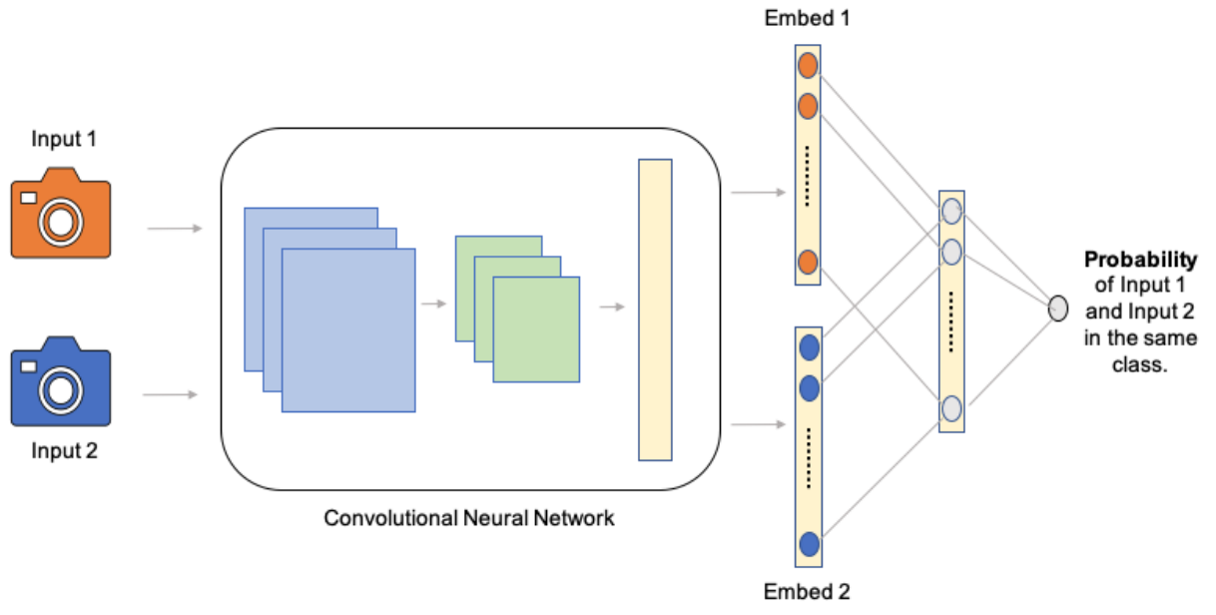
Convolutional Siamese Network
Source: Parnami, Archit, and Minwoo Lee. "Learning from Few Examples: A Summary of Approaches to Few-Shot Learning." arXiv preprint arXiv:2203.04291 (2022).

Slide 67
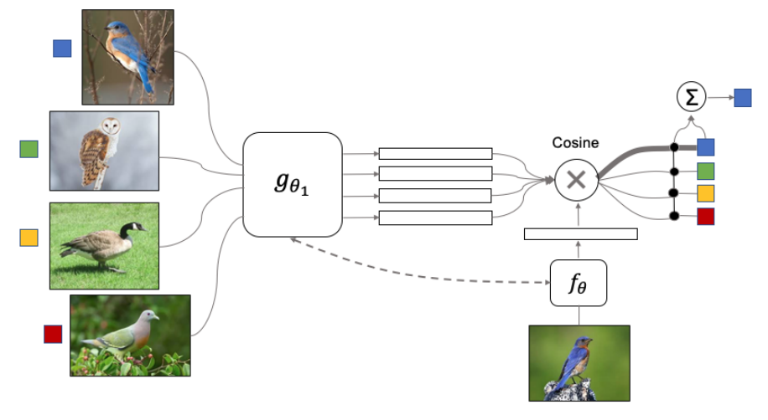
Meta Learning: Matching Networks
Source: Parnami, Archit, and Minwoo Lee. "Learning from Few Examples: A Summary of Approaches to Few-Shot Learning." arXiv preprint arXiv:2203.04291 (2022).

Slide 68
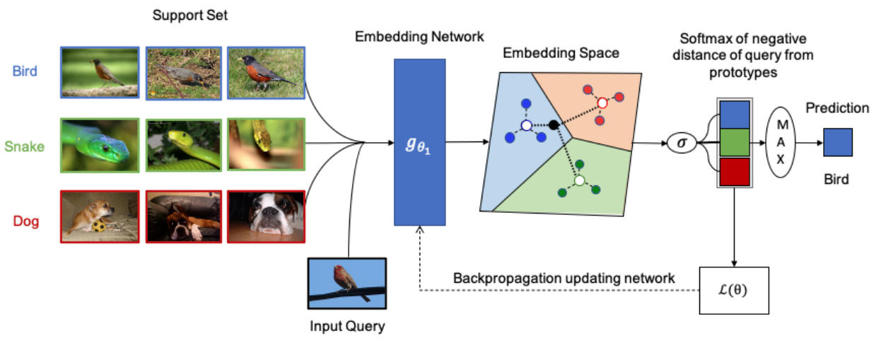
Few-shot Prototypes v_{c} are computed as the mean of embedded support examples for each class
Source: Parnami, Archit, and Minwoo Lee. "Learning from Few Examples: A Summary of Approaches to Few-Shot Learning." arXiv preprint arXiv:2203.04291 (2022).

Slide 69
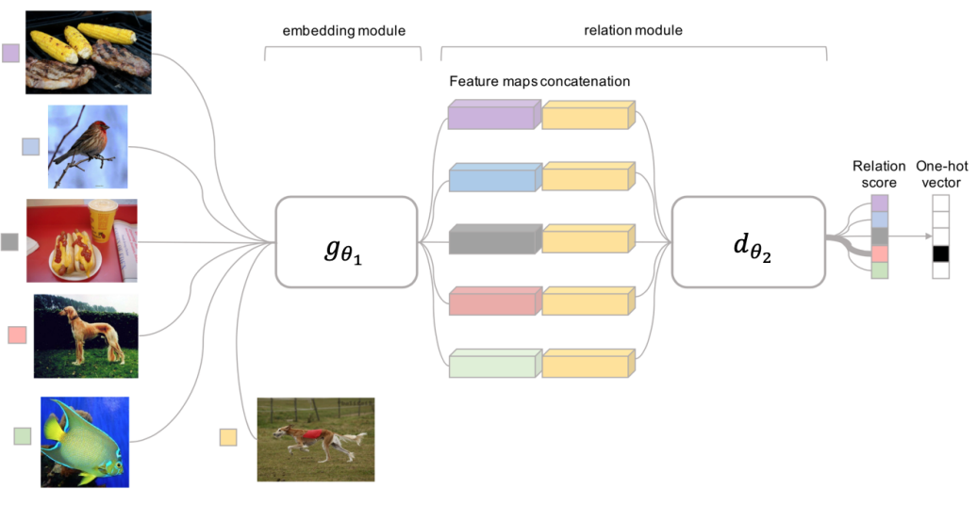
Meta Learning: Relation Network
Source: Parnami, Archit, and Minwoo Lee. "Learning from Few Examples: A Summary of Approaches to Few-Shot Learning." arXiv preprint arXiv:2203.04291 (2022).

Slide 70
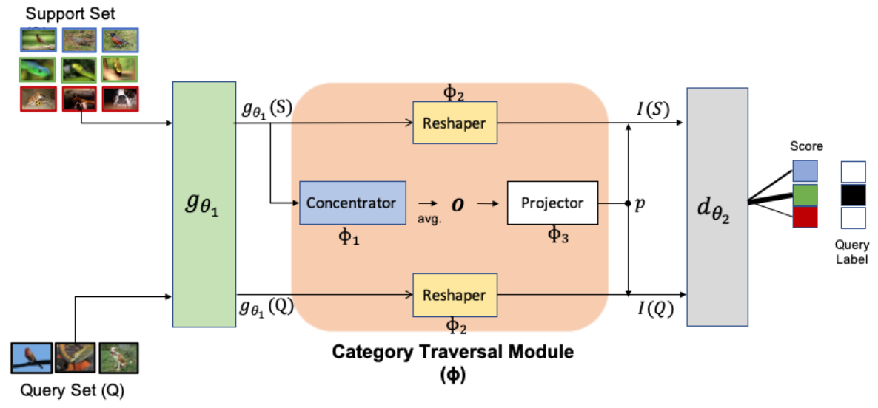
Meta Learning: Category Traversal Module (CTM)
Source: Parnami, Archit, and Minwoo Lee. "Learning from Few Examples: A Summary of Approaches to Few-Shot Learning." arXiv preprint arXiv:2203.04291 (2022).

Slide 71
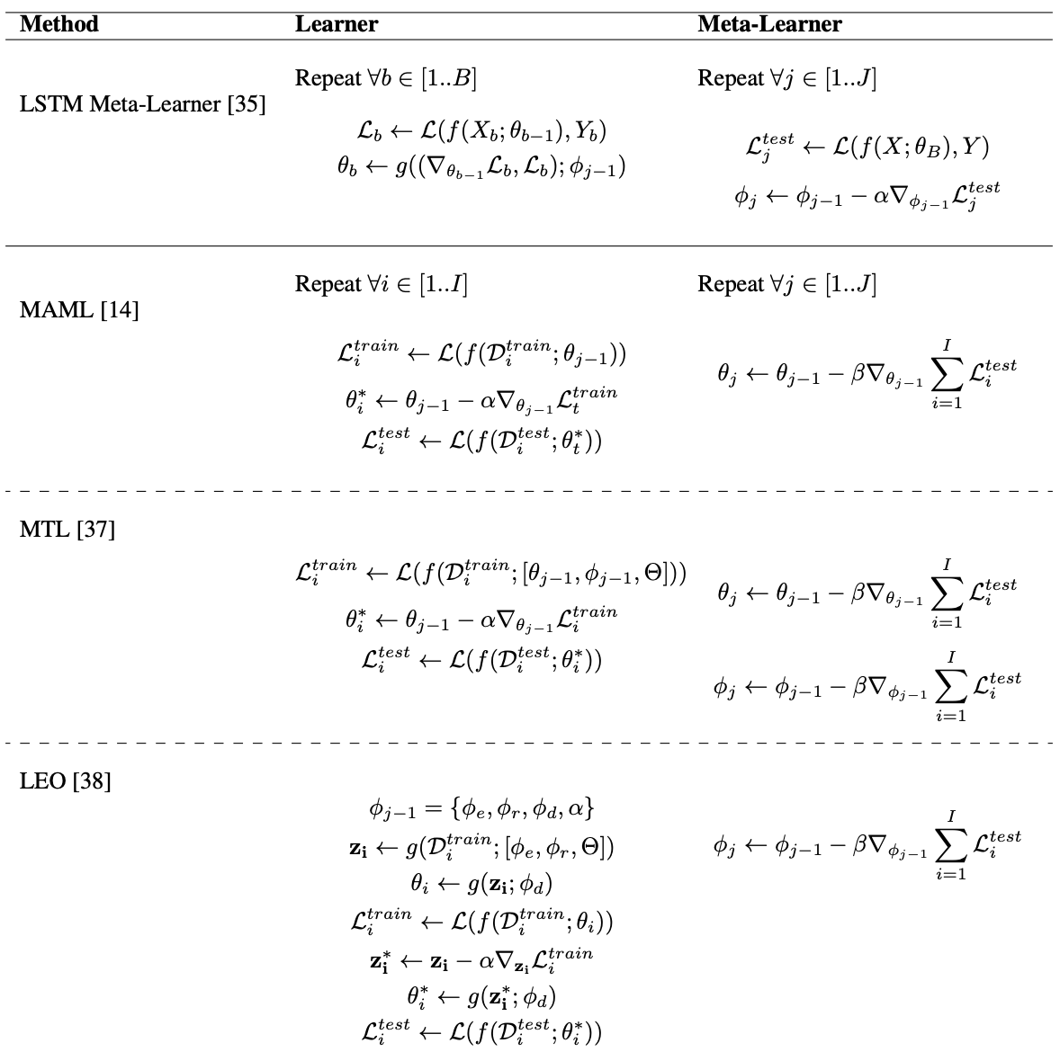
Optimization-based Meta-Learning Methods
Source: Parnami, Archit, and Minwoo Lee. "Learning from Few Examples: A Summary of Approaches to Few-Shot Learning." arXiv preprint arXiv:2203.04291 (2022).

Slide 72
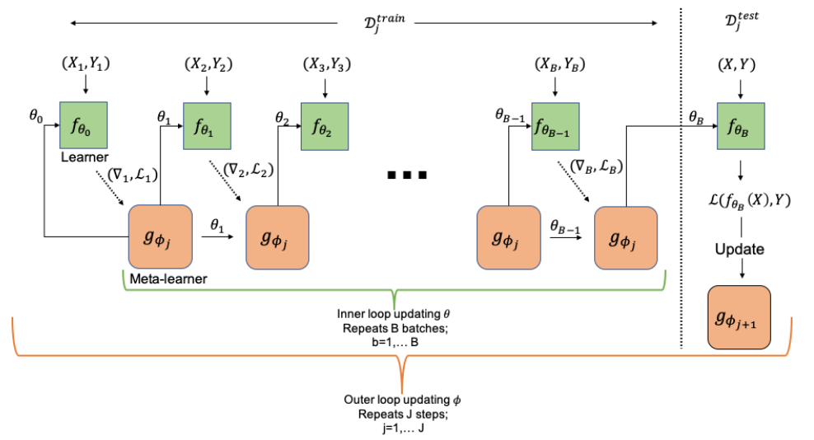
Computational Graph for the Forward Pass of the Meta-learner
Source: Parnami, Archit, and Minwoo Lee. "Learning from Few Examples: A Summary of Approaches to Few-Shot Learning." arXiv preprint arXiv:2203.04291 (2022).

Slide 73
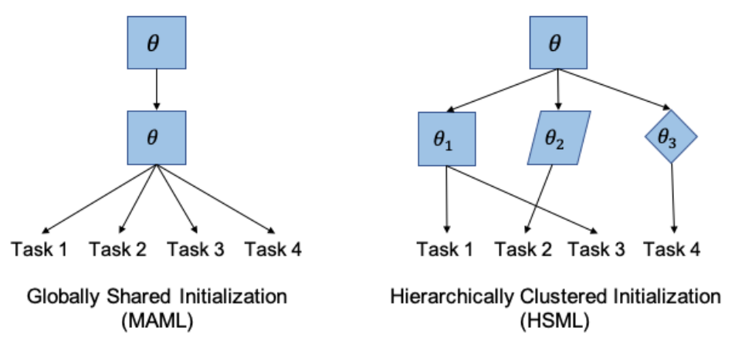
Model-Agnostic Meta-Learning (MAML)
Hierarchically Structured Meta-Learning (HSML)
Source: Parnami, Archit, and Minwoo Lee. "Learning from Few Examples: A Summary of Approaches to Few-Shot Learning." arXiv preprint arXiv:2203.04291 (2022).

Slide 74
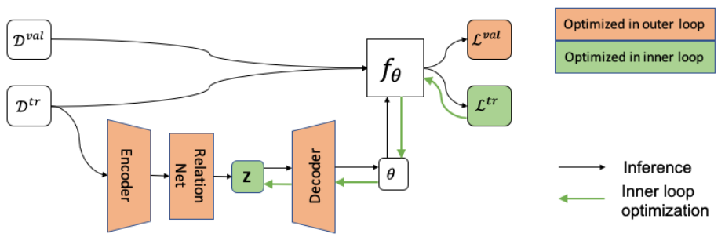
Latent Embedding Optimization (LEO)
Source: Parnami, Archit, and Minwoo Lee. "Learning from Few Examples: A Summary of Approaches to Few-Shot Learning." arXiv preprint arXiv:2203.04291 (2022).

Slide 75
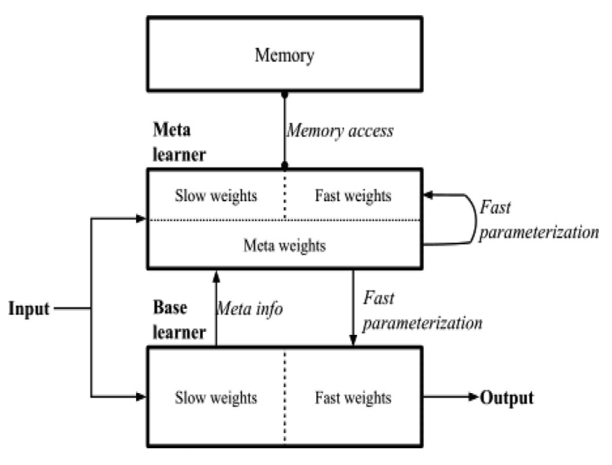
Overall Architecture of Meta Networks
Source: Tian, Yingjie, Xiaoxi Zhao, and Wei Huang. "Meta-learning approaches for learning-to-learn in deep learning: A survey." Neurocomputing 494 (2022): 203-223.

Slide 76
The Transformers Timeline
ULMFit
BERT
RoBERTa
XLM-R
DeBERTa
GPT-Neo
T5
Transformer
GPT
GPT-2
DistrilBERT
GPT-3
GPT-J
2017
2018
2019
2020
2021
2022
Source: Lewis Tunstall, Leandro von Werra, and Thomas Wolf (2022), Natural Language Processing with Transformers: Building Language Applications with Hugging Face, O'Reilly Media.

Slide 77
Transformer Models
Transformer
Encoder
Decoder
DistilBERT
BERT
T5
GPT
RoBERTa
BART
GPT-2
CTRL
XLM-R
XLM
M2M-100
GPT-3
ALBERT
BigBird
GPT-Neo
GPT-J
ELECTRA
DeBERTa
Source: Lewis Tunstall, Leandro von Werra, and Thomas Wolf (2022), Natural Language Processing with Transformers: Building Language Applications with Hugging Face, O'Reilly Media.

Slide 78
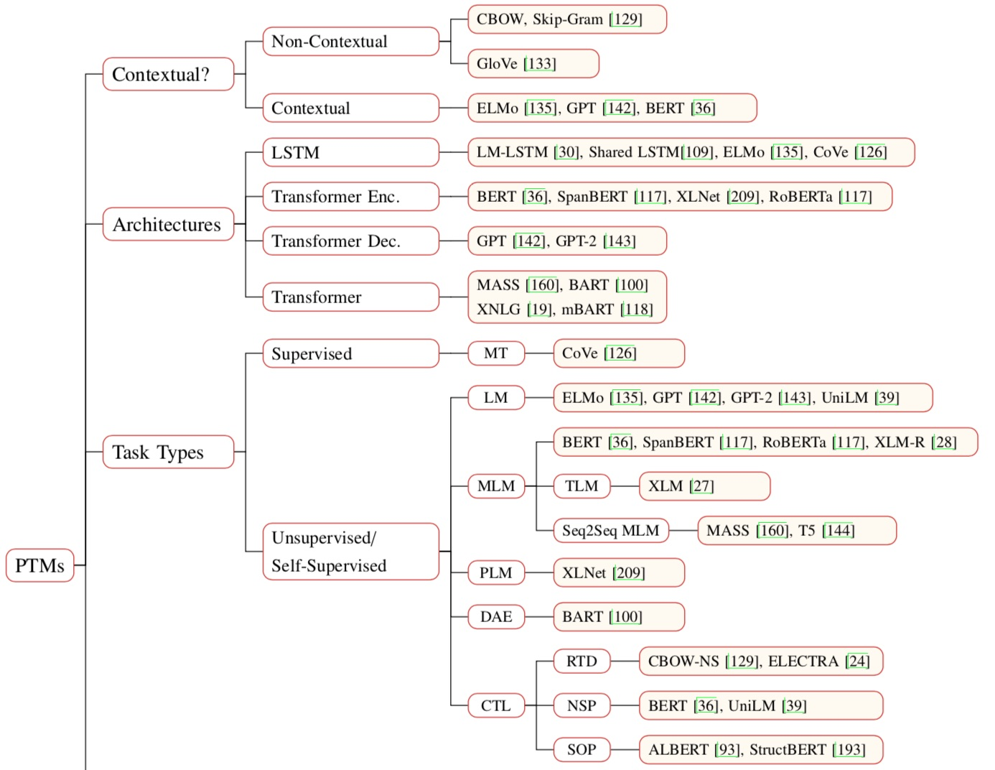
Pre-trained Models (PTM)
Source: Qiu, Xipeng, Tianxiang Sun, Yige Xu, Yunfan Shao, Ning Dai, and Xuanjing Huang. "Pre-trained Models for Natural Language Processing: A Survey." arXiv preprint arXiv:2003.08271 (2020).

Slide 79
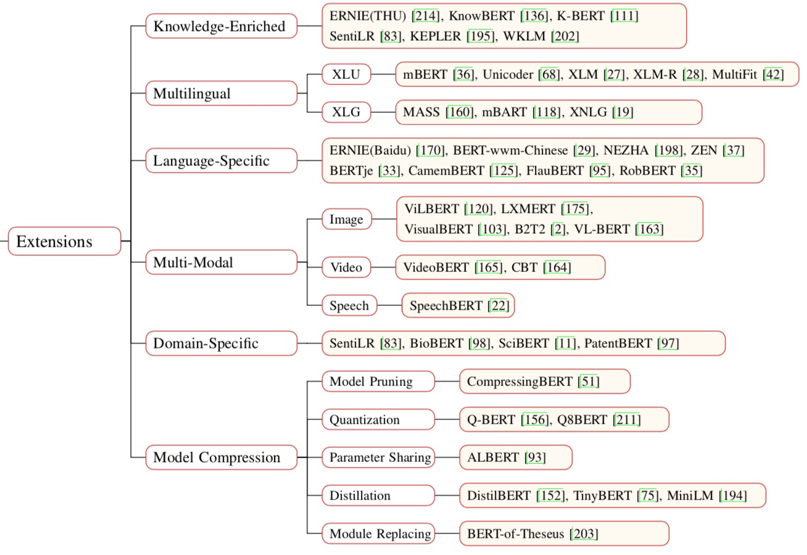
Pre-trained Models (PTM)
Source: Qiu, Xipeng, Tianxiang Sun, Yige Xu, Yunfan Shao, Ning Dai, and Xuanjing Huang. "Pre-trained Models for Natural Language Processing: A Survey." arXiv preprint arXiv:2003.08271 (2020).

Slide 80
ULMFiT: 3 Steps
Transfer Learning in NLP
Wikitet
103
IMDB
IMDB
Language
Model
Language
Model
Classifier
1. Pretraining
2. Domain adaptation
3. Fine-tuning
Source: Lewis Tunstall, Leandro von Werra, and Thomas Wolf (2022), Natural Language Processing with Transformers: Building Language Applications with Hugging Face, O'Reilly Media.

Slide 81
A typical pipeline for training transformer models with the Datasets, Tokenizers, and Transformers libraries
Datasets
Tokenizers
Transformers
Datasets
Load and
process datasets
Tokenize
input texts
Load models,
train and infer
Load metrics
evaluate models
Source: Lewis Tunstall, Leandro von Werra, and Thomas Wolf (2022), Natural Language Processing with Transformers: Building Language Applications with Hugging Face, O'Reilly Media.
https://github.com/nlp-with-transformers/notebooks

Slide 82
Few-Shot Learning (FSL)
Typical Scenarios
Acting as a test bed for learning like human
Learning for rare cases
Reducing data gathering effort and computational cost
Source: Yaqing Wang, Quanming Yao, James T. Kwok, and Lionel M. Ni (2020). "Generalizing from a few examples: A survey on few-shot learning." ACM computing surveys (csur) 53, no. 3 (2020): 1-34.

Slide 83
Few-Shot Learning (FSL)
Few-Shot Learning (FSL) is a sub-area in machine learning.
Machine Learning Definition
  A computer program is said to learn from experience E with respect to some classes of task T and performance measure P if its performance can improve with E on T measured by P.
    Example: Image classification task (T ), a machine learning program can improve its classification accuracy (P) through E obtained by training on a large number of labeled images (e.g., the ImageNet data set).
Source: Yaqing Wang, Quanming Yao, James T. Kwok, and Lionel M. Ni (2020). "Generalizing from a few examples: A survey on few-shot learning." ACM computing surveys (csur) 53, no. 3 (2020): 1-34.

Slide 84
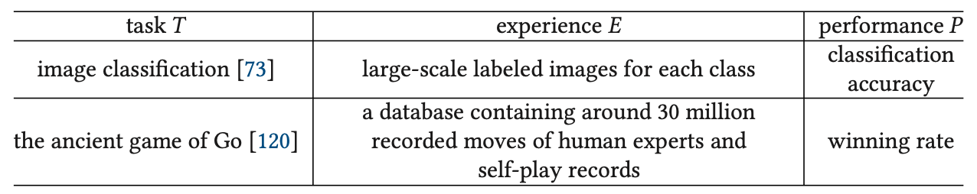
Machine Learning
Source: Yaqing Wang, Quanming Yao, James T. Kwok, and Lionel M. Ni (2020). "Generalizing from a few examples: A survey on few-shot learning." ACM computing surveys (csur) 53, no. 3 (2020): 1-34.

Slide 85
Few-Shot Learning (FSL)
Few-shot Learning (FSL) is a type of machine learning problems (specified by E, T, and P),
where E contains only a limited number of examples with supervised information for the target T.
  Existing FSL problems are mainly supervised learning problems.
  Few-shot classification learns classifiers given only
  a few labeled examples of each class.
    image classification
    sentiment classification from short text
    object recognition
Source: Yaqing Wang, Quanming Yao, James T. Kwok, and Lionel M. Ni (2020). "Generalizing from a few examples: A survey on few-shot learning." ACM computing surveys (csur) 53, no. 3 (2020): 1-34.

Slide 86
Few-Shot Learning (FSL)
Few-shot classification learns a classifier h,
which predicts label y_{i} for each input x_{i}.
Usually, one considers the N-way-K-shot classification,
in which D_{train} contains I = KN examples
from N classes each with K examples
Source: Yaqing Wang, Quanming Yao, James T. Kwok, and Lionel M. Ni (2020). "Generalizing from a few examples: A survey on few-shot learning." ACM computing surveys (csur) 53, no. 3 (2020): 1-34.

Slide 87
Few-Shot Learning (FSL)
Few-Shot Learning (FSL)
  K = 10 ~ 100 examples
One-Shot Learning (1SL)
  K = 1 example
Zero-Shot Learning (0SL)(ZSL)
  K = 0

Slide 88
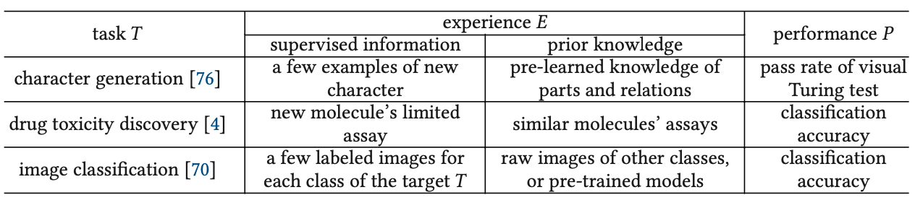
Few-Shot Learning (FSL)
Source: Yaqing Wang, Quanming Yao, James T. Kwok, and Lionel M. Ni (2020). "Generalizing from a few examples: A survey on few-shot learning." ACM computing surveys (csur) 53, no. 3 (2020): 1-34.

Slide 89
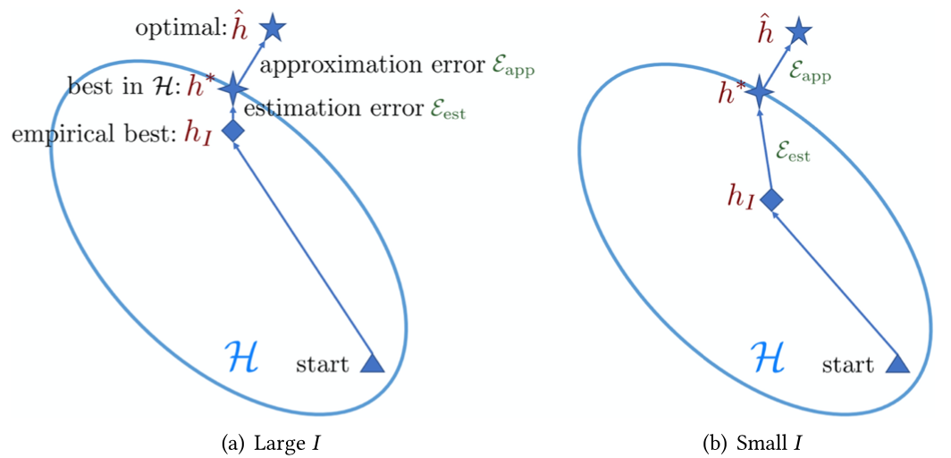
Few-Shot Learning (FSL)
Comparison of learning with sufficient and few training samples
Source: Yaqing Wang, Quanming Yao, James T. Kwok, and Lionel M. Ni (2020). "Generalizing from a few examples: A survey on few-shot learning." ACM computing surveys (csur) 53, no. 3 (2020): 1-34.

Slide 90
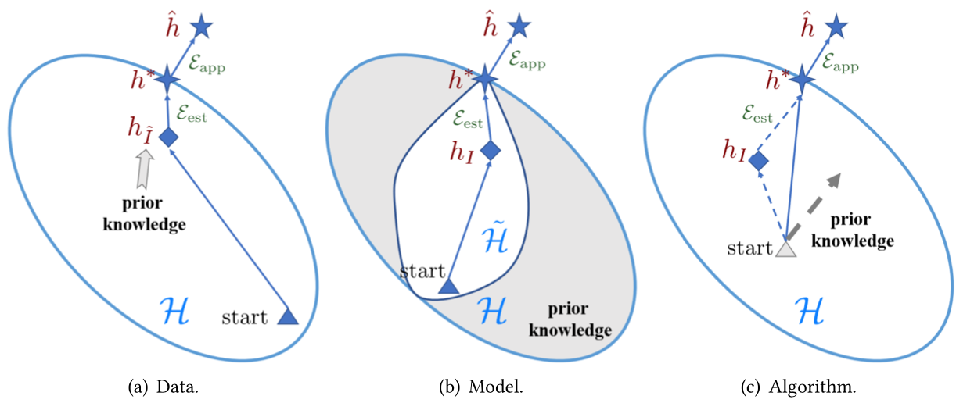
Few-Shot Learning (FSL)
Different perspectives on how FSL methods solve the few-shot problem
Source: Yaqing Wang, Quanming Yao, James T. Kwok, and Lionel M. Ni (2020). "Generalizing from a few examples: A survey on few-shot learning." ACM computing surveys (csur) 53, no. 3 (2020): 1-34.

Slide 91
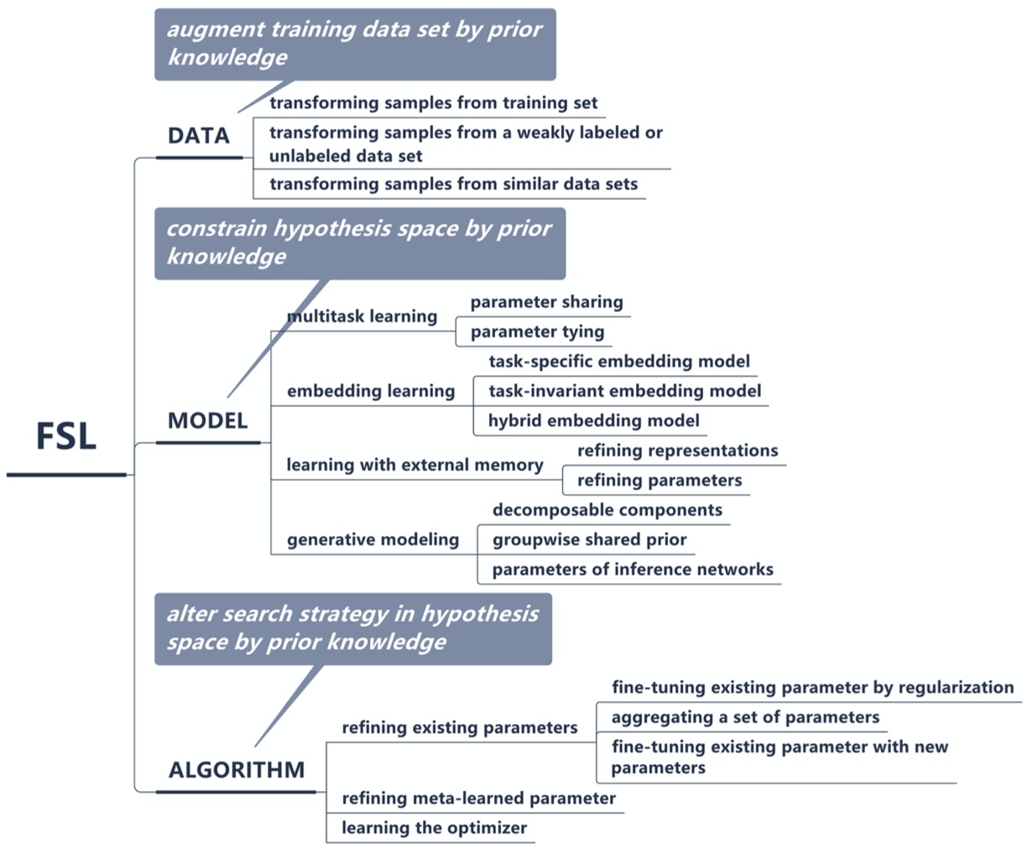
Few-Shot Learning (FSL)
A taxonomy of FSL methods
Source: Yaqing Wang, Quanming Yao, James T. Kwok, and Lionel M. Ni (2020). "Generalizing from a few examples: A survey on few-shot learning." ACM computing surveys (csur) 53, no. 3 (2020): 1-34.

Slide 92
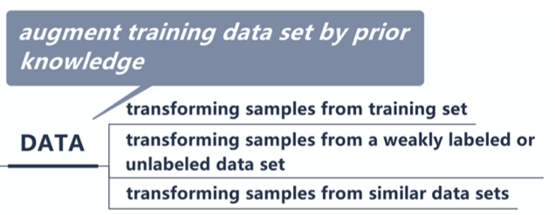
Few-Shot Learning (FSL)
Source: Yaqing Wang, Quanming Yao, James T. Kwok, and Lionel M. Ni (2020). "Generalizing from a few examples: A survey on few-shot learning." ACM computing surveys (csur) 53, no. 3 (2020): 1-34.

Slide 93
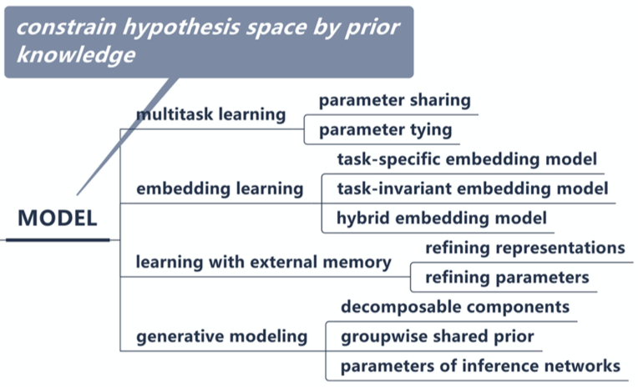
Few-Shot Learning (FSL)
Source: Yaqing Wang, Quanming Yao, James T. Kwok, and Lionel M. Ni (2020). "Generalizing from a few examples: A survey on few-shot learning." ACM computing surveys (csur) 53, no. 3 (2020): 1-34.

Slide 94
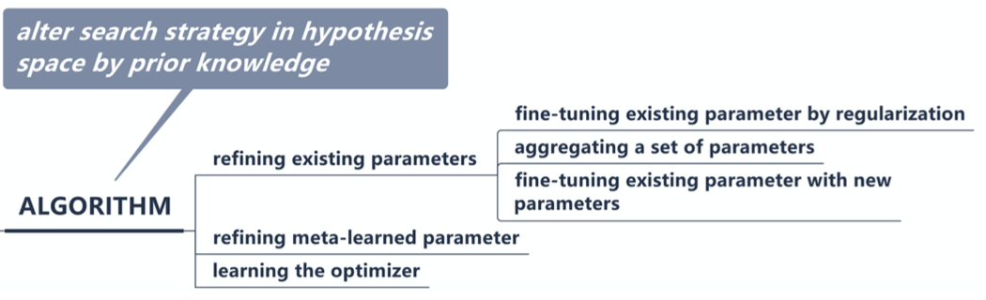
Few-Shot Learning (FSL)
Source: Yaqing Wang, Quanming Yao, James T. Kwok, and Lionel M. Ni (2020). "Generalizing from a few examples: A survey on few-shot learning." ACM computing surveys (csur) 53, no. 3 (2020): 1-34.

Slide 95
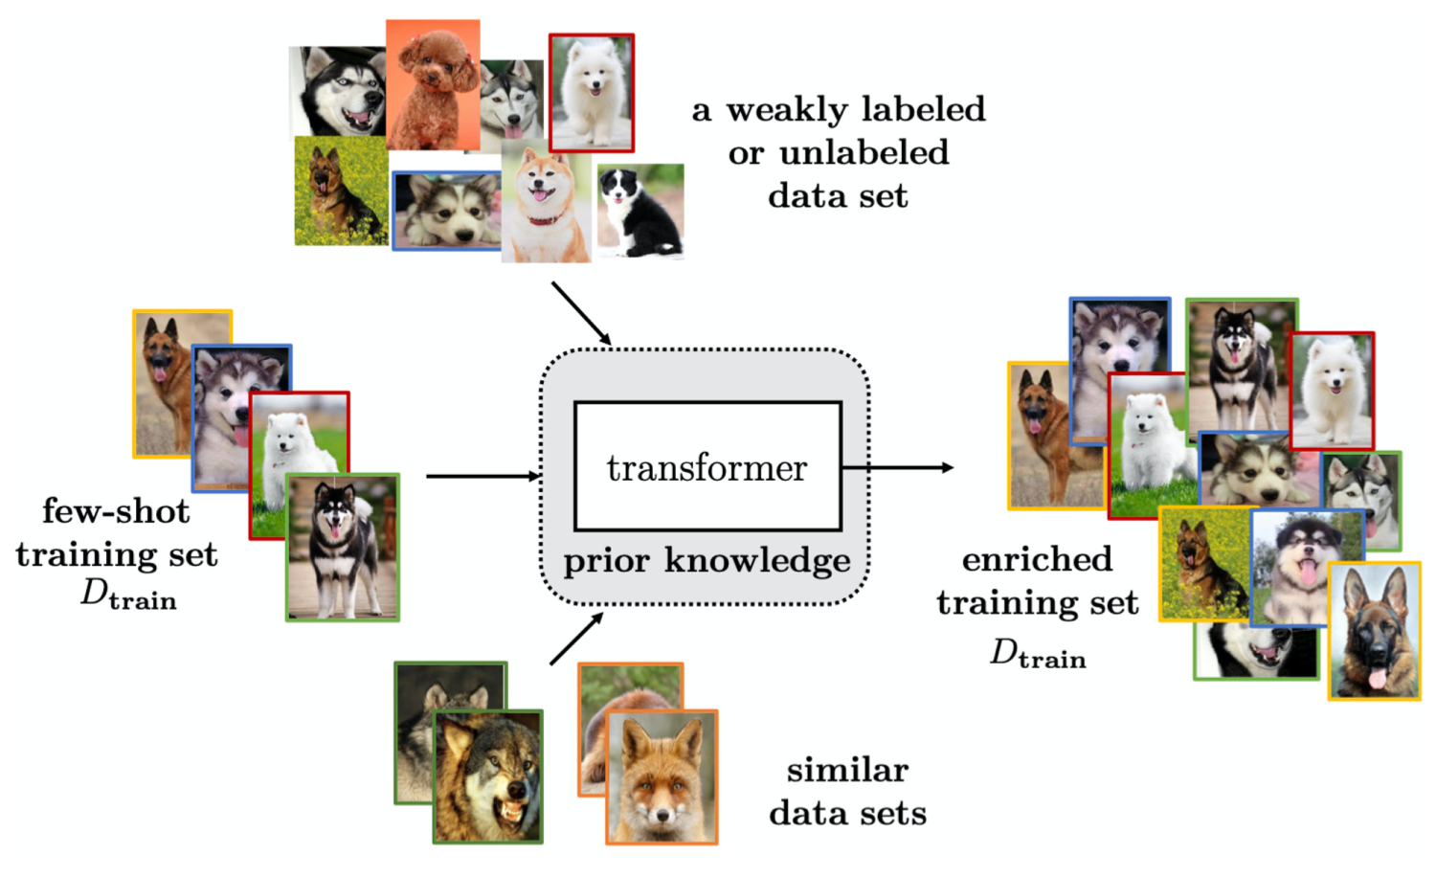
Few-Shot Learning (FSL)
Solving the FSL problem by data augmentation
Source: Yaqing Wang, Quanming Yao, James T. Kwok, and Lionel M. Ni (2020). "Generalizing from a few examples: A survey on few-shot learning." ACM computing surveys (csur) 53, no. 3 (2020): 1-34.

Slide 96
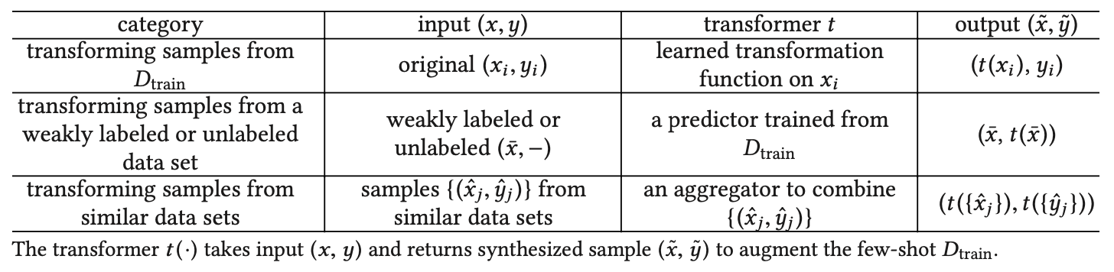
Few-Shot Learning (FSL)
Characteristics for FSL Methods Focusing on the Data Perspective
Source: Yaqing Wang, Quanming Yao, James T. Kwok, and Lionel M. Ni (2020). "Generalizing from a few examples: A survey on few-shot learning." ACM computing surveys (csur) 53, no. 3 (2020): 1-34.

Slide 97
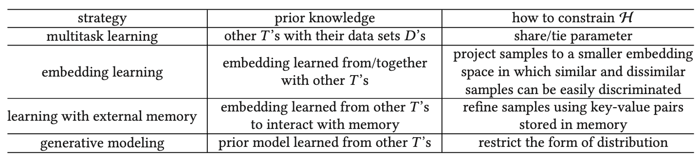
Few-Shot Learning (FSL)
Characteristics for FSL Methods Focusing on the Model Perspective
Source: Yaqing Wang, Quanming Yao, James T. Kwok, and Lionel M. Ni (2020). "Generalizing from a few examples: A survey on few-shot learning." ACM computing surveys (csur) 53, no. 3 (2020): 1-34.

Slide 98
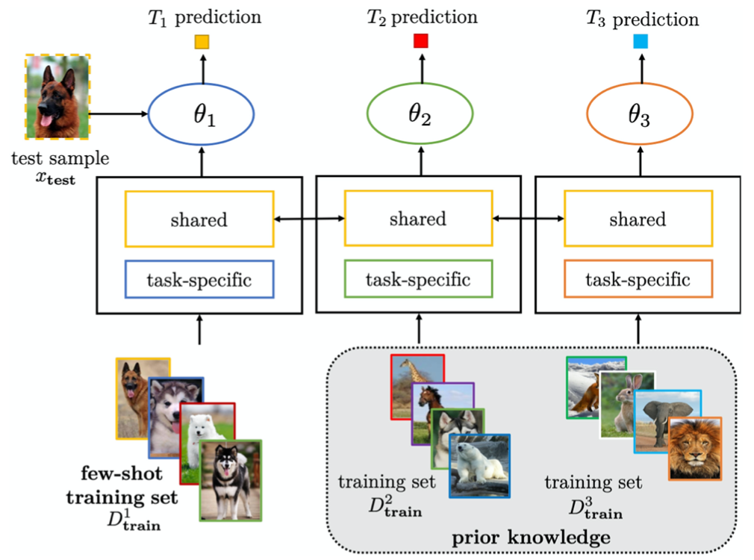
Few-Shot Learning (FSL)
Solving the FSL problem by multitask learning with parameter sharing
Source: Yaqing Wang, Quanming Yao, James T. Kwok, and Lionel M. Ni (2020). "Generalizing from a few examples: A survey on few-shot learning." ACM computing surveys (csur) 53, no. 3 (2020): 1-34.

Slide 99
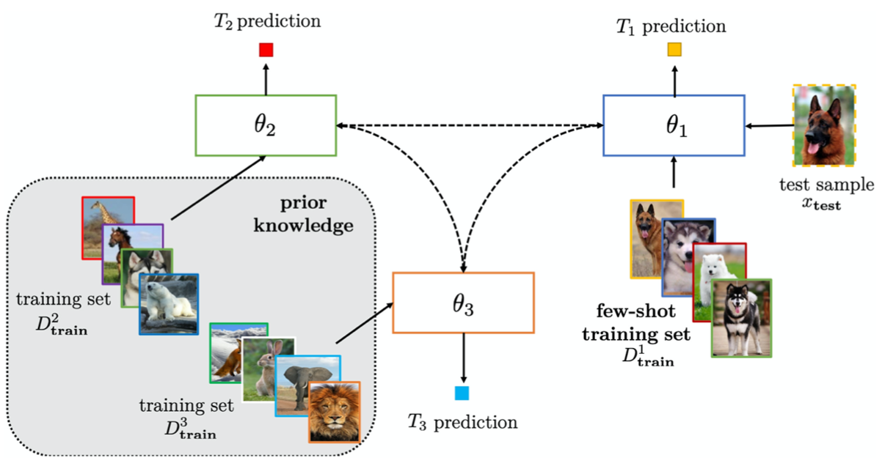
Few-Shot Learning (FSL)
Solving the FSL problem by multitask learning with parameter tying
Source: Yaqing Wang, Quanming Yao, James T. Kwok, and Lionel M. Ni (2020). "Generalizing from a few examples: A survey on few-shot learning." ACM computing surveys (csur) 53, no. 3 (2020): 1-34.

Slide 100
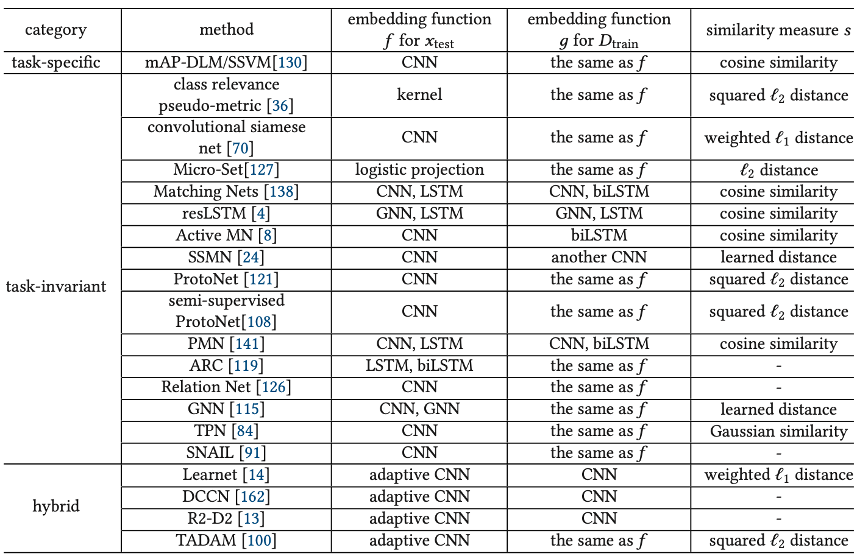
Few-Shot Learning (FSL)
Characteristics of Embedding Learning Methods
Source: Yaqing Wang, Quanming Yao, James T. Kwok, and Lionel M. Ni (2020). "Generalizing from a few examples: A survey on few-shot learning." ACM computing surveys (csur) 53, no. 3 (2020): 1-34.

Slide 101
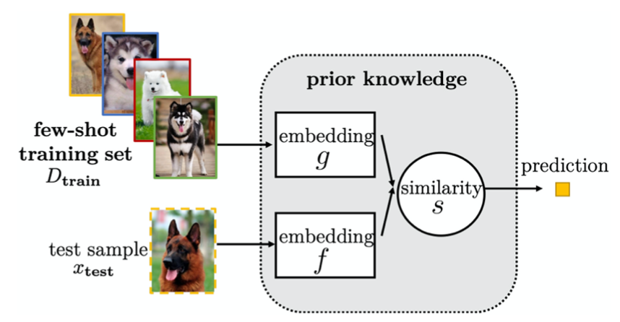
Few-Shot Learning (FSL)
Solving the FSL problem by task-invariant embedding model
Source: Yaqing Wang, Quanming Yao, James T. Kwok, and Lionel M. Ni (2020). "Generalizing from a few examples: A survey on few-shot learning." ACM computing surveys (csur) 53, no. 3 (2020): 1-34.

Slide 102

Few-Shot Learning (FSL)
Solving the FSL problem by hybrid embedding model
Source: Yaqing Wang, Quanming Yao, James T. Kwok, and Lionel M. Ni (2020). "Generalizing from a few examples: A survey on few-shot learning." ACM computing surveys (csur) 53, no. 3 (2020): 1-34.

Slide 103

Few-Shot Learning (FSL)
Solving the FSL problem by learning with external memory
Source: Yaqing Wang, Quanming Yao, James T. Kwok, and Lionel M. Ni (2020). "Generalizing from a few examples: A survey on few-shot learning." ACM computing surveys (csur) 53, no. 3 (2020): 1-34.

Slide 104

Few-Shot Learning (FSL)
Characteristics of FSL Methods
Based on Learning with External Memory
Source: Yaqing Wang, Quanming Yao, James T. Kwok, and Lionel M. Ni (2020). "Generalizing from a few examples: A survey on few-shot learning." ACM computing surveys (csur) 53, no. 3 (2020): 1-34.

Slide 105

Few-Shot Learning (FSL)
Solving the FSL problem by generative modeling
Source: Yaqing Wang, Quanming Yao, James T. Kwok, and Lionel M. Ni (2020). "Generalizing from a few examples: A survey on few-shot learning." ACM computing surveys (csur) 53, no. 3 (2020): 1-34.

Slide 106

Few-Shot Learning (FSL)
Solving the FSL problem by fine-tuning existing parameter θ₀ by regularization
Source: Yaqing Wang, Quanming Yao, James T. Kwok, and Lionel M. Ni (2020). "Generalizing from a few examples: A survey on few-shot learning." ACM computing surveys (csur) 53, no. 3 (2020): 1-34.

Slide 107

Few-Shot Learning (FSL)
Characteristics for FSL Methods
Focusing on the Algorithm Perspective
Source: Yaqing Wang, Quanming Yao, James T. Kwok, and Lionel M. Ni (2020). "Generalizing from a few examples: A survey on few-shot learning." ACM computing surveys (csur) 53, no. 3 (2020): 1-34.

Slide 108
Few-Shot Learning (FSL)
Solving the FSL problem by meta-learning
Source: Yaqing Wang, Quanming Yao, James T. Kwok, and Lionel M. Ni (2020). "Generalizing from a few examples: A survey on few-shot learning." ACM computing surveys (csur) 53, no. 3 (2020): 1-34.

Slide 109
Few-Shot Learning (FSL)
Meta-learning
Each task mimics the few-shot scenario, and can be completely non-overlapping.
Support sets are used to train; query sets are used to evaluate the model
Source: Yao Ge, Yuting Guo, Yuan-Chi Yang, Mohammed Ali Al-Garadi, and Abeed Sarker (2022). "Few-shot learning for medical text: A systematic review." arXiv preprint arXiv:2204.14081 (2022).

Slide 110

Few-Shot Learning (FSL)
Matching networks
Source: Yao Ge, Yuting Guo, Yuan-Chi Yang, Mohammed Ali Al-Garadi, and Abeed Sarker (2022). "Few-shot learning for medical text: A systematic review." arXiv preprint arXiv:2204.14081 (2022).

Slide 111

Few-Shot Learning (FSL)
Prototypical network
Source: Yao Ge, Yuting Guo, Yuan-Chi Yang, Mohammed Ali Al-Garadi, and Abeed Sarker (2022). "Few-shot learning for medical text: A systematic review." arXiv preprint arXiv:2204.14081 (2022).

Slide 112

Few-Shot Learning (FSL) for medical text
Source: Yao Ge, Yuting Guo, Yuan-Chi Yang, Mohammed Ali Al-Garadi, and Abeed Sarker (2022). "Few-shot learning for medical text: A systematic review." arXiv preprint arXiv:2204.14081 (2022).

Slide 113

Few-Shot Learning (FSL) for medical text
Source: Yao Ge, Yuting Guo, Yuan-Chi Yang, Mohammed Ali Al-Garadi, and Abeed Sarker (2022). "Few-shot learning for medical text: A systematic review." arXiv preprint arXiv:2204.14081 (2022).

Slide 114

Multimodal Few-Shot Learning with
Frozen Language Models
Curated samples with about five seeds required to get past well-known language model failure modes of either repeating text for the prompt or emitting text that does not pertain to the image.
These samples demonstrate the ability to generate open-ended outputs that adapt to both images and text, and to make use of facts that it has learned during language-only pre-training.
Source: Maria Tsimpoukelli, Jacob L. Menick, Serkan Cabi, S. M. Eslami, Oriol Vinyals, and Felix Hill (2021). "Multimodal few-shot learning with frozen language models."
Advances in Neural Information Processing Systems 34 (2021): 200-212.

Slide 115

Multimodal Few-Shot Learning with
Frozen Language Models
Gradients through a frozen language model’s self attention layers are used to train the vision encoder.
Source: Maria Tsimpoukelli, Jacob L. Menick, Serkan Cabi, S. M. Eslami, Oriol Vinyals, and Felix Hill (2021). "Multimodal few-shot learning with frozen language models."
Advances in Neural Information Processing Systems 34 (2021): 200-212.

Slide 116

Multimodal Few-Shot Learning with
Frozen Language Models
Inference-Time interface for Frozen. The figure demonstrates how we can support (a) visual question answering,
(b) outside-knowledge question answering and (c) few-shot image classification via in-context learning.
Source: Maria Tsimpoukelli, Jacob L. Menick, Serkan Cabi, S. M. Eslami, Oriol Vinyals, and Felix Hill (2021). "Multimodal few-shot learning with frozen language models."
Advances in Neural Information Processing Systems 34 (2021): 200-212.

Slide 117

Multimodal Few-Shot Learning with
Frozen Language Models
Examples of (a) the Open-Ended miniImageNet evaluation (b) the Fast VQA evaluation.
Source: Maria Tsimpoukelli, Jacob L. Menick, Serkan Cabi, S. M. Eslami, Oriol Vinyals, and Felix Hill (2021). "Multimodal few-shot learning with frozen language models."
Advances in Neural Information Processing Systems 34 (2021): 200-212.

Slide 118

GPT-3: Language Models are Few-Shot Learners
This work was funded by OpenAI.
All models were trained on V100 GPU’s on part of a high- bandwidth cluster provided by Microsoft.
Source: Tom Brown, Benjamin Mann, Nick Ryder, Melanie Subbiah, Jared D. Kaplan, Prafulla Dhariwal, Arvind Neelakantan et al. (2020) "Language models are few-shot learners." Advances in neural information processing systems 33 (2020): 1877-1901

Slide 119

GPT-3: Language Models are Few-Shot Learners
Source: Tom Brown, Benjamin Mann, Nick Ryder, Melanie Subbiah, Jared D. Kaplan, Prafulla Dhariwal, Arvind Neelakantan et al. (2020) "Language models are few-shot learners." Advances in neural information processing systems 33 (2020): 1877-1901

Slide 120

GPT-3: Language Models are Few-Shot Learners
Performance on SuperGLUE increases with model size.
A value of K = 32 means that our model was shown 32 examples per task, for 256 examples total divided across the 8 tasks in SuperGLUE.
Source: Tom Brown, Benjamin Mann, Nick Ryder, Melanie Subbiah, Jared D. Kaplan, Prafulla Dhariwal, Arvind Neelakantan et al. (2020) "Language models are few-shot learners." Advances in neural information processing systems 33 (2020): 1877-1901

Slide 121

GPT-3: Language Models are Few-Shot Learners
Source: Tom Brown, Benjamin Mann, Nick Ryder, Melanie Subbiah, Jared D. Kaplan, Prafulla Dhariwal, Arvind Neelakantan et al. (2020) "Language models are few-shot learners." Advances in neural information processing systems 33 (2020): 1877-1901

Slide 122

GPT-3: Language Models are Few-Shot Learners
Performance on cloze and completion tasks.
GPT-3 significantly improves SOTA on LAMBADA while achieving respectable performance on two difficult completion prediction datasets.
Source: Tom Brown, Benjamin Mann, Nick Ryder, Melanie Subbiah, Jared D. Kaplan, Prafulla Dhariwal, Arvind Neelakantan et al. (2020) "Language models are few-shot learners." Advances in neural information processing systems 33 (2020): 1877-1901

Slide 123

GPT-3: Language Models are Few-Shot Learners
Results on three Open-Domain QA tasks
GPT-3 is shown in the few-, one-, and zero-shot settings, as compared to prior SOTA results for closed book and open domain settings.
TriviaQA few-shot result is evaluated on the wiki split test server.
Source: Tom Brown, Benjamin Mann, Nick Ryder, Melanie Subbiah, Jared D. Kaplan, Prafulla Dhariwal, Arvind Neelakantan et al. (2020) "Language models are few-shot learners." Advances in neural information processing systems 33 (2020): 1877-1901

Slide 124

GPT-3: Language Models are Few-Shot Learners
GPT-3 results on a selection of QA / RC tasks.
CoQA and DROP are F1 while ARC reports accuracy.
See the appendix for additional experiments. a[KKS+20] b[KKS+20] c[JZC+19] d [JN20]
Source: Tom Brown, Benjamin Mann, Nick Ryder, Melanie Subbiah, Jared D. Kaplan, Prafulla Dhariwal, Arvind Neelakantan et al. (2020) "Language models are few-shot learners." Advances in neural information processing systems 33 (2020): 1877-1901

Slide 125

GPT-3: Language Models are Few-Shot Learners
Few-shot GPT-3 outperforms previous unsupervised NMT work by 5 BLEU when translating into English reflecting its strength as an English LM.
Source: Tom Brown, Benjamin Mann, Nick Ryder, Melanie Subbiah, Jared D. Kaplan, Prafulla Dhariwal, Arvind Neelakantan et al. (2020) "Language models are few-shot learners." Advances in neural information processing systems 33 (2020): 1877-1901

Slide 126

GPT-3: Language Models are Few-Shot Learners
Performance of GPT-3 on SuperGLUE
compared to fine-tuned baselines and SOTA
GPT-3 few-shot is given a total of 32 examples within the context of each task and performs no gradient updates.
Source: Tom Brown, Benjamin Mann, Nick Ryder, Melanie Subbiah, Jared D. Kaplan, Prafulla Dhariwal, Arvind Neelakantan et al. (2020) "Language models are few-shot learners." Advances in neural information processing systems 33 (2020): 1877-1901

Slide 127

GPT-3: Language Models are Few-Shot Learners
GPT-3 3B is almost 10x larger than RoBERTa-Large (355M params),
both models took roughly 50 petaflop/s-days of compute during pre-training
Source: Tom Brown, Benjamin Mann, Nick Ryder, Melanie Subbiah, Jared D. Kaplan, Prafulla Dhariwal, Arvind Neelakantan et al. (2020) "Language models are few-shot learners." Advances in neural information processing systems 33 (2020): 1877-1901

Slide 128

GPT-3: Language Models are Few-Shot Learners
Human accuracy in identifying
whether short (∼200 word) news articles are model generated
This table compares mean accuracy between five different models, and shows the results of a two-sample T-Test for the difference in mean accuracy between each model and the control model (an unconditional GPT-3 Small model with increased output randomness).
Source: Tom Brown, Benjamin Mann, Nick Ryder, Melanie Subbiah, Jared D. Kaplan, Prafulla Dhariwal, Arvind Neelakantan et al. (2020) "Language models are few-shot learners." Advances in neural information processing systems 33 (2020): 1877-1901

Slide 129

GPT-3: Language Models are Few-Shot Learners
The GPT-3 generated news article that humans had the greatest difficulty distinguishing from a human written article (accuracy: 12%)
Source: Tom Brown, Benjamin Mann, Nick Ryder, Melanie Subbiah, Jared D. Kaplan, Prafulla Dhariwal, Arvind Neelakantan et al. (2020) "Language models are few-shot learners." Advances in neural information processing systems 33 (2020): 1877-1901

Slide 130

Transformer (Attention is All You Need)
(Vaswani et al., 2017)
Source: Vaswani, Ashish, Noam Shazeer, Niki Parmar, Jakob Uszkoreit, Llion Jones, Aidan N. Gomez, Łukasz Kaiser, and Illia Polosukhin. "Attention is all you need." In Advances in neural information processing systems, pp. 5998-6008. 2017.

Slide 131
BERT: Pre-training of Deep Bidirectional Transformers for Language Understanding
BERT (Bidirectional Encoder Representations from Transformers)
Overall pre-training and fine-tuning procedures for BERT
Source: Devlin, Jacob, Ming-Wei Chang, Kenton Lee, and Kristina Toutanova (2018).
"Bert: Pre-training of deep bidirectional transformers for language understanding." arXiv preprint arXiv:1810.04805.

Slide 132
Transformer Models
Transformer
Encoder
Decoder
DistilBERT
BERT
T5
GPT
RoBERTa
BART
GPT-2
CTRL
XLM-R
XLM
M2M-100
GPT-3
ALBERT
BigBird
GPT-Neo
GPT-J
ELECTRA
DeBERTa
Source: Lewis Tunstall, Leandro von Werra, and Thomas Wolf (2022), Natural Language Processing with Transformers: Building Language Applications with Hugging Face, O'Reilly Media.

Slide 133

Machine Learning: Ensemble Learning
Random Forest
https://tinyurl.com/aintpupython101

Slide 134

Machine Learning: Supervised Learning
Classification and Prediction
https://tinyurl.com/aintpupython101

Slide 135

Aurélien Géron (2019),
Hands-On Machine Learning with Scikit-Learn, Keras, and TensorFlow: Concepts, Tools, and Techniques to Build Intelligent Systems, 2nd Edition
O’Reilly Media, 2019
https://github.com/ageron/handson-ml2
Source: https://www.amazon.com/Hands-Machine-Learning-Scikit-Learn-TensorFlow/dp/1492032646/

Slide 136

Hands-On Machine Learning with
Scikit-Learn, Keras, and TensorFlow
Notebooks
The Machine Learning landscape
End-to-end Machine Learning project
Classification
Training Models
Support Vector Machines
Decision Trees
Ensemble Learning and Random Forests
Dimensionality Reduction
Unsupervised Learning Techniques
Artificial Neural Nets with Keras
Training Deep Neural Networks
Custom Models and Training with TensorFlow
Loading and Preprocessing Data
Deep Computer Vision Using Convolutional Neural Networks
Processing Sequences Using RNNs and CNNs
Natural Language Processing with RNNs and Attention
Representation Learning Using Autoencoders
Reinforcement Learning
Training and Deploying TensorFlow Models at Scale
https://github.com/ageron/handson-ml2

Slide 137
Stuart Russell and Peter Norvig (2020),
Artificial Intelligence: A Modern Approach,
4th Edition, Pearson
Source: Stuart Russell and Peter Norvig (2020), Artificial Intelligence: A Modern Approach, 4th Edition, Pearson
https://www.amazon.com/Artificial-Intelligence-A-Modern-Approach/dp/0134610997/

Slide 138
Artificial Intelligence: A Modern Approach (AIMA)
Artificial Intelligence: A Modern Approach (AIMA)
  http://aima.cs.berkeley.edu/
AIMA Python
  http://aima.cs.berkeley.edu/python/readme.html
  https://github.com/aimacode/aima-python
Learning
  http://aima.cs.berkeley.edu/python/learning.html
Source: Stuart Russell and Peter Norvig (2020), Artificial Intelligence: A Modern Approach, 4th Edition, Pearson

Slide 139

Artificial Intelligence: A Modern Approach (AIMA)
http://aima.cs.berkeley.edu/

Slide 140

Papers with Code
State-of-the-Art (SOTA)
https://paperswithcode.com/sota

Slide 141
Summary
The Theory of Learning
  Computational Learning Theory
  Probably Approximately Correct (PAC) Learning
Ensemble Learning
  Bagging: Random forests
  Stacking
  Boosting: Gradient boosting
  Online learning
Meta Learning: Learning to Learn

Slide 142
References
Stuart Russell and Peter Norvig (2020), Artificial Intelligence: A Modern Approach, 4th Edition, Pearson.
Aurélien Géron (2019), Hands-On Machine Learning with Scikit-Learn, Keras, and TensorFlow: Concepts, Tools, and Techniques to Build Intelligent Systems, 2nd Edition, O’Reilly Media.
Steven D'Ascoli (2022), Artificial Intelligence and Deep Learning with Python: Every Line of Code Explained For Readers New to AI and New to Python, Independently published.
Nithin Buduma, Nikhil Buduma, Joe Papa (2022), Fundamentals of Deep Learning: Designing Next-Generation Machine Intelligence Algorithms, 2nd Edition, ‎O'Reilly Media.
Min-Yuh Day (2022), Python 101, https://tinyurl.com/aintpupython101

