Slide 1








Machine Learning:
Supervised and Unsupervised Learning
Artificial Intelligence
1111AI05
MBA, IM, NTPU (M6132) (Fall 2022)
Wed 2, 3, 4 (9:10-12:00) (B8F40)
Min-Yuh Day, Ph.D,
Associate Professor
Institute of Information Management, National Taipei University
https://web.ntpu.edu.tw/~myday
https://meet.google.com/miy-fbif-max
2022-10-19

Slide 2
Syllabus
Week Date Subject/Topics
1 2022/09/14 Introduction to Artificial Intelligence
2 2022/09/21 Artificial Intelligence and Intelligent Agents
3 2022/09/28 Problem Solving
4 2022/10/05 Knowledge, Reasoning and Knowledge Representation;
Uncertain Knowledge and Reasoning
5 2022/10/12 Case Study on Artificial Intelligence I
6 2022/10/19 Machine Learning: Supervised and Unsupervised Learning

Slide 3
Syllabus
Week Date Subject/Topics
7 2022/10/26 The Theory of Learning and Ensemble Learning
8 2022/11/02 Midterm Project Report
9 2022/11/09 Deep Learning and Reinforcement Learning
10 2022/11/16 Deep Learning for Natural Language Processing
11 2022/11/23 Invited Talk: AI for Information Retrieval
12 2022/11/30 Case Study on Artificial Intelligence II

Slide 4
Syllabus
Week Date Subject/Topics
13 2022/12/07 Computer Vision and Robotics
14 2022/12/14 Philosophy and Ethics of AI and the Future of AI
15 2022/12/21 Final Project Report I
16 2022/12/28 Final Project Report II
17 2023/01/04 Self-learning
18 2023/01/11 Self-learning

Slide 5
Machine Learning:
Supervised and
Unsupervised Learning

Slide 6
Outline
Machine Learning
Supervised Learning
Unsupervised Learning

Slide 7
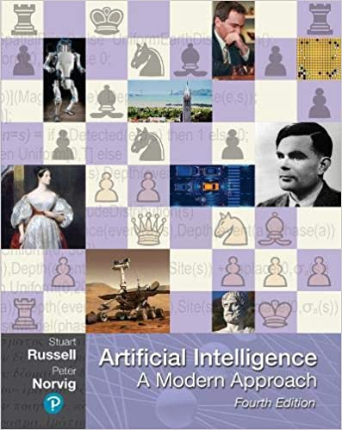
Stuart Russell and Peter Norvig (2020),
Artificial Intelligence: A Modern Approach,
4th Edition, Pearson
Source: Stuart Russell and Peter Norvig (2020), Artificial Intelligence: A Modern Approach, 4th Edition, Pearson
https://www.amazon.com/Artificial-Intelligence-A-Modern-Approach/dp/0134610997/

Slide 8
Artificial Intelligence:
A Modern Approach
Artificial Intelligence
Problem Solving
Knowledge and Reasoning
Uncertain Knowledge and Reasoning
Machine Learning
Communicating, Perceiving, and Acting
Philosophy and Ethics of AI
Source: Stuart Russell and Peter Norvig (2020), Artificial Intelligence: A Modern Approach, 4th Edition, Pearson

Slide 9
Artificial Intelligence:
Machine Learning
Source: Stuart Russell and Peter Norvig (2020), Artificial Intelligence: A Modern Approach, 4th Edition, Pearson

Slide 10
Artificial Intelligence:
5. Machine Learning
Learning from Examples
Learning Probabilistic Models
Deep Learning
Reinforcement Learning
Source: Stuart Russell and Peter Norvig (2020), Artificial Intelligence: A Modern Approach, 4th Edition, Pearson

Slide 11
Reinforcement Learning (DL)
Agent
Environment
Source: Richard S. Sutton & Andrew G. Barto (2018), Reinforcement Learning: An Introduction, 2nd Edition, A Bradford Book.

Slide 12
Reinforcement Learning (DL)
1
2
observation
Agent
action
3
reward
Environment
Source: Richard S. Sutton & Andrew G. Barto (2018), Reinforcement Learning: An Introduction, 2nd Edition, A Bradford Book.

Slide 13
Reinforcement Learning (DL)
1
2
observation
Agent
action
O_{t}
A_{t}
3
reward
R_{t}
Environment
Source: Richard S. Sutton & Andrew G. Barto (2018), Reinforcement Learning: An Introduction, 2nd Edition, A Bradford Book.

Slide 14
Agents interact with environments through sensors and actuators
Source: Stuart Russell and Peter Norvig (2020), Artificial Intelligence: A Modern Approach, 4th Edition, Pearson

Slide 15
Machine Learning
Supervised Learning (Classification)
Learning from Examples
y = f(x)
x
y

Slide 16
Machine Learning
Supervised Learning (Classification)
Learning from Examples
y = f(x)
x
y
input
Output
label

Slide 17
Iris flower data set
setosa
versicolor
virginica
Source: https://en.wikipedia.org/wiki/Iris_flower_data_set
Source: http://suruchifialoke.com/2016-10-13-machine-learning-tutorial-iris-classification/

Slide 18
Iris Classfication
Source: http://suruchifialoke.com/2016-10-13-machine-learning-tutorial-iris-classification/

Slide 19
iris.data
https://archive.ics.uci.edu/ml/machine-learning-databases/iris/iris.data
5.1,3.5,1.4,0.2,Iris-setosa 4.9,3.0,1.4,0.2,Iris-setosa 4.7,3.2,1.3,0.2,Iris-setosa 4.6,3.1,1.5,0.2,Iris-setosa 5.0,3.6,1.4,0.2,Iris-setosa 5.4,3.9,1.7,0.4,Iris-setosa 4.6,3.4,1.4,0.3,Iris-setosa 5.0,3.4,1.5,0.2,Iris-setosa 4.4,2.9,1.4,0.2,Iris-setosa 4.9,3.1,1.5,0.1,Iris-setosa 5.4,3.7,1.5,0.2,Iris-setosa 4.8,3.4,1.6,0.2,Iris-setosa 4.8,3.0,1.4,0.1,Iris-setosa 4.3,3.0,1.1,0.1,Iris-setosa 5.8,4.0,1.2,0.2,Iris-setosa 5.7,4.4,1.5,0.4,Iris-setosa 5.4,3.9,1.3,0.4,Iris-setosa 5.1,3.5,1.4,0.3,Iris-setosa 5.7,3.8,1.7,0.3,Iris-setosa 5.1,3.8,1.5,0.3,Iris-setosa 5.4,3.4,1.7,0.2,Iris-setosa 5.1,3.7,1.5,0.4,Iris-setosa 4.6,3.6,1.0,0.2,Iris-setosa 5.1,3.3,1.7,0.5,Iris-setosa 4.8,3.4,1.9,0.2,Iris-setosa 5.0,3.0,1.6,0.2,Iris-setosa 5.0,3.4,1.6,0.4,Iris-setosa 5.2,3.5,1.5,0.2,Iris-setosa 5.2,3.4,1.4,0.2,Iris-setosa 4.7,3.2,1.6,0.2,Iris-setosa 4.8,3.1,1.6,0.2,Iris-setosa 5.4,3.4,1.5,0.4,Iris-setosa 5.2,4.1,1.5,0.1,Iris-setosa 5.5,4.2,1.4,0.2,Iris-setosa 4.9,3.1,1.5,0.1,Iris-setosa 5.0,3.2,1.2,0.2,Iris-setosa 5.5,3.5,1.3,0.2,Iris-setosa 4.9,3.1,1.5,0.1,Iris-setosa 4.4,3.0,1.3,0.2,Iris-setosa 5.1,3.4,1.5,0.2,Iris-setosa 5.0,3.5,1.3,0.3,Iris-setosa 4.5,2.3,1.3,0.3,Iris-setosa 4.4,3.2,1.3,0.2,Iris-setosa 5.0,3.5,1.6,0.6,Iris-setosa 5.1,3.8,1.9,0.4,Iris-setosa 4.8,3.0,1.4,0.3,Iris-setosa 5.1,3.8,1.6,0.2,Iris-setosa 4.6,3.2,1.4,0.2,Iris-setosa 5.3,3.7,1.5,0.2,Iris-setosa 5.0,3.3,1.4,0.2,Iris-setosa 7.0,3.2,4.7,1.4,Iris-versicolor 6.4,3.2,4.5,1.5,Iris-versicolor 6.9,3.1,4.9,1.5,Iris-versicolor 5.5,2.3,4.0,1.3,Iris-versicolor 6.5,2.8,4.6,1.5,Iris-versicolor 5.7,2.8,4.5,1.3,Iris-versicolor 6.3,3.3,4.7,1.6,Iris-versicolor 4.9,2.4,3.3,1.0,Iris-versicolor 6.6,2.9,4.6,1.3,Iris-versicolor 5.2,2.7,3.9,1.4,Iris-versicolor 5.0,2.0,3.5,1.0,Iris-versicolor 5.9,3.0,4.2,1.5,Iris-versicolor 6.0,2.2,4.0,1.0,Iris-versicolor 6.1,2.9,4.7,1.4,Iris-versicolor 5.6,2.9,3.6,1.3,Iris-versicolor 6.7,3.1,4.4,1.4,Iris-versicolor 5.6,3.0,4.5,1.5,Iris-versicolor 5.8,2.7,4.1,1.0,Iris-versicolor 6.2,2.2,4.5,1.5,Iris-versicolor 5.6,2.5,3.9,1.1,Iris-versicolor 5.9,3.2,4.8,1.8,Iris-versicolor 6.1,2.8,4.0,1.3,Iris-versicolor 6.3,2.5,4.9,1.5,Iris-versicolor 6.1,2.8,4.7,1.2,Iris-versicolor 6.4,2.9,4.3,1.3,Iris-versicolor 6.6,3.0,4.4,1.4,Iris-versicolor 6.8,2.8,4.8,1.4,Iris-versicolor 6.7,3.0,5.0,1.7,Iris-versicolor 6.0,2.9,4.5,1.5,Iris-versicolor 5.7,2.6,3.5,1.0,Iris-versicolor 5.5,2.4,3.8,1.1,Iris-versicolor 5.5,2.4,3.7,1.0,Iris-versicolor 5.8,2.7,3.9,1.2,Iris-versicolor 6.0,2.7,5.1,1.6,Iris-versicolor 5.4,3.0,4.5,1.5,Iris-versicolor 6.0,3.4,4.5,1.6,Iris-versicolor 6.7,3.1,4.7,1.5,Iris-versicolor 6.3,2.3,4.4,1.3,Iris-versicolor 5.6,3.0,4.1,1.3,Iris-versicolor 5.5,2.5,4.0,1.3,Iris-versicolor 5.5,2.6,4.4,1.2,Iris-versicolor 6.1,3.0,4.6,1.4,Iris-versicolor 5.8,2.6,4.0,1.2,Iris-versicolor 5.0,2.3,3.3,1.0,Iris-versicolor 5.6,2.7,4.2,1.3,Iris-versicolor 5.7,3.0,4.2,1.2,Iris-versicolor 5.7,2.9,4.2,1.3,Iris-versicolor 6.2,2.9,4.3,1.3,Iris-versicolor 5.1,2.5,3.0,1.1,Iris-versicolor 5.7,2.8,4.1,1.3,Iris-versicolor 6.3,3.3,6.0,2.5,Iris-virginica 5.8,2.7,5.1,1.9,Iris-virginica 7.1,3.0,5.9,2.1,Iris-virginica 6.3,2.9,5.6,1.8,Iris-virginica 6.5,3.0,5.8,2.2,Iris-virginica 7.6,3.0,6.6,2.1,Iris-virginica 4.9,2.5,4.5,1.7,Iris-virginica 7.3,2.9,6.3,1.8,Iris-virginica 6.7,2.5,5.8,1.8,Iris-virginica 7.2,3.6,6.1,2.5,Iris-virginica 6.5,3.2,5.1,2.0,Iris-virginica 6.4,2.7,5.3,1.9,Iris-virginica 6.8,3.0,5.5,2.1,Iris-virginica 5.7,2.5,5.0,2.0,Iris-virginica 5.8,2.8,5.1,2.4,Iris-virginica 6.4,3.2,5.3,2.3,Iris-virginica 6.5,3.0,5.5,1.8,Iris-virginica 7.7,3.8,6.7,2.2,Iris-virginica 7.7,2.6,6.9,2.3,Iris-virginica 6.0,2.2,5.0,1.5,Iris-virginica 6.9,3.2,5.7,2.3,Iris-virginica 5.6,2.8,4.9,2.0,Iris-virginica 7.7,2.8,6.7,2.0,Iris-virginica 6.3,2.7,4.9,1.8,Iris-virginica 6.7,3.3,5.7,2.1,Iris-virginica 7.2,3.2,6.0,1.8,Iris-virginica 6.2,2.8,4.8,1.8,Iris-virginica 6.1,3.0,4.9,1.8,Iris-virginica 6.4,2.8,5.6,2.1,Iris-virginica 7.2,3.0,5.8,1.6,Iris-virginica 7.4,2.8,6.1,1.9,Iris-virginica 7.9,3.8,6.4,2.0,Iris-virginica 6.4,2.8,5.6,2.2,Iris-virginica 6.3,2.8,5.1,1.5,Iris-virginica 6.1,2.6,5.6,1.4,Iris-virginica 7.7,3.0,6.1,2.3,Iris-virginica 6.3,3.4,5.6,2.4,Iris-virginica 6.4,3.1,5.5,1.8,Iris-virginica 6.0,3.0,4.8,1.8,Iris-virginica 6.9,3.1,5.4,2.1,Iris-virginica 6.7,3.1,5.6,2.4,Iris-virginica 6.9,3.1,5.1,2.3,Iris-virginica 5.8,2.7,5.1,1.9,Iris-virginica 6.8,3.2,5.9,2.3,Iris-virginica 6.7,3.3,5.7,2.5,Iris-virginica 6.7,3.0,5.2,2.3,Iris-virginica 6.3,2.5,5.0,1.9,Iris-virginica 6.5,3.0,5.2,2.0,Iris-virginica 6.2,3.4,5.4,2.3,Iris-virginica 5.9,3.0,5.1,1.8,Iris-virginica
setosa
virginica
versicolor

Slide 20
Machine Learning
Supervised Learning (Classification)
Learning from Examples
y = f(x)
5.1,3.5,1.4,0.2,Iris-setosa 4.9,3.0,1.4,0.2,Iris-setosa 4.7,3.2,1.3,0.2,Iris-setosa 7.0,3.2,4.7,1.4,Iris-versicolor 6.4,3.2,4.5,1.5,Iris-versicolor 6.9,3.1,4.9,1.5,Iris-versicolor 6.3,3.3,6.0,2.5,Iris-virginica 5.8,2.7,5.1,1.9,Iris-virginica 7.1,3.0,5.9,2.1,Iris-virginica

Slide 21
Machine Learning
Supervised Learning (Classification)
Learning from Examples
y = f(x)
Example
5.1,3.5,1.4,0.2,Iris-setosa 4.9,3.0,1.4,0.2,Iris-setosa 4.7,3.2,1.3,0.2,Iris-setosa 7.0,3.2,4.7,1.4,Iris-versicolor 6.4,3.2,4.5,1.5,Iris-versicolor 6.9,3.1,4.9,1.5,Iris-versicolor 6.3,3.3,6.0,2.5,Iris-virginica 5.8,2.7,5.1,1.9,Iris-virginica 7.1,3.0,5.9,2.1,Iris-virginica

Slide 22
Machine Learning
Supervised Learning (Classification)
Learning from Examples
y = f(x)
Example
5.1,3.5,1.4,0.2,Iris-setosa 4.9,3.0,1.4,0.2,Iris-setosa 4.7,3.2,1.3,0.2,Iris-setosa 7.0,3.2,4.7,1.4,Iris-versicolor 6.4,3.2,4.5,1.5,Iris-versicolor 6.9,3.1,4.9,1.5,Iris-versicolor 6.3,3.3,6.0,2.5,Iris-virginica 5.8,2.7,5.1,1.9,Iris-virginica 7.1,3.0,5.9,2.1,Iris-virginica
y
x

Slide 23
Artificial Intelligence
Machine Learning & Deep Learning
Source: https://blogs.nvidia.com/blog/2016/07/29/whats-difference-artificial-intelligence-machine-learning-deep-learning-ai/

Slide 24
AI, ML, DL
Artificial Intelligence (AI)
Machine Learning (ML)
Supervised
Learning
Unsupervised Learning
Deep Learning (DL)
CNN
RNN LSTM GRU
GAN
Semi-supervised Learning
Reinforcement Learning
Source: https://leonardoaraujosantos.gitbooks.io/artificial-inteligence/content/deep_learning.html

Slide 25
3 Machine Learning Algorithms
Source: Enrico Galimberti, http://blogs.teradata.com/data-points/tree-machine-learning-algorithms/

Slide 26
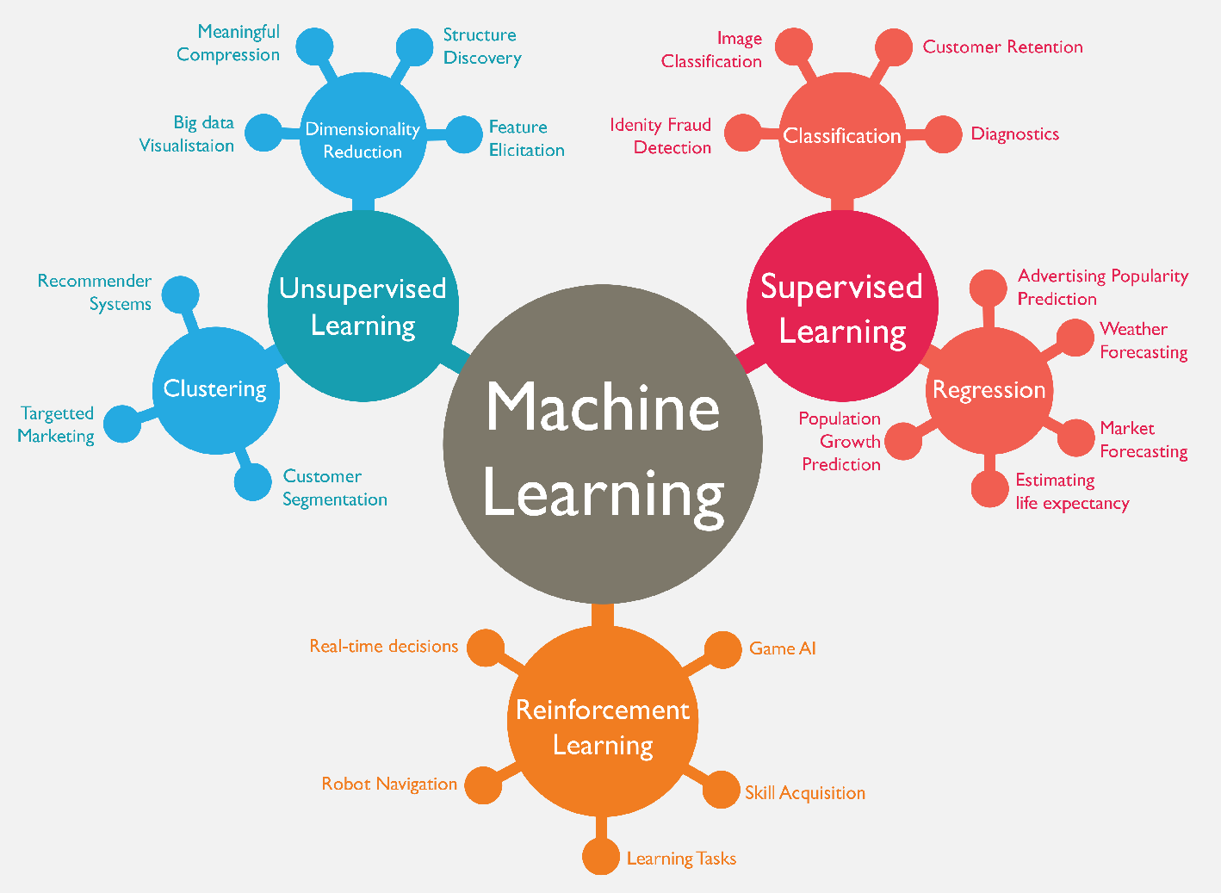
Machine Learning (ML)
Source: https://www.mactores.com/services/aws-big-data-machine-learning-cognitive-services/

Slide 27
Machine Learning (ML) / Deep Learning (DL)
Decision Tree Classifiers
Support Vector Machine (SVM)
Supervised Learning
Neural Network (NN)
Linear Classifiers
Deep Learning (DL)
Machine Learning
(ML)
Rule-based Classifiers
Naïve Bayes
(NB)
Unsupervised Learning
Probabilistic Classifiers
Bayesian Network (BN)
Maximum Entropy (ME)
Reinforcement Learning
Source: Jesus Serrano-Guerrero, Jose A. Olivas, Francisco P. Romero, and Enrique Herrera-Viedma (2015),
"Sentiment analysis: A review and comparative analysis of web services," Information Sciences, 311, pp. 18-38.

Slide 28
Machine Learning Models
Deep Learning
Kernel
Association rules
Ensemble
Decision tree
Dimensionality reduction
Clustering
Regression Analysis
Bayesian
Instance based
Source: Sunila Gollapudi (2016), Practical Machine Learning, Packt Publishing

Slide 29
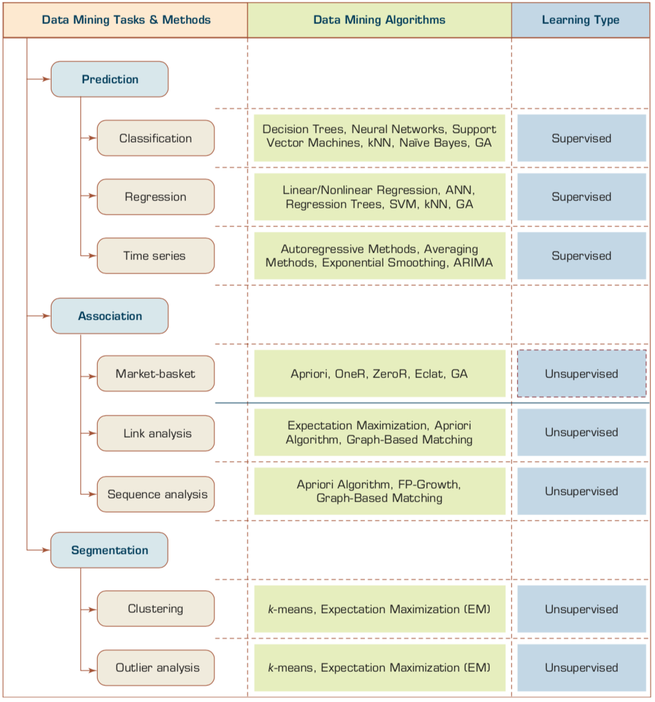
Machine Learning: Data Mining Tasks & Methods
Source: Ramesh Sharda, Dursun Delen, and Efraim Turban (2017), Business Intelligence, Analytics, and Data Science: A Managerial Perspective, 4th Edition, Pearson

Slide 30
Data Mining Methods
Supervised Learning
  Classification
    Class Label Prediction
  Regression
    Numeric Value Prediction
Unsupervised Learning
  Clustering
  Association
Source: Ramesh Sharda, Dursun Delen, and Efraim Turban (2017), Business Intelligence, Analytics, and Data Science: A Managerial Perspective, 4th Edition, Pearson

Slide 31
Scikit-Learn
Machine Learning in Python

Slide 32
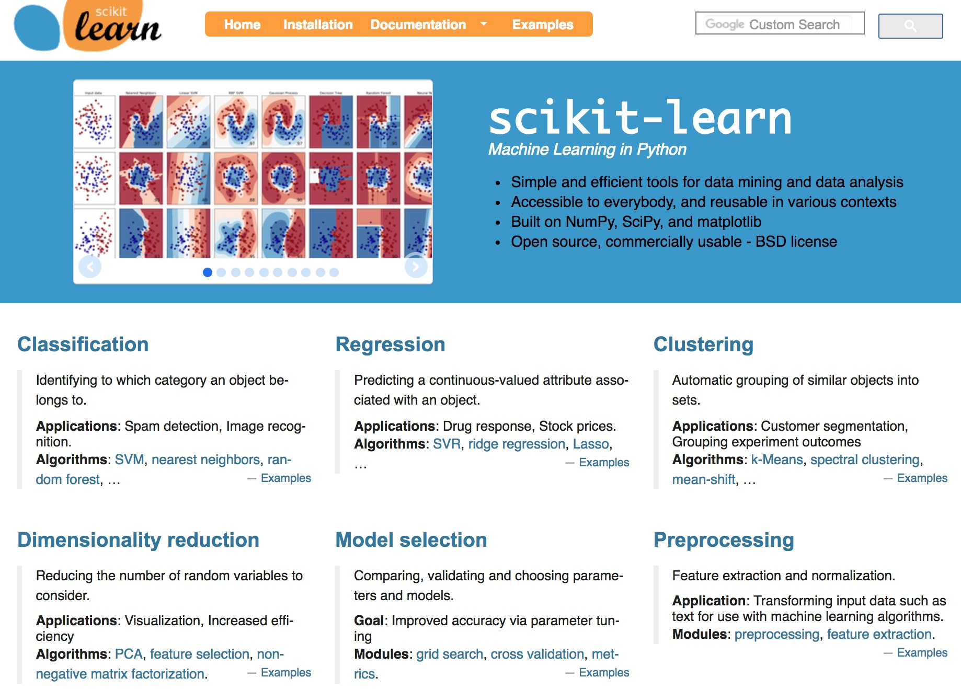
Scikit-Learn
Source: http://scikit-learn.org/

Slide 33
Scikit-Learn Machine Learning Map
Source: http://scikit-learn.org/stable/tutorial/machine_learning_map/index.html

Slide 34
Scikit-Learn Machine Learning Map
Source: http://scikit-learn.org/stable/tutorial/machine_learning_map/index.html

Slide 35
Scikit-Learn Machine Learning Map
Source: http://scikit-learn.org/stable/tutorial/machine_learning_map/index.html

Slide 36
Scikit-Learn Machine Learning Map
Source: http://scikit-learn.org/stable/tutorial/machine_learning_map/index.html

Slide 37
Iris flower data set
setosa
versicolor
virginica
Source: https://en.wikipedia.org/wiki/Iris_flower_data_set
Source: http://suruchifialoke.com/2016-10-13-machine-learning-tutorial-iris-classification/

Slide 38
Iris Classfication
Source: http://suruchifialoke.com/2016-10-13-machine-learning-tutorial-iris-classification/

Slide 39
iris.data
https://archive.ics.uci.edu/ml/machine-learning-databases/iris/iris.data
5.1,3.5,1.4,0.2,Iris-setosa 4.9,3.0,1.4,0.2,Iris-setosa 4.7,3.2,1.3,0.2,Iris-setosa 4.6,3.1,1.5,0.2,Iris-setosa 5.0,3.6,1.4,0.2,Iris-setosa 5.4,3.9,1.7,0.4,Iris-setosa 4.6,3.4,1.4,0.3,Iris-setosa 5.0,3.4,1.5,0.2,Iris-setosa 4.4,2.9,1.4,0.2,Iris-setosa 4.9,3.1,1.5,0.1,Iris-setosa 5.4,3.7,1.5,0.2,Iris-setosa 4.8,3.4,1.6,0.2,Iris-setosa 4.8,3.0,1.4,0.1,Iris-setosa 4.3,3.0,1.1,0.1,Iris-setosa 5.8,4.0,1.2,0.2,Iris-setosa 5.7,4.4,1.5,0.4,Iris-setosa 5.4,3.9,1.3,0.4,Iris-setosa 5.1,3.5,1.4,0.3,Iris-setosa 5.7,3.8,1.7,0.3,Iris-setosa 5.1,3.8,1.5,0.3,Iris-setosa 5.4,3.4,1.7,0.2,Iris-setosa 5.1,3.7,1.5,0.4,Iris-setosa 4.6,3.6,1.0,0.2,Iris-setosa 5.1,3.3,1.7,0.5,Iris-setosa 4.8,3.4,1.9,0.2,Iris-setosa 5.0,3.0,1.6,0.2,Iris-setosa 5.0,3.4,1.6,0.4,Iris-setosa 5.2,3.5,1.5,0.2,Iris-setosa 5.2,3.4,1.4,0.2,Iris-setosa 4.7,3.2,1.6,0.2,Iris-setosa 4.8,3.1,1.6,0.2,Iris-setosa 5.4,3.4,1.5,0.4,Iris-setosa 5.2,4.1,1.5,0.1,Iris-setosa 5.5,4.2,1.4,0.2,Iris-setosa 4.9,3.1,1.5,0.1,Iris-setosa 5.0,3.2,1.2,0.2,Iris-setosa 5.5,3.5,1.3,0.2,Iris-setosa 4.9,3.1,1.5,0.1,Iris-setosa 4.4,3.0,1.3,0.2,Iris-setosa 5.1,3.4,1.5,0.2,Iris-setosa 5.0,3.5,1.3,0.3,Iris-setosa 4.5,2.3,1.3,0.3,Iris-setosa 4.4,3.2,1.3,0.2,Iris-setosa 5.0,3.5,1.6,0.6,Iris-setosa 5.1,3.8,1.9,0.4,Iris-setosa 4.8,3.0,1.4,0.3,Iris-setosa 5.1,3.8,1.6,0.2,Iris-setosa 4.6,3.2,1.4,0.2,Iris-setosa 5.3,3.7,1.5,0.2,Iris-setosa 5.0,3.3,1.4,0.2,Iris-setosa 7.0,3.2,4.7,1.4,Iris-versicolor 6.4,3.2,4.5,1.5,Iris-versicolor 6.9,3.1,4.9,1.5,Iris-versicolor 5.5,2.3,4.0,1.3,Iris-versicolor 6.5,2.8,4.6,1.5,Iris-versicolor 5.7,2.8,4.5,1.3,Iris-versicolor 6.3,3.3,4.7,1.6,Iris-versicolor 4.9,2.4,3.3,1.0,Iris-versicolor 6.6,2.9,4.6,1.3,Iris-versicolor 5.2,2.7,3.9,1.4,Iris-versicolor 5.0,2.0,3.5,1.0,Iris-versicolor 5.9,3.0,4.2,1.5,Iris-versicolor 6.0,2.2,4.0,1.0,Iris-versicolor 6.1,2.9,4.7,1.4,Iris-versicolor 5.6,2.9,3.6,1.3,Iris-versicolor 6.7,3.1,4.4,1.4,Iris-versicolor 5.6,3.0,4.5,1.5,Iris-versicolor 5.8,2.7,4.1,1.0,Iris-versicolor 6.2,2.2,4.5,1.5,Iris-versicolor 5.6,2.5,3.9,1.1,Iris-versicolor 5.9,3.2,4.8,1.8,Iris-versicolor 6.1,2.8,4.0,1.3,Iris-versicolor 6.3,2.5,4.9,1.5,Iris-versicolor 6.1,2.8,4.7,1.2,Iris-versicolor 6.4,2.9,4.3,1.3,Iris-versicolor 6.6,3.0,4.4,1.4,Iris-versicolor 6.8,2.8,4.8,1.4,Iris-versicolor 6.7,3.0,5.0,1.7,Iris-versicolor 6.0,2.9,4.5,1.5,Iris-versicolor 5.7,2.6,3.5,1.0,Iris-versicolor 5.5,2.4,3.8,1.1,Iris-versicolor 5.5,2.4,3.7,1.0,Iris-versicolor 5.8,2.7,3.9,1.2,Iris-versicolor 6.0,2.7,5.1,1.6,Iris-versicolor 5.4,3.0,4.5,1.5,Iris-versicolor 6.0,3.4,4.5,1.6,Iris-versicolor 6.7,3.1,4.7,1.5,Iris-versicolor 6.3,2.3,4.4,1.3,Iris-versicolor 5.6,3.0,4.1,1.3,Iris-versicolor 5.5,2.5,4.0,1.3,Iris-versicolor 5.5,2.6,4.4,1.2,Iris-versicolor 6.1,3.0,4.6,1.4,Iris-versicolor 5.8,2.6,4.0,1.2,Iris-versicolor 5.0,2.3,3.3,1.0,Iris-versicolor 5.6,2.7,4.2,1.3,Iris-versicolor 5.7,3.0,4.2,1.2,Iris-versicolor 5.7,2.9,4.2,1.3,Iris-versicolor 6.2,2.9,4.3,1.3,Iris-versicolor 5.1,2.5,3.0,1.1,Iris-versicolor 5.7,2.8,4.1,1.3,Iris-versicolor 6.3,3.3,6.0,2.5,Iris-virginica 5.8,2.7,5.1,1.9,Iris-virginica 7.1,3.0,5.9,2.1,Iris-virginica 6.3,2.9,5.6,1.8,Iris-virginica 6.5,3.0,5.8,2.2,Iris-virginica 7.6,3.0,6.6,2.1,Iris-virginica 4.9,2.5,4.5,1.7,Iris-virginica 7.3,2.9,6.3,1.8,Iris-virginica 6.7,2.5,5.8,1.8,Iris-virginica 7.2,3.6,6.1,2.5,Iris-virginica 6.5,3.2,5.1,2.0,Iris-virginica 6.4,2.7,5.3,1.9,Iris-virginica 6.8,3.0,5.5,2.1,Iris-virginica 5.7,2.5,5.0,2.0,Iris-virginica 5.8,2.8,5.1,2.4,Iris-virginica 6.4,3.2,5.3,2.3,Iris-virginica 6.5,3.0,5.5,1.8,Iris-virginica 7.7,3.8,6.7,2.2,Iris-virginica 7.7,2.6,6.9,2.3,Iris-virginica 6.0,2.2,5.0,1.5,Iris-virginica 6.9,3.2,5.7,2.3,Iris-virginica 5.6,2.8,4.9,2.0,Iris-virginica 7.7,2.8,6.7,2.0,Iris-virginica 6.3,2.7,4.9,1.8,Iris-virginica 6.7,3.3,5.7,2.1,Iris-virginica 7.2,3.2,6.0,1.8,Iris-virginica 6.2,2.8,4.8,1.8,Iris-virginica 6.1,3.0,4.9,1.8,Iris-virginica 6.4,2.8,5.6,2.1,Iris-virginica 7.2,3.0,5.8,1.6,Iris-virginica 7.4,2.8,6.1,1.9,Iris-virginica 7.9,3.8,6.4,2.0,Iris-virginica 6.4,2.8,5.6,2.2,Iris-virginica 6.3,2.8,5.1,1.5,Iris-virginica 6.1,2.6,5.6,1.4,Iris-virginica 7.7,3.0,6.1,2.3,Iris-virginica 6.3,3.4,5.6,2.4,Iris-virginica 6.4,3.1,5.5,1.8,Iris-virginica 6.0,3.0,4.8,1.8,Iris-virginica 6.9,3.1,5.4,2.1,Iris-virginica 6.7,3.1,5.6,2.4,Iris-virginica 6.9,3.1,5.1,2.3,Iris-virginica 5.8,2.7,5.1,1.9,Iris-virginica 6.8,3.2,5.9,2.3,Iris-virginica 6.7,3.3,5.7,2.5,Iris-virginica 6.7,3.0,5.2,2.3,Iris-virginica 6.3,2.5,5.0,1.9,Iris-virginica 6.5,3.0,5.2,2.0,Iris-virginica 6.2,3.4,5.4,2.3,Iris-virginica 5.9,3.0,5.1,1.8,Iris-virginica
setosa
virginica
versicolor

Slide 40
Machine Learning
Supervised Learning (Classification)
Learning from Examples
5.1,3.5,1.4,0.2,Iris-setosa 4.9,3.0,1.4,0.2,Iris-setosa 4.7,3.2,1.3,0.2,Iris-setosa 7.0,3.2,4.7,1.4,Iris-versicolor 6.4,3.2,4.5,1.5,Iris-versicolor 6.9,3.1,4.9,1.5,Iris-versicolor 6.3,3.3,6.0,2.5,Iris-virginica 5.8,2.7,5.1,1.9,Iris-virginica 7.1,3.0,5.9,2.1,Iris-virginica

Slide 41
Machine Learning
Supervised Learning (Classification)
Learning from Examples
y = f(x)
5.1,3.5,1.4,0.2,Iris-setosa 4.9,3.0,1.4,0.2,Iris-setosa 4.7,3.2,1.3,0.2,Iris-setosa 7.0,3.2,4.7,1.4,Iris-versicolor 6.4,3.2,4.5,1.5,Iris-versicolor 6.9,3.1,4.9,1.5,Iris-versicolor 6.3,3.3,6.0,2.5,Iris-virginica 5.8,2.7,5.1,1.9,Iris-virginica 7.1,3.0,5.9,2.1,Iris-virginica
y
x

Slide 42
Machine Learning
Supervised Learning (Classification)
Learning from Examples
y = f(x)
x
y

Slide 43
Iris Data Visualization
Source: https://seaborn.pydata.org/generated/seaborn.pairplot.html

Slide 44
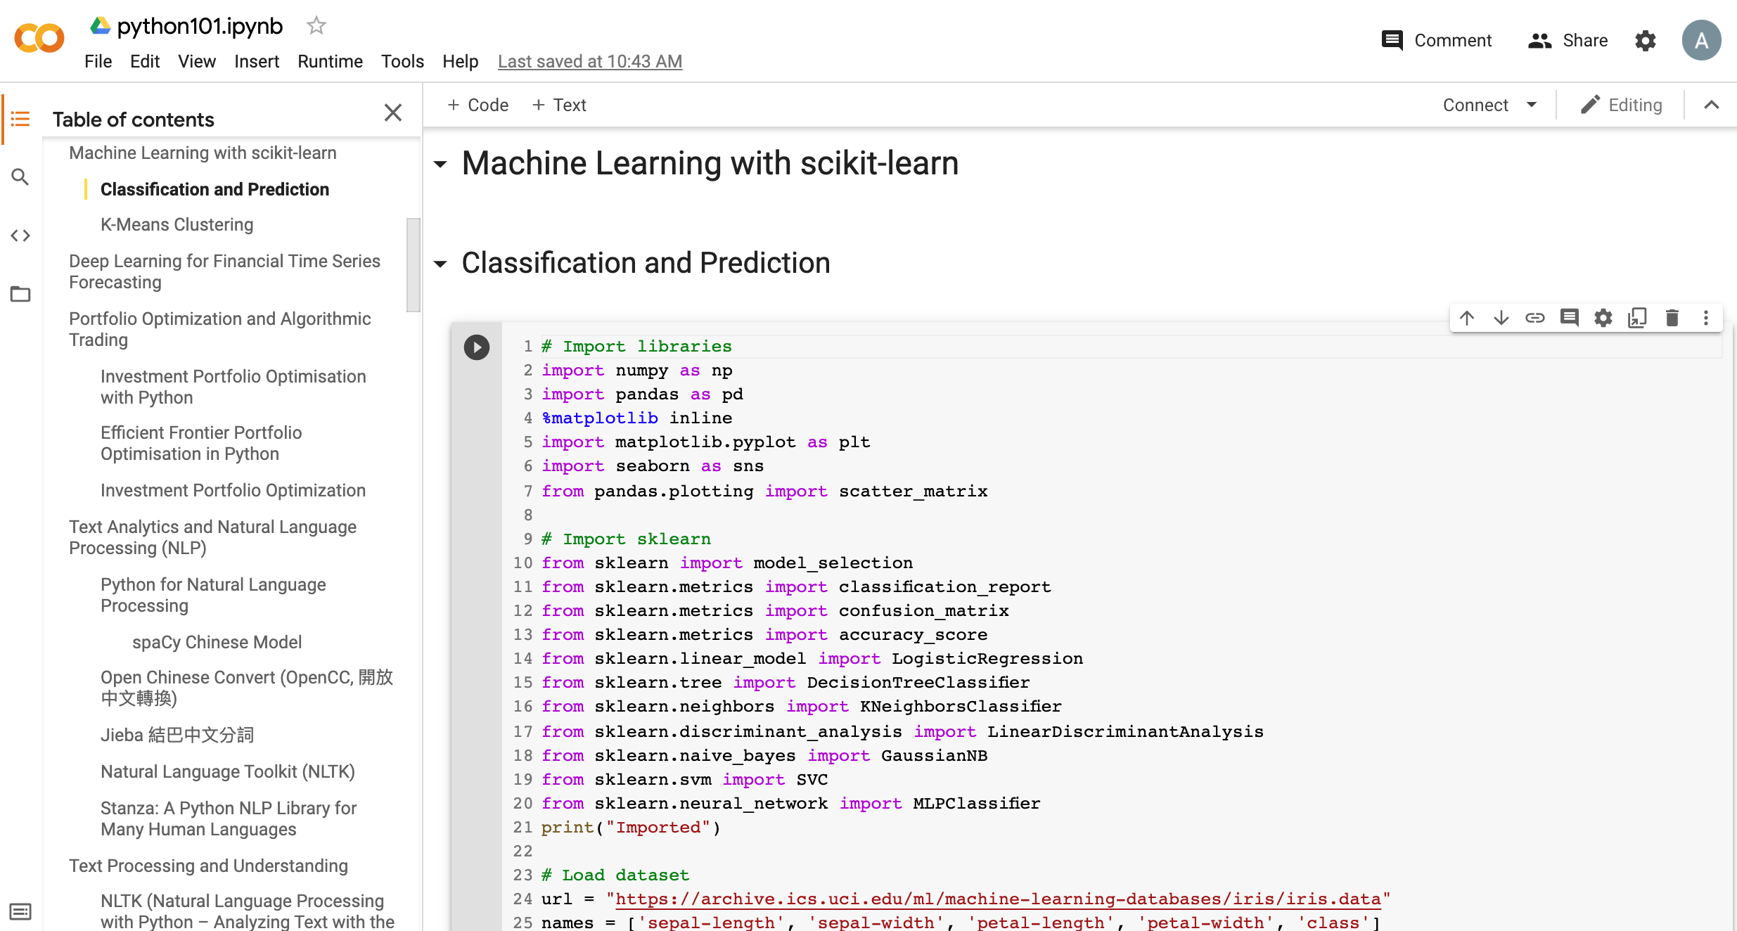
Python in Google Colab (Python101)
https://colab.research.google.com/drive/1FEG6DnGvwfUbeo4zJ1zTunjMqf2RkCrT
https://tinyurl.com/aintpupython101

Slide 45
import seaborn as sns
sns.set(style="ticks", color_codes=True)
iris = sns.load_dataset("iris")
g = sns.pairplot(iris, hue="species")
Source: https://seaborn.pydata.org/generated/seaborn.pairplot.html

Slide 46
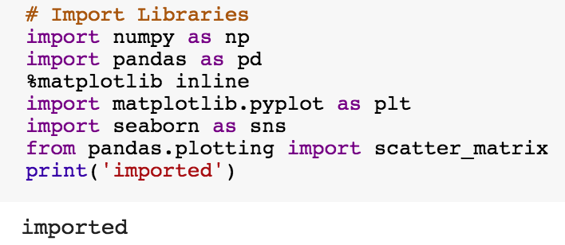
import numpy as np
import pandas as pd
%matplotlib inline
import matplotlib.pyplot as plt
import seaborn as sns
from pandas.plotting import scatter_matrix

Slide 47
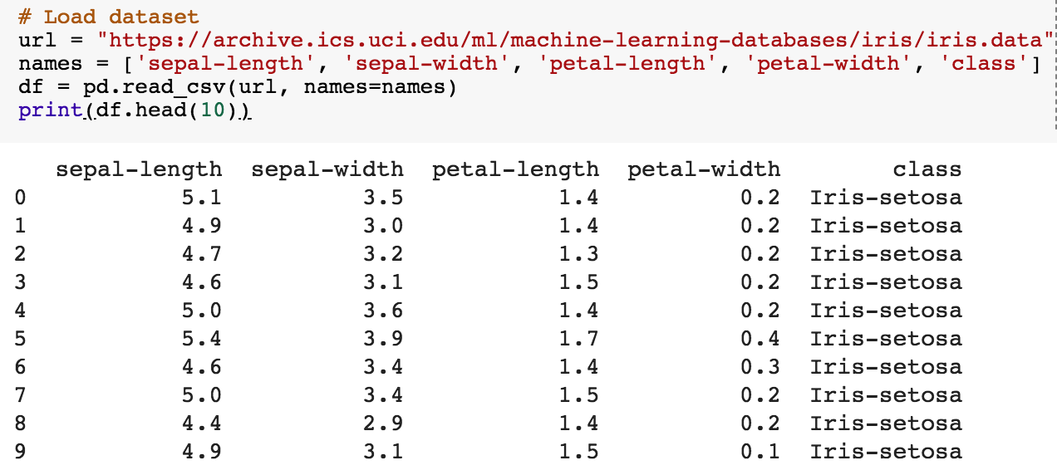
url = "https://archive.ics.uci.edu/ml/machine-learning-databases/iris/iris.data"
names = ['sepal-length', 'sepal-width', 'petal-length', 'petal-width', 'class']
df = pd.read_csv(url, names=names)
print(df.head(10))

Slide 48
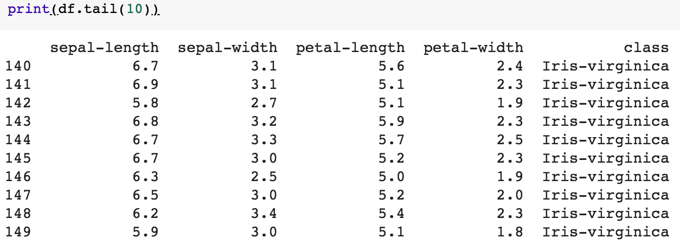
df.tail(10)

Slide 49
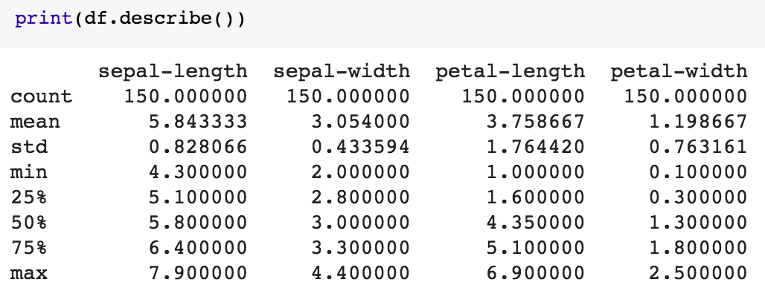
df.describe()

Slide 50
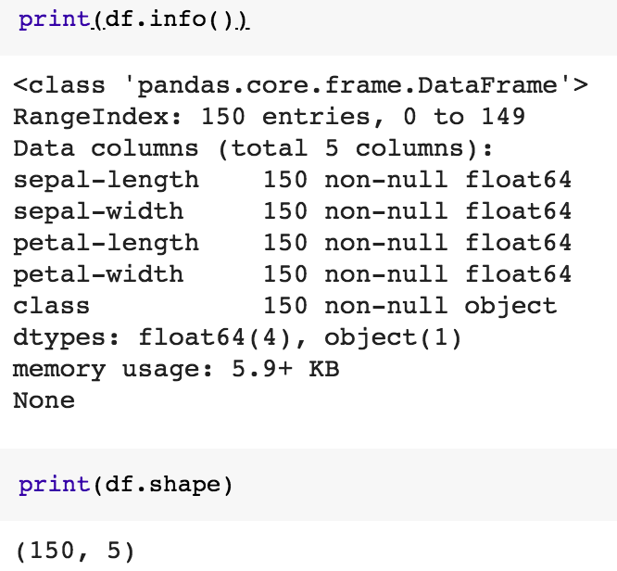
print(df.info())
print(df.shape)

Slide 51
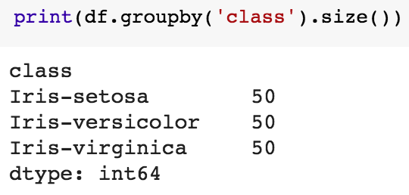
df.groupby('class').size()

Slide 52
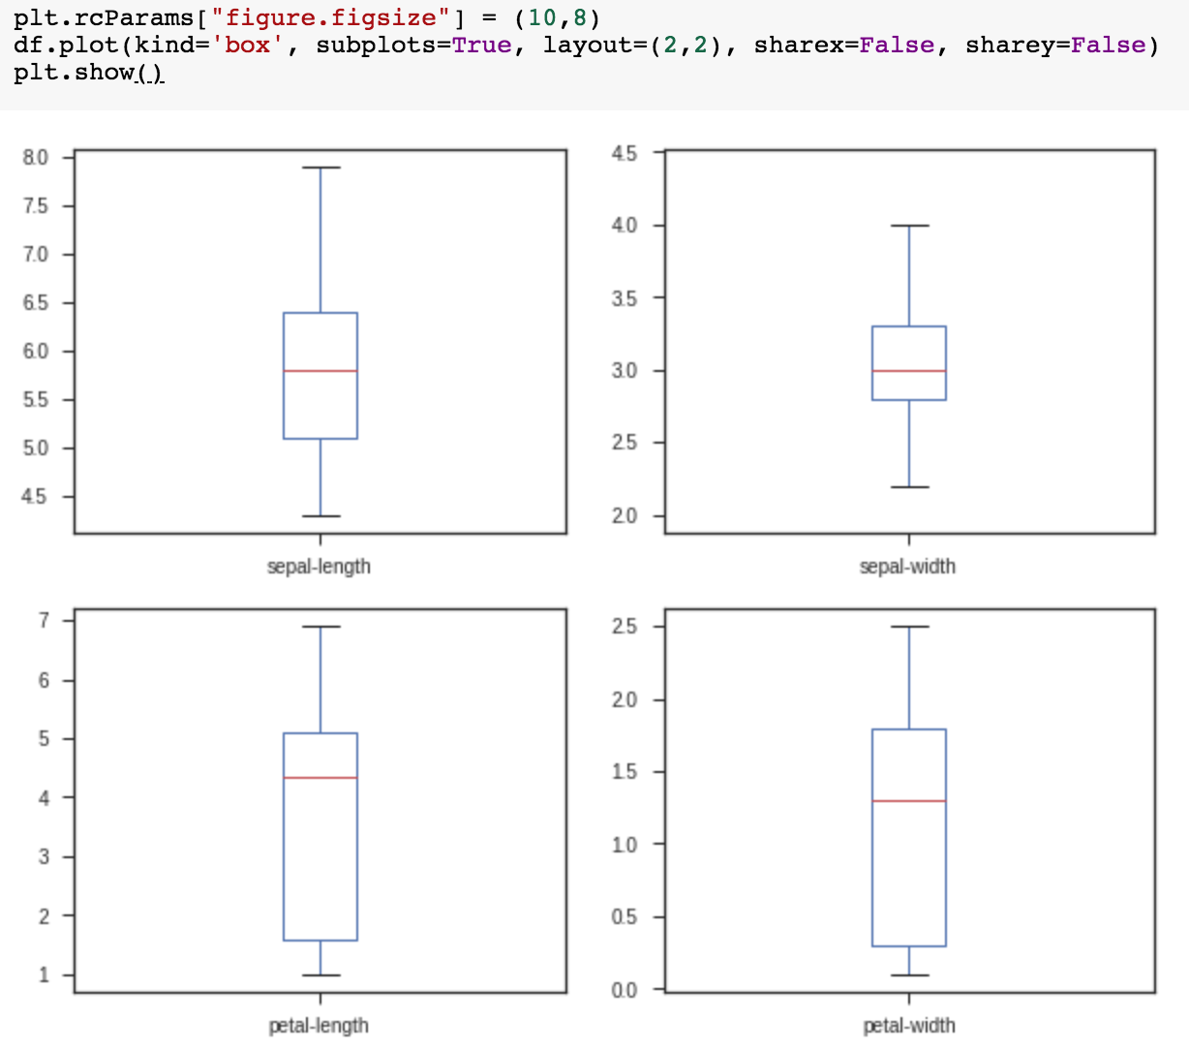
plt.rcParams["figure.figsize"] = (10,8)
df.plot(kind='box', subplots=True, layout=(2,2), sharex=False, sharey=False)
plt.show()

Slide 53
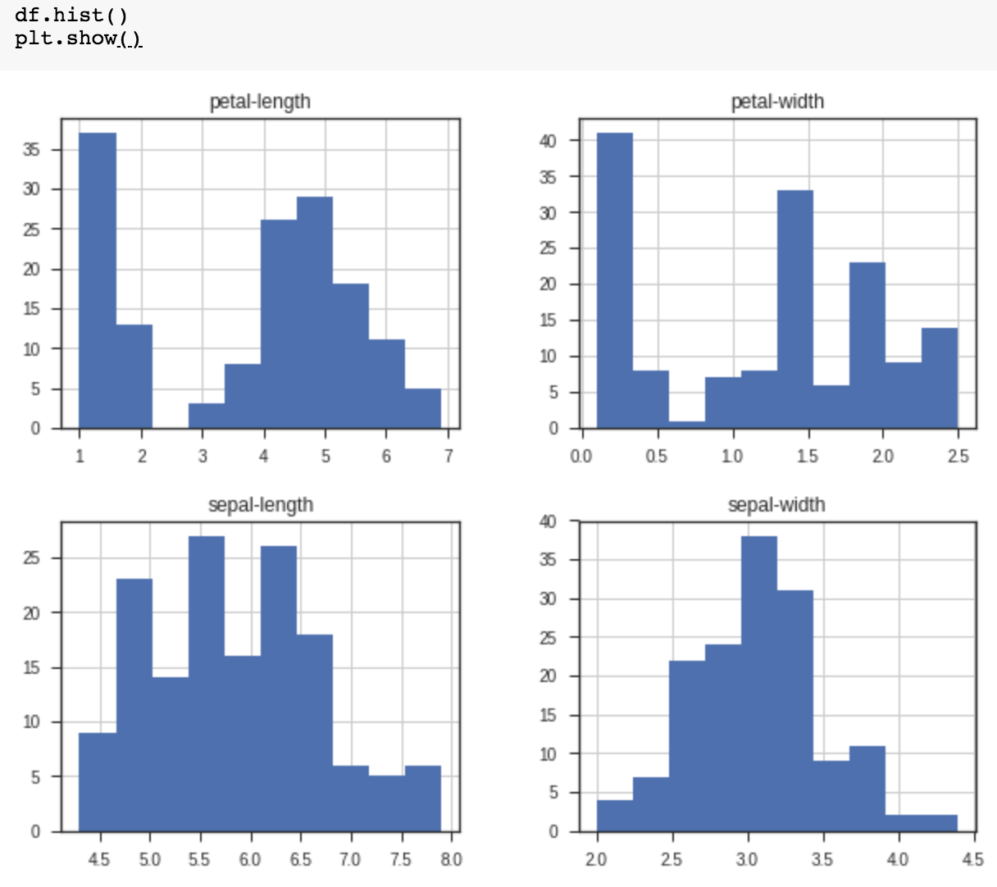
df.hist()
plt.show()

Slide 54
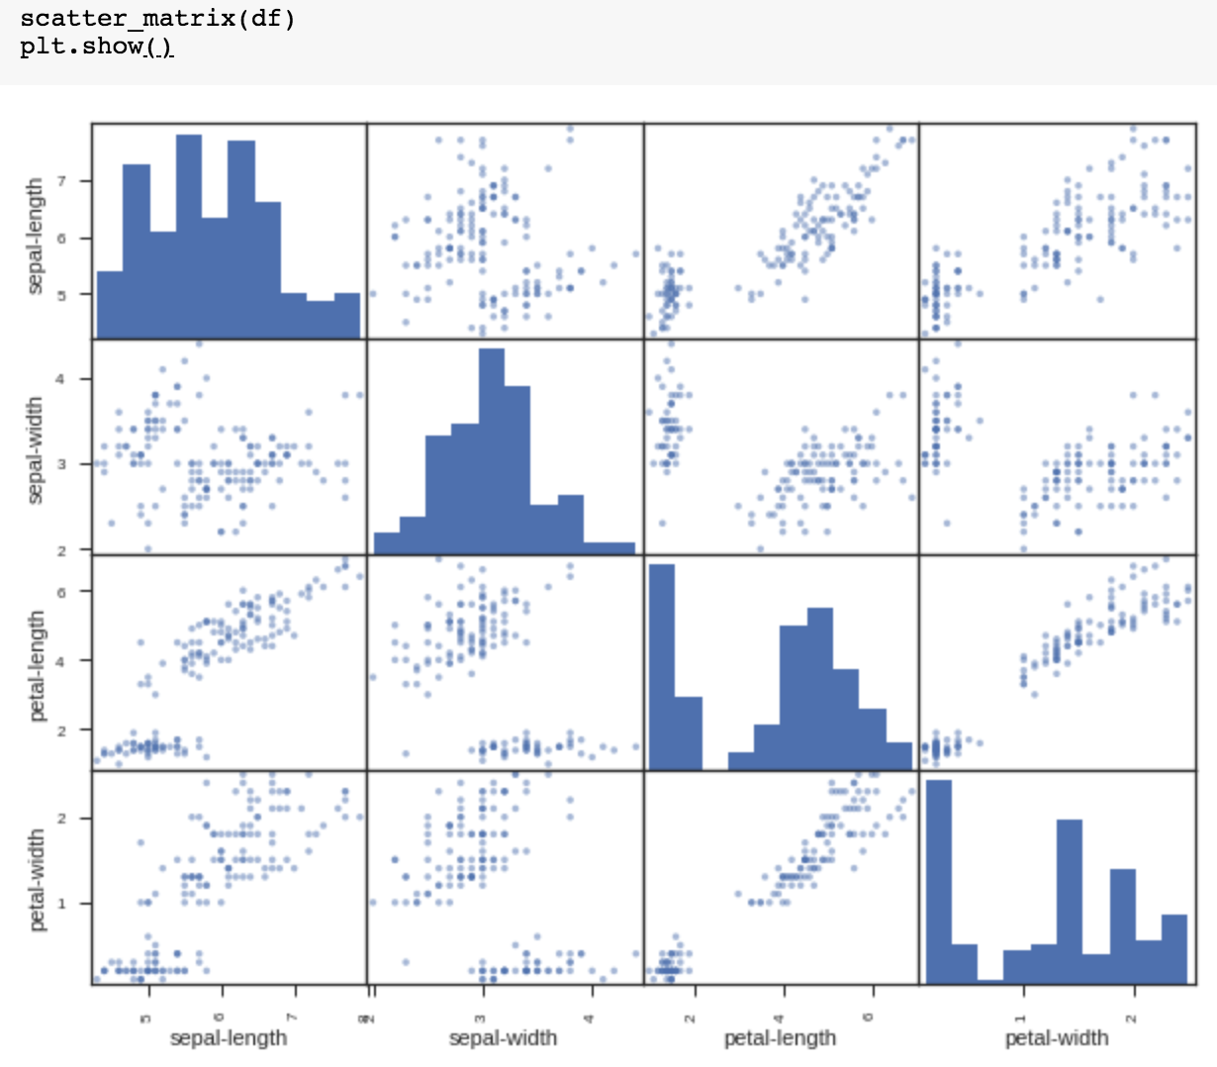
scatter_matrix(df)
plt.show()

Slide 55
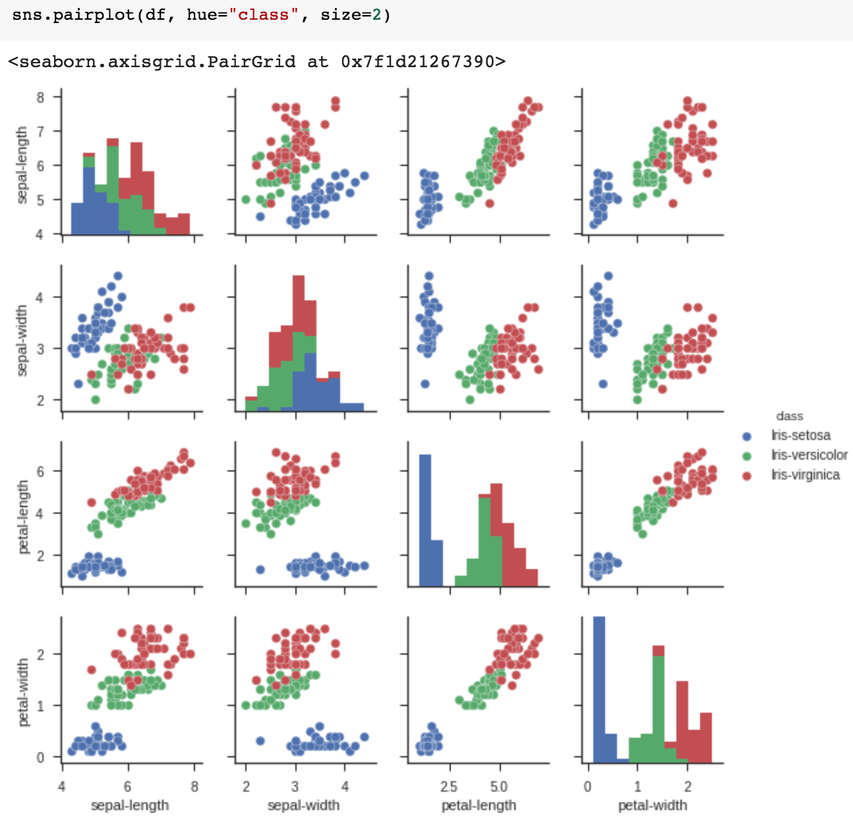
sns.pairplot(df, hue="class", size=2)

Slide 56
Machine Learning:
Supervised Learning:
Classification and
Prediction

Slide 57
Machine Learning: Data Mining Tasks & Methods
Prediction
Classification
Supervised Learning:
Classification
and
Prediction
Source: Ramesh Sharda, Dursun Delen, and Efraim Turban (2017), Business Intelligence, Analytics, and Data Science: A Managerial Perspective, 4th Edition, Pearson

Slide 58
Machine Learning: Supervised Learning
Classification and Prediction
https://tinyurl.com/aintpupython101

Slide 59
# Import sklearn
from sklearn import model_selection
from sklearn.metrics import classification_report
from sklearn.metrics import confusion_matrix
from sklearn.metrics import accuracy_score
from sklearn.linear_model import LogisticRegression
from sklearn.tree import DecisionTreeClassifier
from sklearn.neighbors import KNeighborsClassifier
from sklearn.discriminant_analysis import LinearDiscriminantAnalysis
from sklearn.naive_bayes import GaussianNB
from sklearn.svm import SVC
from sklearn.neural_network import MLPClassifier
print("Imported")
https://tinyurl.com/aintpupython101

Slide 60
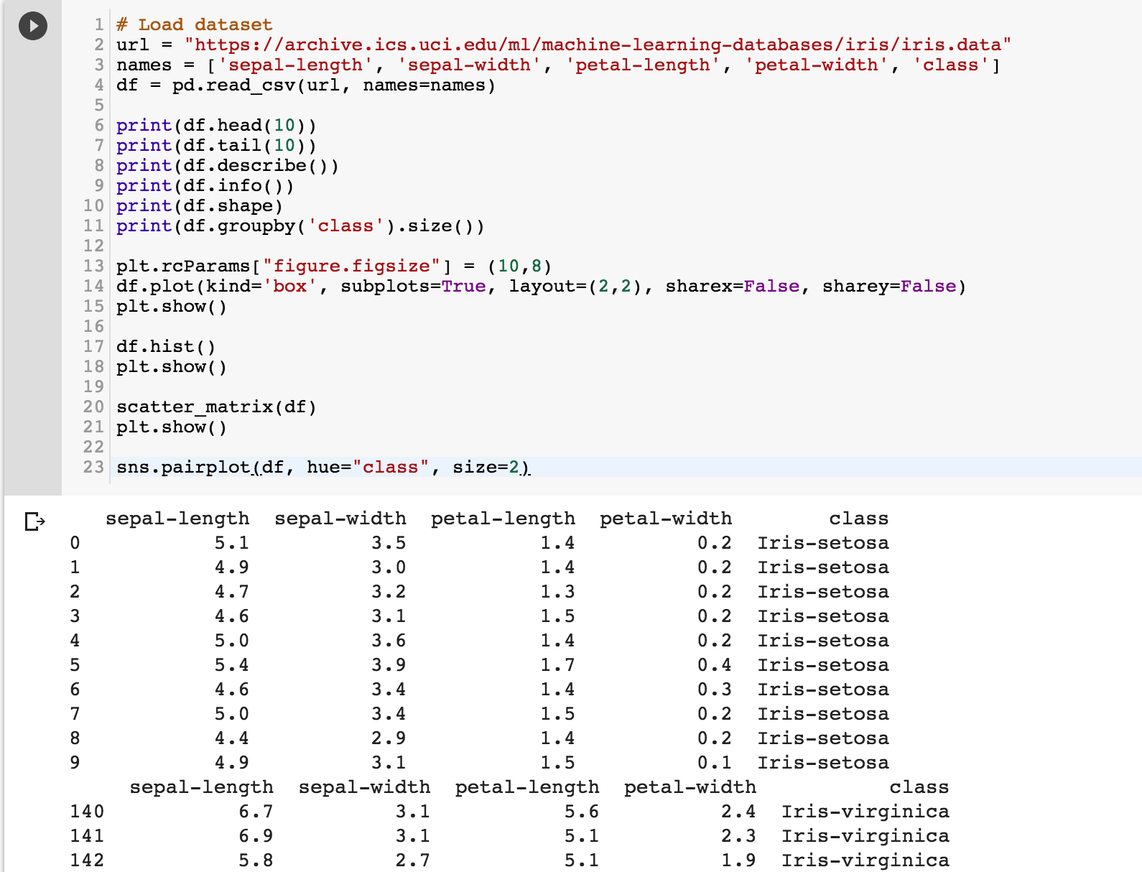
https://tinyurl.com/aintpupython101

Slide 61
https://tinyurl.com/aintpupython101

Slide 62
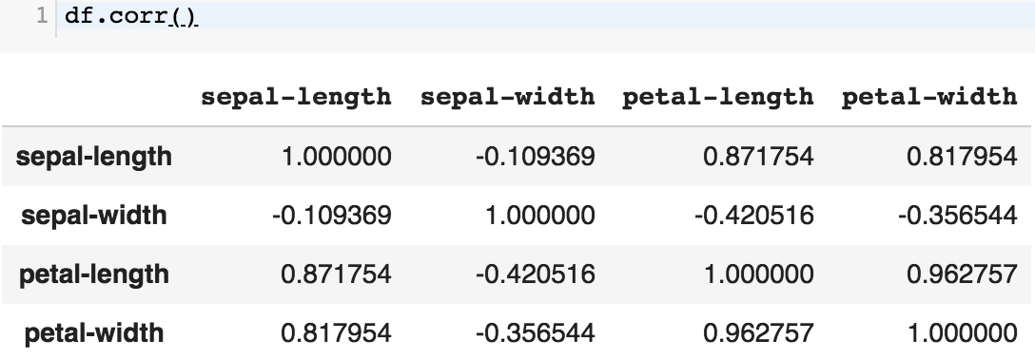
df.corr()
https://tinyurl.com/aintpupython101

Slide 63
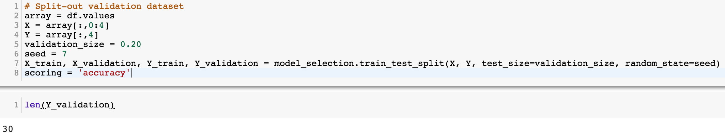
# Split-out validation dataset
array = df.values
X = array[:,0:4]
Y = array[:,4]
validation_size = 0.20
seed = 7
X_train, X_validation, Y_train, Y_validation = model_selection.train_test_split(X, Y, test_size=validation_size, random_state=seed)
scoring = 'accuracy'
https://tinyurl.com/aintpupython101

Slide 64
# Models
models = []
models.append(('LR', LogisticRegression()))
models.append(('LDA', LinearDiscriminantAnalysis()))
models.append(('KNN', KNeighborsClassifier()))
models.append(('DT', DecisionTreeClassifier()))
models.append(('NB', GaussianNB()))
models.append(('SVM', SVC()))
https://tinyurl.com/aintpupython101

Slide 65
# evaluate each model in turn
results = []
names = []
for name, model in models:
kfold = model_selection.KFold(n_splits=10, random_state=seed)
cv_results = model_selection.cross_val_score(model, X_train, Y_train, cv=kfold, scoring=scoring)
results.append(cv_results)
names.append(name)
msg = "%s: %.4f (%.4f)" % (name, cv_results.mean(), cv_results.std())
print(msg)
https://tinyurl.com/aintpupython101

Slide 66
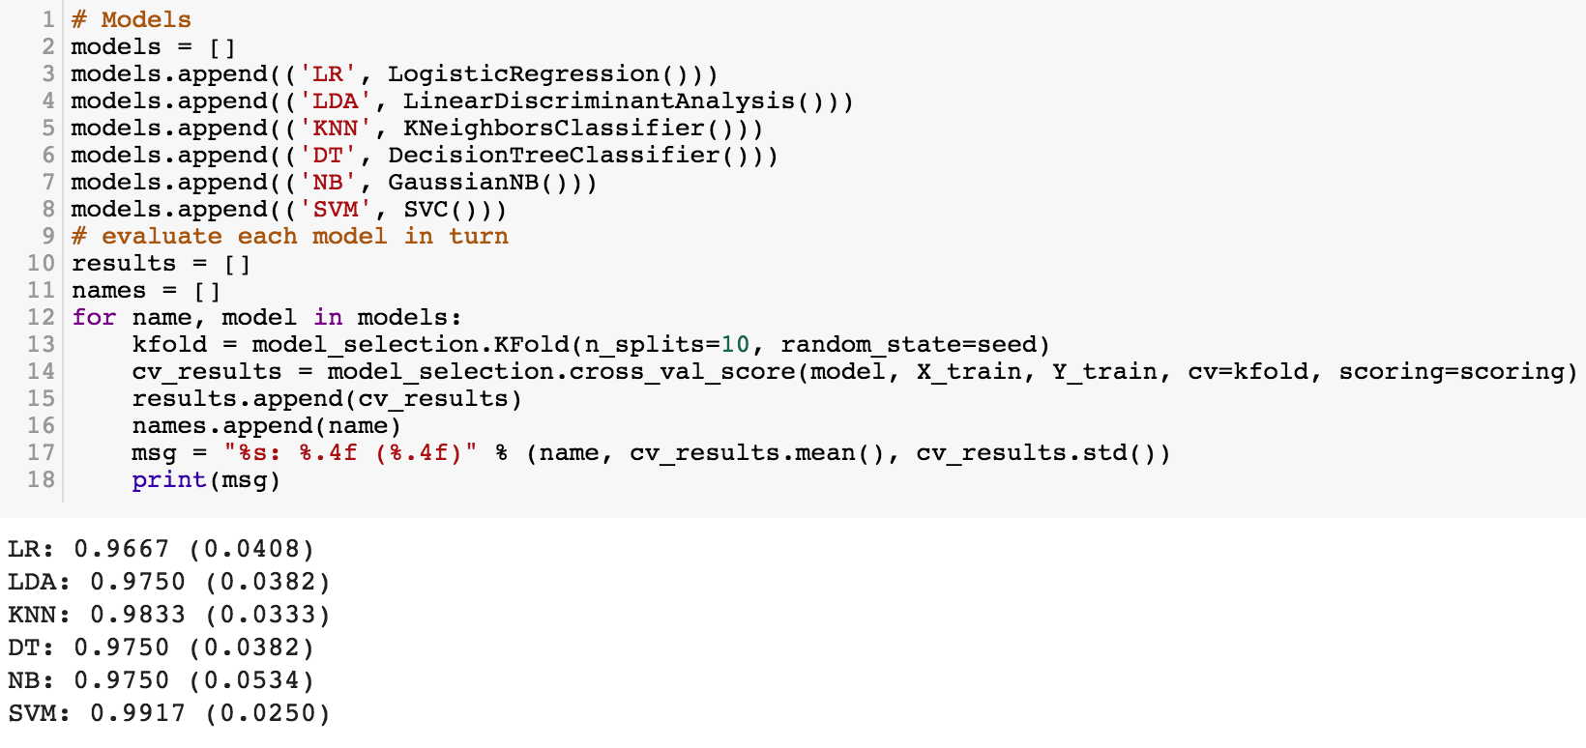
https://tinyurl.com/aintpupython101

Slide 67
# Make predictions on validation dataset
model = KNeighborsClassifier()
model.fit(X_train, Y_train)
predictions = model.predict(X_validation)
print("%.4f" % accuracy_score(Y_validation, predictions))
print(confusion_matrix(Y_validation, predictions))
print(classification_report(Y_validation, predictions))
print(model)
https://tinyurl.com/aintpupython101

Slide 68
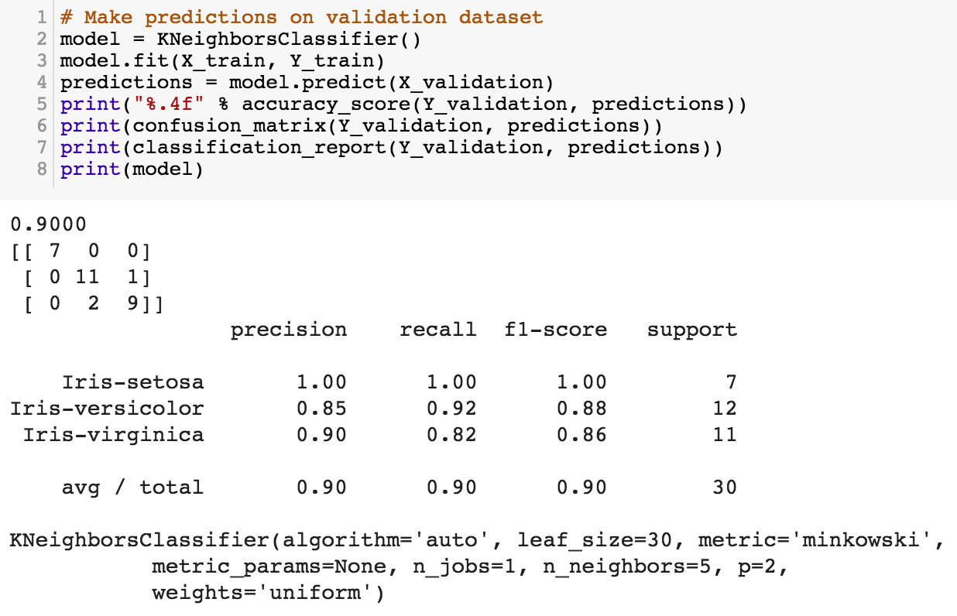
https://tinyurl.com/aintpupython101

Slide 69
# Make predictions on validation dataset
model = SVC()
model.fit(X_train, Y_train)
predictions = model.predict(X_validation)
print("%.4f" % accuracy_score(Y_validation, predictions))
print(confusion_matrix(Y_validation, predictions))
print(classification_report(Y_validation, predictions))
print(model)
https://tinyurl.com/aintpupython101

Slide 70
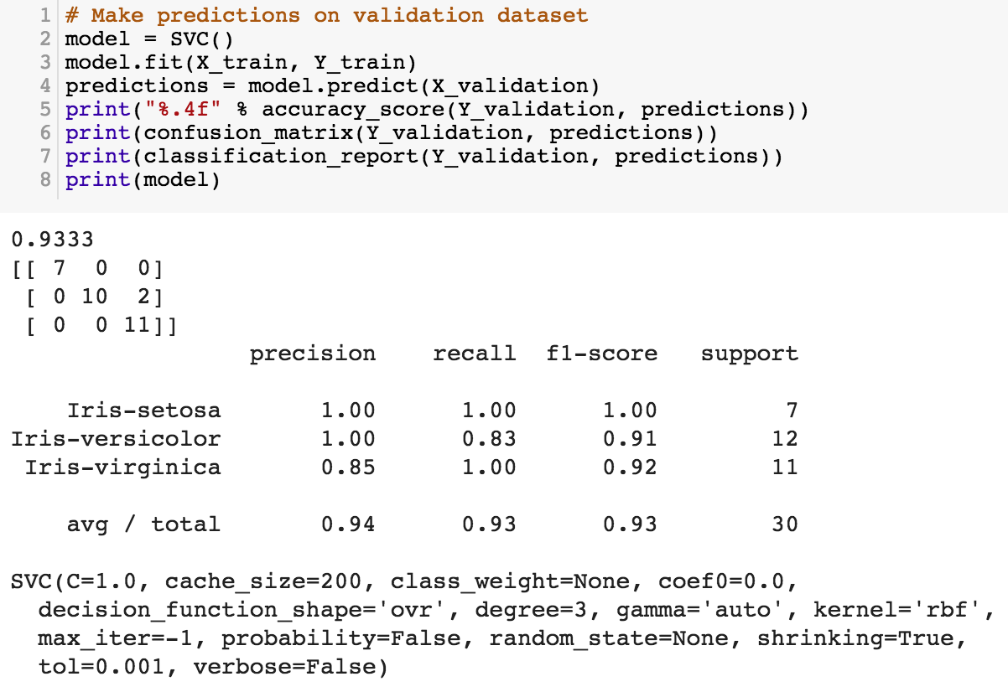
model = SVC()
model.fit(X_train, Y_train)
predictions = model.predict(X_validation)
https://tinyurl.com/aintpupython101

Slide 71
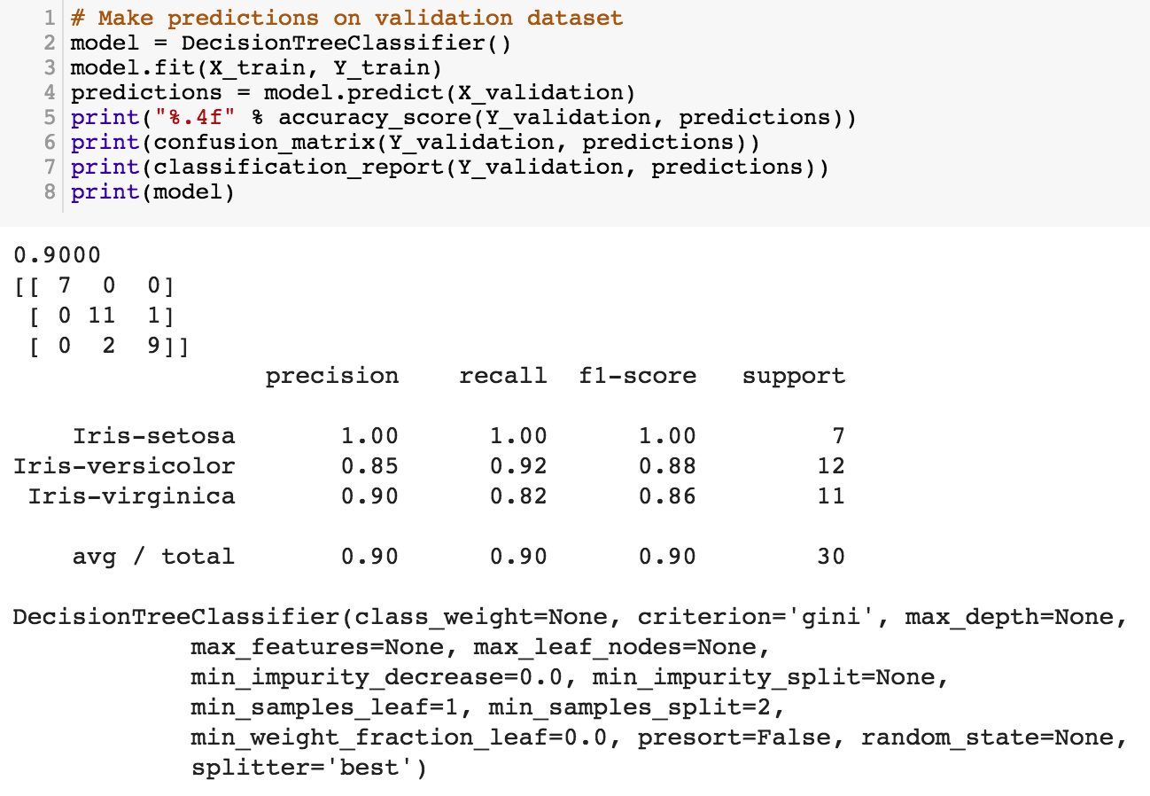
https://tinyurl.com/aintpupython101

Slide 72
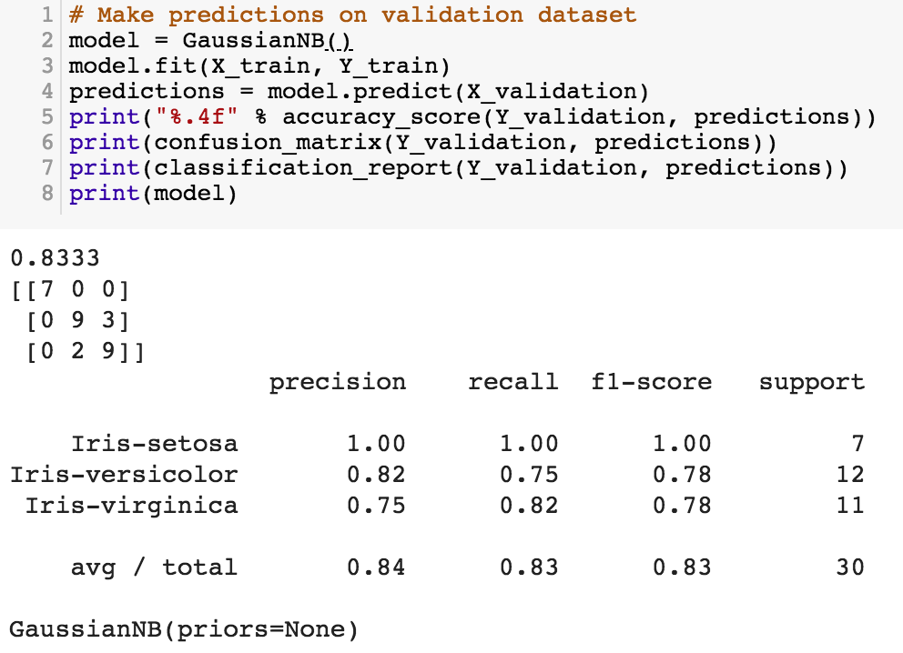
https://tinyurl.com/aintpupython101

Slide 73
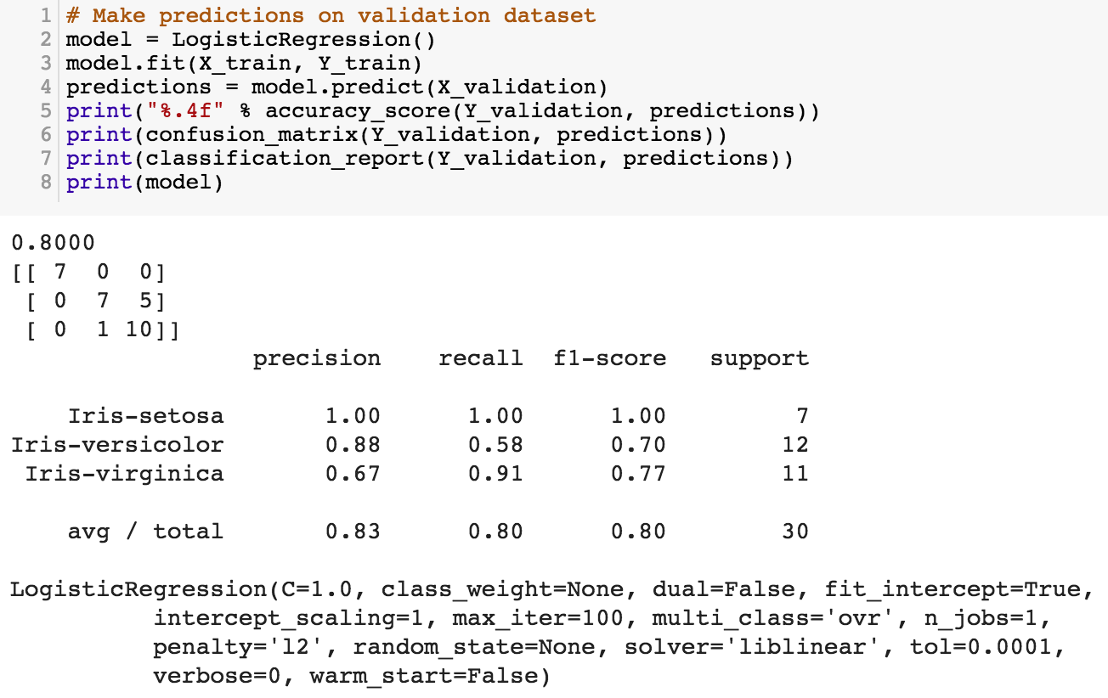
https://tinyurl.com/aintpupython101

Slide 74
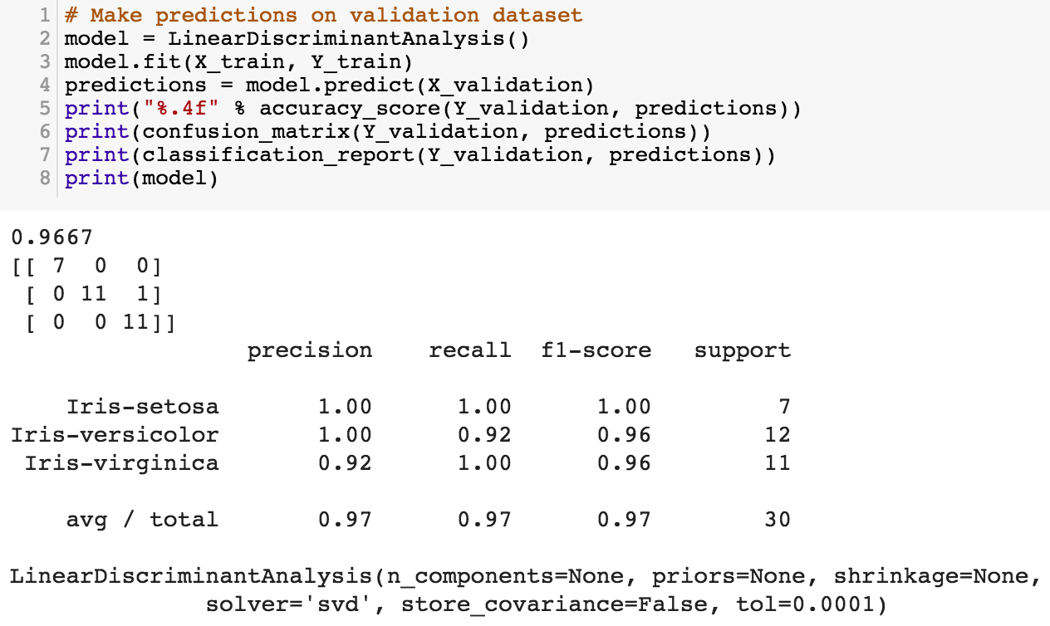
https://tinyurl.com/aintpupython101

Slide 75
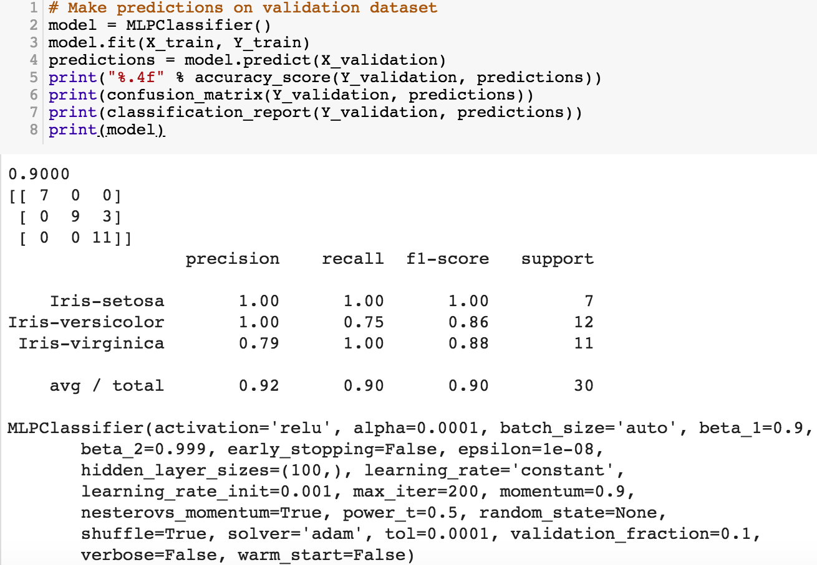
https://tinyurl.com/aintpupython101

Slide 76
Evaluation
(Accuracy of Classification Model)

Slide 77
Assessing the Classification Model
Predictive accuracy
  Hit rate
Speed
  Model building; predicting
Robustness
Scalability
Interpretability
  Transparency, explainability
Source: Ramesh Sharda, Dursun Delen, and Efraim Turban (2017), Business Intelligence, Analytics, and Data Science: A Managerial Perspective, 4th Edition, Pearson

Slide 78
Accuracy
Precision
Validity
Reliability

Slide 80
Accuracy vs. Precision
A
B
High Accuracy
High Precision
Low Accuracy
High Precision
C
D
High Accuracy
Low Precision
Low Accuracy
Low Precision

Slide 81
Accuracy vs. Precision
A
B
High Accuracy
High Precision
Low Accuracy
High Precision
High Validity
High Reliability
Low Validity
High Reliability
C
D
High Accuracy
Low Precision
Low Accuracy
Low Precision
High Validity
Low Reliability
Low Validity
Low Reliability

Slide 82
Accuracy vs. Precision
A
B
High Accuracy
High Precision
Low Accuracy
High Precision
High Validity
High Reliability
Low Validity
High Reliability
C
D
High Accuracy
Low Precision
Low Accuracy
Low Precision
High Validity
Low Reliability
Low Validity
Low Reliability

Slide 83
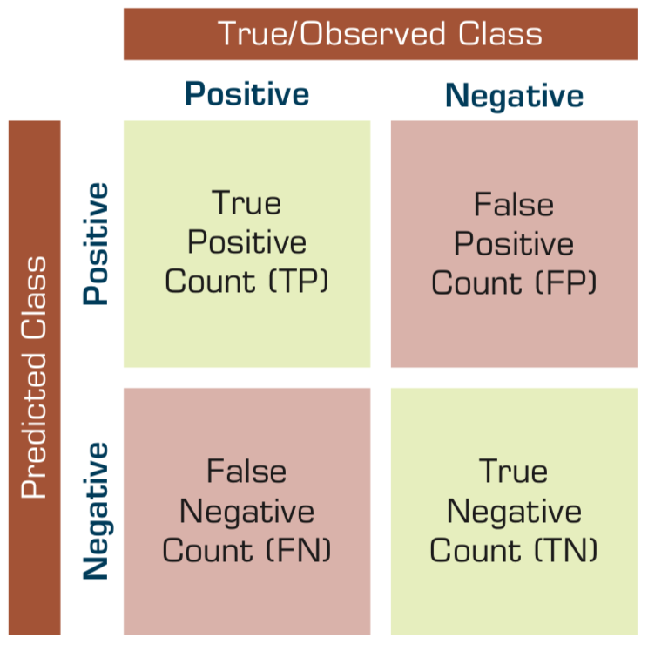
Confusion Matrix for Tabulation of Two-Class Classification Results
Source: Ramesh Sharda, Dursun Delen, and Efraim Turban (2017), Business Intelligence, Analytics, and Data Science: A Managerial Perspective, 4th Edition, Pearson

Slide 84
Sensitivity
Specificity
=True Positive Rate
=True Negative Rate

Slide 85
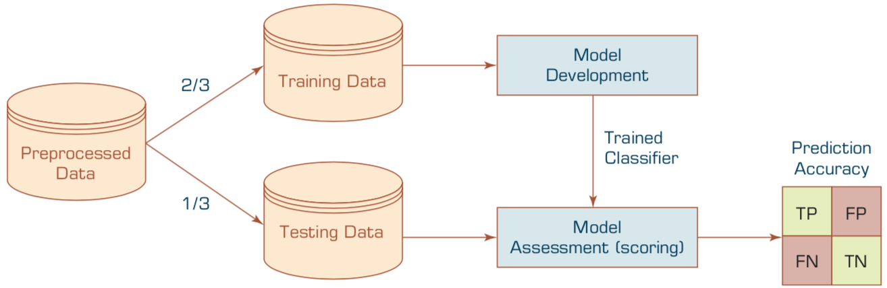
Estimation Methodologies for Classification
Simple split (or holdout or test sample estimation)
  Split the data into 2 mutually exclusive sets
  training (~70%) and testing (30%)
  For ANN, the data is split into three sub-sets
  (training [~60%], validation [~20%], testing [~20%])
Source: Ramesh Sharda, Dursun Delen, and Efraim Turban (2017), Business Intelligence, Analytics, and Data Science: A Managerial Perspective, 4th Edition, Pearson

Slide 86
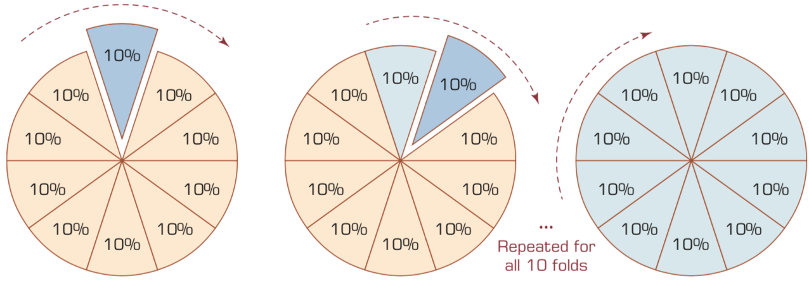
k-Fold Cross-Validation
Source: Ramesh Sharda, Dursun Delen, and Efraim Turban (2017), Business Intelligence, Analytics, and Data Science: A Managerial Perspective, 4th Edition, Pearson

Slide 87
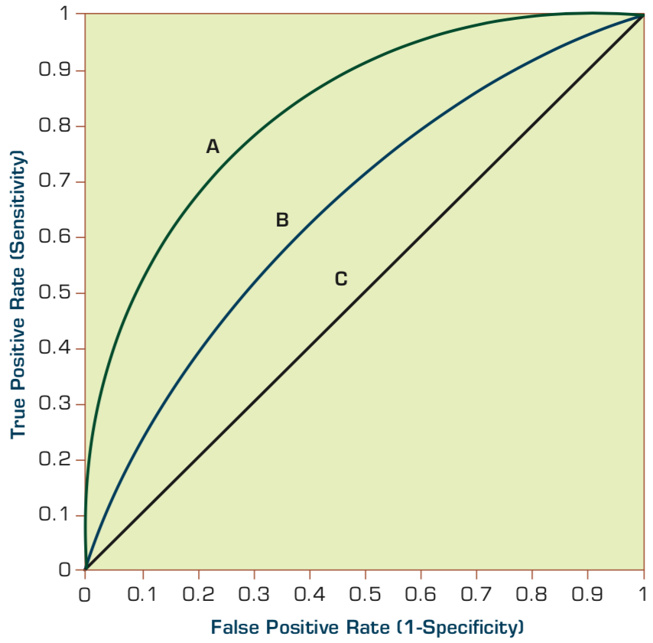
Estimation Methodologies for Classification
Area under the ROC curve
Source: Ramesh Sharda, Dursun Delen, and Efraim Turban (2017), Business Intelligence, Analytics, and Data Science: A Managerial Perspective, 4th Edition, Pearson

Slide 88
True Class
(actual value)
Positive
Negative
total
True
Positive
(TP)
False
Positive
(FP)
Positive
P’
Predictive Class
(prediction outcome)
False
Negative
(FN)
True
Negative
(TN)
Negative
N’
total
P
N
Source: http://en.wikipedia.org/wiki/Receiver_operating_characteristic

Slide 89
True Class
(actual value)
Positive
Negative
total
True
Positive
(TP)
False
Positive
(FP)
Positive
P’
Predictive Class
(prediction outcome)
False
Negative
(FN)
True
Negative
(TN)
Negative
N’
total
P
N
Sensitivity
= True Positive Rate
= Recall
= Hit rate
= TP / (TP + FN)
Source: http://en.wikipedia.org/wiki/Receiver_operating_characteristic

Slide 90
True Class
(actual value)
Positive
Negative
total
True
Positive
(TP)
False
Positive
(FP)
Positive
P’
Predictive Class
(prediction outcome)
False
Negative
(FN)
True
Negative
(TN)
Negative
N’
total
P
N
Specificity
= True Negative Rate
= TN / N
= TN / (TN+ FP)
Source: http://en.wikipedia.org/wiki/Receiver_operating_characteristic

Slide 91
True Class
(actual value)
Precision
= Positive Predictive Value (PPV)
Positive
Negative
total
True
Positive
(TP)
False
Positive
(FP)
Positive
P’
Recall
= True Positive Rate (TPR)
= Sensitivity
= Hit Rate
Predictive Class
(prediction outcome)
False
Negative
(FN)
True
Negative
(TN)
Negative
N’
total
P
N
F1 score (F-score)(F-measure)
is the harmonic mean of precision and recall
= 2TP / (P + P’)
= 2TP / (2TP + FP + FN)
Source: http://en.wikipedia.org/wiki/Receiver_operating_characteristic

Slide 92
A
63
(TP)
28
(FP)
Recall
= True Positive Rate (TPR)
= Sensitivity
= Hit Rate
= TP / (TP + FN)
Specificity
= True Negative Rate
= TN / N
= TN / (TN + FP)
91
37
(FN)
72
(TN)
109
100
100
200
TPR = 0.63
FPR = 0.28
PPV = 0.69
=63/(63+28)
=63/91
Precision
= Positive Predictive Value (PPV)
F1 = 0.66
= 2*(0.63*0.69)/(0.63+0.69)
= (2 * 63) /(100 + 91)
= (0.63 + 0.69) / 2 =1.32 / 2 =0.66
F1 score (F-score)
(F-measure)
is the harmonic mean of precision and recall
= 2TP / (P + P’)
= 2TP / (2TP + FP + FN)
ACC = 0.68
= (63 + 72) / 200
= 135/200 = 67.5
Source: http://en.wikipedia.org/wiki/Receiver_operating_characteristic

Slide 93
A
B
63
(TP)
28
(FP)
77
(TP)
77
(FP)
91
154
37
(FN)
72
(TN)
109
23
(FN)
23
(TN)
46
100
100
200
100
100
200
TPR = 0.63
TPR = 0.77
FPR = 0.77
PPV = 0.50
F1 = 0.61
ACC = 0.50
FPR = 0.28
PPV = 0.69
=63/(63+28)
=63/91
F1 = 0.66
= 2*(0.63*0.69)/(0.63+0.69)
= (2 * 63) /(100 + 91)
= (0.63 + 0.69) / 2 =1.32 / 2 =0.66
Recall
= True Positive Rate (TPR)
= Sensitivity
= Hit Rate
ACC = 0.68
= (63 + 72) / 200
= 135/200 = 67.5
Precision
= Positive Predictive Value (PPV)
Source: http://en.wikipedia.org/wiki/Receiver_operating_characteristic

Slide 94
C
C’
24
(TP)
88
(FP)
76
(TP)
12
(FP)
112
88
76
(FN)
12
(TN)
88
24
(FN)
88
(TN)
112
100
100
200
100
100
200
TPR = 0.24
FPR = 0.88
PPV = 0.21
F1 = 0.22
ACC = 0.18
TPR = 0.76
FPR = 0.12
PPV = 0.86
F1 = 0.81
ACC = 0.82
Recall
= True Positive Rate (TPR)
= Sensitivity
= Hit Rate
Precision
= Positive Predictive Value (PPV)
Source: http://en.wikipedia.org/wiki/Receiver_operating_characteristic

Slide 95
Machine Learning:
Unsupervised Learning:
Cluster Analysis,
Market Segmentation

Slide 96
Machine Learning: Data Mining Tasks & Methods
Unsupervised Learning:
Cluster Analysis,
Market Segmentation
Segmentation
Source: Ramesh Sharda, Dursun Delen, and Efraim Turban (2017), Business Intelligence, Analytics, and Data Science: A Managerial Perspective, 4th Edition, Pearson

Slide 97
Example of Cluster Analysis
Point | P | P(x,y)
p01 | a | (3, 4)
p02 | b | (3, 6)
p03 | c | (3, 8)
p04 | d | (4, 5)
p05 | e | (4, 7)
p06 | f | (5, 1)
p07 | g | (5, 5)
p08 | h | (7, 3)
p09 | i | (7, 5)
p10 | j | (8, 5)

Slide 98
K-Means Clustering
Point | P | P(x,y) | m1 distance | m2 distance | Cluster
p01 | a | (3, 4) | 1.95 | 3.78 | Cluster1
p02 | b | (3, 6) | 0.69 | 4.51 | Cluster1
p03 | c | (3, 8) | 2.27 | 5.86 | Cluster1
p04 | d | (4, 5) | 0.89 | 3.13 | Cluster1
p05 | e | (4, 7) | 1.22 | 4.45 | Cluster1
p06 | f | (5, 1) | 5.01 | 3.05 | Cluster2
p07 | g | (5, 5) | 1.57 | 2.30 | Cluster1
p08 | h | (7, 3) | 4.37 | 0.56 | Cluster2
p09 | i | (7, 5) | 3.43 | 1.52 | Cluster2
p10 | j | (8, 5) | 4.41 | 1.95 | Cluster2
 | m1 | (3.67, 5.83)
 | m2 | (6.75, 3.50)

Slide 99
Cluster Analysis

Slide 100
Cluster Analysis
Used for automatic identification of
natural groupings of things
Part of the machine-learning family
Employ unsupervised learning
Learns the clusters of things from past data, then assigns new instances
There is not an output variable
Also known as segmentation
Source: Turban et al. (2011), Decision Support and Business Intelligence Systems

Slide 101
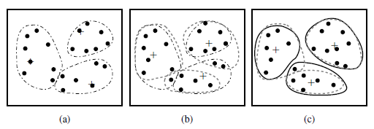
Cluster Analysis
Clustering of a set of objects based on the k-means method.
(The mean of each cluster is marked by a “+”.)
Source: Han & Kamber (2006)

Slide 102
Cluster Analysis
Clustering results may be used to
  Identify natural groupings of customers
  Identify rules for assigning new cases to classes for targeting/diagnostic purposes
  Provide characterization, definition, labeling of populations
  Decrease the size and complexity of problems
  for other data mining methods
  Identify outliers in a specific domain
  (e.g., rare-event detection)
Source: Turban et al. (2011), Decision Support and Business Intelligence Systems

Slide 103
k-Means Clustering Algorithm
k : pre-determined number of clusters
Algorithm (Step 0: determine value of k)
Step 1: Randomly generate k random points as initial cluster centers
Step 2: Assign each point to the nearest cluster center
Step 3: Re-compute the new cluster centers
Repetition step: Repeat steps 2 and 3 until some convergence criterion is met (usually that the assignment of points to clusters becomes stable)
Source: Turban et al. (2011), Decision Support and Business Intelligence Systems

Slide 104
Cluster Analysis for Data Mining - k-Means Clustering Algorithm
Source: Turban et al. (2011), Decision Support and Business Intelligence Systems

Slide 105
Similarity
Distance

Slide 106
Similarity and Dissimilarity Between Objects
Distances are normally used to measure the similarity or dissimilarity between two data objects
Some popular ones include: Minkowski distance:
  where i = (x_{i1}, x_{i2}, …, x_{ip}) and j = (x_{j1}, x_{j2}, …, x_{jp}) are two p-dimensional data objects, and q is a positive integer
If q = 1, d is Manhattan distance
Source: Han & Kamber (2006)

Slide 107
Similarity and Dissimilarity Between Objects (Cont.)
If q = 2, d is Euclidean distance:
  Properties
    d(i,j) ≥ 0
    d(i,i) = 0
    d(i,j) = d(j,i)
    d(i,j) ≤ d(i,k) + d(k,j)
Also, one can use weighted distance, parametric Pearson product moment correlation, or other disimilarity measures
Source: Han & Kamber (2006)

Slide 108
Euclidean distance vs
Manhattan distance
Distance of two point x₁ = (1, 2) and x₂ (3, 5)
Euclidean distance:
= ((3-1)² + (5-2)² )^{1/2}
= (2² + 3²)^{1/2}
= (4 + 9)^{1/2}
= (13)^{1/2}
= 3.61
5
x₂ (3, 5)
4
3
3.61
3
2
2
x₁ = (1, 2)
1
Manhattan distance:
= (3-1) + (5-2)
= 2 + 3
= 5
1
2
3

Slide 109
The K-Means Clustering Method
Example
10
10
9
9
8
8
7
7
6
6
5
5
4
Assign each objects to most similar center
Update the cluster means
4
3
3
2
2
1
1
0
0
0
1
2
3
4
5
6
7
8
9
10
0
1
2
3
4
5
6
7
8
9
10
reassign
reassign
K=2
Arbitrarily choose K object as initial cluster center
Update the cluster means
Source: Han & Kamber (2006)

Slide 110
K-Means Clustering

Slide 111
Example of Cluster Analysis
Point | P | P(x,y)
p01 | a | (3, 4)
p02 | b | (3, 6)
p03 | c | (3, 8)
p04 | d | (4, 5)
p05 | e | (4, 7)
p06 | f | (5, 1)
p07 | g | (5, 5)
p08 | h | (7, 3)
p09 | i | (7, 5)
p10 | j | (8, 5)

Slide 112
K-Means Clustering
Step by Step
Point | P | P(x,y)
p01 | a | (3, 4)
p02 | b | (3, 6)
p03 | c | (3, 8)
p04 | d | (4, 5)
p05 | e | (4, 7)
p06 | f | (5, 1)
p07 | g | (5, 5)
p08 | h | (7, 3)
p09 | i | (7, 5)
p10 | j | (8, 5)

Slide 113
K-Means Clustering
Step 1: K=2, Arbitrarily choose K object as initial cluster center
Point | P | P(x,y)
p01 | a | (3, 4)
p02 | b | (3, 6)
p03 | c | (3, 8)
p04 | d | (4, 5)
p05 | e | (4, 7)
p06 | f | (5, 1)
p07 | g | (5, 5)
p08 | h | (7, 3)
p09 | i | (7, 5)
p10 | j | (8, 5)
Initial | m1 | (3, 4)
Initial | m2 | (8, 5)
M₂ = (8, 5)
m₁ = (3, 4)

Slide 114
Step 2: Compute seed points as the centroids of the clusters of the current partition
Step 3: Assign each objects to most similar center
Point | P | P(x,y) | m1 distance | m2 distance | Cluster
p01 | a | (3, 4) | 0.00 | 5.10 | Cluster1
p02 | b | (3, 6) | 2.00 | 5.10 | Cluster1
p03 | c | (3, 8) | 4.00 | 5.83 | Cluster1
p04 | d | (4, 5) | 1.41 | 4.00 | Cluster1
p05 | e | (4, 7) | 3.16 | 4.47 | Cluster1
p06 | f | (5, 1) | 3.61 | 5.00 | Cluster1
p07 | g | (5, 5) | 2.24 | 3.00 | Cluster1
p08 | h | (7, 3) | 4.12 | 2.24 | Cluster2
p09 | i | (7, 5) | 4.12 | 1.00 | Cluster2
p10 | j | (8, 5) | 5.10 | 0.00 | Cluster2
Initial | m1 | (3, 4)
Initial | m2 | (8, 5)
M₂ = (8, 5)
m₁ = (3, 4)
K-Means Clustering

Slide 115
Step 2: Compute seed points as the centroids of the clusters of the current partition
Step 3: Assign each objects to most similar center
Point | P | P(x,y) | m1 distance | m2 distance | Cluster
p01 | a | (3, 4) | 0.00 | 5.10 | Cluster1
p02 | b | (3, 6) | 2.00 | 5.10 | Cluster1
p03 | c | (3, 8) | 4.00 | 5.83 | Cluster1
p04 | d | (4, 5) | 1.41 | 4.00 | Cluster1
p05 | e | (4, 7) | 3.16 | 4.47 | Cluster1
p06 | f | (5, 1) | 3.61 | 5.00 | Cluster1
p07 | g | (5, 5) | 2.24 | 3.00 | Cluster1
p08 | h | (7, 3) | 4.12 | 2.24 | Cluster2
p09 | i | (7, 5) | 4.12 | 1.00 | Cluster2
p10 | j | (8, 5) | 5.10 | 0.00 | Cluster2
Initial | m1 | (3, 4)
Initial | m2 | (8, 5)
M₂ = (8, 5)
Euclidean distance b(3,6) ←→m2(8,5)
= ((8-3)² + (5-6)² )^{1/2}
= (5² + (-1)²)^{1/2}
= (25 + 1)^{1/2}
= (26)^{1/2}
= 5.10
m₁ = (3, 4)
Euclidean distance b(3,6) ←→m1(3,4)
= ((3-3)² + (4-6)² )^{1/2}
= (0² + (-2)²)^{1/2}
= (0 + 4)^{1/2}
= (4)^{1/2}
= 2.00
K-Means Clustering

Slide 116
Step 4: Update the cluster means,
Repeat Step 2, 3,
stop when no more new assignment
Point | P | P(x,y) | m1 distance | m2 distance | Cluster
p01 | a | (3, 4) | 1.43 | 4.34 | Cluster1
p02 | b | (3, 6) | 1.22 | 4.64 | Cluster1
p03 | c | (3, 8) | 2.99 | 5.68 | Cluster1
p04 | d | (4, 5) | 0.20 | 3.40 | Cluster1
p05 | e | (4, 7) | 1.87 | 4.27 | Cluster1
p06 | f | (5, 1) | 4.29 | 4.06 | Cluster2
p07 | g | (5, 5) | 1.15 | 2.42 | Cluster1
p08 | h | (7, 3) | 3.80 | 1.37 | Cluster2
p09 | i | (7, 5) | 3.14 | 0.75 | Cluster2
p10 | j | (8, 5) | 4.14 | 0.95 | Cluster2
 | m1 | (3.86, 5.14)
 | m2 | (7.33, 4.33)
m₁ = (3.86, 5.14)
M₂ = (7.33, 4.33)
K-Means Clustering

Slide 117
Step 4: Update the cluster means,
Repeat Step 2, 3,
stop when no more new assignment
Point | P | P(x,y) | m1 distance | m2 distance | Cluster
p01 | a | (3, 4) | 1.95 | 3.78 | Cluster1
p02 | b | (3, 6) | 0.69 | 4.51 | Cluster1
p03 | c | (3, 8) | 2.27 | 5.86 | Cluster1
p04 | d | (4, 5) | 0.89 | 3.13 | Cluster1
p05 | e | (4, 7) | 1.22 | 4.45 | Cluster1
p06 | f | (5, 1) | 5.01 | 3.05 | Cluster2
p07 | g | (5, 5) | 1.57 | 2.30 | Cluster1
p08 | h | (7, 3) | 4.37 | 0.56 | Cluster2
p09 | i | (7, 5) | 3.43 | 1.52 | Cluster2
p10 | j | (8, 5) | 4.41 | 1.95 | Cluster2
 | m1 | (3.67, 5.83)
 | m2 | (6.75, 3.50)
m₁ = (3.67, 5.83)
M₂ = (6.75., 3.50)
K-Means Clustering

Slide 118
stop when no more new assignment
Point | P | P(x,y) | m1 distance | m2 distance | Cluster
p01 | a | (3, 4) | 1.95 | 3.78 | Cluster1
p02 | b | (3, 6) | 0.69 | 4.51 | Cluster1
p03 | c | (3, 8) | 2.27 | 5.86 | Cluster1
p04 | d | (4, 5) | 0.89 | 3.13 | Cluster1
p05 | e | (4, 7) | 1.22 | 4.45 | Cluster1
p06 | f | (5, 1) | 5.01 | 3.05 | Cluster2
p07 | g | (5, 5) | 1.57 | 2.30 | Cluster1
p08 | h | (7, 3) | 4.37 | 0.56 | Cluster2
p09 | i | (7, 5) | 3.43 | 1.52 | Cluster2
p10 | j | (8, 5) | 4.41 | 1.95 | Cluster2
 | m1 | (3.67, 5.83)
 | m2 | (6.75, 3.50)
K-Means Clustering

Slide 119
K-Means Clustering (K=2, two clusters)
stop when no more new assignment
Point | P | P(x,y) | m1 distance | m2 distance | Cluster
p01 | a | (3, 4) | 1.95 | 3.78 | Cluster1
p02 | b | (3, 6) | 0.69 | 4.51 | Cluster1
p03 | c | (3, 8) | 2.27 | 5.86 | Cluster1
p04 | d | (4, 5) | 0.89 | 3.13 | Cluster1
p05 | e | (4, 7) | 1.22 | 4.45 | Cluster1
p06 | f | (5, 1) | 5.01 | 3.05 | Cluster2
p07 | g | (5, 5) | 1.57 | 2.30 | Cluster1
p08 | h | (7, 3) | 4.37 | 0.56 | Cluster2
p09 | i | (7, 5) | 3.43 | 1.52 | Cluster2
p10 | j | (8, 5) | 4.41 | 1.95 | Cluster2
 | m1 | (3.67, 5.83)
 | m2 | (6.75, 3.50)
K-Means Clustering

Slide 120
K-Means Clustering
Point | P | P(x,y) | m1 distance | m2 distance | Cluster
p01 | a | (3, 4) | 1.95 | 3.78 | Cluster1
p02 | b | (3, 6) | 0.69 | 4.51 | Cluster1
p03 | c | (3, 8) | 2.27 | 5.86 | Cluster1
p04 | d | (4, 5) | 0.89 | 3.13 | Cluster1
p05 | e | (4, 7) | 1.22 | 4.45 | Cluster1
p06 | f | (5, 1) | 5.01 | 3.05 | Cluster2
p07 | g | (5, 5) | 1.57 | 2.30 | Cluster1
p08 | h | (7, 3) | 4.37 | 0.56 | Cluster2
p09 | i | (7, 5) | 3.43 | 1.52 | Cluster2
p10 | j | (8, 5) | 4.41 | 1.95 | Cluster2
 | m1 | (3.67, 5.83)
 | m2 | (6.75, 3.50)

Slide 121
Machine Learning:
Unsupervised Learning:
Cluster Analysis
K-Means Clustering

Slide 122
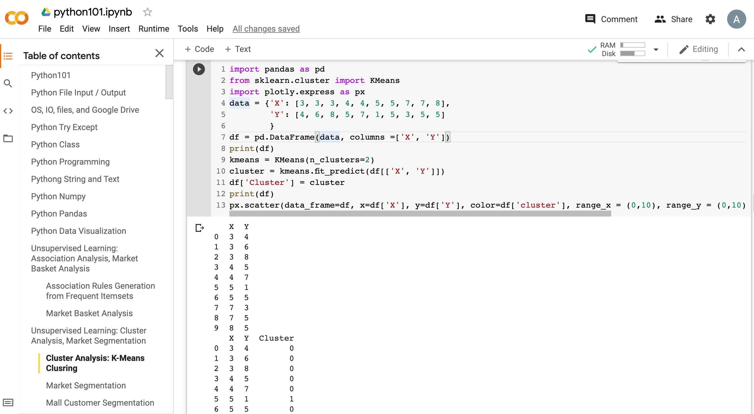
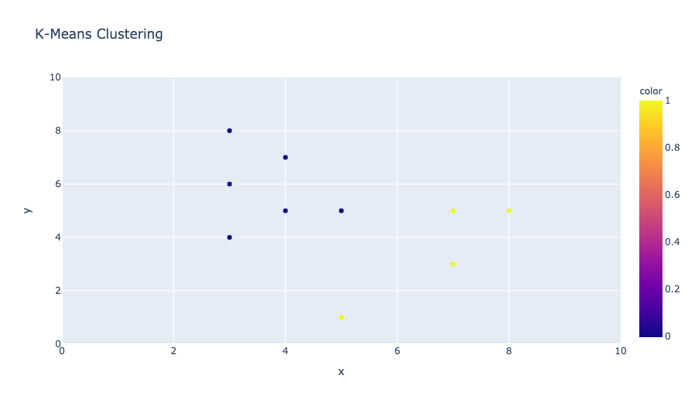
Python in Google Colab (Python101)
https://colab.research.google.com/drive/1FEG6DnGvwfUbeo4zJ1zTunjMqf2RkCrT
https://tinyurl.com/aintpupython101

Slide 123
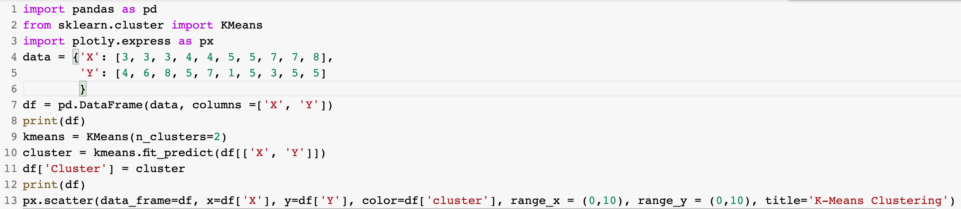
from sklearn.cluster import KMeans
kmeans = KMeans(n_clusters=2)
cluster = kmeans.fit_predict(df[['X', 'Y']])
https://tinyurl.com/aintpupython101

Slide 124
from sklearn.cluster import KMeans
kmeans = KMeans(n_clusters=2)
cluster = kmeans.fit_predict(df[['X', 'Y']])
import pandas as pd
from sklearn.cluster import KMeans
import plotly.express as px
data = {'X': [3, 3, 3, 4, 4, 5, 5, 7, 7, 8],
'Y': [4, 6, 8, 5, 7, 1, 5, 3, 5, 5]
}
df = pd.DataFrame(data, columns =['X', 'Y'])
print(df)
kmeans = KMeans(n_clusters=2)
cluster = kmeans.fit_predict(df[['X', 'Y']])
df['Cluster'] = cluster
print(df)
px.scatter(data_frame=df, x=df['X'], y=df['Y'], color=df['cluster'], range_x = (0,10), range_y = (0,10), title='K-Means Clustering')
https://tinyurl.com/aintpupython101

Slide 125
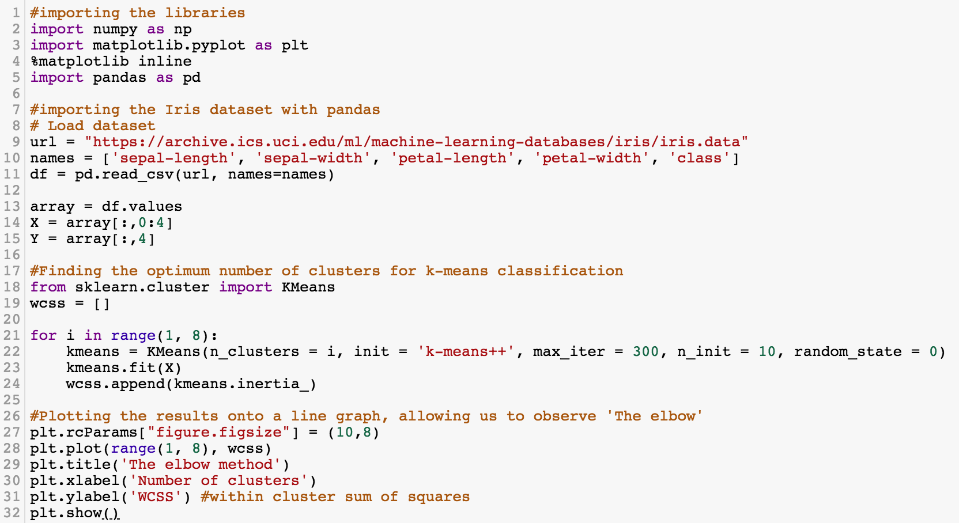
K-Means Clustering
https://tinyurl.com/aintpupython101

Slide 126
#importing the libraries
import numpy as np
import matplotlib.pyplot as plt
%matplotlib inline
import pandas as pd
#importing the Iris dataset with pandas
# Load dataset
url = "https://archive.ics.uci.edu/ml/machine-learning-databases/iris/iris.data"
names = ['sepal-length', 'sepal-width', 'petal-length', 'petal-width', 'class']
df = pd.read_csv(url, names=names)
array = df.values
X = array[:,0:4]
Y = array[:,4]
https://tinyurl.com/aintpupython101

Slide 127
#Finding the optimum number of clusters for k-means classification
from sklearn.cluster import KMeans
wcss = []
for i in range(1, 8):
kmeans = KMeans(n_clusters = i, init = 'k-means++', max_iter = 300, n_init = 10, random_state = 0)
kmeans.fit(X)
wcss.append(kmeans.inertia_)
#Plotting the results onto a line graph, allowing us to observe 'The elbow'
plt.rcParams["figure.figsize"] = (10,8)
plt.plot(range(1, 8), wcss)
plt.title('The elbow method')
plt.xlabel('Number of clusters')
plt.ylabel('WCSS') #within cluster sum of squares
plt.show()
https://tinyurl.com/aintpupython101

Slide 128
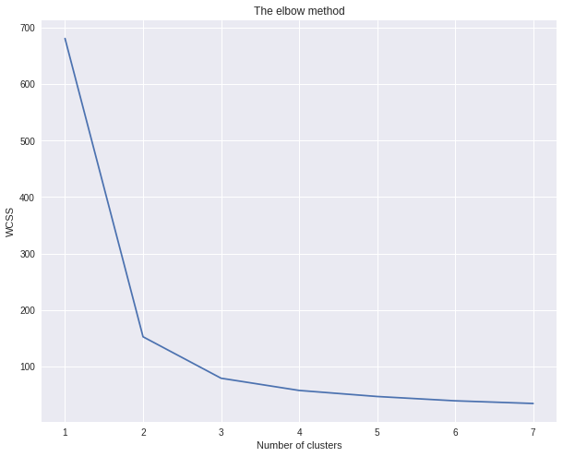
K-Means Clustering
The elbow method (k=3)
https://tinyurl.com/aintpupython101

Slide 129
kmeans = KMeans(n_clusters = 3, init = 'k-means++', max_iter = 300, n_init = 10, random_state = 0)
y_kmeans = kmeans.fit_predict(X)
https://tinyurl.com/aintpupython101

Slide 130
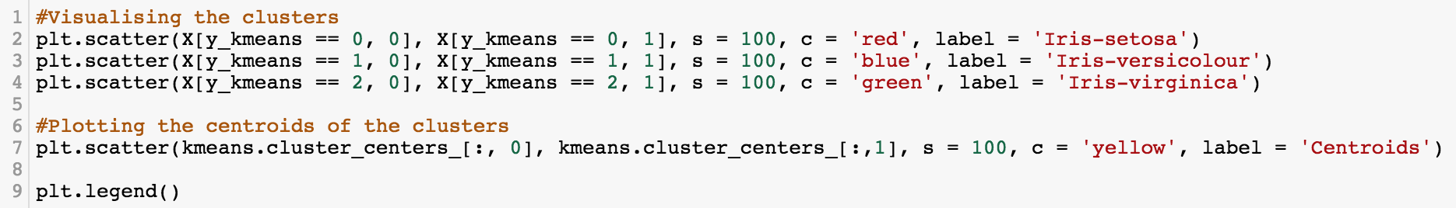
#Visualising the clusters
plt.scatter(X[y_kmeans == 0, 0], X[y_kmeans == 0, 1], s = 100, c = 'red', label = 'Iris-setosa')
plt.scatter(X[y_kmeans == 1, 0], X[y_kmeans == 1, 1], s = 100, c = 'blue', label = 'Iris-versicolour')
plt.scatter(X[y_kmeans == 2, 0], X[y_kmeans == 2, 1], s = 100, c = 'green', label = 'Iris-virginica')
#Plotting the centroids of the clusters
plt.scatter(kmeans.cluster_centers_[:, 0], kmeans.cluster_centers_[:,1], s = 100, c = 'yellow', label = 'Centroids')
plt.legend()
https://tinyurl.com/aintpupython101

Slide 131
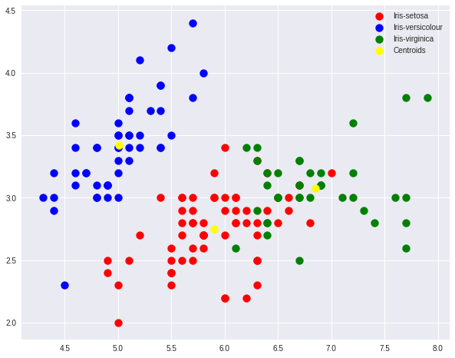
K-Means Clustering
https://tinyurl.com/aintpupython101

Slide 132
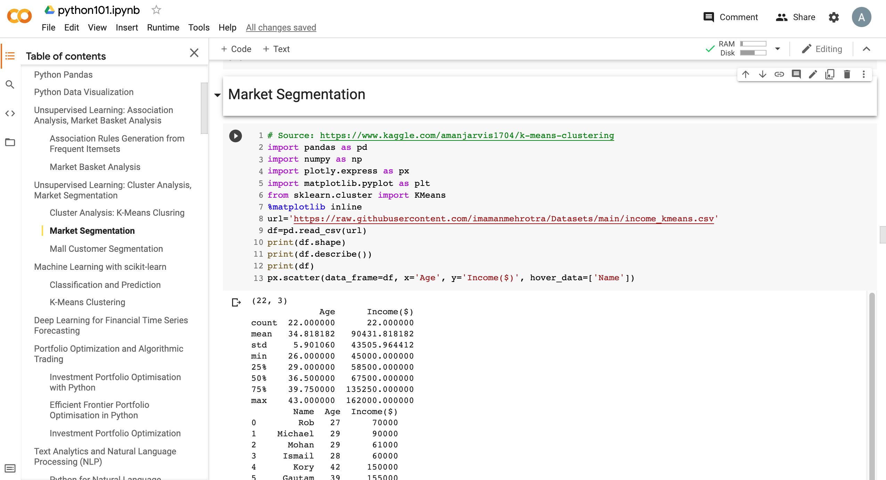
Market Segmentation
https://tinyurl.com/aintpupython101

Slide 133
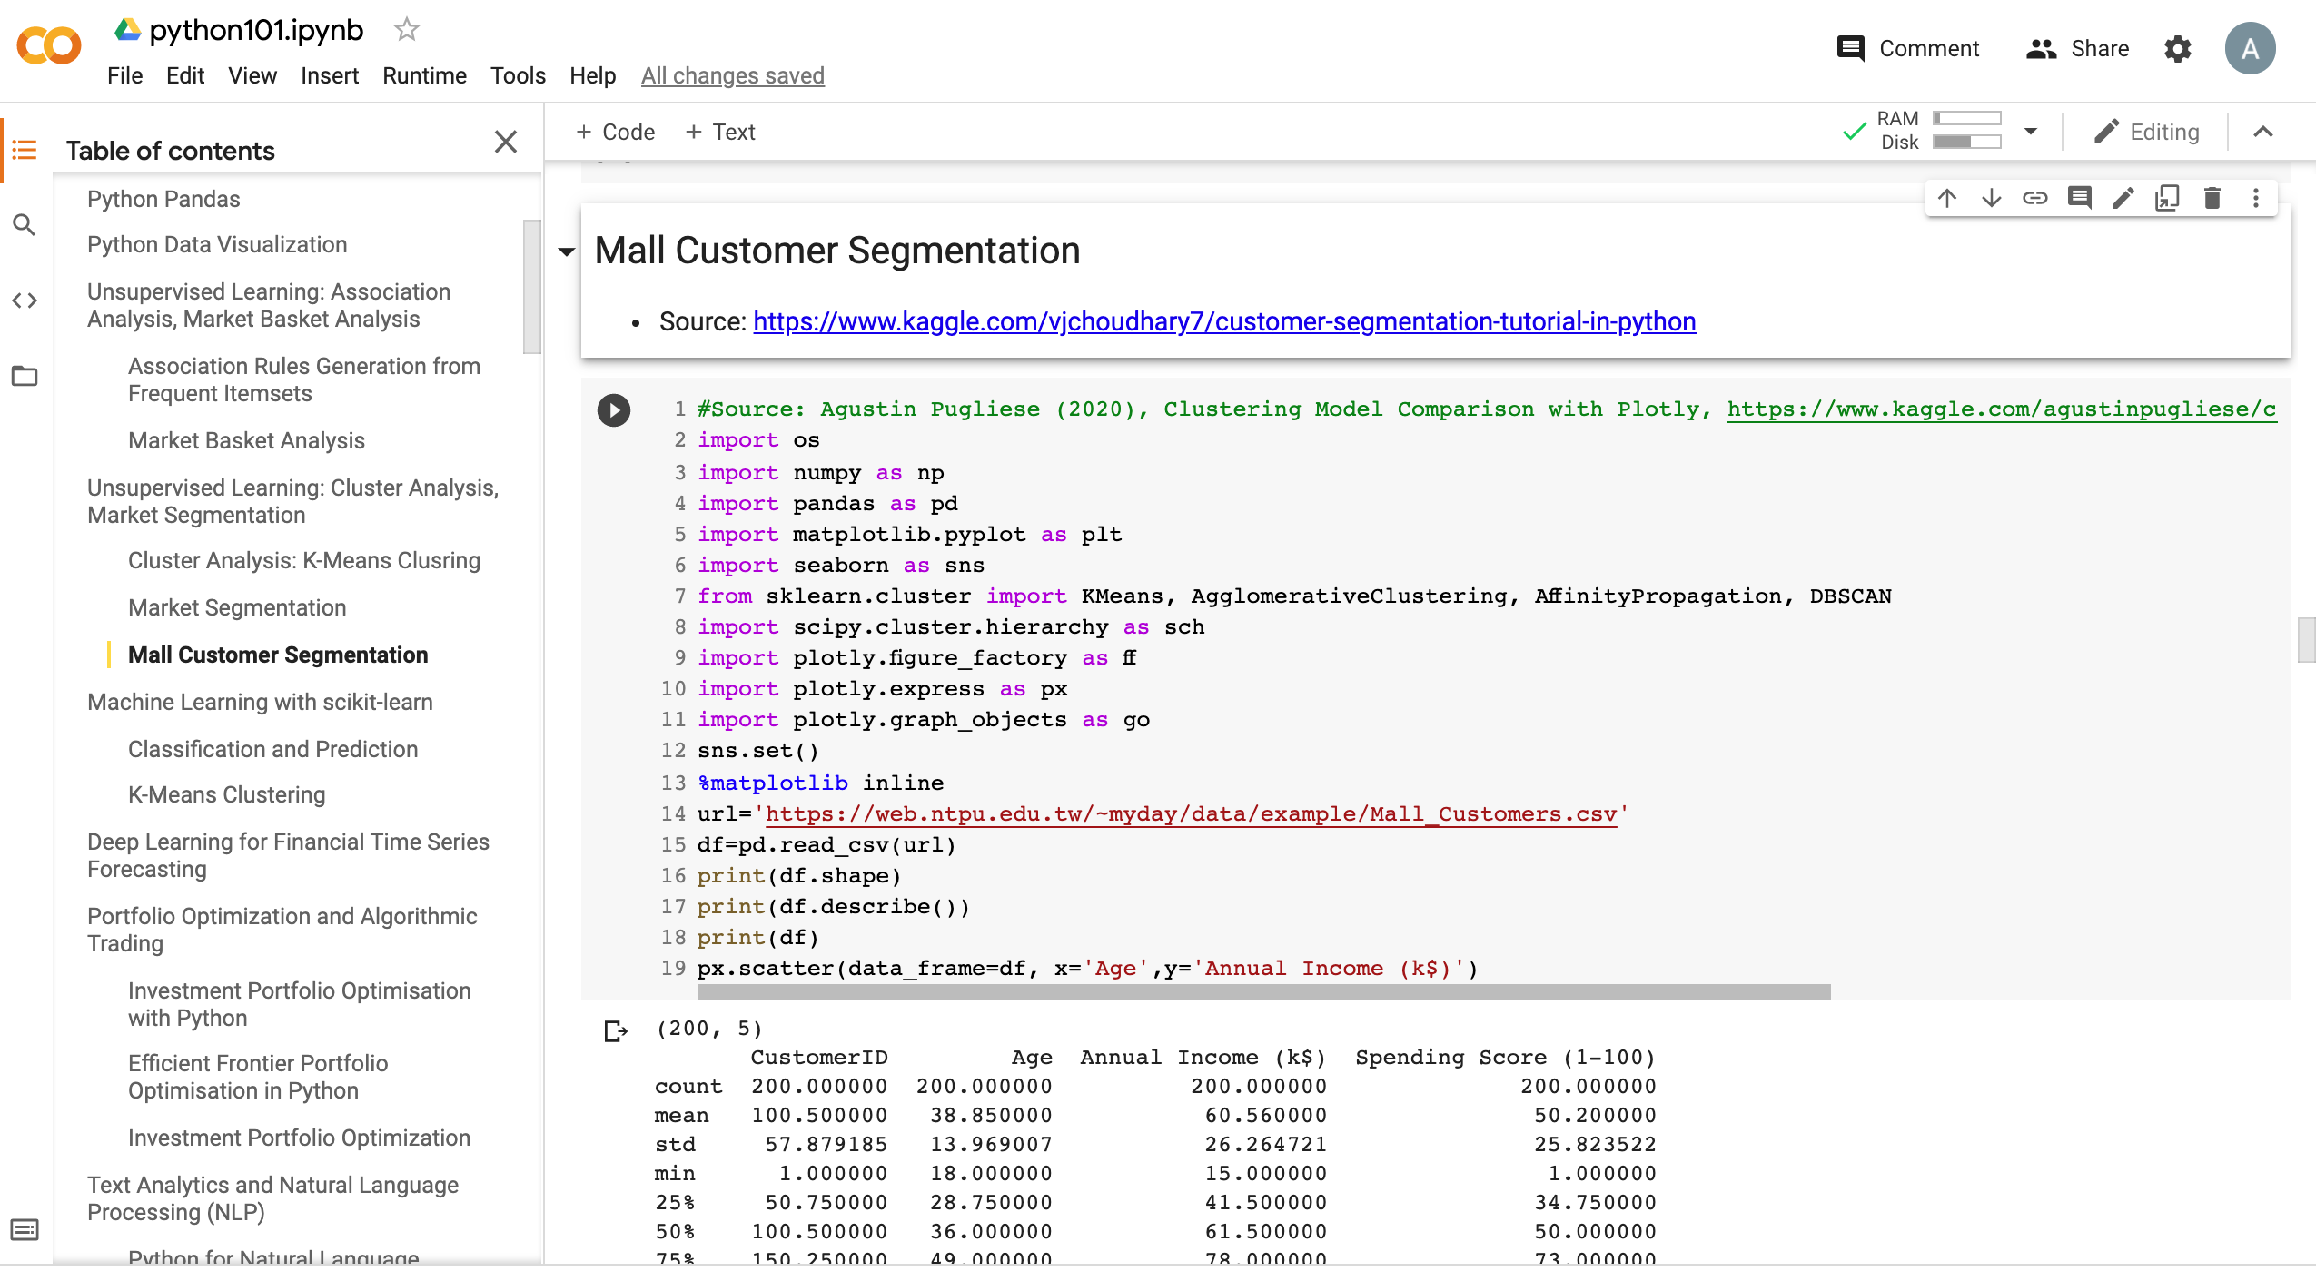
Mall Customer Segmentation
https://tinyurl.com/aintpupython101

Slide 134
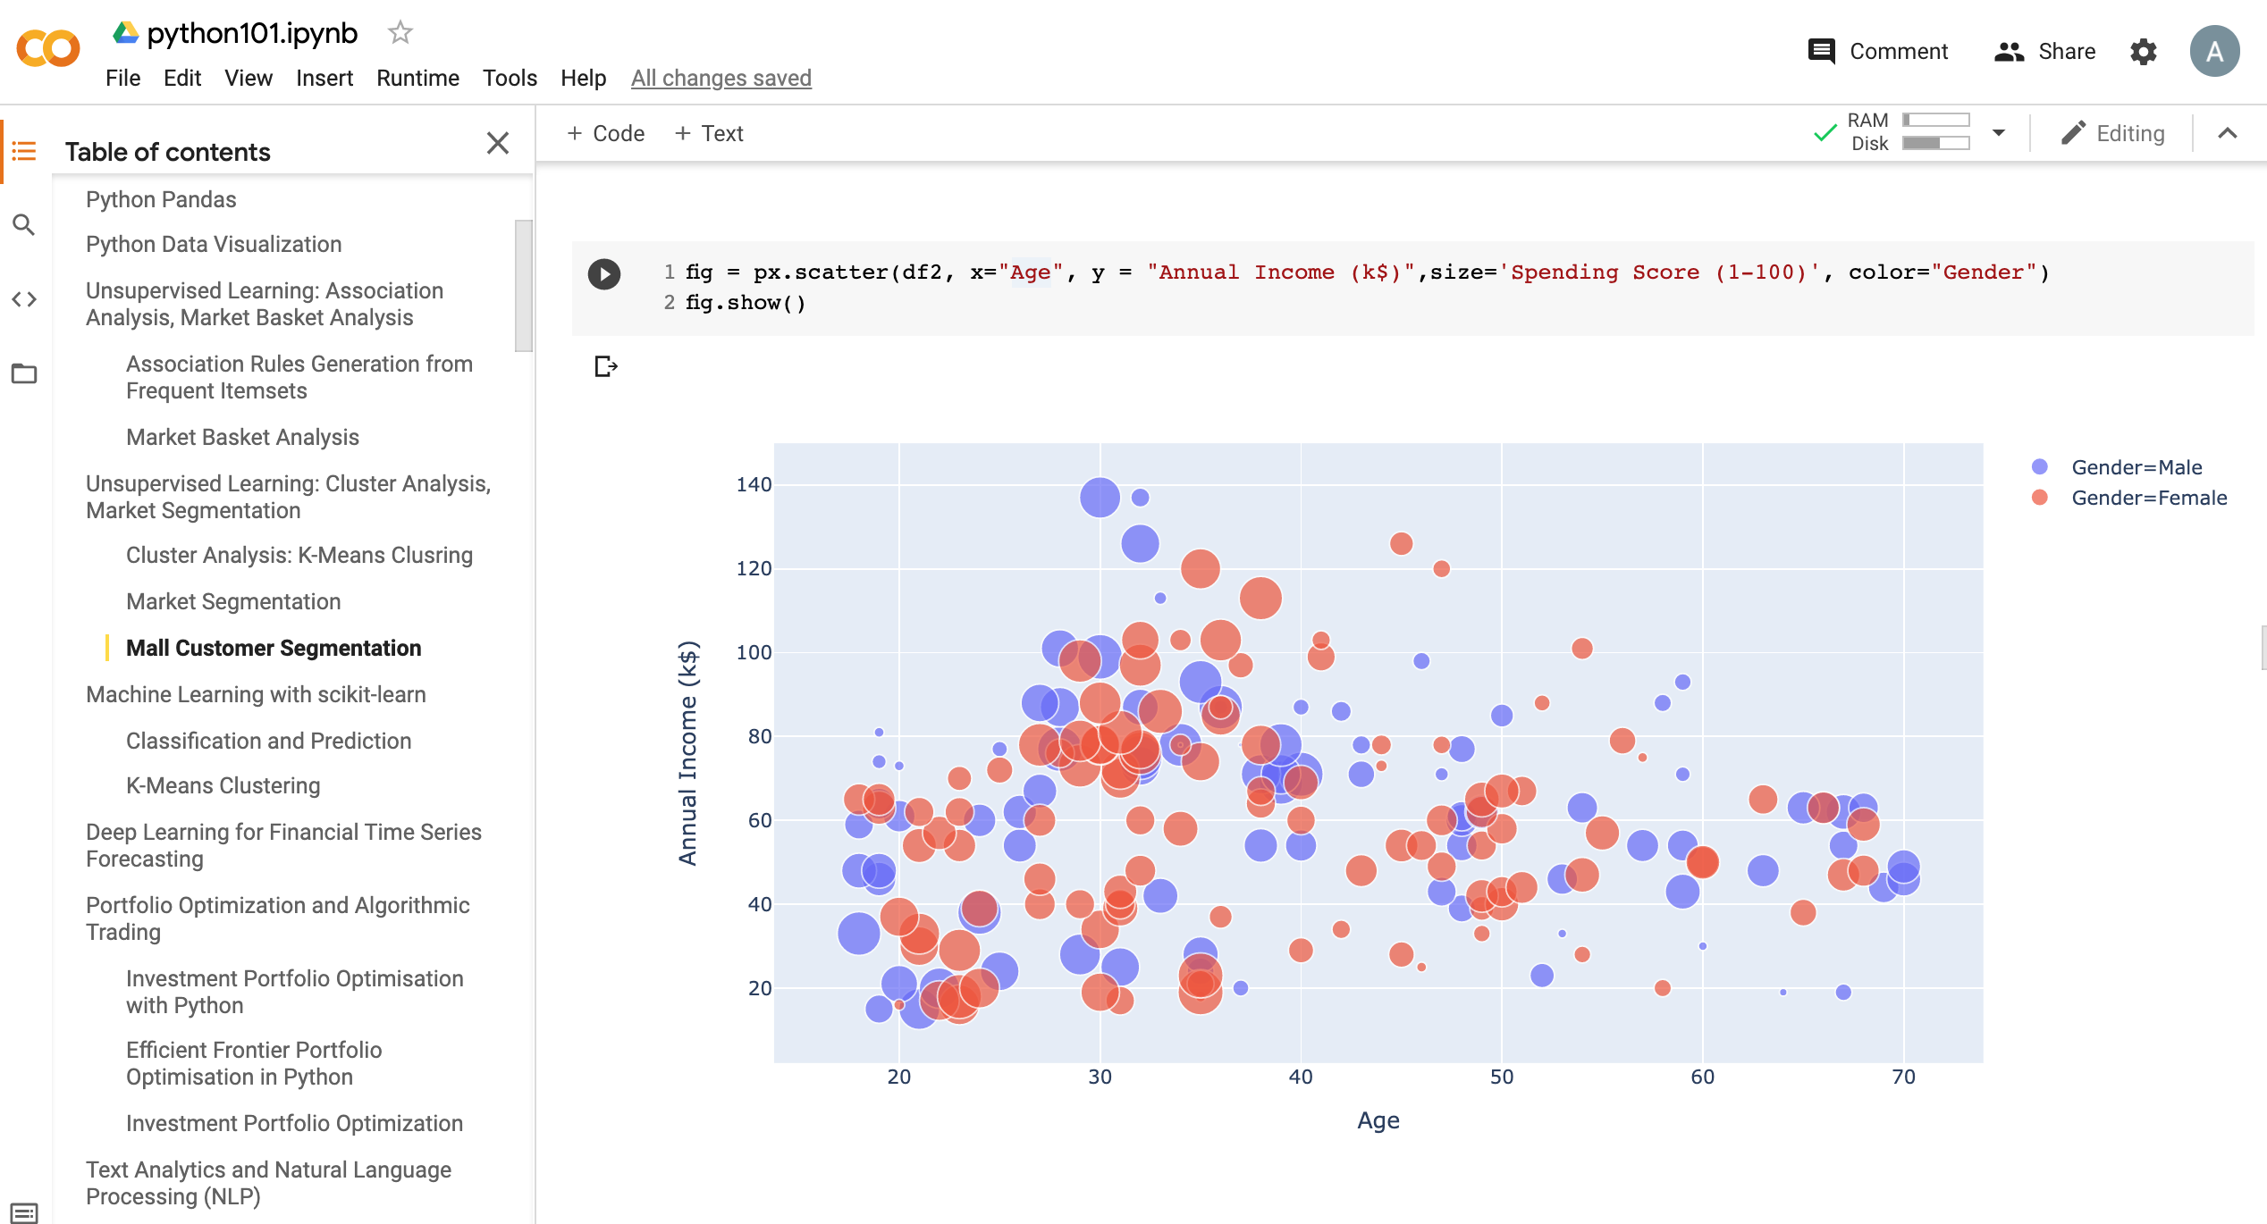
Mall Customer Segmentation
https://tinyurl.com/aintpupython101

Slide 135
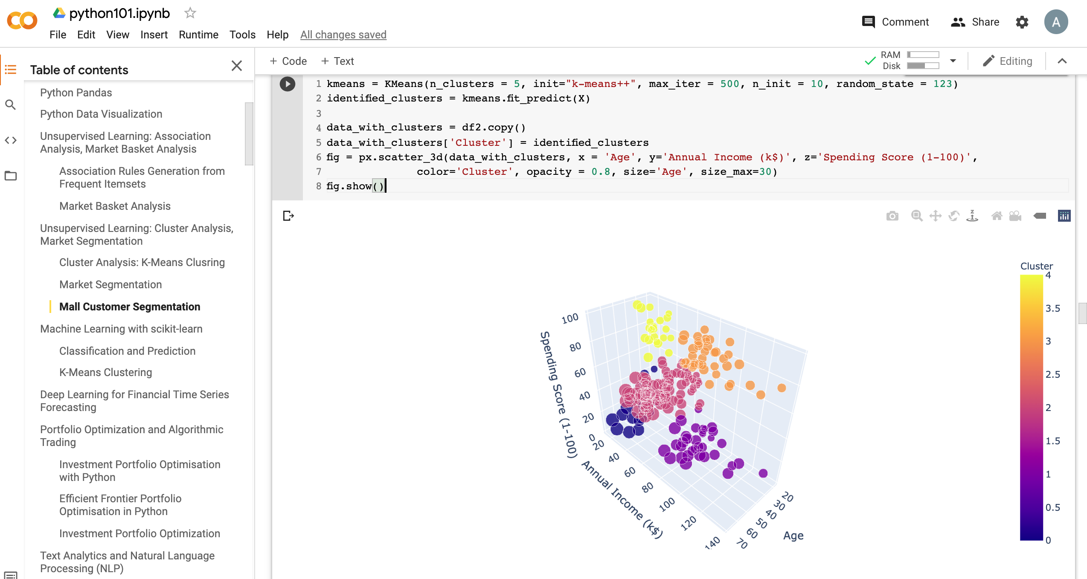
Mall Customer Segmentation
https://tinyurl.com/aintpupython101

Slide 136
Machine Learning:
Unsupervised Learning:
Association Analysis, Market Basket Analysis

Slide 137
Machine Learning: Data Mining Tasks & Methods
Unsupervised Learning:
Association Analysis
Market-basket
Association
Source: Ramesh Sharda, Dursun Delen, and Efraim Turban (2017), Business Intelligence, Analytics, and Data Science: A Managerial Perspective, 4th Edition, Pearson

Slide 138
Transaction Database
Transaction ID | Items bought
T01 | A, B, D
T02 | A, C, D
T03 | B, C, D, E
T04 | A, B, D
T05 | A, B, C, E
T06 | A, C
T07 | B, C, D
T08 | B, D
T09 | A, C, E
T10 | B, D

Slide 139
Association Analysis

Slide 140
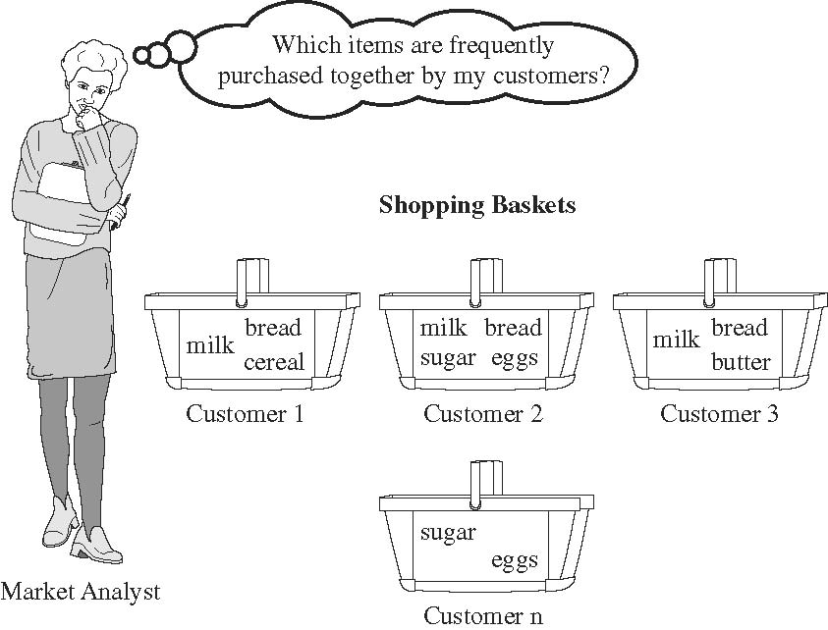
Market Basket Analysis
Source: Han & Kamber (2006)

Slide 141
Python mlxtend Association Rules
# !pip install mlxtend
import pandas as pd
from mlxtend.preprocessing import TransactionEncoder
from mlxtend.frequent_patterns import apriori
from mlxtend.frequent_patterns import association_rules
dataset = [['A', 'B', 'D’],
['A', 'C', 'D'],
['B', 'C', 'D', 'E'],
['A', 'B', 'D’],
['A', 'B', 'C', 'E’],
['A', 'C’],
['B', 'C', 'D’],
['B', 'D’],
['A', 'C', 'E'],
['B', 'D']]
te = TransactionEncoder()
te_ary = te.fit(dataset).transform(dataset)
df = pd.DataFrame(te_ary, columns=te.columns_)
frequent_itemsets = apriori(df, min_support=0.2, use_colnames=True)
association_rules(frequent_itemsets, metric="confidence", min_threshold=0.8)
https://tinyurl.com/aintpupython101

Slide 142
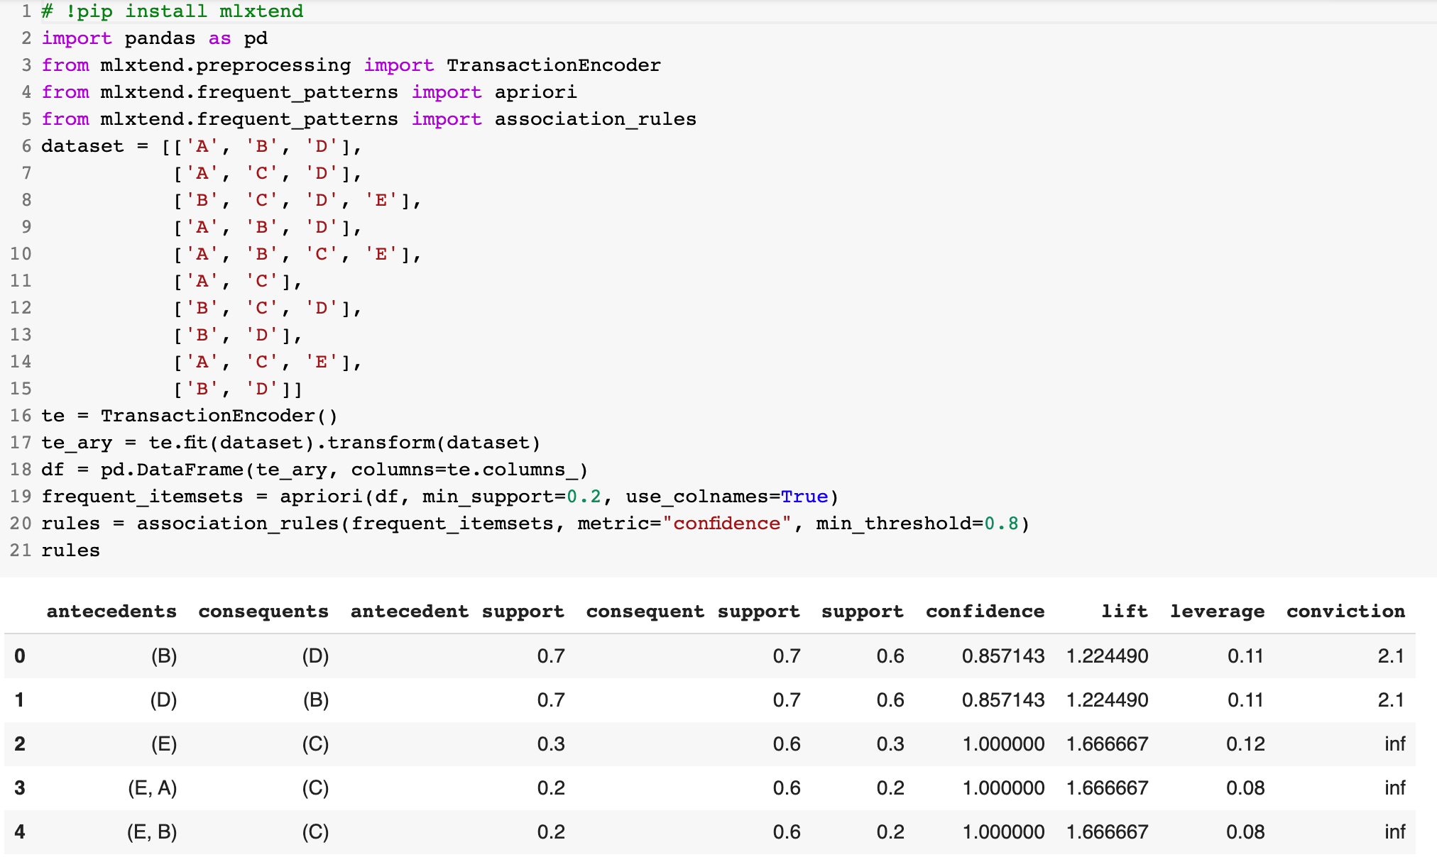
Python mlxtend Association Rules
https://tinyurl.com/aintpupython101

Slide 143
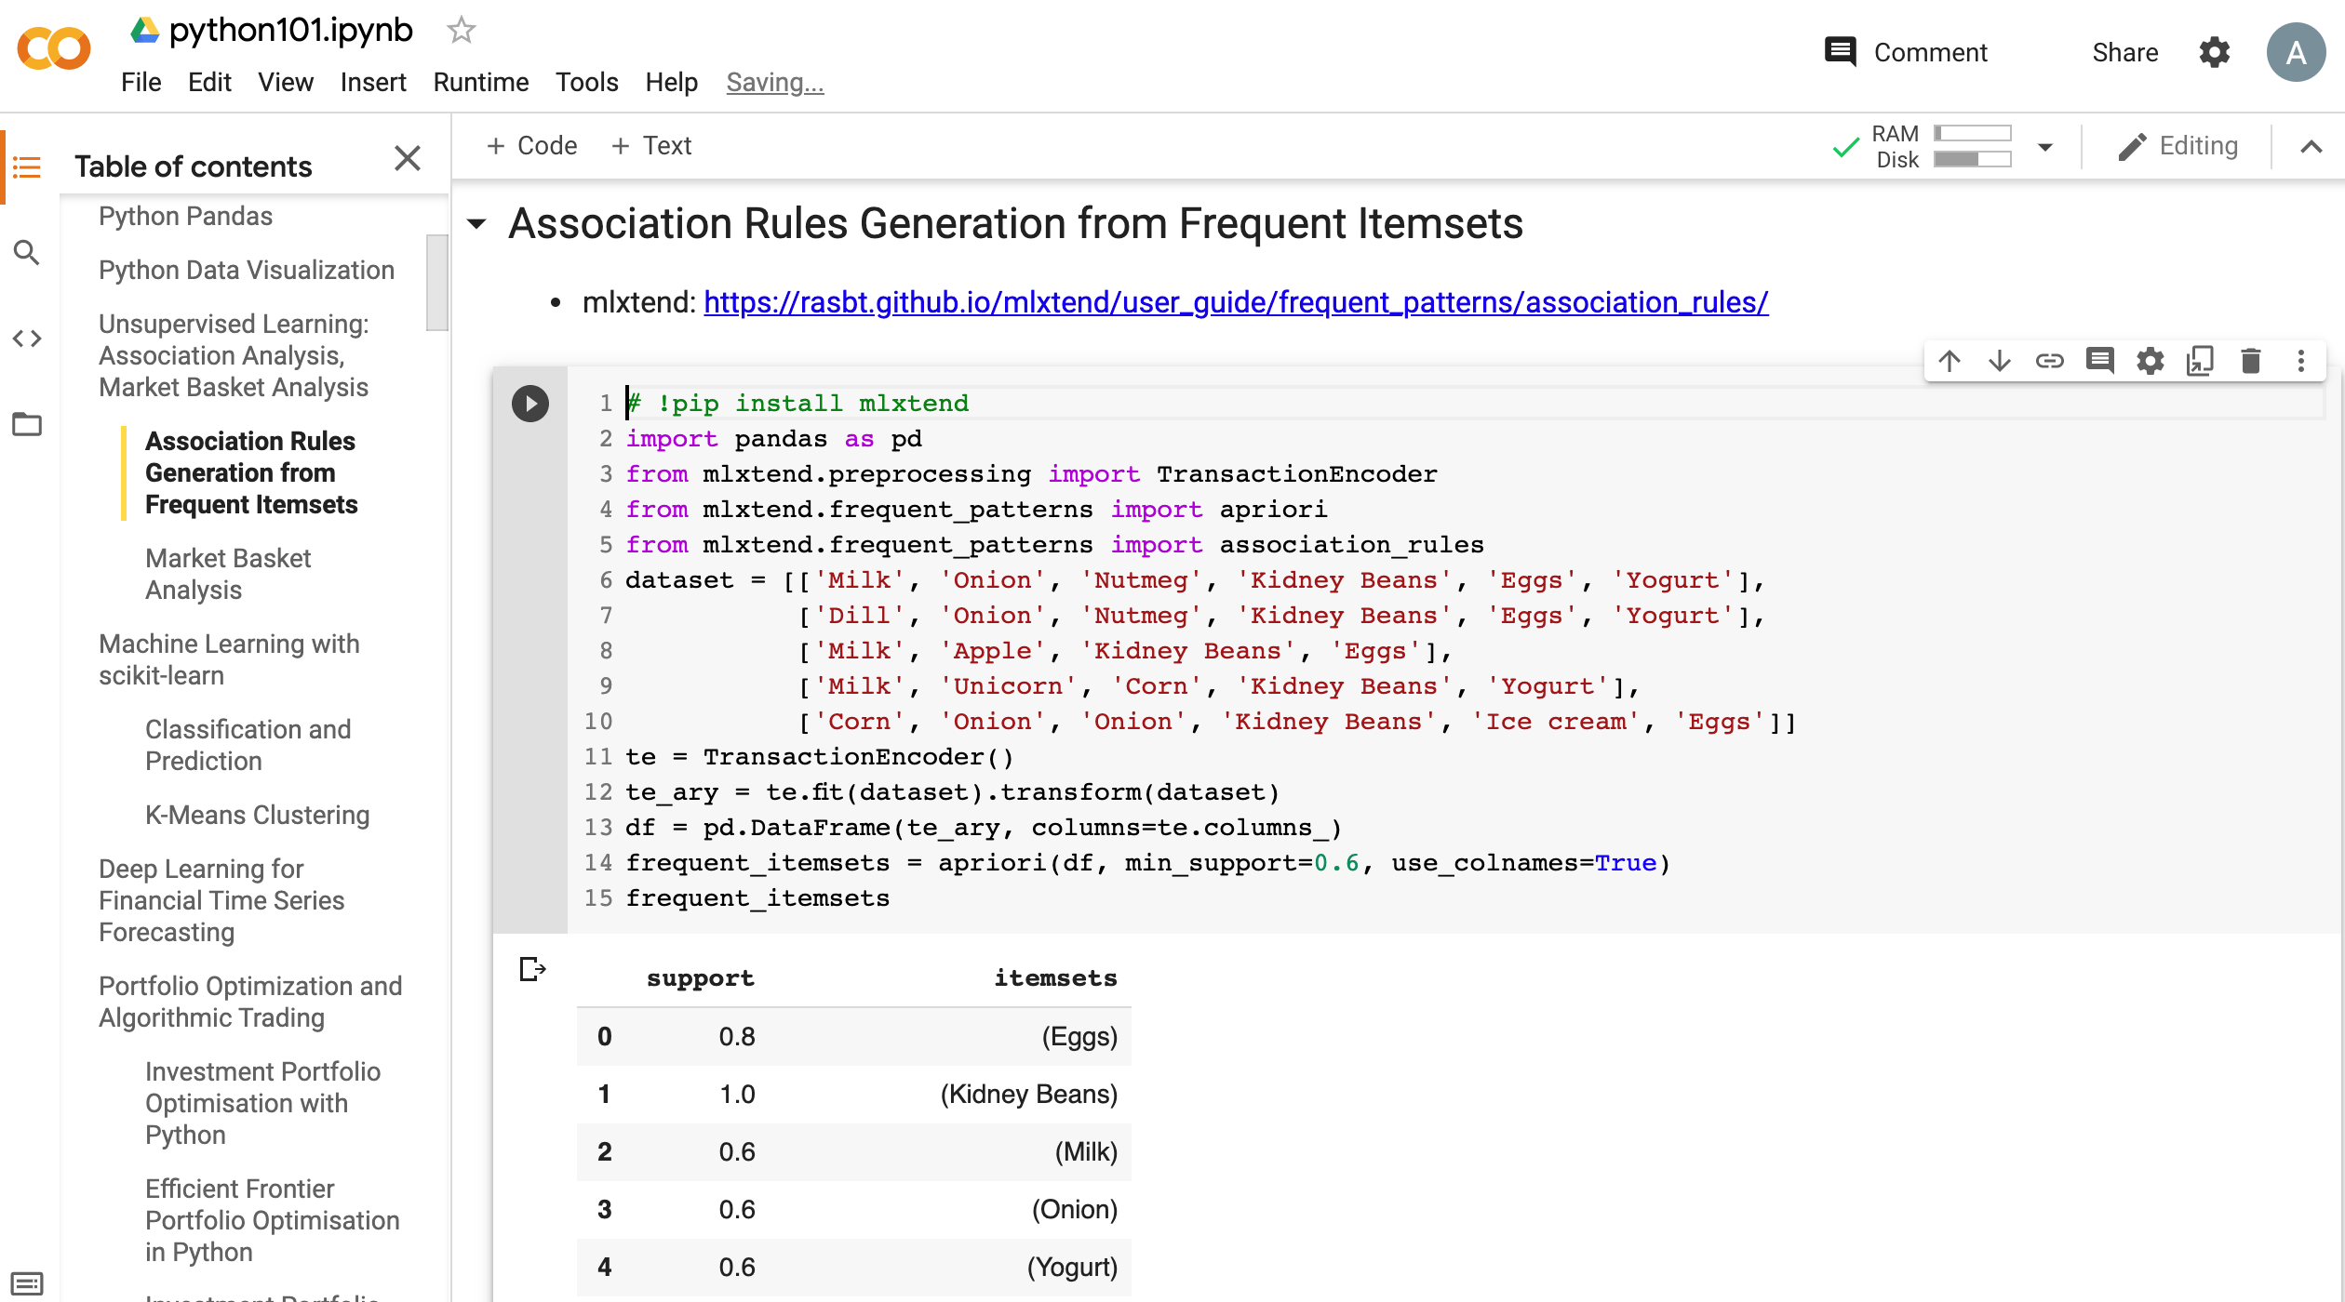
Python in Google Colab (Python101)
https://colab.research.google.com/drive/1FEG6DnGvwfUbeo4zJ1zTunjMqf2RkCrT
https://tinyurl.com/aintpupython101

Slide 144
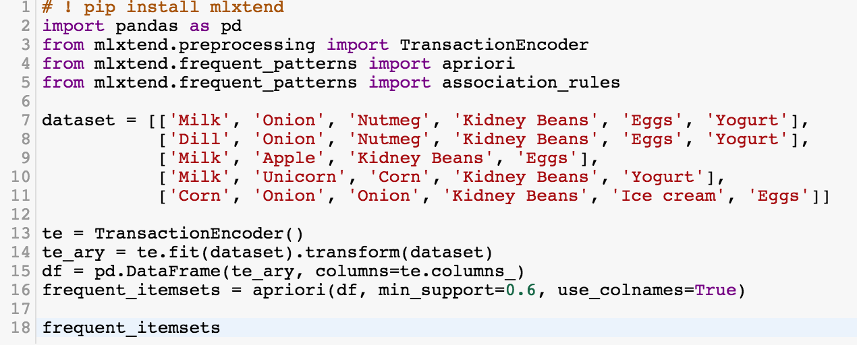
# ! pip install mlxtend
from mlxtend.frequent_patterns import apriori
from mlxtend.frequent_patterns import association_rules
frequent_itemsets = apriori(df, min_support=0.6, use_colnames=True)
https://tinyurl.com/aintpupython101

Slide 145
# ! pip install mlxtend
import pandas as pd
from mlxtend.preprocessing import TransactionEncoder
from mlxtend.frequent_patterns import apriori
from mlxtend.frequent_patterns import association_rules
dataset = [['Milk', 'Onion', 'Nutmeg', 'Kidney Beans', 'Eggs', 'Yogurt'],
['Dill', 'Onion', 'Nutmeg', 'Kidney Beans', 'Eggs', 'Yogurt'],
['Milk', 'Apple', 'Kidney Beans', 'Eggs'],
['Milk', 'Unicorn', 'Corn', 'Kidney Beans', 'Yogurt'],
['Corn', 'Onion', 'Onion', 'Kidney Beans', 'Ice cream', 'Eggs']]
te = TransactionEncoder()
te_ary = te.fit(dataset).transform(dataset)
df = pd.DataFrame(te_ary, columns=te.columns_)
frequent_itemsets = apriori(df, min_support=0.6, use_colnames=True)
frequent_itemsets
https://tinyurl.com/aintpupython101

Slide 146
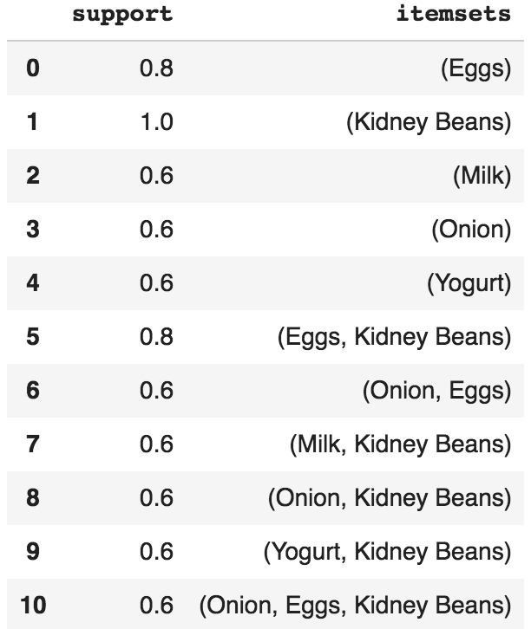
frequent_itemsets = apriori(df, min_support=0.6, use_colnames=True)
https://tinyurl.com/aintpupython101

Slide 147
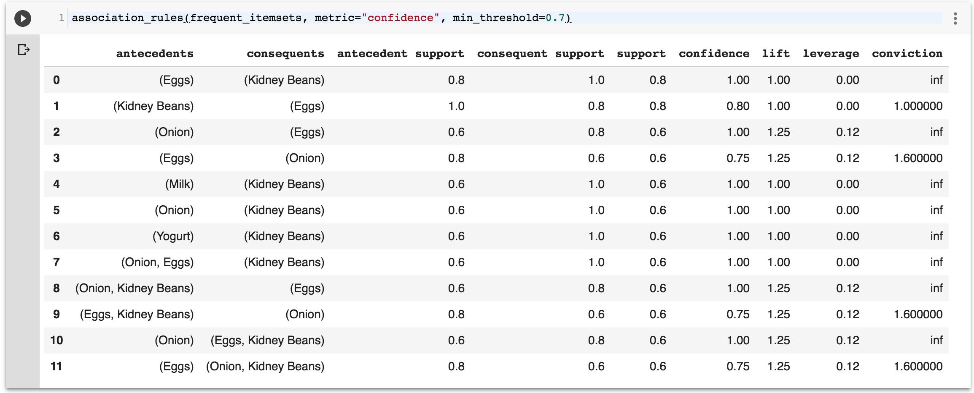
association_rules(frequent_itemsets, metric="confidence", min_threshold=0.7)
https://tinyurl.com/aintpupython101

Slide 148
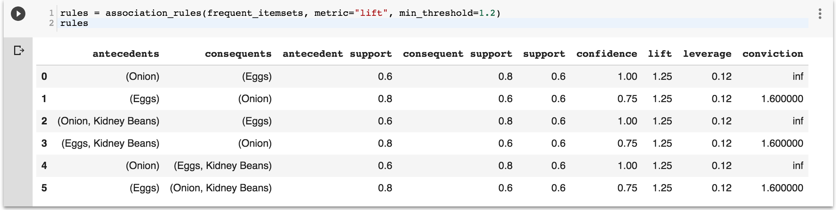
rules = association_rules(frequent_itemsets, metric="lift", min_threshold=1.2)
rules
https://tinyurl.com/aintpupython101

Slide 149
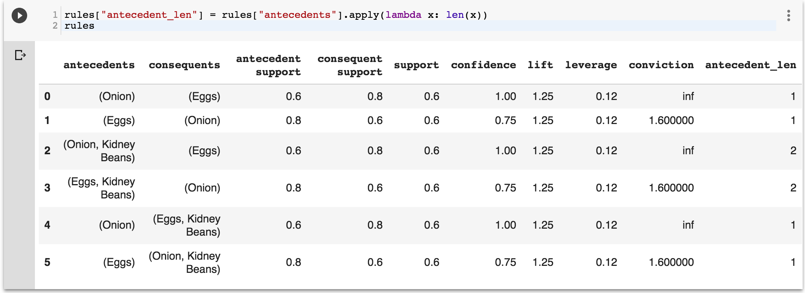
rules["antecedent_len"] = rules["antecedents"].apply(lambda x: len(x))
rules
https://tinyurl.com/aintpupython101

Slide 150

rules[ (rules['antecedent_len'] >= 2) &
(rules['confidence'] > 0.75) &
(rules['lift'] > 1.2) ]
https://tinyurl.com/aintpupython101

Slide 151

rules[rules['antecedents'] == {'Eggs', 'Kidney Beans’}]
https://tinyurl.com/aintpupython101

Slide 152

Aurélien Géron (2019),
Hands-On Machine Learning with Scikit-Learn, Keras, and TensorFlow: Concepts, Tools, and Techniques to Build Intelligent Systems, 2nd Edition
O’Reilly Media, 2019
https://github.com/ageron/handson-ml2
Source: https://www.amazon.com/Hands-Machine-Learning-Scikit-Learn-TensorFlow/dp/1492032646/

Slide 153

Hands-On Machine Learning with
Scikit-Learn, Keras, and TensorFlow
Notebooks
The Machine Learning landscape
End-to-end Machine Learning project
Classification
Training Models
Support Vector Machines
Decision Trees
Ensemble Learning and Random Forests
Dimensionality Reduction
Unsupervised Learning Techniques
Artificial Neural Nets with Keras
Training Deep Neural Networks
Custom Models and Training with TensorFlow
Loading and Preprocessing Data
Deep Computer Vision Using Convolutional Neural Networks
Processing Sequences Using RNNs and CNNs
Natural Language Processing with RNNs and Attention
Representation Learning Using Autoencoders
Reinforcement Learning
Training and Deploying TensorFlow Models at Scale
https://github.com/ageron/handson-ml2

Slide 154
Python in Google Colab (Python101)
https://colab.research.google.com/drive/1FEG6DnGvwfUbeo4zJ1zTunjMqf2RkCrT
https://tinyurl.com/aintpupython101

Slide 155
Stuart Russell and Peter Norvig (2020),
Artificial Intelligence: A Modern Approach,
4th Edition, Pearson
Source: Stuart Russell and Peter Norvig (2020), Artificial Intelligence: A Modern Approach, 4th Edition, Pearson
https://www.amazon.com/Artificial-Intelligence-A-Modern-Approach/dp/0134610997/

Slide 156
Artificial Intelligence: A Modern Approach (AIMA)
Artificial Intelligence: A Modern Approach (AIMA)
  http://aima.cs.berkeley.edu/
AIMA Python
  http://aima.cs.berkeley.edu/python/readme.html
  https://github.com/aimacode/aima-python
Learning
  http://aima.cs.berkeley.edu/python/learning.html
Source: Stuart Russell and Peter Norvig (2020), Artificial Intelligence: A Modern Approach, 4th Edition, Pearson

Slide 157

Artificial Intelligence: A Modern Approach (AIMA)
http://aima.cs.berkeley.edu/

Slide 158

Papers with Code
State-of-the-Art (SOTA)
https://paperswithcode.com/sota

Slide 159
Summary
Machine Learning
Supervised Learning
Unsupervised Learning

Slide 160
References
Stuart Russell and Peter Norvig (2020), Artificial Intelligence: A Modern Approach, 4th Edition, Pearson.
Aurélien Géron (2019), Hands-On Machine Learning with Scikit-Learn, Keras, and TensorFlow: Concepts, Tools, and Techniques to Build Intelligent Systems, 2nd Edition, O’Reilly Media.
Steven D'Ascoli (2022), Artificial Intelligence and Deep Learning with Python: Every Line of Code Explained For Readers New to AI and New to Python, Independently published.
Nithin Buduma, Nikhil Buduma, Joe Papa (2022), Fundamentals of Deep Learning: Designing Next-Generation Machine Intelligence Algorithms, 2nd Edition, ‎O'Reilly Media.

