Slide 1


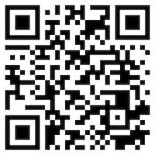





Problem Solving
Artificial Intelligence
1111AI03
MBA, IM, NTPU (M6132) (Fall 2022)
Wed 2, 3, 4 (9:10-12:00) (B8F40)
Min-Yuh Day, Ph.D,
Associate Professor
Institute of Information Management, National Taipei University
https://web.ntpu.edu.tw/~myday
https://meet.google.com/miy-fbif-max
2022-09-28

Slide 2
Syllabus
Week Date Subject/Topics
1 2022/09/14 Introduction to Artificial Intelligence
2 2022/09/21 Artificial Intelligence and Intelligent Agents
3 2022/09/28 Problem Solving
4 2022/10/05 Knowledge, Reasoning and Knowledge Representation;
Uncertain Knowledge and Reasoning
5 2022/10/12 Case Study on Artificial Intelligence I
6 2022/10/19 Machine Learning: Supervised and Unsupervised Learning

Slide 3
Syllabus
Week Date Subject/Topics
7 2022/10/26 The Theory of Learning and Ensemble Learning
8 2022/11/02 Midterm Project Report
9 2022/11/09 Deep Learning and Reinforcement Learning
10 2022/11/16 Deep Learning for Natural Language Processing
11 2022/11/23 Invited Talk: AI for Information Retrieval
12 2022/11/30 Case Study on Artificial Intelligence II

Slide 4
Syllabus
Week Date Subject/Topics
13 2022/12/07 Computer Vision and Robotics
14 2022/12/14 Philosophy and Ethics of AI and the Future of AI
15 2022/12/21 Final Project Report I
16 2022/12/28 Final Project Report II
17 2023/01/04 Self-learning
18 2023/01/11 Self-learning

Slide 5
Artificial Intelligence
Problem Solving

Slide 6
Outline
Solving Problems by Searching
Search in Complex Environments
Adversarial Search and Games
Constraint Satisfaction Problems

Slide 7
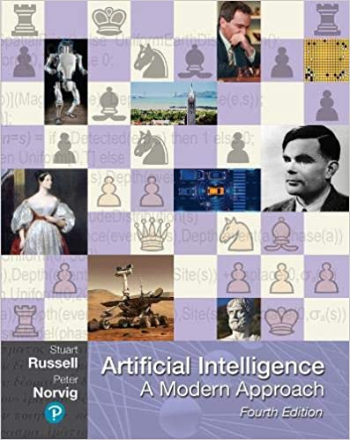
Stuart Russell and Peter Norvig (2020),
Artificial Intelligence: A Modern Approach,
4th Edition, Pearson
Source: Stuart Russell and Peter Norvig (2020), Artificial Intelligence: A Modern Approach, 4th Edition, Pearson
https://www.amazon.com/Artificial-Intelligence-A-Modern-Approach/dp/0134610997/

Slide 8
Artificial Intelligence:
A Modern Approach
Artificial Intelligence
Problem Solving
Knowledge and Reasoning
Uncertain Knowledge and Reasoning
Machine Learning
Communicating, Perceiving, and Acting
Philosophy and Ethics of AI
Source: Stuart Russell and Peter Norvig (2020), Artificial Intelligence: A Modern Approach, 4th Edition, Pearson

Slide 9
Artificial Intelligence:
Problem Solving
Source: Stuart Russell and Peter Norvig (2020), Artificial Intelligence: A Modern Approach, 4th Edition, Pearson

Slide 10
Artificial Intelligence:
2. Problem Solving
Solving Problems by Searching
Search in Complex Environments
Adversarial Search and Games
Constraint Satisfaction Problems
Source: Stuart Russell and Peter Norvig (2020), Artificial Intelligence: A Modern Approach, 4th Edition, Pearson

Slide 11
Intelligent Agents
Source: Stuart Russell and Peter Norvig (2020), Artificial Intelligence: A Modern Approach, 4th Edition, Pearson

Slide 12
4 Approaches of AI
2. Thinking Humanly: The Cognitive Modeling Approach | 3. Thinking Rationally: The “Laws of Thought” Approach
1. Acting Humanly: The Turing Test Approach (1950) | 4. Acting Rationally: The Rational Agent Approach
Source: Stuart Russell and Peter Norvig (2020), Artificial Intelligence: A Modern Approach, 4th Edition, Pearson

Slide 13
Reinforcement Learning (DL)
Agent
Environment
Source: Richard S. Sutton & Andrew G. Barto (2018), Reinforcement Learning: An Introduction, 2nd Edition, A Bradford Book.

Slide 14
Reinforcement Learning (DL)
1
2
observation
Agent
action
3
reward
Environment
Source: Richard S. Sutton & Andrew G. Barto (2018), Reinforcement Learning: An Introduction, 2nd Edition, A Bradford Book.

Slide 15
Reinforcement Learning (DL)
1
2
observation
Agent
action
O_{t}
A_{t}
3
reward
R_{t}
Environment
Source: Richard S. Sutton & Andrew G. Barto (2018), Reinforcement Learning: An Introduction, 2nd Edition, A Bradford Book.

Slide 16
Agents interact with environments through sensors and actuators
Source: Stuart Russell and Peter Norvig (2020), Artificial Intelligence: A Modern Approach, 4th Edition, Pearson

Slide 17
Solving Problems by
Searching
Source: Stuart Russell and Peter Norvig (2020), Artificial Intelligence: A Modern Approach, 4th Edition, Pearson

Slide 18
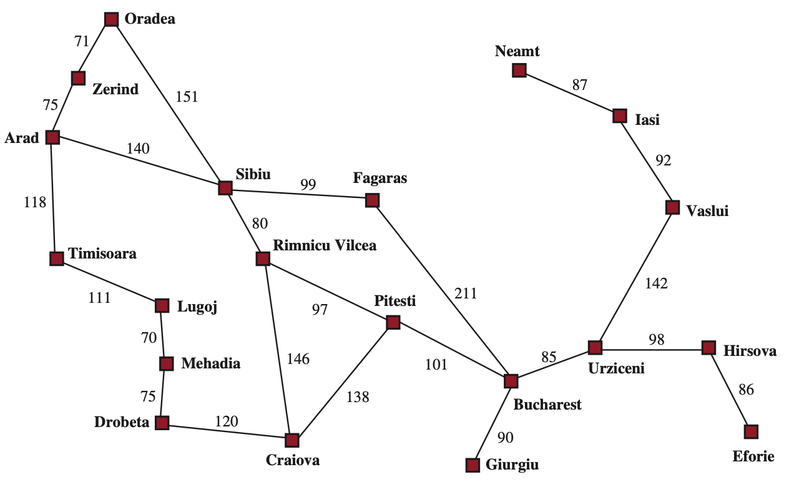
AI: Solving Problems by Searching
A simplified road map of part of Romania, with road distances in miles.
Source: Stuart Russell and Peter Norvig (2020), Artificial Intelligence: A Modern Approach, 4th Edition, Pearson

Slide 19
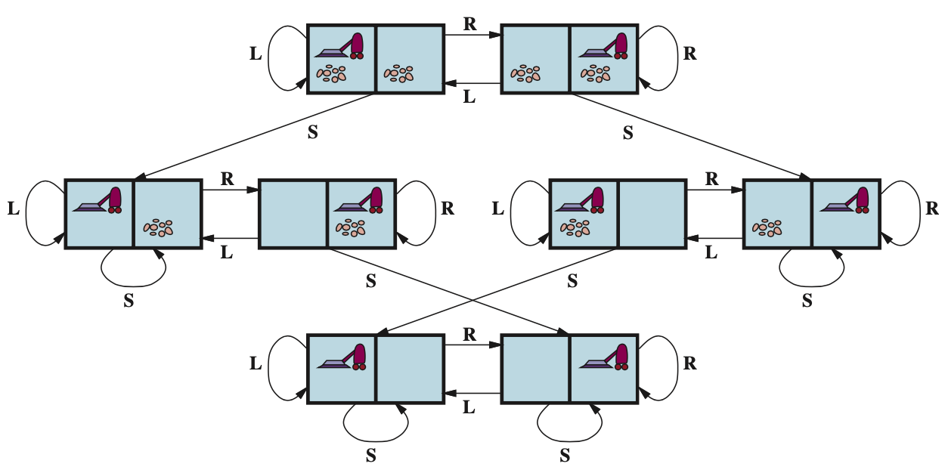
The state-space graph for the two-cell vacuum world
There are 8 states and three actions for each state:
L = Left, R = Right, S = Suck.
Source: Stuart Russell and Peter Norvig (2020), Artificial Intelligence: A Modern Approach, 4th Edition, Pearson

Slide 20
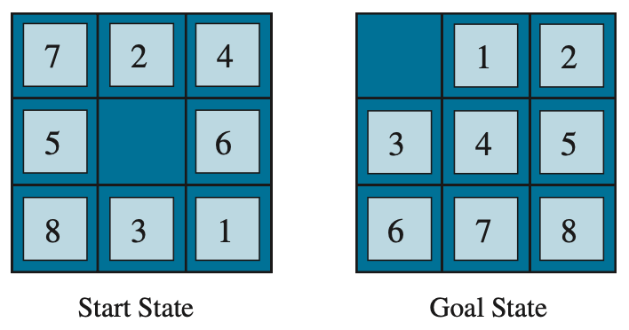
A typical instance of the 8-puzzle
Source: Stuart Russell and Peter Norvig (2020), Artificial Intelligence: A Modern Approach, 4th Edition, Pearson

Slide 21
Arad to Bucharest
Source: Stuart Russell and Peter Norvig (2020), Artificial Intelligence: A Modern Approach, 4th Edition, Pearson

Slide 22
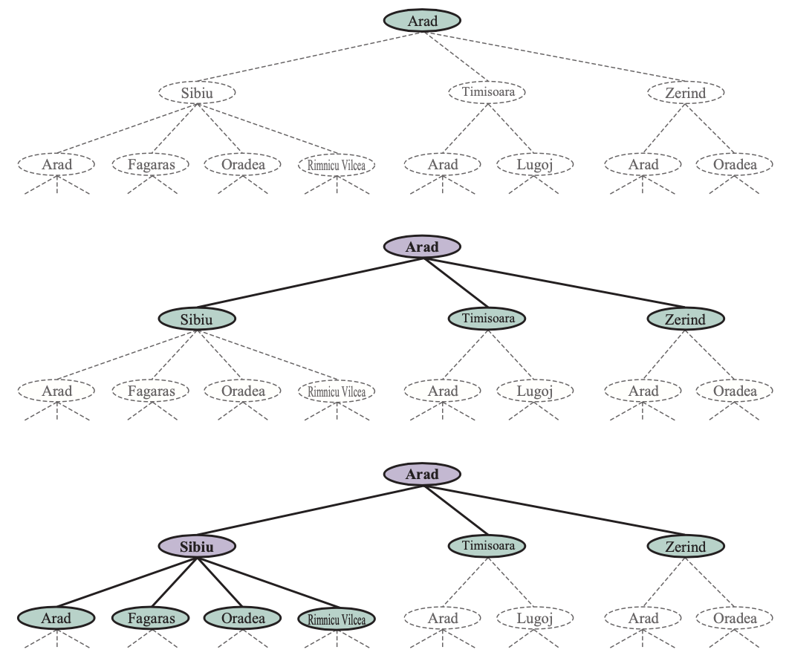
Three partial search trees for finding a route from Arad to Bucharest
Source: Stuart Russell and Peter Norvig (2020), Artificial Intelligence: A Modern Approach, 4th Edition, Pearson

Slide 23
Three partial search trees for finding a route from Arad to Bucharest
Source: Stuart Russell and Peter Norvig (2020), Artificial Intelligence: A Modern Approach, 4th Edition, Pearson

Slide 24
Three partial search trees for finding a route from Arad to Bucharest
Source: Stuart Russell and Peter Norvig (2020), Artificial Intelligence: A Modern Approach, 4th Edition, Pearson

Slide 25
Three partial search trees for finding a route from Arad to Bucharest
Source: Stuart Russell and Peter Norvig (2020), Artificial Intelligence: A Modern Approach, 4th Edition, Pearson

Slide 26
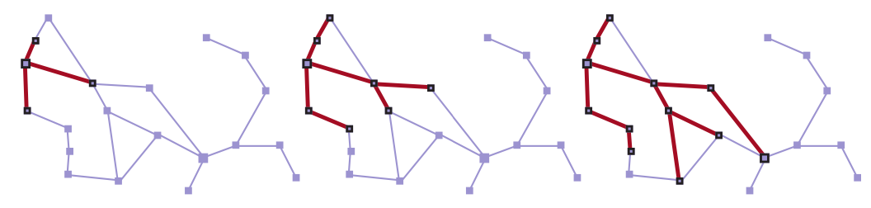
A sequence of search trees generated by a graph search on the Romania problem
Source: Stuart Russell and Peter Norvig (2020), Artificial Intelligence: A Modern Approach, 4th Edition, Pearson

Slide 27
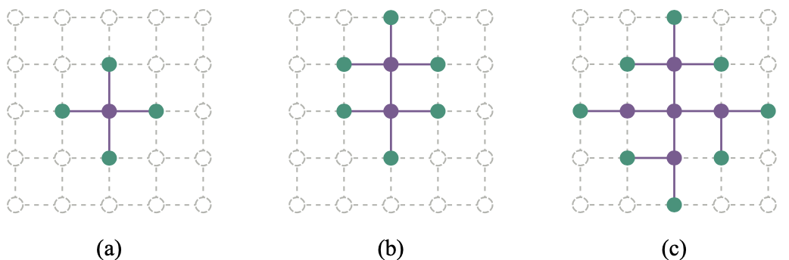
The Separation Property of
Graph Search illustrated on a rectangular-grid problem
The frontier (green) separates
the interior (lavender) from
the exterior (faint dashed)
Source: Stuart Russell and Peter Norvig (2020), Artificial Intelligence: A Modern Approach, 4th Edition, Pearson

Slide 28
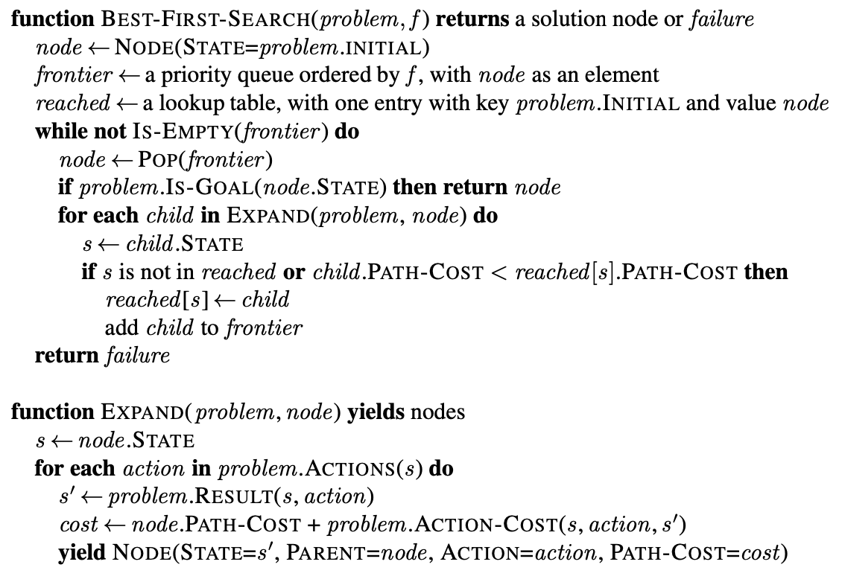
The Best-First Search (BFS) Algorithm
Source: Stuart Russell and Peter Norvig (2020), Artificial Intelligence: A Modern Approach, 4th Edition, Pearson

Slide 29
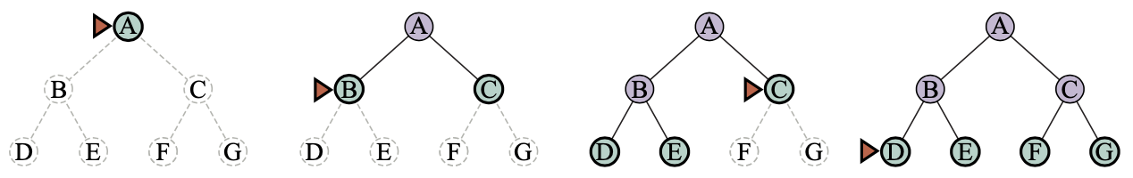
Breadth-First Search on a Simple Binary Tree
Bread-First Search
(BFS)
Source: Stuart Russell and Peter Norvig (2020), Artificial Intelligence: A Modern Approach, 4th Edition, Pearson

Slide 30
Breadth-First Search on a Simple Binary Tree
Bread-First Search
(BFS)
Source: Stuart Russell and Peter Norvig (2020), Artificial Intelligence: A Modern Approach, 4th Edition, Pearson

Slide 31
Breadth-First Search on a Simple Binary Tree
Bread-First Search
(BFS)
Source: Stuart Russell and Peter Norvig (2020), Artificial Intelligence: A Modern Approach, 4th Edition, Pearson

Slide 32
Breadth-First Search on a Simple Binary Tree
Bread-First Search
(BFS)
Source: Stuart Russell and Peter Norvig (2020), Artificial Intelligence: A Modern Approach, 4th Edition, Pearson

Slide 33
Breadth-First Search on a Simple Binary Tree
Bread-First Search
(BFS)
Source: Stuart Russell and Peter Norvig (2020), Artificial Intelligence: A Modern Approach, 4th Edition, Pearson

Slide 34
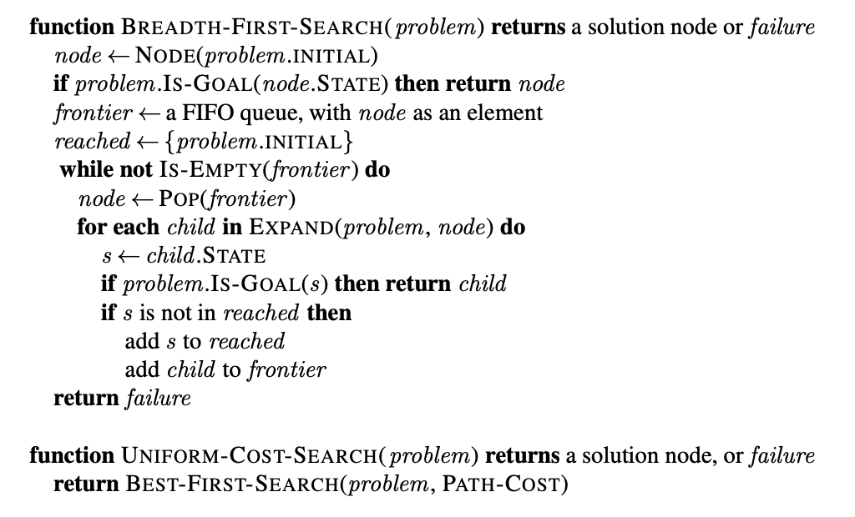
Breadth-First Search and
Uniform-Cost Search Algorithms
Source: Stuart Russell and Peter Norvig (2020), Artificial Intelligence: A Modern Approach, 4th Edition, Pearson

Slide 35
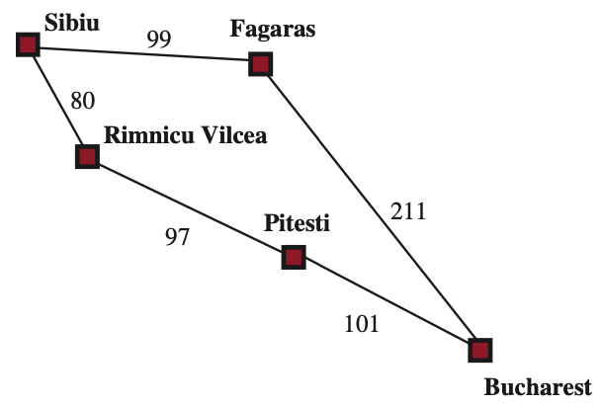
Part of the Romania State Space Uniform-Cost Search
Source: Stuart Russell and Peter Norvig (2020), Artificial Intelligence: A Modern Approach, 4th Edition, Pearson

Slide 36
Depth-First Search
(DFS)
Source: Stuart Russell and Peter Norvig (2020), Artificial Intelligence: A Modern Approach, 4th Edition, Pearson

Slide 37
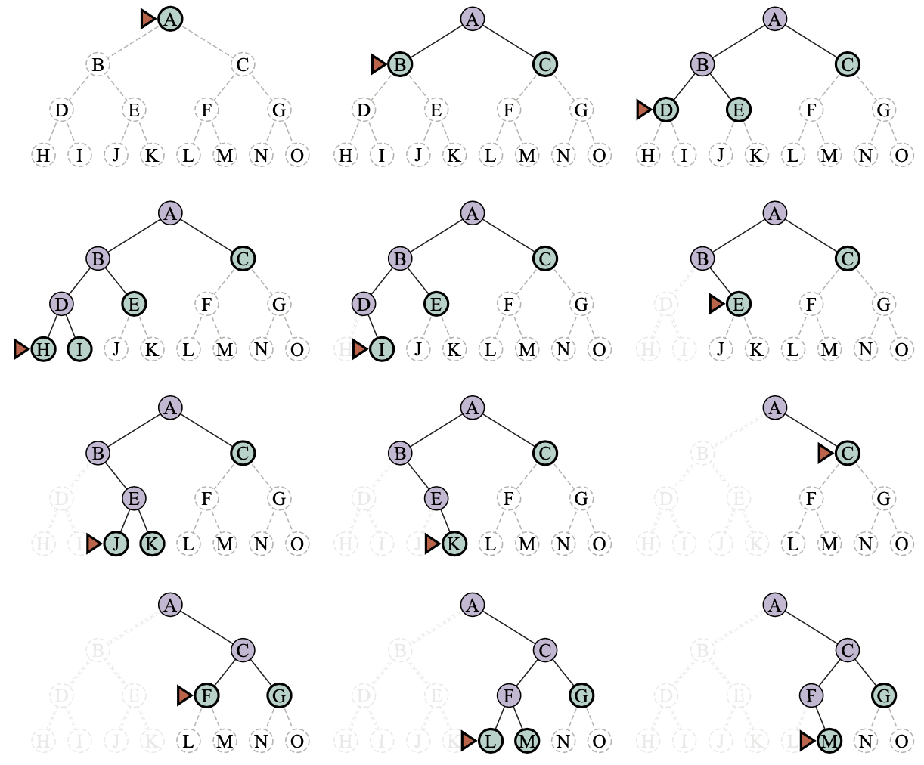
Depth-First Search
(DFS)
Source: Stuart Russell and Peter Norvig (2020), Artificial Intelligence: A Modern Approach, 4th Edition, Pearson

Slide 38
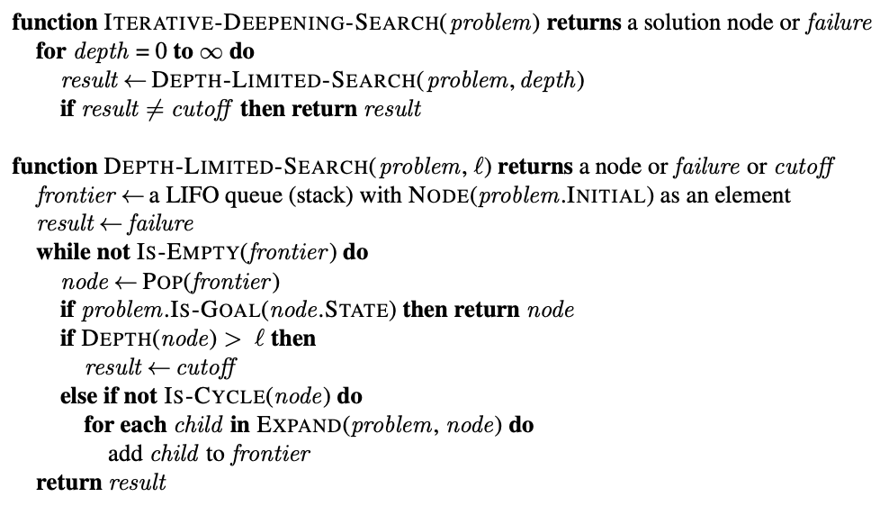
Iterative deepening and depth-limited tree-like search
Source: Stuart Russell and Peter Norvig (2020), Artificial Intelligence: A Modern Approach, 4th Edition, Pearson

Slide 39
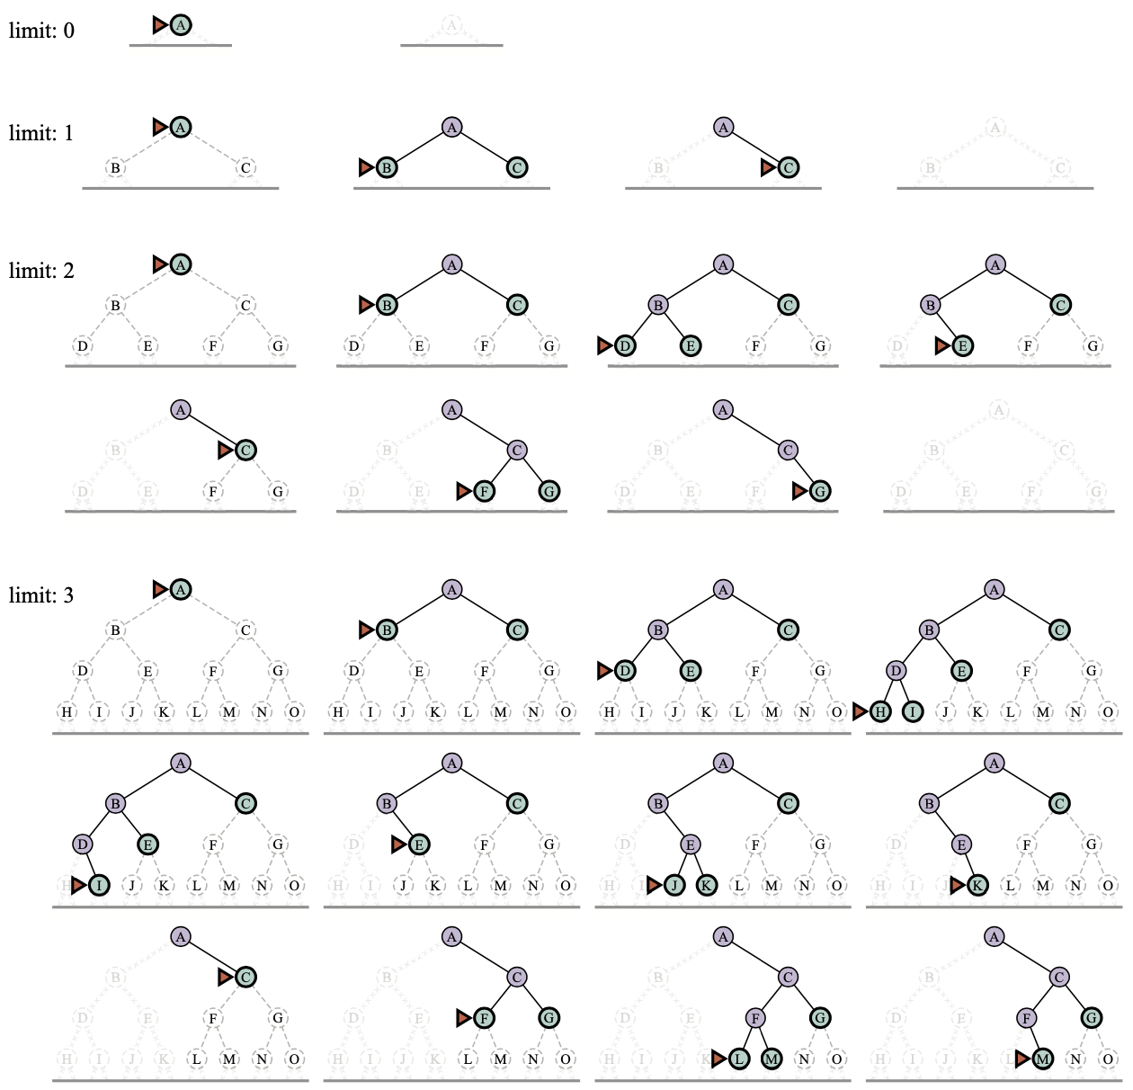
Four iterations of iterative deepening search
Source: Stuart Russell and Peter Norvig (2020), Artificial Intelligence: A Modern Approach, 4th Edition, Pearson

Slide 40
Four iterations of iterative deepening search
Source: Stuart Russell and Peter Norvig (2020), Artificial Intelligence: A Modern Approach, 4th Edition, Pearson

Slide 41
Four iterations of iterative deepening search
Source: Stuart Russell and Peter Norvig (2020), Artificial Intelligence: A Modern Approach, 4th Edition, Pearson

Slide 42
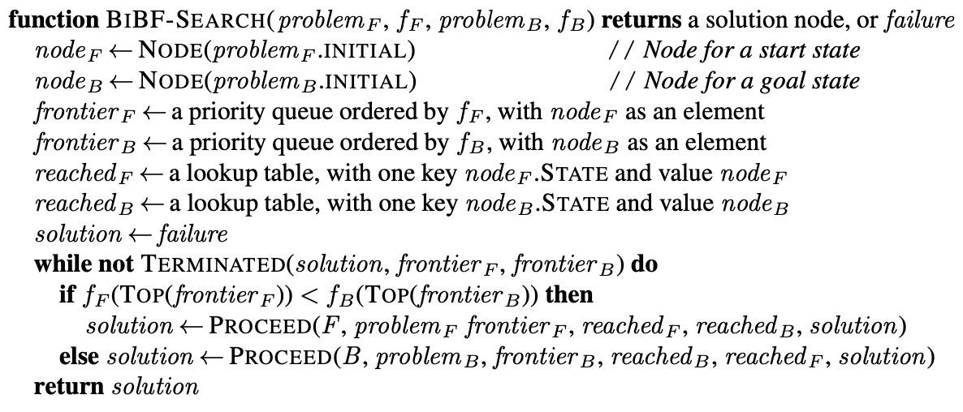
Bidirectional Best-First Search keeps two frontiers and two tables of reached states
Source: Stuart Russell and Peter Norvig (2020), Artificial Intelligence: A Modern Approach, 4th Edition, Pearson

Slide 43
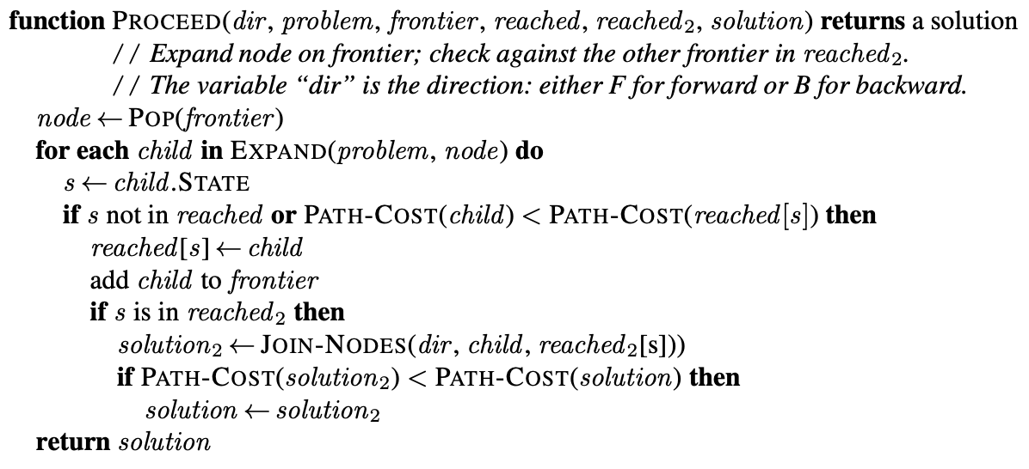
Bidirectional Best-First Search
keeps two frontiers and two tables of reached states
Source: Stuart Russell and Peter Norvig (2020), Artificial Intelligence: A Modern Approach, 4th Edition, Pearson

Slide 44
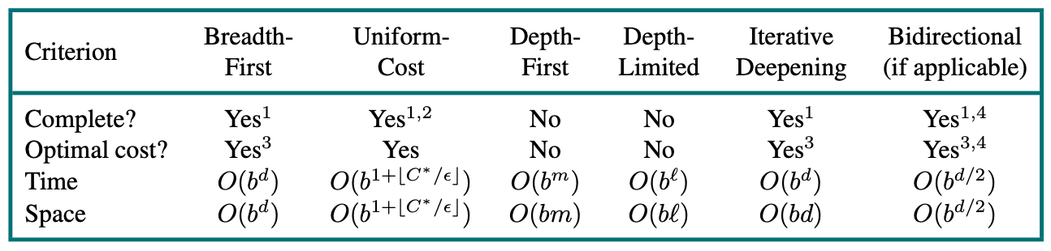
Evaluation of search algorithms
b is the branching factor; m is the maximum depth of the search tree;
d is the depth of the shallowest solution, or is m when there is no solution;
ℓ is the depth limit
Source: Stuart Russell and Peter Norvig (2020), Artificial Intelligence: A Modern Approach, 4th Edition, Pearson

Slide 45
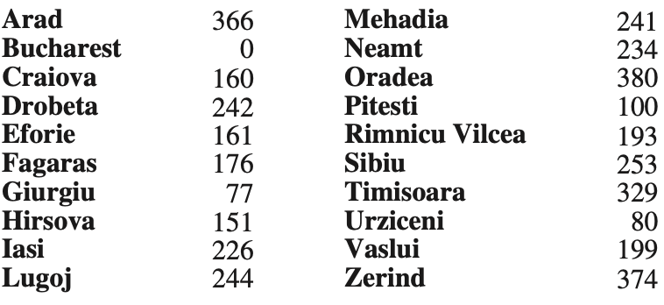
Values of hSLD
—straight-line distances to Bucharest.
Source: Stuart Russell and Peter Norvig (2020), Artificial Intelligence: A Modern Approach, 4th Edition, Pearson

Slide 46
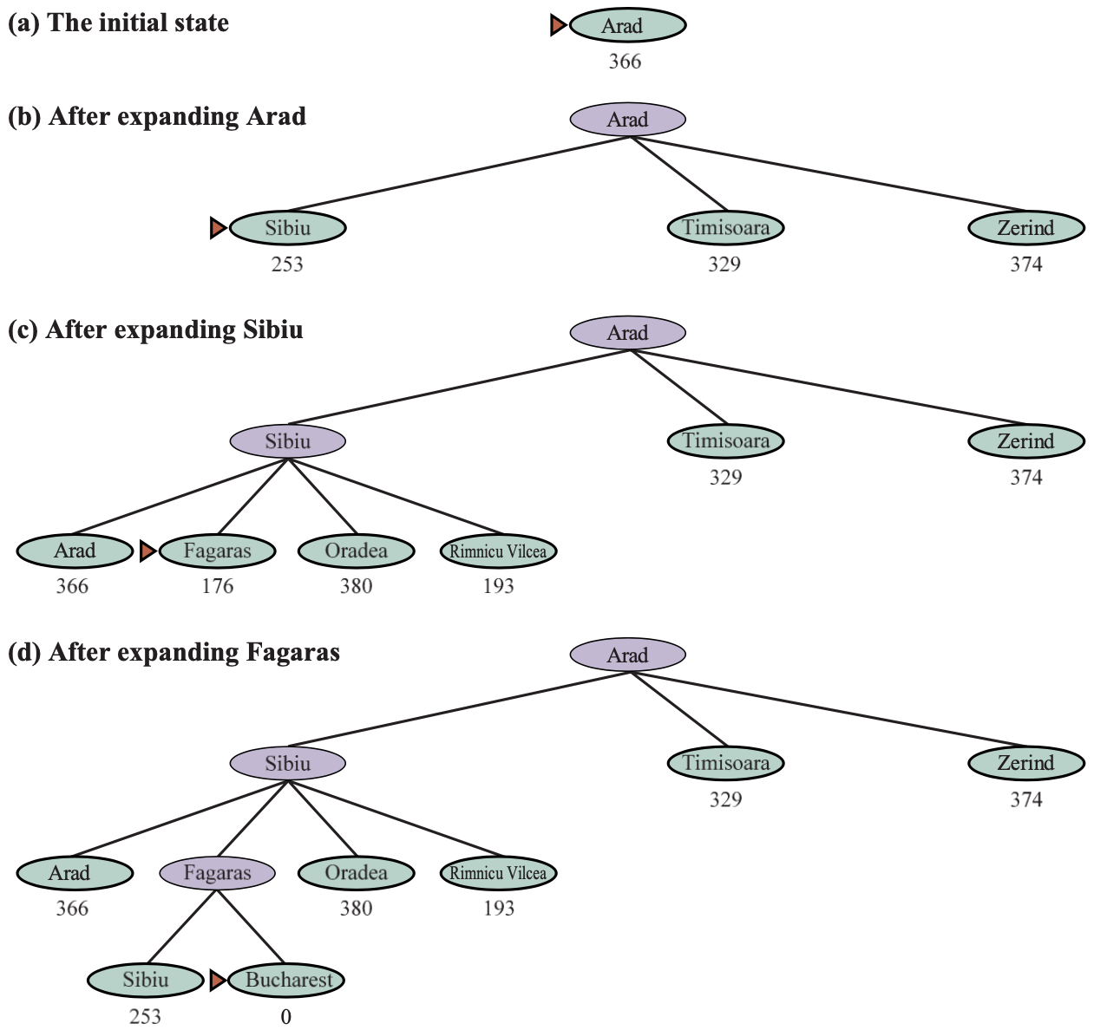
A∗ search
Source: Stuart Russell and Peter Norvig (2020), Artificial Intelligence: A Modern Approach, 4th Edition, Pearson

Slide 47
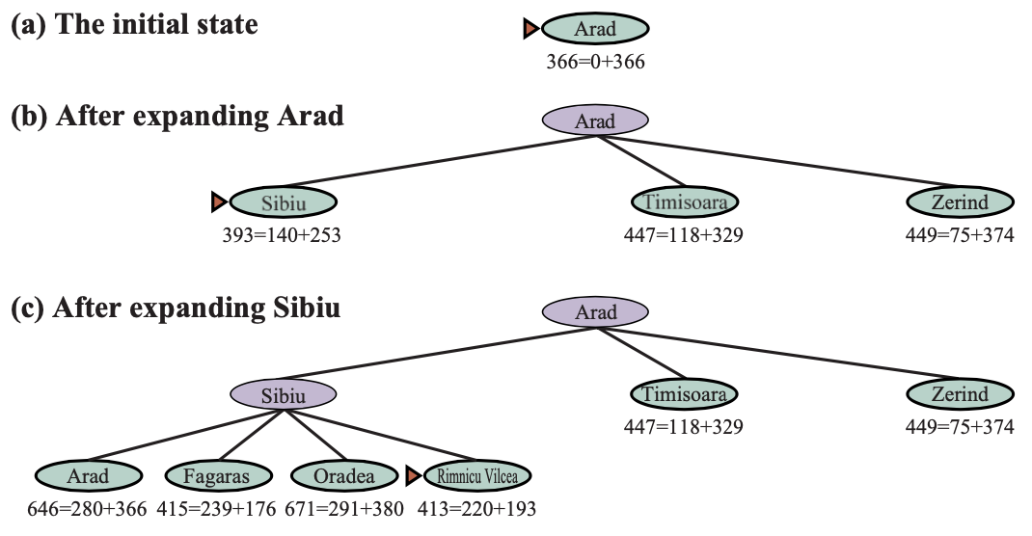
A∗ search
Nodes are labeled with f = g + h.
The h values are the Straight-Line Distances heuristic h_{SLD}
Source: Stuart Russell and Peter Norvig (2020), Artificial Intelligence: A Modern Approach, 4th Edition, Pearson

Slide 48
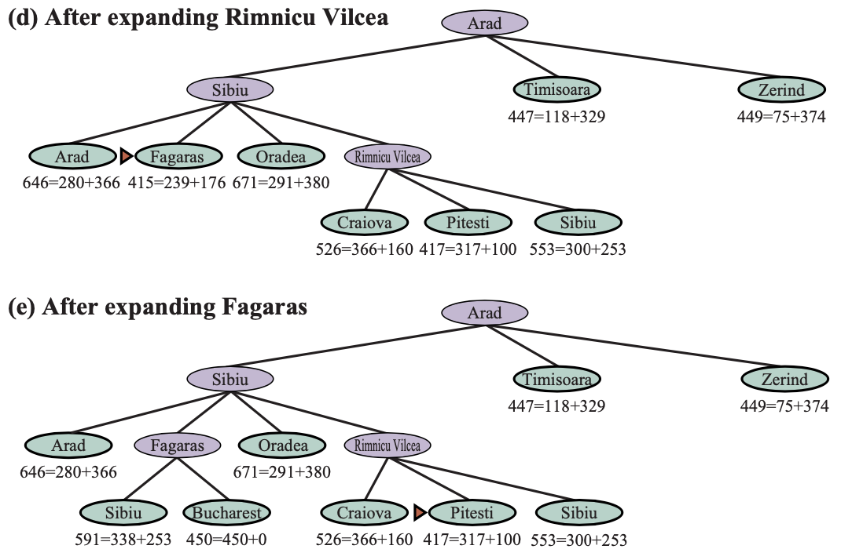
A∗ search
Nodes are labeled with f = g + h.
The h values are the Straight-Line Distances heuristic h_{SLD}
Source: Stuart Russell and Peter Norvig (2020), Artificial Intelligence: A Modern Approach, 4th Edition, Pearson

Slide 49
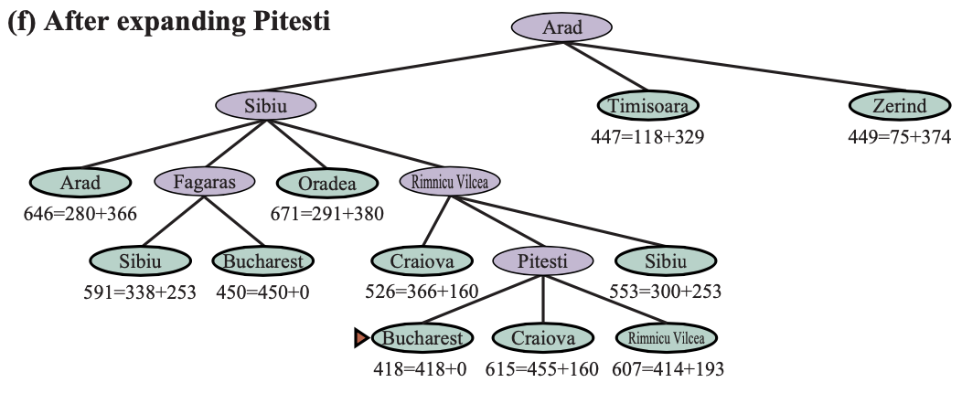
A∗ search
Nodes are labeled with f = g + h.
The h values are the Straight-Line Distances heuristic h_{SLD}
Source: Stuart Russell and Peter Norvig (2020), Artificial Intelligence: A Modern Approach, 4th Edition, Pearson

Slide 50
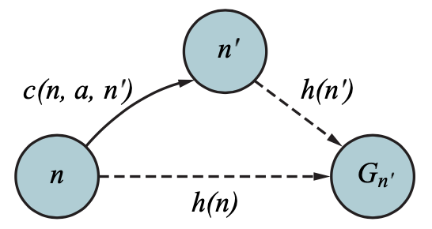
Triangle Inequality
If the heuristic h is consistent, then the single number h(n)
will be less than the sum of the cost c(n, a, a′) of the action
from n to n′ plus the heuristic estimate h(n′).
Source: Stuart Russell and Peter Norvig (2020), Artificial Intelligence: A Modern Approach, 4th Edition, Pearson

Slide 51
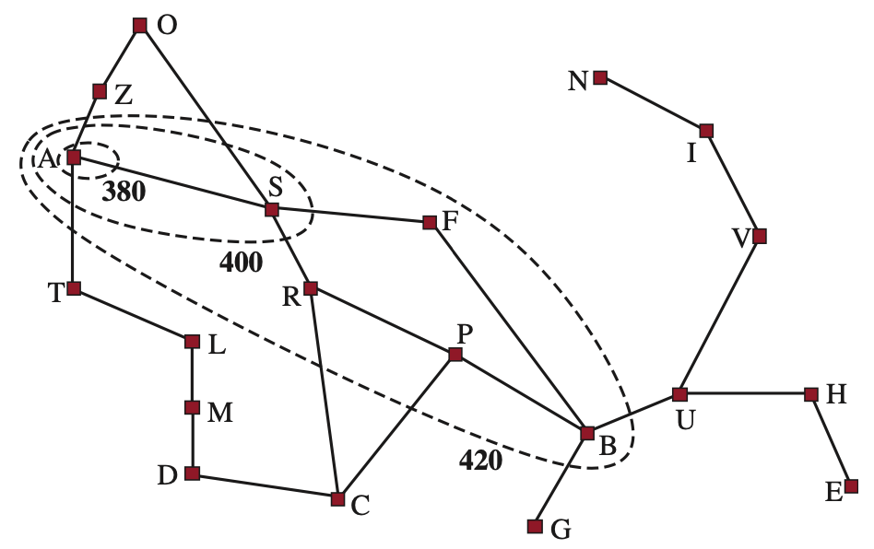
Map of Romania showing contours at f = 380, f = 400, and f = 420, with Arad as the start state
Source: Stuart Russell and Peter Norvig (2020), Artificial Intelligence: A Modern Approach, 4th Edition, Pearson

Slide 52
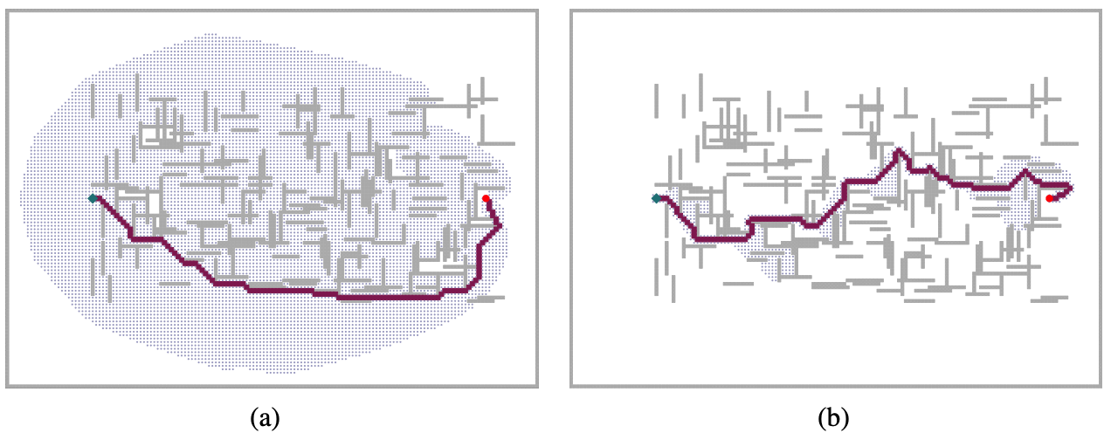
(a) A∗ Search
(b) Weighted A∗ Search
The gray bars are obstacles, the purple line is the path from the green start to red goal, and the small dots are states that were reached by each search.
On this particular problem, weighted A∗ explores 7 times fewer states and finds a path that is 5% more costly.
Source: Stuart Russell and Peter Norvig (2020), Artificial Intelligence: A Modern Approach, 4th Edition, Pearson

Slide 53
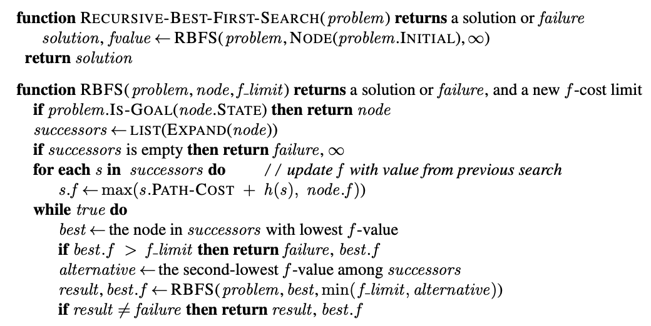
Recursive Best-First Search (RBFS) Algorithm
Source: Stuart Russell and Peter Norvig (2020), Artificial Intelligence: A Modern Approach, 4th Edition, Pearson

Slide 54
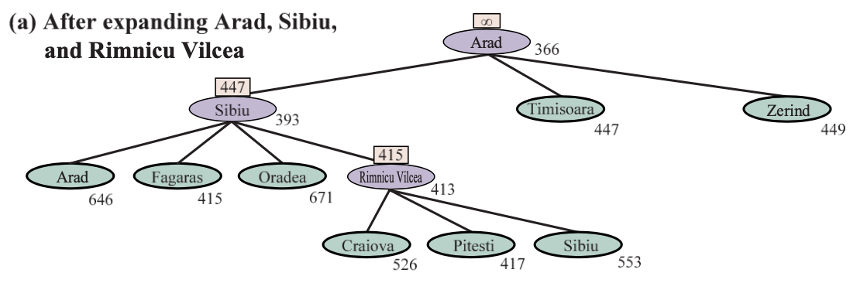
Recursive Best-First Search (RBFS)
Source: Stuart Russell and Peter Norvig (2020), Artificial Intelligence: A Modern Approach, 4th Edition, Pearson

Slide 55
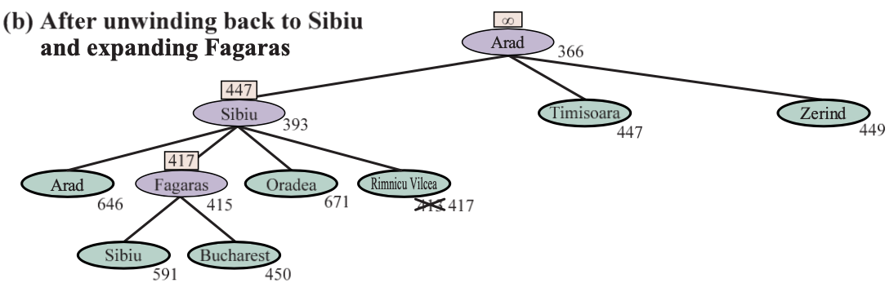
Recursive Best-First Search (RBFS)
Source: Stuart Russell and Peter Norvig (2020), Artificial Intelligence: A Modern Approach, 4th Edition, Pearson

Slide 56
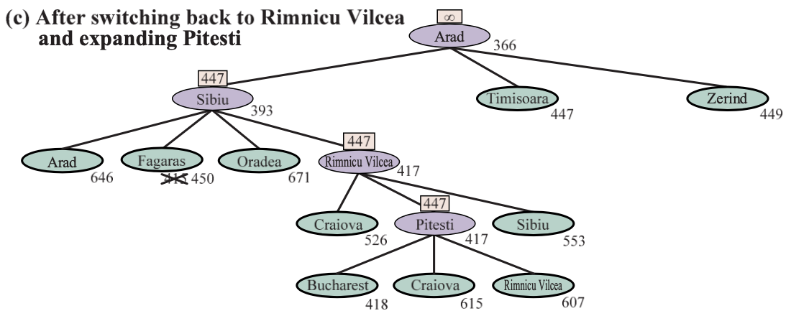
Recursive Best-First Search (RBFS)
Source: Stuart Russell and Peter Norvig (2020), Artificial Intelligence: A Modern Approach, 4th Edition, Pearson

Slide 57
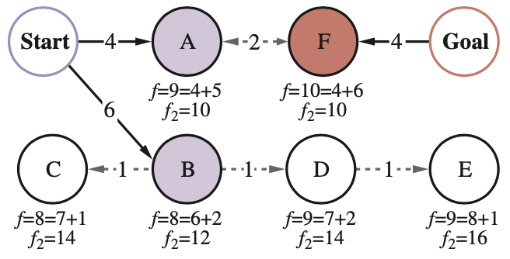
Bidirectional Search maintains two frontiers
On the left, nodes A and B are successors of Start;
on the right, node F is an inverse successor of Goal
Source: Stuart Russell and Peter Norvig (2020), Artificial Intelligence: A Modern Approach, 4th Edition, Pearson

Slide 58
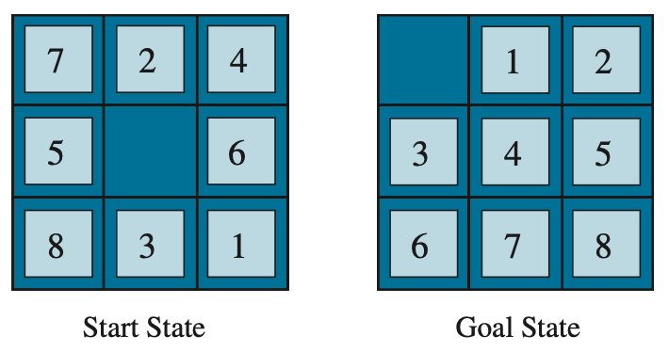
A typical instance of the 8-puzzle
The shortest solution is 26 actions long
Source: Stuart Russell and Peter Norvig (2020), Artificial Intelligence: A Modern Approach, 4th Edition, Pearson

Slide 59
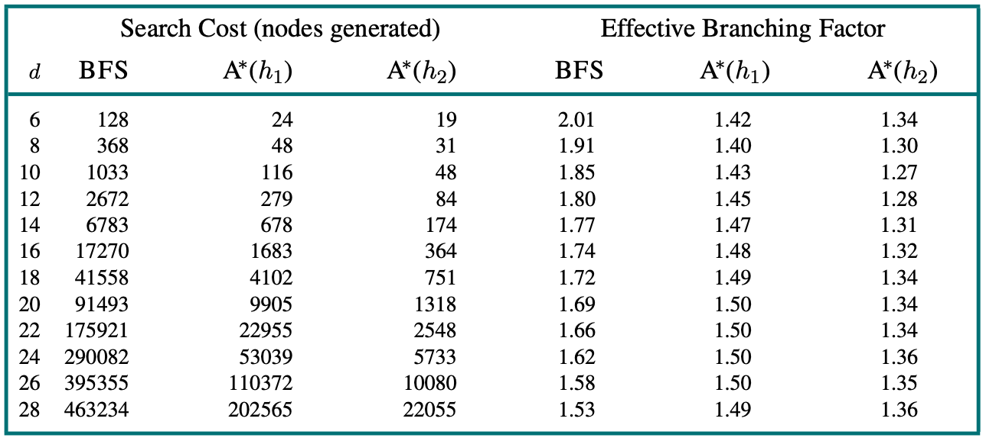
Comparison of the search costs and effective branching factors for 8-puzzle problems
Source: Stuart Russell and Peter Norvig (2020), Artificial Intelligence: A Modern Approach, 4th Edition, Pearson

Slide 60
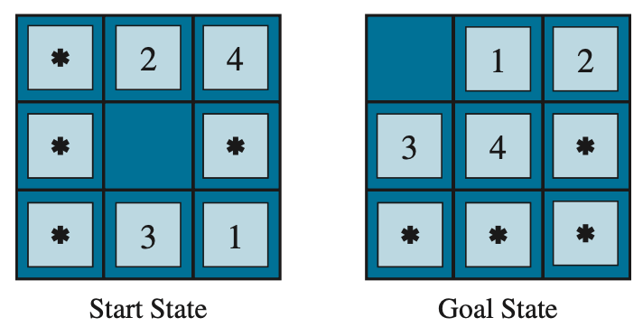
A subproblem of the 8-puzzle
The task is to get tiles 1, 2, 3, 4, and the blank into their correct positions, without worrying about what happens to the other tiles
Source: Stuart Russell and Peter Norvig (2020), Artificial Intelligence: A Modern Approach, 4th Edition, Pearson

Slide 61
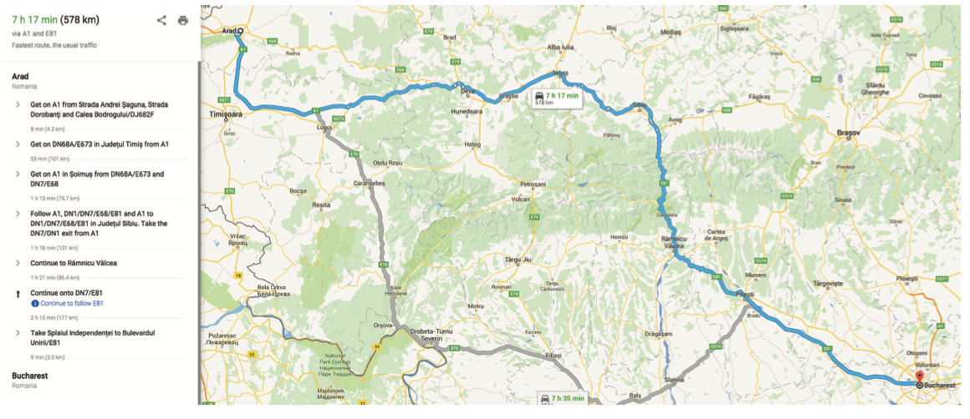
A Web service providing driving directions, computed by a search algorithm.
Source: Stuart Russell and Peter Norvig (2020), Artificial Intelligence: A Modern Approach, 4th Edition, Pearson

Slide 62
Search in
Complex Environments
Source: Stuart Russell and Peter Norvig (2020), Artificial Intelligence: A Modern Approach, 4th Edition, Pearson

Slide 63
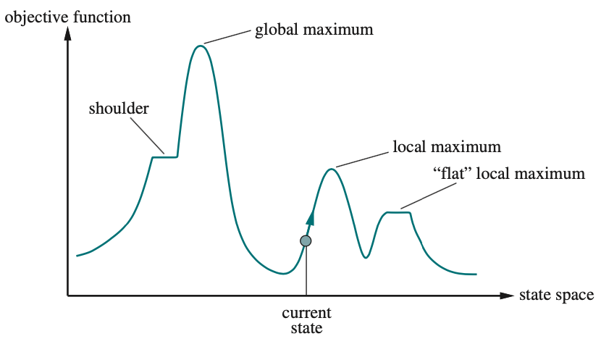
A one-dimensional state-space landscape
Source: Stuart Russell and Peter Norvig (2020), Artificial Intelligence: A Modern Approach, 4th Edition, Pearson

Slide 64
Adversarial
Search and
Games
Source: Stuart Russell and Peter Norvig (2020), Artificial Intelligence: A Modern Approach, 4th Edition, Pearson

Slide 65
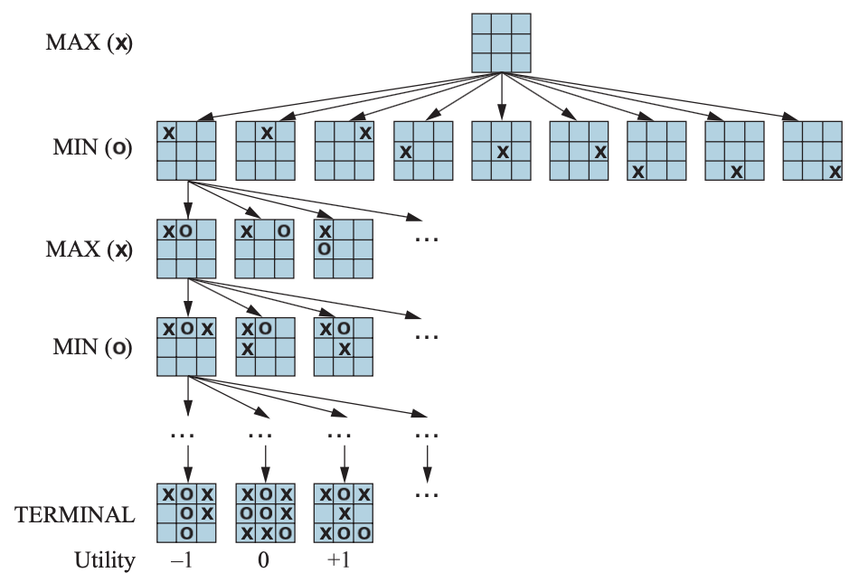
Game Tree for the Game of Tic-tac-toe
Source: Stuart Russell and Peter Norvig (2020), Artificial Intelligence: A Modern Approach, 4th Edition, Pearson

Slide 66
Constraint Satisfaction Problems
Source: Stuart Russell and Peter Norvig (2020), Artificial Intelligence: A Modern Approach, 4th Edition, Pearson

Slide 67
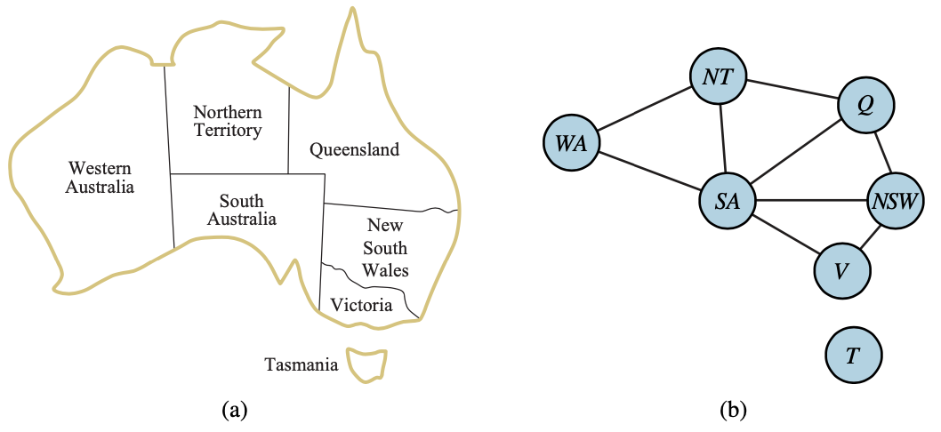
The Map-Coloring Problem Represented as a Constraint Graph
Source: Stuart Russell and Peter Norvig (2020), Artificial Intelligence: A Modern Approach, 4th Edition, Pearson

Slide 68
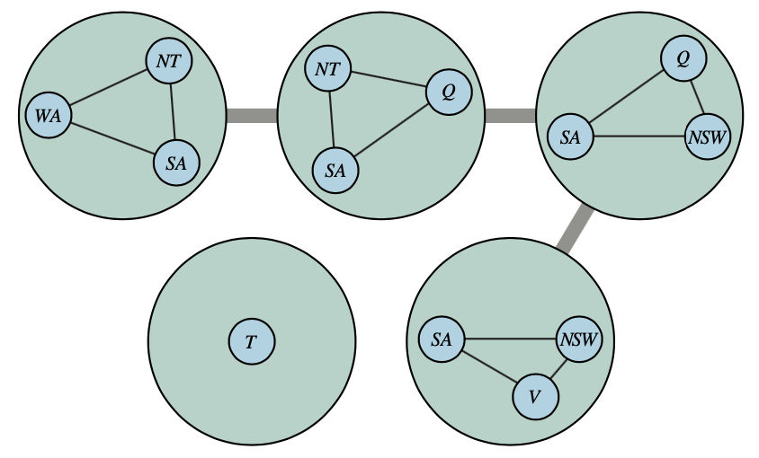
A Tree Decomposition of the Constraint Graph
Source: Stuart Russell and Peter Norvig (2020), Artificial Intelligence: A Modern Approach, 4th Edition, Pearson

Slide 69
Artificial Intelligence: A Modern Approach (AIMA)
Artificial Intelligence: A Modern Approach (AIMA)
  http://aima.cs.berkeley.edu/
AIMA Python
  http://aima.cs.berkeley.edu/python/readme.html
  https://github.com/aimacode/aima-python
Search
  http://aima.cs.berkeley.edu/python/search.html
Games: Adversarial Search
  http://aima.cs.berkeley.edu/python/games.html
CSP (Constraint Satisfaction Problems)
  http://aima.cs.berkeley.edu/python/csp.html
Source: Stuart Russell and Peter Norvig (2020), Artificial Intelligence: A Modern Approach, 4th Edition, Pearson

Slide 70
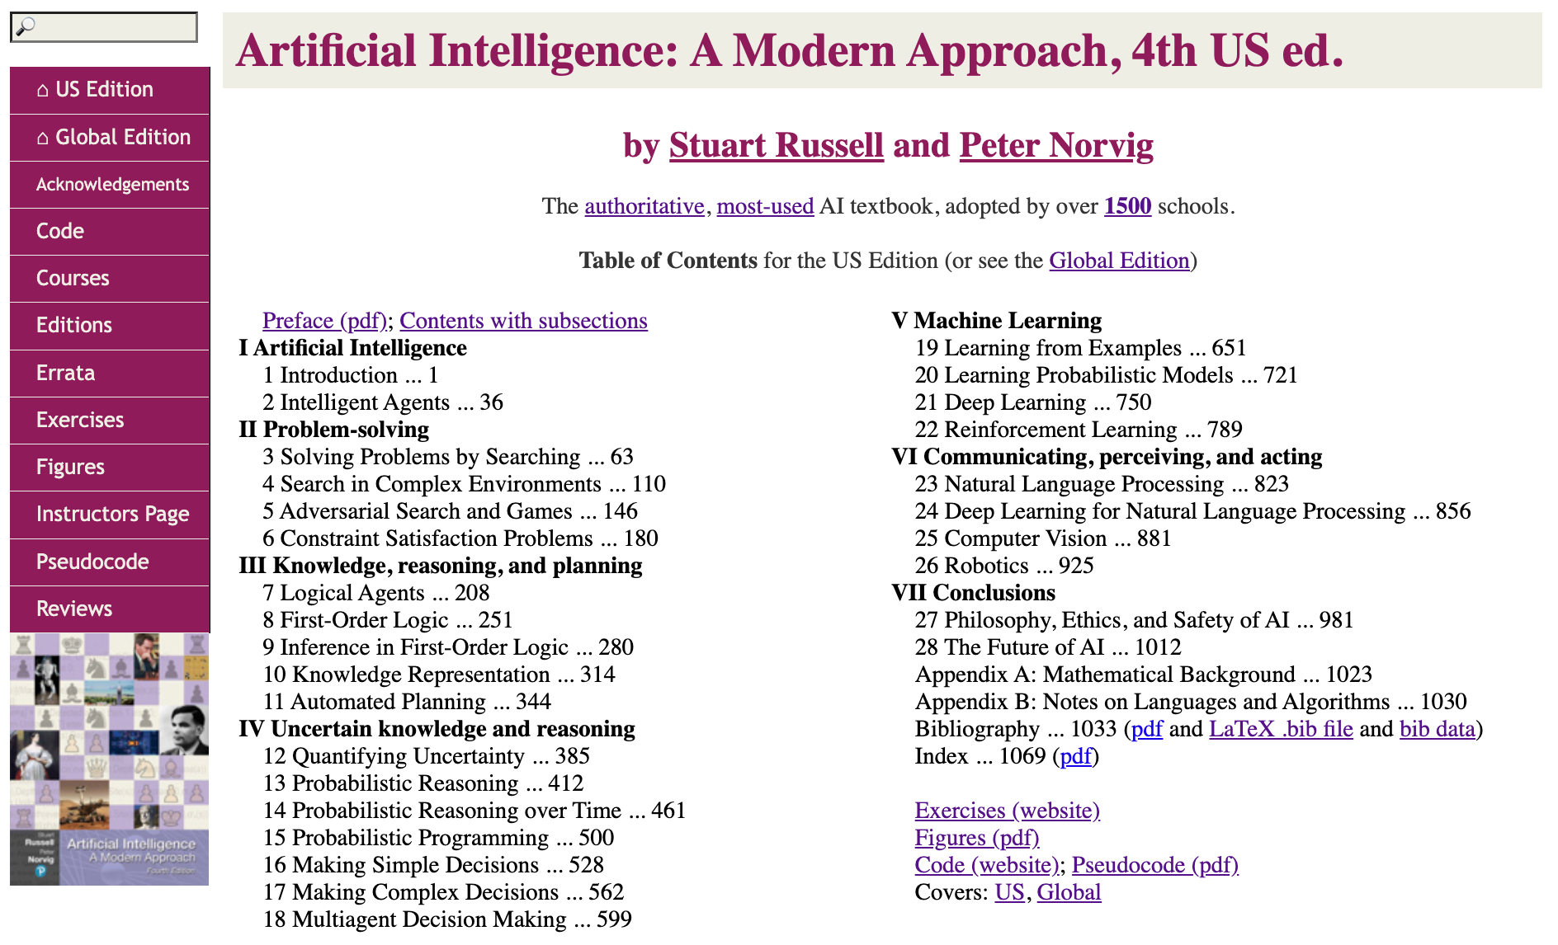
Artificial Intelligence: A Modern Approach (AIMA)
http://aima.cs.berkeley.edu/

Slide 71
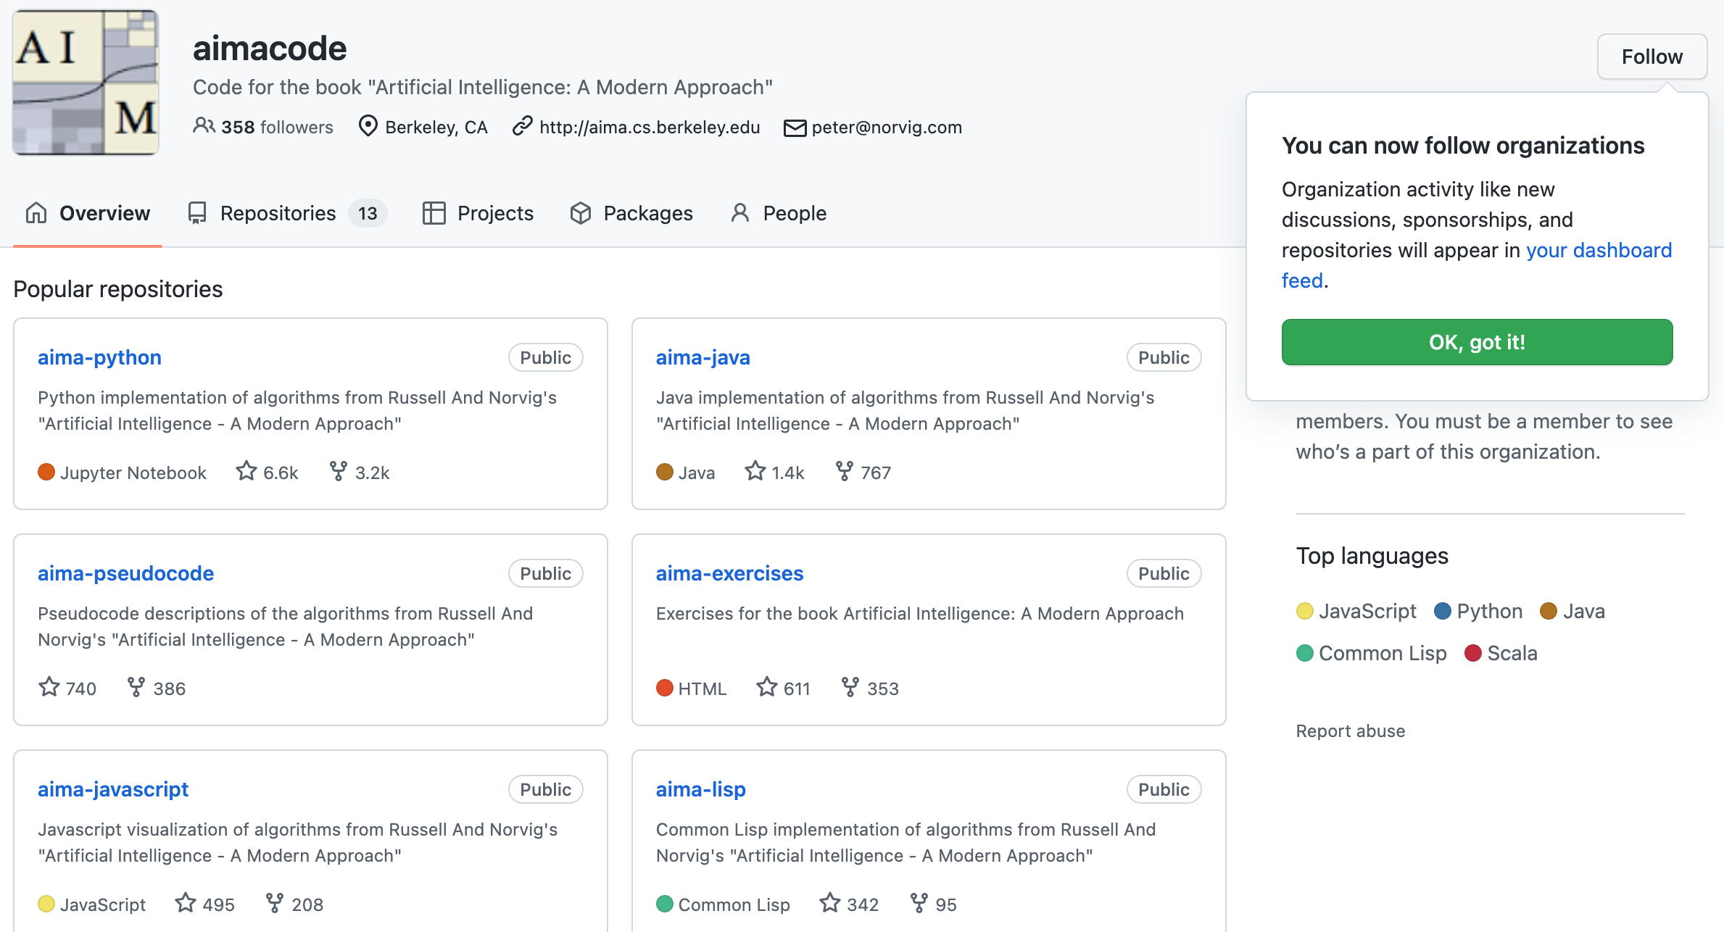
AIMA Code
https://github.com/aimacode

Slide 72
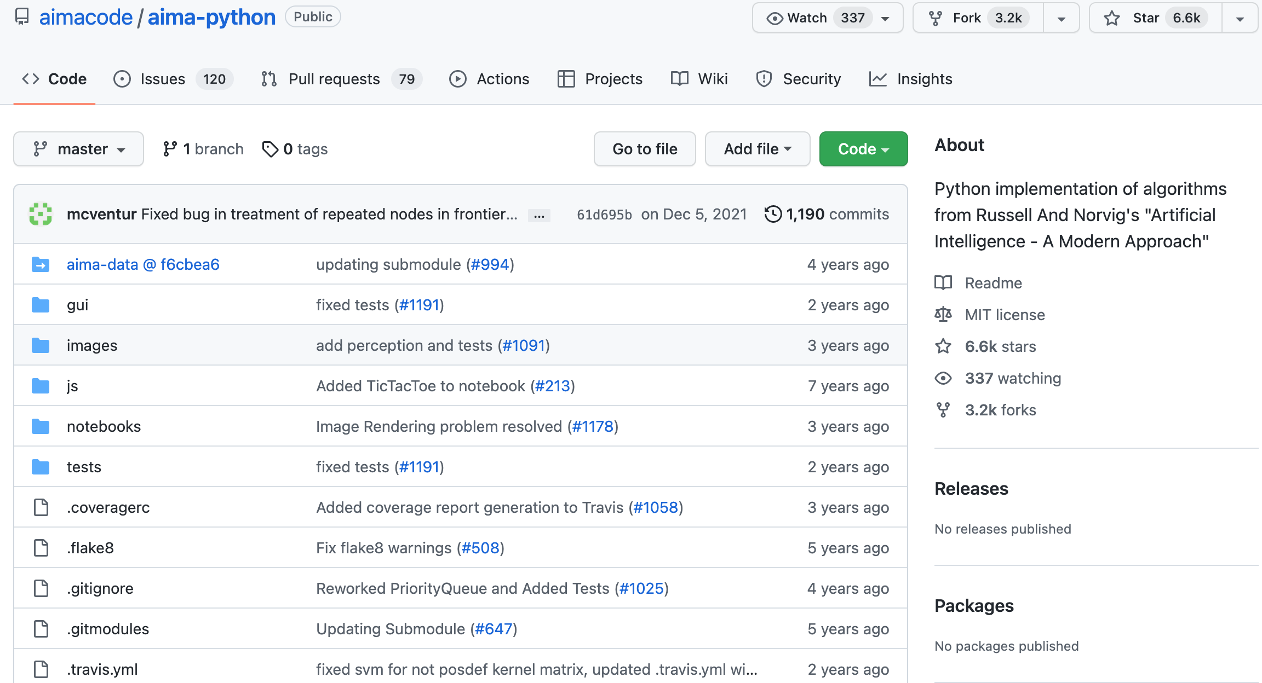
AIMA Python
https://github.com/aimacode/aima-python

Slide 73

Tom Lawry (2020),
AI in Health:
A Leader’s Guide to Winning in the New Age of Intelligent Health Systems,
HIMSS Publishing
Source: Tom Lawry (2020), AI in Health: A Leader’s Guide to Winning in the New Age of Intelligent Health Systems, HIMSS Publishing
https://www.amazon.com/Health-HIMSS-Book-Tom-Lawry/dp/0367333716/

Slide 74
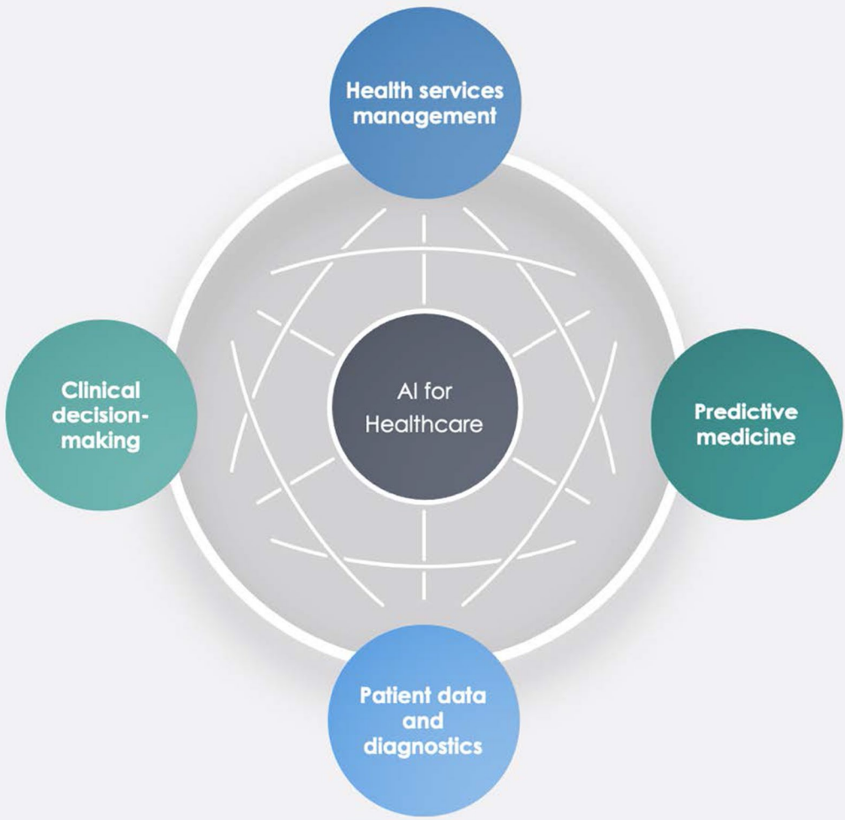
AI in Healthcare
Source: Secinaro, Silvana, Davide Calandra, Aurelio Secinaro, Vivek Muthurangu, and Paolo Biancone. "The role of artificial intelligence in healthcare: a structured literature review." BMC Medical Informatics and Decision Making 21, no. 1 (2021): 1-23.

Slide 75
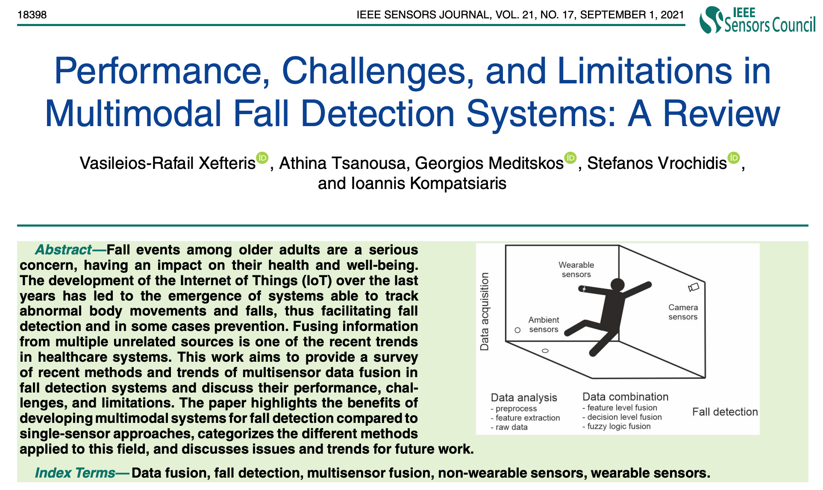
Multimodal Fall Detection
Ambient Assisted Living (AAL)
Source: Xefteris, Vasileios-Rafail, Athina Tsanousa, Georgios Meditskos, Stefanos Vrochidis, and Ioannis Kompatsiaris. "Performance, challenges, and limitations in multimodal fall detection systems: a review." IEEE Sensors Journal (2021).

Slide 76
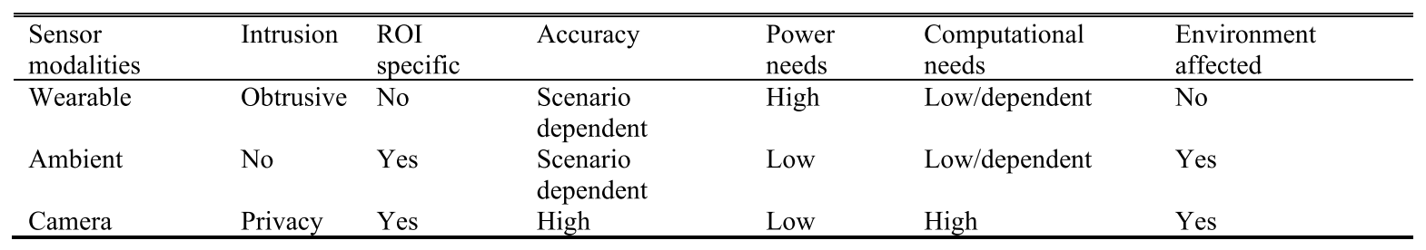
Multimodal Fall Detection
Ambient Assisted Living (AAL)
Source: Xefteris, Vasileios-Rafail, Athina Tsanousa, Georgios Meditskos, Stefanos Vrochidis, and Ioannis Kompatsiaris. "Performance, challenges, and limitations in multimodal fall detection systems: a review." IEEE Sensors Journal (2021).

Slide 77
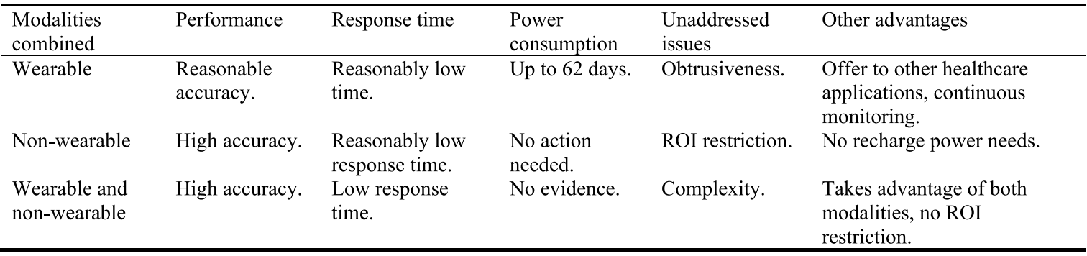
Challenges of Multimodal Fall Detection
Source: Xefteris, Vasileios-Rafail, Athina Tsanousa, Georgios Meditskos, Stefanos Vrochidis, and Ioannis Kompatsiaris. "Performance, challenges, and limitations in multimodal fall detection systems: a review." IEEE Sensors Journal (2021).

Slide 78
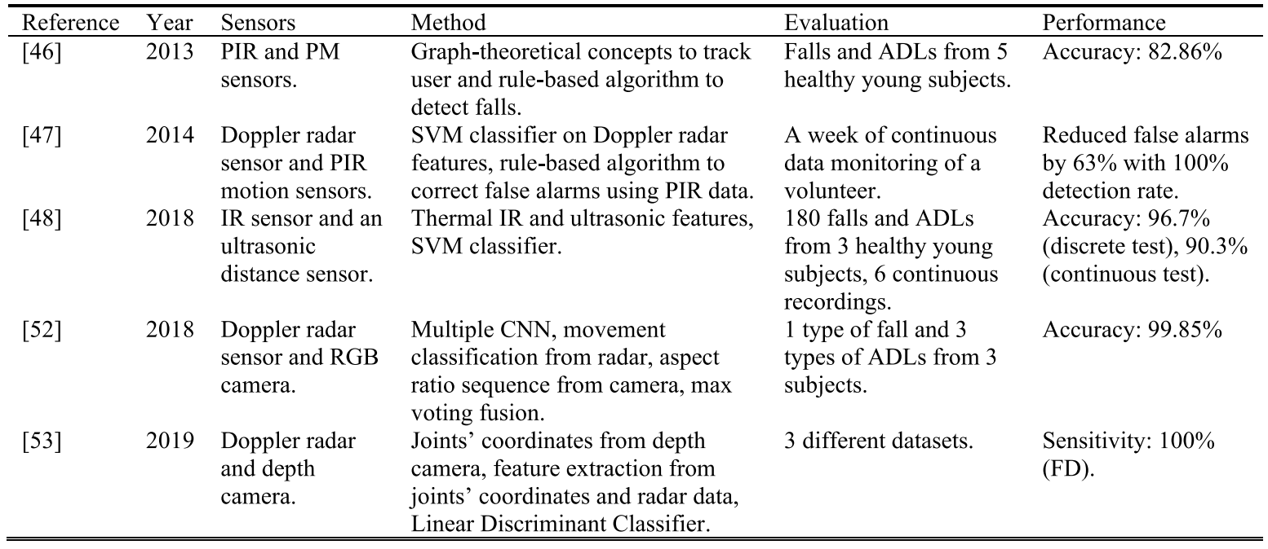
Fall Detection
Non-Wearable Sensors Fusion
Source: Xefteris, Vasileios-Rafail, Athina Tsanousa, Georgios Meditskos, Stefanos Vrochidis, and Ioannis Kompatsiaris. "Performance, challenges, and limitations in multimodal fall detection systems: a review." IEEE Sensors Journal (2021).

Slide 79
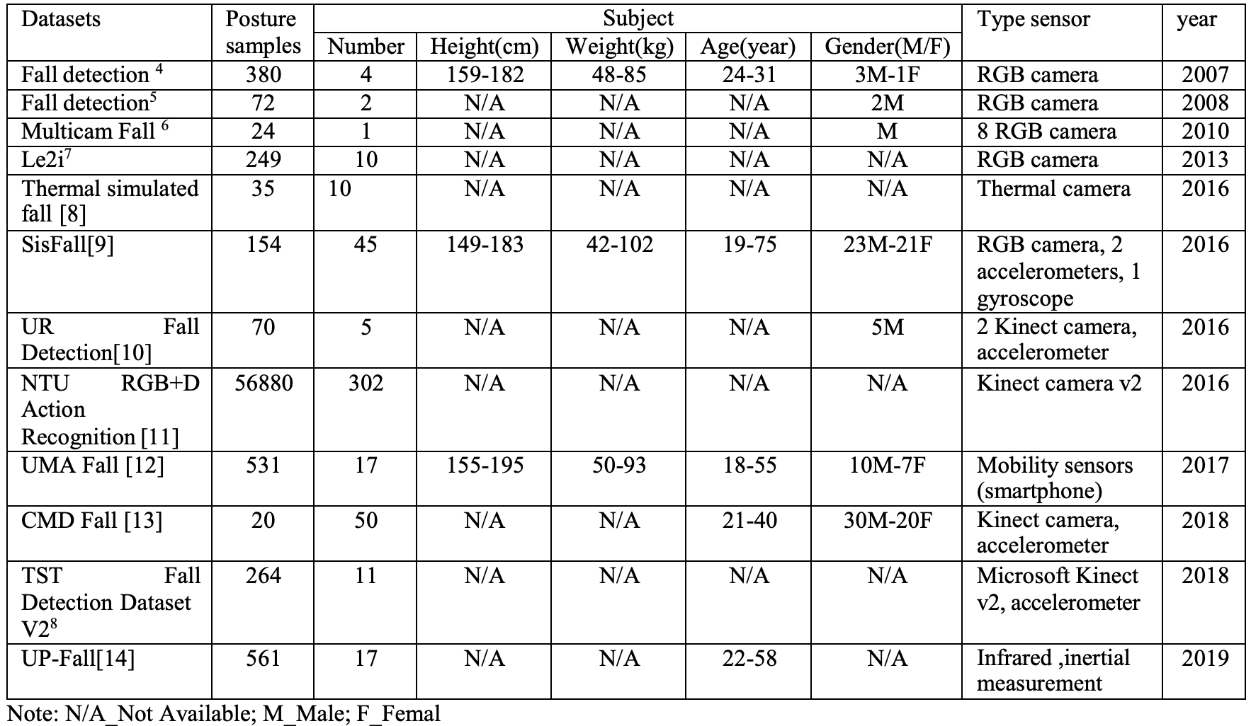
Fall Detection Datasets
Source: Oumaima, Guendoul, Ait Abdelali Hamd, Tabii Youness, Oulad Haj Thami Rachid, and Bourja Omar.
"Vision-based fall detection and prevention for the elderly people: A review & ongoing research." In 2021 Fifth International Conference On Intelligent Computing in Data Sciences (ICDS), pp. 1-6. IEEE, 2021.

Slide 80
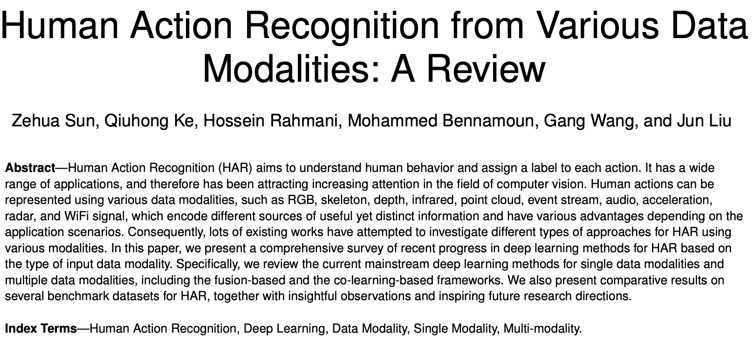
Human Action Recognition
(HAR)
Source: Sun, Zehua, Qiuhong Ke, Hossein Rahmani, Mohammed Bennamoun, Gang Wang, and Jun Liu. "Human action recognition from various data modalities: A review." IEEE transactions on pattern analysis and machine intelligence (2022).

Slide 81
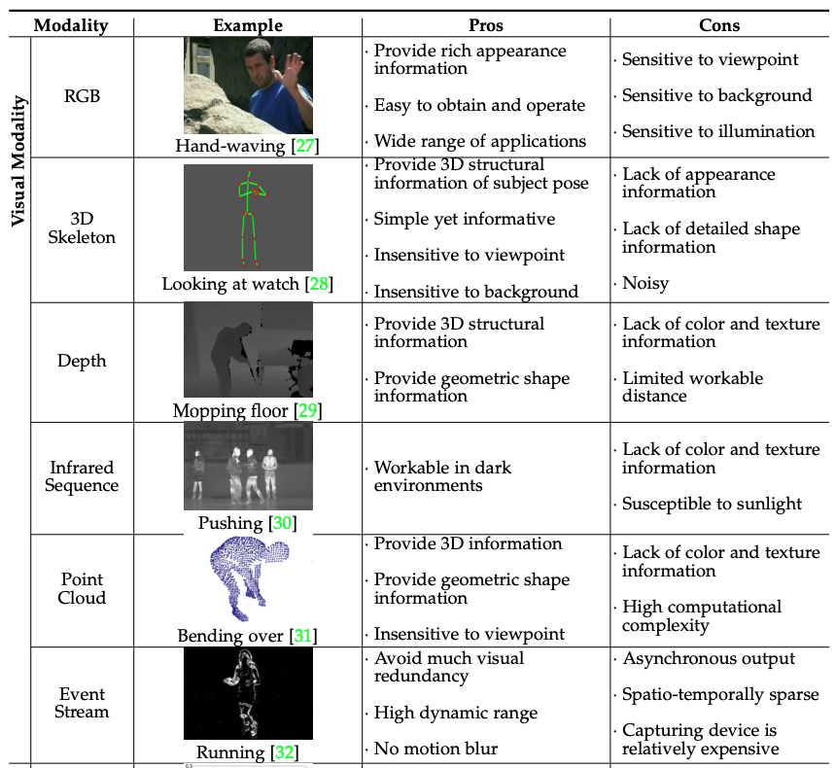
Human Action Recognition (HAR)
Modality
Source: Sun, Zehua, Qiuhong Ke, Hossein Rahmani, Mohammed Bennamoun, Gang Wang, and Jun Liu. "Human action recognition from various data modalities: A review." IEEE transactions on pattern analysis and machine intelligence (2022).

Slide 82

Human Action Recognition (HAR)
Modality
Source: Sun, Zehua, Qiuhong Ke, Hossein Rahmani, Mohammed Bennamoun, Gang Wang, and Jun Liu. "Human action recognition from various data modalities: A review." IEEE transactions on pattern analysis and machine intelligence (2022).

Slide 83

Computer Vision in the Metaverse with scene understanding, object detection, and human action/activity recognition
Source: Huynh-The, Thien, Quoc-Viet Pham, Xuan-Qui Pham, Thanh Thi Nguyen, Zhu Han, and Dong-Seong Kim (2022).
"Artificial Intelligence for the Metaverse: A Survey." arXiv preprint arXiv:2202.10336.

Slide 84

Fall Detection
Source: https://www.ankecare.com/article/1929-2022-05-09-08-29-47

Slide 85

Conversational AI to deliver contextual and personal experience to users
Source: Huynh-The, Thien, Quoc-Viet Pham, Xuan-Qui Pham, Thanh Thi Nguyen, Zhu Han, and Dong-Seong Kim (2022).
"Artificial Intelligence for the Metaverse: A Survey." arXiv preprint arXiv:2202.10336.

Slide 86

Task-Oriented Dialogue (ToD) System
Speech, Text, NLP
Source: Razumovskaia, Evgeniia, Goran Glavas, Olga Majewska, Edoardo M. Ponti, Anna Korhonen, and Ivan Vulic.
"Crossing the conversational chasm: A primer on natural language processing for multilingual task-oriented dialogue systems." Journal of Artificial Intelligence Research 74 (2022): 1351-1402.

Slide 87

Multimodal Pipeline that includes three different modalities (Image, Text. Audio)
Source: Bayoudh, Khaled, Raja Knani, Fayçal Hamdaoui, and Abdellatif Mtibaa (2022).
"A survey on deep multimodal learning for computer vision: advances, trends, applications, and datasets." The Visual Computer 38, no. 8: 2939-2970.

Slide 88

Video and Audio Multimodal Fusion
Source: Bayoudh, Khaled, Raja Knani, Fayçal Hamdaoui, and Abdellatif Mtibaa (2022).
"A survey on deep multimodal learning for computer vision: advances, trends, applications, and datasets." The Visual Computer 38, no. 8: 2939-2970.

Slide 89

Visual and Textual Representation
Source: Bayoudh, Khaled, Raja Knani, Fayçal Hamdaoui, and Abdellatif Mtibaa (2022).
"A survey on deep multimodal learning for computer vision: advances, trends, applications, and datasets." The Visual Computer 38, no. 8: 2939-2970.

Slide 90

Hybrid Multimodal Data Fusion
Text
Audio
Image
Text
Speech
Video
Source: Bayoudh, Khaled, Raja Knani, Fayçal Hamdaoui, and Abdellatif Mtibaa (2022).
"A survey on deep multimodal learning for computer vision: advances, trends, applications, and datasets." The Visual Computer 38, no. 8: 2939-2970.

Slide 91

Multimodal Transfer Learning
Source: Bayoudh, Khaled, Raja Knani, Fayçal Hamdaoui, and Abdellatif Mtibaa (2022).
"A survey on deep multimodal learning for computer vision: advances, trends, applications, and datasets." The Visual Computer 38, no. 8: 2939-2970.

Slide 92

CLIP: Learning Transferable Visual Models From Natural Language Supervision
Source: Radford, Alec, Jong Wook Kim, Chris Hallacy, Aditya Ramesh, Gabriel Goh, Sandhini Agarwal, Girish Sastry et al. (2021) "Learning transferable visual models from natural language supervision." In International Conference on Machine Learning, pp. 8748-8763. PMLR.

Slide 93

ViLT: Vision-and-Language Transformer Without Convolution or Region Supervision
Source: Kim, Wonjae, Bokyung Son, and Ildoo Kim (2021). "Vilt: Vision-and-language transformer without convolution or region supervision."
In International Conference on Machine Learning, pp. 5583-5594. PMLR.

Slide 94

Self-Supervised Representation Learning in Speech Downstream Applications
Self-Supervised Learning
(SSL)
Source: Mohamed, Abdelrahman, Hung-yi Lee, Lasse Borgholt, Jakob D. Havtorn, Joakim Edin, Christian Igel, Katrin Kirchhoff et al. (2022)
"Self-Supervised Speech Representation Learning: A Review." arXiv preprint arXiv:2205.10643.

Slide 95

Stable Diffusion
https://huggingface.co/spaces/stabilityai/stable-diffusion

Slide 96

Papers with Code
State-of-the-Art (SOTA)
https://paperswithcode.com/sota

Slide 97

Python in Google Colab (Python101)
https://colab.research.google.com/drive/1FEG6DnGvwfUbeo4zJ1zTunjMqf2RkCrT
https://tinyurl.com/aintpupython101

Slide 98
Summary
Solving Problems by Searching
Search in Complex Environments
Adversarial Search and Games
Constraint Satisfaction Problems

Slide 99
References
Stuart Russell and Peter Norvig (2020), Artificial Intelligence: A Modern Approach, 4th Edition, Pearson.
Aurélien Géron (2019), Hands-On Machine Learning with Scikit-Learn, Keras, and TensorFlow: Concepts, Tools, and Techniques to Build Intelligent Systems, 2nd Edition, O’Reilly Media.
Steven D'Ascoli (2022), Artificial Intelligence and Deep Learning with Python: Every Line of Code Explained For Readers New to AI and New to Python, Independently published.
Nithin Buduma, Nikhil Buduma, Joe Papa (2022), Fundamentals of Deep Learning: Designing Next-Generation Machine Intelligence Algorithms, 2nd Edition, ‎O'Reilly Media.

