Slide 1
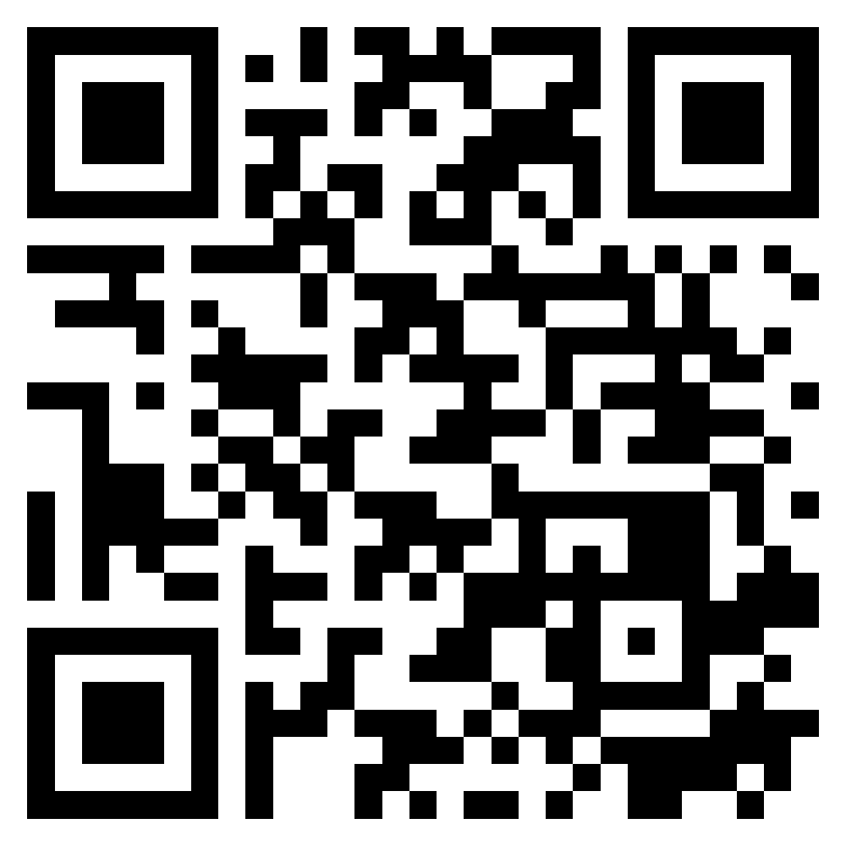
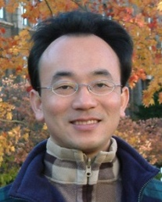
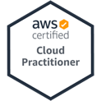
Introduction to Software Engineering
Software Engineering
1102SE01
MBA, IM, NTPU (M5010) (Spring 2022) Wed 2, 3, 4 (9:10-12:00) (B8F40)
Min-Yuh Day, Ph.D, Associate Professor
Institute of Information Management, National Taipei University
https://web.ntpu.edu.tw/~myday
https://meet.google.com/ish-gzmy-pmo
2022-02-23

Slide 2
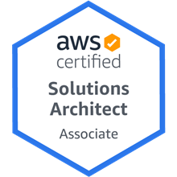
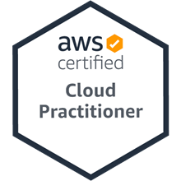
Min-Yuh Day, Ph.D.
Associate Professor, Information Management, NTPU
Visiting Scholar, IIS, Academia Sinica
Ph.D., Information Management, NTU
Director, Intelligent Financial Innovation Technology, IFIT Lab, IM, NTPU
Artificial Intelligence, Financial Technology, Big Data Analytics, Data Mining and Text Mining, Electronic Commerce

Slide 3
Course Syllabus National Taipei University Academic Year 110, 2nd Semester (Spring 2022)
Course Title: Software Engineering
Instructor: Min-Yuh Day
Course Class: MBA, IM, NTPU (3 Credits, Elective)
Details
In-Person and Distance Learning EMI Course (3 Credits, Elective, One Semester) (M5010)
Time & Place: Wed, 2, 3, 4, (9:10-12:00) (B8F40)
Google Meet: https://meet.google.com/ish-gzmy-pmo
https://meet.google.com/ish-gzmy-pmo

Slide 4
Course Objectives
Understand the fundamental concepts and research issues of software engineering.
Equip with Hands-on practices of software engineering.
Conduct information systems research in the context of software engineering.

Slide 5
Course Outline
This course introduces the fundamental concepts, research issues, and hands-on practices of software engineering.
Topics include:
Introduction to Software Engineering
Software Products and Project Management: Software product management and prototyping
Agile Software Engineering: Agile methods, Scrum, and Extreme Programming
Features, Scenarios, and Stories
Software Architecture: Architectural design, System decomposition, and Distribution architecture
Cloud-Based Software: Virtualization and containers, Everything as a service, Software as a service
Cloud Computing and Cloud Software Architecture
Microservices Architecture, RESTful services, Service deployment
Security and Privacy; Reliable Programming
Testing: Functional testing, Test automation, Test-driven development, and Code reviews
DevOps and Code Management: Code management and DevOps automation
Case Study on Software Engineering

Slide 6
Core Competence
Exploring new knowledge in information technology, system development and application 80 %
Internet marketing planning ability 10 %
Thesis writing and independent research skills 10 %

Slide 7
Four Fundamental Qualities
Professionalism
Creative thinking and Problem-solving 30 %
Comprehensive Integration 30 %
Interpersonal Relationship
Communication and Coordination 10 %
Teamwork 10 %
Ethics
Honesty and Integrity 5 %
Self-Esteem and Self-reflection 5 %
International Vision
Caring for Diversity 5 %
Interdisciplinary Vision 5 %

Slide 8
College Learning Goals
Ethics/Corporate Social Responsibility
Global Knowledge/Awareness
Communication
Analytical and Critical Thinking

Slide 9
Department Learning Goals
Information Technologies and System Development Capabilities
Internet Marketing Management Capabilities
Research capabilities

Slide 10
Syllabus
Week Date Subject/Topics
1 2022/02/23 Introduction to Software Engineering
2 2022/03/02 Software Products and Project Management: Software product management and prototyping
3 2022/03/09 Agile Software Engineering: Agile methods, Scrum, and Extreme Programming
4 2022/03/16 Features, Scenarios, and Stories
5 2022/03/23 Case Study on Software Engineering I
6 2022/03/30 Software Architecture: Architectural design, System decomposition, and Distribution architecture

Slide 11
Syllabus
Week Date Subject/Topics
7 2022/04/06 Make-up holiday (No Classes)
8 2022/04/13 Midterm Project Report
9 2022/04/20 Cloud-Based Software: Virtualization and containers, Everything as a service, Software as a service
10 2022/04/27 Cloud Computing and Cloud Software Architecture
11 2022/05/04 Microservices Architecture, RESTful services, Service deployment
12 2022/05/11 Industry Practices of Software Engineering

Slide 12
Syllabus
Week Date Subject/Topics
13 2022/05/18 Case Study on Software Engineering II
14 2022/05/25 Security and Privacy; Reliable Programming; Testing: Test-driven development, and Code reviews; DevOps and Code Management: DevOps automation
15 2022/06/01 Final Project Report I
16 2022/06/08 Final Project Report II
17 2022/06/15 Self-learning
18 2022/06/22 Self-learning

Slide 13
Teaching Methods and Activities
Lecture
Discussion
Practicum

Slide 14
Evaluation Methods
Individual Presentation 60 %
Group Presentation 10 %
Case Report 10 %
Class Participation 10 %
Assignment 10 %

Slide 15
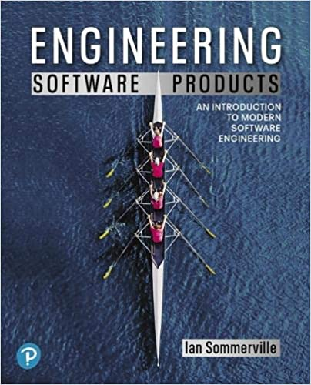
Required Texts
Ian Sommerville (2019), Engineering Software Products: An Introduction to Modern Software Engineering, Pearson.

Slide 16
Reference Books
Ian Sommerville (2015), Software Engineering, 10th Edition, Pearson.
Titus Winters, Tom Manshreck, and Hyrum Wright (2020), Software Engineering at Google: Lessons Learned from Programming Over Time, O'Reilly Media.
Project Management Institute (2017), Agile Practice Guide, PMI
Project Management Institute (2021), A Guide to the Project Management Body of Knowledge (PMBOK Guide) – Seventh Edition and The Standard for Project Management, PMI

Slide 17
Ian Sommerville (2019), Engineering Software Products: An Introduction to Modern Software Engineering, Pearson.

Slide 18
Ian Sommerville (2015), Software Engineering, 10th Edition, Pearson.

Slide 19
Titus Winters, Tom Manshreck, and Hyrum Wright (2020), Software Engineering at Google: Lessons Learned from Programming Over Time, O'Reilly Media.

Slide 20
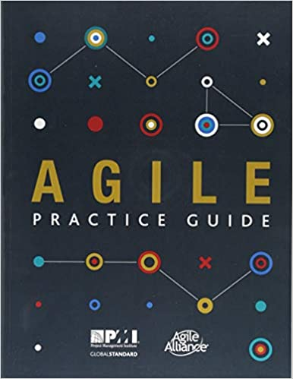
Project Management Institute (2017), Agile Practice Guide PMI

Slide 21
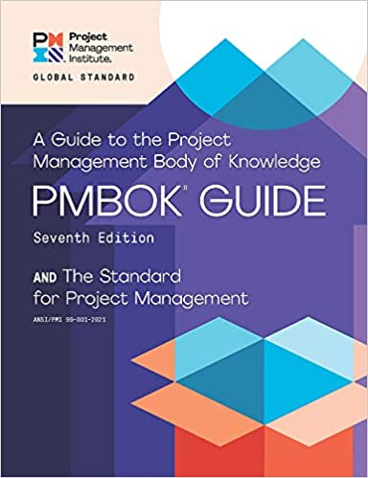
Project Management Institute (2021), A Guide to the Project Management Body of Knowledge (PMBOK Guide) – Seventh Edition and The Standard for Project Management

Slide 22
Software Engineering

Slide 23
Software Engineering and Project Management
Analyze
Requirements definition
Design
System and Software design
Build
Implementation and
unit testing
Test
Integration and system testing
Deliver
Operation and maintenance
Project Management

Slide 24
Information Management Management Information Systems (MIS) Information Systems

Slide 25
Information Management (MIS) Information Systems
Organizations
Technology
Information Systems
Management

Slide 26
Fundamental MIS Concepts
Business Challenges
Management
Organization
Information System
Business Solutions
Technology

Slide 27
Project-based software engineering
CUSTOMER
Problem
generates
helps-with
Requirements
implemented-by
Software
1
CUSTOMER and DEVELOPER
DEVELOPER

Slide 28
Project-based software engineering
The starting point for the software development is a set of ‘software requirements’ that are owned by an external client and which set out what they want a software system to do to support their business processes.
The software is developed by a software company (the contractor) who design and implement a system that delivers functionality to meet the requirements.
The customer may change the requirements at any time in response to business changes (they usually do). The contractor must change the software to reflect these requirements changes.
Custom software usually has a long-lifetime (10 years or more) and it must be supported over that lifetime.

Slide 29
Product software engineering
DEVELOPER
Opportunity
1
inspires
realizes
Product features
implemented-by
Software
DEVELOPER
DEVELOPER

Slide 30
Product software engineering
The starting point for product development is a business opportunity that is identified by individuals or a company. They develop a software product to take advantage of this opportunity and sell this to customers.
The company who identified the opportunity design and implement a set of software features that realize the opportunity and that will be useful to customers.
The software development company are responsible for deciding on the development timescale, what features to include and when the product should change.
Rapid delivery of software products is essential to capture the market for that type of product.

Slide 31
Software execution models
Stand-alone execution
Hybrid execution
Software as a service
User’s computer
User’s computer
User’s computer
User interface
Product functionality
User data
User interface
Partial functionality
User data
User interface
(browser or app)
Product updates
Additional functionality
User data backups
Product updates
Product functionality
User data
Vendor’s servers
Vendor’s servers
Vendor’s servers

Slide 32
Product management concerns
Business needs
Product manager
Technology constraints
Customer experience

Slide 33
Technical interactions of product managers
Product vision management
Product backlog management
User stories and scenarios
Product manager
Acceptance testing
Customer testing
User interface design

Slide 34
Software Development Life Cycle (SDLC) The waterfall model
Requirements definition
System and Software design
Implementation and unit testing
Integration and system testing
Operation and maintenance

Slide 35
Plan-based and Agile development
Plan-based development
Requirements engineering
Requirements specification
Design and implementation
Requirements change requests
Agile development
Requirements engineering
Design and implementation

Slide 36
The Continuum of Life Cycles
High
Incremental
Agile
Frequency of Delivery
Predictive
Iterative
Low
Low
High
Degree of Change

Slide 37
Predictive Life Cycle
Analyze
Design
Build
Test
Deliver

Slide 38
Iterative Life Cycle
Prototype
Refine
Analyze
Analyze
Design
Build
Test
Deliver

Slide 39
A Life Cycle of Varying-Sized Increments
Analyze
Design
Build
Test
Deliver
Analyze
Design
Build
Test
Deliver
Analyze
Design
Build
Test
Deliver

Slide 40
Iteration-Based and Flow-Based Agile Life Cycles
Iteration-Based Agile
Requirements
Analysis
Design
Build
Test
Requirements
Analysis
Design
Build
Test
Requirements
Analysis
Design
Build
Test
Requirements
Analysis
Design
Build
Test
Repeat as needed
…
Requirements
Analysis
Design
Build
Test
Requirements
Analysis
Design
Build
Test
Flow-Based Agile
Requirements
Analysis
Design
Build
Test
the number of features in the WIP limit
Requirements
Analysis
Design
Build
Test
the number of features in the WIP limit
Requirements
Analysis
Design
Build
Test
the number of features in the WIP limit
Repeat as needed
…
Requirements
Analysis
Design
Build
Test
the number of features in the WIP limit
Requirements
Analysis
Design
Build
Test
the number of features in the WIP limit

Slide 41
From personas to features
1
Personas
A way of representing users
inspire
Natural language descriptions of a user interacting with a software product
2
Scenarios
are-developed-into
3
inspire
Stories
Natural language descriptions of something that is needed or wanted by users
4
Features
define
Fragments of product functionality

Slide 42
Multi-tier client-server architecture
Client 1
Client 2
Web Server
Application Server
Database Server
Client 3
Client …

Slide 43
Service-oriented Architecture
Client 1
S1
S2
Client 2
S3
Web Server
Service gateway
S4
Client 3
S5
Client …
S6
Services

Slide 44
VM
Container
Virtual web server
Virtual mail server
User 1 Container 1
User 2 Container 2
Server software
Server software
Application software
Application software
Guest OS
Guest OS
Server software
Server software
Hypervisor
Container manager
Host OS
Host OS
Server Hardware
Server Hardware

Slide 45
Everything as a service
Photo editing
Software as a service (SaaS)
Logistics management
Cloud management Monitoring
Platform as a service (PaaS)
Database
Software development
Storage Network
Infrastructure as a service (IaaS)
Computing Virtualization
Cloud data center

Slide 46
Software as a service
Software customers
Software provider
Software services
Cloud Infrastructure
Cloud provider

Slide 47
Microservices architecture – key design questions
What are the microservices that make up the system?
How should data be distributed and shared?
How should microservices communicate with each other?
Microservices architecture
design
How should the microservices in the system be coordinated?
How should service failure be detected, reported and managed?

Slide 48
Types of security threat
An attacker attempts to deny access to the system for legitimate users
An attacker attempts to damage the system or its data
Availability
threats
Integrity
threats
SOFTWARE PRODUCT
PROGRAM
Distributed denial of service (DDoS) attack
Virus
DATA
Ransomware
Data theft
Confidentiality threats
An attacker tries to gain access to private information held by the system

Slide 49
Software product quality attributes
Reliability
Availability
1
2
Software product quality attributes
Security
Resilience
7
3
Usability
Maintainability
6
4
Responsiveness
5

Slide 50
A refactoring process
1
2
Start
Identify code ‘smell’
Identify refactoring strategy
4
3
Run automated code tests
Make small
improvement until strategy completed

Slide 51
Functional testing
Start
1
Unit Testing
4
2
Release Testing
Feature Testing
3
System Testing

Slide 52
Test-driven development (TDD)
Start
1
Identify new functionality
2
Identify partial implementation
of functionality
3
Write code stub that will fail test
Functionality complete
Functionality incomplete
4
Run all automated test
7
Refactor code if required
5
Implement code that should cause failing test to pass
Test failure
6
Run all automated test
All tests pass

Slide 53
DevOps
Development
Deployment
Support
Multi-skilled DevOps team

Slide 54
Code management and DevOps
DevOps automation
Continuous integration
Continuous deployment
Continuous delivery
Infrastructure as code
Code management system
Branching and merging
Recover version information
Code repository
Save and retrieve versions
Transfer code to/from developer’s filestore
DevOps measurement
Data collection
Data analysis
Report generation

Slide 55
Marketing

Slide 56
Marketing
“Meeting needs profitably”

Slide 57
Marketing
“Marketing is an organizational function and a set of processes for creating, communicating, and delivering value to customers and for managing customer relationships in ways that benefit the organization and its stakeholders.”

Slide 58
Marketing Management

Slide 59
Marketing Management
“Marketing management is the art and science of choosing target markets and getting, keeping, and growing customers through creating, delivering, and communicating superior customer value.”

Slide 60
Marketing Management
1
Understanding Marketing Management
2
Capturing Marketing Insights
3
Connecting with Customers
4
Building Strong Brands
5
Creating Value
6
Delivering Value
7
Communicating Value
8
Conducting Marketing Responsibly for Long-term Success

Slide 61
Software Engineering and Project Management
Analyze
Requirements definition
Design
System and Software design
Build
Implementation and
unit testing
Test
Integration and system testing
Deliver
Operation and maintenance
Project Management

Slide 62
Summary
This course introduces the fundamental concepts, research issues, and hands-on practices of software engineering.
Topics include:
Introduction to Software Engineering
Software Products and Project Management: Software product management and prototyping
Agile Software Engineering: Agile methods, Scrum, and Extreme Programming
Features, Scenarios, and Stories
Software Architecture: Architectural design, System decomposition, and Distribution architecture
Cloud-Based Software: Virtualization and containers, Everything as a service, Software as a service
Cloud Computing and Cloud Software Architecture
Microservices Architecture, RESTful services, Service deployment
Security and Privacy; Reliable Programming
Testing: Functional testing, Test automation, Test-driven development, and Code reviews
DevOps and Code Management: Code management and DevOps automation
Case Study on Software Engineering

Slide 63
Software Engineering
Contact Information
Min-Yuh Day, Ph.D.
Associate Professor
Institute of Information Management, National Taipei University
Tel: 02-86741111 ext. 66873
Office: B8F12
Address: 151, University Rd., San Shia District, New Taipei City, 23741 Taiwan
Email: myday@gm.ntpu.edu.tw
Web: http://web.ntpu.edu.tw/~myday/

