Slide 1
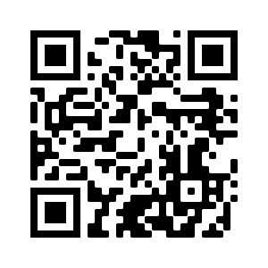
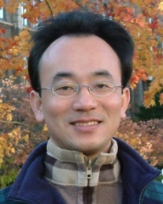
Deep Learning, Transfer Learning, Zero-Shot, and Few-Shot Learning for Text Analytics
Artificial Intelligence for Text Analytics
1102AITA10
MBA, IM, NTPU (M5026) (Spring 2022) Tue 2, 3, 4 (9:10-12:00) (B8F40)
Min-Yuh Day, Ph.D, Associate Professor
Institute of Information Management, National Taipei University
https://web.ntpu.edu.tw/~myday
https://meet.google.com/paj-zhhj-mya
2022-05-24

Slide 2
Syllabus
Week Date Subject/Topics
1 2022/02/22 Introduction to Artificial Intelligence for Text Analytics
2 2022/03/01 Foundations of Text Analytics: Natural Language Processing (NLP)
3 2022/03/08 Python for Natural Language Processing
4 2022/03/15 Natural Language Processing with Transformers
5 2022/03/22 Case Study on Artificial Intelligence for Text Analytics I
6 2022/03/29 Text Classification and Sentiment Analysis

Slide 3
Syllabus
Week Date Subject/Topics
7 2022/04/05 Tomb-Sweeping Day (Holiday, No Classes)
8 2022/04/12 Midterm Project Report
9 2022/04/19 Multilingual Named Entity Recognition (NER), Text Similarity and Clustering
10 2022/04/26 Text Summarization and Topic Models
11 2022/05/03 Text Generation
12 2022/05/10 Case Study on Artificial Intelligence for Text Analytics II

Slide 4
Syllabus
Week Date Subject/Topics
13 2022/05/17 Question Answering and Dialogue Systems
14 2022/05/24 Deep Learning, Transfer Learning, Zero-Shot, and Few-Shot Learning for Text Analytics
15 2022/05/31 Final Project Report I
16 2022/06/07 Final Project Report II
17 2022/06/14 Self-learning
18 2022/06/21 Self-learning

Slide 5
Deep Learning, Transfer Learning, Zero-Shot, and Few-Shot Learning for Text Analytics

Slide 6
Outline
Deep Learning
Transfer Learning
Pre-training, Fine-Tuning (FT)
Few-Shot Learning (FSL)
Meta Learning: Learn to Learn
One-Shot Learning (1SL)
Zero-Shot Learning (0SL)(ZSL)

Slide 7
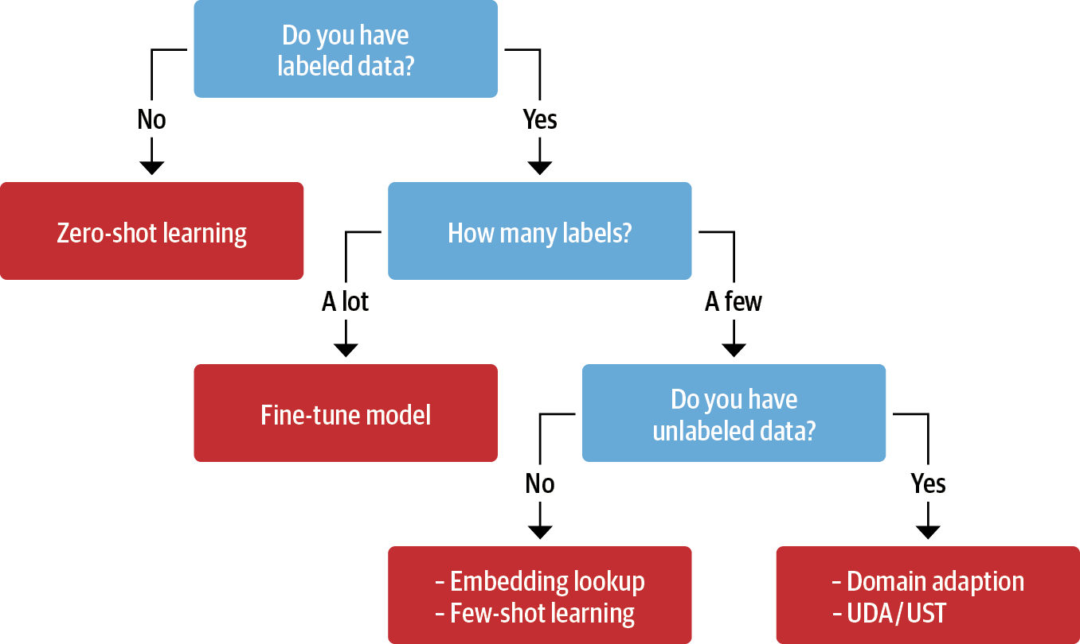
Transfer Learning, Fine-tuning, Few-shot learning
Unsupervised Data Augmentation (UDA)
Uncertainty-aware Self-Training (UST)
Source: Lewis Tunstall, Leandro von Werra, and Thomas Wolf (2022), Natural Language Processing with Transformers: Building Language Applications with Hugging Face, O'Reilly Media.

Slide 8
AI, NLP, ML, DL
Source: Sowmya Vajjala, Bodhisattwa Majumder, Anuj Gupta (2020), Practical Natural Language Processing: A Comprehensive Guide to Building Real-World NLP Systems, O'Reilly Media.

Slide 9
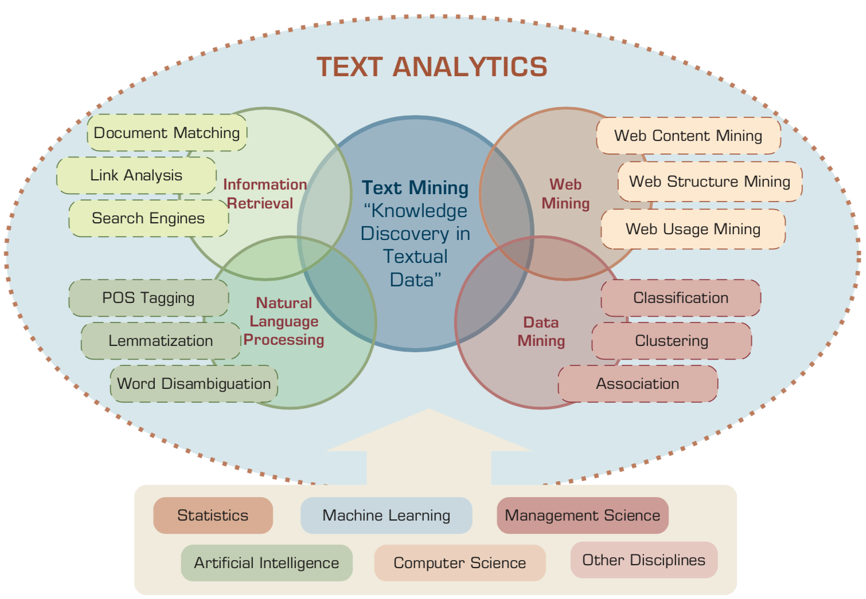
Text Analytics and Text Mining
Source: Ramesh Sharda, Dursun Delen, and Efraim Turban (2017), Business Intelligence, Analytics, and Data Science: A Managerial Perspective, 4th Edition, Pearson

Slide 10
AI, ML, DL
Artificial Intelligence (AI)
Machine Learning (ML)
Supervised Learning
Unsupervised Learning
Deep Learning (DL)
CNN
RNN LSTM GRU
GAN
Semi-supervised Learning
Reinforcement Learning
Source: https://leonardoaraujosantos.gitbooks.io/artificial-inteligence/content/deep_learning.html

Slide 11
Transfer Learning
Pre-training
Fine-Tuning
Transfer Learning

Slide 12
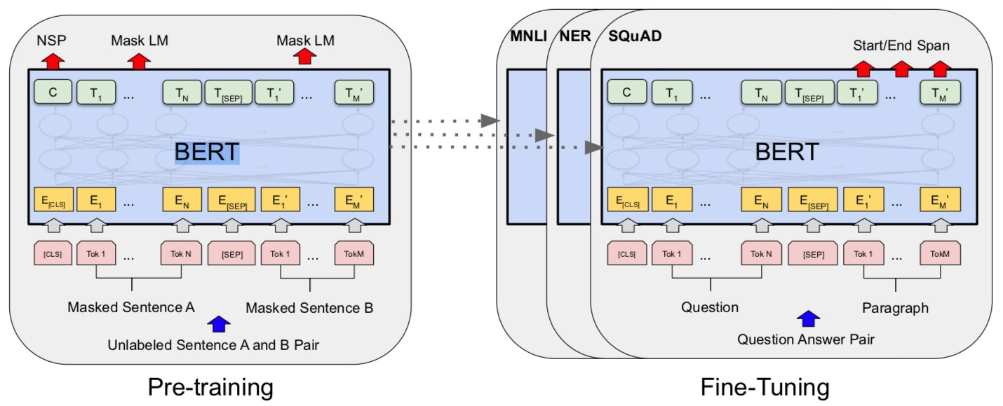
BERT: Pre-training of Deep Bidirectional Transformers for Language Understanding
BERT (Bidirectional Encoder Representations from Transformers)
Overall pre-training and fine-tuning procedures for BERT
Source: Devlin, Jacob, Ming-Wei Chang, Kenton Lee, and Kristina Toutanova (2018). "Bert: Pre-training of deep bidirectional transformers for language understanding." arXiv preprint arXiv:1810.04805.

Slide 13
The Transformers Timeline
ULMFit
BERT
RoBERTa
XLM-R
DeBERTa
GPT-Neo
T5
Transformer
GPT
GPT-2
DistrilBERT
GPT-3
GPT-J
2017
2018
2019
2020
2021
2022
Source: Lewis Tunstall, Leandro von Werra, and Thomas Wolf (2022), Natural Language Processing with Transformers: Building Language Applications with Hugging Face, O'Reilly Media.

Slide 14
Transformer Models
Transformer
Encoder
Decoder
DistilBERT
BERT
T5
GPT
RoBERTa
BART
GPT-2
CTRL
XLM-R
XLM
M2M-100
GPT-3
ALBERT
BigBird
GPT-Neo
GPT-J
ELECTRA
DeBERTa
Source: Lewis Tunstall, Leandro von Werra, and Thomas Wolf (2022), Natural Language Processing with Transformers: Building Language Applications with Hugging Face, O'Reilly Media.

Slide 15
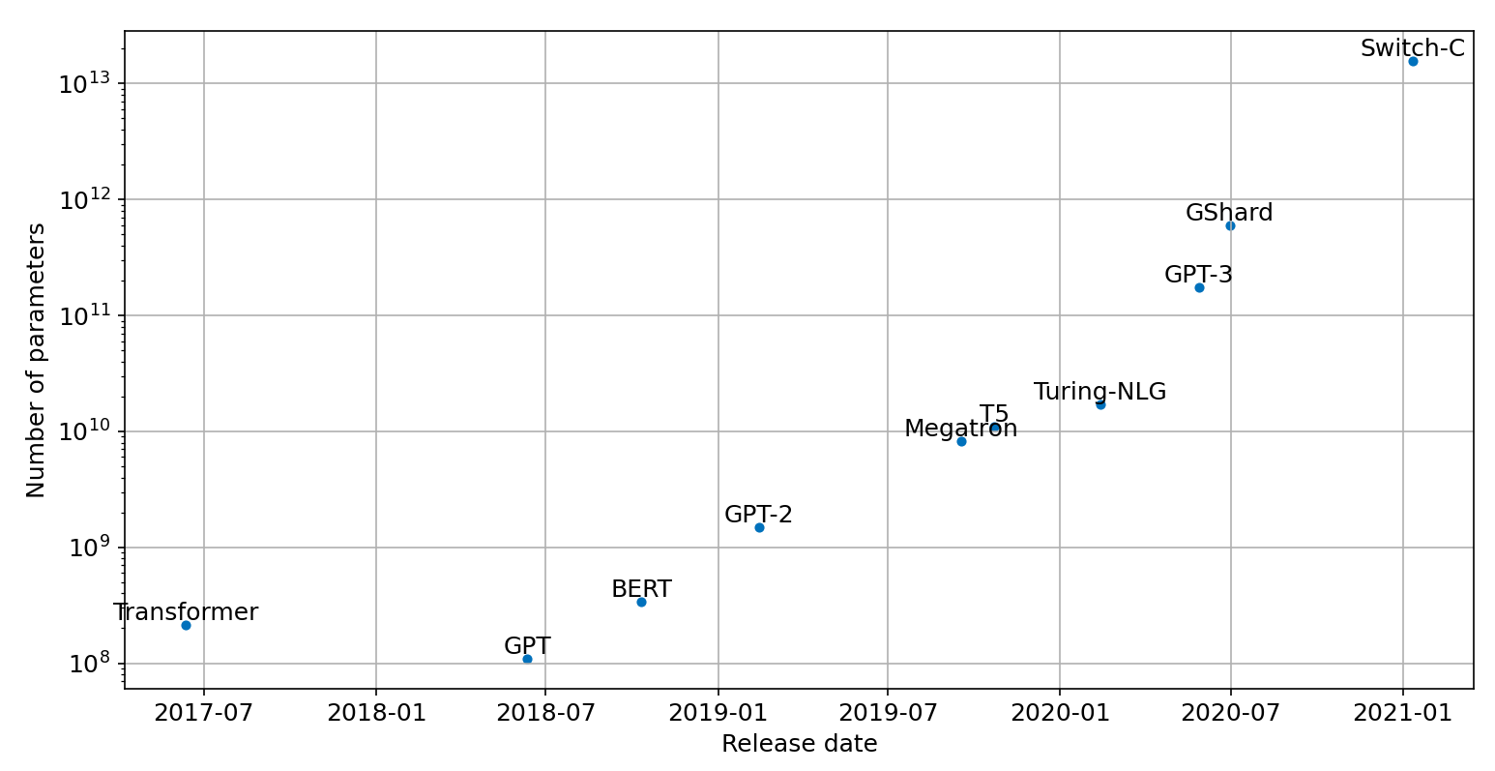
Scaling Transformers

Slide 16
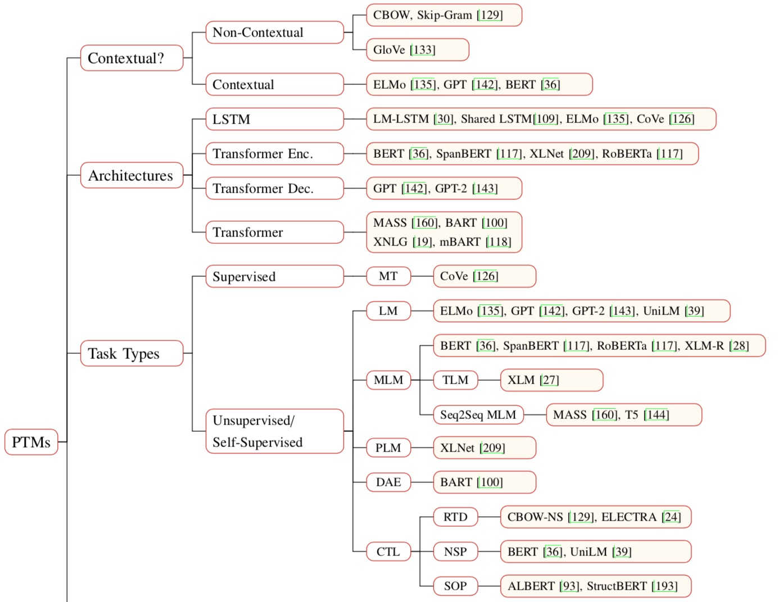
Pre-trained Models (PTM)
Source: Qiu, Xipeng, Tianxiang Sun, Yige Xu, Yunfan Shao, Ning Dai, and Xuanjing Huang. "Pre-trained Models for Natural Language Processing: A Survey." arXiv preprint arXiv:2003.08271 (2020).

Slide 17
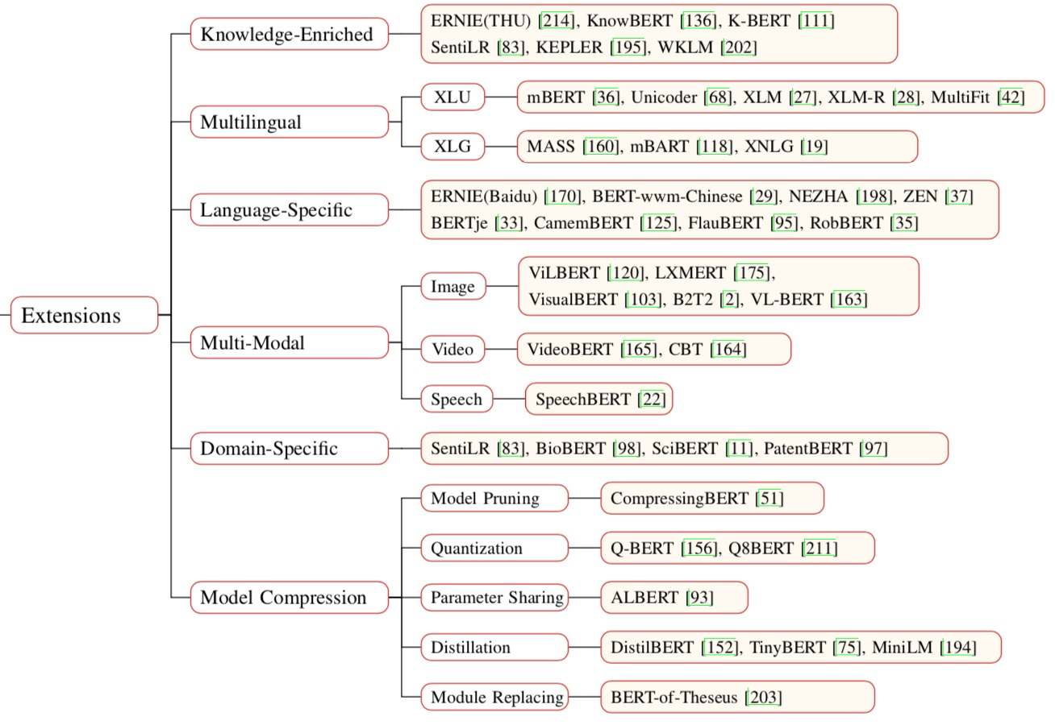
Pre-trained Models (PTM)
Source: Qiu, Xipeng, Tianxiang Sun, Yige Xu, Yunfan Shao, Ning Dai, and Xuanjing Huang. "Pre-trained Models for Natural Language Processing: A Survey." arXiv preprint arXiv:2003.08271 (2020).

Slide 18
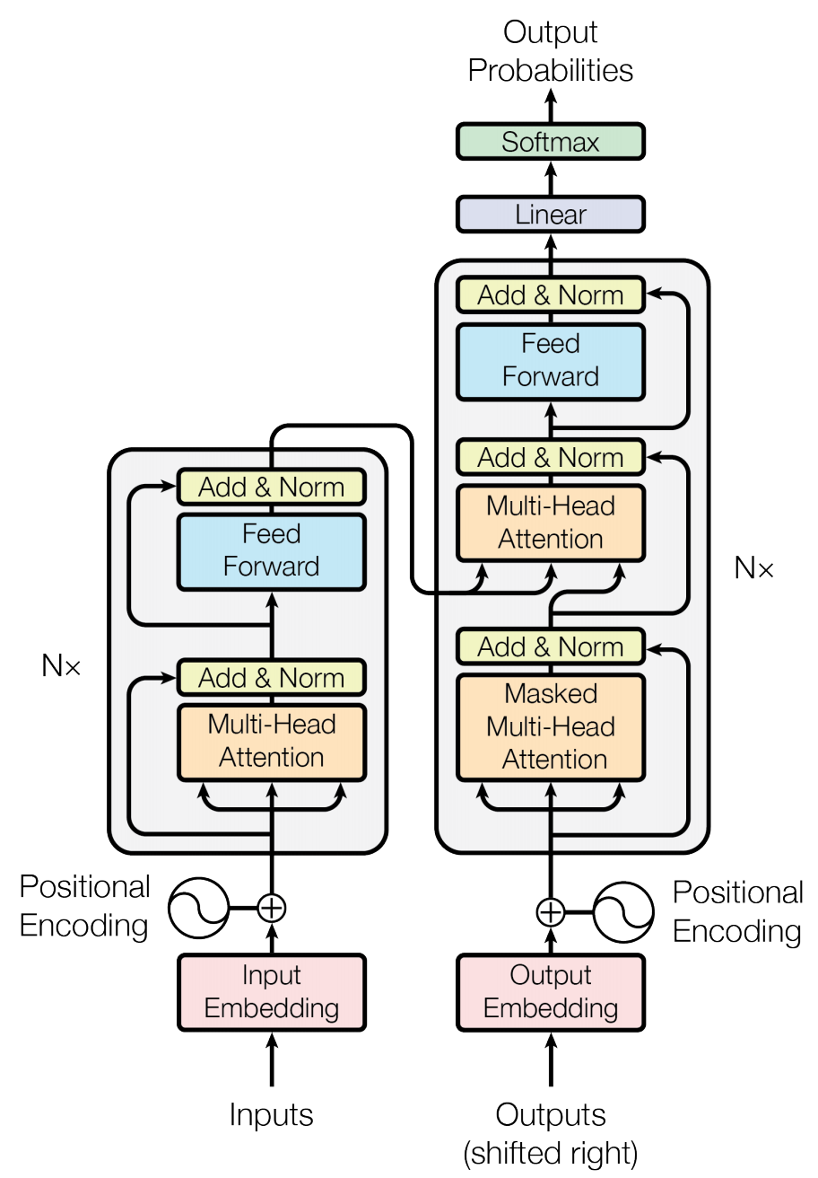
Transformer (Attention is All You Need) (Vaswani et al., 2017)
Source: Vaswani, Ashish, Noam Shazeer, Niki Parmar, Jakob Uszkoreit, Llion Jones, Aidan N. Gomez, Łukasz Kaiser, and Illia Polosukhin. "Attention is all you need." In Advances in neural information processing systems, pp. 5998-6008. 2017.

Slide 19
BERT: Pre-training of Deep Bidirectional Transformers for Language Understanding
BERT (Bidirectional Encoder Representations from Transformers)
Overall pre-training and fine-tuning procedures for BERT
Source: Devlin, Jacob, Ming-Wei Chang, Kenton Lee, and Kristina Toutanova (2018). "Bert: Pre-training of deep bidirectional transformers for language understanding." arXiv preprint arXiv:1810.04805.

Slide 20
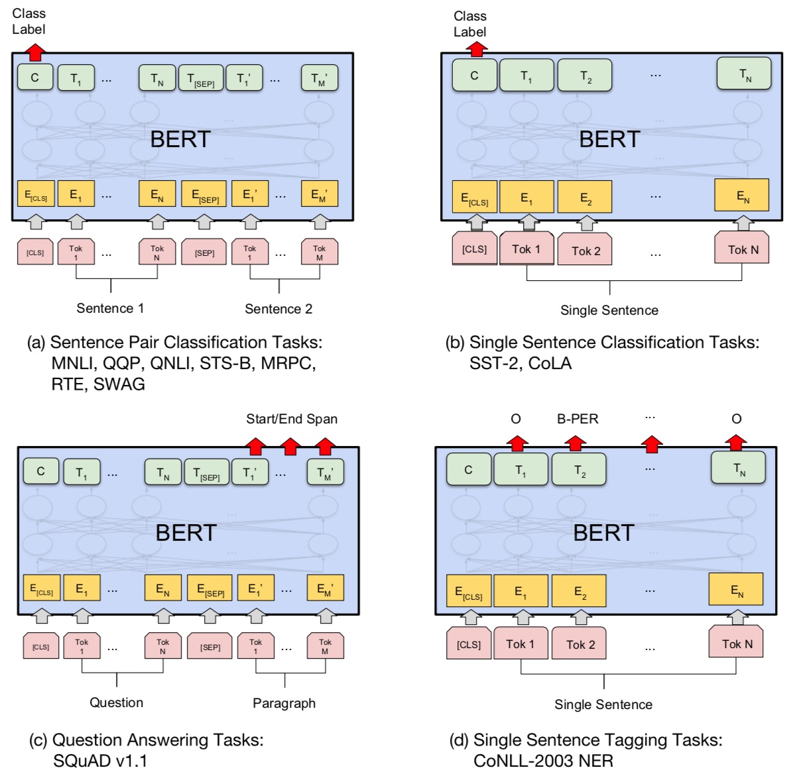
Fine-tuning BERT on Different Tasks
Source: Devlin, Jacob, Ming-Wei Chang, Kenton Lee, and Kristina Toutanova (2018). "Bert: Pre-training of deep bidirectional transformers for language understanding." arXiv preprint arXiv:1810.04805.

Slide 21
Sentiment Analysis: Single Sentence Classification
Source: Devlin, Jacob, Ming-Wei Chang, Kenton Lee, and Kristina Toutanova (2018). "BERT: Pre-training of Deep Bidirectional Transformers for Language Understanding." arXiv preprint arXiv:1810.04805

Slide 22
Fine-tuning BERT on Question Answering (QA)
Source: Devlin, Jacob, Ming-Wei Chang, Kenton Lee, and Kristina Toutanova (2018). "Bert: Pre-training of deep bidirectional transformers for language understanding." arXiv preprint arXiv:1810.04805.

Slide 23
Fine-tuning BERT on Dialogue Intent Detection (ID; Classification)
Source: Devlin, Jacob, Ming-Wei Chang, Kenton Lee, and Kristina Toutanova (2018). "Bert: Pre-training of deep bidirectional transformers for language understanding." arXiv preprint arXiv:1810.04805.

Slide 24
Fine-tuning BERT on Dialogue Slot Filling (SF)
Source: Devlin, Jacob, Ming-Wei Chang, Kenton Lee, and Kristina Toutanova (2018). "Bert: Pre-training of deep bidirectional transformers for language understanding." arXiv preprint arXiv:1810.04805.

Slide 25
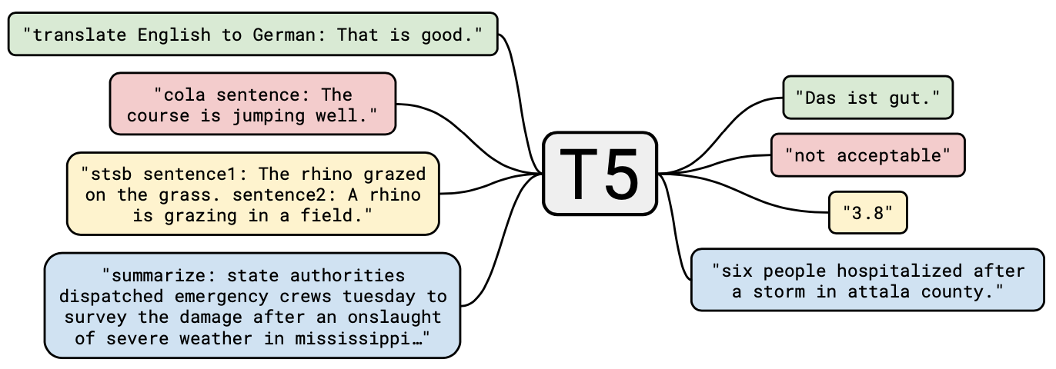
T5 Text-to-Text Transfer Transformer
Source: JColin Raffel, Noam Shazeer, Adam Roberts, Katherine Lee, Sharan Narang, Michael Matena, Yanqi Zhou, Wei Li, and Peter J. Liu (2019). "Exploring the limits of transfer learning with a unified text-to-text transformer." arXiv preprint arXiv:1910.10683 (2019).

Slide 26
Hugging Face
https://huggingface.co/

Slide 27
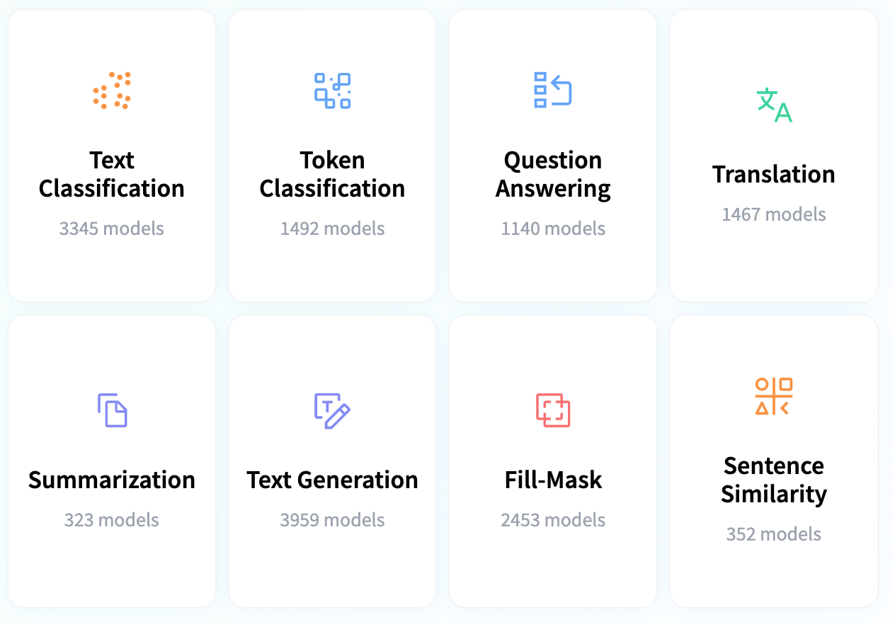
Hugging Face Tasks Natural Language Processing
https://huggingface.co/tasks

Slide 28
ULMFiT: 3 Steps Transfer Learning in NLP
Wikitet
103
IMDB
IMDB
Language Model
Language Model
Classifier
1. Pretraining
2. Domain adaptation
3. Fine-tuning
Source: Lewis Tunstall, Leandro von Werra, and Thomas Wolf (2022), Natural Language Processing with Transformers: Building Language Applications with Hugging Face, O'Reilly Media.

Slide 29
Transfer Learning
Pre-training
Fine-Tuning
Transfer Learning

Slide 30
BERT: Pre-training of Deep Bidirectional Transformers for Language Understanding
BERT (Bidirectional Encoder Representations from Transformers)
Overall pre-training and fine-tuning procedures for BERT
Source: Devlin, Jacob, Ming-Wei Chang, Kenton Lee, and Kristina Toutanova (2018). "Bert: Pre-training of deep bidirectional transformers for language understanding." arXiv preprint arXiv:1810.04805.

Slide 31
A typical pipeline for training transformer models with the Datasets, Tokenizers, and Transformers libraries
Datasets
Tokenizers
Transformers
Datasets
Load and process datasets
Tokenize input texts
Load models, train and infer
Load metrics evaluate models
Source: Lewis Tunstall, Leandro von Werra, and Thomas Wolf (2022), Natural Language Processing with Transformers: Building Language Applications with Hugging Face, O'Reilly Media.
https://github.com/nlp-with-transformers/notebooks

Slide 32
Transfer Learning, Fine-tuning, Few-shot learning
Source: Lewis Tunstall, Leandro von Werra, and Thomas Wolf (2022), Natural Language Processing with Transformers: Building Language Applications with Hugging Face, O'Reilly Media.

Slide 33
Few-Shot Learning (FSL) Typical Scenarios
Acting as a test bed for learning like human
Learning for rare cases
Reducing data gathering effort and computational cost
Source: Yaqing Wang, Quanming Yao, James T. Kwok, and Lionel M. Ni (2020). "Generalizing from a few examples: A survey on few-shot learning." ACM computing surveys (csur) 53, no. 3 (2020): 1-34.

Slide 34
Few-Shot Learning (FSL)
Few-Shot Learning (FSL) is a sub-area in machine learning.
Machine Learning Definition
A computer program is said to learn from experience E with respect to some classes of task T and performance measure P if its performance can improve with E on T measured by P.
Example: Image classification task (T ), a machine learning program can improve its classification accuracy (P) through E obtained by training on a large number of labeled images (e.g., the ImageNet data set).
Source: Yaqing Wang, Quanming Yao, James T. Kwok, and Lionel M. Ni (2020). "Generalizing from a few examples: A survey on few-shot learning." ACM computing surveys (csur) 53, no. 3 (2020): 1-34.

Slide 35
Machine Learning
Source: Yaqing Wang, Quanming Yao, James T. Kwok, and Lionel M. Ni (2020). "Generalizing from a few examples: A survey on few-shot learning." ACM computing surveys (csur) 53, no. 3 (2020): 1-34.

Slide 36
Few-Shot Learning (FSL)
Few-shot Learning (FSL) is a type of machine learning problems (specified by E, T, and P), where E contains only a limited number of examples with supervised information for the target T.
Existing FSL problems are mainly supervised learning problems.
Few-shot classification learns classifiers given only a few labeled examples of each class.
image classification
sentiment classification from short text
object recognition
Source: Yaqing Wang, Quanming Yao, James T. Kwok, and Lionel M. Ni (2020). "Generalizing from a few examples: A survey on few-shot learning." ACM computing surveys (csur) 53, no. 3 (2020): 1-34.

Slide 37
Few-Shot Learning (FSL)
Few-shot classification learns a classifier h, which predicts label y_{i} for each input x_{i}.
Usually, one considers the N-way-K-shot classification, in which D_{train} contains I = KN examples from N classes each with K examples
Source: Yaqing Wang, Quanming Yao, James T. Kwok, and Lionel M. Ni (2020). "Generalizing from a few examples: A survey on few-shot learning." ACM computing surveys (csur) 53, no. 3 (2020): 1-34.

Slide 38
Few-Shot Learning (FSL)
Few-Shot Learning (FSL)
K = 10 ~ 100 examples
One-Shot Learning (1SL)
K = 1 example
Zero-Shot Learning (0SL)(ZSL)
K = 0

Slide 39
Few-Shot Learning (FSL)
Source: Yaqing Wang, Quanming Yao, James T. Kwok, and Lionel M. Ni (2020). "Generalizing from a few examples: A survey on few-shot learning." ACM computing surveys (csur) 53, no. 3 (2020): 1-34.

Slide 40
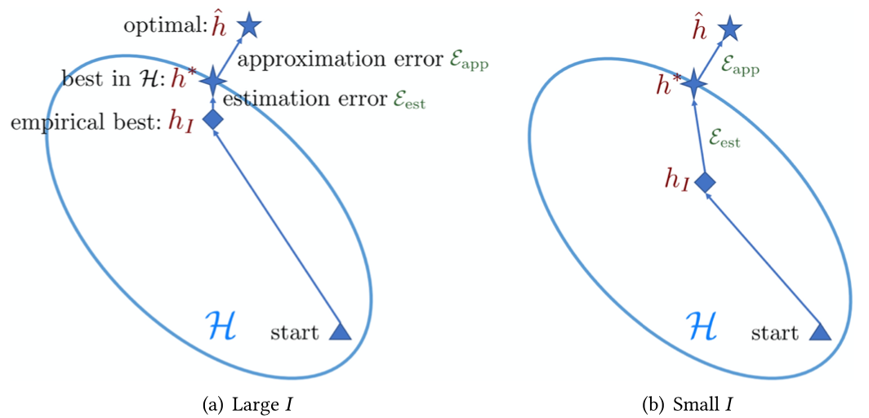
Few-Shot Learning (FSL) Comparison of learning with sufficient and few training samples
Source: Yaqing Wang, Quanming Yao, James T. Kwok, and Lionel M. Ni (2020). "Generalizing from a few examples: A survey on few-shot learning." ACM computing surveys (csur) 53, no. 3 (2020): 1-34.

Slide 41
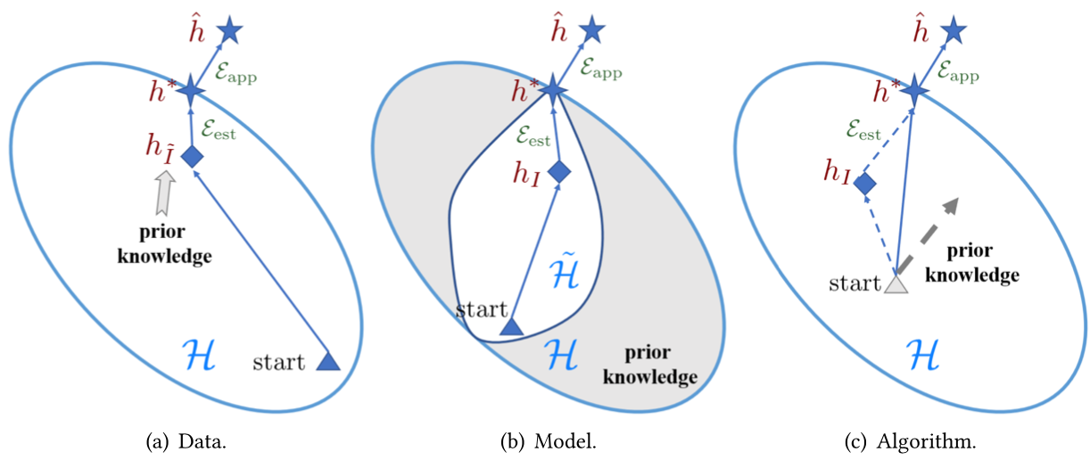
Few-Shot Learning (FSL) Different perspectives on how FSL methods solve the few-shot problem
Source: Yaqing Wang, Quanming Yao, James T. Kwok, and Lionel M. Ni (2020). "Generalizing from a few examples: A survey on few-shot learning." ACM computing surveys (csur) 53, no. 3 (2020): 1-34.

Slide 42
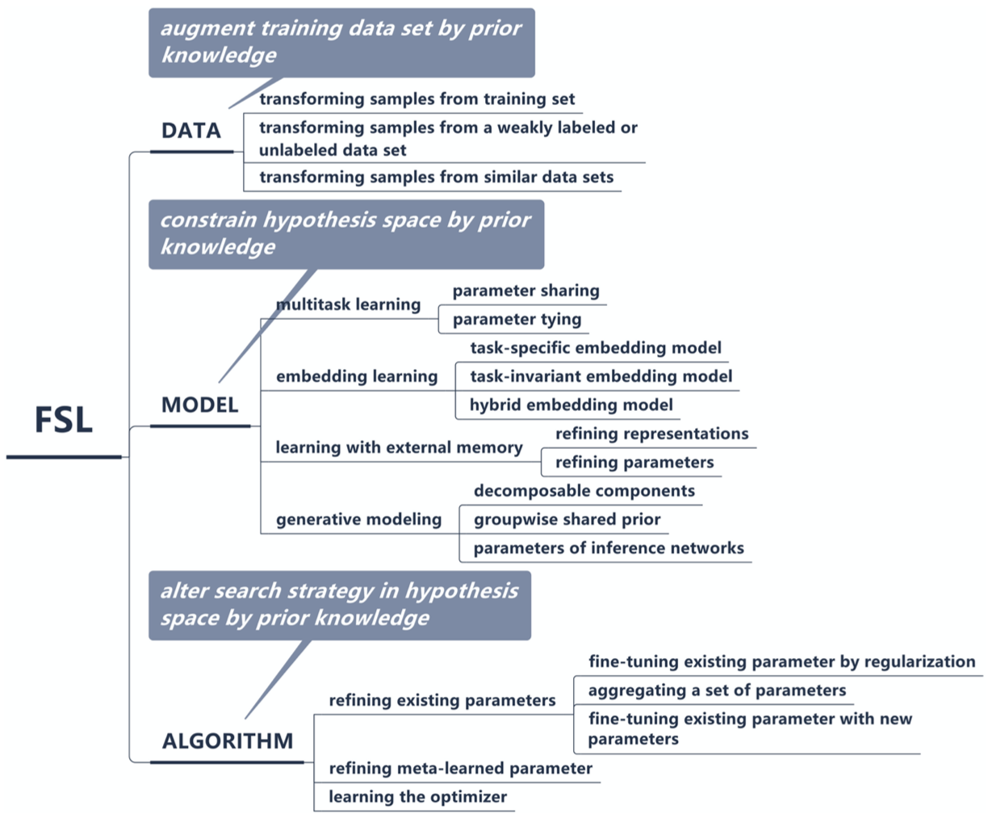
Few-Shot Learning (FSL)
A taxonomy of FSL methods
Source: Yaqing Wang, Quanming Yao, James T. Kwok, and Lionel M. Ni (2020). "Generalizing from a few examples: A survey on few-shot learning." ACM computing surveys (csur) 53, no. 3 (2020): 1-34.

Slide 43
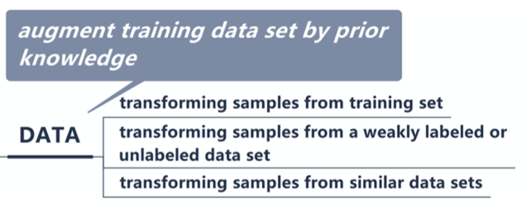
Few-Shot Learning (FSL)
Source: Yaqing Wang, Quanming Yao, James T. Kwok, and Lionel M. Ni (2020). "Generalizing from a few examples: A survey on few-shot learning." ACM computing surveys (csur) 53, no. 3 (2020): 1-34.

Slide 44
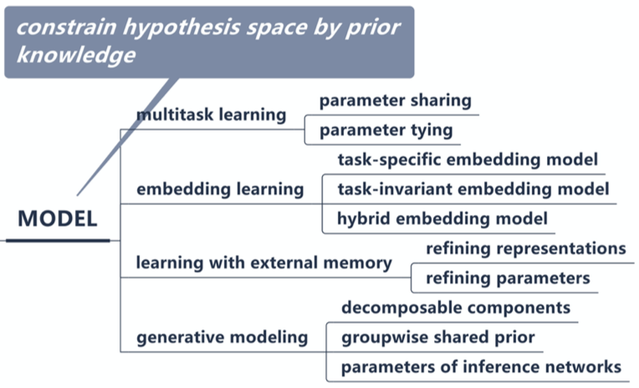
Few-Shot Learning (FSL)
Source: Yaqing Wang, Quanming Yao, James T. Kwok, and Lionel M. Ni (2020). "Generalizing from a few examples: A survey on few-shot learning." ACM computing surveys (csur) 53, no. 3 (2020): 1-34.

Slide 45
Few-Shot Learning (FSL)
Source: Yaqing Wang, Quanming Yao, James T. Kwok, and Lionel M. Ni (2020). "Generalizing from a few examples: A survey on few-shot learning." ACM computing surveys (csur) 53, no. 3 (2020): 1-34.

Slide 46
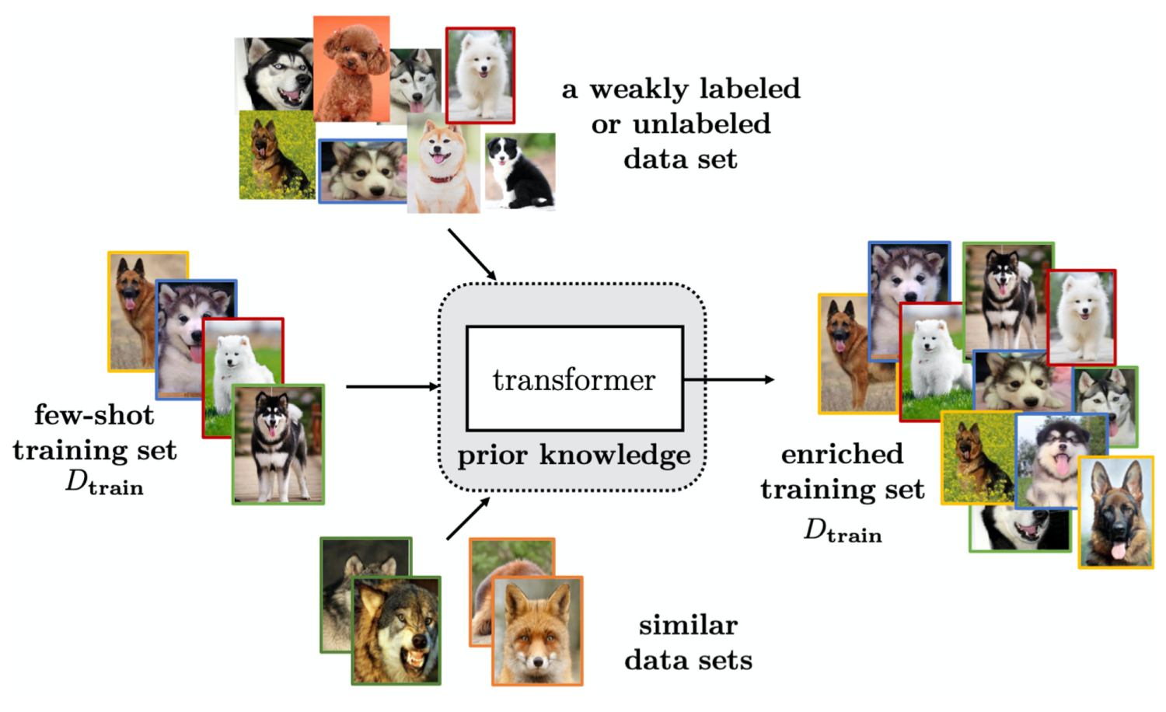
Few-Shot Learning (FSL) Solving the FSL problem by data augmentation
Source: Yaqing Wang, Quanming Yao, James T. Kwok, and Lionel M. Ni (2020). "Generalizing from a few examples: A survey on few-shot learning." ACM computing surveys (csur) 53, no. 3 (2020): 1-34.

Slide 47
Few-Shot Learning (FSL) Characteristics for FSL Methods Focusing on the Data Perspective
Source: Yaqing Wang, Quanming Yao, James T. Kwok, and Lionel M. Ni (2020). "Generalizing from a few examples: A survey on few-shot learning." ACM computing surveys (csur) 53, no. 3 (2020): 1-34.

Slide 48
Few-Shot Learning (FSL) Characteristics for FSL Methods Focusing on the Model Perspective
Source: Yaqing Wang, Quanming Yao, James T. Kwok, and Lionel M. Ni (2020). "Generalizing from a few examples: A survey on few-shot learning." ACM computing surveys (csur) 53, no. 3 (2020): 1-34.

Slide 49
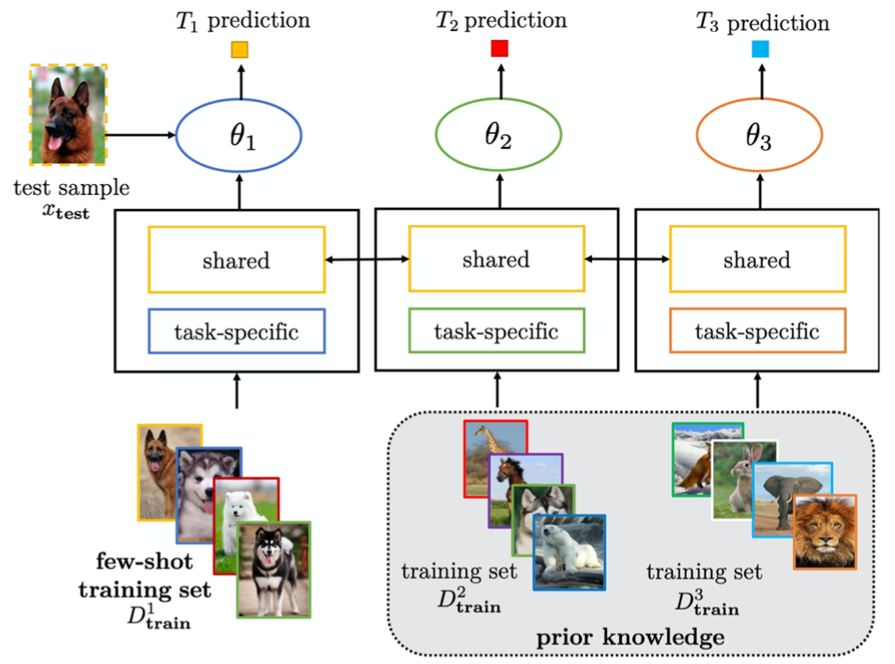
Few-Shot Learning (FSL) Solving the FSL problem by multitask learning with parameter sharing
Source: Yaqing Wang, Quanming Yao, James T. Kwok, and Lionel M. Ni (2020). "Generalizing from a few examples: A survey on few-shot learning." ACM computing surveys (csur) 53, no. 3 (2020): 1-34.

Slide 50
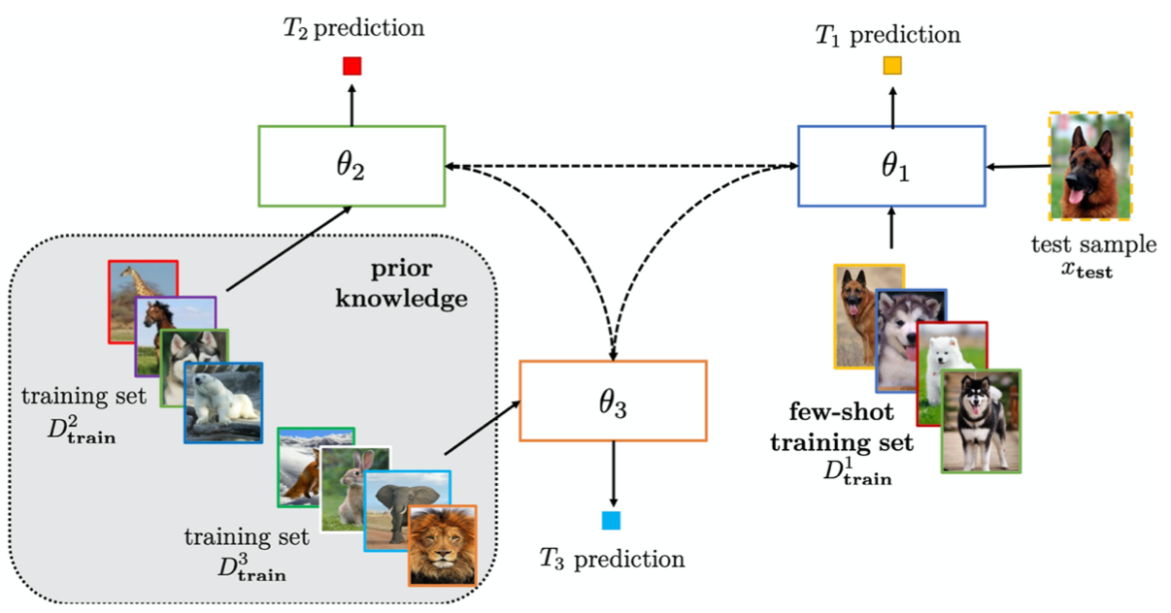
Few-Shot Learning (FSL) Solving the FSL problem by multitask learning with parameter tying
Source: Yaqing Wang, Quanming Yao, James T. Kwok, and Lionel M. Ni (2020). "Generalizing from a few examples: A survey on few-shot learning." ACM computing surveys (csur) 53, no. 3 (2020): 1-34.

Slide 51
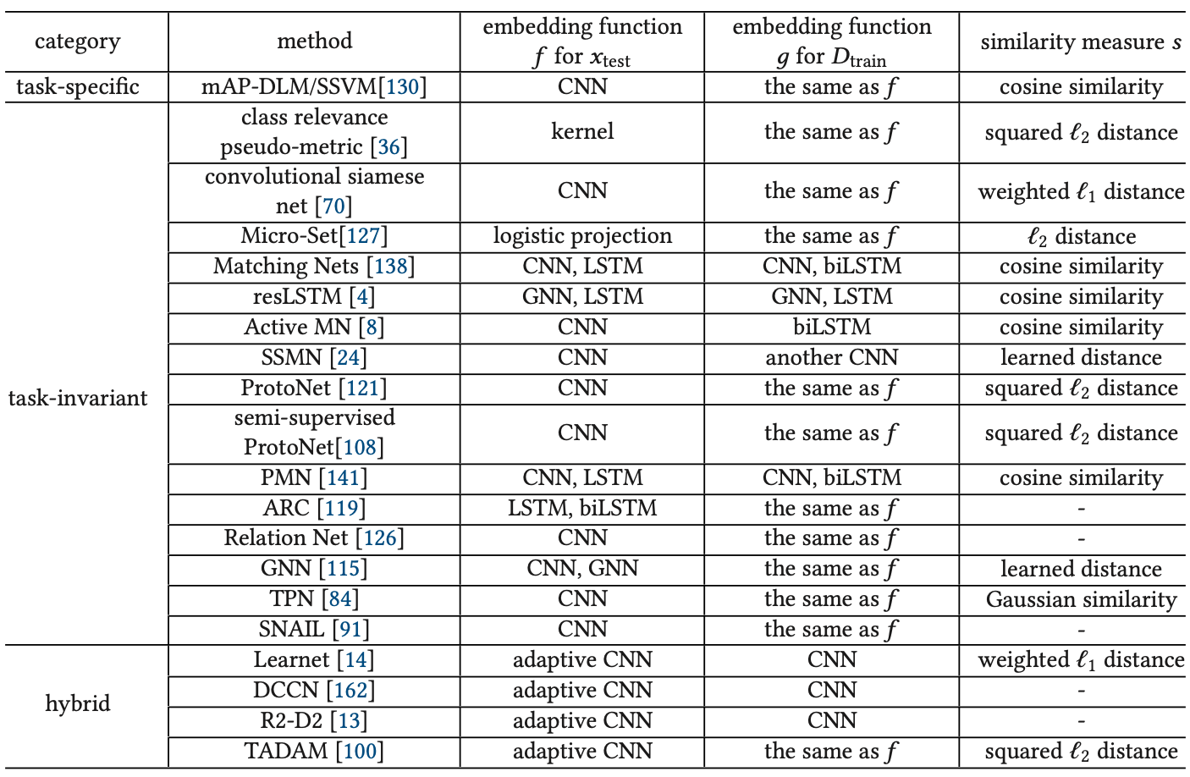
Few-Shot Learning (FSL) Characteristics of Embedding Learning Methods
Source: Yaqing Wang, Quanming Yao, James T. Kwok, and Lionel M. Ni (2020). "Generalizing from a few examples: A survey on few-shot learning." ACM computing surveys (csur) 53, no. 3 (2020): 1-34.

Slide 52
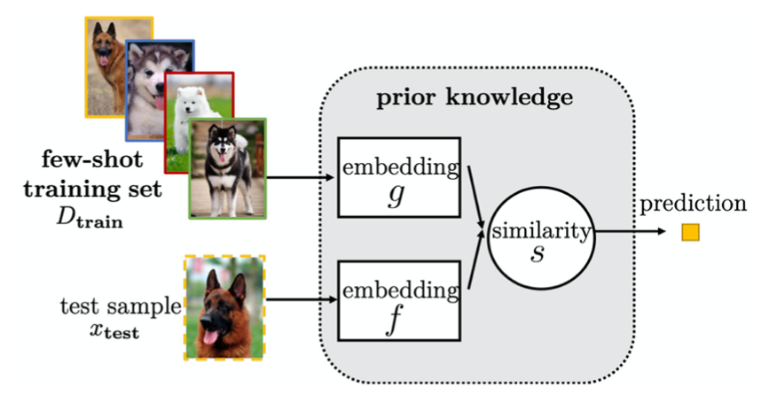
Few-Shot Learning (FSL) Solving the FSL problem by task-invariant embedding model
Source: Yaqing Wang, Quanming Yao, James T. Kwok, and Lionel M. Ni (2020). "Generalizing from a few examples: A survey on few-shot learning." ACM computing surveys (csur) 53, no. 3 (2020): 1-34.

Slide 53
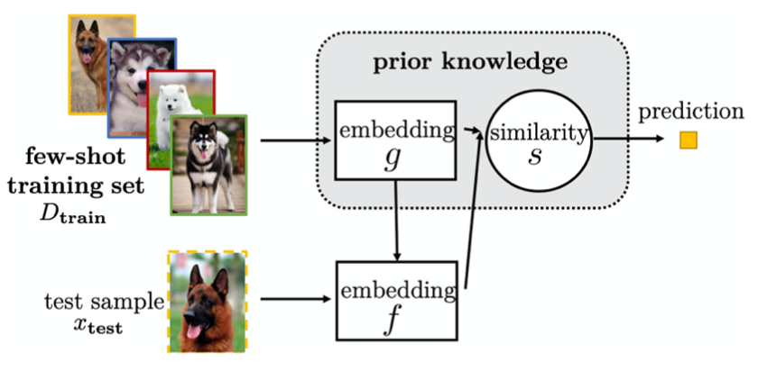
Few-Shot Learning (FSL) Solving the FSL problem by hybrid embedding model
Source: Yaqing Wang, Quanming Yao, James T. Kwok, and Lionel M. Ni (2020). "Generalizing from a few examples: A survey on few-shot learning." ACM computing surveys (csur) 53, no. 3 (2020): 1-34.

Slide 54
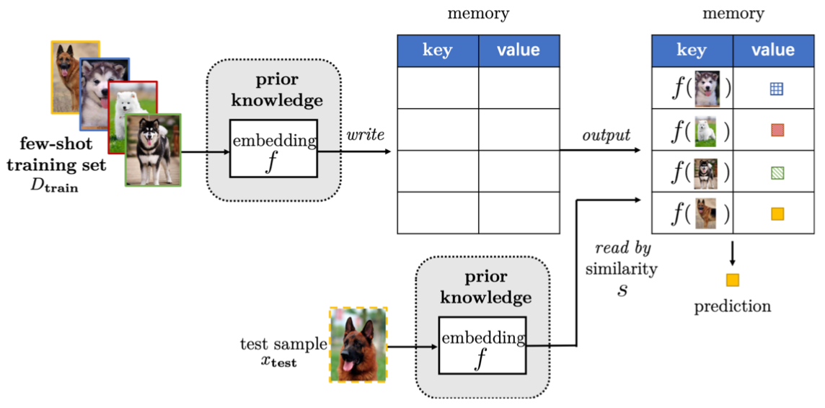
Few-Shot Learning (FSL) Solving the FSL problem by learning with external memory
Source: Yaqing Wang, Quanming Yao, James T. Kwok, and Lionel M. Ni (2020). "Generalizing from a few examples: A survey on few-shot learning." ACM computing surveys (csur) 53, no. 3 (2020): 1-34.

Slide 55
Few-Shot Learning (FSL) Characteristics of FSL Methods Based on Learning with External Memory
Source: Yaqing Wang, Quanming Yao, James T. Kwok, and Lionel M. Ni (2020). "Generalizing from a few examples: A survey on few-shot learning." ACM computing surveys (csur) 53, no. 3 (2020): 1-34.

Slide 56
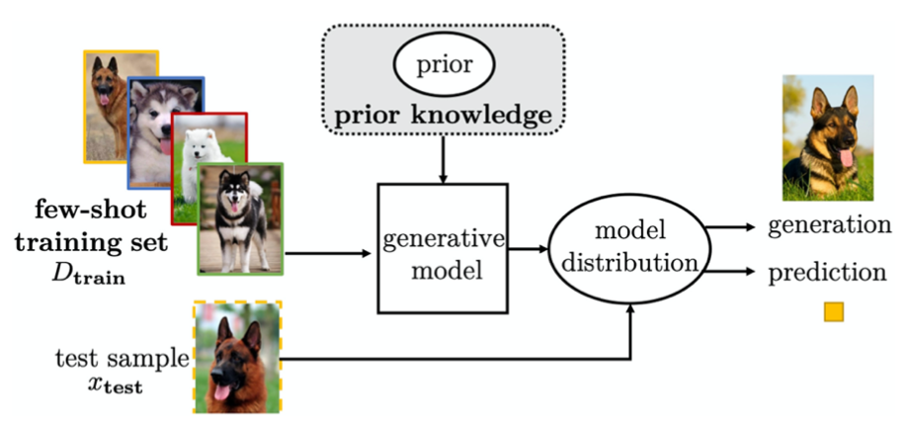
Few-Shot Learning (FSL) Solving the FSL problem by generative modeling
Source: Yaqing Wang, Quanming Yao, James T. Kwok, and Lionel M. Ni (2020). "Generalizing from a few examples: A survey on few-shot learning." ACM computing surveys (csur) 53, no. 3 (2020): 1-34.

Slide 57
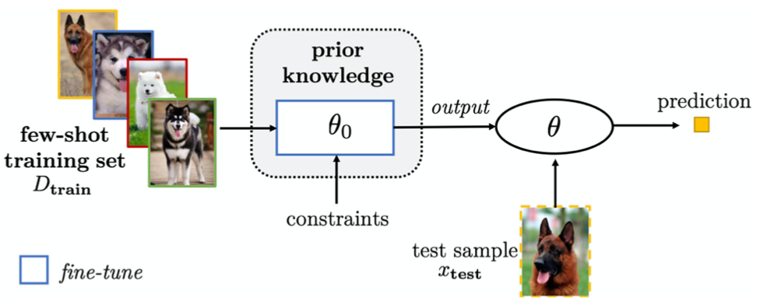
Few-Shot Learning (FSL) Solving the FSL problem by fine-tuning existing parameter θ₀ by regularization
Source: Yaqing Wang, Quanming Yao, James T. Kwok, and Lionel M. Ni (2020). "Generalizing from a few examples: A survey on few-shot learning." ACM computing surveys (csur) 53, no. 3 (2020): 1-34.

Slide 58
Few-Shot Learning (FSL) Characteristics for FSL Methods Focusing on the Algorithm Perspective
Source: Yaqing Wang, Quanming Yao, James T. Kwok, and Lionel M. Ni (2020). "Generalizing from a few examples: A survey on few-shot learning." ACM computing surveys (csur) 53, no. 3 (2020): 1-34.

Slide 59
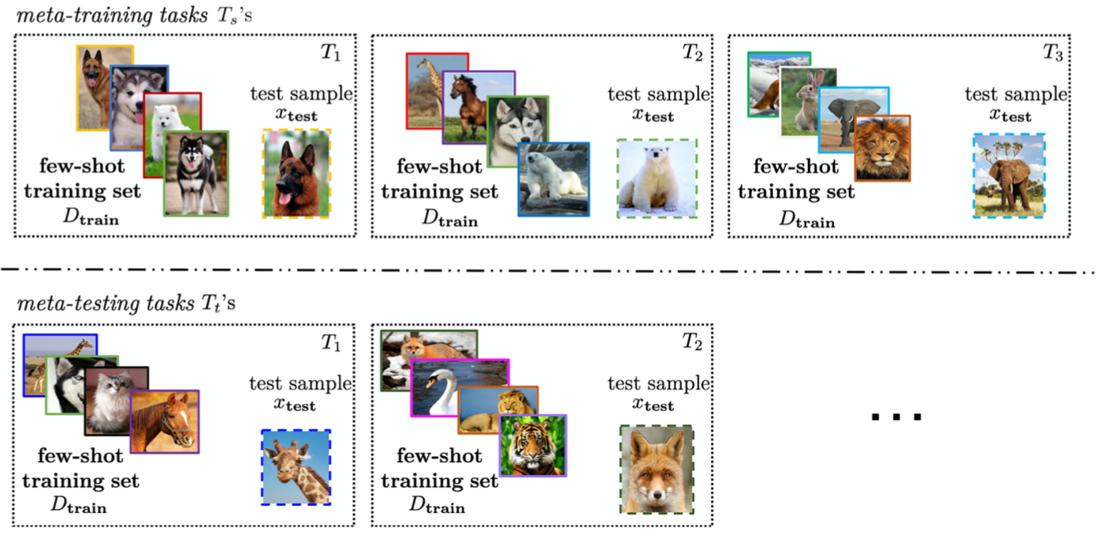
Few-Shot Learning (FSL) Solving the FSL problem by meta-learning
Source: Yaqing Wang, Quanming Yao, James T. Kwok, and Lionel M. Ni (2020). "Generalizing from a few examples: A survey on few-shot learning." ACM computing surveys (csur) 53, no. 3 (2020): 1-34.

Slide 60
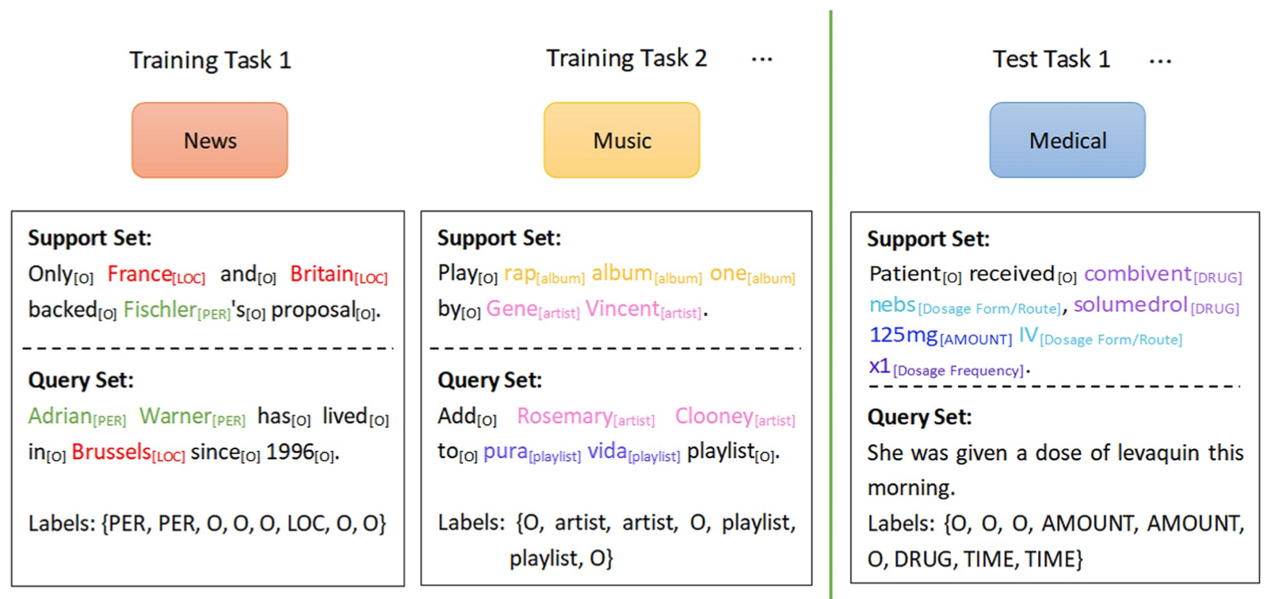
Few-Shot Learning (FSL) Meta-learning
Each task mimics the few-shot scenario, and can be completely non-overlapping. Support sets are used to train; query sets are used to evaluate the model
Source: Yao Ge, Yuting Guo, Yuan-Chi Yang, Mohammed Ali Al-Garadi, and Abeed Sarker (2022). "Few-shot learning for medical text: A systematic review." arXiv preprint arXiv:2204.14081 (2022).

Slide 61
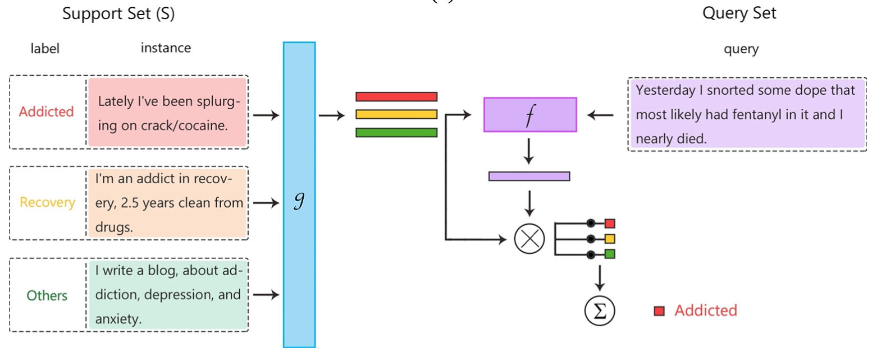
Few-Shot Learning (FSL) Matching networks
Source: Yao Ge, Yuting Guo, Yuan-Chi Yang, Mohammed Ali Al-Garadi, and Abeed Sarker (2022). "Few-shot learning for medical text: A systematic review." arXiv preprint arXiv:2204.14081 (2022).

Slide 62
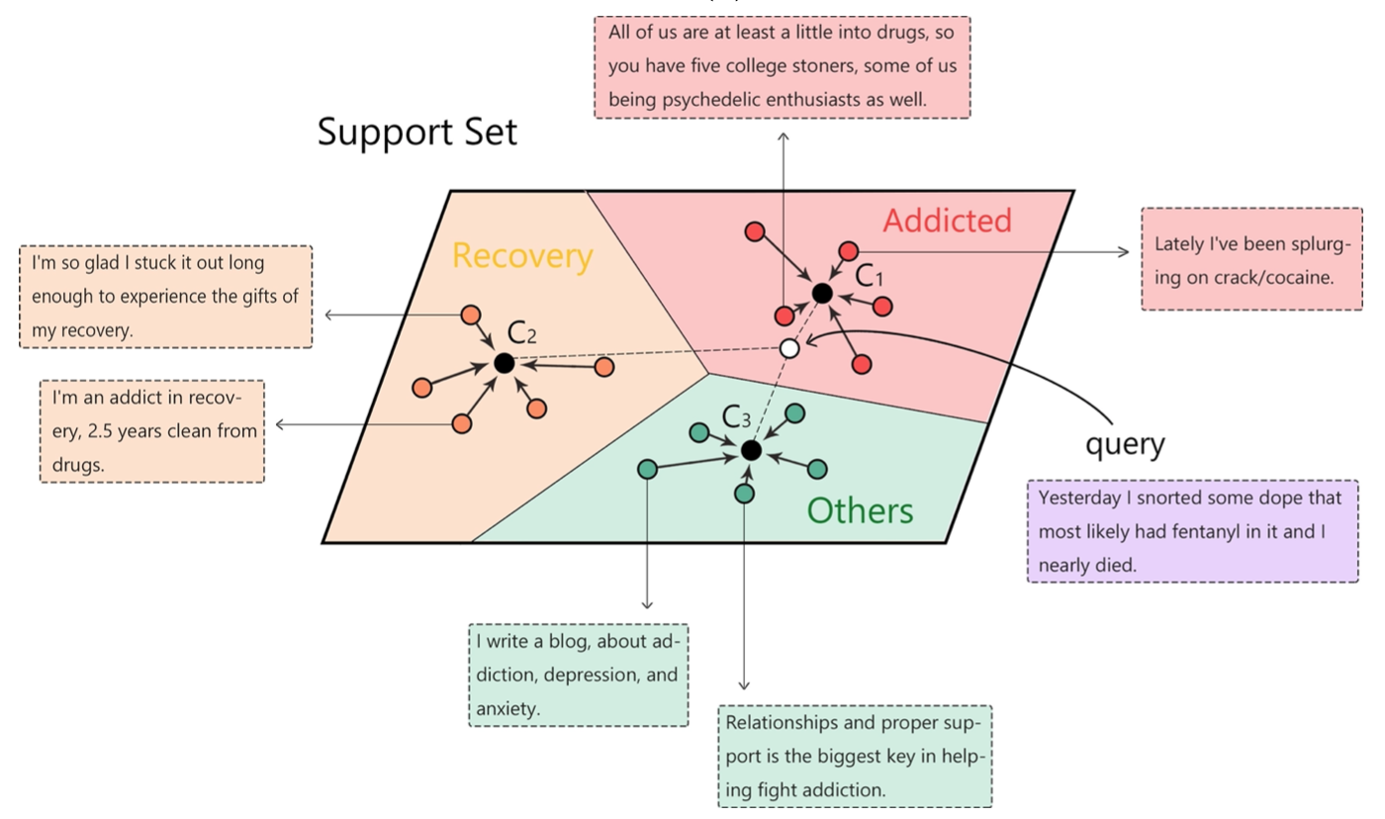
Few-Shot Learning (FSL) Prototypical network
Source: Yao Ge, Yuting Guo, Yuan-Chi Yang, Mohammed Ali Al-Garadi, and Abeed Sarker (2022). "Few-shot learning for medical text: A systematic review." arXiv preprint arXiv:2204.14081 (2022).

Slide 63
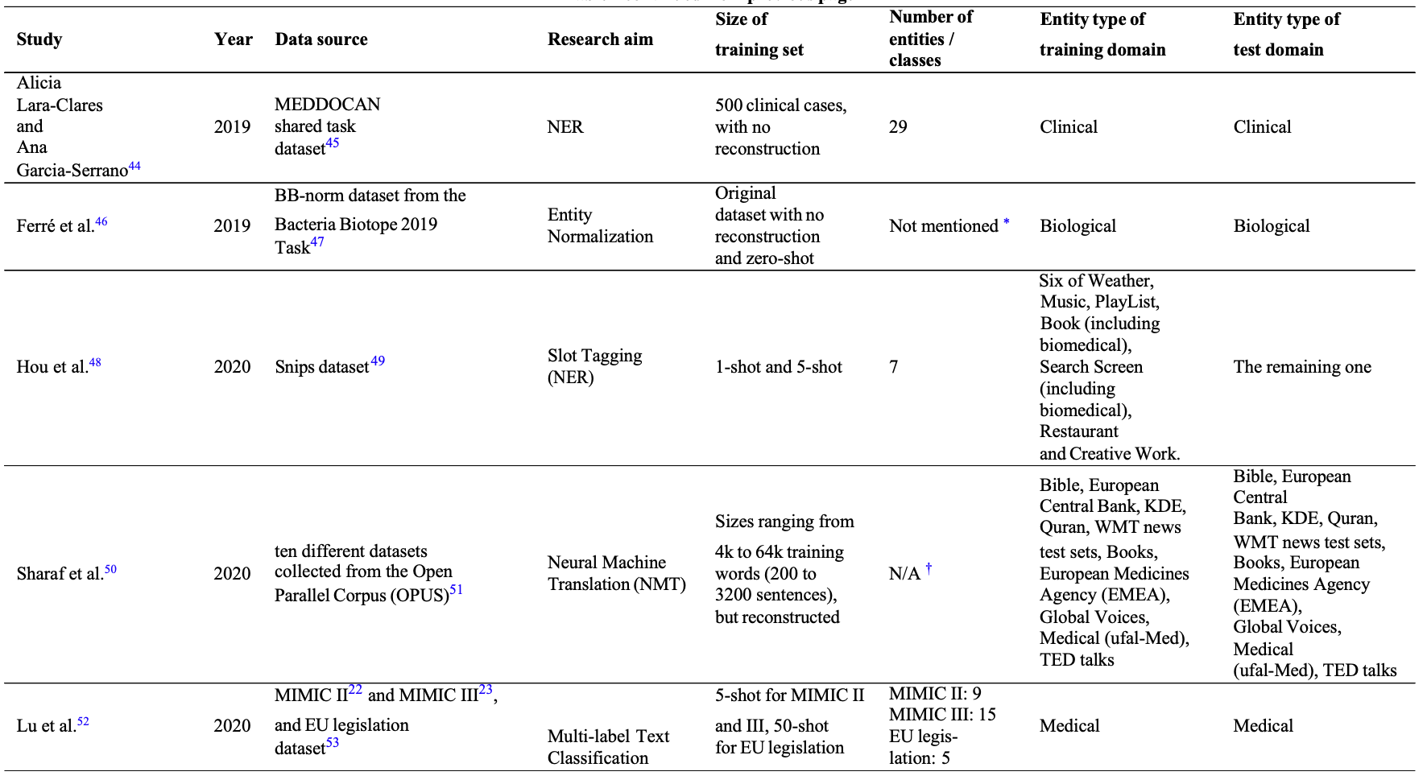
Few-Shot Learning (FSL) for medical text
Source: Yao Ge, Yuting Guo, Yuan-Chi Yang, Mohammed Ali Al-Garadi, and Abeed Sarker (2022). "Few-shot learning for medical text: A systematic review." arXiv preprint arXiv:2204.14081 (2022).

Slide 64
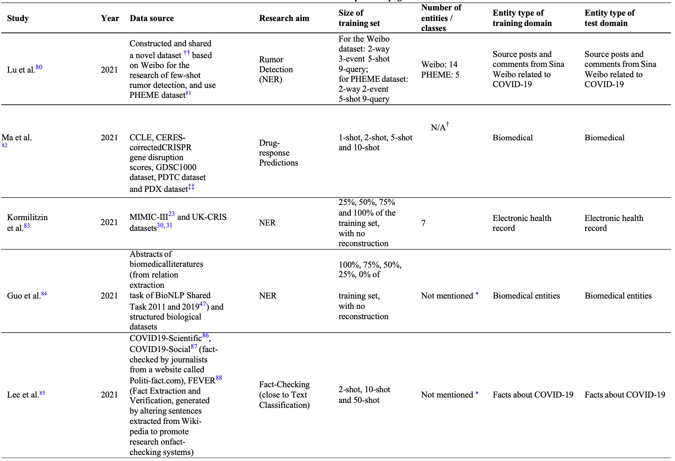
Few-Shot Learning (FSL) for medical text
Source: Yao Ge, Yuting Guo, Yuan-Chi Yang, Mohammed Ali Al-Garadi, and Abeed Sarker (2022). "Few-shot learning for medical text: A systematic review." arXiv preprint arXiv:2204.14081 (2022).

Slide 65
Multimodal Few-Shot Learning with Frozen Language Models
Curated samples with about five seeds required to get past well-known language model failure modes of either repeating text for the prompt or emitting text that does not pertain to the image.
These samples demonstrate the ability to generate open-ended outputs that adapt to both images and text, and to make use of facts that it has learned during language-only pre-training.
Source: Maria Tsimpoukelli, Jacob L. Menick, Serkan Cabi, S. M. Eslami, Oriol Vinyals, and Felix Hill (2021). "Multimodal few-shot learning with frozen language models." Advances in Neural Information Processing Systems 34 (2021): 200-212.

Slide 66
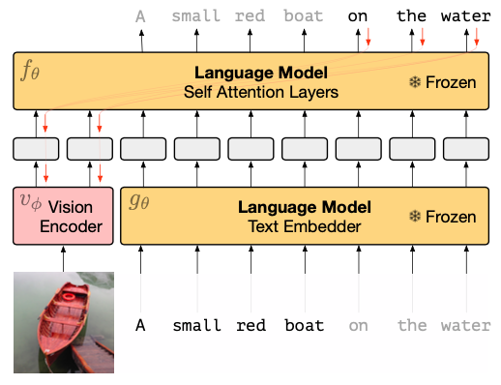
Multimodal Few-Shot Learning with Frozen Language Models
Gradients through a frozen language model’s self attention layers are used to train the vision encoder.
Source: Maria Tsimpoukelli, Jacob L. Menick, Serkan Cabi, S. M. Eslami, Oriol Vinyals, and Felix Hill (2021). "Multimodal few-shot learning with frozen language models." Advances in Neural Information Processing Systems 34 (2021): 200-212.

Slide 67
Multimodal Few-Shot Learning with Frozen Language Models
Inference-Time interface for Frozen. The figure demonstrates how we can support (a) visual question answering, (b) outside-knowledge question answering and (c) few-shot image classification via in-context learning.
Source: Maria Tsimpoukelli, Jacob L. Menick, Serkan Cabi, S. M. Eslami, Oriol Vinyals, and Felix Hill (2021). "Multimodal few-shot learning with frozen language models." Advances in Neural Information Processing Systems 34 (2021): 200-212.

Slide 68
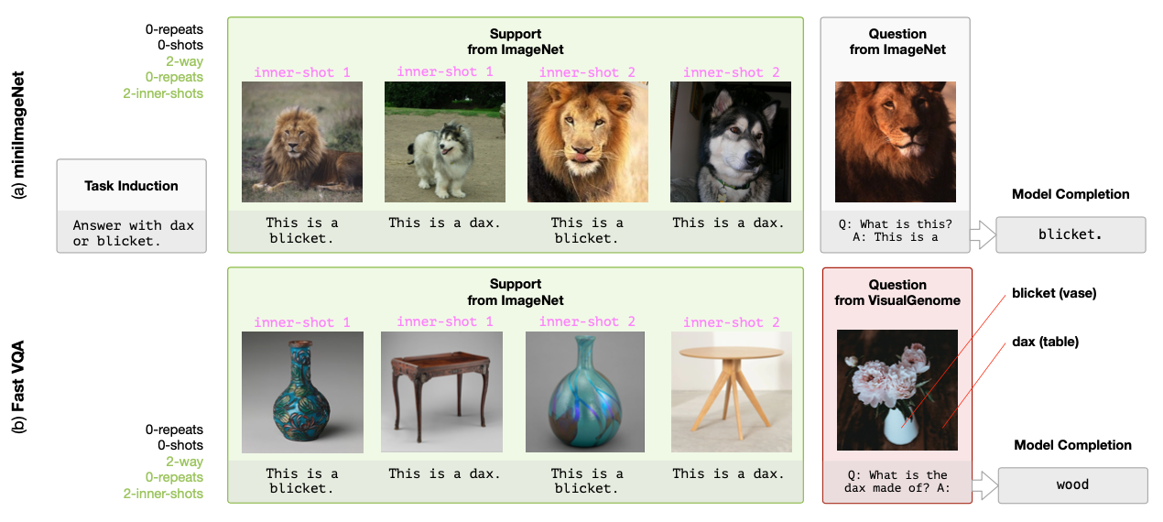
Multimodal Few-Shot Learning with Frozen Language Models
Examples of (a) the Open-Ended miniImageNet evaluation (b) the Fast VQA evaluation.
Source: Maria Tsimpoukelli, Jacob L. Menick, Serkan Cabi, S. M. Eslami, Oriol Vinyals, and Felix Hill (2021). "Multimodal few-shot learning with frozen language models." Advances in Neural Information Processing Systems 34 (2021): 200-212.

Slide 69
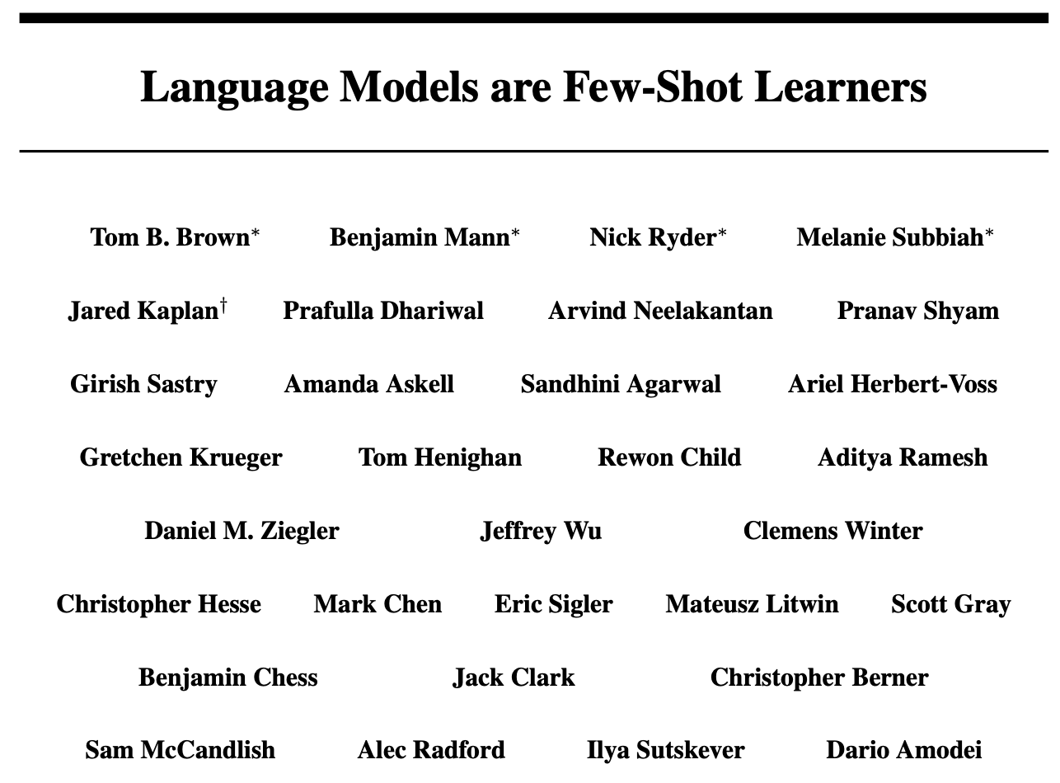
GPT-3: Language Models are Few-Shot Learners
This work was funded by OpenAI.
All models were trained on V100 GPU’s on part of a high- bandwidth cluster provided by Microsoft.
Source: Tom Brown, Benjamin Mann, Nick Ryder, Melanie Subbiah, Jared D. Kaplan, Prafulla Dhariwal, Arvind Neelakantan et al. (2020) "Language models are few-shot learners." Advances in neural information processing systems 33 (2020): 1877-1901

Slide 70
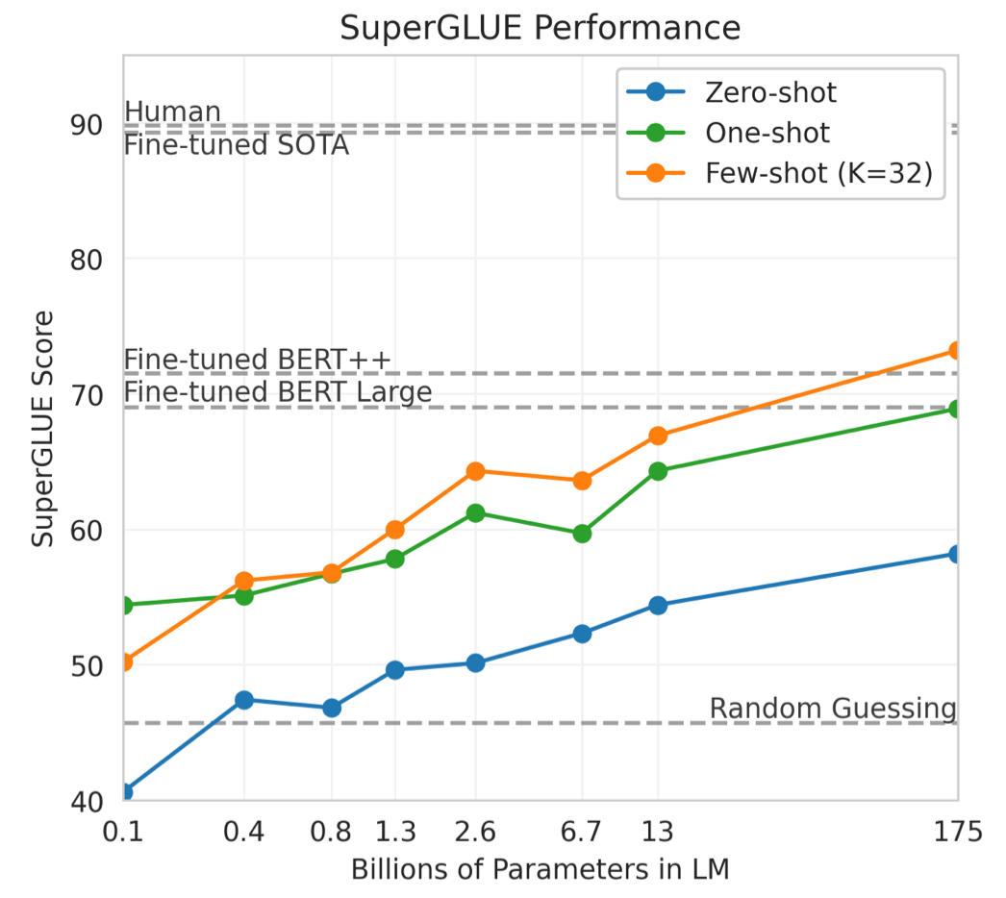
GPT-3: Language Models are Few-Shot Learners
Source: Tom Brown, Benjamin Mann, Nick Ryder, Melanie Subbiah, Jared D. Kaplan, Prafulla Dhariwal, Arvind Neelakantan et al. (2020) "Language models are few-shot learners." Advances in neural information processing systems 33 (2020): 1877-1901

Slide 71
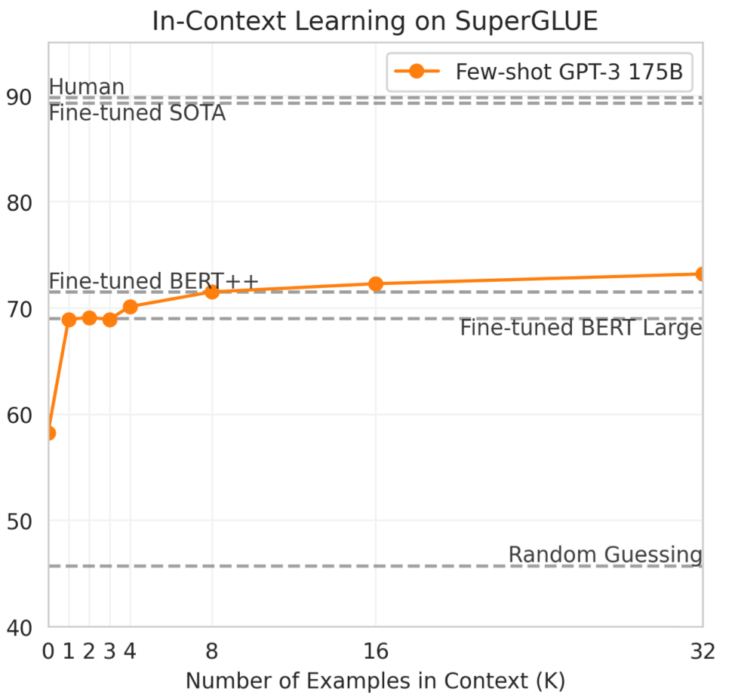
GPT-3: Language Models are Few-Shot Learners
Performance on SuperGLUE increases with model size.
A value of K = 32 means that our model was shown 32 examples per task, for 256 examples total divided across the 8 tasks in SuperGLUE.
Source: Tom Brown, Benjamin Mann, Nick Ryder, Melanie Subbiah, Jared D. Kaplan, Prafulla Dhariwal, Arvind Neelakantan et al. (2020) "Language models are few-shot learners." Advances in neural information processing systems 33 (2020): 1877-1901

Slide 72
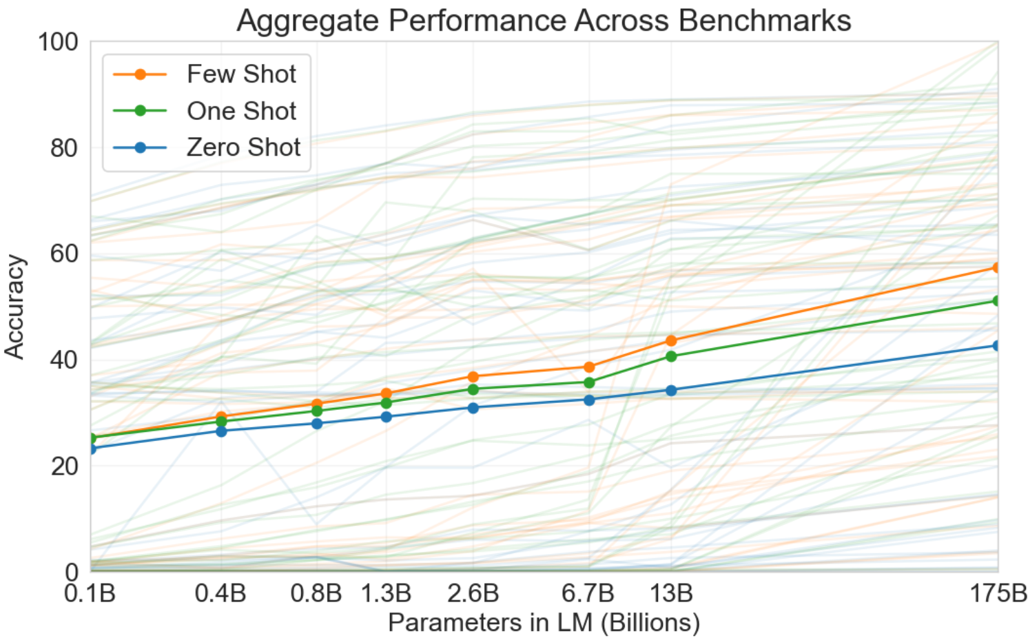
GPT-3: Language Models are Few-Shot Learners
Source: Tom Brown, Benjamin Mann, Nick Ryder, Melanie Subbiah, Jared D. Kaplan, Prafulla Dhariwal, Arvind Neelakantan et al. (2020) "Language models are few-shot learners." Advances in neural information processing systems 33 (2020): 1877-1901

Slide 73
GPT-3: Language Models are Few-Shot Learners
Performance on cloze and completion tasks.
GPT-3 significantly improves SOTA on LAMBADA while achieving respectable performance on two difficult completion prediction datasets.
Source: Tom Brown, Benjamin Mann, Nick Ryder, Melanie Subbiah, Jared D. Kaplan, Prafulla Dhariwal, Arvind Neelakantan et al. (2020) "Language models are few-shot learners." Advances in neural information processing systems 33 (2020): 1877-1901

Slide 74
GPT-3: Language Models are Few-Shot Learners
Results on three Open-Domain QA tasks
GPT-3 is shown in the few-, one-, and zero-shot settings, as compared to prior SOTA results for closed book and open domain settings.
TriviaQA few-shot result is evaluated on the wiki split test server.
Source: Tom Brown, Benjamin Mann, Nick Ryder, Melanie Subbiah, Jared D. Kaplan, Prafulla Dhariwal, Arvind Neelakantan et al. (2020) "Language models are few-shot learners." Advances in neural information processing systems 33 (2020): 1877-1901

Slide 75
GPT-3: Language Models are Few-Shot Learners
GPT-3 results on a selection of QA / RC tasks.
CoQA and DROP are F1 while ARC reports accuracy.
See the appendix for additional experiments. a[KKS+20] b[KKS+20] c[JZC+19] d [JN20]
Source: Tom Brown, Benjamin Mann, Nick Ryder, Melanie Subbiah, Jared D. Kaplan, Prafulla Dhariwal, Arvind Neelakantan et al. (2020) "Language models are few-shot learners." Advances in neural information processing systems 33 (2020): 1877-1901

Slide 76
GPT-3: Language Models are Few-Shot Learners
Few-shot GPT-3 outperforms previous unsupervised NMT work by 5 BLEU when translating into English reflecting its strength as an English LM.
Source: Tom Brown, Benjamin Mann, Nick Ryder, Melanie Subbiah, Jared D. Kaplan, Prafulla Dhariwal, Arvind Neelakantan et al. (2020) "Language models are few-shot learners." Advances in neural information processing systems 33 (2020): 1877-1901

Slide 77
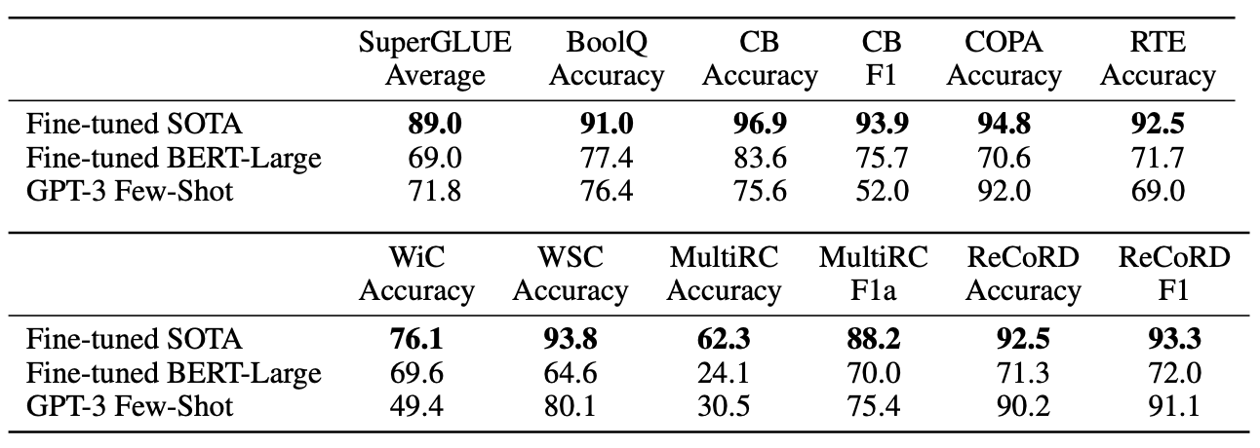
GPT-3: Language Models are Few-Shot Learners
Performance of GPT-3 on SuperGLUE compared to fine-tuned baselines and SOTA
GPT-3 few-shot is given a total of 32 examples within the context of each task and performs no gradient updates.
Source: Tom Brown, Benjamin Mann, Nick Ryder, Melanie Subbiah, Jared D. Kaplan, Prafulla Dhariwal, Arvind Neelakantan et al. (2020) "Language models are few-shot learners." Advances in neural information processing systems 33 (2020): 1877-1901

Slide 78
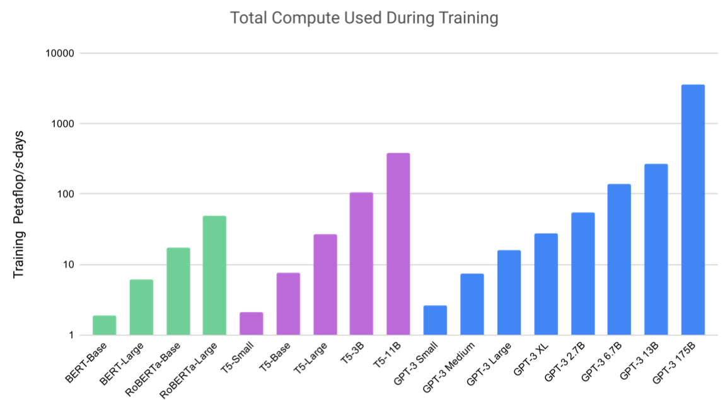
GPT-3: Language Models are Few-Shot Learners
GPT-3 3B is almost 10x larger than RoBERTa-Large (355M params), both models took roughly 50 petaflop/s-days of compute during pre-training
Source: Tom Brown, Benjamin Mann, Nick Ryder, Melanie Subbiah, Jared D. Kaplan, Prafulla Dhariwal, Arvind Neelakantan et al. (2020) "Language models are few-shot learners." Advances in neural information processing systems 33 (2020): 1877-1901

Slide 79
GPT-3: Language Models are Few-Shot Learners
Human accuracy in identifying whether short (∼200 word) news articles are model generated
This table compares mean accuracy between five different models, and shows the results of a two-sample T-Test for the difference in mean accuracy between each model and the control model (an unconditional GPT-3 Small model with increased output randomness).
Source: Tom Brown, Benjamin Mann, Nick Ryder, Melanie Subbiah, Jared D. Kaplan, Prafulla Dhariwal, Arvind Neelakantan et al. (2020) "Language models are few-shot learners." Advances in neural information processing systems 33 (2020): 1877-1901

Slide 80
GPT-3: Language Models are Few-Shot Learners
The GPT-3 generated news article that humans had the greatest difficulty distinguishing from a human written article (accuracy: 12%)
Source: Tom Brown, Benjamin Mann, Nick Ryder, Melanie Subbiah, Jared D. Kaplan, Prafulla Dhariwal, Arvind Neelakantan et al. (2020) "Language models are few-shot learners." Advances in neural information processing systems 33 (2020): 1877-1901

Slide 81
Transformer (Attention is All You Need) (Vaswani et al., 2017)
Source: Vaswani, Ashish, Noam Shazeer, Niki Parmar, Jakob Uszkoreit, Llion Jones, Aidan N. Gomez, Łukasz Kaiser, and Illia Polosukhin. "Attention is all you need." In Advances in neural information processing systems, pp. 5998-6008. 2017.

Slide 82
BERT: Pre-training of Deep Bidirectional Transformers for Language Understanding
BERT (Bidirectional Encoder Representations from Transformers)
Overall pre-training and fine-tuning procedures for BERT
Source: Devlin, Jacob, Ming-Wei Chang, Kenton Lee, and Kristina Toutanova (2018). "Bert: Pre-training of deep bidirectional transformers for language understanding." arXiv preprint arXiv:1810.04805.

Slide 83
Transformer Models
Transformer
Encoder
Decoder
DistilBERT
BERT
T5
GPT
RoBERTa
BART
GPT-2
CTRL
XLM-R
XLM
M2M-100
GPT-3
ALBERT
BigBird
GPT-Neo
GPT-J
ELECTRA
DeBERTa
Source: Lewis Tunstall, Leandro von Werra, and Thomas Wolf (2022), Natural Language Processing with Transformers: Building Language Applications with Hugging Face, O'Reilly Media.

Slide 84
T5 Text-to-Text Transfer Transformer
Source: JColin Raffel, Noam Shazeer, Adam Roberts, Katherine Lee, Sharan Narang, Michael Matena, Yanqi Zhou, Wei Li, and Peter J. Liu (2019). "Exploring the limits of transfer learning with a unified text-to-text transformer." arXiv preprint arXiv:1910.10683 (2019).

Slide 85
Hugging Face Tasks Natural Language Processing
https://huggingface.co/tasks

Slide 86
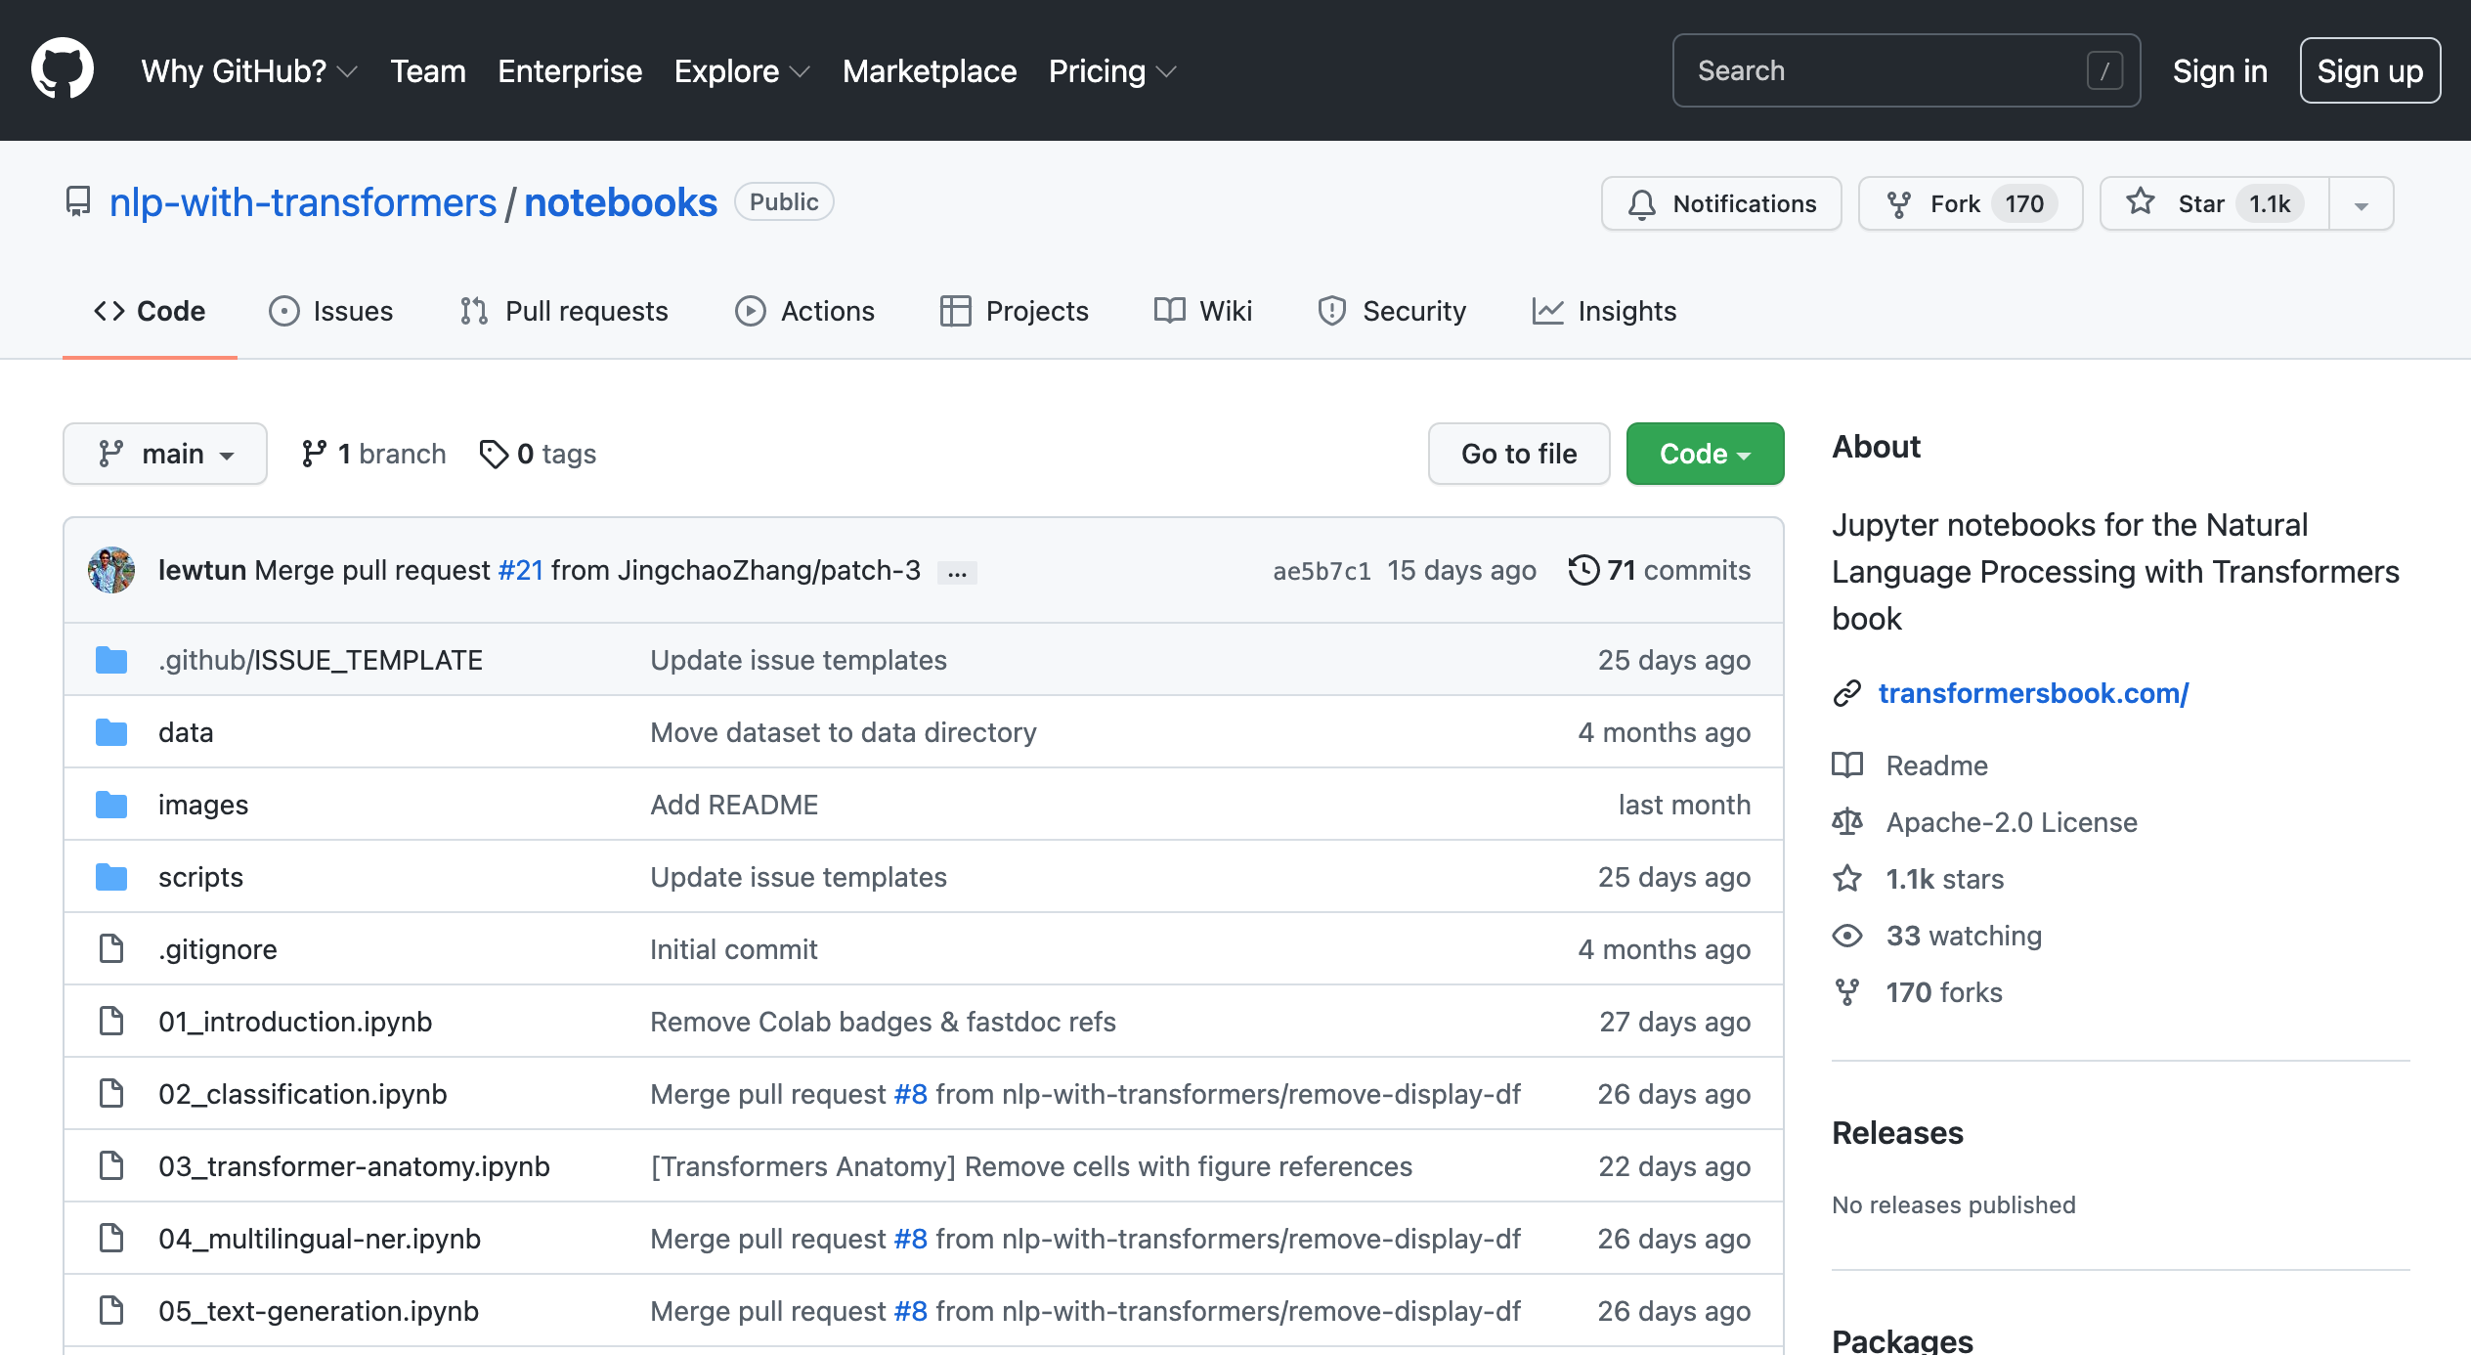
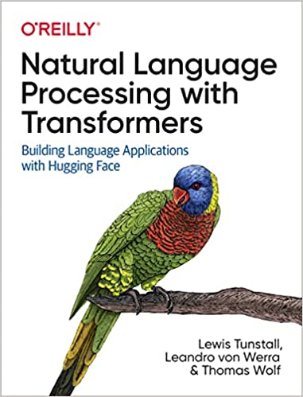
NLP with Transformers Github
https://github.com/nlp-with-transformers/notebooks

Slide 87
NLP with Transformers Github Notebooks
https://github.com/nlp-with-transformers/notebooks

Slide 88
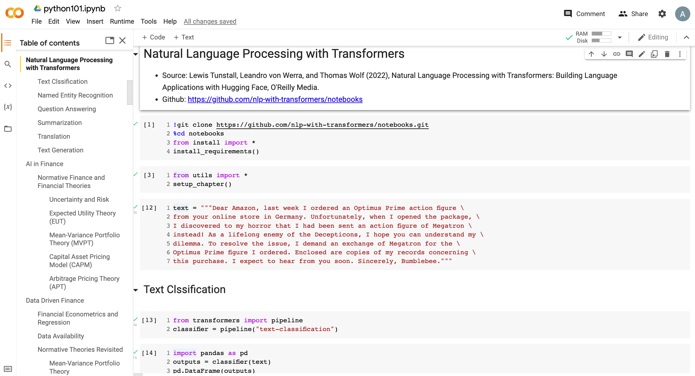
Python in Google Colab (Python101)
https://colab.research.google.com/drive/1FEG6DnGvwfUbeo4zJ1zTunjMqf2RkCrT
NLP with Transformers
https://tinyurl.com/aintpupython101

Slide 89
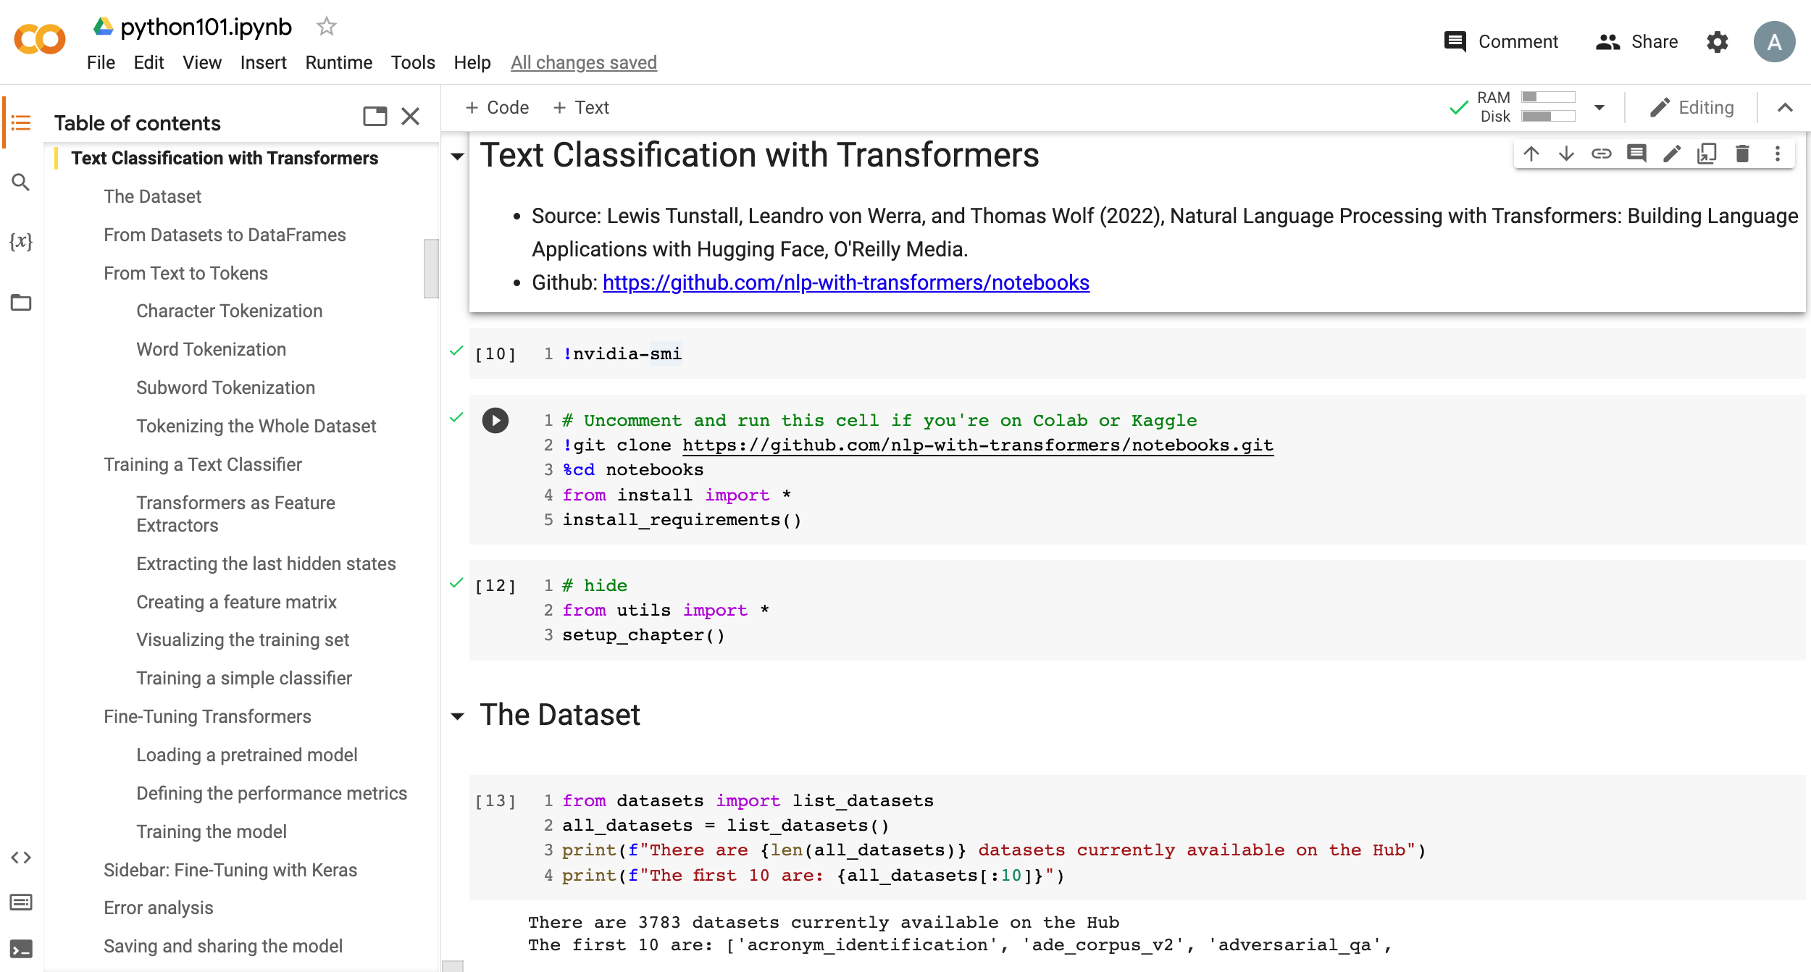
Python in Google Colab (Python101)
https://colab.research.google.com/drive/1FEG6DnGvwfUbeo4zJ1zTunjMqf2RkCrT
Text Classification
https://tinyurl.com/aintpupython101

Slide 90
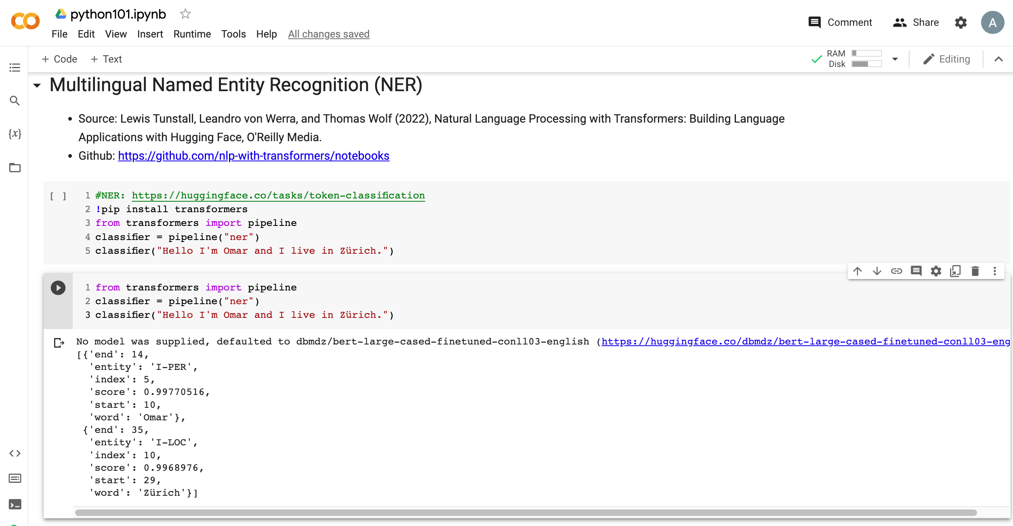
Python in Google Colab (Python101)
https://colab.research.google.com/drive/1FEG6DnGvwfUbeo4zJ1zTunjMqf2RkCrT
Named Entity Recognition (NER)
https://tinyurl.com/aintpupython101

Slide 91
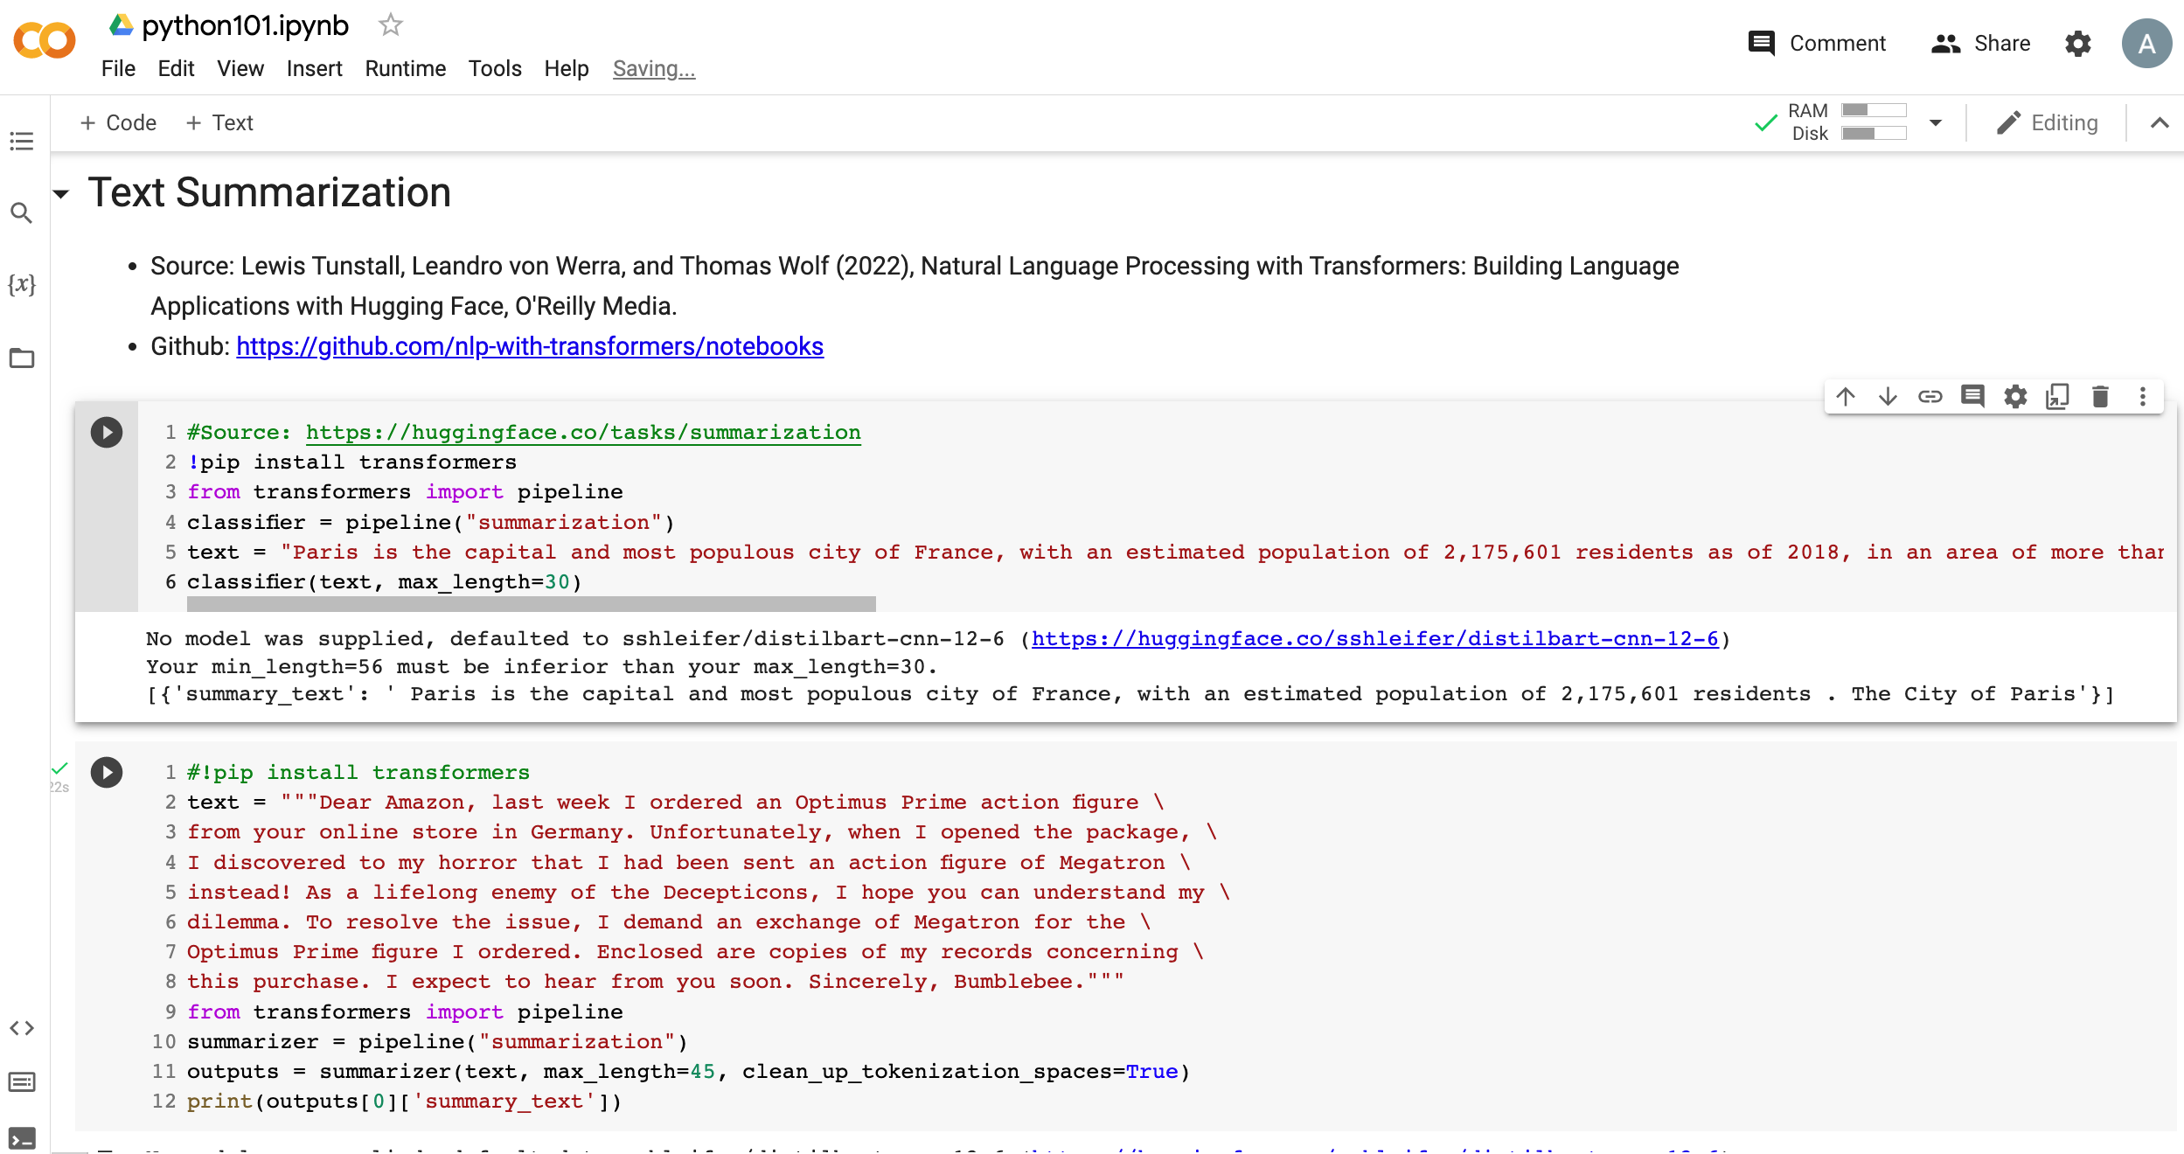
Python in Google Colab (Python101)
https://colab.research.google.com/drive/1FEG6DnGvwfUbeo4zJ1zTunjMqf2RkCrT
Text Summarization
https://tinyurl.com/aintpupython101

Slide 92
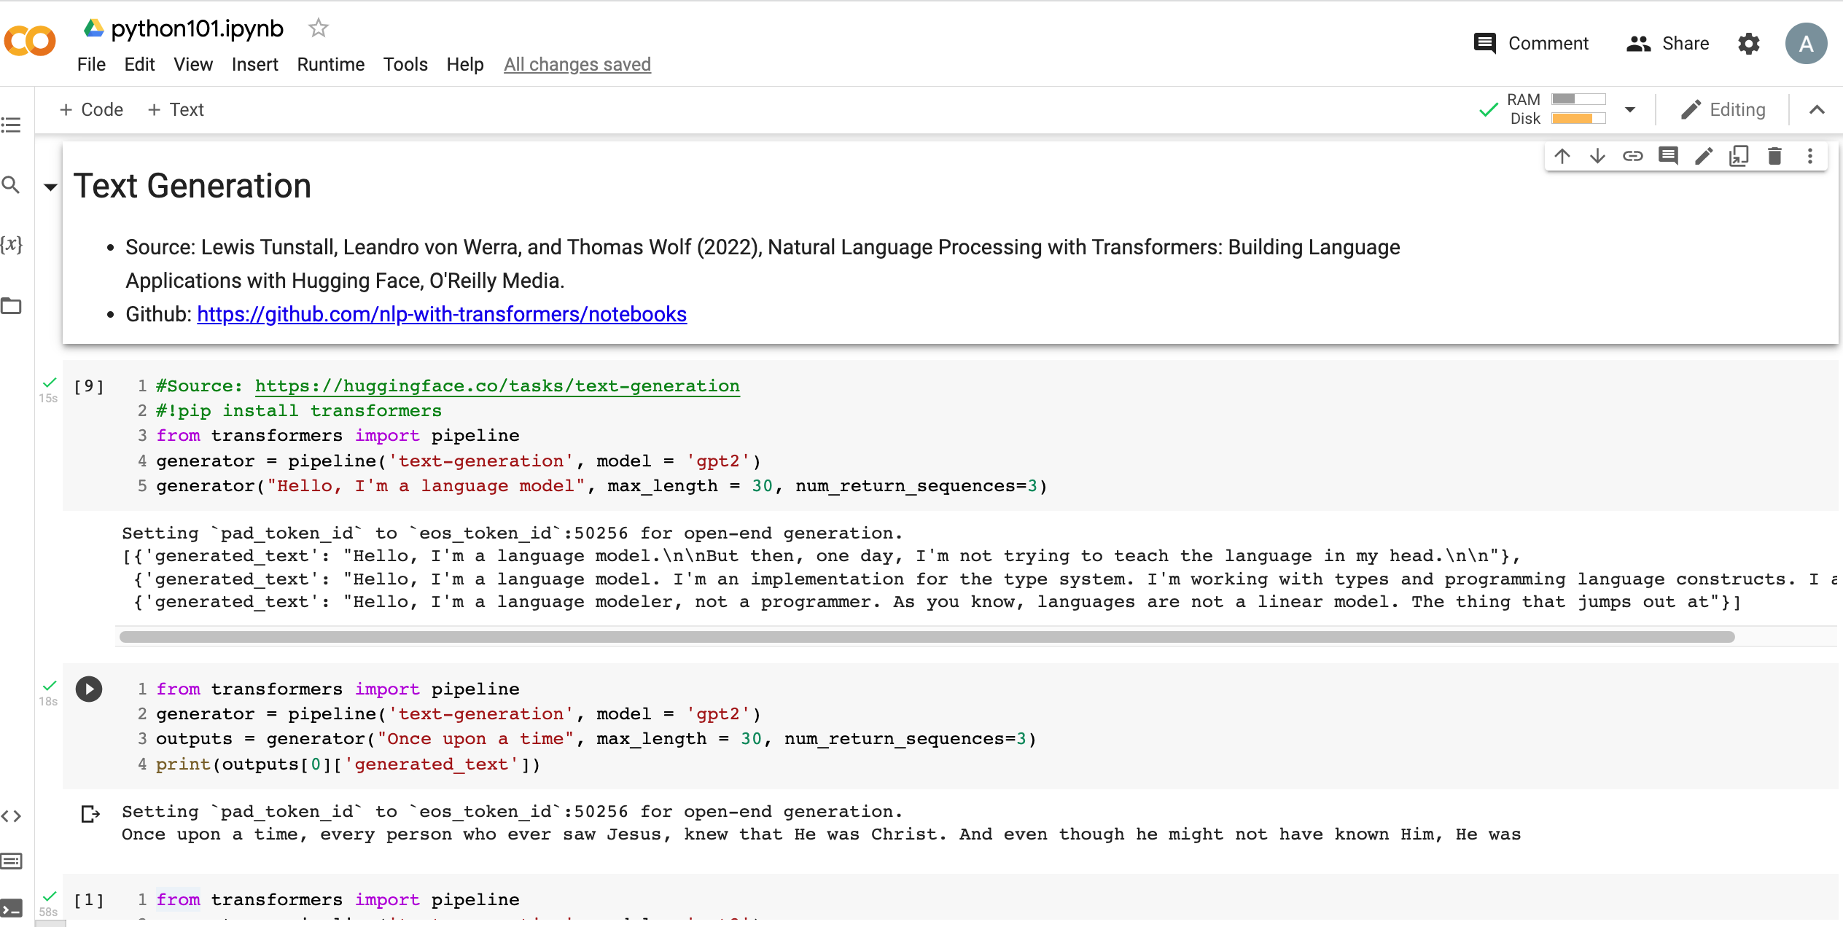
Python in Google Colab (Python101)
https://colab.research.google.com/drive/1FEG6DnGvwfUbeo4zJ1zTunjMqf2RkCrT
Text Generation
https://tinyurl.com/aintpupython101

Slide 93
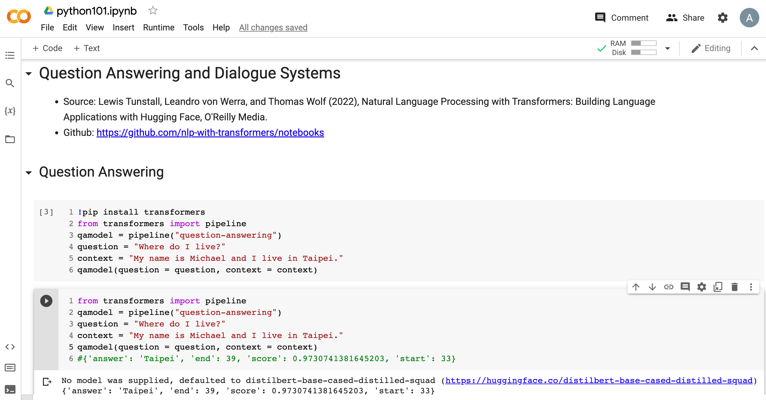
Python in Google Colab (Python101)
https://colab.research.google.com/drive/1FEG6DnGvwfUbeo4zJ1zTunjMqf2RkCrT
Question Answering and Dialogue Systems
https://tinyurl.com/aintpupython101

Slide 94
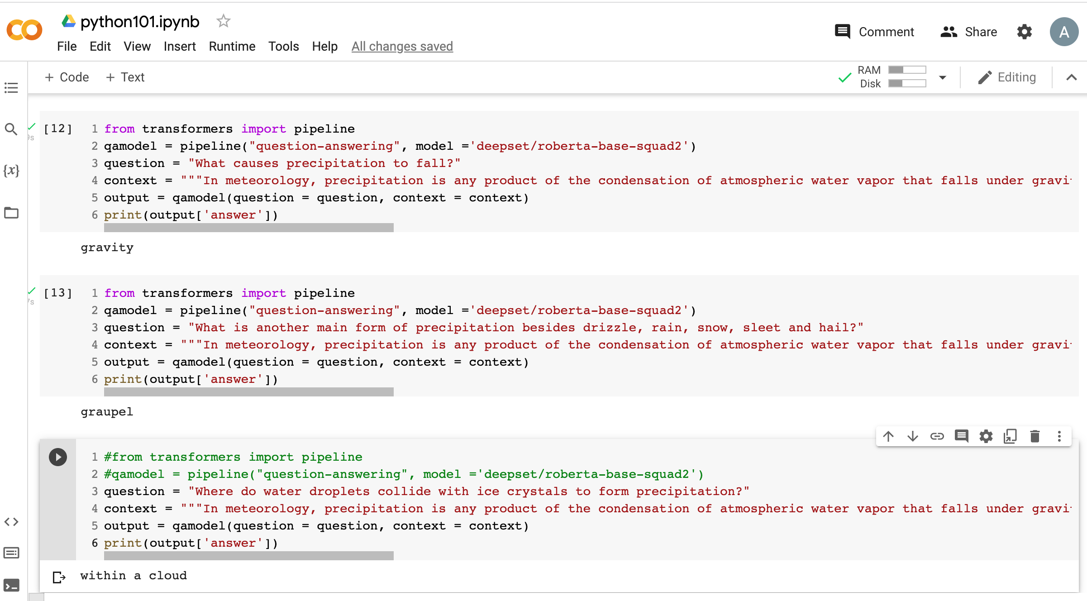
Python in Google Colab (Python101)
https://colab.research.google.com/drive/1FEG6DnGvwfUbeo4zJ1zTunjMqf2RkCrT
Question Answering
https://tinyurl.com/aintpupython101

Slide 95
Python in Google Colab (Python101)
https://colab.research.google.com/drive/1FEG6DnGvwfUbeo4zJ1zTunjMqf2RkCrT
Question Answering and Dialogue Systems
https://tinyurl.com/aintpupython101

Slide 96
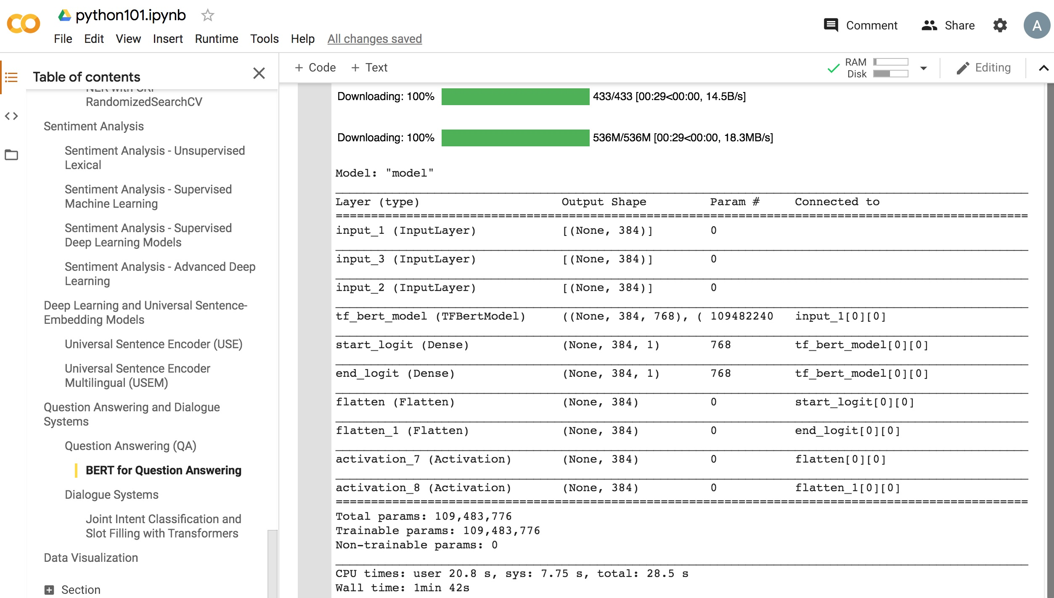
Python in Google Colab (Python101)
https://colab.research.google.com/drive/1FEG6DnGvwfUbeo4zJ1zTunjMqf2RkCrT
https://tinyurl.com/aintpupython101

Slide 97
Python in Google Colab (Python101)
https://colab.research.google.com/drive/1FEG6DnGvwfUbeo4zJ1zTunjMqf2RkCrT
Dialogue Systems
https://tinyurl.com/aintpupython101

Slide 98
Python in Google Colab (Python101)
https://colab.research.google.com/drive/1FEG6DnGvwfUbeo4zJ1zTunjMqf2RkCrT
https://tinyurl.com/aintpupython101

Slide 99
Python in Google Colab (Python101)
https://colab.research.google.com/drive/1FEG6DnGvwfUbeo4zJ1zTunjMqf2RkCrT
https://tinyurl.com/aintpupython101

Slide 100
Summary
Deep Learning
Transfer Learning
Pre-training, Fine-Tuning (FT)
Few-Shot Learning (FSL)
Meta Learning: Learn to Learn
One-Shot Learning (1SL)
Zero-Shot Learning (0SL)(ZSL)

Slide 101
References
Lewis Tunstall, Leandro von Werra, and Thomas Wolf (2022), Natural Language Processing with Transformers: Building Language Applications with Hugging Face, O'Reilly Media.
Denis Rothman (2021), Transformers for Natural Language Processing: Build innovative deep neural network architectures for NLP with Python, PyTorch, TensorFlow, BERT, RoBERTa, and more, Packt Publishing.
Savaş Yıldırım and Meysam Asgari-Chenaghlu (2021), Mastering Transformers: Build state-of-the-art models from scratch with advanced natural language processing techniques, Packt Publishing.
Sowmya Vajjala, Bodhisattwa Majumder, Anuj Gupta (2020), Practical Natural Language Processing: A Comprehensive Guide to Building Real-World NLP Systems, O'Reilly Media.
Dipanjan Sarkar (2019), Text Analytics with Python: A Practitioner’s Guide to Natural Language Processing, Second Edition. APress.
Tom Brown, Benjamin Mann, Nick Ryder, Melanie Subbiah, Jared D. Kaplan, Prafulla Dhariwal, Arvind Neelakantan et al. (2020) "Language models are few-shot learners." Advances in neural information processing systems 33 (2020): 1877-1901
Yaqing Wang, Quanming Yao, James T. Kwok, and Lionel M. Ni (2020). "Generalizing from a few examples: A survey on few-shot learning." ACM computing surveys (csur) 53, no. 3 (2020): 1-34.
Yao Ge, Yuting Guo, Yuan-Chi Yang, Mohammed Ali Al-Garadi, and Abeed Sarker (2022). "Few-shot learning for medical text: A systematic review." arXiv preprint arXiv:2204.14081 (2022).
Maria Tsimpoukelli, Jacob L. Menick, Serkan Cabi, S. M. Eslami, Oriol Vinyals, and Felix Hill (2021). "Multimodal few-shot learning with frozen language models." Advances in Neural Information Processing Systems 34 (2021): 200-212.
Benjamin Bengfort, Rebecca Bilbro, and Tony Ojeda (2018), Applied Text Analysis with Python: Enabling Language-Aware Data Products with Machine Learning, O’Reilly.
Charu C. Aggarwal (2018), Machine Learning for Text, Springer.
Gabe Ignatow and Rada F. Mihalcea (2017), An Introduction to Text Mining: Research Design, Data Collection, and Analysis, SAGE Publications.
Rajesh Arumugam (2018), Hands-On Natural Language Processing with Python: A practical guide to applying deep learning architectures to your NLP applications, Packt.
Jake VanderPlas (2016), Python Data Science Handbook: Essential Tools for Working with Data, O'Reilly Media.
Devlin, Jacob, Ming-Wei Chang, Kenton Lee, and Kristina Toutanova (2018). "BERT: Pre-training of Deep Bidirectional Transformers for Language Understanding." arXiv preprint arXiv:1810.04805.
The Super Duper NLP Repo, https://notebooks.quantumstat.com/
Jay Alammar (2018), The Illustrated Transformer, http://jalammar.github.io/illustrated-transformer/
Jay Alammar (2019), A Visual Guide to Using BERT for the First Time, http://jalammar.github.io/a-visual-guide-to-using-bert-for-the-first-time/
NLP with Transformer, https://github.com/nlp-with-transformers/notebooks
Min-Yuh Day (2022), Python 101, https://tinyurl.com/aintpupython101

