Slide 1
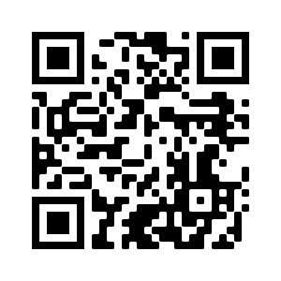
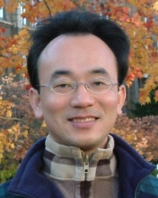
Text Generation Natural Language Generation (NLG)
Artificial Intelligence for Text Analytics
1102AITA08
MBA, IM, NTPU (M5026) (Spring 2022) Tue 2, 3, 4 (9:10-12:00) (B8F40)
Min-Yuh Day, Ph.D, Associate Professor
Institute of Information Management, National Taipei University
https://web.ntpu.edu.tw/~myday
https://meet.google.com/paj-zhhj-mya
2022-05-03

Slide 2
Syllabus
Week Date Subject/Topics
1 2022/02/22 Introduction to Artificial Intelligence for Text Analytics
2 2022/03/01 Foundations of Text Analytics: Natural Language Processing (NLP)
3 2022/03/08 Python for Natural Language Processing
4 2022/03/15 Natural Language Processing with Transformers
5 2022/03/22 Case Study on Artificial Intelligence for Text Analytics I
6 2022/03/29 Text Classification and Sentiment Analysis

Slide 3
Syllabus
Week Date Subject/Topics
7 2022/04/05 Tomb-Sweeping Day (Holiday, No Classes)
8 2022/04/12 Midterm Project Report
9 2022/04/19 Multilingual Named Entity Recognition (NER), Text Similarity and Clustering
10 2022/04/26 Text Summarization and Topic Models
11 2022/05/03 Text Generation
12 2022/05/10 Case Study on Artificial Intelligence for Text Analytics II

Slide 4
Syllabus
Week Date Subject/Topics
13 2022/05/17 Question Answering and Dialogue Systems
14 2022/05/24 Deep Learning, Transfer Learning, Zero-Shot, and Few-Shot Learning for Text Analytics
15 2022/05/31 Final Project Report I
16 2022/06/07 Final Project Report II
17 2022/06/14 Self-learning
18 2022/06/21 Self-learning

Slide 5
Text Generation

Slide 6
Outline
Text Generation
Natural Language Generation (NLG)
Language Modeling
Conditional Language Modeling
Next Word Prediction
Decoding Algorithm
Greedy Search Decoding
Beam Search Decoding
Sampling Methods
Top-k and Nucleus Sampling

Slide 7
Text Generation
Natural Language Generation (NLG)
Language Modeling
Conditional Language Modeling
Next Word Prediction

Slide 8
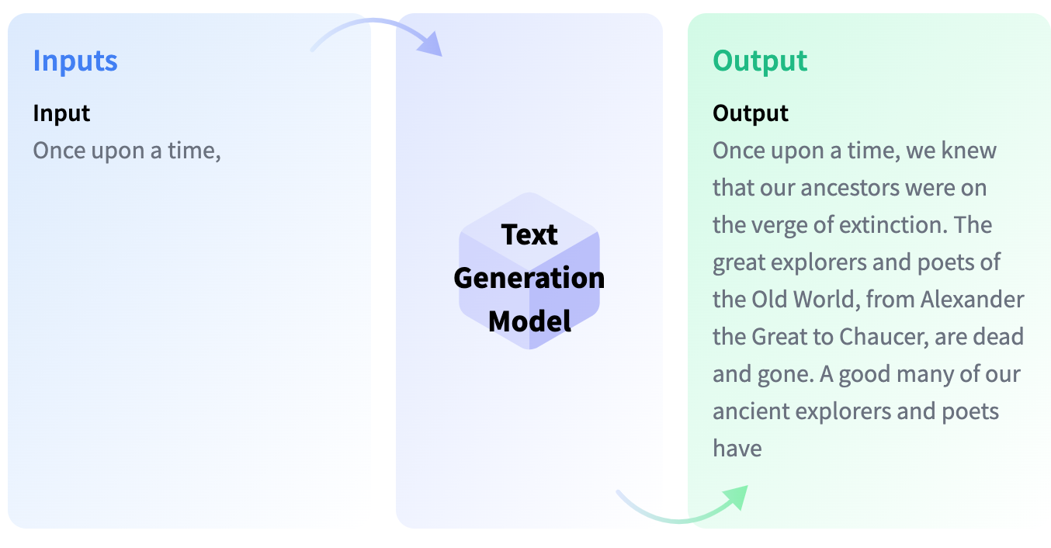
Text Generation
https://huggingface.co/tasks/text-generation

Slide 9
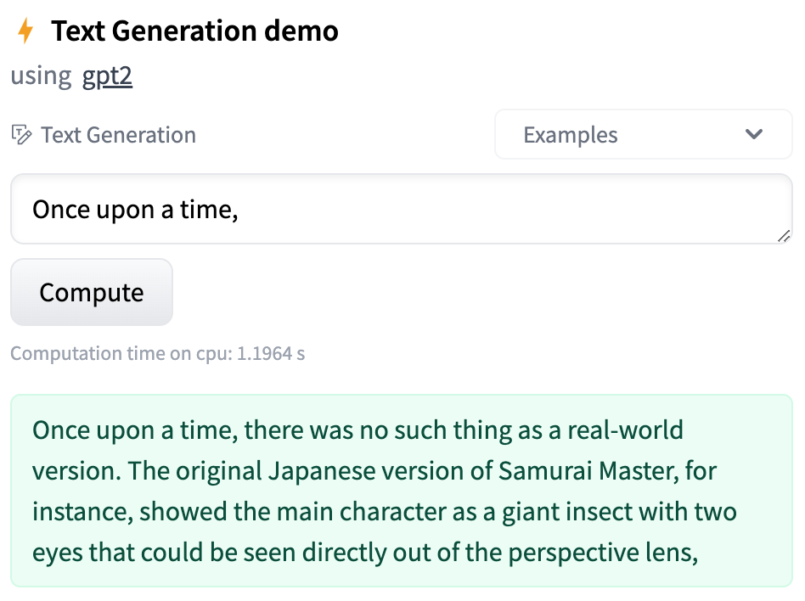
Text Generation
https://huggingface.co/tasks/text-generation

Slide 10
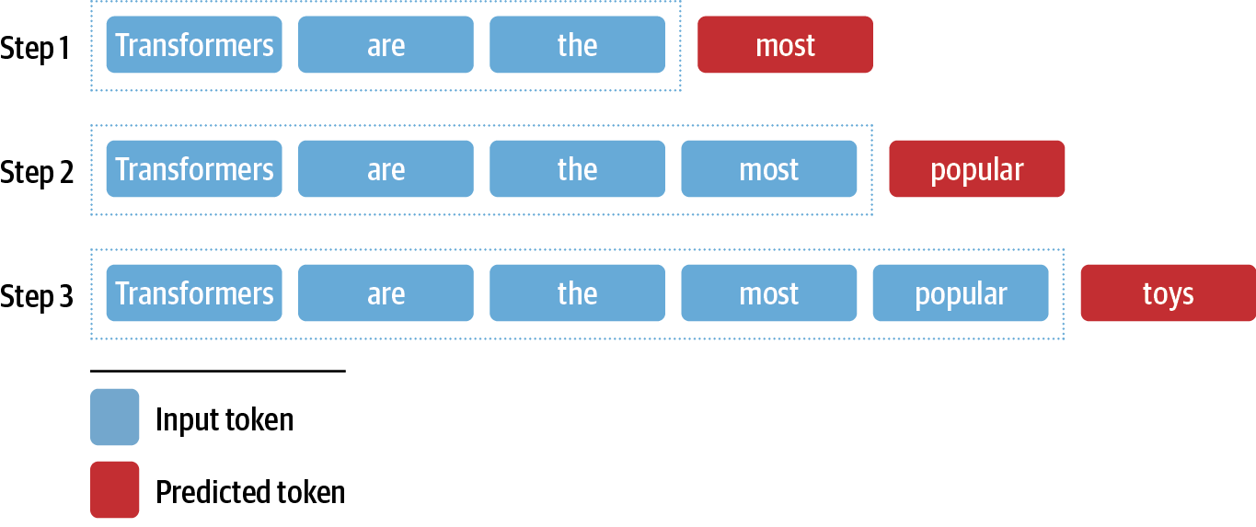
Text Generation Natural Language Generation (NLG) The Challenge with Generating Coherent Text Next Word Prediction
Source: Lewis Tunstall, Leandro von Werra, and Thomas Wolf (2022), Natural Language Processing with Transformers: Building Language Applications with Hugging Face, O'Reilly Media.

Slide 11
Transformer Models
Transformer
Encoder
Decoder
DistilBERT
BERT
T5
GPT
RoBERTa
BART
GPT-2
CTRL
XLM-R
XLM
M2M-100
GPT-3
ALBERT
BigBird
GPT-Neo
GPT-J
ELECTRA
DeBERTa
Source: Lewis Tunstall, Leandro von Werra, and Thomas Wolf (2022), Natural Language Processing with Transformers: Building Language Applications with Hugging Face, O'Reilly Media.

Slide 12
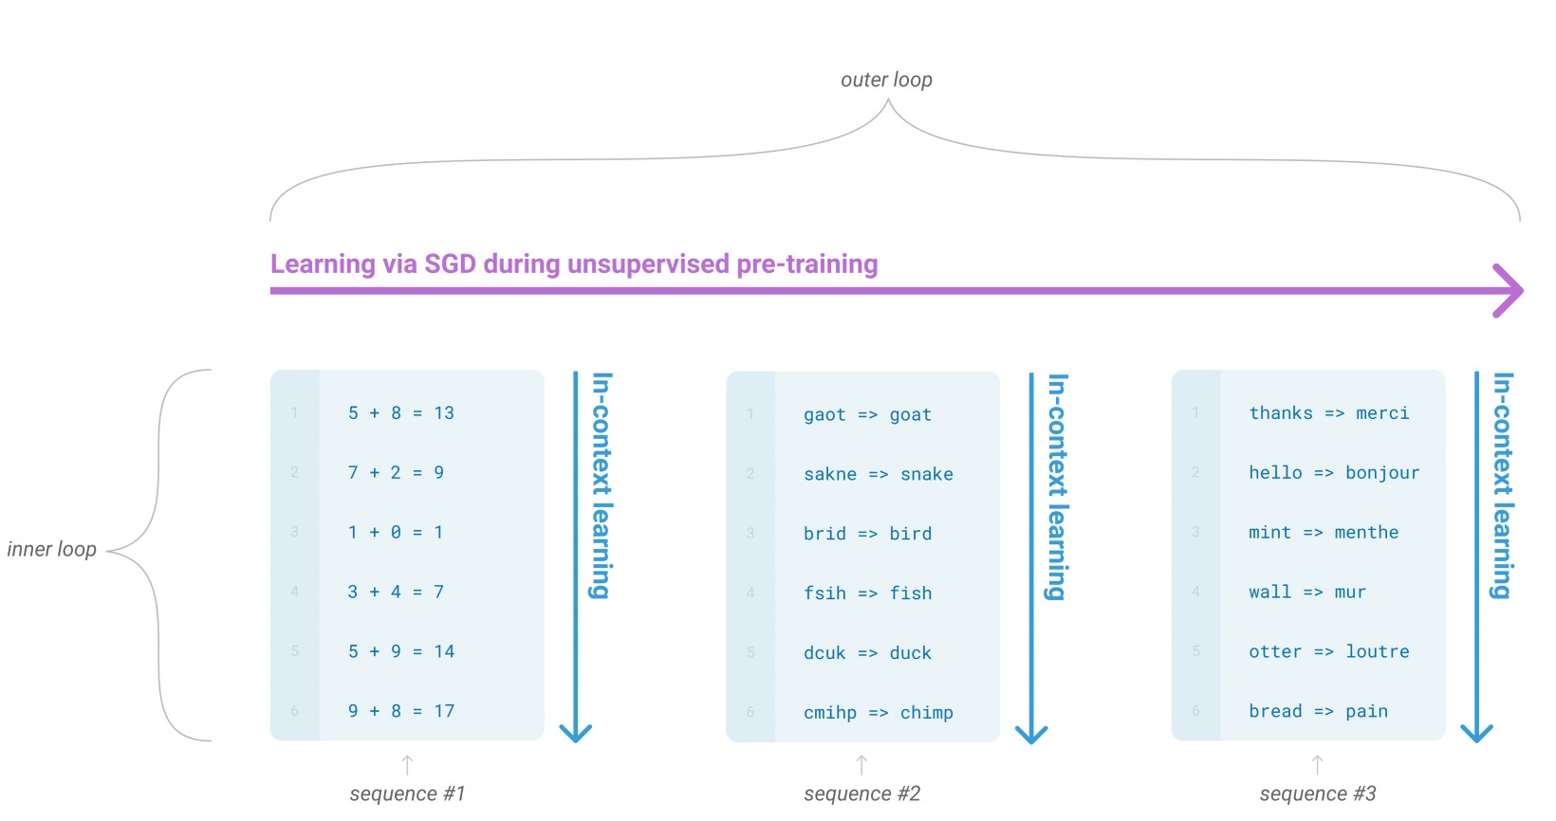
Text Generation
Source: Lewis Tunstall, Leandro von Werra, and Thomas Wolf (2022), Natural Language Processing with Transformers: Building Language Applications with Hugging Face, O'Reilly Media.

Slide 13
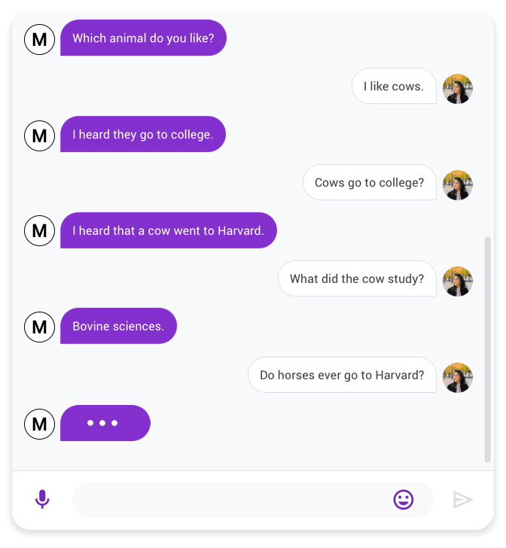
Text Generation
Source: Lewis Tunstall, Leandro von Werra, and Thomas Wolf (2022), Natural Language Processing with Transformers: Building Language Applications with Hugging Face, O'Reilly Media.

Slide 14
Text Generation Decoding Algorithm
Greedy Search Decoding
Beam Search Decoding
Sampling Methods
Top-k and Nucleus Sampling

Slide 15
Text Generation Greedy Search Decoding
 | Input | Choice 1 | Choice 2 | Choice 3 | Choice 4 | Choice 5
0 | Transformers are the | most (8.53%) | only (4.96%) | best (4.65%) | Transformers (4.37%) | ultimate (2.16%)
1 | Transformers are the most | popular (16.78%) | powerful (5.37%) | common (4.96%) | famous (3.72%) | successful (3.20%)
2 | Transformers are the most popular | toy (10.63%) | toys (7.23%) | Transformers (6.60%) | of (5.46%) | and (3.76%)
3 | Transformers are the most popular toy | line (34.38%) | in (18.20%) | of (11.71%) | brand (6.10%) | line (2.69%)
4 | Transformers are the most popular toy line | in (46.28%) | of (15.09%) | , (4.94%) | on (4.40%) | ever (2.72%)
5 | Transformers are the most popular toy line in | the (65.99%) | history (12.42%) | America (6.91%) | Japan (2.44%) | North (1.40%)
6 | Transformers are the most popular toy line in the | world (69.26%) | United (4.55%) | history (4.29%) | US (4.23%) | U (2.30%)
7 | Transformers are the most popular toy line in the world | , (39.73%) | . (30.64%) | and (9.87%) | with (2.32%) | today (1.74%)
Source: Lewis Tunstall, Leandro von Werra, and Thomas Wolf (2022), Natural Language Processing with Transformers: Building Language Applications with Hugging Face, O'Reilly Media.

Slide 16
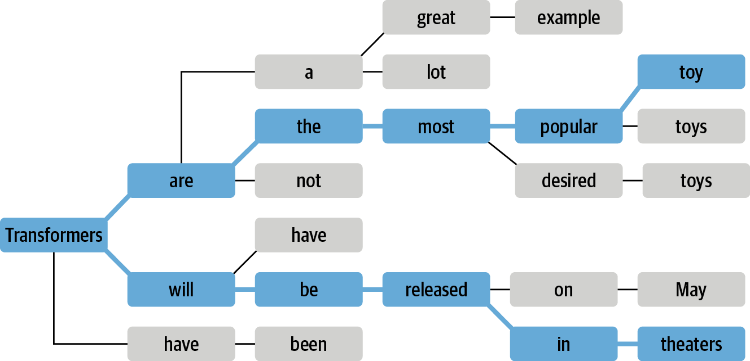
Text Generation Beam Search Decoding
Source: Lewis Tunstall, Leandro von Werra, and Thomas Wolf (2022), Natural Language Processing with Transformers: Building Language Applications with Hugging Face, O'Reilly Media.

Slide 17
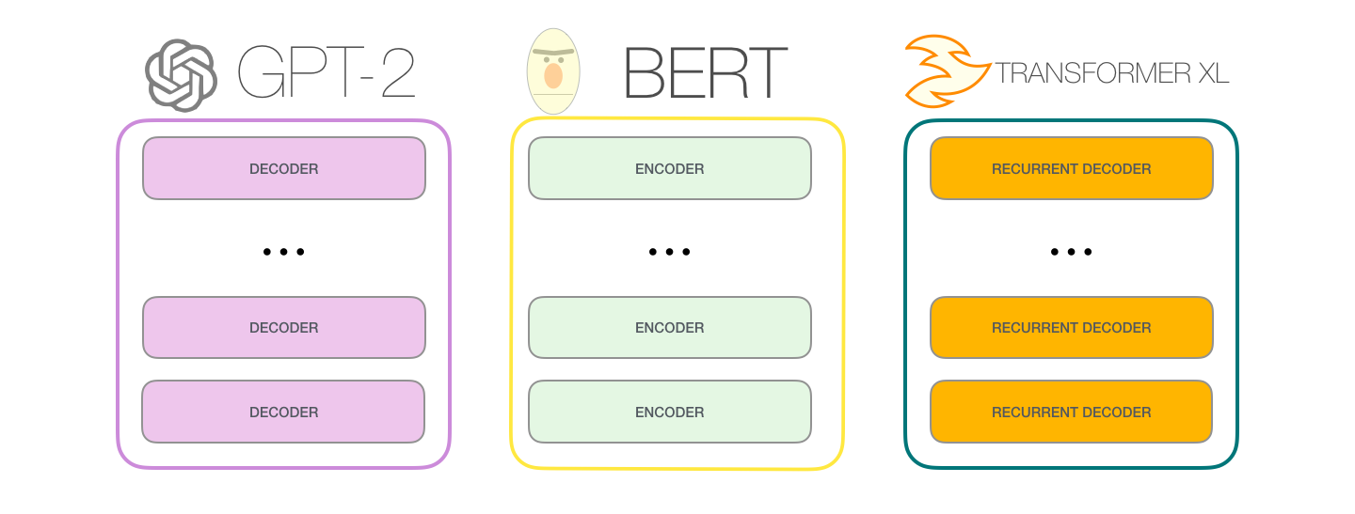
The Illustrated GPT-2 (Visualizing Transformer Language Models) Jay Alammar (2019)
Source: Jay Alammar (2019), The Illustrated GPT-2 (Visualizing Transformer Language Models), https://jalammar.github.io/illustrated-gpt2/

Slide 18
GPT-2 Output
Source: Jay Alammar (2019), The Illustrated GPT-2 (Visualizing Transformer Language Models), https://jalammar.github.io/illustrated-gpt2/

Slide 19
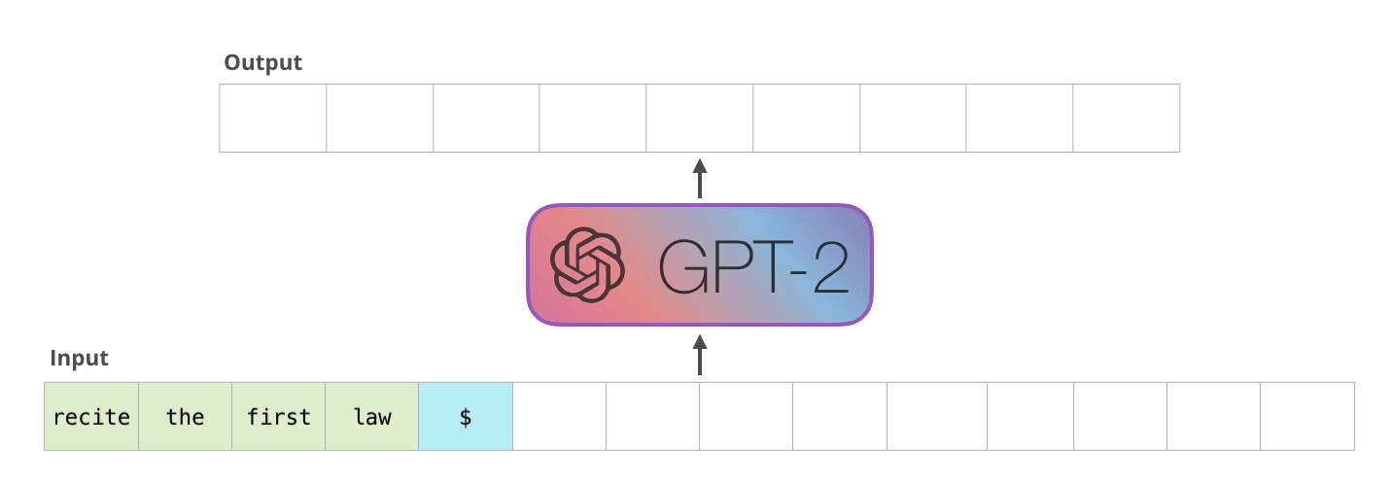
GPT-2 Autoregression
Source: Jay Alammar (2019), The Illustrated GPT-2 (Visualizing Transformer Language Models), https://jalammar.github.io/illustrated-gpt2/

Slide 20
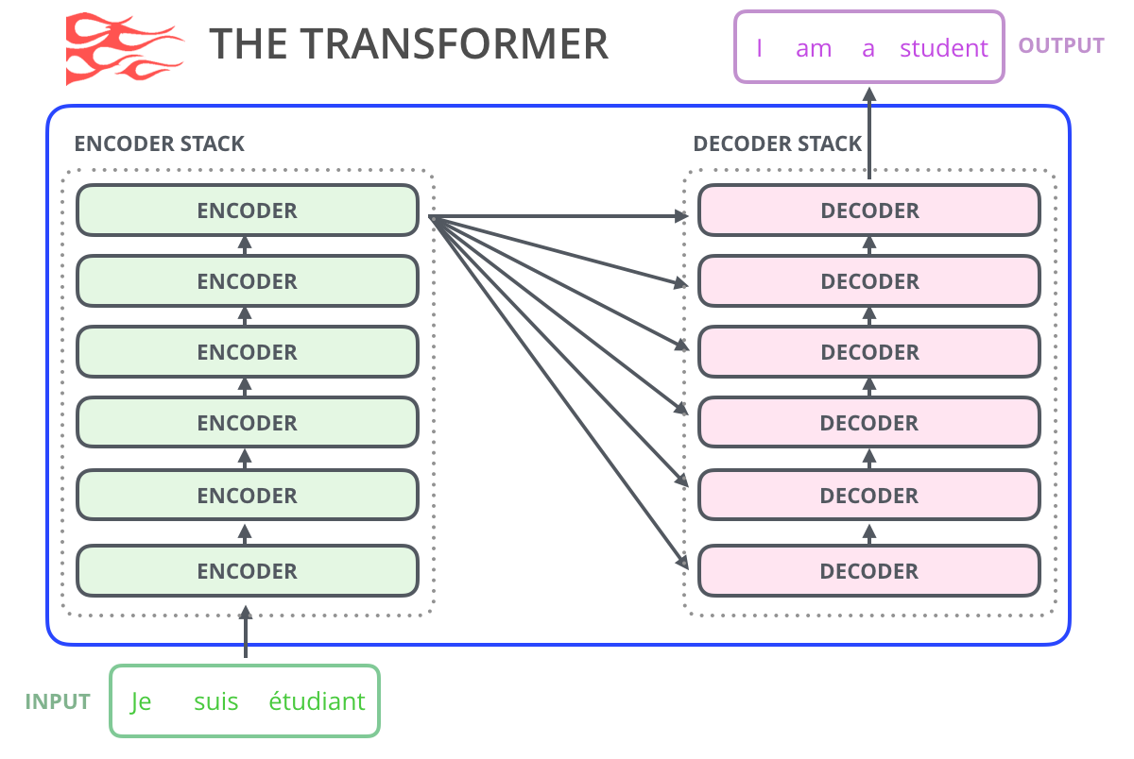
Transformer Encoder Decoder
Source: Jay Alammar (2019), The Illustrated GPT-2 (Visualizing Transformer Language Models), https://jalammar.github.io/illustrated-gpt2/

Slide 21
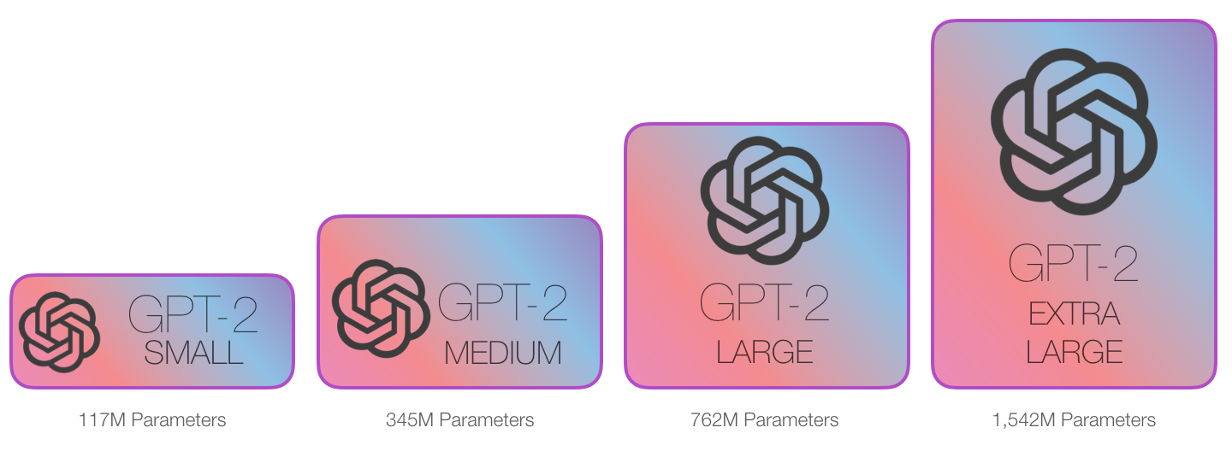
GPT-2 Sizes
Source: Jay Alammar (2019), The Illustrated GPT-2 (Visualizing Transformer Language Models), https://jalammar.github.io/illustrated-gpt2/

Slide 22
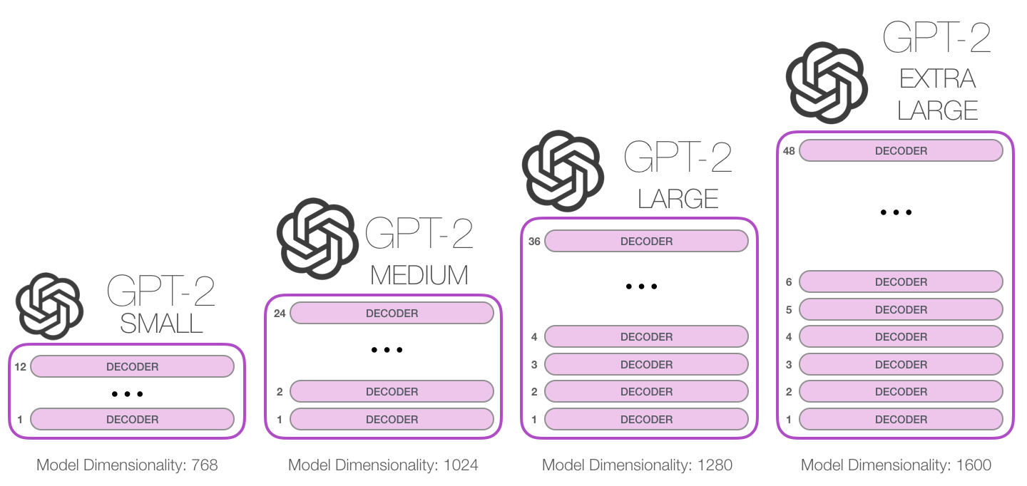
GPT-2 Sizes Hyperparameters
Source: Jay Alammar (2019), The Illustrated GPT-2 (Visualizing Transformer Language Models), https://jalammar.github.io/illustrated-gpt2/

Slide 23
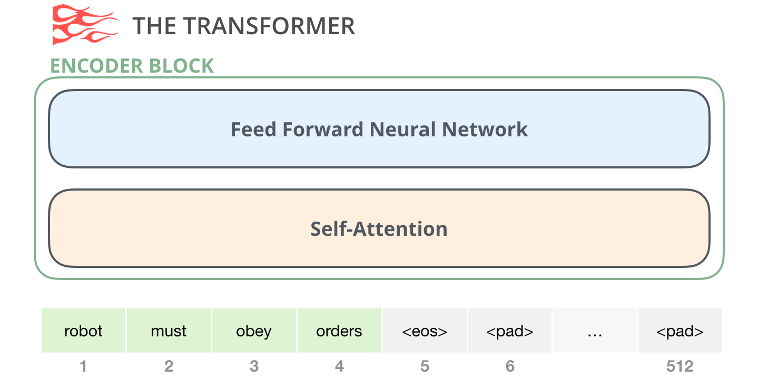
Transformer Encoder
Source: Jay Alammar (2019), The Illustrated GPT-2 (Visualizing Transformer Language Models), https://jalammar.github.io/illustrated-gpt2/

Slide 24
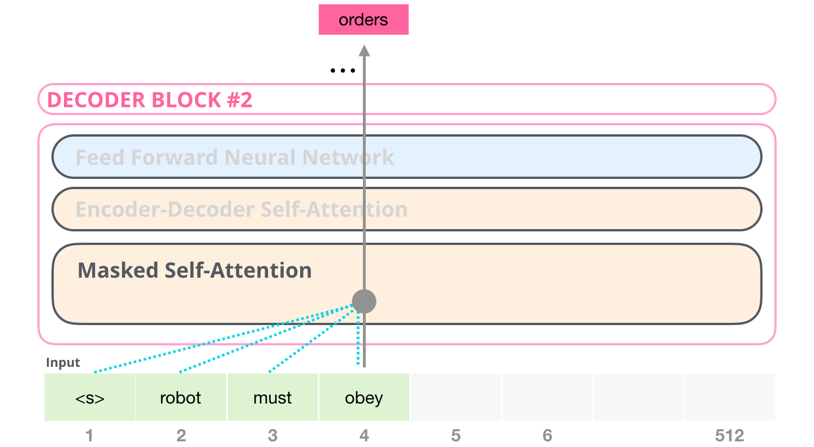
Transformer Decoder
Source: Jay Alammar (2019), The Illustrated GPT-2 (Visualizing Transformer Language Models), https://jalammar.github.io/illustrated-gpt2/

Slide 25
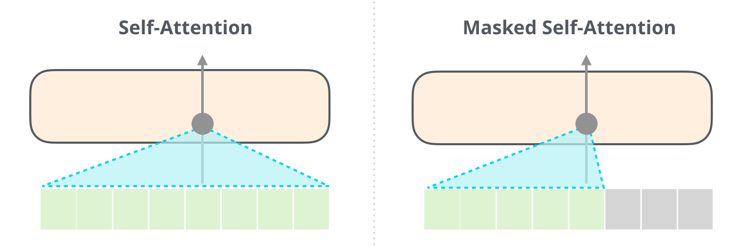
Self-Attention and Masked-Self-Attention
Source: Jay Alammar (2019), The Illustrated GPT-2 (Visualizing Transformer Language Models), https://jalammar.github.io/illustrated-gpt2/

Slide 26
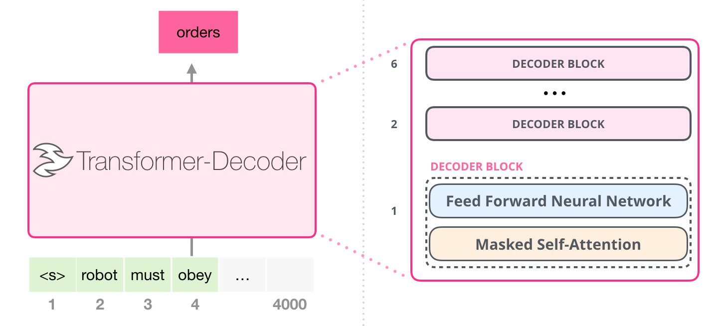
Transformer Decoder
Source: Jay Alammar (2019), The Illustrated GPT-2 (Visualizing Transformer Language Models), https://jalammar.github.io/illustrated-gpt2/

Slide 27
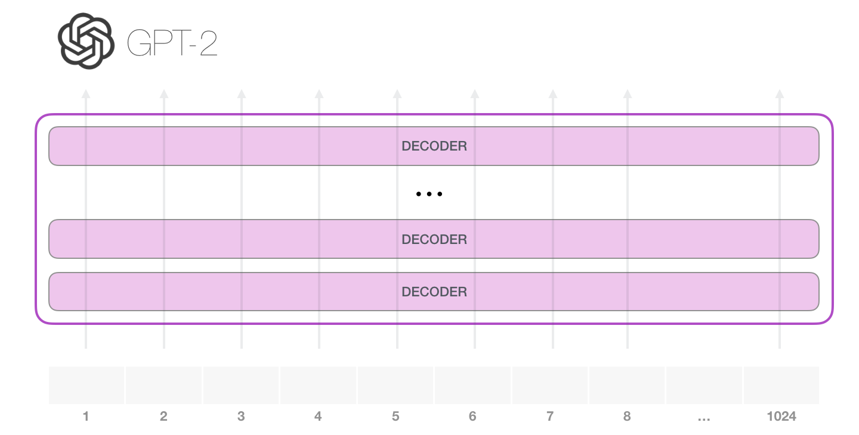
GPT-2 Layers
Source: Jay Alammar (2019), The Illustrated GPT-2 (Visualizing Transformer Language Models), https://jalammar.github.io/illustrated-gpt2/

Slide 28
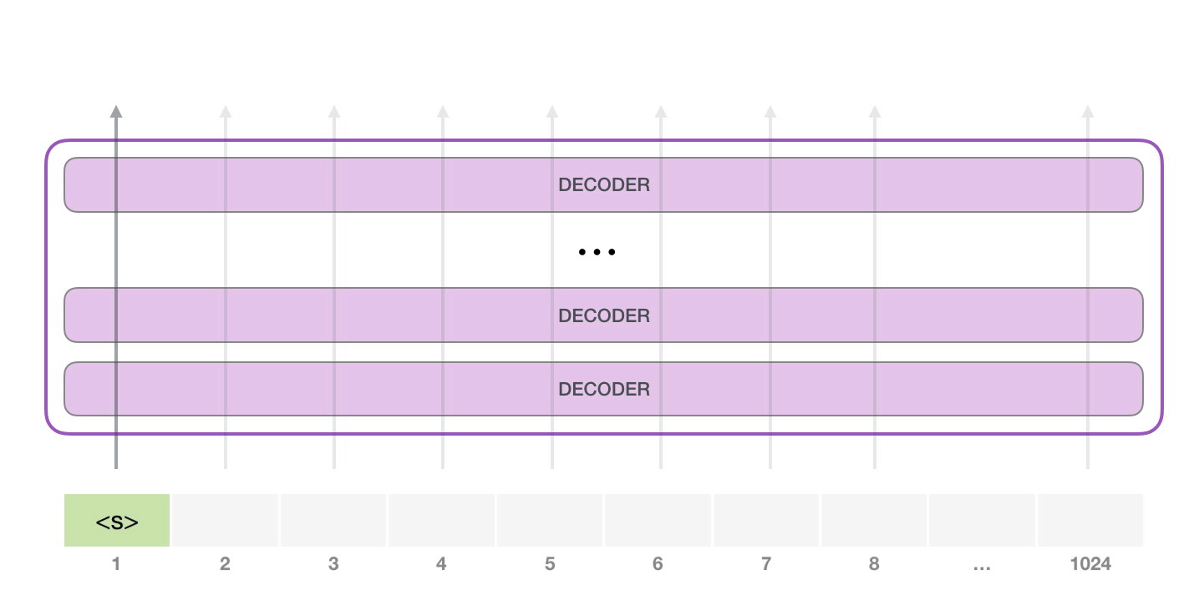
GPT-2 Simple Ooutput
Source: Jay Alammar (2019), The Illustrated GPT-2 (Visualizing Transformer Language Models), https://jalammar.github.io/illustrated-gpt2/

Slide 29
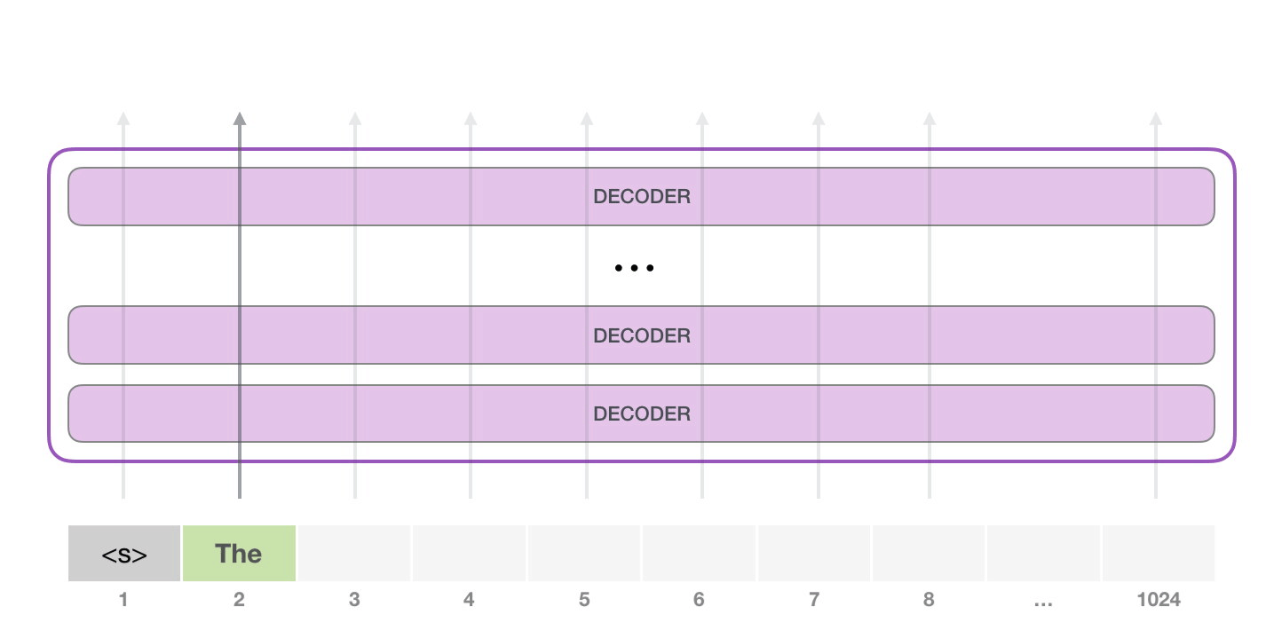
GPT-2 Simple Ooutput
Source: Jay Alammar (2019), The Illustrated GPT-2 (Visualizing Transformer Language Models), https://jalammar.github.io/illustrated-gpt2/

Slide 30
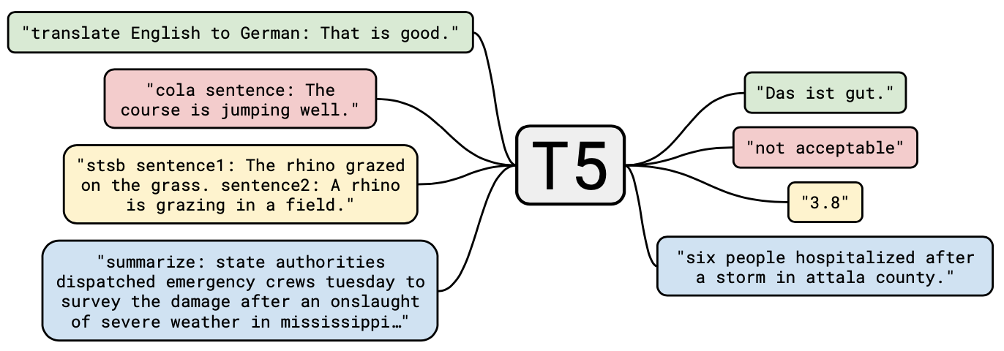
T5 Text-to-Text Transfer Transformer
Source: JColin Raffel, Noam Shazeer, Adam Roberts, Katherine Lee, Sharan Narang, Michael Matena, Yanqi Zhou, Wei Li, and Peter J. Liu (2019). "Exploring the limits of transfer learning with a unified text-to-text transformer." arXiv preprint arXiv:1910.10683 (2019).

Slide 31
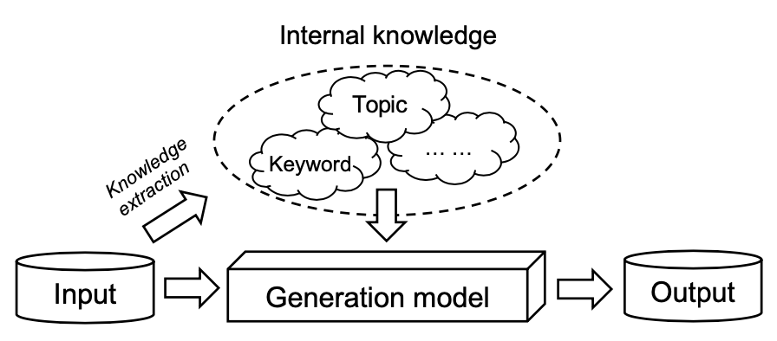
Internal Knowledge-Enhanced Text Generation
Source: Wenhao Yu, Chenguang Zhu, Zaitang Li, Zhiting Hu, Qingyun Wang, Heng Ji, and Meng Jiang (2022). "A survey of knowledge-enhanced text generation." ACM Computing Surveys (2022).

Slide 32
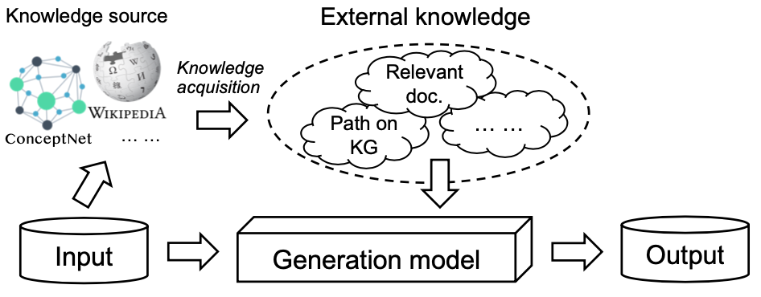
External Knowledge-Enhanced Text Generation
Source: Wenhao Yu, Chenguang Zhu, Zaitang Li, Zhiting Hu, Qingyun Wang, Heng Ji, and Meng Jiang (2022). "A survey of knowledge-enhanced text generation." ACM Computing Surveys (2022).

Slide 33
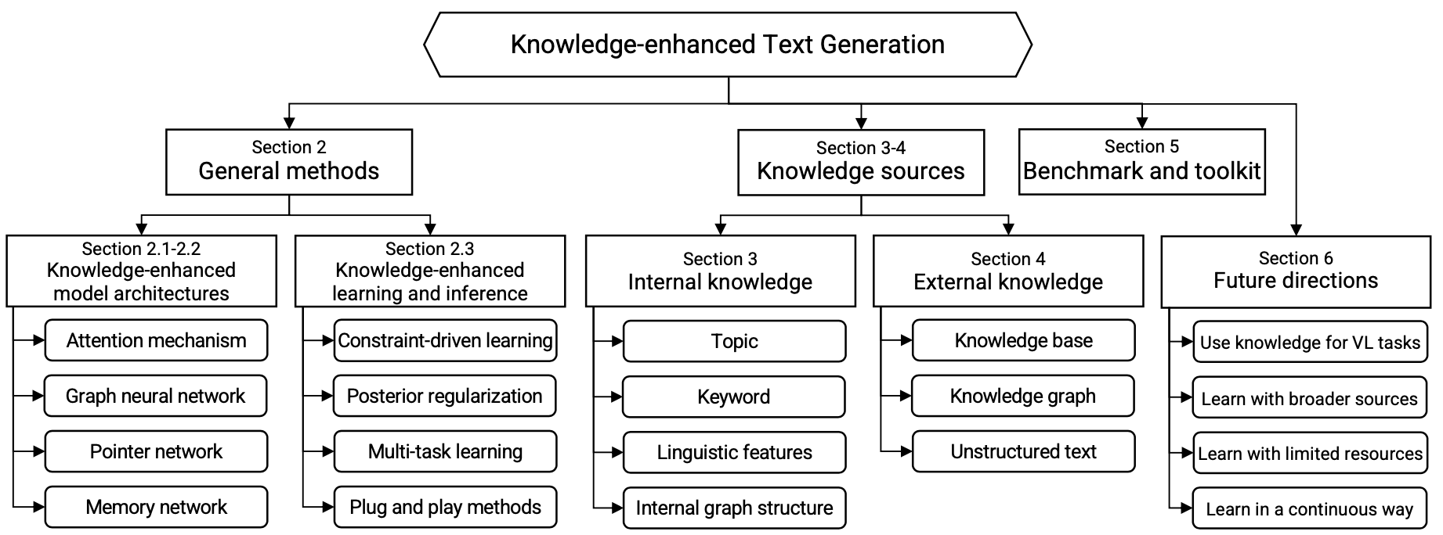
Knowledge-Enhanced Text Generation
Source: Wenhao Yu, Chenguang Zhu, Zaitang Li, Zhiting Hu, Qingyun Wang, Heng Ji, and Meng Jiang (2022). "A survey of knowledge-enhanced text generation." ACM Computing Surveys (2022).

Slide 34
Text Generation Models
Encoder-decoder frameworks
Recurrent Neural Network (RNN)
RNN- Seq2Seq
Convolutional neural network (CNN) based encoder-decoder
Transformer encoder-decoder
Source: Wenhao Yu, Chenguang Zhu, Zaitang Li, Zhiting Hu, Qingyun Wang, Heng Ji, and Meng Jiang (2022). "A survey of knowledge-enhanced text generation." ACM Computing Surveys (2022).

Slide 35
Text Generation Encoder-Decoder Frameworks Conditional Distribution
$$\text{P}\text{(}\text{Y}\text{|}\text{X}\text{) = }\text{P}\text{(}\text{y}\text{1}\text{,··· ,}\text{ym}\text{|}\text{x}\text{1}\text{,··· ,}\text{xn}\text{) =}\prod_{t=1}^{m}{\text{p}\text{(}\text{yt}\text{|}\text{X}\text{,}\text{y}\text{1}\text{,··· ,}\text{y}\text{t}\text{−}\text{1}})$$
Source: Wenhao Yu, Chenguang Zhu, Zaitang Li, Zhiting Hu, Qingyun Wang, Heng Ji, and Meng Jiang (2022). "A survey of knowledge-enhanced text generation." ACM Computing Surveys (2022).

Slide 36
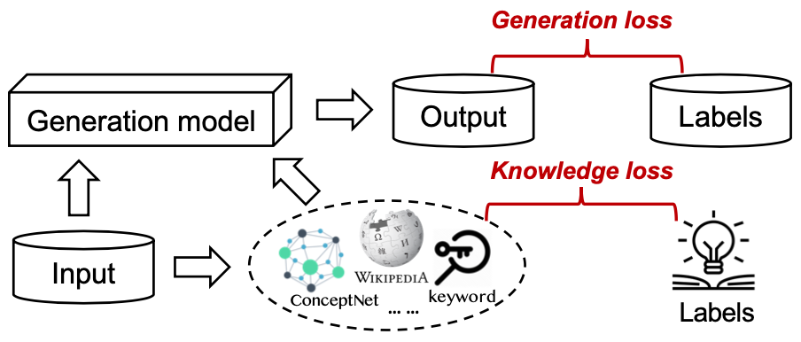
Knowledge-Enhanced Text Generation Incorporating knowledge into text generation by treating knowledge as the target
Source: Wenhao Yu, Chenguang Zhu, Zaitang Li, Zhiting Hu, Qingyun Wang, Heng Ji, and Meng Jiang (2022). "A survey of knowledge-enhanced text generation." ACM Computing Surveys (2022).

Slide 37
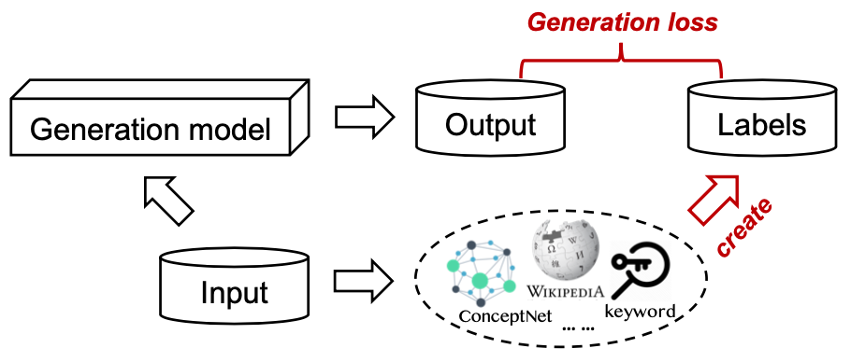
Knowledge-Enhanced Text Generation
Source: Wenhao Yu, Chenguang Zhu, Zaitang Li, Zhiting Hu, Qingyun Wang, Heng Ji, and Meng Jiang (2022). "A survey of knowledge-enhanced text generation." ACM Computing Surveys (2022).

Slide 38
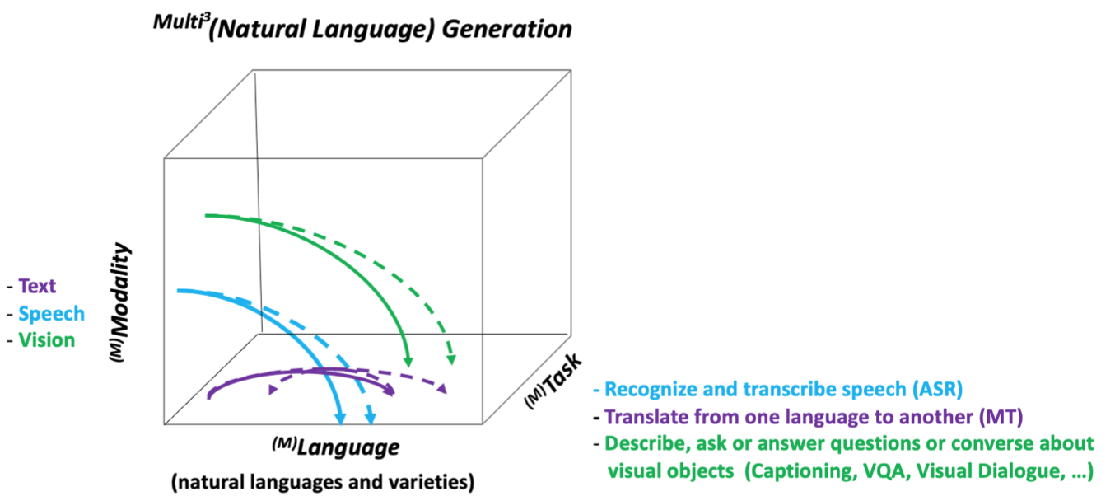
Neural Natural Language Generation: Multilinguality, Multimodality, Controllability and Learning
Source: Erkut Erdem, Menekse Kuyu, Semih Yagcioglu, Anette Frank, Letitia Parcalabescu, Barbara Plank, Andrii Babii et al (2022). "Neural Natural Language Generation: A Survey on Multilinguality, Multimodality, Controllability and Learning." Journal of Artificial Intelligence Research 73 (2022): 1131-1207.

Slide 39
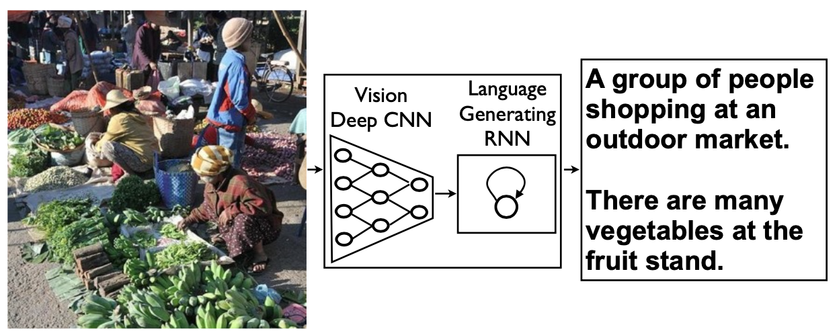
Neural Image Captioning (NIC) image-to-text description generation
Source: Erkut Erdem, Menekse Kuyu, Semih Yagcioglu, Anette Frank, Letitia Parcalabescu, Barbara Plank, Andrii Babii et al (2022). "Neural Natural Language Generation: A Survey on Multilinguality, Multimodality, Controllability and Learning." Journal of Artificial Intelligence Research 73 (2022): 1131-1207.

Slide 40
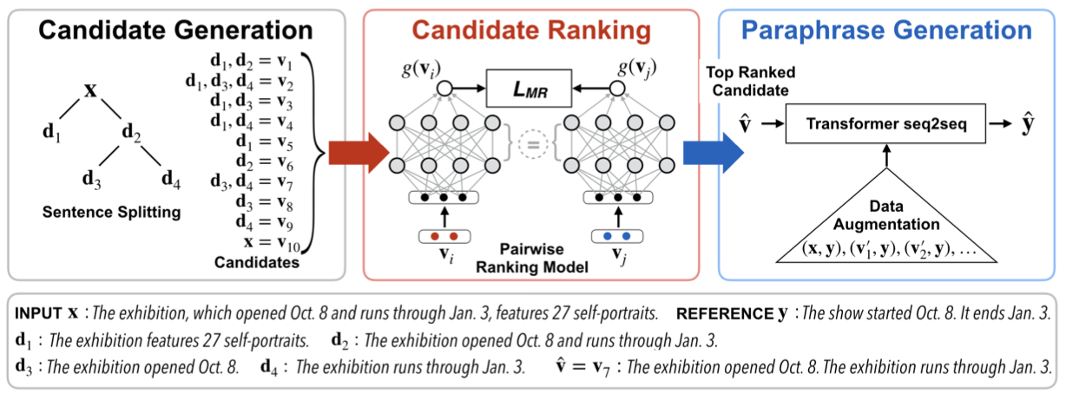
Controllable Text Simplification with an explicit paraphrasing pipeline
Source: Erkut Erdem, Menekse Kuyu, Semih Yagcioglu, Anette Frank, Letitia Parcalabescu, Barbara Plank, Andrii Babii et al (2022). "Neural Natural Language Generation: A Survey on Multilinguality, Multimodality, Controllability and Learning." Journal of Artificial Intelligence Research 73 (2022): 1131-1207.

Slide 41
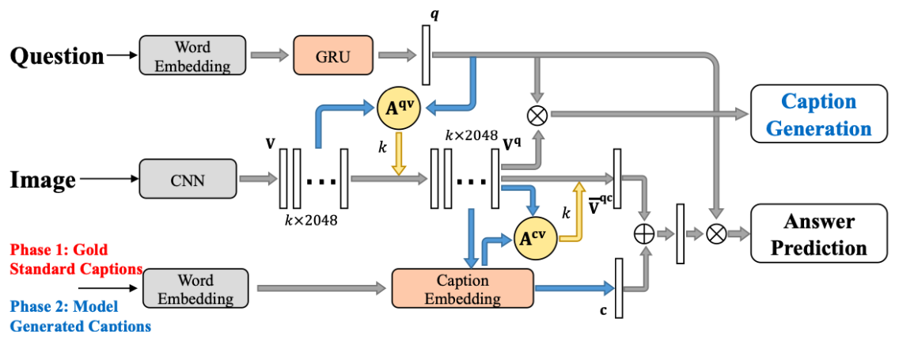
Visual Question Answering Neural caption generation is employed to aid answer prediction
Source: Erkut Erdem, Menekse Kuyu, Semih Yagcioglu, Anette Frank, Letitia Parcalabescu, Barbara Plank, Andrii Babii et al (2022). "Neural Natural Language Generation: A Survey on Multilinguality, Multimodality, Controllability and Learning." Journal of Artificial Intelligence Research 73 (2022): 1131-1207.

Slide 42
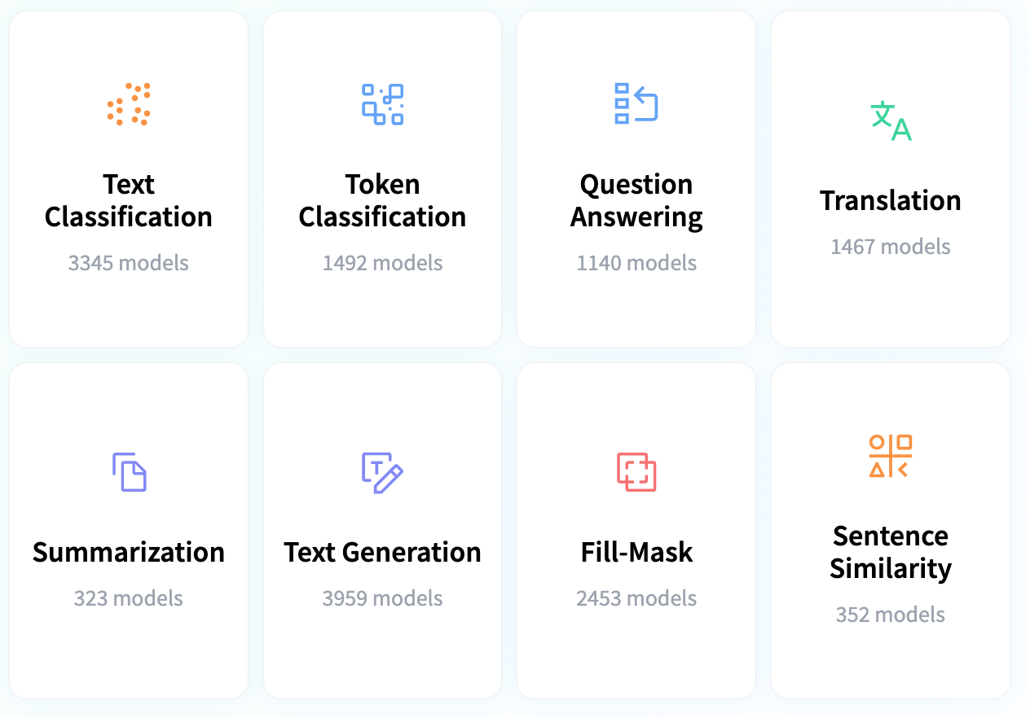
Hugging Face Tasks Natural Language Processing
https://huggingface.co/tasks

Slide 43
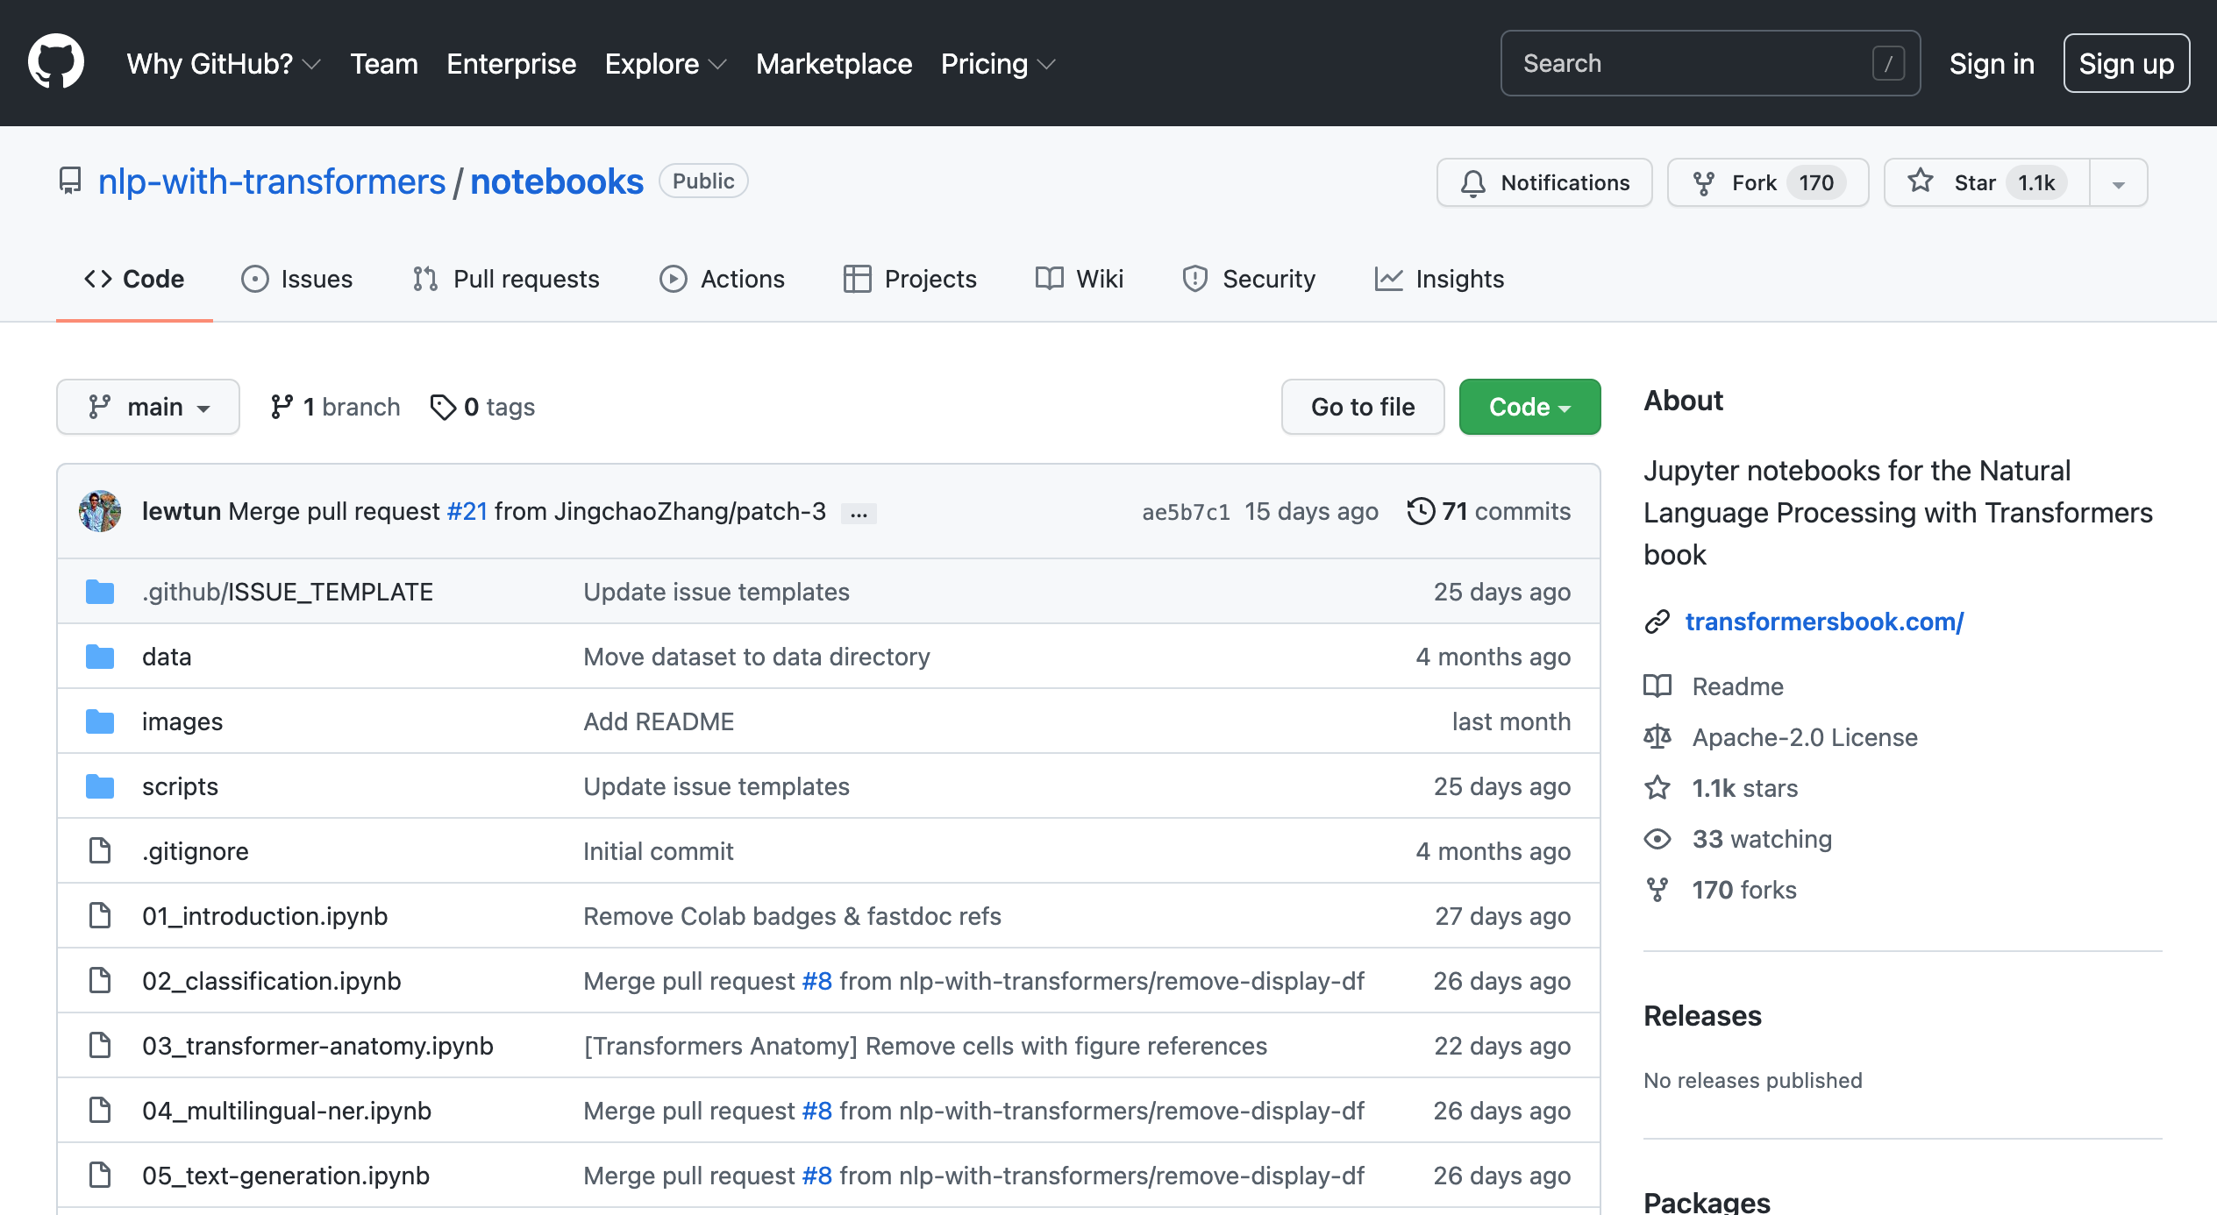
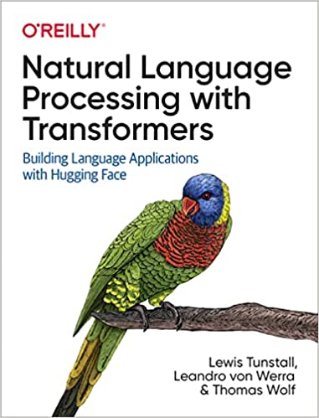
NLP with Transformers Github
https://github.com/nlp-with-transformers/notebooks

Slide 44
NLP with Transformers Github Notebooks
https://github.com/nlp-with-transformers/notebooks

Slide 45
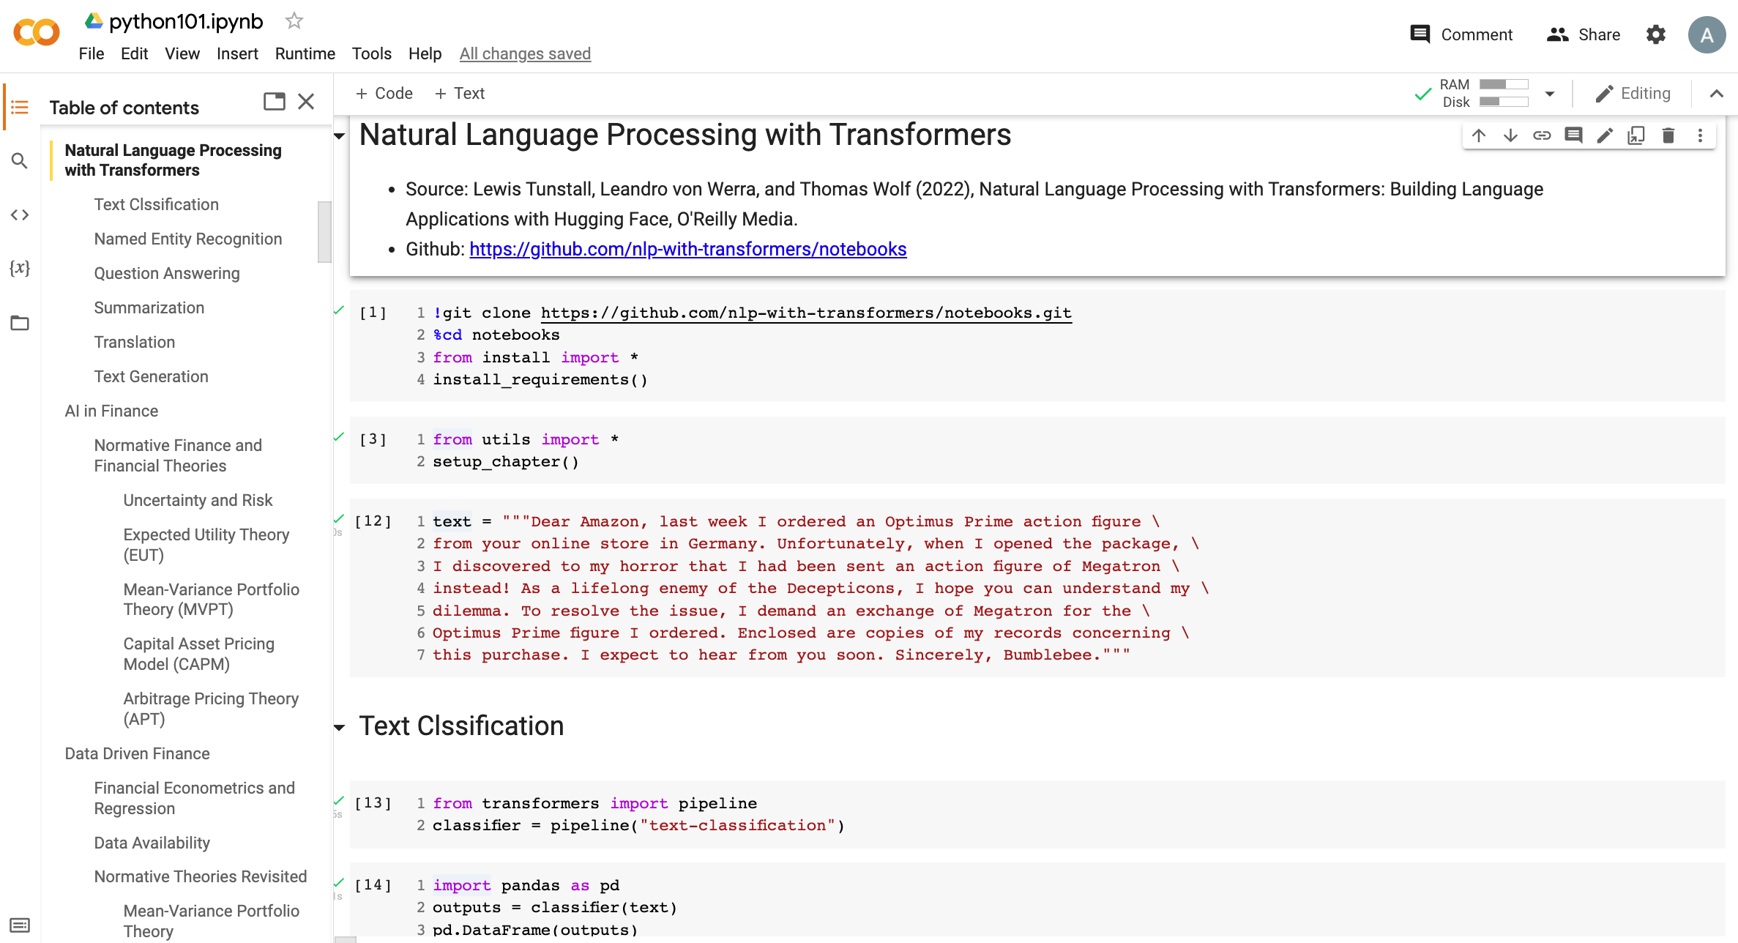
Python in Google Colab (Python101)
https://colab.research.google.com/drive/1FEG6DnGvwfUbeo4zJ1zTunjMqf2RkCrT
NLP with Transformers
https://tinyurl.com/aintpupython101

Slide 46
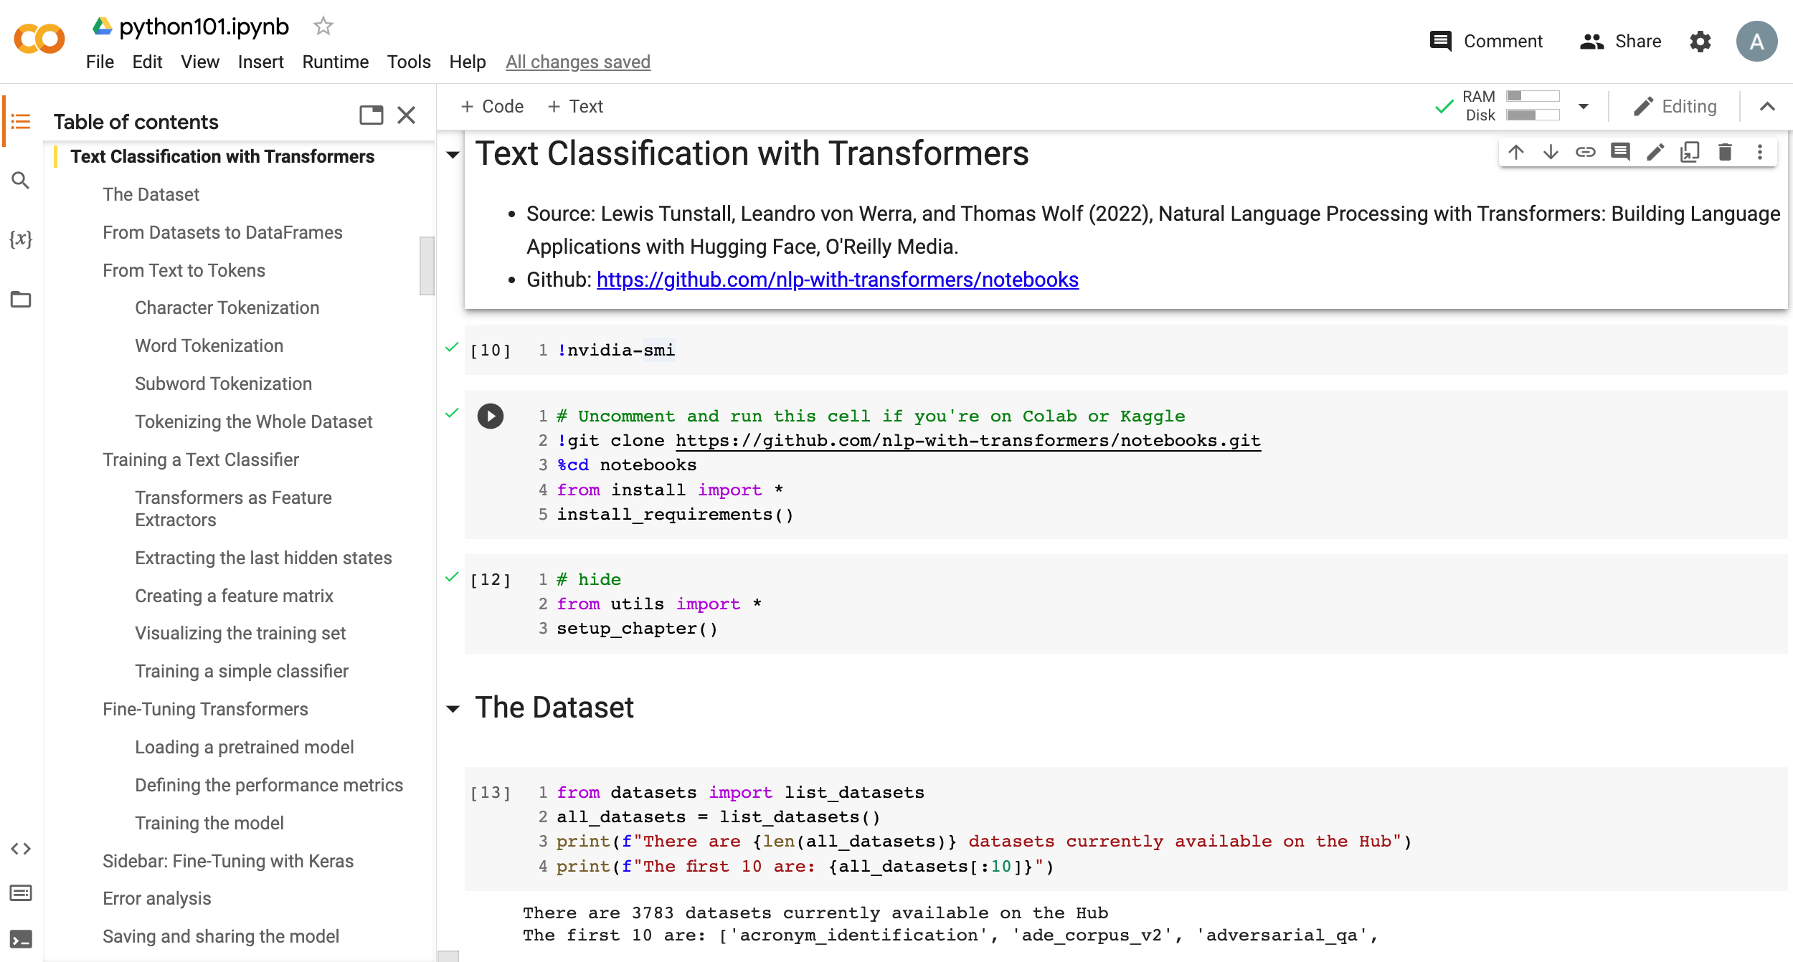
Python in Google Colab (Python101)
https://colab.research.google.com/drive/1FEG6DnGvwfUbeo4zJ1zTunjMqf2RkCrT
Text Classification
https://tinyurl.com/aintpupython101

Slide 47
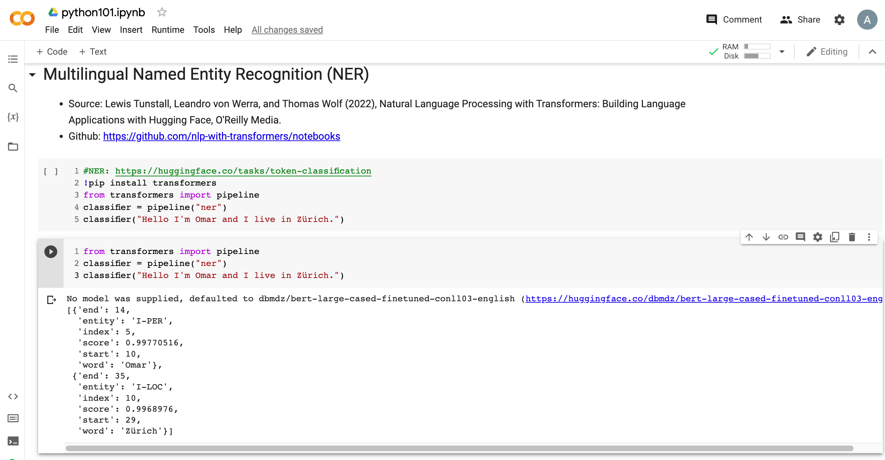
Python in Google Colab (Python101)
https://colab.research.google.com/drive/1FEG6DnGvwfUbeo4zJ1zTunjMqf2RkCrT
Named Entity Recognition (NER)
https://tinyurl.com/aintpupython101

Slide 48
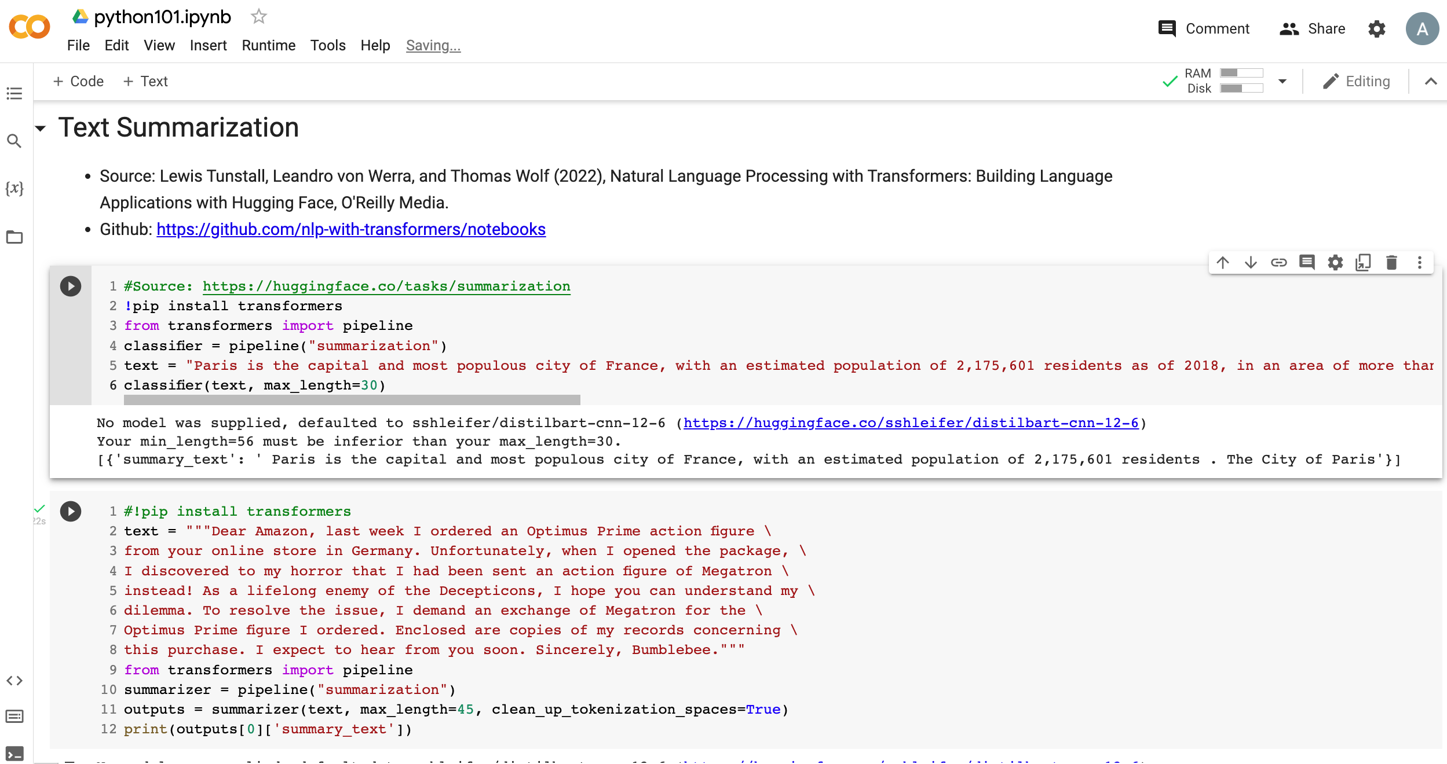
Python in Google Colab (Python101)
https://colab.research.google.com/drive/1FEG6DnGvwfUbeo4zJ1zTunjMqf2RkCrT
Text Summarization
https://tinyurl.com/aintpupython101

Slide 49
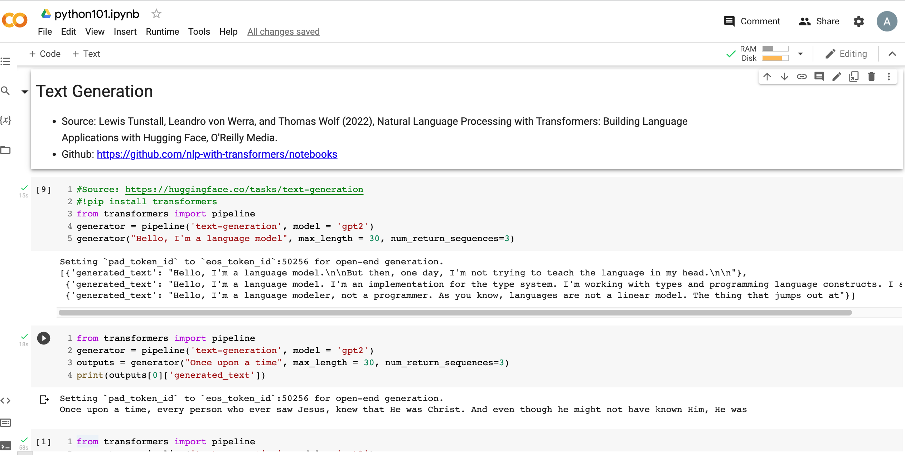
Python in Google Colab (Python101)
https://colab.research.google.com/drive/1FEG6DnGvwfUbeo4zJ1zTunjMqf2RkCrT
Text Generation
https://tinyurl.com/aintpupython101

Slide 50
Text Generation
!pip install transformers
from transformers import pipeline
generator = pipeline('text-generation', model = 'gpt2')
generator("Hello, I'm a language model", max_length = 30, num_return_sequences=3)
[{'generated_text': "Hello, I'm a language model. It's like looking at it, where is each word of the sentence? That's what I mean. Like"}, {'generated_text': "Hello, I'm a language modeler. I'm using this for two purposes: I'm having a lot fewer bugs and faster performance. If I"}, {'generated_text': 'Hello, I\'m a language model, and I was born to code."\n\nNow, I am thinking about this from a different perspective with a'}]
https://tinyurl.com/aintpupython101

Slide 51
Text Generation
from transformers import pipeline
generator = pipeline('text-generation', model = 'gpt2')
outputs = generator("Once upon a time", max_length = 30)
print(outputs[0]['generated_text'])
Once upon a time, every person who ever saw Jesus, knew that He was Christ. And even though he might not have known Him, He was
https://tinyurl.com/aintpupython101

Slide 52
Text Generation
from transformers import pipeline
generator = pipeline('text-generation', model = 'gpt2')
outputs = generator("Once upon a time", max_length = 100)
print(outputs[0]['generated_text'])
Once upon a time we should be able to speak to people who have lost children, so we try to take those that have lost the children to our institutions — but the first time is very hard for us because of our institutions. To me, it's important to acknowledge that in an institution of faith and love they are not children. And that there are many people who are still hurting the child and there are many in need of help, if not a system. So I'm very curious
https://tinyurl.com/aintpupython101

Slide 53
Text2Text Generation
from transformers import pipeline
text2text_generator = pipeline("text2text-generation", model = 't5-base')
outputs = text2text_generator("translate from English to French: I am a student")
print(outputs[0]['generated_text'])
I am a student
Je suis un étudiant
https://tinyurl.com/aintpupython101

Slide 54
Text2Text Generation
from transformers import pipeline text2text_generator = pipeline("text2text-generation")
text2text_generator("question: What is 42 ? context: 42 is the answer to life, the universe and everything")
[{'generated_text': 'the answer to life, the universe and everything'}]
https://tinyurl.com/aintpupython101

Slide 55
Summary
Text Generation
Natural Language Generation (NLG)
Language Modeling
Conditional Language Modeling
Next Word Prediction
Decoding Algorithm
Greedy Search Decoding
Beam Search Decoding
Sampling Methods
Top-k and Nucleus Sampling

Slide 56
References
Lewis Tunstall, Leandro von Werra, and Thomas Wolf (2022), Natural Language Processing with Transformers: Building Language Applications with Hugging Face, O'Reilly Media.
Denis Rothman (2021), Transformers for Natural Language Processing: Build innovative deep neural network architectures for NLP with Python, PyTorch, TensorFlow, BERT, RoBERTa, and more, Packt Publishing.
Savaş Yıldırım and Meysam Asgari-Chenaghlu (2021), Mastering Transformers: Build state-of-the-art models from scratch with advanced natural language processing techniques, Packt Publishing.
Sowmya Vajjala, Bodhisattwa Majumder, Anuj Gupta (2020), Practical Natural Language Processing: A Comprehensive Guide to Building Real-World NLP Systems, O'Reilly Media.
Dipanjan Sarkar (2019), Text Analytics with Python: A Practitioner’s Guide to Natural Language Processing, Second Edition. APress.
Wenhao Yu, Chenguang Zhu, Zaitang Li, Zhiting Hu, Qingyun Wang, Heng Ji, and Meng Jiang (2022). "A survey of knowledge-enhanced text generation." ACM Computing Surveys (2022).
Erkut Erdem, Menekse Kuyu, Semih Yagcioglu, Anette Frank, Letitia Parcalabescu, Barbara Plank, Andrii Babii et al (2022). "Neural Natural Language Generation: A Survey on Multilinguality, Multimodality, Controllability and Learning." Journal of Artificial Intelligence Research 73 (2022): 1131-1207.
Jay Alammar (2019), The Illustrated GPT-2 (Visualizing Transformer Language Models), https://jalammar.github.io/illustrated-gpt2/
Benjamin Bengfort, Rebecca Bilbro, and Tony Ojeda (2018), Applied Text Analysis with Python: Enabling Language-Aware Data Products with Machine Learning, O’Reilly.
Charu C. Aggarwal (2018), Machine Learning for Text, Springer.
Gabe Ignatow and Rada F. Mihalcea (2017), An Introduction to Text Mining: Research Design, Data Collection, and Analysis, SAGE Publications.
Rajesh Arumugam (2018), Hands-On Natural Language Processing with Python: A practical guide to applying deep learning architectures to your NLP applications, Packt.
Jake VanderPlas (2016), Python Data Science Handbook: Essential Tools for Working with Data, O'Reilly Media.
Devlin, Jacob, Ming-Wei Chang, Kenton Lee, and Kristina Toutanova (2018). "BERT: Pre-training of Deep Bidirectional Transformers for Language Understanding." arXiv preprint arXiv:1810.04805.
The Super Duper NLP Repo, https://notebooks.quantumstat.com/
Jay Alammar (2018), The Illustrated Transformer, http://jalammar.github.io/illustrated-transformer/
Jay Alammar (2019), A Visual Guide to Using BERT for the First Time, http://jalammar.github.io/a-visual-guide-to-using-bert-for-the-first-time/
NLP with Transformer, https://github.com/nlp-with-transformers/notebooks
Min-Yuh Day (2022), Python 101, https://tinyurl.com/aintpupython101

