Slide 1
Python for Natural Language Processing
Artificial Intelligence for Text Analytics
1102AITA03
MBA, IM, NTPU (M5026) (Spring 2022) Tue 2, 3, 4 (9:10-12:00) (B8F40)
Min-Yuh Day, Ph.D, Associate Professor
Institute of Information Management, National Taipei University
https://web.ntpu.edu.tw/~myday
https://meet.google.com/paj-zhhj-mya
2022-03-08

Slide 2
Syllabus
Week Date Subject/Topics
1 2022/02/22 Introduction to Artificial Intelligence for Text Analytics
2 2022/03/01 Foundations of Text Analytics: Natural Language Processing (NLP)
3 2022/03/08 Python for Natural Language Processing
4 2022/03/15 Natural Language Processing with Transformers
5 2022/03/22 Case Study on Artificial Intelligence for Text Analytics I
6 2022/03/29 Text Classification and Sentiment Analysis

Slide 3
Syllabus
Week Date Subject/Topics
7 2022/04/05 Tomb-Sweeping Day (Holiday, No Classes)
8 2022/04/12 Midterm Project Report
9 2022/04/19 Multilingual Named Entity Recognition (NER), Text Similarity and Clustering
10 2022/04/26 Text Summarization and Topic Models
11 2022/05/03 Text Generation
12 2022/05/10 Case Study on Artificial Intelligence for Text Analytics II

Slide 4
Syllabus
Week Date Subject/Topics
13 2022/05/17 Question Answering and Dialogue Systems
14 2022/05/24 Deep Learning, Transfer Learning, Zero-Shot, and Few-Shot Learning for Text Analytics
15 2022/05/31 Final Project Report I
16 2022/06/07 Final Project Report II
17 2022/06/14 Self-learning
18 2022/06/21 Self-learning

Slide 5
Python for Natural Language Processing

Slide 6
Outline
Python for Natural Language Processing
Python Ecosystem for Data Science
Python
Programming language
Numpy
Scientific computing
SpaCy
Natural Language Processing

Slide 7
Python

Slide 8
Python is an interpreted, object-oriented, high-level programming language with dynamic semantics.
Source: https://www.python.org/doc/essays/blurb/

Slide 9
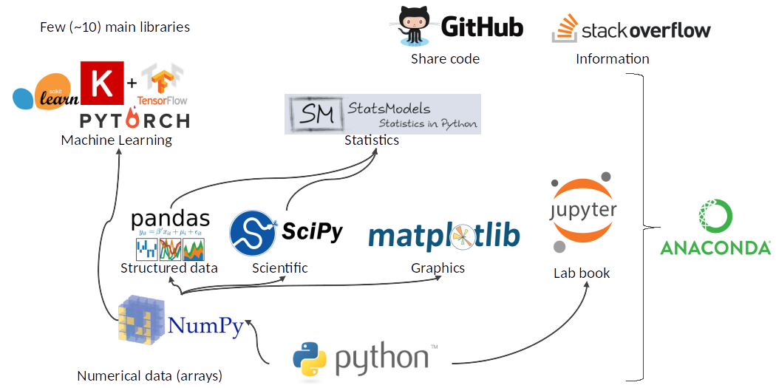
Python Ecosystem for Data Science
Source: https://medium.com/pyfinance/why-python-is-best-choice-for-financial-data-modeling-in-2019-c0d0d1858c45

Slide 10
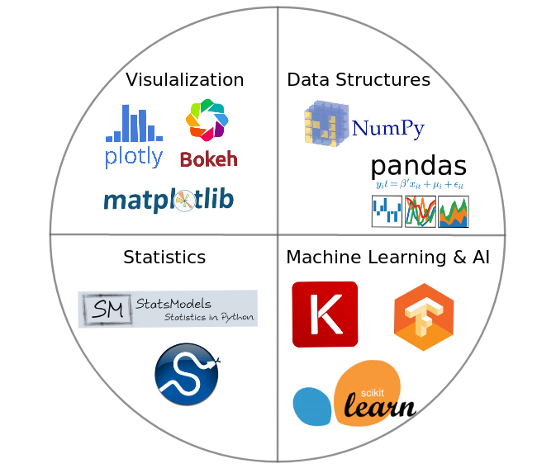
Python Ecosystem for Data Science
Source:https://duchesnay.github.io/pystatsml/introduction/python_ecosystem.html

Slide 11
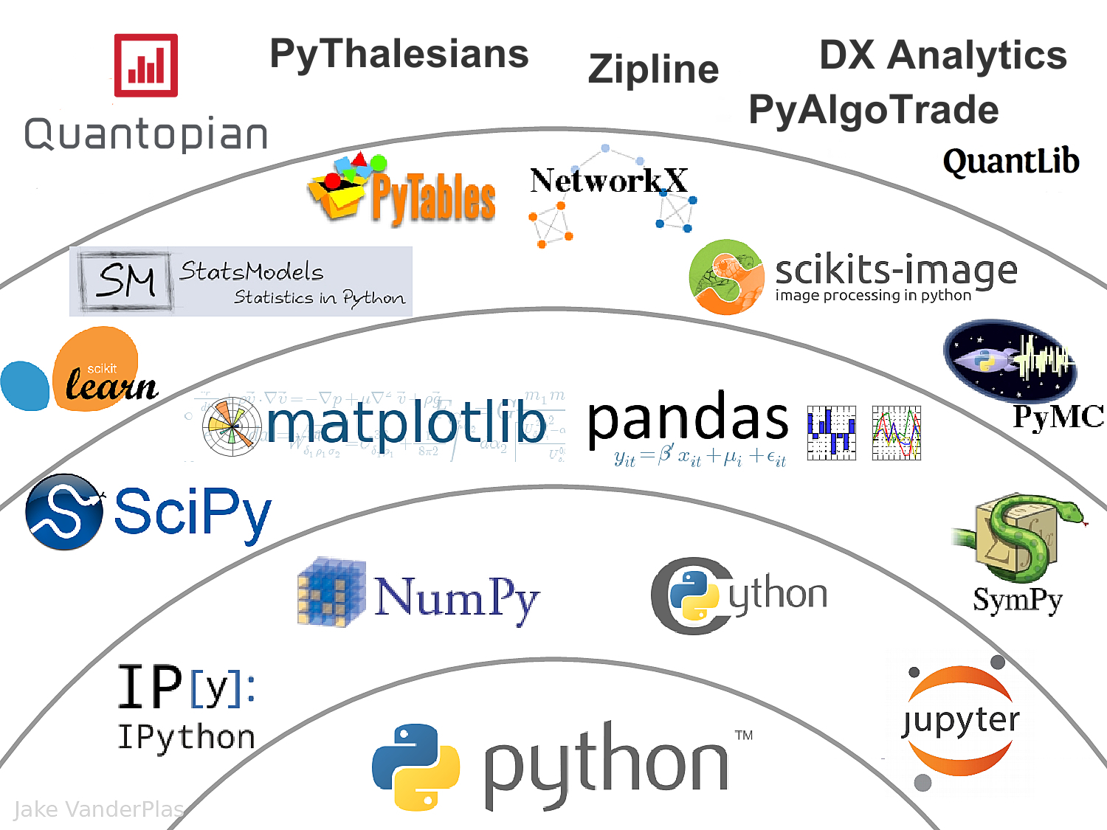
The Quant Finance PyData Stack
Source: http://nbviewer.jupyter.org/format/slides/github/quantopian/pyfolio/blob/master/pyfolio/examples/overview_slides.ipynb#/5

Slide 12
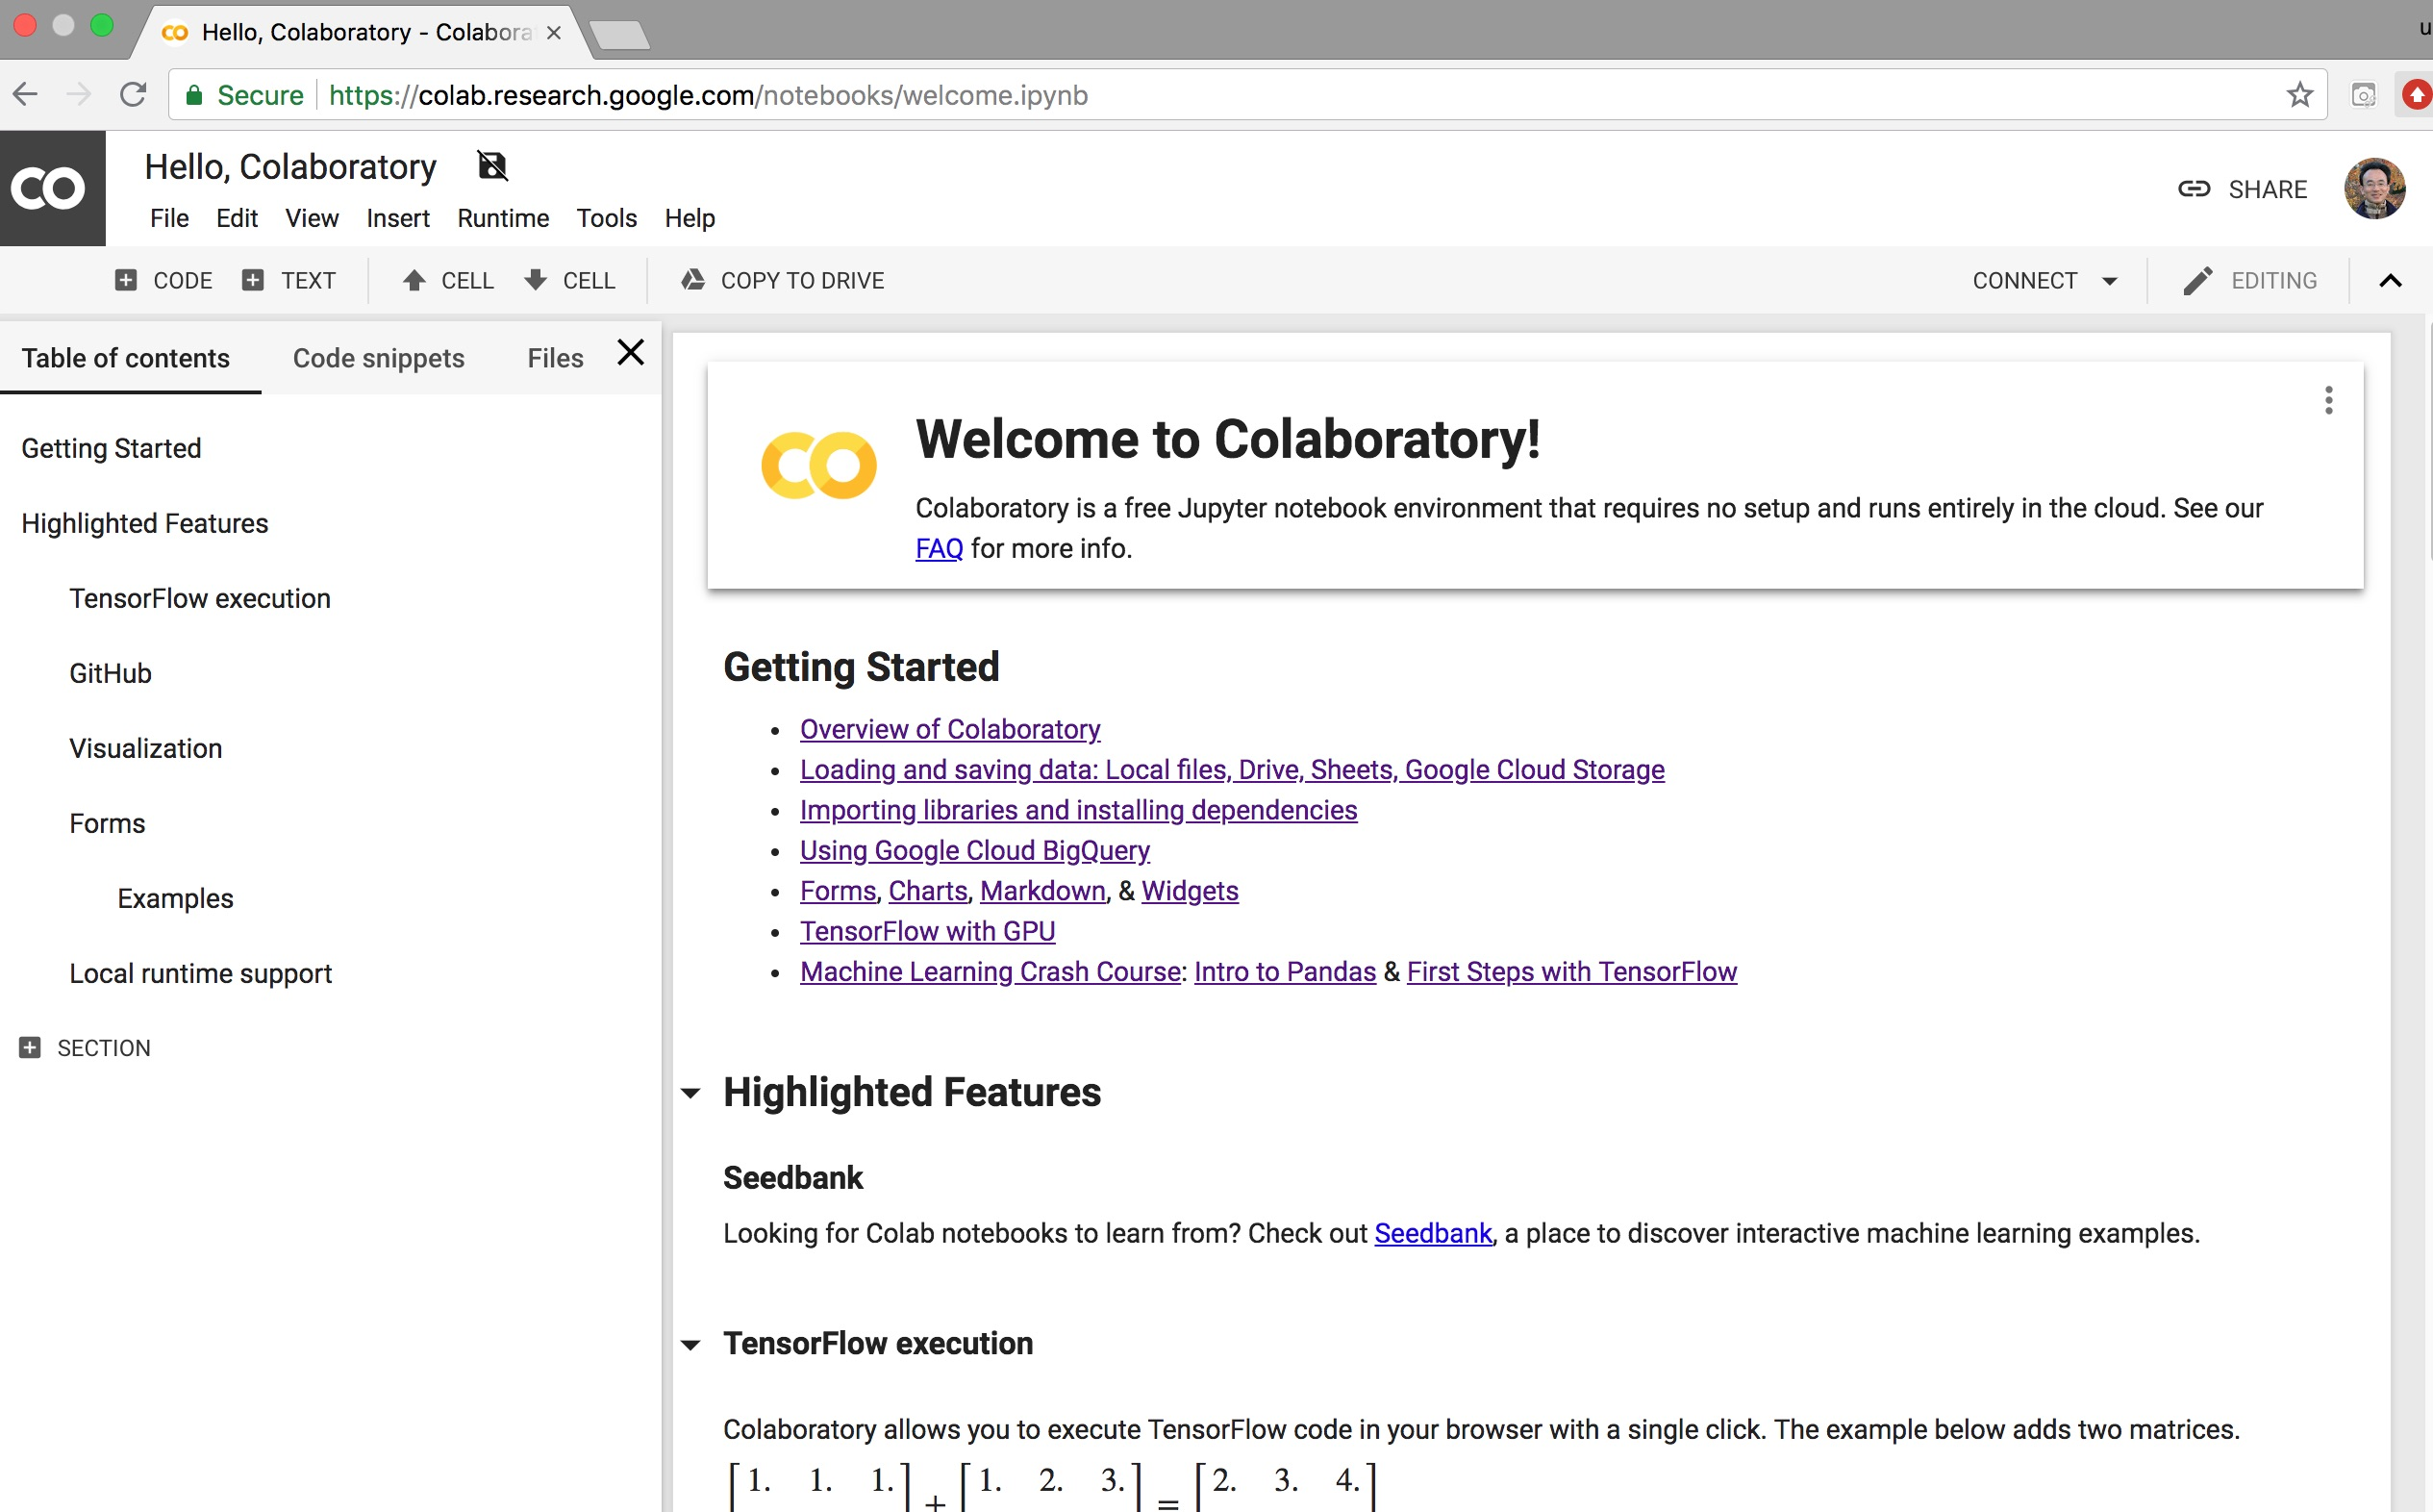
Google Colab
https://colab.research.google.com/notebooks/welcome.ipynb

Slide 13
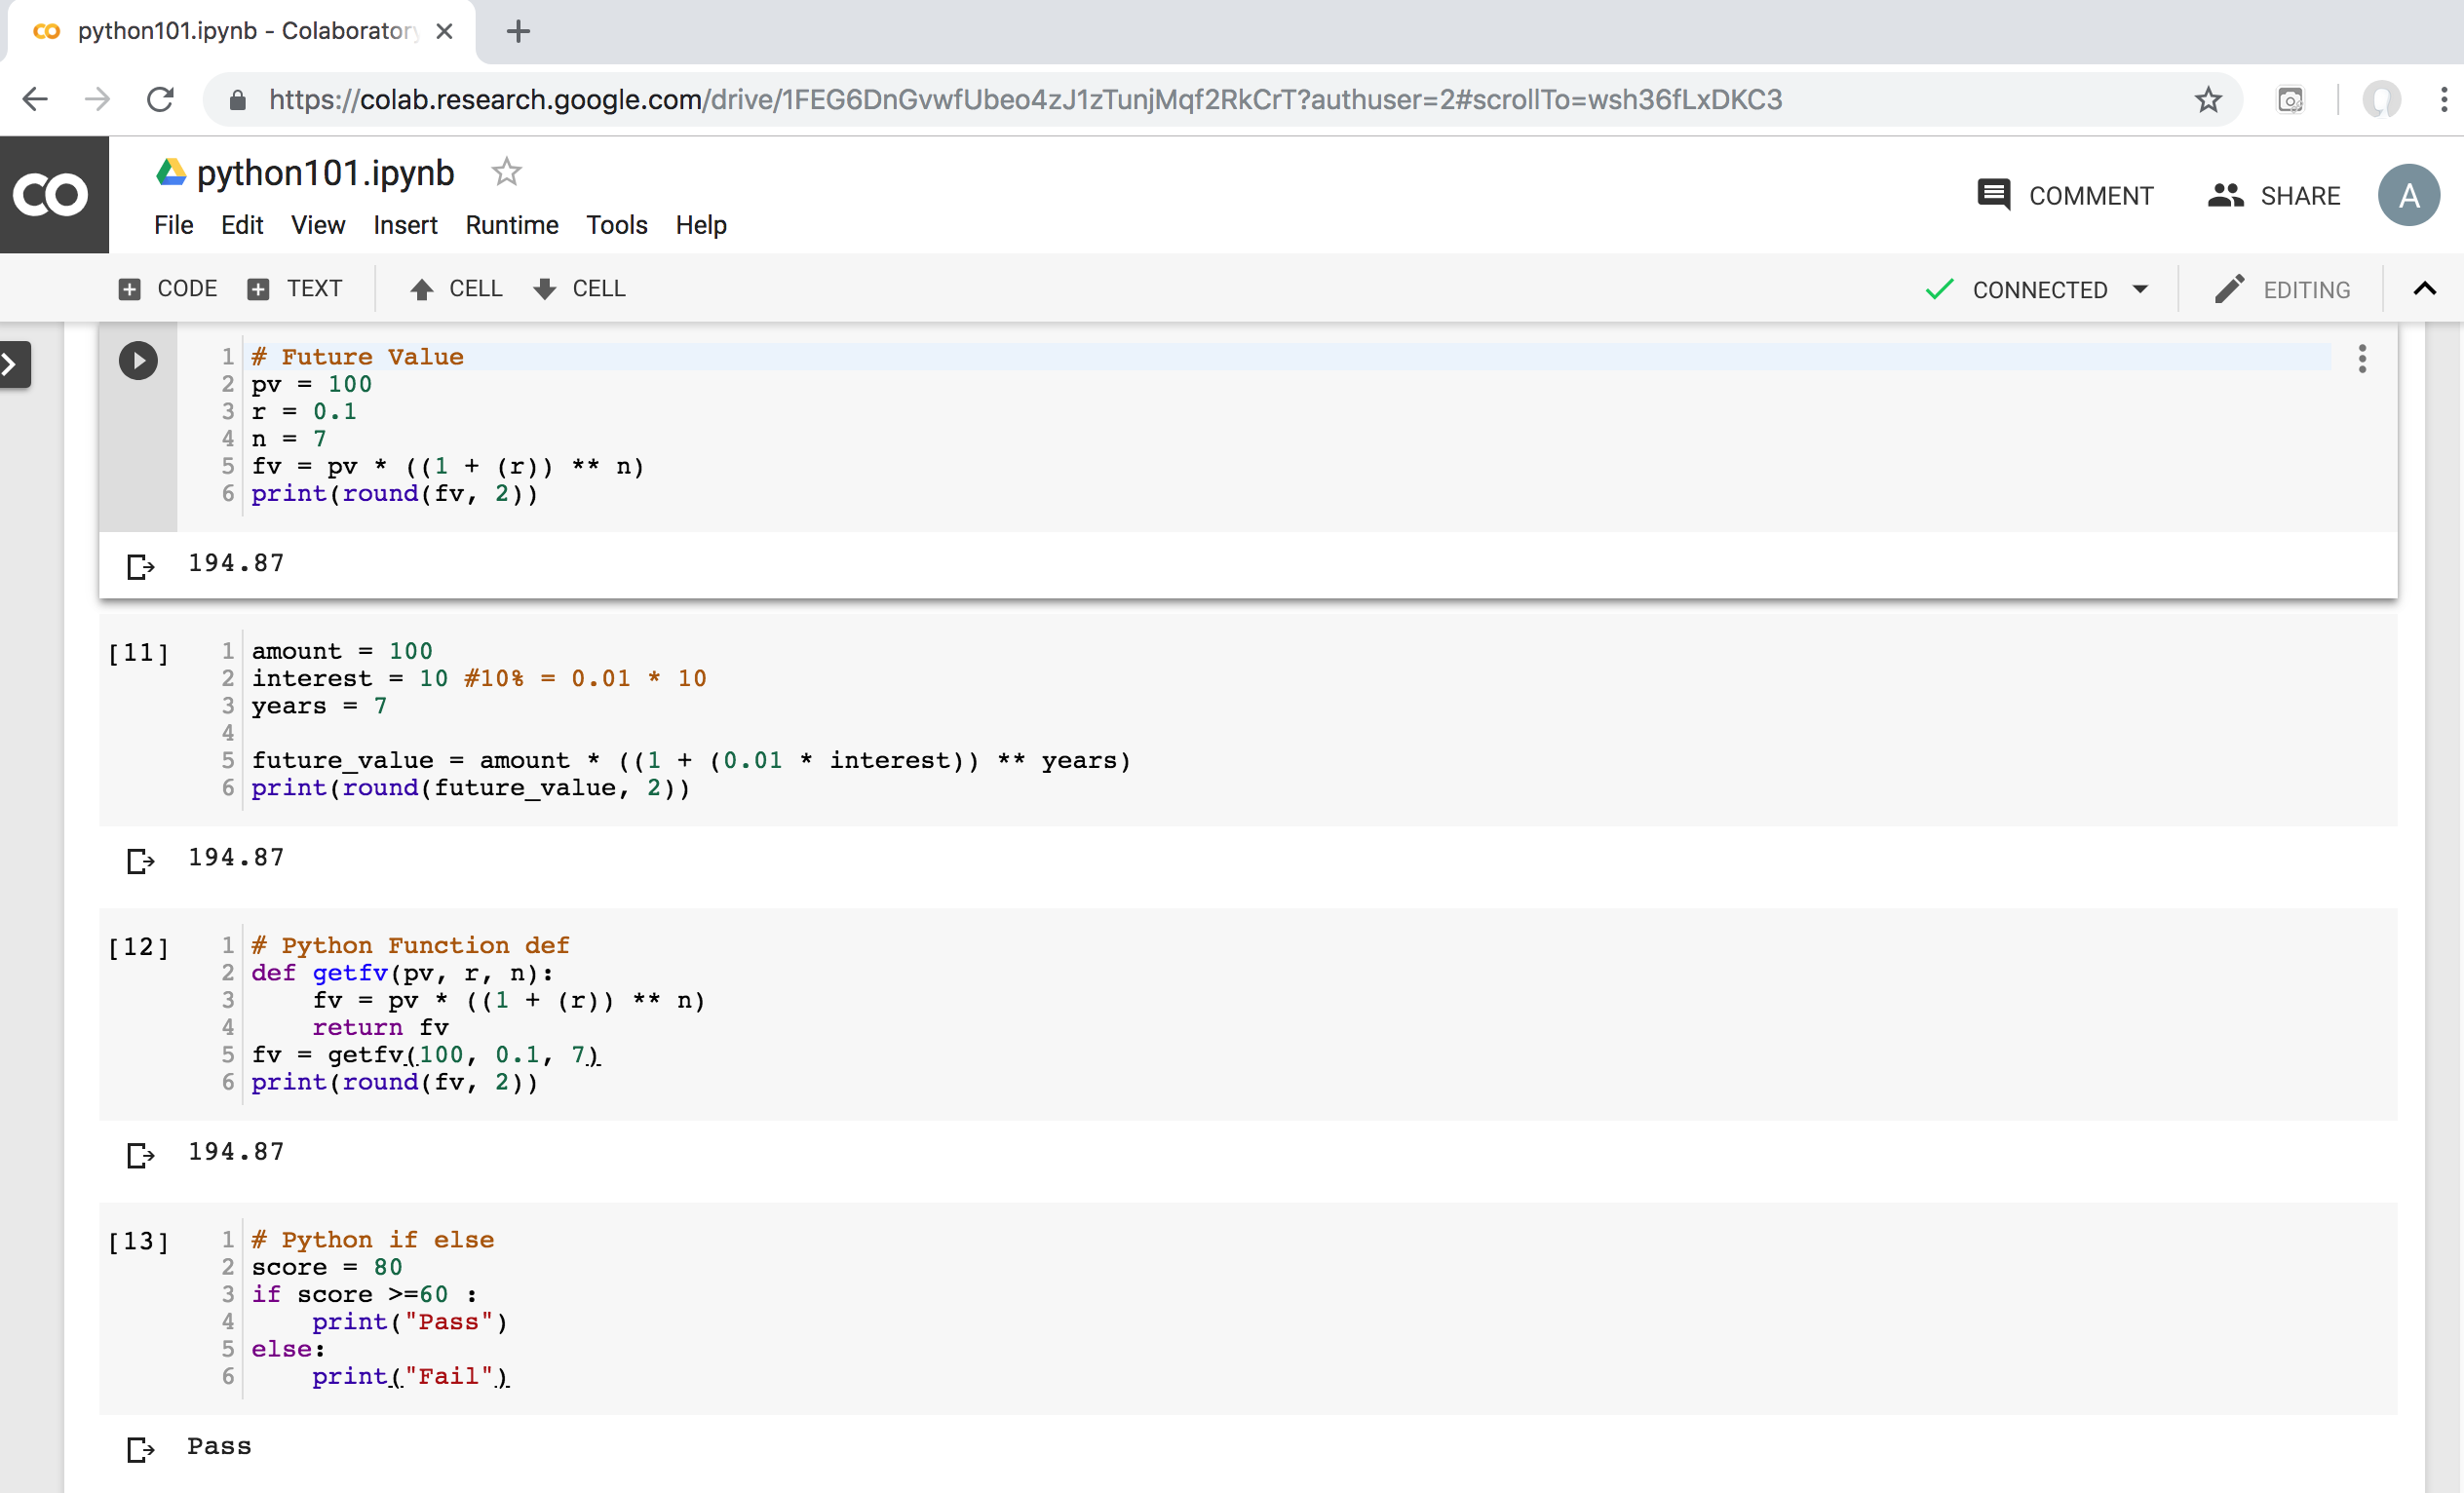
Python in Google Colab (Python101)
https://colab.research.google.com/drive/1FEG6DnGvwfUbeo4zJ1zTunjMqf2RkCrT
https://tinyurl.com/aintpupython101

Slide 14
Numpy
NumPy
Base N-dimensional array package

Slide 15
Python matplotlib
Source: https://matplotlib.org/

Slide 16
Python Pandas
http://pandas.pydata.org/

Slide 17
Connect Google Colab in Google Drive

Slide 18
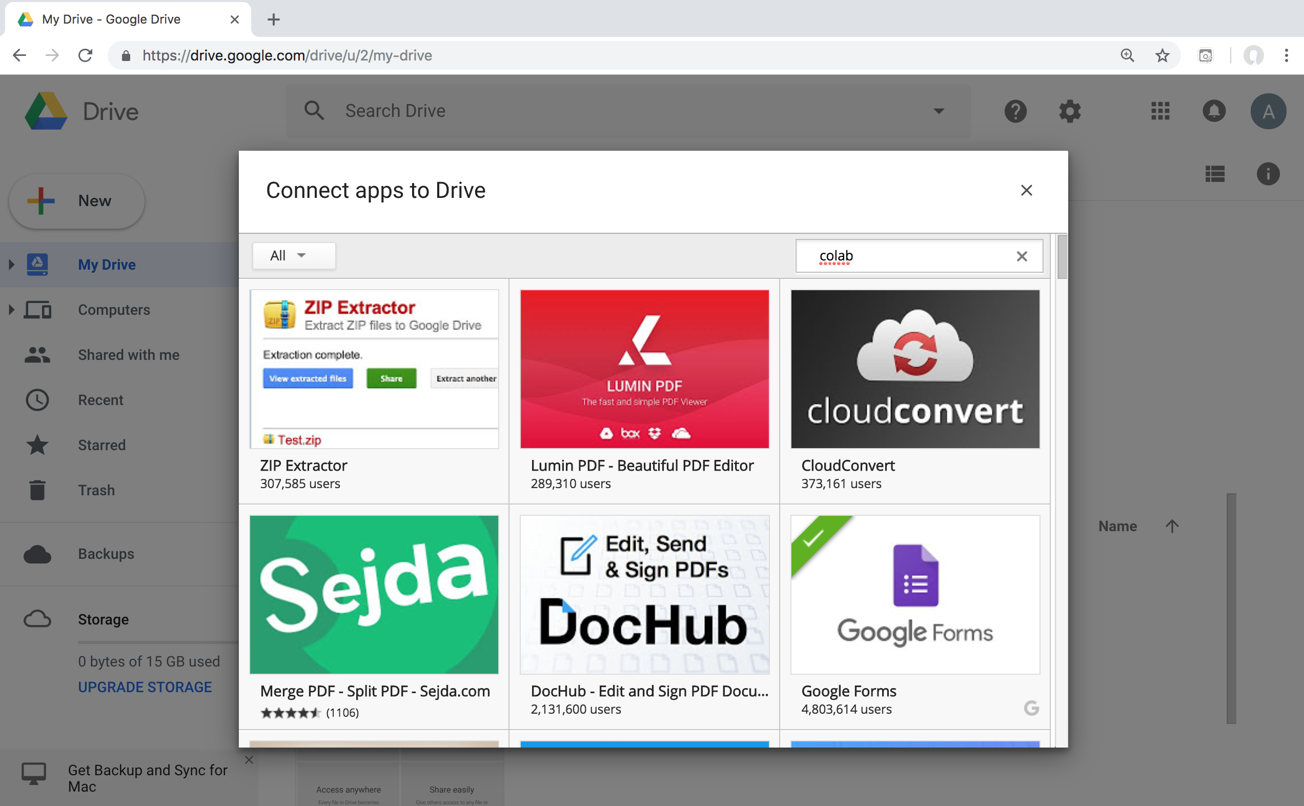
Google Colab

Slide 19
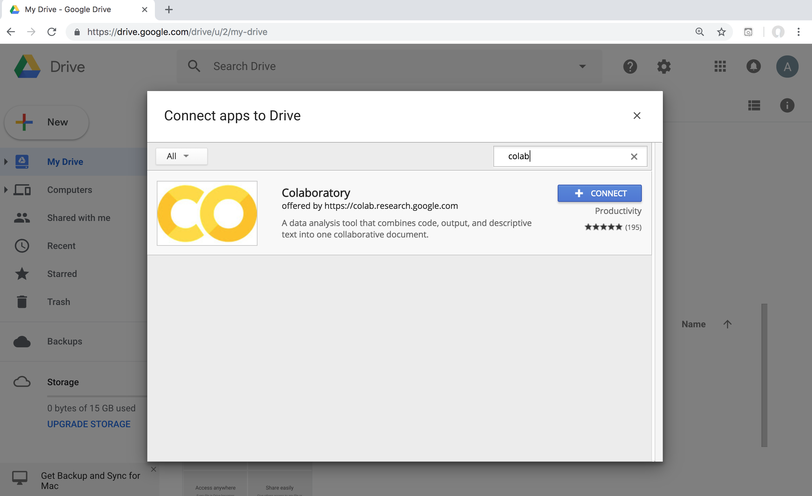
Google Colab

Slide 20
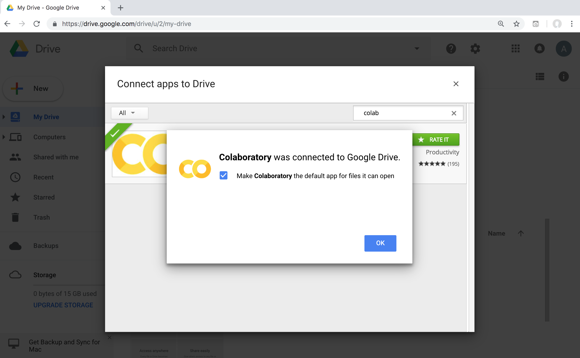
Connect Colaboratory to Google Drive

Slide 21
Google Colab

Slide 22
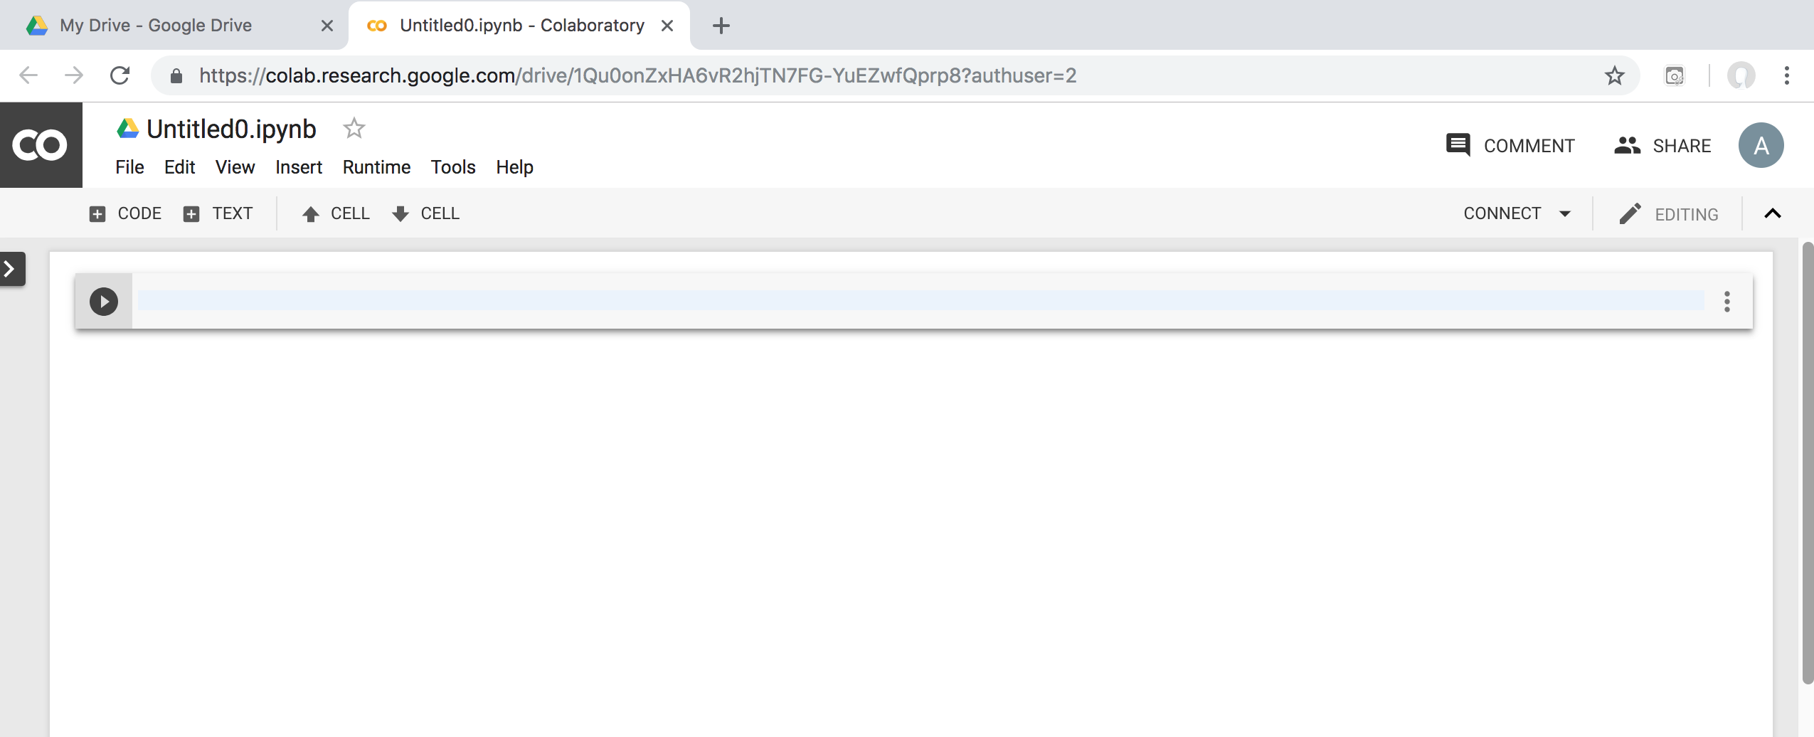
Google Colab

Slide 23
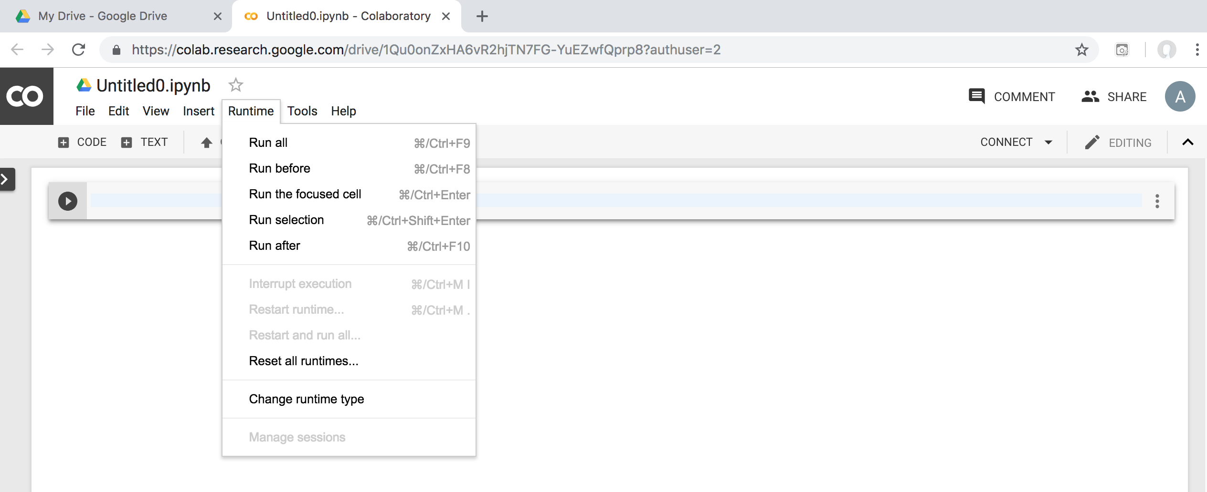
Google Colab

Slide 24
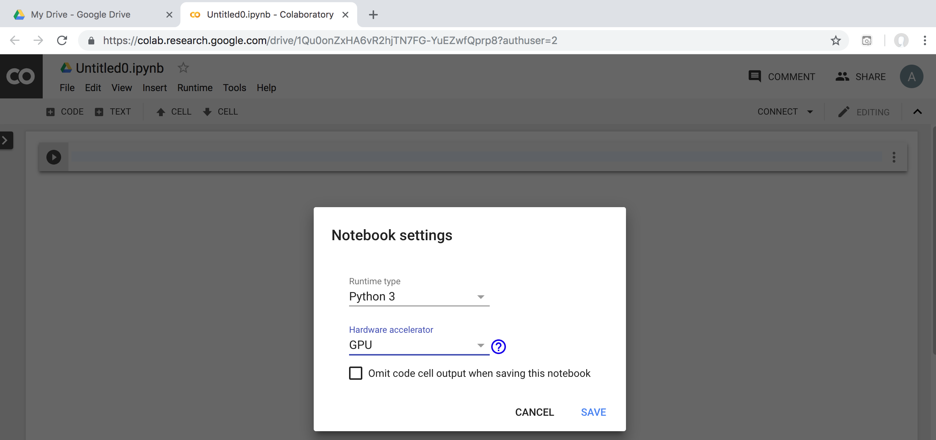
Run Jupyter Notebook Python3 GPU Google Colab

Slide 25
Google Colab Python Hello World print('Hello World')

Slide 26
Anaconda The Most Popular Python Data Science Platform
Source: https://www.anaconda.com/

Slide 27
Download Anaconda
https://www.anaconda.com/download

Slide 28
Python HelloWorld

Slide 29
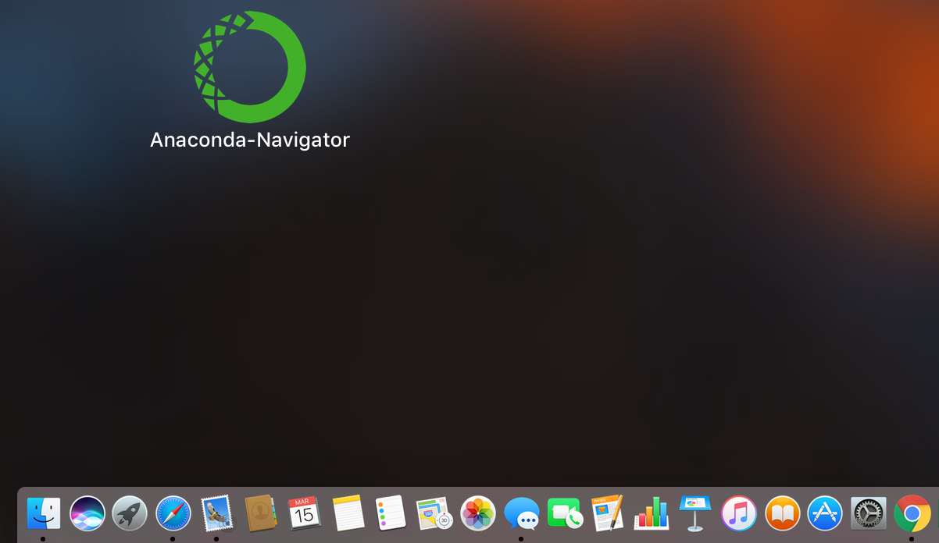
Anaconda-Navigator
Launchpad

Slide 30
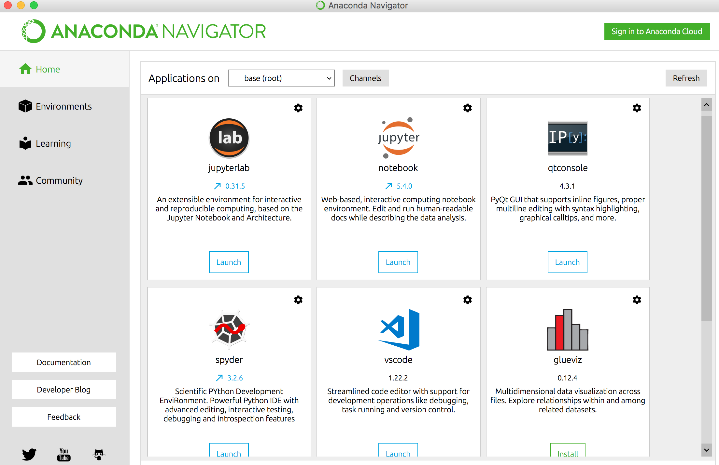
Anaconda Navigator

Slide 31
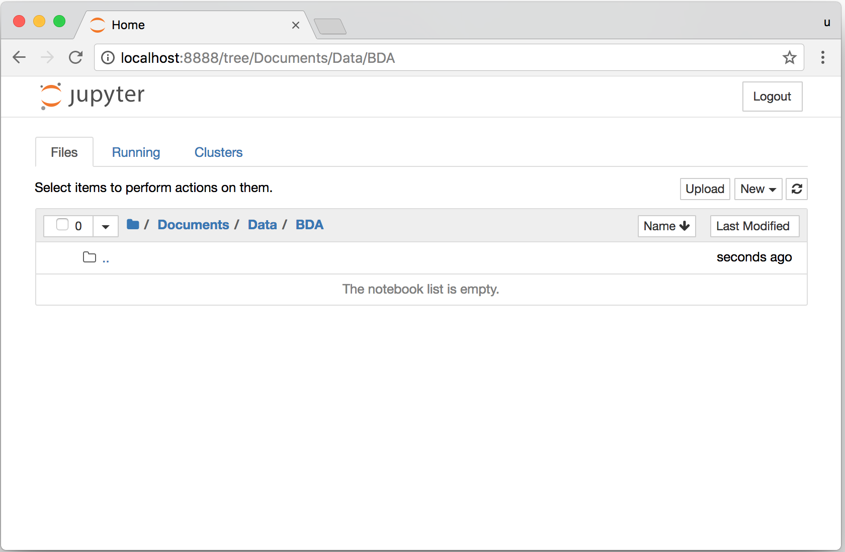
Jupyter Notebook

Slide 32
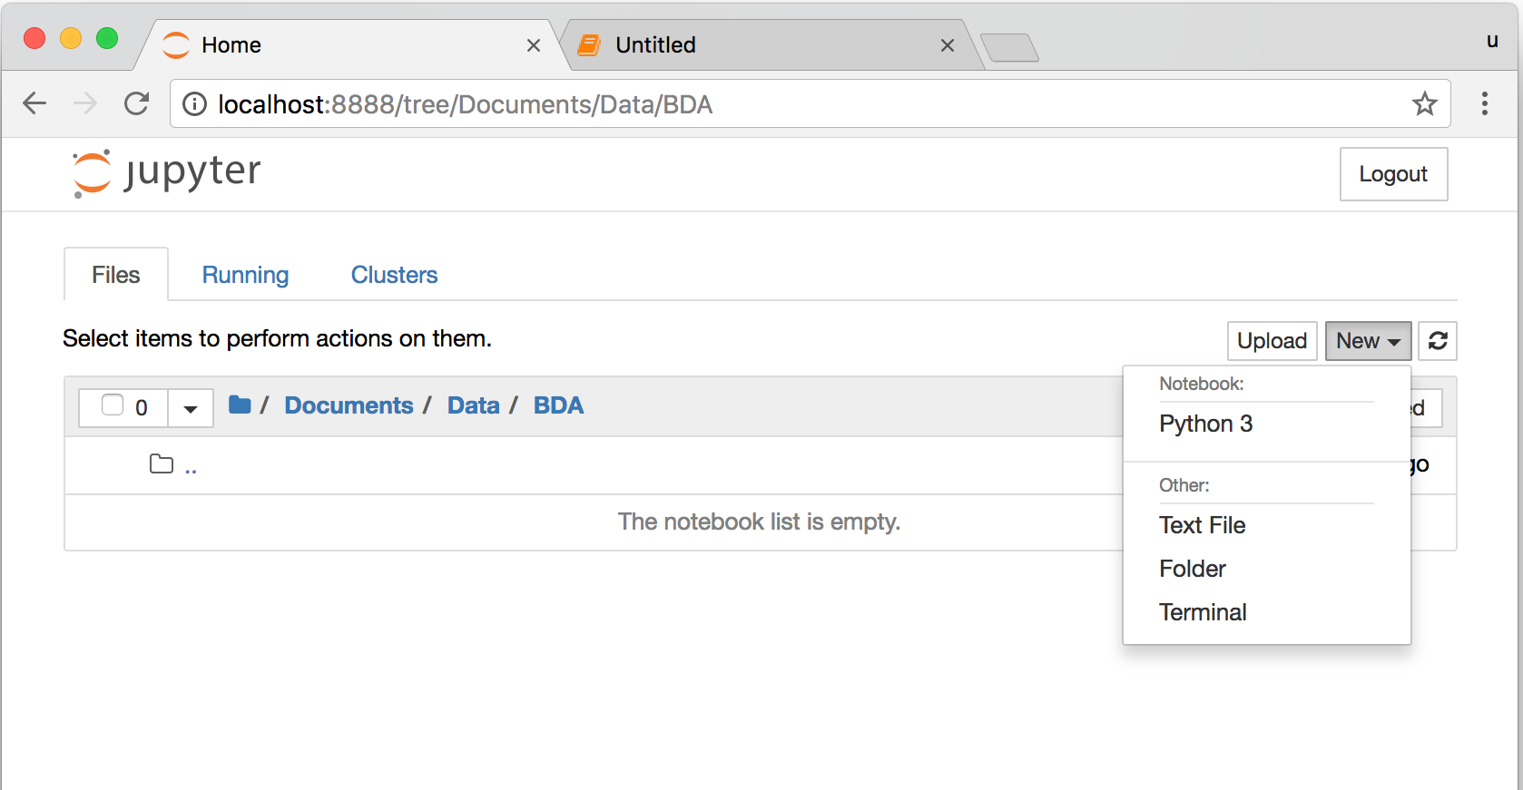
Jupyter Notebook New Python 3

Slide 33
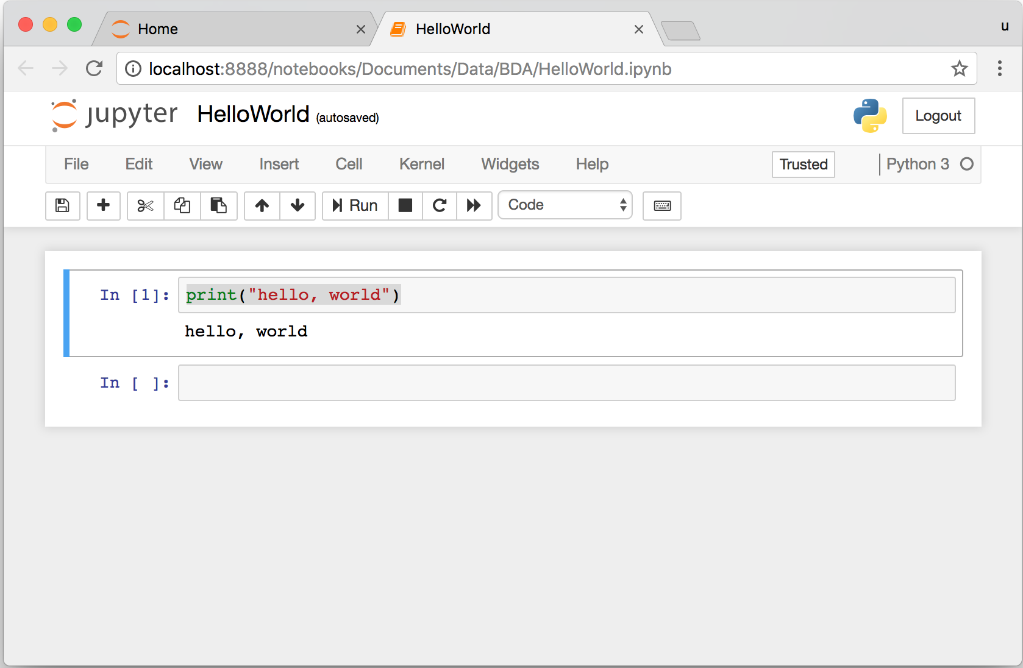
print("hello, world")
Notes:
print("hello, world")

Slide 34
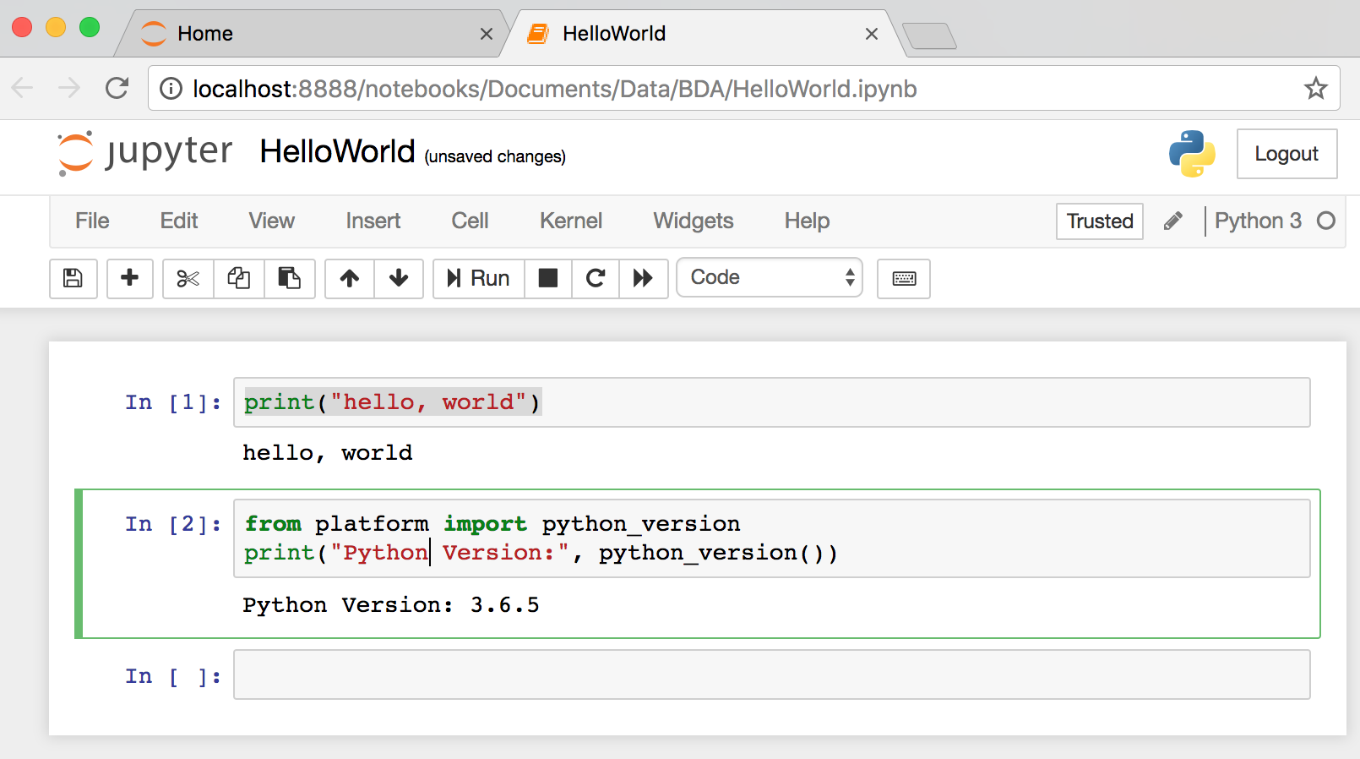
from platform import python_version
print("Python Version:", python_version())
Notes:
from platform import python_version
print("Python Version:", python_version())

Slide 35
Python Programming

Slide 36
Source: https://www.python.org/community/logos/

Slide 37
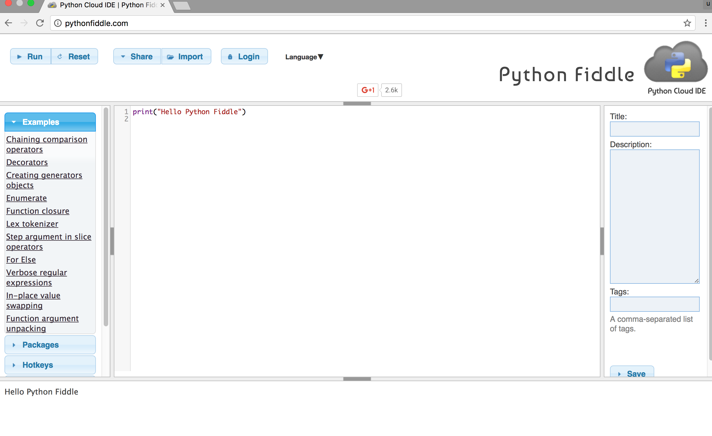
Python Fiddle
http://pythonfiddle.com/

Slide 38
Text input and output
print("Hello World")
print("Hello World\nThis is a message")
x = 3
print(x)
x = 2
y = 3
print(x, ' ', y)
name = input("Enter a name: ")
x = int(input("What is x? "))
x = float(input("Write a number "))
Source: http://pythonprogramminglanguage.com/text-input-and-output/
Notes:
print("Hello World")
print("Hello World\nThis is a message")
x = 3
print(x)
x = 2
y = 3
print(x, ' ', y)
name = input("Enter a name: ")
x = int(input("What is x? "))
x = float(input("Write a number "))

Slide 39
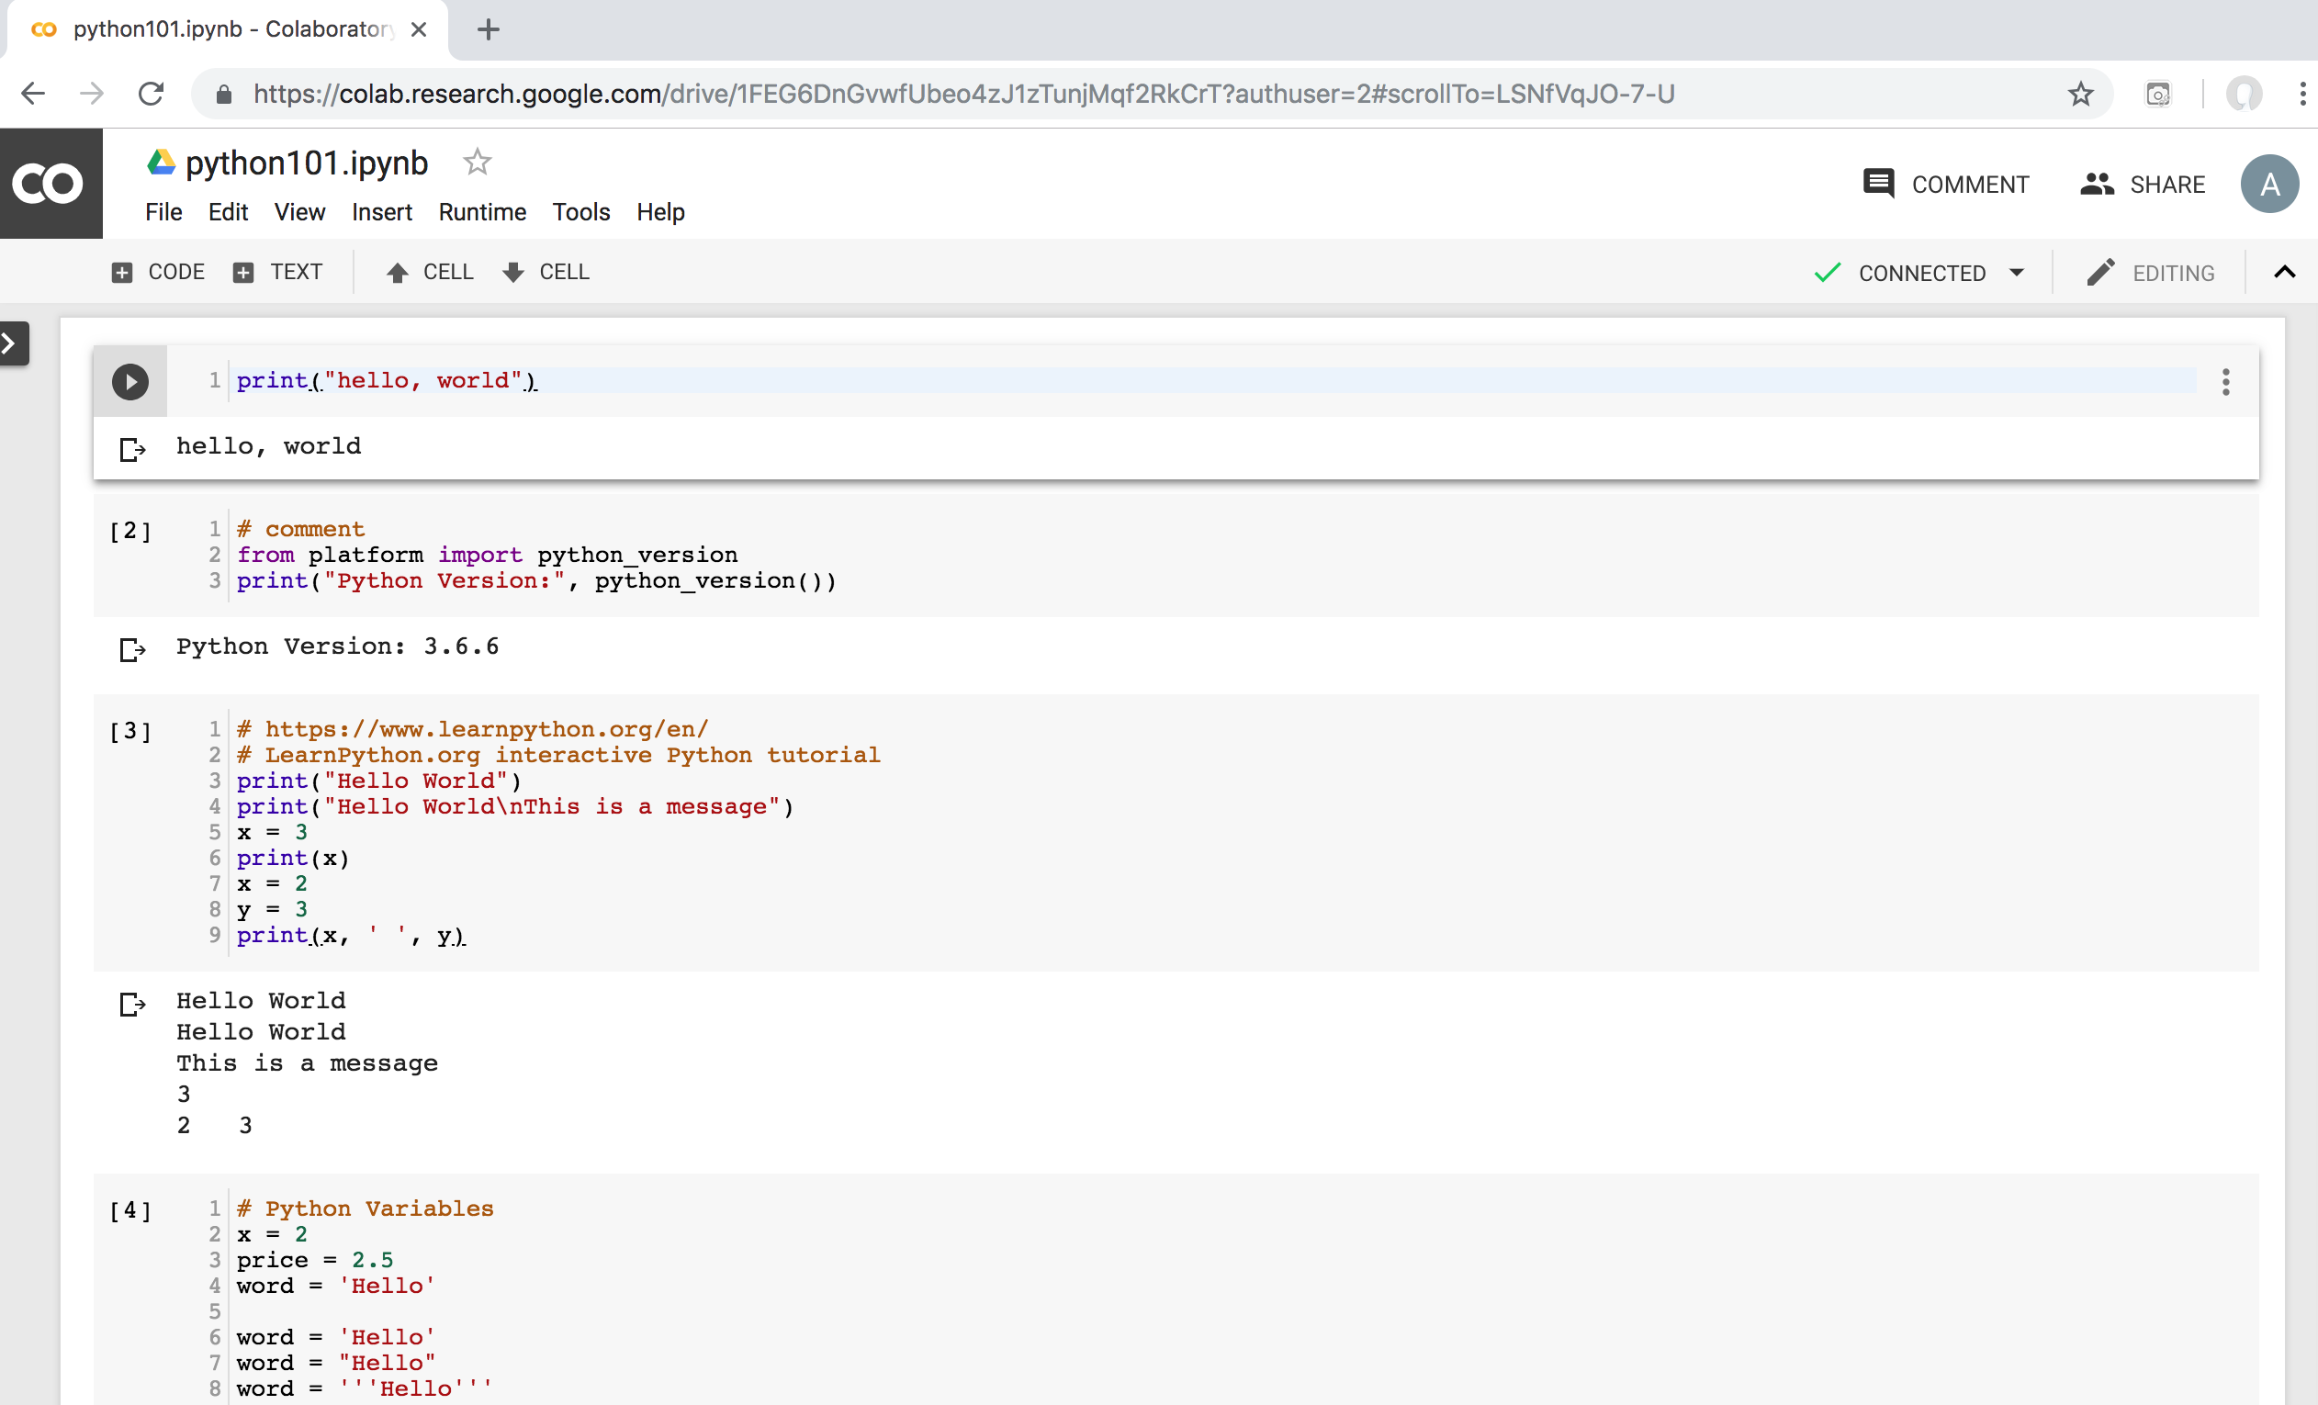
Python in Google Colab
https://colab.research.google.com/drive/1FEG6DnGvwfUbeo4zJ1zTunjMqf2RkCrT
https://tinyurl.com/aintpupython101

Slide 40
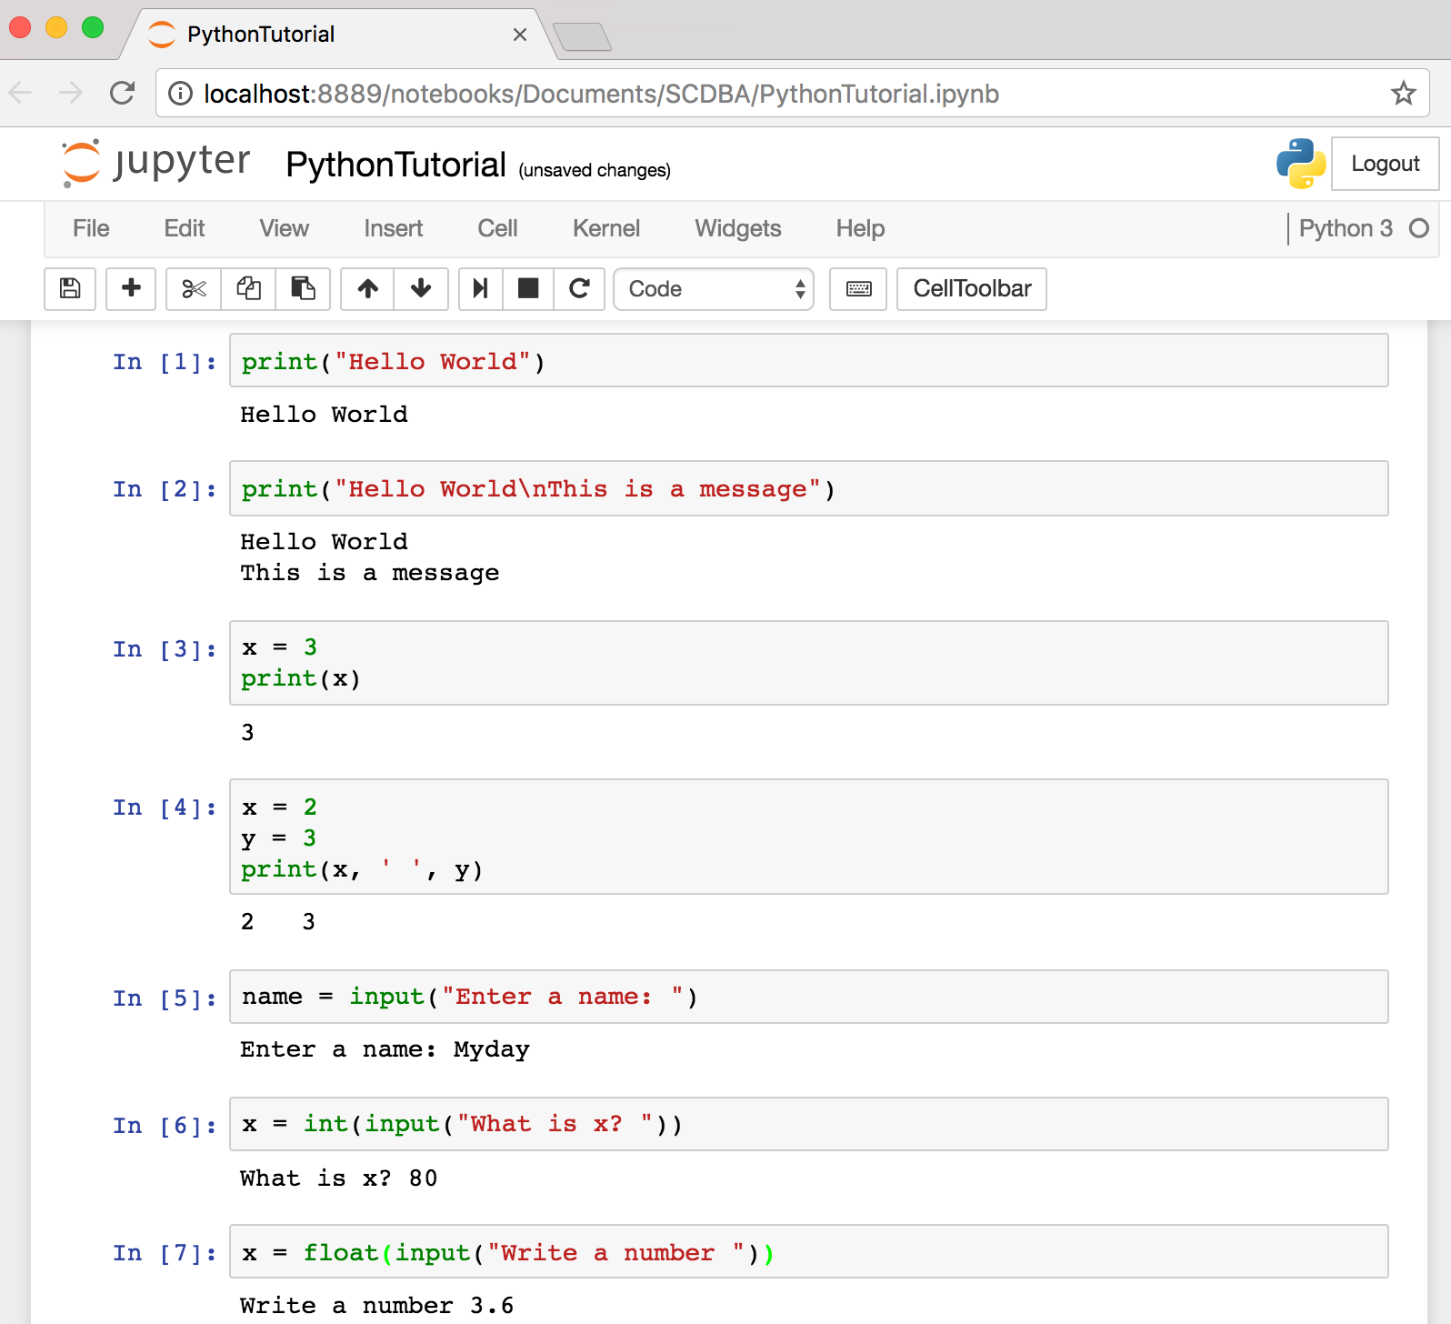
Text input and output
Source: http://pythonprogramminglanguage.com/text-input-and-output/
Notes:
print("Hello World")
print("Hello World\nThis is a message")
x = 3
print(x)
x = 2
y = 3
print(x, ' ', y)
name = input("Enter a name: ")
x = int(input("What is x? "))
x = float(input("Write a number "))

Slide 41
Variables
x = 2
price = 2.5
word = 'Hello'
word = 'Hello'
word = "Hello"
word = '''Hello'''
x = 2
x = x + 1
x = 5
Source: http://pythonprogramminglanguage.com/

Slide 42
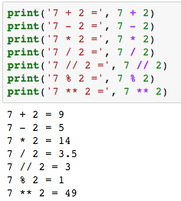
Python Basic Operators
print('7 + 2 =', 7 + 2)
print('7 - 2 =', 7 - 2)
print('7 * 2 =', 7 * 2)
print('7 / 2 =', 7 / 2)
print('7 // 2 =', 7 // 2)
print('7 % 2 =', 7 % 2)
print('7 ** 2 =', 7 ** 2)

Slide 43
BMI Calculator in Python
height_cm = float(input("Enter your height in cm: "))
weight_kg = float(input("Enter your weight in kg: "))
height_m = height_cm/100
BMI = (weight_kg/(height_m**2))
print("Your BMI is: " + str(round(BMI,1)))
Source: http://code.activestate.com/recipes/580615-bmi-code/

Slide 44
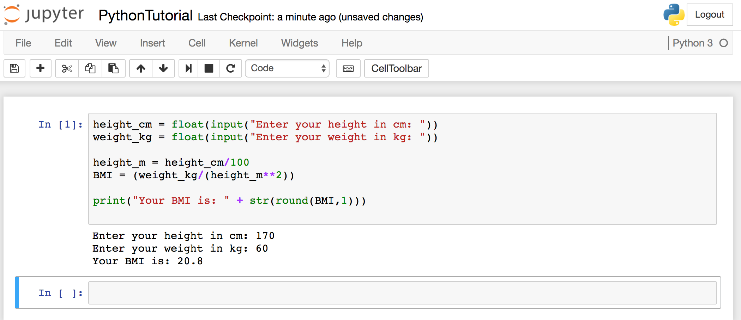
BMI Calculator in Python
Source: http://code.activestate.com/recipes/580615-bmi-code/
Notes:
height_cm = float(input("Enter your height in cm: "))
weight_kg = float(input("Enter your weight in kg: "))
height_m = height_cm/100
BMI = (weight_kg/(height_m**2))
print("Your BMI is: " + str(round(BMI,1)))

Slide 45
Future value of a specified principal amount, rate of interest, and a number of years
Source: https://www.w3resource.com/python-exercises/python-basic-exercise-39.php

Slide 46
Future Value (FV)
# How much is your $100 worth after 7 years?
print(100 * 1.1 ** 7)
# output = 194.87
Source: https://www.w3resource.com/python-exercises/python-basic-exercise-39.php

Slide 47
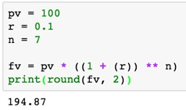
Future Value (FV)
pv = 100
r = 0.1
n = 7
fv = pv * ((1 + (r)) ** n)
print(round(fv, 2))

Slide 48
Future Value (FV)
amount = 100
interest = 10 #10% = 0.01 * 10
years = 7
future_value = amount * ((1 + (0.01 * interest)) ** years)
print(round(future_value, 2))
Source: https://www.w3resource.com/python-exercises/python-basic-exercise-39.php
Notes:
amount = 100
interest = 10 #10% = 0.01 * 10
years = 7
future_value = amount * ((1 + (0.01 * interest)) ** years)
print(round(future_value, 2))

Slide 49
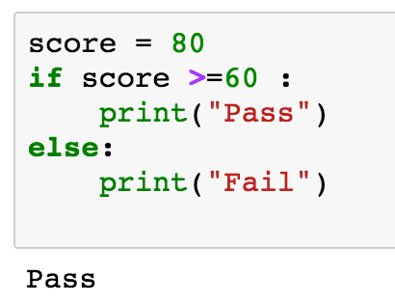
if statements
> greater than
< smaller than
== equals
!= is not
score = 80
if score >=60 :
print("Pass")
else:
print("Fail")
Source: http://pythonprogramminglanguage.com/

Slide 50
if elif else
score = 90
grade = ""
if score >=90:
grade = "A"
elif score >= 80:
grade = "B"
elif score >= 70:
grade = "C"
elif score >= 60:
grade = "D"
else:
grade = "E"
print(grade)
# grade = ”A”
A
http://pythontutor.com/visualize.html
https://goo.gl/E6w5ph
Source: http://pythonprogramminglanguage.com/
Notes:
http://pythontutor.com/visualize.html
https://goo.gl/E6w5ph

Slide 51
for loops
for i in range(1,11):
print(i)
1
2
3
4
5
6
7
8
9
10
Source: http://pythonprogramminglanguage.com/
Notes:
https://goo.gl/YpxMYo

Slide 52
for loops
for i in range(1,10):
for j in range(1,10):
print(i, ' * ' , j , ' = ', i*j)
9 * 1 = 9
9 * 2 = 18
9 * 3 = 27
9 * 4 = 36
9 * 5 = 45
9 * 6 = 54
9 * 7 = 63
9 * 8 = 72
9 * 9 = 81
Source: http://pythonprogramminglanguage.com/
Notes:
for i in range(1,10):
for j in range(1,10):
print(i, ' * ' , j , ' = ', i*j)

Slide 53
while loops
age = 10
while age < 20:
print(age)
age = age + 1
10
11
12
13
14
15
16
17
18
19
Source: https://learnpython.trinket.io/learn-python-part-8-loops#/while-loops/about-while-loops
Notes:
age = 10
while age < 20:
print(age)
age = age + 1

Slide 54
def Functions
def convertCMtoM(xcm):
m = xcm/100
return m
cm = 180
m = convertCMtoM(cm)
print(str(m))
1.8
Notes:
https://goo.gl/6K5qUn

Slide 55
Lists []
x = [60, 70, 80, 90]
print(len(x))
print(x[0])
print(x[1])
print(x[-1])
4
60
70
90

Slide 56
Tuples ()
A tuple in Python is a collection that cannot be modified. A tuple is defined using parenthesis.
x = (10, 20, 30, 40, 50)
print(x[0])
print(x[1])
print(x[2])
print(x[-1])
10
20
30
50
Source: http://pythonprogramminglanguage.com/tuples/

Slide 57
Dictionary {key : value}
k = { 'EN':'English', 'FR':'French' }
print(k['EN'])
English
Source: http://pythonprogramminglanguage.com/dictionary/

Slide 58
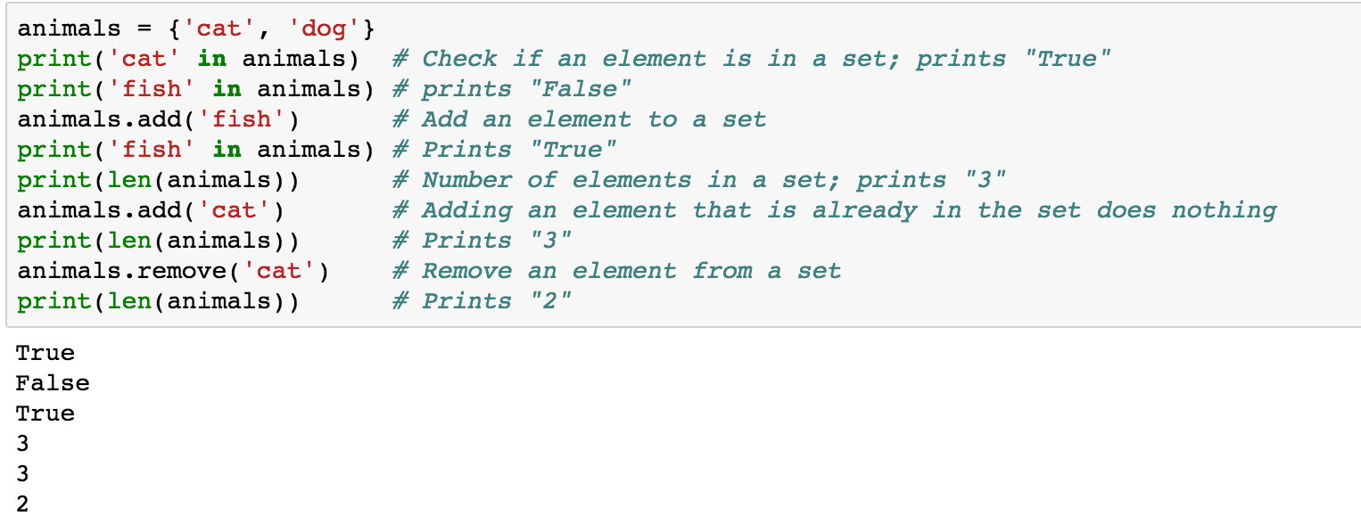
Sets {}
animals = {'cat', 'dog'}
animals = {'cat', 'dog'}
print('cat' in animals)
print('fish' in animals)
animals.add('fish')
print('fish' in animals)
print(len(animals))
animals.add('cat')
print(len(animals))
animals.remove('cat')
print(len(animals))
Source: http://cs231n.github.io/python-numpy-tutorial/
Notes:
#Sets
animals = {'cat', 'dog'}
print('cat' in animals) # Check if an element is in a set; prints "True"
print('fish' in animals) # prints "False"
animals.add('fish') # Add an element to a set
print('fish' in animals) # Prints "True"
print(len(animals)) # Number of elements in a set; prints "3"
animals.add('cat') # Adding an element that is already in the set does nothing
print(len(animals)) # Prints "3"
animals.remove('cat') # Remove an element from a set
print(len(animals)) # Prints "2”
Source: http://cs231n.github.io/python-numpy-tutorial/

Slide 59
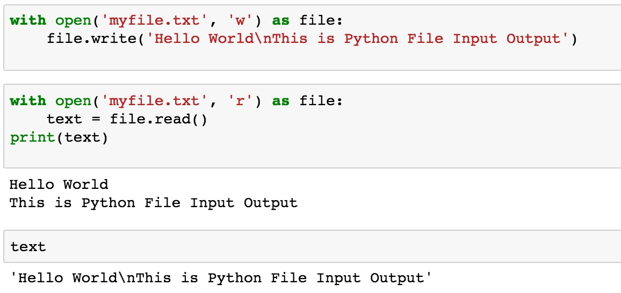
File Input / Output
with open('myfile.txt', 'w') as file:
file.write('Hello World\nThis is Python File Input Output')
with open('myfile.txt', 'r') as file:
text = file.read()
print(text)
Source: https://github.com/TiesdeKok/LearnPythonforResearch/blob/master/0_python_basics.ipynb
Notes:
with open('myfile.txt', 'w') as file:
file.write('Hello World\nThis is Python File Input Output')
with open('myfile.txt', 'r') as file:
text = file.read()
print(text)
with open('myfile.txt', 'a+') as file:
file.write('\n' + 'New line')
with open('myfile.txt', 'r') as file:
text = file.read()
print(text)

Slide 60
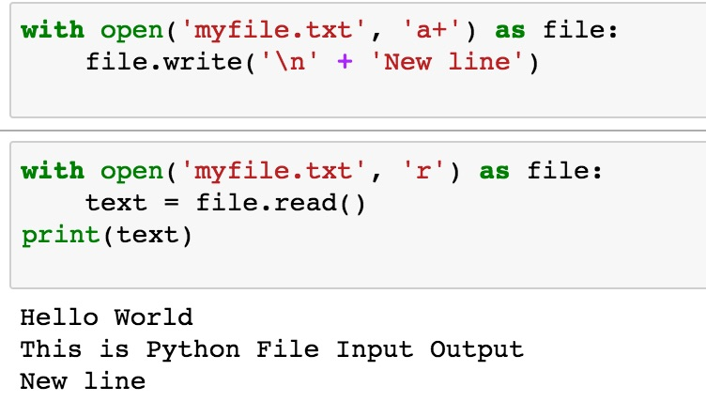
File Input / Output
with open('myfile.txt', 'a+') as file:
file.write('\n' + 'New line')
with open('myfile.txt', 'r') as file:
text = file.read()
print(text)
Source: https://github.com/TiesdeKok/LearnPythonforResearch/blob/master/0_python_basics.ipynb
Notes:
with open('myfile.txt', 'w') as file:
file.write('Hello World\nThis is Python File Input Output')
with open('myfile.txt', 'r') as file:
text = file.read()
print(text)
with open('myfile.txt', 'a+') as file:
file.write('\n' + 'New line')
with open('myfile.txt', 'r') as file:
text = file.read()
print(text)

Slide 61
try except finally
try:
file = open("myfile.txt")
#file = open("myfile.txt", 'w')
file.write("Python write file")
print("file saved")
except:
print("Exception file Error")
finally:
file.close()
print("finally process")
Exception file Error
finally process
Source: https://pythonbasics.org/try-except/
Notes:
try:
file = open("myfile.txt")
#file = open("myfile.txt", 'w')
file.write("Python write file")
print("file saved")
except:
print("Exception file Error")
finally:
file.close()
print("finally process")

Slide 62
class
class Person:
def __init__(self, name, age):
self.name = name
self.age = age
def myfunc(self):
print("Hello my name is " + self.name)
p1 = Person("Alan", 20)
p1.myfunc()
print(p1.name)
print(p1.age)
Hello my name is Alan
Alan
20
Source: https://www.w3schools.com/python/python_classes.asp
Notes:
class Person:
def __init__(self, name, age):
self.name = name
self.age = age
def myfunc(self):
print("Hello my name is " + self.name)
p1 = Person("Alan", 20)
p1.myfunc()
print(p1.name)
print(p1.age)

Slide 63
Big Data Analytics with Numpy in Python

Slide 64
Numpy
NumPy
Base N-dimensional array package

Slide 65
NumPy is the fundamental package for scientific computing with Python.
Source: http://www.numpy.org/

Slide 66
NumPy
NumPy
NumPy provides a multidimensional array object to store homogenous or heterogeneous data; it also provides optimized functions/methods to operate on this array object.
Source: Yves Hilpisch (2014), Python for Finance: Analyze Big Financial Data, O'Reilly

Slide 67
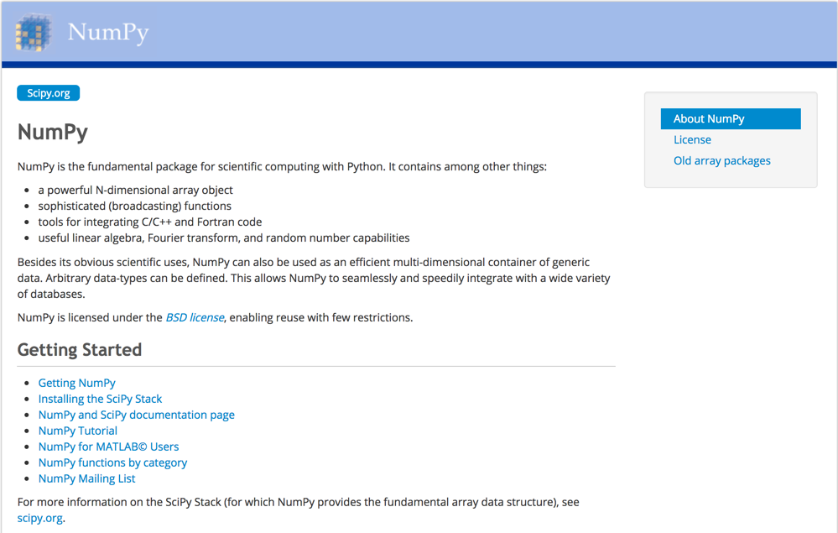
NumPy
http://www.numpy.org/

Slide 68
NumPy ndarray
NumPy
One-dimensional Array (1-D Array)
0 | 1 |  |  | n-1
1 | 2 | 3 | 4 | 5
Two-dimensional Array (2-D Array)
 | 0 | 1 |  |  | n-1
0 | 1 | 2 | 3 | 4 | 5
1 | 6 | 7 | 8 | 9 | 10
 | 11 | 12 | 13 | 14 | 15
m-1 | 16 | 17 | 18 | 19 | 20

Slide 69
v = list(range(1, 6)) v 2 * v import numpy as np v = np.arange(1, 6) v 2 * v
NumPy
NumPy
Source: Yves Hilpisch (2014), Python for Finance: Analyze Big Financial Data, O'Reilly
Notes:
# pip3 install numpy
# pip install numpy
# sudo pip3 install numpy
import numpy as np

Slide 70
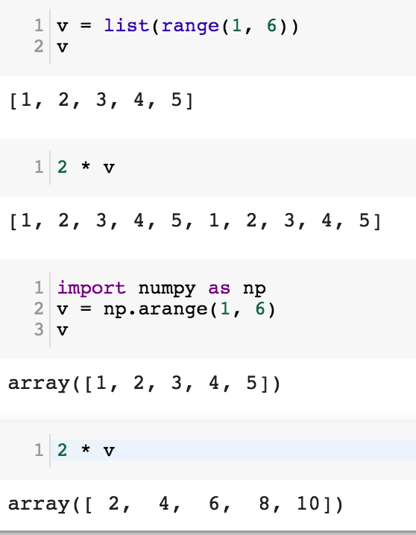
NumPy
Base N-dimensional array package

Slide 71
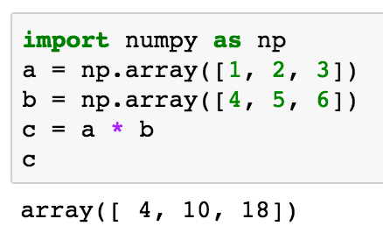
import numpy as np a = np.array([1, 2, 3]) b = np.array([4, 5, 6]) c = a * b c
NumPy Create Array
NumPy
Source: Yves Hilpisch (2014), Python for Finance: Analyze Big Financial Data, O'Reilly

Slide 72
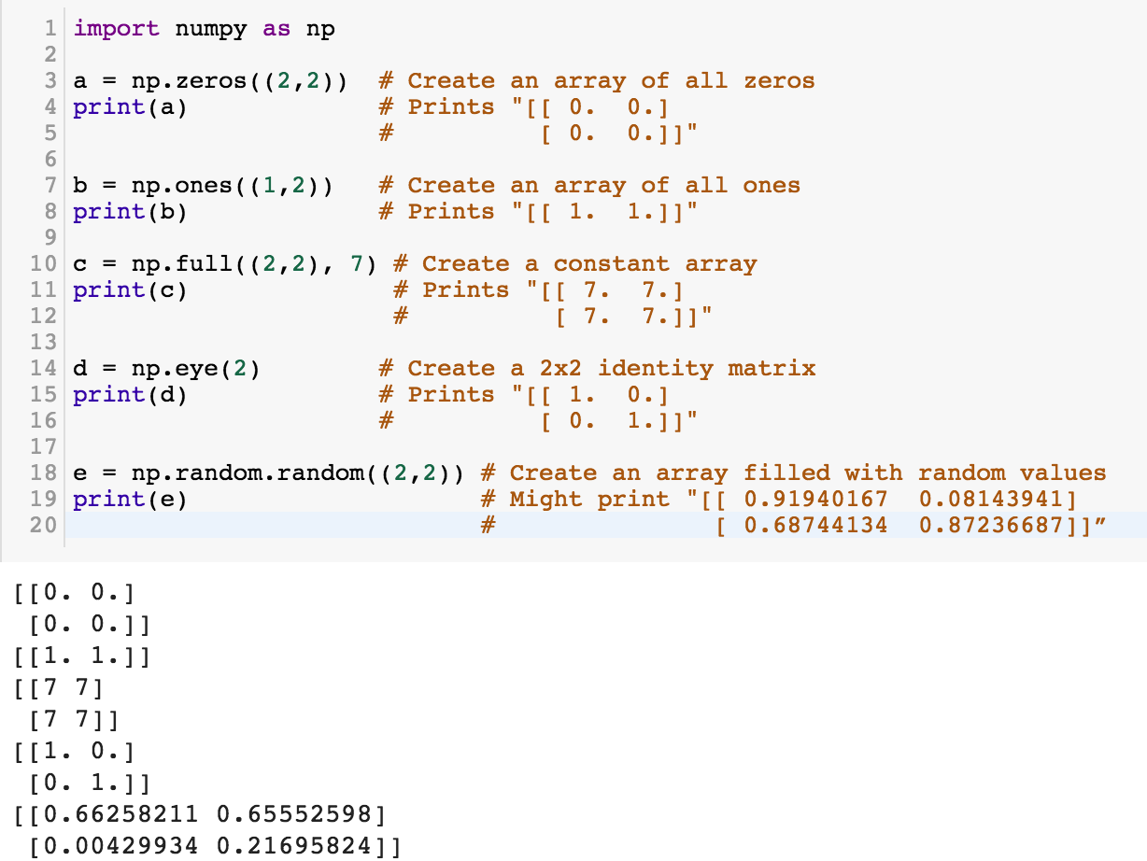
NumPy
NumPy
Source: http://cs231n.github.io/python-numpy-tutorial/
Notes:
import numpy as np
a = np.zeros((2,2)) # Create an array of all zeros
print(a) # Prints "[[ 0. 0.]
# [ 0. 0.]]"
b = np.ones((1,2)) # Create an array of all ones
print(b) # Prints "[[ 1. 1.]]"
c = np.full((2,2), 7) # Create a constant array
print(c) # Prints "[[ 7. 7.]
# [ 7. 7.]]"
d = np.eye(2) # Create a 2x2 identity matrix
print(d) # Prints "[[ 1. 0.]
# [ 0. 1.]]"
e = np.random.random((2,2)) # Create an array filled with random values
print(e) # Might print "[[ 0.91940167 0.08143941]
# [ 0.68744134 0.87236687]]”
Source: http://cs231n.github.io/python-numpy-tutorial/

Slide 73
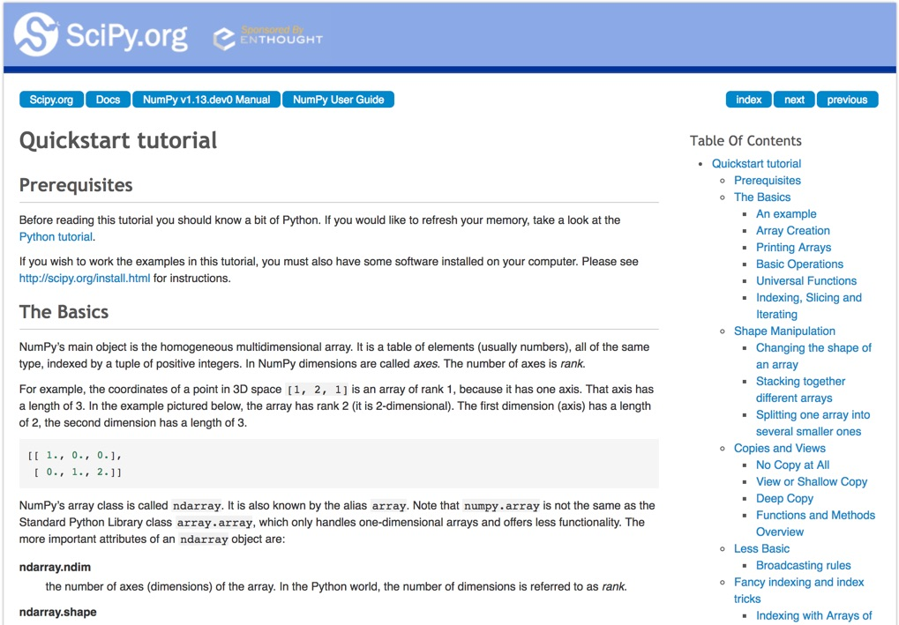
Numpy Quickstart Tutorial
https://docs.scipy.org/doc/numpy-dev/user/quickstart.html

Slide 74
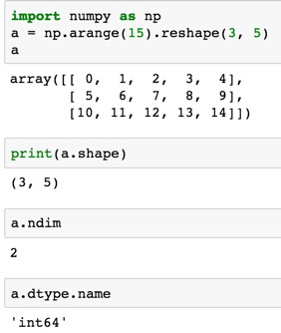
import numpy as np
a = np.arange(15).reshape(3, 5)
a.shape
a.ndim
a.dtype.name
Source: https://docs.scipy.org/doc/numpy-dev/user/quickstart.html
Notes:
Numpy Tutorial
Source: https://docs.scipy.org/doc/numpy-dev/user/quickstart.html
In [1]:
import numpy as np
a = np.arange(15).reshape(3, 5)
a
Out[1]:
array([[ 0, 1, 2, 3, 4],
[ 5, 6, 7, 8, 9],
[10, 11, 12, 13, 14]])
In [2]:
print(a.shape)
(3, 5)
In [3]:
a.ndim
Out[3]:
2
In [4]:
a.dtype.name
Out[4]:
'int64'
In [5]:
a.itemsize
Out[5]:
8
In [6]:
a.size
Out[6]:
15
In [7]:
type(a)
Out[7]:
numpy.ndarray
In [8]:
b = np.array([1, 2, 3])
In [9]:
b
Out[9]:
array([1, 2, 3])
In [10]:
type(b)
Out[10]:
numpy.ndarray

Slide 75
Matrix
Source: https://simple.wikipedia.org/wiki/Matrix_(mathematics)

Slide 76
NumPy ndarray: Multidimensional Array Object

Slide 77
NumPy ndarray
One-dimensional Array (1-D Array)
0 | 1 |  |  | n-1
1 | 2 | 3 | 4 | 5
Two-dimensional Array (2-D Array)
 | 0 | 1 |  |  | n-1
0 | 1 | 2 | 3 | 4 | 5
1 | 6 | 7 | 8 | 9 | 10
 | 11 | 12 | 13 | 14 | 15
m-1 | 16 | 17 | 18 | 19 | 20

Slide 78
import numpy as np a = np.array([1,2,3,4,5])
One-dimensional Array (1-D Array)
0 | 1 |  |  | n-1
1 | 2 | 3 | 4 | 5

Slide 79
a = np.array([[1,2,3,4,5],[6,7,8,9,10],[11,12,13,14,15],[16,17,18,19,20]])
Two-dimensional Array (2-D Array)
 | 0 | 1 |  |  | n-1
0 | 1 | 2 | 3 | 4 | 5
1 | 6 | 7 | 8 | 9 | 10
 | 11 | 12 | 13 | 14 | 15
m-1 | 16 | 17 | 18 | 19 | 20

Slide 80
import numpy as np a = np.array([[0, 1, 2, 3], [10, 11, 12, 13], [20, 21, 22, 23]])
a
0 | 1 | 2 | 3
10 | 11 | 12 | 13
20 | 21 | 22 | 23
Notes:
import numpy as np a = np.array([[0, 1, 2, 3], [10, 11, 12, 13], [20, 21, 22, 23]])
a

Slide 81
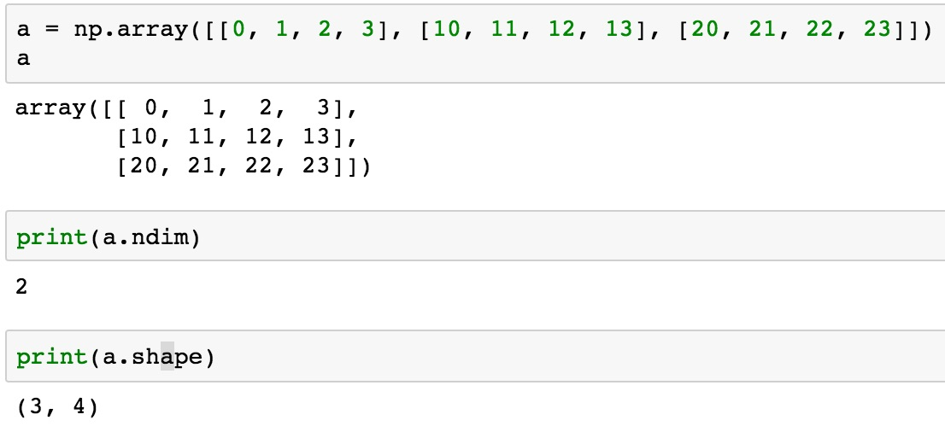
a = np.array([[0, 1, 2, 3], [10, 11, 12, 13], [20, 21, 22, 23]])
0 | 1 | 2 | 3
10 | 11 | 12 | 13
20 | 21 | 22 | 23

Slide 82
NumPy Basics: Arrays and Vectorized Computation
Source: https://www.safaribooksonline.com/library/view/python-for-data/9781449323592/ch04.html

Slide 83
NumPy Array
Source: https://www.safaribooksonline.com/library/view/python-for-data/9781449323592/ch04.html

Slide 84
Numpy Array
Source: https://www.safaribooksonline.com/library/view/python-for-data/9781449323592/ch04.html

Slide 85
Tensor
3
a rank 0 tensor; this is a scalar with shape []
[1. ,2., 3.]
a rank 1 tensor; this is a vector with shape [3]
[[1., 2., 3.], [4., 5., 6.]]
a rank 2 tensor; a matrix with shape [2, 3]
[[[1., 2., 3.]], [[7., 8., 9.]]]
a rank 3 tensor with shape [2, 1, 3]
https://www.tensorflow.org/

Slide 86
Scalar
80
Vector
[50 60 70]
Matrix
50 60 70
55 65 75
[50 60 70] [70 80 90]
[55 65 75] [75 85 95]
Tensor

Slide 87
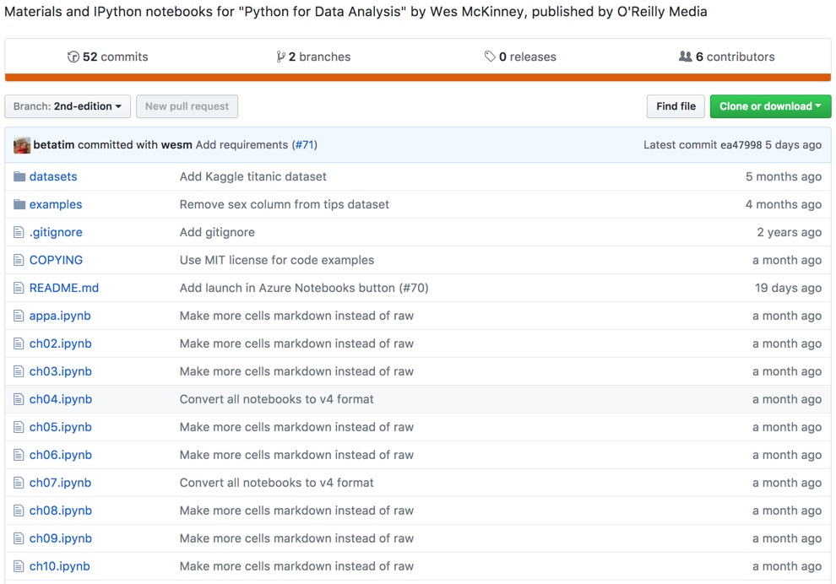
Wes McKinney (2017), "Python for Data Analysis: Data Wrangling with Pandas, NumPy, and IPython", 2nd Edition, O'Reilly Media.
https://github.com/wesm/pydata-book

Slide 88
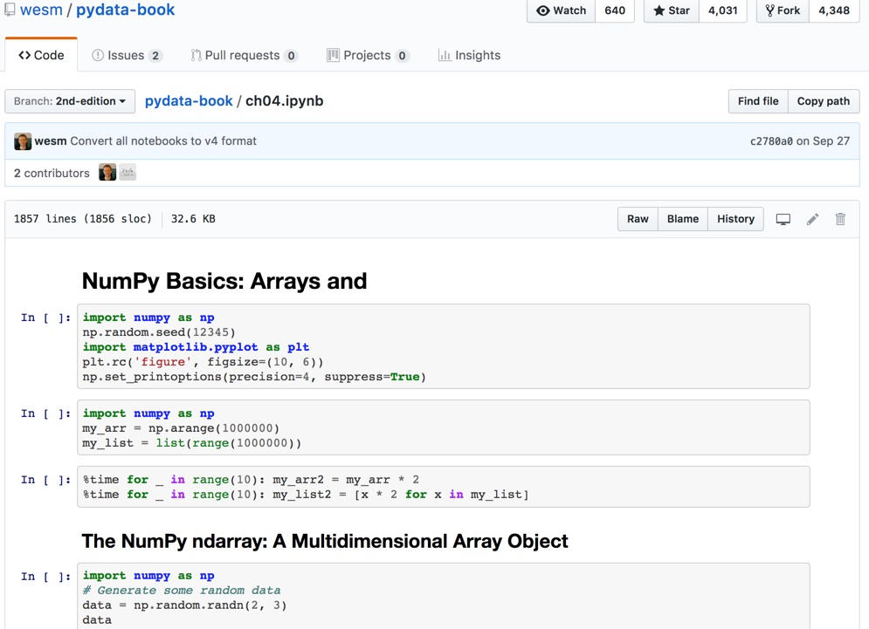
Wes McKinney (2017), "Python for Data Analysis: Data Wrangling with Pandas, NumPy, and IPython", 2nd Edition, O'Reilly Media.
Source: https://github.com/wesm/pydata-book/blob/2nd-edition/ch04.ipynb

Slide 89
Natural Language Processing (NLP) and Text Mining
Raw text
Sentence Segmentation
Tokenization
Part-of-Speech (POS)
Stop word removal
word’s stem
am → am
having → hav
word’s lemma
am → be
having → have
Stemming / Lemmatization
Dependency Parser
String Metrics & Matching
Source: Nitin Hardeniya (2015), NLTK Essentials, Packt Publishing; Florian Leitner (2015), Text mining - from Bayes rule to dependency parsing

Slide 90
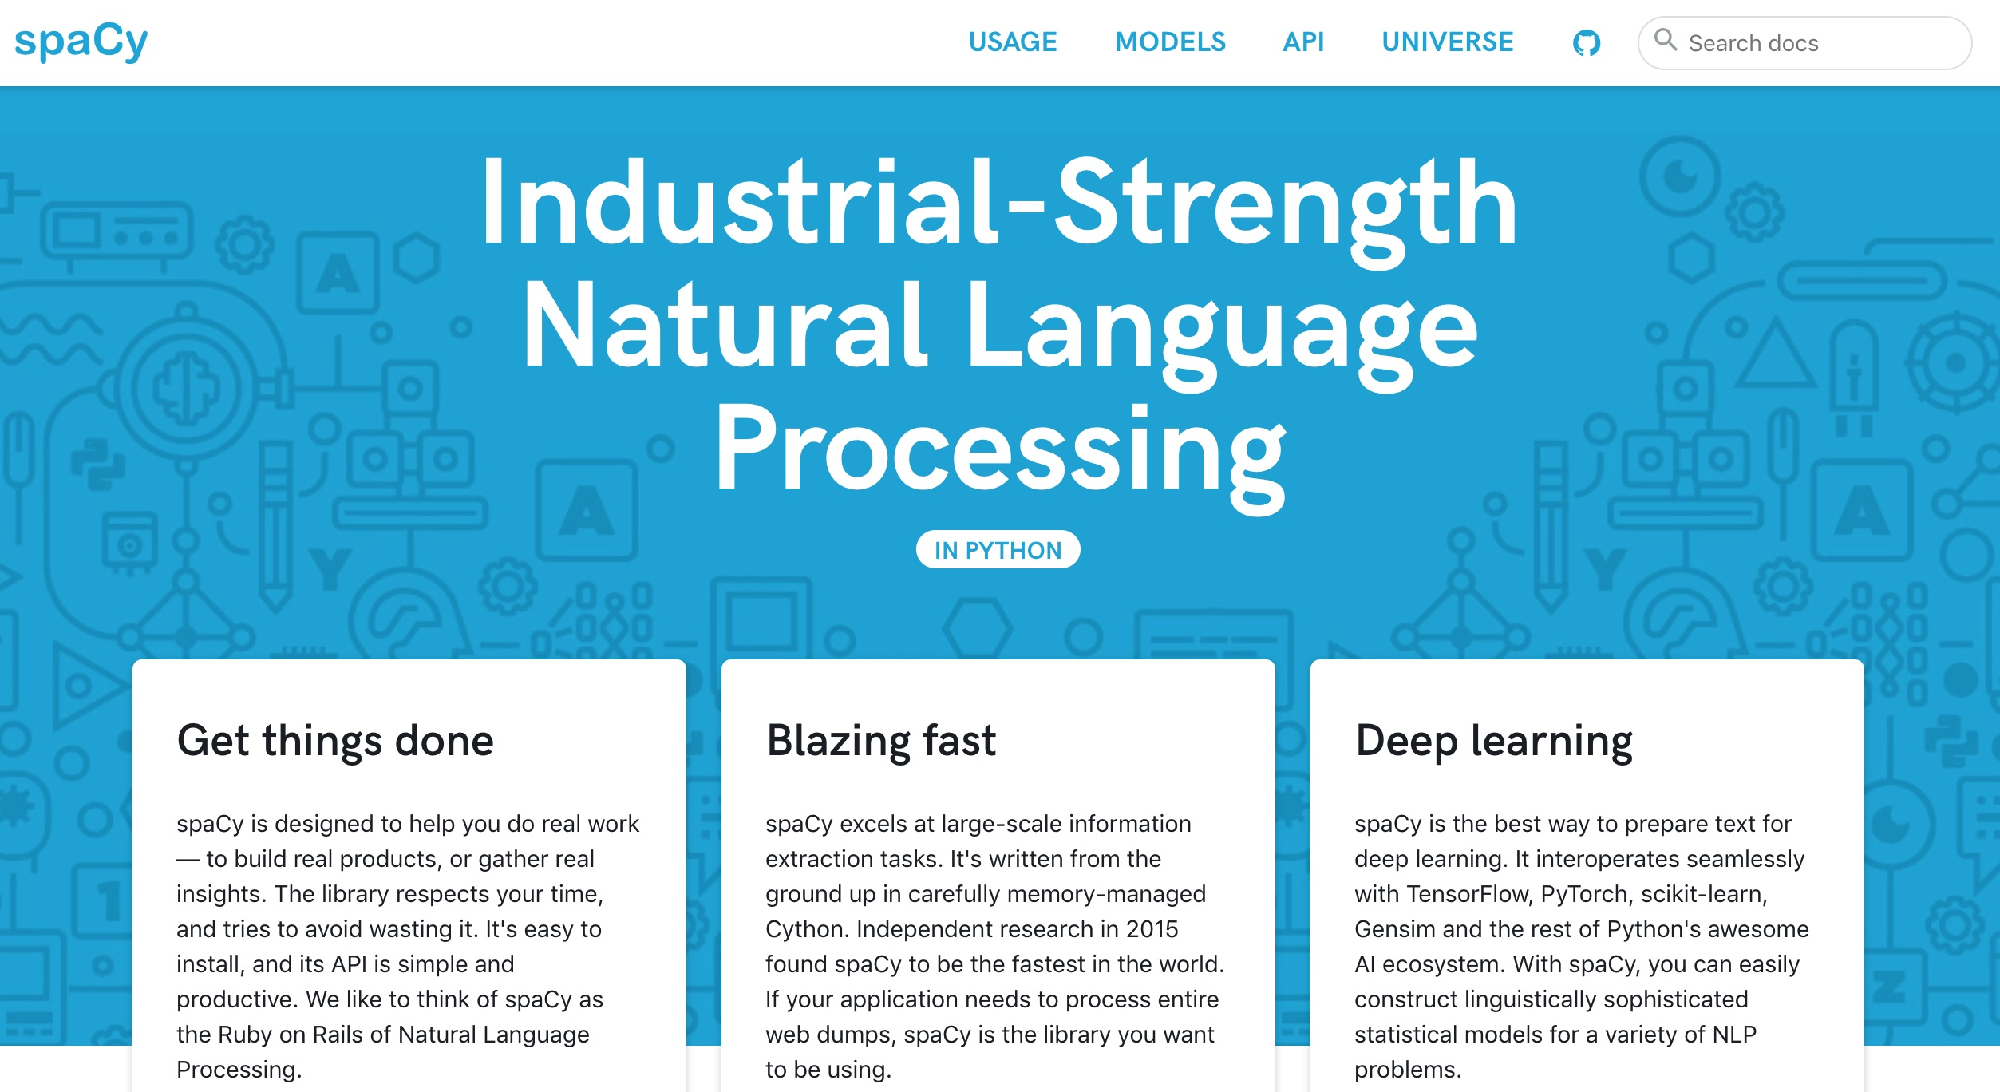
spaCy: Natural Language Processing
https://spacy.io/

Slide 91
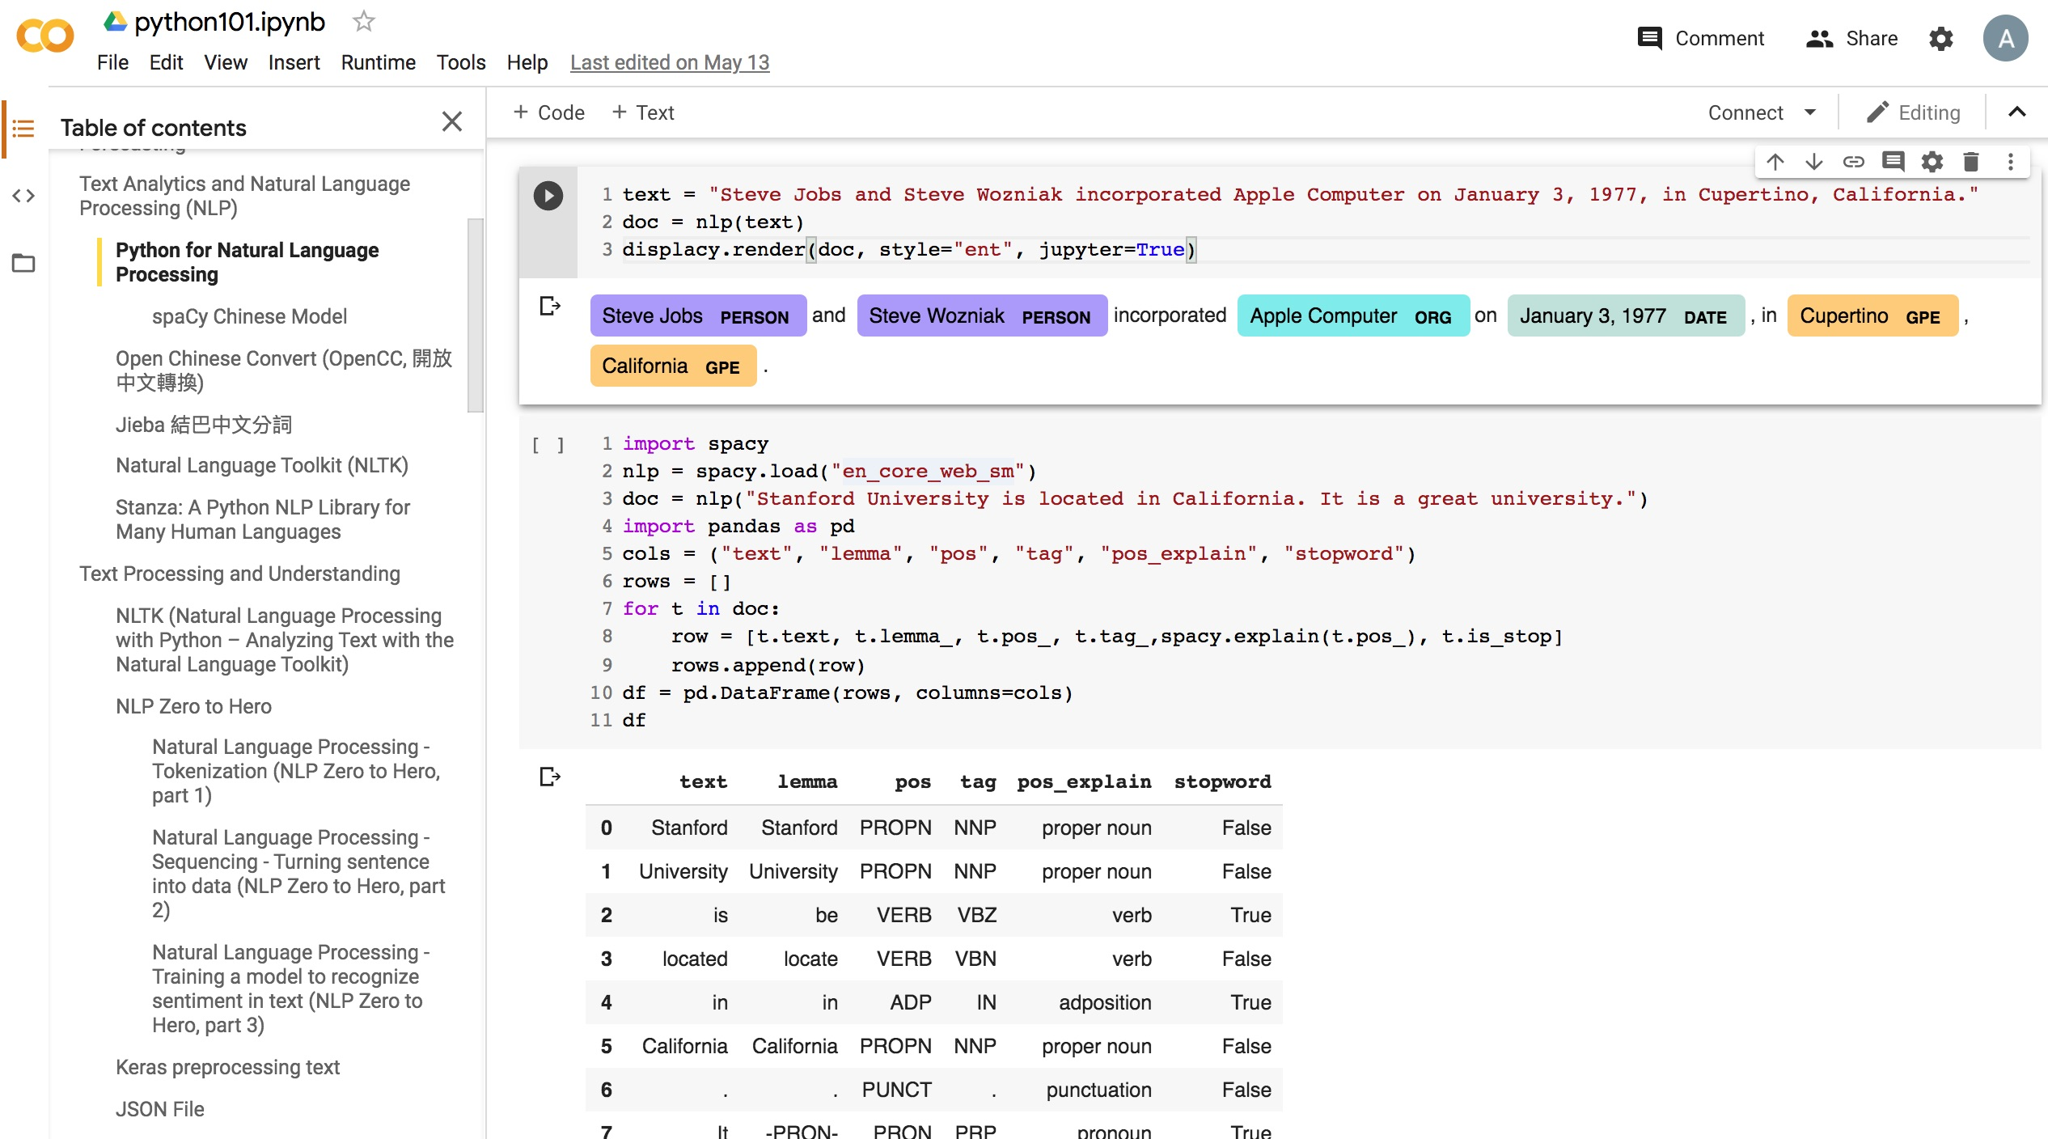
Python in Google Colab (Python101)
https://colab.research.google.com/drive/1FEG6DnGvwfUbeo4zJ1zTunjMqf2RkCrT
https://tinyurl.com/aintpupython101

Slide 92
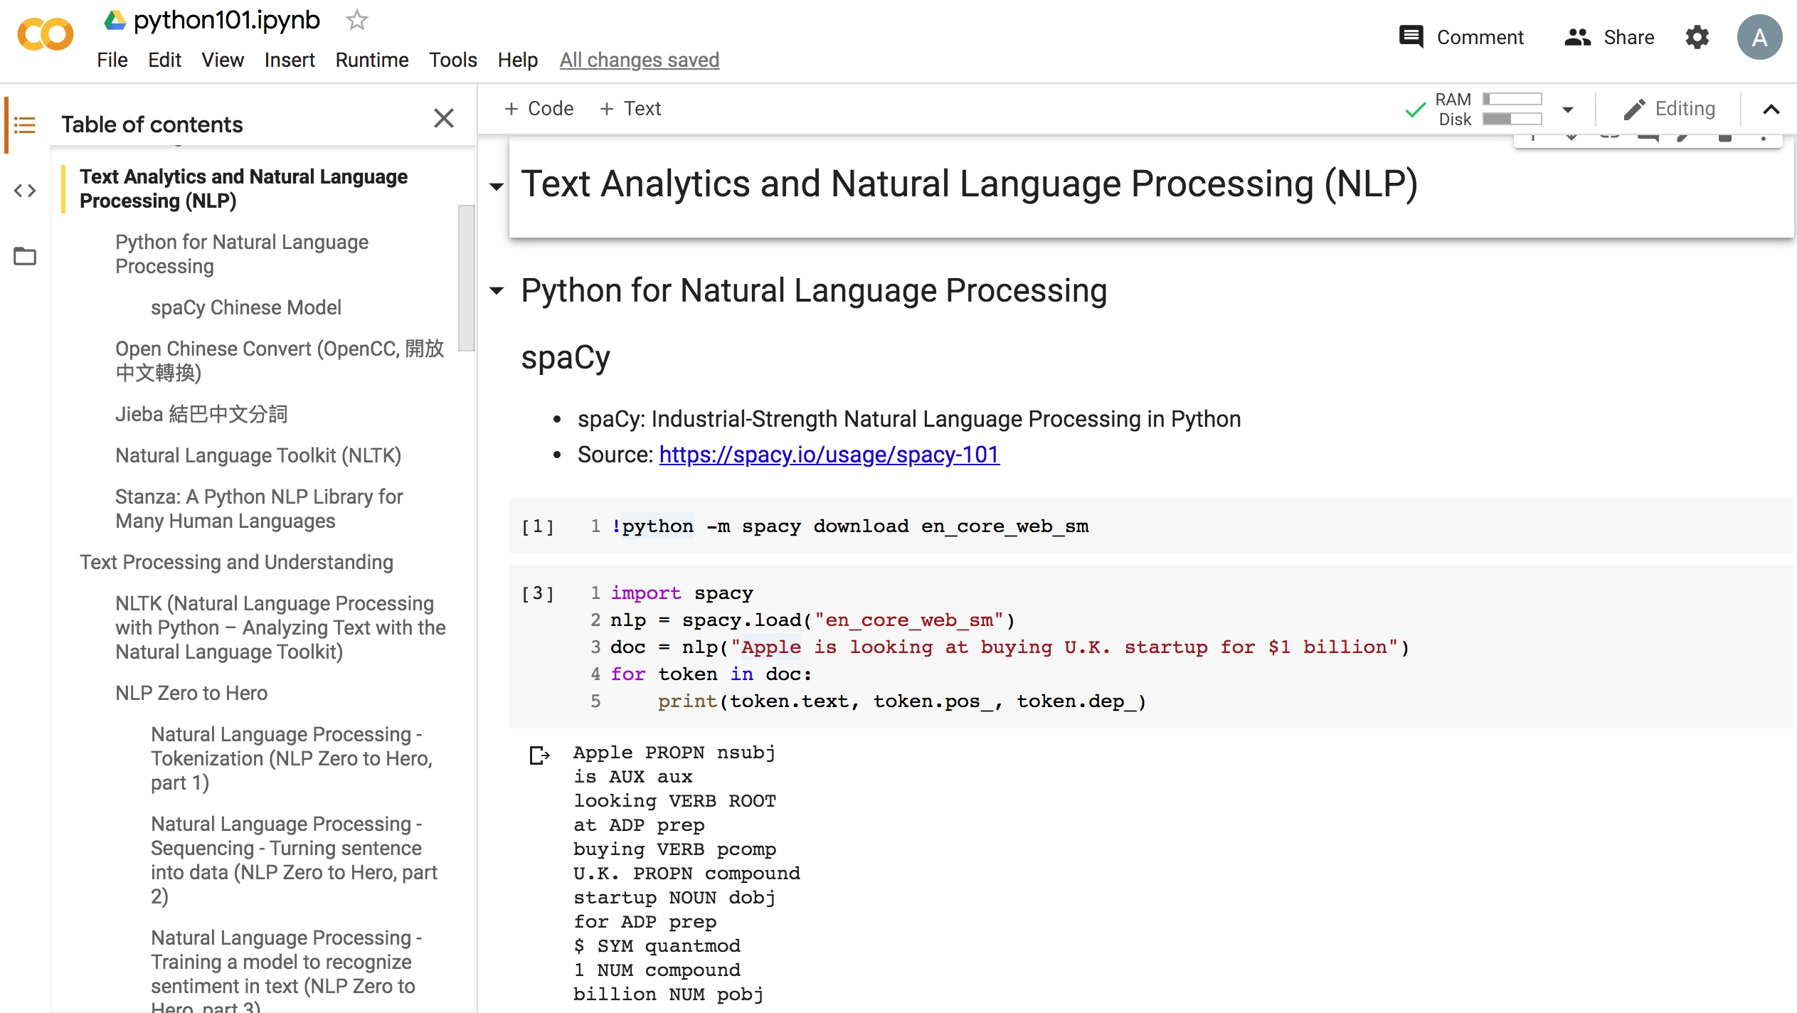
Python in Google Colab (Python101)
https://colab.research.google.com/drive/1FEG6DnGvwfUbeo4zJ1zTunjMqf2RkCrT
https://tinyurl.com/aintpupython101

Slide 93
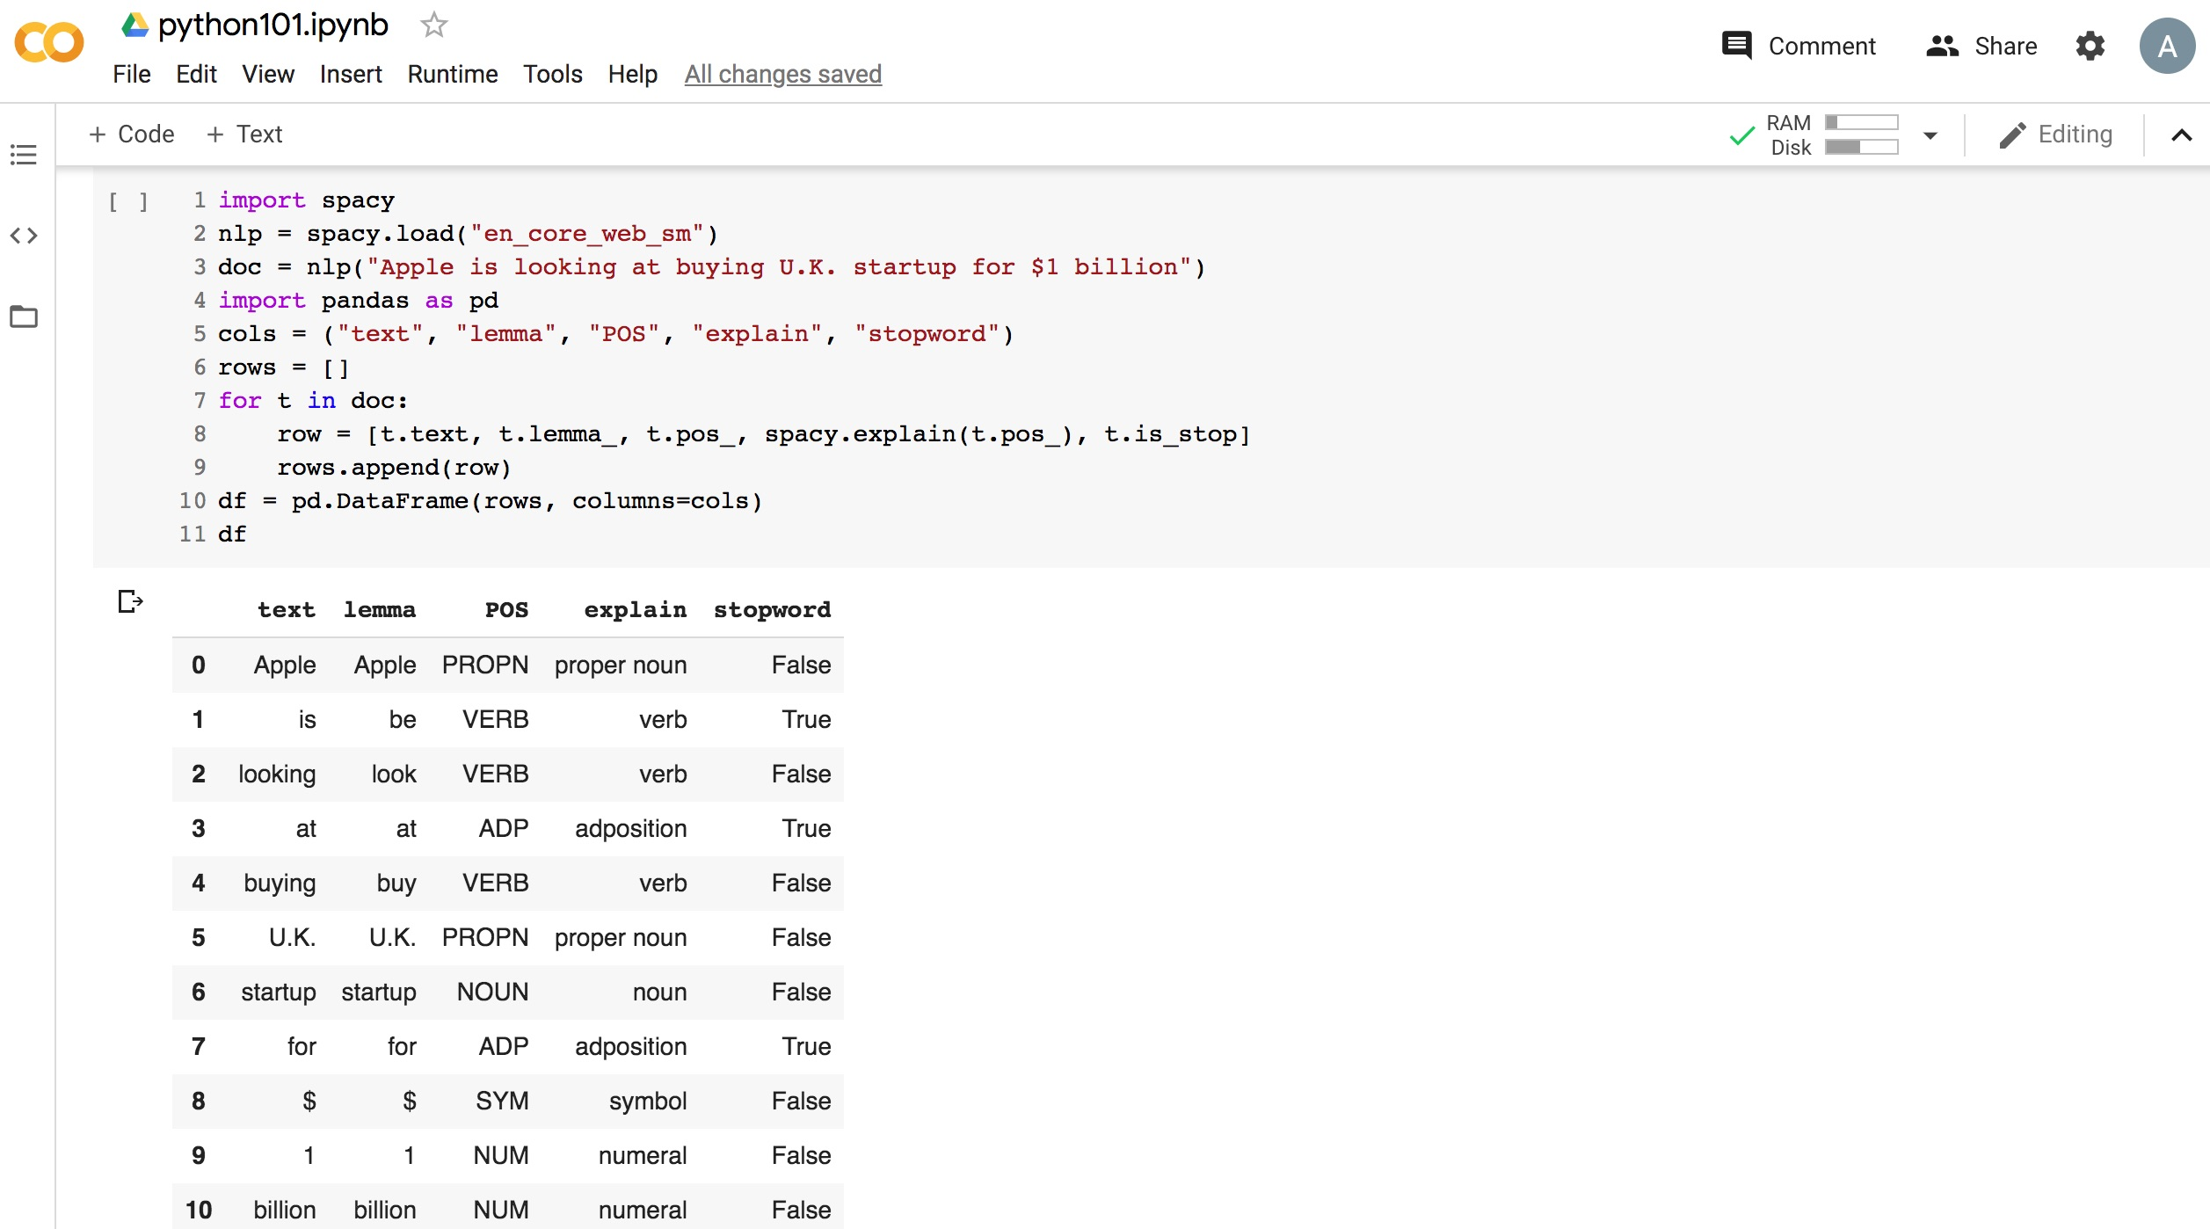
Python in Google Colab (Python101)
https://colab.research.google.com/drive/1FEG6DnGvwfUbeo4zJ1zTunjMqf2RkCrT
https://tinyurl.com/aintpupython101

Slide 94
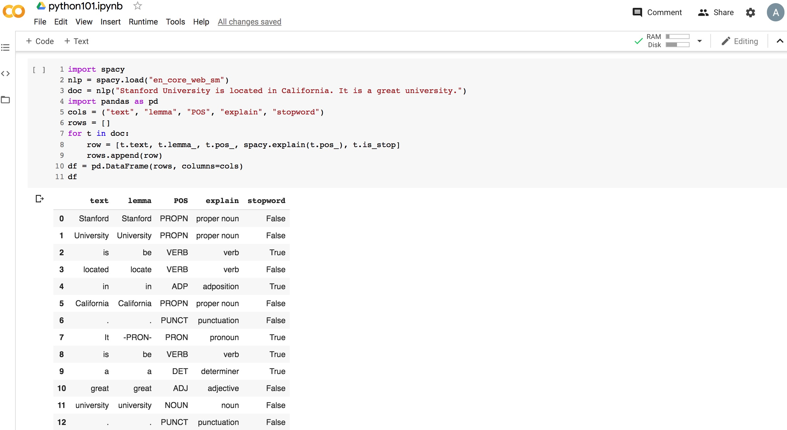
Python in Google Colab (Python101)
https://colab.research.google.com/drive/1FEG6DnGvwfUbeo4zJ1zTunjMqf2RkCrT
https://tinyurl.com/aintpupython101

Slide 95
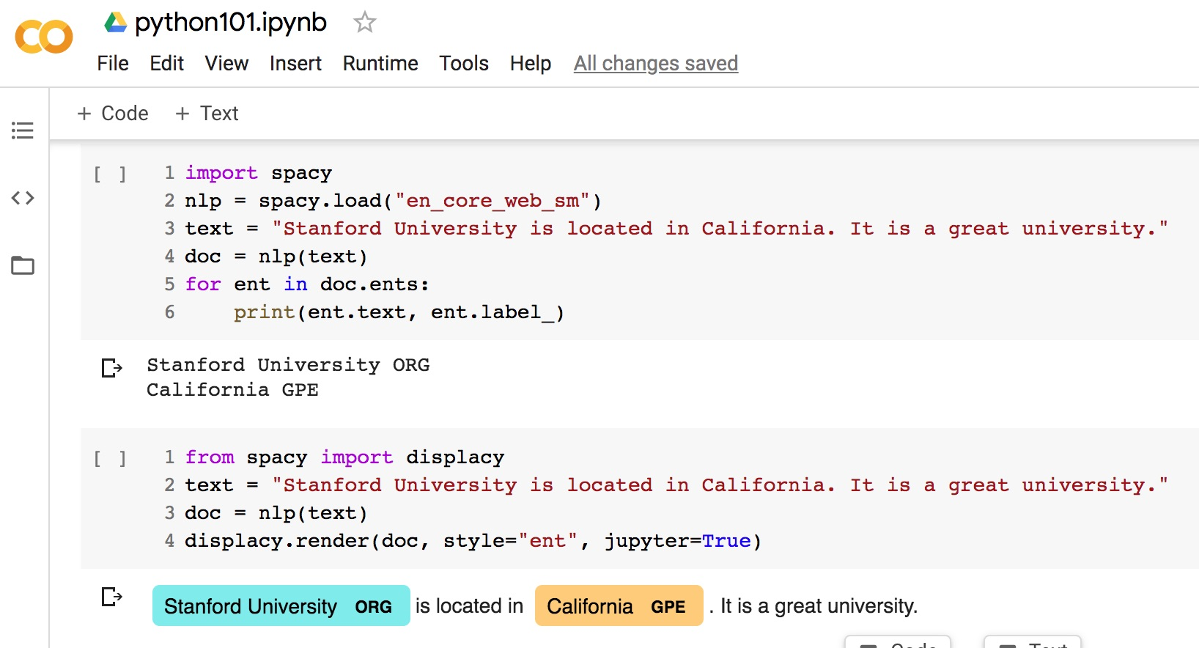
Python in Google Colab (Python101)
https://colab.research.google.com/drive/1FEG6DnGvwfUbeo4zJ1zTunjMqf2RkCrT
https://tinyurl.com/aintpupython101

Slide 96
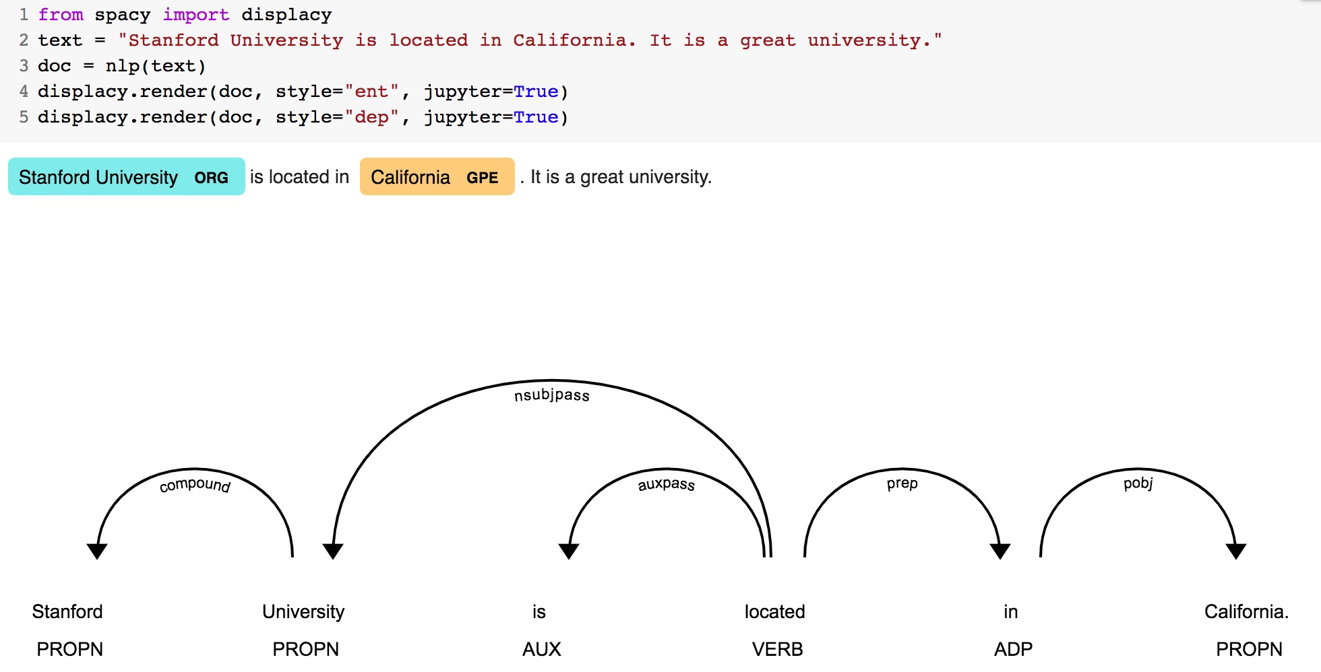
Python in Google Colab (Python101)
https://colab.research.google.com/drive/1FEG6DnGvwfUbeo4zJ1zTunjMqf2RkCrT
https://tinyurl.com/aintpupython101

Slide 97
Python in Google Colab
https://colab.research.google.com/drive/1FEG6DnGvwfUbeo4zJ1zTunjMqf2RkCrT
https://tinyurl.com/aintpupython101

Slide 98
Python in Google Colab (Python101)
https://colab.research.google.com/drive/1FEG6DnGvwfUbeo4zJ1zTunjMqf2RkCrT
https://tinyurl.com/aintpupython101

Slide 99
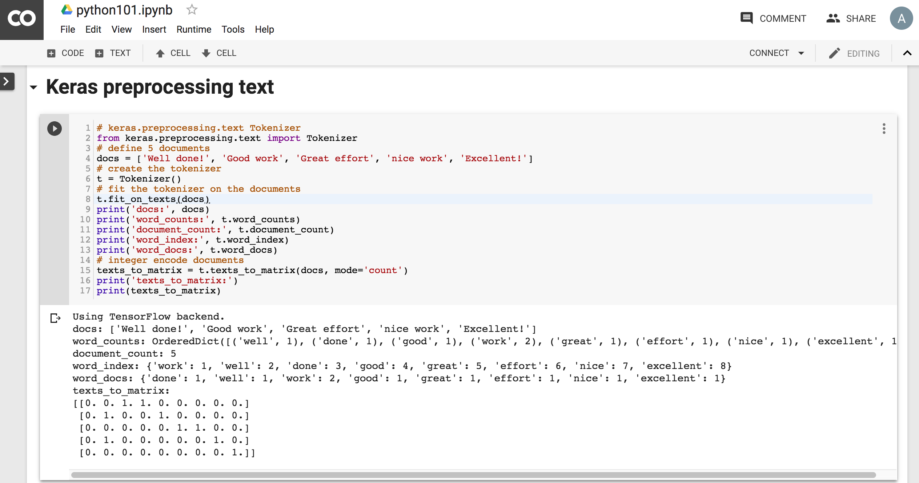
Python in Google Colab (Python101)
https://colab.research.google.com/drive/1FEG6DnGvwfUbeo4zJ1zTunjMqf2RkCrT
https://tinyurl.com/aintpupython101

Slide 100
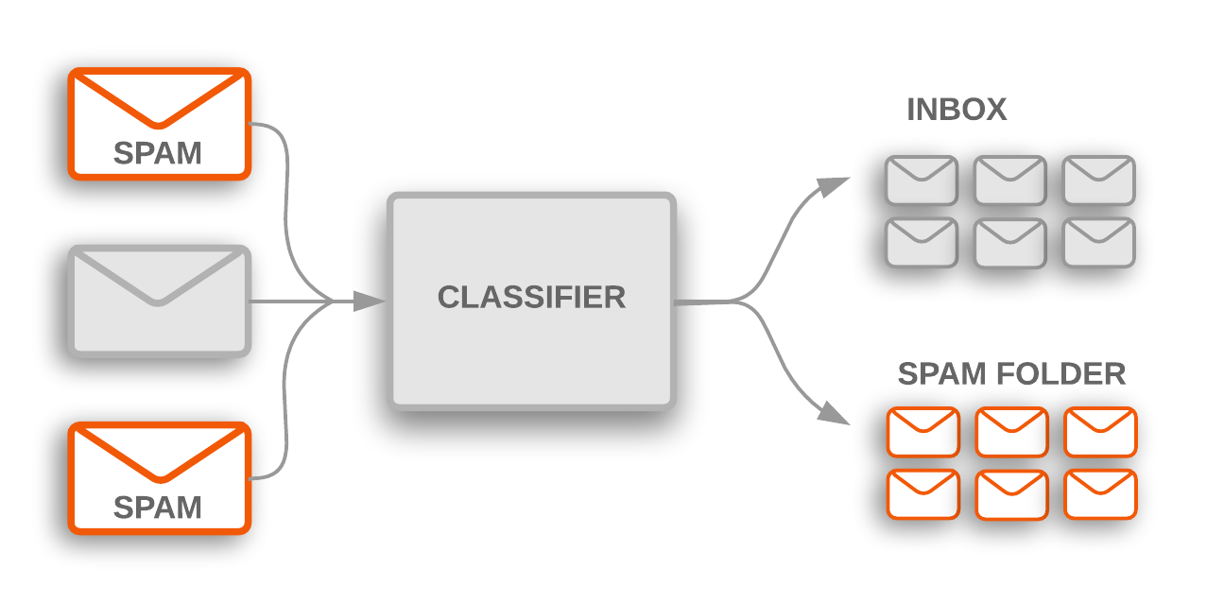
Text Classification
Source: https://developers.google.com/machine-learning/guides/text-classification/

Slide 101
Text Classification Workflow
Step 1: Gather Data
Step 2: Explore Your Data
Step 2.5: Choose a Model*
Step 3: Prepare Your Data
Step 4: Build, Train, and Evaluate Your Model
Step 5: Tune Hyperparameters
Step 6: Deploy Your Model
Source: https://developers.google.com/machine-learning/guides/text-classification/

Slide 102
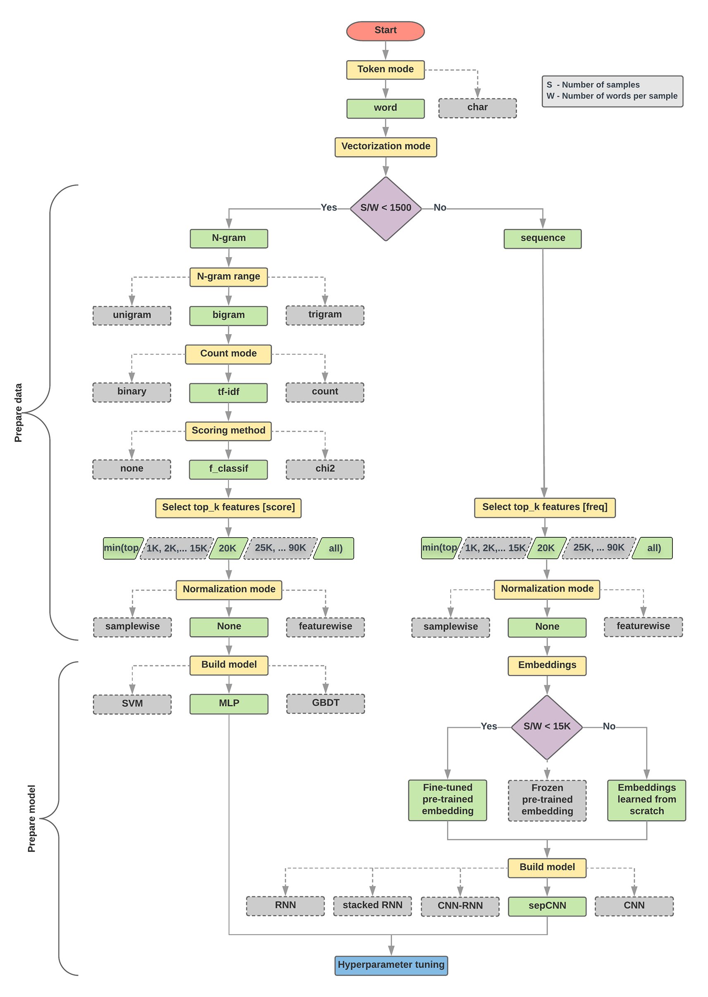
Text Classification Flowchart
Source: https://developers.google.com/machine-learning/guides/text-classification/step-2-5

Slide 103
Text Classification S/W<1500: N-gram
Source: https://developers.google.com/machine-learning/guides/text-classification/step-2-5

Slide 104
Text Classification S/W>=1500: Sequence
Source: https://developers.google.com/machine-learning/guides/text-classification/step-2-5

Slide 105
Step 2.5: Choose a Model Samples/Words < 1500 150,000/100 = 1500
IMDb review dataset, the samples/words-per-sample ratio is ~ 144
Source: https://developers.google.com/machine-learning/guides/text-classification/step-2-5

Slide 106
Step 2.5: Choose a Model Samples/Words < 15,000 1,500,000/100 = 15,000
Source: https://developers.google.com/machine-learning/guides/text-classification/step-2-5

Slide 107
Step 3: Prepare Your Data
Texts: T1: ’The mouse ran up the clock' T2: ’The mouse ran down’
Token Index:
{'the': 1, 'mouse’: 2, 'ran': 3, 'up': 4, 'clock': 5, 'down': 6,}.
NOTE: 'the' occurs most frequently, so the index value of 1 is assigned to it.
Some libraries reserve index 0 for unknown tokens, as is the case here.
Sequence of token indexes: T1: ‘The mouse ran up the clock’ = [1, 2, 3, 4, 1, 5]
T1: ’The mouse ran down’ = [1, 2, 3, 6]
Source: https://developers.google.com/machine-learning/guides/text-classification/step-3

Slide 108
One-hot encoding
'The mouse ran up the clock’ =
[ [0, 1, 0, 0, 0, 0, 0], [0, 0, 1, 0, 0, 0, 0], [0, 0, 0, 1, 0, 0, 0], [0, 0, 0, 0, 1, 0, 0], [0, 1, 0, 0, 0, 0, 0], [0, 0, 0, 0, 0, 1, 0] ]
The mouse ran up the clock
1 2 3 4
1
5
[0, 1, 2, 3, 4, 5, 6]
Source: https://developers.google.com/machine-learning/guides/text-classification/step-3

Slide 109
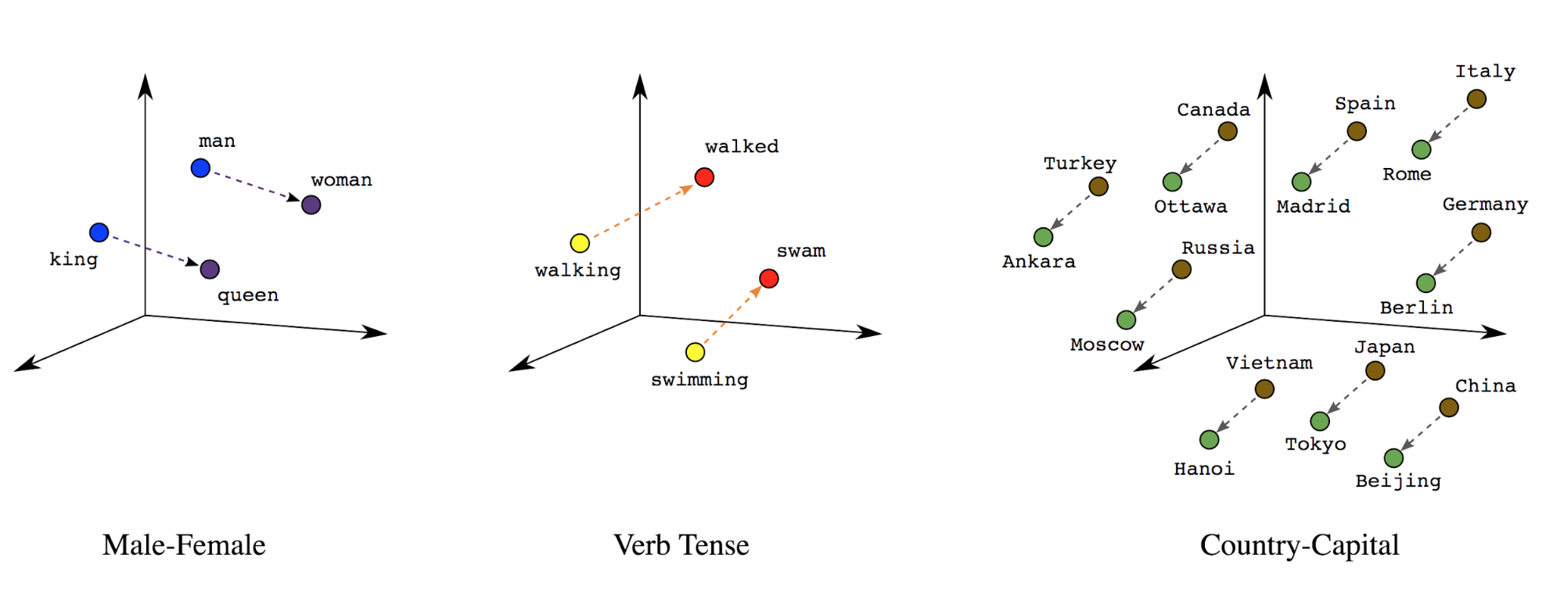
Word embeddings
Source: https://developers.google.com/machine-learning/guides/text-classification/step-3

Slide 110
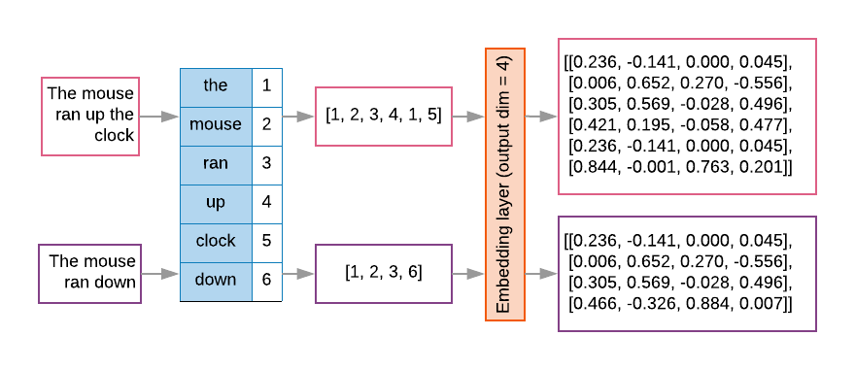
Word embeddings
Source: https://developers.google.com/machine-learning/guides/text-classification/step-3

Slide 111
t1 = 'The mouse ran up the clock'
t2 = 'The mouse ran down'
s1 = t1.lower().split(' ')
s2 = t2.lower().split(' ')
terms = s1 + s2
sortedset = sorted(set(terms))
print('terms =', terms)
print('sortedset =', sortedset)
https://colab.research.google.com/drive/1FEG6DnGvwfUbeo4zJ1zTunjMqf2RkCrT
Notes:
t1 = 'The mouse ran up the clock'
t2 = 'The mouse ran down'
s1 = t1.lower().split(' ')
s2 = t2.lower().split(' ')
terms = s1 + s2
sortedset = sorted(set(terms))
print('terms =', terms)
print('sortedset =', sortedset)

Slide 112
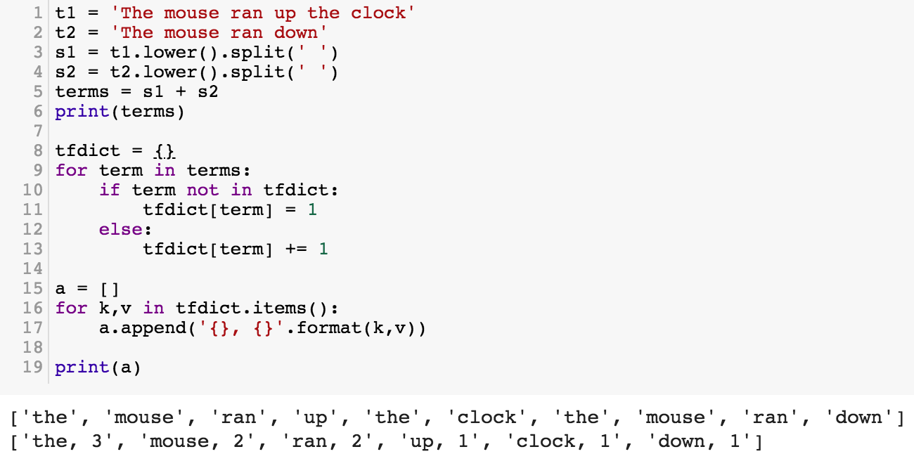
t1 = 'The mouse ran up the clock'
t2 = 'The mouse ran down'
s1 = t1.lower().split(' ')
s2 = t2.lower().split(' ')
terms = s1 + s2
print(terms)
tfdict = {}
for term in terms:
if term not in tfdict:
tfdict[term] = 1
else:
tfdict[term] += 1
a = []
for k,v in tfdict.items():
a.append('{}, {}'.format(k,v))
print(a)
https://colab.research.google.com/drive/1FEG6DnGvwfUbeo4zJ1zTunjMqf2RkCrT

Slide 113
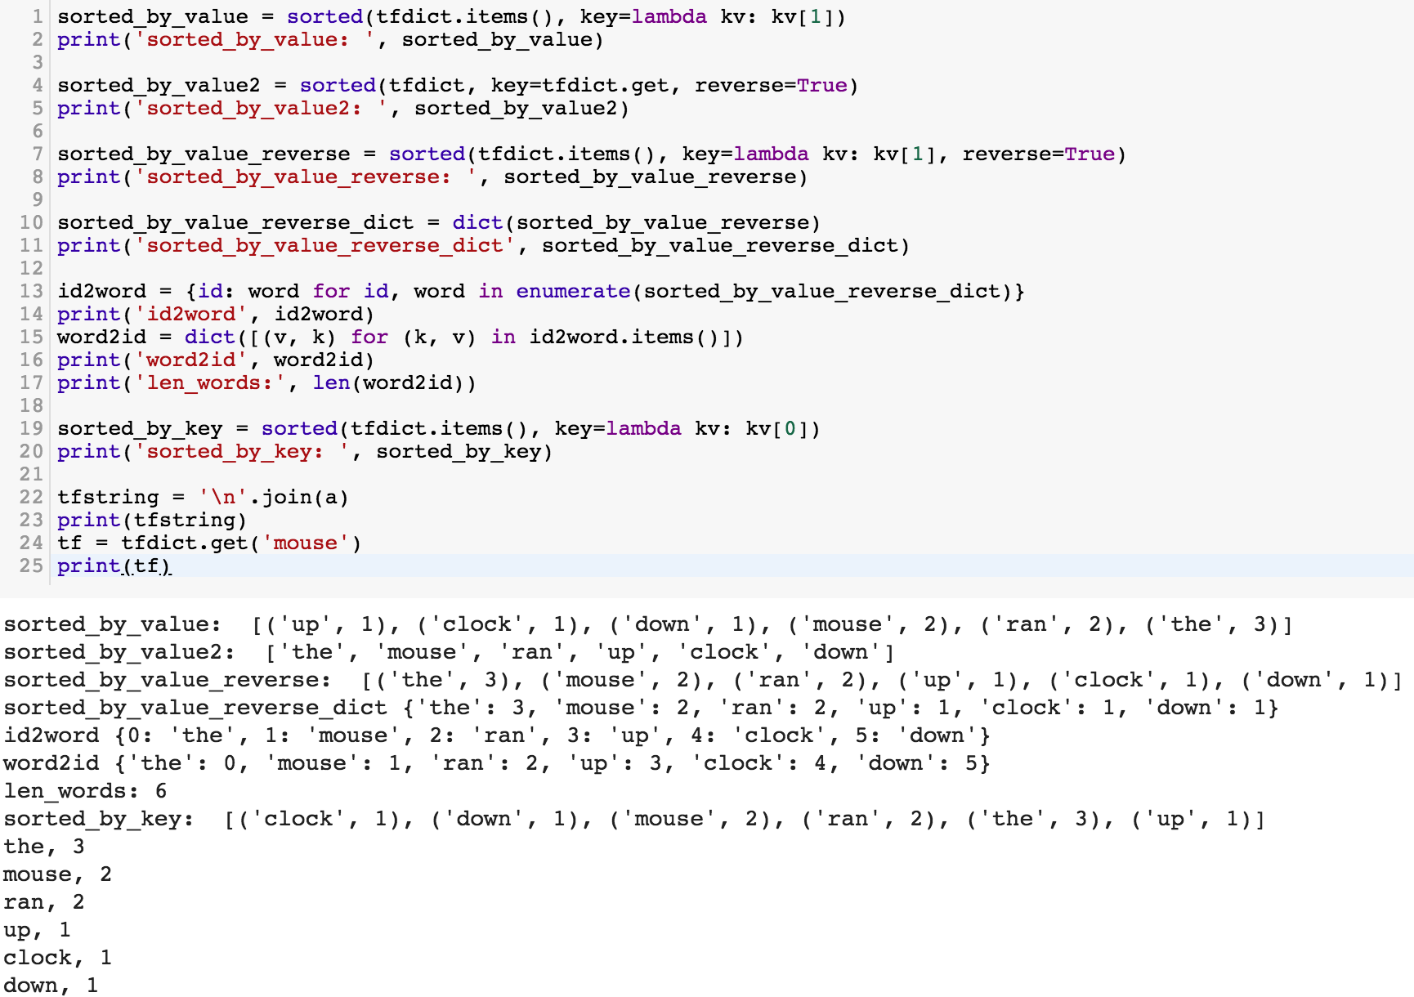
sorted_by_value_reverse = sorted(tfdict.items(), key=lambda kv: kv[1], reverse=True)
sorted_by_value_reverse_dict = dict(sorted_by_value_reverse)
id2word = {id: word for id, word in enumerate(sorted_by_value_reverse_dict)}
word2id = dict([(v, k) for (k, v) in id2word.items()])
https://colab.research.google.com/drive/1FEG6DnGvwfUbeo4zJ1zTunjMqf2RkCrT

Slide 114
sorted_by_value = sorted(tfdict.items(), key=lambda kv: kv[1])
print('sorted_by_value: ', sorted_by_value)
sorted_by_value2 = sorted(tfdict, key=tfdict.get, reverse=True)
print('sorted_by_value2: ', sorted_by_value2)
sorted_by_value_reverse = sorted(tfdict.items(), key=lambda kv: kv[1], reverse=True)
print('sorted_by_value_reverse: ', sorted_by_value_reverse)
sorted_by_value_reverse_dict = dict(sorted_by_value_reverse)
print('sorted_by_value_reverse_dict', sorted_by_value_reverse_dict)
id2word = {id: word for id, word in enumerate(sorted_by_value_reverse_dict)}
print('id2word', id2word)
word2id = dict([(v, k) for (k, v) in id2word.items()])
print('word2id', word2id)
print('len_words:', len(word2id))
sorted_by_key = sorted(tfdict.items(), key=lambda kv: kv[0])
print('sorted_by_key: ', sorted_by_key)
tfstring = '\n'.join(a)
print(tfstring)
tf = tfdict.get('mouse')
print(tf)
https://colab.research.google.com/drive/1FEG6DnGvwfUbeo4zJ1zTunjMqf2RkCrT

Slide 115
from keras.preprocessing.text import Tokenizer
Source: https://machinelearningmastery.com/prepare-text-data-deep-learning-keras/
Notes:
from keras.preprocessing.text import Tokenizer
# define 5 documents
docs = ['Well done!', 'Good work', 'Great effort', 'nice work', 'Excellent!']
# create the tokenizer
t = Tokenizer()
# fit the tokenizer on the documents
t.fit_on_texts(docs)
print('docs:', docs)
print('word_counts:', t.word_counts)
print('document_count:', t.document_count)
print('word_index:', t.word_index)
print('word_docs:', t.word_docs)
# integer encode documents
texts_to_matrix = t.texts_to_matrix(docs, mode='count')
print('texts_to_matrix:')
print(texts_to_matrix)

Slide 116
from keras.preprocessing.text import Tokenizer
from keras.preprocessing.text import Tokenizer
# define 5 documents
docs = ['Well done!', 'Good work', 'Great effort', 'nice work', 'Excellent!']
# create the tokenizer
t = Tokenizer()
# fit the tokenizer on the documents
t.fit_on_texts(docs)
print('docs:', docs)
print('word_counts:', t.word_counts)
print('document_count:', t.document_count)
print('word_index:', t.word_index)
print('word_docs:', t.word_docs)
# integer encode documents
texts_to_matrix = t.texts_to_matrix(docs, mode='count')
print('texts_to_matrix:')
print(texts_to_matrix)
Source: https://machinelearningmastery.com/prepare-text-data-deep-learning-keras/

Slide 117
texts_to_matrix = t.texts_to_matrix(docs, mode='count')
docs: ['Well done!', 'Good work', 'Great effort’, 'nice work', 'Excellent!’]
word_counts: OrderedDict([('well', 1), ('done', 1), ('good', 1), ('work', 2), ('great', 1), ('effort', 1), ('nice', 1), ('excellent', 1)])
document_count: 5
word_index: {'work': 1, 'well': 2, 'done': 3, 'good': 4, 'great': 5, 'effort': 6, 'nice': 7, 'excellent': 8}
word_docs: {'done': 1, 'well': 1, 'work': 2, 'good': 1, 'great': 1, 'effort': 1, 'nice': 1, 'excellent': 1}
texts_to_matrix: [[0. 0. 1. 1. 0. 0. 0. 0. 0.] [0. 1. 0. 0. 1. 0. 0. 0. 0.] [0. 0. 0. 0. 0. 1. 1. 0. 0.] [0. 1. 0. 0. 0. 0. 0. 1. 0.] [0. 0. 0. 0. 0. 0. 0. 0. 1.]]
Source: https://machinelearningmastery.com/prepare-text-data-deep-learning-keras/
Notes:
from keras.preprocessing.text import Tokenizer
# define 5 documents
docs = ['Well done!', 'Good work', 'Great effort', 'nice work', 'Excellent!']
# create the tokenizer
t = Tokenizer()
# fit the tokenizer on the documents
t.fit_on_texts(docs)
print('docs:', docs)
print('word_counts:', t.word_counts)
print('document_count:', t.document_count)
print('word_index:', t.word_index)
print('word_docs:', t.word_docs)
# integer encode documents
texts_to_matrix = t.texts_to_matrix(docs, mode='count')
print('texts_to_matrix:')
print(texts_to_matrix)

Slide 118
t.texts_to_matrix(docs, mode='tfidf')
from keras.preprocessing.text import Tokenizer
# define 5 documents
docs = ['Well done!', 'Good work', 'Great effort', 'nice work', 'Excellent!']
# create the tokenizer
t = Tokenizer()
# fit the tokenizer on the documents
t.fit_on_texts(docs)
print('docs:', docs)
print('word_counts:', t.word_counts)
print('document_count:', t.document_count)
print('word_index:', t.word_index)
print('word_docs:', t.word_docs)
# integer encode documents
texts_to_matrix = t.texts_to_matrix(docs, mode='tfidf')
print('texts_to_matrix:')
print(texts_to_matrix)
texts_to_matrix: [[0. 0. 1.25276297 1.25276297 0. 0. 0. 0. 0. ] [0. 0.98082925 0. 0. 1.25276297 0. 0. 0. 0. ] [0. 0. 0. 0. 0. 1.25276297 1.25276297 0. 0. ] [0. 0.98082925 0. 0. 0. 0. 0. 1.25276297 0. ] [0. 0. 0. 0. 0. 0. 0. 0. 1.25276297]]
Source: https://machinelearningmastery.com/prepare-text-data-deep-learning-keras/
Notes:
from keras.preprocessing.text import Tokenizer
# define 5 documents
docs = ['Well done!', 'Good work', 'Great effort', 'nice work', 'Excellent!']
# create the tokenizer
t = Tokenizer()
# fit the tokenizer on the documents
t.fit_on_texts(docs)
print('docs:', docs)
print('word_counts:', t.word_counts)
print('document_count:', t.document_count)
print('word_index:', t.word_index)
print('word_docs:', t.word_docs)
# integer encode documents
texts_to_matrix = t.texts_to_matrix(docs, mode='tfidf')
print('texts_to_matrix:')
print(texts_to_matrix)
###########
‘’’
docs: ['Well done!', 'Good work', 'Great effort', 'nice work', 'Excellent!'] word_counts: OrderedDict([('well', 1), ('done', 1), ('good', 1), ('work', 2), ('great', 1), ('effort', 1), ('nice', 1), ('excellent', 1)]) document_count: 5 word_index: {'work': 1, 'well': 2, 'done': 3, 'good': 4, 'great': 5, 'effort': 6, 'nice': 7, 'excellent': 8} word_docs: {'done': 1, 'well': 1, 'work': 2, 'good': 1, 'great': 1, 'effort': 1, 'nice': 1, 'excellent': 1} texts_to_matrix: [[0. 0. 1.25276297 1.25276297 0. 0. 0. 0. 0. ] [0. 0.98082925 0. 0. 1.25276297 0. 0. 0. 0. ] [0. 0. 0. 0. 0. 1.25276297 1.25276297 0. 0. ] [0. 0.98082925 0. 0. 0. 0. 0. 1.25276297 0. ] [0. 0. 0. 0. 0. 0. 0. 0. 1.25276297]]
‘’’

Slide 119
NLP Libraries and Tools

Slide 120
spaCy: Natural Language Processing
https://spacy.io/

Slide 121
NLTK (Natural Language Toolkit)
http://www.nltk.org/

Slide 122
Natural Language Processing with Python – Analyzing Text with the Natural Language Toolkit
NLTK
http://www.nltk.org/book/

Slide 123
gensim
https://radimrehurek.com/gensim/

Slide 124
TextBlob
https://textblob.readthedocs.io

Slide 125
Polyglot
https://polyglot.readthedocs.io/

Slide 126
scikit-learn
http://scikit-learn.org/

Slide 127
TensorFlow NLP Examples
Basic Text Classification (Text Classification) (46 Seconds)
https://colab.research.google.com/github/tensorflow/docs/blob/master/site/en/tutorials/keras/basic_text_classification.ipynb
NMT with Attention (20-30 minutes)
https://colab.research.google.com/github/tensorflow/tensorflow/blob/master/tensorflow/contrib/eager/python/examples/nmt_with_attention/nmt_with_attention.ipynb

Slide 128
Text Classification IMDB Movie Reviews
https://colab.research.google.com/drive/1x16h1GhHsLIrLYtPCvCHaoO1W-i_gror
Source: https://colab.research.google.com/github/tensorflow/docs/blob/master/site/en/tutorials/keras/basic_text_classification.ipynb

Slide 129
NLP with Transformers Github
https://github.com/nlp-with-transformers/notebooks

Slide 130
NLP with Transformers Github Notebooks
https://github.com/nlp-with-transformers/notebooks

Slide 131
Python in Google Colab (Python101)
https://colab.research.google.com/drive/1FEG6DnGvwfUbeo4zJ1zTunjMqf2RkCrT
https://tinyurl.com/aintpupython101

Slide 132
Summary
Python for Natural Language Processing
Python Ecosystem for Data Science
Python
Programming language
Numpy
Scientific computing
SpaCy
Natural Language Processing

Slide 133
References
Lewis Tunstall, Leandro von Werra, and Thomas Wolf (2022), Natural Language Processing with Transformers: Building Language Applications with Hugging Face, O'Reilly Media.
Denis Rothman (2021), Transformers for Natural Language Processing: Build innovative deep neural network architectures for NLP with Python, PyTorch, TensorFlow, BERT, RoBERTa, and more, Packt Publishing.
Savaş Yıldırım and Meysam Asgari-Chenaghlu (2021), Mastering Transformers: Build state-of-the-art models from scratch with advanced natural language processing techniques, Packt Publishing.
Sowmya Vajjala, Bodhisattwa Majumder, Anuj Gupta (2020), Practical Natural Language Processing: A Comprehensive Guide to Building Real-World NLP Systems, O'Reilly Media.
Ramesh Sharda, Dursun Delen, and Efraim Turban (2017), Business Intelligence, Analytics, and Data Science: A Managerial Perspective, 4th Edition, Pearson.
Dipanjan Sarkar (2019), Text Analytics with Python: A Practitioner’s Guide to Natural Language Processing, Second Edition. APress.
Benjamin Bengfort, Rebecca Bilbro, and Tony Ojeda (2018), Applied Text Analysis with Python: Enabling Language-Aware Data Products with Machine Learning, O’Reilly.
Charu C. Aggarwal (2018), Machine Learning for Text, Springer.
Gabe Ignatow and Rada F. Mihalcea (2017), An Introduction to Text Mining: Research Design, Data Collection, and Analysis, SAGE Publications.
Rajesh Arumugam (2018), Hands-On Natural Language Processing with Python: A practical guide to applying deep learning architectures to your NLP applications, Packt.
Jake VanderPlas (2016), Python Data Science Handbook: Essential Tools for Working with Data, O'Reilly Media.
Devlin, Jacob, Ming-Wei Chang, Kenton Lee, and Kristina Toutanova (2018). "BERT: Pre-training of Deep Bidirectional Transformers for Language Understanding." arXiv preprint arXiv:1810.04805.
Steven Bird, Ewan Klein and Edward Loper (2009), Natural Language Processing with Python, O'Reilly Media, http://www.nltk.org/book/
The Super Duper NLP Repo, https://notebooks.quantumstat.com/
Avinash Jain (2017), Introduction To Python Programming, Udemy, https://www.udemy.com/pythonforbeginnersintro/
Python Programming, https://pythonprogramming.net/
Python, https://www.python.org/
Python Programming Language, http://pythonprogramminglanguage.com/
Numpy, http://www.numpy.org/
Pandas, http://pandas.pydata.org/
Min-Yuh Day (2022), Python 101, https://tinyurl.com/aintpupython101

