Slide 1
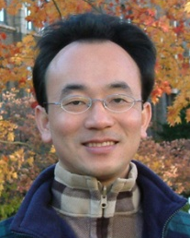
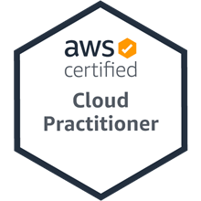
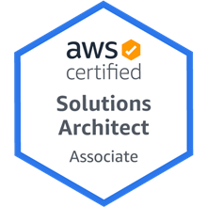
軟體工程 (Software Engineering)
軟體工程概論 (Introduction to Software Engineering)
1101SE01
MBA, IM, NTPU (M6131) (Fall 2021) Thu 11, 12, 13 (19:25-22:10) (209)
Min-Yuh Day
戴敏育
Associate Professor
副教授
Institute of Information Management, National Taipei University
國立臺北大學 資訊管理研究所
https://web.ntpu.edu.tw/~myday
2021-09-23

Slide 2
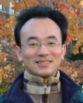
戴敏育 博士 (Min-Yuh Day, Ph.D.)
國立台北大學 資訊管理研究所 副教授
中央研究院 資訊科學研究所 訪問學人
國立台灣大學 資訊管理 博士
Publications Co-Chairs, IEEE/ACM International Conference on Advances in Social Networks Analysis and Mining (ASONAM 2013- )
Program Co-Chair, IEEE International Workshop on Empirical Methods for Recognizing Inference in TExt (IEEE EM-RITE 2012- )
Publications Chair, The IEEE International Conference on Information Reuse and Integration (IEEE IRI)

Slide 3
軟體工程 (Software Engineering) Contact Information
戴敏育 博士 (Min-Yuh Day, Ph.D.)
副教授 (Associate Professor)
國立臺北大學 資訊管理研究所
Institute of Information Management, National Taipei University
電話： 02-86741111 ext. 66873
研究室： 商8F12
地址： 23741 新北市三峽區大學路 151 號
Email：myday@gm.ntpu.edu.tw
網址：http://web.ntpu.edu.tw/~myday/

Slide 4
國立臺北大學 110學年度第1學期 課程大綱 Fall 2021 (2021.09 - 2022.01)
課程名稱：軟體工程 (Software Engineering)
授課教師：戴敏育 (Min-Yuh Day)
開課系所：資管所碩士班 (資訊碩2; 電子商務碩士學程)
開課資料：選修 半學年 3 學分 (3 Credits, Elective)
上課時間：週四 11, 12, 13 (19:25-22:10)
上課教室：209 (台北大學民生校區) Google Meet: http://meet.google.com/zqs-amev-anr

Slide 5
教學目標
瞭解軟體工程基本概念、 與研究議題。
具備軟體工程實務操作能力。
進行軟體工程相關之 資訊管理研究。

Slide 6
Course Objectives
Understand the fundamental concepts and research issues of software engineering.
Equip with Hands-on practices of software engineering.
Conduct information systems research in the context of software engineering.

Slide 7
內容綱要
本課程介紹軟體工程基本概念、研究議題、與實務操作。
課程內容包括
軟體工程概論
軟體產品與專案管理：軟體產品管理，原型設計
敏捷軟體工程：敏捷方法、Scrum、極限程式設計
功能、場景和故事
軟體架構：架構設計、系統分解、分散式架構
基於雲的軟體：虛擬化和容器、軟體即服務
雲端運算與雲軟體架構
微服務架構：RESTful服務、服務部署
安全和隱私; 可靠的程式設計
測試：功能測試、測試自動化、測試驅動的開發、程式審查
DevOps和程式碼管理：程式碼管理和DevOps自動化
軟體工程個案研究

Slide 8
Course Outline
This course introduces the fundamental concepts, research issues, and hands-on practices of software engineering.
Topics include
Introduction to Software Engineering
Software Products and Project Management: Software product management and prototyping
Agile Software Engineering: Agile methods, Scrum, and Extreme Programming
Features, Scenarios, and Stories
Software Architecture: Architectural design, System decomposition, and Distribution architecture
Cloud-Based Software: Virtualization and containers, Everything as a service, Software as a service
Cloud Computing and Cloud Software Architecture
Microservices Architecture, RESTful services, Service deployment
Security and Privacy; Reliable Programming
Testing: Functional testing, Test automation, Test-driven development, and Code reviews
DevOps and Code Management: Code management and DevOps automation
Case Study on Software Engineering

Slide 9
資訊管理研究所 系核心能力 (Core Competence)
資訊科技新知探索與系統開發應用 90 %
網路行銷企劃能力
論文寫作與獨立研究能力 10 %

Slide 10
校四大基本素養 (Four Fundamental Qualities)
專業 (Professionalism)
創意思考與問題解決 (Creative thinking and Problem-solving) 30 %
綜合統整(Comprehensive Integration) 30 %
人際 (Interpersonal Relationship)
溝通協調 (Communication and Coordination) 10 %
團隊合作 (Teamwork) 10 %
倫理 (Ethics)
誠信正直(Honesty and Integrity) 5 %
尊重自省(Self-Esteem and Self-reflection) 5 %
國際觀 (International Vision)
多元關懷 (Caring for Diversity) 5 %
跨界宏觀 (Interdisciplinary Vision) 5 %

Slide 11
商學院學習目標 (College Learning Goals)
Ethics/Corporate Social Responsibility
Global Knowledge/Awareness
Communication
Analytical and Critical Thinking

Slide 12
系所學習目標 (Department Learning Goals)
Information Technologies and System Development Capabilities
Research capabilities

Slide 13
課程大綱 (Syllabus)
週次 (Week) 日期 (Date) 內容 (Subject/Topics)
1 2021/09/23 軟體工程概論 (Introduction to Software Engineering)
2 2021/09/30 軟體產品與專案管理：軟體產品管理，原型設計 (Software Products and Project Management: Software product management and prototyping)
3 2021/10/07 敏捷軟體工程：敏捷方法、Scrum、極限程式設計 (Agile Software Engineering: Agile methods, Scrum, and Extreme Programming)
4 2021/10/14 功能、場景和故事 (Features, Scenarios, and Stories)
5 2021/10/21 軟體工程個案研究 I (Case Study on Software Engineering I)
6 2021/10/28 軟體架構：架構設計、系統分解、分散式架構 (Software Architecture: Architectural design, System decomposition, and Distribution architecture)

Slide 14
課程大綱 (Syllabus)
週次 (Week) 日期 (Date) 內容 (Subject/Topics)
7 2021/11/04 基於雲的軟體：虛擬化和容器、軟體即服務 (Cloud-Based Software: Virtualization and containers, Everything as a service, Software as a service)
8 2021/11/11 期中報告 (Midterm Project Report)
9 2021/11/18 雲端運算與雲軟體架構 (Cloud Computing and Cloud Software Architecture)
10 2021/11/25 微服務架構：RESTful服務、服務部署 (Microservices Architecture, RESTful services, Service deployment)
11 2021/12/02 軟體工程產業實務 (Industry Practices of Software Engineering)
12 2021/12/09 軟體工程個案研究 II (Case Study on Software Engineering II)

Slide 15
課程大綱 (Syllabus)
週次 (Week) 日期 (Date) 內容 (Subject/Topics)
13 2021/12/16 安全和隱私 (Security and Privacy); 可靠的程式設計 (Reliable Programming)
14 2021/12/23 測試：功能測試、測試自動化、 測試驅動的開發、程式碼審查 (Testing: Functional testing, Test automation, Test-driven development, and Code reviews); DevOps和程式碼管理：程式碼管理和DevOps自動化 (DevOps and Code Management: Code management and DevOps automation)
15 2021/12/30 期末報告 I (Final Project Report I)
16 2022/01/06 期末報告 II (Final Project Report II)
17 2022/01/13 學生自主學習 (Self-learning)
18 2022/01/20 學生自主學習 (Self-learning)

Slide 16
教學方法與教學活動 (Teaching methods and activities)
講授 (Lecture)
討論 (Discussion)
實習 (Practicum)

Slide 17
評量方式 (Evaluation Methods)
個人報告 (Individual Presentation) 60 %
團體報告 (Group Presentation) 10 %
個案分析報告 (Case Report) 10 %
課堂參與 (Class Participation) 10 %
作業 (Assignment) 10 %

Slide 18
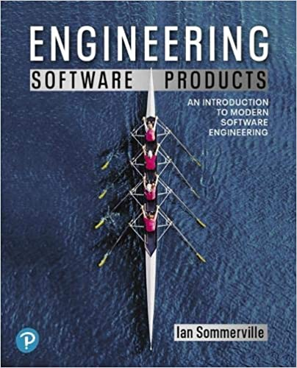
指定用書 (Required Texts)
Ian Sommerville (2019), Engineering Software Products: An Introduction to Modern Software Engineering, Pearson.

Slide 19
參考書目 (Reference Books)
Ian Sommerville (2015), Software Engineering, 10th Edition, Pearson.
Titus Winters, Tom Manshreck, and Hyrum Wright (2020), Software Engineering at Google: Lessons Learned from Programming Over Time, O'Reilly Media.
Project Management Institute (2017), Agile Practice Guide, PMI
Project Management Institute (2021), A Guide to the Project Management Body of Knowledge (PMBOK Guide) – Seventh Edition and The Standard for Project Management, PMI

Slide 20
Ian Sommerville (2019), Engineering Software Products: An Introduction to Modern Software Engineering, Pearson.

Slide 21
Ian Sommerville (2015), Software Engineering, 10th Edition, Pearson.

Slide 22
Titus Winters, Tom Manshreck, and Hyrum Wright (2020), Software Engineering at Google: Lessons Learned from Programming Over Time, O'Reilly Media.

Slide 23
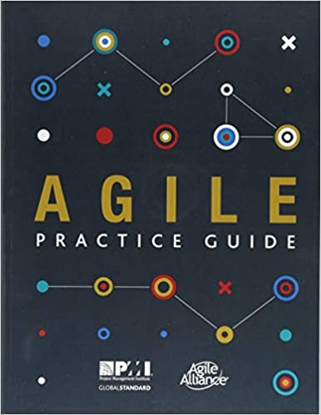
Project Management Institute (2017), Agile Practice Guide PMI

Slide 24
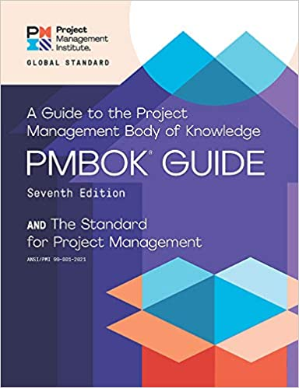
Project Management Institute (2021), A Guide to the Project Management Body of Knowledge (PMBOK Guide) – Seventh Edition and The Standard for Project Management

Slide 25
Software Engineering

Slide 26
Software Engineering and Project Management
Analyze
Requirements definition
Design
System and Software design
Build
Implementation and
unit testing
Test
Integration and system testing
Deliver
Operation and maintenance
Project Management

Slide 27
Information Management Management Information Systems (MIS) Information Systems

Slide 28
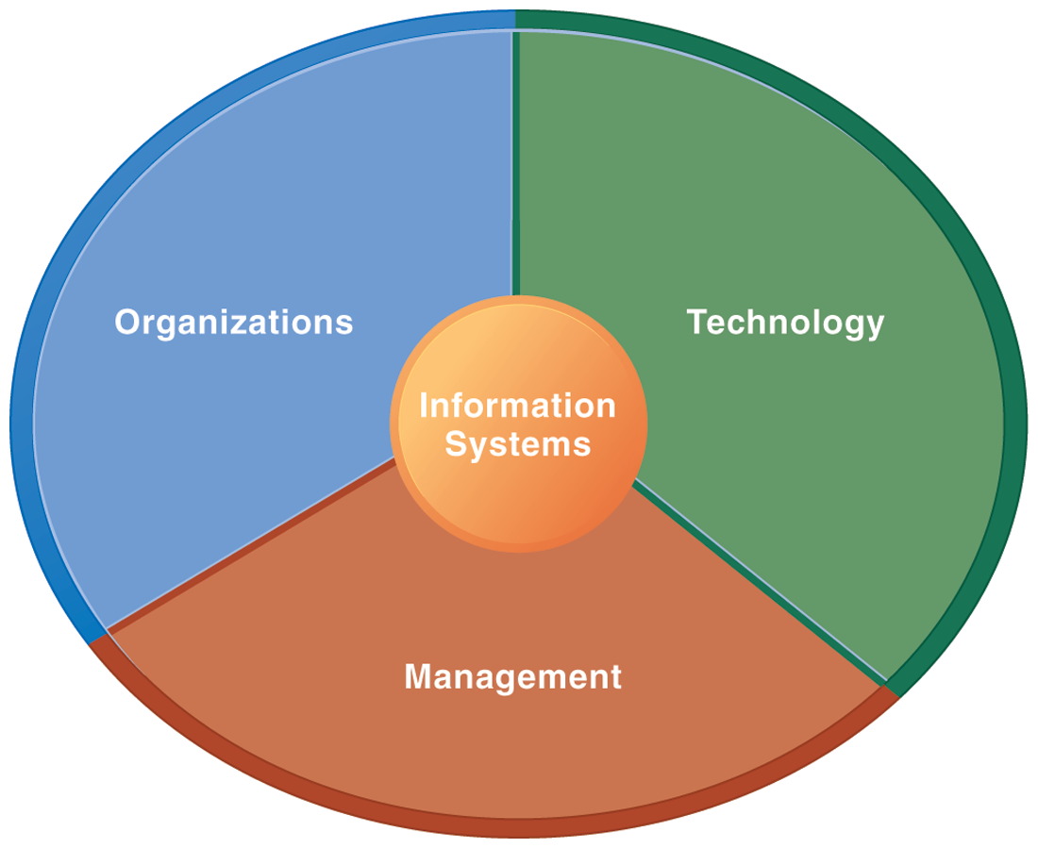
Information Management (MIS) Information Systems

Slide 29
Fundamental MIS Concepts
Business Challenges
Management
Organization
Information System
Business Solutions
Technology

Slide 30
Project-based software engineering
CUSTOMER
Problem
generates
helps-with
Requirements
implemented-by
Software
1
CUSTOMER and DEVELOPER
DEVELOPER

Slide 31
Project-based software engineering
The starting point for the software development is a set of ‘software requirements’ that are owned by an external client and which set out what they want a software system to do to support their business processes.
The software is developed by a software company (the contractor) who design and implement a system that delivers functionality to meet the requirements.
The customer may change the requirements at any time in response to business changes (they usually do). The contractor must change the software to reflect these requirements changes.
Custom software usually has a long-lifetime (10 years or more) and it must be supported over that lifetime.

Slide 32
Product software engineering
DEVELOPER
Opportunity
1
inspires
realizes
Product features
implemented-by
Software
DEVELOPER
DEVELOPER

Slide 33
Product software engineering
The starting point for product development is a business opportunity that is identified by individuals or a company. They develop a software product to take advantage of this opportunity and sell this to customers.
The company who identified the opportunity design and implement a set of software features that realize the opportunity and that will be useful to customers.
The software development company are responsible for deciding on the development timescale, what features to include and when the product should change.
Rapid delivery of software products is essential to capture the market for that type of product.

Slide 34
Software execution models
Stand-alone execution
Hybrid execution
Software as a service
User’s computer
User’s computer
User’s computer
User interface
Product functionality
User data
User interface
Partial functionality
User data
User interface
(browser or app)
Product updates
Additional functionality
User data backups
Product updates
Product functionality
User data
Vendor’s servers
Vendor’s servers
Vendor’s servers

Slide 35
Product management concerns
Business needs
Product manager
Technology constraints
Customer experience

Slide 36
Technical interactions of product managers
Product vision management
Product backlog management
User stories and scenarios
Product manager
Acceptance testing
Customer testing
User interface design

Slide 37
Software Development Life Cycle (SDLC) The waterfall model
Requirements definition
System and Software design
Implementation and unit testing
Integration and system testing
Operation and maintenance

Slide 38
Plan-based and Agile development
Plan-based development
Requirements engineering
Requirements specification
Design and implementation
Requirements change requests
Agile development
Requirements engineering
Design and implementation

Slide 39
The Continuum of Life Cycles
High
Incremental
Agile
Frequency of Delivery
Predictive
Iterative
Low
Low
High
Degree of Change

Slide 40
Predictive Life Cycle
Analyze
Design
Build
Test
Deliver

Slide 41
Iterative Life Cycle
Prototype
Refine
Analyze
Analyze
Design
Build
Test
Deliver

Slide 42
A Life Cycle of Varying-Sized Increments
Analyze
Design
Build
Test
Deliver
Analyze
Design
Build
Test
Deliver
Analyze
Design
Build
Test
Deliver

Slide 43
Iteration-Based and Flow-Based Agile Life Cycles
Iteration-Based Agile
Requirements
Analysis
Design
Build
Test
Requirements
Analysis
Design
Build
Test
Requirements
Analysis
Design
Build
Test
Requirements
Analysis
Design
Build
Test
Repeat as needed
…
Requirements
Analysis
Design
Build
Test
Requirements
Analysis
Design
Build
Test
Flow-Based Agile
Requirements
Analysis
Design
Build
Test
the number of features in the WIP limit
Requirements
Analysis
Design
Build
Test
the number of features in the WIP limit
Requirements
Analysis
Design
Build
Test
the number of features in the WIP limit
Repeat as needed
…
Requirements
Analysis
Design
Build
Test
the number of features in the WIP limit
Requirements
Analysis
Design
Build
Test
the number of features in the WIP limit

Slide 44
From personas to features
1
Personas
A way of representing users
inspire
Natural language descriptions of a user interacting with a software product
2
Scenarios
are-developed-into
3
inspire
Stories
Natural language descriptions of something that is needed or wanted by users
4
Features
define
Fragments of product functionality

Slide 45
Multi-tier client-server architecture
Client 1
Client 2
Web Server
Application Server
Database Server
Client 3
Client …

Slide 46
Service-oriented Architecture
Client 1
S1
S2
Client 2
S3
Web Server
Service gateway
S4
Client 3
S5
Client …
S6
Services

Slide 47
VM
Container
Virtual web server
Virtual mail server
User 1 Container 1
User 2 Container 2
Server software
Server software
Application software
Application software
Guest OS
Guest OS
Server software
Server software
Hypervisor
Container manager
Host OS
Host OS
Server Hardware
Server Hardware

Slide 48
Everything as a service
Photo editing
Software as a service (SaaS)
Logistics management
Cloud management Monitoring
Platform as a service (PaaS)
Database
Software development
Storage Network
Infrastructure as a service (IaaS)
Computing Virtualization
Cloud data center

Slide 49
Software as a service
Software customers
Software provider
Software services
Cloud Infrastructure
Cloud provider

Slide 50
Microservices architecture – key design questions
What are the microservices that make up the system?
How should data be distributed and shared?
How should microservices communicate with each other?
Microservices architecture
design
How should the microservices in the system be coordinated?
How should service failure be detected, reported and managed?

Slide 51
Types of security threat
An attacker attempts to deny access to the system for legitimate users
An attacker attempts to damage the system or its data
Availability
threats
Integrity
threats
SOFTWARE PRODUCT
PROGRAM
Distributed denial of service (DDoS) attack
Virus
DATA
Ransomware
Data theft
Confidentiality threats
An attacker tries to gain access to private information held by the system

Slide 52
Software product quality attributes
Reliability
Availability
1
2
Software product quality attributes
Security
Resilience
7
3
Usability
Maintainability
6
4
Responsiveness
5

Slide 53
A refactoring process
1
2
Start
Identify code ‘smell’
Identify refactoring strategy
4
3
Run automated code tests
Make small
improvement until strategy completed

Slide 54
Functional testing
Start
1
Unit Testing
4
2
Release Testing
Feature Testing
3
System Testing

Slide 55
Test-driven development (TDD)
Start
1
Identify new functionality
2
Identify partial implementation
of functionality
3
Write code stub that will fail test
Functionality complete
Functionality incomplete
4
Run all automated test
7
Refactor code if required
5
Implement code that should cause failing test to pass
Test failure
6
Run all automated test
All tests pass

Slide 56
DevOps
Development
Deployment
Support
Multi-skilled DevOps team

Slide 57
Code management and DevOps
DevOps automation
Continuous integration
Continuous deployment
Continuous delivery
Infrastructure as code
Code management system
Branching and merging
Recover version information
Code repository
Save and retrieve versions
Transfer code to/from developer’s filestore
DevOps measurement
Data collection
Data analysis
Report generation

Slide 58
Marketing

Slide 59
Marketing
“Meeting needs profitably”

Slide 60
Marketing
“Marketing is an organizational function and a set of processes for creating, communicating, and delivering value to customers and for managing customer relationships in ways that benefit the organization and its stakeholders.”

Slide 61
Marketing Management

Slide 62
Marketing Management
“Marketing management is the art and science of choosing target markets and getting, keeping, and growing customers through creating, delivering, and communicating superior customer value.”

Slide 63
Marketing Management
1
Understanding Marketing Management
2
Capturing Marketing Insights
3
Connecting with Customers
4
Building Strong Brands
5
Creating Value
6
Delivering Value
7
Communicating Value
8
Conducting Marketing Responsibly for Long-term Success

Slide 64
Software Engineering and Project Management
Analyze
Requirements definition
Design
System and Software design
Build
Implementation and
unit testing
Test
Integration and system testing
Deliver
Operation and maintenance
Project Management

Slide 65
Summary
This course introduces the fundamental concepts, research issues, and hands-on practices of software engineering.
Topics include
Introduction to Software Engineering
Software Products and Project Management: Software product management and prototyping
Agile Software Engineering: Agile methods, Scrum, and Extreme Programming
Features, Scenarios, and Stories
Software Architecture: Architectural design, System decomposition, and Distribution architecture
Cloud-Based Software: Virtualization and containers, Everything as a service, Software as a service
Cloud Computing and Cloud Software Architecture
Microservices Architecture, RESTful services, Service deployment
Security and Privacy; Reliable Programming
Testing: Functional testing, Test automation, Test-driven development, and Code reviews
DevOps and Code Management: Code management and DevOps automation
Case Study on Software Engineering

Slide 66
軟體工程 (Software Engineering) Contact Information
戴敏育 博士 (Min-Yuh Day, Ph.D.)
副教授 (Associate Professor)
國立臺北大學 資訊管理研究所
Institute of Information Management, National Taipei University
電話： 02-86741111 ext. 66873
研究室： 商8F12
地址： 23741 新北市三峽區大學路 151 號
Email：myday@gm.ntpu.edu.tw
網址：http://web.ntpu.edu.tw/~myday/

