Slide 1
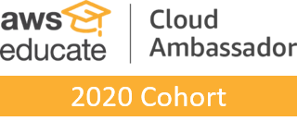
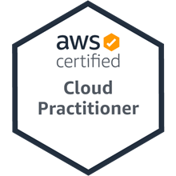
演算法交易 (Algorithmic Trading) 風險管理 (Risk Management); 交易機器人與基於事件的回測 (Trading Bot and Event-Based Backtesting)
智慧金融量化分析 (Artificial Intelligence in Finance and Quantitative Analysis)
1101AIFQA10
MBA, IM, NTPU (M6132) (Fall 2021) Tue 2, 3, 4 (9:10-12:00) (8F40)
戴敏育 副教授
Min-Yuh Day, Ph.D, Associate Professor
國立臺北大學 資訊管理研究所
Institute of Information Management, National Taipei University
https://web.ntpu.edu.tw/~myday
2021-12-28

Slide 2
課程大綱 (Syllabus)
週次 (Week) 日期 (Date) 內容 (Subject/Topics)
1 2021/09/28 智慧金融量化分析概論 (Introduction to Artificial Intelligence in Finance and Quantitative Analysis)
2 2021/10/05 AI 金融科技: 金融服務創新應用 (AI in FinTech: Financial Services Innovation and Application)
3 2021/10/12 投資心理學與行為財務學 (Investing Psychology and Behavioral Finance)
4 2021/10/19 財務金融事件研究法 (Event Studies in Finance)
5 2021/10/26 智慧金融量化分析個案研究 I (Case Study on AI in Finance and Quantitative Analysis I)
6 2021/11/02 財務金融理論 (Finance Theory)

Slide 3
課程大綱 (Syllabus)
週次 (Week) 日期 (Date) 內容 (Subject/Topics)
7 2021/11/09 數據驅動財務金融 (Data-Driven Finance)
8 2021/11/16 期中報告 (Midterm Project Report)
9 2021/11/23 金融計量經濟學 (Financial Econometrics)
10 2021/11/30 人工智慧優先金融 (AI-First Finance)
11 2021/12/07 智慧金融量化分析產業實務 (Industry Practices of AI in Finance and Quantitative Analysis )
[演講主題：指數設計的方法論、數據分析與量化投資應用，演講者：李政剛，基金經理/元大投信] [Invited Talk: Index Design – Methodology、Data Analysis and the Application of Quantitative Investing, Invited Speaker: Jervis J.G. Li, Fund Manager, Yuanta SITC]
12 2021/12/14 智慧金融量化分析個案研究 II (Case Study on AI in Finance and Quantitative Analysis II)

Slide 4
課程大綱 (Syllabus)
週次 (Week) 日期 (Date) 內容 (Subject/Topics)
13 2021/12/21 財務金融深度學習 (Deep Learning in Finance); 財務金融強化學習 (Reinforcement Learning in Finance)
14 2021/12/28 演算法交易 (Algorithmic Trading); 風險管理 (Risk Management); 交易機器人與基於事件的回測 (Trading Bot and Event-Based Backtesting)
15 2022/01/04 期末報告 I (Final Project Report I)
16 2022/01/11 期末報告 II (Final Project Report II)
17 2022/01/18 學生自主學習 (Self-learning)
18 2022/01/25 學生自主學習 (Self-learning)

Slide 5
Algorithmic Trading Risk Management Trading Bot Event-Based Backtesting

Slide 6
Outline
Algorithmic Trading
Risk Management
Trading Bot
Event-Based Backtesting
Source: Yves Hilpisch (2020), Artificial Intelligence in Finance: A Python-Based Guide, O’Reilly Media.

Slide 7
Algorithmic Trading

Slide 8
Algorithmic Trading
Historical Finance Market Data
Live Finance Market Data
Computer Program
Order Status
Broker API
Order
Backtest Results
Order
Order Status
Broker’s Server
Source: Ernest P. Chan (2017), Machine Trading: Deploying Computer Algorithms to Conquer the Markets, Wiley

Slide 9
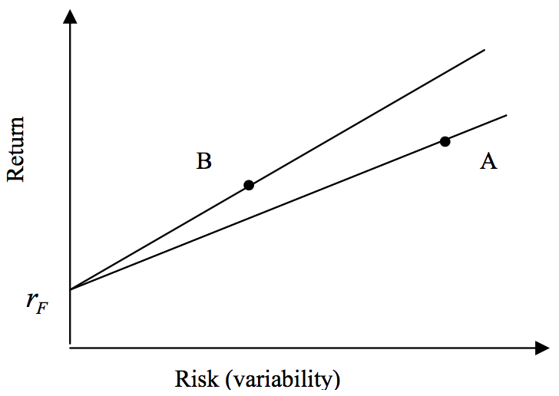
Risk and Return
Source: Bacon, Carl. "How sharp is the Sharpe-ratio?-Risk-adjusted Performance Measures." Statpro White Paper (2000).

Slide 10
Sharpe Ratio
$$Sharpe Ratio= \frac{Portofolio Return−Risk Free Return}{Portofolio Risk}$$
Source: Bacon, Carl. "How sharp is the Sharpe-ratio?-Risk-adjusted Performance Measures." Statpro White Paper (2000).

Slide 11
Sharpe Ratio
$$Sharpe Ratio SR= \frac{r_{P}−r_{F}}{σ_{P}}$$
Where
r_{P} = portfolio return
r_{F} = risk free rate
σ_{P} = portfolio risk (variability, standard deviation of return)
Source: Bacon, Carl. "How sharp is the Sharpe-ratio?-Risk-adjusted Performance Measures." Statpro White Paper (2000).

Slide 12
Sortino Ratio
$$Sortino Ratio = \frac{r_{P}−r_{T}}{σ_{D}}$$
Where
r_{P} = portfolio return
r_{T} = Minimum Target Return
σ_{D} = Downside Risk
$$Downside Risk{ σ}_{D}= \sqrt{\sum_{i=1}^{n}{\frac{\min\left[\left(ri−rT\right),0\right]2}{n}}}$$
Source: Bacon, Carl. "How sharp is the Sharpe-ratio?-Risk-adjusted Performance Measures." Statpro White Paper (2000).

Slide 13
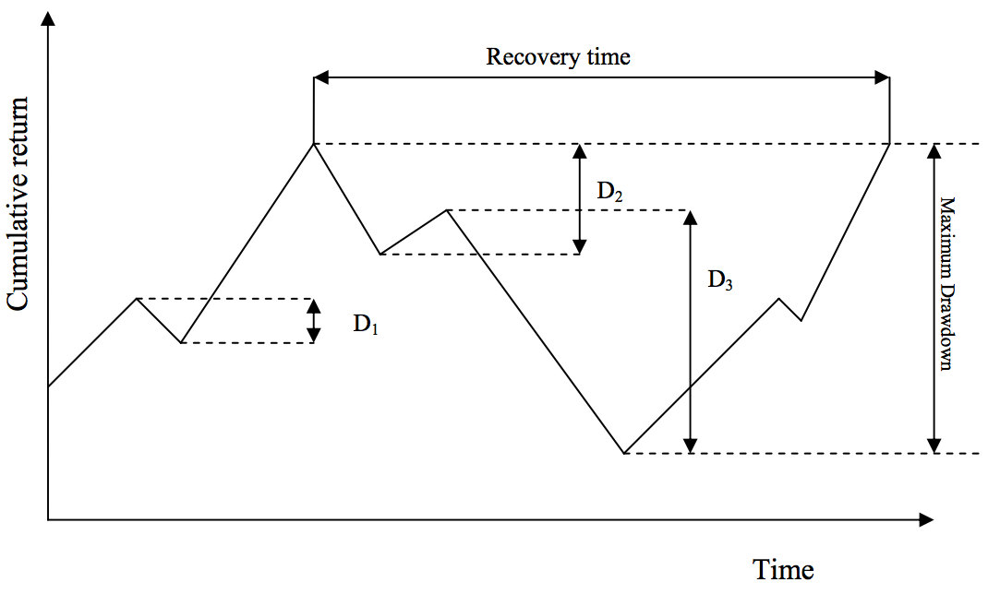
Max Drawdown
Source: Bacon, Carl. "How sharp is the Sharpe-ratio?-Risk-adjusted Performance Measures." Statpro White Paper (2000).

Slide 14
Portfolio Optimization Efficient Frontier
Efficient Frontier
Return
Risk
Source: Tucker Balch (2012), Investment Science: Portfolio Optimization, https://www.youtube.com/watch?v=5qbMhXXq0vI

Slide 15
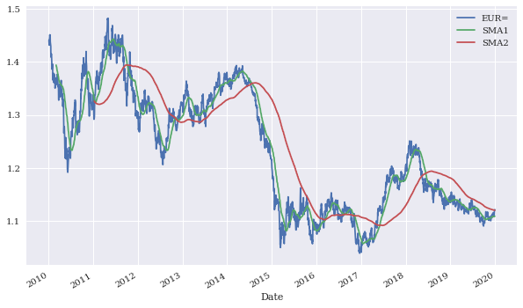
Time series data for EUR/USD and SMAs
Source: Yves Hilpisch (2020), Artificial Intelligence in Finance: A Python-Based Guide, O’Reilly Media.

Slide 16
Time series data for EUR/USD, SMAs, and resulting positions
Source: Yves Hilpisch (2020), Artificial Intelligence in Finance: A Python-Based Guide, O’Reilly Media.

Slide 17
Gross performance of passive benchmark investment and SMA strategy
Source: Yves Hilpisch (2020), Artificial Intelligence in Finance: A Python-Based Guide, O’Reilly Media.

Slide 18
Gross performance of the SMA strategy before and after transaction costs
Source: Yves Hilpisch (2020), Artificial Intelligence in Finance: A Python-Based Guide, O’Reilly Media.

Slide 19
Gross performance of the passive benchmark investment and the daily DNN strategy (in-sample)
Source: Yves Hilpisch (2020), Artificial Intelligence in Finance: A Python-Based Guide, O’Reilly Media.

Slide 20
Gross performance of the passive benchmark investment and the daily DNN strategy (out-of-sample)
Source: Yves Hilpisch (2020), Artificial Intelligence in Finance: A Python-Based Guide, O’Reilly Media.

Slide 21
Gross performance of the daily DNN strategy before and after transaction costs (out-of-sample)
Source: Yves Hilpisch (2020), Artificial Intelligence in Finance: A Python-Based Guide, O’Reilly Media.

Slide 22
Gross performance of the passive benchmark investment and the DNN intraday strategy (out-of-sample)
Source: Yves Hilpisch (2020), Artificial Intelligence in Finance: A Python-Based Guide, O’Reilly Media.

Slide 23
Gross performance of the DNN intraday strategy before and after higher/ lower transaction costs (out-of-sample)
Source: Yves Hilpisch (2020), Artificial Intelligence in Finance: A Python-Based Guide, O’Reilly Media.

Slide 24
Gross performance on training and validation data set
Source: Yves Hilpisch (2020), Artificial Intelligence in Finance: A Python-Based Guide, O’Reilly Media.

Slide 25
Gross performance of the passive benchmark investment and the trading bot (out-of-sample)
Source: Yves Hilpisch (2020), Artificial Intelligence in Finance: A Python-Based Guide, O’Reilly Media.

Slide 26
Gross performance of the trading bot before and after transaction costs (in-sample)
Source: Yves Hilpisch (2020), Artificial Intelligence in Finance: A Python-Based Guide, O’Reilly Media.

Slide 27
Gross performance of the passive benchmark investment and the trading bot (vectorized and event-based backtesting)
Source: Yves Hilpisch (2020), Artificial Intelligence in Finance: A Python-Based Guide, O’Reilly Media.

Slide 28
Average true range (ATR) in absolute (price) and relative (%) terms
Source: Yves Hilpisch (2020), Artificial Intelligence in Finance: A Python-Based Guide, O’Reilly Media.

Slide 29
BTC-USD
Source: Yves Hilpisch (2020), Artificial Intelligence in Finance: A Python-Based Guide, O’Reilly Media.

Slide 30
BTC-USD Returns
Source: Yves Hilpisch (2020), Artificial Intelligence in Finance: A Python-Based Guide, O’Reilly Media.

Slide 31
BTC-USD Returns Box
Source: Yves Hilpisch (2020), Artificial Intelligence in Finance: A Python-Based Guide, O’Reilly Media.

Slide 32
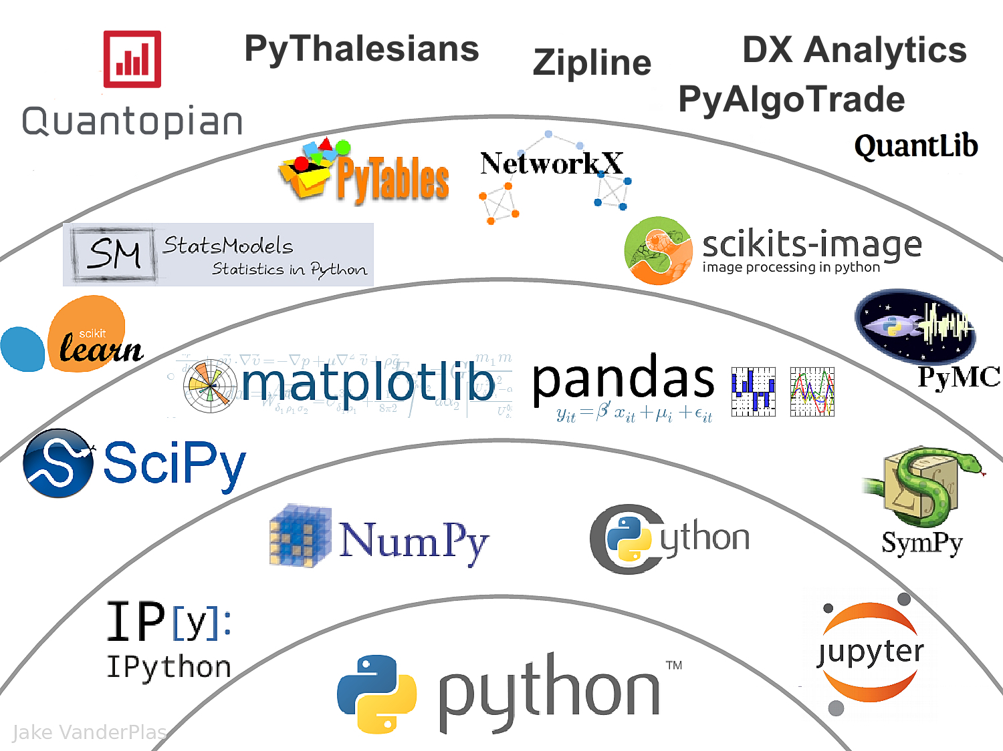
The Quant Finance PyData Stack
Source: http://nbviewer.jupyter.org/format/slides/github/quantopian/pyfolio/blob/master/pyfolio/examples/overview_slides.ipynb#/5

Slide 33
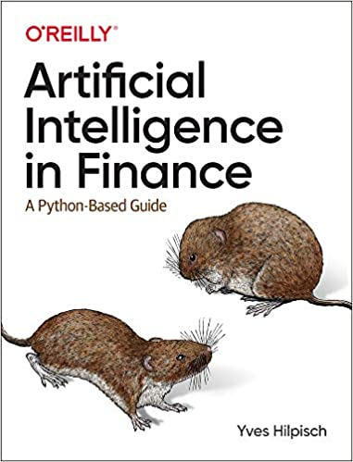
Yves Hilpisch (2020), Artificial Intelligence in Finance: A Python-Based Guide, O’Reilly
Source: https://www.amazon.com/Artificial-Intelligence-Finance-Python-Based-Guide/dp/1492055433

Slide 34
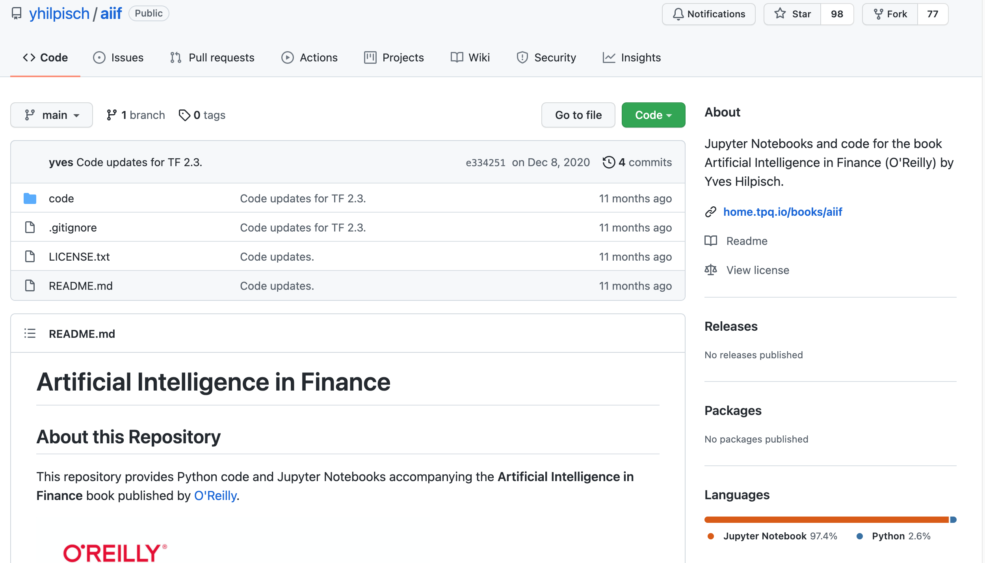
Yves Hilpisch (2020), Artificial Intelligence in Finance: A Python-Based Guide, O’Reilly
https://github.com/yhilpisch/aiif
Source: https://github.com/yhilpisch/aiif

Slide 35
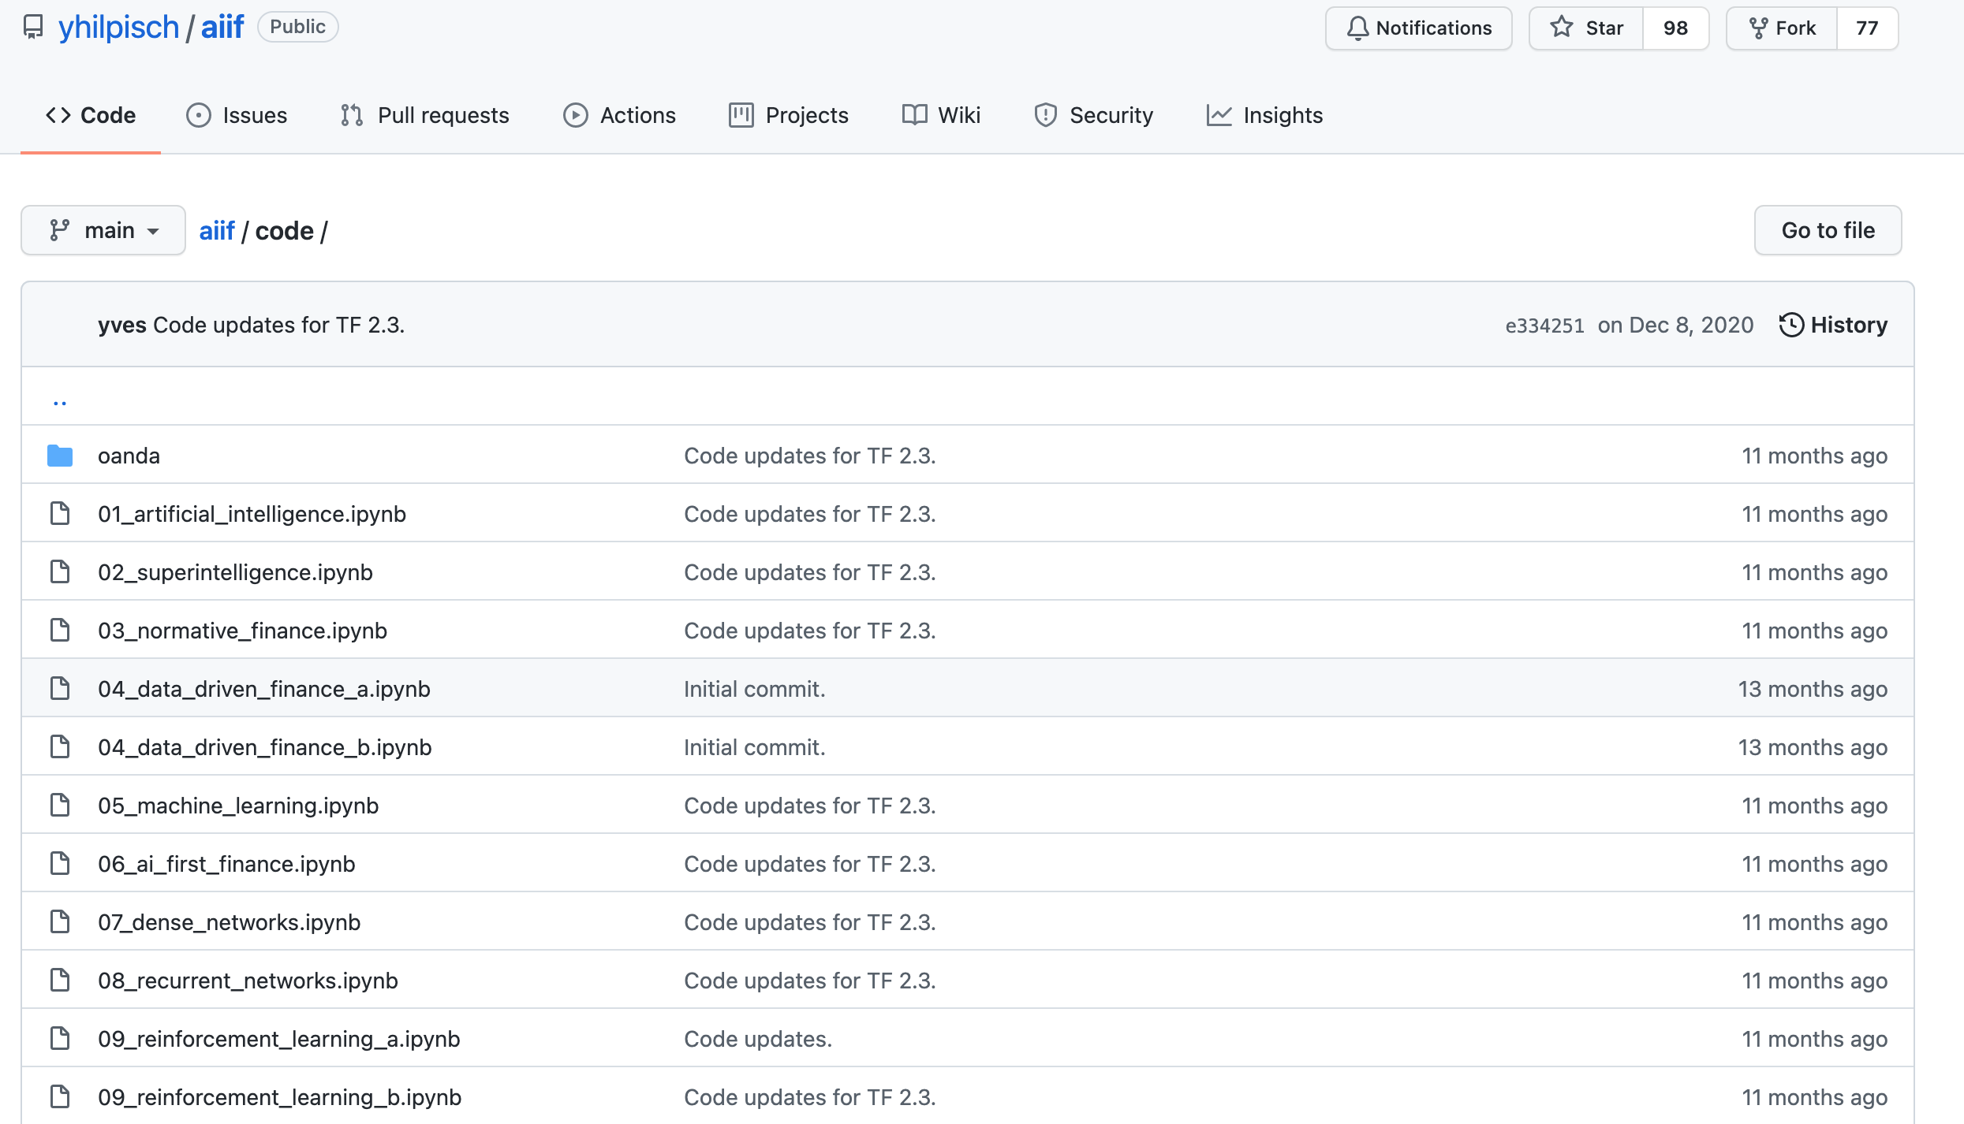
Yves Hilpisch (2020), Artificial Intelligence in Finance: A Python-Based Guide, O’Reilly
https://github.com/yhilpisch/aiif/tree/main/code
Source: https://github.com/yhilpisch/aiif/tree/main/code

Slide 36
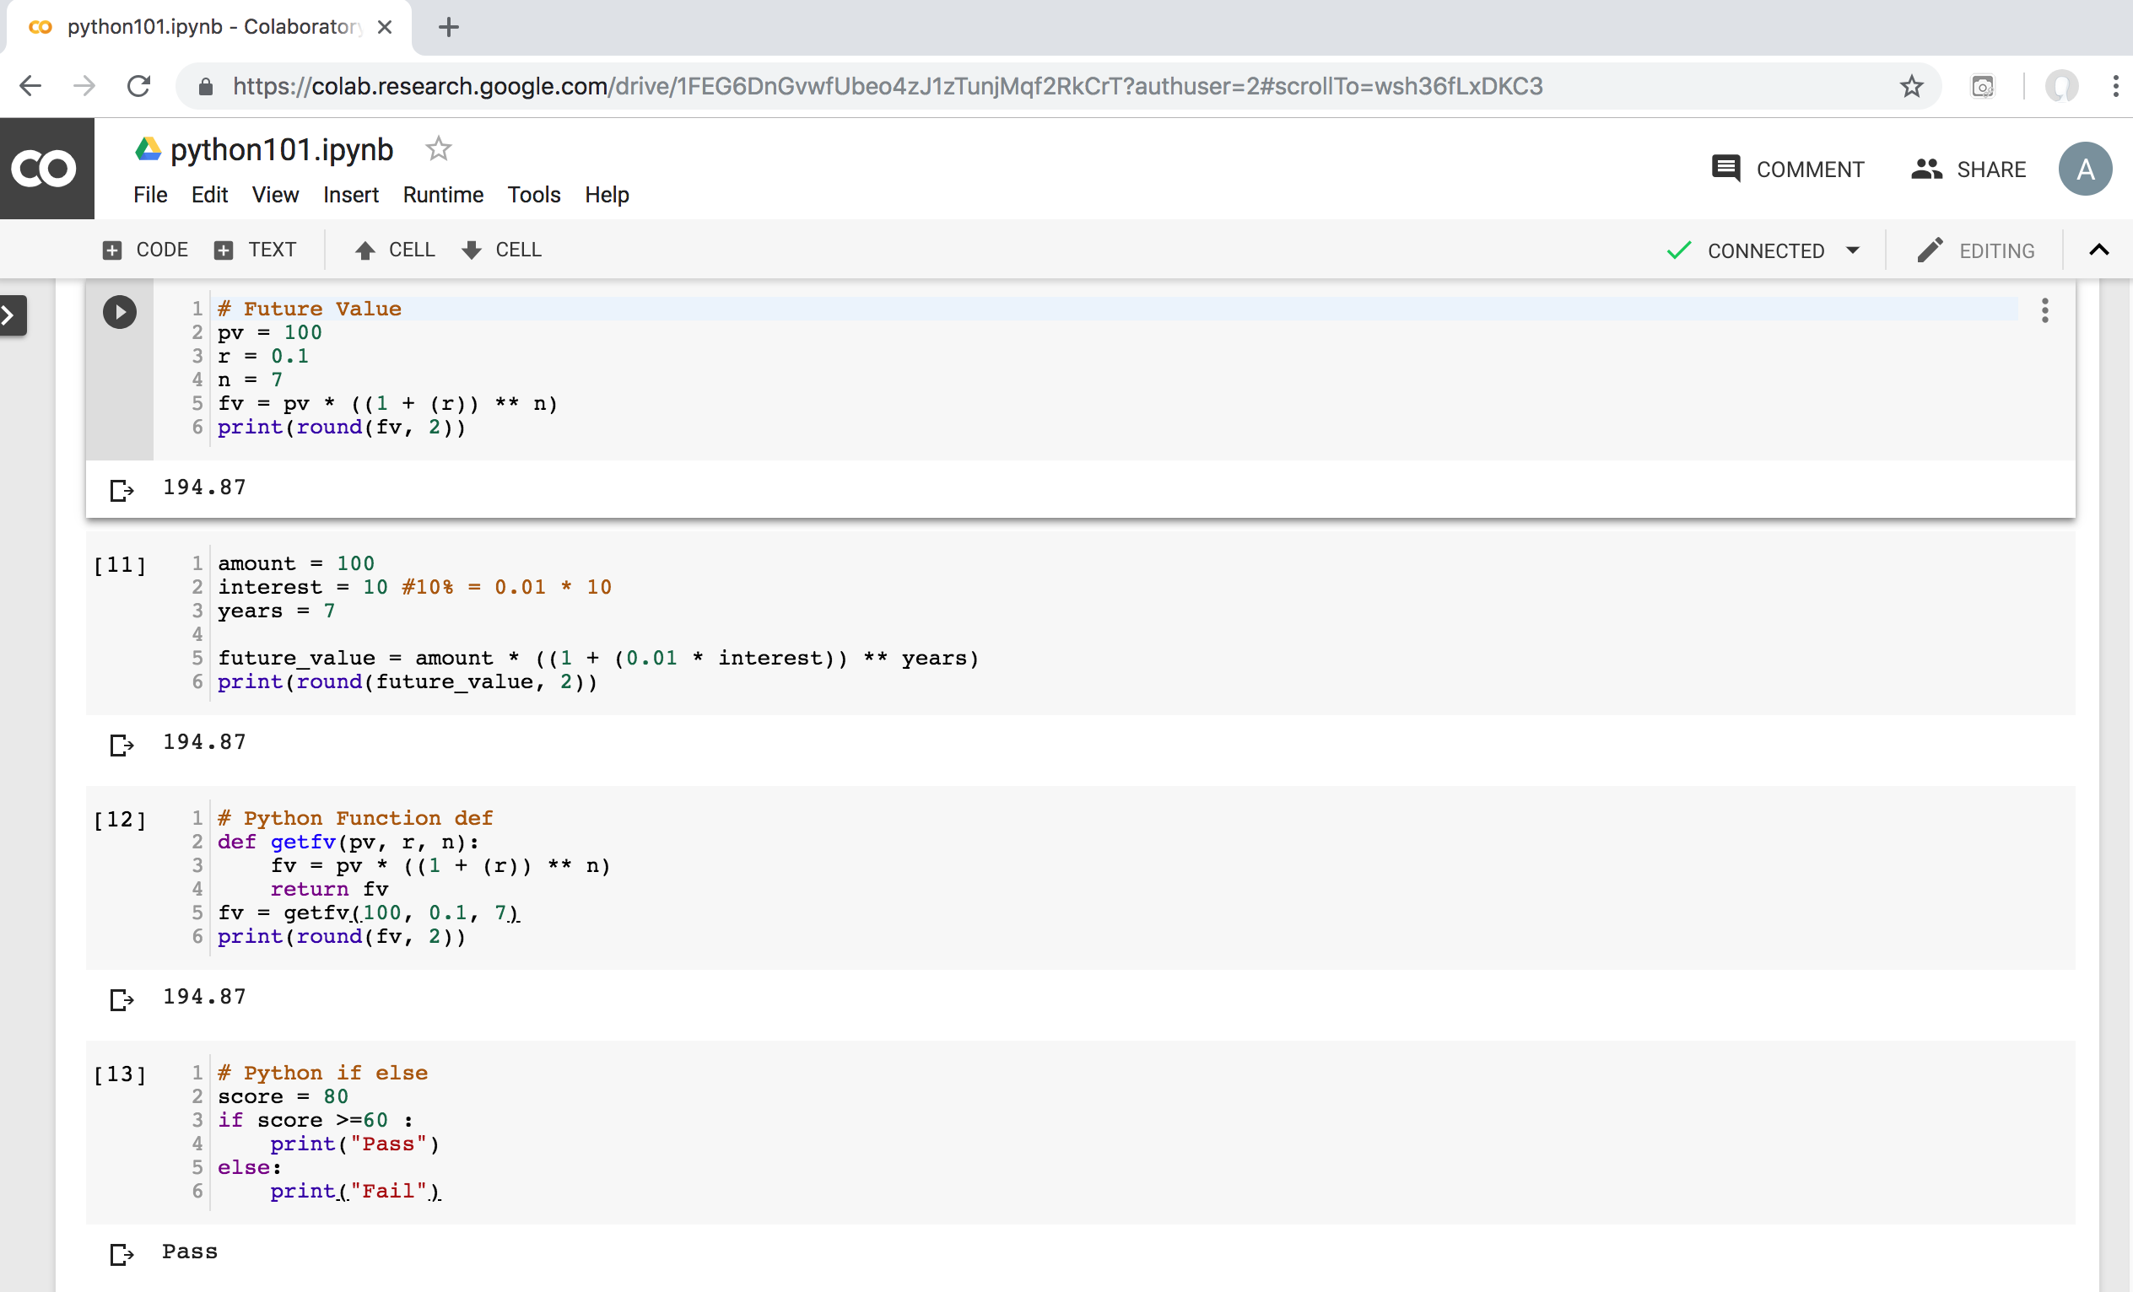
Python in Google Colab (Python101)
https://colab.research.google.com/drive/1FEG6DnGvwfUbeo4zJ1zTunjMqf2RkCrT
https://tinyurl.com/aintpupython101

Slide 37
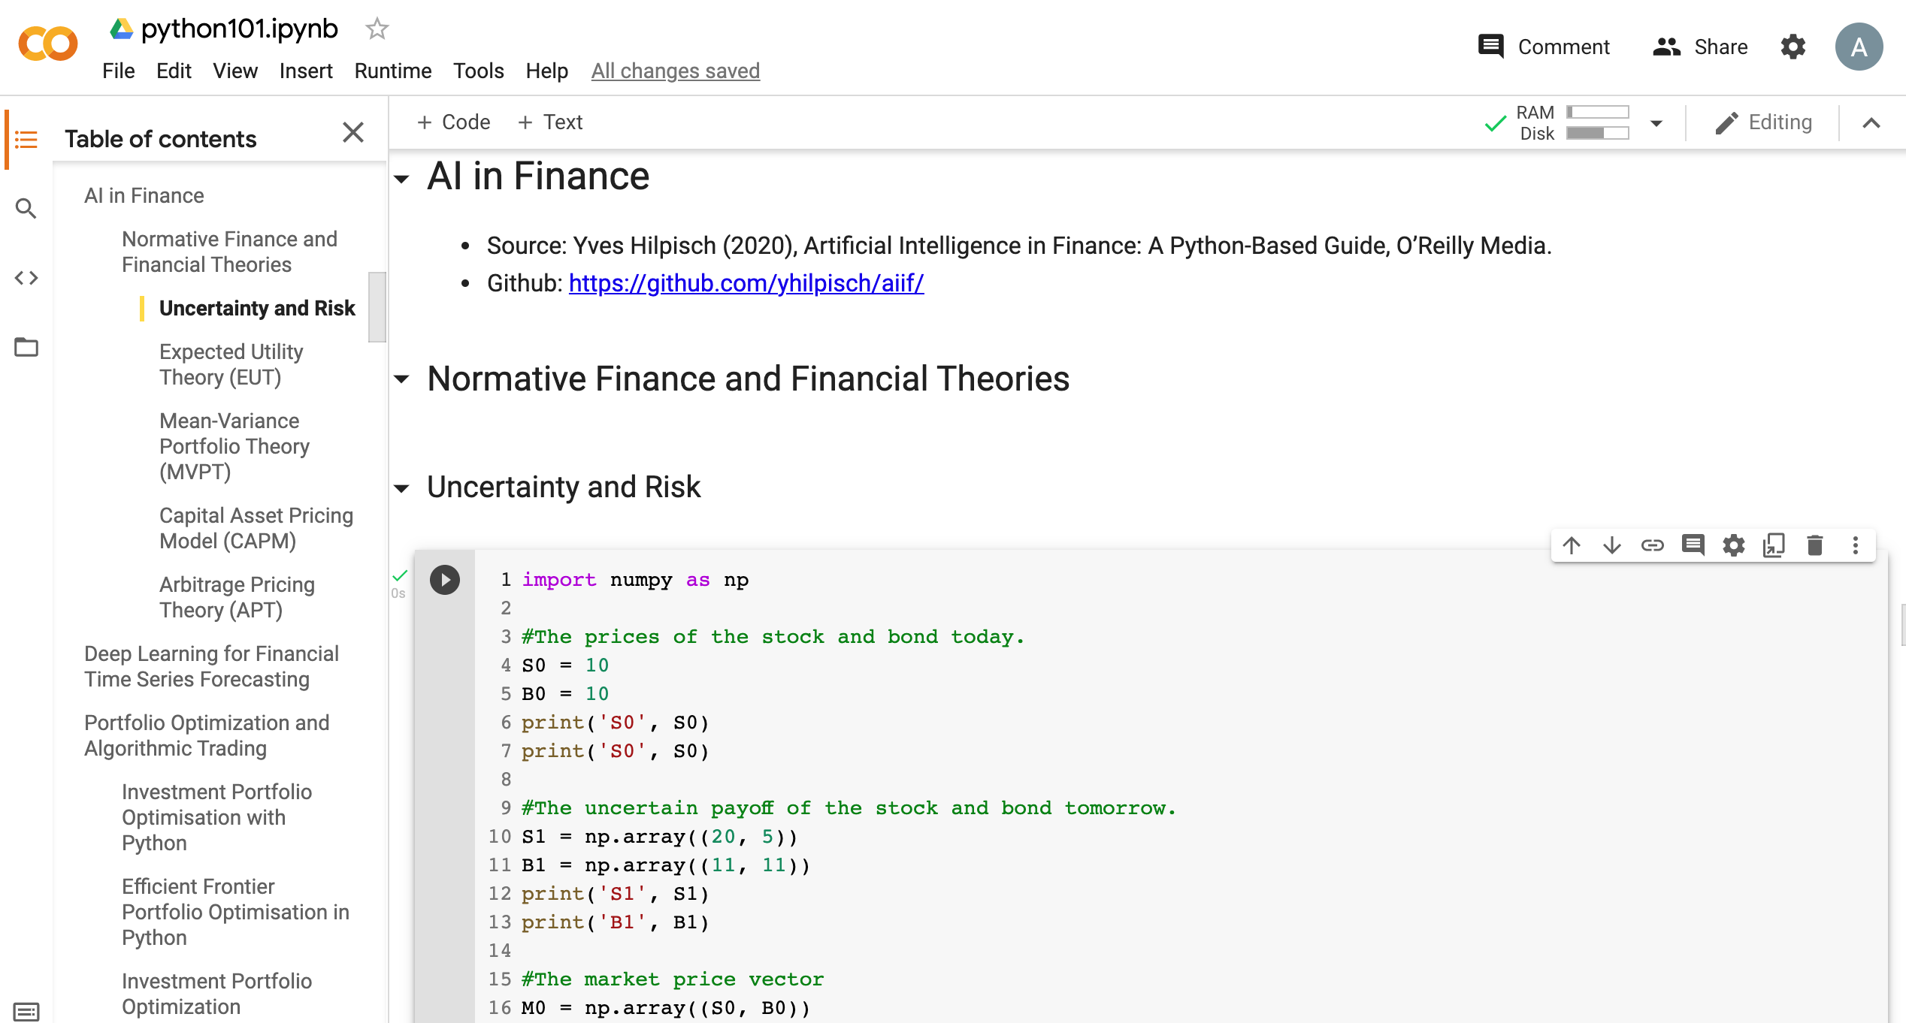
Python in Google Colab (Python101)
https://colab.research.google.com/drive/1FEG6DnGvwfUbeo4zJ1zTunjMqf2RkCrT
https://tinyurl.com/aintpupython101

Slide 38
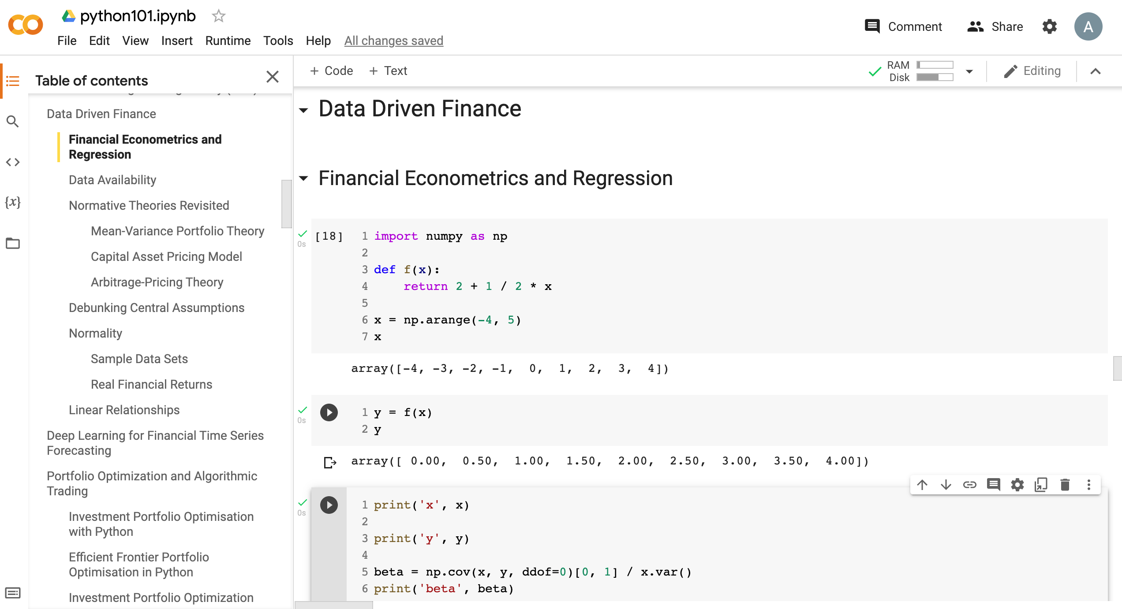
Python in Google Colab (Python101)
https://tinyurl.com/aintpupython101

Slide 39
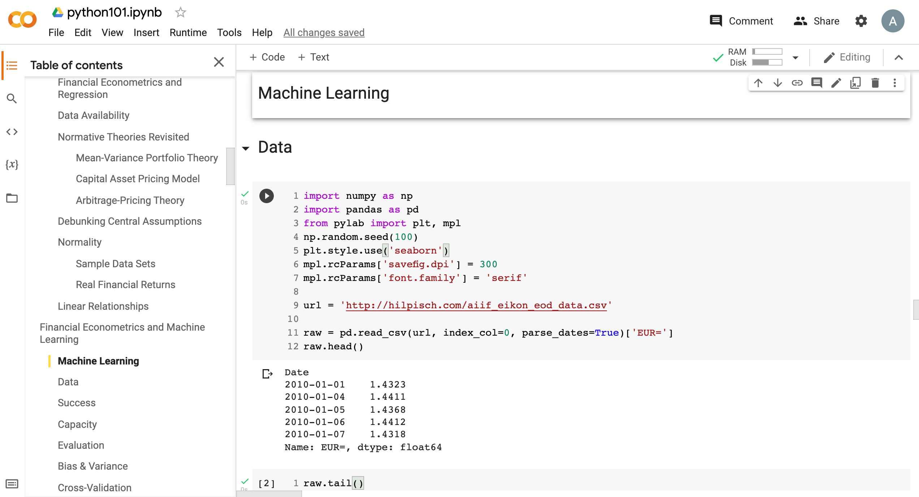
Python in Google Colab (Python101)
https://tinyurl.com/aintpupython101

Slide 40
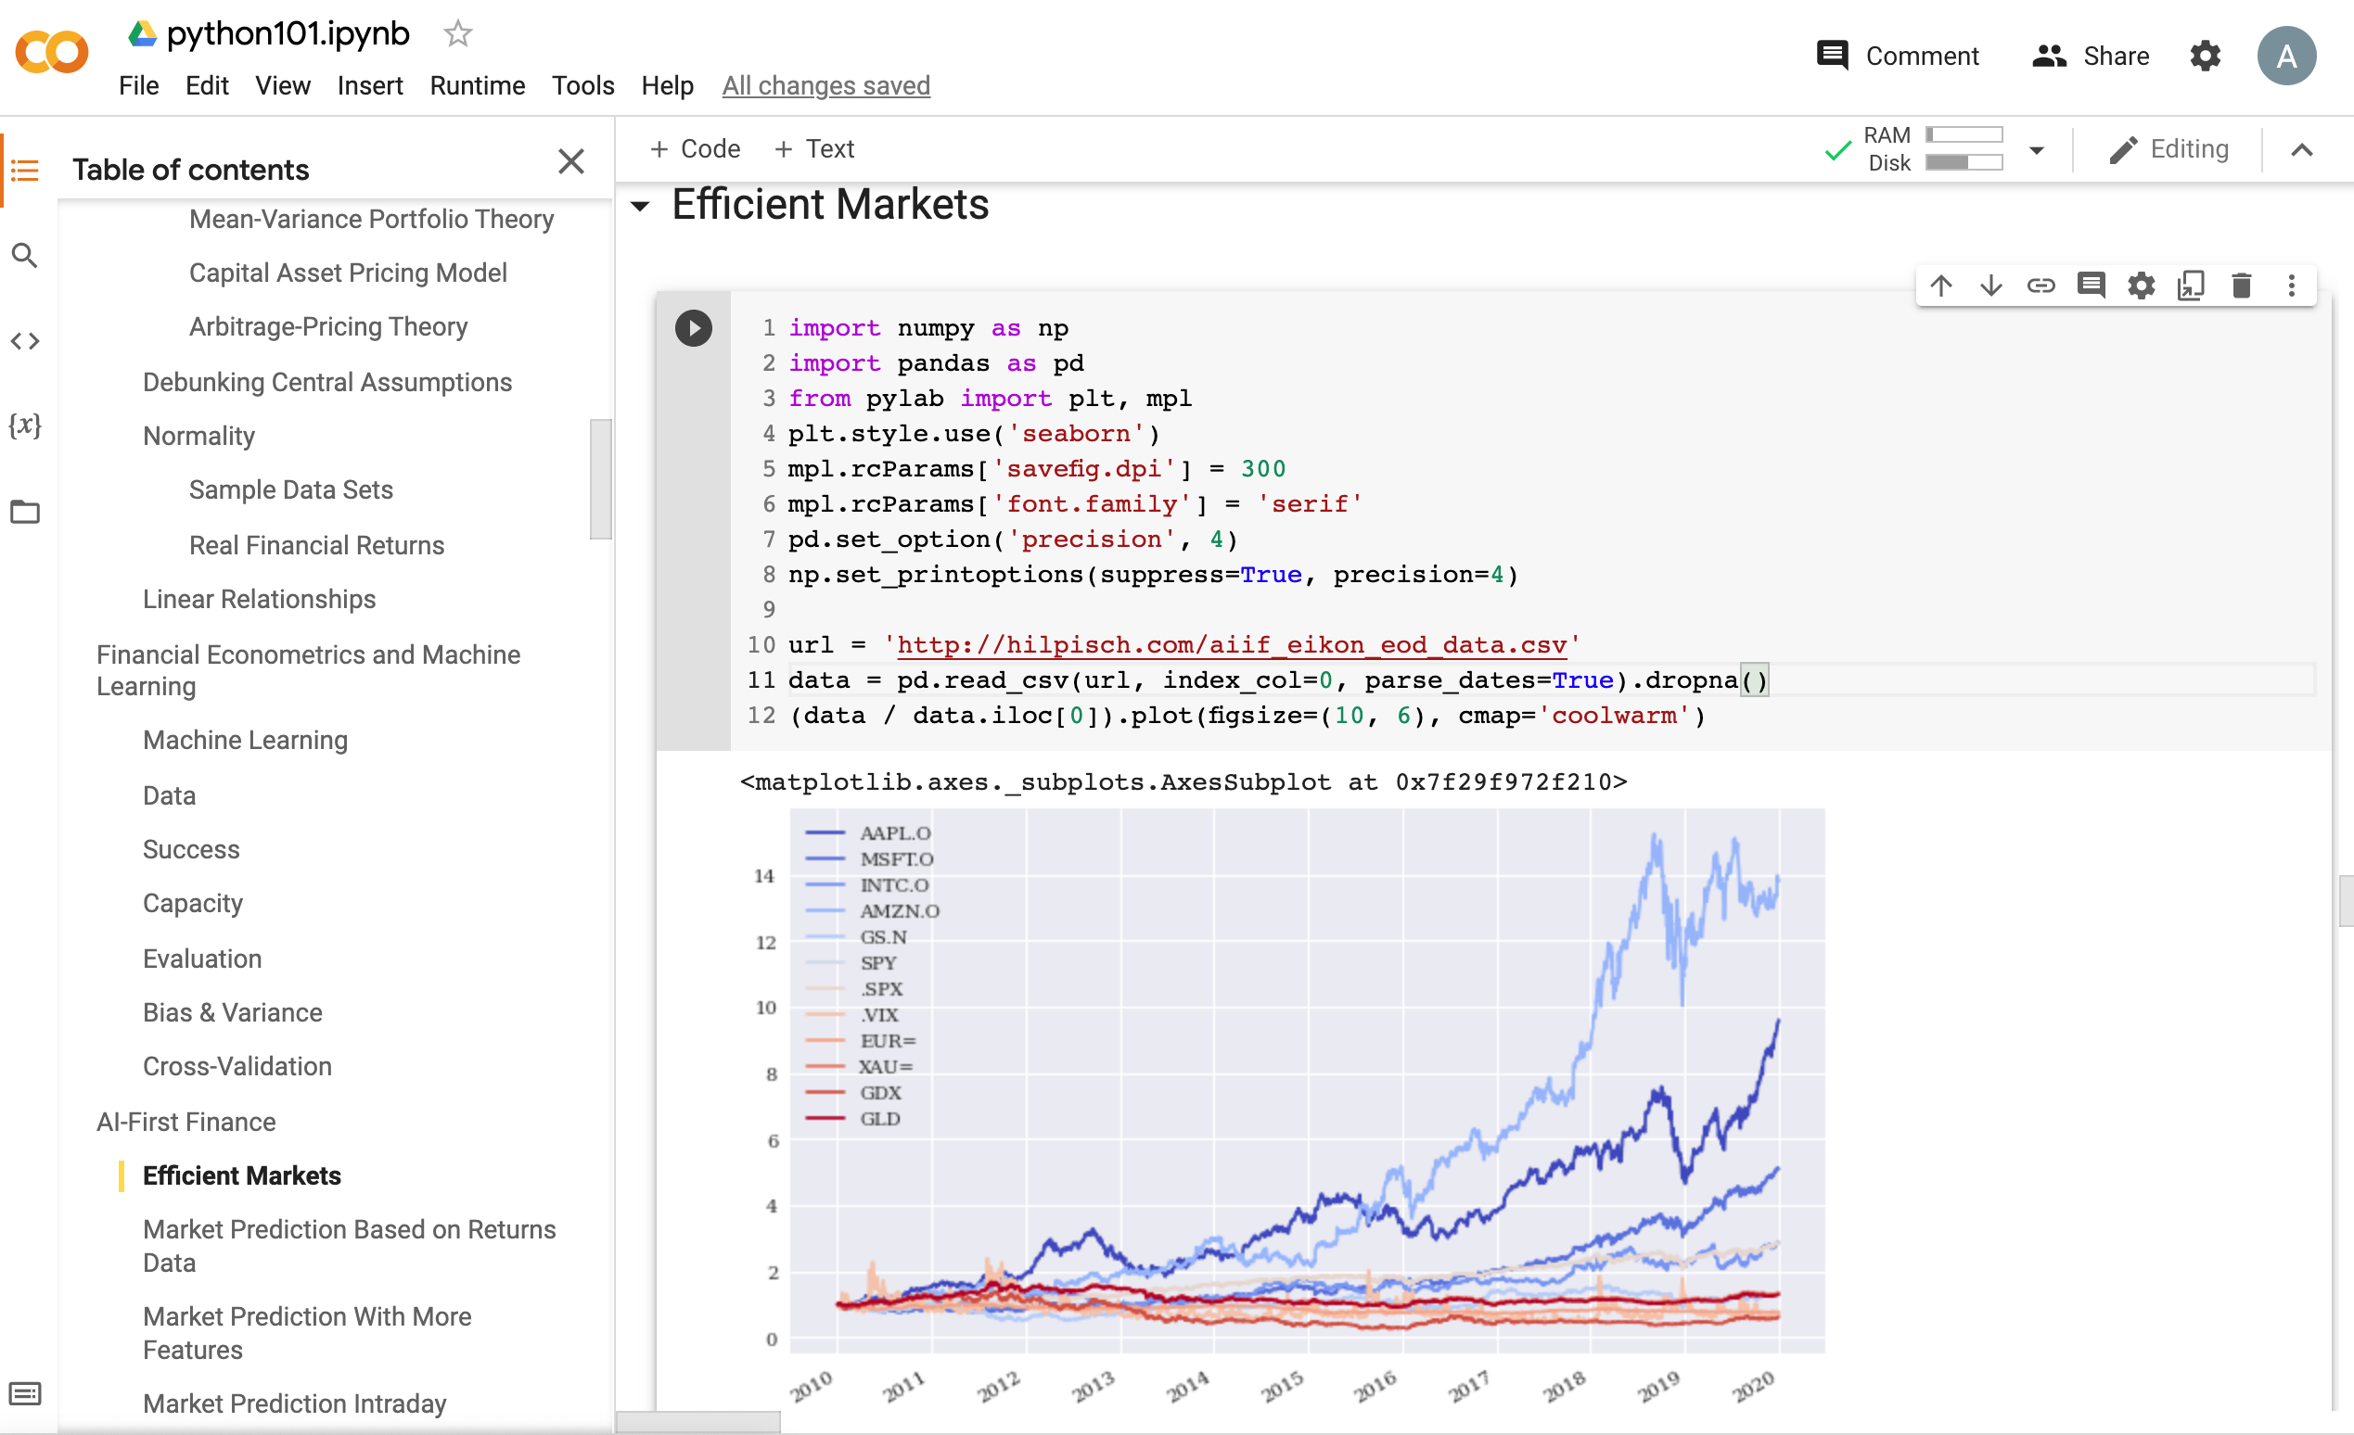
Python in Google Colab (Python101)
https://tinyurl.com/aintpupython101

Slide 41
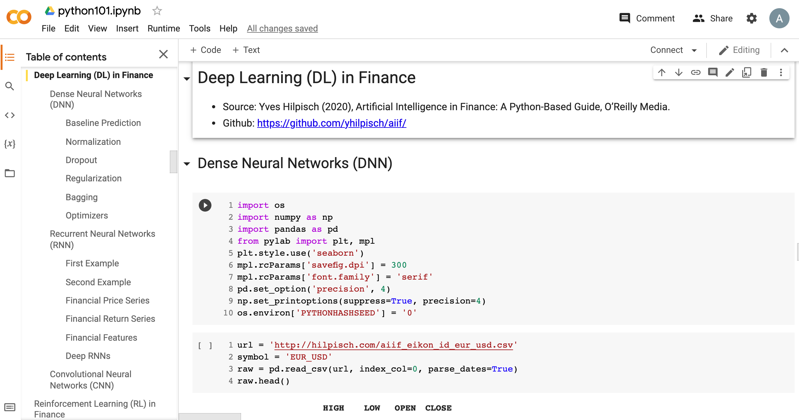
Python in Google Colab (Python101)
https://tinyurl.com/aintpupython101

Slide 42
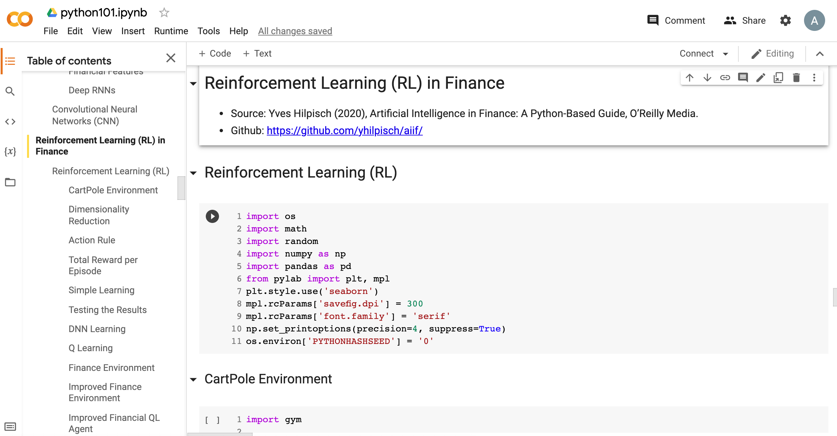
Python in Google Colab (Python101)
https://tinyurl.com/aintpupython101

Slide 43
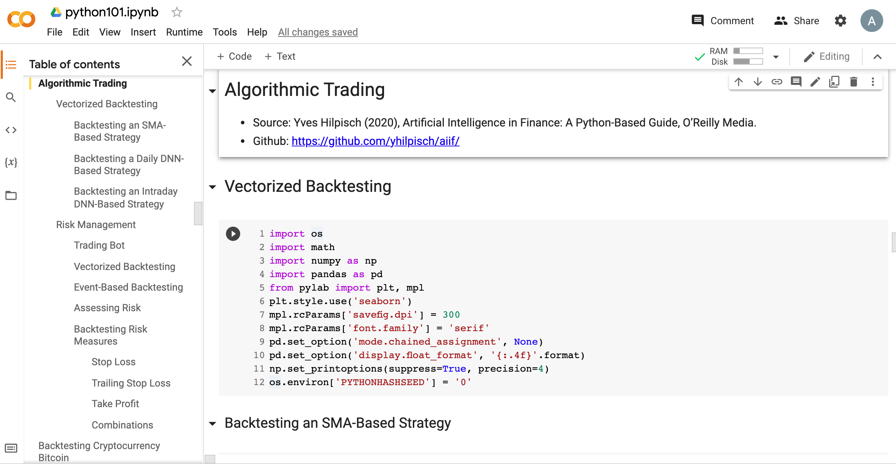
Python in Google Colab (Python101)
https://tinyurl.com/aintpupython101

Slide 44
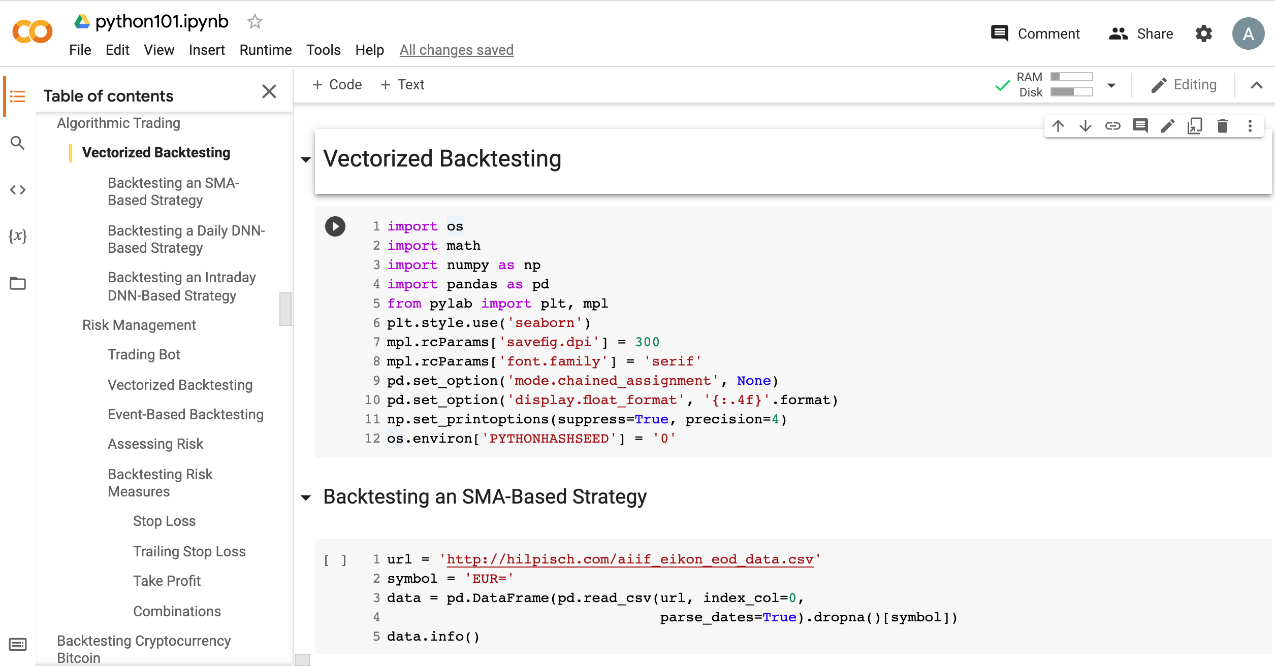
Python in Google Colab (Python101)
https://tinyurl.com/aintpupython101

Slide 45
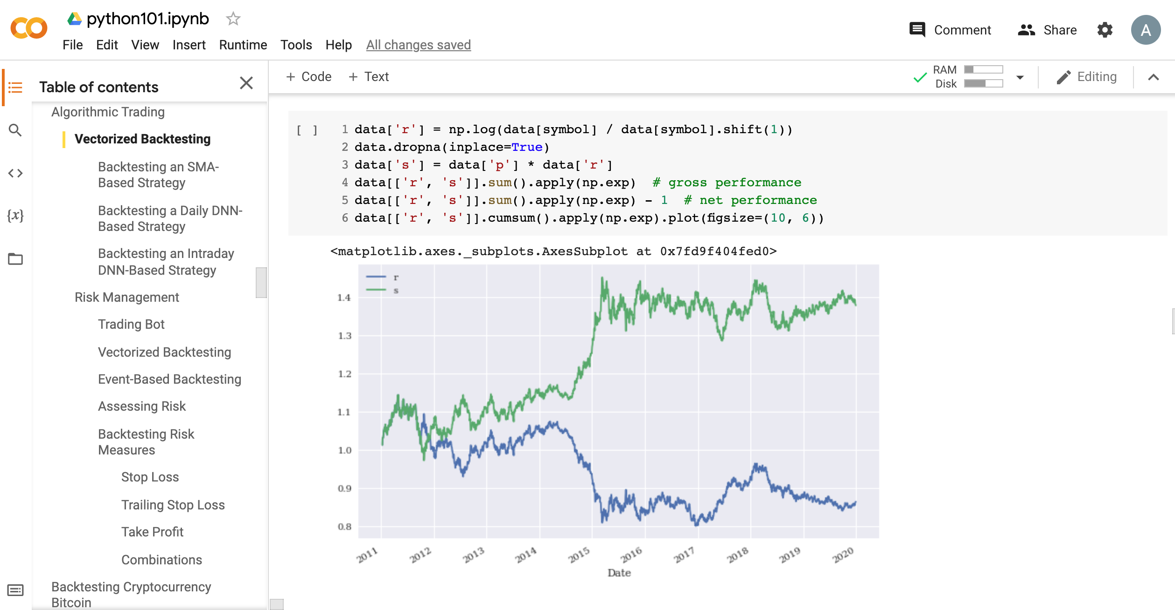
Python in Google Colab (Python101)
https://tinyurl.com/aintpupython101

Slide 46
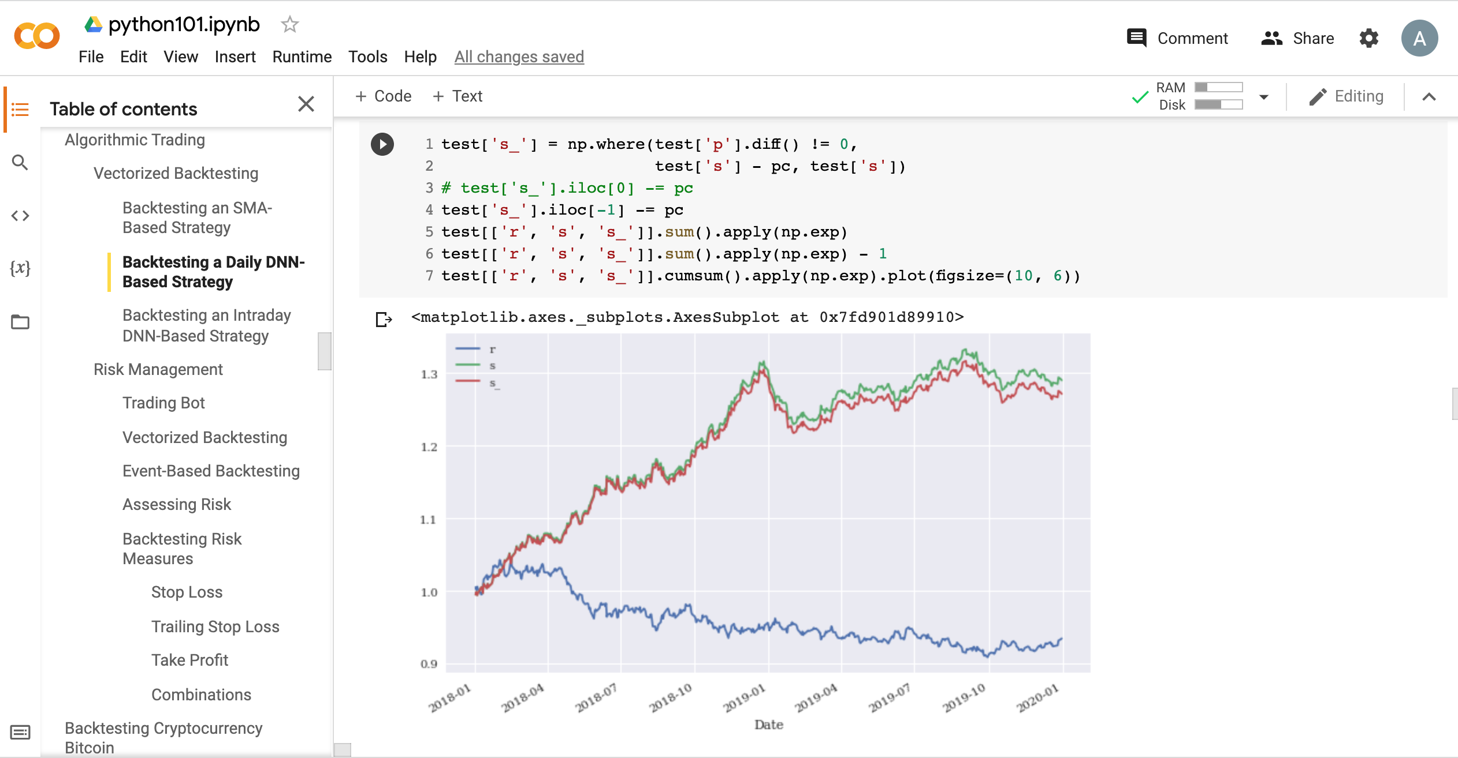
Python in Google Colab (Python101)
https://tinyurl.com/aintpupython101

Slide 47
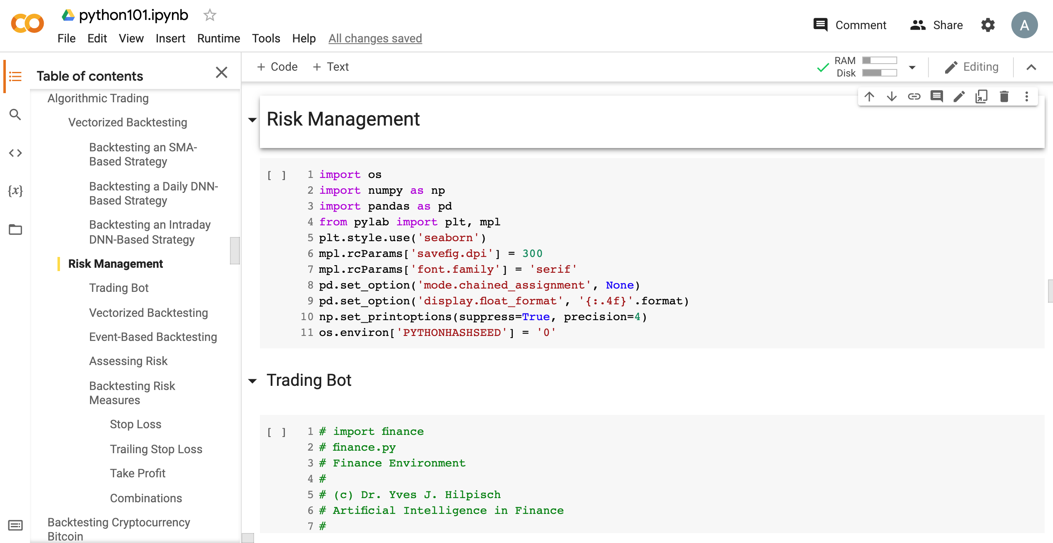
Python in Google Colab (Python101)
https://tinyurl.com/aintpupython101

Slide 48
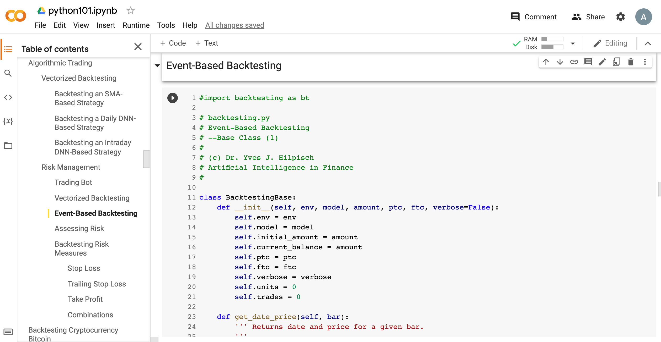
Python in Google Colab (Python101)
https://tinyurl.com/aintpupython101

Slide 49
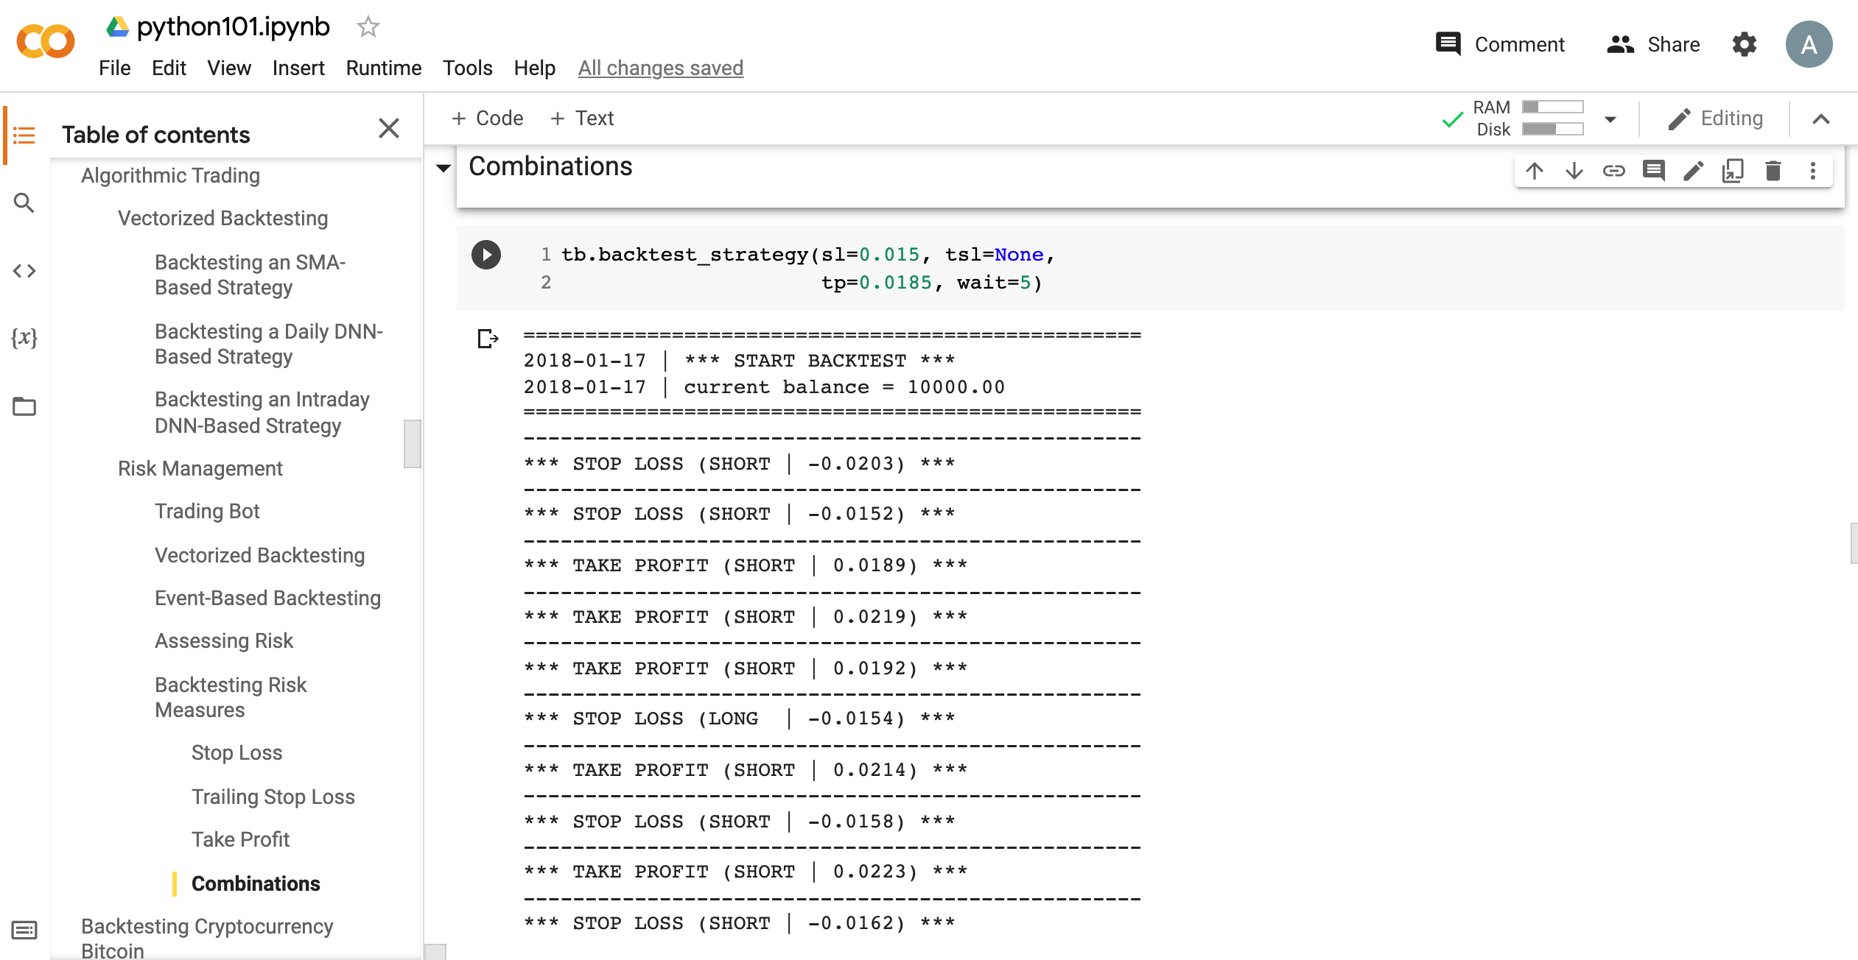
Python in Google Colab (Python101)
https://tinyurl.com/aintpupython101

Slide 50
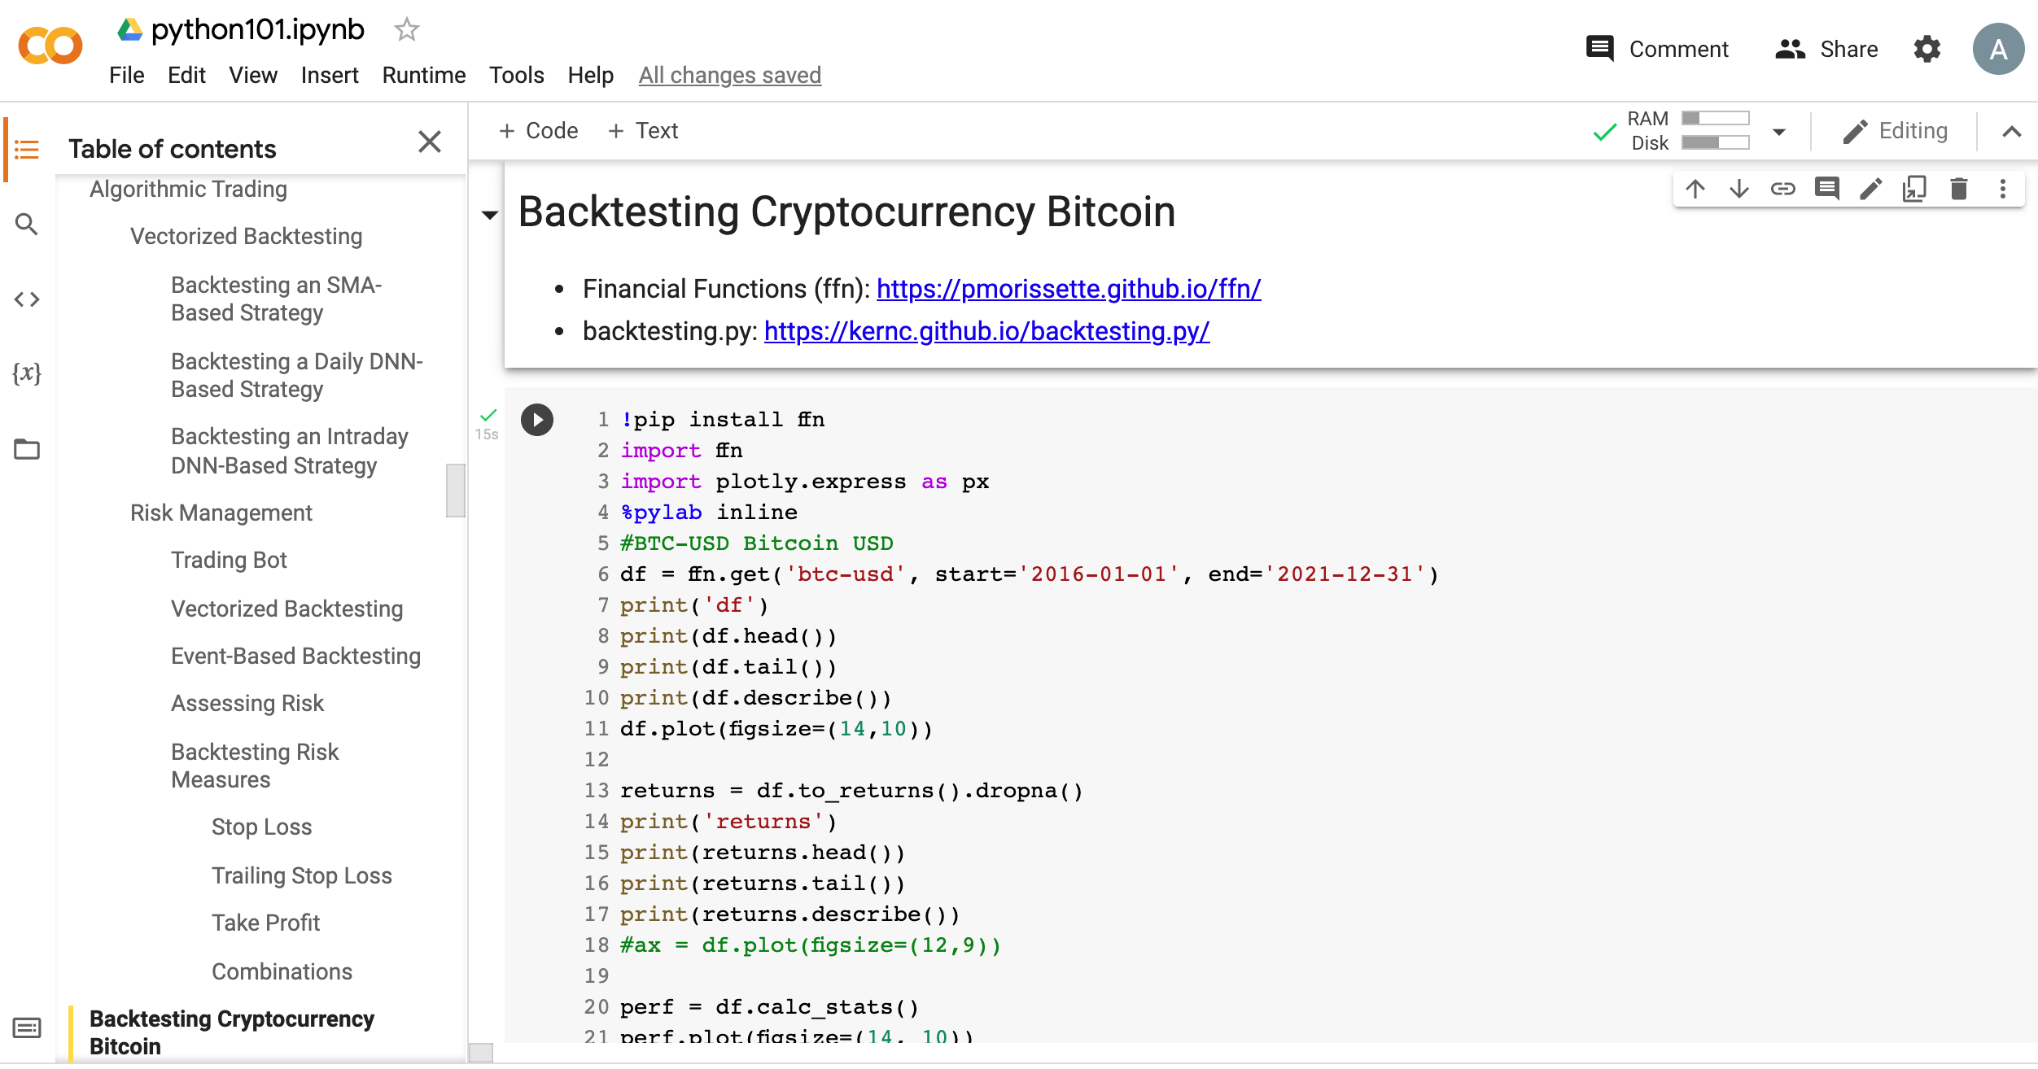
Python in Google Colab (Python101)
https://tinyurl.com/aintpupython101

Slide 51
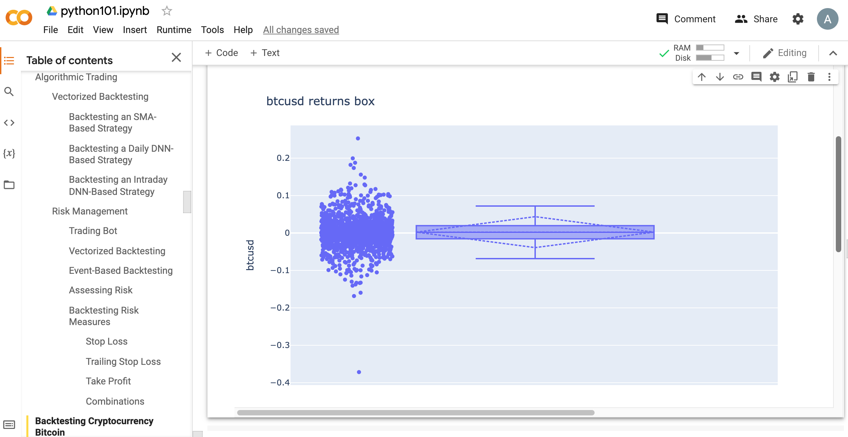
Python in Google Colab (Python101)
https://tinyurl.com/aintpupython101

Slide 52
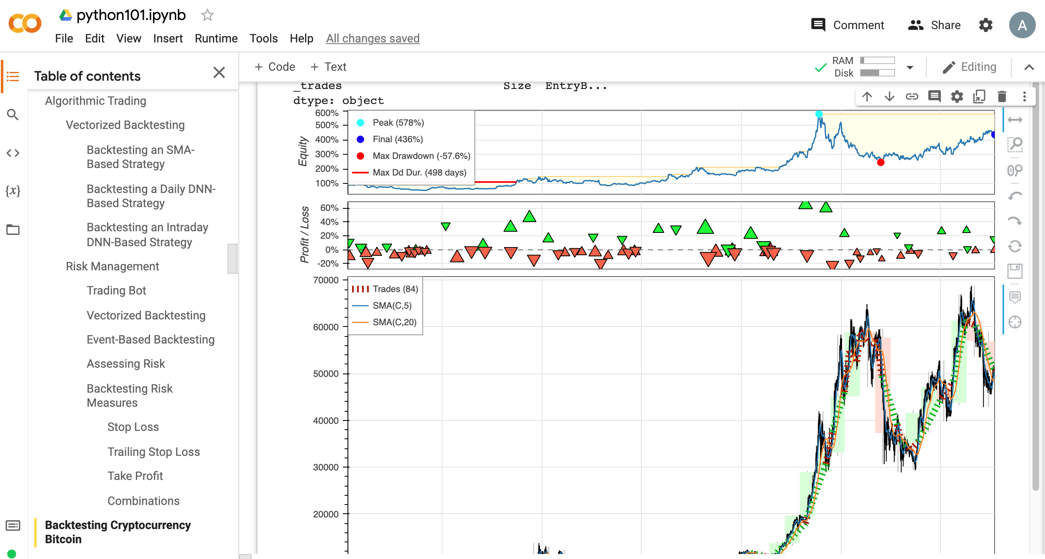
Python in Google Colab (Python101)
https://tinyurl.com/aintpupython101

Slide 53
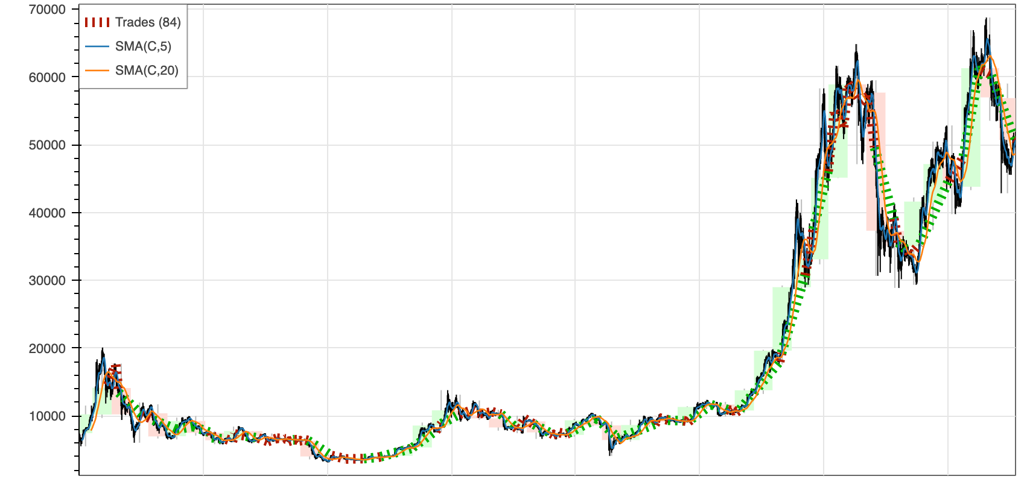
https://tinyurl.com/aintpupython101

Slide 54
Summary
Algorithmic Trading
Risk Management
Trading Bot
Event-Based Backtesting
Source: Yves Hilpisch (2020), Artificial Intelligence in Finance: A Python-Based Guide, O’Reilly Media.

Slide 55
References
Yves Hilpisch (2020), Artificial Intelligence in Finance: A Python-Based Guide, O’Reilly Media, https://github.com/yhilpisch/aiif .
Aurélien Géron (2019), Hands-On Machine Learning with Scikit-Learn, Keras, and TensorFlow: Concepts, Tools, and Techniques to Build Intelligent Systems, 2nd Edition, O’Reilly Media.
Ahmet Murat Ozbayoglu, Mehmet Ugur Gudelek, and Omer Berat Sezer (2020). "Deep learning for financial applications: A survey." Applied Soft Computing (2020): 106384.
Omer Berat Sezer, Mehmet Ugur Gudelek, and Ahmet Murat Ozbayoglu (2020), "Financial time series forecasting with deep learning: A systematic literature review: 2005–2019." Applied Soft Computing 90 (2020): 106181.
Min-Yuh Day (2021), Python 101, https://tinyurl.com/aintpupython101

