Slide 1







智慧金融量化分析概論
(Introduction to Artificial Intelligence in Finance and Quantitative Analysis)
智慧金融量化分析
(Artificial Intelligence in Finance and Quantitative Analysis)
1101AIFQA01
MBA, IM, NTPU (M6132) (Fall 2021)
Tue 2, 3, 4 (9:10-12:00) (8F40)
戴敏育 副教授
Min-Yuh Day, Ph.D, Associate Professor
國立臺北大學 資訊管理研究所
Institute of Information Management, National Taipei University
https://web.ntpu.edu.tw/~myday
2021-09-28

Slide 2


戴敏育 博士
(Min-Yuh Day, Ph.D.)
國立臺北大學 資訊管理研究所 副教授
中央研究院 資訊科學研究所 訪問學人
國立臺灣大學 資訊管理 博士
智慧金融創新科技實驗室
Intelligent Financial Innovation Technology, IFIT Lab, IM, NTPU
人工智慧 (Artificial Intelligence)
金融科技 (Financial Technology)
大數據分析 (Big Data Analytics)
資料與文字探勘 (Data Mining and Text Mining)
電子商務 (Electronic Commerce)

Slide 3
國立臺北大學 110 學年度 第1學期
課程大綱
Fall 2021 (2021.09 - 2022.02)
課程名稱：智慧金融量化分析
(Artificial Intelligence in Finance and Quantitative Analysis)
授課教師：戴敏育 (Min-Yuh Day)
開課系所：資管所碩士班 (資訊管理研究所2 )
開課資料：選修 半學年 3 學分 (3 Credits, Elective) (M6132)
上課時間：週二 2, 3, 4 (9:10-12:00)
上課教室：商8F40 (台北大學三峽校區 )
Google Meet: http://meet.google.com/uaq-vmjj-vff

Slide 4
教學目標
瞭解智慧金融量化分析基本概念與
研究議題。
具備智慧金融量化分析實務操作能力。
進行智慧金融量化分析相關之
資訊管理研究。

Slide 5
Course Objectives
Understand the fundamental concepts and research issues of Artificial Intelligence in Finance and Quantitative Analysis.
Equip with Hands-on practices of
Artificial Intelligence in Finance and Quantitative Analysis.
Conduct information systems research in the context of Artificial Intelligence in Finance and Quantitative Analysis.

Slide 6
內容綱要
本課程介紹智慧金融量化分析
基本概念、研究議題、與實務操作。
課程內容包括：
  智慧金融量化分析概論、
  AI 金融科技: 金融服務創新應用、
  投資心理學與行為財務學、
  財務金融事件研究法、
  財務金融理論、
  數據驅動財務金融、
  金融計量經濟學、
  人工智慧優先金融、
  財務金融深度學習、財務金融強化學習、
  演算法交易、風險管理、交易機器人與基於事件的回測、
  與智慧金融量化分析分析個案研究。

Slide 7
Course Outline
This course introduces the fundamental concepts, research issues, and hands-on practices of AI in Finance and Quantitative Analysis.
Topics include:
  Introduction to Artificial Intelligence in Finance and Quantitative Analysis,
  AI in FinTech: Financial Services Innovation and Application,
  Investing Psychology and Behavioral Finance,
  Event Studies in Finance,
  Finance Theory,
  Data-Driven Finance,
  Financial Econometrics,
  AI-First Finance,
  Deep Learning in Finance, Reinforcement Learning in Finance,
  Algorithmic Trading, Risk Management, Trading Bot and Event-Based Backtesting,
  Case Study on AI in Finance and Quantitative Analysis.

Slide 8
資訊管理研究所
系核心能力
(Core Competence)
資訊科技新知探索與系統開發應用 80 %
網路行銷企劃能力 10 %
論文寫作與獨立研究能力新知 10 %

Slide 9
校四大基本素養
Four Fundamental Qualities
專業 (Professionalism)
  創意思考與問題解決 (Creative thinking and Problem-solving) 40 %
  綜合統整(Comprehensive Integration) 40 %
人際 (Interpersonal Relationship)
  溝通協調 (Communication and Coordination) 10 %
  團隊合作 (Teamwork) 5 %
倫理 (Ethics)
  誠信正直(Honesty and Integrity) 0 %
  尊重自省(Self-Esteem and Self-reflection) 0 %
國際觀 (International Vision)
  多元關懷 (Caring for Diversity) 0 %
  跨界宏觀 (Interdisciplinary Vision) 5 %

Slide 10
商學院學習目標
(College Learning Goals)
Ethics/Corporate Social Responsibility
Global Knowledge/Awareness
Communication
Analytical and Critical Thinking

Slide 11
系所學習目標
(Department Learning Goals)
Information Technologies and
System Development Capabilities
Internet Marketing Management Capabilities
Research capabilities

Slide 12
課程大綱 (Syllabus)
週次 (Week) 日期 (Date) 內容 (Subject/Topics)
1 2021/09/28 智慧金融量化分析概論
(Introduction to Artificial Intelligence in Finance and Quantitative Analysis)
2 2021/10/05 AI 金融科技: 金融服務創新應用
(AI in FinTech: Financial Services Innovation and Application)
3 2021/10/12 投資心理學與行為財務學
(Investing Psychology and Behavioral Finance)
4 2021/10/19 財務金融事件研究法 (Event Studies in Finance)
5 2021/10/26 智慧金融量化分析個案研究 I
(Case Study on AI in Finance and Quantitative Analysis I)
6 2021/11/02 財務金融理論 (Finance Theory)

Slide 13
課程大綱 (Syllabus)
週次 (Week) 日期 (Date) 內容 (Subject/Topics)
7 2021/11/09 數據驅動財務金融 (Data-Driven Finance)
8 2021/11/16 期中報告 (Midterm Project Report)
9 2021/11/23 金融計量經濟學 (Financial Econometrics)
10 2021/11/30 人工智慧優先金融 (AI-First Finance)
11 2021/12/07 智慧金融量化分析產業實務
(Industry Practices of AI in Finance and Quantitative Analysis )
12 2021/12/14 智慧金融量化分析個案研究 II
(Case Study on AI in Finance and Quantitative Analysis II)

Slide 14
課程大綱 (Syllabus)
週次 (Week) 日期 (Date) 內容 (Subject/Topics)
13 2021/12/21 財務金融深度學習(Deep Learning in Finance);
財務金融強化學習 (Reinforcement Learning in Finance)
14 2021/12/28 演算法交易 (Algorithmic Trading);
風險管理 (Risk Management);
交易機器人與基於事件的回測
(Trading Bot and Event-Based Backtesting)
15 2022/01/04 期末報告 I (Final Project Report I)
16 2022/01/11 期末報告 II (Final Project Report II)
17 2022/01/18 學生自主學習 (Self-learning)
18 2022/01/25 學生自主學習 (Self-learning)

Slide 15
教學方法與教學活動
(Teaching methods and activities)
講授 (Lecture)
討論 (Discussion)
實習 (Practicum)

Slide 16
評量方式 (Evaluation Methods)
個人報告 (Individual Presentation) 60 %
個案分析報告 (Case Report) 10 %
課堂參與 (Class Participation) 10 %
團體報告 (Group Presentation) 10 %
作業 (Assignment) 10 %

Slide 17
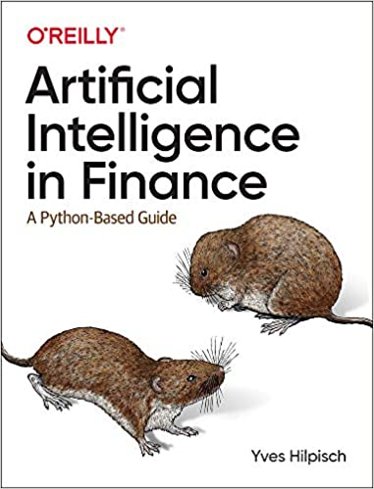
指定用書 (Required Texts)
Yves Hilpisch (2020),
Artificial Intelligence in Finance: A Python-Based Guide,
O’Reilly Media.
Source: https://www.amazon.com/Artificial-Intelligence-Finance-Python-Based-Guide/dp/1492055433

Slide 18
指定用書 (Required Texts)
Aurélien Géron (2019),
Hands-On Machine Learning with Scikit-Learn, Keras, and TensorFlow: Concepts, Tools, and Techniques to Build Intelligent Systems,
2nd Edition, O’Reilly Media.
Yves Hilpisch (2018),
Python for Finance: Mastering Data-Driven Finance,
2nd Edition, O'Reilly Media.

Slide 19
其他參考資料 (Other References)
Paolo Sironi (2016),
FinTech Innovation: From Robo-Advisors to Goal Based Investing and Gamification,
Wiley.
Yuxing Yan (2017),
Python for Finance: Apply powerful finance models and quantitative analysis with Python,
Second Edition, Packt Publishing

Slide 20
Yves Hilpisch (2020),
Artificial Intelligence in Finance:
A Python-Based Guide,
O’Reilly
Source: https://www.amazon.com/Artificial-Intelligence-Finance-Python-Based-Guide/dp/1492055433

Slide 21
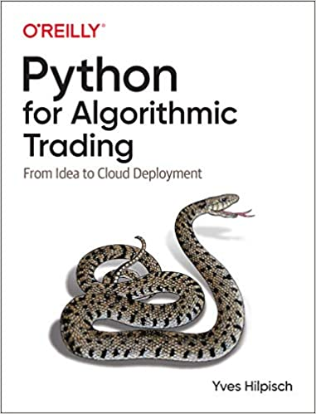
Yves Hilpisch (2020),
Python for Algorithmic Trading:
From Idea to Cloud Deployment,
O’Reilly
Source: https://www.amazon.com/Python-Algorithmic-Trading-Cloud-Deployment/dp/149205335X

Slide 22
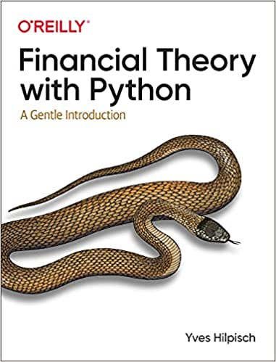
Yves Hilpisch (2021),
Financial Theory with Python:
A Gentle Introduction,
O’Reilly
Source: https://www.amazon.com/Financial-Theory-Python-Gentle-Introduction/dp/1098104358

Slide 23
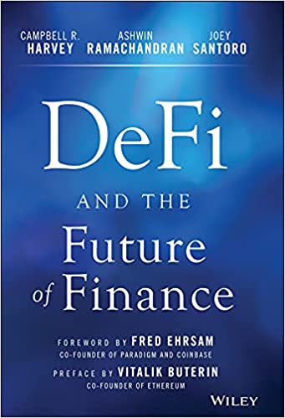
Campbell R. Harvey, Ashwin Ramachandran, Joey Santoro, Fred Ehrsam (2021),
DeFi and the Future of Finance,
Wiley
Source: https://www.amazon.com/DeFi-Future-Finance-Campbell-Harvey-ebook/dp/B09DJV2QLC

Slide 24
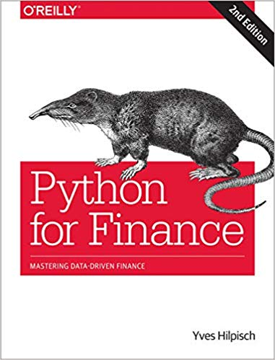
Yves Hilpisch (2018),
Python for Finance: Mastering Data-Driven Finance, O'Reilly
Source: https://www.amazon.com/Python-Finance-Mastering-Data-Driven/dp/1492024333

Slide 25
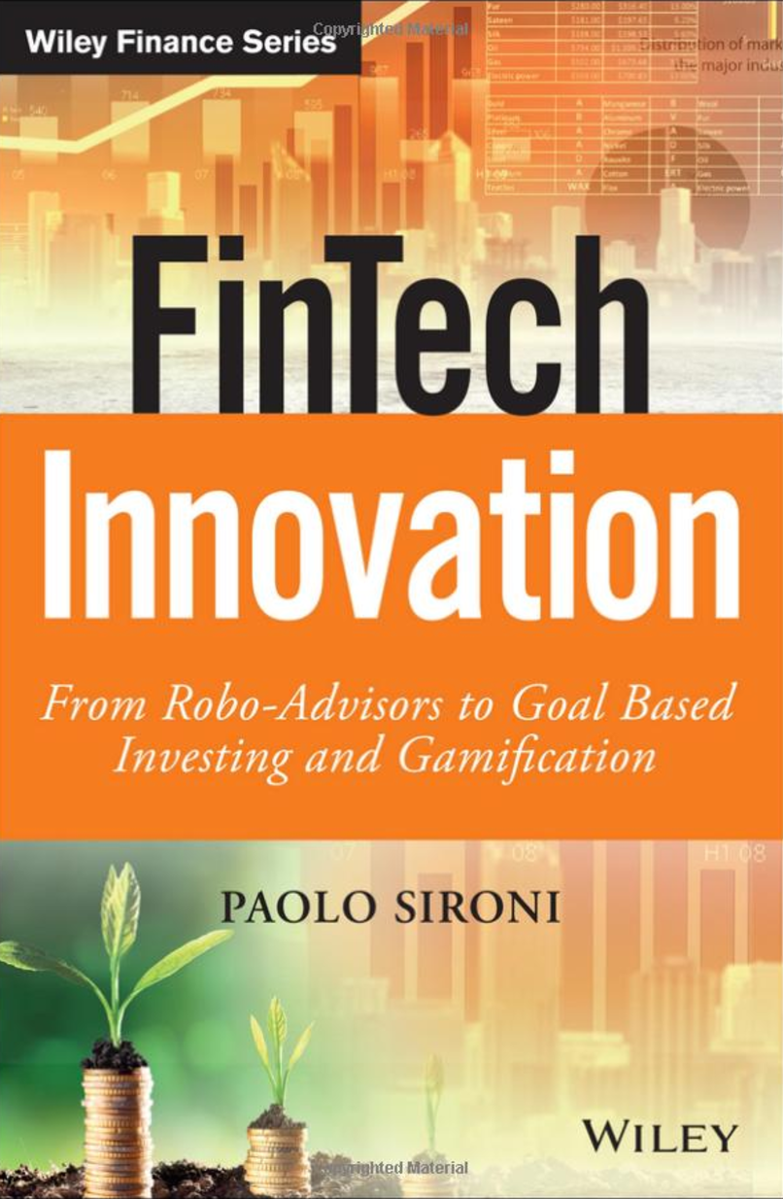
Paolo Sironi (2016)
FinTech Innovation:
From Robo-Advisors to Goal Based Investing and Gamification,
Wiley
Source: https://www.amazon.com/FinTech-Innovation-Robo-Advisors-Investing-Gamification/dp/1119226988

Slide 26
Doron Kliger and Gregory Gurevich (2014),
Event Studies for Financial Research:
A Comprehensive Guide,
Palgrave Macmillan
Source: https://www.amazon.com/Event-Studies-Financial-Research-Comprehensive/dp/1137435380/

Slide 27
Yuxing Yan (2017),
Python for Finance: Apply powerful finance models and quantitative analysis with Python, Second Edition, Packt Publishing
Source: https://www.amazon.com/Python-Finance-powerful-quantitative-analysis/dp/1787125696

Slide 28

Aurélien Géron (2019),
Hands-On Machine Learning with Scikit-Learn, Keras, and TensorFlow: Concepts, Tools, and Techniques to Build Intelligent Systems, 2nd Edition
O’Reilly Media, 2019
https://github.com/ageron/handson-ml2
Source: https://www.amazon.com/Hands-Machine-Learning-Scikit-Learn-TensorFlow/dp/1492032646/

Slide 29

Hands-On Machine Learning with
Scikit-Learn, Keras, and TensorFlow
Notebooks
The Machine Learning landscape
End-to-end Machine Learning project
Classification
Training Models
Support Vector Machines
Decision Trees
Ensemble Learning and Random Forests
Dimensionality Reduction
Unsupervised Learning Techniques
Artificial Neural Nets with Keras
Training Deep Neural Networks
Custom Models and Training with TensorFlow
Loading and Preprocessing Data
Deep Computer Vision Using Convolutional Neural Networks
Processing Sequences Using RNNs and CNNs
Natural Language Processing with RNNs and Attention
Representation Learning Using Autoencoders
Reinforcement Learning
Training and Deploying TensorFlow Models at Scale
https://github.com/ageron/handson-ml2

Slide 30
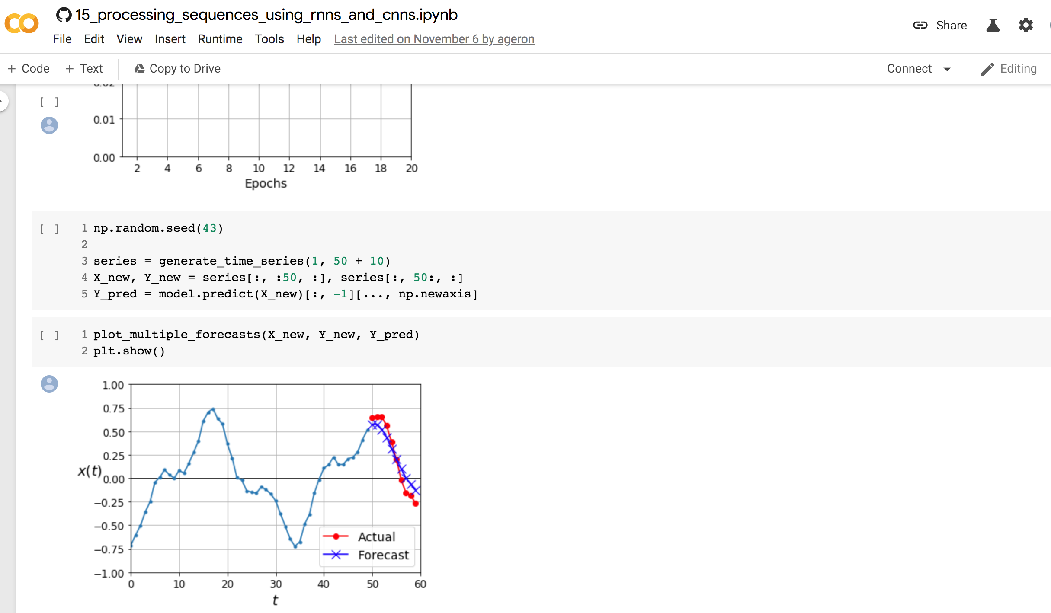
Sequences using RNNs and CNNs
https://colab.research.google.com/github/ageron/handson-ml2/blob/master/15_processing_sequences_using_rnns_and_cnns.ipynb

Slide 31
AI, Big Data, Cloud Computing
Evolution of Decision Support, Business Intelligence, and Analytics
AI
AI
Cloud Computing
Big Data
DM
BI
Source: Ramesh Sharda, Dursun Delen, and Efraim Turban (2017),
Business Intelligence, Analytics, and Data Science: A Managerial Perspective, 4th Edition, Pearson

Slide 32
The Rise of AI
Source: DHL (2018), Artificial Intelligence in Logistics,
http://www.globalhha.com/doclib/data/upload/doc_con/5e50c53c5bf67.pdf/

Slide 33
FinTech

Slide 34
Financial Technology

Slide 35
FinTech

Slide 36
Financial Technology
FinTech
“providing
financial services
by making use of software and
modern technology”
Source: https://www.fintechweekly.com/fintech-definition

Slide 37
Financial Services

Slide 38

Financial Services
Source: http://www.crackitt.com/7-reasons-why-your-fintech-startup-needs-visual-marketing/

Slide 39
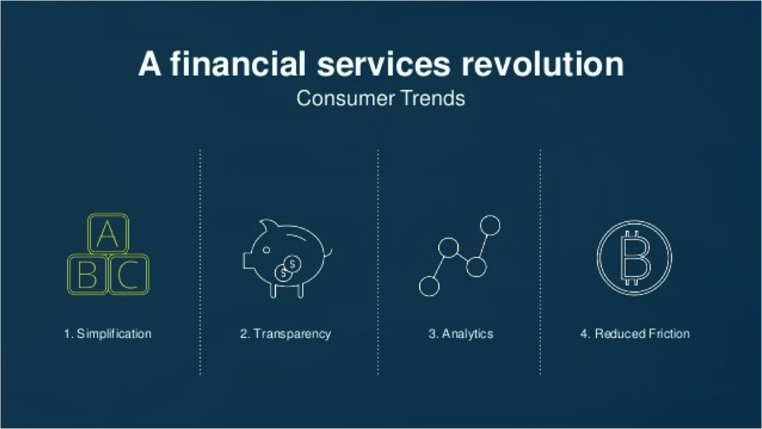
Financial Revolution with Fintech
Source: http://www.hedgethink.com/fintech/european-fintech-top-100/

Slide 40
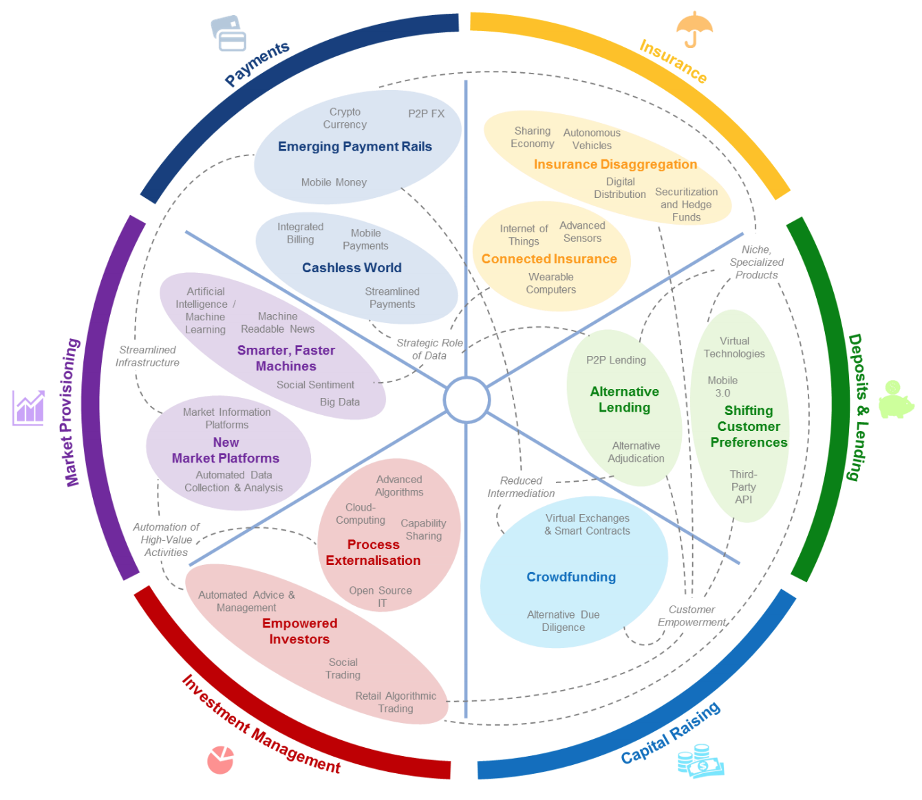
FinTech: Financial Services Innovation
Source: http://www3.weforum.org/docs/WEF_The_future__of_financial_services.pdf

Slide 41
FinTech:
Financial Services Innovation
1. Payments
2. Insurance
3. Deposits & Lending
4. Capital Raising
5. Investment Management
6. Market Provisioning
Source: http://www3.weforum.org/docs/WEF_The_future__of_financial_services.pdf

Slide 42
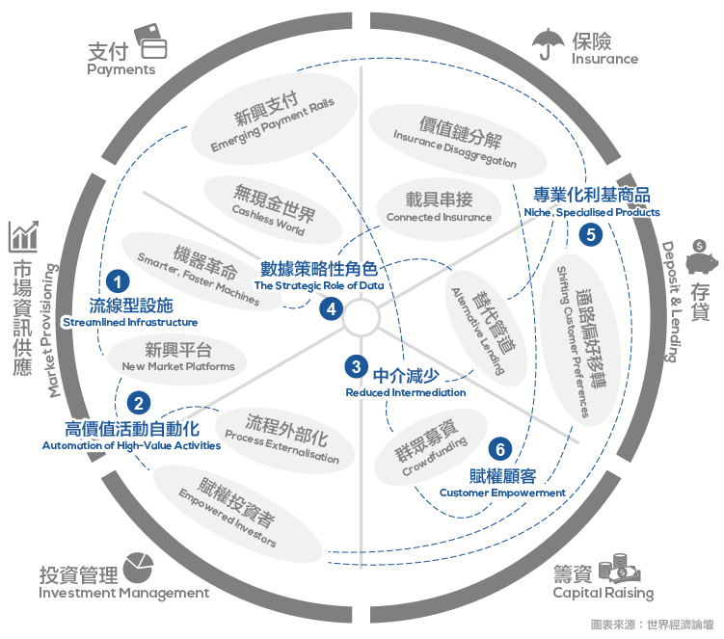
Source: https://www.stockfeel.com.tw/2015年世界經濟論壇－未來的金融服務/

Slide 43
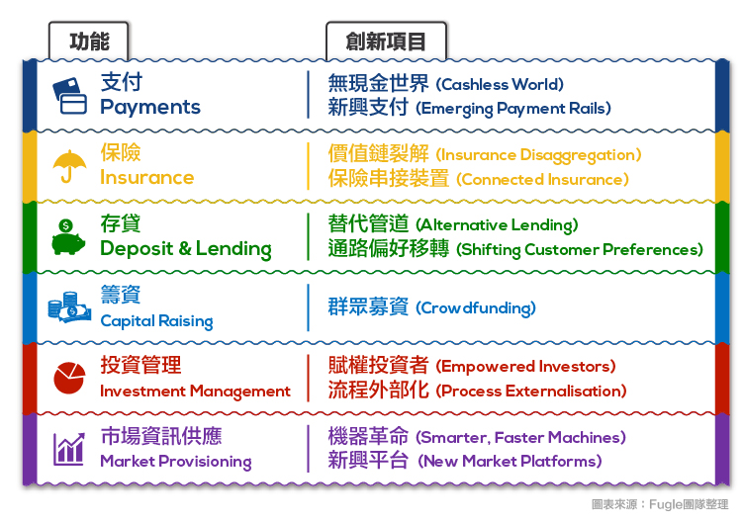
FinTech: Financial Services Innovation
Source: https://www.stockfeel.com.tw/2015年世界經濟論壇－未來的金融服務/

Slide 44
FinTech: Payment
1
Source: http://www3.weforum.org/docs/WEF_The_future__of_financial_services.pdf

Slide 45
FinTech: Payment
Cashless World
Emerging Payment Rails
1
Source: https://www.stockfeel.com.tw/2015年世界經濟論壇－未來的金融服務/

Slide 46
FinTech: Insurance
2
Source: http://www3.weforum.org/docs/WEF_The_future__of_financial_services.pdf

Slide 47
FinTech: Insurance
Insurance Disaggregation
Connected Insurance
2
Source: https://www.stockfeel.com.tw/2015年世界經濟論壇－未來的金融服務/

Slide 48
FinTech: Deposits & Lending
3
Source: http://www3.weforum.org/docs/WEF_The_future__of_financial_services.pdf

Slide 49
FinTech: Deposits & Lending
Alternative Lending
Shifting Customer Preferences
3
Source: https://www.stockfeel.com.tw/2015年世界經濟論壇－未來的金融服務/

Slide 50
FinTech: Capital Raising
4
Source: http://www3.weforum.org/docs/WEF_The_future__of_financial_services.pdf

Slide 51
FinTech: Capital Raising
Crowdfunding
4
Source: https://www.stockfeel.com.tw/2015年世界經濟論壇－未來的金融服務/

Slide 52
FinTech: Investment Management
5
Source: http://www3.weforum.org/docs/WEF_The_future__of_financial_services.pdf

Slide 53
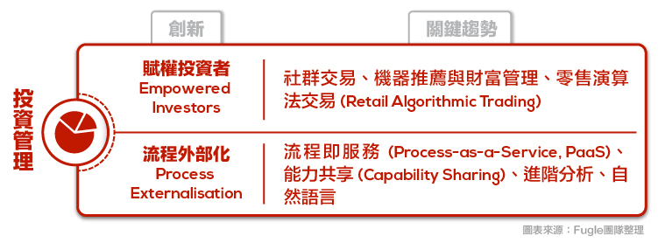
FinTech: Investment Management
Empowered Investors
Process Externalization
5
Source: https://www.stockfeel.com.tw/2015年世界經濟論壇－未來的金融服務/

Slide 54
FinTech: Market Provisioning
6
Source: http://www3.weforum.org/docs/WEF_The_future__of_financial_services.pdf

Slide 55
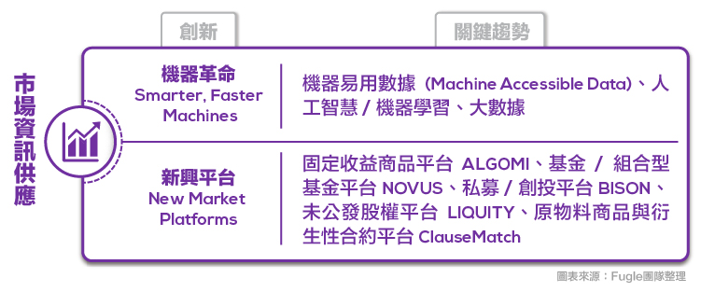
FinTech: Market Provisioning
Smarter, Faster Machines
New Market Platforms
6
Source: https://www.stockfeel.com.tw/2015年世界經濟論壇－未來的金融服務/

Slide 56
Definition of
Artificial Intelligence (A.I.)

Slide 57
Artificial Intelligence
“… the science and engineering of making intelligent machines”
(John McCarthy, 1955)
Source: https://digitalintelligencetoday.com/artificial-intelligence-defined-useful-list-of-popular-definitions-from-business-and-science/

Slide 58
Artificial Intelligence
“… technology that thinks and acts like humans”
Source: https://digitalintelligencetoday.com/artificial-intelligence-defined-useful-list-of-popular-definitions-from-business-and-science/

Slide 59
Artificial Intelligence
“… intelligence exhibited by machines or software”
Source: https://digitalintelligencetoday.com/artificial-intelligence-defined-useful-list-of-popular-definitions-from-business-and-science/

Slide 60
4 Approaches of AI
Thinking Humanly | Thinking Rationally
Acting Humanly | Acting Rationally
Source: Stuart Russell and Peter Norvig (2020), Artificial Intelligence: A Modern Approach, 4th Edition, Pearson

Slide 61
4 Approaches of AI
2. Thinking Humanly: The Cognitive Modeling Approach | 3. Thinking Rationally: The “Laws of Thought” Approach
1. Acting Humanly: The Turing Test Approach (1950) | 4. Acting Rationally: The Rational Agent Approach
Source: Stuart Russell and Peter Norvig (2020), Artificial Intelligence: A Modern Approach, 4th Edition, Pearson

Slide 62
AI Acting Humanly:
The Turing Test Approach
(Alan Turing, 1950)
Knowledge Representation
Automated Reasoning
Machine Learning (ML)
  Deep Learning (DL)
Computer Vision (Image, Video)
Natural Language Processing (NLP)
Robotics
Source: Stuart Russell and Peter Norvig (2020), Artificial Intelligence: A Modern Approach, 4th Edition, Pearson

Slide 63
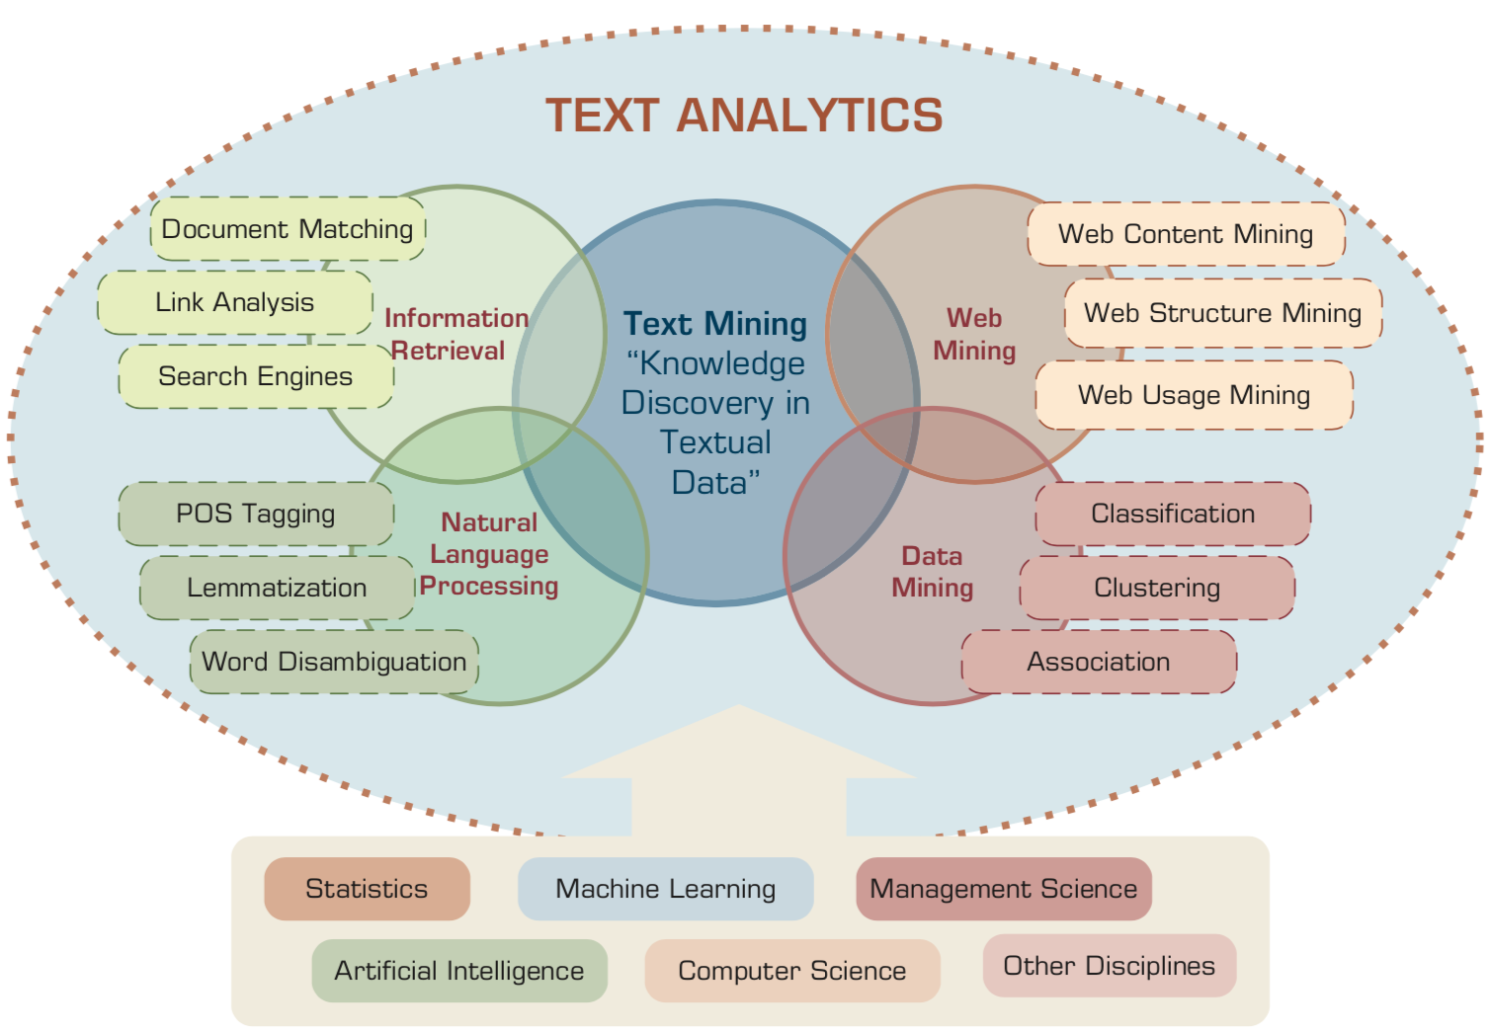
Text Analytics and Text Mining
Source: Ramesh Sharda, Dursun Delen, and Efraim Turban (2017), Business Intelligence, Analytics, and Data Science: A Managerial Perspective, 4th Edition, Pearson

Slide 64

Python in Google Colab (Python101)
https://colab.research.google.com/drive/1FEG6DnGvwfUbeo4zJ1zTunjMqf2RkCrT
https://tinyurl.com/aintpupython101

Slide 65
教學 (Teaching)
智慧金融量化分析 (Artificial Intelligence in Finance and Quantitative)
  國立台北大學資管所碩士班 (Fall 2021)
人工智慧文本分析 (Artificial Intelligence for Text Analytics)
  國立台北大學資管所碩士班 (Spring 2022)
軟體工程 (Software Engineering)
  國立台北大學資管所碩士班 (電子商務碩士學分學程) (Fall 2020, Fall, 2021, Spring 2022)
人工智慧 (Artificial Intelligence)
  國立台北大學資管所碩士班 (Spring 2021)
資料探勘 (Data Mining)
  國立台北大學資管所碩士班 (電子商務碩士學分學程) (Spring 2021)
大數據分析 (Big Data Analytics)
  國立台北大學資管所碩士班(Fall 2020)
企業雲端運算入門 (Foundation of Business Cloud Computing)
  國立台北大學企管系 (Spring 2021)
https://web.ntpu.edu.tw/~myday/teaching.htm

Slide 66
研究計畫 (Research Project)
應用 AI 技術建構加密貨幣反洗錢知識圖譜：少樣本學習模型
(Applying AI technology to construct knowledge graphs of cryptocurrency anti-money laundering: a few-shot learning model)
  科技部 (人文司 - 商事財經法)，110-2410-H-305-013-MY2，2021/08/01~2023/07/31
  [核定經費(新台幣)：1,022,000]
企業永續動機、價值攸關性與人工智慧於企業永續績效評比之應用 (Corporate Sustainability: Motivations, Value Relevance, and the Application of AI in the Assessment)：
子計畫二：人工智慧 AI 於企業永續評比之應用
(An application of artificial intelligence (AI) in the corporate sustainability assessment)
  國立臺北大學，110-NTPU_ORDA-F-001，2021/01/01~2021/12/31
https://web.ntpu.edu.tw/~myday/cindex.htm#projects

Slide 67
Summary
This course introduces the fundamental concepts, research issues, and hands-on practices of AI in Finance and Quantitative Analysis.
Topics include:
  Introduction to Artificial Intelligence in Finance and Quantitative Analysis,
  AI in FinTech: Financial Services Innovation and Application,
  Investing Psychology and Behavioral Finance,
  Event Studies in Finance,
  Finance Theory,
  Data-Driven Finance,
  Financial Econometrics,
  AI-First Finance,
  Deep Learning in Finance, Reinforcement Learning in Finance,
  Algorithmic Trading, Risk Management, Trading Bot and Event-Based Backtesting,
  Case Study on AI in Finance and Quantitative Analysis.

Slide 68
智慧金融量化分析
(Artificial Intelligence in Finance and Quantitative Analysis)
Contact Information
戴敏育 博士 (Min-Yuh Day, Ph.D.)
副教授 (Associate Professor)
國立臺北大學 資訊管理研究所
Institute of Information Management, National Taipei University
電話： 02-86741111 ext. 66873
研究室： 商8F12
地址： 23741 新北市三峽區大學路 151 號
Email：myday@gm.ntpu.edu.tw
網址：http://web.ntpu.edu.tw/~myday/

