Slide 1
資料探勘 (Data Mining)
強化學習 (Reinforcement Learning)
1092DM11
MBA, IM, NTPU (M5026) (Spring 2021) Tue 2, 3, 4 (9:10-12:00) (B8F40)
Min-Yuh Day
戴敏育
Associate Professor
副教授
Institute of Information Management, National Taipei University
國立臺北大學 資訊管理研究所
https://web.ntpu.edu.tw/~myday
2021-06-01

Slide 2
課程大綱 (Syllabus)
週次 (Week) 日期 (Date) 內容 (Subject/Topics)
1 2021/02/23 資料探勘介紹 (Introduction to data mining)
2 2021/03/02 ABC：人工智慧，大數據，雲端運算 (ABC: AI, Big Data, Cloud Computing)
3 2021/03/09 Python資料探勘的基礎 (Foundations of Data Mining in Python)
4 2021/03/16 資料科學與資料探勘：發現，分析，可視化和呈現數據 (Data Science and Data Mining: Discovering, Analyzing, Visualizing and Presenting Data)
5 2021/03/23 非監督學習：關聯分析，購物籃分析 (Unsupervised Learning: Association Analysis, Market Basket Analysis)
6 2021/03/30 資料探勘個案研究 I (Case Study on Data Mining I)

Slide 3
課程大綱 (Syllabus)
週次 (Week) 日期 (Date) 內容 (Subject/Topics)
7 2021/04/06 放假一天 (Day off)
8 2021/04/13 非監督學習：集群分析，行銷市場區隔 (Unsupervised Learning: Cluster Analysis, Market Segmentation)
9 2021/04/20 期中報告 (Midterm Project Report)
10 2021/04/27 監督學習：分類和預測 (Supervised Learning: Classification and Prediction)
11 2021/05/04 機器學習和深度學習 (Machine Learning and Deep Learning)
12 2021/05/11 卷積神經網絡 (Convolutional Neural Networks)

Slide 4
課程大綱 (Syllabus)
週次 (Week) 日期 (Date) 內容 (Subject/Topics)
13 2021/05/18 資料探勘個案研究 II (Case Study on Data Mining II)
14 2021/05/25 遞歸神經網絡 (Recurrent Neural Networks)
15 2021/06/01 強化學習 (Reinforcement Learning)
16 2021/06/08 社交網絡分析 (Social Network Analysis)
17 2021/06/15 期末報告 I (Final Project Report I)
18 2021/06/22 期末報告 II (Final Project Report II)

Slide 5
Reinforcement Learning

Slide 6
Outline
Reinforcement Learning (RL)
Markov Decision Processes (MDP)
Deep Reinforcement Learning (DRL) Algorithms
SARSA
Q-Learning
DQN
A3C
Rainbow

Slide 7
AI, ML, DL
Artificial Intelligence (AI)
Machine Learning (ML)
Supervised Learning
Unsupervised Learning
Deep Learning (DL)
CNN
RNN LSTM GRU
GAN
Semi-supervised Learning
Reinforcement Learning
Source: https://leonardoaraujosantos.gitbooks.io/artificial-inteligence/content/deep_learning.html

Slide 8
3 Machine Learning Algorithms
Source: Enrico Galimberti, http://blogs.teradata.com/data-points/tree-machine-learning-algorithms/

Slide 9
Machine Learning (ML)
Source: https://www.mactores.com/services/aws-big-data-machine-learning-cognitive-services/

Slide 10
Reinforcement Learning (RL)
Computer Science
Engineering
Machine Learning
Neuroscience
Optimal Control
Reward System
Reinforcement Learning
Operations Research
Classical/Operant Conditioning
Mathematics
Bounded Rationality
Psychology
Economics
Source: David Silver (2015), Introduction to reinforcement learning, https://www.youtube.com/playlist?list=PLqYmG7hTraZDM-OYHWgPebj2MfCFzFObQ

Slide 11
Branches of Machine Learning (ML) Reinforcement Learning (RL)
No Labels
No feedback
Find hidden structure
Labeled data
Direct feedback
Predict
Supervised Learning
Unsupervised Learning
Machine Learning
Reinforcement Learning
Decision process
Reward system
Learn series of actions
Source: David Silver (2015), Introduction to reinforcement learning, https://www.youtube.com/playlist?list=PLqYmG7hTraZDM-OYHWgPebj2MfCFzFObQ

Slide 12
David Silver (2015), Introduction to reinforcement learning
Elementary Reinforcement Learning
1: Introduction to Reinforcement Learning
2: Markov Decision Processes
3: Planning by Dynamic Programming
4: Model-Free Prediction
5: Model-Free Control
Reinforcement Learning in Practice
6: Value Function Approximation
7: Policy Gradient Methods
8: Integrating Learning and Planning
9: Exploration and Exploitation
10: Case Study: RL in Classic Games
Source: David Silver (2015), Introduction to reinforcement learning, https://www.youtube.com/playlist?list=PLqYmG7hTraZDM-OYHWgPebj2MfCFzFObQ

Slide 13
Reinforcement Learning AlphaZero (AZ) and AlphaGo Zero (AZ0)
AlphaZero (Silver et al., 2018)
A general reinforcement learning algorithm that masters chess, shogi, and Go through self-play. (Science)
AlphaGo Zero (Silver et al., 2017)
Mastering the game of Go without human knowledge (Nature)

Slide 14
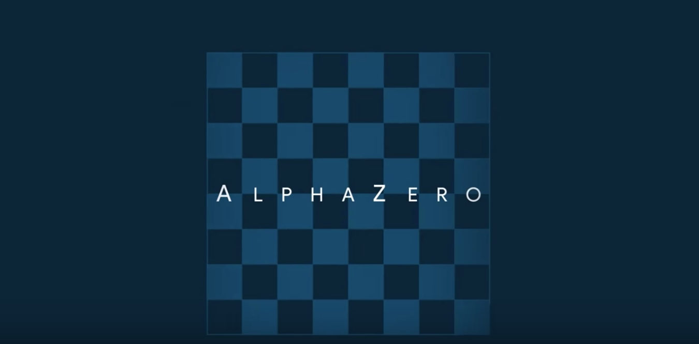
AlphaZero: Shedding new light on the grand games of chess, shogi and Go
https://www.youtube.com/watch?v=7L2sUGcOgh0

Slide 15
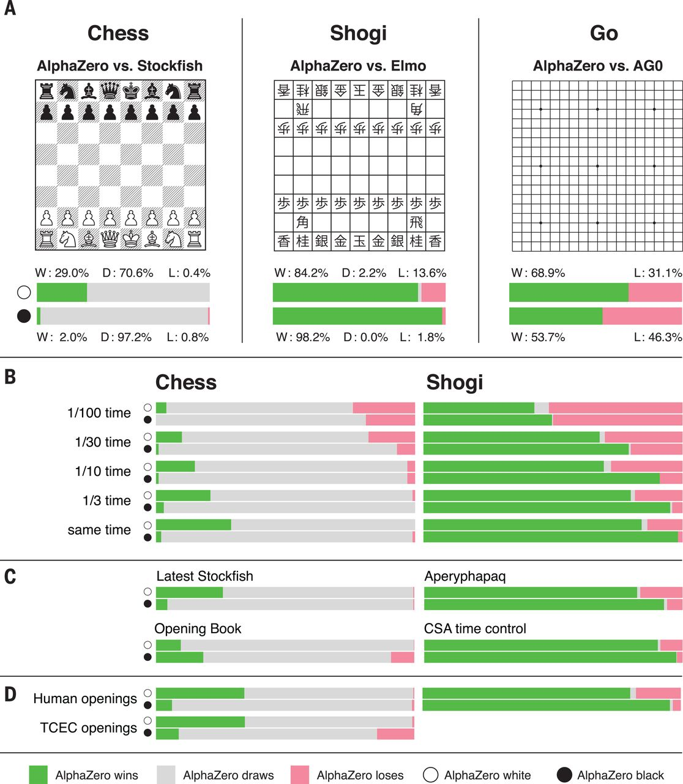
AlphaZero
A general reinforcement learning algorithm that masters chess, shogi, and Go through self-play
Source: David Silver et al. (2018), "A general reinforcement learning algorithm that masters chess, shogi, and Go through self-play." Science 362, no. 6419 (2018): 1140-1144.

Slide 16
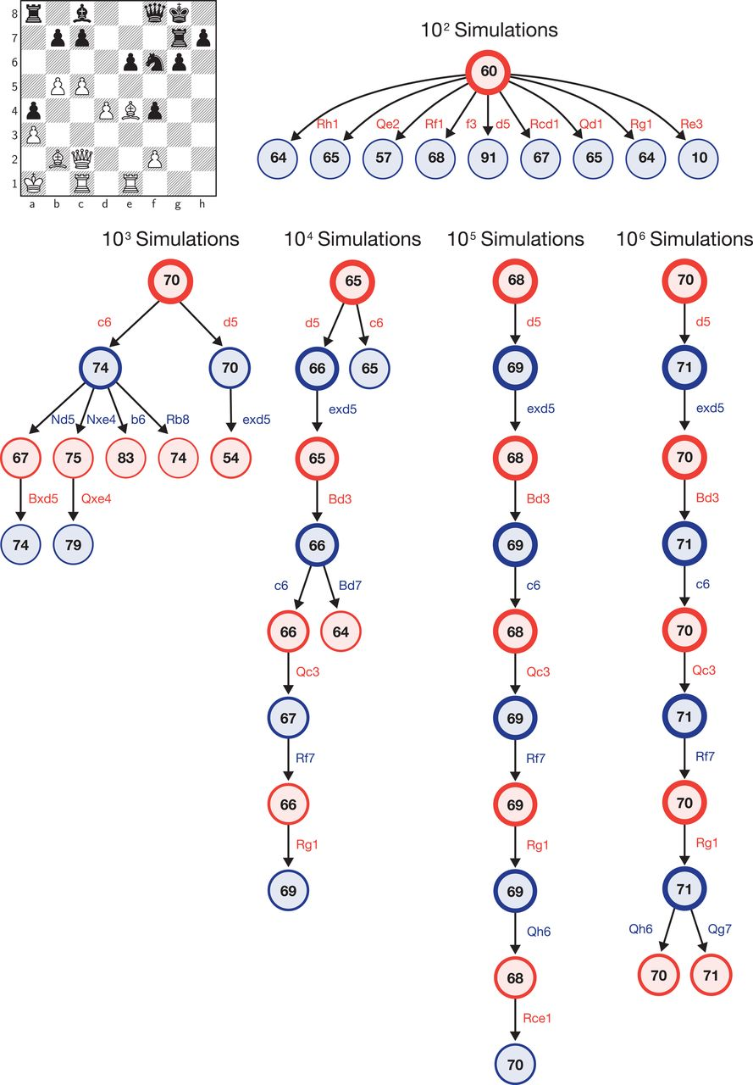
AlphaZero’s search procedure
Source: David Silver et al. (2018), "A general reinforcement learning algorithm that masters chess, shogi, and Go through self-play." Science 362, no. 6419 (2018): 1140-1144.

Slide 17
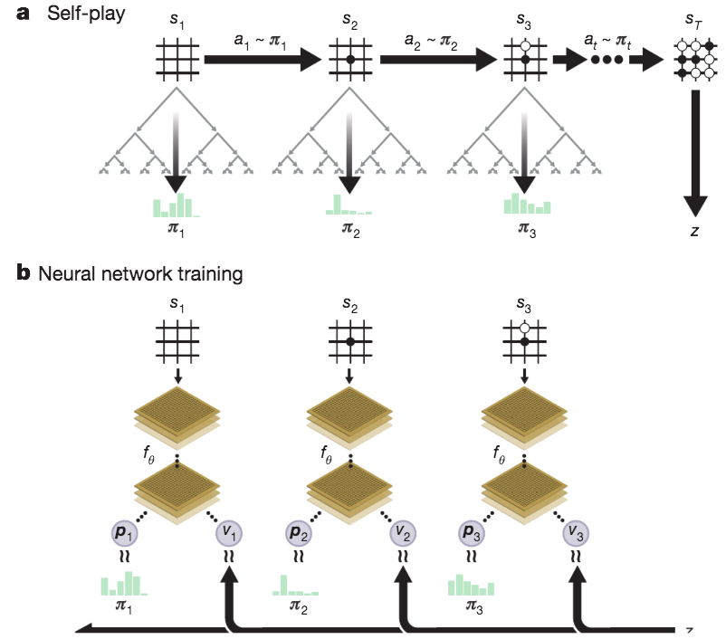
Self-play reinforcement learning in AlphaGo Zero
Source: David Silver et al. (2017), "Mastering the game of Go without human knowledge." Nature 550 (2017): 354–359.

Slide 18
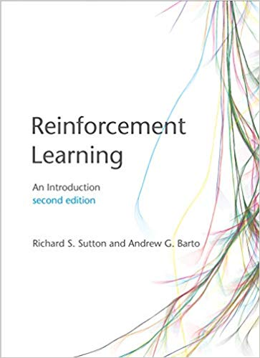
Richard S. Sutton & Andrew G. Barto (2018), Reinforcement Learning: An Introduction, 2nd Edition, A Bradford Book
Source: Richard S. Sutton & Andrew G. Barto (2018), Reinforcement Learning: An Introduction, 2nd Edition, A Bradford Book. https://www.amazon.com/Reinforcement-Learning-Introduction-Adaptive-Computation/dp/0262039249

Slide 19
Reinforcement learning
Reinforcement learning is learning what to do —how to map situations to actions —so as to maximize a numerical reward signal.
Source: Richard S. Sutton & Andrew G. Barto (2018), Reinforcement Learning: An Introduction, 2nd Edition, A Bradford Book.

Slide 20
Two most important distinguishing features of reinforcement learning
trial-and-error search
delayed reward
Source: Richard S. Sutton & Andrew G. Barto (2018), Reinforcement Learning: An Introduction, 2nd Edition, A Bradford Book.

Slide 21
Reinforcement Learning (DL)
Agent
Environment
Source: Richard S. Sutton & Andrew G. Barto (2018), Reinforcement Learning: An Introduction, 2nd Edition, A Bradford Book.

Slide 22
Reinforcement Learning (DL)
1
2
observation
Agent
action
3
reward
Environment
Source: Richard S. Sutton & Andrew G. Barto (2018), Reinforcement Learning: An Introduction, 2nd Edition, A Bradford Book.

Slide 23
Reinforcement Learning (DL)
1
2
observation
Agent
action
O_{t}
A_{t}
3
reward
R_{t}
Environment
Source: Richard S. Sutton & Andrew G. Barto (2018), Reinforcement Learning: An Introduction, 2nd Edition, A Bradford Book.

Slide 24
Agent and Environment
At each step t the agent:
Executes action A_{t}
Receives observation O_{t}
Receives scalar reward R_{t}
The environment:
Receives action A_{t}
Emits observation O_{t+1}
Emits scalar reward R_{t+1}
t increments at env. step
observation
action
Agent
O_{t}
A_{t}
reward
R_{t}
Environment
Source: David Silver (2015), Introduction to reinforcement learning, https://www.youtube.com/playlist?list=PLqYmG7hTraZDM-OYHWgPebj2MfCFzFObQ

Slide 25
History and State
The history is the sequence of observations, actions, rewards
H_{t} = O₁, A₁, R₁,...,A_{t-1},O_{t},R_{t}
i.e. all observable variables up to time t
i.e. the sensorimotor stream of a robot or embodied agent
What happens next depends on the history:
The agent selects actions
The environment selects observations/rewards
State is the information used to determine what happens next
Formally, state is a function of the history:
S_{t} =f(H_{t})
Source: David Silver (2015), Introduction to reinforcement learning, https://www.youtube.com/playlist?list=PLqYmG7hTraZDM-OYHWgPebj2MfCFzFObQ

Slide 26
Information State
An information state (a.k.a. Markov state) contains all useful information from the history.
Definition
A state S_{t} is Markov if and only if
P[S_{t+1} | S_{t}] = P[S_{t+1} | S₁,...,S_{t}]
“The future is independent of the past given the present”
H_{1:t} → S_{t} → H_{t+1:∞}
Once the state is known, the history may be thrown away i.e. The state is a sufficient statistic of the future
The environment state S_{t}^{e} is Markov
The history H_{t} is Markov
Source: David Silver (2015), Introduction to reinforcement learning, https://www.youtube.com/playlist?list=PLqYmG7hTraZDM-OYHWgPebj2MfCFzFObQ

Slide 27
Fully Observable Environments
Full observability:
agent directly observes environment state
Agent state = environment state = information state
Formally, this is a Markov decision process (MDP)
state
Agent
action
S_{t}
A_{t}
reward
R_{t}
Environment
Source: David Silver (2015), Introduction to reinforcement learning, https://www.youtube.com/playlist?list=PLqYmG7hTraZDM-OYHWgPebj2MfCFzFObQ

Slide 28
Partially Observable Environments
Partial observability: agent indirectly observes environment
A robot with camera vision isn’t told its absolute location
A trading agent only observes current prices
A poker playing agent only observes public cards
Now agent state ≠ environment state
Formally this is a partially observable Markov decision process (POMDP)
Agent must construct its own state representation Sª_{t}, e.g.
Complete history: Sª_{t} = H_{t}
Beliefs of environment state: Sª_{t} = (P[S^{e}_{t} = s₁],...,P[S^{e}_{t} = s_{n}])
Recurrent neural network: Sª_{t} = σ(Sª_{t-1} W_{s} + O_{t} W_{o} )
Source: David Silver (2015), Introduction to reinforcement learning, https://www.youtube.com/playlist?list=PLqYmG7hTraZDM-OYHWgPebj2MfCFzFObQ

Slide 29
Reinforcement Learning (DL) The Agent-Environment Interaction in a Markov Decision Process (MDP)
Agent
state
reward
action
S_{t}
R_{t}
A_{t}
R_{t+1}
Environment
S_{t+1}
Source: Richard S. Sutton & Andrew G. Barto (2018), Reinforcement Learning: An Introduction, 2nd Edition, A Bradford Book.

Slide 30
Characteristics of Reinforcement Learning
No supervisor, only a reward signal
Feedback is delayed, not instantaneous
Time really matters (sequential, non i.i.d data)
Agent’s actions affect the subsequent data it receives
Source: David Silver (2015), Introduction to reinforcement learning, https://www.youtube.com/playlist?list=PLqYmG7hTraZDM-OYHWgPebj2MfCFzFObQ

Slide 31
Examples of Reinforcement Learning
Make a humanoid robot walk
Play may different Atari games better than humans
Manage an investment portfolio
Source: David Silver (2015), Introduction to reinforcement learning, https://www.youtube.com/playlist?list=PLqYmG7hTraZDM-OYHWgPebj2MfCFzFObQ

Slide 32
Examples of Rewards
Make a humanoid robot walk
+ve reward for forward motion
-ve reward for falling over
Play may different Atari games better than humans
+/-ve reward for increasing/decreasing score
Manage an investment portfolio
+ve reward for each $ in bank
Source: David Silver (2015), Introduction to reinforcement learning, https://www.youtube.com/playlist?list=PLqYmG7hTraZDM-OYHWgPebj2MfCFzFObQ

Slide 33
Sequential Decision Making
Goal: select actions to maximize total future reward
Actions may have long term consequence
Reward may be delayed
It may be better to sacrifice immediate reward to gain more long-term reward
Examples:
A financial investment (may take months to mature)
Blocking opponent moves (might help winning chances many moves from now)
Source: David Silver (2015), Introduction to reinforcement learning, https://www.youtube.com/playlist?list=PLqYmG7hTraZDM-OYHWgPebj2MfCFzFObQ

Slide 34
Elements of Reinforcement Learning
Agent
Environment
Policy
Reward signal
Value function
Model
Source: Richard S. Sutton & Andrew G. Barto (2018), Reinforcement Learning: An Introduction, 2nd Edition, A Bradford Book.

Slide 35
Elements of Reinforcement Learning
Policy
Agent’s behavior
It is a map from state to action
Reward signal
The goal of a reinforcement learning problem
Value function
How good is each state and/or action
A prediction of future reward
Model
Agent’s representation of the environment
Source: Richard S. Sutton & Andrew G. Barto (2018), Reinforcement Learning: An Introduction, 2nd Edition, A Bradford Book.

Slide 36
Major Components of an RL Agent
Policy: agent’s behaviour function
Value function: how good is each state and/or action
Model: agent’s representation of the environment
Source: David Silver (2015), Introduction to reinforcement learning, https://www.youtube.com/playlist?list=PLqYmG7hTraZDM-OYHWgPebj2MfCFzFObQ

Slide 37
Policy
A policy is the agent’s behaviour
It is a map from state to action, e.g.
Deterministic policy: a = π(s)
Stochastic policy: π(a|s) = P[A_{t} = a|S_{t} = s]
Source: David Silver (2015), Introduction to reinforcement learning, https://www.youtube.com/playlist?list=PLqYmG7hTraZDM-OYHWgPebj2MfCFzFObQ

Slide 38
Value Function
Value function is a prediction of future reward
Used to evaluate the goodness/badness of states
And therefore to select between actions, e.g.
v_{π}(s)=E_{π} [R_{t+1}+γR_{t+2}+γ²R_{t+3}+...|S_{t} =s]
Source: David Silver (2015), Introduction to reinforcement learning, https://www.youtube.com/playlist?list=PLqYmG7hTraZDM-OYHWgPebj2MfCFzFObQ

Slide 39
Model
A model predicts what the environment will do next
P predicts the next state
R predicts the next (immediate) reward, e.g.
Pª_{ss′} = P[S_{t+1} =s′ |S_{t+1}=s, A_{t}=a]
Rª_{s} = E[R_{t+1} |S_{t} =s, A_{t} =a]
Source: David Silver (2015), Introduction to reinforcement learning, https://www.youtube.com/playlist?list=PLqYmG7hTraZDM-OYHWgPebj2MfCFzFObQ

Slide 40
Reinforcement Learning
Value Based
No Policy (Implicit)
Value Function
Policy Based
Policy
No Value Function
Actor Critic
Policy
Value Function
Source: David Silver (2015), Introduction to reinforcement learning, https://www.youtube.com/playlist?list=PLqYmG7hTraZDM-OYHWgPebj2MfCFzFObQ

Slide 41
Reinforcement Learning
Model Free
Policy and/or Value Function
No Model
Model Based
Policy and/or Value Function
Model
Source: David Silver (2015), Introduction to reinforcement learning, https://www.youtube.com/playlist?list=PLqYmG7hTraZDM-OYHWgPebj2MfCFzFObQ

Slide 42
Reinforcement Learning (RL) Taxonomy
Model-Free
Value Function
Actor Critic
Policy
Model-Based
Policy-Based
Value-Based
Model
Source: David Silver (2015), Introduction to reinforcement learning, https://www.youtube.com/playlist?list=PLqYmG7hTraZDM-OYHWgPebj2MfCFzFObQ

Slide 43
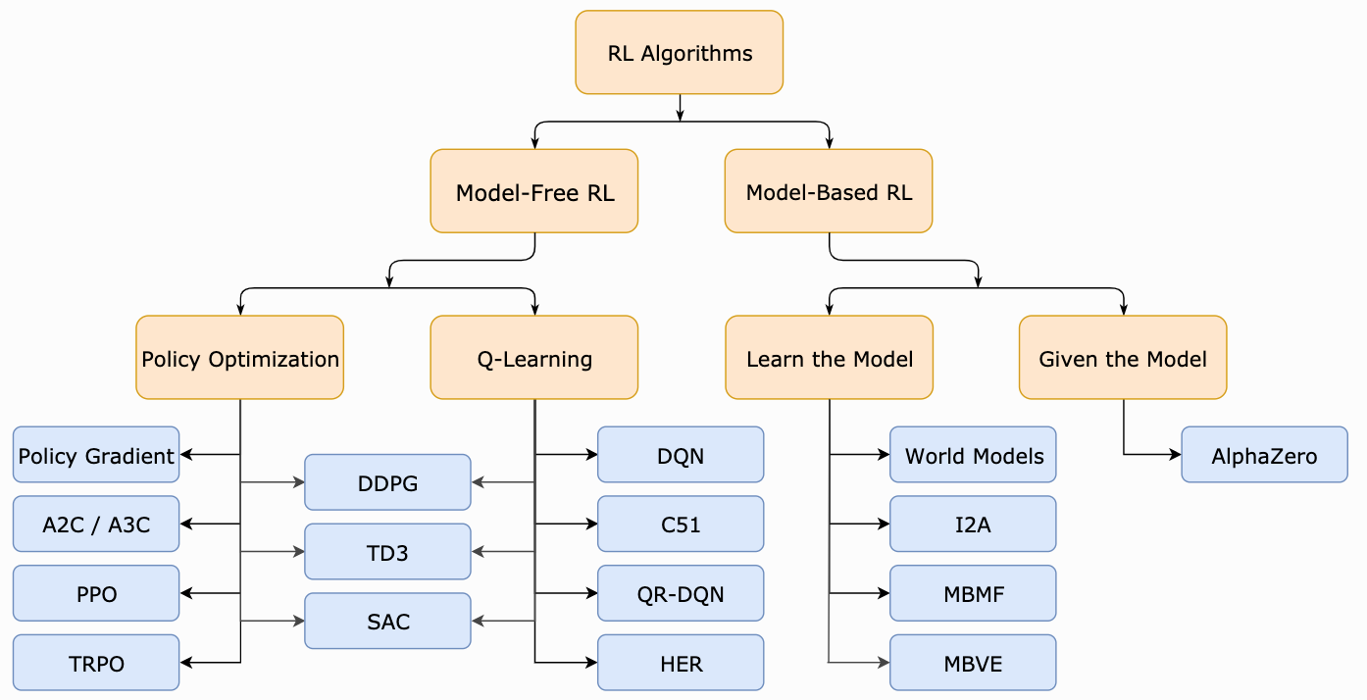
Reinforcement Learning (RL) A Taxonomy of RL Algorithms
Source: https://spinningup.openai.com/en/latest/spinningup/rl_intro2.html

Slide 44
Learning and Planning
Two fundamental problems in sequential decision making
Reinforcement Learning
The environment is initially unknown
The agent interacts with environment
The agent improves its policy
Planning
A model of the environment is known
The agent performs computations with its model (without any external interaction)
The agent improves its policy
a.k.a deliberation, reasoning, introspection, pondering, thought, search
Source: David Silver (2015), Introduction to reinforcement learning, https://www.youtube.com/playlist?list=PLqYmG7hTraZDM-OYHWgPebj2MfCFzFObQ

Slide 45
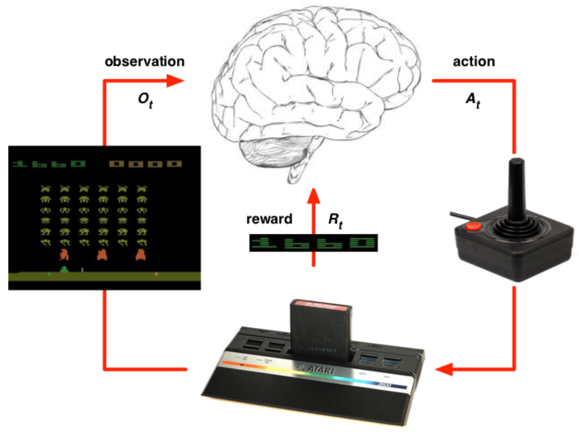
Atari Example: Reinforcement Learning
Rules of the game are unknown
Learn directly from interactive game-play
Pick actions on joystick, see pixels and scores
Source: David Silver (2015), Introduction to reinforcement learning, https://www.youtube.com/playlist?list=PLqYmG7hTraZDM-OYHWgPebj2MfCFzFObQ

Slide 46
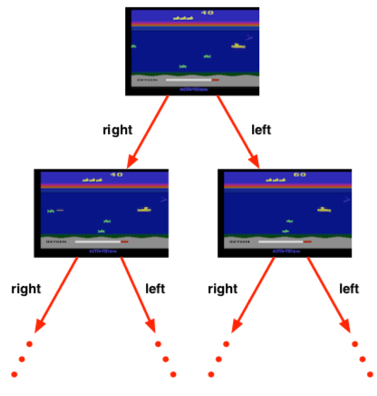
Atari Example: Planning
Rules of the game are known
Can query emulator
perfect model inside agent’s brain
If I take action a from state s:
what would the next state be?
what would the score be?
Plan ahead to find optimal policy
e.g. tree search
Source: David Silver (2015), Introduction to reinforcement learning, https://www.youtube.com/playlist?list=PLqYmG7hTraZDM-OYHWgPebj2MfCFzFObQ

Slide 47
Exploration and Exploitation
Reinforcement learning is like trial-and-error learning
The agent should discover a good policy
From its experiences of the environment
Without losing too much reward along the way
Exploration finds more information about the environment
Exploitation exploits known information to maximise reward
It is usually important to explore as well as exploit
Source: David Silver (2015), Introduction to reinforcement learning, https://www.youtube.com/playlist?list=PLqYmG7hTraZDM-OYHWgPebj2MfCFzFObQ

Slide 48
Exploration and Exploitation Examples
Restaurant Selection
Exploitation: Go to your favorite restaurant
Exploration: Try a new restaurant
Online Banner Advertisements
Exploitation: Show the most successful advert
Exploration: Show a different advert
Source: David Silver (2015), Introduction to reinforcement learning, https://www.youtube.com/playlist?list=PLqYmG7hTraZDM-OYHWgPebj2MfCFzFObQ

Slide 49
Exploration and Exploitation Examples
Oil Drilling
Exploitation: Drill at the best known location
Exploration: Drill at a new location
Game Playing
Exploitation: Play the move you believe is best
Exploration: Play an experimental move
Source: David Silver (2015), Introduction to reinforcement learning, https://www.youtube.com/playlist?list=PLqYmG7hTraZDM-OYHWgPebj2MfCFzFObQ

Slide 50
Prediction and Control
Prediction: evaluate the future
Given a policy
Control: optimize the future
Find the best policy
Source: David Silver (2015), Introduction to reinforcement learning, https://www.youtube.com/playlist?list=PLqYmG7hTraZDM-OYHWgPebj2MfCFzFObQ

Slide 51
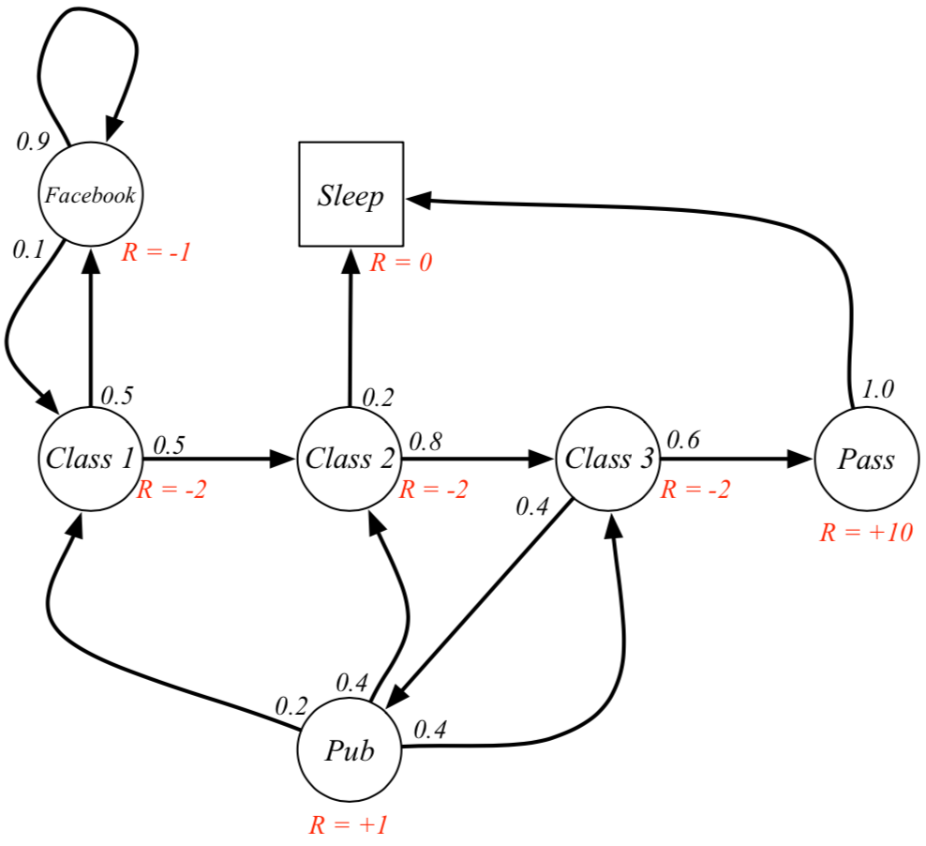
Markov Decision Processes (MDP) Example: Student MDP
Source: David Silver (2015), Introduction to reinforcement learning, https://www.youtube.com/playlist?list=PLqYmG7hTraZDM-OYHWgPebj2MfCFzFObQ

Slide 52
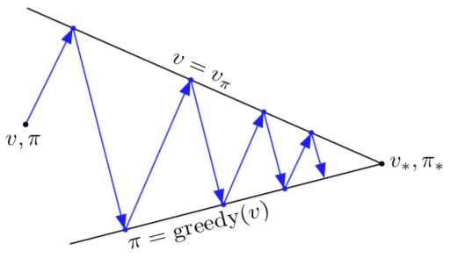
Generalized Policy Iteration (GPI)
evaluation
V → v_{𝜋}
𝜋
V
𝜋 → greedy (V)
improvement
𝜋*
v*
Source: Richard S. Sutton & Andrew G. Barto (2018), Reinforcement Learning: An Introduction, 2nd Edition, A Bradford Book.

Slide 53
Generalized Policy Iteration (GPI)
Any iteration of policy evaluation and policy improvement, independent of their granularity.
evaluation
Ｑ → q_{𝜋}
𝜋
Ｑ
𝜋 → greedy (Ｑ)
improvement
Source: Richard S. Sutton & Andrew G. Barto (2018), Reinforcement Learning: An Introduction, 2nd Edition, A Bradford Book.

Slide 54
Temporal-Difference (TD) Learning
Sarsa: On-policy TD Control
Q-learning: Off-policy TD Control
Source: Richard S. Sutton & Andrew G. Barto (2018), Reinforcement Learning: An Introduction, 2nd Edition, A Bradford Book.

Slide 55
SARSA (state-action-reward-state-action) On-policy TD Control
Q(S_{t}, A_{t}) ← Q(S_{t}, A_{t}) + α[R_{t+1} + γ Q(S_{t+1}, A_{t+1}) - Q(S_{t}, A_{t}) ]
S, A
R
S’
A’
SARSA
Source: Richard S. Sutton & Andrew G. Barto (2018), Reinforcement Learning: An Introduction, 2nd Edition, A Bradford Book.

Slide 56
Q-learning Off-policy TD Control
(Watkins, 1989)
Q(S_{t}, A_{t}) ← Q(S_{t}, A_{t}) + α[R_{t+1} + γ max Q(S_{t+1}, a) - Q(S_{t}, A_{t}) ]
S, A
R
S’
A’
Q-learning
Source: Richard S. Sutton & Andrew G. Barto (2018), Reinforcement Learning: An Introduction, 2nd Edition, A Bradford Book.

Slide 57
Q-learning and Expected SARSA
S, A
S, A
R
R
S’
S’
A’
A’
Q-learning
Expected SARSA
Source: Richard S. Sutton & Andrew G. Barto (2018), Reinforcement Learning: An Introduction, 2nd Edition, A Bradford Book.

Slide 58
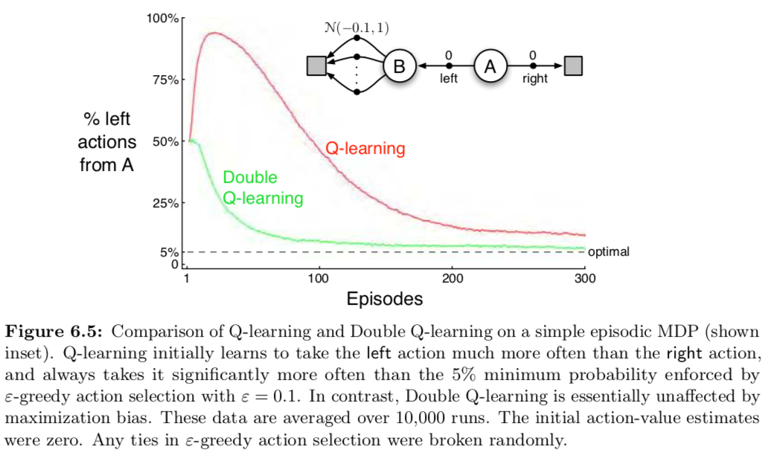
Q-learning and Double Q-learning
Source: Richard S. Sutton & Andrew G. Barto (2018), Reinforcement Learning: An Introduction, 2nd Edition, A Bradford Book.

Slide 59
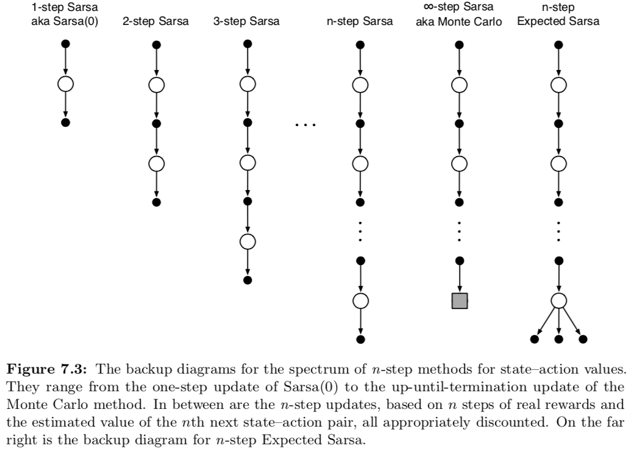
n-step methods for sate-action value
Source: Richard S. Sutton & Andrew G. Barto (2018), Reinforcement Learning: An Introduction, 2nd Edition, A Bradford Book.

Slide 60
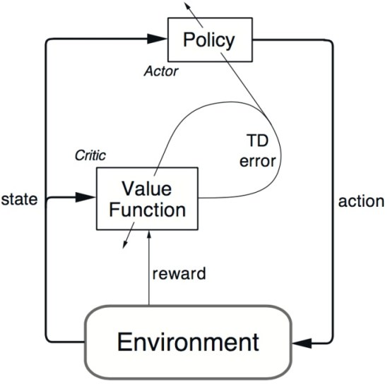
Reinforcement Learning Actor-Critic (AC) Architecture
Source: https://www.kdnuggets.com/2018/03/5-things-reinforcement-learning.html

Slide 61
Reinforcement Learning Actor-Critic (AC) Learning Methods
Policy (Actor)
State
Action
Critique
Value Table (Critic)
State
Reward
Environment

Slide 62
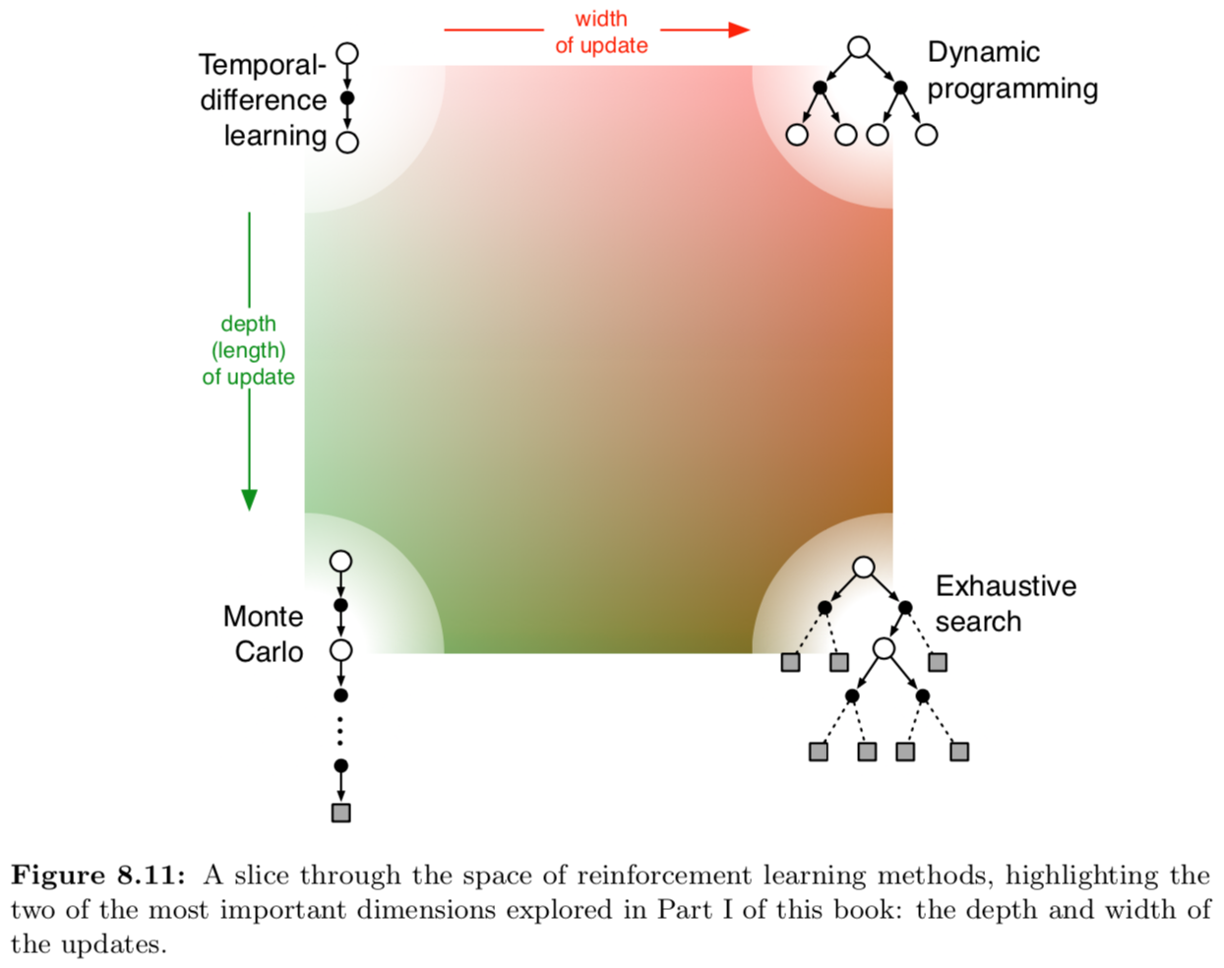
Reinforcement Learning Methods
Source: Richard S. Sutton & Andrew G. Barto (2018), Reinforcement Learning: An Introduction, 2nd Edition, A Bradford Book.

Slide 63
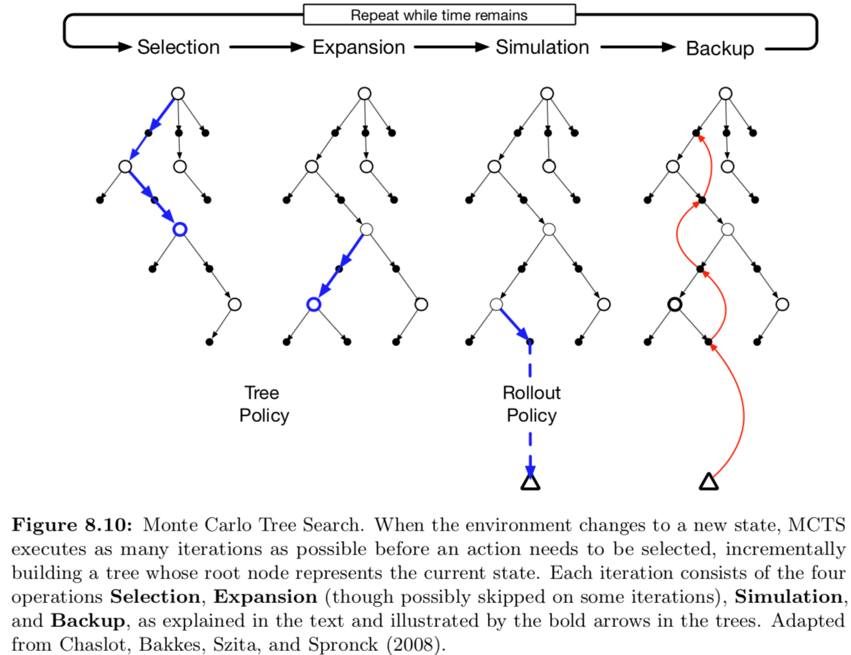
Monte Carlo Tree Search (MCTS)
Source: Richard S. Sutton & Andrew G. Barto (2018), Reinforcement Learning: An Introduction, 2nd Edition, A Bradford Book.

Slide 64
Monte Carlo Tree Search (MCTS) MCTS in AlphaGo Zero
Source: David Silver et al. (2017), "Mastering the game of Go without human knowledge." Nature 550 (2017): 354–359.

Slide 65
MCTS in AlphaGo Zero
a: Each simulation traverses the tree by selecting the edge with maximum action value Q, plus an upper confidence bound U that depends on a stored prior probability P and visit count N for that edge (which is incremented once traversed).
Source: David Silver et al. (2017), "Mastering the game of Go without human knowledge." Nature 550 (2017): 354–359.

Slide 66
MCTS in AlphaGo Zero
b: The leaf node is expanded and the associated position s is evaluated by the neural network (P(s, ·),V(s)) = f_{θ}(s); the vector of P values are stored in the outgoing edges from s.
Source: David Silver et al. (2017), "Mastering the game of Go without human knowledge." Nature 550 (2017): 354–359.

Slide 67
MCTS in AlphaGo Zero
c: Action value Q is updated to track the mean of all evaluations V in the subtree below that action
Source: David Silver et al. (2017), "Mastering the game of Go without human knowledge." Nature 550 (2017): 354–359.

Slide 68
MCTS in AlphaGo Zero
d: Once the search is complete, search probabilities π are returned, proportional to N^{1/τ}, where N is the visit count of each move from the root state and τ is a parameter controlling temperature.
Source: David Silver et al. (2017), "Mastering the game of Go without human knowledge." Nature 550 (2017): 354–359.

Slide 69
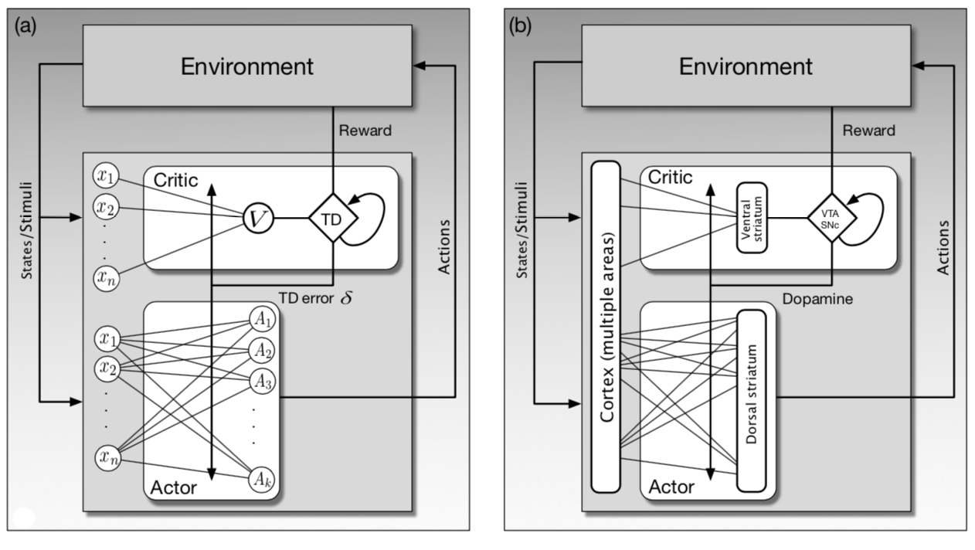
Reinforcement Learning Actor Critic ANN
Source: Richard S. Sutton & Andrew G. Barto (2018), Reinforcement Learning: An Introduction, 2nd Edition, A Bradford Book.

Slide 70
Reinforcement Learning General Dyna Architecture
Policy/value functions
planning update
direct DL update
simulated experience
real experience
model learning
search control
Model
Environment
Source: Richard S. Sutton & Andrew G. Barto (2018), Reinforcement Learning: An Introduction, 2nd Edition, A Bradford Book.

Slide 71
Dyna: Integrated Planning, Acting, and Learning
value/policy
acting
planning
direct RL
model
experience
model learning
Source: Richard S. Sutton & Andrew G. Barto (2018), Reinforcement Learning: An Introduction, 2nd Edition, A Bradford Book.

Slide 72
Model-Based RL
value/policy
acting
planning
model
experience
model learning
Source: Richard S. Sutton & Andrew G. Barto (2018), Reinforcement Learning: An Introduction, 2nd Edition, A Bradford Book.

Slide 73
Model-Free RL (DQN, A3C)
value/policy
acting
planning
direct RL
model
experience
model learning
Source: Richard S. Sutton & Andrew G. Barto (2018), Reinforcement Learning: An Introduction, 2nd Edition, A Bradford Book.

Slide 74
Reinforcement Learning Algorithms
Deep Reinforcement Learning (DRL)
Dynamic Programming
Markov Decision Process (MDP)
Monte Carlo Method
Q-Learning
TD Learning
Partially Observable MDP (POMDP)
Actor-Critic Methods
Deep Q Network (DQN)
Double DQN
Neural Fitted Q Learning
Deep Recurrent Q Network (DQRN)
A3C
Rainbow
Source: https://amitray.com/deep-learning-past-present-and-future-a-review/

Slide 75
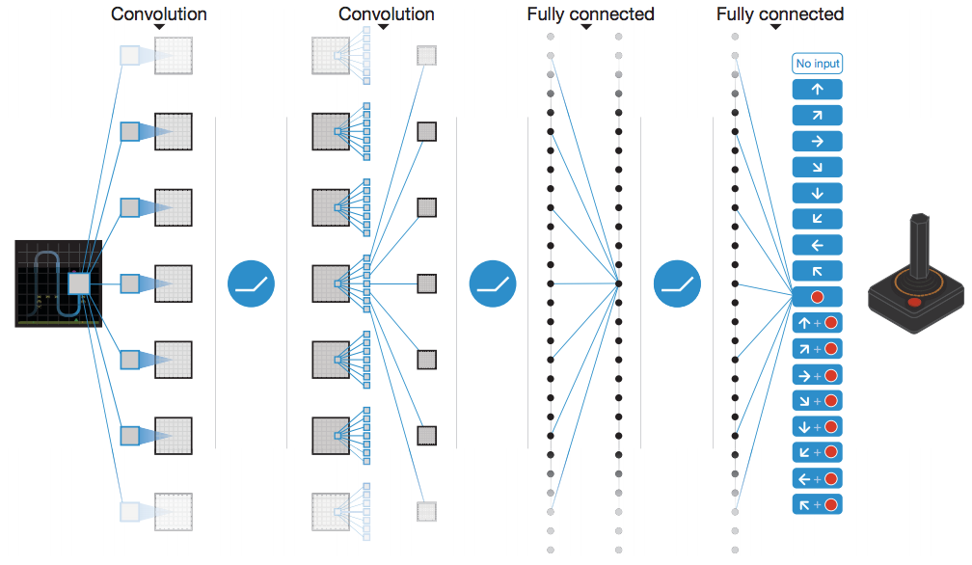
Human-level control through deep reinforcement learning (DQN)
Schematic illustration of the convolutional neural network
Source: Volodymyr Mnih, Koray Kavukcuoglu, David Silver, Andrei A. Rusu, Joel Veness, Marc G. Bellemare, Alex Graves et al. "Human-level control through deep reinforcement learning." Nature 518, no. 7540 (2015): 529.

Slide 76
Deep Q-Network (DQN)
Q-value
Q-value 1
Q-value 2
Q-value 3
Network
Network
State
Action
State
State
State
Source: https://neuro.cs.ut.ee/demystifying-deep-reinforcement-learning/

Slide 77
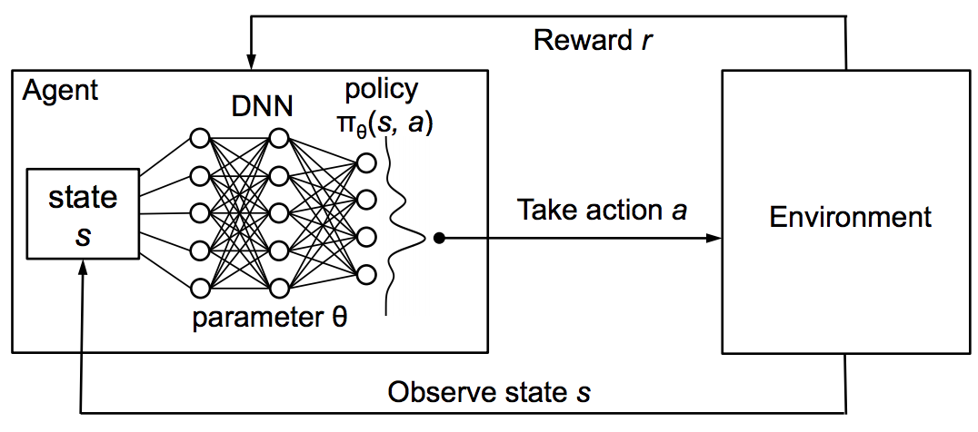
Reinforcement Learning with policy represented via DNN
Source: Hongzi Mao, Mohammad Alizadeh, Ishai Menache, and Srikanth Kandula. (2016) "Resource management with deep reinforcement learning." In Proceedings of the 15th ACM Workshop on Hot Topics in Networks, pp. 50-56. ACM, 2016.

Slide 78
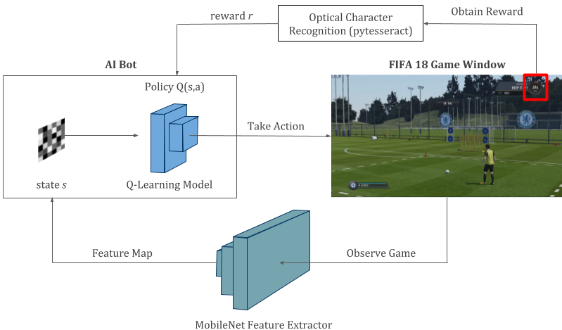
Reinforcement Learning Deep Q-Learning in FIFA 18
Source: https://towardsdatascience.com/using-deep-q-learning-in-fifa-18-to-perfect-the-art-of-free-kicks-f2e4e979ee66

Slide 79
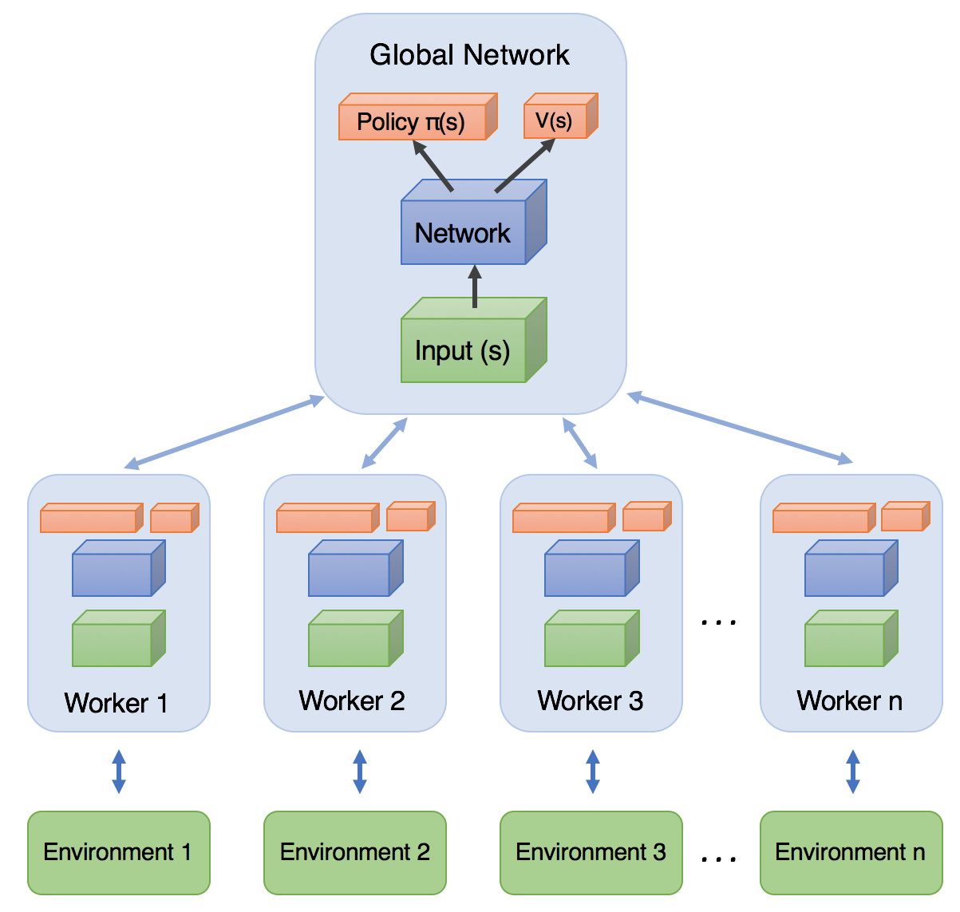
Asynchronous Advantage Actor-Critic (A3C)
Source: https://medium.com/emergent-future/simple-reinforcement-learning-with-tensorflow-part-8-asynchronous-actor-critic-agents-a3c-c88f72a5e9f2

Slide 80
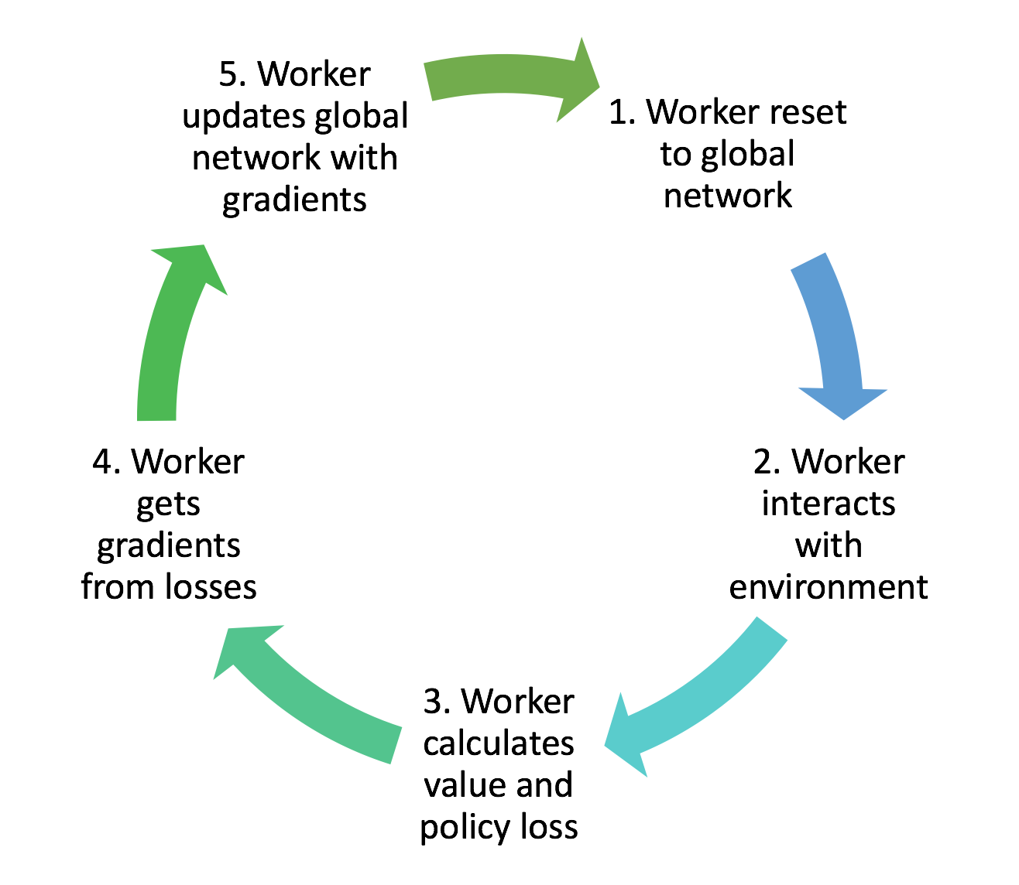
Training workflow of each worker agent in A3C
Source: https://medium.com/emergent-future/simple-reinforcement-learning-with-tensorflow-part-8-asynchronous-actor-critic-agents-a3c-c88f72a5e9f2

Slide 81
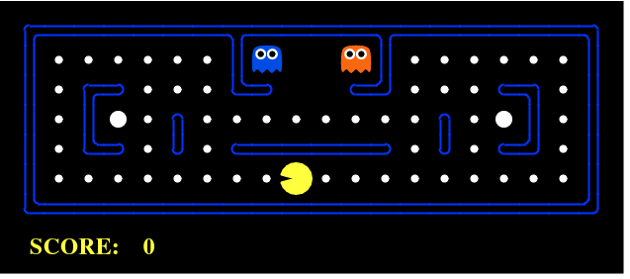
Reinforcement Learning Example: PCMAN
Source: https://www.kdnuggets.com/2018/03/5-things-reinforcement-learning.html

Slide 82
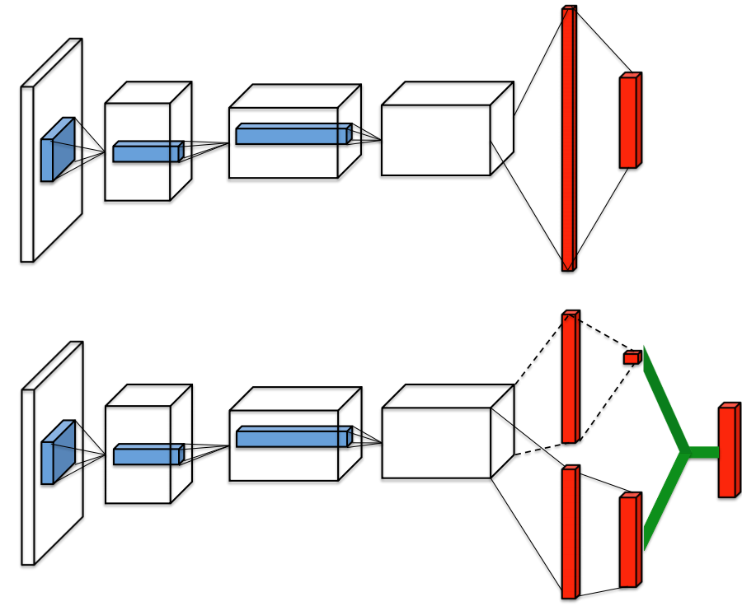
Dueling Network Architectures for Deep Reinforcement Learning
Single stream Q-network
Dueling Q-network
Source: Ziyu Wang et al. (2015). "Dueling network architectures for deep reinforcement learning." arXiv preprint arXiv:1511.06581 (2015)

Slide 83
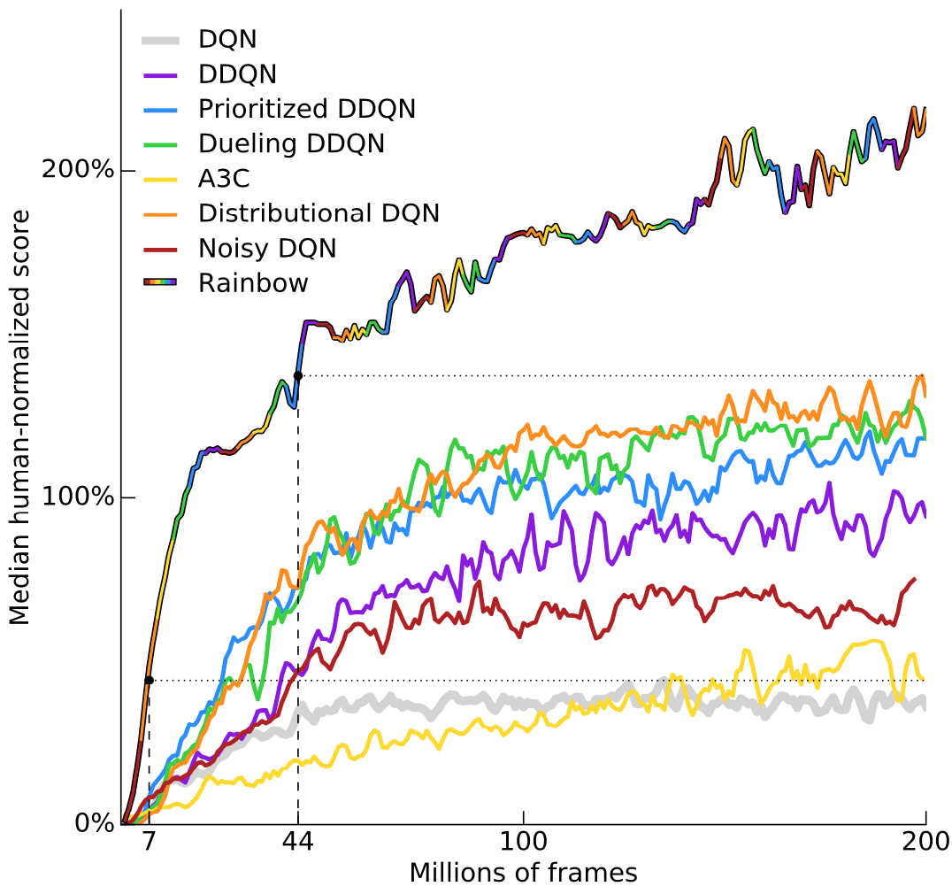
Rainbow: Combining improvements in deep reinforcement learning
Source: Matteo Hessel, Joseph Modayil, Hado Van Hasselt, Tom Schaul, Georg Ostrovski, Will Dabney, Dan Horgan, Bilal Piot, Mohammad Azar, and David Silver (2017). "Rainbow: Combining improvements in deep reinforcement learning." arXiv preprint arXiv:1710.02298 (2017).

Slide 84
A Typical Strategy Development Workflow
Source: http://www.wildml.com/2018/02/introduction-to-learning-to-trade-with-reinforcement-learning/

Slide 85
Reinforcement Learning (RL) in Trading Strategies
Source: http://www.wildml.com/2018/02/introduction-to-learning-to-trade-with-reinforcement-learning/

Slide 86
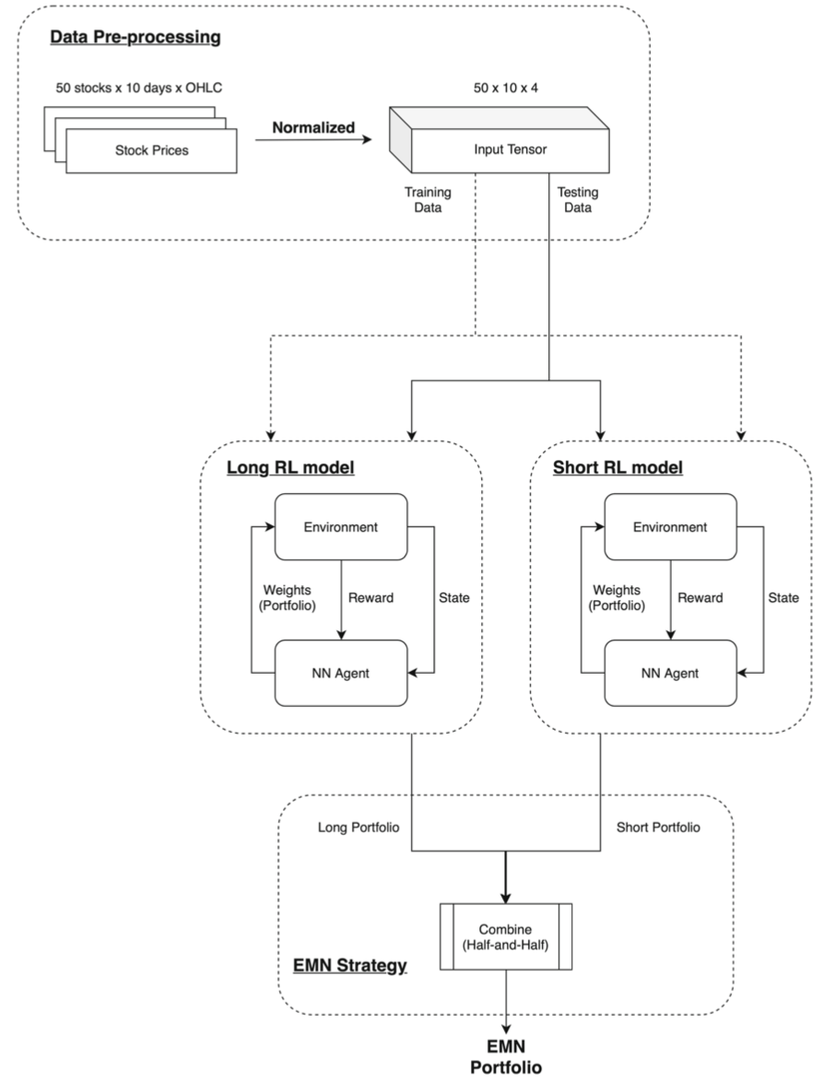
Portfolio management system in equity market neutral using reinforcement learning (Wu et al., 2021)
Source: Mu-En Wu, Jia-Hao Syu, Jerry Chun-Wei Lin, and Jan-Ming Ho. "Portfolio management system in equity market neutral using reinforcement learning." Applied Intelligence (2021): 1-13.

Slide 87
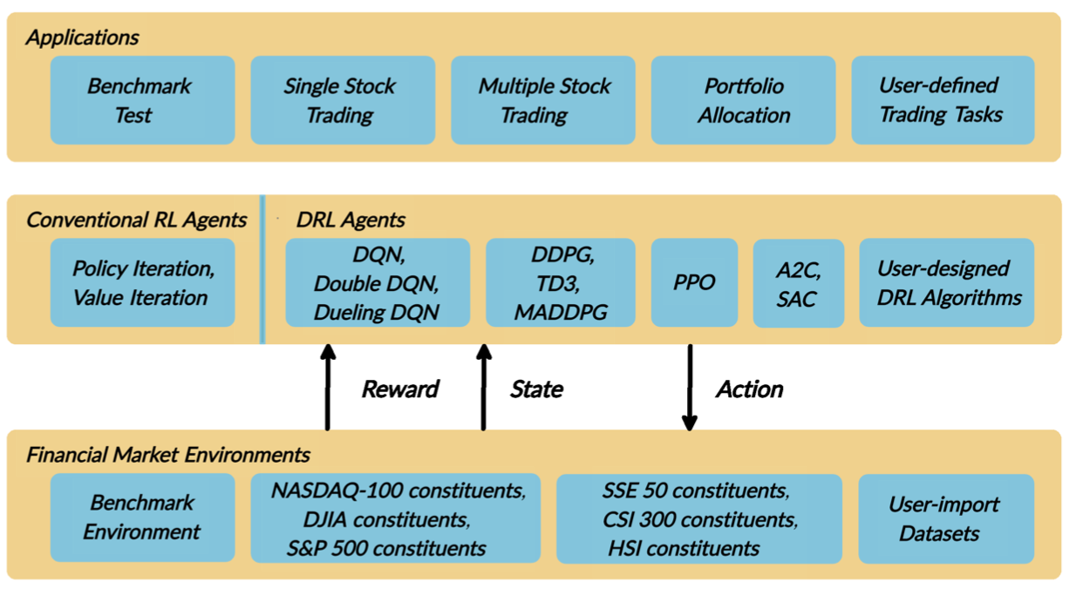
FinRL: A Deep Reinforcement Learning Library for Automated Stock Trading in Quantitative Finance
Source: Xiao-Yang Liu, Hongyang Yang, Qian Chen, Runjia Zhang, Liuqing Yang, Bowen Xiao, and Christina Dan Wang (2020). "FinRL: A Deep Reinforcement Learning Library for Automated Stock Trading in Quantitative Finance." arXiv preprint arXiv:2011.09607 (2020).

Slide 88
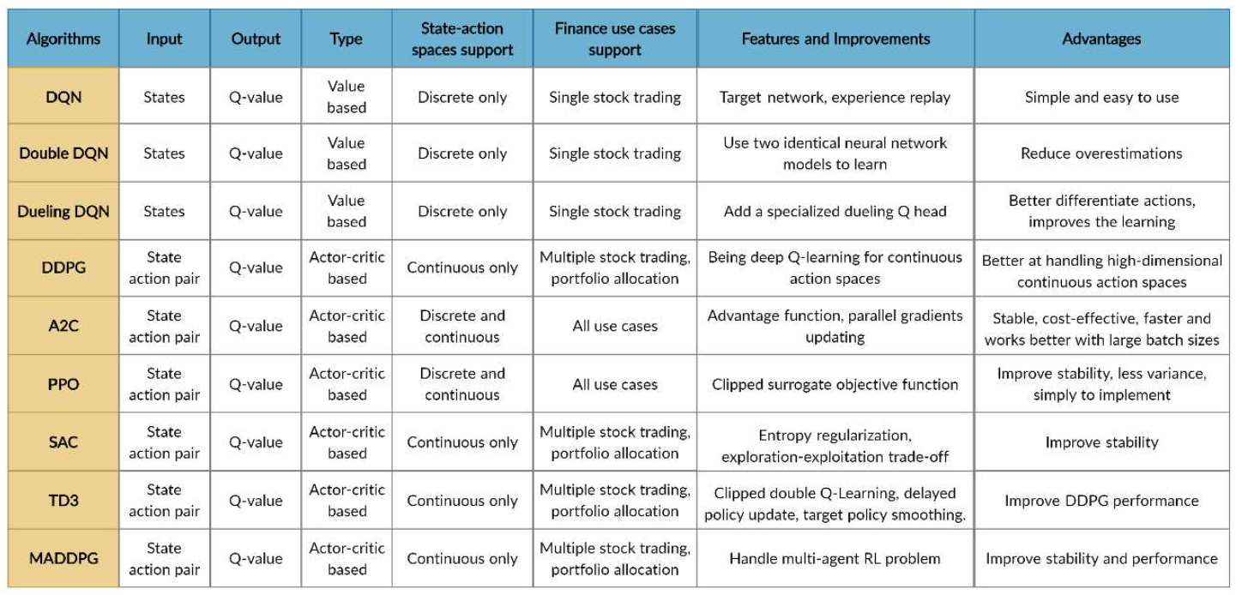
FinRL Deep Reinforcement Learning Algorithms
Source: Xiao-Yang Liu, Hongyang Yang, Qian Chen, Runjia Zhang, Liuqing Yang, Bowen Xiao, and Christina Dan Wang (2020). "FinRL: A Deep Reinforcement Learning Library for Automated Stock Trading in Quantitative Finance." arXiv preprint arXiv:2011.09607 (2020).

Slide 89
FinRL: A Deep Reinforcement Learning Library for Automated Stock Trading in Quantitative Finance
Evaluation of Trading Performance
Training-Validation-Testing Flow
Source: Xiao-Yang Liu, Hongyang Yang, Qian Chen, Runjia Zhang, Liuqing Yang, Bowen Xiao, and Christina Dan Wang (2020). "FinRL: A Deep Reinforcement Learning Library for Automated Stock Trading in Quantitative Finance." arXiv preprint arXiv:2011.09607 (2020).

Slide 90
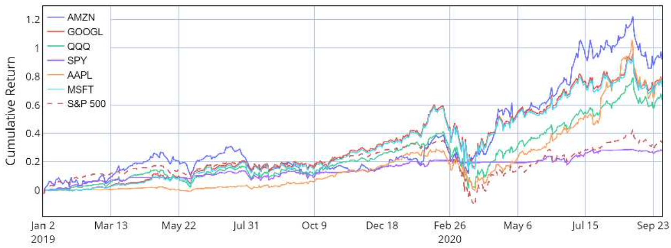
Reinforcement Learning (RL) FinRL Performance of single stock trading using Proximal policy optimization (PPO) in the FinRL library
Source: Xiao-Yang Liu, Hongyang Yang, Qian Chen, Runjia Zhang, Liuqing Yang, Bowen Xiao, and Christina Dan Wang (2020). "FinRL: A Deep Reinforcement Learning Library for Automated Stock Trading in Quantitative Finance." arXiv preprint arXiv:2011.09607 (2020).

Slide 91
Reinforcement Learning (RL) FinRL Performance of multiple stock trading and portfolio allocation using the FinRL library
Source: Xiao-Yang Liu, Hongyang Yang, Qian Chen, Runjia Zhang, Liuqing Yang, Bowen Xiao, and Christina Dan Wang (2020). "FinRL: A Deep Reinforcement Learning Library for Automated Stock Trading in Quantitative Finance." arXiv preprint arXiv:2011.09607 (2020).

Slide 92
Reinforcement Learning (RL) FinRL Performance of single stock trading using Proximal policy optimization (PPO) in the FinRL library
Source: Xiao-Yang Liu, Hongyang Yang, Qian Chen, Runjia Zhang, Liuqing Yang, Bowen Xiao, and Christina Dan Wang (2020). "FinRL: A Deep Reinforcement Learning Library for Automated Stock Trading in Quantitative Finance." arXiv preprint arXiv:2011.09607 (2020).

Slide 93
Reinforcement Learning (RL) FinRL Performance of multiple stock trading and portfolio allocation over the DJIA constituents stocks using the FinRL library
Source: Xiao-Yang Liu, Hongyang Yang, Qian Chen, Runjia Zhang, Liuqing Yang, Bowen Xiao, and Christina Dan Wang (2020). "FinRL: A Deep Reinforcement Learning Library for Automated Stock Trading in Quantitative Finance." arXiv preprint arXiv:2011.09607 (2020).

Slide 94
Deep Reinforcement Learning Library
OpenAI Gym
Google Dopamine
RLlib
Horizon
FinRL

Slide 95
Open AI Gym
https://gym.openai.com/

Slide 96
Google Dopamine
Dopamine is a research framework for fast prototyping of reinforcement learning algorithms.
https://github.com/google/dopamine

Slide 97
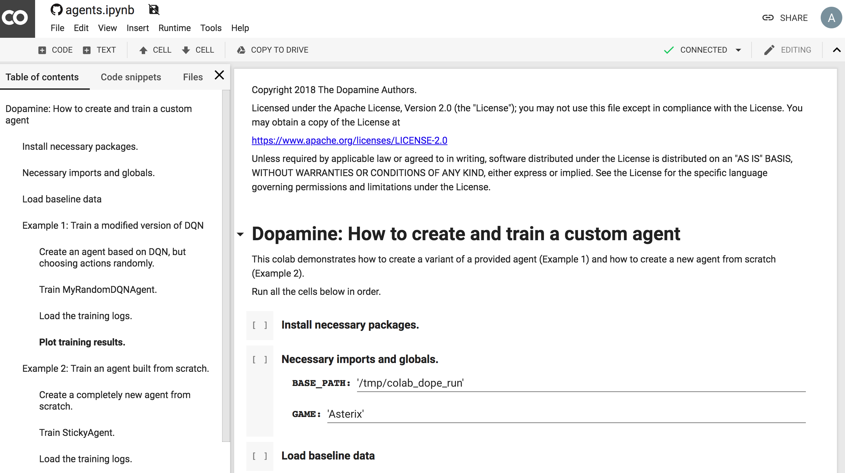
Deep Reinforcement Learning Dopamine Colab Examples DQN Rainbow
https://colab.research.google.com/github/google/dopamine/blob/master/dopamine/colab/agents.ipynb

Slide 98
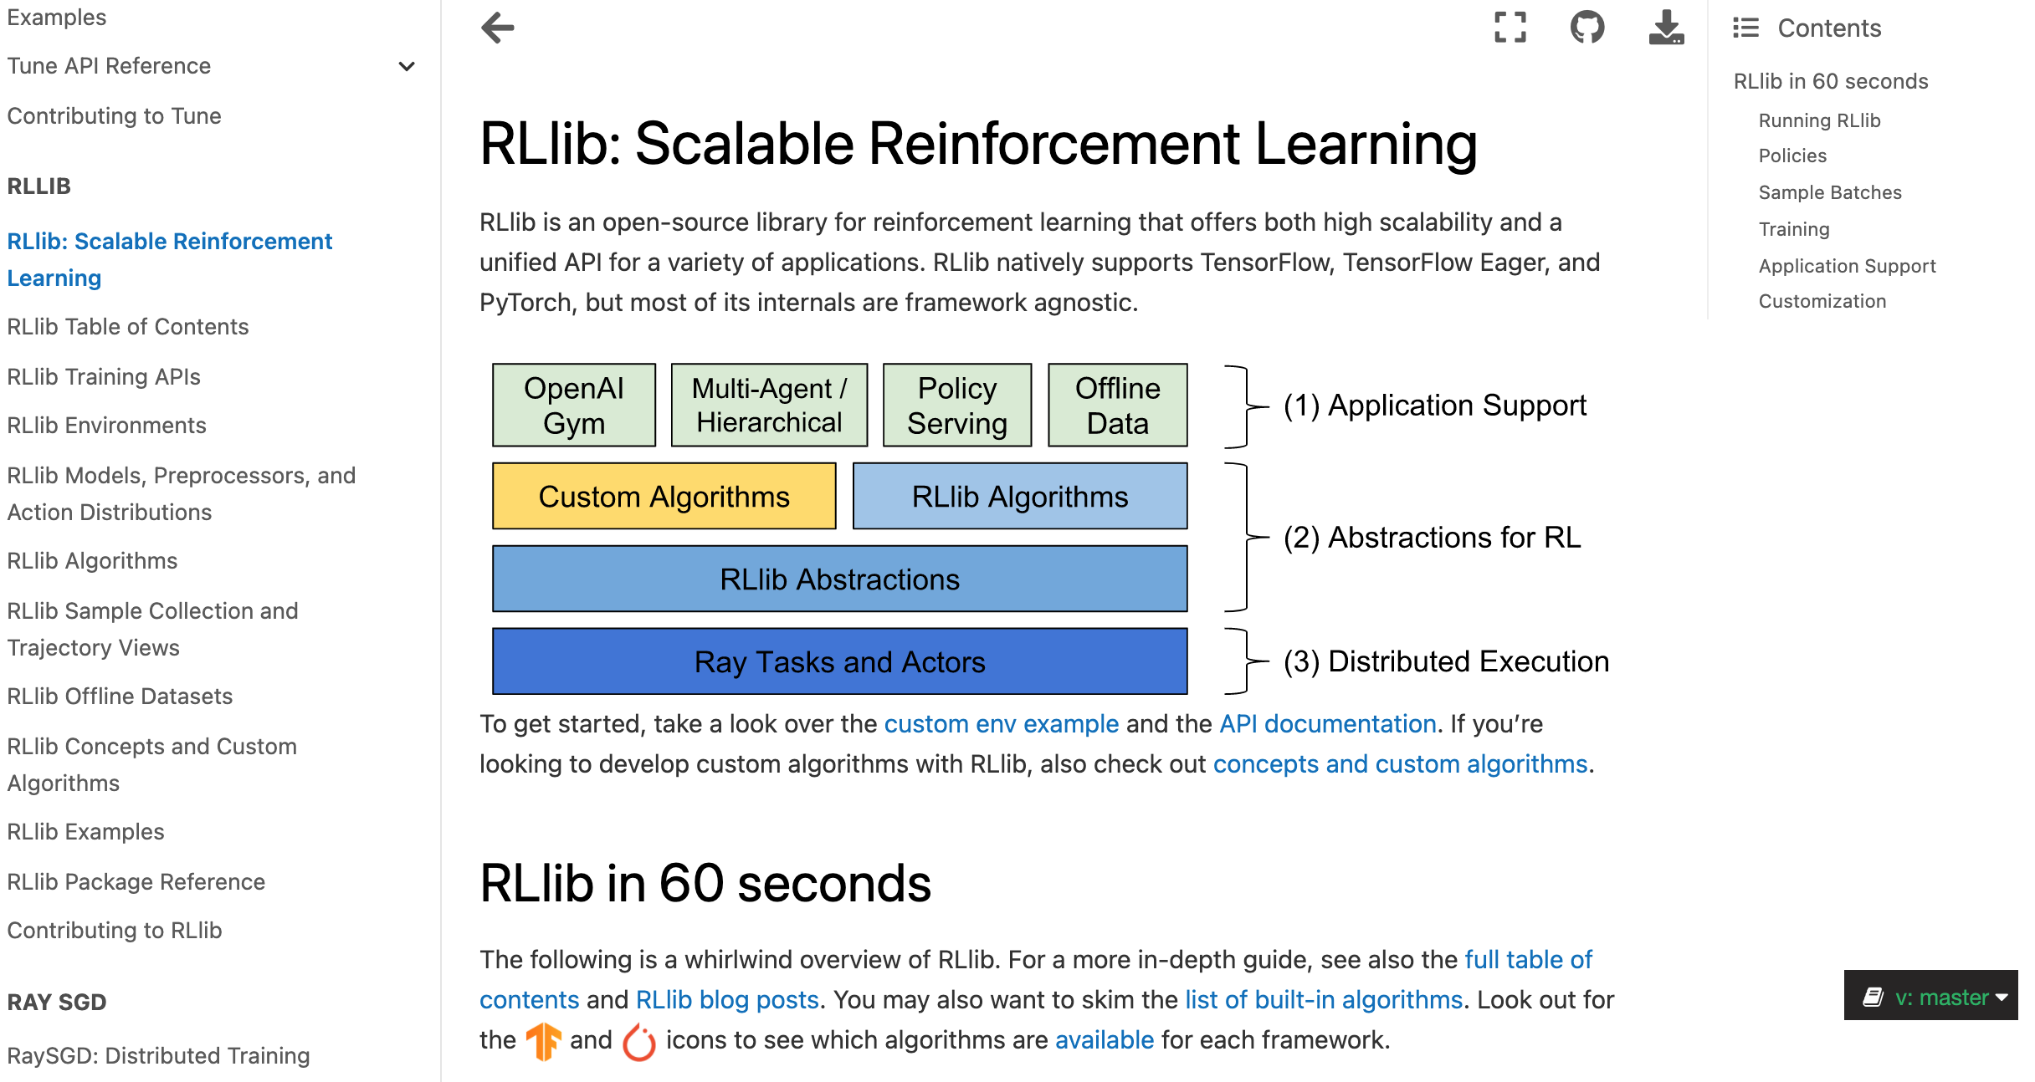
RLlib: Scalable Reinforcement Learning
https://docs.ray.io/en/master/rllib.html

Slide 99
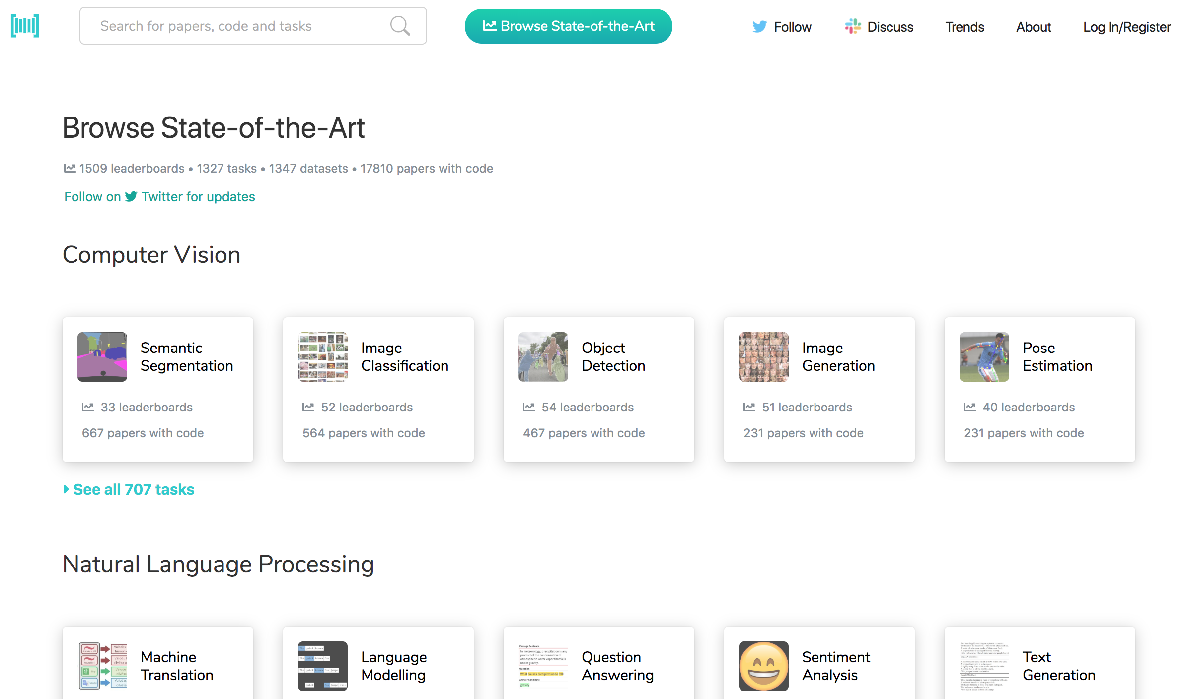
Papers with Code State-of-the-Art (SOTA)
https://paperswithcode.com/sota

Slide 100
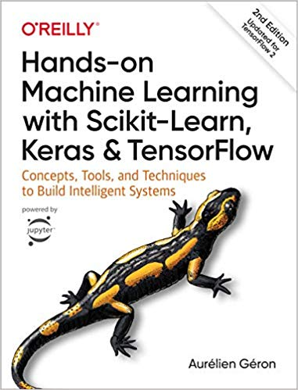
Aurélien Géron (2019), Hands-On Machine Learning with Scikit-Learn, Keras, and TensorFlow: Concepts, Tools, and Techniques to Build Intelligent Systems, 2nd Edition O’Reilly Media, 2019
https://github.com/ageron/handson-ml2
Source: https://www.amazon.com/Hands-Machine-Learning-Scikit-Learn-TensorFlow/dp/1492032646/

Slide 101
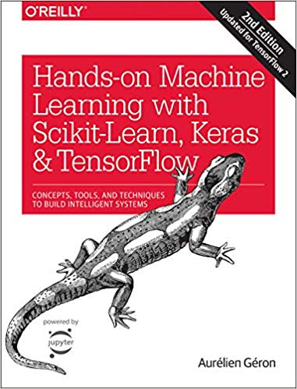
Hands-On Machine Learning with Scikit-Learn, Keras, and TensorFlow
Notebooks
The Machine Learning landscape
End-to-end Machine Learning project
Classification
Training Models
Support Vector Machines
Decision Trees
Ensemble Learning and Random Forests
Dimensionality Reduction
Unsupervised Learning Techniques
Artificial Neural Nets with Keras
Training Deep Neural Networks
Custom Models and Training with TensorFlow
Loading and Preprocessing Data
Deep Computer Vision Using Convolutional Neural Networks
Processing Sequences Using RNNs and CNNs
Natural Language Processing with RNNs and Attention
Representation Learning Using Autoencoders
Reinforcement Learning
Training and Deploying TensorFlow Models at Scale
https://github.com/ageron/handson-ml2

Slide 102
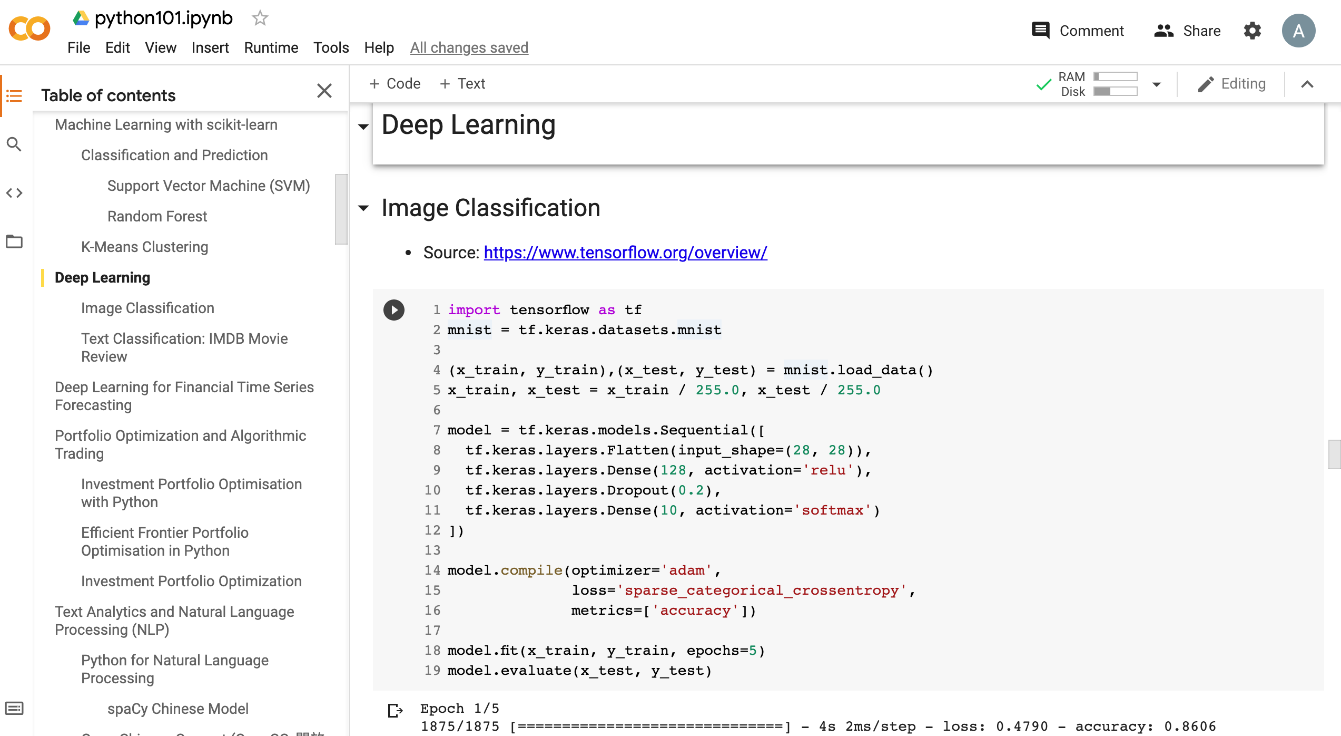
Python in Google Colab (Python101)
https://colab.research.google.com/drive/1FEG6DnGvwfUbeo4zJ1zTunjMqf2RkCrT
https://tinyurl.com/aintpupython101

Slide 103
Summary
Reinforcement Learning (RL)
Markov Decision Processes (MDP)
Deep Reinforcement Learning (DRL) Algorithms
SARSA
Q-Learning
DQN
A3C
Rainbow

Slide 104
References
Stuart Russell and Peter Norvig (2020), Artificial Intelligence: A Modern Approach, 4th Edition, Pearson.
Aurélien Géron (2019), Hands-On Machine Learning with Scikit-Learn, Keras, and TensorFlow: Concepts, Tools, and Techniques to Build Intelligent Systems, 2nd Edition, O’Reilly Media.
Richard S. Sutton & Andrew G. Barto (2018), Reinforcement Learning: An Introduction, 2nd Edition, A Bradford Book.
David Silver (2015), Introduction to reinforcement learning, https://www.youtube.com/playlist?list=PLqYmG7hTraZDM-OYHWgPebj2MfCFzFObQ
David Silver, Thomas Hubert, Julian Schrittwieser, Ioannis Antonoglou, Matthew Lai, Arthur Guez, Marc Lanctot, Laurent Sifre, Dharshan Kumaran, Thore Graepel, Timothy Lillicrap, Karen Simonyan, Demis Hassabis (2018), "A general reinforcement learning algorithm that masters chess, shogi, and Go through self-play." Science 362, no. 6419 (2018): 1140-1144.
David Silver, Julian Schrittwieser, Karen Simonyan, Ioannis Antonoglou, Aja Huang, Arthur Guez, Thomas Hubert, Lucas Baker, Matthew Lai, Adrian Bolton, Yutian Chen, Timothy Lillicrap, Fan Hui, Laurent Sifre, George van den Driessche, Thore Graepel, and Demis Hassabis (2017), "Mastering the game of Go without human knowledge." Nature 550 (2017): 354–359.
Hado Van Hasselt, Arthur Guez, and David Silver (2016). "Deep Reinforcement Learning with Double Q-Learning." In AAAI, vol. 2, p. 5. 2016.
Matteo Hessel, Joseph Modayil, Hado Van Hasselt, Tom Schaul, Georg Ostrovski, Will Dabney, Dan Horgan, Bilal Piot, Mohammad Azar, and David Silver (2017). "Rainbow: Combining improvements in deep reinforcement learning." arXiv preprint arXiv:1710.02298 (2017).
Volodymyr Mnih, Koray Kavukcuoglu, David Silver, Andrei A. Rusu, Joel Veness, Marc G. Bellemare, Alex Graves et al. (2015) "Human-level control through deep reinforcement learning." Nature 518, no. 7540 (2015): 529.
Ziyu Wang, Tom Schaul, Matteo Hessel, Hado Van Hasselt, Marc Lanctot, and Nando De Freitas (2015). "Dueling network architectures for deep reinforcement learning." arXiv preprint arXiv:1511.06581 (2015).
Xiao-Yang Liu, Hongyang Yang, Qian Chen, Runjia Zhang, Liuqing Yang, Bowen Xiao, and Christina Dan Wang (2020). "FinRL: A Deep Reinforcement Learning Library for Automated Stock Trading in Quantitative Finance." arXiv preprint arXiv:2011.09607 (2020).
Mu-En Wu, Jia-Hao Syu, Jerry Chun-Wei Lin, and Jan-Ming Ho. "Portfolio management system in equity market neutral using reinforcement learning." Applied Intelligence (2021): 1-13.
Min-Yuh Day (2021), Python 101, https://tinyurl.com/aintpupython101

