Slide 1



資料探勘
(Data Mining)
機器學習和深度學習
(Machine Learning and Deep Learning)
1092DM08
MBA, IM, NTPU (M5026) (Spring 2021)
Tue 2, 3, 4 (9:10-12:00) (B8F40)
Min-Yuh Day
戴敏育
Associate Professor
副教授
Institute of Information Management, National Taipei University
國立臺北大學 資訊管理研究所
https://web.ntpu.edu.tw/~myday
2021-05-04

Slide 2
課程大綱 (Syllabus)
週次 (Week) 日期 (Date) 內容 (Subject/Topics)
1 2021/02/23 資料探勘介紹 (Introduction to data mining)
2 2021/03/02 ABC：人工智慧，大數據，雲端運算
(ABC: AI, Big Data, Cloud Computing)
3 2021/03/09 Python資料探勘的基礎
(Foundations of Data Mining in Python)
4 2021/03/16 資料科學與資料探勘：發現，分析，可視化和呈現數據
(Data Science and Data Mining:
Discovering, Analyzing, Visualizing and Presenting Data)
5 2021/03/23 非監督學習：關聯分析，購物籃分析
(Unsupervised Learning: Association Analysis,
Market Basket Analysis)
6 2021/03/30 資料探勘個案研究 I
(Case Study on Data Mining I)

Slide 3
課程大綱 (Syllabus)
週次 (Week) 日期 (Date) 內容 (Subject/Topics)
7 2021/04/06 放假一天 (Day off)
8 2021/04/13 非監督學習：集群分析，行銷市場區隔
(Unsupervised Learning: Cluster Analysis, Market Segmentation)
9 2021/04/20 期中報告 (Midterm Project Report)
10 2021/04/27 監督學習：分類和預測
(Supervised Learning: Classification and Prediction)
11 2021/05/04 機器學習和深度學習
(Machine Learning and Deep Learning)
12 2021/05/11 卷積神經網絡
(Convolutional Neural Networks)

Slide 4
課程大綱 (Syllabus)
週次 (Week) 日期 (Date) 內容 (Subject/Topics)
13 2021/05/18 資料探勘個案研究 II
(Case Study on Data Mining II)
14 2021/05/25 遞歸神經網絡
(Recurrent Neural Networks)
15 2021/06/01 強化學習
(Reinforcement Learning)
16 2021/06/08 社交網絡分析
(Social Network Analysis)
17 2021/06/15 期末報告 I (Final Project Report I)
18 2021/06/22 期末報告 II (Final Project Report II)

Slide 5
Machine Learning and
Deep Learning

Slide 6
Outline
Machine Learning
Deep Learning

Slide 7
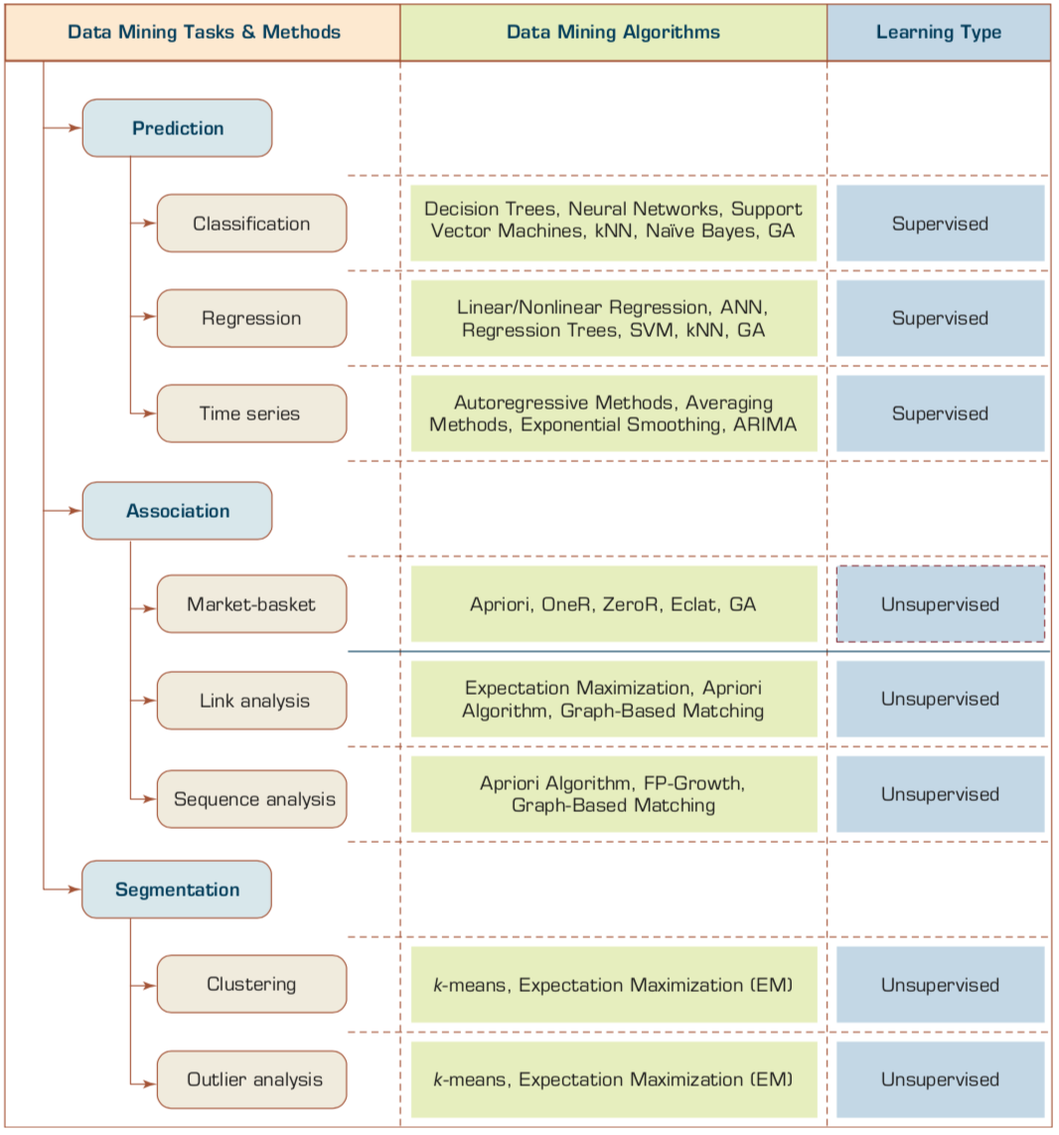
Data Mining Tasks & Methods
Prediction
Association
Segmentation
Source: Ramesh Sharda, Dursun Delen, and Efraim Turban (2017), Business Intelligence, Analytics, and Data Science: A Managerial Perspective, 4th Edition, Pearson

Slide 8
AI-driven Marketing
(Ma and Sun, 2020)
Interactive &
media-rich
Personalization
Real-time
automation
Customer-
journey
focus
Industry Trends
Marketing
Mix
Engagement
Search
Recommendation
Attribution
Marketing Actions
AI & Machine Learning
Source: Liye Ma and Baohong Sun (2020), "Machine learning and AI in marketing – Connecting computing power to human insights." International Journal of Research in Marketing, 37, no. 3, 481-504.

Slide 9
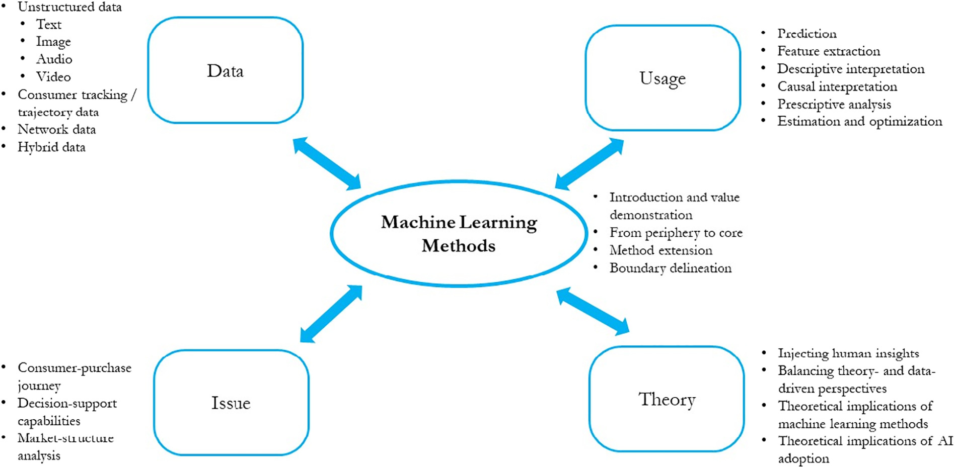
Machine Learning in Marketing Research
(Ma and Sun, 2020)
Source: Liye Ma and Baohong Sun (2020), "Machine learning and AI in marketing – Connecting computing power to human insights." International Journal of Research in Marketing, 37, no. 3, 481-504.

Slide 10
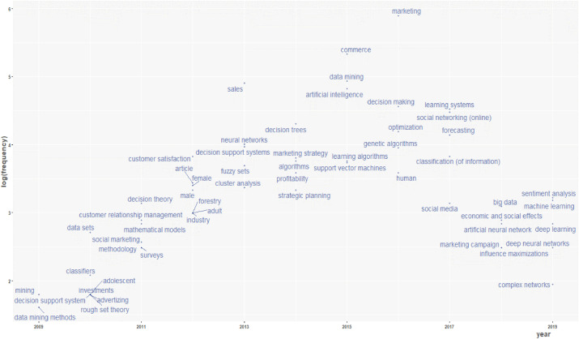
Artificial Intelligence in Marketing
(Verma et al., 2021)
M
DM
AI
BD
ML
DL
Source: Sanjeev Verma, Rohit Sharma, Subhamay Deb, and Debojit Maitra (2021),. "Artificial intelligence in marketing: Systematic review and future research direction." International Journal of Information Management Data Insights (2021): 100002.

Slide 11
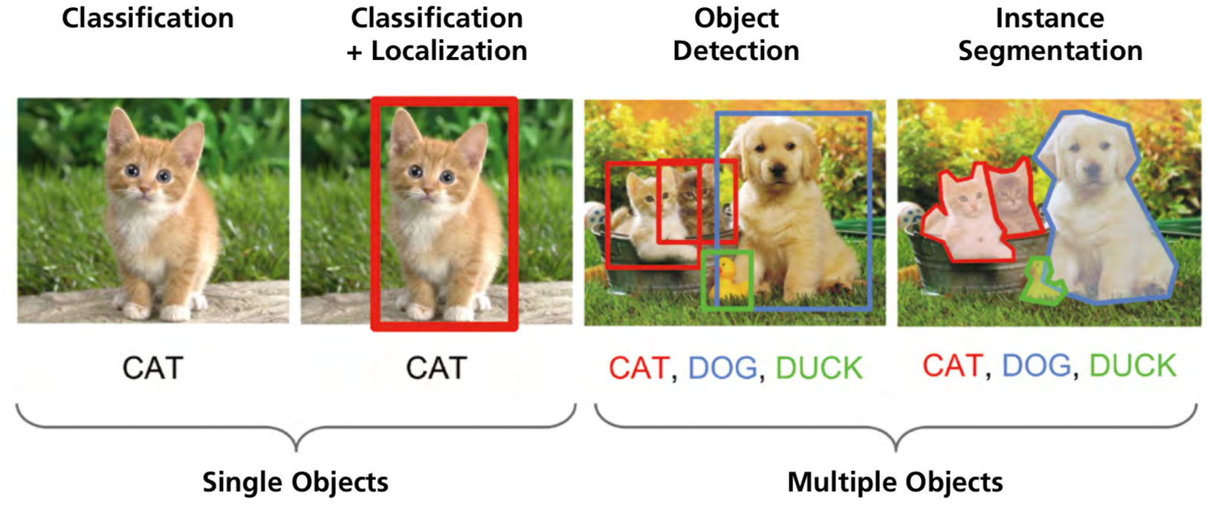
Computer Vision: Image Classification,
Object Detection,
Object Instance Segmentation
Source: DHL (2018), Artificial Intelligence in Logistics,
http://www.globalhha.com/doclib/data/upload/doc_con/5e50c53c5bf67.pdf/

Slide 12
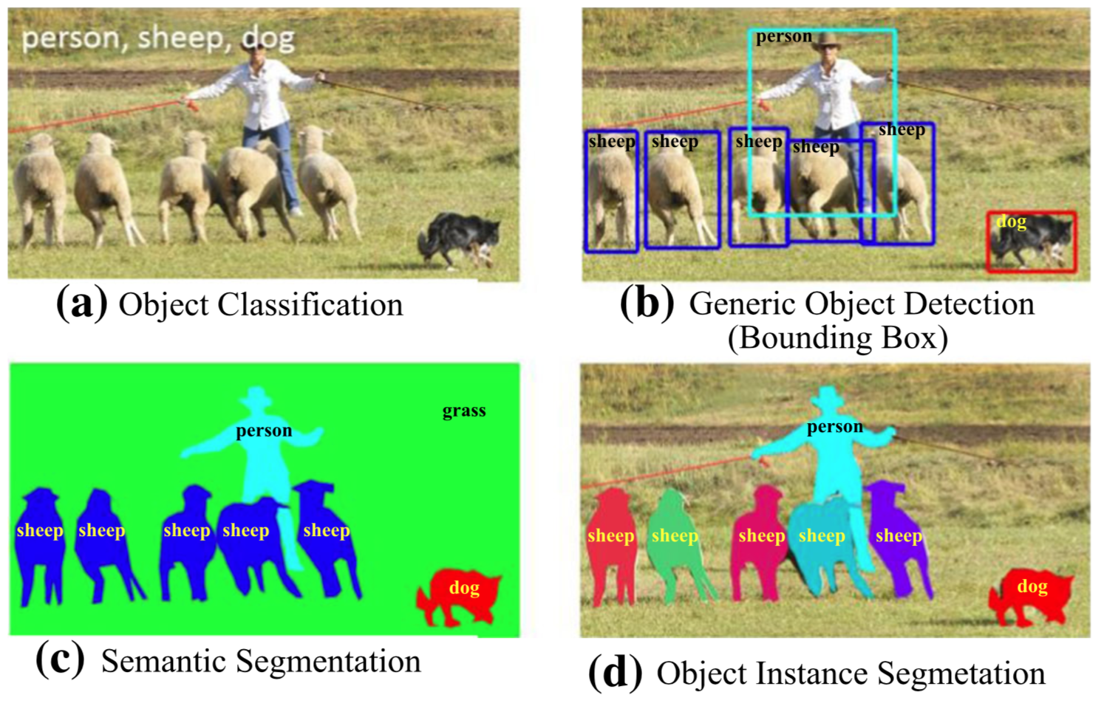
Computer Vision: Object Detection
Source: Li Liu, Wanli Ouyang, Xiaogang Wang, Paul Fieguth, Jie Chen, Xinwang Liu, and Matti Pietikäinen. "Deep learning for generic object detection: A survey." International journal of computer vision 128, no. 2 (2020): 261-318.

Slide 13
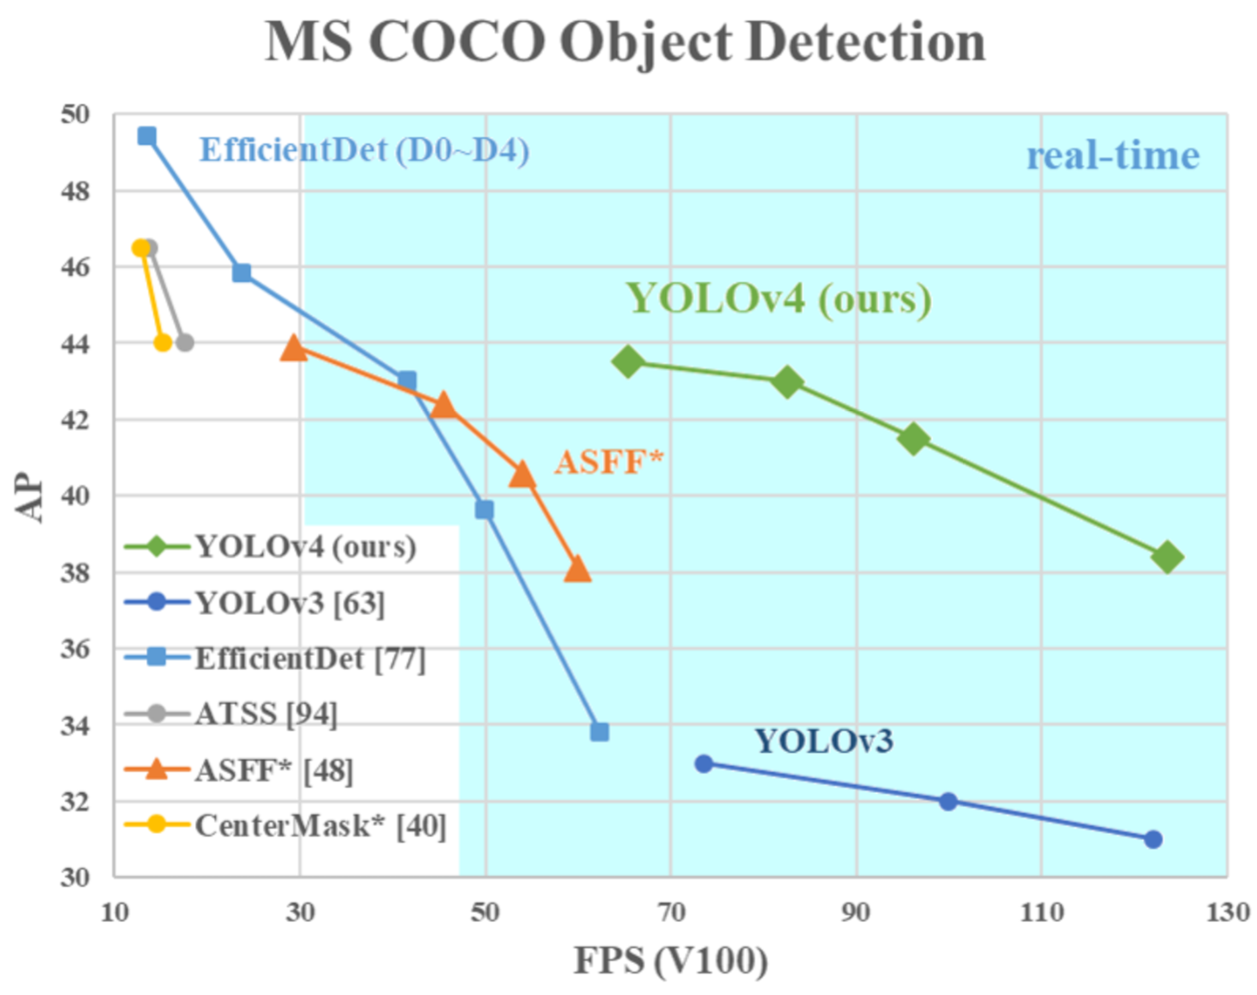
YOLOv4:
Optimal Speed and Accuracy of Object Detection
Source: Alexey Bochkovskiy, Chien-Yao Wang, and Hong-Yuan Mark Liao. "YOLOv4: Optimal Speed and Accuracy of Object Detection." arXiv preprint arXiv:2004.10934 (2020).

Slide 14
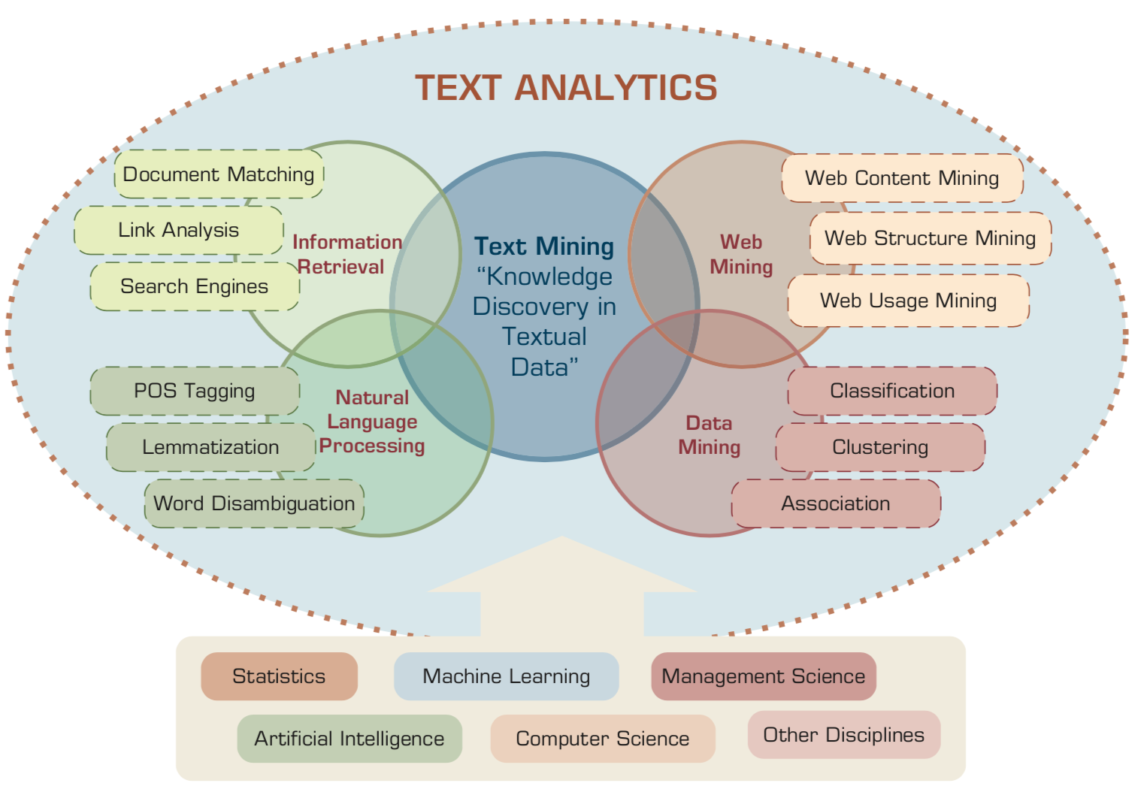
Text Analytics and Text Mining
Source: Ramesh Sharda, Dursun Delen, and Efraim Turban (2017), Business Intelligence, Analytics, and Data Science: A Managerial Perspective, 4th Edition, Pearson

Slide 15
Deep learning for financial applications:
A survey
Applied Soft Computing (2020)
Source:
Ahmet Murat Ozbayoglu, Mehmet Ugur Gudelek, and Omer Berat Sezer (2020). "Deep learning for financial applications: A survey."
Applied Soft Computing (2020): 106384.

Slide 16
Financial time series forecasting with deep learning:
A systematic literature review:
2005–2019
Applied Soft Computing (2020)
Source:
Omer Berat Sezer, Mehmet Ugur Gudelek, and Ahmet Murat Ozbayoglu (2020), "Financial time series forecasting with deep learning: A systematic literature review: 2005–2019." Applied Soft Computing 90 (2020): 106181.

Slide 17
Deep learning for financial applications: Topics
Source: Ahmet Murat Ozbayoglu, Mehmet Ugur Gudelek, and Omer Berat Sezer (2020). "Deep learning for financial applications: A survey." Applied Soft Computing (2020): 106384.

Slide 18
Deep learning for financial applications: Deep Learning Models
Source: Ahmet Murat Ozbayoglu, Mehmet Ugur Gudelek, and Omer Berat Sezer (2020). "Deep learning for financial applications: A survey." Applied Soft Computing (2020): 106384.

Slide 19
Deep learning for financial applications: Topic-Model Heatmap
Source: Ahmet Murat Ozbayoglu, Mehmet Ugur Gudelek, and Omer Berat Sezer (2020). "Deep learning for financial applications: A survey." Applied Soft Computing (2020): 106384.

Slide 20
Deep learning for financial applications: Topic-Feature Heatmap
Source: Ahmet Murat Ozbayoglu, Mehmet Ugur Gudelek, and Omer Berat Sezer (2020). "Deep learning for financial applications: A survey." Applied Soft Computing (2020): 106384.

Slide 21
Deep learning for financial applications: Topic-Dataset Heatmap
Source: Ahmet Murat Ozbayoglu, Mehmet Ugur Gudelek, and Omer Berat Sezer (2020). "Deep learning for financial applications: A survey." Applied Soft Computing (2020): 106384.

Slide 22
Deep learning for financial applications:
Algo-trading applications embedded with time series forecasting models
Source: Ahmet Murat Ozbayoglu, Mehmet Ugur Gudelek, and Omer Berat Sezer (2020). "Deep learning for financial applications: A survey." Applied Soft Computing (2020): 106384.

Slide 23
Deep learning for financial applications:
Algo-trading applications embedded with time series forecasting models
Source: Ahmet Murat Ozbayoglu, Mehmet Ugur Gudelek, and Omer Berat Sezer (2020). "Deep learning for financial applications: A survey." Applied Soft Computing (2020): 106384.

Slide 24
Deep learning for financial applications:
Classification (buy–sell signal, or trend detection) based algo-trading models
Source: Ahmet Murat Ozbayoglu, Mehmet Ugur Gudelek, and Omer Berat Sezer (2020). "Deep learning for financial applications: A survey." Applied Soft Computing (2020): 106384.

Slide 25
Deep learning for financial applications:
Stand-alone and/or other algorithmic models
Source: Ahmet Murat Ozbayoglu, Mehmet Ugur Gudelek, and Omer Berat Sezer (2020). "Deep learning for financial applications: A survey." Applied Soft Computing (2020): 106384.

Slide 26
Deep learning for financial applications:
Credit scoring or classification studies
Source: Ahmet Murat Ozbayoglu, Mehmet Ugur Gudelek, and Omer Berat Sezer (2020). "Deep learning for financial applications: A survey." Applied Soft Computing (2020): 106384.

Slide 27
Deep learning for financial applications:
Financial distress, bankruptcy, bank risk, mortgage risk, crisis forecasting studies.
Source: Ahmet Murat Ozbayoglu, Mehmet Ugur Gudelek, and Omer Berat Sezer (2020). "Deep learning for financial applications: A survey." Applied Soft Computing (2020): 106384.

Slide 28
Deep learning for financial applications:
Fraud detection studies
Source: Ahmet Murat Ozbayoglu, Mehmet Ugur Gudelek, and Omer Berat Sezer (2020). "Deep learning for financial applications: A survey." Applied Soft Computing (2020): 106384.

Slide 29
Deep learning for financial applications:
Portfolio management studies
Source: Ahmet Murat Ozbayoglu, Mehmet Ugur Gudelek, and Omer Berat Sezer (2020). "Deep learning for financial applications: A survey." Applied Soft Computing (2020): 106384.

Slide 30
Deep learning for financial applications:
Asset pricing and derivatives market studies
Source: Ahmet Murat Ozbayoglu, Mehmet Ugur Gudelek, and Omer Berat Sezer (2020). "Deep learning for financial applications: A survey." Applied Soft Computing (2020): 106384.

Slide 31
Deep learning for financial applications:
Cryptocurrency and blockchain studies
Source: Ahmet Murat Ozbayoglu, Mehmet Ugur Gudelek, and Omer Berat Sezer (2020). "Deep learning for financial applications: A survey." Applied Soft Computing (2020): 106384.

Slide 32
Deep learning for financial applications:
Financial sentiment studies coupled with text mining for forecasting
Source: Ahmet Murat Ozbayoglu, Mehmet Ugur Gudelek, and Omer Berat Sezer (2020). "Deep learning for financial applications: A survey." Applied Soft Computing (2020): 106384.

Slide 33
Deep learning for financial applications:
Text mining studies without sentiment analysis for forecasting
Source: Ahmet Murat Ozbayoglu, Mehmet Ugur Gudelek, and Omer Berat Sezer (2020). "Deep learning for financial applications: A survey." Applied Soft Computing (2020): 106384.

Slide 34
Deep learning for financial applications:
Text mining studies without sentiment analysis for forecasting
Source: Ahmet Murat Ozbayoglu, Mehmet Ugur Gudelek, and Omer Berat Sezer (2020). "Deep learning for financial applications: A survey." Applied Soft Computing (2020): 106384.

Slide 35
Deep learning for financial applications:
Financial sentiment studies coupled with text mining without forecasting
Source: Ahmet Murat Ozbayoglu, Mehmet Ugur Gudelek, and Omer Berat Sezer (2020). "Deep learning for financial applications: A survey." Applied Soft Computing (2020): 106384.

Slide 36
Deep learning for financial applications:
Other text mining studies
Source: Ahmet Murat Ozbayoglu, Mehmet Ugur Gudelek, and Omer Berat Sezer (2020). "Deep learning for financial applications: A survey." Applied Soft Computing (2020): 106384.

Slide 37
Deep learning for financial applications:
Other theoretical or conceptual studies
Source: Ahmet Murat Ozbayoglu, Mehmet Ugur Gudelek, and Omer Berat Sezer (2020). "Deep learning for financial applications: A survey." Applied Soft Computing (2020): 106384.

Slide 38
Deep learning for financial applications:
Other financial applications
Source: Ahmet Murat Ozbayoglu, Mehmet Ugur Gudelek, and Omer Berat Sezer (2020). "Deep learning for financial applications: A survey." Applied Soft Computing (2020): 106384.

Slide 39
Financial time series forecasting with deep learning: Topic-model heatmap
Source: Omer Berat Sezer, Mehmet Ugur Gudelek, and Ahmet Murat Ozbayoglu (2020), "Financial time series forecasting with deep learning:
A systematic literature review: 2005–2019." Applied Soft Computing 90 (2020): 106181.

Slide 40
Stock price forecasting using only raw time series data
Source: Omer Berat Sezer, Mehmet Ugur Gudelek, and Ahmet Murat Ozbayoglu (2020), "Financial time series forecasting with deep learning:
A systematic literature review: 2005–2019." Applied Soft Computing 90 (2020): 106181.

Slide 41
Stock price forecasting using various data
Source: Omer Berat Sezer, Mehmet Ugur Gudelek, and Ahmet Murat Ozbayoglu (2020), "Financial time series forecasting with deep learning:
A systematic literature review: 2005–2019." Applied Soft Computing 90 (2020): 106181.

Slide 42
Stock Market Movement Forecast:
Phases of the stock market modeling
Source: O. Bustos and A. Pomares-Quimbaya (2020), "Stock Market Movement Forecast: A Systematic Review."
Expert Systems with Applications (2020): 113464.

Slide 43
AI, ML, DL
Artificial Intelligence (AI)
Machine Learning (ML)
Supervised
Learning
Unsupervised Learning
Deep Learning (DL)
CNN
RNN LSTM GRU
GAN
Semi-supervised Learning
Reinforcement Learning
Source: https://leonardoaraujosantos.gitbooks.io/artificial-inteligence/content/deep_learning.html

Slide 44
3 Machine Learning Algorithms
Source: Enrico Galimberti, http://blogs.teradata.com/data-points/tree-machine-learning-algorithms/

Slide 45
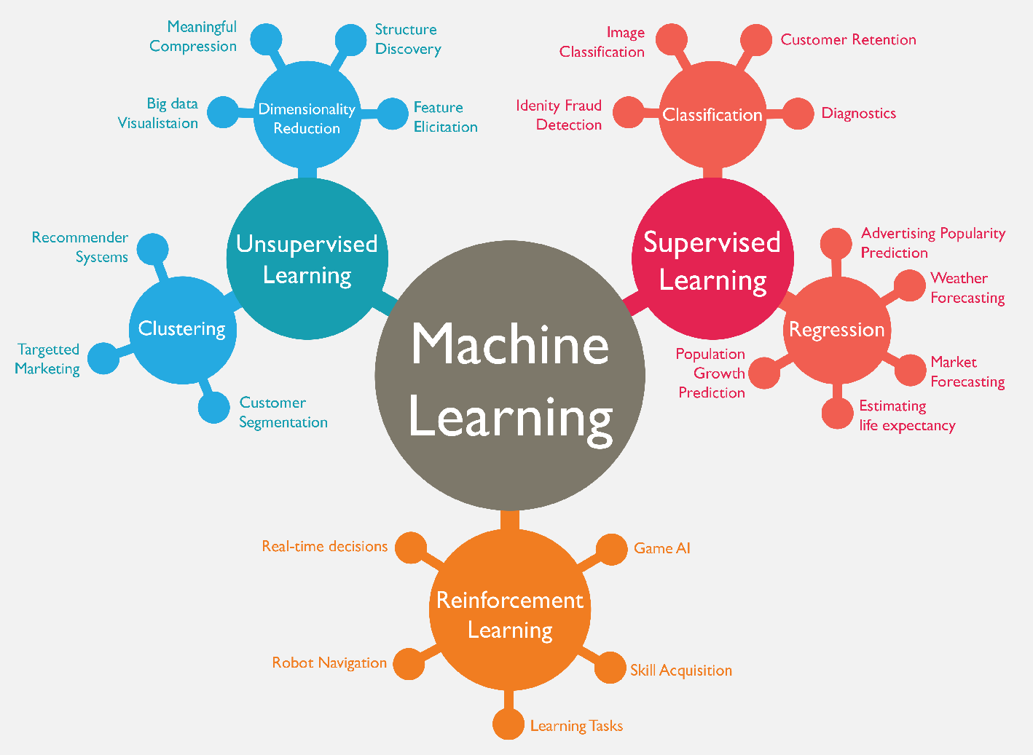
Machine Learning (ML)
Source: https://www.mactores.com/services/aws-big-data-machine-learning-cognitive-services/

Slide 46
Machine Learning Models
Deep Learning
Kernel
Association rules
Ensemble
Decision tree
Dimensionality reduction
Clustering
Regression Analysis
Bayesian
Instance based
Source: Sunila Gollapudi (2016), Practical Machine Learning, Packt Publishing

Slide 47
Machine Learning (ML) / Deep Learning (DL)
Decision Tree Classifiers
Support Vector Machine (SVM)
Supervised Learning
Neural Network (NN)
Linear Classifiers
Deep Learning (DL)
Machine Learning
(ML)
Rule-based Classifiers
Naïve Bayes
(NB)
Unsupervised Learning
Probabilistic Classifiers
Bayesian Network (BN)
Maximum Entropy (ME)
Reinforcement Learning
Source: Jesus Serrano-Guerrero, Jose A. Olivas, Francisco P. Romero, and Enrique Herrera-Viedma (2015),
"Sentiment analysis: A review and comparative analysis of web services," Information Sciences, 311, pp. 18-38.

Slide 48
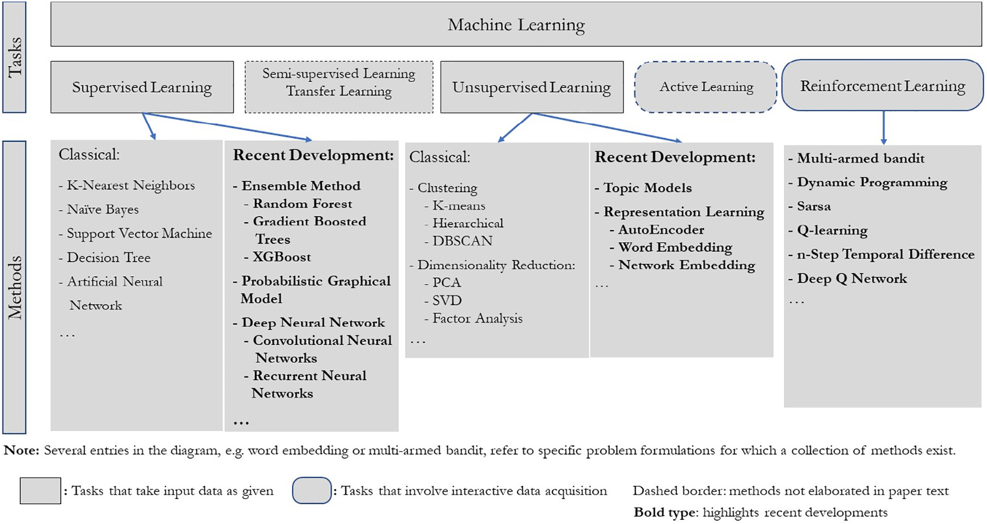
Machine Learning Tasks and Methods
Source: Liye Ma and Baohong Sun (2020), "Machine learning and AI in marketing – Connecting computing power to human insights." International Journal of Research in Marketing, 37, no. 3, 481-504.

Slide 49
Machine Learning Methods in Marketing
High
Causal
interpretation
Prescriptive
analysis
Descriptive
interpretation
Marketing
Theory
Connection
Feature
extraction
Underexplored area
Prediction
Optimization
Low
Black box/Standalone
White box/Integration
Method Transparency
Source: Liye Ma and Baohong Sun (2020), "Machine learning and AI in marketing – Connecting computing power to human insights." International Journal of Research in Marketing, 37, no. 3, 481-504.

Slide 50
Machine Learning

Slide 51
Scikit-Learn
Machine Learning in Python

Slide 52
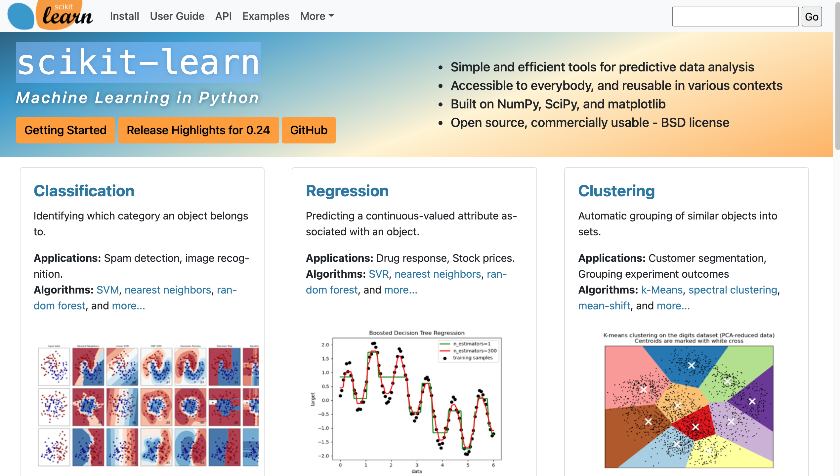
Scikit-Learn
Source: http://scikit-learn.org/

Slide 53
Scikit-Learn Machine Learning Map
Source: http://scikit-learn.org/stable/tutorial/machine_learning_map/index.html

Slide 54
Scikit-Learn Machine Learning Map
Source: http://scikit-learn.org/stable/tutorial/machine_learning_map/index.html

Slide 55
Scikit-Learn Machine Learning Map
Source: http://scikit-learn.org/stable/tutorial/machine_learning_map/index.html

Slide 56
Scikit-Learn Machine Learning Map
Source: http://scikit-learn.org/stable/tutorial/machine_learning_map/index.html

Slide 57
Machine Learning
Supervised Learning (Classification)
Learning from Examples
y = f(x)
x
y

Slide 58
Machine Learning
Supervised Learning (Classification)
Learning from Examples
y = f(x)
5.1,3.5,1.4,0.2,Iris-setosa 4.9,3.0,1.4,0.2,Iris-setosa 4.7,3.2,1.3,0.2,Iris-setosa 7.0,3.2,4.7,1.4,Iris-versicolor 6.4,3.2,4.5,1.5,Iris-versicolor 6.9,3.1,4.9,1.5,Iris-versicolor 6.3,3.3,6.0,2.5,Iris-virginica 5.8,2.7,5.1,1.9,Iris-virginica 7.1,3.0,5.9,2.1,Iris-virginica
y
x

Slide 59
Linear function
y = f(x)
y = w₁x + w₀
h_{w}(x) = w₁x + w₀
Source: Stuart Russell and Peter Norvig (2020), Artificial Intelligence: A Modern Approach, 4th Edition, Pearson

Slide 60
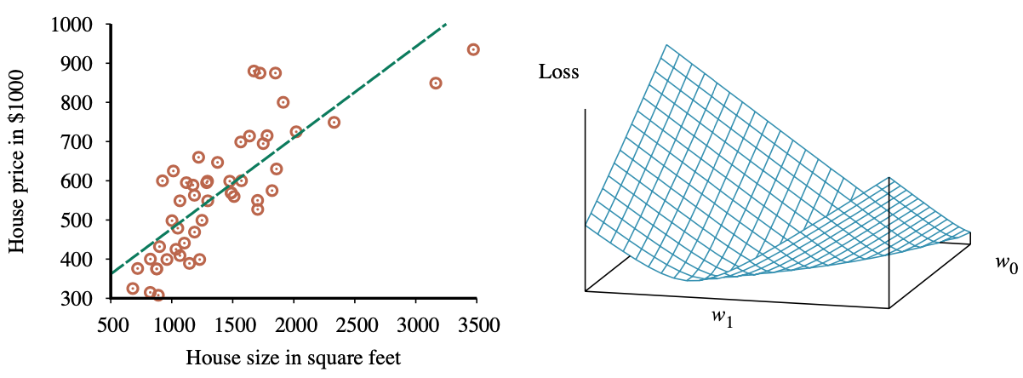
Linear Regression Weight Space
h_{w}(x) = w₁x + w₀
w* = argmin_{w} Loss(h_{w})
y = 0.232 x + 246
Loss function for Weights (w₁, w₀)
Source: Stuart Russell and Peter Norvig (2020), Artificial Intelligence: A Modern Approach, 4th Edition, Pearson

Slide 61
Deep Learning

Slide 62
Deep Learning and
Neural Networks

Slide 63

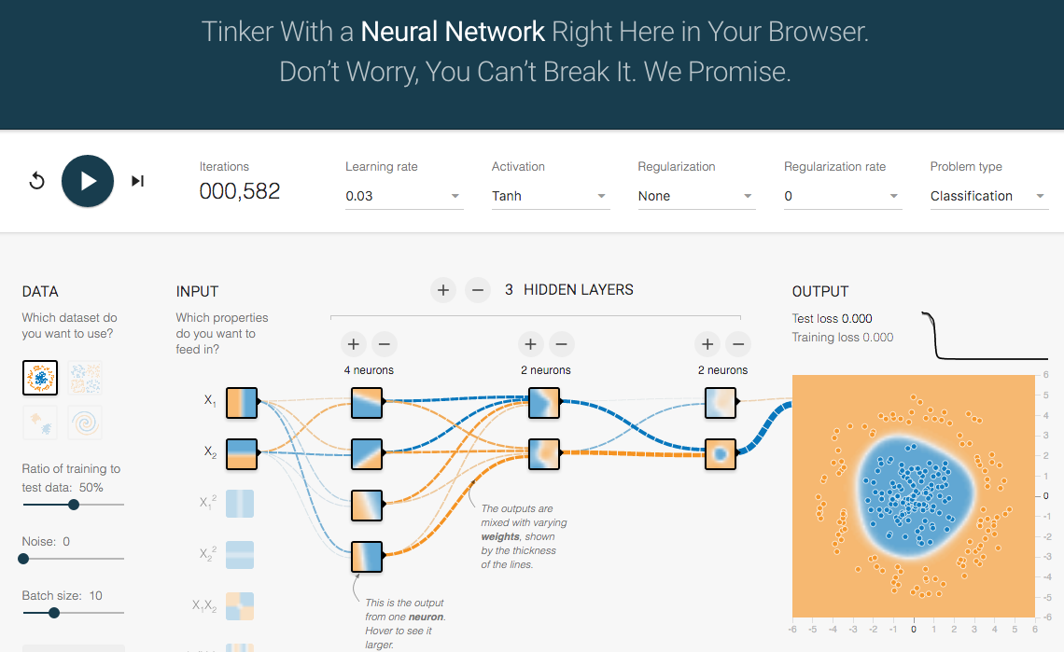
TensorFlow Playground
http://playground.tensorflow.org/

Slide 64
Tensor
3
  # a rank 0 tensor; this is a scalar with shape []
[1. ,2., 3.]
  # a rank 1 tensor; this is a vector with shape [3]
[[1., 2., 3.], [4., 5., 6.]]
  # a rank 2 tensor; a matrix with shape [2, 3]
[[[1., 2., 3.]], [[7., 8., 9.]]]
  # a rank 3 tensor with shape [2, 1, 3]
https://www.tensorflow.org/

Slide 65
Scalar
80
Vector
[50 60 70]
Matrix
50 60 70
55 65 75
[50 60 70] [70 80 90]
[55 65 75] [75 85 95]
Tensor

Slide 66
Deep Learning and
Neural Networks

Slide 67
Deep Learning Foundations:
Neural Networks

Slide 68
Deep Learning and
Neural Networks
Input Layer
(X)
Hidden Layer
(H)
Output Layer
(Y)
X1
Y
X2

Slide 69
Deep Learning and
Neural Networks
Input Layer
(X)
Hidden Layer
(H)
Output Layer
(Y)

Slide 70
Deep Learning and
Neural Networks
Input Layer
(X)
Hidden Layers
(H)
Output Layer
(Y)
Deep Neural Networks
Deep Learning

Slide 71
Deep Learning and
Deep Neural Networks

Slide 72
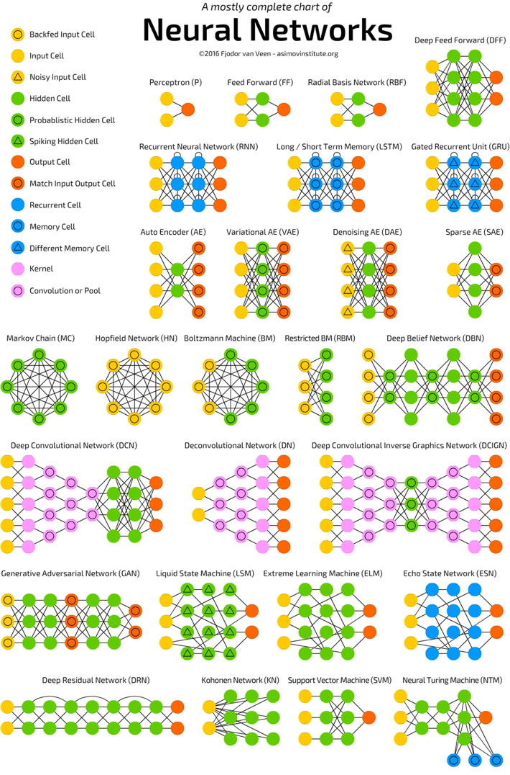
Neural Networks
(NN)
Source: http://www.asimovinstitute.org/neural-network-zoo/

Slide 73
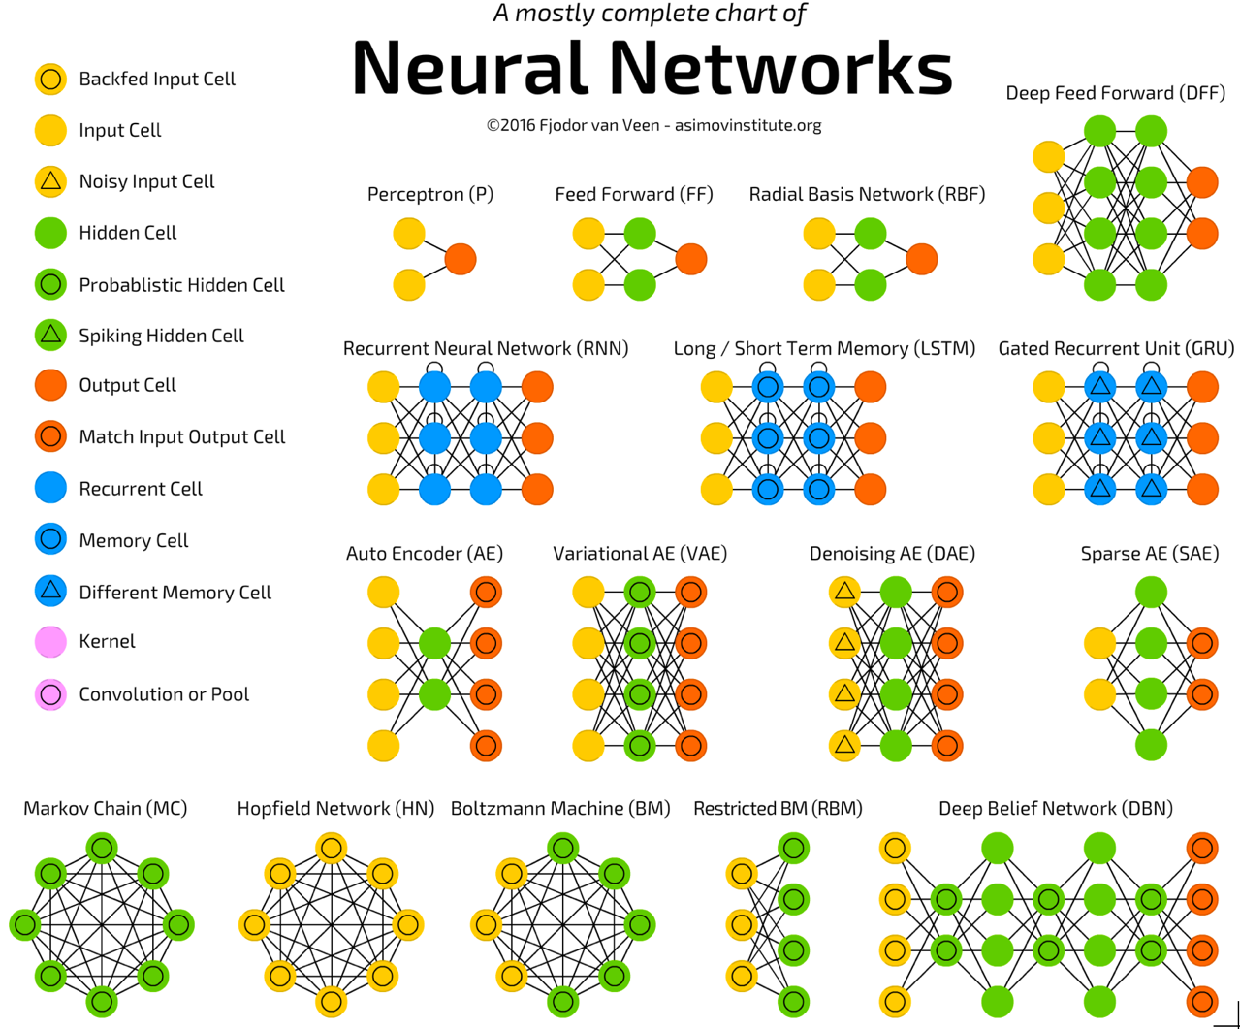
Source: http://www.asimovinstitute.org/neural-network-zoo/

Slide 74
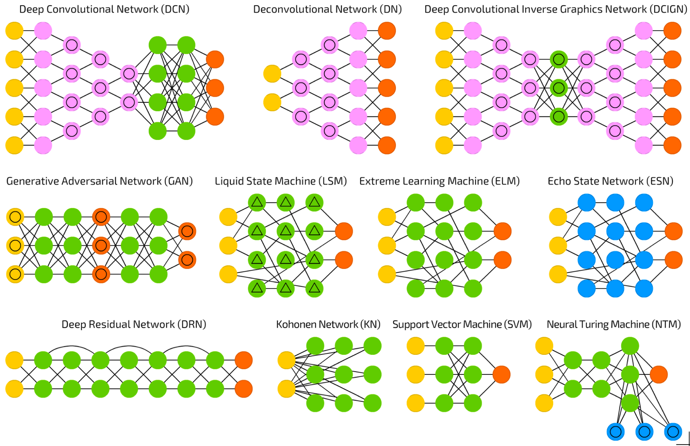
Source: http://www.asimovinstitute.org/neural-network-zoo/

Slide 75
Convolutional Neural Networks (CNN or Deep Convolutional Neural Networks, DCNN)
LeCun, Yann, et al. “Gradient-based learning applied to document recognition.” Proceedings of the IEEE 86.11 (1998): 2278-2324.
Source: http://www.asimovinstitute.org/neural-network-zoo/

Slide 76
Recurrent Neural Networks
(RNN)
Elman, Jeffrey L. “Finding structure in time.” Cognitive science 14.2 (1990): 179-211
Source: http://www.asimovinstitute.org/neural-network-zoo/

Slide 77
Long / Short Term Memory
(LSTM)
Hochreiter, Sepp, and Jürgen Schmidhuber. “Long short-term memory.” Neural computation 9.8 (1997): 1735-1780.
Source: http://www.asimovinstitute.org/neural-network-zoo/

Slide 78
Gated Recurrent Units
(GRU)
Chung, Junyoung, et al. “Empirical evaluation of gated recurrent neural networks on sequence modeling.” arXiv preprint arXiv:1412.3555 (2014).
Source: http://www.asimovinstitute.org/neural-network-zoo/

Slide 79
Generative Adversarial Networks (GAN)
Goodfellow, Ian, et al. “Generative adversarial nets.” Advances in Neural Information Processing Systems. 2014.
Source: http://www.asimovinstitute.org/neural-network-zoo/

Slide 80
Support Vector Machines
(SVM)
Cortes, Corinna, and Vladimir Vapnik. “Support-vector networks.” Machine learning 20.3 (1995): 273-297.
Source: http://www.asimovinstitute.org/neural-network-zoo/

Slide 81
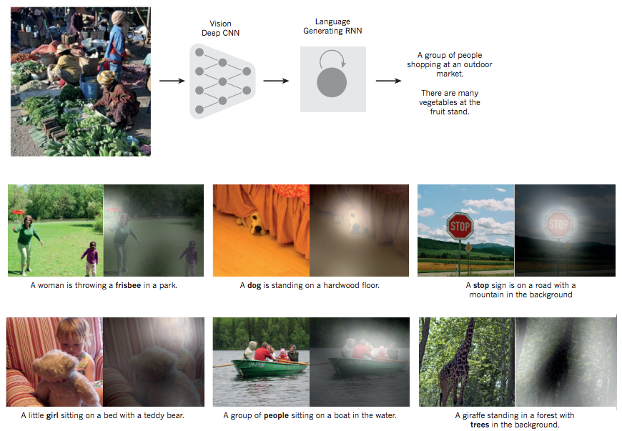
From image to text
Source: LeCun, Yann, Yoshua Bengio, and Geoffrey Hinton. "Deep learning." Nature 521, no. 7553 (2015): 436-444.

Slide 82
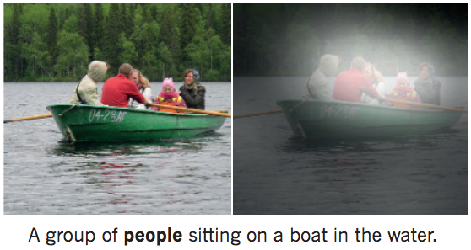
From image to text
Image: deep convolution neural network (CNN)
Text: recurrent neural network (RNN)
Source: LeCun, Yann, Yoshua Bengio, and Geoffrey Hinton. "Deep learning." Nature 521, no. 7553 (2015): 436-444.

Slide 83
Neural Networks
Input Layer
(X)
Hidden Layer
(H)
Output Layer
(Y)
X1
Y
X2
Source: https://www.youtube.com/watch?v=bxe2T-V8XRs&index=1&list=PLiaHhY2iBX9hdHaRr6b7XevZtgZRa1PoU

Slide 84
The Neuron
x₁
w₁
w₂
x₂
y
…
…
w_{n}
x_{n}
Source: Jeff Dean (2016), Large-Scale Deep Learning For Building Intelligent Computer Systems, WSDM 2016

Slide 85
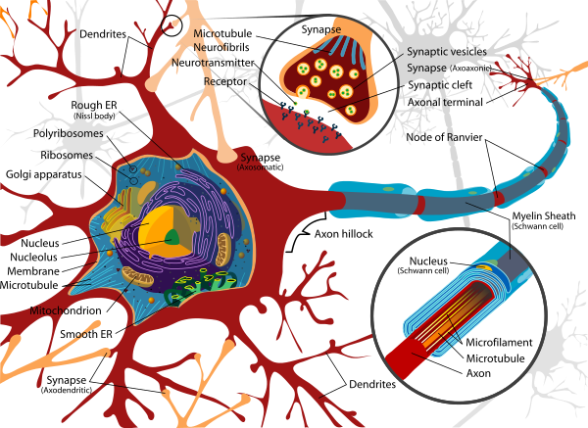
Neuron and Synapse
Source: https://en.wikipedia.org/wiki/Neuron

Slide 86
The Neuron
x₁
w₁
w₂
x₂
y
…
…
w_{n}
x_{n}
Source: Jeff Dean (2016), Large-Scale Deep Learning For Building Intelligent Computer Systems, WSDM 2016

Slide 87
y = max ( 0, -0.21 * x₁ + 0.3 * x₂ + 0.7 * x₃ )
Weights
x₁
-0.21
x₂
0.3
y
Inputs
0.7
x₃
Source: Jeff Dean (2016), Large-Scale Deep Learning For Building Intelligent Computer Systems, WSDM 2016

Slide 88
Neural Networks
Source: https://www.youtube.com/watch?v=bxe2T-V8XRs&index=1&list=PLiaHhY2iBX9hdHaRr6b7XevZtgZRa1PoU

Slide 89
Neural Networks
Input Layer
(X)
Hidden Layer
(H)
Output Layer
(Y)
X1
Y
X2
Source: https://www.youtube.com/watch?v=bxe2T-V8XRs&index=1&list=PLiaHhY2iBX9hdHaRr6b7XevZtgZRa1PoU

Slide 90
Neural Networks
Input Layer
(X)
Hidden Layers
(H)
Output Layer
(Y)
Deep Neural Networks
Deep Learning
Source: https://www.youtube.com/watch?v=bxe2T-V8XRs&index=1&list=PLiaHhY2iBX9hdHaRr6b7XevZtgZRa1PoU

Slide 91
Neural Networks
Input Layer
(X)
Hidden Layer
(H)
Output Layer
(Y)
Neuron
Synapse
Synapse
Neuron
X1
Y
X2
Source: https://www.youtube.com/watch?v=bxe2T-V8XRs&index=1&list=PLiaHhY2iBX9hdHaRr6b7XevZtgZRa1PoU

Slide 92
Neural Networks
Input Layer
(X)
Hidden Layer
(H)
Output Layer
(Y)
Hours
Sleep
Score
Hours
Study
Source: https://www.youtube.com/watch?v=bxe2T-V8XRs&index=1&list=PLiaHhY2iBX9hdHaRr6b7XevZtgZRa1PoU

Slide 93
Neural Networks
Input Layer
(X)
Hidden Layer
(H)
Output Layer
(Y)
Source: https://www.youtube.com/watch?v=P2HPcj8lRJE&list=PLjJh1vlSEYgvGod9wWiydumYl8hOXixNu&index=2

Slide 94
Neural Networks
Input Layer
(X)
Hidden Layer
(H)
Output Layer
(Y)
X1
Y
X2
Source: https://www.youtube.com/watch?v=bxe2T-V8XRs&index=1&list=PLiaHhY2iBX9hdHaRr6b7XevZtgZRa1PoU

Slide 95
X Y
Hours
Sleep
Hours
Study
Score
3 5 75
5 1 82
10 2 93
8 3 ?
Source: https://www.youtube.com/watch?v=bxe2T-V8XRs&index=1&list=PLiaHhY2iBX9hdHaRr6b7XevZtgZRa1PoU

Slide 96
X Y
Hours
Sleep
Hours
Study
Score
3 5 75
Training
5 1 82
10 2 93
8 3 ?
Testing
Source: https://www.youtube.com/watch?v=bxe2T-V8XRs&index=1&list=PLiaHhY2iBX9hdHaRr6b7XevZtgZRa1PoU

Slide 97
Y = W X + b
Source: https://www.youtube.com/watch?v=G8eNWzxOgqE

Slide 98
Output
input
Y = W X + b
Weights
bias
Trained
Source: https://www.youtube.com/watch?v=G8eNWzxOgqE

Slide 99
2.0
1.0
0.1
0.7
0.2
0.1
W X + b = Y
Scores
Probabilities
Source: https://www.youtube.com/watch?v=G8eNWzxOgqE

Slide 100

SoftMAX
2.0
1.0
0.1
0.7
0.2
0.1
W X + b = Y
$$S\left(y_{i}\right)= \frac{e^{y_{i}}}{\sum_{j}{e^{y_{j}}}}$$
Logits
Scores
Probabilities
Source: https://www.youtube.com/watch?v=G8eNWzxOgqE

Slide 101
$S\left(y_{i}\right)=\frac{e^{y_{i}}}{\sum_{j}{e^{y_{i}}}}=\frac{e^{2.0}}{e^{2.0}+e^{1.0}+e^{0.1}}$ $=\frac{{2.7182}^{2.0}}{{2.7182}^{2.0}+{2.7182}^{1.0}+{2.7182}^{0.1}}=0.7$
$S\left(y_{i}\right)=\frac{e^{y_{i}}}{\sum_{j}{e^{y_{j}}}}=\frac{e^{1.0}}{e^{2.0}+e^{1.0}+e^{0.1}}$ $=\frac{{2.7182}^{1.0}}{{2.7182}^{2.0}+{2.7182}^{1.0}+{2.7182}^{0.1}}=0.2$
$S\left(y_{i}\right)=\frac{e^{y_{i}}}{\sum_{j}{e^{y_{j}}}}=\frac{e^{0.1}}{e^{2.0}+e^{1.0}+e^{0.1}}$ $=\frac{{2.7182}^{0.1}}{{2.7182}^{2.0}+{2.7182}^{1.0}+{2.7182}^{0.1}}=0.1$
2.0
1.0
0.1
0.7
0.2
0.1
W X + b = Y
$$S\left(y_{i}\right)= \frac{e^{y_{i}}}{\sum_{j}{e^{y_{j}}}}$$
Logits
Scores
Probabilities
Source: https://www.youtube.com/watch?v=G8eNWzxOgqE

Slide 102
Training a Network
=
Minimize the Cost Function
Source: https://www.youtube.com/watch?v=bxe2T-V8XRs&index=1&list=PLiaHhY2iBX9hdHaRr6b7XevZtgZRa1PoU

Slide 103
Training a Network
=
Minimize the Cost Function
Minimize the Loss Function
Source: https://www.youtube.com/watch?v=bxe2T-V8XRs&index=1&list=PLiaHhY2iBX9hdHaRr6b7XevZtgZRa1PoU

Slide 104



Error = Predict Y - Actual Y
Error : Cost : Loss
100
$$y$$
$$\hat{y}$$
75
$$e$$
50
25
Test1
Test2
Test3
Source: https://www.youtube.com/watch?v=bxe2T-V8XRs&index=1&list=PLiaHhY2iBX9hdHaRr6b7XevZtgZRa1PoU

Slide 105
Error = Predict Y - Actual Y
Error : Cost : Loss
100
$$y$$
$$\hat{y}$$
75
$$e$$
50
25
Test1
Test2
Test3
Source: https://www.youtube.com/watch?v=bxe2T-V8XRs&index=1&list=PLiaHhY2iBX9hdHaRr6b7XevZtgZRa1PoU

Slide 106
Error = Predict Y - Actual Y
Error : Cost : Loss
100
$$y$$
$$\hat{y}$$
75
$$e$$
50
25
Test1
Test2
Test3
Source: https://www.youtube.com/watch?v=bxe2T-V8XRs&index=1&list=PLiaHhY2iBX9hdHaRr6b7XevZtgZRa1PoU

Slide 107
Activation Functions

Slide 108
Activation Functions
Sigmoid
TanH
ReLU
(Rectified Linear Unit)
[0, 1]
[-1, 1]
f(x) = max(0, x)
Source: http://cs231n.github.io/neural-networks-1/

Slide 109
Activation Functions
Source: http://adilmoujahid.com/posts/2016/06/introduction-deep-learning-python-caffe/

Slide 110
Loss
Function

Slide 111
Binary Classification: 2 Class
Activation Function:
Sigmoid
Loss Function:
Binary Cross-Entropy

Slide 112
Multiple Classification: 10 Class
Activation Function:
SoftMAX
Loss Function:
Categorical Cross-Entropy

Slide 113
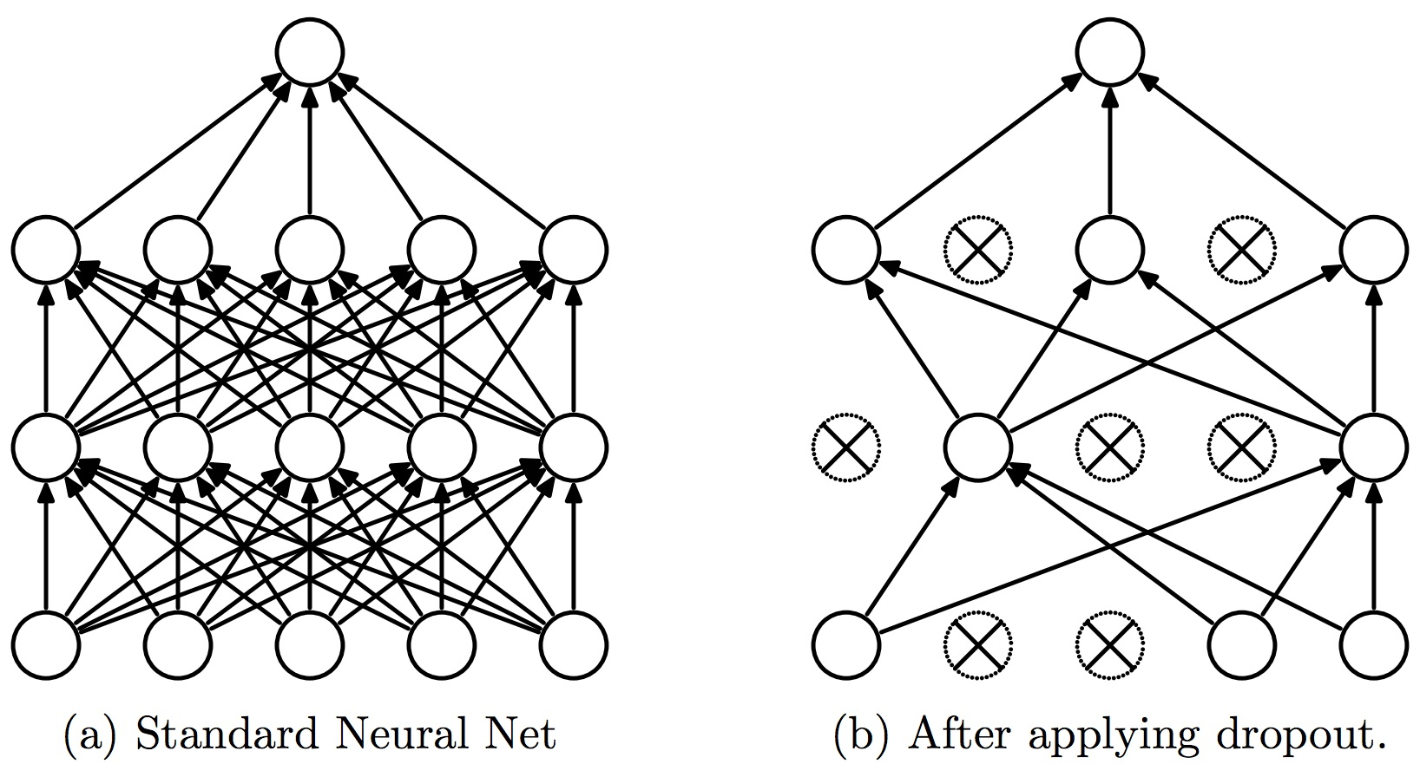
Dropout
Dropout: a simple way to prevent neural networks from overfitting
Source: Srivastava, Nitish, Geoffrey E. Hinton, Alex Krizhevsky, Ilya Sutskever, and Ruslan Salakhutdinov.
"Dropout: a simple way to prevent neural networks from overfitting." Journal of machine learning research 15, no. 1 (2014): 1929-1958.

Slide 114
Learning Algorithm
While not done:
  Pick a random training example “(input, label)”
  Run neural network on “input”
  Adjust weights on edges to make output closer to “label”
Source: Jeff Dean (2016), Large-Scale Deep Learning For Building Intelligent Computer Systems, WSDM 2016

Slide 115
y = max ( 0, -0.21 * x₁ + 0.3 * x₂ + 0.7 * x₃ )
Weights
x₁
-0.21
x₂
0.3
y
Inputs
0.7
x₃
Source: Jeff Dean (2016), Large-Scale Deep Learning For Building Intelligent Computer Systems, WSDM 2016

Slide 116
Next time:
y = max ( 0, -0.23 * x₁ + 0.31 * x₂ + 0.65 * x₃ )
y = max ( 0, -0.21 * x₁ + 0.3 * x₂ + 0.7 * x₃ )
Weights
-0.23
x₁
-0.21
0.31
x₂
0.3
y
Inputs
0.65
x₃
0.7
Source: Jeff Dean (2016), Large-Scale Deep Learning For Building Intelligent Computer Systems, WSDM 2016

Slide 117
Optimizer:
Stochastic Gradient Descent
(SGD)
J(w)
Initial
weight
Gradient
Global cost
minimum
w

Slide 118
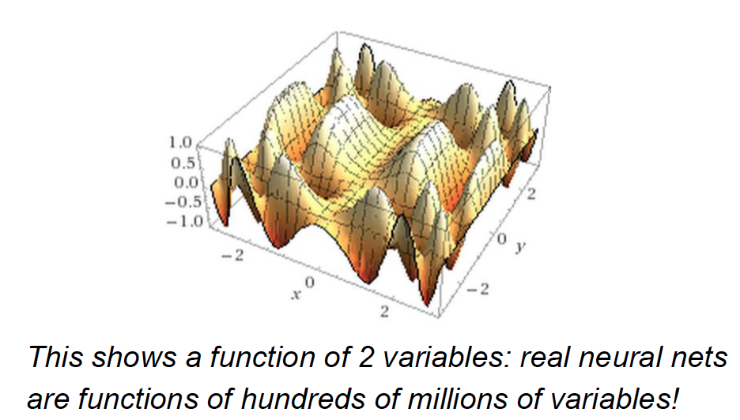
Source: Jeff Dean (2016), Large-Scale Deep Learning For Building Intelligent Computer Systems, WSDM 2016

Slide 119
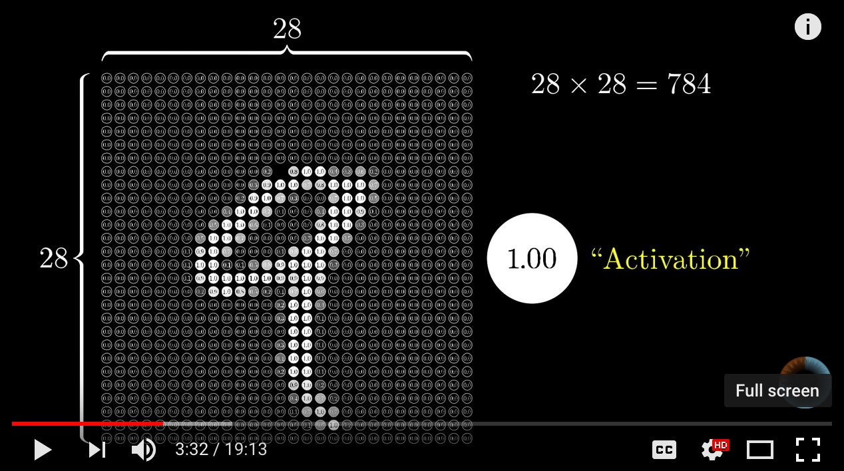
Neural Network and Deep Learning
Source: 3Blue1Brown (2017), But what *is* a Neural Network? | Chapter 1, deep learning, https://www.youtube.com/watch?v=aircAruvnKk

Slide 120
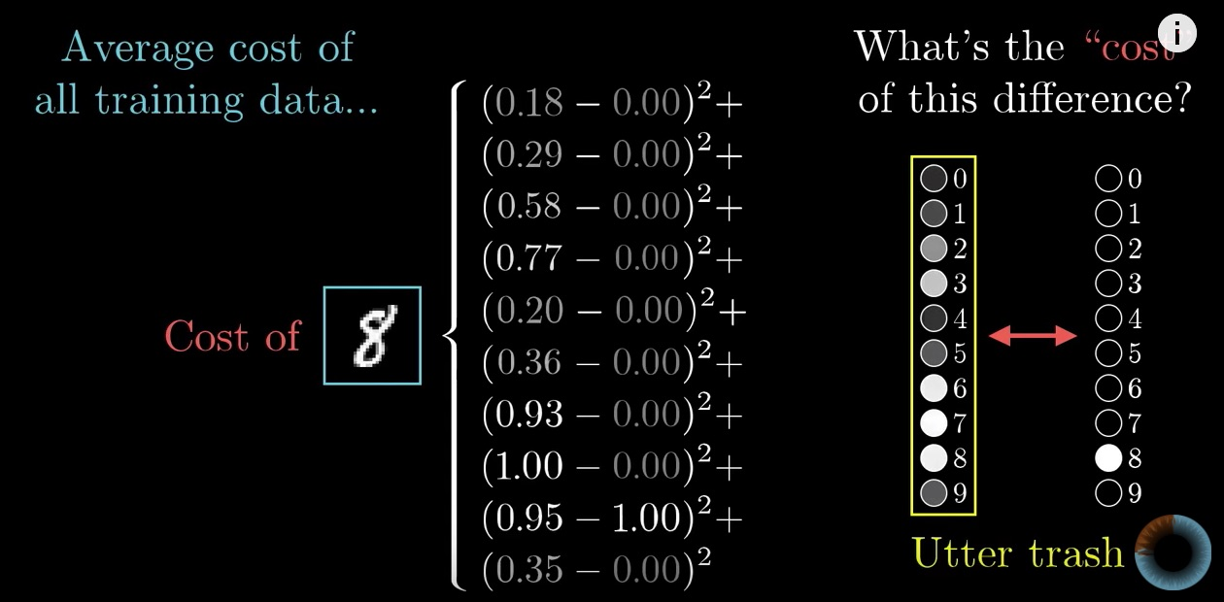
Gradient Descent how neural networks learn
Source: 3Blue1Brown (2017), Gradient descent, how neural networks learn | Chapter 2, deep learning, https://www.youtube.com/watch?v=IHZwWFHWa-w

Slide 121
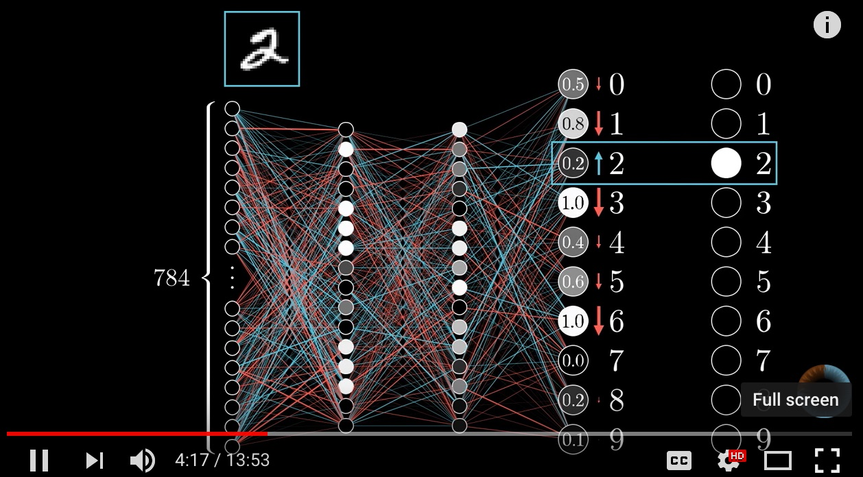
Backpropagation
Source: 3Blue1Brown (2017), What is backpropagation really doing? | Chapter 3, deep learning, https://www.youtube.com/watch?v=Ilg3gGewQ5U

Slide 122
Learning Algorithm
While not done:
  Pick a random training example “(input, label)”
  Run neural network on “input”
  Adjust weights on edges to make output closer to “label”
Source: Jeff Dean (2016), Large-Scale Deep Learning For Building Intelligent Computer Systems, WSDM 2016

Slide 123
Time Series Data
[100, 110, 120, 130, 140, 150]
Y
X
Y
[100 110 120 130 140] 150
X_{t1}
X_{t2}
X_{t3}
X_{t4}
X_{t5}

Slide 124
Time Series Data
[10, 20, 30, 40, 50, 60, 70, 80, 90]
X
Y
[10 20 30] 40
[20 30 40] 50
[30 40 50] 60
[40 50 60] 70
[50 60 70] 80
[60 70 80] 90

Slide 125


TensorFlow
https://www.tensorflow.org/

Slide 126

PyTorch
https://pytorch.org/

Slide 127
TensorFlow
An end-to-end open source
machine learning platform.
The core open source library to help you develop and train ML models.
Get started quickly by running
Colab notebooks directly in your browser.
https://www.tensorflow.org/

Slide 128
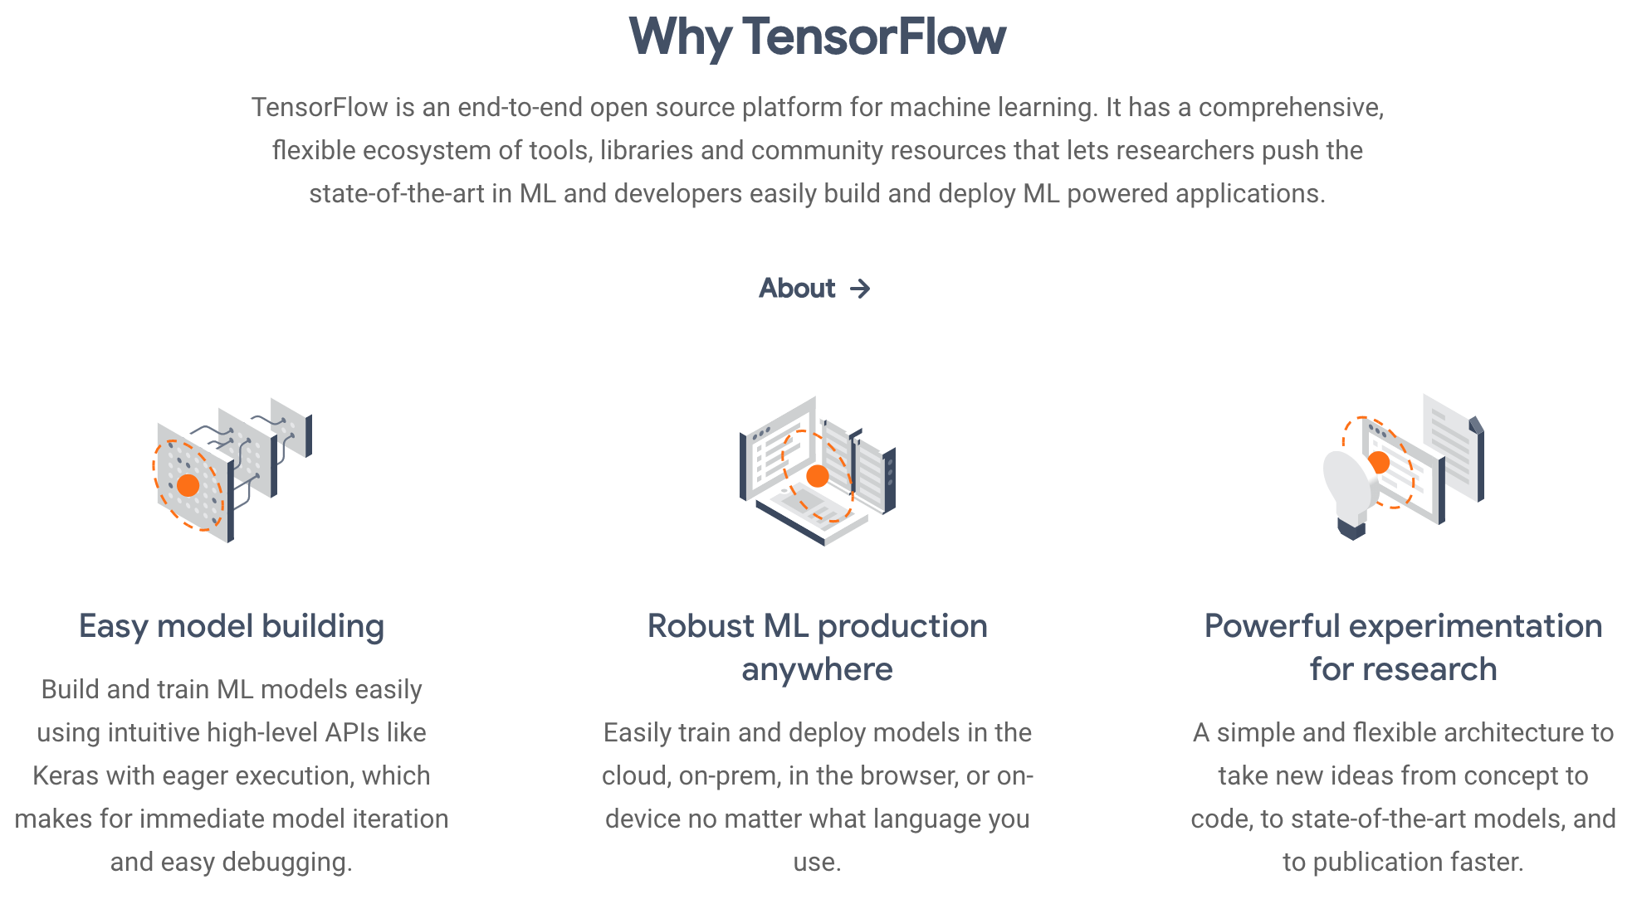
Why TensorFlow 2.0

Slide 129
TensorFlow 2.0 vs. 1.X
# TensorFlow 2.0
outputs = f(input)
# TensorFlow 1.X
outputs = session.run(f(placeholder), feed_dict={placeholder: input})
Source: https://www.tensorflow.org/guide/effective_tf2

Slide 130
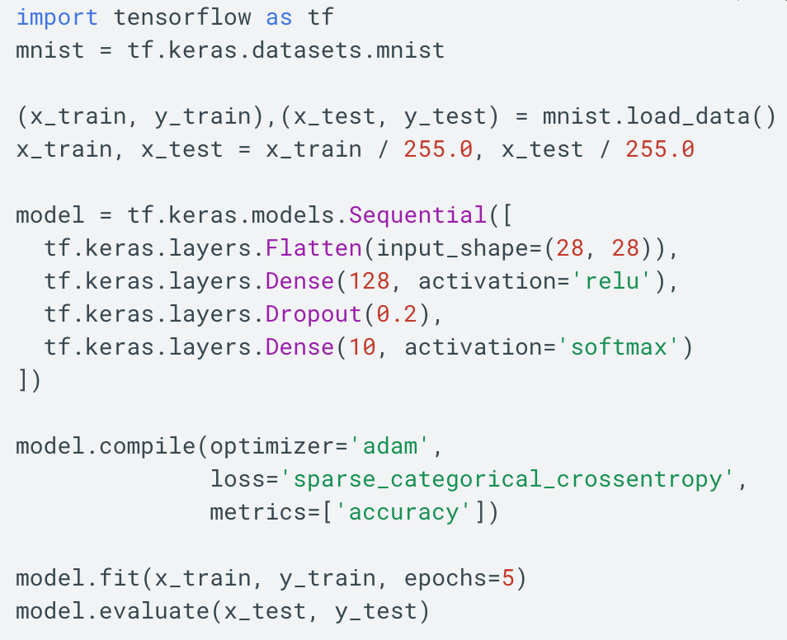
TensorFlow 2.0
https://www.tensorflow.org/overview/

Slide 131
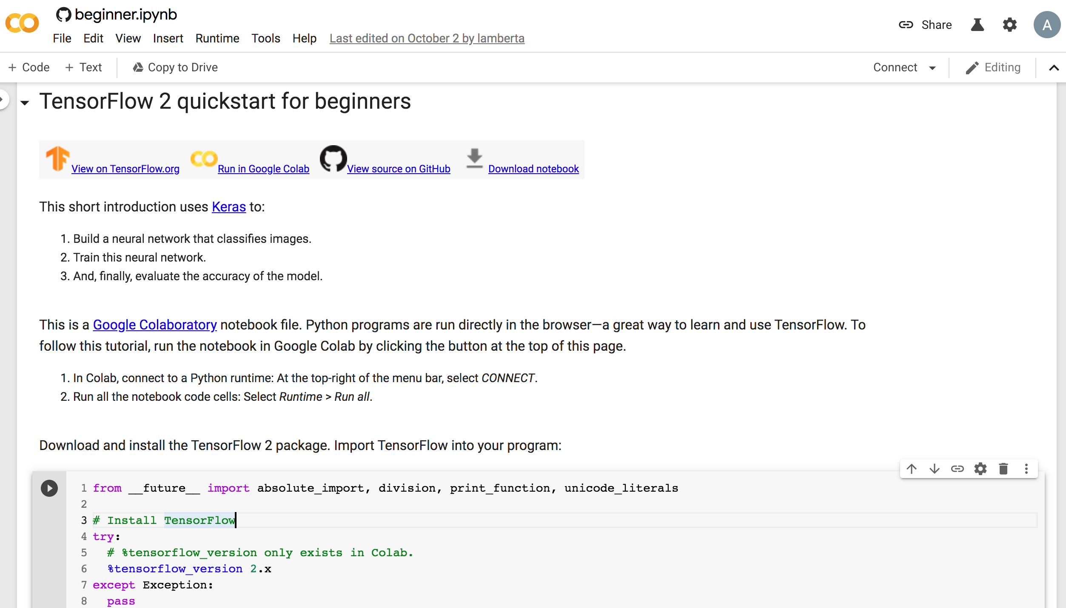
TensorFlow 2 Quick Start
https://colab.research.google.com/github/tensorflow/docs/blob/master/site/en/tutorials/quickstart/beginner.ipynb

Slide 132
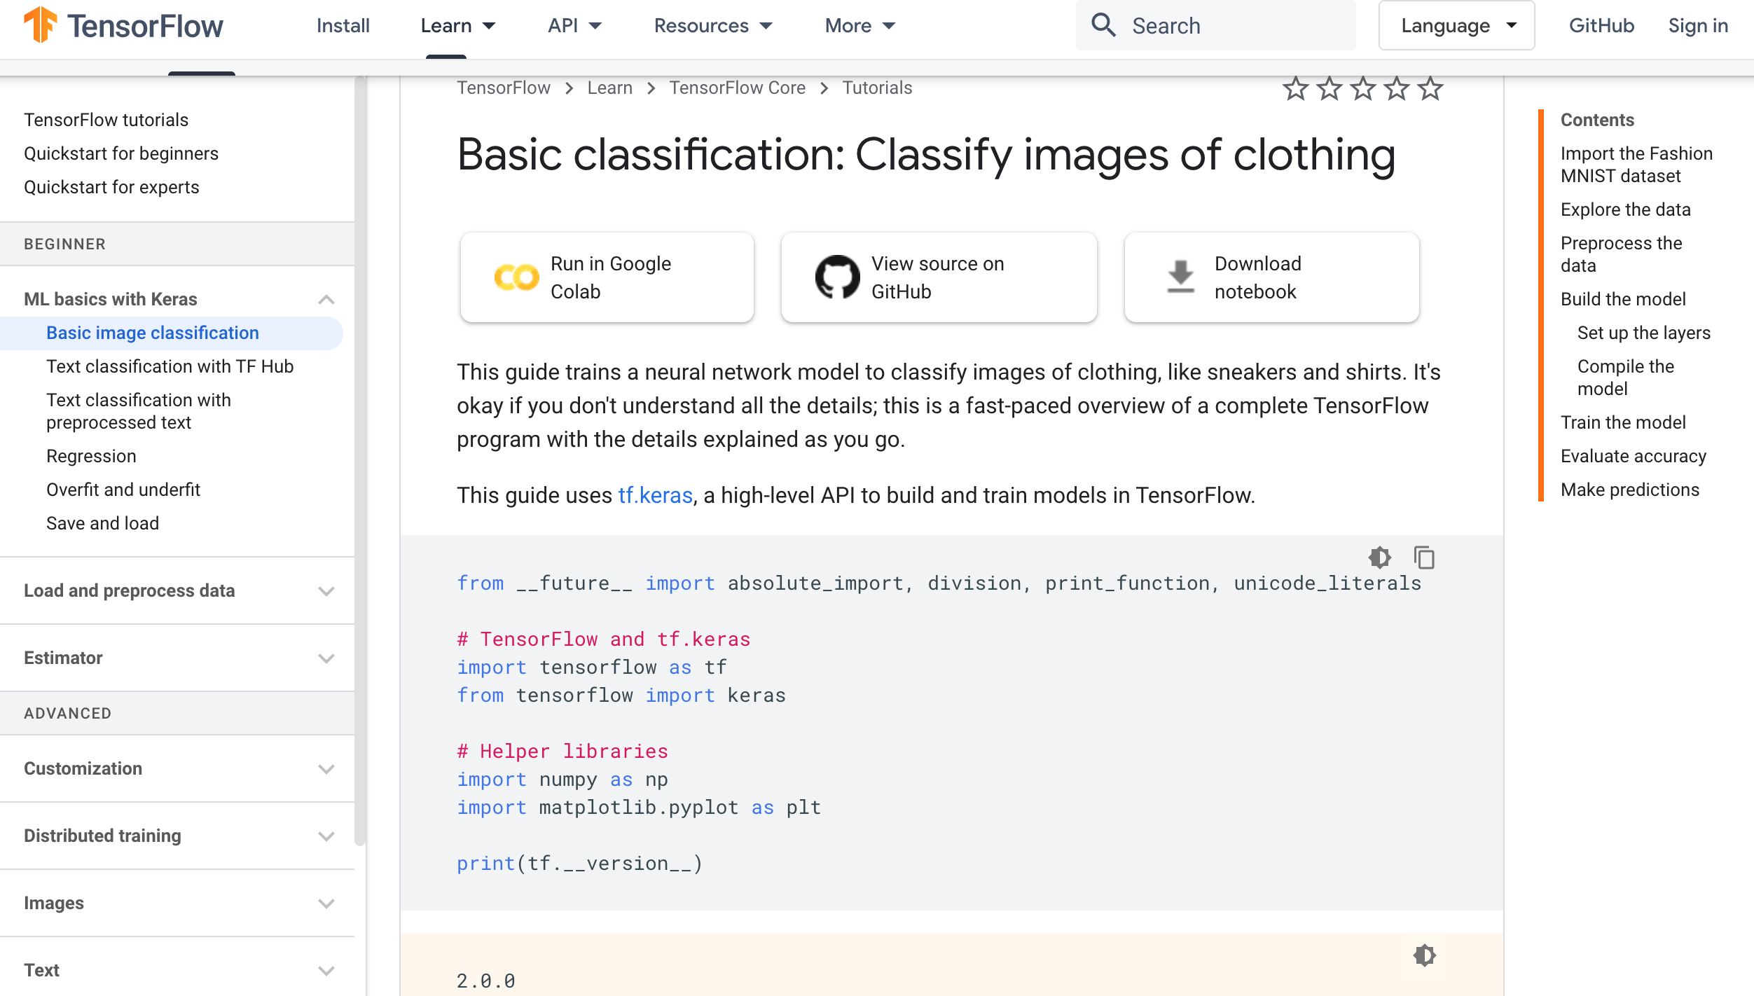
TensorFlow
Image Classification
https://www.tensorflow.org/tutorials/keras/classification

Slide 133
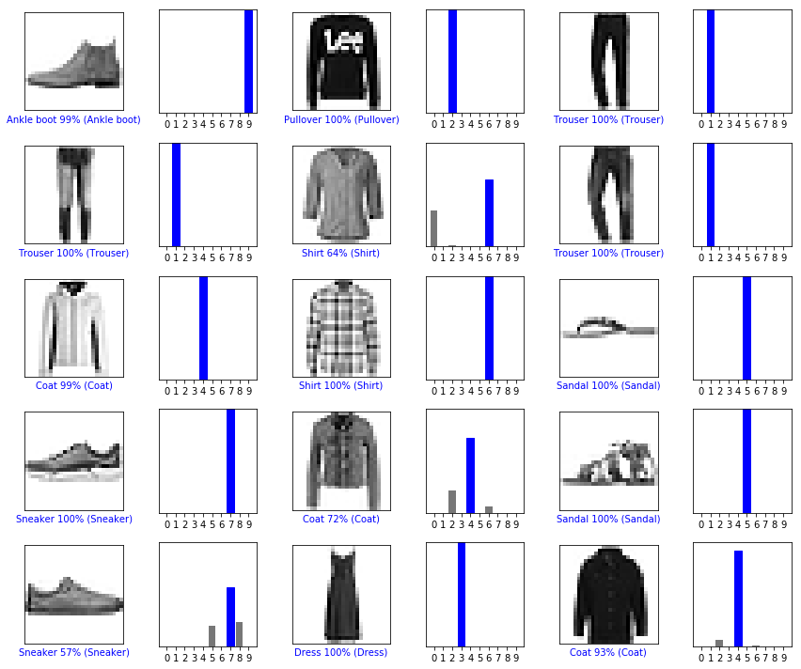
Image Classification
Fashion MNIST dataset
https://www.tensorflow.org/tutorials/keras/classification

Slide 134
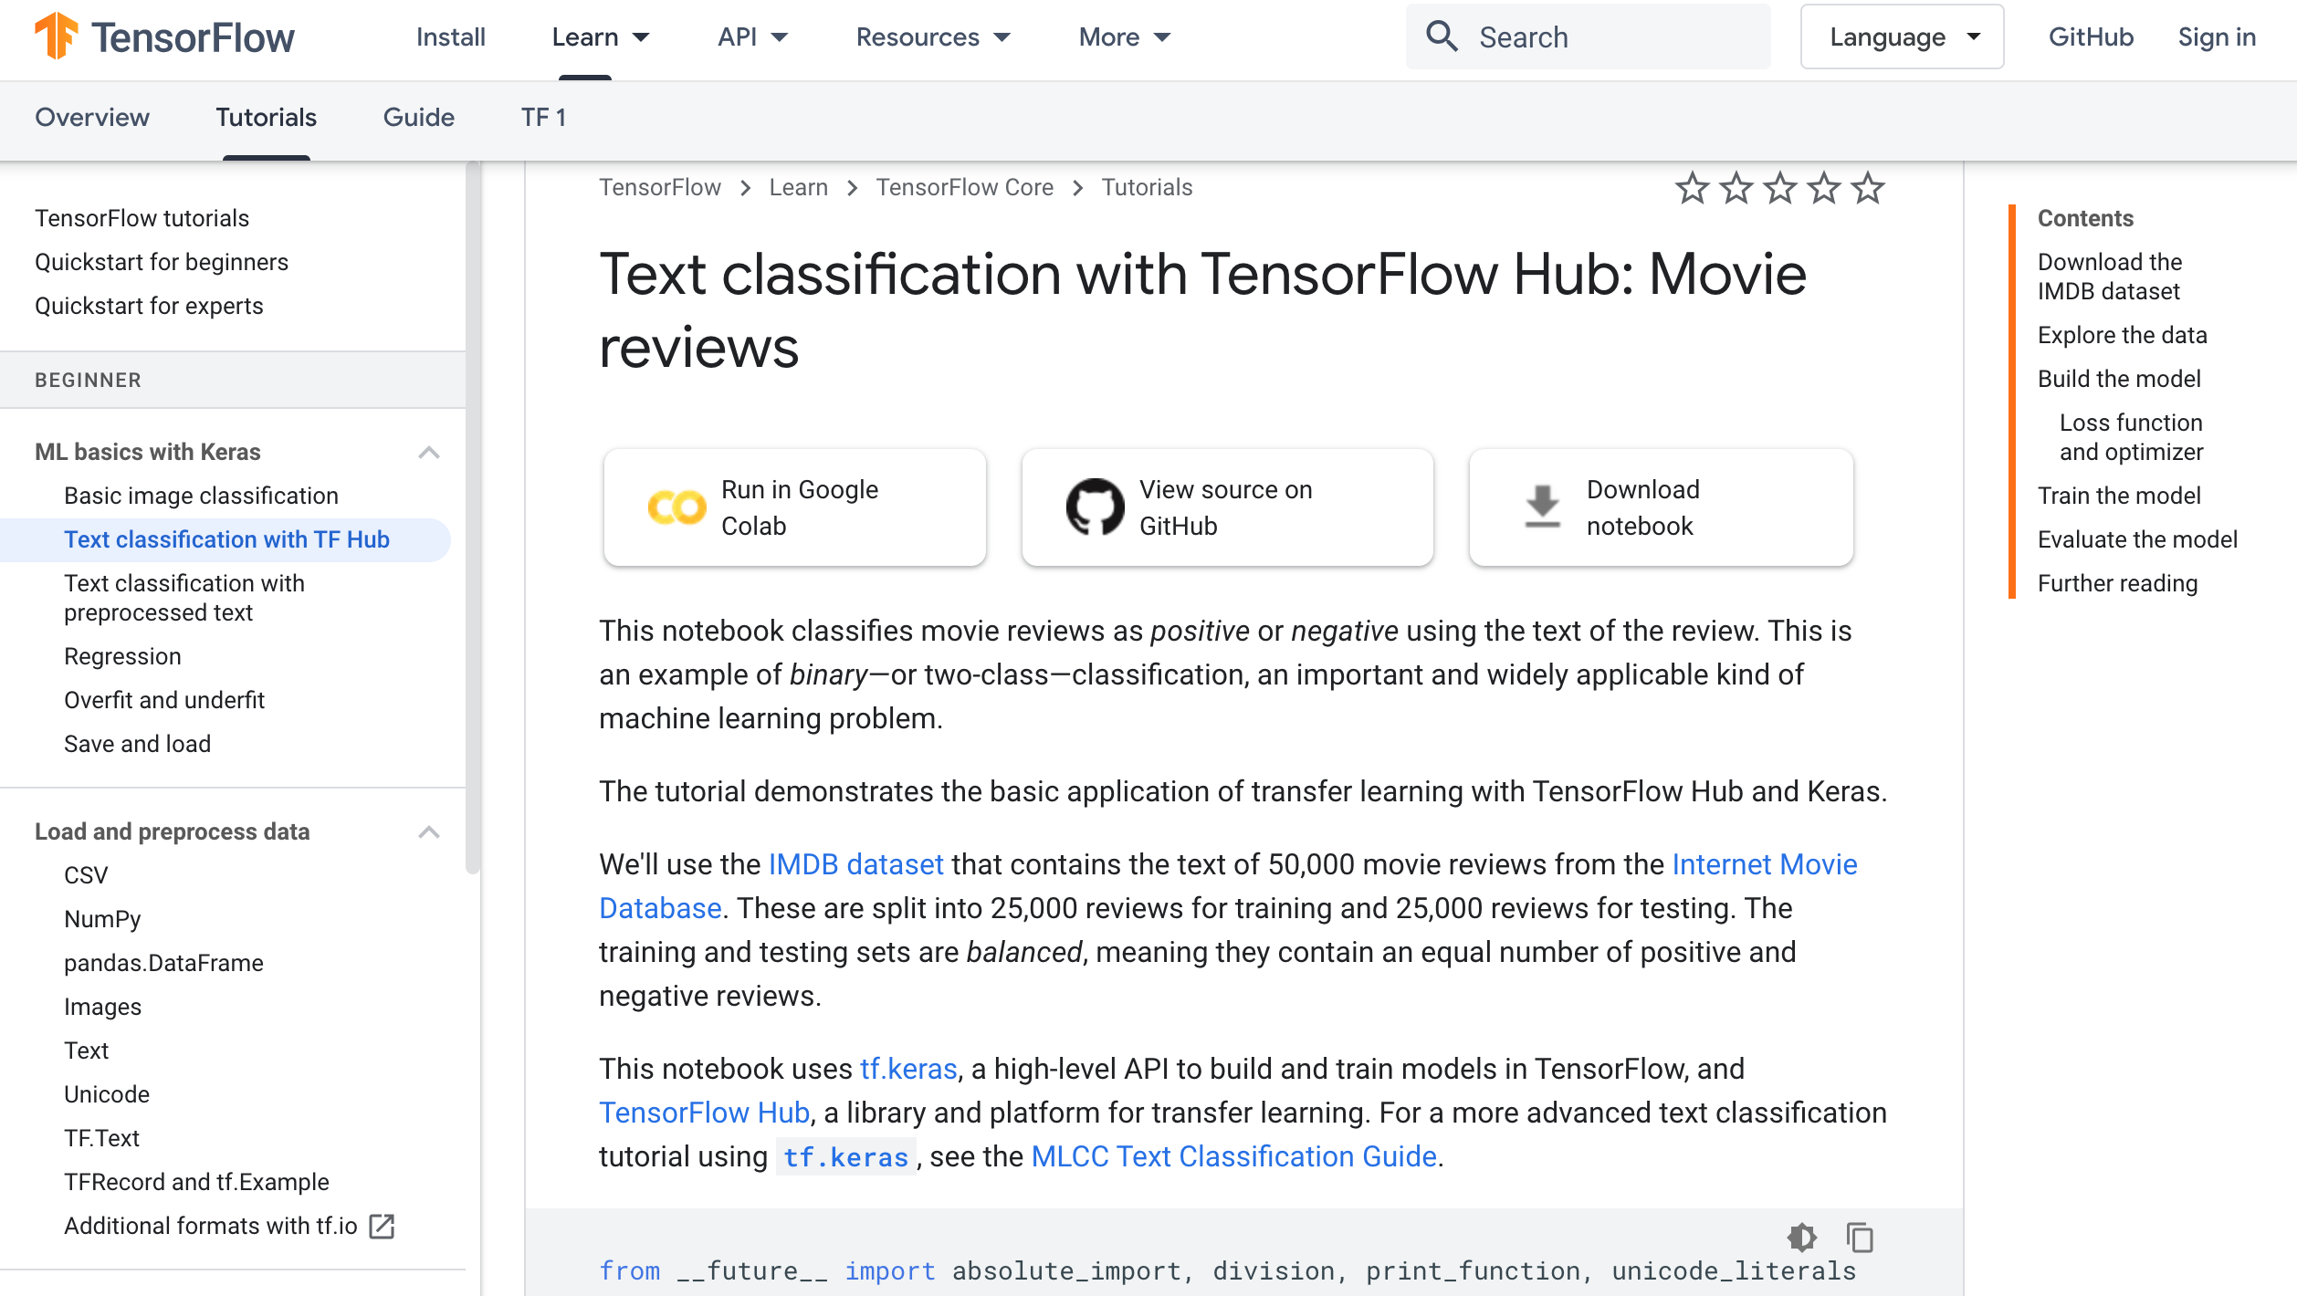
Text Classification with TF Hub
https://www.tensorflow.org/tutorials/keras/text_classification_with_hub

Slide 135
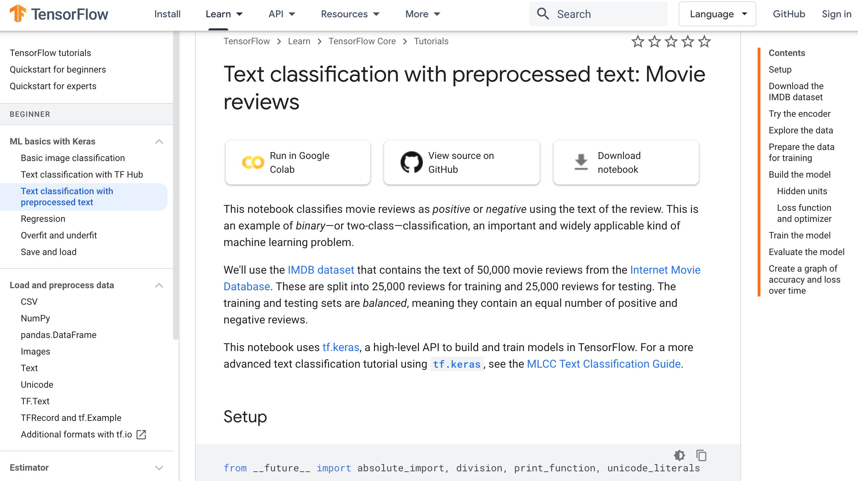
Text Classification with Pre Text
https://www.tensorflow.org/tutorials/keras/text_classification

Slide 136
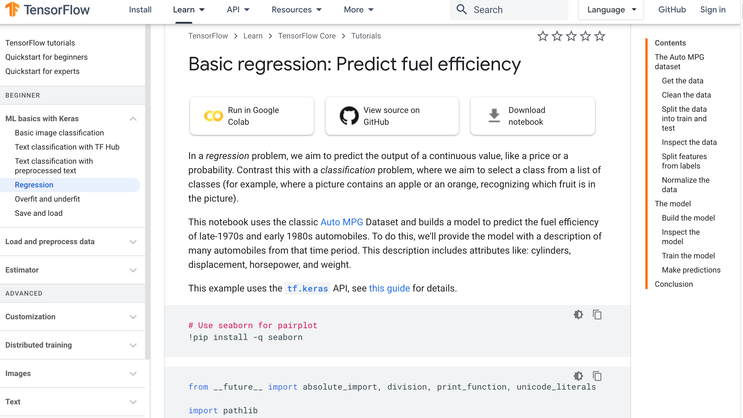
Regression
https://www.tensorflow.org/tutorials/keras/regression

Slide 137
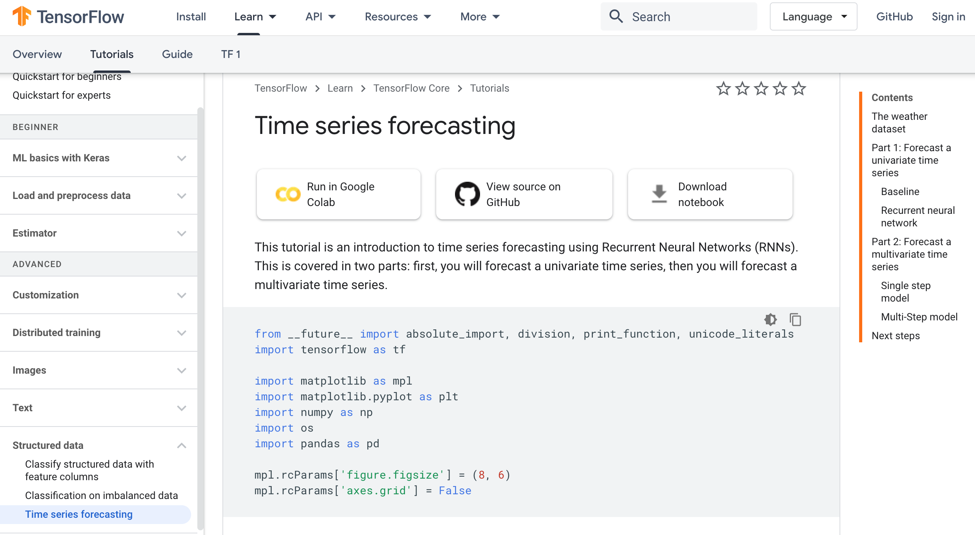
TensorFlow 2.0
Time Series Forecasting
https://www.tensorflow.org/tutorials/structured_data/time_series

Slide 138
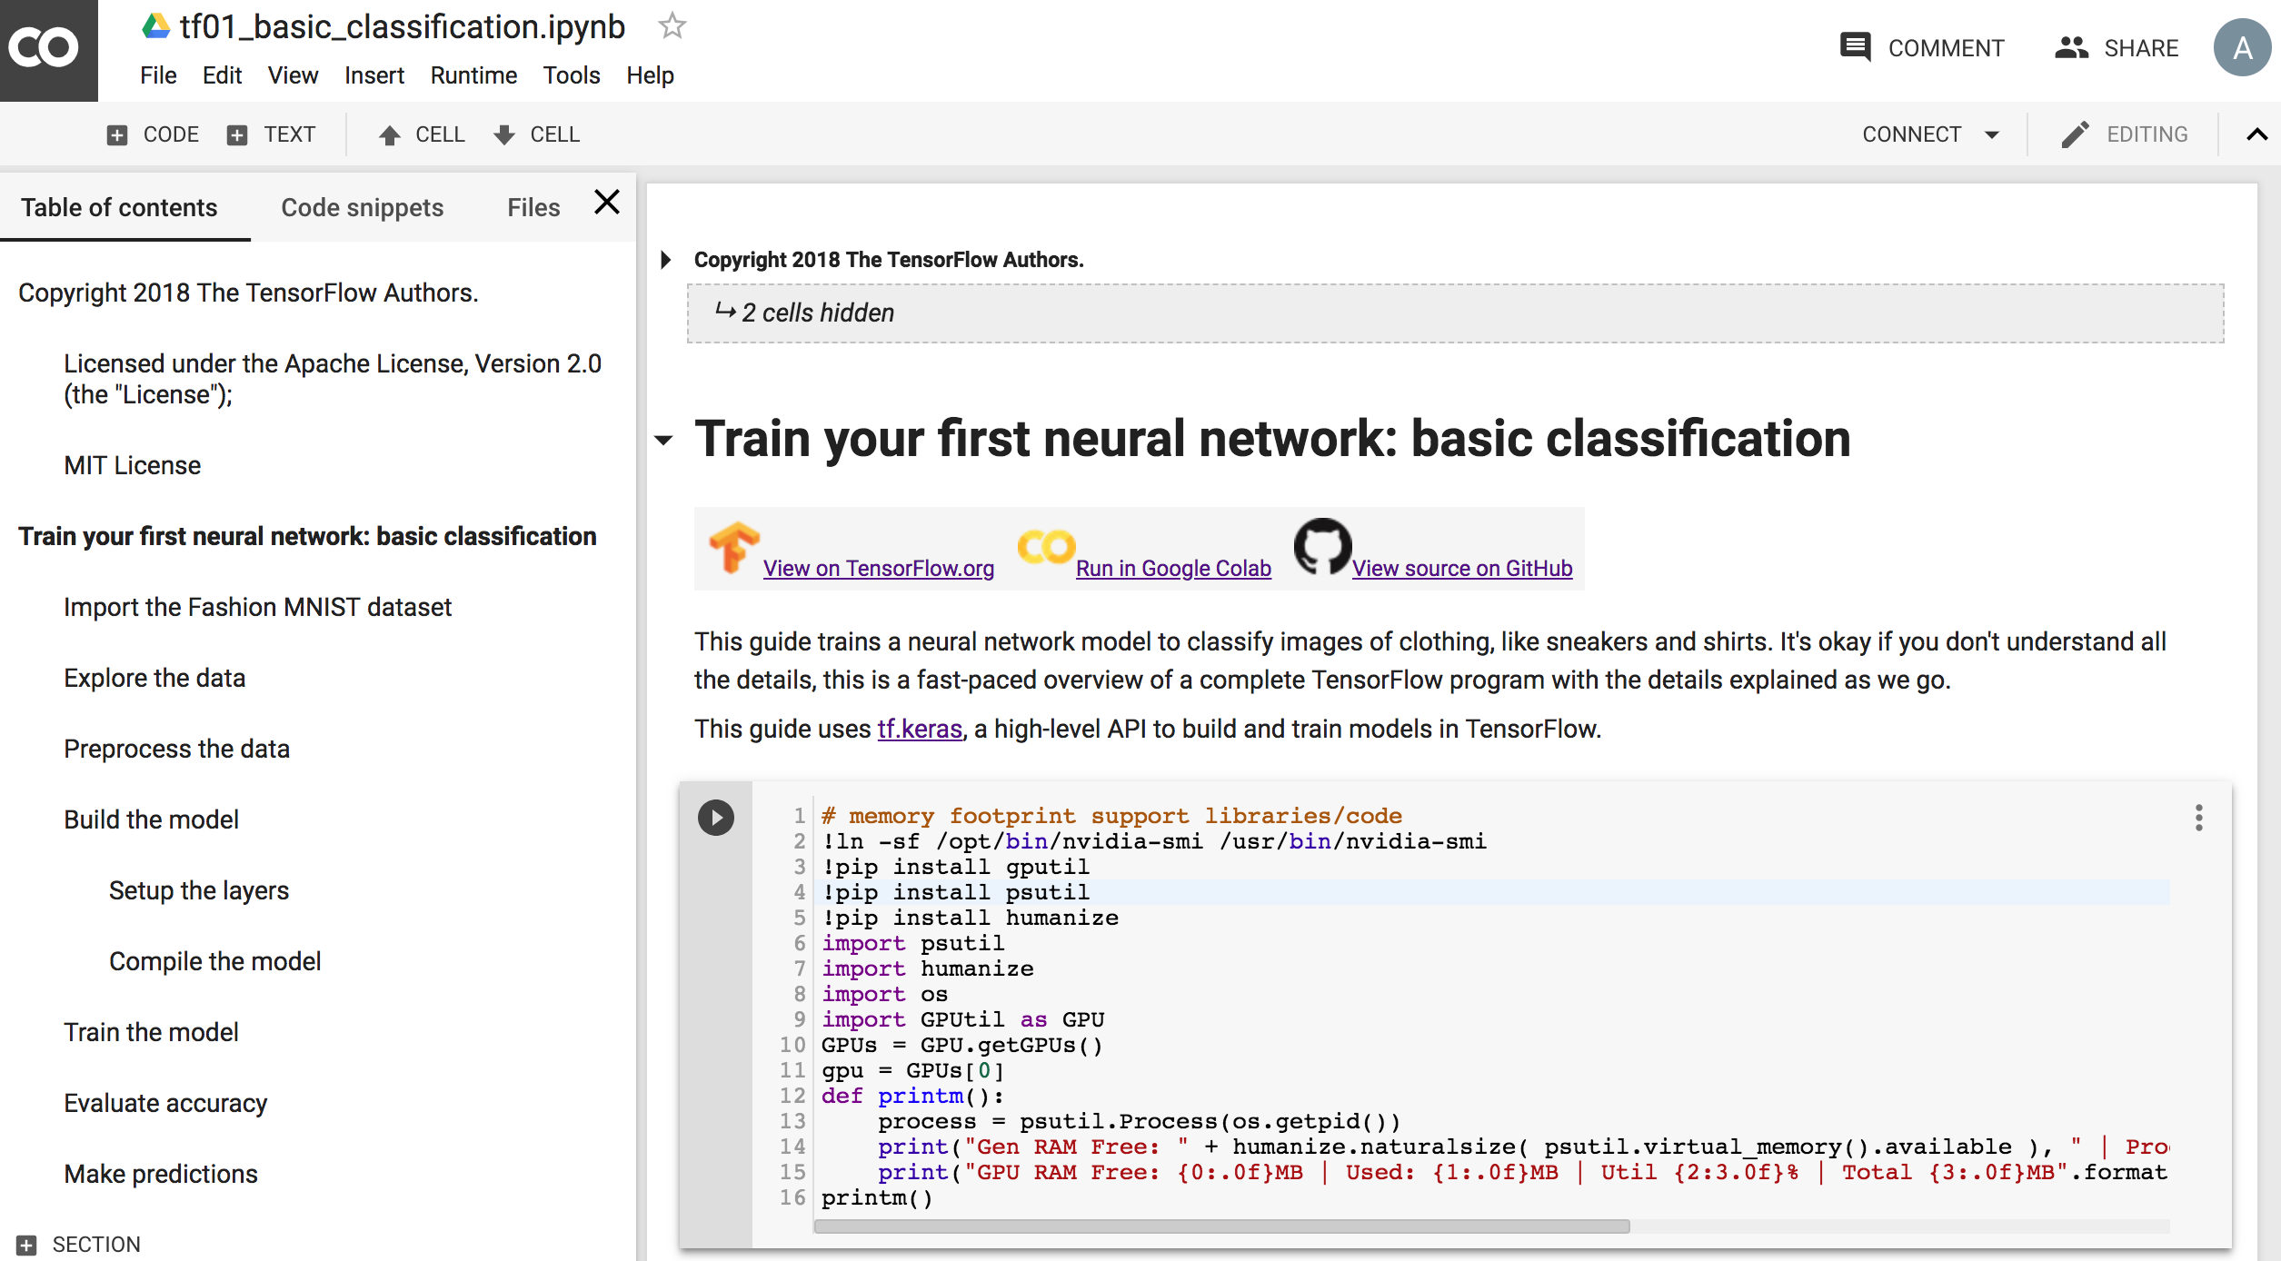
Basic Classification
Fashion MNIST Image Classification
https://colab.research.google.com/drive/19PJOJi1vn1kjcutlzNHjRSLbeVl4kd5z
Source: https://colab.research.google.com/github/tensorflow/docs/blob/master/site/en/tutorials/keras/basic_classification.ipynb

Slide 139
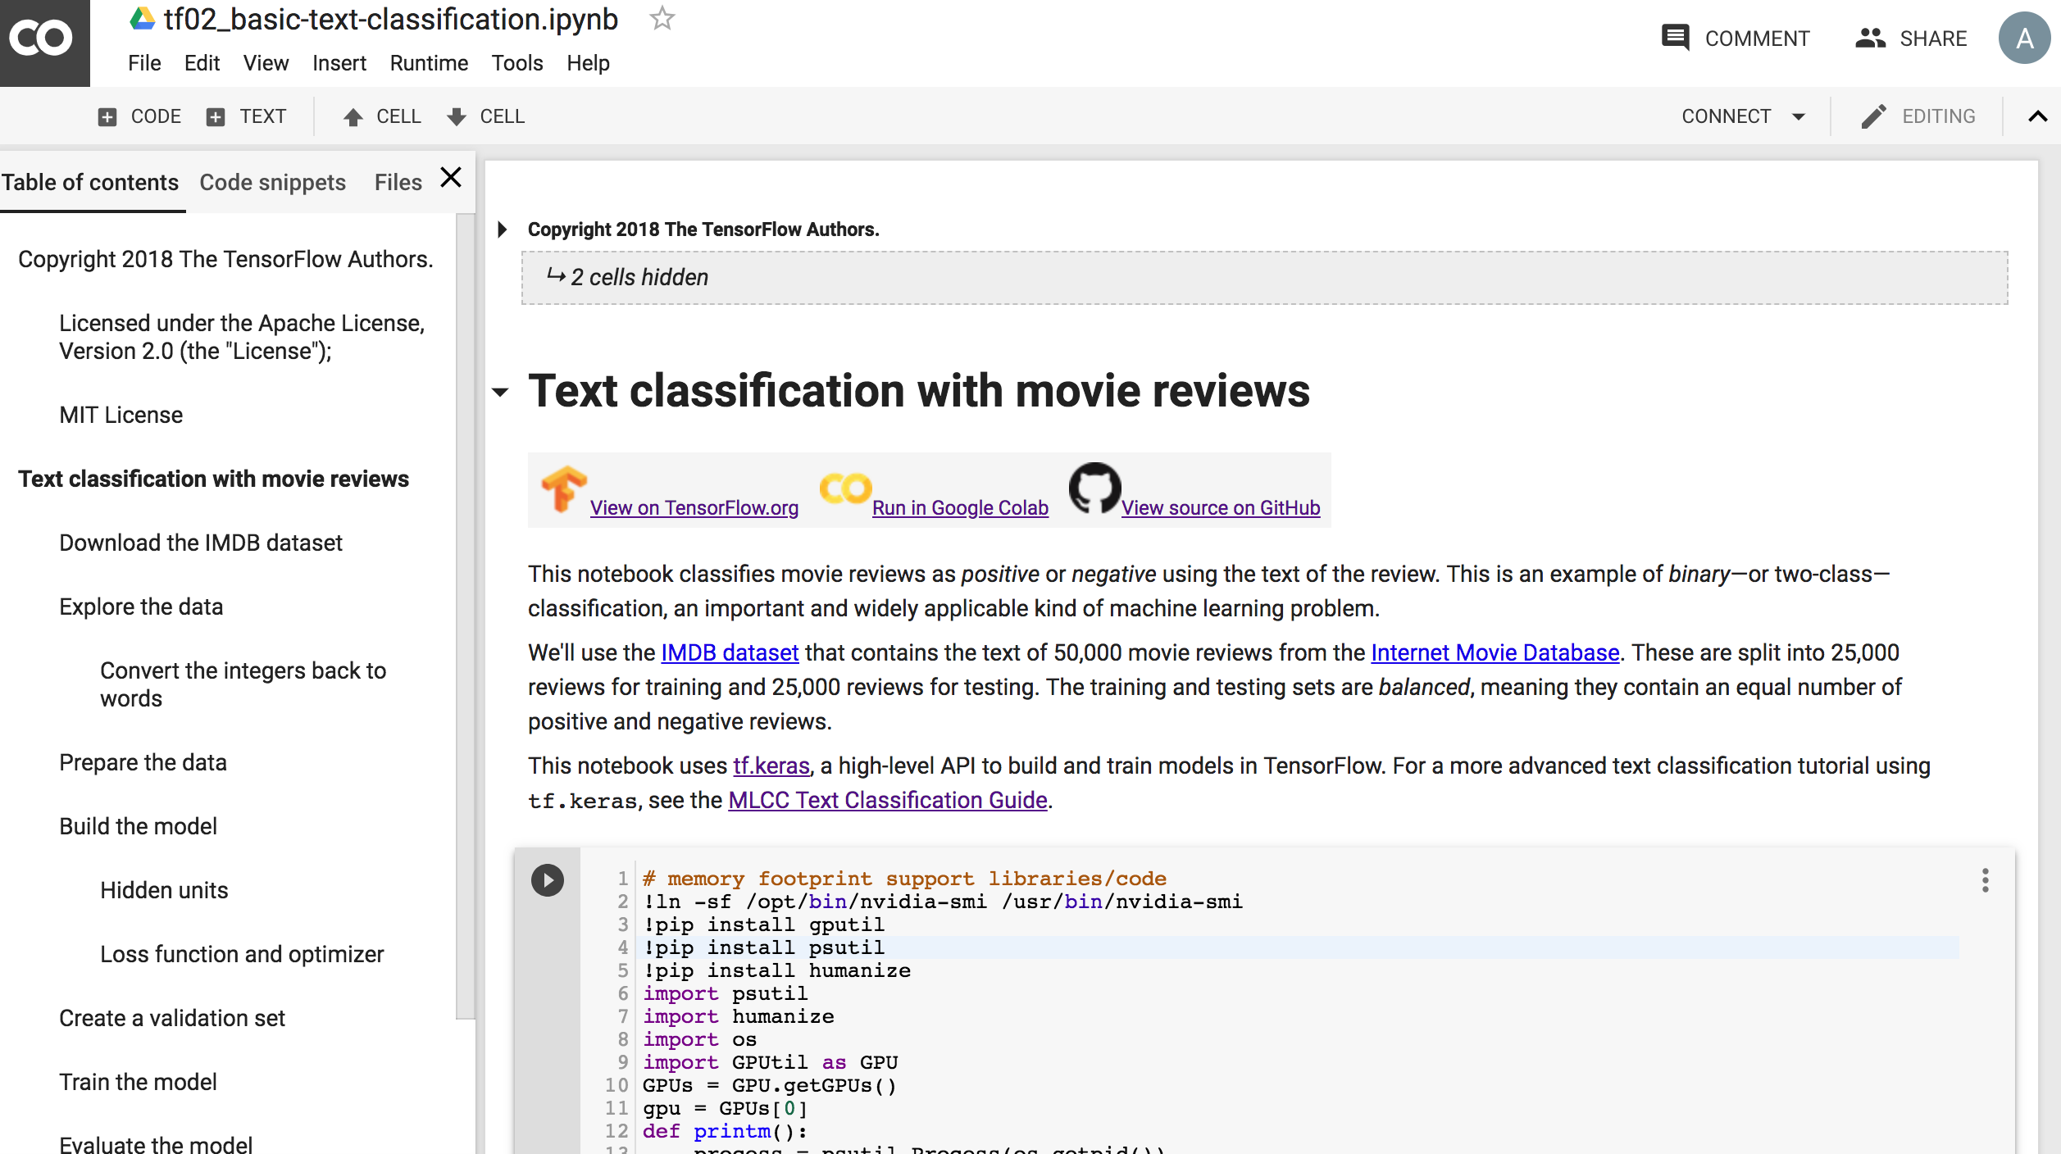
Text Classification
IMDB Movie Reviews
https://colab.research.google.com/drive/1x16h1GhHsLIrLYtPCvCHaoO1W-i_gror
Source: https://colab.research.google.com/github/tensorflow/docs/blob/master/site/en/tutorials/keras/basic_text_classification.ipynb

Slide 140
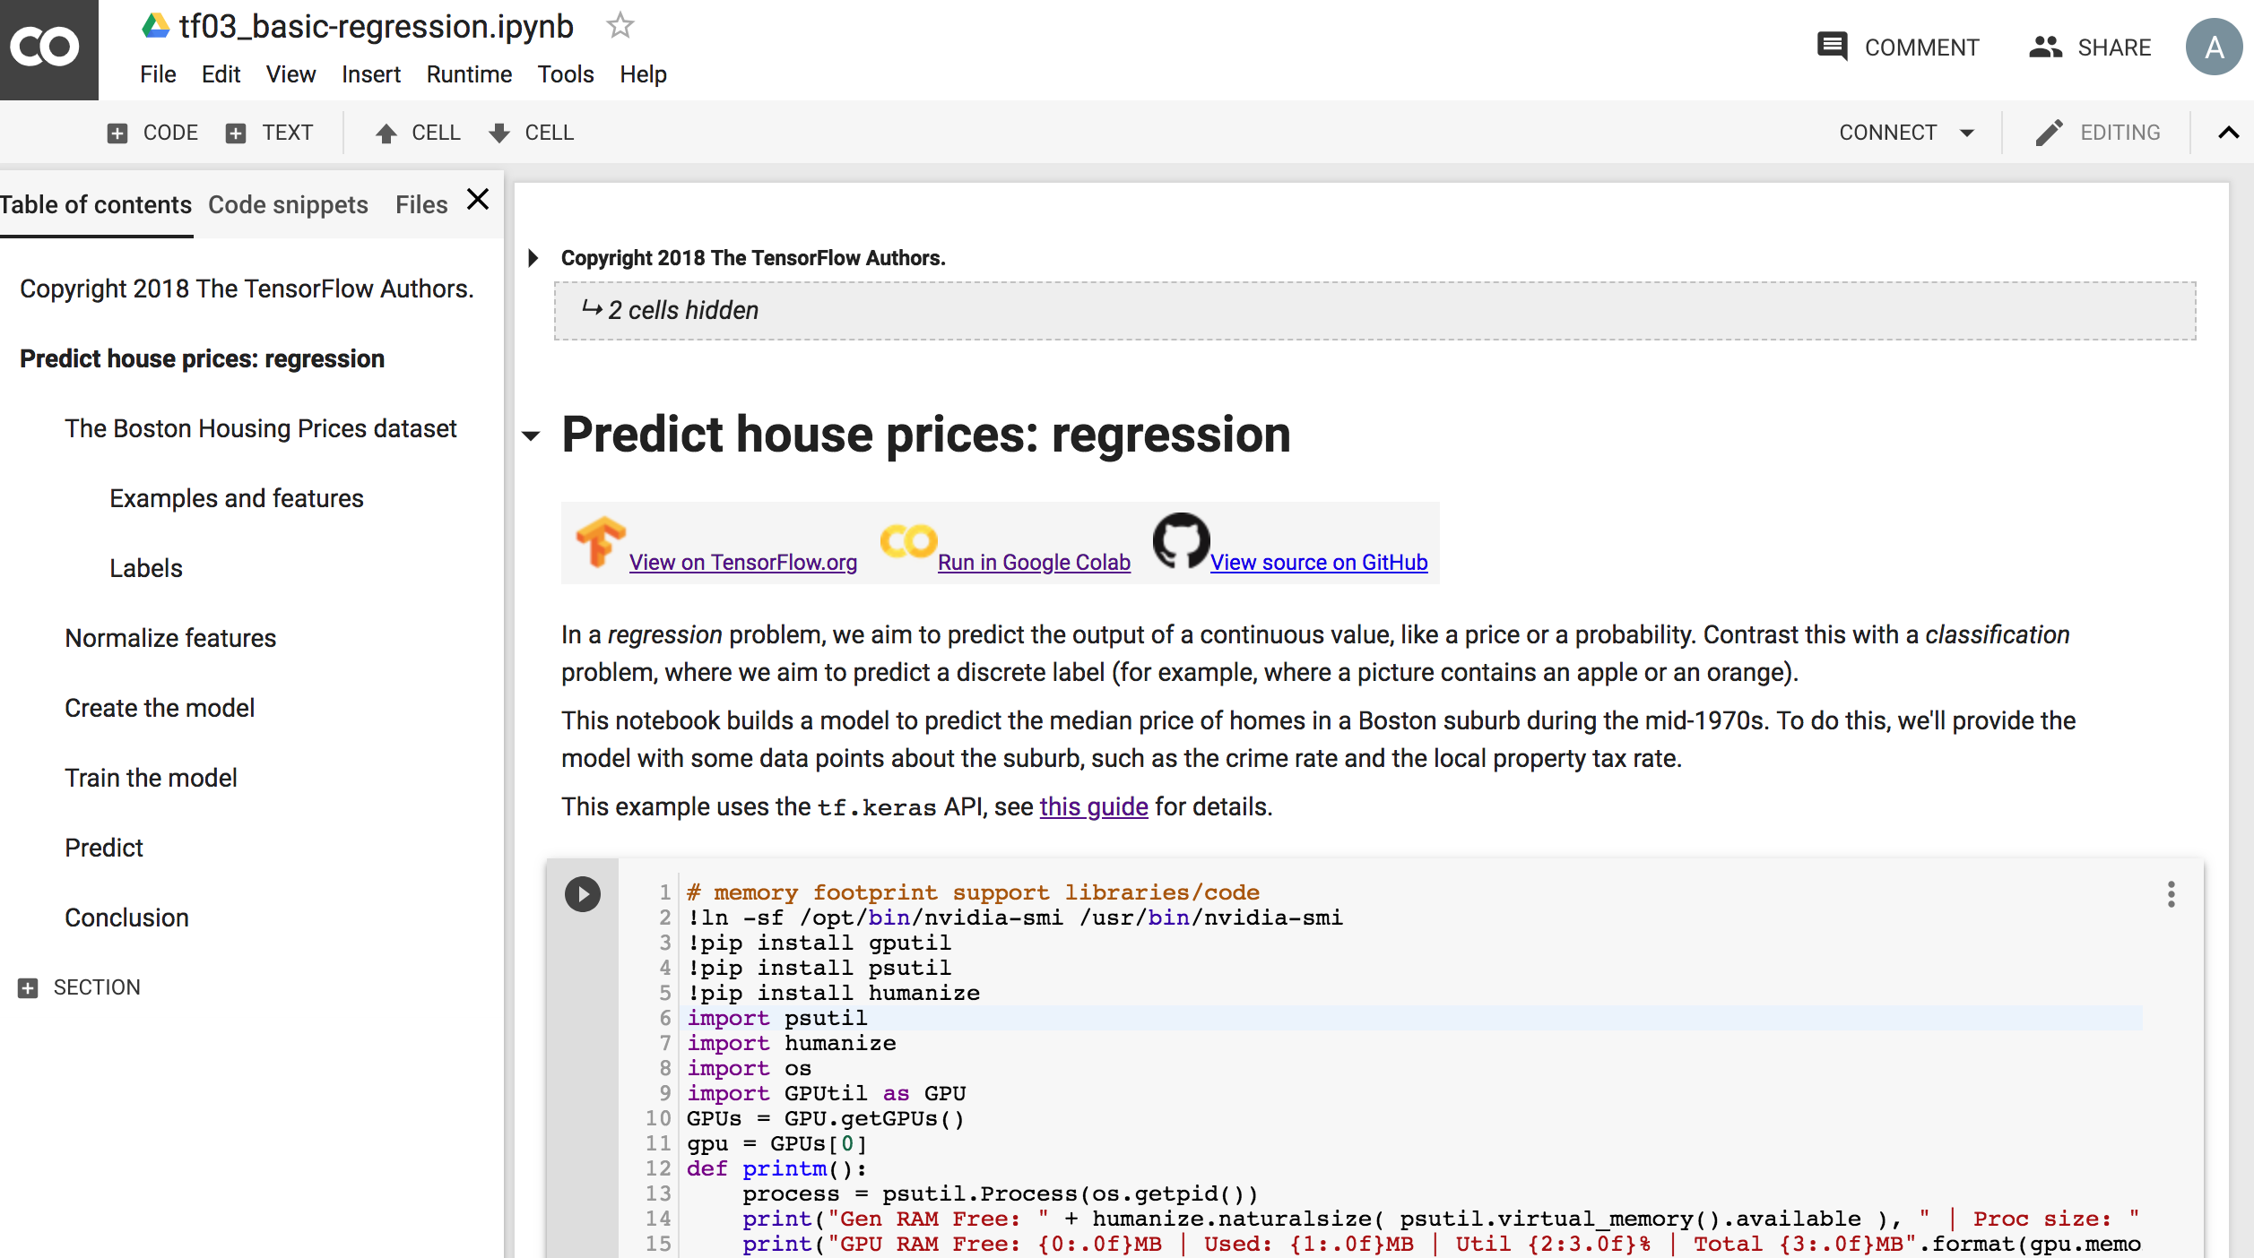
Basic Regression
Predict House Prices
https://colab.research.google.com/drive/1v4c8ZHTnRtgd2_25K_AURjR6SCVBRdlj
Source: https://colab.research.google.com/github/tensorflow/docs/blob/master/site/en/tutorials/keras/basic_regression.ipynb

Slide 141
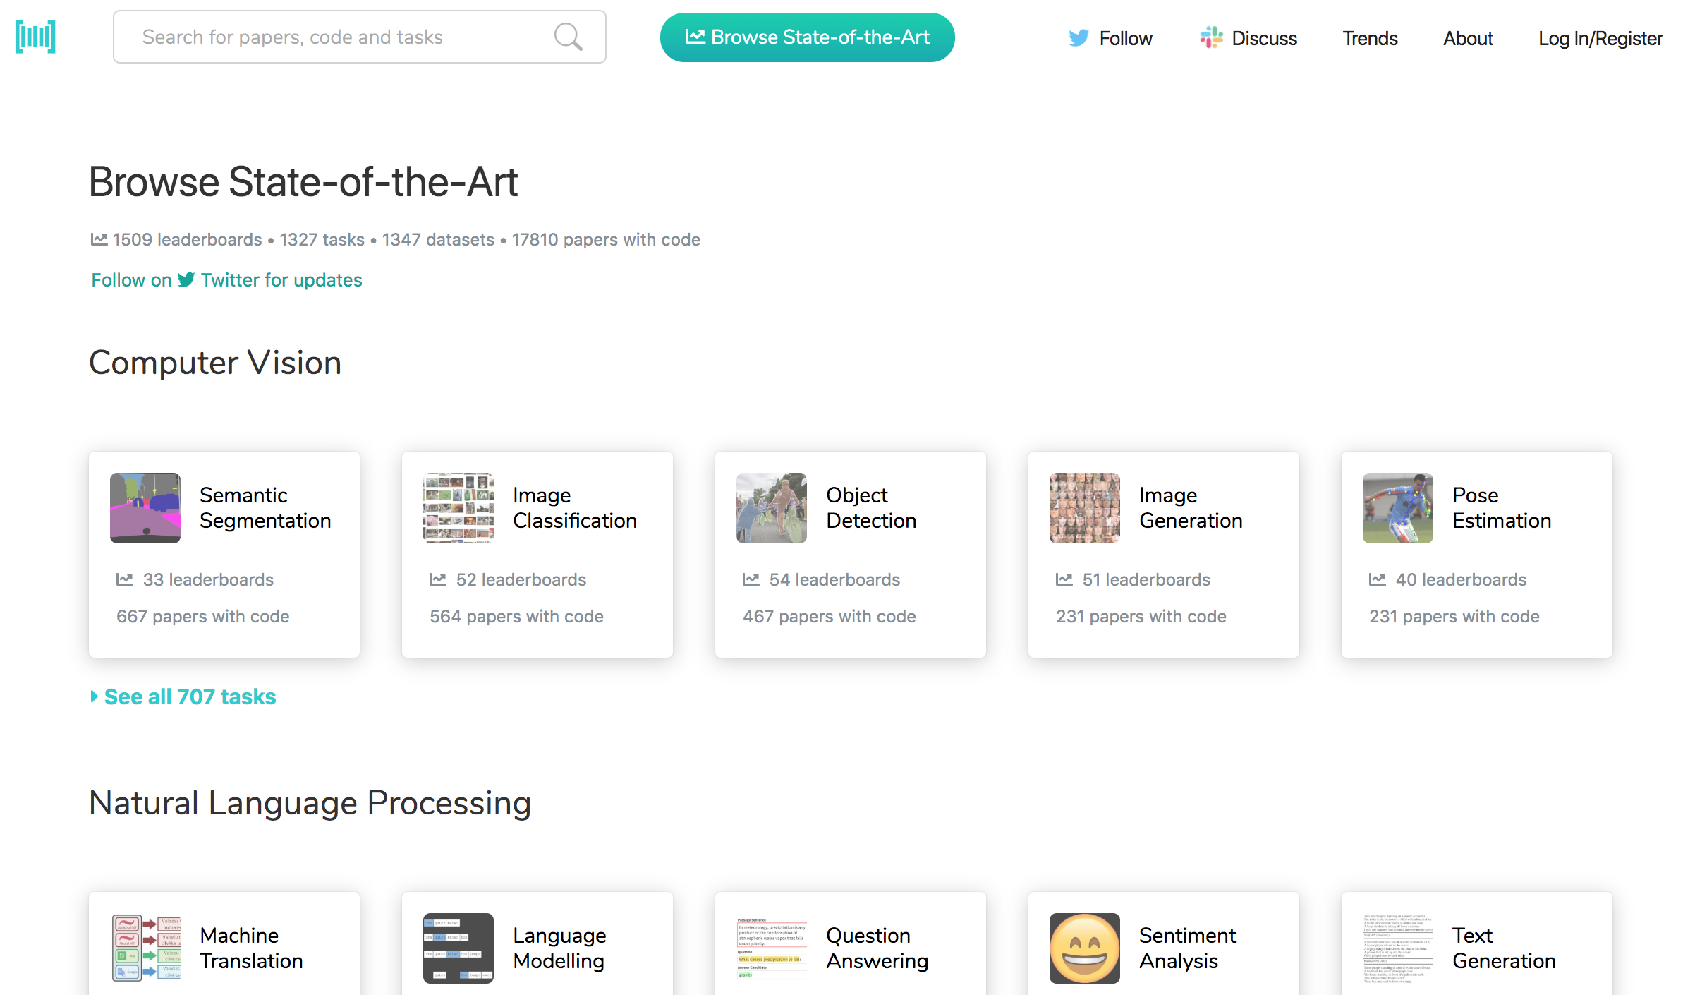
Papers with Code
State-of-the-Art (SOTA)
https://paperswithcode.com/sota

Slide 142

Aurélien Géron (2019),
Hands-On Machine Learning with Scikit-Learn, Keras, and TensorFlow: Concepts, Tools, and Techniques to Build Intelligent Systems, 2nd Edition
O’Reilly Media, 2019
https://github.com/ageron/handson-ml2
Source: https://www.amazon.com/Hands-Machine-Learning-Scikit-Learn-TensorFlow/dp/1492032646/

Slide 143

Hands-On Machine Learning with
Scikit-Learn, Keras, and TensorFlow
Notebooks
The Machine Learning landscape
End-to-end Machine Learning project
Classification
Training Models
Support Vector Machines
Decision Trees
Ensemble Learning and Random Forests
Dimensionality Reduction
Unsupervised Learning Techniques
Artificial Neural Nets with Keras
Training Deep Neural Networks
Custom Models and Training with TensorFlow
Loading and Preprocessing Data
Deep Computer Vision Using Convolutional Neural Networks
Processing Sequences Using RNNs and CNNs
Natural Language Processing with RNNs and Attention
Representation Learning Using Autoencoders
Reinforcement Learning
Training and Deploying TensorFlow Models at Scale
https://github.com/ageron/handson-ml2

Slide 144
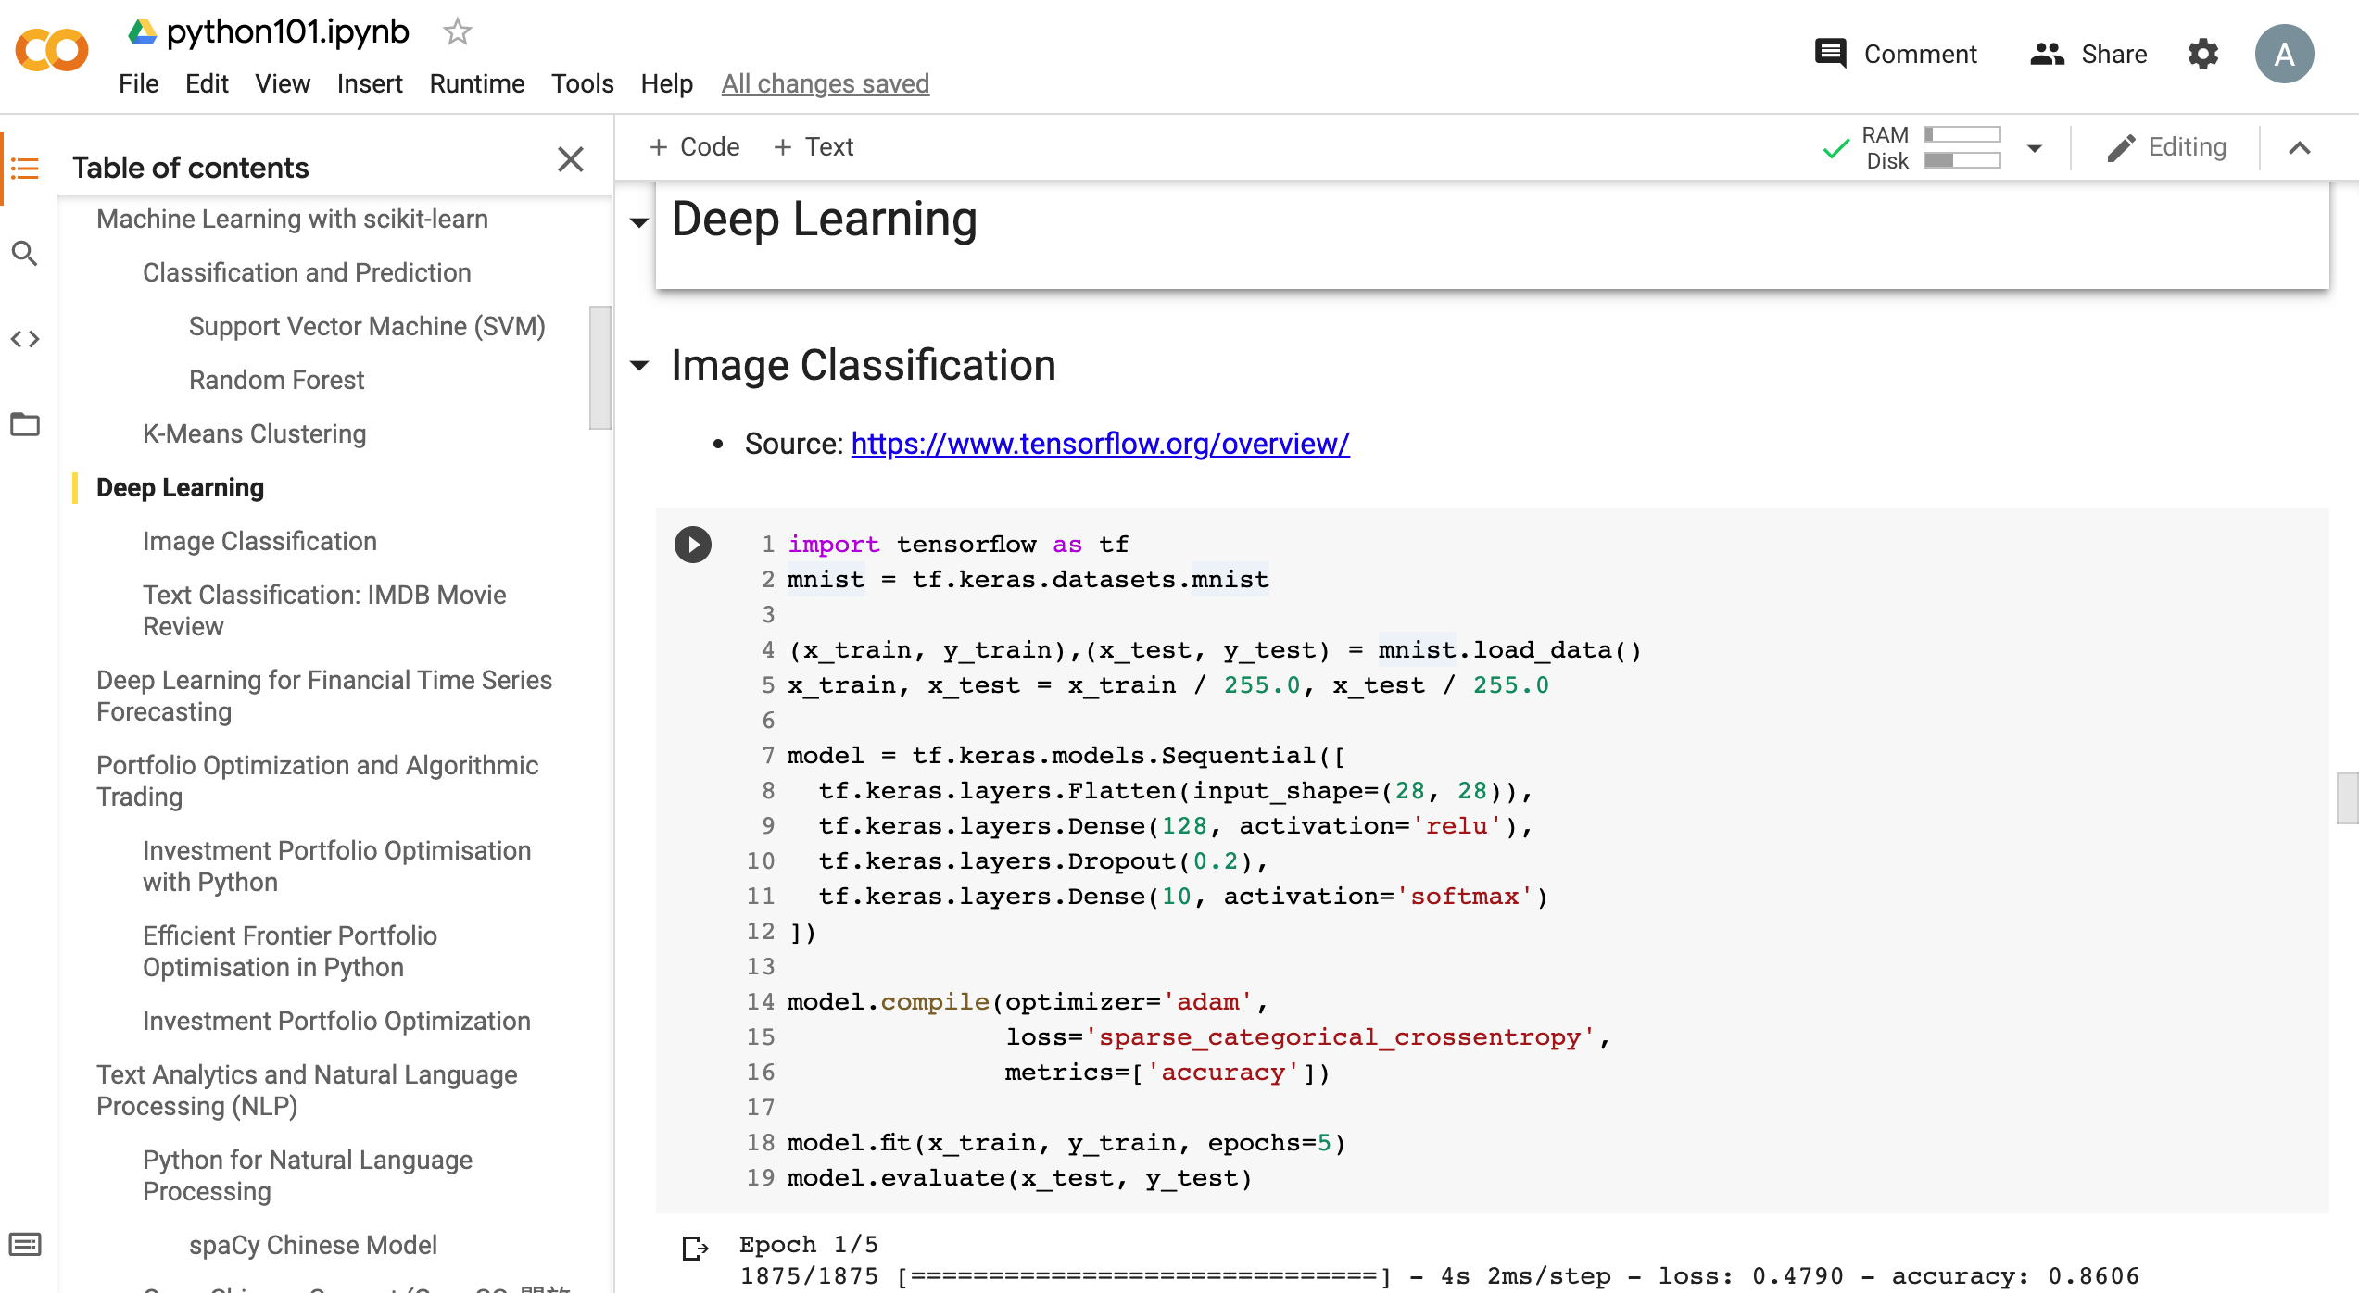
Python in Google Colab (Python101)
https://colab.research.google.com/drive/1FEG6DnGvwfUbeo4zJ1zTunjMqf2RkCrT
https://tinyurl.com/aintpupython101

Slide 145
Summary
Machine Learning
Deep Learning

Slide 146
References
Aurélien Géron (2019), Hands-On Machine Learning with Scikit-Learn, Keras, and TensorFlow: Concepts, Tools, and Techniques to Build Intelligent Systems, 2nd Edition, O’Reilly Media.
https://github.com/wesm/pydata-book
Stuart Russell and Peter Norvig (2020), Artificial Intelligence: A Modern Approach, 4th Edition, Pearson.
Liye Ma and Baohong Sun (2020), "Machine learning and AI in marketing – Connecting computing power to human insights." International Journal of Research in Marketing, 37, no. 3, 481-504.
Ahmet Murat Ozbayoglu, Mehmet Ugur Gudelek, and Omer Berat Sezer (2020). "Deep learning for financial applications: A survey." Applied Soft Computing (2020): 106384.
Omer Berat Sezer, Mehmet Ugur Gudelek, and Ahmet Murat Ozbayoglu (2020), "Financial time series forecasting with deep learning: A systematic literature review: 2005–2019." Applied Soft Computing 90 (2020): 106181.
Deep Learning Basics: Neural Networks Demystified,
https://www.youtube.com/playlist?list=PLiaHhY2iBX9hdHaRr6b7XevZtgZRa1PoU
Deep Learning SIMPLIFIED,
https://www.youtube.com/playlist?list=PLjJh1vlSEYgvGod9wWiydumYl8hOXixNu
3Blue1Brown (2017), But what *is* a Neural Network? | Chapter 1, deep learning, https://www.youtube.com/watch?v=aircAruvnKk
3Blue1Brown (2017), Gradient descent, how neural networks learn | Chapter 2, deep learning, https://www.youtube.com/watch?v=IHZwWFHWa-w
3Blue1Brown (2017), What is backpropagation really doing? | Chapter 3, deep learning, https://www.youtube.com/watch?v=Ilg3gGewQ5U
Scikit-learn – Machine Learning in Python: https://scikit-learn.org/
TensorFlow: https://www.tensorflow.org/
PyTorch: https://pytorch.org/
Min-Yuh Day (2021), Python 101, https://tinyurl.com/aintpupython101

