Slide 1
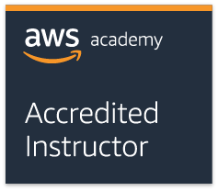
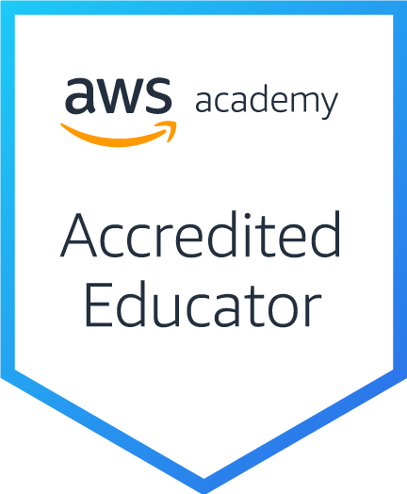
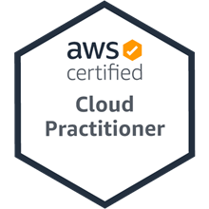
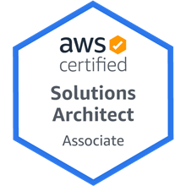
雲端服務架構實務 (Cloud Services Architecting Practices)
Tamkang University
Course orientation on Cloud Services Architecting Practices
雲端服務架構實務 (Cloud Services Architecting Practices) (MI4, TKU) (Spring 2021)
(AWS Academy Cloud Architecting, ACA)(AWS Solutions Architect, SAA)
(MI4, TKU) (2 Credits, Elective) (M2436) (2779)
(1092) (淡江大學資管四 MI4, TKU) (選修2學分) (2021.02 - 2021.06)
(週四 Thu, 9, 10, 16:10-18:00) (淡江大學淡水校園 B216)
Min-Yuh Day, Ph.D, Associate Professor
戴敏育 副教授
Institute of Information Management, National Taipei University
國立臺北大學 資訊管理研究所
https://web.ntpu.edu.tw/~myday
2021-02-25

Slide 2
雲端服務架構實務 (Cloud Services Architecting Practices)
Contact Information
Tamkang University
戴敏育 博士 (Min-Yuh Day, Ph.D.)
副教授 (Associate Professor)
國立臺北大學 資訊管理研究所
Institute of Information Management, National Taipei University
電話： 02-86741111 ext. 66873
研究室： 商8F12
地址： 23741 新北市三峽區大學路 151 號
Email：myday@gm.ntpu.edu.tw
網址：http://web.ntpu.edu.tw/~myday/

Slide 3
Tamkang University

Slide 4
淡江大學109學年度第2學期 課程教學計畫表 Spring 2021 (2021.02 - 2021.06)
Tamkang University
課程名稱：雲端服務架構實務 (Cloud Services Architecting Practices)
授課教師：戴敏育 (Min-Yuh Day)
開課系級：資管四P (TLMXB4P) (M2436) (2779)
開課資料：選修 單學期 2 學分 (2 Credits, Elective)
上課時間：週四 Thu 9, 10 (16:10-18:00)
上課地點： B216 (淡江大學淡水校園)
遠距非同步課程

Slide 5
課程簡介
Tamkang University
雲端服務架構實務課程主要介紹： AWS 技術基礎和在 AWS 上建立架構。
AWS技術基礎介紹 AWS 產品、服務和常見解決方案。
在 AWS 上建立架構內容涵蓋在 AWS 上建置 IT 基礎架構的基礎。
解決方案架構師如何透過了解 AWS 服務來優化對 AWS 雲端的使用，及如何讓這些服務符合雲端解決方案。
AWS 雲端最佳實務與建議的設計模式，協助學員思考在 AWS 上架構最佳 IT 解決方案的程序。

Slide 6
Course Introduction
Tamkang University
This course, Cloud Services Architecting Practices, introduces AWS Technical Essentials and Architecting on AWS.
In AWS Technical Essentials, students will learn about AWS products, services, and common solutions.
Architecting on AWS covers fundamentals of building IT infrastructure on the AWS platform.
Students will learn how to optimize the AWS Cloud by understanding how AWS services fit into cloud-based solutions.
In addition, students explore AWS Cloud best practices and design patterns for architecting optimal IT solutions on AWS.

Slide 7
課程目標
Tamkang University
根據 AWS 推薦的架構原則和最佳實踐做出架構決策。
了解利用 AWS 服務讓您的基礎設施具備可擴展性、可靠性和高可用性。
利用 AWS 託管服務提高基礎設施的靈活性和彈性。
提高基於 AWS 的基礎設施的效率，以提升性能並降低成本。
使用架構完善的框架改進採用解決方案的架構。

Slide 8
Course Objective
Tamkang University
Make architectural decisions based on the AWS recommended architectural principles and best practices.
Explore leveraging AWS services to make your infrastructure scalable, reliable, and highly available.
Leverage AWS managed services to enable greater flexibility and resiliency in an infrastructure.
Make an AWS-based infrastructure more efficient in order to increase performance and reduce costs.
Use the Well-Architected Framework to improve AWS architectures with AWS solutions.

Slide 9
課程大綱 (Syllabus)
Tamkang University
週次 (Week) 日期 (Date) 內容 (Subject/Topics)
1 2021/02/25 Course orientation on Cloud Services Architecting Practices: AWS Solutions Architect Overview
2 2021/03/04 Automating Your Infrastructure
3 2021/03/11 Decoupling Your Infrastructure
4 2021/03/18 Designing Web-Scale Media
5 2021/03/25 Well-Architected Framework
6 2021/04/01 Off-campus study (教學行政觀摩日)
7 2021/04/08 Well-Architected Pillar 1 - Operational Excellence
8 2021/04/15 Well-Architected Pillar 2 - Security

Slide 10
課程大綱 (Syllabus)
Tamkang University
週次 (Week) 日期 (Date) 內容 (Subject/Topics)
9 2021/04/22 期中上機測驗
10 2021/04/29 期中考試週
11 2021/05/06 Well-Architected Pillar 3 - Reliability
12 2021/05/13 Well-Architected Pillar 4 - Performance Efficiency, Well-Architected Pillar 5 - Cost-Optimization
13 2021/05/20 Troubleshooting, Design Patterns and Sample Architectures
14 2021/05/27 期末上機測驗
15 2021/06/03 畢業考試週

Slide 11
教學目標之教學方法與評量方法
Tamkang University
教學方法
講述、討論、發表、實作、體驗、模擬
評量方法
測驗、討論、實作、報告

Slide 12
學期成績計算方式
Tamkang University
期中評量： 30.0 %
期末評量： 30.0 %
平時評量 ：40.0 % (課堂參與及報告討論表現)

Slide 13
教材課本與參考書籍
Tamkang University
教材課本 (Textbook)
Slides
AWS Academy Cloud Foundations (AWS ACF), AWS Academy
AWS Academy Cloud Architecting (AWS ACA), AWS Academy

Slide 14
教材課本與參考書籍
Tamkang University
參考書籍 (References)
Ben Piper and David Clinton (2019), AWS Certified Solutions Architect Study Guide: Associate SAA-C01 Exam, 2 edition, Sybex, 2019
AWS Technical Essentials
https://aws.amazon.com/training/course-descriptions/essentials/
Architecting on AWS
https://aws.amazon.com/training/course-descriptions/architect/
AWS Cloud Practitioner Essentials (Second Edition)
https://aws.amazon.com/training/course-descriptions/cloud-practitioner-essentials/
AWS Certified Cloud Practitioner
https://aws.amazon.com/certification/certified-cloud-practitioner/
AWS Certified Solutions Architect – Associate
https://aws.amazon.com/certification/certified-solutions-architect-associate/

Slide 15
2
SAA
1
CLF
https://aws.amazon.com/certification/

Slide 16
AWS Certified Cloud Practitioner
This certification provides individuals in a larger variety of cloud and technology roles with a way to validate their AWS Cloud knowledge and enhance their professional credibility.
This exam covers four domains, including cloud concepts, security, technology, and billing and pricing.
https://aws.amazon.com/certification/certified-cloud-practitioner/

Slide 17
AWS Certified Solutions Architect – Associate
This certification validates your ability to effectively demonstrate knowledge of how to architect and deploy secure and robust applications on AWS technologies.
This exam is for anyone with at least one year of hands-on experience designing available, cost-efficient, fault-tolerant, and scalable and distributed systems on AWS.
https://aws.amazon.com/certification/certified-solutions-architect-associate/

Slide 18
AWS Academy and Certifications
1
AWS Academy Cloud Foundations (ACF)
AWS Certified Cloud Practitioner (CLF-C01) (2021/01)
https://aws.amazon.com/certification/certified-cloud-practitioner/
AWS Academy Cloud Architecting (ACA)
AWS Certified Solutions Architect – Associate (SAA-C02) (2021/05)
https://aws.amazon.com/certification/certified-solutions-architect-associate/
2
https://aws.amazon.com/training/awsacademy/

Slide 19
AWS Academy and Certifications
1
AWS Academy Cloud Foundations (ACF)
AWS Certified Cloud Practitioner (CLF-C01) (2021/01)
https://aws.amazon.com/certification/certified-cloud-practitioner/
AWS Cloud Practitioner Essentials (Second Edition)
https://aws.amazon.com/training/course-descriptions/cloud-practitioner-essentials/
AWS Technical Essentials
https://aws.amazon.com/training/course-descriptions/essentials/
AWS Academy Cloud Architecting (ACA)
AWS Certified Solutions Architect – Associate (SAA-C02) (2021/05)
https://aws.amazon.com/certification/certified-solutions-architect-associate/
Architecting on AWS
https://aws.amazon.com/training/course-descriptions/architect/
2
https://aws.amazon.com/training/awsacademy/

Slide 20
AWS Certified Cloud Practitioner (CLF-C01)
Domain | % of Examination
Domain 1: Cloud Concepts | 26%
Domain 2: Security and Compliance | 25%
Domain 3: Technology | 33%
Domain 4: Billing and Pricing | 16%
TOTAL | 100%
Source: https://aws.amazon.com/certification/certified-cloud-practitioner/

Slide 21
AWS Certified Solutions Architect – Associate (SAA-C02)
Domain | % of Examination
Domain 1: Design Resilient Architectures | 30%
Domain 2: Design High-Performing Architectures | 28%
Domain 3: Specify Secure Applications and Architectures | 24%
Domain 4: Design Cost-Optimized Architectures | 18%
TOTAL | 100%
Source: https://aws.amazon.com/certification/certified-solutions-architect-associate

Slide 22
AWS Certified Cloud Practitioner (CLF-C01)
Source: https://aws.amazon.com/certification/certified-cloud-practitioner/

Slide 23
AWS Certified Cloud Practitioner (CLF-C01)
Domain 1: Cloud Concepts
1.1 Define the AWS Cloud and its value proposition
1.2 Identify aspects of AWS Cloud economics
1.3 List the different cloud architecture design principles
Source: https://aws.amazon.com/certification/certified-cloud-practitioner/

Slide 24
AWS Certified Cloud Practitioner (CLF-C01)
Domain 2: Security and Compliance
2.1 Define the AWS shared responsibility model
2.2 Define AWS Cloud security and compliance concepts
2.3 Identify AWS access management capabilities
2.4 Identify resources for security support
Source: https://aws.amazon.com/certification/certified-cloud-practitioner/

Slide 25
AWS Certified Cloud Practitioner (CLF-C01)
Domain 3: Technology
3.1 Define methods of deploying and operating in the AWS Cloud
3.2 Define the AWS global infrastructure
3.3 Identify the core AWS services
3.4 Identify resources for technology support
Source: https://aws.amazon.com/certification/certified-cloud-practitioner/

Slide 26
AWS Certified Cloud Practitioner (CLF-C01)
Domain 4: Billing and Pricing
4.1 Compare and contrast the various pricing models for AWS
4.2 Recognize the various account structures in relation to AWS billing and pricing
4.3 Identify resources available for billing support
Source: https://aws.amazon.com/certification/certified-cloud-practitioner/

Slide 27
AWS Certified Solutions Architect – Associate (SAA-C02)
Source: https://aws.amazon.com/certification/certified-solutions-architect-associate

Slide 28
AWS Certified Solutions Architect – Associate (SAA-C02)
Domain 1: Design Resilient Architectures
1.1 Design a multi-tier architecture solution
1.2 Design highly available and/or fault-tolerant architectures
1.3 Design decoupling mechanisms using AWS services
1.4 Choose appropriate resilient storage
Source: https://aws.amazon.com/certification/certified-solutions-architect-associate

Slide 29
AWS Certified Solutions Architect – Associate (SAA-C02)
Domain 2: Design High-Performing Architectures
2.1 Identify elastic and scalable compute solutions for a workload
2.2 Select high-performing and scalable storage solutions for a workload
2.3 Select high-performing networking solutions for a workload
2.4 Choose high-performing database solutions for a workload
Source: https://aws.amazon.com/certification/certified-solutions-architect-associate

Slide 30
AWS Certified Solutions Architect – Associate (SAA-C02)
Domain 3: Design Secure Applications and Architectures
3.1 Design secure access to AWS resources
3.2 Design secure application tiers
3.3 Select appropriate data security options
Source: https://aws.amazon.com/certification/certified-solutions-architect-associate

Slide 31
AWS Certified Solutions Architect – Associate (SAA-C02)
Domain 4: Design Cost-Optimized Architectures
4.1 Identify cost-effective storage solutions
4.2 Identify cost-effective compute and database services
4.3 Design cost-optimized network architectures
Source: https://aws.amazon.com/certification/certified-solutions-architect-associate

Slide 32
AWS Academy Cloud Architecting (ACA)

Slide 33
AWS Academy Cloud Architecting (ACA) Course Overview
Module 0 (Optional): AWS Service Review
Module 1: Course Welcome and Overview
Module 2: Designing the Network
Module 3: Designing for High Availability – Section 1
Module 4: Designing for High Availability with Scaling – Section2
Module 5: Automating Your Infrastructure
Module 6: Decoupling Your Infrastructure
Module 7: Designing Web-Scale Media
https://aws.amazon.com/training/awsacademy/

Slide 34
AWS Academy Cloud Architecting (ACA) Course Overview
Module 8: Well-Architected Framework
Module 9: Well-Architected Pillar 1 - Operational Excellence
Module 10: Well-Architected Pillar 2 - Security
Module 11: Well-Architected Pillar 3 - Reliability
Module 12: Well-Architected Pillar 4 - Performance Efficiency
Module 13: Well-Architected Pillar 5 - Cost-Optimization
Module 14: Troubleshooting
Module 15: Design Patterns and Sample Architectures
https://aws.amazon.com/training/awsacademy/

Slide 35
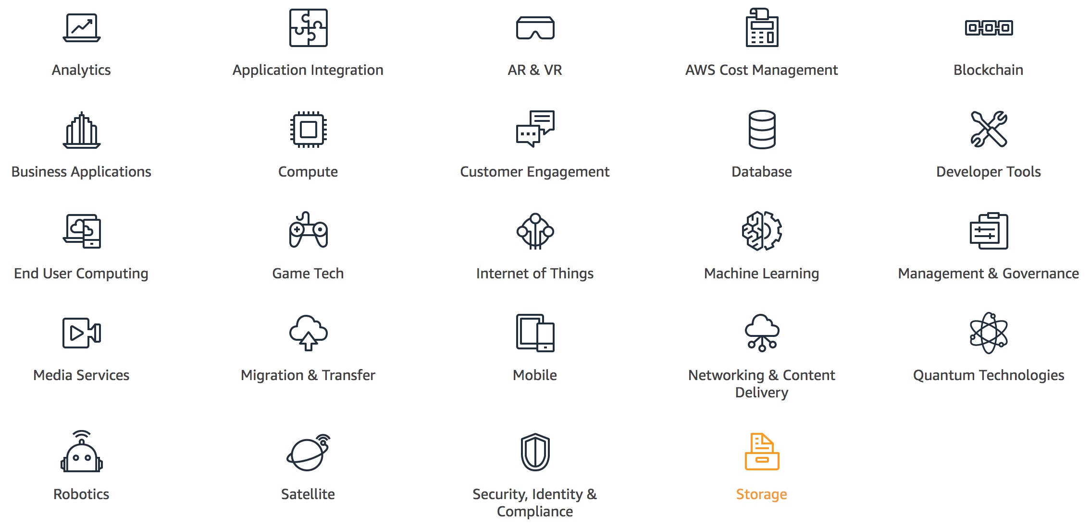
AWS Products and Services
Source: https://aws.amazon.com/

Slide 36
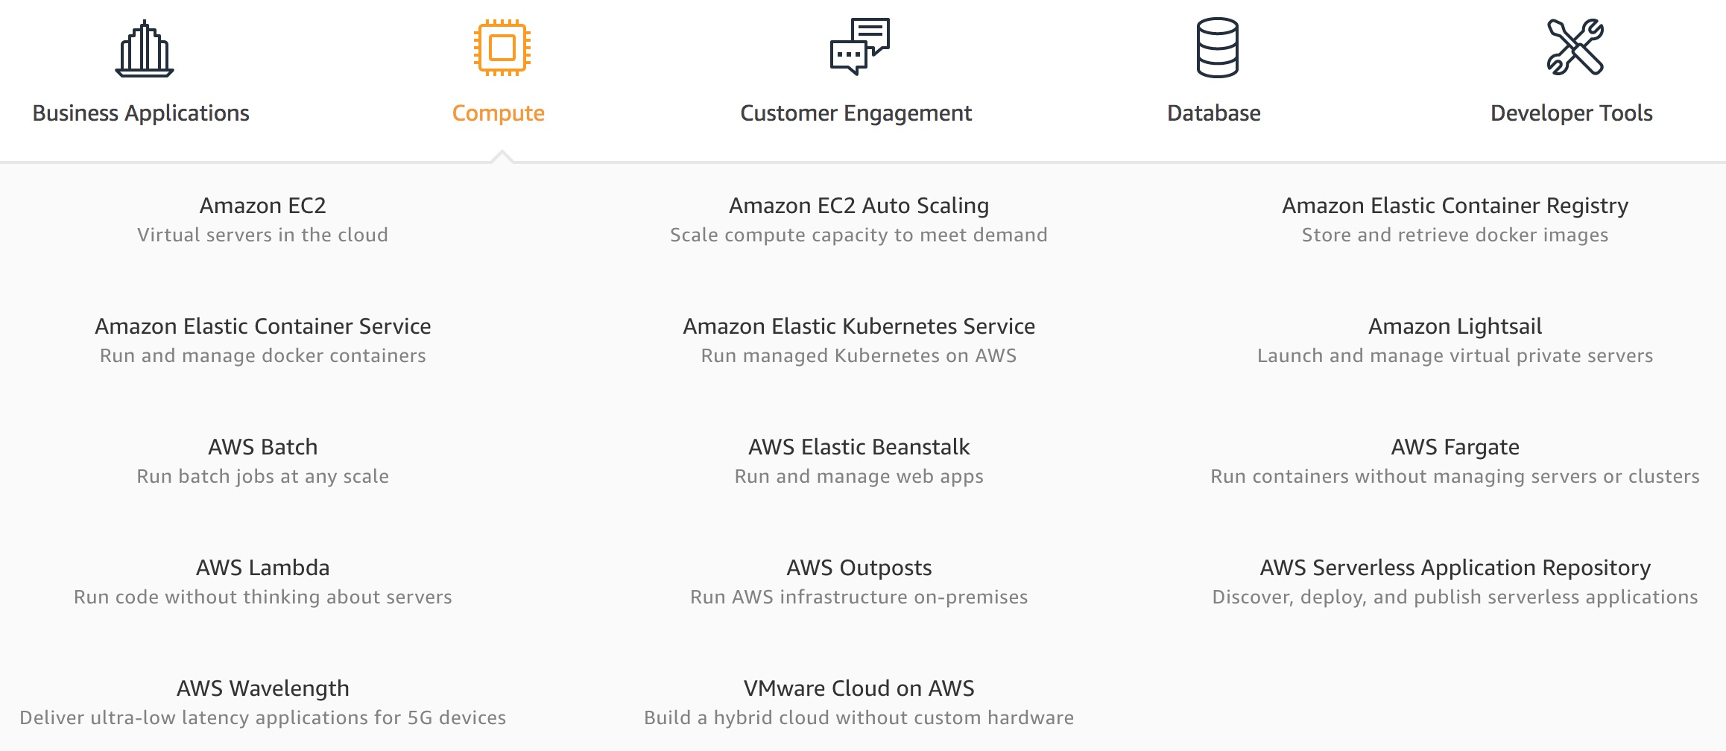
AWS Compute
Source: https://aws.amazon.com/

Slide 37
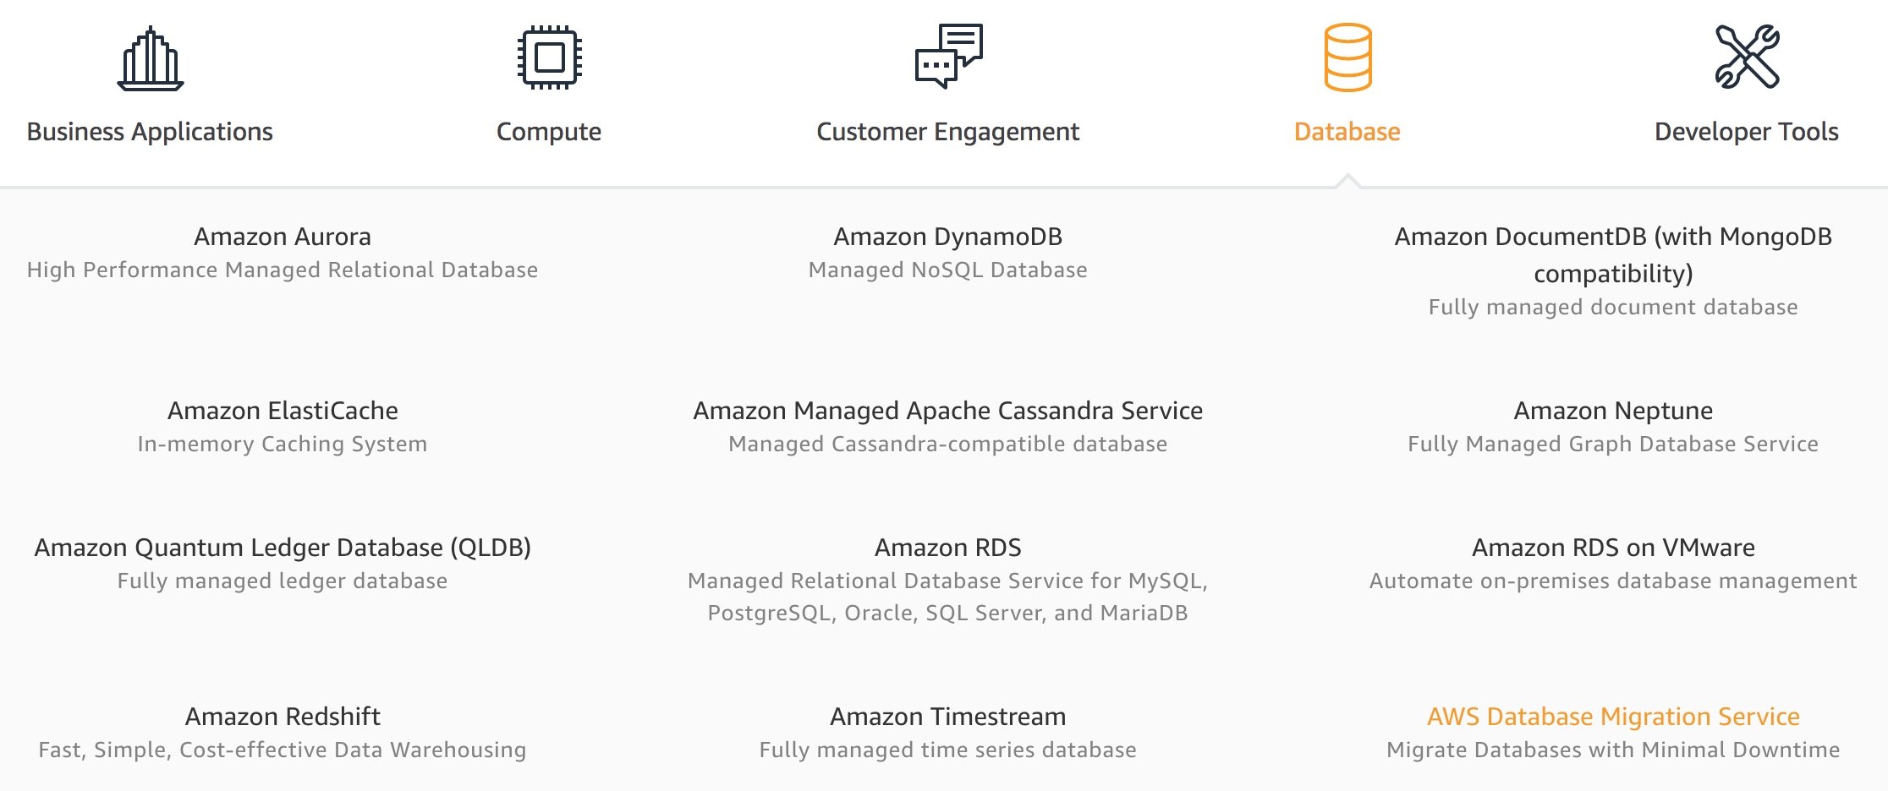
AWS Database
Source: https://aws.amazon.com/

Slide 38
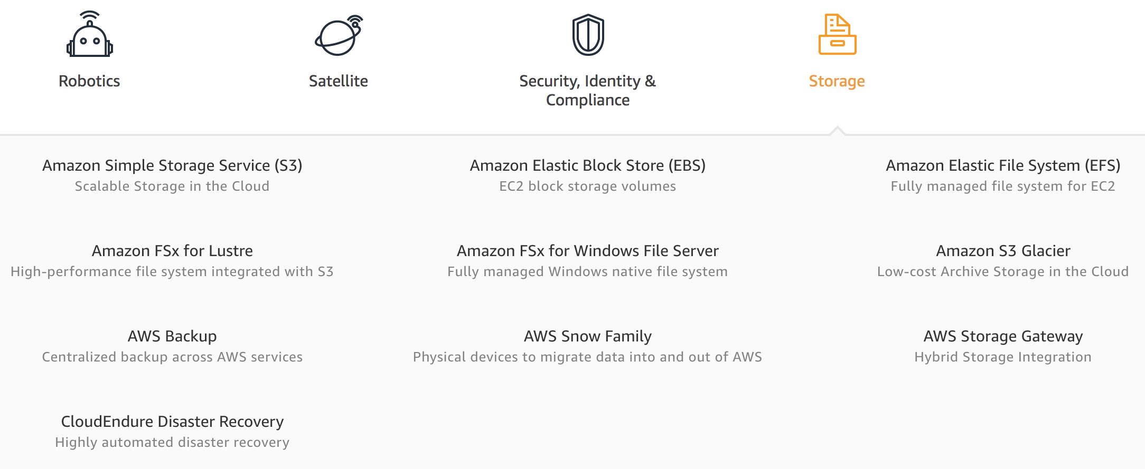
AWS Storage
Source: https://aws.amazon.com/

Slide 39
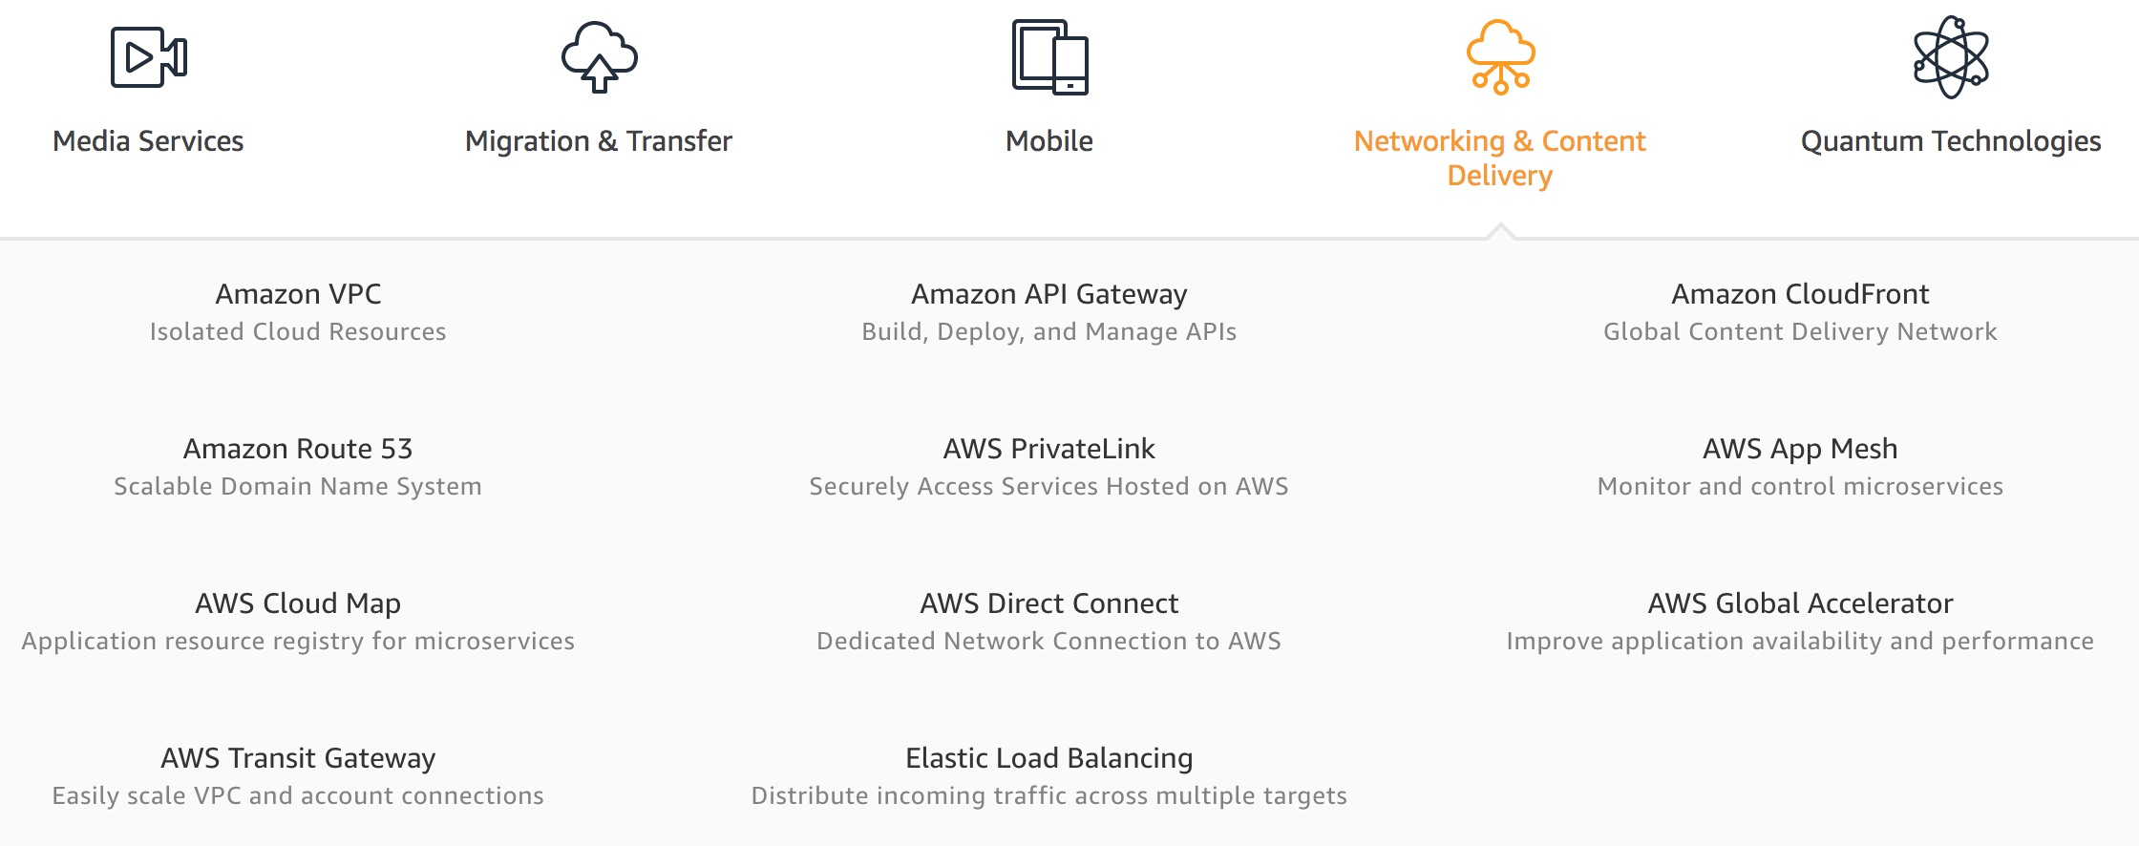
AWS Networking & Content Dilivery
Source: https://aws.amazon.com/

Slide 40
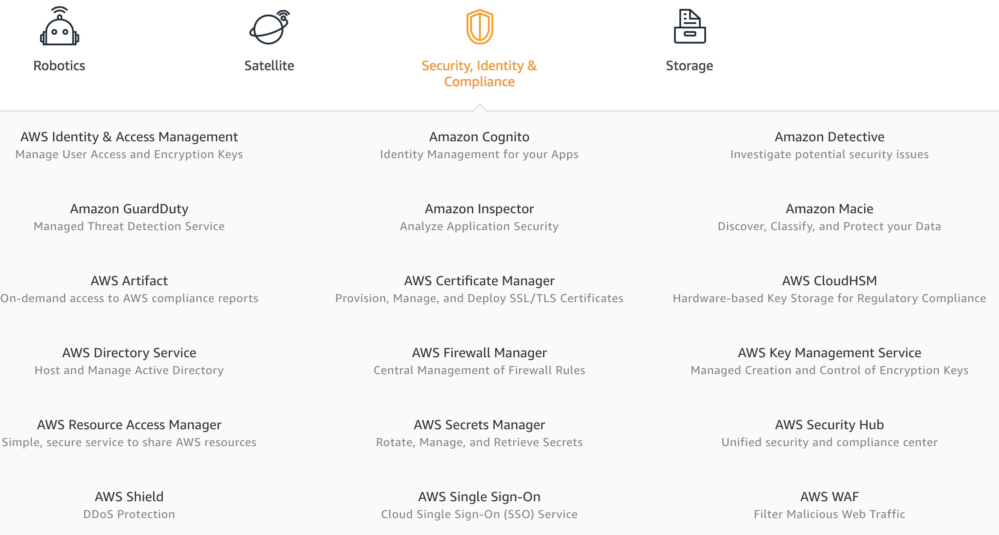
AWS Security, Identity & Compliance
Source: https://aws.amazon.com/

Slide 41
AWS Cost Management
Source: https://aws.amazon.com/

Slide 42
AWS Services
Amazon EC2
Virtual servers in the cloud
Amazon Simple Storage Service (S3)
Scalable storage in the cloud
Amazon Aurora
High performance managed relational database
Amazon DynamoDB
Managed NoSQL database
Amazon RDS
Managed relational database service for MySQL, PostgreSQL, Oracle, SQL Server, and MariaDB
Source: https://aws.amazon.com/

Slide 43
AWS Services
AWS Lambda
Run code without thinking about servers
AWS Elastic Beanstalk
Run and manage web apps
Amazon VPC
Isolated cloud resources
Amazon Lightsail
Launch and manage virtual private servers
Amazon SageMaker
Build, train, and deploy machine learning models at scale
Source: https://aws.amazon.com/

Slide 44
Web Application with AWS Core Services

Slide 45
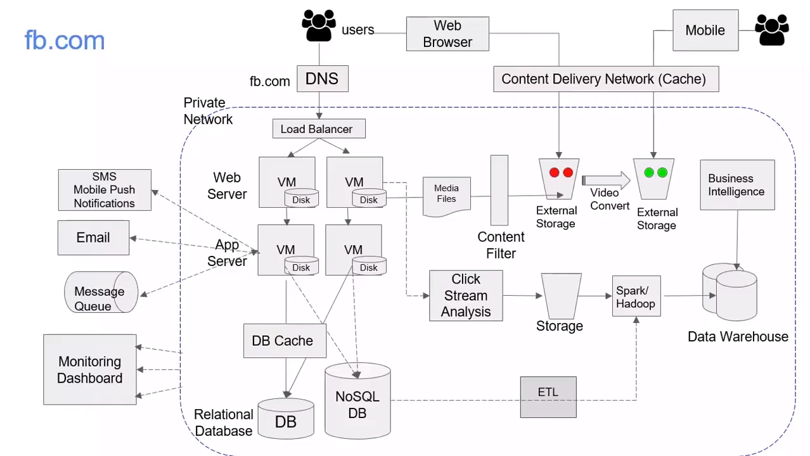
Source: AWS Training Center (2019), Introduction to AWS Services, https://youtu.be/Z3SYDTMP3ME

Slide 46
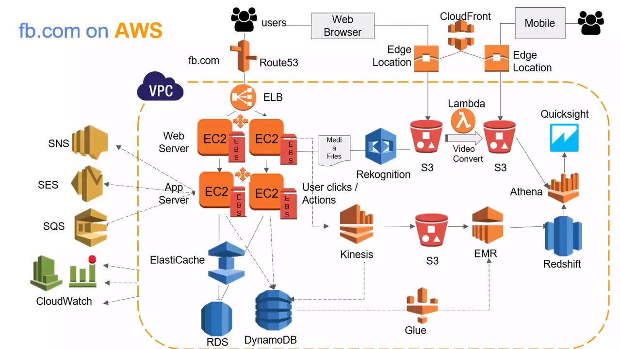
Source: AWS Training Center (2019), Introduction to AWS Services, https://youtu.be/Z3SYDTMP3ME

Slide 47
Source: AWS Training Center (2019), Introduction to AWS Services, https://youtu.be/Z3SYDTMP3ME

Slide 48
Source: AWS Training Center (2019), Introduction to AWS Services, https://youtu.be/Z3SYDTMP3ME

Slide 49
Source: AWS Training Center (2019), Introduction to AWS Services, https://youtu.be/Z3SYDTMP3ME

Slide 50
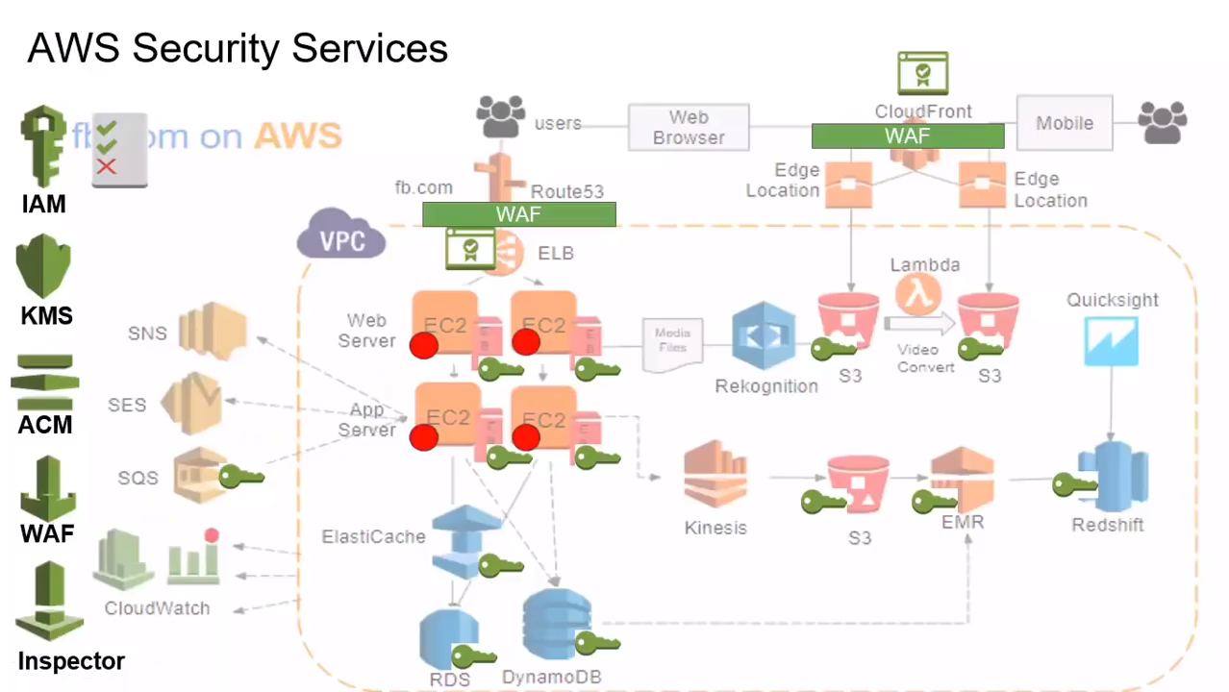
Source: AWS Training Center (2019), Introduction to AWS Services, https://youtu.be/Z3SYDTMP3ME

Slide 51
Source: AWS Training Center (2019), Introduction to AWS Services, https://youtu.be/Z3SYDTMP3ME

Slide 52
AWS Serverless Architecture

Slide 53
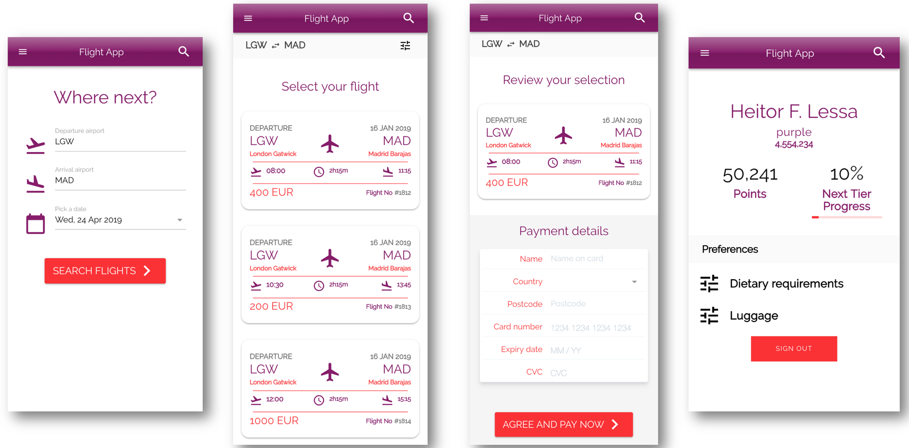
AWS Serverless Airline Booking
Source: https://github.com/aws-samples/aws-serverless-airline-booking

Slide 54
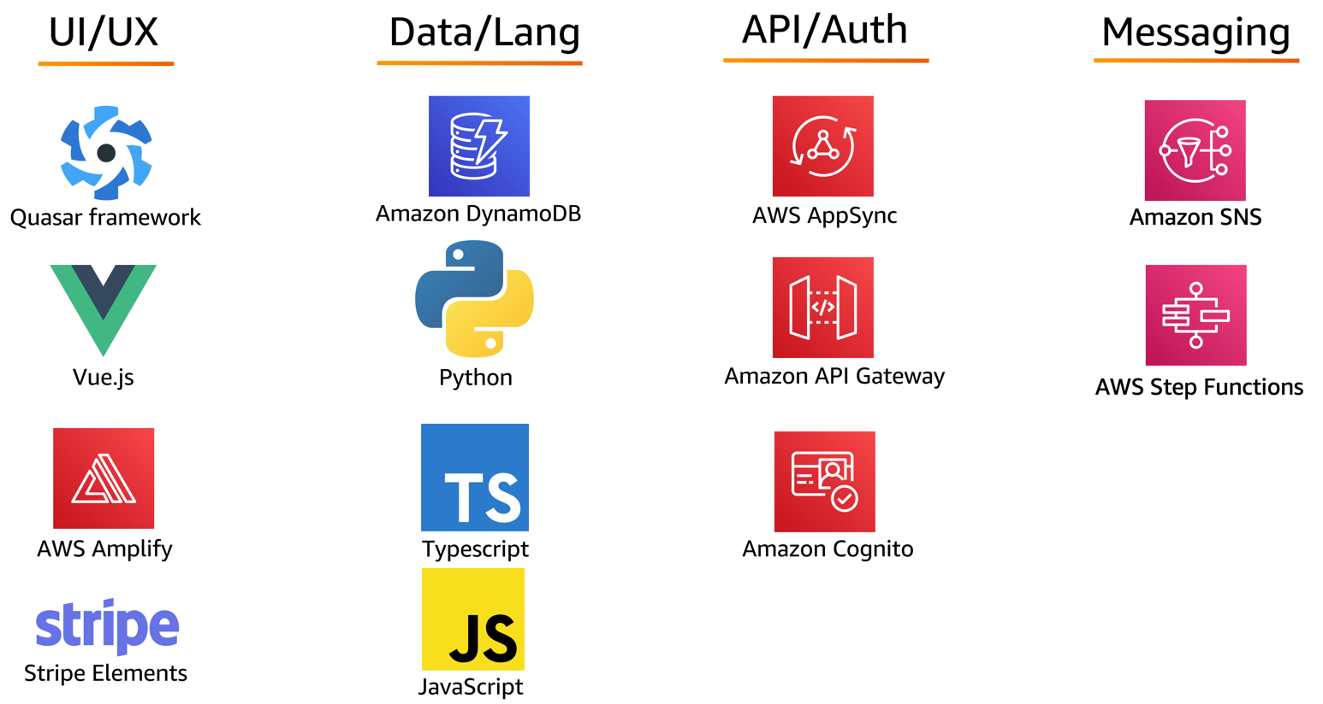
AWS Serverless Airline Booking Stack
Source: https://github.com/aws-samples/aws-serverless-airline-booking

Slide 55
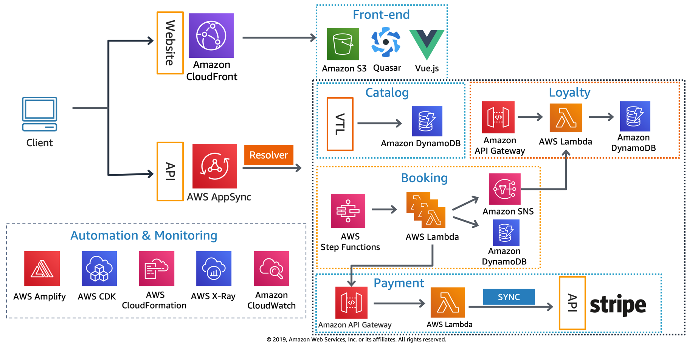
AWS Serverless Airline Booking High level infrastructure architecture
Source: https://github.com/aws-samples/aws-serverless-airline-booking

Slide 56
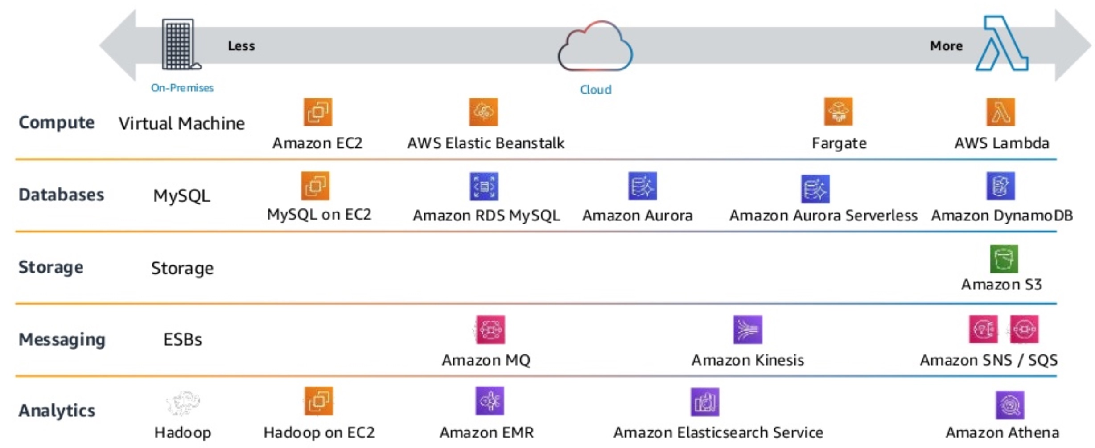
AWS Serverless Architecture AWS Operational Responsibility Models
Source: Heitor Lessa (2019), How to build a full stack serverless airline ticketing web app, https://www.youtube.com/watch?v=MyoOeHTp2pg

Slide 57
Build a Serverless Web Application

Slide 58
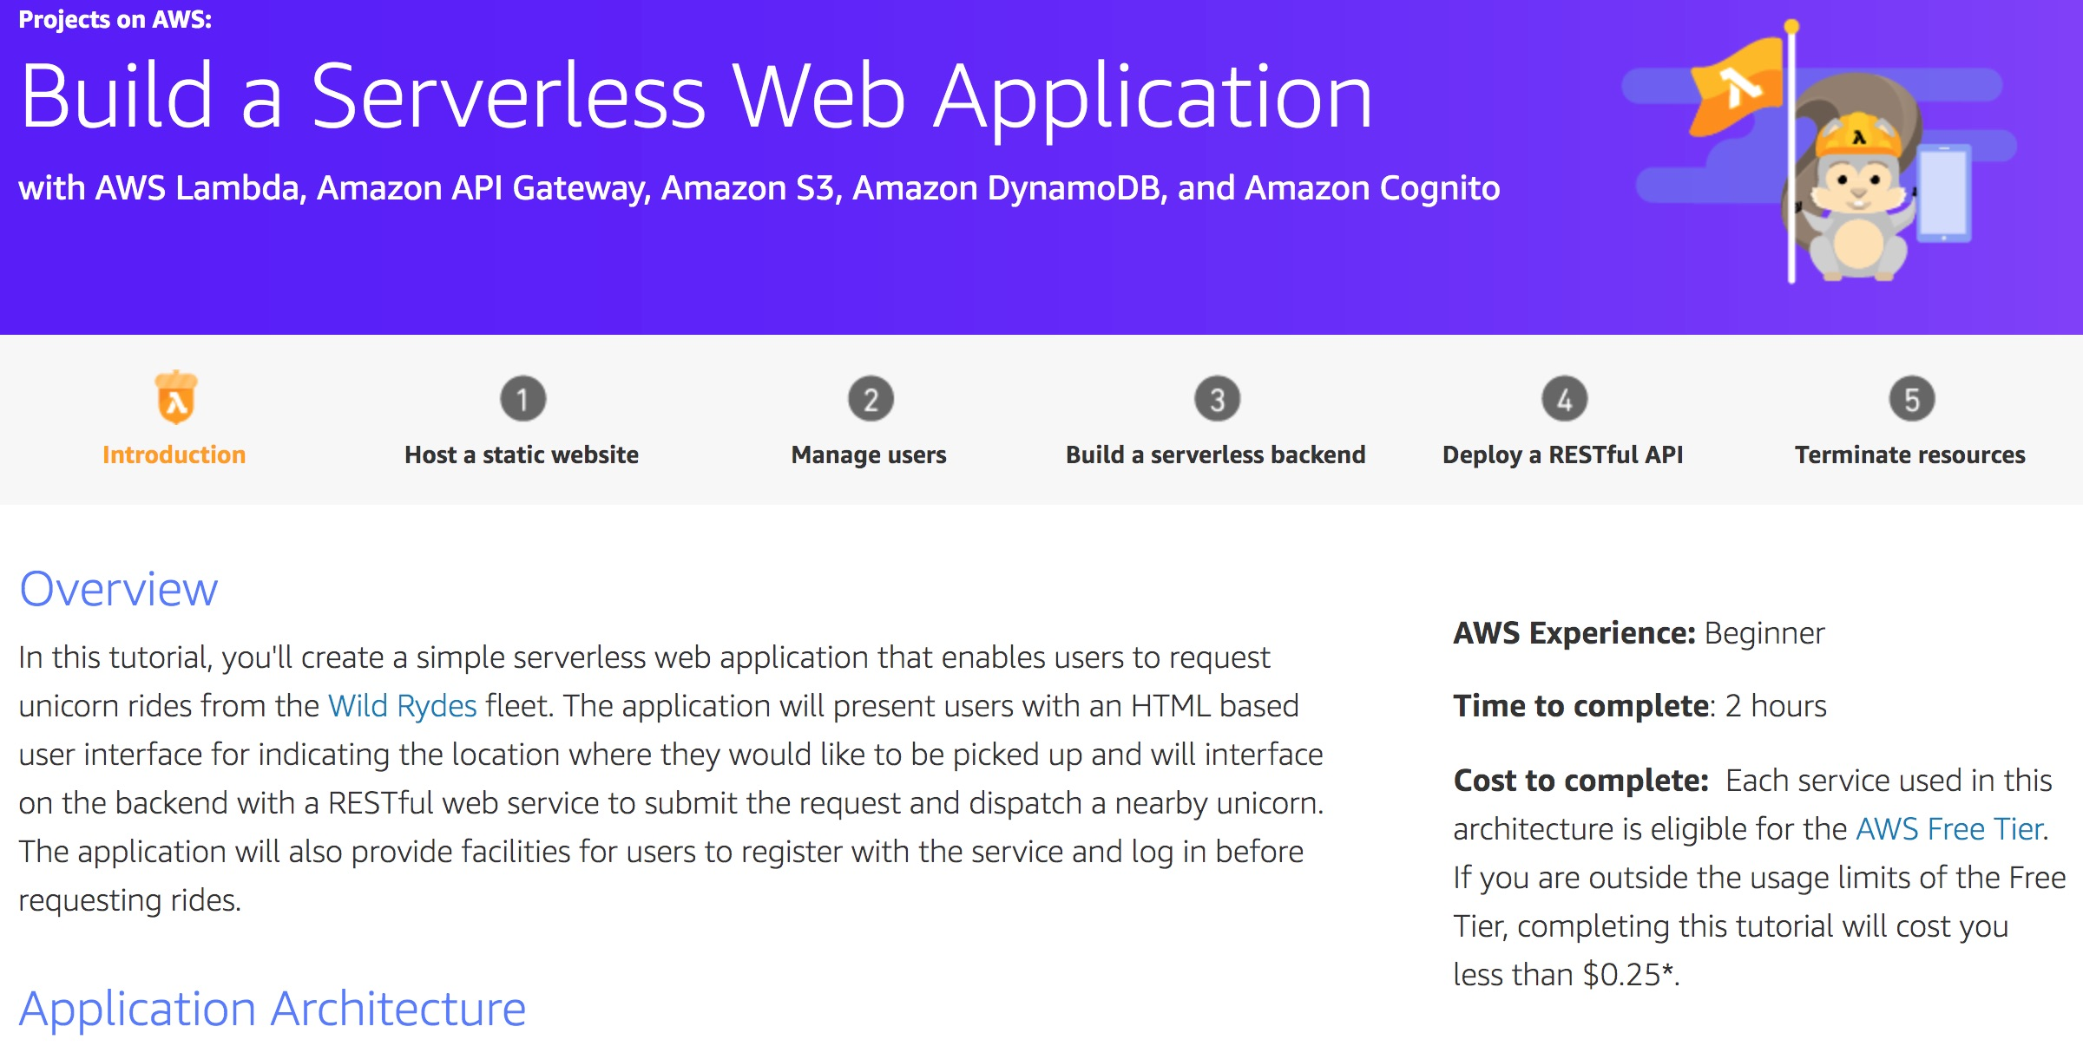
Build a Serverless Web Application
Source: https://aws.amazon.com/getting-started/projects/build-serverless-web-app-lambda-apigateway-s3-dynamodb-cognito/

Slide 59
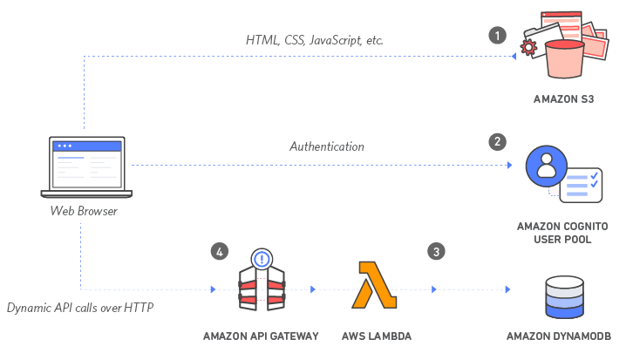
Build a Serverless Web Application with Amazon S3, AWS Lambda, Amazon API Gateway, Amazon DynamoDB, and Amazon Cognito
Source: https://aws.amazon.com/getting-started/projects/build-serverless-web-app-lambda-apigateway-s3-dynamodb-cognito/

Slide 60
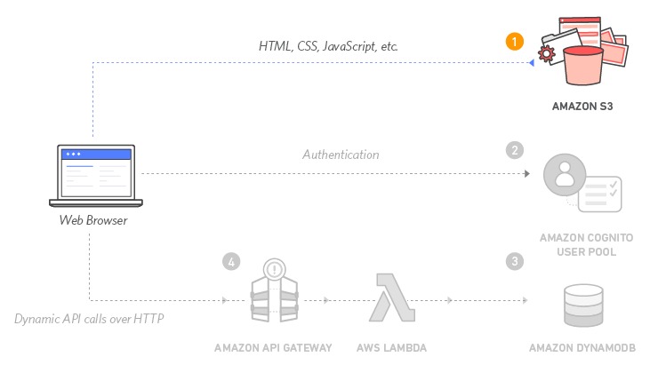
Build a Serverless Web Application with Amazon S3, AWS Lambda, Amazon API Gateway, Amazon DynamoDB, and Amazon Cognito
1
Source: https://aws.amazon.com/getting-started/projects/build-serverless-web-app-lambda-apigateway-s3-dynamodb-cognito/

Slide 61
Build a Serverless Web Application with Amazon S3, AWS Lambda, Amazon API Gateway, Amazon DynamoDB, and Amazon Cognito
1
Static Web Hosting
Amazon S3 hosts static web resources including HTML, CSS, JavaScript, and image files which are loaded in the user's browser.
Source: https://aws.amazon.com/getting-started/projects/build-serverless-web-app-lambda-apigateway-s3-dynamodb-cognito/

Slide 62
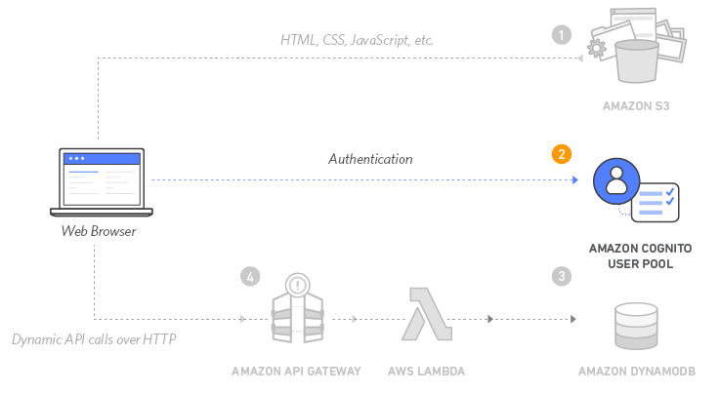
Build a Serverless Web Application with Amazon S3, AWS Lambda, Amazon API Gateway, Amazon DynamoDB, and Amazon Cognito
2
Source: https://aws.amazon.com/getting-started/projects/build-serverless-web-app-lambda-apigateway-s3-dynamodb-cognito/

Slide 63
Build a Serverless Web Application with Amazon S3, AWS Lambda, Amazon API Gateway, Amazon DynamoDB, and Amazon Cognito
2
User Management
Amazon Cognito provides user management and authentication functions to secure the backend API.
Source: https://aws.amazon.com/getting-started/projects/build-serverless-web-app-lambda-apigateway-s3-dynamodb-cognito/

Slide 64
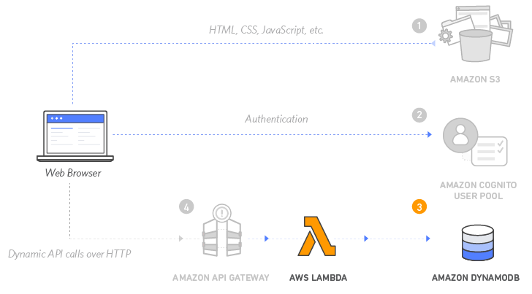
Build a Serverless Web Application with Amazon S3, AWS Lambda, Amazon API Gateway, Amazon DynamoDB, and Amazon Cognito
3
Source: https://aws.amazon.com/getting-started/projects/build-serverless-web-app-lambda-apigateway-s3-dynamodb-cognito/

Slide 65
Build a Serverless Web Application with Amazon S3, AWS Lambda, Amazon API Gateway, Amazon DynamoDB, and Amazon Cognito
3
Serverless Backend
Amazon DynamoDB provides a persistence layer where data can be stored by the API's Lambda function.
Source: https://aws.amazon.com/getting-started/projects/build-serverless-web-app-lambda-apigateway-s3-dynamodb-cognito/

Slide 66
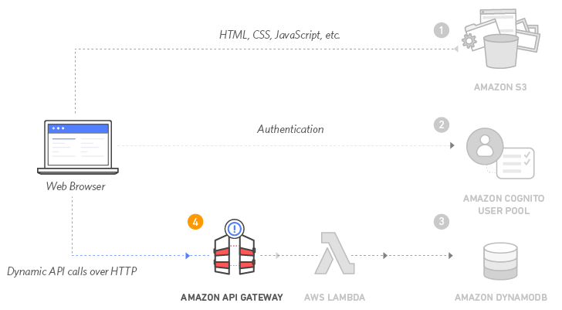
Build a Serverless Web Application with Amazon S3, AWS Lambda, Amazon API Gateway, Amazon DynamoDB, and Amazon Cognito
4
Source: https://aws.amazon.com/getting-started/projects/build-serverless-web-app-lambda-apigateway-s3-dynamodb-cognito/

Slide 67
Build a Serverless Web Application with Amazon S3, AWS Lambda, Amazon API Gateway, Amazon DynamoDB, and Amazon Cognito
4
RESTful API
JavaScript executed in the browser sends and receives data from a public backend API built using Lambda and API Gateway.
Source: https://aws.amazon.com/getting-started/projects/build-serverless-web-app-lambda-apigateway-s3-dynamodb-cognito/

Slide 68
Build a Serverless Web Application with Amazon S3, AWS Lambda, Amazon API Gateway, Amazon DynamoDB, and Amazon Cognito
5
Terminate resources
Resource Cleanup
You will terminate an Amazon S3 bucket, an Amazon Cognito User Pool, an AWS Lambda function, an IAM role, a DynamoDB table, a REST API, and a CloudWatch Log. It is a best practice to delete resources you are no longer using to avoid unwanted charges.
Source: https://aws.amazon.com/getting-started/projects/build-serverless-web-app-lambda-apigateway-s3-dynamodb-cognito/

Slide 69
Summary
Tamkang University
雲端服務架構實務課程主要介紹： AWS 技術基礎和在 AWS 上建立架構。
AWS技術基礎介紹 AWS 產品、服務和常見解決方案。
在 AWS 上建立架構內容涵蓋在 AWS 上建置 IT 基礎架構的基礎。
解決方案架構師如何透過了解 AWS 服務來優化對 AWS 雲端的使用，及如何讓這些服務符合雲端解決方案。
AWS 雲端最佳實務與建議的設計模式，協助學員思考在 AWS 上架構最佳 IT 解決方案的程序。

Slide 70
雲端服務架構實務 (Cloud Services Architecting Practices)
Contact Information
Tamkang University
戴敏育 博士 (Min-Yuh Day, Ph.D.)
副教授 (Associate Professor)
國立臺北大學 資訊管理研究所
Institute of Information Management, National Taipei University
電話： 02-86741111 ext. 66873
研究室： 商8F12
地址： 23741 新北市三峽區大學路 151 號
Email：myday@gm.ntpu.edu.tw
網址：http://web.ntpu.edu.tw/~myday/

