Slide 1



人工智慧
(Artificial Intelligence)
強化學習 (Reinforcement Learning)
1092AI09
MBA, IM, NTPU (M5010) (Spring 2021)
Wed 2, 3, 4 (9:10-12:00) (B8F40)
Min-Yuh Day
戴敏育
Associate Professor
副教授
Institute of Information Management, National Taipei University
國立臺北大學 資訊管理研究所
https://web.ntpu.edu.tw/~myday
2021-05-19

Slide 2
課程大綱 (Syllabus)
週次 (Week) 日期 (Date) 內容 (Subject/Topics)
1 2021/02/24 人工智慧概論
(Introduction to Artificial Intelligence)
2 2021/03/03 人工智慧和智慧代理人
(Artificial Intelligence and Intelligent Agents)
3 2021/03/10 問題解決
(Problem Solving)
4 2021/03/17 知識推理和知識表達
(Knowledge, Reasoning and Knowledge Representation)
5 2021/03/24 不確定知識和推理
(Uncertain Knowledge and Reasoning)
6 2021/03/31 人工智慧個案研究 I
(Case Study on Artificial Intelligence I)

Slide 3
課程大綱 (Syllabus)
週次 (Week) 日期 (Date) 內容 (Subject/Topics)
7 2021/04/07 放假一天 (Day off)
8 2021/04/14 機器學習與監督式學習
(Machine Learning and Supervised Learning)
9 2021/04/21 期中報告
(Midterm Project Report)
10 2021/04/28 學習理論與綜合學習
(The Theory of Learning and Ensemble Learning)
11 2021/05/05 深度學習
(Deep Learning)
12 2021/05/12 人工智慧個案研究 II
(Case Study on Artificial Intelligence II)

Slide 4
課程大綱 (Syllabus)
週次 (Week) 日期 (Date) 內容 (Subject/Topics)
13 2021/05/19 強化學習
(Reinforcement Learning)
14 2021/05/26 深度學習自然語言處理
(Deep Learning for Natural Language Processing)
15 2021/06/02 機器人技術
(Robotics)
16 2021/06/09 人工智慧哲學與倫理，人工智慧的未來
(Philosophy and Ethics of AI, The Future of AI)
17 2021/06/16 期末報告 I
(Final Project Report I)
18 2021/06/23 期末報告 II
(Final Project Report II)

Slide 5
Reinforcement Learning

Slide 6
Outline
Reinforcement Learning (RL)
  Markov Decision Processes (MDP)
Deep Reinforcement Learning (DRL) Algorithms
  SARSA
  Q-Learning
  DQN
  A3C
  Rainbow

Slide 7
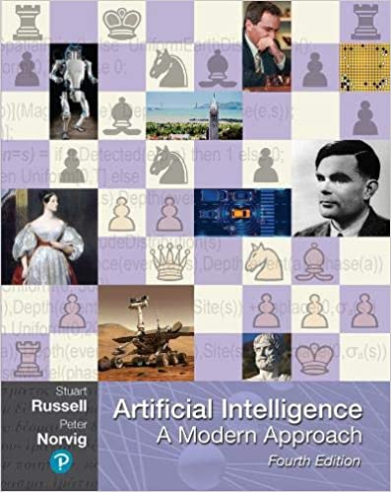
Stuart Russell and Peter Norvig (2020),
Artificial Intelligence: A Modern Approach,
4th Edition, Pearson
Source: Stuart Russell and Peter Norvig (2020), Artificial Intelligence: A Modern Approach, 4th Edition, Pearson
https://www.amazon.com/Artificial-Intelligence-A-Modern-Approach/dp/0134610997/

Slide 8
Artificial Intelligence:
A Modern Approach
Artificial Intelligence
Problem Solving
Knowledge and Reasoning
Uncertain Knowledge and Reasoning
Machine Learning
Communicating, Perceiving, and Acting
Philosophy and Ethics of AI
Source: Stuart Russell and Peter Norvig (2020), Artificial Intelligence: A Modern Approach, 4th Edition, Pearson

Slide 9
Artificial Intelligence:
Machine Learning
Source: Stuart Russell and Peter Norvig (2020), Artificial Intelligence: A Modern Approach, 4th Edition, Pearson

Slide 10
Artificial Intelligence:
5. Machine Learning
Learning from Examples
Learning Probabilistic Models
Deep Learning
Reinforcement Learning
Source: Stuart Russell and Peter Norvig (2020), Artificial Intelligence: A Modern Approach, 4th Edition, Pearson

Slide 11
Artificial Intelligence:
Reinforcement Learning
Learning from Rewards
Passive Reinforcement Learning
Active Reinforcement Learning
Generalization in Reinforcement Learning
Policy Search
Apprenticeship and Inverse Reinforcement Learning
Applications of Reinforcement Learning
Source: Stuart Russell and Peter Norvig (2020), Artificial Intelligence: A Modern Approach, 4th Edition, Pearson

Slide 12
Reinforcement Learning (DL)
Agent
Environment
Source: Richard S. Sutton & Andrew G. Barto (2018), Reinforcement Learning: An Introduction, 2nd Edition, A Bradford Book.

Slide 13
Reinforcement Learning (DL)
1
2
observation
Agent
action
3
reward
Environment
Source: Richard S. Sutton & Andrew G. Barto (2018), Reinforcement Learning: An Introduction, 2nd Edition, A Bradford Book.

Slide 14
Reinforcement Learning (DL)
1
2
observation
Agent
action
O_{t}
A_{t}
3
reward
R_{t}
Environment
Source: Richard S. Sutton & Andrew G. Barto (2018), Reinforcement Learning: An Introduction, 2nd Edition, A Bradford Book.

Slide 15
Agents interact with environments through sensors and actuators
Source: Stuart Russell and Peter Norvig (2020), Artificial Intelligence: A Modern Approach, 4th Edition, Pearson

Slide 16
AI, ML, DL
Artificial Intelligence (AI)
Machine Learning (ML)
Supervised
Learning
Unsupervised Learning
Deep Learning (DL)
CNN
RNN LSTM GRU
GAN
Semi-supervised Learning
Reinforcement Learning
Source: https://leonardoaraujosantos.gitbooks.io/artificial-inteligence/content/deep_learning.html

Slide 17
3 Machine Learning Algorithms
Source: Enrico Galimberti, http://blogs.teradata.com/data-points/tree-machine-learning-algorithms/

Slide 18
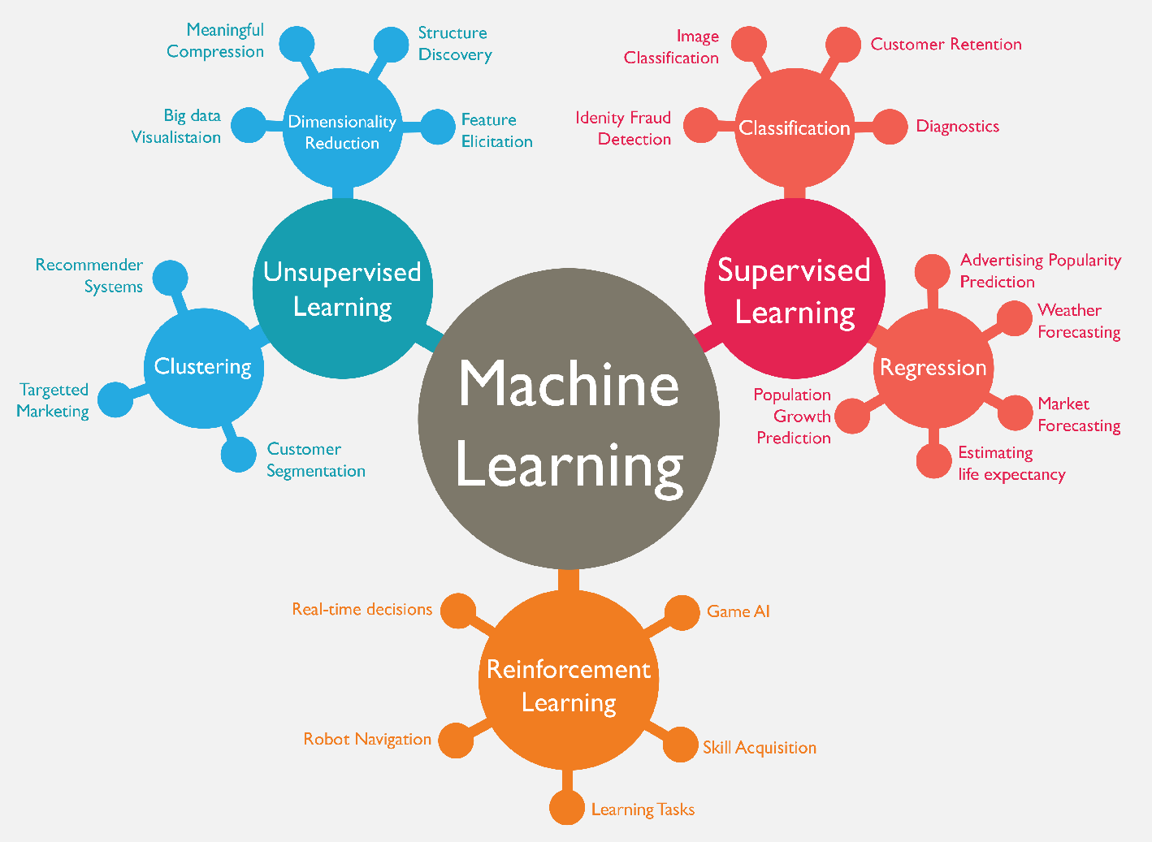
Machine Learning (ML)
Source: https://www.mactores.com/services/aws-big-data-machine-learning-cognitive-services/

Slide 19
Reinforcement Learning (RL)
Computer Science
Engineering
Machine
Learning
Neuroscience
Optimal
Control
Reward
System
Reinforcement
Learning
Operations
Research
Classical/Operant
Conditioning
Mathematics
Bounded
Rationality
Psychology
Economics
Source: David Silver (2015), Introduction to reinforcement learning, https://www.youtube.com/playlist?list=PLqYmG7hTraZDM-OYHWgPebj2MfCFzFObQ

Slide 20
Branches of Machine Learning (ML)
Reinforcement Learning (RL)
No Labels
No feedback
Find hidden structure
Labeled data
Direct feedback
Predict
Supervised
Learning
Unsupervised
Learning
Machine
Learning
Reinforcement
Learning
Decision process
Reward system
Learn series of actions
Source: David Silver (2015), Introduction to reinforcement learning, https://www.youtube.com/playlist?list=PLqYmG7hTraZDM-OYHWgPebj2MfCFzFObQ

Slide 21
David Silver (2015),
Introduction to reinforcement learning
Elementary Reinforcement Learning
  1: Introduction to Reinforcement Learning
  2: Markov Decision Processes
  3: Planning by Dynamic Programming
  4: Model-Free Prediction
  5: Model-Free Control
Reinforcement Learning in Practice
  6: Value Function Approximation
  7: Policy Gradient Methods
  8: Integrating Learning and Planning
  9: Exploration and Exploitation
  10: Case Study: RL in Classic Games
Source: David Silver (2015), Introduction to reinforcement learning, https://www.youtube.com/playlist?list=PLqYmG7hTraZDM-OYHWgPebj2MfCFzFObQ

Slide 22
Reinforcement Learning
AlphaZero (AZ) and AlphaGo Zero (AZ0)
AlphaZero (Silver et al., 2018)
  A general reinforcement learning algorithm that masters chess, shogi, and Go through self-play. (Science)
AlphaGo Zero (Silver et al., 2017)
  Mastering the game of Go without human knowledge (Nature)

Slide 23
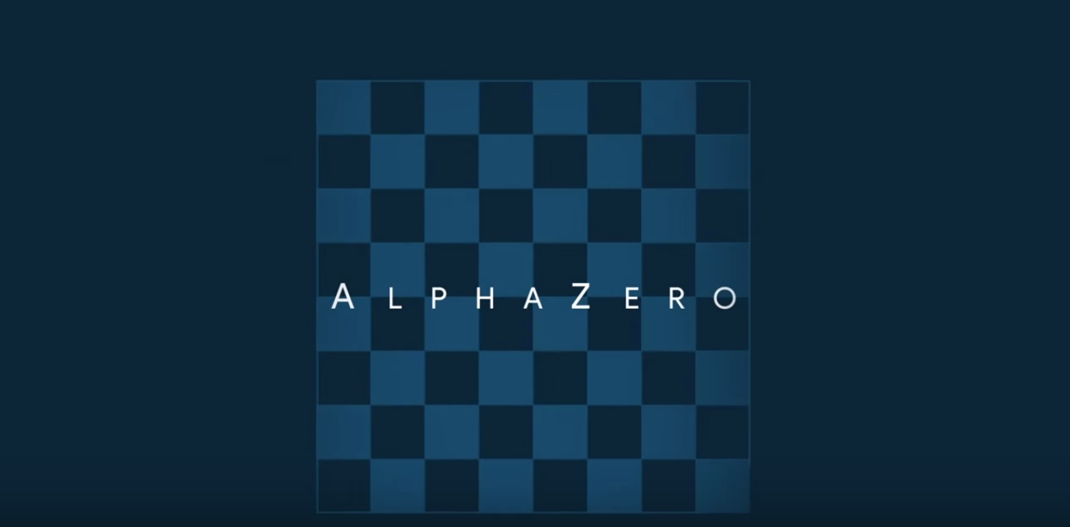
AlphaZero:
Shedding new light on the grand games of chess, shogi and Go
https://www.youtube.com/watch?v=7L2sUGcOgh0

Slide 24
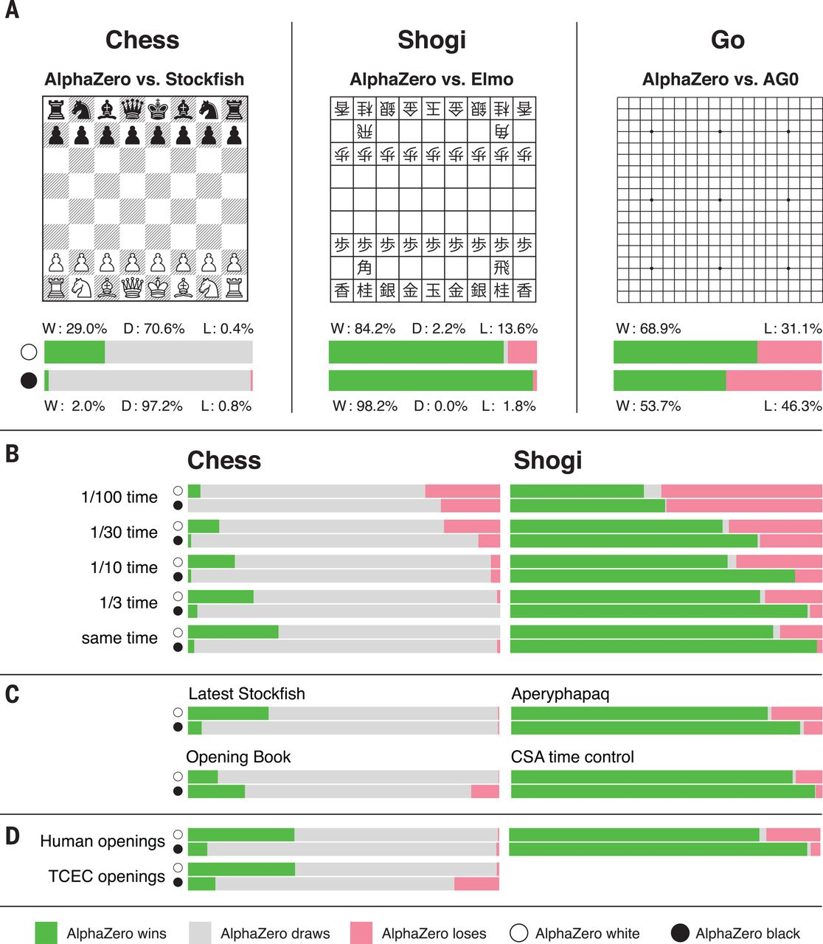
AlphaZero
A general reinforcement learning algorithm
that masters chess, shogi, and Go through self-play
Source: David Silver et al. (2018), "A general reinforcement learning algorithm that masters chess, shogi, and Go through self-play." Science 362, no. 6419 (2018): 1140-1144.

Slide 25
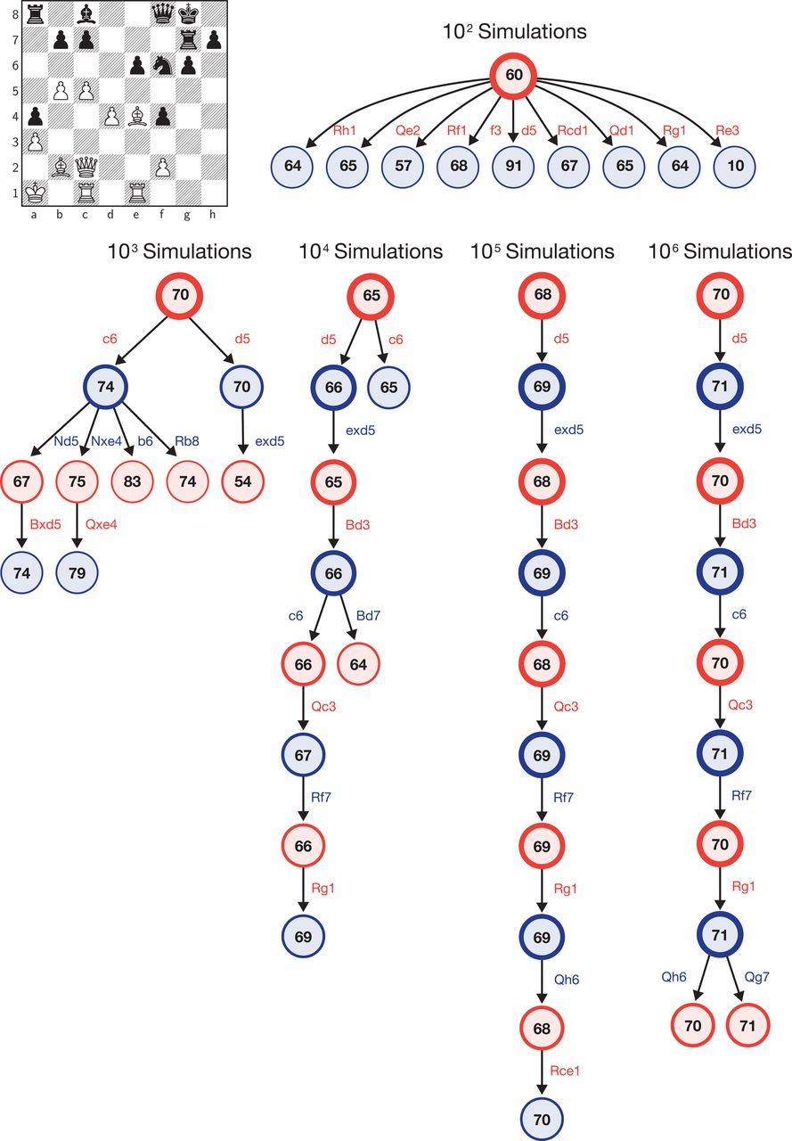
AlphaZero’s search procedure
Source: David Silver et al. (2018), "A general reinforcement learning algorithm that masters chess, shogi, and Go through self-play." Science 362, no. 6419 (2018): 1140-1144.

Slide 26
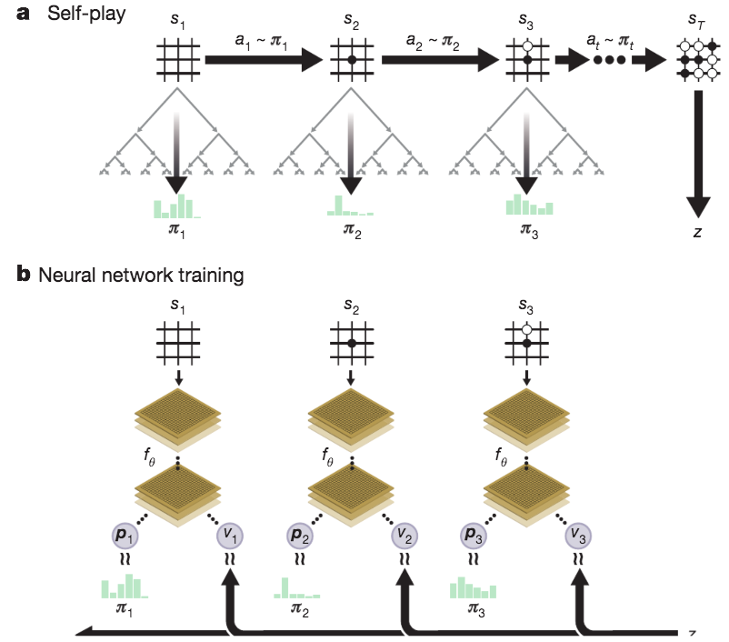
Self-play reinforcement learning in AlphaGo Zero
Source: David Silver et al. (2017), "Mastering the game of Go without human knowledge." Nature 550 (2017): 354–359.

Slide 27
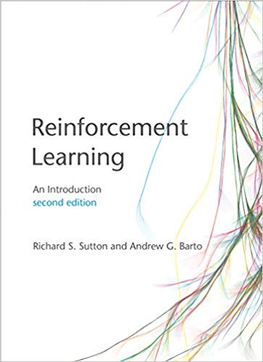
Richard S. Sutton & Andrew G. Barto (2018),
Reinforcement Learning: An Introduction,
2nd Edition, A Bradford Book
Source: Richard S. Sutton & Andrew G. Barto (2018), Reinforcement Learning: An Introduction, 2nd Edition, A Bradford Book.
https://www.amazon.com/Reinforcement-Learning-Introduction-Adaptive-Computation/dp/0262039249

Slide 28
Reinforcement learning
Reinforcement learning is
learning what to do
—how to map situations to actions
—so as to maximize a numerical reward signal.
Source: Richard S. Sutton & Andrew G. Barto (2018), Reinforcement Learning: An Introduction, 2nd Edition, A Bradford Book.

Slide 29
Two most important distinguishing features of reinforcement learning
trial-and-error search
delayed reward
Source: Richard S. Sutton & Andrew G. Barto (2018), Reinforcement Learning: An Introduction, 2nd Edition, A Bradford Book.

Slide 30
Reinforcement Learning (DL)
Agent
Environment
Source: Richard S. Sutton & Andrew G. Barto (2018), Reinforcement Learning: An Introduction, 2nd Edition, A Bradford Book.

Slide 31
Reinforcement Learning (DL)
1
2
observation
Agent
action
3
reward
Environment
Source: Richard S. Sutton & Andrew G. Barto (2018), Reinforcement Learning: An Introduction, 2nd Edition, A Bradford Book.

Slide 32
Reinforcement Learning (DL)
1
2
observation
Agent
action
O_{t}
A_{t}
3
reward
R_{t}
Environment
Source: Richard S. Sutton & Andrew G. Barto (2018), Reinforcement Learning: An Introduction, 2nd Edition, A Bradford Book.

Slide 33
Agent and Environment
At each step t the agent:
  Executes action A_{t}
  Receives observation O_{t}
  Receives scalar reward R_{t}
The environment:
  Receives action A_{t}
  Emits observation O_{t+1}
  Emits scalar reward R_{t+1}
t increments at env. step
observation
action
Agent
O_{t}
A_{t}
reward
R_{t}
Environment
Source: David Silver (2015), Introduction to reinforcement learning, https://www.youtube.com/playlist?list=PLqYmG7hTraZDM-OYHWgPebj2MfCFzFObQ

Slide 34
History and State
The history is the sequence of observations, actions, rewards
  H_{t} = O₁, A₁, R₁,...,A_{t-1},O_{t},R_{t}
i.e. all observable variables up to time t
i.e. the sensorimotor stream of a robot or embodied agent
What happens next depends on the history:
  The agent selects actions
  The environment selects observations/rewards
State is the information used to determine what happens next
Formally, state is a function of the history:
  S_{t} =f(H_{t})
Source: David Silver (2015), Introduction to reinforcement learning, https://www.youtube.com/playlist?list=PLqYmG7hTraZDM-OYHWgPebj2MfCFzFObQ

Slide 35
Information State
An information state (a.k.a. Markov state) contains all useful information from the history.
Definition
    A state S_{t} is Markov if and only if
    P[S_{t+1} | S_{t}] = P[S_{t+1} | S₁,...,S_{t}]
“The future is independent of the past given the present”
  H_{1:t} → S_{t} → H_{t+1:∞}
Once the state is known, the history may be thrown away i.e. The state is a sufficient statistic of the future
The environment state S_{t}^{e} is Markov
The history H_{t} is Markov
Source: David Silver (2015), Introduction to reinforcement learning, https://www.youtube.com/playlist?list=PLqYmG7hTraZDM-OYHWgPebj2MfCFzFObQ

Slide 36
Fully Observable Environments
Full observability:
  agent directly observes environment state
  Agent state = environment state = information state
  Formally, this is a
  Markov decision process (MDP)
state
Agent
action
S_{t}
A_{t}
reward
R_{t}
Environment
Source: David Silver (2015), Introduction to reinforcement learning, https://www.youtube.com/playlist?list=PLqYmG7hTraZDM-OYHWgPebj2MfCFzFObQ

Slide 37
Partially Observable Environments
Partial observability: agent indirectly observes environment
  A robot with camera vision isn’t told its absolute location
  A trading agent only observes current prices
  A poker playing agent only observes public cards
Now agent state ≠ environment state
Formally this is a partially observable Markov decision process (POMDP)
Agent must construct its own state representation Sª_{t}, e.g.
  Complete history: Sª_{t} = H_{t}
  Beliefs of environment state: Sª_{t} = (P[S^{e}_{t} = s₁],...,P[S^{e}_{t} = s_{n}])
  Recurrent neural network: Sª_{t} = σ(Sª_{t-1} W_{s} + O_{t} W_{o} )
Source: David Silver (2015), Introduction to reinforcement learning, https://www.youtube.com/playlist?list=PLqYmG7hTraZDM-OYHWgPebj2MfCFzFObQ

Slide 38
Reinforcement Learning (DL)
The Agent-Environment Interaction in a Markov Decision Process (MDP)
Agent
state
reward
action
S_{t}
R_{t}
A_{t}
R_{t+1}
Environment
S_{t+1}
Source: Richard S. Sutton & Andrew G. Barto (2018), Reinforcement Learning: An Introduction, 2nd Edition, A Bradford Book.

Slide 39
Characteristics of
Reinforcement Learning
No supervisor, only a reward signal
Feedback is delayed, not instantaneous
Time really matters
(sequential, non i.i.d data)
Agent’s actions affect the subsequent data it receives
Source: David Silver (2015), Introduction to reinforcement learning, https://www.youtube.com/playlist?list=PLqYmG7hTraZDM-OYHWgPebj2MfCFzFObQ

Slide 40
Examples of Reinforcement Learning
Make a humanoid robot walk
Play may different Atari games better than humans
Manage an investment portfolio
Source: David Silver (2015), Introduction to reinforcement learning, https://www.youtube.com/playlist?list=PLqYmG7hTraZDM-OYHWgPebj2MfCFzFObQ

Slide 41
Examples of Rewards
Make a humanoid robot walk
  +ve reward for forward motion
  -ve reward for falling over
Play may different Atari games better than humans
  +/-ve reward for increasing/decreasing score
Manage an investment portfolio
  +ve reward for each $ in bank
Source: David Silver (2015), Introduction to reinforcement learning, https://www.youtube.com/playlist?list=PLqYmG7hTraZDM-OYHWgPebj2MfCFzFObQ

Slide 42
Sequential Decision Making
Goal: select actions to maximize total future reward
Actions may have long term consequence
Reward may be delayed
It may be better to sacrifice immediate reward to gain more long-term reward
Examples:
  A financial investment (may take months to mature)
  Blocking opponent moves (might help winning chances many moves from now)
Source: David Silver (2015), Introduction to reinforcement learning, https://www.youtube.com/playlist?list=PLqYmG7hTraZDM-OYHWgPebj2MfCFzFObQ

Slide 43
Elements of Reinforcement Learning
Agent
Environment
Policy
Reward signal
Value function
Model
Source: Richard S. Sutton & Andrew G. Barto (2018), Reinforcement Learning: An Introduction, 2nd Edition, A Bradford Book.

Slide 44
Elements of Reinforcement Learning
Policy
  Agent’s behavior
  It is a map from state to action
Reward signal
  The goal of a reinforcement learning problem
Value function
  How good is each state and/or action
  A prediction of future reward
Model
  Agent’s representation of the environment
Source: Richard S. Sutton & Andrew G. Barto (2018), Reinforcement Learning: An Introduction, 2nd Edition, A Bradford Book.

Slide 45
Major Components of an RL Agent
Policy: agent’s behaviour function
Value function: how good is each state and/or action
Model: agent’s representation of the environment
Source: David Silver (2015), Introduction to reinforcement learning, https://www.youtube.com/playlist?list=PLqYmG7hTraZDM-OYHWgPebj2MfCFzFObQ

Slide 46
Policy
A policy is the agent’s behaviour
It is a map from state to action, e.g.
  Deterministic policy: a = π(s)
  Stochastic policy: π(a|s) = P[A_{t} = a|S_{t} = s]
Source: David Silver (2015), Introduction to reinforcement learning, https://www.youtube.com/playlist?list=PLqYmG7hTraZDM-OYHWgPebj2MfCFzFObQ

Slide 47
Value Function
Value function is a prediction of future reward
Used to evaluate the goodness/badness of states
And therefore to select between actions, e.g.
      v_{π}(s)=E_{π} [R_{t+1}+γR_{t+2}+γ²R_{t+3}+...|S_{t} =s]
Source: David Silver (2015), Introduction to reinforcement learning, https://www.youtube.com/playlist?list=PLqYmG7hTraZDM-OYHWgPebj2MfCFzFObQ

Slide 48
Model
A model predicts what the environment will do next
P predicts the next state
R predicts the next (immediate) reward, e.g.
    Pª_{ss′} = P[S_{t+1} =s′ |S_{t+1}=s, A_{t}=a]
    Rª_{s} = E[R_{t+1} |S_{t} =s, A_{t} =a]
Source: David Silver (2015), Introduction to reinforcement learning, https://www.youtube.com/playlist?list=PLqYmG7hTraZDM-OYHWgPebj2MfCFzFObQ

Slide 49
Reinforcement Learning
Value Based
  No Policy (Implicit)
  Value Function
Policy Based
  Policy
  No Value Function
Actor Critic
  Policy
  Value Function
Source: David Silver (2015), Introduction to reinforcement learning, https://www.youtube.com/playlist?list=PLqYmG7hTraZDM-OYHWgPebj2MfCFzFObQ

Slide 50
Reinforcement Learning
Model Free
  Policy and/or Value Function
  No Model
Model Based
  Policy and/or Value Function
  Model
Source: David Silver (2015), Introduction to reinforcement learning, https://www.youtube.com/playlist?list=PLqYmG7hTraZDM-OYHWgPebj2MfCFzFObQ

Slide 51
Reinforcement Learning (RL) Taxonomy
Model-Free
Value Function
Actor
Critic
Policy
Model-Based
Policy-Based
Value-Based
Model
Source: David Silver (2015), Introduction to reinforcement learning, https://www.youtube.com/playlist?list=PLqYmG7hTraZDM-OYHWgPebj2MfCFzFObQ

Slide 52
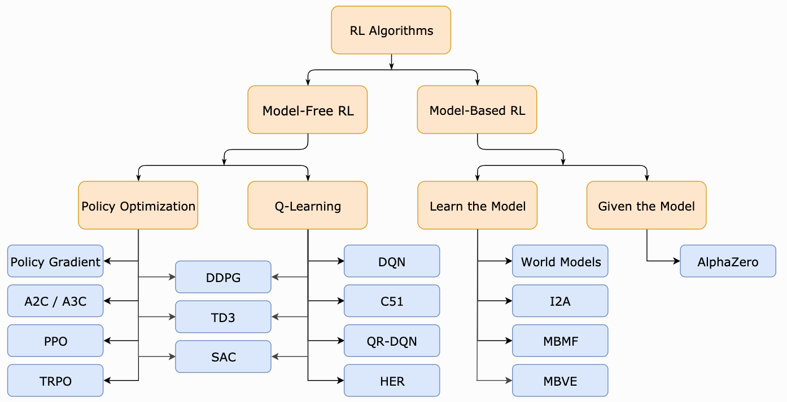
Reinforcement Learning (RL)
A Taxonomy of RL Algorithms
Source: https://spinningup.openai.com/en/latest/spinningup/rl_intro2.html

Slide 53
Learning and Planning
Two fundamental problems in
sequential decision making
  Reinforcement Learning
    The environment is initially unknown
    The agent interacts with environment
    The agent improves its policy
  Planning
    A model of the environment is known
    The agent performs computations with its model
    (without any external interaction)
    The agent improves its policy
    a.k.a deliberation, reasoning, introspection, pondering, thought, search
Source: David Silver (2015), Introduction to reinforcement learning, https://www.youtube.com/playlist?list=PLqYmG7hTraZDM-OYHWgPebj2MfCFzFObQ

Slide 54
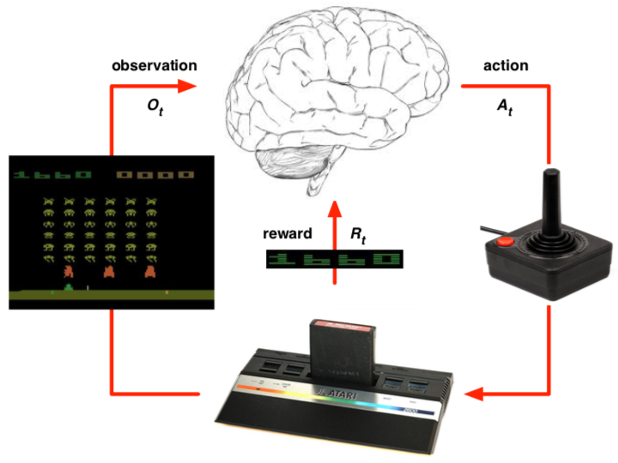
Atari Example:
Reinforcement Learning
Rules of the game are unknown
Learn directly from interactive game-play
Pick actions on joystick, see pixels and scores
Source: David Silver (2015), Introduction to reinforcement learning, https://www.youtube.com/playlist?list=PLqYmG7hTraZDM-OYHWgPebj2MfCFzFObQ

Slide 55
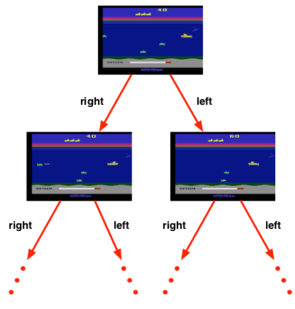
Atari Example:
Planning
Rules of the game are known
Can query emulator
  perfect model inside agent’s brain
If I take action a from state s:
  what would the next state be?
  what would the score be?
Plan ahead to find optimal policy
  e.g. tree search
Source: David Silver (2015), Introduction to reinforcement learning, https://www.youtube.com/playlist?list=PLqYmG7hTraZDM-OYHWgPebj2MfCFzFObQ

Slide 56
Exploration and Exploitation
Reinforcement learning is like trial-and-error learning
The agent should discover a good policy
From its experiences of the environment
Without losing too much reward along the way
Exploration finds more information about the environment
Exploitation exploits known information to maximise reward
It is usually important to explore as well as exploit
Source: David Silver (2015), Introduction to reinforcement learning, https://www.youtube.com/playlist?list=PLqYmG7hTraZDM-OYHWgPebj2MfCFzFObQ

Slide 57
Exploration and Exploitation
Examples
Restaurant Selection
  Exploitation: Go to your favorite restaurant
  Exploration: Try a new restaurant
Online Banner Advertisements
  Exploitation: Show the most successful advert
  Exploration: Show a different advert
Source: David Silver (2015), Introduction to reinforcement learning, https://www.youtube.com/playlist?list=PLqYmG7hTraZDM-OYHWgPebj2MfCFzFObQ

Slide 58
Exploration and Exploitation
Examples
Oil Drilling
  Exploitation: Drill at the best known location
  Exploration: Drill at a new location
Game Playing
  Exploitation: Play the move you believe is best
  Exploration: Play an experimental move
Source: David Silver (2015), Introduction to reinforcement learning, https://www.youtube.com/playlist?list=PLqYmG7hTraZDM-OYHWgPebj2MfCFzFObQ

Slide 59
Prediction and Control
Prediction: evaluate the future
  Given a policy
Control: optimize the future
  Find the best policy
Source: David Silver (2015), Introduction to reinforcement learning, https://www.youtube.com/playlist?list=PLqYmG7hTraZDM-OYHWgPebj2MfCFzFObQ

Slide 60
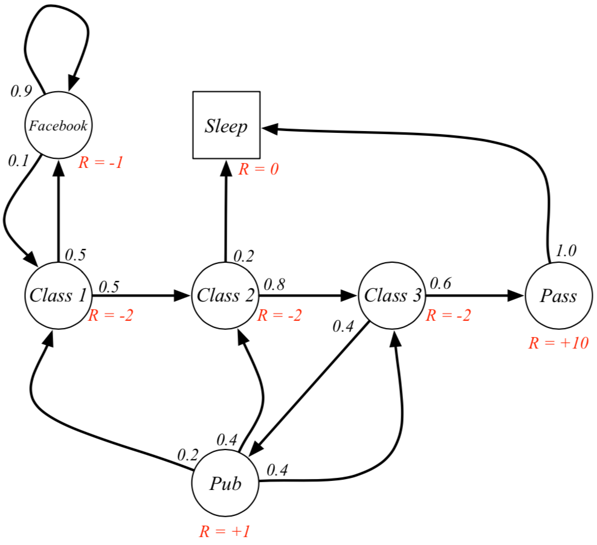
Markov Decision Processes (MDP)
Example: Student MDP
Source: David Silver (2015), Introduction to reinforcement learning, https://www.youtube.com/playlist?list=PLqYmG7hTraZDM-OYHWgPebj2MfCFzFObQ

Slide 61
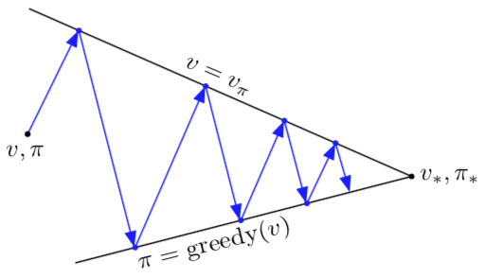
Generalized Policy Iteration (GPI)
evaluation
V → v_{𝜋}
𝜋
V
𝜋 → greedy (V)
improvement
𝜋*
v*
Source: Richard S. Sutton & Andrew G. Barto (2018), Reinforcement Learning: An Introduction, 2nd Edition, A Bradford Book.

Slide 62
Generalized Policy Iteration (GPI)
Any iteration of policy evaluation and policy improvement,
independent of their granularity.
evaluation
Ｑ → q_{𝜋}
𝜋
Ｑ
𝜋 → greedy (Ｑ)
improvement
Source: Richard S. Sutton & Andrew G. Barto (2018), Reinforcement Learning: An Introduction, 2nd Edition, A Bradford Book.

Slide 63
Temporal-Difference (TD) Learning
Sarsa: On-policy TD Control
Q-learning: Off-policy TD Control
Source: Richard S. Sutton & Andrew G. Barto (2018), Reinforcement Learning: An Introduction, 2nd Edition, A Bradford Book.

Slide 64
SARSA
(state-action-reward-state-action)
On-policy TD Control
Q(S_{t}, A_{t}) ← Q(S_{t}, A_{t}) + α[R_{t+1} + γ Q(S_{t+1}, A_{t+1}) - Q(S_{t}, A_{t}) ]
S, A
R
S’
A’
SARSA
Source: Richard S. Sutton & Andrew G. Barto (2018), Reinforcement Learning: An Introduction, 2nd Edition, A Bradford Book.

Slide 65
Q-learning
Off-policy TD Control
(Watkins, 1989)
Q(S_{t}, A_{t}) ← Q(S_{t}, A_{t}) + α[R_{t+1} + γ max Q(S_{t+1}, a) - Q(S_{t}, A_{t}) ]
S, A
R
S’
A’
Q-learning
Source: Richard S. Sutton & Andrew G. Barto (2018), Reinforcement Learning: An Introduction, 2nd Edition, A Bradford Book.

Slide 66
Q-learning and Expected SARSA
S, A
S, A
R
R
S’
S’
A’
A’
Q-learning
Expected SARSA
Source: Richard S. Sutton & Andrew G. Barto (2018), Reinforcement Learning: An Introduction, 2nd Edition, A Bradford Book.

Slide 67
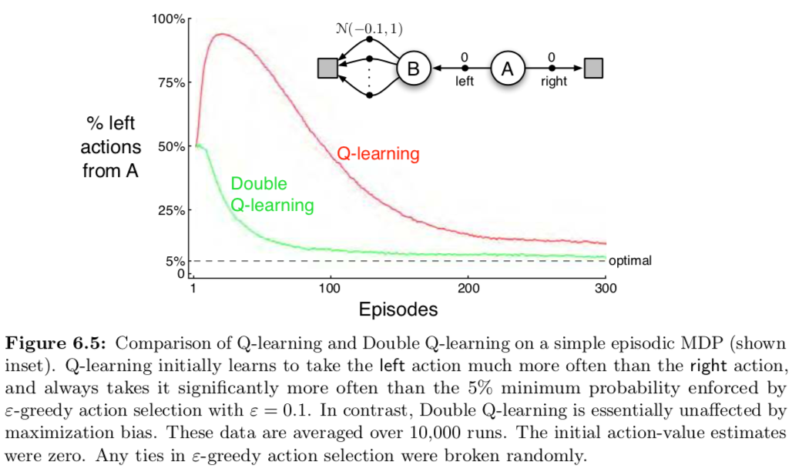
Q-learning and Double Q-learning
Source: Richard S. Sutton & Andrew G. Barto (2018), Reinforcement Learning: An Introduction, 2nd Edition, A Bradford Book.

Slide 68
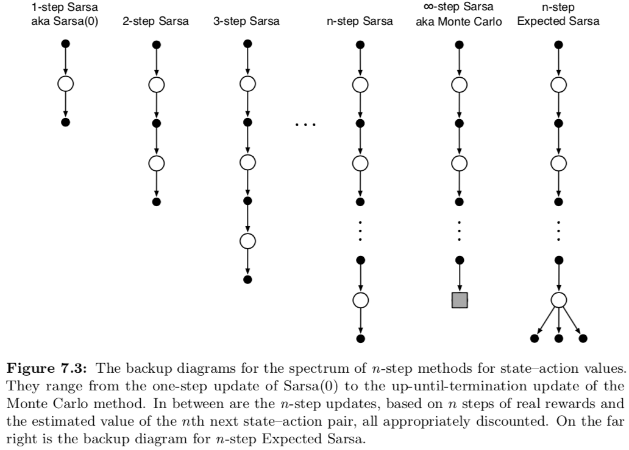
n-step methods for sate-action value
Source: Richard S. Sutton & Andrew G. Barto (2018), Reinforcement Learning: An Introduction, 2nd Edition, A Bradford Book.

Slide 69
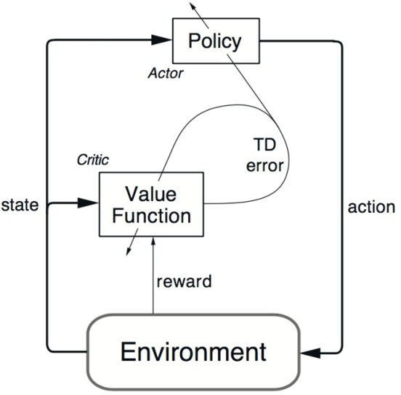
Reinforcement Learning
Actor-Critic (AC) Architecture
Source: https://www.kdnuggets.com/2018/03/5-things-reinforcement-learning.html

Slide 70
Reinforcement Learning
Actor-Critic (AC) Learning Methods
Policy
(Actor)
State
Action
Critique
Value Table
(Critic)
State
Reward
Environment

Slide 71
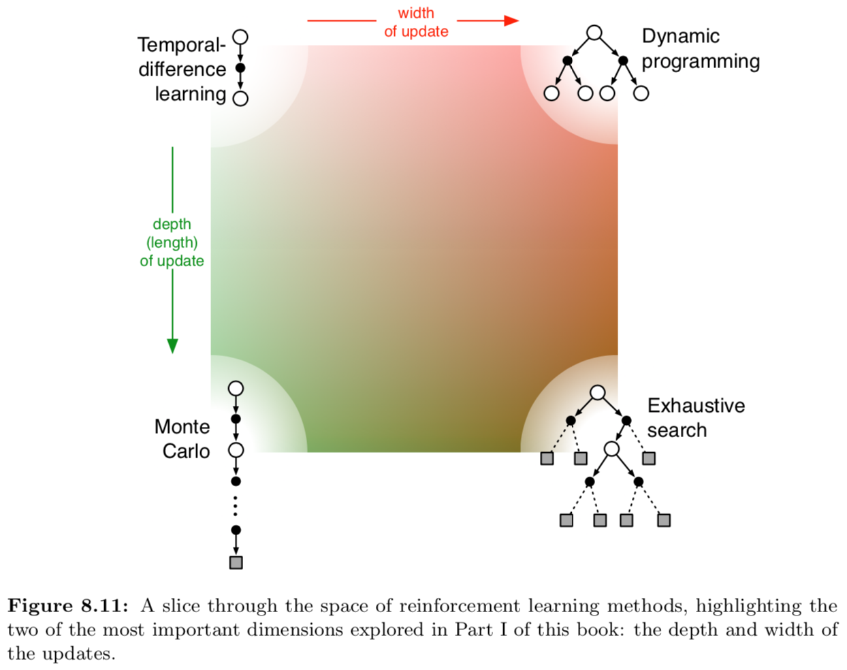
Reinforcement Learning Methods
Source: Richard S. Sutton & Andrew G. Barto (2018), Reinforcement Learning: An Introduction, 2nd Edition, A Bradford Book.

Slide 72
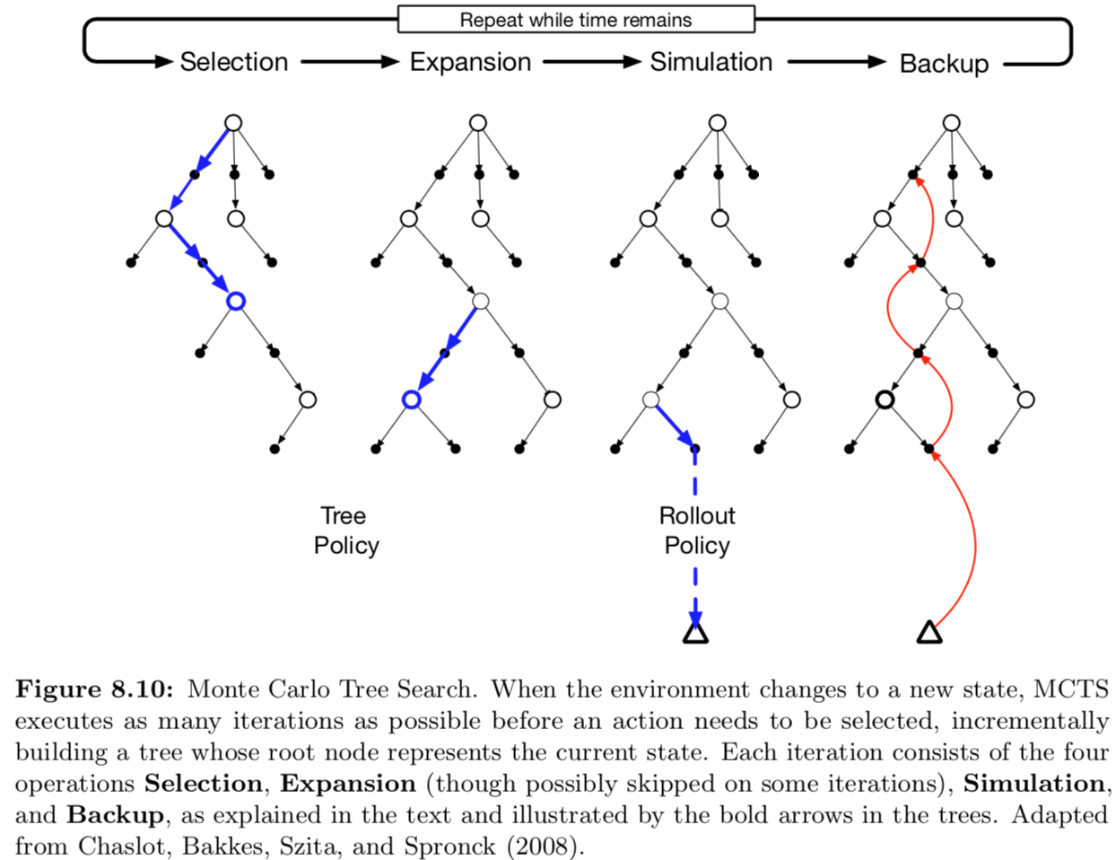
Monte Carlo Tree Search (MCTS)
Source: Richard S. Sutton & Andrew G. Barto (2018), Reinforcement Learning: An Introduction, 2nd Edition, A Bradford Book.

Slide 73
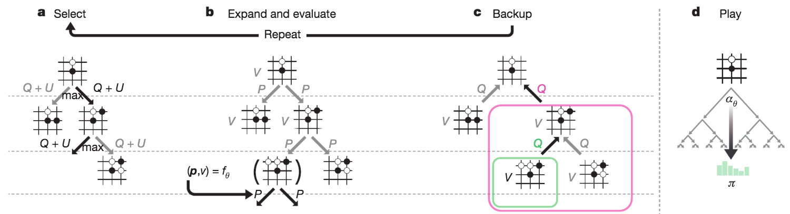
Monte Carlo Tree Search (MCTS)
MCTS in AlphaGo Zero
Source: David Silver et al. (2017), "Mastering the game of Go without human knowledge." Nature 550 (2017): 354–359.

Slide 74
MCTS in AlphaGo Zero
a: Each simulation traverses the tree by selecting the edge with maximum action value Q, plus an upper confidence bound U that depends on a stored prior probability P and visit count N for that edge (which is incremented once traversed).
Source: David Silver et al. (2017), "Mastering the game of Go without human knowledge." Nature 550 (2017): 354–359.

Slide 75
MCTS in AlphaGo Zero
b: The leaf node is expanded and the associated position s is evaluated by the neural network (P(s, ·),V(s)) = f_{θ}(s); the vector of P values are stored in the outgoing edges from s.
Source: David Silver et al. (2017), "Mastering the game of Go without human knowledge." Nature 550 (2017): 354–359.

Slide 76
MCTS in AlphaGo Zero
c: Action value Q is updated to track the mean of all evaluations V in the subtree below that action
Source: David Silver et al. (2017), "Mastering the game of Go without human knowledge." Nature 550 (2017): 354–359.

Slide 77
MCTS in AlphaGo Zero
d: Once the search is complete, search probabilities π are returned, proportional to N^{1/τ}, where N is the visit count of each move from the root state and τ is a parameter controlling temperature.
Source: David Silver et al. (2017), "Mastering the game of Go without human knowledge." Nature 550 (2017): 354–359.

Slide 78
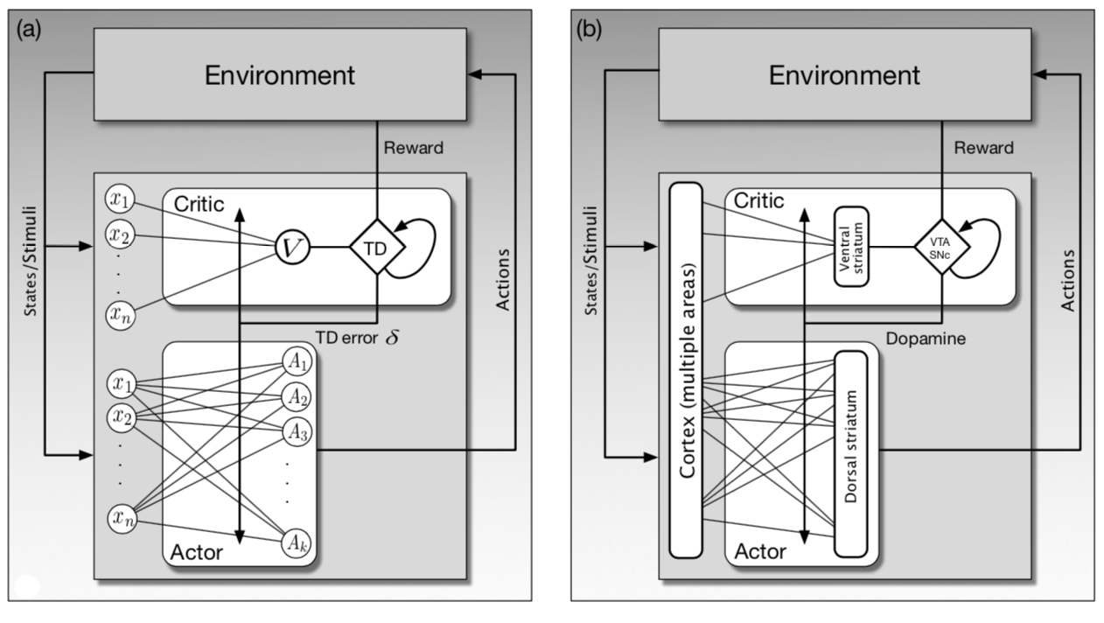
Reinforcement Learning
Actor Critic ANN
Source: Richard S. Sutton & Andrew G. Barto (2018), Reinforcement Learning: An Introduction, 2nd Edition, A Bradford Book.

Slide 79
Reinforcement Learning
General Dyna Architecture
Policy/value functions
planning update
direct DL
update
simulated experience
real experience
model
learning
search
control
Model
Environment
Source: Richard S. Sutton & Andrew G. Barto (2018), Reinforcement Learning: An Introduction, 2nd Edition, A Bradford Book.

Slide 80
Dyna:
Integrated Planning, Acting, and Learning
value/policy
acting
planning
direct
RL
model
experience
model
learning
Source: Richard S. Sutton & Andrew G. Barto (2018), Reinforcement Learning: An Introduction, 2nd Edition, A Bradford Book.

Slide 81
Model-Based RL
value/policy
acting
planning
model
experience
model
learning
Source: Richard S. Sutton & Andrew G. Barto (2018), Reinforcement Learning: An Introduction, 2nd Edition, A Bradford Book.

Slide 82
Model-Free RL
(DQN, A3C)
value/policy
acting
planning
direct
RL
model
experience
model
learning
Source: Richard S. Sutton & Andrew G. Barto (2018), Reinforcement Learning: An Introduction, 2nd Edition, A Bradford Book.

Slide 83
Reinforcement Learning Algorithms
Deep Reinforcement Learning (DRL)
Dynamic Programming
Markov Decision Process (MDP)
Monte Carlo Method
Q-Learning
TD Learning
Partially Observable MDP
(POMDP)
Actor-Critic Methods
Deep Q Network (DQN)
Double DQN
Neural Fitted Q Learning
Deep Recurrent Q Network (DQRN)
A3C
Rainbow
Source: https://amitray.com/deep-learning-past-present-and-future-a-review/

Slide 84
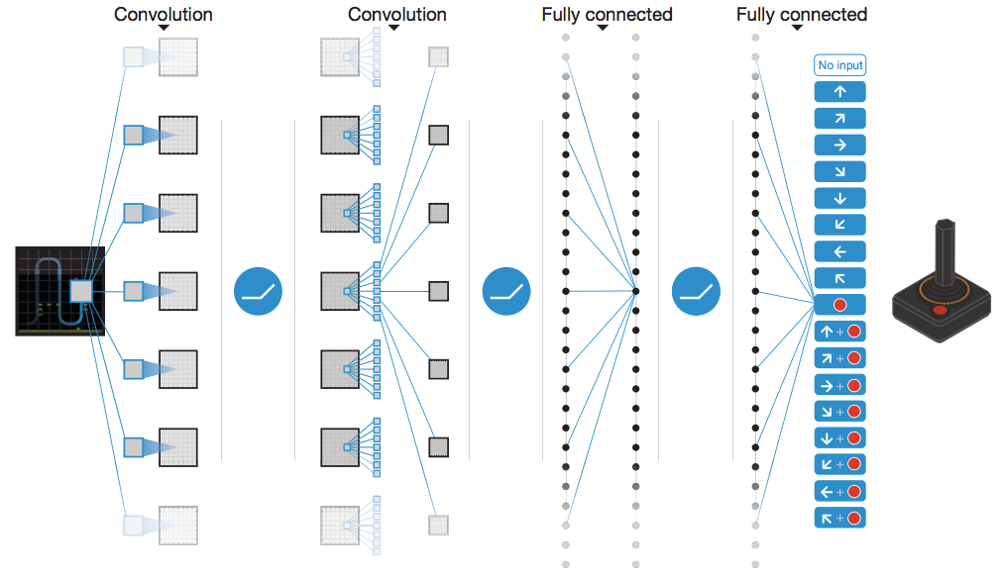
Human-level control through deep reinforcement learning (DQN)
Schematic illustration of the convolutional neural network
Source: Volodymyr Mnih, Koray Kavukcuoglu, David Silver, Andrei A. Rusu, Joel Veness, Marc G. Bellemare, Alex Graves et al. "Human-level control through deep reinforcement learning." Nature 518, no. 7540 (2015): 529.

Slide 85
Deep Q-Network (DQN)
Q-value
Q-value 1
Q-value 2
Q-value 3
Network
Network
State
Action
State
State
State
Source: https://neuro.cs.ut.ee/demystifying-deep-reinforcement-learning/

Slide 86
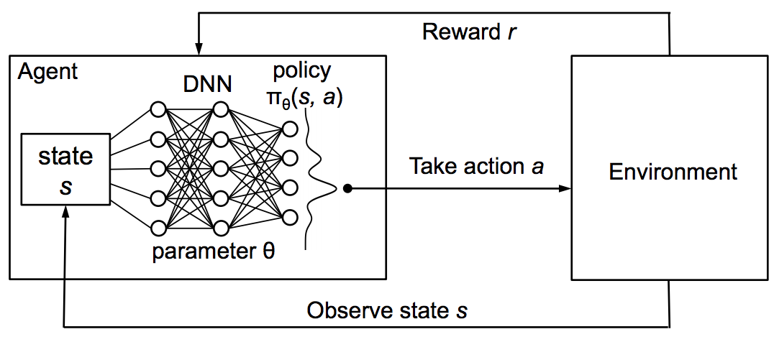
Reinforcement Learning with policy represented via DNN
Source: Hongzi Mao, Mohammad Alizadeh, Ishai Menache, and Srikanth Kandula. (2016) "Resource management with deep reinforcement learning." In Proceedings of the 15th ACM Workshop on Hot Topics in Networks, pp. 50-56. ACM, 2016.

Slide 87
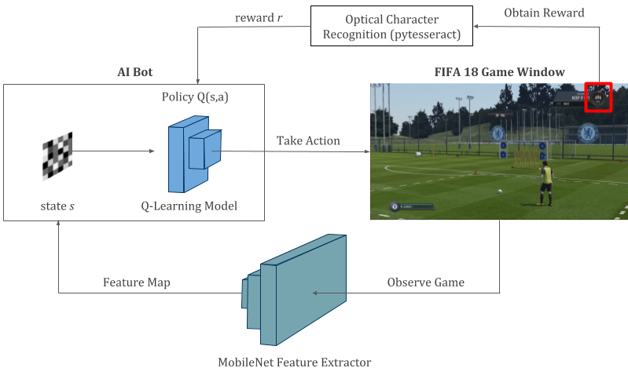
Reinforcement Learning
Deep Q-Learning in FIFA 18
Source: https://towardsdatascience.com/using-deep-q-learning-in-fifa-18-to-perfect-the-art-of-free-kicks-f2e4e979ee66

Slide 88
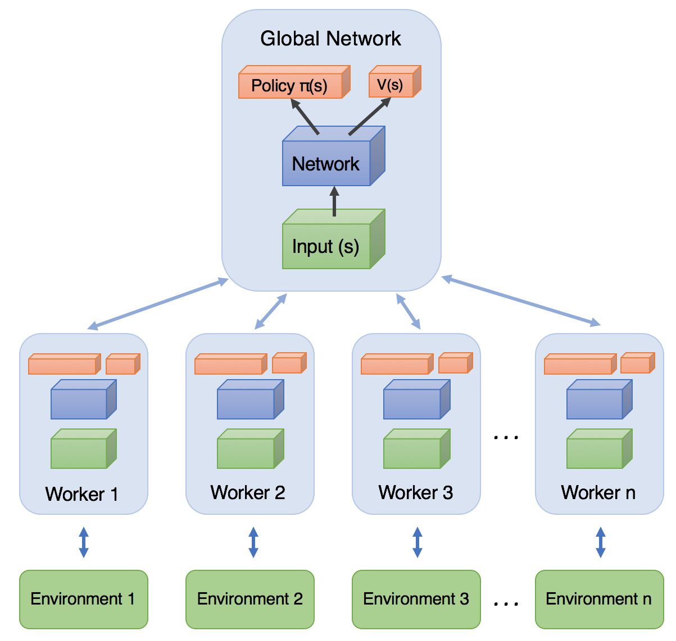
Asynchronous Advantage Actor-Critic
(A3C)
Source: https://medium.com/emergent-future/simple-reinforcement-learning-with-tensorflow-part-8-asynchronous-actor-critic-agents-a3c-c88f72a5e9f2

Slide 89
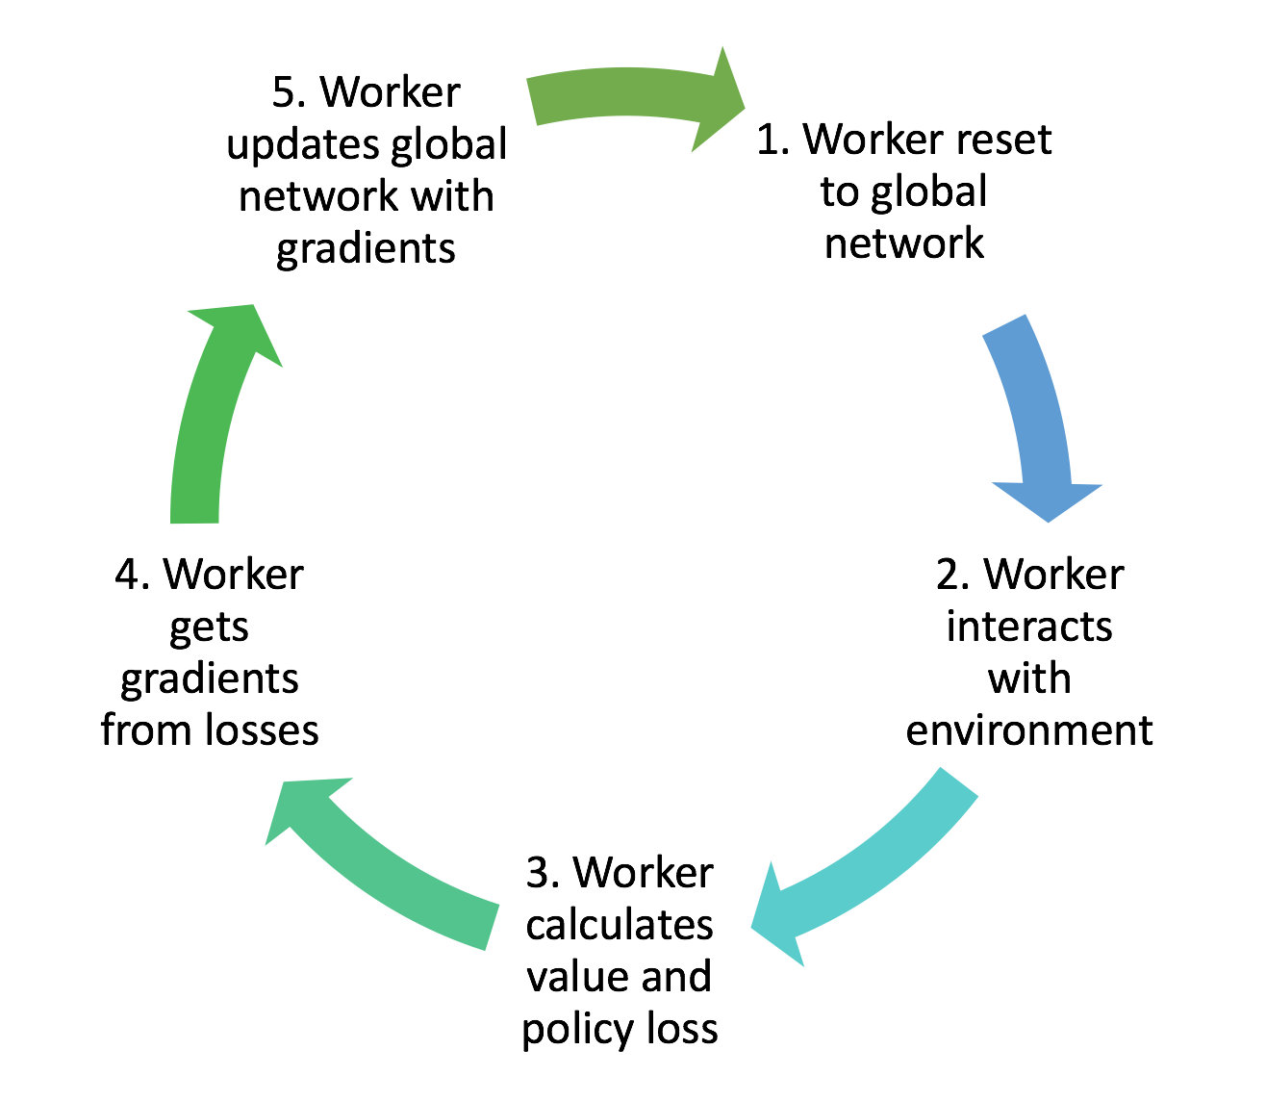
Training workflow of each worker agent in A3C
Source: https://medium.com/emergent-future/simple-reinforcement-learning-with-tensorflow-part-8-asynchronous-actor-critic-agents-a3c-c88f72a5e9f2

Slide 90
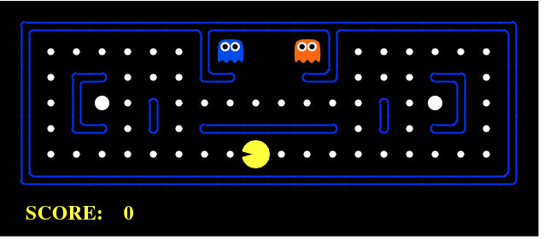
Reinforcement Learning
Example: PCMAN
Source: https://www.kdnuggets.com/2018/03/5-things-reinforcement-learning.html

Slide 91
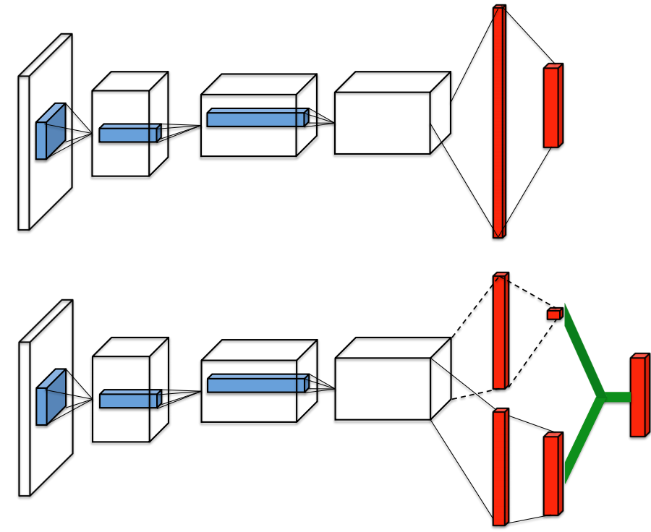
Dueling Network Architectures for Deep Reinforcement Learning
Single stream Q-network
Dueling Q-network
Source: Ziyu Wang et al. (2015). "Dueling network architectures for deep reinforcement learning." arXiv preprint arXiv:1511.06581 (2015)

Slide 92
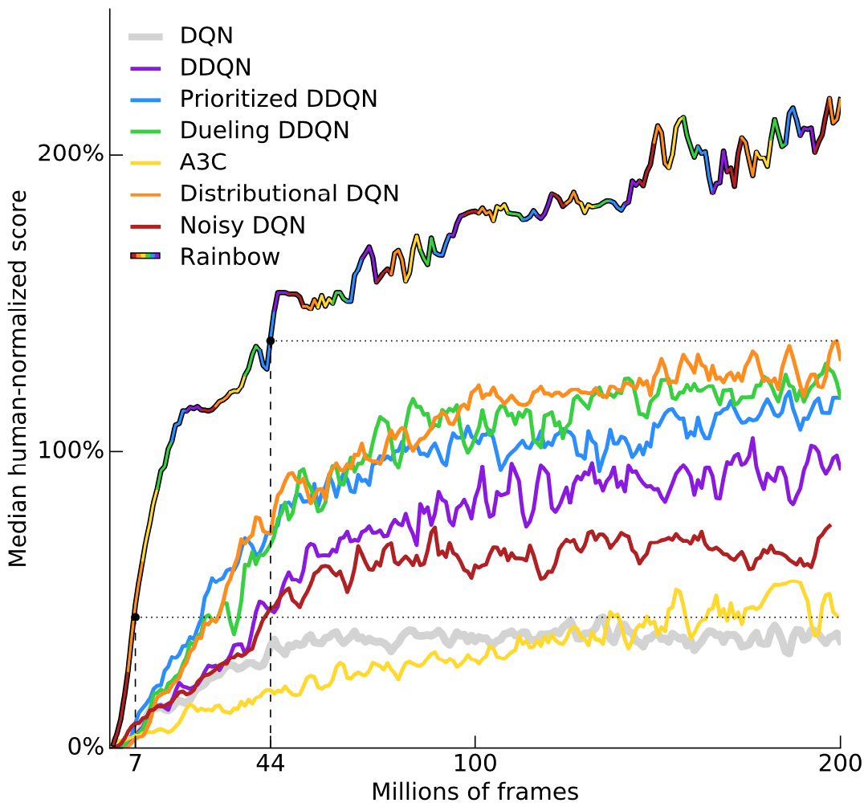
Rainbow: Combining improvements in deep reinforcement learning
Source: Matteo Hessel, Joseph Modayil, Hado Van Hasselt, Tom Schaul, Georg Ostrovski, Will Dabney, Dan Horgan, Bilal Piot, Mohammad Azar, and David Silver (2017). "Rainbow: Combining improvements in deep reinforcement learning." arXiv preprint arXiv:1710.02298 (2017).

Slide 93
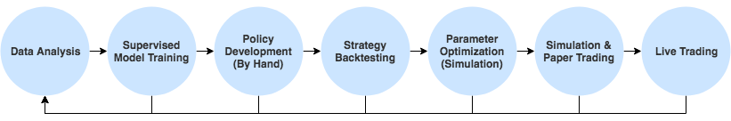
A Typical Strategy Development Workflow
Source: http://www.wildml.com/2018/02/introduction-to-learning-to-trade-with-reinforcement-learning/

Slide 94
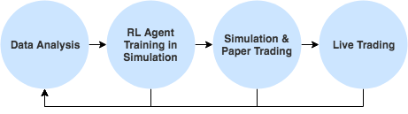
Reinforcement Learning (RL) in Trading Strategies
Source: http://www.wildml.com/2018/02/introduction-to-learning-to-trade-with-reinforcement-learning/

Slide 95
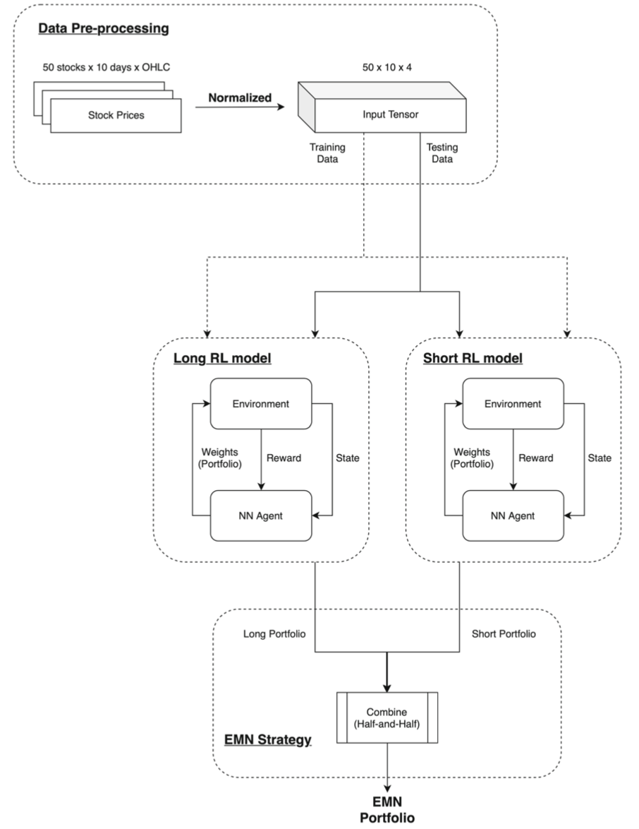
Portfolio management system in equity market neutral using reinforcement learning
(Wu et al., 2021)
Source: Mu-En Wu, Jia-Hao Syu, Jerry Chun-Wei Lin, and Jan-Ming Ho. "Portfolio management system in equity market neutral using reinforcement learning."
Applied Intelligence (2021): 1-13.

Slide 96
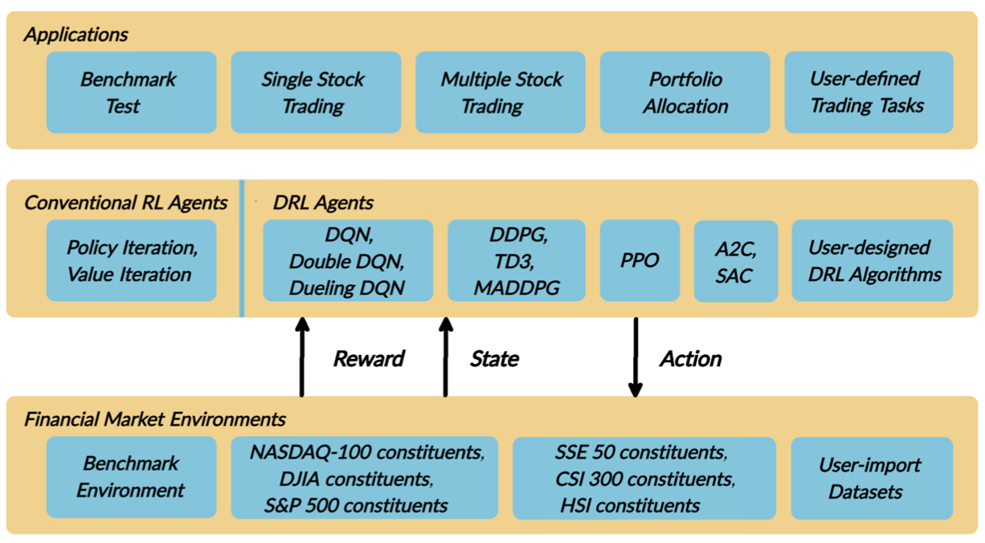
FinRL:
A Deep Reinforcement Learning Library for
Automated Stock Trading in Quantitative Finance
Source: Xiao-Yang Liu, Hongyang Yang, Qian Chen, Runjia Zhang, Liuqing Yang, Bowen Xiao, and Christina Dan Wang (2020). "FinRL: A Deep Reinforcement Learning Library for Automated Stock Trading in Quantitative Finance." arXiv preprint arXiv:2011.09607 (2020).

Slide 97
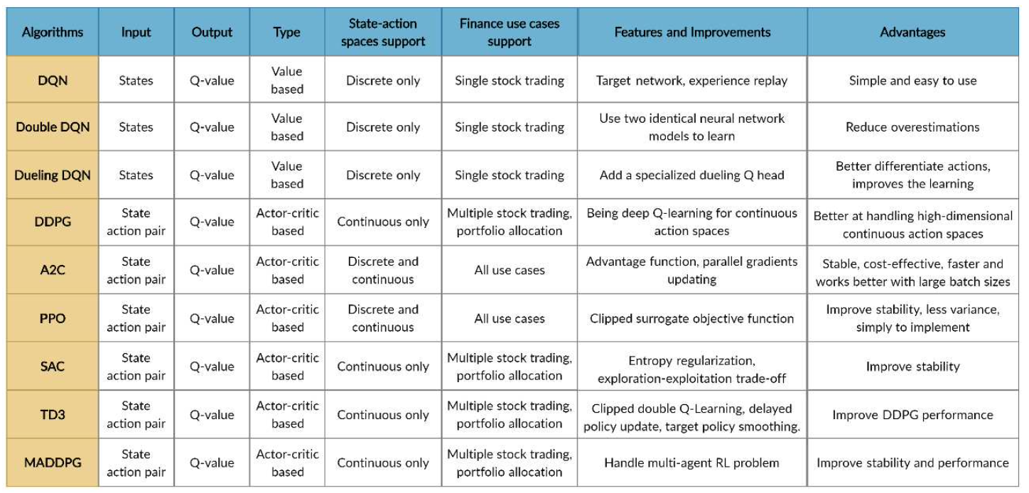
FinRL
Deep Reinforcement Learning Algorithms
Source: Xiao-Yang Liu, Hongyang Yang, Qian Chen, Runjia Zhang, Liuqing Yang, Bowen Xiao, and Christina Dan Wang (2020). "FinRL: A Deep Reinforcement Learning Library for Automated Stock Trading in Quantitative Finance." arXiv preprint arXiv:2011.09607 (2020).

Slide 98
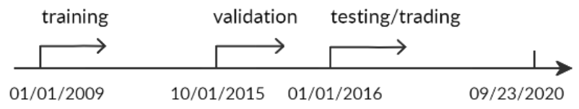
FinRL:
A Deep Reinforcement Learning Library for
Automated Stock Trading in Quantitative Finance
Evaluation of Trading Performance
Training-Validation-Testing Flow
Source: Xiao-Yang Liu, Hongyang Yang, Qian Chen, Runjia Zhang, Liuqing Yang, Bowen Xiao, and Christina Dan Wang (2020). "FinRL: A Deep Reinforcement Learning Library for Automated Stock Trading in Quantitative Finance." arXiv preprint arXiv:2011.09607 (2020).

Slide 99
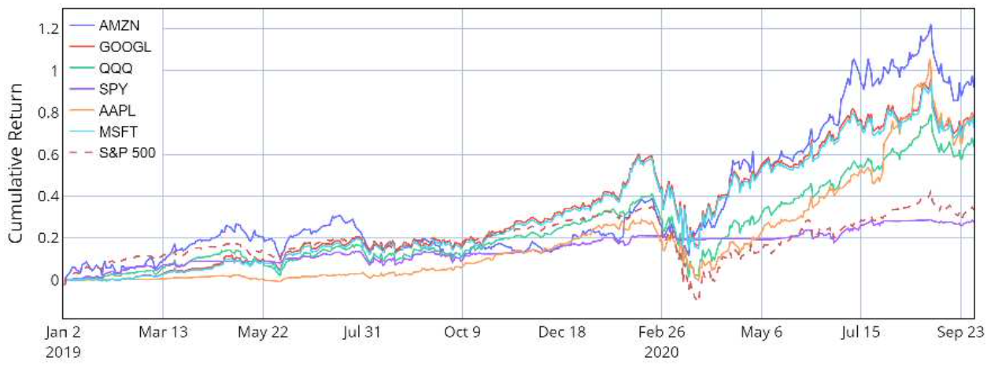
Reinforcement Learning (RL)
FinRL
Performance of single stock trading using Proximal policy optimization (PPO) in the FinRL library
Source: Xiao-Yang Liu, Hongyang Yang, Qian Chen, Runjia Zhang, Liuqing Yang, Bowen Xiao, and Christina Dan Wang (2020). "FinRL: A Deep Reinforcement Learning Library for Automated Stock Trading in Quantitative Finance." arXiv preprint arXiv:2011.09607 (2020).

Slide 100
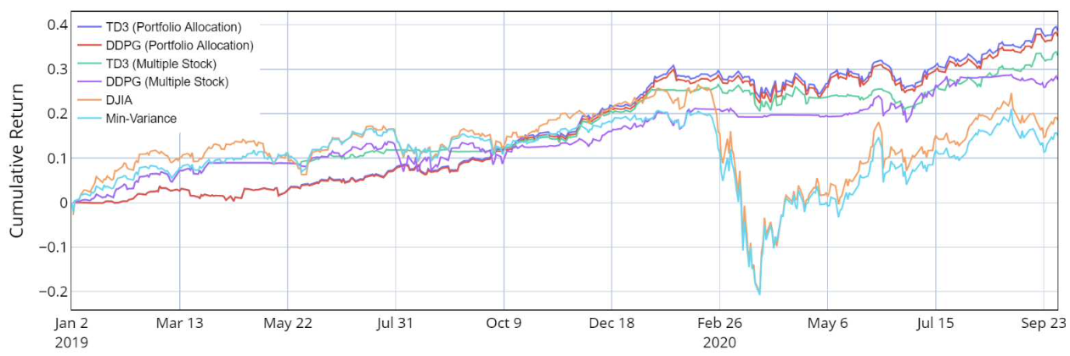
Reinforcement Learning (RL)
FinRL
Performance of multiple stock trading and portfolio allocation using the FinRL library
Source: Xiao-Yang Liu, Hongyang Yang, Qian Chen, Runjia Zhang, Liuqing Yang, Bowen Xiao, and Christina Dan Wang (2020). "FinRL: A Deep Reinforcement Learning Library for Automated Stock Trading in Quantitative Finance." arXiv preprint arXiv:2011.09607 (2020).

Slide 101
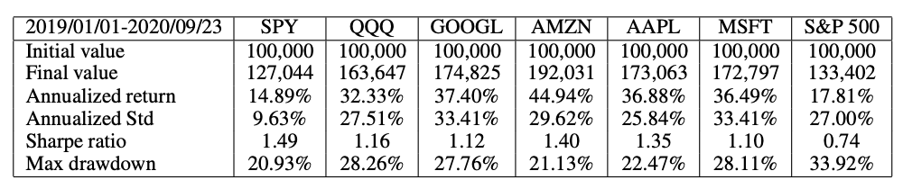
Reinforcement Learning (RL)
FinRL
Performance of single stock trading using Proximal policy optimization (PPO) in the FinRL library
Source: Xiao-Yang Liu, Hongyang Yang, Qian Chen, Runjia Zhang, Liuqing Yang, Bowen Xiao, and Christina Dan Wang (2020). "FinRL: A Deep Reinforcement Learning Library for Automated Stock Trading in Quantitative Finance." arXiv preprint arXiv:2011.09607 (2020).

Slide 102
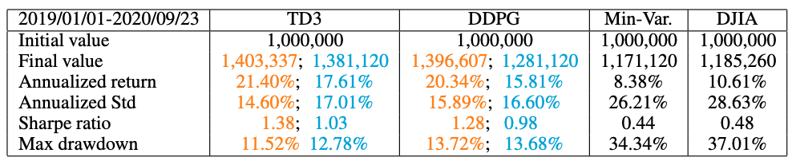
Reinforcement Learning (RL)
FinRL
Performance of multiple stock trading and portfolio allocation over the DJIA constituents stocks using the FinRL library
Source: Xiao-Yang Liu, Hongyang Yang, Qian Chen, Runjia Zhang, Liuqing Yang, Bowen Xiao, and Christina Dan Wang (2020). "FinRL: A Deep Reinforcement Learning Library for Automated Stock Trading in Quantitative Finance." arXiv preprint arXiv:2011.09607 (2020).

Slide 103
Deep Reinforcement Learning Library
OpenAI Gym
Google Dopamine
RLlib
Horizon
FinRL

Slide 104
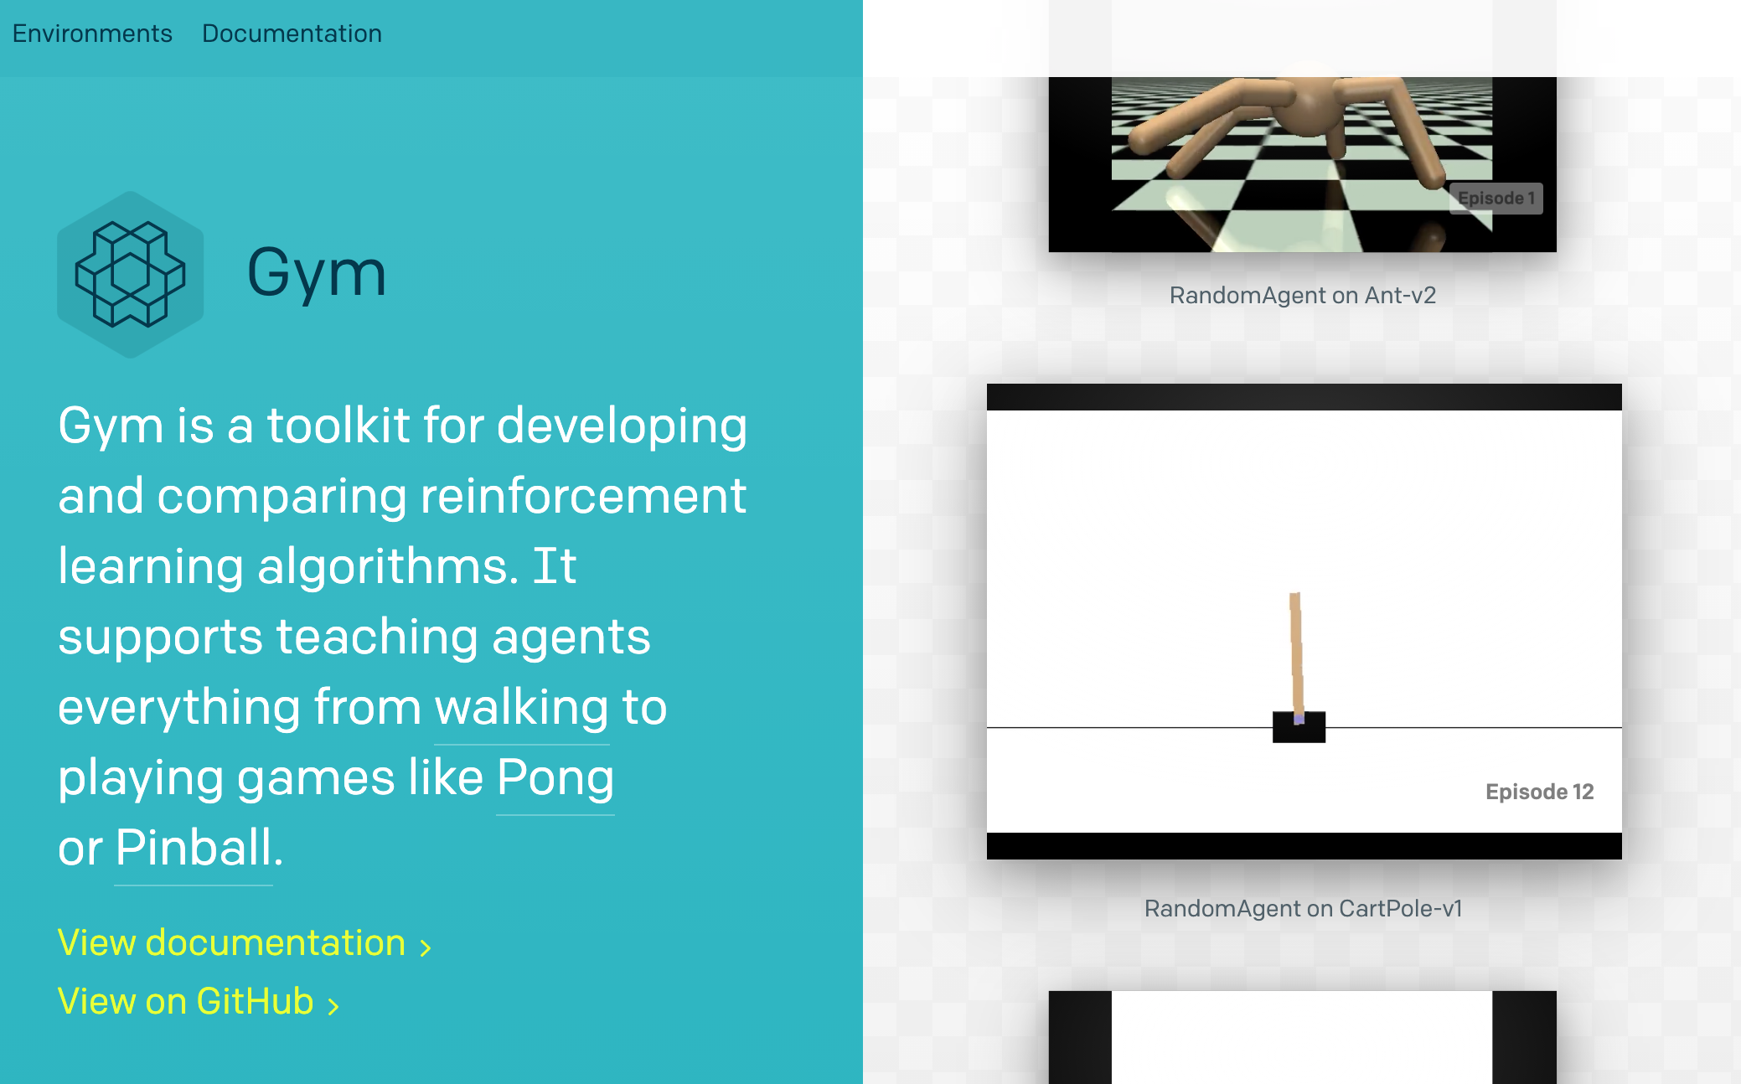
Open AI Gym
https://gym.openai.com/

Slide 105

Google Dopamine
Dopamine is a research framework
for fast prototyping of
reinforcement learning algorithms.
https://github.com/google/dopamine

Slide 106
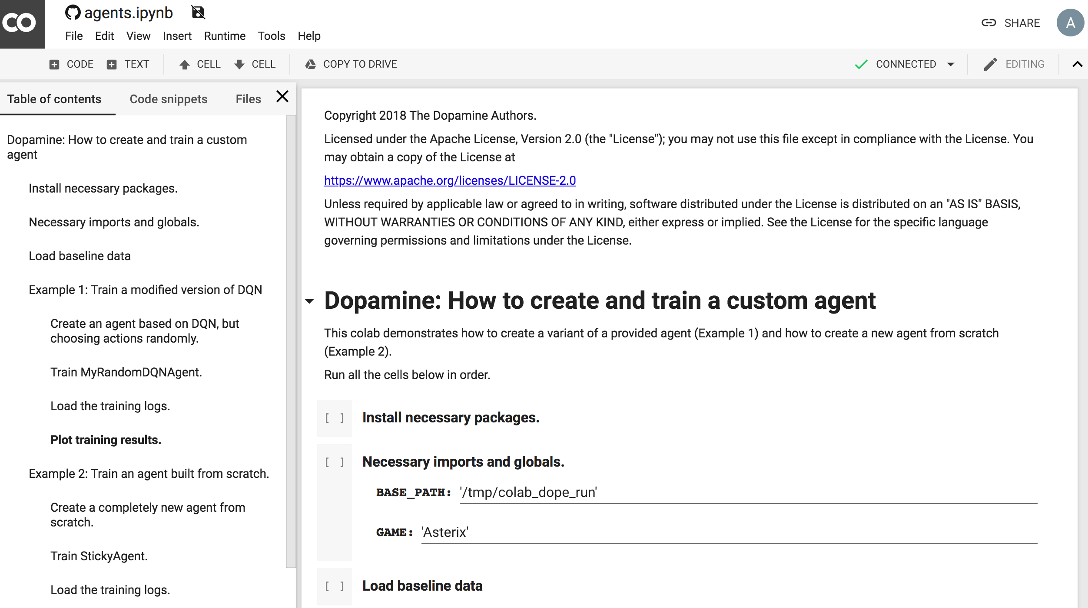
Deep Reinforcement Learning
Dopamine Colab Examples
DQN Rainbow
https://colab.research.google.com/github/google/dopamine/blob/master/dopamine/colab/agents.ipynb

Slide 107
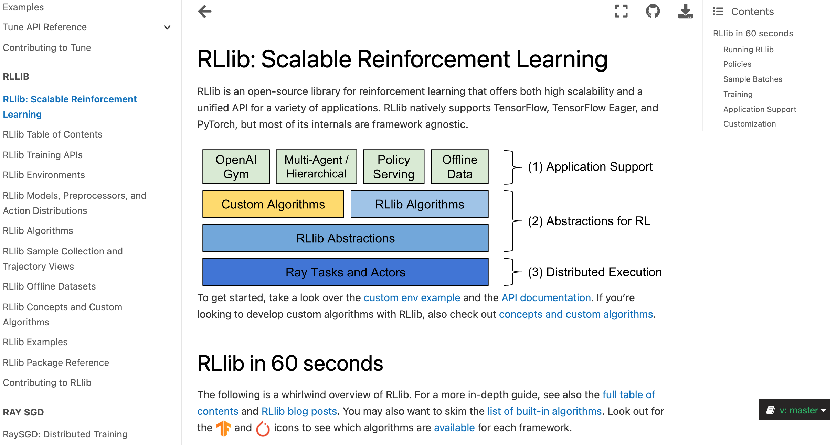
RLlib:
Scalable Reinforcement Learning
https://docs.ray.io/en/master/rllib.html

Slide 108
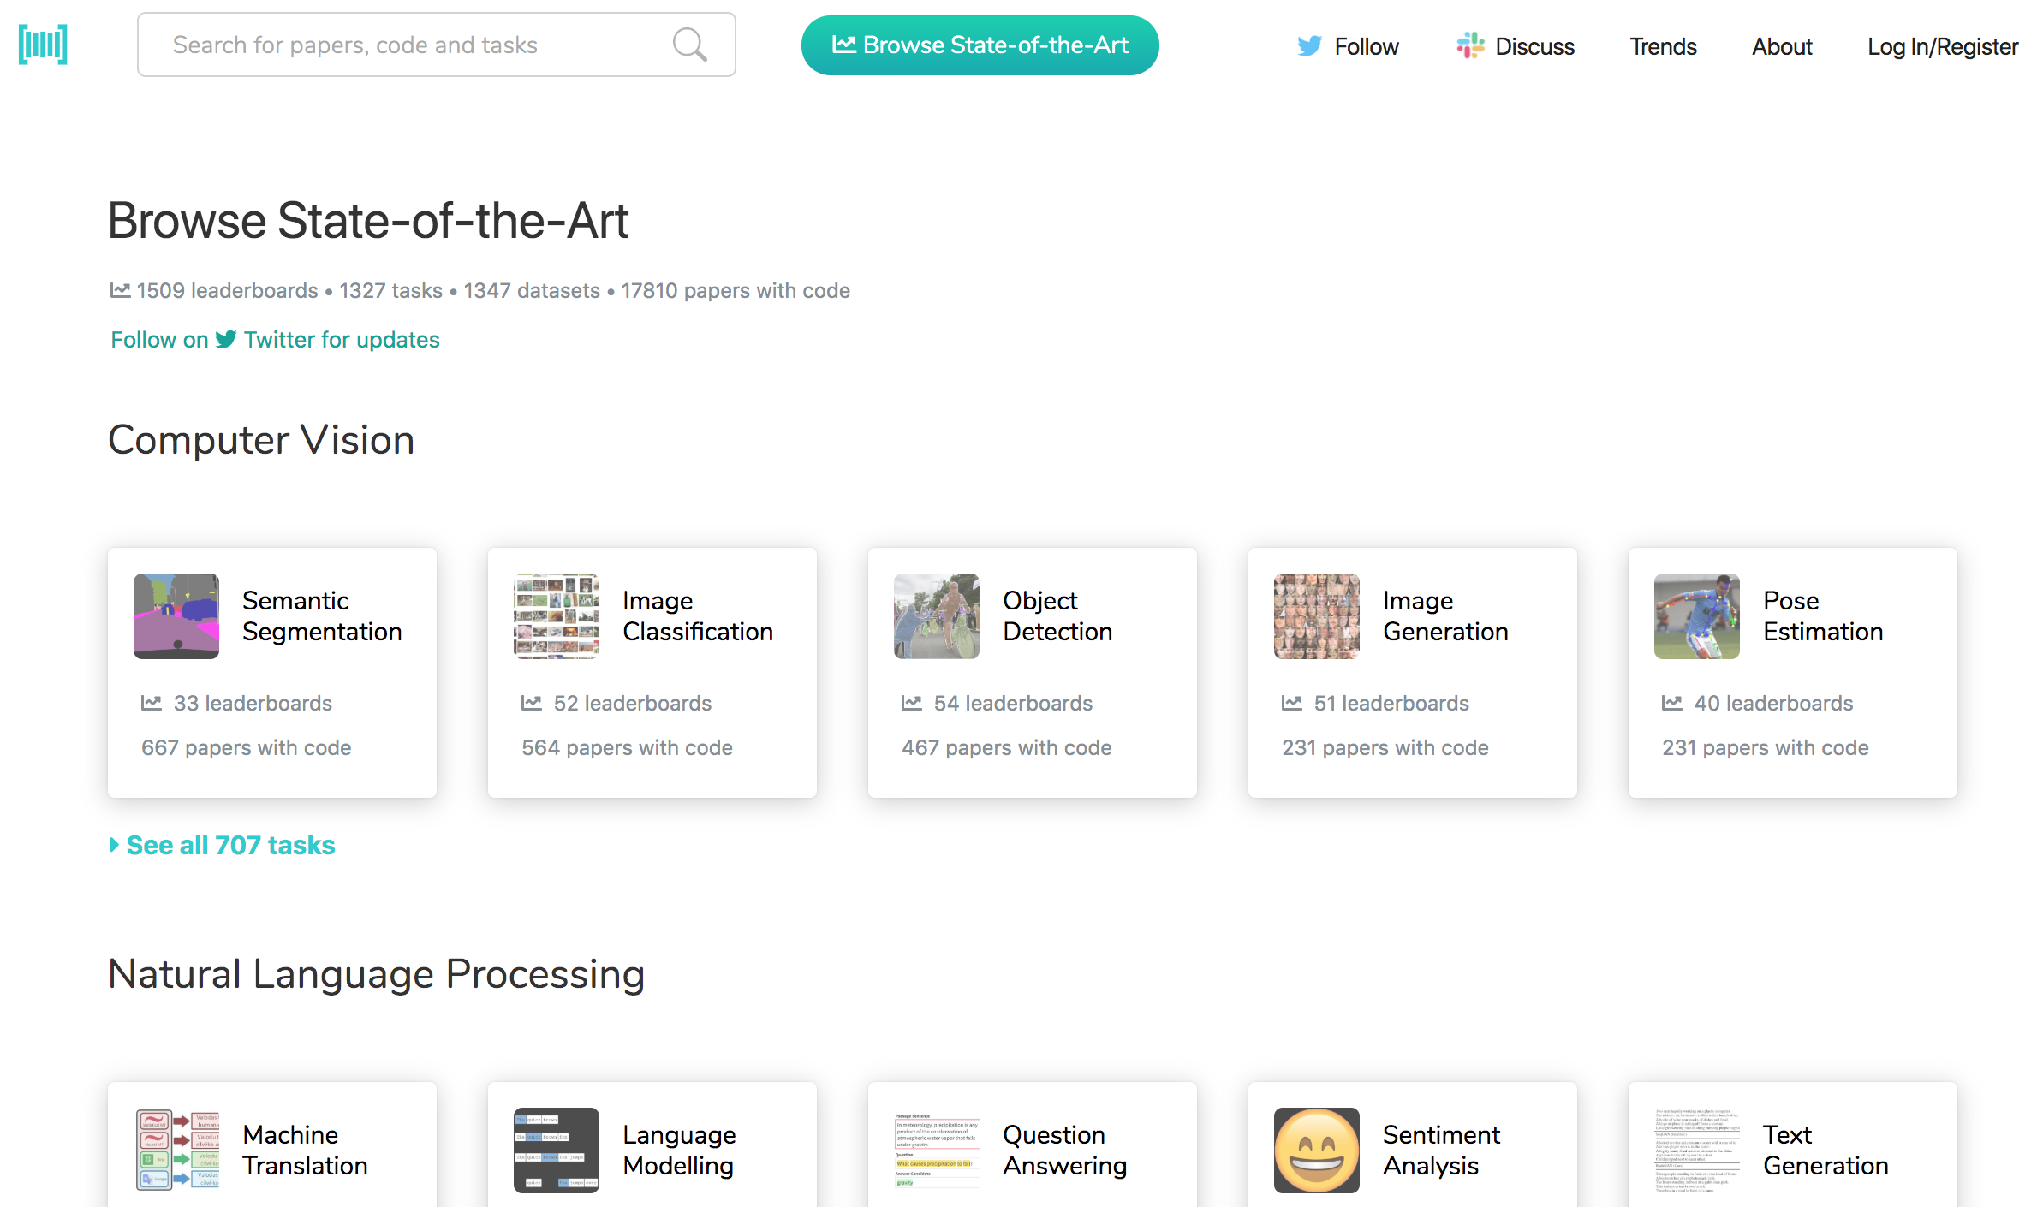
Papers with Code
State-of-the-Art (SOTA)
https://paperswithcode.com/sota

Slide 109

Aurélien Géron (2019),
Hands-On Machine Learning with Scikit-Learn, Keras, and TensorFlow: Concepts, Tools, and Techniques to Build Intelligent Systems, 2nd Edition
O’Reilly Media, 2019
https://github.com/ageron/handson-ml2
Source: https://www.amazon.com/Hands-Machine-Learning-Scikit-Learn-TensorFlow/dp/1492032646/

Slide 110

Hands-On Machine Learning with
Scikit-Learn, Keras, and TensorFlow
Notebooks
The Machine Learning landscape
End-to-end Machine Learning project
Classification
Training Models
Support Vector Machines
Decision Trees
Ensemble Learning and Random Forests
Dimensionality Reduction
Unsupervised Learning Techniques
Artificial Neural Nets with Keras
Training Deep Neural Networks
Custom Models and Training with TensorFlow
Loading and Preprocessing Data
Deep Computer Vision Using Convolutional Neural Networks
Processing Sequences Using RNNs and CNNs
Natural Language Processing with RNNs and Attention
Representation Learning Using Autoencoders
Reinforcement Learning
Training and Deploying TensorFlow Models at Scale
https://github.com/ageron/handson-ml2

Slide 111
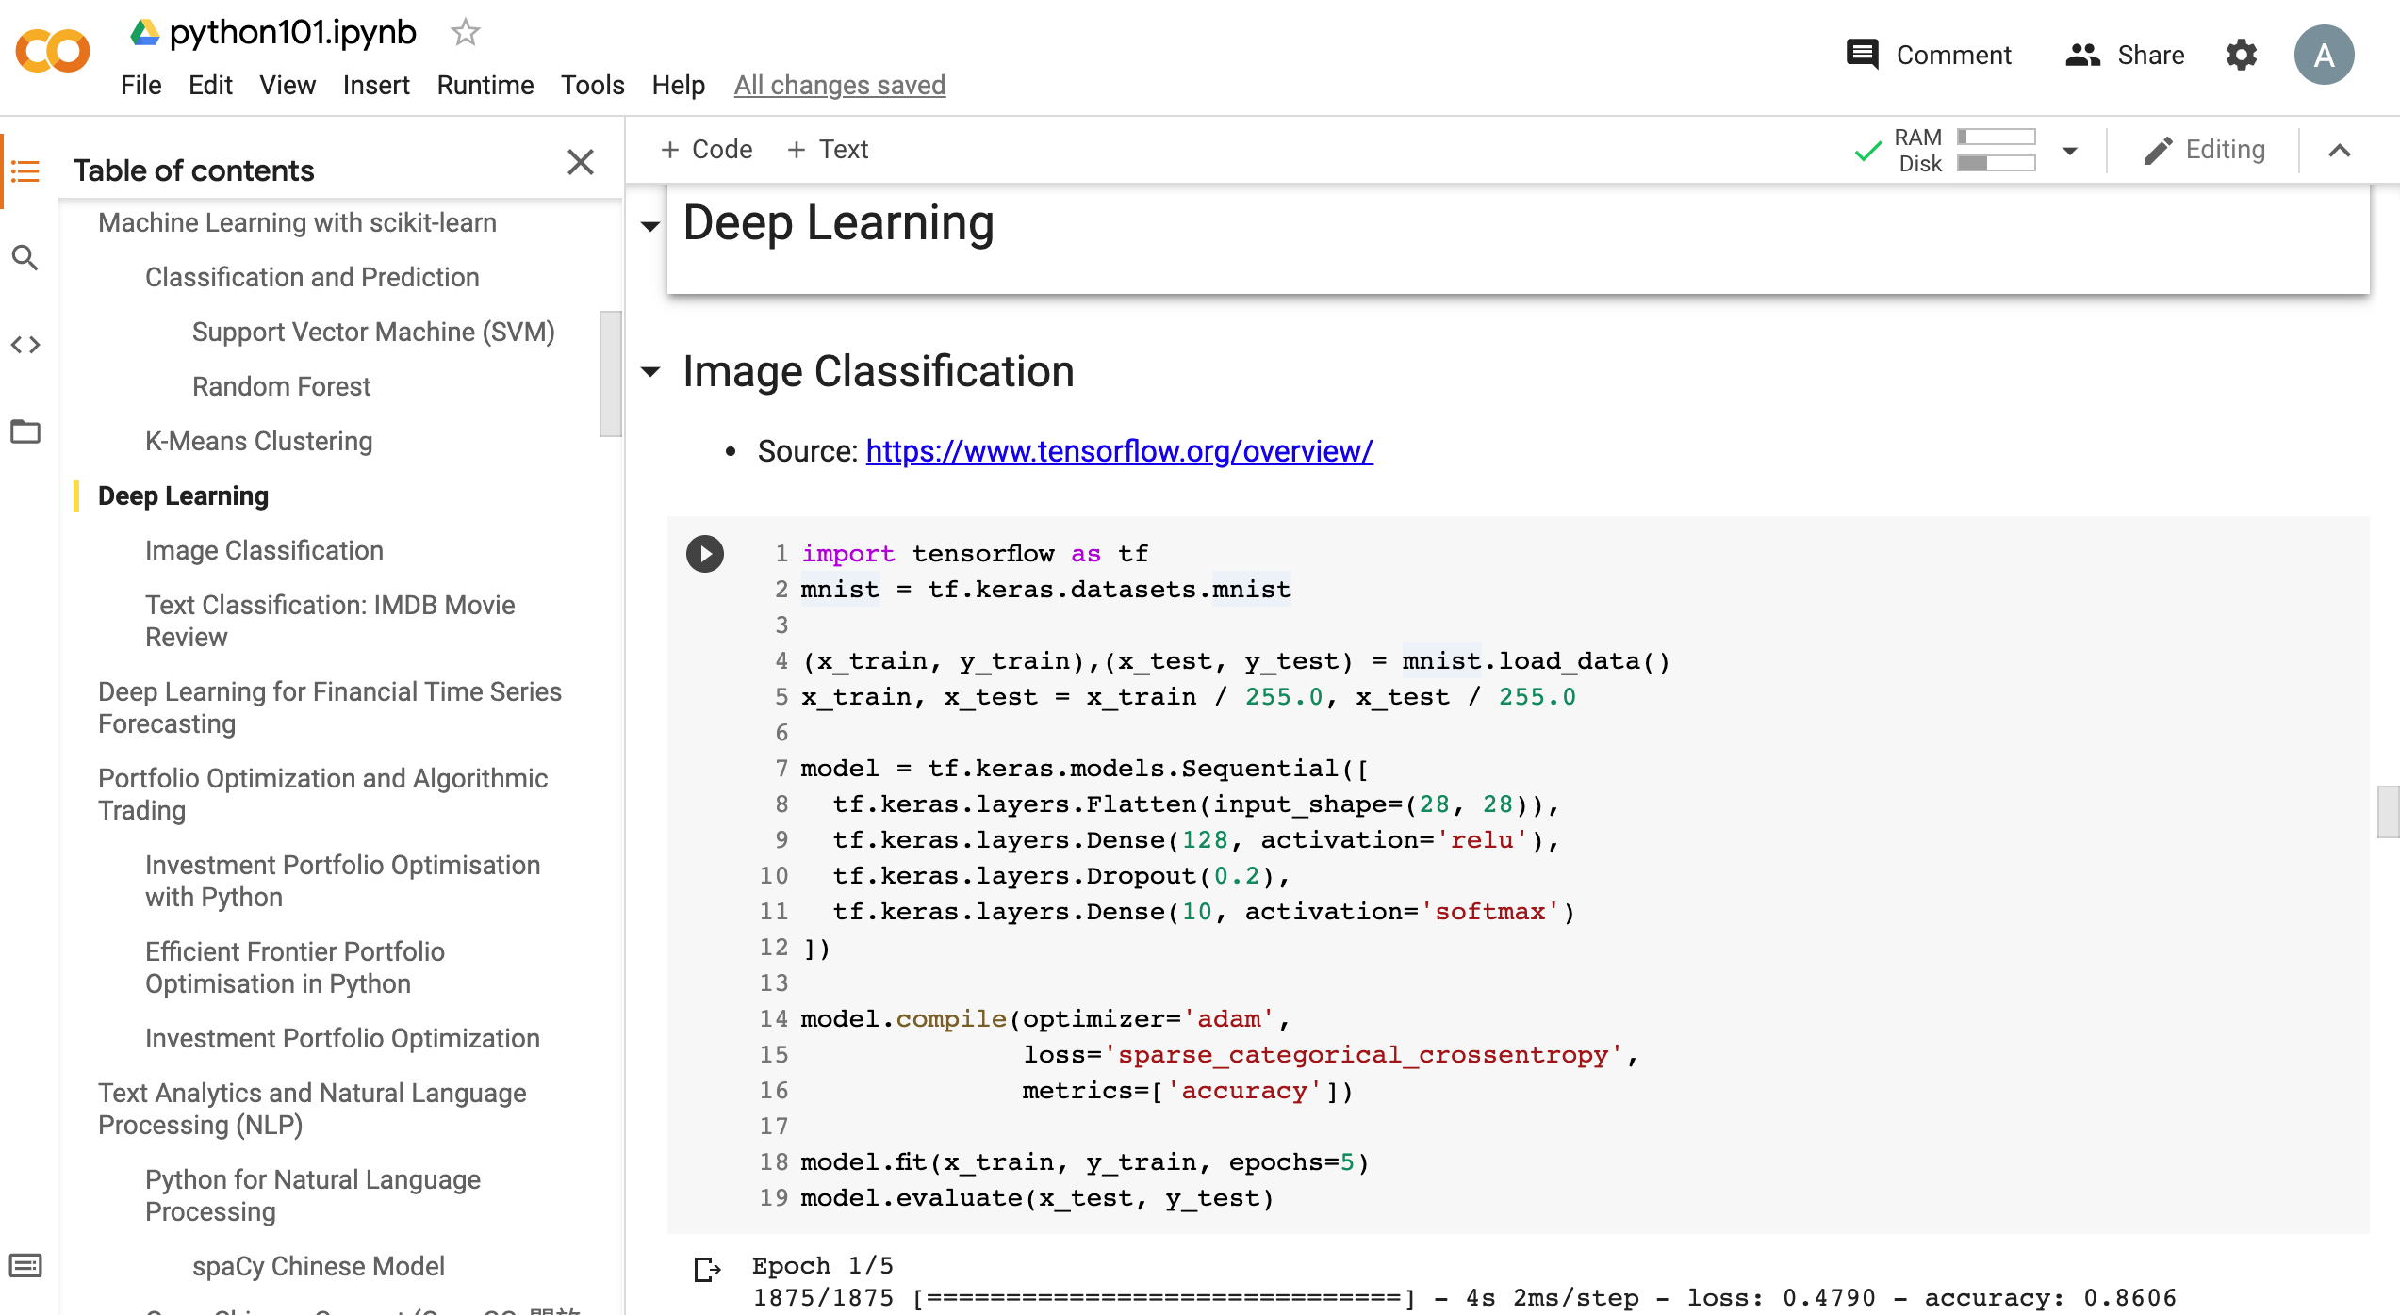
Python in Google Colab (Python101)
https://colab.research.google.com/drive/1FEG6DnGvwfUbeo4zJ1zTunjMqf2RkCrT
https://tinyurl.com/aintpupython101

Slide 112
Summary
Reinforcement Learning (RL)
  Markov Decision Processes (MDP)
Deep Reinforcement Learning (DRL) Algorithms
  SARSA
  Q-Learning
  DQN
  A3C
  Rainbow

Slide 113
References
Stuart Russell and Peter Norvig (2020), Artificial Intelligence: A Modern Approach, 4th Edition, Pearson.
Aurélien Géron (2019), Hands-On Machine Learning with Scikit-Learn, Keras, and TensorFlow: Concepts, Tools, and Techniques to Build Intelligent Systems, 2nd Edition, O’Reilly Media.
Richard S. Sutton & Andrew G. Barto (2018), Reinforcement Learning: An Introduction, 2nd Edition, A Bradford Book.
David Silver (2015), Introduction to reinforcement learning, https://www.youtube.com/playlist?list=PLqYmG7hTraZDM-OYHWgPebj2MfCFzFObQ
David Silver, Thomas Hubert, Julian Schrittwieser, Ioannis Antonoglou, Matthew Lai, Arthur Guez, Marc Lanctot, Laurent Sifre, Dharshan Kumaran, Thore Graepel, Timothy Lillicrap, Karen Simonyan, Demis Hassabis (2018), "A general reinforcement learning algorithm that masters chess, shogi, and Go through self-play." Science 362, no. 6419 (2018): 1140-1144.
David Silver, Julian Schrittwieser, Karen Simonyan, Ioannis Antonoglou, Aja Huang, Arthur Guez, Thomas Hubert, Lucas Baker, Matthew Lai, Adrian Bolton, Yutian Chen, Timothy Lillicrap, Fan Hui, Laurent Sifre, George van den Driessche, Thore Graepel, and Demis Hassabis (2017), "Mastering the game of Go without human knowledge." Nature 550 (2017): 354–359.
Hado Van Hasselt, Arthur Guez, and David Silver (2016). "Deep Reinforcement Learning with Double Q-Learning." In AAAI, vol. 2, p. 5. 2016.
Matteo Hessel, Joseph Modayil, Hado Van Hasselt, Tom Schaul, Georg Ostrovski, Will Dabney, Dan Horgan, Bilal Piot, Mohammad Azar, and David Silver (2017). "Rainbow: Combining improvements in deep reinforcement learning." arXiv preprint arXiv:1710.02298 (2017).
Volodymyr Mnih, Koray Kavukcuoglu, David Silver, Andrei A. Rusu, Joel Veness, Marc G. Bellemare, Alex Graves et al. (2015) "Human-level control through deep reinforcement learning." Nature 518, no. 7540 (2015): 529.
Ziyu Wang, Tom Schaul, Matteo Hessel, Hado Van Hasselt, Marc Lanctot, and Nando De Freitas (2015). "Dueling network architectures for deep reinforcement learning." arXiv preprint arXiv:1511.06581 (2015).
Xiao-Yang Liu, Hongyang Yang, Qian Chen, Runjia Zhang, Liuqing Yang, Bowen Xiao, and Christina Dan Wang (2020). "FinRL: A Deep Reinforcement Learning Library for Automated Stock Trading in Quantitative Finance." arXiv preprint arXiv:2011.09607 (2020).
Mu-En Wu, Jia-Hao Syu, Jerry Chun-Wei Lin, and Jan-Ming Ho. "Portfolio management system in equity market neutral using reinforcement learning." Applied Intelligence (2021): 1-13.
Min-Yuh Day (2021), Python 101, https://tinyurl.com/aintpupython101

