Slide 1



人工智慧
(Artificial Intelligence)
人工智慧概論
(Introduction to Artificial Intelligence)
1092AI01
MBA, IM, NTPU (M5010) (Spring 2021)
Wed 2, 3, 4 (9:10-12:00) (B8F40)
Min-Yuh Day
戴敏育
Associate Professor
副教授
Institute of Information Management, National Taipei University
國立臺北大學 資訊管理研究所
https://web.ntpu.edu.tw/~myday
2021-02-24

Slide 2



戴敏育 博士
(Min-Yuh Day, Ph.D.)
國立台北大學 資訊管理研究所 副教授
中央研究院 資訊科學研究所 訪問學人
國立台灣大學 資訊管理 博士
Publications Co-Chairs, IEEE/ACM International Conference on
Advances in Social Networks Analysis and Mining (ASONAM 2013- )
Program Co-Chair, IEEE International Workshop on
Empirical Methods for Recognizing Inference in TExt (IEEE EM-RITE 2012- )
Publications Chair, The IEEE International Conference on
Information Reuse and Integration (IEEE IRI)

Slide 3



人工智慧
(Artificial Intelligence)
Contact Information
戴敏育 博士 (Min-Yuh Day, Ph.D.)
副教授 (Associate Professor)
國立臺北大學 資訊管理研究所
Institute of Information Management, National Taipei University
電話： 02-86741111 ext. 66873
研究室： 商8F12
地址： 23741 新北市三峽區大學路 151 號
Email：myday@gm.ntpu.edu.tw
網址：http://web.ntpu.edu.tw/~myday/

Slide 4
國立臺北大學
109學年度第2學期
課程大綱
Spring 2021 (2021.02 - 2021.06)
課程名稱：人工智慧 (Artificial Intelligence)
授課教師：戴敏育 (Min-Yuh Day)
開課系所：資管所碩士班
開課資料：選修 半學年 3 學分 (3 Credits, Elective)
上課時間：週三 2, 3, 4 (9:10-12:00)
上課教室：商7F40 (台北大學三峽校區)

Slide 5
教學目標
瞭解人工智慧基本概念與
研究議題。。
具備人工智慧實務操作能力。
進行人工智慧相關之
資訊管理研究。

Slide 6
Course Objectives
Understand the fundamental concepts and research issues of
Artificial Intelligence.
Equip with Hands-on practices of
Artificial Intelligence.
Conduct information systems research in the context of Artificial Intelligence.

Slide 7
內容綱要
本課程介紹人工智慧基本概念、研究議題、與實務操作。
課程內容包括
  人工智慧概論
  人工智慧和智慧代理人
  問題解決
  知識推理和知識表達、不確定知識和推理
  監督式學習
  學習理論與綜合學習
  深度學習、強化學習
  自然語言處理、深度學習自然語言處理
  機器人技術
  人工智慧的哲學與倫理與人工智慧的未來
  人工智慧個案研究

Slide 8
Course Outline
This course introduces the fundamental concepts,
research issues, and hands-on practices of Artificial Intelligence.
Topics include
  Introduction to Artificial Intelligence
  Artificial Intelligence and Intelligent Agents
  Problem Solving
  Knowledge, Reasoning and Knowledge Representation, Uncertain Knowledge and Reasoning
  Supervised Learning
  The Theory of Learning and Ensemble Learning
  Deep Learning, Reinforcement Learning
  Natural Language Processing, Deep Learning for Natural Language Processing
  Robotics
  Philosophy and Ethics of AI and the Future of AI
  Case Study on AI.

Slide 9
資訊管理研究所
系核心能力
(Core Competence)
資訊科技新知探索與系統開發應用 80 %
網路行銷企劃能力 10 %
論文寫作與獨立研究能力 10 %

Slide 10
校四大基本素養
(Four Fundamental Qualities)
專業 (Professionalism)
  創意思考與問題解決 (Creative thinking and Problem-solving) 30 %
  綜合統整(Comprehensive Integration) 30 %
人際 (Interpersonal Relationship)
  溝通協調 (Communication and Coordination) 10 %
  團隊合作 (Teamwork) 10 %
倫理 (Ethics)
  誠信正直(Honesty and Integrity) 5 %
  尊重自省(Self-Esteem and Self-reflection) 5 %
國際觀 (International Vision)
  多元關懷 (Caring for Diversity) 5 %
  跨界宏觀 (Interdisciplinary Vision) 5 %

Slide 11
商學院學習目標
(College Learning Goals)
Ethics/Corporate Social Responsibility
Global Knowledge/Awareness
Communication
Analytical and Critical Thinking

Slide 12
系所學習目標
(Department Learning Goals)
Information Technologies and System Development Capabilities
Internet Marketing Management Capabilities
Research capabilities

Slide 13
課程大綱 (Syllabus)
週次 (Week) 日期 (Date) 內容 (Subject/Topics)
1 2021/02/24 人工智慧概論
(Introduction to Artificial Intelligence)
2 2021/03/03 人工智慧和智慧代理人
(Artificial Intelligence and Intelligent Agents)
3 2021/03/10 問題解決
(Problem Solving)
4 2021/03/17 知識推理和知識表達
(Knowledge, Reasoning and Knowledge Representation)
5 2021/03/24 不確定知識和推理
(Uncertain Knowledge and Reasoning)
6 2021/03/31 人工智慧個案研究 I
(Case Study on Artificial Intelligence I)

Slide 14
課程大綱 (Syllabus)
週次 (Week) 日期 (Date) 內容 (Subject/Topics)
7 2021/04/07 放假一天 (Day off)
8 2021/04/14 機器學習與監督式學習
(Machine Learning and Supervised Learning)
9 2021/04/21 期中報告
(Midterm Project Report)
10 2021/04/28 學習理論與綜合學習
(The Theory of Learning and Ensemble Learning)
11 2021/05/05 深度學習
(Deep Learning)
12 2021/05/12 人工智慧個案研究 II
(Case Study on Artificial Intelligence II)

Slide 15
課程大綱 (Syllabus)
週次 (Week) 日期 (Date) 內容 (Subject/Topics)
13 2021/05/19 強化學習
(Reinforcement Learning)
14 2021/05/26 深度學習自然語言處理
(Deep Learning for Natural Language Processing)
15 2021/06/02 機器人技術
(Robotics)
16 2021/06/09 人工智慧哲學與倫理，人工智慧的未來
(Philosophy and Ethics of AI, The Future of AI)
17 2021/06/16 期末報告 I
(Final Project Report I)
18 2021/06/23 期末報告 II
(Final Project Report II)

Slide 16
教學方法與教學活動
(Teaching methods and activities)
講授 (Lecture)
討論 (Discussion)
實習 (Practicum)

Slide 17
評量方式
(Evaluation Methods)
個人報告 (Individual Presentation) 60 %
團體報告 (Group Presentation) 10 %
個案分析報告 (Case Report) 10 %
課堂參與 (Class Participation) 10 %
作業 (Assignment) 10 %

Slide 18
指定用書
(Required Texts)
Stuart Russell and Peter Norvig (2020),
Artificial Intelligence: A Modern Approach,
4th Edition, Pearson.

Slide 19
參考書目
(Reference Books)
Aurélien Géron (2019),
Hands-On Machine Learning with Scikit-Learn, Keras, and TensorFlow: Concepts, Tools, and Techniques to Build Intelligent Systems,
2nd Edition, O’Reilly Media.

Slide 20
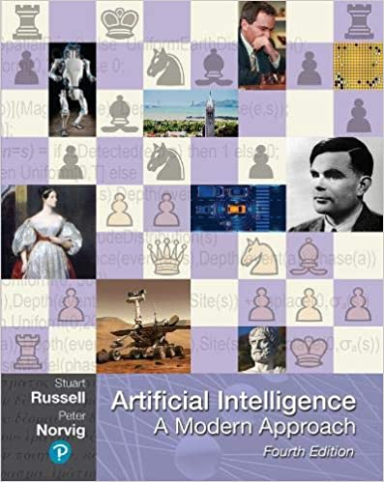
Stuart Russell and Peter Norvig (2020),
Artificial Intelligence: A Modern Approach,
4th Edition, Pearson
Source: Stuart Russell and Peter Norvig (2020), Artificial Intelligence: A Modern Approach, 4th Edition, Pearson
https://www.amazon.com/Artificial-Intelligence-A-Modern-Approach/dp/0134610997/

Slide 21

Aurélien Géron (2019),
Hands-On Machine Learning with Scikit-Learn, Keras, and TensorFlow: Concepts, Tools, and Techniques to Build Intelligent Systems, 2nd Edition
O’Reilly Media, 2019
https://github.com/ageron/handson-ml2
Source: https://www.amazon.com/Hands-Machine-Learning-Scikit-Learn-TensorFlow/dp/1492032646/

Slide 22

Hands-On Machine Learning with
Scikit-Learn, Keras, and TensorFlow
Notebooks
The Machine Learning landscape
End-to-end Machine Learning project
Classification
Training Models
Support Vector Machines
Decision Trees
Ensemble Learning and Random Forests
Dimensionality Reduction
Unsupervised Learning Techniques
Artificial Neural Nets with Keras
Training Deep Neural Networks
Custom Models and Training with TensorFlow
Loading and Preprocessing Data
Deep Computer Vision Using Convolutional Neural Networks
Processing Sequences Using RNNs and CNNs
Natural Language Processing with RNNs and Attention
Representation Learning Using Autoencoders
Reinforcement Learning
Training and Deploying TensorFlow Models at Scale
https://github.com/ageron/handson-ml2

Slide 23
AI, Big Data, Cloud Computing
Evolution of Decision Support, Business Intelligence, and Analytics
AI
AI
Cloud Computing
Big Data
DM
BI
Source: Ramesh Sharda, Dursun Delen, and Efraim Turban (2017),
Business Intelligence, Analytics, and Data Science: A Managerial Perspective, 4th Edition, Pearson

Slide 24
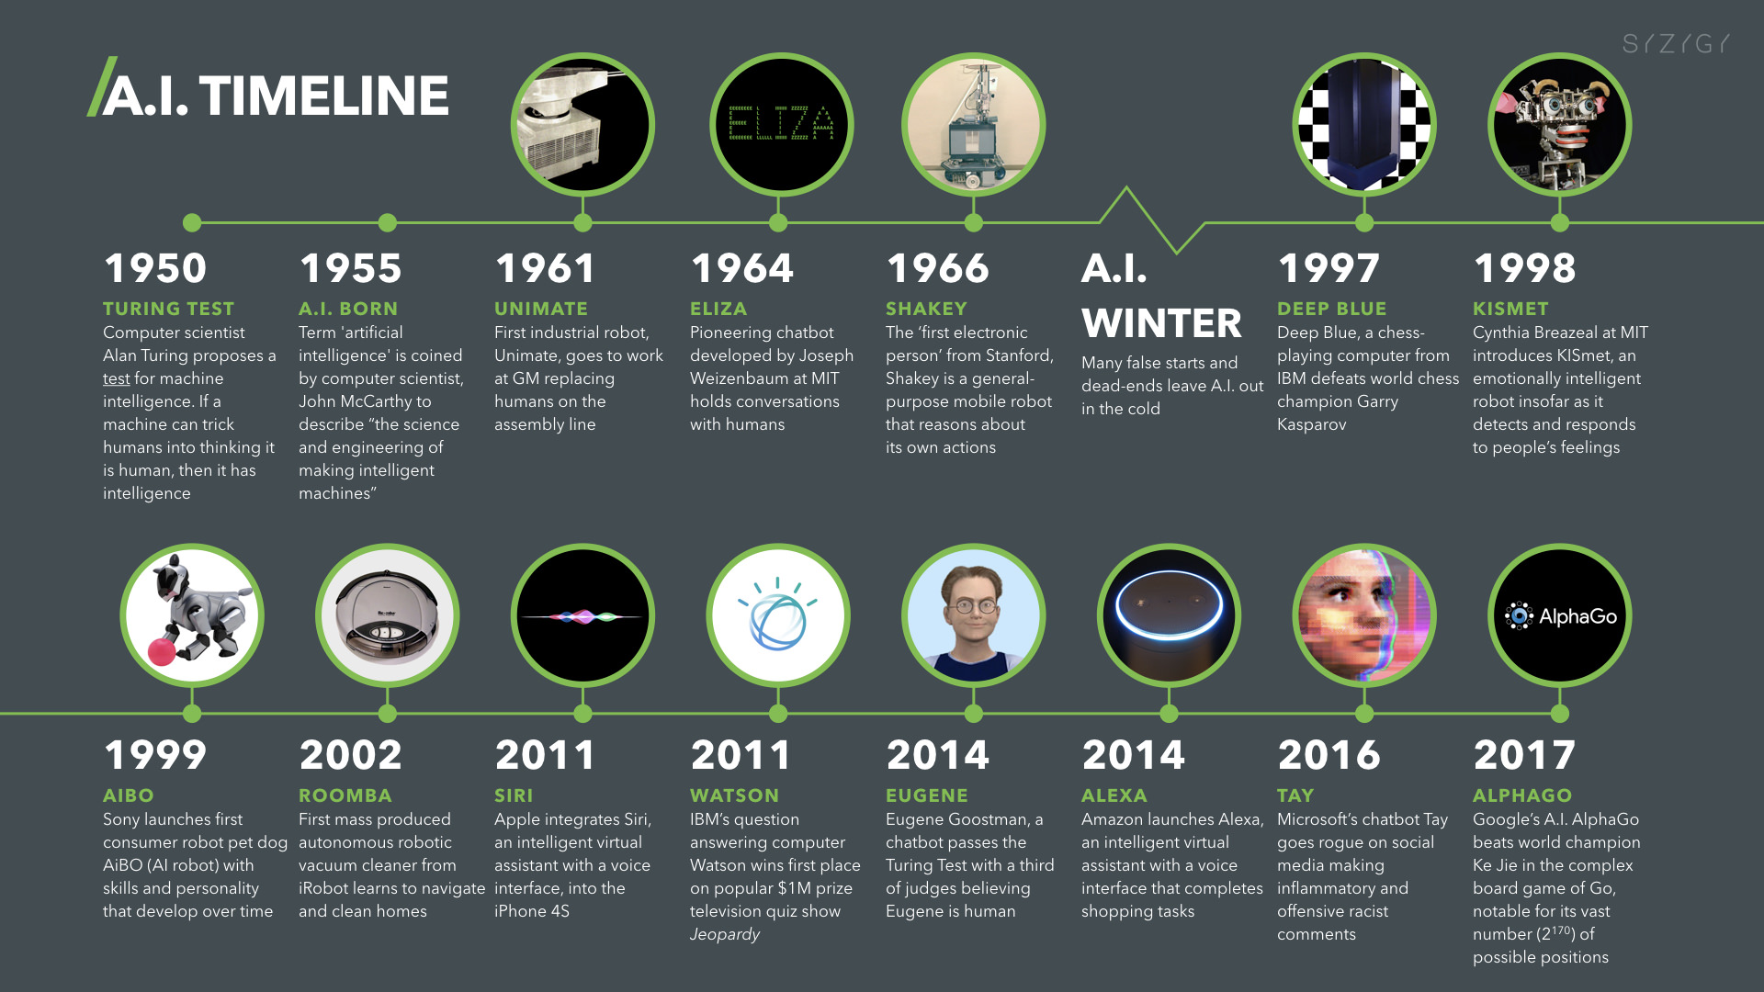
Artificial Intelligence (A.I.) Timeline
Source: https://digitalintelligencetoday.com/artificial-intelligence-timeline-infographic-from-eliza-to-tay-and-beyond/

Slide 25
The Rise of AI
Source: DHL (2018), Artificial Intelligence in Logistics,
http://www.globalhha.com/doclib/data/upload/doc_con/5e50c53c5bf67.pdf/

Slide 26
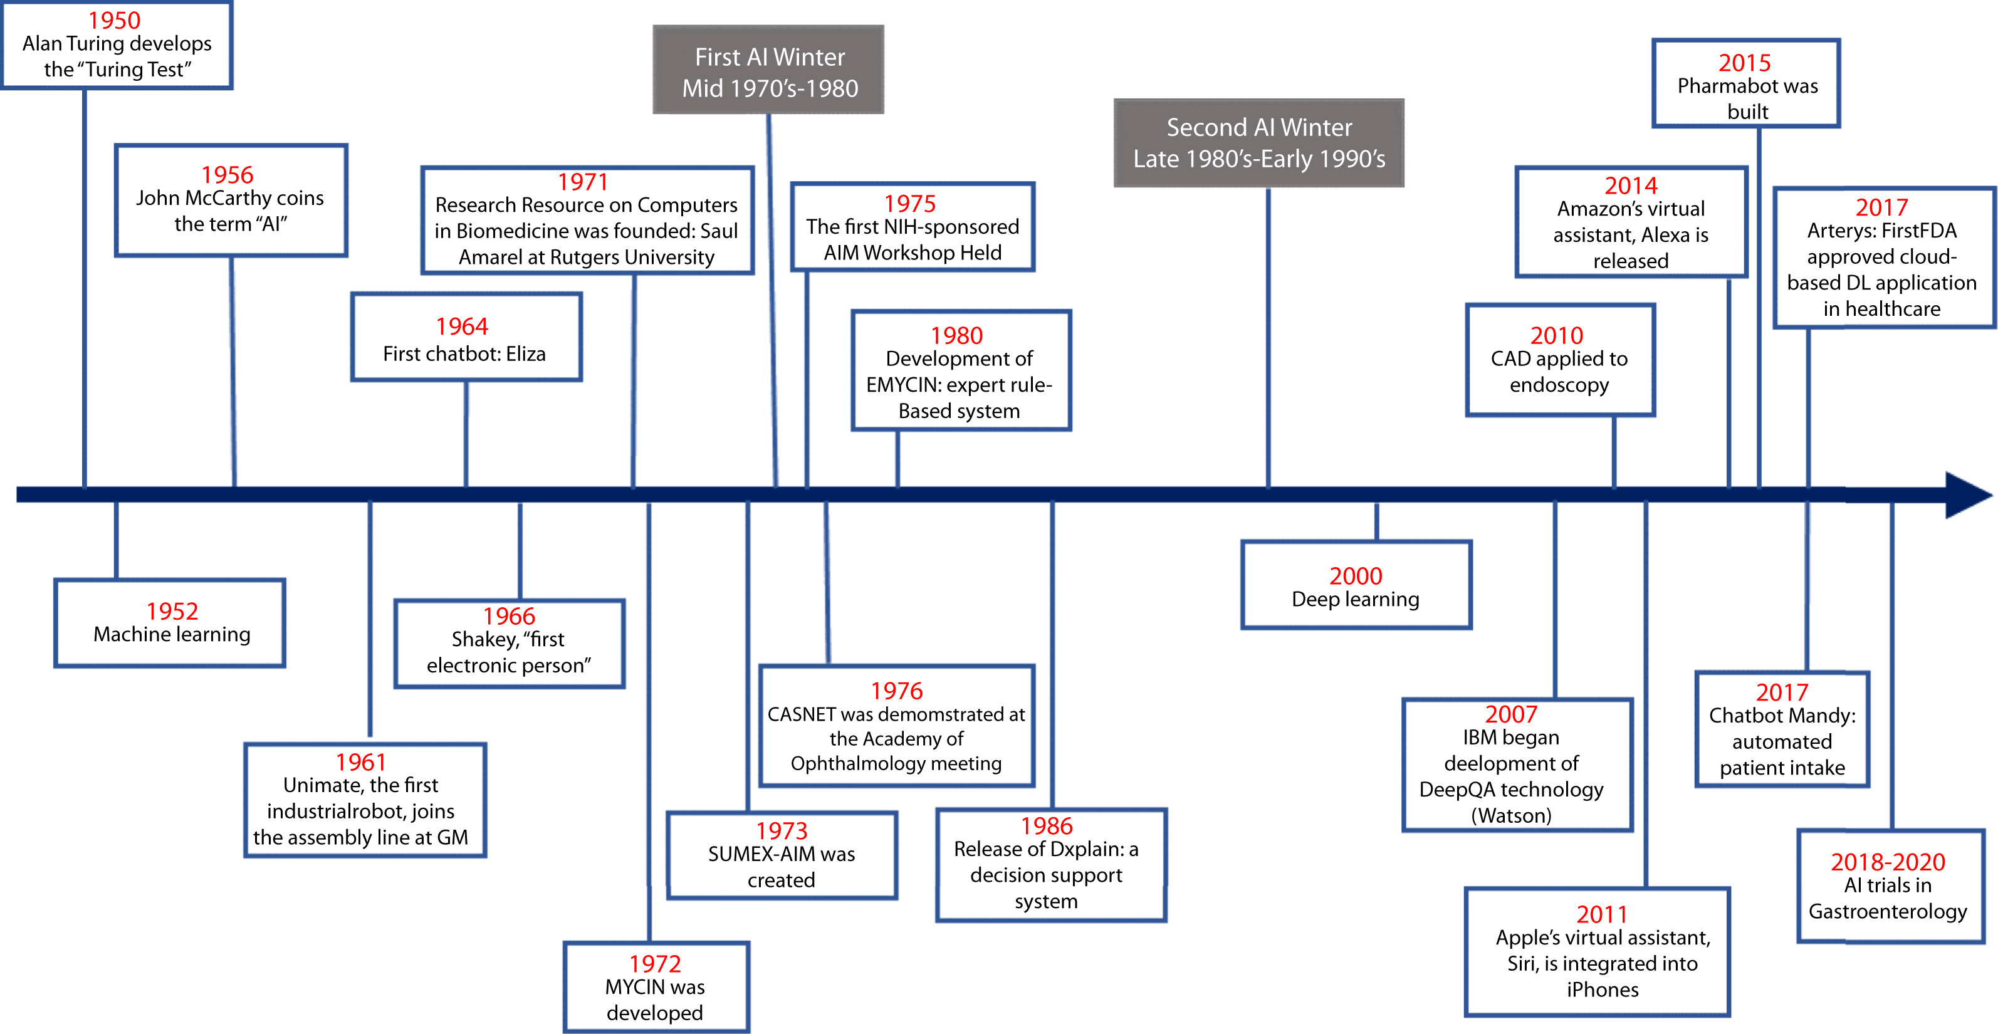
Artificial Intelligence in Medicine
Source: Vivek Kaul, Sarah Enslin, and Seth A. Gross (2020), "The history of artificial intelligence in medicine." Gastrointestinal endoscopy..

Slide 27
AI

Slide 28
Definition of
Artificial Intelligence (A.I.)

Slide 29
Artificial Intelligence
“… the science and engineering of making intelligent machines”
(John McCarthy, 1955)
Source: https://digitalintelligencetoday.com/artificial-intelligence-defined-useful-list-of-popular-definitions-from-business-and-science/

Slide 30
Artificial Intelligence
“… technology that thinks and acts like humans”
Source: https://digitalintelligencetoday.com/artificial-intelligence-defined-useful-list-of-popular-definitions-from-business-and-science/

Slide 31
Artificial Intelligence
“… intelligence exhibited by machines or software”
Source: https://digitalintelligencetoday.com/artificial-intelligence-defined-useful-list-of-popular-definitions-from-business-and-science/

Slide 32
4 Approaches of AI
Thinking Humanly | Thinking Rationally
Acting Humanly | Acting Rationally
Source: Stuart Russell and Peter Norvig (2020), Artificial Intelligence: A Modern Approach, 4th Edition, Pearson

Slide 33
4 Approaches of AI
2. Thinking Humanly: The Cognitive Modeling Approach | 3. Thinking Rationally: The “Laws of Thought” Approach
1. Acting Humanly: The Turing Test Approach (1950) | 4. Acting Rationally: The Rational Agent Approach
Source: Stuart Russell and Peter Norvig (2020), Artificial Intelligence: A Modern Approach, 4th Edition, Pearson

Slide 34
AI Acting Humanly:
The Turing Test Approach
(Alan Turing, 1950)
Knowledge Representation
Automated Reasoning
Machine Learning (ML)
  Deep Learning (DL)
Computer Vision (Image, Video)
Natural Language Processing (NLP)
Robotics
Source: Stuart Russell and Peter Norvig (2020), Artificial Intelligence: A Modern Approach, 4th Edition, Pearson

Slide 35
Artificial Intelligence:
A Modern Approach
Artificial Intelligence
Problem Solving
Knowledge and Reasoning
Uncertain Knowledge and Reasoning
Machine Learning
Communicating, Perceiving, and Acting
Philosophy and Ethics of AI
Source: Stuart Russell and Peter Norvig (2020), Artificial Intelligence: A Modern Approach, 4th Edition, Pearson

Slide 36
Artificial Intelligence:
Intelligent Agents
Source: Stuart Russell and Peter Norvig (2020), Artificial Intelligence: A Modern Approach, 4th Edition, Pearson

Slide 37
Artificial Intelligence:
2. Problem Solving
Solving Problems by Searching
Search in Complex Environments
Adversarial Search and Games
Constraint Satisfaction Problems
Source: Stuart Russell and Peter Norvig (2020), Artificial Intelligence: A Modern Approach, 4th Edition, Pearson

Slide 38
Artificial Intelligence:
3. Knowledge and Reasoning
Logical Agents
First-Order Logic
Inference in First-Order Logic
Knowledge Representation
Automated Planning
Source: Stuart Russell and Peter Norvig (2020), Artificial Intelligence: A Modern Approach, 4th Edition, Pearson

Slide 39
Artificial Intelligence:
4. Uncertain Knowledge and Reasoning
Quantifying Uncertainty
Probabilistic Reasoning
Probabilistic Reasoning over Time
Probabilistic Programming
Making Simple Decisions
Making Complex Decisions
Multiagent Decision Making
Source: Stuart Russell and Peter Norvig (2020), Artificial Intelligence: A Modern Approach, 4th Edition, Pearson

Slide 40
Artificial Intelligence:
5. Machine Learning
Learning from Examples
Learning Probabilistic Models
Deep Learning
Reinforcement Learning
Source: Stuart Russell and Peter Norvig (2020), Artificial Intelligence: A Modern Approach, 4th Edition, Pearson

Slide 41
Artificial Intelligence:
6. Communicating, Perceiving, and Acting
Natural Language Processing
Deep Learning for Natural Language Processing
Computer Vision
Robotics
Source: Stuart Russell and Peter Norvig (2020), Artificial Intelligence: A Modern Approach, 4th Edition, Pearson

Slide 42
Artificial Intelligence:
Philosophy and Ethics of AI
The Future of AI
Source: Stuart Russell and Peter Norvig (2020), Artificial Intelligence: A Modern Approach, 4th Edition, Pearson

Slide 43
Artificial Intelligence
Machine Learning & Deep Learning
Source: https://blogs.nvidia.com/blog/2016/07/29/whats-difference-artificial-intelligence-machine-learning-deep-learning-ai/

Slide 44
AI, ML, DL
Artificial Intelligence (AI)
Machine Learning (ML)
Supervised
Learning
Unsupervised Learning
Deep Learning (DL)
CNN
RNN LSTM GRU
GAN
Semi-supervised Learning
Reinforcement Learning
Source: https://leonardoaraujosantos.gitbooks.io/artificial-inteligence/content/deep_learning.html

Slide 45
3 Machine Learning Algorithms
Source: Enrico Galimberti, http://blogs.teradata.com/data-points/tree-machine-learning-algorithms/

Slide 46
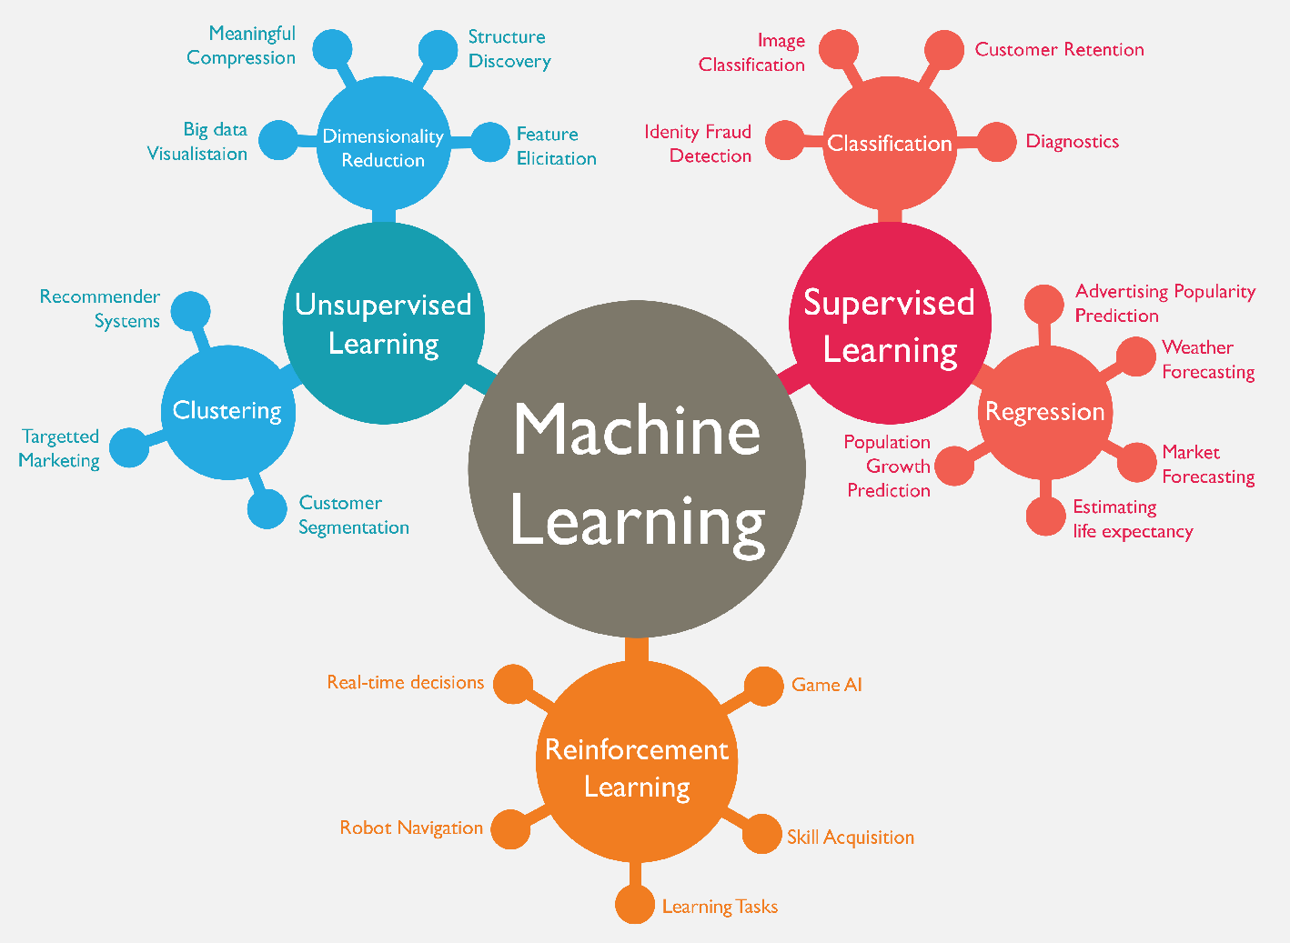
Machine Learning (ML)
Source: https://www.mactores.com/services/aws-big-data-machine-learning-cognitive-services/

Slide 47
Machine Learning (ML) / Deep Learning (DL)
Decision Tree Classifiers
Support Vector Machine (SVM)
Supervised Learning
Neural Network (NN)
Linear Classifiers
Deep Learning (DL)
Machine Learning
(ML)
Rule-based Classifiers
Naïve Bayes
(NB)
Unsupervised Learning
Probabilistic Classifiers
Bayesian Network (BN)
Maximum Entropy (ME)
Reinforcement Learning
Source: Jesus Serrano-Guerrero, Jose A. Olivas, Francisco P. Romero, and Enrique Herrera-Viedma (2015),
"Sentiment analysis: A review and comparative analysis of web services," Information Sciences, 311, pp. 18-38.

Slide 48
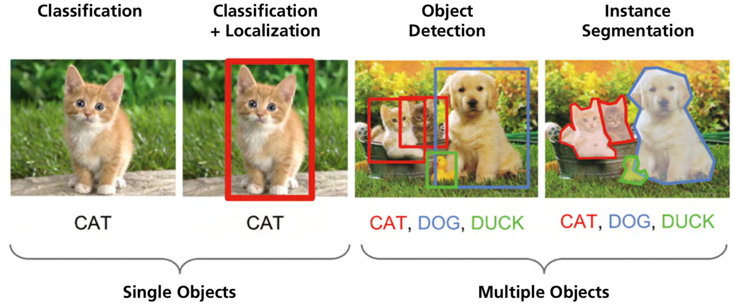
Computer Vision: Image Classification,
Object Detection,
Object Instance Segmentation
Source: DHL (2018), Artificial Intelligence in Logistics,
http://www.globalhha.com/doclib/data/upload/doc_con/5e50c53c5bf67.pdf/

Slide 49
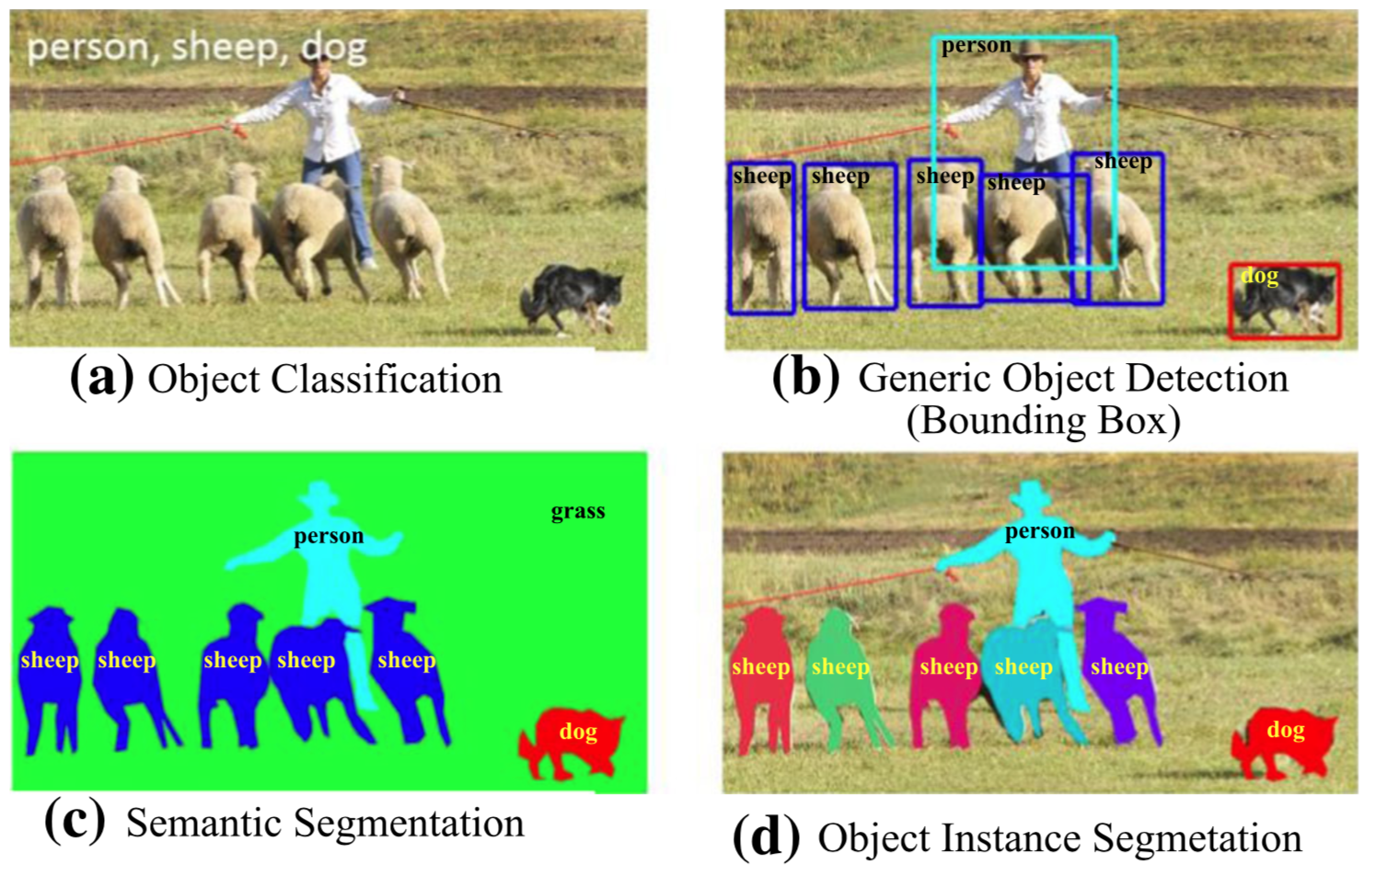
Computer Vision: Object Detection
Source: Li Liu, Wanli Ouyang, Xiaogang Wang, Paul Fieguth, Jie Chen, Xinwang Liu, and Matti Pietikäinen. "Deep learning for generic object detection: A survey." International journal of computer vision 128, no. 2 (2020): 261-318.

Slide 50
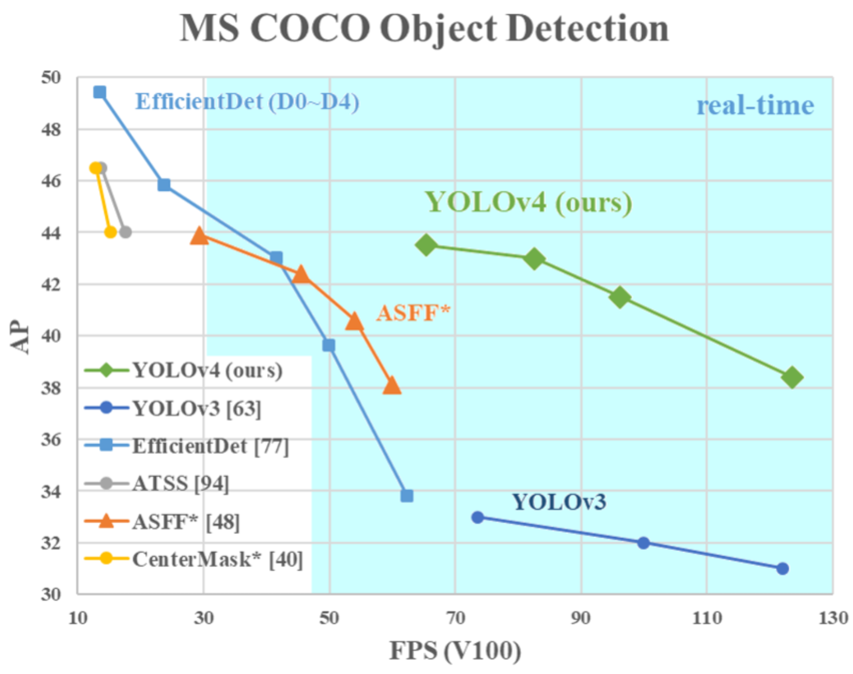
YOLOv4:
Optimal Speed and Accuracy of Object Detection
Source: Alexey Bochkovskiy, Chien-Yao Wang, and Hong-Yuan Mark Liao. "YOLOv4: Optimal Speed and Accuracy of Object Detection." arXiv preprint arXiv:2004.10934 (2020).

Slide 51
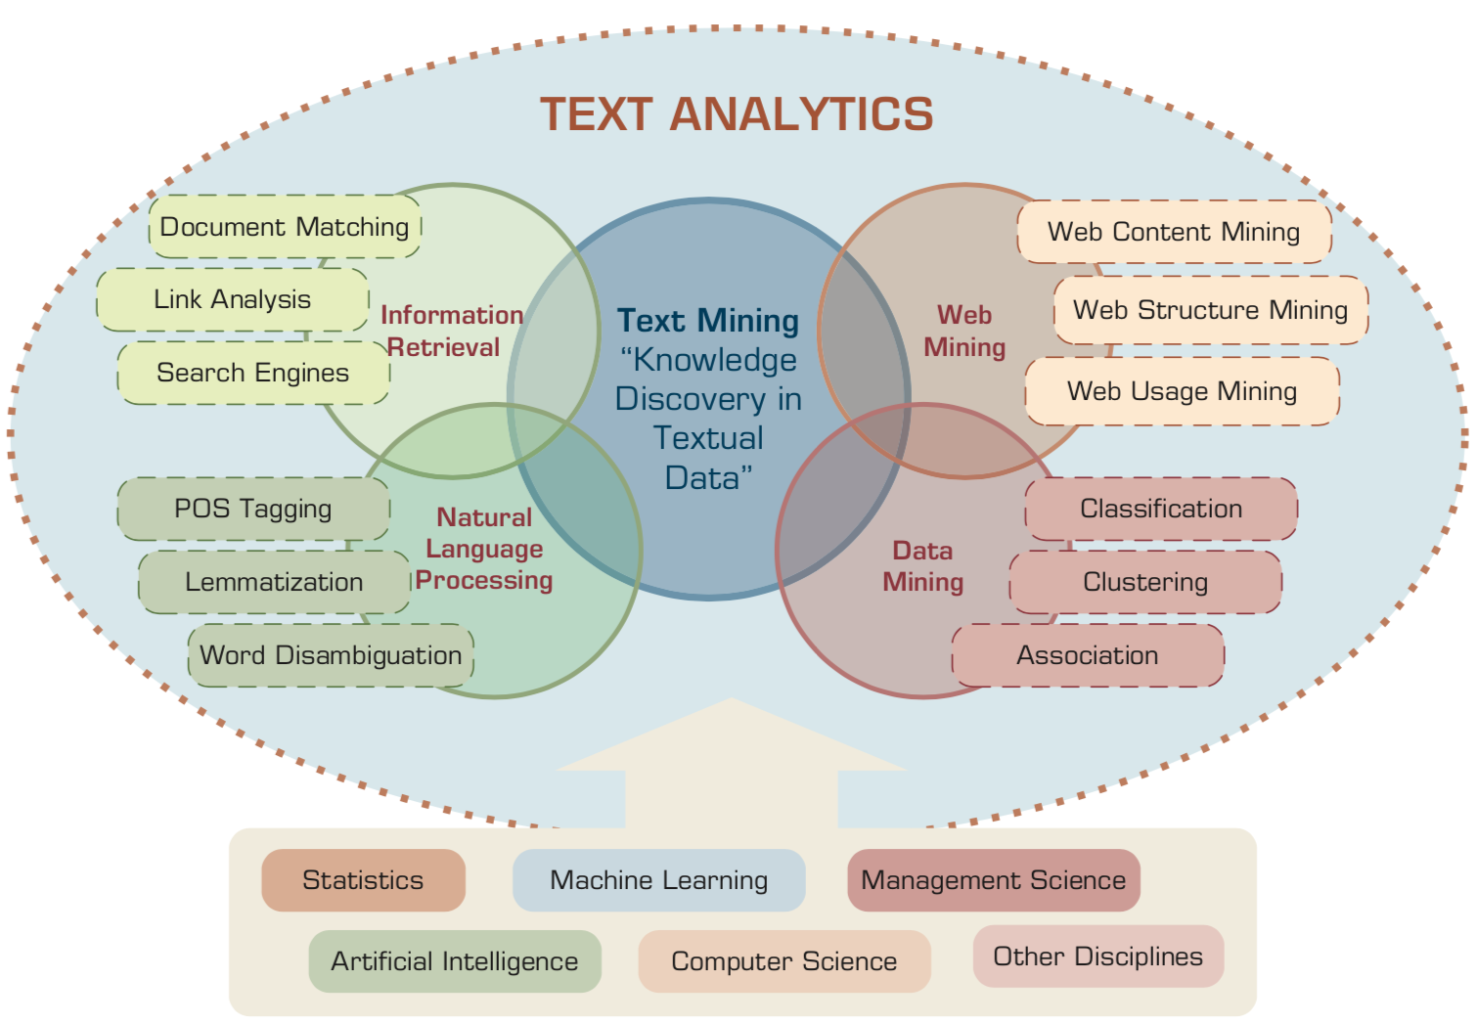
Text Analytics and Text Mining
Source: Ramesh Sharda, Dursun Delen, and Efraim Turban (2017), Business Intelligence, Analytics, and Data Science: A Managerial Perspective, 4th Edition, Pearson

Slide 52
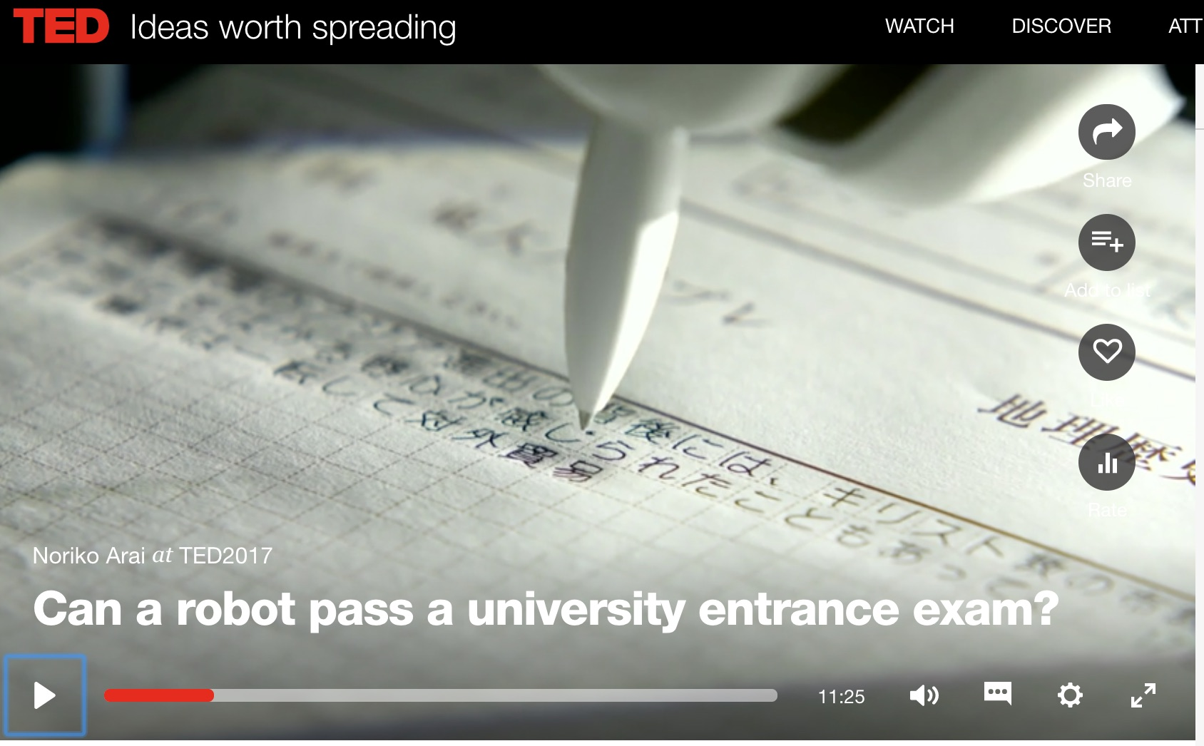
Can a robot pass a university entrance exam?
Noriko Arai at TED2017
https://www.ted.com/talks/noriko_arai_can_a_robot_pass_a_university_entrance_exam
https://www.youtube.com/watch?v=XQZjkPyJ8KU

Slide 53

Python in Google Colab (Python101)
https://colab.research.google.com/drive/1FEG6DnGvwfUbeo4zJ1zTunjMqf2RkCrT
https://tinyurl.com/aintpupython101

Slide 54
Summary
This course introduces the fundamental concepts,
research issues, and hands-on practices of Artificial Intelligence.
Topics include
  Introduction to Artificial Intelligence
  Artificial Intelligence and Intelligent Agents
  Problem Solving
  Knowledge, Reasoning and Knowledge Representation, Uncertain Knowledge and Reasoning
  Supervised Learning
  The Theory of Learning and Ensemble Learning
  Deep Learning, Reinforcement Learning
  Natural Language Processing, Deep Learning for Natural Language Processing
  Robotics
  Philosophy and Ethics of AI and the Future of AI
  Case Study on AI.

Slide 55
人工智慧
(Artificial Intelligence)
Contact Information
戴敏育 博士 (Min-Yuh Day, Ph.D.)
副教授 (Associate Professor)
國立臺北大學 資訊管理研究所
Institute of Information Management, National Taipei University
電話： 02-86741111 ext. 66873
研究室： 商8F12
地址： 23741 新北市三峽區大學路 151 號
Email：myday@gm.ntpu.edu.tw
網址：http://web.ntpu.edu.tw/~myday/

