Slide 1



大數據分析
(Big Data Analysis)
AI人工智慧與大數據分析
(AI and Big Data Analysis)
1091BDA02
MBA, IM, NTPU (M5127) (Fall 2020)
Wed 7, ,8, 9 (15:10-18:00) (B8F40)
Min-Yuh Day
戴敏育
Associate Professor
副教授
Institute of Information Management, National Taipei University
國立臺北大學 資訊管理研究所
https://web.ntpu.edu.tw/~myday
2020-09-23

Slide 2
課程大綱 (Syllabus)
週次 (Week) 日期 (Date) 內容 (Subject/Topics)
1 2020/09/16 大數據分析介紹 (Introduction to Big Data Analysis)
2 2020/09/23 AI人工智慧與大數據分析
(AI and Big Data Analysis)
3 2020/09/30 Python 大數據分析基礎
(Foundations of Big Data Analysis in Python)
4 2020/10/07 數位沙盒第一堂課：數位沙盒服務平台簡介
(Digital Sandbox Lesson 1: Introduction to
FintechSpace Digital Sandbox)
5 2020/10/14 數位沙盒第二堂課：工程師操作說明與實作教學
(Digital Sandbox Lesson 2: Hands-on Practices)
6 2020/10/21 Python Pandas 大數據量化分析
(Quantitative Big Data Analysis with Pandas in Python)

Slide 3
課程大綱 (Syllabus)
週次 (Week) 日期 (Date) 內容 (Subject/Topics)
7 2020/10/28 數位沙盒第三堂課：學生小組討論實作與成果發表
(Digital Sandbox Lesson 3: Learning Teams
Hands-on Project Discussion and Project Presentation)
8 2020/11/04 Python Scikit-Learn 機器學習 I
(Machine Learning with Scikit-Learn In Python I)
9 2020/11/11 期中報告 (Midterm Project Report)
10 2020/11/18 Python Scikit-Learn 機器學習 II
(Machine Learning with Scikit-Learn In Python II)
11 2020/11/25 TensorFlow 深度學習金融大數據分析 I
(Deep Learning for Finance Big Data Analysis with TensorFlow I)
12 2020/12/02 大數據分析個案研究
(Case Study on Big Data Analysis)

Slide 4
課程大綱 (Syllabus)
週次 (Week) 日期 (Date) 內容 (Subject/Topics)
13 2020/12/09 TensorFlow 深度學習金融大數據分析 II
(Deep Learning for Finance Big Data Analysis with TensorFlow II)
14 2020/12/16 TensorFlow 深度學習金融大數據分析 III
(Deep Learning for Finance Big Data Analysis with TensorFlow III)
15 2020/12/23 AI 機器人理財顧問
(Artificial Intelligence for Robo-Advisors)
16 2020/12/30 金融科技智慧型交談機器人
(Conversational Commerce and
Intelligent Chatbots for Fintech)
17 2021/01/06 期末報告 I (Final Project Report I)
18 2021/01/13 期末報告 II (Final Project Report I)

Slide 5
Outline
AI
Big Data Analytics

Slide 6
AI, Big Data, Cloud Computing
Evolution of Decision Support, Business Intelligence, and Analytics
AI
AI
Cloud Computing
Big Data
DM
BI
Source: Ramesh Sharda, Dursun Delen, and Efraim Turban (2017),
Business Intelligence, Analytics, and Data Science: A Managerial Perspective, 4th Edition, Pearson

Slide 7
AI

Slide 8
Definition of
Artificial Intelligence (A.I.)

Slide 9
Artificial Intelligence
“… the science and engineering of making intelligent machines”
(John McCarthy, 1955)
Source: https://digitalintelligencetoday.com/artificial-intelligence-defined-useful-list-of-popular-definitions-from-business-and-science/

Slide 10
Artificial Intelligence
“… technology that thinks and acts like humans”
Source: https://digitalintelligencetoday.com/artificial-intelligence-defined-useful-list-of-popular-definitions-from-business-and-science/

Slide 11
Artificial Intelligence
“… intelligence exhibited by machines or software”
Source: https://digitalintelligencetoday.com/artificial-intelligence-defined-useful-list-of-popular-definitions-from-business-and-science/

Slide 12
4 Approaches of AI
Thinking Humanly | Thinking Rationally
Acting Humanly | Acting Rationally
Source: Stuart Russell and‎ Peter Norvig (2016) , Artificial Intelligence: A Modern Approach, 3rd Edition, Pearson International

Slide 13
4 Approaches of AI
2. Thinking Humanly: The Cognitive Modeling Approach | 3. Thinking Rationally: The “Laws of Thought” Approach
1. Acting Humanly: The Turing Test Approach (1950) | 4. Acting Rationally: The Rational Agent Approach
Source: Stuart Russell and‎ Peter Norvig (2016) , Artificial Intelligence: A Modern Approach, 3rd Edition, Pearson International

Slide 14
AI Acting Humanly:
The Turing Test Approach
(Alan Turing, 1950)
Natural Language Processing (NLP)
Knowledge Representation
Automated Reasoning
Machine Learning (ML)
Computer Vision
Robotics
Source: Stuart Russell and‎ Peter Norvig (2016) , Artificial Intelligence: A Modern Approach, 3rd Edition, Pearson International

Slide 15
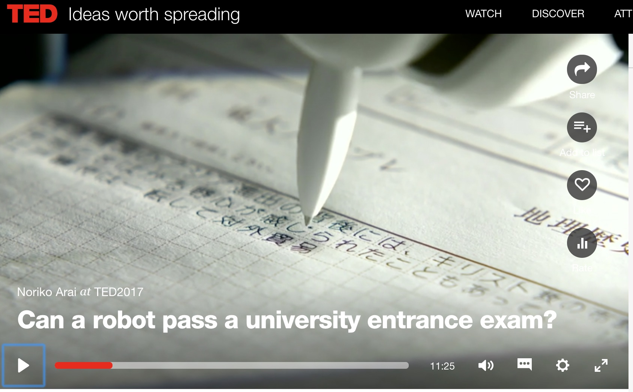
Can a robot pass a university entrance exam?
Noriko Arai at TED2017
https://www.ted.com/talks/noriko_arai_can_a_robot_pass_a_university_entrance_exam
https://www.youtube.com/watch?v=XQZjkPyJ8KU

Slide 16
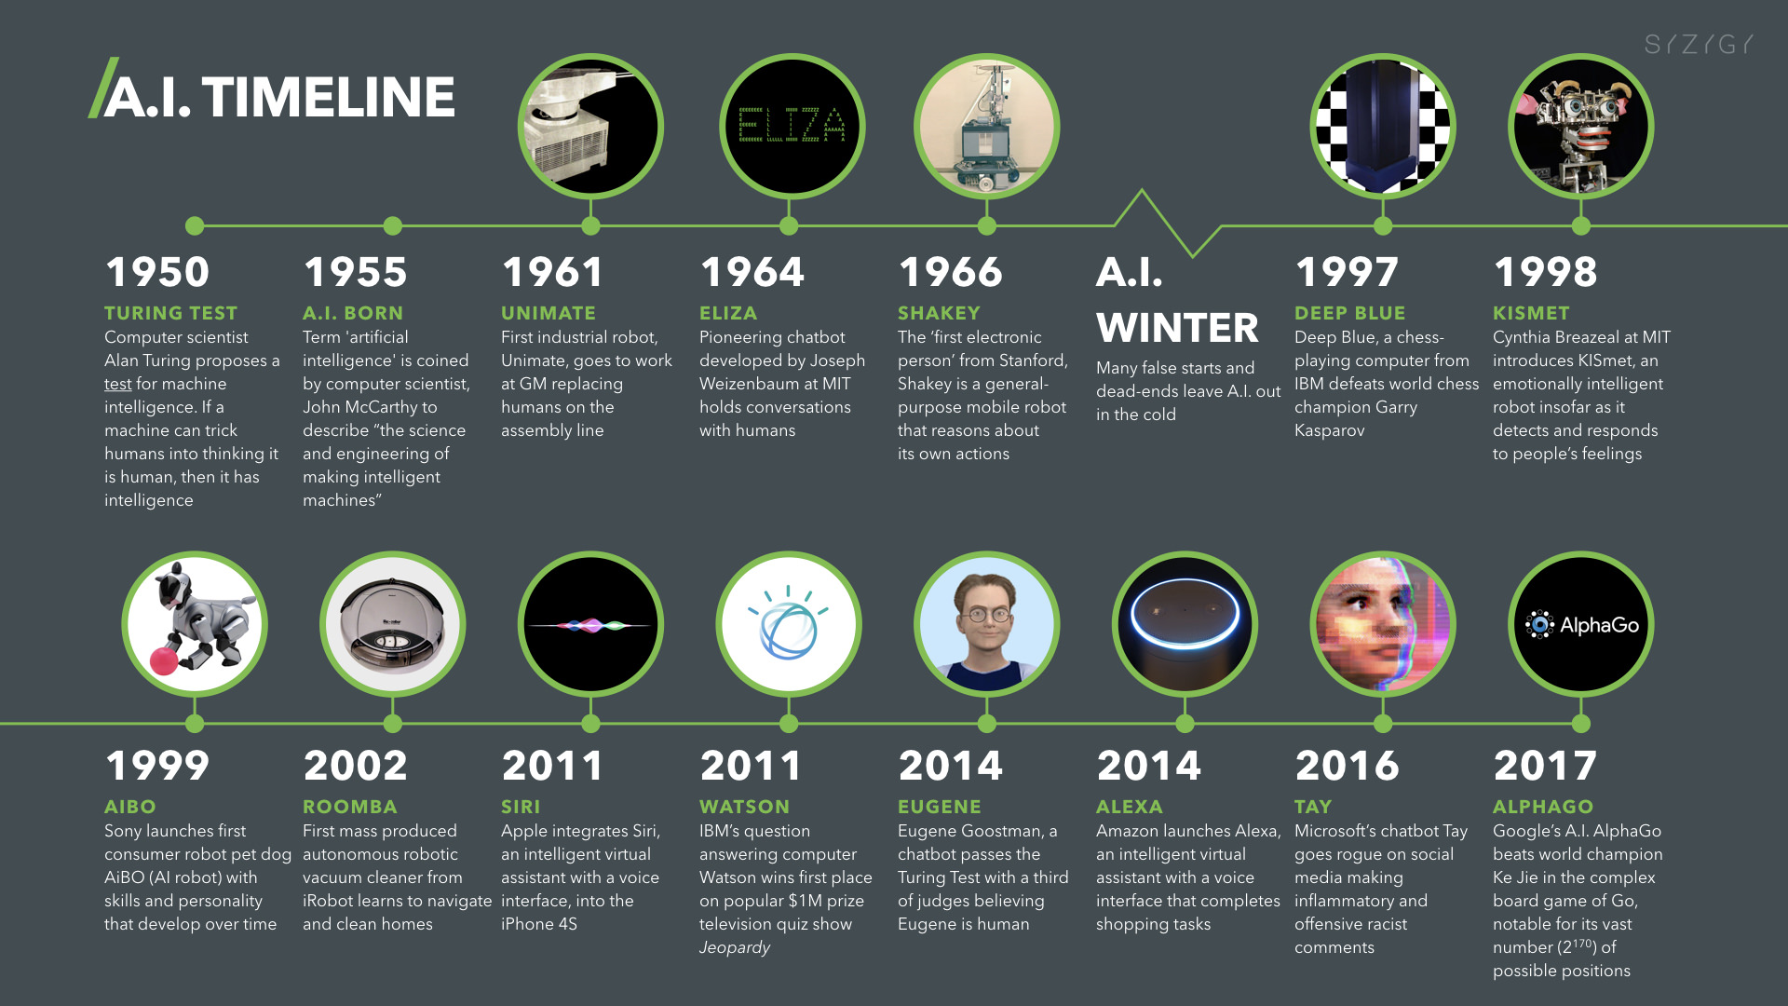
Artificial Intelligence (A.I.) Timeline
Source: https://digitalintelligencetoday.com/artificial-intelligence-timeline-infographic-from-eliza-to-tay-and-beyond/

Slide 17
Artificial Intelligence
Machine Learning & Deep Learning
Source: https://blogs.nvidia.com/blog/2016/07/29/whats-difference-artificial-intelligence-machine-learning-deep-learning-ai/

Slide 18
AI, ML, DL
Artificial Intelligence (AI)
Machine Learning (ML)
Supervised
Learning
Unsupervised Learning
Deep Learning (DL)
CNN
RNN LSTM GRU
GAN
Semi-supervised Learning
Reinforcement Learning
Source: https://leonardoaraujosantos.gitbooks.io/artificial-inteligence/content/deep_learning.html

Slide 19
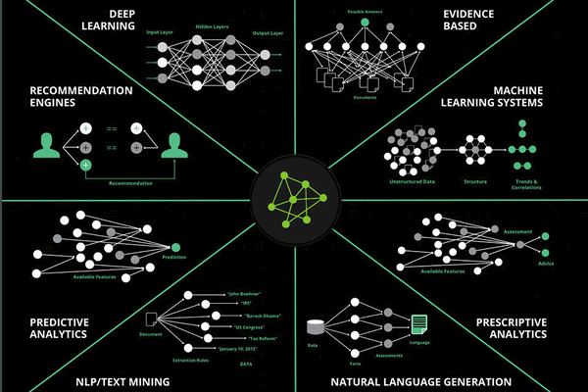
Artificial Intelligence (AI) is many things
Ecosystem of AI
Source: https://www.i-scoop.eu/artificial-intelligence-cognitive-computing/

Slide 20
Deep Learning Evolution
Deep Learning
Source: http://www.erogol.com/brief-history-machine-learning/

Slide 21
3 Machine Learning Algorithms
Source: Enrico Galimberti, http://blogs.teradata.com/data-points/tree-machine-learning-algorithms/

Slide 22
Machine Learning (ML) / Deep Learning (DL)
Decision Tree Classifiers
Support Vector Machine (SVM)
Supervised Learning
Neural Network (NN)
Linear Classifiers
Deep Learning (DL)
Machine Learning
(ML)
Rule-based Classifiers
Naïve Bayes
(NB)
Unsupervised Learning
Probabilistic Classifiers
Bayesian Network (BN)
Maximum Entropy (ME)
Reinforcement Learning
Source: Jesus Serrano-Guerrero, Jose A. Olivas, Francisco P. Romero, and Enrique Herrera-Viedma (2015),
"Sentiment analysis: A review and comparative analysis of web services," Information Sciences, 311, pp. 18-38.

Slide 23
Deep learning for financial applications:
A survey
Applied Soft Computing (2020)
Source:
Ahmet Murat Ozbayoglu, Mehmet Ugur Gudelek, and Omer Berat Sezer (2020). "Deep learning for financial applications: A survey."
Applied Soft Computing (2020): 106384.

Slide 24
Financial time series forecasting with deep learning:
A systematic literature review:
2005–2019
Applied Soft Computing (2020)
Source:
Omer Berat Sezer, Mehmet Ugur Gudelek, and Ahmet Murat Ozbayoglu (2020), "Financial time series forecasting with deep learning: A systematic literature review: 2005–2019." Applied Soft Computing 90 (2020): 106181.

Slide 25
Deep learning for financial applications: Topics
Source: Ahmet Murat Ozbayoglu, Mehmet Ugur Gudelek, and Omer Berat Sezer (2020). "Deep learning for financial applications: A survey." Applied Soft Computing (2020): 106384.

Slide 26
Deep learning for financial applications: Deep Learning Models
Source: Ahmet Murat Ozbayoglu, Mehmet Ugur Gudelek, and Omer Berat Sezer (2020). "Deep learning for financial applications: A survey." Applied Soft Computing (2020): 106384.

Slide 27
Deep learning for financial applications: Topic-Model Heatmap
Source: Ahmet Murat Ozbayoglu, Mehmet Ugur Gudelek, and Omer Berat Sezer (2020). "Deep learning for financial applications: A survey." Applied Soft Computing (2020): 106384.

Slide 28
Deep learning for financial applications: Topic-Feature Heatmap
Source: Ahmet Murat Ozbayoglu, Mehmet Ugur Gudelek, and Omer Berat Sezer (2020). "Deep learning for financial applications: A survey." Applied Soft Computing (2020): 106384.

Slide 29
Deep learning for financial applications: Topic-Dataset Heatmap
Source: Ahmet Murat Ozbayoglu, Mehmet Ugur Gudelek, and Omer Berat Sezer (2020). "Deep learning for financial applications: A survey." Applied Soft Computing (2020): 106384.

Slide 30
Deep learning for financial applications:
Algo-trading applications embedded with time series forecasting models
Source: Ahmet Murat Ozbayoglu, Mehmet Ugur Gudelek, and Omer Berat Sezer (2020). "Deep learning for financial applications: A survey." Applied Soft Computing (2020): 106384.

Slide 31
Deep learning for financial applications:
Algo-trading applications embedded with time series forecasting models
Source: Ahmet Murat Ozbayoglu, Mehmet Ugur Gudelek, and Omer Berat Sezer (2020). "Deep learning for financial applications: A survey." Applied Soft Computing (2020): 106384.

Slide 32
Deep learning for financial applications:
Classification (buy–sell signal, or trend detection) based algo-trading models
Source: Ahmet Murat Ozbayoglu, Mehmet Ugur Gudelek, and Omer Berat Sezer (2020). "Deep learning for financial applications: A survey." Applied Soft Computing (2020): 106384.

Slide 33
Deep learning for financial applications:
Stand-alone and/or other algorithmic models
Source: Ahmet Murat Ozbayoglu, Mehmet Ugur Gudelek, and Omer Berat Sezer (2020). "Deep learning for financial applications: A survey." Applied Soft Computing (2020): 106384.

Slide 34
Deep learning for financial applications:
Credit scoring or classification studies
Source: Ahmet Murat Ozbayoglu, Mehmet Ugur Gudelek, and Omer Berat Sezer (2020). "Deep learning for financial applications: A survey." Applied Soft Computing (2020): 106384.

Slide 35
Deep learning for financial applications:
Financial distress, bankruptcy, bank risk, mortgage risk, crisis forecasting studies.
Source: Ahmet Murat Ozbayoglu, Mehmet Ugur Gudelek, and Omer Berat Sezer (2020). "Deep learning for financial applications: A survey." Applied Soft Computing (2020): 106384.

Slide 36
Deep learning for financial applications:
Fraud detection studies
Source: Ahmet Murat Ozbayoglu, Mehmet Ugur Gudelek, and Omer Berat Sezer (2020). "Deep learning for financial applications: A survey." Applied Soft Computing (2020): 106384.

Slide 37
Deep learning for financial applications:
Portfolio management studies
Source: Ahmet Murat Ozbayoglu, Mehmet Ugur Gudelek, and Omer Berat Sezer (2020). "Deep learning for financial applications: A survey." Applied Soft Computing (2020): 106384.

Slide 38
Deep learning for financial applications:
Asset pricing and derivatives market studies
Source: Ahmet Murat Ozbayoglu, Mehmet Ugur Gudelek, and Omer Berat Sezer (2020). "Deep learning for financial applications: A survey." Applied Soft Computing (2020): 106384.

Slide 39
Deep learning for financial applications:
Cryptocurrency and blockchain studies
Source: Ahmet Murat Ozbayoglu, Mehmet Ugur Gudelek, and Omer Berat Sezer (2020). "Deep learning for financial applications: A survey." Applied Soft Computing (2020): 106384.

Slide 40
Deep learning for financial applications:
Financial sentiment studies coupled with text mining for forecasting
Source: Ahmet Murat Ozbayoglu, Mehmet Ugur Gudelek, and Omer Berat Sezer (2020). "Deep learning for financial applications: A survey." Applied Soft Computing (2020): 106384.

Slide 41
Deep learning for financial applications:
Text mining studies without sentiment analysis for forecasting
Source: Ahmet Murat Ozbayoglu, Mehmet Ugur Gudelek, and Omer Berat Sezer (2020). "Deep learning for financial applications: A survey." Applied Soft Computing (2020): 106384.

Slide 42
Deep learning for financial applications:
Text mining studies without sentiment analysis for forecasting
Source: Ahmet Murat Ozbayoglu, Mehmet Ugur Gudelek, and Omer Berat Sezer (2020). "Deep learning for financial applications: A survey." Applied Soft Computing (2020): 106384.

Slide 43
Deep learning for financial applications:
Financial sentiment studies coupled with text mining without forecasting
Source: Ahmet Murat Ozbayoglu, Mehmet Ugur Gudelek, and Omer Berat Sezer (2020). "Deep learning for financial applications: A survey." Applied Soft Computing (2020): 106384.

Slide 44
Deep learning for financial applications:
Other text mining studies
Source: Ahmet Murat Ozbayoglu, Mehmet Ugur Gudelek, and Omer Berat Sezer (2020). "Deep learning for financial applications: A survey." Applied Soft Computing (2020): 106384.

Slide 45
Deep learning for financial applications:
Other theoretical or conceptual studies
Source: Ahmet Murat Ozbayoglu, Mehmet Ugur Gudelek, and Omer Berat Sezer (2020). "Deep learning for financial applications: A survey." Applied Soft Computing (2020): 106384.

Slide 46
Deep learning for financial applications:
Other financial applications
Source: Ahmet Murat Ozbayoglu, Mehmet Ugur Gudelek, and Omer Berat Sezer (2020). "Deep learning for financial applications: A survey." Applied Soft Computing (2020): 106384.

Slide 47
Financial time series forecasting with deep learning: Topic-model heatmap
Source: Omer Berat Sezer, Mehmet Ugur Gudelek, and Ahmet Murat Ozbayoglu (2020), "Financial time series forecasting with deep learning:
A systematic literature review: 2005–2019." Applied Soft Computing 90 (2020): 106181.

Slide 48
Stock price forecasting using only raw time series data
Source: Omer Berat Sezer, Mehmet Ugur Gudelek, and Ahmet Murat Ozbayoglu (2020), "Financial time series forecasting with deep learning:
A systematic literature review: 2005–2019." Applied Soft Computing 90 (2020): 106181.

Slide 49
Stock price forecasting using various data
Source: Omer Berat Sezer, Mehmet Ugur Gudelek, and Ahmet Murat Ozbayoglu (2020), "Financial time series forecasting with deep learning:
A systematic literature review: 2005–2019." Applied Soft Computing 90 (2020): 106181.

Slide 50
Stock Market Movement Forecast:
Phases of the stock market modeling
Source: O. Bustos and A. Pomares-Quimbaya (2020), "Stock Market Movement Forecast: A Systematic Review."
Expert Systems with Applications (2020): 113464.

Slide 51
Big Data Analytics

Slide 52
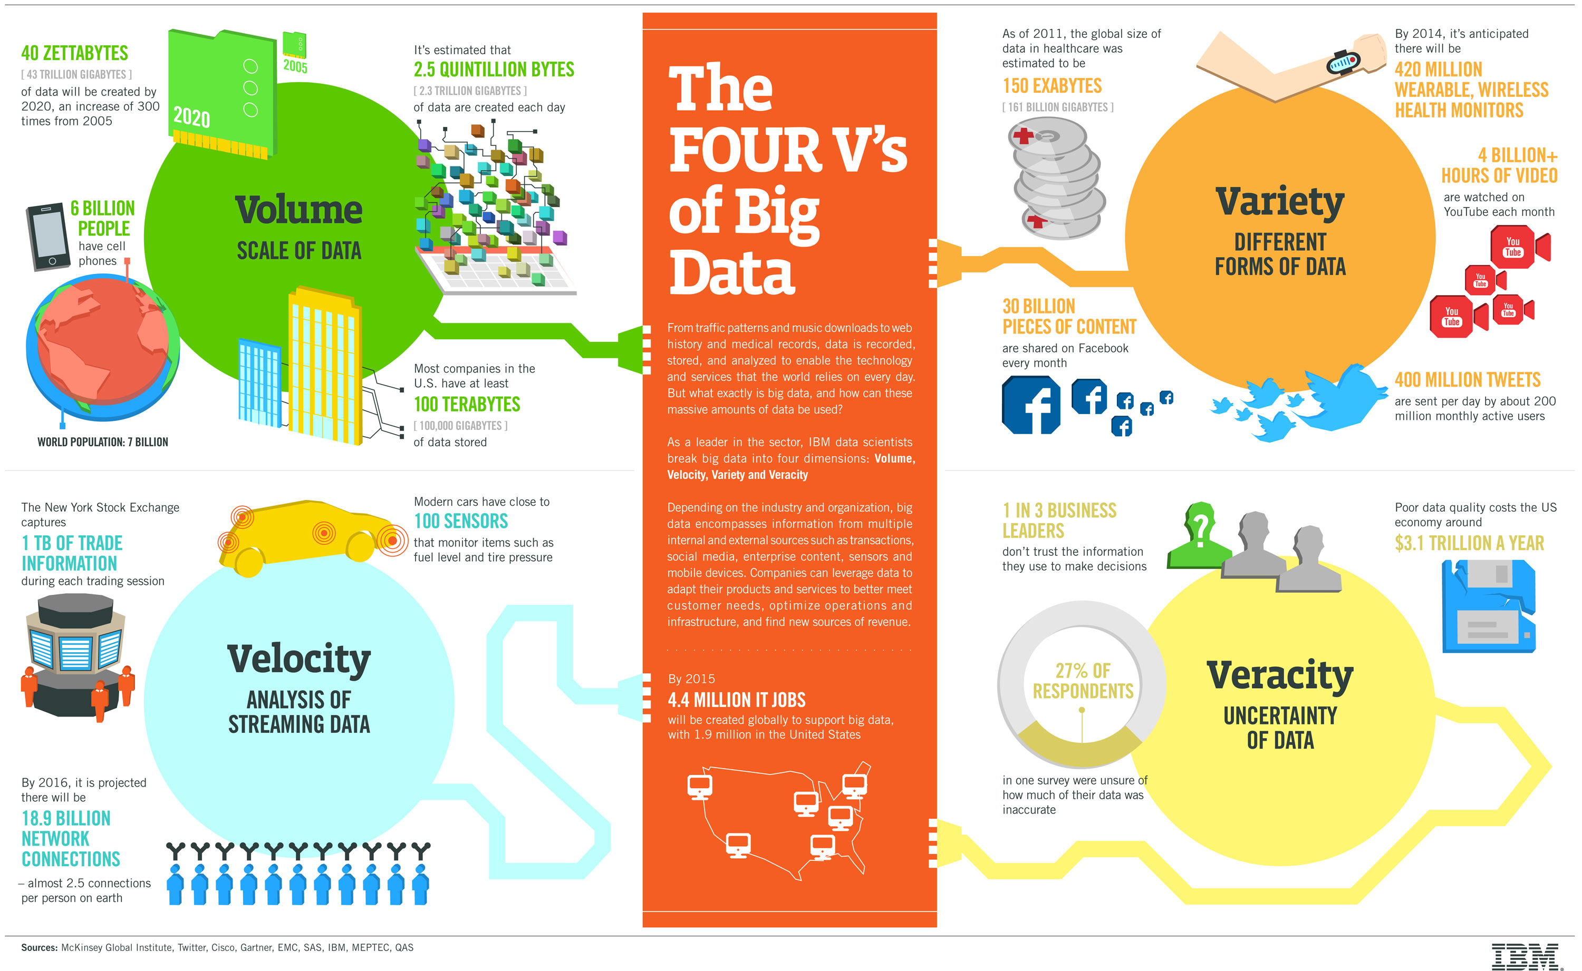
Big Data 4 V
Source: https://www-01.ibm.com/software/data/bigdata/

Slide 53
Value

Slide 54
Value Creation by Big Data Analytics
(Grover et al., 2018)
Source: Varun Grover, Roger HL Chiang, Ting-Peng Liang, and Dongsong Zhang (2018), "Creating Strategic Business Value from Big Data Analytics: A Research Framework", Journal of Management Information Systems, 35, no. 2, pp. 388-423.

Slide 55
Research Landscape of
Business Intelligence and Big Data Analytics: A bibliometrics study
A bibliometric analysis on Big Data and Business Intelligence from 1990 to 2016.
Big Data papers grow much faster than Business Intelligence papers
Computer Science and information systems are two core disciplines.
Most influential papers are identified and a research framework is proposed.
Source: Ting-Peng Liang and Yu-Hsi Liu (2018), "Research Landscape of Business Intelligence and Big Data analytics: A bibliometrics study”,
Expert Systems with Applications, Volume 111, 30, 2018, pp. 2-10

Slide 56
Evolution of top keywords in
“BD & BI” publications
2014
2015
2016
2017
Management
Text Mining
Data Mining
Data Science
Big Data Analytics
Social Media
Business Analytics
Information System
Cloud Computing
Data Warehouse
Knowledge Management
Source: Ting-Peng Liang and Yu-Hsi Liu (2018), "Research Landscape of Business Intelligence and Big Data analytics: A bibliometrics study”,
Expert Systems with Applications, Volume 111, 30, 2018, pp. 2-10

Slide 57
Framework for BD and BI Research
Data Collection
Data Storage
Data Analytics
Infrastructure
Business
Medicate
Supply Chain
Engineering
Services
Technology
Application
Impact
Management
Adoption of BD/BI
Cost Benefit
Security/Privacy
Human Resource
Value Creation
Individual Impact
Organizational Impact
Social Impact
Source: Ting-Peng Liang and Yu-Hsi Liu (2018), "Research Landscape of Business Intelligence and Big Data analytics: A bibliometrics study”,
Expert Systems with Applications, Volume 111, 30, 2018, pp. 2-10

Slide 58
Business Intelligence and Big Data analytics
Source: Ting-Peng Liang and Yu-Hsi Liu (2018), "Research Landscape of Business Intelligence and Big Data analytics: A bibliometrics study”,
Expert Systems with Applications, Volume 111, 30, 2018, pp. 2-10

Slide 59
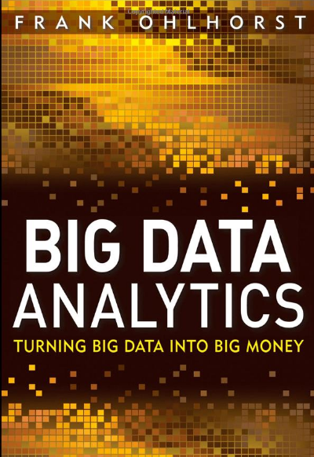
Source: http://www.amazon.com/Big-Data-Analytics-Turning-Money/dp/1118147596

Slide 60
Business Intelligence, Analytics, and Data Science:
A Managerial Perspective, 4th Edition,
Ramesh Sharda, Dursun Delen, and Efraim Turban,
Pearson, 2017.
Source: https://www.amazon.com/Business-Intelligence-Analytics-Data-Science/dp/0134633288

Slide 61
Big Data, Data Mining, and Machine Learning: Value Creation for Business Leaders and Practitioners,
Jared Dean,
Wiley, 2014.
Source: https://www.amazon.com/Data-Mining-Machine-Learning-Practitioners/dp/1118618041

Slide 62
Social Network Based Big Data Analysis and Applications,
Lecture Notes in Social Networks,
Mehmet Kaya, Jalal Kawash, Suheil Khoury, Min-Yuh Day,
Springer International Publishing, 2018.
Source: https://www.amazon.com/Network-Analysis-Applications-Lecture-Networks/dp/3319781952

Slide 63
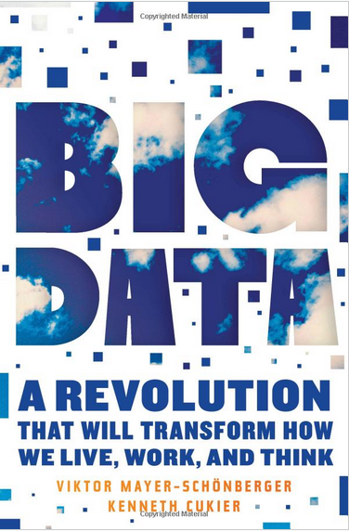
Source: http://www.amazon.com/Big-Data-Revolution-Transform-Mayer-Schonberger/dp/B00D81X2YE

Slide 64
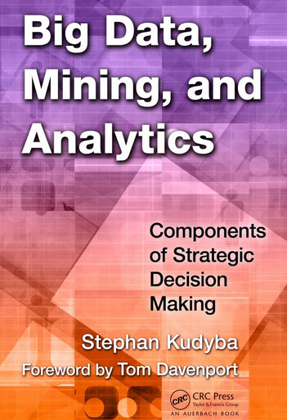
Stephan Kudyba (2014),
Big Data, Mining, and Analytics:
Components of Strategic Decision Making, Auerbach Publications
Source: http://www.amazon.com/gp/product/1466568704

Slide 65
Architecture of Big Data Analytics
Big Data
Analytics
Applications
Big Data
Sources
Big Data
Transformation
Big Data
Platforms & Tools
* Internal
* External
* Multiple formats
* Multiple
locations
* Multiple applications
Middleware
Hadoop
MapReduce
Pig
Hive
Jaql
Zookeeper
Hbase
Cassandra
Oozie
Avro
Mahout
Others
Queries
Raw
Data
Transformed
Data
Big Data
Analytics
Extract Transform Load
Reports
Data Warehouse
OLAP
Traditional Format
CSV, Tables
Data Mining
Source: Stephan Kudyba (2014), Big Data, Mining, and Analytics: Components of Strategic Decision Making, Auerbach Publications

Slide 66
Architecture of Big Data Analytics
Big Data
Analytics
Applications
Big Data
Sources
Big Data
Transformation
Big Data
Platforms & Tools
* Internal
* External
* Multiple formats
* Multiple
locations
* Multiple applications
Data Mining
Big Data Analytics Applications
Middleware
Hadoop
MapReduce
Pig
Hive
Jaql
Zookeeper
Hbase
Cassandra
Oozie
Avro
Mahout
Others
Queries
Raw
Data
Transformed
Data
Big Data
Analytics
Extract Transform Load
Reports
Data Warehouse
OLAP
Traditional Format
CSV, Tables
Data Mining
Source: Stephan Kudyba (2014), Big Data, Mining, and Analytics: Components of Strategic Decision Making, Auerbach Publications

Slide 67
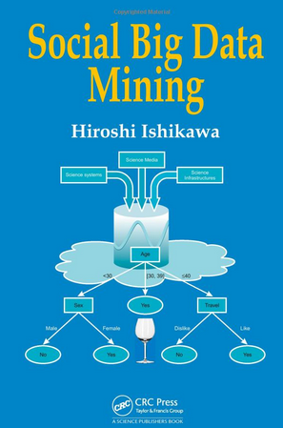
Social Big Data Mining
(Hiroshi Ishikawa, 2015)
Source: http://www.amazon.com/Social-Data-Mining-Hiroshi-Ishikawa/dp/149871093X

Slide 68
Architecture for
Social Big Data Mining
(Hiroshi Ishikawa, 2015)
Enabling Technologies
Analysts
Integrated analysis
Integrated analysis model
Model Construction
Explanation by Model
Conceptual Layer
Natural Language Processing
Information Extraction
Anomaly Detection
Discovery of relationships
among heterogeneous data
Large-scale visualization
Construction and
confirmation
of individual
hypothesis
Description and
execution of
application-specific
task
Data
Mining
Multivariate analysis
Application specific task
Logical Layer
Parallel distrusted processing
Software
Social Data
Hardware
Physical Layer
Source: Hiroshi Ishikawa (2015), Social Big Data Mining, CRC Press

Slide 69
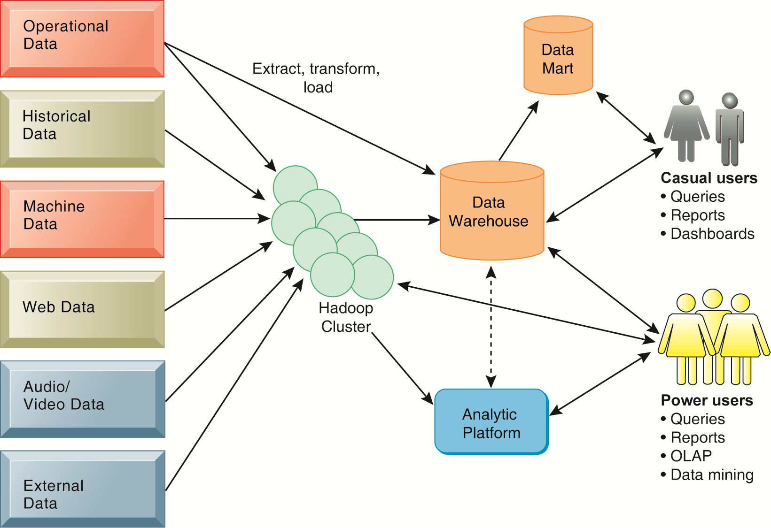
Business Intelligence (BI) Infrastructure

Slide 70
Data Warehouse
Data Mining and Business Intelligence
Increasing potential
to support
business decisions
End User
Decision Making
Data Presentation
Business
Analyst
Visualization Techniques
Data Mining
Data
Analyst
Information Discovery
Data Exploration
Statistical Summary, Querying, and Reporting
Data Preprocessing/Integration, Data Warehouses
Data Sources
DBA
Paper, Files, Web documents, Scientific experiments, Database Systems
Source: Jiawei Han and Micheline Kamber (2006), Data Mining: Concepts and Techniques, Second Edition, Elsevier

Slide 71
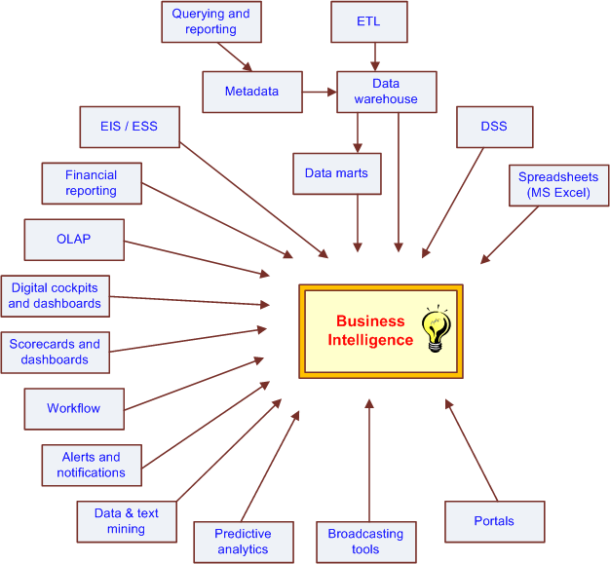
The Evolution of BI Capabilities
Source: Turban et al. (2011), Decision Support and Business Intelligence Systems

Slide 72
Three Types of Analytics
Source: Ramesh Sharda, Dursun Delen, and Efraim Turban (2017),
Business Intelligence, Analytics, and Data Science: A Managerial Perspective, 4th Edition, Pearson

Slide 73
Data Mining at the
Intersection of Many Disciplines
Source: Turban et al. (2011), Decision Support and Business Intelligence Systems

Slide 74
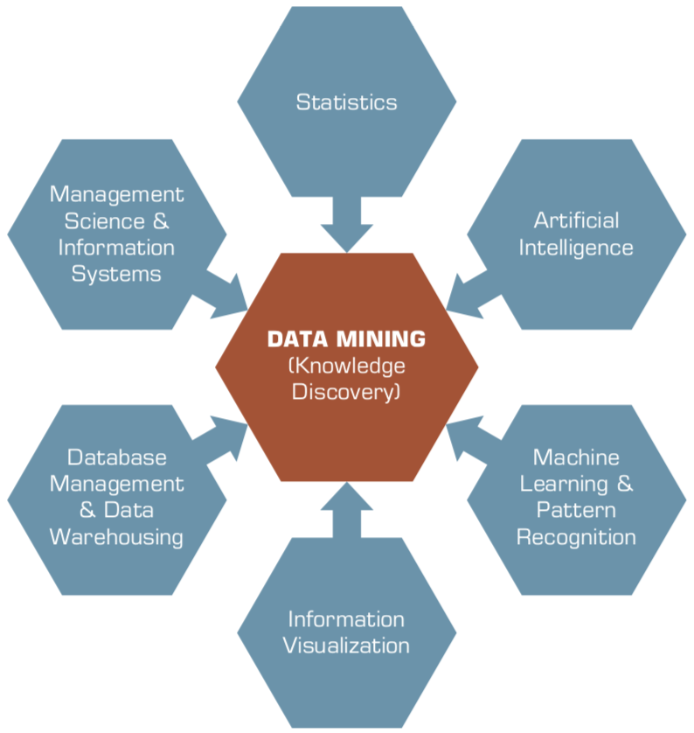
Data Mining
Is a Blend of Multiple Disciplines
Source: Ramesh Sharda, Dursun Delen, and Efraim Turban (2017), Business Intelligence, Analytics, and Data Science: A Managerial Perspective, 4th Edition, Pearson

Slide 75
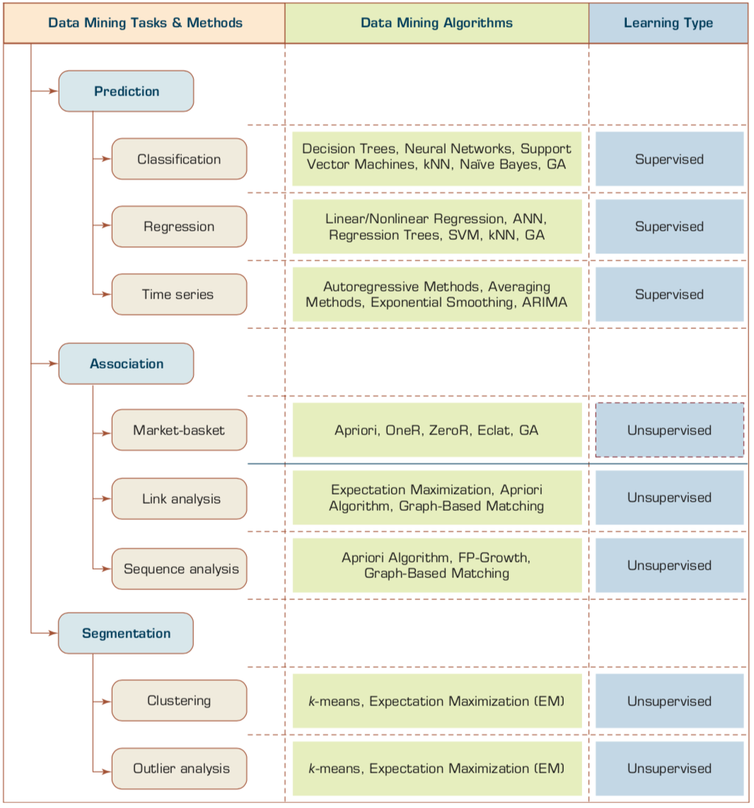
Data Mining Tasks & Methods
Source: Ramesh Sharda, Dursun Delen, and Efraim Turban (2017), Business Intelligence, Analytics, and Data Science: A Managerial Perspective, 4th Edition, Pearson

Slide 76
Evolution of Business Intelligence (BI)
Source: Ramesh Sharda, Dursun Delen, and Efraim Turban (2017),
Business Intelligence, Analytics, and Data Science: A Managerial Perspective, 4th Edition, Pearson

Slide 77
A High-Level Architecture of BI
Source: Ramesh Sharda, Dursun Delen, and Efraim Turban (2017),
Business Intelligence, Analytics, and Data Science: A Managerial Perspective, 4th Edition, Pearson

Slide 78
A Data to Knowledge Continuum
Source: Ramesh Sharda, Dursun Delen, and Efraim Turban (2017),
Business Intelligence, Analytics, and Data Science: A Managerial Perspective, 4th Edition, Pearson

Slide 79
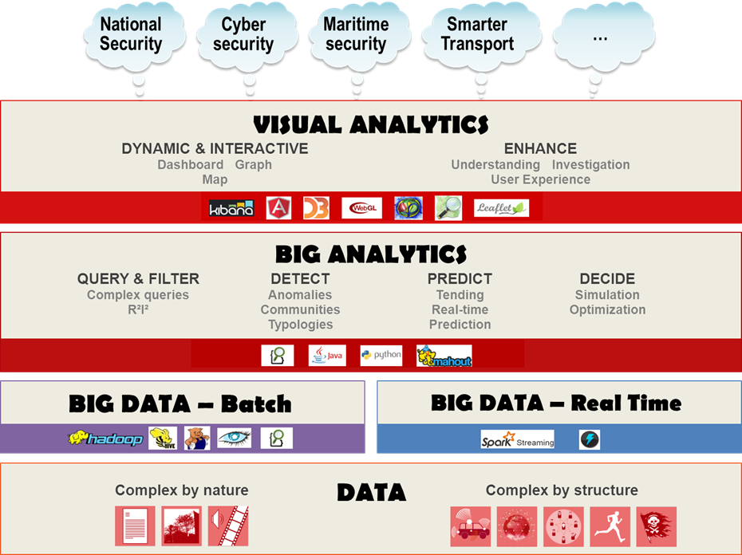
Source: https://www.thalesgroup.com/en/worldwide/big-data/big-data-big-analytics-visual-analytics-what-does-it-all-mean

Slide 80
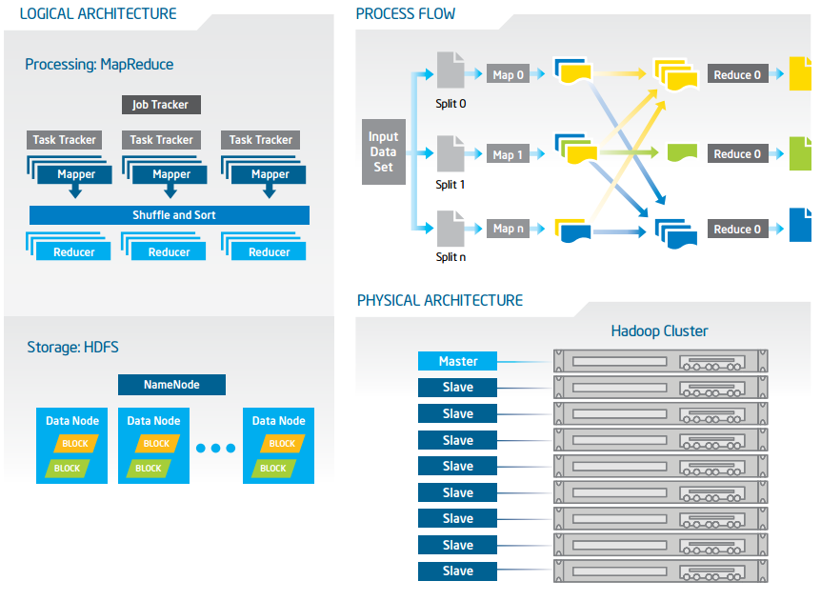
Big Data with Hadoop Architecture
Source: https://software.intel.com/sites/default/files/article/402274/etl-big-data-with-hadoop.pdf

Slide 81
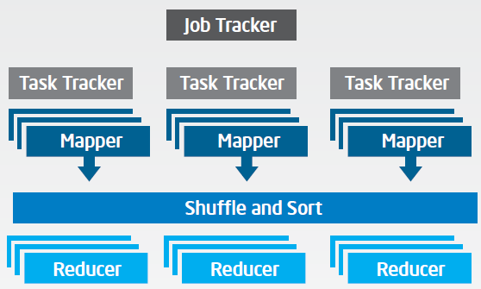
Big Data with Hadoop Architecture
Logical Architecture
Processing: MapReduce
Source: https://software.intel.com/sites/default/files/article/402274/etl-big-data-with-hadoop.pdf

Slide 82
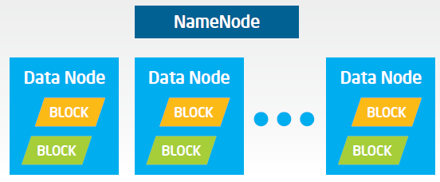
Big Data with Hadoop Architecture
Logical Architecture
Storage: HDFS
Source: https://software.intel.com/sites/default/files/article/402274/etl-big-data-with-hadoop.pdf

Slide 83
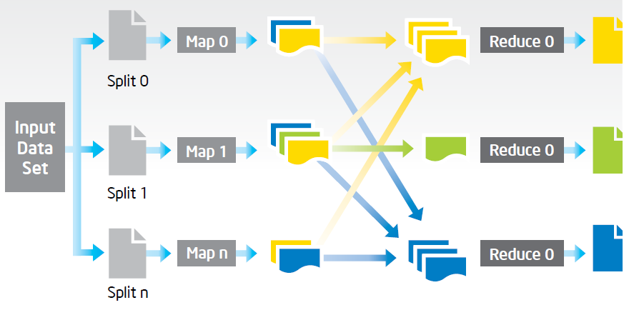
Big Data with Hadoop Architecture
Process Flow
Source: https://software.intel.com/sites/default/files/article/402274/etl-big-data-with-hadoop.pdf

Slide 84
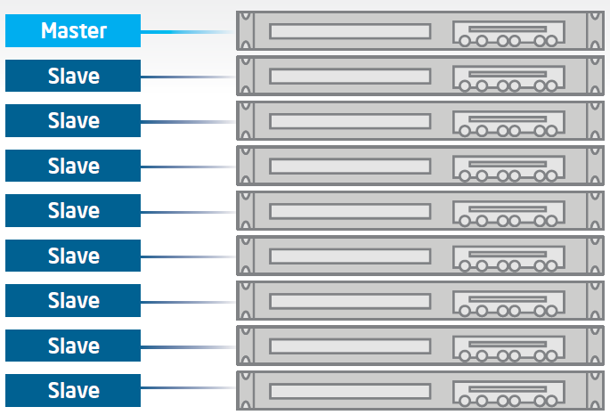
Big Data with Hadoop Architecture
Hadoop Cluster
Source: https://software.intel.com/sites/default/files/article/402274/etl-big-data-with-hadoop.pdf

Slide 85
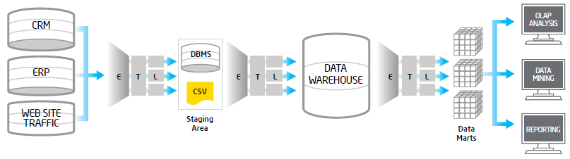
Traditional ETL Architecture
Source: https://software.intel.com/sites/default/files/article/402274/etl-big-data-with-hadoop.pdf

Slide 86
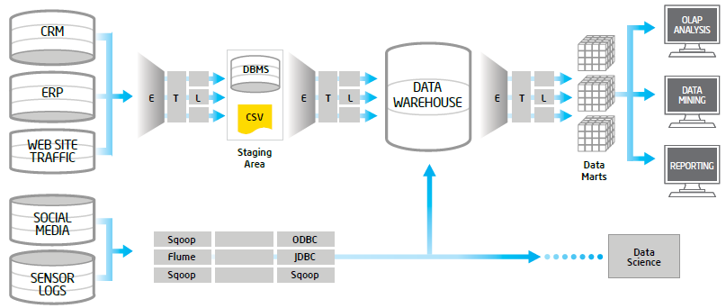
Offload ETL with Hadoop
(Big Data Architecture)
Source: https://software.intel.com/sites/default/files/article/402274/etl-big-data-with-hadoop.pdf

Slide 87
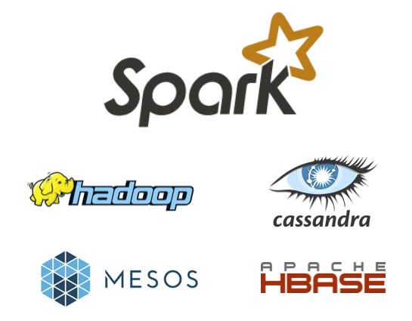
Spark and Hadoop
Source: http://spark.apache.org/

Slide 88
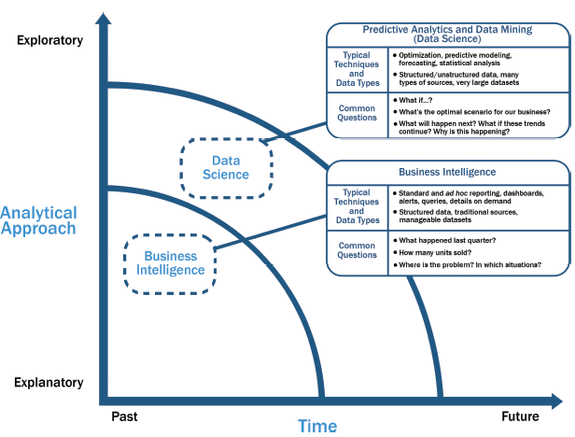
Data Science and
Business Intelligence
Source: EMC Education Services, Data Science and Big Data Analytics: Discovering, Analyzing, Visualizing and Presenting Data, Wiley, 2015

Slide 89
Data Science and
Business Intelligence
Predictive Analytics
and Data Mining
(Data Science)
Source: EMC Education Services, Data Science and Big Data Analytics: Discovering, Analyzing, Visualizing and Presenting Data, Wiley, 2015

Slide 90
Data Science and
Business Intelligence
Predictive Analytics
and Data Mining
(Data Science)
Structured/unstructured data, many types of sources,
very large datasets
Optimization, predictive modeling, forecasting statistical analysis
What if…?
What’s the optimal scenario for our business?
What will happen next?
What if these trends countinue?
Why is this happening?
Source: EMC Education Services, Data Science and Big Data Analytics: Discovering, Analyzing, Visualizing and Presenting Data, Wiley, 2015

Slide 91
Profile of a Data Scientist
Quantitative
  mathematics or statistics
Technical
  software engineering,
  machine learning,
  and programming skills
Skeptical mind-set and critical thinking
Curious and creative
Communicative and collaborative
Source: EMC Education Services, Data Science and Big Data Analytics: Discovering, Analyzing, Visualizing and Presenting Data, Wiley, 2015

Slide 92
Data Scientist Profile
Quantitative
Technical
Curious
and
Creative
Data Scientist
Skeptical
Communicative
and
Collaborative
Source: EMC Education Services, Data Science and Big Data Analytics: Discovering, Analyzing, Visualizing and Presenting Data, Wiley, 2015

Slide 93
Big Data Analytics Lifecycle

Slide 94
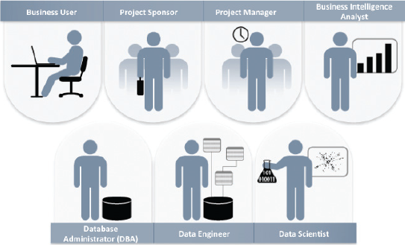
Key Roles for a
Successful Analytics Project
Source: EMC Education Services, Data Science and Big Data Analytics: Discovering, Analyzing, Visualizing and Presenting Data, Wiley, 2015

Slide 95
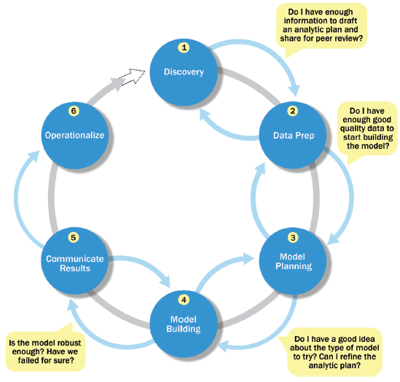
Overview of Data Analytics Lifecycle
Source: EMC Education Services, Data Science and Big Data Analytics: Discovering, Analyzing, Visualizing and Presenting Data, Wiley, 2015

Slide 96
Overview of Data Analytics Lifecycle
1. Discovery
2. Data preparation
3. Model planning
4. Model building
5. Communicate results
6. Operationalize
Source: EMC Education Services, Data Science and Big Data Analytics: Discovering, Analyzing, Visualizing and Presenting Data, Wiley, 2015

Slide 97
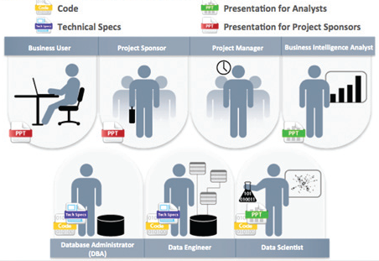
Key Outputs from a
Successful Analytics Project
Source: EMC Education Services, Data Science and Big Data Analytics: Discovering, Analyzing, Visualizing and Presenting Data, Wiley, 2015

Slide 98
Summary
AI
Big Data Analytics

Slide 99
References
Ramesh Sharda, Dursun Delen, and Efraim Turban (2017), Business Intelligence, Analytics, and Data Science: A Managerial Perspective, 4th Edition, Pearson.
Jared Dean (2014), Big Data, Data Mining, and Machine Learning: Value Creation for Business Leaders and Practitioners, Wiley.
Mehmet Kaya, Jalal Kawash, Suheil Khoury, and Min-Yuh Day (2018), Social Network Based Big Data Analysis and Applications, Lecture Notes in Social Networks, Springer International Publishing.
Varun Grover, Roger HL Chiang, Ting-Peng Liang, and Dongsong Zhang (2018), "Creating Strategic Business Value from Big Data Analytics: A Research Framework", Journal of Management Information Systems, 35, no. 2, pp. 388-423.
Ting-Peng Liang and Yu-Hsi Liu (2018), "Research Landscape of Business Intelligence and Big Data analytics: A bibliometrics study”, Expert Systems with Applications, 111, no. 30, pp. 2-10.
Stuart Russell and‎ Peter Norvig (2016) , Artificial Intelligence: A Modern Approach, 3rd Edition, Pearson International.
Javier Mata, Ignacio de Miguel, Ramón J. Durán, Noemí Merayo, Sandeep Kumar Singh, Admela Jukan, and Mohit Chamania (2018), "Artificial intelligence (AI) methods in optical networks: A comprehensive survey", Optical Switching and Networking, 28, pp. 43-57
Stephan Kudyba (2014), Big Data, Mining, and Analytics: Components of Strategic Decision Making, Auerbach Publications
Ahmet Murat Ozbayoglu, Mehmet Ugur Gudelek, and Omer Berat Sezer (2020). "Deep learning for financial applications: A survey." Applied Soft Computing (2020): 106384.
Omer Berat Sezer, Mehmet Ugur Gudelek, and Ahmet Murat Ozbayoglu (2020), "Financial time series forecasting with deep learning: A systematic literature review: 2005–2019." Applied Soft Computing 90 (2020): 106181.
O. Bustos and A. Pomares-Quimbaya (2020), "Stock Market Movement Forecast: A Systematic Review." Expert Systems with Applications (2020): 113464.

