Slide 1




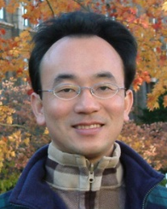
人工智慧文本分析
(AI for Text Analytics)
Tamkang
University
文本表達特徵工程
(Feature Engineering for
Text Representation)
1091AITA05
MBA, IMTKU (M2455) (8418) (Fall 2020)
Thu 3, 4 (10:10-12:00) (B206)
Min-Yuh Day
戴敏育
Associate Professor
副教授
Institute of Information Management, National Taipei University
國立臺北大學 資訊管理研究所
https://web.ntpu.edu.tw/~myday
2020-10-22

Slide 2
課程大綱 (Syllabus)
週次 (Week) 日期 (Date) 內容 (Subject/Topics)
1 2020/09/17 人工智慧文本分析課程介紹
(Course Orientation on Artificial Intelligence for Text Analytics)
2 2020/09/24 文本分析的基礎：自然語言處理
(Foundations of Text Analytics: Natural Language Processing; NLP)
3 2020/10/01 中秋節 (Mid-Autumn Festival) 放假一天 (Day off)
4 2020/10/08 Python自然語言處理
(Python for Natural Language Processing)
5 2020/10/15 處理和理解文本
(Processing and Understanding Text)
6 2020/10/22 文本表達特徵工程
(Feature Engineering for Text Representation)

Slide 3
課程大綱 (Syllabus)
週次 (Week) 日期 (Date) 內容 (Subject/Topics)
7 2020/10/29 人工智慧文本分析個案研究 I
(Case Study on Artificial Intelligence for Text Analytics I)
8 2020/11/05 文本分類
(Text Classification)
9 2020/11/12 文本摘要和主題模型
(Text Summarization and Topic Models)
10 2020/11/19 期中報告 (Midterm Project Report)
11 2020/11/26 文本相似度和分群
(Text Similarity and Clustering)
12 2020/12/03 語意分析和命名實體識別
(Semantic Analysis and Named Entity Recognition; NER)

Slide 4
課程大綱 (Syllabus)
週次 (Week) 日期 (Date) 內容 (Subject/Topics)
13 2020/12/10 情感分析
(Sentiment Analysis)
14 2020/12/17 人工智慧文本分析個案研究 II
(Case Study on Artificial Intelligence for Text Analytics II)
15 2020/12/24 深度學習和通用句子嵌入模型
(Deep Learning and Universal Sentence-Embedding Models)
16 2020/12/31 問答系統與對話系統
(Question Answering and Dialogue Systems)
17 2021/01/07 期末報告 I (Final Project Presentation I)
18 2021/01/14 期末報告 II (Final Project Presentation II)

Slide 5
Outline
Traditional Feature Engineering for Text Data
  Bag of Words Model
  Bag of N-Grams Model
  TF-IDF Model
Advanced Word Embeddings with Deep Learning
  Word2Vec Model
  Robust Word2Vec Models with Gensim
  GloVe Model
  FastText Model

Slide 6
Feature Engineering for
Text Representation

Slide 7
NLP
Source: http://blog.aylien.com/leveraging-deep-learning-for-multilingual/

Slide 8
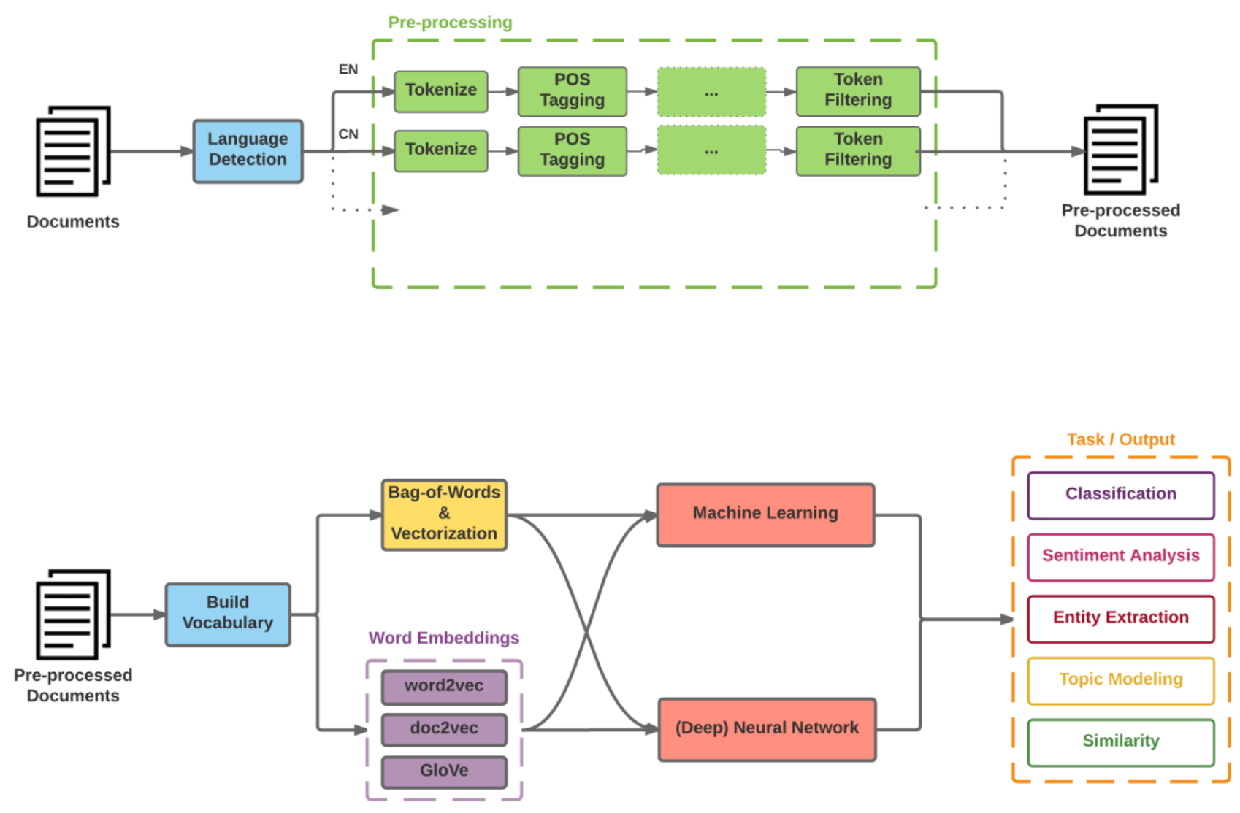
Modern NLP Pipeline
Source: https://github.com/fortiema/talks/blob/master/opendata2016sh/pragmatic-nlp-opendata2016sh.pdf

Slide 9
Modern NLP Pipeline
Source: http://mattfortier.me/2017/01/31/nlp-intro-pt-1-overview/

Slide 10
Deep Learning NLP
Source: http://mattfortier.me/2017/01/31/nlp-intro-pt-1-overview/

Slide 11
Overview of
Text Vectorization Methods
Vectorization Method | Function | Good For | Considerations
Frequency | Counts term frequencies | Bayesian models | Most frequent words not always most informative
One-Hot Encoding | Binarizes term occurrence (0, 1) | Neural networks | All words equidistant, so normalization extra important
TF–IDF | Normalizes term frequencies across documents | General purpose | Moderately frequent terms may not be representative of document topics
Distributed Representations | Context-based, continuous term similarity encoding | Modeling more complex relationships | Performance intensive; difficult to scale without additional tools (e.g., Tensorflow)
Source: Benjamin Bengfort, Rebecca Bilbro, and Tony Ojeda (2018), Applied Text Analysis with Python, O'Reilly Media.

Slide 12
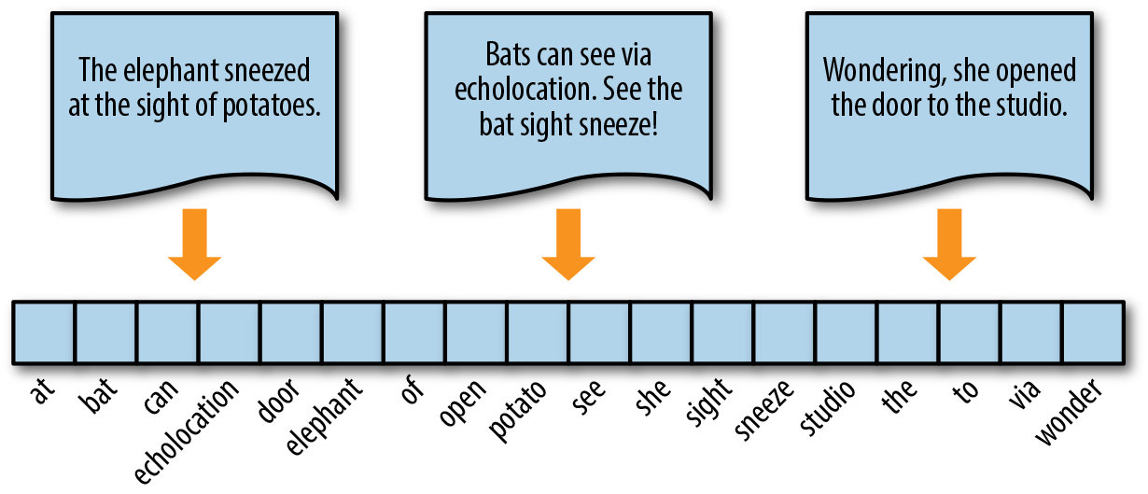
Encoding Documents as Vectors
Source: Benjamin Bengfort, Rebecca Bilbro, and Tony Ojeda (2018), Applied Text Analysis with Python, O'Reilly Media.

Slide 13
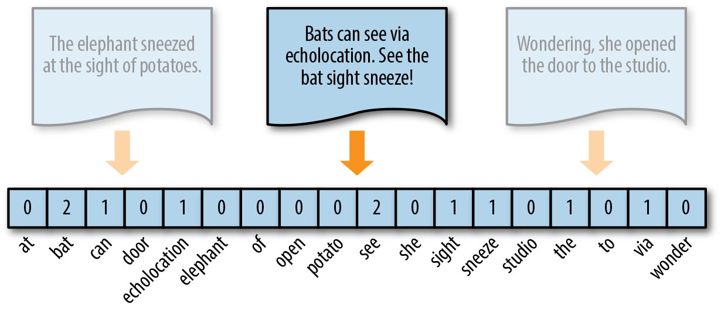
Token Frequency as
Vector Encoding
Source: Benjamin Bengfort, Rebecca Bilbro, and Tony Ojeda (2018), Applied Text Analysis with Python, O'Reilly Media.

Slide 14
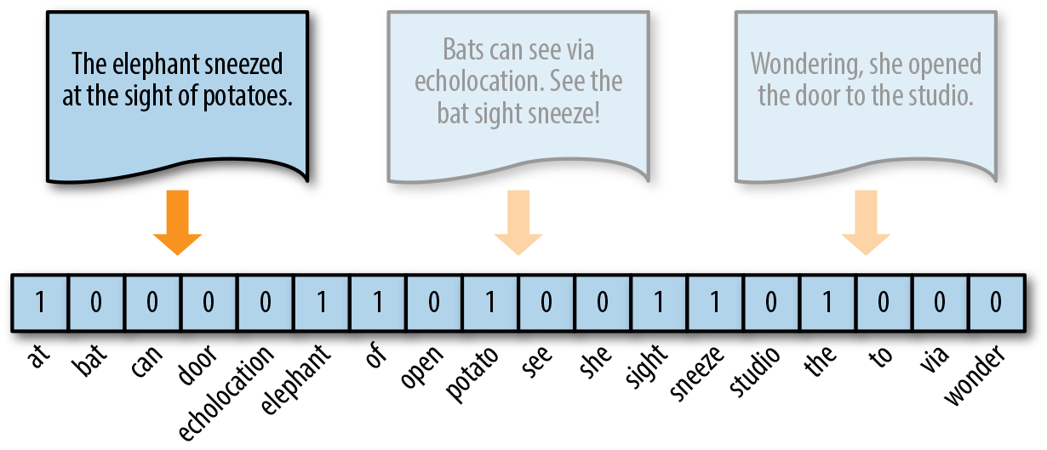
One-hot Encoding
Source: Benjamin Bengfort, Rebecca Bilbro, and Tony Ojeda (2018), Applied Text Analysis with Python, O'Reilly Media.

Slide 15
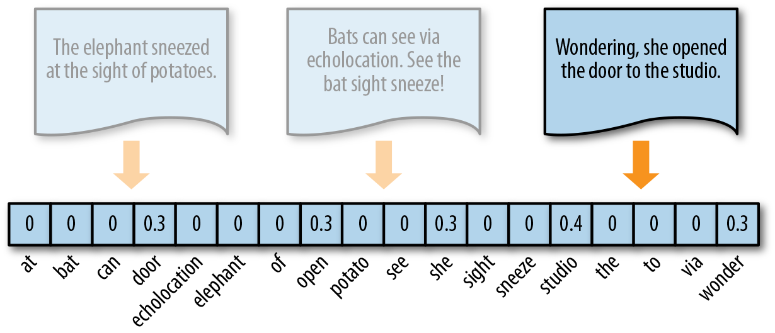
TF-IDF Encoding
Source: Benjamin Bengfort, Rebecca Bilbro, and Tony Ojeda (2018), Applied Text Analysis with Python, O'Reilly Media.

Slide 16
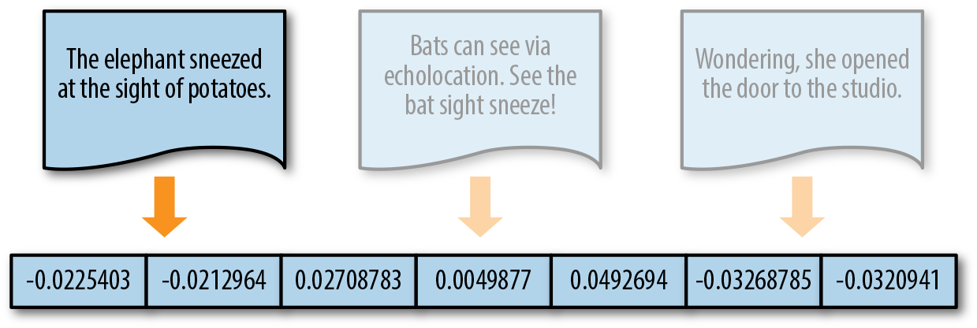
Distributed Representation
Source: Benjamin Bengfort, Rebecca Bilbro, and Tony Ojeda (2018), Applied Text Analysis with Python, O'Reilly Media.

Slide 17
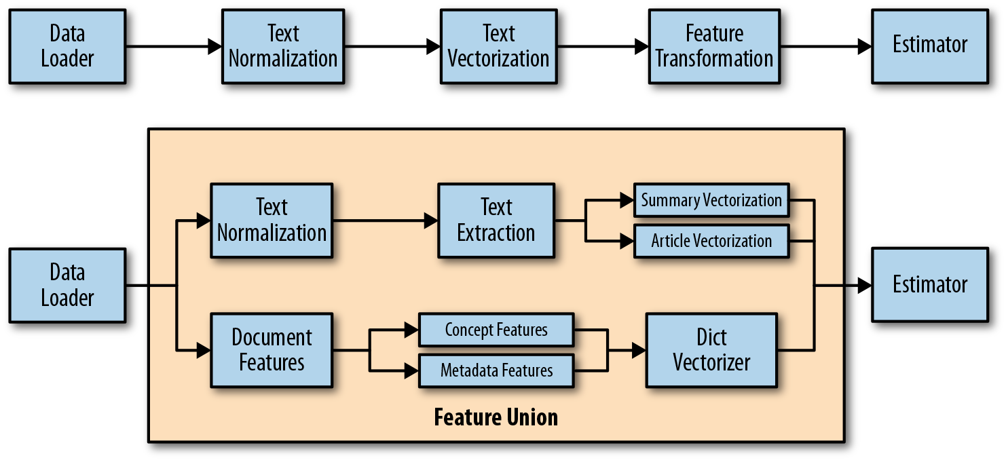
Pipelines for Text Vectorization and Feature Extraction
Source: Benjamin Bengfort, Rebecca Bilbro, and Tony Ojeda (2018), Applied Text Analysis with Python, O'Reilly Media.

Slide 18
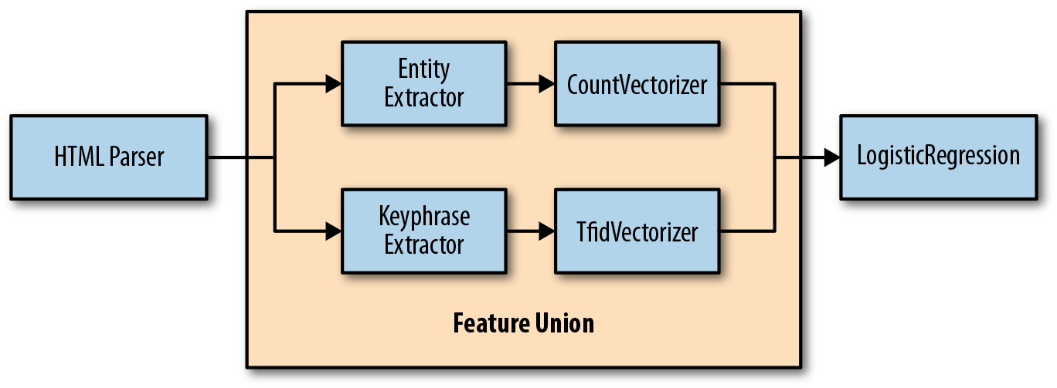
Feature Unions for
Branching Vectorization
Source: Benjamin Bengfort, Rebecca Bilbro, and Tony Ojeda (2018), Applied Text Analysis with Python, O'Reilly Media.

Slide 19
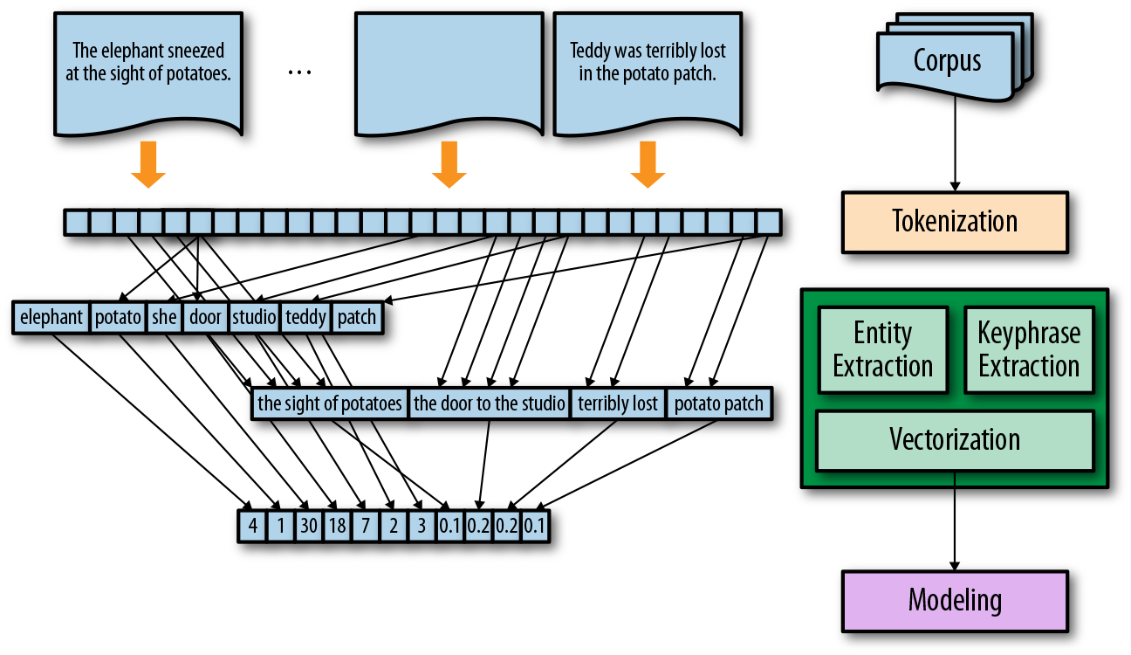
Feature Extraction and Union
Source: Benjamin Bengfort, Rebecca Bilbro, and Tony Ojeda (2018), Applied Text Analysis with Python, O'Reilly Media.

Slide 20
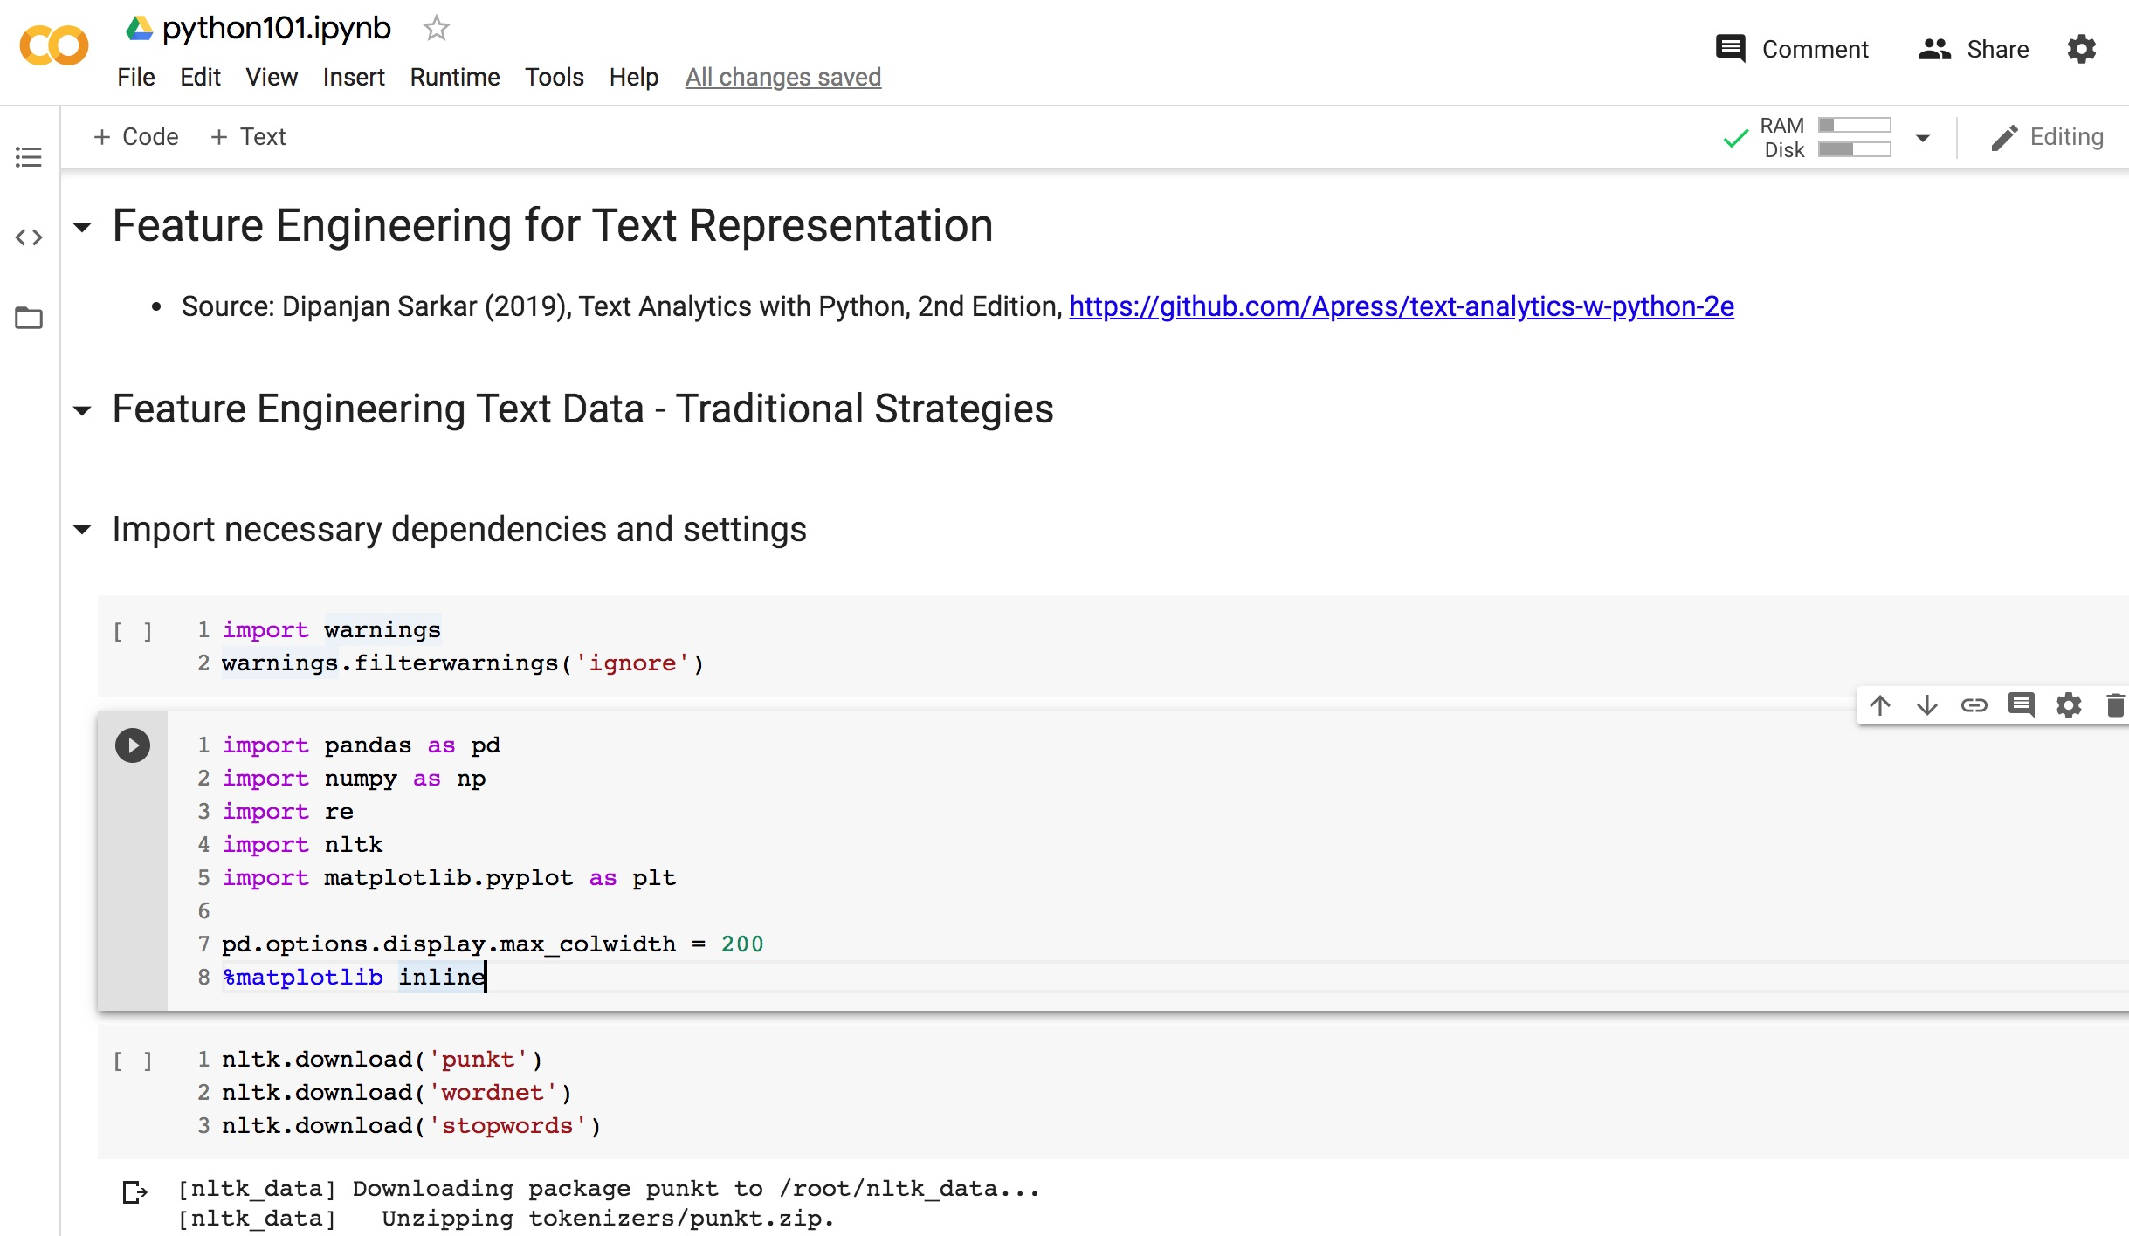
Python in Google Colab (Python101)
https://colab.research.google.com/drive/1FEG6DnGvwfUbeo4zJ1zTunjMqf2RkCrT
https://tinyurl.com/aintpupython101

Slide 21
corpus = ['The sky is blue and beautiful.',
'Love this blue and beautiful sky!',
'The quick brown fox jumps over the lazy dog.',
"A king's breakfast has sausages, ham, bacon, eggs, toast and beans",
'I love green eggs, ham, sausages and bacon!',
'The brown fox is quick and the blue dog is lazy!',
'The sky is very blue and the sky is very beautiful today',
'The dog is lazy but the brown fox is quick!'
]
labels = ['weather', 'weather', 'animals', 'food', 'food', 'animals', 'weather', 'animals']
corpus = np.array(corpus)
corpus_df = pd.DataFrame({'Document': corpus,
'Category': labels})
corpus_df = corpus_df[['Document', 'Category']]
corpus_df
https://tinyurl.com/aintpupython101

Slide 22
corpus = np.array(corpus)
corpus_df = pd.DataFrame({'Document': corpus,
'Category': labels})
corpus_df = corpus_df[['Document', 'Category']]
corpus_df
 | Document | Category
0 | The sky is blue and beautiful. | weather
1 | Love this blue and beautiful sky! | weather
2 | The quick brown fox jumps over the lazy dog. | animals
3 | A king's breakfast has sausages, ham, bacon, eggs, toast and beans | food
4 | I love green eggs, ham, sausages and bacon! | food
5 | The brown fox is quick and the blue dog is lazy! | animals
6 | The sky is very blue and the sky is very beautiful today | weather
7 | The dog is lazy but the brown fox is quick! | animals
https://tinyurl.com/aintpupython101

Slide 23
wpt = nltk.WordPunctTokenizer()
stop_words = nltk.corpus.stopwords.words('english')
def normalize_document(doc):
# lower case and remove special characters\whitespaces
doc = re.sub(r'[^a-zA-Z\s]', '', doc, re.I|re.A)
doc = doc.lower()
doc = doc.strip()
# tokenize document
tokens = wpt.tokenize(doc)
# filter stopwords out of document
filtered_tokens = [token for token in tokens if token not in stop_words]
# re-create document from filtered tokens
doc = ' '.join(filtered_tokens)
return doc
normalize_corpus = np.vectorize(normalize_document)
norm_corpus = normalize_corpus(corpus)
norm_corpus
https://tinyurl.com/aintpupython101

Slide 24
from sklearn.feature_extraction.text import CountVectorizer
# get bag of words features in sparse format
cv = CountVectorizer(min_df=0., max_df=1.)
cv_matrix = cv.fit_transform(norm_corpus)
cv_matrix
# view non-zero feature positions in the sparse matrix
print(cv_matrix)
# view dense representation
# warning might give a memory error if data is too big
cv_matrix = cv_matrix.toarray()
cv_matrix
array([
[0, 0, 1, 1, 0, 0, 0, 0, 0, 0, 0, 0, 0, 0, 0, 0, 0, 1, 0, 0],
[0, 0, 1, 1, 0, 0, 0, 0, 0, 0, 0, 0, 0, 0, 1, 0, 0, 1, 0, 0],
[0, 0, 0, 0, 0, 1, 1, 0, 1, 0, 0, 1, 0, 1, 0, 1, 0, 0, 0, 0],
[1, 1, 0, 0, 1, 0, 0, 1, 0, 0, 1, 0, 1, 0, 0, 0, 1, 0, 1, 0],
[1, 0, 0, 0, 0, 0, 0, 1, 0, 1, 1, 0, 0, 0, 1, 0, 1, 0, 0, 0],
[0, 0, 0, 1, 0, 1, 1, 0, 1, 0, 0, 0, 0, 1, 0, 1, 0, 0, 0, 0],
[0, 0, 1, 1, 0, 0, 0, 0, 0, 0, 0, 0, 0, 0, 0, 0, 0, 2, 0, 1],
[0, 0, 0, 0, 0, 1, 1, 0, 1, 0, 0, 0, 0, 1, 0, 1, 0, 0, 0, 0]])
https://tinyurl.com/aintpupython101

Slide 25
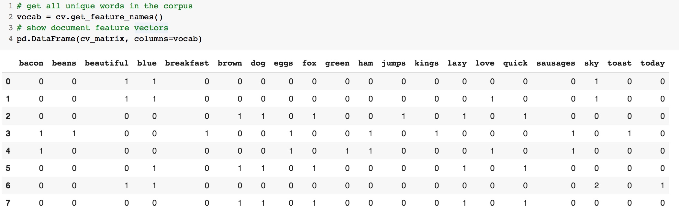
# get all unique words in the corpus
vocab = cv.get_feature_names()
# show document feature vectors
pd.DataFrame(cv_matrix, columns=vocab)
https://tinyurl.com/aintpupython101

Slide 26
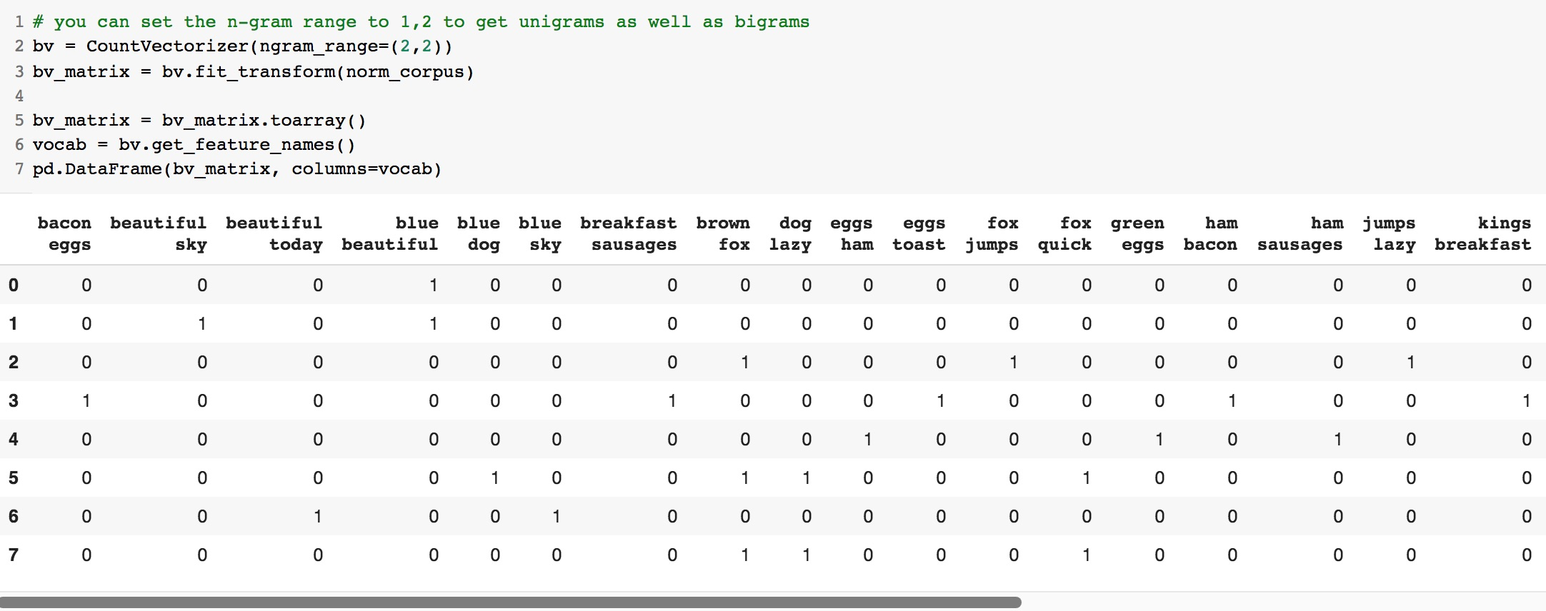
https://tinyurl.com/aintpupython101

Slide 27
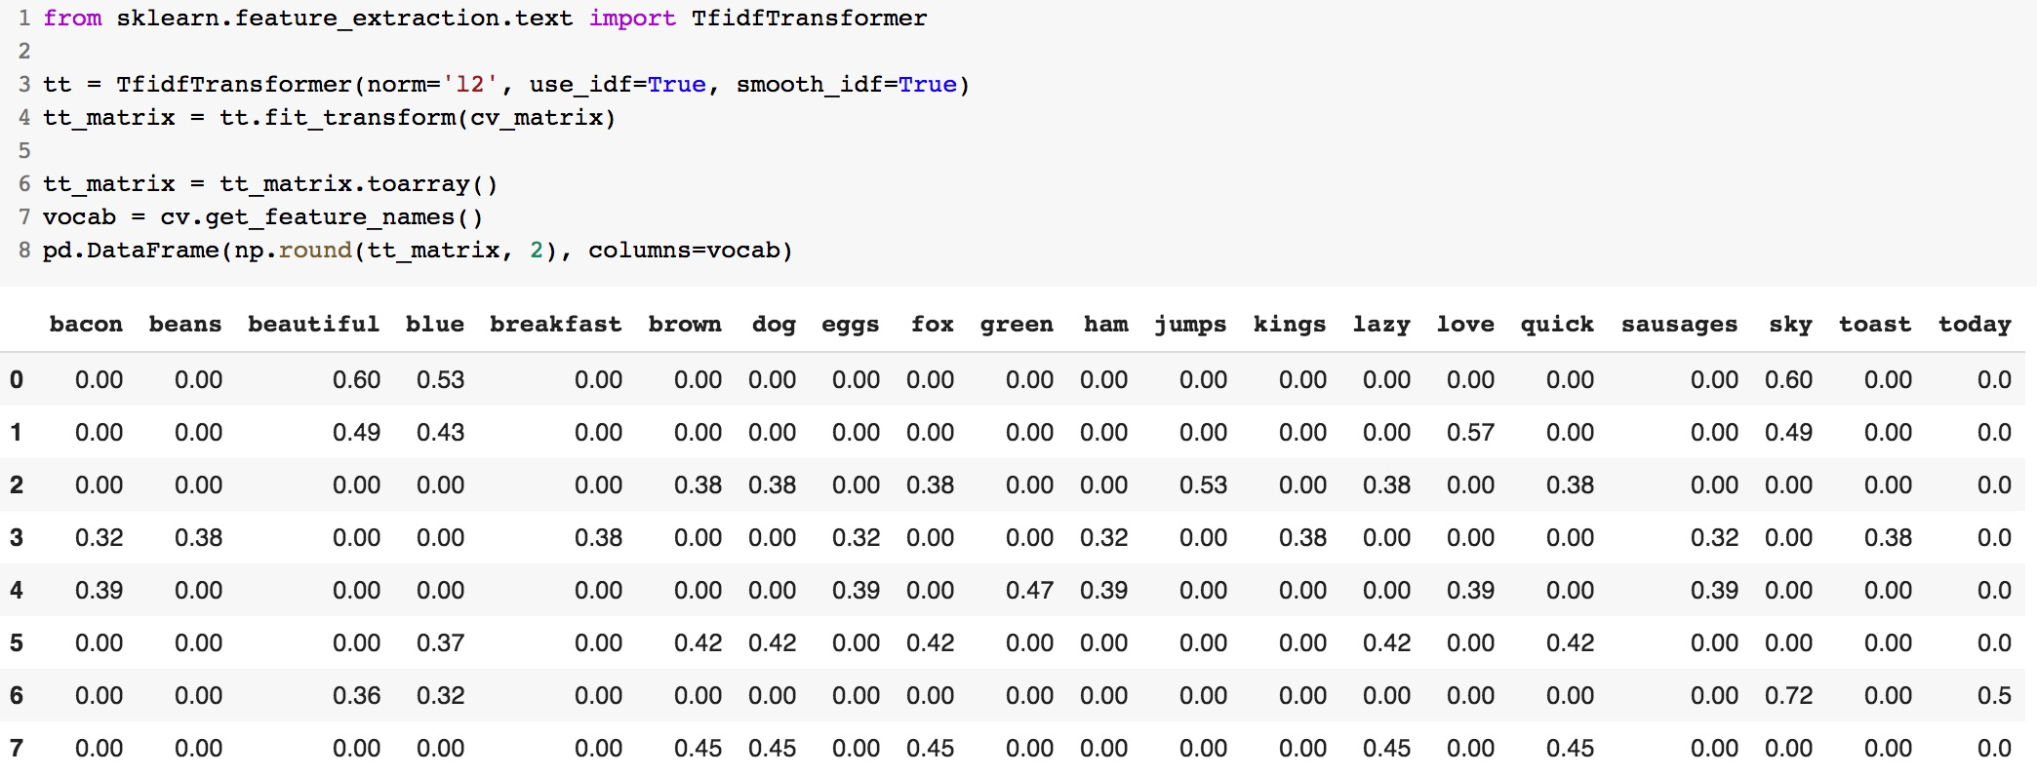
https://tinyurl.com/aintpupython101

Slide 28
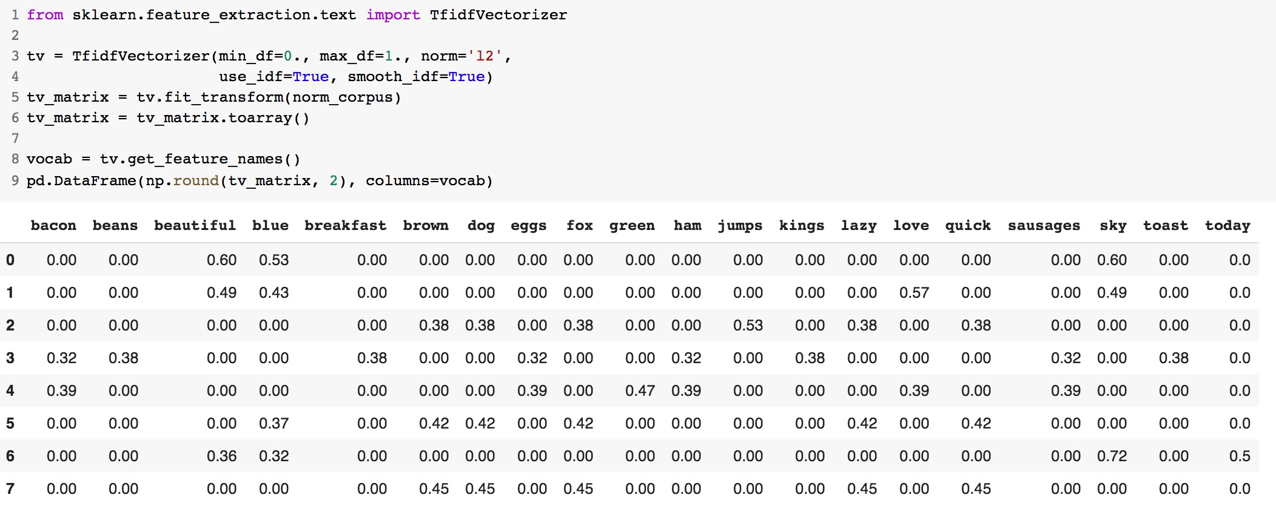
https://tinyurl.com/aintpupython101

Slide 29
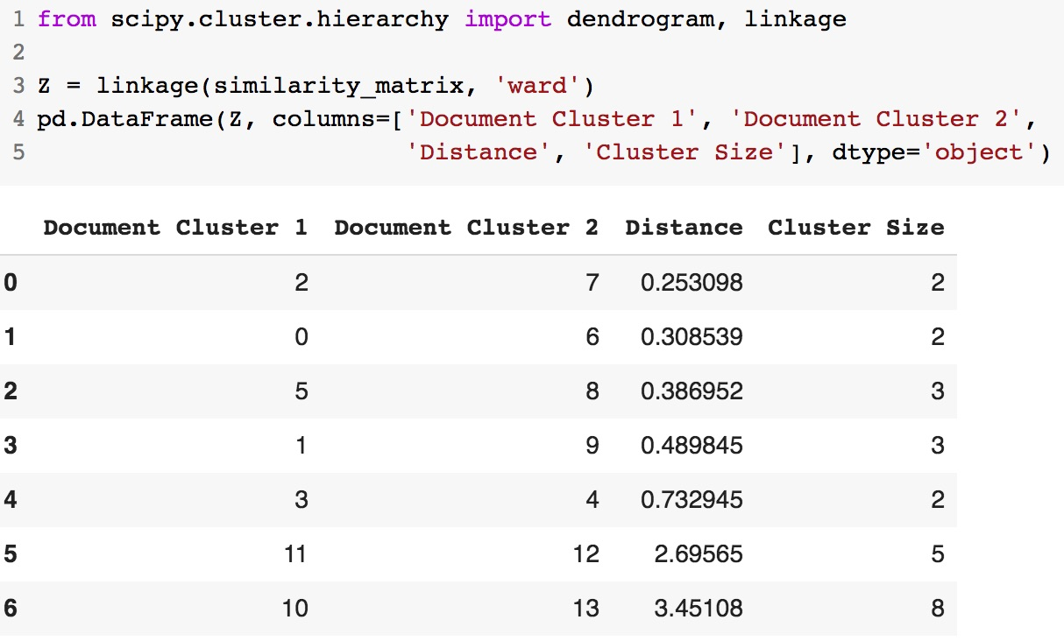
https://tinyurl.com/aintpupython101

Slide 30
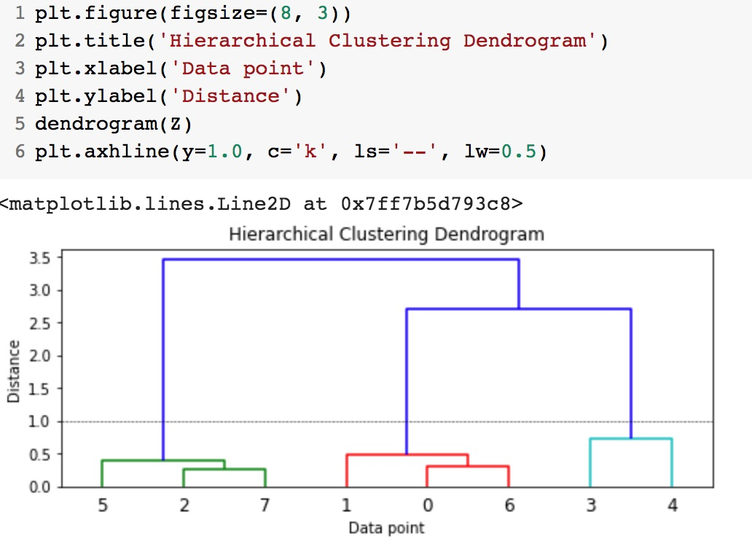
https://tinyurl.com/aintpupython101

Slide 31
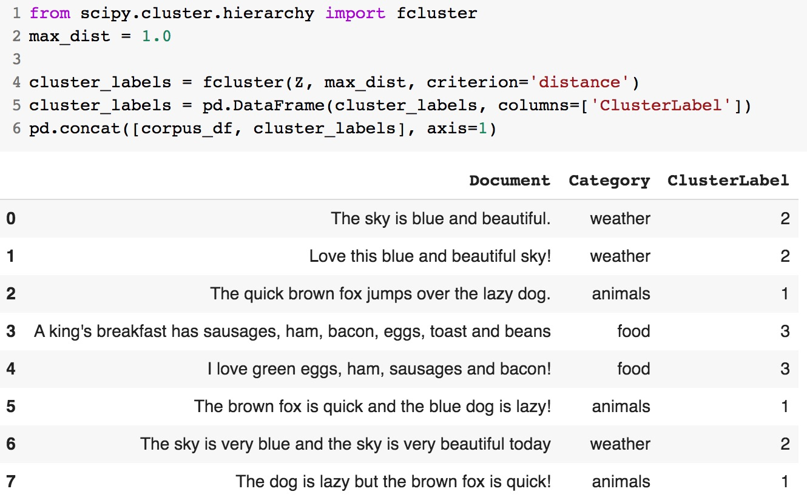
https://tinyurl.com/aintpupython101

Slide 32
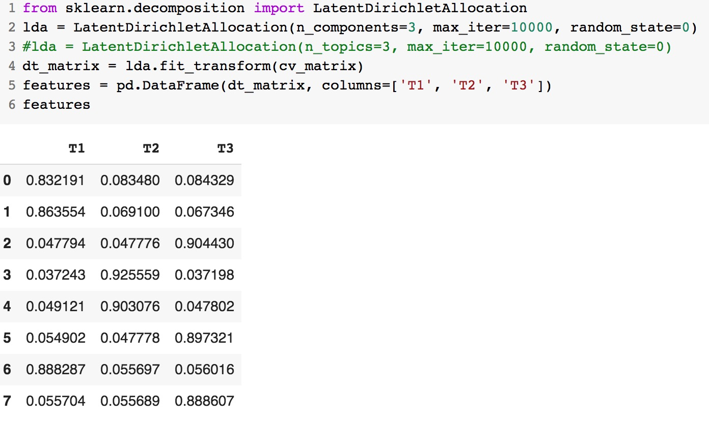
https://tinyurl.com/aintpupython101

Slide 33
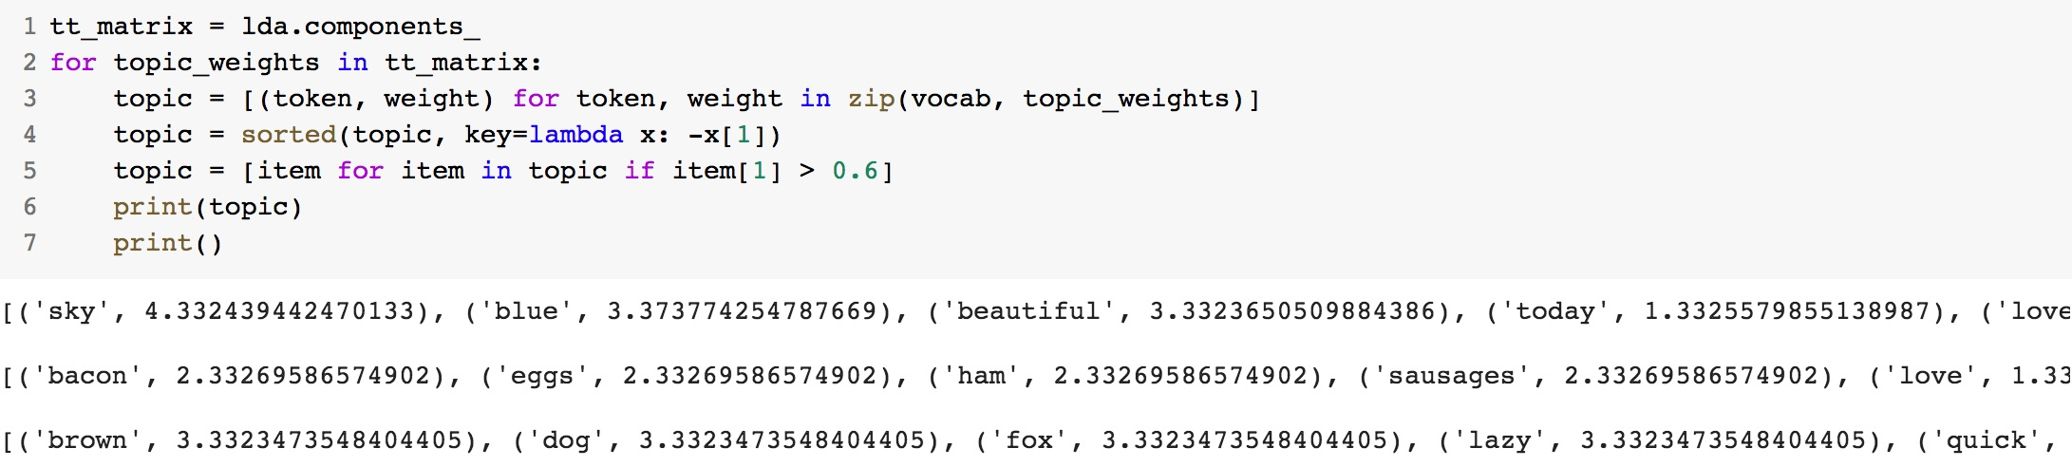
https://tinyurl.com/aintpupython101

Slide 34
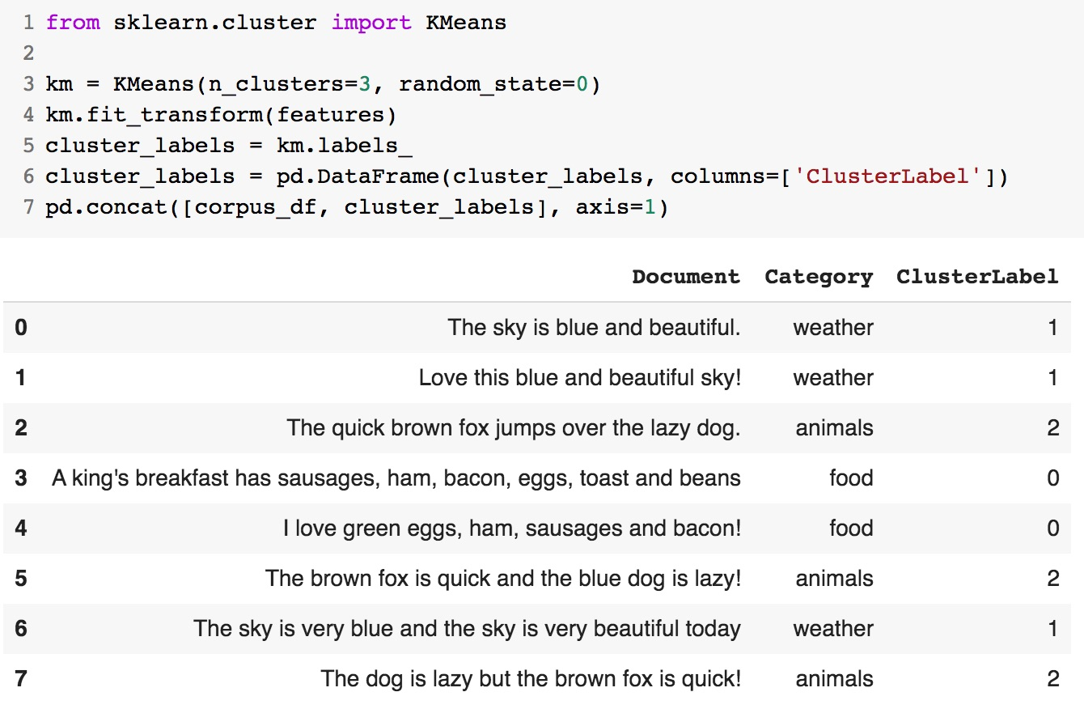
https://tinyurl.com/aintpupython101

Slide 35
from gensim.models import word2vec
# tokenize sentences in corpus
wpt = nltk.WordPunctTokenizer()
tokenized_corpus = [wpt.tokenize(document) for document in norm_bible]
# Set values for various parameters
feature_size = 100 # Word vector dimensionality
window_context = 30 # Context window size
min_word_count = 1 # Minimum word count
sample = 1e-3 # Downsample setting for frequent words
w2v_model = word2vec.Word2Vec(tokenized_corpus, size=feature_size,
window=window_context, min_count=min_word_count,
sample=sample, iter=50)
# view similar words based on gensim's model
similar_words = {search_term: [item[0] for item in w2v_model.wv.most_similar([search_term], topn=5)]
for search_term in ['god', 'jesus', 'noah', 'egypt', 'john', 'gospel', 'moses','famine']}
similar_words
https://tinyurl.com/aintpupython101

Slide 36
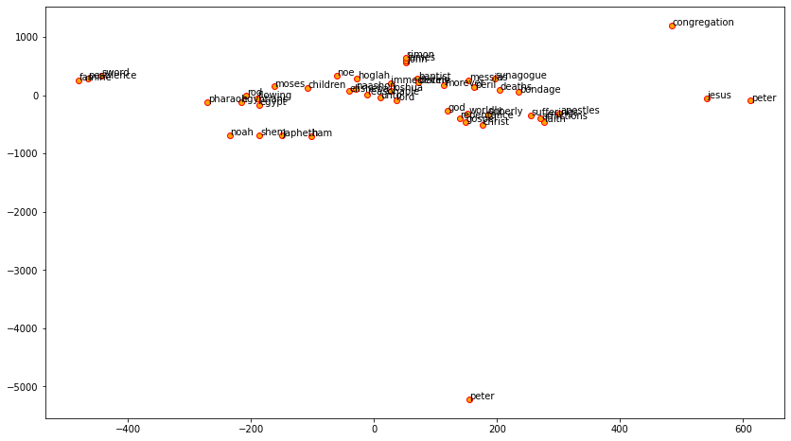
https://tinyurl.com/aintpupython101

Slide 37
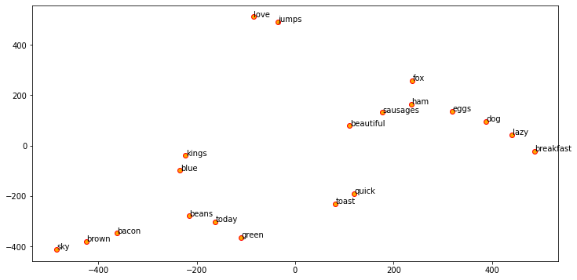
https://tinyurl.com/aintpupython101

Slide 38
w2v_model.wv.most_similar([search_term], topn=5)]
{'egypt': ['egyptians', 'pharaoh', 'bondage', 'flowing', 'rod'], 'famine': ['pestilence', 'peril', 'deaths', 'morever', 'sword'], 'god': ['lord', 'worldly', 'soberly', 'reasonable', 'unto'], 'gospel': ['christ', 'faith', 'repentance', 'sufferings', 'afflictions'], 'jesus': ['peter', 'messias', 'immediately', 'apostles', 'synagogue'], 'john': ['james', 'baptist', 'devine', 'peter', 'simon'], 'moses': ['congregation', 'elisheba', 'naashon', 'joshua', 'children'], 'noah': ['shem', 'japheth', 'ham', 'noe', 'hoglah']}
https://tinyurl.com/aintpupython101

Slide 39
from sklearn.decomposition import PCA
pca = PCA(n_components=2, random_state=0)
pcs = pca.fit_transform(w2v_feature_array)
labels = ap.labels_
categories = list(corpus_df['Category'])
plt.figure(figsize=(8, 6))
for i in range(len(labels)):
label = labels[i]
color = 'orange' if label == 0 else 'blue' if label == 1 else 'green'
annotation_label = categories[i]
x, y = pcs[i]
plt.scatter(x, y, c=color, edgecolors='k')
plt.annotate(annotation_label, xy=(x+1e-4, y+1e-3), xytext=(0, 0), textcoords='offset points')
https://tinyurl.com/aintpupython101

Slide 40
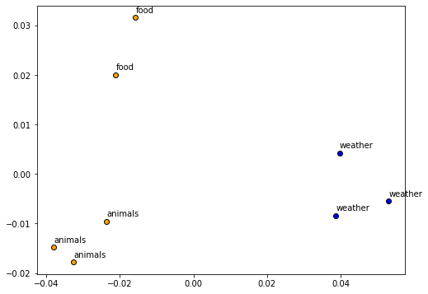
https://tinyurl.com/aintpupython101

Slide 41
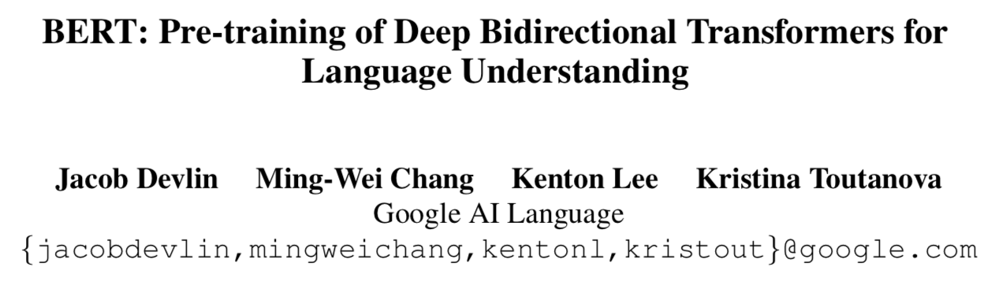
BERT:
Pre-training of Deep
Bidirectional Transformers for Language Understanding
Source: Devlin, Jacob, Ming-Wei Chang, Kenton Lee, and Kristina Toutanova (2018).
"BERT: Pre-training of Deep Bidirectional Transformers for Language Understanding." arXiv preprint arXiv:1810.04805

Slide 42
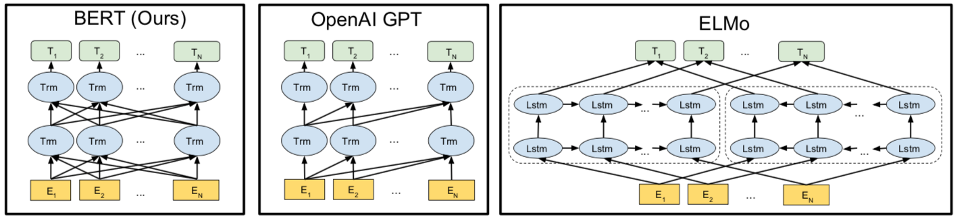
BERT
Bidirectional Encoder Representations from Transformers
Pre-training model architectures
BERT uses a bidirectional Transformer.
OpenAI GPT uses a left-to-right Transformer.
ELMo uses the concatenation of independently trained left-to-right and right- to-left LSTM to generate features for downstream tasks.
Among three, only BERT representations are jointly conditioned on both left and right context in all layers.
Source: Devlin, Jacob, Ming-Wei Chang, Kenton Lee, and Kristina Toutanova (2018).
"BERT: Pre-training of Deep Bidirectional Transformers for Language Understanding." arXiv preprint arXiv:1810.04805

Slide 43
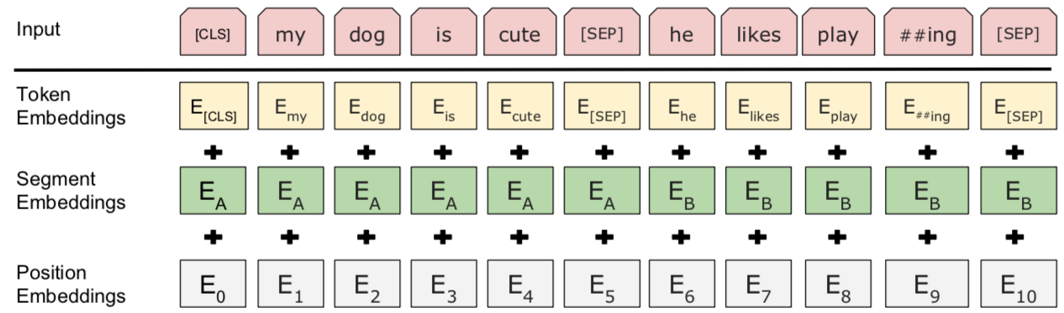
BERT input representation
The input embeddings is the sum of the token embeddings, the segmentation embeddings and the position embeddings.
Source: Devlin, Jacob, Ming-Wei Chang, Kenton Lee, and Kristina Toutanova (2018).
"BERT: Pre-training of Deep Bidirectional Transformers for Language Understanding." arXiv preprint arXiv:1810.04805

Slide 44
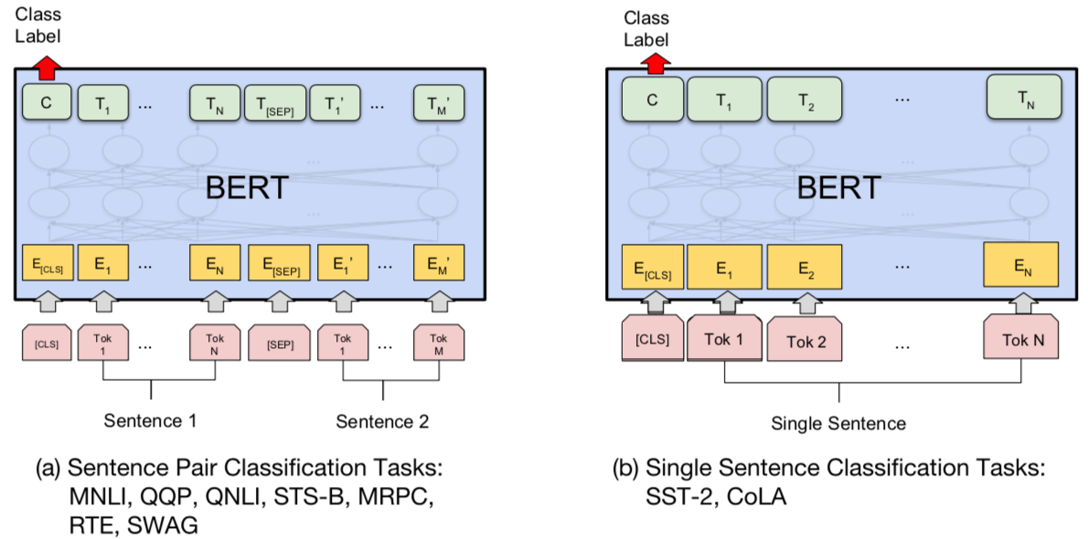
BERT Sequence-level tasks
Source: Devlin, Jacob, Ming-Wei Chang, Kenton Lee, and Kristina Toutanova (2018).
"BERT: Pre-training of Deep Bidirectional Transformers for Language Understanding." arXiv preprint arXiv:1810.04805

Slide 45
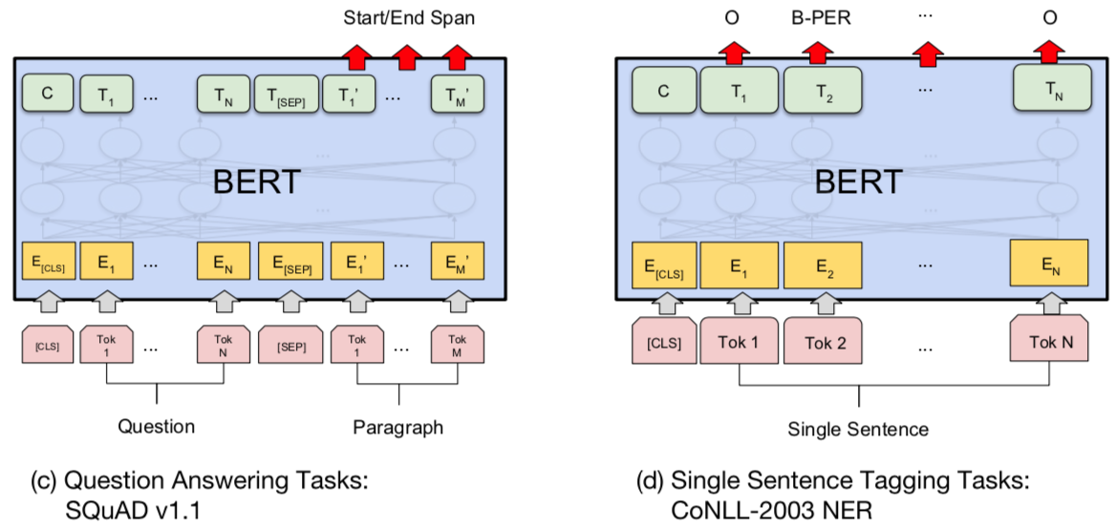
BERT Token-level tasks
Source: Devlin, Jacob, Ming-Wei Chang, Kenton Lee, and Kristina Toutanova (2018).
"BERT: Pre-training of Deep Bidirectional Transformers for Language Understanding." arXiv preprint arXiv:1810.04805

Slide 46
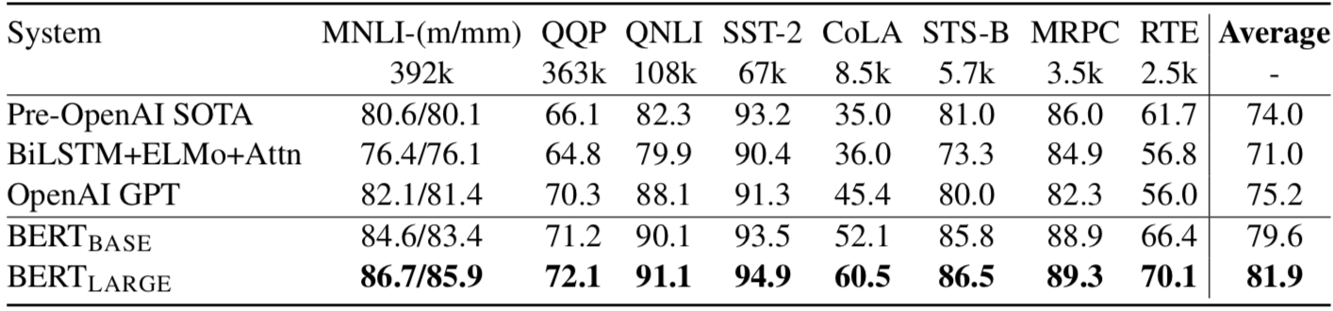
General Language Understanding Evaluation (GLUE) benchmark
GLUE Test results
MNLI: Multi-Genre Natural Language Inference
QQP: Quora Question Pairs
QNLI: Question Natural Language Inference
SST-2: The Stanford Sentiment Treebank
CoLA: The Corpus of Linguistic Acceptability
STS-B:The Semantic Textual Similarity Benchmark
MRPC: Microsoft Research Paraphrase Corpus
RTE: Recognizing Textual Entailment
Source: Devlin, Jacob, Ming-Wei Chang, Kenton Lee, and Kristina Toutanova (2018).
"BERT: Pre-training of Deep Bidirectional Transformers for Language Understanding." arXiv preprint arXiv:1810.04805

Slide 47
Facebook Research FastText
Pre-trained word vectors
Word2Vec
wiki.zh.vec (861MB)
332647 word
300 vec
Pre-trained word vectors for 90 languages,
trained on Wikipedia using fastText.
These vectors in dimension 300 were obtained using the skip-gram model with default parameters.
https://github.com/facebookresearch/fastText/blob/master/pretrained-vectors.md
Source: Bojanowski, Piotr, Edouard Grave, Armand Joulin, and Tomas Mikolov. "Enriching word vectors with subword information." arXiv preprint arXiv:1607.04606 (2016).

Slide 48
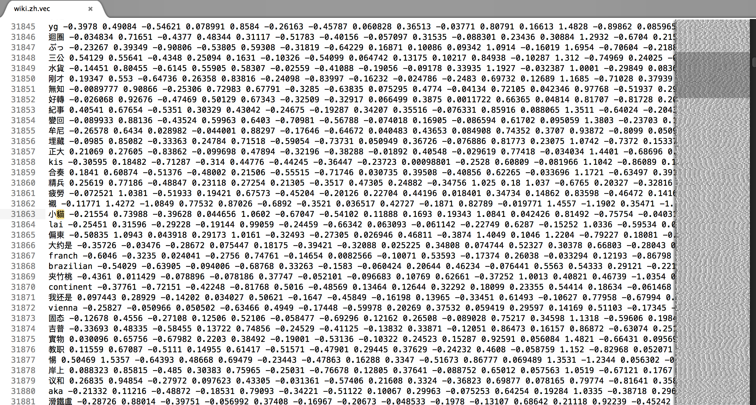
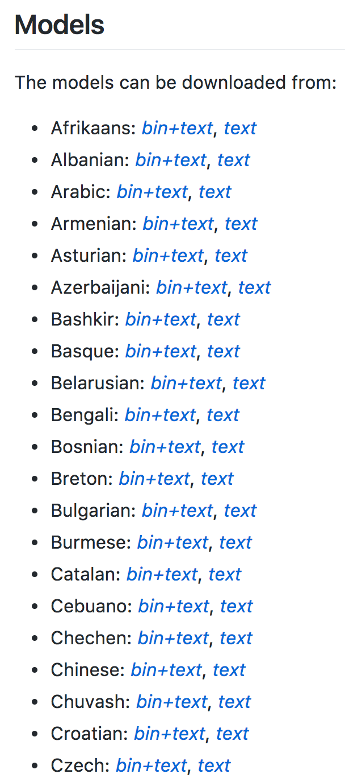
Facebook Research FastText Word2Vec: wiki.zh.vec
(861MB) (332647 word 300 vec)
https://github.com/facebookresearch/fastText/blob/master/pretrained-vectors.md

Slide 49
Word Embeddings in LSTM RNN
Source: https://avisingh599.github.io/deeplearning/visual-qa/

Slide 50
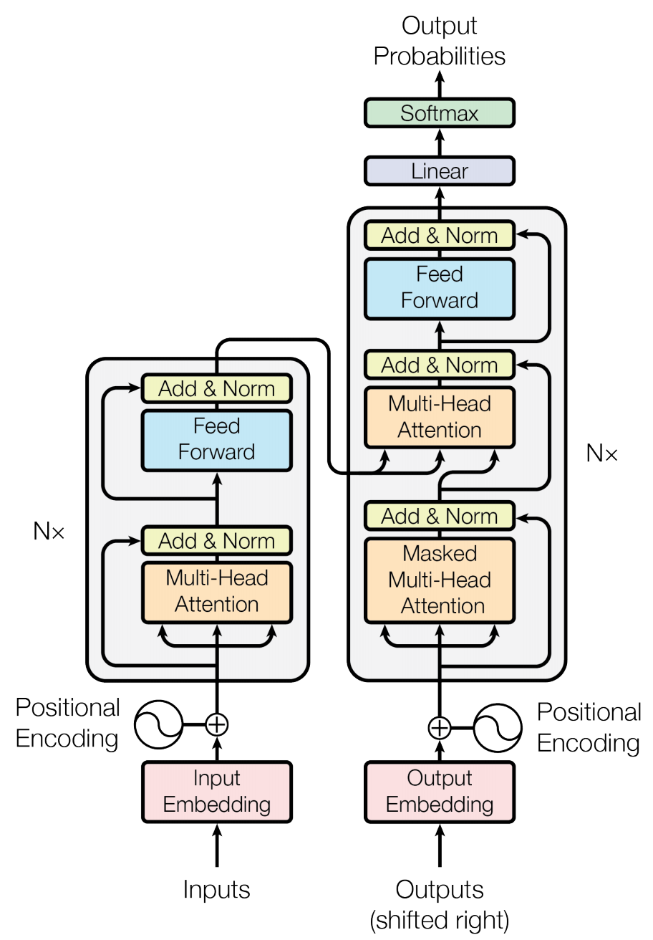
Transformer (Attention is All You Need)
(Vaswani et al., 2017)
Source: Vaswani, Ashish, Noam Shazeer, Niki Parmar, Jakob Uszkoreit, Llion Jones, Aidan N. Gomez, Łukasz Kaiser, and Illia Polosukhin. "Attention is all you need." In Advances in neural information processing systems, pp. 5998-6008. 2017.

Slide 51
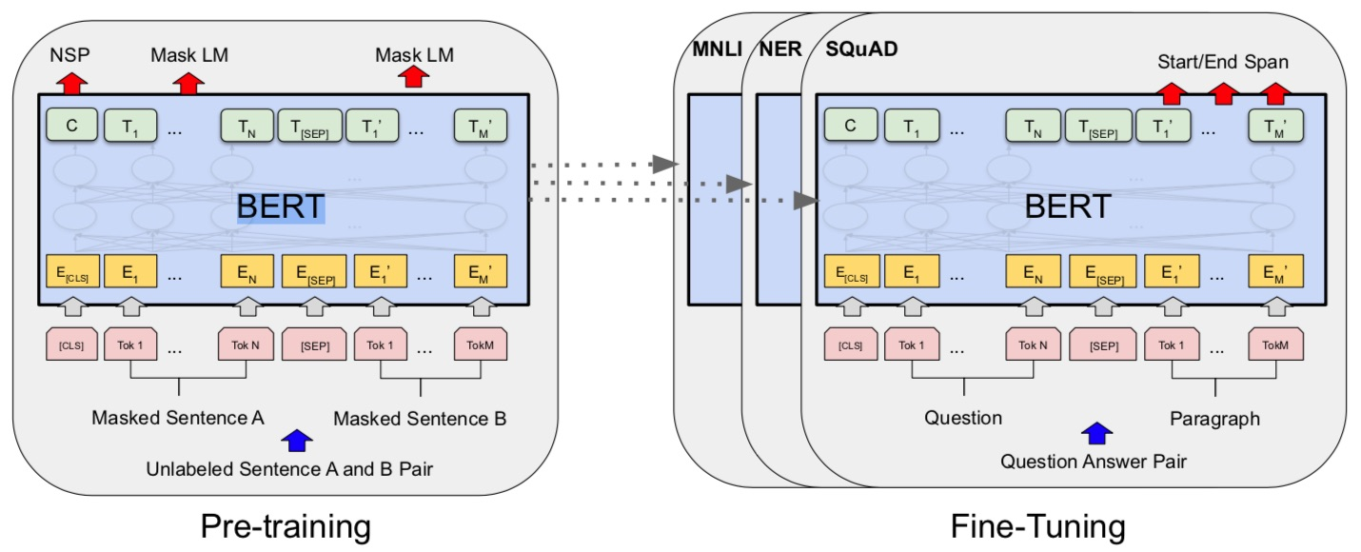
BERT: Pre-training of Deep Bidirectional Transformers for Language Understanding
BERT (Bidirectional Encoder Representations from Transformers)
Overall pre-training and fine-tuning procedures for BERT
Source: Devlin, Jacob, Ming-Wei Chang, Kenton Lee, and Kristina Toutanova (2018).
"Bert: Pre-training of deep bidirectional transformers for language understanding." arXiv preprint arXiv:1810.04805.

Slide 52
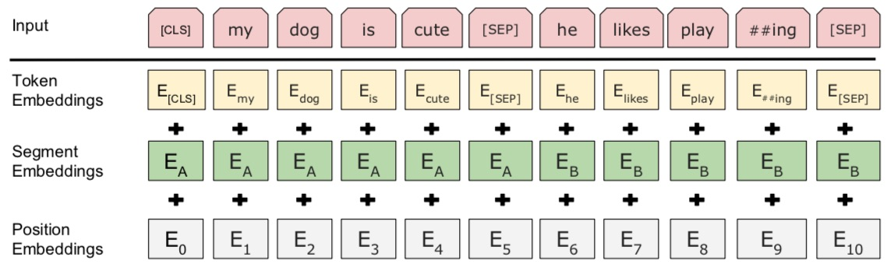
BERT: Pre-training of Deep Bidirectional Transformers for Language Understanding
BERT (Bidirectional Encoder Representations from Transformers)
BERT input representation
Source: Devlin, Jacob, Ming-Wei Chang, Kenton Lee, and Kristina Toutanova (2018).
"Bert: Pre-training of deep bidirectional transformers for language understanding." arXiv preprint arXiv:1810.04805.

Slide 53
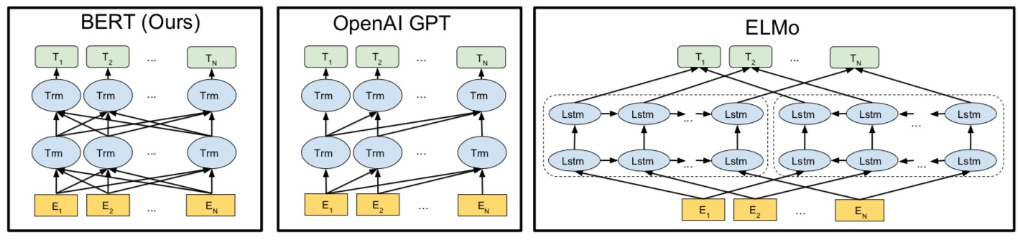
BERT, OpenAI GPT, ELMo
Source: Devlin, Jacob, Ming-Wei Chang, Kenton Lee, and Kristina Toutanova (2018).
"Bert: Pre-training of deep bidirectional transformers for language understanding." arXiv preprint arXiv:1810.04805.

Slide 54
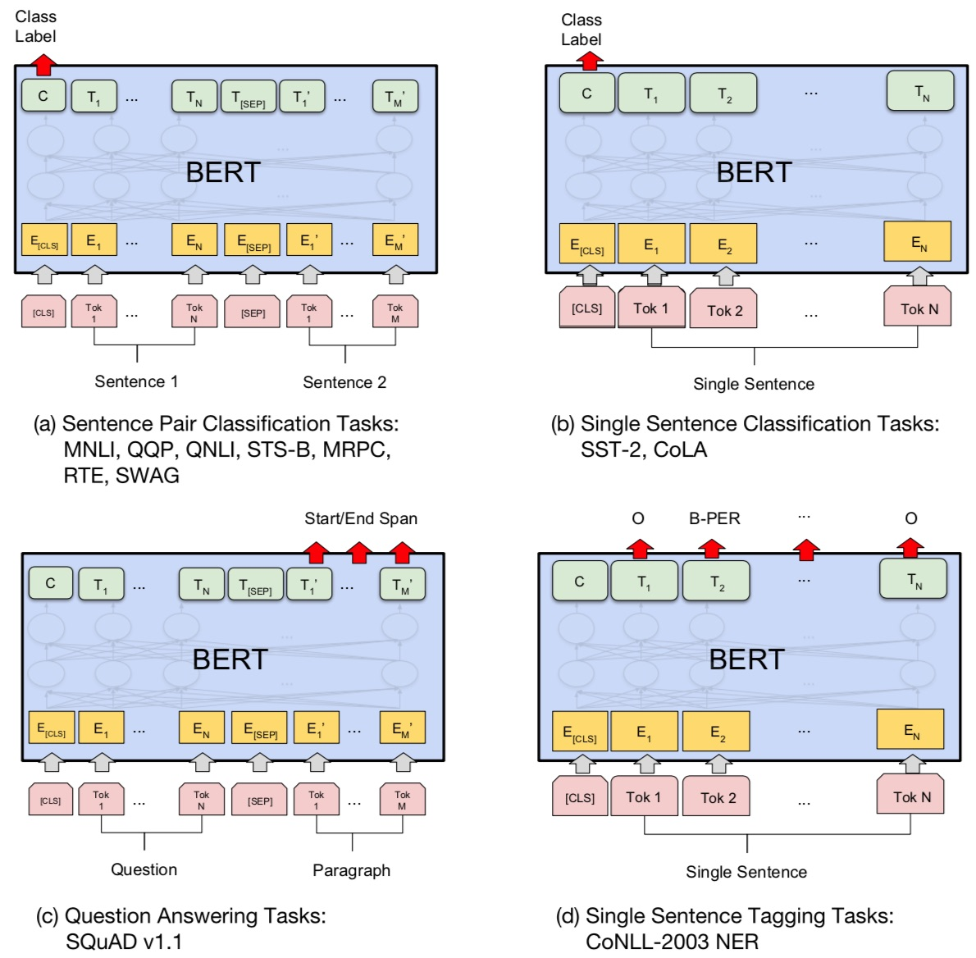
Fine-tuning BERT on Different Tasks
Source: Devlin, Jacob, Ming-Wei Chang, Kenton Lee, and Kristina Toutanova (2018).
"Bert: Pre-training of deep bidirectional transformers for language understanding." arXiv preprint arXiv:1810.04805.

Slide 55
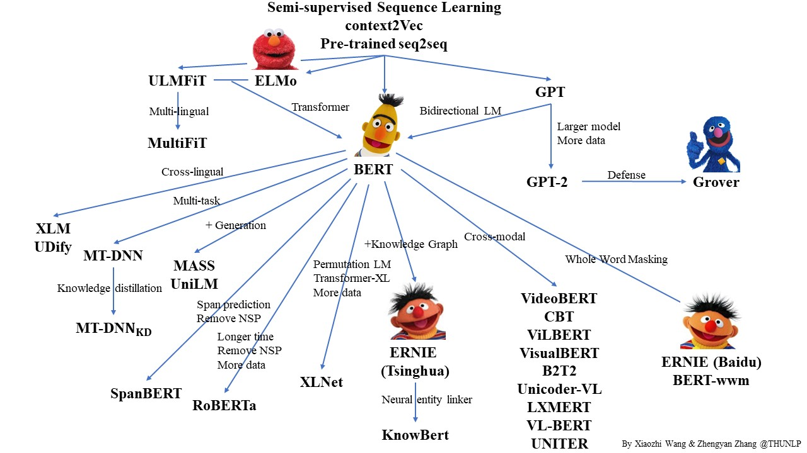
Pre-trained Language Model (PLM)
Source: https://github.com/thunlp/PLMpapers

Slide 56
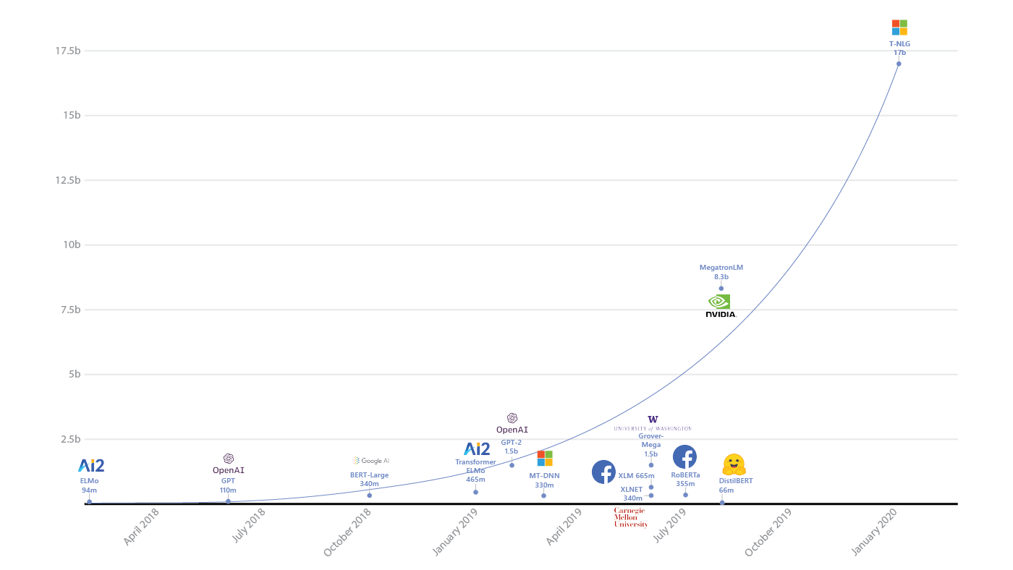
Turing Natural Language Generation (T-NLG)
T-NLG
17b
MegatronLM
8.3b
GPT-2
1.5b
BERT-Large
340m
RoBERTa
355m
DistilBERT
66m
2018
2019
2020
Source: https://www.microsoft.com/en-us/research/blog/turing-nlg-a-17-billion-parameter-language-model-by-microsoft/

Slide 57
Transformers
State-of-the-art Natural Language Processing for TensorFlow 2.0 and PyTorch
Transformers
  pytorch-transformers
  pytorch-pretrained-bert
provides state-of-the-art general-purpose architectures
  (BERT, GPT-2, RoBERTa, XLM, DistilBert, XLNet, CTRL...)
  for Natural Language Understanding (NLU) and
  Natural Language Generation (NLG)
  with over 32+ pretrained models
  in 100+ languages
  and deep interoperability between
  TensorFlow 2.0 and
  PyTorch.
Source: https://github.com/huggingface/transformers

Slide 58
Transfer Learning in Natural Language Processing
Source: Sebastian Ruder, Matthew E. Peters, Swabha Swayamdipta, and Thomas Wolf (2019), "Transfer learning in natural language processing." In Proceedings of the 2019 Conference of the North American Chapter of the Association for Computational Linguistics: Tutorials, pp. 15-18.

Slide 59
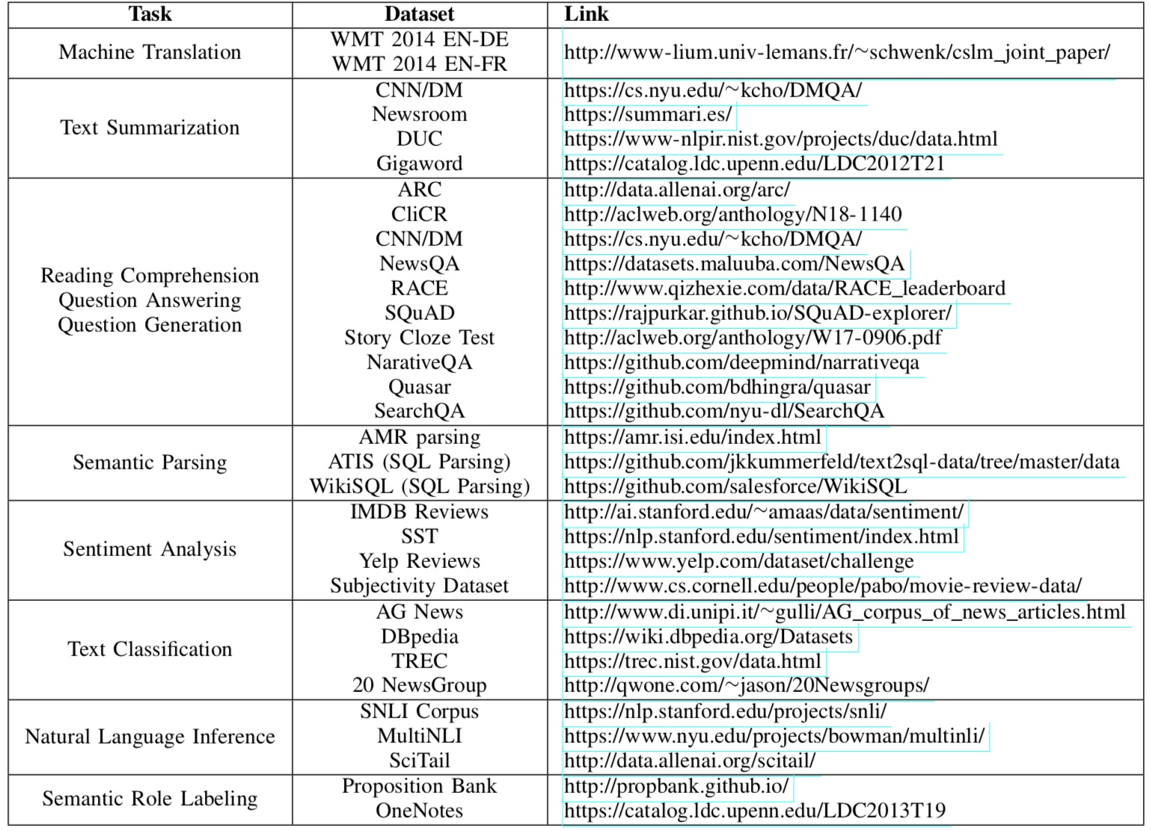
NLP Benchmark Datasets
Source: Amirsina Torfi, Rouzbeh A. Shirvani, Yaser Keneshloo, Nader Tavvaf, and Edward A. Fox (2020).
"Natural Language Processing Advancements By Deep Learning: A Survey." arXiv preprint arXiv:2003.01200.

Slide 60
Summary
Traditional Feature Engineering for Text Data
  Bag of Words Model
  Bag of N-Grams Model
  TF-IDF Model
Advanced Word Embeddings with Deep Learning
  Word2Vec Model
  Robust Word2Vec Models with Gensim
  GloVe Model
  FastText Model

Slide 61
References
Dipanjan Sarkar (2019),
Text Analytics with Python: A Practitioner’s Guide to Natural Language Processing, Second Edition. APress. https://github.com/Apress/text-analytics-w-python-2e
Benjamin Bengfort, Rebecca Bilbro, and Tony Ojeda (2018), Applied Text Analysis with Python,
O'Reilly Media.
https://www.oreilly.com/library/view/applied-text-analysis/9781491963036/

