Slide 1
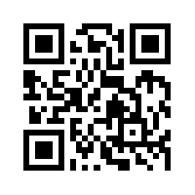
Big Data Mining 巨量資料探勘
Tamkang University
Tamkang University
關連分析 (Association Analysis)
1082DM05
MI4 (M2244) (2744)
Tue 3, 4 (10:10-12:00) (B218)
Min-Yuh Day
戴敏育
Associate Professor
副教授
Dept. of Information Management, Tamkang University
淡江大學 資訊管理學系
http://mail. tku.edu.tw/myday/
2020-03-31

Slide 2
課程大綱 (Syllabus)
週次 (Week) 日期 (Date) 內容(Subject/Topics)
1 2020/03/03 巨量資料探勘課程介紹 (Course Orientation for Big Data Mining)
2 2020/03/10 AI人工智慧與大數據分析 (Artificial Intelligence and Big Data Analytics)
3 2020/03/17 分群分析 (Cluster Analysis)
4 2020/03/24 個案分析與實作一 (SAS EM 分群分析)： Case Study 1 (Cluster Analysis - K-Means using SAS EM)
5 2020/03/31 關連分析 (Association Analysis)
6 2020/04/07 個案分析與實作二 (SAS EM 關連分析)： Case Study 2 (Association Analysis using SAS EM)
7 2020/04/14 分類與預測 (Classification and Prediction)
8 2020/04/21 期中報告 (Midterm Project Presentation)

Slide 3
課程大綱 (Syllabus)
週次 (Week) 日期 (Date) 內容(Subject/Topics)
9 2020/04/28 期中考試週
10 2020/05/05 個案分析與實作三 (SAS EM 決策樹、模型評估)： Case Study 3 (Decision Tree, Model Evaluation using SAS EM)
11 2020/05/12 個案分析與實作四 (SAS EM 迴歸分析、類神經網路)： Case Study 4 (Regression Analysis, Artificial Neural Network using SAS EM)
12 2020/05/19 機器學習與深度學習 (Machine Learning and Deep Learning)
13 2020/05/26 期末報告 (Final Project Presentation)
14 2020/06/02 畢業考試週
15 2020/06/09 教師彈性補充教學

Slide 4
Association Analysis

Slide 5
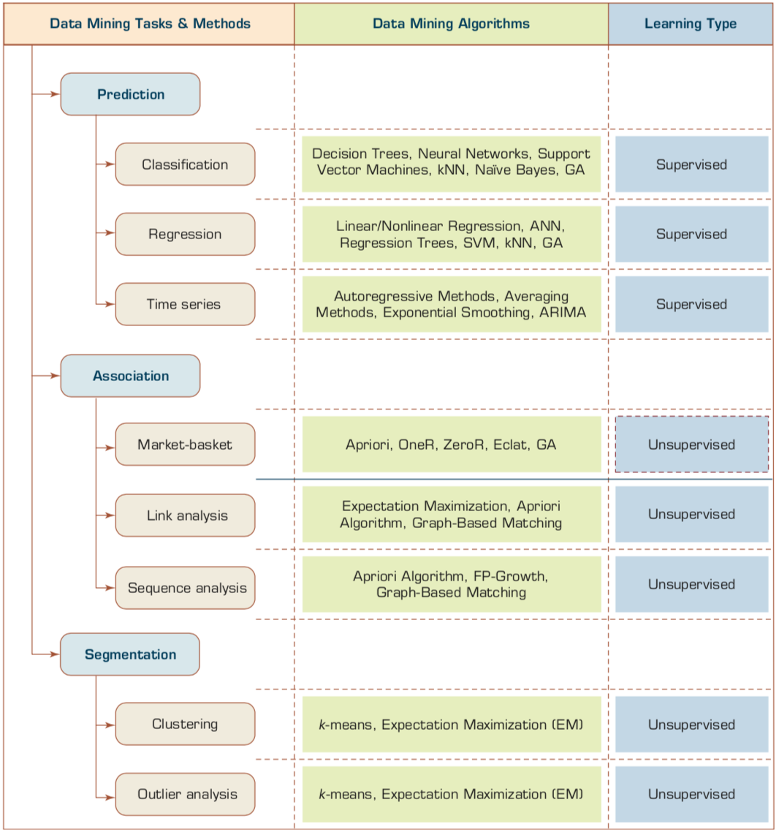
Data Mining Tasks & Methods
Source: Ramesh Sharda, Dursun Delen, and Efraim Turban (2017), Business Intelligence, Analytics, and Data Science: A Managerial Perspective, 4th Edition, Pearson

Slide 6
Transaction Database
Transaction ID | Items bought
T01 | A, B, D
T02 | A, C, D
T03 | B, C, D, E
T04 | A, B, D
T05 | A, B, C, E
T06 | A, C
T07 | B, C, D
T08 | B, D
T09 | A, C, E
T10 | B, D

Slide 7
Association Analysis: Mining Frequent Patterns, Association and Correlations
Association Analysis
Mining Frequent Patterns
Association and Correlations
Apriori Algorithm
Source: Han & Kamber (2006)

Slide 8
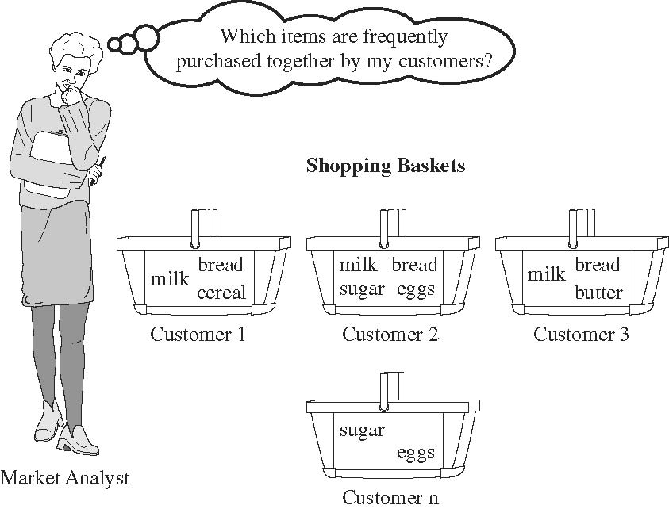
Market Basket Analysis
Source: Han & Kamber (2006)

Slide 9
Association Rule Mining
Apriori Algorithm
Source: Turban et al. (2011), Decision Support and Business Intelligence Systems

Slide 10
Association Rule Mining
A very popular DM method in business
Finds interesting relationships (affinities) between variables (items or events)
Part of machine learning family
Employs unsupervised learning
There is no output variable
Also known as market basket analysis
Often used as an example to describe DM to ordinary people, such as the famous “relationship between diapers and beers!”
Source: Turban et al. (2011), Decision Support and Business Intelligence Systems

Slide 11
Association Rule Mining
Input: the simple point-of-sale transaction data
Output: Most frequent affinities among items
Example: according to the transaction data…
“Customer who bought a laptop computer and a virus protection software, also bought extended service plan 70 percent of the time."
How do you use such a pattern/knowledge?
Put the items next to each other for ease of finding
Promote the items as a package (do not put one on sale if the other(s) are on sale)
Place items far apart from each other so that the customer has to walk the aisles to search for it, and by doing so potentially seeing and buying other items
Source: Turban et al. (2011), Decision Support and Business Intelligence Systems

Slide 12
Association Rule Mining
A representative applications of association rule mining include
In business: cross-marketing, cross-selling, store design, catalog design, e-commerce site design, optimization of online advertising, product pricing, and sales/promotion configuration
In medicine: relationships between symptoms and illnesses; diagnosis and patient characteristics and treatments (to be used in medical DSS); and genes and their functions (to be used in genomics projects)…
Source: Turban et al. (2011), Decision Support and Business Intelligence Systems

Slide 13
Association Rule Mining
Are all association rules interesting and useful?
A Generic Rule: X ⇒ Y [S%, C%]
X, Y: products and/or services
X: Left-hand-side (LHS)
Y: Right-hand-side (RHS)
S: Support: how often X and Y go together
C: Confidence: how often Y go together with the X
Example: {Laptop Computer, Antivirus Software} ⇒ {Extended Service Plan} [30%, 70%]
Source: Turban et al. (2011), Decision Support and Business Intelligence Systems

Slide 14
Association Rule Mining
Algorithms are available for generating association rules
Apriori
Eclat
FP-Growth
+ Derivatives and hybrids of the three
The algorithms help identify the frequent item sets, which are, then converted to association rules
Source: Turban et al. (2011), Decision Support and Business Intelligence Systems

Slide 15
Association Rule Mining
Apriori Algorithm
Finds subsets that are common to at least a minimum number of the itemsets
uses a bottom-up approach
frequent subsets are extended one item at a time (the size of frequent subsets increases from one-item subsets to two-item subsets, then three-item subsets, and so on), and
groups of candidates at each level are tested against the data for minimum
Source: Turban et al. (2011), Decision Support and Business Intelligence Systems

Slide 16
Basic Concepts: Frequent Patterns and Association Rules
Transaction-id | Items bought
10 | A, B, D
20 | A, C, D
30 | A, D, E
40 | B, E, F
50 | B, C, D, E, F
Itemset X = {x₁, …, x_{k}}
Find all the rules X → Y with minimum support and confidence
support, s, probability that a transaction contains X ∪ Y
confidence, c, conditional probability that a transaction having X also contains Y
Customer
buys both
Customer
buys diaper
Let sup_{min} = 50%, conf_{min} = 50%
Freq. Pat.: {A:3, B:3, D:4, E:3, AD:3}
Association rules:
A → D (60%, 100%)
D → A (60%, 75%)
Customer
buys beer
A → D (support = 3/5 = 60%, confidence = 3/3 =100%)
D → A (support = 3/5 = 60%, confidence = 3/4 = 75%)
Source: Han & Kamber (2006)

Slide 17
Market basket analysis
Example
Which groups or sets of items are customers likely to purchase on a given trip to the store?
Association Rule
Computer → antivirus_software [support = 2%; confidence = 60%]
A support of 2% means that 2% of all the transactions under analysis show that computer and antivirus software are purchased together.
A confidence of 60% means that 60% of the customers who purchased a computer also bought the software.
Source: Han & Kamber (2006)

Slide 18
Association rules
Association rules are considered interesting if they satisfy both
a minimum support threshold and
a minimum confidence threshold.
Source: Han & Kamber (2006)

Slide 19
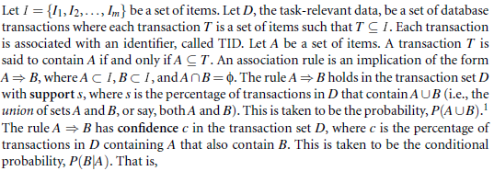
Frequent Itemsets, Closed Itemsets, and Association Rules
Support (A→ B) = P(A ∪ B)
Confidence (A→ B) = P(B|A)
Source: Han & Kamber (2006)

Slide 20
Support (A→ B) = P(A ∪ B) Confidence (A→ B) = P(B|A)
The notation P(A ∪ B) indicates the probability that a transaction contains the union of set A and set B
(i.e., it contains every item in A and in B).
This should not be confused with P(A or B), which indicates the probability that a transaction contains either A or B.
Source: Han & Kamber (2006)

Slide 21
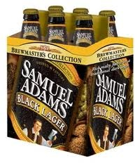
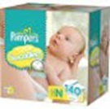
Does diaper purchase predict beer purchase?
Contingency tables
Beer
Yes No
Beer
Yes No
6 | 94
40 | 60
100
100
23 | 77
23 | 77
No diapers
diapers
DEPENDENT (yes)
INDEPENDENT (no predictability)
Source: Dickey (2012) http://www4.stat.ncsu.edu/~dickey/SAScode/Encore_2012.ppt

Slide 22
Support (A→ B) = P(A ∪ B)
Confidence (A→ B) = P(B|A)
Conf (A → B) = Supp (A ∪ B)/ Supp (A)
Lift (A → B) = Supp (A ∪ B) / (Supp (A) x Supp (B))
Lift (Correlation) Lift (A→B) = Confidence (A→B) / Support(B)
Source: Dickey (2012) http://www4.stat.ncsu.edu/~dickey/SAScode/Encore_2012.ppt

Slide 23
Lift
Lift = Confidence / Expected Confidence if Independent
Checking Saving | No (1500) | Yes (8500) | (10000)
No | 500 | 3500 | 4000
Yes | 1000 | 5000 | 6000
SVG=>CHKG Expect 8500/10000 = 85% if independent
Observed Confidence is 5000/6000 = 83%
Lift = 83/85 < 1.
Savings account holders actually LESS likely than others to have checking account !!!
Source: Dickey (2012) http://www4.stat.ncsu.edu/~dickey/SAScode/Encore_2012.ppt

Slide 24
Minimum Support and Minimum Confidence
Rules that satisfy both a minimum support threshold (min_sup) and a minimum confidence threshold (min_conf) are called strong.
By convention, we write support and confidence values so as to occur between 0% and 100%, rather than 0 to 1.0.
Source: Han & Kamber (2006)

Slide 25
K-itemset
itemset
A set of items is referred to as an itemset.
K-itemset
An itemset that contains k items is a k-itemset.
Example:
The set {computer, antivirus software} is a 2-itemset.
Source: Han & Kamber (2006)

Slide 26
Absolute Support and Relative Support
Absolute Support
The occurrence frequency of an itemset is the number of transactions that contain the itemset
frequency, support count, or count of the itemset
Ex: 3
Relative support
Ex: 60%
Source: Han & Kamber (2006)

Slide 27
Frequent Itemset
If the relative support of an itemset I satisfies a prespecified minimum support threshold, then I is a frequent itemset.
i.e., the absolute support of I satisfies the corresponding minimum support count threshold
The set of frequent k-itemsets is commonly denoted by L_{K}
Source: Han & Kamber (2006)

Slide 28
Confidence
the confidence of rule A→ B can be easily derived from the support counts of A and A ∪ B.
once the support counts of A, B, and A ∪ B are found, it is straightforward to derive the corresponding association rules A→B and B→A and check whether they are strong.
Thus the problem of mining association rules can be reduced to that of mining frequent itemsets.
Source: Han & Kamber (2006)

Slide 29
Association rule mining: Two-step process
1. Find all frequent itemsets
By definition, each of these itemsets will occur at least as frequently as a predetermined minimum support count, min_sup.
2. Generate strong association rules from the frequent itemsets
By definition, these rules must satisfy minimum support and minimum confidence.
Source: Han & Kamber (2006)

Slide 30
Efficient and Scalable Frequent Itemset Mining Methods
The Apriori Algorithm
Finding Frequent Itemsets Using Candidate Generation
Source: Han & Kamber (2006)

Slide 31
Apriori Algorithm
Apriori is a seminal algorithm proposed by R. Agrawal and R. Srikant in 1994 for mining frequent itemsets for Boolean association rules.
The name of the algorithm is based on the fact that the algorithm uses prior knowledge of frequent itemset properties, as we shall see following.
Source: Han & Kamber (2006)

Slide 32
Apriori Algorithm
Apriori employs an iterative approach known as a level-wise search, where k-itemsets are used to explore (k+1)-itemsets.
First, the set of frequent 1-itemsets is found by scanning the database to accumulate the count for each item, and collecting those items that satisfy minimum support. The resulting set is denoted L₁.
Next, L₁ is used to find L₂, the set of frequent 2-itemsets, which is used to find L₃, and so on, until no more frequent k-itemsets can be found.
The finding of each L_{k} requires one full scan of the database.
Source: Han & Kamber (2006)

Slide 33
Apriori Algorithm
To improve the efficiency of the level-wise generation of frequent itemsets, an important property called the Apriori property.
Apriori property
All nonempty subsets of a frequent itemset must also be frequent.
Source: Han & Kamber (2006)

Slide 34
Apriori algorithm (1) Frequent Itemsets (2) Association Rules

Slide 35
Transaction Database
Transaction ID | Items bought
T01 | A, B, D
T02 | A, C, D
T03 | B, C, D, E
T04 | A, B, D
T05 | A, B, C, E
T06 | A, C
T07 | B, C, D
T08 | B, D
T09 | A, C, E
T10 | B, D

Slide 36
Table 1 shows a database with 10 transactions. Let minimum support = 20% and minimum confidence = 80%. Please use Apriori algorithm for generating association rules from frequent itemsets.
Table 1: Transaction Database
Transaction ID | Items bought
T01 | A, B, D
T02 | A, C, D
T03 | B, C, D, E
T04 | A, B, D
T05 | A, B, C, E
T06 | A, C
T07 | B, C, D
T08 | B, D
T09 | A, C, E
T10 | B, D

Slide 37
Transaction ID | Items bought
T01 | A, B, D
T02 | A, C, D
T03 | B, C, D, E
T04 | A, B, D
T05 | A, B, C, E
T06 | A, C
T07 | B, C, D
T08 | B, D
T09 | A, C, E
T10 | B, D
Apriori Algorithm
C₁ → L₁
Step 1-1
C₁
L₁
Itemset | Support Count
A | 6
B | 7
C | 6
D | 7
E | 3
minimum support = 20%
= 2 / 10
Min. Support Count = 2
Itemset | Support Count
A | 6
B | 7
C | 6
D | 7
E | 3

Slide 38
Transaction ID | Items bought
T01 | A, B, D
T02 | A, C, D
T03 | B, C, D, E
T04 | A, B, D
T05 | A, B, C, E
T06 | A, C
T07 | B, C, D
T08 | B, D
T09 | A, C, E
T10 | B, D
Apriori Algorithm
C₂ → L₂
Step 1-2
C₂
L₂
Itemset | Support Count
A, B | 3
A, C | 4
A, D | 3
A, E | 2
B, C | 3
B, D | 6
B, E | 2
C, D | 3
C, E | 3
D, E | 1
Itemset | Support Count
A, B | 3
A, C | 4
A, D | 3
A, E | 2
B, C | 3
B, D | 6
B, E | 2
C, D | 3
C, E | 3
L₁
minimum support = 20%
= 2 / 10
Min. Support Count = 2
Itemset | Support Count
A | 6
B | 7
C | 6
D | 7
E | 3

Slide 39
Transaction ID | Items bought
T01 | A, B, D
T02 | A, C, D
T03 | B, C, D, E
T04 | A, B, D
T05 | A, B, C, E
T06 | A, C
T07 | B, C, D
T08 | B, D
T09 | A, C, E
T10 | B, D
Apriori Algorithm
C₃ → L₃
Step 1-3
C₃
L₃
Itemset | Support Count
A, B, C | 1
A, B, D | 2
A, B, E | 1
A, C, D | 1
A, C, E | 2
B, C, D | 2
B, C, E | 2
minimum support = 20%
= 2 / 10
Min. Support Count = 2
Itemset | Support Count
A, B, D | 2
A, C, E | 2
B, C, D | 2
B, C, E | 2
L₂
Itemset | Support Count
A, B | 3
A, C | 4
A, D | 3
A, E | 2
B, C | 3
B, D | 6
B, E | 2
C, D | 3
C, E | 3

Slide 40
Transaction ID | Items bought
T01 | A, B, D
T02 | A, C, D
T03 | B, C, D, E
T04 | A, B, D
T05 | A, B, C, E
T06 | A, C
T07 | B, C, D
T08 | B, D
T09 | A, C, E
T10 | B, D
Generating Association Rules
Step 2-1
minimum confidence = 80%
L₂
Association Rules Generated from L₂
L₁
Itemset | Support Count
A, B | 3
A, C | 4
A, D | 3
A, E | 2
B, C | 3
B, D | 6
B, E | 2
C, D | 3
C, E | 3
A→B: 3/6 | B→A: 3/7
A→C: 4/6 | C→A: 4/6
A→D: 3/6 | D→A: 3/7
A→E: 2/6 | E→A: 2/3
B→C: 3/7 | C→B: 3/6
B→D: 6/7=85.7% * | D→B: 6/7=85.7% *
B→E: 2/7 | E→B: 2/3
C→D: 3/6 | D→C: 2/7
C→E: 3/6 | E→C: 3/3=100% *
Itemset | Support Count
A | 6
B | 7
C | 6
D | 7
E | 3

Slide 41
Transaction ID | Items bought
T01 | A, B, D
T02 | A, C, D
T03 | B, C, D, E
T04 | A, B, D
T05 | A, B, C, E
T06 | A, C
T07 | B, C, D
T08 | B, D
T09 | A, C, E
T10 | B, D
Generating Association Rules
Step 2-2
minimum confidence = 80%
Association Rules Generated from L₃
A→BD: 2/6 | B→CD: 2/7
B→AD: 2/7 | C→BD: 2/6
D→AB: 2/7 | D→BC: 2/7
AB→D: 2/3 | BC→D: 2/3
AD→B: 2/3 | BD→C: 2/6
BD→A: 2/6 | CD→B: 2/3
A→CE: 2/6 | B→CE: 2/7
C→AE: 2/6 | C→BE: 2/6
E→AC: 2/3 | E→BC: 2/3
AC→E: 2/4 | BC→E: 2/3
AE→C: 2/2=100%* | BE→C: 2/2=100%*
CE→A: 2/3 | CE→B: 2/3
L₁
L₂
L₃
Itemset | Support Count
A | 6
B | 7
C | 6
D | 7
E | 3
Itemset | Support Count
A, B | 3
A, C | 4
A, D | 3
A, E | 2
B, C | 3
B, D | 6
B, E | 2
C, D | 3
C, E | 3
Itemset | Support Count
A, B, D | 2
A, C, E | 2
B, C, D | 2
B, C, E | 2

Slide 42
Transaction ID | Items bought
T01 | A, B, D
T02 | A, C, D
T03 | B, C, D, E
T04 | A, B, D
T05 | A, B, C, E
T06 | A, C
T07 | B, C, D
T08 | B, D
T09 | A, C, E
T10 | B, D
Frequent Itemsets and Association Rules
L₁
L₂
L₃
Itemset | Support Count
A | 6
B | 7
C | 6
D | 7
E | 3
Itemset | Support Count
A, B | 3
A, C | 4
A, D | 3
A, E | 2
B, C | 3
B, D | 6
B, E | 2
C, D | 3
C, E | 3
Itemset | Support Count
A, B, D | 2
A, C, E | 2
B, C, D | 2
B, C, E | 2
minimum support = 20%
minimum confidence = 80%
Association Rules:
B→D (60%, 85.7%) (Sup.: 6/10, Conf.: 6/7)
D→B (60%, 85.7%) (Sup.: 6/10, Conf.: 6/7)
E→C (30%, 100%) (Sup.: 3/10, Conf.: 3/3)
AE→C (20%, 100%) (Sup.: 2/10, Conf.: 2/2)
BE→C (20%, 100%) (Sup.: 2/10, Conf.: 2/2)

Slide 43
Table 1 shows a database with 10 transactions. Let minimum support = 20% and minimum confidence = 80%. Please use Apriori algorithm for generating association rules from frequent itemsets.
Transaction ID | Items bought
T01 | A, B, D
T02 | A, C, D
T03 | B, C, D, E
T04 | A, B, D
T05 | A, B, C, E
T06 | A, C
T07 | B, C, D
T08 | B, D
T09 | A, C, E
T10 | B, D
Association Rules:
B→D (60%, 85.7%) (Sup.: 6/10, Conf.: 6/7)
D→B (60%, 85.7%) (Sup.: 6/10, Conf.: 6/7)
E→C (30%, 100%) (Sup.: 3/10, Conf.: 3/3)
AE→C (20%, 100%) (Sup.: 2/10, Conf.: 2/2)
BE→C (20%, 100%) (Sup.: 2/10, Conf.: 2/2)

Slide 44
Summary
Association Analysis
Apriori algorithm
Frequent Itemsets
Association Rules

Slide 45
References
Jiawei Han and Micheline Kamber, Data Mining: Concepts and Techniques, Second Edition, Elsevier, 2006.
Jiawei Han, Micheline Kamber and Jian Pei, Data Mining: Concepts and Techniques, Third Edition, Morgan Kaufmann 2011.
Efraim Turban, Ramesh Sharda, Dursun Delen, Decision Support and Business Intelligence Systems, Ninth Edition, Pearson, 2011.
EMC Education Services, Data Science and Big Data Analytics: Discovering, Analyzing, Visualizing and Presenting Data, Wiley, 2015

