Slide 1
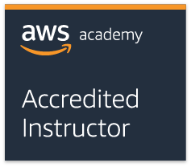
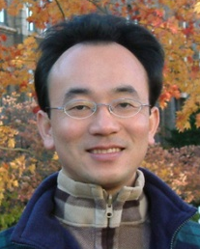
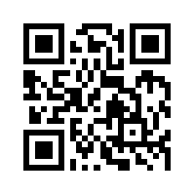
雲端服務架構實務 (Cloud Services Architecting Practices)
Tamkang University
Course orientation on Cloud Services Architecting Practices
雲端服務架構實務 (Cloud Services Architecting Practices) (MI4) (Fall 2019) (AWS Academy Cloud Foundations; ACF) (AWS Cloud Practitioner, AWS Solutions Architect) (MI4, TKU) (2 Credits, Elective) (1081) (資管四 MI4) (選修2學分) (2019.09 - 2020.01) (週四 Thu, 9, 10, 16:10-18:00) (B113)
Min-Yuh Day, Ph.D, Associate Professor
戴敏育 副教授
Dept. of Information Management, Tamkang University
淡江大學 資訊管理學系
http://mail.tku.edu.tw/myday
2019-09-12

Slide 2
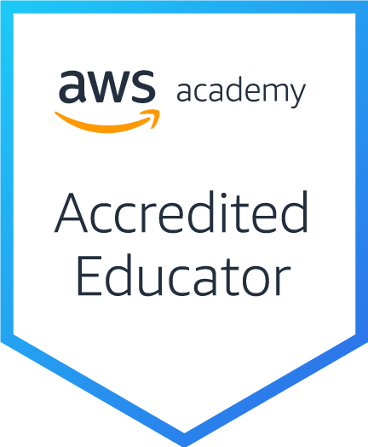
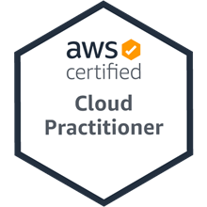
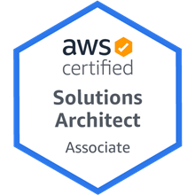
Tamkang University

Slide 3
淡江大學108學年度第1學期 課程教學計畫表 Fall 2019 (2019.09.12 - 2020.01.09)
Tamkang University
課程名稱：雲端服務架構實務 (Cloud Services Architecting Practices)
授課教師：戴敏育 (Min-Yuh Day)
開課系級：資管四P (TLMXB4P) (M2436) (2790)
開課資料：選修 單學期 2 學分 (2 Credits, Elective)
上課時間地點：週四 Thu 9, 10 (16:10-18:00) B113

Slide 4
課程簡介
Tamkang University
雲端服務架構實務課程主要介紹： AWS 技術基礎和在 AWS 上建立架構。
AWS技術基礎介紹 AWS 產品、服務和常見解決方案。
在 AWS 上建立架構內容涵蓋在 AWS 上建置 IT 基礎架構的基礎。
解決方案架構師如何透過了解 AWS 服務來優化對 AWS 雲端的使用，及如何讓這些服務符合雲端解決方案。
AWS 雲端最佳實務與建議的設計模式，協助學員思考在 AWS 上架構最佳 IT 解決方案的程序。

Slide 5
Course Introduction
Tamkang University
This course, Cloud Services Architecting Practices, introduces AWS Technical Essentials and Architecting on AWS.
In AWS Technical Essentials, students will learn about AWS products, services, and common solutions.
Architecting on AWS covers fundamentals of building IT infrastructure on the AWS platform.
Students will learn how to optimize the AWS Cloud by understanding how AWS services fit into cloud-based solutions.
In addition, students explore AWS Cloud best practices and design patterns for architecting optimal IT solutions on AWS.

Slide 6
課程目標
Tamkang University
與 AWS 平台有關的術語和概念
瀏覽 AWS 管理主控台的方法
AWS 安全措施和 AWS Identity and Access Management (IAM) 的關鍵概念
根據 AWS 架構原則和最佳實務做出架構決策
利用 AWS 服務，讓您的基礎設施可擴展、可靠且高度可用

Slide 7
Course Objective
Tamkang University
Terminology and concepts related to the AWS platform
How to navigate the AWS Management Console
Key concepts of AWS security measures and AWS Identity and Access Management (IAM)
Make architectural decisions based on AWS architectural principles and best practices
Leverage AWS services to make your infrastructure scalable, reliable, and highly available

Slide 8
課程大綱 (Syllabus)
Tamkang University
週次 (Week) 日期 (Date) 內容 (Subject/Topics)
1 2019/09/12 Course orientation on Cloud Services Architecting Practices
2 2019/09/19 Introduction to Cloud Computing
3 2019/09/26 Getting Started with AWS: AWS Compute, Storage, and Networking
4 2019/10/03 Creating Amazon EC2 instances with Microsoft Windows
5 2019/10/10 國慶日放假
6 2019/10/17 Build Your Virtual Private Cloud (VPC) and Launch a Web Server, Working with Amazon Elastic Block Store (EBS)

Slide 9
課程大綱 (Syllabus)
Tamkang University
週次 (Week) 日期 (Date) 內容 (Subject/Topics)
7 2019/10/24 AWS Security, Identity, and Access Management: Introduction to AWS Identity and Access Management (IAM)
8 2019/10/31 AWS Database Options: Build Your Database Server and Interact with Your Database using an Application
9 2019/11/07 AWS Elasticity and Management Tools: Scale and Load Balance Your Architecture
10 2019/11/14 期中考試週
11 2019/11/21 Architecting on AWS: Introduction to System Design
12 2019/11/28 Cloud Billing and Support Services

Slide 10
課程大綱 (Syllabus)
Tamkang University
週次 (Week) 日期 (Date) 內容 (Subject/Topics)
13 2019/12/05 Designing Your Environment and Deploy a Web Application on AWS
14 2019/12/12 Group discussion: Forklift an Existing Application onto AWS
15 2019/12/19 System Design for High Availability (Part I)
16 2019/12/26 Making Your Environment Highly Available
17 2020/01/02 System Design for High Availability (Part II)
18 2020/01/09 期末考試週

Slide 11
教學目標之教學方法與評量方法
Tamkang University
教學方法
講述、討論、發表、實作、體驗、模擬
評量方法
測驗、討論、實作、報告

Slide 12
學期成績計算方式
Tamkang University
期中評量： 30.0 %
期末評量： 30.0 %
平時評量 ：40.0 % (課堂參與及報告討論表現)

Slide 13
教材課本與參考書籍
Tamkang University
教材課本 (Textbook)
Slides
AWS Academy Cloud Foundations (AWS ACF), AWS Academy
AWS Academy Cloud Architecting (AWS ACA), AWS Academy

Slide 14
教材課本與參考書籍
Tamkang University
參考書籍 (References)
Ben Piper and David Clinton (2019), AWS Certified Solutions Architect Study Guide: Associate SAA-C01 Exam, 2 edition, Sybex, 2019
AWS Technical Essentials
https://aws.amazon.com/training/course-descriptions/essentials/
Architecting on AWS
https://aws.amazon.com/training/course-descriptions/architect/
AWS Cloud Practitioner Essentials (Second Edition)
https://aws.amazon.com/training/course-descriptions/cloud-practitioner-essentials/
AWS Certified Cloud Practitioner
https://aws.amazon.com/certification/certified-cloud-practitioner/
AWS Certified Solutions Architect – Associate
https://aws.amazon.com/certification/certified-solutions-architect-associate/

Slide 15
SAA
CLF
https://aws.amazon.com/certification/

Slide 16
AWS Certified Cloud Practitioner
This certification provides individuals in a larger variety of cloud and technology roles with a way to validate their AWS Cloud knowledge and enhance their professional credibility.
This exam covers four domains, including cloud concepts, security, technology, and billing and pricing.
https://aws.amazon.com/certification/certified-cloud-practitioner/

Slide 17
AWS Certified Solutions Architect – Associate
This certification validates your ability to effectively demonstrate knowledge of how to architect and deploy secure and robust applications on AWS technologies.
This exam is for anyone with at least one year of hands-on experience designing available, cost-efficient, fault-tolerant, and scalable and distributed systems on AWS.
https://aws.amazon.com/certification/certified-solutions-architect-associate/

Slide 18
AWS Academy and Certifications
AWS Academy Cloud Foundations (ACF)
AWS Certified Cloud Practitioner (CLF-C01) (2020/01/02)
https://aws.amazon.com/certification/certified-cloud-practitioner/
AWS Academy Cloud Architecting (ACA)
AWS Certified Solutions Architect – Associate (SAA-C01) (2020/05/15)
https://aws.amazon.com/certification/certified-solutions-architect-associate/
https://aws.amazon.com/training/awsacademy/

Slide 19
AWS Academy and Certifications
AWS Academy Cloud Foundations (ACF)
AWS Certified Cloud Practitioner (CLF-C01) (2020/01/02)
https://aws.amazon.com/certification/certified-cloud-practitioner/
AWS Cloud Practitioner Essentials (Second Edition)
https://aws.amazon.com/training/course-descriptions/cloud-practitioner-essentials/
AWS Technical Essentials
https://aws.amazon.com/training/course-descriptions/essentials/
AWS Academy Cloud Architecting (ACA)
AWS Certified Solutions Architect – Associate (SAA-C01) (2020/05/15)
https://aws.amazon.com/certification/certified-solutions-architect-associate/
Architecting on AWS
https://aws.amazon.com/training/course-descriptions/architect/
https://aws.amazon.com/training/awsacademy/

Slide 20
AWS Certified Cloud Practitioner (CLF-C01)
Domain | % of Examination
Domain 1: Cloud Concepts | 26%
Domain 2: Security and Compliance | 25%
Domain 3: Technology | 33%
Domain 4: Billing and Pricing | 16%
TOTAL | 100%
Source: https://aws.amazon.com/certification/certified-cloud-practitioner/

Slide 21
AWS Certified Solutions Architect – Associate (SAA-C01)
Domain | % of Examination
Domain 1: Design Resilient Architectures | 34%
Domain 2: Define Performant Architectures | 24%
Domain 3: Specify Secure Applications and Architectures | 26%
Domain 4: Design Cost-Optimized Architectures | 10%
Domain 5: Define Operationally Excellent Architectures | 6%
TOTAL | 100%
Source: https://aws.amazon.com/certification/certified-solutions-architect-associate

Slide 22
AWS Certified Cloud Practitioner (CLF-C01)
Domain 1: Cloud Concepts
1.1 Define the AWS Cloud and its value proposition
1.2 Identify aspects of AWS Cloud economics
1.3 List the different cloud architecture design principles
Source: https://aws.amazon.com/certification/certified-cloud-practitioner/

Slide 23
AWS Certified Cloud Practitioner (CLF-C01)
Domain 2: Security and Compliance
2.1 Define the AWS shared responsibility model
2.2 Define AWS Cloud security and compliance concepts
2.3 Identify AWS access management capabilities
2.4 Identify resources for security support
Source: https://aws.amazon.com/certification/certified-cloud-practitioner/

Slide 24
AWS Certified Cloud Practitioner (CLF-C01)
Domain 3: Technology
3.1 Define methods of deploying and operating in the AWS Cloud
3.2 Define the AWS global infrastructure
3.3 Identify the core AWS services
3.4 Identify resources for technology support
Source: https://aws.amazon.com/certification/certified-cloud-practitioner/

Slide 25
AWS Certified Cloud Practitioner (CLF-C01)
Domain 4: Billing and Pricing
4.1 Compare and contrast the various pricing models for AWS
4.2 Recognize the various account structures in relation to AWS billing and pricing
4.3 Identify resources available for billing support
Source: https://aws.amazon.com/certification/certified-cloud-practitioner/

Slide 26
AWS Certified Solutions Architect – Associate (SAA-C01)
Domain 1: Design Resilient Architectures
1.1 Choose reliable/resilient storage.
1.2 Determine how to design decoupling mechanisms using AWS services.
1.3 Determine how to design a multi-tier architecture solution.
1.4 Determine how to design high availability and/or fault tolerant architectures.
Source: https://aws.amazon.com/certification/certified-solutions-architect-associate

Slide 27
AWS Certified Solutions Architect – Associate (SAA-C01)
Domain 2: Define Performant Architectures
2.1 Choose performant storage and databases.
2.2 Apply caching to improve performance.
2.3 Design solutions for elasticity and scalability.
Source: https://aws.amazon.com/certification/certified-solutions-architect-associate

Slide 28
AWS Certified Solutions Architect – Associate (SAA-C01)
Domain 3: Specify Secure Applications and Architectures
3.1 Determine how to secure application tiers.
3.2 Determine how to secure data.
3.3 Define the networking infrastructure for a single VPC application.
Source: https://aws.amazon.com/certification/certified-solutions-architect-associate

Slide 29
AWS Certified Solutions Architect – Associate (SAA-C01)
Domain 4: Design Cost-Optimized Architectures
4.1 Determine how to design cost-optimized storage.
4.2 Determine how to design cost-optimized compute.
Domain 5: Define Operationally-Excellent Architectures
5.1 Choose design features in solutions that enable operational excellence.
Source: https://aws.amazon.com/certification/certified-solutions-architect-associate

Slide 30
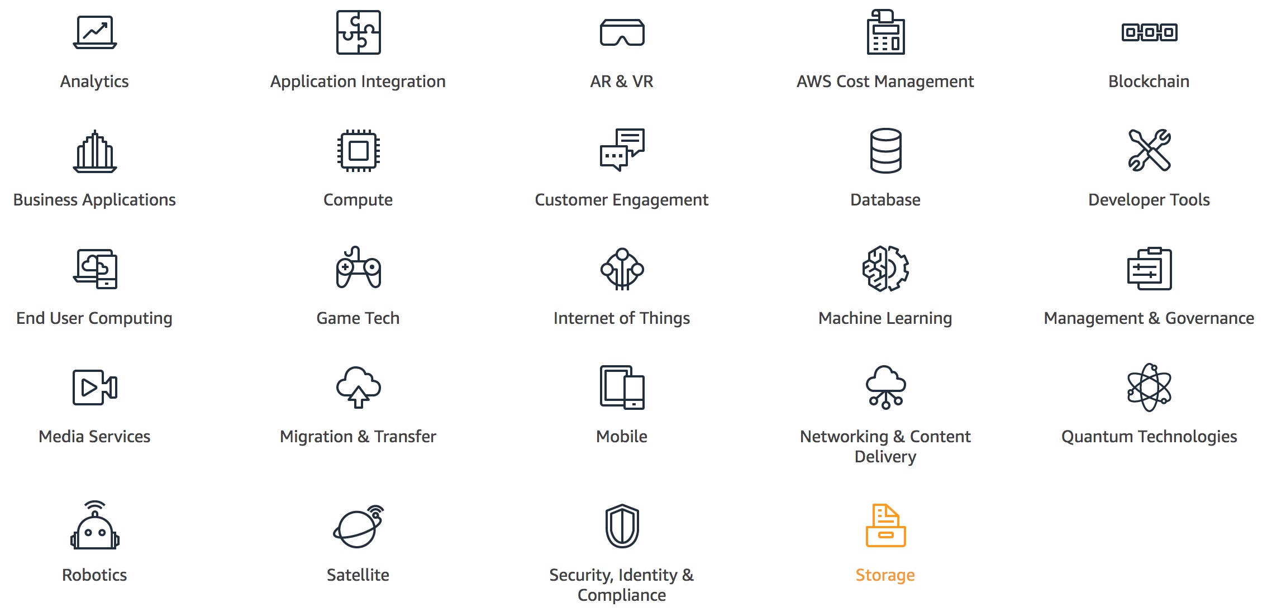
AWS Products and Services
Source: https://aws.amazon.com/

Slide 31
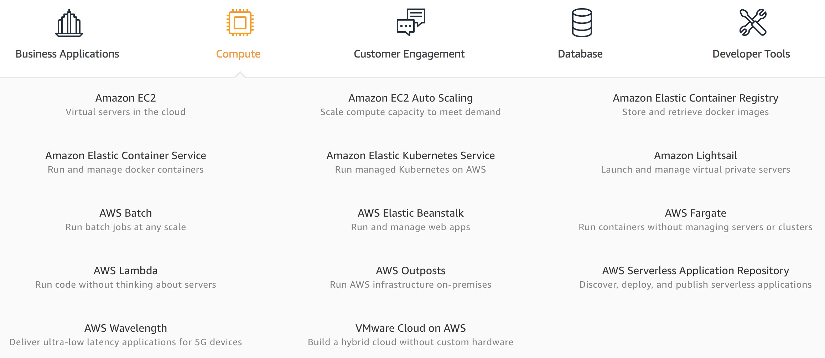
AWS Compute
Source: https://aws.amazon.com/

Slide 32
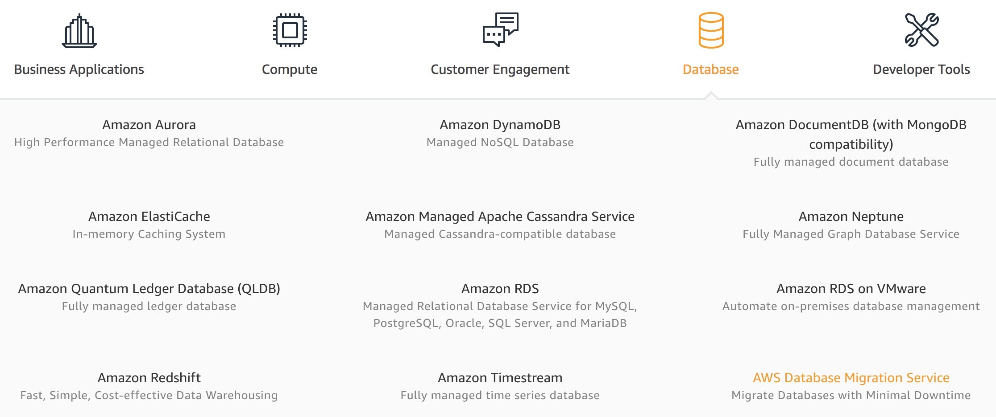
AWS Database
Source: https://aws.amazon.com/

Slide 33
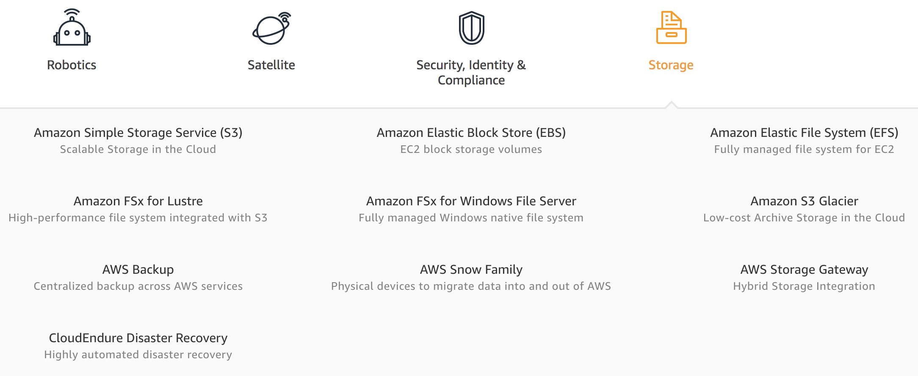
AWS Storage
Source: https://aws.amazon.com/

Slide 34
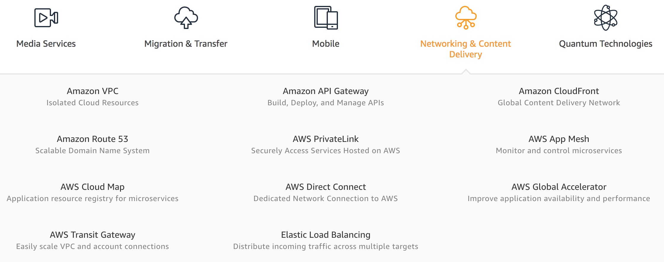
AWS Networking & Content Dilivery
Source: https://aws.amazon.com/

Slide 35
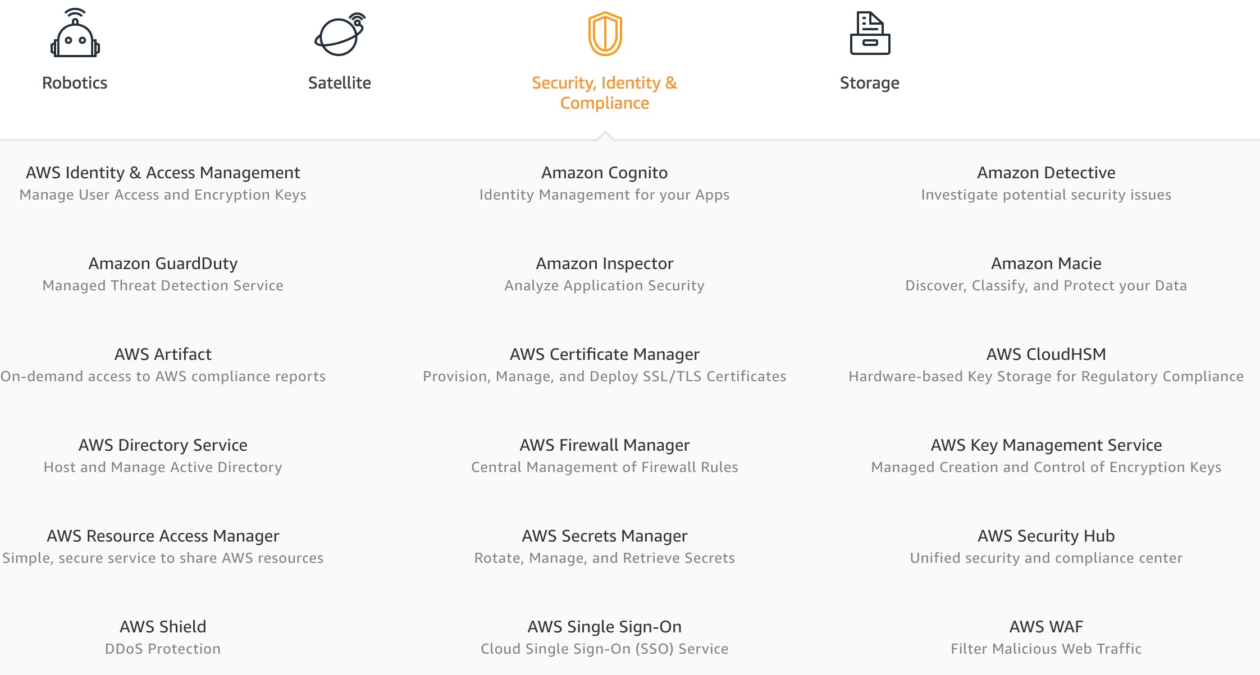
AWS Security, Identity & Compliance
Source: https://aws.amazon.com/

Slide 36
AWS Cost Management
Source: https://aws.amazon.com/

Slide 37
AWS Services
Amazon EC2
Virtual servers in the cloud
Amazon Simple Storage Service (S3)
Scalable storage in the cloud
Amazon Aurora
High performance managed relational database
Amazon DynamoDB
Managed NoSQL database
Amazon RDS
Managed relational database service for MySQL, PostgreSQL, Oracle, SQL Server, and MariaDB
Source: https://aws.amazon.com/

Slide 38
AWS Services
AWS Lambda
Run code without thinking about servers
AWS Elastic Beanstalk
Run and manage web apps
Amazon VPC
Isolated cloud resources
Amazon Lightsail
Launch and manage virtual private servers
Amazon SageMaker
Build, train, and deploy machine learning models at scale
Source: https://aws.amazon.com/

Slide 39
Summary
Tamkang University
雲端服務架構實務課程主要介紹： AWS 技術基礎和在 AWS 上建立架構。
AWS技術基礎介紹 AWS 產品、服務和常見解決方案。
在 AWS 上建立架構內容涵蓋在 AWS 上建置 IT 基礎架構的基礎。
解決方案架構師如何透過了解 AWS 服務來優化對 AWS 雲端的使用，及如何讓這些服務符合雲端解決方案。
AWS 雲端最佳實務與建議的設計模式，協助學員思考在 AWS 上架構最佳 IT 解決方案的程序。

Slide 40
Contact Information
Tamkang University
戴敏育 博士 (Min-Yuh Day, Ph.D.)
專任副教授
淡江大學 資訊管理學系
電話：02-26215656 #2846
傳真：02-26209737
研究室：B929
地址： 25137 新北市淡水區英專路151號
Email： myday@mail.tku.edu.tw
網址：http://mail.tku.edu.tw/myday/

