Slide 1
AI in Finance Big Data Analytics
Tamkang University
Deep Learning for Financial Time Series Forecasting with TensorFlow
1081AIFBDA09
TLVXM2A (M2449) (8497) (Fall 2019)
(MBA, DBETKU) (3 Credits, Required) [Full English Course]
(Master’s Program in Digital Business and Economics)
Tue, 2, 3, 4, (9:10-12:00) (B1012)
Min-Yuh Day, Ph.D.
Associate Professor
Department of Information Management
Tamkang University
http://mail.tku.edu.tw/myday
2019-11-26

Slide 2
Course Schedule (1/2)
Tamkang University
Week Date Subject/Topics
1 2019/09/10 Course Orientation on AI in Finance Big Data Analytics
2 2019/09/17 AI in FinTech: Financial Services Innovation and Application
3 2019/09/24 ABC: AI, Big Data, Cloud Computing
4 2019/10/01 Business Models of Fintech
5 2019/10/08 Event Studies in Finance
6 2019/10/15 Case Study on AI in Finance Big Data Analytics I
7 2019/10/22 Foundations of AI in Finance Big Data Analytics with Python
8 2019/10/29 Case Study on Financial Industry Practice I
9 2019/11/05 Quantitative Investing with Pandas in Python

Slide 3
Course Schedule (2/2)
Tamkang University
Week Date Subject/Topics
10 2019/11/12 Midterm Project Report
11 2019/11/19 Machine Learning in Finance Application with Scikit-Learn In Python
12 2019/11/26 Deep Learning for Financial Time Series Forecasting with TensorFlow I
13 2019/12/03 Case Study on AI in Finance Big Data Analytics II
14 2019/12/10 Deep Learning for Financial Time Series Forecasting with TensorFlow II
15 2019/12/17 Case Study on Financial Industry Practice II
16 2019/12/24 Deep Learning for Financial Time Series Forecasting with TensorFlow III
17 2019/12/31 Final Project Presentation I
18 2020/01/07 Final Project Presentation II

Slide 4
Deep Learning for Financial Time Series Forecasting with TensorFlow

Slide 5
Outline
Deep Learning for Financial Time Series Forecasting with TensorFlow
Deep Learning
Financial Time Series Forecasting
TensorFlow

Slide 6
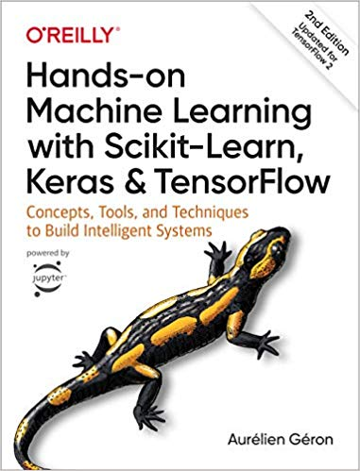
Aurélien Géron (2019), Hands-On Machine Learning with Scikit-Learn, Keras, and TensorFlow: Concepts, Tools, and Techniques to Build Intelligent Systems, 2nd Edition O’Reilly Media, 2019
https://github.com/ageron/handson-ml2
Source: https://www.amazon.com/Hands-Machine-Learning-Scikit-Learn-TensorFlow/dp/1492032646/

Slide 7
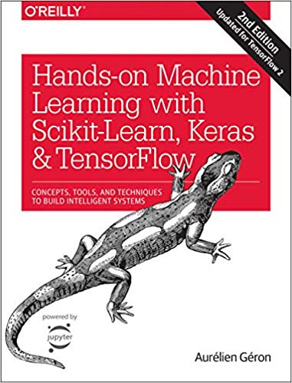
Hands-On Machine Learning with Scikit-Learn, Keras, and TensorFlow
Notebooks
The Machine Learning landscape
End-to-end Machine Learning project
Classification
Training Models
Support Vector Machines
Decision Trees
Ensemble Learning and Random Forests
Dimensionality Reduction
Unsupervised Learning Techniques
Artificial Neural Nets with Keras
Training Deep Neural Networks
Custom Models and Training with TensorFlow
Loading and Preprocessing Data
Deep Computer Vision Using Convolutional Neural Networks
Processing Sequences Using RNNs and CNNs
Natural Language Processing with RNNs and Attention
Representation Learning Using Autoencoders
Reinforcement Learning
Training and Deploying TensorFlow Models at Scale
https://github.com/ageron/handson-ml2

Slide 8
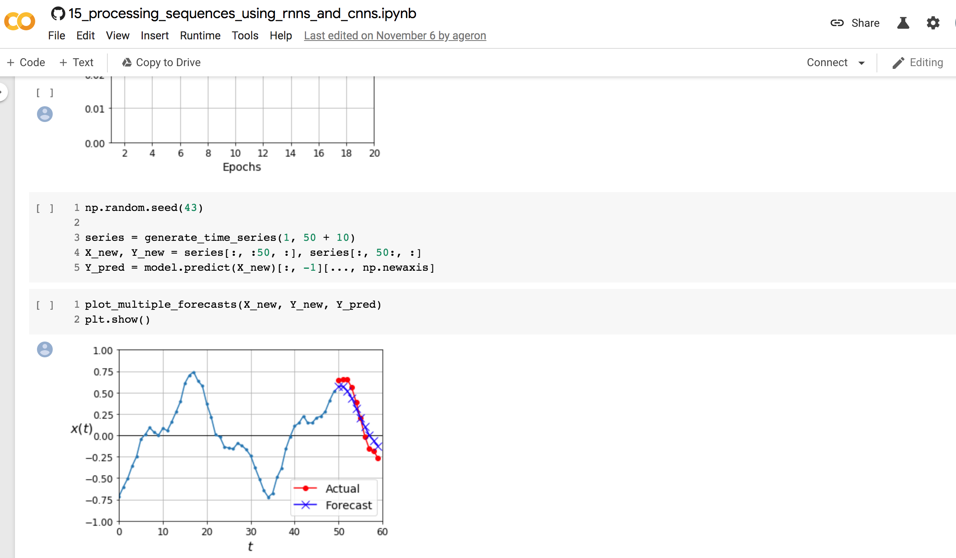
Sequences using RNNs and CNNs
https://colab.research.google.com/github/ageron/handson-ml2/blob/master/15_processing_sequences_using_rnns_and_cnns.ipynb

Slide 9
TensorFlow
https://www.tensorflow.org/

Slide 10
TensorFlow
An end-to-end open source machine learning platform.
The core open source library to help you develop and train ML models.
Get started quickly by running Colab notebooks directly in your browser.
https://www.tensorflow.org/

Slide 11
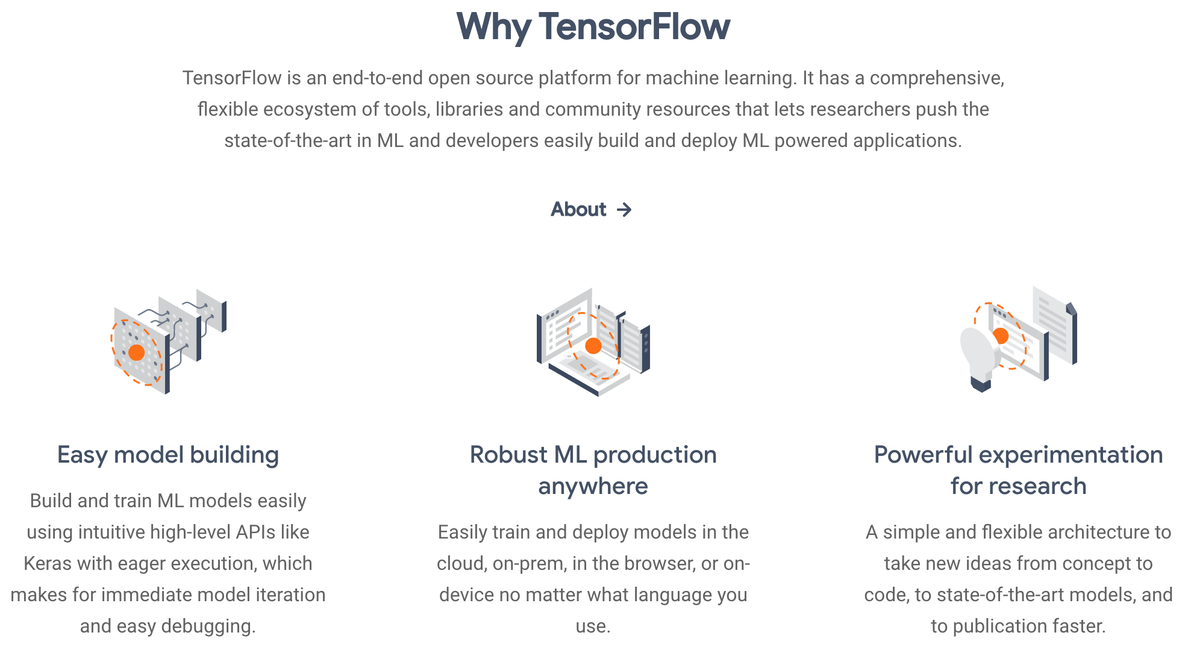
Why TensorFlow 2.0

Slide 12
TensorFlow 2.0 vs. 1.X
# TensorFlow 2.0 outputs = f(input)
# TensorFlow 1.X outputs = session.run(f(placeholder), feed_dict={placeholder: input})
Source: https://www.tensorflow.org/guide/effective_tf2

Slide 13
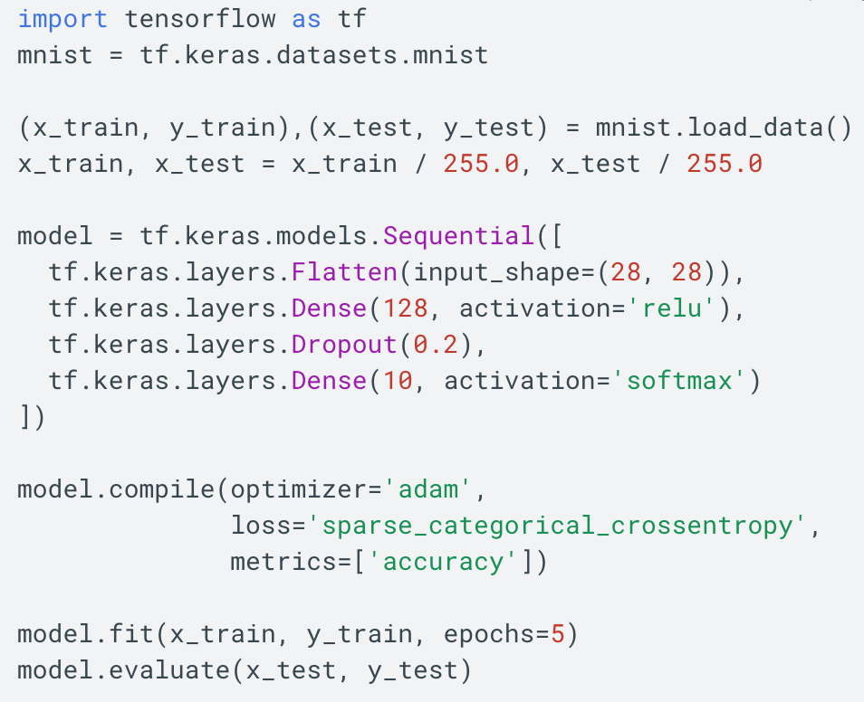
TensorFlow 2.0
https://www.tensorflow.org/overview/

Slide 14
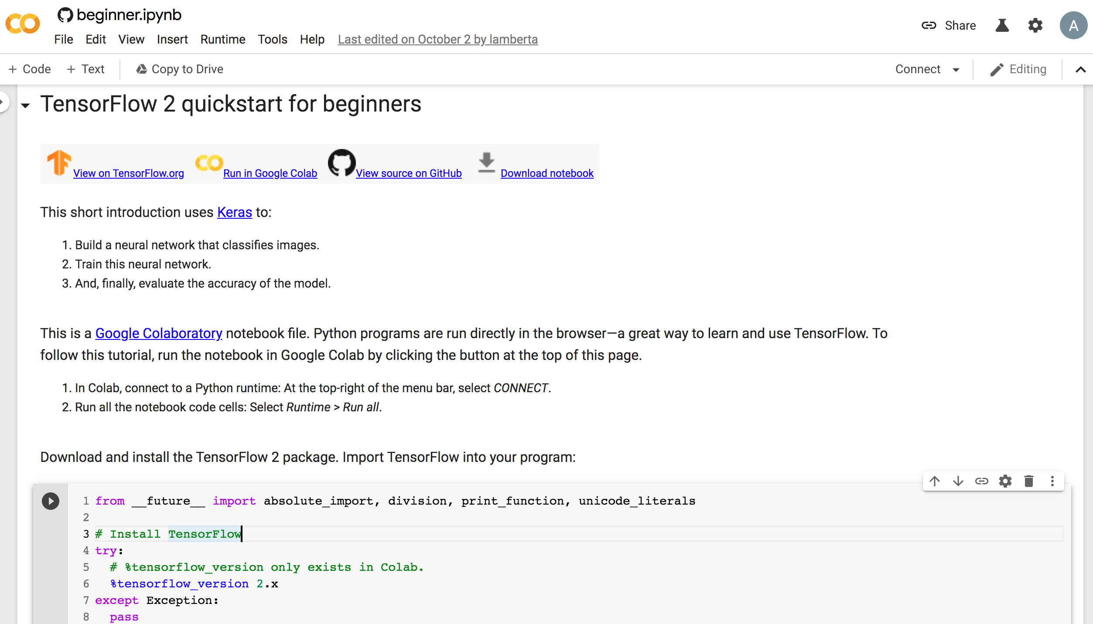
TensorFlow 2 Quick Start
https://colab.research.google.com/github/tensorflow/docs/blob/master/site/en/tutorials/quickstart/beginner.ipynb

Slide 15
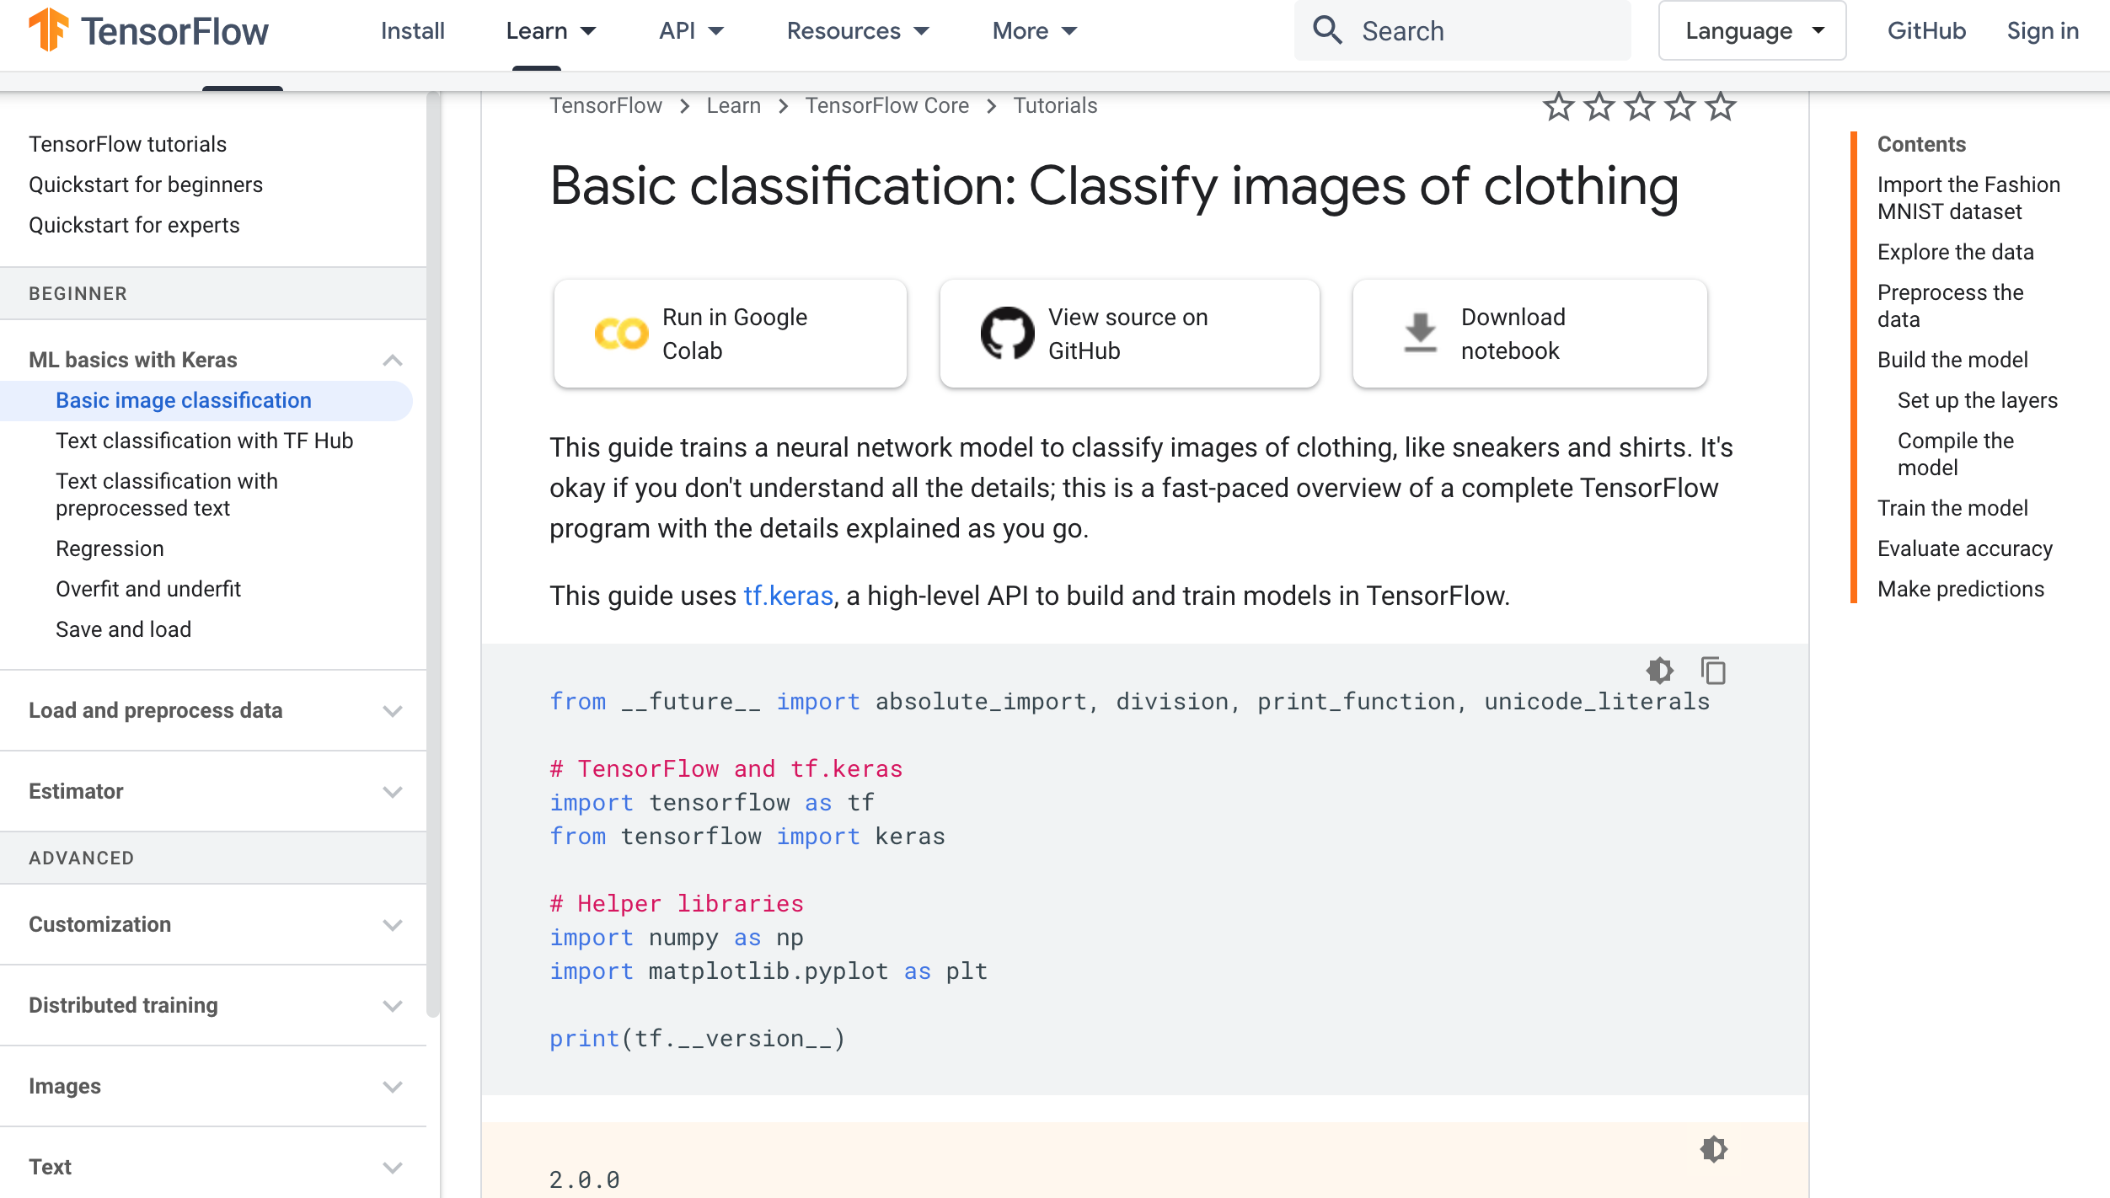
TensorFlow Image Classification
https://www.tensorflow.org/tutorials/keras/classification

Slide 16
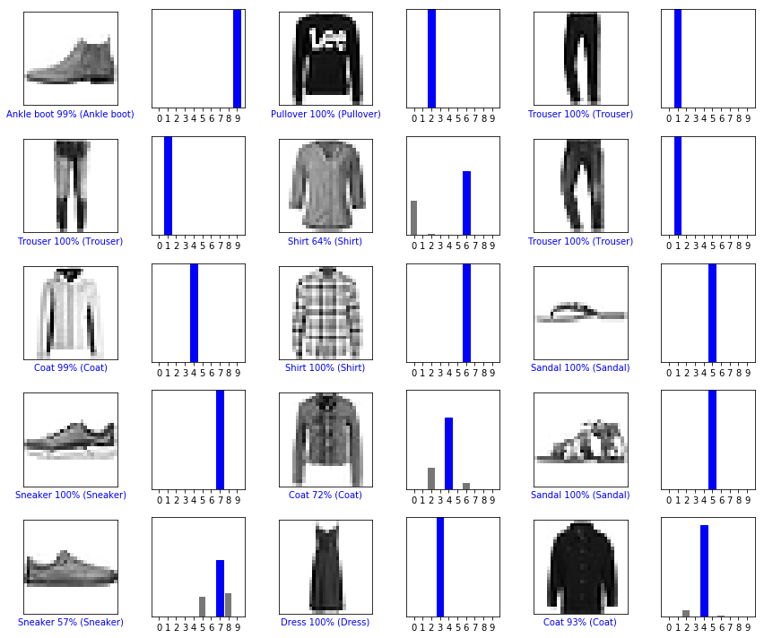
Image Classification Fashion MNIST dataset
https://www.tensorflow.org/tutorials/keras/classification

Slide 17
Text Classification with TF Hub
https://www.tensorflow.org/tutorials/keras/text_classification_with_hub

Slide 18
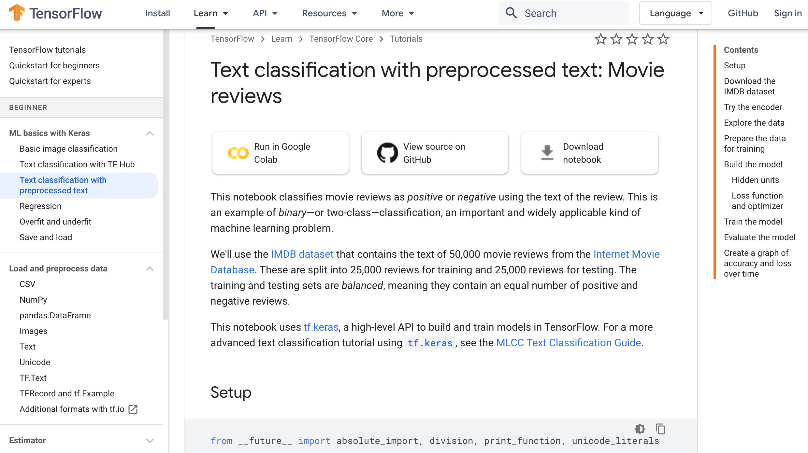
Text Classification with Pre Text
https://www.tensorflow.org/tutorials/keras/text_classification

Slide 19
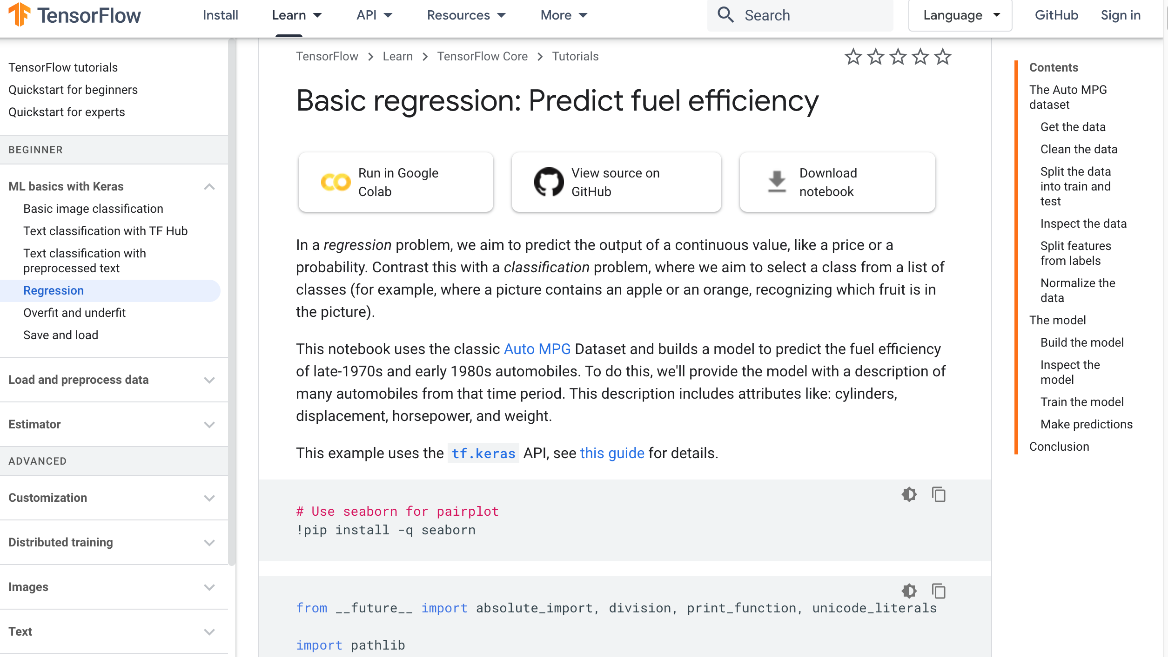
Regression
https://www.tensorflow.org/tutorials/keras/regression

Slide 20
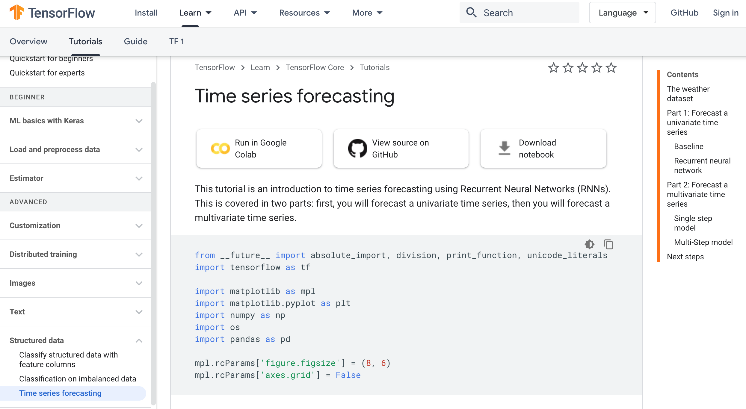
TensorFlow 2.0 Time Series Forecasting
https://www.tensorflow.org/tutorials/structured_data/time_series

Slide 21
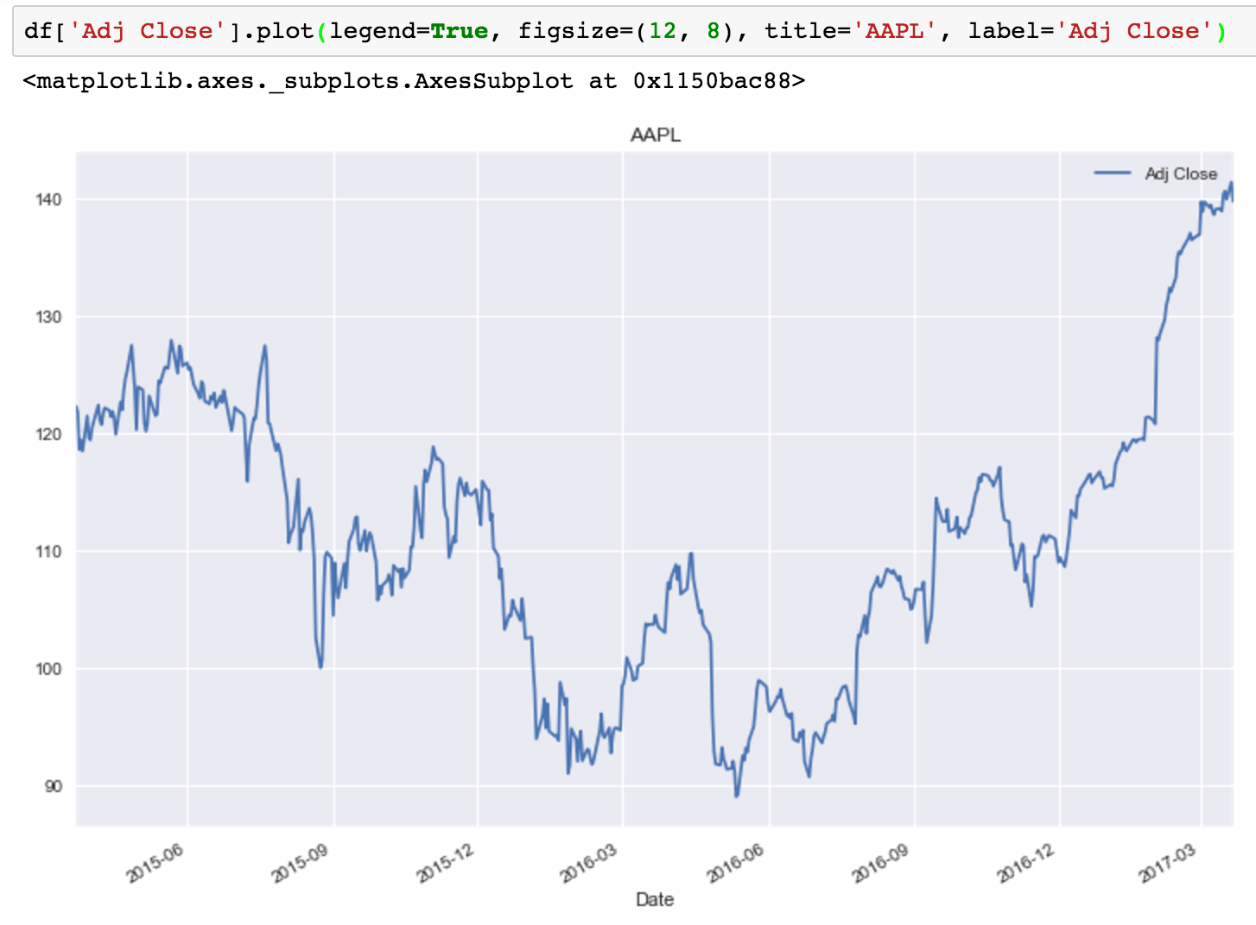
Time Series Data
Source: https://mapattack.wordpress.com/2017/02/12/using-python-for-stocks-1/

Slide 22
Time Series Data
[100, 110, 120, 130, 140, 150]
Y
X
Y
[100 110 120 130 140] 150
X_{t1}
X_{t2}
X_{t3}
X_{t4}
X_{t5}

Slide 23
Long Short Term Memory (LSTM) for Time Series Forecasting
h_{t-2}
h_{t-1}
h_{t}
h_{t+1}
h_{t+2}
LSTM
LSTM
LSTM
LSTM
LSTM
X_{t-2}
X_{t-1}
X_{t}
X_{t+1}
X_{t+2}

Slide 24
Time Series Data
[10, 20, 30, 40, 50, 60, 70, 80, 90]
X
Y
[10 20 30] 40
[20 30 40] 50
[30 40 50] 60
[40 50 60] 70
[50 60 70] 80
[60 70 80] 90

Slide 25
Deep Learning and Neural Networks

Slide 26
Deep Learning Foundations: Neural Networks

Slide 27
Deep Learning and Neural Networks
Input Layer
(X)
Hidden Layer
(H)
Output Layer
(Y)
X1
Y
X2

Slide 28
Deep Learning and Neural Networks
Input Layer
(X)
Hidden Layer
(H)
Output Layer
(Y)

Slide 29
Deep Learning and Neural Networks
Input Layer
(X)
Hidden Layers
(H)
Output Layer
(Y)
Deep Neural Networks
Deep Learning

Slide 30
Deep Learning and Deep Neural Networks

Slide 31
LeCun, Yann, Yoshua Bengio, and Geoffrey Hinton. "Deep learning." Nature 521, no. 7553 (2015): 436-444.

Slide 32
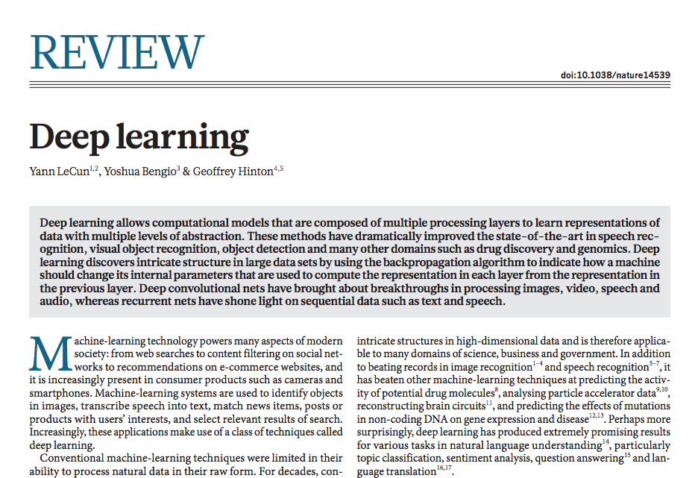
Source: LeCun, Yann, Yoshua Bengio, and Geoffrey Hinton. "Deep learning." Nature 521, no. 7553 (2015): 436-444.

Slide 33
Deep Learning
A powerful class of machine learning model
Modern reincarnation of artificial neural networks
Collection of simple, trainable mathematical functions
Compatible with many variants of machine learning
Source: Jeff Dean (2016), Large-Scale Deep Learning For Building Intelligent Computer Systems, WSDM 2016

Slide 34
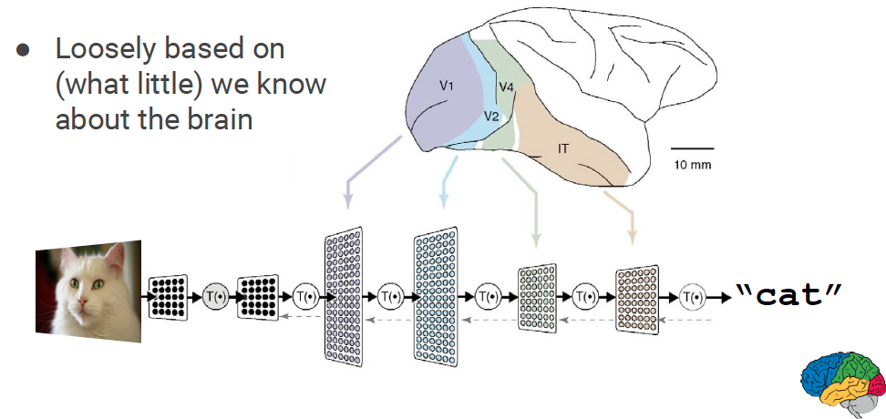
What is Deep Learning?
Source: Jeff Dean (2016), Large-Scale Deep Learning For Building Intelligent Computer Systems, WSDM 2016

Slide 35
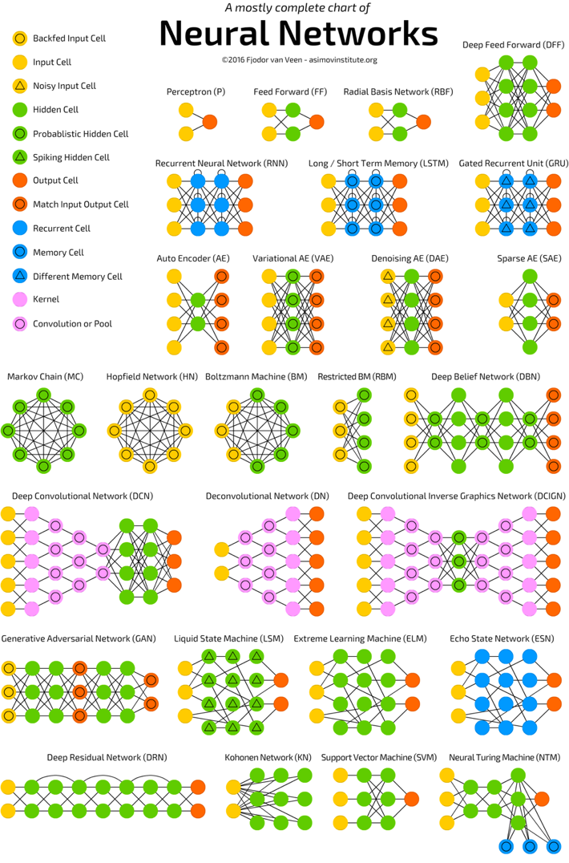
Neural Networks (NN)
Source: http://www.asimovinstitute.org/neural-network-zoo/

Slide 36
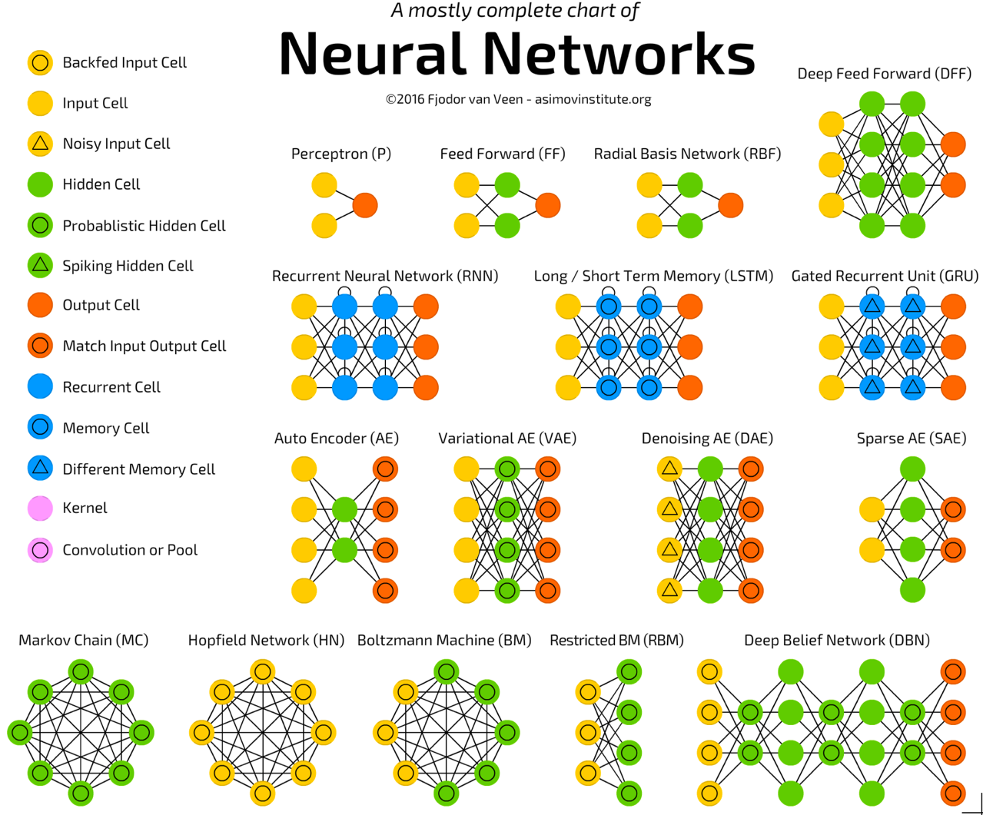
Source: http://www.asimovinstitute.org/neural-network-zoo/

Slide 37
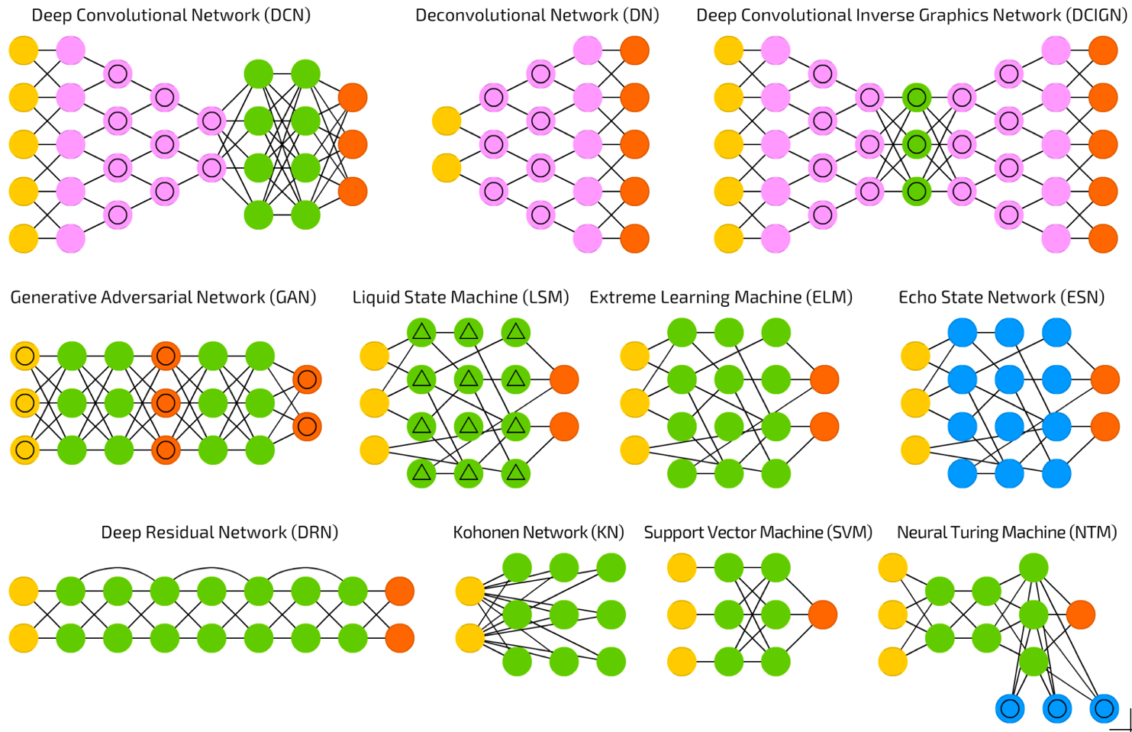
Source: http://www.asimovinstitute.org/neural-network-zoo/

Slide 38
Convolutional Neural Networks (CNN or Deep Convolutional Neural Networks, DCNN)
LeCun, Yann, et al. “Gradient-based learning applied to document recognition.” Proceedings of the IEEE 86.11 (1998): 2278-2324.
Source: http://www.asimovinstitute.org/neural-network-zoo/

Slide 39
Recurrent Neural Networks (RNN)
Elman, Jeffrey L. “Finding structure in time.” Cognitive science 14.2 (1990): 179-211
Source: http://www.asimovinstitute.org/neural-network-zoo/

Slide 40
Long / Short Term Memory (LSTM)
Hochreiter, Sepp, and Jürgen Schmidhuber. “Long short-term memory.” Neural computation 9.8 (1997): 1735-1780.
Source: http://www.asimovinstitute.org/neural-network-zoo/

Slide 41
Gated Recurrent Units (GRU)
Chung, Junyoung, et al. “Empirical evaluation of gated recurrent neural networks on sequence modeling.” arXiv preprint arXiv:1412.3555 (2014).
Source: http://www.asimovinstitute.org/neural-network-zoo/

Slide 42
Generative Adversarial Networks (GAN)
Goodfellow, Ian, et al. “Generative adversarial nets.” Advances in Neural Information Processing Systems. 2014.
Source: http://www.asimovinstitute.org/neural-network-zoo/

Slide 43
Support Vector Machines (SVM)
Cortes, Corinna, and Vladimir Vapnik. “Support-vector networks.” Machine learning 20.3 (1995): 273-297.
Source: http://www.asimovinstitute.org/neural-network-zoo/

Slide 44
Neural networks (NN) 1960
Source: Sunila Gollapudi (2016), Practical Machine Learning, Packt Publishing

Slide 45
Neural Networks
Input Layer
(X)
Hidden Layer
(H)
Output Layer
(Y)
X1
Y
X2
Source: https://www.youtube.com/watch?v=bxe2T-V8XRs&index=1&list=PLiaHhY2iBX9hdHaRr6b7XevZtgZRa1PoU

Slide 46
Multilayer Perceptrons (MLP) 1985
Source: Sunila Gollapudi (2016), Practical Machine Learning, Packt Publishing

Slide 47
Support Vector Machine (SVM) 1995
Source: Sunila Gollapudi (2016), Practical Machine Learning, Packt Publishing

Slide 48
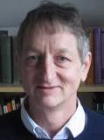
Hinton presents the Deep Belief Network (DBN) New interests in deep learning and RBM State of the art MNIST 2005
Source: Sunila Gollapudi (2016), Practical Machine Learning, Packt Publishing

Slide 49
Deep Recurrent Neural Network (RNN) 2009
Source: Sunila Gollapudi (2016), Practical Machine Learning, Packt Publishing

Slide 50
Convolutional DBN 2010
Source: Sunila Gollapudi (2016), Practical Machine Learning, Packt Publishing

Slide 51
Max-Pooling CDBN 2011
Source: Sunila Gollapudi (2016), Practical Machine Learning, Packt Publishing

Slide 52
Deep Learning Geoffrey Hinton Yann LeCun Yoshua Bengio Andrew Y. Ng

Slide 53
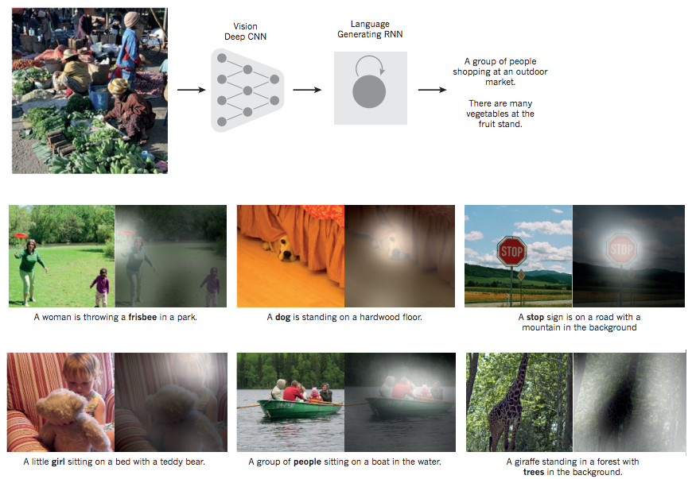
From image to text
Source: LeCun, Yann, Yoshua Bengio, and Geoffrey Hinton. "Deep learning." Nature 521, no. 7553 (2015): 436-444.

Slide 54
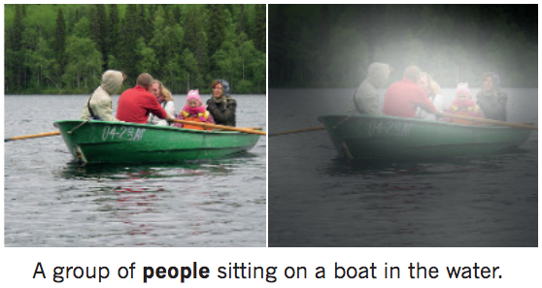
From image to text Image: deep convolution neural network (CNN) Text: recurrent neural network (RNN)
Source: LeCun, Yann, Yoshua Bengio, and Geoffrey Hinton. "Deep learning." Nature 521, no. 7553 (2015): 436-444.

Slide 55
Convolutional Neural Networks (CNN)

Slide 56
Convolutional Neural Networks (CNN)
Architecture of LeNet-5 (7 Layers)
(LeCun et al., 1998)
Source: http://yann.lecun.com/exdb/publis/pdf/lecun-01a.pdf
Source: LeCun, Yann, Léon Bottou, Yoshua Bengio, and Patrick Haffner. "Gradient-based learning applied to document recognition." Proceedings of the IEEE 86, no. 11 (1998): 2278-2324.

Slide 57
Convolutional Neural Networks (CNN)
Convolution
Pooling
Fully Connection (FC) (Flattening)

Slide 58
A friendly introduction to Convolutional Neural Networks and Image Recognition
+
-
4
-4
-
+
-4
4
1
-1
1
-1
1
-1
1
-1
1
-
+
-4
4
+
-
4
-4
Convolution Layer
Pooling Layer
Source: Luis Serrano (2017), A friendly introduction to Convolutional Neural Networks and Image Recognition,
https://www.youtube.com/watch?v=2-Ol7ZB0MmU

Slide 59
A friendly introduction to Convolutional Neural Networks and Image Recognition
1
-1
1
1
-1
-1
1
-1
1
-1
1
-1
-1
1
1
-1
1
-1
1
-1
1
-1
1
-1
1
1
-1
-1
1
-1
1
-1
-1
1
-1
-1
1
-1
1
-1
-1
-1
-1
-1
1
-1
-1
-1
1
1
-1
1
-1
-1
-1
1
-1
1
-1
-1
1
-1
-1
1
-1
-1
-1
-1
Source: Luis Serrano (2017), A friendly introduction to Convolutional Neural Networks and Image Recognition,
https://www.youtube.com/watch?v=2-Ol7ZB0MmU

Slide 60
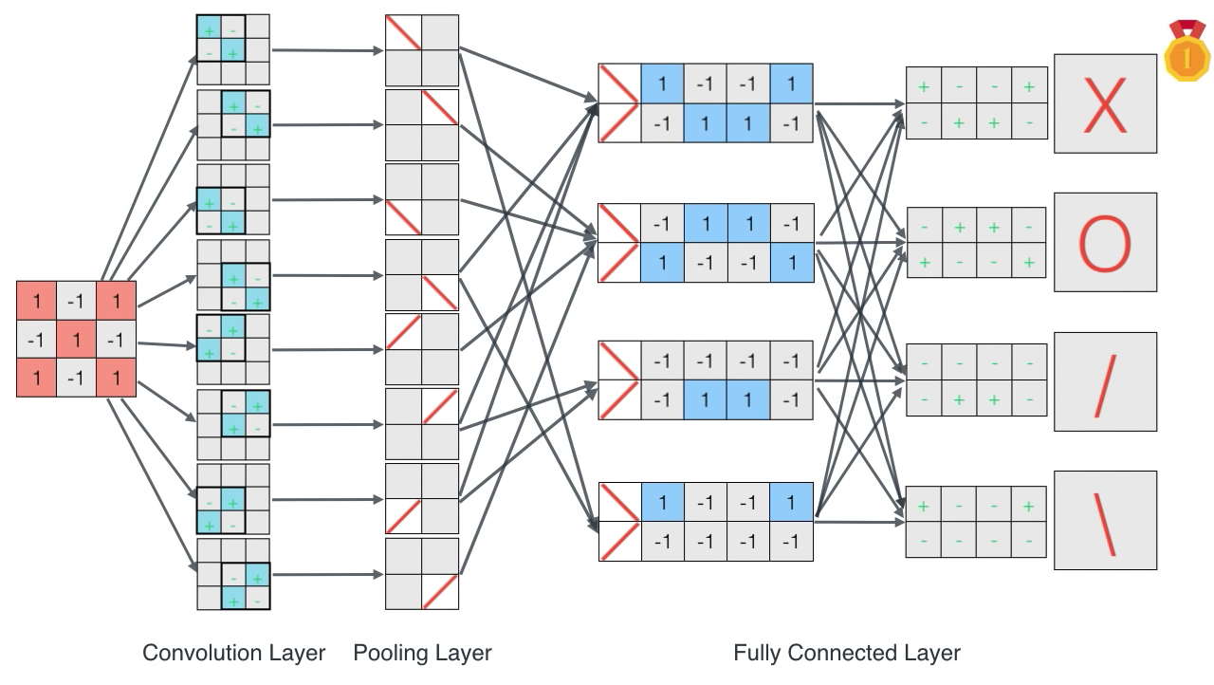
A friendly introduction to Convolutional Neural Networks and Image Recognition
Source: Luis Serrano (2017), A friendly introduction to Convolutional Neural Networks and Image Recognition,
https://www.youtube.com/watch?v=2-Ol7ZB0MmU

Slide 61
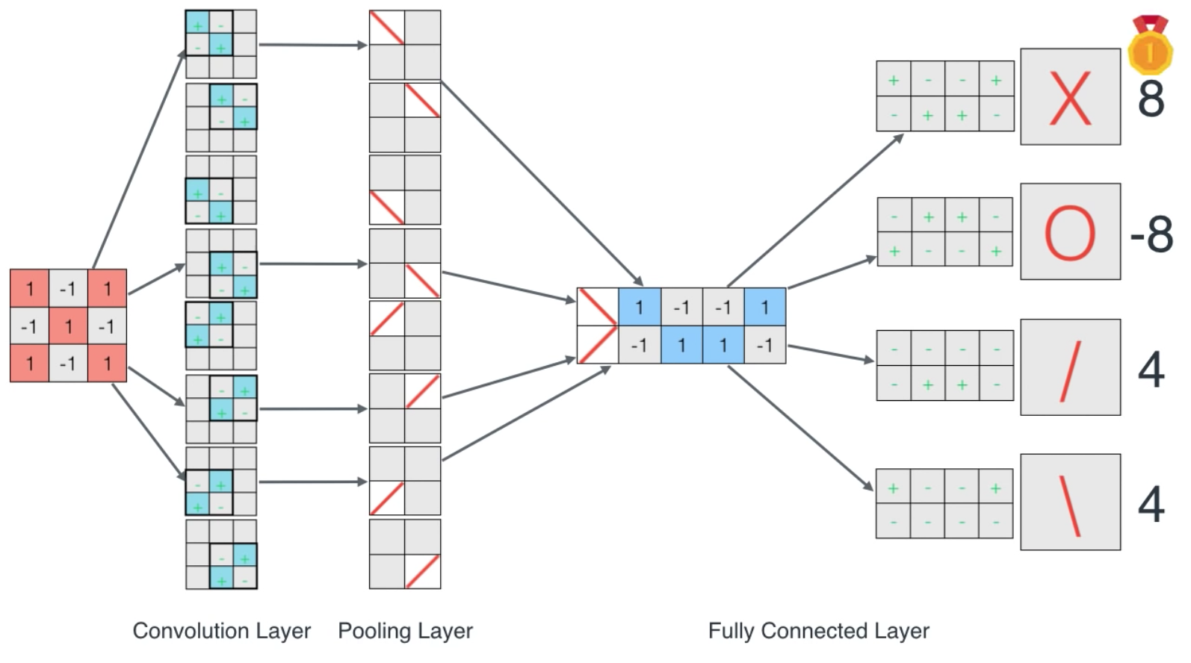
A friendly introduction to Convolutional Neural Networks and Image Recognition
Source: Luis Serrano (2017), A friendly introduction to Convolutional Neural Networks and Image Recognition,
https://www.youtube.com/watch?v=2-Ol7ZB0MmU

Slide 62
CNN Architecture
Source: Arden Dertat (2017), Applied Deep Learning - Part 4: Convolutional Neural Networks, https://towardsdatascience.com/applied-deep-learning-part-4-convolutional-neural-networks-584bc134c1e2

Slide 63
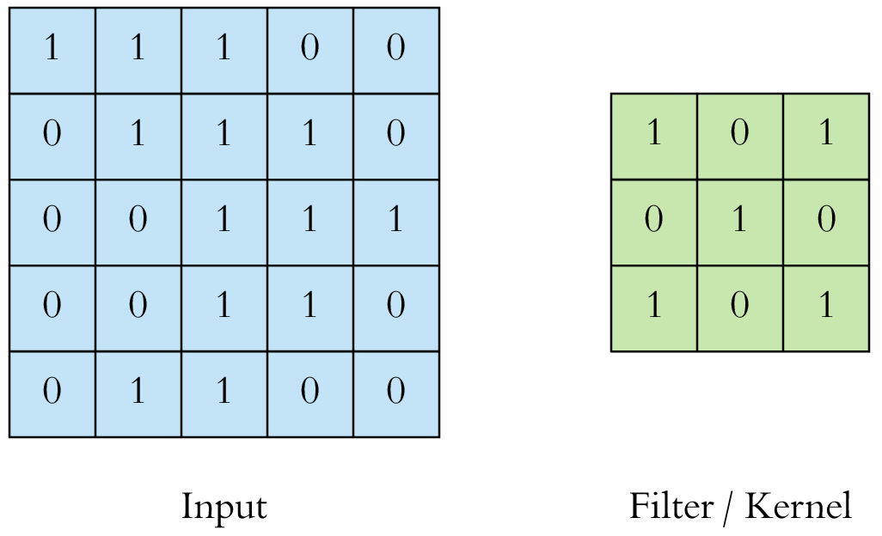
CNN Convolution Layer
Convolution is a mathematical operation to merge two sets of information
3x3 convolution
Source: Arden Dertat (2017), Applied Deep Learning - Part 4: Convolutional Neural Networks, https://towardsdatascience.com/applied-deep-learning-part-4-convolutional-neural-networks-584bc134c1e2

Slide 64
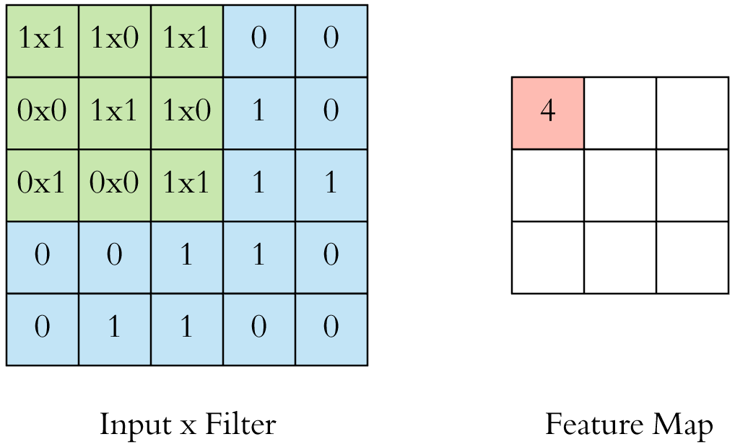
CNN Convolution Layer Input x Filter --> Feature Map
receptive field: 3x3
Source: Arden Dertat (2017), Applied Deep Learning - Part 4: Convolutional Neural Networks, https://towardsdatascience.com/applied-deep-learning-part-4-convolutional-neural-networks-584bc134c1e2

Slide 65
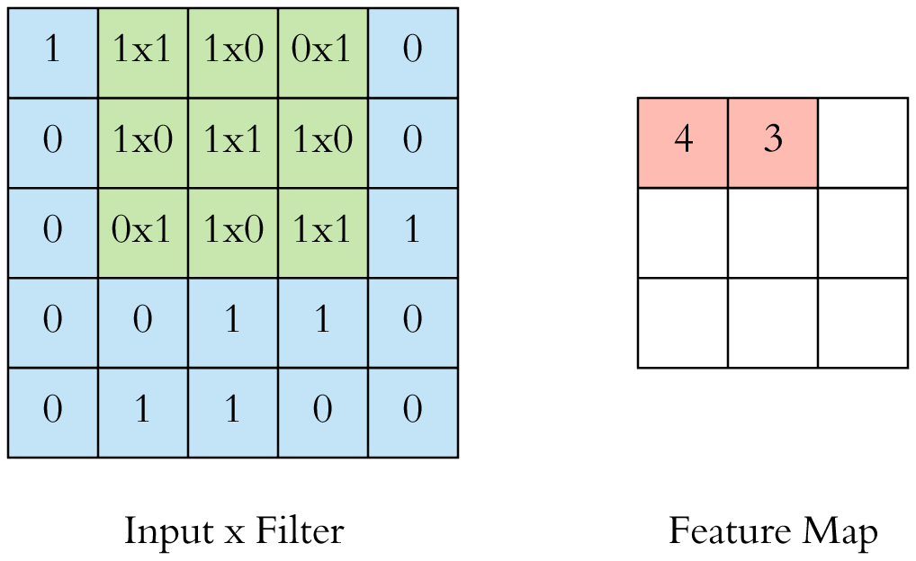
CNN Convolution Layer Input x Filter --> Feature Map
receptive field: 3x3
Source: Arden Dertat (2017), Applied Deep Learning - Part 4: Convolutional Neural Networks, https://towardsdatascience.com/applied-deep-learning-part-4-convolutional-neural-networks-584bc134c1e2

Slide 66
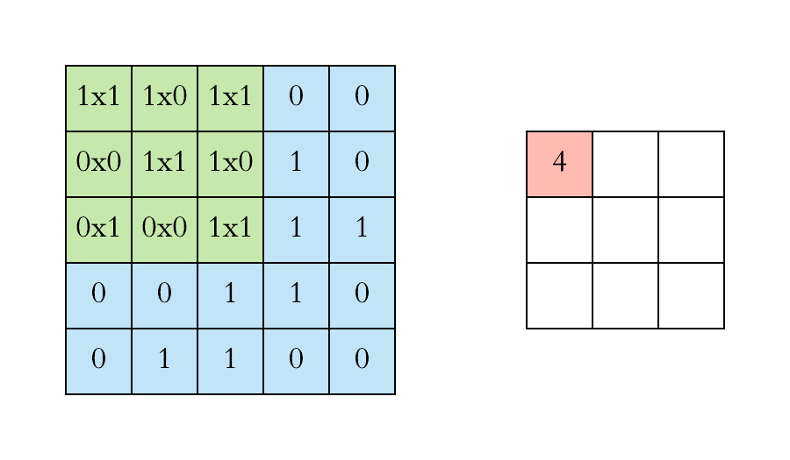
CNN Convolution Layer
Example convolution operation shown in 2D using a 3x3 filter
Source: Arden Dertat (2017), Applied Deep Learning - Part 4: Convolutional Neural Networks, https://towardsdatascience.com/applied-deep-learning-part-4-convolutional-neural-networks-584bc134c1e2

Slide 67
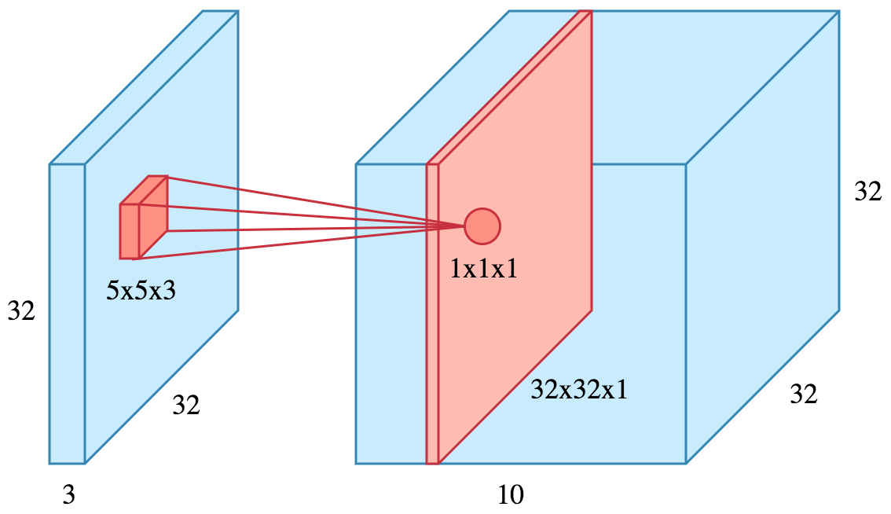
CNN Convolution Layer
10 different filters
10 feature maps of size 32x32x1
final output of the convolution layer: a volume of size 32x32x10
Source: Arden Dertat (2017), Applied Deep Learning - Part 4: Convolutional Neural Networks, https://towardsdatascience.com/applied-deep-learning-part-4-convolutional-neural-networks-584bc134c1e2

Slide 68
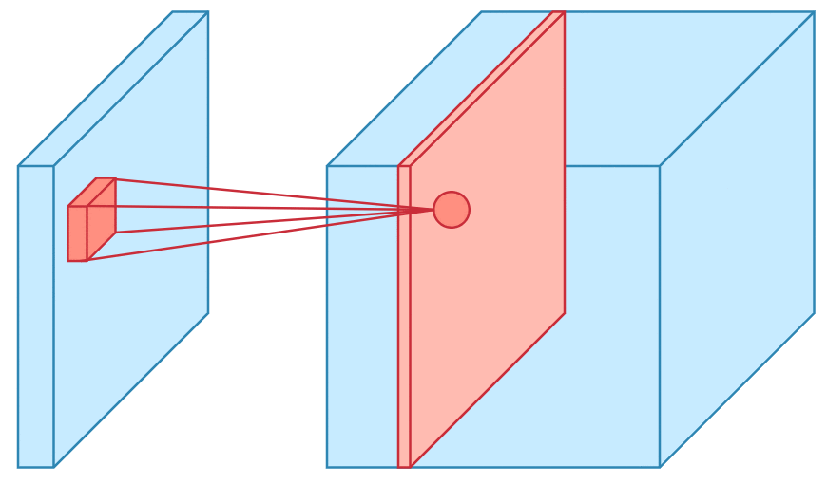
CNN Convolution Layer
Sliding operation at 4 locations
Source: Arden Dertat (2017), Applied Deep Learning - Part 4: Convolutional Neural Networks, https://towardsdatascience.com/applied-deep-learning-part-4-convolutional-neural-networks-584bc134c1e2

Slide 69
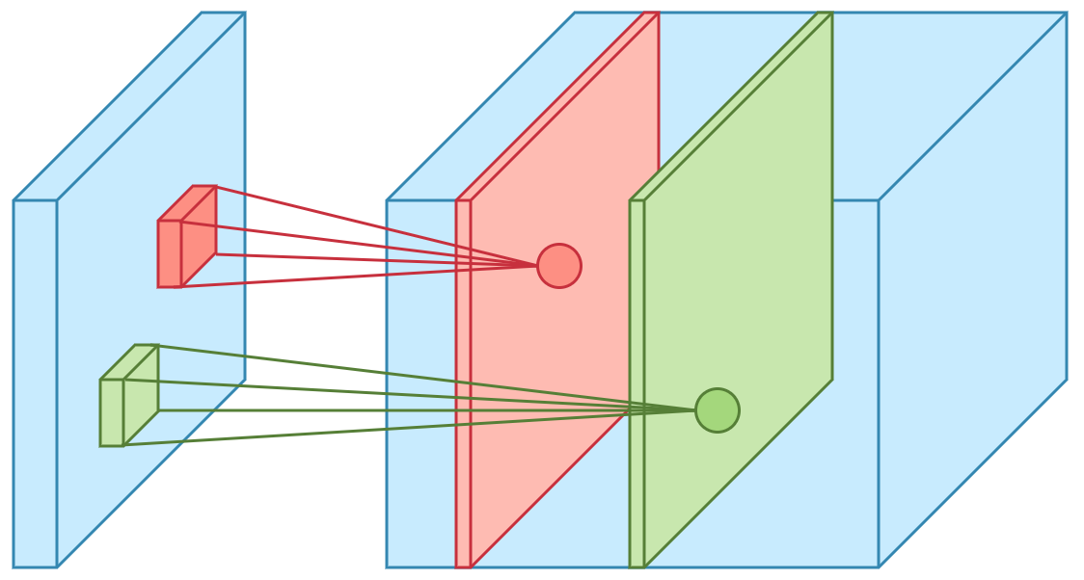
CNN Convolution Layer
two feature maps
Source: Arden Dertat (2017), Applied Deep Learning - Part 4: Convolutional Neural Networks, https://towardsdatascience.com/applied-deep-learning-part-4-convolutional-neural-networks-584bc134c1e2

Slide 70
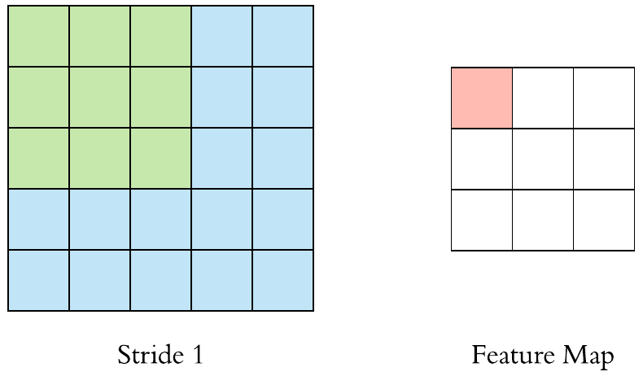
CNN Convolution Layer
Stride specifies how much we move the convolution filter at each step
Source: Arden Dertat (2017), Applied Deep Learning - Part 4: Convolutional Neural Networks, https://towardsdatascience.com/applied-deep-learning-part-4-convolutional-neural-networks-584bc134c1e2

Slide 71
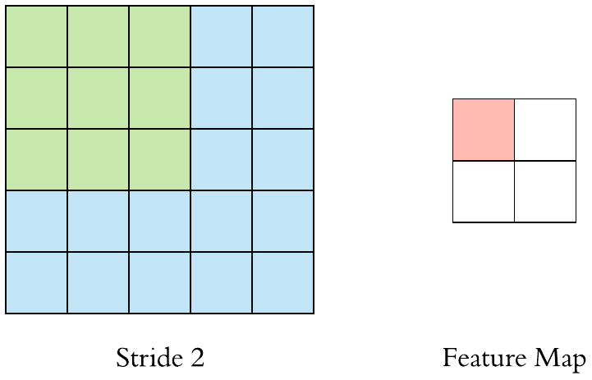
CNN Convolution Layer
Stride specifies how much we move the convolution filter at each step
Source: Arden Dertat (2017), Applied Deep Learning - Part 4: Convolutional Neural Networks, https://towardsdatascience.com/applied-deep-learning-part-4-convolutional-neural-networks-584bc134c1e2

Slide 72
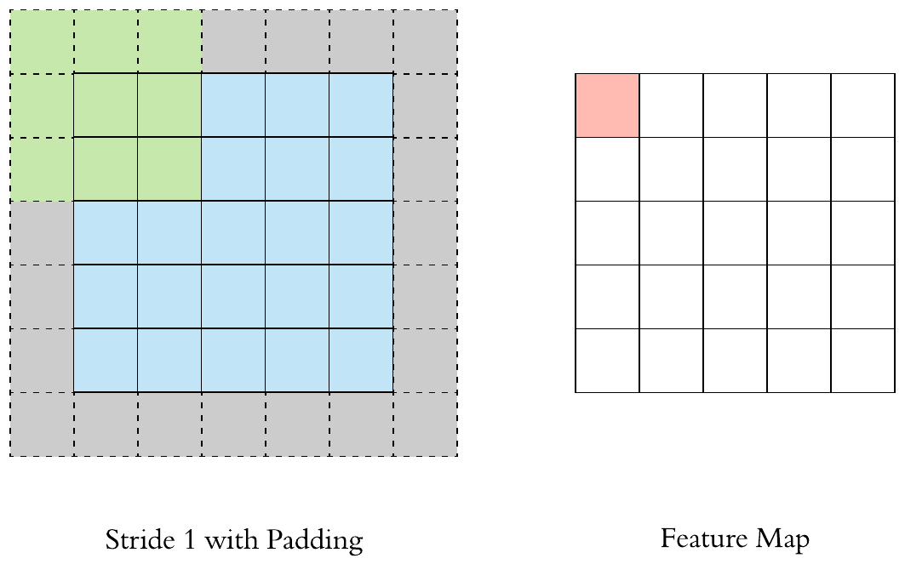
CNN Convolution Layer
Stride 1 with Padding
Source: Arden Dertat (2017), Applied Deep Learning - Part 4: Convolutional Neural Networks, https://towardsdatascience.com/applied-deep-learning-part-4-convolutional-neural-networks-584bc134c1e2

Slide 73
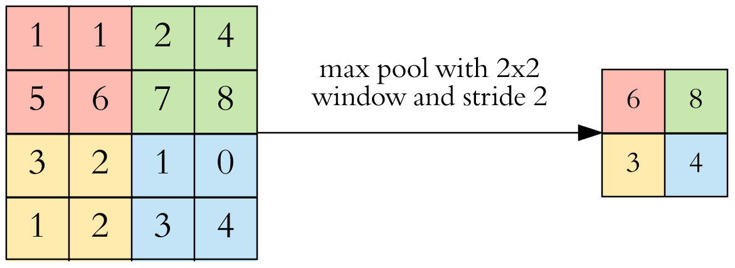
CNN Pooling Layer
Max Pooling
Source: Arden Dertat (2017), Applied Deep Learning - Part 4: Convolutional Neural Networks, https://towardsdatascience.com/applied-deep-learning-part-4-convolutional-neural-networks-584bc134c1e2

Slide 74
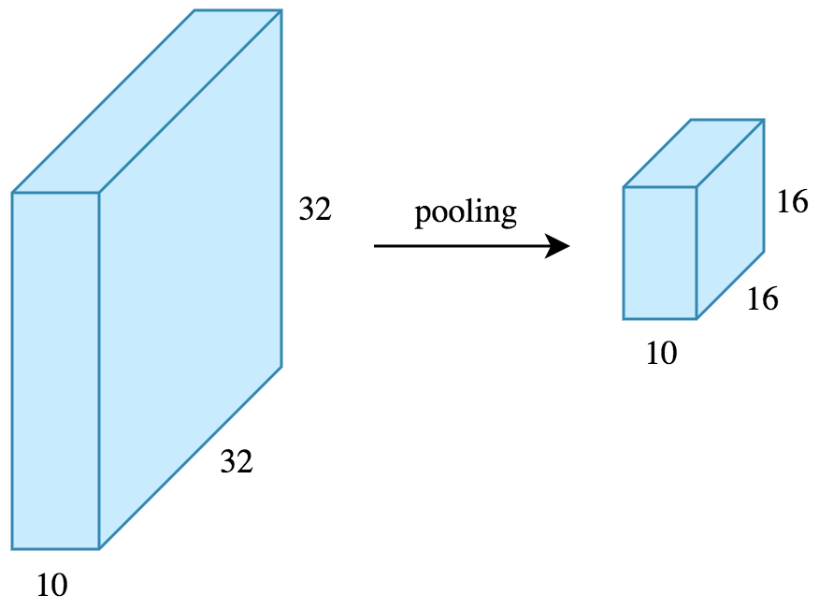
CNN Pooling Layer
Source: Arden Dertat (2017), Applied Deep Learning - Part 4: Convolutional Neural Networks, https://towardsdatascience.com/applied-deep-learning-part-4-convolutional-neural-networks-584bc134c1e2

Slide 75
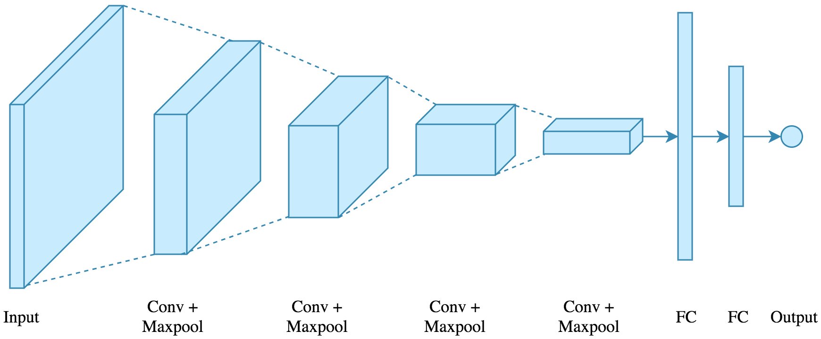
CNN Architecture
4 convolution + pooling layers, followed by 2 fully connected layers
Source: Arden Dertat (2017), Applied Deep Learning - Part 4: Convolutional Neural Networks, https://towardsdatascience.com/applied-deep-learning-part-4-convolutional-neural-networks-584bc134c1e2

Slide 76
CNN Architecture
4 convolution + pooling layers, followed by 2 fully connected layers
https://gist.github.com/ardendertat/0fc5515057c47e7386fe04e9334504e3
model = Sequential()
model.add(Conv2D(32, (3, 3), activation='relu', padding='same', name='conv_1',
input_shape=(150, 150, 3)))
model.add(MaxPooling2D((2, 2), name='maxpool_1'))
model.add(Conv2D(64, (3, 3), activation='relu', padding='same', name='conv_2'))
model.add(MaxPooling2D((2, 2), name='maxpool_2'))
model.add(Conv2D(128, (3, 3), activation='relu', padding='same', name='conv_3'))
model.add(MaxPooling2D((2, 2), name='maxpool_3'))
model.add(Conv2D(128, (3, 3), activation='relu', padding='same', name='conv_4'))
model.add(MaxPooling2D((2, 2), name='maxpool_4'))
model.add(Flatten())
model.add(Dropout(0.5))
model.add(Dense(512, activation='relu', name='dense_1'))
model.add(Dense(128, activation='relu', name='dense_2'))
model.add(Dense(1, activation='sigmoid', name='output'))
Source: Arden Dertat (2017), Applied Deep Learning - Part 4: Convolutional Neural Networks, https://towardsdatascience.com/applied-deep-learning-part-4-convolutional-neural-networks-584bc134c1e2

Slide 77
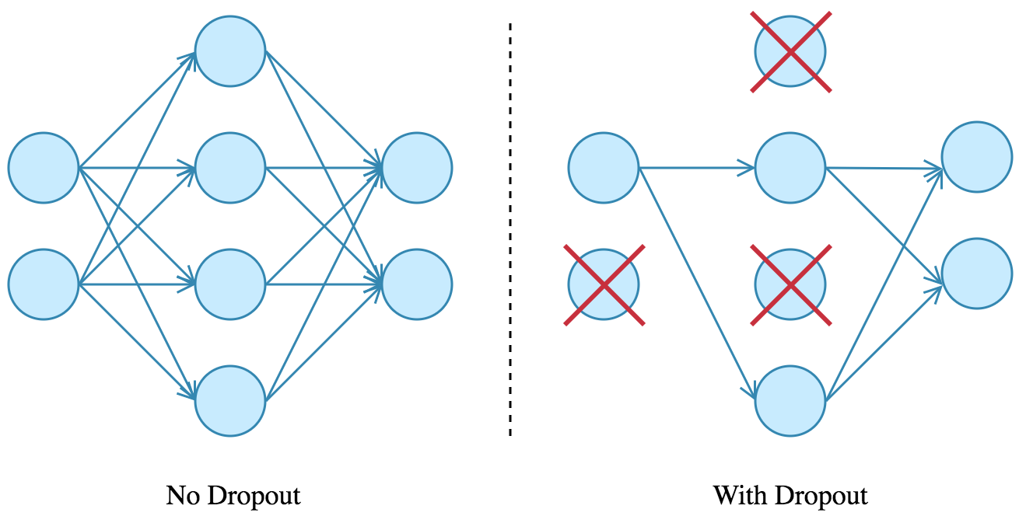
Dropout
Source: Arden Dertat (2017), Applied Deep Learning - Part 4: Convolutional Neural Networks, https://towardsdatascience.com/applied-deep-learning-part-4-convolutional-neural-networks-584bc134c1e2

Slide 78
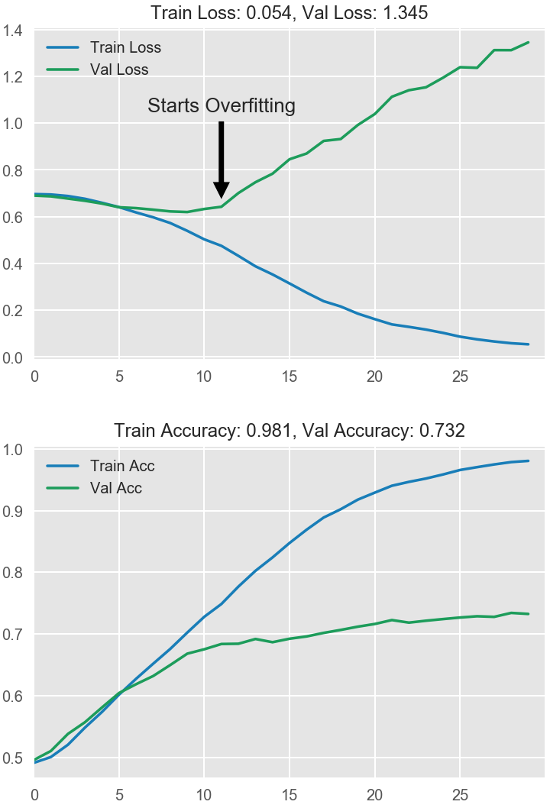
Model Performance
Source: Arden Dertat (2017), Applied Deep Learning - Part 4: Convolutional Neural Networks, https://towardsdatascience.com/applied-deep-learning-part-4-convolutional-neural-networks-584bc134c1e2

Slide 79
Visual Recognition Image Classification

Slide 80
Source: Jeff Dean (2016), Large-Scale Deep Learning For Building Intelligent Computer Systems, WSDM 2016

Slide 81
Convolutional Neural Networks (CNNs / ConvNets)
http://cs231n.github.io/convolutional-networks/

Slide 82
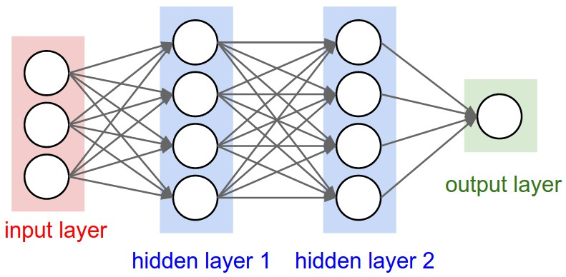
A regular 3-layer Neural Network
http://cs231n.github.io/convolutional-networks/

Slide 83
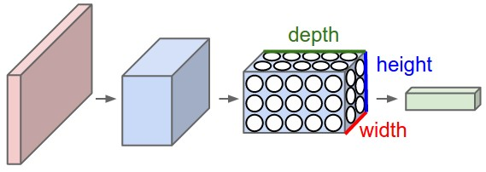
A ConvNet arranges its neurons in three dimensions (width, height, depth)
http://cs231n.github.io/convolutional-networks/

Slide 84
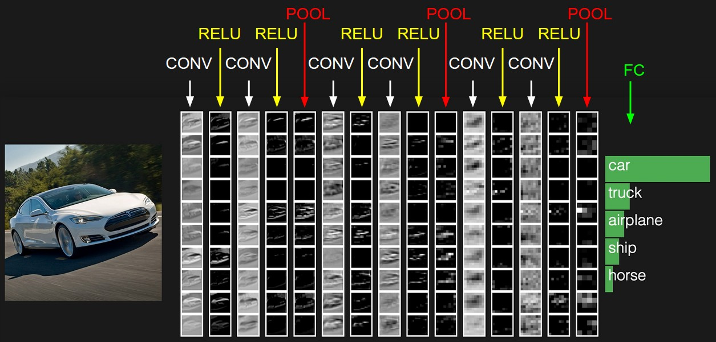
The activations of an example ConvNet architecture.
http://cs231n.github.io/convolutional-networks/

Slide 85
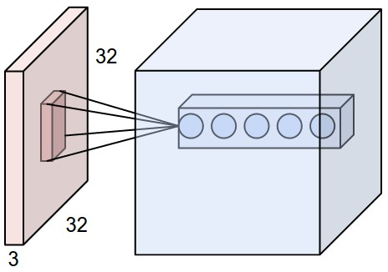
ConvNets
32x32x3 CIFAR-10 image
first Convolutional layer
http://cs231n.github.io/convolutional-networks/

Slide 86
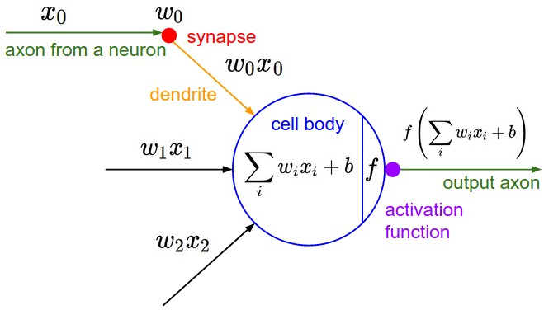
ConvNets
http://cs231n.github.io/convolutional-networks/

Slide 87
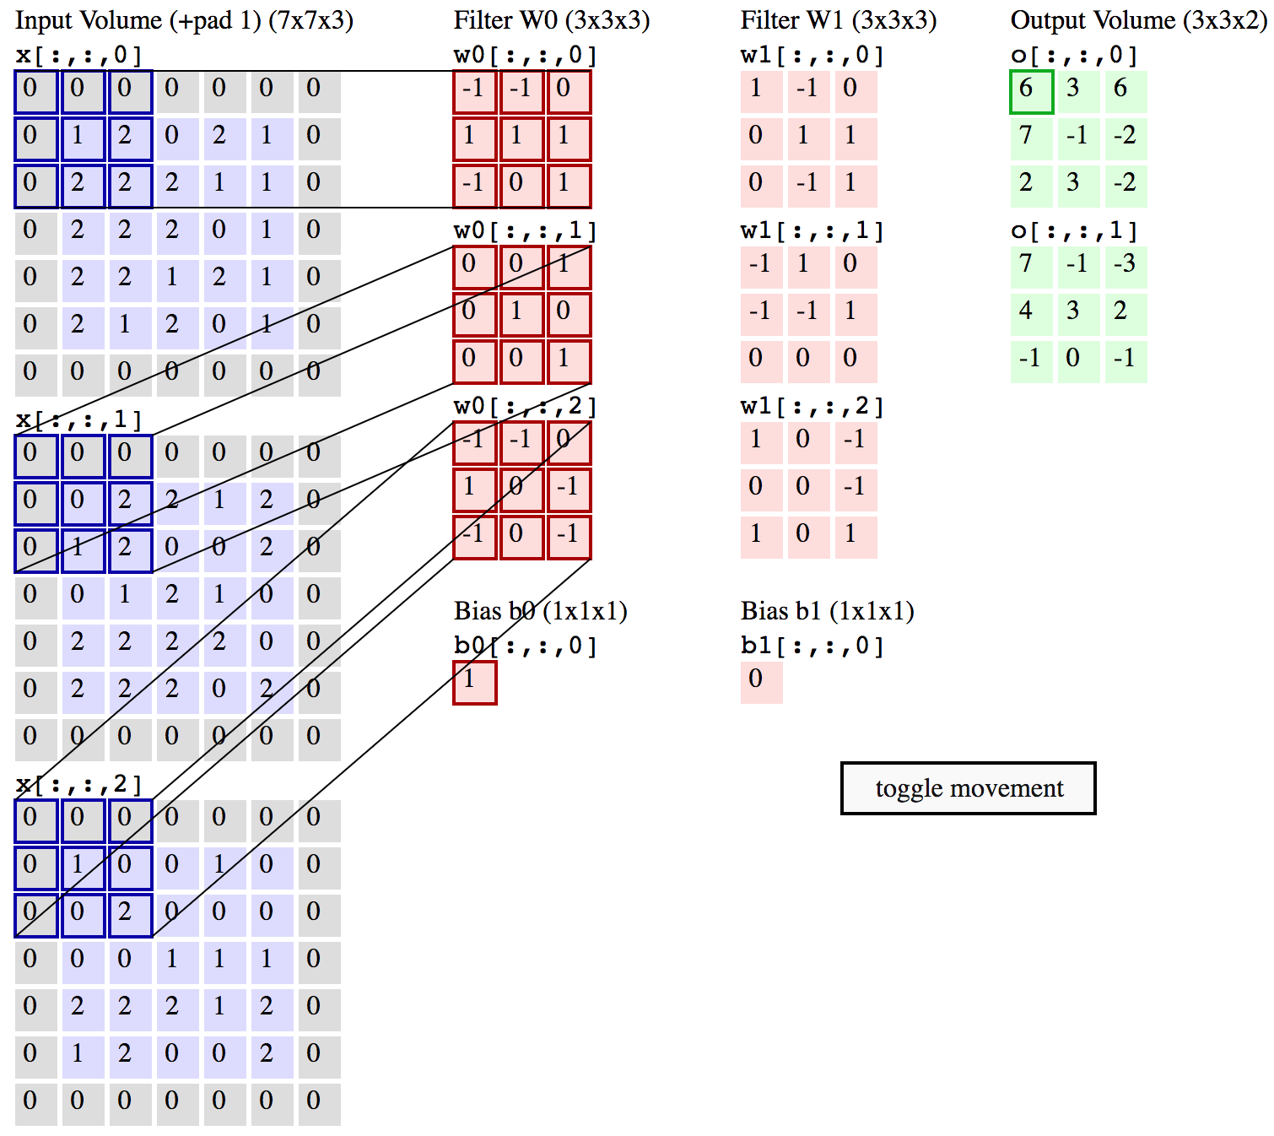
Convolution Demo
http://cs231n.github.io/convolutional-networks/

Slide 88
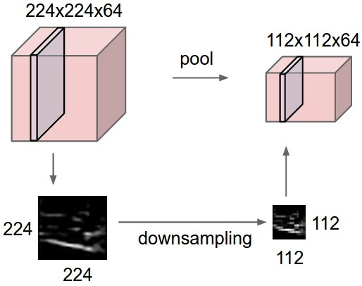
ConvNets
input volume of size [224x224x64] is pooled with filter size 2, stride 2 into output volume of size [112x112x64]
http://cs231n.github.io/convolutional-networks/

Slide 89
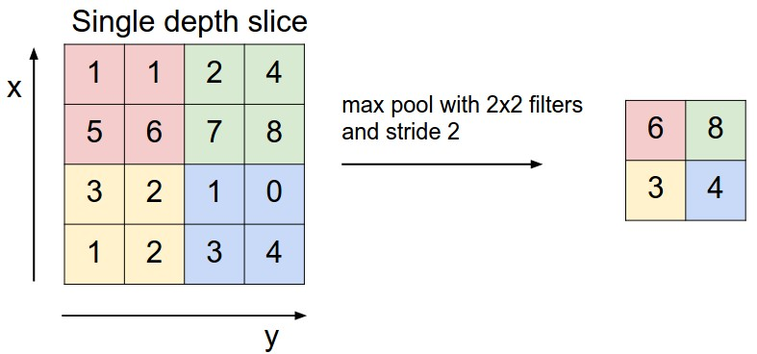
ConvNets max pooling
http://cs231n.github.io/convolutional-networks/

Slide 90
Convolutional Neural Networks (CNN) (LeNet)
Source: http://deeplearning.net/tutorial/lenet.html

Slide 91
Recurrent Neural Networks (RNN)

Slide 92
Recurrent Neural Networks (RNN)
y_{t-2}
y_{t-1}
y_{t}
y_{t+1}
y_{t+2}
output
h_{t-2}
h_{t-1}
h_{t}
h_{t+1}
h_{t+2}
hidden
X_{t-2}
X_{t-1}
X_{t}
X_{t+1}
X_{t+2}
Input

Slide 93
Recurrent Neural Networks (RNN) Time Series Forecasting
110
120
130
140
150
y_{t-2}
y_{t-1}
y_{t}
y_{t+1}
y_{t+2}
output
h_{t-2}
h_{t-1}
h_{t}
h_{t+1}
h_{t+2}
hidden
X_{t-2}
X_{t-1}
X_{t}
X_{t+1}
X_{t+2}
Input
100
110
120
130
140

Slide 94
Recurrent Neural Networks (RNN)
y
output
h_{t-2}
h_{t-1}
h_{t}
h_{t+1}
h_{t+2}
hidden
X_{t-2}
X_{t-1}
X_{t}
X_{t+1}
X_{t+2}
Input

Slide 95
Recurrent Neural Networks (RNN) Sentiment Analysis
y
output
h_{t-2}
h_{t-1}
h_{t}
h_{t+1}
h_{t+2}
hidden
X_{t-2}
X_{t-1}
X_{t}
X_{t+1}
X_{t+2}
Input
This
movie
is
very
good

Slide 96
Recurrent Neural Networks (RNN) Sentiment Analysis
y
output
h_{t-2}
h_{t-1}
h_{t}
h_{t+1}
h_{t+2}
hidden
X_{t-2}
X_{t-1}
X_{t}
X_{t+1}
X_{t+2}
Input
This
movie
is
very
boring

Slide 97
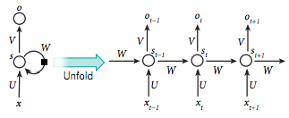
Recurrent Neural Network (RNN)
Source: LeCun, Yann, Yoshua Bengio, and Geoffrey Hinton. "Deep learning." Nature 521, no. 7553 (2015): 436-444.

Slide 98
CS224d: Deep Learning for Natural Language Processing
http://cs224d.stanford.edu/

Slide 99
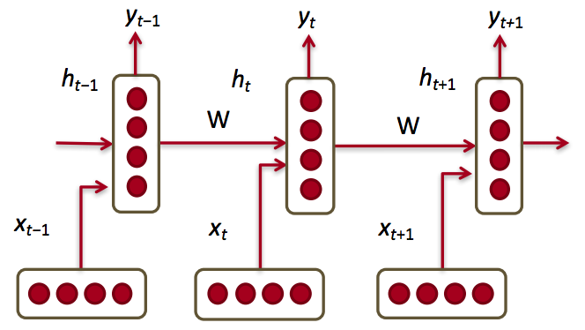
Recurrent Neural Networks (RNNs)
Source: http://cs224d.stanford.edu/lectures/CS224d-Lecture8.pdf

Slide 100
RNN
Source: Christopher Olah, (2015) Understanding LSTM Networks, http://colah.github.io/posts/2015-08-Understanding-LSTMs/

Slide 101
RNN long-term dependencies
I grew up in France… I speak fluent French.
Source: Christopher Olah, (2015) Understanding LSTM Networks, http://colah.github.io/posts/2015-08-Understanding-LSTMs/

Slide 102
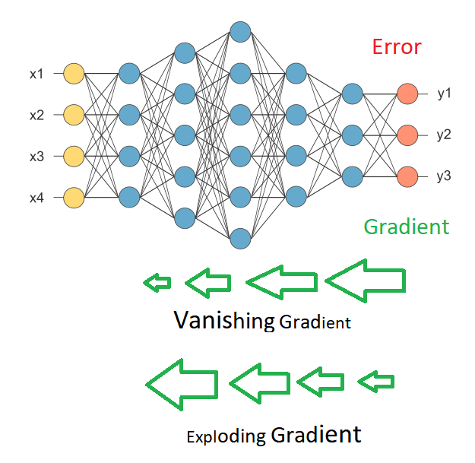
Vanishing Gradient Exploding Gradient
Source: https://medium.com/deep-math-machine-learning-ai/chapter-10-1-deepnlp-lstm-long-short-term-memory-networks-with-math-21477f8e4235

Slide 103
Recurrent Neural Networks (RNN)
y_{t-2}
y_{t-1}
y_{t}
y_{t+1}
y_{t+2}
output
V
V
V
V
W
W
W
W
h_{t-2}
h_{t-1}
h_{t}
h_{t+1}
h_{t+2}
hidden
U
U
U
U
X_{t-2}
X_{t-1}
X_{t}
X_{t+1}
X_{t+2}
Input

Slide 104
RNN Vanishing Gradient problem Exploding Gradient problem
Error
y_{t-2}
y_{t-1}
y_{t}
y_{t+1}
y_{t+2}
output
V
V
V
V
W
W
W
W
h_{t-2}
h_{t-1}
h_{t}
h_{t+1}
h_{t+2}
hidden
U
U
U
U
X_{t-2}
X_{t-1}
X_{t}
X_{t+1}
X_{t+2}
Input
if |W| < 1 (Vanishing)
if |W| > 1 (Exploding)
Source: https://medium.com/deep-math-machine-learning-ai/chapter-10-1-deepnlp-lstm-long-short-term-memory-networks-with-math-21477f8e4235

Slide 105
RNN Vanishing Gradient problem
Error
y_{t-2}
y_{t-1}
y_{t}
y_{t+1}
y_{t+2}
output
V
V
V
V
0.9
0.9
0.9
0.9
h_{t-2}
h_{t-1}
h_{t}
h_{t+1}
h_{t+2}
hidden
U
U
U
U
X_{t-2}
X_{t-1}
X_{t}
X_{t+1}
X_{t+2}
Input
W = 0.9 < 1 (Vanishing)
Source: https://medium.com/deep-math-machine-learning-ai/chapter-10-1-deepnlp-lstm-long-short-term-memory-networks-with-math-21477f8e4235

Slide 106
RNN Exploding Gradient problem
Error
y_{t-2}
y_{t-1}
y_{t}
y_{t+1}
y_{t+2}
output
V
V
V
V
1.1
1.1
1.1
1.1
h_{t-2}
h_{t-1}
h_{t}
h_{t+1}
h_{t+2}
hidden
U
U
U
U
X_{t-2}
X_{t-1}
X_{t}
X_{t+1}
X_{t+2}
Input
W = 1.1 > 1 (Exploding)
Source: https://medium.com/deep-math-machine-learning-ai/chapter-10-1-deepnlp-lstm-long-short-term-memory-networks-with-math-21477f8e4235

Slide 107
RNN LSTM
RNN
LSTM
Source: Christopher Olah, (2015) Understanding LSTM Networks, http://colah.github.io/posts/2015-08-Understanding-LSTMs/

Slide 108
Long Short Term Memory (LSTM)
Source: Christopher Olah, (2015) Understanding LSTM Networks, http://colah.github.io/posts/2015-08-Understanding-LSTMs/

Slide 109
Long Short Term Memory (LSTM)
forget gate
input gate
output gate
Source: Christopher Olah, (2015) Understanding LSTM Networks, http://colah.github.io/posts/2015-08-Understanding-LSTMs/

Slide 110
Gated Recurrent Unit (GRU)
Source: Christopher Olah, (2015) Understanding LSTM Networks, http://colah.github.io/posts/2015-08-Understanding-LSTMs/

Slide 111
Gated Recurrent Unit (GRU)
reset gate
update gate
Source: Christopher Olah, (2015) Understanding LSTM Networks, http://colah.github.io/posts/2015-08-Understanding-LSTMs/

Slide 112
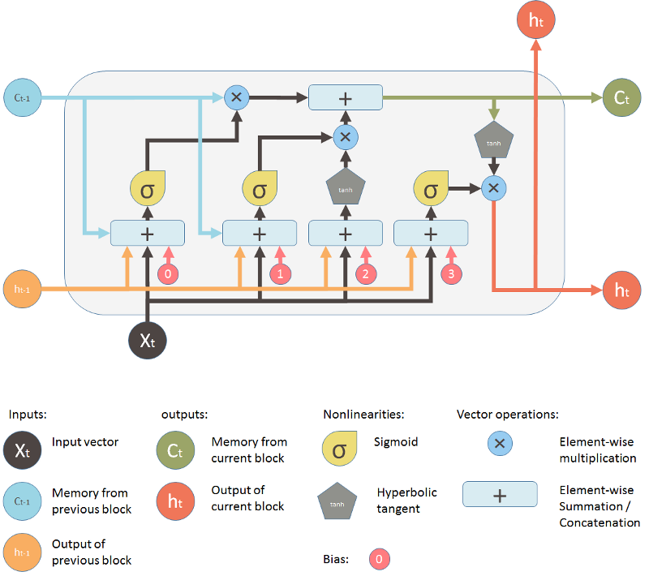
LSTM
Source: Shi Yan (2016), Understanding LSTM and its diagrams, https://medium.com/mlreview/understanding-lstm-and-its-diagrams-37e2f46f1714

Slide 113
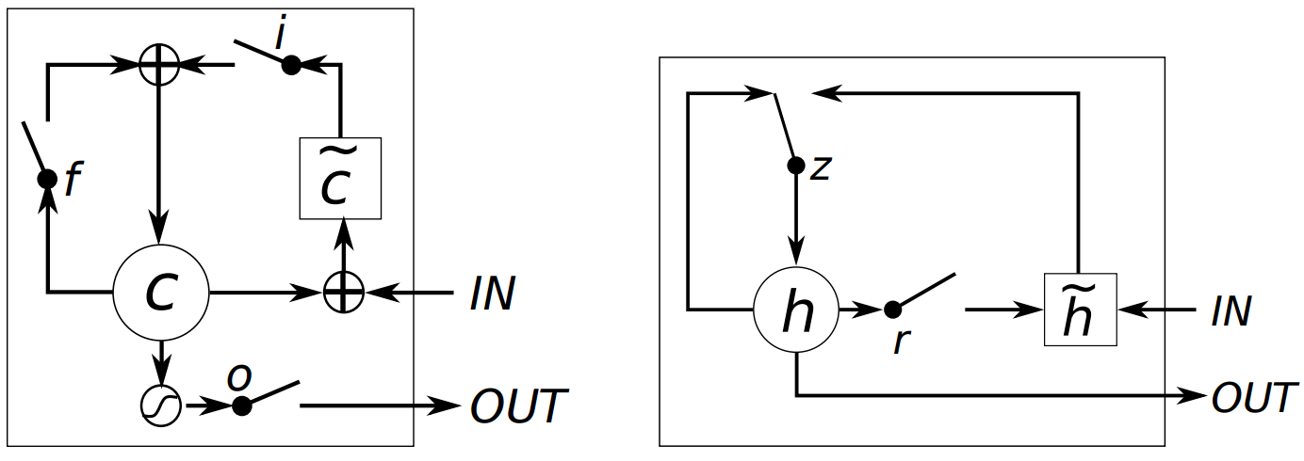
LSTM vs GRU
LSTM
GRU
i, f and o are the input, forget and output gates, respectively.
c and c˜ denote the memory cell and the new memory cell content.
r and z are the reset and update gates, and h and h˜ are the activation and the candidate activation.
Source: Chung, Junyoung, Caglar Gulcehre, KyungHyun Cho, and Yoshua Bengio. "Empirical evaluation of gated recurrent neural networks on sequence modeling." arXiv preprint arXiv:1412.3555 (2014).

Slide 114
Long Short Term Memory (LSTM)
h_{t}
C_{t-1}
C_{t}
X
+
tanh
f_{t}
i_{t}
X
o_{t}
X
∼
C_{t}
h_{t-1}
σ
σ
tanh
σ
h_{t}
x_{t}
Source: Christopher Olah, (2015) Understanding LSTM Networks, http://colah.github.io/posts/2015-08-Understanding-LSTMs/

Slide 115
Long Short Term Memory (LSTM)
forget gate
input gate
output gate
h_{t}
C_{t-1}
C_{t}
X
+
tanh
f_{t}
i_{t}
X
o_{t}
X
∼
C_{t}
h_{t-1}
σ
σ
tanh
σ
h_{t}
x_{t}
Source: Christopher Olah, (2015) Understanding LSTM Networks, http://colah.github.io/posts/2015-08-Understanding-LSTMs/

Slide 116
LSTM Memory state (C)
Source: Christopher Olah, (2015) Understanding LSTM Networks, http://colah.github.io/posts/2015-08-Understanding-LSTMs/

Slide 117
LSTM forget gate (f)
Source: Christopher Olah, (2015) Understanding LSTM Networks, http://colah.github.io/posts/2015-08-Understanding-LSTMs/

Slide 118
LSTM input gate (i)
Source: Christopher Olah, (2015) Understanding LSTM Networks, http://colah.github.io/posts/2015-08-Understanding-LSTMs/

Slide 119
LSTM Memory state (C)
Source: Christopher Olah, (2015) Understanding LSTM Networks, http://colah.github.io/posts/2015-08-Understanding-LSTMs/

Slide 120
LSTM output gate (o)
Source: Christopher Olah, (2015) Understanding LSTM Networks, http://colah.github.io/posts/2015-08-Understanding-LSTMs/

Slide 121
LSTM forget (f), input (i), output (o) gates
Source: Christopher Olah, (2015) Understanding LSTM Networks, http://colah.github.io/posts/2015-08-Understanding-LSTMs/

Slide 122
Gated Recurrent Unit (GRU) update (z), reset (r) gates
Source: Christopher Olah, (2015) Understanding LSTM Networks, http://colah.github.io/posts/2015-08-Understanding-LSTMs/

Slide 123
LSTM Recurrent Neural Network
Traditional Neural Network
Music Generation
Sentiment Classification
Name Entity Recognition
Machine Translation
Source: https://github.com/Vict0rSch/deep_learning/tree/master/keras/recurrent

Slide 124
Long Short Term Memory (LSTM) for Time Series Forecasting
h_{t-2}
h_{t-1}
h_{t}
h_{t+1}
h_{t+2}
LSTM
LSTM
LSTM
LSTM
LSTM
X_{t-2}
X_{t-1}
X_{t}
X_{t+1}
X_{t+2}

Slide 125
The Sequence to Sequence model (seq2seq)
Source: http://suriyadeepan.github.io/2016-12-31-practical-seq2seq/

Slide 126
Sequence to Sequence (Seq2Seq)
Source: https://google.github.io/seq2seq/

Slide 127
Transformer (Attention is All You Need) (Vaswani et al., 2017)
Source: Vaswani, Ashish, Noam Shazeer, Niki Parmar, Jakob Uszkoreit, Llion Jones, Aidan N. Gomez, Łukasz Kaiser, and Illia Polosukhin. "Attention is all you need." In Advances in neural information processing systems, pp. 5998-6008. 2017.

Slide 128
Transformer
Source: Jay Alammar (2019), The Illustrated Transformer, http://jalammar.github.io/illustrated-transformer/

Slide 129
Transformer Encoder Decoder
Source: Jay Alammar (2019), The Illustrated Transformer, http://jalammar.github.io/illustrated-transformer/

Slide 130
Transformer Encoder Decoder Stack
Source: Jay Alammar (2019), The Illustrated Transformer, http://jalammar.github.io/illustrated-transformer/

Slide 131
Transformer Encoder Self-Attention
Source: Jay Alammar (2019), The Illustrated Transformer, http://jalammar.github.io/illustrated-transformer/

Slide 132
Transformer Decoder
Source: Jay Alammar (2019), The Illustrated Transformer, http://jalammar.github.io/illustrated-transformer/

Slide 133
Transformer Encoder with Tensors Word Embeddings
Source: Jay Alammar (2019), The Illustrated Transformer, http://jalammar.github.io/illustrated-transformer/

Slide 134
Transformer Self-Attention Visualization
Source: Jay Alammar (2019), The Illustrated Transformer, http://jalammar.github.io/illustrated-transformer/

Slide 135
Transformer Positional Encoding Vectors
Source: Jay Alammar (2019), The Illustrated Transformer, http://jalammar.github.io/illustrated-transformer/

Slide 136
Transformer Self-Attention Softmax Output
Source: Jay Alammar (2019), The Illustrated Transformer, http://jalammar.github.io/illustrated-transformer/

Slide 137
BERT: Pre-training of Deep Bidirectional Transformers for Language Understanding
BERT (Bidirectional Encoder Representations from Transformers)
Overall pre-training and fine-tuning procedures for BERT
Source: Devlin, Jacob, Ming-Wei Chang, Kenton Lee, and Kristina Toutanova (2018). "Bert: Pre-training of deep bidirectional transformers for language understanding." arXiv preprint arXiv:1810.04805.

Slide 138
BERT: Pre-training of Deep Bidirectional Transformers for Language Understanding
BERT (Bidirectional Encoder Representations from Transformers)
BERT input representation
Source: Devlin, Jacob, Ming-Wei Chang, Kenton Lee, and Kristina Toutanova (2018). "Bert: Pre-training of deep bidirectional transformers for language understanding." arXiv preprint arXiv:1810.04805.

Slide 139
BERT, OpenAI GPT, ELMo
Source: Devlin, Jacob, Ming-Wei Chang, Kenton Lee, and Kristina Toutanova (2018). "Bert: Pre-training of deep bidirectional transformers for language understanding." arXiv preprint arXiv:1810.04805.

Slide 140
Fine-tuning BERT on Different Tasks
Source: Devlin, Jacob, Ming-Wei Chang, Kenton Lee, and Kristina Toutanova (2018). "Bert: Pre-training of deep bidirectional transformers for language understanding." arXiv preprint arXiv:1810.04805.

Slide 141
Illustrated BERT
Source: Jay Alammar (2019), The Illustrated BERT, ELMo, and co. (How NLP Cracked Transfer Learning), http://jalammar.github.io/illustrated-bert/

Slide 142
BERT Classification Input Output
Source: Jay Alammar (2019), The Illustrated BERT, ELMo, and co. (How NLP Cracked Transfer Learning), http://jalammar.github.io/illustrated-bert/

Slide 143
BERT Encoder Input
Source: Jay Alammar (2019), The Illustrated BERT, ELMo, and co. (How NLP Cracked Transfer Learning), http://jalammar.github.io/illustrated-bert/

Slide 144
BERT Classifier
Source: Jay Alammar (2019), The Illustrated BERT, ELMo, and co. (How NLP Cracked Transfer Learning), http://jalammar.github.io/illustrated-bert/

Slide 145
Neural Networks
Input Layer
(X)
Hidden Layer
(H)
Output Layer
(Y)
X1
Y
X2
Source: https://www.youtube.com/watch?v=bxe2T-V8XRs&index=1&list=PLiaHhY2iBX9hdHaRr6b7XevZtgZRa1PoU

Slide 146
The Neuron
x₁
w₁
w₂
x₂
y
…
…
w_{n}
x_{n}
Source: Jeff Dean (2016), Large-Scale Deep Learning For Building Intelligent Computer Systems, WSDM 2016

Slide 147
Neuron and Synapse
Source: https://en.wikipedia.org/wiki/Neuron

Slide 148
The Neuron
x₁
w₁
w₂
x₂
y
…
…
w_{n}
x_{n}
Source: Jeff Dean (2016), Large-Scale Deep Learning For Building Intelligent Computer Systems, WSDM 2016

Slide 149
y = max ( 0, -0.21 * x₁ + 0.3 * x₂ + 0.7 * x₃ )
Weights
x₁
-0.21
x₂
0.3
y
Inputs
0.7
x₃
Source: Jeff Dean (2016), Large-Scale Deep Learning For Building Intelligent Computer Systems, WSDM 2016

Slide 150
Neural Networks
Source: https://www.youtube.com/watch?v=bxe2T-V8XRs&index=1&list=PLiaHhY2iBX9hdHaRr6b7XevZtgZRa1PoU

Slide 151
Neural Networks
Input Layer
(X)
Hidden Layer
(H)
Output Layer
(Y)
X1
Y
X2
Source: https://www.youtube.com/watch?v=bxe2T-V8XRs&index=1&list=PLiaHhY2iBX9hdHaRr6b7XevZtgZRa1PoU

Slide 152
Neural Networks
Input Layer
(X)
Hidden Layers
(H)
Output Layer
(Y)
Deep Neural Networks
Deep Learning
Source: https://www.youtube.com/watch?v=bxe2T-V8XRs&index=1&list=PLiaHhY2iBX9hdHaRr6b7XevZtgZRa1PoU

Slide 153
Neural Networks
Input Layer
(X)
Hidden Layer
(H)
Output Layer
(Y)
Neuron
Synapse
Synapse
Neuron
X1
Y
X2
Source: https://www.youtube.com/watch?v=bxe2T-V8XRs&index=1&list=PLiaHhY2iBX9hdHaRr6b7XevZtgZRa1PoU

Slide 154
Neural Networks
Input Layer
(X)
Hidden Layer
(H)
Output Layer
(Y)
Hours Sleep
Score
Hours Study
Source: https://www.youtube.com/watch?v=bxe2T-V8XRs&index=1&list=PLiaHhY2iBX9hdHaRr6b7XevZtgZRa1PoU

Slide 155
Neural Networks
Input Layer
(X)
Hidden Layer
(H)
Output Layer
(Y)
Source: https://www.youtube.com/watch?v=P2HPcj8lRJE&list=PLjJh1vlSEYgvGod9wWiydumYl8hOXixNu&index=2

Slide 156
Neural Networks
Input Layer
(X)
Hidden Layer
(H)
Output Layer
(Y)
X1
Y
X2
Source: https://www.youtube.com/watch?v=bxe2T-V8XRs&index=1&list=PLiaHhY2iBX9hdHaRr6b7XevZtgZRa1PoU

Slide 157
X Y
Hours Sleep
Hours Study
Score
3 5 75
5 1 82
10 2 93
8 3 ?
Source: https://www.youtube.com/watch?v=bxe2T-V8XRs&index=1&list=PLiaHhY2iBX9hdHaRr6b7XevZtgZRa1PoU

Slide 158
X Y
Hours Sleep
Hours Study
Score
3 5 75
Training
5 1 82
10 2 93
8 3 ?
Testing
Source: https://www.youtube.com/watch?v=bxe2T-V8XRs&index=1&list=PLiaHhY2iBX9hdHaRr6b7XevZtgZRa1PoU

Slide 159
Y = W X + b
Source: https://www.youtube.com/watch?v=G8eNWzxOgqE

Slide 160
Output
input
Y = W X + b
Weights
bias
Trained
Source: https://www.youtube.com/watch?v=G8eNWzxOgqE

Slide 161
2.0
1.0
0.1
0.7
0.2
0.1
W X + b = Y
Scores
Probabilities
Source: https://www.youtube.com/watch?v=G8eNWzxOgqE

Slide 162
SoftMAX
2.0
1.0
0.1
0.7
0.2
0.1
W X + b = Y
$$S\left(y_{i}\right)= \frac{e^{y_{i}}}{\sum_{j}{e^{y_{j}}}}$$
Logits
Scores
Probabilities
Source: https://www.youtube.com/watch?v=G8eNWzxOgqE

Slide 163
$S\left(y_{i}\right)=\frac{e^{y_{i}}}{\sum_{j}{e^{y_{i}}}}=\frac{e^{2.0}}{e^{2.0}+e^{1.0}+e^{0.1}}$ $=\frac{{2.7182}^{2.0}}{{2.7182}^{2.0}+{2.7182}^{1.0}+{2.7182}^{0.1}}=0.7$
$S\left(y_{i}\right)=\frac{e^{y_{i}}}{\sum_{j}{e^{y_{j}}}}=\frac{e^{1.0}}{e^{2.0}+e^{1.0}+e^{0.1}}$ $=\frac{{2.7182}^{1.0}}{{2.7182}^{2.0}+{2.7182}^{1.0}+{2.7182}^{0.1}}=0.2$
$S\left(y_{i}\right)=\frac{e^{y_{i}}}{\sum_{j}{e^{y_{j}}}}=\frac{e^{0.1}}{e^{2.0}+e^{1.0}+e^{0.1}}$ $=\frac{{2.7182}^{0.1}}{{2.7182}^{2.0}+{2.7182}^{1.0}+{2.7182}^{0.1}}=0.1$
2.0
1.0
0.1
0.7
0.2
0.1
W X + b = Y
$$S\left(y_{i}\right)= \frac{e^{y_{i}}}{\sum_{j}{e^{y_{j}}}}$$
Logits
Scores
Probabilities
Source: https://www.youtube.com/watch?v=G8eNWzxOgqE

Slide 164
Training a Network = Minimize the Cost Function
Source: https://www.youtube.com/watch?v=bxe2T-V8XRs&index=1&list=PLiaHhY2iBX9hdHaRr6b7XevZtgZRa1PoU

Slide 165
Training a Network = Minimize the Cost Function Minimize the Loss Function
Source: https://www.youtube.com/watch?v=bxe2T-V8XRs&index=1&list=PLiaHhY2iBX9hdHaRr6b7XevZtgZRa1PoU

Slide 166
Error = Predict Y - Actual Y Error : Cost : Loss
100
$$y$$
$$\hat{y}$$
75
$$e$$
50
25
Test1
Test2
Test3
Source: https://www.youtube.com/watch?v=bxe2T-V8XRs&index=1&list=PLiaHhY2iBX9hdHaRr6b7XevZtgZRa1PoU

Slide 167
Error = Predict Y - Actual Y Error : Cost : Loss
100
$$y$$
$$\hat{y}$$
75
$$e$$
50
25
Test1
Test2
Test3
Source: https://www.youtube.com/watch?v=bxe2T-V8XRs&index=1&list=PLiaHhY2iBX9hdHaRr6b7XevZtgZRa1PoU

Slide 168
Error = Predict Y - Actual Y Error : Cost : Loss
100
$$y$$
$$\hat{y}$$
75
$$e$$
50
25
Test1
Test2
Test3
Source: https://www.youtube.com/watch?v=bxe2T-V8XRs&index=1&list=PLiaHhY2iBX9hdHaRr6b7XevZtgZRa1PoU

Slide 169
Activation Functions

Slide 170
Activation Functions
Sigmoid
TanH
ReLU
(Rectified Linear Unit)
[0, 1]
[-1, 1]
f(x) = max(0, x)
Source: http://cs231n.github.io/neural-networks-1/

Slide 171
Activation Functions
Source: http://adilmoujahid.com/posts/2016/06/introduction-deep-learning-python-caffe/

Slide 172
Loss Function

Slide 173
Binary Classification: 2 Class Activation Function: Sigmoid Loss Function: Binary Cross-Entropy

Slide 174
Multiple Classification: 10 Class Activation Function: SoftMAX Loss Function: Categorical Cross-Entropy

Slide 175
Dropout
Dropout: a simple way to prevent neural networks from overfitting
Source: Srivastava, Nitish, Geoffrey E. Hinton, Alex Krizhevsky, Ilya Sutskever, and Ruslan Salakhutdinov. "Dropout: a simple way to prevent neural networks from overfitting." Journal of machine learning research 15, no. 1 (2014): 1929-1958.

Slide 176
Learning Algorithm
While not done:
Pick a random training example “(input, label)”
Run neural network on “input”
Adjust weights on edges to make output closer to “label”
Source: Jeff Dean (2016), Large-Scale Deep Learning For Building Intelligent Computer Systems, WSDM 2016

Slide 177
y = max ( 0, -0.21 * x₁ + 0.3 * x₂ + 0.7 * x₃ )
Weights
x₁
-0.21
x₂
0.3
y
Inputs
0.7
x₃
Source: Jeff Dean (2016), Large-Scale Deep Learning For Building Intelligent Computer Systems, WSDM 2016

Slide 178
Next time:
y = max ( 0, -0.23 * x₁ + 0.31 * x₂ + 0.65 * x₃ )
y = max ( 0, -0.21 * x₁ + 0.3 * x₂ + 0.7 * x₃ )
Weights
-0.23
x₁
-0.21
0.31
x₂
0.3
y
Inputs
0.65
x₃
0.7
Source: Jeff Dean (2016), Large-Scale Deep Learning For Building Intelligent Computer Systems, WSDM 2016

Slide 179
Optimizer: Stochastic Gradient Descent (SGD)
J(w)
Initial weight
Gradient
Global cost minimum
w

Slide 180
Source: Jeff Dean (2016), Large-Scale Deep Learning For Building Intelligent Computer Systems, WSDM 2016

Slide 181
Neural Network and Deep Learning
Source: 3Blue1Brown (2017), But what *is* a Neural Network? | Chapter 1, deep learning, https://www.youtube.com/watch?v=aircAruvnKk

Slide 182
Gradient Descent how neural networks learn
Source: 3Blue1Brown (2017), Gradient descent, how neural networks learn | Chapter 2, deep learning, https://www.youtube.com/watch?v=IHZwWFHWa-w

Slide 183
Backpropagation
Source: 3Blue1Brown (2017), What is backpropagation really doing? | Chapter 3, deep learning, https://www.youtube.com/watch?v=Ilg3gGewQ5U

Slide 184
Learning Algorithm
While not done:
Pick a random training example “(input, label)”
Run neural network on “input”
Adjust weights on edges to make output closer to “label”
Source: Jeff Dean (2016), Large-Scale Deep Learning For Building Intelligent Computer Systems, WSDM 2016

Slide 185
Financial Time Series Forecasting

Slide 186
Time Series Data

Slide 187
Time Series Data
[100, 110, 120, 130, 140, 150]
Y
X
Y
[100 110 120 130 140] 150
X_{t1}
X_{t2}
X_{t3}
X_{t4}
X_{t5}

Slide 188
Deep Learning with TensorFlow

Slide 189
Deep Learning Software
TensorFlow
TensorFlow™ is an open source software library for high performance numerical computation.
Keras
Deep Learning library for TensorFlow, CNTK
PyTorch
An open source deep learning platform that provides a seamless path from research prototyping to production deployment.
CNTK
Computational Network Toolkit by Microsoft Research
Source: http://deeplearning.net/software_links/

Slide 190
tf.keras Keras: High-level API for TensorFlow

Slide 191
Keras
http://keras.io/

Slide 192
PyTorch
http://pytorch.org/

Slide 193
Keras

Slide 194
Keras
Keras is a high-level neural networks API
Written in Python and capable of running on top of TensorFlow, CNTK, or Theano.
It was developed with a focus on enabling fast experimentation.
Being able to go from idea to result with the least possible delay is key to doing good research.
Source: https://keras.io/

Slide 195
Source: https://github.com/tensorflow/tensorflow

Slide 196
TensorFlow
https://www.tensorflow.org/

Slide 197
TensorFlow
An end-to-end open source machine learning platform.
The core open source library to help you develop and train ML models.
Get started quickly by running Colab notebooks directly in your browser.
https://www.tensorflow.org/

Slide 198
TensorFlow 2.0
https://www.tensorflow.org/overview/

Slide 199
TensorFlow 2 Quick Start
https://colab.research.google.com/github/tensorflow/docs/blob/master/site/en/tutorials/quickstart/beginner.ipynb

Slide 200
TensorFlow 2 Time Series Forecasting
https://colab.research.google.com/github/tensorflow/docs/blob/master/site/en/tutorials/quickstart/beginner.ipynb

Slide 201
TensorFlow Playground
http://playground.tensorflow.org/

Slide 202
TensorFlow is an Open Source Software Library for Machine Intelligence
https://www.tensorflow.org/

Slide 203
Tensor
3
# a rank 0 tensor; this is a scalar with shape []
[1. ,2., 3.]
# a rank 1 tensor; this is a vector with shape [3]
[[1., 2., 3.], [4., 5., 6.]]
# a rank 2 tensor; a matrix with shape [2, 3]
[[[1., 2., 3.]], [[7., 8., 9.]]]
# a rank 3 tensor with shape [2, 1, 3]
https://www.tensorflow.org/

Slide 204
Scalar
80
Vector
[50 60 70]
Matrix
50 60 70
55 65 75
[50 60 70] [70 80 90]
[55 65 75] [75 85 95]
Tensor

Slide 205
TensorFlow

Slide 206
TensorBoard
https://www.tensorflow.org/tensorboard/index.html#graphs

Slide 207
Deep Learning for Financial Time Series Forecasting

Slide 208
Deep Learning for Financial Market Prediction Stock Market Prediction Stock Price Prediction Time Series Prediction

Slide 209
Time Series Data
Source: https://mapattack.wordpress.com/2017/02/12/using-python-for-stocks-1/

Slide 210
Time Series Data
[100, 110, 120, 130, 140, 150]
Y
X
Y
[100 110 120 130 140] 150
X_{t1}
X_{t2}
X_{t3}
X_{t4}
X_{t5}

Slide 211
Long Short Term Memory (LSTM) for Time Series Forecasting
h_{t-2}
h_{t-1}
h_{t}
h_{t+1}
h_{t+2}
LSTM
LSTM
LSTM
LSTM
LSTM
X_{t-2}
X_{t-1}
X_{t}
X_{t+1}
X_{t+2}

Slide 212
Time Series Data
[10, 20, 30, 40, 50, 60, 70, 80, 90]
X
Y
[10 20 30] 40
[20 30 40] 50
[30 40 50] 60
[40 50 60] 70
[50 60 70] 80
[60 70 80] 90

Slide 213
Deep Learning for Financial Time Series Forecasting
https://colab.research.google.com/drive/1aEK0eSev8Q-Y0nNY32geFk7CB8pVgSQM
Source: https://machinelearningmastery.com/how-to-develop-lstm-models-for-time-series-forecasting/

Slide 214
Deep Learning for Financial Time Series Forecasting
https://colab.research.google.com/drive/1aEK0eSev8Q-Y0nNY32geFk7CB8pVgSQM
Source: https://machinelearningmastery.com/how-to-develop-lstm-models-for-time-series-forecasting/

Slide 215
Deep Learning for Financial Time Series Forecasting
https://colab.research.google.com/drive/1aEK0eSev8Q-Y0nNY32geFk7CB8pVgSQM
Source: https://machinelearningmastery.com/how-to-develop-lstm-models-for-time-series-forecasting/

Slide 216
Deep Learning for Financial Time Series Forecasting
https://colab.research.google.com/drive/1aEK0eSev8Q-Y0nNY32geFk7CB8pVgSQM
Source: https://machinelearningmastery.com/how-to-develop-lstm-models-for-time-series-forecasting/

Slide 217
Deep Learning for Financial Time Series Forecasting
https://colab.research.google.com/drive/1aEK0eSev8Q-Y0nNY32geFk7CB8pVgSQM
Source: https://github.com/yash-1337/AAPL_LSTM_Stock_Predictor/blob/master/AAPL_daily_LSTM_stock_predictor.ipynb

Slide 218
Basic Classification Fashion MNIST Image Classification
https://colab.research.google.com/drive/19PJOJi1vn1kjcutlzNHjRSLbeVl4kd5z
Source: https://colab.research.google.com/github/tensorflow/docs/blob/master/site/en/tutorials/keras/basic_classification.ipynb

Slide 219
Text Classification IMDB Movie Reviews
https://colab.research.google.com/drive/1x16h1GhHsLIrLYtPCvCHaoO1W-i_gror
Source: https://colab.research.google.com/github/tensorflow/docs/blob/master/site/en/tutorials/keras/basic_text_classification.ipynb

Slide 220
Basic Regression Predict House Prices
https://colab.research.google.com/drive/1v4c8ZHTnRtgd2_25K_AURjR6SCVBRdlj
Source: https://colab.research.google.com/github/tensorflow/docs/blob/master/site/en/tutorials/keras/basic_regression.ipynb

Slide 221
Python in Google Colab
https://colab.research.google.com/drive/1FEG6DnGvwfUbeo4zJ1zTunjMqf2RkCrT

Slide 222
https://colab.research.google.com/drive/1FEG6DnGvwfUbeo4zJ1zTunjMqf2RkCrT

Slide 223
np.where (df['MA20'] > df['MA60'], 12000, 9000)
# simple moving averages
df['MA05'] = df['Adj Close'].rolling(5).mean() #5 days
df['MA20'] = df['Adj Close'].rolling(20).mean() #20 days
df['MA60'] = df['Adj Close'].rolling(60).mean() #60 days
df['Positions'] = np.where(df['MA20'] > df['MA60'], 12000, 9000)
df2 = pd.DataFrame({'Adj Close': df['Adj Close'],'MA05': df['MA05'],'MA20': df['MA20'], 'MA60': df['MA60'], 'Positions': df['Positions']})

Slide 224
https://colab.research.google.com/drive/1FEG6DnGvwfUbeo4zJ1zTunjMqf2RkCrT
df2.plot(figsize=(12, 9), legend=True, title='AAPL’, secondary_y ='Positions').legend(bbox_to_anchor=(1.2, 0.5))

Slide 225
np.where (df['MA20'] > df['MA60’], 1, 0)
# simple moving averages
df['MA05'] = df['Adj Close'].rolling(5).mean() #5 days
df['MA20'] = df['Adj Close'].rolling(20).mean() #20 days
df['MA60'] = df['Adj Close'].rolling(60).mean() #60 days
df['Positions'] = np.where(df['MA20'] > df['MA60’], 1, 0)
df2 = pd.DataFrame({'Adj Close': df['Adj Close'],'MA05': df['MA05'],'MA20': df['MA20'], 'MA60': df['MA60'], 'Positions': df['Positions’]})

Slide 226
Yves Hilpisch (2018), Python for Finance: Mastering Data-Driven Finance, O'Reilly
https://github.com/yhilpisch/py4fi2nd
Source: https://www.amazon.com/Python-Finance-Mastering-Data-Driven/dp/1492024333

Slide 227
Aurélien Géron (2019), Hands-On Machine Learning with Scikit-Learn, Keras, and TensorFlow: Concepts, Tools, and Techniques to Build Intelligent Systems, 2nd Edition O’Reilly Media, 2019
https://github.com/ageron/handson-ml2
Source: https://www.amazon.com/Hands-Machine-Learning-Scikit-Learn-TensorFlow/dp/1492032646/

Slide 228
Hands-On Machine Learning with Scikit-Learn, Keras, and TensorFlow
https://github.com/ageron/handson-ml2

Slide 229
Hands-On Machine Learning with Scikit-Learn, Keras, and TensorFlow
Notebooks
The Machine Learning landscape
End-to-end Machine Learning project
Classification
Training Models
Support Vector Machines
Decision Trees
Ensemble Learning and Random Forests
Dimensionality Reduction
Unsupervised Learning Techniques
Artificial Neural Nets with Keras
Training Deep Neural Networks
Custom Models and Training with TensorFlow
Loading and Preprocessing Data
Deep Computer Vision Using Convolutional Neural Networks
Processing Sequences Using RNNs and CNNs
Natural Language Processing with RNNs and Attention
Representation Learning Using Autoencoders
Reinforcement Learning
Training and Deploying TensorFlow Models at Scale
https://github.com/ageron/handson-ml2

Slide 230
Papers with Code State-of-the-Art (SOTA)
https://paperswithcode.com/sota

Slide 231
Papers with Code Stock Market Prediction
https://paperswithcode.com/task/stock-market-prediction

Slide 232
The Quant Finance PyData Stack
Source: http://nbviewer.jupyter.org/format/slides/github/quantopian/pyfolio/blob/master/pyfolio/examples/overview_slides.ipynb#/5

Slide 233
Summary
Deep Learning for Financial Time Series Forecasting with TensorFlow
Deep Learning
Financial Time Series Forecasting
TensorFlow

Slide 234
References
Aurélien Géron (2019), Hands-On Machine Learning with Scikit-Learn, Keras, and TensorFlow: Concepts, Tools, and Techniques to Build Intelligent Systems, 2nd Edition, O’Reilly Media, 2019, https://github.com/ageron/handson-ml2
Yves Hilpisch (2018), "Python for Finance: Mastering Data-Driven Finance", 2nd Edition, O'Reilly Media. https://github.com/yhilpisch/py4fi2nd
Wes McKinney (2017), "Python for Data Analysis: Data Wrangling with Pandas, NumPy, and IPython", 2nd Edition, O'Reilly Media. https://github.com/wesm/pydata-book
Ties de Kok (2017), Learn Python for Research, https://github.com/TiesdeKok/LearnPythonforResearch
Avinash Jain (2017), Introduction To Python Programming, Udemy, https://www.udemy.com/pythonforbeginnersintro/
Data School (2015), Machine learning in Python with scikit-learn, https://www.youtube.com/playlist?list=PL5-da3qGB5ICeMbQuqbbCOQWcS6OYBr5A
Jason Brownlee (2016), Your First Machine Learning Project in Python Step-By-Step, https://machinelearningmastery.com/machine-learning-in-python-step-by-step/
Jason Brownlee (2018), How to Develop LSTM Models for Time Series Forecasting, https://machinelearningmastery.com/how-to-develop-lstm-models-for-time-series-forecasting/
Deep Learning Basics: Neural Networks Demystified, https://www.youtube.com/playlist?list=PLiaHhY2iBX9hdHaRr6b7XevZtgZRa1PoU
Deep Learning SIMPLIFIED, https://www.youtube.com/playlist?list=PLjJh1vlSEYgvGod9wWiydumYl8hOXixNu
3Blue1Brown (2017), But what *is* a Neural Network? | Chapter 1, deep learning, https://www.youtube.com/watch?v=aircAruvnKk
3Blue1Brown (2017), Gradient descent, how neural networks learn | Chapter 2, deep learning, https://www.youtube.com/watch?v=IHZwWFHWa-w
3Blue1Brown (2017), What is backpropagation really doing? | Chapter 3, deep learning, https://www.youtube.com/watch?v=Ilg3gGewQ5U
Devlin, Jacob, Ming-Wei Chang, Kenton Lee, and Kristina Toutanova (2018). "Bert: Pre-training of deep bidirectional transformers for language understanding." arXiv preprint arXiv:1810.04805.
Jay Alammar (2019), The Illustrated Transformer, http://jalammar.github.io/illustrated-transformer/
Jay Alammar (2019), The Illustrated BERT, ELMo, and co. (How NLP Cracked Transfer Learning), http://jalammar.github.io/illustrated-bert/
TensorFlow: https://www.tensorflow.org/
Keras: http://keras.io/
Udacity, Deep Learning, https://www.youtube.com/playlist?list=PLAwxTw4SYaPn_OWPFT9ulXLuQrImzHfOV
http://p.migdal.pl/2017/04/30/teaching-deep-learning.html
https://github.com/leriomaggio/deep-learning-keras-tensorflow

