Slide 1



AI in Finance
Big Data Analytics
Tamkang
University
Foundations of AI in Finance
Big Data Analytics with Python
1081AIFBDA06
TLVXM2A (M2449) (8497) (Fall 2019)
(MBA, DBETKU) (3 Credits, Required) [Full English Course]
(Master’s Program in Digital Business and Economics)
Tue, 2, 3, 4, (9:10-12:00) (B1012)
Min-Yuh Day, Ph.D.
Associate Professor
Department of Information Management
Tamkang University
http://mail.tku.edu.tw/myday
2019-10-22

Slide 2
Course Schedule (1/2)
Tamkang
University
Week Date Subject/Topics
1 2019/09/10 Course Orientation on AI in Finance Big Data
Analytics
2 2019/09/17 AI in FinTech: Financial Services Innovation
and Application
3 2019/09/24 ABC: AI, Big Data, Cloud Computing
4 2019/10/01 Business Models of Fintech
5 2019/10/08 Event Studies in Finance
6 2019/10/15 Case Study on AI in Finance Big Data Analytics I
7 2019/10/22 Foundations of AI in Finance Big Data Analytics
with Python
8 2019/10/29 Case Study on Financial Industry Practice I
9 2019/11/05 Quantitative Investing with Pandas in Python

Slide 3
Course Schedule (2/2)
Tamkang
University
Week Date Subject/Topics
10 2019/11/12 Midterm Project Report
11 2019/11/19 Machine Learning in Finance Application with
Scikit-Learn In Python
12 2019/11/26 Deep Learning for Financial Time Series
Forecasting with TensorFlow I
13 2019/12/03 Case Study on AI in Finance Big Data Analytics II
14 2019/12/10 Deep Learning for Financial Time Series
Forecasting with TensorFlow II
15 2019/12/17 Case Study on Financial Industry Practice II
16 2019/12/24 Deep Learning for Financial Time Series
Forecasting with TensorFlow III
17 2019/12/31 Final Project Presentation I
18 2020/01/07 Final Project Presentation II

Slide 4
Foundations of
AI in Finance
Big Data Analytics with Python

Slide 5
Outline
Foundations of AI in Finance Big Data Analytics with Python
  Python
    Programming language
  Numpy
    Scientific computing
  Pandas
    Data structures and data analysis tools

Slide 6
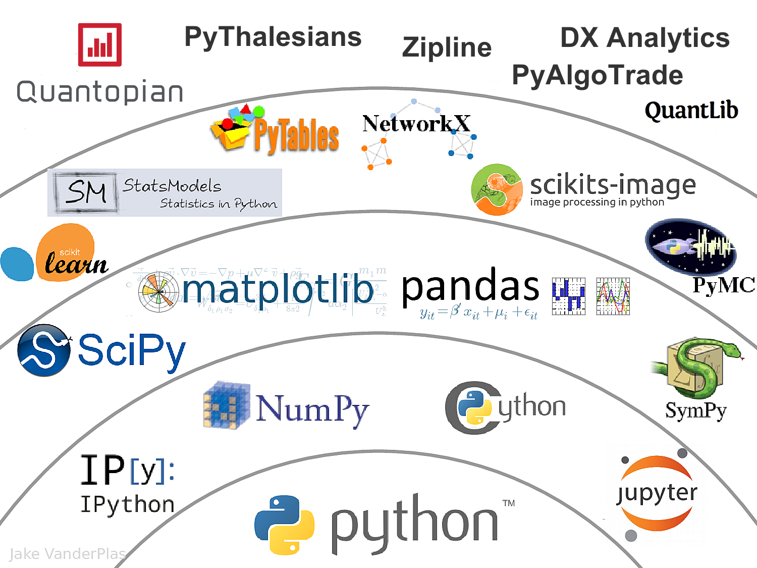
The Quant Finance PyData Stack
Source: http://nbviewer.jupyter.org/format/slides/github/quantopian/pyfolio/blob/master/pyfolio/examples/overview_slides.ipynb#/5

Slide 7
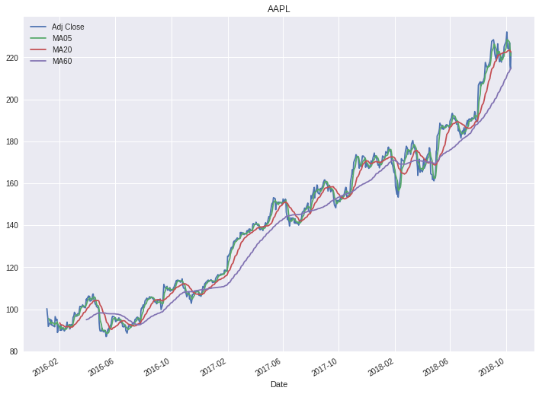

Slide 8

Python

Slide 9
Python is an interpreted, object-oriented, high-level programming language with dynamic semantics.
Source: https://www.python.org/doc/essays/blurb/

Slide 10
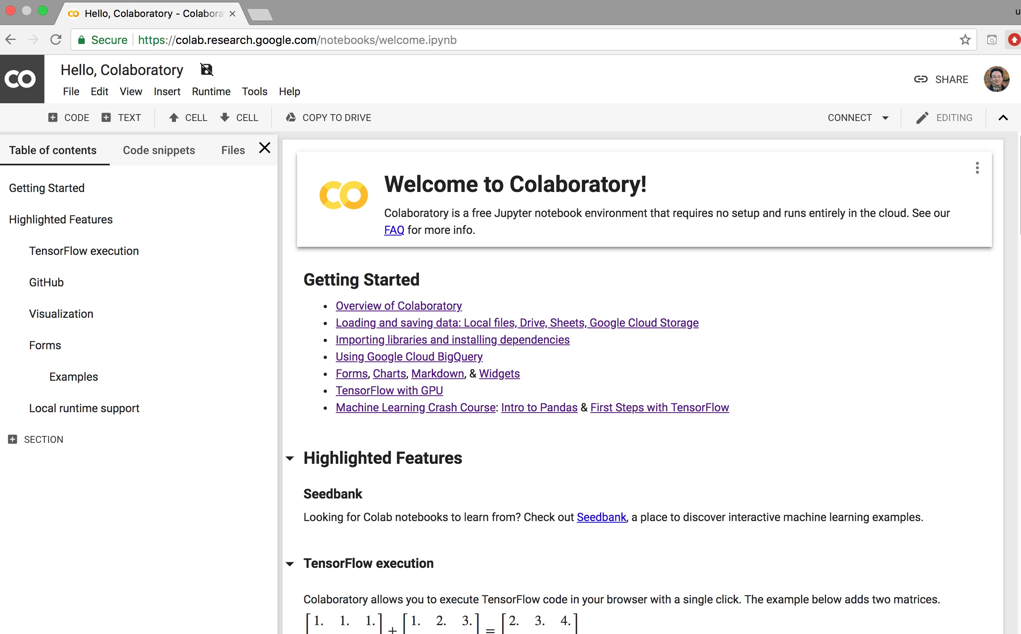
Google Colab
https://colab.research.google.com/notebooks/welcome.ipynb

Slide 11

Python in Google Colab
https://colab.research.google.com/drive/1FEG6DnGvwfUbeo4zJ1zTunjMqf2RkCrT

Slide 12
Numpy
NumPy
Base
N-dimensional array package

Slide 13
Python matplotlib
Source: https://matplotlib.org/

Slide 14
Python Pandas
http://pandas.pydata.org/

Slide 15
Iris flower data set
setosa
versicolor
virginica
Source: https://en.wikipedia.org/wiki/Iris_flower_data_set
Source: http://suruchifialoke.com/2016-10-13-machine-learning-tutorial-iris-classification/

Slide 16
Iris Classfication
Source: http://suruchifialoke.com/2016-10-13-machine-learning-tutorial-iris-classification/

Slide 17
iris.data
https://archive.ics.uci.edu/ml/machine-learning-databases/iris/iris.data
5.1,3.5,1.4,0.2,Iris-setosa 4.9,3.0,1.4,0.2,Iris-setosa 4.7,3.2,1.3,0.2,Iris-setosa 4.6,3.1,1.5,0.2,Iris-setosa 5.0,3.6,1.4,0.2,Iris-setosa 5.4,3.9,1.7,0.4,Iris-setosa 4.6,3.4,1.4,0.3,Iris-setosa 5.0,3.4,1.5,0.2,Iris-setosa 4.4,2.9,1.4,0.2,Iris-setosa 4.9,3.1,1.5,0.1,Iris-setosa 5.4,3.7,1.5,0.2,Iris-setosa 4.8,3.4,1.6,0.2,Iris-setosa 4.8,3.0,1.4,0.1,Iris-setosa 4.3,3.0,1.1,0.1,Iris-setosa 5.8,4.0,1.2,0.2,Iris-setosa 5.7,4.4,1.5,0.4,Iris-setosa 5.4,3.9,1.3,0.4,Iris-setosa 5.1,3.5,1.4,0.3,Iris-setosa 5.7,3.8,1.7,0.3,Iris-setosa 5.1,3.8,1.5,0.3,Iris-setosa 5.4,3.4,1.7,0.2,Iris-setosa 5.1,3.7,1.5,0.4,Iris-setosa 4.6,3.6,1.0,0.2,Iris-setosa 5.1,3.3,1.7,0.5,Iris-setosa 4.8,3.4,1.9,0.2,Iris-setosa 5.0,3.0,1.6,0.2,Iris-setosa 5.0,3.4,1.6,0.4,Iris-setosa 5.2,3.5,1.5,0.2,Iris-setosa 5.2,3.4,1.4,0.2,Iris-setosa 4.7,3.2,1.6,0.2,Iris-setosa 4.8,3.1,1.6,0.2,Iris-setosa 5.4,3.4,1.5,0.4,Iris-setosa 5.2,4.1,1.5,0.1,Iris-setosa 5.5,4.2,1.4,0.2,Iris-setosa 4.9,3.1,1.5,0.1,Iris-setosa 5.0,3.2,1.2,0.2,Iris-setosa 5.5,3.5,1.3,0.2,Iris-setosa 4.9,3.1,1.5,0.1,Iris-setosa 4.4,3.0,1.3,0.2,Iris-setosa 5.1,3.4,1.5,0.2,Iris-setosa 5.0,3.5,1.3,0.3,Iris-setosa 4.5,2.3,1.3,0.3,Iris-setosa 4.4,3.2,1.3,0.2,Iris-setosa 5.0,3.5,1.6,0.6,Iris-setosa 5.1,3.8,1.9,0.4,Iris-setosa 4.8,3.0,1.4,0.3,Iris-setosa 5.1,3.8,1.6,0.2,Iris-setosa 4.6,3.2,1.4,0.2,Iris-setosa 5.3,3.7,1.5,0.2,Iris-setosa 5.0,3.3,1.4,0.2,Iris-setosa 7.0,3.2,4.7,1.4,Iris-versicolor 6.4,3.2,4.5,1.5,Iris-versicolor 6.9,3.1,4.9,1.5,Iris-versicolor 5.5,2.3,4.0,1.3,Iris-versicolor 6.5,2.8,4.6,1.5,Iris-versicolor 5.7,2.8,4.5,1.3,Iris-versicolor 6.3,3.3,4.7,1.6,Iris-versicolor 4.9,2.4,3.3,1.0,Iris-versicolor 6.6,2.9,4.6,1.3,Iris-versicolor 5.2,2.7,3.9,1.4,Iris-versicolor 5.0,2.0,3.5,1.0,Iris-versicolor 5.9,3.0,4.2,1.5,Iris-versicolor 6.0,2.2,4.0,1.0,Iris-versicolor 6.1,2.9,4.7,1.4,Iris-versicolor 5.6,2.9,3.6,1.3,Iris-versicolor 6.7,3.1,4.4,1.4,Iris-versicolor 5.6,3.0,4.5,1.5,Iris-versicolor 5.8,2.7,4.1,1.0,Iris-versicolor 6.2,2.2,4.5,1.5,Iris-versicolor 5.6,2.5,3.9,1.1,Iris-versicolor 5.9,3.2,4.8,1.8,Iris-versicolor 6.1,2.8,4.0,1.3,Iris-versicolor 6.3,2.5,4.9,1.5,Iris-versicolor 6.1,2.8,4.7,1.2,Iris-versicolor 6.4,2.9,4.3,1.3,Iris-versicolor 6.6,3.0,4.4,1.4,Iris-versicolor 6.8,2.8,4.8,1.4,Iris-versicolor 6.7,3.0,5.0,1.7,Iris-versicolor 6.0,2.9,4.5,1.5,Iris-versicolor 5.7,2.6,3.5,1.0,Iris-versicolor 5.5,2.4,3.8,1.1,Iris-versicolor 5.5,2.4,3.7,1.0,Iris-versicolor 5.8,2.7,3.9,1.2,Iris-versicolor 6.0,2.7,5.1,1.6,Iris-versicolor 5.4,3.0,4.5,1.5,Iris-versicolor 6.0,3.4,4.5,1.6,Iris-versicolor 6.7,3.1,4.7,1.5,Iris-versicolor 6.3,2.3,4.4,1.3,Iris-versicolor 5.6,3.0,4.1,1.3,Iris-versicolor 5.5,2.5,4.0,1.3,Iris-versicolor 5.5,2.6,4.4,1.2,Iris-versicolor 6.1,3.0,4.6,1.4,Iris-versicolor 5.8,2.6,4.0,1.2,Iris-versicolor 5.0,2.3,3.3,1.0,Iris-versicolor 5.6,2.7,4.2,1.3,Iris-versicolor 5.7,3.0,4.2,1.2,Iris-versicolor 5.7,2.9,4.2,1.3,Iris-versicolor 6.2,2.9,4.3,1.3,Iris-versicolor 5.1,2.5,3.0,1.1,Iris-versicolor 5.7,2.8,4.1,1.3,Iris-versicolor 6.3,3.3,6.0,2.5,Iris-virginica 5.8,2.7,5.1,1.9,Iris-virginica 7.1,3.0,5.9,2.1,Iris-virginica 6.3,2.9,5.6,1.8,Iris-virginica 6.5,3.0,5.8,2.2,Iris-virginica 7.6,3.0,6.6,2.1,Iris-virginica 4.9,2.5,4.5,1.7,Iris-virginica 7.3,2.9,6.3,1.8,Iris-virginica 6.7,2.5,5.8,1.8,Iris-virginica 7.2,3.6,6.1,2.5,Iris-virginica 6.5,3.2,5.1,2.0,Iris-virginica 6.4,2.7,5.3,1.9,Iris-virginica 6.8,3.0,5.5,2.1,Iris-virginica 5.7,2.5,5.0,2.0,Iris-virginica 5.8,2.8,5.1,2.4,Iris-virginica 6.4,3.2,5.3,2.3,Iris-virginica 6.5,3.0,5.5,1.8,Iris-virginica 7.7,3.8,6.7,2.2,Iris-virginica 7.7,2.6,6.9,2.3,Iris-virginica 6.0,2.2,5.0,1.5,Iris-virginica 6.9,3.2,5.7,2.3,Iris-virginica 5.6,2.8,4.9,2.0,Iris-virginica 7.7,2.8,6.7,2.0,Iris-virginica 6.3,2.7,4.9,1.8,Iris-virginica 6.7,3.3,5.7,2.1,Iris-virginica 7.2,3.2,6.0,1.8,Iris-virginica 6.2,2.8,4.8,1.8,Iris-virginica 6.1,3.0,4.9,1.8,Iris-virginica 6.4,2.8,5.6,2.1,Iris-virginica 7.2,3.0,5.8,1.6,Iris-virginica 7.4,2.8,6.1,1.9,Iris-virginica 7.9,3.8,6.4,2.0,Iris-virginica 6.4,2.8,5.6,2.2,Iris-virginica 6.3,2.8,5.1,1.5,Iris-virginica 6.1,2.6,5.6,1.4,Iris-virginica 7.7,3.0,6.1,2.3,Iris-virginica 6.3,3.4,5.6,2.4,Iris-virginica 6.4,3.1,5.5,1.8,Iris-virginica 6.0,3.0,4.8,1.8,Iris-virginica 6.9,3.1,5.4,2.1,Iris-virginica 6.7,3.1,5.6,2.4,Iris-virginica 6.9,3.1,5.1,2.3,Iris-virginica 5.8,2.7,5.1,1.9,Iris-virginica 6.8,3.2,5.9,2.3,Iris-virginica 6.7,3.3,5.7,2.5,Iris-virginica 6.7,3.0,5.2,2.3,Iris-virginica 6.3,2.5,5.0,1.9,Iris-virginica 6.5,3.0,5.2,2.0,Iris-virginica 6.2,3.4,5.4,2.3,Iris-virginica 5.9,3.0,5.1,1.8,Iris-virginica
setosa
virginica
versicolor

Slide 18
Iris Data Visualization
Source: https://seaborn.pydata.org/generated/seaborn.pairplot.html

Slide 19
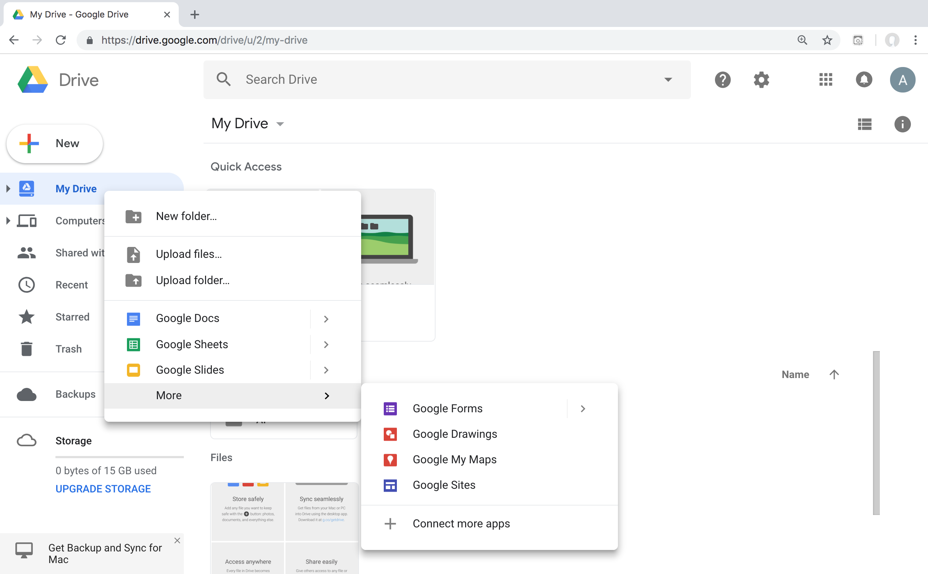
Connect Google Colab in Google Drive

Slide 20
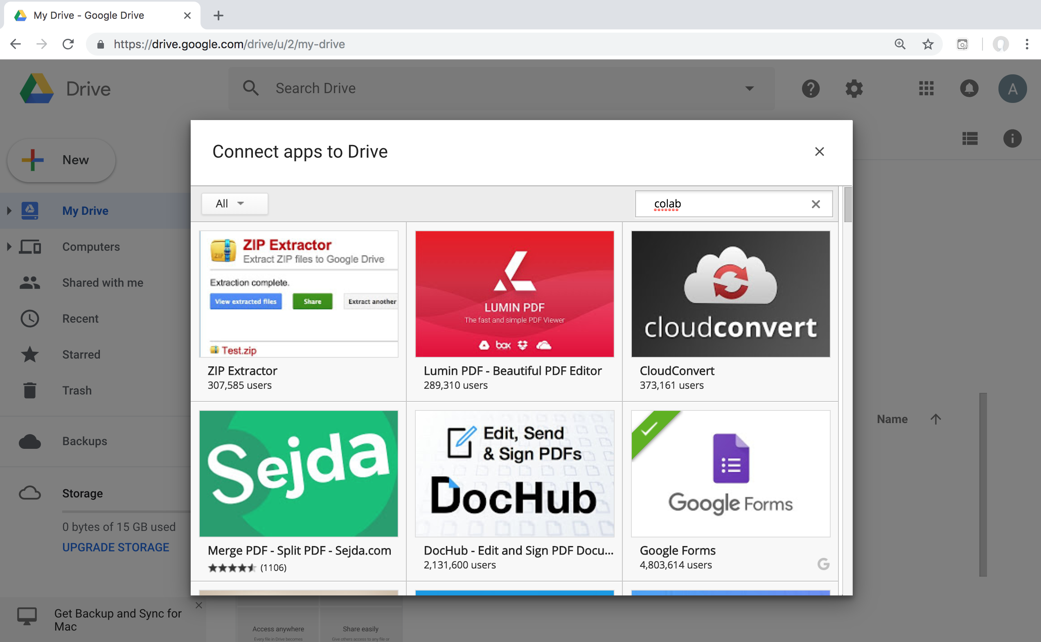
Google Colab

Slide 21
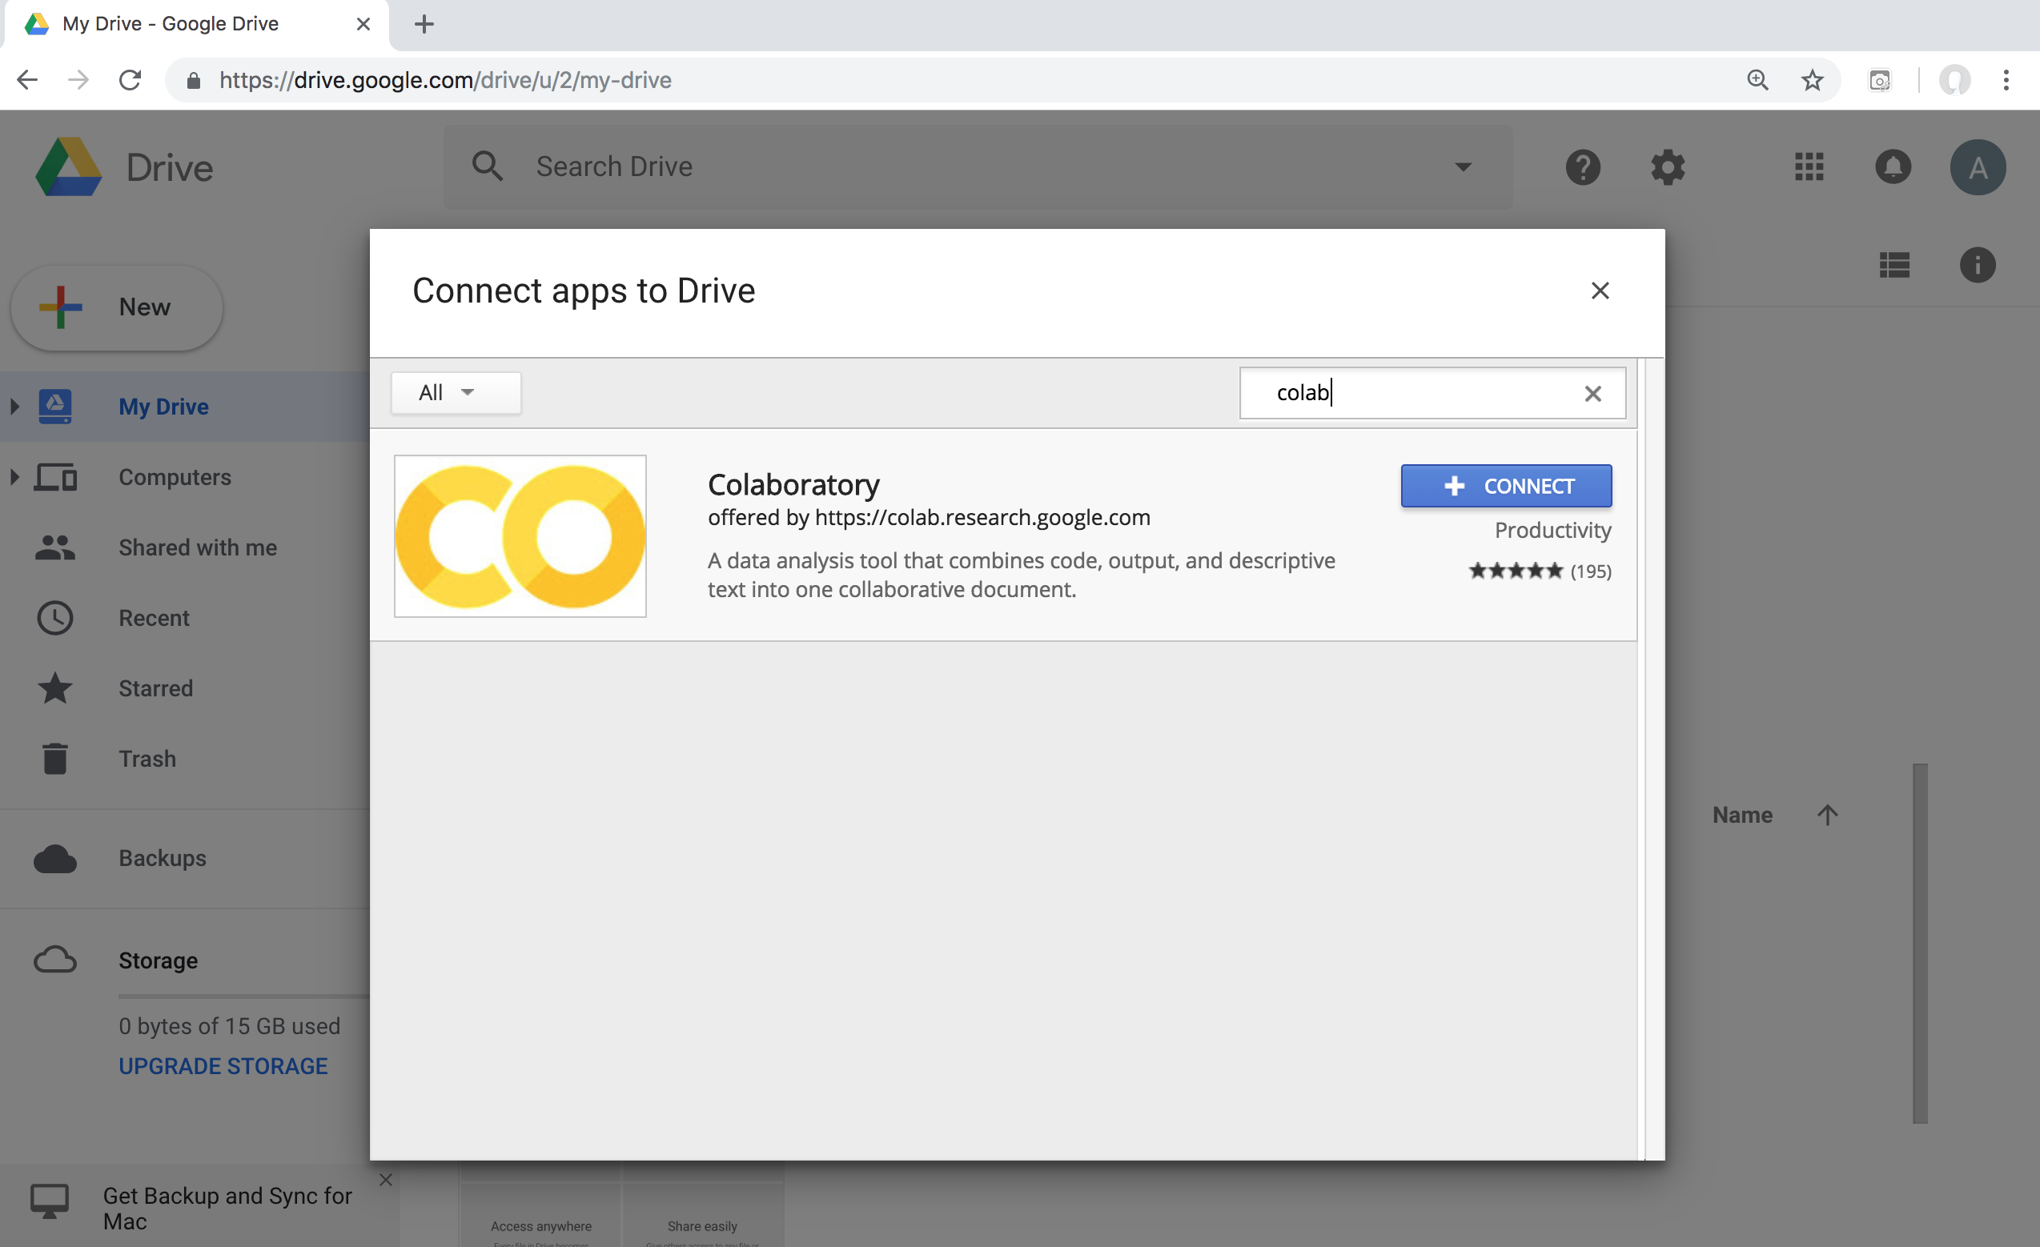
Google Colab

Slide 22
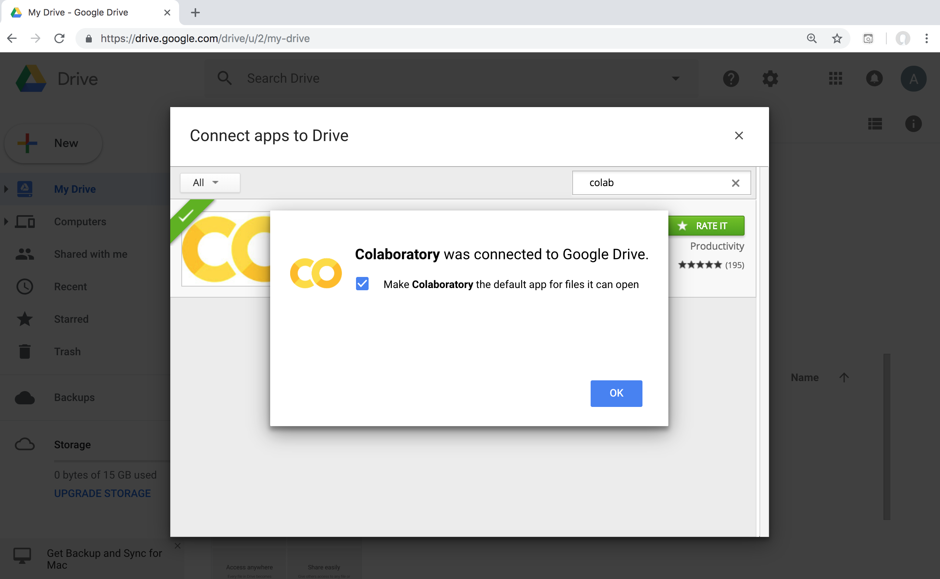
Connect Colaboratory to Google Drive

Slide 23
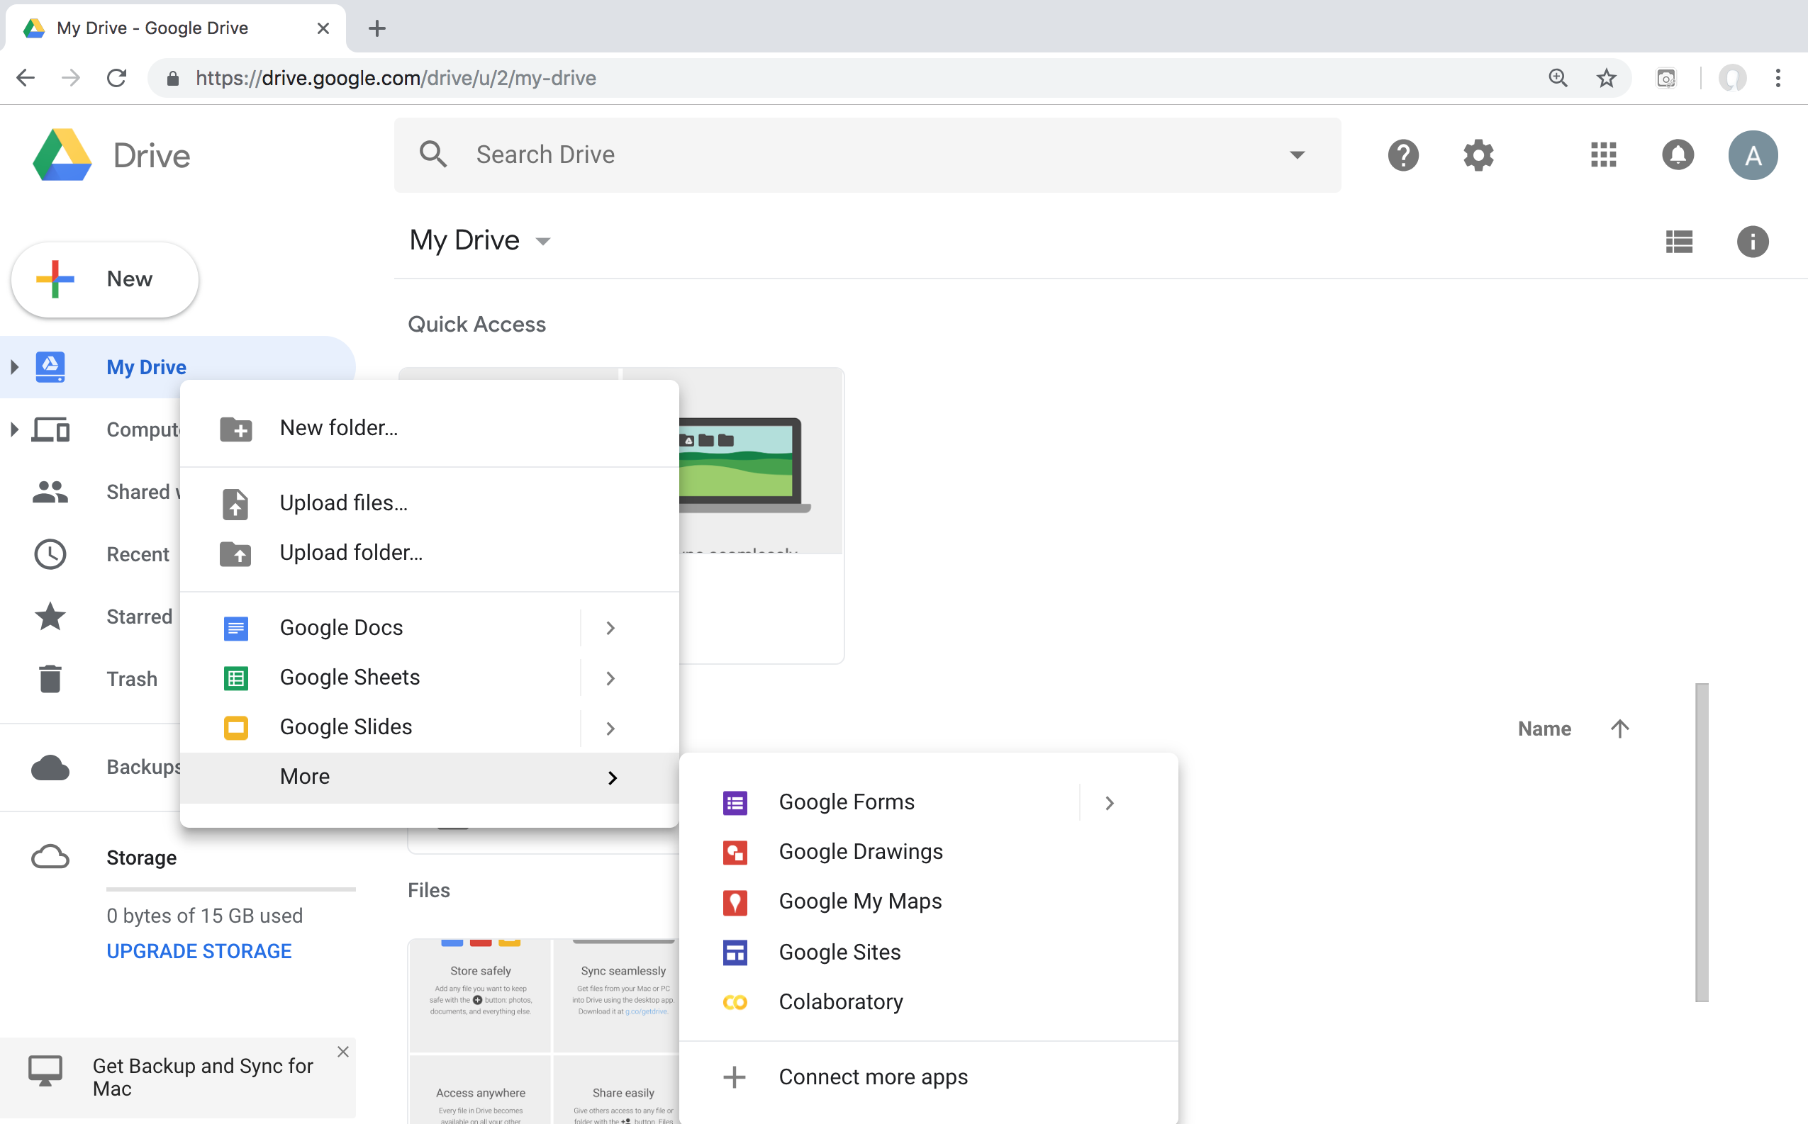
Google Colab

Slide 24
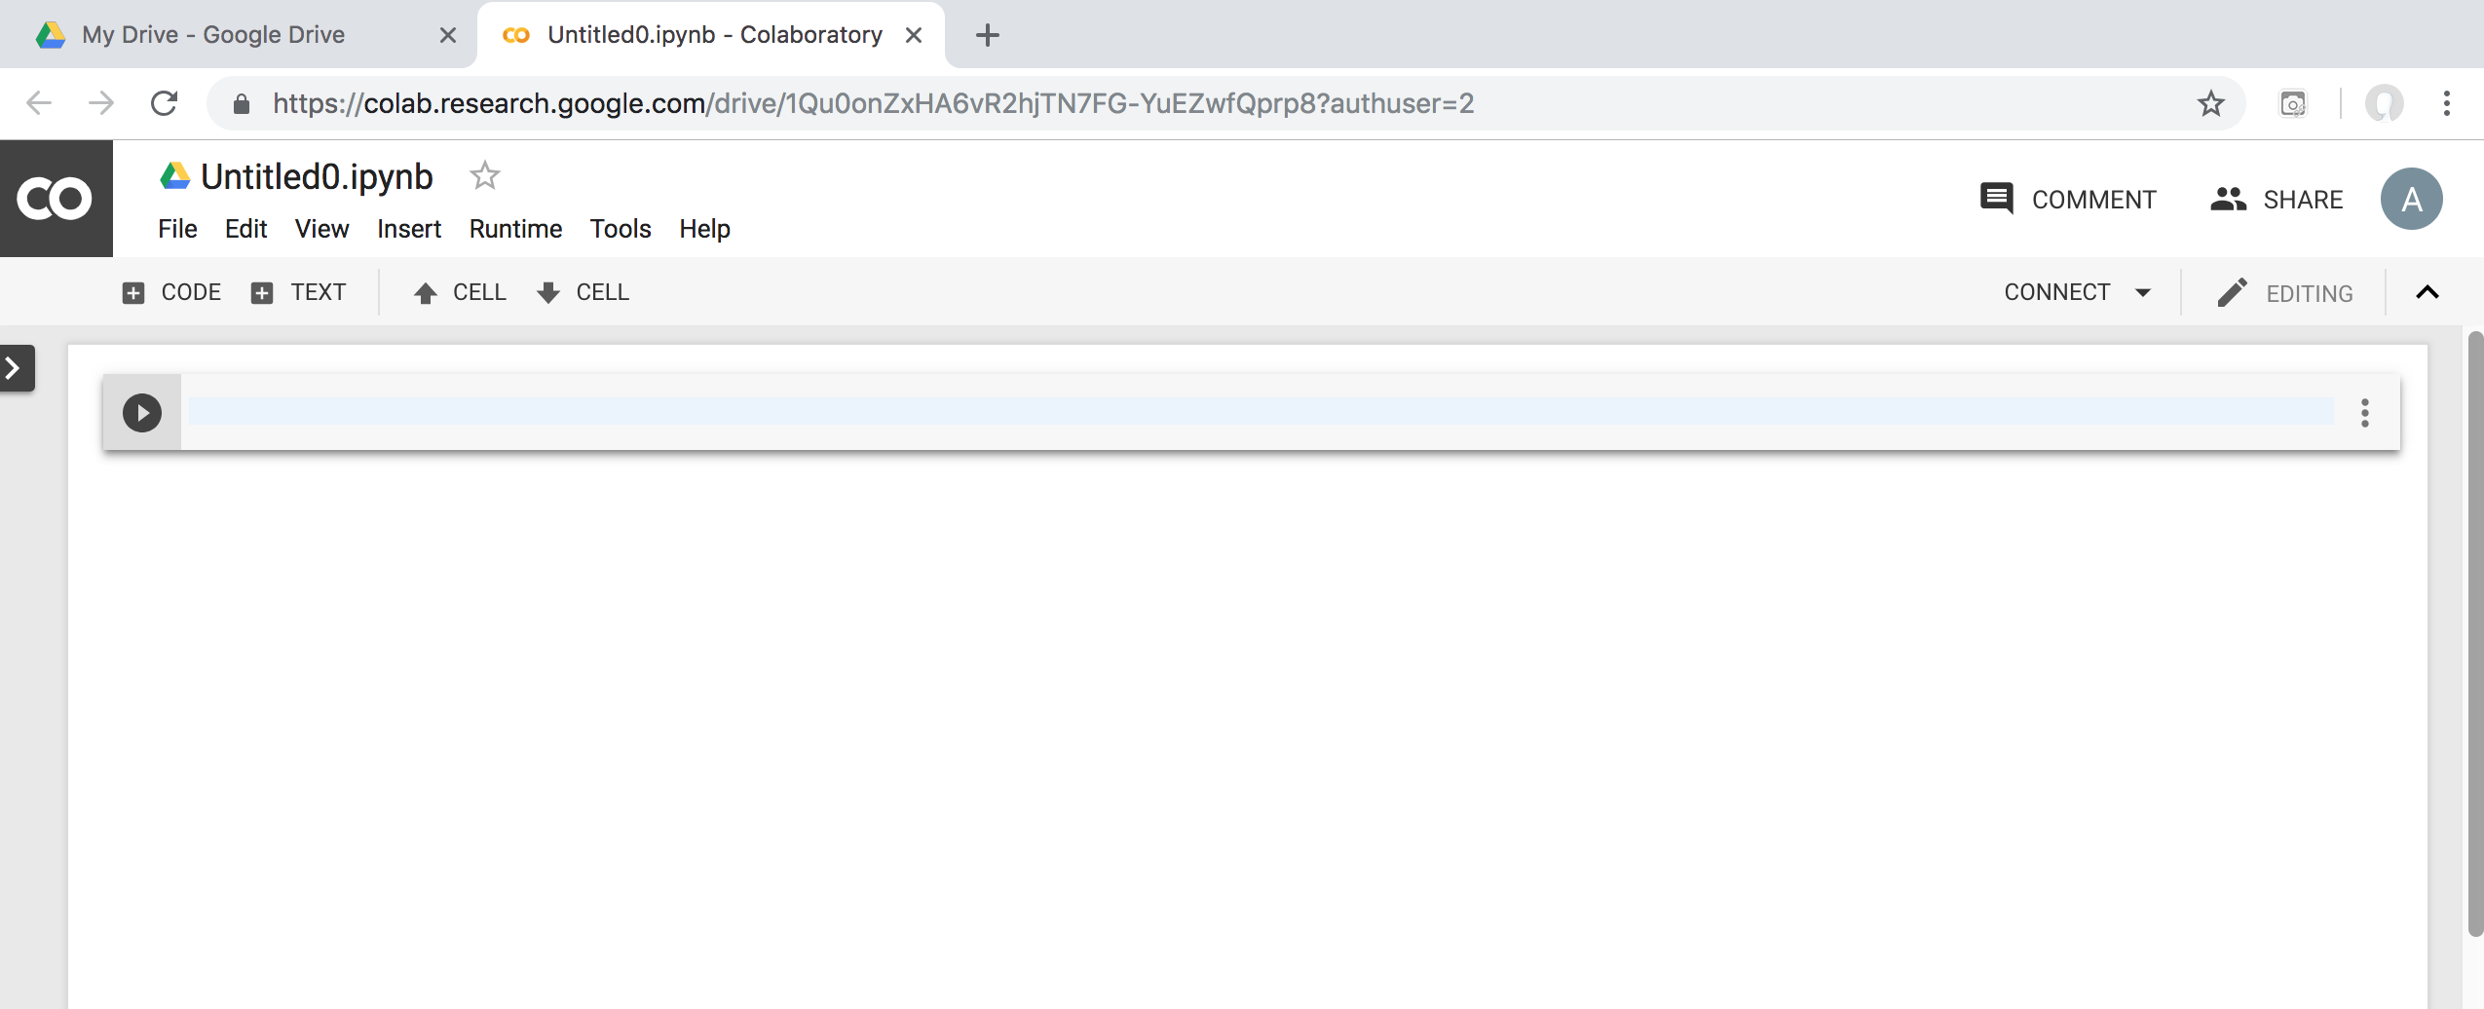
Google Colab

Slide 25
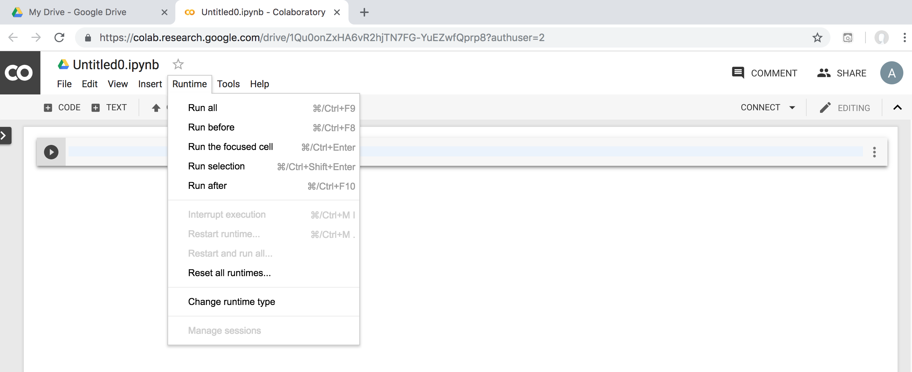
Google Colab

Slide 26
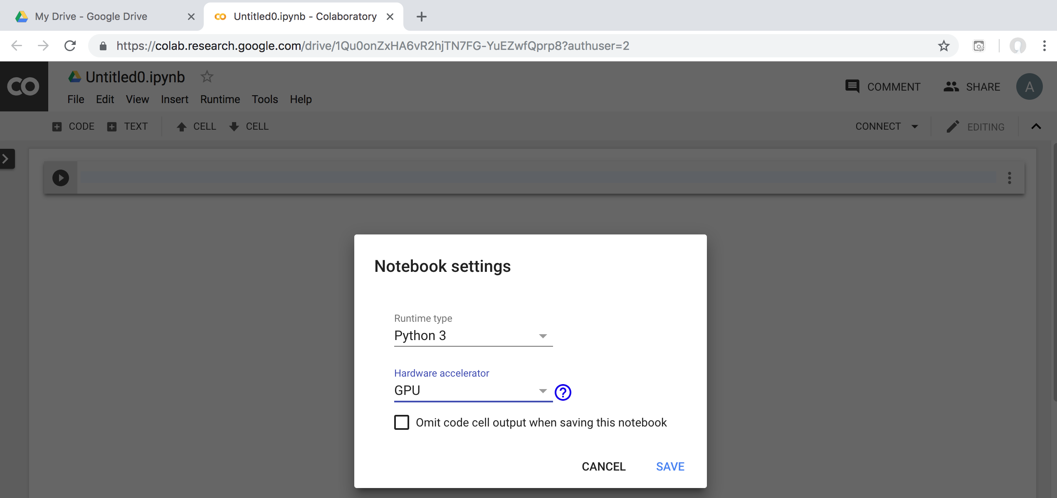
Run Jupyter Notebook
Python3 GPU
Google Colab

Slide 27
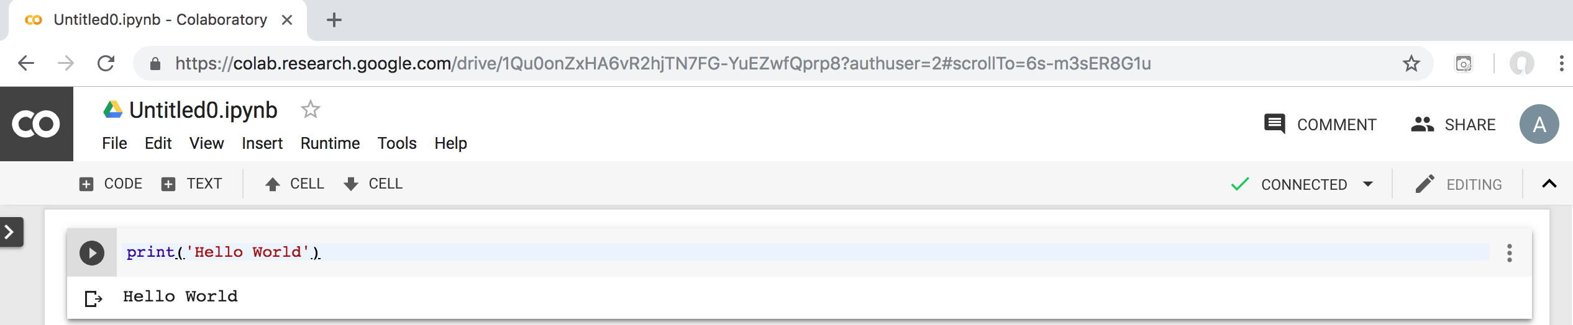
Google Colab Python Hello World print('Hello World')

Slide 28
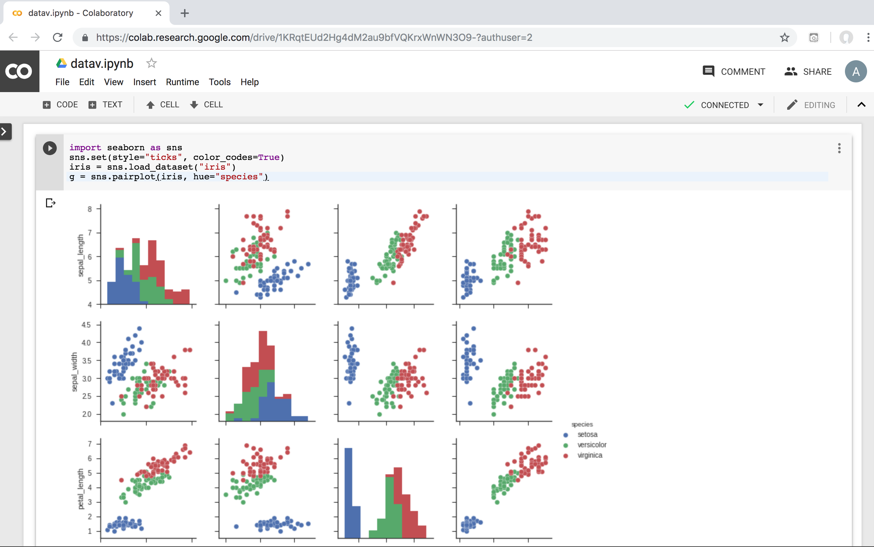
Data Visualization in Google Colab
https://colab.research.google.com/drive/1KRqtEUd2Hg4dM2au9bfVQKrxWnWN3O9-
Source: https://seaborn.pydata.org/generated/seaborn.pairplot.html

Slide 29
import seaborn as sns
sns.set(style="ticks", color_codes=True)
iris = sns.load_dataset("iris")
g = sns.pairplot(iris, hue="species")
Source: https://seaborn.pydata.org/generated/seaborn.pairplot.html

Slide 30
https://colab.research.google.com/drive/1KRqtEUd2Hg4dM2au9bfVQKrxWnWN3O9-
import numpy as np
import pandas as pd
%matplotlib inline
import matplotlib.pyplot as plt
import seaborn as sns
from pandas.plotting import scatter_matrix
# Load dataset
url = "https://archive.ics.uci.edu/ml/machine-learning-databases/iris/iris.data"
names = ['sepal-length', 'sepal-width', 'petal-length', 'petal-width', 'class']
df = pd.read_csv(url, names=names)
print(df.head(10))
print(df.tail(10))
print(df.describe())
print(df.info())
print(df.shape)
print(df.groupby('class').size())
plt.rcParams["figure.figsize"] = (10,8)
df.plot(kind='box', subplots=True, layout=(2,2), sharex=False, sharey=False)
plt.show()
df.hist()
plt.show()
scatter_matrix(df)
plt.show()
sns.pairplot(df, hue="class", size=2)
Source: https://machinelearningmastery.com/machine-learning-in-python-step-by-step/
Notes:
# coding: utf-8
# Source: https://machinelearningmastery.com/machine-learning-in-python-step-by-step/
# https://colab.research.google.com/drive/1KRqtEUd2Hg4dM2au9bfVQKrxWnWN3O9-
import numpy as np
import pandas as pd
%matplotlib inline
import matplotlib.pyplot as plt
import seaborn as sns
from pandas.plotting import scatter_matrix
# Load dataset
url = "https://archive.ics.uci.edu/ml/machine-learning-databases/iris/iris.data"
names = ['sepal-length', 'sepal-width', 'petal-length', 'petal-width', 'class']
df = pd.read_csv(url, names=names)
print(df.head(10))
print(df.tail(10))
print(df.describe())
print(df.info())
print(df.shape)
print(df.groupby('class').size())
plt.rcParams["figure.figsize"] = (10,8)
df.plot(kind='box', subplots=True, layout=(2,2), sharex=False, sharey=False)
plt.show()
df.hist()
plt.show()
scatter_matrix(df)
plt.show()
sns.pairplot(df, hue="class", size=2)

Slide 31
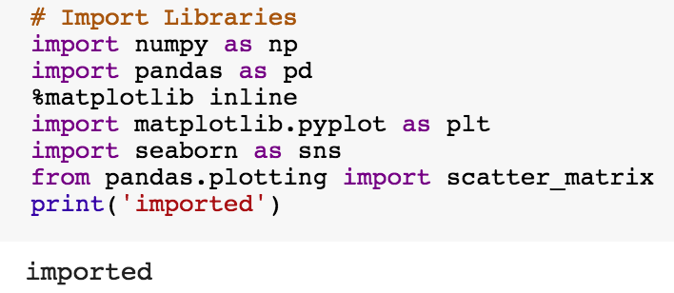
import numpy as np
import pandas as pd
%matplotlib inline
import matplotlib.pyplot as plt
import seaborn as sns
from pandas.plotting import scatter_matrix

Slide 32
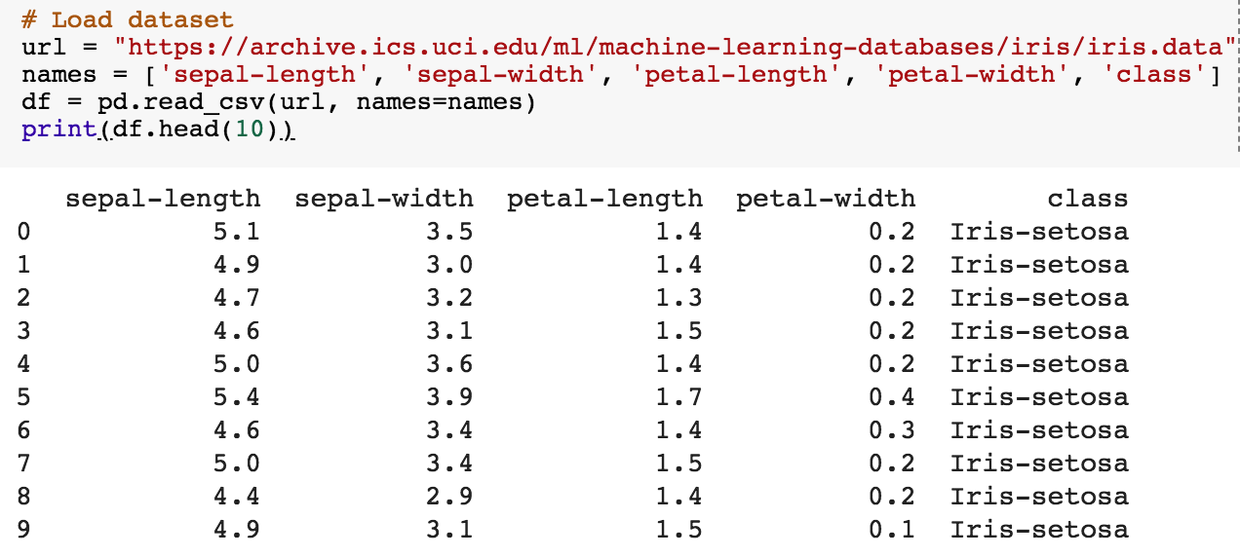
url = "https://archive.ics.uci.edu/ml/machine-learning-databases/iris/iris.data"
names = ['sepal-length', 'sepal-width', 'petal-length', 'petal-width', 'class']
df = pd.read_csv(url, names=names)
print(df.head(10))

Slide 33
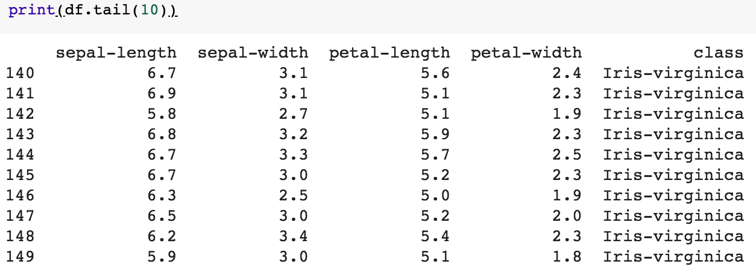
df.tail(10)

Slide 34
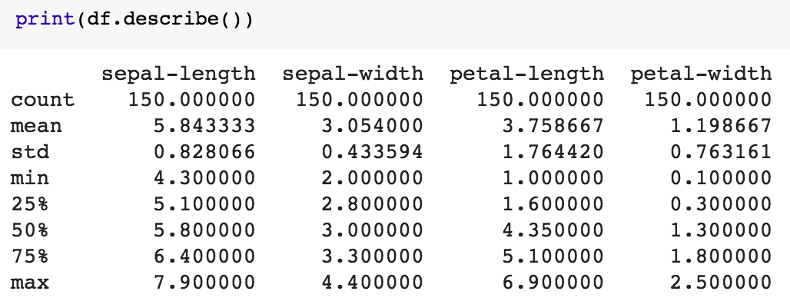
df.describe()

Slide 35
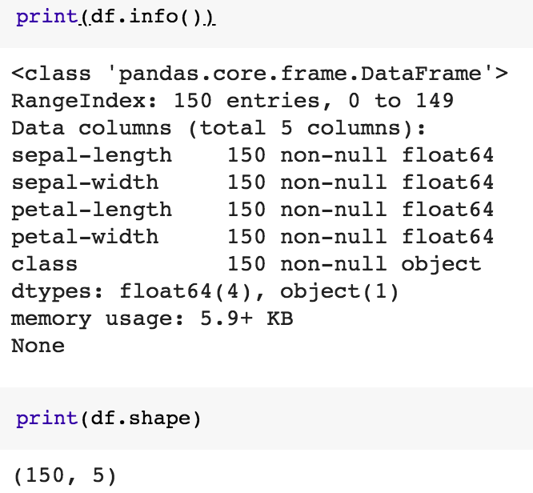
print(df.info())
print(df.shape)

Slide 36
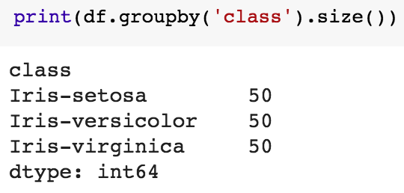
df.groupby('class').size()

Slide 37
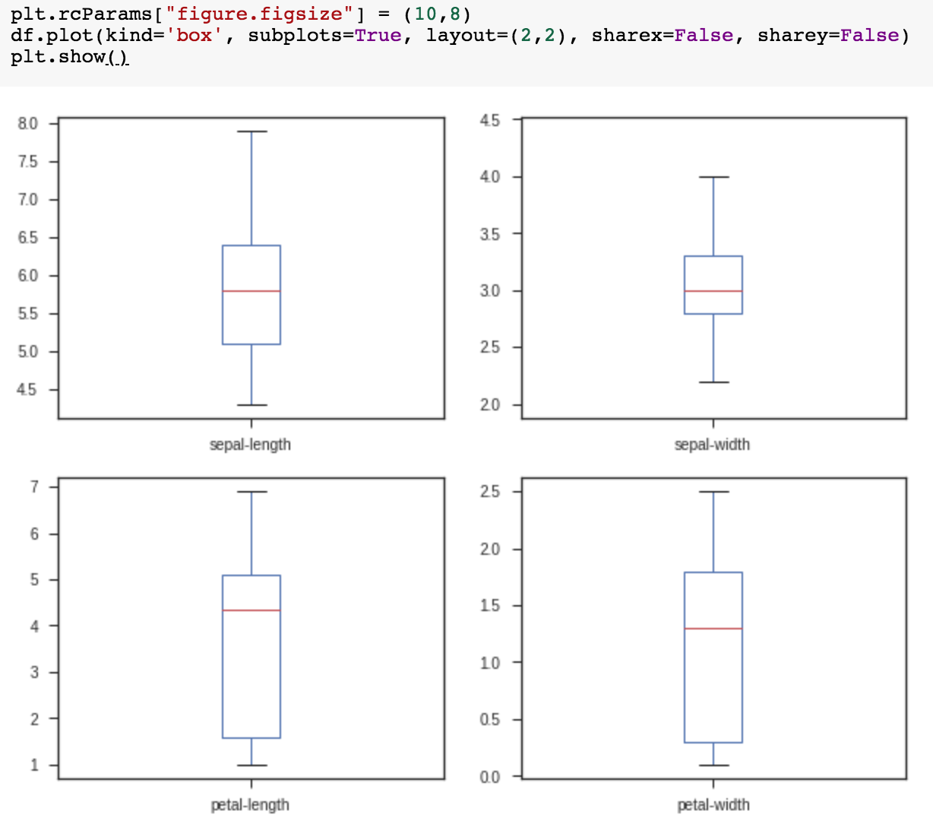
plt.rcParams["figure.figsize"] = (10,8)
df.plot(kind='box', subplots=True, layout=(2,2), sharex=False, sharey=False)
plt.show()

Slide 38
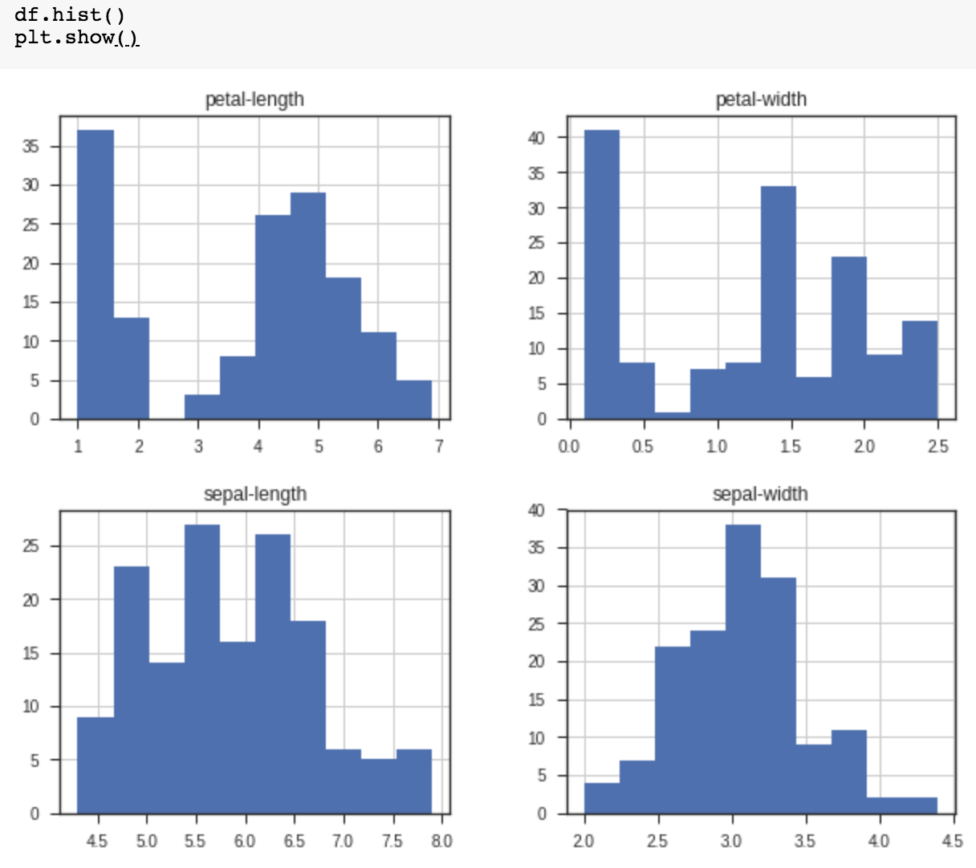
df.hist()
plt.show()

Slide 39
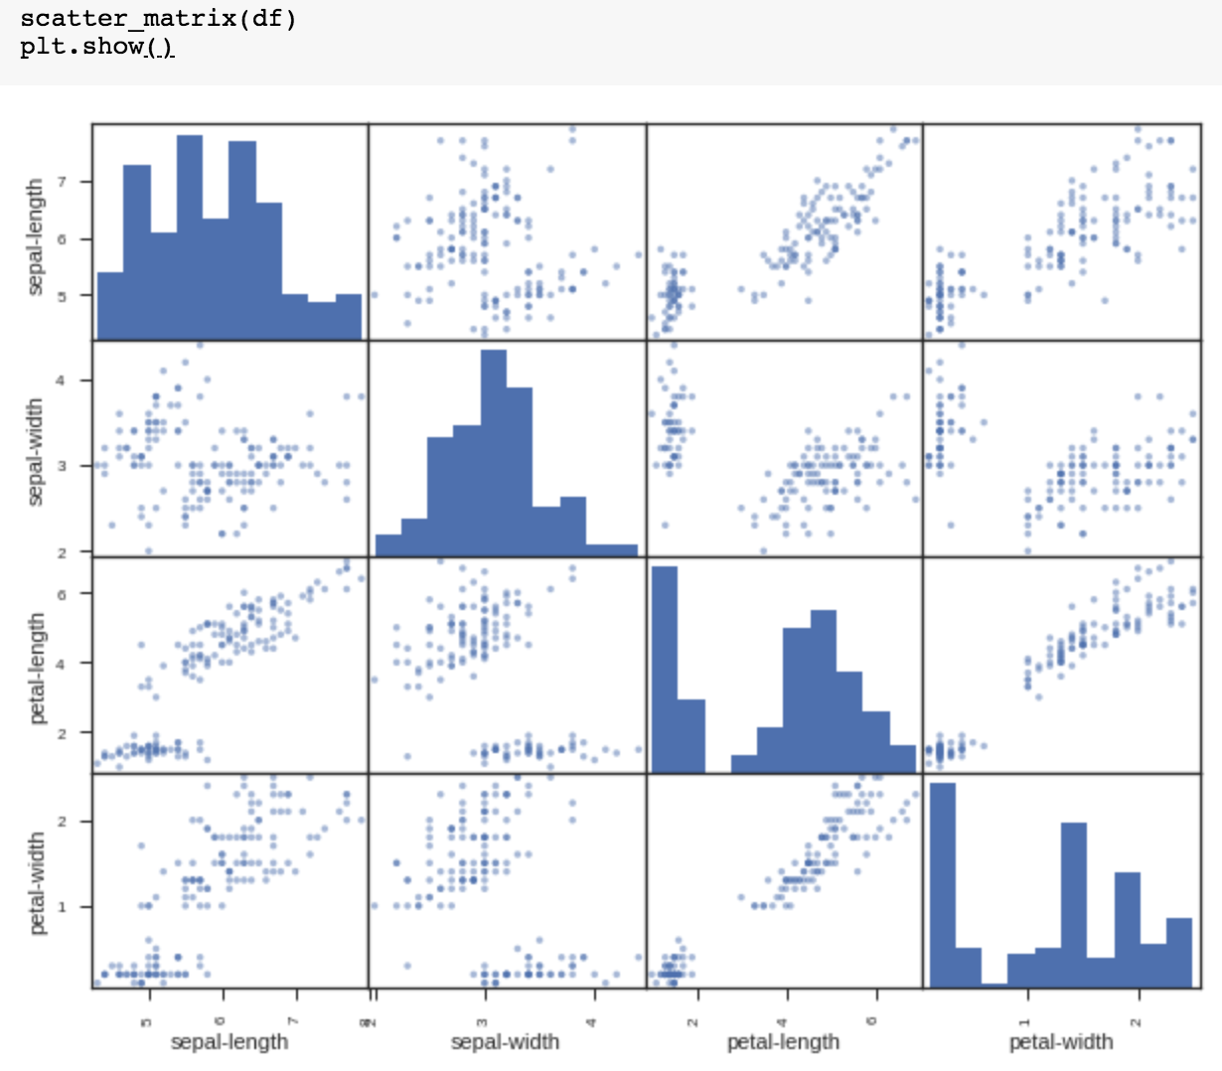
scatter_matrix(df)
plt.show()

Slide 40
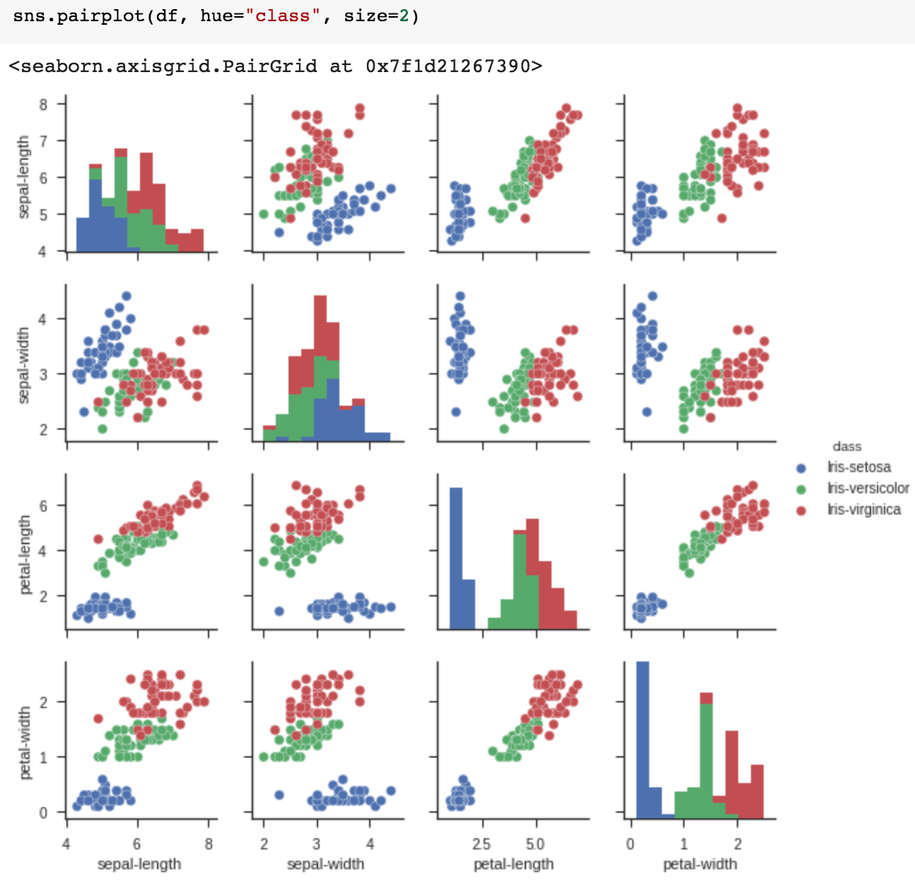
sns.pairplot(df, hue="class", size=2)

Slide 41
Anaconda
The Most Popular Python
Data Science Platform
Source: https://www.anaconda.com/

Slide 42
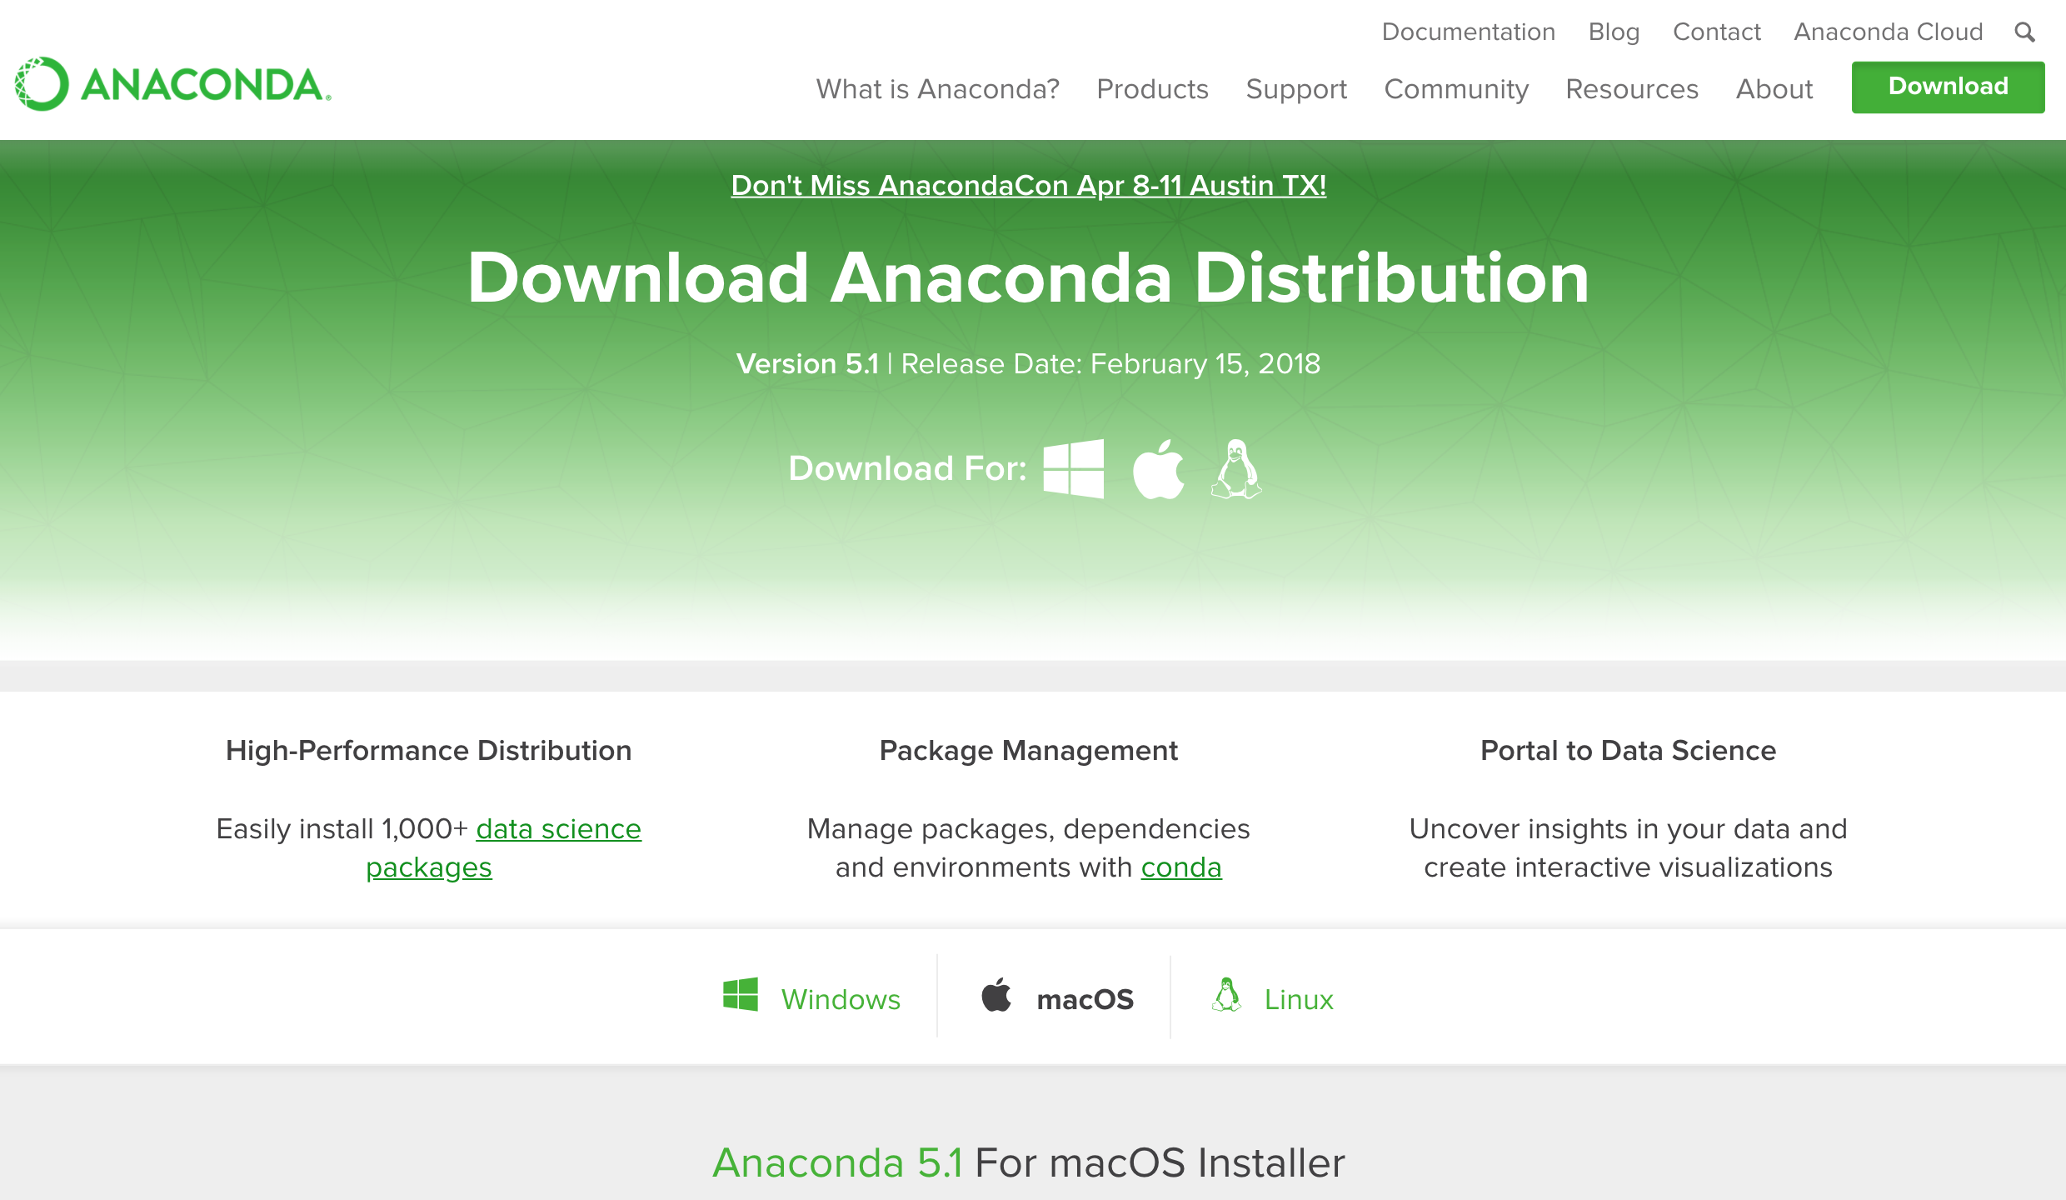
Download Anaconda
https://www.anaconda.com/download

Slide 43
Python
HelloWorld

Slide 44
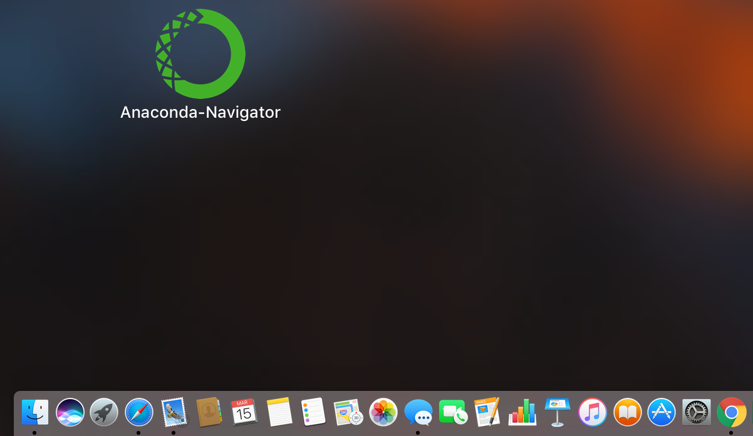
Anaconda-Navigator
Launchpad

Slide 45
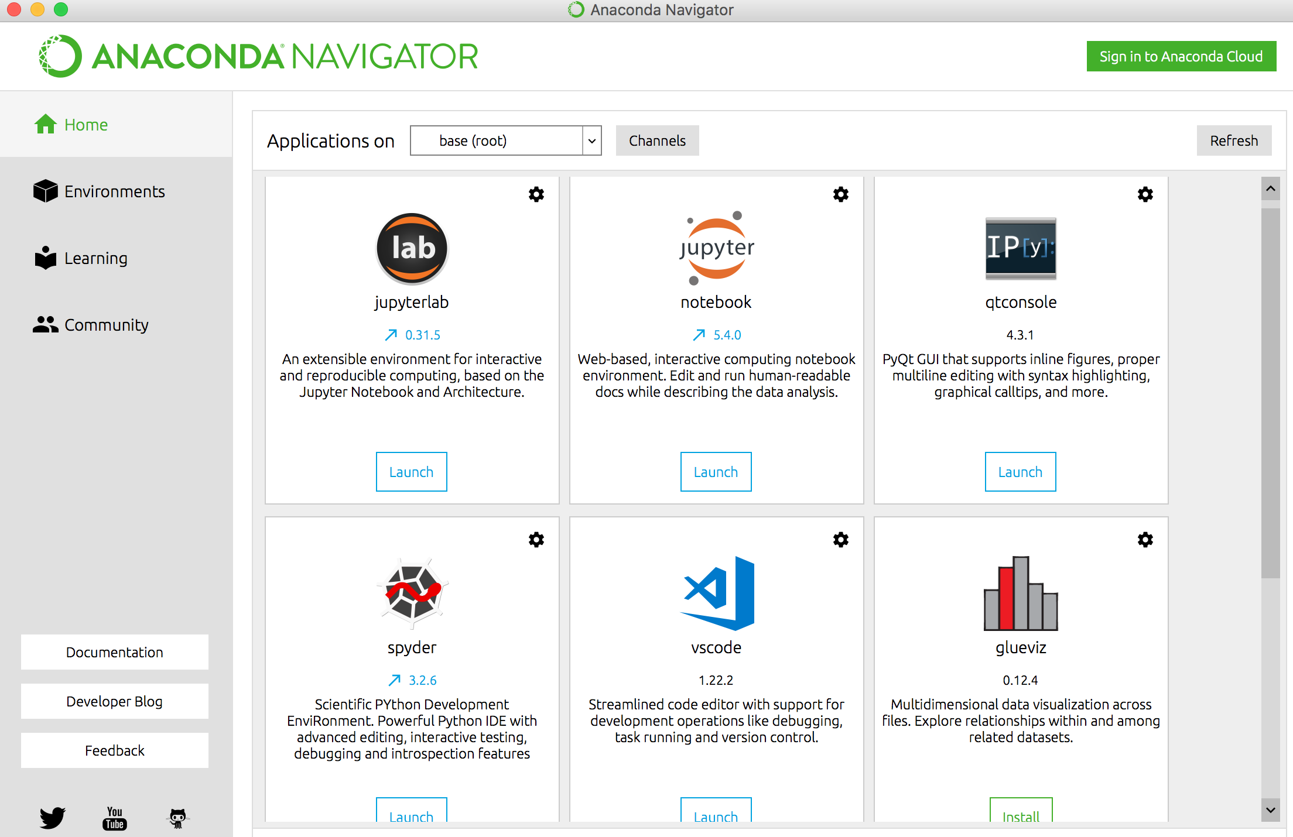
Anaconda Navigator

Slide 46
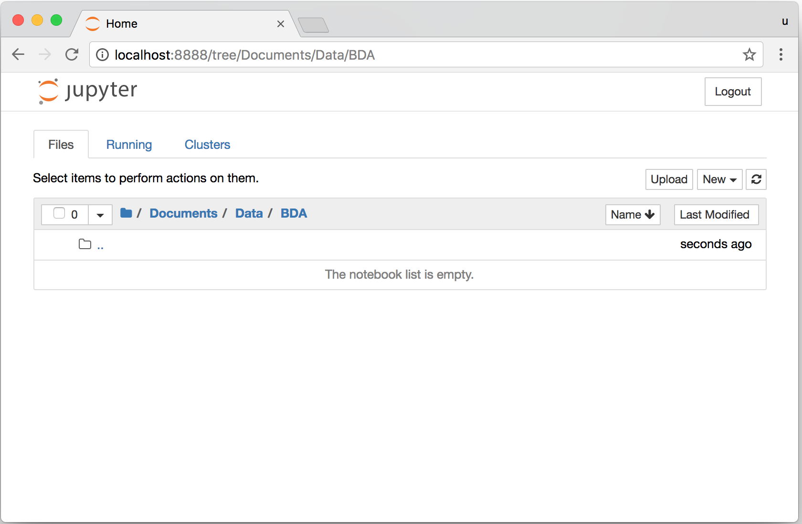
Jupyter Notebook

Slide 47
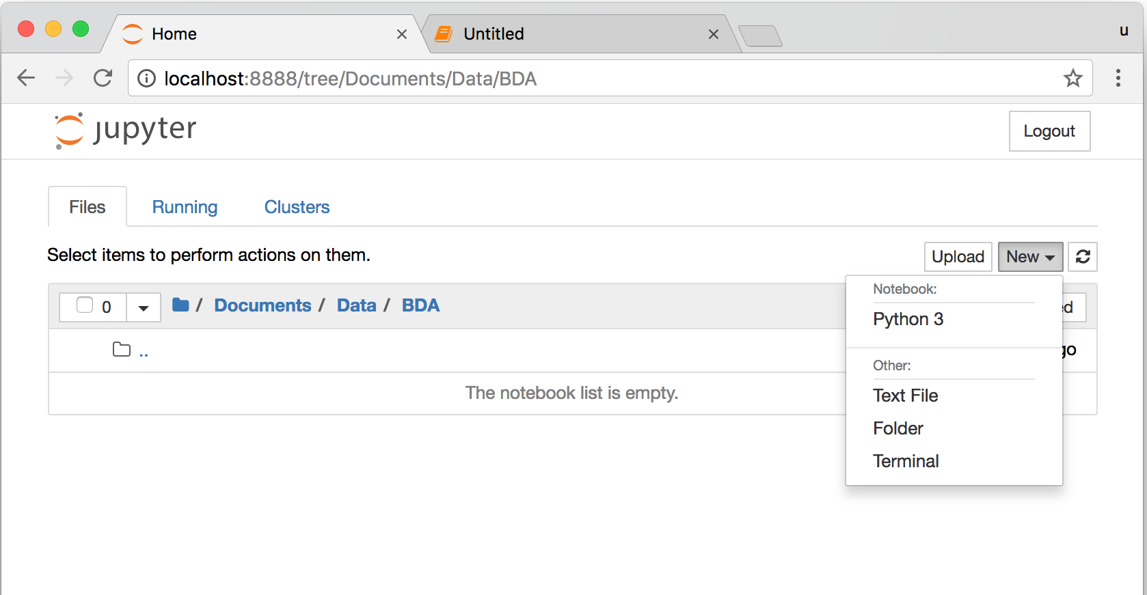
Jupyter Notebook
New Python 3

Slide 48
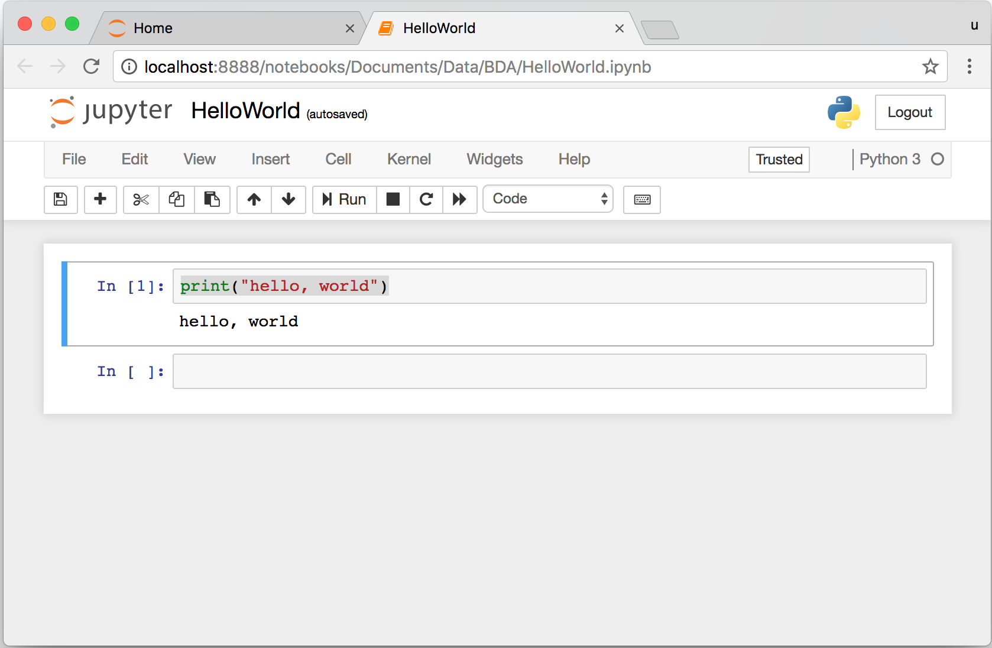
print("hello, world")
Notes:
print("hello, world")

Slide 49
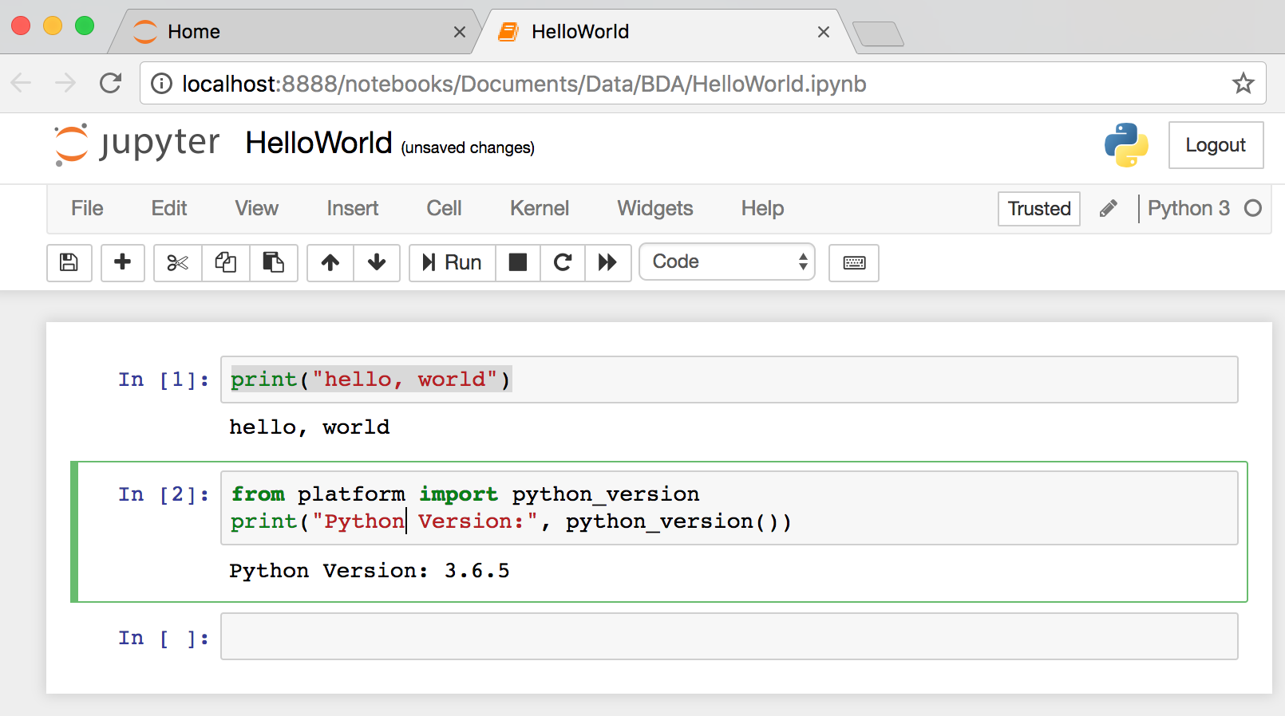
from platform import python_version
print("Python Version:", python_version())
Notes:
from platform import python_version
print("Python Version:", python_version())

Slide 50
Python
Programming

Slide 51
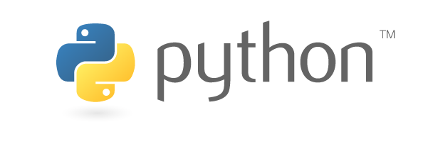
Source: https://www.python.org/community/logos/

Slide 52
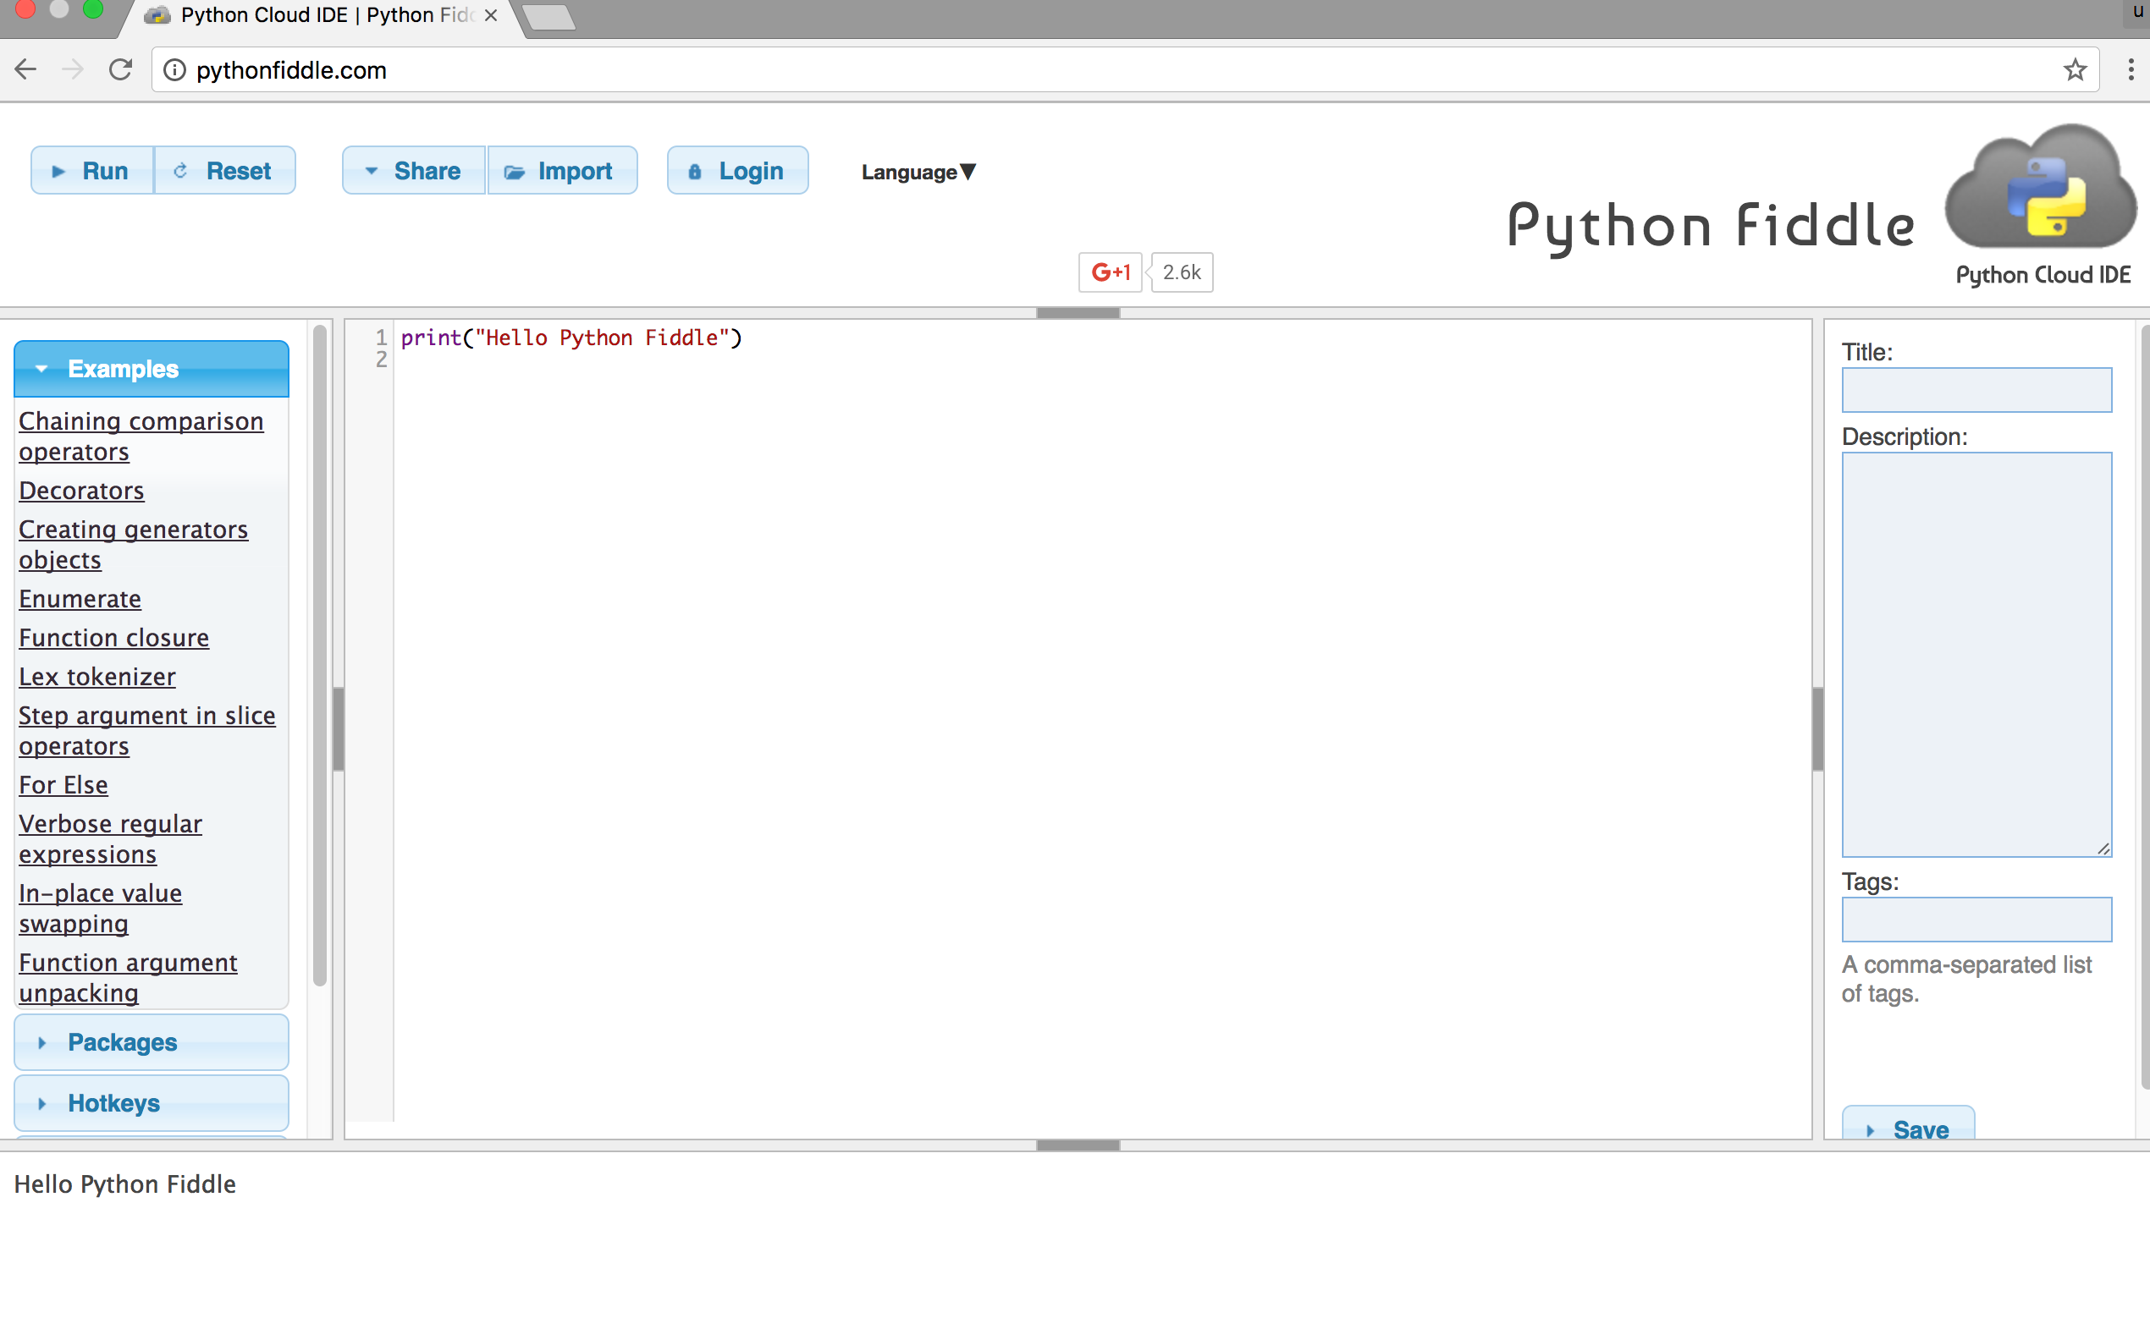
Python Fiddle
http://pythonfiddle.com/

Slide 53
Text input and output
print("Hello World")
print("Hello World\nThis is a message")
x = 3
print(x)
x = 2
y = 3
print(x, ' ', y)
name = input("Enter a name: ")
x = int(input("What is x? "))
x = float(input("Write a number "))
Source: http://pythonprogramminglanguage.com/text-input-and-output/
Notes:
print("Hello World")
print("Hello World\nThis is a message")
x = 3
print(x)
x = 2
y = 3
print(x, ' ', y)
name = input("Enter a name: ")
x = int(input("What is x? "))
x = float(input("Write a number "))

Slide 54
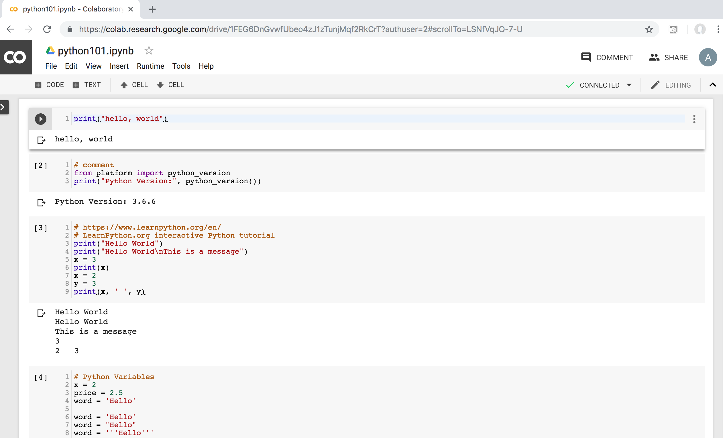
Python in Google Colab
https://colab.research.google.com/drive/1FEG6DnGvwfUbeo4zJ1zTunjMqf2RkCrT

Slide 55
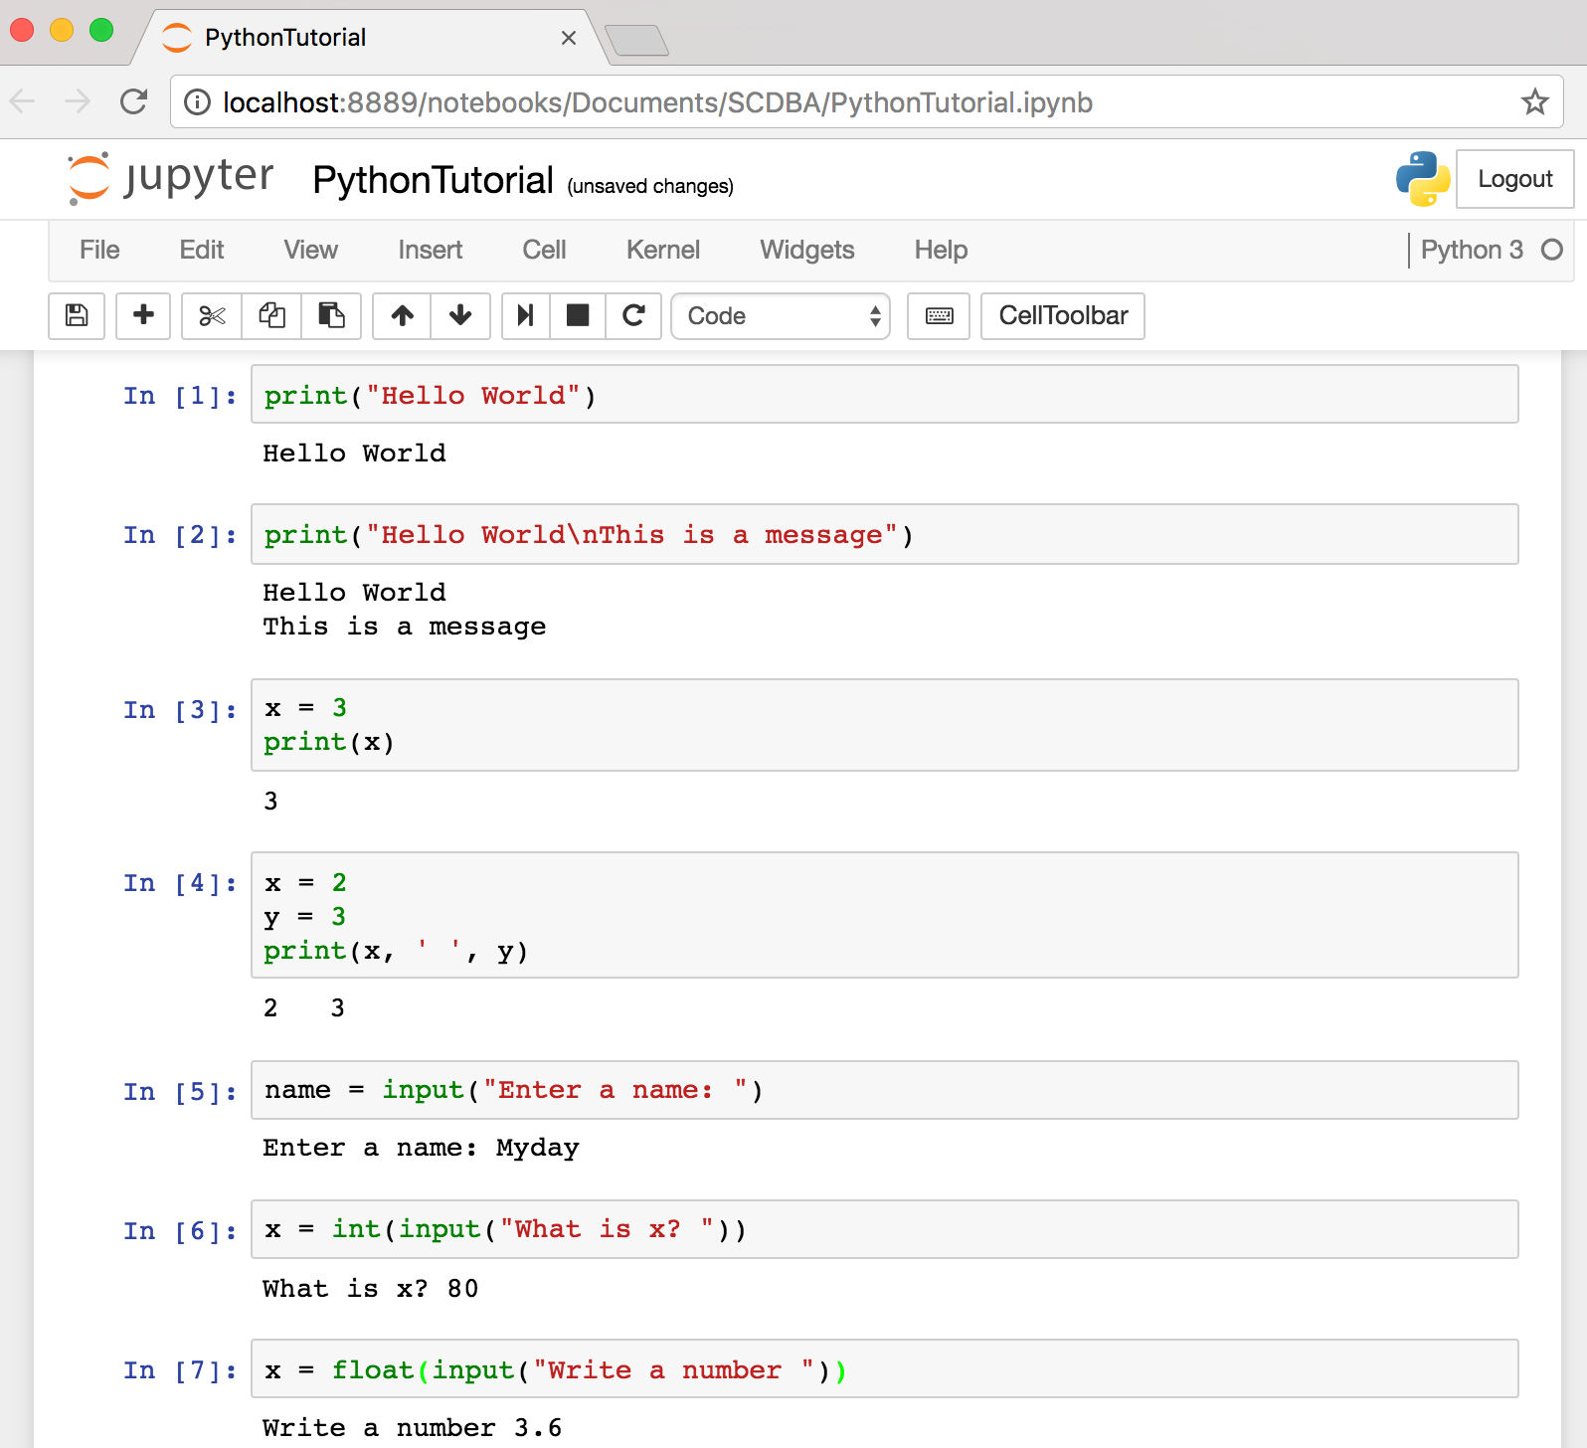
Text input and output
Source: http://pythonprogramminglanguage.com/text-input-and-output/
Notes:
print("Hello World")
print("Hello World\nThis is a message")
x = 3
print(x)
x = 2
y = 3
print(x, ' ', y)
name = input("Enter a name: ")
x = int(input("What is x? "))
x = float(input("Write a number "))

Slide 56
Variables
x = 2
price = 2.5
word = 'Hello'
word = 'Hello'
word = "Hello"
word = '''Hello'''
x = 2
x = x + 1
x = 5
Source: http://pythonprogramminglanguage.com/

Slide 57
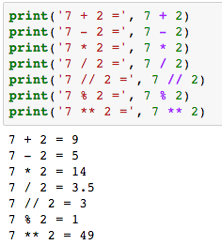
Python Basic Operators
print('7 + 2 =', 7 + 2)
print('7 - 2 =', 7 - 2)
print('7 * 2 =', 7 * 2)
print('7 / 2 =', 7 / 2)
print('7 // 2 =', 7 // 2)
print('7 % 2 =', 7 % 2)
print('7 ** 2 =', 7 ** 2)

Slide 58
BMI Calculator in Python
height_cm = float(input("Enter your height in cm: "))
weight_kg = float(input("Enter your weight in kg: "))
height_m = height_cm/100
BMI = (weight_kg/(height_m**2))
print("Your BMI is: " + str(round(BMI,1)))
Source: http://code.activestate.com/recipes/580615-bmi-code/

Slide 59
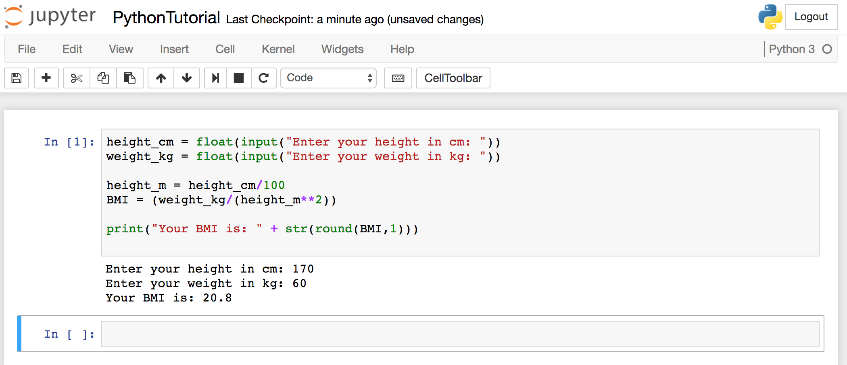
BMI Calculator in Python
Source: http://code.activestate.com/recipes/580615-bmi-code/
Notes:
height_cm = float(input("Enter your height in cm: "))
weight_kg = float(input("Enter your weight in kg: "))
height_m = height_cm/100
BMI = (weight_kg/(height_m**2))
print("Your BMI is: " + str(round(BMI,1)))

Slide 60
Future value of a specified principal amount, rate of interest, and a number of years
Source: https://www.w3resource.com/python-exercises/python-basic-exercise-39.php

Slide 61

Future Value (FV)
# How much is your $100 worth after 7 years?
print(100 * 1.1 ** 7)
# output = 194.87
Source: https://www.w3resource.com/python-exercises/python-basic-exercise-39.php

Slide 62
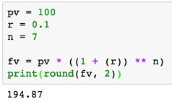
Future Value (FV)
pv = 100
r = 0.1
n = 7
fv = pv * ((1 + (r)) ** n)
print(round(fv, 2))

Slide 63
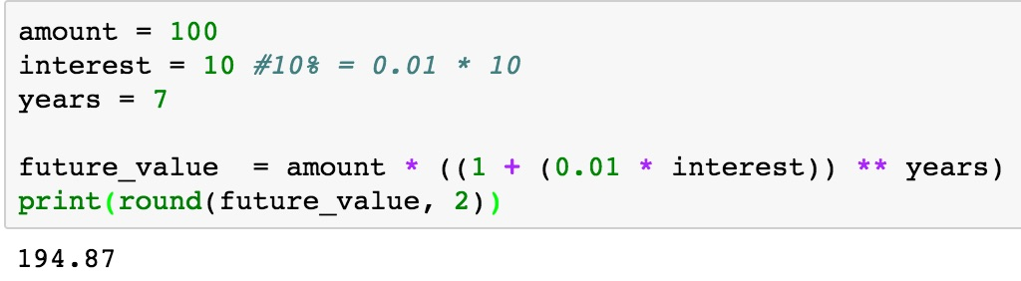
Future Value (FV)
amount = 100
interest = 10 #10% = 0.01 * 10
years = 7
future_value = amount * ((1 + (0.01 * interest)) ** years)
print(round(future_value, 2))
Source: https://www.w3resource.com/python-exercises/python-basic-exercise-39.php
Notes:
amount = 100
interest = 10 #10% = 0.01 * 10
years = 7
future_value = amount * ((1 + (0.01 * interest)) ** years)
print(round(future_value, 2))

Slide 64
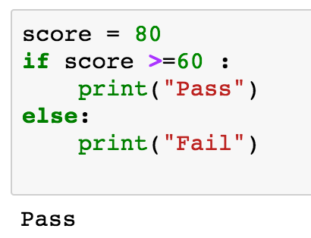
if statements
> greater than
< smaller than
== equals
!= is not
score = 80
if score >=60 :
print("Pass")
else:
print("Fail")
Source: http://pythonprogramminglanguage.com/

Slide 65
if elif else
score = 90
grade = ""
if score >=90:
grade = "A"
elif score >= 80:
grade = "B"
elif score >= 70:
grade = "C"
elif score >= 60:
grade = "D"
else:
grade = "E"
print(grade)
# grade = ”A”
A
http://pythontutor.com/visualize.html
https://goo.gl/E6w5ph
Source: http://pythonprogramminglanguage.com/
Notes:
http://pythontutor.com/visualize.html
https://goo.gl/E6w5ph

Slide 66
for loops
for i in range(1,11):
print(i)
1
2
3
4
5
6
7
8
9
10
Source: http://pythonprogramminglanguage.com/
Notes:
https://goo.gl/YpxMYo

Slide 67
for loops
for i in range(1,10):
for j in range(1,10):
print(i, ' * ' , j , ' = ', i*j)
9 * 1 = 9
9 * 2 = 18
9 * 3 = 27
9 * 4 = 36
9 * 5 = 45
9 * 6 = 54
9 * 7 = 63
9 * 8 = 72
9 * 9 = 81
Source: http://pythonprogramminglanguage.com/
Notes:
for i in range(1,10):
for j in range(1,10):
print(i, ' * ' , j , ' = ', i*j)

Slide 68
while loops
age = 10
while age < 20:
print(age)
age = age + 1
10
11
12
13
14
15
16
17
18
19
Source: https://learnpython.trinket.io/learn-python-part-8-loops#/while-loops/about-while-loops
Notes:
age = 10
while age < 20:
print(age)
age = age + 1

Slide 69
Functions
def convertCMtoM(xcm):
m = xcm/100
return m
cm = 180
m = convertCMtoM(cm)
print(str(m))
1.8
Notes:
https://goo.gl/6K5qUn

Slide 70
Lists
x = [60, 70, 80, 90]
print(len(x))
print(x[0])
print(x[1])
print(x[-1])
4
60
70
90

Slide 71
Tuples
A tuple in Python is a collection that
cannot be modified.
A tuple is defined using parenthesis.
x = (10, 20, 30, 40, 50)
print(x[0])
print(x[1])
print(x[2])
print(x[-1])
10
20
30
50
Source: http://pythonprogramminglanguage.com/tuples/

Slide 72
Dictionary
k = { 'EN':'English', 'FR':'French' }
print(k['EN'])
English
Source: http://pythonprogramminglanguage.com/dictionary/

Slide 73
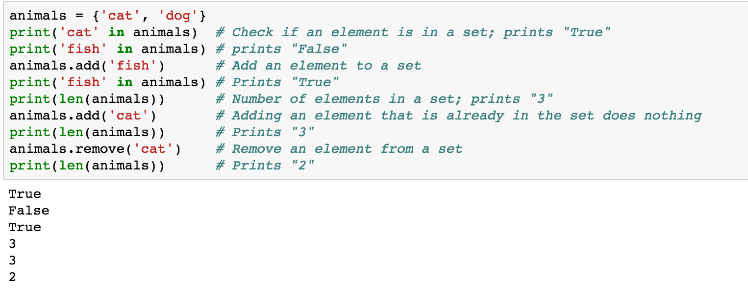
Sets
animals = {'cat', 'dog'}
animals = {'cat', 'dog'}
print('cat' in animals)
print('fish' in animals)
animals.add('fish')
print('fish' in animals)
print(len(animals))
animals.add('cat')
print(len(animals))
animals.remove('cat')
print(len(animals))
Source: http://cs231n.github.io/python-numpy-tutorial/
Notes:
#Sets
animals = {'cat', 'dog'}
print('cat' in animals) # Check if an element is in a set; prints "True"
print('fish' in animals) # prints "False"
animals.add('fish') # Add an element to a set
print('fish' in animals) # Prints "True"
print(len(animals)) # Number of elements in a set; prints "3"
animals.add('cat') # Adding an element that is already in the set does nothing
print(len(animals)) # Prints "3"
animals.remove('cat') # Remove an element from a set
print(len(animals)) # Prints "2”
Source: http://cs231n.github.io/python-numpy-tutorial/

Slide 74
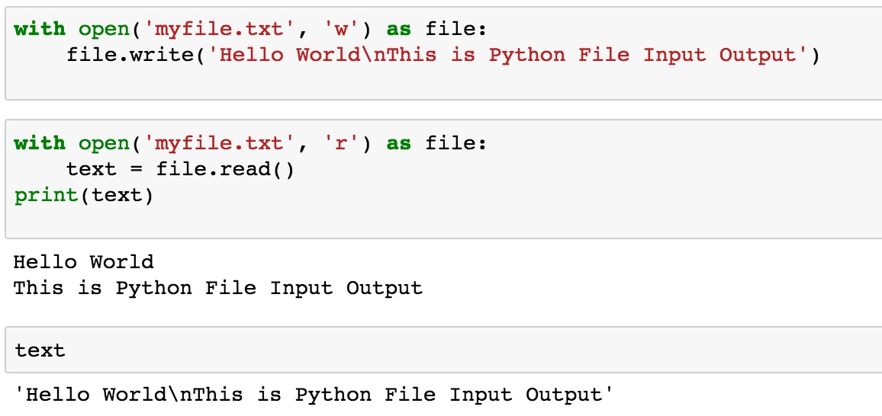
File Input / Output
with open('myfile.txt', 'w') as file:
file.write('Hello World\nThis is Python File Input Output')
with open('myfile.txt', 'r') as file:
text = file.read()
print(text)
Source: https://github.com/TiesdeKok/LearnPythonforResearch/blob/master/0_python_basics.ipynb
Notes:
with open('myfile.txt', 'w') as file:
file.write('Hello World\nThis is Python File Input Output')
with open('myfile.txt', 'r') as file:
text = file.read()
print(text)
with open('myfile.txt', 'a+') as file:
file.write('\n' + 'New line')
with open('myfile.txt', 'r') as file:
text = file.read()
print(text)

Slide 75
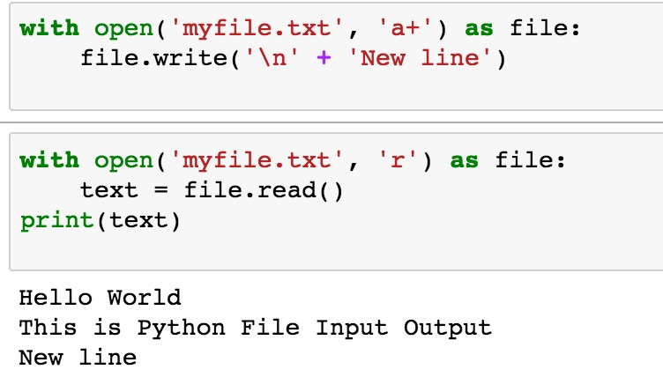
File Input / Output
with open('myfile.txt', 'a+') as file:
file.write('\n' + 'New line')
with open('myfile.txt', 'r') as file:
text = file.read()
print(text)
Source: https://github.com/TiesdeKok/LearnPythonforResearch/blob/master/0_python_basics.ipynb
Notes:
with open('myfile.txt', 'w') as file:
file.write('Hello World\nThis is Python File Input Output')
with open('myfile.txt', 'r') as file:
text = file.read()
print(text)
with open('myfile.txt', 'a+') as file:
file.write('\n' + 'New line')
with open('myfile.txt', 'r') as file:
text = file.read()
print(text)

Slide 76
Big Data Analytics with
Numpy in Python

Slide 77
Numpy
NumPy
Base
N-dimensional array package

Slide 78
NumPy is the fundamental package for scientific computing with Python.
Source: http://www.numpy.org/

Slide 79
NumPy
NumPy
NumPy provides a
multidimensional array object
to store homogenous or heterogeneous data;
it also provides
optimized functions/methods to operate on this array object.
Source: Yves Hilpisch (2014), Python for Finance: Analyze Big Financial Data, O'Reilly

Slide 80
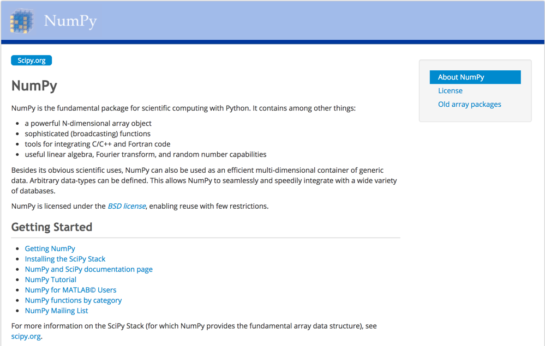
NumPy
http://www.numpy.org/

Slide 81
NumPy ndarray
NumPy
One-dimensional Array
(1-D Array)
0 | 1 |  |  | n-1
1 | 2 | 3 | 4 | 5
Two-dimensional Array
(2-D Array)
 | 0 | 1 |  |  | n-1
0 | 1 | 2 | 3 | 4 | 5
1 | 6 | 7 | 8 | 9 | 10
 | 11 | 12 | 13 | 14 | 15
m-1 | 16 | 17 | 18 | 19 | 20

Slide 82
v = list(range(1, 6)) v
2 * v import numpy as np v = np.arange(1, 6) v
2 * v
NumPy
NumPy
Source: Yves Hilpisch (2014), Python for Finance: Analyze Big Financial Data, O'Reilly
Notes:
# pip3 install numpy
# pip install numpy
# sudo pip3 install numpy
import numpy as np

Slide 83
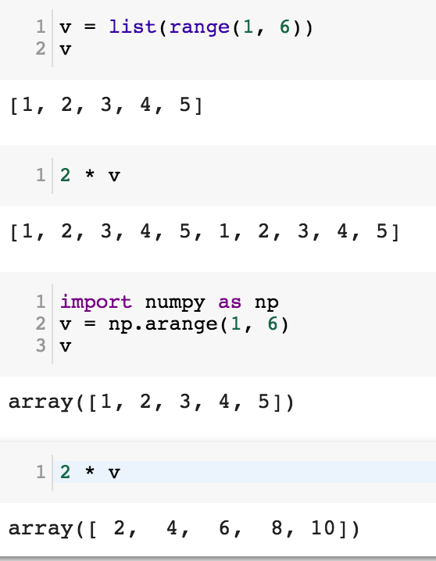
NumPy
Base
N-dimensional array package

Slide 84
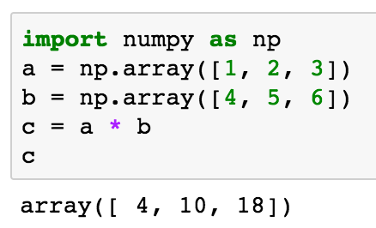
import numpy as np a = np.array([1, 2, 3]) b = np.array([4, 5, 6]) c = a * b c
NumPy Create Array
NumPy
Source: Yves Hilpisch (2014), Python for Finance: Analyze Big Financial Data, O'Reilly

Slide 85
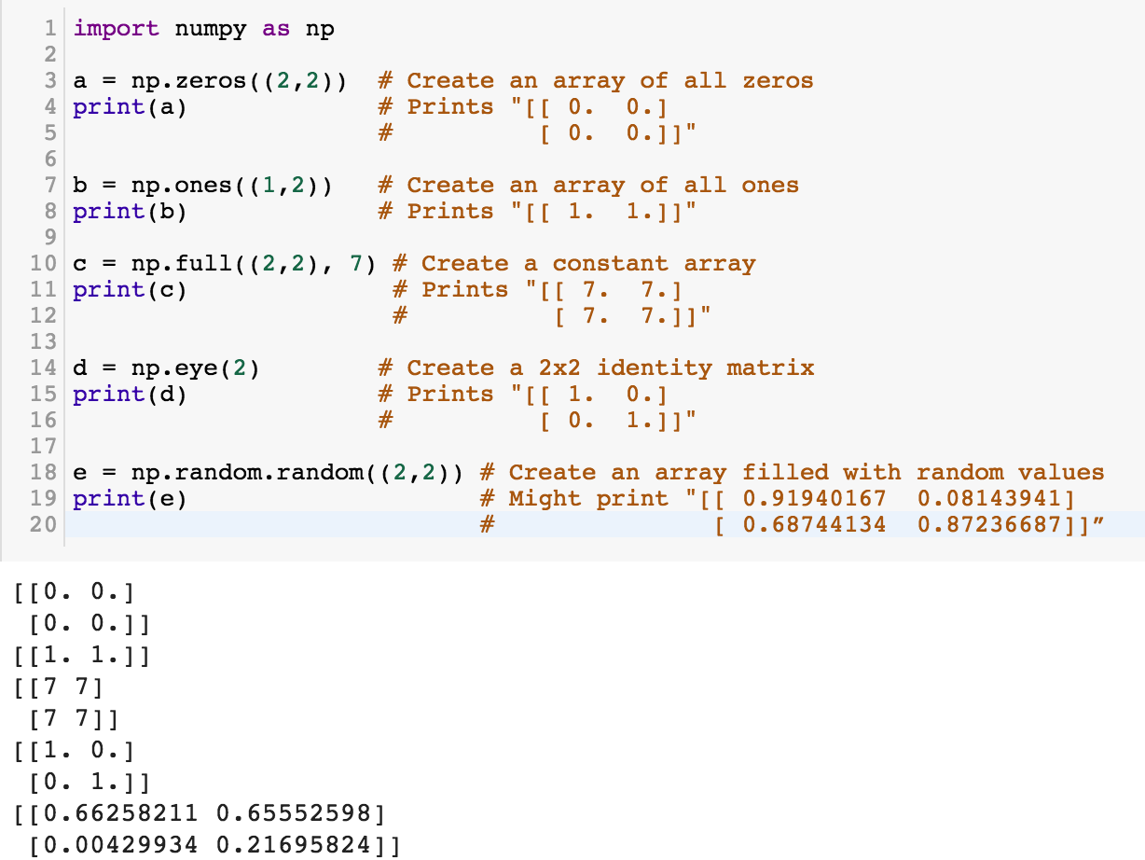
NumPy
NumPy
Source: http://cs231n.github.io/python-numpy-tutorial/
Notes:
import numpy as np
a = np.zeros((2,2)) # Create an array of all zeros
print(a) # Prints "[[ 0. 0.]
# [ 0. 0.]]"
b = np.ones((1,2)) # Create an array of all ones
print(b) # Prints "[[ 1. 1.]]"
c = np.full((2,2), 7) # Create a constant array
print(c) # Prints "[[ 7. 7.]
# [ 7. 7.]]"
d = np.eye(2) # Create a 2x2 identity matrix
print(d) # Prints "[[ 1. 0.]
# [ 0. 1.]]"
e = np.random.random((2,2)) # Create an array filled with random values
print(e) # Might print "[[ 0.91940167 0.08143941]
# [ 0.68744134 0.87236687]]”
Source: http://cs231n.github.io/python-numpy-tutorial/

Slide 86
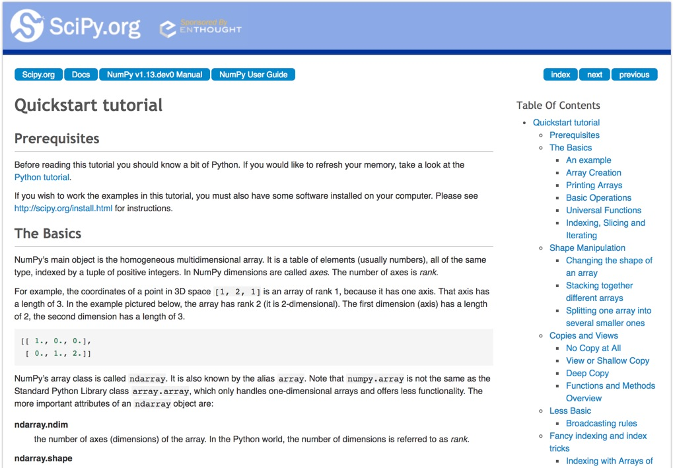
Numpy Quickstart Tutorial
https://docs.scipy.org/doc/numpy-dev/user/quickstart.html

Slide 87
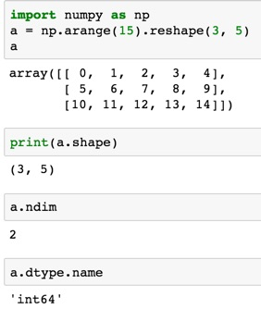
import numpy as np
a = np.arange(15).reshape(3, 5)
a.shape
a.ndim
a.dtype.name
Source: https://docs.scipy.org/doc/numpy-dev/user/quickstart.html
Notes:
Numpy Tutorial
Source: https://docs.scipy.org/doc/numpy-dev/user/quickstart.html
In [1]:
import numpy as np
a = np.arange(15).reshape(3, 5)
a
Out[1]:
array([[ 0, 1, 2, 3, 4],
[ 5, 6, 7, 8, 9],
[10, 11, 12, 13, 14]])
In [2]:
print(a.shape)
(3, 5)
In [3]:
a.ndim
Out[3]:
2
In [4]:
a.dtype.name
Out[4]:
'int64'
In [5]:
a.itemsize
Out[5]:
8
In [6]:
a.size
Out[6]:
15
In [7]:
type(a)
Out[7]:
numpy.ndarray
In [8]:
b = np.array([1, 2, 3])
In [9]:
b
Out[9]:
array([1, 2, 3])
In [10]:
type(b)
Out[10]:
numpy.ndarray

Slide 88
Matrix
Source: https://simple.wikipedia.org/wiki/Matrix_(mathematics)

Slide 89
NumPy ndarray:
Multidimensional Array Object

Slide 90
NumPy ndarray
One-dimensional Array
(1-D Array)
0 | 1 |  |  | n-1
1 | 2 | 3 | 4 | 5
Two-dimensional Array
(2-D Array)
 | 0 | 1 |  |  | n-1
0 | 1 | 2 | 3 | 4 | 5
1 | 6 | 7 | 8 | 9 | 10
 | 11 | 12 | 13 | 14 | 15
m-1 | 16 | 17 | 18 | 19 | 20

Slide 91

import numpy as np a = np.array([1,2,3,4,5])
One-dimensional Array
(1-D Array)
0 | 1 |  |  | n-1
1 | 2 | 3 | 4 | 5

Slide 92
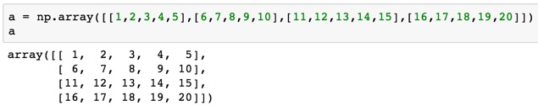
a = np.array([[1,2,3,4,5],[6,7,8,9,10],[11,12,13,14,15],[16,17,18,19,20]])
Two-dimensional Array
(2-D Array)
 | 0 | 1 |  |  | n-1
0 | 1 | 2 | 3 | 4 | 5
1 | 6 | 7 | 8 | 9 | 10
 | 11 | 12 | 13 | 14 | 15
m-1 | 16 | 17 | 18 | 19 | 20

Slide 93
import numpy as np
a = np.array([[0, 1, 2, 3], [10, 11, 12, 13],
[20, 21, 22, 23]])
a
0 | 1 | 2 | 3
10 | 11 | 12 | 13
20 | 21 | 22 | 23
Notes:
import numpy as np
a = np.array([[0, 1, 2, 3], [10, 11, 12, 13],
[20, 21, 22, 23]])
a

Slide 94
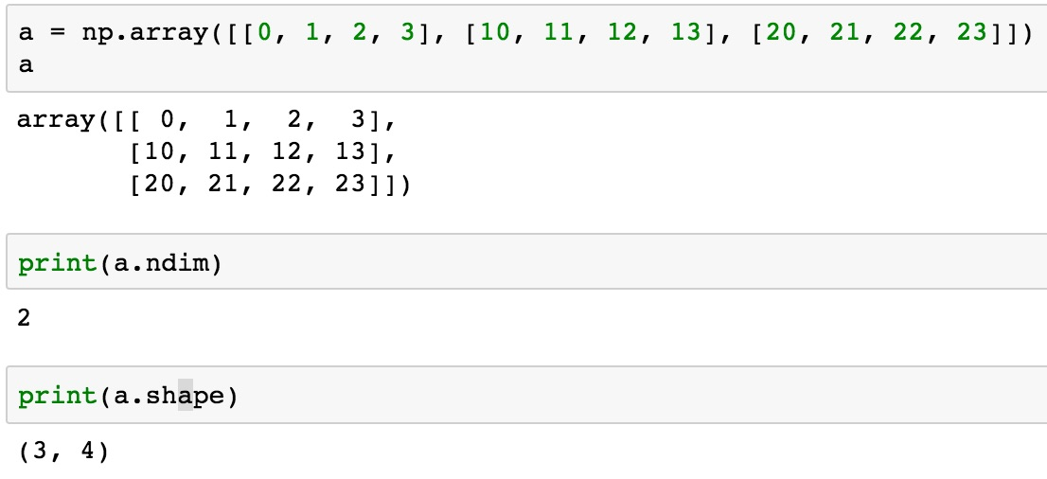
a = np.array([[0, 1, 2, 3], [10, 11, 12, 13], [20, 21, 22, 23]])
0 | 1 | 2 | 3
10 | 11 | 12 | 13
20 | 21 | 22 | 23

Slide 95
NumPy Basics:
Arrays and Vectorized Computation
Source: https://www.safaribooksonline.com/library/view/python-for-data/9781449323592/ch04.html

Slide 96
NumPy Array
Source: https://www.safaribooksonline.com/library/view/python-for-data/9781449323592/ch04.html

Slide 97
Numpy Array
Source: https://www.safaribooksonline.com/library/view/python-for-data/9781449323592/ch04.html

Slide 98

Wes McKinney (2017), "Python for Data Analysis: Data Wrangling with Pandas, NumPy, and IPython", 2nd Edition, O'Reilly Media.
https://github.com/wesm/pydata-book

Slide 99

Wes McKinney (2017), "Python for Data Analysis: Data Wrangling with Pandas, NumPy, and IPython", 2nd Edition, O'Reilly Media.
Source: https://github.com/wesm/pydata-book/blob/2nd-edition/ch04.ipynb

Slide 100
Python Pandas

Slide 101
Python Pandas for Finance
Source: https://mapattack.wordpress.com/2017/02/12/using-python-for-stocks-1/

Slide 102

! pip install pandas_datareader

Slide 103

conda install pandas-datareader

Slide 105
Finance Data from Yahoo Finance
# !pip install pandas_datareader
import pandas_datareader.data as web
import datetime as dt
#Read Stock Data from Yahoo Finance
end = dt.datetime(2017, 12, 31)
start = dt.datetime(2016, 1, 1)
df = web.DataReader("AAPL", 'yahoo', start, end)
df.to_csv('AAPL.csv')
df.from_csv('AAPL.csv')
df.tail()

Slide 106
# !pip install pandas_datareader
import pandas as pd
import pandas_datareader.data as web
import matplotlib.pyplot as plt
import seaborn as sns
import datetime as dt
%matplotlib inline
#Read Stock Data from Yahoo Finance
end = dt.datetime.now()
#start = dt.datetime(end.year-2, end.month, end.day)
start = dt.datetime(2016, 1, 1)
df = web.DataReader("AAPL", 'yahoo', start, end)
df.to_csv('AAPL.csv')
df.from_csv('AAPL.csv')
df.tail()

Slide 107

df['Adj Close'].plot(legend=True, figsize=(12, 8), title='AAPL’, label='Adj Close')

Slide 108

plt.figure(figsize=(12,9))
top = plt.subplot2grid((12,9), (0, 0), rowspan=10, colspan=9)
bottom = plt.subplot2grid((12,9), (10,0), rowspan=2, colspan=9)
top.plot(df.index, df['Adj Close'], color='blue') #df.index gives the dates
bottom.bar(df.index, df['Volume'])

Slide 110

# set the labels
top.axes.get_xaxis().set_visible(False)
top.set_title('AAPL')
top.set_ylabel('Adj Close')
bottom.set_ylabel('Volume')
plt.figure(figsize=(12,9))
sns.distplot(df['Adj Close'].dropna(), bins=50, color='purple')

Slide 112
# simple moving averages
df['MA05'] = df['Adj Close'].rolling(5).mean() #5 days
df['MA20'] = df['Adj Close'].rolling(20).mean() #20 days
df['MA60'] = df['Adj Close'].rolling(60).mean() #60 days
df2 = pd.DataFrame({'Adj Close': df['Adj Close'],'MA05': df['MA05'],'MA20': df['MA20'], 'MA60': df['MA60']})
df2.plot(figsize=(12, 9), legend=True, title='AAPL')
df2.to_csv('AAPL_MA.csv')
fig = plt.gcf()
fig.set_size_inches(12, 9)
fig.savefig('AAPL_plot.png', dpi=300)
plt.show()

Slide 114
# !pip install pandas_datareader
import pandas as pd
import pandas_datareader.data as web
import matplotlib.pyplot as plt
import seaborn as sns
import datetime as dt
%matplotlib inline
#Read Stock Data from Yahoo Finance
end = dt.datetime.now()
#start = dt.datetime(end.year-2, end.month, end.day)
start = dt.datetime(2016, 1, 1)
df = web.DataReader("AAPL", 'yahoo', start, end)
df.to_csv('AAPL.csv')
df.from_csv('AAPL.csv')
df.tail()
df['Adj Close'].plot(legend=True, figsize=(12, 8), title='AAPL', label='Adj Close')
plt.figure(figsize=(12,9))
top = plt.subplot2grid((12,9), (0, 0), rowspan=10, colspan=9)
bottom = plt.subplot2grid((12,9), (10,0), rowspan=2, colspan=9)
top.plot(df.index, df['Adj Close'], color='blue') #df.index gives the dates
bottom.bar(df.index, df['Volume'])
# set the labels
top.axes.get_xaxis().set_visible(False)
top.set_title('AAPL')
top.set_ylabel('Adj Close')
bottom.set_ylabel('Volume')
plt.figure(figsize=(12,9))
sns.distplot(df['Adj Close'].dropna(), bins=50, color='purple')
# simple moving averages
df['MA05'] = df['Adj Close'].rolling(5).mean() #5 days
df['MA20'] = df['Adj Close'].rolling(20).mean() #20 days
df['MA60'] = df['Adj Close'].rolling(60).mean() #60 days
df2 = pd.DataFrame({'Adj Close': df['Adj Close'],'MA05': df['MA05'],'MA20': df['MA20'], 'MA60': df['MA60']})
df2.plot(figsize=(12, 9), legend=True, title='AAPL')
df2.to_csv('AAPL_MA.csv')
fig = plt.gcf()
fig.set_size_inches(12, 9)
fig.savefig('AAPL_plot.png', dpi=300)
plt.show()

Slide 115


Slide 116

Finance Data from Quandl
# ! pip install quandl
import quandl
# quandl.ApiConfig.api_key = "YOURAPIKEY"
df = quandl.get("WIKI/AAPL", start_date="2016-01-01", end_date="2017-12-31")
df.to_csv('AAPL.csv')
df.from_csv('AAPL.csv')
df.tail()
Source: https://www.quandl.com/tools/python
Notes:
# ! pip install quandl
import quandl
# quandl.ApiConfig.api_key = "YOURAPIKEY"
df = quandl.get("WIKI/AAPL", start_date="2016-01-01", end_date="2017-12-31")
df.to_csv('AAPL.csv')
df.from_csv('AAPL.csv')
df.tail()

Slide 117
The Quant Finance PyData Stack
Source: http://nbviewer.jupyter.org/format/slides/github/quantopian/pyfolio/blob/master/pyfolio/examples/overview_slides.ipynb#/5

Slide 118
Summary
Foundations of AI in Finance Big Data Analytics with Python
  Python
    Programming language
  Numpy
    Scientific computing
  Pandas
    Data structures and data analysis tools

Slide 119
References
Wes McKinney (2017), "Python for Data Analysis: Data Wrangling with Pandas, NumPy, and IPython", 2nd Edition, O'Reilly Media.
https://github.com/wesm/pydata-book
Ties de Kok (2017), Learn Python for Research, https://github.com/TiesdeKok/LearnPythonforResearch
Avinash Jain (2017), Introduction To Python Programming, Udemy, https://www.udemy.com/pythonforbeginnersintro/
Python Programming, https://pythonprogramming.net/
Python, https://www.python.org/
Python Programming Language, http://pythonprogramminglanguage.com/
Numpy, http://www.numpy.org/
Pandas, http://pandas.pydata.org/
Skikit-learn, http://scikit-learn.org/
Data School (2015), Machine learning in Python with scikit-learn, https://www.youtube.com/playlist?list=PL5-da3qGB5ICeMbQuqbbCOQWcS6OYBr5A
Jason Brownlee (2016), Your First Machine Learning Project in Python Step-By-Step, https://machinelearningmastery.com/machine-learning-in-python-step-by-step/

