Slide 1



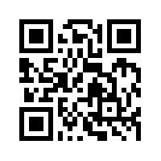
Big Data Mining
巨量資料探勘
Tamkang University
Tamkang
University
分類與預測
(Classification and Prediction)
1072DM07
MI4 (M2244) (2849)
Wed 6, 7 (13:10-15:00) (B206)
Min-Yuh Day
戴敏育
Assistant Professor
專任助理教授
Dept. of Information Management, Tamkang University
淡江大學 資訊管理學系
http://mail. tku.edu.tw/myday/
2019/04/10

Slide 2
課程大綱 (Syllabus)
週次 (Week) 日期 (Date) 內容(Subject/Topics)
1 2019/02/20 巨量資料探勘課程介紹
(Course Orientation for Big Data Mining)
2 2019/02/27 AI人工智慧與大數據分析
(Artificial Intelligence and Big Data Analytics)
3 2019/03/06 分群分析 (Cluster Analysis)
4 2019/03/13 個案分析與實作一 (SAS EM 分群分析)：
Case Study 1 (Cluster Analysis - K-Means using SAS EM)
5 2019/03/20 關連分析 (Association Analysis)
6 2019/03/27 個案分析與實作二 (SAS EM 關連分析)：
Case Study 2 (Association Analysis using SAS EM)
7 2019/04/03 教學行政觀摩日 (Off-campus study)
8 2019/04/10 分類與預測 (Classification and Prediction)

Slide 3
課程大綱 (Syllabus)
週次 (Week) 日期 (Date) 內容 (Subject/Topics)
9 2019/04/17 期中報告 (Midterm Project Presentation)
10 2019/04/24 期中考試週 (Midterm Exam)
11 2019/05/01 個案分析與實作三 (SAS EM 決策樹、模型評估)：
Case Study 3 (Decision Tree, Model Evaluation using SAS EM)
12 2019/05/08 個案分析與實作四 (SAS EM 迴歸分析、類神經網路)：
Case Study 4 (Regression Analysis, Artificial Neural Network using SAS EM)
13 2019/05/15 機器學習與深度學習
(Machine Learning and Deep Learning)
14 2019/05/22 期末報告 (Final Project Presentation)
15 2019/05/29 畢業考試週 (Final Exam)

Slide 4
Outline
Classification and Prediction
Supervised Learning (Classification)
Decision Tree (DT)
  Information Gain (IG)
Support Vector Machine (SVM)
Data Mining Evaluation
  Accuracy
  Precision
  Recall
  F1 score (F-measure) (F-score)

Slide 5
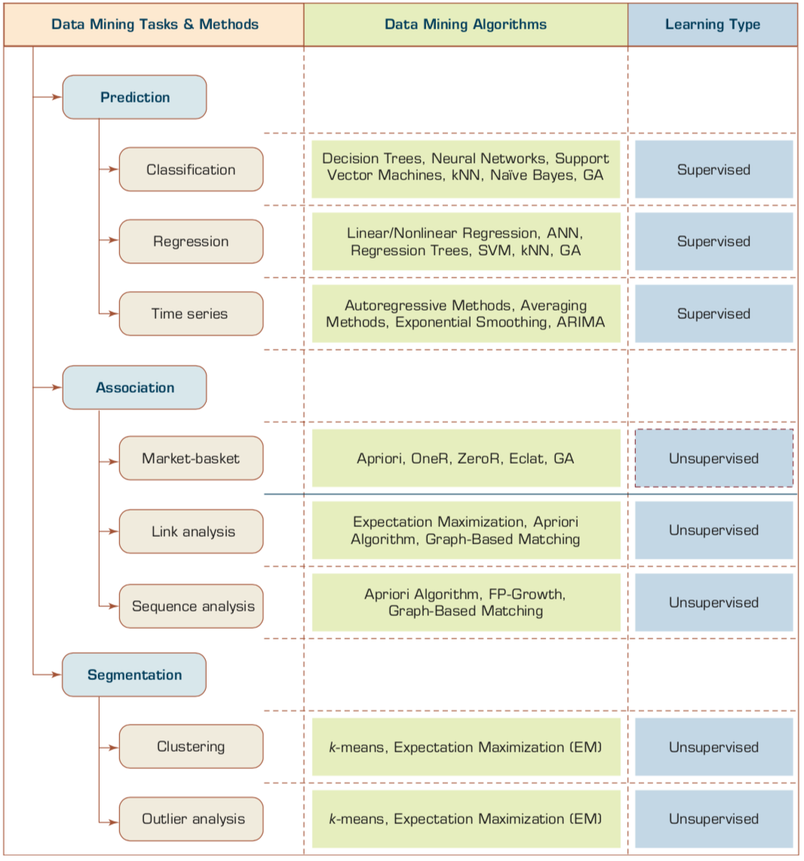
Data Mining Tasks & Methods
Source: Ramesh Sharda, Dursun Delen, and Efraim Turban (2017), Business Intelligence, Analytics, and Data Science: A Managerial Perspective, 4th Edition, Pearson

Slide 6
Customer database
ID | age | income | student | credit_rating | Class: buys_computer
1 | youth | high | no | fair | no
2 | middle_aged | high | no | fair | yes
3 | youth | high | no | excellent | no
4 | senior | medium | no | fair | yes
5 | senior | high | yes | fair | yes
6 | senior | low | yes | excellent | no
7 | middle_aged | low | yes | excellent | yes
8 | youth | medium | no | fair | no
9 | youth | low | yes | fair | yes
10 | senior | medium | yes | excellent | yes

Slide 7
What is the class
(buys_computer = “yes” or buys_computer = “no”) for a customer
(age=youth, income=medium, student =yes, credit= fair )?

Slide 8
Customer database
ID | age | income | student | credit_rating | Class: buys_computer
1 | youth | high | no | fair | no
2 | middle_aged | high | no | fair | yes
3 | youth | high | no | excellent | no
4 | senior | medium | no | fair | yes
5 | senior | high | yes | fair | yes
6 | senior | low | yes | excellent | no
7 | middle_aged | low | yes | excellent | yes
8 | youth | medium | no | fair | no
9 | youth | low | yes | fair | yes
10 | senior | medium | yes | excellent | yes
11 | youth | medium | yes | fair | ?

Slide 9
Customer database
ID | age | income | student | credit_rating | Class: buys_computer
1 | youth | high | no | fair | no
2 | middle_aged | high | no | fair | yes
3 | youth | high | no | excellent | no
4 | senior | medium | no | fair | yes
5 | senior | high | yes | fair | yes
6 | senior | low | yes | excellent | no
7 | middle_aged | low | yes | excellent | yes
8 | youth | medium | no | fair | no
9 | youth | low | yes | fair | yes
10 | senior | medium | yes | excellent | yes
11 | youth | medium | yes | fair | Yes (0.0889)

Slide 10
What is the class
(buys_computer = “yes” or buys_computer = “no”) for a customer
(age=youth, income=medium, student =yes, credit= fair )?
Yes = 0.0889
No = 0.0167

Slide 11
Classification vs. Prediction
Classification
  predicts categorical class labels (discrete or nominal)
  classifies data (constructs a model) based on the training set and the values (class labels) in a classifying attribute and uses it in classifying new data
Prediction
  models continuous-valued functions
    i.e., predicts unknown or missing values
Typical applications
  Credit approval
  Target marketing
  Medical diagnosis
  Fraud detection
Source: Han & Kamber (2006)

Slide 12
Data Mining Methods: Classification
Most frequently used DM method
Part of the machine-learning family
Employ supervised learning
Learn from past data, classify new data
The output variable is categorical
(nominal or ordinal) in nature
Classification versus regression?
Classification versus clustering?
Source: Turban et al. (2011), Decision Support and Business Intelligence Systems

Slide 13
Classification Techniques
Decision Tree analysis (DT)
Statistical analysis
Neural networks (NN)
Deep Learning (DL)
Support Vector Machines (SVM)
Case-based reasoning
Bayesian classifiers
Genetic algorithms (GA)
Rough sets
Source: Turban et al. (2011), Decision Support and Business Intelligence Systems

Slide 14
Text Mining
(Text Data Mining)

Slide 15


Example of Opinion: review segment on iPhone
“I bought an iPhone a few days ago.
It was such a nice phone.
The touch screen was really cool.
The voice quality was clear too.
However, my mother was mad with me as I did not tell her before I bought it.
She also thought the phone was too expensive, and wanted me to return it to the shop. … ”
Source: Bing Liu (2011) , “Web Data Mining: Exploring Hyperlinks, Contents, and Usage Data,” Springer, 2nd Edition,

Slide 16
Example of Opinion:
review segment on iPhone
“(1) I bought an iPhone a few days ago.
(2) It was such a nice phone.
(3) The touch screen was really cool.
(4) The voice quality was clear too.
(5) However, my mother was mad with me as I did not tell her before I bought it.
(6) She also thought the phone was too expensive, and wanted me to return it to the shop. … ”
+Positive Opinion
-Negative Opinion
Source: Bing Liu (2011) , “Web Data Mining: Exploring Hyperlinks, Contents, and Usage Data,” Springer, 2nd Edition,

Slide 17
Text mining
Text Data Mining
Intelligent Text Analysis
Knowledge-Discovery in Text (KDT)
Source: Vishal Gupta and Gurpreet S. Lehal (2009), "A survey of text mining techniques and applications,"
Journal of emerging technologies in web intelligence, vol. 1, no. 1, pp. 60-76.

Slide 18
Text Mining: the process of extracting interesting and non-trivial information and knowledge from unstructured text.
Source: Vishal Gupta and Gurpreet S. Lehal (2009), "A survey of text mining techniques and applications,"
Journal of emerging technologies in web intelligence, vol. 1, no. 1, pp. 60-76.

Slide 19
Text Mining: discovery by computer of new, previously unknown information, by automatically extracting information from different written resources.
Source: Vishal Gupta and Gurpreet S. Lehal (2009), "A survey of text mining techniques and applications,"
Journal of emerging technologies in web intelligence, vol. 1, no. 1, pp. 60-76.

Slide 20
Natural Language Processing
(NLP)
Text Mining
(TM)

Slide 21
An Example of Text Mining
Knowledge
Analyze Text
Management Information System
Information Extraction
Classification
Summarization
Retrieve and preprocess document
Clustering
Document Collection
Source: Vishal Gupta and Gurpreet S. Lehal (2009), "A survey of text mining techniques and applications,"
Journal of emerging technologies in web intelligence, vol. 1, no. 1, pp. 60-76.

Slide 22
Overview of
Information Extraction based
Text Mining Framework
Text Data Mining
Text
Text
DB
Text
Information Extraction
Data Mining
Rule
Source: Vishal Gupta and Gurpreet S. Lehal (2009), "A survey of text mining techniques and applications,"
Journal of emerging technologies in web intelligence, vol. 1, no. 1, pp. 60-76.

Slide 23
Text Mining Technologies
Statistics
Machine Learning
Pattern Recognition
Database Systems
Visualization
Text Mining
Natural Language Processing
Algorithms
Information Retrieval
Applications
High-performance Computing
Adapted from: Jiawei Han and Micheline Kamber (2011), Data Mining: Concepts and Techniques, Third Edition, Elsevier

Slide 24
Data Mining versus Text Mining
Both seek for novel and useful patterns
Both are semi-automated processes
Difference is the nature of the data:
  Structured versus unstructured data
  Structured data: in databases
  Unstructured data: Word documents, PDF files, text excerpts, XML files, and so on
Text mining – first, impose structure to the data, then mine the structured data
Source: Turban et al. (2011), Decision Support and Business Intelligence Systems

Slide 25
Sentiment Analysis Architecture
Positive
tweets
Negative
tweets
Word
features
Training
set
Features
extractor
Classifier
Features
extractor
Tweet
Positive
Negative
Vishal Kharde and Sheetal Sonawane (2016), "Sentiment Analysis of Twitter Data: A Survey of Techniques,"
International Journal of Computer Applications, Vol 139, No. 11, 2016. pp.5-15

Slide 26
Sentiment Classification Based on Emoticons
Tweeter
Tweeter Streaming API 1.1
Tweet preprocessing
Based on Positive Emotions
Based on Negative Emotions
Generate Training Dataset for Tweet
Positive tweets
Negative tweets
Test Dataset
Training Dataset
Classifier
Feature Extraction
Positive
Negative
Vishal Kharde and Sheetal Sonawane (2016), "Sentiment Analysis of Twitter Data: A Survey of Techniques,"
International Journal of Computer Applications, Vol 139, No. 11, 2016. pp.5-15

Slide 27
Lexicon-Based Model
Tokenized Document Collection
Preassembled Word Lists
Sentiment Scoring and Classification:
Polarity
Merged
Lexicon
Generic
Word Lists
Sentiment
Polarity
Vishal Kharde and Sheetal Sonawane (2016), "Sentiment Analysis of Twitter Data: A Survey of Techniques,"
International Journal of Computer Applications, Vol 139, No. 11, 2016. pp.5-15

Slide 28
Sentiment Analysis Tasks
Object/Feature extraction
Opinionated Document
Subjectivity Classification
Sentiment Classification
Opinion holder extraction
Vishal Kharde and Sheetal Sonawane (2016), "Sentiment Analysis of Twitter Data: A Survey of Techniques,"
International Journal of Computer Applications, Vol 139, No. 11, 2016. pp.5-15

Slide 29
Sentiment Analysis vs.
Subjectivity Analysis
Sentiment Analysis
Subjectivity Analysis
Positive
Subjective
Negative
Neutral
Objective

Slide 30
Levels of Sentiment Analysis
Sentiment Analysis
Word
level
Sentiment Analysis
Sentence
level
Sentiment Analysis
Document
level
Sentiment Analysis
Feature level
Sentiment Analysis
Vishal Kharde and Sheetal Sonawane (2016), "Sentiment Analysis of Twitter Data: A Survey of Techniques,"
International Journal of Computer Applications, Vol 139, No. 11, 2016. pp.5-15

Slide 31
Sentiment Analysis
Subjectivity
Classification
Polarity Determination
Approaches
Machine Learning based
Sentiment Classification
Vagueness resolution in opinionated text
Lexicon based
Sentiment Analysis
Review Usefulness Measurement
Multi- & Cross- Lingual SC
Hybrid
approaches
Opinion Spam Detection
Cross-domain SC
Lexicon Creation
Ontology based
Tasks
Non-Ontology based
Aspect Extraction
Application
Source: Kumar Ravi and Vadlamani Ravi (2015), "A survey on opinion mining and sentiment analysis: tasks, approaches and applications." Knowledge-Based Systems, 89, pp.14-46.

Slide 32
Sentiment Classification Techniques
Decision Tree Classifiers
Support Vector Machine (SVM)
Supervised Learning
Neural Network (NN
Machine Learning Approach
Linear Classifiers
Deep Learning (DL)
Rule-based Classifiers
Naïve Bayes
(NB)
Sentiment Analysis
Unsupervised Learning
Probabilistic Classifiers
Bayesian Network (BN)
Dictionary-based Approach
Maximum Entropy (ME)
Lexicon-based Approach
Statistical
Corpus-based Approach
Semantic
Source: Jesus Serrano-Guerrero, Jose A. Olivas, Francisco P. Romero, and Enrique Herrera-Viedma (2015),
"Sentiment analysis: A review and comparative analysis of web services," Information Sciences, 311, pp. 18-38.

Slide 33
Machine Learning Models
Deep Learning
Kernel
Association rules
Ensemble
Decision tree
Dimensionality reduction
Clustering
Regression Analysis
Bayesian
Instance based
Source: Sunila Gollapudi (2016), Practical Machine Learning, Packt Publishing

Slide 34
Example of Classification
Loan Application Data
  Which loan applicants are “safe” and which are “risky” for the bank?
  “Safe” or “risky” for load application data
Marketing Data
  Whether a customer with a given profile will buy a new computer?
  “yes” or “no” for marketing data
Classification
  Data analysis task
  A model or Classifier is constructed to predict categorical labels
    Labels: “safe” or “risky”; “yes” or “no”;
    “treatment A”, “treatment B”, “treatment C”
Source: Han & Kamber (2006)

Slide 35
What Is Prediction?
(Numerical) prediction is similar to classification
  construct a model
  use model to predict continuous or ordered value for a given input
Prediction is different from classification
  Classification refers to predict categorical class label
  Prediction models continuous-valued functions
Major method for prediction: regression
  model the relationship between one or more independent or predictor variables and a dependent or response variable
Regression analysis
  Linear and multiple regression
  Non-linear regression
  Other regression methods: generalized linear model, Poisson regression, log-linear models, regression trees
Source: Han & Kamber (2006)

Slide 36
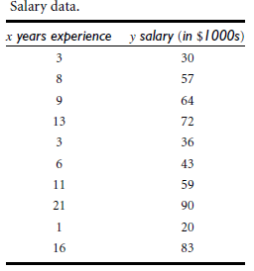
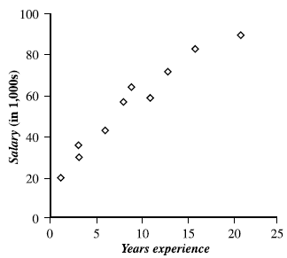
Prediction Methods
Linear Regression
Nonlinear Regression
Other Regression Methods
Source: Han & Kamber (2006)

Slide 37
Classification and Prediction
Classification and prediction are two forms of data analysis that can be used to extract models describing important data classes or to predict future data trends.
Classification
  Effective and scalable methods have been developed for decision trees induction, Naive Bayesian classification, Bayesian belief network, rule-based classifier, Backpropagation, Support Vector Machine (SVM), associative classification, nearest neighbor classifiers, and case-based reasoning, and other classification methods such as genetic algorithms, rough set and fuzzy set approaches.
Prediction
  Linear, nonlinear, and generalized linear models of regression can be used for prediction. Many nonlinear problems can be converted to linear problems by performing transformations on the predictor variables. Regression trees and model trees are also used for prediction.
Source: Han & Kamber (2006)

Slide 38
Classification
—A Two-Step Process
Model construction: describing a set of predetermined classes
  Each tuple/sample is assumed to belong to a predefined class, as determined by the class label attribute
  The set of tuples used for model construction is training set
  The model is represented as classification rules, decision trees, or mathematical formulae
Model usage: for classifying future or unknown objects
  Estimate accuracy of the model
    The known label of test sample is compared with the classified result from the model
    Accuracy rate is the percentage of test set samples that are correctly classified by the model
    Test set is independent of training set, otherwise over-fitting will occur
  If the accuracy is acceptable, use the model to classify data tuples whose class labels are not known
Source: Han & Kamber (2006)

Slide 39
Supervised Learning vs.
Unsupervised Learning
Supervised learning (classification)
  Supervision: The training data (observations, measurements, etc.) are accompanied by labels indicating the class of the observations
  New data is classified based on the training set
Unsupervised learning (clustering)
  The class labels of training data is unknown
  Given a set of measurements, observations, etc. with the aim of establishing the existence of classes or clusters in the data
Source: Han & Kamber (2006)

Slide 40
Issues Regarding Classification and Prediction:
Data Preparation
Data cleaning
  Preprocess data in order to reduce noise and handle missing values
Relevance analysis (feature selection)
  Remove the irrelevant or redundant attributes
  Attribute subset selection
    Feature Selection in machine learning
Data transformation
  Generalize and/or normalize data
  Example
    Income: low, medium, high
Source: Han & Kamber (2006)

Slide 41
Issues:
Evaluating Classification and Prediction Methods
Accuracy
  classifier accuracy: predicting class label
  predictor accuracy: guessing value of predicted attributes
  estimation techniques: cross-validation and bootstrapping
Speed
  time to construct the model (training time)
  time to use the model (classification/prediction time)
Robustness
  handling noise and missing values
Scalability
  ability to construct the classifier or predictor efficiently given large amounts of data
Interpretability
  understanding and insight provided by the model
Source: Han & Kamber (2006)

Slide 42
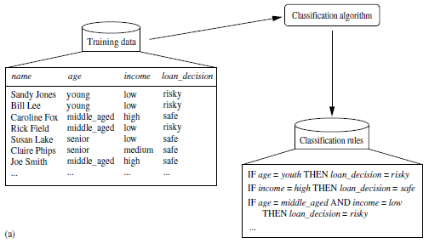
Data Classification Process 1: Learning (Training) Step
(a) Learning: Training data are analyzed by classification algorithm
y= f(X)
Source: Han & Kamber (2006)

Slide 43
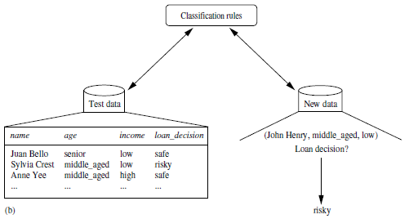
Data Classification Process 2
(b) Classification: Test data are used to estimate the accuracy of the classification rules.
Source: Han & Kamber (2006)

Slide 44
Process (1):
Model Construction
Classification
Algorithms
Training
Data
Classifier
(Model)
IF rank = ‘professor’
OR years > 6
THEN tenured = ‘yes’
Source: Han & Kamber (2006)

Slide 45
Process (2):
Using the Model in Prediction
Classifier
Testing
Data
Unseen Data
(Jeff, Professor, 4)
Tenured?
Source: Han & Kamber (2006)

Slide 46
Decision Trees

Slide 47
Decision Trees
A general algorithm for decision tree building
Employs the divide and conquer method
Recursively divides a training set until each division consists of examples from one class
  Create a root node and assign all of the training data to it
  Select the best splitting attribute
  Add a branch to the root node for each value of the split. Split the data into mutually exclusive subsets along the lines of the specific split
  Repeat the steps 2 and 3 for each and every leaf node until the stopping criteria is reached
Source: Turban et al. (2011), Decision Support and Business Intelligence Systems

Slide 48
Decision Trees
DT algorithms mainly differ on
  Splitting criteria
    Which variable to split first?
    What values to use to split?
    How many splits to form for each node?
  Stopping criteria
    When to stop building the tree
  Pruning (generalization method)
    Pre-pruning versus post-pruning
Most popular DT algorithms include
  ID3, C4.5, C5; CART; CHAID; M5
Source: Turban et al. (2011), Decision Support and Business Intelligence Systems

Slide 49
Decision Trees
Alternative splitting criteria
  Gini index determines the purity of a specific class as a result of a decision to branch along a particular attribute/value
    Used in CART
  Information gain uses entropy to measure the extent of uncertainty or randomness of a particular attribute/value split
    Used in ID3, C4.5, C5
  Chi-square statistics (used in CHAID)
Source: Turban et al. (2011), Decision Support and Business Intelligence Systems

Slide 50
Classification by Decision Tree Induction
Training Dataset
This follows an example of Quinlan’s ID3 (Playing Tennis)
Source: Han & Kamber (2006)

Slide 51
Output: A Decision Tree for “buys_computer”
Classification by Decision Tree Induction
age?
youth
<=30
middle_aged
31..40
senior
>40
student?
yes
credit rating?
no
yes
fair
excellent
no
yes
no
yes
buys_computer=“yes” or buys_computer=“no”
Source: Han & Kamber (2006)

Slide 52
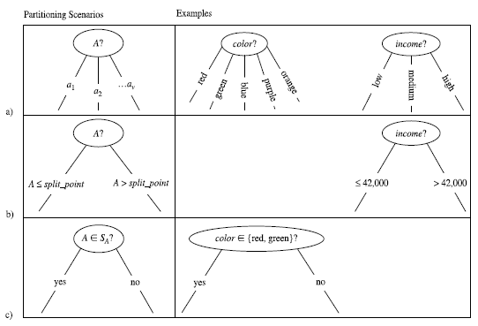
Three possibilities for partitioning tuples based on the splitting Criterion
Source: Han & Kamber (2006)

Slide 53
Algorithm for Decision Tree Induction
Basic algorithm (a greedy algorithm)
  Tree is constructed in a top-down recursive divide-and-conquer manner
  At start, all the training examples are at the root
  Attributes are categorical (if continuous-valued, they are discretized in advance)
  Examples are partitioned recursively based on selected attributes
  Test attributes are selected on the basis of a heuristic or statistical measure (e.g., information gain)
Conditions for stopping partitioning
  All samples for a given node belong to the same class
  There are no remaining attributes for further partitioning –
  majority voting is employed for classifying the leaf
  There are no samples left
Source: Han & Kamber (2006)

Slide 54
Attribute Selection Measure
Notation: Let D, the data partition, be a training set of class-labeled tuples.
Suppose the class label attribute has m distinct values defining m distinct classes, C_{i} (for i = 1, … , m).
Let C_{i,D} be the set of tuples of class C_{i} in D.
Let |D| and | C_{i,D} | denote the number of tuples in D and C_{i,D} , respectively.
Example:
  Class: buys_computer= “yes” or “no”
  Two distinct classes (m=2)
    Class C_{i} (i=1,2):
    C₁ = “yes”,
    C₂ = “no”
Source: Han & Kamber (2006)

Slide 55
Attribute Selection Measure:
Information Gain (ID3/C4.5)
Select the attribute with the highest information gain
Let p_{i} be the probability that an arbitrary tuple in D belongs to class C_{i}, estimated by |C_{i, D}|/|D|
Expected information (entropy) needed to classify a tuple in D:
Information needed (after using A to split D into v partitions) to classify D:
Information gained by branching on attribute A
Source: Han & Kamber (2006)
Notes:
I : the expected information needed to classify a given sample
E (entropy) : expected information based on the partitioning into subsets by A

Slide 56
log₂ (1) = 0
log₂ (2) = 1
log₂ (3) = 1.5850
log₂ (4) = 2
log₂ (5) = 2.3219
log₂ (6) = 2.5850
log₂ (7) = 2.8074
log₂ (8) = 3
log₂ (9) = 3.1699
log₂ (10) = 3.3219
log₂ (0.1) = -3.3219
log₂ (0.2) = -2.3219
log₂ (0.3) = -1.7370
log₂ (0.4) = -1.3219
log₂ (0.5) = -1
log₂ (0.6) = -0.7370
log₂ (0.7) = -0.5146
log₂ (0.8) = -0.3219
log₂ (0.9) = -0.1520
log₂ (1) = 0

Slide 57
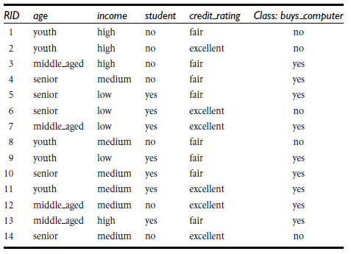
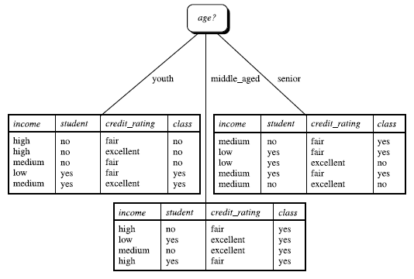
Class-labeled training tuples from the AllElectronics customer database
The attribute age has the highest information gain and therefore becomes the splitting attribute at the root node of the decision tree
Source: Han & Kamber (2006)

Slide 58
Attribute Selection: Information Gain
Class P: buys_computer = “yes”
Class N: buys_computer = “no”
means “age <=30” has 5 out of 14 samples, with 2 yes’es and 3 no’s. Hence
Similarly,
Source: Han & Kamber (2006)

Slide 59
Decision Tree
Information Gain

Slide 60
Customer database
ID | age | income | student | credit_rating | Class: buys_computer
1 | youth | high | no | fair | no
2 | middle_aged | high | no | fair | yes
3 | youth | high | no | excellent | no
4 | senior | medium | no | fair | yes
5 | senior | high | yes | fair | yes
6 | senior | low | yes | excellent | no
7 | middle_aged | low | yes | excellent | yes
8 | youth | medium | no | fair | no
9 | youth | low | yes | fair | yes
10 | senior | medium | yes | excellent | yes

Slide 61
What is the class
(buys_computer = “yes” or buys_computer = “no”) for a customer
(age=youth, income=medium, student =yes, credit= fair )?

Slide 62
Customer database
ID | age | income | student | credit_rating | Class: buys_computer
1 | youth | high | no | fair | no
2 | middle_aged | high | no | fair | yes
3 | youth | high | no | excellent | no
4 | senior | medium | no | fair | yes
5 | senior | high | yes | fair | yes
6 | senior | low | yes | excellent | no
7 | middle_aged | low | yes | excellent | yes
8 | youth | medium | no | fair | no
9 | youth | low | yes | fair | yes
10 | senior | medium | yes | excellent | yes
11 | youth | medium | yes | fair | ?

Slide 63
What is the class
(buys_computer = “yes” or buys_computer = “no”) for a customer
(age=youth, income=medium, student =yes, credit= fair )?
Yes = 0.0889
No = 0.0167

Slide 64
Table 1 shows the class-labeled training tuples from customer database.
Please calculate and illustrate the final decision tree returned by decision tree induction using information gain.
(1) What is the Information Gain of “age”?
(2) What is the Information Gain of “income”?
(3) What is the Information Gain of “student”?
(4) What is the Information Gain of “credit_rating”?
(5) What is the class (buys_computer = “yes” or buys_computer = “no”) for a customer (age=youth, income=medium, student =yes, credit= fair ) based on the classification result by decision three induction?
ID | age | income | student | credit_rating | Class: buys_computer
1 | youth | high | no | fair | no
2 | middle_aged | high | no | fair | yes
3 | youth | high | no | excellent | no
4 | senior | medium | no | fair | yes
5 | senior | high | yes | fair | yes
6 | senior | low | yes | excellent | no
7 | middle_aged | low | yes | excellent | yes
8 | youth | medium | no | fair | no
9 | youth | low | yes | fair | yes
10 | senior | medium | yes | excellent | yes

Slide 65
Attribute Selection Measure:
Information Gain (ID3/C4.5)
Select the attribute with the highest information gain
Let p_{i} be the probability that an arbitrary tuple in D belongs to class C_{i}, estimated by |C_{i, D}|/|D|
Expected information (entropy) needed to classify a tuple in D:
Information needed (after using A to split D into v partitions) to classify D:
Information gained by branching on attribute A
Source: Han & Kamber (2006)
Notes:
I : the expected information needed to classify a given sample
E (entropy) : expected information based on the partitioning into subsets by A

Slide 66
log₂ (1) = 0
log₂ (2) = 1
log₂ (3) = 1.5850
log₂ (4) = 2
log₂ (5) = 2.3219
log₂ (6) = 2.5850
log₂ (7) = 2.8074
log₂ (8) = 3
log₂ (9) = 3.1699
log₂ (10) = 3.3219
log₂ (0.1) = -3.3219
log₂ (0.2) = -2.3219
log₂ (0.3) = -1.7370
log₂ (0.4) = -1.3219
log₂ (0.5) = -1
log₂ (0.6) = -0.7370
log₂ (0.7) = -0.5146
log₂ (0.8) = -0.3219
log₂ (0.9) = -0.1520
log₂ (1) = 0

Slide 67
ID | age | income | student | credit_rating | Class: buys_computer
1 | youth | high | no | fair | no
2 | middle_aged | high | no | fair | yes
3 | youth | high | no | excellent | no
4 | senior | medium | no | fair | yes
5 | senior | high | yes | fair | yes
6 | senior | low | yes | excellent | no
7 | middle_aged | low | yes | excellent | yes
8 | youth | medium | no | fair | no
9 | youth | low | yes | fair | yes
10 | senior | medium | yes | excellent | yes
Class P (Positive): buys_computer = “yes”
Class N (Negative): buys_computer = “no”
P(buys = yes) = P_{i=1} = P₁ = 6/10 = 0.6
P(buys = no) = P_{i=2} = P₂ = 4/10 = 0.4
log₂ (0.1) = -3.3219
log₂ (0.2) = -2.3219
log₂ (0.3) = -1.7370
log₂ (0.4) = -1.3219
log₂ (0.5) = -1
log₂ (0.6) = -0.7370
log₂ (0.7) = -0.5146
log₂ (0.8) = -0.3219
log₂ (0.9) = -0.1520
log₂ (1) = 0
log₂ (1) = 0
log₂ (2) = 1
log₂ (3) = 1.5850
log₂ (4) = 2
log₂ (5) = 2.3219
log₂ (6) = 2.5850
log₂ (7) = 2.8074
log₂ (8) = 3
log₂ (9) = 3.1699
log₂ (10) = 3.3219
Step 1: Expected information
Info(D) = I(6,4) = 0.971

Slide 68
ID | age | income | student | credit_rating | Class: buys_computer
1 | youth | high | no | fair | no
2 | middle_aged | high | no | fair | yes
3 | youth | high | no | excellent | no
4 | senior | medium | no | fair | yes
5 | senior | high | yes | fair | yes
6 | senior | low | yes | excellent | no
7 | middle_aged | low | yes | excellent | yes
8 | youth | medium | no | fair | no
9 | youth | low | yes | fair | yes
10 | senior | medium | yes | excellent | yes
student | p_{i} | n_{i} | total
yes | 4 | 1 | 5
no | 2 | 3 | 5
age | p_{i} | n_{i} | total
youth | 1 | 3 | 4
middle_aged | 2 | 0 | 2
senior | 3 | 1 | 4
income | p_{i} | n_{i} | total
high | 2 | 2 | 4
medium | 2 | 1 | 3
low | 2 | 1 | 3
credit_ rating | p_{i} | n_{i} | total
excellent | 2 | 2 | 4
fair | 4 | 2 | 6

Slide 69
Step 2: Information
Step 3: Information Gain
age | p_{i} | n_{i} | total | I(p_{i}, n_{i}) | I(p_{i}, n_{i})
youth | 1 | 3 | 4 | I(1,3) | 0.8112
middle_aged | 2 | 0 | 2 | I(2,0) | 0
senior | 3 | 1 | 4 | I(3,1) | 0.8112
Info(D) = I(6,4) = 0.971
(1) Gain(age)= 0.3221

Slide 70
income | p_{i} | n_{i} | total | I(p_{i}, n_{i}) | I(p_{i}, n_{i})
high | 2 | 2 | 4 | I(2,2) | 1
medium | 2 | 1 | 3 | I(2,1) | 0.9182
low | 2 | 1 | 3 | I(2,1) | 0.9182
Info(D) = I(6,4) = 0.971
(2) Gain(income)= 0.02

Slide 71
student | p_{i} | n_{i} | total | I(p_{i}, n_{i}) | I(p_{i}, n_{i})
yes | 4 | 1 | 5 | I(4,1) | 0.7219
no | 2 | 3 | 5 | I(2,3) | 0.971
Info(D) = I(6,4) = 0.971
(3) Gain(student)= 0.1245

Slide 72
credit | p_{i} | n_{i} | total | I(p_{i}, n_{i}) | I(p_{i}, n_{i})
excellent | 2 | 2 | 4 | I(2,2) | 1
fair | 4 | 2 | 6 | I(4,2) | 0.9183
Info(D) = I(6,4) = 0.971
(4) Gain(credit)= 0.019

Slide 73
What is the class
(buys_computer = “yes” or buys_computer = “no”) for a customer
(age=youth, income=medium, student =yes, credit= fair )?

Slide 74
income | p_{i} | n_{i} | total
high | 2 | 2 | 4
midium | 2 | 1 | 3
low | 2 | 1 | 3
age | p_{i} | n_{i} | total
youth | 1 | 3 | 4
middle_aged | 2 | 0 | 2
senior | 3 | 1 | 4
student | p_{i} | n_{i} | total
yes | 4 | 1 | 5
no | 2 | 3 | 5
credit_ rating | p_{i} | n_{i} | total
excellent | 2 | 2 | 4
fair | 4 | 2 | 6
(5) What is the class (buys_computer = “yes” or buys_computer = “no”) for a customer (age=youth, income=medium, student =yes, credit= fair ) based on the classification result by decision three induction?
(5) Yes =0.0889 (No=0.0167)
age (0.3221) > student (0.1245) > income (0.02) > credit (0.019)
buys_computer = “yes”
age:youth (1/4) x student:yes (4/5) x income:medium (2/3) x credit:fair (4/6)
Yes: 1/4 x 4/5 x 2/3 x 4/6 = 4/45 = 0.0889
buys_computer = “no”
age:youth (3/4) x student:yes (1/5) x income:medium (1/3) x credit:fair (2/6)
No: 3/4 x 1/5 x 1/3 x 2/6 = 0.01667

Slide 75
What is the class
(buys_computer = “yes” or buys_computer = “no”) for a customer
(age=youth, income=medium, student =yes, credit= fair )?
Yes = 0.0889
No = 0.0167

Slide 76
Customer database
ID | age | income | student | credit_rating | Class: buys_computer
1 | youth | high | no | fair | no
2 | middle_aged | high | no | fair | yes
3 | youth | high | no | excellent | no
4 | senior | medium | no | fair | yes
5 | senior | high | yes | fair | yes
6 | senior | low | yes | excellent | no
7 | middle_aged | low | yes | excellent | yes
8 | youth | medium | no | fair | no
9 | youth | low | yes | fair | yes
10 | senior | medium | yes | excellent | yes

Slide 77
Customer database
ID | age | income | student | credit_rating | Class: buys_computer
1 | youth | high | no | fair | no
2 | middle_aged | high | no | fair | yes
3 | youth | high | no | excellent | no
4 | senior | medium | no | fair | yes
5 | senior | high | yes | fair | yes
6 | senior | low | yes | excellent | no
7 | middle_aged | low | yes | excellent | yes
8 | youth | medium | no | fair | no
9 | youth | low | yes | fair | yes
10 | senior | medium | yes | excellent | yes
11 | youth | medium | yes | fair | ?

Slide 78
Customer database
ID | age | income | student | credit_rating | Class: buys_computer
1 | youth | high | no | fair | no
2 | middle_aged | high | no | fair | yes
3 | youth | high | no | excellent | no
4 | senior | medium | no | fair | yes
5 | senior | high | yes | fair | yes
6 | senior | low | yes | excellent | no
7 | middle_aged | low | yes | excellent | yes
8 | youth | medium | no | fair | no
9 | youth | low | yes | fair | yes
10 | senior | medium | yes | excellent | yes
11 | youth | medium | yes | fair | Yes (0.0889)

Slide 79
Support Vector Machines
(SVM)

Slide 80
SVM—Support Vector Machines
A new classification method for both linear and nonlinear data
It uses a nonlinear mapping to transform the original training data into a higher dimension
With the new dimension, it searches for the linear optimal separating hyperplane (i.e., “decision boundary”)
With an appropriate nonlinear mapping to a sufficiently high dimension, data from two classes can always be separated by a hyperplane
SVM finds this hyperplane using support vectors (“essential” training tuples) and margins (defined by the support vectors)
Source: Han & Kamber (2006)

Slide 81
SVM—History and Applications
Vapnik and colleagues (1992)—groundwork from Vapnik & Chervonenkis’ statistical learning theory in 1960s
Features: training can be slow but accuracy is high owing to their ability to model complex nonlinear decision boundaries (margin maximization)
Used both for classification and prediction
Applications:
  handwritten digit recognition, object recognition, speaker identification, benchmarking time-series prediction tests, document classification
Source: Han & Kamber (2006)

Slide 82
SVM—General Philosophy
Small Margin
Large Margin
Support Vectors
Source: Han & Kamber (2006)

Slide 83
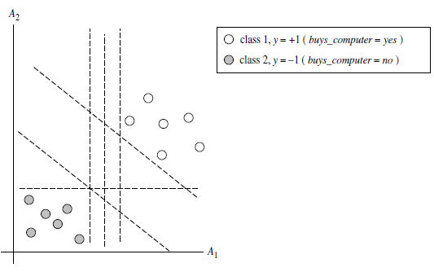
Classification (SVM)
The 2-D training data are linearly separable. There are an infinite number of (possible) separating hyperplanes or “decision boundaries.”Which one is best?
Source: Han & Kamber (2006)

Slide 84
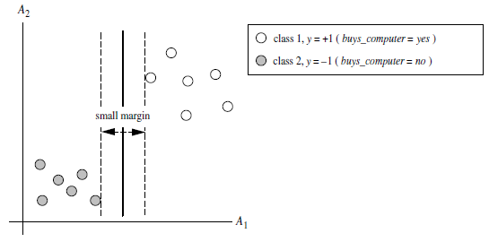
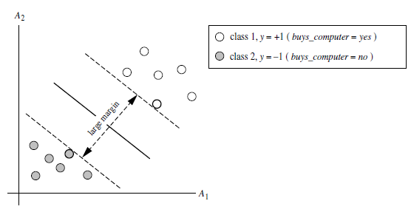
Classification (SVM)
Which one is better? The one with the larger margin should have greater generalization accuracy.
Source: Han & Kamber (2006)

Slide 85
SVM—When Data Is Linearly Separable
m
Let data D be (X₁, y₁), …, (X_{|D|}, y_{|D|}), where X_{i} is the set of training tuples associated with the class labels y_{i}
There are infinite lines (hyperplanes) separating the two classes but we want to find the best one (the one that minimizes classification error on unseen data)
SVM searches for the hyperplane with the largest margin, i.e., maximum marginal hyperplane (MMH)
Source: Han & Kamber (2006)

Slide 86
SVM—Linearly Separable
A separating hyperplane can be written as
    W ● X + b = 0
  where W={w₁, w₂, …, w_{n}} is a weight vector and b a scalar (bias)
For 2-D it can be written as
    w₀ + w₁ x₁ + w₂ x₂ = 0
The hyperplane defining the sides of the margin:
    H₁: w₀ + w₁ x₁ + w₂ x₂ ≥ 1 for y_{i} = +1, and
    H₂: w₀ + w₁ x₁ + w₂ x₂ ≤ – 1 for y_{i} = –1
Any training tuples that fall on hyperplanes H₁ or H₂ (i.e., the
sides defining the margin) are support vectors
This becomes a constrained (convex) quadratic optimization problem: Quadratic objective function and linear constraints → Quadratic Programming (QP) → Lagrangian multipliers
Source: Han & Kamber (2006)

Slide 87
Why Is SVM Effective on High Dimensional Data?
The complexity of trained classifier is characterized by the # of support vectors rather than the dimensionality of the data
The support vectors are the essential or critical training examples —they lie closest to the decision boundary (MMH)
If all other training examples are removed and the training is repeated, the same separating hyperplane would be found
The number of support vectors found can be used to compute an (upper) bound on the expected error rate of the SVM classifier, which is independent of the data dimensionality
Thus, an SVM with a small number of support vectors can have good generalization, even when the dimensionality of the data is high
Source: Han & Kamber (2006)

Slide 88
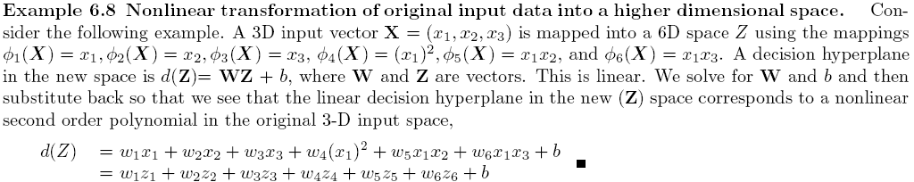
SVM—Linearly Inseparable
Transform the original input data into a higher dimensional space
Search for a linear separating hyperplane in the new space
Source: Han & Kamber (2006)

Slide 89
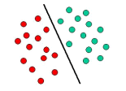
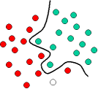
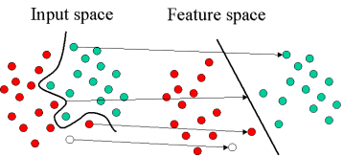
Mapping Input Space to Feature Space
Source: http://www.statsoft.com/textbook/support-vector-machines/

Slide 90
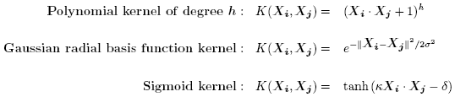
SVM—Kernel functions
Instead of computing the dot product on the transformed data tuples, it is mathematically equivalent to instead applying a kernel function K(X_{i}, X_{j}) to the original data, i.e., K(X_{i}, X_{j}) = Φ(X_{i}) Φ(X_{j})
Typical Kernel Functions
SVM can also be used for classifying multiple (> 2) classes and for regression analysis (with additional user parameters)
Source: Han & Kamber (2006)

Slide 91
SVM Related Links
SVM Website
  http://www.kernel-machines.org/
Representative implementations
  LIBSVM
    an efficient implementation of SVM, multi-class classifications, nu-SVM, one-class SVM, including also various interfaces with java, python, etc.
  SVM-light
    simpler but performance is not better than LIBSVM, support only binary classification and only C language
  SVM-torch
    another recent implementation also written in C.
Source: Han & Kamber (2006)

Slide 92
Deep Learning and
Neural Networks

Slide 93
Deep Learning and
Neural Networks
Input Layer
(X)
Hidden Layer
(H)
Output Layer
(Y)
X1
Y
X2

Slide 94
Deep Learning and
Neural Networks
Input Layer
(X)
Hidden Layer
(H)
Output Layer
(Y)

Slide 95
Deep Learning and
Neural Networks
Input Layer
(X)
Hidden Layers
(H)
Output Layer
(Y)
Deep Neural Networks
Deep Learning

Slide 96
Data Mining Evaluation

Slide 97
Evaluation
(Accuracy of Classification Model)

Slide 98
Assessment Methods for Classification
Predictive accuracy
  Hit rate
Speed
  Model building; predicting
Robustness
Scalability
Interpretability
  Transparency, explainability
Source: Turban et al. (2011), Decision Support and Business Intelligence Systems

Slide 99
Accuracy
Precision
Validity
Reliability

Slide 101
Accuracy vs. Precision
A
B
High Accuracy
High Precision
Low Accuracy
High Precision
C
D
High Accuracy
Low Precision
Low Accuracy
Low Precision

Slide 102
Accuracy vs. Precision
A
B
High Accuracy
High Precision
Low Accuracy
High Precision
High Validity
High Reliability
Low Validity
High Reliability
C
D
High Accuracy
Low Precision
Low Accuracy
Low Precision
High Validity
Low Reliability
Low Validity
Low Reliability

Slide 103
Accuracy vs. Precision
A
B
High Accuracy
High Precision
Low Accuracy
High Precision
High Validity
High Reliability
Low Validity
High Reliability
C
D
High Accuracy
Low Precision
Low Accuracy
Low Precision
High Validity
Low Reliability
Low Validity
Low Reliability

Slide 104
Accuracy of Classification Models
In classification problems, the primary source for accuracy estimation is the confusion matrix
Source: Turban et al. (2011), Decision Support and Business Intelligence Systems

Slide 105
Estimation Methodologies for Classification
Simple split (or holdout or test sample estimation)
  Split the data into 2 mutually exclusive sets
  training (~70%) and testing (30%)
  For ANN, the data is split into three sub-sets
  (training [~60%], validation [~20%], testing [~20%])
Source: Turban et al. (2011), Decision Support and Business Intelligence Systems

Slide 106
Estimation Methodologies for Classification
k-Fold Cross Validation (rotation estimation)
  Split the data into k mutually exclusive subsets
  Use each subset as testing while using the rest of the subsets as training
  Repeat the experimentation for k times
  Aggregate the test results for true estimation of prediction accuracy training
Other estimation methodologies
  Leave-one-out, bootstrapping, jackknifing
  Area under the ROC curve
Source: Turban et al. (2011), Decision Support and Business Intelligence Systems

Slide 107
Estimation Methodologies for Classification – ROC Curve
Source: Turban et al. (2011), Decision Support and Business Intelligence Systems

Slide 108
Sensitivity
Specificity
=True Positive Rate
=True Negative Rate

Slide 109
True Class
(actual value)
Positive
Negative
total
True
Positive
(TP)
False
Positive
(FP)
Positive
P’
Predictive Class
(prediction outcome)
False
Negative
(FN)
True
Negative
(TN)
Negative
N’
total
P
N
Source: http://en.wikipedia.org/wiki/Receiver_operating_characteristic

Slide 110
True Class
(actual value)
Positive
Negative
total
True
Positive
(TP)
False
Positive
(FP)
Positive
P’
Predictive Class
(prediction outcome)
False
Negative
(FN)
True
Negative
(TN)
Negative
N’
total
P
N
Sensitivity
= True Positive Rate
= Recall
= Hit rate
= TP / (TP + FN)
Source: http://en.wikipedia.org/wiki/Receiver_operating_characteristic

Slide 111
True Class
(actual value)
Positive
Negative
total
True
Positive
(TP)
False
Positive
(FP)
Positive
P’
Predictive Class
(prediction outcome)
False
Negative
(FN)
True
Negative
(TN)
Negative
N’
total
P
N
Specificity
= True Negative Rate
= TN / N
= TN / (TN+ FP)
Source: http://en.wikipedia.org/wiki/Receiver_operating_characteristic

Slide 112
True Class
(actual value)
Precision
= Positive Predictive Value (PPV)
Positive
Negative
total
True
Positive
(TP)
False
Positive
(FP)
Positive
P’
Recall
= True Positive Rate (TPR)
= Sensitivity
= Hit Rate
Predictive Class
(prediction outcome)
False
Negative
(FN)
True
Negative
(TN)
Negative
N’
total
P
N
F1 score (F-score)(F-measure)
is the harmonic mean of precision and recall
= 2TP / (P + P’)
= 2TP / (2TP + FP + FN)
Source: http://en.wikipedia.org/wiki/Receiver_operating_characteristic

Slide 113
A
63
(TP)
28
(FP)
Recall
= True Positive Rate (TPR)
= Sensitivity
= Hit Rate
= TP / (TP + FN)
Specificity
= True Negative Rate
= TN / N
= TN / (TN + FP)
91
37
(FN)
72
(TN)
109
100
100
200
TPR = 0.63
FPR = 0.28
PPV = 0.69
=63/(63+28)
=63/91
Precision
= Positive Predictive Value (PPV)
F1 = 0.66
= 2*(0.63*0.69)/(0.63+0.69)
= (2 * 63) /(100 + 91)
= (0.63 + 0.69) / 2 =1.32 / 2 =0.66
F1 score (F-score)
(F-measure)
is the harmonic mean of precision and recall
= 2TP / (P + P’)
= 2TP / (2TP + FP + FN)
ACC = 0.68
= (63 + 72) / 200
= 135/200 = 67.5
Source: http://en.wikipedia.org/wiki/Receiver_operating_characteristic

Slide 114
A
B
63
(TP)
28
(FP)
77
(TP)
77
(FP)
91
154
37
(FN)
72
(TN)
109
23
(FN)
23
(TN)
46
100
100
200
100
100
200
TPR = 0.63
TPR = 0.77
FPR = 0.77
PPV = 0.50
F1 = 0.61
ACC = 0.50
FPR = 0.28
PPV = 0.69
=63/(63+28)
=63/91
F1 = 0.66
= 2*(0.63*0.69)/(0.63+0.69)
= (2 * 63) /(100 + 91)
= (0.63 + 0.69) / 2 =1.32 / 2 =0.66
Recall
= True Positive Rate (TPR)
= Sensitivity
= Hit Rate
ACC = 0.68
= (63 + 72) / 200
= 135/200 = 67.5
Precision
= Positive Predictive Value (PPV)
Source: http://en.wikipedia.org/wiki/Receiver_operating_characteristic

Slide 115
C
C’
24
(TP)
88
(FP)
76
(TP)
12
(FP)
112
88
76
(FN)
12
(TN)
88
24
(FN)
88
(TN)
112
100
100
200
100
100
200
TPR = 0.24
FPR = 0.88
PPV = 0.21
F1 = 0.22
ACC = 0.18
TPR = 0.76
FPR = 0.12
PPV = 0.86
F1 = 0.81
ACC = 0.82
Recall
= True Positive Rate (TPR)
= Sensitivity
= Hit Rate
Precision
= Positive Predictive Value (PPV)
Source: http://en.wikipedia.org/wiki/Receiver_operating_characteristic

Slide 116
Summary
Classification and Prediction
Supervised Learning (Classification)
Decision Tree (DT)
  Information Gain (IG)
Support Vector Machine (SVM)
Data Mining Evaluation
  Accuracy
  Precision
  Recall
  F1 score (F-measure) (F-score)

Slide 117
References
Jiawei Han and Micheline Kamber, Data Mining: Concepts and Techniques, Second Edition, Elsevier, 2006.
Jiawei Han, Micheline Kamber and Jian Pei, Data Mining: Concepts and Techniques, Third Edition, Morgan Kaufmann 2011.
Efraim Turban, Ramesh Sharda, Dursun Delen, Decision Support and Business Intelligence Systems, Ninth Edition, Pearson, 2011.

