Slide 1
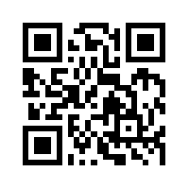
Social Media Apps Programming
Tamkang University
Google Cloud Platform
1071SMAP10
TLMXM1A (8550) (M2143) (Fall 2018)
(MIS MBA) (2 Credits, Elective) [Full English Course]
Thu 8,9 (10:10-12:00) B206
Min-Yuh Day, Ph.D.
Assistant Professor
Department of Information Management
Tamkang University
http://mail.tku.edu.tw/myday
2018-11-29

Slide 2
Course Schedule (1/2)
Tamkang University
Week Date Subject/Topics
1 2018/09/13 Course Orientation and Introduction to Social Media and Mobile Apps Programming
2 2018/09/20 Introduction to Android / iOS Apps Programming
3 2018/09/27 Developing Android Native Apps with Java (Android Studio)
4 2018/10/04 Developing iPhone / iPad Native Apps with Swift (XCode)
5 2018/10/11 Mobile Apps using HTML5/CSS3/JavaScript
6 2018/10/18 jQuery Mobile
7 2018/10/25 Create Hybrid Apps with Phonegap
8 2018/11/01 jQuery Mobile/Phonegap
9 2018/11/08 jQuery Mobile/Phonegap

Slide 3
Course Schedule (2/2)
Tamkang University
Week Date Subject/Topics
10 2018/11/15 Midterm Exam Week / Project Presentation
11 2018/11/22 Case Study on Social Media Apps Programming and Marketing in Google Play and App Store
12 2018/11/29 Google Cloud Platform
13 2018/12/06 Google App Engine
14 2018/12/13 Google Map API
15 2018/12/20 Facebook API (Facebook JavaScript SDK) (Integrate Facebook with iOS/Android Apps)
16 2018/12/27 Twitter API
17 2019/01/03 Final Project Presentation
18 2019/01/10 Final Exam Week / Final Project Presentation

Slide 4
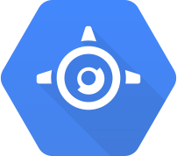
Outline
Google Cloud Platform
Google App Engine
Google Cloud Datastore
Google Cloud Endpoints
Firebase
Mobile App with Google Cloud Platform

Slide 5
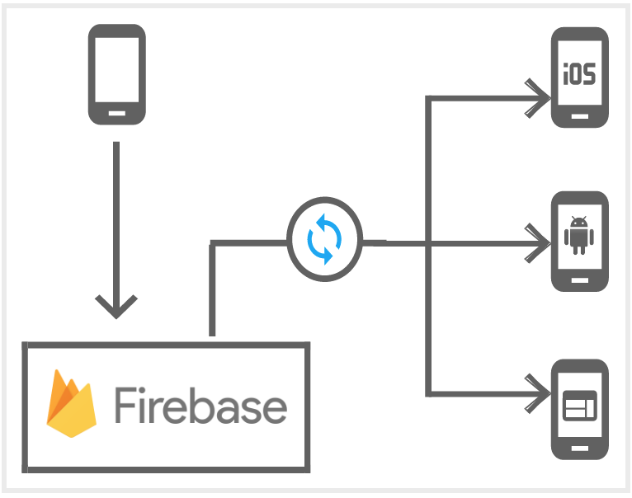
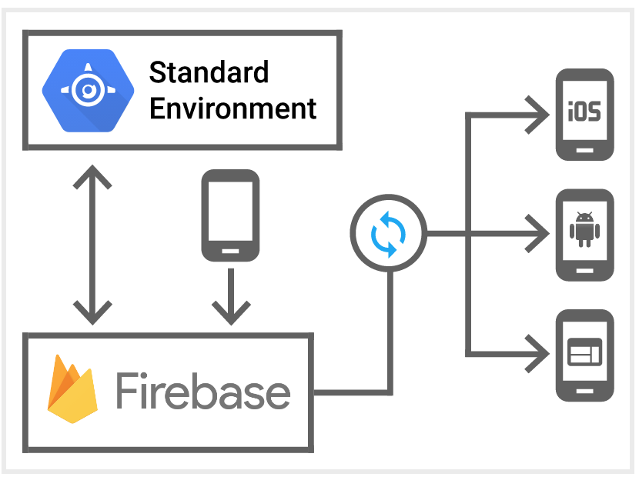
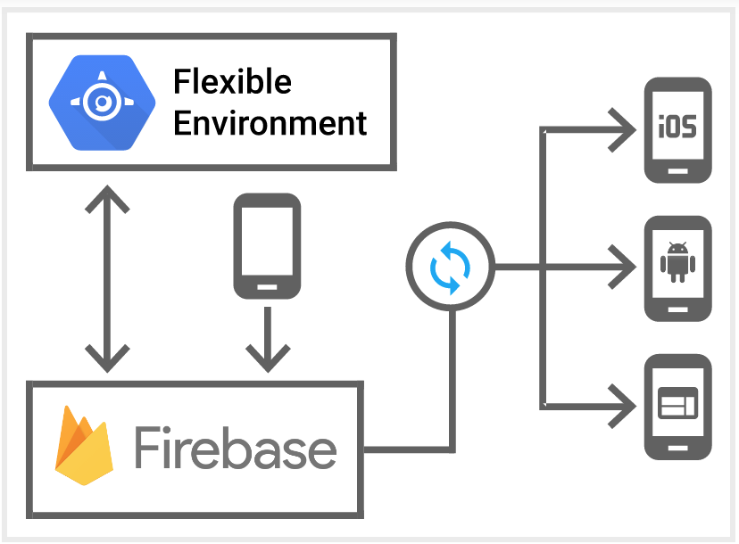
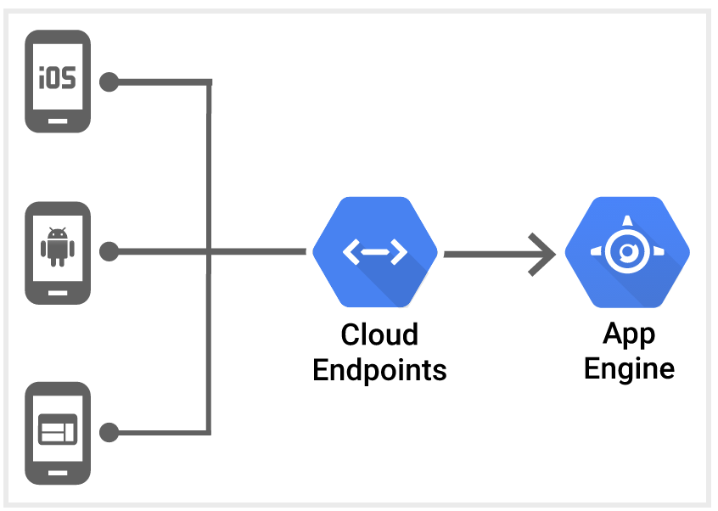
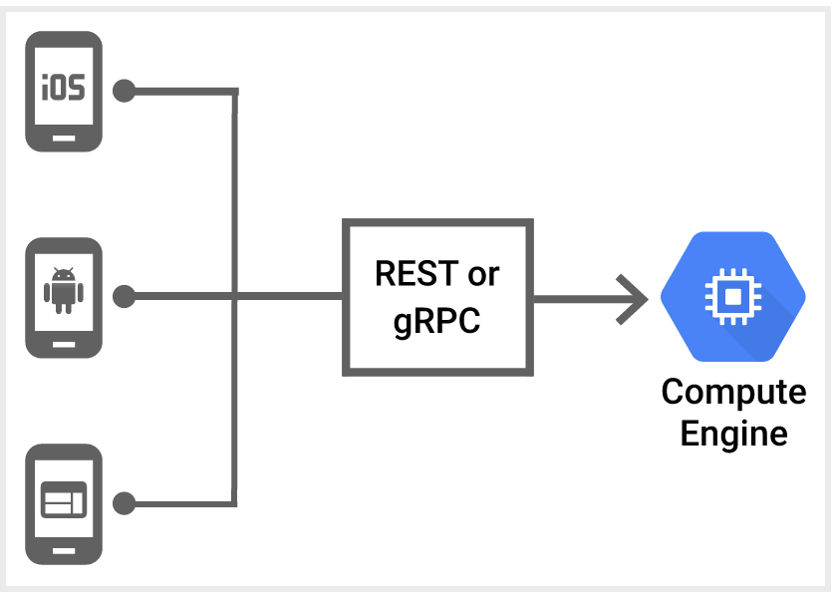
Mobile App Backend Services
Source: https://cloud.google.com/solutions/mobile/mobile-app-backend-services

Slide 6
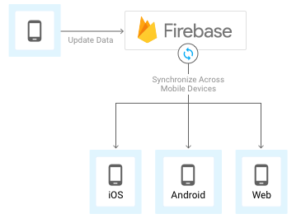
Firebase
Source: https://cloud.google.com/solutions/mobile/mobile-app-backend-services

Slide 7
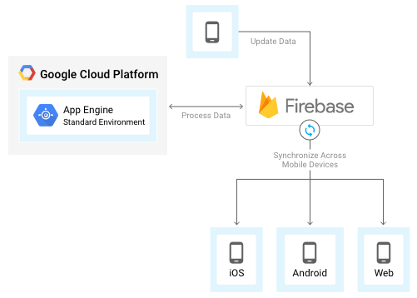
Firebase and Google App Engine standard environment
Source: https://cloud.google.com/solutions/mobile/mobile-app-backend-services

Slide 8
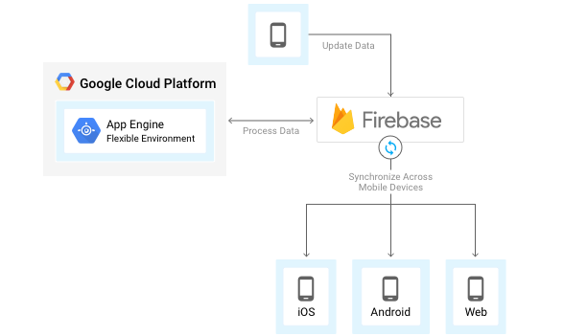
Firebase and App Engine flexible environment
Source: https://cloud.google.com/solutions/mobile/mobile-app-backend-services

Slide 9
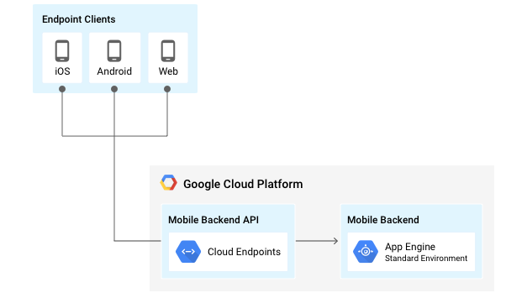
App Engine and Cloud Endpoints
Source: https://cloud.google.com/solutions/mobile/mobile-app-backend-services

Slide 10
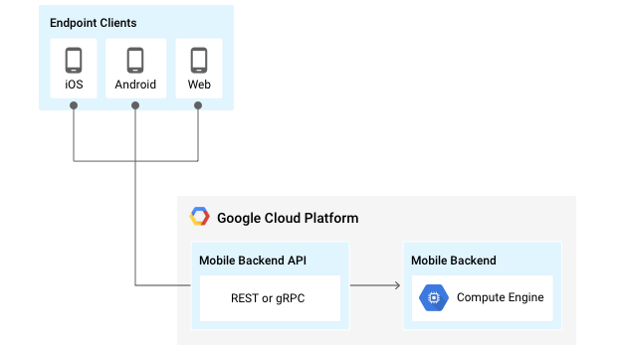
Compute Engine and REST or gRPC
Source: https://cloud.google.com/solutions/mobile/mobile-app-backend-services

Slide 11
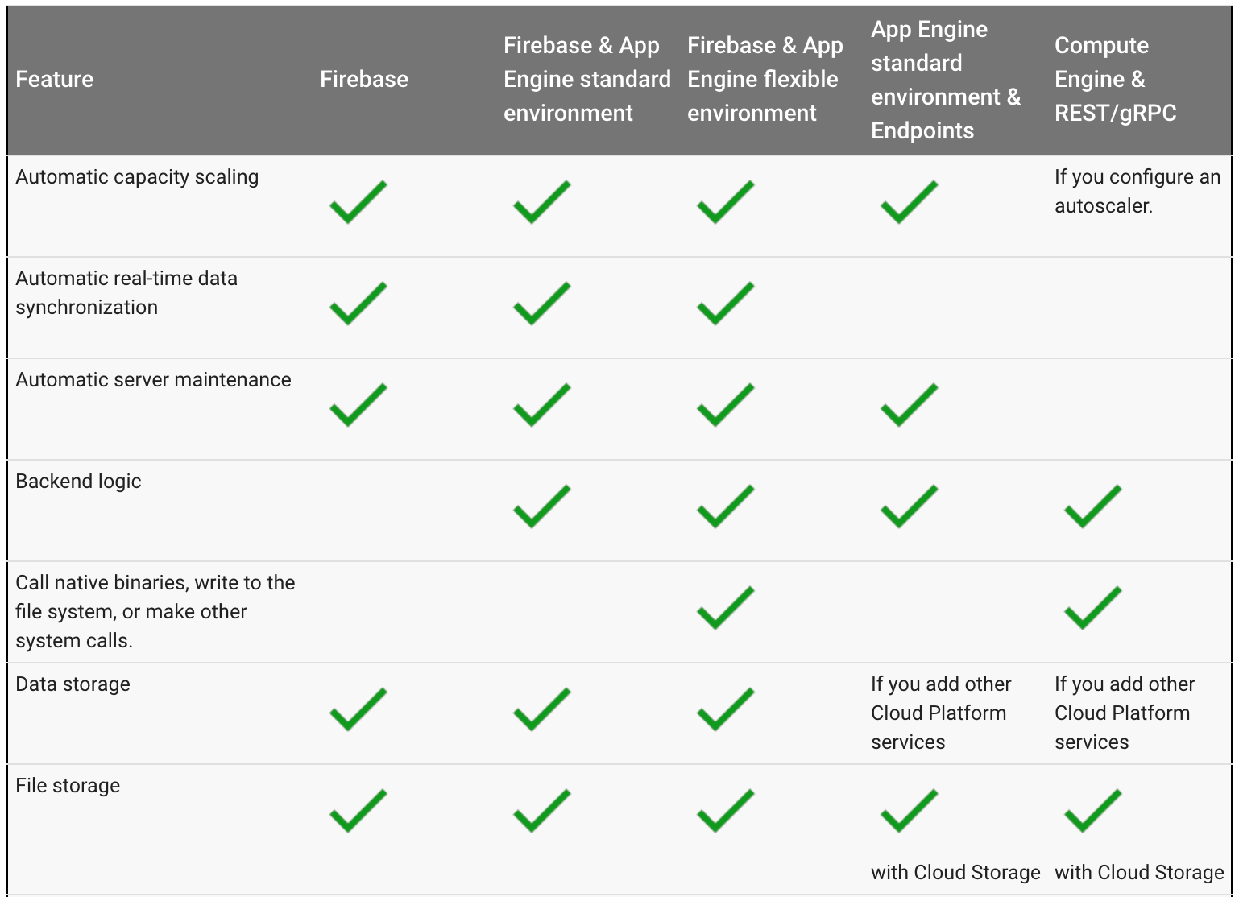
Source: https://cloud.google.com/solutions/mobile/mobile-app-backend-services

Slide 12
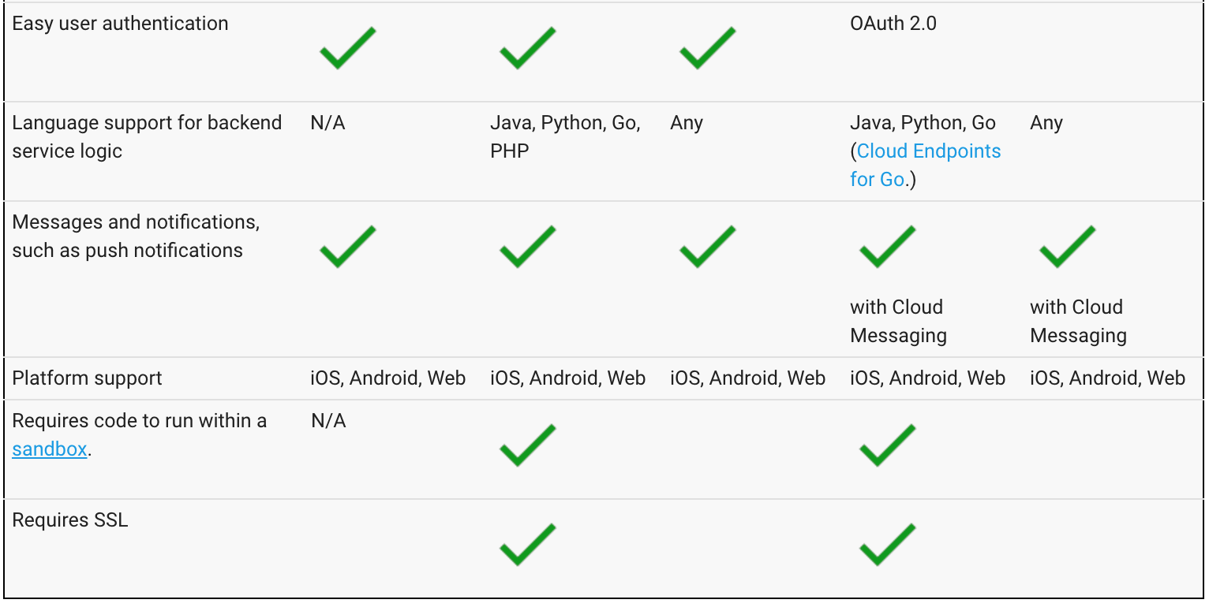
Source: https://cloud.google.com/solutions/mobile/mobile-app-backend-services

Slide 13
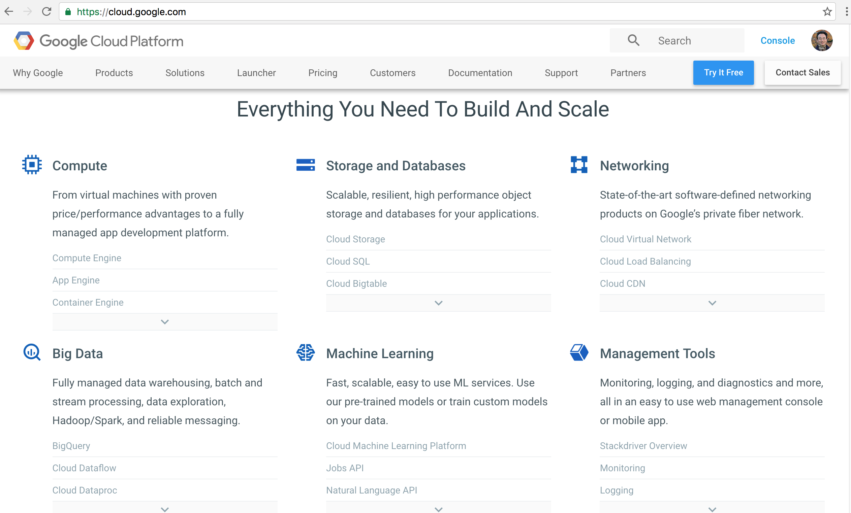
Google Cloud Platform
https://cloud.google.com/

Slide 14
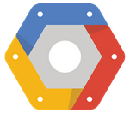
Google Cloud Platform
Hosting + Compute
Storage
Big Data
Services
Source: https://cloud.google.com/products/

Slide 15
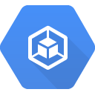
Google Cloud Platform
Compute
Storage
Big Data
Services
App Engine
Cloud Datastore
Cloud Endpoints
Compute Engine
Cloud SQL
Big Query
Translate API
Container Engine
Cloud Storage
Prediction API
Source: https://cloud.google.com/products/

Slide 16
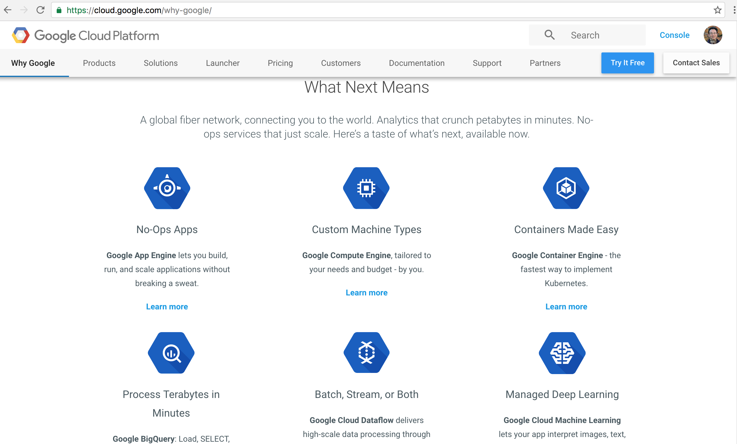
Why Google Cloud Platform
Source: https://cloud.google.com/why-google/

Slide 17
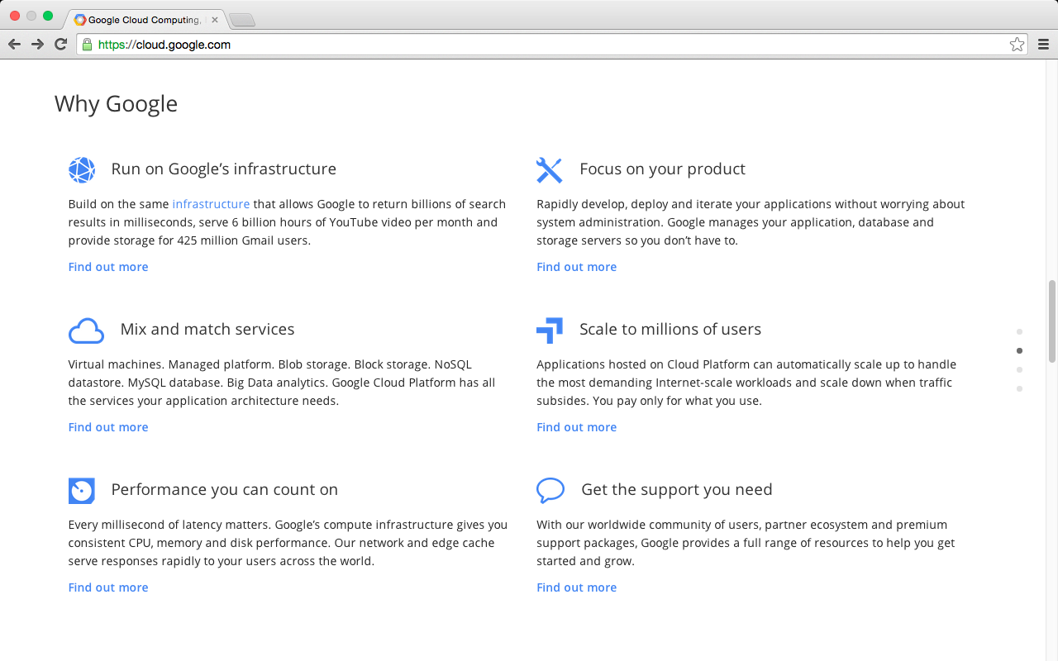
Why Google Cloud Platform
Source: https://cloud.google.com/

Slide 18
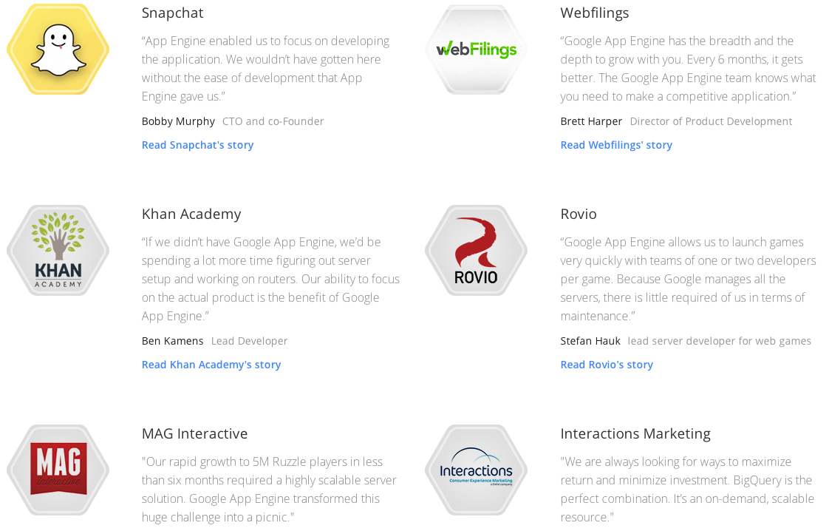
Customers of Google Cloud Platform
Source: https://cloud.google.com/customers/

Slide 19
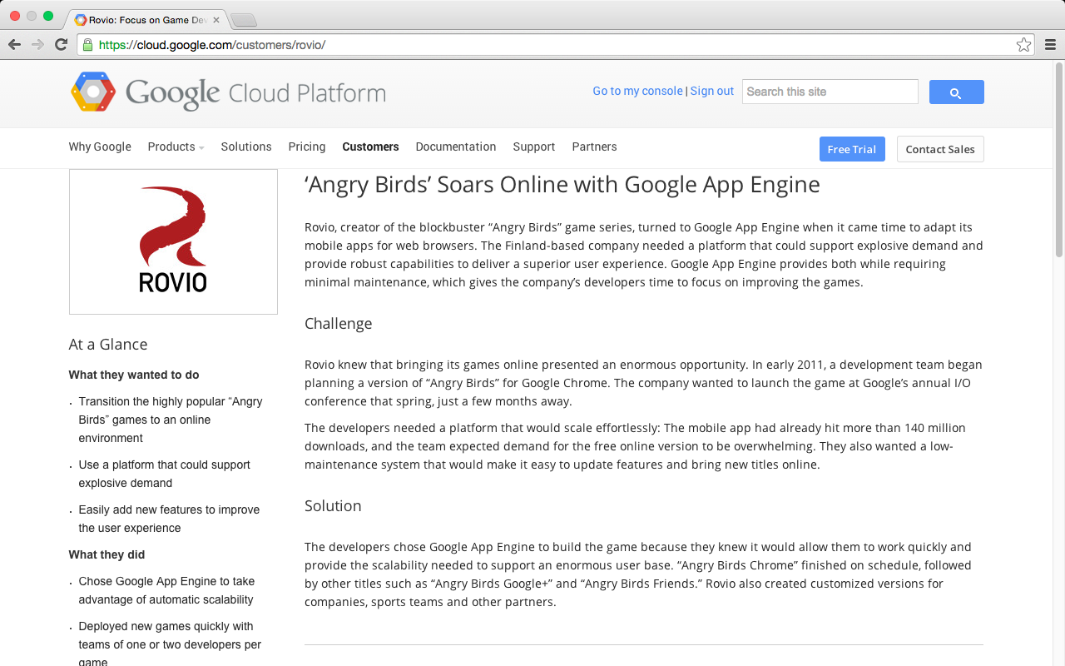
Angry Birds
Source: https://cloud.google.com/customers/

Slide 20
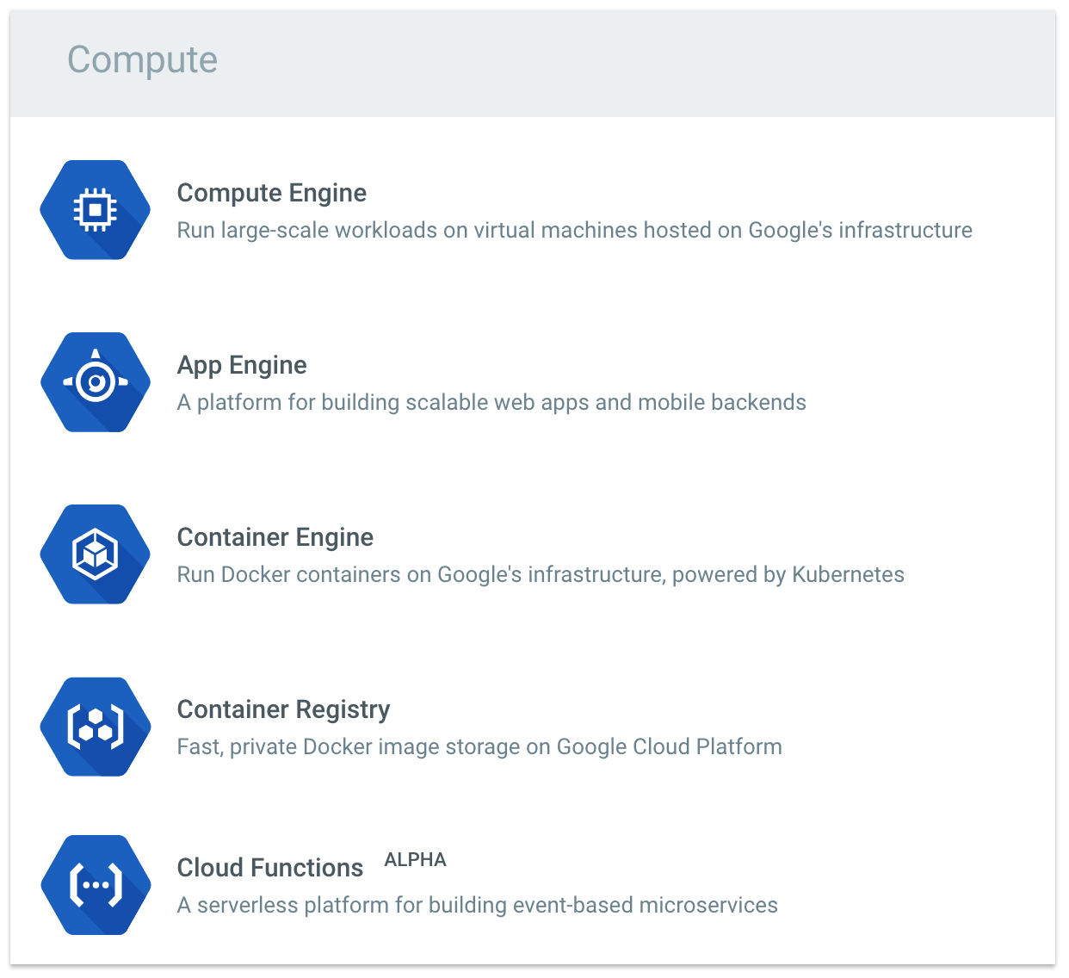
Source: https://cloud.google.com/products/

Slide 21
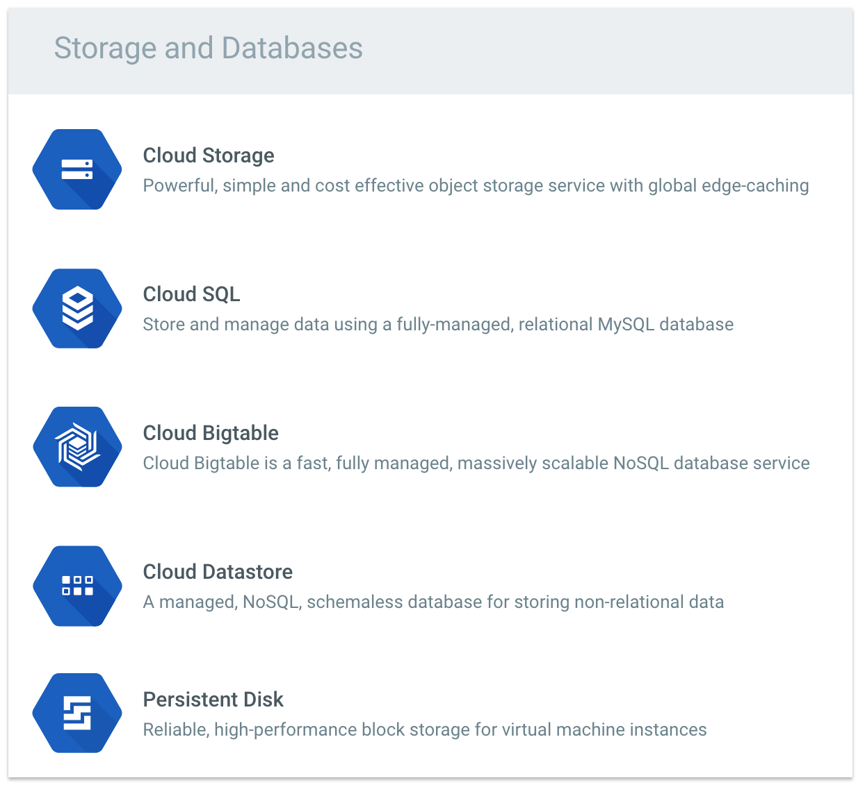
Source: https://cloud.google.com/products/

Slide 22
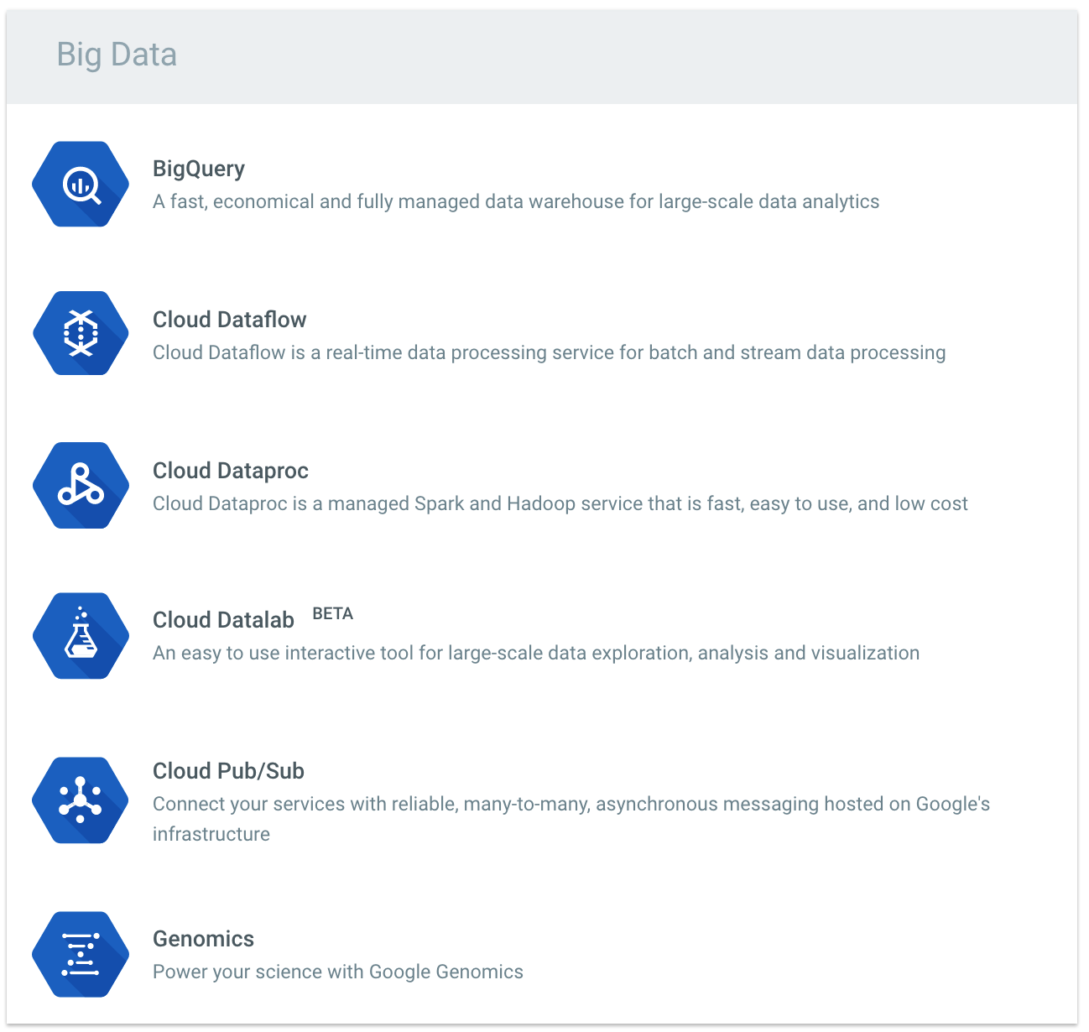
Source: https://cloud.google.com/products/

Slide 23
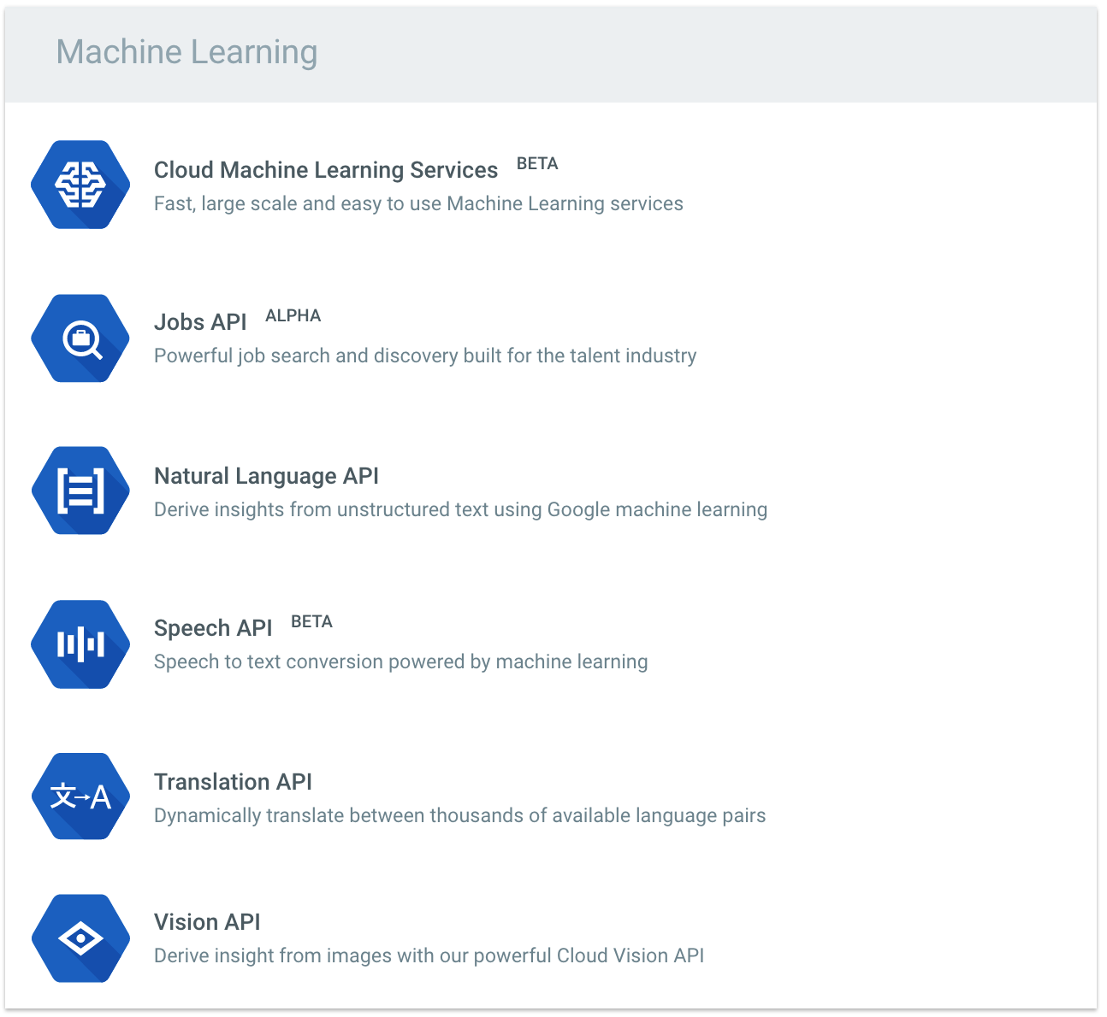
Source: https://cloud.google.com/products/

Slide 24
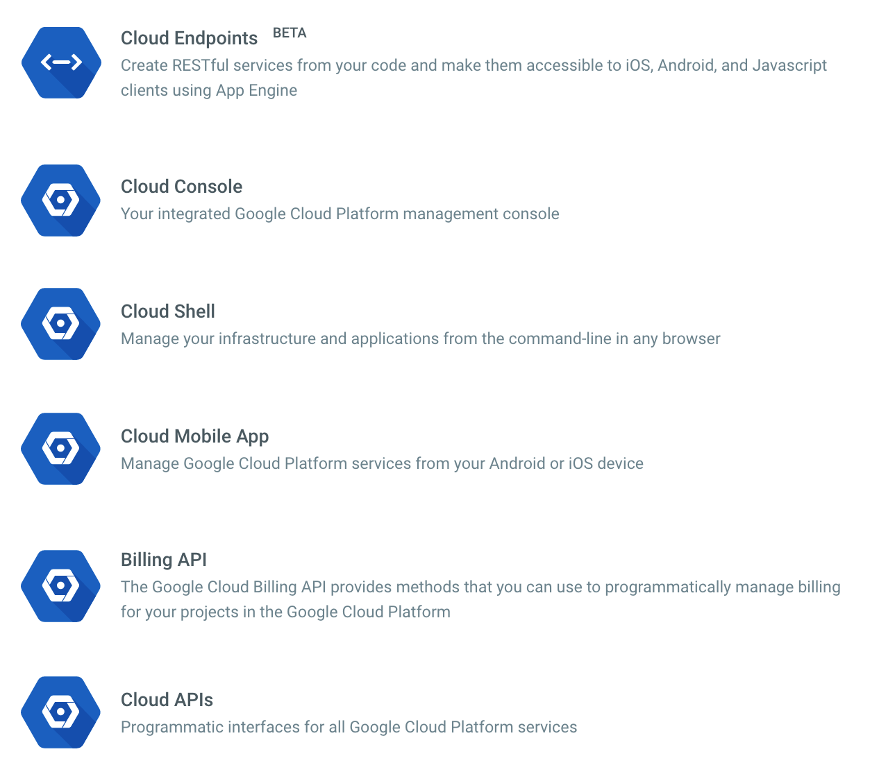
Management Tools
Source: https://cloud.google.com/products/

Slide 25
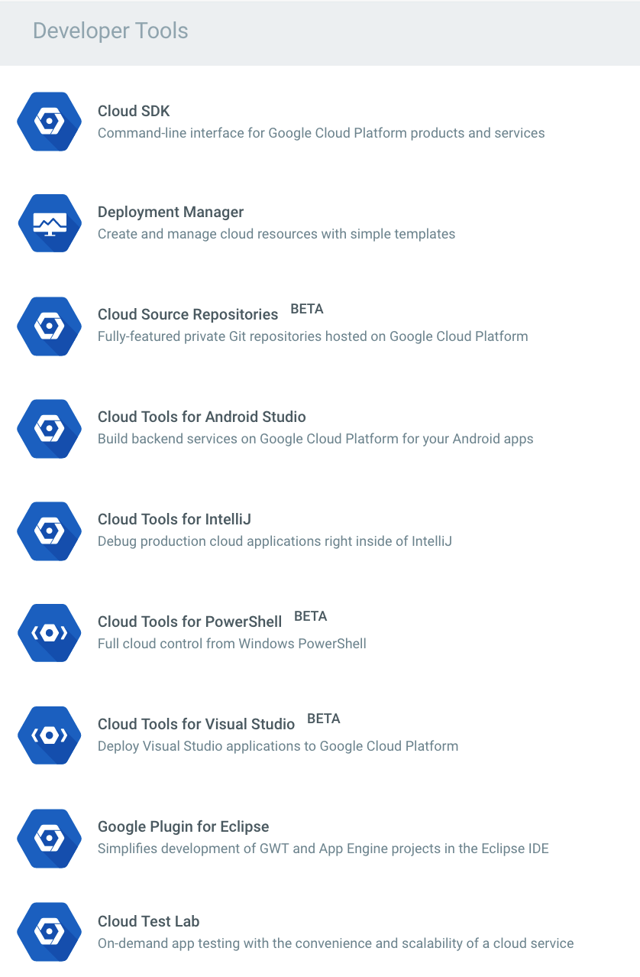
Source: https://cloud.google.com/products/

Slide 26
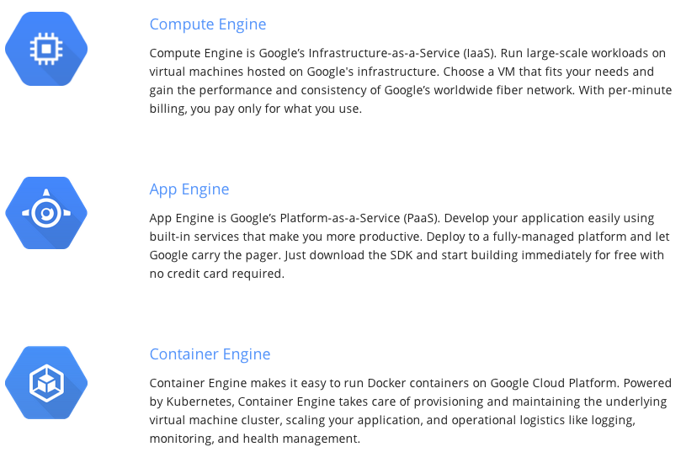
Compute
Source: https://cloud.google.com/products/

Slide 27
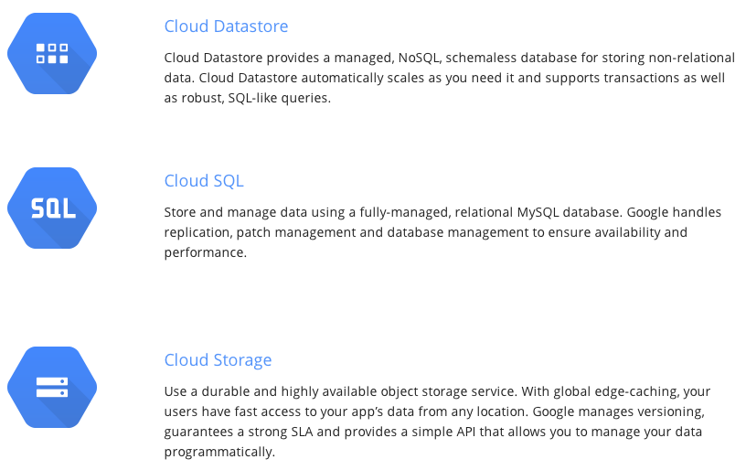
Storage
Source: https://cloud.google.com/products/

Slide 28
BigQuery
Analyze Big Data in the cloud with BigQuery.
Run fast, SQL-like queries against multi-terabyte datasets in seconds.
Scalable and easy to use, BigQuery gives you real-time insights about your data
Source: https://cloud.google.com/products/

Slide 29
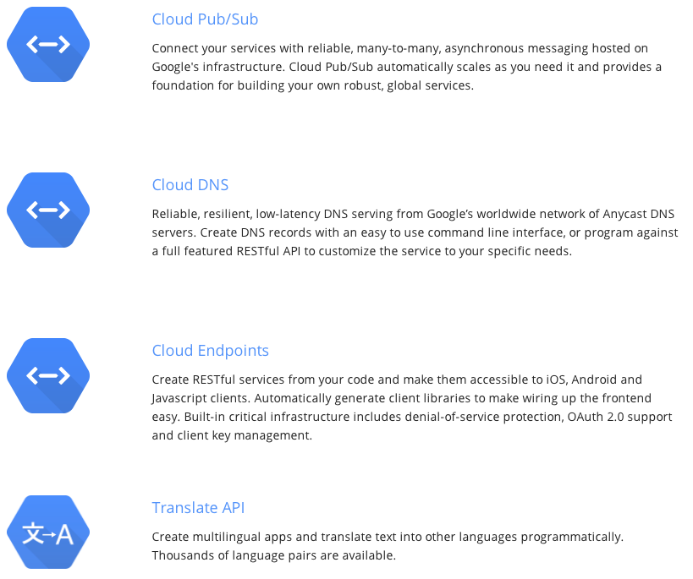
Services
Source: https://cloud.google.com/products/

Slide 30
Prediction API
Use Google’s machine learning algorithms to analyze data and predict future outcomes using a familiar RESTful interface.
Source: https://cloud.google.com/products/

Slide 31
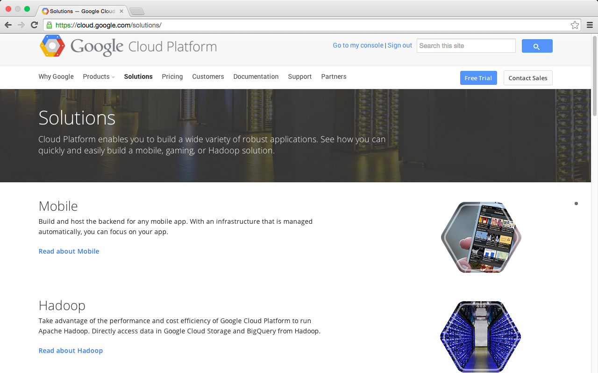
Google Cloud Platform Solutions
Source: https://cloud.google.com/solutions/

Slide 32
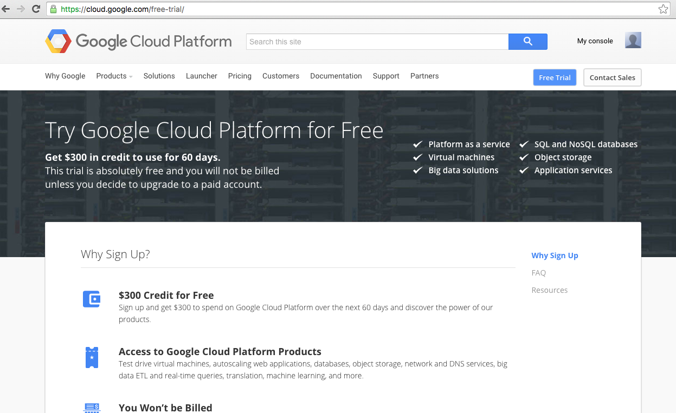
Try Google Cloud Platform for Free
Source: https://cloud.google.com/free-trial/

Slide 33
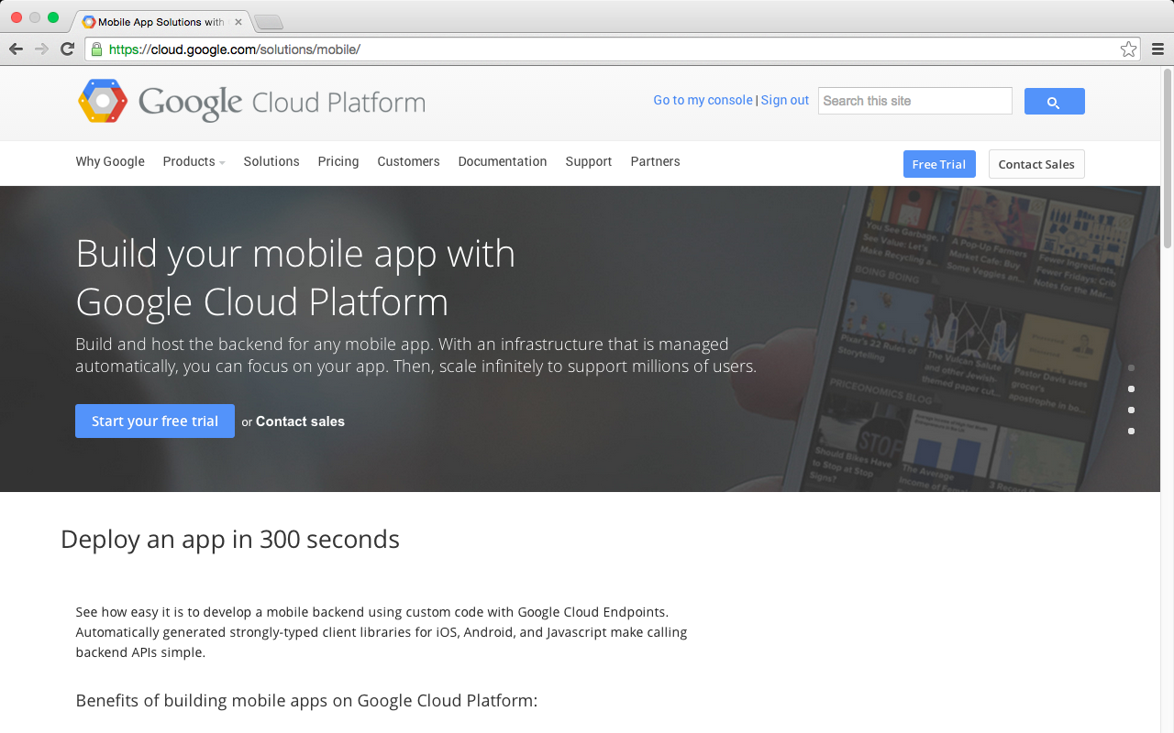
Mobile App with Google Cloud Platform
Source: https://cloud.google.com/solutions/mobile/

Slide 34
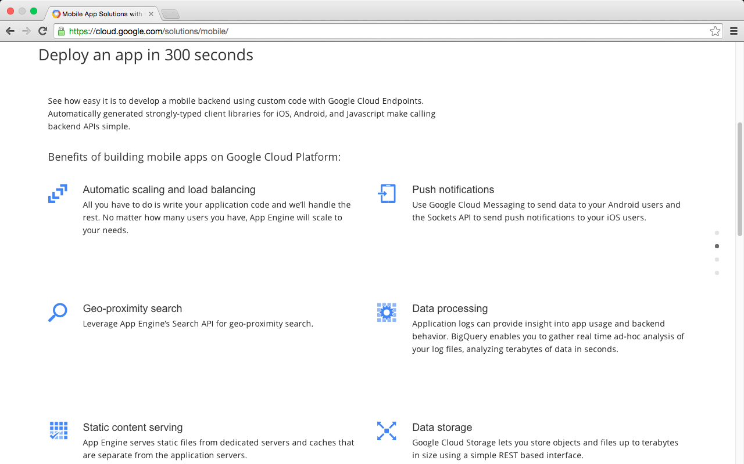
Mobile App with Google Cloud Platform
Source: https://cloud.google.com/solutions/mobile/

Slide 35
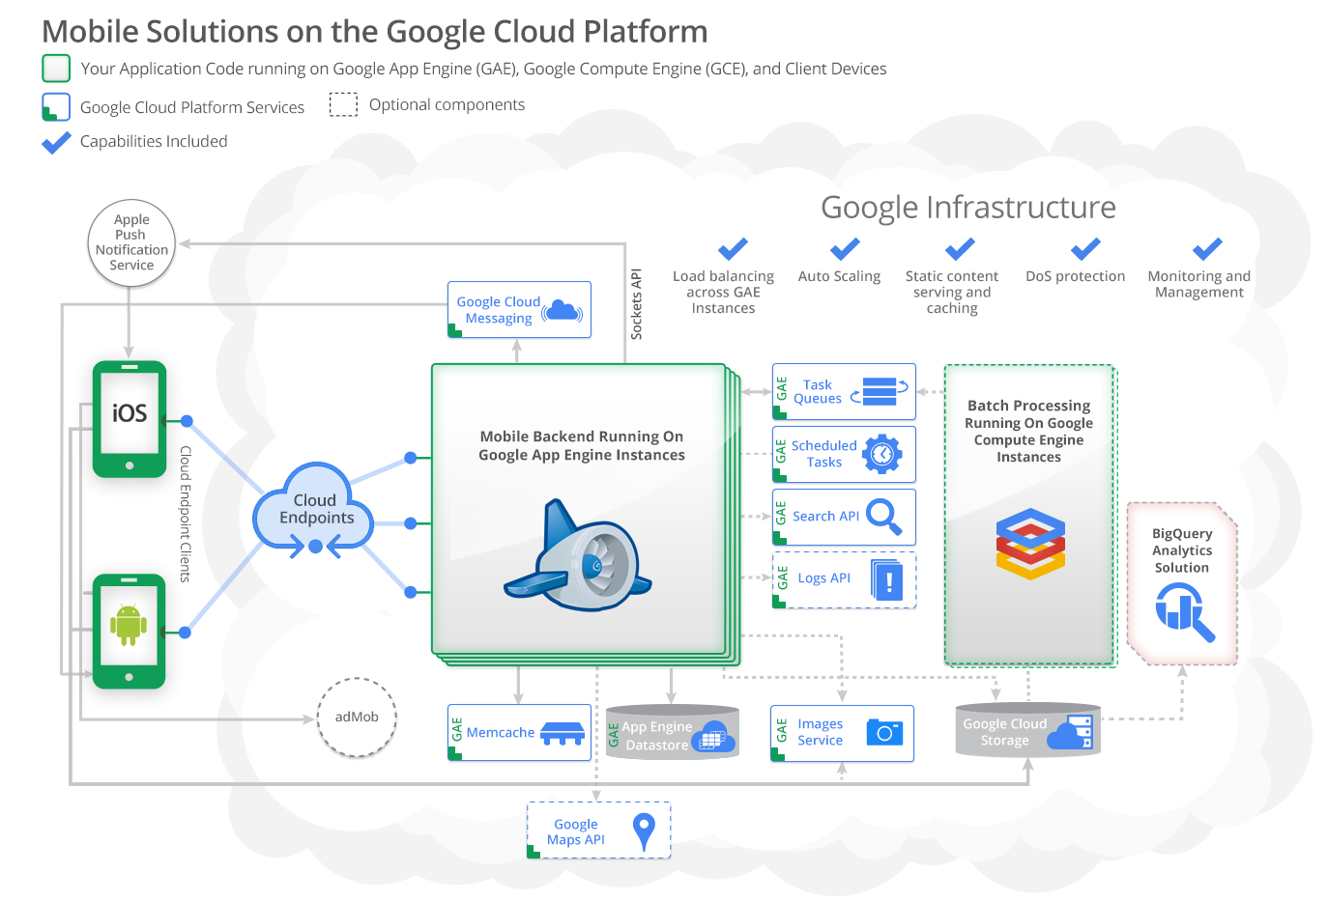
Source: https://cloud.google.com/developers/articles/mobile-application-solutions/

Slide 36
Mobile Solution on Google Cloud Platform
Support for Android and iOS devices through native applications
Storage, retrieval, and processing data outside of mobile devices
Orchestrating push notification to Android and IOS devices
Geo-location awareness and geo-proximity search
User authentication
High scalability
Source: https://cloud.google.com/developers/articles/mobile-application-solutions/

Slide 37
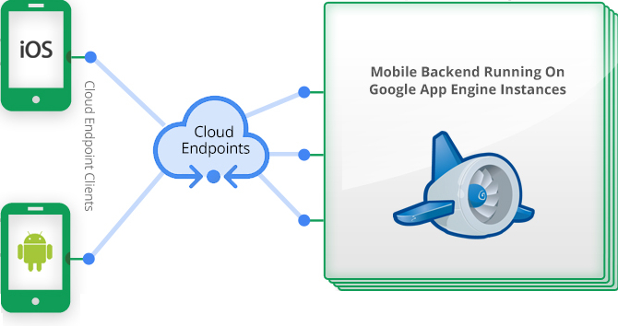
Mobile App Solutions Architecture
Source: https://cloud.google.com/developers/articles/mobile-application-solutions/

Slide 38
Mobile App Solutions Architecture
Android and/or iOS mobile clients.
Google Cloud Endpoints used for communications between the clients and the backend over REST API with optional OAuth2 authentication.
Your mobile backend application code running on Google App Engine and responsible for serving requests from the clients.
Source: https://cloud.google.com/developers/articles/mobile-application-solutions/

Slide 39
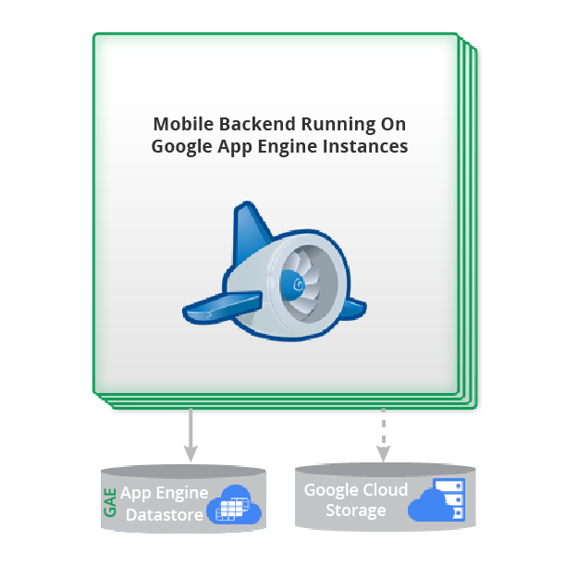
Storing data

Slide 40
Google App Engine Datastore Quotas and limits
Limit | Amount
Maximum entity size | 1 megabyte
Maximum transaction size | 10 megabytes
Maximum number of index entries for an entity | 20000
Maximum number of bytes in composite indexes for an entity | 2 megabytes
Source: https://cloud.google.com/appengine/docs/java/datastore/

Slide 41
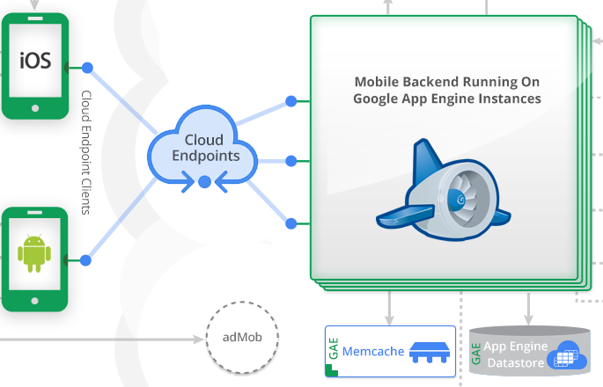
Optimizing data access with Memcache
Source: https://cloud.google.com/developers/articles/mobile-application-solutions/

Slide 42
Google App Engine Platform as a Service (PaaS)
build and run applications on Google’s infrastructure
Source: https://cloud.google.com/appengine/docs

Slide 43
Google App Engine Platform as a Service (PaaS)
Google Compute Engine Infrastructure as a Service (IaaS)
Source: https://cloud.google.com/appengine/docs

Slide 44
Mobile App Backend Services
Source: https://cloud.google.com/solutions/mobile/mobile-app-backend-services

Slide 45
Mobile App Backend Services
Source: https://cloud.google.com/solutions/mobile/mobile-app-backend-services

Slide 46
Google App Engine
1 GB of data storage and traffic for free
can be increased by enabling paid applications
Source: https://cloud.google.com/appengine/docs/whatisgoogleappengine

Slide 47
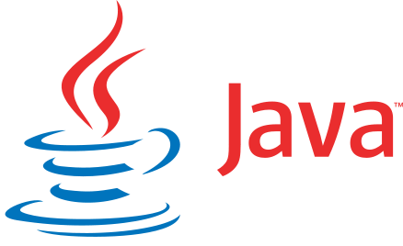
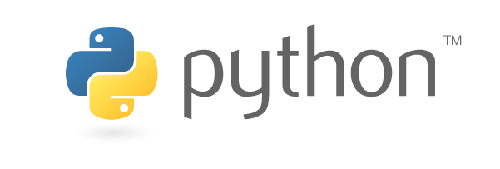
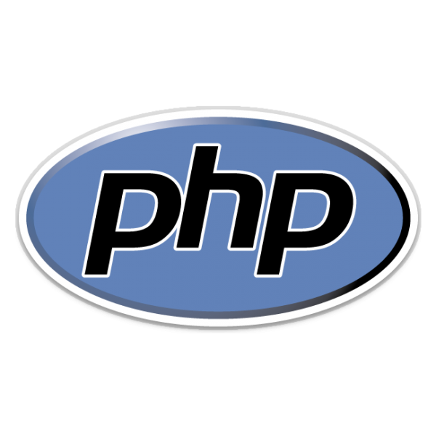
Google App Engine
Google App Engine supports apps written in a variety of programming languages: Python, Java, PHP, Go
Python
Java
PHP
Go
Source: https://cloud.google.com/appengine/docs/whatisgoogleappengine

Slide 48
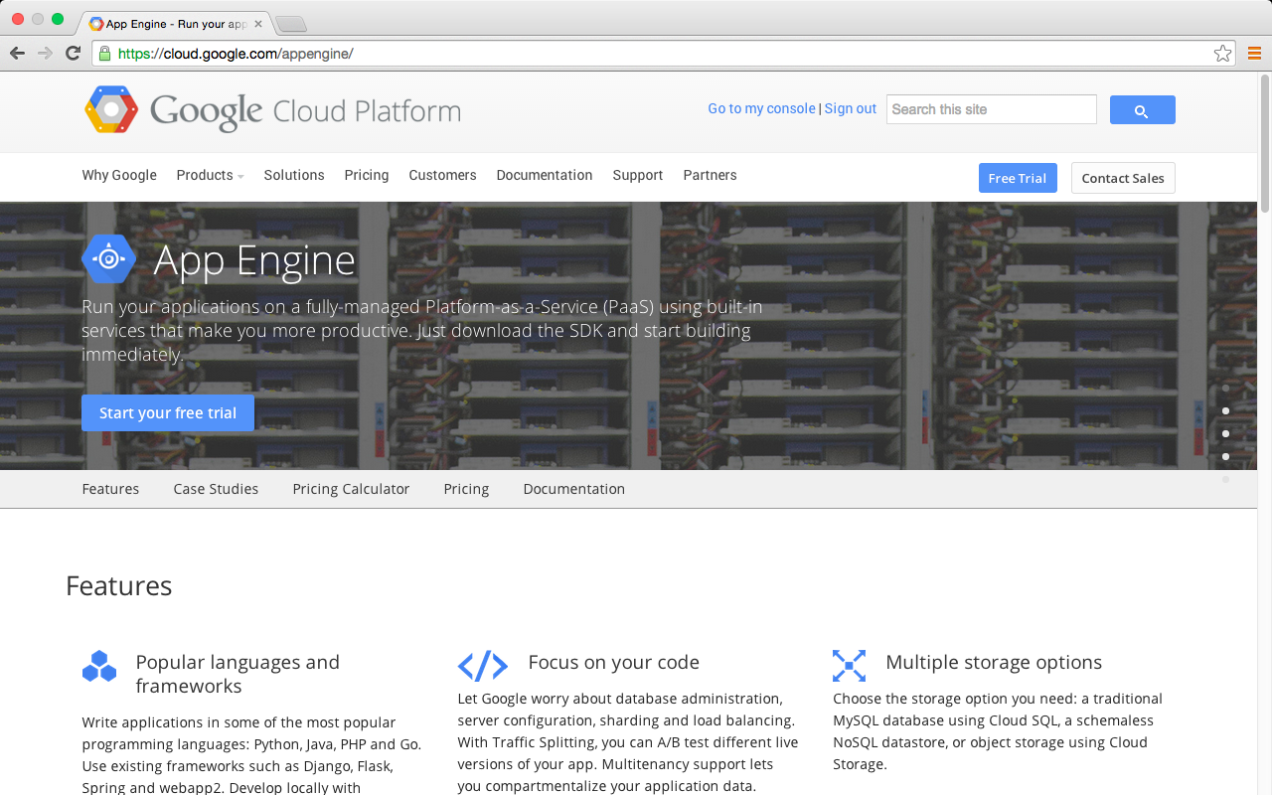
Google App Engine
https://cloud.google.com/appengine/

Slide 49
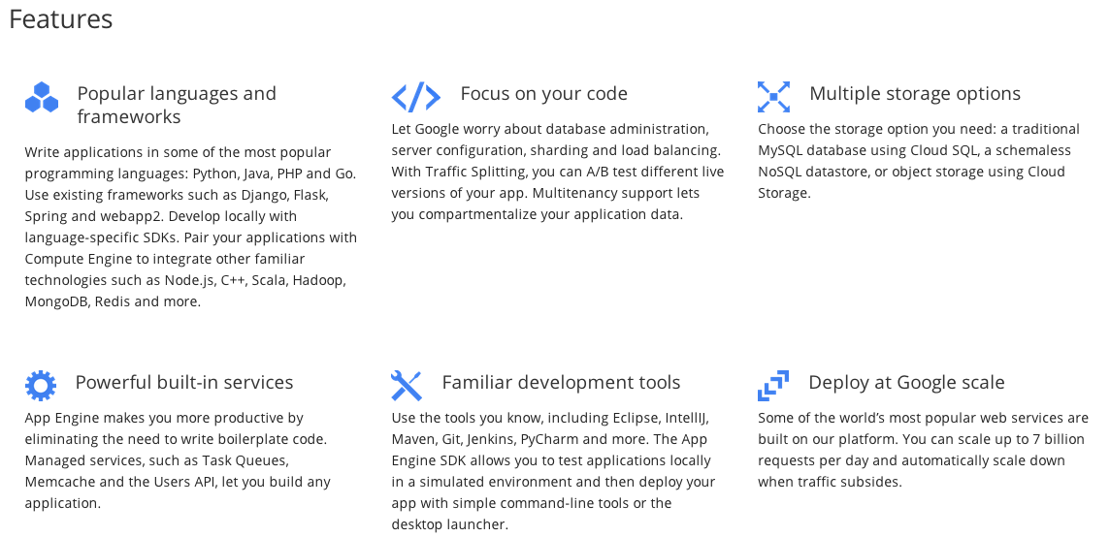
Google App Engine
https://cloud.google.com/appengine/

Slide 50
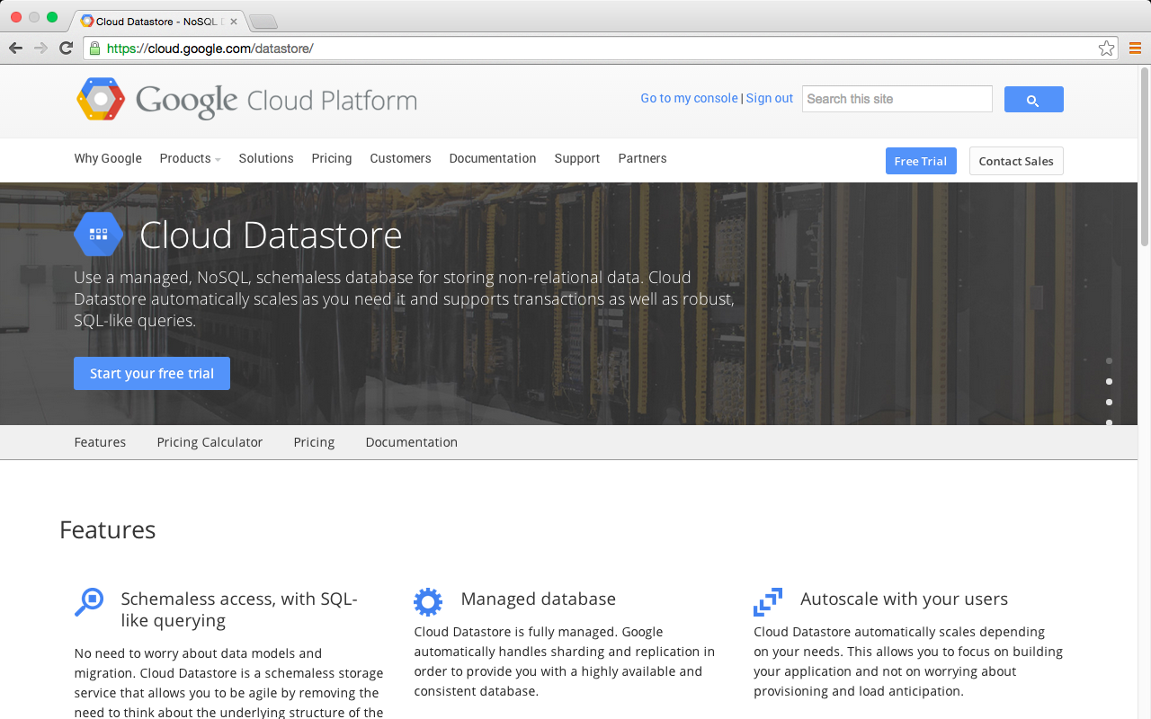
Google Cloud Datastore
https://cloud.google.com/datastore/

Slide 51
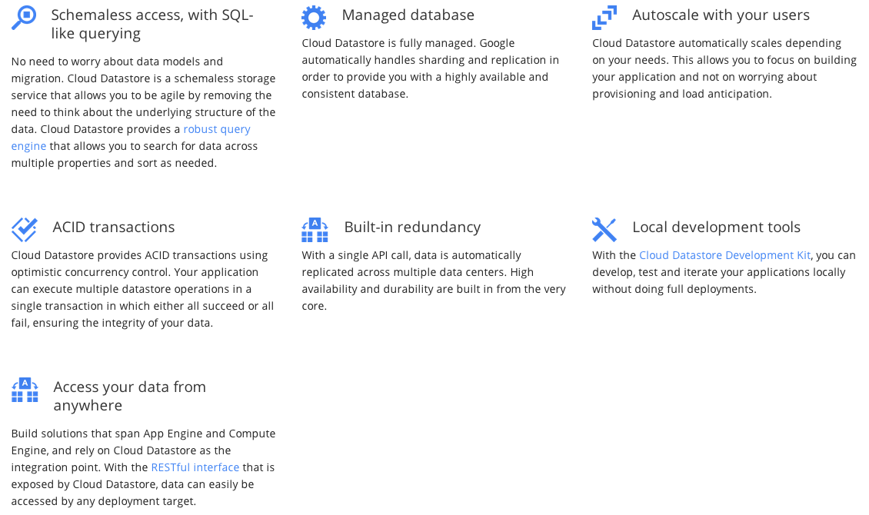
Google Cloud Datastore
https://cloud.google.com/datastore/

Slide 52
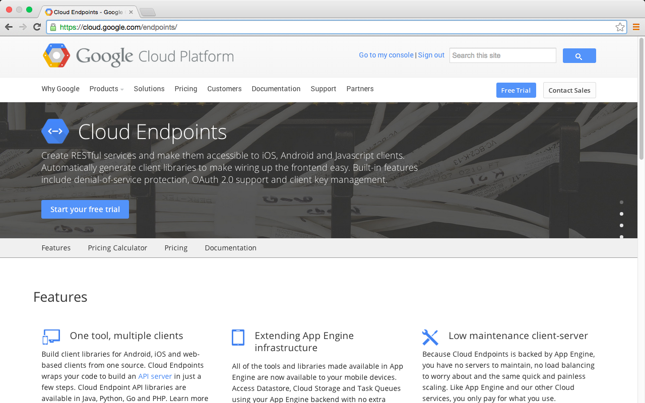
Google Cloud Endpoints
Source: https://cloud.google.com/endpoints/

Slide 53
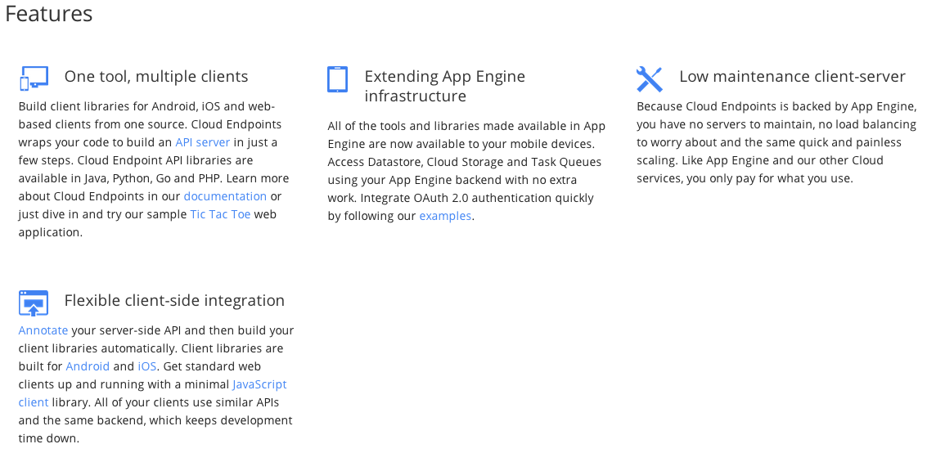
Google Cloud Endpoints
Source: https://cloud.google.com/endpoints/

Slide 54
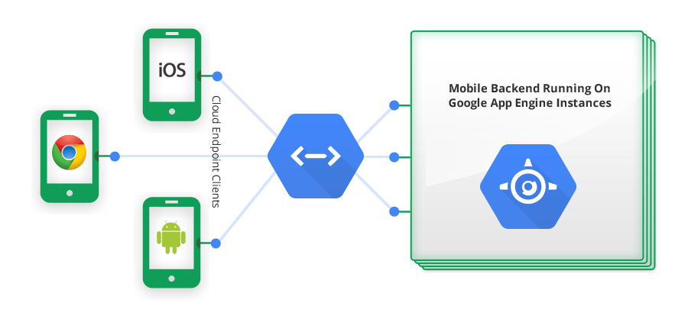
Mobile Apps Backend on Google App Engine
Cloud Endpoints
App Engine
Google Cloud Endpoints Architecture
Source: https://cloud.google.com/appengine/docs/java/endpoints/

Slide 55
Mobile App, Goolge App Engine, Cloud Datasotre
http://www.youtube.com/watch?v=v5u_Owtbfew

Slide 56
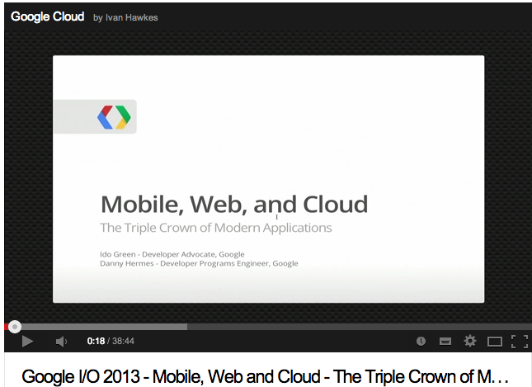
Mobile, Web and Cloud
http://www.youtube.com/watch?v=6_oO9Gwf_do

Slide 57
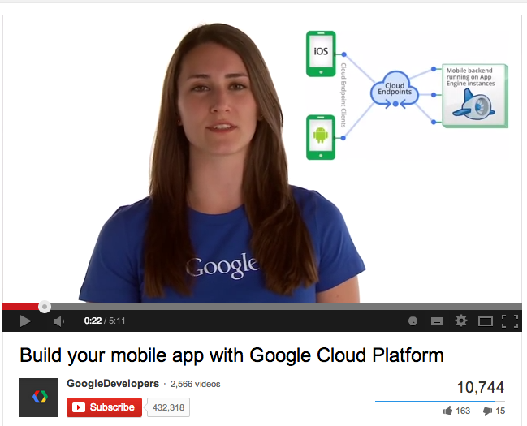
Build your mobile app with Google Cloud Platform
http://www.youtube.com/watch?v=ZZNb1NOPTp8

Slide 58
App Engine Architecture and Services
http://www.youtube.com/watch?v=QJp6hmASstQ
Notes:
Google App Engine Architecture and Services, http://www.youtube.com/watch?v=QJp6hmASstQ
GoogleDevelopers
Published on Feb 5, 2013
This lesson introduces how App Engine solves the needs of a real-time earthquake monitor in Japan, in a robust scalable way that handles peak request throughput during earthquakes without needing to keep server resources up and running all the time.
Learn how to configure your App Engine applications to best take advantage of the underlying Google infrastructure, including edge caching and load balancing, to optimize response speed and minimize cost.

Slide 59
Datastore Introduction
Source: Datastore Introduction, http://www.youtube.com/watch?v=fQazhzcC-rg
Notes:
Datastore Introduction, http://www.youtube.com/watch?v=fQazhzcC-rg
GoogleDevelopers
Published on Feb 5, 2013
Datastore service in App Engine is the core component of the platform and an essential part of learning App Engine technologies. In this lesson we will cover topics including "What is Datastore?", "Datastore Internals" and "Datastore Basic Operation". We will be looking at basic concepts including the difference between a Relational Database and Datastore, scalability, reliability and performance characteristics of Datastore. We will also dive deeper into the underlying technology, Google Bigtable. As basic operations, we will learn Datastore concepts like Entity, Property and Key as well as Datastore APIs.

Slide 60
Google Cloud Datastore
Datasotre is a database (persistent storage) for App Engine
Google App Engine
Traditional Web applications
Web application framework
(AP)
Google App Engine
(Java, Python, Go)
Perl/CGI
PHP
Ruby on Rails
ASP/JSP
Persistent storage
(Database)
Datastore
RDBMS
MySQL
PostgreSQL
SQL Server
Oracle
Source: Datastore Introduction, http://www.youtube.com/watch?v=fQazhzcC-rg

Slide 61
Google Cloud Platform
https://cloud.google.com/docs/

Slide 62
Try Google Cloud Platform for free

Slide 63
Try Google Cloud Platform for free

Slide 64
Google Cloud Platform
https://cloud.google.com/docs/

Slide 65
Google Cloud Platform
https://cloud.google.com/docs/

Slide 66
App Engine "Hello World" starter
Google App Engine
https://console.developers.google.com/start/appengine
Deploy your first app in five minutes
Start editing a working "Hello World" app right now, in the browser.
This gives you a good starting point and a feel for what it's like editing a working App Engine application.

Slide 67
Try Google App Engine Now
NAME YOUR PROJECT
SELECT YOUR LANGUAGE
EXPLORE THE STARTER CODE
INSTALL GOOGLE CLOUD SDK
RUN YOUR APP LOCALLY
CREATE YOUR PROJECT AND DEPLOY

Slide 68
Google App Engine

Slide 69
Google App Engine

Slide 70
Google App Engine

Slide 71
Google App Engine

Slide 72
Google App Engine

Slide 73
Google App Engine

Slide 74
Google App Engine

Slide 75
Google App Engine

Slide 76
Google App Engine Build an App Engine Application using Python
Creating a Guestbook
1. Download the App Engine SDK
2. Explaining the webapp2 Framework
3. Using the Users Service
4. Handling Forms with webapp2
5. Using the Datastore
6. Using Templates
7. Using Static Files
8. Uploading Your Application
Source: https://cloud.google.com/appengine/docs/python/gettingstartedpython27/introduction

Slide 77
Google App Engine
Source: https://cloud.google.com/appengine/docs/python/gettingstartedpython27/introduction

Slide 78
Google App Engine
Source: https://cloud.google.com/appengine/docs/python/gettingstartedpython27/introduction

Slide 79
Google App Engine
Source: https://cloud.google.com/appengine/docs/python/gettingstartedpython27/introduction

Slide 80
Google App Engine
Source: https://cloud.google.com/appengine/docs/python/gettingstartedpython27/introduction

Slide 81
Google App Engine
Source: https://cloud.google.com/appengine/docs/python/gettingstartedpython27/introduction

Slide 82
Google App Engine
Source: https://cloud.google.com/appengine/docs/python/gettingstartedpython27/introduction

Slide 83
Google App Engine
Source: https://cloud.google.com/appengine/docs/python/gettingstartedpython27/introduction

Slide 84
Google App Engine
Source: https://cloud.google.com/appengine/docs/python/gettingstartedpython27/introduction

Slide 85
Google App Engine
Source: https://cloud.google.com/appengine/docs/python/gettingstartedpython27/introduction

Slide 86
Google Cloud Platform

Slide 87
Google Cloud Platform
Google Cloud Platform is a set of modular cloud-based services that allow you to create anything from simple websites to complex applications.
Source: https://cloud.google.com/

Slide 88
Mobile App Backend Services
Source: https://cloud.google.com/solutions/mobile/mobile-app-backend-services

Slide 89
Firebase: Backend as a Service (BaaS)
Source: https://firebase.google.com/

Slide 90
Mobile App Backend Services
Source: https://cloud.google.com/solutions/mobile/mobile-app-backend-services

Slide 91
Mobile App Backend Services
Source: https://cloud.google.com/solutions/mobile/mobile-app-backend-services

Slide 92
Firebase
Source: https://firebase.google.com/

Slide 93
Firebase
Firebase is a mobile platform that helps you quickly develop high-quality apps, grow your user base, and earn more money.
Source: https://firebase.google.com/

Slide 94
Firebase
Source: https://firebase.google.com/

Slide 95
Firebase
Source: https://firebase.google.com/

Slide 96
Cloud Computing

Slide 98
Google Cloud Big Data Analytics
Source: https://cloud.google.com/solutions/big-data/

Slide 99
Google Cloud Machine learning and Cloud AI
Source: https://cloud.google.com/solutions/big-data/overview/machine-learning-cloud-ai/

Slide 100
Google Colab
https://colab.research.google.com/notebooks/welcome.ipynb

Slide 101
Summary
Google Cloud Platform
Google App Engine
Google Cloud Datastore
Google Cloud Endpoints
Firebase
Mobile App with Google Cloud Platform

Slide 102
References
Google Cloud Platform, https://cloud.google.com/
Google App Engine, https://cloud.google.com/appengine/
Google Cloud Datastore, https://cloud.google.com/datastore/
Google Cloud Endpoints, https://cloud.google.com/endpoints/
Google Firebase https://firebase.google.com/

