Slide 1
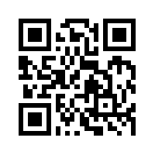
Social Media Apps Programming
Tamkang University
Developing Android Native Apps with Java (Android Studio)
1071SMAP03
TLMXM1A (8550) (M2143) (Fall 2018)
(MIS MBA) (2 Credits, Elective) [Full English Course]
Thu 8,9 (10:10-12:00) B206
Min-Yuh Day, Ph.D.
Assistant Professor
Department of Information Management
Tamkang University
http://mail.tku.edu.tw/myday
2018-09-27

Slide 2
Course Schedule (1/2)
Tamkang University
Week Date Subject/Topics
1 2018/09/13 Course Orientation and Introduction to Social Media and Mobile Apps Programming
2 2018/09/20 Introduction to Android / iOS Apps Programming
3 2018/09/27 Developing Android Native Apps with Java (Android Studio)
4 2018/10/04 Developing iPhone / iPad Native Apps with Swift (XCode)
5 2018/10/11 Mobile Apps using HTML5/CSS3/JavaScript
6 2018/10/18 jQuery Mobile
7 2018/10/25 Create Hybrid Apps with Phonegap
8 2018/11/01 jQuery Mobile/Phonegap
9 2018/11/08 jQuery Mobile/Phonegap

Slide 3
Course Schedule (2/2)
Tamkang University
Week Date Subject/Topics
10 2018/11/15 Midterm Exam Week / Project Presentation
11 2018/11/22 Case Study on Social Media Apps Programming and Marketing in Google Play and App Store
12 2018/11/29 Google Cloud Platform
13 2018/12/06 Google App Engine
14 2018/12/13 Google Map API
15 2018/12/20 Facebook API (Facebook JavaScript SDK) (Integrate Facebook with iOS/Android Apps)
16 2018/12/27 Twitter API
17 2019/01/03 Final Project Presentation
18 2019/01/10 Final Exam Week / Final Project Presentation

Slide 4
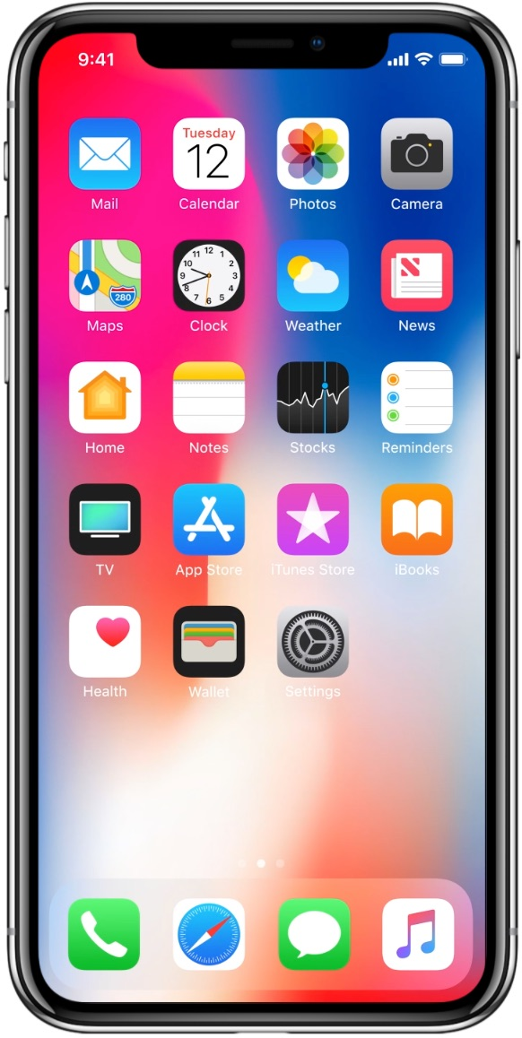
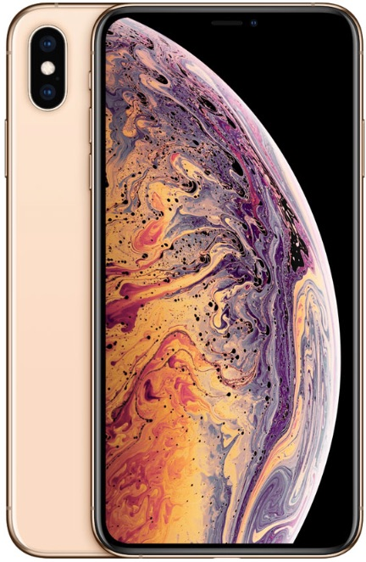
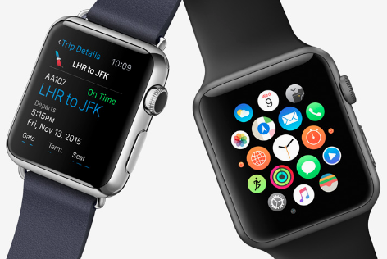
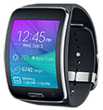
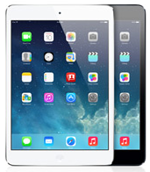
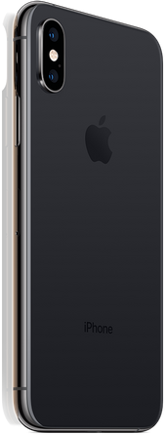
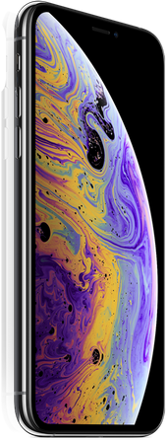
Android /iOS Apps Programming
Native Apps
Hybrid Apps
Mobile Web Apps

Slide 5
App Development Comparison
Device Access
Speed
Development Cost
App Store
Approval Process
Native Apps
Full
Very Fast
Expensive
Available
Mandatory
Hybrid Apps
Full
Native Speed as Necessary
Reasonable
Available
Low Overhead
Web Apps
Partial
Fast
Reasonable
Not Available
None
Source: http://www.scribd.com/doc/50805466/Native-Web-or-Hybrid-Mobile-App-Development

Slide 6
Outline
Developing Android Native Apps with Java
Android Studio
Eclipse
Android Developer Tools (ADT) Bundle
Building Your First Android App

Slide 7
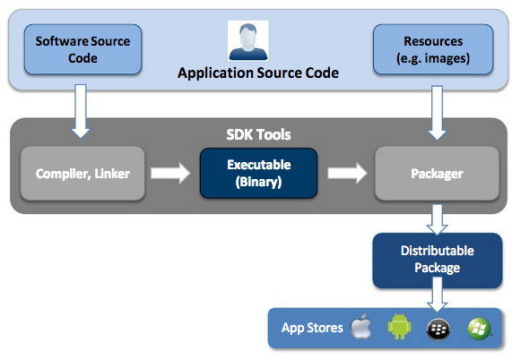
Native App Development
Source: http://www.scribd.com/doc/50805466/Native-Web-or-Hybrid-Mobile-App-Development

Slide 8
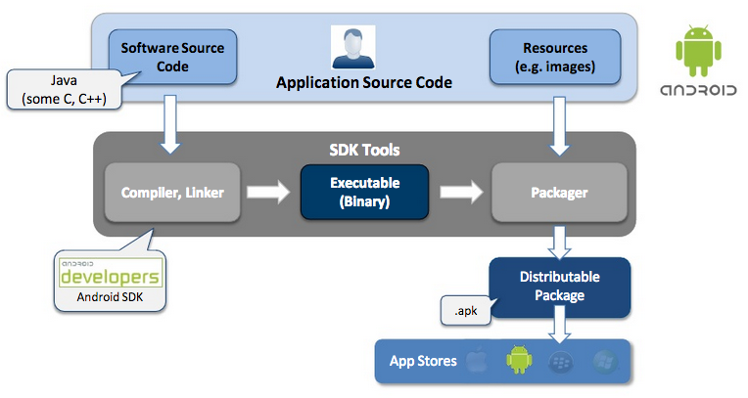
Android - Native App Development
Source: http://www.scribd.com/doc/50805466/Native-Web-or-Hybrid-Mobile-App-Development

Slide 9
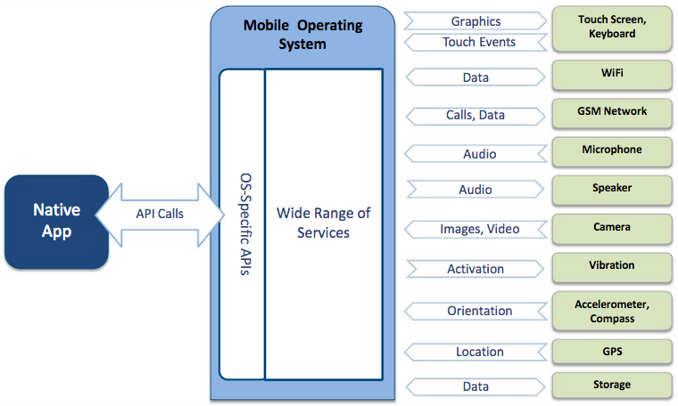
Native App – Interaction with Mobile Device
Source: http://www.scribd.com/doc/50805466/Native-Web-or-Hybrid-Mobile-App-Development

Slide 10
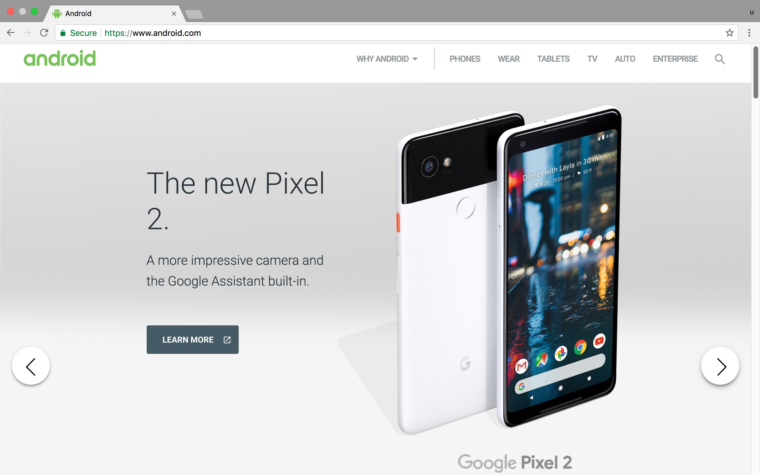
Android
http://www.android.com/

Slide 11
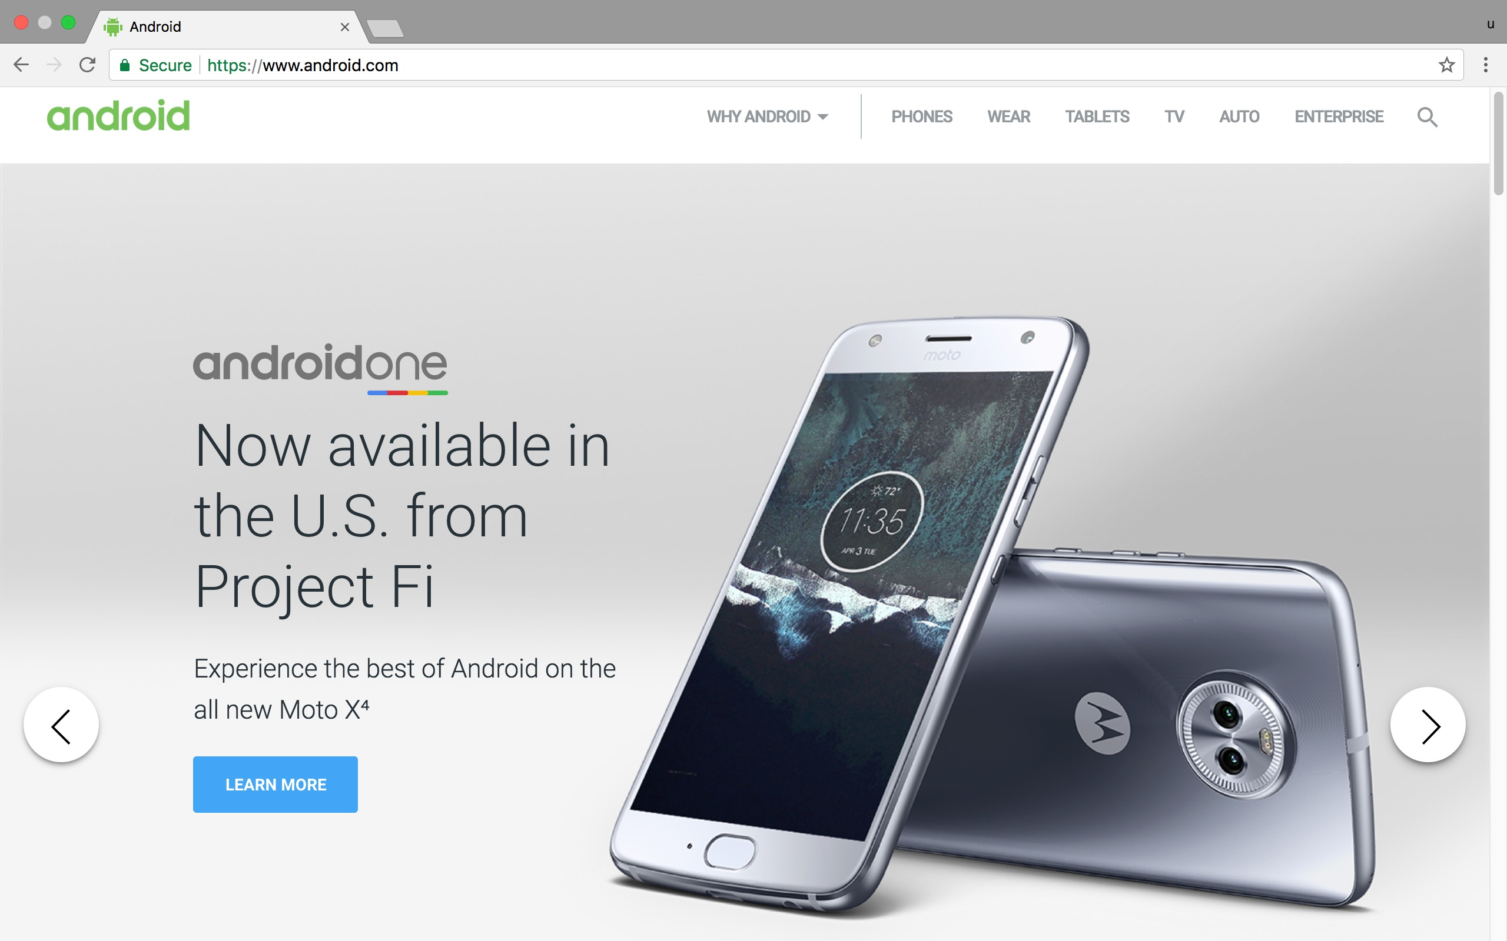
Android
http://www.android.com/

Slide 12
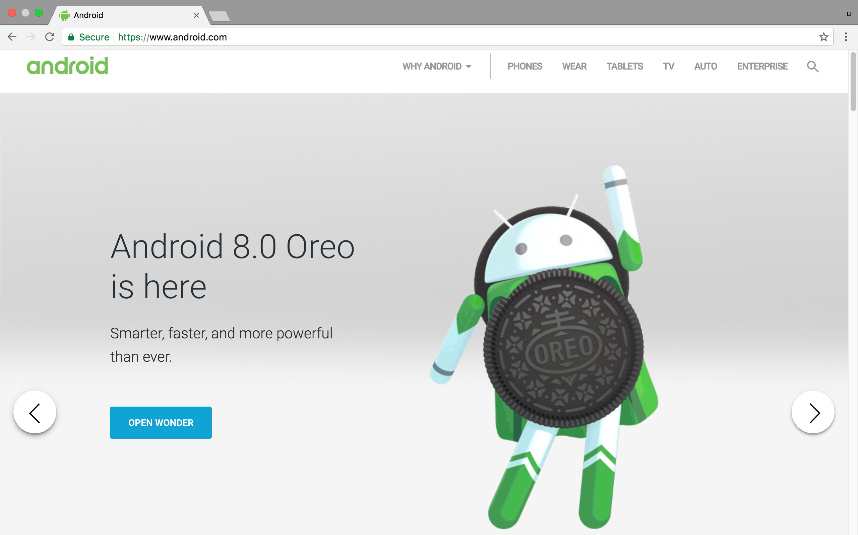
Android
http://www.android.com/

Slide 13
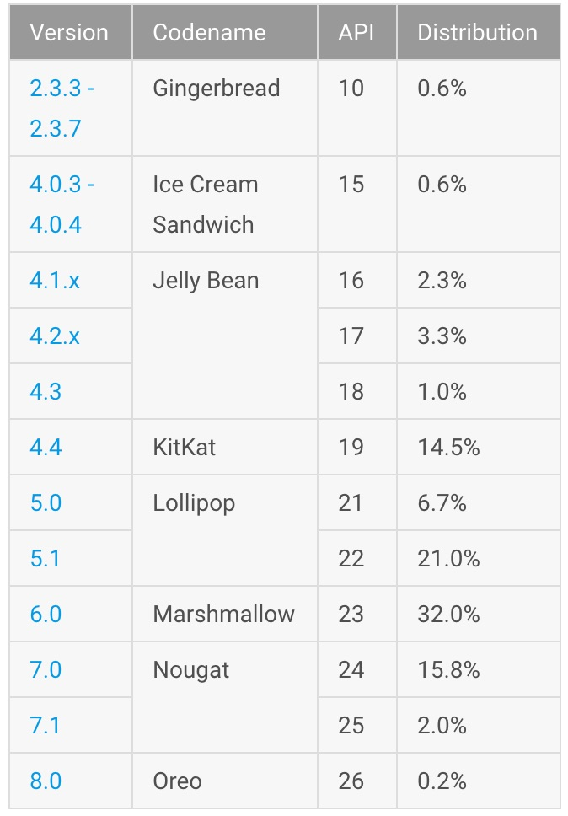
Android Platform
Data collected during a 7-day period ending on October 2, 2017.
http://developer.android.com/about/dashboards/index.html

Slide 14
Android Platform
Data collected during a 7-day period ending on October 2, 2017.
http://developer.android.com/about/dashboards/index.html

Slide 15
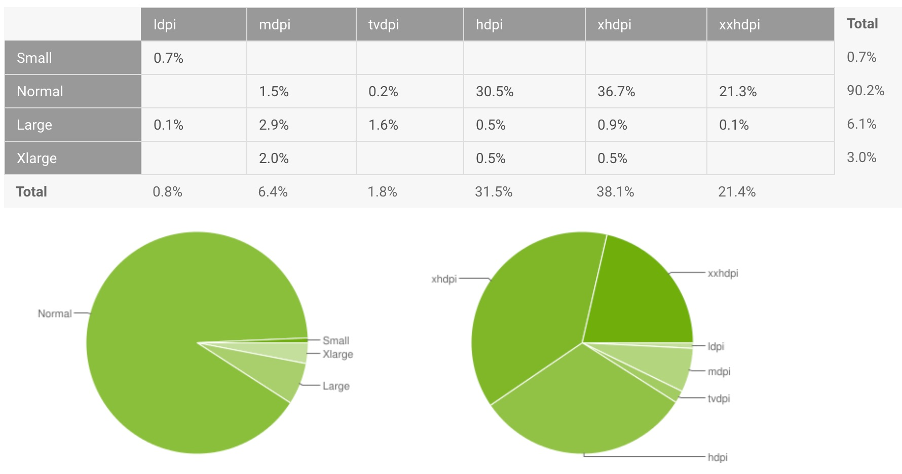
Android Screen Sizes and Densities
Data collected during a 7-day period ending on October 2, 2017.
http://developer.android.com/about/dashboards/index.html

Slide 16
Android Development Environment
Android Native Apps
1
JDK (Java Development Kit)
http://www.oracle.com/technetwork/java/javase/downloads/index.html
Android Studio
2
http://developer.android.com/sdk/index.html

Slide 17
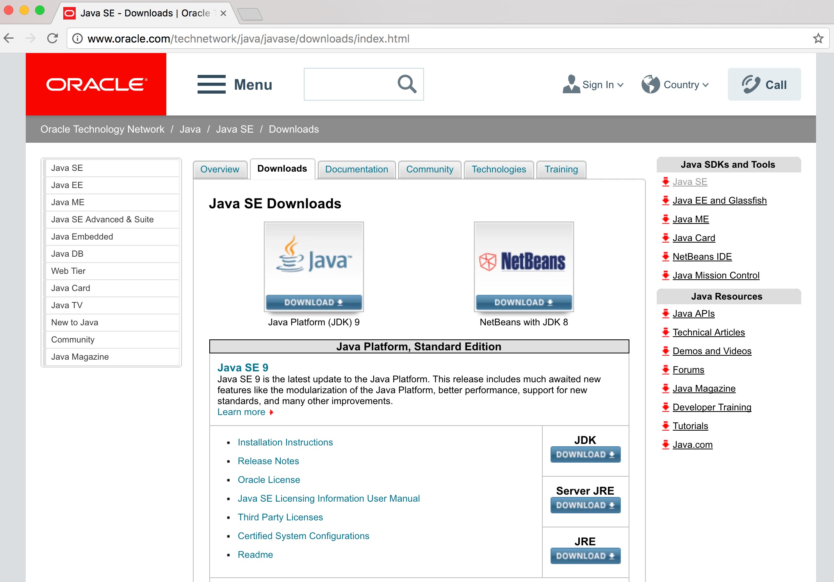
JDK (Java Development Kit)
1
http://www.oracle.com/technetwork/java/javase/downloads/index.html

Slide 18
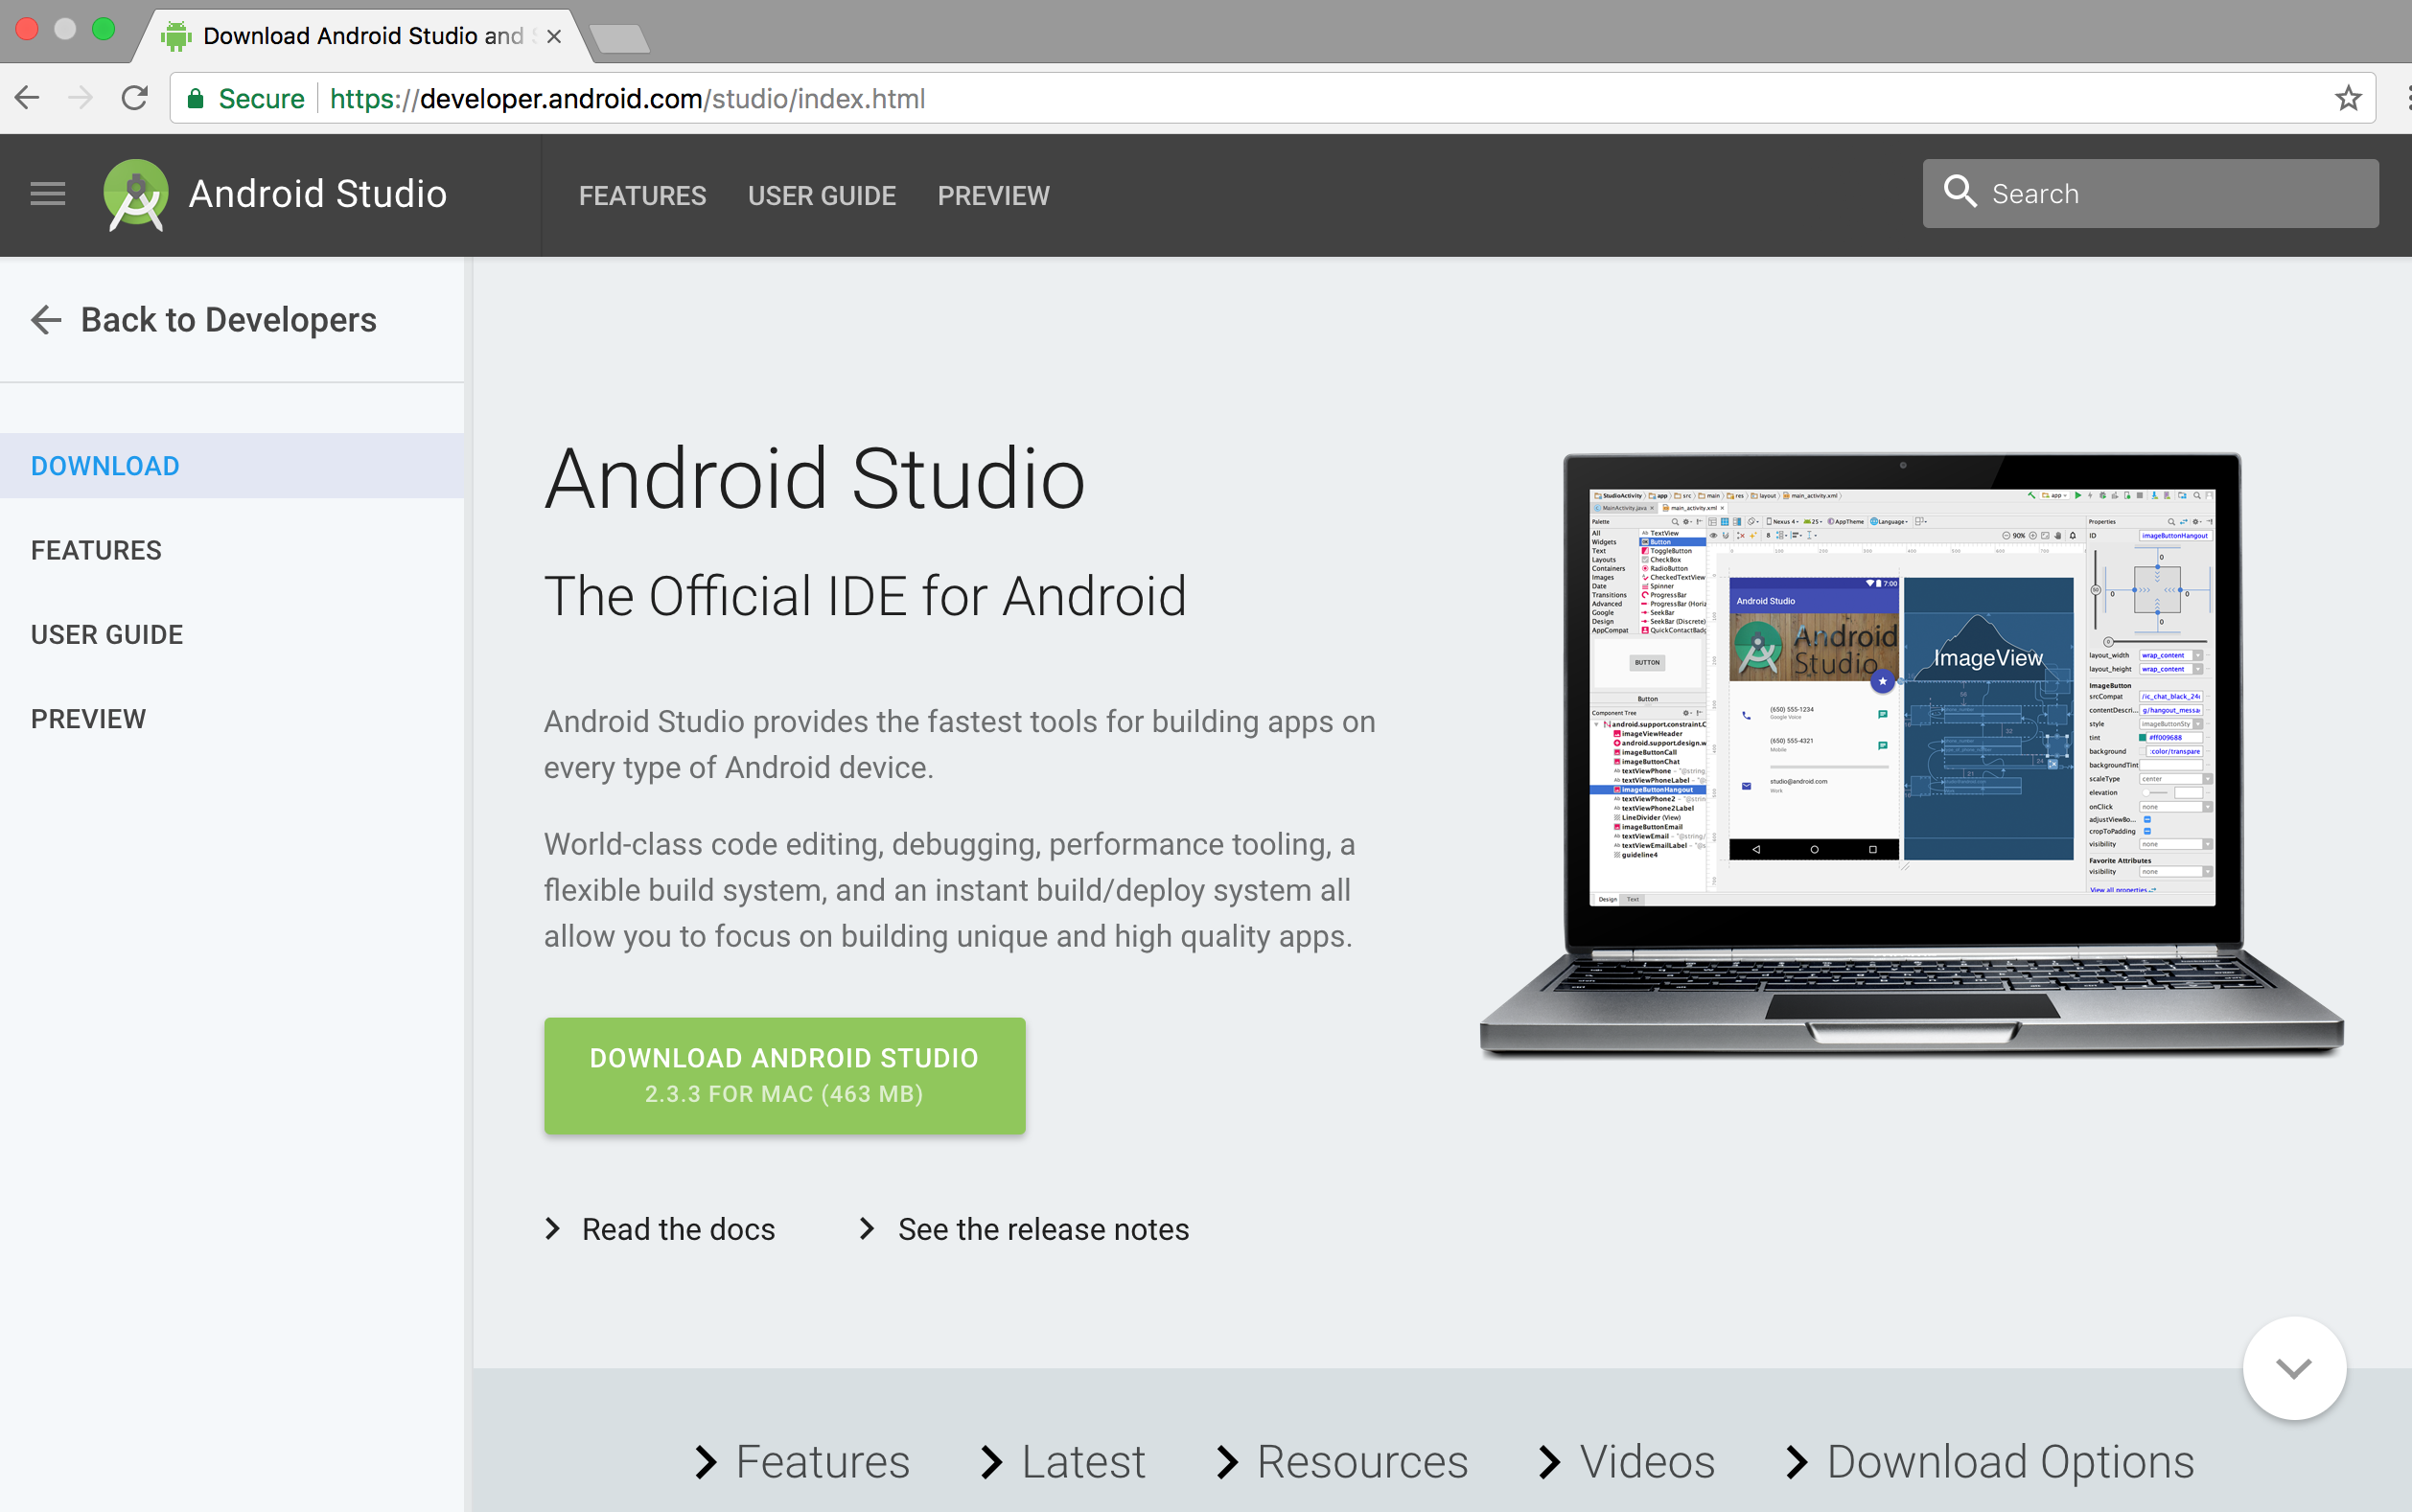
Android Studio
2
Source: https://developer.android.com/studio/index.html

Slide 19
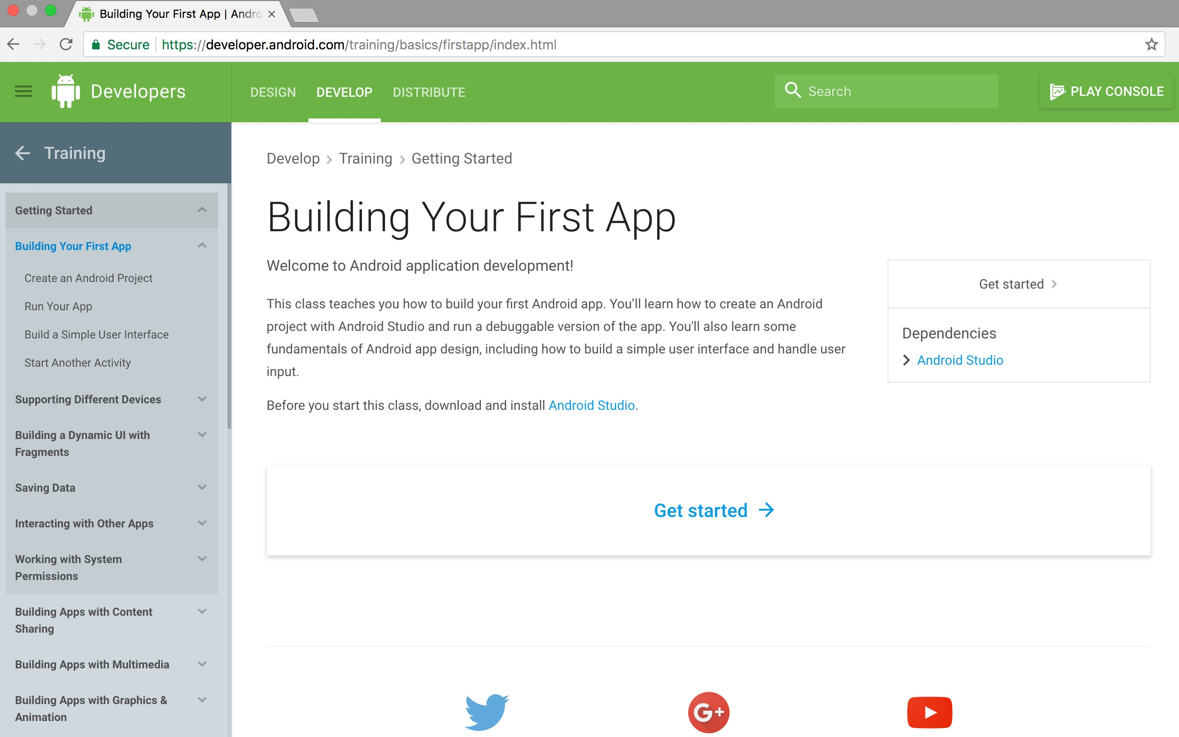
Building Your First App Android Studio
Source: https://developer.android.com/training/basics/firstapp/index.html

Slide 20
Android App Building Blocks
1
Activity
2
Service
3
Broadcast Receiver
4
Content Provider
Source: http://developer.android.com/guide/components/fundamentals.html
Notes:
http://developer.android.com/guide/components/fundamentals.html
Application Components
Application components are the essential building blocks of an Android application. Each component is a different point through which the system can enter your application. Not all components are actual entry points for the user and some depend on each other, but each one exists as its own entity and plays a specific role—each one is a unique building block that helps define your application's overall behavior.
There are four different types of application components. Each type serves a distinct purpose and has a distinct lifecycle that defines how the component is created and destroyed.
Here are the four types of application components:
Activities
An activity represents a single screen with a user interface. For example, an email application might have one activity that shows a list of new emails, another activity to compose an email, and another activity for reading emails. Although the activities work together to form a cohesive user experience in the email application, each one is independent of the others. As such, a different application can start any one of these activities (if the email application allows it). For example, a camera application can start the activity in the email application that composes new mail, in order for the user to share a picture.
An activity is implemented as a subclass of Activity and you can learn more about it in the Activities developer guide.
Services
A service is a component that runs in the background to perform long-running operations or to perform work for remote processes. A service does not provide a user interface. For example, a service might play music in the background while the user is in a different application, or it might fetch data over the network without blocking user interaction with an activity. Another component, such as an activity, can start the service and let it run or bind to it in order to interact with it.
A service is implemented as a subclass of Service and you can learn more about it in the Services developer guide.
Content providers
A content provider manages a shared set of application data. You can store the data in the file system, an SQLite database, on the web, or any other persistent storage location your application can access. Through the content provider, other applications can query or even modify the data (if the content provider allows it). For example, the Android system provides a content provider that manages the user's contact information. As such, any application with the proper permissions can query part of the content provider (such as ContactsContract.Data) to read and write information about a particular person.
Content providers are also useful for reading and writing data that is private to your application and not shared. For example, the Note Pad sample application uses a content provider to save notes.
A content provider is implemented as a subclass of ContentProvider and must implement a standard set of APIs that enable other applications to perform transactions. For more information, see the Content Providers developer guide.
Broadcast receivers
A broadcast receiver is a component that responds to system-wide broadcast announcements. Many broadcasts originate from the system—for example, a broadcast announcing that the screen has turned off, the battery is low, or a picture was captured. Applications can also initiate broadcasts—for example, to let other applications know that some data has been downloaded to the device and is available for them to use. Although broadcast receivers don't display a user interface, they may create a status bar notification to alert the user when a broadcast event occurs. More commonly, though, a broadcast receiver is just a "gateway" to other components and is intended to do a very minimal amount of work. For instance, it might initiate a service to perform some work based on the event.
A broadcast receiver is implemented as a subclass of BroadcastReceiver and each broadcast is delivered as an Intent object. For more information, see the BroadcastReceiver class.
A unique aspect of the Android system design is that any application can start another application’s component. For example, if you want the user to capture a photo with the device camera, there's probably another application that does that and your application can use it, instead of developing an activity to capture a photo yourself. You don't need to incorporate or even link to the code from the camera application. Instead, you can simply start the activity in the camera application that captures a photo. When complete, the photo is even returned to your application so you can use it. To the user, it seems as if the camera is actually a part of your application.
When the system starts a component, it starts the process for that application (if it's not already running) and instantiates the classes needed for the component. For example, if your application starts the activity in the camera application that captures a photo, that activity runs in the process that belongs to the camera application, not in your application's process. Therefore, unlike applications on most other systems, Android applications don't have a single entry point (there's no main() function, for example).
Because the system runs each application in a separate process with file permissions that restrict access to other applications, your application cannot directly activate a component from another application. The Android system, however, can. So, to activate a component in another application, you must deliver a message to the system that specifies your intent to start a particular component. The system then activates the component for you.
Activating Components
Three of the four component types—activities, services, and broadcast receivers—are activated by an asynchronous message called an intent. Intents bind individual components to each other at runtime (you can think of them as the messengers that request an action from other components), whether the component belongs to your application or another.
An intent is created with an Intent object, which defines a message to activate either a specific component or a specific type of component—an intent can be either explicit or implicit, respectively.
For activities and services, an intent defines the action to perform (for example, to "view" or "send" something) and may specify the URI of the data to act on (among other things that the component being started might need to know). For example, an intent might convey a request for an activity to show an image or to open a web page. In some cases, you can start an activity to receive a result, in which case, the activity also returns the result in an Intent (for example, you can issue an intent to let the user pick a personal contact and have it returned to you—the return intent includes a URI pointing to the chosen contact).

Slide 21
Android App Building Blocks
1
Activity
activated by an asynchronous message
2
Service
Intent
3
Broadcast Receiver
4
Content Provider
Source: http://developer.android.com/guide/components/fundamentals.html
Notes:
http://developer.android.com/guide/components/fundamentals.html
Application Components
Application components are the essential building blocks of an Android application. Each component is a different point through which the system can enter your application. Not all components are actual entry points for the user and some depend on each other, but each one exists as its own entity and plays a specific role—each one is a unique building block that helps define your application's overall behavior.
There are four different types of application components. Each type serves a distinct purpose and has a distinct lifecycle that defines how the component is created and destroyed.
Here are the four types of application components:
Activities
An activity represents a single screen with a user interface. For example, an email application might have one activity that shows a list of new emails, another activity to compose an email, and another activity for reading emails. Although the activities work together to form a cohesive user experience in the email application, each one is independent of the others. As such, a different application can start any one of these activities (if the email application allows it). For example, a camera application can start the activity in the email application that composes new mail, in order for the user to share a picture.
An activity is implemented as a subclass of Activity and you can learn more about it in the Activities developer guide.
Services
A service is a component that runs in the background to perform long-running operations or to perform work for remote processes. A service does not provide a user interface. For example, a service might play music in the background while the user is in a different application, or it might fetch data over the network without blocking user interaction with an activity. Another component, such as an activity, can start the service and let it run or bind to it in order to interact with it.
A service is implemented as a subclass of Service and you can learn more about it in the Services developer guide.
Content providers
A content provider manages a shared set of application data. You can store the data in the file system, an SQLite database, on the web, or any other persistent storage location your application can access. Through the content provider, other applications can query or even modify the data (if the content provider allows it). For example, the Android system provides a content provider that manages the user's contact information. As such, any application with the proper permissions can query part of the content provider (such as ContactsContract.Data) to read and write information about a particular person.
Content providers are also useful for reading and writing data that is private to your application and not shared. For example, the Note Pad sample application uses a content provider to save notes.
A content provider is implemented as a subclass of ContentProvider and must implement a standard set of APIs that enable other applications to perform transactions. For more information, see the Content Providers developer guide.
Broadcast receivers
A broadcast receiver is a component that responds to system-wide broadcast announcements. Many broadcasts originate from the system—for example, a broadcast announcing that the screen has turned off, the battery is low, or a picture was captured. Applications can also initiate broadcasts—for example, to let other applications know that some data has been downloaded to the device and is available for them to use. Although broadcast receivers don't display a user interface, they may create a status bar notification to alert the user when a broadcast event occurs. More commonly, though, a broadcast receiver is just a "gateway" to other components and is intended to do a very minimal amount of work. For instance, it might initiate a service to perform some work based on the event.
A broadcast receiver is implemented as a subclass of BroadcastReceiver and each broadcast is delivered as an Intent object. For more information, see the BroadcastReceiver class.
A unique aspect of the Android system design is that any application can start another application’s component. For example, if you want the user to capture a photo with the device camera, there's probably another application that does that and your application can use it, instead of developing an activity to capture a photo yourself. You don't need to incorporate or even link to the code from the camera application. Instead, you can simply start the activity in the camera application that captures a photo. When complete, the photo is even returned to your application so you can use it. To the user, it seems as if the camera is actually a part of your application.
When the system starts a component, it starts the process for that application (if it's not already running) and instantiates the classes needed for the component. For example, if your application starts the activity in the camera application that captures a photo, that activity runs in the process that belongs to the camera application, not in your application's process. Therefore, unlike applications on most other systems, Android applications don't have a single entry point (there's no main() function, for example).
Because the system runs each application in a separate process with file permissions that restrict access to other applications, your application cannot directly activate a component from another application. The Android system, however, can. So, to activate a component in another application, you must deliver a message to the system that specifies your intent to start a particular component. The system then activates the component for you.
Activating Components
Three of the four component types—activities, services, and broadcast receivers—are activated by an asynchronous message called an intent. Intents bind individual components to each other at runtime (you can think of them as the messengers that request an action from other components), whether the component belongs to your application or another.
An intent is created with an Intent object, which defines a message to activate either a specific component or a specific type of component—an intent can be either explicit or implicit, respectively.
For activities and services, an intent defines the action to perform (for example, to "view" or "send" something) and may specify the URI of the data to act on (among other things that the component being started might need to know). For example, an intent might convey a request for an activity to show an image or to open a web page. In some cases, you can start an activity to receive a result, in which case, the activity also returns the result in an Intent (for example, you can issue an intent to let the user pick a personal contact and have it returned to you—the return intent includes a URI pointing to the chosen contact).

Slide 22
Android App Building Blocks
1
Activity
a single screen with a user interface
2
Service
3
Broadcast Receiver
4
Content Provider
Source: http://developer.android.com/guide/components/fundamentals.html
Notes:
http://developer.android.com/guide/components/fundamentals.html
Application Components
Application components are the essential building blocks of an Android application. Each component is a different point through which the system can enter your application. Not all components are actual entry points for the user and some depend on each other, but each one exists as its own entity and plays a specific role—each one is a unique building block that helps define your application's overall behavior.
There are four different types of application components. Each type serves a distinct purpose and has a distinct lifecycle that defines how the component is created and destroyed.
Here are the four types of application components:
Activities
An activity represents a single screen with a user interface. For example, an email application might have one activity that shows a list of new emails, another activity to compose an email, and another activity for reading emails. Although the activities work together to form a cohesive user experience in the email application, each one is independent of the others. As such, a different application can start any one of these activities (if the email application allows it). For example, a camera application can start the activity in the email application that composes new mail, in order for the user to share a picture.
An activity is implemented as a subclass of Activity and you can learn more about it in the Activities developer guide.
Services
A service is a component that runs in the background to perform long-running operations or to perform work for remote processes. A service does not provide a user interface. For example, a service might play music in the background while the user is in a different application, or it might fetch data over the network without blocking user interaction with an activity. Another component, such as an activity, can start the service and let it run or bind to it in order to interact with it.
A service is implemented as a subclass of Service and you can learn more about it in the Services developer guide.
Content providers
A content provider manages a shared set of application data. You can store the data in the file system, an SQLite database, on the web, or any other persistent storage location your application can access. Through the content provider, other applications can query or even modify the data (if the content provider allows it). For example, the Android system provides a content provider that manages the user's contact information. As such, any application with the proper permissions can query part of the content provider (such as ContactsContract.Data) to read and write information about a particular person.
Content providers are also useful for reading and writing data that is private to your application and not shared. For example, the Note Pad sample application uses a content provider to save notes.
A content provider is implemented as a subclass of ContentProvider and must implement a standard set of APIs that enable other applications to perform transactions. For more information, see the Content Providers developer guide.
Broadcast receivers
A broadcast receiver is a component that responds to system-wide broadcast announcements. Many broadcasts originate from the system—for example, a broadcast announcing that the screen has turned off, the battery is low, or a picture was captured. Applications can also initiate broadcasts—for example, to let other applications know that some data has been downloaded to the device and is available for them to use. Although broadcast receivers don't display a user interface, they may create a status bar notification to alert the user when a broadcast event occurs. More commonly, though, a broadcast receiver is just a "gateway" to other components and is intended to do a very minimal amount of work. For instance, it might initiate a service to perform some work based on the event.
A broadcast receiver is implemented as a subclass of BroadcastReceiver and each broadcast is delivered as an Intent object. For more information, see the BroadcastReceiver class.
A unique aspect of the Android system design is that any application can start another application’s component. For example, if you want the user to capture a photo with the device camera, there's probably another application that does that and your application can use it, instead of developing an activity to capture a photo yourself. You don't need to incorporate or even link to the code from the camera application. Instead, you can simply start the activity in the camera application that captures a photo. When complete, the photo is even returned to your application so you can use it. To the user, it seems as if the camera is actually a part of your application.
When the system starts a component, it starts the process for that application (if it's not already running) and instantiates the classes needed for the component. For example, if your application starts the activity in the camera application that captures a photo, that activity runs in the process that belongs to the camera application, not in your application's process. Therefore, unlike applications on most other systems, Android applications don't have a single entry point (there's no main() function, for example).
Because the system runs each application in a separate process with file permissions that restrict access to other applications, your application cannot directly activate a component from another application. The Android system, however, can. So, to activate a component in another application, you must deliver a message to the system that specifies your intent to start a particular component. The system then activates the component for you.
Activating Components
Three of the four component types—activities, services, and broadcast receivers—are activated by an asynchronous message called an intent. Intents bind individual components to each other at runtime (you can think of them as the messengers that request an action from other components), whether the component belongs to your application or another.
An intent is created with an Intent object, which defines a message to activate either a specific component or a specific type of component—an intent can be either explicit or implicit, respectively.
For activities and services, an intent defines the action to perform (for example, to "view" or "send" something) and may specify the URI of the data to act on (among other things that the component being started might need to know). For example, an intent might convey a request for an activity to show an image or to open a web page. In some cases, you can start an activity to receive a result, in which case, the activity also returns the result in an Intent (for example, you can issue an intent to let the user pick a personal contact and have it returned to you—the return intent includes a URI pointing to the chosen contact).

Slide 23
Android App Building Blocks
1
Activity
2
Service
runs in the background to perform long-running operations or to perform work for remote processes
3
Broadcast Receiver
4
Content Provider
Source: http://developer.android.com/guide/components/fundamentals.html
Notes:
http://developer.android.com/guide/components/fundamentals.html
Application Components
Application components are the essential building blocks of an Android application. Each component is a different point through which the system can enter your application. Not all components are actual entry points for the user and some depend on each other, but each one exists as its own entity and plays a specific role—each one is a unique building block that helps define your application's overall behavior.
There are four different types of application components. Each type serves a distinct purpose and has a distinct lifecycle that defines how the component is created and destroyed.
Here are the four types of application components:
Activities
An activity represents a single screen with a user interface. For example, an email application might have one activity that shows a list of new emails, another activity to compose an email, and another activity for reading emails. Although the activities work together to form a cohesive user experience in the email application, each one is independent of the others. As such, a different application can start any one of these activities (if the email application allows it). For example, a camera application can start the activity in the email application that composes new mail, in order for the user to share a picture.
An activity is implemented as a subclass of Activity and you can learn more about it in the Activities developer guide.
Services
A service is a component that runs in the background to perform long-running operations or to perform work for remote processes. A service does not provide a user interface. For example, a service might play music in the background while the user is in a different application, or it might fetch data over the network without blocking user interaction with an activity. Another component, such as an activity, can start the service and let it run or bind to it in order to interact with it.
A service is implemented as a subclass of Service and you can learn more about it in the Services developer guide.
Content providers
A content provider manages a shared set of application data. You can store the data in the file system, an SQLite database, on the web, or any other persistent storage location your application can access. Through the content provider, other applications can query or even modify the data (if the content provider allows it). For example, the Android system provides a content provider that manages the user's contact information. As such, any application with the proper permissions can query part of the content provider (such as ContactsContract.Data) to read and write information about a particular person.
Content providers are also useful for reading and writing data that is private to your application and not shared. For example, the Note Pad sample application uses a content provider to save notes.
A content provider is implemented as a subclass of ContentProvider and must implement a standard set of APIs that enable other applications to perform transactions. For more information, see the Content Providers developer guide.
Broadcast receivers
A broadcast receiver is a component that responds to system-wide broadcast announcements. Many broadcasts originate from the system—for example, a broadcast announcing that the screen has turned off, the battery is low, or a picture was captured. Applications can also initiate broadcasts—for example, to let other applications know that some data has been downloaded to the device and is available for them to use. Although broadcast receivers don't display a user interface, they may create a status bar notification to alert the user when a broadcast event occurs. More commonly, though, a broadcast receiver is just a "gateway" to other components and is intended to do a very minimal amount of work. For instance, it might initiate a service to perform some work based on the event.
A broadcast receiver is implemented as a subclass of BroadcastReceiver and each broadcast is delivered as an Intent object. For more information, see the BroadcastReceiver class.
A unique aspect of the Android system design is that any application can start another application’s component. For example, if you want the user to capture a photo with the device camera, there's probably another application that does that and your application can use it, instead of developing an activity to capture a photo yourself. You don't need to incorporate or even link to the code from the camera application. Instead, you can simply start the activity in the camera application that captures a photo. When complete, the photo is even returned to your application so you can use it. To the user, it seems as if the camera is actually a part of your application.
When the system starts a component, it starts the process for that application (if it's not already running) and instantiates the classes needed for the component. For example, if your application starts the activity in the camera application that captures a photo, that activity runs in the process that belongs to the camera application, not in your application's process. Therefore, unlike applications on most other systems, Android applications don't have a single entry point (there's no main() function, for example).
Because the system runs each application in a separate process with file permissions that restrict access to other applications, your application cannot directly activate a component from another application. The Android system, however, can. So, to activate a component in another application, you must deliver a message to the system that specifies your intent to start a particular component. The system then activates the component for you.
Activating Components
Three of the four component types—activities, services, and broadcast receivers—are activated by an asynchronous message called an intent. Intents bind individual components to each other at runtime (you can think of them as the messengers that request an action from other components), whether the component belongs to your application or another.
An intent is created with an Intent object, which defines a message to activate either a specific component or a specific type of component—an intent can be either explicit or implicit, respectively.
For activities and services, an intent defines the action to perform (for example, to "view" or "send" something) and may specify the URI of the data to act on (among other things that the component being started might need to know). For example, an intent might convey a request for an activity to show an image or to open a web page. In some cases, you can start an activity to receive a result, in which case, the activity also returns the result in an Intent (for example, you can issue an intent to let the user pick a personal contact and have it returned to you—the return intent includes a URI pointing to the chosen contact).

Slide 24
Android App Building Blocks
1
Activity
2
Service
3
Broadcast Receiver
responds to system-wide broadcast announcements
4
Content Provider
Source: http://developer.android.com/guide/components/fundamentals.html
Notes:
http://developer.android.com/guide/components/fundamentals.html
Application Components
Application components are the essential building blocks of an Android application. Each component is a different point through which the system can enter your application. Not all components are actual entry points for the user and some depend on each other, but each one exists as its own entity and plays a specific role—each one is a unique building block that helps define your application's overall behavior.
There are four different types of application components. Each type serves a distinct purpose and has a distinct lifecycle that defines how the component is created and destroyed.
Here are the four types of application components:
Activities
An activity represents a single screen with a user interface. For example, an email application might have one activity that shows a list of new emails, another activity to compose an email, and another activity for reading emails. Although the activities work together to form a cohesive user experience in the email application, each one is independent of the others. As such, a different application can start any one of these activities (if the email application allows it). For example, a camera application can start the activity in the email application that composes new mail, in order for the user to share a picture.
An activity is implemented as a subclass of Activity and you can learn more about it in the Activities developer guide.
Services
A service is a component that runs in the background to perform long-running operations or to perform work for remote processes. A service does not provide a user interface. For example, a service might play music in the background while the user is in a different application, or it might fetch data over the network without blocking user interaction with an activity. Another component, such as an activity, can start the service and let it run or bind to it in order to interact with it.
A service is implemented as a subclass of Service and you can learn more about it in the Services developer guide.
Content providers
A content provider manages a shared set of application data. You can store the data in the file system, an SQLite database, on the web, or any other persistent storage location your application can access. Through the content provider, other applications can query or even modify the data (if the content provider allows it). For example, the Android system provides a content provider that manages the user's contact information. As such, any application with the proper permissions can query part of the content provider (such as ContactsContract.Data) to read and write information about a particular person.
Content providers are also useful for reading and writing data that is private to your application and not shared. For example, the Note Pad sample application uses a content provider to save notes.
A content provider is implemented as a subclass of ContentProvider and must implement a standard set of APIs that enable other applications to perform transactions. For more information, see the Content Providers developer guide.
Broadcast receivers
A broadcast receiver is a component that responds to system-wide broadcast announcements. Many broadcasts originate from the system—for example, a broadcast announcing that the screen has turned off, the battery is low, or a picture was captured. Applications can also initiate broadcasts—for example, to let other applications know that some data has been downloaded to the device and is available for them to use. Although broadcast receivers don't display a user interface, they may create a status bar notification to alert the user when a broadcast event occurs. More commonly, though, a broadcast receiver is just a "gateway" to other components and is intended to do a very minimal amount of work. For instance, it might initiate a service to perform some work based on the event.
A broadcast receiver is implemented as a subclass of BroadcastReceiver and each broadcast is delivered as an Intent object. For more information, see the BroadcastReceiver class.
A unique aspect of the Android system design is that any application can start another application’s component. For example, if you want the user to capture a photo with the device camera, there's probably another application that does that and your application can use it, instead of developing an activity to capture a photo yourself. You don't need to incorporate or even link to the code from the camera application. Instead, you can simply start the activity in the camera application that captures a photo. When complete, the photo is even returned to your application so you can use it. To the user, it seems as if the camera is actually a part of your application.
When the system starts a component, it starts the process for that application (if it's not already running) and instantiates the classes needed for the component. For example, if your application starts the activity in the camera application that captures a photo, that activity runs in the process that belongs to the camera application, not in your application's process. Therefore, unlike applications on most other systems, Android applications don't have a single entry point (there's no main() function, for example).
Because the system runs each application in a separate process with file permissions that restrict access to other applications, your application cannot directly activate a component from another application. The Android system, however, can. So, to activate a component in another application, you must deliver a message to the system that specifies your intent to start a particular component. The system then activates the component for you.
Activating Components
Three of the four component types—activities, services, and broadcast receivers—are activated by an asynchronous message called an intent. Intents bind individual components to each other at runtime (you can think of them as the messengers that request an action from other components), whether the component belongs to your application or another.
An intent is created with an Intent object, which defines a message to activate either a specific component or a specific type of component—an intent can be either explicit or implicit, respectively.
For activities and services, an intent defines the action to perform (for example, to "view" or "send" something) and may specify the URI of the data to act on (among other things that the component being started might need to know). For example, an intent might convey a request for an activity to show an image or to open a web page. In some cases, you can start an activity to receive a result, in which case, the activity also returns the result in an Intent (for example, you can issue an intent to let the user pick a personal contact and have it returned to you—the return intent includes a URI pointing to the chosen contact).

Slide 25
Android App Building Blocks
1
Activity
2
Service
3
Broadcast Receiver
4
Content Provider
manages a shared set of application data
Source: http://developer.android.com/guide/components/fundamentals.html
Notes:
http://developer.android.com/guide/components/fundamentals.html
Application Components
Application components are the essential building blocks of an Android application. Each component is a different point through which the system can enter your application. Not all components are actual entry points for the user and some depend on each other, but each one exists as its own entity and plays a specific role—each one is a unique building block that helps define your application's overall behavior.
There are four different types of application components. Each type serves a distinct purpose and has a distinct lifecycle that defines how the component is created and destroyed.
Here are the four types of application components:
Activities
An activity represents a single screen with a user interface. For example, an email application might have one activity that shows a list of new emails, another activity to compose an email, and another activity for reading emails. Although the activities work together to form a cohesive user experience in the email application, each one is independent of the others. As such, a different application can start any one of these activities (if the email application allows it). For example, a camera application can start the activity in the email application that composes new mail, in order for the user to share a picture.
An activity is implemented as a subclass of Activity and you can learn more about it in the Activities developer guide.
Services
A service is a component that runs in the background to perform long-running operations or to perform work for remote processes. A service does not provide a user interface. For example, a service might play music in the background while the user is in a different application, or it might fetch data over the network without blocking user interaction with an activity. Another component, such as an activity, can start the service and let it run or bind to it in order to interact with it.
A service is implemented as a subclass of Service and you can learn more about it in the Services developer guide.
Content providers
A content provider manages a shared set of application data. You can store the data in the file system, an SQLite database, on the web, or any other persistent storage location your application can access. Through the content provider, other applications can query or even modify the data (if the content provider allows it). For example, the Android system provides a content provider that manages the user's contact information. As such, any application with the proper permissions can query part of the content provider (such as ContactsContract.Data) to read and write information about a particular person.
Content providers are also useful for reading and writing data that is private to your application and not shared. For example, the Note Pad sample application uses a content provider to save notes.
A content provider is implemented as a subclass of ContentProvider and must implement a standard set of APIs that enable other applications to perform transactions. For more information, see the Content Providers developer guide.
Broadcast receivers
A broadcast receiver is a component that responds to system-wide broadcast announcements. Many broadcasts originate from the system—for example, a broadcast announcing that the screen has turned off, the battery is low, or a picture was captured. Applications can also initiate broadcasts—for example, to let other applications know that some data has been downloaded to the device and is available for them to use. Although broadcast receivers don't display a user interface, they may create a status bar notification to alert the user when a broadcast event occurs. More commonly, though, a broadcast receiver is just a "gateway" to other components and is intended to do a very minimal amount of work. For instance, it might initiate a service to perform some work based on the event.
A broadcast receiver is implemented as a subclass of BroadcastReceiver and each broadcast is delivered as an Intent object. For more information, see the BroadcastReceiver class.
A unique aspect of the Android system design is that any application can start another application’s component. For example, if you want the user to capture a photo with the device camera, there's probably another application that does that and your application can use it, instead of developing an activity to capture a photo yourself. You don't need to incorporate or even link to the code from the camera application. Instead, you can simply start the activity in the camera application that captures a photo. When complete, the photo is even returned to your application so you can use it. To the user, it seems as if the camera is actually a part of your application.
When the system starts a component, it starts the process for that application (if it's not already running) and instantiates the classes needed for the component. For example, if your application starts the activity in the camera application that captures a photo, that activity runs in the process that belongs to the camera application, not in your application's process. Therefore, unlike applications on most other systems, Android applications don't have a single entry point (there's no main() function, for example).
Because the system runs each application in a separate process with file permissions that restrict access to other applications, your application cannot directly activate a component from another application. The Android system, however, can. So, to activate a component in another application, you must deliver a message to the system that specifies your intent to start a particular component. The system then activates the component for you.
Activating Components
Three of the four component types—activities, services, and broadcast receivers—are activated by an asynchronous message called an intent. Intents bind individual components to each other at runtime (you can think of them as the messengers that request an action from other components), whether the component belongs to your application or another.
An intent is created with an Intent object, which defines a message to activate either a specific component or a specific type of component—an intent can be either explicit or implicit, respectively.
For activities and services, an intent defines the action to perform (for example, to "view" or "send" something) and may specify the URI of the data to act on (among other things that the component being started might need to know). For example, an intent might convey a request for an activity to show an image or to open a web page. In some cases, you can start an activity to receive a result, in which case, the activity also returns the result in an Intent (for example, you can issue an intent to let the user pick a personal contact and have it returned to you—the return intent includes a URI pointing to the chosen contact).

Slide 26
Developing Android Apps
Screen Layout Design: Views and Layouts
Graphical Layout
activity_main.xml
App Components (Activity) Programming
MainActivity.java

Slide 27
Building a Simple User Interface
Create a Linear Layout
Add a Text Field
Add String Resources
Add a Button
Make the Input Box Fill in the Screen Width
Source: http://developer.android.com/training/basics/firstapp/building-ui.html

Slide 28
Building a Simple User Interface
ViewGroup
ViewGroup
View
View
View
View
View
Source: http://developer.android.com/training/basics/firstapp/building-ui.html

Slide 29
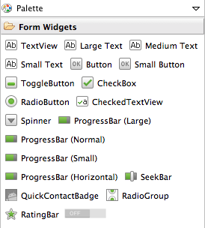
Building a Simple User Interface
View
ViewGroup
TextView
Button
ViewGroup
View
View
View
View
View
View
Source: http://developer.android.com/training/basics/firstapp/building-ui.html

Slide 30
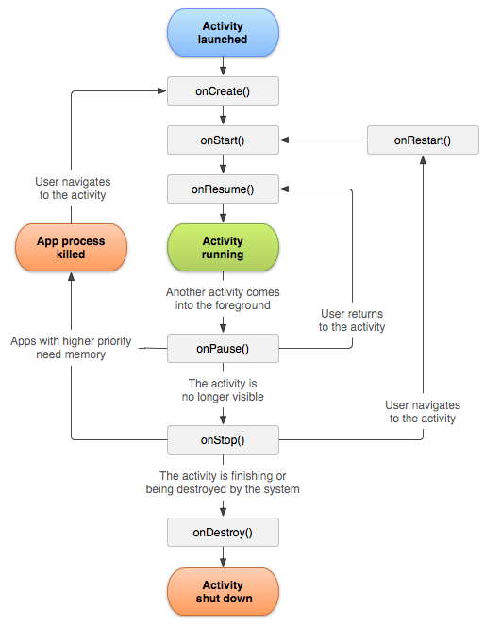
Android App Activity Lifecycle
Source: http://developer.android.com/reference/android/app/Activity.html

Slide 31
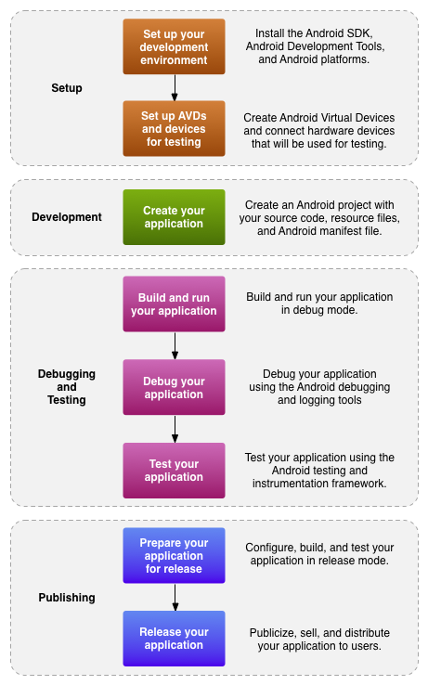
The development process for Android applications
Source: http://developer.android.com/tools/workflow/index.html

Slide 32
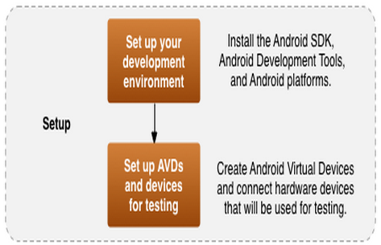
1. Setup

Slide 33
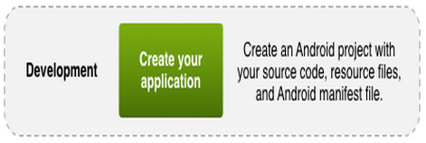
2. Development

Slide 34
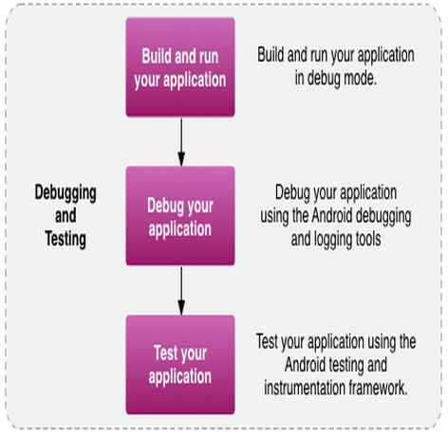
3. Debugging and Testing

Slide 35
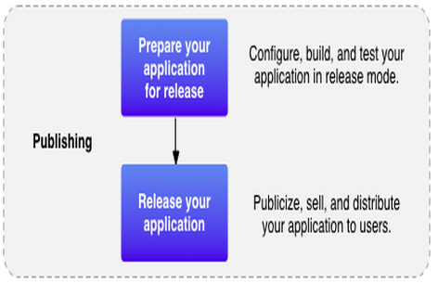
4. Publishing

Slide 36
Demo: Building Your First Android App with Android Studio

Slide 37
Java SE Development Kit (JDK)
http://www.oracle.com/technetwork/java/javase/downloads/index.html

Slide 38
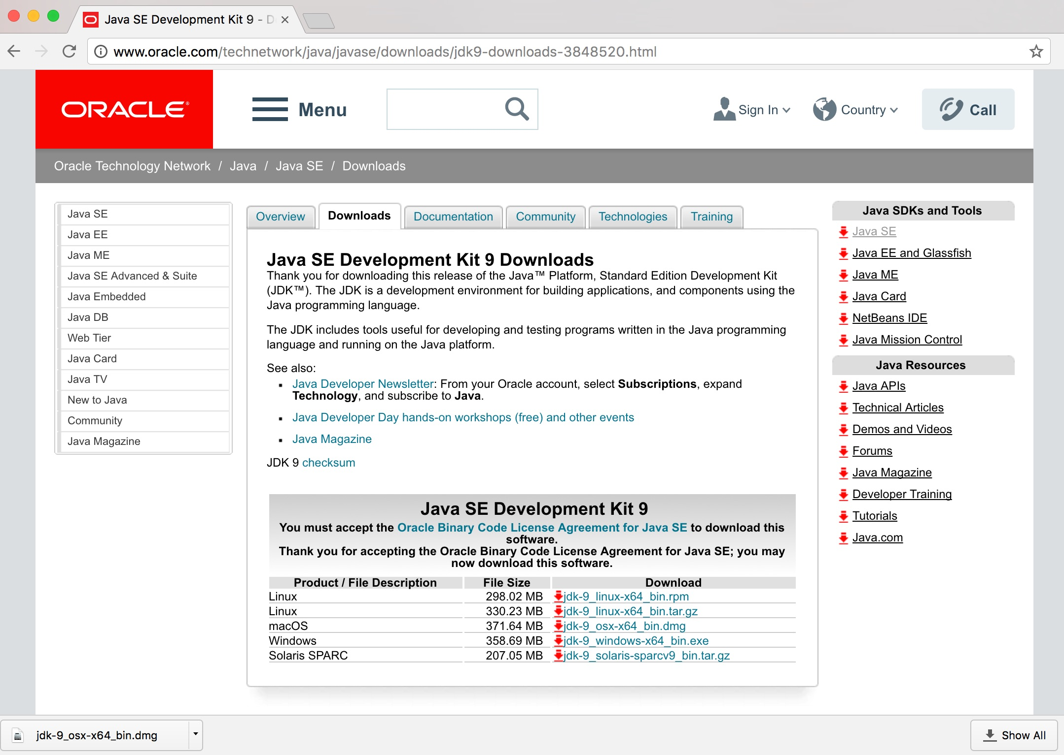
Java SE Development Kit (JDK)
http://www.oracle.com/technetwork/java/javase/downloads/jdk9-downloads-3848520.html

Slide 39
Android Studio
Source: https://developer.android.com/studio/index.html

Slide 40
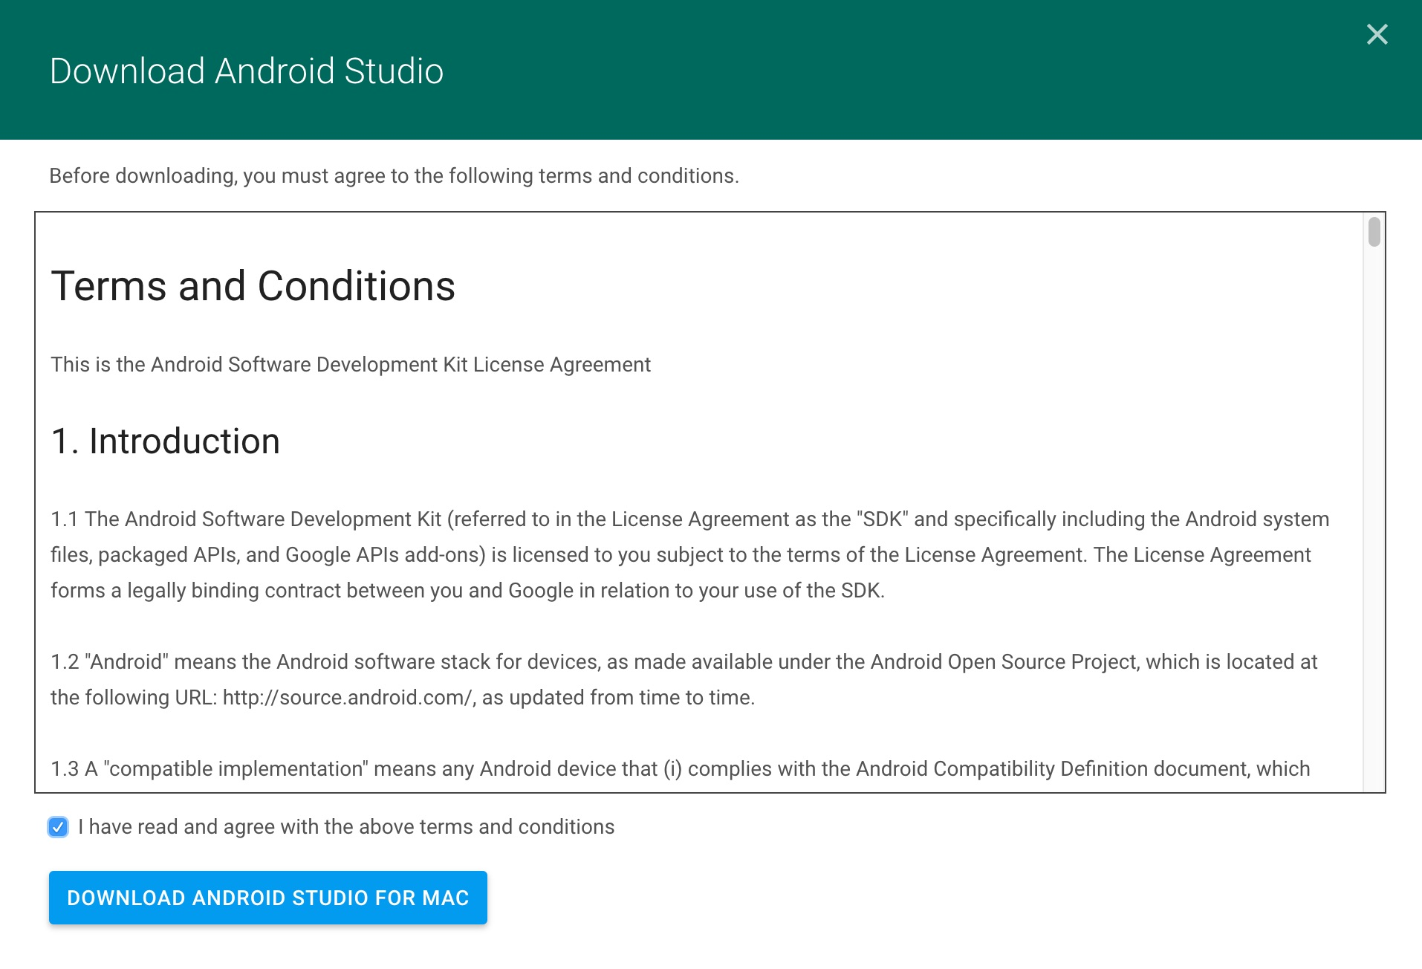

Slide 41
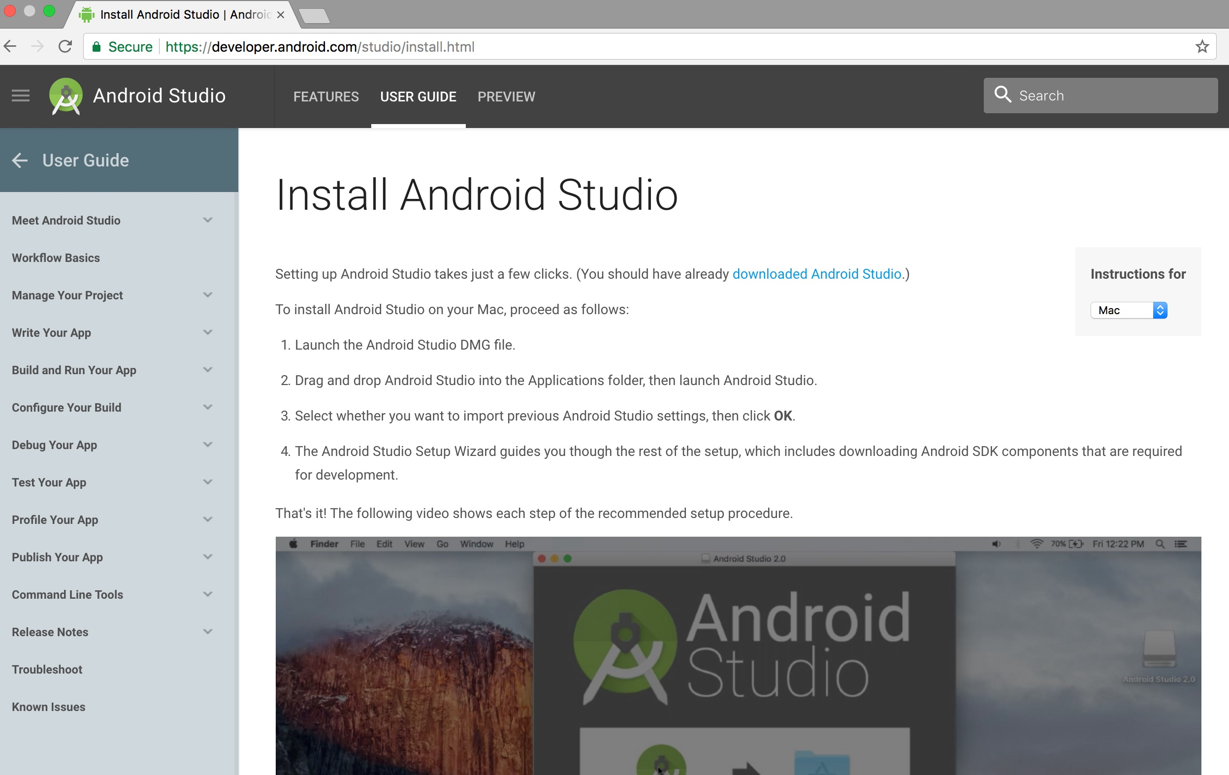
Install Android Studio

Slide 42
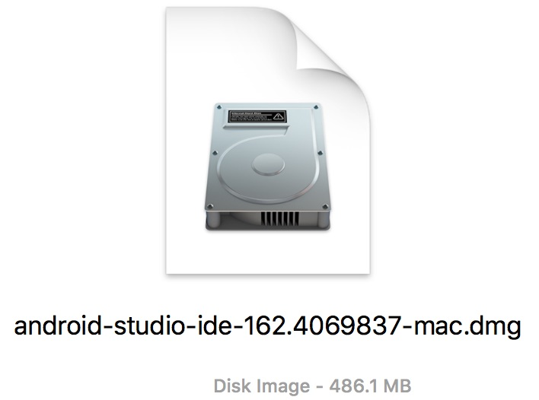
Install Android Studio

Slide 43
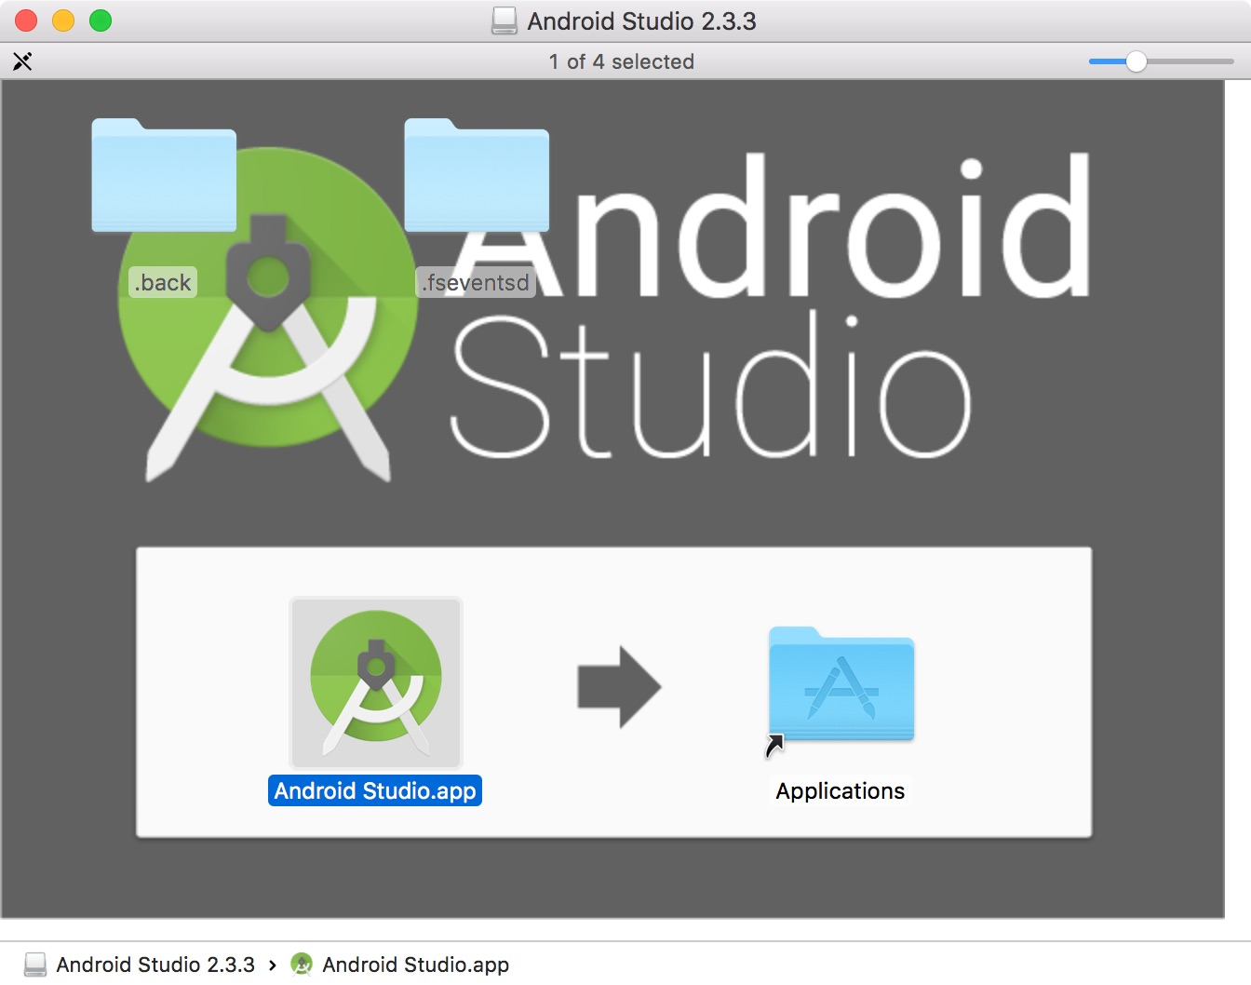
Install Android Studio

Slide 44
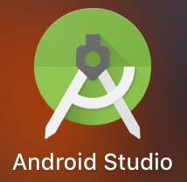
Android Studio

Slide 45
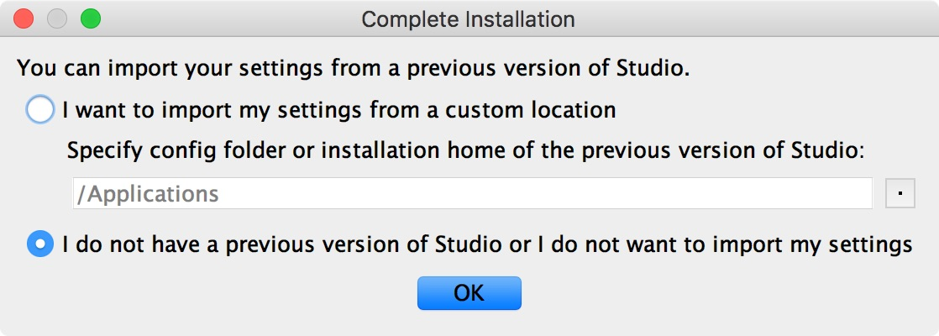

Slide 46
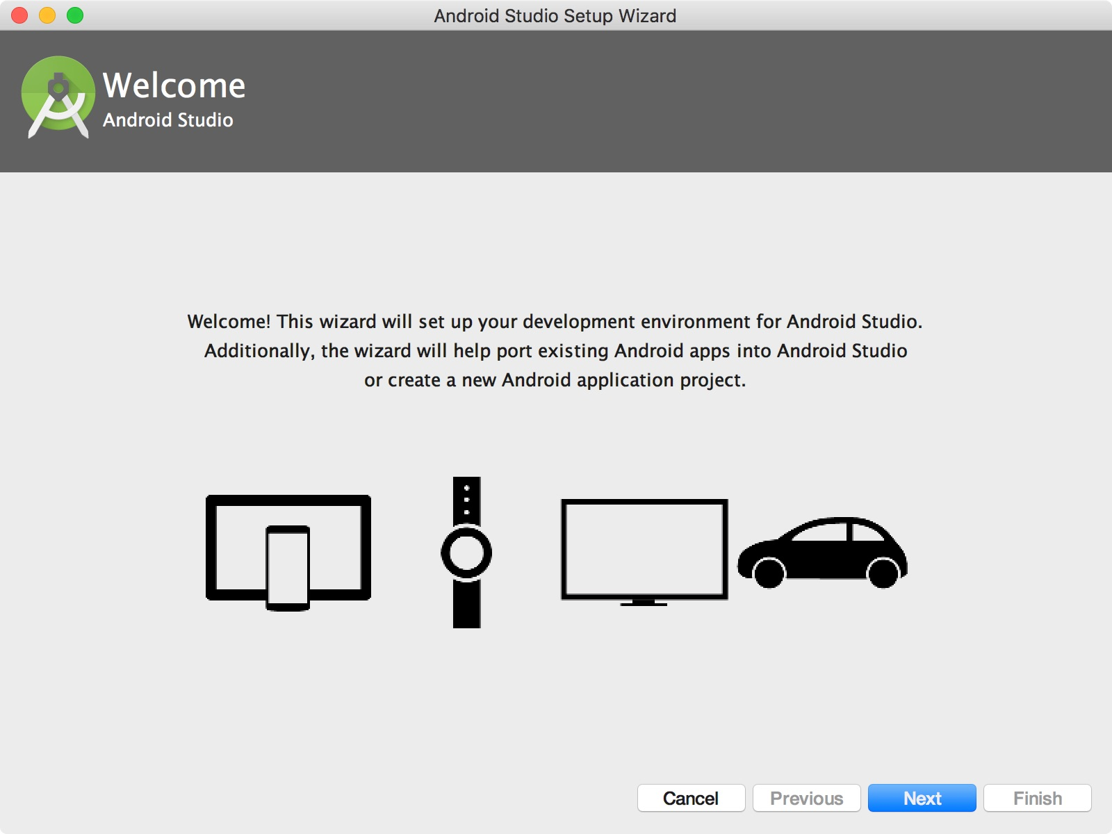

Slide 47
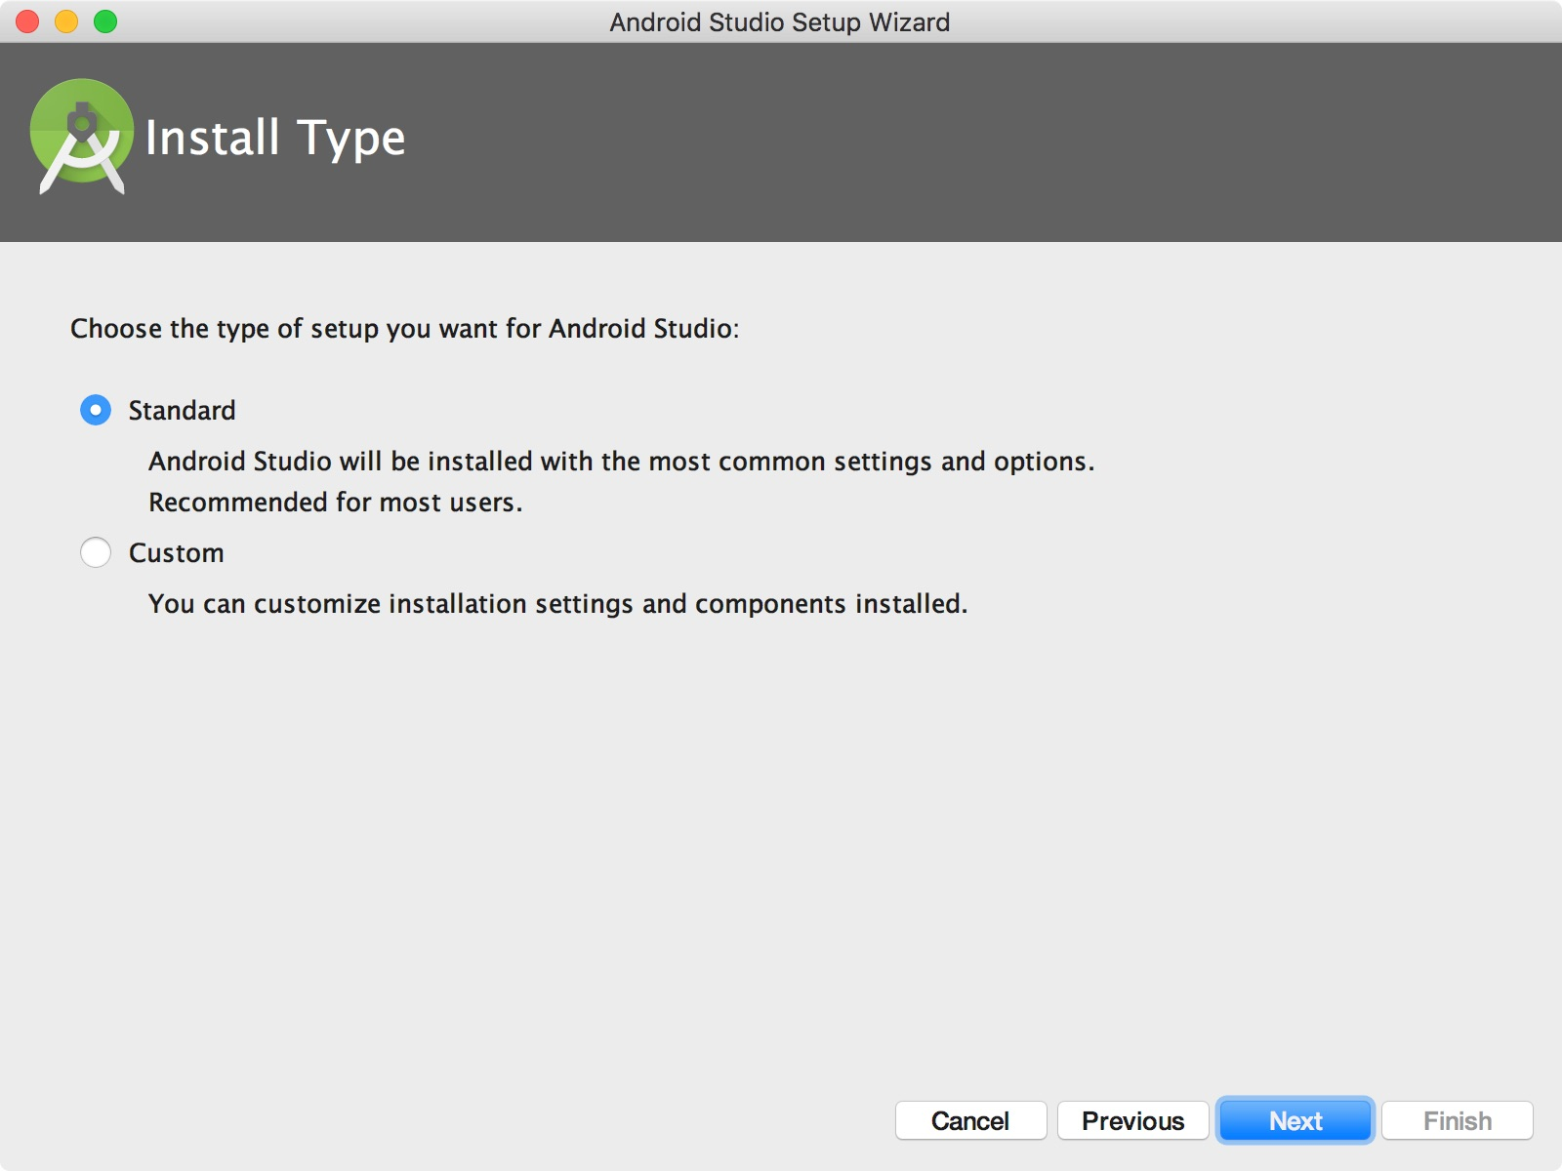

Slide 48
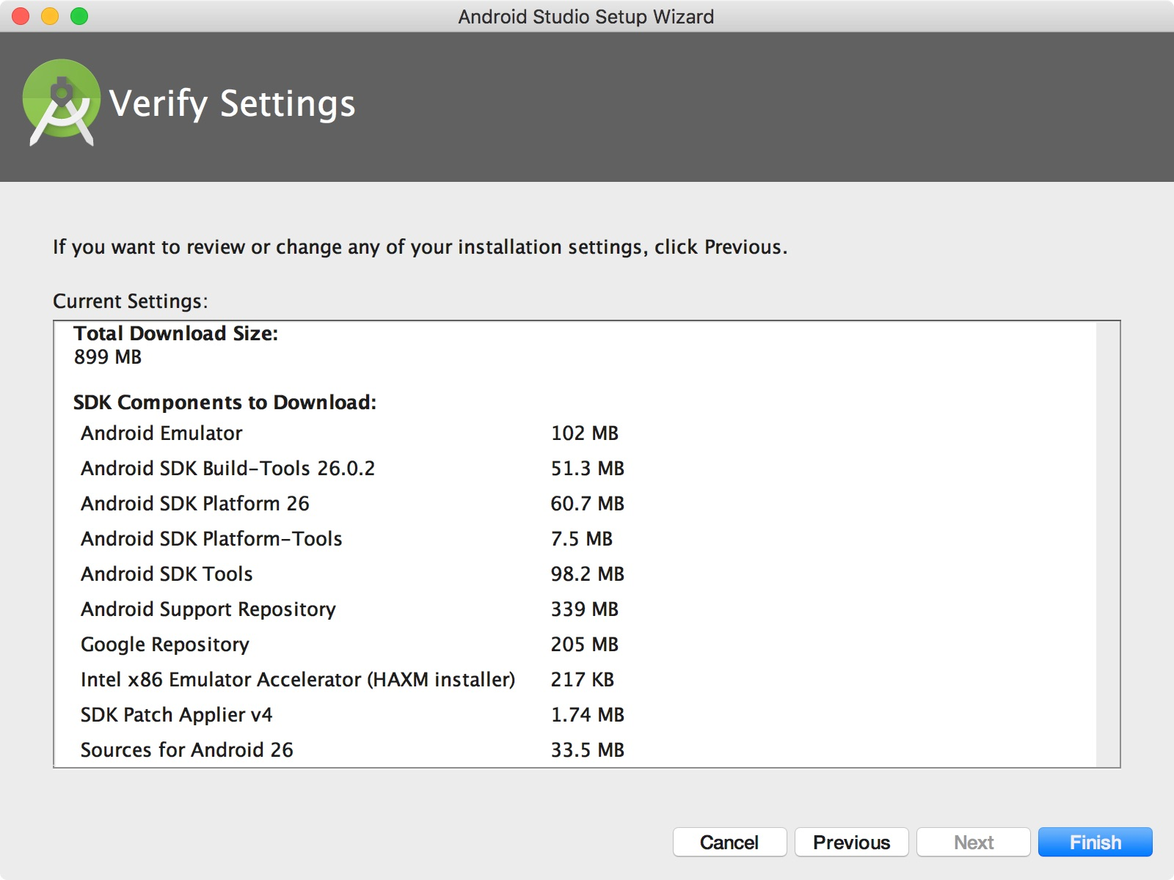

Slide 49
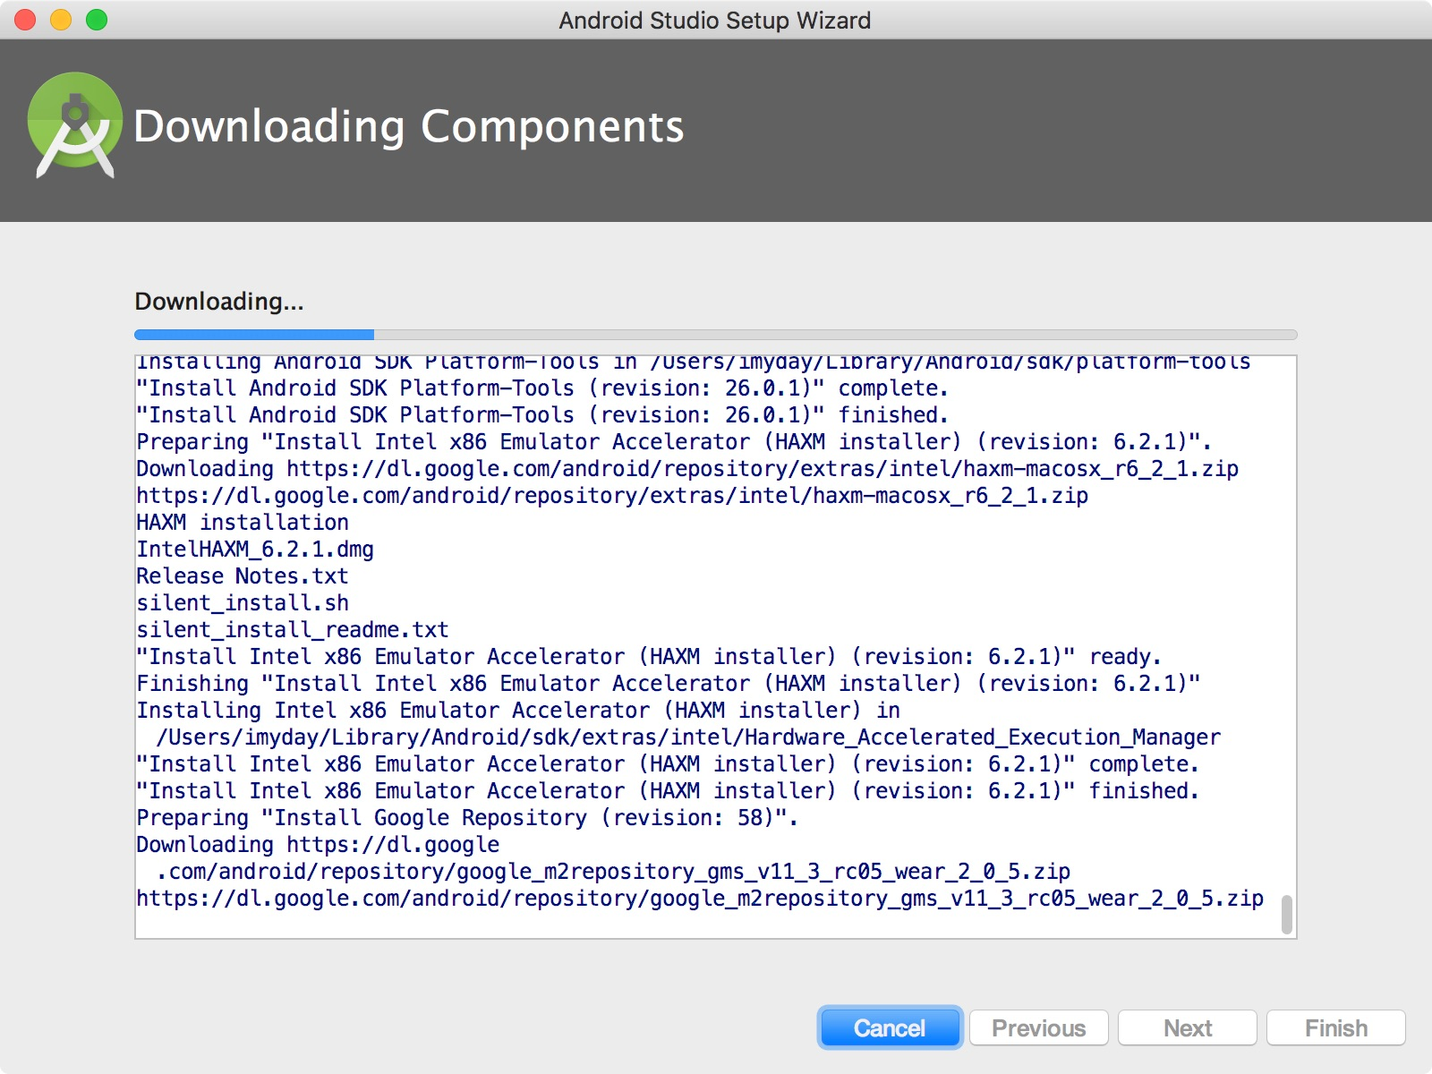

Slide 50
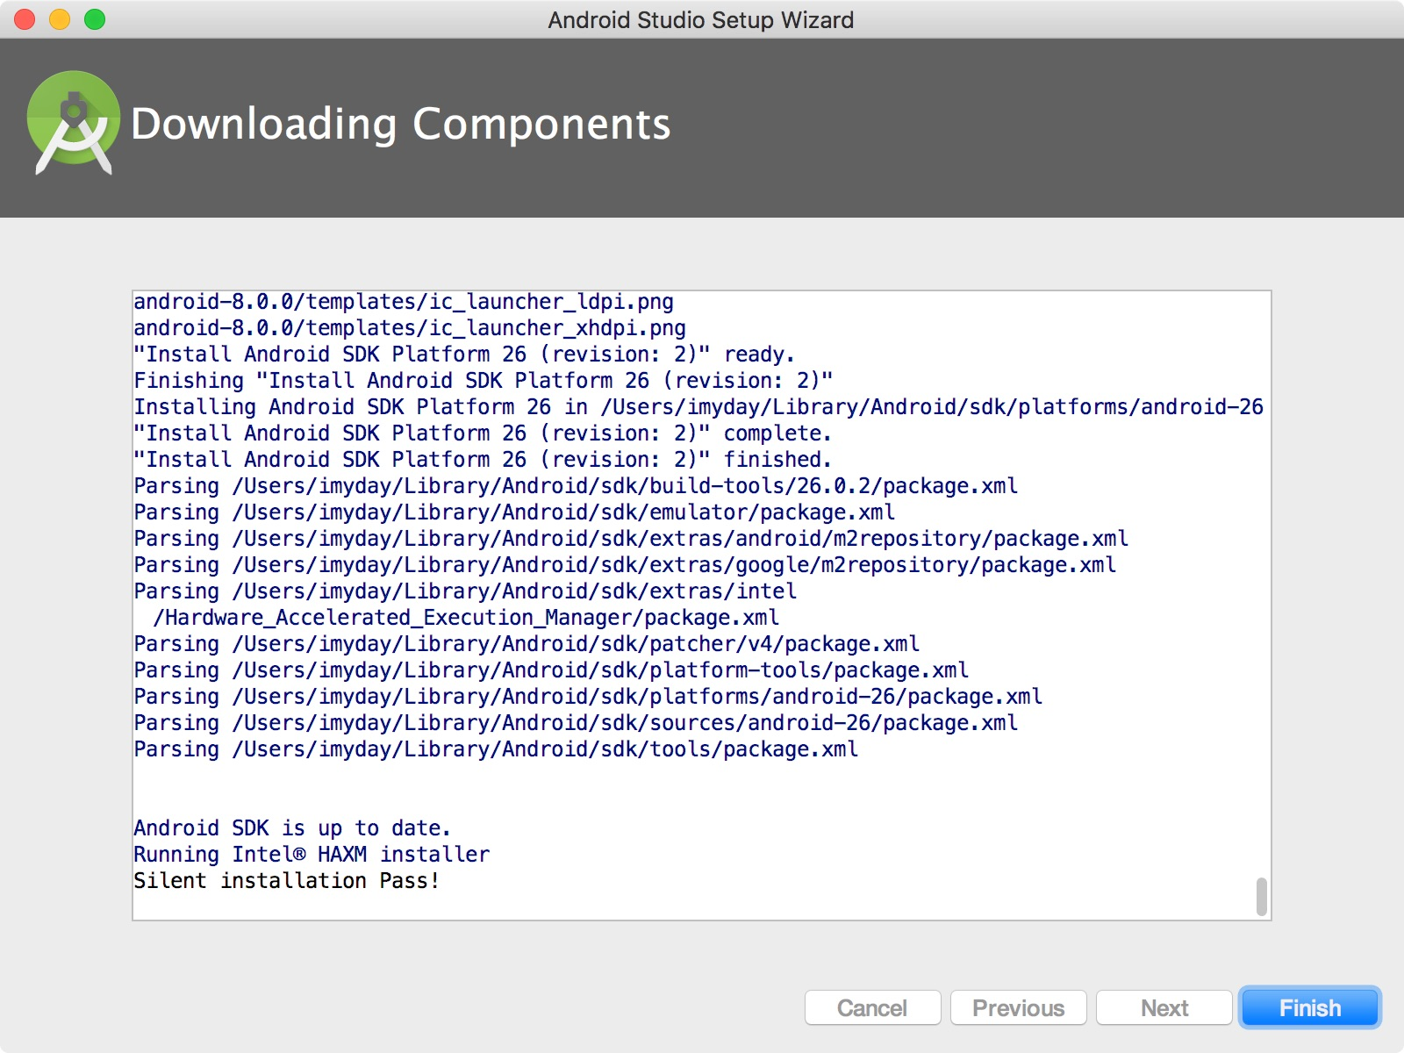

Slide 51
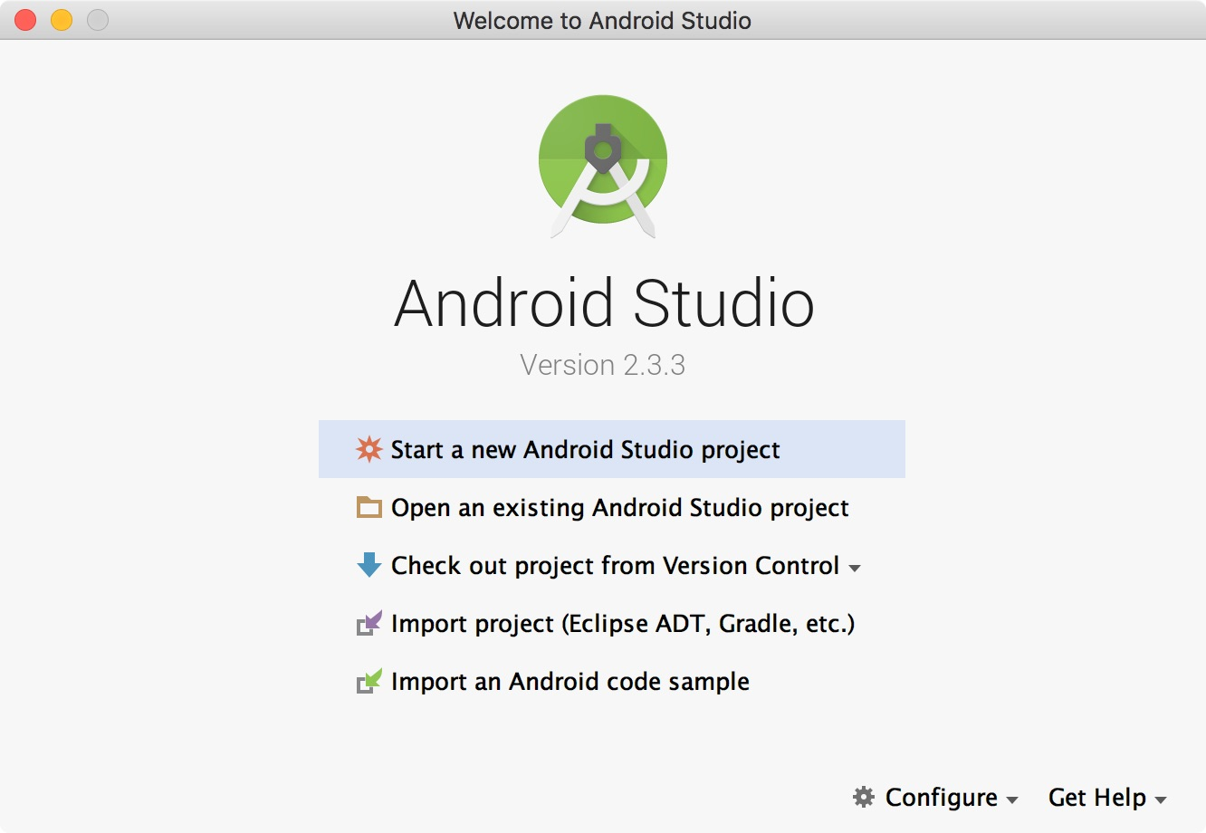

Slide 52
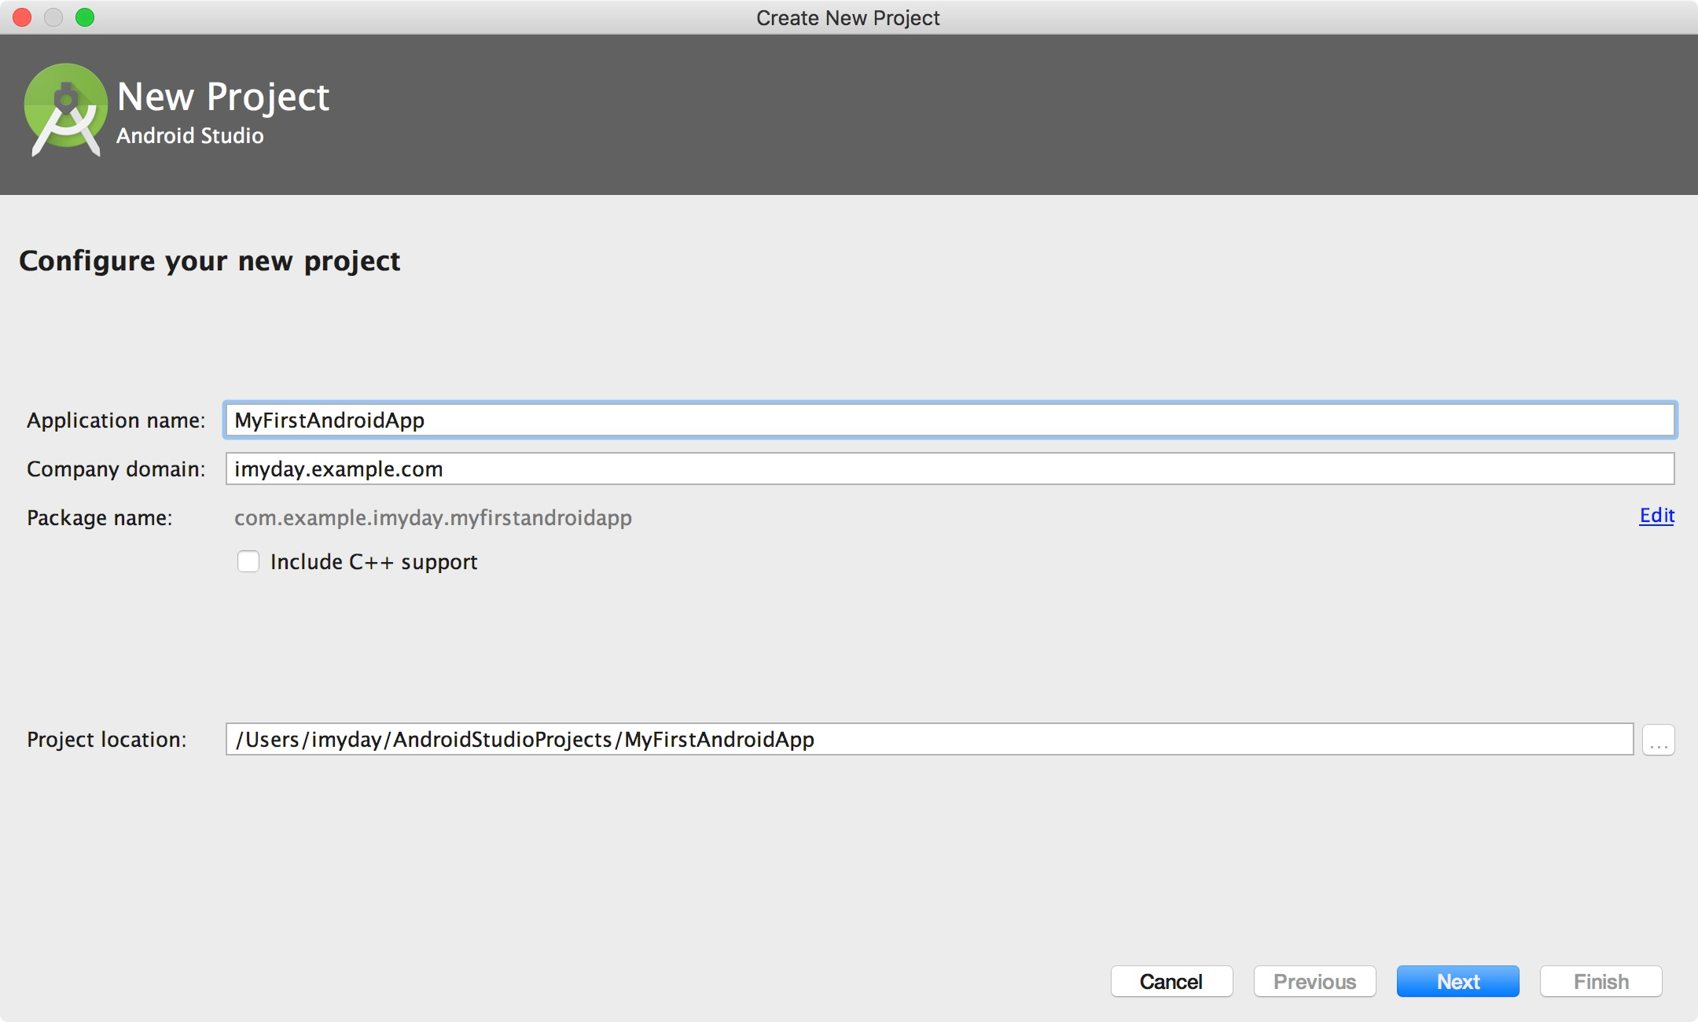

Slide 53
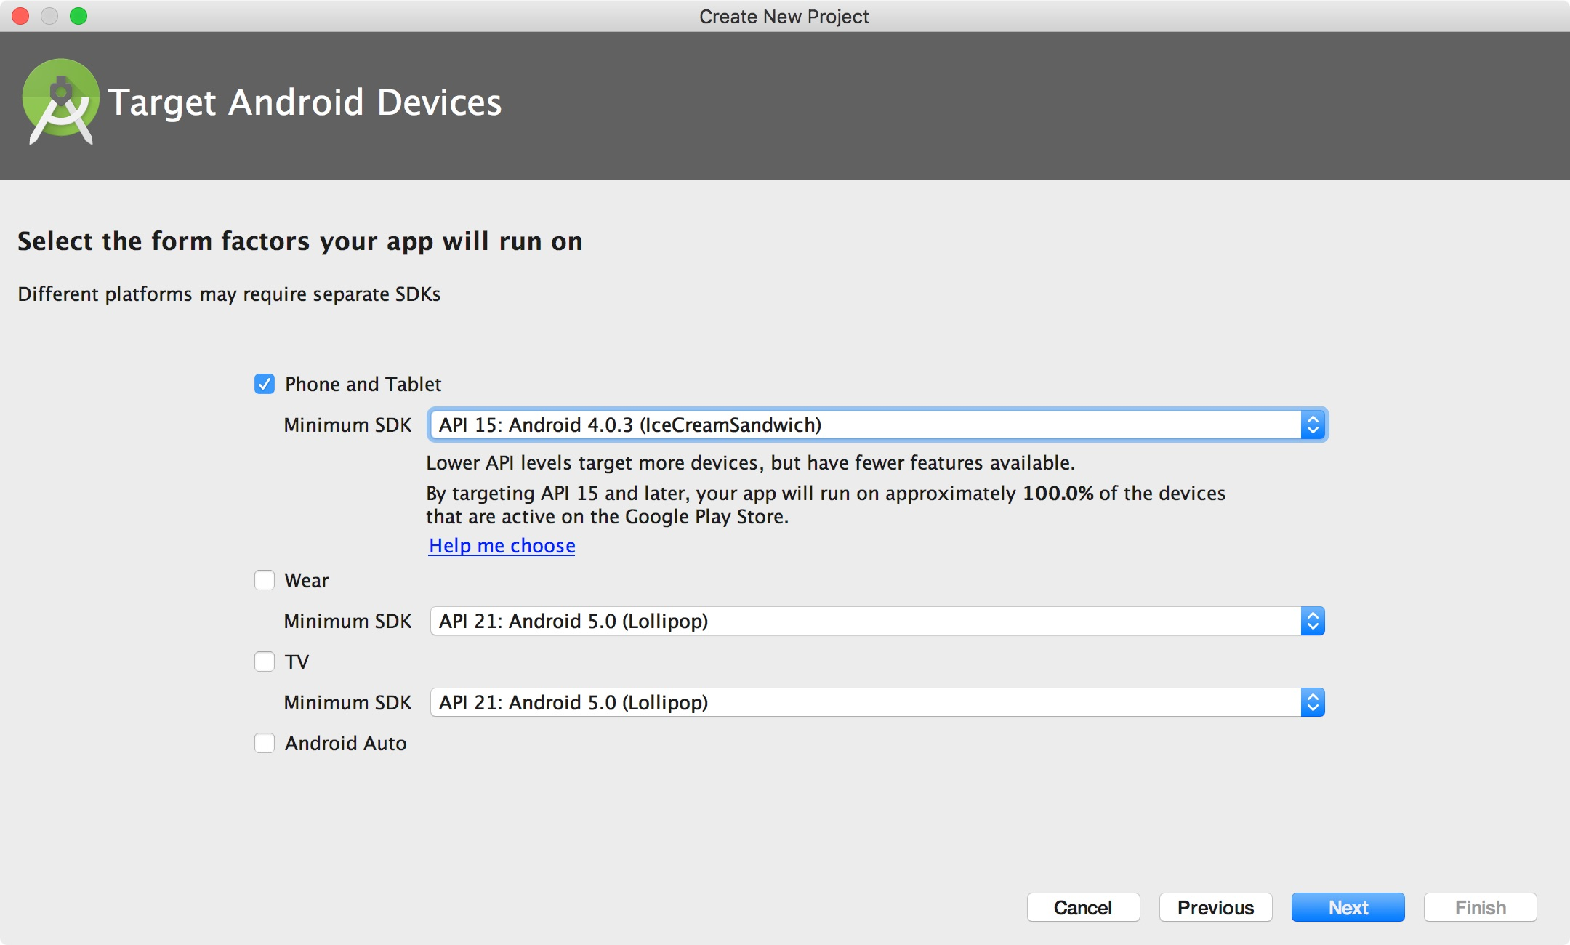

Slide 54
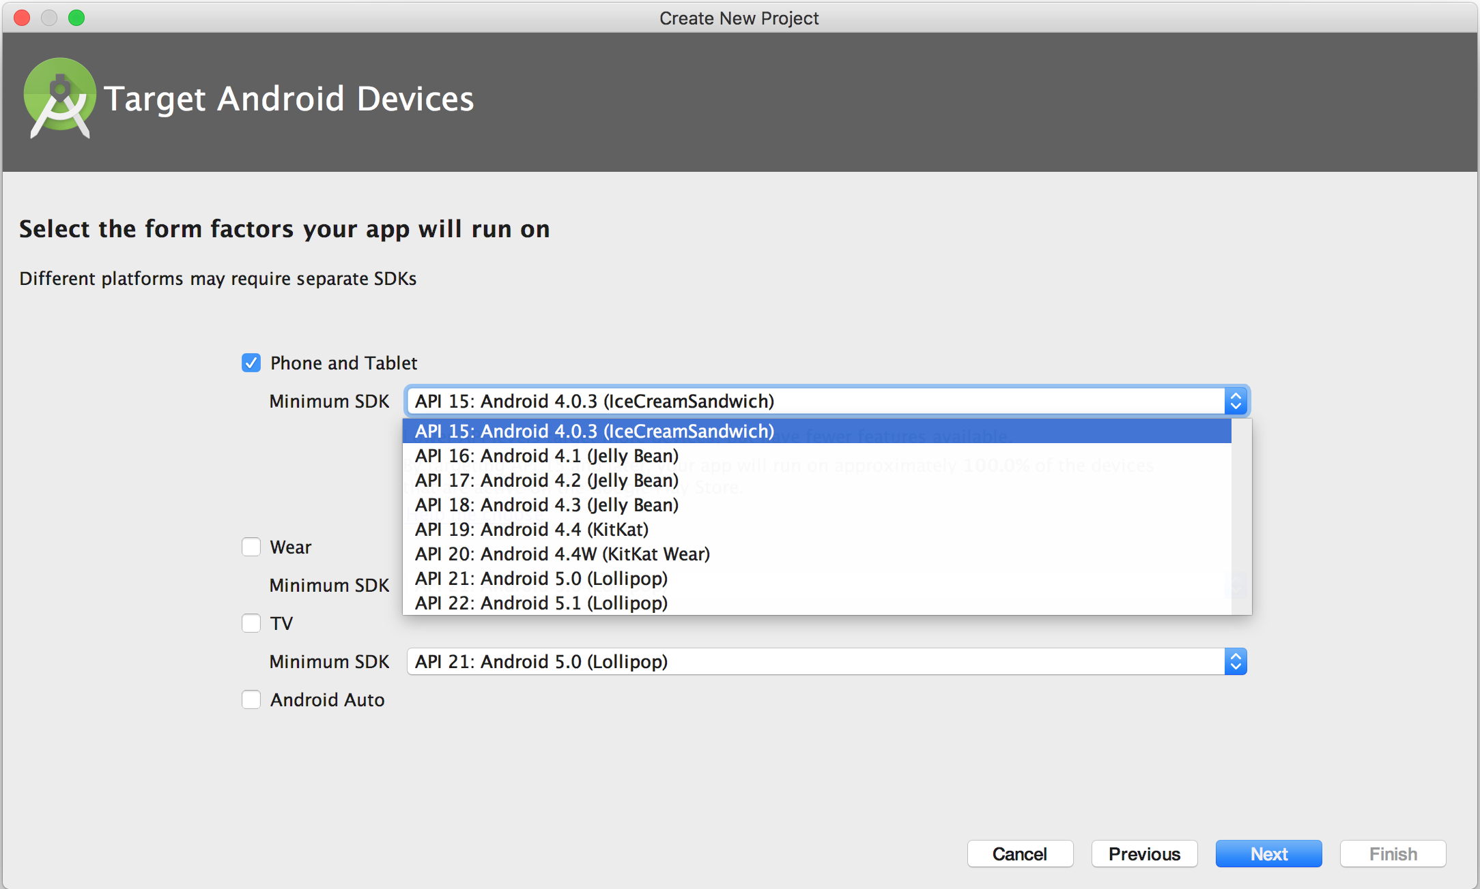

Slide 55
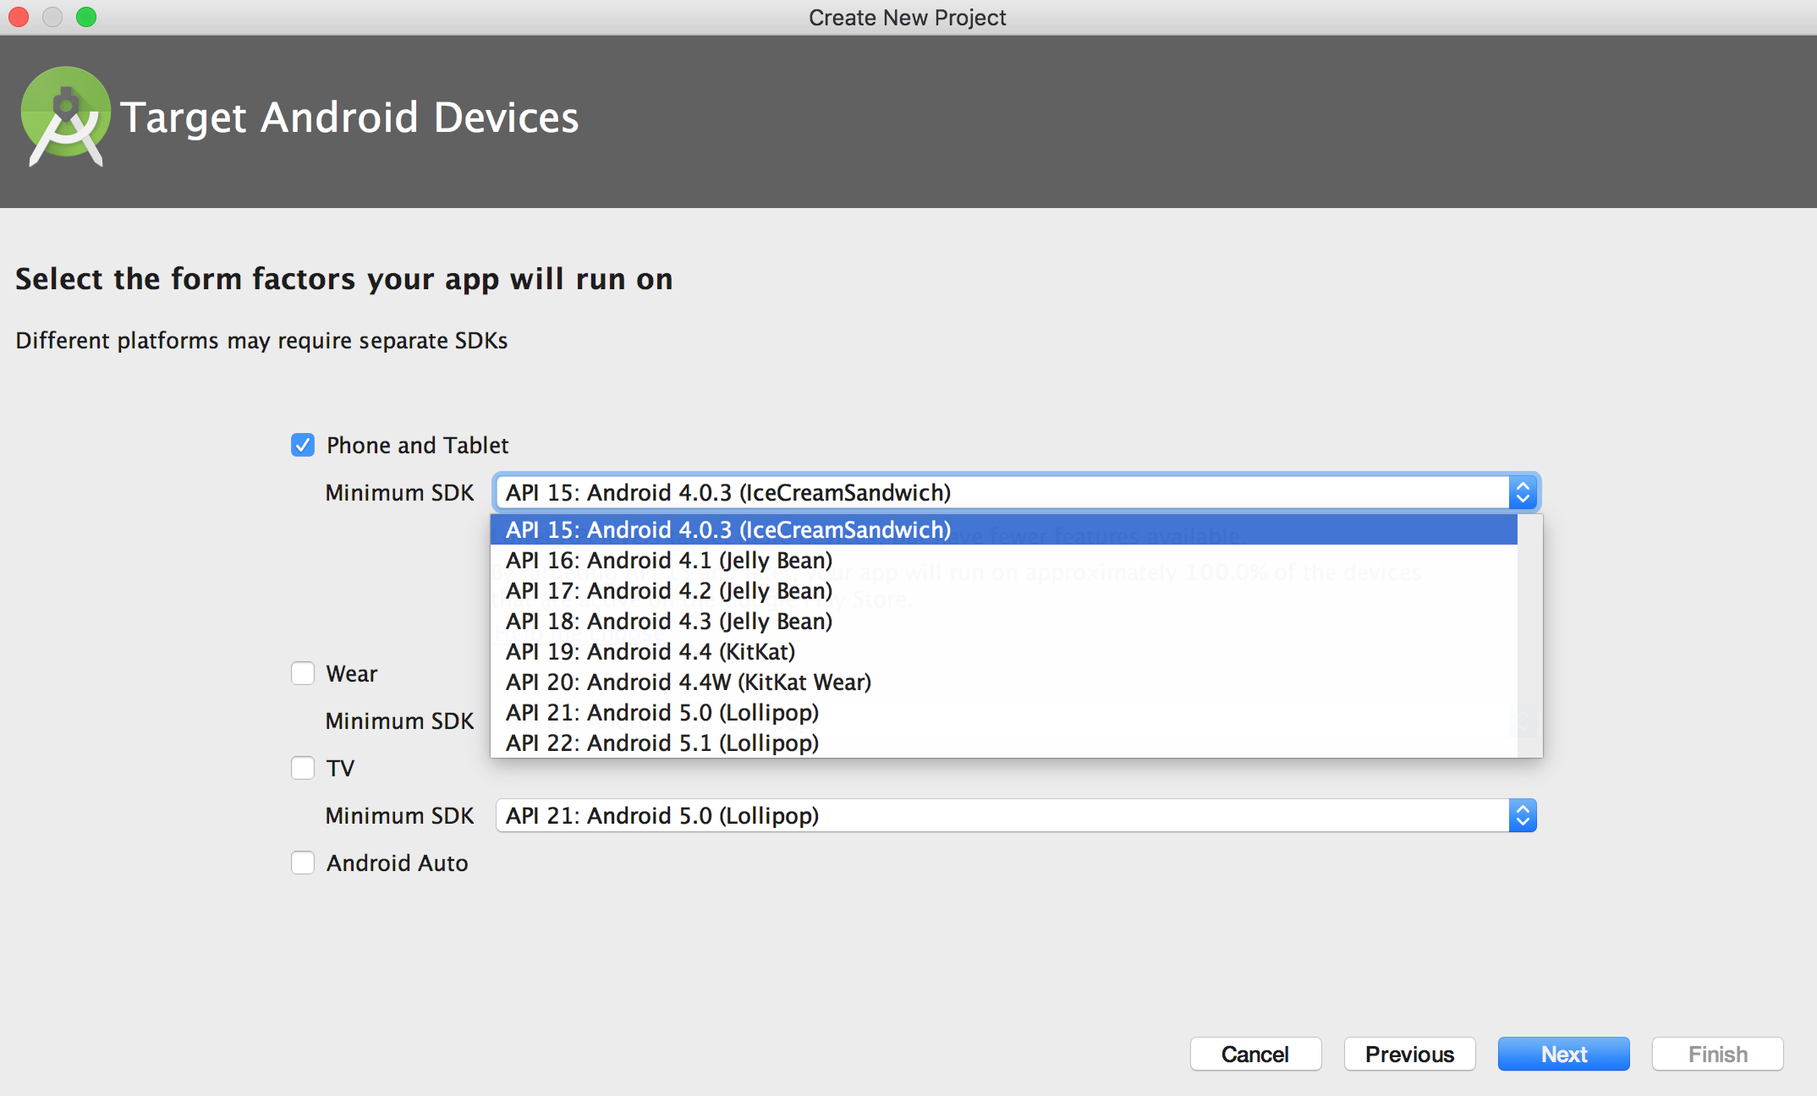

Slide 56
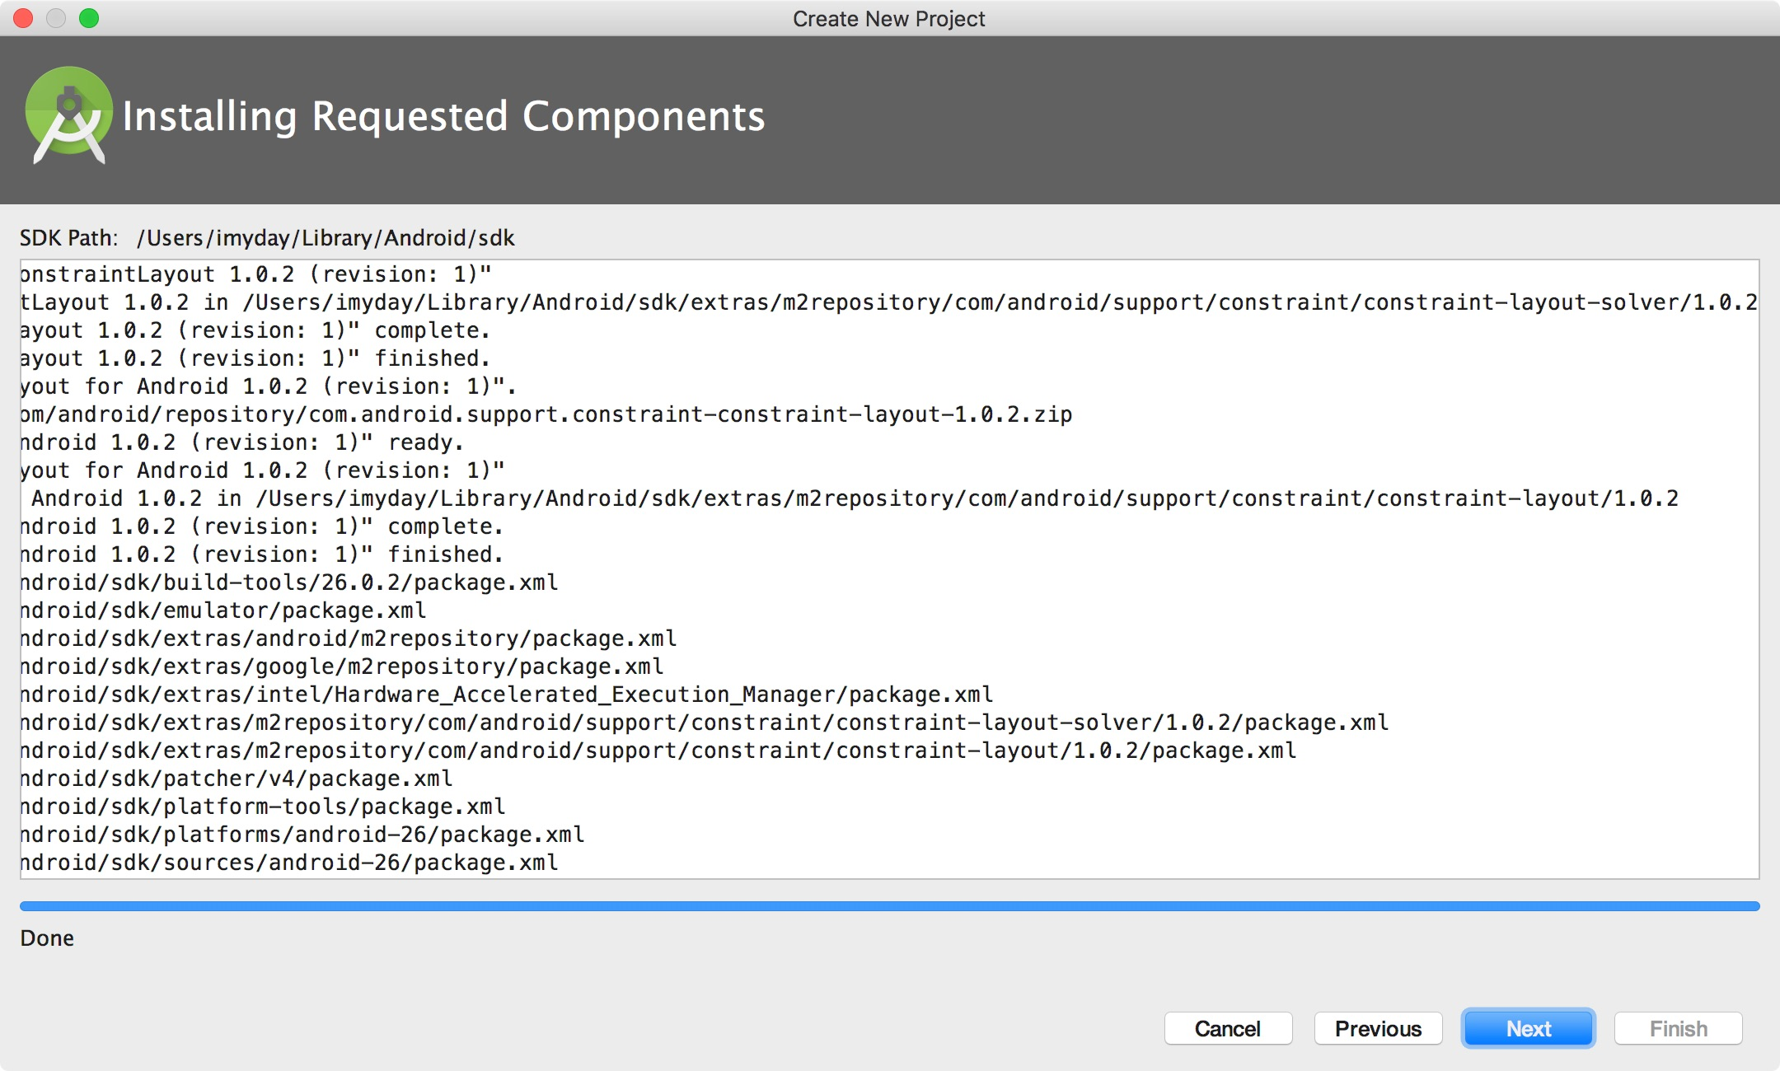

Slide 57
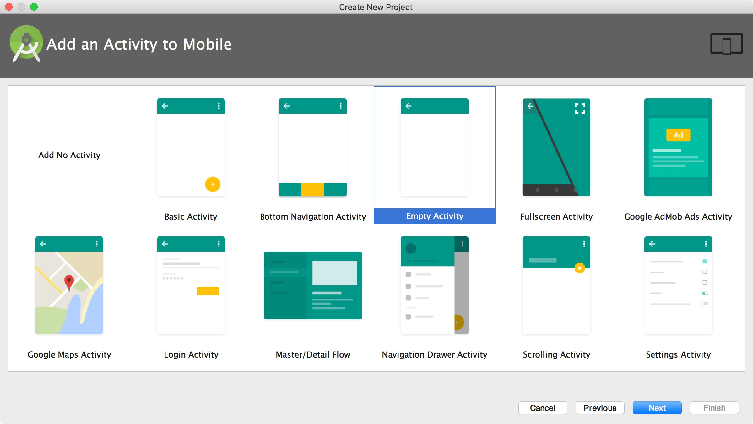

Slide 58
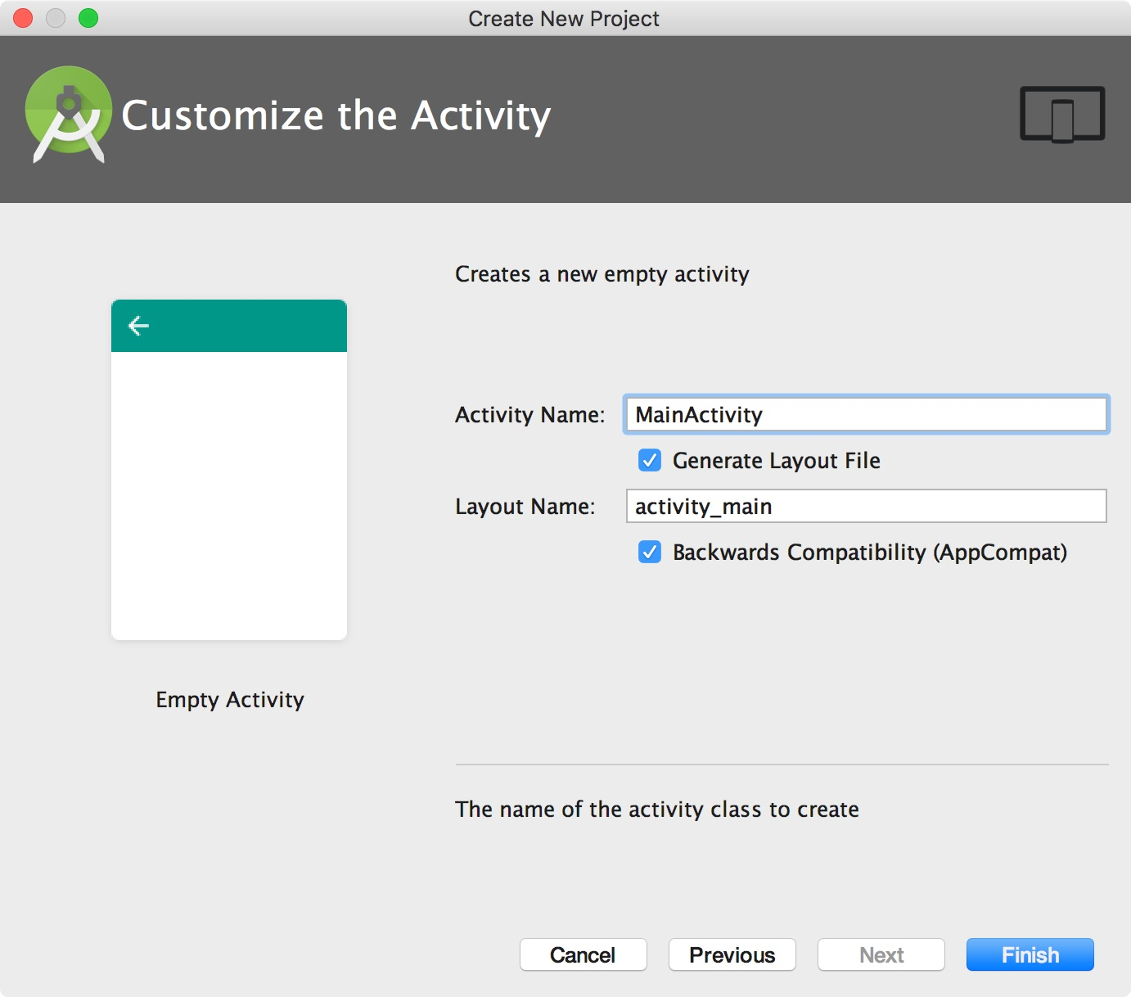

Slide 59
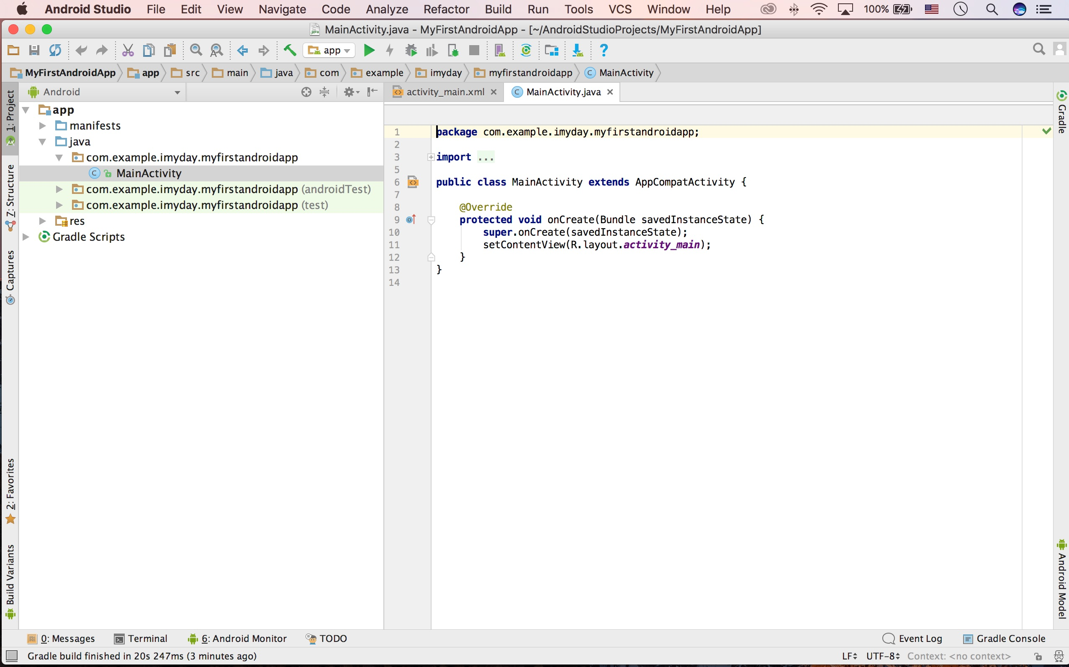

Slide 60
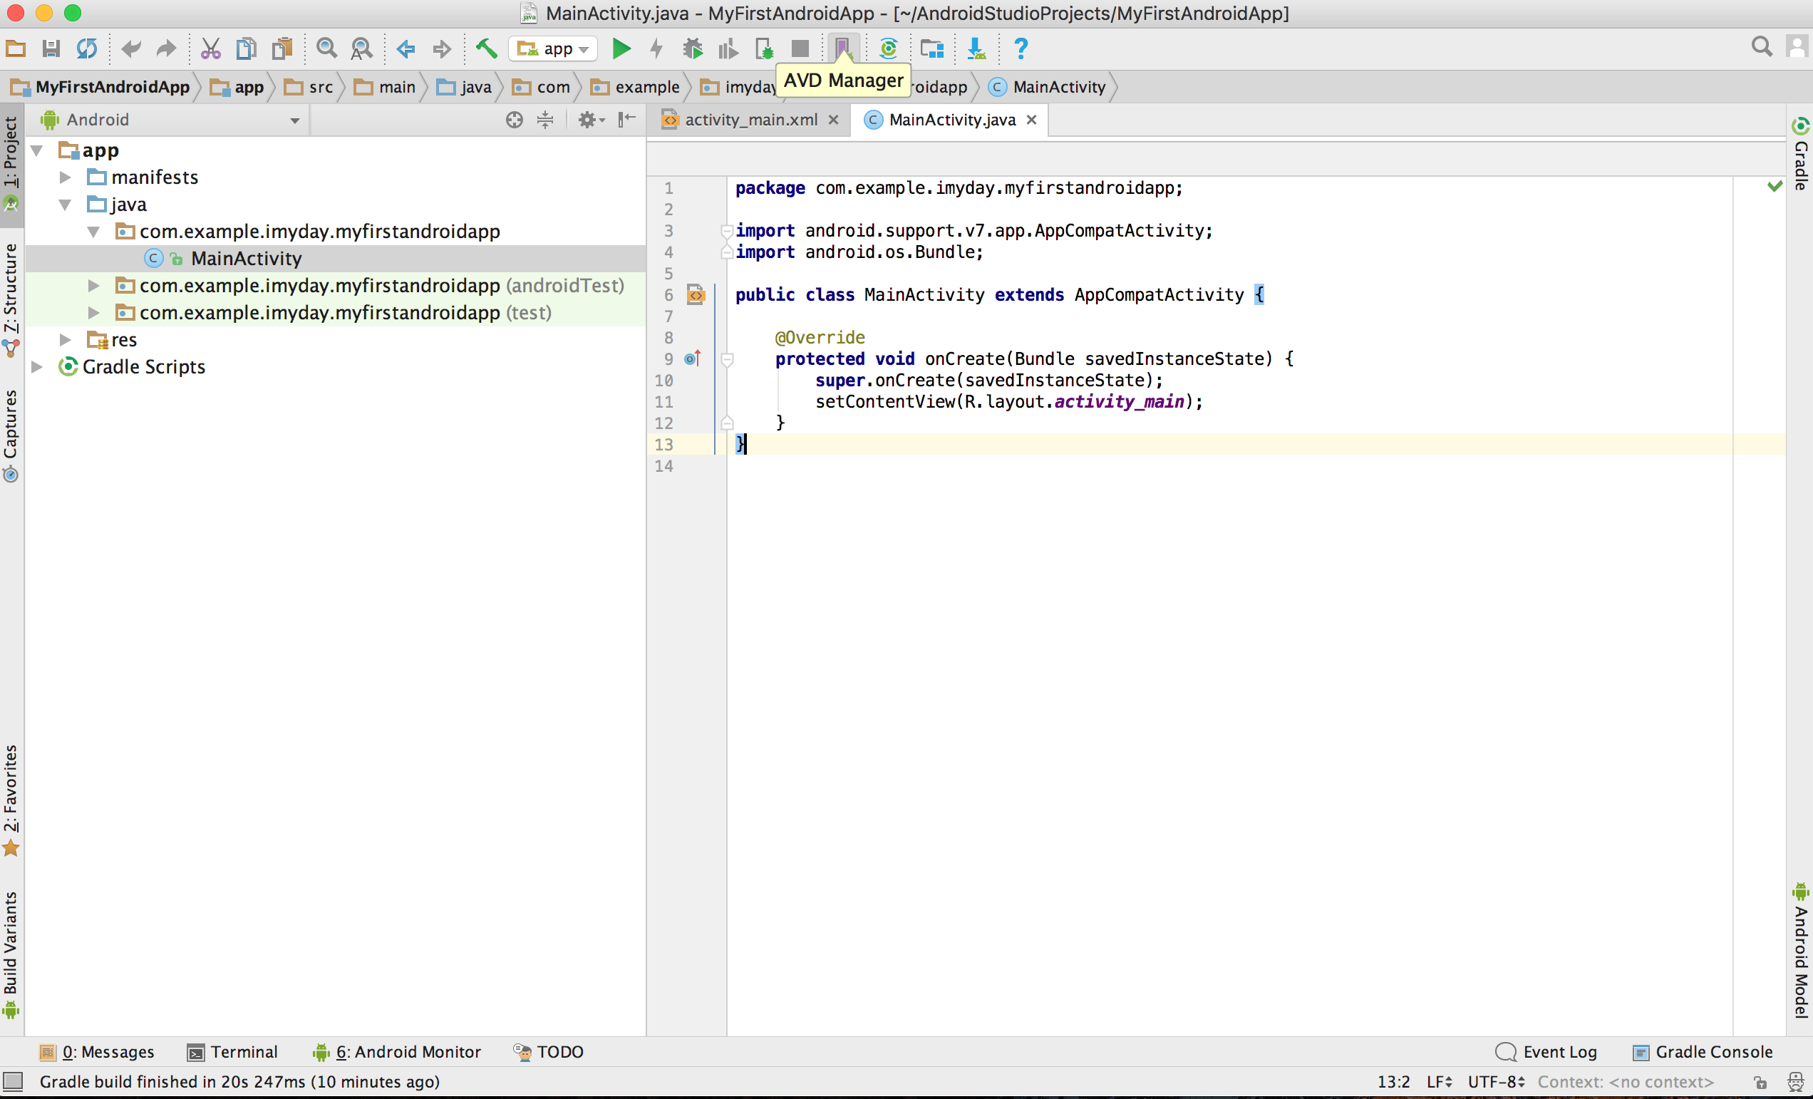

Slide 61
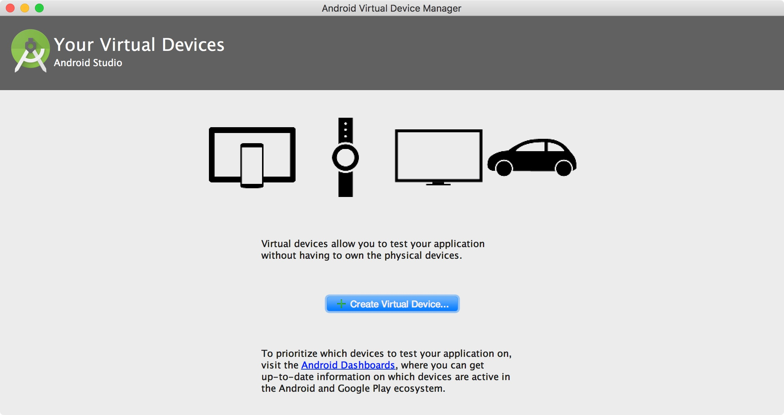

Slide 62
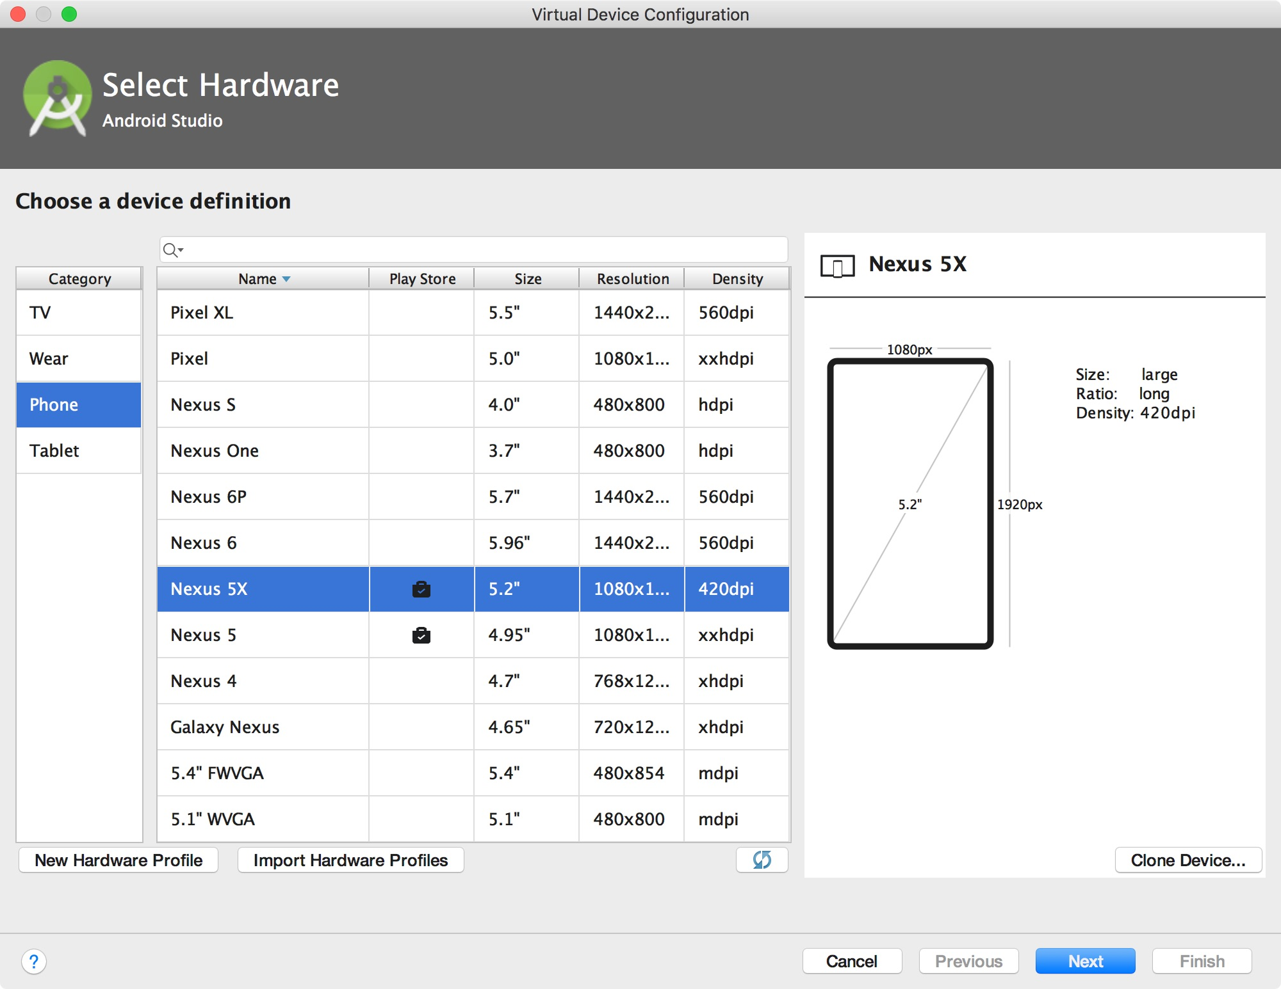

Slide 74
Demo: Building Your First Android App with Android Developer Tools (ADT)

Slide 76
http://developer.android.com/training/basics/firstapp/index.html

Slide 78
http://developer.android.com/training/basics/firstapp/creating-project.html

Slide 103
http://developer.android.com/training/basics/firstapp/starting-activity.html

Slide 108
activity_main.xml
<?xml version="1.0" encoding="utf-8"?>
<LinearLayout xmlns:android="http://schemas.android.com/apk/res/android"
xmlns:tools="http://schemas.android.com/tools"
android:layout_width="match_parent"
android:layout_height="match_parent"
android:orientation="horizontal">
<EditText android:id="@+id/edit_message"
android:layout_weight="1"
android:layout_width="0dp"
android:layout_height="wrap_content"
android:hint="@string/edit_message" />
<Button
android:layout_width="wrap_content"
android:layout_height="wrap_content"
android:text="@string/button_send"
android:onClick="sendMessage" />
</LinearLayout>

Slide 109
activity_display_message.xml
<RelativeLayout xmlns:android="http://schemas.android.com/apk/res/android"
xmlns:tools="http://schemas.android.com/tools"
android:layout_width="match_parent"
android:layout_height="match_parent"
android:paddingBottom="@dimen/activity_vertical_margin"
android:paddingLeft="@dimen/activity_horizontal_margin"
android:paddingRight="@dimen/activity_horizontal_margin"
android:paddingTop="@dimen/activity_vertical_margin"
tools:context=".DisplayMessageActivity" >
<TextView
android:layout_width="wrap_content"
android:layout_height="wrap_content"
android:text="@string/hello_world" />
</RelativeLayout>

Slide 110
strings.xml
<?xml version="1.0" encoding="utf-8"?>
<resources>
<string name="app_name">My First App</string>
<string name="action_settings">Settings</string>
<string name="hello_world">Hello world!</string>
<string name="edit_message">Enter a message</string>
<string name="button_send">Send</string>
<string name="title_activity_main">MainActivity</string>
<string name="title_activity_display_message">My Message</string>
</resources>

Slide 111
AndroidManifest.xml
<?xml version="1.0" encoding="utf-8"?>
<manifest xmlns:android="http://schemas.android.com/apk/res/android"
package="tw.edu.tku.im.smap2013.imyday.myfirstapp"
android:versionCode="1"
android:versionName="1.0" >
<uses-sdk
android:minSdkVersion="8"
android:targetSdkVersion="18" />
<application
android:allowBackup="true"
android:icon="@drawable/ic_launcher"
android:label="@string/app_name"
android:theme="@style/AppTheme" >
<activity
android:name="tw.edu.tku.im.smap2013.imyday.myfirstapp.MainActivity"
android:label="@string/app_name" >
<intent-filter>
<action android:name="android.intent.action.MAIN" />
<category android:name="android.intent.category.LAUNCHER" />
</intent-filter>
</activity>
<activity
android:name="tw.edu.tku.im.smap2013.imyday.myfirstapp.DisplayMessageActivity"
android:label="@string/title_activity_display_message"
android:parentActivityName="tw.edu.tku.im.smap2013.imyday.myfirstapp" >
<meta-data
android:name="android.support.PARENT_ACTIVITY"
android:value="tw.edu.tku.im.smap2013.imyday.myfirstapp" />
</activity>
</application>
</manifest>

Slide 112
DisplayMessageActivity.java
package tw.edu.tku.im.smap2013.imyday.myfirstapp;
import android.os.Bundle;
import android.app.Activity;
import android.view.Menu;
import android.view.MenuItem;
import android.support.v4.app.NavUtils;
import android.annotation.SuppressLint;
import android.annotation.TargetApi;
import android.os.Build;
import android.content.Intent;
import android.widget.TextView;
public class DisplayMessageActivity extends Activity {
@SuppressLint("NewApi")
@Override
protected void onCreate(Bundle savedInstanceState) {
super.onCreate(savedInstanceState);
setContentView(R.layout.activity_display_message);
// Show the Up button in the action bar.
setupActionBar();
//Get the message from the intent
Intent intent = getIntent();
String message = intent.getStringExtra(MainActivity.EXTRA_MESSAGE);
//Great the text view
TextView textView = new TextView(this);
textView.setTextSize(40);
textView.setText(message);
setContentView(textView);
}
…

Slide 113
MainActivity.java
package tw.edu.tku.im.smap2013.imyday.myfirstapp;
import android.os.Bundle;
import android.app.Activity;
import android.view.Menu;
import android.view.View;
import android.content.Intent;
import android.widget.EditText;
public class MainActivity extends Activity {
public final static String EXTRA_MESSAGE = "tw.edu.tku.im.smap2013.imyday.myfirstapp.MESSAGE";
@Override
protected void onCreate(Bundle savedInstanceState) {
super.onCreate(savedInstanceState);
setContentView(R.layout.activity_main);
}
@Override
public boolean onCreateOptionsMenu(Menu menu) {
// Inflate the menu; this adds items to the action bar if it is present.
getMenuInflater().inflate(R.menu.main, menu);
return true;
}
/** Called when the user clicks the Send button */
public void sendMessage(View view) {
Intent intent = new Intent(this, DisplayMessageActivity.class);
EditText editText = (EditText) findViewById(R.id.edit_message);
String message = editText.getText().toString();
intent.putExtra(EXTRA_MESSAGE, message);
startActivity(intent);
}
}

Slide 114
DisplayMessageActivity.java
/**
* Set up the {@link android.app.ActionBar}, if the API is available.
*/
@TargetApi(Build.VERSION_CODES.HONEYCOMB)
private void setupActionBar() {
if (Build.VERSION.SDK_INT >= Build.VERSION_CODES.HONEYCOMB) {
getActionBar().setDisplayHomeAsUpEnabled(true);
}
}
@Override
public boolean onCreateOptionsMenu(Menu menu) {
// Inflate the menu; this adds items to the action bar if it is present.
getMenuInflater().inflate(R.menu.display_message, menu);
return true;
}
@Override
public boolean onOptionsItemSelected(MenuItem item) {
switch (item.getItemId()) {
case android.R.id.home:
// This ID represents the Home or Up button. In the case of this
// activity, the Up button is shown. Use NavUtils to allow users
// to navigate up one level in the application structure. For
// more details, see the Navigation pattern on Android Design:
//
// http://developer.android.com/design/patterns/navigation.html#up-vs-back
//
NavUtils.navigateUpFromSameTask(this);
return true;
}
return super.onOptionsItemSelected(item);
}
}

Slide 115
Alternatives for Developing Android Apps
MIT App Inventor
drag-and-drop Android app development tool.
http://appinventor.mit.edu/
Appery.io
develop apps for Android (iOS / Windows Phone).
http://appery.io
Appnotch
drag-and-drop service that allows you to develop apps for Android (iOS).
http://www.appnotch.com/

Slide 116
MIT App Inventor
http://appinventor.mit.edu/

Slide 117
appery.io
http://appery.io/

Slide 118
appery.io
http://appery.io/

Slide 119
Appnotch
http://www.appnotch.com/

Slide 120
References
Android Developer: http://developer.android.com/
Building Your First App, https://developer.android.com/training/basics/firstapp/index.html
Bill Butterfield (2017), Android Studio Tutorials, https://www.youtube.com/watch?v=dFlPARW5IX8&list=PLp9HFLVct_ZvMa7IVdQyUUyh8t2re9apm

