Slide 1
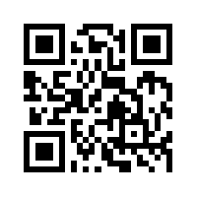
Social Media Apps Programming
Tamkang University
Course Orientation and Introduction to Social Media and Mobile Apps Programming
1071SMAP01
TLMXM1A (8550) (M2143) (Fall 2018)
(MIS MBA) (2 Credits, Elective) [Full English Course]
Thu 8,9 (10:10-12:00) B206
Min-Yuh Day, Ph.D.
Assistant Professor
Department of Information Management
Tamkang University
http://mail.tku.edu.tw/myday
2018-09-13

Slide 2
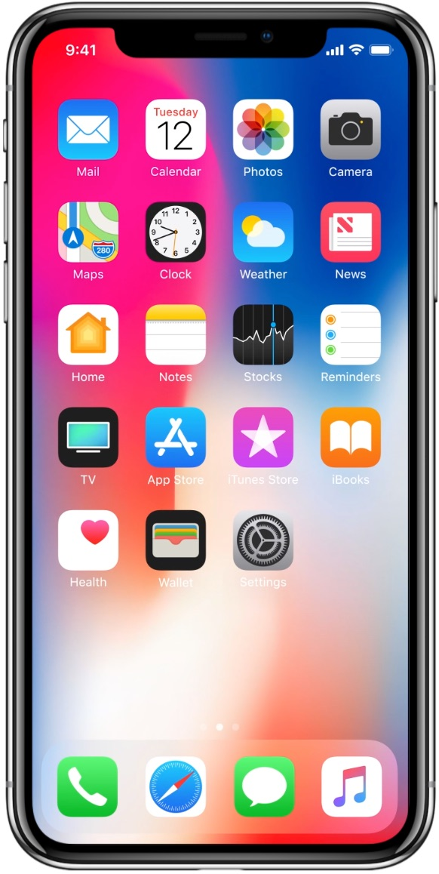
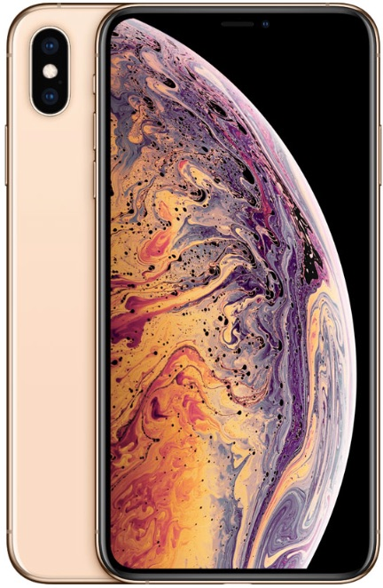
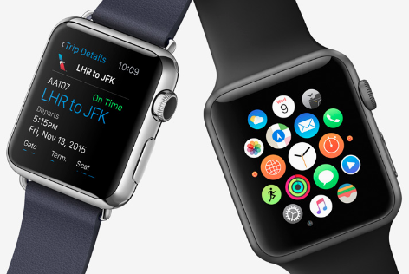
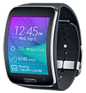
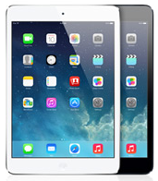
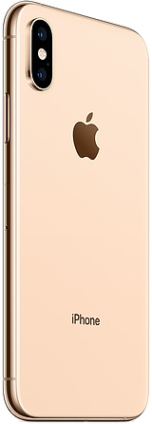
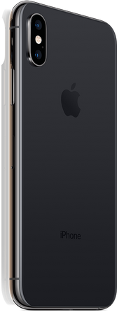
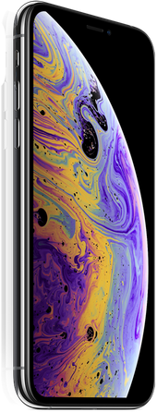
Android /iOS Apps Programming
Native Apps
Hybrid Apps
Mobile Web Apps

Slide 3
Native Mobile App Hybrid Mobile App Responsive Web App Progressive Web App (PWA)
Source: http://srishta.com/blog_hybrid.html

Slide 4
Progressive Web App (PWA) Responsive Web Apps Responsive Design HTML5/CSS3/JavaScript
Source: http://www.ihealthspot.com/ResponsiveWebsiteDesign.aspx

Slide 5
Enterprise Apps in 2015
Hybrid Apps
Gartner recommend hybrid apps over native apps development for businesses
Source: http://blog.commontime.com/hybrid-apps-the-right-response-to-byod-in-business/

Slide 6
Enterprise Apps (Hybrid HTML5) in 2016
Source: http://justcreative.com/2016/03/17/html5-vs-native-apps-whats-best-for-2016/
Notes:
Enterprises Will Deploy More Than 50% of Hybrid HTML5 in 2016

Slide 7
App Development Comparison
Device Access
Speed
Development Cost
App Store
Approval Process
Native Apps
Full
Very Fast
Expensive
Available
Mandatory
Hybrid Apps
Full
Native Speed as Necessary
Reasonable
Available
Low Overhead
Web Apps
Partial
Fast
Reasonable
Not Available
None
Source: http://www.scribd.com/doc/50805466/Native-Web-or-Hybrid-Mobile-App-Development

Slide 8
Course Syllabus Tamkang University Academic Year 107, 1st Semester (Fall, 2018)
Tamkang University
Course Title: Social Media Apps Programming
Instructor: Min-Yuh Day
Course Class: TLMXM1A (MIS MBA)
Master’s Program, Department of Information Management, 1A
Details
Selective
One Semester
2 Credits
Time & Place: Thu 8,9 (10:10-12:00) B206

Slide 9
Department Teaching Objectives
Tamkang University
Devoting to the integration and research of information technology and business management knowledge
Cultivating for society, middle and higher level managers with both information capabilities and modern management skills

Slide 10
Department Core Competences
Tamkang University
Use of modern management knowledge
Logical thinking
Critical analysis
Integration of information technology and business management
Research and innovation
Theory and applications data analysis
Information and communication security management
Verbal and writing communication skills

Slide 11
Course Introduction
Tamkang University
This course introduces the fundamental concepts and practices of social media and mobile apps programming.
Topics include
Introduction to Android / iOS apps programming,
Developing Android native apps with Java (Android Studio),
Developing iPhone / iPad apps native apps with Swift (XCode),
Mobile apps using HTML5/CSS3/JavaScript,
jQuery Mobile,
Create hybrid apps with Phonegap,
Google Cloud Platform,
Google app engine, Google map API,
Facebook API,
Twitter API,
Case study on social media apps programming and marketing in Google Play and App Store.

Slide 12
Teaching Objectives
Tamkang University
Students will be able to understand and apply the fundamental concepts and practices of social media and mobile apps programming

Slide 13
Teaching Methods
Tamkang University
Lecture
Discussion
Simulation
Practicum
Problem Solving

Slide 14
Assessment
Tamkang University
Practicum
Report
Participation

Slide 15
Course Schedule (1/2)
Tamkang University
Week Date Subject/Topics
1 2018/09/13 Course Orientation and Introduction to Social Media and Mobile Apps Programming
2 2018/09/20 Introduction to Android / iOS Apps Programming
3 2018/09/27 Developing Android Native Apps with Java (Android Studio)
4 2018/10/04 Developing iPhone / iPad Native Apps with Swift (XCode)
5 2018/10/11 Mobile Apps using HTML5/CSS3/JavaScript
6 2018/10/18 jQuery Mobile
7 2018/10/25 Create Hybrid Apps with Phonegap
8 2018/11/01 jQuery Mobile/Phonegap
9 2018/11/08 jQuery Mobile/Phonegap

Slide 16
Course Schedule (2/2)
Tamkang University
Week Date Subject/Topics
10 2018/11/15 Midterm Exam Week / Project Presentation
11 2018/11/22 Case Study on Social Media Apps Programming and Marketing in Google Play and App Store
12 2018/11/29 Google Cloud Platform
13 2018/12/06 Google App Engine
14 2018/12/13 Google Map API
15 2018/12/20 Facebook API (Facebook JavaScript SDK) (Integrate Facebook with iOS/Android Apps)
16 2018/12/27 Twitter API
17 2019/01/03 Final Project Presentation
18 2019/01/10 Final Exam Week / Final Project Presentation

Slide 17
Grading Policy
Tamkang University
Mark of Usual: 40%
Final Apps Project: 60%
Midterm Project Report
Final Project Report

Slide 18
Textbooks and References
Tamkang University
Textbook: Slides
http://mail.tku.edu.tw/myday/teaching.htm#1071SMAP
References
Scott Preston, Learn HTML5 and JavaScript for iOS: Web Standards-based Apps for iPhone, iPad, and iPod touch, Apress, 2012
Jonathan Stark, Brian Jepson and Brian MacDonald, Building Android Apps with HTML, CSS, and JavaScript: Making Native Apps with Standards-Based Web Tools, O'Reilly Media, 2012
Zainul Setyo Pamungkas, PhoneGap 4 Mobile Application Development Cookbook, Packt Publishing, 2015
Kerri Shotts, Mastering PhoneGap Mobile Application Development, Packt Publishing, 2016
Chris Griffith, Mobile App Development with Ionic 2: Cross-Platform Apps with Ionic, Angular, and Cordova, O'Reilly, 2017

Slide 19
References
jQuery Mobil: http://jquerymobile.com/
PhoneGap: http://phonegap.com/
Apple Developer: https://developer.apple.com/
Android Developer: http://developer.android.com/
Facebook Developers: https://developers.facebook.com/
Twitter Developers: https://dev.twitter.com/
Google App Engine: https://developers.google.com/appengine/
Gephi: Social Network Analysis and Visualization: https://gephi.org/
Netvizz: Facebook Netvizz app: https://apps.facebook.com/netvizz/

Slide 20
Scott Preston, Learn HTML5 and JavaScript for iOS: Web Standards-based Apps for iPhone, iPad, and iPod touch, Apress, 2012
Source: https://www.amazon.com/Learn-HTML5-JavaScript-iOS-Standards-based/dp/1430240385/

Slide 21
Jonathan Stark, Brian Jepson and Brian MacDonald, Building Android Apps with HTML, CSS, and JavaScript: Making Native Apps with Standards-Based Web Tools, O'Reilly Media, 2012
Source: https://www.amazon.com/Building-Android-Apps-HTML-JavaScript/dp/1449316417

Slide 22
Zainul Setyo Pamungkas, PhoneGap 4 Mobile Application Development Cookbook, Packt Publishing, 2015
Source: https://www.amazon.com/PhoneGap-Mobile-Application-Development-Cookbook/dp/1783287942

Slide 23
Kerri Shotts, Mastering PhoneGap Mobile Application Development, Packt Publishing, 2016
Source: https://www.amazon.com/Mastering-PhoneGap-Mobile-Application-Development/dp/1783288434

Slide 24
Chris Griffith, Mobile App Development with Ionic 2: Cross-Platform Apps with Ionic, Angular, and Cordova, O'Reilly, 2017
Source: https://www.amazon.com/Mobile-App-Development-Ionic-Cross-Platform/dp/1491937785

Slide 25
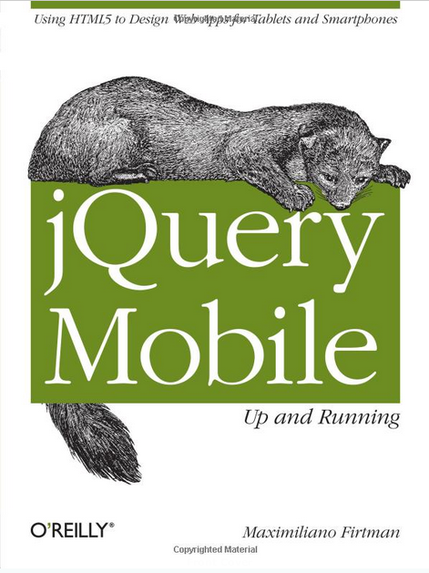
Jon Reid, jQuery Mobile, O’reilly, 2012
Source: http://www.amazon.com/jQuery-Mobile-Running-Maximiliano-Firtman/dp/1449397654

Slide 26
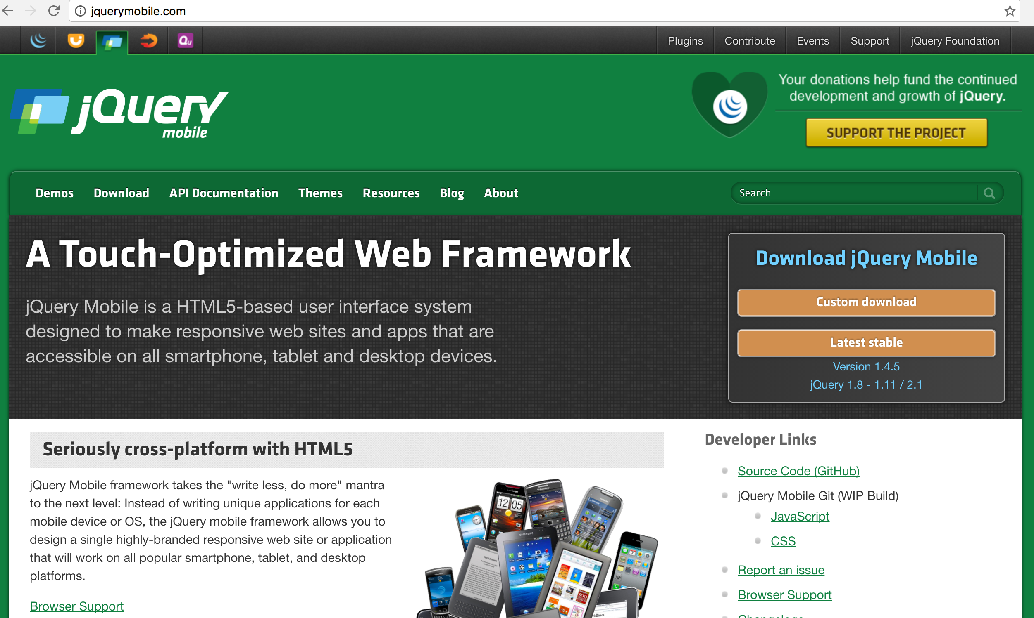
jQuery Mobile http://jquerymobile.com/

Slide 27
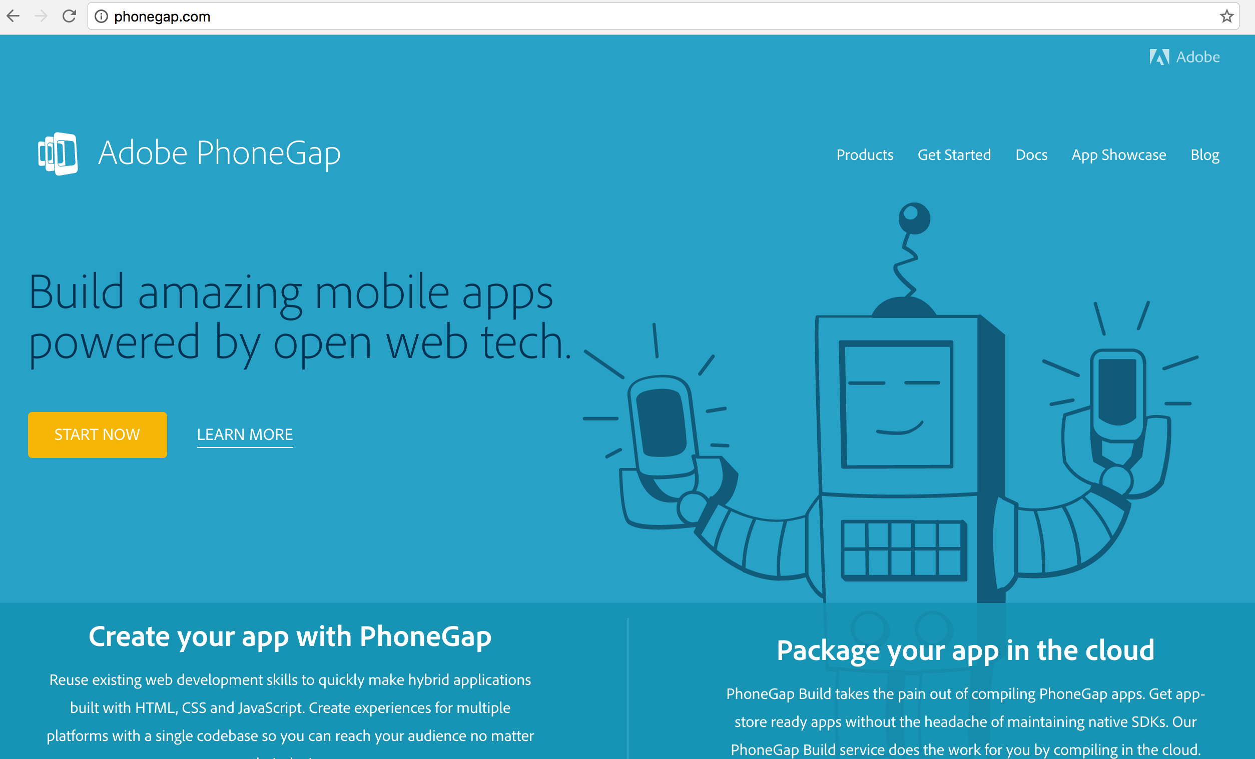
PhoneGap http://phonegap.com/

Slide 28
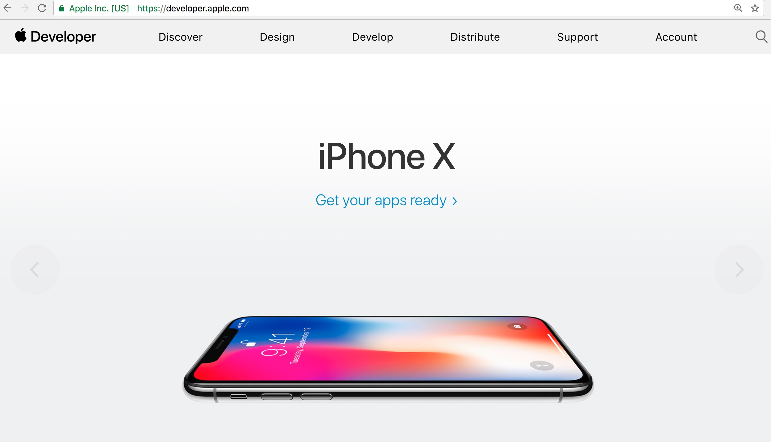
Apple Developer https://developer.apple.com/

Slide 29
Apple Swift for iOS
Source: https://developer.apple.com/swift/

Slide 30
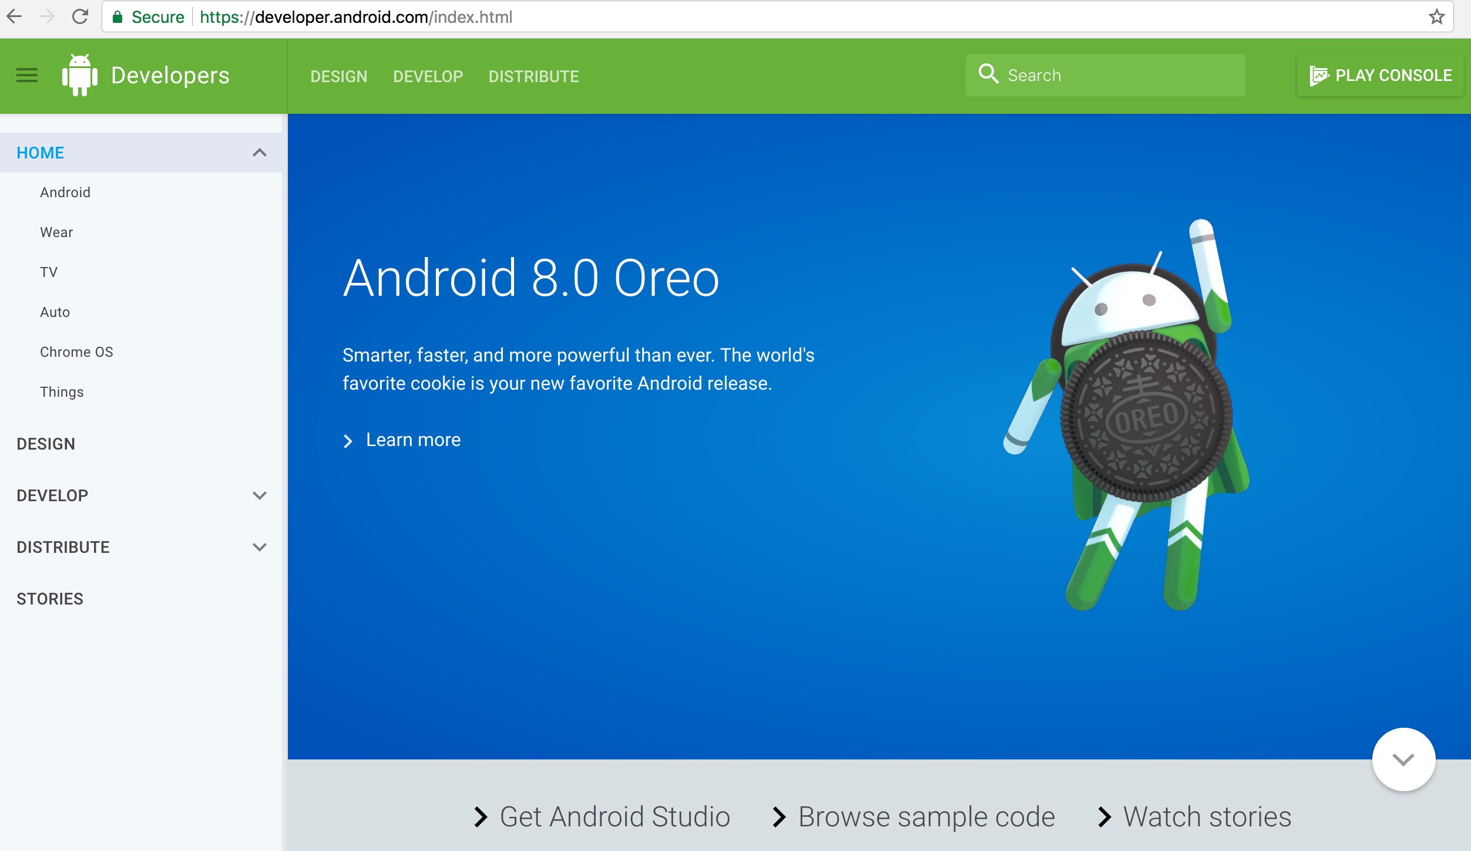
Android Developer http://developer.android.com/

Slide 31
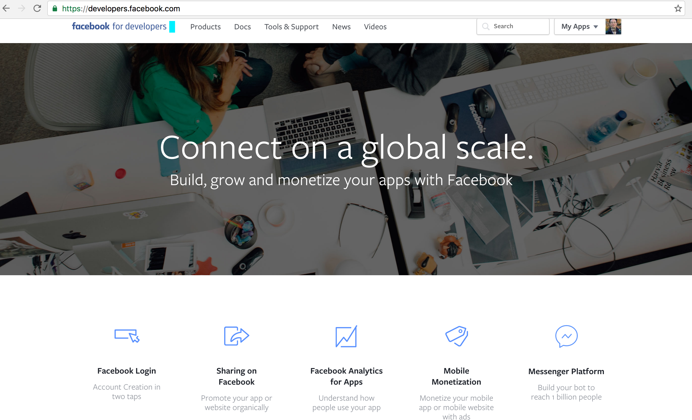
Facebook Developers
https://developers.facebook.com/

Slide 32
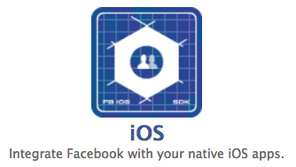
Integrate Facebook with your native iOS apps
https://developers.facebook.com/

Slide 33
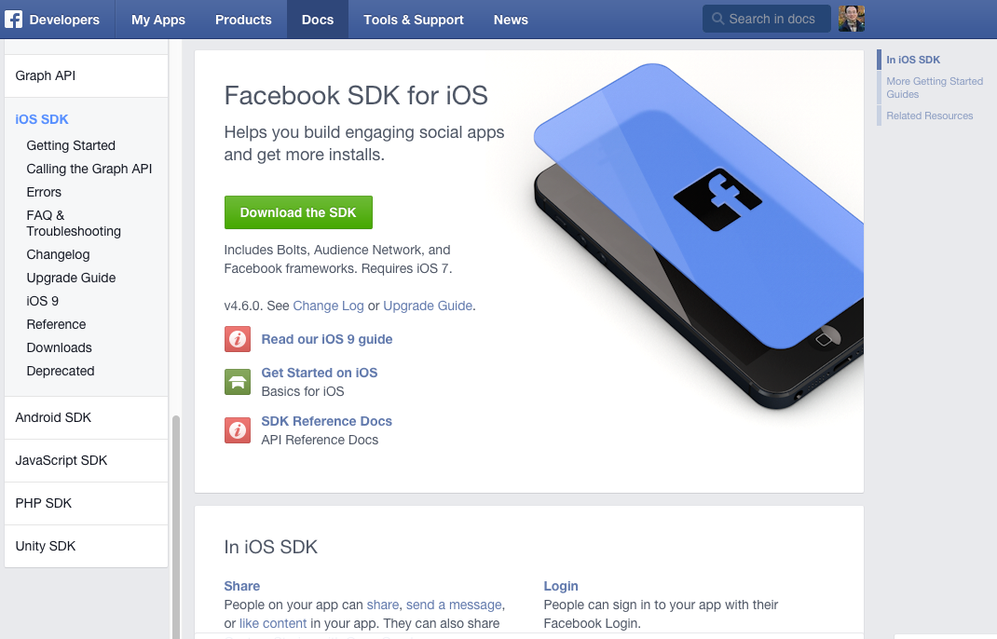
Facebook SDK for iOS
https://developers.facebook.com/docs/ios/

Slide 34
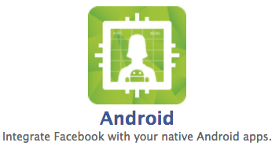
Integrate Facebook with your native Android apps.
https://developers.facebook.com/

Slide 35
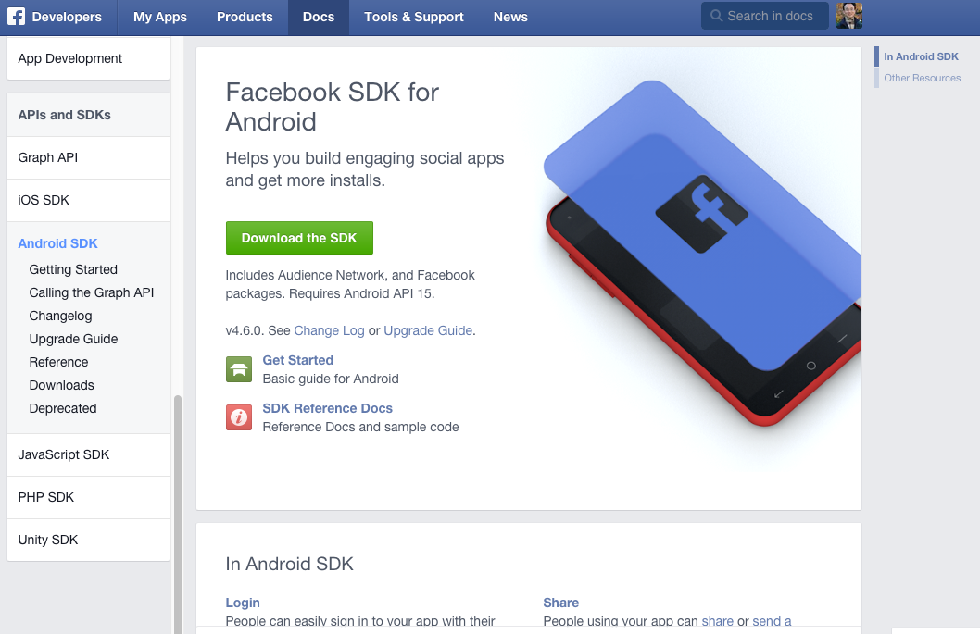
Facebook SDK for Android
Source: https://developers.facebook.com/docs/android

Slide 36
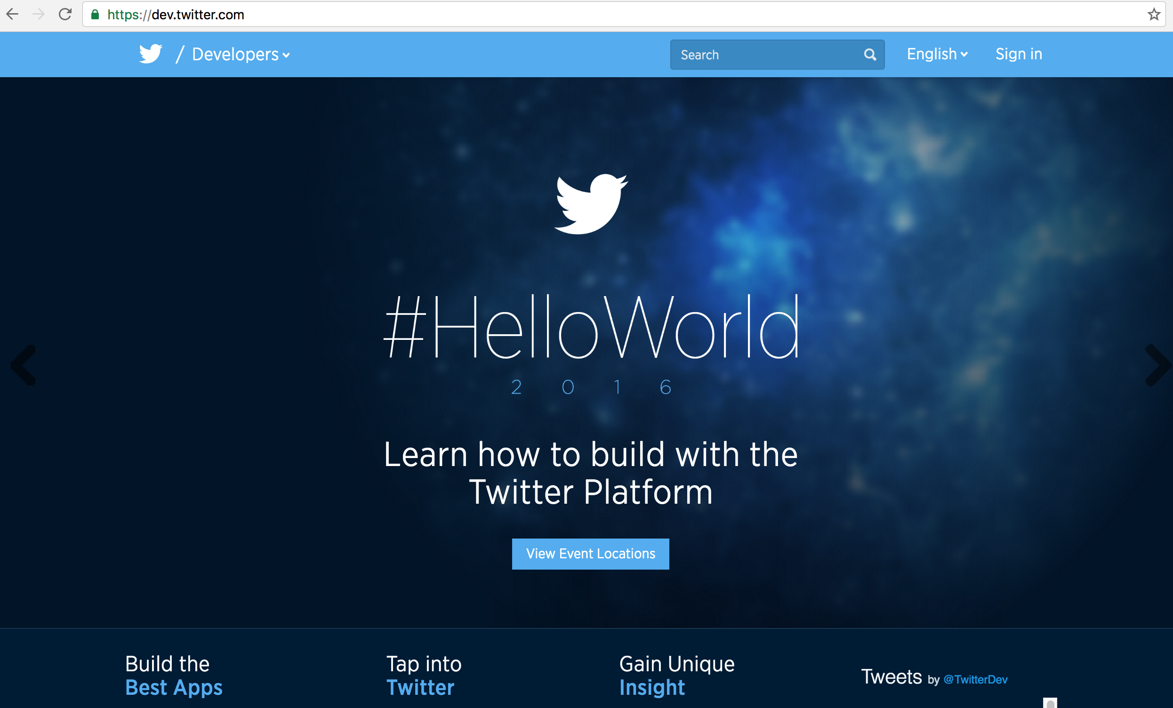
Twitter Developers https://dev.twitter.com/

Slide 37
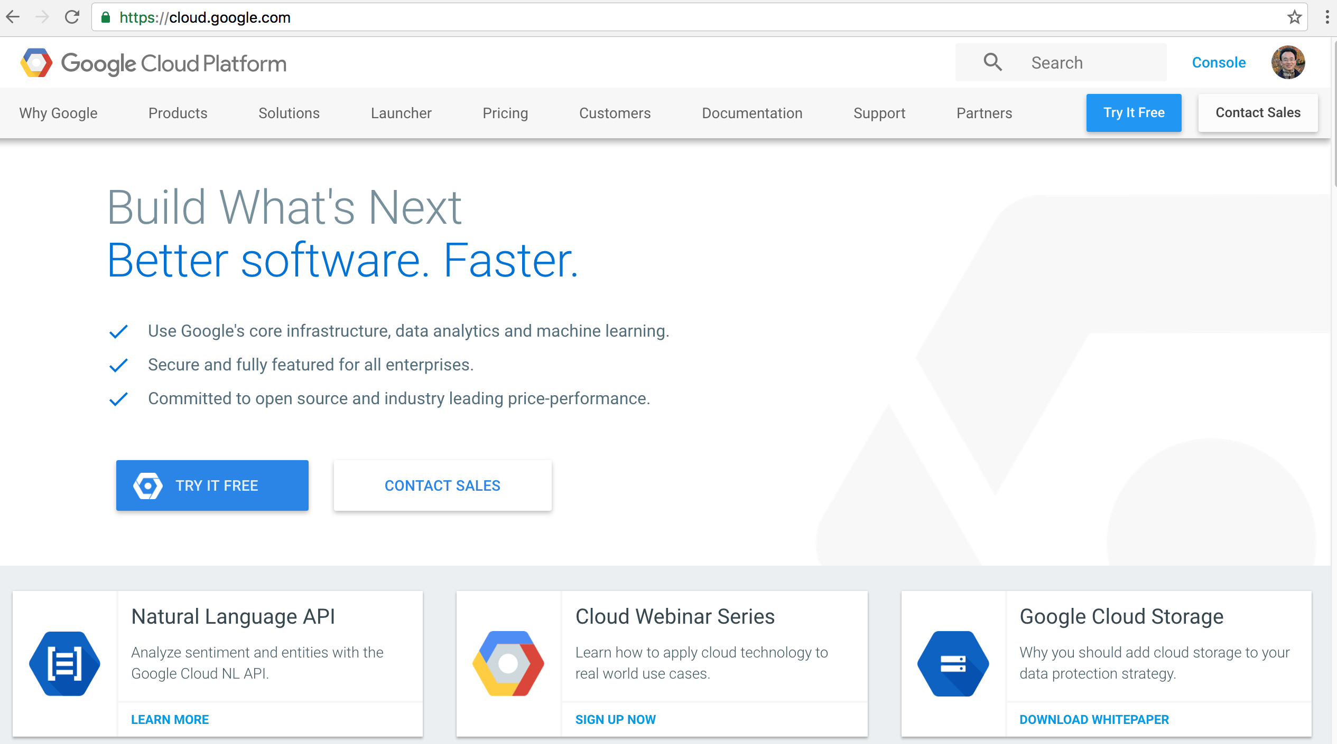
Google Cloud Platform
https://cloud.google.com/

Slide 38
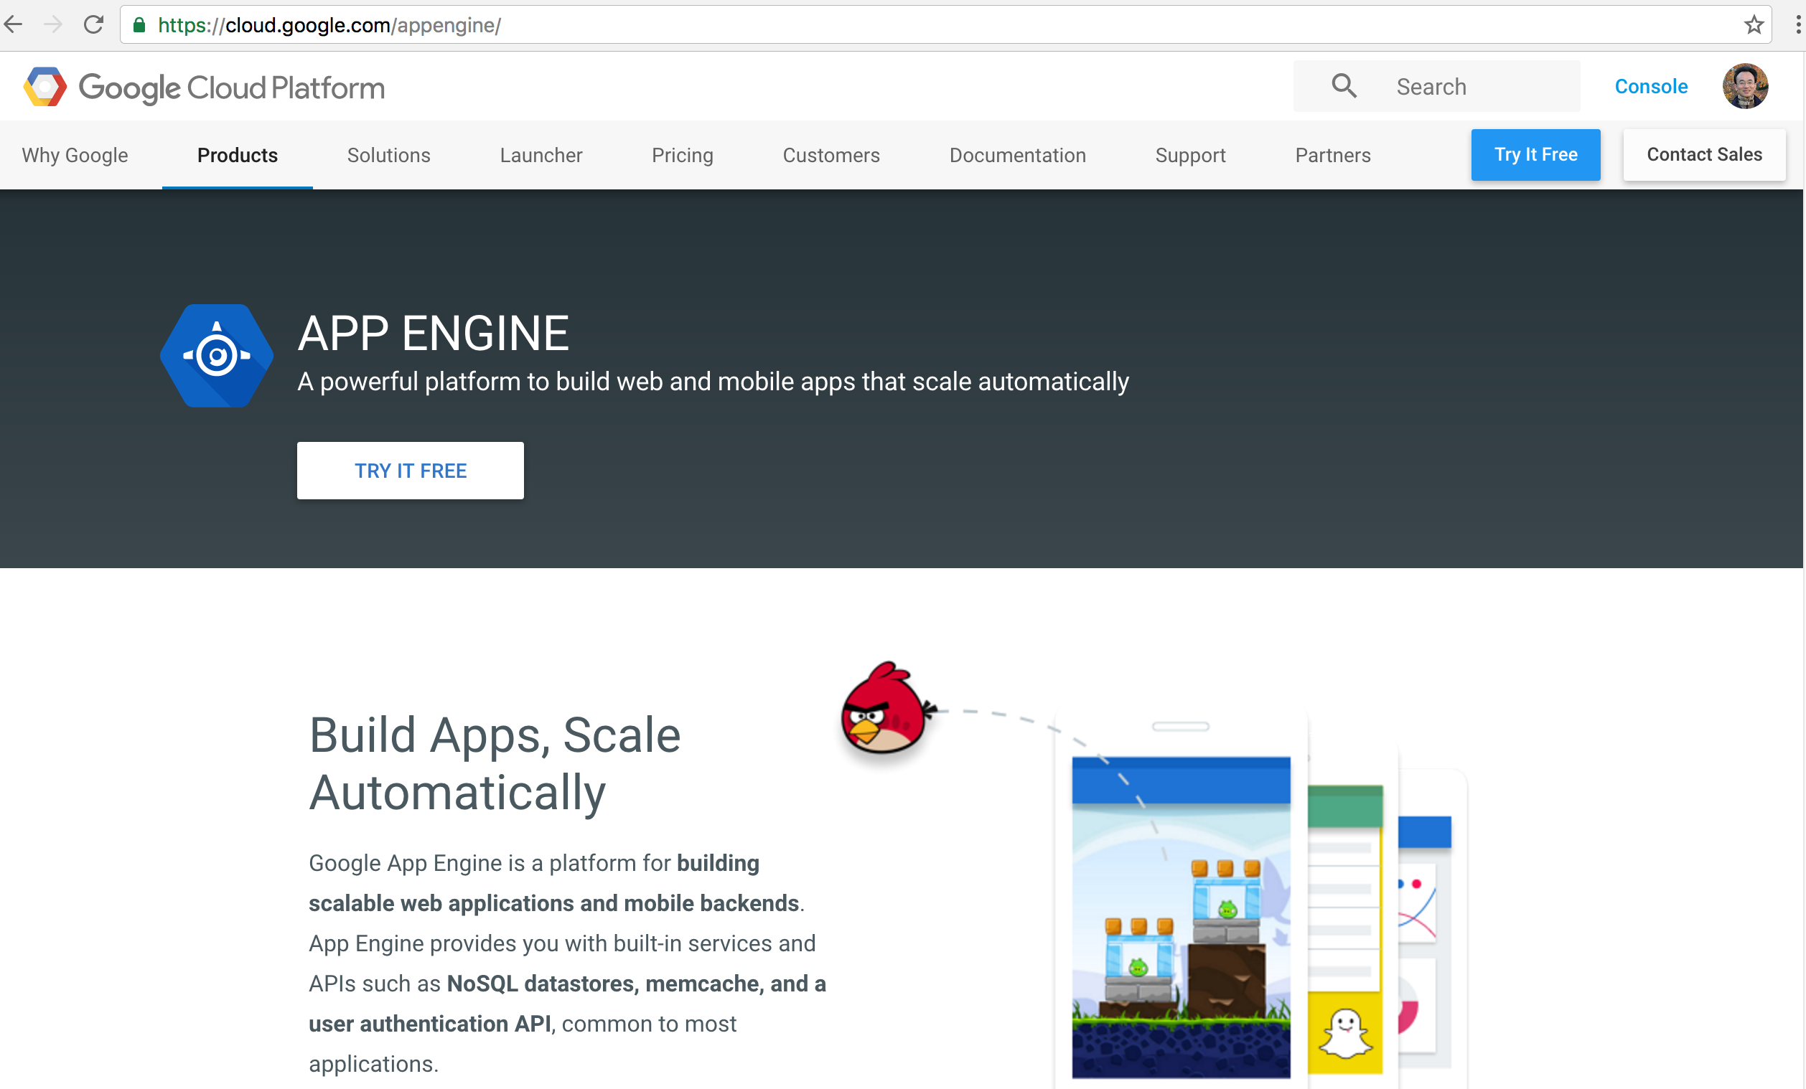
Google App Engine
https://cloud.google.com/appengine/

Slide 39
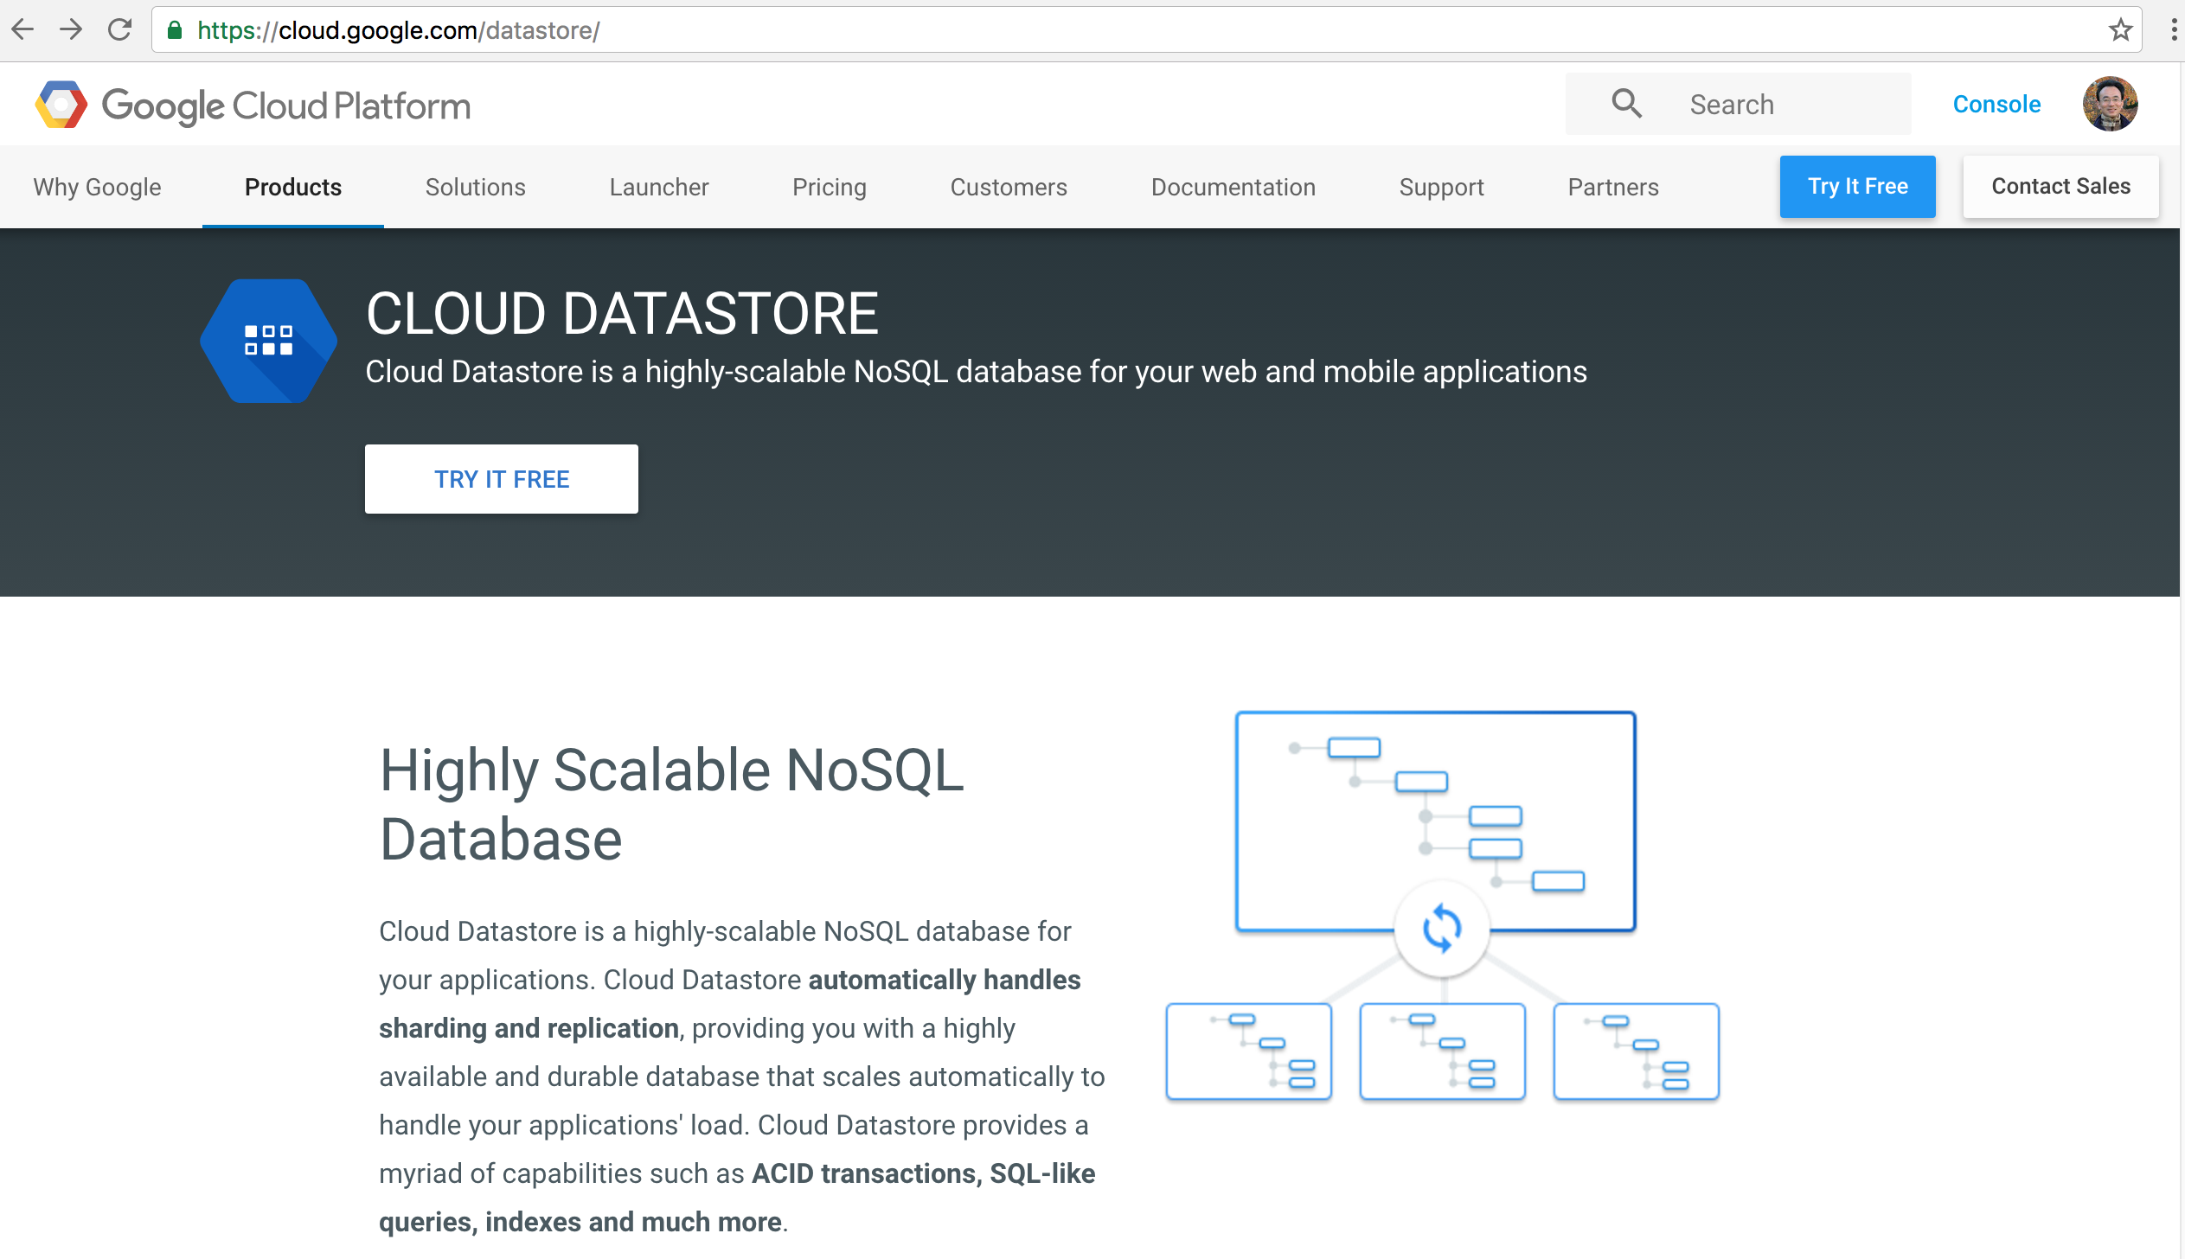
Google Cloud Datastore
https://cloud.google.com/datastore/

Slide 40
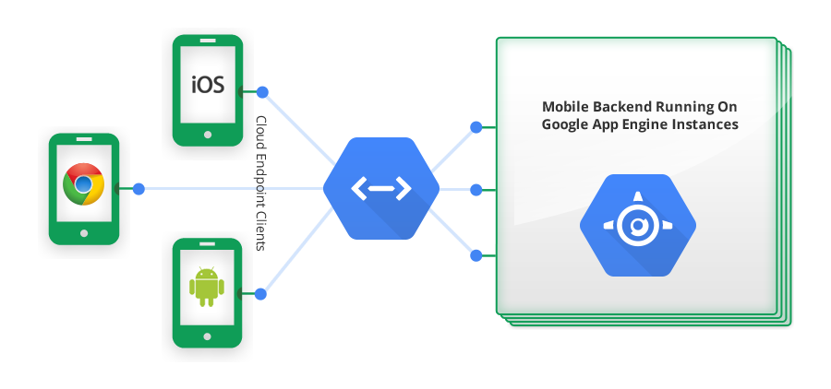
Google Cloud Endpoints
https://developers.google.com/appengine/docs/java/endpoints/

Slide 41
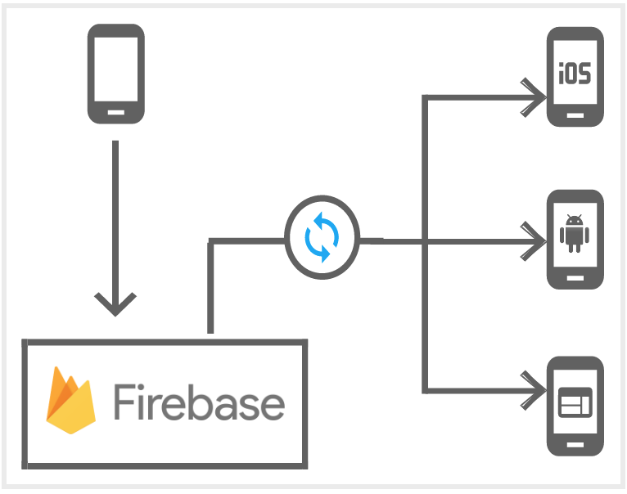
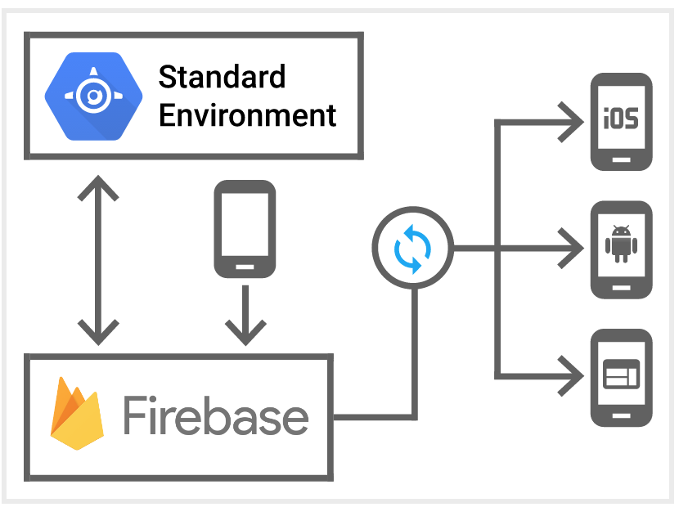
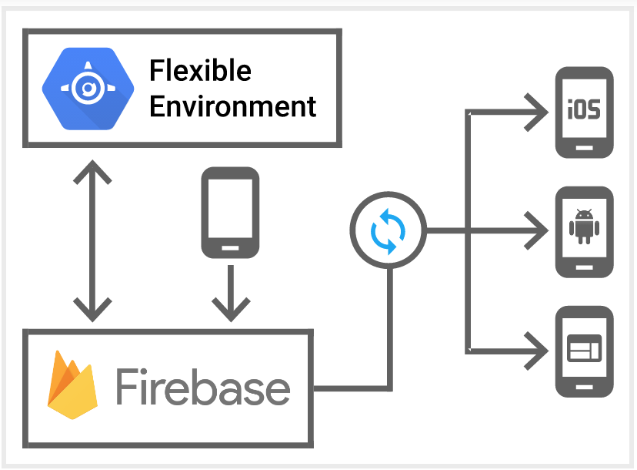
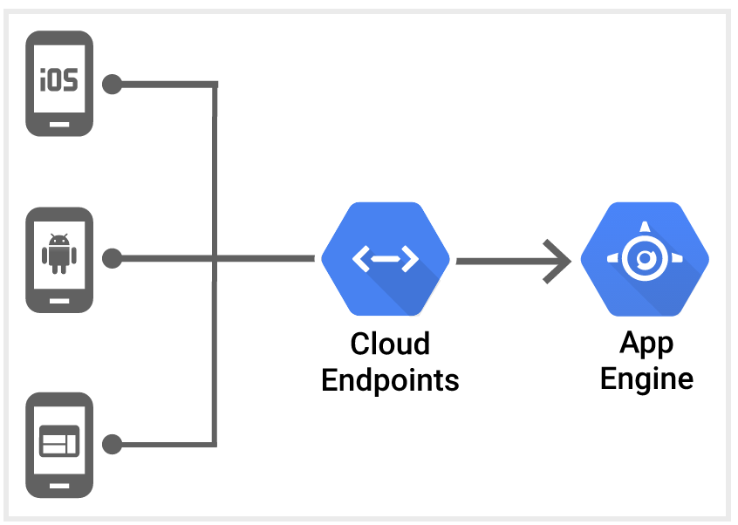
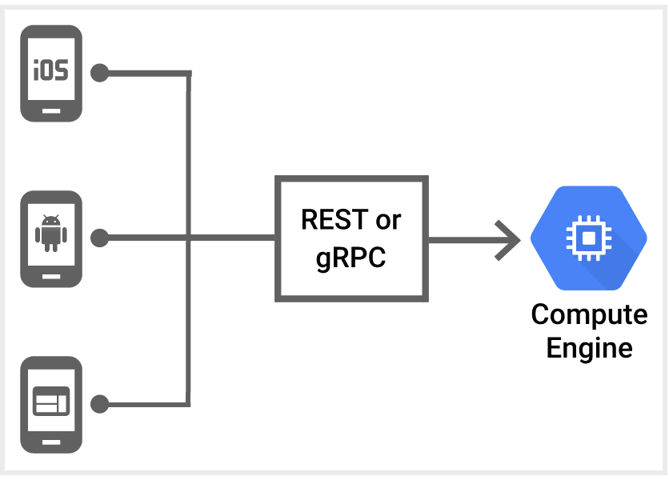
Mobile App Backend Services
Source: https://cloud.google.com/solutions/mobile/mobile-app-backend-services

Slide 42
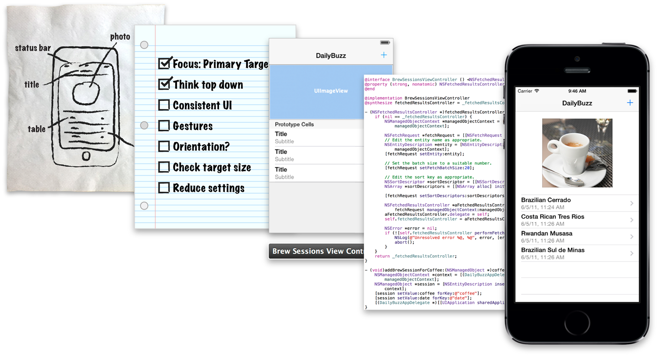
iOS App Development Process
Source: https://developer.apple.com/library/ios/referencelibrary/GettingStarted/RoadMapiOS/AppDevelopmentProcess.html

Slide 43
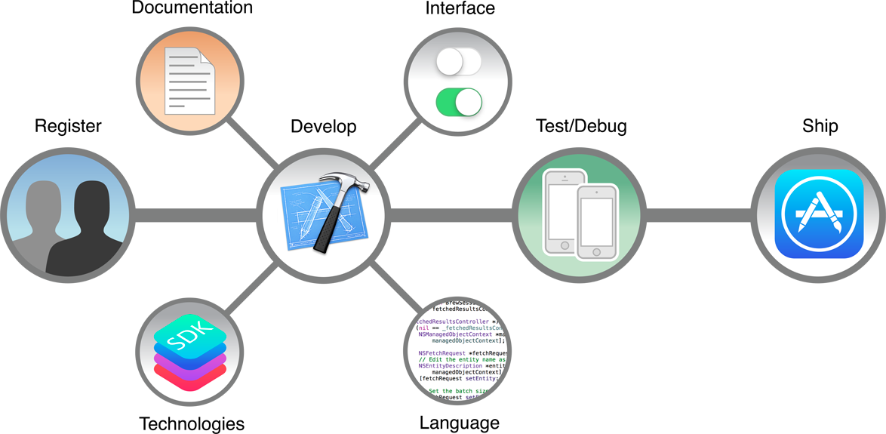
Apps Development Life Cycle
Source: https://developer.apple.com/library/ios/referencelibrary/GettingStarted/RoadMapiOS/WhereToGoFromHere.html

Slide 44
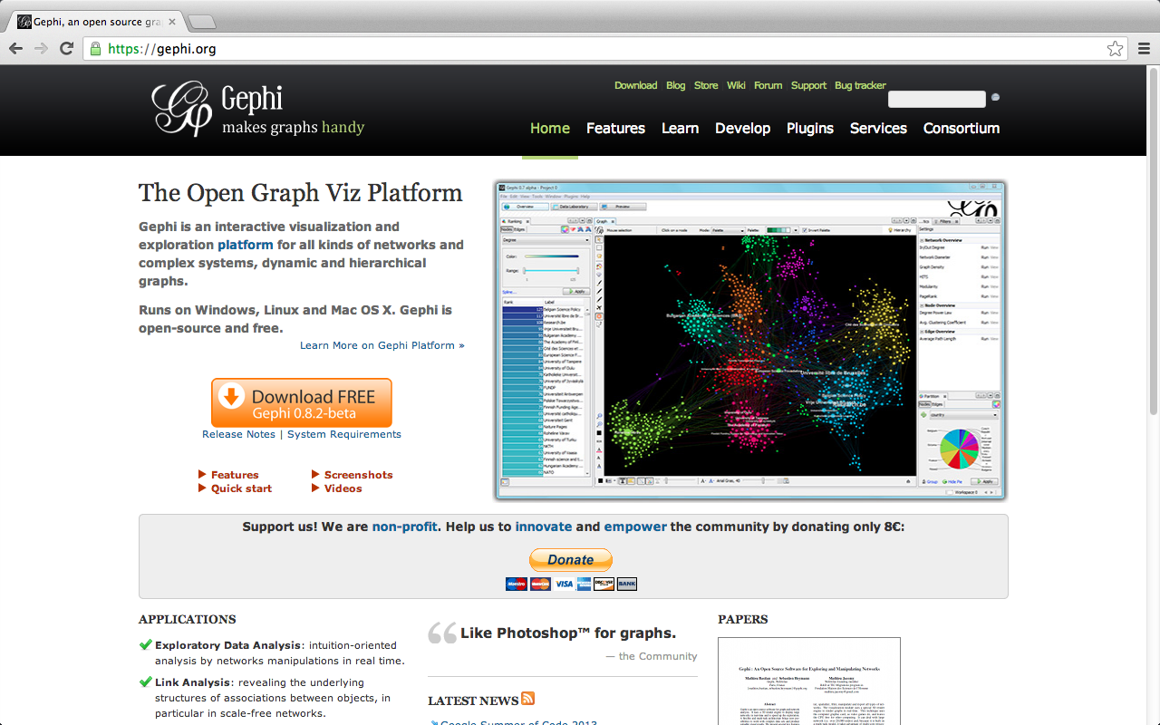
Gephi: Social Network Analysis and Visualization: https://gephi.org/

Slide 45
Summary
This course introduces the fundamental concepts and practices of social media and mobile apps programming.
Topics include
Introduction to Android / iOS apps programming,
Developing Android native apps with Java (Android Studio),
Developing iPhone / iPad apps native apps with Swift (XCode),
Mobile apps using HTML5/CSS3/JavaScript,
jQuery Mobile,
Create hybrid apps with Phonegap,
Google Cloud Platform,
Google app engine, Google map API,
Facebook API,
Twitter API,
Case study on social media apps programming and marketing in Google Play and App Store.

Slide 46
Contact
Tamkang University
Social Media Apps Programming
Min-Yuh Day, Ph.D.
Assistant Professor
Department of Information Management, Tamkang University
Tel: 886-2-26215656 ext. 2846
Fax: 886-2-26209737
Office: B929
Address: No.151, Yingzhuan Rd., Danshui Dist., New Taipei City 25137, Taiwan (R.O.C.)
Email: myday@mail.tku.edu.tw
Web: http://mail.tku.edu.tw/myday/

