Slide 1




商業智慧實務
Practices of Business Intelligence
Tamkang University
Tamkang
University
預測性分析 I：
資料探勘流程、方法與演算法
(Predictive Analytics I:
Data Mining Process, Methods, and Algorithms)
1071BI06
MI4 (M2084) (2888)
Wed, 7, 8 (14:10-16:00) (B217)
Min-Yuh Day
戴敏育
Assistant Professor
專任助理教授
Dept. of Information Management, Tamkang University
淡江大學 資訊管理學系
http://mail. tku.edu.tw/myday/
2018-10-24

Slide 2
課程大綱 (Syllabus)
週次 (Week) 日期 (Date) 內容(Subject/Topics)
1 2018/09/12 商業智慧實務課程介紹
(Course Orientation for Practices of Business Intelligence)
2 2018/09/19 商業智慧、分析與資料科學
(Business Intelligence, Analytics, and Data Science)
3 2018/09/26 人工智慧、大數據與雲端運算
(ABC: AI, Big Data, and Cloud Computing)
4 2018/10/03 描述性分析I：數據的性質、統計模型與可視化
(Descriptive Analytics I: Nature of Data, Statistical Modeling,
and Visualization)
5 2018/10/10 國慶紀念日 (放假一天) (National Day) (Day off)
6 2018/10/17 描述性分析II：商業智慧與資料倉儲
(Descriptive Analytics II: Business Intelligence and
Data Warehousing)

Slide 3
課程大綱 (Syllabus)
週次 (Week) 日期 (Date) 內容(Subject/Topics)
7 2018/10/24 預測性分析I：資料探勘流程、方法與演算法
(Predictive Analytics I: Data Mining Process,
Methods, and Algorithms)
8 2018/10/31 預測性分析II：文本、網路與社群媒體分析
(Predictive Analytics II: Text, Web, and
Social Media Analytics)
9 2018/11/07 期中報告 (Midterm Project Report)
10 2018/11/14 期中考試 (Midterm Exam)
11 2018/11/21 處方性分析：最佳化與模擬
(Prescriptive Analytics: Optimization and Simulation)
12 2018/11/28 社會網絡分析
(Social Network Analysis)

Slide 4
課程大綱 (Syllabus)
週次 (Week) 日期 (Date) 內容(Subject/Topics)
13 2018/12/05 機器學習與深度學習
(Machine Learning and Deep Learning)
14 2018/12/12 自然語言處理
(Natural Language Processing)
15 2018/12/19 AI交談機器人與對話式商務
(AI Chatbots and Conversational Commerce)
16 2018/12/26 商業分析的未來趨勢、隱私與管理考量
(Future Trends, Privacy and
Managerial Considerations in Analytics)
17 2019/01/02 期末報告 (Final Project Presentation)
18 2019/01/09 期末考試 (Final Exam)

Slide 5
Business Intelligence (BI)
1
Introduction to BI and Data Science
2
Descriptive Analytics
3
Predictive Analytics
4
Prescriptive Analytics
5
Big Data Analytics
6
Future Trends

Slide 6
Predictive Analytics I:
Data Mining Process, Methods, and Algorithms

Slide 7
Outline
Data Mining Concepts and Applications
Data Mining Applications
Data Mining Process
Data Mining Methods
Data Mining Software Tools
Data Mining Privacy Issues, Myths, and Blunders

Slide 8
Data Mining
Data Mining
  Discovering or “mining” knowledge from large amounts of data.
Data mining is a misnomer
  Mining of gold from within rocks or dirt
  is referred to as “gold” mining
  rather than “rock” or “dirt” mining.
  Data mining
    “knowledge mining”
    “knowledge discovery ”
Source: Ramesh Sharda, Dursun Delen, and Efraim Turban (2017), Business Intelligence, Analytics, and Data Science: A Managerial Perspective, 4th Edition, Pearson

Slide 9
Data Mining
Knowledge extraction
Pattern analysis
Data archaeology
Information harvesting
Pattern searching
Data dredging
Source: Ramesh Sharda, Dursun Delen, and Efraim Turban (2017), Business Intelligence, Analytics, and Data Science: A Managerial Perspective, 4th Edition, Pearson

Slide 10
Data Mining
Technical Definition
Data mining is a process that uses statistical, mathematical, and artificial intelligence techniques to extract and identify useful information and subsequent knowledge (or patterns) from large sets of data
These patterns can be in the form of business rules, affinities, correlations, trends, or prediction models.
Source: Ramesh Sharda, Dursun Delen, and Efraim Turban (2017), Business Intelligence, Analytics, and Data Science: A Managerial Perspective, 4th Edition, Pearson

Slide 11
Data Mining Definition
(Fayyad et al., 1996)
“The nontrivial process of identifying valid, novel, potentially useful, and ultimately understandable patterns in data stored in structured databases.”
Source: Ramesh Sharda, Dursun Delen, and Efraim Turban (2017), Business Intelligence, Analytics, and Data Science: A Managerial Perspective, 4th Edition, Pearson

Slide 12
Data Mining
Process
  data mining comprises many iterative steps.
Nontrivial
  some experimentation-type search or inference is involved
  it is not as straightforward as a computation of predefined quantities.
Valid
  the discovered patterns should hold true on new data with a sufficient degree of certainty.
Novel
  the patterns are not previously known to the user within the context of the system being analyzed.
Potentially useful
  the discovered patterns should lead to some benefit to the user or task.
Ultimately understandable
  the pattern should make business sense
Source: Ramesh Sharda, Dursun Delen, and Efraim Turban (2017), Business Intelligence, Analytics, and Data Science: A Managerial Perspective, 4th Edition, Pearson

Slide 13
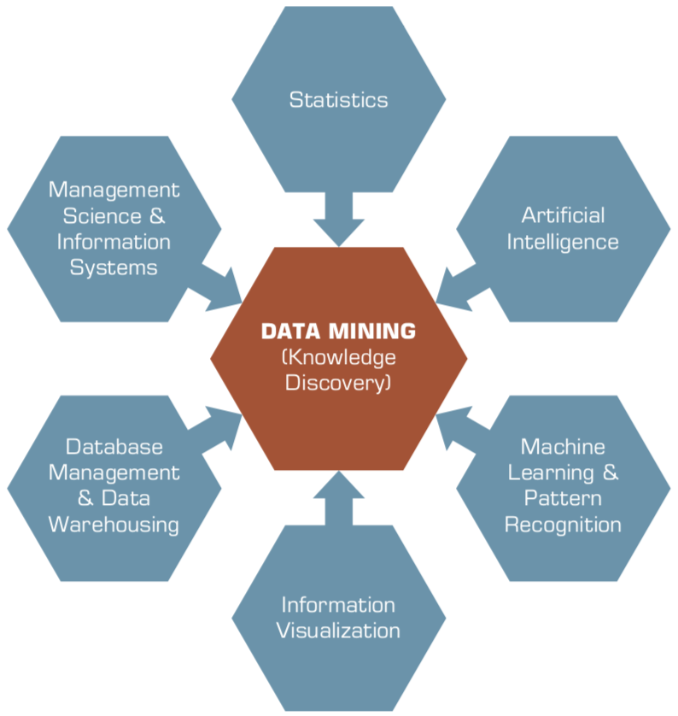
Data Mining
Is a Blend of Multiple Disciplines
Source: Ramesh Sharda, Dursun Delen, and Efraim Turban (2017), Business Intelligence, Analytics, and Data Science: A Managerial Perspective, 4th Edition, Pearson

Slide 14
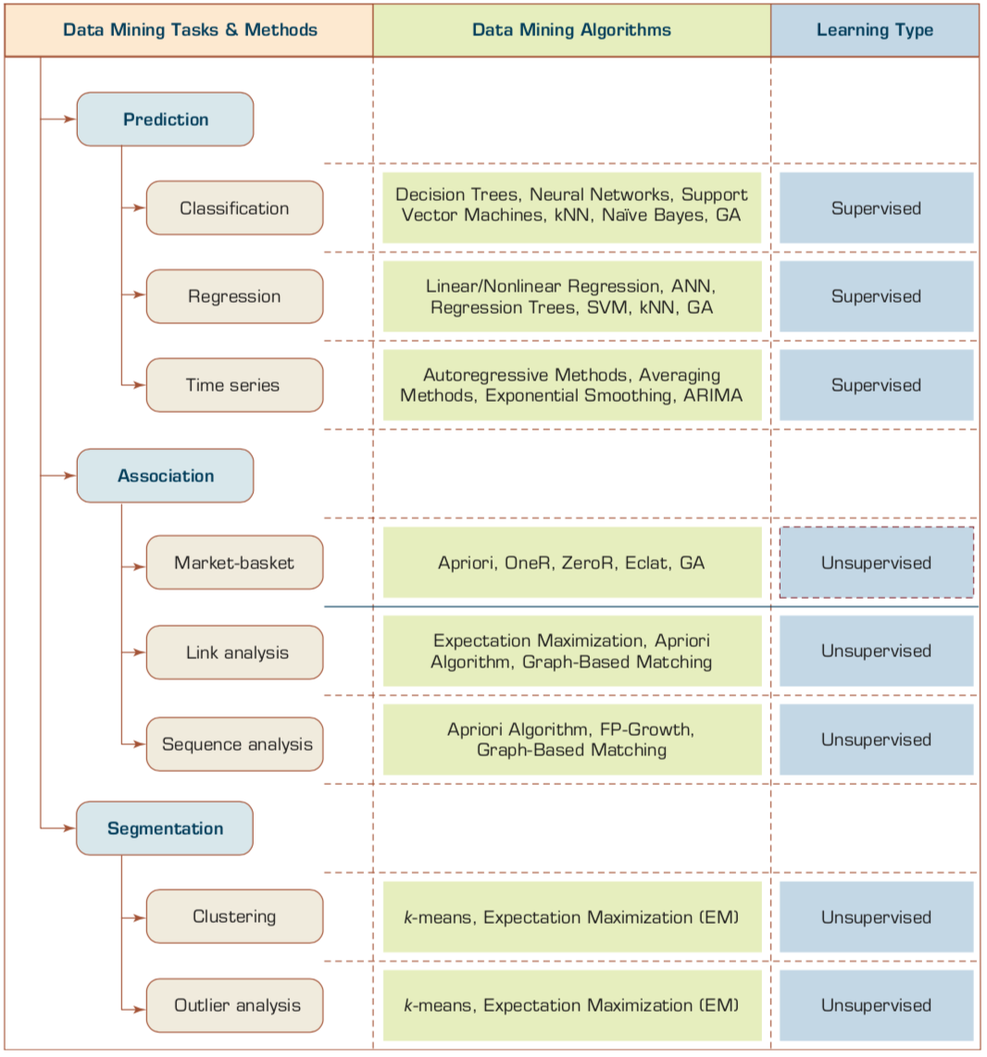
Data Mining Tasks & Methods
Source: Ramesh Sharda, Dursun Delen, and Efraim Turban (2017), Business Intelligence, Analytics, and Data Science: A Managerial Perspective, 4th Edition, Pearson

Slide 15
Data Mining Applications
Customer Relationship Management (CRM)
Banking
Retailing and logistics
Manufacturing and production
Brokerage and securities trading
Computer hardware and software
Government and defense
Travel industry (airlines, hotels/resorts, rental car companies)
Healthcare
Medicine
Entertainment industry
Homeland security and law enforcement
Sports
Source: Ramesh Sharda, Dursun Delen, and Efraim Turban (2017), Business Intelligence, Analytics, and Data Science: A Managerial Perspective, 4th Edition, Pearson

Slide 16
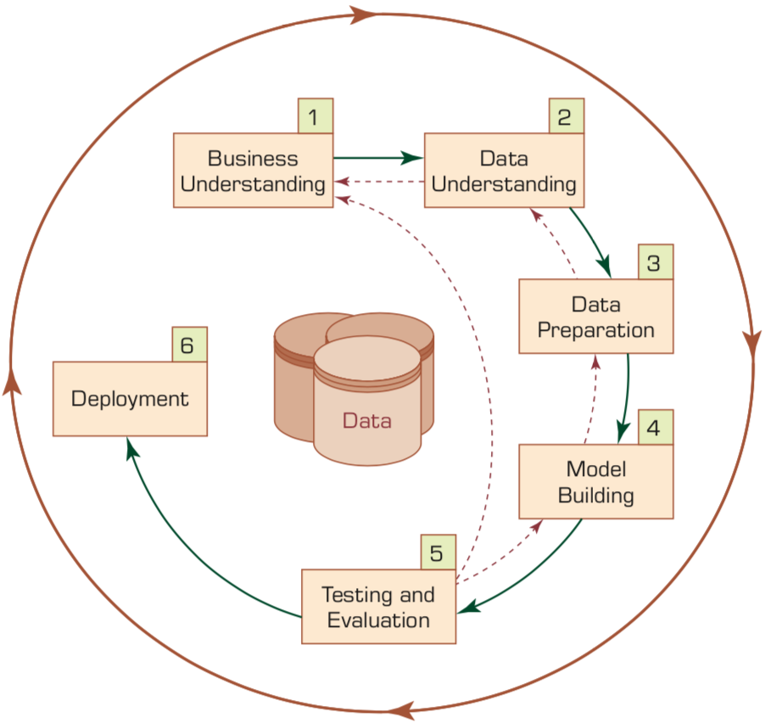
The Six-Step
CRISP-DM Data Mining Process
Source: Ramesh Sharda, Dursun Delen, and Efraim Turban (2017), Business Intelligence, Analytics, and Data Science: A Managerial Perspective, 4th Edition, Pearson

Slide 17
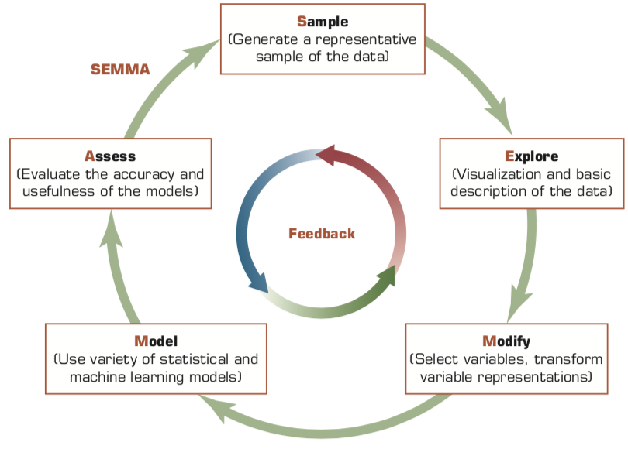
SEMMA Data Mining Process
Source: Ramesh Sharda, Dursun Delen, and Efraim Turban (2017), Business Intelligence, Analytics, and Data Science: A Managerial Perspective, 4th Edition, Pearson

Slide 18
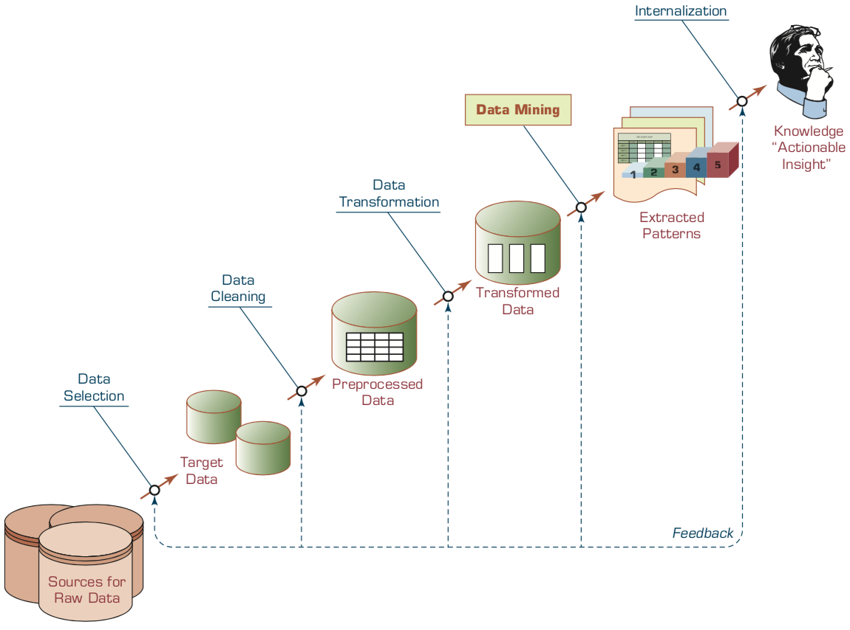
KDD (Knowledge Discovery in Databases) Process
Source: Ramesh Sharda, Dursun Delen, and Efraim Turban (2017), Business Intelligence, Analytics, and Data Science: A Managerial Perspective, 4th Edition, Pearson

Slide 19
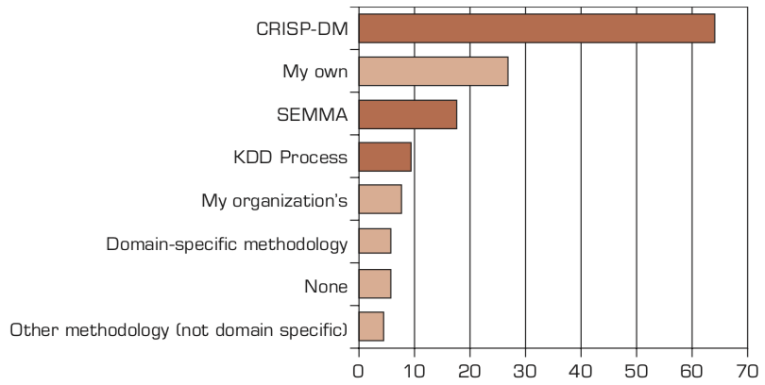
Ranking of
Data Mining Methodologies/Processes
Source: Ramesh Sharda, Dursun Delen, and Efraim Turban (2017), Business Intelligence, Analytics, and Data Science: A Managerial Perspective, 4th Edition, Pearson

Slide 20
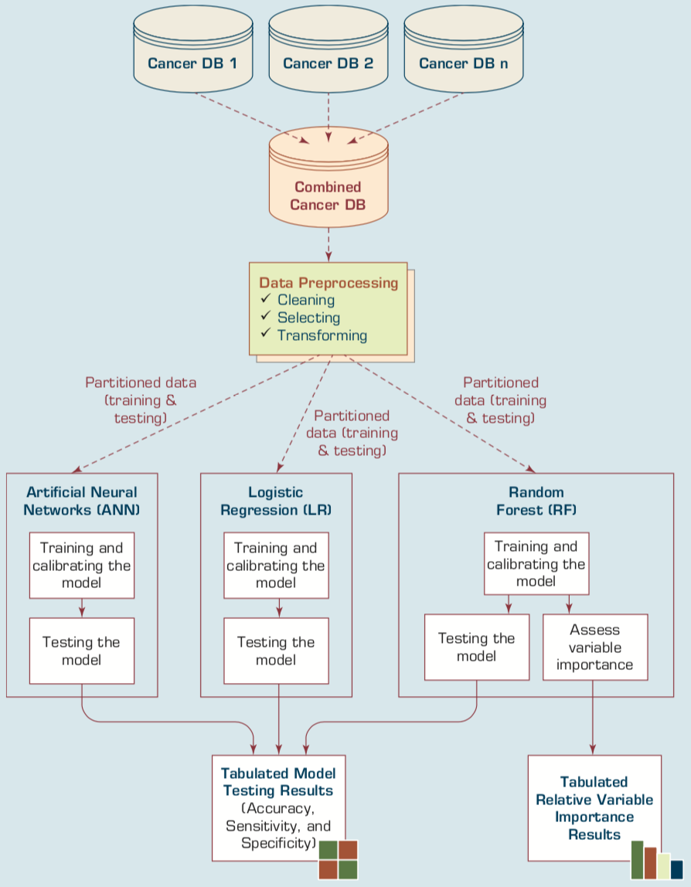
A Data Mining Methodology for Investigation of Comorbidity in Cancer Survivability
Source: Ramesh Sharda, Dursun Delen, and Efraim Turban (2017), Business Intelligence, Analytics, and Data Science: A Managerial Perspective, 4th Edition, Pearson

Slide 21
Data Mining Methods
Classification
  Classification
    Class Label Prediction
  Regression
    Numeric Value Prediction
Clustering
Association
Source: Ramesh Sharda, Dursun Delen, and Efraim Turban (2017), Business Intelligence, Analytics, and Data Science: A Managerial Perspective, 4th Edition, Pearson

Slide 22
Assessing the Classification Model
Predictive accuracy
  Hit rate
Speed
  Model building; predicting
Robustness
Scalability
Interpretability
  Transparency, explainability
Source: Ramesh Sharda, Dursun Delen, and Efraim Turban (2017), Business Intelligence, Analytics, and Data Science: A Managerial Perspective, 4th Edition, Pearson

Slide 23
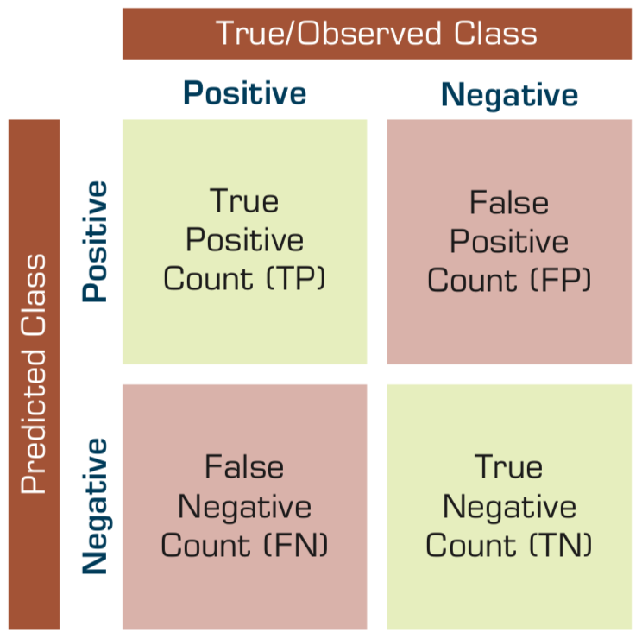
Confusion Matrix for Tabulation of Two-Class Classification Results
Source: Ramesh Sharda, Dursun Delen, and Efraim Turban (2017), Business Intelligence, Analytics, and Data Science: A Managerial Perspective, 4th Edition, Pearson

Slide 24
Accuracy
Precision
Validity
Reliability

Slide 26
Accuracy vs. Precision
A
B
High Accuracy
High Precision
Low Accuracy
High Precision
C
D
High Accuracy
Low Precision
Low Accuracy
Low Precision

Slide 27
Accuracy vs. Precision
A
B
High Accuracy
High Precision
Low Accuracy
High Precision
High Validity
High Reliability
Low Validity
High Reliability
C
D
High Accuracy
Low Precision
Low Accuracy
Low Precision
High Validity
Low Reliability
Low Validity
Low Reliability

Slide 28
Accuracy vs. Precision
A
B
High Accuracy
High Precision
Low Accuracy
High Precision
High Validity
High Reliability
Low Validity
High Reliability
C
D
High Accuracy
Low Precision
Low Accuracy
Low Precision
High Validity
Low Reliability
Low Validity
Low Reliability

Slide 29
Sensitivity
Specificity
=True Positive Rate
=True Negative Rate

Slide 30
True Class
(actual value)
Positive
Negative
total
True
Positive
(TP)
False
Positive
(FP)
Positive
P’
Predictive Class
(prediction outcome)
False
Negative
(FN)
True
Negative
(TN)
Negative
N’
total
P
N
Source: http://en.wikipedia.org/wiki/Receiver_operating_characteristic

Slide 31
True Class
(actual value)
Positive
Negative
total
True
Positive
(TP)
False
Positive
(FP)
Positive
P’
Predictive Class
(prediction outcome)
False
Negative
(FN)
True
Negative
(TN)
Negative
N’
total
P
N
Sensitivity
= True Positive Rate
= Recall
= Hit rate
= TP / (TP + FN)
Source: http://en.wikipedia.org/wiki/Receiver_operating_characteristic

Slide 32
True Class
(actual value)
Positive
Negative
total
True
Positive
(TP)
False
Positive
(FP)
Positive
P’
Predictive Class
(prediction outcome)
False
Negative
(FN)
True
Negative
(TN)
Negative
N’
total
P
N
Specificity
= True Negative Rate
= TN / N
= TN / (TN+ FP)
Source: http://en.wikipedia.org/wiki/Receiver_operating_characteristic

Slide 33
True Class
(actual value)
Precision
= Positive Predictive Value (PPV)
Positive
Negative
total
True
Positive
(TP)
False
Positive
(FP)
Positive
P’
Recall
= True Positive Rate (TPR)
= Sensitivity
= Hit Rate
Predictive Class
(prediction outcome)
False
Negative
(FN)
True
Negative
(TN)
Negative
N’
total
P
N
F1 score (F-score)(F-measure)
is the harmonic mean of precision and recall
= 2TP / (P + P’)
= 2TP / (2TP + FP + FN)
Source: http://en.wikipedia.org/wiki/Receiver_operating_characteristic

Slide 34
A
63
(TP)
28
(FP)
Recall
= True Positive Rate (TPR)
= Sensitivity
= Hit Rate
= TP / (TP + FN)
Specificity
= True Negative Rate
= TN / N
= TN / (TN + FP)
91
37
(FN)
72
(TN)
109
100
100
200
TPR = 0.63
FPR = 0.28
PPV = 0.69
=63/(63+28)
=63/91
Precision
= Positive Predictive Value (PPV)
F1 = 0.66
= 2*(0.63*0.69)/(0.63+0.69)
= (2 * 63) /(100 + 91)
= (0.63 + 0.69) / 2 =1.32 / 2 =0.66
F1 score (F-score)
(F-measure)
is the harmonic mean of precision and recall
= 2TP / (P + P’)
= 2TP / (2TP + FP + FN)
ACC = 0.68
= (63 + 72) / 200
= 135/200 = 67.5
Source: http://en.wikipedia.org/wiki/Receiver_operating_characteristic

Slide 35
A
B
63
(TP)
28
(FP)
77
(TP)
77
(FP)
91
154
37
(FN)
72
(TN)
109
23
(FN)
23
(TN)
46
100
100
200
100
100
200
TPR = 0.63
TPR = 0.77
FPR = 0.77
PPV = 0.50
F1 = 0.61
ACC = 0.50
FPR = 0.28
PPV = 0.69
=63/(63+28)
=63/91
F1 = 0.66
= 2*(0.63*0.69)/(0.63+0.69)
= (2 * 63) /(100 + 91)
= (0.63 + 0.69) / 2 =1.32 / 2 =0.66
Recall
= True Positive Rate (TPR)
= Sensitivity
= Hit Rate
ACC = 0.68
= (63 + 72) / 200
= 135/200 = 67.5
Precision
= Positive Predictive Value (PPV)
Source: http://en.wikipedia.org/wiki/Receiver_operating_characteristic

Slide 36
C
C’
24
(TP)
88
(FP)
76
(TP)
12
(FP)
112
88
76
(FN)
12
(TN)
88
24
(FN)
88
(TN)
112
100
100
200
100
100
200
TPR = 0.24
FPR = 0.88
PPV = 0.21
F1 = 0.22
ACC = 0.18
TPR = 0.76
FPR = 0.12
PPV = 0.86
F1 = 0.81
ACC = 0.82
Recall
= True Positive Rate (TPR)
= Sensitivity
= Hit Rate
Precision
= Positive Predictive Value (PPV)
Source: http://en.wikipedia.org/wiki/Receiver_operating_characteristic

Slide 37
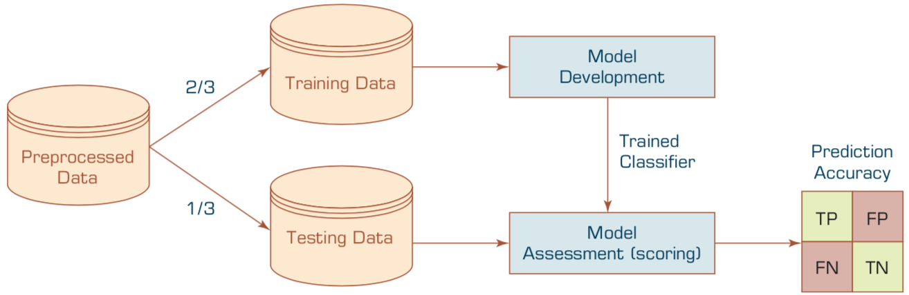
Estimation Methodologies for Classification
Simple split (or holdout or test sample estimation)
  Split the data into 2 mutually exclusive sets
  training (~70%) and testing (30%)
  For ANN, the data is split into three sub-sets
  (training [~60%], validation [~20%], testing [~20%])
Source: Ramesh Sharda, Dursun Delen, and Efraim Turban (2017), Business Intelligence, Analytics, and Data Science: A Managerial Perspective, 4th Edition, Pearson

Slide 38
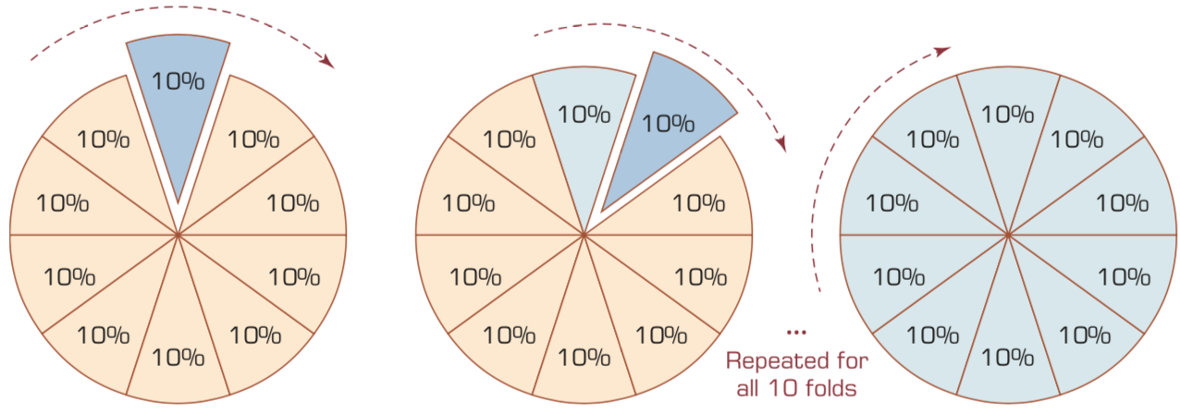
k-Fold Cross-Validation
Source: Ramesh Sharda, Dursun Delen, and Efraim Turban (2017), Business Intelligence, Analytics, and Data Science: A Managerial Perspective, 4th Edition, Pearson

Slide 39
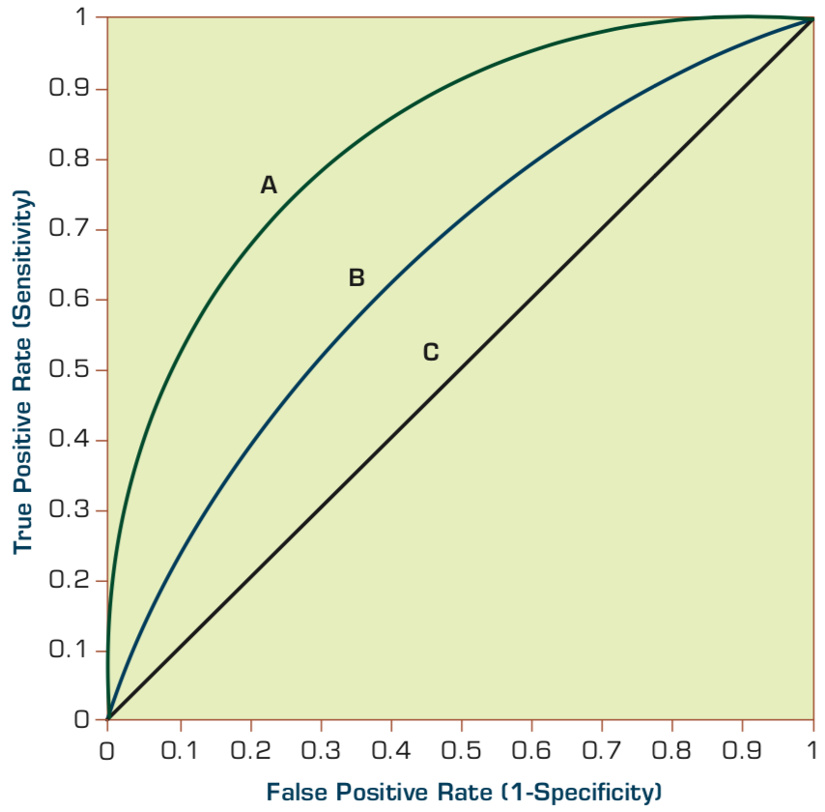
Estimation Methodologies for Classification
Area under the ROC curve
Source: Ramesh Sharda, Dursun Delen, and Efraim Turban (2017), Business Intelligence, Analytics, and Data Science: A Managerial Perspective, 4th Edition, Pearson

Slide 40
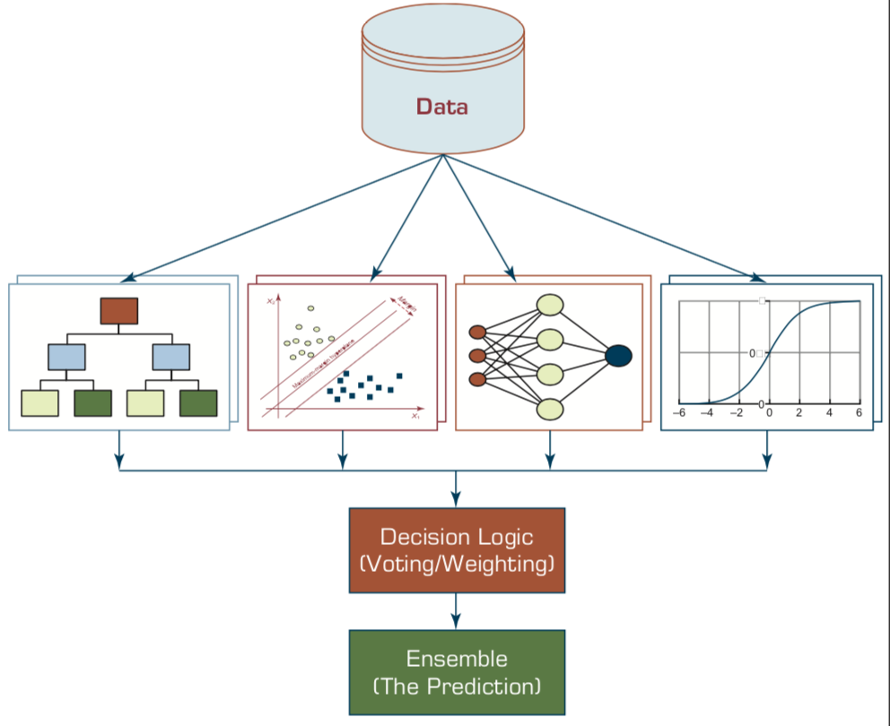
Ensemble Models
Heterogeneous Ensemble
Source: Ramesh Sharda, Dursun Delen, and Efraim Turban (2017), Business Intelligence, Analytics, and Data Science: A Managerial Perspective, 4th Edition, Pearson

Slide 41
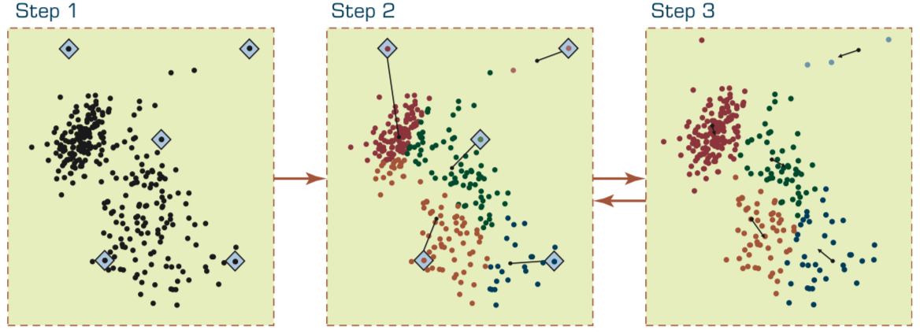
Steps in the k-Means Algorithm
Source: Ramesh Sharda, Dursun Delen, and Efraim Turban (2017), Business Intelligence, Analytics, and Data Science: A Managerial Perspective, 4th Edition, Pearson

Slide 42
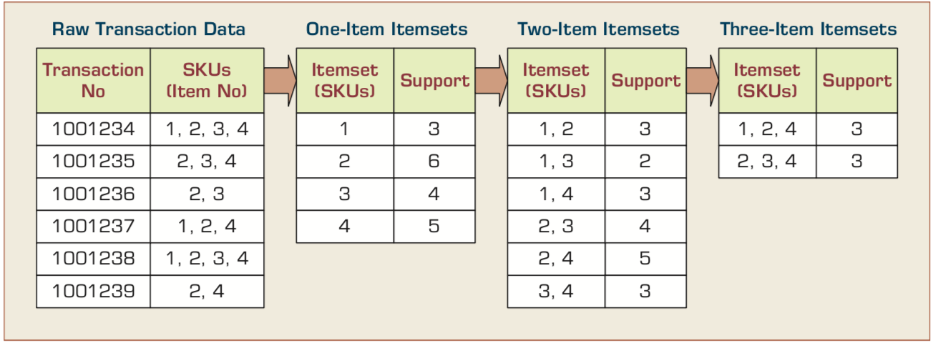
Identification of Frequent Itemsets in the Apriori Algorithm
Source: Ramesh Sharda, Dursun Delen, and Efraim Turban (2017), Business Intelligence, Analytics, and Data Science: A Managerial Perspective, 4th Edition, Pearson

Slide 43
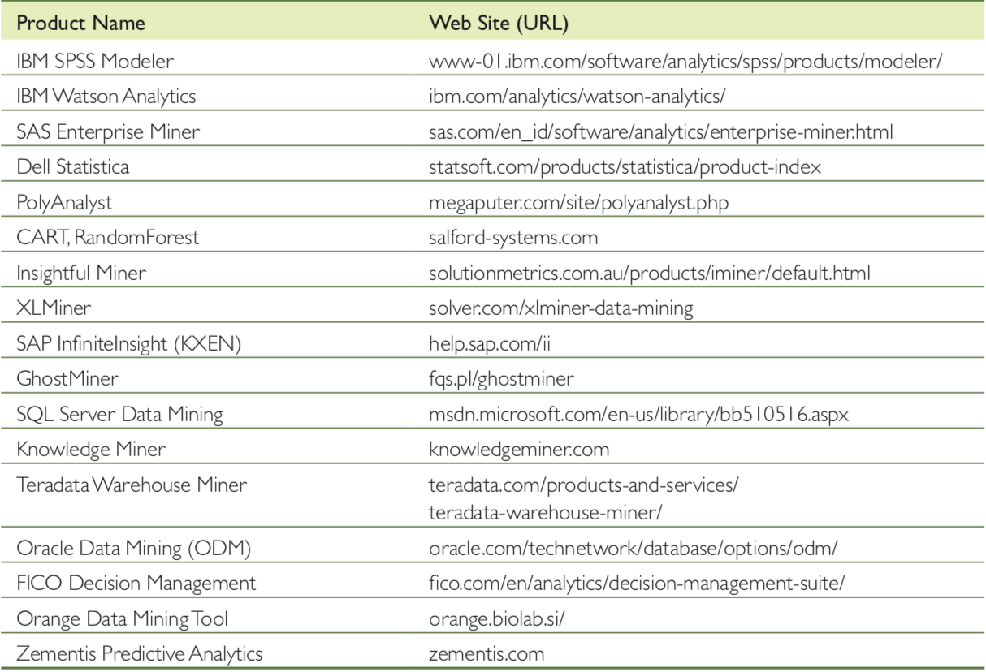
Selected Data Mining Software
Source: Ramesh Sharda, Dursun Delen, and Efraim Turban (2017), Business Intelligence, Analytics, and Data Science: A Managerial Perspective, 4th Edition, Pearson

Slide 44
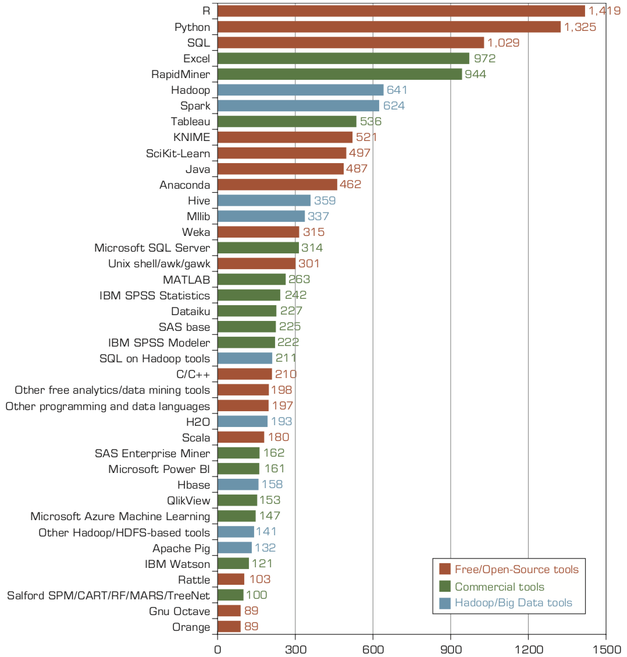
Popular Data Mining Software Tools
(Poll Results)
Source: Ramesh Sharda, Dursun Delen, and Efraim Turban (2017), Business Intelligence, Analytics, and Data Science: A Managerial Perspective, 4th Edition, Pearson

Slide 45
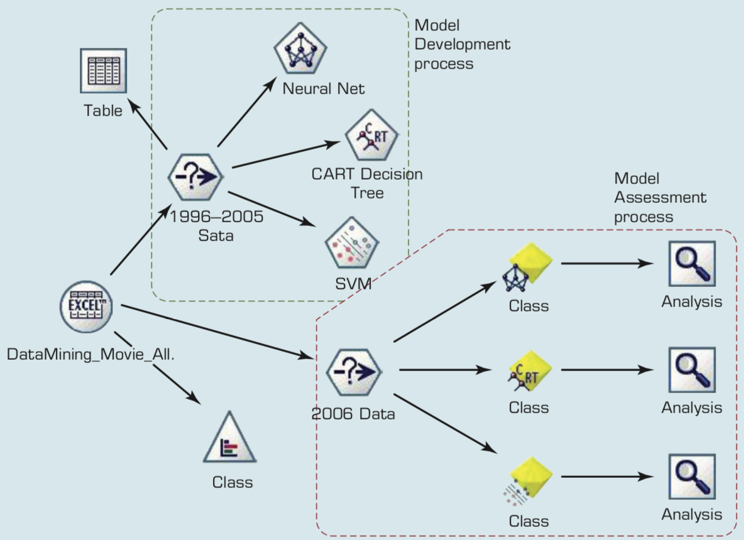
Process Flow Screenshot for the
Box-Office Prediction System
Source: Ramesh Sharda, Dursun Delen, and Efraim Turban (2017), Business Intelligence, Analytics, and Data Science: A Managerial Perspective, 4th Edition, Pearson

Slide 46
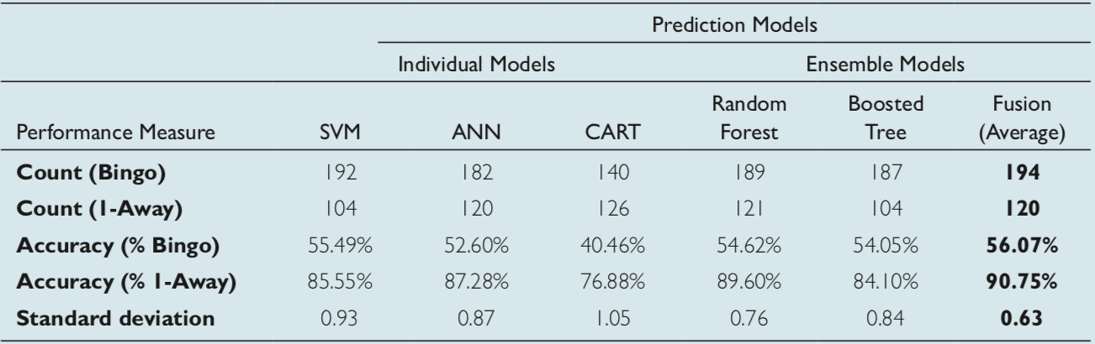
Tabulated Prediction Results for
Individual and Ensemble Models
Source: Ramesh Sharda, Dursun Delen, and Efraim Turban (2017), Business Intelligence, Analytics, and Data Science: A Managerial Perspective, 4th Edition, Pearson

Slide 47
Data Mining Privacy Issues
De-identification
Many publicly available data sources
(e.g., CDC data, SEER data, UNOS data)
are already de-identified.
Source: Ramesh Sharda, Dursun Delen, and Efraim Turban (2017), Business Intelligence, Analytics, and Data Science: A Managerial Perspective, 4th Edition, Pearson

Slide 48
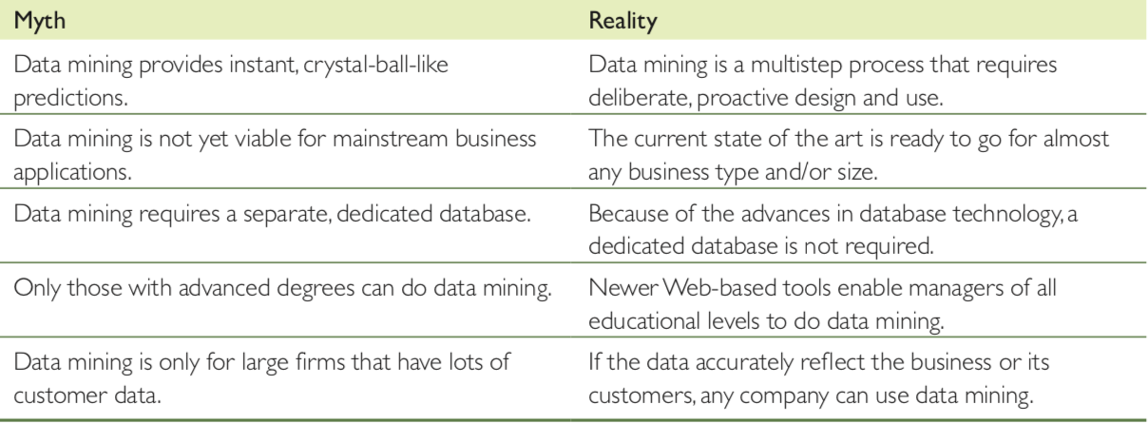
Data Mining Myths
Source: Ramesh Sharda, Dursun Delen, and Efraim Turban (2017), Business Intelligence, Analytics, and Data Science: A Managerial Perspective, 4th Edition, Pearson

Slide 49
Foundations of
Big Data Mining in Python
  Python
    Programming language
  Numpy
    Scientific computing
  Pandas
    Data structures and data analysis tools

Slide 50

Python
HelloWorld

Slide 51
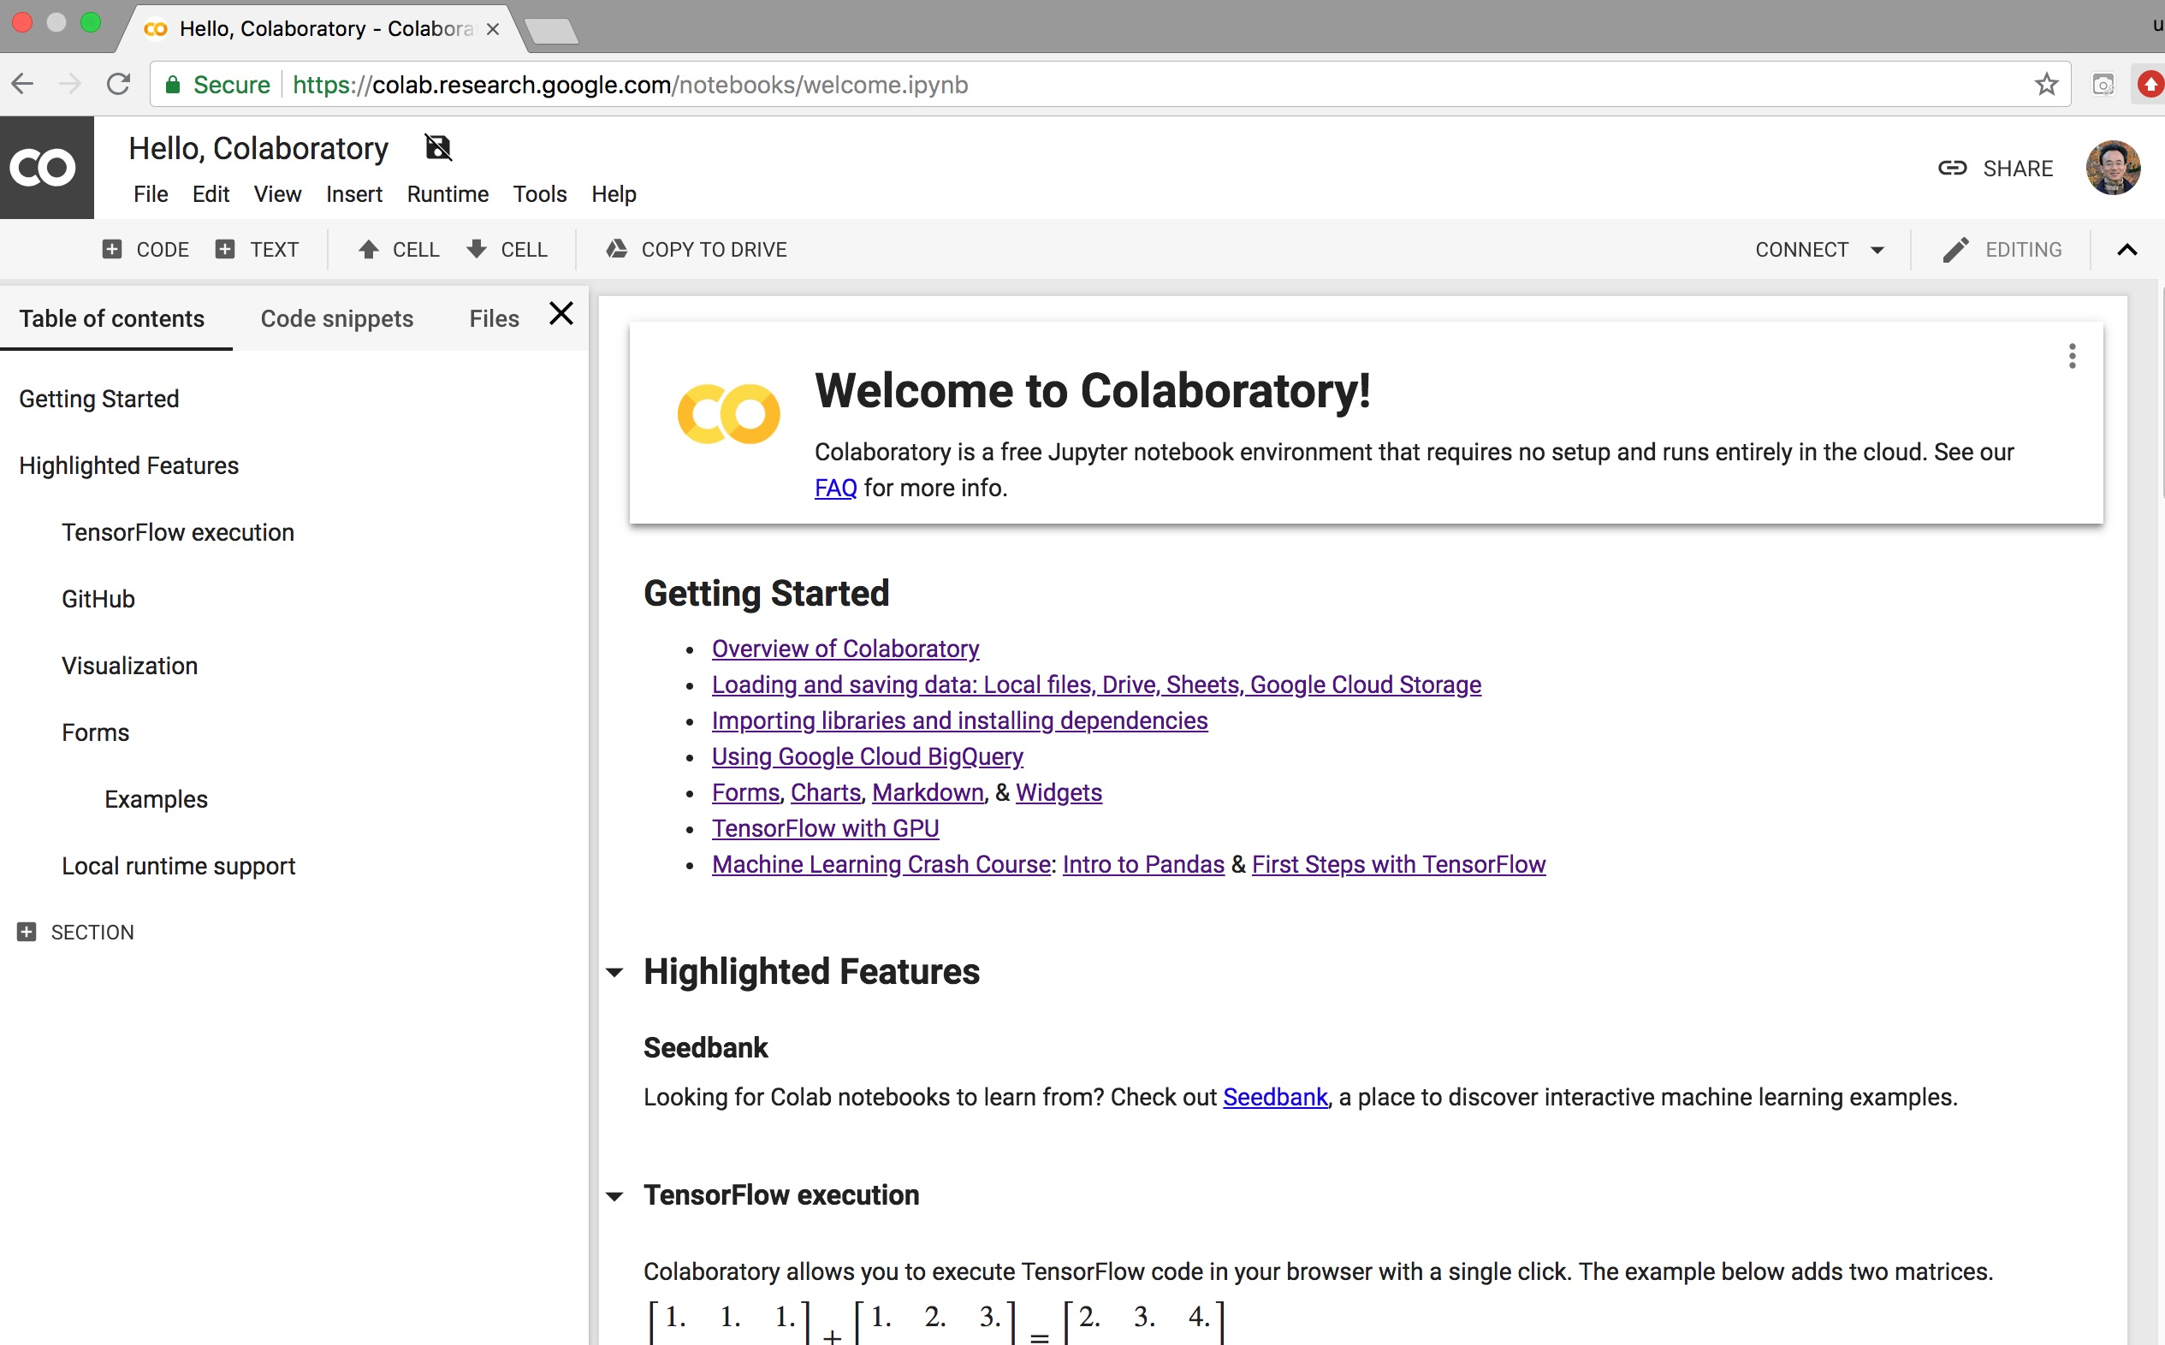
Google Colab
https://colab.research.google.com/notebooks/welcome.ipynb

Slide 52
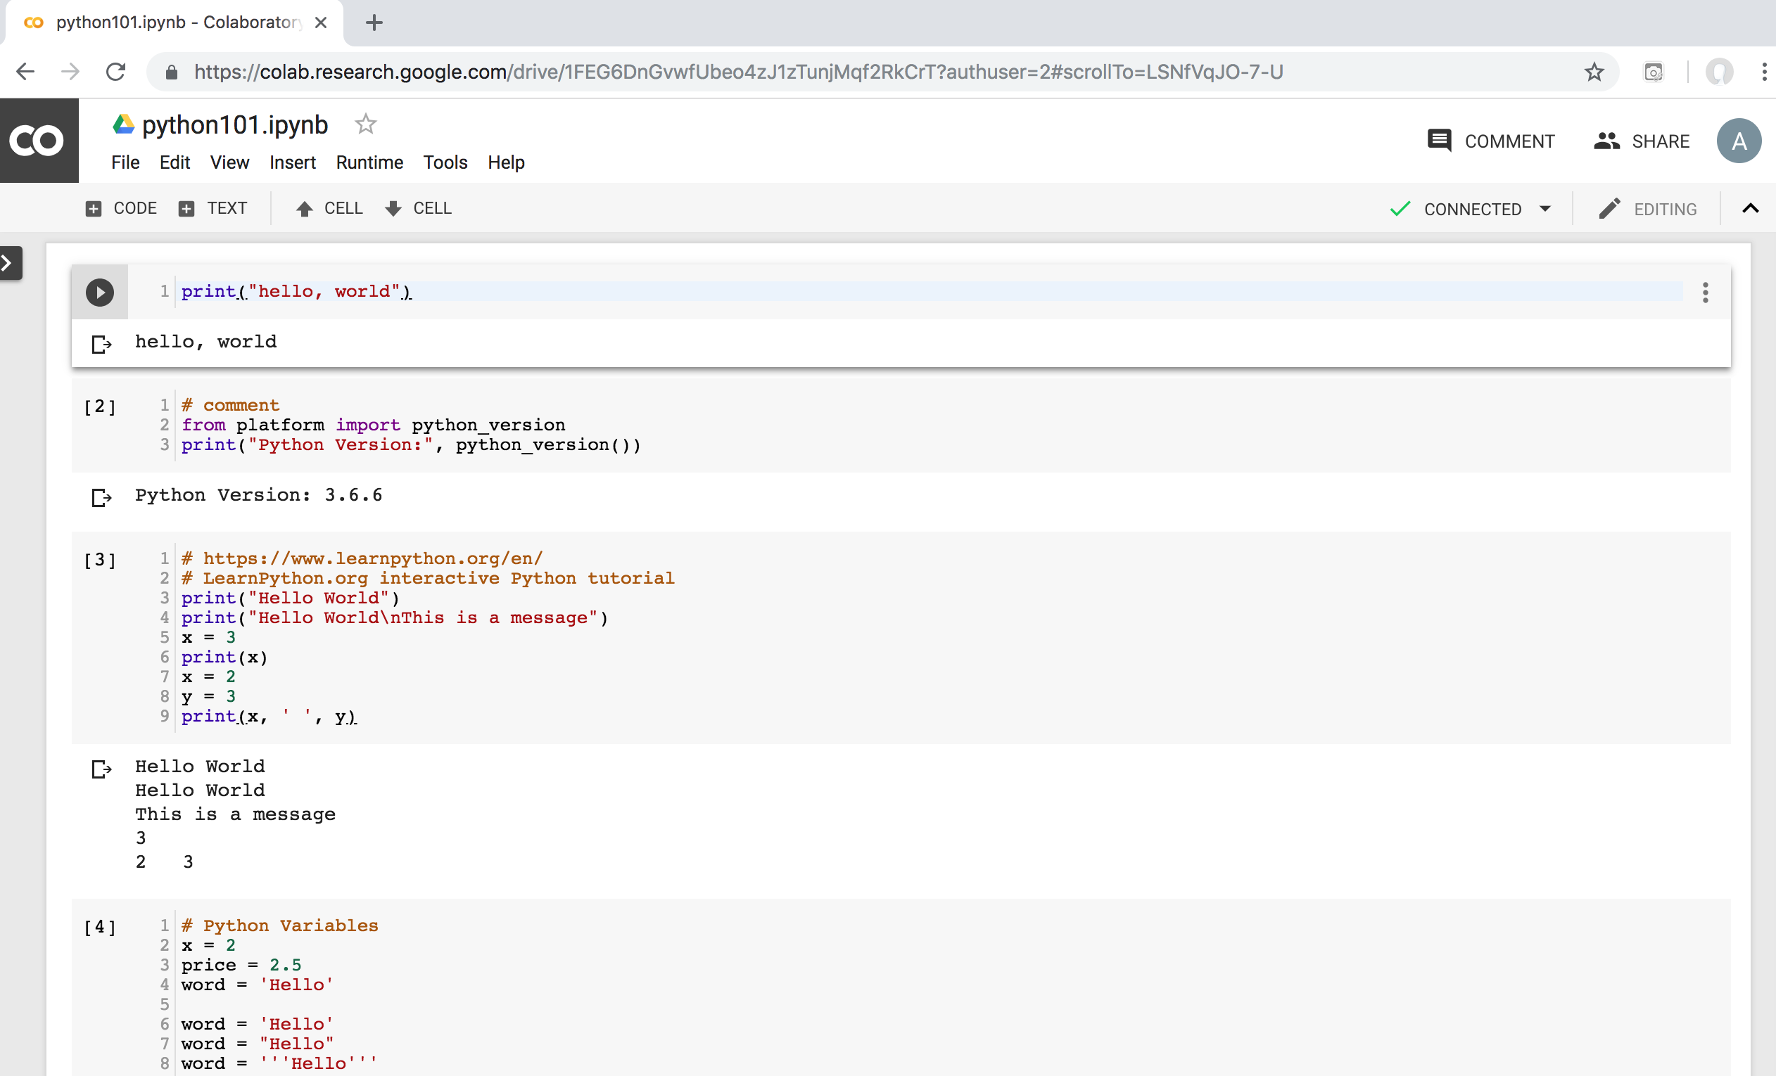
Python in Google Colab
https://colab.research.google.com/drive/1FEG6DnGvwfUbeo4zJ1zTunjMqf2RkCrT

Slide 53

Python in Google Colab
https://colab.research.google.com/drive/1FEG6DnGvwfUbeo4zJ1zTunjMqf2RkCrT

Slide 54
Variables
x = 2
price = 2.5
word = 'Hello'
word = 'Hello'
word = "Hello"
word = '''Hello'''
x = 2
x = x + 1
x = 5
Source: http://pythonprogramminglanguage.com/

Slide 55
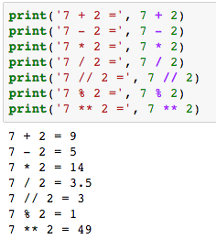
Python Basic Operators
print('7 + 2 =', 7 + 2)
print('7 - 2 =', 7 - 2)
print('7 * 2 =', 7 * 2)
print('7 / 2 =', 7 / 2)
print('7 // 2 =', 7 // 2)
print('7 % 2 =', 7 % 2)
print('7 ** 2 =', 7 ** 2)

Slide 56
BMI Calculator in Python
height_cm = float(input("Enter your height in cm: "))
weight_kg = float(input("Enter your weight in kg: "))
height_m = height_cm/100
BMI = (weight_kg/(height_m**2))
print("Your BMI is: " + str(round(BMI,1)))
Source: http://code.activestate.com/recipes/580615-bmi-code/

Slide 57
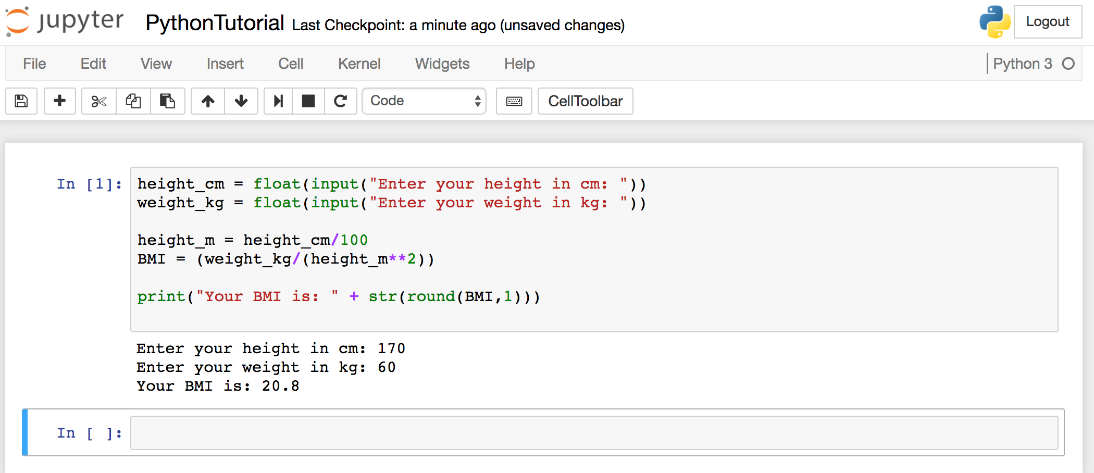
BMI Calculator in Python
Source: http://code.activestate.com/recipes/580615-bmi-code/
Notes:
height_cm = float(input("Enter your height in cm: "))
weight_kg = float(input("Enter your weight in kg: "))
height_m = height_cm/100
BMI = (weight_kg/(height_m**2))
print("Your BMI is: " + str(round(BMI,1)))

Slide 58
Future value of a specified principal amount, rate of interest, and a number of years
Source: https://www.w3resource.com/python-exercises/python-basic-exercise-39.php

Slide 59

Future Value (FV)
# How much is your $100 worth after 7 years?
print(100 * 1.1 ** 7)
# output = 194.87
Source: https://www.w3resource.com/python-exercises/python-basic-exercise-39.php

Slide 60
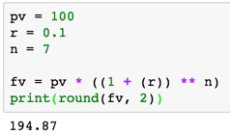
Future Value (FV)
pv = 100
r = 0.1
n = 7
fv = pv * ((1 + (r)) ** n)
print(round(fv, 2))

Slide 61
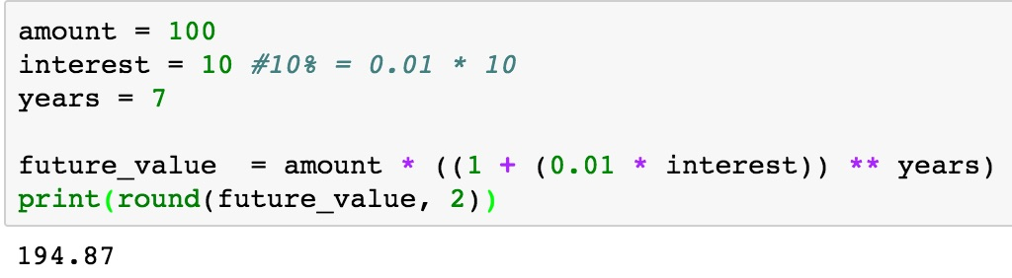
Future Value (FV)
amount = 100
interest = 10 #10% = 0.01 * 10
years = 7
future_value = amount * ((1 + (0.01 * interest)) ** years)
print(round(future_value, 2))
Source: https://www.w3resource.com/python-exercises/python-basic-exercise-39.php
Notes:
amount = 100
interest = 10 #10% = 0.01 * 10
years = 7
future_value = amount * ((1 + (0.01 * interest)) ** years)
print(round(future_value, 2))

Slide 62
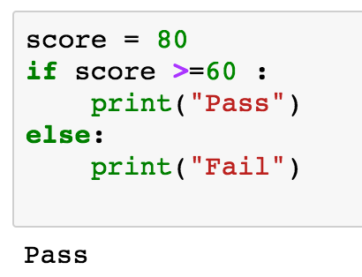
if statements
> greater than
< smaller than
== equals
!= is not
score = 80
if score >=60 :
print("Pass")
else:
print("Fail")
Source: http://pythonprogramminglanguage.com/

Slide 63
if elif else
score = 90
grade = ""
if score >=90:
grade = "A"
elif score >= 80:
grade = "B"
elif score >= 70:
grade = "C"
elif score >= 60:
grade = "D"
else:
grade = "E"
print(grade)
# grade = ”A”
A
http://pythontutor.com/visualize.html
https://goo.gl/E6w5ph
Source: http://pythonprogramminglanguage.com/
Notes:
http://pythontutor.com/visualize.html
https://goo.gl/E6w5ph

Slide 64
for loops
for i in range(1,11):
print(i)
1
2
3
4
5
6
7
8
9
10
Source: http://pythonprogramminglanguage.com/
Notes:
https://goo.gl/YpxMYo

Slide 65
for loops
for i in range(1,10):
for j in range(1,10):
print(i, ' * ' , j , ' = ', i*j)
9 * 1 = 9
9 * 2 = 18
9 * 3 = 27
9 * 4 = 36
9 * 5 = 45
9 * 6 = 54
9 * 7 = 63
9 * 8 = 72
9 * 9 = 81
Source: http://pythonprogramminglanguage.com/
Notes:
for i in range(1,10):
for j in range(1,10):
print(i, ' * ' , j , ' = ', i*j)

Slide 66
while loops
age = 10
while age < 20:
print(age)
age = age + 1
10
11
12
13
14
15
16
17
18
19
Source: https://learnpython.trinket.io/learn-python-part-8-loops#/while-loops/about-while-loops
Notes:
age = 10
while age < 20:
print(age)
age = age + 1

Slide 67
Functions
def convertCMtoM(xcm):
m = xcm/100
return m
cm = 180
m = convertCMtoM(cm)
print(str(m))
1.8
Notes:
https://goo.gl/6K5qUn

Slide 68
Lists
x = [60, 70, 80, 90]
print(len(x))
print(x[0])
print(x[1])
print(x[-1])
4
60
70
90

Slide 69
Tuples
A tuple in Python is a collection that
cannot be modified.
A tuple is defined using parenthesis.
x = (10, 20, 30, 40, 50)
print(x[0])
print(x[1])
print(x[2])
print(x[-1])
10
20
30
50
Source: http://pythonprogramminglanguage.com/tuples/

Slide 70
Dictionary
k = { 'EN':'English', 'FR':'French' }
print(k['EN'])
English
Source: http://pythonprogramminglanguage.com/dictionary/

Slide 71
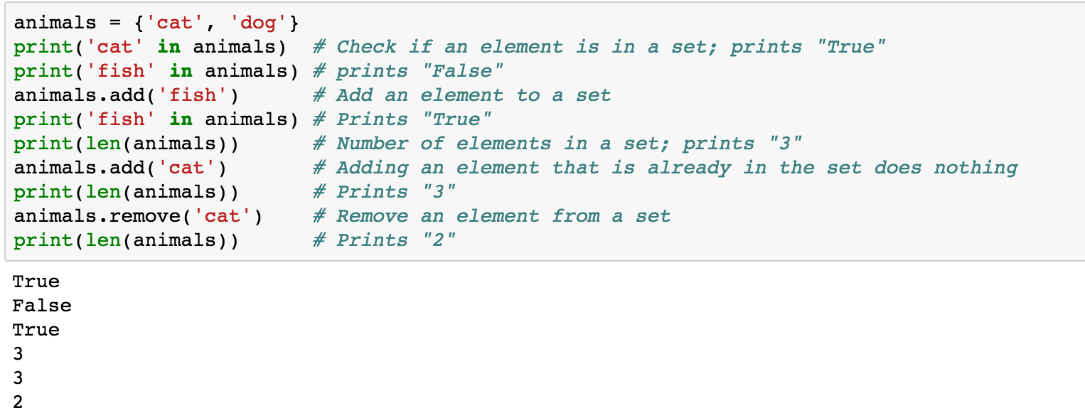
Sets
animals = {'cat', 'dog'}
animals = {'cat', 'dog'}
print('cat' in animals)
print('fish' in animals)
animals.add('fish')
print('fish' in animals)
print(len(animals))
animals.add('cat')
print(len(animals))
animals.remove('cat')
print(len(animals))
Source: http://cs231n.github.io/python-numpy-tutorial/
Notes:
#Sets
animals = {'cat', 'dog'}
print('cat' in animals) # Check if an element is in a set; prints "True"
print('fish' in animals) # prints "False"
animals.add('fish') # Add an element to a set
print('fish' in animals) # Prints "True"
print(len(animals)) # Number of elements in a set; prints "3"
animals.add('cat') # Adding an element that is already in the set does nothing
print(len(animals)) # Prints "3"
animals.remove('cat') # Remove an element from a set
print(len(animals)) # Prints "2”
Source: http://cs231n.github.io/python-numpy-tutorial/

Slide 72
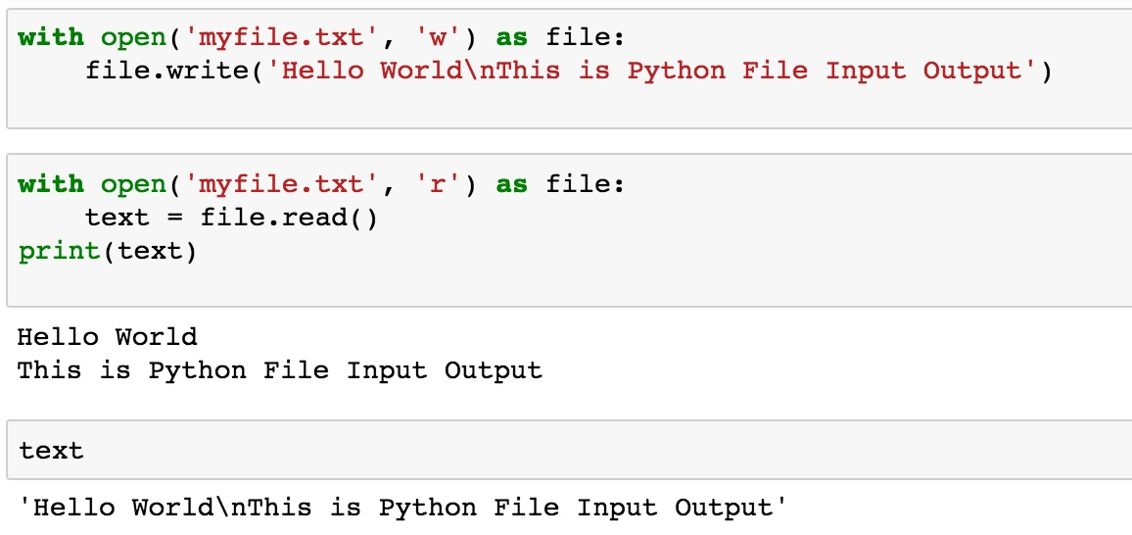
File Input / Output
with open('myfile.txt', 'w') as file:
file.write('Hello World\nThis is Python File Input Output')
with open('myfile.txt', 'r') as file:
text = file.read()
print(text)
Source: https://github.com/TiesdeKok/LearnPythonforResearch/blob/master/0_python_basics.ipynb
Notes:
with open('myfile.txt', 'w') as file:
file.write('Hello World\nThis is Python File Input Output')
with open('myfile.txt', 'r') as file:
text = file.read()
print(text)
with open('myfile.txt', 'a+') as file:
file.write('\n' + 'New line')
with open('myfile.txt', 'r') as file:
text = file.read()
print(text)

Slide 73
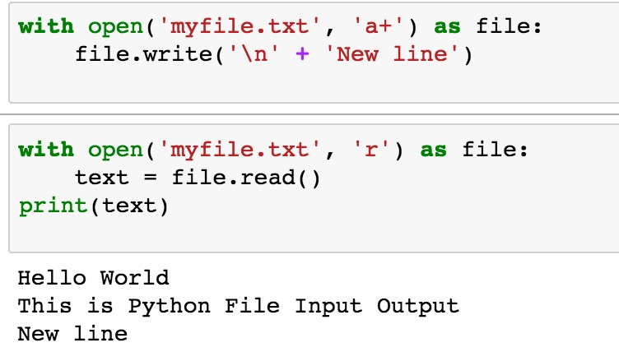
File Input / Output
with open('myfile.txt', 'a+') as file:
file.write('\n' + 'New line')
with open('myfile.txt', 'r') as file:
text = file.read()
print(text)
Source: https://github.com/TiesdeKok/LearnPythonforResearch/blob/master/0_python_basics.ipynb
Notes:
with open('myfile.txt', 'w') as file:
file.write('Hello World\nThis is Python File Input Output')
with open('myfile.txt', 'r') as file:
text = file.read()
print(text)
with open('myfile.txt', 'a+') as file:
file.write('\n' + 'New line')
with open('myfile.txt', 'r') as file:
text = file.read()
print(text)

Slide 74
Big Data Analytics with
Numpy in Python

Slide 75
Numpy
NumPy
Base
N-dimensional array package

Slide 76
NumPy is the fundamental package for scientific computing with Python.
Source: http://www.numpy.org/

Slide 77
NumPy
NumPy
NumPy provides a
multidimensional array object
to store homogenous or heterogeneous data;
it also provides
optimized functions/methods to operate on this array object.
Source: Yves Hilpisch (2014), Python for Finance: Analyze Big Financial Data, O'Reilly

Slide 78
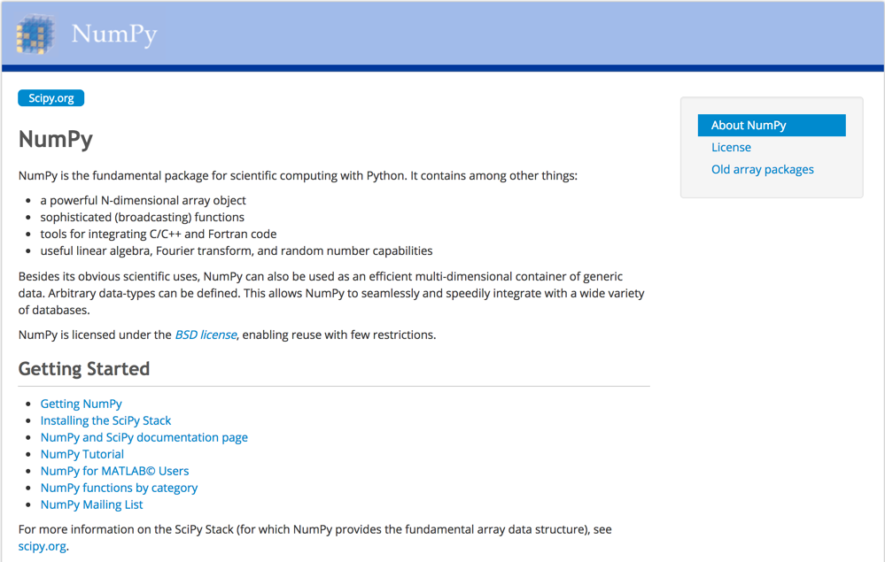
NumPy
http://www.numpy.org/

Slide 79
NumPy ndarray
NumPy
One-dimensional Array
(1-D Array)
0 | 1 |  |  | n-1
1 | 2 | 3 | 4 | 5
Two-dimensional Array
(2-D Array)
 | 0 | 1 |  |  | n-1
0 | 1 | 2 | 3 | 4 | 5
1 | 6 | 7 | 8 | 9 | 10
 | 11 | 12 | 13 | 14 | 15
m-1 | 16 | 17 | 18 | 19 | 20

Slide 80
v = list(range(1, 6)) v
2 * v import numpy as np v = np.arange(1, 6) v
2 * v
NumPy
NumPy
Source: Yves Hilpisch (2014), Python for Finance: Analyze Big Financial Data, O'Reilly
Notes:
# pip3 install numpy
# pip install numpy
# sudo pip3 install numpy
import numpy as np

Slide 81
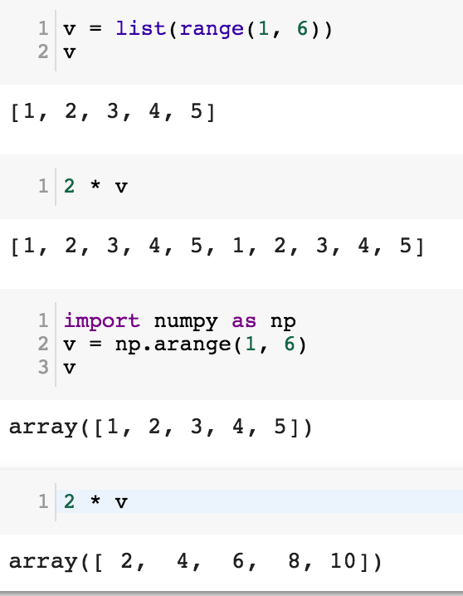
NumPy
Base
N-dimensional array package

Slide 82
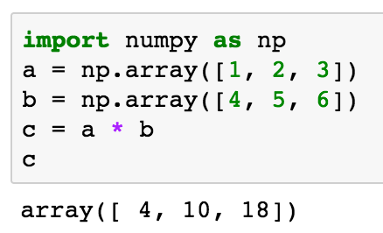
import numpy as np a = np.array([1, 2, 3]) b = np.array([4, 5, 6]) c = a * b c
NumPy Create Array
NumPy
Source: Yves Hilpisch (2014), Python for Finance: Analyze Big Financial Data, O'Reilly

Slide 83
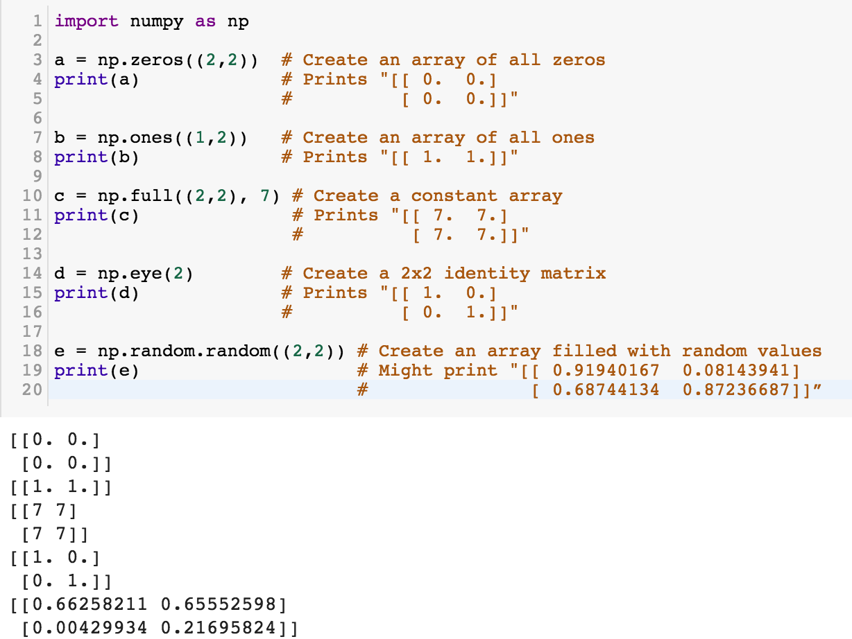
NumPy
NumPy
Source: http://cs231n.github.io/python-numpy-tutorial/
Notes:
import numpy as np
a = np.zeros((2,2)) # Create an array of all zeros
print(a) # Prints "[[ 0. 0.]
# [ 0. 0.]]"
b = np.ones((1,2)) # Create an array of all ones
print(b) # Prints "[[ 1. 1.]]"
c = np.full((2,2), 7) # Create a constant array
print(c) # Prints "[[ 7. 7.]
# [ 7. 7.]]"
d = np.eye(2) # Create a 2x2 identity matrix
print(d) # Prints "[[ 1. 0.]
# [ 0. 1.]]"
e = np.random.random((2,2)) # Create an array filled with random values
print(e) # Might print "[[ 0.91940167 0.08143941]
# [ 0.68744134 0.87236687]]”
Source: http://cs231n.github.io/python-numpy-tutorial/

Slide 84
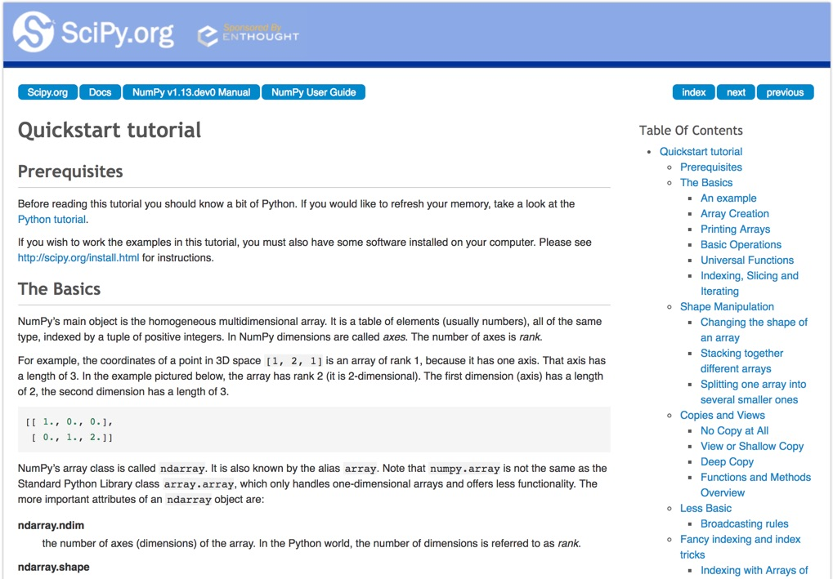
Numpy Quickstart Tutorial
https://docs.scipy.org/doc/numpy-dev/user/quickstart.html

Slide 85
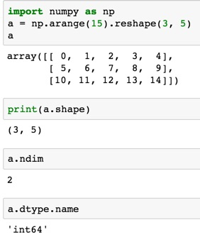
import numpy as np
a = np.arange(15).reshape(3, 5)
a.shape
a.ndim
a.dtype.name
Source: https://docs.scipy.org/doc/numpy-dev/user/quickstart.html
Notes:
Numpy Tutorial
Source: https://docs.scipy.org/doc/numpy-dev/user/quickstart.html
In [1]:
import numpy as np
a = np.arange(15).reshape(3, 5)
a
Out[1]:
array([[ 0, 1, 2, 3, 4],
[ 5, 6, 7, 8, 9],
[10, 11, 12, 13, 14]])
In [2]:
print(a.shape)
(3, 5)
In [3]:
a.ndim
Out[3]:
2
In [4]:
a.dtype.name
Out[4]:
'int64'
In [5]:
a.itemsize
Out[5]:
8
In [6]:
a.size
Out[6]:
15
In [7]:
type(a)
Out[7]:
numpy.ndarray
In [8]:
b = np.array([1, 2, 3])
In [9]:
b
Out[9]:
array([1, 2, 3])
In [10]:
type(b)
Out[10]:
numpy.ndarray

Slide 86
Matrix
Source: https://simple.wikipedia.org/wiki/Matrix_(mathematics)

Slide 87
NumPy ndarray:
Multidimensional Array Object

Slide 88
NumPy ndarray
One-dimensional Array
(1-D Array)
0 | 1 |  |  | n-1
1 | 2 | 3 | 4 | 5
Two-dimensional Array
(2-D Array)
 | 0 | 1 |  |  | n-1
0 | 1 | 2 | 3 | 4 | 5
1 | 6 | 7 | 8 | 9 | 10
 | 11 | 12 | 13 | 14 | 15
m-1 | 16 | 17 | 18 | 19 | 20

Slide 89

import numpy as np a = np.array([1,2,3,4,5])
One-dimensional Array
(1-D Array)
0 | 1 |  |  | n-1
1 | 2 | 3 | 4 | 5

Slide 90
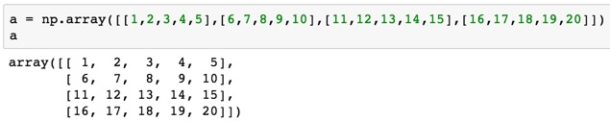
a = np.array([[1,2,3,4,5],[6,7,8,9,10],[11,12,13,14,15],[16,17,18,19,20]])
Two-dimensional Array
(2-D Array)
 | 0 | 1 |  |  | n-1
0 | 1 | 2 | 3 | 4 | 5
1 | 6 | 7 | 8 | 9 | 10
 | 11 | 12 | 13 | 14 | 15
m-1 | 16 | 17 | 18 | 19 | 20

Slide 91
import numpy as np
a = np.array([[0, 1, 2, 3], [10, 11, 12, 13],
[20, 21, 22, 23]])
a
0 | 1 | 2 | 3
10 | 11 | 12 | 13
20 | 21 | 22 | 23
Notes:
import numpy as np
a = np.array([[0, 1, 2, 3], [10, 11, 12, 13],
[20, 21, 22, 23]])
a

Slide 92
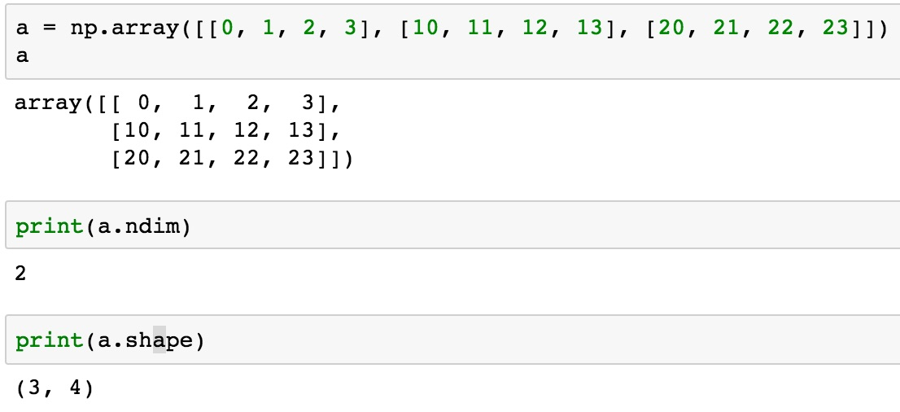
a = np.array([[0, 1, 2, 3], [10, 11, 12, 13], [20, 21, 22, 23]])
0 | 1 | 2 | 3
10 | 11 | 12 | 13
20 | 21 | 22 | 23

Slide 93
NumPy Basics:
Arrays and Vectorized Computation
Source: https://www.safaribooksonline.com/library/view/python-for-data/9781449323592/ch04.html

Slide 94
NumPy Array
Source: https://www.safaribooksonline.com/library/view/python-for-data/9781449323592/ch04.html

Slide 95
Numpy Array
Source: https://www.safaribooksonline.com/library/view/python-for-data/9781449323592/ch04.html

Slide 96
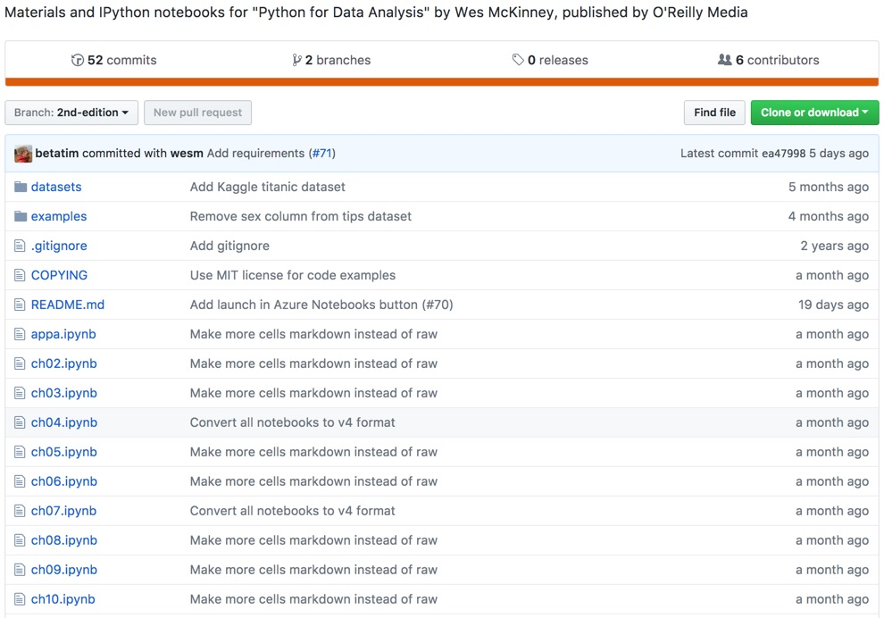
Wes McKinney (2017), "Python for Data Analysis: Data Wrangling with Pandas, NumPy, and IPython", 2nd Edition, O'Reilly Media.
https://github.com/wesm/pydata-book

Slide 97
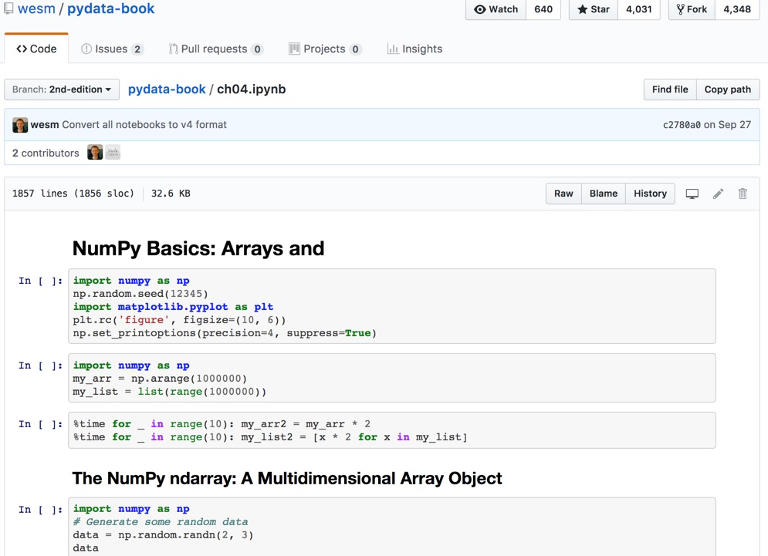
Wes McKinney (2017), "Python for Data Analysis: Data Wrangling with Pandas, NumPy, and IPython", 2nd Edition, O'Reilly Media.
Source: https://github.com/wesm/pydata-book/blob/2nd-edition/ch04.ipynb

Slide 98
Python Pandas

Slide 99
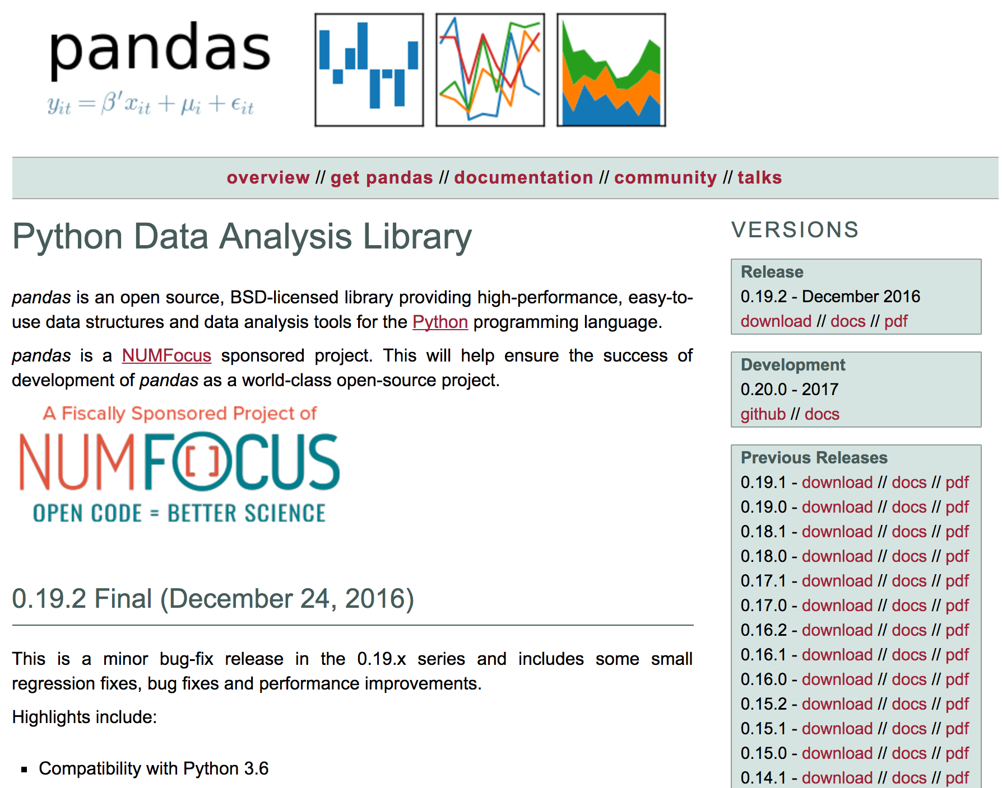
pandas
http://pandas.pydata.org/

Slide 100
pandas
Python Data Analysis Library providing high-performance, easy-to-use data structures and data analysis tools for the Python programming language.
Source: http://pandas.pydata.org/

Slide 101
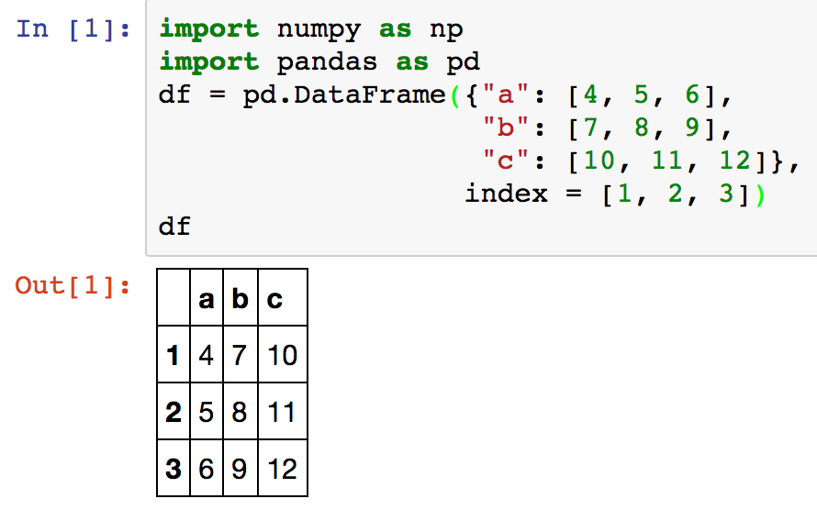
Creating pd.DataFrame
 | a | b | c
1 | 4 | 7 | 10
2 | 5 | 8 | 11
3 | 6 | 9 | 12
import pandas as pd
df = pd.DataFrame({"a": [4, 5, 6],
"b": [7, 8, 9],
"c": [10, 11, 12]},
index = [1, 2, 3])
Source: https://github.com/pandas-dev/pandas/blob/master/doc/cheatsheet/Pandas_Cheat_Sheet.pdf
Notes:
import numpy as np
import pandas as pd
df = pd.DataFrame({"a": [4, 5, 6],
"b": [7, 8, 9],
"c": [10, 11, 12]},
index = [1, 2, 3])
df

Slide 102
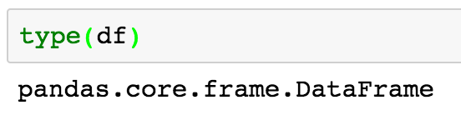
Pandas DataFrame
type(df)

Slide 103
import numpy as np
import pandas as pd
import matplotlib.pyplot as plt
print('pandas imported')
s = pd.Series([1,3,5,np.nan,6,8])
s
dates = pd.date_range('20181001', periods=6)
dates
Source: http://pandas.pydata.org/pandas-docs/stable/10min.html

Slide 104
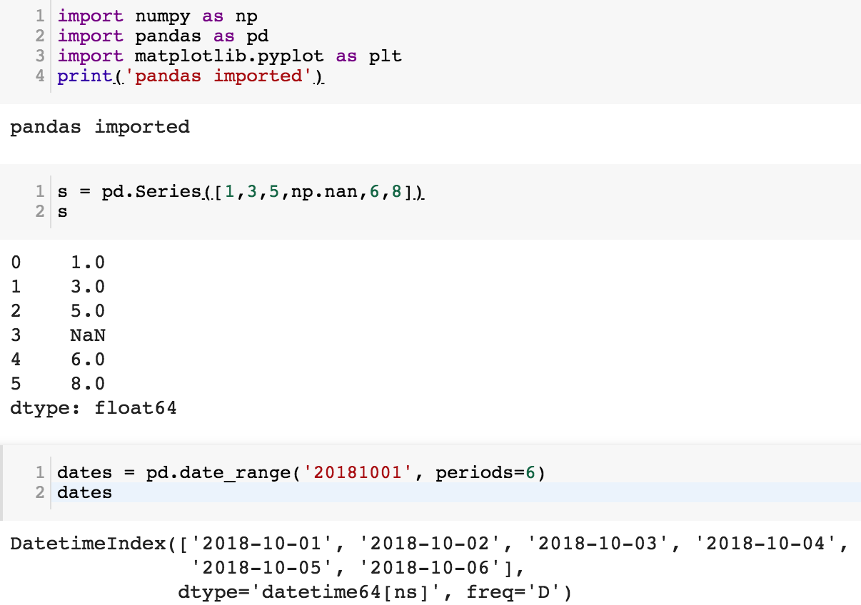

Slide 105
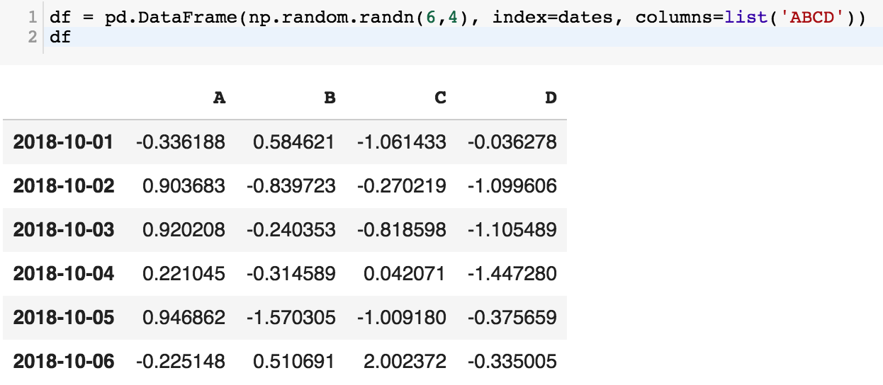
df = pd.DataFrame(np.random.randn(6,4), index=dates, columns=list('ABCD'))
df

Slide 106
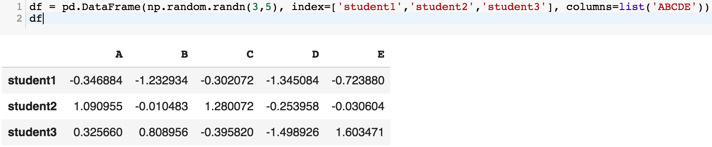
df = pd.DataFrame(np.random.randn(3,5), index=['student1','student2','student3'], columns=list('ABCDE'))
df

Slide 107
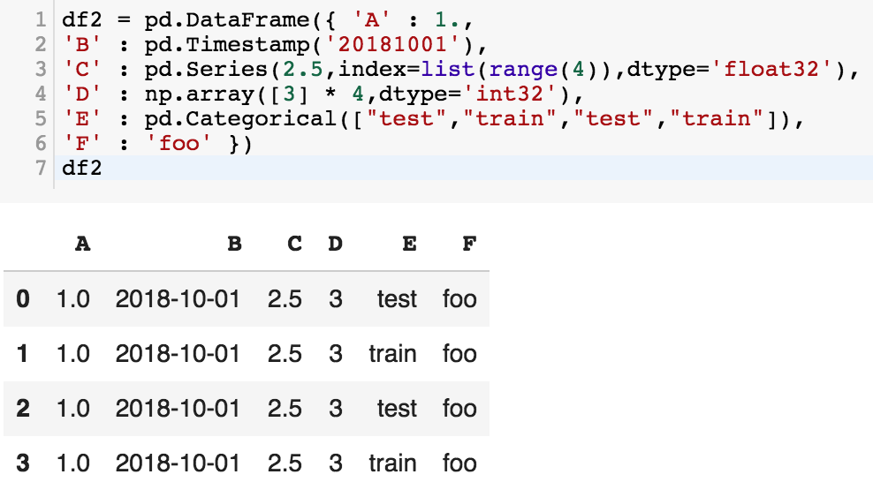
df2 = pd.DataFrame({ 'A' : 1.,
'B' : pd.Timestamp('20181001'),
'C' : pd.Series(2.5,index=list(range(4)),dtype='float32'),
'D' : np.array([3] * 4,dtype='int32'),
'E' : pd.Categorical(["test","train","test","train"]),
'F' : 'foo' })
df2

Slide 108
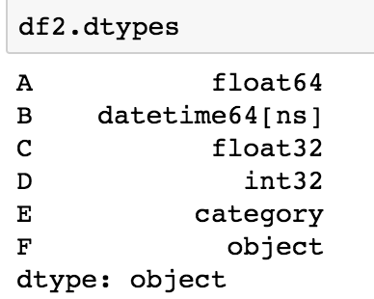
df2.dtypes

Slide 109
Python Pandas for Finance
Source: https://mapattack.wordpress.com/2017/02/12/using-python-for-stocks-1/

Slide 110
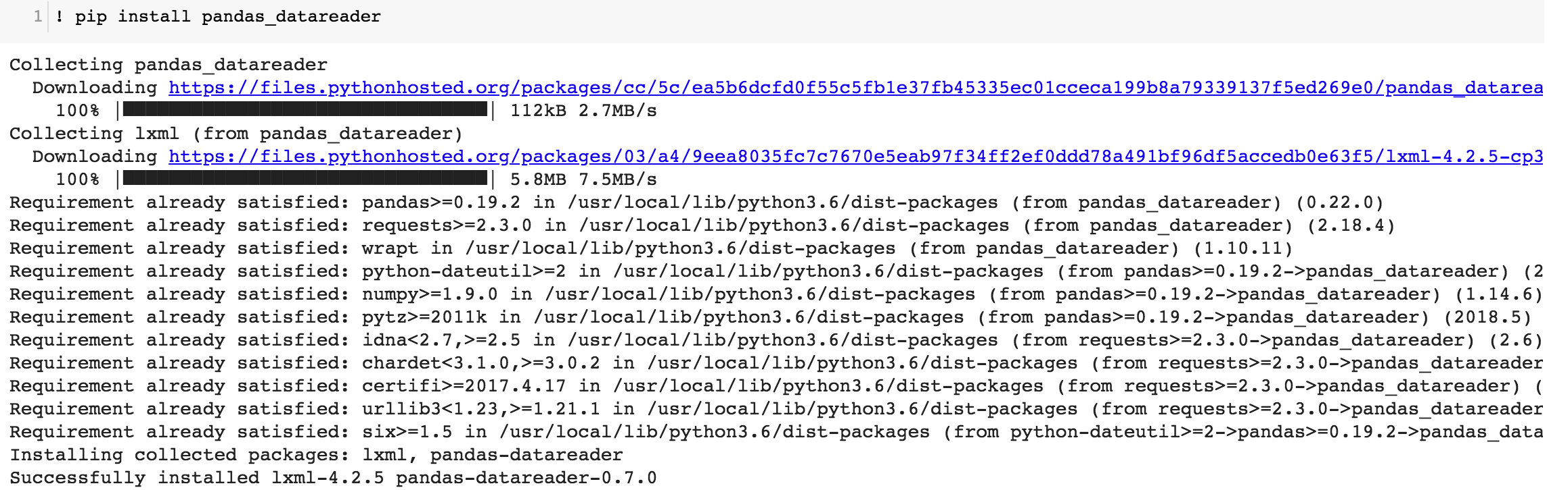
! pip install pandas_datareader

Slide 111
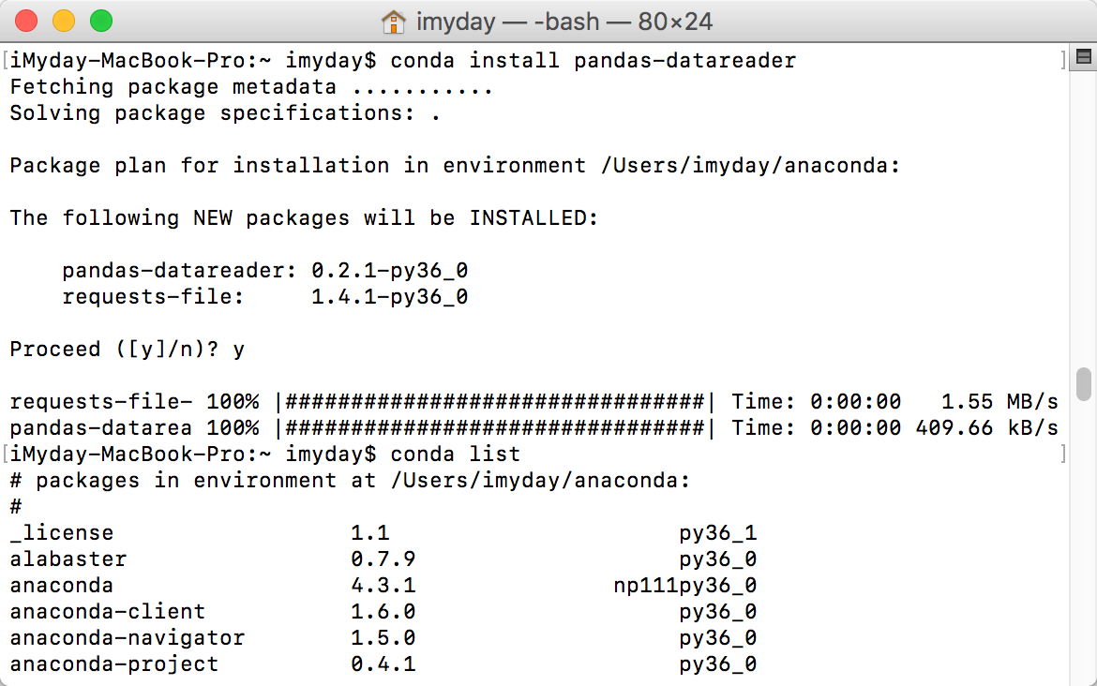
conda install pandas-datareader

Slide 112
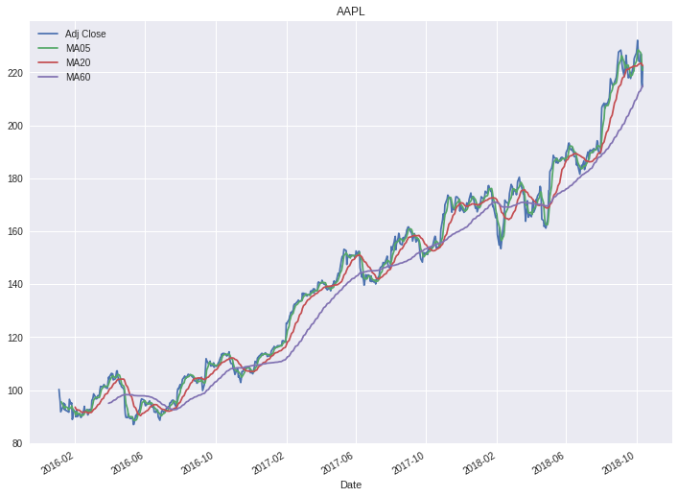

Slide 113
Finance Data from Yahoo Finance
# !pip install pandas_datareader
import pandas_datareader.data as web
import datetime as dt
#Read Stock Data from Yahoo Finance
end = dt.datetime(2017, 12, 31)
start = dt.datetime(2016, 1, 1)
df = web.DataReader("AAPL", 'yahoo', start, end)
df.to_csv('AAPL.csv')
df.from_csv('AAPL.csv')
df.tail()

Slide 114
# !pip install pandas_datareader
import pandas as pd
import pandas_datareader.data as web
import matplotlib.pyplot as plt
import seaborn as sns
import datetime as dt
%matplotlib inline
#Read Stock Data from Yahoo Finance
end = dt.datetime.now()
#start = dt.datetime(end.year-2, end.month, end.day)
start = dt.datetime(2016, 1, 1)
df = web.DataReader("AAPL", 'yahoo', start, end)
df.to_csv('AAPL.csv')
df.from_csv('AAPL.csv')
df.tail()

Slide 115

df['Adj Close'].plot(legend=True, figsize=(12, 8), title='AAPL’, label='Adj Close')

Slide 116

plt.figure(figsize=(12,9))
top = plt.subplot2grid((12,9), (0, 0), rowspan=10, colspan=9)
bottom = plt.subplot2grid((12,9), (10,0), rowspan=2, colspan=9)
top.plot(df.index, df['Adj Close'], color='blue') #df.index gives the dates
bottom.bar(df.index, df['Volume'])

Slide 118

# set the labels
top.axes.get_xaxis().set_visible(False)
top.set_title('AAPL')
top.set_ylabel('Adj Close')
bottom.set_ylabel('Volume')
plt.figure(figsize=(12,9))
sns.distplot(df['Adj Close'].dropna(), bins=50, color='purple')

Slide 120
# simple moving averages
df['MA05'] = df['Adj Close'].rolling(5).mean() #5 days
df['MA20'] = df['Adj Close'].rolling(20).mean() #20 days
df['MA60'] = df['Adj Close'].rolling(60).mean() #60 days
df2 = pd.DataFrame({'Adj Close': df['Adj Close'],'MA05': df['MA05'],'MA20': df['MA20'], 'MA60': df['MA60']})
df2.plot(figsize=(12, 9), legend=True, title='AAPL')
df2.to_csv('AAPL_MA.csv')
fig = plt.gcf()
fig.set_size_inches(12, 9)
fig.savefig('AAPL_plot.png', dpi=300)
plt.show()

Slide 122
# !pip install pandas_datareader
import pandas as pd
import pandas_datareader.data as web
import matplotlib.pyplot as plt
import seaborn as sns
import datetime as dt
%matplotlib inline
#Read Stock Data from Yahoo Finance
end = dt.datetime.now()
#start = dt.datetime(end.year-2, end.month, end.day)
start = dt.datetime(2016, 1, 1)
df = web.DataReader("AAPL", 'yahoo', start, end)
df.to_csv('AAPL.csv')
df.from_csv('AAPL.csv')
df.tail()
df['Adj Close'].plot(legend=True, figsize=(12, 8), title='AAPL', label='Adj Close')
plt.figure(figsize=(12,9))
top = plt.subplot2grid((12,9), (0, 0), rowspan=10, colspan=9)
bottom = plt.subplot2grid((12,9), (10,0), rowspan=2, colspan=9)
top.plot(df.index, df['Adj Close'], color='blue') #df.index gives the dates
bottom.bar(df.index, df['Volume'])
# set the labels
top.axes.get_xaxis().set_visible(False)
top.set_title('AAPL')
top.set_ylabel('Adj Close')
bottom.set_ylabel('Volume')
plt.figure(figsize=(12,9))
sns.distplot(df['Adj Close'].dropna(), bins=50, color='purple')
# simple moving averages
df['MA05'] = df['Adj Close'].rolling(5).mean() #5 days
df['MA20'] = df['Adj Close'].rolling(20).mean() #20 days
df['MA60'] = df['Adj Close'].rolling(60).mean() #60 days
df2 = pd.DataFrame({'Adj Close': df['Adj Close'],'MA05': df['MA05'],'MA20': df['MA20'], 'MA60': df['MA60']})
df2.plot(figsize=(12, 9), legend=True, title='AAPL')
df2.to_csv('AAPL_MA.csv')
fig = plt.gcf()
fig.set_size_inches(12, 9)
fig.savefig('AAPL_plot.png', dpi=300)
plt.show()

Slide 123


Slide 124

Finance Data from Quandl
# ! pip install quandl
import quandl
# quandl.ApiConfig.api_key = "YOURAPIKEY"
df = quandl.get("WIKI/AAPL", start_date="2016-01-01", end_date="2017-12-31")
df.to_csv('AAPL.csv')
df.from_csv('AAPL.csv')
df.tail()
Source: https://www.quandl.com/tools/python
Notes:
# ! pip install quandl
import quandl
# quandl.ApiConfig.api_key = "YOURAPIKEY"
df = quandl.get("WIKI/AAPL", start_date="2016-01-01", end_date="2017-12-31")
df.to_csv('AAPL.csv')
df.from_csv('AAPL.csv')
df.tail()

Slide 125

Scikit-Learn
Source: http://scikit-learn.org/

Slide 126
Iris flower data set
setosa
versicolor
virginica
Source: https://en.wikipedia.org/wiki/Iris_flower_data_set
Source: http://suruchifialoke.com/2016-10-13-machine-learning-tutorial-iris-classification/

Slide 127
Iris Classfication
Source: http://suruchifialoke.com/2016-10-13-machine-learning-tutorial-iris-classification/

Slide 128
iris.data
https://archive.ics.uci.edu/ml/machine-learning-databases/iris/iris.data
5.1,3.5,1.4,0.2,Iris-setosa 4.9,3.0,1.4,0.2,Iris-setosa 4.7,3.2,1.3,0.2,Iris-setosa 4.6,3.1,1.5,0.2,Iris-setosa 5.0,3.6,1.4,0.2,Iris-setosa 5.4,3.9,1.7,0.4,Iris-setosa 4.6,3.4,1.4,0.3,Iris-setosa 5.0,3.4,1.5,0.2,Iris-setosa 4.4,2.9,1.4,0.2,Iris-setosa 4.9,3.1,1.5,0.1,Iris-setosa 5.4,3.7,1.5,0.2,Iris-setosa 4.8,3.4,1.6,0.2,Iris-setosa 4.8,3.0,1.4,0.1,Iris-setosa 4.3,3.0,1.1,0.1,Iris-setosa 5.8,4.0,1.2,0.2,Iris-setosa 5.7,4.4,1.5,0.4,Iris-setosa 5.4,3.9,1.3,0.4,Iris-setosa 5.1,3.5,1.4,0.3,Iris-setosa 5.7,3.8,1.7,0.3,Iris-setosa 5.1,3.8,1.5,0.3,Iris-setosa 5.4,3.4,1.7,0.2,Iris-setosa 5.1,3.7,1.5,0.4,Iris-setosa 4.6,3.6,1.0,0.2,Iris-setosa 5.1,3.3,1.7,0.5,Iris-setosa 4.8,3.4,1.9,0.2,Iris-setosa 5.0,3.0,1.6,0.2,Iris-setosa 5.0,3.4,1.6,0.4,Iris-setosa 5.2,3.5,1.5,0.2,Iris-setosa 5.2,3.4,1.4,0.2,Iris-setosa 4.7,3.2,1.6,0.2,Iris-setosa 4.8,3.1,1.6,0.2,Iris-setosa 5.4,3.4,1.5,0.4,Iris-setosa 5.2,4.1,1.5,0.1,Iris-setosa 5.5,4.2,1.4,0.2,Iris-setosa 4.9,3.1,1.5,0.1,Iris-setosa 5.0,3.2,1.2,0.2,Iris-setosa 5.5,3.5,1.3,0.2,Iris-setosa 4.9,3.1,1.5,0.1,Iris-setosa 4.4,3.0,1.3,0.2,Iris-setosa 5.1,3.4,1.5,0.2,Iris-setosa 5.0,3.5,1.3,0.3,Iris-setosa 4.5,2.3,1.3,0.3,Iris-setosa 4.4,3.2,1.3,0.2,Iris-setosa 5.0,3.5,1.6,0.6,Iris-setosa 5.1,3.8,1.9,0.4,Iris-setosa 4.8,3.0,1.4,0.3,Iris-setosa 5.1,3.8,1.6,0.2,Iris-setosa 4.6,3.2,1.4,0.2,Iris-setosa 5.3,3.7,1.5,0.2,Iris-setosa 5.0,3.3,1.4,0.2,Iris-setosa 7.0,3.2,4.7,1.4,Iris-versicolor 6.4,3.2,4.5,1.5,Iris-versicolor 6.9,3.1,4.9,1.5,Iris-versicolor 5.5,2.3,4.0,1.3,Iris-versicolor 6.5,2.8,4.6,1.5,Iris-versicolor 5.7,2.8,4.5,1.3,Iris-versicolor 6.3,3.3,4.7,1.6,Iris-versicolor 4.9,2.4,3.3,1.0,Iris-versicolor 6.6,2.9,4.6,1.3,Iris-versicolor 5.2,2.7,3.9,1.4,Iris-versicolor 5.0,2.0,3.5,1.0,Iris-versicolor 5.9,3.0,4.2,1.5,Iris-versicolor 6.0,2.2,4.0,1.0,Iris-versicolor 6.1,2.9,4.7,1.4,Iris-versicolor 5.6,2.9,3.6,1.3,Iris-versicolor 6.7,3.1,4.4,1.4,Iris-versicolor 5.6,3.0,4.5,1.5,Iris-versicolor 5.8,2.7,4.1,1.0,Iris-versicolor 6.2,2.2,4.5,1.5,Iris-versicolor 5.6,2.5,3.9,1.1,Iris-versicolor 5.9,3.2,4.8,1.8,Iris-versicolor 6.1,2.8,4.0,1.3,Iris-versicolor 6.3,2.5,4.9,1.5,Iris-versicolor 6.1,2.8,4.7,1.2,Iris-versicolor 6.4,2.9,4.3,1.3,Iris-versicolor 6.6,3.0,4.4,1.4,Iris-versicolor 6.8,2.8,4.8,1.4,Iris-versicolor 6.7,3.0,5.0,1.7,Iris-versicolor 6.0,2.9,4.5,1.5,Iris-versicolor 5.7,2.6,3.5,1.0,Iris-versicolor 5.5,2.4,3.8,1.1,Iris-versicolor 5.5,2.4,3.7,1.0,Iris-versicolor 5.8,2.7,3.9,1.2,Iris-versicolor 6.0,2.7,5.1,1.6,Iris-versicolor 5.4,3.0,4.5,1.5,Iris-versicolor 6.0,3.4,4.5,1.6,Iris-versicolor 6.7,3.1,4.7,1.5,Iris-versicolor 6.3,2.3,4.4,1.3,Iris-versicolor 5.6,3.0,4.1,1.3,Iris-versicolor 5.5,2.5,4.0,1.3,Iris-versicolor 5.5,2.6,4.4,1.2,Iris-versicolor 6.1,3.0,4.6,1.4,Iris-versicolor 5.8,2.6,4.0,1.2,Iris-versicolor 5.0,2.3,3.3,1.0,Iris-versicolor 5.6,2.7,4.2,1.3,Iris-versicolor 5.7,3.0,4.2,1.2,Iris-versicolor 5.7,2.9,4.2,1.3,Iris-versicolor 6.2,2.9,4.3,1.3,Iris-versicolor 5.1,2.5,3.0,1.1,Iris-versicolor 5.7,2.8,4.1,1.3,Iris-versicolor 6.3,3.3,6.0,2.5,Iris-virginica 5.8,2.7,5.1,1.9,Iris-virginica 7.1,3.0,5.9,2.1,Iris-virginica 6.3,2.9,5.6,1.8,Iris-virginica 6.5,3.0,5.8,2.2,Iris-virginica 7.6,3.0,6.6,2.1,Iris-virginica 4.9,2.5,4.5,1.7,Iris-virginica 7.3,2.9,6.3,1.8,Iris-virginica 6.7,2.5,5.8,1.8,Iris-virginica 7.2,3.6,6.1,2.5,Iris-virginica 6.5,3.2,5.1,2.0,Iris-virginica 6.4,2.7,5.3,1.9,Iris-virginica 6.8,3.0,5.5,2.1,Iris-virginica 5.7,2.5,5.0,2.0,Iris-virginica 5.8,2.8,5.1,2.4,Iris-virginica 6.4,3.2,5.3,2.3,Iris-virginica 6.5,3.0,5.5,1.8,Iris-virginica 7.7,3.8,6.7,2.2,Iris-virginica 7.7,2.6,6.9,2.3,Iris-virginica 6.0,2.2,5.0,1.5,Iris-virginica 6.9,3.2,5.7,2.3,Iris-virginica 5.6,2.8,4.9,2.0,Iris-virginica 7.7,2.8,6.7,2.0,Iris-virginica 6.3,2.7,4.9,1.8,Iris-virginica 6.7,3.3,5.7,2.1,Iris-virginica 7.2,3.2,6.0,1.8,Iris-virginica 6.2,2.8,4.8,1.8,Iris-virginica 6.1,3.0,4.9,1.8,Iris-virginica 6.4,2.8,5.6,2.1,Iris-virginica 7.2,3.0,5.8,1.6,Iris-virginica 7.4,2.8,6.1,1.9,Iris-virginica 7.9,3.8,6.4,2.0,Iris-virginica 6.4,2.8,5.6,2.2,Iris-virginica 6.3,2.8,5.1,1.5,Iris-virginica 6.1,2.6,5.6,1.4,Iris-virginica 7.7,3.0,6.1,2.3,Iris-virginica 6.3,3.4,5.6,2.4,Iris-virginica 6.4,3.1,5.5,1.8,Iris-virginica 6.0,3.0,4.8,1.8,Iris-virginica 6.9,3.1,5.4,2.1,Iris-virginica 6.7,3.1,5.6,2.4,Iris-virginica 6.9,3.1,5.1,2.3,Iris-virginica 5.8,2.7,5.1,1.9,Iris-virginica 6.8,3.2,5.9,2.3,Iris-virginica 6.7,3.3,5.7,2.5,Iris-virginica 6.7,3.0,5.2,2.3,Iris-virginica 6.3,2.5,5.0,1.9,Iris-virginica 6.5,3.0,5.2,2.0,Iris-virginica 6.2,3.4,5.4,2.3,Iris-virginica 5.9,3.0,5.1,1.8,Iris-virginica
setosa
virginica
versicolor

Slide 129
Iris Data Visualization
Source: https://seaborn.pydata.org/generated/seaborn.pairplot.html

Slide 130

Data Visualization in Google Colab
Source: https://seaborn.pydata.org/generated/seaborn.pairplot.html

Slide 131
import seaborn as sns
sns.set(style="ticks", color_codes=True)
iris = sns.load_dataset("iris")
g = sns.pairplot(iris, hue="species")
Source: https://seaborn.pydata.org/generated/seaborn.pairplot.html

Slide 132
https://colab.research.google.com/drive/1KRqtEUd2Hg4dM2au9bfVQKrxWnWN3O9-
import numpy as np
import pandas as pd
%matplotlib inline
import matplotlib.pyplot as plt
import seaborn as sns
from pandas.plotting import scatter_matrix
# Load dataset
url = "https://archive.ics.uci.edu/ml/machine-learning-databases/iris/iris.data"
names = ['sepal-length', 'sepal-width', 'petal-length', 'petal-width', 'class']
df = pd.read_csv(url, names=names)
print(df.head(10))
print(df.tail(10))
print(df.describe())
print(df.info())
print(df.shape)
print(df.groupby('class').size())
plt.rcParams["figure.figsize"] = (10,8)
df.plot(kind='box', subplots=True, layout=(2,2), sharex=False, sharey=False)
plt.show()
df.hist()
plt.show()
scatter_matrix(df)
plt.show()
sns.pairplot(df, hue="class", size=2)
Source: https://machinelearningmastery.com/machine-learning-in-python-step-by-step/
Notes:
# coding: utf-8
# Source: https://machinelearningmastery.com/machine-learning-in-python-step-by-step/
# https://colab.research.google.com/drive/1KRqtEUd2Hg4dM2au9bfVQKrxWnWN3O9-
import numpy as np
import pandas as pd
%matplotlib inline
import matplotlib.pyplot as plt
import seaborn as sns
from pandas.plotting import scatter_matrix
# Load dataset
url = "https://archive.ics.uci.edu/ml/machine-learning-databases/iris/iris.data"
names = ['sepal-length', 'sepal-width', 'petal-length', 'petal-width', 'class']
df = pd.read_csv(url, names=names)
print(df.head(10))
print(df.tail(10))
print(df.describe())
print(df.info())
print(df.shape)
print(df.groupby('class').size())
plt.rcParams["figure.figsize"] = (10,8)
df.plot(kind='box', subplots=True, layout=(2,2), sharex=False, sharey=False)
plt.show()
df.hist()
plt.show()
scatter_matrix(df)
plt.show()
sns.pairplot(df, hue="class", size=2)

Slide 133

import numpy as np
import pandas as pd
%matplotlib inline
import matplotlib.pyplot as plt
import seaborn as sns
from pandas.plotting import scatter_matrix

Slide 134

url = "https://archive.ics.uci.edu/ml/machine-learning-databases/iris/iris.data"
names = ['sepal-length', 'sepal-width', 'petal-length', 'petal-width', 'class']
df = pd.read_csv(url, names=names)
print(df.head(10))

Slide 135

df.describe()

Slide 136

df.tail(10)

Slide 137

print(df.info())
print(df.shape)

Slide 138

df.groupby('class').size()

Slide 139

plt.rcParams["figure.figsize"] = (10,8)
df.plot(kind='box', subplots=True, layout=(2,2), sharex=False, sharey=False)
plt.show()

Slide 140

df.hist()
plt.show()

Slide 141

scatter_matrix(df)
plt.show()

Slide 142

sns.pairplot(df, hue="class", size=2)

Slide 143

Classification and Prediction
https://colab.research.google.com/drive/1QE7fR2OxHiQ0_p6l1nnZDIFF354Nf_Lw
https://colab.research.google.com/drive/1QE7fR2OxHiQ0_p6l1nnZDIFF354Nf_Lw
Notes:
# -*- coding: utf-8 -*-
"""Classification_Prediction.ipynb
Automatically generated by Colaboratory.
Original file is located at
https://colab.research.google.com/drive/1QE7fR2OxHiQ0_p6l1nnZDIFF354Nf_Lw
"""
print('Hello Google Colab')
import seaborn as sns
sns.set(style="ticks", color_codes=True)
iris = sns.load_dataset("iris")
g = sns.pairplot(iris, hue="species")
print('Iris Data')
print(iris.head(10))
print(iris.tail(10))
print('Iris Describe Summary')
print(iris.describe())
import numpy as np
import pandas as pd
# %matplotlib inline
import matplotlib.pyplot as plt
import seaborn as sns
from pandas.plotting import scatter_matrix
# Load dataset
url = "https://archive.ics.uci.edu/ml/machine-learning-databases/iris/iris.data"
names = ['sepal-length', 'sepal-width', 'petal-length', 'petal-width', 'class']
df = pd.read_csv(url, names=names)
print(df.head(10))
print(df.tail(10))
print(df.describe())
print(df.info())
print(df.shape)
print(df.groupby('class').size())
plt.rcParams["figure.figsize"] = (10,8)
df.plot(kind='box', subplots=True, layout=(2,2), sharex=False, sharey=False)
plt.show()
df.hist()
plt.show()
scatter_matrix(df)
plt.show()
sns.pairplot(df, hue="class", size=2)
# Import Libraries
import numpy as np
import pandas as pd
# %matplotlib inline
import matplotlib.pyplot as plt
import seaborn as sns
from pandas.plotting import scatter_matrix
print('imported')
# Load dataset
url = "https://archive.ics.uci.edu/ml/machine-learning-databases/iris/iris.data"
names = ['sepal-length', 'sepal-width', 'petal-length', 'petal-width', 'class']
df = pd.read_csv(url, names=names)
print(df.head(10))
print(df.tail(10))
print(df.describe())
print(df.info())
print(df.shape)
print(df.groupby('class').size())
plt.rcParams["figure.figsize"] = (10,8)
df.plot(kind='box', subplots=True, layout=(2,2), sharex=False, sharey=False)
plt.show()
df.hist()
plt.show()
scatter_matrix(df)
plt.show()
sns.pairplot(df, hue="class", size=2)
# Source: https://machinelearningmastery.com/machine-learning-in-python-step-by-step/
"""## Data Mining and Machine Learning in Google Colab"""
# Import libraries
import numpy as np
import pandas as pd
# %matplotlib inline
import matplotlib.pyplot as plt
import seaborn as sns
from pandas.plotting import scatter_matrix
# Import sklearn
from sklearn import model_selection
from sklearn.metrics import classification_report
from sklearn.metrics import confusion_matrix
from sklearn.metrics import accuracy_score
from sklearn.linear_model import LogisticRegression
from sklearn.tree import DecisionTreeClassifier
from sklearn.neighbors import KNeighborsClassifier
from sklearn.discriminant_analysis import LinearDiscriminantAnalysis
from sklearn.naive_bayes import GaussianNB
from sklearn.svm import SVC
from sklearn.neural_network import MLPClassifier
print("Imported")
# Load dataset
url = "https://archive.ics.uci.edu/ml/machine-learning-databases/iris/iris.data"
names = ['sepal-length', 'sepal-width', 'petal-length', 'petal-width', 'class']
df = pd.read_csv(url, names=names)
print(df.head(10))
print(df.tail(10))
print(df.describe())
print(df.info())
print(df.shape)
print(df.groupby('class').size())
plt.rcParams["figure.figsize"] = (10,8)
df.plot(kind='box', subplots=True, layout=(2,2), sharex=False, sharey=False)
plt.show()
df.hist()
plt.show()
scatter_matrix(df)
plt.show()
sns.pairplot(df, hue="class", size=2)
# Load dataset
url = "https://archive.ics.uci.edu/ml/machine-learning-databases/iris/iris.data"
names = ['sepal-length', 'sepal-width', 'petal-length', 'petal-width', 'class']
df = pd.read_csv(url, names=names)
print(df.head(10))
print(df.tail(10))
print(df.describe())
print(df.info())
print(df.shape)
print(df.groupby('class').size())
plt.rcParams["figure.figsize"] = (10,8)
df.plot(kind='box', subplots=True, layout=(2,2), sharex=False, sharey=False)
plt.show()
df.hist()
plt.show()
scatter_matrix(df)
plt.show()
sns.pairplot(df, hue="class", size=2)
df.corr()
# Split-out validation dataset
array = df.values
X = array[:,0:4]
Y = array[:,4]
validation_size = 0.20
seed = 7
X_train, X_validation, Y_train, Y_validation = model_selection.train_test_split(X, Y, test_size=validation_size, random_state=seed)
scoring = 'accuracy'
len(Y_validation)
# Test options and evaluation metric
seed = 7
scoring = 'accuracy'
# Models
models = []
models.append(('LR', LogisticRegression()))
models.append(('LDA', LinearDiscriminantAnalysis()))
models.append(('KNN', KNeighborsClassifier()))
models.append(('DT', DecisionTreeClassifier()))
models.append(('NB', GaussianNB()))
models.append(('SVM', SVC()))
# evaluate each model in turn
results = []
names = []
for name, model in models:
kfold = model_selection.KFold(n_splits=10, random_state=seed)
cv_results = model_selection.cross_val_score(model, X_train, Y_train, cv=kfold, scoring=scoring)
results.append(cv_results)
names.append(name)
msg = "%s: %.4f (%.4f)" % (name, cv_results.mean(), cv_results.std())
print(msg)
# Make predictions on validation dataset
model = KNeighborsClassifier()
model.fit(X_train, Y_train)
predictions = model.predict(X_validation)
print("%.4f" % accuracy_score(Y_validation, predictions))
print(confusion_matrix(Y_validation, predictions))
print(classification_report(Y_validation, predictions))
print(model)
# Make predictions on validation dataset
model = SVC()
model.fit(X_train, Y_train)
predictions = model.predict(X_validation)
print("%.4f" % accuracy_score(Y_validation, predictions))
print(confusion_matrix(Y_validation, predictions))
print(classification_report(Y_validation, predictions))
print(model)
# Make predictions on validation dataset
model = DecisionTreeClassifier()
model.fit(X_train, Y_train)
predictions = model.predict(X_validation)
print("%.4f" % accuracy_score(Y_validation, predictions))
print(confusion_matrix(Y_validation, predictions))
print(classification_report(Y_validation, predictions))
print(model)
# Make predictions on validation dataset
model = GaussianNB()
model.fit(X_train, Y_train)
predictions = model.predict(X_validation)
print("%.4f" % accuracy_score(Y_validation, predictions))
print(confusion_matrix(Y_validation, predictions))
print(classification_report(Y_validation, predictions))
print(model)
# Make predictions on validation dataset
model = LogisticRegression()
model.fit(X_train, Y_train)
predictions = model.predict(X_validation)
print("%.4f" % accuracy_score(Y_validation, predictions))
print(confusion_matrix(Y_validation, predictions))
print(classification_report(Y_validation, predictions))
print(model)
# Make predictions on validation dataset
model = LinearDiscriminantAnalysis()
model.fit(X_train, Y_train)
predictions = model.predict(X_validation)
print("%.4f" % accuracy_score(Y_validation, predictions))
print(confusion_matrix(Y_validation, predictions))
print(classification_report(Y_validation, predictions))
print(model)
# Make predictions on validation dataset
model = MLPClassifier()
model.fit(X_train, Y_train)
predictions = model.predict(X_validation)
print("%.4f" % accuracy_score(Y_validation, predictions))
print(confusion_matrix(Y_validation, predictions))
print(classification_report(Y_validation, predictions))
print(model)
# Make predictions on validation dataset
model = SVC()
model.fit(X_train, Y_train)
predictions = model.predict(X_validation)
print("%.4f" % accuracy_score(Y_validation, predictions))
print(confusion_matrix(Y_validation, predictions))
print(classification_report(Y_validation, predictions))
print("X_train: ", X_train)
print("Y_train: ", Y_train)
print("X_validation: ", X_validation)
print("Y_validation: ", Y_validation)
print("predictions: ", predictions)
print(model)
import pickle
model_pickle = pickle.dumps(model)
print(model_pickle)
model2 = pickle.loads(model_pickle)
predictions2 = model2.predict(X_validation[0:1])
a2 = X_validation[0:1]
print("a2:", a2)
print("predictions2: ", predictions2)
a2
# Plot different SVM classifiers in the iris dataset
# Source: http://scikit-learn.org/stable/auto_examples/svm/plot_iris.html
import numpy as np
import matplotlib.pyplot as plt
from sklearn import svm, datasets
# %matplotlib inline
def make_meshgrid(x, y, h=.02):
"""Create a mesh of points to plot in
Parameters
----------
x: data to base x-axis meshgrid on
y: data to base y-axis meshgrid on
h: stepsize for meshgrid, optional
Returns
-------
xx, yy : ndarray
"""
x_min, x_max = x.min() - 1, x.max() + 1
y_min, y_max = y.min() - 1, y.max() + 1
xx, yy = np.meshgrid(np.arange(x_min, x_max, h),
np.arange(y_min, y_max, h))
return xx, yy
def plot_contours(ax, clf, xx, yy, **params):
"""Plot the decision boundaries for a classifier.
Parameters
----------
ax: matplotlib axes object
clf: a classifier
xx: meshgrid ndarray
yy: meshgrid ndarray
params: dictionary of params to pass to contourf, optional
"""
Z = clf.predict(np.c_[xx.ravel(), yy.ravel()])
Z = Z.reshape(xx.shape)
out = ax.contourf(xx, yy, Z, **params)
return out
# import some data to play with
iris = datasets.load_iris()
# Take the first two features. We could avoid this by using a two-dim dataset
X = iris.data[:, :2]
y = iris.target
# we create an instance of SVM and fit out data. We do not scale our
# data since we want to plot the support vectors
C = 1.0 # SVM regularization parameter
models = (svm.SVC(kernel='linear', C=C),
svm.LinearSVC(C=C),
svm.SVC(kernel='rbf', gamma=0.7, C=C),
svm.SVC(kernel='poly', degree=3, C=C))
models = (clf.fit(X, y) for clf in models)
# title for the plots
titles = ('SVC with linear kernel',
'LinearSVC (linear kernel)',
'SVC with RBF kernel',
'SVC with polynomial (degree 3) kernel')
# Set-up 2x2 grid for plotting.
plt.rcParams["figure.figsize"] = (10,8)
fig, sub = plt.subplots(2, 2)
plt.subplots_adjust(wspace=0.4, hspace=0.4)
X0, X1 = X[:, 0], X[:, 1]
xx, yy = make_meshgrid(X0, X1)
for clf, title, ax in zip(models, titles, sub.flatten()):
plot_contours(ax, clf, xx, yy,
cmap=plt.cm.coolwarm, alpha=0.8)
ax.scatter(X0, X1, c=y, cmap=plt.cm.coolwarm, s=20, edgecolors='k')
ax.set_xlim(xx.min(), xx.max())
ax.set_ylim(yy.min(), yy.max())
ax.set_xlabel('Sepal length')
ax.set_ylabel('Sepal width')
ax.set_xticks(())
ax.set_yticks(())
ax.set_title(title)
plt.show()
"""
================================
SVM Exercise
================================
A tutorial exercise for using different SVM kernels.
This exercise is used in the :ref:`using_kernels_tut` part of the
:ref:`supervised_learning_tut` section of the :ref:`stat_learn_tut_index`.
"""
print(__doc__)
import numpy as np
import matplotlib.pyplot as plt
from sklearn import datasets, svm
iris = datasets.load_iris()
X = iris.data
y = iris.target
X = X[y != 0, :2]
y = y[y != 0]
n_sample = len(X)
np.random.seed(0)
order = np.random.permutation(n_sample)
X = X[order]
y = y[order].astype(np.float)
X_train = X[:int(.9 * n_sample)]
y_train = y[:int(.9 * n_sample)]
X_test = X[int(.9 * n_sample):]
y_test = y[int(.9 * n_sample):]
# fit the model
for fig_num, kernel in enumerate(('linear', 'rbf', 'poly')):
clf = svm.SVC(kernel=kernel, gamma=10)
clf.fit(X_train, y_train)
plt.figure(fig_num)
plt.clf()
plt.scatter(X[:, 0], X[:, 1], c=y, zorder=10, cmap=plt.cm.Paired,
edgecolor='k', s=20)
# Circle out the test data
plt.scatter(X_test[:, 0], X_test[:, 1], s=80, facecolors='none',
zorder=10, edgecolor='k')
plt.axis('tight')
x_min = X[:, 0].min()
x_max = X[:, 0].max()
y_min = X[:, 1].min()
y_max = X[:, 1].max()
XX, YY = np.mgrid[x_min:x_max:200j, y_min:y_max:200j]
Z = clf.decision_function(np.c_[XX.ravel(), YY.ravel()])
# Put the result into a color plot
Z = Z.reshape(XX.shape)
plt.pcolormesh(XX, YY, Z > 0, cmap=plt.cm.Paired)
plt.contour(XX, YY, Z, colors=['k', 'k', 'k'],
linestyles=['--', '-', '--'], levels=[-.5, 0, .5])
plt.title(kernel)
plt.show()
# https://chrisalbon.com/machine_learning/trees_and_forests/random_forest_classifier_example/
# Load the library with the iris dataset
from sklearn.datasets import load_iris
# Load scikit's random forest classifier library
from sklearn.ensemble import RandomForestClassifier
# Load pandas
import pandas as pd
# Load numpy
import numpy as np
# Set random seed
np.random.seed(0)
# Create an object called iris with the iris data
iris = load_iris()
# Create a dataframe with the four feature variables
df = pd.DataFrame(iris.data, columns=iris.feature_names)
# View the top 5 rows
df.head()
# Add a new column with the species names, this is what we are going to try to predict
df['species'] = pd.Categorical.from_codes(iris.target, iris.target_names)
# View the top 5 rows
df.head()
# Create a new column that for each row, generates a random number between 0 and 1, and
# if that value is less than or equal to .75, then sets the value of that cell as True
# and false otherwise. This is a quick and dirty way of randomly assigning some rows to
# be used as the training data and some as the test data.
df['is_train'] = np.random.uniform(0, 1, len(df)) <= .75
# View the top 5 rows
df.head()
# Create two new dataframes, one with the training rows, one with the test rows
train, test = df[df['is_train']==True], df[df['is_train']==False]
# Show the number of observations for the test and training dataframes
print('Number of observations in the training data:', len(train))
print('Number of observations in the test data:',len(test))
# Create a list of the feature column's names
features = df.columns[:4]
# View features
features
# train['species'] contains the actual species names. Before we can use it,
# we need to convert each species name into a digit. So, in this case there
# are three species, which have been coded as 0, 1, or 2.
y = pd.factorize(train['species'])[0]
# View target
y
# Create a random forest Classifier. By convention, clf means 'Classifier'
clf = RandomForestClassifier(n_jobs=2, random_state=0)
# Train the Classifier to take the training features and learn how they relate
# to the training y (the species)
clf.fit(train[features], y)
# Apply the Classifier we trained to the test data (which, remember, it has never seen before)
clf.predict(test[features])
# View the predicted probabilities of the first 10 observations
clf.predict_proba(test[features])[0:10]
# Create actual english names for the plants for each predicted plant class
preds = iris.target_names[clf.predict(test[features])]
# View the PREDICTED species for the first five observations
preds[0:5]
# View the ACTUAL species for the first five observations
test['species'].head()
# Create confusion matrix
pd.crosstab(test['species'], preds, rownames=['Actual Species'], colnames=['Predicted Species'])
# View a list of the features and their importance scores
list(zip(train[features], clf.feature_importances_))
! pip install pydotplus
"""%%bash
apt-get update -y
%%bash
apt-get install python-pydot -y --allow-unauthenticated
"""
# Visualize A Decision Tree
# Source: https://chrisalbon.com/machine_learning/trees_and_forests/visualize_a_decision_tree/
# Preliminaries
# Load libraries
# ! pip install pydotplus
from sklearn.tree import DecisionTreeClassifier
from sklearn import datasets
from IPython.display import Image
from sklearn import tree
import pydotplus
# Load Iris Data
# Load data
iris = datasets.load_iris()
X = iris.data
y = iris.target
# Train Decision Tree
# Create decision tree classifer object
clf = DecisionTreeClassifier(random_state=0)
# Train model
model = clf.fit(X, y)
# Visualize Decision Tree
# Create DOT data
dot_data = tree.export_graphviz(clf, out_file=None,
feature_names=iris.feature_names,
class_names=iris.target_names)
# Draw graph
graph = pydotplus.graph_from_dot_data(dot_data)
# Show graph
Image(graph.create_png())
# Save Decision Tree Image To File
# Create PDF
graph.write_pdf("iris.pdf")
# Create PNG
graph.write_png("iris.png")
! ls
# Plotting Cross-Validated Predictions
# Source: http://scikit-learn.org/stable/auto_examples/model_selection/plot_cv_predict.html
from sklearn import datasets
from sklearn.model_selection import cross_val_predict
from sklearn import linear_model
import matplotlib.pyplot as plt
lr = linear_model.LinearRegression()
boston = datasets.load_boston()
y = boston.target
# cross_val_predict returns an array of the same size as `y` where each entry
# is a prediction obtained by cross validation:
predicted = cross_val_predict(lr, boston.data, y, cv=10)
print('y: ', y[:5])
print('predicted: ', predicted[:5])
fig, ax = plt.subplots()
ax.scatter(y, predicted, edgecolors=(0, 0, 0))
ax.plot([y.min(), y.max()], [y.min(), y.max()], 'k--', lw=4)
ax.set_xlabel('Measured')
ax.set_ylabel('Predicted')
plt.show()
# Source: https://github.com/Sagarsharma4244/Linear-Regression-Sklearn-Python/blob/master/Sklearn_linea_reg.py
import pandas as pd
import pprint
from sklearn.datasets import load_boston
from sklearn import linear_model
from sklearn.model_selection import train_test_split
boston = load_boston()
# pprint.pprint(boston)
df_x = pd.DataFrame(boston.data, columns = boston.feature_names)
df_y = pd.DataFrame(boston.target)
model = linear_model.LinearRegression()
x_train, x_test, y_train, y_test = train_test_split(df_x, df_y, test_size = 0.2, random_state = 4 )
model.fit(x_train,y_train)
results = model.predict(x_test)
print('results', results[4] )
print('y_test', y_test)
import pandas as pd
import seaborn as sns
from scipy.stats import pearsonr
from sklearn.datasets import load_boston
from sklearn.linear_model import LinearRegression
from sklearn.metrics import mean_squared_error
from sklearn.model_selection import train_test_split
from sklearn.preprocessing import StandardScaler
from sklearn.decomposition import PCA
import matplotlib.pyplot as plt
from mpl_toolkits.mplot3d import Axes3D
import statsmodels.formula.api as sm
# %matplotlib inline
#Source: https://www.kaggle.com/tonzowonzo/simple-k-means-clustering-on-the-iris-dataset/notebook
#importing the libraries
import numpy as np
import matplotlib.pyplot as plt
# %matplotlib inline
import pandas as pd
#importing the Iris dataset with pandas
# Load dataset
url = "https://archive.ics.uci.edu/ml/machine-learning-databases/iris/iris.data"
names = ['sepal-length', 'sepal-width', 'petal-length', 'petal-width', 'class']
df = pd.read_csv(url, names=names)
array = df.values
X = array[:,0:4]
Y = array[:,4]
#Finding the optimum number of clusters for k-means classification
from sklearn.cluster import KMeans
wcss = []
for i in range(1, 8):
kmeans = KMeans(n_clusters = i, init = 'k-means++', max_iter = 300, n_init = 10, random_state = 0)
kmeans.fit(X)
wcss.append(kmeans.inertia_)
#Plotting the results onto a line graph, allowing us to observe 'The elbow'
plt.rcParams["figure.figsize"] = (10,8)
plt.plot(range(1, 8), wcss)
plt.title('The elbow method')
plt.xlabel('Number of clusters')
plt.ylabel('WCSS') #within cluster sum of squares
plt.show()
#Applying kmeans to the dataset / Creating the kmeans classifier
kmeans = KMeans(n_clusters = 3, init = 'k-means++', max_iter = 300, n_init = 10, random_state = 0)
y_kmeans = kmeans.fit_predict(X)
#Visualising the clusters
plt.scatter(X[y_kmeans == 0, 0], X[y_kmeans == 0, 1], s = 100, c = 'red', label = 'Iris-setosa')
plt.scatter(X[y_kmeans == 1, 0], X[y_kmeans == 1, 1], s = 100, c = 'blue', label = 'Iris-versicolour')
plt.scatter(X[y_kmeans == 2, 0], X[y_kmeans == 2, 1], s = 100, c = 'green', label = 'Iris-virginica')
#Plotting the centroids of the clusters
plt.scatter(kmeans.cluster_centers_[:, 0], kmeans.cluster_centers_[:,1], s = 100, c = 'yellow', label = 'Centroids')
plt.legend()
# https://machinelearningmastery.com/how-to-get-started-with-deep-learning-for-time-series-forecasting-7-day-mini-course/
# univariate cnn-lstm example
from numpy import array
from keras.models import Sequential
from keras.layers import LSTM
from keras.layers import Dense
from keras.layers import Flatten
from keras.layers import TimeDistributed
from keras.layers.convolutional import Conv1D
from keras.layers.convolutional import MaxPooling1D
# define dataset
X = array([[10, 20, 30, 40], [20, 30, 40, 50], [30, 40, 50, 60], [40, 50, 60, 70]])
y = array([50, 60, 70, 80])
# reshape from [samples, timesteps] into [samples, subsequences, timesteps, features]
X = X.reshape((X.shape[0], 2, 2, 1))
# define model
model = Sequential()
model.add(TimeDistributed(Conv1D(filters=64, kernel_size=1, activation='relu'), input_shape=(None, 2, 1)))
model.add(TimeDistributed(MaxPooling1D(pool_size=2)))
model.add(TimeDistributed(Flatten()))
model.add(LSTM(50, activation='relu'))
model.add(Dense(1))
model.compile(optimizer='adam', loss='mse')
# fit model
model.fit(X, y, epochs=500, verbose=1)
# demonstrate prediction
x_input = array([50, 60, 70, 80])
x_input = x_input.reshape((1, 2, 2, 1))
yhat = model.predict(x_input, verbose=0)
print(yhat)
# multi-step encoder-decoder lstm example
from numpy import array
from keras.models import Sequential
from keras.layers import LSTM
from keras.layers import Dense
from keras.layers import RepeatVector
from keras.layers import TimeDistributed
# define dataset
X = array([[10, 20, 30], [20, 30, 40], [30, 40, 50], [40, 50, 60]])
y = array([[40,50],[50,60],[60,70],[70,80]])
# reshape from [samples, timesteps] into [samples, timesteps, features]
X = X.reshape((X.shape[0], X.shape[1], 1))
y = y.reshape((y.shape[0], y.shape[1], 1))
# define model
model = Sequential()
model.add(LSTM(100, activation='relu', input_shape=(3, 1)))
model.add(RepeatVector(2))
model.add(LSTM(100, activation='relu', return_sequences=True))
model.add(TimeDistributed(Dense(1)))
model.compile(optimizer='adam', loss='mse')
# fit model
model.fit(X, y, epochs=100, verbose=0)
# demonstrate prediction
x_input = array([50, 60, 70])
x_input = x_input.reshape((1, 3, 1))
yhat = model.predict(x_input, verbose=0)
print(yhat)
# KNN Regression
from pandas import read_csv
from sklearn.model_selection import KFold
from sklearn.model_selection import cross_val_score
from sklearn.neighbors import KNeighborsRegressor
url = "https://raw.githubusercontent.com/jbrownlee/Datasets/master/housing.data"
names = ['CRIM', 'ZN', 'INDUS', 'CHAS', 'NOX', 'RM', 'AGE', 'DIS', 'RAD', 'TAX', 'PTRATIO', 'B', 'LSTAT', 'MEDV']
dataframe = read_csv(url, delim_whitespace=True, names=names)
array = dataframe.values
X = array[:,0:13]
Y = array[:,13]
kfold = KFold(n_splits=10, random_state=7)
model = KNeighborsRegressor()
scoring = 'neg_mean_squared_error'
results = cross_val_score(model, X, Y, cv=kfold, scoring=scoring)
print(results.mean())

Slide 144

https://colab.research.google.com/drive/1QE7fR2OxHiQ0_p6l1nnZDIFF354Nf_Lw

Slide 145
https://colab.research.google.com/drive/1QE7fR2OxHiQ0_p6l1nnZDIFF354Nf_Lw

Slide 146

df.corr()
https://colab.research.google.com/drive/1QE7fR2OxHiQ0_p6l1nnZDIFF354Nf_Lw

Slide 147

# Split-out validation dataset
array = df.values
X = array[:,0:4]
Y = array[:,4]
validation_size = 0.20
seed = 7
X_train, X_validation, Y_train, Y_validation = model_selection.train_test_split(X, Y, test_size=validation_size, random_state=seed)
scoring = 'accuracy'
https://colab.research.google.com/drive/1QE7fR2OxHiQ0_p6l1nnZDIFF354Nf_Lw

Slide 148
# Models
models = []
models.append(('LR', LogisticRegression()))
models.append(('LDA', LinearDiscriminantAnalysis()))
models.append(('KNN', KNeighborsClassifier()))
models.append(('DT', DecisionTreeClassifier()))
models.append(('NB', GaussianNB()))
models.append(('SVM', SVC()))
https://colab.research.google.com/drive/1QE7fR2OxHiQ0_p6l1nnZDIFF354Nf_Lw

Slide 149
# evaluate each model in turn
results = []
names = []
for name, model in models:
kfold = model_selection.KFold(n_splits=10, random_state=seed)
cv_results = model_selection.cross_val_score(model, X_train, Y_train, cv=kfold, scoring=scoring)
results.append(cv_results)
names.append(name)
msg = "%s: %.4f (%.4f)" % (name, cv_results.mean(), cv_results.std())
print(msg)
https://colab.research.google.com/drive/1QE7fR2OxHiQ0_p6l1nnZDIFF354Nf_Lw

Slide 150

https://colab.research.google.com/drive/1QE7fR2OxHiQ0_p6l1nnZDIFF354Nf_Lw

Slide 151
# Make predictions on validation dataset
model = KNeighborsClassifier()
model.fit(X_train, Y_train)
predictions = model.predict(X_validation)
print("%.4f" % accuracy_score(Y_validation, predictions))
print(confusion_matrix(Y_validation, predictions))
print(classification_report(Y_validation, predictions))
print(model)
https://colab.research.google.com/drive/1QE7fR2OxHiQ0_p6l1nnZDIFF354Nf_Lw

Slide 152

https://colab.research.google.com/drive/1QE7fR2OxHiQ0_p6l1nnZDIFF354Nf_Lw

Slide 153
# Make predictions on validation dataset
model = SVC()
model.fit(X_train, Y_train)
predictions = model.predict(X_validation)
print("%.4f" % accuracy_score(Y_validation, predictions))
print(confusion_matrix(Y_validation, predictions))
print(classification_report(Y_validation, predictions))
print(model)
https://colab.research.google.com/drive/1QE7fR2OxHiQ0_p6l1nnZDIFF354Nf_Lw

Slide 154

model = SVC()
model.fit(X_train, Y_train)
predictions = model.predict(X_validation)
https://colab.research.google.com/drive/1QE7fR2OxHiQ0_p6l1nnZDIFF354Nf_Lw

Slide 155

https://colab.research.google.com/drive/1QE7fR2OxHiQ0_p6l1nnZDIFF354Nf_Lw

Slide 156

https://colab.research.google.com/drive/1QE7fR2OxHiQ0_p6l1nnZDIFF354Nf_Lw

Slide 157

https://colab.research.google.com/drive/1QE7fR2OxHiQ0_p6l1nnZDIFF354Nf_Lw

Slide 158

https://colab.research.google.com/drive/1QE7fR2OxHiQ0_p6l1nnZDIFF354Nf_Lw

Slide 159

https://colab.research.google.com/drive/1QE7fR2OxHiQ0_p6l1nnZDIFF354Nf_Lw

Slide 160
Summary
Data Mining Concepts and Applications
Data Mining Applications
Data Mining Process
Data Mining Methods
Data Mining Software Tools
Data Mining Privacy Issues, Myths, and Blunders

Slide 161
References
Ramesh Sharda, Dursun Delen, and Efraim Turban (2017), Business Intelligence, Analytics, and Data Science: A Managerial Perspective, 4th Edition, Pearson.
Jake VanderPlas (2016),
Python Data Science Handbook: Essential Tools for Working with Data, O'Reilly Media.

