Slide 1




商業智慧實務
Practices of Business Intelligence
Tamkang University
Tamkang
University
Course Orientation for
Practices of Business Intelligence
(商業智慧實務課程介紹)
1071BI01
MI4 (M2084) (2888)
Wed, 7, 8 (14:10-16:00) (B217)
Min-Yuh Day
戴敏育
Assistant Professor
專任助理教授
Dept. of Information Management, Tamkang University
淡江大學 資訊管理學系
http://mail. tku.edu.tw/myday/
2018-09-12

Slide 2
淡江大學107學年度第1學期
課程教學計畫表
Fall 2018 (2018.09 - 2019.01)
課程名稱：商業智慧實務
(Practices of Business Intelligence)
授課教師：戴敏育 (Min-Yuh Day)
開課系級：資管四P (TLMXB4P) (M2244) (2995)
開課資料：選修 單學期 2 學分 (2 Credits, Elective)
上課時間：週三 7, 8 (Wed 12:10-16:00)
上課教室： B217

Slide 3
Business Intelligence (BI)
1
Introduction to BI and Data Science
2
Descriptive Analytics
3
Predictive Analytics
4
Prescriptive Analytics
5
Big Data Analytics
6
Future Trends

Slide 4
淡江資管系( 所) 教育目標
一、精進資訊管理知能。
二、提升資訊科技專業。
三、獨立思考邏輯分析。
四、強化團隊合作能力。
五、重視企業資訊倫理。
六、培育全球化世界觀。

Slide 5
淡江資管系( 所) 核心能力
A. 問題分析與關鍵思考。
B. 企業基礎與實務知識。
C. 資訊系統運用。
D. 程式設計。
E. 網路系統規劃。
F. 資料庫設計與管理。
G. 資訊系統分析、設計與整合。
H. 專案管理。

Slide 6
課程簡介
本課程介紹商業智慧 (BI) 的基礎概念及技術實務
課程內容
  商業智慧、分析與資料科學、人工智慧、大數據與雲端運算
  描述性分析：數據的性質、統計模型與可視化、
  商業智慧與資料倉儲、
  預測性分析：資料探勘流程、方法與演算法、
  文本、網路與社群媒體分析
  處方性分析：最佳化與模擬
  社會網絡分析
  機器學習與深度學習
  自然語言處理
  AI交談機器人與對話式商務
  商業分析的未來趨勢、隱私與管理考量

Slide 7
Course Introduction
This course introduces the fundamental concepts and technology practices of business intelligence.
Topics include
  Business Intelligence, Analytics, and Data Science,
  AI, Big Data, and Cloud Computing,
  Descriptive Analytics: Nature of Data, Statistical Modeling, and Visualization, Business Intelligence and Data Warehousing,
  Predictive Analytics: Data Mining Process, Methods, and Algorithms, Text, Web, and Social Media Analytics,
  Prescriptive Analytics: Optimization and Simulation,
  SNA, Machine and Deep Learning, NLP,
  AI Chatbots and Conversational Commerce,
  Future Trends in Analytics.

Slide 8
課程目標
(Objective)
瞭解及應用商業智慧
基本概念與技術實務。
Understand and apply the
fundamental concepts and
technology practice of
business intelligence.

Slide 9
Business Intelligence (BI)
1
Introduction to BI and Data Science
2
Descriptive Analytics
3
Predictive Analytics
4
Prescriptive Analytics
5
Big Data Analytics
6
Future Trends

Slide 10
課程大綱 (Syllabus)
週次 (Week) 日期 (Date) 內容(Subject/Topics)
1 2018/09/12 商業智慧實務課程介紹
(Course Orientation for Practices of Business Intelligence)
2 2018/09/19 商業智慧、分析與資料科學
(Business Intelligence, Analytics, and Data Science)
3 2018/09/26 人工智慧、大數據與雲端運算
(ABC: AI, Big Data, and Cloud Computing)
4 2018/10/03 描述性分析I：數據的性質、統計模型與可視化
(Descriptive Analytics I: Nature of Data, Statistical Modeling,
and Visualization)
5 2018/10/10 國慶紀念日 (放假一天) (National Day) (Day off)
6 2018/10/17 描述性分析II：商業智慧與資料倉儲
(Descriptive Analytics II: Business Intelligence and
Data Warehousing)

Slide 11
課程大綱 (Syllabus)
週次 (Week) 日期 (Date) 內容(Subject/Topics)
7 2018/10/24 預測性分析I：資料探勘流程、方法與演算法
(Predictive Analytics I: Data Mining Process,
Methods, and Algorithms)
8 2018/10/31 預測性分析II：文本、網路與社群媒體分析
(Predictive Analytics II: Text, Web, and
Social Media Analytics)
9 2018/11/07 期中報告 (Midterm Project Report)
10 2018/11/14 期中考試 (Midterm Exam)
11 2018/11/21 處方性分析：最佳化與模擬
(Prescriptive Analytics: Optimization and Simulation)
12 2018/11/28 社會網絡分析
(Social Network Analysis)

Slide 12
課程大綱 (Syllabus)
週次 (Week) 日期 (Date) 內容(Subject/Topics)
13 2018/12/05 機器學習與深度學習
(Machine Learning and Deep Learning)
14 2018/12/12 自然語言處理
(Natural Language Processing)
15 2018/12/19 AI交談機器人與對話式商務
(AI Chatbots and Conversational Commerce)
16 2018/12/26 商業分析的未來趨勢、隱私與管理考量
(Future Trends, Privacy and
Managerial Considerations in Analytics)
17 2019/01/02 期末報告 (Final Project Presentation)
18 2019/01/09 期末考試 (Final Exam)

Slide 13
教學方法與評量方法
教學方法
  講述、討論、賞析、模擬、實作、問題解決
評量方法
  紙筆測驗、實作、報告、上課表現

Slide 14
教材課本
教材課本
  講義 (Slides)
  iClass
  http://mail.tku.edu.tw/myday/teaching.htm#1071BI
參考書籍
  Business Intelligence, Analytics, and Data Science: A Managerial Perspective, 4th Edition, Ramesh Sharda, Dursun Delen, and Efraim Turban, Pearson, 2017.
  Decision Support and Business Intelligence Systems, Ninth Edition, Efraim Turban, Ramesh Sharda, Dursun Delen, Pearson, 2011.
  決策支援與企業智慧系統，九版，Efraim Turban 等著，李昇暾審定，2011，華 泰

Slide 15
作業與學期成績計算方式
作業篇數
  3篇
學期成績計算方式
  期中評量：30 ％
  期末評量：30 ％
  其他（課堂參與及報告討論表現）： 40 ％

Slide 16
Team Term Project
Term Project Topics
  Business Intelligence
  AI Challenge Champion
  Social Network Analysis (SNA)
  FinTech
  Short Text Conversation (STC)
3-4 人為一組
  分組名單於 2018/09/19 (三) 課程下課時繳交
  由班代統一收集協調分組名單

Slide 17
Business Intelligence, Analytics, and Data Science:
A Managerial Perspective, 4th Edition,
Ramesh Sharda, Dursun Delen, and Efraim Turban,
Pearson, 2017.
Source: https://www.amazon.com/Business-Intelligence-Analytics-Data-Science/dp/0134633288

Slide 18
Decision Support and Business Intelligence Systems, Ninth Edition,
Efraim Turban, Ramesh Sharda, Dursun Delen,
Pearson, 2011.
Source: https://www.amazon.com/Decision-Support-Business-Intelligence-Systems/dp/013610729X

Slide 19
Hands-On Machine Learning with Scikit-Learn and TensorFlow: Concepts, Tools, and Techniques to Build Intelligent Systems,
Aurélien Géron,
O’Reilly Media, 2017
Source: https://www.amazon.com/Hands-Machine-Learning-Scikit-Learn-TensorFlow/dp/1491962291

Slide 20
Practical Machine Learning with Python: A Problem-Solver’s Guide to Building Real-World Intelligent Systems,
Dipanjan Sarkar, Raghav Bali, Tushar Sharma,
Apress, 2017.
Source: https://www.amazon.com/Practical-Machine-Learning-Python-Problem-Solvers/dp/1484232062

Slide 21
Python Machine Learning: Machine Learning and Deep Learning with Python, scikit-learn, and TensorFlow, 2nd Edition,
Sebastian Raschka and Vahid Mirjalili,
Packt Publishing, 2017.
Source: https://www.amazon.com/Python-Machine-Learning-scikit-learn-TensorFlow/dp/1787125939

Slide 22
Big Data, Data Mining, and Machine Learning: Value Creation for Business Leaders and Practitioners,
Jared Dean,
Wiley, 2014.
Source: https://www.amazon.com/Data-Mining-Machine-Learning-Practitioners/dp/1118618041

Slide 23
Social Network Based Big Data Analysis and Applications,
Lecture Notes in Social Networks,
Mehmet Kaya, Jalal Kawash, Suheil Khoury, Min-Yuh Day,
Springer International Publishing, 2018.
Source: https://www.amazon.com/Network-Analysis-Applications-Lecture-Networks/dp/3319781952

Slide 24
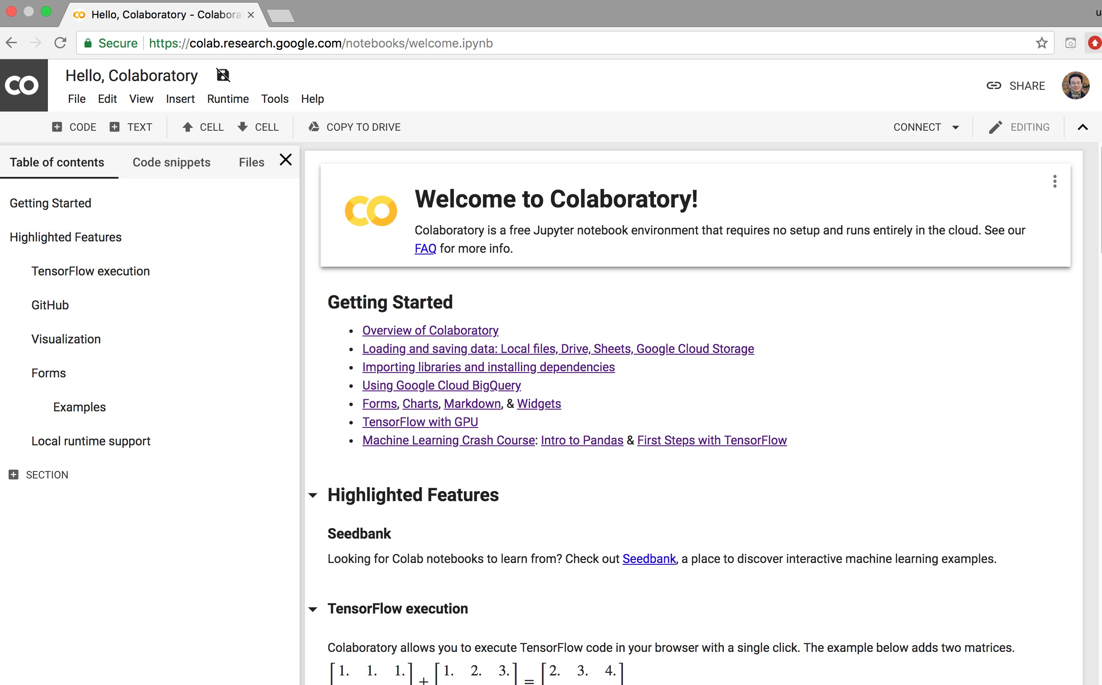
Google Colab
https://colab.research.google.com/notebooks/welcome.ipynb

Slide 25
Evolution of Decision Support, Business Intelligence, and Analytics
Source: Ramesh Sharda, Dursun Delen, and Efraim Turban (2017),
Business Intelligence, Analytics, and Data Science: A Managerial Perspective, 4th Edition, Pearson

Slide 26
Evolution of Business Intelligence (BI)
Source: Ramesh Sharda, Dursun Delen, and Efraim Turban (2017),
Business Intelligence, Analytics, and Data Science: A Managerial Perspective, 4th Edition, Pearson

Slide 27
A High-Level Architecture of BI
Source: Ramesh Sharda, Dursun Delen, and Efraim Turban (2017),
Business Intelligence, Analytics, and Data Science: A Managerial Perspective, 4th Edition, Pearson

Slide 28
Three Types of Analytics
Source: Ramesh Sharda, Dursun Delen, and Efraim Turban (2017),
Business Intelligence, Analytics, and Data Science: A Managerial Perspective, 4th Edition, Pearson

Slide 29
Analytics Ecosystem
Source: Ramesh Sharda, Dursun Delen, and Efraim Turban (2017),
Business Intelligence, Analytics, and Data Science: A Managerial Perspective, 4th Edition, Pearson

Slide 30
Job Titles of Analytics
Source: Ramesh Sharda, Dursun Delen, and Efraim Turban (2017),
Business Intelligence, Analytics, and Data Science: A Managerial Perspective, 4th Edition, Pearson

Slide 31
A Data to Knowledge Continuum
Source: Ramesh Sharda, Dursun Delen, and Efraim Turban (2017),
Business Intelligence, Analytics, and Data Science: A Managerial Perspective, 4th Edition, Pearson

Slide 32
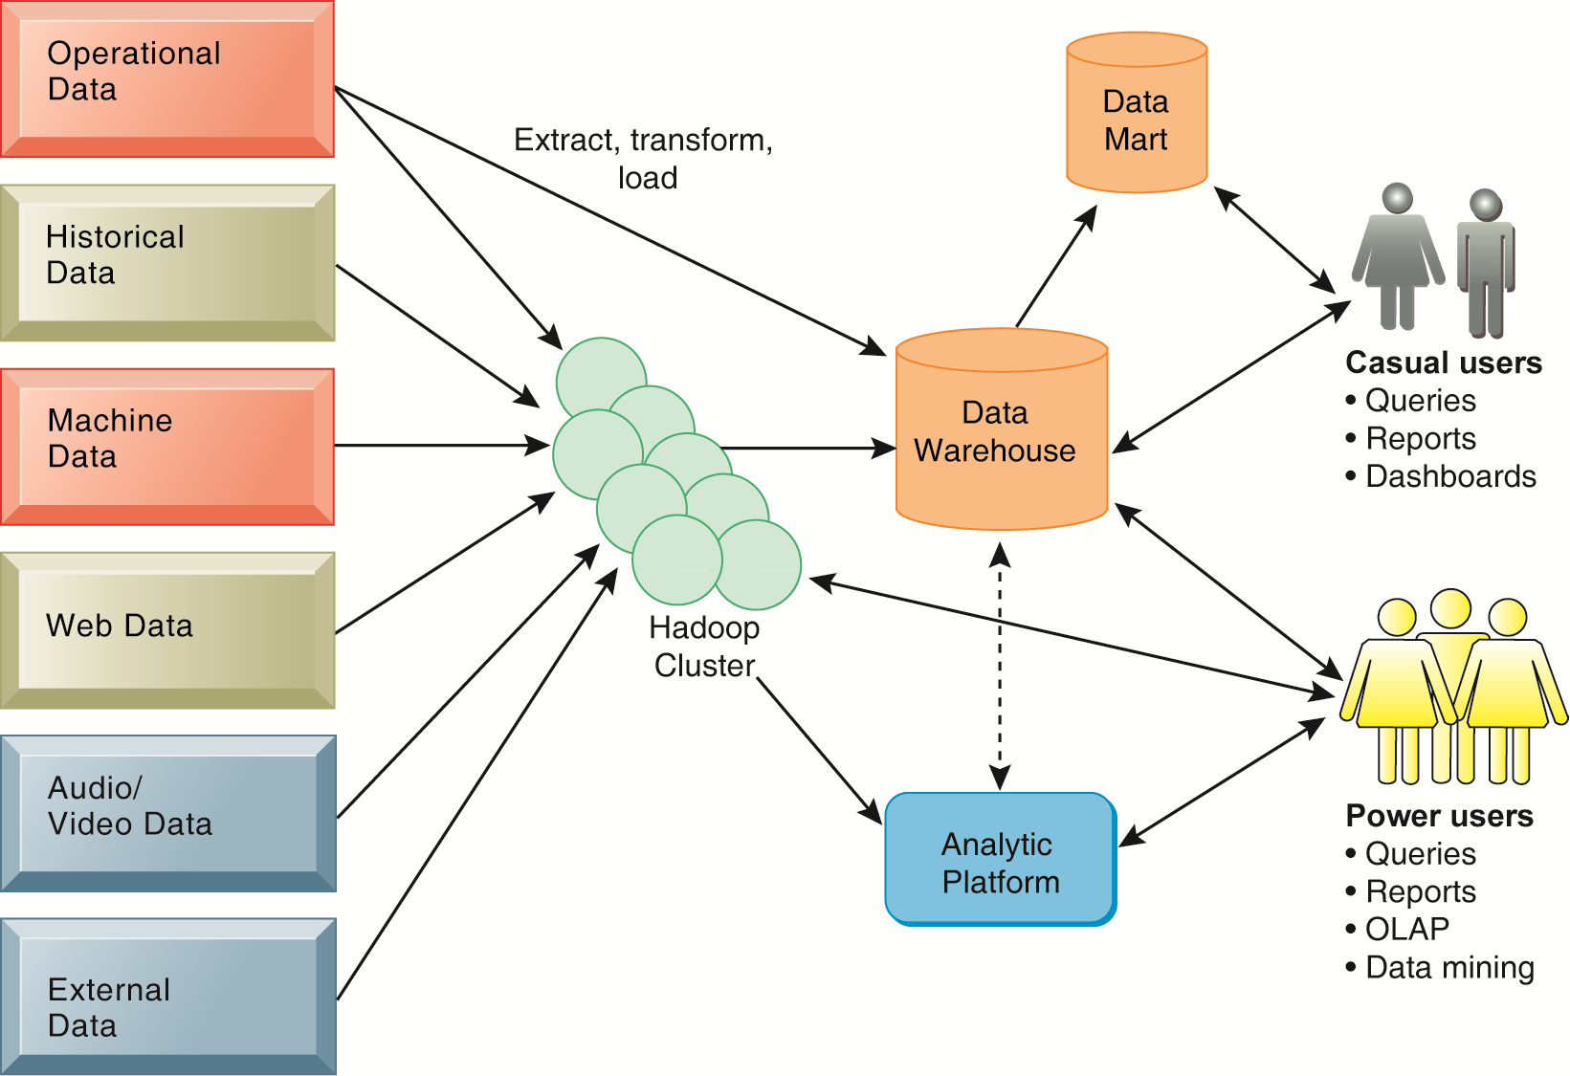
Business Intelligence (BI) Infrastructure

Slide 33
Business Intelligence and Data Mining
Increasing potential
to support
business decisions
End User
Decision Making
Data Presentation
Business
Analyst
Visualization Techniques
Data Mining
Data
Analyst
Information Discovery
Data Exploration
Statistical Summary, Querying, and Reporting
Data Preprocessing/Integration, Data Warehouses
Data Sources
DBA
Paper, Files, Web documents, Scientific experiments, Database Systems
Source: Jiawei Han and Micheline Kamber (2006), Data Mining: Concepts and Techniques, Second Edition, Elsevier

Slide 34
Business Insights with
Social Analytics

Slide 35
Analyzing the Social Web:
Social Network Analysis

Slide 36
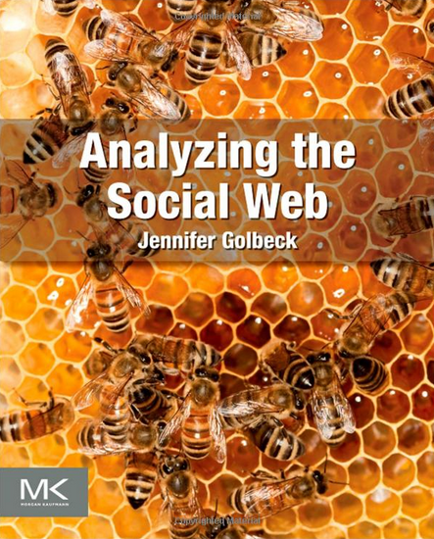
Jennifer Golbeck (2013), Analyzing the Social Web, Morgan Kaufmann
Source: http://www.amazon.com/Analyzing-Social-Web-Jennifer-Golbeck/dp/0124055311

Slide 37
AI
Challenge
Champion

Slide 38
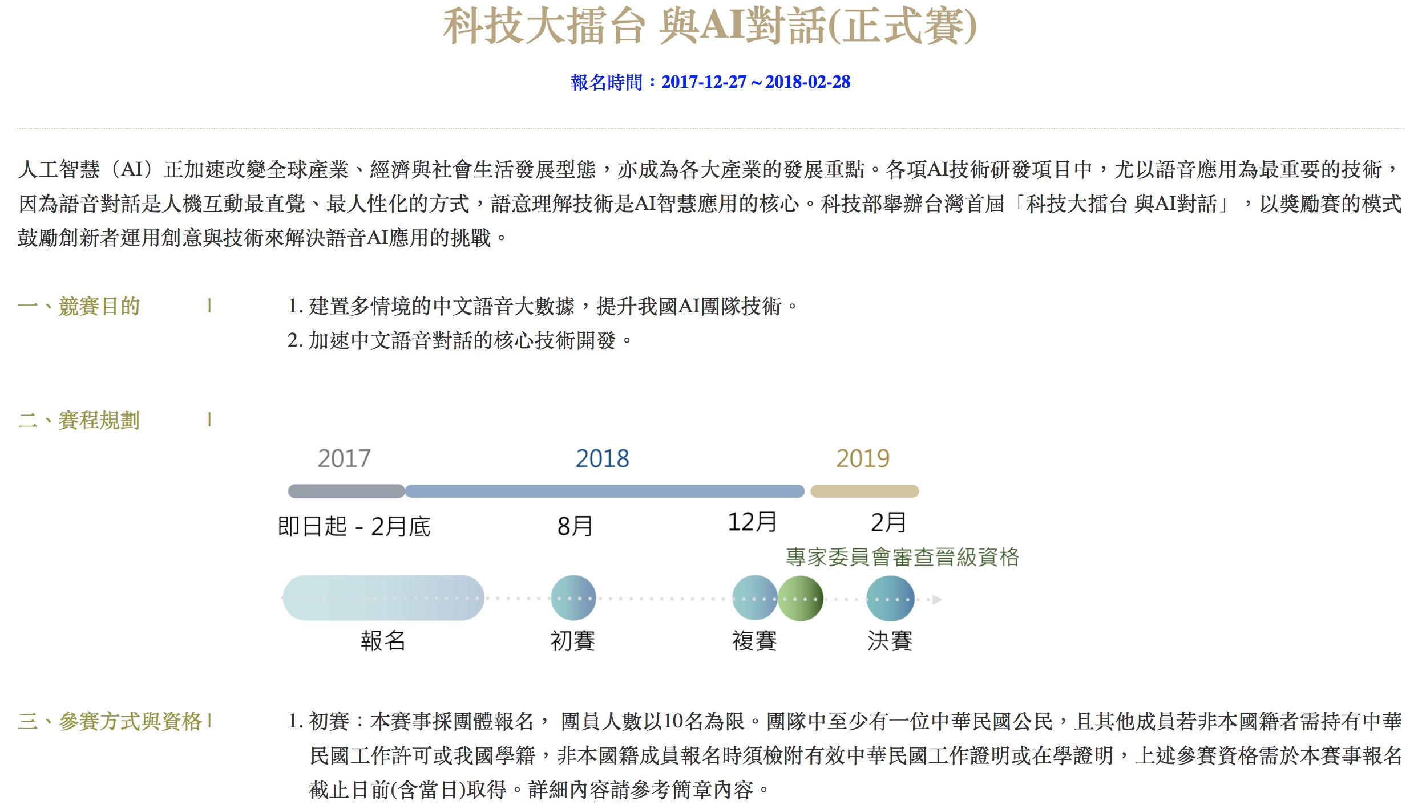
科技大擂台 與AI對話 (正式賽)
https://fgc.stpi.narl.org.tw/activity/techai2018

Slide 39
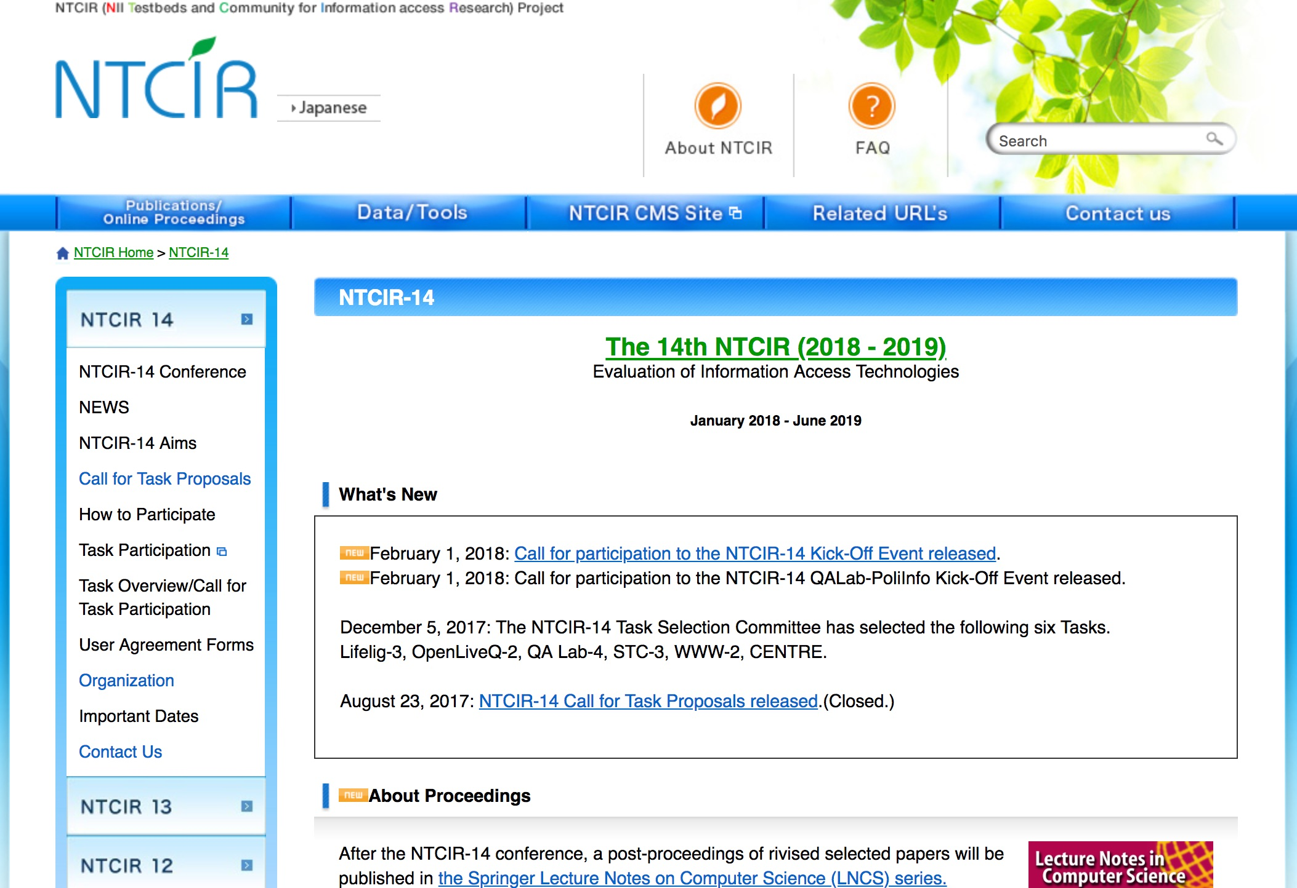
The 14th NTCIR (2018 - 2019)
http://research.nii.ac.jp/ntcir/ntcir-14/index.html

Slide 40
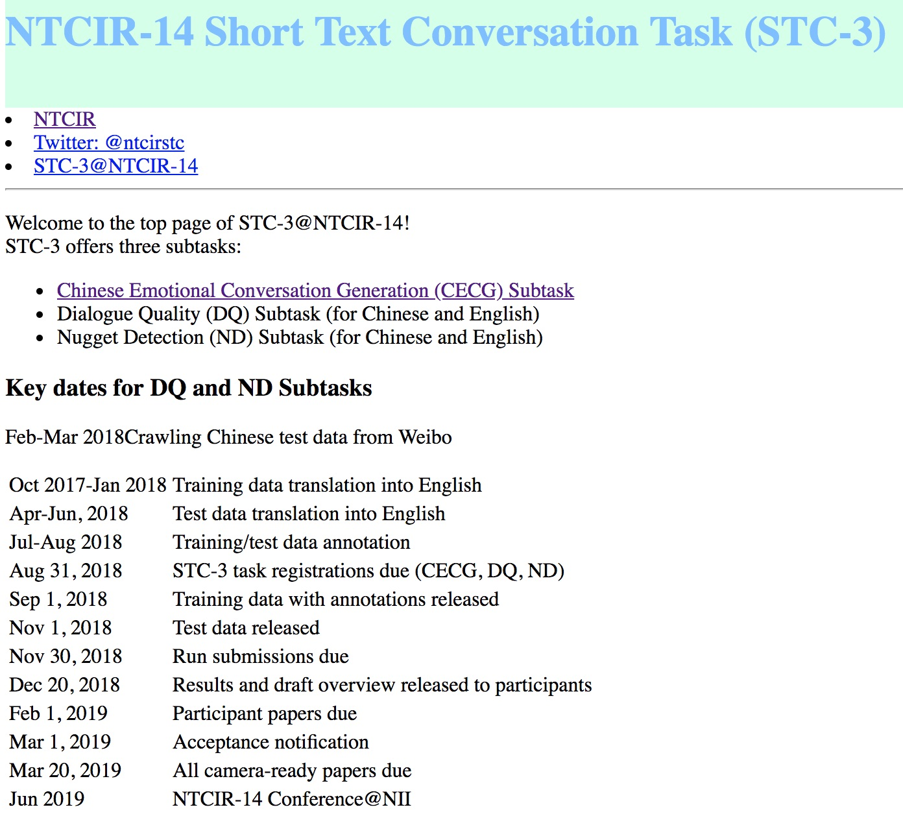
NTCIR-14
Short Text Conversation Task (STC-3)

Slide 41
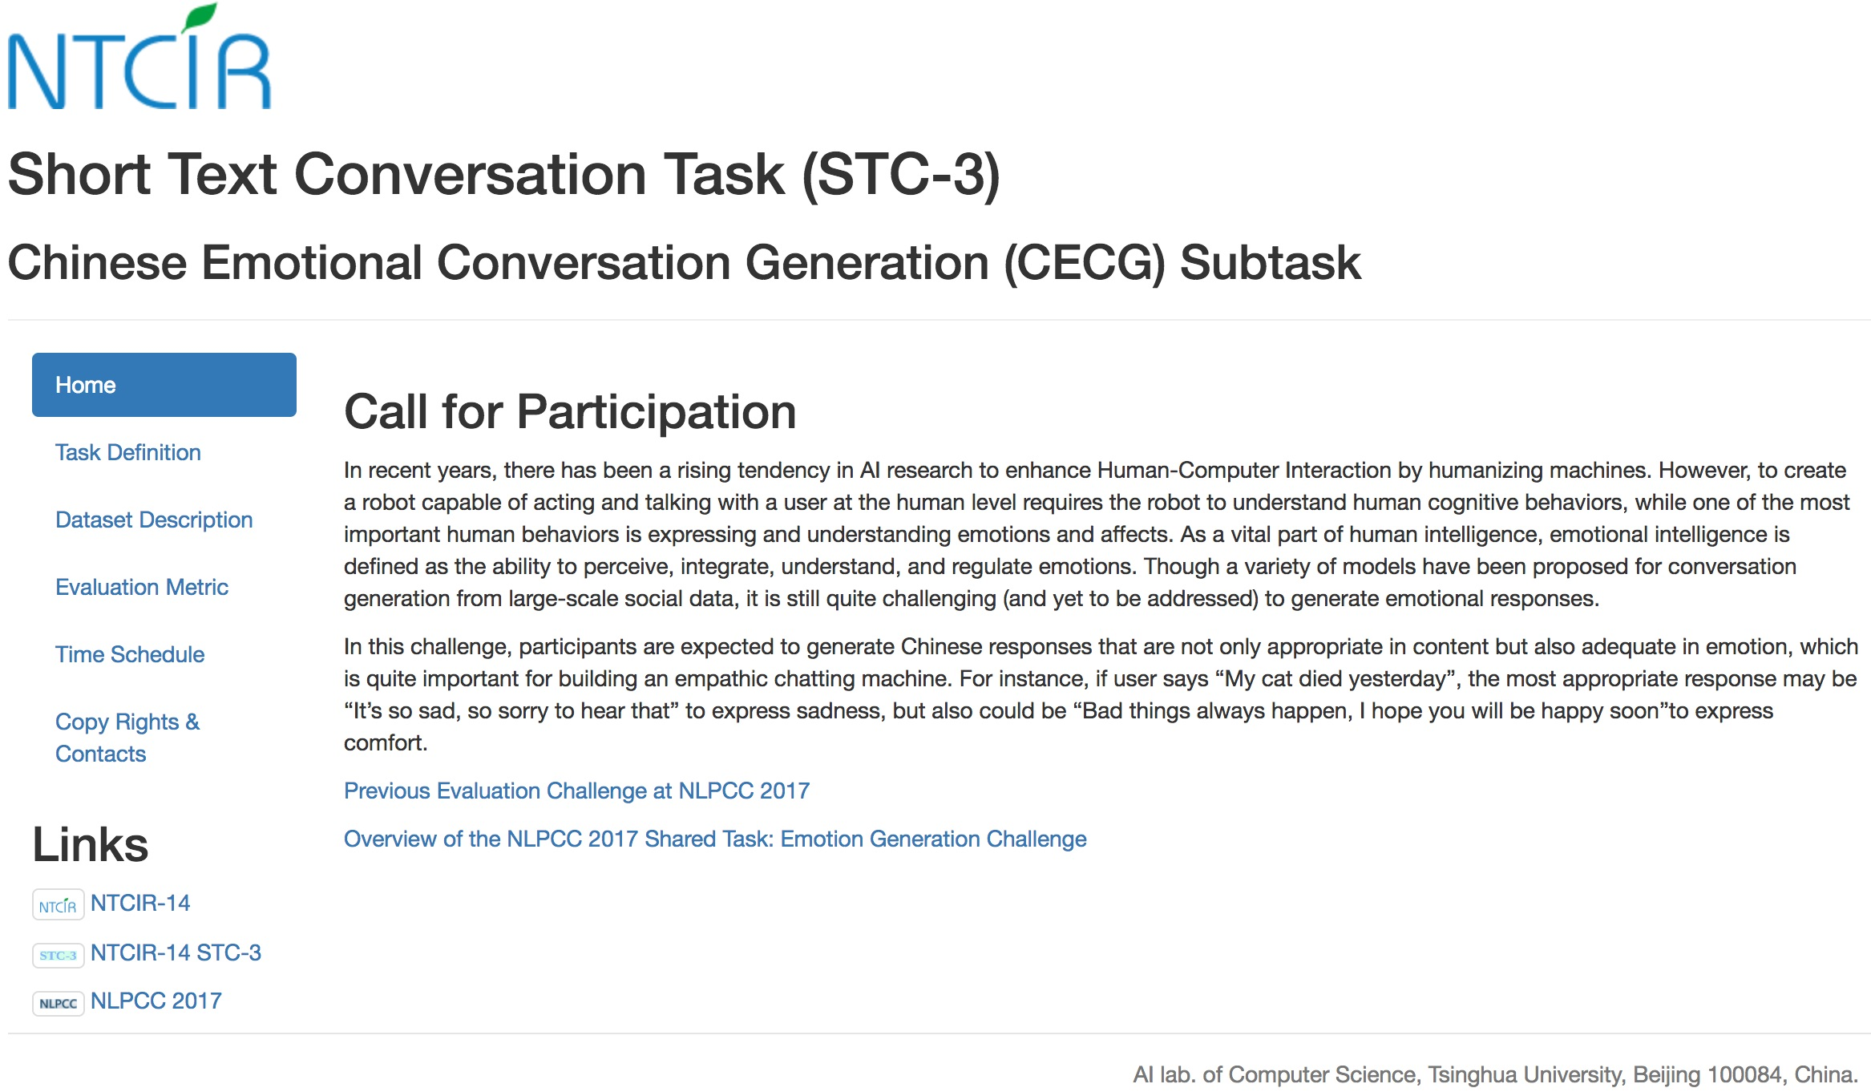
NTCIR-14 STC-3
Short Text Conversation Task (STC-3)
Chinese Emotional Conversation Generation (CECG) Subtask
http://www.aihuang.org/p/challenge.html

Slide 42
Short Text Conversation
(NTCIR-13 STC2)
Retrieval-based
Source: http://ntcirstc.noahlab.com.hk/STC2/stc-cn.htm

Slide 43
Short Text Conversation
(NTCIR-13 STC2)
Generation-based
Source: http://ntcirstc.noahlab.com.hk/STC2/stc-cn.htm

Slide 44
Summary
This course introduces the fundamental concepts and technology practices of business intelligence.
Topics include
  Business Intelligence, Analytics, and Data Science,
  AI, Big Data, and Cloud Computing,
  Descriptive Analytics: Nature of Data, Statistical Modeling, and Visualization, Business Intelligence and Data Warehousing,
  Predictive Analytics: Data Mining Process, Methods, and Algorithms, Text, Web, and Social Media Analytics,
  Prescriptive Analytics: Optimization and Simulation,
  SNA, Machine and Deep Learning, NLP,
  AI Chatbots and Conversational Commerce,
  Future Trends in Analytics.

Slide 45

Contact Information
戴敏育 博士 (Min-Yuh Day, Ph.D.)
專任助理教授
淡江大學 資訊管理學系
電話：02-26215656 #2846
傳真：02-26209737
研究室：B929
地址： 25137 新北市淡水區英專路151號
Email： myday@mail.tku.edu.tw
網址：http://mail.tku.edu.tw/myday/

